Slide 1



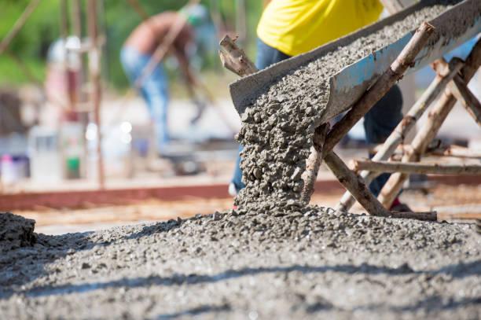



University of Global Village (UGV), Barishal
Concrete Mix Design
Content of Laboratory Course
Prepared By
Rubieyat Bin Ali
Assistant Professor & HOD
Department of Civil Engineering
University of Global Village (UGV), Barishal
Program: B.Sc. in CE

Slide 2
Course Title | Concrete Mix Design
Course Code | CE 0732-2104
Credits | 01
CIE Marks | 30
SEE Marks | 20
Exam Hours | 2 hours (Semester Final Exam)
Level | 3rd Semester
BASIC COURSE INFORMATION

Slide 3
Concrete Mix Design
COURSE CODE: CE 0732-2104 | CREDIT:01
 | TOTAL MARKS:50
 | CIE MARKS: 30
Semester End Exam Hours 2 | SEE MARKS: 20
Course Learning Outcomes (CLOs): After completing this course successfully, the students will be able to-
CLO 1 | Understand concepts of Structural Design of Reinforced concrete members.
CLO 2 | Analyze various structural components of slab bridge, balanced cantilever bridge and PC girder bridge.
CLO 3 | Develop intellectual communication skills through working in groups in performing the laboratory experiments/field supervisions and by interpreting the experimental results.
CLO 4 | Generate the detailing of various structural components of buildings and bridges.

Slide 4
SL | Content of Course | Hrs | CLOs
1 | Basic concepts of coarse aggregate, fine aggregate and cement | 10 | CLO1
2 | Concrete Mix Design Math Solved | 20 | CLO3
3 | Materials purchasing and Mixing | 20 | CLO2, CLO4
4 | Determination of Slump Value | 5 | CLO1, CLO3
5 | Details of Bridges | 10 | CLO1
6 | Practice, Review/Reserved Day, Lab Report Assessment, Self study | 10 | CLO3
7 | Lab Test, Viva, Quiz, Overall Assessment, Skill Development Test (Competency) | 10 | CLO1
Text Book:
1. Design of Concrete Structures by Arthur H. Nilson, David Darwin, Charles W. Dolan (Mc Graw Hill) – 13th edition.
2. Design of Concrete Structures by Arthur H. Nilson – 7th edition.
3. Design of Reinforced Concrete by Jack C. McCormac, Russell H. Brown – 9th edition
4. Design of Prestressed Concrete Structures by T. Y. Lin and Ned H. Burns
5. Design of Modern Highway Bridges by Narendra Tally
6. Bangladesh National Building Code (BNBC)-2012
7. AASHTO LRFD Bridge: Design Specifications 2012

Slide 5
ASSESSMENT PATTERN
CIE- Continuous Internal Evaluation (30 Marks)
SEE- Semester End Examination (20 Marks)
SEE- Semester End Examination (40 Marks) (should be converted in actual marks (20))
Bloom’s Category | Tests
Remember | 05
Understand | 07
Apply | 08
Analyze | 07
Evaluate | 08
Create | 05
CIE- Continuous Internal Evaluation (100 Marks) (should be converted in actual marks (30))
Bloom’s Category Marks (out of 100) | Lab Final (30) | Lab Report (10) | Continuous lab performance (30) | Presentation & Viva (10) | External Participation in Curricular/Final Project Exhibition (10)
Remember/Imitation | 05 |  | 05 | 02 | Attendance 10
Understand/manipulation | 05 | 05 | 05 | 03
Apply/Precision | 05 |  | 05
Analyze/Articulation | 05 |  | 05
Evaluate/Naturalisation | 05 | 05 | 05
Create | 05 |  | 05 | 05

Slide 6
Couse plan specifying content, CLOs, teaching learning and assessment strategy mapped with CLOs
Week | Topic | Teaching-Learning Strategy | Assessment Strategy | Corresponding CLOs
1-2 | Basic concepts of coarse aggregate, fine aggregate and cement | Lecture, discussion, Experiment | Quiz, Lab Test | CLO1
3-5 | Concrete Mix Design Math Solved | Oral Presentation, Project Exhibition | Lab Report Assessment, viva | CLO3
6-9 | Materials purchasing and Mixing | Presentation, Field visit | Skill Development Test | CLO2, CLO4
10 | Determination of Slump Value | Lecture, discussion, Experiment, Demonstration | Quiz, Lab Test | CLO1, CLO3
11-13 | Details of Bridges | Oral Presentation, Project Exhibition | Lab Report Assessment, viva | CLO1
14-15 | Practice, Review/Reserved Day, Lab Report Assessment, Self study | Presentation, Field visit | Skill Development Test | CLO3
16-17 | Lab Test, Viva, Quiz, Overall Assessment, Skill Development Test (Competency) | Lecture, discussion, Experiment | Quiz, Lab Test | CLO2, CLO4

Slide 7
Basic concepts of coarse aggregate, fine aggregate and cement
Week 1-2
Pages 8-57

Slide 8
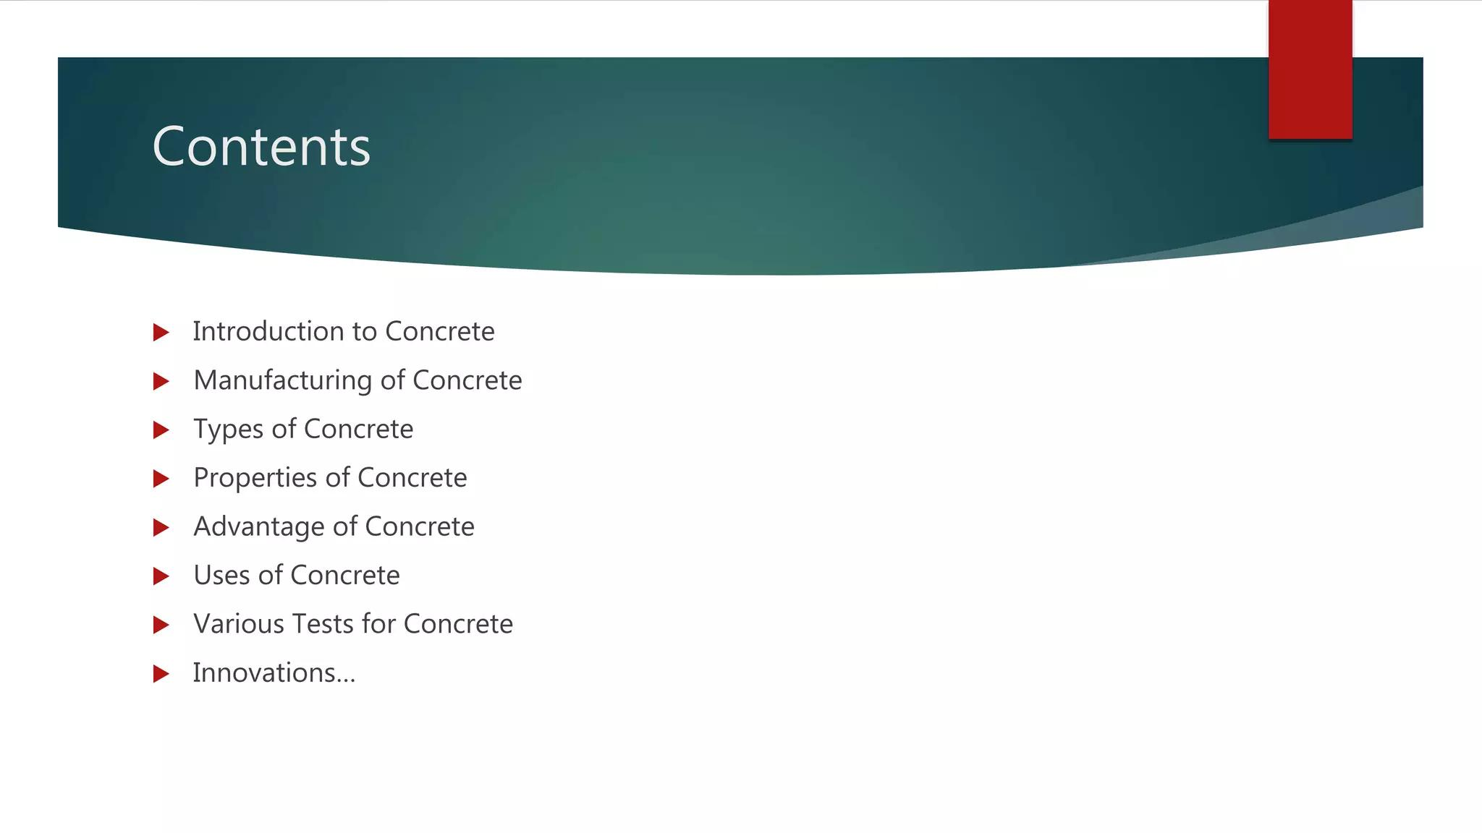

Slide 9
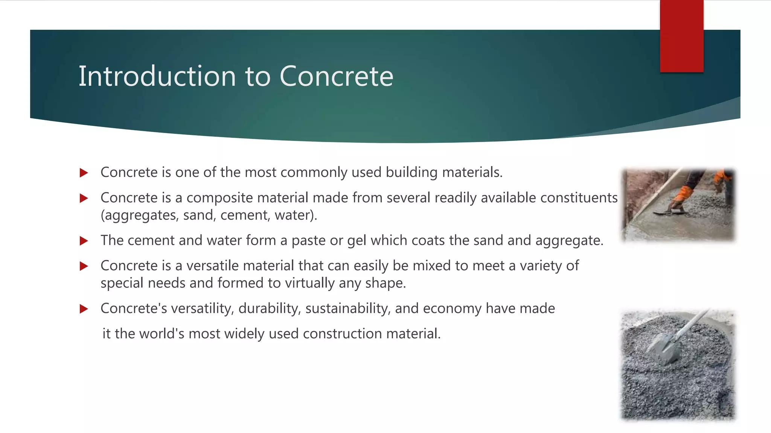

Slide 10
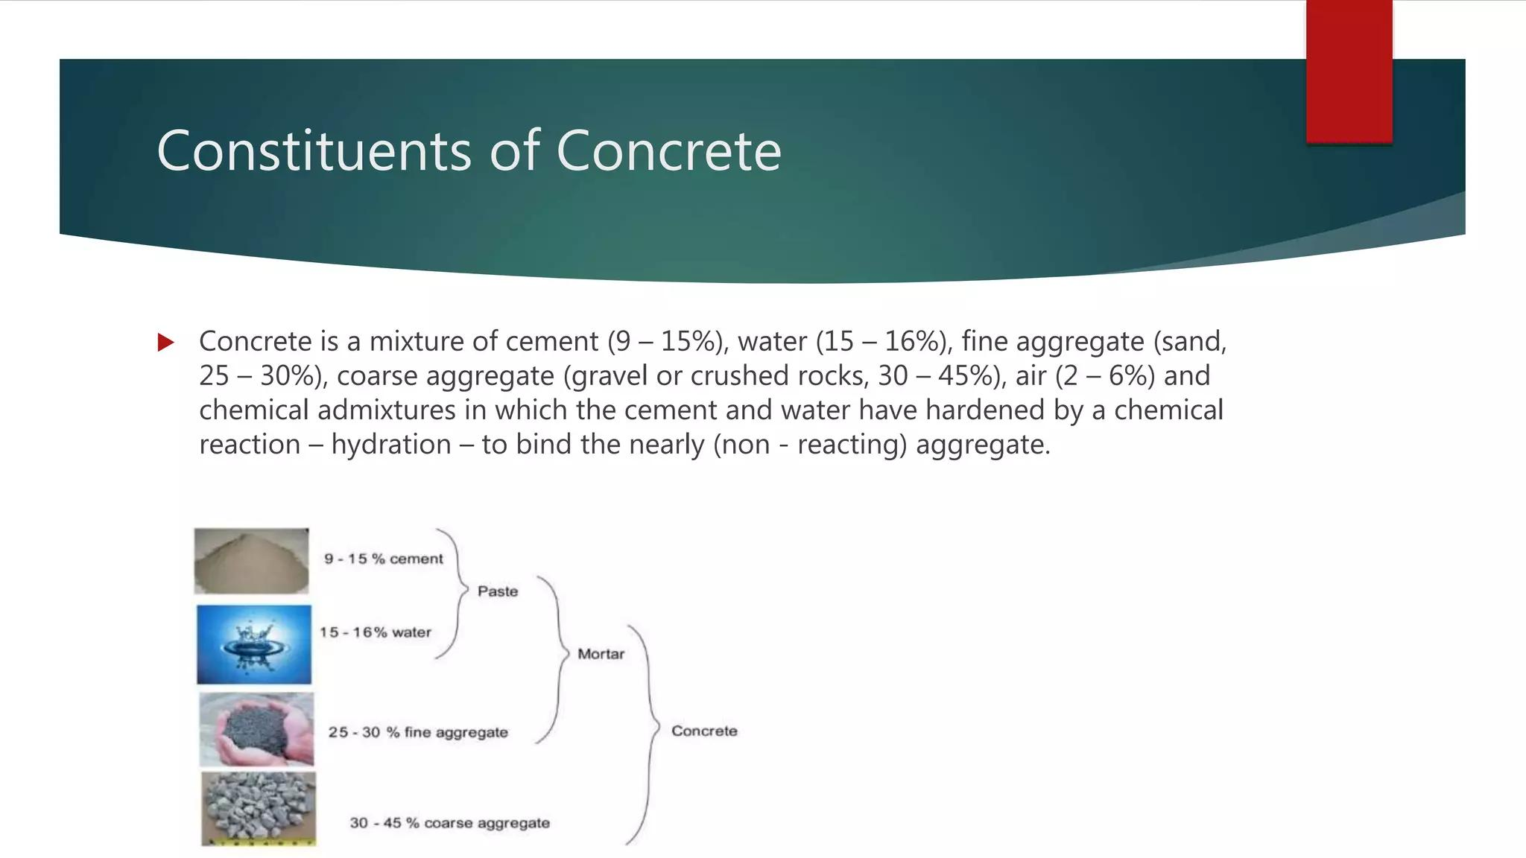

Slide 11
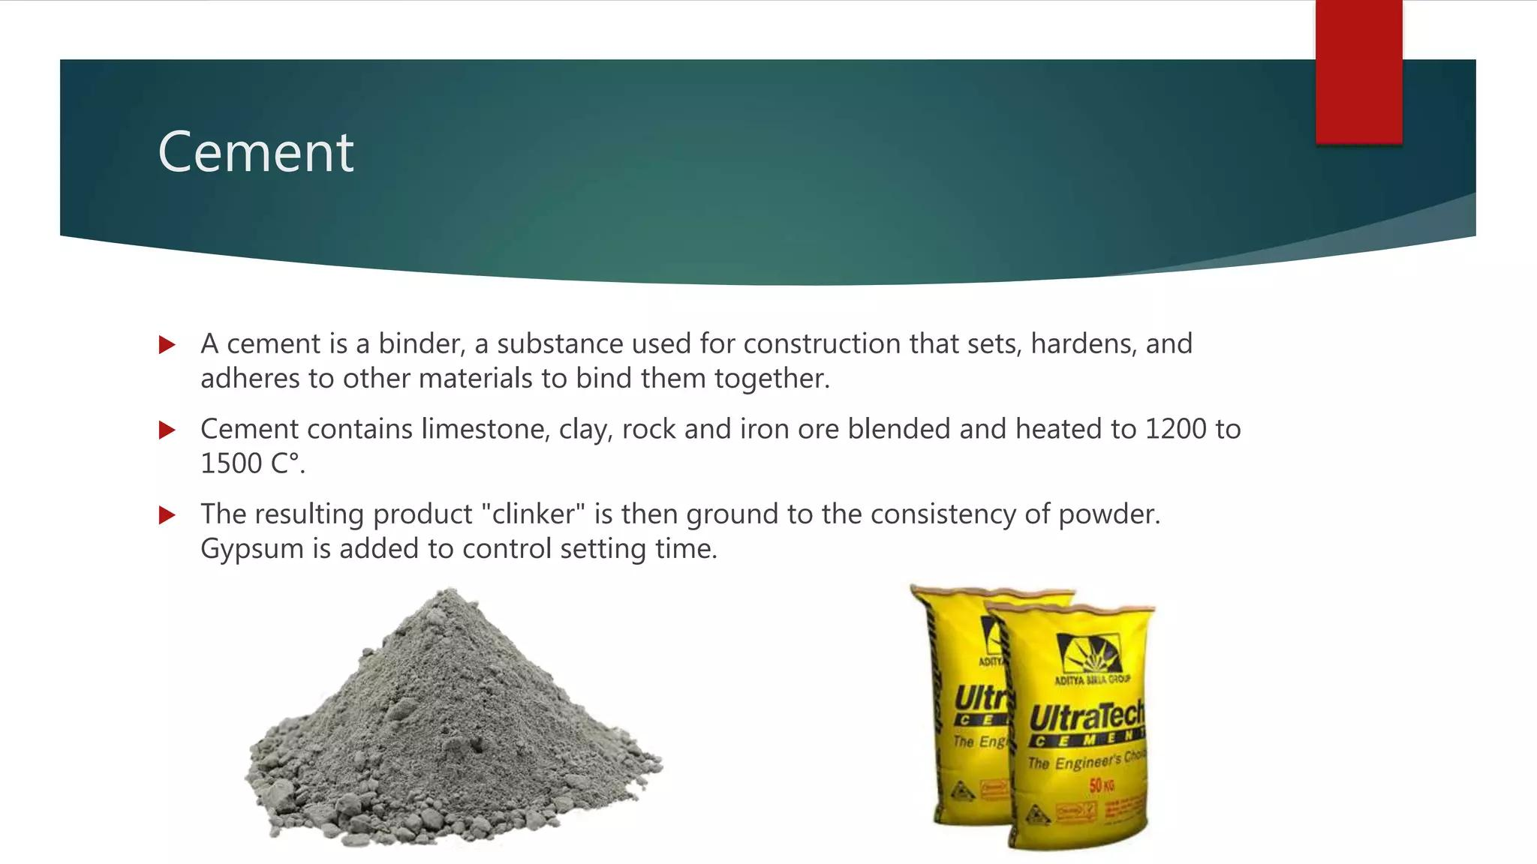

Slide 12
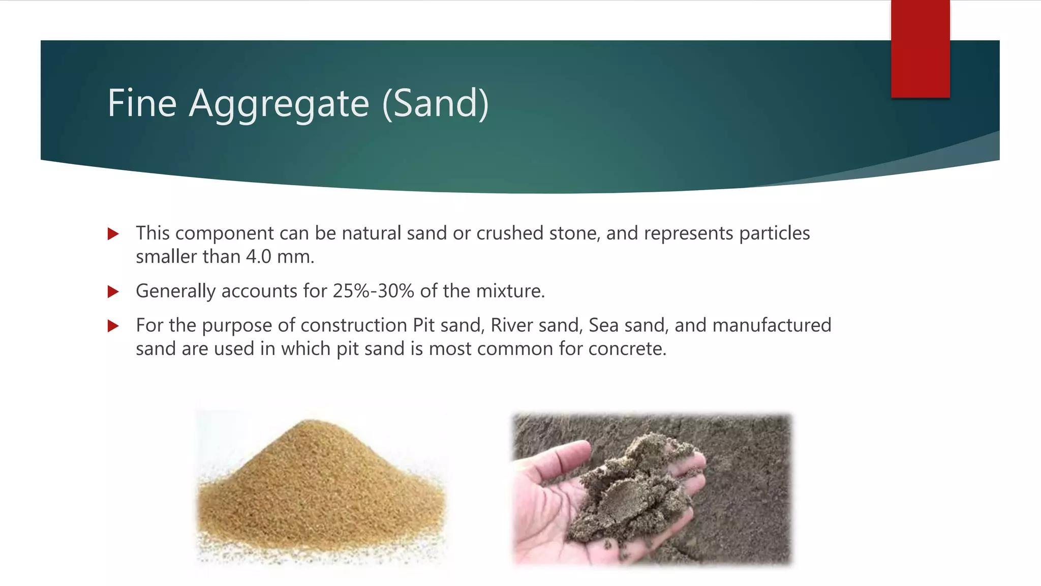

Slide 13
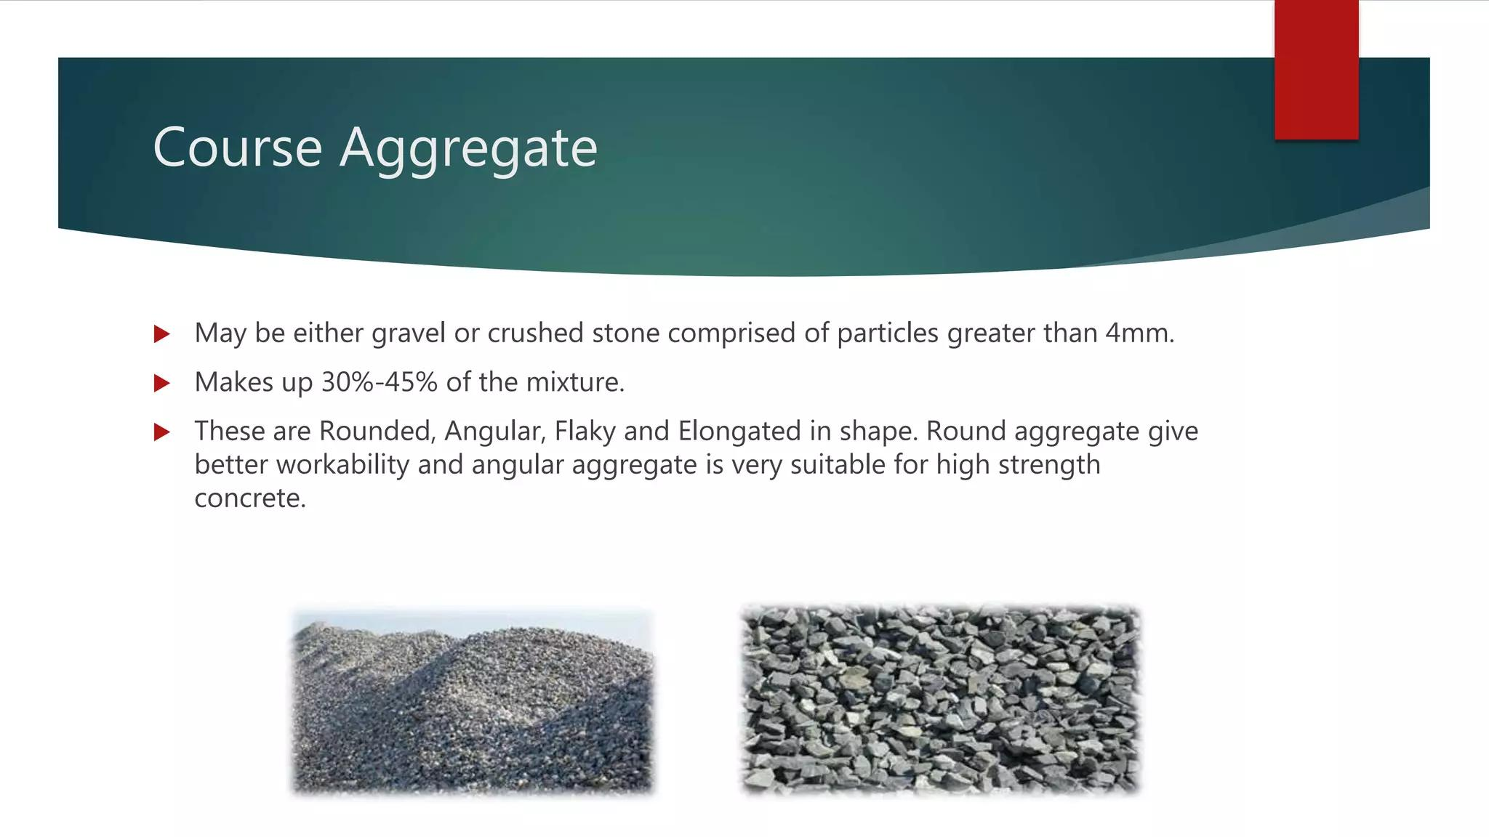

Slide 14
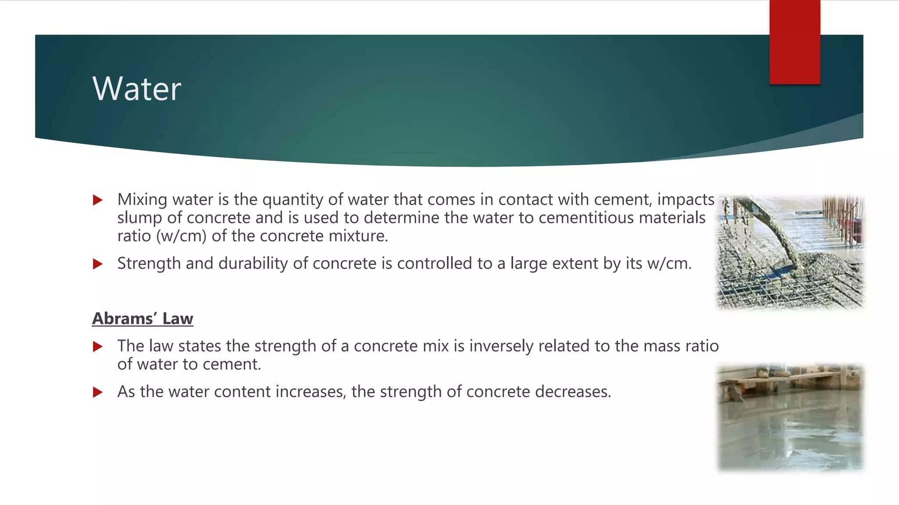

Slide 15
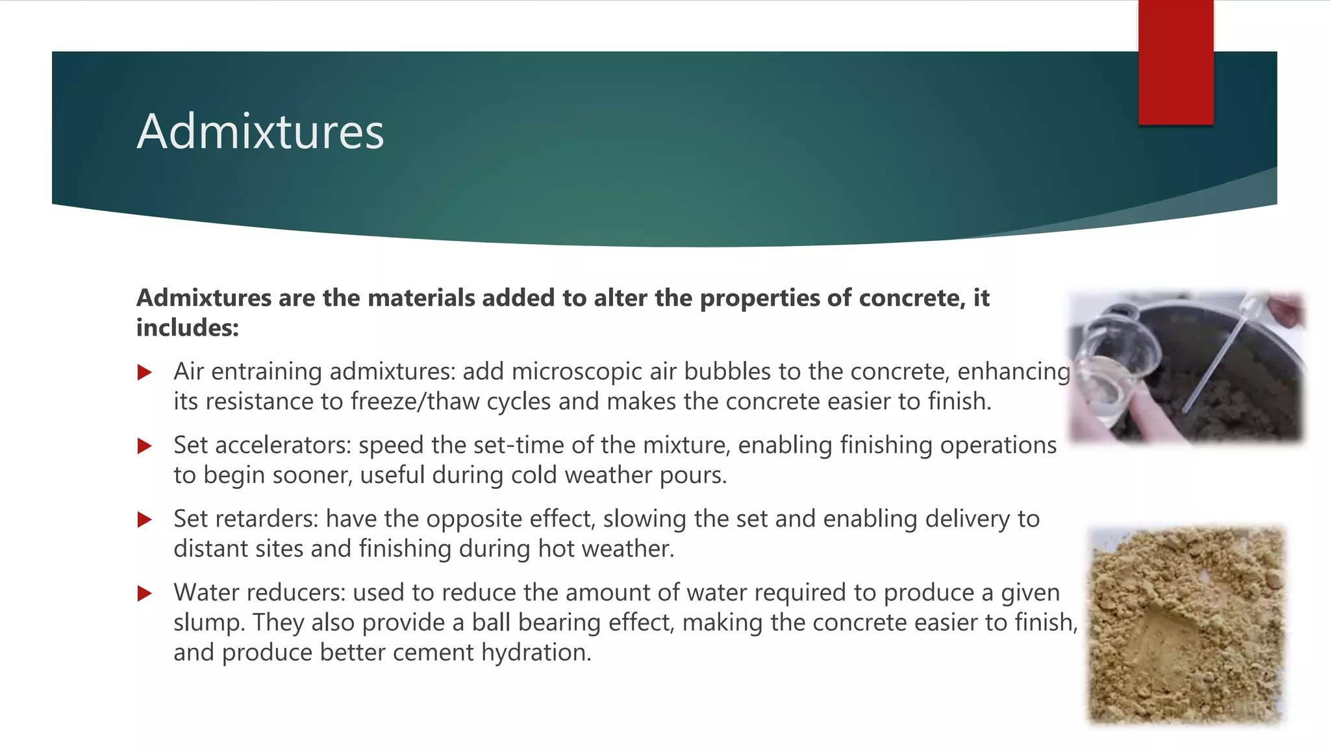

Slide 16
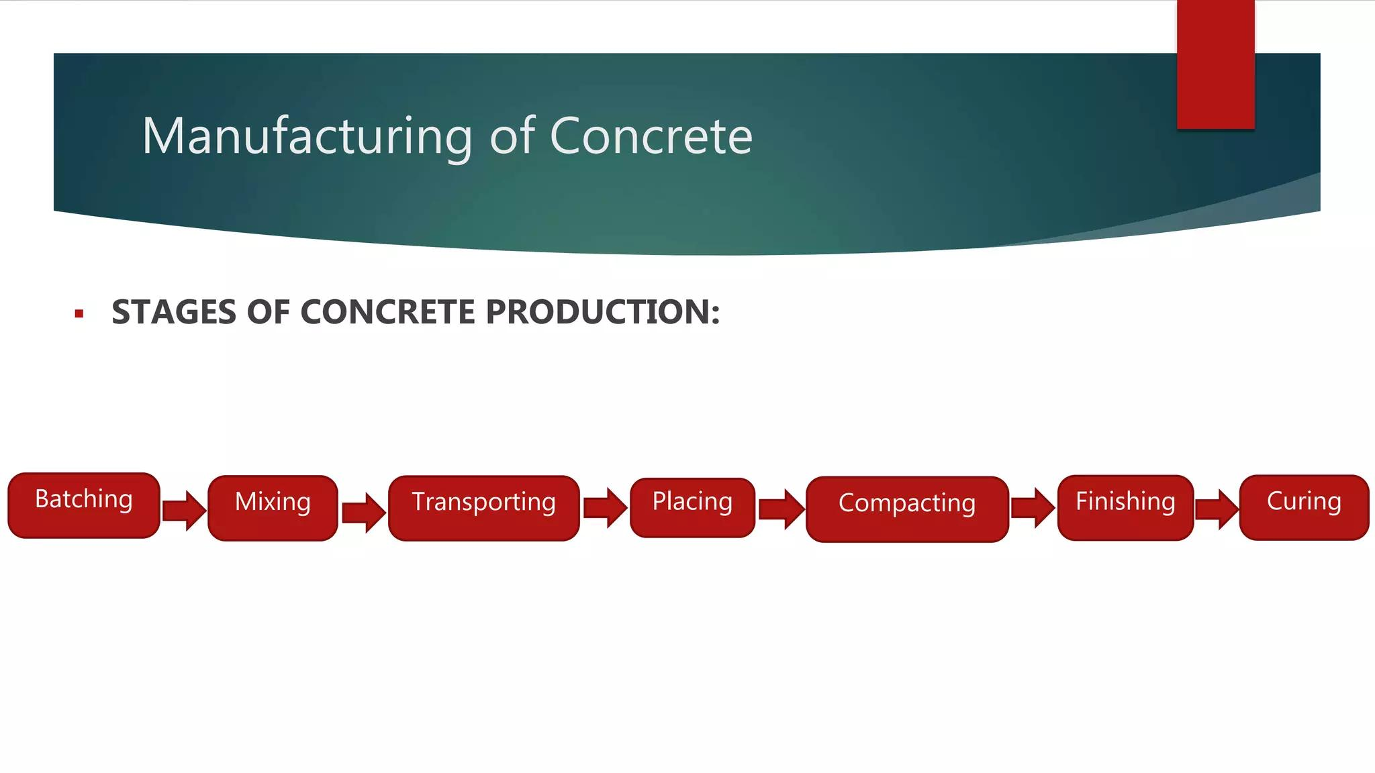

Slide 17
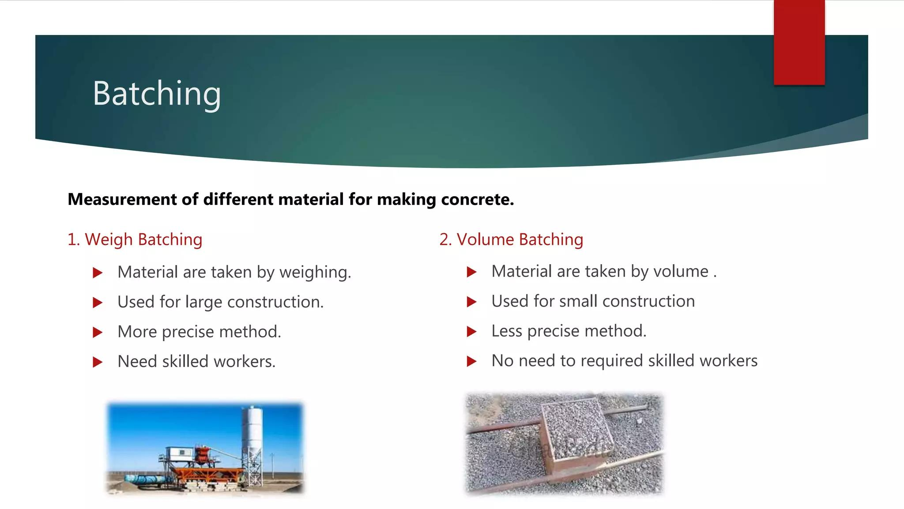

Slide 18
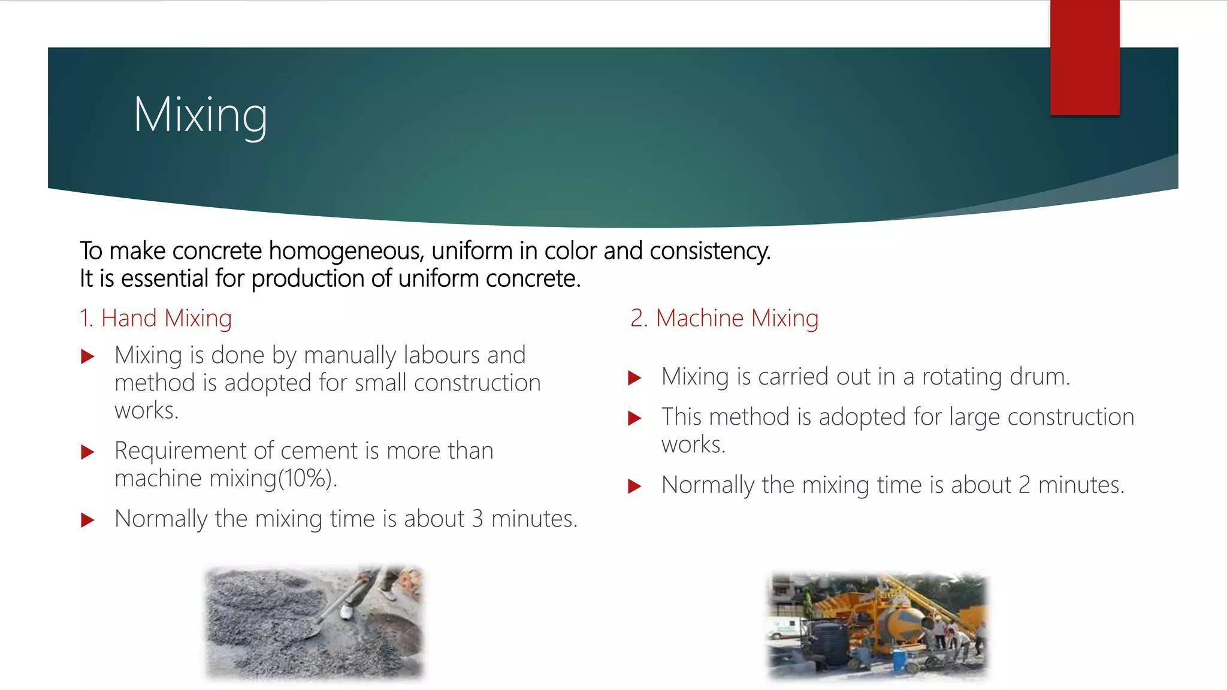

Slide 19
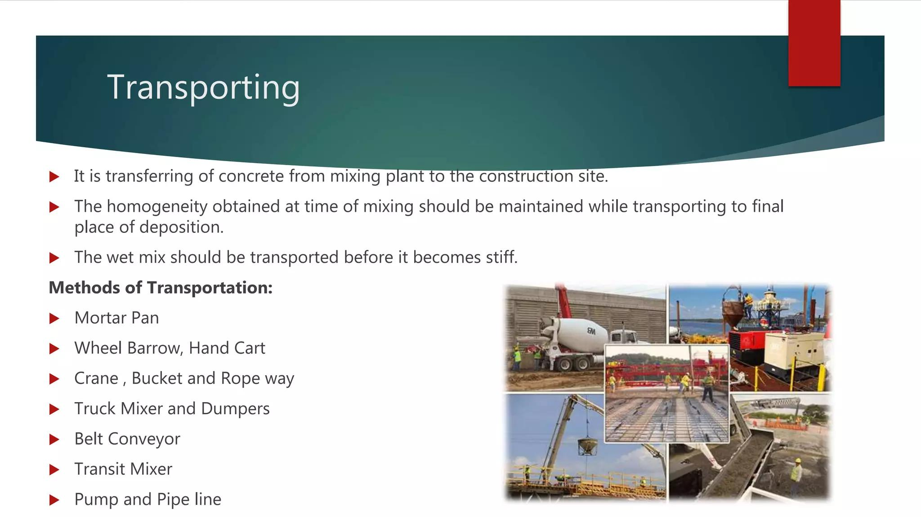

Slide 20
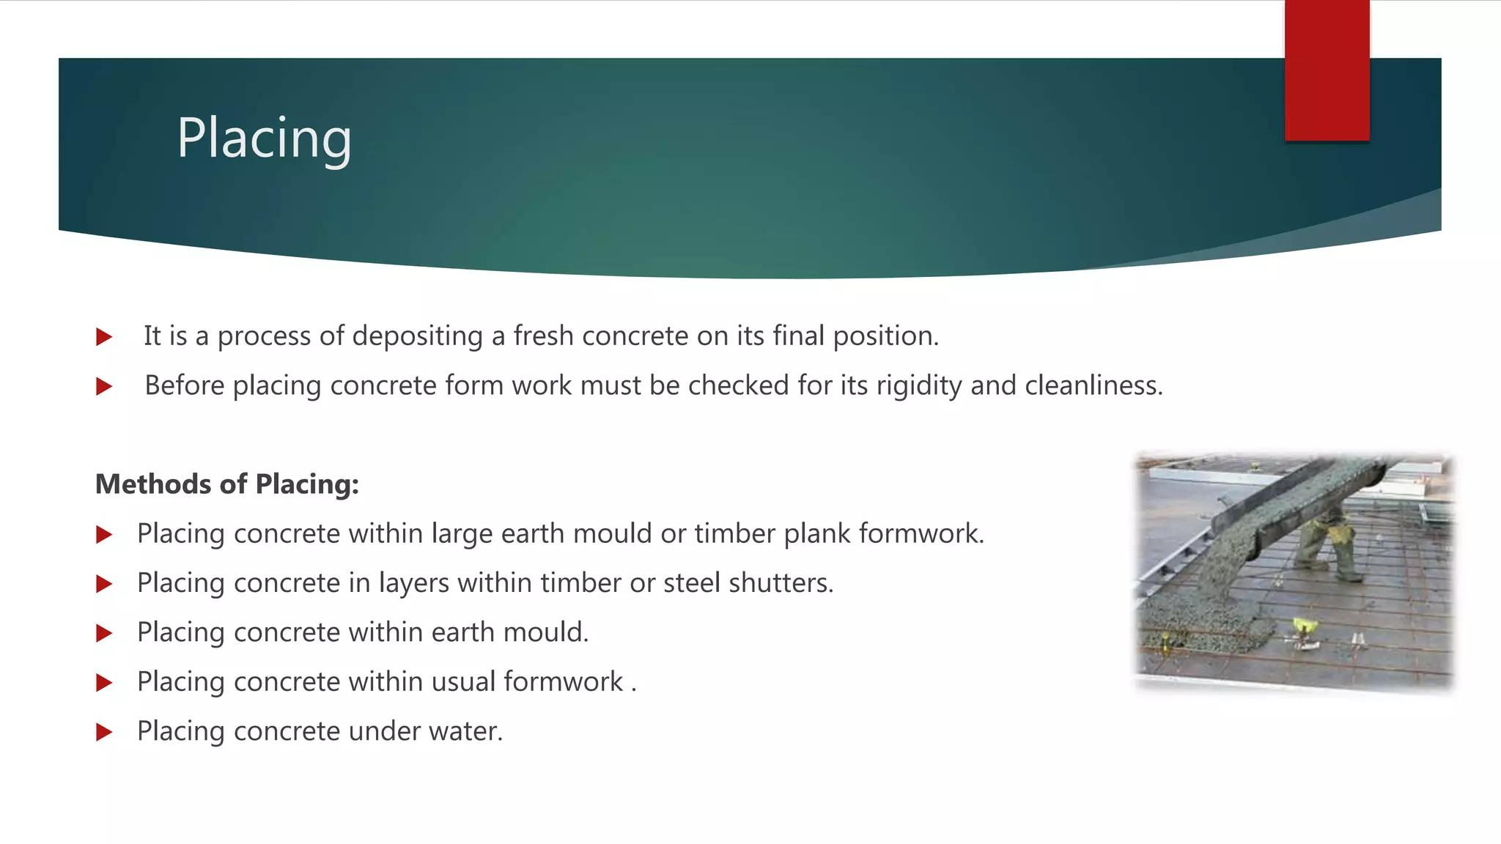

Slide 21
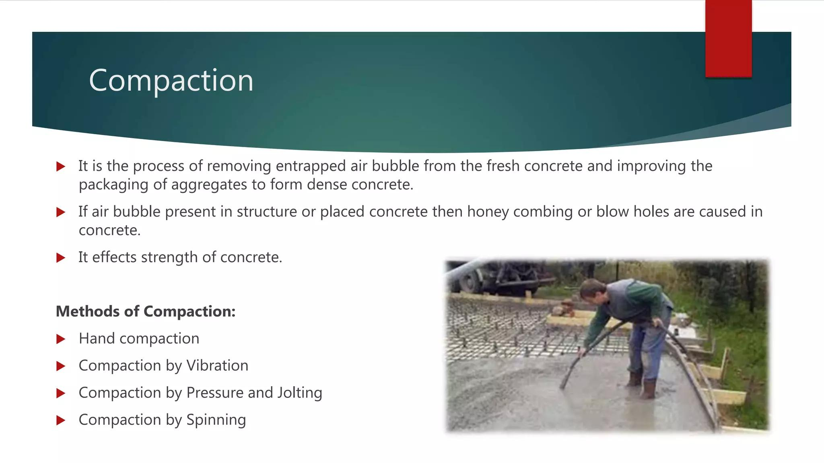

Slide 22
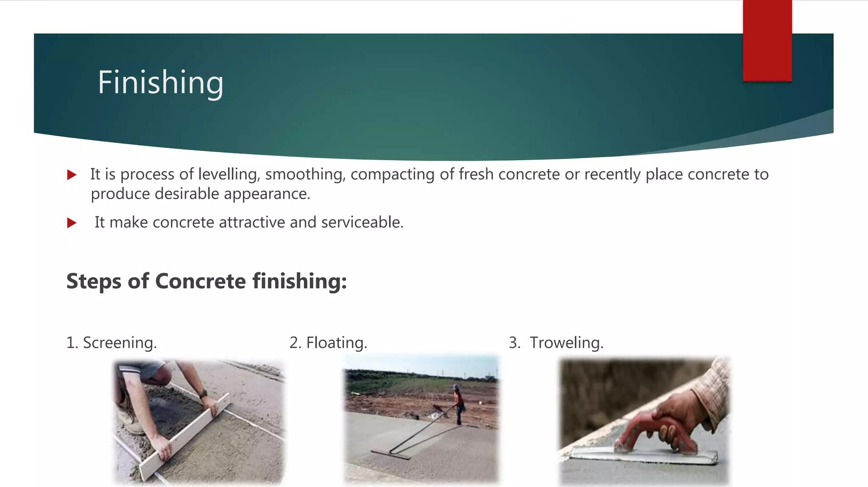

Slide 23
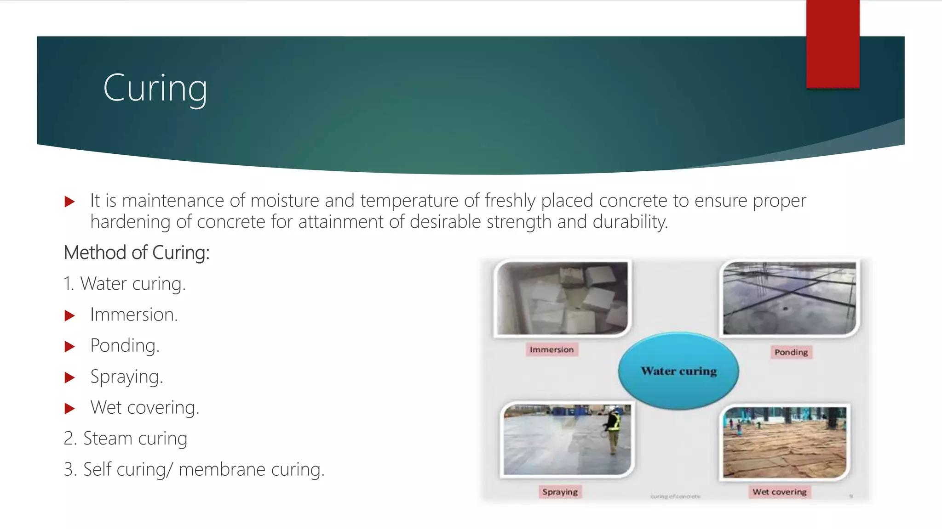

Slide 24
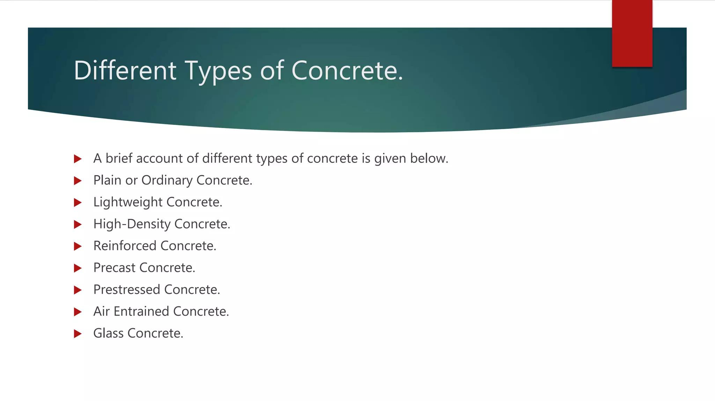

Slide 25
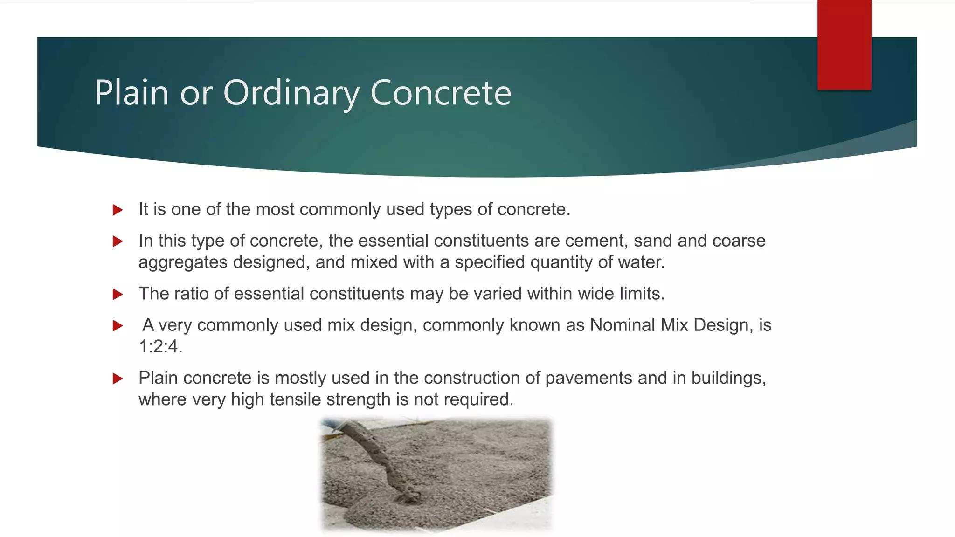

Slide 26
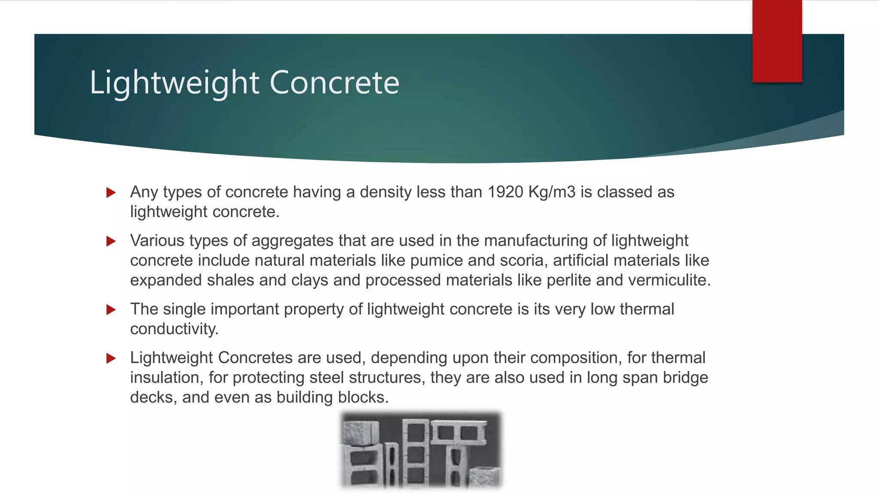

Slide 27
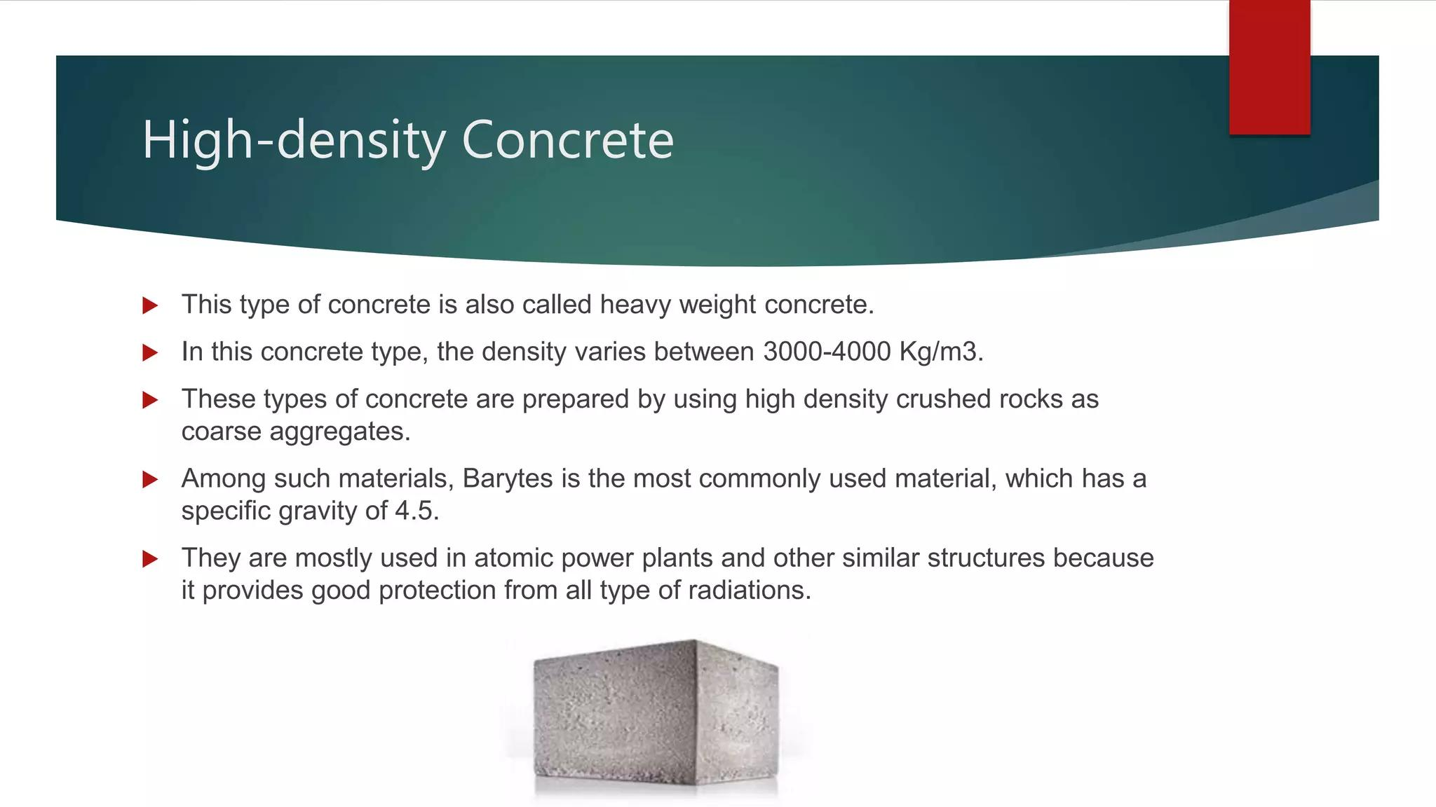

Slide 28
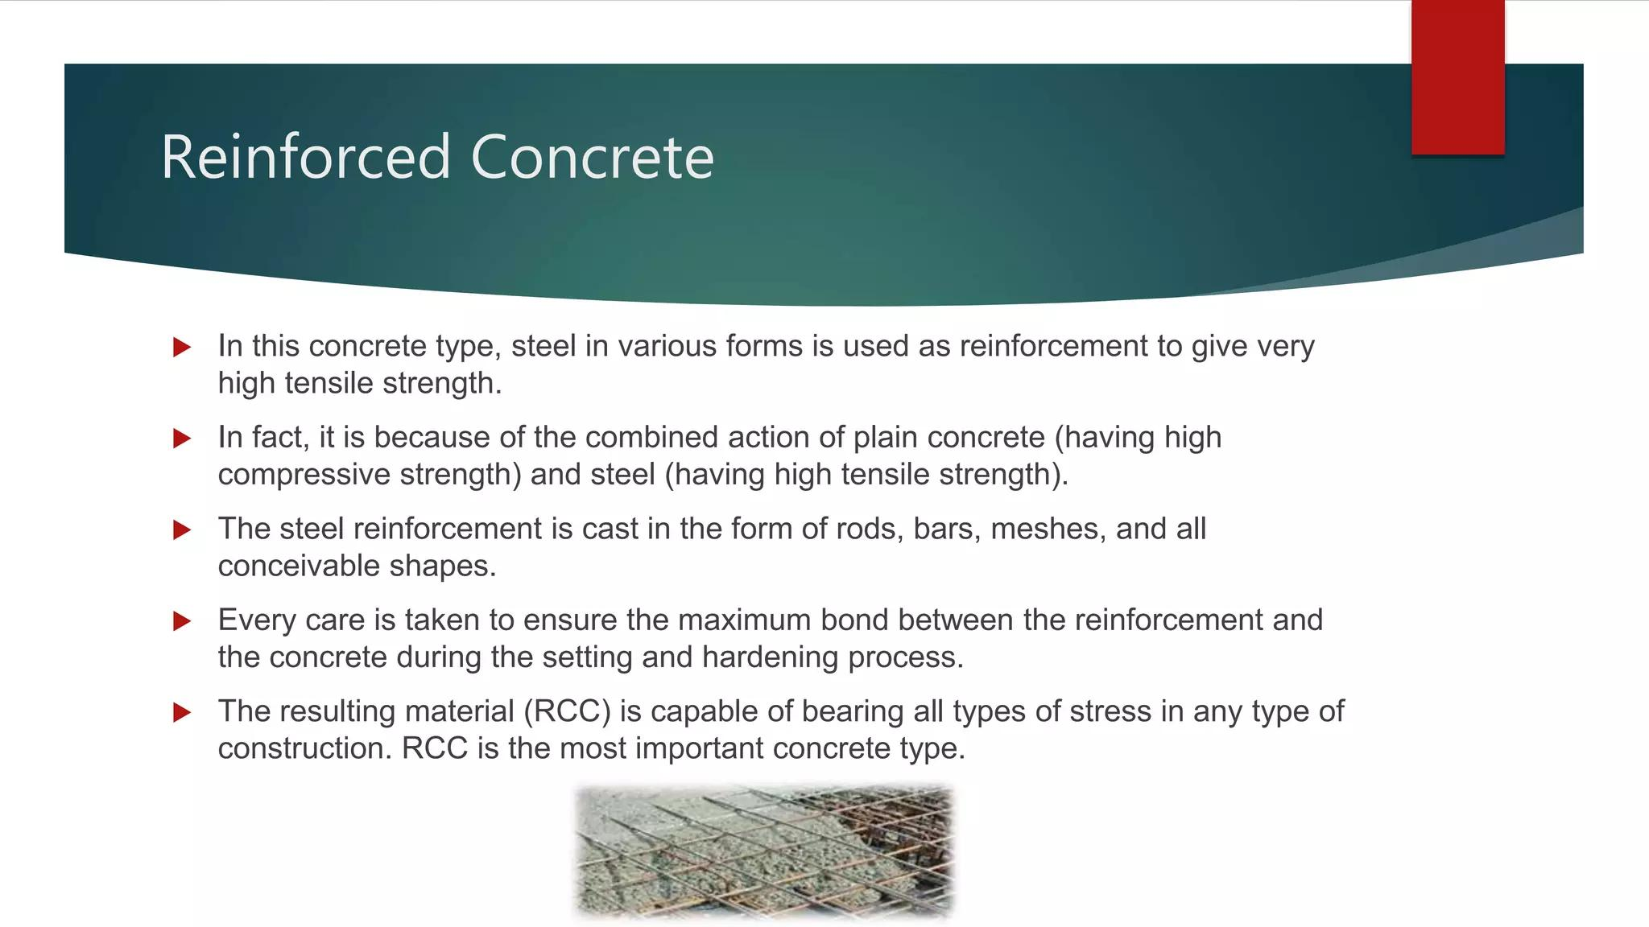

Slide 29
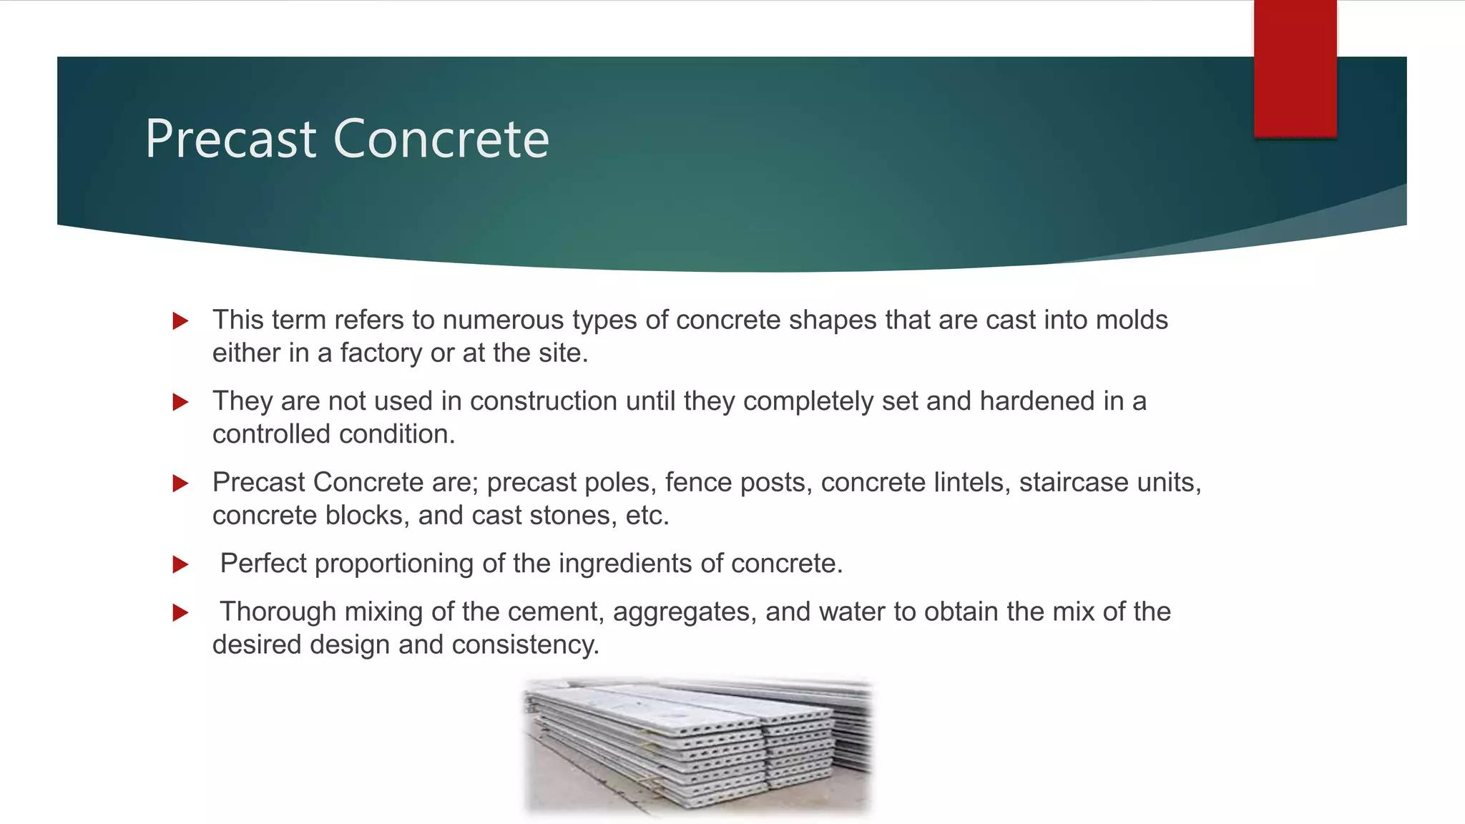

Slide 30
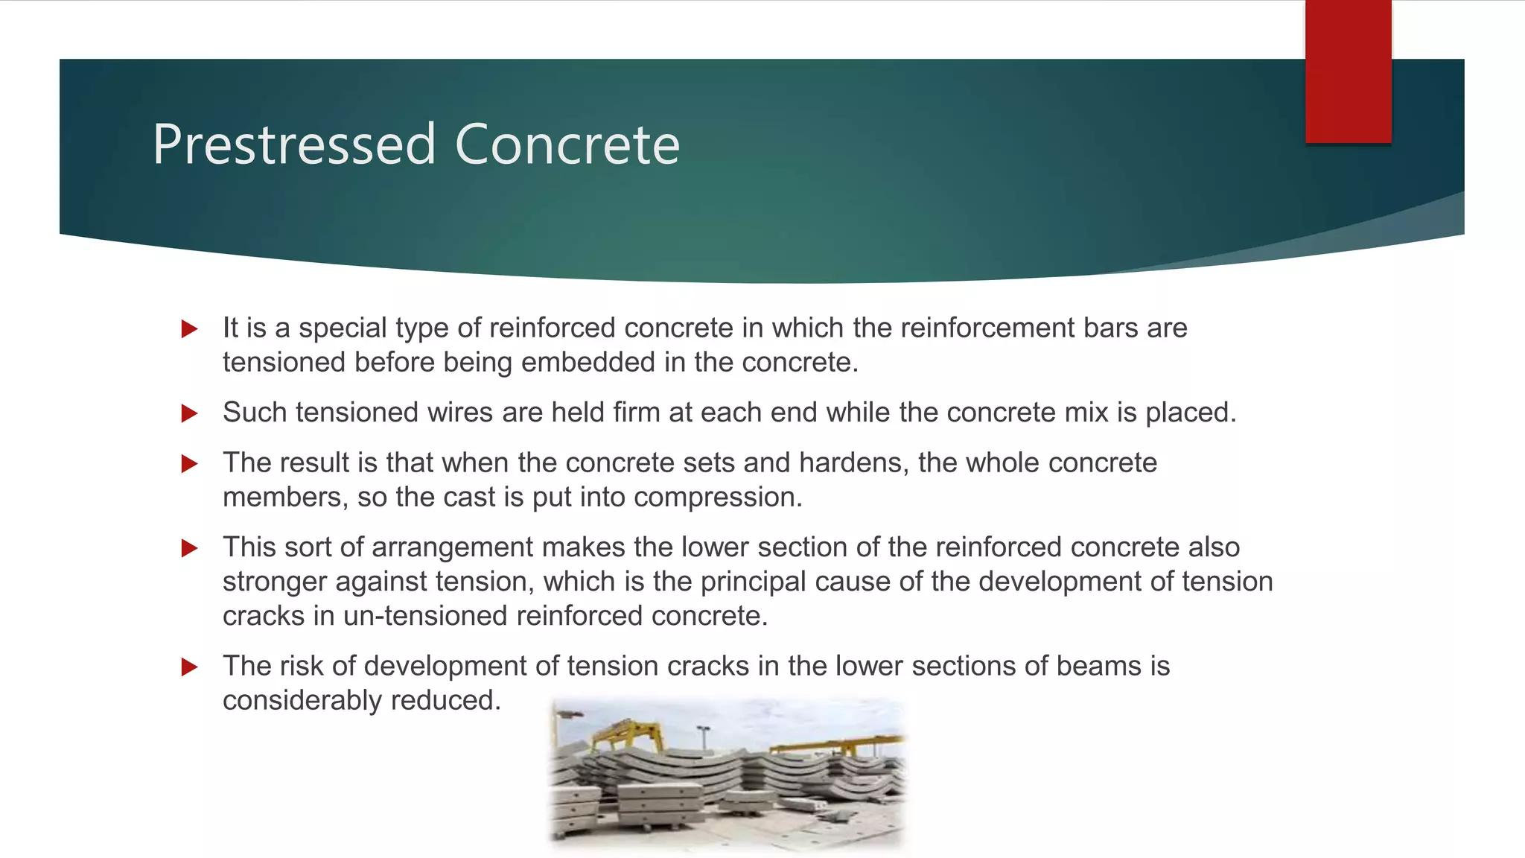

Slide 31
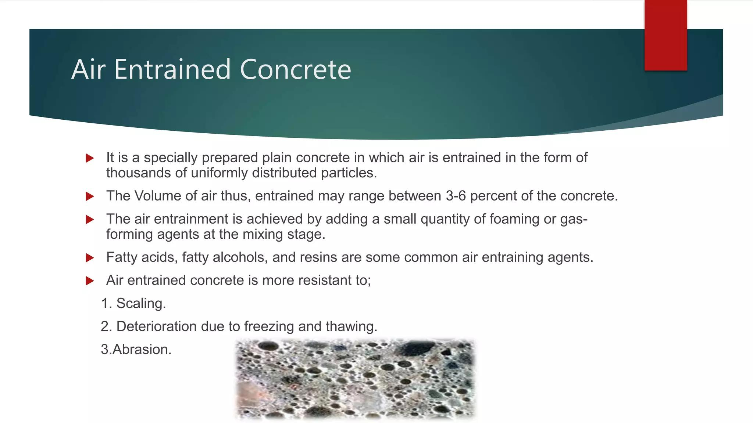

Slide 32
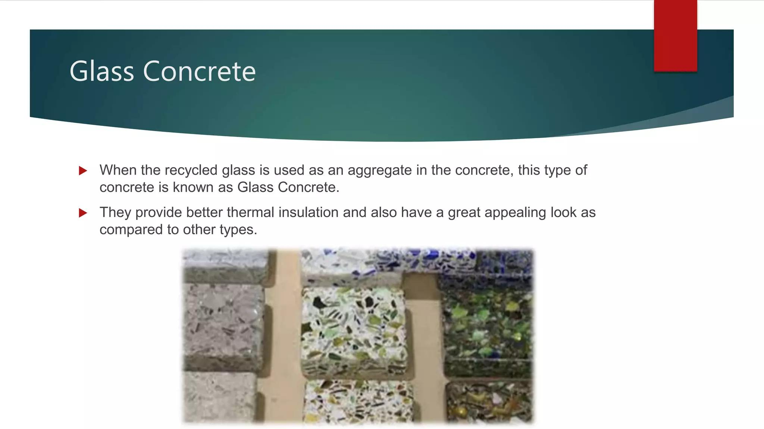

Slide 33
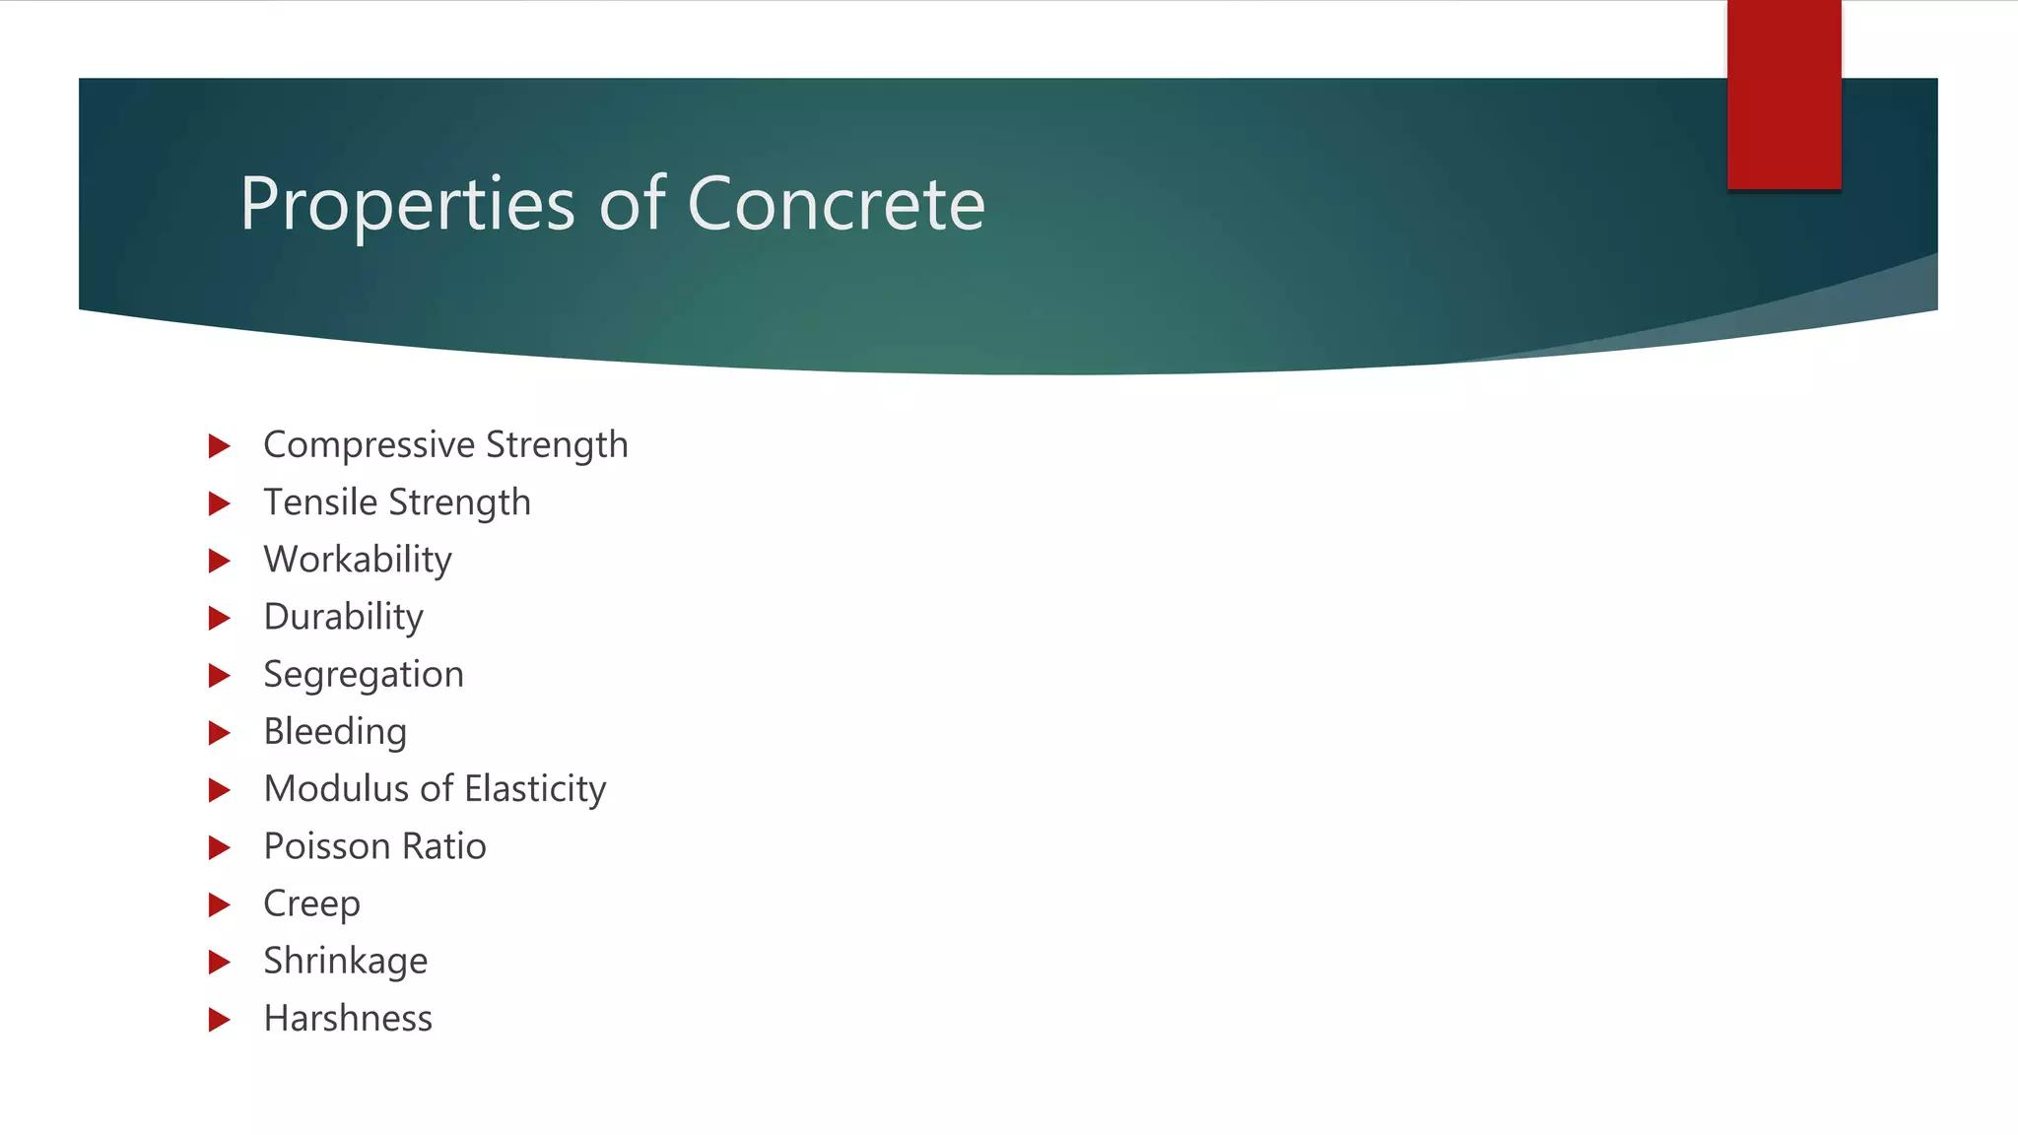

Slide 34
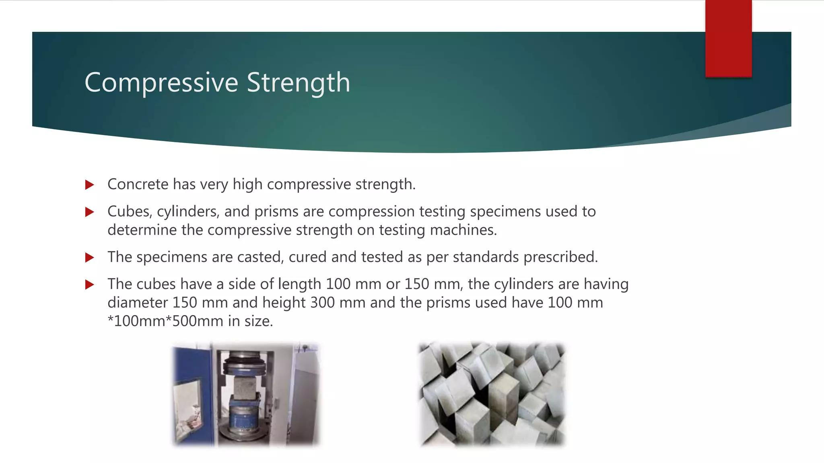

Slide 35
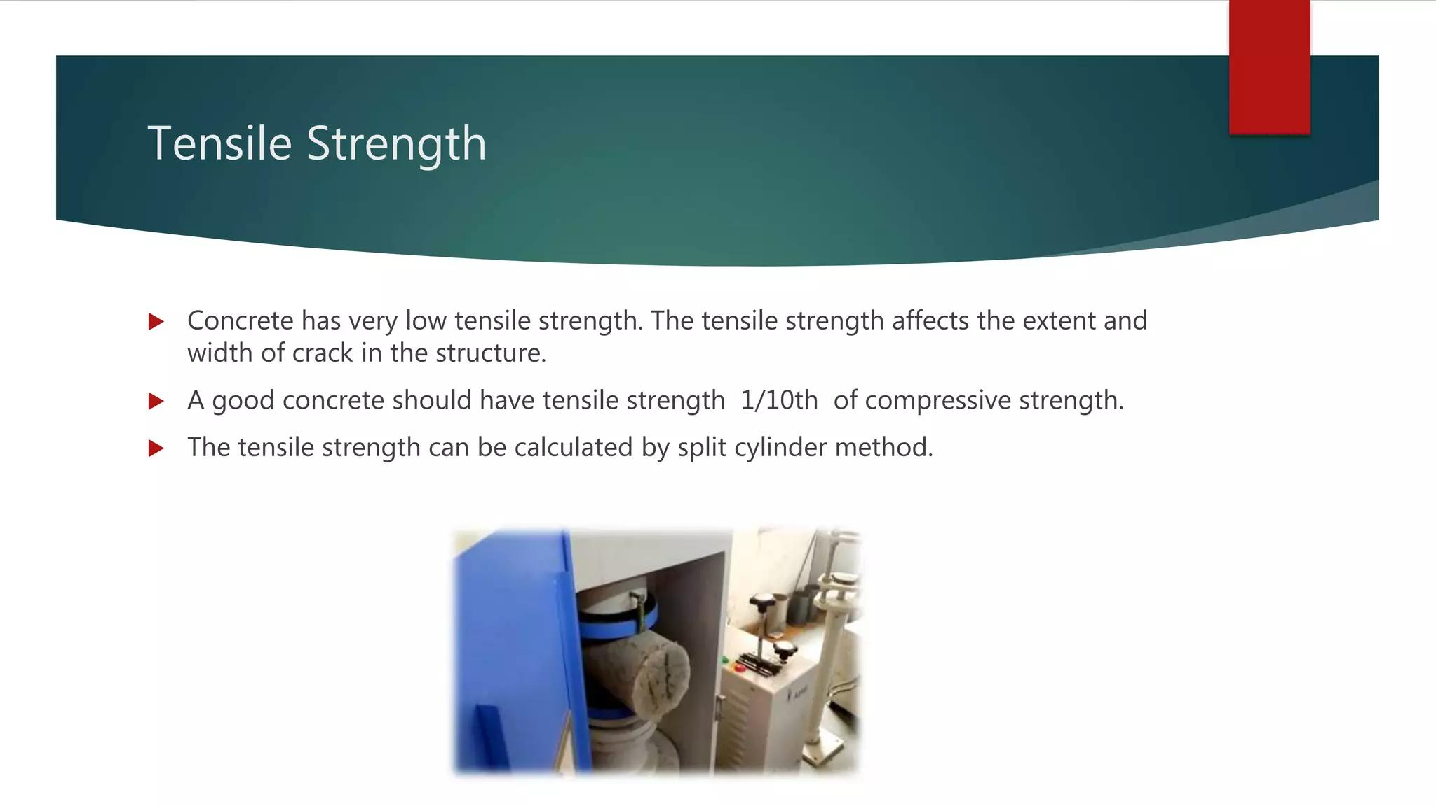

Slide 36
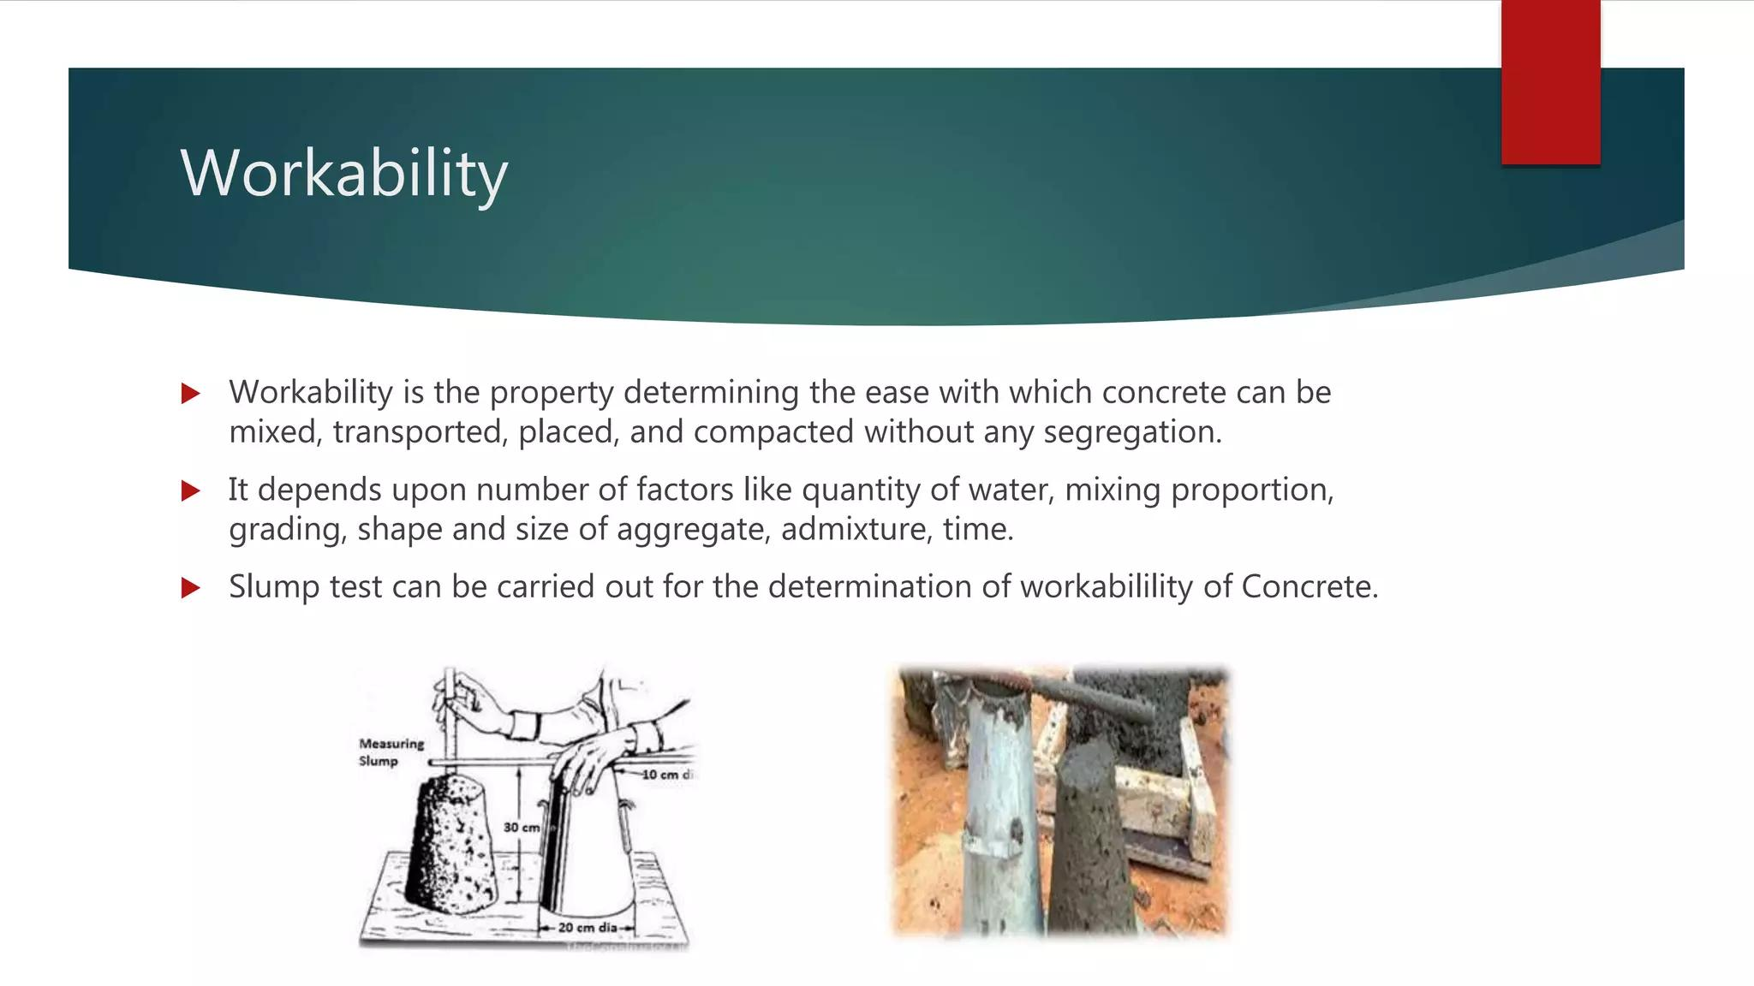

Slide 37
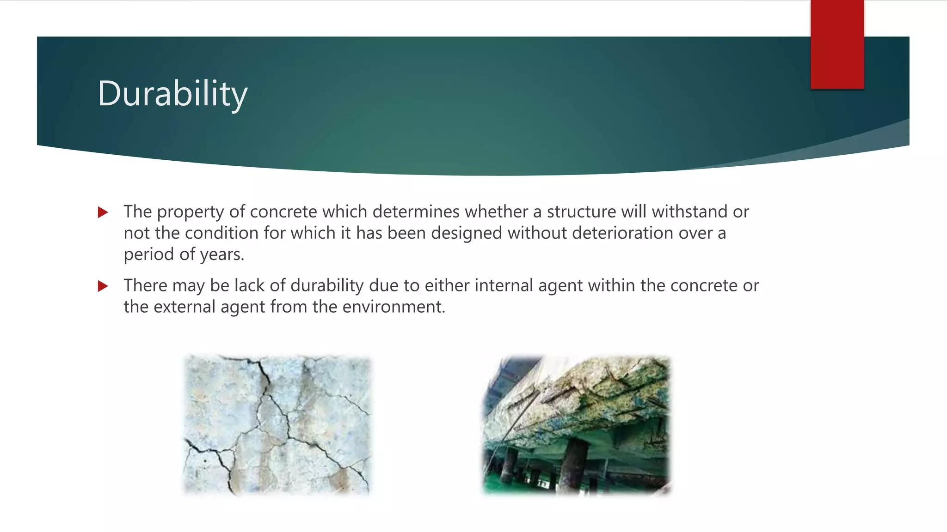

Slide 38
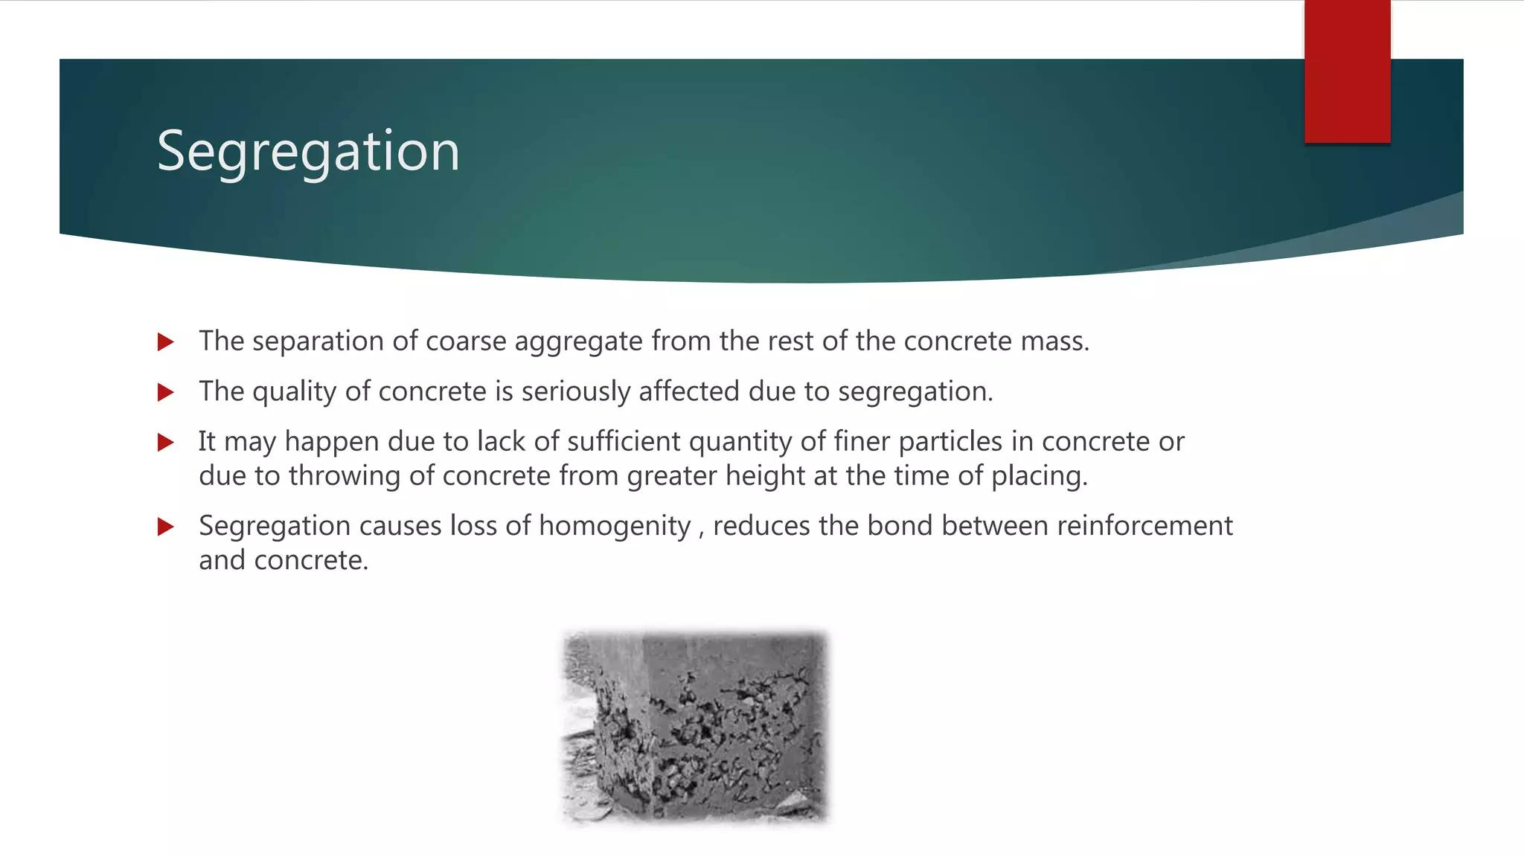

Slide 39
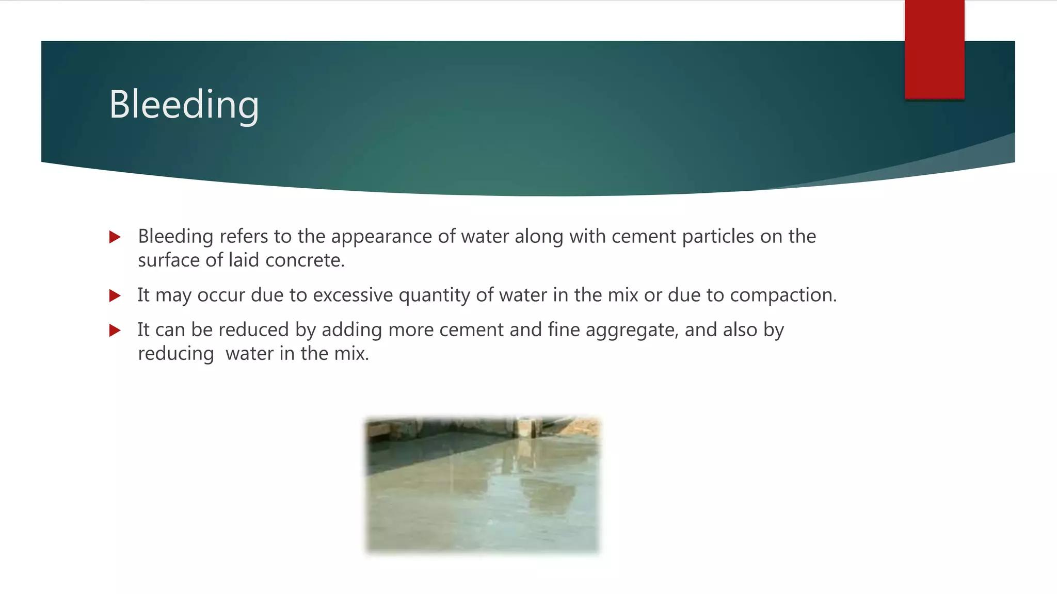

Slide 40
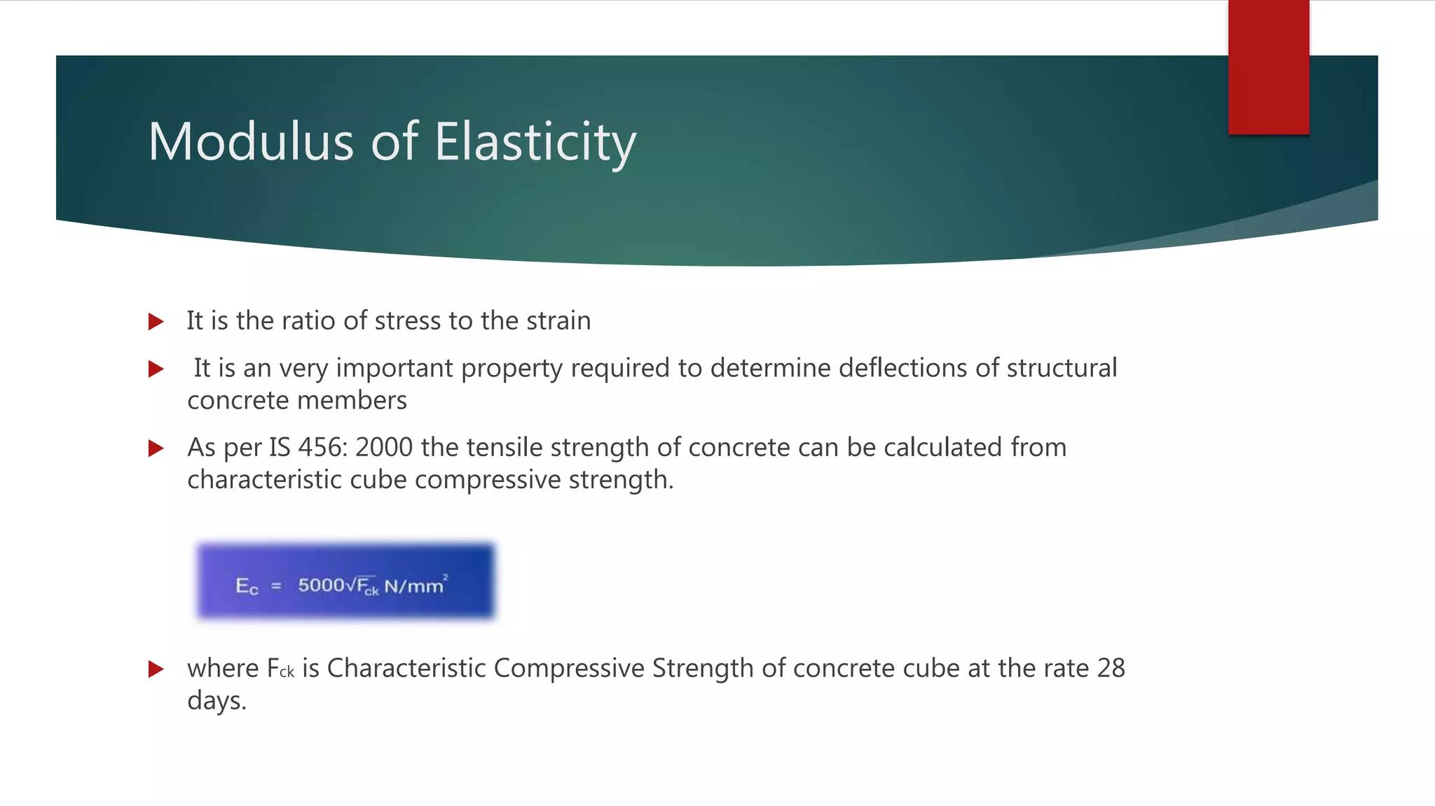

Slide 41
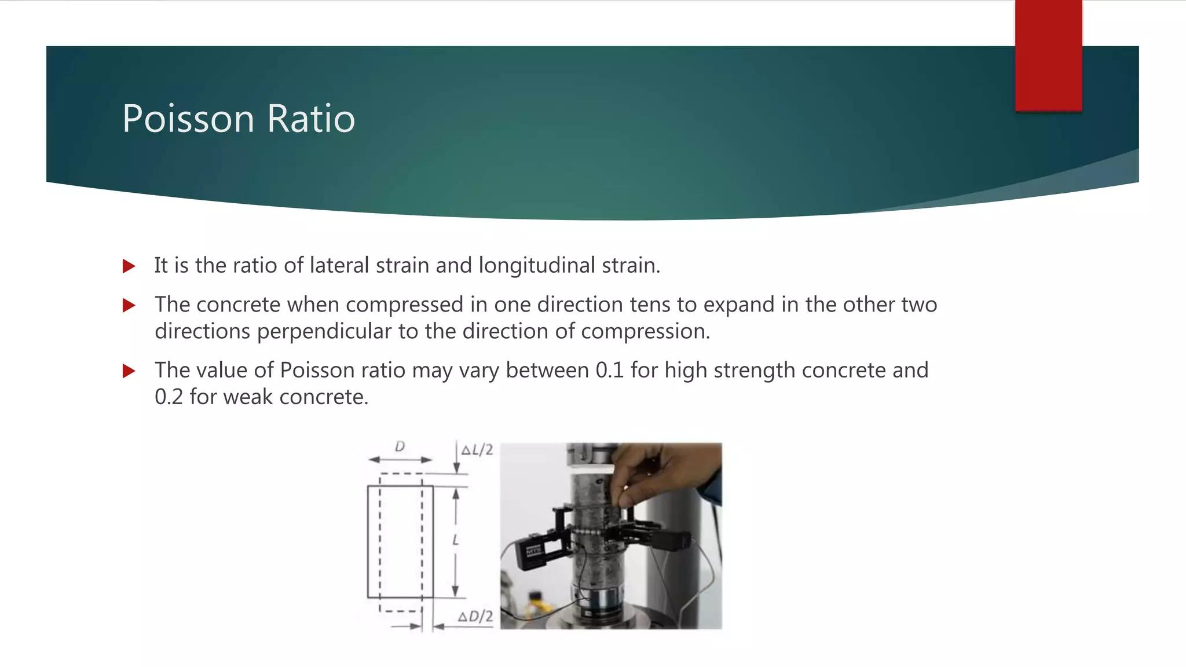

Slide 42
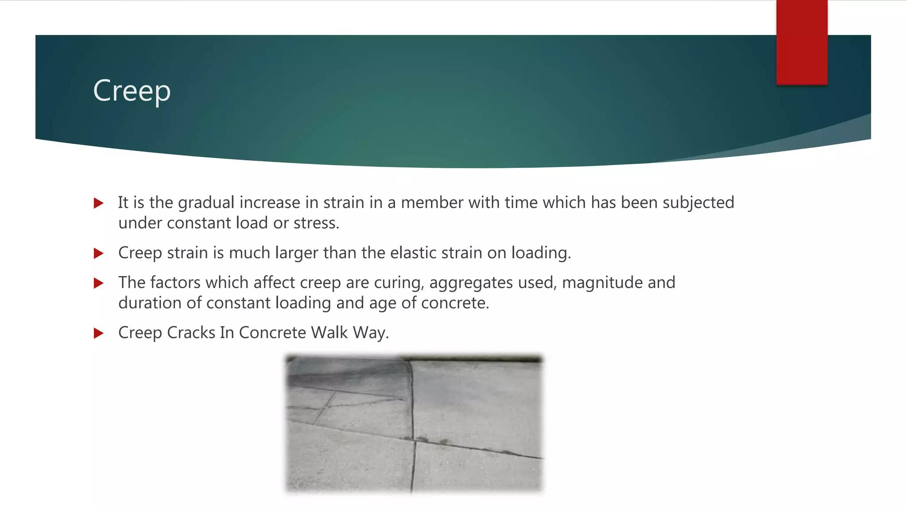

Slide 43
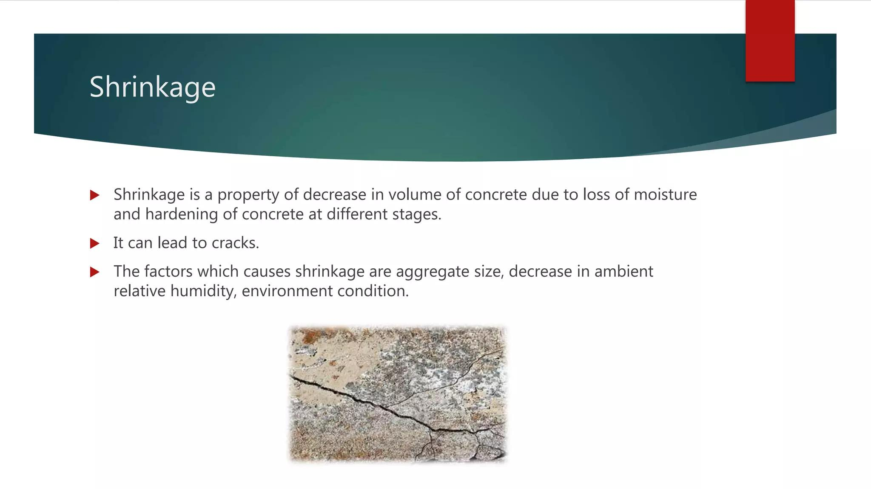

Slide 44
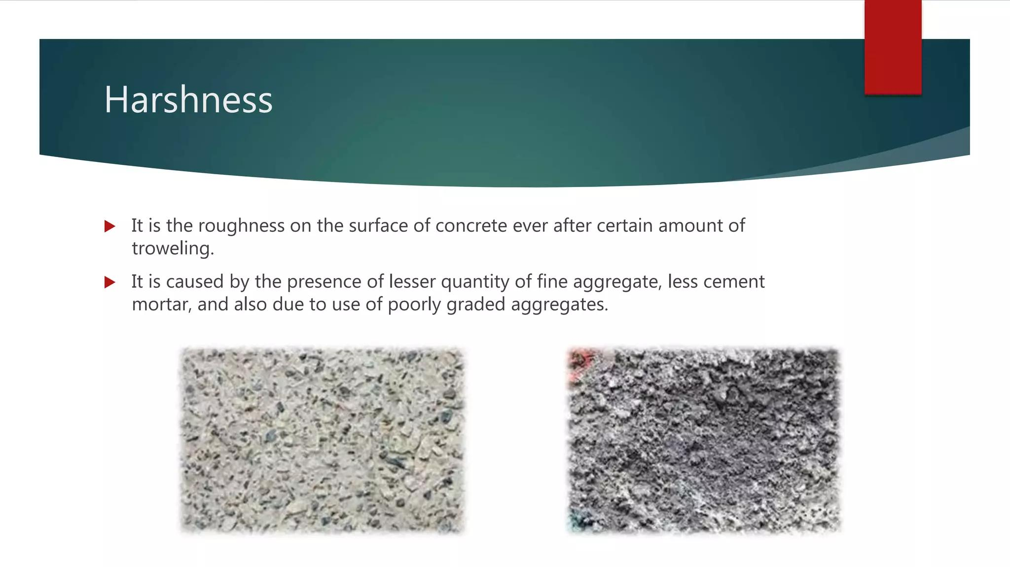

Slide 45
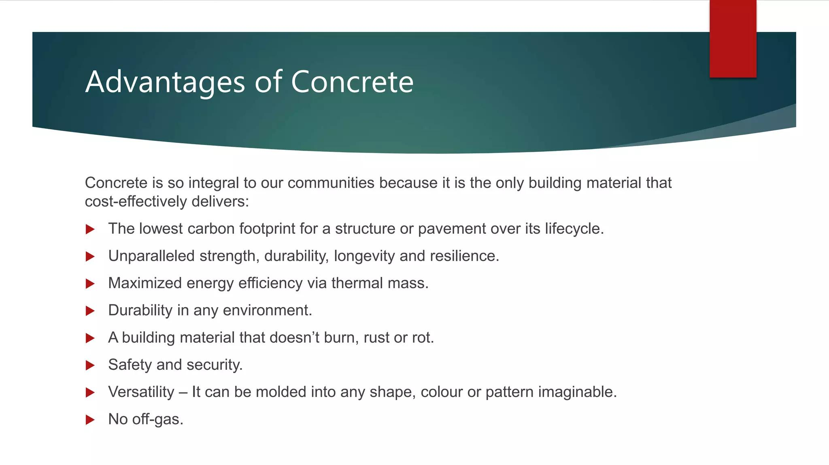

Slide 46
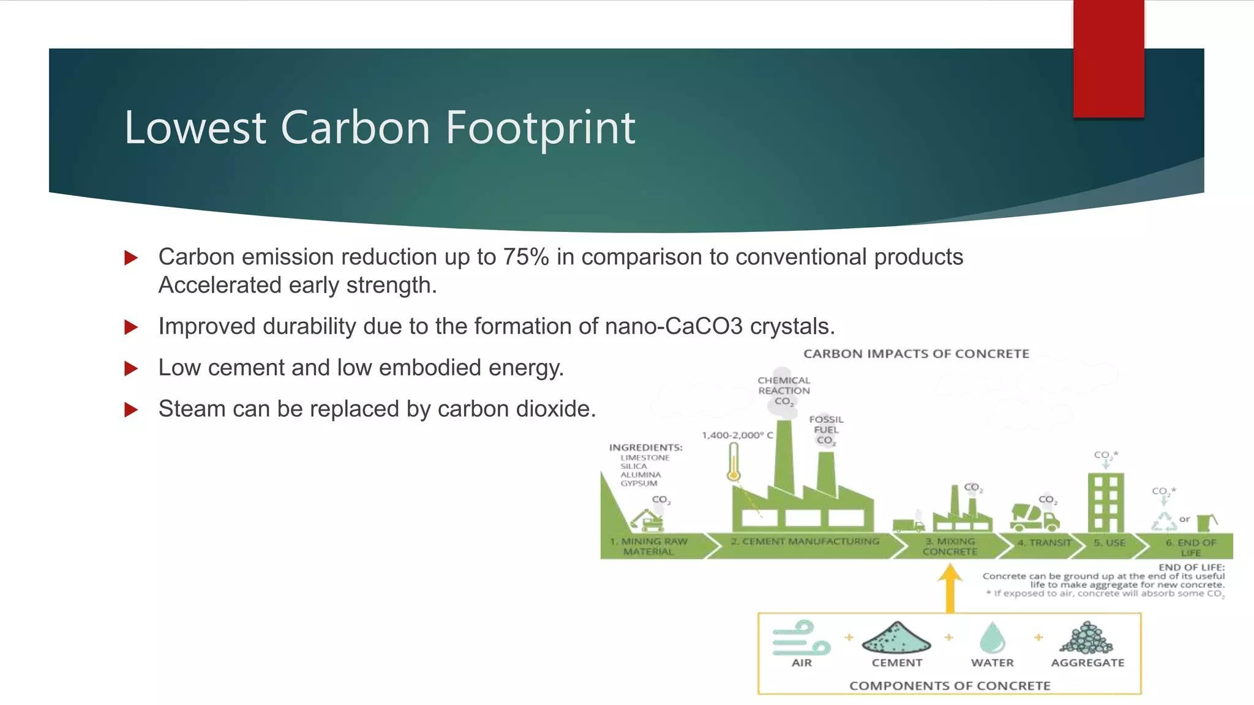

Slide 47
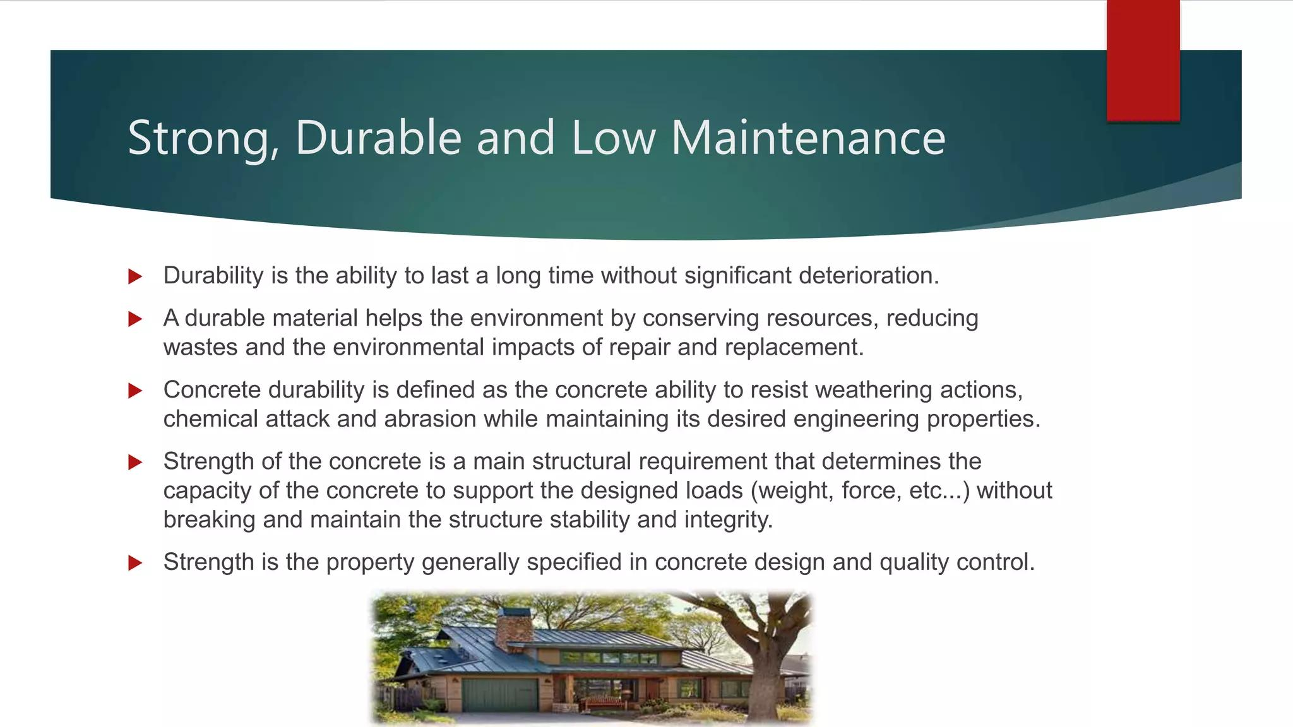

Slide 48
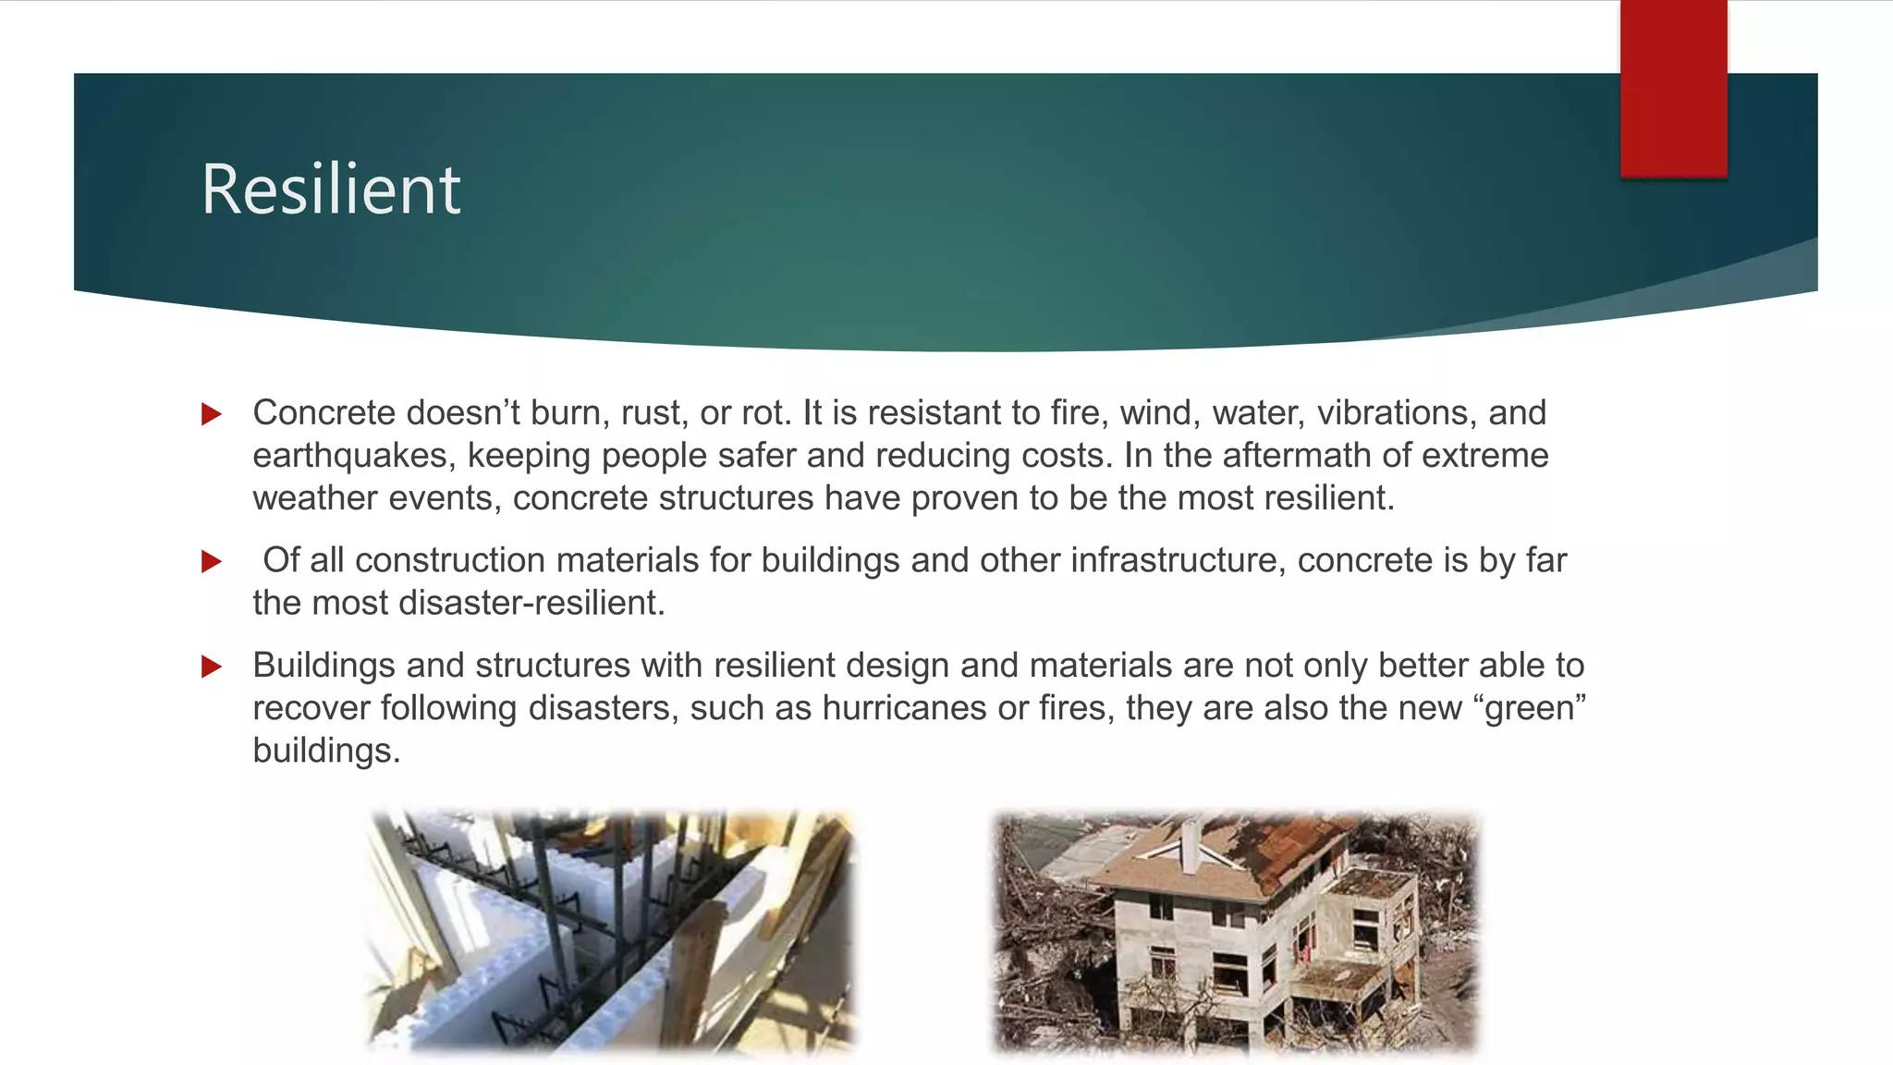

Slide 49


Slide 50
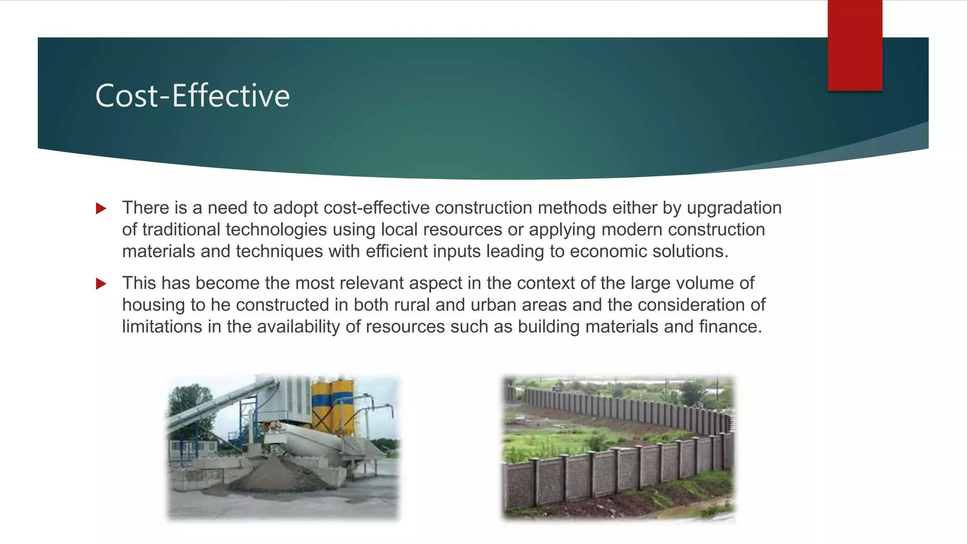

Slide 51
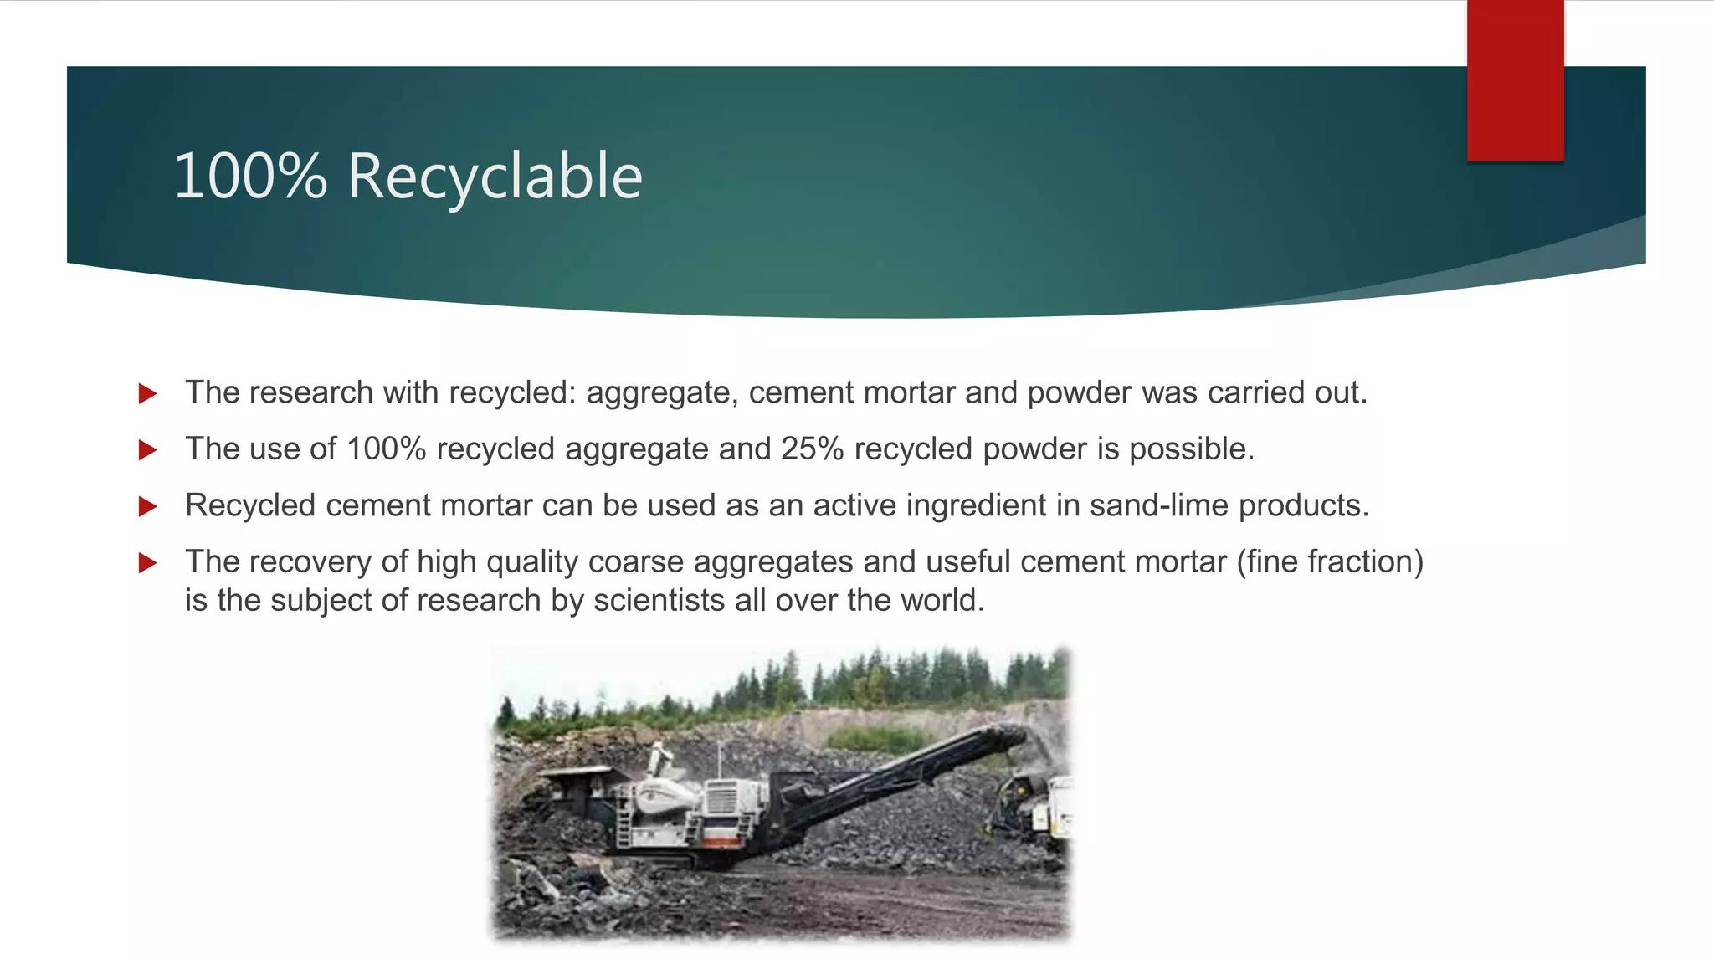

Slide 52
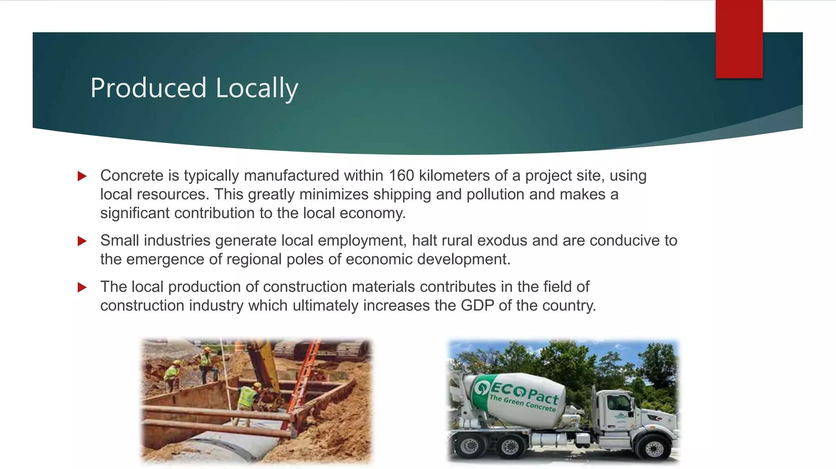

Slide 53
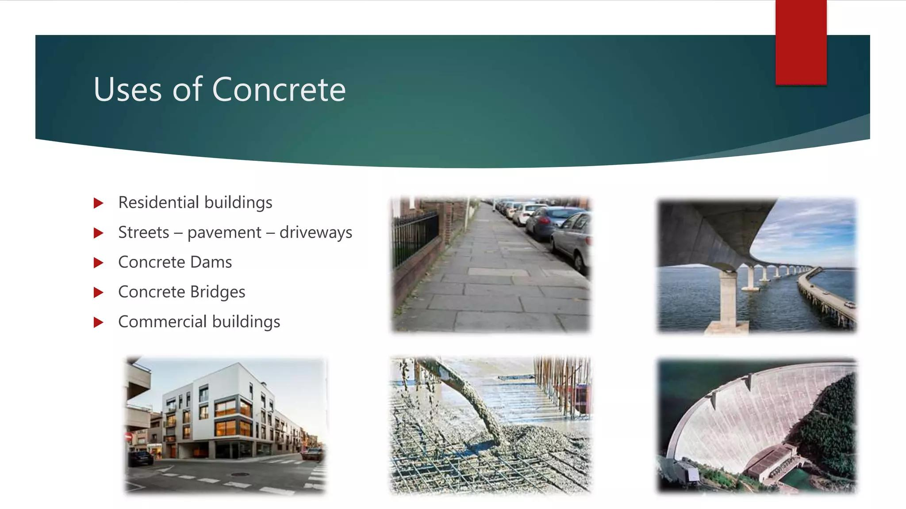

Slide 54
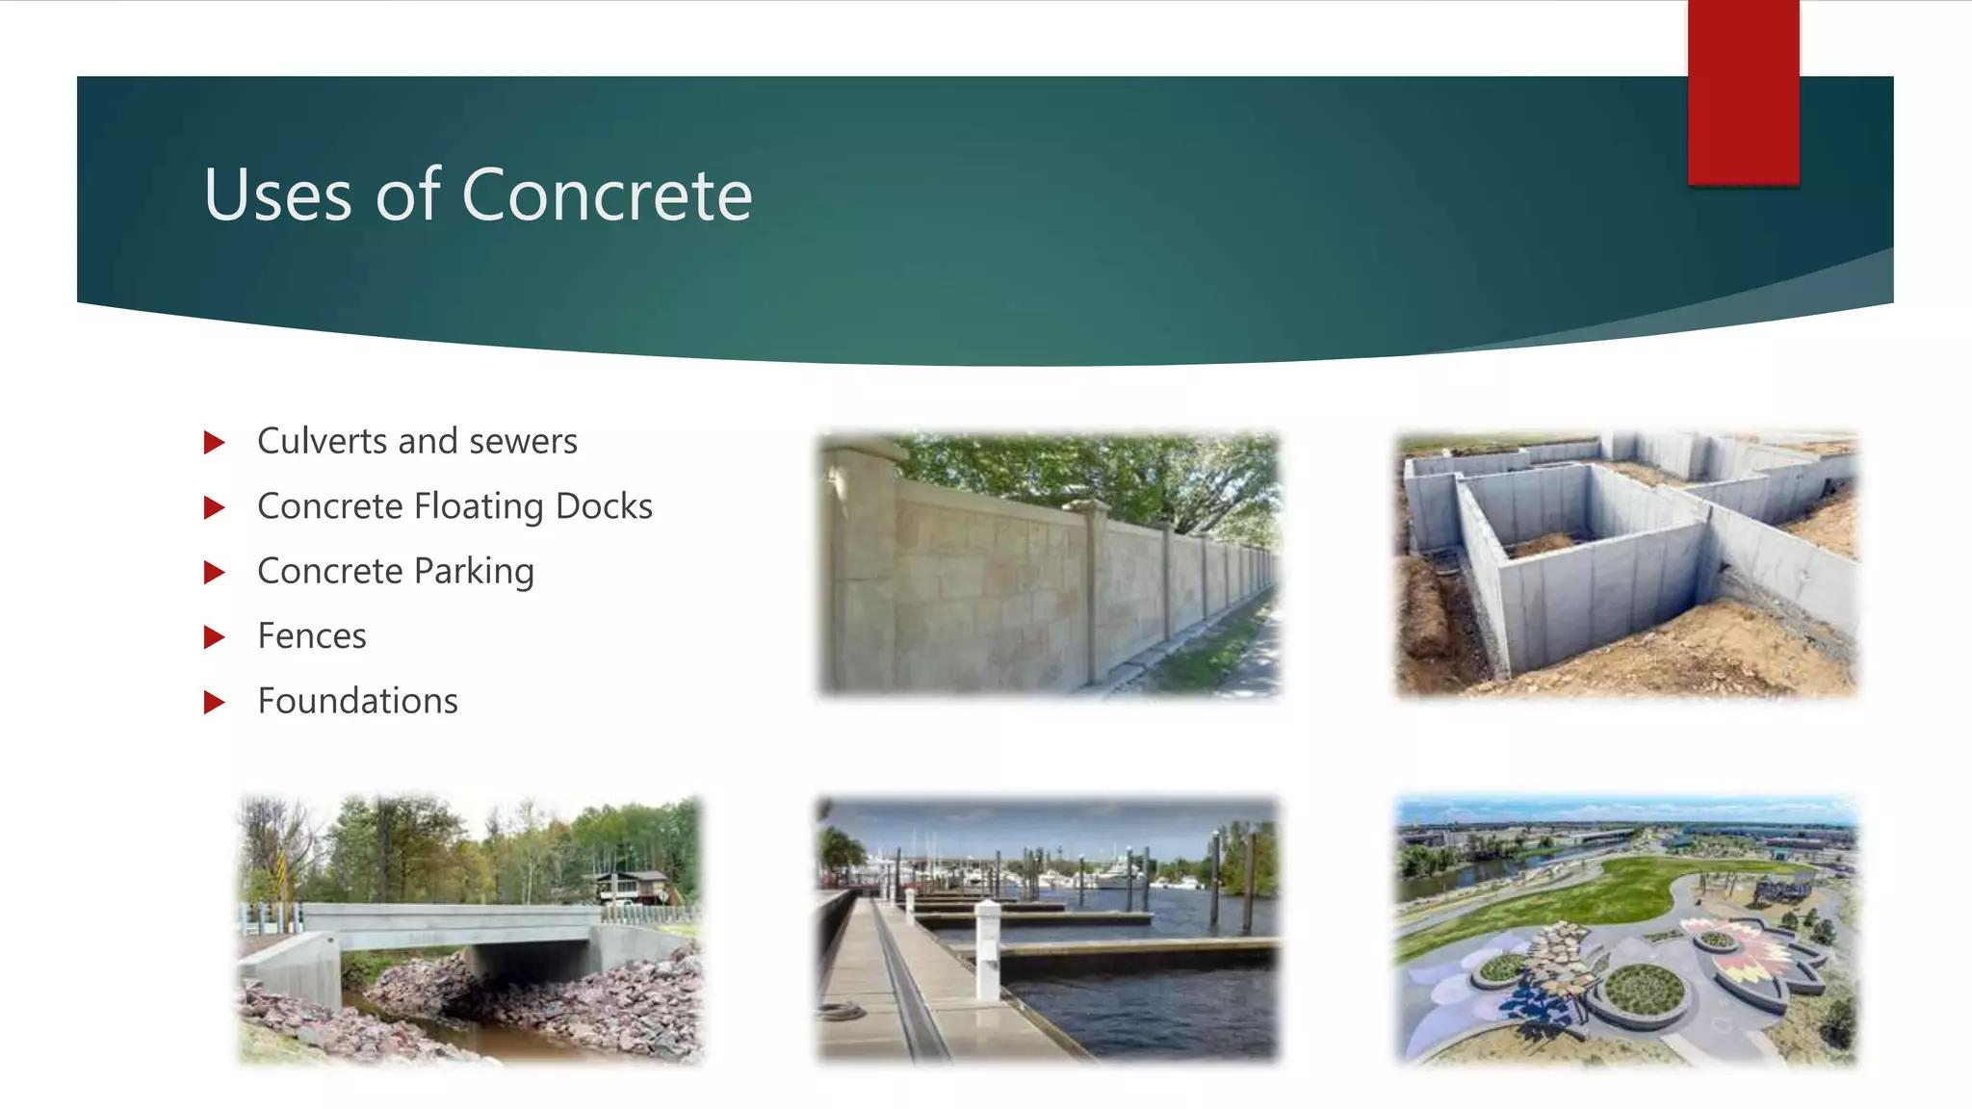

Slide 55
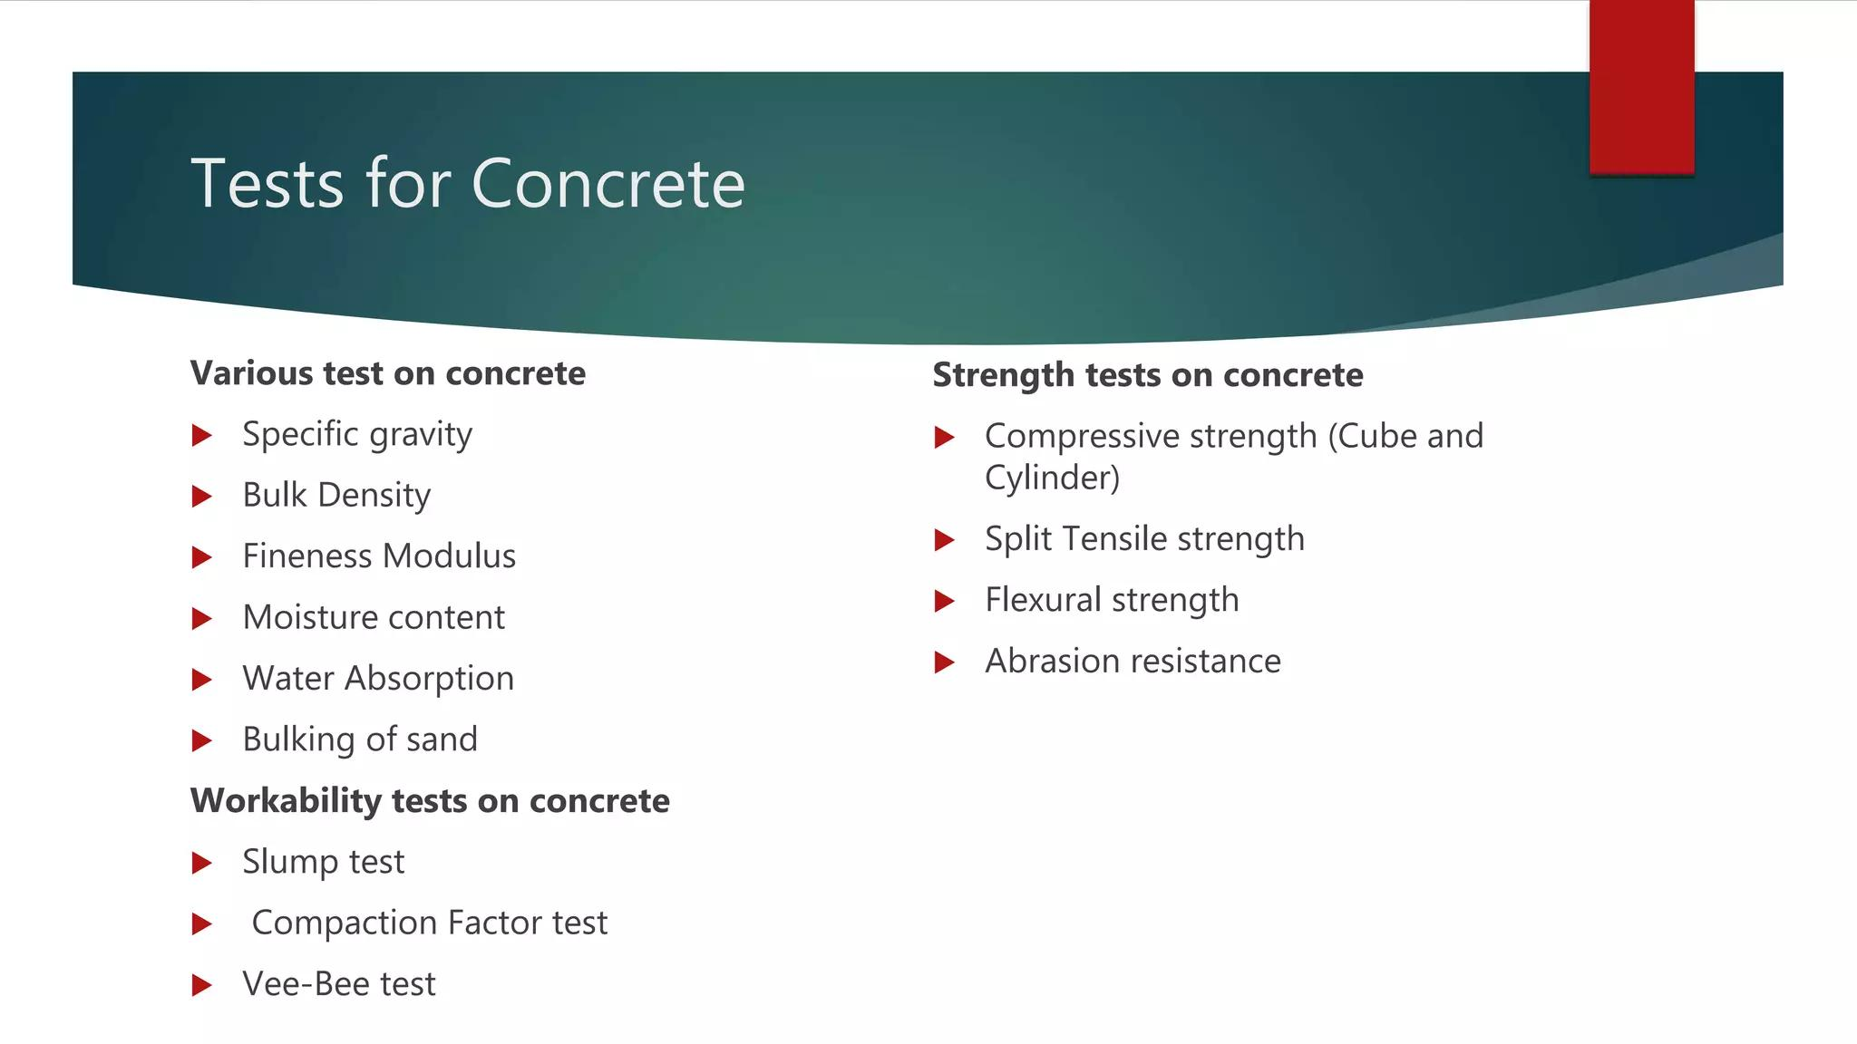

Slide 56
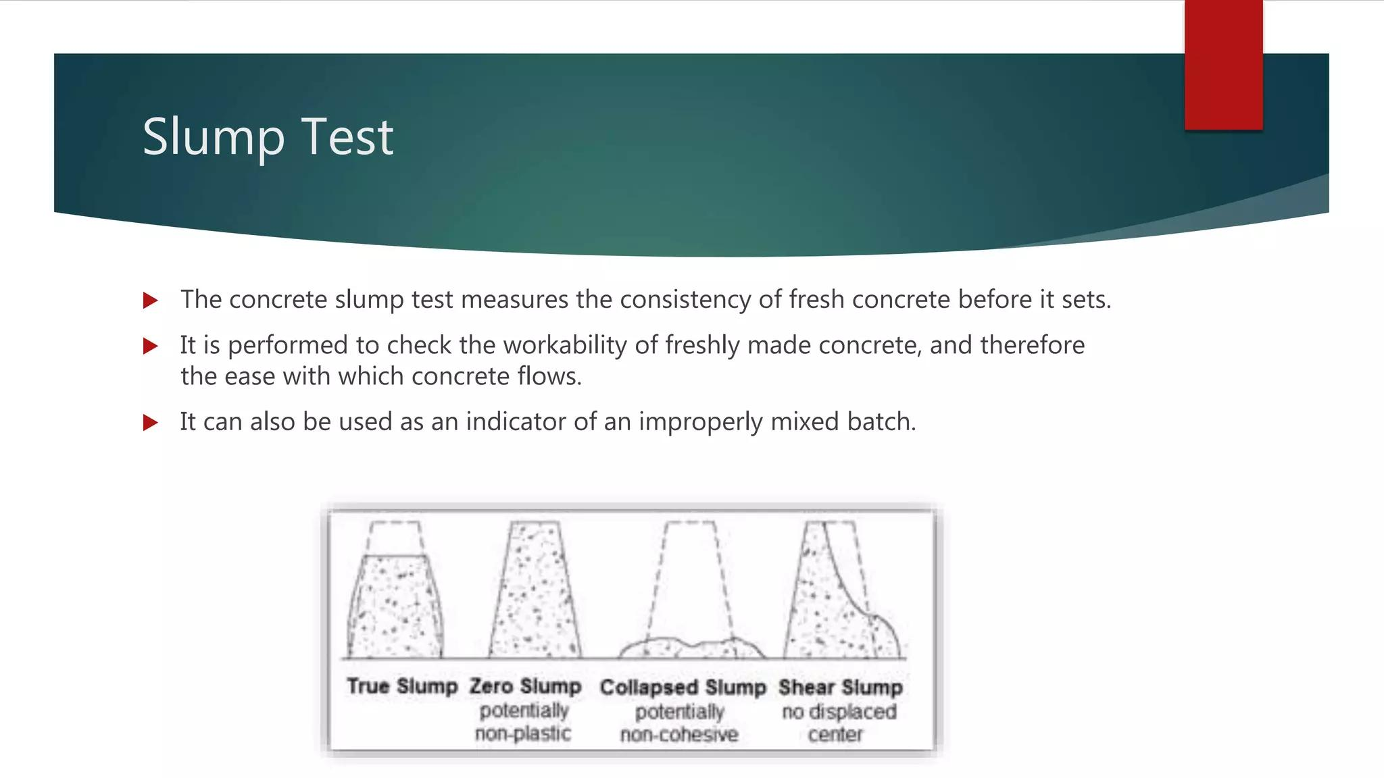

Slide 57
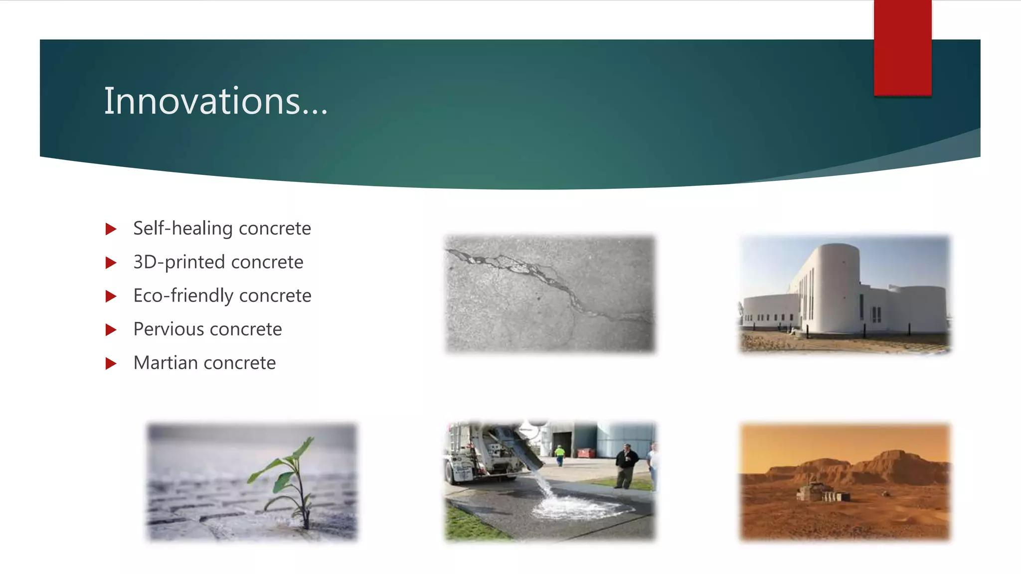

Slide 58
Concrete Mix Design Math
Week 3-5
Pages 59-79

Slide 59

Workability of Concrete

Slide 60


Slide 61


Slide 62


Slide 63


Slide 64


Slide 65


Slide 66


Slide 67


Slide 68


Slide 69


Slide 70
Freeze-thaw Effect on Concrete
The freeze-thaw cycle is a major cause of damage to concrete, and can lead to cracking, flaking, and settling:
How it happens
When water in concrete freezes, it expands by about 9%. This expansion puts pressure on the concrete's pores, which can "pop".
The effect
When the water thaws, it leaves behind larger empty pockets in the concrete. This allows more water to enter the pores, which can lead to more cracking when it freezes again.
The result
Over time, the repeated freeze-thaw cycle can weaken the concrete and cause structural defects.
Other effects
Freeze-thaw cycles can also disrupt the soil or sub-material below the concrete, causing it to shift and settle.

Slide 71


Slide 72


Slide 73


Slide 74


Slide 75


Slide 76


Slide 77


Slide 78


Slide 79


Slide 80
It’s time to Materials Purchasing and Mixing
Week 6-9

Slide 81
Determination of Slump Value
Week 10
Pages 82-86

Slide 82


Slide 83


Slide 84


Slide 85


Slide 86


Slide 87
Bridge Details
Week 11-13
Pages 88-114

Slide 88


Slide 89


Slide 90


Slide 91


Slide 92


Slide 93


Slide 94


Slide 95


Slide 96


Slide 97


Slide 98


Slide 99


Slide 100


Slide 101


Slide 102


Slide 103


Slide 104


Slide 105


Bridge Basic Components
by Rubieyat Bin Ali

Slide 106
Introduction to Bridge Design
Spanning Gaps
Engineering Challenges
Bridges are structures that span gaps, connecting roadways, railways, and waterways. They play a crucial role in transportation, facilitating movement and accessibility.
Designing bridges requires careful consideration of factors like structural integrity, load capacity, environmental conditions, and aesthetic appeal. Engineers face challenges in ensuring the bridge's stability and safety.

Slide 107

Superstructure Components
1
Deck
2
Beams & Girders
The bridge's deck, which carries the traffic, is typically made of concrete or steel. It is supported by beams or girders, which transfer the weight to the substructure.
Beams and girders provide horizontal support to the deck, distributing the load evenly. They are usually made of steel or reinforced concrete.
3
Railings
Railings provide safety and prevent vehicles from falling off the edge of the deck. They are typically made of steel or concrete and are designed to withstand wind forces.

Slide 108

Substructure Components
Supports
Anchoring
The substructure, the foundation of the bridge, supports the superstructure and transfers loads to the ground. It consists of piers, abutments, and foundations.
The substructure provides stability and anchors the bridge to the ground, ensuring its resilience against forces such as wind, earthquakes, and traffic loads.
Resilience
The substructure must be designed to withstand extreme weather conditions, seismic activity, and the constant wear and tear of traffic, ensuring the bridge's longevity.

Slide 109




Foundations
Pile Foundations
Used in soft ground, pile foundations consist of driven or drilled shafts that transfer loads to deeper, more stable soil layers.
Caissons
Large, hollow structures sunk into the ground to provide support in challenging soil conditions. They are often used for bridges with large spans.
Spread Footings
Wide, flat foundations distributed over a large area, suitable for stable ground conditions and lighter loads.

Slide 110

Abutments
1
Transitional Structure
Abutments are structural elements that support the bridge deck at the ends and transition the structure to the ground, forming a connection with the roadway or waterway.
2
Wing Walls
Wing walls extend from the abutments to contain the backfill, preventing erosion and ensuring stability.
3
Backfill
Backfill is the material placed behind the abutment to provide stability and support to the structure.

Slide 111




Piers
Intermediate Supports
Piers are intermediate supports that provide vertical support to the bridge deck, transferring loads from the beams to the foundation.
Column & Beam System
Piers are typically constructed of columns and beams, designed to withstand significant forces and maintain stability.
Environmental Conditions
Piers must be designed to withstand various environmental conditions, such as water currents, temperature changes, and ice forces.

Slide 112



Bearings
Movement
1
Bearings are essential components that allow the bridge deck to move freely, accommodating thermal expansion and contraction, seismic activity, and traffic loads.
Types
2
Types include fixed, expansion, and roller bearings, each serving a specific purpose and providing the necessary movement.
Transferring Forces
3
Bearings transfer the weight of the bridge deck to the piers or abutments, ensuring the stability and longevity of the structure.

Slide 113
Expansion Joints
Bridge Movement
1
Expansion joints are gaps incorporated into the bridge deck to accommodate thermal expansion and contraction, preventing damage to the structure.
Flexible Material
2
The gaps are filled with flexible materials like rubber or asphalt, which allow for movement without compromising the structural integrity.
Traffic Flow
3
Expansion joints are designed to ensure smooth traffic flow by minimizing the impact of bridge movement on vehicles.

Slide 114

Approach Slabs
1
Smooth Transition
Approach slabs are the sections of roadway that connect to the bridge deck, providing a smooth transition for vehicles entering and exiting the bridge.
2
Drainage
Approach slabs are typically designed with a slight incline to facilitate drainage, preventing water accumulation and potential damage.
3
Load Distribution
They are reinforced to distribute the load from vehicles, ensuring the stability of the roadway and the bridge deck.

Slide 115
Review and Practical Classes
Week 14-16

Slide 116
Click the link for Report writing
Design of Concrete Structure I Manual

Slide 117
Practical Exams
Week 14-16

Slide 118

Any Questions?

Slide 119
Thank you for your kind attention
Prepared By
Rubieyat Bin Ali
Assistant Professor & HOD
Department of Civil Engineering
University of Global Village (UGV), Barishal

