Slide 1
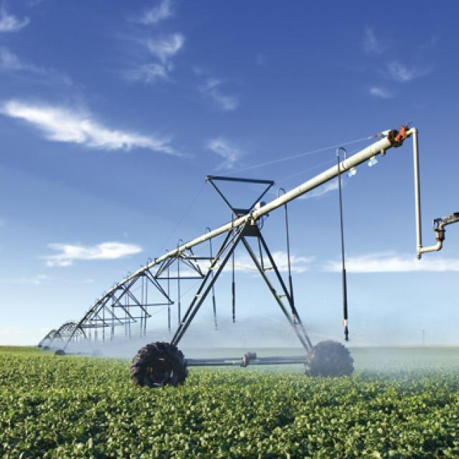

Irrigation and Flood Control
Content of Laboratory Course
Prepared By
Kishor Roy Akash
Lab Assistant
Department of Civil Engineering
University of Global Village (UGV), Barishal
Program: B.Sc. in Civil Engineering

Slide 2
Course Title | Irrigation and Flood Control Lab
Course Code | CE 4202
Credits | 01
CIE Marks | 30
SEE Marks | 20
Exam Hours | 2 hours (Semester Final Exam)
Level | 7th Semester
BASIC COURSE INFORMATION

Slide 3

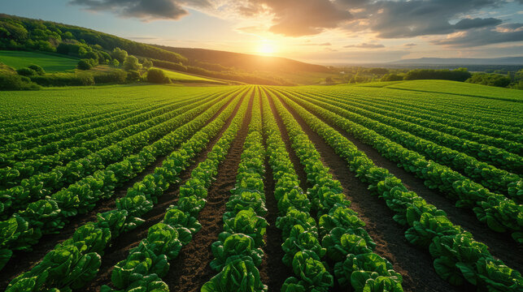
Concrete Mix Design
COURSE CODE: CE 0732-2104 | CREDIT:01
 | TOTAL MARKS:50
 | CIE MARKS: 30
Semester End Exam Hours 2 | SEE MARKS: 20
Course Learning Outcomes (CLOs): After completing this course successfully, the students will be able to-
CLO 1 | Understand concepts of Irrigation and Flood Control in agriculture.
CLO 2 | Analyze various types of soil.
CLO 3 | Develop intellectual communication skills through working in groups in performing the laboratory experiments/field supervisions and by interpreting the experimental results.
CLO 4 | Generate the detailing of various soil properties.

Slide 4
SL | Content of Course | Hrs | CLOs
1 | Determination of Soil Bulk Density by Field Method | 10 | CLO1
2 | Soil Suction Measurement with Tensiometer | 20 | CLO3
3 | Determination of Soil Intake Characteristics using Cylinder Infiltrometer | 20 | CLO2, CLO4
4 | Measurement of Canal Seepage Loss by Ponding Method | 5 | CLO1, CLO3
5 | Irrigation Scheduling by Book Keeping Method | 10 | CLO1
6 | Design of Branch Canal in an Irrigation Project | 10 | CLO3
6 | Practice, Review/Reserved Day, Lab Report Assessment, Self study | 10 | CLO3
7 | Lab Test, Viva, Quiz, Overall Assessment, Skill Development Test (Competency) | 10 | CLO1
Text Book:
1. Irrigation Fundamentals by George H. Hargreaves and Gary P. Merkley
2. Flood Control and Drainage Engineering by S.N. Ghosh – 4th edition.

Slide 5
ASSESSMENT PATTERN
CIE- Continuous Internal Evaluation (30 Marks)
SEE- Semester End Examination (20 Marks)
SEE- Semester End Examination (40 Marks) (should be converted in actual marks (20))
Bloom’s Category | Tests
Remember | 05
Understand | 07
Apply | 08
Analyze | 07
Evaluate | 08
Create | 05
CIE- Continuous Internal Evaluation (100 Marks) (should be converted in actual marks (30))
Bloom’s Category Marks (out of 100) | Lab Final (30) | Lab Report (10) | Continuous lab performance (30) | Presentation & Viva (10) | External Participation in Curricular/Final Project Exhibition (10)
Remember/Imitation | 05 |  | 05 | 02 | Attendance 10
Understand/manipulation | 05 | 05 | 05 | 03
Apply/Precision | 05 |  | 05
Analyze/Articulation | 05 |  | 05
Evaluate/Naturalisation | 05 | 05 | 05
Create | 05 |  | 05 | 05

Slide 6
Couse plan specifying content, CLOs, teaching learning and assessment strategy mapped with CLOs
Week | Topic | Teaching-Learning Strategy | Assessment Strategy | Corresponding CLOs
1-2 | Determination of Soil Bulk Density by Field Method | Lecture, discussion, Experiment | Quiz, Lab Test | CLO1
3-4 | Soil Suction Measurement with Tensiometer | Oral Presentation, Project Exhibition | Lab Report Assessment, viva | CLO3
5-6 | Determination of Soil Intake Characteristics using Cylinder Infiltrometer | Presentation, Field visit | Skill Development Test | CLO2, CLO4
7-8 | Measurement of Canal Seepage Loss by Ponding Method | Lecture, discussion, Experiment, Demonstration | Quiz, Lab Test | CLO1, CLO3
9-10 | Irrigation Scheduling by Book Keeping Method | Oral Presentation, Project Exhibition | Lab Report Assessment, viva | CLO1
11-12 | Design of Branch Canal in an Irrigation Project | Presentation, Field visit | Lab Report Assessment, viva | CLO3
13-14 | Practice, Review/Reserved Day, Lab Report Assessment, Self study | Presentation, Field visit | Skill Development Test | CLO3
15-16 | Lab Test, Viva, Quiz, Overall Assessment, Skill Development Test (Competency) | Lecture, discussion, Experiment | Quiz, Lab Test | CLO2, CLO4

Slide 7
Experiment No 01
Week 1-2

Slide 8
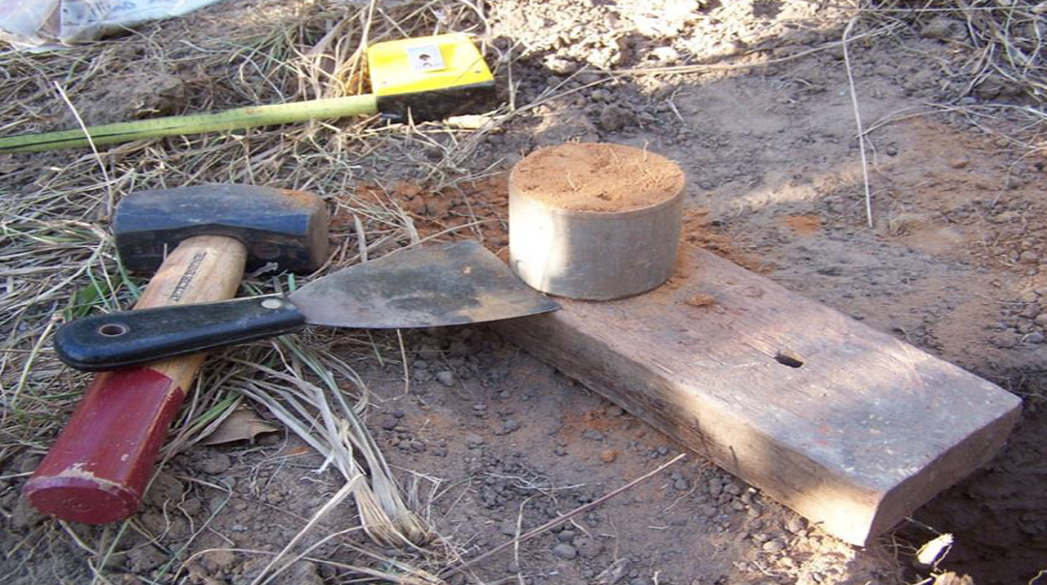
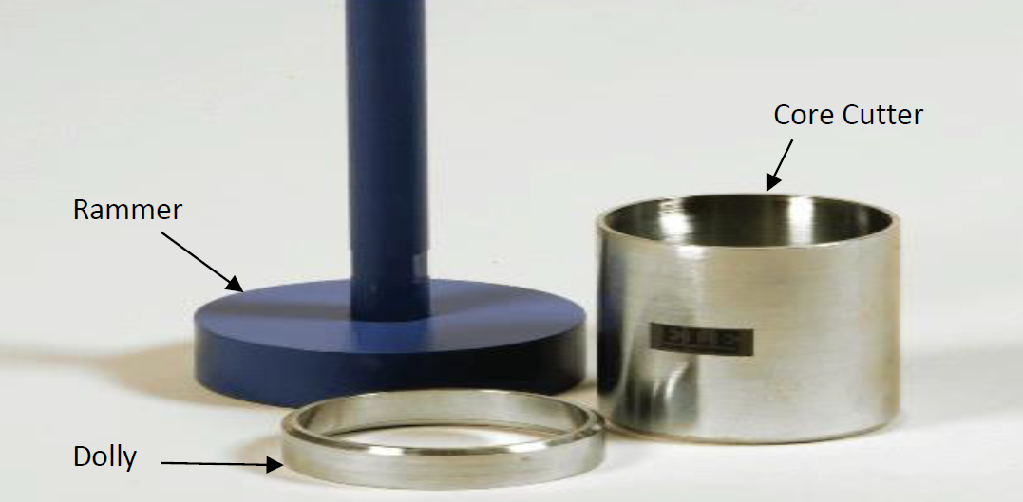
Determination of Soil Bulk Density by Field Method

Slide 9
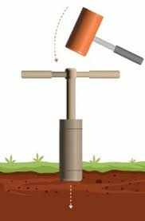
Knowledge of soil and water relationship is valuable to improve irrigation practices and to make the best use of water. Soil bulk density is an important parameter, which influences the soil-water relationship. It is very useful in irrigated regions as it influences the capacities of well drained soils in the field to retain water available for plants, and the flow, or movement of water in soils.
General

Slide 10
Bulk density
The bulk density of a soil is defined as the ratio of the mass of dried soil to the total volume of soil. In other words, it is the mass of a dry soil per unit bulk volume, the latter being determined before drying. It is expressed as
ρb= Ms/Vt = Ms/(Vs+Va+Vw (1)
Here,
ρb = bulk density; gm/cc
Ms= Mass of solid; gm
Vt= Total soil volume; cc
Vs= Volume of solid; cc
Va= Volume of air; cc
Vw= Volume of water; cc
The term bulk density and apparent specific gravity are often used synonymously. Apparent specific gravity is the ratio of the weight of a unit bulk volume of soil to the weight of an equal volume of water. However, since, 1gm of water fills a volume of 1 cc at normal temperatures; the two terms have equal numerical value.
Theory

Slide 11
Bulk density is an important soil physical property considering its influence on the water holding capacity and hydraulic conductivity of soil. It is influenced by the structure, texture and compactness of the soil. The bulk density of uncultivated soils usually varies between 1.0 and 1.6; however compact layers may have a bulk density of 1.7 to 1.8. When working with the irrigated soils, it is necessary to know their bulk density in order to account for the water applied in irrigation, since it is impractical to measure, by direct means, the volume of water, which exists in the form of soil moisture in a given volume of soil. It is necessary to measure the weight of water in a given weight of soil by observing the loss of weight in drying and then convert the weight percentage so obtained to a volume percentage by use of the bulk density; thus, the volume of water in a given volume of soil may be determined. From this data the additional requirement of water in volumetric basis may also be calculated.
Scope of the Test

Slide 12
1) To determine the bulk density of soil.
2) To plot moisture content by weight and moisture content by volume and then determine the soil bulk density from the graph.
Objective

Slide 13
1) The usual method of determining the bulk density or apparent specific gravity of a soil is to obtain an uncompacted soil sample of known volume. Core samplers are commonly used for this purpose. The sampler that has a cutting core is driven into the soil and an uncompacted core obtained within the tube.
2) The samples are carefully trimmed at both ends of the cylinder.
3) They are dried in an oven at 105°C-110°C for about 24 hours until the moisture is driven off and the sample is then weighted. The volume of a soil core is the same as the inside volume of the core cylinder.
4) The weight of the soil in grams divided by the volume of soil core in cc is the bulk density of soil.
5) From the data, calculate moisture content by weight.
6) Find moisture content by volume by multiplying the m/c by weight with bulk density.
Procedure

Slide 14
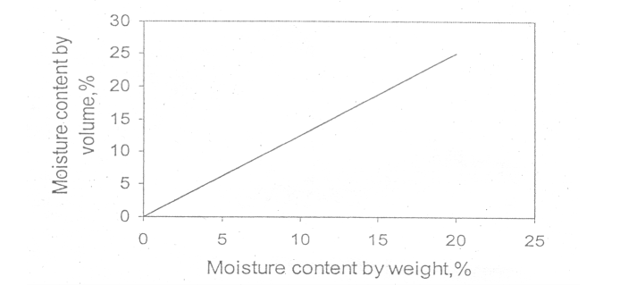
Qualitative Curve
Figure: Moisture content by volume Vs moisture content by weight

Slide 15
1.8 Data Sheet
DETERMINATION OF SOIL BULK DENSITY BY FIELD METHOD
Group No. | Volume of Cylinder (c.c) | Weight of beaker (gm) | Weight of beaker + wet soil (gm) | Weight of Wet soil (gm) | Weight of beaker+ dry soil (gm) | Weight of dry soil (gm) | Moisture content by weight (%) (θm ) | Bulk Density ρb | Moisture content by volume (%)

Slide 16
Experiment No 02
Week 3-4

Slide 17
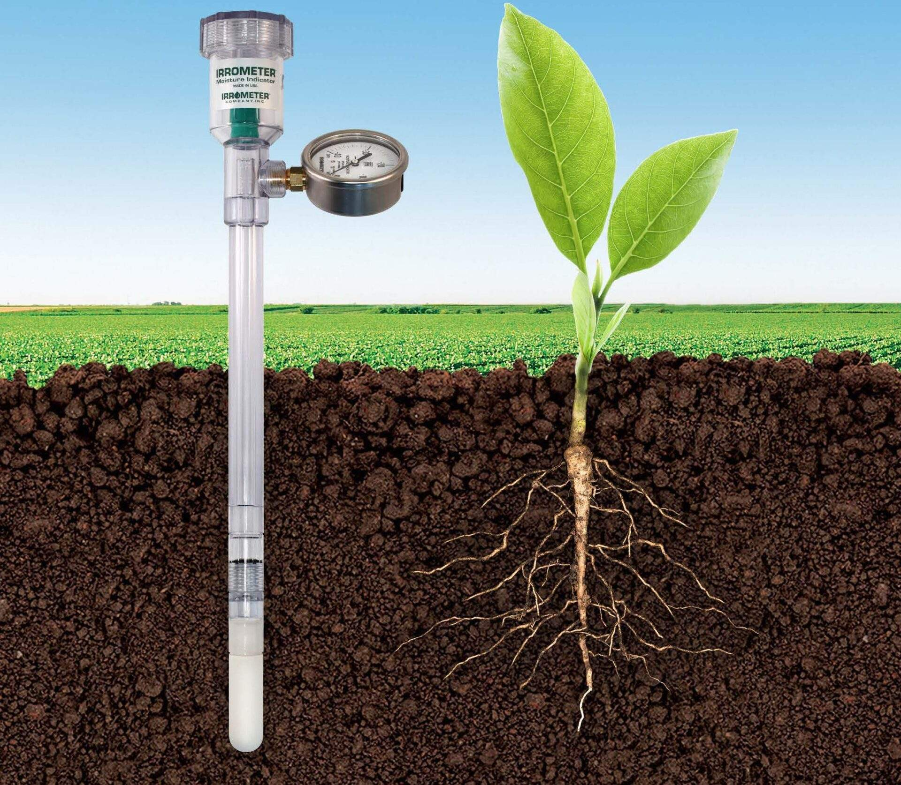
Soil Suction Measurement with Tensiometer

Slide 18
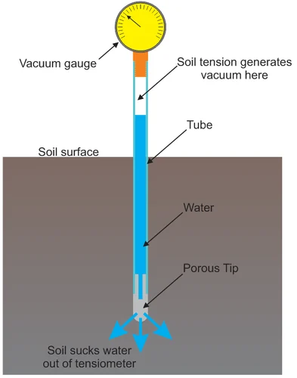
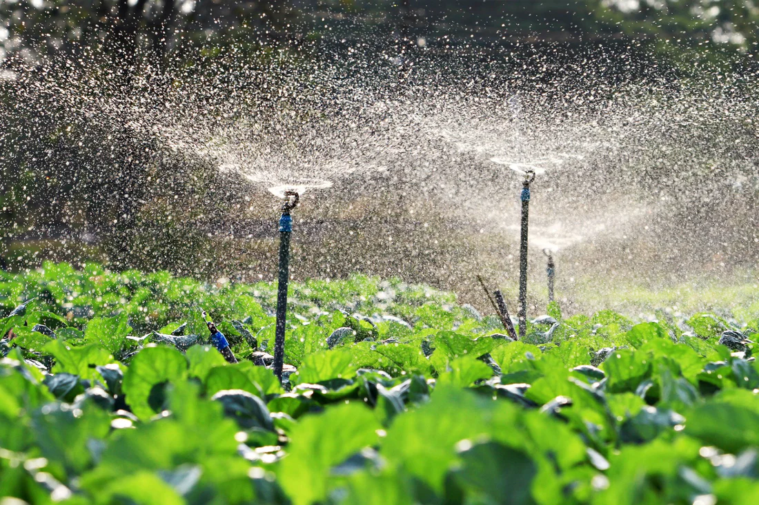
General
The functions of soil moisture in plant growth are very important. Particularly in irrigated regions the soil moisture condition is of special interest and importance, because the depth of water to apply in irrigation and the interval between irrigations are both influenced by present moisture condition and use rate of applied water. Soil suction measurement with tensiometer at various time intervals is an indirect mean of measuring soil moisture
in the soil.

Slide 19
Theory
In unsaturated soils, water is held in the soil matrix under negative pressure due to attraction of the soil matrix for water. Instead of referring to this negative pressure the water is said to be subjected to a tension exerted by the soil matrix. The tension with which the water is held in unsaturated soil is termed as soil-moisture suction or soil-moisture tension.
Soil Suction

Slide 20
The tensiometer is a mechanical device for measuring soil- water tension in the field. The essential parts of a tensiometer consist of the porous cup with a reservoir of water inside, the connecting tube, and the sensing element of a vacuum gauge or a mercury manometer.
The figure 1 below shows the essential parts of a tensiometer. A porous ceramic cup is positioned in the soil where information regarding soil water is desired. The cup, the connecting tube, and the sensing element of a vacuum indicator are all filled with water. Water in the soil near the cup is in hydraulic contact with bulk water inside the cup through pores in the cup wall. Flow, in or out through the cup wall, tends to bring the cup water into hydraulic equilibrium with the soil water. As water moves out of the cup because of the suction in the soil water, the vacuum created in the cup is registered on the gauge. Conversely an increase of water will lower the tension, water will move into the cup, and the gauge will read less tension. Fluctuations of soil moisture are registered by the tensiometer, as long
as tension does not exceed 0.8 atm. As soil water is depleted by
root extraction, or replenished by rainfall or irrigation,
corresponding changes in readings on the tensiometer
gauges occur.
Theory
Tensiometer

Slide 21
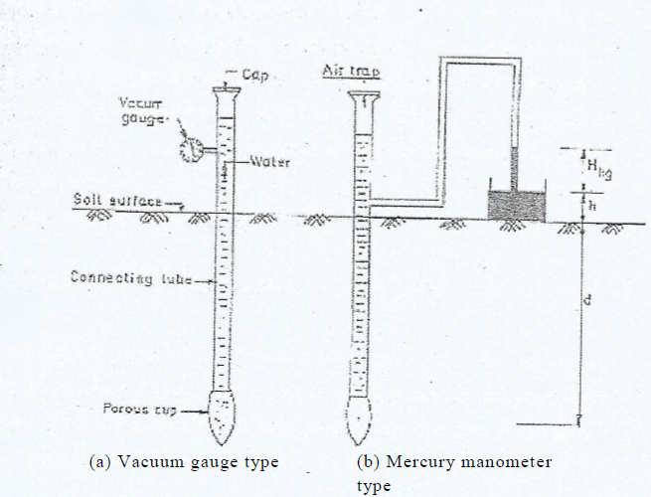
Scope of the test
Tensiometer readings plotted as a function of time provide a useful record of soil water conditions in the neighborhood of the cup. They do not provide direct information on the amount of water held in the soil. Tension measurements are useful in deciding when to irrigate, but they do not indicate how much water should be applied. A special curve named soil moisture characteristic curve (Moisture Content Vs. soil suction curve), plotted from tensiometer readings is an indirect measure of soil moisture content. The
tensiometer readings are also very useful in
determining the use rate of applied water.

Slide 22
Limitation of Tensiometer
Tensiometer does have a definite limitation in the range of values they can measure. The practical limit is about 0.8 atm. At this pressure air enters the closed system through the pores of the cup and makes the unit inoperative. The air entry or bubbling pressure of the ceramic cup limits this range.

Slide 23
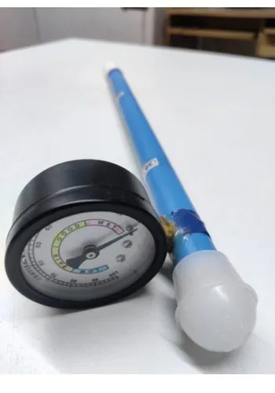
Objective
1) Use of tensiometer to measure soil moisture tension.
2) Measure the moisture content of the soil by weight.
3) Plot the soil moisture characteristic curve (moisture content vs. suction).

Slide 24
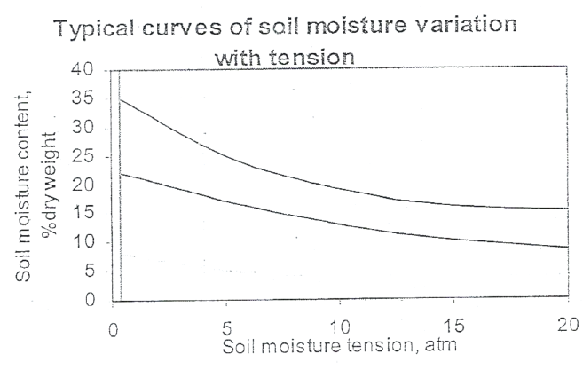
Procedure
1) For field installation, a hole is made in the soil using an auger of diameter larger than the porous ceramic tube. Insert the porous ceramic tube part in the hole and refill the hole with the material excavated. The soil surrounding the tensiometer ceramic tube should be refilled and compacted well to ensure good contact.
2) When suction equilibrium has been reached, take the necessary measurements. For the laboratory set-up, take tensiometer reading 1 day after installation.
3) Take soil samples from the depth where tensiometer was installed. Determine the weight of the soil.
4) Put the soil sample in an oven at about 110°C and allow
the water to evaporate. The evaporation process at least
takes 24 hours. Determine the weight of the dry soil
and the weight of water.

Slide 25
2.9 Data Sheet
Group No. | Weight of can (gm) | Weight of wet soil + can (gm) | Weight of dry soil + can (gm) | Moisture Content (%) | Soil suction (cm of Hg) | Soil Suction (atm) | Soil Suction (centibar)

Slide 26
Experiment No 03
Week 5-6

Slide 27
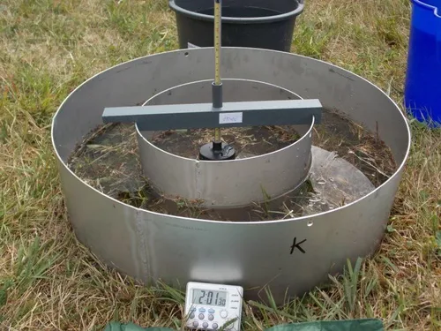
Determination of Soil Intake Characteristics using Cylinder Infiltrometer

Slide 28
Knowledge of the rate of entry of water into soil is of fundamental importance for efficient irrigation. Soil intake characteristic gives us information about the rate of entry of water into soil to avoid excess irrigation or shortage of irrigation.
Intake rate
The rate of entry of water into soil under field conditions is called intake rate. Whenever the configuration of soil surface influences the rate of water entry, the term intake rate should be used rather than the term infiltration rate to refer to the rate of entry of water into soil. Intake rate is therefore influenced by furrow size, shape as this term indicates infiltration under a particular soil surface configuration. On the other hand the term "infiltration" applies to a level surface covered with water.
General
& Theory

Slide 29
In all irrigation methods, except sub-surface irrigation, water is applied to the surface of land where it subsequently enters the soil and is stored for later use by plants. The object of irrigation is to get water into the soil where it can be stored. The intake rates obtained from the tests are indicative of the rates to be expected during irrigation provided, the surface condition is same. If intake rate is greater than irrigation rate sufficient water will neither enter the soil nor be stored therein and crop growth is significantly reduced. Again, if irrigation rate is greater than intake rate, runoff loss will occur. One of the major problems of irrigated farms is the low intake rate of fine textured soil, which is often reduced further by excessive working of soil and by salinity. Thus the determination of soil intake characteristic is of fundamental importance in irrigation practice.
Scope of the test

Slide 30
Intake rate varies with many factors, including depth of water on the surface, temperature of water and soil, soil structure and texture, moisture content and salinity of the soil.
Retarding layers of soil will greatly influence the rate.
Configuration of the surface such as furrow shape and size, as well as the method of application, will be influencing factor also. Hence intake rate varies from place to place on a field and it also varies with time.
Factors affecting Intake Rate

Slide 31
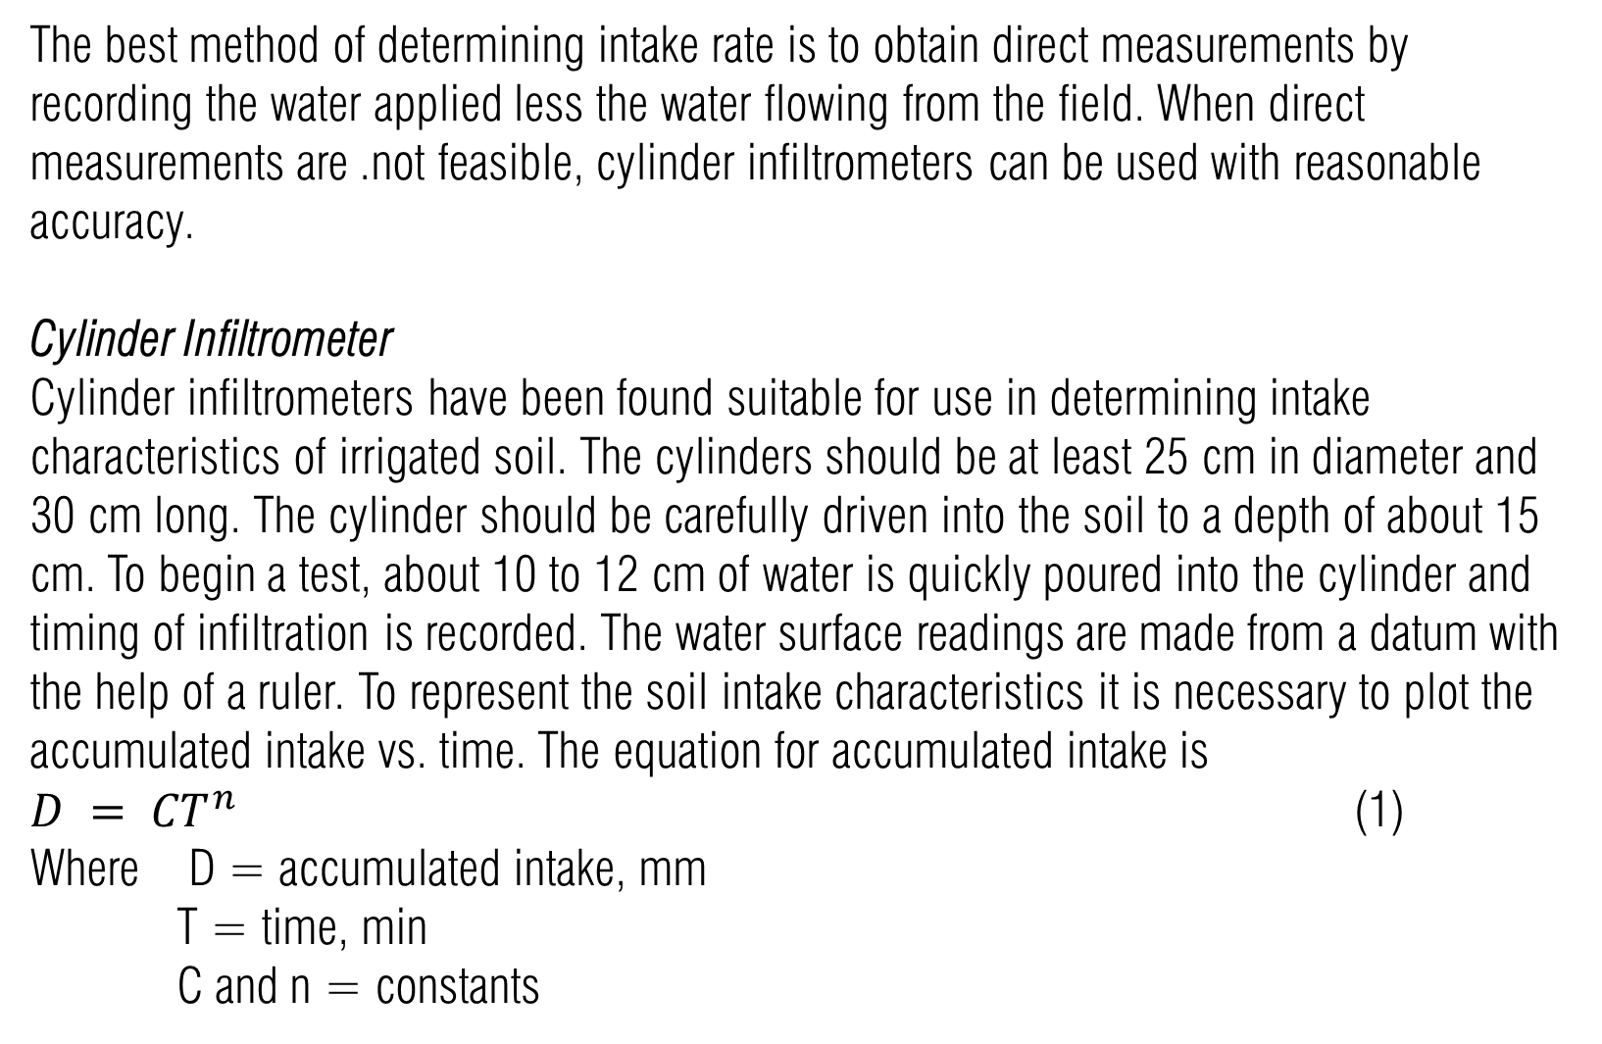
The best method of determining intake rate is to obtain direct measurements by recording the water applied less the water flowing from the field. When direct measurements are .not feasible, cylinder infiltrometers can be used with reasonable accuracy.
Cylinder Infiltrometer
Cylinder infiltrometers have been found suitable for use in determining intake characteristics of irrigated soil. The cylinders should be at least 25 cm in diameter and 30 cm long. The cylinder should be carefully driven into the soil to a depth of about 15 cm. To begin a test, about 10 to 12 cm of water is quickly poured into the cylinder and timing of infiltration is recorded. The water surface readings are made from a datum with the help of a ruler. To represent the soil intake characteristics it is necessary to plot the accumulated intake vs. time. The equation for accumulated intake is
$D = {CT}^{n}$ (1)
Where D = accumulated intake, mm
T = time, min
C and n = constants
Method of determining Intake Rate

Slide 32
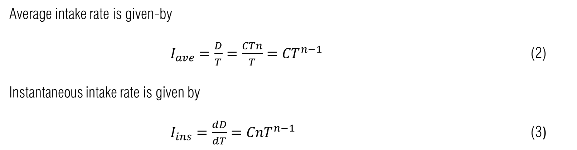
Average intake rate is given-by
$I_{ave}=\frac{D}{T}=\frac{CTn}{T}={CT}^{n−1}$ (2)
Instantaneous intake rate is given by
$I_{ins}=\frac{dD}{dT}={CnT}^{n−1}$ (3)
Method of determining Intake Rate
Double Ring Infiltrometer (Buffer ponds)
After water penetrates to the bottom of the cylinder, it will begin to spread radially and the rate of intake will change accordingly. When a principal-restricting layer does not lie within the depth of penetration of the cylinder, the radial flow will cause considerable change in the intake rate. Buffer ponds surrounding the cylinder are used to minimize this effect. Buffer ponds can be constructed by forming an earth dike around the cylinder or by driving a larger diameter cylinder concentric with the intake cylinder into the soil. The water level in both the cylinders should be equal and approximately the depth to be expected during the irrigation. Care should be taken not to puddle the soil when water is added to the cylinder or the buffer pond.

Slide 33
1) To familiarize with the field testing procedure.
2) To plot accumulated depth vs. time in a log-log paper and to find (a) the constant C, and (b) the exponent, n.
3) To develop the equations for accumulated intake, average and instantaneous intake rates from the test data.
4) To plot accumulated depth, average and instantaneous intake rate vs. time in one plain graph paper.
Objective

Slide 34
1) Note the soil profile and surface condition.
2) The cylinder should be carefully driven into the soil to a depth of about 15 cm.
3) To begin a test, about 10 to 12 cm of water is quickly poured into the cylinder and timing of infiltration is recorded.
4) At various time intervals, measure the water level.
5) Calculate the time difference and water level difference.
6) The ratio of water level difference and time difference gives the instantaneous intake rate at different times.
7) The ratio of cumulative depth and cumulative time gives average intake rate.
Procedure

Slide 35
1) To familiarize with the field testing procedure.
2) To plot accumulated depth vs. time in a log-log paper and to find (a) the constant C, and (b) the exponent, n.
3) To develop the equations for accumulated intake, average and instantaneous intake rates from the test data.
4) To plot accumulated depth, average and instantaneous intake rate vs. time in one plain graph paper.
Objective

Slide 36
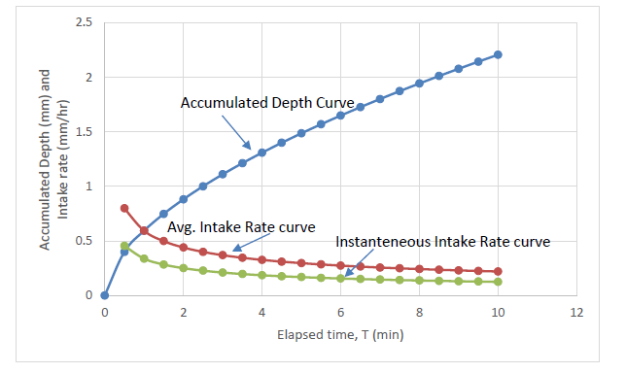
Typical Intake Curves
Figure: Typical Intake Curves

Slide 37
3.8 Data Sheet
DETERMINATION OF SOIL INTAKE CHARACTERISTICS USING CYLINDER INFILTROMETER
Cylinder No. _______________________Diameter of Cylinder= _____________________
Time (min) |  |  | Infiltration (mm) |  |  | Average Intake Rate, I_{avg} (mm/hr) | Instantaneous Intake Rate, I_{ins} (mm/hr)
Actual Time | Difference (min) | Cumulative | Difference | Depth (mm) | Cumulative

Slide 38
Experiment No 04
Week 7-8

Slide 39
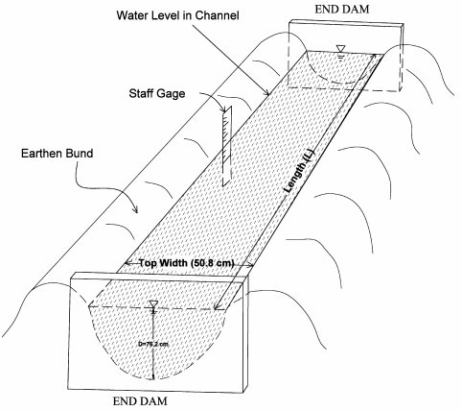
Measurement of Canal Seepage Loss by Ponding Method

Slide 40
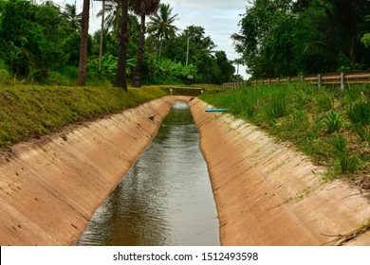
General
&
Theory
Determination of canal seepage loss is of very importance to make a provision for water loss in irrigation canal and to consider the other phenomena associated with canal seepage.
Canal Seepage Loss
During the passage of water from the main canal to the outlet at the head of the watercourse, water may be lost either by evaporation from the surface or by seepage through the peripheries of the channels. These losses are sometimes very high of the order of 25% to 50% of the water diverted. Evaporation losses are generally of the order of 2 to 3 percent of the total loss and may be more but seldom exceed 7%. So the major portion of the total loss is seepage loss and a minor portion is evaporation loss.

Slide 41
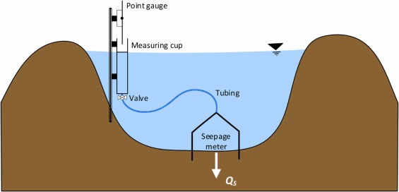
Scope of the test
In determining the channel capacity a provision, for water loss must be made. In this regard measurement of seepage loss is very important. Moreover seepage of water from irrigation canals is a serious problem. Not only is water lost, but also drainage problems are often aggravated on adjacent or lower lands. Occasionally water that seeps out of canal re-enters the river valley where it can be redirected, or enters in an aquifer where it can be reused. It is a more serious economic loss when the seepage losses are not recoverable. Also economic and legal problems may result from water seepage from canals causing drainage problems on the lower lying lands. So determination of canal seepage loss is of very importance to visualize the total loss as well as the other effects.

Slide 42
Factors affecting Canal Seepage Loss
Type of seepage, i.e. whether "percolation" or absorption.
Soil permeability.
The condition of the canal. The seepage through a silted canal is less than that from a new canal.
Amount of silt carried by the canal; the more the silt, the lesser are the losses.
Velocity of canal water; the more the velocity, the lesser will be the losses.
Cross-section of the canal and its wetted perimeter.

Slide 43
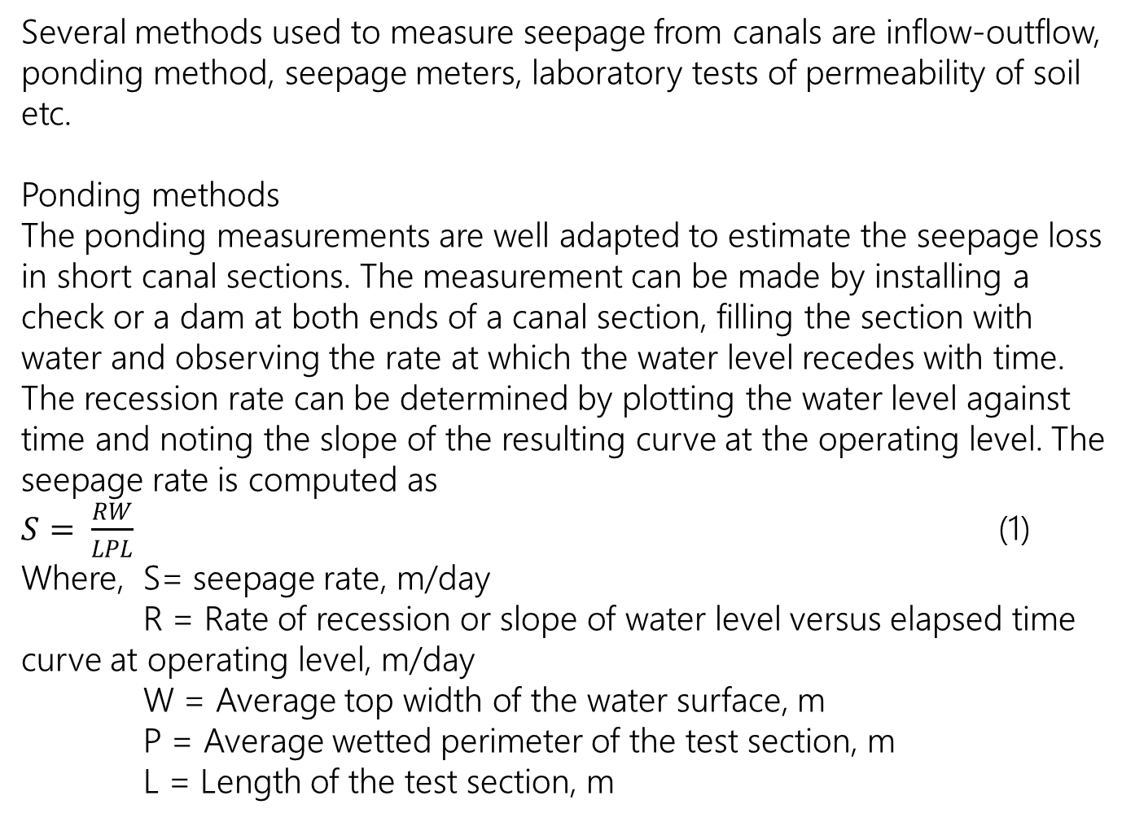
Methods of determining Canal Seepage Loss
Several methods used to measure seepage from canals are inflow-outflow, ponding method, seepage meters, laboratory tests of permeability of soil etc.
Ponding methods
The ponding measurements are well adapted to estimate the seepage loss in short canal sections. The measurement can be made by installing a check or a dam at both ends of a canal section, filling the section with water and observing the rate at which the water level recedes with time. The recession rate can be determined by plotting the water level against time and noting the slope of the resulting curve at the operating level. The seepage rate is computed as
$S= \frac{RW}{LPL}$ (1)
Where, S= seepage rate, m/day
R = Rate of recession or slope of water level versus elapsed time curve at operating level, m/day
W = Average top width of the water surface, m
P = Average wetted perimeter of the test section, m
L = Length of the test section, m

Slide 44
Objective
1) To get acquainted with the field testing procedure.
2) To estimate the seepage loss in the test canal section.
3) Interpretation of the test results.

Slide 45
1) At first construct a dam or check at the both ends of a short reach of the canal.
2) Fill the section with water.
3) Observe the rate at which the water level recedes with time.
4) Plot the water level against time.
5) Find the slope of resulting curve at operating level. The value of the slope is called recession constant.
6) Determine channel seepage loss using equation (1).
Procedure

Slide 46
Data Sheet
MEASUREMENT OF CANAL SEEPAGE LOSS BY PONDING METHOD
Test Section Characterization.
Canal: _________________________ Section No: ______________________________
Soil Type: ______________________ Canal condition: ___________________________
Section Length: _________________ Operating Level: ___________________________
B. Cross-sectional Profile:
Cross section 1 Cross section 2 Cross section 3
W= _______________ W= ______________ W= ______________
Average width, W= ________________________

Slide 47
C. Recession
Time |  |  | Water Level (mm)
Actual Time | Difference (min) | Cumulative | Water Level (mm)

Slide 48
Experiment No 05
Week 9-10

Slide 49
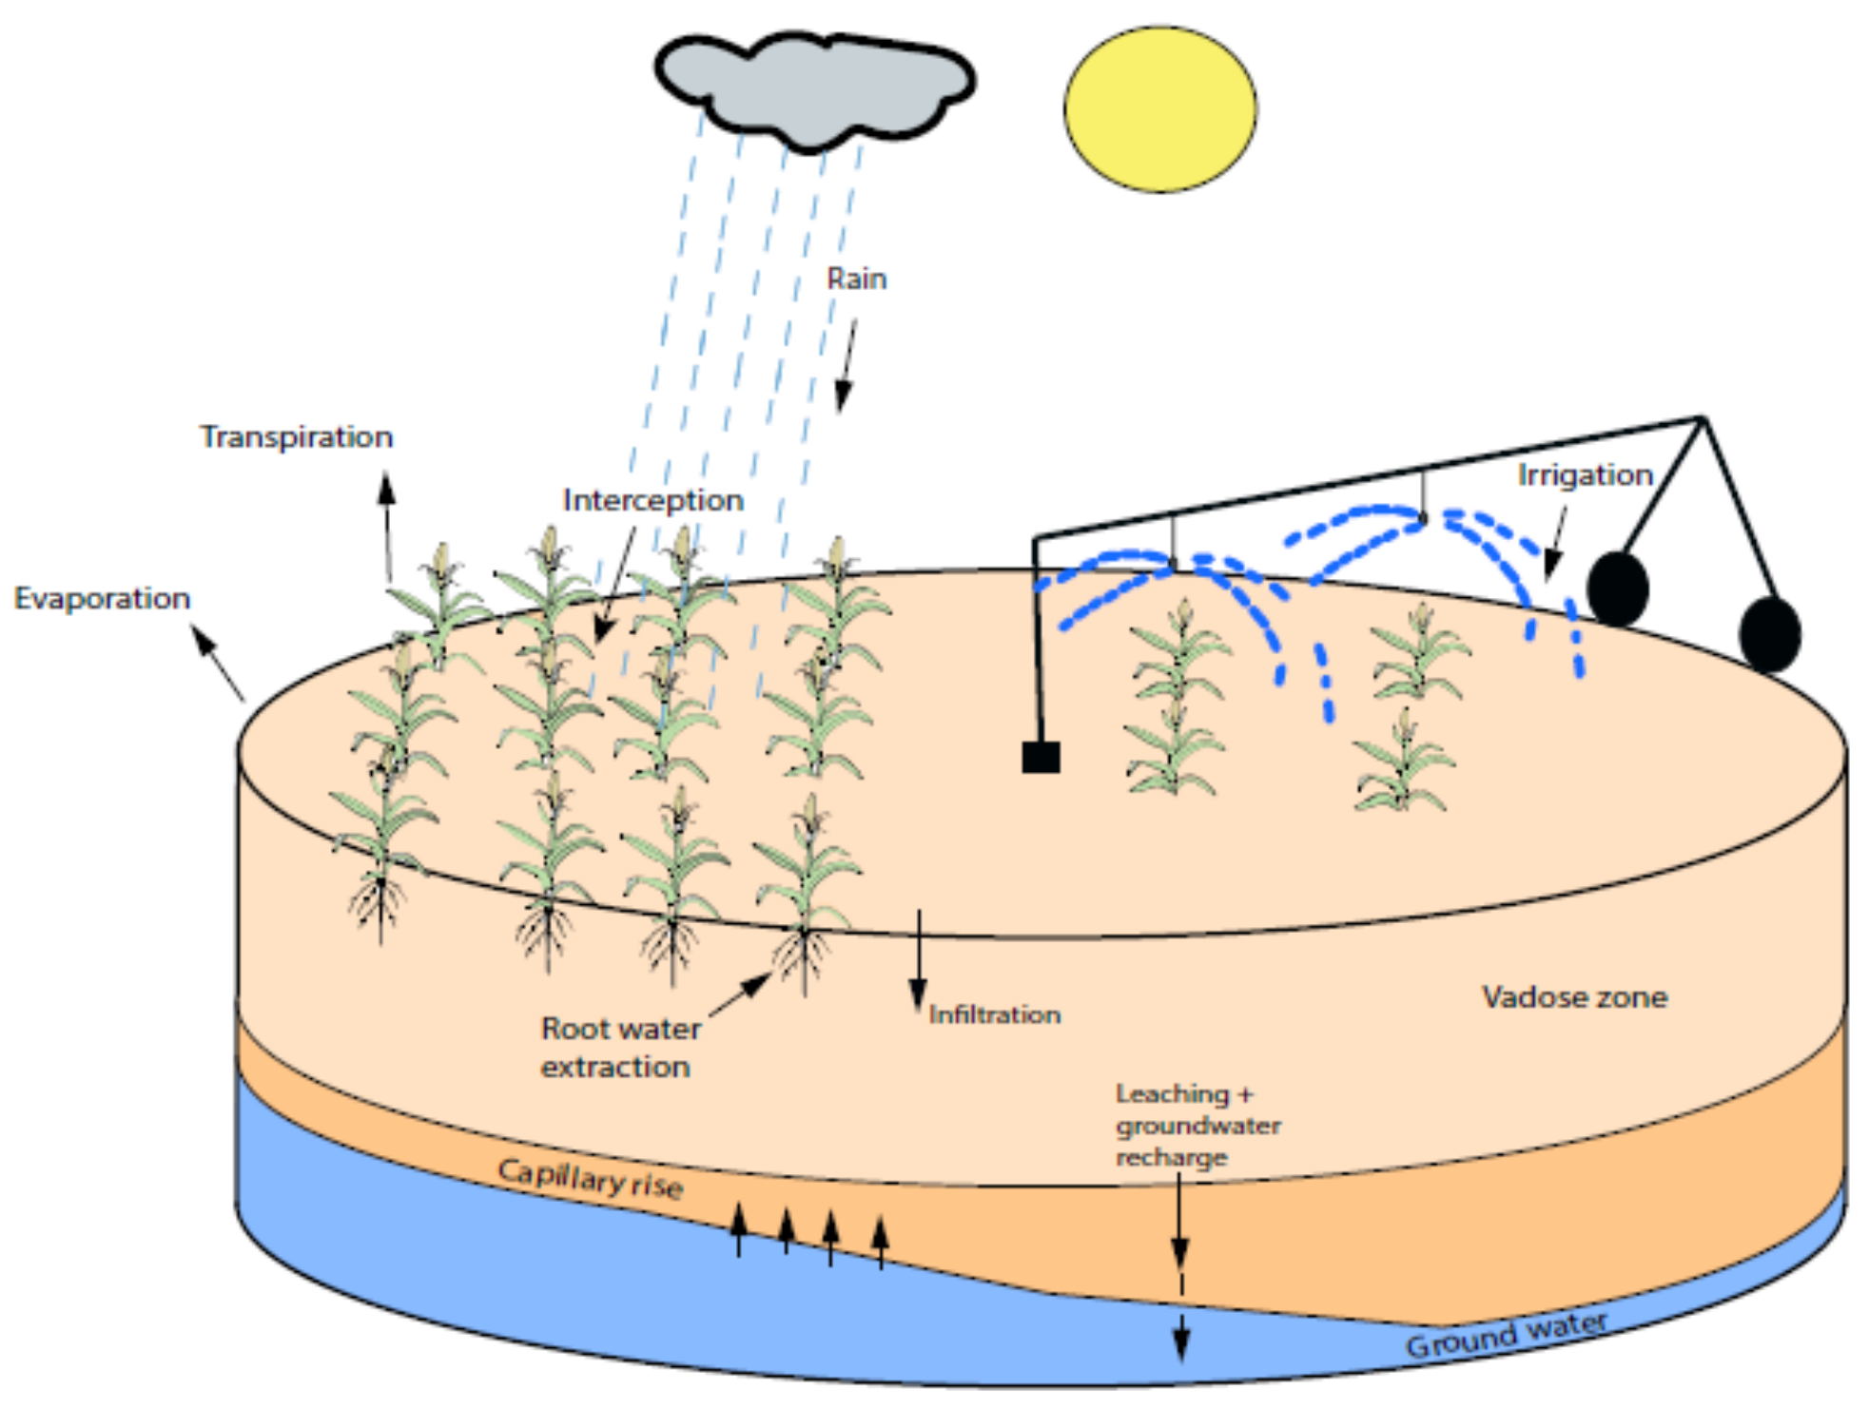
IRRIGATION SCHEDULING BY BOOK KEEPING METHOD

Slide 50
The knowledge of irrigation scheduling, total water requirement and irrigation requirement is fundamental in the design of irrigation scheme and water supply system and in irrigated crop production.
Irrigation Scheduling
Irrigation scheduling is a decision making process involving when to irrigate, how much water to apply each time and how to apply. In other words scheduling of irrigation refers to application of water at the right time in the right amount by the right method.
Necessity of Irrigation Scheduling
The main objective of irrigation scheduling is management of water so that it is applied at right time and in the amount needed. In water short areas this can result in increased yields through an extension of cropped areas. In water surplus areas it can help to alleviate problems which may result from excess water applications. It can also reduce loss of nutrients through deep percolation.
General
&
Theory

Slide 51
Dependable Factors
An efficient and accurate irrigation-scheduling program depends on the following information of that area:
Soil information
Crop information
Meteorological information
Water supply information
Methods of irrigation
Social & economic factors
Two basic information that must be known before irrigation scheduling are:
Soil moisture available for crop
Rate of daily water use by the crop
Irrigation Scheduling by Book Keeping Method
In this method a worksheet for "Moisture balance for scheduling irrigation" is used for weekly or daily basis. Before starting this scheduling three major items should be known:
Water holding capacity (WHC) of soil in the root depth
Estimated Etc of the crop to be grown
Soil moisture balance at the beginning of the scheduling period
By entering all these in the appropriate column of the worksheet the moisture balance at the end of the week is determined.
Theory

Slide 52
Field Capacity (FC)
Yield capacity is the moisture content of the soil when rapid drainage has essentially ceased and any farther drainage occurs at a very slow rate. The FC corresponds to a soil moisture tension of about 1/10 to 1/3 atmosphere.
Permanent Wilting Point (PWP)
The Soil moisture content at which the plant wilts permanently or dies is known as permanent wilting point. The soil still contains some water but it is too difficult for the roots to extract it from the soil as it is held with a suction force of about 15 atm. Typically for medium soils the moisture content at PWP is about one-half the FC.
Gravitational Water
The water in the large pores that moves downward freely under the influence of gravity is known as the. gravitational water. This is the water between the saturated point and FC.
Available Water
The water contained in the, soil between FC and PWP is known as the available water.
Total Available Water (TAW)
The amount of water, which will be available for plants in the root zone, is known as the total available water. It is the difference in volumetric moisture content at FC and at PWP; multiplied-by root zone depth.
Management Allowable Depletion (MAD)
MAD is the degree, to which the water in the soil is allowed to be depleted by management decision.
Theory

Slide 53
Reference Crop Evapotranspiration (ETo)
The rate of evapotranspiration from an extensive surface of 8 to 15 cm tall green grass cover of uniform height, actively growing, completely shading the ground and of not short of water is known as the reference crop evapotranspiration.
Crop Evapotranspiration (ETc)
The depth of water needed to meet the water loss through evapotranspiration of a disease-free crop, growing in large fields under non-restricting soil conditions including water and fertility and achieving full production potential under-the given growing environment.
Crop Coefficient (Kc)
The ratio of ETc / ETo is termed as crop coefficient.
Effective Rainfall (Re)
Rain that is retained in the root zone and used by plants is considered as effective rainfall.
Effective Rainfall (Re) =Total rainfall(R)-Runoff (R0)-Evaporation (E)-Deep
Percolation (P)
Theory

Slide 54
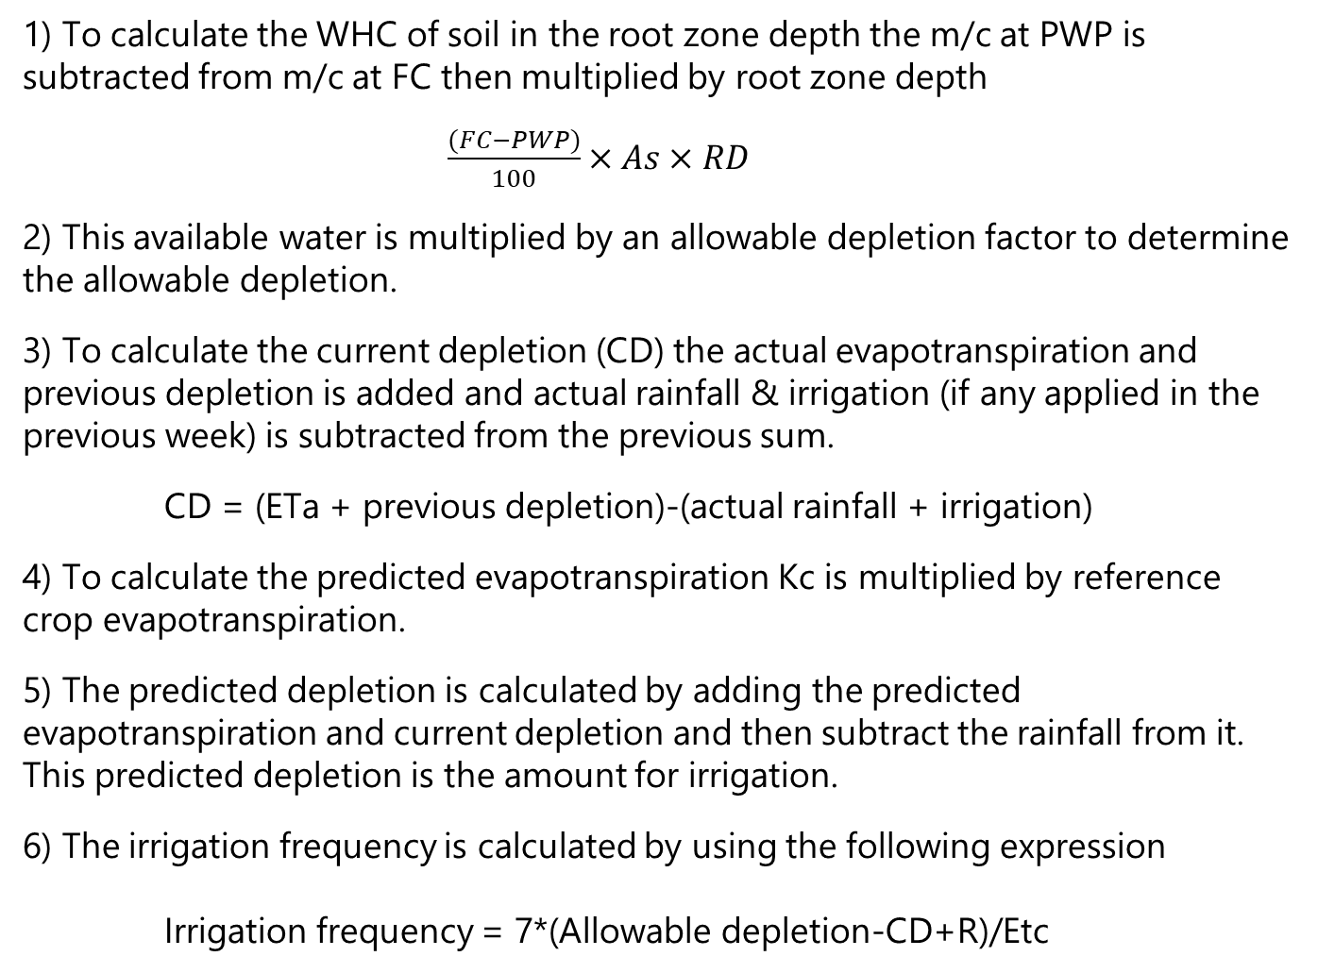
1) To calculate the WHC of soil in the root zone depth the m/c at PWP is subtracted from m/c at FC then multiplied by root zone depth
$\frac{(FC−PWP)}{100}×As×RD$
2) This available water is multiplied by an allowable depletion factor to determine the allowable depletion.
3) To calculate the current depletion (CD) the actual evapotranspiration and previous depletion is added and actual rainfall & irrigation (if any applied in the previous week) is subtracted from the previous sum.
CD = (ETa + previous depletion)-(actual rainfall + irrigation)
4) To calculate the predicted evapotranspiration Kc is multiplied by reference crop evapotranspiration.
5) The predicted depletion is calculated by adding the predicted evapotranspiration and current depletion and then subtract the rainfall from it. This predicted depletion is the amount for irrigation.
6) The irrigation frequency is calculated by using the following expression
Irrigation frequency = 7*(Allowable depletion-CD+R)/Etc
Procedure

Slide 55
1) To calculate the WHC of soil in the root zone depth the m/c at PWP is subtracted from m/c at FC then multiplied by root zone depth
$\frac{(FC−PWP)}{100}×As×RD$
2) This available water is multiplied by an allowable depletion factor to determine the allowable depletion.
3) To calculate the current depletion (CD) the actual evapotranspiration and previous depletion is added and actual rainfall & irrigation (if any applied in the previous week) is subtracted from the previous sum.
CD = (ETa + previous depletion)-(actual rainfall + irrigation)
4) To calculate the predicted evapotranspiration Kc is multiplied by reference crop evapotranspiration.
5) The predicted depletion is calculated by adding the predicted evapotranspiration and current depletion and then subtract the rainfall from it. This predicted depletion is the amount for irrigation.
6) The irrigation frequency is calculated by using the following expression
Irrigation frequency = 7*(Allowable depletion-CD+R)/Etc
Procedure

Slide 56
Data Sheet
IRRIGATION SCHEDUALING BY HAND CALCULATOR METHOD
REVIOUS WEEK SOIL WATER BUDGET |  |  |  |  | IRRIGATION PREDICTION NEXT 7 DAYS
Week ending | Etc Actual mm | Previous Depletion+ Etc mm | Rain Actual + Irrigation mm | Current Depletion CD mm | Next 7 Days Etc = EtrxKc mm | Root Depth RD mm | Water Holding Capacity HC mm/m | Available Water AW = RDxHC mm | Allowable Depletion AD % | Allowable Depletion ADI= AWx AD mm | Expected Effective Rainfall Re mm | Predicted Depletion Etc+CD-Re mm | Days to Next Irrigation = 7(ADI-CD+Re)/Etc | Comment

Slide 57
Experiment No 06
Week 11-12

Slide 58
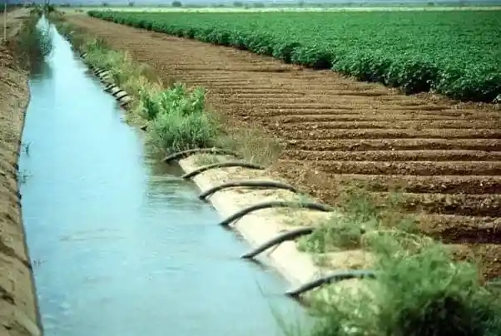
DESIGN OF A BRANCH CANAL IN AN IRRIGATION PROJECT

Slide 59
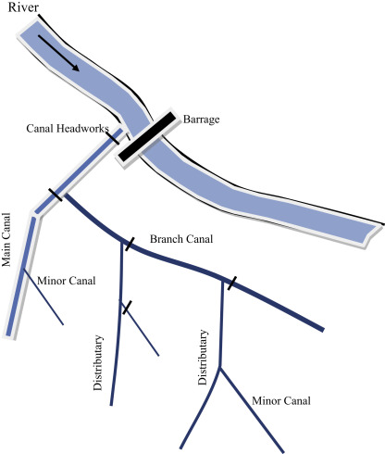
In irrigation project a branch canal is needed to convey water from main canal to the tertiary canal.
Regime Channels
A channel is said to be in a state of regime if there is neither silting nor scouring in the channel. The shape, longitudinal slope, cross sectional dimension of a regime channel depends on the discharge, the sediment size, and sediment load. Two approaches of regime channel design are:
1. Kennedy's approach
2. Lacey’s approach
In Kennedy and Lacey's approach the channel should be trapezoidal with side slope ½ H : 1V
Kennedy’s Approach
If the velocity in channel is sufficient to keep the sediment is suspension then silting in the channel will be avoided. Kennedy defined the critical velocity (V0) as the mean velocity in a channel, which will just keep the channel free from silting& scouring.
Lacey's Approach
Lacey found many drawbacks in Kennedy's theory & put forward his new theory. Kennedy stated that a channel is said to be in a regime state if there is no silting &nor scouring. Lacey stated that a channel showing no silting & non-scouring might not be in regime. According to Lacey a channel is in true regime only if the following conditions are satisfied.
General & Theory

Slide 60
Discharge is constant
Flow is uniform
Silt charge is constant; i.e. the amount of silt is constant
Silt grade is constant; i.e. the type & size of silt is always same
Channel is flowing through a material which can be scoured as easily as it can be deposited (such soil is known as incoherent alluvium) & is of the same grade as is transported.
Design procedure for Lacey’s approach
1) Calculate the silt factor fs from the average particle size d
fs =1.76√(d)
Here, d in mm (1)
2) Calculate the hydraulic radius R
R = 0.47 (Q/fs)1/3
Here R in m and Q in cumec (2)
3) Calculate perimeter P
P = 4.75√Q
Here, P in m & Q in cumec (3)
Theory

Slide 61
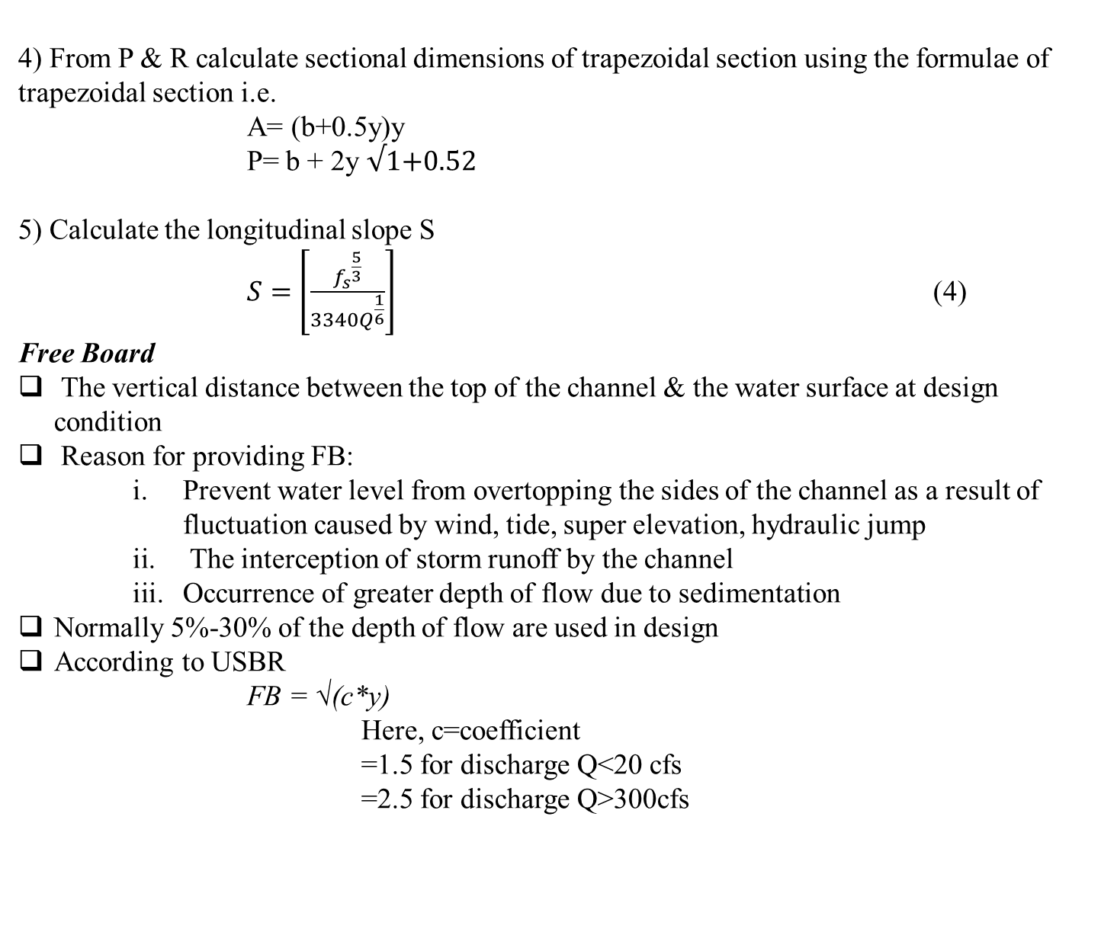
4) From P & R calculate sectional dimensions of trapezoidal section using the formulae of trapezoidal section i.e.
A= (b+0.5y)y
P= b + 2y √1+0.52
5) Calculate the longitudinal slope S
$S=$ $\left[\frac{{f_{s}}^{\frac{5}{3}}}{{3340Q}^{\frac{1}{6}}}\right]$ (4)
Free Board
The vertical distance between the top of the channel & the water surface at design condition
Reason for providing FB:
Prevent water level from overtopping the sides of the channel as a result of fluctuation caused by wind, tide, super elevation, hydraulic jump
The interception of storm runoff by the channel
Occurrence of greater depth of flow due to sedimentation
Normally 5%-30% of the depth of flow are used in design
According to USBR
FB = √(c*y)
Here, c=coefficient
=1.5 for discharge Q<20 cfs
=2.5 for discharge Q>300cfs
Theory

Slide 62
To determine the section dimensions of a channel using the Lacey's regime equations, the following steps are involved.
Compute the silt factor f using Eq. (1)
2) Compute the longitudinal slope S using Eq. (4) based on Qavg.
3) Compute the wetted perimeter P using Eq. (3) based on Qmax.
4) Compute the hydraulic radius R using Eq. (2) based on Qmax.
5) Compute the cross-sectional area A=P*R based on Qmax.
6) Express A and P in terms of bottom width b and depth of flow y for trapezoidal section.
7) Solve the two equations for A and P simultaneously to obtain b and y.
8) Add a proper freeboard using the equations for freeboard.
Procedure

Slide 63
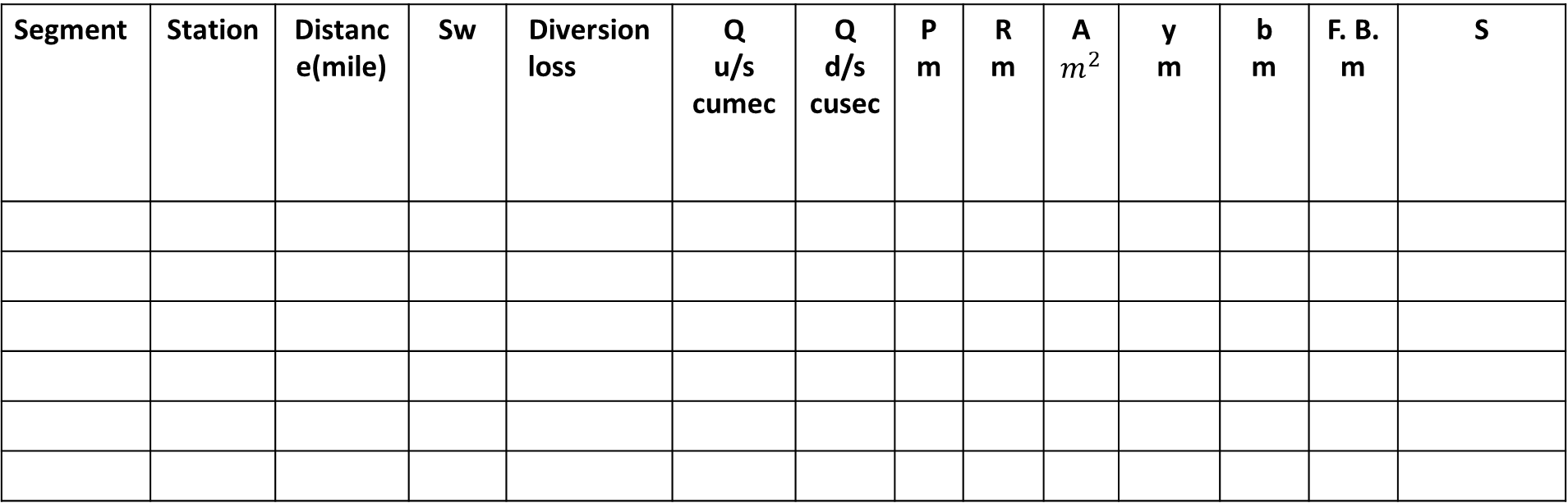
Data Sheet
DETERMINATION OF DESIGN PARAMETERS OF A BRANCH CANAL IN IRRIGATION PROJECT
Segment | Station | Distance(mile) | Sw | Diversion loss | Q u/s cumec | Q d/s cusec | P m | R m | A $m^{2}$ | y m | b m | F. B. m | S

Slide 64
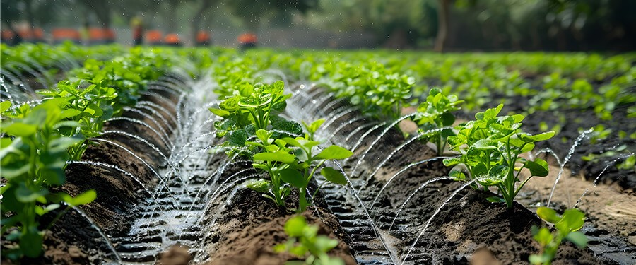
THANK
YOU

