Slide 1
CSE-0613-3103 Compiler Design
Md. Masudur Rahman
Lecturer
Dept. of CSE,
University of Global Village

Slide 2
Compiler Design
Course Code: | CSE-0613-3103 | Credits: | 02
 |  | CIE Marks: | 60
Exam Hours: | 03 | SEE Marks: | 40
Course Learning Outcome (CLOs): After Completing this course successfully, the student will be able to…
CLO | Description
CLO1 | Understand the fundamental principles of lexical analysis and how tokens are generated from the source code.
CLO2 | Demonstrate the ability to perform syntax analysis and recognize different parsing techniques.
CLO3 | Apply concepts of parsing to construct parse trees and abstract syntax trees.
CLO4 | Develop skills in syntax-directed translation for creating intermediate representations of source code.
CLO5 | Understand the principles of intermediate code generation and its role in the compilation process.
CLO6 | Implement type checking mechanisms to ensure type safety in programs.
CLO7 | Analyze and optimize intermediate code for improving program performance.

Slide 3
Summary of Course Content
Sl. | Course Content | HRs | CLOs
1 | Introduction to Compilers: Overview of the compilation process, phases of a compiler, the role of a compiler in program execution | 2 | CLO1
2 | Lexical Analysis: Understanding tokens, lexemes, and patterns; designing lexical analyzers; regular expressions and finite automata; tools for lexical analysis | 3 | CLO1
3 | Syntax Analysis: Role of syntax analysis in compilation; context-free grammars and parse trees; top-down vs bottom-up parsing approaches; common parsing techniques | 4 | CLO2
4 | Parsing Techniques: LL parsers (e.g., Recursive descent parser); LR parsers (e.g., SLR, LALR, and Canonical LR parsers); error handling and recovery in parsing; ambiguities and grammar transformations | 5 | CLO3
5 | Syntax-Directed Translation: Syntax-directed definitions; annotated parse trees; translation schemes; type checking using syntax-directed translation | 4 | CLO4
6 | Intermediate Code Generation: Role of intermediate code in compilation; intermediate representations (e.g., Three-address code, Abstract syntax trees); translation of different programming constructs; symbol tables and their management | 4 | CLO5
7 | Type Checking: Type systems and type expressions; type checking rules; implementing type checking in a compiler; type conversions and coercions | 3 | CLO6
8 | Code Optimization: Importance of code optimization; local and global optimization techniques; data flow analysis and optimization; loop optimizations (e.g., loop unrolling, loop invariant code motion); machine-independent and machine-dependent optimizations | 5 | CLO7

Slide 4
Recommended Resources
• Aho, A. V., Lam, M. S., Sethi, R., & Ullman, J. D.
Compilers: Principles, Techniques, and Tools (2nd Edition). Pearson Education.
• GeeksforGeeks
GeeksforGeeks: Compiler Design
• TutorialsPoint
TutorialsPoint: Compiler Design

Slide 5
Assessment Pattern
CIE- Continuous Internal Evaluation (60 Marks)
Bloom's Category Marks (out of 60) | Tests (30) | Assignments (10) | Quizzes (10) | Attendance (10)
Remember | 5 |  | 3
Understand | 5 | 3 | 3
Apply | 5 | 3 | 4
Analyze | 5
Evaluate | 5
Create | 5 | 4
SEE- Semester End Examination (40 Marks)
Bloom's Category | Test
Remember | 5
Understand | 10
Apply | 10
Analyze | 5
Evaluate | 5
Create | 5

Slide 6
Week No | Topics | Teaching Learning Strategy(s) | Assessment Strategy(s) | Alignment to CLO
1 | Introduction to Compilers: Overview of the compilation process, phases of a compiler, the role of a compiler in program execution | Lectures, Reading assignments | Class Participation, Quiz | CLO1
2 | Lexical Analysis: Understanding tokens, lexemes, and patterns; designing lexical analyzers; regular expressions and finite automata; tools for lexical analysis | Lectures, Practical demonstrations | Lab exercises, Quiz | CLO1
3 | Lexical Analysis (Continued): Regular expressions and finite automata; tools for lexical analysis; Lexical analyzer implementation | Lectures, Practical demonstrations | Lab exercises, Assignment | CLO1
4 | Syntax Analysis: Role of syntax analysis in compilation; context-free grammars and parse trees; top-down vs bottom-up parsing approaches | Lectures, Group discussions | Quiz, Class Participation | CLO2
5 | Syntax Analysis (Continued): Top-down vs bottom-up parsing approaches; common parsing techniques; Syntax error handling | Lectures, Group discussions | Assignment | CLO2
6 | Parsing Techniques: LL parsers (e.g., Recursive descent parser); LR parsers (e.g., SLR, LALR, and Canonical LR parsers) | Lectures, Practical demonstrations, Group discussions | Lab exercises, Quiz | CLO3
7 | Parsing Techniques (Continued): Error handling and recovery in parsing; ambiguities and grammar transformations | Lectures, Practical demonstrations, Group discussions | Lab exercises, Assignment | CLO3
8 | Syntax-Directed Translation: Syntax-directed definitions; annotated parse trees; translation schemes | Lectures, Case studies | Lab exercises, Quiz | CLO4
9 | Syntax-Directed Translation (Continued): Translation schemes; type checking using syntax-directed translation | Lectures, Case studies | Lab exercises, Assignment | CLO4
Course Plan

Slide 7
Week No | Topics | Teaching Learning Strategy(s) | Assessment Strategy(s) | Alignment to CLO
10 | Intermediate Code Generation: Role of intermediate code in compilation; intermediate representations (e.g., Three-address code, Abstract syntax trees) | Lectures, Practical demonstrations | Lab exercises, Quiz | CLO5
11 | Intermediate Code Generation (Continued): Translation of different programming constructs; symbol tables and their management | Lectures, Practical demonstrations | Lab exercises, Assignment | CLO5
12 | Type Checking: Type systems and type expressions; type checking rules | Lectures, Problem-solving sessions | Quiz, Class Participation | CLO6
13 | Type Checking (Continued): Implementing type checking in a compiler; type conversions and coercions | Lectures, Problem-solving sessions | Assignment | CLO6
14 | Code Optimization: Importance of code optimization; local and global optimization techniques; data flow analysis and optimization | Lectures, Practical demonstrations, Group discussions | Lab exercises, Quiz | CLO7
15 | Code Optimization (Continued): Loop optimizations (e.g., loop unrolling, loop invariant code motion); machine-independent and machine-dependent optimizations | Lectures, Practical demonstrations, Group discussions | Lab exercises, Assignment | CLO7
16 | Revision and Review: Group discussions, Review sessions of all previously covered topics | Group discussions, Review sessions | Mock exam, Class Participation | All CLOs
17 | Project Presentations and Feedback: Students present their projects, receive feedback, and discuss their learning experiences | Presentations, Peer review, Instructor feedback | Project assessment, Class Participation | All CLOs
Course Plan

Slide 8
Week 1
Slides 8-25

Slide 9
Compiler
A compiler is a computer program (or set of programs) that -
transforms source code written in a programming language (the source language) into another computer language (the target language, often having a binary form known as object code).
Is a translator program.
A compiler acts as a translator, transforming human-oriented programming languages into computer oriented machine languages.
Ignore machine-dependent details for programmer.

Slide 10
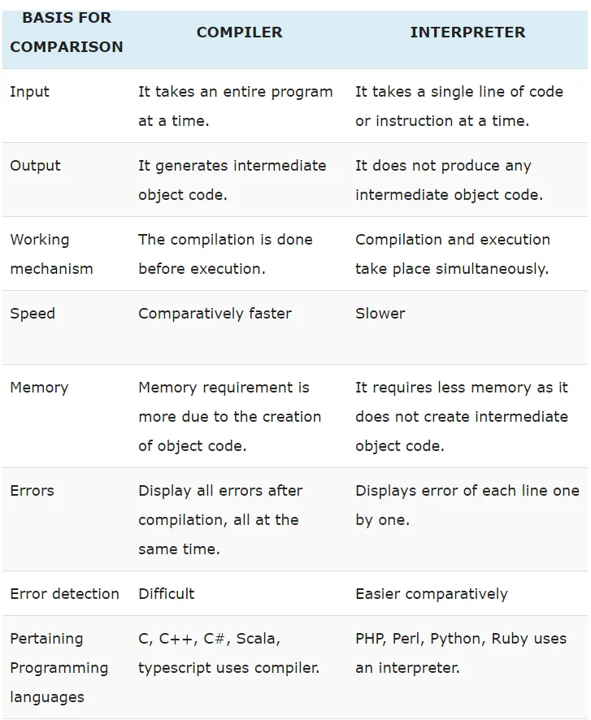
Difference between Compiler and Interpreter

Slide 11
Compiler
Programming
Language Machine (Source)
(Target)
Compiler

Slide 12
Why Do We Study Compilers?
To design a translator
Influences on programming language design
• Influences on computer design
• Compiling techniques are useful for software development
─ Parsing techniques are often used
─ Learn practical data structures and algorithms
─ Basis for many tools such as text formatters, structure editors, design verification tools,…

Slide 13
Learning outcome as a whole
A great chance to "concretize" your knowledge of Data Structures and Algorithms and it teaches you to apply those concepts in non trivial scenarios.
It helps you to develop skills which have so much application in other areas like
Text and language processing;
Specially translate one form to another
Getting an insight into how your own programs can be optimized;
Getting new ideas about better computer architectures.
Even if you don't have to write a programming language ever in your life, a Compiler design course makes you a better programmer.

Slide 14
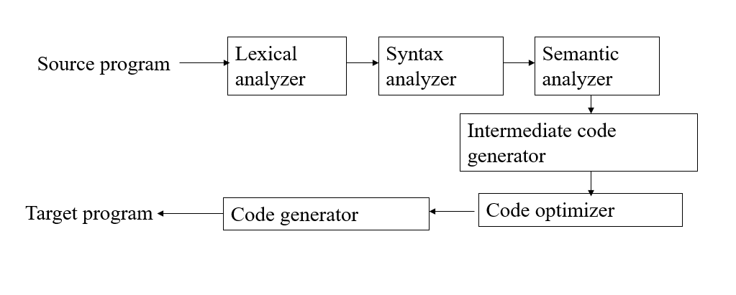
Phases of a Compiler

Slide 15
Summary : Compiler Design
Lexical analysis –
You will get good hands on experience with Regular Expressions and will be important when you deal with
big text files;
automating routine text processing tasks.
Syntax Analyzer-
you're going to learn the most basic parsing algorithms
Parsing is important in
text and language processing tasks; if you're trying to interpret tweets or sentences, etc.

Slide 16
Summary : Compiler Design
Semantic analysis –
At this stage, you'll actually start to understand the programming languages that you use even in your day to day life.
Understanding various constraints related to assignment, allocation; and you'll be able to appreciate why different programming languages do different things in different ways.
Intermediate code generation-
Generates middle level code according to the semantics.
You will learn different platform independent codes
Code optimization –
you will be introduced to various Optimization techniques in code generation.
Once you are introduced this; you will also be more critical of the code you write for other works.
You will be more conscious about used/unused variables and will develop the ability to think in terms of program analysis and optimization techniques which help you write more efficient code more quickly.

Slide 17
Summary : Compiler Design
Code generation –
you learn to generate the Machine Code.
This forces you to learn Assembly Language;
how the computer interprets and executes instructions;
an overview of applying basic Computer Architecture concepts.

Slide 18
The Structure of a Compiler
Source
Program
Scanner
Tokens
Parser
Syntactic
Semantic
Routines
Structure
(Character Stream)
Intermediate
Representation
Symbol and
Attribute
Tables
Optimizer
(Used by all Phases of The Compiler)
Code
Generator
Target machine code

Slide 19
The Structure of a Compiler
Source
Program
Scanner
Tokens
Parser
Syntactic
Semantic
Routines
Structure
(Character Stream)
Intermediate
Representation
Scanner
The scanner begins the analysis of the source program by reading the input, character by character, and grouping characters into individual words and symbols (tokens)
RE ( Regular expression )
NFA ( Non-deterministic Finite Automata )
DFA ( Deterministic Finite Automata )
FLEX
Symbol and
Attribute
Tables
Optimizer
(Used by all
Phases of
The Compiler)
Code
Generator
Target machine code

Slide 20
The Structure of a Compiler
Source
Program
Scanner
Tokens
Parser
Syntactic
Semantic
Routines
(Character Stream)
Structure
Parser
Given a formal syntax specification (typically as a CFG ), the parser reads tokens and groups them into units as specified by the productions of the CFG being used.
As syntactic structure is recognized, the parser either calls corresponding semantic routines directly or builds a syntax tree.
CFG ( Context-Free Grammar )
BNF ( Backus-Naur Form )
GAA ( Grammar Analysis Algorithms )
LL, LR, SLR, LALR Parsers
Bison
Intermediate
Representation
Symbol and
Attribute
Tables
Optimizer
(Used by all
Phases of
The Compiler)
Code
Generator
Target machine code

Slide 21
The Structure of a Compiler
Source
Program
Scanner
Tokens
Parser
Syntactic
Semantic
Routines
(Character Stream)
Structure
Intermediate
Representation
Semantic Routines
Perform two functions
Check the static semantics of each construct
Do the actual translation
The heart of a compiler
Syntax Directed Translation
Semantic Processing Techniques
IR (Intermediate Representation)
Symbol and
Attribute
Tables
Optimizer
(Used by all
Phases of
The Compiler)
Code
Generator
Target machine code

Slide 22
The Structure of a Compiler
Source
Program
Scanner
Tokens
Parser
Syntactic
Semantic
Routines
(Character Stream)
Structure
Intermediate
Representation
Optimizer
The IR code generated by the semantic routines is analyzed and transformed into functionally equivalent but improved IR code
This phase can be very complex and slow
loop optimization, register allocation, code scheduling
Register and Temporary Management
Peephole Optimization
Symbol and
Attribute
Tables
Optimizer
(Used by all
Phases of
The Compiler)
Code
Generator
Target machine code

Slide 23
The Structure of a Compiler
Source
Program
Scanner
Tokens
Parser
Syntactic
Semantic
Routines
(Character Stream)
Structure
Intermediate
Representation
Code Generator
Interpretive Code Generation
Generating Code from Tree/Dag
Grammar-Based Code Generator
Optimizer
Code
Generator
Target machine code

Slide 24
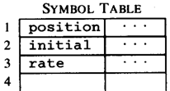




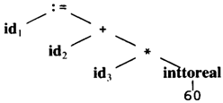
The Structure of a Compiler
Code Generator
[Intermediate Code Generator]
Non-optimized Intermediate Code
Scanner [Lexical Analyzer]
Tokens
Code Optimizer
Parser [Syntax Analyzer]
Optimized Intermediate Code
Parse tree
Code Generator
Semantic Process [Semantic analyzer]
Target machine code
Abstract Syntax Tree w/ Attributes

Slide 25
References
1. Lecture Slides and Materials
2. A. Aho, R. Sethi and D. Ullman, “Compilers: Principles, Techniques and Tools”, Addison Wesley.
The Dragon faced book
Old book, but still sufficient
3. A. I. Holub, “Compiler Design in C”, Prentice Hill.

Slide 26
Week 2-3
Slides 26-40

Slide 27
Lexical analyzer

Slide 28
The role of the lexical analyzer
First phase of a compiler
Main task
To read the input characters
To produce a sequence of tokens
used by the parser for syntax analysis
An assistant of parser

Slide 29
The role of the lexical analyzer
Interaction of lexical analyzer with parser
token
Source program
Lexical analyzer
Parser
Get next token
Symbol table
Dr. Azhar, KUET.
20-Jan-25

Slide 30
The role of the lexical analyzer
Terms of the lexical analyzer
Token
Types of words in source program
Keywords, operators,
identifiers, constants,
literal strings,
punctuation symbols (such as commas, semicolons)
Lexeme
Actual words in source program matched by pattern
valid token
Pattern
A rule describing the set of lexemes that can represent a particular token in source program
Relation {<.<=,>,>=,==,<>}

Slide 31
The role of the lexical analyzer
Example
Token
Informal description
Sample lexemes
if
Characters i, f
if
else
Characters e, l, s, e
else
relation
< or > or <= or >= or == or !=
<=, !=
id
Letter followed by letter and digits
pi, score, D2
number
Any numeric constant
3.14159, 0, 6.02e23
literal
Anything but “ sorrounded by “
“Hello, world!”
Dr. Azhar, KUET.
20-Jan-25

Slide 32
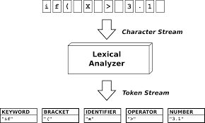
The role of the lexical analyzer

Slide 33
Tokens
Attributes for Tokens
When more than one pattern matches a lexeme, the lexical analyzer must provide additional information about the lexeme
The token influences parsing decision and attribute influences translation of tokens
Token has single attribute namely pointer to the symbol table entry where information about the token is kept.

Slide 34
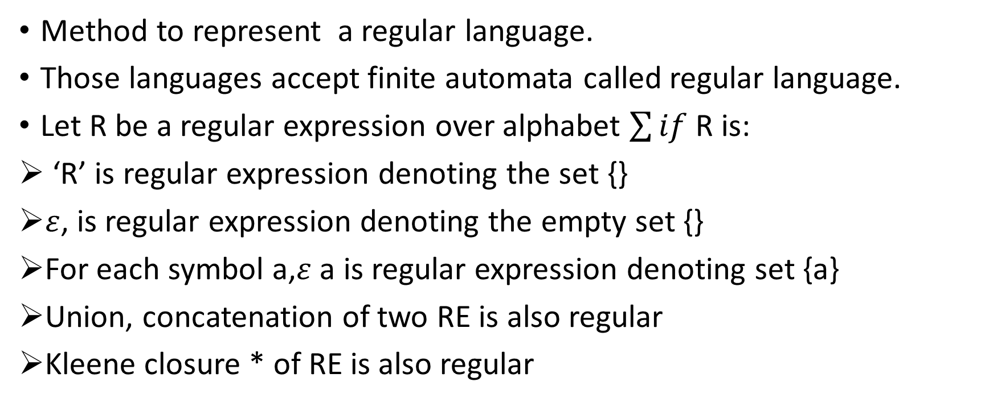
Regular Expression
Method to represent a regular language.
Those languages accept finite automata called regular language.
Let R be a regular expression over alphabet $\sum{if}$ R is:
‘R’ is regular expression denoting the set {}
$ε$, is regular expression denoting the empty set {}
For each symbol a,$ε$ a is regular expression denoting set {a}
Union, concatenation of two RE is also regular
Kleene closure * of RE is also regular

Slide 35
Regular Expression
Some definitions
alphabet : a finite set of symbols. E.g. {a, b, c}
A string over an alphabet is a finite sequence of symbols drawn from that alphabet (sometimes a string is also called a sentence or a word).
A language is a set of strings over an alphabet.
Operation on languages (a set):
union of L and M, L U M = {s|s is in L or s is in M}
concatenation of L and M
LM = {st | s is in L and t is in M}
Kleene closure of L, *
Positive closure of L, +

Slide 36
Recognition of Tokens
Regular Expression
Token
Attribute-Value
Regular Expression
ws
if
then
else
id
num
<
<=
=
< >
>
>=
-
if
then
else
id
num
relop
relop
relop
relop
relop
relop
-
-
-
-
pointer to table entry
pointer to table entry
LT
LE
EQ
NE
GT
GE
Dr. Azhar, KUET.
20-Jan-25

Slide 37
Function of Lexical Analysis
Convert the source code into stream of tokens
Removing white spaces
Removing Comments
Recognizing keyword and identifiers
Recognizing the constants
Show the errors when the lexeme doesn’t match the pattern.
Token: <token name, attribute value>

Slide 38
Function of Lexical Analysis
Tokenization process: <token name, attribute value>

Slide 39
Example: Lexeme(1/2)
Divide the following C++ program into appropriate lexemes.
float limitedSquare(x)
{ float x
return (x <= -10.0 || x >= 10.0) ? 100 : x*x;
}
Answer
<float> <id, limitedSquaare> <(> <id, x> <)> <{> <float> <id, x> <return> <(> <id, x> <op,"<="> <num, -10.0> <op, "||"> <id, x> <op, ">="> <num, 10.0> <)> <op, "?"> <num, 100> <op, ":"> <id, x> <op, "*"> <id, x> <}>

Slide 40
Example: Lexeme(2/2)
Tagged languages like HTML or XML are different from conventional programming languages in that the tags are either very numerous (as in HTML) or a user-definable set (as in XML). Further, tags can often have parameters. Suggest and divide the following HTML document into appropriate lexemes.
Here is a photo of <b>my house</b>; <p><img src="house.gif"/><br/> see <a href="morePix.html">More Picture</a> if you liked that one.</p>
Answer
<text, "Here is a photo of"> <nodestart, b> <text, "my house"> <nodeend, b> <nodestart, p> <selfendnode, img> <selfendnode, br> <text, "see"> <nodestart, a> <text, "More Picture"> <nodeend, a> <text, "if you liked that one."> <nodeend, p>

Slide 41
Week 4-5
Slides 41-77

Slide 42
Syntax Analysis

Slide 43
Phases of a Compiler
Source program
Lexical analyzer
Symbol table
manager
Syntax analyzer
Error handler
Semantic analyzer
Intermediate code generator
Code optimizer
Code generator
Dr. Azhar, KUET.
20-Jan-25

Slide 44
Syntax Analyzer
Syntax Analyzer creates the syntactic structure of the given source program.
This syntactic structure is mostly a parse tree.
Syntax Analyzer is also known as parser.
The syntax of a programming is described by a context-free grammar (CFG) or BNF (Backus-Naur Form) notation.

Slide 45
Context Free Grammars
CFG is a formal grammar which is used to generate all possible patterns of strings in a giver F.L.
A CFG G can be represented by four components, denoted G=(V,T, P,S)
V is the set of variables (uppercase symbol)
T is the set of terminals (lowercase symbol)
P is the set of production rules (used for replacing non-terminal symbols in a string with other terminals or other non terminal symbols)
S is the start symbol.

Slide 46
Context-Free Grammars
In a context-free grammar, we have:
A finite set of terminals
A finite set of non-terminals
A finite set of production rules of the form
A → α
where A is a non-terminal and α is a string of terminals and non-terminals (including the empty string)
A start symbol (one of the non-terminal symbol)
Example:
E → E + E | E – E | E * E | E / E | - E
E → ( E )
E → id

Slide 47
CFG: An Example
Terminals: id, ‘+’, ‘-’, ‘*’, ‘/’, ‘(’, ‘)’
Nonterminals: expr, op
Productions: expr → expr op expr expr → ‘(’ expr ‘)’ expr → ‘-’ expr expr → id op → ‘+’ | ‘-’ | ‘*’ | ‘/’
The start symbol: expr

Slide 48
Notational Conventions in CFG
a, b, c, … [+-0-9], id: symbols are terminals
A, B, C,…,S, expr,stmt: symbols are non terminals
U, V, W,…,X,Y,Z: grammar symbols
α, β, γ,…denotes strings of grammar symbols
u, v, w,… denotes strings of terminals

Slide 49
Notational Conventions in CFG
A set of terminals: basic symbols from which sentences are formed
A set of nonterminals: syntactic variables denoting set of strings
A set of productions: rules specifying how the terminals and nonterminals can be combined to form sentences
The start symbol: a distinguished nonterminal denoting the language

Slide 50
Derivations
E ⇒ E+E
E+E derives from E
we can replace E by E+E
E ⇒ E+E ⇒ id+E ⇒ id+id
A sequence of replacements of non-terminal symbols is called a derivation of id+id from E.

Slide 51
Derivations
In general a derivation step is
αAβ ⇒ αγβ
if there is a production rule A→γ in our grammar where α and β are arbitrary strings of terminal and non-terminal symbols
α₁ ⇒ α₂ ⇒ ... ⇒ α_{n} (α_{n} derives from α₁ or α₁ derives α_{n} )
⇒ : derives in one step
⇒ * : derives in zero or more steps
⇒ + : derives in one or more steps

Slide 52
CFG - Terminology
L(G) is the language of G (the language generated by G) which is a set of sentences.
A sentence of L(G) is a string of terminal symbols of G.
If S is the start symbol of G then
ω is a sentence of L(G) iff S ⇒ ω where ω is a string of terminals of G.
If G is a context-free grammar, L(G) is a context-free language.
Two grammars are equivalent if they produce the same language.
S ⇒ α
If α contains non-terminals, it is called a sentential form of G.
If α does not contain non-terminals, it is called a sentence of G.

Slide 53
Derivation Example
E ⇒ -E ⇒ -(E) ⇒ -(E+E) ⇒ -(id+E) ⇒ -(id+id)
OR
E ⇒ -E ⇒ -(E) ⇒ -(E+E) ⇒ -(E+id) ⇒ -(id+id)
At each derivation step, we can choose any of the non-terminal in the sentential form of G for the replacement.
If we always choose the left-most non-terminal in each derivation step, this derivation is called as left-most derivation.
If we always choose the right-most non-terminal in each derivation step, this derivation is called as right-most derivation.

Slide 54
Left-Most and Right-Most Derivations
Left-Most Derivation
E ⇒ -E ⇒ -(E) ⇒ -(E+E) ⇒ -(id+E) ⇒ -(id+id)
Right-Most Derivation
E ⇒ -E ⇒ -(E) ⇒ -(E+E) ⇒ -(E+id) ⇒ -(id+id)
We will see
the top-down parsers try to find the left-most derivation of the given source program.
the bottom-up parsers try to find the right-most derivation of the given source program in the reverse order.

Slide 55
Left-Most and Right-Most Derivations
Let any set of production rules in a CFG be
X → X+X | X*X |X| a
over an alphabet {a}.
The leftmost derivation for the string "a+a*a" may be −
X → X+X → a+X → a + X*X → a+a*X → a+a*a

Slide 56
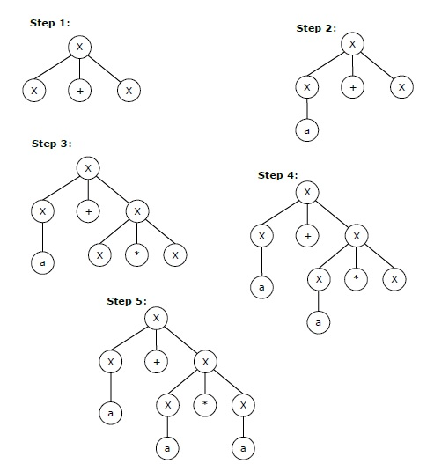
Left-Most and Right-Most Derivations

Slide 57
Left-Most and Right-Most Derivations
The rightmost derivation for the above string "a+a*a" may be −
X → X*X → X*a → X+X*a → X+a*a → a+a*a

Slide 58
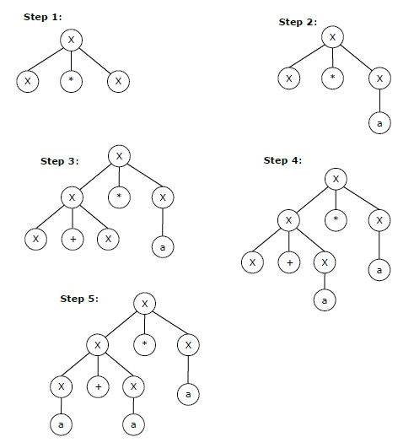
Left-Most and Right-Most Derivations

Slide 59
Parser
source
Lexical
Analyzer
token
syntax
Semantic
Analyzer
Parser
code
tree
next token
Symbol
Table
Dr. Azhar, KUET.
20-Jan-25

Slide 60
Parsers (cont.)
Parsers can be categorized into two groups:
Top-Down Parser
the parse tree is created top to bottom, starting from the root.
Bottom-Up Parser
the parse tree is created bottom to top; starting from the leaves
Both top-down and bottom-up parsers scan the input from left to right (one symbol at a time).
Efficient top-down and bottom-up parsers can be implemented only for sub-classes of context-free grammars.
LL for top-down parsing ( Left to right scan, Left most derivation)
LR for bottom-up parsing ( Left to right scan, Right most derivation)

Slide 61
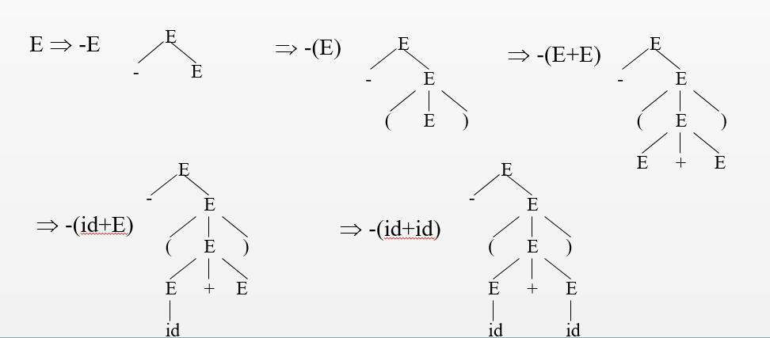
Parse Tree
Inner nodes of a parse tree are non-terminal symbols.
The leaves of a parse tree are terminal symbols.
A parse tree can be seen as a graphical representation of a derivation.

Slide 62
Ambiguity
A grammar produces more than one parse tree for a sentence is
called as an ambiguous grammar.
E
E
+
E
E ⇒ E+E ⇒ id+E ⇒ id+E*E
⇒ id+id*E ⇒ id+id*id
id
E
*
E
id
id
E
E ⇒ E*E ⇒ E+E*E ⇒ id+E*E
⇒ id+id*E ⇒ id+id*id
E
*
E
E
+
E
id
id
id
Dr. Azhar, KUET.
20-Jan-25

Slide 63
Ambiguity (cont.)
For most of the parsers, the grammar must be unambiguous.
Unambiguous grammar posses the unique selection of the parse tree for a sentence
We should eliminate the ambiguity in the grammar during the design phase of the compiler.
We have to prefer one of the parse trees of a sentence (generated by an ambiguous grammar) to disambiguate that grammar to restrict to this choice.

Slide 64
Ambiguity (cont.)
To convert ambiguous grammar to unambiguous –
Ambiguous grammars (because of ambiguous operators) can be disambiguated according to the precedence and associativity rules.
E → E+E | E*E | E^E | id | (E)
disambiguate the grammar
precedence: ^ (right to left)
* (left to right)
+ (left to right)
E → E+T | T
T → T*F | F
F → G^F | G
G → id |(E)
⇓

Slide 65
Ambiguity (cont.)
stmt → if expr then stmt |
if expr then stmt else stmt | otherstmts
stmt
if expr then stmt else stmt
E₁ if expr then stmt S₂
E₂ S₁
if E₁ then if E₂ then S₁ else S₂
stmt
if expr then stmt
E₁ if expr then stmt else stmt
E₂ S₁ S₂
1
2
Dr. Azhar, KUET.
20-Jan-25

Slide 66
Ambiguity (cont.)
We prefer the second parse tree (else matches with closest if).
So, we have to disambiguate our grammar to reflect this choice.
The unambiguous grammar will be:
stmt → matchedstmt | unmatchedstmt
matchedstmt → if expr then matchedstmt else matchedstmt
| otherstmts
unmatchedstmt → if expr then stmt |
if expr then matchedstmt else unmatchedstmt
Dr. Azhar, KUET.
20-Jan-25

Slide 67
Left Recursion
A grammar is left recursive if it has a non-terminal A such that there is a derivation
A ⇒ Aα for some string α
The left-recursion may appear in a single step of the derivation (immediate left-recursion), or may appear in more than one step of the derivation.

Slide 68
Eliminate Left-Recursion
A → A α | β where β does not start with A
⇓ eliminate immediate left recursion
A → β A′
A′ → α A ′ | ε an equivalent grammar

Slide 69
Immediate Left-Recursion - Example
E → E+T | T
T → T*F | F
F → id | (E)
⇓ eliminate immediate left recursion
E → TE′
E′ → +TE′ | ε
T → FT′
T’ → *FT′ | ε
F → id | (E)
Dr. Azhar, KUET.
20-Jan-25

Slide 70
Immediate Left-Recursion
In general,
A → A α₁ | ... | A α_{m} | β₁ | ... | β_{n} where β₁ ... β_{n} do not start with A
⇓ eliminate immediate left recursion
A → β₁ A′ | ... | β_{n} A ′
A′ → α₁ A′ | ... | α_{m} A′ | ε an equivalent grammar

Slide 71
Left-Recursion -- Problem
A grammar cannot be immediately left-recursive, but it still can be
left-recursive.
By just eliminating the immediate left-recursion, we may not get
a grammar which is not left-recursive.
S → Aa | b
A → Ac |Sd | ε This grammar is not immediately left-recursive,
but it is still left-recursive.
S ⇒ Aa ⇒ Sda or
A ⇒ Sd ⇒ Aad causes to a left-recursion
So, we have to eliminate all left-recursions from this grammar
Dr. Azhar, KUET.
20-Jan-25

Slide 72
Eliminate Left-Recursion -- Algorithm
- Arrange non-terminals in some order: A₁ ... A_{n}
- for i from 1 to n do {
- for j from 1 to i-1 do {
replace each production
A_{i} → A_{j} γ by
A_{i} → α₁ γ | ... | α_{k} γ
where A_{j} → α₁ | ... | α_{k}
}
- eliminate immediate left-recursions among A_{i} productions
}
Will not work for a grammar which has cycle, A ⇒ A.
And for ε productions.

Slide 73
Eliminate Left-Recursion -- Example
S → Aa | b
A → Ac | Sd | f
- Order of non-terminals: S, A
for S:
- we do not enter the inner loop.
- there is no immediate left recursion in S.
for A:
- Replace A → Sd with A → Aad | bd
So, we will have A → Ac | Aad | bd | f
- Eliminate the immediate left-recursion in A
A → bdA′ | fA′
A’ → cA′ | adA′ | ε
So, the resulting equivalent grammar which is not left-recursive is:
S → Aa | b
A → bdA′ | fA′
A’ → cA′ | adA′ | ε
Eliminate Left-Recursion -- Algorithm

Slide 74
Left-Factoring
A predictive parser (a top-down parser without backtracking) insists that the grammar must be left-factored.
stmt → if expr then stmt else stmt |
if expr then stmt
when we see if, we cannot now which production rule to choose to re-write stmt in the derivation.

Slide 75
Left-Factoring (cont.)
In general,
A → αβ₁ | αβ₂
where α is non-empty and the first symbols of β₁ and β₂ (if they have one)are different.
when processing α we cannot know whether expand
A to αβ₁ or A to αβ₂
But, if we re-write the grammar as follows
A → αA ′
A′ → β₁ | β₂
so, we can immediately expand A to αA ′

Slide 76
Left-Factoring -- Algorithm
For each non-terminal A with two or more alternatives (production rules) with a common non-empty prefix,
A → αβ₁ | ... | αβ_{n} | γ₁ | ... | γ_{m}
convert it into
A → αA′ | γ₁ | ... | γ_{m}
A’ → β₁ | ... | β_{n}

Slide 77
Left-Factoring – Example
A → abB | aB | cdg | cdeB | cdfB
⇓
A → aA′ | cdg | cdeB | cdfB
A′ → bB | B
⇓
A → aA′ | cdA′′
A′ → bB | B
A′′ → g | eB | fB

Slide 78
Week 6-7
Slides 78-105

Slide 79
Parsing

Slide 80
The parse tree is created top to bottom.
Top-down parser
Recursive-Descent Parsing
Backtracking is needed
If a choice of a production rule does not work, we backtrack to try other alternatives.
It is a general parsing technique, but not widely used.
Not efficient
Predictive Parsing
no backtracking
efficient
needs a special form of grammars (LL(1) grammars). (LL- Left to right scan, Left derivation )
Non-Recursive (Table Driven) Predictive Parser is also known as LL(1) parser.
Top-Down Parsing

Slide 81
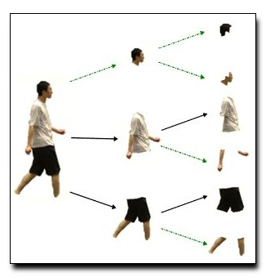
Top-Down Parsing

Slide 82
Predictive Parser
A grammar
Eliminate ambiguity
eliminate left recursion
left factor
suitable for predictive parsing (LL(1))
Given the input symbol a, the non terminal A to be expand
A → α₁ | ... | α_{n}
will be the unique alternatives with first symbol a.

Slide 83
LL(k) Parsing
The first L stands for scanning the input from left to right
The second L stands for producing a leftmost derivation
The k stands for the number of input symbols for look ahead used to choose alternative productions at each derivation step

Slide 84
Non-Recursive Predictive Parsing -- LL(1) Parser
Non-Recursive predictive parsing is a table-driven parser.
It is a top-down parser.
It is also known as LL(1) Parser.
input buffer
stack Non-recursive output
Predictive Parser
Parsing Table

Slide 85
Non recursive Predictive Parsing
a | b | c | … | x | y | $
Input
X
_{Y}
Z
$
Predictive Parsing
Program
Output
Stack
Parsing table

Slide 86
LL(1) Parser
input buffer
our string to be parsed. We will assume that its end is marked with a special symbol $.
output
a production rule representing a step of the derivation sequence (left-most derivation) of the string in the input buffer.
stack
contains the grammar symbols
at the bottom of the stack, there is a special end marker symbol $.
initially the stack contains only the symbol $ and the starting symbol S.
when the stack is emptied (ie. only $ left in the stack), the parsing is completed.

Slide 87
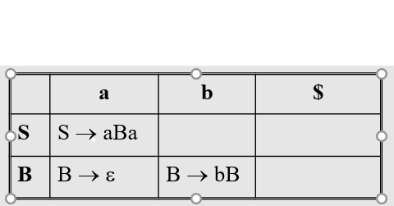
LL(1) Parser
parsing table
a two-dimensional array M[A,a]
each row is a non-terminal symbol
each column is a terminal symbol or the special symbol $
each entry holds a production rule.

Slide 88
LL(1) Parser – Parser Actions
The symbol at the top of the stack (say X) and the current symbol in the input string (say a) determine the parser action.
There are four possible parser actions.
If (X = $, a = $ ) parser halts (successful completion)
If X= a (but not $)
parser pops X from the stack, and moves the next symbol in the input buffer.

Slide 89
LL(1) Parser – Parser Actions
If X is a non-terminal
parser looks at the parsing table entry M[X, a].
If M[X, a] holds a production rule X→Y₁Y₂...Y_{k}, it pops X from the stack and pushes Y_{k},Y_{k-1},...,Y₁ into the stack.
The parser also outputs the production rule X→Y₁Y₂...Y_{k} to represent a step of the derivation.
none of the above : error
all empty entries in the parsing table are errors.
If X is a terminal symbol different from a, this is also an error case.

Slide 90
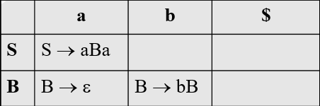
LL(1) Parser – Example1
S → aBa
B → bB | ε
stack input output
$S abba$ S → aBa
$aBa abba$
$aB bba$ B → bB
$aBb bba$
$aB ba$ B → bB
$aBb ba$
$aB a$ B → ε
$a a$
$ $ accept, successful completion

Slide 91
LL(1) Parser – Example1 (cont.)
Outputs: S → aBa B → bB B → ε
Derivation(left-most): S⇒aBa⇒abBa⇒abbBa⇒abba
S
parse tree
a
B
a
b
B
b
B
ε

Slide 92
LL(1) Parser – Example2
E → TE′
E’ → +TE′ | ε
T → FT′
T’ → *FT′ | ε
F → (E) | id
 | id | + | * | ( | ) | $
E | E → TE’ |  |  | E → TE’
E’ |  | E’ → +TE’ |  |  | E’ → ε | E’ → ε
T | T → FT’ |  |  | T → FT’
T’ |  | T’ → ε | T’ → *FT’ |  | T’ → ε | T’ → ε
F | F → id |  |  | F → (E)

Slide 93
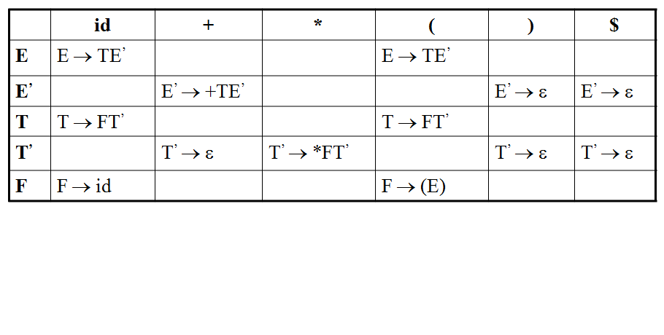
LL(1) Parser – Example2
stack input output
$E id+id$ E → TE’
$E’T id+id$ T → FT’
$E’ T’F id+id$ F → id
$ E’ T’id id+id$
$ E’ T’ +id$ T’ → ε
$ E’ +id$ E’ → +TE’
$ E’ T+ +id$
$ E’ T id$ T → FT’
$ E’ T’ F id$ F → id
$ E’ T’id id$
$ E’ T’ $ T’ → ε
$ E’ $ E’ → ε
$ $ accept

Slide 94
LL(1) Parser -Example3
Stack Input Output
$E id + id * id$
$E'T id + id * id$ E → TE'
$E'T'F id + id * id$ T → FT'
$E'T'id id + id * id$ F → id
$E'T' + id * id$
$E' + id * id$ T' → ε
$E'T+ + id * id$ E' → + TE'
$E'T id * id$
$E'T'F id * id$ T → FT'
$E'T'id id * id$ F → id
$E'T' * id$
$E'T'F* * id$ T' → * FT'
$E'T'F id$
$E'T'id id$ F → id
$E'T' $
$E' $ T' → ε
$ $ E' → ε

Slide 95
Computing FIRST for Any String X
If X is a terminal then First(X) ={X}
If there is a Production X → ε then add ε to first(X)
If there is a Production X → Y₁Y₂…Y_{k} then add first(Y₁Y₂…Yk) to first(X)
First(Y1Y2...Y_{k}) is either
First(Y1) (if Y1 doesn't derive to ε)
Or if Y1 derive to ε
Add First (Y1) <except for ε > as well as everything in First(Y2…Yk) . And so on…
If First(Y1) First(Y2)...First(Yk) all contain ε then add ε to First(Y1Y2..Yk) as well.

Slide 96
FIRST Example(1)
E → TE’
E’ → +TE’ | ε
T → FT’
T’ → *FT’ | ε
F → (E) | id
FIRST(F) = {(,id} FIRST(TE’) = {(,id}
FIRST(T’) = {*, ε} FIRST(+TE’ ) = {+}
FIRST(T) = {(,id} FIRST(ε) = {ε}
FIRST(E’) = {+, ε} FIRST(FT’) = {(,id}
FIRST(E) = {(,id} FIRST(*FT’) = {*}
FIRST((E)) = {(}
FIRST(id) = {id}

Slide 97
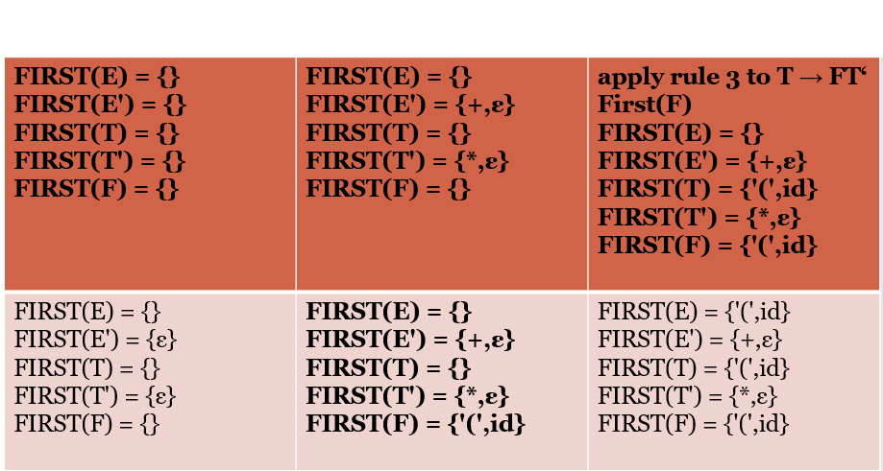
FIRST Example(2)
E → TE’
E’ → +TE’ | ε
T → FT’
T’ → *FT’ | ε
F → (E) | id

Slide 98
Computing FOLLOW for non-terminals
First put $ in Follow(S) (S is the start symbol)
If there is a production A → αBβ, then everything in FIRST(β ) except for ε is placed in FOLLOW(B).
If there is a production A → αB, then everything in FOLLOW(A) is in FOLLOW(B)
If there is a production A → αBβ, where FIRST(β) contains ε, then everything in FOLLOW(A) is in FOLLOW(B)

Slide 99
FOLLOW Example
E → TE’
E’ → +TE’ | ε
T → FT’
T’ → *FT’ | ε
F → (E) | id
FOLLOW(E) = { $, ) }
FOLLOW(E’) = { $, ) }
FOLLOW(T) = { +, ), $ }
FOLLOW(T’) = { +, ), $ }
FOLLOW(F) = {+, *, ), $ }

Slide 100
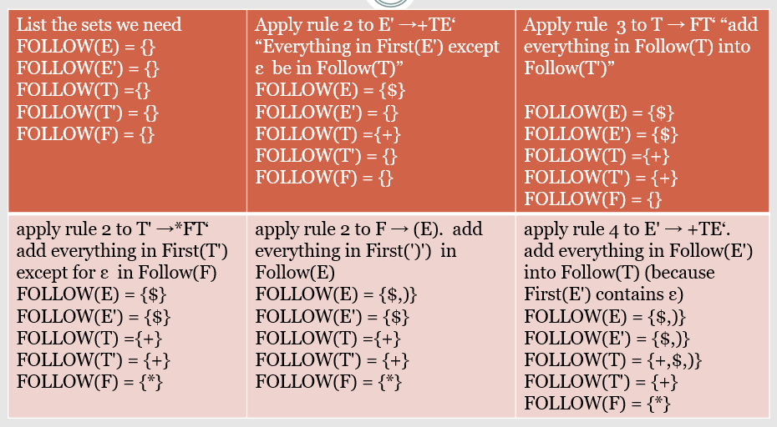
FOLLOW Example

Slide 101
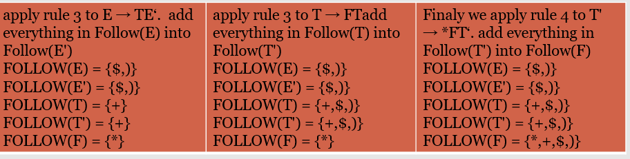
FOLLOW Example

Slide 102
Constructing LL(1) Parsing Table -- Algorithm
for each production rule A → α of a grammar G
for each terminal a in FIRST(α)
➔ add A → α to M[A,a]
If ε in FIRST(α)
➔ for each terminal a in FOLLOW(A) add A → α to M[A,a]
If ε in FIRST(α) and $ in FOLLOW(A)
➔ add A → α to M[A,$]
All other undefined entries of the parsing table are error entries.

Slide 103
Constructing LL(1) Parsing Table -- Example
E → TE’ FIRST(TE’)={(,id} ➔ E → TE’ into M[E,(] and M[E,id]
E’ → +TE’ FIRST(+TE’ )={+} ➔ E’ → +TE’ into M[E’,+]
E’ → ε FIRST(ε)={ε} ➔ none
but since ε in FIRST(ε)
and FOLLOW(E’)={$,)} ➔ E’ → ε into M[E’,$] and M[E’,)]
T → FT’ FIRST(FT’)={(,id} ➔ T → FT’ into M[T,(] and M[T,id]
T’ → *FT’ FIRST(*FT’ )={*} ➔ T’ → *FT’ into M[T’,*]
T’ → ε FIRST(ε)={ε} ➔ none
but since ε in FIRST(ε)
and FOLLOW(T’)={$,),+}➔ T’ → ε into M[T’,$], M[T’,)] and M[T’,+]
F → (E) FIRST((E) )={(} ➔ F → (E) into M[F,(]
F → id FIRST(id)={id} ➔ F → id into M[F,id]

Slide 104
LL(1) Grammars
The parsing table of a grammar may contain more than one production rule i.e. multiple defined. This is possible if G is left recursive or ambiguous.
In this case, we say that it is not a LL(1) grammar.
A grammar whose parsing table has no multiply-defined entries is said to be LL(1) grammar.

Slide 105
A Grammar which is not LL(1)
S → i C t S E | a FOLLOW(S) = { $,e }
E → e S | ε FOLLOW(E) = { $,e }
C → b FOLLOW(C) = { t }
FIRST(iCtSE) = {i}
FIRST(a) = {a}
FIRST(eS) = {e}
FIRST(ε) = {ε}
FIRST(b) = {b}
two production rules for M[E,e]
Problem ➔ ambiguity
 | a | b | e | i | t | $
S | S → a |  |  | S → iCtSE
E |  |  | E → e S E → ε |  |  | E → ε
C |  | C → b

Slide 106
Week 8-9
Slides 106-125

Slide 107
Syntax-Directed Translation

Slide 108
Syntax-Directed Translation
Attributes associate information with the programming language constructs that they represent.
Values of these attributes are evaluated by the semantic rules associated with the production rules.
Evaluation of these semantic rules:
may generate intermediate codes
may put information into the symbol table
may perform type checking
may issue error message
An attribute may hold almost any thing.
a string, a number, a memory location, a complex record.

Slide 109
Syntax-Directed Definitions and Translation Schemes
When we associate semantic rules with productions, we use two notations:
Syntax-Directed Definitions
Translation Schemes
Syntax-Directed Definitions:
give high-level specifications for translations
hide many implementation details such as order of evaluation of semantic actions.
We associate a production rule with a set of semantic actions, and we do not say when they will be evaluated.
Translation Schemes:
indicate the order of evaluation of semantic actions associated with a production rule.
In other words, translation schemes give a little bit information about implementation details.
Syntax-Directed Translation

Slide 110
Syntax-Directed Definitions
A syntax directed definition specifies the values of attributes by associating semantic rules with the grammar productions.
A syntax-directed definition is a generalization of a context-free grammar in which:
Each grammar symbol is associated with a set of attributes.
This set of attributes for a grammar symbol is partitioned into two subsets called
A synthesized attribute at node N is defined only in terms of attribute values of children of N and at N it
inherited attribute at node N is defined only in terms of attribute values at N’s parent, N itself and N’s siblings
Each production rule is associated with a set of semantic rules.
Evaluation of a semantic rule defines the value of an attribute. But a semantic rule may also have some side effects such as printing a value.

Slide 111
Syntax-Directed Definition
In a syntax-directed definition, each production A→α is associated with a set of semantic rules of the form:
b=f(c₁,c₂,…,c_{n})
where f is a function and b can be one of the followings:
➔ b is a synthesized attribute of A and c₁,c₂,…,c_{n} are attributes of the grammar symbols in the production ( A→α ).
OR
➔ b is an inherited attribute one of the grammar symbols in α (on the right side of the production), and c₁,c₂,…,c_{n} are attributes of the grammar symbols in the production ( A→α ).

Slide 112
Annotated Parse Tree
A parse tree showing the values of attributes at each node is called an annotated parse tree.
The process of computing the attributes values at the nodes is called annotating (or decorating) of the parse tree.
Of course, the order of these computations depends on the dependency graph induced by the semantic rules.

Slide 113
Syntax-Directed Definition – Synthesized Atttibutes
Production Semantic Rules
L → E return print(E.val)
E → E₁ + T E.val = E₁.val + T.val
E → T E.val = T.val
T → T₁ * F T.val = T₁.val * F.val
T → F T.val = F.val
F → ( E ) F.val = E.val
F → digit F.val = digit.lexval (from symbol table)
Symbols E, T, and F are associated with a synthesized attribute val.
The token digit has a synthesized attribute lexval (it is assumed that it is evaluated by the lexical analyzer).

Slide 114
Annotated Parse Tree -- Example
Input: 5+3*4
L
E.val=17 return print(E.val)
E.val=5 + T.val=12
T.val=5 T.val=3 * F.val=4
F.val=5 F.val=3 digit.lexval=4
digit.lexval=5 digit.lexval=3

Slide 115
Dependency Graph
Dependency graph shows the flow of information among the attribute instances in parse tree. It is used to determine the order of computation of attributes
Semantic rules set up dependencies between attributes which can be represented by a dependency graph.
This dependency graph determines the evaluation order of these semantic rules.

Slide 116
Dependency Graph
Input: 5+3*4
L
E.val=17
E.val=5 T.val=12
T.val=5 T.val=3 F.val=4
F.val=5 F.val=3 digit.lexval=4
digit.lexval=5 digit.lexval=3

Slide 117
Attributes
We distinguish between two kinds of attributes:
Synthesized Attributes. They are computed from the values of the attributes of the children nodes.
Inherited Attributes. They are computed from the values of the attributes of both the siblings and the parent nodes.

Slide 118
Inherited Attributes
• Inherited Attributes are useful for expressing the dependence of a construct on the context in which it appears.
• It is always possible to rewrite a syntax directed definition to use only synthesized attributes, but it is often more natural to use both synthesized and inherited attributes.
• Evaluation Order. Inherited attributes cannot be evaluated by a simple PreOrder traversal of the parse-tree:
– Unlike synthesized attributes, the order in which the inherited attributes of the children are computed is important!!! Indeed:
∗ Inherited attributes of the children can depend from both left and right siblings!

Slide 119
Syntax-Directed Definition – Inherited Attributes
Let us consider the syntax directed definition with both inherited and synthesized attributes for the grammar for “type declarations”:
Production Semantic Rules
D → T L; L.in = T.type
T → int T.type = integer
T → real T.type = real
L → L₁ ,id L₁.in = L.in, addtype(id.entry,L.in)
L → id addtype(id.entry,L.in)
The non terminal T has a synthesized attribute, type, determined by the keyword in the declaration
. The production D → T L is associated with the semantic rule L.in := T .type which set the inherited attribute L.in.
Symbol L is associated with an inherited attribute in.

Slide 120
Annotated Parse Tree for real, id1, id2, id3
D
T.Type = real
L.in = real
L.in = real
,
id3
real
L.In = real
,
id2
id1

Slide 121
A Dependency Graph – Inherited Attributes
Input: real p q
D L.in=real
T L T.type=real L₁.in=real addtype(q,real)
real L id addtype(p,real) id.entry=q
id id.entry=p
parse tree dependency graph

Slide 122
Example of mixed attributes
Production
Semantic Rules
T → FT’
T’ → *FT₁’
T’ → ε
F → digit
T’.inh = F.val
T.val = T’.syn
T₁’.inh = T’.inh * F.val
T’.syn = T’1.syn
T’.syn = T’.inh
F.val = digit.lexval

Slide 123
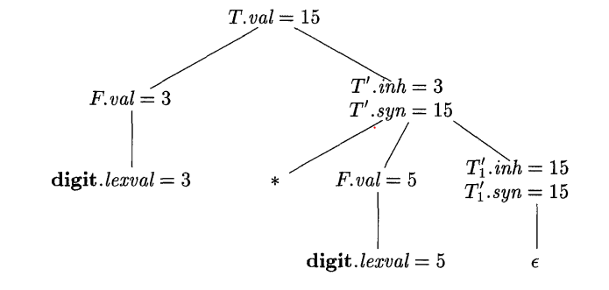
Example of mixed attributes

Slide 124
S-Attributed definitions
An SDD is S-attributed if every attribute is synthesized
We can have a post-order traversal of parse-tree to evaluate attributes in S-attributed definitions
postorder(N) {
for (each child C of N, from the left) postorder(C);
evaluate the attributes associated with node N;
}
S-Attributed definitions can be implemented during bottom-up parsing without the need to explicitly create parse trees

Slide 125
L-Attributed definitions
A SDD is L-Attributed if the edges in dependency graph goes from Left to Right but not from Right to Left.
More precisely, each attribute must be either
Synthesized
OR
Inherited, but if there us a production A->X1X2…Xn and there is an inherited attribute Xi.a computed by a rule associated with this production, then the rule may only use:
Inherited attributes associated with the head A
Either inherited or synthesized attributes associated with the occurrences of symbols X1,X2,…,Xi-1 located to the left of Xi
Inherited or synthesized attributes associated with this occurrence of Xi itself, but in such a way that there is no cycle in the graph

Slide 126
Week 10-11
Slides 126-148

Slide 127
Intermediate Code Generation

Slide 128
Intermediate Code
Defined as
The source code of a program is translated into a form called intermediate code which is suitable for code improvement and transformations before use to generate object or machine code for a target machine.

Slide 129
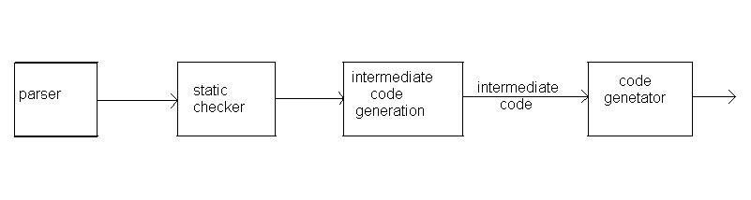
Intermediate Code Generation
Translate the source program Such as
declarations,
assignments and
flow-of-control statements
into an intermediate form

Slide 130
Intermediate Languages
Three types of intermediate representations
Syntax Trees
2. Postfix notation
3. Three Address Code

Slide 131
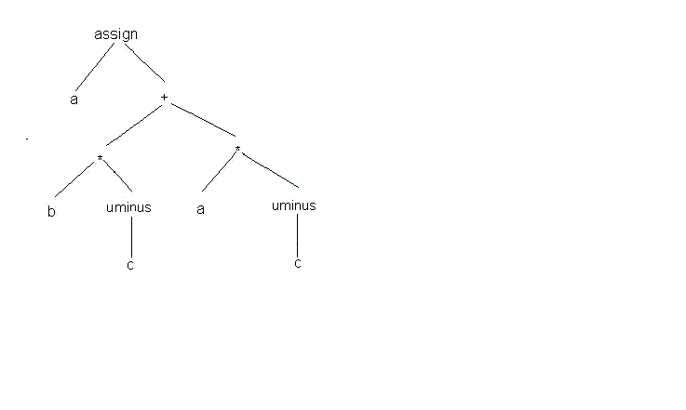
Graphical Representations
A syntax tree depicts the natural hierarchical structure of a source program.
Ex. A syntax tree for the assignment statement
a:=b*-c+a*-c
Dr. Azhar, CSE Dept. KUET
20 January 2025

Slide 132
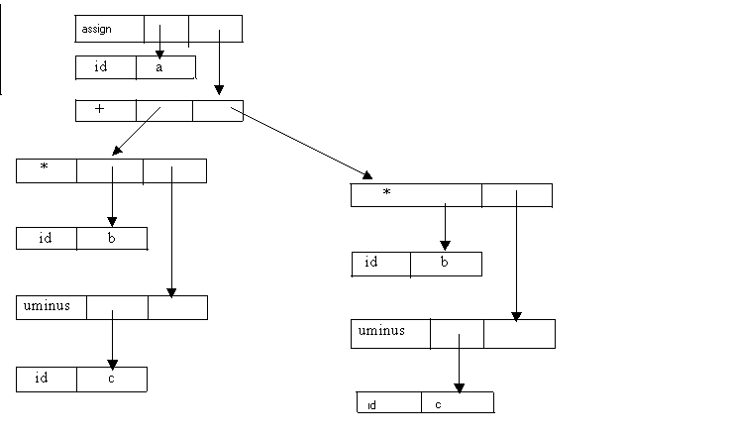
Graphical Representations
There are two representations of the syntax tree.
Tree and array of records
Each node is represented as a record with a field for its operator and additional fields for pointers to its children.
All the nodes in the syntax tree can be visited by following pointers, starting from the root at position .
20 January 2025

Slide 133
Graphical Representations
All nodes are allocated from an array of records and the index or position of the node serves as the pointer to the node.
0
id
b
1
id
c
2
uminus
1
3
*
0
2
4
id
a
5
id
c
6
uminus
5
7
*
4
6
8
+
3
7
9
id
a
10
assign
9
8
11
……
Dr. Azhar, CSE Dept. KUET
20 January 2025

Slide 134
Three-Address Code
A three-address statement is an abstract form of intermediate code.
Three-address code is a sequence of statements of the form
x:= y op z
where x, y, and z are names, constants, or compiler-generated temporaries;
op stands for any operator, such as arithmetic operator, or a logical operator on Boolean-valued data.
The reason for the term ”three-address code” is that each statement usually contains three addresses, two for the operands and one for the result.
Dr. Azhar, CSE Dept. KUET
20 January 2025

Slide 135
Three-Address Code(Cont…)
No arithmetic expressions are permitted, as there is only one operator on the right side of a statement
Thus expression like x+y*z might be translated into a sequence
t₁: = y*z
t₂:=x+t₁
where t1 and t2 are compiler-generated temporary names.
Dr. Azhar, CSE Dept. KUET
20 January 2025

Slide 136
Three-Address Code(Cont…)
The use of names for the intermediate values computed by a program allow- three-address code to be easily rearranged
a : = b*-c + a*-c
t1 := -c
t2 := b * t1
t3 := -c
t4 := a * t3
t5 := t2 + t4
a := t5
Dr. Azhar, CSE Dept. KUET
20 January 2025

Slide 137
Three-Address Code : Types
Assignment statements of the form x: = y op z, where op is a binary arithmetic or logical operation.
Assignment instructions of the form x: = op y, where op is a unary operation.
Unary operations include
unary minus, logical negation, shift operators, and conversion operators.
Dr. Azhar, CSE Dept. KUET
20 January 2025

Slide 138
Three-Address Code : Types
Copy statements of the form x: = y where the value of y is assigned to x.
The unconditional jump goto L. The three-address statement with label L is the next to be executed.
Conditional jumps such as if x relop y goto L. This instruction applies a relational operator (<, =, >=, etc.)
Dr. Azhar, CSE Dept. KUET
20 January 2025

Slide 139
Three-Address Code : Types
param x and call p, n for procedure calls and return y, where y representing a returned value that is optional.
param x1
param x2
param xn
call p, n
Dr. Azhar, CSE Dept. KUET
20 January 2025

Slide 140
Three-Address Code : Types
Indexed assignments of the form x: = y[ i ] and x [ i ]: = y.
The statement x[i]:=y sets the contents of the location i units beyond x to the value of y.
Address and pointer assignments of the form x:= &y, x:= *y and *x: = y.
Dr. Azhar, CSE Dept. KUET
20 January 2025

Slide 141
Implementations of three-Address Statements
Three address statements can be implemented as records with fields for the operator and the operands.
Three such representations are
quadruples
triples
indirect triples.
Dr. Azhar, CSE Dept. KUET
20 January 2025

Slide 142
Implementations of three-Address Statements
Quadruples
A quadruple is a record structure with four fields
op, argl, arg2, and result.
The op field contains an internal code for the operator.
The three-address statement x := y op z is represented by placing y in arg1, z in arg2 and x in result.
Statements with unary operators like x: = – y or x: = y do not use arg 2.
Dr. Azhar, CSE Dept. KUET
20 January 2025

Slide 143
Implementations of three-Address Statements
Quadruples
Operators like param use neither arg2 nor result.
Conditional and unconditional jumps put the target label in result.
t1 := -c
t2 := b * t1
t3 := -c
t4 := a * t3
t5 := t2 + t4
a := t5
op
Arg1
Arg2
Result
(0)
uminus
c
t1
(1)
*
b
t1
t2
(2)
uminus
c
t3
(3)
*
a
t3
t4
(4)
+
t2
t4
t5
(5)
:=
t5
a
Dr. Azhar, CSE Dept. KUET
20 January 2025

Slide 144
Implementations of three-Address Statements
Triples
To avoid entering temporary names into the symbol table. refer to a temporary value by the position of the statement
three-address statements can be represented by records with only three fields: op, arg1 and arg2.
The fields argl and arg2, for the arguments of op, are either pointers to the symbol table or pointers into the triple structure.
Since three fields are used, this intermediate code format is known as triples.
Dr. Azhar, CSE Dept. KUET
20 January 2025

Slide 145
Implementations of three-Address Statements
op
Arg1
Arg2
Result
(0)
uminus
c
t1
op
Arg1
Arg2
(1)
*
b
t1
t2
(2)
uminus
c
t3
(0)
uminus
c
(3)
*
a
t3
t4
(4)
+
t2
t4
t5
(1)
*
b
(0)
(5)
:=
t5
a
(2)
uminus
c
Quadruples
t1 := -c
t2 := b * t1
t3 := -c
t4 := a * t3
t5 := t2 + t4
a := t5
(3)
*
a
(2)
(4)
+
(1)
(3)
(5)
:=
a
(4)
Triples
Dr. Azhar, CSE Dept. KUET
20 January 2025

Slide 146
Implementations of three-Address Statements
A ternary operation like x[ i ]: = y requires two entries in the triple structure.
Dr. Azhar, CSE Dept. KUET
20 January 2025

Slide 147
Comparison of the Implementations
Using the quadruple notation, a three- address statement a temporary can immediately access the location via the symbol table.
In the triples declaration; moving a statement that defines a temporary value requires to change all references to that statement in the arg1 and arg2 arrays.
This problem makes triples difficult to use in an optimizing compiler.
Dr. Azhar, CSE Dept. KUET
20 January 2025

Slide 148
Comparison of the Implementations
Indirect triples present no such problem. A statement can be moved by reordering the statement list.
Indirect triples can save some space compared with quadruples if the same temporary value is used more than once.
The reason is that two or more entries in the statement array can point to the same line of the op-arg1-arg2 structure.
Dr. Azhar, CSE Dept. KUET
20 January 2025

Slide 149
Week 12-13
Slides 149-188

Slide 150
Type Checking

Slide 151
Introduction
A compiler must check that the source program follows both the syntactic and semantic conventions of the source language.
This checking, called static checking, ensures that certain kinds of programming errors will be detected and reported.
The static checks includes:
Type checks.
Flow-of-control check.
Uniqueness checks.
Name-related checks.

Slide 152
Static Checking
Token
Stream
Abstract Syntax Tree
Static Checker
Parser
Intermediate Code Generator
Decorated Abstract Syntax Tree
Intermediate Code
Static (Semantic) Checks
Type checks: operator applied to incompatible operands?
Flow of control checks: break (outside while?)
Uniqueness checks: labels in case statements
Name related checks: same name?

Slide 153
Variants of Syntax tree
Nodes I syntax tree represent constructs in the source program, children of a node represent components of a construct.
Abstract Syntax Trees (AST) – retain essential structure of the parse tree, eliminating unneeded nodes.
Directed Acyclic Graphs (DAG) – compacted AST to avoid duplication – smaller footprint as well

Slide 154
Directed Acyclic Graphs for Expressions
a + a * ( b – c ) + ( b – c ) * d
+
+
*
*
d
a
-
b
c

Slide 155
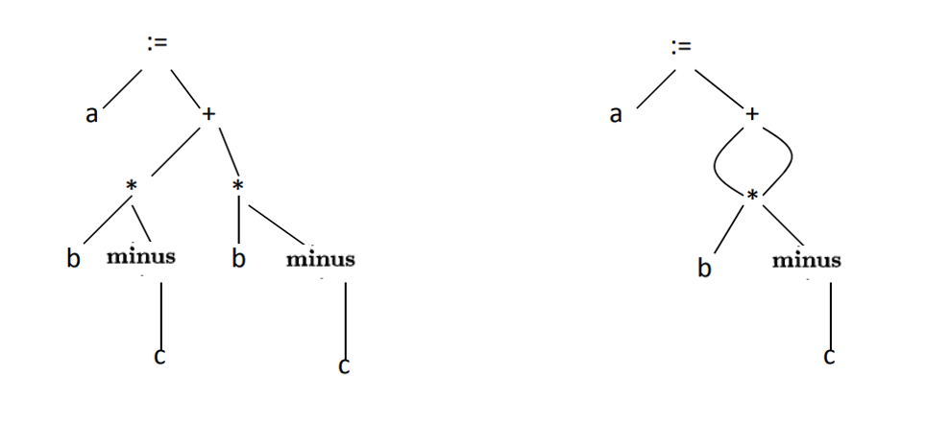
ASTs and DAGs: a := b *‐c + b*‐c

Slide 156
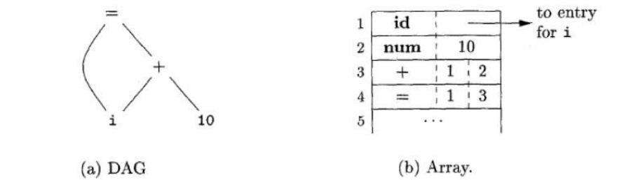
Nodes of a syntax tree or DAG are stored in an array of records.
Each row = one record,
1st field = operation code
Leaves have additional field for lexical values
Non-leaf nodes have 2 field for left and right children
Each node is indexed by an integer value called value number
Value-number method for constructing DAG’s

Slide 157
Language Constructs
Is a syntactically allowable part of a program that may be formed from one or more lexical tokens in accordance with the rules of programming language.
printf(“Hello World”)

Slide 158
Static Checking
We inter information about a name into a symbol table, we can check that the name is declared uniquely.
A type checker verifies that the type of a construct matches that expected by its context.
Examples:
mod requires integer operands (PASCAL)
* (dereferencing) – applied to a pointer
a[i] – indexing applied to an array
f(a1, a2, …, an) – function applied to correct arguments.
Information gathered by a type checker needed during code generation

Slide 159
Type Systems
The design of a type checker for a language is based on information about:
The syntactic constructs in the language.
The notion of types.
The rules for assigning types to the language constructs.
Examples: If both operators of “+”, “-”, “*” are of type integer then so is the result.
The result of the unary “&” operator is a pointer to the object referred to by the operand. If the type of the operand is ‘…….’, the type of the result is ‘pointer to …………’.

Slide 160
Type Systems
In both Pascal and C, types are either basic or constructed.
Basic types are atomic types with no internal structure as far as the programmer is concerned.
In Pascal the basic types are Boolean, character, integer, and real.
Pascal allows a programmer to construct types from basic types.
Pointers and functions can also be treated as constructed types.

Slide 161
Type Expressions
The type of a language construct will be denoted by a “Type Expression”.
Type Expression
Basic type.
Formed by applying an operator called a type constructor to other type expressions.

Slide 162
Definition of Type Expression
A basic type
a primitive data type such as integer, real, char, boolean, …
type-error to signal a type error
void : no type
A type name
a name can be used to denote a type expression.
typedef int X;
X a;

Slide 163
Definition of Type Expression
A type constructor applies to other type expressions.
arrays: If T is a type expression, then array(I,T) is a type expression denoting the type of an array with elements of type T and index range I. Example: var A: array [ 1 .. 10 ] of integer associates the type expression array( 1 .. 10, integer ) with A.
products: If T₁ and T₂ are type expressions, then their cartesian product T₁ x T₂ is a type expression. Ex: int x int.
pointers: If T is a type expression, then pointer(T) is a type expression denoting the type “pointer to an object of type T.” example: var p: ↑ row declares variable p to have type pointer(row).

Slide 164
Definition of Type Expression
Records: The difference between a record and a product is that the fields of a record have names.
The record type constructor will be applied to a tuple formed from field names and field types.
type row = record
address : integer;
lexeme: array [ 1 .. 15 ] of char
ends;
var table: array [ 1 .. 101 ] of row;
Declares the type name row representing the type expression
record((address X integer) X (lexeme X array( 1 .. 15, char )))

Slide 165
Definition of Type Expression
Functions: We may treat functions in a programming language as mapping from a domain type D to a range type R. So, the type of a function can be denoted by the type expression D→R where D are R type expressions.
Built in function mod of pascal has domain type int × int i.e pair of int and range type int
int × int int

Slide 166
Definition of Type Expression
Functions: We may treat functions in a programming language as mapping from a domain type D to a range type R. So, the type of a function can be denoted by the type expression D→R where D are R type expressions.
function f ( a ,b : char ) : ↑ integer;
Domain type char × char and range type pointer(integer)
Thus the type of f is denoted by the type expression:
char × char integer pointer

Slide 167
Definition of Type Expression
Records: will be applied to a tuple formed from field name and field types.
type name
type row = record
address : integer;
lexeme: array [1….15] of char
end;
var table : array [1….10] of row;
struct row
{
int address;
char lexeme[15];
}table[100];
type expression
record((address × integer) × (lexeme × array(1….15,char)))

Slide 168
Type Expression Overall
Implicit Assumptions:
Each program has a type
Types have a structure
Basic Types
Type Constructors
Boolean | Character
Real | Integer
Enumerations | Sub-ranges
Void | Error
Variables | Names
Arrays
Records
Sets
Pointers
Functions

Slide 169
Representation of Type Expressions
->
->
x
pointer
x
pointer
char
char
integer
char
integer
cell = record
Tree
DAG
x
(char x char)-> pointer (integer)
x
x
info
int
next
ptr
struct cell {
int info;
struct cell * next;
};

Slide 170
Static vs Dynamic Checking
Checking done by a compiler is static.
Checking done when target program runs is dynamic.
Any check can be done dynamically, if the target code carries the type of an element along with the value of that element.
Sound type system eliminates the need for dynamic checking for type errors because it allows us to determine statically that these errors cannot occur when the target program runs.
A sound type system assigns a type other than type_error.
A language is strongly typed if its compiler can guarantee that the programs it accepts will execute without type errors.

Slide 171
Error recovery
Since type checking has the potential for catching errors in programs, it is important to do something when an error is discovered.
At the very least, the compiler must report the nature and location of the error.
It is desirable for the type checker to recover from errors, so it can check the rest of the input.
Error handling affects the type-checking rules, it has to be designed into the type system right from the start.
The rules must be prepared to cope with errors.
The inclusion of error handling may result in a type system that goes beyond the one needed to specify correct programs.

Slide 172
Specification of a Simple Type Checker
The type of each identifier must be declared before the identifier is used.
The type checker is a translation scheme that synthesizes the type of each expression from the type of its sub-expressions.
The type checker can handle arrays, pointers, statements, and functions.

Slide 173
Specification of a Simple Type Checker
A Simple Language:
Here is a Pascal-like grammar for a sequence of declarations (D) followed by an expression (E).
Grammar:
P → D ; E
D → D ; D | id : T
T → char | integer | array [ num ] of T | ↑T
E → literal | num | id | E mod E | E [ E ] | E ↑
Basic Types: char, integer, type-error
Sample Program:
Key: integer; X: integer; Key mod x

Slide 174
Specification of a Simple Type Checker
The basic types are char and integer.
Type_error signals an error.
All arrays start at 1, so array[256] of char leads to type
Expression : array(1..256,char)
The symbol ↑ in an declaration specifies a pointer type, so ↑ integer leads to type
Expression : pointer(integer)
Constructor
Basic Type
Constructor
Basic Type

Slide 175
Translation Scheme for Declarations
P → D ; E
D → D ; D
D → id : T { addtype(id.entry, T.type) }
T → char { T.type := char }
T → integer { T.type := integer }
T → ↑T₁ { T.type := pointer(T₁.type) }
T → array [ num ] of T₁ { T.type := array(1 .. num.val, T₁.type) }
Try to derive the annotated parse tree for the
declaration X: array[100] of ↑ char

Slide 176
Type Checking for Expressions
Once the identifiers and their types have been inserted into the symbol table, we can check the type of the elements of an expression:
E → literal { E.type := char }
E → num { E.type := integer }
E → id { E.type := lookup(id.entry) }
E → E₁ mod E₂ { if E₁.type =integer and E₂.type = integer then E.type := integer
else E.type := type_error }
E → E₁ [ E₂ ] { if E₂.type = integer and E₁.type = array(s,t)
then E.type := t else E.type := type_error }
E → E₁↑ { if E₁.type = pointer(t)
then E.type := t else E.type := type_error }

Slide 177
How About Boolean Types?
Try adding
T -> boolean
Relational operators < <= = >= >
Logical connectives and or not
to the grammar, then add appropriate type checking semantic actions.

Slide 178
Type Checking for Statements
Usually we assign the type VOID to statements.
If a type error is found during type checking, though, we should set the type to type_error
Let’s change our grammar allow statements:
P → D ; S
i.e., a program is a sequence of declarations followed by a sequence of statements.

Slide 179
Type Checking for Statements
S → id := E { if id.type = E.type then S.type := void
else S.type := type_error }
S → if E then S₁ { if E.type = boolean
then S.type := S₁.type
else S.type := type_error }
S → while E do S₁ { if E.type = boolean
then S.type := S₁.type
else S.type := type_error }
S → S₁ ; S₂ { if S₁.type = void and S₂.type = void
then S.type := void
else S.type := type_error.

Slide 180
Type Checking of Functions
Multiple-argument functions can be modeled as functions that take a single PRODUCT argument.
root : ( real → real ) x real → real
This would model a function that takes a real function over the reals, and a real, and returns a real.
In C: float root( float (*f)(float), float x );
function root (function f (real) : real; x: real): real

Slide 181
Type Checking of Functions
Suppose we add a production E → E ( E )
Then we need productions for function declarations:
T → T1 ‘→’ T2 { T.type := T1.type → T2.type }
and function calls:
E → E1 ( E2 ) { if E2.type = s and E1.type = s → t
then E.type := t
else E.type := type_error
}

Slide 182
Type Conversions
Expression x + i where x is real and i is integer.
Compiler ensures that both operands of + operator are of same type by type conversion.
Convert according to the left assignment.
The type conversions are language dependent.
Postfix notation for x + i, might be
x i inttoreal real+

Slide 183
Coercions
Conversion from one type to another is said to be implicit if it is to be done automatically by the computer.
Implicit type conversions are called coercions.
Conversion is said to be explicit if the programmer must write something to cause the conversion.
Conversions like x = ( int ) y are explicit.

Slide 184
Expression formed by applying arithmetic operator op to constants and identifiers.
Two basic data types – Integer and real
Production Semantic Rule
E → num { E.type = integer }
E → num.num { E.type = real }
E → id { E.type = lookup(id.entry) }
E → E₁ op E₂ { E.type = if E₁.type=integer and E₂.type=integer
then integer
else if E₁.type=integer and E₂.type=real
then real
else if E₁.type=real and E₂.type=integer
then real
else if E₁.type=real and E₂.type=real
then real
else type-error }
Type Conversions – Example

Slide 185
Implicit conversion of constants can usually be done at compile time, often with a great improvement to the running time of the object program.
Let X be an array of real type.
for I = 1 to N do X[I] = 1, took 48.4N microseconds for a Pascal Compiler.
for I = 1 to N do X[I] = 1.0, took 5.4N microseconds.
Here 1 is converted to 1.0 at compile time.
Type Conversions – Example

Slide 186
An overloaded symbol has different meanings depending on its context.
Overloading is resolved when a unique meaning is determined for each occurrence of a name.
function "*" (i, j : integer ) return integer;
function "*" (i, j : integer ) return complex;
function "*" (x, y :complex ) return complex;
Type Conversions – Example

Slide 187
Overloading of Functions and Operators
After the above declarations, the possible types for * include:
integer X integer → integer
integer X integer → complex
complex X complex → complex
Ex: 2*(3*5)
(2*5)*z

Slide 188
Overloading of Functions and Operators
PRODUCTION SEMANTIC RULE
E’→E E' types := E.types
E → id E.types := lookup (id.entry)
E → E₁(E₂) E.types := {t | there exists an s in E₂.types such that s → t is in E₁.types}

Slide 189
Week 14-15
Slides 189-247

Slide 190
Code Optimization

Slide 191
Code Optimization
REQUIREMENTS:
Meaning must be preserved (correctness)
Speedup must occur on average.
Work done must be worth the effort.
OPPORTUNITIES:
Programmer (algorithm, directives)
Intermediate code
Target code

Slide 192
Code Optimization
Syntactic/semantic
structure
tokens
Syntactic
structure
Source
language
Scanner
(lexical
analysis)
Parser
(syntax
analysis)
Semantic
Analysis
(IC generator)
Code
Generator
Target
language
Code
Optimizer
Symbol
Table

Slide 193
Levels
Window – peephole optimization
Basic block
Procedural – global (control flow graph)
Program level – intraprocedural (program dependence graph)

Slide 194
Peephole Optimizations
Constant Folding
x := 32 becomes x := 64
x := x + 32
Unreachable Code
goto L2
x := x + 1 ← unneeded
Flow of control optimizations
goto L1 becomes goto L2
…
L1: goto L2

Slide 195
Peephole Optimizations
Algebraic Simplification
x := x + 0 ← unneeded
Dead code
x := 32 ← where x not used after statement
y := x + y → y := y + 32
Reduction in strength
x := x * 2 → x := x + x

Slide 196
Peephole Optimizations
Local in nature
Pattern driven
Limited by the size of the window

Slide 197
Basic Block Level
Common Subexpression elimination
Constant Propagation
Dead code elimination
Plus many others such as copy propagation, value numbering, partial redundancy elimination, …

Slide 198
Simple example: a[i+1] = b[i+1]
t1 = i+1
t2 = b[t1]
t3 = i + 1
a[t3] = t2
t1 = i + 1
t2 = b[t1]
t3 = i + 1 ← no longer live
a[t1] = t2
Common expression can be eliminated

Slide 199
Simple example: a[i+1] = b[i+1]
i = 4
t1 = i+1
t2 = b[t1]
a[t1] = t2
Now, suppose i is a constant:
i = 4
t1 = 5
t2 = b[t1]
a[t1] = t2
i = 4
t1 = 5
t2 = b[5]
a[5] = t2
Final Code:
i = 4
t2 = b[5]
a[5] = t2

Slide 200
CFG = < V, E, Entry >, where
V = vertices or nodes, representing an instruction or basic block (group of statements).
E = (V x V) edges, potential flow of control
Entry is an element of V, the unique program entry
Two sets used in algorithms:
Succ(v) = {x in V| exists e in E, e = v →x}
Pred(v) = {x in V| exists e in E, e = x →v}
Control Flow Graph - CFG
1
2
3
4
5

Slide 201
Definitions
point - any location between adjacent statements and before and after a basic block.
A path in a CFG from point p₁ to p_{n} is a sequence of points such that ∀ j, 1 <= j < n, either p_{i} is the point immediately preceding a statement and p_{i+1} is the point immediately following that statement in the same block, or p_{i} is the end of some block and p_{i+1} is the start of a successor block.

Slide 202
CFG
c = a + b
d = a * c
i = 1
points
path
f[i] = a + b
c = c * 2
if c > d
g = a * c g = d * d
i = i + 1
if i > 10

Slide 203
Optimizations on CFG
Must take control flow into account
Common Sub-expression Elimination
Constant Propagation
Dead Code Elimination
Partial redundancy Elimination
…
Applying one optimization may create opportunities for other optimizations.

Slide 204
Redundant Expressions
An expression x op y is redundant at a point p if it has already been computed at some point(s) and no intervening operations redefine x or y.
m = 2*y*z t0 = 2*y t0 = 2*y
m = t0*z m = t0*z
n = 3*y*z t1 = 3*y t1 = 3*y
n = t1*z n = t1*z
o = 2*y–z t2 = 2*y
o = t2-z o = t0-z
redundant

Slide 205
Redundant Expressions
c = a + b
d = a * c
i = 1
Definition site
Candidates:
a + b
a * c
d * d
c * 2
i + 1
Since a + b is
available here,
➔ redundant!
f[i] = a + b
c = c * 2
if c > d
g = a * c g = d * d
i = i + 1
if i > 10

Slide 206
Redundant Expressions
c = a + b
d = a * c
i = 1
Definition site
Candidates:
a + b
a * c
d * d
c * 2
i + 1
Kill site
f[i] = a + b
c = c * 2
if c > d
Not available
➔ Not redundant
g = a * c g = d * d
i = i + 1
if i > 10

Slide 207
Redundant Expressions
An expression e is defined at some point p in the CFG if its value is computed at p. (definition site)
An expression e is killed at point p in the CFG if one or more of its operands is defined at p. (kill site)
An expression is available at point p in a CFG if every path leading to p contains a prior definition of e and e is not killed between that definition and p.

Slide 208
Removing Redundant Expressions
t1 = a + b
c = t1
d = a * c
i = 1
Candidates:
a + b
a * c
d * d
c * 2
i + 1
f[i] = t1
c = c * 2
if c > d
g = a * c g = d*d
i = i + 1
if i > 10

Slide 209
Constant Propagation
b = 5
c = 4*b
c > b
b = 5
c = 20
c > 5
b = 5
c = 20
20 > 5
t
t
t
f
f
f
d = b + 2
d = 7
d = 7
e = a + b
e = a + b
e = a + 5
e = a + 5

Slide 210
Constant Propagation
b = 5
c = 20
20 > 5
b = 5
c = 20
d = 7
e = a + 5
t
f
d = 7
e = a + 5

Slide 211
Copy Propagation
b = a
c = 4*b
c > b
b = a
c = 4*a
c > a
d = b + 2
d = a + 2
e = a + b
e = a + b
e = a + a

Slide 212
Simple Loop Optimizations: Code Motion
while (i <= limit - 2)
t := limit - 2
while (i <= t)
L1:
t1 = limit – 2
if (i > t1) goto L2
body of loop
goto L1
L2:
t1 = limit – 2
L1:
if (i > t1) goto L2
body of loop
goto L1
L2:

Slide 213
Simple Loop Optimizations: Strength Reduction
Induction Variables control loop iterations
t4 = 4*j
j = j – 1
t4 = 4 * j
t5 = a[t4]
if t5 > v
j = j – 1
t4 = t4 - 4
t5 = a[t4]
if t5 > v

Slide 214
Simple Loop Optimizations
Loop transformations are often used to expose other optimization opportunities:
Normalization
Loop Interchange
Loop Fusion
Loop Reversal
…

Slide 215
Consider Matrix Multiplication
for i = 1 to n do
for j = 1 to n do
for k = 1 to n do
C[i,j] = C[i,j] + A[i,k] + B[k,j]
end
end
end
C
A
B
i
i
k
=
+
k
j
j

Slide 216
Memory Usage
For A: Elements are accessed across rows, spatial locality is exploited for cache (assuming row major storage)
For B: Elements are accessed along columns, unless cache can hold all of B, cache will have problems.
For C: Single element computed per loop – use register to hold
C
A
B
i
i
k
=
+
k
j
j

Slide 217
Matrix Multiplication Version 2
for i = 1 to n do
for k = 1 to n do
for j = 1 to n do
C[i,j] = C[i,j] + A[i,k] + B[k,j]
end
end
end
loop interchange
C
A
B
i
i
k
=
+
j
k
j

Slide 218
Memory Usage
For A: Single element loaded for loop body
For B: Elements are accessed along rows to exploit spatial locality.
For C: Extra loading/storing, but across rows
C
A
B
i
i
k
=
+
j
k
j

Slide 219
Simple Loop Optimizations
How to determine safety?
Does the new multiply give the same answer?
Can be reversed??
for (I=1 to N) a[I] = a[I+1] – can this loop be safely reversed?

Slide 220
Data Dependencies
Flow Dependencies - write/read
x := 4;
y := x + 1
Output Dependencies - write/write
x := 4;
x := y + 1;
Antidependencies - read/write
y := x + 1;
x := 4;

Slide 221
x := 4
y := 6
x := 4
y := 6
p := x + 2
z := y + p
x := z
y := p
p := x + 2
z := y + p
Flow
Output
Anti
x := z
y := p

Slide 222
Global Data Flow Analysis
Collecting information about the way data is used in a program.
Takes control flow into account
HL control constructs
Simpler – syntax driven
Useful for data flow analysis of source code
General control constructs – arbitrary branching
Information needed for optimizations such as: constant propagation, common sub-expressions, partial redundancy elimination …

Slide 223
Dataflow Analysis: Iterative Techniques
First, compute local (block level) information.
Iterate until no changes
while change do
change = false
for each basic block
apply equations updating IN and OUT
if either IN or OUT changes, set change to true
end

Slide 224
Live Variable Analysis
A variable x is live at a point p if there is some path from p where x is used before it is defined.
Want to determine for some variable x and point p whether the value of x could be used along some path starting at p.
Information flows backwards
May – ‘along some path starting at p’
is x live
here?

Slide 225
Global Live Variable Analysis
Want to determine for some variable x and point p whether the value of x could be used along some path starting at p.
DEF[B] - set of variables assigned values in B prior to any use of that variable
USE[B] - set of variables used in B prior to any definition of that variable
OUT[B] - variables live immediately after the block OUT[B] - ∪IN[S] for all S in succ(B)
IN[B] - variables live immediately before the block
IN[B] = USE[B] + (OUT[B] - DEF[B])

Slide 226
d1: a = 1
d2: b = 2
B1
DEF=a,b
USE =
d3: c = a + b
d4: d = c - a
B2
DEF=c,d
USE = a,b
d8: b = a + b
d9: e = c - 1
B5
DEF= e
USE = a,b,c
d5: d = b * d
B3
DEF=
USE = b,d
d10: a = b * d
d22: b = a - d
B6
B4
DEF= a
USE = b,d
d6: d = a + b
d7: e = e + 1
DEF=d
USE = a,b,e

Slide 227
Global Live Variable Analysis
Want to determine for some variable x and point p whether the value of x could be used along some path starting at p.
DEF[B] - set of variables assigned values in B prior to any use of that variable
USE[B] - set of variables used in B prior to any definition of that variable
OUT[B] - variables live immediately after the block OUT[B] - ∪ IN[S] for all S in succ(B)
IN[B] - variables live immediately before the block
IN[B] = USE[B] ∪ (OUT[B] - DEF[B])

Slide 228
Global Live Variable Analysis
 | IN | OUT | IN | OUT | IN | OUT
B1 | ∅ | a,b | ∅ | a,b | e | a,b,e
B2 | a,b | a,b,c,d | a,b,e | a,b,c,d ,e | a,b,e | a,b,c,d,e
B3 | a,b,c,d e | a,b,c,e | a,b,c,d,e | a,b,c,d,e | a,b,c,d,e | a,b,c,d,e
B4 | a,b,c,e | a,b,c,d,e | a,b,c,e | a,b,c,d,e | a,b,c,e | a,b,c,d,e
B5 | a,b,c,d | a,b,d | a,b,c,d | a,b,d,e | a,b,c,d | a,b,d,e
B6 | b,d | ∅ | b,d | ∅ | b,d | ∅
Block | DEF | USE
B1 | {a,b} | { }
B2 | {c,d} | {a,b}
B3 | { } | {b,d}
B4 | {d} | {a,b,e}
B5 | {e} | {a,b,c}
B6 | {a} | {b,d}
OUT[B] = ∪ IN[S] for all S in succ(B)
IN[B] = USE[B] + (OUT[B] - DEF[B])

Slide 229
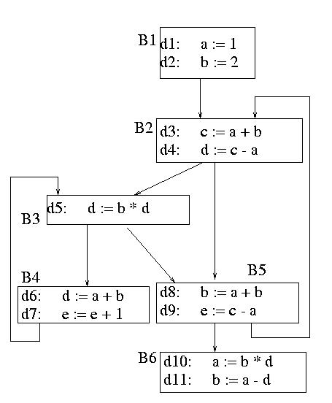
{e}
{a,b,e}
{a,b,e}
{a,b,c,d,e}
{a,b,c,d,e}
{a,b,c,d,e}
{a,b,c,e}
{a,b,c,d}
{a,b,c,d,e}
{a,b,d,e}
{b,d}
{ }

Slide 230
Dataflow Analysis Problem #2: Reachability
A definition of a variable x is a statement that may assign a value to x.
A definition may reach a program point p if there exists some path from the point immediately following the definition to p such that the assignment is not killed along that path.
Concept: relationship between definitions and uses

Slide 231
What blocks do definitions d2 and d4 reach?
d1 i = m – 1
d2 j = n
B1
d2
d4
d3 i = i + 1
B2
d4 j = j - 1
B3
B4
B5

Slide 232
Reachability Analysis: Unstructured Input
Compute GEN and KILL at block—level
Compute IN[B] and OUT[B] for B
IN[B] = U OUT[P] where P is a predecessor of B
OUT[B] = GEN[B] U (IN[B] - KILL[B])
Repeat step 2 until there are no changes to OUT sets

Slide 233
Reachability Analysis: Step 1
For each block, compute local (block level) information = GEN/KILL sets
GEN[B] = set of definitions generated by B
KILL[B] = set of definitions that can not reach the end of B
This information does not take control flow between blocks into account.

Slide 234
Reasoning about Basic Blocks
Effect of single statement: a = b + c
Uses variables {b,c}
Kills all definitions of {a}
Generates new definition (i.e. assigns a value) of {a}
Local Analysis:
Analyze the effect of each instruction
Compose these effects to derive information about the entire block

Slide 235
Example
d1 i = m – 1
d2 j = n
d3 a = u1
Gen = 1,2,3
Kill = 4,5,6,7
B1
Gen = 4,5
Kill = 1,2,7
d4 i = i + 1
d5 j = j - 1
B2
B3
d6 a = u2
B4
Gen = 7
Kill = 1,4
Gen = 6
Kill = 3
d7 i = u2

Slide 236
Reachability Analysis: Step 2
Compute IN/OUT for each block in a forward direction. Start with IN[B] = ∅
IN[B] = set of defns reaching the start of B
= ∪ (out[P]) for all predecessor blocks in the CFG
OUT[B] = set of defns reaching the end of B
= GEN[B] ∪ (IN[B] – KILL[B])
Keep computing IN/OUT sets until a fixed point is reached.

Slide 237
Reaching Definitions Algorithm
Input: Flow graph with GEN and KILL for each block
Output: in[B] and out[B] for each block.
For each block B do out[B] = gen[B], (true if in[B] = emptyset)
change := true;
while change do begin
change := false;
for each block B do begin
in[B] := U out[P], where P is a predecessor of B;
oldout = out[B];
out[B] := gen[B] U (in[B] - kill [B])
if out[B] != oldout then change := true;
end
end

Slide 238
Gen = 1,2,3
Kill = 4,5,6,7
d1 i = m – 1
d2 j = n
d3 a = u1
 | IN | OUT
B1 | ∅ | 1,2,3
B2 | ∅ | 4,5
B3 | ∅ | 6
B4 | ∅ | 7
Reaching Definitions Algorithm
B1
Gen = 4,5
Kill = 1,2,7
d4 i = i + 1
d5 j = j - 1
B2
B3
d6 a = u2
B4
Gen = 6
Kill = 3
d7 i = u2
Gen = 7
Kill = 1,4
IN[B] = ∪(out[P]) for all predecessor blocks in the CFG
OUT[B] = GEN[B] ∪ (IN[B] – KILL[B])

Slide 239
 | IN | OUT | IN | OUT
B1 | ∅ | 1,2,3 | ∅ | 1,2,3
B2 | ∅ | 4,5 | OUT[1]+OUT[4] = 1,2,3,7 | 4,5 + (1,2,3,7 – 1,2,7) = 3,4,5
B3 | ∅ | 6 | OUT[2] = 3,4,5 | 6 + (3,4,5 – 3) = 4,5,6
B4 | ∅ | 7 | OUT[2]+OUT[3] = 3,4,5,6 | 7 + (3,4,5,6 – 1,4) = 3,5,6,7
Reaching Definitions Algorithm
IN[B] = ∪(out[P]) for all predecessor blocks in the CFG
OUT[B] = GEN[B] + (IN[B] – KILL[B])

Slide 240
 | IN | OUT | IN | OUT | IN | OUT
B1 | ∅ | 1,2,3 | ∅ | 1,2,3 | ∅ | 1,2,3
B2 | ∅ | 4,5 | 1,2,3,7 | 3,4,5 | OUT[1] + OUT[4] = 1,2,3,5,6,7 | 4,5 + (1,2,3,5,6,7-1,2,7) = 3,4,5,6
B3 | ∅ | 6 | 3,4,5 | 4,5,6 | OUT[2] = 3,4,5,6 | 6 + (3,4,5,6 – 3) = 4,5,6
B4 | ∅ | 7 | 3,4,5,6 | 3,5,6,7 | OUT[2] + OUT[3] = 3,4,5,6 | 7+(3,4,5,6 – 1,4) = 3,5,6,7
Reaching Definitions Algorithm
IN[B] = ∪(out[P]) for all predecessor blocks in the CFG
OUT[B] = GEN[B] + (IN[B] – KILL[B])

Slide 241
Forward vs. Backward
Forward flow vs. Backward flow
Forward: Compute OUT for given IN,GEN,KILL
Information propagates from the predecessors of a vertex.
Examples: Reachability, available expressions, constant propagation
Backward: Compute IN for given OUT,GEN,KILL
Information propagates from the successors of a vertex.
Example: Live variable Analysis

Slide 242
Forward vs. Backward Equations
Forward vs. backward
Forward:
IN[B] - process OUT[P] for all P in predecessors(B)
OUT[B] = local U (IN[B] – local)
Backward:
OUT[B] - process IN[S] for all S in successor(B)
IN[B] = local U (OUT[B] – local)

Slide 243
May vs. Must
May vs. Must
Must – true on all paths
Ex: constant propagation – variable must provably hold appropriate constant on all paths in order to do a substitution
May – true on some path
Ex: Live variable analysis – a variable is live if it could be used on some path; reachability – a definition reaches a point if it can reach it on some path

Slide 244
May vs. Must Equations
May vs. Must
May – IN[B] = ∪(out[P]) for all P in pred(B)
Must – IN[B] = ∩(out[P]) for all P in pred(B)

Slide 245
May vs. Must Equations
Reachability
IN[B] = ∪(out[P]) for all P in pred(B)
OUT[B] = GEN[B] + (IN[B] – KILL[B])
Live Variable Analysis
OUT[B] = ∪(IN[S]) for all S in succ(B)
IN[B] = USE[B] ∪ (OUT[B] - DEF[B])
Constant Propagation
IN[B] = ∩(out[P]) for all P in pred(B)
OUT[B] = DEF_CONST[B] ∪ (IN[B] – KILL_CONST[B])

Slide 246
Discussion
Why does this work?
Finite set – can be represented as bit vectors
Theory of lattices
Is this guaranteed to terminate?
Sets only grow and since finite in size …
Can we find ways to reduce the number of iterations?

Slide 247
Choosing visit order for Dataflow Analysis
In forward flow analysis situations, if we visit the blocks in depth first order, we can reduce the number of iterations.
Suppose definition d follows block path 3 → 5 → 19 → 35 → 16 → 23 → 45 → 4 → 10 → 17 where the block numbering corresponds to the preorder depth-first numbering.
Then we can compute the reach of this definition in 3 iterations of our algorithm.
3 → 5 → 19 → 35 → 16 → 23 → 45 → 4 → 10 → 17

Slide 248
Week 16
Slides 248-249

Slide 249
Revision & Review

Slide 250
Week 17
Slides 250-251

Slide 251
Project Presentation & Feedback

