Slide 1
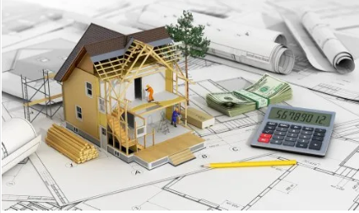

Details of Construction and Estimation
CE 0732-1203
Prepared By-
Oaisul Mostofa Karim
Lecturer
Dept. of Civil Engineering
University of Global Village (UGV), Barishal

Slide 2
Details of Construction and Estimation
COURSE CODE: CE 0732-1203 CREDIT: 02
CIE MARKS: 60
SEE MARKS: 40
 | Course Outcomes
CLO1 | Understand Construction Practices: Students will gain a comprehensive understanding of the construction industry, including its organization, processes, and the role of construction and project management in delivering successful projects.
CLO2 | Apply Project Management Principles: Students will be able to utilize key project management concepts such as planning, scheduling, and resource allocation to manage construction projects effectively.
CLO3 | Analyze and Solve Estimation Problems: Students will develop the ability to calculate material quantities, costs, and resources for beams, columns, and foundations, and solve advanced estimation-related mathematical problems.
CLO4 | Utilize Construction Equipment Knowledge: Students will learn the selection, operation, and optimization of construction equipment for various types of construction activities, ensuring efficient resource use and project execution.

Slide 3
Sl. | Course Contents | Hours | CLOs
1 | Discussion of overview of the Construction, Construction Project Environment, Construction Industry, Construction Management, Project, Project Management, Roles and Skills of a Project Manager, Project life cycle, Project Development. | 08 | CLO 1, CLO 2
2 | Construction Equipment: Definition, Classification. Details of Earth Compacting Equipment, Concrete Production Plants, Pile Driving Equipment. Estimation of Different types of Construction. | 07 | CLO 3, CLO 4
3 | Construction Feasibility: Definition, Five areas of Feasibility, Advantages of it. Beam: Definition, Classification, Reinforcement of beam, ACI and BNBC Guidelines for Beam Design. Failure Patterns of Beam. | 08 | CLO 1
4 | Column: Definition, Classification, Effective Length of a Column for Different Support Conditions, Slenderness Ratio. Foundation: Definition, Objectives of it, Classification, Comparative Discussion of Different types of Foundation. | 07 | CLO 1
Recommended Books
1.Construction Project Management: A Practical Guide to Field Construction Management - Keoki Sears
2. Estimating in Building Construction - Frank R. Dagostino
3. Construction Cost Estimating: Process and Practices - Leonard Holm.

Slide 4
WEEK | TOPIC | TEACHING-LEARNING STRATEGY | ASSESSMENT STRATEGY | CORRESPO-NDING CLO_{S}
01-02 | Overview of the construction Industry | Lecture, Presentation | Class Test, Assignment | CLO1
03-04 | Construction Management and Project Management. | Lecture, Presentation | Class Test, Assignment | CLO2
05-08 | Construction Equipment, Construction Estimation | Lecture, Presentation | Class Test, Assignment | CLO3, CLO4
09-12 | Construction Feasibility, Beam | Lecture, Presentation | Class Test, Assignment | CLO1
13-15 | Column, Foundation | Lecture, Presentation | Class Test, Assignment | CLO1
16-17 | Doubt Solving | Discussion

Slide 5
ASSESSMENT PATTERN
CIE-Continuous Internal Evaluation (60 Marks)
Bloom’s Category Marks (out of 60) | Tests (30) | Assignments (10) | Quizzes (10) | External Participation in Curricular/Co-Curricular Activities (10)
Remember | 05 |  | 05 | Attendance 10
Understand | 05 |  | 05
Apply | 05
Analyze | 05
Evaluate | 05
Create | 05 | 10
SEE- Semester End Examination (40 Marks)
Bloom’s Category | Tests
Remember | 06
Understand | 06
Apply | 06
Analyze | 06
Evaluate | 06
Create | 10

Slide 6
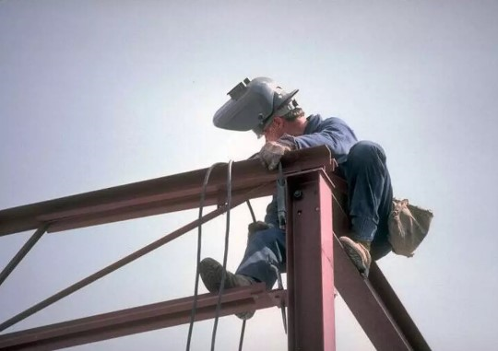
CE-0732-1203
Details of Construction and Estimation
WEEK 01-02
Overview of Construction Industry

Slide 7


Slide 8
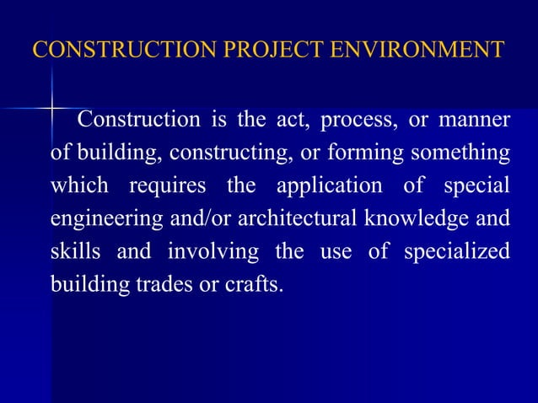

Slide 9
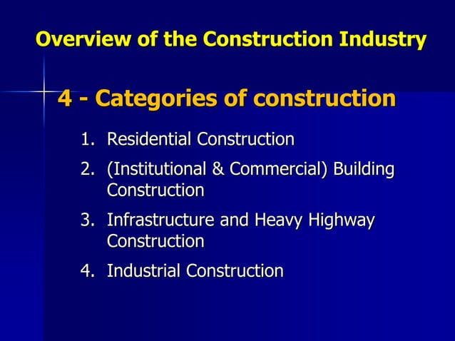

Slide 10
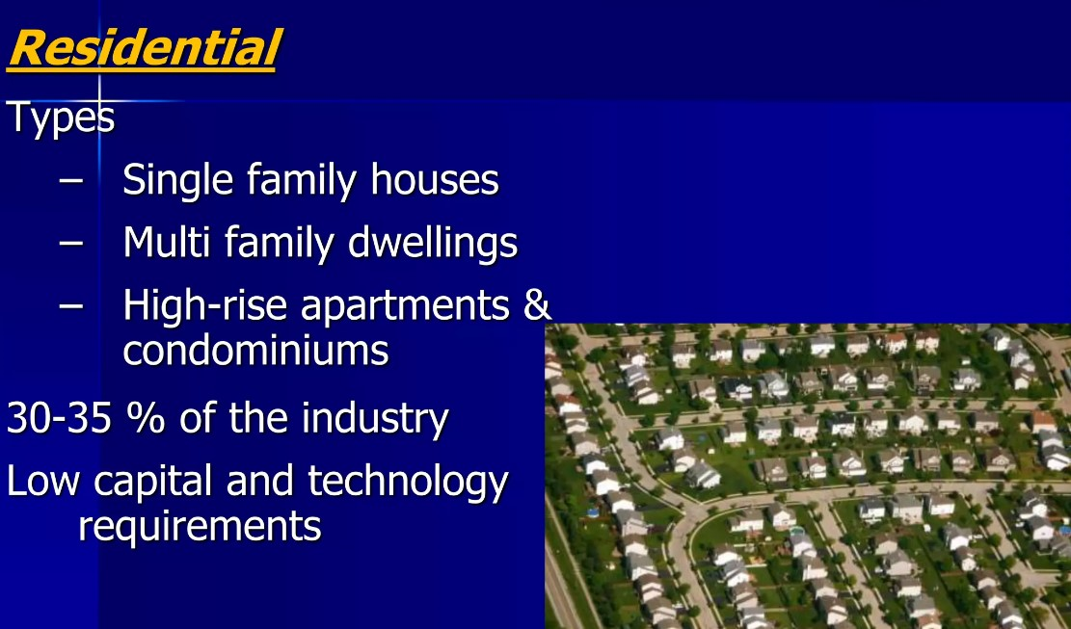

Slide 11
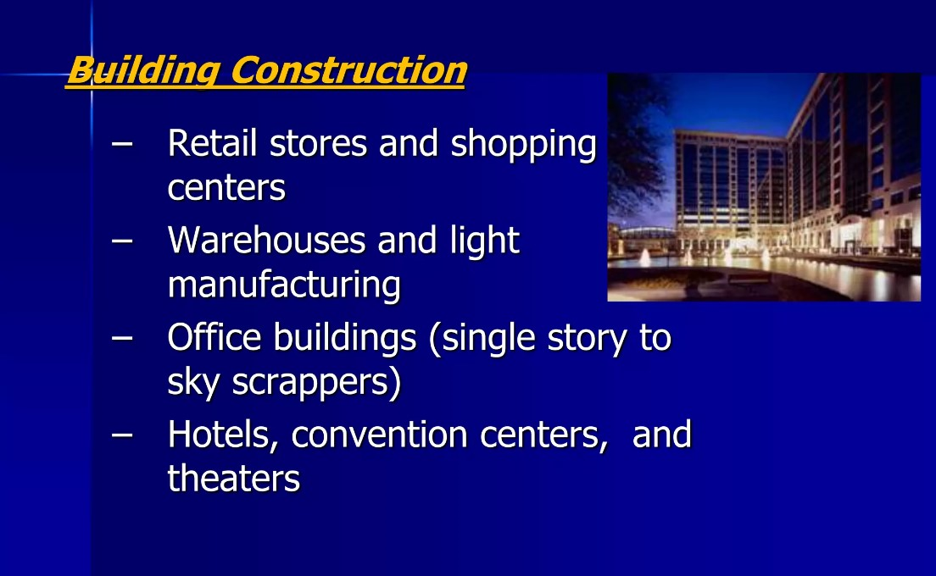

Slide 12
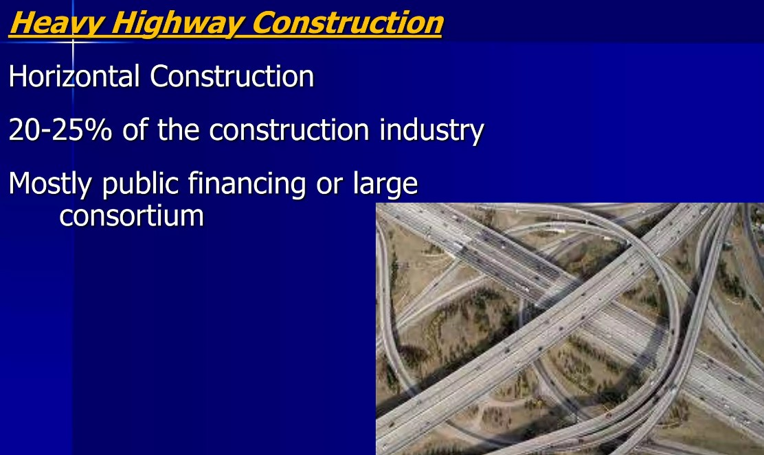

Slide 13
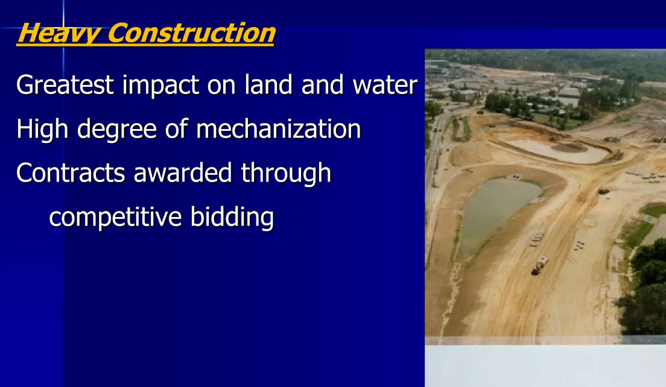

Slide 14
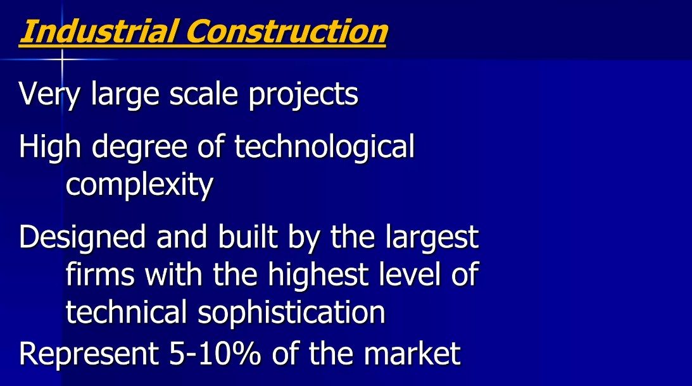

Slide 15
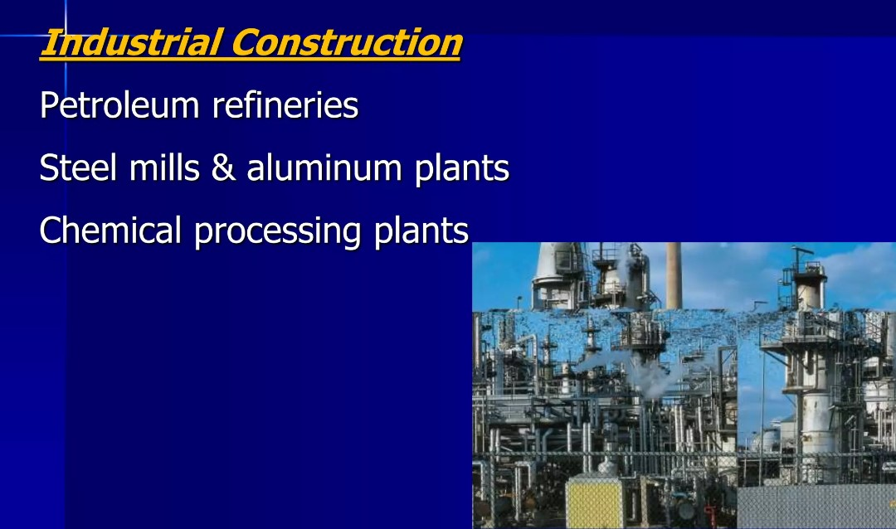

Slide 16
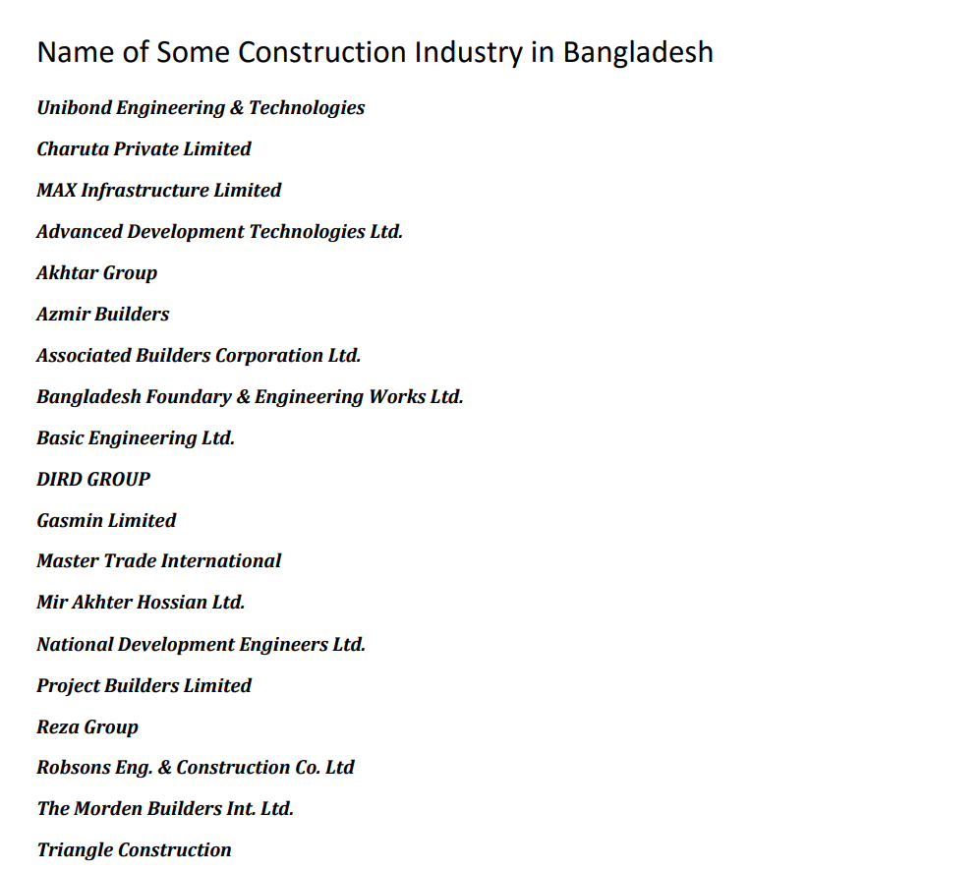

Slide 17
CE-0732-1203
Details of Construction and Estimation
WEEK 03-04
Construction Management and Project Management

Slide 18
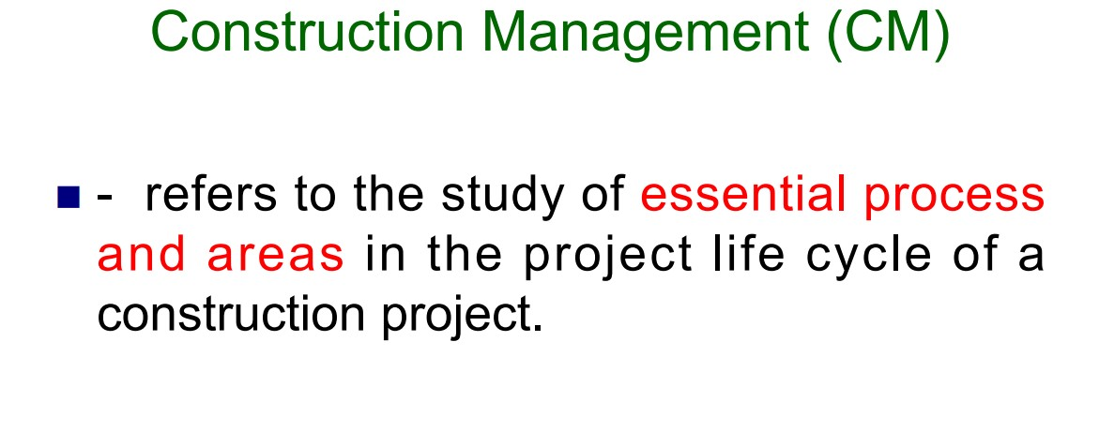

Slide 19
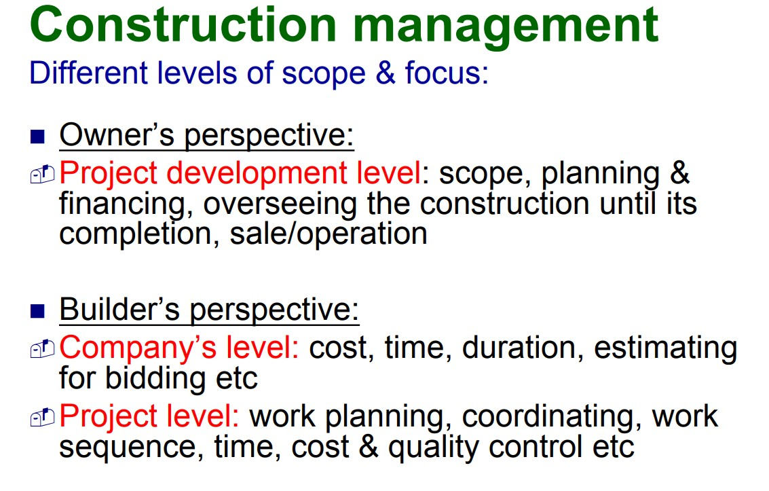

Slide 20
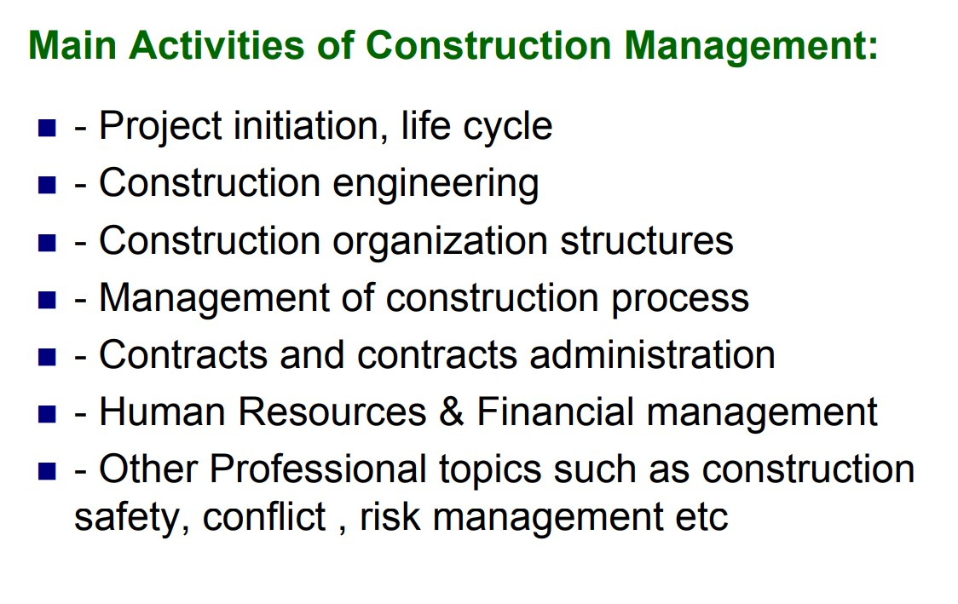

Slide 21
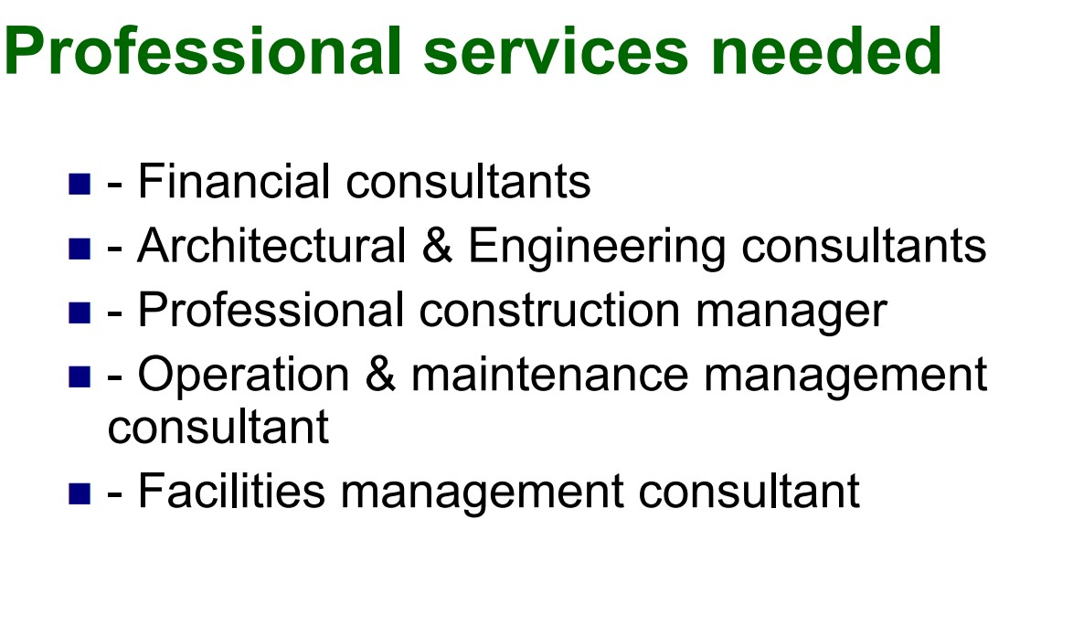

Slide 22
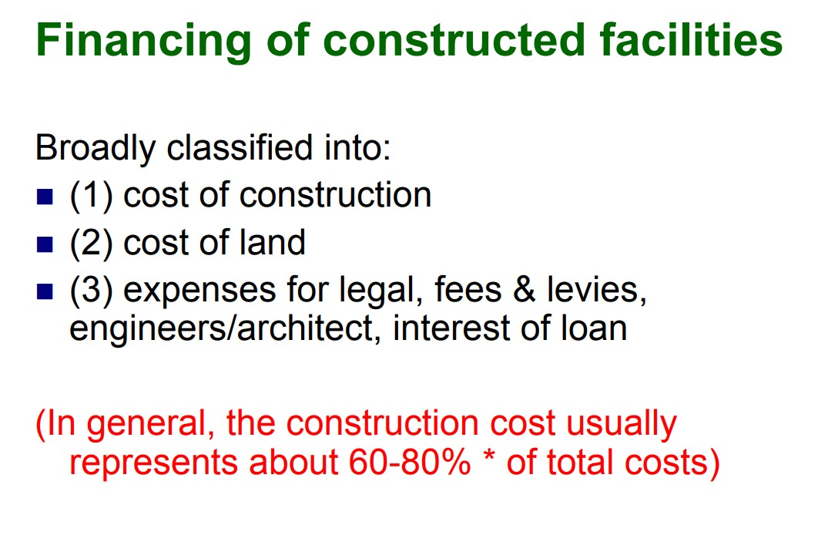

Slide 23
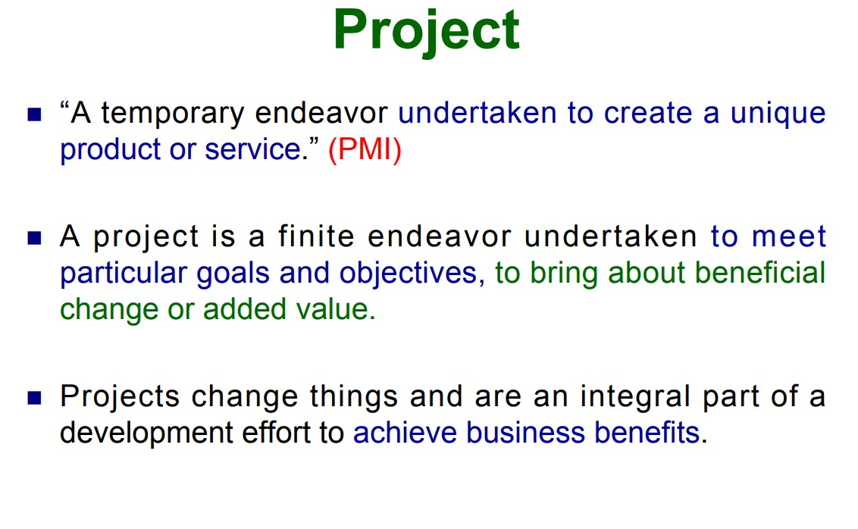

Slide 24
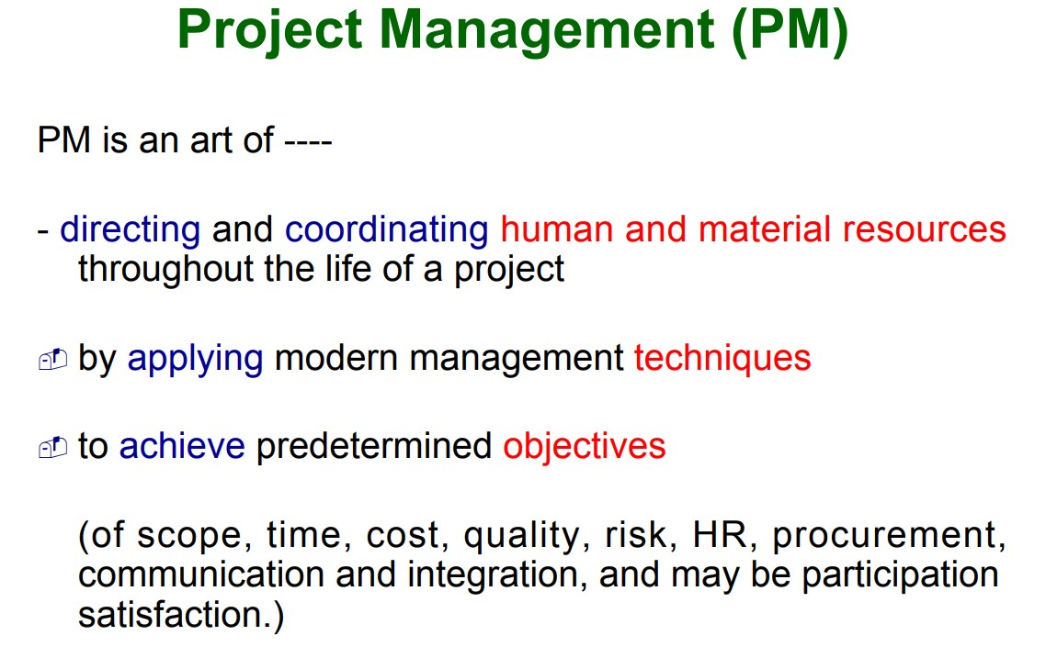

Slide 25
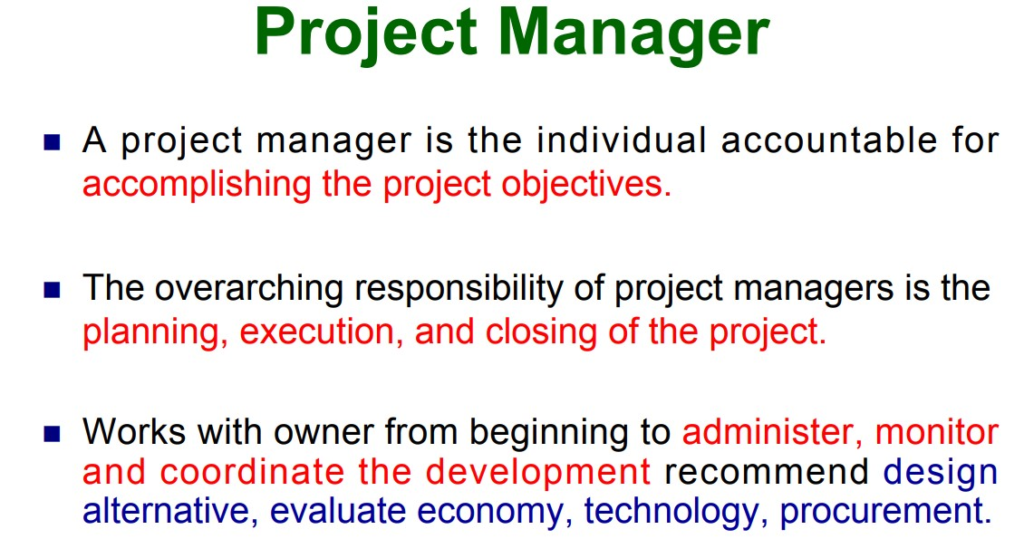

Slide 26
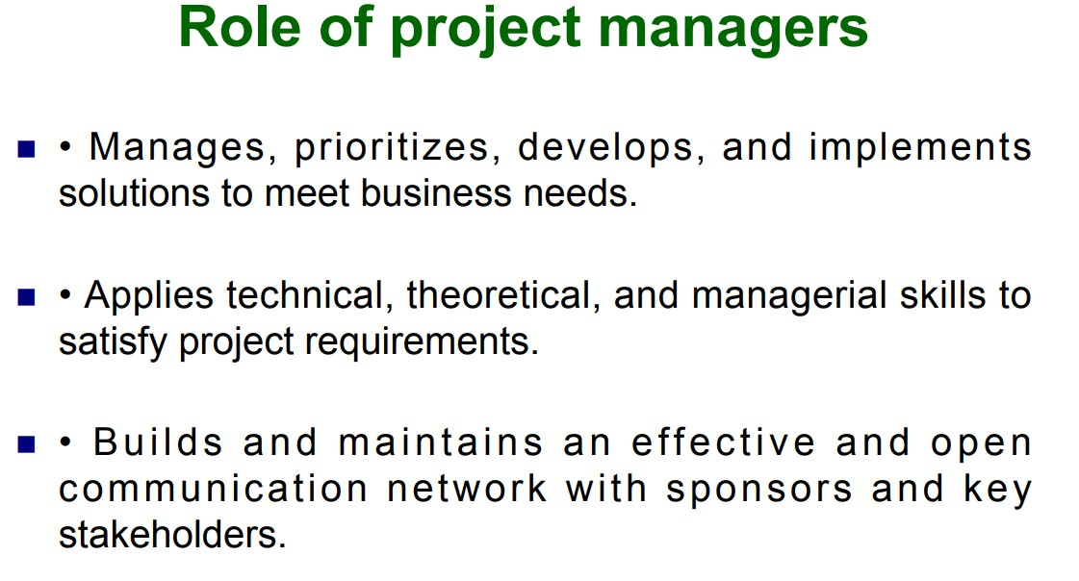

Slide 27
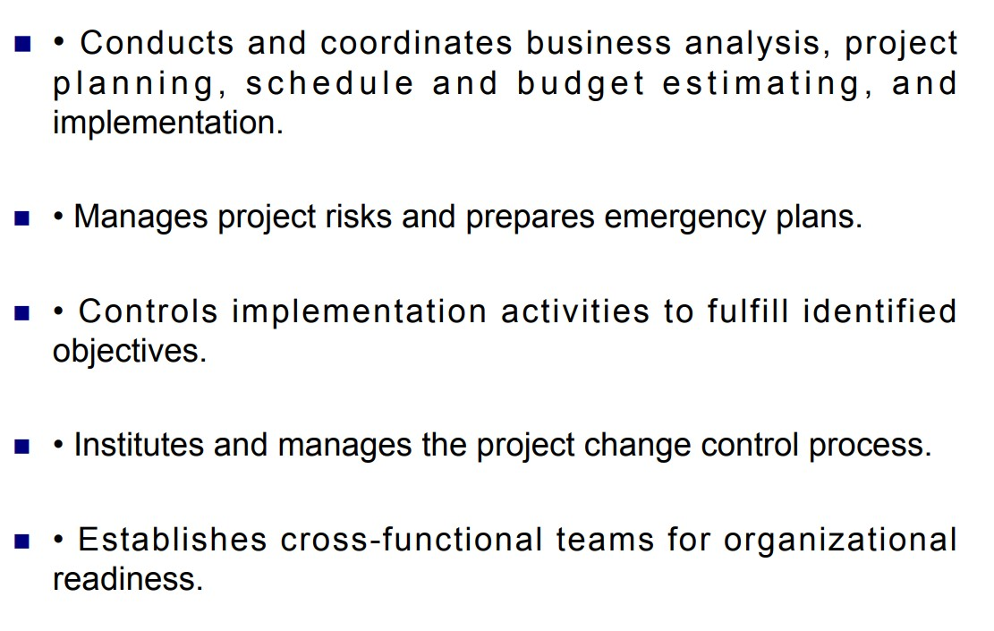

Slide 28


Slide 29
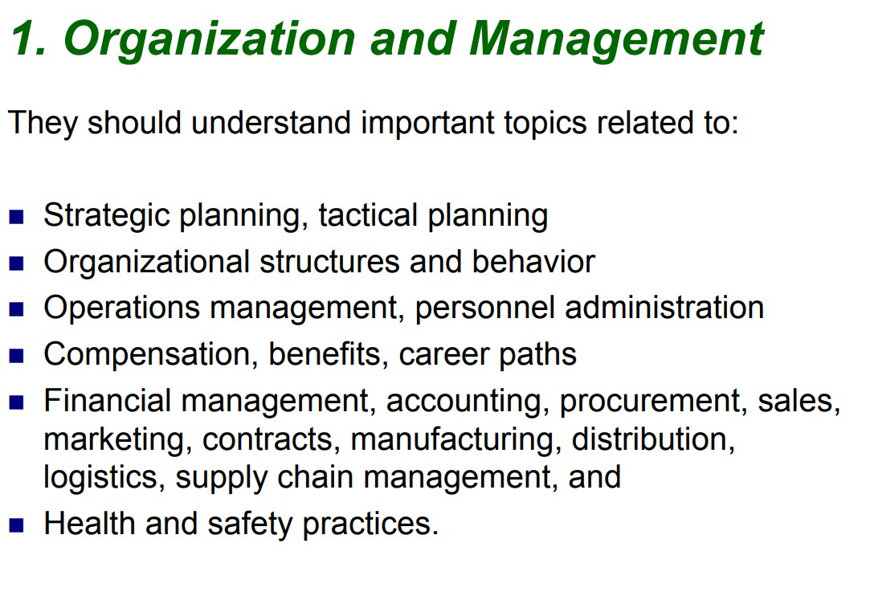

Slide 30
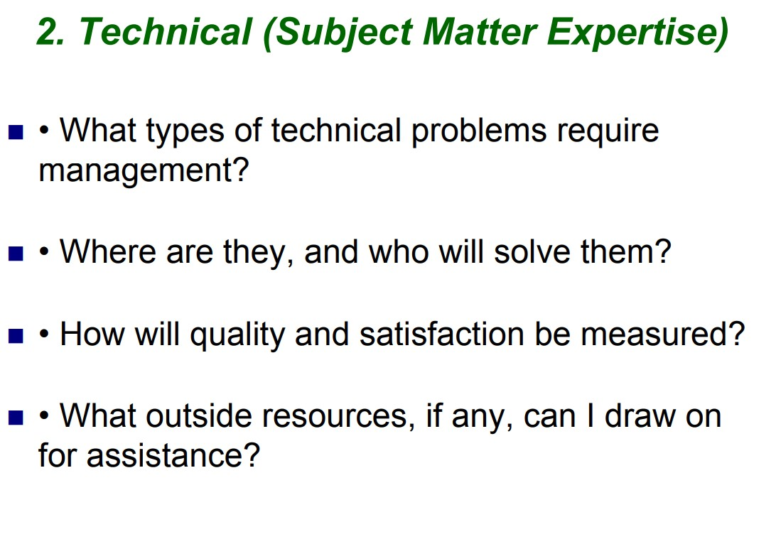

Slide 31
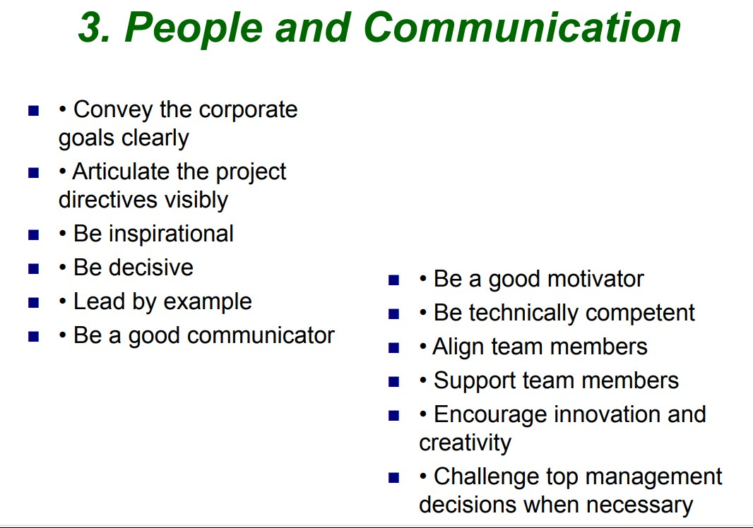

Slide 32
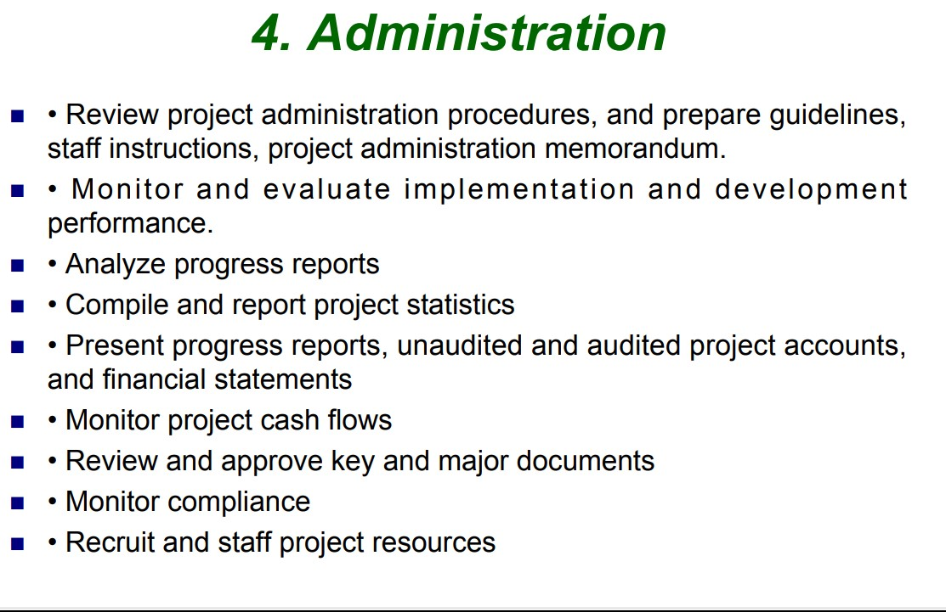

Slide 33
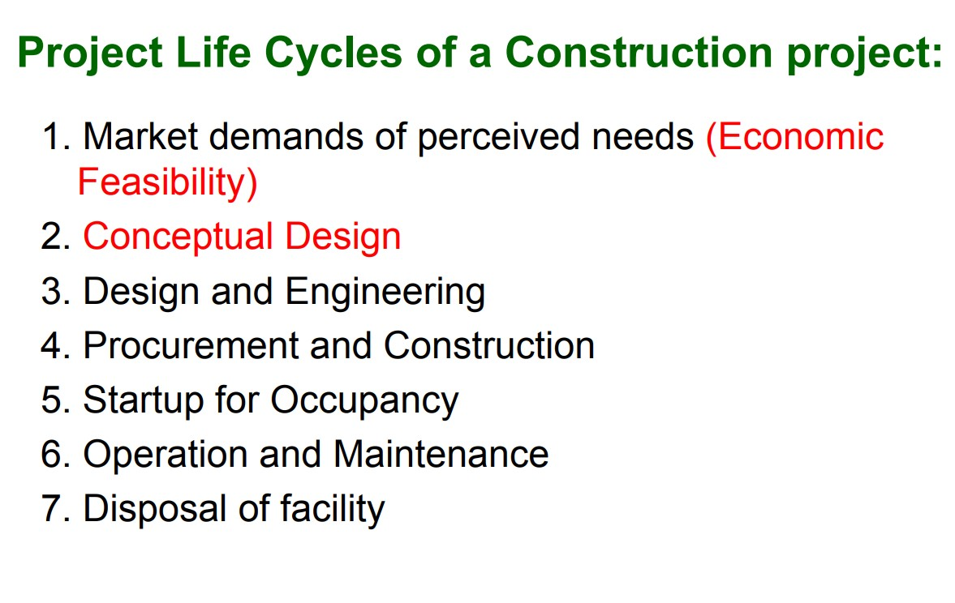

Slide 34
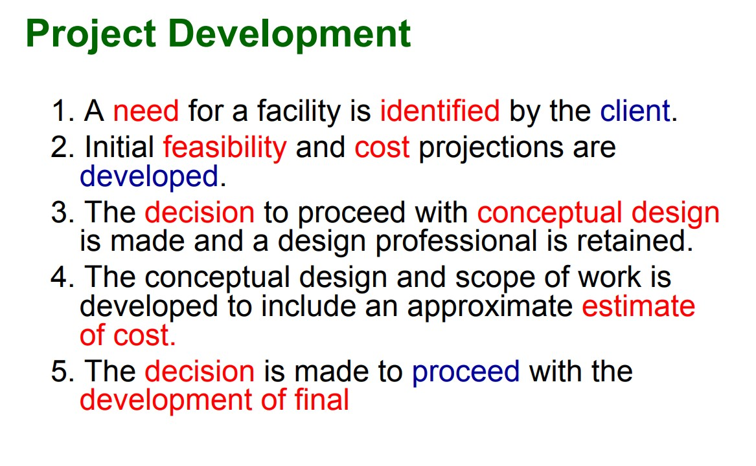

Slide 35
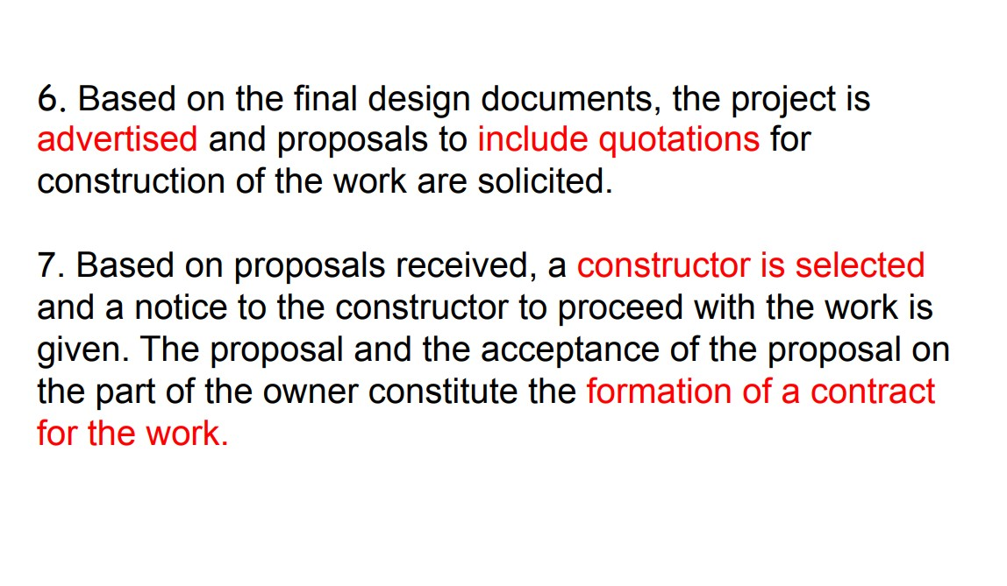

Slide 36
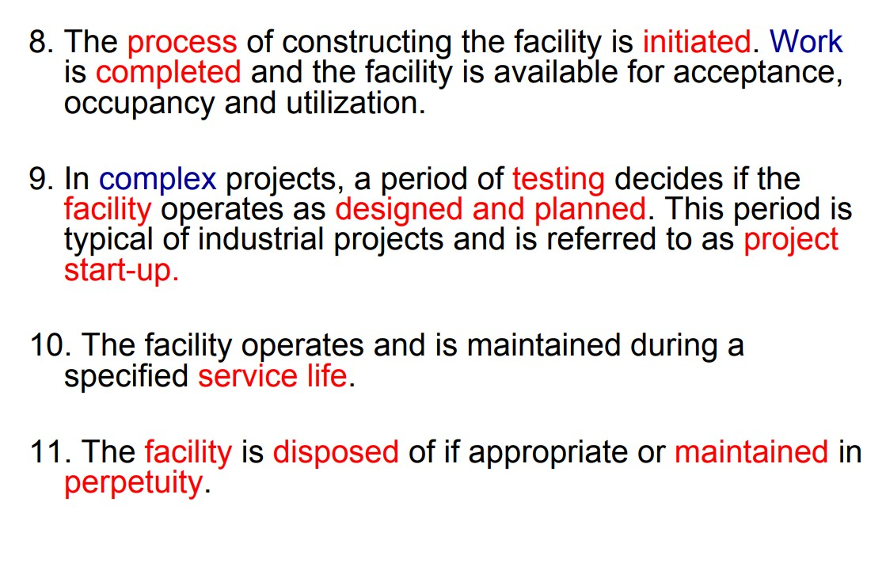

Slide 37
CE-0732-1203
Details of Construction and Estimation
WEEK 05-08
Construction Equipment
Construction Estimation

Slide 38
CONSTRUCTION EQUIPMENT
It is a common fact that we find a wide variety of construction machines on every construction sites, which make the construction jobs easy, safe and quicker. Good project management in construction must vigorously pursue the efficient utilization of labor, material and equipment.
These act as a backbone in the case of huge construction projects. Proper use of the appropriate equipment contributes to economy, quality, safety, speed and timely completion of a project. Equipments are use for highway projects, irrigation, buildings, power projects etc. Almost 15-30% of total project cost has been accounted towards equipment and machinery.

Slide 39
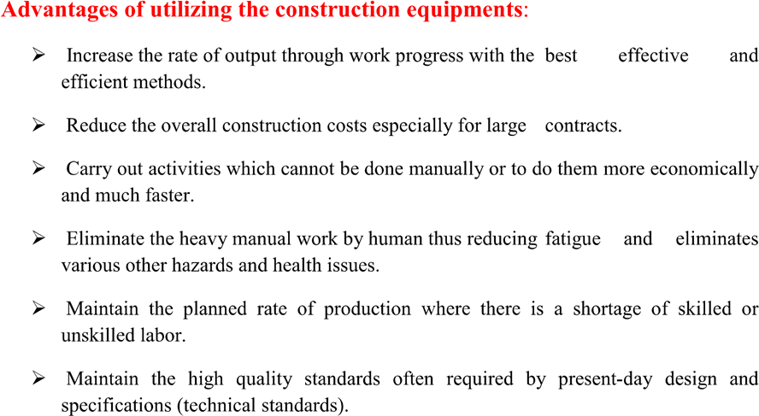

Slide 40
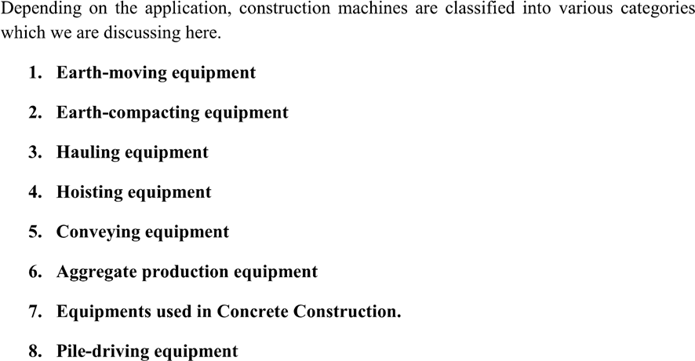
CLASSIFICATION

Slide 41
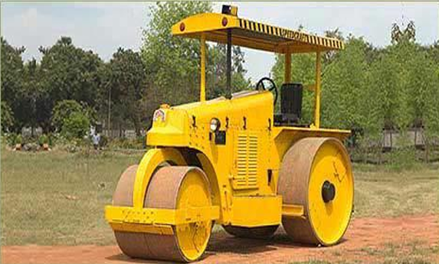
EARTH COMPACTION EQUIPMENTS
1. Smooth-wheel rollers:
These are most suitable for compacting gravels, sand and such like materials. Examples are Three wheeled or macadam rollers and tandem rollers.
Plain steel rollers
Self-propelled type
Weighing from 5 to 15 tonnes
Used for ordinary rolling work where deep compaction is not required

Slide 42
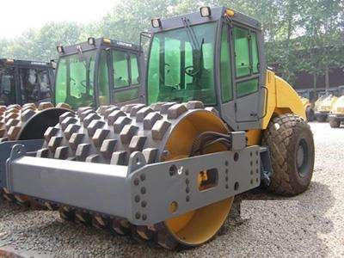
2. Sheep-foot rollers
It consists steel cylindrical drum with projection extending radial direction outward from surface of cylinder & may be propelled or towed by tractor. It is suitable for silty & clay sand, medium and heavy clay.
For compacting earth work in embankments and canals (where compaction deep into the layer of the earth is required)
These gives best result in compaction when the soil is clay or predominantly cohesive and impervious.
The sheep foot rollers may weigh upto 15 tonnes or more
Travel at a speed of 25 kmph

Slide 43
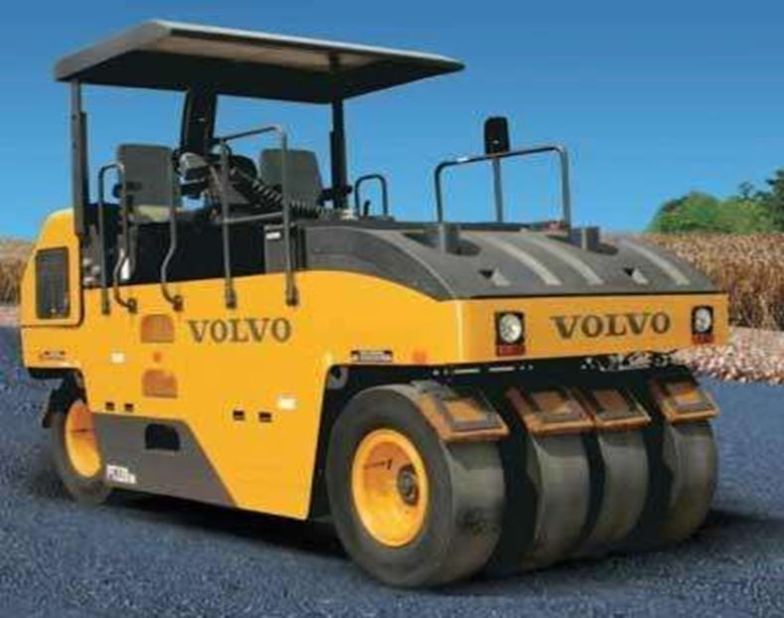
3. Pneumatic-tyred rollers
It gives kneading action as well as compression to the soil underneath. It is suitable for moderately cohesive silty soils, clayey soils, gravelly and clen sand.
It consists of a base or a platform mounted between two axles.
The rear of which has one more wheel than the front.
Most suitable for compacting fine-grained soil and well graded sands.
Ballasting is done using water, sand or pig iron in order to increase the self weight.
Major advantages are the ability to control the ground contact pressure by:
Altering the weights of machines,
Increasing the number of wheels,
Increasing the tyre width
Changing the contact area of the tyre by altering the contact pressure.

Slide 44
CONCRETING EQUIPMENTS
They are mainly used for weighing and mixing large quantity of concrete constituents. capacity:- 20cum/hr-250cum/hr
Concrete is basically cement, aggregate & water mixed together and then deposited and permitted to solidify.
Operation involved in concrete production batching, mixing, handling and transportation, placing, finishing curing.
In huge concreting concrete and quality depends on time of mixing, so mixers are used.
Concrete production plants
For mixing different ingredients in required proportion.
It consists of storage bins for storing materials like cement and admixtures.
Aggregate is mix in it with the help of a hopper which is fixed in plant.

Slide 45
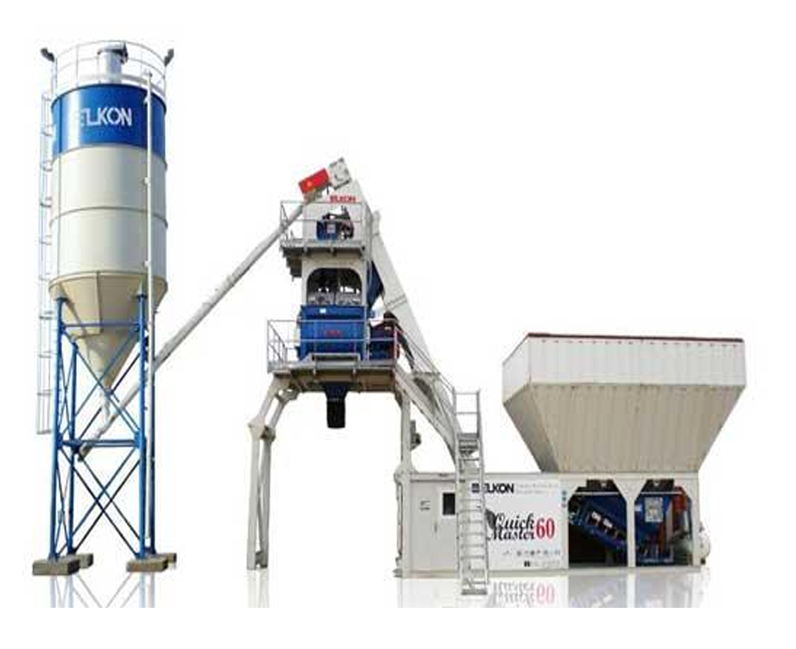
Concrete Production Plant

Slide 46
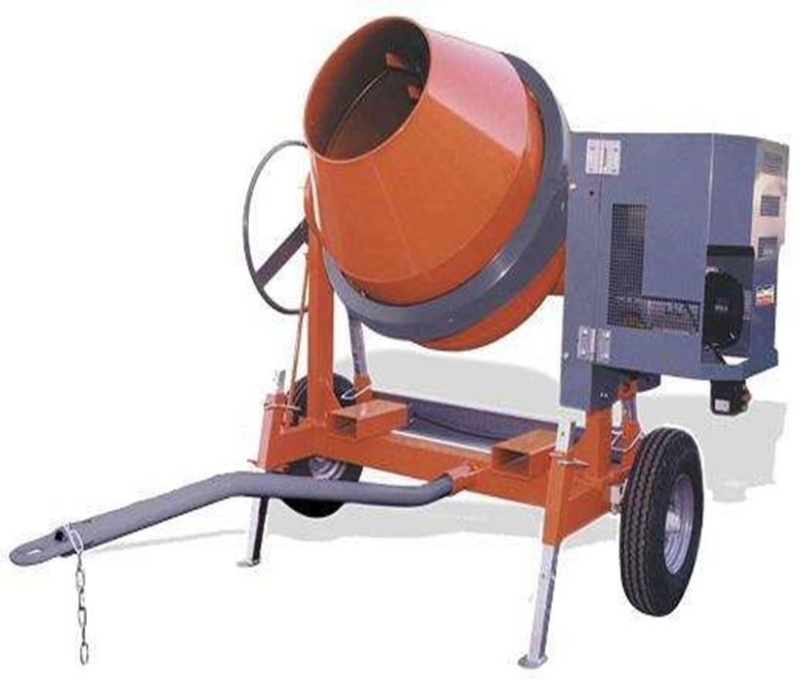
2. Concrete mixers
A concrete mixer (also commonly called a cement mixer) is a device that homogeneously combines cement, aggregate such as sand or gravel, and water to form concrete.
Special concrete transport trucks (in–transit mixers) are made to transport and mix concrete up to the construction site. They can be charged with dry materials and water, with the mixing occurring during transport. With this process, the material has already been mixing. The concrete mixing transport truck maintains the material's liquid state through agitation, or turning of the drum, until delivery.
They are mainly used for mixing small quantities of concrete constituents.
Capacity: 200lt/batch (small mixers) and 200-750l/batch (large mixers)

Slide 47
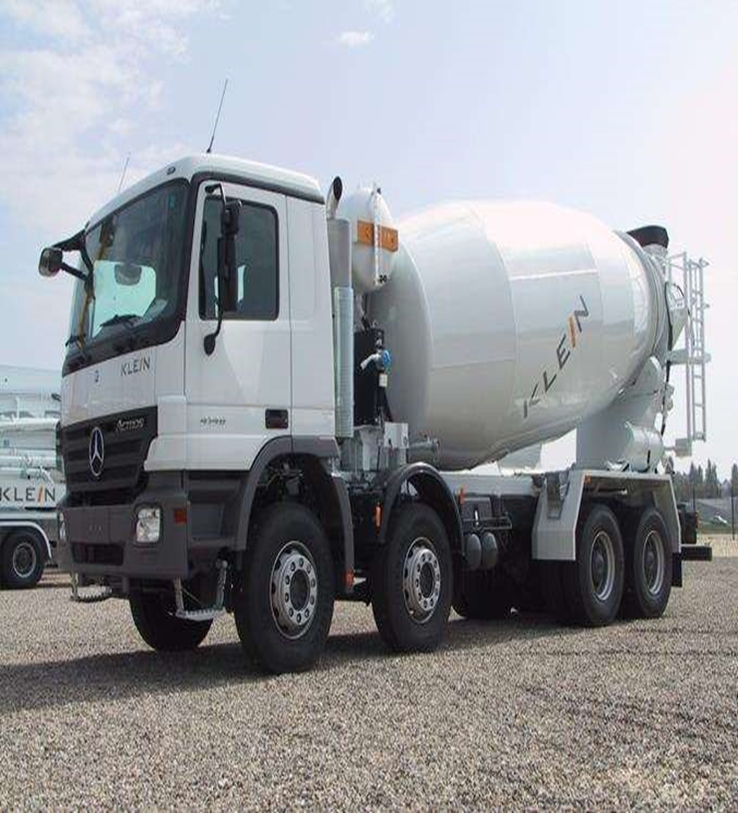
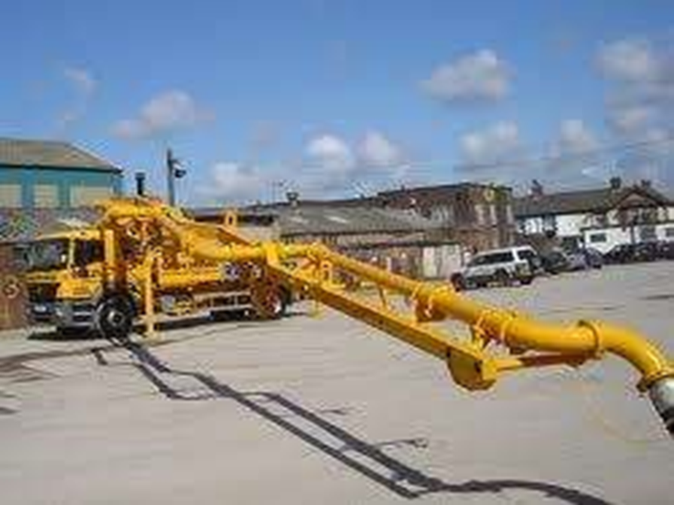
3. Concrete transit mixers
They are mainly used for transporting concrete from batching point.
capacity:- 3cum- 9cum
4. Concrete pumps
They are used for horizontal and vertical transportation of large volumes of concrete in short duration.
capacity:- 30cum/hr (ordinary construction)and 120cum/hr(specialized construction)

Slide 48
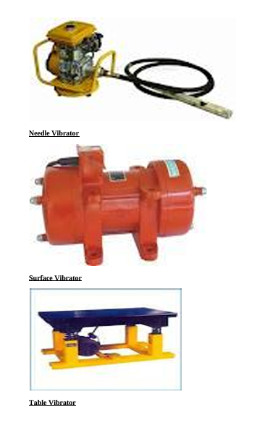
5. Vibrator
For compacting the concrete after its placement concrete vibrator is used. It helps volume of concrete quickly placed, give high density , reduce air voids.
Types of Vibrators
Internal vibrators-Use on large work for flat slab.
External or form vibrators-uses for thin section of walls.
Surface vibrator-used to finish concrete surface such as bridge floor, road slab, section platform.
Table Vibrator-used for consolidation of precast units.

Slide 49
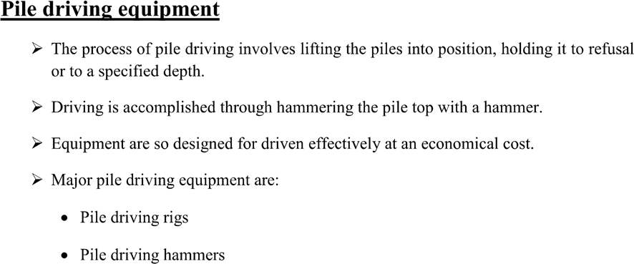

Slide 50
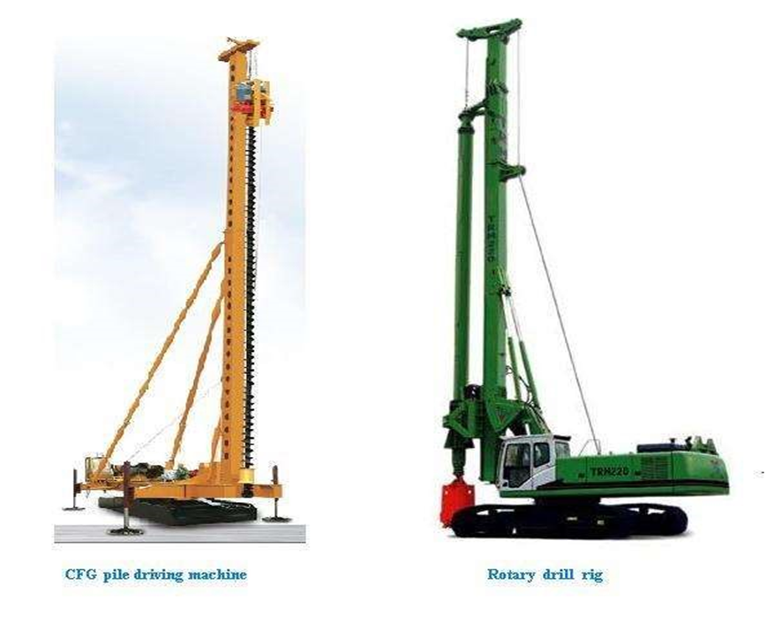

Slide 51
1. Calculate the quantity of cement required for 1m³ of concrete (1:2:4 mix).
Solution:
Ratio: 1:2:4 (Cement:Sand:Aggregate)
Total parts = 1+2+4 = 7
Cement part = 1/7
Cement quantity = 71​×1m3=0.143m3
Convert to bags: 0.143×1440kg/m3÷50kg/bag=4.1bags
2. How much sand is needed for 1m³ of 1:2:4 concrete?
Solution:
Sand part = 2/7
Quantity = 72​×1=0.286m3
Convert to kg: 0.286×1600=457.6kg
3. Find the aggregate quantity for 1m³ of 1:2:4 concrete.
Solution:
Aggregate part = 4/7
Quantity = 74​×1=0.571m3
Convert to kg: 0.571×1500=856.5kg

Slide 52
4. Design a concrete mix for a slab with a water-cement ratio of 0.4, considering a 1:1.5:3 mix and a target strength of 30 MPa. Calculate the quantities of materials for 10m³ of concrete.
Solution:
Cement:
Cement part=5.51​×10=1.818m3
Mass of cement=1.818×1440=2618.88kg = 2618.88÷50=52.4bags.
Sand:
Sand part=5.51.5​×10=2.727m3.
Aggregate:
Aggregate part=5.53​×10=5.454m3.
Water:
Water=0.4×2618.88=1047.55kg=1047.55liters
5. Calculate the reinforcement steel required for a 12m x 6m slab with a thickness of 150mm and main bars of 12mm diameter @ 150mm c/c. Distribution bars are 10mm @ 200mm c/c.
Solution:
Number of main bars:
Bars in one direction=0.156​+1=41.
Length per bar = 12+0.3(anchorage)=12.3m.
Total length = 41×12.3=504.3m.
Weight of main bars = 504.3×0.89 (unit wt. of 12mm)=448.83kg.
Number of distribution bars:
Bars in the other direction=0.212​+1=61.
Length per bar = 6+0.3=6.3m.
Total length = 61×6.3=384.3m.
Weight of distribution bars = 384.3×0.62(unitwt.of10mm)=238.27kg.
Total steel weight:
448.83+238.27=687.1kg.

Slide 53
6. A 2-storey building (10m x 10m) has a total wall area of 300m². Calculate the total number of bricks required if the wall thickness is 250mm, and 20% of the volume is occupied by mortar. Assume standard brick size.
Solution:
Wall volume = 300×0.25=75m3.
Brick volume with mortar = 0.19×0.09×0.09=0.001539m3.
Adjusted brick volume = 0.001539×1.2=0.001847m3.
Number of bricks = 0.00184775​=40,616bricks (approx).
7. A circular water tank with an internal diameter of 6m and a height of 5m needs to be plastered inside. Calculate the quantity of plaster (1:4 mix) required if the thickness of plaster is 15mm.
Solution:
Surface area = 2πrh+πr2=2π(3)(5)+π(32)=94.2m2.
Plaster volume = 94.2×0.015=1.413m3.
Cement = 51​×1.413=0.2826m3=406.94kg (approx 8.13 bags).
Sand = 54​×1.413=1.13m3

Slide 54
8. A 6-storey building requires a footing with a base size of 2m x 2m and a depth of 1.5m. Calculate the concrete and reinforcement required if the footing is reinforced with 16mm diameter bars @ 200mm c/c in both directions.
Solution:
Concrete:
Volume = 2×2×1.5=6m3.
Reinforcement steel:
Number of bars in each direction = 0.22​+1=11.
Length of one bar = 2.3m.
Total bars = 11×2=22.
Total length = 22×2.3=50.6m.
Weight = 50.6×1.58=79.95kg
9. Estimate the total cost of a 5m³ concrete mix (1:1.5:3) if cement costs $6/bag, sand $20/m³, and aggregate $25/m³. Water is free.
Solution:
Cement = 5.51​×5=0.91m3 = 0.91×1440÷50=26.2bags.
Cost = 26.2 \times 6 = $157.2.
Sand = 5.51.5​×5=1.36m3.
Cost = 1.36 \times 20 = $27.2.
Aggregate = 5.53​×5=2.73m3.
Cost = 2.73 \times 25 = $68.25.
Total cost = 157.2 + 27.2 + 68.25 = $252.65.

Slide 55
CE-0732-1203
Details of Construction and Estimation
WEEK 09-12
Construction Feasibility
Beam

Slide 56
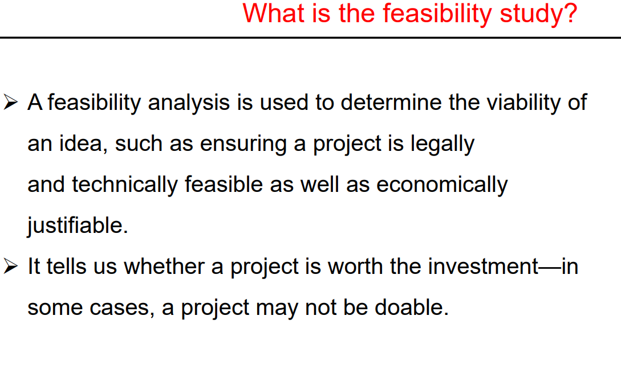

Slide 57
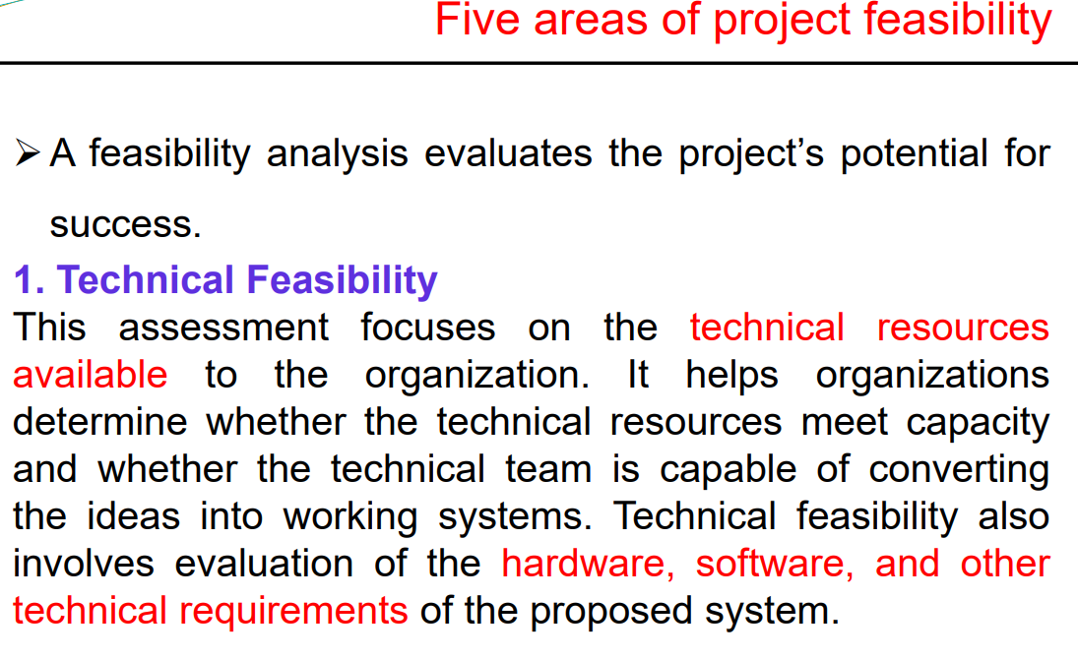

Slide 58
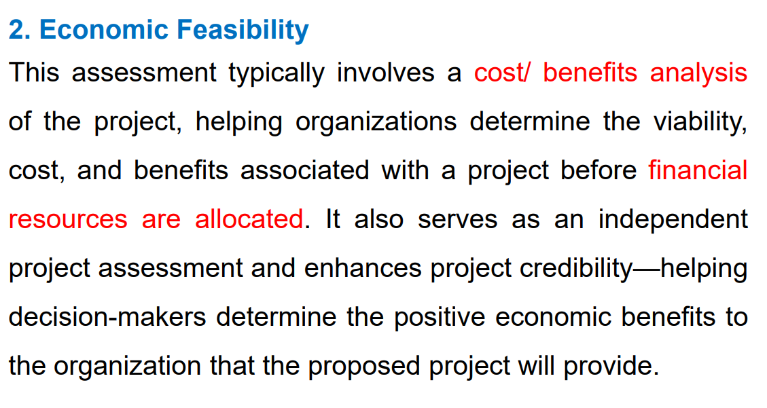

Slide 59
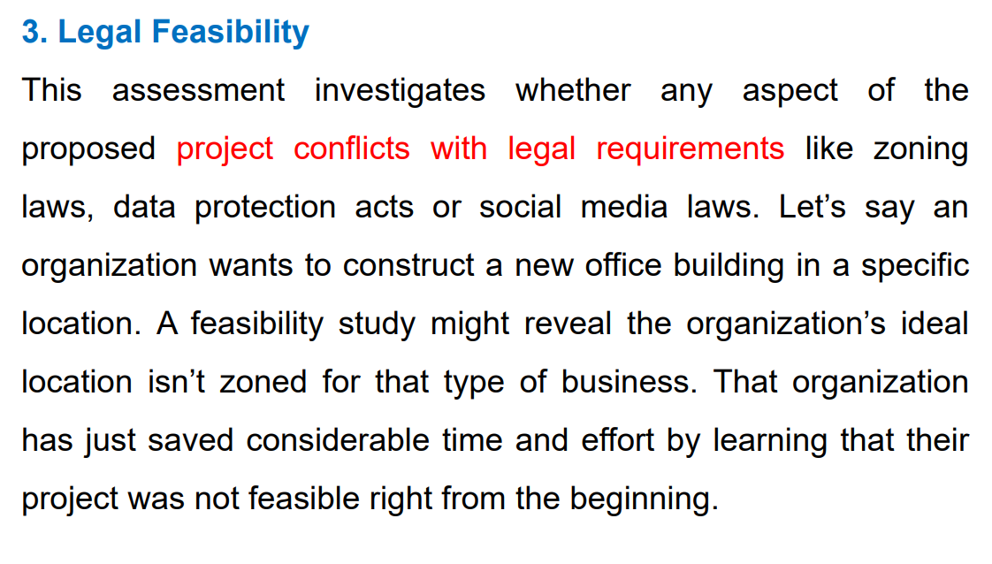

Slide 60
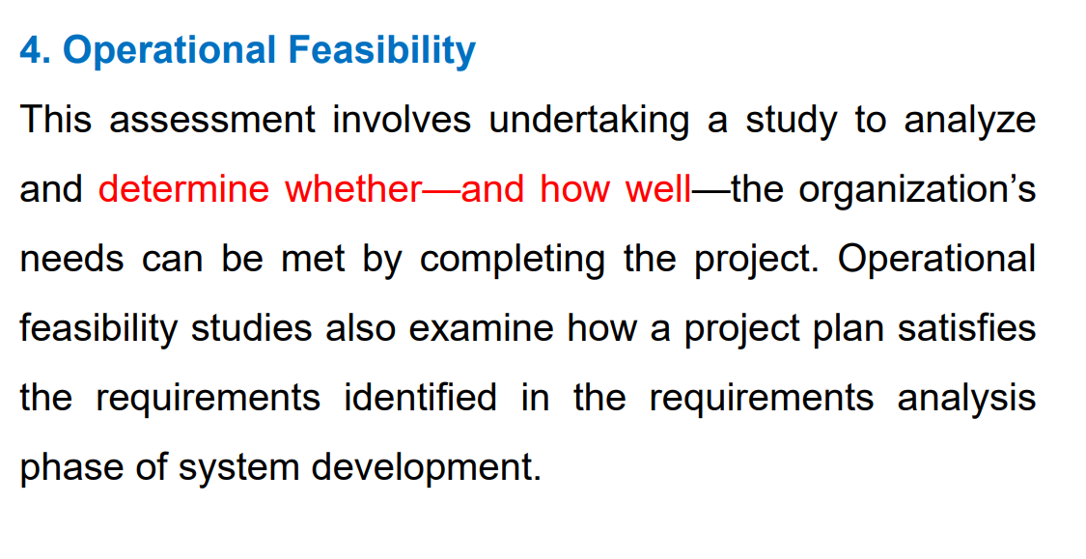

Slide 61
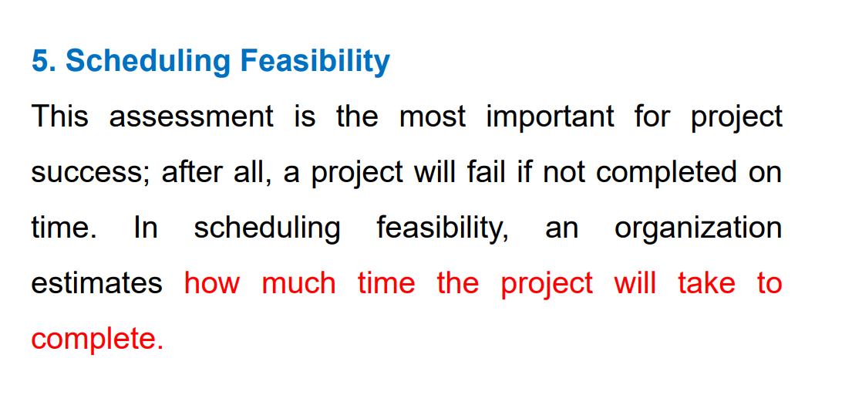

Slide 62
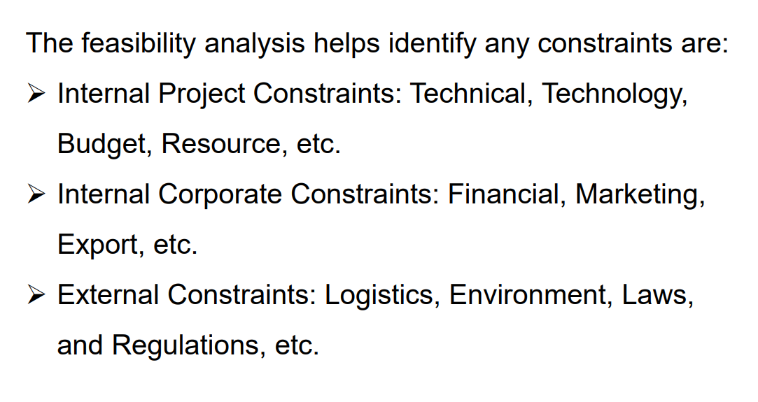

Slide 63
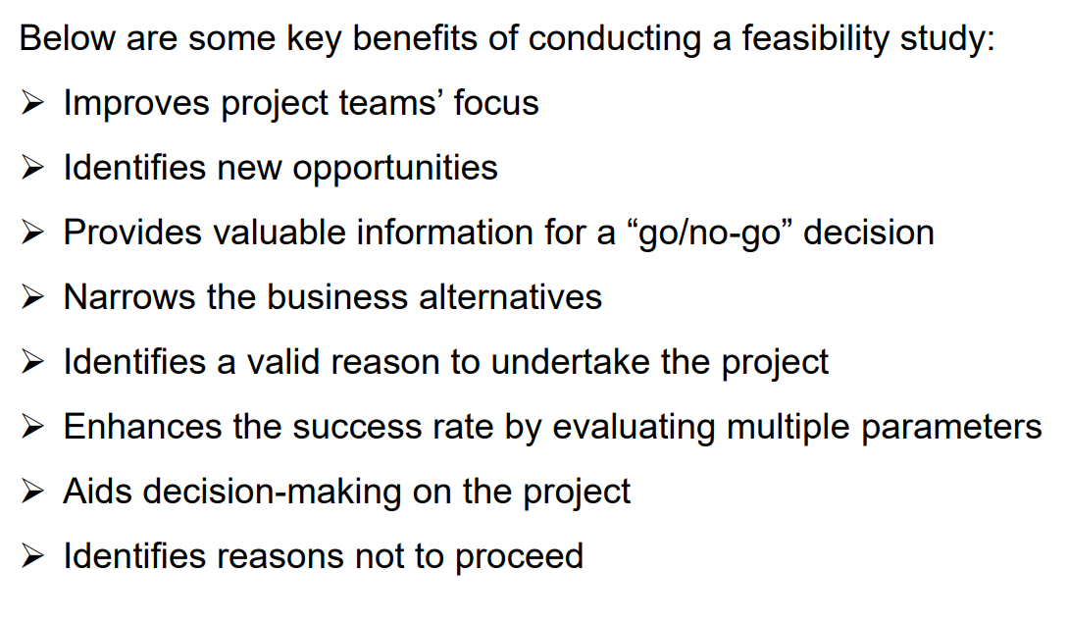

Slide 64
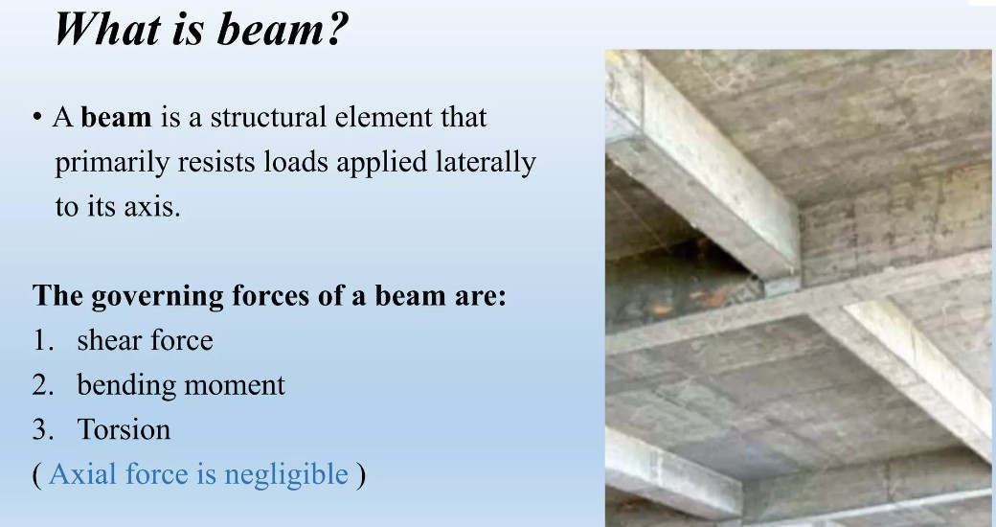

Slide 65


Slide 66


Slide 67


Slide 68


Slide 69


Slide 70

TYPES OF BEAM ACCORDING TO PLACEMENT OF REINFORCEMENT

Slide 71


Slide 72


Slide 73


Slide 74


Slide 75


Slide 76


Slide 77


Slide 78


Slide 79
CE-0732-1203
Details of Construction and Estimation
WEEK 13-15
Column
Foundation

Slide 80


Slide 81


Slide 82


Slide 83


Slide 84


Slide 85


Slide 86


Slide 87


Slide 88


Slide 89


Slide 90


Slide 91



Slide 92


Slide 93


Slide 94


Slide 95


Slide 96


FOUNDATION

Slide 97



Slide 98



Slide 99


Slide 100



Slide 101


Slide 102



Slide 103


Slide 104



Slide 105



Slide 106


Slide 107


Slide 108


Slide 109


Slide 110



Slide 111


Slide 112


Slide 113


Slide 114


Slide 115
Feature | Shallow Foundation | Deep Foundation
Depth | Relatively shallow, typically less than 3 meters | Deep, extending several meters into the ground
Load Distribution | Spreads load over a larger area of soil | Transfers load to deeper, more stable soil layers
Types | Spread footing, Mat (Raft) foundation | Pile foundation, Pier foundation, Caisson foundation
Soil Conditions | Suitable for stable soils with sufficient bearing capacity | Used in areas with weak or compressible soils
Construction Method | Generally simpler and less costly | Often requires specialized equipment and techniques
Suitable for | Small to medium-sized structures | Large and heavy structures, or when soil near the surface is weak
Settlement Tolerance | Generally less tolerant of settlement | More tolerant of settlement due to deeper embedment
Examples | Residential buildings, small commercial structures | High-rise buildings, bridges, heavy industrial structures

Slide 116
Feature | Pier Foundation | Caisson Foundation | Pile Foundation
Definition | Vertical columns of large diameter supporting the structure | Large-diameter cylindrical structures sunk into the ground | Long, slender columns driven deep into the ground
Load Distribution | Transfers load vertically through piers into deeper soil layers | Transfers load vertically through the caisson into deeper soil layers | Transfers load vertically through piles into deeper, more stable soil layers
Types | Typically used for bridge piers and elevated structures | Open caissons, pneumatic caissons, drilled caissons | End-bearing piles, friction piles, combination piles
Construction Method | Constructed by pouring concrete into forms or casting on-site | Constructed by drilling or excavating a hole into the ground and filling it with concrete | Driven into the ground using impact hammers or vibratory methods
Suitability | Suitable for areas with high lateral loads and uneven settlement | Suitable for structures requiring deep embedment and in areas with weak or compressible soils | Suitable for areas with weak or compressible soils, or when soil near the surface is unable to support the structure
Application | Commonly used in bridge construction and heavy industrial structures | Utilized in bridge piers, offshore structures, and tall buildings | Widely used in various construction projects including buildings, bridges, and retaining walls
Advantages | Offers resistance to lateral forces and settlement | Provides high load-bearing capacity and resistance to settlement | Can be installed in a variety of soil conditions and depths, offering flexibility in design and construction
Disadvantages | Requires deeper excavation and more material, potentially increasing costs | May require specialized equipment and expertise for construction | Vulnerable to corrosion in marine environments, may require protective measures

Slide 117


