Slide 1
Fault Tolerant System
CSE-508

Slide 2
Fault Tolerant System
Course Code: | CSE-508 | Credits: | 03
 |  | CIE Marks: | 90
Exam Hours: | 03 | SEE Marks: | 60
Course Learning Outcome (CLOs): After Completing this course successfully, the student will be able to…
CLOs | Description
CLO1 | Demonstrate an understanding of fault tolerance concepts, including faults, errors, and failures, and explain their impact on system reliability.
CLO2 | Identify and apply various redundancy techniques (hardware, software, time, and information redundancy) to design fault-tolerant systems.
CLO3 | Analyze dependability attributes such as reliability, availability, and safety, and use dependability evaluation techniques like Markov processes.
CLO4 | Design and implement fault-tolerant systems using passive, active, and hybrid redundancy techniques for critical applications.
CLO5 | Evaluate and model system reliability and availability using metrics such as MTTF, MTTR, MTBF, and fault coverage.

Slide 3
Summary of Course Content
Sl. | Course Content | HRs | CLOs
1 | Introduction to Fault Tolerance, Faults, and Effects | 2 | CLO1
2 | Dependability Attributes: Reliability, Availability, and Safety | 3 | CLO1, CLO3
3 | Redundancy Techniques: Hardware, Software, Time, and Information Redundancy | 4 | CLO2
4 | Reliability and Availability Evaluation Techniques | 4 | CLO3, CLO5
5 | Markov Processes and State Transition Analysis | 3 | CLO3, CLO5
6 | Passive Hardware Redundancy (TMR, NMR) | 3 | CLO2, CLO4
7 | Active Hardware Redundancy (Standby Sparing, Duplication with Comparison) | 3 | CLO2, CLO4
8 | Hybrid Redundancy: Static and Dynamic Techniques | 3 | CLO2, CLO4
9 | Dependability Modeling and System Evaluation | 4 | CLO3, CLO5
10 | Safety Analysis and Safety-Critical Applications | 3 | CLO3, CLO5
11 | Fault-Tolerant Design Examples and Case Studies | 4 | CLO4, CLO5
Recommended Books:
Design of Fault-Tolerant Systems by Elena Dubrova, Springer, 2013
Fault-Tolerant Systems by Israel Koren and C. Mani Krishna, Morgan Kaufmann, 2010
Reliable Computer Systems: Design and Evaluation by Daniel P. Siewiorek and Robert S. Swarz, CRC Press, 2011

Slide 4
Assessment Pattern
CIE- Continuous Internal Evaluation (90 Marks)
Bloom's Category Marks (out of 90) | Tests (45) | Assignments (15) | Quizzes (15) | Attendance (15)
Remember | 5 | 03
Understand | 5 | 04 | 05
Apply | 15 | 05 | 05
Analyze | 10
Evaluate | 5 | 03 | 05
Create | 5
SEE- Semester End Examination (60 Marks)
Bloom's Category | Test
Remember | 7
Understand | 7
Apply | 20
Analyze | 15
Evaluate | 6
Create | 5

Slide 5
Course Plan
Week No | Topics | Teaching Learning Strategy(s) | Assessment Strategy(s) | Alignment to CLO
1 | Introduction to Fault Tolerance, Faults, and Effects | Lecture, Discussion | Quiz | CLO1
2 | Dependability Attributes: Reliability, Availability, Safety | Lecture, Examples, Q&A | Assignment | CLO1, CLO3
3 | Dependability Impairments: Faults, Errors, Failures | Lecture, Case Study | Quiz | CLO1
4 | Redundancy Techniques: Hardware Redundancy | Lecture, Problem-Solving | Assignment | CLO2
5 | Redundancy Techniques: Software, Time, and Information | Lecture, Demonstration | In-Class Exercise | CLO2
6 | Reliability and Availability Evaluation Metrics | Lecture, Numerical Problem Solving | Quiz | CLO3, CLO5
7 | Markov Processes and State Transition Analysis | Lecture, Worked Examples | Assignment | CLO3, CLO5
8 | Passive Hardware Redundancy: TMR, NMR | Lecture, Case Studies | Quiz | CLO2, CLO4
9 | Active Hardware Redundancy: Standby Sparing | Lecture, Group Discussion | Mid-Term Exam | CLO2, CLO4
10 | Active Hardware Redundancy: Duplication with Comparison | Lecture, Demonstration | In-Class Exercise | CLO2, CLO4
11 | Hybrid Redundancy Techniques | Lecture, Examples, Problem-Solving | Assignment | CLO2, CLO4
12 | Dependability Modeling Techniques | Lecture, Group Work | Quiz | CLO3, CLO5
13 | Safety Analysis and Safety-Critical Applications | Lecture, Case Studies | Assignment | CLO3, CLO5
14 | Fault-Tolerant Design Examples and Case Studies | Lecture, Project Discussion | Group Presentation | CLO4, CLO5
15 | Fault Detection and Coverage Techniques | Lecture, Problem Solving | In-Class Problem Solving | CLO2, CLO5
16 | Reliability and Safety Evaluation Using Case Studies | Lecture, Hands-On Activity | Final Project Submission | CLO3, CLO5
17 | Course Review and Final Exam | Recap, Q&A | Final Exam | CLO1, CLO2, CLO3, CLO4, CLO5

Slide 6
Week 1 Slides 6-14

Slide 7
Objectives
understanding fault tolerance
faults and their effects (errors, failures)
redundancy techniques
evaluation of fault-tolerant systems
balance
concepts, underlying principles
applications
p. 11 - Design of Fault Tolerant Systems - Elena Dubrova, ESDlab

Slide 8
Overview
Introduction
definition of fault tolerance, applications
Fundamentals of dependability
dependability attributes: reliability, availability, safety
dependability impairments: faults, errors, failures
dependability means
Dependability evaluation techniques
common measures: failure rate, MTTF, MTTR
reliability block diagrams
Markov processes
p. 12 - Design of Fault Tolerant Systems - Elena Dubrova, ESDlab

Slide 9
Overview
Redundancy techniques
space redundancy
hardware redundancy
information redundancy
software redundancy
time redundancy
p. 13 - Design of Fault Tolerant Systems - Elena Dubrova, ESDlab

Slide 10
Introduction to Fault Tolerance

Slide 11
Fault tolerance
fault-tolerance is the ability of a system to continue performing its function
in spite of faults
broken connection bug in program
hardware software
p. 15 - Design of Fault Tolerant Systems - Elena Dubrova, ESDlab

Slide 12
Easily testable system
Easily testable system is one whose ability to work correctly can be verified in a simple manner
p. 16 - Design of Fault Tolerant Systems - Elena Dubrova, ESDlab

Slide 13
Why do we need fault-tolerance?
It is practically impossible to build a perfect system
suppose a component has the reliability 99.99%
a system consisting of 100 non-redundant components will have the reliability 99.01%
a system consisting of 10.000 components will have the reliability 36.79%
It is hard to forsee all the factors
p. 17 - Design of Fault Tolerant Systems - Elena Dubrova, ESDlab

Slide 14
Redundancy
Redundancy is the provision of functional capabilities that would be unnecessary in a fault-free environment
replicated hardware component
parity check bit attached to digital data
a line of program verfiying the correcntess of the resut
p. 18 - Design of Fault Tolerant Systems - Elena Dubrova, ESDlab

Slide 15
Week 2 Slides 15-23

Slide 16
History
early computer systems
basic components had very low reliability
fault-tolerant techniques were need to overcome it
redundant structures with voting
error-detection and error correction codes
p. 19 - Design of Fault Tolerant Systems - Elena Dubrova, ESDlab

Slide 17
History
early computer systems
– EDVAC (1949)
duplicate ALU and compare results of both
continue processing if agreed, else report error
Bell Relay Computer (1950)
2 CPU’s
one unit begin executing the next instruction if the other encounts an error
– IBM650, UNIVAC (1955)
parity check on data transfers
p. 20 - Design of Fault Tolerant Systems - Elena Dubrova, ESDlab

Slide 18
History
Advent of transistors
more reliable components
led to temporary decrease in the emphasis on fault-tolerant computing
designers thought it is enough to depend on the improved reliability of the transistor to guarantee correct computations
p. 21 - Design of Fault Tolerant Systems - Elena Dubrova, ESDlab

Slide 19
History
last decades
more critical applications
space programs, military applications
control of nuclear power stations
banking transactions
VLSI made the implementation of many redundancy techniques practical and cost effective
Other than hardware component faults need to be tolerated:
transient faults (soft errors) caused by environmental factors
software faults
p. 22 - Design of Fault Tolerant Systems - Elena Dubrova, ESDlab

Slide 20
Applications
safety-critical applications
critical to human safety
aircraft flight control
environmental disaster must be avoided
chemical plants, nuclear plants
requirements
99.99999% probability to be operational at the end of a 3-hour period
p. 23 - Design of Fault Tolerant Systems - Elena Dubrova, ESDlab

Slide 21
Applications
mission-critical applications
it is important to complete the mission
repair is impossible or prohibitively expensive
Pioneer 10 was launched 2 March 1970,
passed Pluto 13 June 1983
requirements
95% probability to be operational at the end of mission (e.g. 10 years)
may be degraded or reconfigured before (operator interaction possible)
p. 24 - Design of Fault Tolerant Systems - Elena Dubrova, ESDlab

Slide 22
Applications
bisness-critical applications
users want to have a high probability of receiving service when it is requested
transaction processing (banking, stock exchange or other time-shared systems)
ATM: < 10 hours/year unavailable
airline reservation: < 1 min/day unavailable
p. 25 - Design of Fault Tolerant Systems - Elena Dubrova, ESDlab

Slide 23
Applications
maintenance postponement applications
avoid unscheduled maintenance
should continue to function until next planned repair (economical benefits)
examples:
remotely controlled systems
telephone switching systems (in remote areas)
p. 26 - Design of Fault Tolerant Systems - Elena Dubrova, ESDlab

Slide 24
Week 3 Slides 24-43

Slide 25
Goals of fault tolerance
The main goal of fault tolerance is
to increase the dependability of a system
p. 27 - Design of Fault Tolerant Systems - Elena Dubrova, ESDlab

Slide 26
Dependability
Dependability
is the ability of a system to deliver its intended level of service to its users
p. 28 - Design of Fault Tolerant Systems - Elena Dubrova, ESDlab

Slide 27
Dependability tree
availability reliability safety
attributes
fault tolerance fault prevention fault removal fault forecasting
faults errors failures
dependability
means
impairments
p. 29 - Design of Fault Tolerant Systems - Elena Dubrova, ESDlab

Slide 28
Reliability
R(t) is the probability that a system operates without failure in the interval [0,t], given that it worked at time 0
We need high reliability when:
even momentary periods of incorrect performance are unacceptable (aircraft, heart pace maker)
no repair possible (satellite, spacecraft)
p. 30 - Design of Fault Tolerant Systems - Elena Dubrova, ESDlab

Slide 29
High reliability examples
airplane:
– R(several hours) = 0.999 999 9 = 0.9₇
spacecraft:
– R(several years) = 0.95
p. 31 - Design of Fault Tolerant Systems - Elena Dubrova, ESDlab

Slide 30
Reliability versus fault tolerance
Fault tolerance is a technique that can improve reliability, but
a fault tolerant system does not necessarily have a high reliability
a system can be designed to tolerate any single error, but the probability of such error to occur can be so high that the reliability is very low
p. 32 - Design of Fault Tolerant Systems - Elena Dubrova, ESDlab

Slide 31
Reliability versus fault tolerance
A highly reliable system is not necessarily fault tolerant
a very simple system can be designed using very good components such that the probability of hardware failing is very low
but if the hardware fails, the system cannot continue its functions
p. 33 - Design of Fault Tolerant Systems - Elena Dubrova, ESDlab

Slide 32
How fault tolerance helps
Fault tolerance can improve a system’s reliability by keeping the system operational when hardware or software faults occur
a computer system with one redundant processor can be designed to continue working correctly even if one of the processors fails
QUESTION: Will a fault-tolerant system always be more reliable than an individual component?
p. 34 - Design of Fault Tolerant Systems - Elena Dubrova, ESDlab

Slide 33
Availability
A(t) is the probability that a system is functioning correctly at the instant of time t
depends on
how frequently the system becomes non- operational
how quickly it can be repaired
p. 35 - Design of Fault Tolerant Systems - Elena Dubrova, ESDlab

Slide 34
Steady-state availability
Often the availability assumes a time- indepentent value after some initial time interval
This value is called steady-state availability ^{A}ss
Steady-state availability is often specified in terms of downtime per year
A_{ss} = 90%, downtime = 36.5 days/year A_{ss} = 99%, downtime = 3.65 days/year
p. 36 - Design of Fault Tolerant Systems - Elena Dubrova, ESDlab

Slide 35
Reliability versus availability
reliability depends on an interval of time
availability is taken at an instant of time
a system can be highly available yet experience frequent periods of being non- operational as long as the length of each period is extremely short
p. 37 - Design of Fault Tolerant Systems - Elena Dubrova, ESDlab

Slide 36
High availability examples
examples
transaction processing
ATM: A_{ss}=0.9₃ (< 10 hours/year unavailable)
banking: A_{ss}=0.997 (< 10 s/hour unavailable)
computing
supercomputer centres
A_{ss}=0.997 (< 10 days/year unavailable)
embedded
telecom: A_{ss}=0.9₅ (< 5 min./year unavailable)
p. 38 - Design of Fault Tolerant Systems - Elena Dubrova, ESDlab

Slide 37
How fault tolerance helps
Fault tolerance can improve a system’s availability by keeping the system operational when a failure occur
– a spare processor can perform the functions of the system, keeping its available for use, while the primary processor is being repaired
p. 39 - Design of Fault Tolerant Systems - Elena Dubrova, ESDlab

Slide 38
Safety
Safety is the probability that a system will either perform its function correctly or will discontinue its operation in a safe way
System is safe
if it functions correctly, or
if it fails, it remains in a safe state
p. 40 - Design of Fault Tolerant Systems - Elena Dubrova, ESDlab

Slide 39
High safety examples
railway signalling
all semaphores red
nuclear energy
stop reactor if a problem occur
banking
don’t give the money if in doubt
p. 41 - Design of Fault Tolerant Systems - Elena Dubrova, ESDlab

Slide 40
Reliability versus safety
Reliability is the probability that a system will perform its functions correctly
Safety is the probability that a system will either work correctly or will stop in a manner that causes no harm
p. 42 - Design of Fault Tolerant Systems - Elena Dubrova, ESDlab

Slide 41
How fault tolerance helps
Fault tolerance techniques can improve safety by turning a system off if a failure of a certain sort is detected
– in a nuclear power plant the reaction process should be stopped if some discrepancy is detected
p. 43 - Design of Fault Tolerant Systems - Elena Dubrova, ESDlab

Slide 42
Summary: attributes of dependability
reliability:
continuity of service
availability:
readiness for usage
safety:
non-occurrence of catastrophic consequences
p. 44 - Design of Fault Tolerant Systems - Elena Dubrova, ESDlab

Slide 43
Next lecture
Faults, error and failures
Design philosophies to combat faults
Read chapters 1 and 2 of the text book
p. 45 - Design of Fault Tolerant Systems - Elena Dubrova, ESDlab

Slide 44
Week 4 Slides 44-53

Slide 45
Evaluation Techniques

Slide 46
Two approaches
Qualitative evaluation
aims to identify, classify and rank the failure modes, or event combinations that would lead to system failures
Quantitative evaluation
aims to evaluate in terms of probabilities the attributes of dependability (reliability, availability, safety)

Slide 47
Common dependability measures
failure rate
mean time to failure
mean time to repair
mean time between failures
fault coverage

Slide 48
Failure rate
failure rate
expected # of failures per time-unit
example
1000 controllers working at t₀
after 10 hours: 950 working
failure rate for each controller:
0.005 failures / hour
(50 failures / 1000 controllers) / 10 hours

Slide 49
Failure rate and reliability
Reliability R(t) is the conditional probability that the system will perform correctly throughout [0,t], given that it worked at time 0
Noperating(t)
Noperating(t) +Nfailed(t)
R(t) =

Slide 50
Failure rate
typical evolution of λ(t) for hardware:
λ(t)
I
III
II
t
bathtub: I infant mortality, II useful life, III wear-out
for useful life period Α = constant, the reliability is
given by
R(t ) = e^{−λt}

Slide 51
Exponential failure law
R(t ) = e^{−λt}
If λ is constant, R(t) varies exponentially as a function of time
1
0.8
0.6
0.4
0.2
0

Slide 52
Time varying failure rate
Failure rate is not always constant
– software failure rate decreases as package matures
Weibull distribution:
z(t ) = αλ(λt )^{α −1}
if α=1, then z(t) = constant = λ
if α>1, then z(t) increases as time increases
if α<1, then z(t) decreases as time increases
R(t ) = e^{−(λt )α}

Slide 53
Failure rate calculation
determined for components
systems: combination of components
λ of the system = sum of λ of the components
determine Α experimentally
slow
e.g. 1 failure per 100 000 hours (=11.4 years)
expensive
many components required for significance
use standards for λ

Slide 54
Week 5 Slides 54-64

Slide 55
MTTF
MTTF: mean time to failure
– expected time until the first failure occurs
If we have a system of N identical components and we measure the time t_{i} before each component fails, then MTTF is given by
N
MTTF = ¹ .∑ ti
^{N} i =1

Slide 56
MTTF
MTTF is defined in terms of reliability as:
∞
MTTF = ∫ R(t )dt
0
If R(t) obeys the exponential failure law, then MTTF is the inverse of the failure rate:
∞
1
λ
MTTF = e
−λt
dt =
∫
0

Slide 57
MTTF
R(t ) = e^{−λt}
R(t)
1
0.8
0.6
0.4
0.2
0
1/λ 2/λ 3/λ
t

Slide 58
MTTF
MTTF is meaningful only for systems which operate without repair until they experience a failure
Most of mission-critical systems a undergo a complete check-up before the next mission
all failed redundant components are replaced
system is returned to fully operational state
When evaluating reliability of such system, mission time rather then MTTF is used

Slide 59
MTTR
MTTR: mean time to repair
– expected time until repaired
If we have a system of N identical components and i_{th} component requires time t_{i} to repair, then MTTR is given by
N
MTTR = .
∑
ti
1
N
i =1

Slide 60
MTTR
difficult to calculate
determined experimentally
normally specified in terms of repair rate repair rate μ, which is the average number of repairs that occur per time period
MTTR = ¹
μ

Slide 61
MTTR
Low MTTR requirement implies high operational cost
if hardware spares are kept on cite and the cite is maintained 24hr a day, MTTR=30min
if the cite is maintained 8hr 5 days a week,
MTTR = 3 days
if system is remotely located MTTR = 2 weeks

Slide 62
MTBF
MTBF: mean time between failures
functional + repair
MTBF = MTTF + MTTR
small time difference: MTBF ≈ MTTF
conceptual difference
time of 1st failure time of 2nd failure
MTBF
time
MTTF
MTTR
MTTF
MTTR

Slide 63
Fault coverage
Fault detection coverage is the conditional probability that, given the existence of a fault, the fault is detected
Difficult to calculate
Usually computed as
number of faults which can be detected total number of faults
C =

Slide 64
Example
Suppose your circuit has 10 lines and you use single-stuck at fault as a model
Then the total number of faults is 20
Suppose you have 1 undetectable fault
Then the coverage is
19
C = ₂₀

Slide 65
Week 6 Slides 65-71

Slide 66
Dependability modelling
up to now: λ and R(t) for components
systems are sets of components
system evaluation approaches:
reliability block diagrams
Markov processes

Slide 67
Serial system
system functions
if and only if all components function
reliability block diagram (RBD)

Slide 68
Serial system
C₁
C₂
C_{N}
Rseries (t ) = ∏ Ri (t )
if C_{i} are independent:
N
λseries = ∑ λi
i =1

Slide 69
Parallel system
system works as long as
one component works
C₁
C₂
C_{N}

Slide 70
Parallel system
unreliabity: Q(t) = 1 - R(t)
N
Qparallel(t ) = Π Qi (t )
i =1
if C_{i} are independent:
N
Rparallel(t ) = 1− Π (1− Ri (t ))
i =1

Slide 71
Reliability block diagram
RBD
may be difficult to build
equations get complex
difficult to take coverage into account
difficult to represent repair
not possible to represent dependency between components

Slide 72
Week 7 Slides 72-78

Slide 73
Markov chains
Markov chains
illustrated by state transition diagrams
idea:
states
components working or not
state transitions
when components fail or get repaired

Slide 74
Single-component system, no repair
Only two states
one operational (state 1) and one failed (state 2)
if no repair is allow, there is a single, non-reversible transition between the states (used in availability analysis)
label ″ corresponds to the failure rate of the component
λ
1
2

Slide 75
Single-component system with repair
If repair is allowed (used in availability analysis)
then a transition between the failed and the operational state is possible
the label is the repair rate μ
λ
1 2
μ

Slide 76
Failed-safe and failed-unsafe
In safety analysis, we need to distinguish between failed-
safe and failed-unsafe states
let 2 be a failed-safe state and 3 be a failed-unsafe state
the transition between the 1 and 2 depends on failure rate and the probability that, if a fault occurs, it is detected and handled appropriately (i.e. fault coverage C)
if C is the probability that a fault is detected, 1-C is the
probability that a fault is not detected
λC
2
1
λ(1-C)
3

Slide 77
Two-component system
Has four possible states
O O state 1 F O state 2
2
λ₂
λ₁
O F state 3
F F state 4
1
4
λ₂
3
λ₁
Components are assumed to be independent and non- repairable
If components are in serial
state 1 is operational state, states 2,3,4 are failed states
If components are in parallel
states 1,2,3 are operational states, state 4 is failed state

Slide 78
State transition diagram simplification
Suppose two components are in parallel
Suppose ″₁ = ″₂ = ″
Then, it is not necessary to distinguish between between the states 2 and 3
both represent a condition where one component is operational and one is failed
since components are independent events, transition rate from state 1 to 2 is the sum of the two transition rates
2λ λ
1 2 3

Slide 79
Week 8 Slides 79-90

Slide 80
Markov chain analysis
The aim is to compute P_{i}(t), the probability that the system is in the state i at time t
Once P_{i}(t) is known, the reliability, availability or safety of the system can be computed as a sum taken over all operating states
To compute P_{i}(t), we derive a set of differential equations, called state transition equations, one for each state of the system

Slide 81
Transition matrix
State transition equations are usually presented in matrix form
Transition matrix M has entries m_{ij}, representing the rates of transition between the states i and j
index i is used for the number of columns
index j is used for the number of rows
^{m}11 ^{m}21
M =
^{m}12 ^{m}22

Slide 82
Single-component system, no repair
λ
1 2
Transition matrix M has the form:
-λ 0
λ 0
M =
entries in each columns must sum up to 0
– entries m_{ii}, corresponding to self-transitions, are computed as –(sum of other entries in this column)

Slide 83
Single-component system with repair
λ
1
2
μ
Transition matrix M has the form:
-λ μ
λ -μ
M =

Slide 84
Single-component system, safety analysis
λC
2
1
λ(1-C)
3
Transition matrix M has the form:
-λ 0 0
λC 0 0
λ(1-C) 0 0
M =

Slide 85
Two-component parallel system
2λ λ
1
2
3
Transition matrix M has the form:
-2λ 0 0
2λ -λ 0
0 λ 0
M =

Slide 86
Important properties of matrix M
Sum of the entries in each column is 0
Positive sign of an ij_{th} entry indicates that the transition originates from the i_{th} state
In reliability analysis, M allows us to distinguish between the operational and failed states
– each failed state i has a zero diagonal element
m_{ii} (a failed state cannot leaved)

Slide 87
State transition equations
Let P(t) be a vector whose i_{th} element is the probability P_{i}(t), the probability that the system is in the state i at time t
The matrix representation of a system of state transition equations is given by
d dt
P(t) = M • P(t)

Slide 88
Two-component parallel system
Using transition matrix derived earlier, we get:
P₁(t) -2λ 0 0
0
0
P₁(t)
d dt
P (t) 2λ -λ
P (t)
=
·
2
P₃(t) 0 λ
2
P₃(t)
This represents the following system of equations
^{d} P (t) = -2λP (t)
dt
1 1
^{d} P (t) = 2λP (t) - λP (t)
dt 2
1 2
d
dt
P₃(t) = λP₂(t)

Slide 89
Solving state transition equations
By solving these equations, we get
P₁(t) = e^{-2λt}
P₂(t) = 2e^{-λt} - 2e^{-2λt}
P₃(t) = 1- 2e^{-λt} + e^{-2λt}
Since the P_{i}(t) are known, we can compute the reliability of the system as a sum of probabilities taken over all operating states
R_{parallel}(t) = P₁(t) + P₂(t) = 2e^{-λt} - e^{-2λt}

Slide 90
Comparison to RBD result
Since R = e^{-λt}, the previous equation can be written as
R_{parallel}(t) = 2R – R²
which agrees with the expression derived using RBD
two results are the same because we assumed that the failure rates of the two components are independent

Slide 91
Week 9 Slides 91-102

Slide 92
Dependant component case
The value of Markov chains become evident when component failures cannot be assumed to be independent
load-sharing components
examples: electrical load, mechanical load, information load
If two components share the same load and one fails, the additional load on the second component increases its failure rate

Slide 93
Parallel system with load sharing
As before, we have four states, but after the 1st component failure, the failure rate of the 2nd component increases
2
λ'₂
λ₁
1
4
λ₂
3
λ'₁

Slide 94
Parallel system with load sharing
State transition equations are:
P₁(t)
P₂(t)
-λ₁-λ₂ 0 0 0
λ₁ -λ'₂ 0 0
λ 0 -λ' 0
0 λ'₂ λ'₁ 0
P₁(t)
P₂(t)
d dt
=
·
P (t)
P (t)
3
P₄(t)
2
1
3
P₄(t)
^{d} P (t) = (-λ -λ )P (t)
dt
1 1 2 1
^{d} P₂(t) = λ₁P₁(t) -λ'₂P₂(t)
dt
^{d} P₃(t) = λ₂P₁(t) -λ'₁P₃(t)
dt
d P₄(t) = λ'₂P₂(t)+λ'₁P₃(t)
dt

Slide 95
Effect of the load
If λ'₁= λ₁ and λ'₂= λ₂ , the equation of load sharing parallel system reduces to well- known
R_{parallel}(t) = 2e^{-λt} - e^{-2λt}

Slide 96
Availability evaluation
Difference with reliability analysis:
in reliability analysis components are allowed to be repaired as long as the system has not failed
in availability analysis components can also be
repaired after the system failure

Slide 97
Two-component standby system
First component is primary
Second is held in reserve and only brought to operation if the first component fails
We assume that
fault detection unit which detect failure of the primary component are replace is with standby is perfect
standby component cannot fail while in the standby mode

Slide 98
State transition diagram for reliability analysis with repair
λ₁
state 1: both OK
state 2: primary failed and
replaced by spare
state 3: both failed
Repair replaces a broken component by a working one.
λ₂
1
2
3
μ
-λ μ 0
1
M =
λ₁ -λ₂-μ 0
0 λ₂ 0

Slide 99
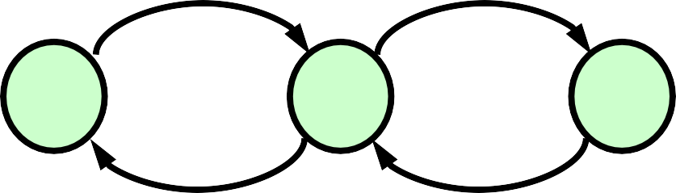
State transition diagram for availability analysis with repair
λ₁ λ₂
States are the same.
Repair replaces a broken component by a working one. Here we assume that there is only one repair team.
1
2
3
μ μ
-″₁ μ 0
″₁ -″₂-μ μ
0 ″₂ -μ
M =

Slide 100
State transition diagram for availability analysis with repair
λ₁ λ₂
If we assume that there are two independent repair teams, then μ on the edge from 3 to 2 gets the coefficient 2 (the rate doubles).
1
2
3
μ 2μ
-λ₁ μ 0
λ₁ -λ₂-μ 2μ
0 λ₂ -2μ
M =

Slide 101
Availability analysis
None of the diagonal elements of M are 0
By solving the system, we can get P_{i}(t) are compute the availability as a sum of probabilities taken over all operating states
Usually steady-state availability rather than time
dependent one is of interest
As time approaches infinity, the derivative of the right- hand side of the equation d/dt P(t) = M • P(t) vanishes and we get time-independent relationship
M • P(∝) = 0

Slide 102
Two-component standby system
Using transition matrix derived earlier, we get the following
system of equations
-λ₁P₁(∝) + μP₂(∝) = 0
λ₁P₁(∝) – (λ₂+ μ)P₂(∝) + μP₃(∝) = 0
λ₂P₂(∝) – μP₃(∝) = 0
By solving the equations, we get
A(∝) ≈ 1 - (λ/μ)²

Slide 103
Week 10 Slides 103-110

Slide 104
Safety evaluation
λC
2
1
λ(1-C)
3
The state transition equations are:
P₁(t)
-λ 0 0
λC 0 0
λ(1-C) 0 0
P₁(t)
d dt
P (t)
=
·
P (t)
2
P₃(t)
2
P₃(t)

Slide 105
Safety evaluation
By solving these equations, we get
P₁(t) = e^{-λt}
P₂(t) = C(1- e^{-λt})
P₃(t) = (1-C) – (1-C)e^{-λ t}
Since the P_{i}(t) are known, we can compute the reliability of the system as a sum of probabilities of neing the operational and fail-safe states
R(t) = P₁(t) + P₂(t) = C + (1-C)e^{-λt}
At time t=0, the safety is 1. As time approaches infinity, the safety approaches C

Slide 106
How to deal with cases of systems with “k out of n choices”
Suppose we want to solve the following task:
What is the probability that more than two engines in a 4-engine airplane will fail during a t-hour flight if the failure rate of a single engine is λ per hour?
The probability that more than two engines fail can be expressed as:
^{P}>2 failed ^{= ( 4 )P}1 works 3 failed ^{+ P}4 failed
1
^{= 1 – (P}4 work ^{+ ( 4 )P}3 work 1 failed ^{+ ( 4 )P}2 work 2 failed ⁾
3 2
Only probabilities of mutually exclusive events can be summed up like this

Slide 107
“k out of n choices”
“k out of n choices” can be computed as
n!
( ^{n} ) =
k
(n-k)! k!
For example
4!
( ⁴ ) =
= 6
2
(4-2)! 2!

Slide 108
Example cont.
So, we get
^{P}>2 failed ^{= 4 P}1 works 3 failed ^{+ P}4 failed
where
^{P}1 works 3 failed ^{= R (1-R)3} P_{4 failed} = (1-R)⁴
where R is the reliability of a single engine computed as R = e^{-λt}

Slide 109
Summary
Methods for evaluating the reliability, availability and safety of a system
RBDs
Markov chains

Slide 110
Next lecture
Hardware redundancy
Read chapter 4 of the text book

Slide 111
Week 11 Slides 111-122

Slide 112
Hardware redundancy

Slide 113
Techniques for fault tolerance
Fault masking “hides” faults that occur. Do not require detecting faults, but require containment of faults (the effect of all faults should be local)
Another approach is to first to detect, locate and contain faults, and then to recover from faults using reconfiguration
p. 2 - Design of Fault Tolerant Systems - Elena Dubrova, ESDlab

Slide 114
Redundancy
hardware redundancy
2nd CPU, 2nd ALU, ...
software redundancy
validation test...
information redundancy
error-detecting and correcting codes, ...
time redundancy
repeating tasks several times, ...
p. 3 - Design of Fault Tolerant Systems - Elena Dubrova, ESDlab

Slide 115
Example
FT digital filter
acceptance test [0 - 255]
SW: detect overflow
HW: memory for test
time: to execute test
transients: via re-execution
time to re-execute
p. 4 - Design of Fault Tolerant Systems - Elena Dubrova, ESDlab

Slide 116
Redundancy (5)
NOTHING FOR FREE!
costs
HW: components, area, power, ...
SW: development costs, ...
information: extra HW to code / decode
time: faster CPUs, components
trade-off against increase in dependability
p. 5 - Design of Fault Tolerant Systems - Elena Dubrova, ESDlab

Slide 117
Types of redundancy
hardware redundancy
information redundancy
software redundancy
time redundancy
p. 6 - Design of Fault Tolerant Systems - Elena Dubrova, ESDlab

Slide 118
HW redundancy: overview
passive redundancy techniques
fault masking
active redundancy techniques
detection, localisation, containment, recovery
hybrid redundancy techniques
static + dynamic
fault masking + reconfiguration
p. 7 - Design of Fault Tolerant Systems - Elena Dubrova, ESDlab

Slide 119
Passive HW redundancy
Triple Modular Redundancy (TMR)
input 1
M1
input 2
M2
voter
output
input 3
M3
p. 8 - Design of Fault Tolerant Systems - Elena Dubrova, ESDlab

Slide 120
Passive HW redundancy
Triple Modular Redundancy (TMR)
3 active components
fault masking by voter
Problem: voter is a single point of failure
p. 9 - Design of Fault Tolerant Systems - Elena Dubrova, ESDlab

Slide 121
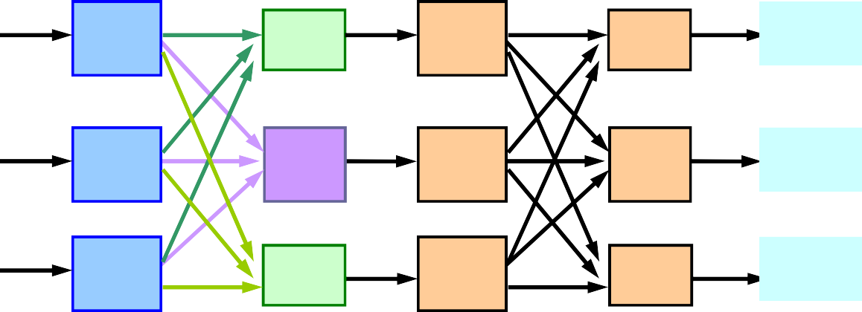
Passive HW redundancy
in1
M1
V1
M1
V1
out1
in1
in2
M2
V2
M2
V2
out2
in2
in3
M3
V3 M3
restoring organ
V3
out3
in3
p. 10 - Design of Fault Tolerant Systems - Elena Dubrova, ESDlab

Slide 122
Passive HW redundancy
N-modular redundancy (NMR)
N active components (N A)
N odd, for majority voting
tolerates ⎣N/2⎦ module faults
example Apollo
N=5
2 faults can be tolerated (masked)
p. 11 - Design of Fault Tolerant Systems - Elena Dubrova, ESDlab

Slide 123
Week 12 Slides 123-130

Slide 124
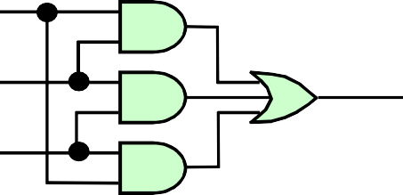
HW voting
hardware realisation of 1-bit majority voter f = ab + ac + bc
a
f
a
0 0 1 0
0 1 1 1
b c
f
c
b
n-bit majority voter: n times 1-bit requires 2 gate delays
p. 12 - Design of Fault Tolerant Systems - Elena Dubrova, ESDlab

Slide 125
SW voting
Voting can be performed using software
voter is software implemented by a microprocessor
voting program can be as simple as a sequence of three comparisons, with the outcome of the vote being the value that agrees with at least on on the other two
p. 13 - Design of Fault Tolerant Systems - Elena Dubrova, ESDlab

Slide 126
HW vs. SW Voting
HW: fast, but expensive
32-bit voter: 128 gates and 256 flip-flops
1 TMR level = 3 voters
SW: slow, but more flexible
use existing CPUs
p. 14 - Design of Fault Tolerant Systems - Elena Dubrova, ESDlab

Slide 127
Problem with voting
Major problem with practical application of voting is that the three results may not completely agree
sensors, used in many control systems, can seldom be manufactured so that their values agree exactly
analog-to-digital converter can produce quantities that disagree in the least significant bits
p. 15 - Design of Fault Tolerant Systems - Elena Dubrova, ESDlab

Slide 128
Problems with voting
(1) When values that disagree slightly are processed, the disagreement can grow larger
small difference in inputs can produce large differences in outputs
(2) A single result must ultimately be produced
potential point where one failure can cause a system failure
p. 16 - Design of Fault Tolerant Systems - Elena Dubrova, ESDlab

Slide 129

How to cure problem 1
Mid-value select technique
– choose a value from the three which lies between the other two
value
time
p. 17 - Design of Fault Tolerant Systems - Elena Dubrova, ESDlab

Slide 130
How to cure problem 1
Ignore the least-significant bits of data
disagreement which occurs only in the least- significant bits is acceptable
disagreement which affects the most-significant bits is not acceptable and must be corrected
p. 18 - Design of Fault Tolerant Systems - Elena Dubrova, ESDlab

Slide 131
Week 13 Slides 131-144

Slide 132
Types of HW redundancy
static techniques (passive)
fault masking
dynamic techniques (active)
detection, localisation, containment and recovery
hybrid techniques
static + dynamic
fault masking + reconfiguration
p. 19 - Design of Fault Tolerant Systems - Elena Dubrova, ESDlab

Slide 133
Active HW redundancy
dynamic redundancy
actions required for correct result
detection, localization, containment, recovery
no fault masking
does not attempt to prevent faults from producing errors within the system
p. 20 - Design of Fault Tolerant Systems - Elena Dubrova, ESDlab

Slide 134
Active HW redundancy
most common in applications that can tolerate temporary erroneous results
– satellite systems - preferable to have temporary failures that high degree of redundancy
types of active redundancy:
duplication with comparison
standby sparing
pair-and-a-spare
watchdog timer
p. 21 - Design of Fault Tolerant Systems - Elena Dubrova, ESDlab

Slide 135
Duplication with comparison
Two identical modules perform the same computation in parallel and their results are compared
out
M1
in
comp
agree/ disagree
M2
p. 22 - Design of Fault Tolerant Systems - Elena Dubrova, ESDlab

Slide 136
Duplication with comparison
The duplication concept can only detect faults, not tolerate them
– there is no way to determine which module is faulty
p. 23 - Design of Fault Tolerant Systems - Elena Dubrova, ESDlab

Slide 137
Duplication with comparison
Problems:
if there is a fault on input line, both modules will receive the same erroneous signal and produce the erroneous result
comparator may not be able to perform an exact comparison
synchronisation
no exact matching
comparator is a single point of failure
p. 24 - Design of Fault Tolerant Systems - Elena Dubrova, ESDlab

Slide 138
Implementation of comparator
In hardware, a bit-by-bit comparison can be done using two-input exclusive-or gates
In software, a comparison can be implemented a a COMPARE instruction
– commonly found in instruction sets of almost all microprocessors
p. 25 - Design of Fault Tolerant Systems - Elena Dubrova, ESDlab

Slide 139
Standby sparing
One module is operational and one or more serve as stand-bys, or spares
error detection is used to determine when a module has become faulty
error location is used to determine which module is faulty
faulty module is removed from operation and replaced with a spare
p. 26 - Design of Fault Tolerant Systems - Elena Dubrova, ESDlab

Slide 140
Standby sparing
M1
Error detection
in
M2
N to 1 switch
out
Error detection
...
Mn
Error detection
p. 27 - Design of Fault Tolerant Systems - Elena Dubrova, ESDlab

Slide 141
Switch
The switch examines error reports from the error detection circuitry associated with each module
if the module is error-free, the selection is made using a fixed priority
any module with errors is eliminated from consideration
momentary disruption in operation occur while the reconfiguration is performed
p. 28 - Design of Fault Tolerant Systems - Elena Dubrova, ESDlab

Slide 142
Hot standby sparing
In hot standby sparing spares operate in synchrony with on-line module and are prepared to take over any time
M1
in
err
out
spare
err
p. 29 - Design of Fault Tolerant Systems - Elena Dubrova, ESDlab

Slide 143
Cold standby sparing
In cold standby sparing spares are unpowered until needed to replace a faulty module
M1
in
err
out
spare
err
p. 30 - Design of Fault Tolerant Systems - Elena Dubrova, ESDlab

Slide 144
+ and - of cold standby sparing
(-) time is required to bring the module to operational state
time to apply power to spare and to initialize it
not desirable in applications requiring minimal reconfiguration time (control of chemical reactions)
(+) spares do not consume power
desirable in applications where power consumption is critical (satellite)
p. 31 - Design of Fault Tolerant Systems - Elena Dubrova, ESDlab

Slide 145
Week 14 Slides 145-163

Slide 146
Pair-and-a-spare technique
Combines standby sparing and dublication with comparison
like standby sparing, but two instead of one modules are operated in parallel at all times – their results are compared to provide error
detection
– error signal initiates reconfiguration
p. 32 - Design of Fault Tolerant Systems - Elena Dubrova, ESDlab

Slide 147
Pair-and-a-spare technique
M1
out
Error detection
in
compare
M2
N to 2 switch
Error detection
...
Mn
Error detection
p. 33 - Design of Fault Tolerant Systems - Elena Dubrova, ESDlab

Slide 148
Pair-and-a-spare technique
As long as two selected outputs agree, the spares are not used
If they disagree, the switch uses error reports to locate the faulty module and to select the replacement module
p. 34 - Design of Fault Tolerant Systems - Elena Dubrova, ESDlab

Slide 149
Watchdog timer
watchdog timer
must be reset an on a repetitive basic
if not reset - system is turned off (or reset)
detection of
crash
overload
infinite loop
frequency depends on application
aircraft control system - 100 msec
banking - 1 sec
p. 35 - Design of Fault Tolerant Systems - Elena Dubrova, ESDlab

Slide 150
HW redundancy: overview
static techniques (passive)
fault masking
dynamic techniques (active)
detection, localisation, containment, recovery
hybrid techniques
static + dynamic
fault masking + reconfiguration
p. 36 - Design of Fault Tolerant Systems - Elena Dubrova, ESDlab

Slide 151

Hybrid HW redundancy
combines
static redundancy
fault masking
dynamic redundancy
detection, location, containment and recovery
very expensive but more FT
p. 37 - Design of Fault Tolerant Systems - Elena Dubrova, ESDlab

Slide 152
Types of hybrid redundancy
Self-purging redundancy
N-modular redundancy with spares
Triple-duplex architecture
p. 38 - Design of Fault Tolerant Systems - Elena Dubrova, ESDlab

Slide 153
Self-purging redundancy
All units are actively participate in the system
each module has a capability to remove itself from the system if its faulty
– very attractive feature: maintenance personnel can disable individual modules and replace them without interrupting the system
p. 39 - Design of Fault Tolerant Systems - Elena Dubrova, ESDlab

Slide 154
Self-purging redundancy
M1
switch
M2
…
switch
voter
out
Mn
switch
p. 40 - Design of Fault Tolerant Systems - Elena Dubrova, ESDlab

Slide 155

Basic structure of a switch
Is output of a module disagrees with the output of the system, its contribution to the voter is forced to be 0 (threshold voter)
Mi
voter
out
initialize
J
KQ
p. 41 - Design of Fault Tolerant Systems - Elena Dubrova, ESDlab

Slide 156
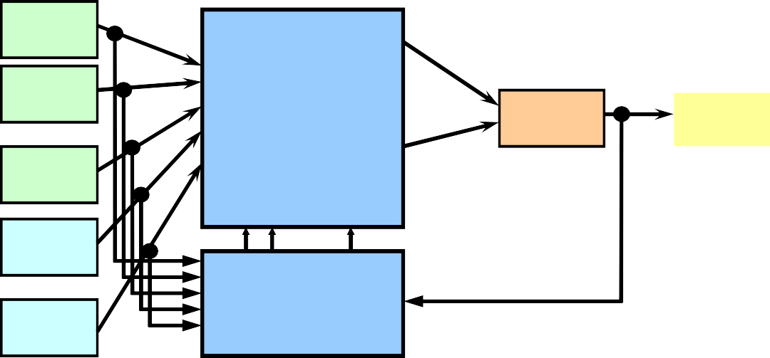
N-modular redundancy with spares
M1
M2
…
Mn
…
switch
voter
out
…
S1
…
Sm
disagreement detector
p. 42 - Design of Fault Tolerant Systems - Elena Dubrova, ESDlab

Slide 157
NMR with spares
System remains in the basic NMR configuration until the disagreement vector determines a fault
the output of the voter is compared to the individual outputs of the modules
module which disagrees is labeled as faulty and removed from the NMR core
spare is switched to replace it
p. 43 - Design of Fault Tolerant Systems - Elena Dubrova, ESDlab

Slide 158
NMR with spares
The reliability is maintained as long as the pool of spares is not exhausted
3-modular redundancy with 1 spare can tolerate 2 faults
to do it in a passive approach, we would need to have 5 modules
p. 44 - Design of Fault Tolerant Systems - Elena Dubrova, ESDlab

Slide 159
Triple-duplex architecture
Combines duplication with comparison and triple modular redundancy
p. 45 - Design of Fault Tolerant Systems - Elena Dubrova, ESDlab

Slide 160
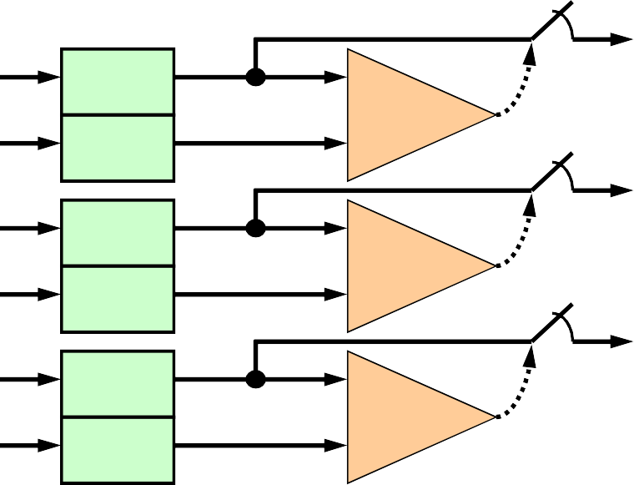
Triple-duplex architecture
M1a M1b
comp
voter
M2a M2b
out
comp
M3a M3b
comp
p. 46 - Design of Fault Tolerant Systems - Elena Dubrova, ESDlab

Slide 161
Triple-duplex architecture
TMR allows faults to be masked
performance without interruption
duplication with comparison allows faults to be detected and faulty module removed from voting
removal of faulty module allows to tolerate future faults
two module faults can be tolerated
p. 47 - Design of Fault Tolerant Systems - Elena Dubrova, ESDlab

Slide 162
Summary
application-dependent choice
critical-computation - momentary erroneous results are not acceptable
passive or hybrid
long-life, high-availability - system should be restored quickly
active
very critical applications - highest reliability
hybrid
p. 48 - Design of Fault Tolerant Systems - Elena Dubrova, ESDlab

Slide 163
Next lecture
Information redundancy
Read chapter 5 of the text book
p. 49 - Design of Fault Tolerant Systems - Elena Dubrova, ESDlab

Slide 164
Week 15 Slides 164-184

Slide 165
Information redundancy

Slide 166
Information redundancy
add information to date to tolerate faults
error detecting codes
error correcting codes
data applications
communication
memory
p. 2 - Design of Fault Tolerant Systems - Elena Dubrova, ESDlab

Slide 167
Code
of
Code of length n is a set of n-tuples satisfying some well-defined set rules
binary code uses only 0 and 1 symbols
binary coded decimal (BCD) code
uses 4 bits for each decimal digit
0000 0
0001 1
0010 2
…
1001 9
p. 3 - Design of Fault Tolerant Systems - Elena Dubrova, ESDlab

Slide 168
Code word
Codeword is an element of the code satisfying the rules of the code
Word is an n-tuple not satisfying the rules of the code
Codewords should be a subset of all possible 2^{n} binary tuples to make error detection/correction possible
BCD: 0110 valid; 1110 invalid
any binary code: 2013 invalid
The number of codewords in a code C is called the size of C
p. 4 - Design of Fault Tolerant Systems - Elena Dubrova, ESDlab

Slide 169
Encoding/decoding
encoding
transform data into code word
data encoding
decoding
recover data from code word
code word decoding
code word
data
p. 5 - Design of Fault Tolerant Systems - Elena Dubrova, ESDlab

Slide 170
Encoding/decoding
2 scenario if errors affect codeword:
correct codeword → another codeword
correct codeword → word
p. 6 - Design of Fault Tolerant Systems - Elena Dubrova, ESDlab

Slide 171
Error detection
We can define a code so that errors introduced in a codeword force it to lie outside the range of codewords
– basic principle of error detection
p. 7 - Design of Fault Tolerant Systems - Elena Dubrova, ESDlab

Slide 172
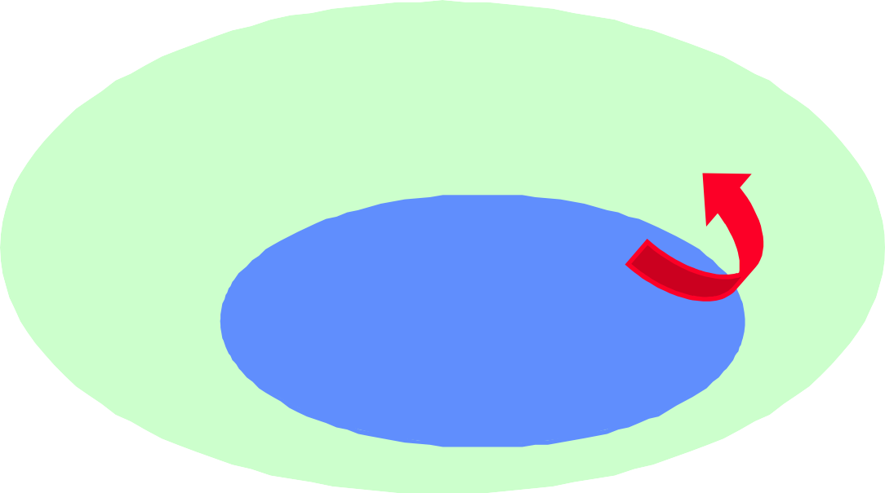
Error detection
all possible words
code words
p. 8 - Design of Fault Tolerant Systems - Elena Dubrova, ESDlab

Slide 173
Error correction
We can define a code so that it is possible to determine the correct code word from the erroneous codeword
– basic principle of error correction
p. 9 - Design of Fault Tolerant Systems - Elena Dubrova, ESDlab

Slide 174
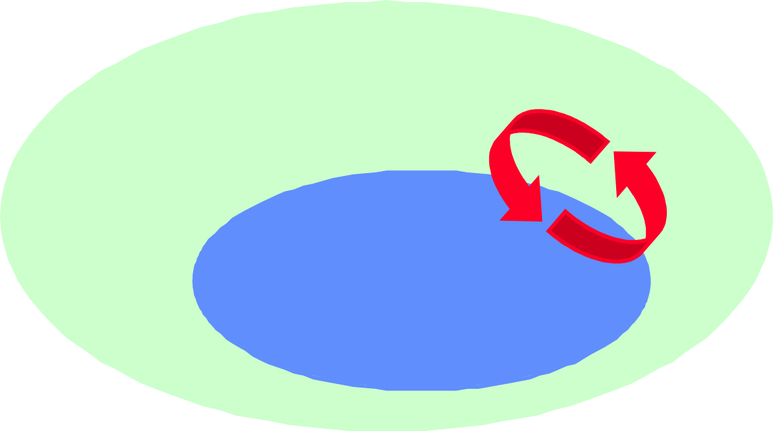
Error correction
all possible codewords
code words
p. 10 - Design of Fault Tolerant Systems - Elena Dubrova, ESDlab

Slide 175
Error detecting/correcting code
Characterized by the number of bits that can be corrected
double-bit detecting code can detect two single-bit errors
single-bit correcting code can correct one single-bit error
Hamming distance gives a measure of error detecting/correcting capabilities of a code
p. 11 - Design of Fault Tolerant Systems - Elena Dubrova, ESDlab

Slide 176
Hamming distance
Hamming distance is the number of bit positions in which two n-tuples differ
x 0000
δ (x,y) = 2
y 0101
p. 12 - Design of Fault Tolerant Systems - Elena Dubrova, ESDlab

Slide 177
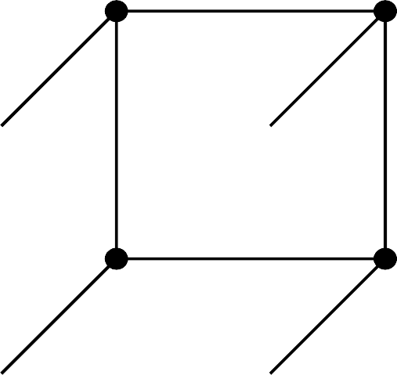
3-dimensional space (3-bit words)
011 111
010
δ=1
y
110
z
001
101
0x0yz0 10_{x}0
p. 13 - Design of Fault Tolerant Systems - Elena Dubrova, ESDlab

Slide 178


Error detection
011 111
If codewords are on distance ≥ 2, we can detect single-bit errors
010
110
001
101
000 100
p. 14 - Design of Fault Tolerant Systems - Elena Dubrova, ESDlab

Slide 179

Error correction
011 111
If codewords are on distance ≥ 3, we can correct single-bit errors
010
110
001
101
000 100
p. 15 - Design of Fault Tolerant Systems - Elena Dubrova, ESDlab

Slide 180
Code distance
code distance is the minimum Hamming distance between any two distinct codewords
C_{d} = 2
code detects all single-bit errors code: 00, 11
invalid code words: 01 or 10
C_{d} = 3
code corrects all single-bit errors code: 000, 111
invalid code words: 001, 010, 100,
101, 011, 110
p. 16 - Design of Fault Tolerant Systems - Elena Dubrova, ESDlab

Slide 181
Relation b/w code distance and capabilities of the code
A code can correct up to c bit errors and detect up to d additional bit errors if and only if:
2c + d + 1 ≤ Cd
p. 17 - Design of Fault Tolerant Systems - Elena Dubrova, ESDlab

Slide 182
Separable/non-separable code
separable code
codeword = data + check bits
e.g. parity: 11011 = 1101 + 1
non-separable code
codeword = data mixed with check bits
e.g. cyclic: 1010001 -> 1101
decoding process is much easier for separable codes (remove check bits)
p. 18 - Design of Fault Tolerant Systems - Elena Dubrova, ESDlab

Slide 183
Information rate
The ratio k/n, where
k is the number of data bits
n is the number of data + check bits
is called the information rate of the code
Example: a code obtained by repeating data three times has the information rate 1/3
p. 19 - Design of Fault Tolerant Systems - Elena Dubrova, ESDlab

Slide 184
Next: Types of codes
parity codes
linear codes
Hamming codes
cyclic codes
CRC codes
Reed-Solomon codes
unordered codes
m-of-n codes
Berger codes
arithmetic codes
AN-codes
residue codes
p. 20 - Design of Fault Tolerant Systems - Elena Dubrova, ESDlab

Slide 185
Week 16 Slides 185-192

Slide 186
Single-bit parity code
Add an extra bit to binary word so that that resulting code word has either even or odd number of 1s
even parity: even # ‘1’
odd parity: odd # ‘1’
single bit error detection: C_{d} = 2
separable code
use: bus, memory, transmission, …
p. 21 - Design of Fault Tolerant Systems - Elena Dubrova, ESDlab

Slide 187
Organization of memory with single- bit parity code
Parity Parity
error
parity
generator
parity
checker
memory
Data in
Data out
extra HW required (parity generator, checker, extra memory)
p. 22 - Design of Fault Tolerant Systems - Elena Dubrova, ESDlab

Slide 188
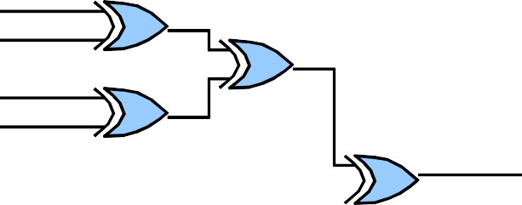
Parity generation and checking
d0 d1 d2 d3
Data bits
1 if odd
d0 d1 d2 d3
Parity bit
error if 1
p. 23 - Design of Fault Tolerant Systems - Elena Dubrova, ESDlab

Slide 189
Problem with single-bit parity code
Multiple-bit errors (even number of bits) cannot be detected
some of them are often very common
failure of the individual memory chip
p. 24 - Design of Fault Tolerant Systems - Elena Dubrova, ESDlab

Slide 190
Other parity codes
The purpose is to provide additional error capability
bit-per-word
bit-per-byte
bit-per-multiple-chips
bit-per-chip
interlaced
overlapping
p. 25 - Design of Fault Tolerant Systems - Elena Dubrova, ESDlab

Slide 191
Overlapping parity code (Hamming code)
Overlapping parity for 4-bits of data - each data bit is assigned to multiple parity groups
3 2 1 0
P2 P1 P0
Bit in error | Parity pattern
3 | P2 P1 P0
2 | P2 P1
1 | P2 P0
0 | P1 P0
P2 | P2
P1 | P1
P0 | P0
no error
p. 26 - Design of Fault Tolerant Systems - Elena Dubrova, ESDlab

Slide 192
Overlapping parity code (Hamming code)
k data bits, c parity bits
to have unique parity pattern per error:
k | c | redundancy
2 | 3 | 150%
4 | 3 | 75%
8 | 4 | 50%
16 | 5 | 31%
32 | 6 | 19%
64 | 7 | 11%
2^{c} ≥ k+c+1
p. 27 - Design of Fault Tolerant Systems - Elena Dubrova, ESDlab

Slide 193
Week 17 Slides 193-209

Slide 194
Background
A field Z₂ is the set { 0,1} together with two operations of addition and multiplication (modulo 2) satisfying a given set of properties
A vector space V_{n} over a field Z₂ is a subset of Z ^{n}, with
2
two operations of addition and multiplication (modulo 2)
satisfying a given set of properties
A subspace is a subset of a vector space which is itself a vector space
A set of vectors {v₀,…,v_{k-1} } is linearly independent if a₀v₀ + a₁v₁ + …+ a_{k-1}v_{k-1} = 0 implies a₀ = a₁= …= a_{k-1} = 0
p. 28 - Design of Fault Tolerant Systems - Elena Dubrova, ESDlab

Slide 195
Cyclic codes
Cyclic codes are special class of linear codes
Used in applications where burst errors can occur
a group of adjacent bits is affected
digital communication, storage devices (disks, CDs)
Important classes of cyclic codes:
Cyclic redundancy check (CRC)
used in modems and network protocols
Reed-Solomon code
used in CD and DVD players
p. 51 - Design of Fault Tolerant Systems - Elena Dubrova, ESDlab

Slide 196
Cyclic code: Definition
A linear code is called cyclic if any end-around shift of codeword produces another codeword
if [c₀c₁c₂…c_{n-2}c_{n-1}] is a codeword, then [c_{n-1}c₀c₁c₂…c_{n-2}], is a codeword, too
it is convenient to think of words as polynomials rather than vectors
for example, a codeword [c₀c₁…c_{n-1}] is represented as a polynomial
c₀·x⁰+ c₁·x¹+…+ c_{n-1} ·x^{n -1}
p. 52 - Design of Fault Tolerant Systems - Elena Dubrova, ESDlab

Slide 197
Polynomials
Since the code is binary, the coefficients are 0 and 1
For example, d(x) = 1·x⁰+0·x¹+1·x²+1·x³ represents the data (1011)
We always write least significant digit on the left
p. 53 - Design of Fault Tolerant Systems - Elena Dubrova, ESDlab

Slide 198
Polynomials
The degree of a polynomial equals to its highest exponent
e.g. the degree of 1+ x¹+ x³ is 3
a cyclic code with the generator polynomial of degree (n-k) detects all burst errors affecting (n-k) bits or less
n is the number of bits in codeword
k is the number of bits in data word
p. 54 - Design of Fault Tolerant Systems - Elena Dubrova, ESDlab

Slide 199
Encoding/decoding
d(x)
Encode c(x)=d(x)·g(x)
Decode/Correct d(x)=c(x)/g(x)
d(x)
transmit
p. 55 - Design of Fault Tolerant Systems - Elena Dubrova, ESDlab

Slide 200
Encoding
Multiply data polynomial by generator polynomial:
c(x) = d(x).g(x)
Calculations are performed in Galois Field GF(2):
multiplication modulo 2 = AND operation
addition modulo 2 = XOR operation
in GF(2), subtraction = addition
p. 56 - Design of Fault Tolerant Systems - Elena Dubrova, ESDlab

Slide 201
Properties of generator polynomial
g(x) is the generator polynomial for a linear cyclic code of length n if and only if g(x) divides 1+x^{n} without a reminder
p. 57 - Design of Fault Tolerant Systems - Elena Dubrova, ESDlab

Slide 202
Example of polymomial multiplication (1)
d(x) = (1011) = x³ + x² + 1
g(x) = x³ + x + 1
k = 4
c(x) = d(x).g(x)
= (x³ + x² + 1).(x³ + x + 1)
= x⁶ + x⁴ + x³ + x⁵ + x³ + x² + x³ + x + 1
= x⁶ + x⁵ + x⁴ + x³ + x² + x¹ + 1
n = 7
= (1111111)
p. 58 - Design of Fault Tolerant Systems - Elena Dubrova, ESDlab

Slide 203
CRC codes
CRC-16 and CRC-CCITT are widely used in modems and network protocols in the USA and Europe, respectively, and give adequate protection for most applications
the number of non-zero terms in their polynomials is small (just four)
LFSR required to implement encoding and decoding is simpler
Applications that need extra protection, e.g.
DD, use CRC-32
p. 79 - Design of Fault Tolerant Systems - Elena Dubrova, ESDlab

Slide 204
Encoding/decoding
The encoding and decoding is done either in software, or in hardware using the usual procedure for separable cyclic codes
To encode:
shift data polynomial right by deg(g(x)) bit position
divided it by the generator polynomial
the coefficients of the remainder form the check bits of the CRC codeword
p. 80 - Design of Fault Tolerant Systems - Elena Dubrova, ESDlab

Slide 205
Encoding/decoding
The number check bits equals to the degree of the generator polynomial
an CRC detects all burst error of length less or equal than deg(g(x))
CRC also detects many errors which are larger than deg(g(x))
apart from detecting all burst errors of length 16 or less, CRC-16 and CRC-CCITT are also capable to detect 99.997% of burst errors of length 17 and 99.985% burst errors of length 18
p. 81 - Design of Fault Tolerant Systems - Elena Dubrova, ESDlab

Slide 206
Reed-Solomon codes
Reed-Solomon (RS) codes are a class of separable cyclic codes used to correct errors in a wide range of applications including
storage devices (tapes, compact disks, DVDs, bar-codes), wireless
communication (cellular telephones, microwave links), satellite
communication, digital television, high-speed modems (ADSL, xDSL).
p. 82 - Design of Fault Tolerant Systems - Elena Dubrova, ESDlab

Slide 207
Reed-Solomon codes
The encoding for Reed-Solomon code is done the using the usual procedure
codeword is computed by shifting the data right n-k positions, dividing it by the generator polynomial and then adding the obtained reminder to the shifted data
A key difference is that groups of m bits rather than individual bits are used as symbols of the code.
usually m = 8, i.e. a byte.
the theory behind is a field Z^{m}₂ of degree m over {0,1}
p. 83 - Design of Fault Tolerant Systems - Elena Dubrova, ESDlab

Slide 208
Encoding
An encoder for an RS code takes k data symbols of s bits each and computes a codeword containing n symbols of m bits each
A Reed-Solomon code can correct up to ⎣n- k⎦/2 symbols that contain errors
p. 84 - Design of Fault Tolerant Systems - Elena Dubrova, ESDlab

Slide 209
Summary of cyclic codes
Any end-around shift of a codeword produce another codeword
code is characterized by its generator polynomial g(x), with a degree (n-k), n = bits in codeword, k = bits in data word
detect all single errors and all multiple adjacent error affecting (n-k) bits or less
p. 87 - Design of Fault Tolerant Systems - Elena Dubrova, ESDlab

Slide 210
Week 18 Slides 209-222

Slide 211
Unordered codes
Designed to detect unidirectional errors
An error is unidirectional if all affected bits are changed to either 0 → 1 or 1 → 0, but not both
Example:
correct codeword: 010101
same codeword with unidirectional errors: 110101 000101
111101 000001
111111 000000
p. 88 - Design of Fault Tolerant Systems - Elena Dubrova, ESDlab

Slide 212
Unidirectional error detection
Theorem: A code C detects all unidirectional errors if and only if every pair of codewords in C is unordered
two binary n-tuples x and y are ordered if either x_{i} ≤ y_{i} or x_{i} ≥ y_{i} for all i ∈ {1,2,...,n}
Examples of ordered codewords:
0110 < 0111 < 1111
0110 > 0100 > 0000
p. 89 - Design of Fault Tolerant Systems - Elena Dubrova, ESDlab

Slide 213
Unidirectional error detection
A unidirectional error always changes a word x to a word y which is either smaller or greater than x
A unidirectional error cannot change x to a word which is not ordered with x
Therefore, if any pair of codewords are unordered, a unidirectional error will never transform a codeword to another codeword
p. 90 - Design of Fault Tolerant Systems - Elena Dubrova, ESDlab

Slide 214
Berger code
Append c check bits to k data bits
c = ⎡log₂(k+1)⎤
separable code
how to create code word:
count number of 1’s in k data bits
complement resulting binary number and append it to the data bits
p. 93 - Design of Fault Tolerant Systems - Elena Dubrova, ESDlab

Slide 215
Example of Berger codeword
data = (0111010), k = 7
c = ⎡log₂(7+1)⎤ = 3
number of 1’s in (0111010) is 4 = (100)
complement of (100) is (011) resulting codeword is (0111010011)
p. 94 - Design of Fault Tolerant Systems - Elena Dubrova, ESDlab

Slide 216
Berger code capability
Berger code detects all unidirectional errors
for the error detection capability it provides, the Berger code uses the fewest number of check bits of the available separable unordered codes
p. 95 - Design of Fault Tolerant Systems - Elena Dubrova, ESDlab

Slide 217
Arithmetic codes
For checking arithmetic operations
before the operation, data is encoded
after the operation, code words are checked
Arithmetic code is the invariant to “*” if:
A(b*c) = A(b) * A(c)
b, c - operands
A(b), A(c), A(b*c) - codes for b, c and b*c
p. 96 - Design of Fault Tolerant Systems - Elena Dubrova, ESDlab

Slide 218
Examples of arithmetic codes
Two common types of arithmetic codes are
AN codes
residue codes
p. 97 - Design of Fault Tolerant Systems - Elena Dubrova, ESDlab

Slide 219
AN code
AN code is formed by multiplying each data word N by some constant A
AN codes are invariant to addition (and subtraction):
A(b + c) = A(b) + A(c)
If no error occurred, A(b+c) is evenly divisible by A
p. 98 - Design of Fault Tolerant Systems - Elena Dubrova, ESDlab

Slide 220
Residue codes
Residue codes are created by computing a residue for data and appending it to the data
The residue is generate by dividing a data by a integer, called modulus.
Decoding is done by simply removing the residue
p. 103 - Design of Fault Tolerant Systems - Elena Dubrova, ESDlab

Slide 221
Residue codes
Residue codes are invariants with respect to addition, since
(b + c) mod m = b mod m + c mod m
where b and c are data words and m is modulus
This allows us to handle residues separately from data during addition process.
Value of the modulus determines the information rate and the error detection capability of the code
p. 104 - Design of Fault Tolerant Systems - Elena Dubrova, ESDlab

Slide 222
Next lecture
Time redundancy
Read chapter 6 of the text book
p. 105 - Design of Fault Tolerant Systems - Elena Dubrova, ESDlab

