Slide 1
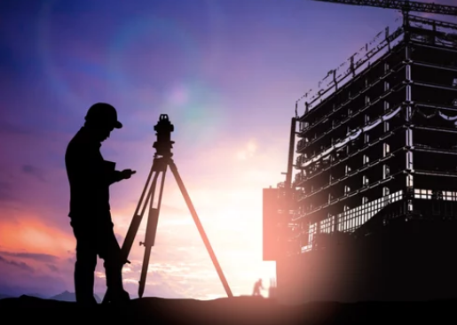
CE-0732-1201
SURVEYING
Oaisul Mostofa Karim
Lecturer
Dept. of Civil Engineering
University of Global Village (UGV), Barishal

Slide 2
SURVEYING
COURSE CODE: CE-0732-1201 CREDIT: 04
MID EXAMINATION: 2 HOURS CIE MARKS: 120
SEMESTER END EXAMINATION: 3 HOURS SEE MARKS: 80
Course Learning Outcomes (CLOs): After completing this course, students will be able to-
CLO 01 Understand the fundamentals of surveying and linear measurements and develop skills to conduct practical measurements.
CLO 02 Identify the fields of chain surveying and compass traversing and determine offsets, errors and bearings in practical field.
CLO 03 Analyze the area of a specific site for earthwork excavation.
CLO 04 Assess the volume of a specific site to be excavated before starting construction.

Slide 3
Sl. | Course Contents | Hours | CLOs
01 | Introduction to Surveying, levelling, Objectives, Classifications, Calculation for the Error Due to the Use of Wrong Scale. Introduction to Linear Measurements, Types of Chain, Calculation for the Error Due to the Incorrect Chain and Corrections. | 10 | CLO1, CLO2
02 | Chain Surveying, Errors and Calculations for Chain Surveying, Field Book, Introduction to Compass Traversing, Conversion of Bearing, Calculation of Bearing from Angles, Mathematical Problems related to Compass Traversing. | 10 | CLO1,CLO4
03 | Introduction to GIS and GPS: Definitions, Existing Technology, Application of Google Map, Advantages of GIS, How does a GIS work, GPS definition, Output from it. Introduction to Remote Sensing: Definition, Classifications, Principles and Observation Platforms of it, Application of Remote Sensing, Advantages of it. | 08 | CLO2,CLO3
REFERENCES
1. “Surveying and Levelling” by N N BASAK.
2. “Surveying Vol.1, 2 & 3” By B.C. Punmia.
3. “A Textbook of Surveying” by Aziz and Shahjahan.

Slide 4
Week | Topic | Teaching Learning Strategy | Assessment Strategy | CLOs | Page No.
01 | Fundamental of Surveying | Lecture, Discussion | Mid, Final | CLO 1
02 | Fundamental of Surveying | Lecture, Discussion | Mid, Final | CLO 1
03-04 | Linear Measurements | Lecture, Presentation | Assignment, Mid, Final | CLO 3
05 | Linear Measurements | Lecture, Presentation | Assignment, Mid, Final | CLO 2
06 | Chain Surveying | Lecture, Presentation | Assignment, Class Test, Mid, Final | CLO 4
07 | Chain Surveying | Lecture, Presentation | Problem solving, Class Test, Final | CLO 4
08-09 | Compass Traversing | Lecture, Discussion | Mid, Final | CLO 4
10 | Calculation of Volume | Lecture, Presentation | Problem solving, Class Test, Final | CLO 3
11-12 | Introduction of GIS and GPS | Lecture, Discussion | Assignment, Mid, Final | CLO 3
13-14 | Introduction to Remote Sensing | Lecture, Presentation | Assignment, Final | CLO 2

Slide 5
ASSESSMENT PATTERN
CIE-Continuous Internal Evaluation (120 Marks)
Bloom’s Category Marks (out of 120) | Tests (60) | Assignments (20) | Quizzes (20) | External Participation in Curricular/Co-Curricular Activities (20)
Remember | 10 |  | 10 | Attendance 20
Understand | 10 |  | 10
Apply | 10
Analyze | 10
Evaluate | 10
Create | 10 | 20
SEE- Semester End Examination (80 Marks)
Bloom’s Category | Tests
Remember | 10
Understand | 15
Apply | 15
Analyze | 15
Evaluate | 15
Create | 10

Slide 6

Fundamentals of Surveying
(Week 1)

Slide 7
Fundamentals of Surveying
What is Surveying?
Surveying is the art of determining the relative position of points on, above or below the surface of the earth by means of direct or indirect measurements.
What is Levelling?
This is the branch of surveying which helps in finding the elevations of different points with respect to a reference point.

Slide 8
Fundamentals of Surveying
Objectives and Uses of Surveying
To determine the relative positions of any objects or points of the earth.
To determine the distance and angle between different objects.
To prepare map or plan.
To develop methods through the knowledge of modern science and technology.
To solve measurement problems in an optimal way.

Slide 9
Fundamentals of Surveying
Objectives and Uses of Levelling
To determine the elevation of given point with respect to some assumed reference line, which is called datum.
To establish the point at required elevation with respect to the datum.

Slide 10
Fundamentals of Surveying
Classifications of Surveying
Based on the nature of the field survey:
Land survey (Topographical survey, Cadastral survey, City survey)
Marine survey
Astronomical survey

Slide 11
Fundamentals of Surveying
Classifications of Surveying
Based on the object of the field survey:
Engineering survey
Military survey
Mine survey
Geological survey etc.

Slide 12
Fundamentals of Surveying
Classifications of Surveying
Based on the instruments:
Chain survey
Theodolite survey
Traverse survey
Triangulation survey
Tacheometric survey
Plane table survey etc.

Slide 13
Fundamentals of Surveying
(Week 2)

Slide 14
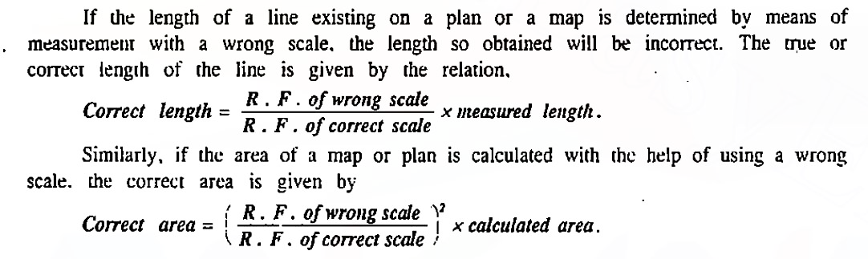
Fundamentals of Surveying
Error Due to the Use of Wrong Scale
R.F-Representative Fraction

Slide 15
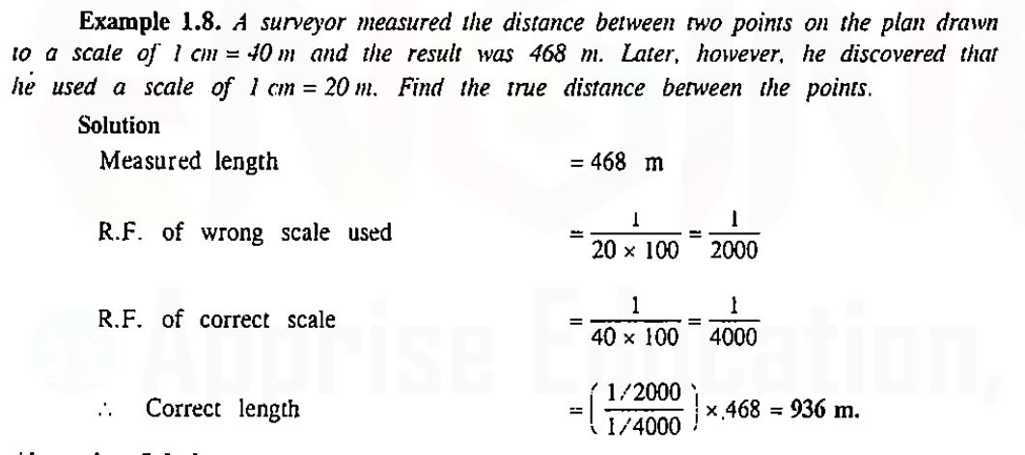
Fundamentals of Surveying
Error Due to the Use of Wrong Scale

Slide 16
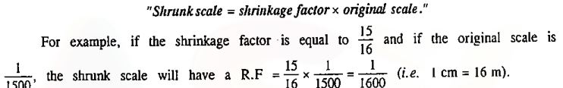
Fundamentals of Surveying
Error Due to the Use of Shrunk Scale

Slide 17
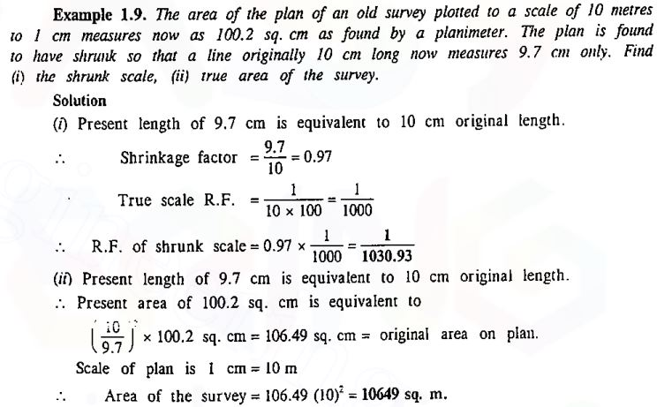
Fundamentals of Surveying
Error Due to the Use of Shrunk Scale

Slide 18
Linear Measurements
(Week 03-04)

Slide 19
Linear Measurements
Chaining
Chaining is a term used to denote measuring distance with the help of chain or tape.
No matter how accurately the angles are measured, survey can be no more precise than that of chaining.

Slide 20
Linear Measurements
Types of Chain
Metric
Gunter’s / Surveyor’s
Engineer’s
Revenue
Steel band

Slide 21
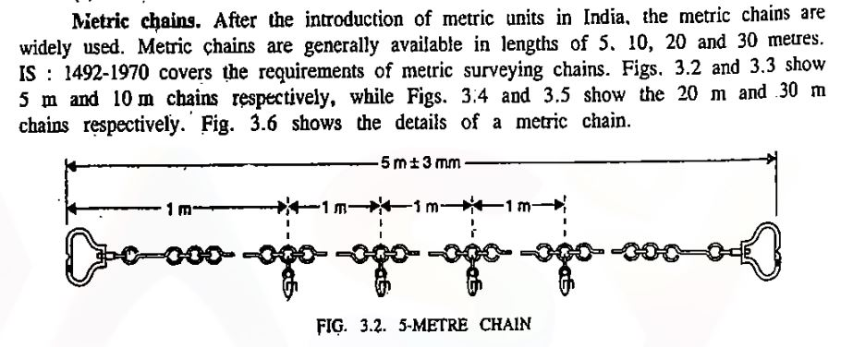
Linear Measurements
Types of Chain

Slide 22
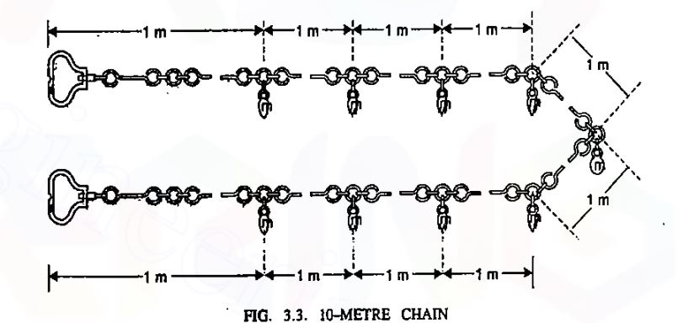
Linear Measurements
Types of Chain

Slide 23
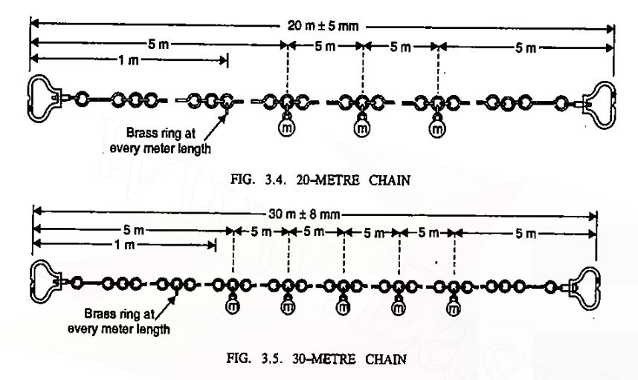
Linear Measurements
Types of Chain

Slide 24
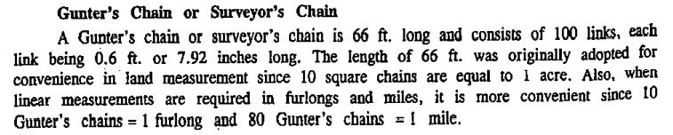
Linear Measurements
Types of Chain

Slide 25
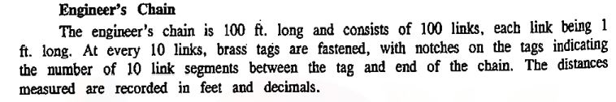

Linear Measurements
Types of Chain

Slide 26
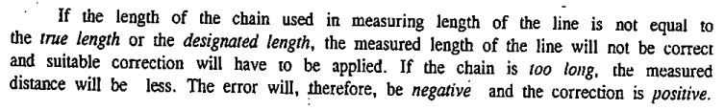
Linear Measurements
Error Due to Incorrect Chain

Slide 27
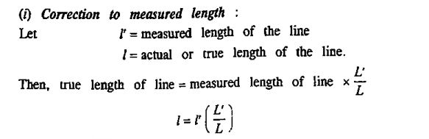
Linear Measurements
Error Due to Incorrect Chain

Slide 28
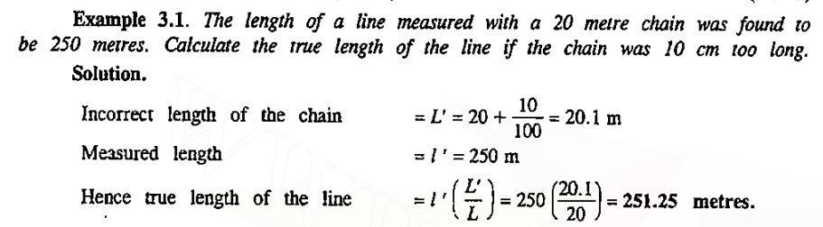
Linear Measurements
Error Due to Incorrect Chain

Slide 29
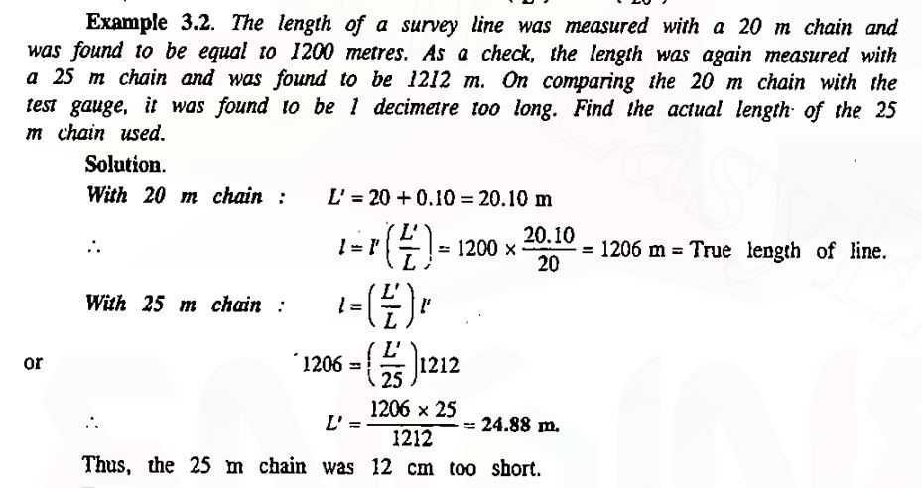
Linear Measurements
Error Due to Incorrect Chain
25-24.88 = 0.12 m = 12 cm

Slide 30
Linear Measurements
(Week 05)

Slide 31
Linear Measurements
Corrections
Corrections for-
Absolute length
Temperature
Sag
Pull
Slope etc.

Slide 32
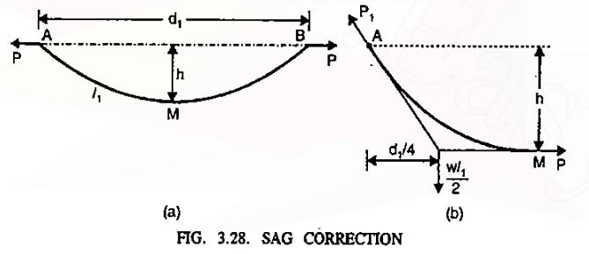
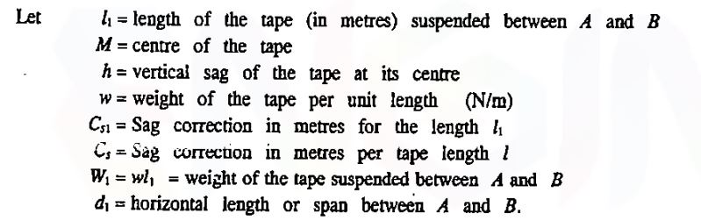
Linear Measurements
Corrections
Sag Corrections-
The difference between horizontal distance and measured length along the catenary is termed as Sag.

Slide 33
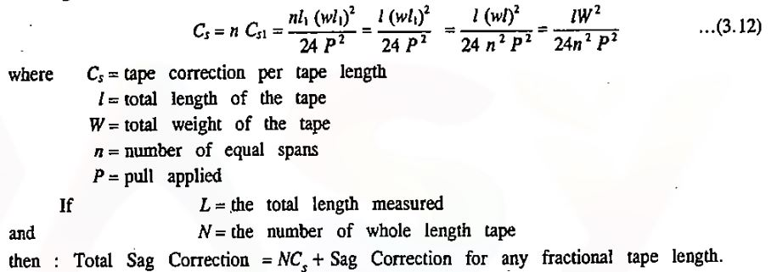
Linear Measurements
Corrections
Sag Corrections-

Slide 34
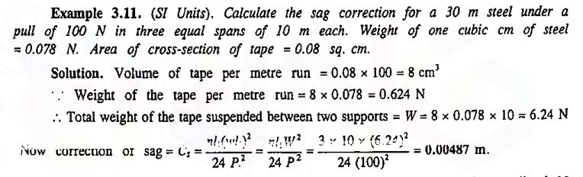

Linear Measurements
Corrections
Sag Corrections-

Slide 35
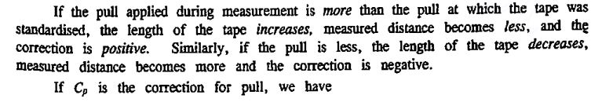
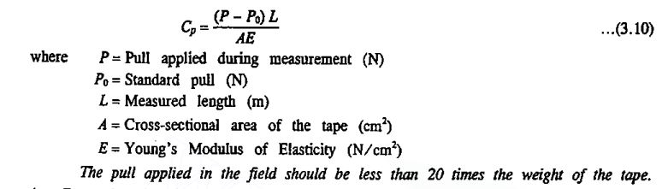
Linear Measurements
Corrections
Pull Corrections-

Slide 36
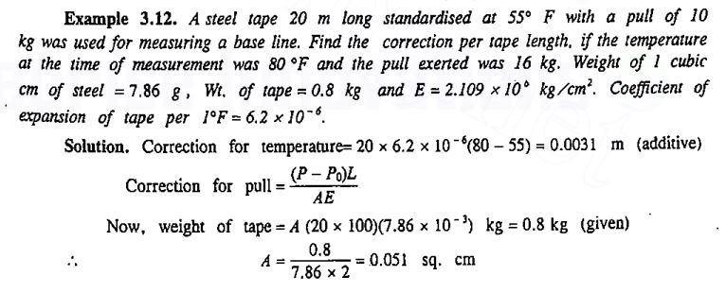
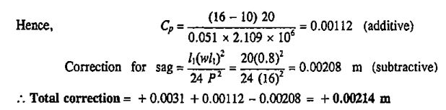
Linear Measurements
Corrections
Pull Corrections-

Slide 37
Chain Surveying
(Week 06)

Slide 38
Chain Surveying
Chain Surveying is a type of surveying in which only linear measurements are made in the field.
Principle: To provide a framework consisting a number of connected triangles, as triangles are the only simple figure in case of chain surveying.

Slide 39
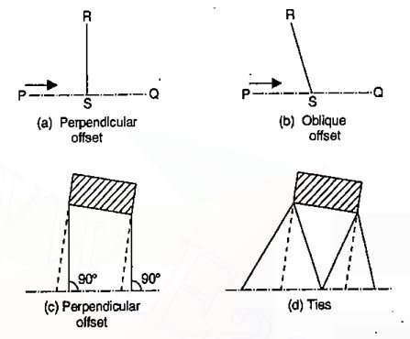
Chain Surveying
Offsets: Usually offsets are of four types-

Slide 40
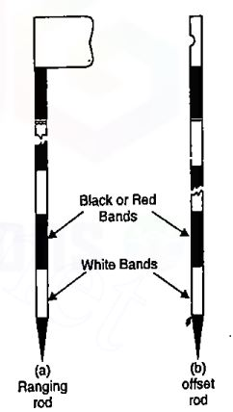

Chain Surveying
Instruments: Generally, the instruments that are used in case of chain surveying are shown here:
Figure: Tape
Figure: Rods

Slide 41
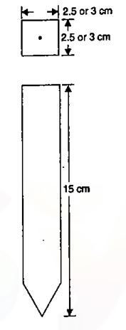
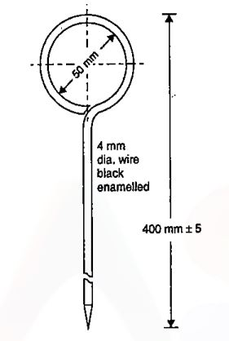
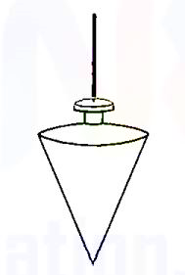
Chain Surveying
Figure: Wooden Peg
Figure: Arrow
Figure: Plumb Bob

Slide 42
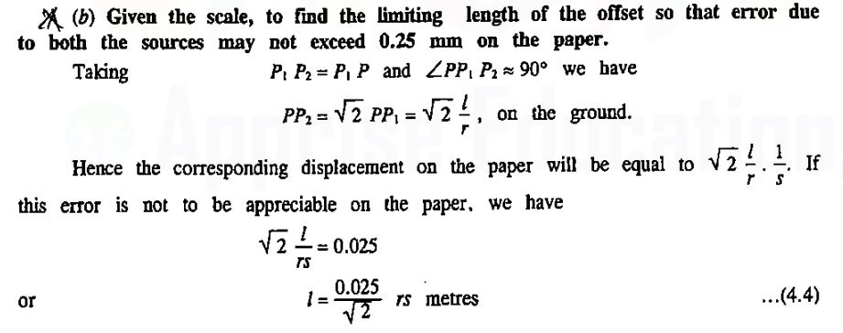
Chain Surveying
Limiting length of Offsets-

Slide 43
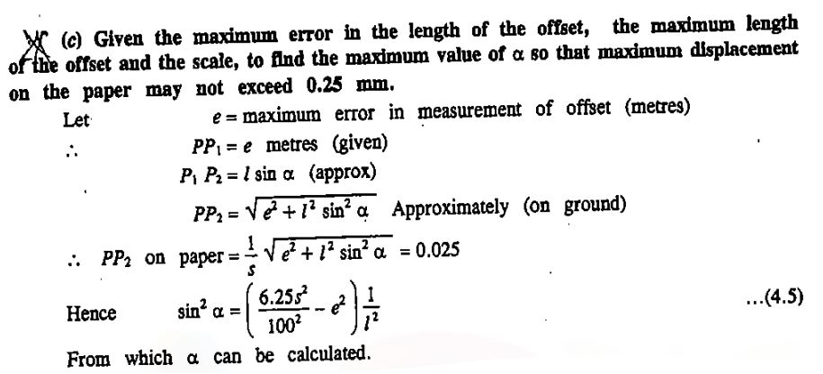
Chain Surveying
Limiting length of Offsets-

Slide 44
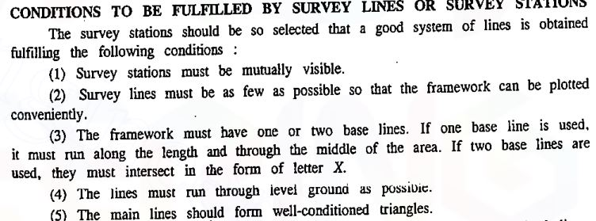
Chain Surveying

Slide 45
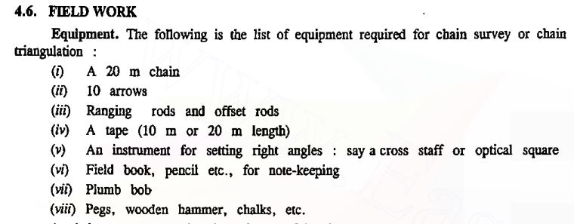
Chain Surveying

Slide 46
Chain Surveying
(Week 07)

Slide 47
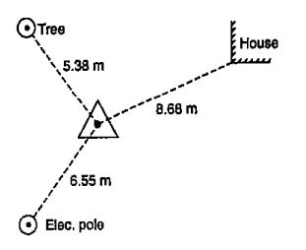
Chain Surveying
Chain Surveying can be done in the following steps:
Reconnaissance survey
Fixing stations
Running survey lines

Slide 48
Chain Surveying
Errors in Chaining: Errors arise in the following ways-
Faulty chain/tape length
Bad ranging
Careless holding & marking
Bad straightening
Sag in chain
Variation in temperature, pull
Personal mistakes

Slide 49
Chain Surveying
What is “Field Book ?”
The book in which field measurements are entered is termed as field book.
At the beginning of a particular chain survey, what details should be given in a field book?
Date of survey, name of surveyors
Sketch and details of survey lines
Page index of survey lines
Location sketches of survey lines.

Slide 50
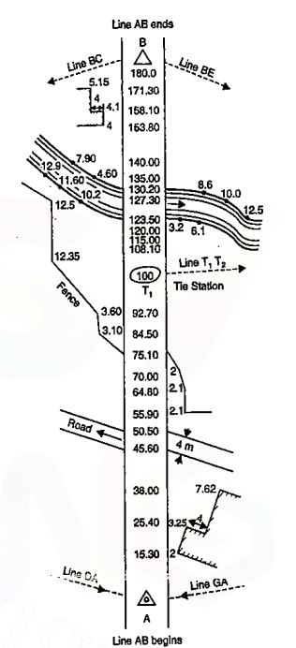
Chain Surveying
Field Book

Slide 51
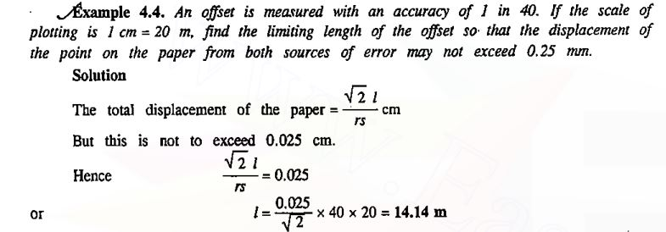
Chain Surveying

Slide 52
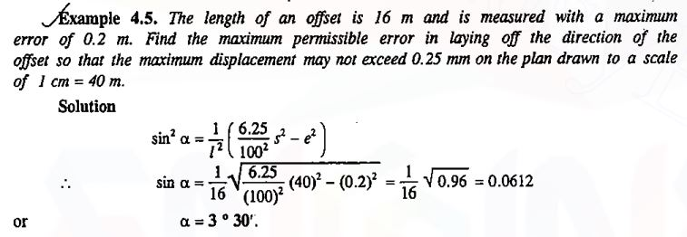
Chain Surveying

Slide 53
Compass Traversing
(Week 08)

Slide 54

Compass Traversing
Introduction

Slide 55
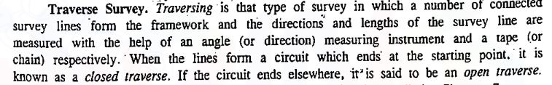
Compass Traversing
Introduction

Slide 56
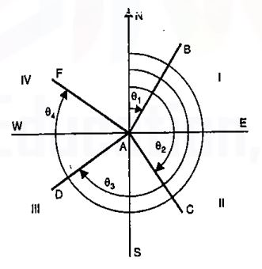
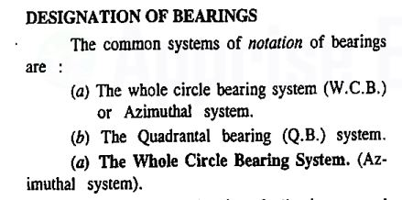
Compass Traversing
Designation of Bearings

Slide 57
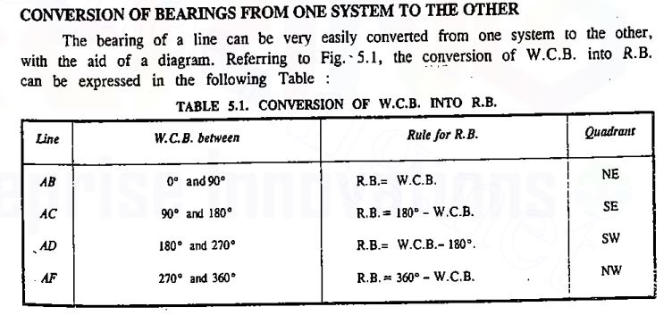
Compass Traversing
Conversion of Bearing from One System to the Other

Slide 58
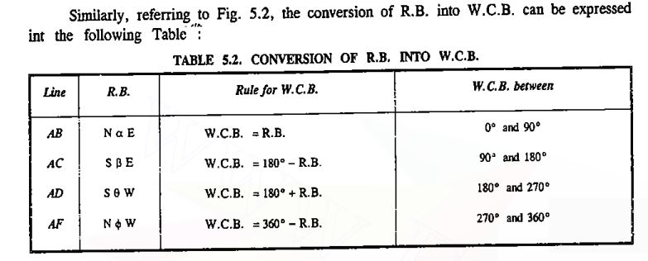
Compass Traversing
Conversion of Bearing from One System to the Other

Slide 59
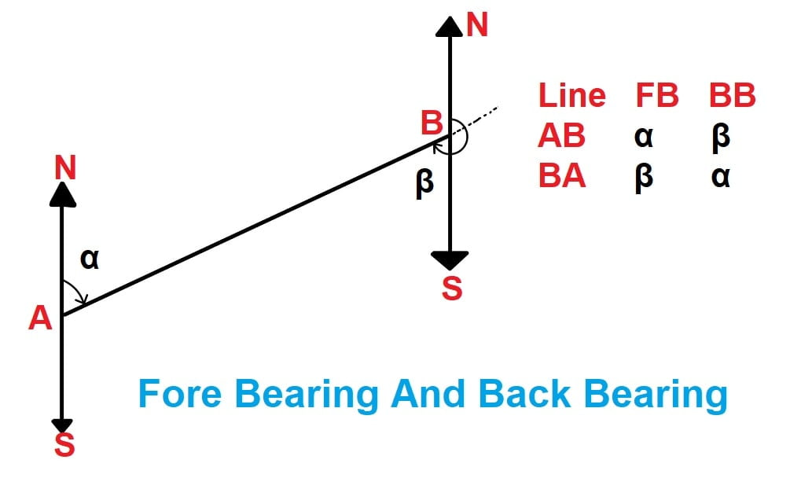
Compass Traversing
Fore and Back Bearing
Fore Bearing (FB) - Bearing measured in the direction of progress of the survey.
Back Bearing (BB) - Bearing measured opposite to the direction of survey.

Slide 60
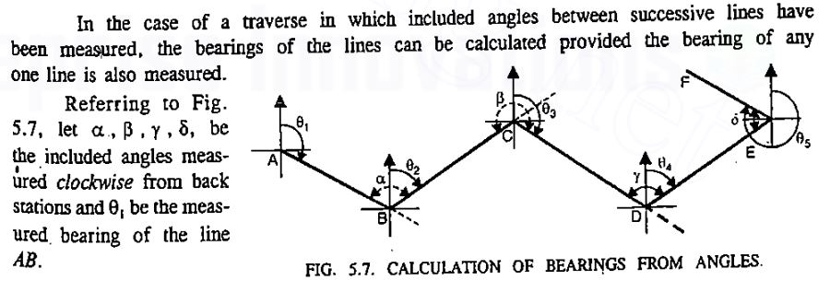
Compass Traversing
Calculation of Bearing from Angles

Slide 61
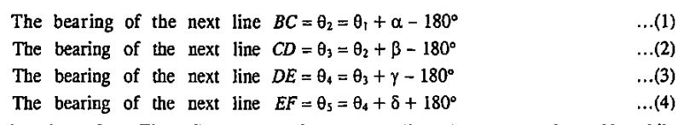
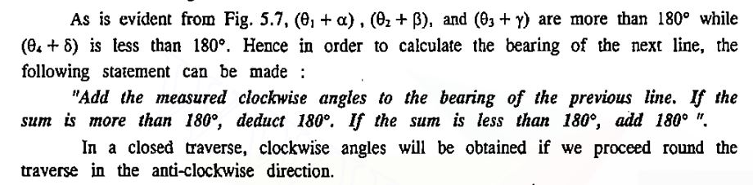
Compass Traversing
Calculation of Bearing from Angles

Slide 62
Compass Traversing
(Week 09)

Slide 63
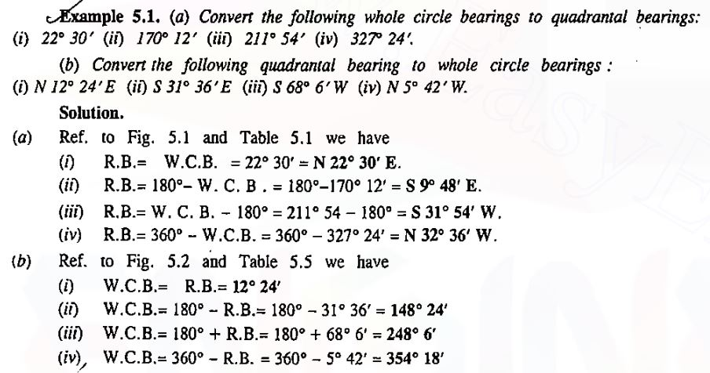
Compass Traversing
Mathematical Problems

Slide 64
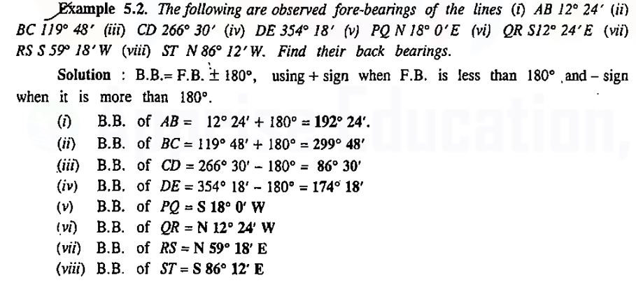
Compass Traversing
Mathematical Problems

Slide 65
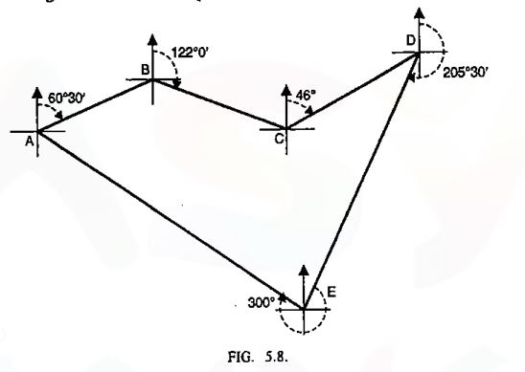
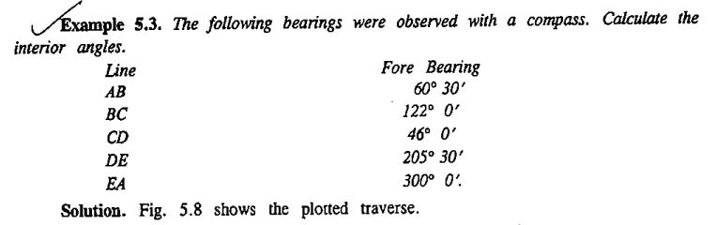
Compass Traversing
Mathematical Problems

Slide 66
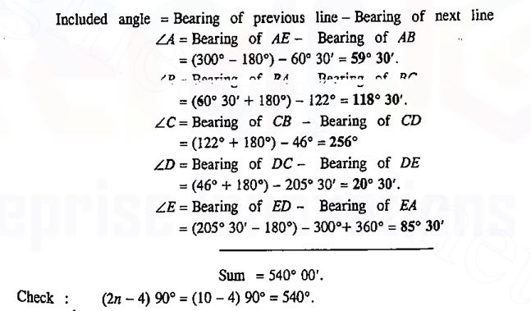
Compass Traversing
Mathematical Problems
Bearing of BA – Bearing of BC

Slide 67
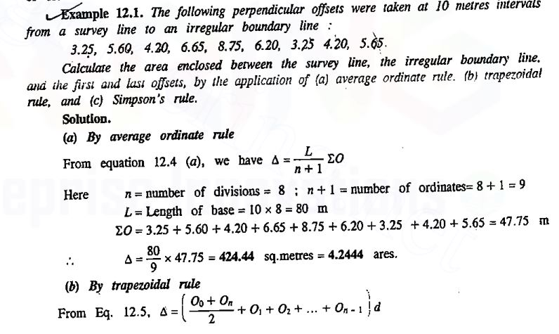
Calculation of Area

Slide 68

Calculation of Area

Slide 69

Calculation of Area

Slide 70
Calculation of Area

Slide 71
Calculation of Volume
(Week 10)

Slide 72


Calculation of Volume
Two Level Section:
Technique to understand - 2 slopes.
Formula for area -
b = the breadth of formation or sub-grade which is usually constant.
n:1 = the side slope (n horizontal to 1 vertical).
1 in m = the transverse slope of the original ground (1 vertical in m horizontal)
h = the height of earthwork (cutting or filling) on the centre line
h1 and h2 = the side heights.
W1 and W2 = the side-widths or half breadths i.e. the horizontal distances from the centre line to the intersections of the side slopes with the original surface.
A = the area of cross-section.
Volume, V=A x L

Slide 73

Calculation of Volume

Slide 74


Calculation of Volume
Prismoidal & Trapezoidal Formula:
(P)Volume,
(T) Volume,

Slide 75


Calculation of Volume

Slide 76
Introduction to GIS and GPS
(Week 11-12)

Slide 77


Slide 78


Slide 79


Slide 80


Slide 81


Slide 82


Slide 83


Slide 84


Slide 85


Slide 86


Slide 87


Slide 88


Slide 89


Slide 90


Slide 91


Slide 92


Slide 93


Slide 94


Slide 95


Slide 96


Slide 97


Slide 98


Slide 99


Slide 100


Slide 101
Introduction to Remote Sensing
(Week 13-14)

Slide 102


Slide 103


Slide 104


Slide 105


Slide 106


Slide 107


Slide 108


Slide 109


Slide 110


Slide 111


Slide 112


Slide 113


Slide 114


Slide 115


