Slide 1
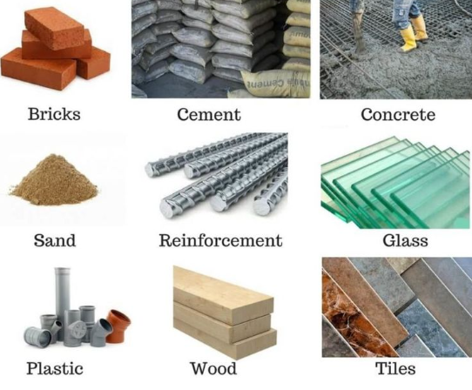

ENGINEERING MATERIALS-II
CE-0732-2105
Prepared By-
Oaisul Mostofa Karim
Lecturer
Dept. of Civil Engineering
University of Global Village (UGV), Barishal

Slide 2
ENGINEERING MATERIALS-II COURSE CODE: CE-0732-2105 CREDIT: 04 MID EXAMINATION: 2 HOURS CIE MARKS: 120 SEMESTER END EXAMINATION: 3 HOURS SEE MARKS: 80
Course Learning Outcomes (CLOs): After completing this course, students will be able to-
CLO 01 Understand the properties and applications of engineering materials.
CLO 02 Analyze stress-strain behavior of mild steel.
CLO 03 Gain knowledge of concrete, its properties, defects, and finishing materials.
CLO 04 Perform accurate concrete mix design calculations.

Slide 3
Sl. | Course Contents | Hours | CLOs
1. | Properties of Engineering materials, Stress-strain diagram for mild steel, Details of Concrete and it’s properties such as creep, laitance, segregation, bleeding. | 14 | CLO1
2. | Mortar, Properties, use, types, preparation of it, Precautions of using mortar, Plaster, objectives, types of it, Pointing, method and type of it, Paint Varnish, Distemper. | 12 | CLO2, CLO3
3. | Coating, Epoxy Coating, Mix-Design math calculation. | 04 | CLO4
REFERENCES
“ Building Construction” authored by S.C. Rangwala
“Building Construction” authored by Bindra and Aurora
“ Engineering Materials” authored by M.A. Aziz

Slide 4
Week | Topic | Teaching Learning Strategy | Assessment Strategy | CLOs | Page No.
01 | Properties of Engineering Materials | Lecture, Discussion | Mid, Final | CLO1 | 05-27
02-03 | Concrete and it’s Classifications | Lecture, Presentation | Mid, Final | CLO1 | 28-40
04 | Details of Concrete | Lecture, Discussion | Assignment, Mid, Final | CLO1 | 41-48
05-06 | Fresh and Harden Properties of Concrete | Lecture, Discussion | Assignment, Mid, Final | CLO1 | 49-59
07 | Defects in Concrete | Lecture, Discussion | Assignment, Class Test, Mid, Final | CLO2, CLO3 | 60-72
08-10 | Mortar, Plaster and Pointing | Lecture, Discussion | Problem solving, Class Test, Final | CLO2, CLO3 | 73-113
11-13 | Paint, Varnish, White Washing | Lecture, Presentation | Mid, Final | CLO2, CLO3 | 114-144
14-15 | Coating, Mix Design | Lecture, Discussion | Mid, Final | CLO4 | 145-164

Slide 5
ASSESSMENT PATTERN
CIE-Continuous Internal Evaluation (120 Marks)
Bloom’s Category Marks (out of 120) | Tests (60) | Assignments (20) | Quizzes (20) | External Participation in Curricular/Co-Curricular Activities (20)
Remember | 10 |  | 10 | Attendance 20
Understand | 10 |  | 10
Apply | 10
Analyze | 10
Evaluate | 10
Create | 10 | 20
SEE- Semester End Examination (80 Marks)
Bloom’s Category | Tests
Remember | 10
Understand | 15
Apply | 15
Analyze | 15
Evaluate | 15
Create | 10

Slide 6
Properties of Engineering Materials
(Week 1)

Slide 7
Properties of Engineering Materials
What is an Engineering Materials?
- Any material which is used on applied in engineering purposes is known as Engineering material.
Examples of Engineering materials
Metals
Ceramics
Polymers
Composites
Semiconductor
Biomaterial
Concrete etc

Slide 8
Examples of Civil Engineering materials
Bricks
Timber
Aggregate
Cement
Reinforcement (M.S Bar)
Concrete (sand + cement + khoa + water))
Paint
Glass
Tiles
Fittings ( water supply, sewage line Etc)

Slide 9
Basic properties of Engineering materials
Classification of Properties:
1.Physical Properties:
Are those properties of a material which can be observed and measured. Example :Size, Shape, Density, Porosity Etc.
2.Mechanical Properties:
Are those properties of a material which can be measured and compute by mechanical means. Example: Strength, Elasticity, plasticity, stiffness, Ductility, malleability, Hardness, Brittleness, etc
3.Chemical Properties:
Are those properties of a material which can be measured and observed by chemical means. Example : Corrosion resistance , Alkalinity , Acidity, Chemical composition Etc.
4.Electrical Properties:
Are those properties of a material which can be measured and compute by electrical means. Example : Conductivity, Dielectric permittivity, Dielectric strength etc.

Slide 10
5.Thermal Properties:
Are those properties of a material which can be measured and compute by thermal means. Example : Specific heat, Thermal Expansion Etc
Assignment
1. Difference between physical property and mechanical property?

Slide 11
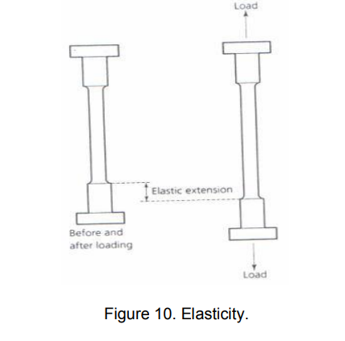
Details about different Mechanical Properties:
1.Elasticity: It is the ability of a material to deform under load and return to its original size and shape when the load is removed

Slide 12
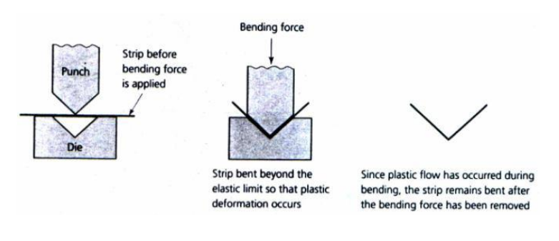
2.Plasticity:
It is the state of a material which has been loaded beyond its elastic limit so as to cause the material to deform permanently. Under such conditions the material takes a permanent set and will not return to its original size and shape when the load is removed.

Slide 13

3.Stress:
When a material is subjected to an external force, a resisting force is set up within the component. The internal resistance force per unit area acting on a material or intensity of the forces distributed over a given section is called the stress at a point.
σ = P/A

Slide 14
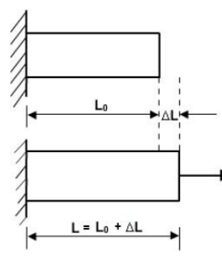
4.Strain
The displacement per unit length (dimensionless) is known as strain.
εt = ∆L/ Lo

Slide 15
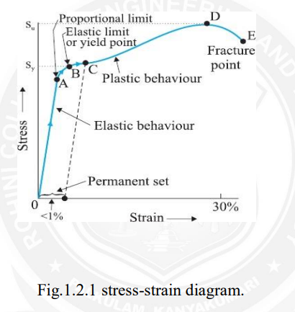

Slide 16
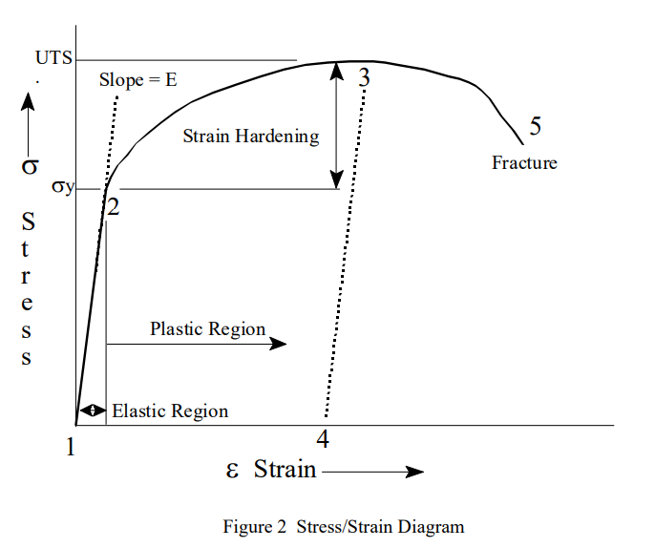

Slide 17
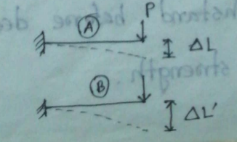
5.Stiffness
It is the measure of a material's ability not to deflect under an applied load. Example : Glass is stiffer material.

Slide 18
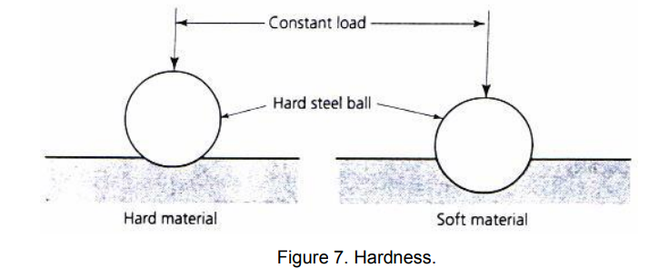
6.Hardness
It is the ability of a material to withstand scratching.

Slide 19
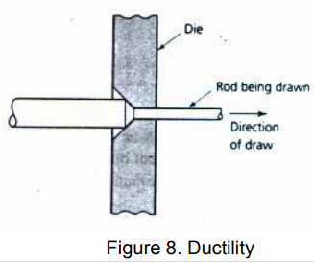
7.Ductility
It refer to the capacity of substance to undergo deformation under tension without rupture. Example: Mild steel , Bitumen

Slide 20
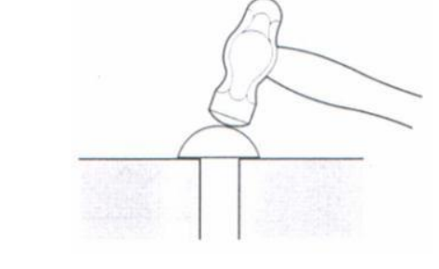
8.Malleability
Malleability of a material is its ability to be flattered into thin sheets without cracking by hot or cold working. Example: Mild steel , Gold

Slide 21
9.Brittleness
It is the property of a material that shows little or no plastic deformation before fracture when a force is applied. Example : Glass

Slide 22
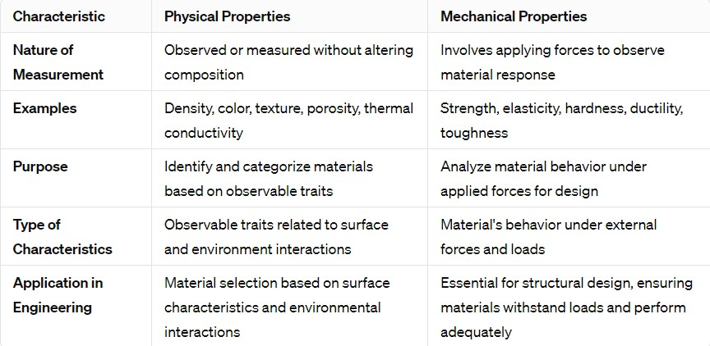
DIFFERENCE BETWEEN PHYSICAL and MECHANICAL PROPERTIES OF ENGINEERING MATERIAL

Slide 23
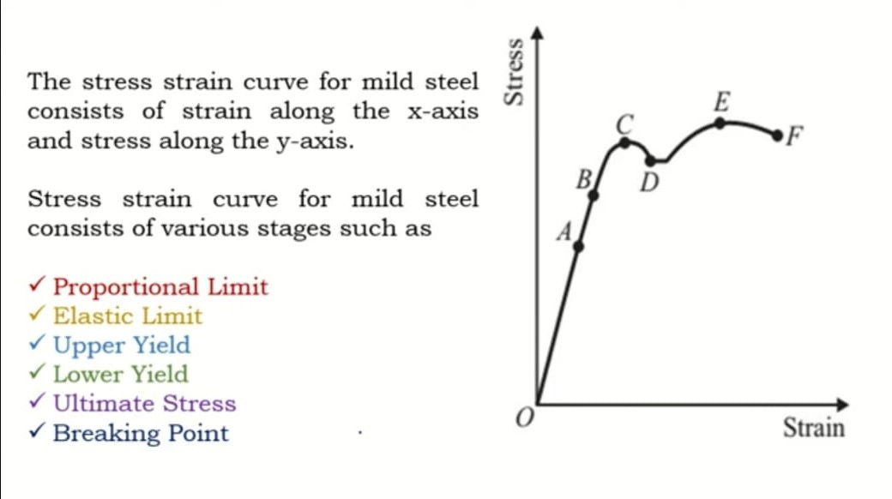
EXPLANATION of STRESS-SRAIN DIAGRAM

Slide 24
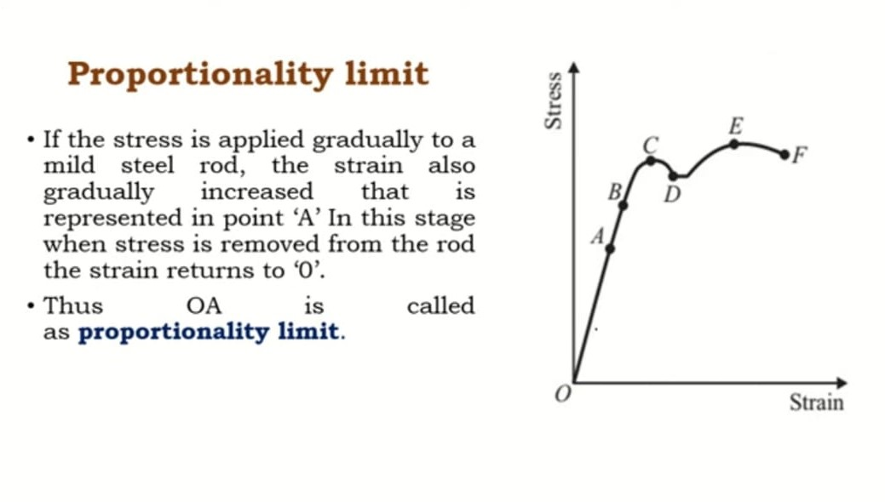

Slide 25
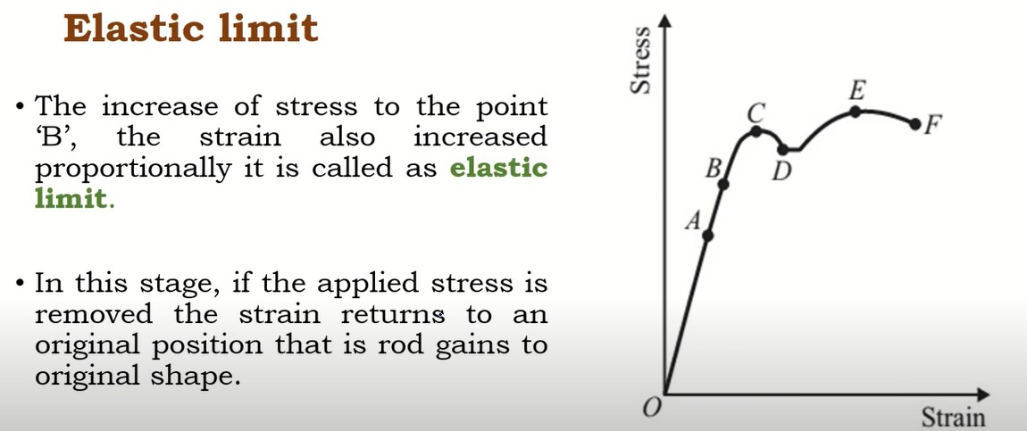

Slide 26
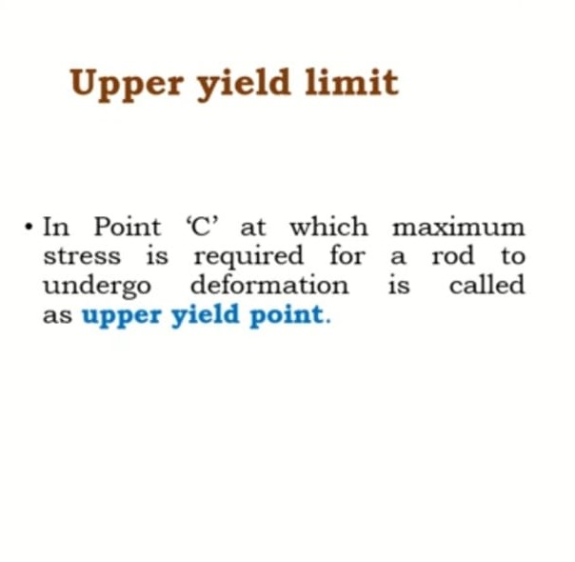
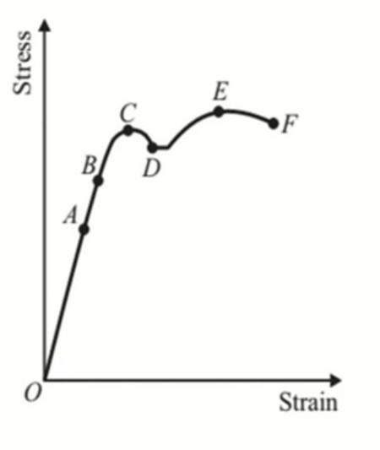
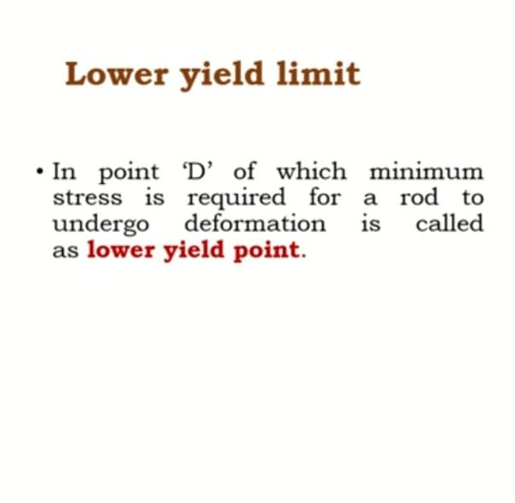

Slide 27
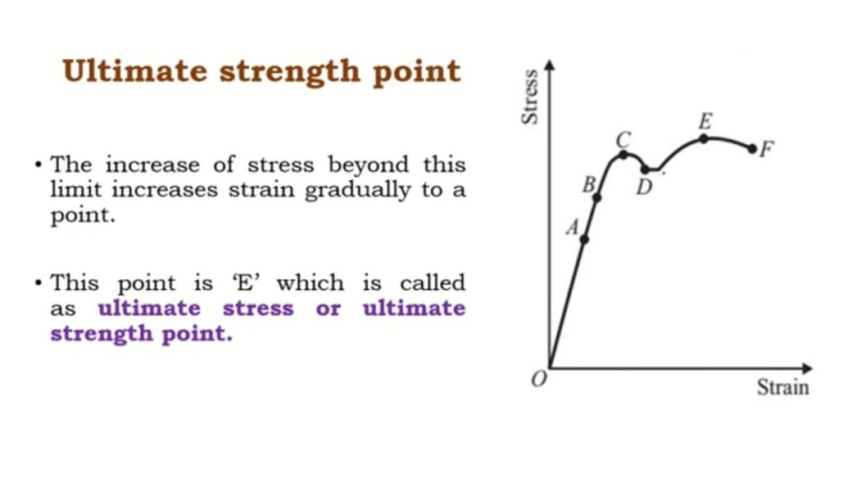

Slide 28
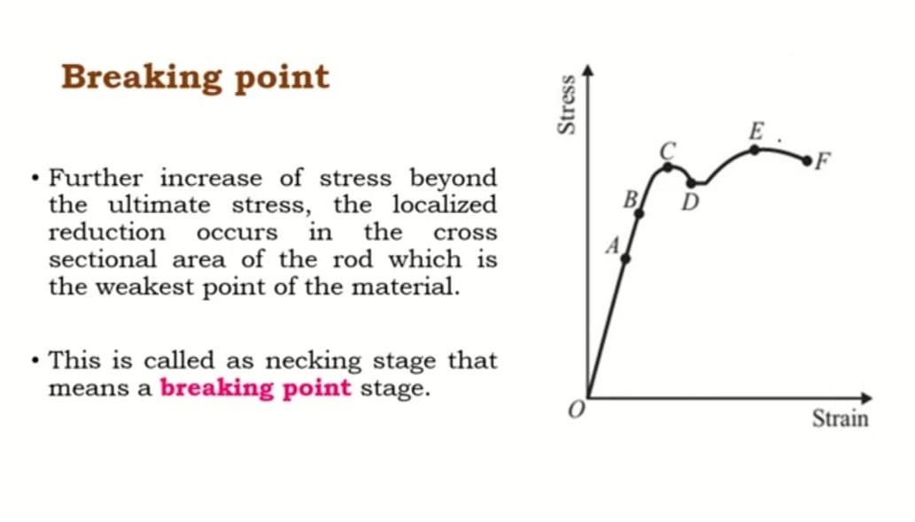

Slide 29
Concrete and It’s Classifications
(Week 02-03)

Slide 30
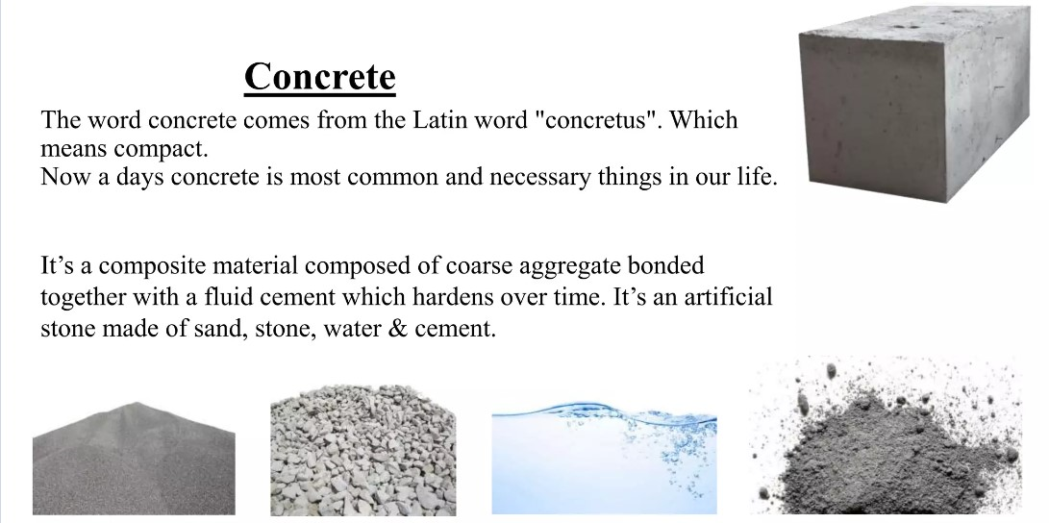

Slide 31
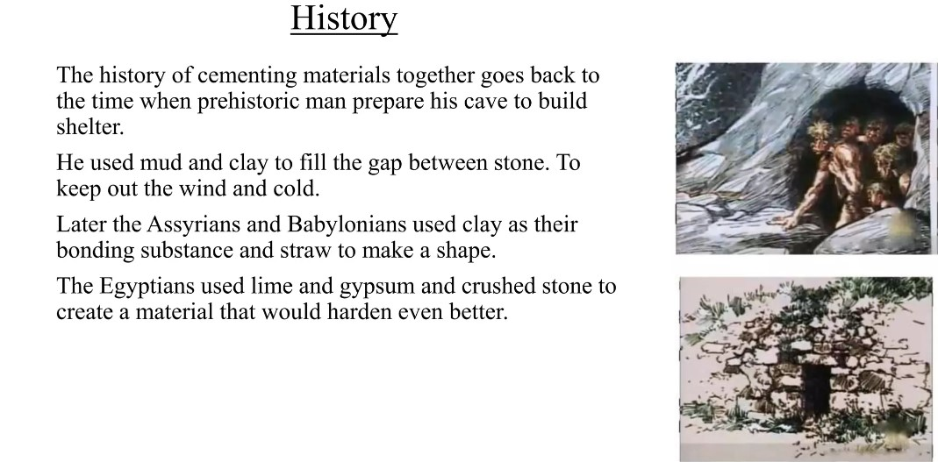

Slide 32
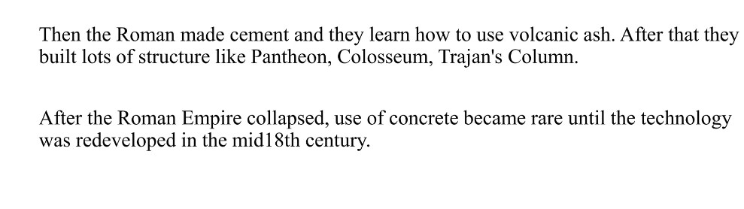
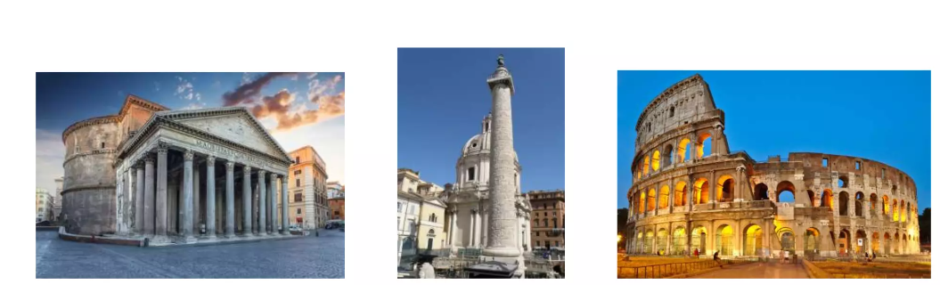

Slide 33
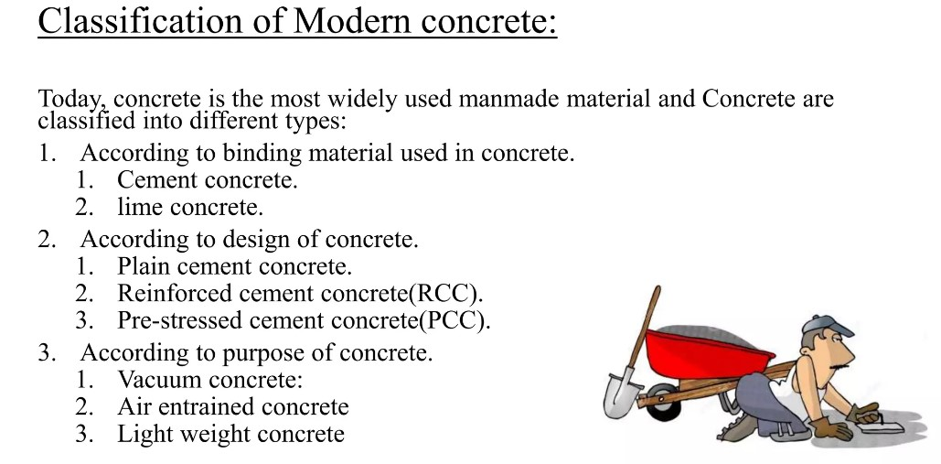

Slide 34

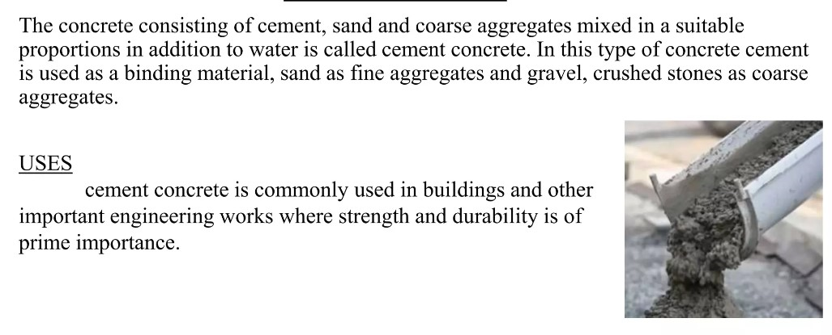

Slide 35
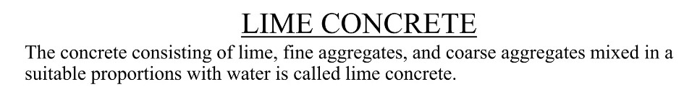
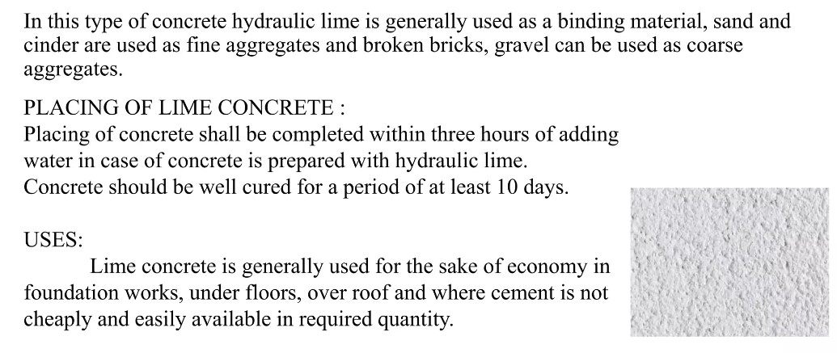

Slide 36
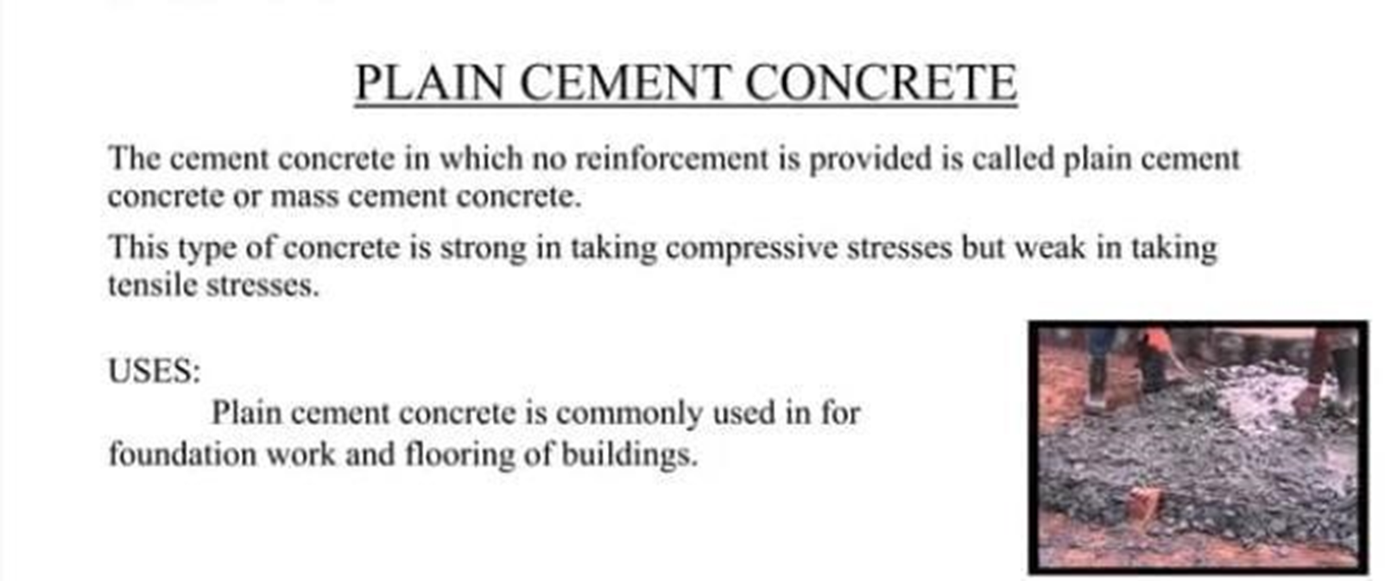
CLASSIFICATION ACCORDING TO DESIGN OF CONCRETE

Slide 37
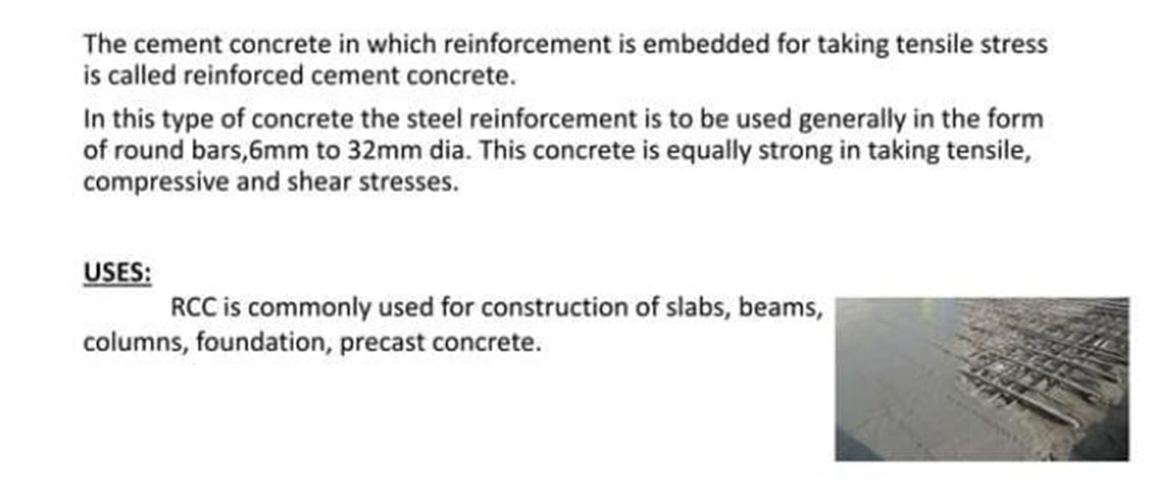
REINFORCED CEMENT CONCRETE

Slide 38
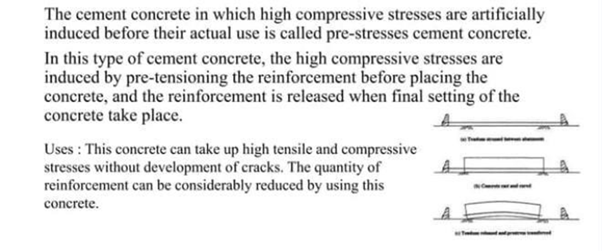
PRE-STRESSED CEMENT CONCRETE

Slide 39
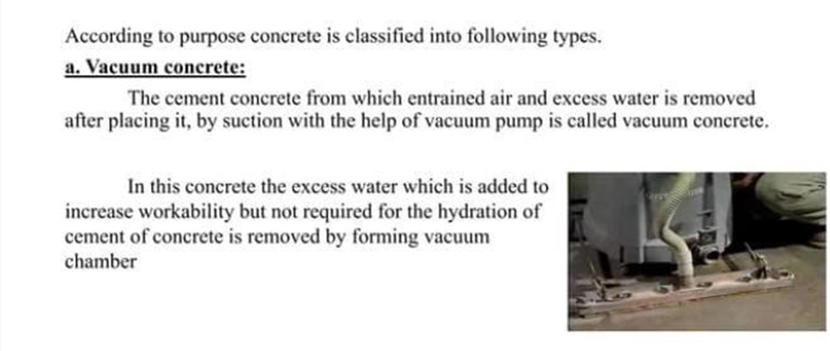
CLASSIFICATION ACCORDING TO PURPOSE

Slide 40
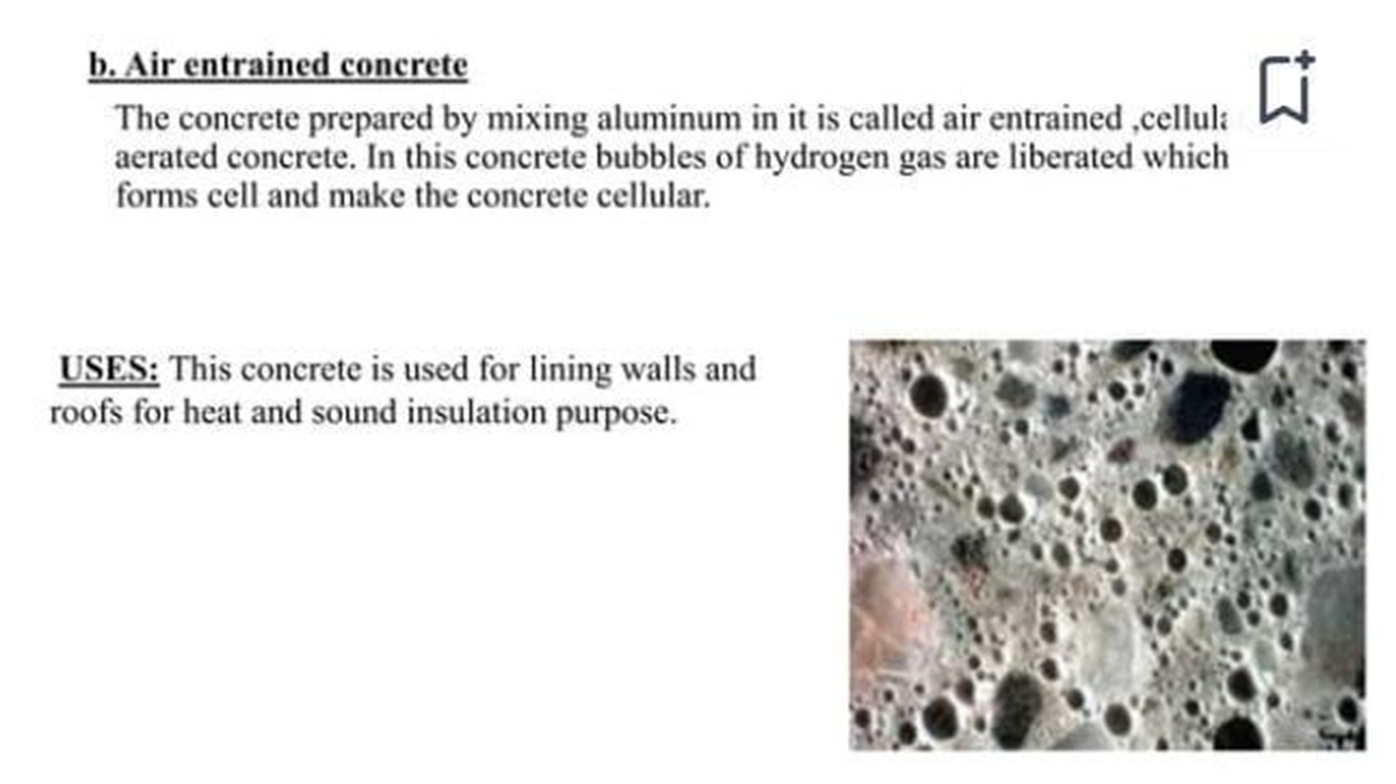

Slide 41
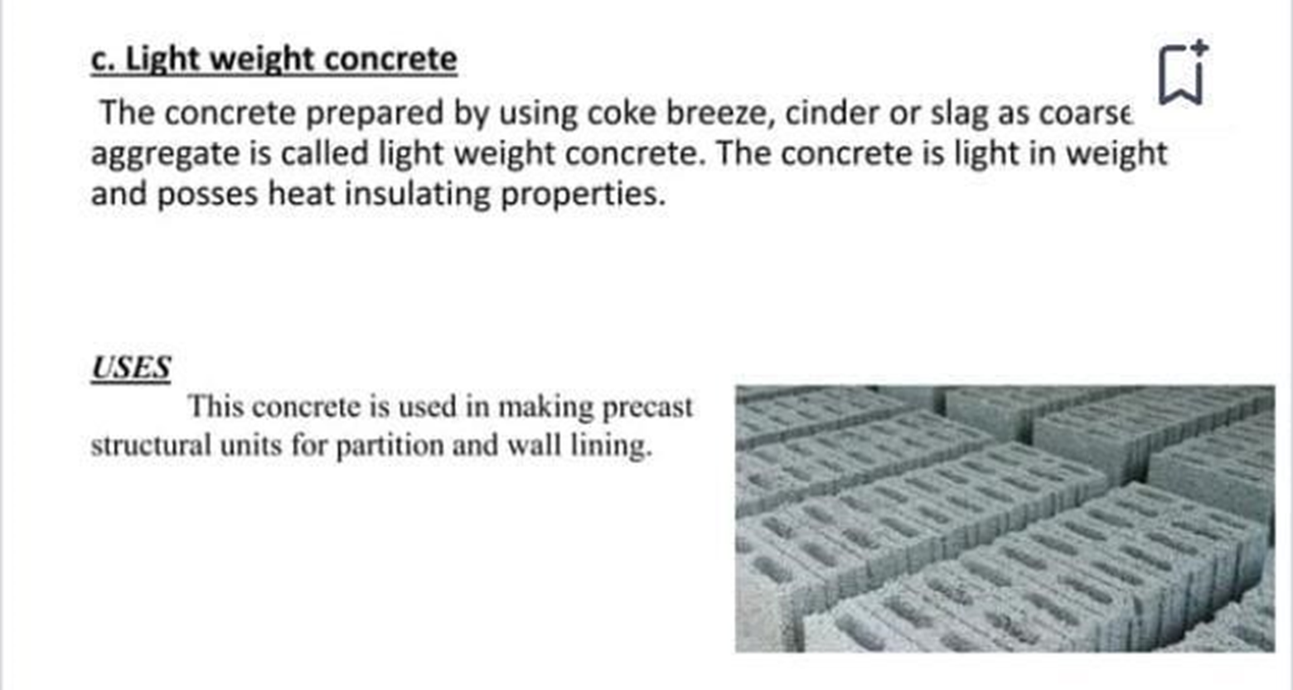

Slide 42
Details of Concrete
(Week 04)

Slide 43
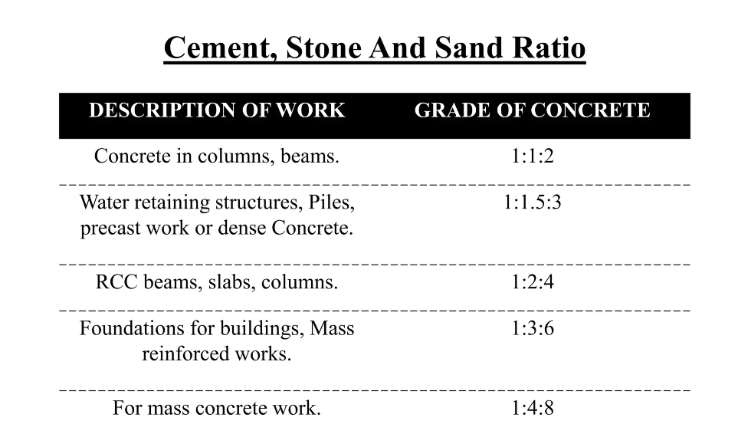

Slide 44
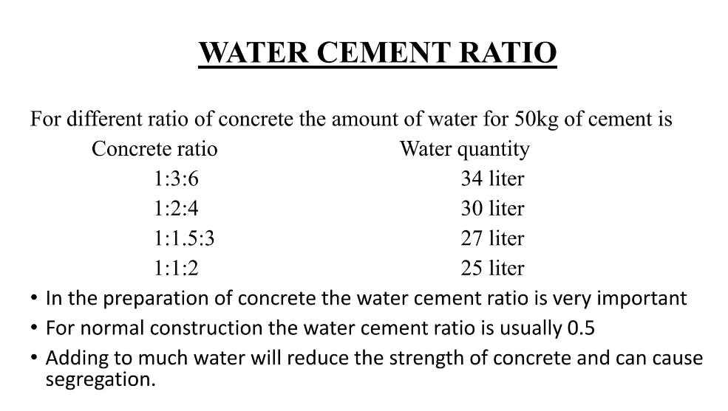

Slide 45
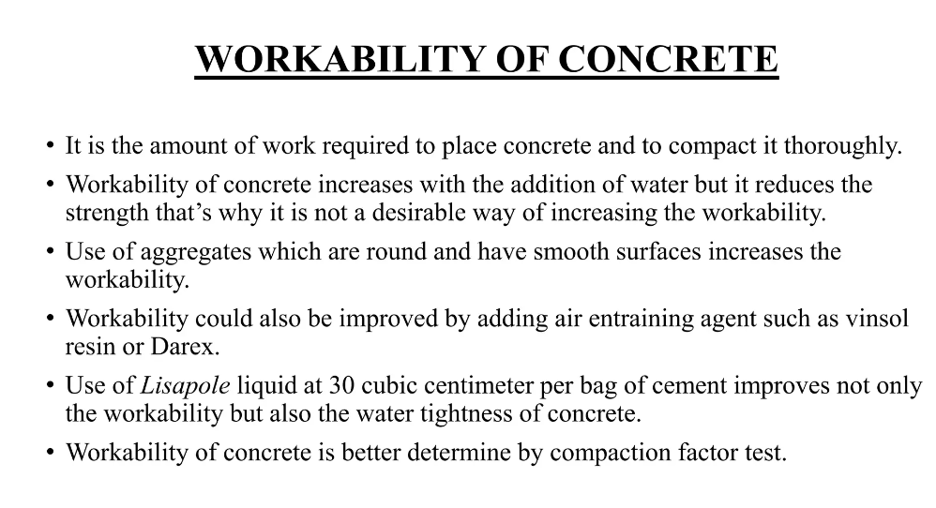

Slide 46
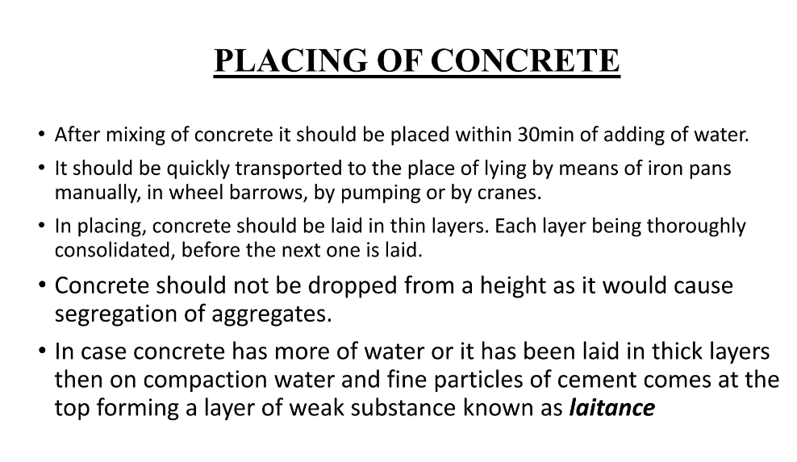

Slide 47
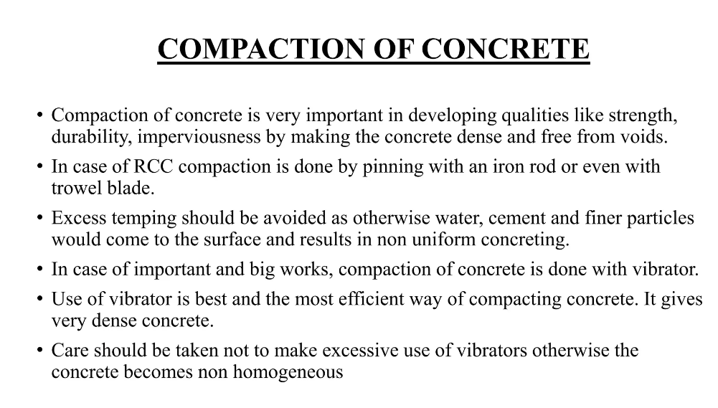

Slide 48
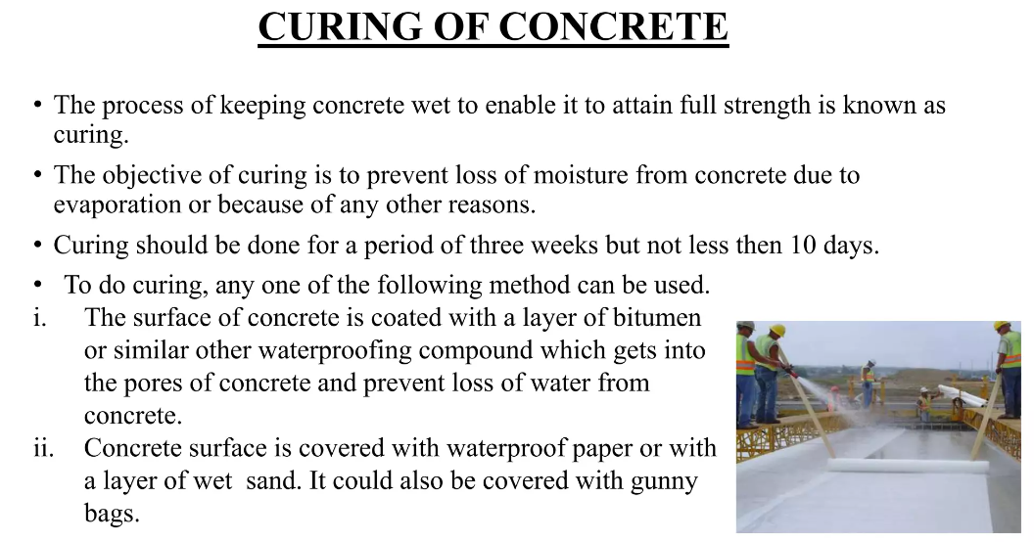

Slide 49
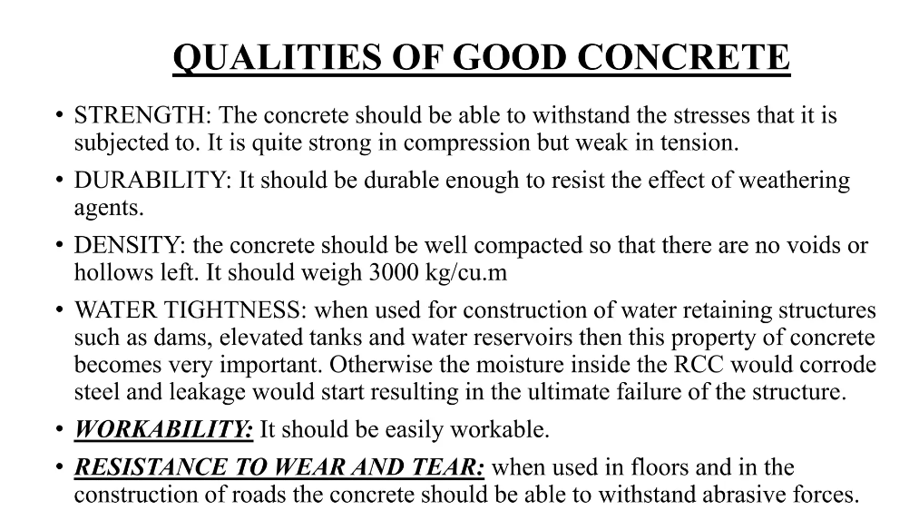

Slide 50
Fresh and Harden Properties of Concrete
(Week 05-06)

Slide 51
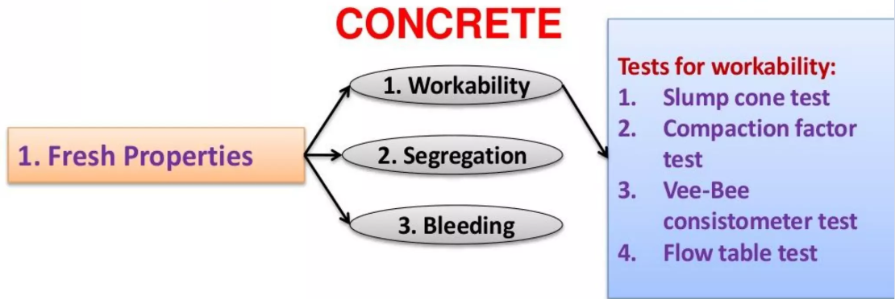
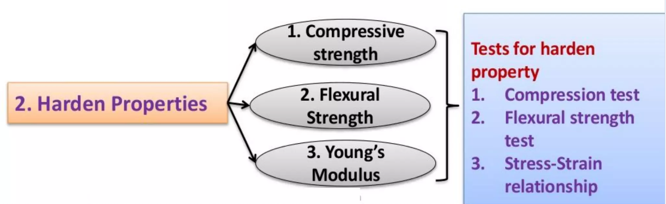

Slide 52
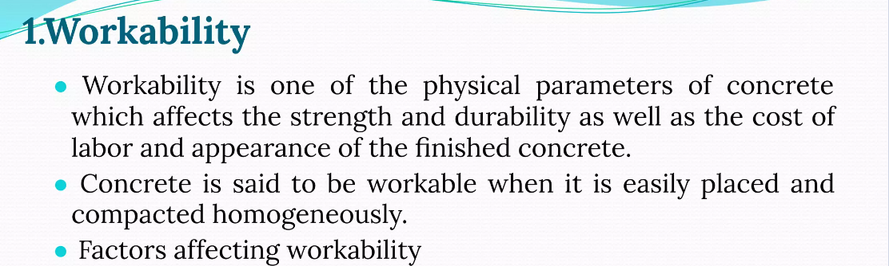
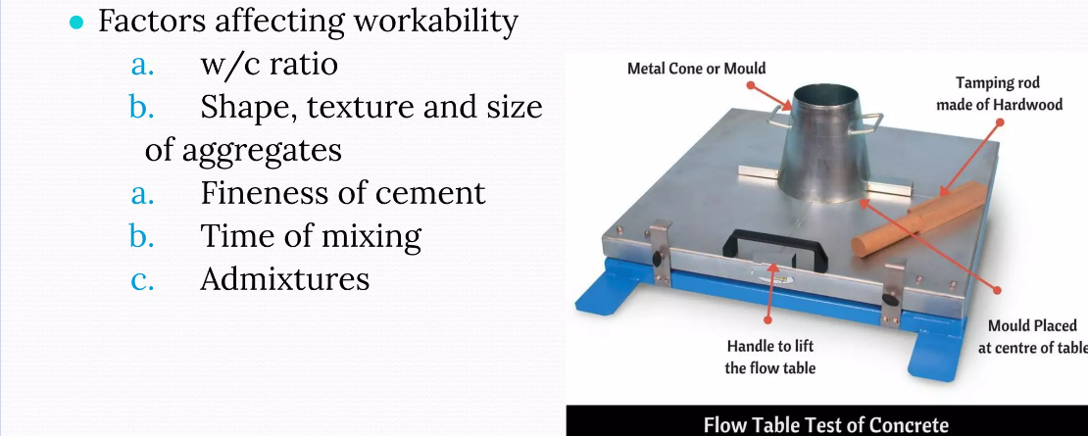

Slide 53
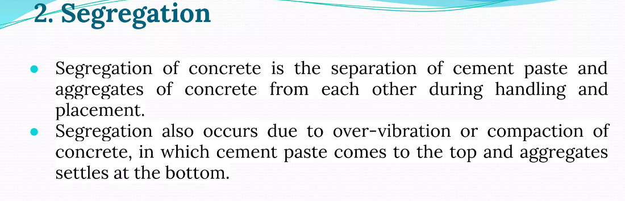
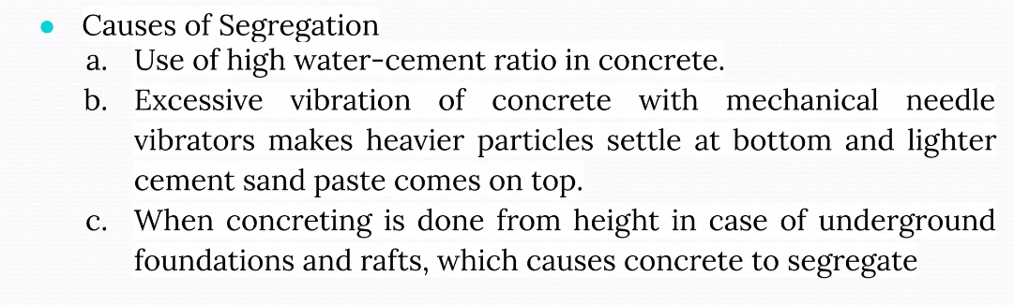

Slide 54
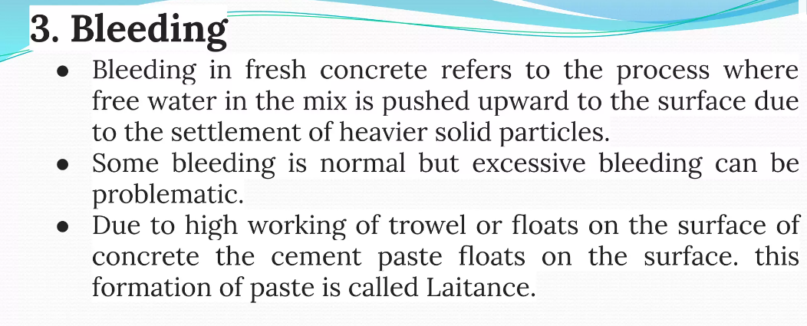
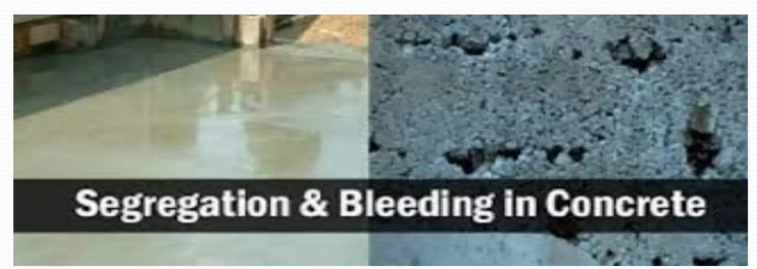

Slide 55
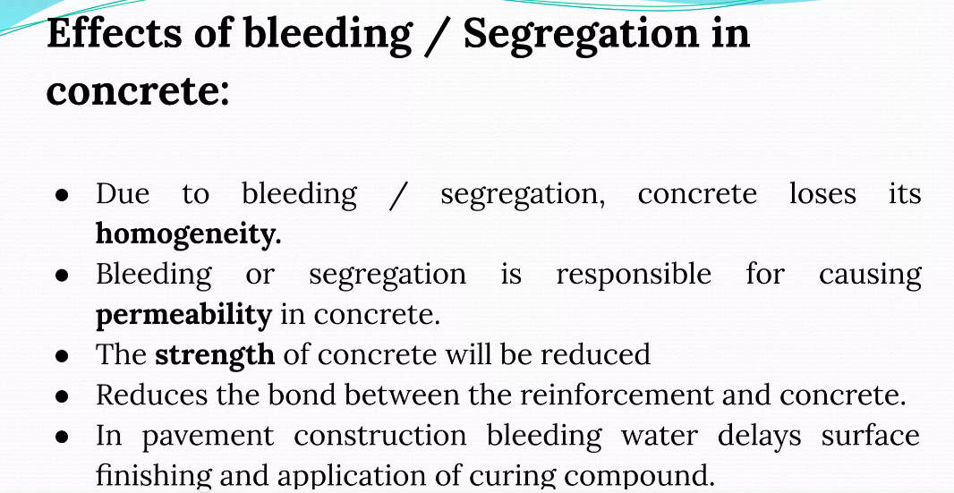
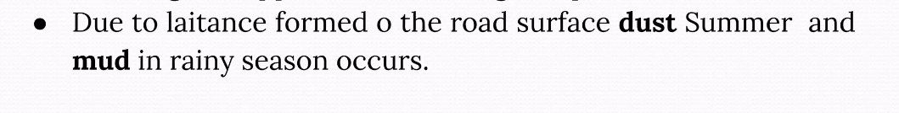

Slide 56


Slide 57


Slide 58



Slide 59



Slide 60



Slide 61
Defects in Concrete
(Week 07)

Slide 62


Slide 63


Slide 64


Slide 65


Slide 66



Slide 67


Slide 68



Slide 69


Slide 70


Slide 71


Slide 72


Slide 73


Slide 74
Mortar, Plaster, and Pointing
(Week 08-10)

Slide 75


Slide 76


Slide 77


Slide 78


Slide 79


Slide 80


Slide 81


Slide 82


Slide 83


Slide 84


Slide 85


Slide 86


Slide 87


Slide 88


Slide 89


Slide 90


Slide 91


Slide 92


Slide 93


Slide 94


Slide 95


Slide 96


Slide 97


Slide 98


Slide 99


Slide 100


Slide 101


Slide 102


Slide 103


Slide 104


Slide 105


Slide 106


Slide 107


Slide 108


Slide 109


Slide 110


Slide 111


Slide 112


Slide 113


Slide 114


Slide 115
Paint, Varnish, White Washing
(Week 11-13)

Slide 116


Slide 117


Slide 118


Slide 119


Slide 120


Slide 121


Slide 122


Slide 123


Slide 124


Slide 125


Slide 126


Slide 127


Slide 128


Slide 129


Slide 130


Slide 131


Slide 132


Slide 133


Slide 134


Slide 135


Slide 136


Slide 137


Slide 138


Slide 139


Slide 140


Slide 141


Slide 142


Slide 143


Slide 144


Slide 145


Slide 146
Coating and Mix Design
(Week 14-15)

Slide 147


Slide 148


Slide 149

EPOXY COATING
Epoxy coating is a protective substance that's applied to surfaces to protect them from corrosion, chemicals, and other damage. It's used in many industries, including construction, automotive, aerospace, and oil and gas.

Slide 150
USES OF EPOXY COATING
Flooring
Epoxy coating can be used to protect floors in factories, warehouses, schools, hospitals, and offices. It's also used in garages and basements.
Water protection
Epoxy coating can protect concrete and steel from water damage, including acid mist, organic acids, and corrosive chemicals. It can also be used in sewage and water treatment tanks.
Corrosion protection
Epoxy coating can protect steel and concrete structures from corrosion. It can also be used to protect aircraft, car bodies, and pipelines.
Paints
Epoxy coating can be used as a paint for floors and metals. It can be customized with patterns or textures.

Slide 151


Slide 152


Slide 153


Slide 154


Slide 155


Slide 156


Slide 157


Slide 158


Slide 159


Slide 160


Slide 161


Slide 162


Slide 163


Slide 164


Slide 165


Slide 166


