Slide 1
Multimedia Applications
Multimedia Applications University Student (UGV) Format
Course Code: CSE 317 | Credits: 01
Exam Hours: 03 | CIE Marks: 90
Course for 6th Semester, Bachelor of Science in Computer Science and Engineering (CSE) | SEE Marks: 60
Course Learning Outcome (CLO) at the end of the course, the students will be able to-
CLO1 | Understand the Basic Concepts of Multimedia Define multimedia and explain its components. Describe the history and evolution of multimedia. Identify various multimedia software tools and their uses.
CLO2 | Apply Multimedia Presentation and Production Techniques Create and manage multimedia presentations. Utilize data compression techniques for multimedia. Develop and share multimedia productions.
CLO3 | Handle Different Graphics/Image Data Types and File Formats Describe and differentiate various image data types. Use popular file formats for graphics and images.

Slide 2
Course Learning Outcome (CLO) at the end of the course, the students will be able to-
CLO4 | Apply Color Theory in Multimedia Applications Explain and utilize different color models. Perform color transformations and corrections.
CLO5 | Process and Compress Audio Understand the basics of sound and digitization. Apply audio filtering and compression techniques.
CLO6 | Implement Video Processing Techniques Understand and apply video compression standards and techniques.
CLO7 | Utilize Multimedia Networking Explain network layers and protocols relevant to multimedia. Address multimedia networking issues and solutions.

Slide 3
Course Summary:
Topic | Details | CLOs
Introduction to Multimedia | Overview of Multimedia and its significance Components of Multimedia Multimedia: Past and Present Multimedia Software Tools: A Quick Scan | CLO1
Multimedia Tasks and Concerns | Multimedia Presentation Data Compression Multimedia Production Multimedia Sharing and Distribution | CLO2
Graphics/Image Data Types | Types of Images: 1-Bit, 8-Bit Gray-Level, 24-Bit Color Image Data Types and Color Lookup Tables Popular File Formats: GIF, JPEG, PNG, TIFF | CLO3
Color Theory and Specifications | Color Models: RGB, CMY, CMYK, Lab* Transformations and Gamma Correction Color in Digital Devices | CLO4
Audio Processing | What is Sound? Digitization and Nyquist Theorem Signal-to-Noise Ratio (SNR) and Signal-to-Quantization-Noise Ratio (SQNR) Audio Filtering and Quality Versus Data Rate Synthetic Sounds and Quantization | CLO5

Slide 4
Course Summary:
Topic | Details | CLOs
Multimedia Compression and Transmission | Coding of Audio: Pulse Code Modulation and Differential Coding Huffman Coding and Adaptive Huffman Coding | CLO6
Video Processing | MPEG Standards: MPEG-1, MPEG-2, MPEG-4, MPEG-7 Video Compression Techniques Motion Compensation in MPEG | CLO7
Multimedia Networking | Network Layers: IP, TCP, UDP Network Address Translation and Firewall Characteristics of Wireless Channels | CLO7

Slide 5
Textbooks and other resources
Conducted Textbook | Reference Books
"Multimedia: Making It Work" by Tay Vaughan | Principles of Multimedia" by Ranjan Parekh
Faculty Note | 2. Fundamentals of Multimedia" by Ze-Nian Li and Mark S. Drew
Other Resources: Online Tutorials, YouTube, Simulation video, Animation video etc. W3Schools - Multimedia GeeksforGeeks - Multimedia Systems Programiz - Digital Multimedia YouTube - Multimedia Applications Playlist by Tech Guru YouTube - Multimedia Tutorials by Learn Engineering

Slide 6
CIE- Continuous Internal Evaluation (90 Marks)
Bloom's Category Marks (out of 90) | Tests (45) | Assignments (15) | Quizzes (15) | Attendance (15)
Remember | 5 | 03
Understand | 5 | 04 | 05
Apply | 15 | 05 | 05
Analyze | 10
Evaluate | 5 | 03 | 05
Create | 5
SEE- Semester End Examination (60 Marks)
Bloom's Category | Test
Remember | 7
Understand | 7
Apply | 20
Analyze | 15
Evaluate | 6
Create | 5

Slide 7
Course Plan
Class no | Week no | Topics | Teaching Learning strategy(s) | Assessment strategy(s) | Alignment to CLO
1 | 1 | Introduction to Multimedia Understand the significance and components of multimedia. | Interactive discussion, Lecture with aids, Group discussion | Feedback through Q&A, Practical setup exercises | CLO1
 |  | Components of Multimedia Identify and explain the components of multimedia. | Lecture, Group discussion, Practical exercises | Assessment of understanding and practical exercises | CLO1
2 | 2 | Multimedia: Past and Present Describe the history and evolution of multimedia. | Lecture with multimedia aids, Interactive discussion | Midterm Quiz #1, Assessment of historical knowledge | CLO1
 |  | Multimedia Software Tools: A Quick Scan Identify and use various multimedia software tools. | Lecture, Group discussion, Practical exercises | Midterm Quiz #1, Practical assessment | CLO1

Slide 8
Course Plan
Class no | Week no | Topics | Teaching Learning strategy(s) | Assessment strategy(s) | Alignment to CLO
3 | 3 | Multimedia Presentation Data Compression Create and manage multimedia presentations. Apply data compression techniques for multimedia. | Lecture, Interactive discussion, Practical exercises | Midterm Case Study #1, Home assignment #1 | CLO2
4 | 4 | Multimedia Production Graphics/Image Data Types Develop and share multimedia productions. Describe and differentiate various image data types. | Lecture, Interactive discussion, Practical exercises | Midterm Quiz #1, Production assessment | CLO2
 |  |  | Lecture, Group discussion, Practical exercises | Midterm Quiz #1, Practical assessment | CLO3
5 | 5 | Popular File Formats Color Theory: RGB, CMY, CMYK, Lab* Use popular file formats for graphics and images. Explain and utilize different color models. | Lecture, Interactive discussion, Practical exercises | Midterm Case Study #2, Home assignment #2 | CLO3
 |  |  | Lecture, Group discussion, Practical exercises | Midterm Quiz #2, Practical assessment | CLO4
6 | 6 | Color Transformations and Corrections What is Sound? Perform color transformations and corrections. Understand the basics of sound and digitization. | Lecture, Interactive discussion, Practical exercises | Practical assessment, Home assignment #2 | CLO4
 |  |  | Lecture, Group discussion, Practical exercises | Midterm Quiz #2, Practical assessment | CLO5

Slide 9
Course Plan
Class no | Week no | Topics | Teaching Learning strategy(s) | Assessment strategy(s) | Alignment to CLO
7 | 7 | Signal-to-Noise Ratio (SNR) and SQNR Audio Filtering and Compression Apply SNR and SQNR in audio processing. Apply audio filtering and compression techniques. | Lecture, Interactive discussion, Practical exercises | Practical assessment, Home assignment #4 | CLO5
 |  |  | Lecture, Group discussion, Practical exercises | Practical assessment, Midterm Case Study #3 | CLO5
8 | 8 | Synthetic Sounds and Quantization Understand synthetic sounds and quantization techniques. | Lecture, Interactive discussion, Practical exercises | Practical assessment, Home assignment #5 | CLO5
 | MID TERM EXAMINATION

Slide 10
Course Plan
Class no | Week no | Topics | Teaching Learning strategy(s) | Assessment strategy(s) | Alignment to CLO
9 | 9 | Coding of Audio: Pulse Code Modulation Implement pulse code modulation in audio coding. | Lecture, Group discussion, Practical exercises | Finalterm Quiz #1, Practical assessment | CLO6
10 | 10 | Differential Coding of Audio Huffman Coding and Adaptive Huffman Coding Apply differential coding techniques in audio. Implement Huffman and adaptive Huffman coding techniques. | Lecture, Interactive discussion, Practical exercises | Practical assessment, Home assignment #6 | CLO6
 |  |  | Lecture, Group discussion, Practical exercises | Midterm Case Study #4, Practical assessment | CLO6
11 | 11 | Introduction to MPEG Standards MPEG-1 and MPEG-2 Understand the basics of MPEG standards. Apply MPEG-1 and MPEG-2 video compression techniques. | Lecture, Interactive discussion, Practical exercises | Midterm Quiz #6, Practical assessment | CLO6
 |  |  | Lecture, Group discussion, Practical exercises | Practical assessment, Home assignment #7 | CLO6
12 | 12 | MPEG-4 and MPEG-7 Motion Compensation Techniques Understand and apply MPEG-4 and MPEG-7 standards. Apply motion compensation in video processing. | Lecture, Interactive discussion, Practical exercises | Practical assessment, Midterm Case Study #5 | CLO6
 |  |  | Lecture, Group discussion, Practical exercises | Practical assessment, Home assignment #8 | CLO6

Slide 11
Course Plan
Class no | Week no | Topics | Teaching Learning strategy(s) | Assessment strategy(s) | Alignment to CLO
13 | 13 | Multimedia Networking: IP, TCP, UDP Network Address Translation and Firewall Explain network layers and protocols relevant to multimedia. Address issues with network address translation and firewall. | Lecture, Interactive discussion, Practical exercises | Finalterm Quiz #2, Practical assessment | CLO7
 |  |  | Lecture, Group discussion, Practical exercises | Practical assessment, Home assignment #9 | CLO7
14 | 14 | Characteristics of Wireless Channels Path Loss and Multipath Fading Understand the characteristics of wireless channels. Address path loss and multipath fading in wireless communication. | Lecture, Interactive discussion, Practical exercises | Midterm Case Study #6, Practical assessment | CLO7
 |  |  | Lecture, Group discussion, Practical exercises | Practical assessment, Home assignment #10 | CLO7
15 | 15 | Practical Session: Multimedia Tools and Techniques Practical Session: Audio and Video Processing Apply multimedia tools and techniques in practical scenarios. Implement audio and video processing techniques in practical scenarios. | Practical exercises, Group projects | Practical assessment, Group project evaluation | CLO2, CLO3
 |  |  | Practical exercises, Group projects | Practical assessment, Group project evaluation | CLO5, CLO6

Slide 12
Course Plan
Class no | Week no | Topics | Teaching Learning strategy(s) | Assessment strategy(s) | Alignment to CLO
16 | 16 | Practical Session: Multimedia Networking Final Project Presentations and Review Address multimedia networking issues in practical scenarios. Present and review final multimedia projects. | Practical exercises, Group projects | Practical assessment, Group project evaluation | CLO7
17 | 17 | Present and review final multimedia projects | Group project presentations, Peer review | Final project evaluation, Peer review | CLO1 to CLO7
 | Final TERM EXAMINATION

Slide 13

Dept. of Computer Science and Engineering
Course Code: CSE-317
Course Name: Multimedia Applications
Instructor: Mohammad Rony
Lecturer, Dept. of CSE
University Of Global Village (UGV), Barishal

Slide 14
Week: 01
Introduction to Multimedia
Understand the significance and components of multimedia.
Components of Multimedia
Identify and explain the components of multimedia.

Slide 15

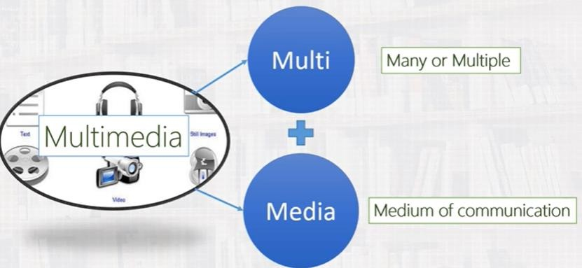
INTRODUCTION

Slide 16
THE TERM MEDIA
As with most generic words, the meaning of the word media varies with the context in which it is used. Our definition of medium is “A means to distribute and represent information.” Media are, for example, text, graphics, pictures, voice, sound, and music.

Slide 17

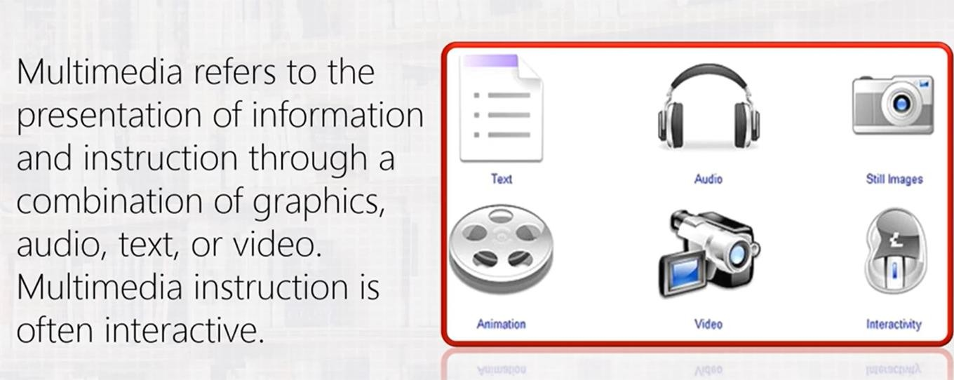
MULTIMEDIA

Slide 18
TYPES OF MEDIA
Media
Perception
Representation media
Presentation
media
Storage
Media
Transmission
Media
Information
media
exchange
How do humans perceive information?
How is information encoded in the computer?
Which medium is used to output information from the computer or input in the computer?
Where is information stored?
Which medium is used to transmit data?
Which data medium is used to exchange information betwee different locations?

Slide 19
Perception media
Perception media refers to the nature of information perceived by humans.
For example, a still image and a movie convey information of a different nature, though stimulating the same sense.
We distinguish primarily between what we see and what we hear. Auditory media include music, sound, and voice. Visual media include text, graphics, and still and moving pictures.

Slide 20
Representation media
The term representation media refers to how information is represented internally to the computer. The encoding used is of essential importance.
Each character of a piece of text is encoded in ascii.
An audio data stream is available in simple pcm encoding and a linear quantize
A single image is encoded as group-3 facsimile or in JPEG format

Slide 21
PRESENTATION MEDIA
The term presentation media refers to the physical means used by systems to reproduce information for humans. For example, a TV set uses a cathode-ray tube and loudspeaker.
We distinguish primarily between output and input. Media such as paper, computer monitors, and loudspeakers are output media, while keyboards, cameras, and microphones are input media.

Slide 22
STORAGE MEDIA
The term storage media is often used in computing to refer to various physical means for storing computer data, such as magnetic tapes, magnetic disks, or digital optical disks. However, data storage is not limited to the components available in a computer, which means that paper is also considered a storage medium.

Slide 23
TRANSMISSION MEDIA
The term transmission media refers to the physical means-cables of various types, radio tower, satellite, or ether (the medium that transmit radio waves)-that allow the transmission of telecommunication signals.

Slide 24
INFORMATION EXCHANGE MEDIA
Information exchange media include all data media used to transport information,
e.G., All storage and transmission media.
For example, information can be exchanged by storing it on a removable medium and transporting the medium from one location to another. These storage media include microfilms, paper, and floppy disks. Information can also be exchanged directly, if transmission media such as coaxial cables, optical fibers, or radio waves are used.

Slide 25
PRESENTATION SPACE
Paper or computer monitors are examples of visual presentation spaces.
A computer-controlled slide show that projects a screen’s content over the entire projection screen is a visual presentation space. Stereophony and quadrophony define acoustic presentation spaces.
Presentation spaces are part of the above-described presentation media used to output information

Slide 26
PRESENTATION VALUES
Representation values are the actual information representation of a media.
Text is a medium that represents a sentence visually as a sequence of characters.
Voice is a medium that represents information acoustically in the form of pressure waves.
In some media, the presentation values cannot be interpreted correctly by humans.
Examples include temperature, taste, and smell.
Other media require a predefined set of symbols we have to learn to be able to
understand this information. This class includes text, voice, and gestures.

Slide 27
PRESENTATION VALUES
Present ation Values
Continuum value
Discrete value
Fluctuations in pressure waves: acoustic signals
Electromagnetic waves
Characters of a piece of text sampling values of an audio signal

Slide 28
PRESENTATION DIMENSIONS
Each presentation space has one or more presentation dimensions.
Media are classified in two categories with regard to the time dimensions of their presentation space:
Text, graphics, and pictures are called discrete media, as they are composed of time-independent information items.
  Indeed, they may be displayed according to a wide variety of timing or even sequencing, and still remain meaningful. We say that time is not part of the semantics of discrete media.

Slide 29
2. Continuous media refers to sound or motion video, where the presentation requires a continuous playout as time passes.
In other words, time, or more exactly time-dependency between information items, is part of the information itself.
If the timing is changed, or the sequencing of the items modified, the meaning is altered. We say that time is part of the semantics of continuous media. Continuous media are also called time-dependent.

Slide 30
KEY PROPERTIES OF A MULTIMEDIA SYSTEM
Multimedia systems involve several fundamental notions.
They must be computer-controlled. Thus, a computer must be involved at least in the presentation of the information to the user. They are integrated, that is, they use a minimal number of different devices.
The use of a single computer screen to display all types of visual information. They must support media independence.
And lastly, they need to handle discrete and continuous media.

Slide 31
DISCRETE AND CONTINUOUS MEDIA
Not just any arbitrary combination of media deserves the name multimedia.
Many people call a simple word processor that handles embedded graphics a multimedia application because it uses two media.
By our definition, we talk about multimedia if the application uses both discrete and continuous media. This means that a multimedia application should process at least one discrete and one continuous medium. A word processor with embedded graphics is not a multimedia application by our definition.

Slide 32
INDEPENDENT MEDIA
An important aspect is that the media used in a multimedia system should be independent. Although a computer-controlled video recorder handles audio and moving image information, there is a temporal dependence between the audio part and the video part. In contrast, a system that combines signals recorded on a DAT (digital audio tape) recorder with some text stored in a computer to create a presentation meets the independence criterion. Other examples are combined text and graphics blocks, which can be in an arbitrary space arrangement in relation to one another.

Slide 33
COMPUTER-CONTROLLED SYSTEMS
The independence of media creates a way to combine media in an arbitrary form for presentation. For this purpose, the computer is the ideal tool. That is, we need a system capable of processing media in a computer-controlled way. The system can be optionally programmed by a system programmer and/or by a user (within certain limits). The simple recording or playout of various media in a system, such as a video recorder, is not sufficient to meet the computer-control criterion.

Slide 34
INTEGRATION
Computer-controlled independent media streams can be integrated to form a global system so that, together, they provide a certain function. To this end, synchronic relationships of time, space, and content are created between them. A word processor that supports text, spreadsheets, and graphics does not meet the integration criterion unless it allows program-supported references between the data. We achieve a high degree of integration only if the application is capable of, for example, updating graphics and text elements automatically as soon as the contents of the related spreadsheet cell changes.

Slide 35
Such systems should allow us to do with moving images and sound what we can do
with text and graphics
While conventional systems can send a text message to another user, a highly integrated multimedia system provides this function and support for voice messages or a voice-text combination.

Slide 36
Week: 02
Multimedia: Past and Present
Describe the history and evolution of multimedia.
Multimedia Software Tools: A Quick Scan
Identify and use various multimedia software tools.

Slide 37
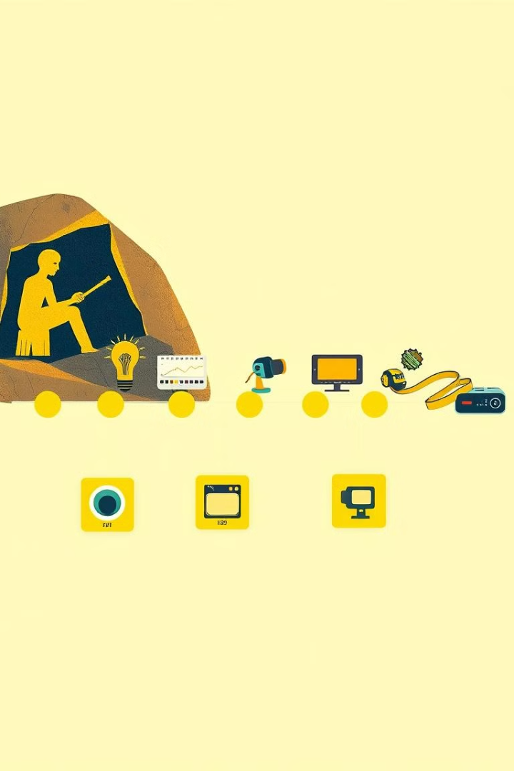
Multimedia: A Journey Through Time
This presentation explores the fascinating history of multimedia, from its humble beginnings to its ever-evolving future.
MR
by Mohammad Rony

Slide 38

Evolution of Multimedia
Early Forms
The Digital Revolution
Cave paintings, ancient storytelling, and early printing presses laid the groundwork for multimedia.
Personal computers, internet, and digital media ushered in a new era of multimedia.
1
2
3
4
Emergence of Film and Sound
Interactive Experiences
The invention of film and phonograph marked a significant shift, merging visual and audio elements.
The focus shifted towards interactive multimedia, with technologies like VR and AR becoming integral.

Slide 39
Multimedia Before the Digital Age
Cave Paintings
Ancient Storytelling
Printing Press
Cave paintings combined visual imagery and storytelling, representing the earliest forms of multimedia.
Storytelling traditions often incorporated music, dance, and dramatic elements, creating a rich multimedia experience.
The printing press revolutionized information sharing, combining text and images, a foundational step in multimedia.

Slide 40




Multimedia in the Digital Era
Personal Computers
1
Computers enabled the creation and manipulation of digital images, audio, and video.
Internet
2
The internet facilitated the global distribution and sharing of multimedia content.
Digital Media Formats
3
Multimedia formats like MP3, JPG, and AVI became widely adopted.
Interactive Multimedia
4
The rise of interactive media, including websites, games, and simulations, redefined multimedia experiences.

Slide 41

Multimedia Software Tools Overview
Image Editing
Video Editing
Tools like Adobe Photoshop and GIMP are used for creating, editing, and manipulating images.
Software like Adobe Premiere Pro and Final Cut Pro allow for professional video editing and post-production.
Audio Editing
Presentation Software
Tools such as Audacity and GarageBand enable recording, editing, and mixing audio files.
Programs like PowerPoint and Keynote are used for creating dynamic multimedia presentations.

Slide 42
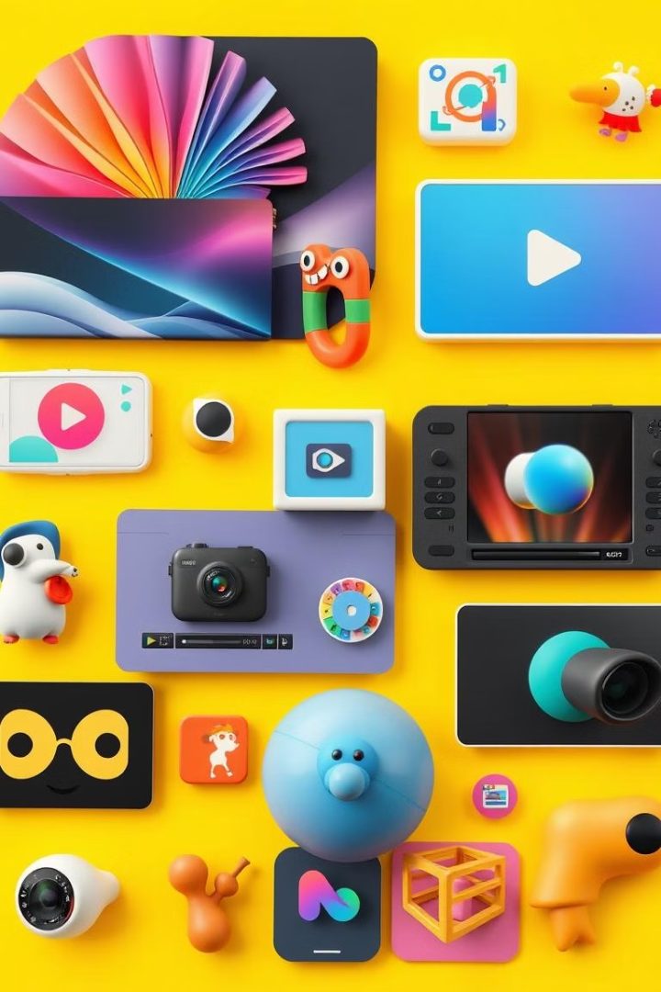




Popular Multimedia Software Tools
Adobe Creative Cloud
Apple Final Cut Pro
Adobe Creative Cloud offers a comprehensive suite of multimedia software for professionals.
A powerful video editing tool renowned for its user-friendly interface and advanced features.
Blender
Canva
A free and open-source 3D creation suite used for animation, modeling, and rendering.
A user-friendly design platform for creating graphics, presentations, and social media content.

Slide 43
Hands-on with Multimedia Software
Step 1: Choose Your Tools
1
Select the software tools that best suit your needs and skill level.
Step 2: Experiment with Features
2
Explore the various features and functionalities of your chosen software.
Step 3: Create Your First Project
3
Start with a simple project, such as editing an image or creating a short video.
Step 4: Refine and Improve
4
Practice and continue to learn, building your multimedia skills over time.

Slide 44

Trends and Future of Multimedia
1
2
Immersive Experiences
AI-powered Tools
Virtual reality and augmented reality will continue to transform multimedia experiences.
Artificial intelligence will automate and enhance multimedia creation and editing processes.
3
4
Personalized Content
Ethical Considerations
Multimedia content will become more personalized and tailored to individual preferences.
Ethical considerations regarding data privacy, accessibility, and responsible use will become increasingly important.

Slide 45
Week: 03
Data Compression
Create and manage multimedia presentations.
Apply data compression techniques for multimedia.

Slide 46
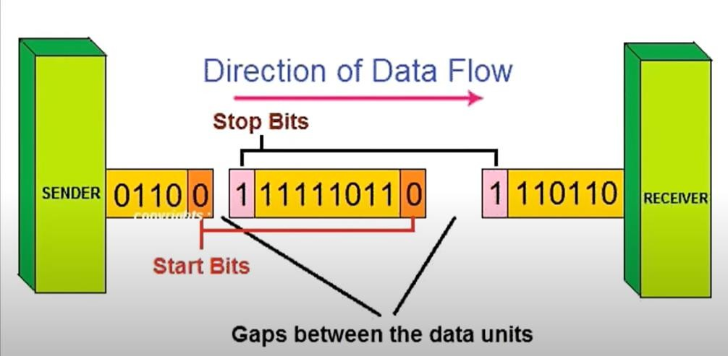
Asynchronous data transmission

Slide 47
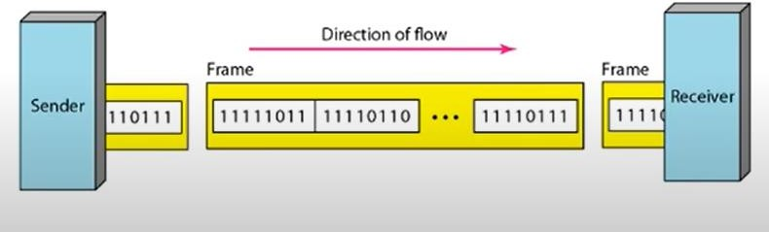
Synchronous data transmission

Slide 48
Compression
Compression is a process that creates a compact data representation for storage and transmission purposes.
Image compression methods rely upon the removal of information within images to reduce the amount of data necessary to represent them.
The information to be removed is usually characterized as one of two classes: statistically redundant or visually irrelevant.
Multimedia computer systems have opened the wide range of potential applications by combining a variety of information sources, such as voice, graphics, animation, images, audio and full-motion video.
Multimedia compression is employing tools and techniques in order to reduce the file size of various media formats. With the development of World Wide Web the importance of compress algorithm was highlighted because it performs faster in networks due to its highly reduced file size.

Slide 49
Why Compression?
Storage: Large storage requirements of multimedia data
Device Speed: Relatively slow storage devices which does not allow playing multimedia data in real time
Transmission speed: File compression also reduces the financial cost of running a network. It reduces the transmission.
Archiving and Back up: Archived files don’t have to be compressed but they are often several gigabytes in size. So, they are usually compressed to save storage space and transmission time. Most operating system compress their back up files.

Slide 50
Lossless Compression
Lossless compression refers to compression methods for which the original uncompressed data set can be recovered exactly from the compressed stream.
The need for lossless compression arises from the fact that many applications, such as the compression of digitized medical data, require that no loss be introduced from the compression method. In recent years, several compression standards have been developed for the lossless compression of such images.
In general, even when lossy compression is allowed, the overall compression scheme may be a combination of a lossy compression process followed by a lossless compression process.

Slide 51
Lossy Compression
Lossy compression differs from its counterpart, lossless compression, as its name
implies some amount of data may be lost in the process. Thus, after a
compression/decompression cycle, the data set will be modified from the uncompressed original and information may be lost.
Lossy compression techniques attempt to eliminate unnecessary or redundant
information, focusing more on saving space over preserving the accuracy of the
data. Ideally, the loss is either minimal or undetectable by human observations.
Lossy compression techniques are used for pictures and music files that can be
trimmed at the edges. Unlike text files and processing files, pictures and music do
not require reconstruction to be identical to the original, especially if the data
dropped is insignificant or undetectable.
Lossy compression is achieved by combining standard compression techniques
plus simplifications to the image that reduce the amount of data required to store
it. A very popular image format, jpeg, is also lossy. The goal in lossy compression
is to reduce the file size further than is possible with lossless compression but to
keep the appearance of the image as intact as possible while making the simplifications.

Slide 52
Compression denotes compact representation of data. Examples for the kind of data typically want to compress are e.g.
Text
Source-code
Arbitrary files
Images
Video
Audio data
Speech

Slide 53
COMPRESSION TERMINOLOGY
Terminologies are the resources of compressed data to find out the perfect data size .The following section to discusses some of the basic compression terminology.
Temporal compression and spatial compression: The two general categories of compression for video and audio data are spatial and temporal.
Spatial compression is applied to a single frame of data, independent of any surrounding frames. Spatial compression is often called intraframe compression.
Temporal compression identifies the differences between frames and stores only those differences, so that frames are described based on their difference from the preceding frame. Unchanged areas are repeated from the previous frames. Temporal compression is often called interframe compression.

Slide 54
Bitrate:
The bit rate, or data rate of a video file is the size of the data stream when the video is playing, as measured in kilobits or megabits per second (Kbps or Mbps). Bit rate is a critical characteristic of a file because it specifies the minimum capabilities of the hard drive transfer rate or Internet connection needed to play a video without interruption. Because bit rate describes how much data can be in the video signal, it has a vital impact on the video quality. With higher bit rates, a particular codec can have a

Slide 55
Compression Ratio: A compression ratio is the average number of bits per pixel (bpp) before compression divided by the number of bits per pixel after compression. For example, if an 8 bit image is compressed and each pixel is then represented by 1 bit per pixel, the compression ratio = 8/1 = 8. Or equivalently for a 24 bit image, if the compression ratio = 18, the compressed image will have 24/18 = 1.33 bpp. Data compression ratio is defined as the ratio between the uncompressed size and compressed size. Compression ratio = Uncompressed Size Compressed Size Thus a representation that compresses a 10MB file to 2MB has a compression ratio of 10/2 = 5, often notated as an explicit ratio, 5:1 (read "five" to "one"), or as an implicit ratio, 5/1. Note that this formulation applies equally for compression, where the uncompressed size is that of the original; and for decompression, where the uncompressed size is that of the reproduction

Slide 56
Bandwidth:
Bandwidth is the speed at which data is transmitted, like 10 MBPS, 100 MBPS etc. Data compression is used to transmit more data with the given bandwidth. Bandwidth is the range within a band of frequencies or wavelengths and the amount of data that can be transmitted in a fixed amount of time. For digital devices, the bandwidth is usually expressed in bits per second (bps) or bytes per second. For analog devices, the bandwidth is

Slide 57
Pixels: The number of dots, or points of color, that are the unit of measurement for video. For example, a video clip can be 240 x 180, 360 x 240, 800 x 600, etc. The most common ratio for video clips is 4:3 (width to height)
Resolution: Common resolutions for SD video include 640 x 480 px (4:3 aspect ratio) and 640 x 360 px (16:9 aspect ratio). HD video is usually formatted at 720p (1280 x 720 px) or 1080p (1920 x 1080 px)

Slide 58
Sample rate: Sample rate indicates the number of digital samples taken of an audio signal each second. This rate determines the frequency range of an audio file. The higher the sample rate, the closer the shape of the digital waveform is to that of the original analog waveform. Low sample rates limit the range of frequencies that can be recorded, which can result in a recording that poorly represents the original sound. Two sample rates A. Low sample rate that distorts the original sound wave
B. High sample rate that perfectly reproduces the original sound wav

Slide 59
Frame rate: Video is a sequence of images that appear on the screen in rapid succession, giving the illusion of motion. The number of frames that appear every second is known as the frame rate, and it is measured in frames per second (fps). The higher the frame rate, the more frames per second are used to display the sequence of images, resulting in smoother motion. The trade-off for higher quality, however, is that higher frame rates require a larger amount of data, which uses more bandwidth.

Slide 60
BASIC COMPRESSION TECHNIQUES
The most basic compression techniques are described here:
Null compression - Replaces a series of blank spaces with a compression code, followed by a value that represents the number of spaces.
Run-length compression - Expands on the null compression technique by
compressing any series of four or more repeating characters. The characters are
replaced with a compression
code, one of the characters, and a value that represents the number of characters to repeat. Some synchronous data transmissions can be compressed by as much as 98 percent using this scheme.
Keyword encoding - Creates a table with values that represent common sets of characters. Frequently occurring words like for and the or character pairs like sh or th are represented with tokens used to store or transmit the characters.
Huffman coding and Lempel Ziv algorithms - These compression techniques use a symbol dictionary to represent recurring patterns. The dictionary is dynamically updated during a compression as new patterns occur. For data transmissions, the dictionary is passed to a receiving system so it knows how to decode the characters. For file storage, the dictionary is stored with the compressed file.

Slide 61
The simplest
encoding
algorithm, called run-length encoding,
represents multiplier.
strings
of redundant values as a single value and a
For example, consider the following bit values:
000000000000000000000000111111111111111100
0000000000000000000000 Using run-length encoding on the bit values above can reduce the amount of information to: 0 x 24, 1 x 16, 0 x 24 Or in binary: 0 [11000], 1 [10000], 0 [11000] In the example above, the original 64 bits can be transmitted using only 18 bits. Run- length encoding is lossless, because all the information is retained after decoding. This technique is particularly useful for computer graphics applications, because there are often large fields of identical colors

Slide 62
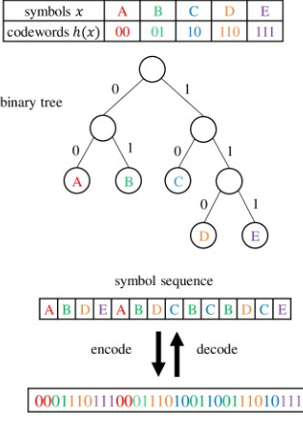
Huffman coding

Slide 63
Week: 04
Multimedia Production
Graphics/Image Data Types
Develop and share multimedia productions.
Describe and differentiate various image data types..

Slide 64

Fundamentals of MuTtimedia
2nd Edition 2014 Ze-Nian Li Mark S. Drew jiangchuan Liu
Chapter 3 :
Graphics and Image Data Representations

Slide 65
This chapter introduces:
how best to represent the graphics and image data since it is of crucial importance in the study of multimedia.
° The specifics of file formats for storing such images are also discussed

Slide 66
3.1 Graphics/Image Data Types
Table 3. I shows a list of file formats used in the popular
product Adobe Premiere.
We concentrate on GIF and jPG image file formats, since the GIF file format is one of the simplest and contains several fundamental features,
and the JPG overall.
file format is arguably the most important

Slide 67
3. i. I i -Bit Images
Images consist of pixels (picture elements in digital images).
A I -bit image (also called binary image) consists of on and ok bits only and thus is the simplest type of image.
Each pixel is stored as a single bit (0 or I)
It is also sometimes called a /-bit monochrome (coiled Lena imoge by scientists} image since it contains no color. See Figure in next slide.
Monochrome
I -bit images can be satisfactory for pictures containing only simple graphics and text.
fax machines use I -bit data, so in fact I -bit images are still important.

Slide 68

Monochrome I -bit Lena image
A 640•480 monochrome image requires 38.4 kB of storage

Slide 69
3. i.2 8-Bit Gray-Level Images
8-bit image is one for which each pixel has a gray value between
0 and 255.
Each pixel is represented by a single byte.
The entire image can be thought of as a two-dimensional array of pixel values referred to as a bitmap.
Image resolution refers to the number of pixels in a digital image (higher resolution always yields better quality but increases size)

Slide 70
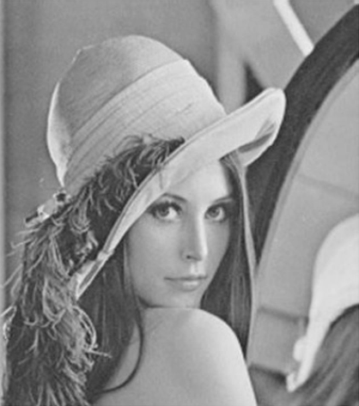
Grayscale image -If Lena
640•480 grayscale image requires 300kB of storage

Slide 71
3. i.4 24-Bit Color Images
In a color 24-bit image, each pixel is represented by three bytes, usually representing RGB.
Since each value is in the range 0—255, this format supports 256^256^ 256, or a total of I 6,777,216, possible combined colors; which increases storage size.
a 640 ^ 480 24-bit color image would require 921.6 kB of
storage. (without any compression applied)
Compression is used to decrease the image size by simply grouping pixels efiectively. (chapter 7).

Slide 72
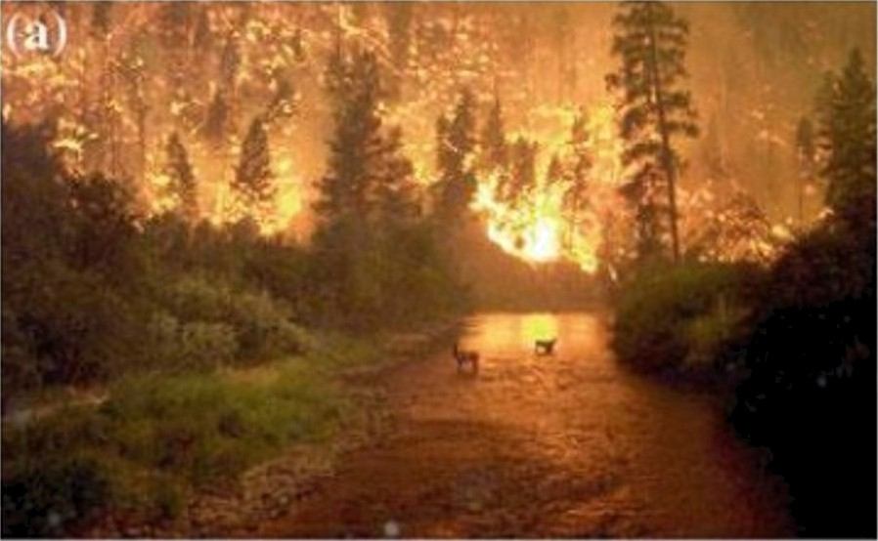
24-bit color image forestfire.bmp
Microsoù Windows BMP format

Slide 73
3. i.5 Higher Bit-Depth Images
In some fields such as medicine (security cameras, satellite imaging) more accurate images are required to see the patient's liver, for example.
To get such images, special cameras that view more than just 3 colors (RGB) are used.
Such images are called multispe‹::tral (more than three colors) or
hyperspectrol (224 colors for satellite imaging).

Slide 74
3. i.6 8-Bit Color Images
Note the great savings in space for 8-bit images over 24-bit ones:
a 640 ^ 480 8-bit color image requires only 300 kB of
storage,
compared to 92 I .6 kB for a color image (again, without any compression applied).

Slide 75


hJotice that the difference between Fig. 3.5a, the 24-bit image, and Fig. 3.7, the 8-bit image, is reasonably small.
Fig. 3.5a, the 24-bit image
Fig. 3.7, the 8-bit image

Slide 76
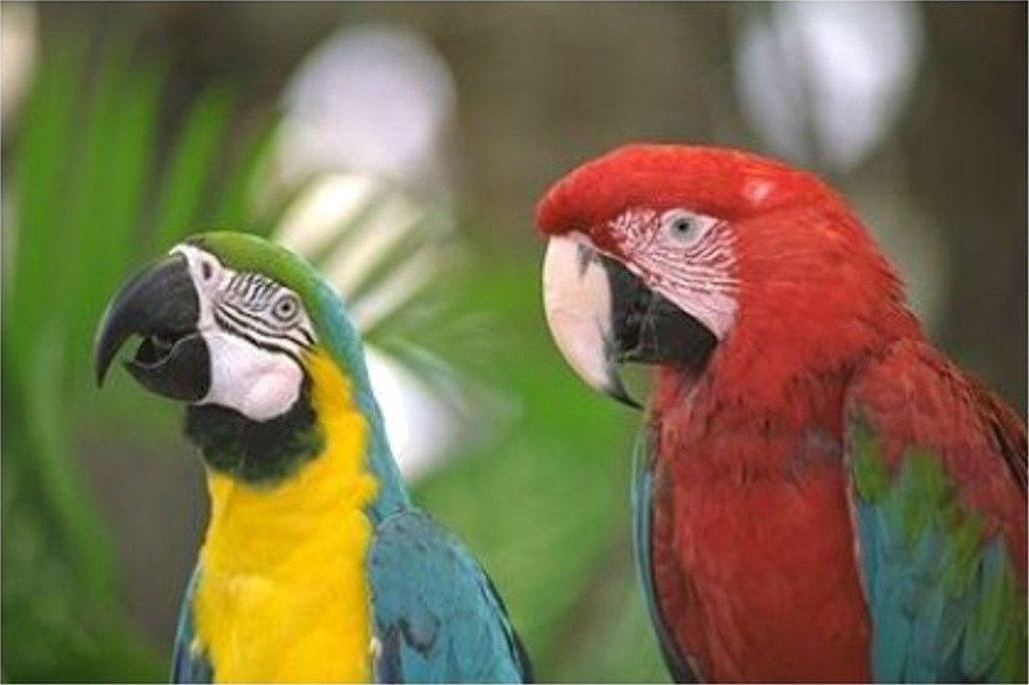

Another example for diPerence between Fig. 3.5a, the 24-bit image, and Fig. 3.7, the 8-bit image, is reasonably small.
Fig. 3.5a, the 24-bit image
Fig. 3.7, the 8-bit image

Slide 77
3. i.6 8-Bit Color Images
Note the great savings in space for 8-bit images over 24-bit ones:
a 640 ^ 480 8-bit color image requires only 300 kB of
storage,
compared to 92 I .6 kB for a color image (again, without any compression applied).

Slide 78

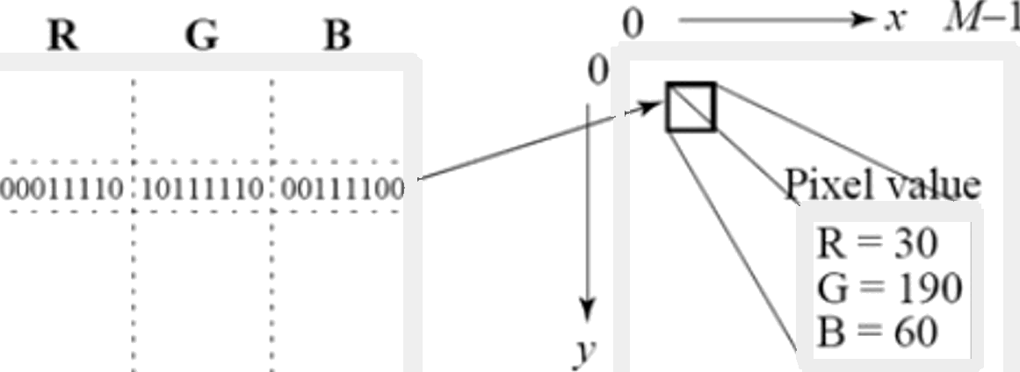
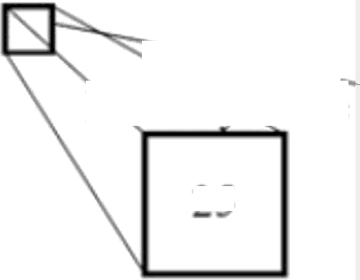



3. i.7 Color Lookup Tables
The LUT is oken called a po/ette.
The idea is to store only the index, or code value, for each pixel.
if a pixel stores, say, the value 25 (Figure 3.8), the meaning is to go to row 25 in a color lookup table (LUT).
(
.\’—l

Slide 79

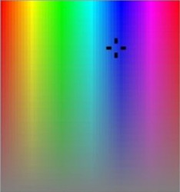



•A Color-picker consists of an array of fairly large blocks of color (or a semi- continuous range of colors) such that a mouse-click will select the color indicated.
In reality, a color-picker displays the palette colors associated with index values from 0 to 255.
Fig. 3.9 (next slide) displays the concept of a color-picker: if the user selects the color block with index value 2, then the color meant is cyan, with RGB values (0, 255, 255).
Edit Colors
@d5JC COIOFS
”0
Custom cobrs
Hue: 153
Sa: ]8l
Red 0
Gern 0
Blue 0
ColorSolid

Slide 80

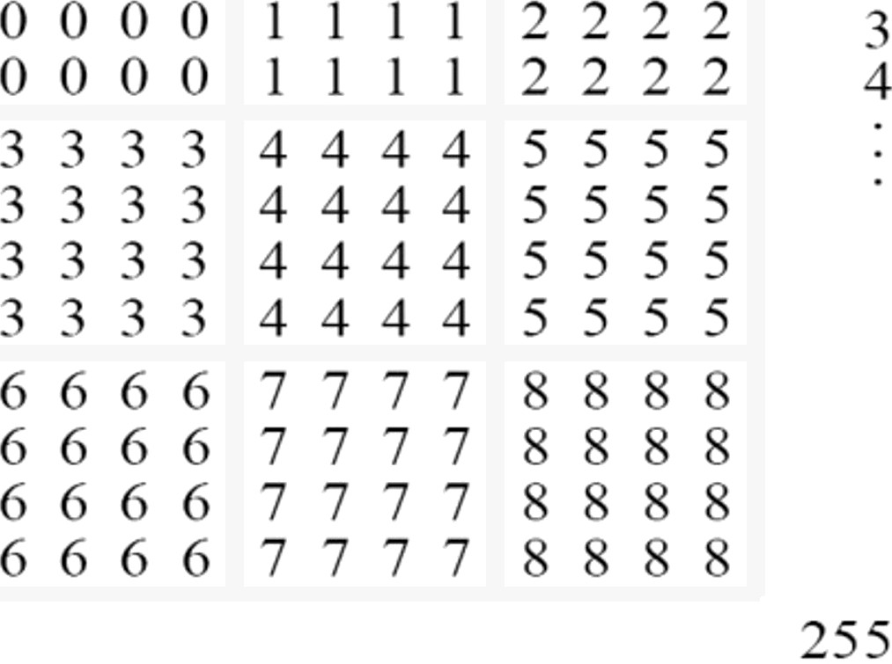
R
G
B
•_l
0 | 255 | 255
C yini
Fig. 3.9: Color-picker for 8-bit color: each block of the color-picker corresponds to one row of the color LUT

Slide 81
3.2 Popular File Formats
8-bit GIF : one of the most imporant formats because of its historical connection to the WV¥”\/V and HTML markup language as the first image type recognized by net browsers.
JPEG: currently the most important common file format.

Slide 82





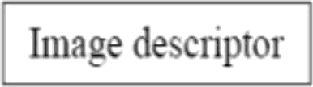




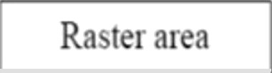



IF87
For the standard specification, the general file format of a GIF87 ćle is
as in Fig. 3. 12.
The Signature is six byes
the Screen Oescriptor is a seven-bye
GIF \sl Rllilllll 0
Locol Color Jop {i§does not exist
A global color map can be de(ned)
A GIF87 file can contain more than one image definition, usually to fit on several different parts of the screen.
oauo/ roster doto itse/[is /irst
comgressed using tńe LZW compression
scheme (see Chap.7)
l0l’1l11llI1łt*l
Fig. 3. 12: GIF file format.

Slide 83




Screen Descriptor comprises a set of attributes that belong to every image in the file.According to the GIF87 standard, it is defined as in Fig. 3. 13.
LSB/ MSB
Least/Most Significant Byte
Bit 7 is filled with zeros
7 L› S 4 1 2 I II
hate *
I
Raster s'idth in pixels (I.SB first)
Sci‘een width
in | cr | 0 | pixel
Background
tl t1 tl t1 IN t) I) tJ
t
Rasier heieht in pixels (LSB tirst)
5
6 BacLqrtiund - color index tit’screen
7
rite Alt bal color map or i1 none
specified. lrt»ii the delauli imap)
iii 1
cr 1
li bits pixel in iin:ixv
Fig. 3. 13: GIF screen descriptor.
22

Slide 84

Color Hap is set up in a very simple fashion as in Fig. 3. 14. However, the actual length of the table equals 2*’*^{e}*”!)as given in the Screen Descriptor.
Bits
7 6 5 4 3 2 1 0 Byte #
l Red value for color index 0
Green ralue for color index 0
Blue value for color index 0
Red value for color index 1
Green value for color index l
Blue i^{f}alue for color index l
(continues for remaining colors)
Fig. 3. 14: GIF color map.
Red intensity
Green intensity
Blue intensity
Red intensity
Green intensity
Bltie intensity
23

Slide 85
Each image in the file has its own Image Descriptor, defined as in
Fig. 3.15.
Bits
7 6 5 4 3 2 1 0 Byte #
1
2
0 | 0 | 1 | 0 |  | 1 | 1 | 0 | 0
lmage let”
Imagc top
Imagc width
Image height
m | i | 0 |  | 0 |  | 0 | pixQj
Imape separator character (coiiiiiia)
Start of” iinape in pixels from the left side of” lhe screen (LSR first)
Start of” image in pixels morn the top ot”ihe screen (LSB first)
4
s
6
7
8
Width o1 the image in pixels (LSB first)
Hcight of the image in pixels (LSB tirst)
10
in 0 (Jse global color inap, igiioie ‘pixel’ Local color inap follou s, risc ‘pixel’ linage lonnatted in Sequential ordei linape liiniiatied iii Interlaccd order
m = l
i = 0
i l
pixel + 1
Fig. 3.15: GIF image descriptor.
24

Slide 86
interface
If the interlace bit is set to (I), then the local Image Descriptor, the rows of the image are displayed in a four-pass sequence, as in Fig. 3. 16. (next slide)
Here, the first pass displays rows 0 and 8, the second pass displays
rows 4 and 12, and so on.

Slide 87






litiape row | Pass 1 | Pass 2 | Pass S | Pass 4 | Result
0 | * i a*
l 2 |  |  | *4o* |  | *4a*
i\ 4 S |  | *2a* | *4b* *4c* |  | *4b* *2:i* *4c*
7 ‹J | * 1 b* |  | *4ct* *4c* |  | *4ct* * l!»* *4c*
l (I
1 1 |  |  | *4f* |  | *41*
12 |  | *2b*
Fig. 3.16: GIF 4-pass interlace display row order.

Slide 88

3.2.2 JPEG
JPEG {joint Photographic Experts Group):The most imporant
current standard for image compression (.jpg, .jpeg, .jpe).
The human vision system has some specific limitations (The eye—brain system cannot see extremely fine detail; those are dropped ) and jPEG takes advantage of these to achieve high rates of compression.
jPEG allows the user to set a desired level of quality, or compression ratio (input divided by output).
As an example, Fig. 3. 17 shows our forestfire image, with a quality factor @' 10%.
- This image is a mere I .5% of the original size. In comparison, a jPEG image with S}=7S% yields an image size 5.6% of the original, whereas a GIF version of this image compresses down to 23.0% of uncompressed image size.

Slide 89

A photo of a flower compressed with successively more lossy
compression ratios from left to right.

Slide 90
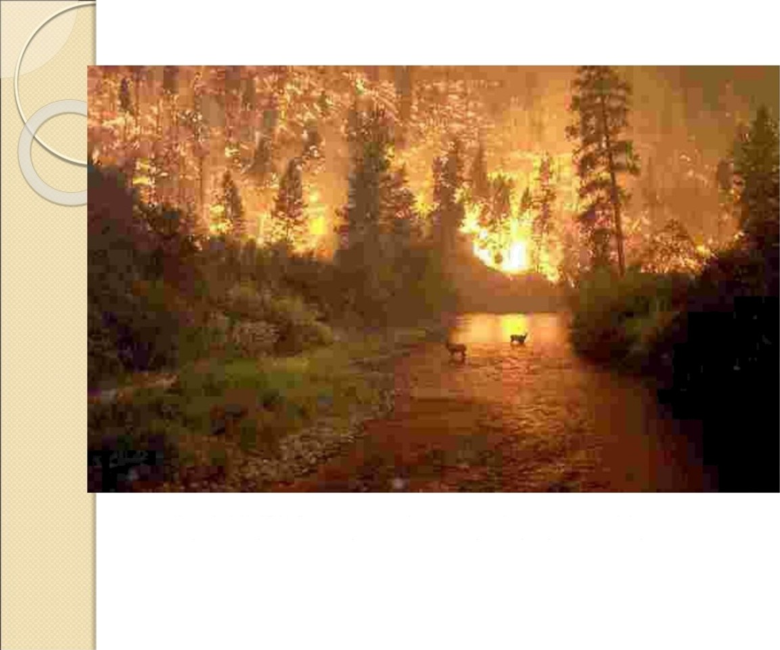
Fig. 3. I 7:jPEG image with low quality speciŃed by user.
29

Slide 91

PNG
PNG format: standing for Portable Network Graphics meant
to supersede the GIF standard, and extends it in important ways.
Special features of PNG files include:
  Support for up to 48 bits of color information a large increase.
Files may contain gamma-correction information for correct display of color images, as well as alpha-channel information for such uses as control of transparency.
The display progressively displays pixels in a 2-dimensional fashion by showing a few pixels at a time over seven passes through each
8 X 8 block of an image.

Slide 92
TI
TIFF: stands for Tagged Image File Format.
•”. The support for attachment of additional information (referred to as “ags”) provides a great deal of flexibility.
I .The most important ag is a format signifier: what type of compression etc. is in use in the stored image.
TIFF can store many different types of image: I -bit, grayscale, 8-bit
color, 24-bit RGB, etc.
TIFF was originally a lossless format but now a new jPEG tag allows
one to opt for jPEG compression.
The TIFF format was developed by the Aldus Corporation in the
1980's and was later supported by Microsoft.

Slide 93
.2.9 PS and PDF
Therefore, another text + figures language has largely superseded PostScript is Portable Document Format (PDF) /i/e (ormat.
PDF gles that do not include images have about the same compression ratio, while
For files containing images, PDF may achieve higher compression ratios by using separate jPEG compression for the image content

Slide 94
.2.9 PS and PDF
Therefore, another text + figures language has largely superseded PostScript is Portable Document Format (PDF) /i/e (ormat.
PDF gles that do not include images have about the same compression ratio, while
For files containing images, PDF may achieve higher compression ratios by using separate jPEG compression for the image content

Slide 95
Week: 05
Popular File Formats
Color Theory: RGB, CMY, CMYK, Lab*
Use popular file formats for graphics and images.
Explain and utilize different color models.

Slide 96
This chapter explores:
several issues in the use of color, since color is vitally important in multimedia programs
in this chapter we shall consider the following topics:
Color Science
Color Models in Images
Color Models in Video.

Slide 97
Color in Image and Video
4.1 Color Science
4.2 Color Models in Images
4.3 Color Models in Video
4.4 Further Exploration

Slide 98
4.1 Color Science
Light and Spectra
Light is an electromagnetic wave. Its color is characterized by the wavelength content of the light.
(a) Laser light consists of a single wavelength: e.g., a ruby (ياقوت) laser produces a bright, scarlet(أحمر قرمزي)-red beam.
(b) Most light sources produce contributions over many wavelengths.
(c) However, humans cannot detect all light, just contributions that fall in the "visible wavelengths".
(d) Short wavelengths produce a blue sensation, long wavelengths produce a red one.

Slide 99
4.1 Color Science
Spectrophotometer: device used to measure visible light, by reflecting light from a diffraction grating
(prism حاجز انكسار كالمنشور) (a ruled surface) that spreads out the different wavelengths.
Figure 4.1 shows the phenomenon that white light contains all the colors of a rainbow.
Visible light is an electromagnetic wave in the range 400 nm to 700 nm (where nm stands for nanometer, 10−9 meters).

Slide 100
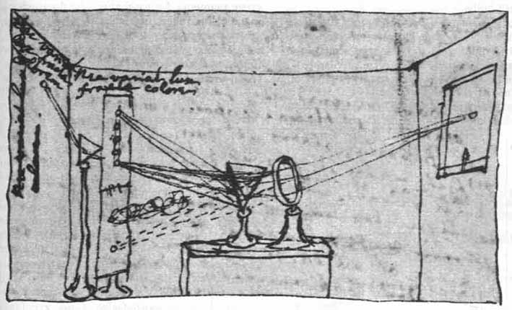
4.1 Color Science
Fig. 4.1: Sir Isaac Newton's experiments.

Slide 101
4.1 Color Science
Fig. 4.2 (See Book) shows the relative power in each wavelength interval for typical outdoor light on a sunny day.
This type of curve is called a Spectral Power Distribution (SPD) or a spectrum.
The symbol for wavelength is λ. This curve is called E(λ ).

Slide 102
4.1 Color Science
Human Vision
The eye works like a camera, with the lens focusing an image onto the retina شبكية (upside-down and left-right reversed).
The retina consists of an array of rods and three kinds of cones. See images (rods_cones, rods_cones1).
The rods come into play when light levels are low and produce a image in shades of gray ("all cats are gray at night!").
For higher light levels, the cones each produce a signal. Because of their differing pigments, the three kinds of cones are most sensitive to red (R), green (G), and blue (B) light.
It seems likely that the brain makes use of differences R-G, G-B, and B-R, as well as combining all of R, G, and B into a high-light-level achromatic channel.

Slide 103
4.1 Color Science
Spectral طيفيSensitivity of the Eye
The eye is most sensitive to light in the middle of the visible Spectrum طيف.
The sensitivity of our receptors is also a function of wave-length (Fig. 4.3 See Book).
The Blue receptor sensitivity is not shown to scale because it is much smaller than the curves for Red or Green – Blue is a late addition, in evolution.
Fig. 4.3 shows the overall sensitivity as a dashed line – this important curve is called the luminousاضاءة -efficiency function.
  It is usually denoted V (λ) and is formed as the sum of the response curves for Red, Green, and Blue.

Slide 104
4.1 Color Science
Spectral طيفيSensitivity of the Eye
The eye has about 6 million cones, but the proportions of R, G, and B cones are different.
They likely are present in the ratios 40:20:1
So the achromatic اللوني channel produced by the cones is thus something like 2R + G + B/20.

Slide 105
4.1 Color Science
Image Formation
In most situations, we actually image light that is reflected from a surface.
Surfaces reflect different amounts of light at different wavelengths, and dark surfaces reflect less energy than light surfaces.
then the reflected light filtered by the eye’s cone
See Figure 4.5 Next slide

Slide 106
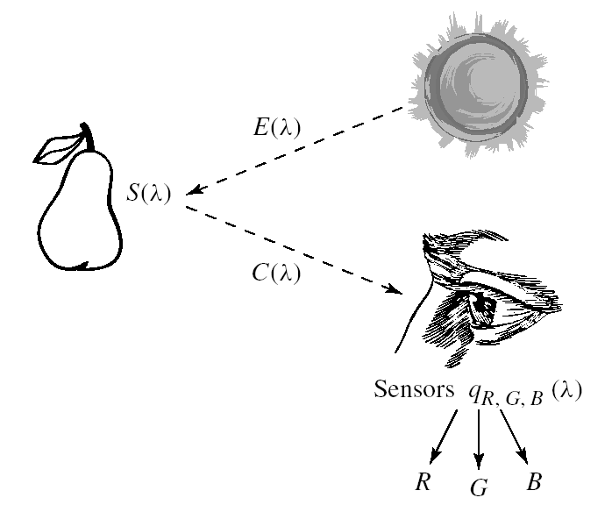
4.1 Color Science
Fig. 4.5: Image formation model.

Slide 107
4.1 Color Science
Camera Systems
Camera systems are made in a similar fashion; a good camera has three signals produced at each pixel location (corresponding to a retinal position).
Analog signals are converted to digital, truncated to integers, and stored. If the precision used is 8-bit, then the maximum value for any of R; G;B is 255, and the minimum is 0.

Slide 108
Week: 06 & 07 & 08
Color Transformations and Corrections
What is Sound?
Perform color transformations and corrections.
Understand the basics of sound and digitization.
Signal-to-Noise Ratio (SNR) and SQNR
Audio Filtering and Compression
Apply SNR and SQNR in audio processing.
Apply audio filtering and compression techniques.

Slide 109
Audio
Most modern audio signals are stored in digital form (for example MP3s and CDs) and in order to be heard through speakers they must be converted into an analog signal.
 DACs are therefore found in:
 CD players,
 digital music players, and PC sound cards.
Specialist standalone DACs can also be found in high-end hi-fi systems. These normally take the digital output of a compatible CD player or
High fidelity (often shortened to hi-fi or hifi) is a term used by listeners, audiophiles and home audio enthusiasts to refer to high-
quality reproduction of sound
2

Slide 110
AUDIO :
dedicated transport (which is basically a CD player with no internal DAC) and convert the signal into an analog line-level output that can then be fed into an amplifier to drive speakers.
Similar; digital-to-analog converters can be found in digital speakers such as USB speakers, and in sound cards.
In VoIP (Voice over IP) applications, the source must first be digitized for transmission, so it undergoes conversion via an Analog-to-Digital Converter, and is then reconstructed into analog using a DAC on the receiving party's end.

Slide 111
AUDIO :
A multimedia application may require the use of speech, music and sound effects. These are called audio or the sound elements.
 There are two basic types of audio or sound: analog and digital audio.
 Analog audio refers to the original sound signal .
 Digital audio refers to the digital sampling of the actual sound . The sound used in multimedia is digital audio.
Introduction to Multimedia

Slide 112
Sound
 2.1 Classes of Sound
 · Voice
 · Music
 · Sound Effects
 2.2 Characteristic of Sound Waves
 Amplitude - Power or intensity of sound, the louder the sound, the larger the amplitude
 Frequency - The rate which sound is measured, the higher the frequency, the clearer and sharper the sound

Slide 113
Frequency of a sound wave
Frequency is the reciprocal value of the period., or represents the number of periods/sec .it measures by hertz (Hz) or cycle/sec. a common abbreviation is KHz which describes 1,000 oscillation per second
Air pressure
period
Amplitude perceived as volume or loudness
time
Introduction to Multimedia

Slide 114
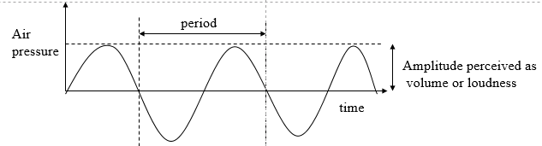
Basic Sound Concepts
Acoustics :is the science of the sound, which is energy , “sound is energy”
study of sound - generation, transmission and reception of sound waves.
Sound is produced by vibration of matter.
During vibration, pressure variations are created in the surrounding air molecules.
Pattern of oscillation creates a waveform
the wave is made up of pressure differences.
Waveform repeats the same shape at intervals called a
period.
Periodic sound sources - exhibit more periodicity, more musical –Generated by musical instruments .
Non-periodic sound sources - less periodic - unpatched percussion, sneeze, cough,drums

Slide 115
Basic Sound Concepts
Sound Transmission
Sound is transmitted by molecules bumping into each other.
Sound is a continuous wave that travels through air.
Sound is detected by measuring the pressure level at a point.
Receiving
Microphone in sound field moves according to the varying pressure exerted on it.
Transducer converts energy into a voltage level (i.e. energy of another form - electrical energy)
Sending
Speaker transforms electrical energy into sound waves.

Slide 116
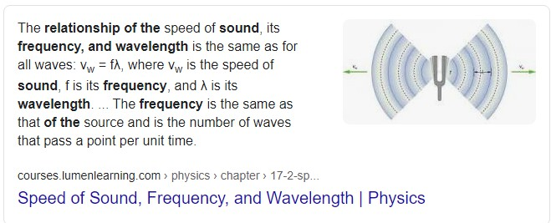
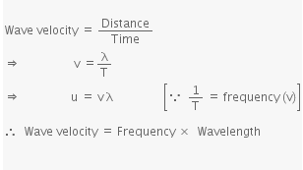
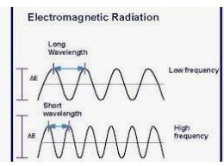
Wavelength is the distance travelled in one cycle
20Hz is 56 feet, 20KHz is 0.7 in.

Slide 117
Basic Sound Concepts
Frequency represents the number of periods in a second (measured in hertz, cycles/second). Acommon abbreviation is KHz which describes 1000 oscillations per second
Frequency is the reciprocal value of the period.
Human hearing frequency range: 20Hz - 20Khz, voice is about 500Hz to 2Khz.
Infrasound Human range Ultrasound Hypersound
from 0 - 20 Hz (Infrasonic)
from 20Hz - 20KHz (Audio sonic) music from 20kHz - 1GHz (Ultrasonic)
from 1GHz - 10THz

Slide 118
Basic Sound Concepts
Amplitude of a sound is the measure of the displacement of the air pressure wave from its mean or quiescent state.
Subjectively heard as loudness. Measured in
decibels.( توصلا ةدش سايق ةدحو)
0 db
35 db
essentially no sound heard
quiet home
noisy street
70 db
120db -
discomfort
db( decibels measurements is actually the ratio between a
chosen reference point on a longitude scale and the level
that actually experienced.

Slide 119
 Audiology :is the discipline interested in manipulating a caustic signals that can be perceived by humans. most MM applications use audio in the form of music and
/or speech.
 The sound in audiosonic frequency range is primarily important for MM systems ,music signals have frequencies in the 20Hz- 20KHz range.
 The waves in the audiocostic frequency range are called acoustic signals .
 To play sound with windows ,you need to have a sound board (card) with the correct drivers installed in your pc and from control panel choose sound icons to find some sound in the sound control panel.
 In windows system sounds are .WAV files

Slide 120
From Sound to Signals
 As was mentioned above, a device such as a microphone can be used to sense the changes in air pressure--the peaks and through--at a particular point in space, just as the human ear does. The result is an electrical signal, known as an audio signal, which describes the local changes in air pressure at the microphone as a function of time. Figure
10.1 shows an example of an audio signal that is an idealization of one that would be created by a transient sound source, such as that from a book striking the floor and recorded with a microphone.

Slide 121
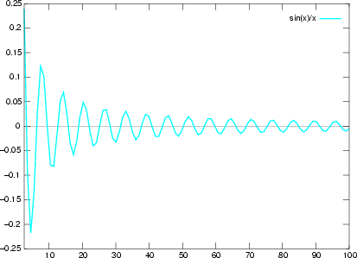
Figure 10.1: A signal such as would be created by a transient audio source upon transformation by a microphone into an electrical signal. The horizontal scale represents time in tenths of
milliseconds

Slide 122
In this figure, the measurement of pressure has been converted into an electrical voltage, and the waveform shown depicts the voltage as it changes in time.
 The vertical axis shows the voltage (proportional to air pressure) at any instant, and the horizontal axis represents time in tenths of milliseconds.
Louder sounds will create a greater vertical displacement; that is, the swings in air pressure due to loud sounds are greater.

Slide 123
Frequency Content of Audio Signals
 Because all audio signals are comprised of a sum of different pure tones, each at a different frequency, we can describe a given audio signal in two different ways. One way we have already seen-
 -we can use the waveform that describes how the audio signal varies with respect to time. This waveform is sometimes referred to as the
 time-domain description of the signal.
 The second way to describe an audio signal is by its frequency spectrum--that is, by specifying which frequency components the signal contains, and in what amount each frequency or pure tone occurs. This description of a signal is referred to as the frequency-domain description.

Slide 124
Figure 10.12: A male saying
``information.''

Slide 125
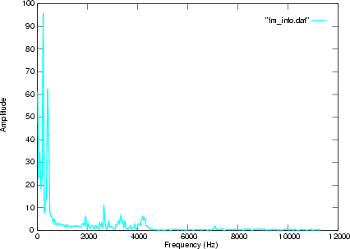
Figure 10.13: The frequency spectrum of a male saying ``information.''

Slide 126
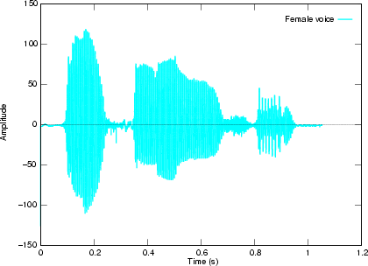
Figure 10.14: A female saying ``information.''
Figure 10.14: A female saying ``information.''

Slide 127
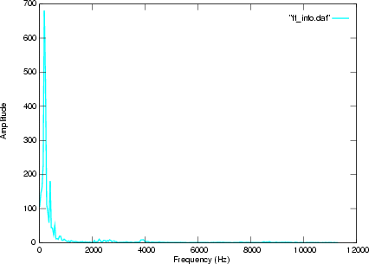
Figure 10.15: The frequency spectrum of a female saying ``information.''

Slide 128
Lect 6: Sound in Multimedia
Digital Audio

Slide 129
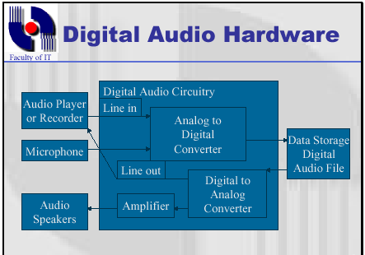
Based on circuits that interfaces the computer with external audio components such as microphones, recorders, speakers. Converts audio signals into digital signal via Analog-to-Digital Converter (ADC). Transfer the digital data to the computer storage media. For playback, storage is converted to analog sound via DAC
Introduction to Multimedia

Slide 130
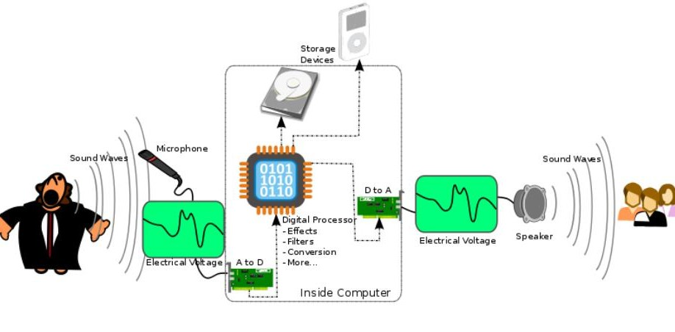
Transfer the digital data to the computer storage media.
Based on circuits that interfaces the computer with external audio components such as microphones, recorders,
For playback, storage is converted to analog sound via DAC.
speakers. Converts audio signals into digital signal via Analog-to-Digital Converter (ADC).

Slide 131
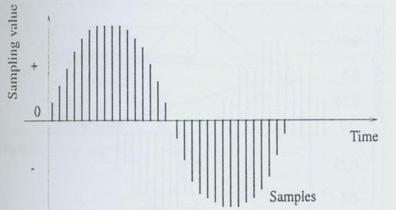
3 Computer Representation of Sound
Computer measures the amplitude of waveform at regular intervals to produce a series of numbers. Each measurement is a sample. Sampling rate is the rate which a continuous waveform is sampled.
Quantization is the possible (range of) values of the sample

Slide 132
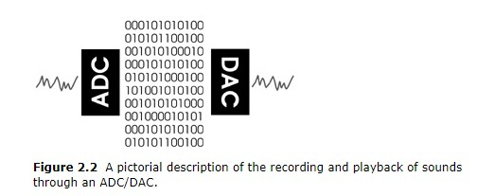
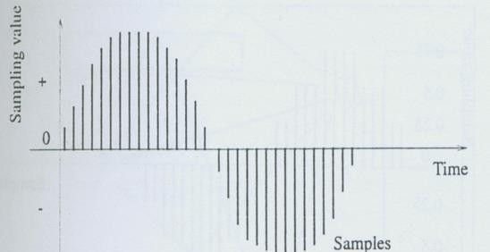
Audio representation on computers
 Before the continuous curve of a sound wave can be represented on a computer , the computer has to measure the wave's amplitude in regular time intervals. it then takes the result and generates a sequence of sampling values. or samples for short. figure 3.4 shows the period of a digitally sampled wave. The mechanism that converts an audio signal into sequence of digital samples is called an analog –to-digital converter (ADC) and a digital to-analog converter (DAC) is used to achieve the apposite conversion

Slide 133
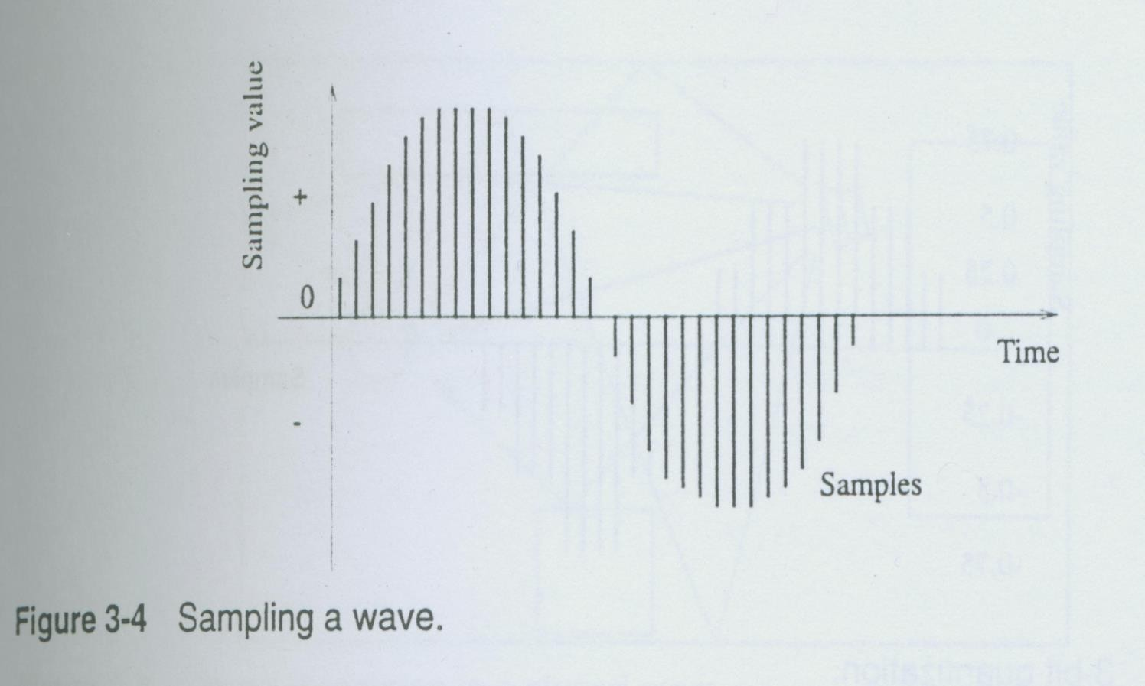
Sampling wave

Slide 134
sampling rate:
 the rate at which a continuous wave form is sampled (see fig below) is called the sampling rate.
 like frequency ,the sampling rate is measured in Hz
.for example , CDs are sampled at a rate of 44100 Hz , which may appear to be above the frequency range perceived by human .however the bandwidth in this case ,20000 Hz-20 Hz=19980 Hz.-that can represent digitally sampled audio signal is only about half as big as a CD's sampling rate ,
 because CDs use the Nyquist sampling theorem (which states that the signal being sampled cannot contain any frequency components that exceed half the sampling frequency) .This means that a sampling rate of 44100 Hz covers only frequencies in the range from 0 Hz to 22050 Hz. this limit is very close to the human hearing capability.

Slide 135
QUANTIZATION:
 The digitization process requires two steps:
 first the analog signal must be sampled .this means that only a discrete set of values is retained at (generally regular) time or space intervals.
 The second step involves quantization .the quantization process consists of converting a sampled signal into a signal that can take only a limited number of values. an 8-bit quantization provides 256 possible values ,while a 16-bit quantization in CD quality results in more than 65,536 possible values. The figure below shows a 3-bit quantization

Slide 136
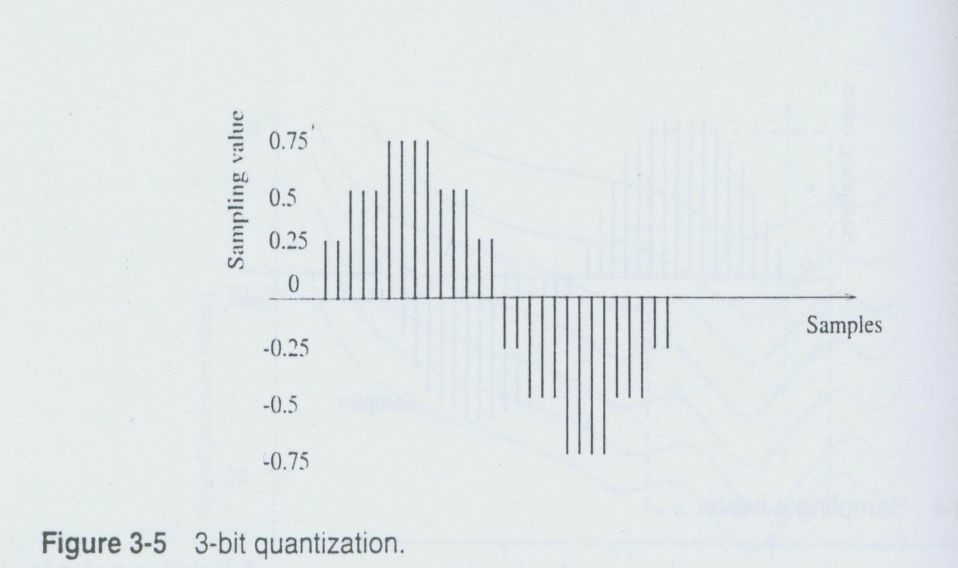
3-bit quantization

Slide 137
The values transformed by a 3-bit quantization process can accept eight different characteristics :0.75,0.5,0.25,0,-
0.25,-0,5, -0.75, and -1 so that we obtain an "angular shape" wave. This means that the lower the quantization (in bit) ,the more the resulting sound quality deteriorates

Slide 138
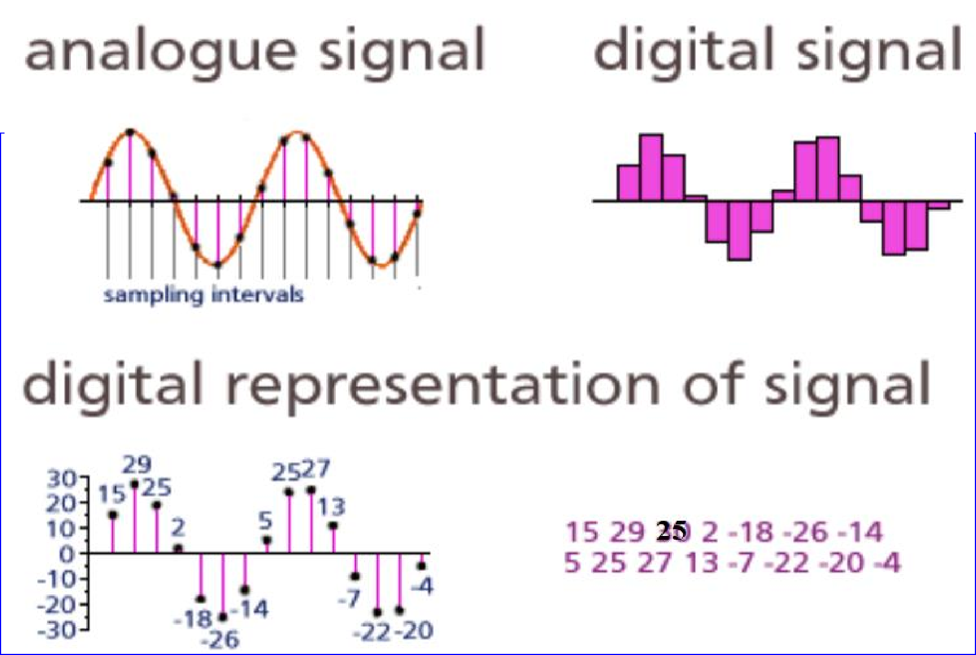

Slide 139
3.2 Digital Audio Representations
 · Sampling frequency (rate) - sampling freq is at least twice the highest freq present in original signal
 ·
 · Number of channels (tracks) - stereo have 2 channels, some products have 4, 16, 32
 · Negative samples - analog signals alternate between positive and negative
 · Encoding - common methods are Pulse Code Modulation (PCM) and Adaptive Delta Pulse Code Modulation (ADPCM).

Slide 140
File size versus quality
Remember that the sampling rate determines the frequency makeup of the recording.
Sampling at higher rates more accurately captures the high frequency content of your sound. Resolution determines the accuracy with which a sound can be digitized. Using more bits yields a recording that sounds more like its original.

Slide 141
Warning: the higher the sound quality, the longer your file will be.
Stereo recording are more lifelike and realistic, because human being have two ears. mono recordings are fine, but tend to sound a bit "flat" and uninteresting when compared with stereo recordings. Stereo sound files require twice as much storage space as mono files.

Slide 142
For a monophonic recording
Here are the formulas for determining the size (in bytes) of a digital recording.
sampling rate * duration of recording in second *(bit
resolution / 8)*1
For a stereo recording:
sampling rate * duration of recording
in sec ond *(bit
resolution / 8) * 2

Slide 143
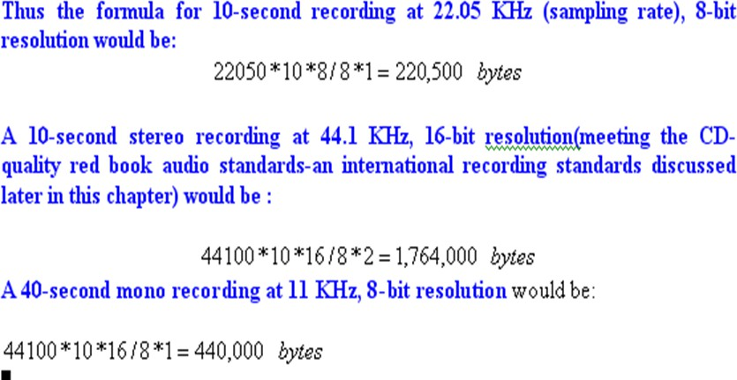
Example
sampling rate * duration of recording in second *(bit resolution / 8)*1

Slide 144
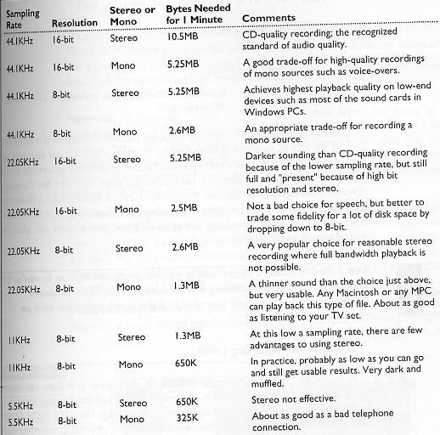

Slide 145
3.3 Digital Audio Operations
 · Storage
 · Retrieval
 · Editing
 · Effects and filtering
 · Conversion
 3.4 Audio Capacity of CD-ROM
 Based on 650 MB size of CD-ROM.
 1. Voice quality (11 kHz, 8 bit, mono, about 600 kbyte/minute) : 1083 minutes.
 2. High quality music (44 kHz, 16 bit, stereo, about 10 MB/minute): 61 minutes.
 3. Good voice or acceptable music (22 kHz, 16 bit, stereo): 122 minutes.
650 Mbyte=44 x1000x Tx (16/8)x2; →T(sec)/60=61.55 Minutes

Slide 146
Digital Audio
Multimedia Systems (Module 1 Lesson 1)
Summary:
Basic concepts
underlying sound
Facts about human perception of sound
Computer representation of sound (Audio)
A brief introduction to
MIDI
Sources:
My research notes
Dr. Ze-Nian Li’s course
material at:
http://www.cs.sfu.ca/CourseCentral/365/li/
1

Slide 147
CñIPT 365 Multimedia Systems
flu.ca/CourseCentral/365/li/
Spring 2019
aTves chi st o d
Lecture Time: hA\T I:30—2:20 Classroom:
CSIL, Room ASB9700, 9804, etc.
For CSIL information, see httn-//ivwnv sfu calcoiripu ting/about/support/csil html,
Lab:
for the PC workstation map in C SIL, see here To get an access card, see here
For remote desktop access to the CSIL lab, see here
Fundamentals of multimedia, 2nd ed.S.pring 14
Ti:
ISBN: 974-3-3f9-0?249-2, Bpriager (studezzYs con don'n/âa‹f via ttvw'Ziâ.s/sea)
Table of C'onteots
http-8/vavw cs sfu ca/rrinibook (lst ed., plus student resources)

Slide 148
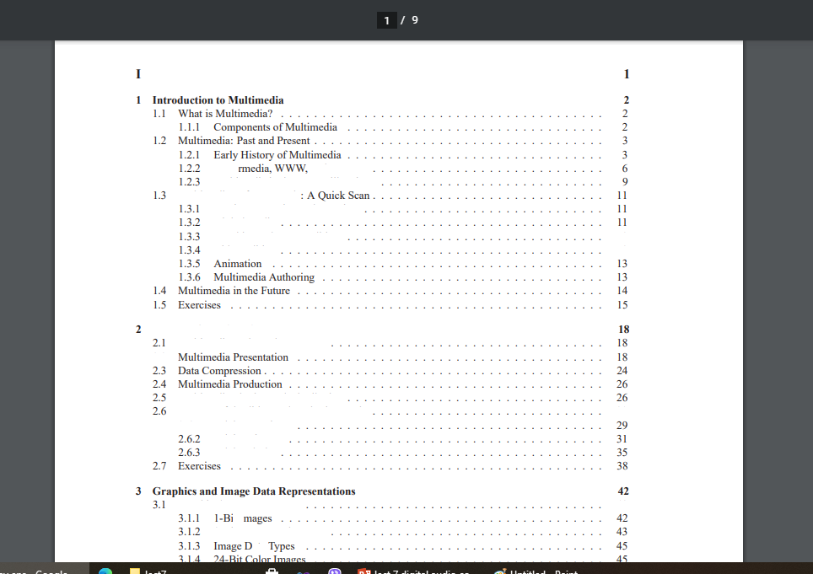
flu.ca/CourseCentral/365/li/toc.pdf
Introduction and Multimedia Data Representations
Hype and Internet M ultimcdia in the New Millennium
k4 ultimcdia Sofiwarc Tools
Music Sequencing and l'notat ion Digital Audio
G mphics and tmagc Editing
\’idco Editing
12
12
A Taste of Multimedia
k4 ultimcdia Tasks and Concerns
2.2
k4 ultimcdia Sharing and Distnbut ion Some Usctiil Editing and Authoring Tools
29
2.6.1 Adobe Premiere
Adobe Director Adobe Flash
Graphics/Image Data Types t t
8•Bit Gray• kev cl 1makes
42

Slide 149
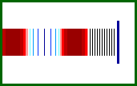
Sound Facts
Sound is a continuous wave that travels through the air
The wave is made up of pressure differences.
Sound is detected by measuring the pressure level at a location
Sound waves have normal wave properties (reflection, refraction, diffraction etc.)
The human Ear detecting Sound

Slide 150
Sound Facts
Wave Characteristics
Frequency: Represents the number of periods in a second and is measured in hertz (Hz) or cycles per second.
Human hearing frequency range: 20Hz to 20kHz (audio)
Amplitude: The measure of displacement of the air pressure wave from its mean. Related to but not the same as loudness
Air Pressure
Amplitude
Time
One Period
One particular frequency component

Slide 151
Principles of Digitization
Why Digitize?
  Microphones, video
cameras produce analog signals (continuous- valued voltages)
To store audio or video data into a computer, we must digitize it by converting it into a stream of numbers.
Time
Sound as analog signal

Slide 152
Principles of Digitization
Sampling: Divide the horizontal axis (time) into discrete pieces
Quantization: Divide the vertical axis (signal strength - voltage) into pieces. For example, 8-bit quantization divides the vertical axis into 256 levels. 16 bit gives you 65536 levels. Lower the quantization, lower the quality of the sound
  Linear vs. Non-Linear quantization:
    If the scale used for the vertical axis is linear we say its linear quantization;
    If its logarithmic then we call it non-linear (μ-law or A-law in Europe). The non-linear scale is used because small amplitude signals are more likely to occur than large amplitude signals, and they are less likely to mask any noise.

Slide 153
Sampling and Quantization
Sample
Sample
Time
Time
Sampling
Sampling rate: Number of samples per second (measured in Hz)
E.g., CD standard audio uses a sampling rate of 44,100 Hz (44100 samples per second)
3-bit quantization
3-bit quantization gives 8
possible sample values
E.g., CD standard audio uses 16-bit quantization giving 65536 values.
Why Quantize?
  To Digitize!

Slide 154
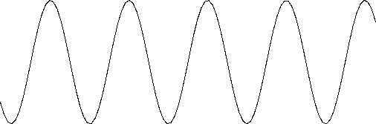
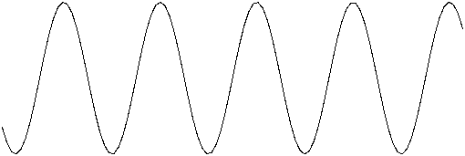
Nyquist Theorem
Consider a sine wave
Sampling once a cycle Appears as a constant signal
Sampling 1.5 times each cycle
Appears as a low frequency sine signal
For Lossless digitization, the sampling rate should be at least twice the maximum frequency responses

Slide 155
Application of Nyquist Theorem
Nyquist theorem is used to calculate the optimum sampling
rate in order to obtain good audio quality.
The CD standard sampling rate of 44100 Hz means that the waveform is sampled 44100 times per sec.
Digitally sampled audio has a bandwidth of (20 Hz - 20 KHz). By sampling at twice the maximum frequency (40 KHz) we could have achieved good audio quality.
CD audio slightly exceeds this, resulting in an ability to represent a bandwidth of around 22050 Hz.

Slide 156
Quantization (Quality ->SNR)
In any analog system, some of the voltage is what you want to measure (signal), and some of it is random fluctuations (noise).
SNR: Signal to Noise ratio captures the quality of a signal (dB)
Signal to Quantization Noise Ratio (SQNR)
The quantization error (or quantization noise) is the difference between the actual value of the analog signal at the sampling time and the nearest quantization interval value.
The largest (worst) quantization error is half of the interval?
SNR = 10 log ^{V2signal}
= 20 log
_{V}2
noise
V
signal
^{V}noise

Slide 157
SQNR Calculation (WC)
If we use N bits per sample, the range of the digital signal is: -2^{N-1} to 2^{N-1}
The worst-case signal to quantization noise ratio is given by:
^{V}signal
₂N-1
SQNR = 20 log = 20 log = N x 20 log 2 = 6.02N (dB)
^{V}quant - noise
1/2
Each bit adds about 6 dB of resolution, so 16 bits enable a maximum SQNR = 96 dB.
SQNR= N x 20 log 2 = 6.02N (dB) x 16 bit=96 dB

Slide 158
Miscellaneous Audio Facts
Typical Audio Formats
Popular audio file formats include .au (Unix), .aiff (MAC, SGI), .wav (PC, DEC)
A simple and widely used audio compression method is Adaptive Delta Pulse Code Modulation (ADPCM). Based on past samples, it predicts the next sample and encodes the difference between the actual value and the predicted value.
An audio file format is a file format for storing digital audio data on a computer system
DEC system was a line of server computers from Digital Equipment Corporation
SGI (Silicon Graphics) is a leading manufacturer of high-performance computing, data management, and
visualization products.

Slide 159
Audio Quality vs. Data Rate
Quality | Sample Rate (kHz) | Bits per Sample | Mono/ Stereo | Data Rate (kBytes/sec) (uncompressed) | Frequency Band
Telephone | 8 | 8 | Mono | 8 | 200-3400 Hz
AM Radio | 11.025 | 8 | Mono | 11.0 | 540-1700 KHz
FM Radio | 22.050 | 16 | Stereo | 88.2
CD | 44.1 | 16 | Stereo | 176.4 | 20-20000 Hz
DAT | 48 | 16 | Stereo | 192.0 | 20-20000 Hz

Slide 160
Week: 10
Coding of Audio: Pulse Code Modulation
Implement pulse code modulation in audio coding.

Slide 161
6.3 Quantization and Transmission of Audio
Coding of Audio: Quantization and transformation of data are collectively known as coding of the data.
  For audio, the μ-law technique for companding audio signals is usually combined with an algorithm that exploits the temporal redundancy present in audio signals.
  Differences in signals between the present and a past time can reduce the size of signal values and also concentrate the histogram of pixel values (differences, now) into a much smaller range.
  The result of reducing the variance of values is that lossless compression methods produce a bitstream with shorter bit lengths for more likely values (→ expanded discussion in Chap.7).
In general, producing quantized sampled output for audio is called PCM (Pulse Code Modulation). The differences version is called DPCM (and a crude but efficient variant is called DM). The adaptive version is called ADPCM.

Slide 162
Pulse Code Modulation
The basic techniques for creating digital signals from analog signals are sampling and quantization.
Quantization consists of selecting breakpoints in magnitude, and then re-mapping any value within an interval to one of the representative output levels. −→ Repeat of Fig. 6.2:
  The set of interval boundaries are called decision boundaries, and the representative values are called reconstruction levels.
  The boundaries for quantizer input intervals that will all be mapped into the same output level form a coder mapping.
  The representative values that are the output values from a quantizer are a decoder mapping.
  Finally, we may wish to compress the data, by assigning a bit stream that uses fewer bits for the most prevalent signal values

Slide 163
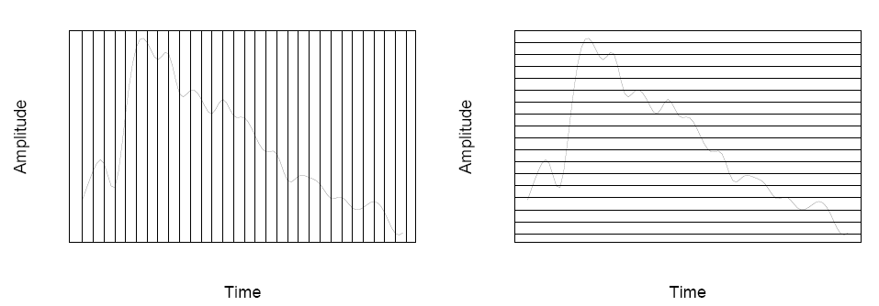
(a)
(b)
Fig. 6.2: Sampling and Quantization.

Slide 164
Every compression scheme has three stages:
  The input data is transformed to a new representation that is easier or more efficient to compress.
  We may introduce loss of information. Quantization is the main lossy step ⇒ we use a limited number of reconstruction levels, fewer than in the original signal.
  Coding. Assign a codeword (thus forming a binary bitstream) to each output level or symbol. This could be a fixed-length code, or a variable length code such as Huffman coding.
For audio signals, we first consider PCM for digitization. This leads to Lossless Predictive Coding as well as the DPCM scheme; both methods use differential coding. As well, we look at the adaptive version, ADPCM, which can provide better compression.

Slide 165
PCM in Speech Compression
Assuming a bandwidth for speech from about 50 Hz to about 10 kHz, the Nyquist rate would dictate a sampling rate of 20 kHz.
  Using uniform quantization without companding, the minimum sample size we could get away with would likely be about 12 bits. Hence for mono speech transmission the bit-rate would be 240 kbps.
  With companding, we can reduce the sample size down to about 8 bits with the same perceived level of quality, and thus reduce the bit-rate to 160 kbps.
  However, the standard approach to telephony in fact assumes that the highest-frequency audio signal we want to reproduce is only about 4 kHz. Therefore the sampling rate is only 8 kHz, and the companded bit-rate thus reduces this to 64 kbps.

Slide 166
However, there are two small wrinkles we must also address:
  Since only sounds up to 4 kHz are to be considered, all other frequency content must be noise. Therefore, we should remove this high-frequency content from the analog input signal. This is done using a band-limiting filter that blocks out high, as well as very low, frequencies. Also, once we arrive at a pulse signal, such as that in Fig. 6.13(a) below, we must still perform DA conversion and then construct a final output analog signal. But, effectively, the signal we arrive at is the staircase shown in Fig. 6.13(b).
  A discontinuous signal contains not just frequency components due to the original signal, but also a theoretically infinite set of higher-frequency components:
      This result is from the theory of Fourier analysis, in signal processing.
      These higher frequencies are extraneous.
      Therefore the output of the digital-to-analog converter goes to a low-pass filter that allows only frequencies up to the original maximum to be retained.

Slide 167
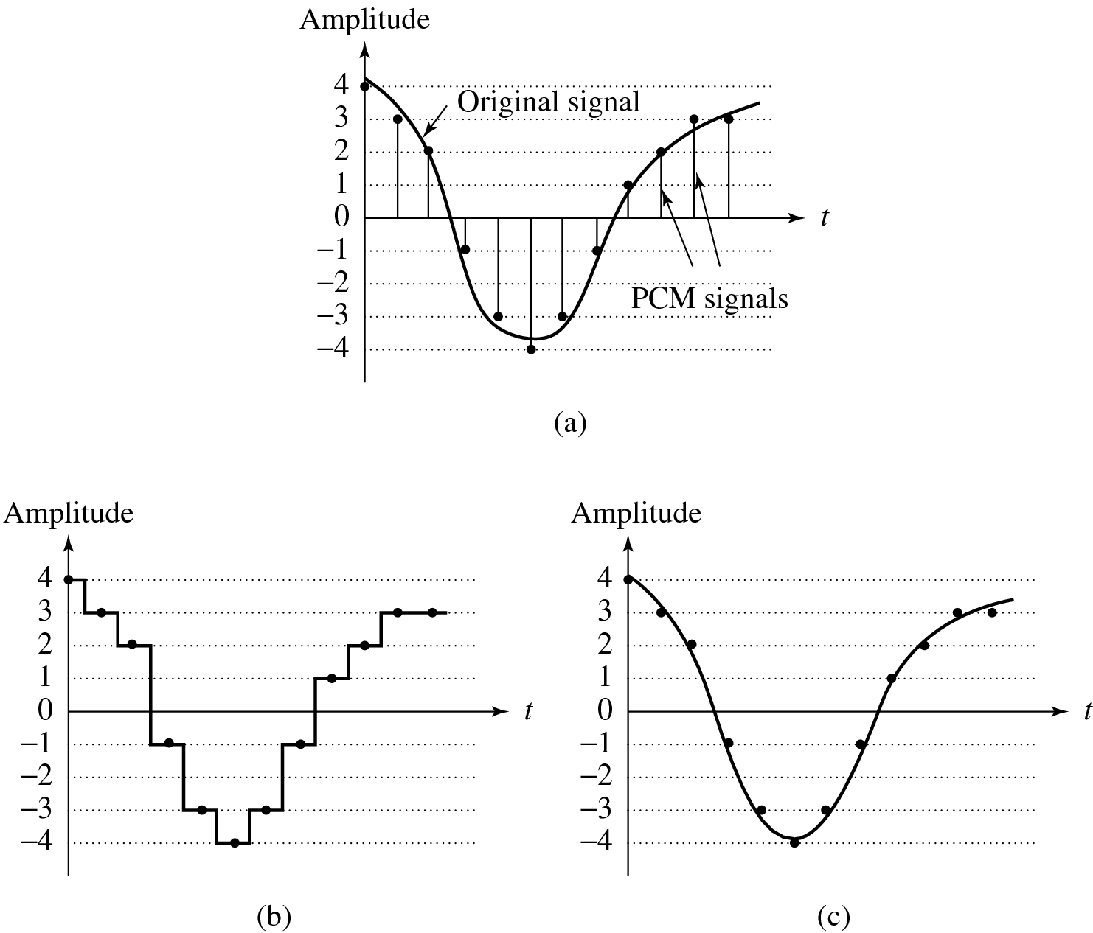
Fig. 6.13: Pulse Code Modulation (PCM). (a) Original analog signal and its corresponding PCM signals. (b) Decoded staircase signal. (c) Reconstructed signal after low-pass filtering.

Slide 168
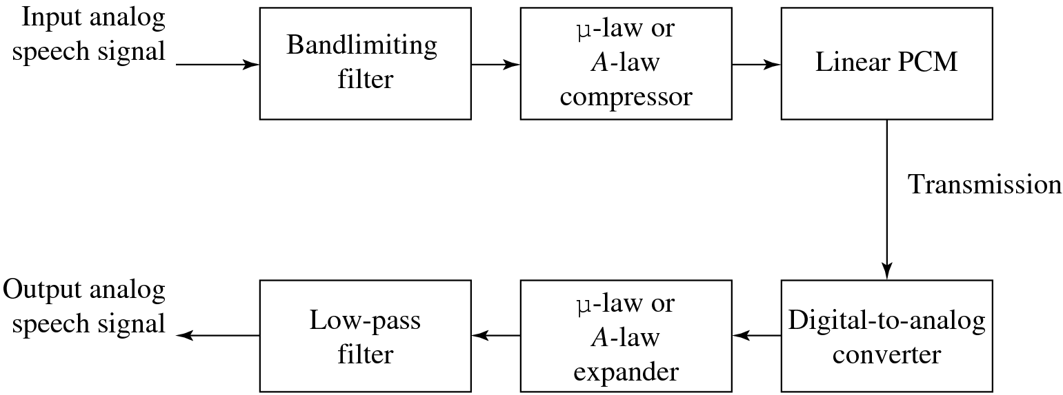
The complete scheme for encoding and decoding telephony signals is shown as a schematic in Fig. 6.14. As a result of the low-pass filtering, the output becomes smoothed and Fig. 6.13(c) above showed this effect.
Fig. 6.14: PCM signal encoding and decoding.

Slide 169
Differential Coding of Audio
Audio is often stored not in simple PCM but instead in a form that exploits differences — which are generally smaller numbers, so offer the possibility of using fewer bits to store.
  If a time-dependent signal has some consistency over time (“temporal redundancy”), the difference signal, subtracting the current sample from the previous one, will have a more peaked histogram, with a maximum around zero.
  For example, as an extreme case the histogram for a linear ramp signal that has constant slope is flat, whereas the histogram for the derivative of the signal (i.e., the differences, from sampling point to sampling point) consists of a spike at the slope value.
  So if we then go on to assign bit-string codewords to differences, we can assign short codes to prevalent values and long codewords to rarely occurring ones.

Slide 170
Lossless Predictive Coding
Predictive coding: simply means transmitting differences — predict the next sample as being equal to the current sample; send not the sample itself but the difference between previous and next.
  Predictive coding consists of finding differences, and transmitting these using a PCM system.
  Note that differences of integers will be integers. Denote the integer input signal as the set of values f_{n}. Then we predict values as simply the previous value, and define the error e_{n} as the difference between the actual and the predicted signal:
  (6.12)

Slide 171
  But it is often the case that some function of a few of the previous values, f_{n−1}, f_{n−2}, f_{n−3}, etc., provides a better prediction. Typically, a linear predictor function is used:
(6.13)

Slide 172
The idea of forming differences is to make the histogram of sample values more peaked.
  For example, Fig.6.15(a) plots 1 second of sampled speech at 8 kHz, with magnitude resolution of 8 bits per sample.
  A histogram of these values is actually centered around zero, as in Fig. 6.15(b).
  Fig. 6.15(c) shows the histogram for corresponding speech signal differences: difference values are much more clustered around zero than are sample values themselves.
  As a result, a method that assigns short codewords to frequently occurring symbols will assign a short code to zero and do rather well: such a coding scheme will much more efficiently code sample differences than samples themselves.

Slide 173
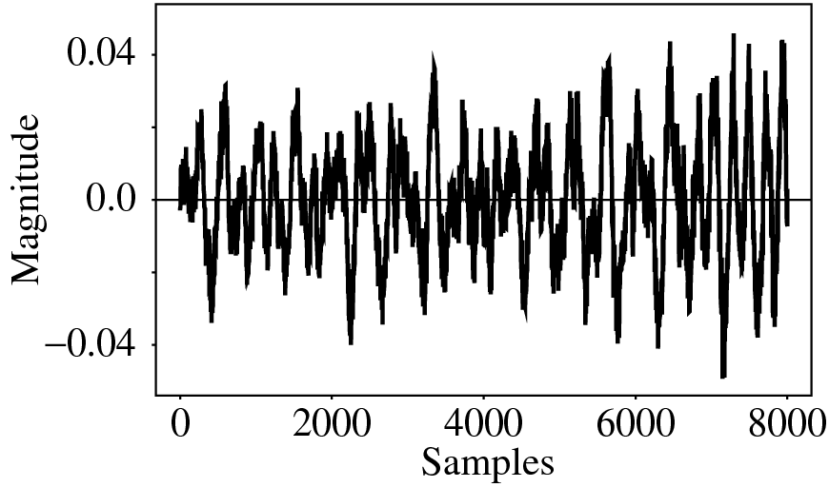
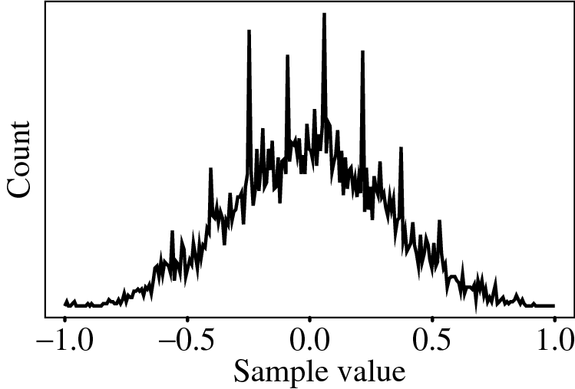
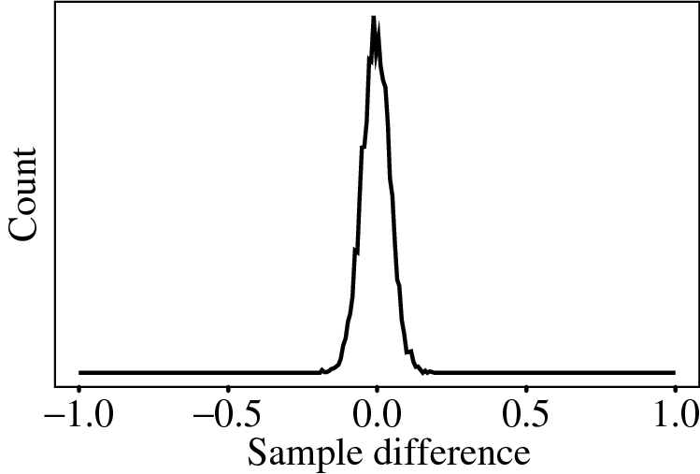
Fig. 6.15: Differencing concentrates the histogram. (a): Digital speech signal. (b): Histogram of digital speech signal values. (c): Histogram of digital speech signal differences.

Slide 174
One problem: suppose our integer sample values are in the range 0..255. Then differences could be as much as -255..255 —we’ve increased our dynamic range (ratio of maximum to minimum) by a factor of two → need more bits to transmit some differences.
  A clever solution for this: define two new codes, denoted SU and SD, standing for Shift-Up and Shift-Down. Some special code values will be reserved for these.
  Then we can use codewords for only a limited set of signal differences, say only the range −15..16. Differences which lie in the limited range can be coded as is, but with the extra two values for SU, SD, a value outside the range −15..16 can be transmitted as a series of shifts, followed by a value that is indeed inside the range −15..16.
  For example, 100 is transmitted as: SU, SU, SU, 4, where (the codes for) SU and for 4 are what are transmitted (or stored).

Slide 175
Lossless predictive coding — the decoder produces the same signals as the original. As a simple example, suppose we devise a predictor for as follows:
(6.14)

Slide 176
Let’s consider an explicit example. Suppose we wish to code the sequence f₁, f₂, f₃, f₄, f₅ = 21, 22, 27, 25, 22. For the purposes of the predictor, we’ll invent an extra signal value f₀, equal to f₁ = 21, and first transmit this initial value, uncoded:
(6.15)

Slide 177
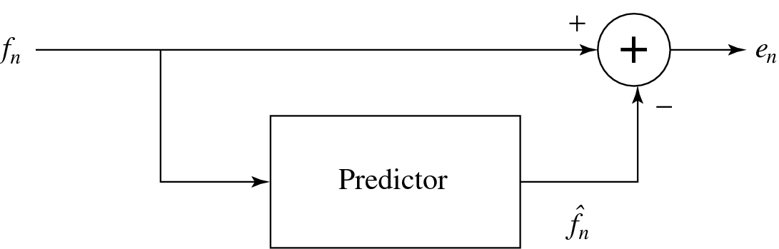
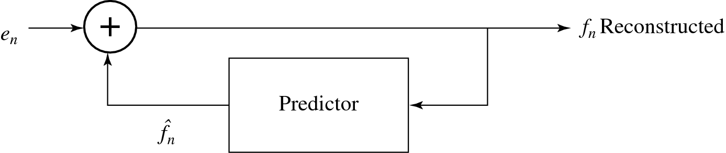
The error does center around zero, we see, and coding (assigning bit-string codewords) will be efficient. Fig. 6.16 shows a typical schematic diagram used to encapsulate this type of system:
Fig. 6.16: Schematic diagram for Predictive Coding encoder and decoder.

Slide 178
DPCM
Differential PCM is exactly the same as Predictive Coding, except that it incorporates a quantizer step.
  One scheme for analytically determining the best set of quantizer steps, for a non-uniform quantizer, is the Lloyd-Max quantizer, which is based on a least-squares minimization of the error term.
  Our nomenclature: signal values: f_{n} – the original signal, – the predicted signal, and the quantized, reconstructed signal.
  DPCM: form the prediction; form an error en by subtracting the prediction from the actual signal; then quantize the error to a quantized version

Slide 179
    The set of equations that describe DPCM are as follows:
  (6.16)
    Then codewords for quantized error values are produced using entropy coding, e.g. Huffman coding.

Slide 180
The main effect of the coder-decoder process is to produce reconstructed, quantized signal values
  The distortion is the average squared error
  one often plots distortion versus the number of bit-levels used. A Lloyd-Max quantizer will do better (have less distortion) than a uniform quantizer.
For speech, we could modify quantization steps adaptively by estimating the mean and variance of a patch of signal values, and shifting quantization steps accordingly, for every block of signal values. That is, starting at time i we could take a block of N values f_{n} and try to minimize the quantization error:
(6.17)

Slide 181
Since signal differences are very peaked, we could model them using a Laplacian probability distribution function, which is strongly peaked at zero: it looks like
(6.18)
for variance σ².
So typically one assigns quantization steps for a quantizer with nonuniform steps by assuming signal differences, d_{n} are drawn from such a distribution and then choosing steps to minimize
(6.19)

Slide 182
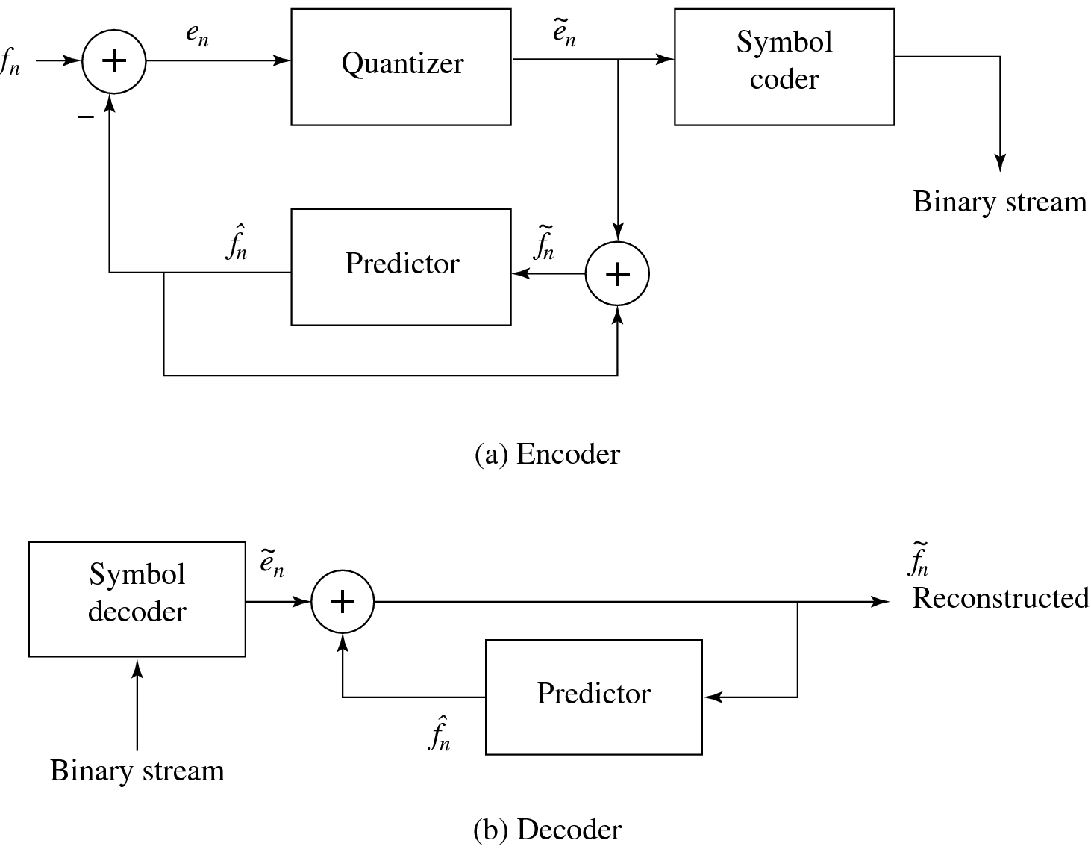
This is a least-squares problem, and can be solved iteratively using the Lloyd-Max quantizer.
Schematic diagram for DPCM:
Fig. 6.17: Schematic diagram for DPCM encoder and decoder

Slide 183
Notice that the quantization noise, , is equal to the quantization effect on the error term, .
Let’s look at actual numbers: Suppose we adopt the particular predictor below:
(6.19)
so that is an integer.
As well, use the quantization scheme:
(6.20)

Slide 184
First, we note that the error is in the range −255..255, i.e., there are 511 possible levels for the error term. The quantizer simply divides the error range into 32 patches of about 16 levels each. It also makes the representative reconstructed value for each patch equal to the midway point for each group of 16 levels.
Table 6.7 gives output values for any of the input codes: 4-bit codes are mapped to 32 reconstruction levels in a staircase fashion.
e_{n} in range | Quantized to value
-255 .. -240 -239 .. -224 . . . -31 .. -16 -15 .. 0 1 .. 16 17 .. 32 . . . 225 .. 240 241 .. 255 | -248 -232 . . . -24 -8 8 24 . . . 232 248
Table 6.7 DPCM quantizer reconstruction levels.

Slide 185
As an example stream of signal values, consider the set of values:
Prepend extra values f = 130 to replicate the first value, f₁. Initialize with quantized error ≡ 0, so that the first reconstructed value is exact:
  = 130. Then the rest of the values calculated are as follows (with prepended values in a box):
= 130, 130, 142, 144, 167
e = 0 , 20, −2, 56, 63
= 0 , 24, −8, 56, 56
= 130, 154, 134, 200, 223
On the decoder side, we again assume extra values equal to the correct value , so that the first reconstructed value is correct. What is received is , and the reconstructed is identical to that on the encoder side, provided we use exactly the same prediction rule.
f₁ | f₂ | f₃ | f₄ | f₅
130 | 150 | 140 | 200 | 300

Slide 186
DM
DM (Delta Modulation): simplified version of DPCM. Often used as a quick AD converter.
  Uniform-Delta DM: use only a single quantized error value, either positive or negative.
    a 1-bit coder. Produces coded output that follows the original signal in a staircase fashion. The set of equations is:
        Note that the prediction simply involves a delay.

Slide 187
    Consider actual numbers: Suppose signal values are
      As well, define an exact reconstructed value .
      E.g., use step value k = 4:
    The reconstructed set of values 10, 14, 10, 14 is close to the correct set 10, 11, 13, 15.
    However, DM copes less well with rapidly changing signals. One approach to mitigating this problem is to simply increase the sampling, perhaps to many times the Nyquist rate.
f₁ | f₂ | f₃ | f₄
10 | 11 | 13 | 15
 | e2 = 11 − 10 = 1,
 | e3 = 13 − 14 = −1,
 | e4 = 15 − 10 = 5,

Slide 188
Adaptive DM: If the slope of the actual signal curve is high, the staircase approximation cannot keep up. For a steep curve, should change the step size k adaptively.
  One scheme for analytically determining the best set of quantizer steps, for a non-uniform quantizer, is Lloyd-Max.

Slide 189
ADPCM
ADPCM (Adaptive DPCM) takes the idea of adapting the coder to suit the input much farther. The two pieces that make up a DPCM coder: the quantizer and the predictor.
  In Adaptive DM, adapt the quantizer step size to suit the input. In DPCM, we can change the step size as well as decision boundaries, using a non-uniform quantizer. We can carry this out in two ways:
    Forward adaptive quantization: use the properties of the input signal.
    Backward adaptive quantizationor: use the properties of the quantized output. If quantized errors become too large, we should change the non-uniform quantizer.

Slide 190
  We can also adapt the predictor, again using forward or backward adaptation. Making the predictor coefficients adaptive is called Adaptive Predictive Coding (APC):
    Recall that the predictor is usually taken to be a linear function of previous reconstructed quantized values, .
    The number of previous values used is called the “order” of the predictor. For example, if we use M previous values, we need M coefficients a_{i}, i = 1..M in a predictor
    (6.22)

Slide 191
However we can get into a difficult situation if we try to change the prediction coefficients, that multiply previous quantized values, because that makes a complicated set of equations to solve for these coefficients:
  Suppose we decide to use a least-squares approach to solving a minimization trying to find the best values of the a_{i}:
(6.23)
  Here we would sum over a large number of samples f_{n}, for the current patch of speech, say. But because depends on the quantization we have a difficult problem to solve. As well, we should really be changing the fineness of the quantization at the same time, to suit the signal’s changing nature; this makes things problematical.

Slide 192
  Instead, one usually resorts to solving the simpler problem that results from using not in the prediction, but instead simply the signal f_{n} itself. Explicitly writing in terms of the coefficients a_{i}, we wish to solve:
(6.24)
  Differentiation with respect to each of the a_{i}, and setting to zero, produces a linear system of M equations that is easy to solve. (The set of equations is called the Wiener-Hopf equations.)

Slide 193

Fig. 6.18 shows a schematic diagram for the ADPCM coder and decoder:
Fig. 6.18: Schematic diagram for ADPCM encoder and decoder

Slide 194
Week: 11
Differential Coding of Audio
Huffman Coding and Adaptive Huffman Coding
Apply differential coding techniques in audio.
Implement Huffman and adaptive Huffman coding techniques.

Slide 195
In this Part we examine the role played in multimedia by data compression, perhaps the most important enabling technology that makes modern multimedia systems possible.
So much data exist, in archives, via streaming, and elsewhere, that it has become critical to compress this information.
We start off in Chap. 7 looking at lossless data compression i.e., involving no distortion of the original signal once it is decompressed or reconstituted.

Slide 196

7.1 Introduction
Compression: the process of coding that will effectively reduce the total number of bits needed to represent certain information.
Figure 7.1 depicts a general data compression scheme, in which compression is performed by an encoder and decompression is performed by a decoder.
Fig. 7.1: A General Data Compression Scheme.

Slide 197

7.1 Introduction
If the compression and decompression processes induce no information loss, then the compression scheme is lossless; otherwise, it is lossy.
Compression ratio:
(7.1)
B₀ – number of bits before compression
B₁ – number of bits after compression
In general, we would desire any codec (encoder/decoder scheme) to have a compression ratio much larger than 1.0.
The higher the compression ratio, the better the lossless compression scheme, as long as it is computationally feasible.

Slide 198
7.2 Basics of Information Theory
The entropy η of an information source with alphabet S = {s₁, s₂, . . . , s_{n}} is:
(7.2)
(7.3)
p_{i} – probability that symbol s_{i} will occur in S.
– indicates the amount of information ( self-information as defined by Shannon) contained in s_{i}, which corresponds to the number of bits needed to encode s_{i}.

Slide 199
7.2 Basics of Information Theory
What is entropy? is a measure of the number of specific ways in which a system may be arranged, commonly understood as a measure of the disorder of a system.
As an example, if the information source S is a gray-level digital image, each s_{i} is a gray-level intensity ranging from 0 to (2^{k} − 1), where k is the number of bits used to represent each pixel in an uncompressed image.
We need to find the entropy of this image; which the number of bits to represent the image after compression.

Slide 200

Distribution of Gray-Level Intensities
Fig. 7.2 Histograms for Two Gray-level Images.
• Fig. 7.2(a) shows the histogram of an image with uniform distribution of gray-level intensities, i.e., ∀i p_{i} = 1/256. Hence, the entropy of this image is:
log₂256 = 8 (7.4)
• Fig. 7.2(b) shows the histogram of an image with two possible values (binary image). Its entropy is 0.92.

Slide 201
Distribution of Gray-Level Intensities
It is interesting to observe that in the above uniform-distribution example (fig. 7-2 (a)) we found that α = 8, the minimum average number of bits to represent each gray-level intensity is at least 8. No compression is possible for this image.
In the context of imaging, this will correspond to the “worst case,” where neighboring pixel values have no similarity.

Slide 202
7.3 Run-Length Coding
RLC is one of the simplest forms of data compression.
The basic idea is that if the information source has the property that symbols tend to form continuous groups, then such symbol and the length of the group can be coded.
Consider a screen containing plain black text on a solid white background.
There will be many long runs of white pixels in the blank space, and many short runs of black pixels within the text. Let us take a hypothetical single scan line, with B representing a black pixel and W representing white: WWWWWBWWWWBBBWWWWWWBWWW
If we apply the run-length encoding (RLE) data compression algorithm to the above hypothetical scan line, we get the following: 5W1B4W3B6W1B3W
The run-length code represents the original 21 characters in only 14.

Slide 203
7.4 Variable-Length Coding
variable-length coding (VLC) is one of the best-known entropy coding methods
Here, we will study the Shannon–Fano algorithm, Huffman coding, and adaptive Huffman coding.

Slide 204
7.4.1 Shannon–Fano Algorithm
To illustrate the algorithm, let us suppose the symbols to be coded are the characters in the word HELLO.
The frequency count of the symbols is
Symbol H E L O
Count 1 1 2 1
The encoding steps of the Shannon–Fano algorithm can be presented in the following top-down manner:
1. Sort the symbols according to the frequency count of their occurrences.
2. Recursively divide the symbols into two parts, each with approximately the same number of counts, until all parts contain only one symbol.

Slide 205
7.4.1 Shannon–Fano Algorithm
A natural way of implementing the above procedure is to build a binary tree.
As a convention, let us assign bit 0 to its left branches and 1 to the right branches.
Initially, the symbols are sorted as LHEO.
As Fig. 7.3 shows, the first division yields two parts: L with a count of 2, denoted as L:(2); and H, E and O with a total count of 3, denoted as H, E, O:(3).
The second division yields H:(1) and E, O:(2).
The last division is E:(1) and O:(1).

Slide 206

7.4.1 Shannon–Fano Algorithm
Fig. 7.3: Coding Tree for HELLO by Shannon-Fano.

Slide 207
Table 7.1: Result of Performing Shannon-Fano on HELLO
Symbol | Count | Log₂ | Code | # of bits used
L | 2 | 1.32 | 0 | 2
H | 1 | 2.32 | 10 | 2
E | 1 | 2.32 | 110 | 3
O | 1 | 2.32 | 111 | 3
TOTAL # of bits: |  |  |  | 10

Slide 208

Fig. 7.4 Another coding tree for HELLO by Shannon-Fano.

Slide 209
Table 7.2: Another Result of Performing Shannon-Fano
on HELLO (see Fig. 7.4)
Symbol | Count | Log₂ | Code | # of bits used
L | 2 | 1.32 | 00 | 4
H | 1 | 2.32 | 01 | 2
E | 1 | 2.32 | 10 | 2
O | 1 | 2.32 | 11 | 2
TOTAL # of bits: |  |  |  | 10

Slide 210
7.4.1 Shannon–Fano Algorithm
The Shannon–Fano algorithm delivers satisfactory coding results for data compression, but it was soon outperformed and overtaken by the Huffman coding method.
The Huffman algorithm requires prior statistical knowledge about the information source, and such information is often not available.
This is particularly true in multimedia applications, where future data is unknown before its arrival, as for example in live (or streaming) audio and video.
Even when the statistics are available, the transmission of the symbol table could represent heavy overhead
The solution is to use adaptive Huffman coding compression algorithms, in which statistics are gathered and updated dynamically as the data stream arrives.

Slide 211
7.5 Dictionary-Based Coding
The Lempel-Ziv-Welch (LZW) algorithm employs an adaptive, dictionary-based compression technique.
Unlike variable-length coding, in which the lengths of the codewords are different, LZW uses fixed-length codewords to represent variable length strings of symbols/characters that commonly occur together, such as words in English text.
As in the other adaptive compression techniques, the LZW encoder and decoder builds up the same dictionary dynamically while receiving the data—the encoder and the decoder both develop the same dictionary.

Slide 212
7.5 Dictionary-Based Coding
LZW proceeds by placing longer and longer repeated entries into a dictionary, then emitting (sending) the code for an element rather than the string itself, if the element has already been placed in the dictionary.
Remember, the LZW is an adaptive algorithm, in which the encoder and decoder independently build their own string tables. Hence, there is no overhead involving transmitting the string table.
LZW is used in many applications, such as UNIX compress, GIF for images, WinZip, and others.

Slide 213
Week: 12
Introduction to MPEG Standards
MPEG-1 and MPEG-2
Understand the basics of MPEG standards.
Apply MPEG-1 and MPEG-2 video compression techniques.

Slide 214
Fundamentals of Multimedia, Chapter 11
11.1 Overview
• MPEG: Moving Pictures Experts Group, established in 1988
for the development of digital video.
• It is appropriately recognized that proprietary interests need
to be maintained within the family of MPEG standards:
– Accomplished by deﬁning only a compressed bitstream
that implicitly deﬁnes the decoder.
– The compression algorithms, and thus the encoders, are
completely up to the manufacturers.
2
Li & Drew c Prentice Hall 2003

Slide 215
Fundamentals of Multimedia, Chapter 11
11.2 MPEG-1
• MPEG-1 adopts the CCIR601 digital TV format also known
as SIF (Source Input Format).
• MPEG-1 supports only non-interlaced video. Normally, its
picture resolution is:
– 352 × 240 for NTSC video at 30 fps
– 352 × 288 for PAL video at 25 fps
– It uses 4:2:0 chroma subsampling
• The MPEG-1 standard is also referred to as ISO/IEC 11172.
It has ﬁve parts: 11172-1 Systems, 11172-2 Video, 11172-3
Audio, 11172-4 Conformance, and 11172-5 Software.

Slide 216
Fundamentals of Multimedia, Chapter 11
Motion Compensation in MPEG-1
• Motion Compensation (MC) based video encoding in H.261
works as follows:
– In Motion Estimation (ME), each macroblock (MB) of
the Target P-frame is assigned a best matching MB from
the previously coded I or P frame - prediction.
– prediction error: The diﬀerence between the MB and its
matching MB, sent to DCT and its subsequent encoding
steps.
– The prediction is from a previous frame — forward pre-
diction.

Slide 217

Fundamentals of Multimedia, Chapter 11
Previous frame
Target frame
Next frame
Fig 11.1: The Need for Bidirectional Search.
The MB containing part of a ball in the Target frame cannot ﬁnd a good
matching MB in the previous frame because half of the ball was occluded
by another object. A match however can readily be obtained from the next
frame.

Slide 218
Fundamentals of Multimedia, Chapter 11
Motion Compensation in MPEG-1 (Cont’d)
• MPEG introduces a third frame type — B-frames, and its
accompanying bi-directional motion compensation.
• The MC-based B-frame coding idea is illustrated in Fig. 11.2:
– Each MB from a B-frame will have up to two motion vectors (MVs)
(one from the forward and one from the backward prediction).
– If matching in both directions is successful, then two MVs will be sent
and the two corresponding matching MBs are averaged (indicated by
‘%’ in the ﬁgure) before comparing to the Target MB for generating
the prediction error.
– If an acceptable match can be found in only one of the reference
frames, then only one MV and its corresponding MB will be used
from either the forward or backward prediction.

Slide 219

Fundamentals of Multimedia, Chapter 11
Previous reference frame
−
Target frame
%
Motion vectors
Future reference frame
Difference macroblock
Y
Cb
Cr
For each 8 ⋅ 8 block
DCT
Quantization
Entropy coding
0011101…
Fig 11.2: B-frame Coding Based on Bidirectional Motion Compensation.

Slide 220

Fundamentals of Multimedia, Chapter 11
Time
Display order
Coding and
transmission order
I
B
B
P
B
B
P
B
B
I
I
P
B
B
P
B
B
I
B
B
Fig 11.3: MPEG Frame Sequence.

Slide 221

Fundamentals of Multimedia, Chapter 11
Other Major Diﬀerences from H.261
• Source formats supported:
– H.261 only supports CIF (352 × 288) and QCIF (176 × 144) source
formats, MPEG-1 supports SIF (352 × 240 for NTSC, 352 × 288 for
PAL).
– MPEG-1 also allows speciﬁcation of other formats as long as the
Constrained Parameter Set (CPS) as shown in Table 11.1 is satisﬁed:
Table 11.1: The MPEG-1 Constrained Parameter Set
Parameter
Horizontal size of picture
Vertical size of picture
No. of MBs / picture
No. of MBs / second
Frame rate
Bit-rate
Value
≤ 768
≤ 576
≤ 396
≤ 9, 900
≤ 30 fps
≤ 1, 856 kbps

Slide 222
Fundamentals of Multimedia, Chapter 11
Other Major Diﬀerences from H.261 (Cont’d)
• Instead of GOBs as in H.261, an MPEG-1 picture can be
divided into one or more slices (Fig. 11.4):
– May contain variable numbers of macroblocks in a single
picture.
– May also start and end anywhere as long as they ﬁll the
whole picture.
– Each slice is coded independently — additional ﬂexibility
in bit-rate control.
– Slice concept is important for error recovery.

Slide 223

Fundamentals of Multimedia, Chapter 11
Fig 11.4: Slices in an MPEG-1 Picture.

Slide 224
Fundamentals of Multimedia, Chapter 11
Other Major Diﬀerences from H.261 (Cont’d)
• Quantization:
– MPEG-1 quantization uses diﬀerent quantization tables for its Intra
and Inter coding (Table 11.2 and 11.3).
For DCT coeﬃcients in Intra mode:
8 × DCT [i, j ]
step size[i, j ]
8 × DCT [i, j ]
Q1[i, j ] ∗ scale
QDCT [i, j ] = round
= round
(11.1)
For DCT coeﬃcients in Inter mode,
8 × DCT [i, j ]
step size[i, j ]
8 × DCT [i, j ]
Q2[i, j ] ∗ scale
QDCT [i, j ] =
=
(11.2)

Slide 225

Fundamentals of Multimedia, Chapter 11
Table 11.2: Default Quantization Table (Q1) for Intra-Coding
8
16
19
22
22
26
26
27
16
16
22
22
26
27
27
29
19
22
26
26
27
29
29
35
22
24
27
27
29
32
34
38
26
27
29
29
32
35
38
46
27
29
34
34
35
40
46
56
29
34
34
37
40
48
56
69
34
37
38
40
48
58
69
83
Table 11.3: Default Quantization Table (Q2) for Inter-Coding
16
16
16
16
16
16
16
16
16
16
16
16
16
16
16
16
16
16
16
16
16
16
16
16
16
16
16
16
16
16
16
16
16
16
16
16
16
16
16
16
16
16
16
16
16
16
16
16
16
16
16
16
16
16
16
16
16
16
16
16
16
16
16
16

Slide 226
Fundamentals of Multimedia, Chapter 11
Other Major Diﬀerences from H.261 (Cont’d)
• MPEG-1 allows motion vectors to be of sub-pixel precision
(1/2 pixel). The technique of “bilinear interpolation” for
H.263 can be used to generate the needed values at half-
pixel locations.
• Compared to the maximum range of ±15 pixels for motion
vectors in H.261, MPEG-1 supports a range of [−512, 511.5]
for half-pixel precision and [−1, 024, 1, 023] for full-pixel pre-
cision motion vectors.
• The MPEG-1 bitstream allows random access — accom-
plished by GOP layer in which each GOP is time coded.

Slide 227

Fundamentals of Multimedia, Chapter 11
Typical Sizes of MPEG-1 Frames
• The typical size of compressed P-frames is signiﬁcantly smaller
than that of I-frames — because temporal redundancy is ex-
ploited in inter-frame compression.
• B-frames are even smaller than P-frames — because of (a)
the advantage of bi-directional prediction and (b) the lowest
priority given to B-frames.
Table 11.4: Typical Compression Performance of MPEG-1 Frames
Type
I
P
B
Avg
Size
18 kB
6 kB
2.5 kB
4.8 kB
Compression
7:1
20:1
50:1
27:1

Slide 228

Fundamentals of Multimedia, Chapter 11
Video sequence
Sequence
header
GOP
header
Picture
header
GOP
Picture
Slice
GOP
Picture
Slice
GOP
Picture
Slice
...
...
...
Sequence
end code
Picture
Slice
Sequence
layer
Group of picture
layer
Picture
layer
Slice
header
Macroblock
Macroblock
...
Macroblock
Slice
layer
Macroblock
header
Block 0
Block 1
Block 2
Block 3
Block 4
Block 5
Macroblock
layer
Differential
DC coefficient
VLC run
VLC run
...
end_of_block
Block
layer
(if intra macroblock)
Fig 11.5: Layers of MPEG-1 Video Bitstream.

Slide 229
Fundamentals of Multimedia, Chapter 11
11.3 MPEG-2
• MPEG-2: For higher quality video at a bit-rate of more than
4 Mbps.
• Deﬁned seven proﬁles aimed at diﬀerent applications:
– Simple, Main, SNR scalable, Spatially scalable, High,
4:2:2, Multiview.
– Within each proﬁle, up to four levels are deﬁned (Table
11.5).
– The DVD video speciﬁcation allows only four display res-
olutions: 720 × 480, 704 × 480, 352 × 480, and 352 × 240
— a restricted form of the MPEG-2 Main proﬁle at the
Main and Low levels.

Slide 230


Fundamentals of Multimedia, Chapter 11
Table 11.5: Proﬁles and Levels in MPEG-2
SNR
Spatially
Level
Simple
Proﬁle
Main
Proﬁle
Scalable
Proﬁle
Scalable
Proﬁle
High
Proﬁle
4:2:2
Proﬁle
Multiview
Proﬁle
High
*
*
High 1440
*
*
*
Main
*
*
*
*
*
*
Low
*
*
Table 11.6: Four Levels in the Main Proﬁle of MPEG-2
Level
High
High 1440
Main
Low
Max
Resolution
1, 920 × 1, 152
1, 440 × 1, 152
720 × 576
352 × 288
Max
fps
60
60
30
30
Max
Pixels/sec
62.7 × 106
47.0 × 106
10.4 × 106
3.0 × 106
Max coded
Data Rate (Mbps)
80
60
15
4
Application
ﬁlm production
consumer HDTV
studio TV
consumer tape equiv.

Slide 231
Fundamentals of Multimedia, Chapter 11
Supporting Interlaced Video
• MPEG-2 must support interlaced video as well since this is
one of the options for digital broadcast TV and HDTV.
• In interlaced video each frame consists of two ﬁelds, referred
to as the top-ﬁeld and the bottom-ﬁeld.
– In a Frame-picture, all scanlines from both ﬁelds are in-
terleaved to form a single frame, then divided into 16 × 16
macroblocks and coded using MC.
– If each ﬁeld is treated as a separate picture, then it is
called Field-picture.

Slide 232

Fundamentals of Multimedia, Chapter 11
Top−field
Bottom−field
(a) Frame−picture vs. Field−pictures
...
I or P
B
P
(b) Field Prediction for Field−pictures
Fig. 11.6: Field pictures and Field-prediction for Field-pictures in MPEG-2.

Slide 233
Fundamentals of Multimedia, Chapter 11
Five Modes of Predictions
• MPEG-2 deﬁnes Frame Prediction and Field Prediction
as well as ﬁve prediction modes:
1. Frame Prediction for Frame-pictures: Identical to MPEG-
1 MC-based prediction methods in both P-frames and B-
frames.
2. Field Prediction for Field-pictures: A macroblock size
of 16 × 16 from Field-pictures is used. For details, see
Fig. 11.6(b).

Slide 234
Fundamentals of Multimedia, Chapter 11
3. Field Prediction for Frame-pictures: The top-ﬁeld and
bottom-ﬁeld of a Frame-picture are treated separately.
Each 16 × 16 macroblock (MB) from the target Frame-
picture is split into two 16 × 8 parts, each coming from
one ﬁeld. Field prediction is carried out for these 16 × 8
parts in a manner similar to that shown in Fig. 11.6(b).
4. 16 × 8 MC for Field-pictures: Each 16 × 16 macroblock
(MB) from the target Field-picture is split into top and
bottom 16 × 8 halves. Field prediction is performed on
each half. This generates two motion vectors for each
16 × 16 MB in the P-Field-picture, and up to four motion
vectors for each MB in the B-Field-picture.
This mode is good for a ﬁner MC when motion is rapid
and irregular.

Slide 235
Fundamentals of Multimedia, Chapter 11
5. Dual-Prime for P-pictures: First, Field prediction from
each previous ﬁeld with the same parity (top or bottom)
is made. Each motion vector mv is then used to derive
a calculated motion vector cv in the ﬁeld with the oppo-
site parity taking into account the temporal scaling and
vertical shift between lines in the top and bottom ﬁelds.
For each MB the pair mv and cv yields two preliminary
predictions. Their prediction errors are averaged and used
as the ﬁnal prediction error.
This mode mimics B-picture prediction for P-pictures with-
out adopting backward prediction (and hence with less
encoding delay).
This is the only mode that can be used for either Frame-
pictures or Field-pictures.

Slide 236
Fundamentals of Multimedia, Chapter 11
Alternate Scan and Field DCT
• Techniques aimed at improving the eﬀectiveness of DCT on
prediction errors, only applicable to Frame-pictures in inter-
laced videos:
– Due to the nature of interlaced video the consecutive rows in the 8 × 8
blocks are from diﬀerent ﬁelds, there exists less correlation between
them than between the alternate rows.
– Alternate scan recognizes the fact that in interlaced video the verti-
cally higher spatial frequency components may have larger magnitudes
and thus allows them to be scanned earlier in the sequence.
• In MPEG-2, Field DCT can also be used to address the
same issue.

Slide 237

Fundamentals of Multimedia, Chapter 11
(a)
(b)
Fig 11.7: Zigzag and Alternate Scans of DCT Coeﬃcients for
Progressive and Interlaced Videos in MPEG-2.

Slide 238
Fundamentals of Multimedia, Chapter 11
MPEG-2 Scalabilities
• The MPEG-2 scalable coding: A base layer and one or more
enhancement layers can be deﬁned — also known as layered
coding.
– The base layer can be independently encoded, transmitted and de-
coded to obtain basic video quality.
– The encoding and decoding of the enhancement layer is dependent
on the base layer or the previous enhancement layer.
• Scalable coding is especially useful for MPEG-2 video trans-
mitted over networks with following characteristics:
– Networks with very diﬀerent bit-rates.
– Networks with variable bit rate (VBR) channels.
– Networks with noisy connections.

Slide 239
Fundamentals of Multimedia, Chapter 11
MPEG-2 Scalabilities (Cont’d)
• MPEG-2 supports the following scalabilities:
1. SNR Scalability — enhancement layer provides higher SNR.
2. Spatial Scalability — enhancement layer provides higher
spatial resolution.
3. Temporal Scalability — enhancement layer facilitates higher
frame rate.
4. Hybrid Scalability — combination of any two of the above
three scalabilities.
5. Data Partitioning — quantized DCT coeﬃcients are split
into partitions.

Slide 240
Fundamentals of Multimedia, Chapter 11
SNR Scalability
• SNR scalability: Refers to the enhencement/reﬁnement
over the base layer to improve the Signal-Noise-Ratio (SNR).
• The MPEG-2 SNR scalable encoder will generate output bit-
streams Bits base and Bits enhance at two layers:
1. At the Base Layer, a coarse quantization of the DCT coeﬃcients is
employed which results in fewer bits and a relatively low quality video.
2. The coarsely quantized DCT coeﬃcients are then inversely quantized
(Q−1) and fed to the Enhancement Layer to be compared with the
original DCT coeﬃcient.
3. Their diﬀerence is ﬁnely quantized to generate a DCT coeﬃcient re-
ﬁnement, which, after VLC, becomes the bitstream called Bits enhance.

Slide 241

Fundamentals of Multimedia, Chapter 11
SNR Enhancement Encoder
+
−
Q
VLC
Bits_enhance
Q−1
Base Encoder
+
Current
Frame
+
−
DCT
Q
VLC
Bits_base
Q−1
IDCT
+
MC−based
Frame
Prediction
Prediction
Motion
Memory
Motion vectors
Estimation
(a) Encoder
Fig 11.8 (a): MPEG-2 SNR Scalability (Encoder).

Slide 242



Fundamentals of Multimedia, Chapter 11
SNR Enhancement Decoder
Bits_enhance
VLD
Q−1
+
Base Decoder
Bits_base
VLD
Q−1
IDCT
+
Output_base,
Output_high
Frame
Memory
MC−based
Prediction
Motion vectors
(b) Decoder
Fig 11.8 (b): MPEG-2 SNR Scalability (Decoder).

Slide 243
Fundamentals of Multimedia, Chapter 11
Spatial Scalability
• The base layer is designed to generate bitstream of reduced-
resolution pictures. When combined with the enhancement
layer, pictures at the original resolution are produced.
• The Base and Enhancement layers for MPEG-2 spatial scal-
ability are not as tightly coupled as in SNR scalability.
• Fig. 11.9(a) shows a typical block diagram. Fig. 11.9(b)
shows a case where temporal and spatial predictions are com-
bined.

Slide 244

Fundamentals of Multimedia, Chapter 11
Current
frame
Spatial
enhancement layer
encoder
Bits_enhance
Predicted MB
from Enh. layer
16 × 16
1 − w
Spatial
Spatial
+
16 × 16
decimator
interpolator
Interpolated MB
from Base layer
16 × 16
w
Spatial
base layer
encoder
Example Weight Table
Bits_base
Spatial
Interpolation
8 × 8
w
1.0
0.5
...
0
Predicted MB
from Base layer
(a)
(b)
Fig. 11.9: Encoder for MPEG-2 Spatial Scalability. (a) Block
Diagram. (b) Combining Temporal and Spatial Predictions for
Encoding at Enhancement Layer.

Slide 245
Fundamentals of Multimedia, Chapter 11
Temporal Scalability
• The input video is temporally demultiplexed into two pieces,
each carrying half of the original frame rate.
• Base Layer Encoder carries out the normal single-layer cod-
ing procedures for its own input video and yields the output
bitstream Bits base.
• The prediction of matching MBs at the Enhancement Layer
can be obtained in two ways:
– Interlayer MC (Motion-Compensated) Prediction (Fig. 11.10(b))
– Combined MC Prediction and Interlayer MC Prediction (Fig. 11.10(c))

Slide 246

Fundamentals of Multimedia, Chapter 11
Temporal
enhancement layer
encoder
Bits_enhance
Current
frame
Temporal
demultiplexer
Temporal
Bits_base
base layer
encoder
(a) Block Diagram
Fig 11.10: Encoder for MPEG-2 Temporal Scalability.

Slide 247





Fundamentals of Multimedia, Chapter 11
Temporal
enhancement layer
B
B
B
B
Base layer
I
B
B
P
...
(b) Interlayer Motion-Compensated (MC) Prediction.
Temporal
Enhancement Layer
P
B
B
B
Base Layer
...
I
B
B
P
(c) Combined MC Prediction and Interlayer MC Prediction
Fig 11.10 (Cont’d): Encoder for MPEG-2 Temporal Scalability

Slide 248
Fundamentals of Multimedia, Chapter 11
Hybrid Scalability
• Any two of the above three scalabilities can be combined to
form hybrid scalability:
1. Spatial and Temporal Hybrid Scalability.
2. SNR and Spatial Hybrid Scalability.
3. SNR and Temporal Hybrid Scalability.
• Usually, a three-layer hybrid coder will be adopted which con-
sists of Base Layer, Enhancement Layer 1, and Enhancement
Layer 2.

Slide 249
Fundamentals of Multimedia, Chapter 11
Data Partitioning
• Base partition contains lower-frequency DCT coeﬃcients,
enhancement partition contains high-frequency DCT coef-
ﬁcients.
• Strictly speaking, data partitioning is not layered coding,
since a single stream of video data is simply divided up and
there is no further dependence on the base partition in gen-
erating the enhancement partition.
• Useful for transmission over noisy channels and for progres-
sive transmission.

Slide 250
Fundamentals of Multimedia, Chapter 11
Other Major Diﬀerences from MPEG-1
• Better resilience to bit-errors: In addition to Program
Stream, a Transport Stream is added to MPEG-2 bit streams.
• Support of 4:2:2 and 4:4:4 chroma subsampling.
• More restricted slice structure: MPEG-2 slices must start
and end in the same macroblock row. In other words, the left
edge of a picture always starts a new slice and the longest
slice in MPEG-2 can have only one row of macroblocks.
• More ﬂexible video formats: It supports various picture
resolutions as deﬁned by DVD, ATV and HDTV.

Slide 251

Fundamentals of Multimedia, Chapter 11
Other Major Diﬀerences from MPEG-1 (Cont’d)
• Nonlinear quantization — two types of scales are allowed:
1. For the ﬁrst type, scale is the same as in MPEG-1 in which
it is an integer in the range of [1, 31] and scalei = i.
2. For the second type, a nonlinear relationship exists, i.e.,
scalei = i. The ith scale value can be looked up from
Table 11.7.
Table 11.7: Possible Nonlinear Scale in MPEG-2
i
scalei
i
scalei
1
1
17
28
2
2
18
32
3
3
19
36
4
4
20
40
5
5
21
44
6
6
22
48
7
7
23
52
8
8
24
56
9
10
25
64
10
12
26
72
11
14
27
80
12
16
28
88
13
18
29
96
14
20
30
104
15
22
31
112
16
24

Slide 252
Fundamentals of Multimedia, Chapter 11
11.4 Further Exploration
• Text books:
– Video Compression Standard by J.L. Mitchell et al
– Digital Video: An Introduction to MPEG-2 by B.G. Haskell et al
• Web sites:
−→ Link to Further Exploration for Chapter 11..
includ-
ing:
– The MPEG home page.
– MPEG FAQ page.
– Overviews and working documents of the MPEG-1 and MPEG-2 stan-
dards.

Slide 253
Week: 13
MPEG-4 and MPEG-7
Motion Compensation Techniques
Understand and apply MPEG-4 and MPEG-7 standards.
Apply motion compensation in video processing.

Slide 254
Fundamentals of Multimedia, Chapter 12
12.1 Overview of MPEG-4
• MPEG-4: a newer standard. Besides compression, pays
great attention to issues about user interactivities.
• MPEG-4 departs from its predecessors in adopting a new
object-based coding:
– Oﬀering higher compression ratio, also beneﬁcial for dig-
ital video composition, manipulation, indexing, and re-
trieval.
– Figure 12.1 illustrates how MPEG-4 videos can be com-
posed and manipulated by simple operations on the visual
objects.
• The bit-rate for MPEG-4 video now covers a large range
between 5 kbps to 10 Mbps.

Slide 255

Fundamentals of Multimedia, Chapter 12
Fig. 12.1: Composition and Manipulation of MPEG-4 Videos.

Slide 256
Fundamentals of Multimedia, Chapter 12
Overview of MPEG-4 (Cont’d)
• MPEG-4 (Fig. 12.2(b)) is an entirely new standard for:
(a) Composing media objects to create desirable audiovisual
scenes.
(b) Multiplexing and synchronizing the bitstreams for these
media data entities so that they can be transmitted with
guaranteed Quality of Service (QoS).
(c) Interacting with the audiovisual scene at the receiving end
— provides a toolbox of advanced coding modules and
algorithms for audio and video compressions.

Slide 257

Fundamentals of Multimedia, Chapter 12
BIFS
D
e
m
u
l
t
i
p
l
e
x
D
e
m
u
l
t
i
p
l
e
x
C
o
m
p
o
s
i
t
i
o
n
P
r
e
s
e
n
t
a
t
i
o
n
Video
Audio
Video
Audio
Animation
D
e
l
i
v
e
r
y
D
e
l
i
v
e
r
y
S
o
u
r
c
e
S
o
u
r
c
e
Text
Interaction
Interaction
(a)
(b)
Fig. 12.2: Comparison of interactivities in MPEG standards:
(a) reference models in MPEG-1 and 2 (interaction in dashed
lines supported only by MPEG-2); (b) MPEG-4 reference model.

Slide 258
Fundamentals of Multimedia, Chapter 12
Overview of MPEG-4 (Cont’d)
• The hierarchical structure of MPEG-4 visual bitstreams is
very diﬀerent from that of MPEG-1 and -2, it is very much
video object-oriented.
Video-object Sequence (VS)
Video Object (VO)
Video Object Layer (VOL)
Group of VOPs (GOV)
Video Object Plane (VOP)
Fig. 12.3: Video Object Oriented Hierarchical Description
of a Scene in MPEG-4 Visual Bitstreams.

Slide 259
Fundamentals of Multimedia, Chapter 12
Overview of MPEG-4 (Cont’d)
1. Video-object Sequence (VS) — delivers the complete MPEG-
4 visual scene, which may contain 2-D or 3-D natural or
synthetic objects.
2. Video Object (VO) — a particular object in the scene,
which can be of arbitrary (non-rectangular) shape corre-
sponding to an object or background of the scene.
3. Video Object Layer (VOL) — facilitates a way to support
(multi-layered) scalable coding. A VO can have multiple
VOLs under scalable coding, or have a single VOL under
non-scalable coding.
4. Group of Video Object Planes (GOV) — groups Video
Object Planes together (optional level).
5. Video Object Plane (VOP) — a snapshot of a VO at a
particular moment.

Slide 260
Fundamentals of Multimedia, Chapter 12
12.2 Object-based Visual Coding in MPEG-4
VOP-based vs. Frame-based Coding
• MPEG-1 and -2 do not support the VOP concept, and hence
their coding method is referred to as frame-based (also
known as Block-based coding).
• Fig. 12.4 (c) illustrates a possible example in which both po-
tential matches yield small prediction errors for block-based
coding.
• Fig. 12.4 (d) shows that each VOP is of arbitrary shape and
ideally will obtain a unique motion vector consistent with the
actual object motion.

Slide 261

Fundamentals of Multimedia, Chapter 12
Previous frame
Previous frame
Current frame
(a)
Block-based
coding
MPEG-1 and 2
(b)
MV1
Potential Match 1
MV2
Potential Match 2
(c)
Next frame
Block motion
estimation
MV
Current frame
VOP1
VOP2
VOP1
Object (VOP)
Object
based coding
motions
VOP2
MPEG-4
(d)
Fig. 12.4: Comparison between Block-based Coding and Object-based Coding.

Slide 262
Fundamentals of Multimedia, Chapter 12
VOP-based Coding
• MPEG-4 VOP-based coding also employs the Motion Com-
pensation technique:
– An Intra-frame coded VOP is called an I-VOP.
– The Inter-frame coded VOPs are called P-VOPs if only
forward prediction is employed, or B-VOPs if bi-directional
predictions are employed.
• The new diﬃculty for VOPs: may have arbitrary shapes,
shape information must be coded in addition to the texture
of the VOP.
Note: texture here actually refers to the visual content, that
is the gray-level (or chroma) values of the pixels in the VOP.

Slide 263
Fundamentals of Multimedia, Chapter 12
VOP-based Motion Compensation (MC)
• MC-based VOP coding in MPEG-4 again involves three steps:
(a) Motion Estimation.
(b) MC-based Prediction.
(c) Coding of the prediction error.
• Only pixels within the VOP of the current (Target) VOP are
considered for matching in MC.
• To facilitate MC, each VOP is divided into many macroblocks
(MBs). MBs are by default 16 × 16 in luminance images and
8 × 8 in chrominance images.

Slide 264
Fundamentals of Multimedia, Chapter 12
• MPEG-4 deﬁnes a rectangular bounding box for each VOP
(see Fig. 12.5 for details).
• The macroblocks that are entirely within the VOP are re-
ferred to as Interior Macroblocks.
The macroblocks that straddle the boundary of the VOP are
called Boundary Macroblocks.
• To help matching every pixel in the target VOP and meet
the mandatory requirement of rectangular blocks in trans-
form codine (e.g., DCT), a pre-processing step of padding is
applied to the Reference VOPs prior to motion estimation.
Note: Padding only takes place in the Reference VOPs.

Slide 265

Fundamentals of Multimedia, Chapter 12
Video frame
(0, 0)
Shift
Boundary macroblock
Bounding box
of the VOP
VOP
Interior macroblock
Fig. 12.5: Bounding Box and Boundary Macroblocks of VOP.

Slide 266
Fundamentals of Multimedia, Chapter 12
I. Padding
• For all Boundary MBs in the Reference VOP, Horizontal
Repetitive Padding is invoked ﬁrst, followed by Vertical Repet-
itive Padding.
Horizontal
Repetitive
Padding
Vertical
Repetitive
Padding
Extended
Padding
Fig. 12.6: A Sequence of Paddings for Reference VOPs in MPEG-4.
• Afterwards, for all Exterior Macroblocks that are outside
of the VOP but adjacent to one or more Boundary MBs,
extended padding will be applied.

Slide 267
Fundamentals of Multimedia, Chapter 12
Algorithm 12.1 Horizontal Repetitive Padding:
begin
for all rows in Boundary MBs in the Reference VOP
if ∃ (boundary pixel) in the row
for all interval outside of VOP
if interval is bounded by only one boundary pixel b
assign the value of b to all pixels in interval
else
// interval is bounded by two boundary pixels b1 and b2
assign the value of (b1 + b2)/2 to all pixels in interval
end
• The subsequent Vertical Repetitive Padding algorithm works
in a similar manner.

Slide 268

Fundamentals of Multimedia, Chapter 12
Example 12.1: Repetitive Paddings
45 | 52 | 55 | 60
42 | 48 | 50
 |  |  | 60 | 70
40 | 50 |  |  | 80 | 90
45 | 52 | 55 | 60 | 60 | 60
42 | 48 | 50 | 50 | 50 | 50
60 | 60 | 60 | 60 | 70 | 70
40 | 50 | 65 | 65 | 80 | 90
45 | 52 | 55 | 60 | 60 | 60
42 | 48 | 50 | 50 | 50 | 50
51 | 54 | 55 | 55 | 60 | 60
51 | 54 | 55 | 55 | 60 | 60
60 | 60 | 60 | 60 | 70 | 70
40 | 50 | 65 | 65 | 80 | 90
(a)
(b)
(c)
Fig. 12.7: An example of Repetitive Padding in a boundary
macroblock of a Reference VOP: (a) Original pixels within the
VOP, (b) After Horizontal Repetitive Padding, (c) Followed by
Vertical Repetitive Padding.

Slide 269
Fundamentals of Multimedia, Chapter 12
II. Motion Vector Coding
• Let C (x + k, y + l) be pixels of the MB in Target VOP, and
R(x + i + k, y + j + l) be pixels of the MB in Reference VOP.
• A Sum of Absolute Diﬀerence (SAD) for measuring the
diﬀerence between the two MBs can be deﬁned as:
N −1 N −1
SAD(i, j ) =
|C (x + k, y + l) − R(x + i + k, y + j + l)|
· M ap(x + k, y + l)
k=0 l=0
N — the size of the MB. M ap(p, q) = 1 when C (p, q) is
a pixel within the target VOP, otherwise M ap(p, q) = 0.
• The vector (i, j ) that yields the minimum SAD is adopted as
the motion vector MV(u, v):
(u, v) = [ (i, j ) | SAD(i, j ) is minimum, i ∈ [−p, p], j ∈ [−p, p] ]
p — the maximal allowable magnitude for u and v.
(12.1)

Slide 270
Fundamentals of Multimedia, Chapter 12
Texture Coding
• Texture coding in MPEG-4 can be based on:
– DCT or
– Shape Adaptive DCT (SA-DCT).
I. Texture coding based on DCT
• In I-VOP, the gray values of the pixels in each MB of the
VOP are directly coded using the DCT followed by VLC,
similar to what is done in JPEG.
• In P-VOP or B-VOP, MC-based coding is employed — it is
the prediction error that is sent to DCT and VLC.

Slide 271
Fundamentals of Multimedia, Chapter 12
• Coding for the Interior MBs:
– Each MB is 16 × 16 in the luminance VOP and 8 × 8 in
the chrominance VOP.
– Prediction errors from the six 8 × 8 blocks of each MB are
obtained after the conventional motion estimation step.
• Coding for Boundary MBs:
– For portions of the Boundary MBs in the Target VOP
outside of the VOP, zeros are padded to the block sent
to DCT since ideally prediction errors would be near zero
inside the VOP.
– After MC, texture prediction errors within the Target VOP
are obtained.

Slide 272
Fundamentals of Multimedia, Chapter 12
II. SA-DCT based coding for Boundary MBs
• Shape Adaptive DCT (SA-DCT) is another texture coding
method for boundary MBs.
• Due to its eﬀectiveness, SA-DCT has been adopted for cod-
ing boundary MBs in MPEG-4 Version 2.
• It uses the 1D DCT-N transform and its inverse, IDCT-N:
– 1D DCT-N:
2
N
N −1
i=0
(2i + 1)uπ
2N
F (u) =
C (u)
cos
f (i)
(12.2)
– 1D IDCT-N:
N −1
u=0
2
N
(2i + 1)uπ
2N
f˜(i) =
C (u) cos
F (u)
(12.3)

Slide 273
Fundamentals of Multimedia, Chapter 12
where i = 0, 1, . . . , N − 1, u = 0, 1, . . . , N − 1, and
√
2
2
1
C (u) =
if u = 0,
otherwise.
• SA-DCT is a 2D DCT and it is computed as a separable 2D
transform in two iterations of 1D DCT-N.
• Fig. 12.8 illustrates the process of texture coding for bound-
ary MBs using the Shape Adaptive DCT (SA-DCT).

Slide 274

Fundamentals of Multimedia, Chapter 12
x
(a) f (x, y)
v
x
(b) f (x, y)
v
x
(c) F (x, v)
DCT−6
DCT−5
DCT−4
DCT−2
DCT−1
y
y
v
DCT−2
DCT−3
DCT−5
DCT−3
DCT−4
DCT−1
x
u
(d) F (x, v)
(e) G(u, v)
Fig. 12.8: Texture Coding for Boundary MBs Using the Shape
Adaptive DCT (SA-DCT).

Slide 275
Fundamentals of Multimedia, Chapter 12
Shape Coding
• MPEG-4 supports two types of shape information, binary
and gray scale.
• Binary shape information can be in the form of a binary map
(also known as binary alpha map) that is of the size as the
rectangular bounding box of the VOP.
• A value ‘1’ (opaque) or ‘0’ (transparent) in the bitmap indi-
cates whether the pixel is inside or outside the VOP.
• Alternatively, the gray-scale shape information actually refers
to the transparency of the shape, with gray values ranging
from 0 (completely transparent) to 255 (opaque).

Slide 276
Fundamentals of Multimedia, Chapter 12
I. Binary Shape Coding
• BABs (Binary Alpha Blocks): to encode the binary alpha
map more eﬃciently, the map is divided into 16 × 16. blocks
• It is the boundary BABs that contain the contour and hence
the shape information for the VOP — the subject of binary
shape coding.
• Two bitmap-based algorithms:
(a) Modiﬁed Modiﬁed READ (MMR).
(b) Context-based Arithmetic Encoding (CAE).

Slide 277
Fundamentals of Multimedia, Chapter 12
Modiﬁed Modiﬁed READ (MMR)
• MMR is basically a series of simpliﬁcations of the Relative
Element Address Designate (READ) algorithm
• The READ algorithm starts by identifying ﬁve pixel locations
in the previous and current lines:
– a0: the last pixel value known to both the encoder and
decoder;
– a1: the transition pixel to the right of a0;
– a2: the second transition pixel to the right of a0;
– b1: the ﬁrst transition pixel whose color is opposite to a0
in the previously coded line; and
– b2: the ﬁrst transition pixel to the right of b1 on the
previously coded line.

Slide 278
Fundamentals of Multimedia, Chapter 12
Modiﬁed Modiﬁed READ (MMR) (Cont’d)
• The READ algorithm works by examining the relative posi-
tion of these pixels:
– At any point in time, both the encoder and decoder know the position
of a0, b1, and b2 while the positions a1 and a2 are known only in the
encoder.
– Three coding modes are used:
1. If the run lengths on the previous line and the current line are
similar, the distance between a1 and b1 should be much smaller
than the distance between a0 and a1. The vertical mode encodes
the current run length as a1 − b1.
2. If the previous line has no similar run length, the current run length
is coded using one-dimensional run length coding — horizontal
mode.
3. If a0 ≤ b1 < b2 < a1, simply transmit a codeword indicating it is in
pass mode and advance a0 to the position under b2 and continue
the coding process.

Slide 279
Fundamentals of Multimedia, Chapter 12
• Some simpliﬁcations can be made to the READ algorithm
for practical implementation.
– For example, if a1 − b1 < 3, then it is enough to indicate
that we can apply the vertical mode.
– Also, to prevent error propagation, a k-factor is deﬁned
such that every k lines must contain at least one line coded
using conventional run length coding.
– These modiﬁcations constitute the Modiﬁed READ al-
gorithm used in the G3 standard. The MMR (Modiﬁed
Modiﬁed READ) algorithm simply removes the restric-
tions imposed by the k-factor.

Slide 280

Fundamentals of Multimedia, Chapter 12
CAE (Context-based Arithmetic Encoding)
Current frame
9 8 7
6 5 4 3 2
Reference frame
Current frame
3 2 1
0
 | 8
7 | 6 | 5
 | 4
1 0
Corresponding positions
(a)
(b)
Fig. 12.9: Contexts in CAE for a pixel in the boundary BAB.
(a) Intra-CAE, (b) Inter-CAE.

Slide 281
Fundamentals of Multimedia, Chapter 12
CAE (con’t)
• Certain contexts (e.g., all 1s or all 0s) appear more frequently
than others.
With some prior statistics, a probability table can be built
to indicate the probability of occurrence for each of the 2k
contexts, where k is the number of neighboring pixels.
• Each pixel can look up the table to ﬁnd a probability value
for its context. CAE simply scans the 16 × 16 pixels in each
BAB sequentially and applies Arithmetic coding to eventually
derive a single ﬂoating-point number for the BAB.
• Inter-CAE mode is a natural extension of intra-CAE: it in-
volves both the target and reference alpha maps.

Slide 282
Fundamentals of Multimedia, Chapter 12
II. Gray-scale Shape Coding
• The gray-scale here is used to describe the transparency
of the shape, not the texture.
• Gray-scale shape coding in MPEG-4 employs the same
technique as in the texture coding described above.
– Uses the alpha map and block-based motion compensa-
tion, and encodes the prediction errors by DCT.
– The boundary MBs need padding as before since not all
pixels are in the VOP.

Slide 283
Fundamentals of Multimedia, Chapter 12
Static Texture Coding
• MPEG-4 uses wavelet coding for the texture of static objects.
• The coding of subbands in MPEG-4 static texture coding is
conducted in the following manner:
– The subbands with the lowest frequency are coded using
DPCM. Prediction of each coeﬃcient is based on three
neighbors.
– Coding of other subbands is based on a multiscale zero-
tree wavelet coding method.
• The multiscale zero-tree has a Parent-Child Relation tree
(PCR tree) for each coeﬃcient in the lowest frequency sub-
band to better track locations of all coeﬃcients.
• The degree of quantization also aﬀects the data rate.

Slide 284
Fundamentals of Multimedia, Chapter 12
Sprite Coding
• A sprite is a graphic image that can freely move around
within a larger graphic image or a set of images.
• To separate the foreground object from the background, we
introduce the notion of a sprite panorama: a still image
that describes the static background over a sequence of video
frames.
– The large sprite panoramic image can be encoded and sent to the
decoder only once at the beginning of the video sequence.
– When the decoder receives separately coded foreground objects and
parameters describing the camera movements thus far, it can recon-
struct the scene in an eﬃcient manner.
– Fig. 12.10 shows a sprite which is a panoramic image stitched from
a sequence of video frames.

Slide 285

Fundamentals of Multimedia, Chapter 12
Fig. 12.10: Sprite Coding. (a) The sprite panoramic image
of the background, (b) the foreground object (piper) in a blue-
screen image, (c) the composed video scene.
Piper image courtesy of Simon Fraser University Pipe Band.

Slide 286
Fundamentals of Multimedia, Chapter 12
Global Motion Compensation (GMC)
• “Global” – overall change due to camera motions (pan, tilt,
rotation and zoom)
Without GMC this will cause a large number of signiﬁcant
motion vectors
• There are four major components within the GMC algorithm:
– Global motion estimation
– Warping and blending
– Motion trajectory coding
– Choice of LMC (Local Motion Compensation) or GMC.

Slide 287
Fundamentals of Multimedia, Chapter 12
• Global motion is computed by minimizing the sum of square
diﬀerences between the sprite S and the global motion com-
pensated image I :
N
(S (xi, yi) − I (xi, yi))2
i=1
E =
(12.4)
• The motion over the whole image is then parameterized by
a perspective motion model using eight parameters deﬁned
as:
a + a x + a2y
6 i 7 i
a + a x + a5y
6 i 7 i
yi = a3 x +4 ai y + 1i
(12.5)

Slide 288
Fundamentals of Multimedia, Chapter 12
12.3 Synthetic Object Coding in MPEG-4
2D Mesh Object Coding
• 2D mesh: a tessellation (or partition) of a 2D planar region
using polygonal patches:
– The vertices of the polygons are referred to as nodes of
the mesh.
– The most popular meshes are triangular meshes where all
polygons are triangles.
– The MPEG-4 standard makes use of two types of 2D
mesh: uniform mesh and Delaunay mesh
– 2D mesh object coding is compact. All coordinate values
of the mesh are coded in half-pixel precision.
– Each 2D mesh is treated as a mesh object plane (MOP).

Slide 289




Fundamentals of Multimedia, Chapter 12
dxn, dyn
Mesh
Geometry
Encoded
Mesh Data
xn, yn, tm
Coding
Mesh
Variable
Length
Coding
Mesh Data
Motion
Coding
exn, eyn
Mesh Data
Memory
Fig. 12.11: 2D Mesh Object Plane (MOP) Encoding Process

Slide 290

Fundamentals of Multimedia, Chapter 12
I. 2D Mesh Geometry Coding
• MPEG-4 allows four types of uniform meshes with diﬀerent
triangulation structures.
(a) Type 0
(b) Type 1
(c) Type 2
(d) Type 3
Fig. 12.12: Four Types of Uniform Meshes.

Slide 291
Fundamentals of Multimedia, Chapter 12
• Deﬁnition: If D is a Delaunay triangulation, then any of its
triangles tn = (Pi, Pj , Pk ) ∈ D satisﬁes the property that the
circumcircle of tn does not contain in its interior any other
node point Pl.
• A Delaunay mesh for a video object can be obtained in the
following steps:
1. Select boundary nodes of the mesh: A polygon is used to approx-
imate the boundary of the object.
2. Choose interior nodes: Feature points, e.g., edge points or corners,
within the object boundary can be chosen as interior nodes for the
mesh.
3. Perform Delaunay triangulation: A constrained Delaunay trian-
gulation is performed on the boundary and interior nodes with the
polygonal boundary used as a constraint.

Slide 292
Fundamentals of Multimedia, Chapter 12
Constrained Delaunay Triangulation
• Interior edges are ﬁrst added to form new triangles.
• The algorithm will examine each interior edge to make sure
it is locally Delaunay.
• Given two triangles (Pi, Pj , Pk ) and (Pj , Pk , Pl) sharing an
edge jk, if (Pi, Pj , Pk ) contains Pl or (Pj , Pk , Pl) contains
Pi in its interior, then jk is not locally Delaunay, and it will
be replaced by a new edge il.
• If Pl falls exactly on the circumcircle of (Pi, Pj , Pk ) (and ac-
cordingly, Pi also falls exactly on the circumcircle of (Pj , Pk , Pl)),
then jk will be viewed as locally Delaunay only if Pi or Pl has
the largest x coordinate among the four nodes.

Slide 293

Fundamentals of Multimedia, Chapter 12
P7
P6
P7
P6
P5
P5
P0
P9
P0
P9
P8
P10
P8
P10
P13
P4
P13
P4
P1
P11
P1
P12
P11
P12
P2
P3
P2
P3
(a)
(b)
Fig. 12.13: Delaunay Mesh: (a) Boundary nodes (P0 to P7) and Interior
nodes (P8 to P13). (b) Triangular mesh obtained by Constrained Delaunay
Triangulation.
• Except for the ﬁrst location (x0, y0), all subsequent coordi-
nates are coded diﬀerentially — that is, for n ≥ 1,
dxn = xn − xn−1,
dyn = yn − yn−1,
(12.6)
and afterward, dxn, dyn are variable-length coded.

Slide 294
Fundamentals of Multimedia, Chapter 12
II. 2D Mesh Motion Coding
• A new mesh structure can be created only in the Intra-frame,
and its triangular topology will not alter in the subsequent
Inter-frames — enforces a one-to-one mapping in 2D mesh
motion estimation.
• For any MOP triangle (Pi, Pj , Pk ), if the motion vectors for
Pi and Pj are known to be MVi and MVj, then a prediction
Predk will be made for the motion vector of Pk and this is
rounded to a half-pixel precision:
Predk = 0.5 · (MVi + MVj)
The prediction error ek is coded as
ek = MVk − Predk.
(12.7)
(12.8)

Slide 295

Fundamentals of Multimedia, Chapter 12
t6
t0
t2
t10
t13
t16
t15
t17
t1
t7
t5
t9
t3
t4
t8
t12
t14
t11
Fig. 12.14: A breadth-ﬁrst order of MOP triangles for 2D mesh
motion coding.

Slide 296


Fundamentals of Multimedia, Chapter 12
(a)
(b)
Fig. 12.15: Mesh-based texture mapping for 2D object anima-
tion.

Slide 297
Fundamentals of Multimedia, Chapter 12
12.3.2 3D Model-Based Coding
• MPEG-4 has deﬁned special 3D models for face objects and
body objects because of the frequent appearances of human
faces and bodies in videos.
• Some of the potential applications for these new video ob-
jects include teleconferencing, human-computer interfaces,
games, and e-commerce.
• MPEG-4 goes beyond wireframes so that the surfaces of the
face or body objects can be shaded or texture-mapped.

Slide 298
Fundamentals of Multimedia, Chapter 12
I. Face Object Coding and Animation
• MPEG-4 has adopted a generic default face model, which
was developed by VRML Consortium.
• Face Animation Parameters (FAPs) can be speciﬁed to
achieve desirable animations — deviations from the original
“neutral” face.
• In addition, Face Deﬁnition Parameters (FDPs) can be
speciﬁed to better describe individual faces.
• Fig. 12.16 shows the feature points for FDPs. Feature
points that can be aﬀected by animation (FAPs) are shown
as solid circles, and those that are not aﬀected are shown as
empty circles.

Slide 299

Fundamentals of Multimedia, Chapter 12
(a)
(b)
Fig. 12.16: Feature Points for Face Deﬁnition Parameters
(FDPs). (Feature points for teeth and tongue not shown.)

Slide 300
Fundamentals of Multimedia, Chapter 12
II. Body Object Coding and Animation
• MPEG-4 Version 2 introduced body objects, which are a
natural extension to face objects.
• Working with the Humanoid Animation (H-Anim) Group in
the VRML Consortium, a generic virtual human body with
default posture is adopted.
– The default posture is a standing posture with feet point-
ing to the front, arms on the side and palms facing inward.
– There are 296 Body Animation Parameters (BAPs).
When applied to any MPEG-4 compliant generic body,
they will produce the same animation.

Slide 301
Fundamentals of Multimedia, Chapter 12
– A large number of BAPs are used to describe joint angles
connecting diﬀerent body parts: spine, shoulder, clavicle,
elbow, wrist, ﬁnger, hip, knee, ankle, and toe — yields
186 degrees of freedom to the body, and 25 degrees of
freedom to each hand alone.
– Some body movements can be speciﬁed in multiple levels
of detail.
• For speciﬁc bodies, Body Deﬁnition Parameters (BDPs)
can be speciﬁed for body dimensions, body surface geometry,
and optionally, texture.
• The coding of BAPs is similar to that of FAPs: quantization
and predictive coding are used, and the prediction errors are
further compressed by arithmetic coding.

Slide 302
Fundamentals of Multimedia, Chapter 12
12.4 MPEG-4 Object types, Proﬁles and Levels
• The standardization of Proﬁles and Levels in MPEG-4 serve
two main purposes:
(a) ensuring interoperability between implementations
(b) allowing testing of conformance to the standard
• MPEG-4 not only speciﬁed Visual proﬁles and Audio proﬁles,
but it also speciﬁed Graphics proﬁles, Scene description pro-
ﬁles, and one Object descriptor proﬁle in its Systems part.
• Object type is introduced to deﬁne the tools needed to
create video objects and how they can be combined in a
scene.

Slide 303

Fundamentals of Multimedia, Chapter 12
Table 12.1:
Tools for MPEG-4 Natural Visual Object
Types
Object Types
Simple
Scalable
Tools
Basic MC-based tools
B-VOP
Simple
*
Core
*
*
Main
*
*
scalable
*
*
N-bit
*
*
Still Texture
Binary Shape Coding
Gray-level Shape Coding
Sprite
Interlace
Temporal scalability (P-VOP)
Spat. & Temp Scal. (r. VOP)
N-bit
Scalable Still Texture
*
*
*
*
*
*
*
*
*
*
*
*
Error Resilience
*
*
*
*
*

Slide 304

Fundamentals of Multimedia, Chapter 12
Table 12.2:
MPEG-4 Natural Visual Object Types and Proﬁles
Proﬁles
Object
Simple
Scalable
Types
Simple
Simple
*
Core
*
Main
*
scalable
*
N-bit
*
Texture
Core
*
*
*
Main
Simple Scalable
N-bit
*
*
*
Scalable Still Texture
*
*
• For “Main Proﬁle”, for example, only Object Types “Sim-
ple”, “Core”, “Main”, and “Scalable Still Texture” are sup-
ported.

Slide 305

Fundamentals of Multimedia, Chapter 12
Table 12.3:
MPEG-4 Levels in Simple, Core, and Main Visual
Proﬁles
Typical
Bit-rate
Max number
Proﬁle
Simple
Core
Main
Level
1
2
3
1
2
1
2
3
picture size
176 × 144 (QCIF)
352 × 288 (CIF)
352 × 288 (CIF)
176 × 144 (QCIF)
352 × 288 (CIF)
352 × 288 (CIF)
720 × 576 (CCIR601)
1920 × 1080 (HDTV)
(bits/sec)
64 k
128 k
384 k
384 k
2 M
2 M
15 M
38.4 M
of objects
4
4
4
4
16
16
32
32

Slide 306
Fundamentals of Multimedia, Chapter 12
12.5 MPEG-4 Part10/H.264
• The H.264 video compression standard, formerly known as
“H.26L”, is being developed by the Joint Video Team (JVT)
of ISO/IEC MPEG and ITU-T VCEG.
• Preliminary studies using software based on this new standard
suggests that H.264 oﬀers up to 30-50% better compression
than MPEG-2, and up to 30% over H.263+ and MPEG-4
advanced simple proﬁle.
• The outcome of this work is actually two identical standards:
ISO MPEG-4 Part10 and ITU-T H.264.
• H.264 is currently one of the leading candidates to carry
High Deﬁnition TV (HDTV) video content on many potential
applications.

Slide 307
Fundamentals of Multimedia, Chapter 12
• Core Features
– VLC-Based Entropy Decoding:
Two entropy methods are used in the variable-length en-
tropy decoder: Uniﬁed-VLC (UVLC) and Context Adap-
tive VLC (CAVLC).
– Motion Compensation (P-Prediction):
Uses a tree-structured motion segmentation down to 4 × 4
block size (16 × 16, 16 × 8, 8 × 16, 8 × 8, 8 × 4, 4 × 8, 4 × 4).
This allows much more accurate motion compensation of
moving objects. Furthermore, motion vectors can be up
to half-pixel or quarter-pixel accuracy.
– Intra-Prediction (I-Prediction):
H.264 exploits much more spatial prediction than in pre-
vious video standards such as H.263+.

Slide 308
Fundamentals of Multimedia, Chapter 12
– Uses a simple integer-precision 4 × 4 DCT, and a quanti-
zation scheme with nonlinear step-sizes.
– In-Loop Deblocking Filters.
• Baseline Proﬁle Features
The Baseline proﬁle of H.264 is intended for real-time con-
versational applications, such as videoconferencing.
It contains all the core coding tools of H.264 discussed above
and the following additional error-resilience tools, to allow for
error-prone carriers such as IP and wireless networks:
– Arbitrary slice order (ASO).
– Flexible macroblock order (FMO).
– Redundant slices.

Slide 309
Fundamentals of Multimedia, Chapter 12
• Main Proﬁle Features
Represents non-low-delay applications such as broadcasting
and stored-medium.
The Main proﬁle contains all Baseline proﬁle features (except
ASO, FMO, and redundant slices) plus the following:
– B slices.
– Context Adaptive Binary Arithmetic Coding (CABAC).
– Weighted Prediction.
• Extended Proﬁle Features
The eXtended proﬁle (or proﬁle X) is designed for the new
video streaming applications. This proﬁle allows non-low-
delay features, bitstream switching features, and also more
error-resilience tools.

Slide 310
Fundamentals of Multimedia, Chapter 12
12.6 MPEG-7
• The main objective of MPEG-7 is to serve the need of audio-
visual content-based retrieval (or audiovisual object retrieval)
in applications such as digital libraries.
• Nevertheless, it is also applicable to any multimedia applica-
tions involving the generation (content creation) and usage
(content consumption) of multimedia data.
• MPEG-7 became an International Standard in September
2001 — with the formal name Multimedia Content De-
scription Interface.

Slide 311
Fundamentals of Multimedia, Chapter 12
Applications Supported by MPEG-7
• MPEG-7 supports a variety of multimedia applications. Its
data may include still pictures, graphics, 3D models, audio,
speech, video, and composition information (how to combine
these elements).
• These MPEG-7 data elements can be represented in textual
format, or binary format, or both.
• Fig. 12.17 illustrates some possible applications that will
beneﬁt from the MPEG-7 standard.

Slide 312

Fundamentals of Multimedia, Chapter 12
MPEG-7
descriptions
Feature extraction
(manual/automatic)
MPEG-7
encoder
Ds
DSs
Coded
descriptions
Storage and transmission media
DDL
Pull
Search/query
engines
Push
Filter
agents
Content
creator
(MM data)
Content consumer
(user and MM Systems and Applicatons)
Fig. 12.17: Possible Applications using MPEG-7.

Slide 313
Fundamentals of Multimedia, Chapter 12
MPEG-7 and Multimedia Content Description
• MPEG-7 has developed Descriptors (D), Description Schemes
(DS) and Description Deﬁnition Language (DDL). The fol-
lowing are some of the important terms:
– Feature — characteristic of the data.
– Description — a set of instantiated Ds and DSs that describes the
structural and conceptual information of the content, the storage and
usage of the content, etc.
– D — deﬁnition (syntax and semantics) of the feature.
– DS — speciﬁcation of the structure and relationship between Ds and
between DSs.
– DDL — syntactic rules to express and combine DSs and Ds.
• The scope of MPEG-7 is to standardize the Ds, DSs and
DDL for descriptions. The mechanism and process of pro-
ducing and consuming the descriptions are beyond the scope
of MPEG-7.

Slide 314
Fundamentals of Multimedia, Chapter 12
Descriptor (D)
• The descriptors are chosen based on a comparison of their
performance, eﬃciency, and size. Low-level visual descriptors
for basic visual features include:
– Color
∗ Color space. (a) RGB, (b) YCbCr, (c) HSV (hue, saturation,
value), (d) HMMD (HueMaxMinDiﬀ), (e) 3D color space derivable
by a 3 × 3 matrix from RGB, (f) monochrome.
∗ Color quantization. (a) Linear, (b) nonlinear, (c) lookup tables.
∗ Dominant colors.
∗ Scalable color.
∗ Color layout.
∗ Color structure.
∗ Group of Frames/Group of Pictures (GoF/GoP) color.

Slide 315
Fundamentals of Multimedia, Chapter 12
– Texture
∗ Homogeneous texture.
∗ Texture browsing.
∗ Edge histogram.
– Shape
∗ Region-based shape.
∗ Contour-based shape.
∗ 3D shape.

Slide 316
Fundamentals of Multimedia, Chapter 12
– Motion
∗ Camera motion (see Fig. 12.18).
∗ Object motion trajectory.
∗ Parametric object motion.
∗ Motion activity.
– Localization
∗ Region locator.
∗ Spatiotemporal locator.
– Others
∗ Face recognition.

Slide 317

Fundamentals of Multimedia, Chapter 12
y
Boom
Pan
Track
O
Tilt
x
f
Zoom
Roll
z
Dolly
Camera motions: pan, tilt, roll, dolly, track, and
Fig. 12.18:
boom.

Slide 318
Fundamentals of Multimedia, Chapter 12
Description Scheme (DS)
• Basic elements
– Datatypes and mathematical structures.
– Constructs.
– Schema tools.
• Content Management
– Media Description.
– Creation and Production Description.
– Content Usage Description.
• Content Description
– Structural Description.

Slide 319
Fundamentals of Multimedia, Chapter 12
A Segment DS, for example, can be implemented as a class object.
It can have ﬁve subclasses: Audiovisual segment DS, Audio segment
DS, Still region DS, Moving region DS, and Video segment DS. The
subclass DSs can recursively have their own subclasses.
– Conceptual Description.
• Navigation and access
– Summaries.
– Partitions and Decompositions.
– Variations of the Content.
• Content Organization
– Collections.
– Models.
• User Interaction
– UserPreference.

Slide 320

Fundamentals of Multimedia, Chapter 12
Fig. 12.19: MPEG-7 video segment.

Slide 321

Fundamentals of Multimedia, Chapter 12
Fig. 12.20: A video summary.

Slide 322
Fundamentals of Multimedia, Chapter 12
Description Deﬁnition Language (DDL)
• MPEG-7 adopted the XML Schema Language initially de-
veloped by the WWW Consortium (W3C) as its Description
Deﬁnition Language (DDL). Since XML Schema Language
was not designed speciﬁcally for audiovisual contents, some
extensions are made to it:
– Array and matrix data types.
– Multiple media types, including audio, video, and audiovi-
sual presentations.
– Enumerated data types for MimeType, CountryCode,
RegionCode, CurrencyCode, and CharacterSetCode.
– Intellectual Property Management and Protection (IPMP)
for Ds and DSs.

Slide 323
Fundamentals of Multimedia, Chapter 12
12.7 MPEG-21
• The development of the newest standard, MPEG-21: Mul-
timedia Framework, started in June 2000, and was ex-
pected to become International Stardard by 2003.
• The vision for MPEG-21 is to deﬁne a multimedia framework
to enable transparent and augmented use of multimedia re-
sources across a wide range of networks and devices used by
diﬀerent communities.
• The seven key elements in MPEG-21 are:
– Digital item declaration — to establish a uniform and ﬂexible ab-
straction and interoperable schema for declaring Digital items.
– Digital item identiﬁcation and description — to establish a frame-
work for standardized identiﬁcation and description of digital items
regardless of their origin, type or granularity.

Slide 324
Fundamentals of Multimedia, Chapter 12
– Content management and usage — to provide an interface and
protocol that facilitate the management and usage (searching, caching,
archiving, distributing, etc.) of the content.
– Intellectual property management and protection (IPMP) — to
enable contents to be reliably managed and protected.
– Terminals and networks — to provide interoperable and transparent
access to content with Quality of Service (QoS) across a wide range
of networks and terminals.
– Content representation — to represent content in an adequate way
for pursuing the objective of MPEG-21, namely “content anytime
anywhere”.
– Event reporting — to establish metrics and interfaces for report-
ing events (user interactions) so as to understand performance and
alternatives.

Slide 325
Fundamentals of Multimedia, Chapter 12
12.8 Further Exploration
• Text books:
– Multimedia Systems, Standards, and Networks by A. Puri and T.
Chen
– The MPEG-4 Book by F. Pereira and T. Ebrahimi
– Introduction to MPEG-7: Multimedia Content Description Interface
by B.S. Manjunath et al.
• Web sites:
−→ Link to Further Exploration for Chapter 12..
includ-
ing:
– The MPEG home page
– The MPEG FAQ page
– Overviews, tutorials, and working documents of MPEG-4
– Tutorials on MPEG-4 Part 10/H.264
– Overviews of MPEG-7 and working documents for MPEG-21
– Documentation for XML schemas that form the basis of MPEG-7
DDL

Slide 326
Week: 14
Multimedia Networking: IP, TCP, UDP
Network Address Translation and Firewall
Explain network layers and protocols relevant to multimedia.
Address issues with network address translation and firewall.

Slide 327
Network Services and Protocols for Multimedia Communications
Protocol Layers of Computer Communication Networks
Multicast
QoS (Quality of Service)
RTSP Operation

Slide 328
Protocol Layers of Computer Communication Networks
The OSI Reference Model has the following networking layers:
  Physical Layer
  Data link layer
  Network layer
  Transport layer
  Session layer
  Presentation layer
  Application layer
Ref: Section 15.1 (Fundamentals of Multimedia)

Slide 329


Protocol Layers of Computer Communication Networks

Slide 330
Multicast
In network terminology, a broadcast message is sent to all nodes in a domain, a unicast message is sent to only one node, and a multicast message is sent to a set of specified nodes
A large number of emerging applications, including Internet TV, online games, and distance education, require support for broadcast or multicast, i.e., simultaneous content delivery to a large number of receivers
A widely accepted view was “Multicast should be implemented at the network layer”
Ref: Section 15.4 (Fundamentals of Multimedia)

Slide 331
Multicast
Advantages and disadvantages of implementing multicast in network layer?
  Given that the network topology is best-known in the network layer, multicast routing in this layer is also the most efficient. It remains a best-effort service and attempts to conform to the traditional separation of routing and transport that has worked well in the unicast context.
  However, providing higher level features such as error, flow, and congestion control has been shown to be more difficult than in the unicast case.
  For reliable file sharing or replication, reliable multicast transport protocols need to be implemented on top of UDP.
Is it possible to implement multicast in other layer?
  Read Section 15.4.2
Ref: Section 15.4 (Fundamentals of Multimedia)

Slide 332
Quality of Service (QoS)
QoS for multimedia data transmission depends on many parameters. We now list the most important ones as below:
  Bandwidth: A measure of transmission speed over digital links or networks, often in kilobits per second (kbps) or megabits per second (Mbps)
  Latency (maximum frame/packet delay): The maximum time needed from transmission to reception, often measured in milliseconds (msec, or ms)
  Packet loss or error: A measure (in percentage) of the loss- or error rate of the
packetized data transmission. The packets can get lost due to network congestion or garbled during transmission over the physical links.
  Jitter (or delay jitter): A measure of smoothness (along time axis) of the audio/video playback. Technically, jitter is related to the variance of frame/packet delays.
- Sync skew: A measure of multimedia data synchronization, often measured in
milliseconds (msec). For a good lip synchronization, the limit of sync skew is ±80 msec
between audio and video.
Ref: Section 15.5.1 (Fundamentals of Multimedia)

Slide 333
Protocols for Multimedia Transmission and Interaction
These protocols build on top of UDP or TCP, and work with the best-effort Internet or with IntServ or DiffServ to provide quality multimedia data transmission, particularly in the streaming model, and also enable various interactions between a media server and its clients.
  Hyper Text Transfer Protocol (HTTP)
  Real-Time Transport Protocol (RTP)
  RTP Control Protocol (RTCP)
  Real-Time Streaming Protocol (RTSP)
Ref: Section 15.6 (Fundamentals of Multimedia)
333

Slide 334
RTP Operation
Real-Time Transport Protocol (RTP), defined in RFC 3550, is designed for the transport of real-time data, such as audio and video streams.
RTP’s design follows two key principles, namely application layer framing, i.e., framing for media data should be performed properly by the application layer, and integrated layer processing, i.e., integrating multiple layers into one to allow efficient cooperation
RTP usually runs on top of UDP, which provides an efficient connectionless transport service. There are three main reasons for using UDP instead of TCP:
  First, TCP is a connection-oriented transport protocol; hence, it is more difficult to scale up in a multicast environment. From the very beginning, RTP had already targeted multicast streaming, with unicast being a special case only.
  Second, TCP achieves its reliability by retransmitting missing packets. As mentioned earlier, multimedia data transmissions is loss-tolerant and perfect reliability is not necessary; the late arrival of retransmitted data may not be usable in real-time applications, either, and persistent retransmission would even block the data flow, which is undesirable for continuous streaming.
  Last, the dramatic rate fluctuation (sawtooth behavior) in TCP is often not desirable for continuous media.
Ref: Section 15.6.2 (Fundamentals of Multimedia)
334

Slide 335
RTSP Operation
The Real-Time Streaming Protocol (RTSP), defined in RFC 2326, is a signaling protocol to control streaming media servers.
The protocol is used for establishing and controlling media sessions between end points.
Four typical RTSP operations:
  Requesting presentation description
  Session setup
  Requesting and receiving media
  Session closure
Ref: Section 15.6.2 (Fundamentals of Multimedia)
335

Slide 336
Possible scenario of RTSP operations:

Slide 337
Week: 15
Characteristics of Wireless Channels
Path Loss and Multipath Fading
Understand the characteristics of wireless channels.
Address path loss and multipath fading in wireless communication.

Slide 338

Understanding Wireless Channel Characteristics
This presentation explores the fundamental characteristics of wireless channels and the impact of path loss and multipath fading on wireless communication.
MR
by Mohammad Rony

Slide 339
Wireless Channel Propagation
Free Space Propagation
Reflection and Diffraction
Scattering
Absorption
Radio waves interact with small objects, leading to scattering and multiple signal paths.
Radio waves can be absorbed by materials, causing signal attenuation.
Radio waves travel in a straight line in an ideal environment without any obstacles.
Radio waves encounter obstacles and reflect or diffract, creating multiple paths.

Slide 340




Path Loss in Wireless Channels
Distance
1
Signal strength decreases with distance.
Frequency
2
Higher frequencies experience more path loss.
Obstacles
3
Walls and buildings cause significant attenuation.
Environment
4
Urban areas exhibit higher path loss than open spaces.

Slide 341




Multipath Fading
Multiple Paths
Signal arrives at the receiver via multiple paths.
Phase Differences
Paths have different lengths, causing phase differences.
Constructive and Destructive Interference
Signals can interfere constructively or destructively, causing fading.

Slide 342
Rayleigh and Rician Fading Models
Rayleigh Fading
Rician Fading
Models fading when no dominant path exists.
Accounts for a dominant path, with weaker scattered paths.

Slide 343

Impact of Fading on Wireless Systems
Signal Strength Fluctuation
Data Errors
Interference
Fading causes fluctuations in signal strength, leading to poor reception.
Fading can introduce errors in data transmission.
Fading increases interference from other signals.

Slide 344




Mitigating Fading through Diversity Techniques
Spatial Diversity
Frequency Diversity
Multiple antennas at the receiver.
Transmitting on multiple frequencies.
Time Diversity
Transmitting the same data at different times.

Slide 345

Conclusion and Key Takeaways
Understanding wireless channel characteristics is crucial for designing robust wireless systems. By addressing path loss and multipath fading through diversity techniques, we can ensure reliable wireless communication in challenging environments.

Slide 346
Week: 16
Practical Session: Multimedia Networking
Final Project Presentations and Review
Address multimedia networking issues in practical scenarios.
Present and review final multimedia projects.

Slide 347

Practical Session: Multimedia Networking
Welcome to the practical session on multimedia networking. We'll dive into real-world challenges and explore effective solutions for seamless multimedia experiences.
MR
by Mohammad Rony

Slide 348
Final Project Presentations and Review
Project Showcase
Expert Feedback
Witness the culmination of your multimedia networking knowledge through engaging project presentations.
Receive valuable feedback from instructors on the technical aspects, design considerations, and overall effectiveness of your projects.

Slide 349

Multimedia Networking Issues and Challenges
Bandwidth Constraints
Latency and Jitter
Managing delays and variations in network transmission for real-time multimedia applications.
Addressing limited bandwidth for high-quality multimedia streaming and downloads.
Security Concerns
Protecting sensitive multimedia data from unauthorized access and cyber threats.

Slide 350



Real-World Scenario Demonstrations
Wireless Network Setup
Video Conferencing
Demonstrating the setup and configuration of a secure and reliable wireless network for multimedia sharing.
Analyzing the factors affecting video conferencing quality and exploring optimization techniques.
Cloud Storage Integration
Illustrating the seamless integration of cloud storage solutions for multimedia content management.

Slide 351

Troubleshooting and Optimization Techniques
1
Identifying and resolving network connectivity issues.
2
Optimizing network settings for multimedia streaming.
3
Implementing security measures to protect multimedia content.
4
Analyzing network performance and identifying areas for improvement.

Slide 352




Student Project Presentations
Multimedia Streaming Application
A comprehensive presentation on a multimedia streaming application, highlighting its features, architecture, and performance.
Interactive Multimedia Platform
A demonstration of an interactive multimedia platform, showcasing its engaging features and user experience.
Multimedia Content Management System
A presentation on a robust multimedia content management system, emphasizing its organization, accessibility, and security.

Slide 353



Project Feedback and Peer Review
Technical Proficiency
1
Evaluating the technical soundness of the multimedia projects.
Multimedia Design
2
Assessing the aesthetic and user-friendly design principles.
Multimedia Networking Implementation
3
Reviewing the effectiveness of multimedia networking solutions employed.

Slide 354
Key Takeaways and Next Steps
Master Multimedia Networking Fundamentals
1
Solidify your understanding of key multimedia networking concepts and principles.
Explore Advanced Technologies
2
Investigate emerging technologies related to multimedia networking and content delivery.
Embrace Continuous Learning
3
Stay updated with industry trends and advancements in multimedia networking.

Slide 355
Week: 17
Present and review final multimedia projects

