Slide 1
Pattern Recognition
Pattern Recognition University Student (UGV) Format
Course Code: CSE-409 | Credits: 02
Exam Hours: 03 | CIE Marks: 90
Course for 8th Semester, Bachelor of Science in Computer Science Engineering (CSE) | SEE Marks: 60
Course Learning Outcome (CLO) at the end of the course, the students will be able to-
CLO1 | Understand the Fundamental Concepts and Theories of Pattern Recognition Key Concepts: Understand key pattern recognition concepts such as feature extraction, classification, clustering, and neural networks. Mathematical Foundations: Grasp the mathematical principles underlying pattern recognition algorithms, including probability, statistics, and linear algebra. Applications: Identify various applications of pattern recognition across different industries.
CLO2 | Apply Statistical Methods and Machine Learning Algorithms to Solve Pattern Recognition Problems Statistical Methods: Implement statistical methods such as Bayes decision theory, parametric and non-parametric techniques. Machine Learning Algorithms: Apply machine learning algorithms including nearest neighbor methods, decision trees, SVM, and neural networks. Model Evaluation: Evaluate and fine-tune pattern recognition models using appropriate metrics.
CLO3 | Develop and Implement Pattern Recognition Models Using Python and Relevant Libraries Python Programming: Use Python for pattern recognition development, focusing on libraries such as NumPy, pandas, scikit-learn, TensorFlow, and PyTorch. Data Preprocessing: Perform data cleaning, normalization, and transformation to prepare datasets for pattern recognition models. Model Training and Testing: Train pattern recognition models using training data and evaluate their performance on test data.

Slide 2
CLO4 | Design and Optimize Systems Using Pattern Recognition Techniques Optimization Algorithms: Implement optimization techniques for pattern recognition systems. System Design: Apply pattern recognition in the design of systems, enhancing efficiency and reliability. Simulation and Testing: Use simulation tools to test pattern recognition-driven designs and validate their effectiveness.
CLO5 | Analyze and Interpret Data Using Pattern Recognition Tools Data Visualization: Create data visualizations to explore and present data insights using libraries like Matplotlib and Seaborn. Exploratory Data Analysis (EDA): Conduct EDA to uncover patterns, anomalies, and relationships within datasets. Interpretability: Develop skills to interpret and explain pattern recognition model predictions to stakeholders.
CLO6 | Evaluate and Address the Ethical Implications and Societal Impact of Pattern Recognition Bias and Fairness: Identify and mitigate bias in pattern recognition models to ensure fairness and equity. Privacy and Security: Address privacy concerns and ensure the security of pattern recognition systems. Regulatory Compliance: Understand and comply with regulations and standards governing pattern recognition. Impact Assessment: Assess the broader societal impacts of pattern recognition technologies, including job displacement and economic implications.
CLO7 | Explore Advanced Pattern Recognition Topics and Emerging Trends Deep Learning: Dive into advanced topics in deep learning for pattern recognition. Natural Language Processing (NLP): Implement NLP techniques for pattern recognition tasks. Computer Vision: Apply pattern recognition to computer vision tasks such as image classification and object detection. Research and Development: Stay updated with the latest pattern recognition research and contribute to the development of innovative solutions.

Slide 3
Course Summary:
Topic | Details | CLOs
Introduction to Pattern Recognition | Definition and history of pattern recognition Basic concepts and goals Applications and impact in various fields | CLO1
Statistical Pattern Recognition | Statistical methods in pattern recognition Bayesian decision theory Maximum likelihood estimation | CLO2
Feature Extraction and Selection | Methods of feature extraction Feature selection techniques Principal Component Analysis (PCA) | CLO3
Clustering Techniques | K-means clustering Hierarchical clustering Evaluation of clustering results | CLO4
Classification Algorithms | Linear classifiers Support Vector Machines (SVM) Neural Networks | CLO4
Hidden Markov Models (HMM) | Fundamentals of HMM Application of HMM in pattern recognition | CLO5

Slide 4
Course Summary:
Topic | Details | CLOs
Neural Networks and Deep Learning | Introduction to neural networks Deep learning basics Convolutional Neural Networks (CNNs) | CLO6
Ensemble Methods | Bagging and boosting Random forests | CLO6
Applications of Pattern Recognition | Real-world applications Ethical considerations and societal impact | CLO7
Hands-on Projects and Practical Implementation | Implementation of machine learning algorithms using libraries such as TensorFlow, PyTorch, scikit-learn, etc. Hands-on projects to apply AI and ML techniques to real-world datasets | CLO7
Advanced Topics (Optional): | Emerging trends and future directions | CLO7

Slide 5
Textbooks and other resources
Category | Details
Conducted Textbook | Duda, R. O., Hart, P. E., & Stork, D. G. (2000). Pattern Classification. Wiley. Bishop, C. M. (2006). Pattern Recognition and Machine Learning. Springer.
Reference Books | Theodoridis, S., & Koutroumbas, K. (2009). Pattern Recognition. Academic Press. Hastie, T., Tibshirani, R., & Friedman, J. (2009). The Elements of Statistical Learning. Springer.
Other Resources: | Online Resources: Coursera: Machine Learning and Pattern Recognition courses edX: Data Science and Machine Learning programs Kaggle: Datasets and competitions for hands-on practice Scikit-learn Documentation: Comprehensive guide for machine learning in Python Journals and Conferences: IEEE Transactions on Pattern Analysis and Machine Intelligence Journal of Machine Learning Research International Conference on Pattern Recognition (ICPR) Conference on Neural Information Processing Systems (NeurIPS)

Slide 6
CIE- Continuous Internal Evaluation (90 Marks)
Bloom's Category | Test
Remember | 7
Understand | 7
Apply | 20
Analyze | 15
Evaluate | 6
Create | 5
SEE- Semester End Examination (60 Marks)
Bloom's Category Marks (out of 90) | Tests (45) | Assignments (15) | Quizzes (15) | Attendance (15)
Remember | 5 | 03
Understand | 5 | 04 | 05
Apply | 15 | 05 | 05
Analyze | 10
Evaluate | 5 | 03 | 05
Create | 5

Slide 7
Course Plan
Sl no | Week no | Class no | Topics | Teaching Learning Strategy(s) | Assessment Strategy(s) | Alignment to CLO
1 | 1 | 1, 2 | Introduction to Pattern Recognition Describe pattern recognition concepts, history, and applications. | Lecture, multimedia, group discussion, interactive sessions | Feedback, Q&A, assessment of LOs | CLO1
2 | 2 | 3, 4 | Statistical Pattern Recognition Explain statistical methods in pattern recognition. | Lecture, multimedia, practical examples, simulations | Feedback, Q&A, quizzes | CLO2
3 | 3 | 5, 6 | Feature Extraction and Selection Apply feature extraction and selection techniques. | Lecture, multimedia, hands-on practice, case studies | Midterm Quiz #1, assessment of LOs | CLO2
4 | 4 | 7, 8 | Clustering Techniques Explain and apply clustering techniques. | Lecture, multimedia, interactive sessions, group work | Feedback, Q&A, assessment of LOs | CLO2
5 | 5 | 9, 10 | Classification Algorithms Discuss and implement classification algorithms. | Lecture, multimedia, interactive sessions, simulations | Midterm Quiz #1, feedback, assessment of LOs | CLO2, CLO3

Slide 8
Course Plan
Sl no | Week no | Class no | Topics | Teaching Learning Strategy(s) | Assessment Strategy(s) | Alignment to CLO
6 | 6 | 11,12 | Hidden Markov Models Explain and apply HMM in pattern recognition. | Lecture, multimedia, practical examples, hands-on practice | Feedback, Q&A, quizzes | CLO2, CLO3
7 | 7&8 | 13,14,15, 16 | Neural Networks and Deep Learning Discuss neural networks and their applications in pattern recognition. | Lecture, multimedia, practical examples, hands-on practice | Feedback, Q&A, assessment of LOs | CLO2, CLO3
 | Mid-Term Examination

Slide 9
Course Plan
Sl no | Week no | Class no | Topics | Teaching Learning Strategy(s) | Assessment Strategy(s) | Alignment to CLO
8 | 9 | 17,18 | Template Matching Explain and implement template matching techniques. | Lecture, multimedia, practical examples, hands-on practice | Midterm Quiz #3, feedback, assessment of LOs | CLO2, CLO3
9 | 10 | 19,20 | Ensemble Methods Discuss and apply ensemble methods. | Lecture, multimedia, practical examples, simulations | Feedback, Q&A, quizzes | CLO2, CLO3
10 | 11 | 21,22 | Applications of Pattern Recognition Explore various applications and ethical considerations. | Lecture, multimedia, case studies, interactive sessions | Feedback, Q&A, assessment of LOs | CLO4, CLO5
11 | 12 | 23,24 | Hands-on Projects and Practical Implementation Implement pattern recognition models using Python. | Lecture, hands-on practice, project-based learning, group work | Midterm Quiz #4, project assessment | CLO3, CLO5, CLO6

Slide 10
Course Plan
Sl no | Week no | Class no | Topics | Teaching Learning Strategy(s) | Assessment Strategy(s) | Alignment to CLO
12 | 13 | 25,26 | Advanced Topics in Pattern Recognition Explore advanced topics and emerging trends. | Lecture, multimedia, interactive sessions, guest lectures | Feedback, Q&A, final assessment | CLO3, CLO7
13 | 14 | 27,28 | Real-World Applications Apply pattern recognition to real-world problems. | Lecture, case studies, hands-on projects | Feedback, Q&A, project presentations | CLO4, CLO5
14 | 15 | 29,30 | Ethical Considerations in Pattern Recognition Discuss ethical implications and societal impact. | Lecture, discussions, multimedia, guest lectures | Feedback, Q&A, assessment of LOs | CLO6
15 | 16&17 | 31,32,33,34 | Course Review and Final Exam Preparation Review key concepts and prepare for the final exam. | Lecture, interactive review sessions, Q&A | Feedback, final exam | All CLOs
 | Final Term Examination

Slide 11

Dept. of Computer Science and Engineering
Course Code: CSE-409
Course Name: Pattern Recognition
Instructor: Mohammad Rony
Lecturer, Dept. of CSE
University Of Global Village (UGV), Barishal

Slide 12

Pattern Recognition

Slide 13
Week: 01 Introduction to Pattern Recognition
Describe pattern recognition concepts, history, and applications.

Slide 14
Definition:
Pattern recognition is the process of identifying and categorizing patterns in data using algorithms or models.
Key Features:
Deals with raw data and converts it into useful information.
Involves recognizing regularities, trends, and relationships in data.
Can be supervised (labelled data), unsupervised (unlabelled data), or semi-supervised.
Example:
Identifying handwritten digits in scanned documents.
Recognizing faces in an image or video stream.

Slide 15
History of Pattern Recognition
Pre-1960s:
Early developments in statistics and mathematical models laid the groundwork.
1960s - 1970s:
Introduction of computers enabled automated pattern recognition.
Applications in speech and image recognition emerged.
1980s - 1990s:
Neural Networks developed for learning patterns.
Early machine learning algorithms such as k-means, decision trees, and Bayesian classifiers.
2000s:
The rise of Support Vector Machines (SVM) and other robust techniques.
Introduction of large datasets and computational power.
2010s - Present:
Emergence of Deep Learning techniques (e.g., CNNs, RNNs).
AI-driven solutions in image processing, speech recognition, and natural language processing (NLP).

Slide 16
Basic Concepts of Pattern Recognition
Feature Extraction:
Identifying the key properties or characteristics of data to simplify and analyze.
Example: Edges, colors, and textures in image recognition.
Classification:
Assigning data into predefined categories.
Example: Categorizing emails as spam or non-spam.

Slide 17
Basic Concepts of Pattern Recognition
Clustering:
Grouping similar patterns in data without predefined labels.
Example: Identifying customer segments in marketing.
Regression:
Predicting continuous outputs based on input data.
Example: Predicting house prices based on features like size and location.
Decision Boundaries:
Defining regions in data space to separate different classes.

Slide 18
Goals of Pattern Recognition
Automation:
Replace or assist humans in recognizing patterns and making decisions.
Accuracy:
Minimize errors and maximize precision in recognizing patterns.
Efficiency:
Process large datasets quickly and effectively.
Scalability:
Handle increasing volumes of complex data without a significant drop in performance.
Generalization:
Ensure models perform well on unseen data, not just on the training set.

Slide 19
Applications of Pattern Recognition
Healthcare:
Medical image analysis (X-rays, MRI, CT scans).
Disease diagnosis and prediction using machine learning models.
Genome sequencing and personalized medicine.
Finance:
Fraud detection in transactions.
Stock market trend prediction.
Credit scoring and risk assessment.
Security:
Biometric systems (face recognition, fingerprint scanning).
Anomaly detection in cybersecurity.
Surveillance and threat detection systems.

Slide 20
Applications of Pattern Recognition
Transportation:
Autonomous vehicles using image and sensor recognition.
Traffic pattern analysis for smart cities.
Retail and Marketing:
Customer behavior analysis.
Product recommendation systems (e.g., Amazon, Netflix).
Inventory optimization using demand forecasting.
Natural Language Processing (NLP):
Speech-to-text applications.
Language translation systems.

Slide 21
Challenges in Pattern Recognition
Data Quality:
Incomplete, noisy, or inconsistent data affects performance.
Scalability:
Handling massive datasets with high dimensionality.
Computational Complexity:
High-resource requirements for complex algorithms like Deep Learning.
Generalization:
Ensuring models perform well on unseen data.
Privacy Concerns:
Ethical concerns over surveillance and misuse of data.

Slide 22
Week: 02 Statistical Pattern Recognition
Explain statistical methods in pattern recognition.

Slide 23
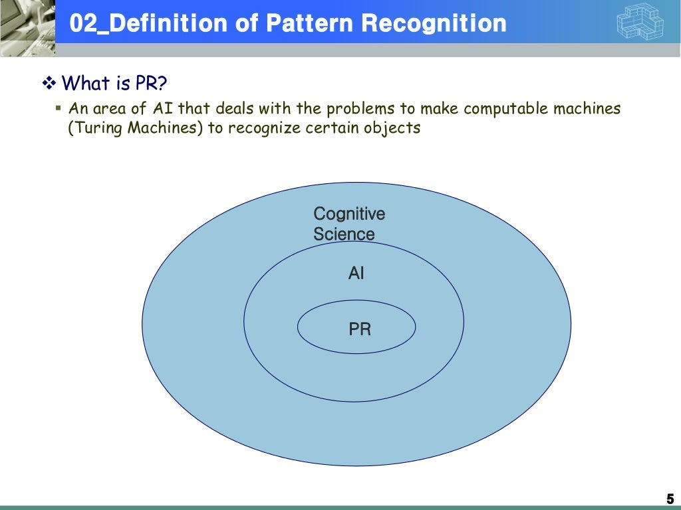

Slide 24
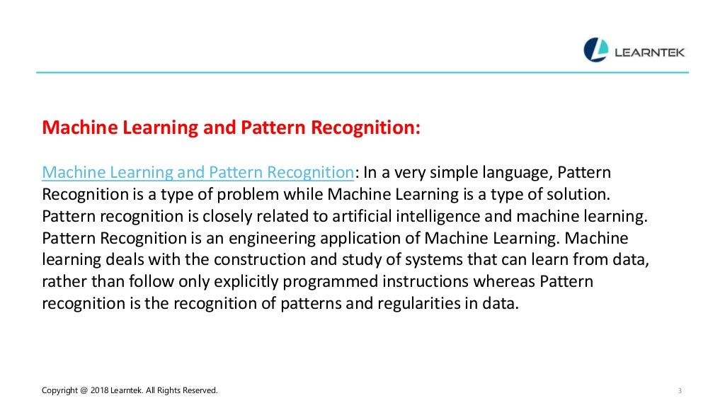

Slide 25
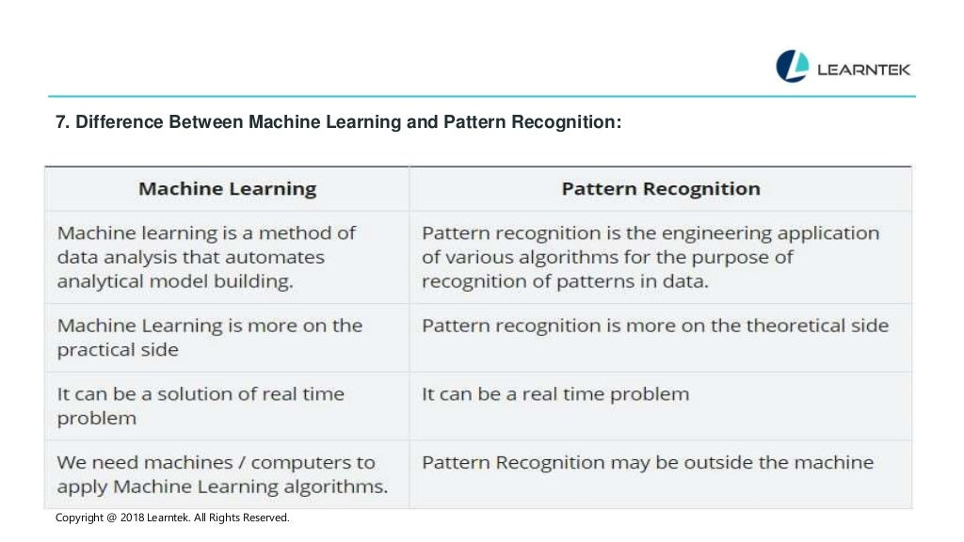

Slide 26
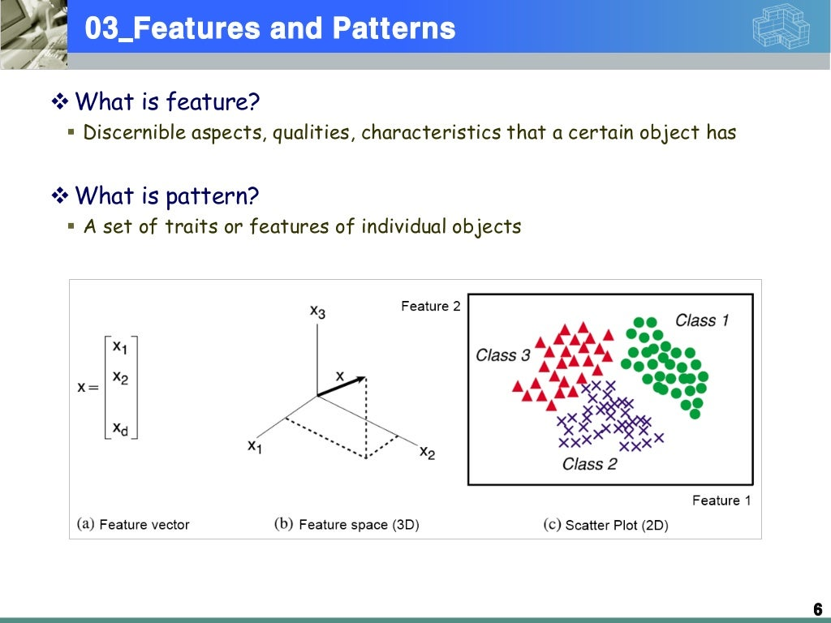

Slide 27
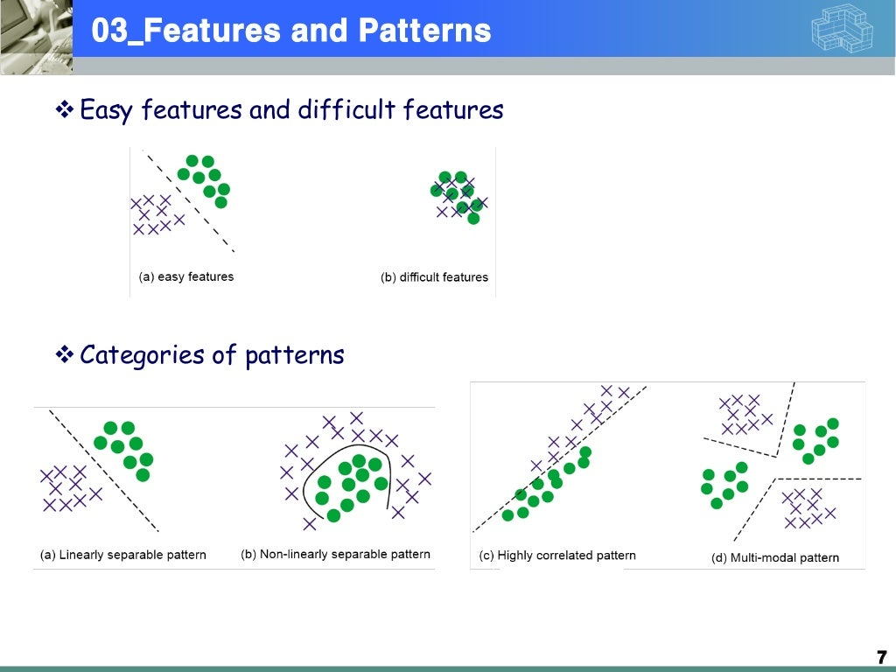

Slide 28
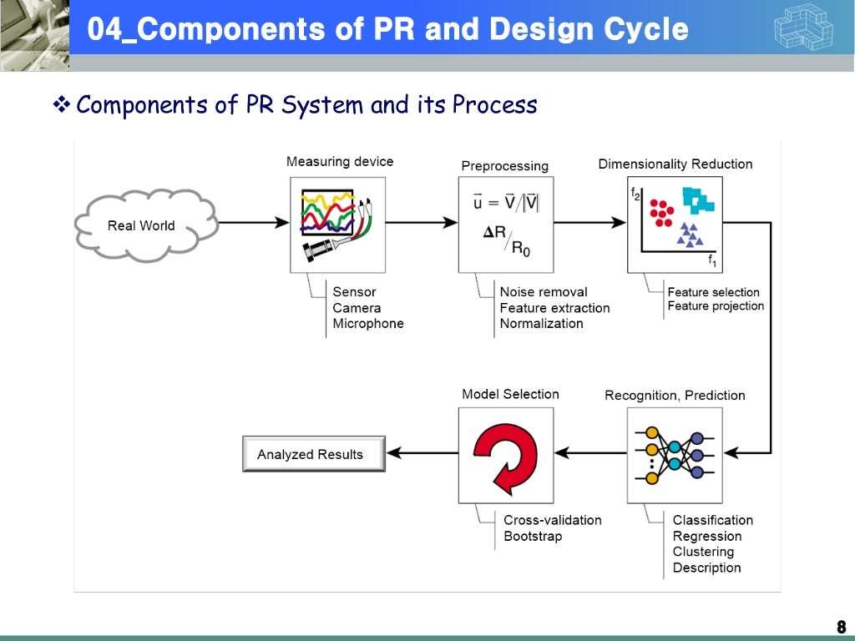

Slide 29
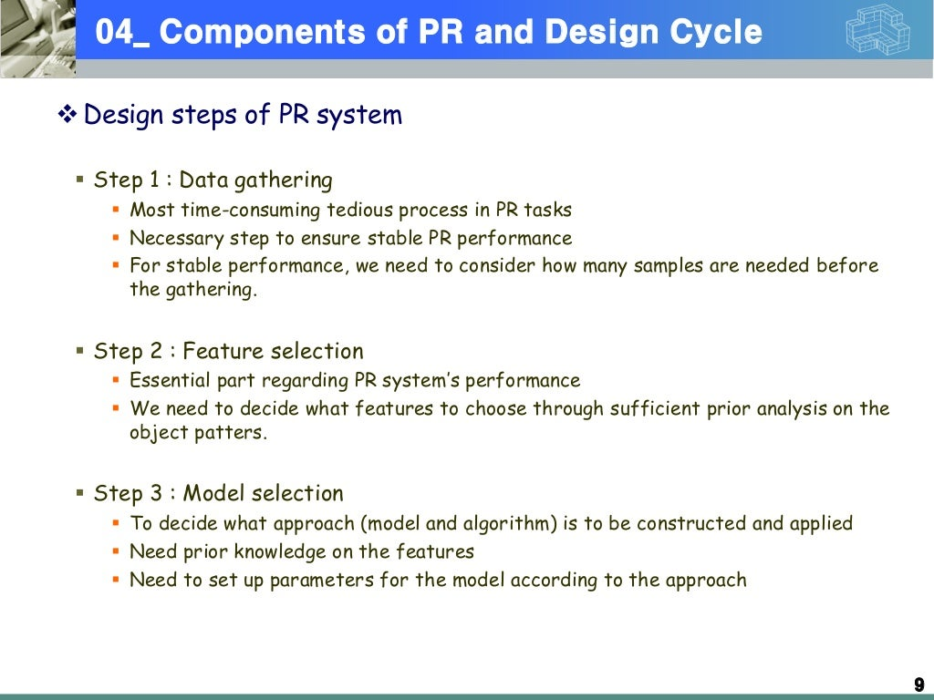

Slide 30
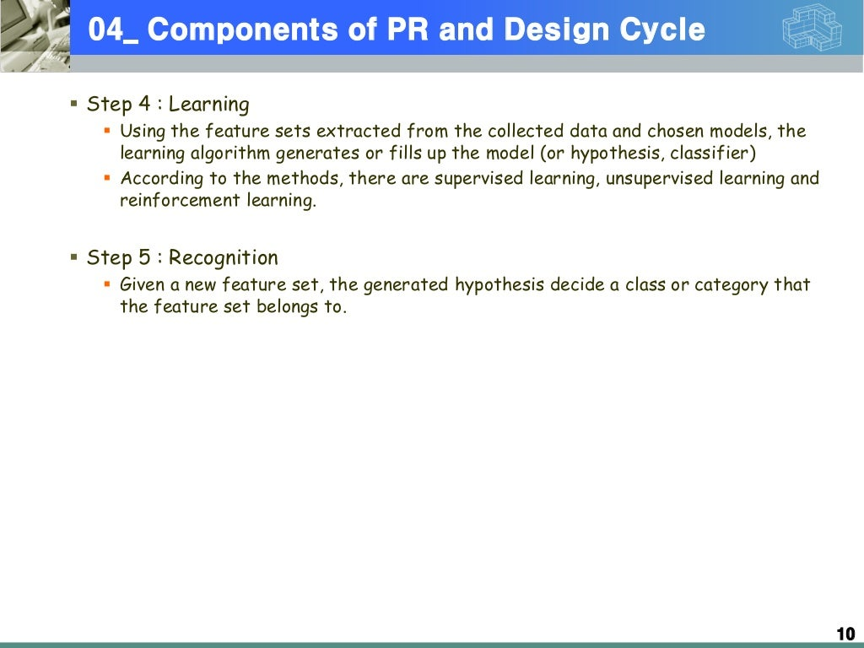

Slide 31
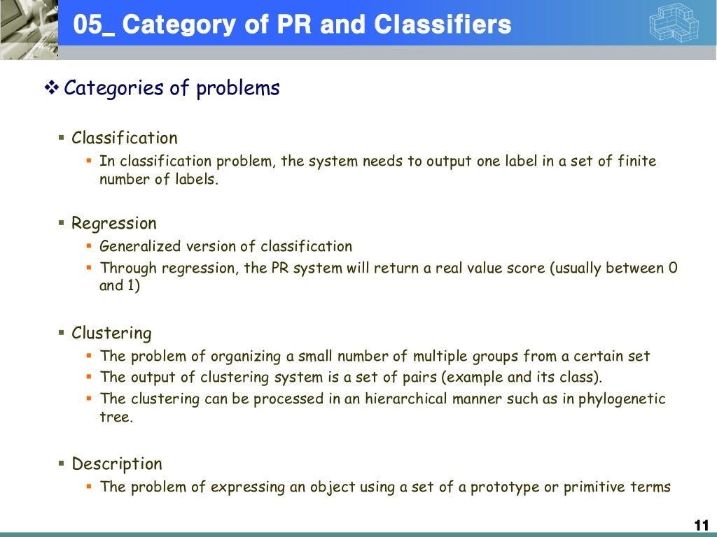

Slide 32
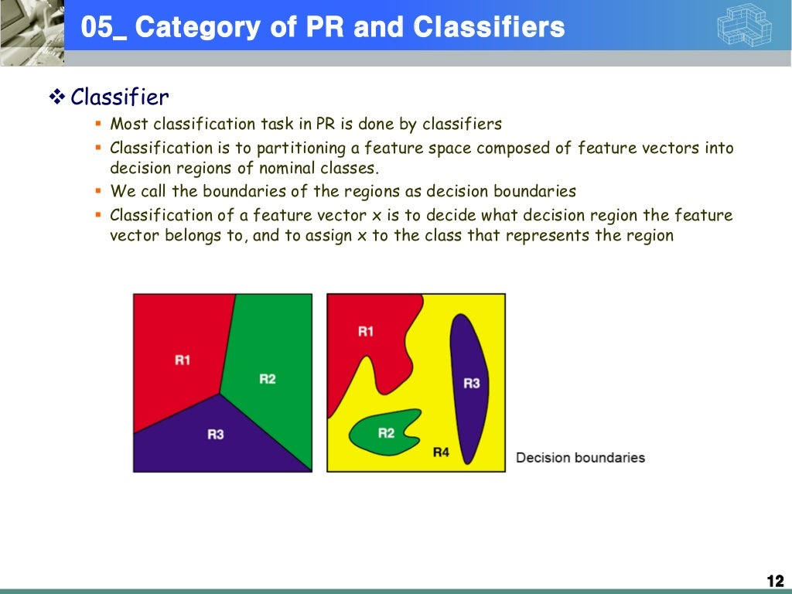

Slide 33
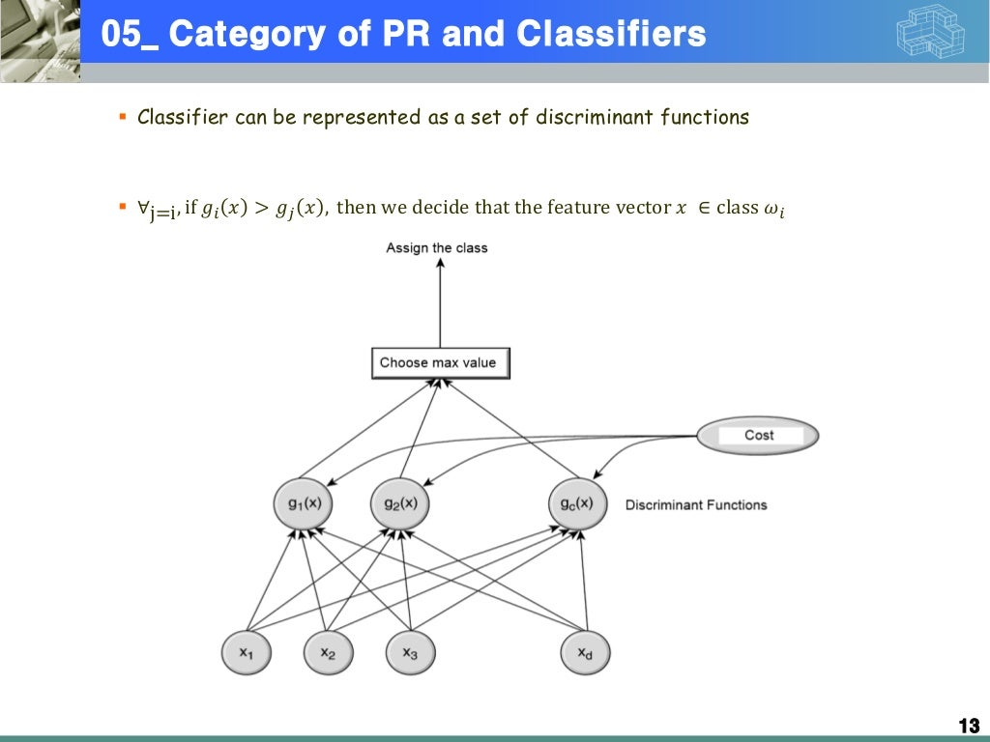

Slide 34
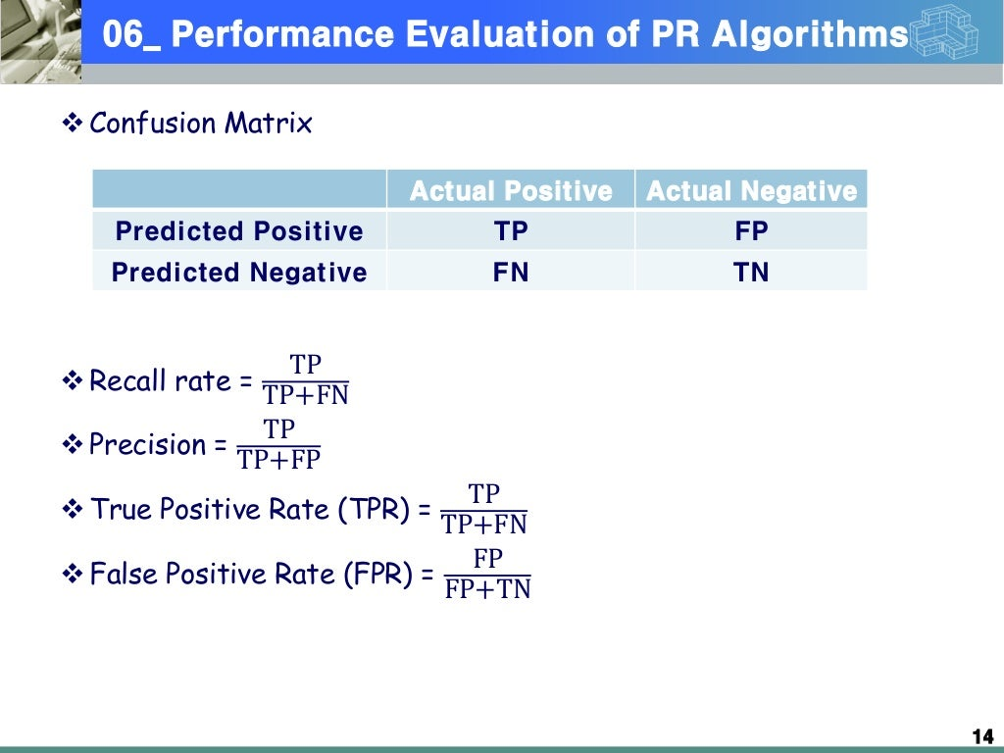

Slide 35
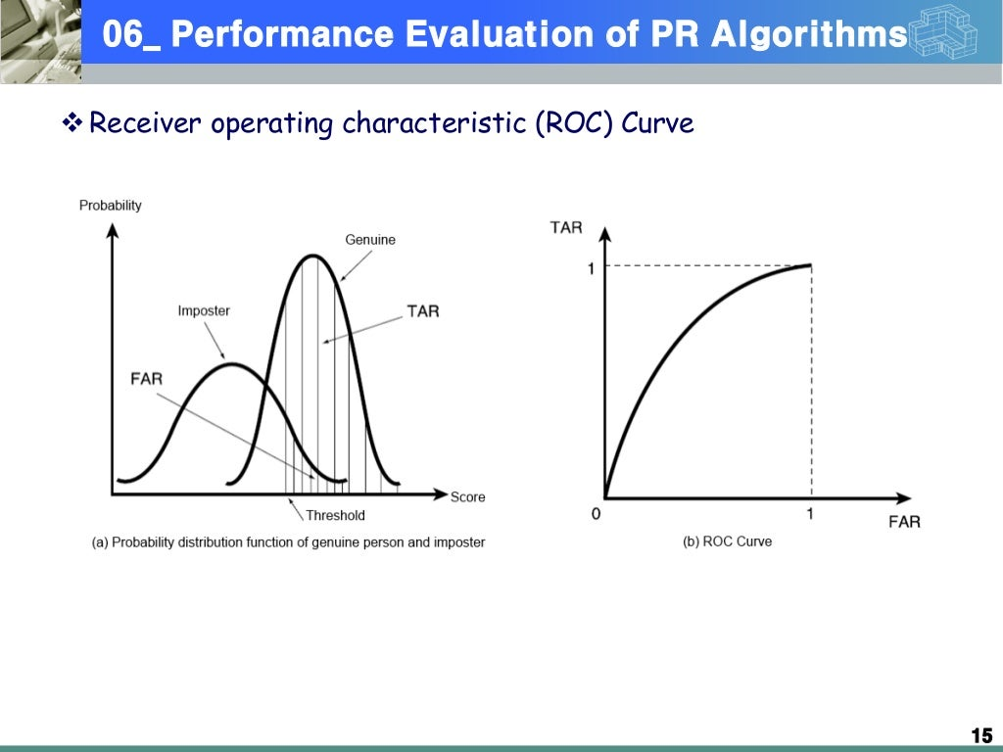

Slide 36
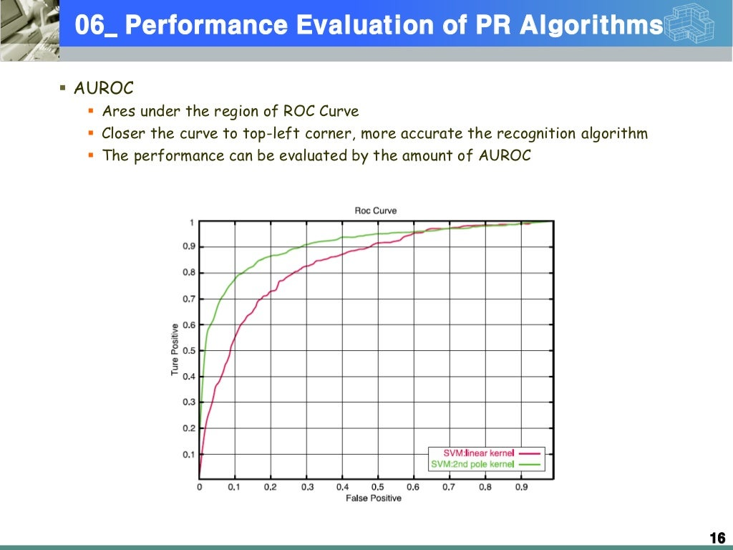

Slide 37
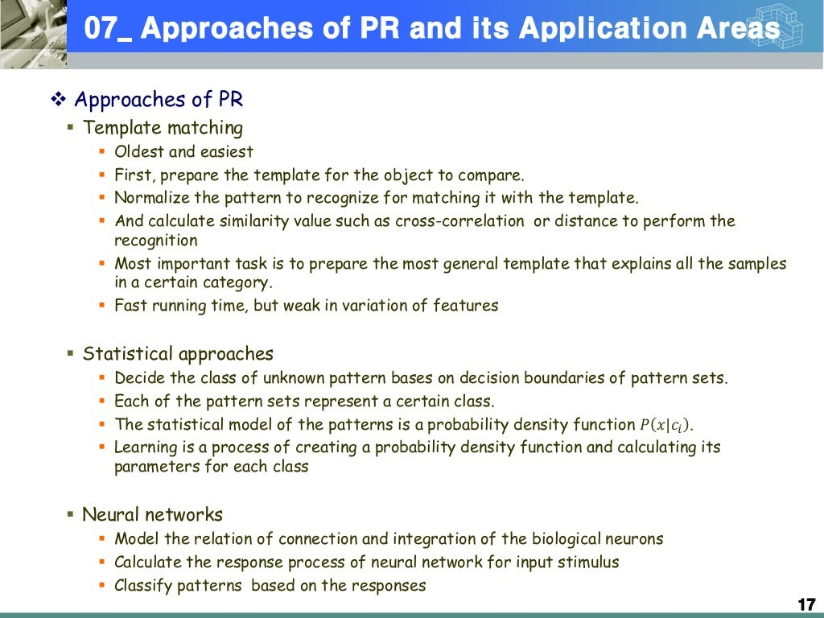

Slide 38
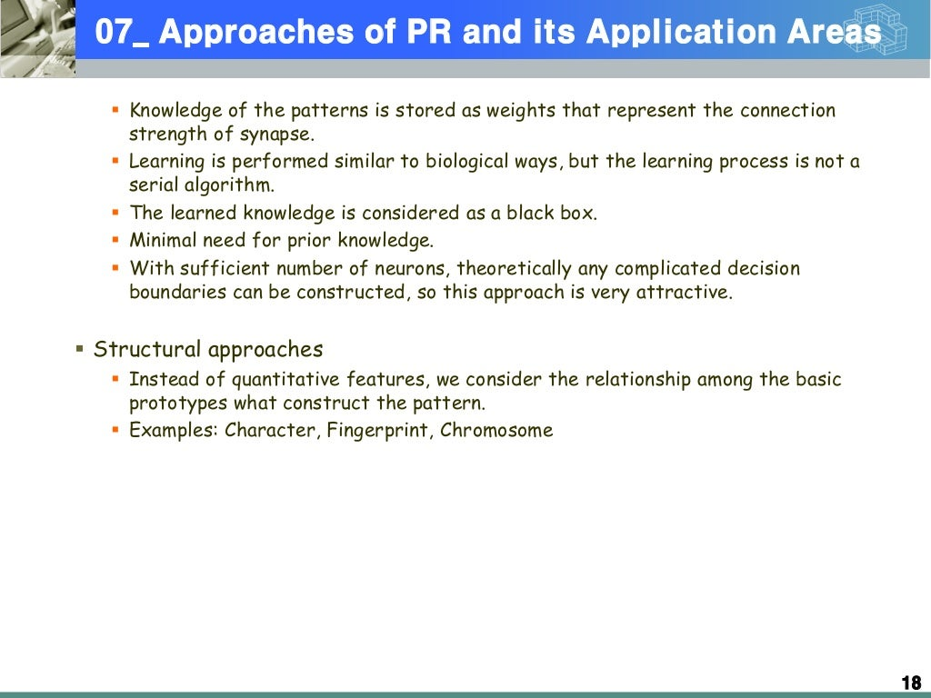

Slide 39
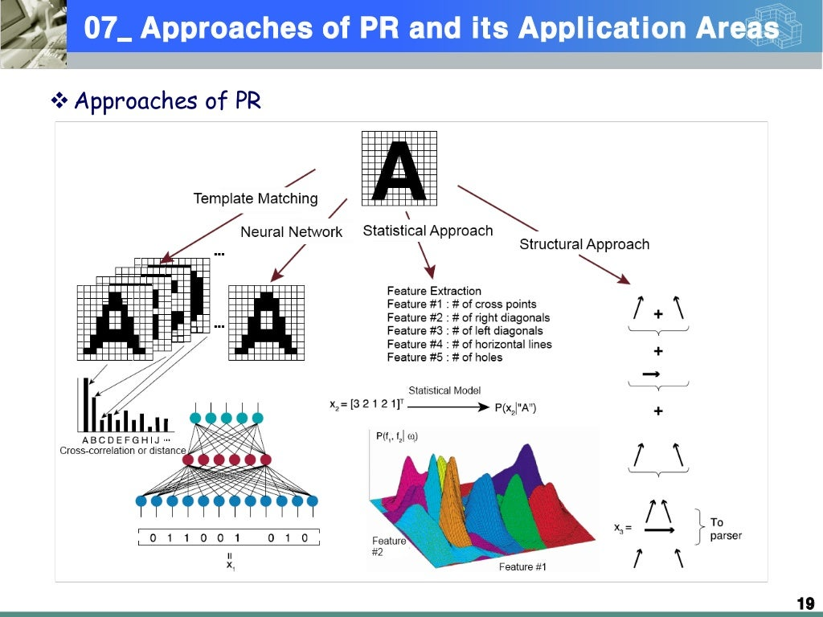

Slide 40
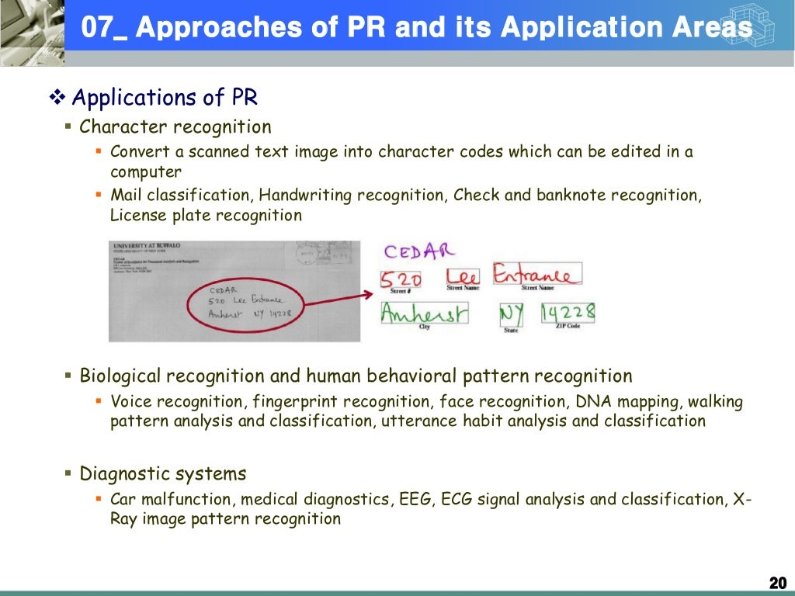

Slide 41
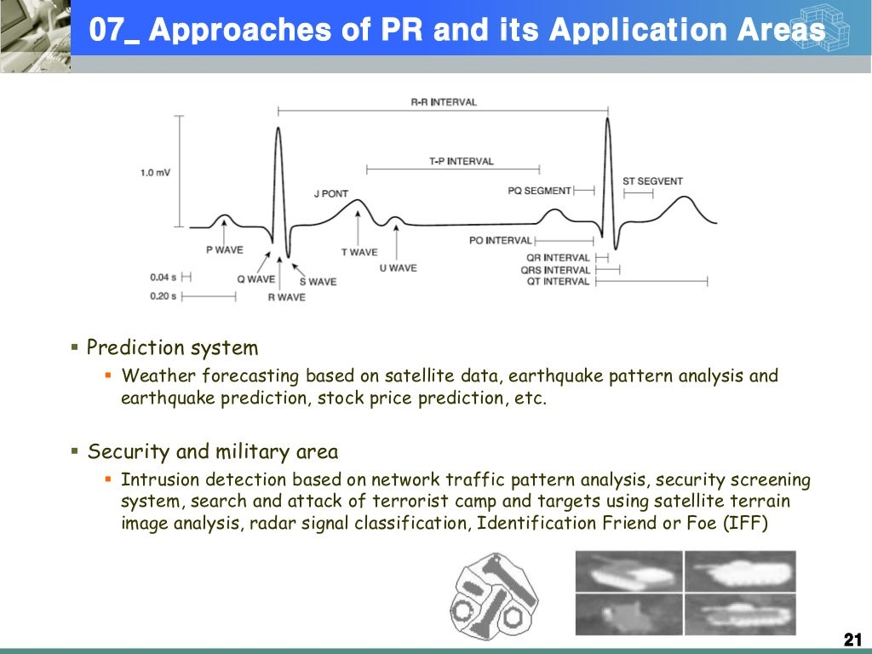

Slide 42
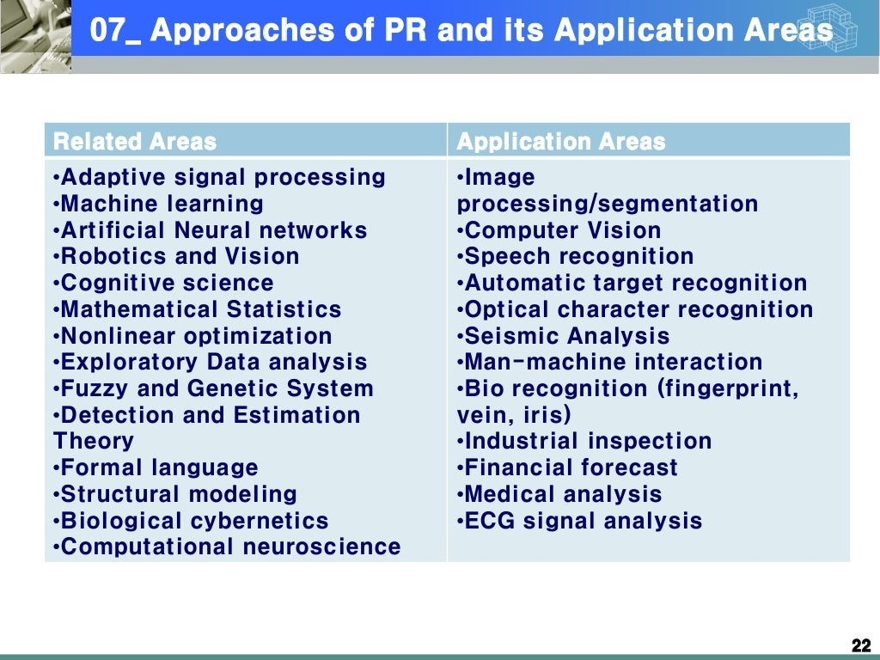

Slide 43
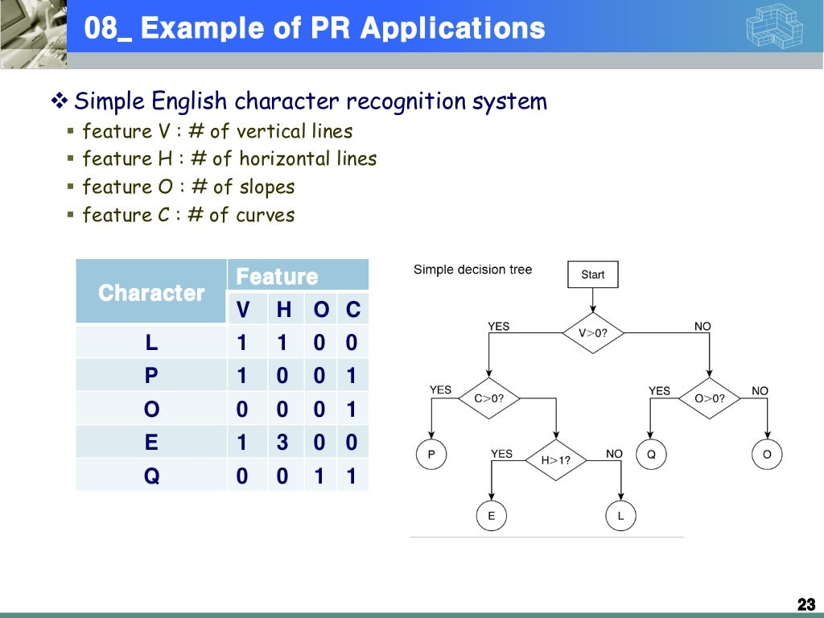

Slide 44
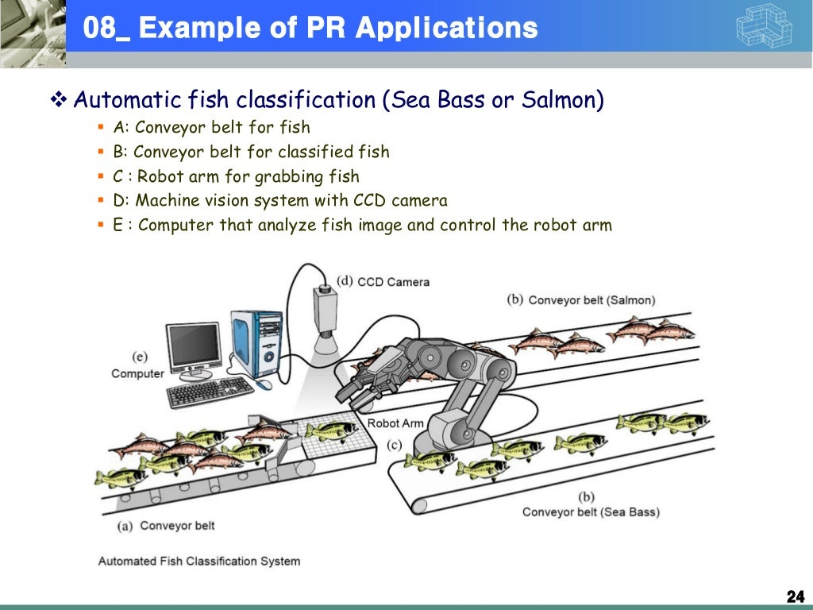

Slide 45
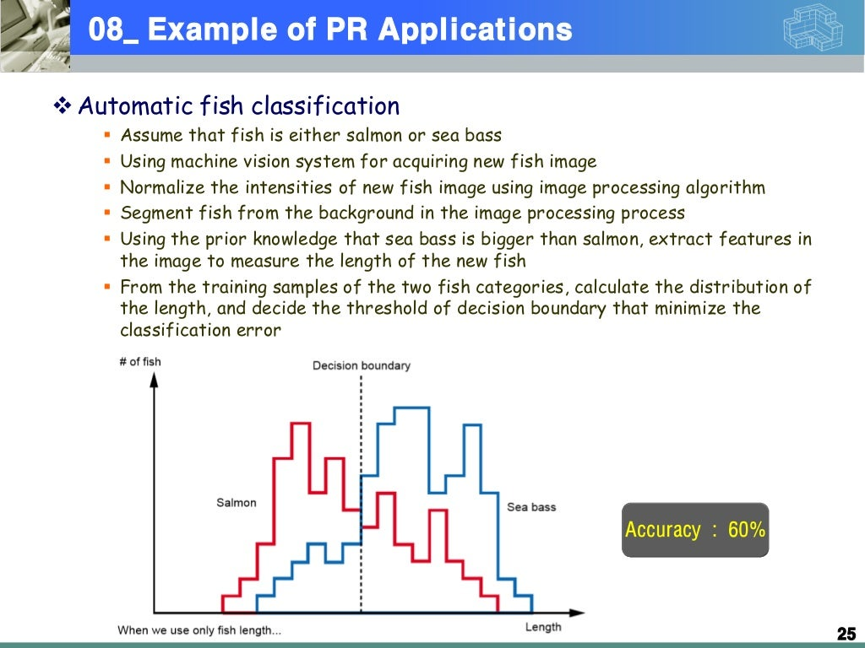

Slide 46
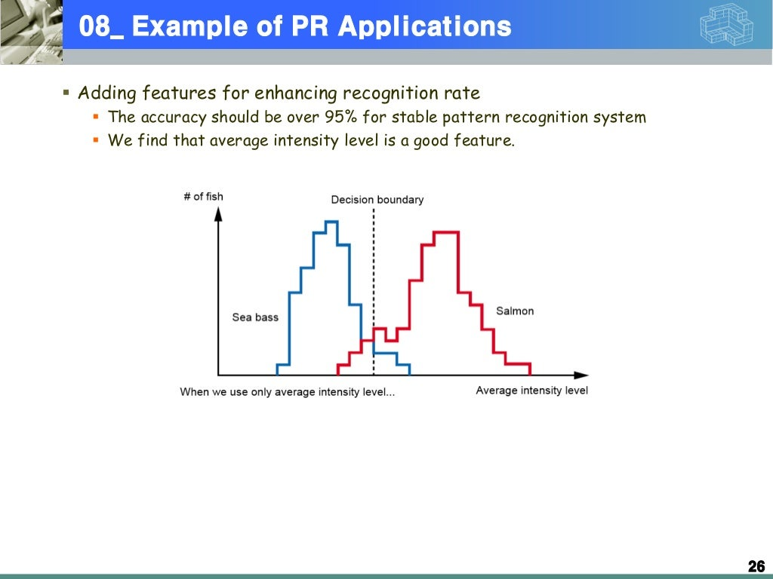

Slide 47
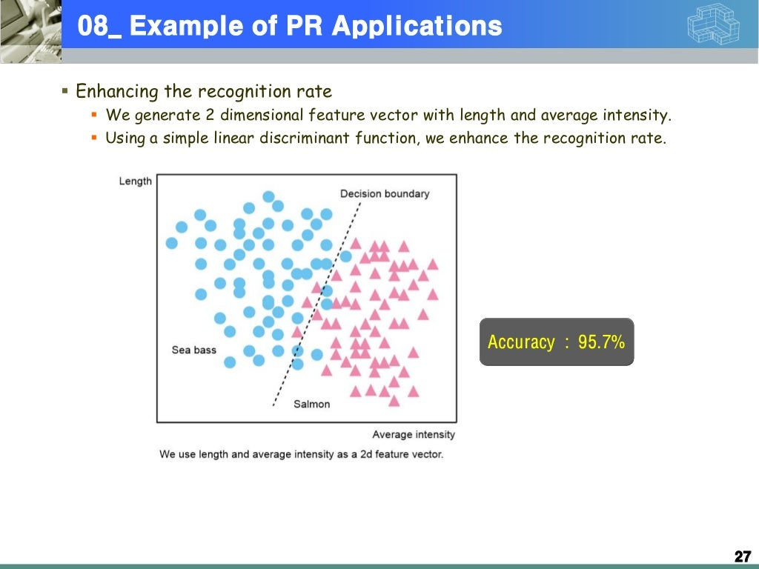

Slide 48
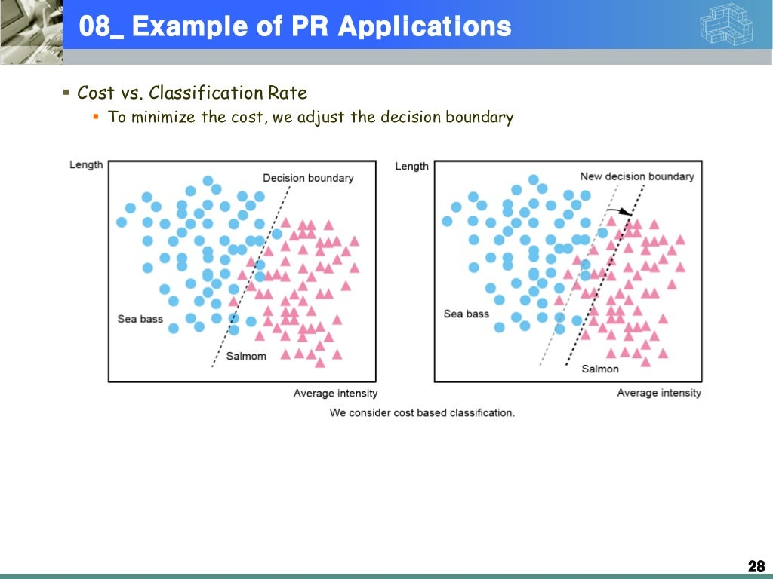

Slide 49
Week: 03 Feature Extraction and Selection
Apply feature extraction and selection techniques.

Slide 50
What is the concept?
banana
+ grapefruit
firetruck
+ airplane
duck
fire
+ graduation
-r yellow
basket
+ garden
class

Slide 51
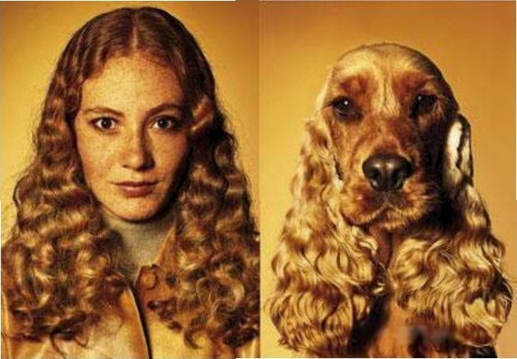
What is Similarity?

Slide 52
Classifier Construction
Objective: Construct a classifier for the data such that predictive accuracy is maximized
Prepare/collect training instances
Generate/select descriptive features
Collect and label instances
Construct a classifier

Slide 53
Creating Features
“Good” features are the key to accurate generalization
Domain knowledge can be used to generate a feature set
Medical Example: results of blood tests, age, smoking history
Game Playing example: number of pieces on the board, control of
the center of the board
Data might not be in vector form
Example: spam classification
“Bag of words”: throw out order, keep count of how many times each word appears.
Sequence: one feature for first letter in the email, one for second
letter, etc.
Ngrams: one feature for every unique string of n features

Slide 54
What is feature selection?
Reducing the feature space by throwing out some of the features

Slide 55
Reasons for Feature Selection
Want to find which features are relevant
Domain specialist not sure which factors are predictive of disease
Common practice: throw in every feature you can think of, let feature
selection get rid of useless ones
Want to maximize accuracy, by removing
irrelevant and noisy features
For Spam, create a feature for each of 10⁵ English words
Training with all features computationally expensive
Irrelevant features hurt generalization
Features have associated costs, want to optimize accuracy with least expensive features
Embedded systems with limited resources
Voice recognition on a cell phone
Branch prediction in a CPU (4K cOde limit)

Slide 56
Terminology
Univariate method: considers one variable
(feature) at a time
Multivariate method: considers subsets of variables (features) together
Filter method: ranks features or feature subsets independently of the predictor (classifier)
Wrapper method: uses a classifier to assess features or feature subsets

Slide 57
Filtering
Advantages:
Fast, simple to apply
Disadvantages:
Doesn’ t take into account which learning algorithm will be used
Doesn’ t take into account correlations between features, just correlation of each feature to the class label

Slide 58
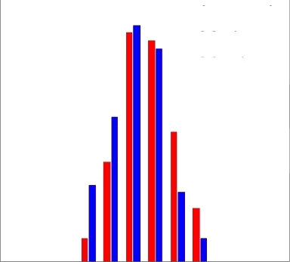
Individual Feature Irrelevance
Legend:
Y=1
Y=-1
P(X;, Y) = P(X;) P(Y)
densit
Y
P(X;| Y)
P(X;| Y=1)
P(X_{i)}
P(X_{iI} Y=-1)
Xi

Slide 59
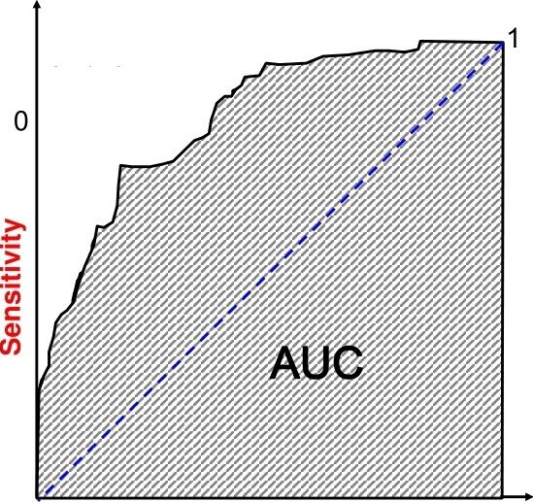
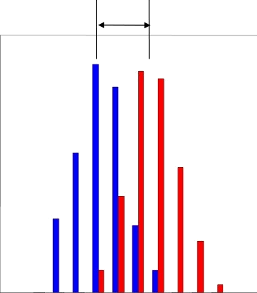
Individual Feature Relevance
ROC
curve
^’- ^’*
0
1
s-
5+
1- Specificity
X¡

Slide 60
Univariate Dependence
Independence:
P(X, Y) = P(X) P(Y)
Measures of dependence:
Mutual Information (see notes from board)
Correlation (see notes from board)

Slide 61
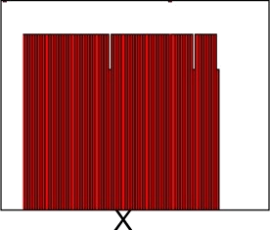
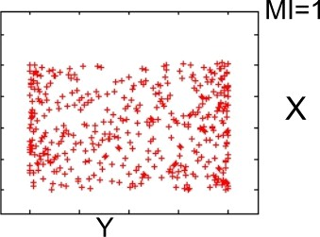
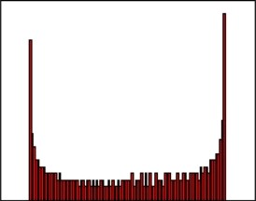
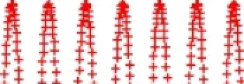

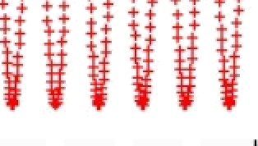

Correlation and MI
R=0.02
.03 nat
P(X)
Y
P(Y)
R=0.00₀₂
MI=1.65 nat
Y

Slide 62
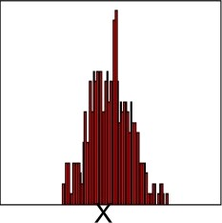
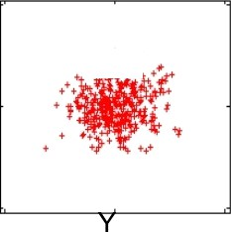

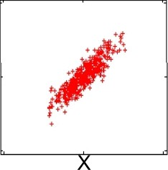
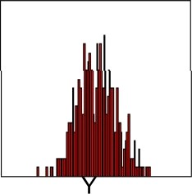

Gaussian Distribution
P(X)
P(Y)
MI(X, Y) = •(1/2) lag(1•R²)

Slide 63

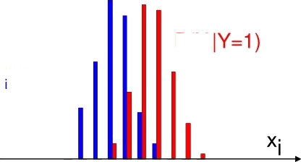
.
T-test
P(X,
P(X |Y=-1)
Normally distributed classes, equal variance ? ²
unknown; estimated from data as ? ² i,_{h}i_{n}.
Null hypothesis H₀: i + =
T statistic: If H₀ is true,
t= (I + - _{'-) ( ? ,}§’m*+1/f'o'm
within
S†uden†mm*+m--a d.f.m

Slide 64
Other ideas for Univariate
Feature Selection?

Slide 65

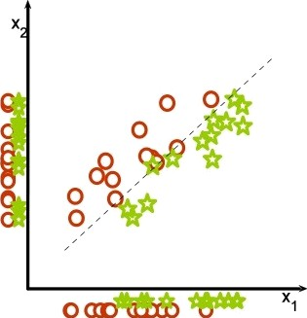
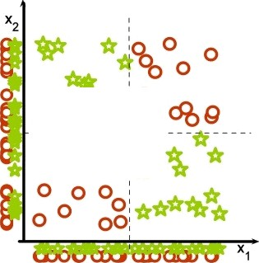
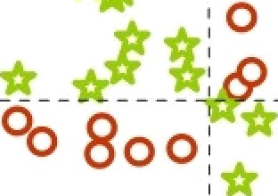
Consideri each feature alone may fail
Guyon-Elieaeeff, üMLR 2004; Springer
fł9fi

Slide 66
Multivariate Filter Methods?

Slide 67
Filtering
Advantages:
Fast, simple to apply
Disadvantages:
Doesn’ t take into account which learning algorithm will be used
Doesn’ t take into account correlations between features, just correlation of each feature to the class label

Slide 68

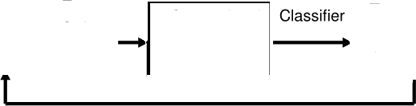
Feature Selection Methods
Filter:
Filter
Selected
Features
Supervised Learning Algorithm
ciassifier
All Features
Selected Features
Wrapper:
Feature
Subset
Supervised Learning Algorithm
Feature Evaluation Criterion
Classifier
All Features
Search
Selected
Features
Criterion Value

Slide 69
Feature
Subset
U^{p}Et
Learning Algorithm
Classifier
Feature EValuation Criterion
All Features
Selected
Features
Criterion Value
Search Method: sequential backward elimination
ABC ACD BCD
AB
BD

Slide 70
Feature
Subset
U^{p}Et
Learning Algorithm
Classifier
Feature EValuation Criterion
All Features
Selected
Features
Criterion Value
Search Method: sequential backward elimination
ABC ACD BCD
AB
BD

Slide 71
Feature
Subset
U^{p}Et
Learning Algorithm
Classifier
Feature EValuation Criterion
All Features
Selected
Features
Criterion Value
Search Method: sequential backward elimination
ABC ACD BCD
AB
BD

Slide 72
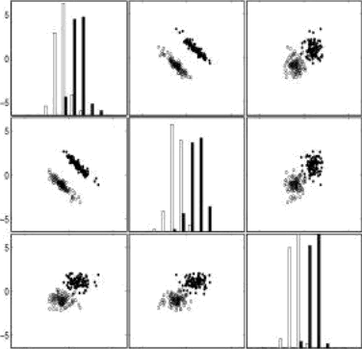
Forward or backward selection? Of the three variables of this example, the third one separates the two classes best by itself (bottom right histogram). It is therefore the best candidate in a forward selection prOcess. Still, the two other variables are better taken together than any subset of two including it. A backward selection method may perform better in this case.

Slide 73
Model search
More sophisticated search strategies exist
Best-first search
Stochastic search
See “Wrappers for Feature Subset Selection”,
Kohavi and John 1997
Other objective functions exist which add a model-complexity penalty to the training error
AI 1 BIC

Slide 74

Regularization
Regularization: add model complexity penalty to training error.
i—1
for some constant C
Now ?fi argmin /(tr)
Regularization forces weights to be small, but
does it force weights to be exactly zero?
— u/ 0 is equivalent to removing feature f from the
model

Slide 75
Regularization
Regularization: add model complexity penalty to training error.
i—1
for some constant C
Now ?fi argmin /(tr)
Regularization forces weights to be small, but
does it force weights to be exactly zero?
— u/ 0 is equivalent to removing feature f from the
model

Slide 76
Kernel Methods (Quick Review)
Expanding feature space gives us new potentially useful features
Kernel methods let us work implicitly in a high- dimensional feature space
— All calculations performed quickly in low- dimensional space

Slide 77




















Feature Engineering
Linear models: convenient,
fairly broad, but limited
We can increase the expressiveness of linear models by expanding the feature space.
— E.g.
1
,, •
..
.
*
2 21
Now feature space is R⁶ rather than R²
Example linear predictor in these features:
y t1 0 0 0 -1 -1j • 4(x) — 1 —z2 —z₂

Slide 78
END OF MATERIAL
Follow up slides require knowledge of ROC and L1, L2 Norms — have not yet covered these ideas in Fall 2012

Slide 79
Individual Feature Relevance
ROC
curve
^’- ^’*
0
1
s-
5+
1- Specificity
X¡

Slide 80






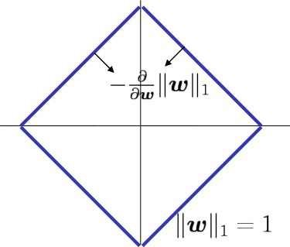
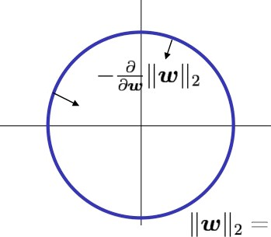
versus
Regularimtion
1

Slide 81
Week: 04 Clustering Techniques
Explain and apply clustering techniques

Slide 82
Chapter 8. Cluster Analysis
What is Cluster Analysis?
Types of Data in Cluster Analysis
A Categorization of Major Clustering Methods
Partitioning Methods
Hierarchical Methods
Density-Based Methods
Grid-Based Methods
Model-Based Clustering Methods
Outlier Analysis
Summary

Slide 83
What is Cluster Analysis?
Cluster: a collection of data objects
Similar to one another within the same cluster
Dissimilar to the objects in other clusters
Cluster analysis
Grouping a set of data objects into clusters
Clustering is unsupervised classification: no predefined classes
Typical applications
As a stand-alone tool to get insight into data distribution
As a preprocessing step for other algorithms

Slide 84
General Applications of Clustering
Pattern Recognition
Spatial Data Analysis
create thematic maps in GIS by clustering feature spaces
detect spatial clusters and explain them in spatial data mining
Image Processing
Economic Science (especially market research)
WWW
Document classification
Cluster Weblog data to discover groups of similar access patterns

Slide 85
Examples of Clustering Applications
Marketing: Help marketers discover distinct groups in their customer bases, and then use this knowledge to develop targeted marketing programs
Land use: Identification of areas of similar land use in an earth observation database
Insurance: Identifying groups of motor insurance policy holders with a high average claim cost
City-planning: Identifying groups of houses according to their house type, value, and geographical location
Earth-quake studies: Observed earth quake epicenters should be clustered along continent faults

Slide 86
What Is Good Clustering?
A good clustering method will produce high quality clusters with
high intra-class similarity
low inter-class similarity
The quality of a clustering result depends on both the similarity measure used by the method and its implementation.
The quality of a clustering method is also measured by its ability to discover some or all of the hidden patterns.

Slide 87
Requirements of Clustering in Data Mining
Scalability
Ability to deal with different types of attributes
Discovery of clusters with arbitrary shape
Minimal requirements for domain knowledge to determine input parameters
Able to deal with noise and outliers
Insensitive to order of input records
High dimensionality
Incorporation of user-specified constraints
Interpretability and usability

Slide 88
Chapter 8. Cluster Analysis
What is Cluster Analysis?
Types of Data in Cluster Analysis
A Categorization of Major Clustering Methods
Partitioning Methods
Hierarchical Methods
Density-Based Methods
Grid-Based Methods
Model-Based Clustering Methods
Outlier Analysis
Summary

Slide 89
Data Structures
Data matrix
(two modes)
Dissimilarity matrix
(one mode)

Slide 90
Measure the Quality of Clustering
Dissimilarity/Similarity metric: Similarity is expressed in terms of a distance function, which is typically metric: d(i, j)
There is a separate “quality” function that measures the “goodness” of a cluster.
The definitions of distance functions are usually very different for interval-scaled, boolean, categorical, ordinal and ratio variables.
Weights should be associated with different variables based on applications and data semantics.
It is hard to define “similar enough” or “good enough”
the answer is typically highly subjective.

Slide 91
Type of data in clustering analysis
Interval-scaled variables:
Binary variables:
Nominal, ordinal, and ratio variables:
Variables of mixed types:

Slide 92
Interval-valued variables
Standardize data
Calculate the mean absolute deviation:
where
Calculate the standardized measurement (z-score)
Using mean absolute deviation is more robust than using standard deviation

Slide 93
Similarity and Dissimilarity Between Objects
Distances are normally used to measure the similarity or dissimilarity between two data objects
Some popular ones include: Minkowski distance:
where i = (x_{i1}, x_{i2}, …, x_{ip}) and j = (x_{j1}, x_{j2}, …, x_{jp}) are two p-dimensional data objects, and q is a positive integer
If q = 1, d is Manhattan distance

Slide 94
Similarity and Dissimilarity Between Objects (Cont.)
If q = 2, d is Euclidean distance:
Properties
d(i,j) ≥ 0
d(i,i) = 0
d(i,j) = d(j,i)
d(i,j) ≤ d(i,k) + d(k,j)
Also one can use weighted distance, parametric Pearson product moment correlation, or other disimilarity measures.

Slide 95
Binary Variables
A contingency table for binary data
Simple matching coefficient (invariant, if the binary variable is symmetric):
Jaccard coefficient (noninvariant if the binary variable is asymmetric):
Object j
Object i

Slide 96
Dissimilarity between Binary Variables
Example
gender is a symmetric attribute
the remaining attributes are asymmetric binary
let the values Y and P be set to 1, and the value N be set to 0

Slide 97
Nominal Variables
A generalization of the binary variable in that it can take more than 2 states, e.g., red, yellow, blue, green
Method 1: Simple matching
m: # of matches, p: total # of variables
Method 2: use a large number of binary variables
creating a new binary variable for each of the M nominal states

Slide 98
Ordinal Variables
An ordinal variable can be discrete or continuous
order is important, e.g., rank
Can be treated like interval-scaled
replacing x_{if} by their rank
map the range of each variable onto [0, 1] by replacing i-th object in the f-th variable by
compute the dissimilarity using methods for interval-scaled variables

Slide 99
Ratio-Scaled Variables
Ratio-scaled variable: a positive measurement on a nonlinear scale, approximately at exponential scale, such as Ae^{Bt} or Ae^{-Bt}
Methods:
treat them like interval-scaled variables — not a good choice! (why?)
apply logarithmic transformation
y_{if} = log(x_{if})
treat them as continuous ordinal data treat their rank as interval-scaled.

Slide 100
Variables of Mixed Types
A database may contain all the six types of variables
symmetric binary, asymmetric binary, nominal, ordinal, interval and ratio.
One may use a weighted formula to combine their effects.
f is binary or nominal:
d_{ij}^{(f)} = 0 if x_{if} = x_{jf} , or d_{ij}^{(f)} = 1 o.w.
f is interval-based: use the normalized distance
f is ordinal or ratio-scaled
compute ranks r_{if} and
and treat z_{if} as interval-scaled

Slide 101
Week: 05 Classification Algorithms
Discuss and implement classification

Slide 102
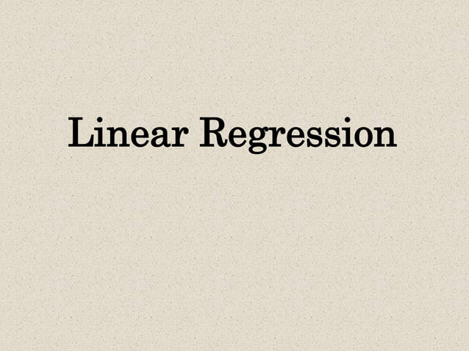

Slide 103
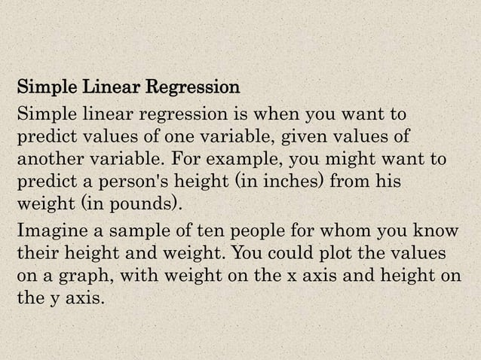

Slide 104
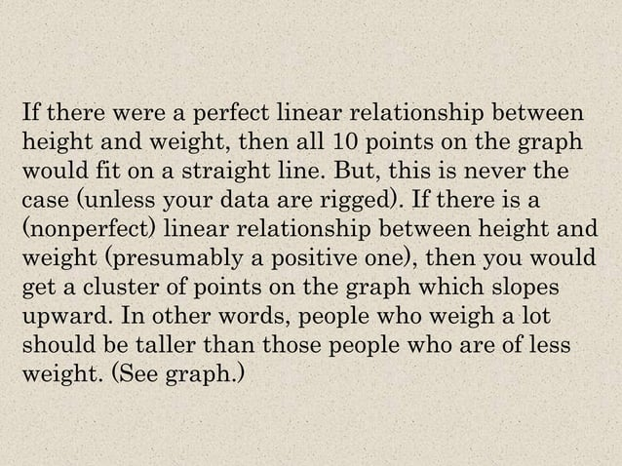

Slide 105


Slide 106


Slide 107


Slide 108


Slide 109


Slide 110


Slide 111


Slide 112


Slide 113


Slide 114


Slide 115


Slide 116


Slide 117


Slide 118


Slide 119


Slide 120


Slide 121


Slide 122


Slide 123


Slide 124


Slide 125


Slide 126


Slide 127


Slide 128


Slide 129


Slide 130


Slide 131


Slide 132


Slide 133


Slide 134


Slide 135


Slide 136


Slide 137


Slide 138


Slide 139


Slide 140


Slide 141


Slide 142


Slide 143


Slide 144


Slide 145


Slide 146


Slide 147


Slide 148


Slide 149


Slide 150


Slide 151


Slide 152
Week: 06 Hidden Markov Models
Explain and apply HMM in pattern recognition.

Slide 153
Week: 07 & 08 Neural Networks and Deep Learning
Discuss neural networks and their applications in pattern recognition.

Slide 154
What is Neural Net ?
A neural tries to (ANN} is
net is an artificial representation of the human brain that
simulate its learning process. An artificial neural network
often called a "Neural Network" or simply Neural Net (NN).
Traditionally, the word neural network is referred to a network of biological neurons in the nervous sYstem that process ano transmit information.
Artificial neural network is an interconnected group of artificial neurons that uses a mathematical model or computational model for information processing based on a conn ectionist app roach to co mputation.
The artificial neural networks are made of interconnecting artificial neurons which may share some properties of biological neural networks.
e Artificial Neural network is a network of simple processing ele ments
fneurons) which can exhibit complex global connections between the processing elements
behavior, determined by the and element parameters.
e Artificial neural network is an structure based on external or through the network.
adaptive
internal
sysLem that changes its
information that flows

Slide 155




6 Functions
The Function y= f(x) describes a relationship, an input-output mapping,
from x to
v
Threshold or Sign function : sgn(x) defined as
Threshold or Sign function : sigmoid(x) defined (differentiable} form of the threshold fun ction
4 I/ P
as a smoothed
1
sigmoid (x) =
-4

Slide 156


@ Artificial Neuron - Basic El ements
Neuron consists of three basi c components - weig hts, th resho) an d a
*r
single activation function.
Function
Wn
Synaptic Weights
Threshold
Fig Basic Elements of an Artificial Linear Neuron
Weighting Factors w
The values w 1 , wz , ... wn are weights to determine the strength of input vector X = 1 _{r} 2 @ ... xn§*. EaCh input is multiplied by the
_{x}T
associated weight of the neuron connection w. The +ve weight
excites and the -ve weight inhibits the node output.
Threshold 6
The node‘s internal threshold s is the magnitude offset. It
activation of the node ou tput y as:
affects the
Y - f (y} = f T y. xi wi - 6x T
r=a
To generate the final output Y the sum is passed a n to a non-linear
filter r called Activation Function or Transfer function or Squas h function which releases the output Y.

Slide 157
In practice, neurons generally do not fire produce an output) unless their total input goes above a threshold value.
Th e total input for each neuron is the sum of the weighted inputs to the neuron minus its threshold value. This is then passed through the sigmaid function . The equation for the transition in a n euron is :
a | = | 1/ {1 + exp(- x)) | where
x |  | ai wi - q
a is the activation for the neuron ai is the activation for neuron I wi is the weig ht
Q is the threshold subtracted
Activation Function
An activation function f performs a mathematical operation on the
signal output, The most common activation functions are:
Linear Function,
Piecewise Linear runction,
Tangent hyperbolic function
Threshold Function,
- Sig moidal (S shaped) function,
The activation functions are chosen depending upon the type of
prob Ie m to be solved by the netwo rk.

Slide 158




This activation function is also call ed saturating linear function and can have either a binary or bipolar range for the saturation limits of the output. The m athe matical m ode I for a symmetric saturation function is described below.
Piecewise Linea r This is a sloping function that produces :
-1 for a -ve weighted sum of inputs,
1 for a + ve weighted sum of inputs.
I proportional to input for values between +1 and -1 weighted sum,
O/ p
I/ P
Y - f (I) =
7 if -1 1 1 1 1
—1 if I < D
M4-eaeurdf eaec¥vo rJ'— mQoef 0 r f¥euron
g*
›S Sigmoidal Function (S-shape function)
The nonlinear curved S-shape function is called the sigmoid function.
This is most common type of activation used to construct the neural networks. It is mathematically well behaved, differentiable and strictly increasing function.
Sigmoidal fu nction
A sigmoidal transfer function can be written in the form:
1 •r e "°
This is explained as
- a for large -ve input val ues, for large +ve values, with a
smooth transition between tne two.
u is slope parameter also called s hape parameter; symbol the 1 is also used to

Slide 159

rep resented this pa rameter.
The sig moidal function is achieved using exponential equation. By varying CI different shapes of the function can be obtained which
adjusts the abruptness of the asymptoLic values.
yY Example
The neuron shown consists
X1= 1
function as it chBnges between the two
of four inputs with the weights.
Activatien Function
xz=2
X3= 5
Summing function
Xn = @
Threshold
Synaptic Weights
Fig Neuron Structure of Exa mple

Slide 160

The out put I of the network, prior to the activation function stage, is
› x•. w (• • • • ] • * ‹
+z
= ‹1 x zj + Is x EJ + ‹s x -1j + IB x z) = 14
With a bina ry activation function the outputs of the neuron is:
y [threshold) = 1;
3. t?éuraI Network Architectures
4*'
* An Artificial Neural Network (ANN) is a oata processing syste m, consisting
Iarge number of simple highly interco nnected processing elements as artificial neuron in a network structure that can be rep resented using a directed graph G, an ordered 2-tuple {V, E} , consisting a set V of \zertices and a set E of edg es.
The vertices may represent neurons (in put/output) and
The edges may represent syn aptic links labeled by the weights attached.
Example
ea
e,
e‹
e,
e,
Fig. Directed Graph
Vertices V = vt , vy , V,$ vq, vs
Edges E * { ei, en, e„e‹ e l

Slide 161

FIG single layer feed forward network

Slide 162

luIti Layer Feed-forward Network
The name suggests, it consists of multiple layers. The architecture of this class of network, besides having the input and the output layers, also have one or more intermediary layers called hidden layers. The computational units of the hidden layer are known as hidden neurons,
xnput hfdden lsysr wolghts Vf/
Output hldden layer weights lv/k
Hidden L•yar
neurena y’J
input Layer neurone x
Output Layer neurone z8
Flg. Bgultllayer feed-forward network In {# - m - n} configuration.
The hidden layer does intermediate computation before directing the
input to output layer.
The input layer neurons are linked to the hidden layer neurons; the
weights on these links are referred to as input-hidden layer weights.
The hidden layer neurons and the corresponding weights are referred to
as output-hiddan layer weights.
A multi-layer feed-forward network with d' input neurons, m neurons in the first hidden layers, m2 neurons in the second hidden layers, and n output neurons in the output layers is written as (# - mi - m› - n ).
Fig. above illustrates a multilayer feed-forward network with a
configuration f¥'- m - nJ•

Slide 163

3 rtecurrent n etworxs
The Recurrent Networks differ from feed -forward architecture.
A Recurrent network h as at Ieast o n e feed back loop.
Example
**
FeedDacH
finf‹s
I n p ut La yer
neu rons xi
Hidden Layer neu rons fi)
Recurrent n eural
Output Layer neurons zk
network
Fig.
There could be neurons with self-feed back links;
that is the output of a neuron is feed back i nto itse If as
in put.

Slide 164





1@ Artificial Neuron model
An artificial neuron is a mathematical function conceived as a simple model of a real fbiological) neuron.
e The f4cCulloch-Pitts Neuron
This is a simplified model af real neurons, known as a Threshold Logic Unit.
Input
Input a
Output
Input
A set of input connections brings in activations from other neurons.
A p rocessing unit sum s the inputs, and then applies a non - linear
activation function (i, e. squ ashing / transi'er / threshold function).
An output line transmits the result to other neurons. n otner words ,
The input to a neuron arrives in the form of signals.
The signals build up in the cell.
Finally the cell discharges (cell fires) throug h the output .
The cell can start building up signals again.

Slide 165

assification of Learning Algorithms
Fig . below indicate the hie ra rchica I representation of the a lg orithms mentioned
in the previous slide. These algorithm s are explained in subsequent slides.
Fig- Classification of learni ng algorith me

Slide 166
Supervised Lea rning
A teacher is present during learnin g expected output.
Every input pattern is used to train the network.
process and presents
Lea rning process is based on compa rison, between network's computed output and the correct expected output, generating "error".
The "error" generated is used to chan ge network pa ra meters that result improved performance.
e Unsupervised Learning
No teacher is present.
The expected or desi red ou tput is not presented to the network,
The system learns of it own by discoverin g and adapting to the structural features in the input patterns
e Reinforced Learning
A teacher is present but does not present the expected or desired
output but only indicated if the computed output is correct or incorrect.
The inform ation provided helps the network in its learning process.
A rewa rd is given for correct answer co mputed and a pena Ity for a wron g
q^ AT-Neural Network: —Learning methods
›N Competitive Learning
In this method, those neurons w hich respond strongly to the input
stimuli h ave their weights updated.
When an in put pattern is presented, all neurons in the I ayer compete,
and the winning neuron undergoes weight adjustment
This strategy is called "winner-ta kes -all".
e Stochastic learning
In this method the weights are add usted in a probabilistic fashion.
Exa mple : Simulated annea ling which is a lea rning mechanism employed by Boltzmann and Cauch y machines.

Slide 167




5.E Single Layer Perceptron
Definition in arrangement of one input I ayer of neurons feed forward to one output layer of neurons is known as Single Layer Perceptron,
ingut xi
weights wit
SingIe Iayer
Perceptron
Fig.
Simple
Perceptron Model
y j = f (net j) =
E if net j ñ 0
where net =
II Wij
O if net j < 0

Slide 168

Applications of neural network

Slide 169

Importance of artificial intelligence
The importance of artificial intelligence is the ability to create a never-ending thought process and collective that could solve our problems. Accomplishing this by thinking of every possible solution. We are limited now by the number of people who can do this. With artificial intelligence, we could build computers, upon thousands of computers, that could all work in unison to solve our great and most dire problems. One example is global warming. Whether you believe we are the cause or not, the fact is that global temperatures are on the rise. We need a way out or around or an idea to slow the process down. We need something.... Artificial intelligence could, and should solve this faster than we are or could....
+ 84 others 85 people found this useful
Natural language processing (NLP)
Natural language processing (NLP) is a field of computer science, artificial intelligence, and linguistics concerned with the interactions between computers and human (natural) languages. As such, NLP is related to the area of human–computer interaction. Many challenges in NLP involve natural language understanding, that is, enabling computers to derive meaning from human or natural language input, and others involve natural language generation.

Slide 170

Backpropagation network
Backpropagation, an abbreviation for "backward propagation of errors", is a common method of training artificial neural networks used in conjunction with an optimization method such as gradient descent. The method calculates the gradient of a loss function with respects to all the weights in the network. The gradient is fed to the optimization method which in turn uses it to update the weights, in an attempt to minimize the loss function.
Backpropagation requires a known, desired output for each input value in order to calculate the loss function gradient. It is therefore usually considered to be a supervised learning method, although it is also used in some unsupervised networks such as autoencoders. It is a generalization of the delta rule to multi-layered feedforward networks, made possible by using the chain rule to iteratively compute gradients for each layer. Backpropagation requires that the activation function used by the artificial neurons (or "nodes") be differentiable.
The back propagation (BP) neural network algorithm is a multi-layer feedforward network trained according to error back propagation algorithm and is one of the most widely applied neural network models. BP network can be used to learn and store a great deal of mapping relations of input-output model, and no need to disclose in advance the mathematical equation that describes these mapping relations. Its learning rule is to adopt the steepest descent method in which the back propagation is
**SVM:
https://monkeylearn.com/blog/introduction-to-support-vector-machi

Slide 171


used to regulate the weight value and threshold value of the network to achieve the minimum error sum of square. This paper focuses on the analysis of the characteristics and mathematical theory of BP neural network and also points out the shortcomings of BP algorithm as well as several methods for improvement.
In computer programming, the term free variable refers to variables used in a function that are not local variables nor parameters of that function.^{[1]} The term non-local variable is often a synonym in this context.
A bound variable is a variable that was previously free, but has been bound to a specific value or set of values. For example, the variable x becomes a bound variable when we write:
'For all x, (x + 1)² = x² + 2x + 1.'
or
'There exists x such that x² = 2.'
In either of these propositions, it does not matter logically whether we use x or some other letter. However, it could be confusing to use the same letter again elsewhere in some compound proposition. That is, free variables become bound, and then in a sense retire from being available as stand-in values for other values in the creation of formulae.
In the expression
n is a free variable and k is a bound variable; consequently the value of this expression depends on the value of n, but there is nothing called k on which it could depend.
In the expression

Slide 172
Valid and satisfiable
A formula is valid if it is true for all values of its terms. Satisfiability refers to the existence of a combination of values to make the expression true. So in short, a proposition is satisfiable if there is at least one true result in its truth table, valid if all values it returns in the truth table are true.
The expression (p .AND. q) is satisfiable-- it returns true whenever both p and q are true. On the other hand, (p .OR. .NOT.p) is valid, it always is true regardless of the value of p.
The expression in your Q is satisfiable but not valid. It returns true for (p, q, r)=(true, true, true) and false for (true, false, true).
Is the following proposition Satisfiable? Is it Valid?
(P→Q)⇔(Q→R)
Associative Networks
Associative networks are cognitive models that incorporate long-known principles of association to represent key features of human memory. When two things (e.g., “bacon” and “eggs”) are thought about simultaneously, they may become linked in memory. Subsequently, when one thinks about bacon, eggs are likely to come to mind as well. Over 2,000 years ago, Aristotle described some of the principles governing the role of such associations in memory. Similar principles were elaborated by British philosophers in the 1700s, and contributed to a variety of psychological theories, including those developed by contemporary cognitive psychologists to model memory
Conceptual graphs (CGs) are a formalism for knowledge representation. In the first published paper on CGs, John F. Sowa (Sowa 1976) used them to represent the conceptual schemas used in database systems. The first book on CGs (Sowa 1984) applied them to a wide range of topics in artificial intelligence, computer science, and cognitive science.
A graphical interface for first-order logic
In this approach, a formula in first-order logic (predicate calculus) is represented by a labeled graph.

Slide 173

A linear notation, called the Conceptual Graph Interchange Format (CGIF), has been standardized in the ISO standard for common logic.
Elsie the cat is sitting on a mat
The diagram on the right is an example of the display form for a conceptual graph. Each box is called a concept node, and each oval is called a relation node. In CGIF, this CG would be represented by the following statement:
[Cat Elsie] [Sitting *x] [Mat *y] (agent ?x Elsie) (location ?x ?y) Conceptual graphs are a knowledge representation language designed as a synthesis of several different traditions. First are the semantic networks, which have been used in machine translation and
computational linguistics for over thirty years. Second are the logic-based techniques of unification, lambda calculus, and Peirce's existential graphs. Third is the linguistic research based on Tesnière's dependency graphs and various forms of case grammar and thematic relations. Fourth are the dataflow diagrams and Petri nets, which provide a computational mechanism for relating conceptual graphs to external procedures and databases. The result is a highly expressive system of logic with a direct mapping to and from natural languages. The lambda calculus supports the definitions for a taxonomic system and provides a general mechanism for restructuring knowledge bases. With the definitional mechanisms, conceptual graphs can be used an intermediate stage between natural languages and the rules and frames of expert systems—an important feature for knowledge acquisition and for help and explanations. During the past five years, conceptual graphs have been applied to almost every aspect of AI, ranging from expert systems and natural language to computer vision and neural networks. This paper surveys conceptual graphs, their development from each of these traditions, and the applications based on them.
deterministic parsing refers to parsing algorithms that do not back up. LR-parsers are an example. (This meaning of the words "deterministic" and "non-deterministic" differs from that used to describe nondeterministic algorithms.)
The deterministic behavior is desired and expected in compiling programming languages. In natural language processing, it was thought for a long time that deterministic parsing is impossible due to ambiguity inherent in natural languages (many sentences have more than one plausible parse). Thus, non-deterministic approaches such as the chart parser had to be applied. However, Mitch Marcus proposed in 1978 the Parsifal parser that was able to deal with ambiguities while still keeping the deterministic behavior.

Slide 174
Empiricism is the theory that philosphers and psychologists have proposed that all knowledge and behaviour are acquired through experience, and not at all attributable through innate or inborn characteristics. Rationalism is the theory that the excercise of reason, rather than experience, authority, or spiritual revelation, provides the primary basis for knowledge.
Empiricism is the view that what we can see and hear and touch and taste is what is really there, and that our perceptions are accurate reflections of it. Truth, for an empiricist, is based on evidence. Linked to this is the idea that we come into the world as mental blank slates (philosophers often use the Latin "tabula rasa") with no preconceptions or understandings imbedded in our minds already. This is a less popular add-on to empiricism than it used to be.The chief classical empiricists are Locke and Hume; it's a very British philosophical tradition, less popular in Europe.
Rationalists believe that we cannot be sure there is a world out there at all. How would we know if, for example, we're really all wired into the matrix? Or an evil demon is deceiving us? Or, more plausibly, that what I see as blue is what you see as blue? Truth, for a rationalist, is based on what we can be sure about because of the rules of logic. Famously Descartes argued that the only thing we can be sure about is our own existence (the good ol' Cogito: I think therefore I am). Rationalists think we 'know' an awful lot of stuff from the word go; for example, we know that all triangles have three sides. This is because triangles have three sides by definition, and definitions are true irrelevant of things in the world, so we can be sure of them (theoretically) before we are born. These are what's called 'innate' ideas. Rationalism is the traditional standpoint of philosophers from all over Europe.
Heuristic
heuristic is a technique designed for solving a problem more quickly when classic methods are too slow, or for finding an approximate solution when classic methods fail to find any exact solution. This is achieved by trading optimality, completeness, accuracy, or precision for speed. In a way, it can be considered a shortcut.
hill climbing is a technique in which path is find form strating position to goal node....it finds a better solution by repeatedly changing a single element to the solution...on the other hand best first search finds the best way to find the goal...
Now, in hill-climbing search, you sort[1] the current node's children before adding them to the queue. In best-first search, you add the current node's children to the queue in any old order, then sort[1] the entire queue. If you think about the effect that might have on the order in which nodes are searched, you should get an idea of the practical difference.
Best-first search calculates the value of ALL neighboring nodes and then iterates with the best one. Simple hill climbing calculates the value of each neighbouring node in turn and iterates as soon as it finds one better than the current node.

Slide 175
Week: 09 Template Matching
Explain and implement template matching techniques.

Slide 176
Matching
Set of edges M c E such that no vertex is endpoint of more than one edge.
Maximal matching
— No e eE with M o {e} also a matching
Maximum matching
Matching with |M| as large as possible
Perfect matching
|MI ° y/2: each vertex endpoint of edge in
M.

Slide 177
Cost versions
Each edge has cost; look for perfect matching with minimum cost

Slide 178
Problems
Given graph G, find
Maximal matching: easy (greedy algorithm)
Maximum matching
Polynomial time; not easy.
Important easier case: bipartite graphs
Perfect matching
Special case of maximum matching
A theorem for regular bipartite graphs and Schrijvers algorithm

Slide 179
Applications
Personnel assignment
— Tasks and competences
Classroom assignment
Scheduling
Opponents selection for sport competitions

Slide 180

Application: matching moving objects
Moving objects, seen at two successive time moments
Which object came
from where?

Slide 181


Bipartite graphs: using maximum flow algorithms
Finding maximum matching in bipartite graphs:
Model as flow problem, and solve it: make sure
algorithm finds integral flow.
Capacities 1

Slide 182

Technique works for variants too
Minimum cost perfect matching in bipartite
graphs
Model as mincost flow problem
b-matchings in bipartite graphs
Function b: V —› N.
Look for set of edges M, with each v endpoint of exactly b(v) edges in M.

Slide 183

simple non-constructive proof of a well known theorem
Let G be a regular bipartite graph with each vertex degree d. Then G has a perfect
matching.
— Construct flow model of G. Set flow of edges from s, or to r to 1, and other edges flow to 1/d. Ford-Fulkerson will find flow of value ii/2;
which corresponds to perfect matching.

Slide 184


What does Ford-Fulkerson on the bipartite graph
M-augmenting path:
in a flow augmentation step

Slide 185
A theorem that also works when
the graph is not bipartite
Let M be a matching in graph G. M is a maximum matching, if and only if there is no M-augmenting path.
If there is an M-augmenting path, then M is not a maximum matching.
Suppose M is not a maximum matching. Let N be a larger matching. Look at N*M = N M — N M.
Every node in N*M has degree 0, 1, 2: collection of paths and
cycles. All cycles alternatingly have edge from N and from M.
There must be a path in N*M with more edges from N than from M: this is an augmenting path.

Slide 186

Definitions
M-alternating walk:
(Possibly not simple) path with edges alternatingly in M, and not M.
M—ilower
M-alternating walk that starts in an unmatched vertex, and ends as:
1 2
Netwerk A s

Slide 187
Finding an M-augmenting path or
an M-flower
Let X be the set of unmatched vertices.
Let Y be the set of vertices with an edge not in M to a vertex in X.
Build digraph D = (V,A) with A = { {u,v) 1there is an x
with {u,x) in E-M and )x,v in M}.
Find a shortest walk P from a vertex in X to a vertex in Y of length at least l. (BFS in D.)
Take P’: P, followed by an edge to X.
P’ is M-alternating walk between two unmatched vertices.

Slide 188
Finding M-augmenting path or
M-flower
Two cases:
P’ is a simple path: it is an M-augmenting walk
P’ is not simple. Look to start of P’ until the first time a vertex is visited for the second time.
This is an M-flower:
Cycle-part of walk cannot be of even size, as it then can be removed and we have a shorter walk in D.

Slide 189
Algorithmic idea
Start with some matching M, and find either M-augmenting path or M-blossom.
If we find an M-augmenting path:
— Augment M, and obtain matching of one larger
size; repeat.
If we find an M-blossom, we shrink it, and obtain an equivalent smaller problem; recurse.

Slide 190
Shrinking M-blossoms
B a set of vertices in G. G/B is the graph,
obtained from G by contracting B to a
single vertex.
— M/B: those edges in M that are not entirely on
B.

Slide 191


Theorem
Theorem: Let B be an M-blossom. Then M is a maximum size matching in G, if and only if M/B is a maximum size matching in G/B.
Suppose M/B is not max matching in G/B. Let P be M/B- augmenting path in G/B.
P travei'ses the vertex representing B: P also M-augmenting path in G: M not max matching in G.
P traverses B: case analysis helps to construct M-augmenting path in G.
Suppose M not max matching in G. Change M, such that vertex on
M-blossom not endpoint of M.
17

Slide 192



Slide 193




Slide 194
Proof (continued)
Take M-augmenting path P in G.
If P does not intersect B then P also M/B- augmenting path, M/B not maximum matching.
Otherwise, assume P does not start in B, otherwise reverse P.
Now, use start of P to get M/B augmenting
path.

Slide 195
Subroutine
Given: Matching M
Question: Find M-augmenting path if it exists.
Let X be the vertices not endpoint of edge in M.
Build D, and test if there is an M-alternating walk P from X to X of
positive length. (Using Y, etc.)
If no such walk exists: M is maximum matching.
If P is a path: output P.
If P is not a path:
Find M-blossom B on P.
Shrink B, and recurse on G/B and M/B.
If G/B has no M/B augmenting path, then M is maximum matching.
Otherwise, expand M/B-augmenting path to an M-augmenting
path.

Slide 196
Edmonds algorithm
A maximum matching can be found in
O(n²m) time.
— Start with empty (or any) matching, and repeat improving it with M-augmenting paths until this stops.
O(n) iterations. Recursion depth is O(is); work
per recursive call O(ni).
A perfect matching in a graph can be found
in O(n²rt) time, if it exists.

Slide 197
Improvements
Better analysis and datastructures gives
O(n') algorithm.
Faster is possible: O(n' ² m) time.
Minimum cost matchings with more complicated structural ideas.

Slide 198
Perfect matchings in regular bipartite graphs
Schrijver's algorithm to find one:
Each edge e has a weight w{e).
Initially all weights are 1.
Let Gp denote the graph formed by the edges of positive weight.
While Gq has a circuit
Take such a circuit C (which must have even length).
Split C into two matchings M and N, with w(M)
Inci'ease the weight of each edge in M by 1.
Decrease the weight of each edge in N by 1.
w(N).

Slide 199
On the algorithm
Let each vertex have degree d.
Invariant: the sum of the weights of the
incident edges of a vertex is d.
At termination: no circuit in Gq, and by the invariant, it follows Gp must be a perfect matching.

Slide 200
Time to find circuits
Finding circuits:
Keep a path P with edges of weight between 1 and d — 1
Let v be last vertex on P.
v must have edge not on P with weight between l and d-1, say ( v,x .
If x on P: we have a circuit.
Apply step on circuit.
Remove circuit from P, and work with smaller path.
Otherwise, add v,x to P, and repedt
O(ICI) per circuit, plus O(n+iti) additional

Slide 201



Time analysis
Look at the sum over all edges of w(e)².
Each improving over a cycle C increases
this sum by at least ICI.
Initially m, never larger than
So, total time O(dm).
There is a nice application for
finding time schedules / edge coloring bipartite graphs

Slide 202








Sum of squares increases by !C!
(w‹e) + l)²
(w(e) —1)²
ee N
+ 2₂₋₍e)—2₂₋₍e)+ M in N I»
2
_{Z(}w(e)) -r I M W N \
eeM
eeM

Slide 203
Edge coloring and classroom schedules
Teachers
Class
Some teachers should teach some classes but:
No teacher more than one class at a time
No class more than one
lesson at the time
How many hours needed???
 | Jansen | Petersen | Klaassen
ib | X
2a |  |  | X
2b |  | X

Slide 204

 | Jansen | Petersen | Klaassen
I b |  | 1-2 | 2-3
2a | 1-2 | 2—3
2b | 2-3 |  | 1-2

Slide 205
Edge coloring model
Take bipartite graph with vertices for teachers and for classes
Look for a coloring of the edges such that no vertex has two incident edges with the same color.
What is the minimum number of colors needed?
Lower bound: minimum degree. (Interpretdtion!)
We can attain the lower bound with help of matchings! !

Slide 206

theorem
Let G be a bipartite graph with maximum degree d. Then G has an edge coloring with d colors.
— Step 1: Make G regular by adding vertices and edges.
Step 2: Repeatedly find a matching and remove it.

Slide 207

Making regular
Suppose G has vertex sets V and V₂ with edges only
between V _{l} and V₂. (Usually called: color classe.‹).
If !V₁!> 1V₂1then add !V₁!- !V₂!isolated vertices to !V₂l.
If lV₂1> 1V₁1then add 1V₂1- IV₁1isolated vertices to IV₁1.
While not every vertex in V, c V₂ has degree d:
Find a vertex r in V_{l} of degree less than d
Find a vertex w in V₂ of degree less than d
Add the edge {v,w) to the graph.
p exi,i/

Slide 208
Edge coloring a regular graph
Say G’ is regular of degree d.
For i = 1 to d do
Find a perfect matching M in G’.
Give all edges in M color i.
Remove all edges in M from G’. (Note that G’ stays regular!)

Slide 209
Final step
Take the edge coloring c of G’. Color G in the same way: G is subgraph of G.
Time: carrying out d times a perfect matching algorithm in a regular graph:
O(nd3) if we use Schrijver's algorithm.
Can be done faster by other algorithms.

Slide 210

Trivial drawing strategies in multidimensional tictactoe
Tic—tae—toe
Generalisations
More dimensions
Larger board size
Who has a winning strategy?
Either first player has winning strategy, or second player has drawing strategy

Slide 211
Trivial drawing strategy
If lines are long
enough: pairing of squares such that each line has a pair
If player 1 plays in a pair, then player 2 plays to other square in pair
v | i | a | a | f
 | b | h | u | b
c | i |  | g | c
d | u | h | d | f
j | e | e | g | v

Slide 212
Trivial drawing strategies and generalized matchings
Bipartite graph: line-vertices and square-vertices; edge when square is part of line
Look for set of edges M, such that:
Each line-vertex is incident to two edges in M
Each square-vertex is incident to at most one edge in M
There exists such a set of edges M, if and only if there is a trivial drawing strategy (of the described type).

Slide 213
Consequences
Testing if trivial drawing strategy exists and finding one if so can be done efficiently tflow algorithm).
ii by n by ...by ii tic-tac-toe Id-dimensional) has a
Yivial drawing strategy if ii is at least 3^-1
A square belongs to at most 3*-1lines.
So, if D is at least 3*-1then line-square graph has an edge coloring with B colors.
— Let M be the set of edges with colors 1 and 2.

Slide 214
Conclusion
Many applications of matching! Often
bipartite. ..
Algorithms for finding matchings:
Bipartite: flow models
Bipartite, regular: Schrijver
General: with M-augmenting paths and blossom-shrinking

Slide 215
Week: 10 & 11 Ensemble Methods

Slide 216



sem Ie ethods
Construct a set of classifiers from the training data
Predict class label of previously unseen records by aggregating predictions made by multiple classifiers
In Olympic Ice-Skating you have multiple judges?
Why?

Slide 217






erai i
Original
D Training data
Step 1:
Create Multipie Data Sets
o₁
D₂ • • • •
^{D}t-1
D,
Step 2:
Build Multiple
Classifiers
C₁
C₂
Step 3: Combine Classifiers
_{c}.

Slide 218




Why d‹c›es it w‹ork?
Suppose there are _{s} base classifiers
Each classifier has error rate, fil = o._{s5}
Assume classifiers are independent
Probability that the ensemble classifier malxes a wrong
prediction: ₂, _{@5}
(1 $$)²⁵* n0.06
Practice has shown that even when independence does not hold results are good

Slide 219

ethods for generating Multiple Classifiers
Manipulate the training data
Sample the data differently each time
Examples: Bagging and Boosting
Manipulate the input features
Sample the featurres differently each time
Makes especially good sense if there is redundancy
Example: Random Forest Manipulate the learning algorithm
Vary some parameter of the learning algorithm
E.g., amount of pruning, ANN network topology, etc.
Use different learning algorithms

Slide 220

ackground
Classifier performance can be impacted by:
Bias: assumptions made to help with generalization
”Simpler is better” is a bias
Variance: a learning method will give different results based on small changes (e.g., in training data).
When I run experiments and use random sampling with repeated runs, I get different results each time.
Noise: measurements may have errors or the class may be inherently probabilistic

Slide 221

How Ensembles Heip
Ensemble methods can assist with the bias and variance
Averaging the results over multiple runs will reduce the variance
I observe this when I use io runs with random sampling and see that my learning curves are much smoother
Ensemble methods especially helpful for unstable
classifier algorithms
Decision trees are unstable since small changes in the training data can greatly impact the structure of the learned decision tree
If you combine different classifier methods into an ensemble, then you are using methods with different biases
You are more lilxely to use a classifier with a bias that is a good match for the problem
You may even be able to identify the best methods and weight them
more

Slide 222




Exam les sem Ie ethods
How to generate an ensemble of classifiers?
Bagging
Boosting
These methods have been shown to be quite effective
A technique ignored by the textboolx is to combine classifiers built separately
By simple voting
By voting and factoring in the reliability of each classifier

Slide 223

Bagging
Sampling with replacement
Build classifier on each bootstrap sample
Each sample has probability (i — i/n^{)n}of being selected
(about 6₃% for large n)
Some values will be piclxed more than once
Combine the resulting classifiers, such as by majority
voting
Greatly reduces the variance when compared to a single base classifier

Slide 224
Boosting
Records that are wrongly classified will have their weights increased
Records that are classified correctly will have their weights decreased
Original Data | 1 |  |  | 2 |  | 3 | 4 | 5 |  | 6 | 7 |  | 8 | 9 | 10
Boosting (Round 1) | 7 |  |  | 3 |  | 2 | 8 | 7 |  | 9 | 4 |  | 10 | 6 | 3
Boosting (Round 2) | 5 |  |  | 4 |  | 9 | 4 | 2 |  | 5 | 1 |  | 7 | 4 | 2
Boosting (Round 3) | { | ’4" | ) | | | r₄ | 8 | 10 | 4'} |  | 5 | 4"} |  | 6 | 3 | | | 4" | )
Example 4 is hard to classify
Its weight is increased, therefore it is more likely to be chosen again in subsequent rounds

Slide 225
Boosting
Records that are wrongly classified will have their weights increased
Records that are classified correctly will have their weights decreased
Original Data | 1 |  |  | 2 |  | 3 | 4 | 5 |  | 6 | 7 |  | 8 | 9 | 10
Boosting (Round 1) | 7 |  |  | 3 |  | 2 | 8 | 7 |  | 9 | 4 |  | 10 | 6 | 3
Boosting (Round 2) | 5 |  |  | 4 |  | 9 | 4 | 2 |  | 5 | 1 |  | 7 | 4 | 2
Boosting (Round 3) | { | ’4" | ) | | | r₄ | 8 | 10 | 4'} |  | 5 | 4"} |  | 6 | 3 | | | 4" | )
Example 4 is hard to classify
Its weight is increased, therefore it is more likely to be chosen again in subsequent rounds

Slide 226


Slide 227
Netfİix Prize Video
https://www.youtube.com/watch?v=ImpV₇ouLxyw

Slide 228

IX
•
Netflix is a subscription-based movie and television show rental service that offers media to subscribers:
Physically by mail
Over the internet
Has a catalog of over ioo,ooo movies and television shows
Subscriber base of over io million

Slide 229

Recommendations
Netflix offers users the ability to rate movies and television shows that they have seen
Depending on those ratings, Netflix provides recommendations of movies and television shows that the subscriber would lilie to watch
These recommendations are based on an algorithm
called Cinematch

Slide 230


ematc
Uses straightforward statistical linear models with a lot of data conditioning
This means that the more a subscriber rates, the more
accurate the recommendations will become

Slide 231

Netfiix Prize
Competition for the best collaborative filtering algorithm to predict user ratings for movies and television shows, based on previous ratings
Offered a $i million prize to the team who could improve
Cinematch's accuracy by io%
Awarded a $jo,ooo progress prize for the team who makes the most progress for each year before the io% marlx was reached
The contest started on October z, zoo6 and would run until at least October z, zoii, depending on when a winner was chosen

Slide 232

etrics
Cinematch scored o.95 s on the test subset
The winning team needed to score at least io% lower,
with an RMSE of o.8$6q

Slide 233
etrics
Cinematch scored o.95 s on the test subset
The winning team needed to score at least io% lower,
with an RMSE of o.8$6q

Slide 234

Results
The contest ended on June z6, Z
9
The threshold was brol<en by the teams “BellIfor's Pragmatic Chaos” and “The Ensemble”, both achieving a io.o6% improvement over Cinematch, with an RMSE of o.8$67
“Belll'for's Pragmatic Chaos” won the prize due to the team submitting their results zo minutes before “The Ensemble”

Slide 235

Netfiix Prize Sequel
Due to the success of their contest, Netfiix announced another contest to further improve their recommender system
Unfortunately, it was discovered that the anonymized customer data that they provided to the contestants could actually be used to identify individual customers
This, combined with a resulting investigation by the FTC
and a lawsuit, led Netflix to cancel their sequel

Slide 236


Slide 237
Week: 14 & 15 Pattern Recognition Project

Slide 238


Slide 239

Contents
Doto set
e Iris (Fisher's data)
e Riply's data set
Hand-written numerals
Clossifier — (/V\ATLAB CODE)
e Boyesion
6 SVM
K-nearest neighbor

Slide 240

Fisher's Iris Plonts Dotobose
e The iris data published by Fisher [1936j hove been widely used for examples in discriminont analysis and cluster analysis.
e The sepol length, sepol width, petal length, and petal width ore measured in centimeters on fifty iris specimens from each of three species, Iris setoso,1. versicolor, and 1. 'virginico.
e Download the package from
http://chien.csie.ncku.edu.tw/web/course/iris
svm.ror

Slide 241


Attribute lnformotion:
sepol length
sepol width
petal length
petol width
class:
—Iris Setoso = 1
—Iris Versicolour 2
- Iris Virginico 3

Slide 242

Exomples
No. | Sepal. | Sepal. | Petal. | Petal. | Species
 | eng{h | widh |  | widh
 |  |  |  | 0.2 | setosa
 | 4.9 | 3.0 | 1.4 | 0.2 | setosa
 | 4.7 | 3.2 |  | 0.2 | setosa
 | 4.6 |  |  | 0.2 | setosa
76 | 6.6 | 3.0 | 4.4 | 1.4 | versicolor
150 |  |  |  |  | virginica

Slide 243

%Lood the sample data, which includes Fisher's
iris data of 5 measurements on a sample of 150 irises.
Example: SVM (MATLAB Tool)
load fisheriris
%Creote data, a two-column matrix containing
sepol length and sepol width measurements
for 150 irises.
data = [meos{:.l j, meos(:,2j]:
%From the species vector, create a new column
vector, groups. to classify data into two
groups: Setoso and non-Setoso.
groups = ismember|species. setoso'):

Slide 244
%RondomIy select training and test sets.
[train, test] = crossvalind('hoIdOut’,groupsj: cp =
cIossperf(groupsj:
%Troin on SVM clossifier using a linear kernel
function and plot the grouped data.
svmt\truct = svmtroin(doto(train,:j,groups(troinj,'showpIot’,t ruej:
title(sprintf( Kernel Function:’%s',func2str(svmStruct.KernelFunctio nj). interpreter'.'none'):

Slide 245

Kernel Function: linear kernel
Support Vectors
25,
4.5
5
5.5
6
6.5
75

Slide 246
%Use the csv ess function to classify
the test set.
O”
classes = svmclossify(svmStruct,doto(test,:j,'show plot',truej:
%EvaIuote the performance of the classifier.
clossperf(cp,cIosses,testj: cp.CorrectRote

Slide 247

Kernel Function: linear kernel
0 (training)
1 (training)
1 (classified)
Support Veclors
55
6.5
75

Slide 248

Riply's doto set
e The well-known Ripley dataset problem consists of two classes where the data for each class hove been generated by a mixture of two Gaussian distributions.
e This has two real-valued co-ordinotes (xs and ysj and a class (ycj which is 0 or 1.
ripIy.tra: has 250 rows of the training set
ripIy.tes: has 1000 rows of the test set
e Download the package from http://chien.csie.ncku.edu.tw/web/course/stpr tool.ror

Slide 249

Example
XS | S | yc
0.05i 00797 | 0.16086i 64 | 0
-0.74807425 | 0.08904024 | 0
—0.77293371 | 0.26317168 | 0
0.21837360 | 0.12706142 | 0
-0.59823393 | 0.98701425 | 1
—0.20194736 | 0.62101680 | 1
0.47146103 | 0.48221146 | 1

Slide 250

Evoluated on &e @sltng
Example: Bayesian classifier
No load input training data
trn = Iood(’ripIy_trn'):
inxl = find(trn.y==1):
inx2 = find(trn.y==2).
% Estimotion of class-conditional distributions by E/v\
bayes model.PcIoss(\) = emgmm(trn.X(:,inxJ),struct(’ncomp',2)): bayes model.PcIoss(2) = emgmm(trn.X(:.inx2).struct('ncomp'.2)):
% Estimation of priors
nl = Iength(inxï ): n2 = Iength(inx2):
bayes model.Prior = [n1 n2]/(nt+n2);
% Evaluation on testing data
tst lOad('ripl'/’_tst'):
ypred bayescls(tst.X,bayes model): cerror(ypred.tst.y)

Slide 251
Example: Binary SVM
..
trn - load(’ripIy trn'); options.her = ’rbf“, options.arg = 1;
options.C = 10;
% load training data
% use RBF kernel
% kernel argument
% regularization constant
^{O}F train SVM classifier model - smo(trn,options);
O
Visualization figure;
ppatterns(trn); psvm(model);
tst = load('riply tst’); % load testing data
ypred - svmclass(tst.X,model) ^{O}F classify data cerror(ypred1tst.y) % compute error

Slide 252
Example: /f-nearest neighbor classifier
..
^{O}›9 load training data and setup 8-NN rule trn = load(’ripIy trn');
model = knnrule(trn,8);
^{O}•Lvisualize decision boundary and training data figure;
ppatterns(trn);
pboundary(model);
% evaluate classifier
tst load(’ripIy_tst');
ypred = knnclass(tst X,model);
cerror(ypred,tst.y)

Slide 253
Hond-wri¥en numerols
O”
Pen-Bosed Recognition of Handwritten
Digits.
Examples of numerals collected from
44 different persons.
The samples written by 30 writers ore used for training. cross-validation and writer dependent testing.
The digits written by the other 14 ore used for writer independent testing.
Each person drew 250 examples of each of numerals from ’0’ to '9’.

Slide 254

Number of Instances
e pendigits.txt |  | 10992
e pendigits.mo | Training | 7494
pendigits.tes | Testing | 3498
Number of Attributes
e 16 input+ 1 class attribute
For Each Attribute:
All input attributes ore integers in the range
0..100
The lost attribute is the class code 0..9

Slide 255
*.
''
Number of example
Class | Training set | Testing set
0 | 780 | 363
 | 779 | 364
2 | 780 | 364
3 | 7J 9 | 336
4 | 780 | 364
5 | 720 | 335
 | 720 | 336
7 | 778 | 364
8 | 7J 9 | 336
9 | 7J 9 | 336

Slide 256

47,100, 27, 81, 57, 37, 26, 0, 0, 23, 56, 53,100, 90, 40, 98, 8
0, 89, 27,100, 42, 75, 29, 45, 15, 15, 37, 0, 69, 2,100, 6, 2
0, 57, 31, 68, 72, 90,100,100, 76, 75, 50, 51, 28, 25, 16, 0, 1
0,100, 7, 92, 5, 68, 19, 45, 86, 34,100, 45, 74, 23, 67, 0, 4
0, 67, 49, 83,100,100, 81, 80, 60, 60, 40, 40, 33, 20, 47, 0, 1
100,100, 88, 99, 49, 74, 17, 47, 0, 16, 37, 0, 73, 16, 20, 20, 6
0,100, 3, 72, 26, 35, 85, 35,100, 71, 73, 97, 65, 49, 66, 0, 4
0, 39, 2, 62, 11, 5, 63, 0,100, 43, 89, 99, 36,100, 0, 57, 0
13, 89, 12, 50, 72, 38, 56, 0, 4, 17, 0, 61, 32, 94,100,100, 5
57,100, 22, 72, 0, 31, 25, 0, 75, 13,100, 50, 75, 87, 26, 85, 0
74, 87, 31,100, 0, 69, 62, 64,100, 79,100, 38, 84, 0, 18, 1, 9
48, 96, 62, 65, 88, 27, 21, 0, 21, 33, 79, 67,100,100, 0, 85, 8
100,100, 72, 99, 36, 78, 34, 54, 79, 47, 64, 13, 19, 0, 0, 2, 5

Slide 257
Instollotion for MATLAB code
O”
Install MATLAB in your mochine.
Downlood the pockoge from htt ://chien csie n ku edu I / urse/MATLABArsenol.ror
eb/co
Unzip the .zip files into a arbitrary directory, soy $fv\ATLABArsenoIRoot
Add the path $MATLABArsenolRoot ond its subfolders in MATLAB. Use oddpoth command or menu File->Set Path.

Slide 258
How to use clossifiers
test classify('classify -I input file [general option] [-- EvaluationMethod [evaluation options]] ... [-- ClassifierWrapper [param] ] -- BaseClassifier [param] );
Example 1
test classify('classify -t pendigits.txt -sf 1 -- LibSVM -Kernel 0 -CostFactor 3');
Prec:0.979803, Rec:0.979803, Err:0.020197
566 | 0 | 10 | 0 | 1 | 0 | 0 | 2 | 0 | 1
0 | 547 | 0 | 0 | 0 | 1 | 0 | 0 | 22 | 0
10 | 0 | 565 | 1 | 0 | 0 | 0 | 1 | 0 | 0
2 | 0 | 0 | 534 | 0 | 4 | 0 | 0 | 0 | 1
0 | 0 | 0 | 1 | 557 | 0 | 0 | 0 | 0 | 0
Classify pengigit.txt
Shuffle the data before classfication (’-sf1’) | 0 0 | 0 0 | 0 0 | 1 0 | 0 0 | 514 0 | 1 543 | 0 0 | 12 1 | 3 0
50%-50^{D}âtrain-testspIit(default) | 4 | 0 | 0 | 1 | 1 | 0 | 0 | 562 | 0 | 2
LinearKernelSupportVectorMachine | 0 | 10 | 0 | 0 | 0 | 5 | 0 | 0 | 484 | 1
 | 0 2 0 1 0 8 0 1 0513

Slide 259

' * ” Example 2
”*
Classify pendigits.txt
Training the model using pendigits.tea Linear Kernel Support Vector Machine
classify(strcat(’classify -I pendigits.tra -- Train Only -m pendigits.!ibSVM.model -- LibSVM -Kernel 0 -CostFactor 3'));
test
Error - 0.009608
Classify pendigits.txt
Testing the new data for pendigits.tes using pendigits.IibSVM.model Linear Kernel Support Vector Machine
test c1assify(strcat(’classify t pendigits.tes -- Test Only -m pend‹gits.libSVM.model - LibSVM -Kernel 0 -CostFactor 3'));
Error - 0.069754

Slide 260

Example 3
Classify pendigits.txt
Do not shuffle the data
Use first 7494 data as training, the rest as testing
Apply a multi-class classification wrapper
RBF Kernel SVM LIGHT Support Vector Machine
test cîassiÎ 'classif endiqits.txt -sf 0 - train test validate -t 7494
-- train test multiple class -- SVM LIGHT -Kernel 2 -KernelParam 0.01 -CostFactor 3'
Error - 0.047170

Slide 261
Week: 16 & 17
Course Review and Final Exam Preparation

