Slide 1
Structured Programming with Python
Structured Programming with Python University Student (UGV) Format
Course Code: CSE 0611-1209 | Credits: 02
Exam Hours: 03 | CIE Marks: 90
Course for 2nd Semester, Bachelor of Science in Electrical and Electronic Engineering (EEE) | SEE Marks: 60
Course Learning Outcome (CLO) at the end of the course, the students will be able to-
CLO 1 | Understand the Basic Syntax and Semantics of Python > Basic Syntax: Learn the structure of Python code including how to write and execute statements, use comments, and the importance of indentation. > Semantics: Understand the meaning behind Python constructs such as variables, expressions, data types, and operators. > Data Types: Familiarize with built-in data types like integers, floats, strings, and Booleans. > Operators: Use arithmetic, logical, and comparison operators to perform computations and make decisions. > Basic Input/Output: Implement basic input and output operations using functions like input () and print ().
CLO 2 | Apply Control Structures to Manage the Flow of a Program > Conditional Statements: Use if, elif, and else statements to execute code based on specific conditions. > Loops: Implement loops using for and while constructs to repeat actions. > Control Flow Modifiers: Utilize break, continue, and pass to modify the flow within loops. > Boolean Logic: Apply Boolean logic to combine conditions and control program flow.
CLO 3 | Use Functions and Modules to Create Modular Code > Defining Functions: Write functions using the def keyword to encapsulate reusable blocks of code. > Arguments and Return Values: Understand how to pass arguments to functions and return values from them. > Scope and Lifetime: Explore variable scope and lifetime within functions. > Modules and Packages: Import and use built-in and third-party modules to extend functionality.

Slide 2
 | > Documentation: Write docstrings and comments to document functions and modules for better readability and maintenance.
CLO 4 | Implement and Manipulate Data Structures in Python > Lists: Create and manipulate lists for ordered collections of data. > Tuples: Use tuples for immutable ordered collections. > Dictionaries: Implement dictionaries for key-value pair mappings. > Sets: Work with sets for unordered collections of unique elements. > Comprehensions: Utilize list, set, and dictionary comprehensions for concise and efficient data structure manipulation.
CLO 5 | Perform File Operations and Handle Exceptions > File Handling: Open, read, write, and close files using built-in functions and context managers. > File Modes: Understand different file modes such as read ('r'), write ('w'), append ('a'), and binary modes. > Exception Handling: Implement try-except blocks to handle runtime errors and ensure the program continues to run smoothly. > Custom Exceptions: Define and raise custom exceptions to handle specific error cases. > Resource Management: Use the with statement to ensure proper resource management and avoid file handling errors.
CLO 6 | Develop Object-Oriented Programs in Python > Classes and Objects: Define classes and create objects to represent real-world entities. > Attributes and Methods: Understand and implement instance variables and methods. > Inheritance: Use inheritance to create a hierarchy of classes and promote code reuse. > Polymorphism: Implement polymorphism to allow different classes to be used interchangeably. > Encapsulation: Encapsulate data to protect the internal state of objects and ensure modularity. > Special Methods: Use special methods like init, str, and others to enhance class functionality.
CLO 7 | Explore Advanced Topics and Libraries in Python > Advanced Data Structures: Work with collections such as deque, named tuple, and defaultdict from the collection’s module. > Decorators and Generators: Understand and implement decorators and generators to simplify and enhance code functionality. > Concurrency: Explore threading and multiprocessing for concurrent execution of code.

Slide 3
Summary of Course Content:
Topic | Details | CLOs
Introduction to Python Programming | - Overview of Python programming language, features, and applications. - Installation and setup of Python environment. - Basic syntax, variables, and data types. | CLO1
Control Structures | - Conditional statements (if, elif, else). - Loops (for, while). - Control flow techniques (break, continue, pass). | CLO2
Functions and Modules | - Function definition and scope. - Arguments and return values. - Lambda functions. - Modules and packages. - Importing and using libraries. | CLO3
Data Structures | - Lists, tuples, sets, and dictionaries. - Comprehensions and iterators. - String manipulation and regular expressions. | CLO4
File Handling | - Reading from and writing to files. - Handling exceptions and errors. - Context managers. | CLO5
Object-Oriented Programming | - Classes and objects. - Inheritance and polymorphism. - Encapsulation and abstraction. | CLO6
Advanced Topics | - Introduction to Python libraries for data science (NumPy, pandas, matplotlib). - Introduction to web development using Flask/Django. - Basics of database interaction with SQLite. | CLO7

Slide 4
Textbooks and other resources
 | Conducted Textbook | Reference Books
1. | "Python Crash Course" by Eric Matthes | 1. "Automate the Borin2 Stuff with Python" by Al Swei2art
2. | Faculty Note | 2. "Effective Python: 90 Specific Ways to Write Better Python" by Brett Slatkin
3. | Other Resources: Online Tutorials, YouTube, Simulation video, Animation video etc.
 | • https://www.w3schools.com/python/ • https://www.2eeksfor2eeks.or2/python-pro2rammin2-lan2uage-tutorial/
 | • https://www.pro2ramiz.com/python-pro2rammin2 • https://youtube.com/playlist?list=PL2H5OX0i9K3rz5XaMsTk41 i15 6682BN&si=06kkMC4
 | 3SsLfCYpX • https://youtube.com/playlist?list=PLNMnAEaLBwmpR8JDBOEl0irzmH1vPnO7v&si=L22N
 | K5LIc1BCx5TM

Slide 5
Assessment Pattern
CIE- Continuous Internal Evaluation (90 Marks)
Bloom's Category | Tests | Assignments | Quizzes | Attendance
Marks (out of 90) | (45) | (15) | (15) | (15)
Remember | 5 | 03
Understand | 5 | 04 | 05
^{A}pp^{l}y | 15 | 05 | 05
Analyze | 10
Evaluate | 5 | 03 | 05
Create | 5
SEE- Semester End Examination (60 Marks)
Bloom's Category | Test
Remember | 7
Understand | 7
^{A}pp^{l}y | 20
Analyze | 15
Evaluate | 6
Create | 5
6 | Page

Slide 6
Course Plan
Week No | Topics | Teaching Learning Strategy(s) | Assessment Strategy(s) | Alignment to CLO
1 | Introduction to Python: Overview and Setup - Understand Python's history and features. - Set up Python environment and run simple programs. | - Interactive discussion - Lecture with multimedia aids - Group discussion - Practical setup exercises | - Feedback through Q&A - Assessment of practical setup exercises | CLO1
2 | Basic Syntax, Variables, and Data Types - Understand basic syntax and data types in Python. - Write simple programs using variables and data types. | - Recap main points - Forward Plan - Interactive discussion - Lecture with multimedia aids - Group discussion | - Feedback through Q&A - Assessment of basic programs | CLO1
3 | Control Structures: If, For, While - Implement control structures to manage program flow. - Write programs using conditional statements and loops. | - Recap main points - Forward Plan - Interactive discussion Lecture with multimedia aids - Group discussion | - Midterm Quiz - Assessment of control structure programs | CLO2
7 | Page

Slide 7
Week No | Topics | Teaching Learning Strategy(s) | Assessment Strategy(s) | Alignment to CLO
4 | Functions and Modules: Definition and Usage - Define and use functions in Python programs. - Understand scope, arguments, and return values. | - Recap main points - Forward Plan - Interactive discussion - Lecture with multimedia aids - Group discussion | - Midterm Quiz #1 - Assessment of function-based programs | CLO3
5 | Functions and Modules: Lambda, Modules, and Packages - Use lambda functions, modules, and packages. - Write modular and reusable code. | - Recap main points - Forward Plan - Interactive discussion - Lecture with multimedia aids - Group discussion | - Midterm Case Study #1 - Home assignment #1 | CLO3
6 | Data Structures: Lists, Tuples, Sets, Dictionaries Understand and use Python's built-in data structures. - Write programs to manipulate lists, tuples, sets, and dictionaries. | - Recap main points - Forward Plan Interactive discussion - Lecture with multimedia aids - Group discussion | - Midterm Case Study #1 - Home assignment #1 | CLO4
8 | Page

Slide 8
Week No | Topics | Teaching Learning Strategy(s) | Assessment Strategy(s) | Alignment to CLO
7 | String Manipulation and Regular Expressions - Manipulate strings using Python. - Use regular expressions for pattern matching. | - Recap main points - Forward Plan - Interactive discussion - Lecture with multimedia aids - Group discussion | - Midterm Quiz #2 - Assessment of string manipulation programs | CLO4
8&9 | File Handling: Read/Write, Exceptions - Perform file operations in Python. - Handle exceptions and errors. | - Recap main points. - Forward Plan - Interactive discussion - Lecture with multimedia aids - Group discussion | - Midterm Quiz #2 - Assessment of file handling programs | CLO5
10 | Object-Oriented Programming: Classes and Objects, - Understand OOP concepts. - Create and use classes and objects in Python. | Recap main points - Forward Plan - Interactive discussion - Lecture with multimedia aids - Group discussion | -Final term Case Study #2 - Home assignment #2 | CLO6
9 | Page

Slide 9
Week No | Topics | Teaching Learning Strategy(s) | Assessment Strategy(s) | Alignment to CLO
11 | OOP: Inheritance, Polymorphism, Encapsulation, Abstraction - Implement inheritance and polymorphism in Python. - Use encapsulation and abstraction to manage complexity. | - Recap main points - Forward Plan - Interactive discussion - Lecture with multimedia aids - Group discussion | -Final term Case Study #2 - Home assignment #2 | CLO7
12 | Advanced Data Structures: Stacks, Queues - Understand and implement stacks and queues. Write programs using advanced data structures. | - Recap main points - Forward Plan - Interactive discussion - Lecture with multimedia aids - Group discussion | - Practical exercises - Assessment of programs | CLO7
13 | Exception Handling and Debugging - Implement exception handling in Python. - Use debugging tools to find and fix errors. | - Recap main points - Forward Plan - Interactive discussion - Lecture with multimedia aids - Group discussion | - Practical exercises - Assessment of debugging tasks | CLO7
10 | Page

Slide 10
Week No | Topics | Teaching Learning Strategy(s) | Assessment Strategy(s) | Alignment to CLO
14 | File I/O Operations - Perform advanced file I/O operations. - Handle different file formats. | - Recap main points - Forward Plan - Interactive discussion - Lecture with multimedia aids - Group discussion | - Practical exercises - Assessment of file handling tasks | CLO5
15&16 | Working with Databases - Connect to databases using Python. - Perform CRUD operations with databases. | - Recap main points - Forward Plan - Interactive discussion - Lecture with multimedia aids - Group discussion | - Practical exercises - Assessment of database tasks | CLO7
17 | Web Scraping and Data Visualization - Perform web scraping to collect data. - Visualize data using Python libraries. | - Recap main points - Forward Plan - Interactive discussion - Lecture with multimedia aids - Group discussion | - Practical exercises - Assessment of data visualization tasks | CLO7
11 | Page

Slide 11

Dept. of Computer Science and Engineering
Course Code: CSE-0611-1209
Course Name: Structured Programming with Python
Instructor: Mohammad Rony
Lecturer, Dept. of CSE
University Of Global Village (UGV), Barishal

Slide 12
Week: 01 Introduction to Python Programming

Slide 13
CHAPTER-1
What is Python?
Python is a high-level, interpreted, interactive and object-oriented scripting language. Python is designed to be highly readable. It uses English keywords frequently where as other languages use punctuation, and it has fewer syntactical constructions than other languages.
Name some of the features of Python.
Following are some of the salient features of python -
• It supports functional and structured programming methods as well as OOP.
• It can be used as a scripting language or can be compiled to byte-code for building large applications.
• It provides very high-level dynamic data types and supports dynamic type checking.
• It supports automatic garbage collection.
• It can be easily integrated with C, C++, COM, ActiveX, CORBA, and Java.
What is the purpose of PYTHONPATH environment variable?
PYTHONPATH - It has a role similar to PATH. This variable tells the Python interpreter where to locate the module files imported into a program. It should include the Python source library directory and the directories containing Python source code. PYTHONPATH is sometimes preset by the Python installer.
What is the purpose of PYTHONSTARTUP environment variable?
PYTHONCASEOK - It is used in Windows to instruct Python to find the first case-insensitive match in an import statement. Set this variable to any value to activate it.
13 | Page

Slide 14
What is the purpose of PYTHONHOME environment variable?
PYTHONHOME - It is an alternative module search path. It is usually embedded in the PYTHONSTARTUP or PYTHONPATH directories to make switching module libraries easy.
What is a statement in Python?
A statement is an instruction that a Python interpreter can execute. So, in simple words, we can say anything written in Python is a statement.
There are mainly four types of statements in Python, print statements, Assignment statements, Conditional statements. Looping statements.
14 | Page

Slide 15
Example
# statement 1 print('Hello')
# statement 2 x = 20
# statement 3 print(x)
Output
Hello
20
Multi-Line Statements
Python statement ends with the token NEWLINE character. But we can extend the statement over multiple lines using line continuation character (\). This is known as an explicit continuation.
Example
addition = 10 + 20 + \ 30 + 40 + \ 50 + 60 + 70 print(addition)
# Output: 28
15 | Page

Slide 16
What is Comment in Python?
The comments are descriptions that help programmers to understand the functionality of the program. Thus, comments are necessary while writing code in Python.
In Python, we use the hash (#) symbol to start writing a comment. The comment begins with a hash sign (#) and whitespace character and continues to the end of the line. Python has two types of comments single-line and multi-line comments.
Single-line Comment
Example: Writing single-line Comments
# welcome message
print('Welcome to PYnative...')
Output:
Welcome to PYnative...
16 | Page

Slide 17
Multi-Line Comments
Example
# This is a
# multiline
# comment
print('Welcome to PYnative.. | .')
Output
Welcome to PYnative...
What is keyword in Python?
Python keywords are reserved words that have a special meaning associated with them and can't be used for anything but those specific purposes. Each keyword is designed to achieve specific functionality.
17 | Page

Slide 18
Python keywords are case-sensitive.
1. All keywords contain only letters (no special symbols)
2. Except for three keywords (True, False, None), all keywords have lower case letters
True | class | finally | is | return
and | continue | for | lambda | try
as | def | from | nonlocal | while
assert | del | global | not | with
async | elif | if | or | yield
18 | Page

Slide 19
PYTHON IDENTIFIERS:
A Python identifier is a name used to identify a variable, function, class, module, or other object.
An identifier starts with a letter A to Z or a to z or an underscore () followed by zero or more letters, underscores, and digits (0 to 9). Python does not allow punctuation characters such as @, $, and % within identifiers.
Python is a case sensitive programming language.
Thus Manpower and manpower are two different identifiers in Python. Here are following identifier naming convention for Python:
• Identifiers can be combination of uppercase and lowercase letters, digits or an underscored). So myVariable, variable_1, variable_for_print all are valid python identifiers.
• An Identifier can not start with digit. So while variable1 is valid, 1variable is not valid.
• We can't use special symbols like !,#,@,%,$ etc in our Identifier.
• Identifier can be of any length.
19 | Page

Slide 20
Week: 02 Basic Syntax, Variables, and Data Types

Slide 21
CHAPTER-2
Python Operators
Python has seven types of operators
1. Arithmetic operator
2. Relational operators
3. Assignment operators
4. Logical operators
5. Membership operators
6. Identity operators
7. Bitwise operators
20 | Page

Slide 22
Arithmetic operator
There are seven arithmetic operators we can use :
1. + (Addition)
2. - (Subtraction)
3. * (Multiplication)
4. / (Division)
5. // Floor division)
6. % (Modulus)
7. ** (Exponentiation)
Addition operator +
21 | Page

Slide 23
Example
x = 10 y = 40 print(x + y) # Output 50
Subtraction -
Example
x = 10 y = 40 print(y - x) # Output 30
Multiplication *
Example
x = 2 y = 4
print(x * y)
# Output 8 (2*4)
22 | Page

Slide 24
Division /
Example
x = 2 y = 4
print(y / x) # Output 2.0
Floor division //
Example
x = 2 y = 4 z = 2.2
# normal division print(y / x)
# Output 2.0
# floor division to get result as integer
print(y // x)
23 | P a g e

Slide 25
Modulus %
Example
x = 15 y = 4
print(x % # Output 3
Exponent **
Example
num = 2 # 2*2*2
print(num ** 3) # Output 8
24 | Page

Slide 26
Relational (comparison) operators
Python has the following six relational operators. Assume variable x holds 10 and variable y holds 5
Operator | Description | Example
> (Greater than) | It returns True if the left operand is greater than the right | x > y result is True
 |  | x < | ^{y}
< (Less than) | It returns True if the left operand is less than the right | result
 |  | is False
 |  | x == | ^{y}
== (Equal to) | It returns True if both operands are equal | result
 |  | is False
25 | Page

Slide 27
Operator | Description | Example
!= (Not equal to) | It returns True if both operands are equal | x != y result is True
>= (Greater than or equal | It returns True if the left operand is greater than or equal to | x >= y
to) | the right | result is True
<= (Less than or equal to) | It returns True if the left operand is less than or equal to the right | x <= y result is False
26 | Page

Slide 28
Example
x = 10
y = 5
z = 2
# > Greater than print(x > y) # True print(x > y > z) # True
# < Less than print(x < y) # False print(y < x) # True
# Equal to
print(x == y) # False print(x == 10) # True
# != Not Equal to print(x != y) # True print(10 != x) # False
# >= Greater than equal to print(x >= y) # True print(10 >= x) # True
# <= Less than equal to print(x <= y) # False print(10 <= x) # True
27 | Page

Slide 29
Assignment operators
Operator | Meaning | Equivalent
= (Assign) | a=5Assign 5 to variable a | a = 5
+= (Add and assign) | a+=5Add 5 to a and assign it as a new value to a | a = a+5
-= (Subtract and assign) | a-=5Subtract 5 from variable a and assign it as a new value to a | a = a-5
*= (Multiply and assign) | a*=5Multiply variable a by 5 and assign it as a new value to a | a = a*5
/= (Divide and assign) | a/=5Divide variable a by 5 and assign a new value to a | a = a/5
28 | Page

Slide 30
Operator | Meaning | Equivalent
%= (Modulus and assign) | a%=5Performs modulus on two values and assigns it as a new value to a | a = a%5
**= (Exponentiation and assign) | a**=5Multiply a five times and assigns the result to a | a = a**5
//= (Floor-divide and assign) | a//=5Floor-divide a by 5 and assigns the result to a | £3 II L/l
29 | Page

Slide 31
Example
print(a) # 6
a = 4 a -= 2
print(a) # 2
a = 4 a *= 2
print(a) # 8
a = 4 a /= 2
print(a) # 2.0
a = 4 a **= 2
print(a) # 16
a = 5 a %= 2
print(a) # 1
a = 4 a //= 2 print(a) # 2
30 | Page

Slide 32
Logical operators
Operator | Description
and (Logical and) | True if both the operands are True
or (Logical or) | True if either of the operands is True
not (Logical not) | True if the operand is False
and (Logical and) Example
print(10 and 20) # 20
print(10 and 5) #5
print(100 and 300) # 300
31 | Page

Slide 33
or (Logical or)
Example
print(10 or 20) # 10 print(10 or 5) # 10 print(l00 or 300) # 100
not (Logical not)
Example
print(not 10) | # | False, | . Non-zero value
print(not 1) | # | True. | Non-zero value
print(not 5) | # | False, | . Non-zero value
print(not 0) | # | True. | zero value
32 | Page

Slide 34
Membership operators
Python's membership operators are used to check for membership of objects in sequence, such as string, list, tuple. It checks whether the given value or variable is present in a given sequence. If present, it will return True else False.
In Python, there are two membership operator in and not in
In operator
It returns a result as True if it finds a given object in the sequence. Otherwise, it returns False. Let's check if the number 15 present in a given list using the in operator.
Example
my_list = [11, 15, 21, 29, 50, 70] number = 15 if number in my_list:
print("number is present") else:
print("number is not present")
Output
number is present
33 | Page

Slide 35
Not in operator
It returns True if the object is not present in a given sequence. Otherwise, it returns False Example
my_tuple = (11, 15, 21, 29, 50, 70) number = 35
if number not in my_tuple:
print("number is not present") else:
print("number is present")
Output
number not is present
Identity operators
Use the Identity operator to check whether the value of two variables is the same or not. This operator is known as a reference-quality operator because the identity operator compares values according to two variables’ memory addresses.
Python has 2 identity operators is and is not.
34 | Page

Slide 36
is operator
The is operator returns Boolean True or False. It Return True if the memory address first value is equal to the second value. Otherwise, it returns False.
Example
x = 10 y = 11 z = 10
print(x is y) # it compare memory address of x and y print(x is z) # it compare memory address of x and z
Output
False
True
is not operator
The is not the operator returns boolean values either True or False. It Return True if the first value is not equal to the second value. Otherwise, it returns False.
Example
x = 10 y = 11
35 | Page

Slide 37
z = 10
print(x is not y) # it campare memory address of x and y print(x is not z) # it campare memory address of x and z
Output
True
False
Bitwise Operators
In Python, bitwise operators are used to performing bitwise operations on integers. To perform bitwise, we first need to convert integer value to binary (0 and 1) value.
The bitwise operator operates on values bit by bit, so it’s called bitwise. It always returns the result in decimal format. Python has 6 bitwise operators listed below.
1. & Bitwise and
2. | Bitwise or
3. ^{A} Bitwise xor
4. ~ Bitwise 1's complement
5. << Bitwise left-shift
6. >> Bitwise right-shift
36 | Page

Slide 38
Bitwise and &
It performs logical AND operation on the integer value after converting an integer to a binary value and gives the result as a decimal value. It returns True only if both operands are True. Otherwise, it returns False.
Example
a = 7 b = 4 c = 5
print(a & b) print(a & c) print(b & c)
Output
Following diagram shows AND operator evaluation.
37 | Page

Slide 39
0 111 —v Binary value of 7
AND 0 10 0 —► Binary value of 4
Ans 0 10 0 —► Binary value of 4
AND operators Truth table (True = 1: False - 0)
First operand (X) | Second Operand(l⁷) | X& Y
1 | 1 | 1
1 | 0 | 0
0 | 1 | 0
0 | 0 | 0
38 | Page

Slide 40

Bitwise or
It performs logical OR operation on the integer value after converting integer value to binary value and gives the result a decimal value. It returns False only if both operands are True. Otherwise, it returns True.
Example
a = 7 b = 4 c = 5
print(a | b) print(a | c) print(b | c)
Output
39 | Page

Slide 41
0 111 —► Binaiy value of 7
OR 0 10 0 —► Binary value of 4
Ans 0 111 ^ Binary value of 7
OR operators Truth table (True = 1₌ False = 0)
First operand (X) | Second Operand (Y) | X| Y
1 | 1 | 1
1 | 0 | 1
0 | 1 | 1
0 | 0 | 0
40 | Page

Slide 42
Bitwise xor ^{A}
It performs Logical XOR ^{A} operation on the binary value of a integer and gives the result as a decimal value. Example: -
a = 7 b = 4 c = 5
print(a A c) print(b A c)
Output
3
2
1
Here, again every integer value is converted into binary. For example, a =7 its binary value is 0111 and b=4, and its binary value is 0100, after logical XOR we got 0011 as a result. Similarly for a and c, b and c.
41 | Page

Slide 43
0 111 —► Binary value of 7
XOR. 0 10 0 —► Binary value of 4
Ans 0 0 11 —► Binary value of 3
XOR operators Truth table (True = 1₌ False = 0)
First operand (X) | Second Operand (Y) | X ^{A} Y
1 | 1 | 0
1 | 0 | 1
0 | 1 | 1
0 | 0 | 0
42 | Page

Slide 44
Bitwise 1's complement ~
It performs 1’s complement operation. It invert each bit of binary value and returns the bitwise negation of a value as a result. Example
a = 7 b = 4 c = 3
print(~a, ~b, ~c) # Output -8 -5 -4
Bitwise left-shift <<
The left-shift << operator performs a shifting bit of value by a given number of the place and fills 0’s to new positions. Example: -
print(4 << 2)
# Output 16 print(5 << 3)
# Output 40
43 | Page

Slide 45
Example: 4«2
Here we have to shift to 2 bits
So, the binary value of 4 is = 100
Now, shifting every bit to the left w’ith 2 spaces and |
filling blank spaces with '0.'
That is,
1 0 0 0 0 = 16 (This binary value is equal of 16)
•*- HiH
Shifting bit to left Filling space with ‘O'
Bitwise right-shift >>
The right-shift >> operator performs shifting a bit of value to the right by a given number of places. Here some bits are lost.
print(4 >> 2)
# Output print(5 >> 2)
# Output
44 | Page

Slide 46
Example 4»2
Here we have to shift to 2 bits So, the binary value of 4 is = 100 Now, shifting every bit to the right 4 2 1 (1 = on, 0 = off)
t t t
10 0= binary value of 4
After shifting to right with 2 bits 4 2 1
t
1 0 0=1 (binary value equal to decimal 1)
These bits are loss
45 | Page

Slide 47
Python Variables
A variable is a reserved memory area (memory address) to store value. For example, we want to store an employee's salary. In such a case, we can create a variable and store salary using it. Using that variable name, you can read or modify the salary amount.
In other words, a variable is a value that varies according to the condition or input pass to the program. Everything in Python is treated as an object so every variable is nothing but an object in Python.
A variable can be either mutable or immutable. If the variable's value can change, the object is called mutable, while if the value cannot change, the object is called immutable.
46 | Page

Slide 48
Creating a variable and assigning a value
We can assign a value to the variable at that time variable is created. We can use the assignment operator = to assign a value to a variable.
The operand, which is on the left side of the assignment operator, is a variable name. And the operand, which is the right side of the assignment operator, is the variable's value.
variable name = variable value
Example
name = "John" # string assignment age = 25 # integer assignment
salary = 25800.60 # float assignment
print(name) # John print(age) # 25 print(salary) # 25800.6
Home » Python » Python Variables
47 | Page

Slide 49
CHAPTER-3
Python Variables
A variable is a reserved memory area (memory address) to store value. For example, we want to store an employee’s salary. In such a case, we can create a variable and store salary using it. Using that variable name, you can read or modify the salary amount.
In other words, a variable is a value that varies according to the condition or input pass to the program. Everything in Python is treated as an object so every variable is nothing but an object in Python.
A variable can be either mutable or immutable. If the variable’s value can change, the object is called mutable, while if the value cannot change, the object is called immutable. We will learn the difference between mutable and immutable types in the later section of this article.
48 | Page

Slide 50
Week: 02 Control Structures: If, For, While

Slide 51
Creating a variable
Python programming language is dynamically typed, so there is no need to declare a variable before using it or declare the data type of variable like in other programming languages. The declaration happens automatically when we assign a value to the variable.
Creating a variable and assigning a value
We can assign a value to the variable at that time variable is created. We can use the assignment operator = to assign a value to a variable.
variable name = variable value
Example
name = "John" # string assignment age = 25 # integer assignment
salary = 25800.60 # float assignment
print(name) # John print(age) # 25 print(salary) # 25800.6
In the above example, “John”, 25, 25800.60 are values that are assigned to name, age, and salary respectively.
49 | Page

Slide 52
Changing the value of a variable
Many programming languages are statically typed languages where the variable is initially declared with a specific type, and during its lifetime, it must always have that type.
But in Python, variables are dynamically typed and not subject to the data type restriction. A variable may be assigned to a value of one type, and then later, we can also re-assigned a value of a different type. Let’s see the example.
Example
var = 10 print(var) # 10
# print its type
print(type(var)) # <class 'int'>
# assign different integer value to var var = 55
print(var) # 55
# change var to string var = "Now I'm a string" print(var) # Now I'm a string
# print its type
print(type(var)) # <class 'str'>
# change var to float var = 35.69 print(var) # 35.69
# print its type
print(type(var)) # <class 'float'>
50 | Page

Slide 53
Create Number, String, List variables
We can create different types of variables as per our requirements. Let’s see each one by one.
Number
A number is a data type to store numeric values. The object for the number will be created when we assign a value to the variable. In Python3, we can use the following three data types to store numeric values.
1. Int
2. float
3. complex
51 | Page

Slide 54
Integer variable
The int is a data type that returns integer type values (signed integers); they are also called ints or integers. The integer value can be positive or negative without a decimal point.
Example
# create integer variable age = 28
print(age) # 28
print(type(age)) # <class 'int'>
Float variable
Floats are the values with the decimal point dividing the integer and the fractional parts of the number. Use float data type to store decimal values.
Example
# create float variable salary = 10800.55 print(salary) # 10800.55 print(type(salary)) # <class 'float'>
52 | Page

Slide 55
Complex type
The complex is the numbers that come with the real and imaginary part. A complex number is in the form of a+bj, where a and b contain integers or floating-point values.
Example
a = 3 + 5j
print(a) # (3+5j)
print(type(a)) # <class 'complex'>
String variable
In Python, a string is a set of characters represented in quotation marks. Python allows us to define a string in either pair of single or double quotation marks. For example, to store a person's name we can use a string type.
To retrieve a piece of string from a given string, we can use to slice operator [] or [:]. Slicing provides us the subset of a string with an index starting from index 0 to index end-1.To concatenate the string, we can use the addition(+) operator.
Example
# create a variable of type string str = 'PYnative'
# prints complete string
print(str) # PYnative
53 | Page

Slide 56
# prints first character of the string
print(str[0]) # P
# prints characters starting from 2nd to 5th
print(str[2:5]) # nat
# length of string
print(len(str)) # 8
# concatenate string
print(str + "TEST") # PYnativeTEST
List type variable
If we want to represent a group of elements (or value) as a single entity, we should go for the list variable type. For example, we can use them to store student names. In the list, the insertion order of elements is preserved. That means, in which order elements are inserted in the list, the order will be intact.
Read: Complete Guide on Python lists
The list can be accessed in two ways, either positive or negative index. The list has the following characteristics:
1. In the list insertion order of elements is preserved.
2. Heterogeneous (all types of data types int, float, string) elements are allowed.
3. Duplicates elements are permitted.
4. The list is mutable(can change).
5. Growable in nature means based on our requirement, we can increase or decrease the list's size.
6. List elements should be enclosed within square brackets [].
54 | Page

Slide 57
Example
# create list
my_list = ['Jessa', 10, 20, 'Kelly', 50, 10.5]
# print entire list
print(my_list) # ['Jessa', 10, 20, 'Kelly', 50, 10.5]
# Accessing 1st element of a list print(my_list[0]) # 'Jessa'
# Accessing last element of a
print(my_list[-1]) # 10.5
# access chunks of list data
print(my_list[1:3]) # [10, 20]
# Modifying first element of a list my_list[0] = 'Emma' print(my_list[0]) # 'Emma'
# add one more elements to list my_list.append(100)
print(my_list) # ['Emma', 10, 20, 'Kelly', 50, 10.5, 100]
55 | Page

Slide 58
Get the data type of variable
No matter what is stored in a variable (object), a variable can be any type like int, float, str, list, tuple, diet, etc. There is a built-in function called type() to get the data type of any variable.
The type() function has a simple and straightforward syntax.
Syntax of type() :
type(<variable_name>)
Example
a = 100
print(type(a)) # class 'int'
b = 100.568
print(type(b)) # class 'float'
str1 = "PYnative" print(type(str1)) # class 'str'
my_list = [10, 20, 20.5, 100] print(type(my_list)) # class 'list'
my_set = {'Emma', 'Jessa', 'Kelly'} print(type(my_set)) # class 'set'
my_tuple = (5, 10, 15, 20, 25) print(type(my_tuple)) # class 'tuple'
my_dict = {1: 'William', 2: 'John'} print(type(my_dict)) # class 'dict'
56 | Page

Slide 59
Assigning a single value to multiple variables
we can assign a single value to multiple variables simultaneously using the assignment operator =. Now, let's create an example to assign the single value 10 to all three variables a, b, and c.
Example
a = b = c = 10 print(a) # 10 print(b) # 10 print(c) # 10
57 | Page

Slide 60
Variable scope
Depending on the scope, the variable can categorize into two types local variable and the global variable.
Local variable
A local variable is a variable that is accessible inside a block of code only where it is declared. That means, If we declare a variable inside a method, the scope of the local variable is limited to the method only. So it is not accessible from outside of the method. If we try to access it, we will get an error.
Example
def test1(): # defining 1st function price = 900 # local variable
print("Value of price in test1 function :", price)
def test2(): # defining 2nd function
# NameError: name 'price' is not defined print("Value price in test2 function:", price)
# call functions
test1()
test2()
In the above example, we created a function with the name test1. Inside it, we created a local variable price. Similarly, we created another function with the name test2 and tried to access price, but we got an error "price is not defined" because its scope is limited to function test1(). This error occurs because we cannot access the local variable from outside the code block.
58 | Page

Slide 61
Global variable
A Global variable is a variable that is defined outside of the method (block of code). That is accessible anywhere in the code file.
Example
price = 900 # Global variable
def test1(): # defining 1st function
print("price in 1st function :", price) # 900
def test2(): # defining 2nd function
print("price in 2nd function :", price) # 900
# call functions
test1()
test2()
59 | Page

Slide 62
CHAPTER-4
Python Data Types
There are mainly four types of basic/primitive data types available in Python
• Numeric: int, float, and complex
• Sequence: String, list, and tuple
• Set
• Dictionary (dict)
60 | Page

Slide 63
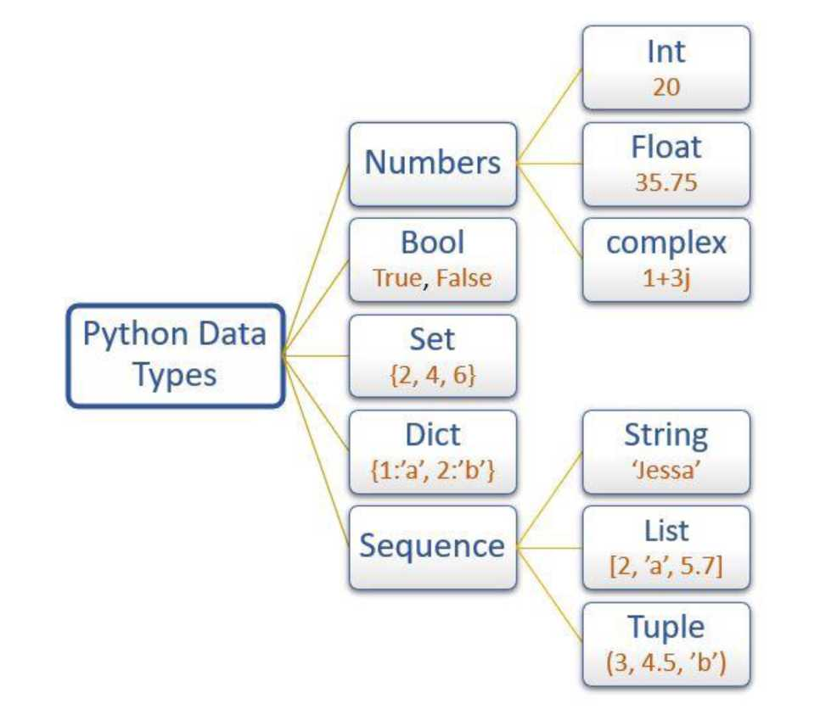
To check the data type of variable use the built-in function type() and isinstance().
61 | Page

Slide 64
• The type() function returns the data type of the variable
• The isinstanceP function checks whether an object belongs to a particular class.
Data type | Description | Example
int | To store integer values | n = 20
float | To store decimal values | n = 20.75
complex | To store complex numbers (real and imaginary part) | n = 10+20j
str | To store textual/string data | name = 'Jessa'
bool | To store boolean values | flag = True
list | To store a sequence of mutable data | l = [3, 'a', 2.5]
tuple | To store sequence immutable data | t = (2, 'b', 6.4)
diet | To store key: value pair | d = {1:'J', 2:'E'}
set | To store unorder and unindexed values | s = {1, 3, 5}
62 | Page

Slide 65
Data type | Description
frozenset | To store immutable version of the set
range | To generate a sequence of number
bytes | To store bytes values
Example
f_set=frozenset({5,7}) numbers = range(10) b=bytes([5,10,15,11])
Int data type
We can create an integer variable using the two ways
1. Directly assigning an integer value to a variable
2. Using a into class.
Example
# store int value roll_no = 33
# display roll no print("Roll number is:", roll_no)
# output 33
63 | P a g e

Slide 66
print(type(rollno))
# output class 'int'
# store integer using int() class id = int(25)
print(id) # 25 print(type(id)) # class 'int'
Str data type
Example
platform = "PYnative" print(type(platform)) # <class 'str'>
# display string print(platform) # 'PYnative'
# accessing 2nd character of a string
print(platform[l]) # Y
Float data type
We can create a float variable using the two ways
64 | Page

Slide 67
z = 11.2 + 1.2j # both value are float type
print(type(x)) # class 'complex'>
print(x) # (9+8j)
print(y) # (10+4.5j)
print(z) # (11.2+1.2j)
List data type
The Python List is an ordered collection (also known as a sequence ) of elements. List elements can be accessed, iterated, and removed according to the order they inserted at the creation time.
We use the list data type to represent groups of the element as a single entity. For example: If we want to store all student's names, we can use list type.
1. The list can contain data of all data types such as int, float, string
2. Duplicates elements are allowed in the list
3. The list is mutable which means we can modify the value of list elements We can create a list using the two ways
1. By enclosing elements in the square brackets [].
2. Using a iist() class.
66 | Page

Slide 68
Example list creation and manipulation
my_list = ["Jessa", "Kelly", 20, 35.75]
# display list
print(my_list) # ['Jessa', 'Kelly', 20, 35.75] print(type(my_list)) # class 'list'
# Accessing first element of list print(my_list[0]) # 'Jessa'
# slicing list elements
print(my_list[1:5]) # ['Kelly', 20, 35.75]
# modify 2nd element of a list my_list[1] = "Emma" print(my_list[1]) # 'Emma'
# create list using a list class
my_list2 = list(["Jessa", "Kelly", 20, 35.75]) print(my_list2) # ['Jessa', 'Kelly', 20, 35.75]
Tuple data type
Tuples are ordered collections of elements that are unchangeable. The tuple is the same as the list, except the tuple is immutable means we can't modify the tuple once created.
In other words, we can say a tuple is a read-only version of the list.
67 | Page

Slide 69
For example: If you want to store the roll numbers of students that you don't change, you can use the tuple data type.
Note: Tuple maintains the insertion order and also, allows us to store duplicate elements. We can create a tuple using the two ways
1. By enclosing elements in the parenthesis ()
2. Using a tupie() class.
Example Tuple creation and manipulation
# create a tuple
my_tuple = (11, 24, 56, 88, 78) print(my_tuple) # (11, 24, 56, 88, 78) print(type(my_tuple)) # class 'tuple'
# Accessing 3rd element of a tuple print(my_tuple[2]) # 56
# slice a tuple
print(my_tuple[2:7]) # (56, 88, 78)
# create a tuple using a tuple() class my_tuple2 = tuple((10, 20, 30, 40)) print(my_tuple2) # (10, 20, 30, 40)
68 | Page

Slide 70
Tuple is immutable
A tuple is immutable means once we create a tuple, we can't modify it
# create a tuple
my_tuple = (11, 24, 56, 88, 78)
# modify 2nd element of tuple my_tuple[1] = 35
print(my_tuple)
# TypeError: 'tuple' object does not support item assignment
Diet data type
In Python, dictionaries are unordered eolleetions of unique values stored in (Key-Value) pairs. Use a dictionary data type to store data as a key-value pair.
The dictionary type is represented using a dict class. For example, If you want to store the name and roll number of all students, then you can use the dict type.
In a dictionary, duplicate keys are not allowed, but the value can be duplicated. If we try to insert a value with a duplicate key, the old value will be replaced with the new value.
Dictionary has some characteristics which are listed below:
69 | Page

Slide 71
1. A heterogeneous (i.e., str, list, tuple) elements are allowed for both key and value in a dictionary. But An object can be a key in a dictionary if it is hashable.
2. The dictionary is mutable which means we can modify its items
3. Dictionary is unordered so we can't perform indexing and slicing
We can create a dictionary using the two ways
1. By enclosing key and values in the curly brackets {}
2. Using a dict() class.
Example dictionary creation and manipulation
# create a dictionary
my_dict = {1: "Smith", 2: "Emma", 3: "Jessa"}
# display dictionary
print(my_dict) # {1: 'Smith', 2: 'Emma', 3: 'Jessa'} print(type(my_dict)) # class 'dict'
# create a dictionary using a dit class
my_dict = dict({1: "Smith", 2: "Emma", 3: "Jessa"})
# display dictionary
print(my_dict) # {1: 'Smith', 2: 'Emma', 3: 'Jessa'} print(type(my_dict)) # class 'dict'
# access value using a key name print(my_dict[1]) # Smith
# change the value of a key my_dict[1] = "Kelly"
70 | Page

Slide 72
print(my_dict[1]) # Kelly
Python Casting: Type Conversion and Type Casting
Python performs the following two types of casting.
• Implicit casting: The Python interpreter automatically performs an implicit Type conversion, which avoids loss of data.
• Explicit casting: The explicit type conversion is performed by the user using built-in functions.
To perform a type casting, we are going to use the following built-in functions
1. int(): convert any type variable to the integer type.
2. fioat(): convert any type variable to the float type.
3. compiex(): convert any type variable to the complex type.
4. booi(): convert any type variable to the bool type.
5. str(): convert any type variable to the string type.
Int type conversion
71 | Page

Slide 73
Casting float value to an integer
pi = 3.14 # float number
print(type(pi))
# Output class 'float'
# converting float integer num = int(pi)
print("Integer number:", num)
# Output 3 print(type(num))
# Output class 'int'
Casting float value to an integer
pi = 3.14 # float number
print(type(pi))
# Output class 'float'
# converting float integer num = int(pi)
print("Integer number:", num)
# Output 3 print(type(num))
# Output class 'int'
72 | Page

Slide 74
Casting a string to an integer
string_num = "225" print(type(stringnum))
# Output class 'str'
# converting str to integer numl = int(string_num)
print("Integer number 1:", numl)
# Output 225 print(type(numl))
# Output class 'int'
Float type conversion
Casting integer to float
num = 725 print(type(num))
# Output class 'int'
# converting float to integer numl = float(num)
print("Float number:", numl)
# Output 725.0
73 | P a g e

Slide 75
print(type(num1))
# Output class 'float'
Casting Boolean to float
flag_true = True flag_false = False print(type(flag_true))
# Output class 'bool'
# converting boolean to float num1 = float(flag_true)
num2 = float(flag_false)
print("Float number 1:", num1)
# Output 1.0 print(type(num1))
# class 'float'
print("Float number 2:", num2)
# Output 0.0 print(type(num2))
# class 'float'
74 | Page

Slide 76
Casting string to float
string_num = "725.535" print(type(stringnum))
# Output class 'str'
# converting str to float numl = float(string_num)
print("Float number:", numl)
# Output 725.535 print(type(numl))
# class 'float'
Complex type conversion
Casting integer type to complex type
r_num = 135
print(type(rnum)) # class 'int'
# converting int to complex(x) cnum = complex(rnum)
print("Complex number:", c_num)
# Output (135+0j) print(type(c_num))
75 | P a g e

Slide 77
# class 'complex'
# converting int to complex(x, y) r_num, i_num2 = 135, 235
c_num = complex(r_num, i_num2)
print("Complex number:", c_num)
# Output (135+235j) print(type(c_num)) # class 'complex'
Casting float type to complex type
r_num = 53.250
print(type(r_num)) # class 'float'
# converting float to complex(x) c_num = complex(r_num)
print("Complex number:", c_num)
# Output (53.25+0j) print(type(c_num))
# class 'complex'
# converting float to complex(x, y) r_num, i_num2 = 53.250, 350.750 c_num = complex(r_num, i_num2)
print("Complex number:", c_num)
# Output (53.25+350.75j) print(type(c_num))
76 | Page

Slide 78
Casting Boolean type to complex type
boolean_true = True
print(type(boolean_true)) # class 'bool'
# converting boolean to complex(x) c_num = complex(boolean_true)
print("Complex number:", c_num)
# Output (1+0j) print(type(c_num))
# class 'complex'
# converting boolean to complex(x, y) r_bool, i_bool = False, True
c_num = complex(r_bool, i_bool)
print("Complex number:", c_num)
# Output 1j print(type(c_num))
# class 'complex'
Bool type conversion
77 | Page

Slide 79
Casting integer to Boolean type
numl = 10 num2 = 0
print(type(numl)) # class 'int'
# Convert into to bool bl = bool(numl)
b2 = bool(num2)
print(bl)
# Output True print(b2)
# Output False
print(type(bl))
# class 'bool'
Casting float to Boolean type
f_numl = 25.35 f_num2 = 0.0
print(type(f_numl)) # class 'float'
# Convert float into to bool bl = bool(f_numl)
b2 = bool(f_num2)
print(bl)
# Output True
78 | Page

Slide 80
print(b2)
# Output False
print(type(b1))
# Output class 'bool'
Casting string to Boolean type
si = "False" s2 = "True" s3 = "812" s4 = ""
print(type(s1)) # class 'str'
# Convert string into to bool b1 = bool(s1) b2 = bool(s2) b3 = bool(s3) b4 = bool(s4)
print(b1) # True
print(b2) # True
print(b3) # True
print(b4) # False
print(type(b1)) # class 'bool'
79 | Page

Slide 81
Casting complex type to Boolean type
c1 = 33 + 9j c2 = 0 + 0j
print(type(c1)) # class 'complex'
# Convert complex value into to bool bl = bool(c1) b2 = bool(c2)
print(b1) # True
print(b2) # False
print(type(b1)) # class 'bool'
String type conversion
Casting int to str type
num = 15
print(type(num)) # class 'int'
# converting int to str type s1 = str(num)
print(s1)
# Output '15' print(type(s1))
80 | Page

Slide 82
Casting float type to str type
num = 75.35
print(type(num)) # class 'float'
# converting float to str type si = str(num)
print(sl)
# Output '75.35' print(type(si))
# Output class 'str'
Casting complex type to str type
complex_num = 15 + 5j
print(type(complex_num)) # class 'complex'
# converting complex to str type si = str(complex_num) print(sl)
# Output '(15+5j)' print(type(si))
81 | Page

Slide 83
# class 'str'
Casting bool type to str type
b1 = True b2 = False
print(type(b1)) # class 'bool'
# converting bool to str type si = str(b1)
s2 = str(b2) print(si)
# Output 'True' print(s2)
# Output 'False'
print(type(si)) # class 'str'
82 | Page

Slide 84
Python Numbers
Integer Number
We can create an integer variable using the two ways
1. Directly assigning an integer value to a variable
2. Using a int() class.
Example to create Integer number
roll_no = 33
# display roll no
print("Roll number is:", roll_no) # 33 print(type(roll_no)) # class 'int'
# create integer using int() class id = int(25)
print(id) # 25
print(type(id)) # class 'int'
Float Number
83 | Page

Slide 85
We can create a integer or Float variable by assigning values. We can get the type of a variable by using the type function.
#data types x=-9999 y=99.99 print(type(x)) print(type(y))
Output
<class 'int'> <class 'float'>
Hexadecimal and Octal Numbers
i = 10
print("in octal form::", oct(i)) print("in hexa decimal form ::", hex(i))
Output
in octal form:: | 0o12
in hexa decimal | form : | : 0xa
84 | Page

Slide 86
Square root, GCD, Power, and Exponentials of a Number
In addition to the above methods, there are methods that are commonly used like
• sqrt(): For finding the square root,
• gcd(): For finding the greatest common divisor,
• pow(x,y): For finding number x raised to power y and
• exp(x): exponentials of number x
Let us see one simple example for all the above functions.
#finding sqrt
print("The square root of 25 is ::", math.sqrt(25)) print("The square root of 10 is ::", math.sqrt(10))
#Greatest Common Divisor
print("The greatest common divisor is ::", math.gcd(6,12)) #exponential value
print("The value os e(x) is::", math.exp(-2))
#Number raised to power
print("The value of 9^{A}3 is ::", math.pow(9, 3))
Output
The square root of 25 is :: 5.0
85 | Page

Slide 87
The square root of 10 is :: 3.1622776601683795 The greatest common divisor is :: 6 The value os e(x) is:: 0.1353352832366127 The value of 9^{A}3 is :: 729.0
86 | Page

Slide 88
Week: 04 Functions and Modules: Definition and Usage

Slide 89
Python Functions
A function is a block of code that performs a specific task.
Suppose we need to create a program to make a circle and color it. We can create two functions to solve this problem:
1. function to create a circle
2. function to color the shape
Dividing a complex problem into smaller chunks makes our program easy to understand and reuse.
Create a Function
Let's create our first function.
def greet ():
print (’Hello World!’)
Here are the different parts of the program:
87 | Page

Slide 90


name of the function
I I greetO \ :
def keyword is used
print('Hello World!’) |
to create a function
1
function body
Create a Python Function
Here, we have created a simple function named greet () that prints Hello World!
Calling a Function
In the above example, we have declared a function named greet ().
def greet (): print ('Hello World!')
If we run the above code, we won't get an output.
It's because creating a function doesn't mean we are executing the code inside it. It means the code is there for us to use if we want to.
To use this function, we need to call the function.
88 | Page

Slide 91
Function Call
greet ()
Example: Python Function Call
def greet ():
print (’Hello World!’)
# Call the function greet ()
print (’Outside function’)
Output Hello World!
Outside function
In the above example, we have created a function named greet(). Here's how the control of the program flows:
89 | Page

Slide 92
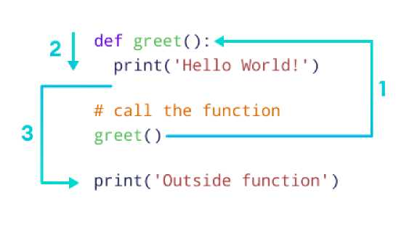
Working of Python Function Here,
1. When the function greet () is called, the program's control transfers to the function definition.
2. All the code inside the function is executed.
3. The control of the program jumps to the next statement after the function call.
Python Function Arguments
Arguments are inputs given to the function.
def greet(name): print ("Hello", name)
# pass argument greet("John")
90 | Page

Slide 93
Sample Output 1
Hello John
Here, we passed 'John' as an argument to the greet () function.
We can pass different arguments in each call, making the function re-usable and dynamic. Let's call the function with a different argument.
greet("David")
Sample Output 2
Hello David
Example: Function to Add Two Numbers
# function with two arguments def add numbers (num1, num2): sum = num1 + num2 print ("Sum: ", sum)
91 | Page

Slide 94
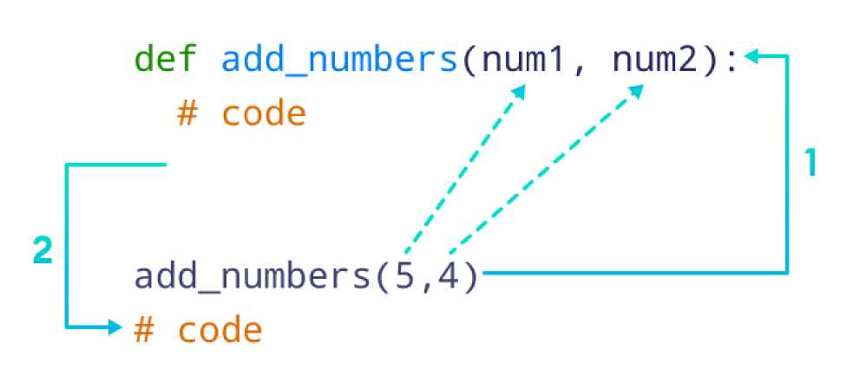
# function call with two values add numbers (5, 4)
Output
Sum: 9
In the above example, we have created a function named add numbers() with arguments: numl and num2.
Python Function with Arguments
The return Statement
We return a value from the function using the return statement.
# function definition def find square(num):
92 | Page

Slide 95
result = num * num return result
# function call square = find_square(3)
print (’Square:’, square)
Output Square: 9
In the above example, we have created a function named find square(). The function accepts a number and returns the square of the number.
def find_square(num): 4-
# code
return result
²J
square = find_square(3)-
# code
Working of functions in Python
Python Library Functions
Python provides some built-in functions that can be directly used in our program.
93 | Page

Slide 96
We don't need to create the function; we just need to call them.
Some Python library functions are:
1. print () - prints the string inside the quotation marks
2. sqrt () - returns the square root of a number
3. pow () - returns the power of a number
These library functions are defined inside the module. And to use them, we must include the module inside our program.
For example, sqrt () is defined inside the math module.
Note: To learn more about library functions, please visit Python Library Functions.
Example: Python Library Function import math
# sqrt computes the square root square root = math. sqrt (4)
print ("Square Root of 4 is”, square root)
# pow() comptes the power power = pow (2, 3)
94 | Page

Slide 97
Week: 05 Functions and Modules: Lambda, Modules, and Packages

Slide 98
print (”2 to the power 3 is”, power)
Output
Square Root of 4 is 2.0 2 to the power 3 is 8
Here, we imported a math module to use the library functions sqrt() and pow().
More on Python Functions
User Defined Function Vs Standard Library Functions
In Python, functions are divided into two categories: user-defined functions and standard library functions. These two differ in several ways:
User-Defined Functions
These are the functions we create ourselves. They're like our custom tools, designed for specific tasks we have in mind.
They're not part of Python's standard toolbox, which means we have the freedom to tailor them exactly to our needs, adding a personal touch to our code.
Standard Library Functions
Think of these as Python's pre-packaged gifts. They come built-in with Python, ready to use.
These functions cover a wide range of common tasks such as mathematics, file operations, working with strings, etc.
95 | Page

Slide 99
They've been tried and tested by the Python community, ensuring efficiency and reliability.
Python Variable Scope
In Python, we can declare variables in three different scopes: local scope, global, and nonlocal scope. A variable scope specifies the region where we can access a variable. For example,
def add numbers (): sum = 5 + 4
Here, the sum variable is created inside the function, so it can only be accessed within it (local scope). This type of variable is called a local variable.
Based on the scope, we can classify Python variables into three types:
1. Local Variables
2. Global Variables
3. Nonlocal Variables
96 | Page

Slide 100
Python Local Variables
When we declare variables inside a function, these variables will have a local scope (within the function). We cannot access them outside the function.
These types of variables are called local variables. For example,
def greet ():
# local variable
message = 'Hello' print ('Local', message)
greet ()
97 | Page

Slide 101
# Try to access message variable
# outside greet () function
print(message)
Output
Local Hello
NameError: name 'message' is not defined
Here, the message variable is local to the greet () function, so it can only be accessed within the function. That's why we get an error when we try to access it outside the greet () function.
To fix this issue, we can make the variable named message global.
Python Global Variables
In Python, a variable declared outside of the function or in global scope is known as a global variable. This means that a global variable can be accessed inside or outside of the function.
Let's see an example of how a global variable is created in Python.
# Declare global variable message = 'Hello'
98 | Page

Slide 102
def greet ():
# Declare local variable print ('Local', message) greet ()
print ('Global', message)
Output
Local Hello Global Hello
This time we can access the message variable from outside of the greet () function. This is because we have created the message variable as the global variable.
# Declare global variable message = 'Hello'
Now, message will be accessible from any scope (region) of the program.
Python Nonlocal Variables
99 | Page

Slide 103
In Python, the nonlocal keyword is used within nested functions to indicate that a variable is not local to the inner function, but rather belongs to an enclosing function’s scope.
This allows you to modify a variable from the outer function within the nested function, while still keeping it distinct from global variables.
# outside function
def outer ():
message = 'local'
# nested function
def inner ():
# Declare nonlocal variable nonlocal message
message = 'nonlocal' print ("inner:", message)
inner ()
print ("outer:", message) outer ()_
100 | Page

Slide 104
Output
inner: nonlocal outer: nonlocal
In the above example, there is a nested inner () function. The inner () function is defined in the scope of another function outer ().
We have used the nonlocal keyword to modify the message variable from the outer function within the nested function.
Python Global Keyword
In Python, the global keyword allows us to modify the variable outside of the current scope.
It is used to create a global variable and make changes to the variable in a local context.
Before we learn about the global keyword, make sure you have got some basics of Python Variable Scope.
Access and Modify Python Global Variable
First let's try to access a global variable from the inside of a function,
# global variable c = 1
101 | Page

Slide 105
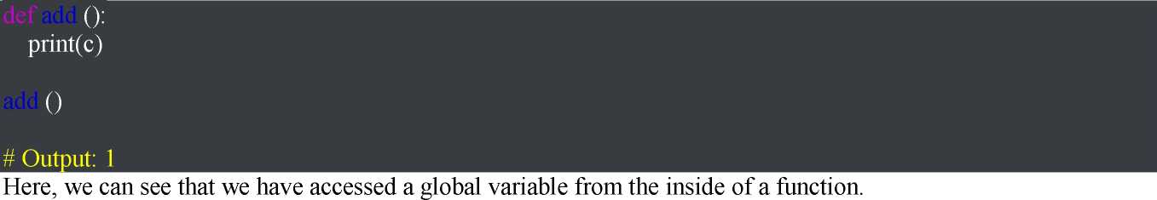
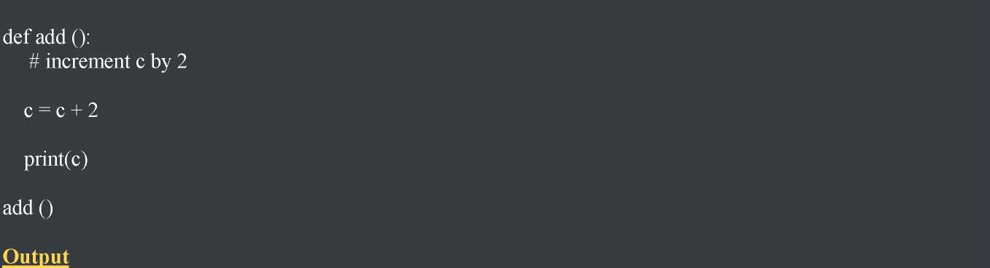
However, if we try to modify the global variable from inside a function as:
# global variable c = 1
Unbound Local Error: local variable ’c’ referenced before assignment
This is because we can only access the global variable but cannot modify it from inside the function. The solution for this is to use the global keyword.
102 | Page

Slide 106
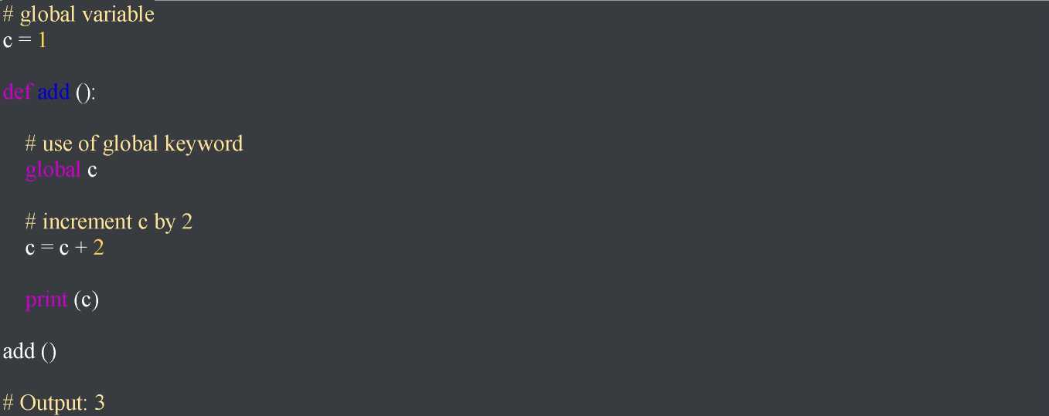
Example: Changing Global Variable from Inside a Function using global
In the above example, we have defined c as the global keyword inside add ().
Then, we have incremented the variable c by 2, i.e. c = c + 2.
As we can see while calling add (), the value of global variable c is modified from 1 to 3.
Rules of global Keyword
103 | Page

Slide 107
The basic rules for global keyword in Python are:
• When we create a variable inside a function, it is local by default.
• When we define a variable outside of a function, it is global by default. You don't have to use the global keyword.
• We use the global keyword to modify (write to) a global variable inside a function.
• Use of the global keyword outside a function has no effect.
Python Recursion
Recursion is the process of defining something in terms of itself.
A physical world example would be to place two parallel mirrors facing each other. Any object in between them would be reflected recursively.
Python Recursive Function
In Python, we know that a function can call other functions. It is even possible for the function to call itself. These types of construct are termed as recursive functions.
The following image shows the working of a recursive function called recurse.
104 | Page

Slide 108
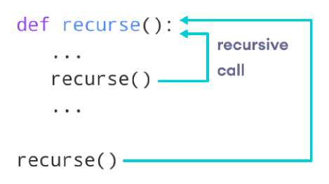
Following is an example of a recursive function to find the factorial of an integer.
Factorial of a number is the product of all the integers from 1 to that number. For example, the factorial of 6 (denoted as 6!) is 1*2*3*4*5*6 = 720.
Example of a recursive function
def factorial(x):
"""This is a recursive function to find the factorial of an integer"""
if x == 1: return 1 else:
return (x * factorial(x-1))
num = 3
print ("The factorial of", num, "is", factorial(num))
105 | Page

Slide 109
Output
The factorial of 3 is 6
In the above example, factorial () is a recursive function as it calls itself.
When we call this function with a positive integer, it will recursively call itself by decreasing the number.
Each function multiplies the number with the factorial of the number below it until it is equal to one. This recursive call can be explained in the following steps.
factorial (3) | # 1st call with 3
3 * factorial (2) | # 2nd call with 2
3 * 2 * factorial | (1) # 3rd call with 1
3 * 2 * 1 | # return from 3rd call as number=1
3 * 2 | # return from 2nd call
6 | # return from 1st call
Let's look at an image that shows a step-by-step process of what is going on:
106 | Page

Slide 110
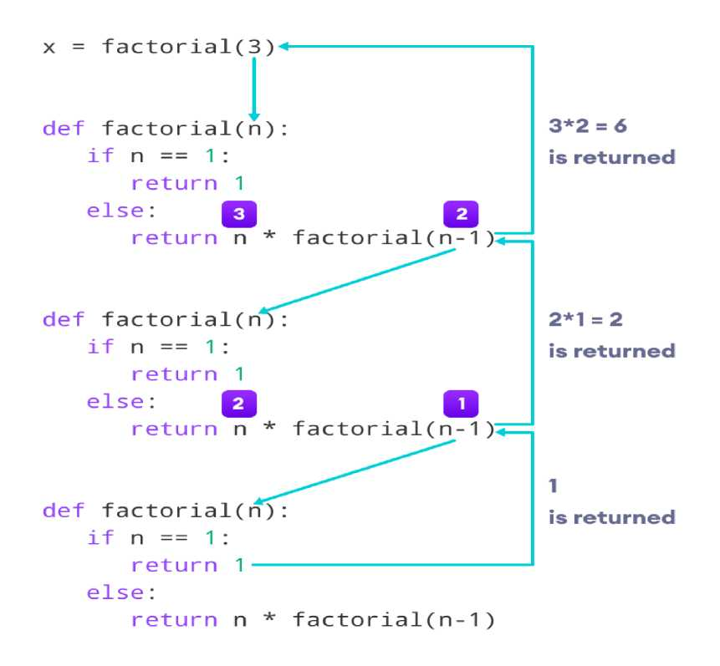
Our recursion ends when the number reduces to 1. This is called the base condition.
Every recursive function must have a base condition that stops the recursion or else the function calls itself infinitely.
107 | Page

Slide 111
Advantages of Recursion
1. Recursive functions make the code look clean and elegant.
2. A complex task can be broken down into simpler sub-problems using recursion.
3. Sequence generation is easier with recursion than using some nested iteration.
Disadvantages of Recursion
1. Sometimes the logic behind recursion is hard to follow through.
2. Recursive calls are expensive (inefficient) as they take up a lot of memory and time.
3. Recursive functions are hard to debug.
108 | Page

Slide 112
Week: 06 Data Structures: Lists, Tuples, Sets, Dictionaries

Slide 113
List data type
In fundamental data types every variable can hold only single value. If we want to represent a group of values (i.e., Names of all students, roll numbers of all students or mobile numbers of all students etc.,) as a single entity where insertion order required to preserve and duplicates are allowed then we should go for list data type. lists can be represented by using square brackets ([ ])
For example, In [1]:
list1 = [10,20,30,45]
tuple1 = (10,20,30)
set1 = {10,20,30}
dictionary1 = {100:'karthi',200:'sahasra',300:'sri’}
How to represent list?
In [3]:
l = [10,'karthi',10.5,30]
print(type(l))
print(l)
[10, 'karthi', 10.5, 30]

Slide 114
Important conclusions observed with respect to list data type :
1. insertion order is preserved.
2. heterogeneous objects are allowed.
3. duplicates are allowed.
4. Growable in nature. i.e., based on our requirement you can add or remove the elements of the list.
5. values should be enclosed within square brackets.
6. Indexing concept is applicable.
7. slicing concept is applicable.
8. List is mutable (i.e., we can chnage the content of the list. It is acceptable).

Slide 115
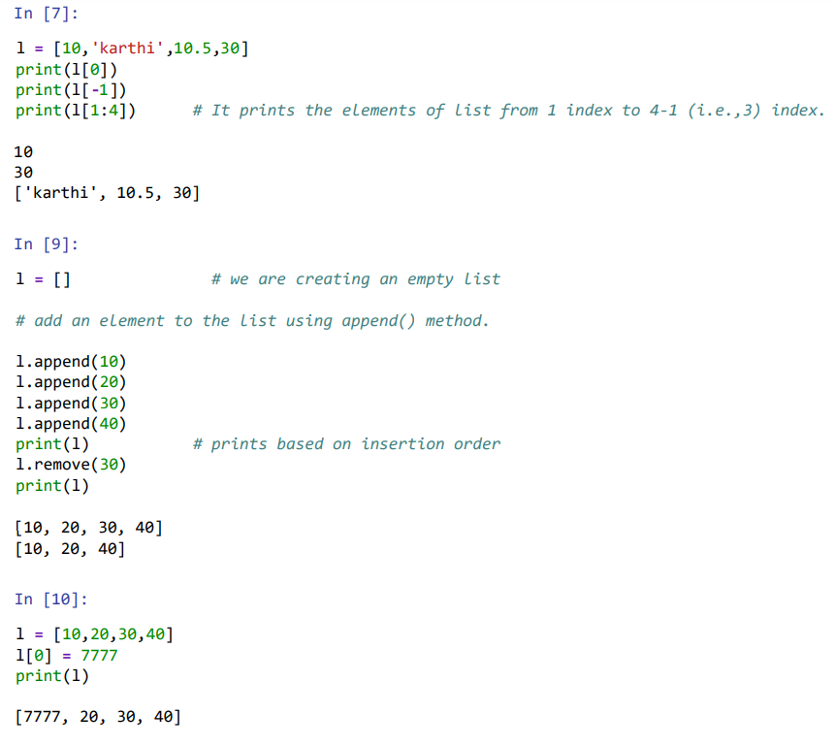

Slide 116
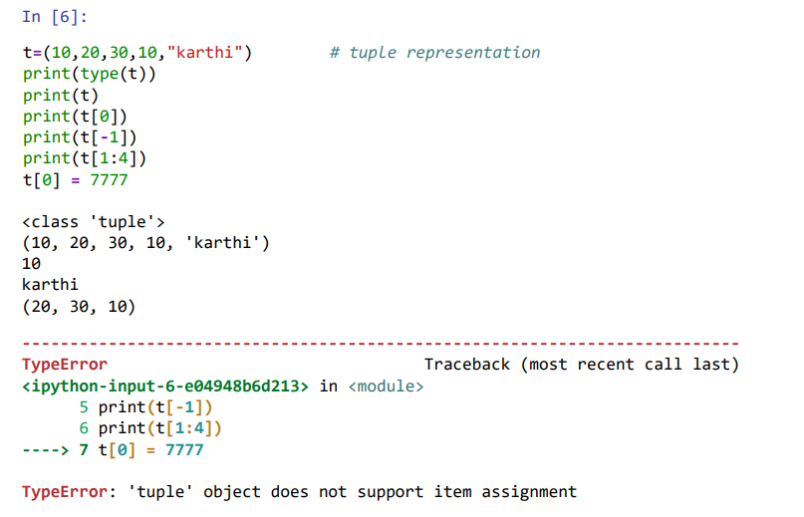
Tuple data type
Tuple data type is exactly same as list data type except that it is immutable, i.e., once we create a tuple object, we cannot perform any changes in that object.
Read-only version of list is tuple. Tuple elements can be represented within parenthesis.

Slide 117
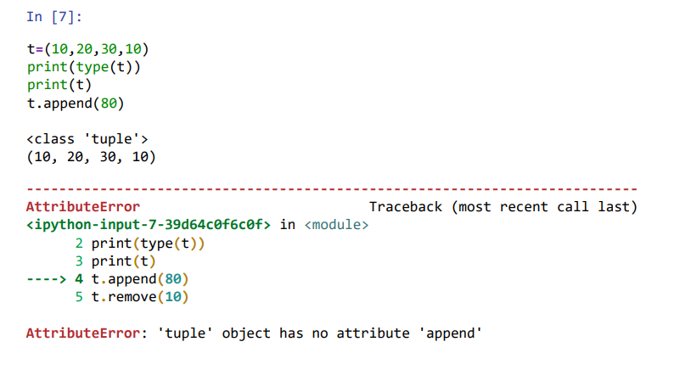
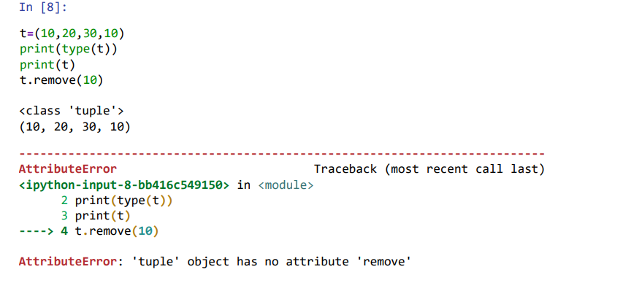

Slide 118
What is the difference between list and tuple?
List is mutable and tuple is non-mutable.
List elements are represented by using square brackets. Tuple elements are represented by using parenthesis.
To store tuple elements, Python Virtual Memory requires less memory. To store list elements, Python Virtual Memory requires more memory
Tuple elements can be access within less time, because they are fixed (Performance is more). Performance is less compared with tuples.

Slide 119
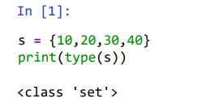
Set data type
If we want to represent a group of values without duplicates and where order is not important then we should go for set Data Type.
For example, we want to send one SMS to all the students of a class. In this duplicate numbers are not allowed and in any order we can send SMS. At last all the students should receive the message. if you have such type of requirement, then it is better to go for set data type.
In general mathematics also, if the sets are like shown below
a = {1,2,3}
b = {2,3,1}
c = {1,3,2}
all these 3 sets are equal.

Slide 120
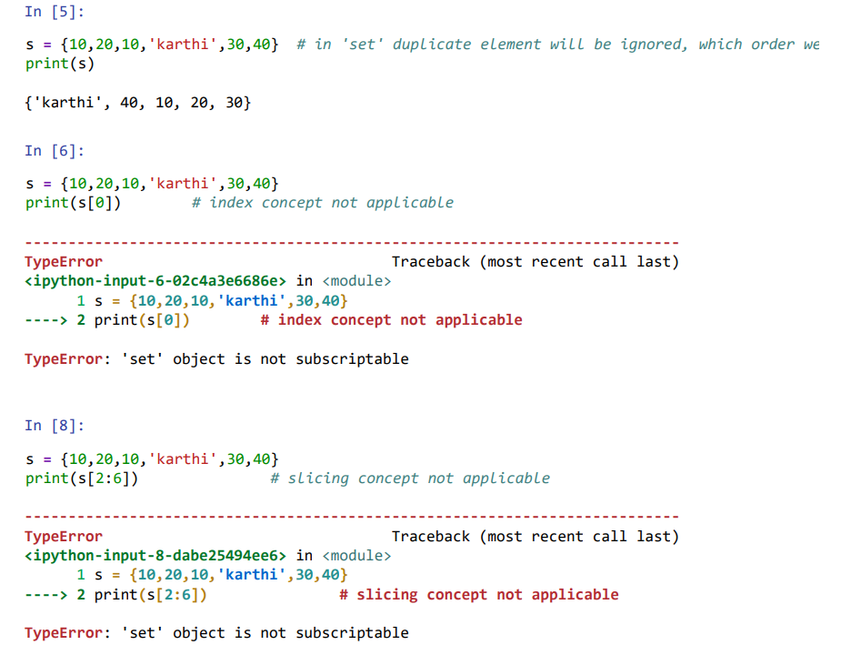

Slide 121
Dictonary (Dict)
So far, we have discussed about list,tuple,set,frozen set. All these data types are having some common point is,
list [10,20,30,40]
tuple (10,20,30,40)
set {10,20,30,40}
forzen set frozenset({10,20,30,40})
If you observed this, all thase data types are talks about a group of individual values.
Some times, If we want to represent a group of values as key-value pairs then we should go for dict data type.
-Eg:
- roll Number - name
- mobile number - address
In general, In our English dictionary we found,
Word : Meaning
The same thing will happens in Python dictionary also.

Slide 122
How can you represent dictionary in Python?
d = {key1 : value1, key2 : value2, key3 : value3}
You van take any number of key-value pairs
In [5]:
d = {100:"karthi", 101:'sahasra', 150:'guido'} print(type(d))
print(d)
<class 'dict'>
{100: 'karthi', 101: 'sahasra', 150: 'guido'}
We can create an empty dictionary, and later we can add key-value pairs into that dictionary. If you want to add key-value pair into a dictionary, the following syntax is used in Python: dictionaryName[key] = value

Slide 123
Key points with respect to Dictionary:
Duplicate keys are not allowed but values can be duplicated.
If we are trying to insert an entry with duplicate key then old value will be replaced with new value.
In [10]:
d={10:'karthi',20:'karthi',30:'karthi'} print(d)
{10: 'karthi', 20: 'karthi', 30: 'karthi'}
In [11]:
d={10:'karthi',10:'karthi',30:'karthi'} print(d)
{10: 'karthi', 30: 'karthi'}
In [14]:
d={10:'karthi',10:'sahasra',30:'ravi'} print(d)
{10: 'sahasra', 30: 'ravi'}
In [15]:
d={10:'sahasra',10:'karthi',30:'ravi'} print(d)
{10: 'karthi', 30: 'ravi'}

Slide 124
Important conclusions observed with respect to dict data type :
If you want to represent a group of values as key-value pairs then we should go for dict data type.
Order is not applicable.
Duplicate keys are not allowed but values can be duplicated.
If we are trying to insert an entry with duplicate key then old value will be replaced with new value.
Heterogeneous objects are allowed.
It is mutable.
Indexing, slicing is not applicable.

Slide 125
Week: 07 String Manipulation and Regular Expressions

Slide 126
Regular Expressions
If we want to represent a group of Strings according to a particular format/pattern then we should go for Regular Expressions. i.e., Regualr Expressions is a declarative mechanism to represent a group of Strings accroding to particular format/pattern.
Eg 1: We can write a regular expression to represent all mobile numbers. (i.e., All mobile numbers having a particular format i.e., exactly 10 numbers only)
Eg 2: We can write a regular expression to represent all mail ids.
Eg 3: We can write a regular expression to represent all java/python/C identifiers.
Note: Regular Expressions is language independent concept.

Slide 127
The main important application areas of Regular Expressions are as follows:
To develop validation frameworks/validation logic. For example, mail id validation, mobile number validation etc.
To develop Pattern matching applications (ctrl-f in windows, grep in UNIX etc).
To develop Translators like compilers, interpreters etc. In compiler design, Lexical analysis phase is internally implemented using Regular expressions only.
To develop digital circuits. For example, Binary Incrementor, Binary adder, Binary subtractor etc.
To develop communication protocols like TCP/IP, UDP etc. (Protocol means set of rules, to follow the rules during communication, we use regular expressions).

Slide 128
re module:
We can develop Regular Expression Based applications by using python module known as re.
This module contains several in-built functions to use Regular Expressions very easily in our applications.
1. compile():
re module contains compile() function to compile a pattern into RegexObject.
For example, if you want to find the pattern 'python' in the given string, first you need to convert this pattern into RegexObject form.
In [1]:
import re
pattern = re.compile("python") print(type(pattern))
<class 're.Pattern'>

Slide 129
2. finditer():
Returns an Iterator object which yields Match object for every Match.
In [ ]:
matcher = pattern.finditer("Learning python is very easy...")
On Match object we can call the following methods.
start() ==> Returns start index of the match
end() ==> Returns end+1 index of the match
group() ==> Returns the matched string
Eg: Write a python program to find whether the given pattern is available in the given string or not?

Slide 130
2. finditer():
Returns an Iterator object which yields Match object for every Match.
In [ ]:
matcher = pattern.finditer("Learning python is very easy...")
On Match object we can call the following methods.
start() ==> Returns start index of the match
end() ==> Returns end+1 index of the match
group() ==> Returns the matched string
Eg: Write a python program to find whether the given pattern is available in the given string or not?

Slide 131
Week: 08 & 09 File Handling: Read/Write, Exceptions

Slide 132
What is File Handling?
File handling allows reading from and writing to files in Python.
Commonly used for:
Storing data.
Reading configurations.
Writing logs or reports.
File Modes in Python Content (Table Format):
Mode | Description | Examples
'r' | Read-only mode | file.read()
'w' | Write mode (overwrites file) | file.write("Hi")
'a' | Append mode | file.write("New")
'rb' | Read binary mode | file.read()
'wb' | Write binary mode | file.write(b"X")

Slide 133
How to Read a File
1. Open the file using open() in 'r' mode.
2. Read content using:
- read() to read the whole file
- readline() for a single line
- readlines() for a list of lines
3. Always close the file or use 'with' to manage the file lifecycle.
with open("example.txt", "r") as file:
content = file.read()
print(content)

Slide 134
How to Write to a File
1. Open the file in 'w' or 'a' mode.
2. Use write() or writelines().
3. Ensure proper file closure.
with open("example.txt", "w") as file:
file.write("Hello, World!")

Slide 135
Handling Exceptions in File Handling
Files might not exist (FileNotFoundError).
Permissions may be denied (PermissionError).
Prevent program crashes using try-except.
try:
with open("example.txt", "r") as file:
content = file.read()
except FileNotFoundError:
print("File not found!")

Slide 136
Best Practices in File Handling
Always use 'with' for file handling (automatic closure).
Use exception handling (try-except) for robust code.
Avoid hardcoding file paths; use os.path.
Read/write files in chunks for large files.

Slide 137
Week: 10 Object-Oriented Programming: Classes and Objects

Slide 138
Some Drawbacks Of Using A List
The parts of a composite list can be accessed via [index] but they cannot be labeled (what do these fields store?)
Which field contains what type of information? This isn’t immediately clear from looking at the program statements.
client = [“xxxxxxxxxxxxxxx",
“0000000000",
“xxxxxxxxx",
0]
Is there any way to specify rules about the type of information to be stored in a field e.g., a data entry error could allow alphabetic information (e.g., 1-800-BUY-NOWW) to be entered in the phone number field.

Slide 139

Classes
Can be used to define a generic template for a new non-homogeneous composite type.
It can label and define more complex entities than a list.
This template defines what an instance (example) of this new composite type would consist of but it doesn’t create an instance.
Copyright information unknown

Slide 140


Classes Define A Composite Type
The class definition specifies the type of information (called “attributes”) that each instance (example) tracks.
Name:
Phone:
Email:
Purchases:
Name:
Phone:
Email:
Purchases:
Name:
Phone:
Email:
Purchases:

Slide 141
Defining A Class¹
Note the convention: The first letter is capitalized.
Format:
class <Name of the class>:
name of first field = <default value>
name of second field = <default value>
Example:
class Client:
name = "default"
phone = "(123)456-7890"
email = "foo@bar.com"
purchases = 0
Describes what information that would be tracked by a “Client” but doesn’t actually create a client variable
Contrast this with a list definition of a client
client = [“xxxxxxxxxxxxxxx",
“0000000000",
“xxxxxxxxx",
0]
1 Although this structure isn’t commonly used in Python it is common to many other programming languages: Java, C++

Slide 142
Creating An Instance Of A Class
instantiation
Creating an actual instance (instance = object) is referred to as
Format:
<reference name> = <name of class>()
Example:
firstClient = Client()

Slide 143


Defining A Class Vs. Creating An Instance Of That Class
Defining a class
A template that describes that class: how many fields, what type of information will be stored by each field, what default information will be stored in a field.
Creating an object
Instances of that class (during instantiation) which can take on different forms.
Image copyright unknown

Slide 144
Accessing And Changing The Attributes
Format:
<reference name>.<field name> # Accessing value
<reference name>.<field name> = <value> # Changing value
Example:
aClient.name = "James"

Slide 145
The Client List Example Implemented Using Classes And Objects
Name of the online example: client.py
class Client:
name = "default"
phone = "(123)456-7890"
email = "foo@bar.com"
purchases = 0

Slide 146

The Client List Example Implemented Using Classes (2)
name = "default"
phone = "(123)456-7890"
email = "foo@bar.com"
purchases = 0
name = "James Tam"
email = "tam@ucalgary.ca"
def main():
firstClient = Client()
firstClient.name = "James Tam"
firstClient.email = "tam@ucalgary.ca"
print(firstClient.name)
print(firstClient.phone)
print(firstClient.email)
print(firstClient.purchases)
main()

Slide 147
What Is The Benefit Of Defining A Class?
It allows new types of variables to be declared.
The new type can model information about most any arbitrary entity:
Car
Movie
Your pet
A bacteria or virus in a medical simulation
A ‘critter’ (e.g., monster, computer-controlled player) a video game
An ‘object’ (e.g., sword, ray gun, food, treasure) in a video game
A member of a website (e.g., a social network user could have attributes to specify the person’s: images, videos, links, comments and other posts associated with the ‘profile’ object).
Notes:
147

Slide 148
What Is The Benefit Of Defining A Class (2)
Unlike creating a composite type by using a list a predetermined number of fields can be specified and those fields can be named.
class Client:
name = "default"
phone = "(123)456-7890"
email = "foo@bar.com"
purchases = 0
firstClient = Client ()
print(firstClient.middleName) # Error: no such field defined

Slide 149
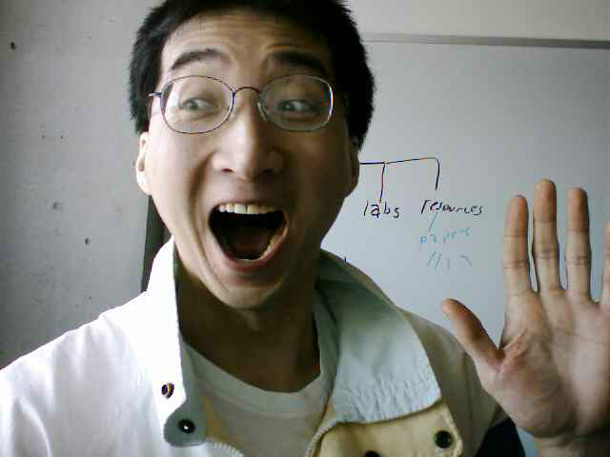
Classes Have Attributes
But Also Behaviors
ATTRIBUTES
Name:
Phone:
Email:
Purchases:
BEHAVIORS
Open account
Buy investments
Sell investments
Close account
Image of James curtesy of James Tam

Slide 150
Class Methods (“Behaviors”)
String
Method operating on that string
1 Not all composites have methods e.g., arrays in ‘C’ are a composite but don’t have methods
Functions: not tied to a composite type or object
The call is ‘stand alone’, just name of function
E.g.,
print(), input()
Methods: must be called through an instance of a composite¹.
E.g.,
filename = "foo.txt"
name, suffix = filename.split('.')
Unlike these pre-created functions, the ones that you associate with classes can be customized to do anything that a regular function can.
Functions that are associated with classes are referred to as methods.

Slide 151
Defining Class Methods
Format:
class <classname>:
def <method name> (self, <other parameters>):
<method body>
Example:
class Person:
name = "I have no name :("
def sayName (self):
print ("My name is...", self.name)
Unlike functions, every method of a class must have the ‘self’ parameter (more on this later)
When the attributes are accessed inside the methods of a class they MUST be preceded by the suffix “.self”

Slide 152

Defining Class Methods: Full Example
Name of the online example: person1.py
class Person:
name = "I have no name :("
def sayName(self):
print("My name is...", self.name)
def main():
aPerson = Person()
aPerson.sayName()
aPerson.name = "Big Smiley :D"
aPerson.sayName()
main()

Slide 153
What Is The ‘Self’ Parameter
Reminder: When defining/calling methods of a class there is always at least one parameter.
This parameter is called the ‘self’ reference which allows an object to access attributes inside its methods.
‘Self’ needed to distinguish the attributes of different objects of the same class.
Example:
bart = Person()
lisa = Person()
lisa.sayName()
def sayName():
print "My name is...", name
Whose name is this? (This won’t work)

Slide 154
The Self Parameter: A Complete Example
Name of the online example: person2.py
class Person:
name = "I have no name :("
def sayName(self):
print("My name is...", self.name)
def main():
lisa = Person()
lisa.name = "Lisa Simpson, pleased to meet you."
bart = Person()
bart.name = "I'm Bart Simpson, who the hek are you???!!!"
lisa.sayName()
bart.sayName()
main()
“The Simpsons” © Fox

Slide 155
Recap: Accessing Attributes & Methods
Inside the class definition (inside the body of the class methods)
Preface the attribute or method using the ‘self’ reference
class Person:
name = "No-name"
def sayName(self):
print("My name is...", self.name)
Outside the class definition
Preface the attribute or method using the name of the reference used when creating the object.
def main():
lisa = Person()
bart = Person()
lisa.name = "Lisa Simpson, pleased to meet you."

Slide 156
Initializing The Attributes Of A Class
Classes have a special method that can be used to initialize the starting values of a class to some specific values.
This method is automatically called whenever an object is created.
Format:
class <Class name>:
def __init__(self, <other parameters>):
<body of the method>
Example:
class Person:
name = ""
def __init__(self):
self.name = "No name"
No spaces here
This design approach is consistent with many languages

Slide 157
Initializing The Attributes Of A Class
Because the ‘init()’ method is a method it can also be called with parameters which are then used to initialize the attributes.
Example:
# Attribute is set to a default in the class definition and then the # attribute can be set to a non-default value in the init() method.
# (Not standard Python but a common approach with many languages)
class Person
name = "Default name" # Create attribute here
def __init___(self, aName):
self.name = aName
OR
# Create the attribute in the init() method. (Approach often used in
# Python).
class Person
def __init___(self, aName):
self.name = aName # Create attribute here

Slide 158
Full Example: Using The “Init()” Method
The name of the online example: init_method1.py
class Person:
name = "Nameless bard"
def __init__(self, aName):
self.name = aName
def main():
aPerson = Person("Finder Wyvernspur")
print(aPerson.name)
main()
“Nameless bard” & “Finder Wyvernspur” © Wizards of the Coast (April 24, 2012)

Slide 159
Constructor: A Special Method
Constructor method: a special method that is used when defining a class and it is automatically called when an object of that class has been created.
E.g., aPerson = Person() # This calls the constructor
In Python this method is named ‘init’.
Other languages may require a different name for the syntax but it serves the same purpose (initializing the fields of an object as it’s being created).
This method should never have a return statement that returns a value.
Should be (if return is needed) “return”
Never return a type e.g., return(12)

Slide 160
Objects Employ References
Assign the address of the object into the reference
aPerson = Person()
Creates the reference variable
Calls the constructor and creates an object

Slide 161
Objects Employ References (2)
Similar to lists, objects are accessed through a reference.
The reference and the object are two separate memory locations.
Name of the online example: objectReference.py
class Person:
age = 0
name = "none"
def __init__(self,newAge,newName):
self.age = newAge
self.name = newName
def displayAge(aPerson):
print("%s age %d" %(aPerson.name,aPerson.age))

Slide 162

Objects Employ References (3)
def start():
person1 = Person(13,"Person2")
person2 = person1
displayAge(person1)
displayAge(person2)
print()
start()
Address = 1000
person2
@=1000
Age: 13
Name: Person2
person1
@=1000

Slide 163

Objects Employ References (2)
def start():
person1 = Person(13,"Person2")
person2 = person1
displayAge(person1)
displayAge(person2)
print()
person1 = Person(888,"Person1")
displayAge(person1)
displayAge(person2)
start()
Address = 1000
person2
@=1000
Age: 13
Name: Person2
@=1000
person1
@=2000
Address = 2000
Age: 888
Name: Person1

Slide 164
Default Parameters
Similar to other methods, ‘init’ can be defined so that if parameters aren’t passed into them then default values can be assigned.
Example:
def __init__ (self, name = "I have no name"):
Method calls (to ‘init’), both will work
smiley = Person()
jt = Person("James")
This method can be called either when a personalized name is given or if the name is left out.

Slide 165

Default Parameters: Full Example
Name of the online example: init_method2.py
class Person:
name = ""
def __init__(self, name = "I have no name"):
self.name = name
def main():
smiley = Person()
print("My name is...", smiley.name)
jt = Person("James")
print("My name is...", jt.name)
main()

Slide 166
Modules: Dividing Up A Large Program
File: driver.py
File: functions.py
import functions
def main():
functions.fun()
main()
def fun ():
print("I'm fun!")
1 Import syntax:
From <file name> import <function names> # Import some functions
From <file name> import * # Import all functions
OR
import <file name> # Import only module/file
Module: In Python a module contains a part of a program in a separate file (module name matches the file name).
In order to access a part of a program that resides in another file you must ‘import’ it.¹
Example:

Slide 167
Function Modules: Complete Example
Subdirectory name with all the files for this example: modules1
Run the program method type: “python driver.py”
<< In module file1.py >>
def fun1():
print("I'm fun1!")
def fun2():
print("I'm fun2!")
<< In module file2.py >>
def fun3():
print("I'm fun3!")

Slide 168
Modules: Complete Example (2)
<< In file driver.py >>
from file1 import fun1, fun2 #Import file name, function name
import file2 #Imports only file name
def start():
fun1()
fun2()
file2.fun3()
main ()
Note the difference in how fun1 & fun2 vs. fun3 are called

Slide 169
Modules And Classes
Class definitions are frequently contained in their own module.
A common convention is to have the module (file) name match the name of the class.
To use the code of class Person from another file module you must include an import:
from <filename> import <class name>
from Person import Person
Filename: Person.py
class Person:
def fun1(self):
print(“fun1”)
def fun2 (self):
print(“fun2”)

Slide 170
Modules And Classes: Complete Example
Subdirectory name with all the files for this example: modules2
To run the program type: “python Driver.py”
<< File Driver.py >>
from Greetings import *
def start():
aGreeting = Greeting()
aGreeting.sayGreeting()
start()
When importing modules containing class definitions the syntax is (star ‘*’ imports everything):
From <filename> import <classes to be used in this module>

Slide 171
Modules And Classes: Complete Example (2)
<< File Greetings.py >>
class Greetings:
def sayGreeting(self):
print("Hello! Hallo! Sup?! Guten tag/morgen/aben! Buenos! Wei! \
Konichiwa! Shalom! Bonjour! Salaam alikum! Kamostaka?")

Slide 172
Calling A Classes’ Method Inside Another Method Of The Same Class
Similar to how attributes must be preceded by the keyword ‘self’ before they can be accessed so must the classes’ methods:
Example:
class Bar:
x = 1
def fun1(self):
print(self.x) # Accessing attribute ‘x’
def fun2(self):
self.fun1() # Calling method ‘fun1’

Slide 173
Naming The Starting Module
Recall: The function that starts a program (first one called) should have a good self-explanatory name e.g., “start()” or follow common convention e.g., “main()”
Similarly the file module that contains the ‘start()’ or ‘main()’ function should be given an appropriate name e.g., “Driver.py” (it’s the ‘driver’ of the program or the starting point)
Filename: “Driver.py”
def start():
#Instructions
start()

Slide 174
Complete Example: Accessing Attributes And Methods: Person Module
Subdirectory name with all the files for this example: modules3
To start the program run the ‘start’ method (type: “python Driver.py” because ‘start()’ resides in the ‘Driver’ module.
<< Person.py >>
class Person:
name = "Not named yet"
age = 0
def __init__(self,newName,newAge):
self.name = newName
self.age = newAge

Slide 175
Complete Example: Accessing Attributes And Methods: Person Module (2)
def haveBirthday(self):
print("Happy Birthday!")
self.mature()
def mature(self):
self.age = self.age + 1

Slide 176
Complete Example: Accessing Attributes And Methods: The “Driver” Module
<< Driver.py >>
from Person import Person
def main():
aPerson = Person("Cartman",8)
print("%s is %d." %(aPerson.name,aPerson.age))
aPerson.haveBirthday()
print("%s is %d." %(aPerson.name,aPerson.age))
main()
def __init__(self,newName,newAge):
self.name = newName
self.age = newAge
def haveBirthday(self)
print("Happy Birthday!")
self.mature()
def mature(self):
self.age = self.age + 1

Slide 177
After This Section You Should Now Know
How to define an arbitrary composite type using a class
What are the benefits of defining a composite type by using a class definition over using a list
How to create instances of a class (instantiate)
How to access and change the attributes (fields) of a class
How to define methods/call methods of a class
What is the ‘self’ parameter and why is it needed
What is a constructor (__init__ in Python), when it is used and why is it used
How to write a method with default parameters
How to divide your program into different modules
Notes:
177

Slide 178
Week: 11 OOP: Inheritance, Polymorphism, Encapsulation, Abstraction

Slide 179
What is Inheritance?
Allows a class (child) to inherit properties and methods of another class (parent).
Promotes code reuse.
class Animal:
def speak(self):
print("Animal speaks")
class Dog(Animal):
def speak(self):
print("Dog barks")
d = Dog()
d.speak()

Slide 180
What is Polymorphism?
Different classes can define methods with the same name.
Achieved via method overriding.
Encapsulation and Abstraction
Encapsulation: Restricts access to data by using private attributs (_ or __).
Abstraction: Hides complexity and shows essential features.

Slide 181
Week: 12 Advanced Data Structures: Stacks, Queues

Slide 182
Runtime Efficiency
efficiency: A measure of the use of computing resources by code.
can be relative to speed (time), memory (space), etc.
most commonly refers to run time
Assume the following:
Any single Java statement takes the same amount of time to run.
A method call's runtime is measured by the total of the statements inside the method's body.
A loop's runtime, if the loop repeats N times, is N times the runtime of the statements in its body.

Slide 183
ArrayList methods
Which operations are most/least efficient, and why?
add(value) | appends value at end of list
add(index, value) | inserts given value at given index, shifting subsequent values right
clear() | removes all elements of the list
indexOf(value) | returns first index where given value is found in list (-1 if not found)
get(index) | returns the value at given index
remove(index) | removes/returns value at given index, shifting subsequent values left
set(index, value) | replaces value at given index with given value
size() | returns the number of elements in list
toString() | returns a string representation of the list such as "[3, 42, -7, 15]"

Slide 184
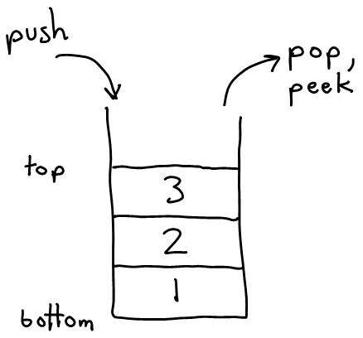
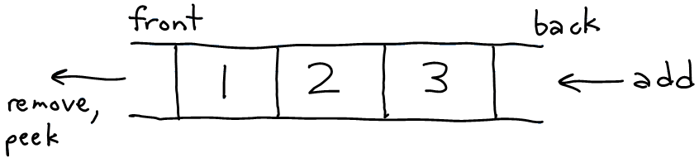
Stacks and queues
Sometimes it is good to have a collection that is less powerful, but is optimized to perform certain operations very quickly.
Today we will examine two specialty collections:
stack: Retrieves elements in the reverse of the order they were added.
queue: Retrieves elements in the same order they were added.
queue
stack

Slide 185
Abstract data types (ADTs)
abstract data type (ADT): A specification of a collection of data and the operations that can be performed on it.
Describes what a collection does, not how it does it
We don't know exactly how a stack or queue is implemented, and we don't need to.
We just need to understand the idea of the collection and what operations it can perform.
(Stacks are usually implemented with arrays; queues are often implemented using another structure called a linked list.)

Slide 186

Stacks
stack: A collection based on the principle of adding elements and retrieving them in the opposite order.
Last-In, First-Out ("LIFO")
The elements are stored in order of insertion, but we do not think of them as having indexes.
The client can only add/remove/examine the last element added (the "top").
basic stack operations:
push: Add an element to the top.
pop: Remove the top element.
Notes:
analogy: trays of food at the sizzler

Slide 187
Stacks in computer science
Programming languages and compilers:
method calls are placed onto a stack (call=push, return=pop)
compilers use stacks to evaluate expressions
Matching up related pairs of things:
find out whether a string is a palindrome
examine a file to see if its braces { } and other operators match
convert "infix" expressions to "postfix" or "prefix"
Sophisticated algorithms:
searching through a maze with "backtracking"
many programs use an "undo stack" of previous operations
method3 | return var local vars parameters
method2 | return var local vars parameters
method1 | return var local vars parameters

Slide 188
Class Stack
Stack<Integer> s = new Stack<Integer>();
s.push(42);
s.push(-3);
s.push(17); // bottom [42, -3, 17] top
System.out.println(s.pop()); // 17
Stack has other methods, but we forbid you to use them.
Stack<E>() | constructs a new stack with elements of type E
push(value) | places given value on top of stack
pop() | removes top value from stack and returns it; throws EmptyStackException if stack is empty
peek() | returns top value from stack without removing it; throws EmptyStackException if stack is empty
size() | returns number of elements in stack
isEmpty() | returns true if stack has no elements

Slide 189
Stack limitations/idioms
Remember: You cannot loop over a stack in the usual way.
Stack<Integer> s = new Stack<Integer>();
...
for (int i = 0; i < s.size(); i++) {
do something with s.get(i);
}
Instead, you must pull contents out of the stack to view them.
common idiom: Removing each element until the stack is empty.
while (!s.isEmpty()) {
do something with s.pop();
}

Slide 190
Exercise
Consider an input file of exam scores in reverse ABC order:
Yeilding Janet 87
White Steven 84
Todd Kim 52
Tashev Sylvia 95
...
Write code to print the exam scores in ABC order using a stack.
What if we want to further process the exams after printing?
Notes:
notion of looping over a collection while modifying it
notion of not destroying a stack while examining it (write 1st version that destroys stack, 2nd version puts it back)

Slide 191
What happened to my stack?
Suppose we're asked to write a method max that accepts a Stack of integers and returns the largest integer in the stack.
The following solution is seemingly correct:
// Precondition: s.size() > 0
public static void max(Stack<Integer> s) {
int maxValue = s.pop();
while (!s.isEmpty()) {
int next = s.pop();
maxValue = Math.max(maxValue, next);
}
return maxValue;
}
The algorithm is correct, but what is wrong with the code?

Slide 192
What happened to my stack?
The code destroys the stack in figuring out its answer.
To fix this, you must save and restore the stack's contents:
public static void max(Stack<Integer> s) {
Stack<Integer> backup = new Stack<Integer>();
int maxValue = s.pop();
backup.push(maxValue);
while (!s.isEmpty()) {
int next = s.pop();
backup.push(next);
maxValue = Math.max(maxValue, next);
}
while (!backup.isEmpty()) {
s.push(backup.pop());
}
return maxValue;
}

Slide 193
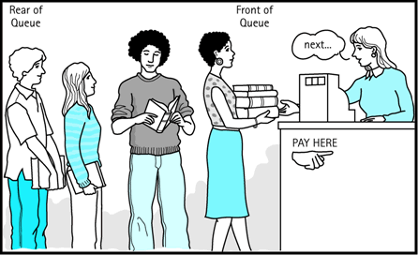
Queues
queue: Retrieves elements in the order they were added.
First-In, First-Out ("FIFO")
Elements are stored in order of insertion but don't have indexes.
Client can only add to the end of the queue, and can only examine/remove the front of the queue.
basic queue operations:
add (enqueue): Add an element to the back.
remove (dequeue): Remove the front element.
Notes:
analogy: trays of food at the sizzler

Slide 194
Queues in computer science
Operating systems:
queue of print jobs to send to the printer
queue of programs / processes to be run
queue of network data packets to send
Programming:
modeling a line of customers or clients
storing a queue of computations to be performed in order
Real world examples:
people on an escalator or waiting in a line
cars at a gas station (or on an assembly line)

Slide 195
Programming with Queues
Queue<Integer> q = new LinkedList<Integer>();
q.add(42);
q.add(-3);
q.add(17); // front [42, -3, 17] back
System.out.println(q.remove()); // 42
IMPORTANT: When constructing a queue you must use a new LinkedList object instead of a new Queue object.
This has to do with a topic we'll discuss later called interfaces.
add(value) | places given value at back of queue
remove() | removes value from front of queue and returns it; throws a NoSuchElementException if queue is empty
peek() | returns front value from queue without removing it; returns null if queue is empty
size() | returns number of elements in queue
isEmpty() | returns true if queue has no elements

Slide 196
Queue idioms
As with stacks, must pull contents out of queue to view them.
while (!q.isEmpty()) {
do something with q.remove();
}
another idiom: Examining each element exactly once.
int size = q.size();
for (int i = 0; i < size; i++) {
do something with q.remove();
(including possibly re-adding it to the queue)
}
Why do we need the size variable?
Notes:
examining each element once is like

Slide 197
Mixing stacks and queues
We often mix stacks and queues to achieve certain effects.
Example: Reverse the order of the elements of a queue.
Queue<Integer> q = new LinkedList<Integer>();
q.add(1);
q.add(2);
q.add(3); // [1, 2, 3]
Stack<Integer> s = new Stack<Integer>();
while (!q.isEmpty()) { // Q -> S
s.push(q.remove());
}
while (!s.isEmpty()) { // S -> Q
q.add(s.pop());
}
System.out.println(q); // [3, 2, 1]

Slide 198
Exercise
Modify our exam score program so that it reads the exam scores into a queue and prints the queue.
Next, filter out any exams where the student got a score of 100.
Then perform your previous code of reversing and printing the remaining students.
What if we want to further process the exams after printing?
Notes:
You wouldn't want me to just throw your exam in the garbage as I read it, would you?

Slide 199
Exercises
Write a method stutter that accepts a queue of integers as a parameter and replaces every element of the queue with two copies of that element.
front [1, 2, 3] back becomes front [1, 1, 2, 2, 3, 3] back
Write a method mirror that accepts a queue of strings as a parameter and appends the queue's contents to itself in reverse order.
front [a, b, c] back becomes front [a, b, c, c, b, a] back

Slide 200
Exercise
A postfix expression is a mathematical expression but with the operators written after the operands rather than before.
1 + 1 becomes 1 1 +
1 + 2 * 3 + 4 becomes 1 2 3 * + 4 +
Write a method postfixEvaluate that accepts a postfix expression string, evaluates it, and returns the result.
All operands are integers; legal operators are + and *
postFixEvaluate("1 2 3 * + 4 +") returns 11
The algorithm: Use a stack
When you see operands, push them.
When you see an operator, pop the last two operands, apply the operator, and push the result onto the stack.
When you're done, the one remaining stack element is the result.

Slide 201
Week: 13 Exception Handling and Debugging

Slide 202
Python Exceptions Handling
Python provides two very important features to handle any unexpected error in your Python programs and to add debugging capabilities in them:
Exception Handling: This would be covered in this tutorial.
Assertions: This would be covered in Assertions in Python tutorial.
What is Exception?
An exception is an event, which occurs during the execution of a program, that disrupts the normal flow of the program's instructions.
In general, when a Python script encounters a situation that it can't cope with, it raises an exception. An exception is a Python object that represents an error.
When a Python script raises an exception, it must either handle the exception immediately otherwise it would terminate and come out.

Slide 203
Handling an exception:
If you have some suspicious code that may raise an exception, you can defend your program by placing the suspicious code in a try: block. After the try: block, include an except: statement, followed by a block of code which handles the problem as elegantly as possible.
Syntax:
try:
You do your operations here;
......................
except Exception I:
If there is ExceptionI, then execute this block.
except Exception II:
If there is ExceptionII, then execute this block.
......................
else:
If there is no exception then execute this block.

Slide 204
Here are few important points above the above mentioned syntax:
A single try statement can have multiple except statements. This is useful when the try block contains statements that may throw different types of exceptions.
You can also provide a generic except clause, which handles any exception.
After the except clause(s), you can include an else-clause. The code in the else-block executes if the code in the try: block does not raise an exception.
The else-block is a good place for code that does not need the try: block's protection.

Slide 205
Example:
try:
fh = open("testfile", "w")
fh.write("This is my test file for exception handling!!")
except IOError: print "Error: can\'t find file or read data"
else: print "Written content in the file successfully"
fh.close()
This will produce following result:
Written content in the file successfully

Slide 206
The except clause with no exceptions:
You can also use the except statement with no exceptions defined as follows:
try:
You do your operations here;
......................
except:
If there is any exception, then execute this block. ......................
else:
If there is no exception then execute this block.
This kind of a try-except statement catches all the exceptions that occur. Using this kind of try-except statement is not considered a good programming practice, though, because it catches all exceptions but does not make the programmer identify the root cause of the problem that may occur.

Slide 207
The except clause with multiple exceptions:
You can also use the same except statement to handle multiple exceptions as follows:
try:
You do your operations here;
......................
except(Exception1[, Exception2[,...ExceptionN]]]):
If there is any exception from the given exception list, then execute this block
.......................
else:
If there is no exception then execute this block.

Slide 208
Standard Exceptions:
Here is a list standard Exceptions available in Python: Standard Exceptions
The try-finally clause:
You can use a finally: block along with a try: block. The finally block is a place to put any code that must execute, whether the try-block raised an exception or not. The syntax of the try-finally statement is this:
try:
You do your operations here;
......................
Due to any exception, this may be skipped.
finally:
This would always be executed.
......................
Note that you can provide except clause(s), or a finally clause, but not both. You can not use else clause as well along with a finally clause.

Slide 209
Example:
try:
fh = open("testfile", "w")
fh.write("This is my test file for exception handling!!")
finally:
print "Error: can\'t find file or read data"
If you do not have permission to open the file in writing mode then this will produce following result:
Error: can't find file or read data

Slide 210
Reading and Writing Files:
The file object provides a set of access methods to make our lives easier. We would see how to use read() and write() methods to read and write files.
The write() Method:
The write() method writes any string to an open file. It is important to note that Python strings can have binary data and not just text.
The write() method does not add a newline character ('\n') to the end of the string:
Syntax:
fileObject.write(string);

Slide 211
Argument of an Exception:
An exception can have an argument, which is a value that gives additional information about the problem. The contents of the argument vary by exception. You capture an exception's argument by supplying a variable in the except clause as follows:
try:
You do your operations here;
......................
except ExceptionType, Argument:
You can print value of Argument here...
If you are writing the code to handle a single exception, you can have a variable follow the name of the exception in the except statement. If you are trapping multiple exceptions, you can have a variable follow the tuple of the exception.
This variable will receive the value of the exception mostly containing the cause of the exception. The variable can receive a single value or multiple values in the form of a tuple. This tuple usually contains the error string, the error number, and an error location.

Slide 212
Example:
Following is an example for a single exception:
def temp_convert(var):
try:
return int(var)
except ValueError, Argument:
print "The argument does not contain numbers\n", Argument
temp_convert("xyz");
This would produce following result:
The argument does not contain numbers
invalid literal for int() with base 10: 'xyz'

Slide 213
Raising an exceptions:
You can raise exceptions in several ways by using the raise statement. The general syntax for the raise statement.
Syntax:
raise [Exception [, args [, traceback]]]
Here Exception is the type of exception (for example, NameError) and argument is a value for the exception argument. The argument is optional; if not supplied, the exception argument is None.
The final argument, traceback, is also optional (and rarely used in practice), and, if present, is the traceback object used for the exception
Example:
def functionName( level ):
if level < 1:
raise "Invalid level!", level
# The code below to this would not be executed
# if we raise the exception

Slide 214
Note: In order to catch an exception, an "except" clause must refer to the same exception thrown either class object or simple string. For example to capture above exception we must write our except clause as follows:
try:
Business Logic here...
except "Invalid level!":
Exception handling here...
else:
Rest of the code here...

Slide 215
User-Defined Exceptions:
Python also allows you to create your own exceptions by deriving classes from the standard built-in exceptions.
Here is an example related to RuntimeError. Here a class is created that is subclassed from RuntimeError. This is useful when you need to display more specific information when an exception is caught.
In the try block, the user-defined exception is raised and caught in the except block. The variable e is used to create an instance of the class Networkerror.
class Networkerror(RuntimeError):
def __init__(self, arg):
self.args = arg
So once you defined above class, you can raise your exception as follows:
try:
raise Networkerror("Bad hostname")
except Networkerror,e:
print e.args

Slide 216
Week: 14 File I/O Operations

Slide 217
16. Python Files I/O
Printing to the Screen:
The simplest way to produce output is using the print statement where you can pass zero or more expressions, separated by commas. This function converts the expressions you pass it to a string and writes the result to standard output as follows:
print "Python is really a great language,", "isn't it?";
This would produce following result on your standard screen:
Python is really a great language, isn't it?

Slide 218
Reading Keyboard Input:
Python provides two built-in functions to read a line of text from standard input, which by default comes from the keyboard. These functions are:
raw_input
input
The raw_input Function:
The raw_input([prompt]) function reads one line from standard input and returns it as a string (removing the trailing newline):
str = raw_input("Enter your input: ");
print "Received input is : ", str
This would prompt you to enter any string and it would display same string on the screen. When I typed "Hello Python!", it output is like this:
Enter your input: Hello Python
Received input is : Hello Python

Slide 219
The input Function:
The input([prompt]) function is equivalent to raw_input, except that it assumes the input is a valid Python expression and returns the evaluated result to you:
str = input("Enter your input: ");
print "Received input is : ", str
This would produce following result against the entered input:
Enter your input: [x*5 for x in range(2,10,2)]
Recieved input is : [10, 20, 30, 40]

Slide 220
Opening and Closing Files:
Until now, you have been reading and writing to the standard input and output. Now we will see how to play with actual data files.
Python provides basic functions and methods necessary to manipulate files by default. You can do your most of the file manipulation using a file object.
The open Function:
Before you can read or write a file, you have to open it using Python's built-in open() function. This function creates a file object which would be utilized to call other support methods associated with it.
Syntax:
file object = open(file_name [, access_mode][, buffering])

Slide 221
Paramters detail:
file_name: The file_name argument is a string value that contains the name of the file that you want to access.
access_mode: The access_mode determines the mode in which the file has to be opened ie. read, write append etc. A complete list of possible values is given below in the table. This is optional parameter and the default file access mode is read (r)
buffering: If the buffering value is set to 0, no buffering will take place. If the buffering value is 1, line buffering will be performed while accessing a file. If you specify the buffering value as an integer greater than 1, then buffering action will be performed with the indicated buffer size. If negative, the buffer size is the system default(default behavior).

Slide 222
A list of the different modes of opening a file:
Modes | Description
r | Opens a file for reading only. The file pointer is placed at the beginning of the file. This is the default mode.
rb | Opens a file for reading only in binary format. The file pointer is placed at the beginning of the file. This is the default mode.
r+ | Opens a file for both reading and writing. The file pointer will be at the beginning of the file.
rb+ | Opens a file for both reading and writing in binary format. The file pointer will be at the beginning of the file.
w | Opens a file for writing only. Overwrites the file if the file exists. If the file does not exist, creates a new file for writing.
wb | Opens a file for writing only in binary format. Overwrites the file if the file exists. If the file does not exist, creates a new file for writing.
w+ | Opens a file for both writing and reading. Overwrites the existing file if the file exists. If the file does not exist, creates a new file for reading and writing.

Slide 223
A list of the different modes of opening a file:
wb+ | Opens a file for both writing and reading in binary format. Overwrites the existing file if the file exists. If the file does not exist, creates a new file for reading and writing.
a | Opens a file for appending. The file pointer is at the end of the file if the file exists. That is, the file is in the append mode. If the file does not exist, it creates a new file for writing.
ab | Opens a file for appending in binary format. The file pointer is at the end of the file if the file exists. That is, the file is in the append mode. If the file does not exist, it creates a new file for writing.
a+ | Opens a file for both appending and reading. The file pointer is at the end of the file if the file exists. The file opens in the append mode. If the file does not exist, it creates a new file for reading and writing.
ab+ | Opens a file for both appending and reading in binary format. The file pointer is at the end of the file if the file exists. The file opens in the append mode. If the file does not exist, it creates a new file for reading and writing.

Slide 224
The file object atrributes:
Once a file is opened and you have one file object, you can get various information related to that file.
Here is a list of all attributes related to file object:
Attribute | Description
file.closed | Returns true if file is closed, false otherwise.
file.mode | Returns access mode with which file was opened.
file.name | Returns name of the file.
file.softspace | Returns false if space explicitly required with print, true otherwise.

Slide 225
Example:
fo = open("foo.txt", "wb")
print "Name of the file: ", fo.name
print "Closed or not : ", fo.closed
print "Opening mode : ", fo.mode
print "Softspace flag : ", fo.softspace
This would produce following result:
Name of the file: foo.txt
Closed or not : False
Opening mode : wb
Softspace flag : 0

Slide 226
The close() Method:
The close() method of a file object flushes any unwritten information and closes the file object, after which no more writing can be done.
Python automatically closes a file when the reference object of a file is reassigned to another file. It is a good practice to use the close() method to close a file.
Syntax:
fileObject.close();
Example:
fo = open("foo.txt", "wb")
print "Name of the file: ", fo.name
fo.close()
This would produce following result:
Name of the file: foo.txt

Slide 227
Reading and Writing Files:
The file object provides a set of access methods to make our lives easier. We would see how to use read() and write() methods to read and write files.
The write() Method:
The write() method writes any string to an open file. It is important to note that Python strings can have binary data and not just text.
The write() method does not add a newline character ('\n') to the end of the string:
Syntax:
fileObject.write(string);

Slide 228
Example:
fo = open("foo.txt", "wb")
fo.write( "Python is a great language.\r\nYeah its great!!\r\n");
fo.close()
The above method would create foo.txt file and would write given content in that file and finally it would close that file. If you would open this file, it would have following content
Python is a great language.
Yeah its great!!

Slide 229
The read() Method:
The read() method read a string from an open file. It is important to note that Python strings can have binary data and not just text.
Syntax:
fileObject.read([count]);
Here passed parameter is the number of bytes to be read from the opend file. This method starts reading from the beginning of the file and if count is missing then it tries to read as much as possible, may be until the end of file.
Example:
fo = open("foo.txt", "r+")
str = fo.read(10);
print "Read String is : ", str
fo.close()
This would produce following result:
Read String is : Python is

Slide 230
File Positions:
The tell() method tells you the current position within the file in other words, the next read or write will occur at that many bytes from the beginning of the file:
The seek(offset[, from]) method changes the current file position. The offset argument indicates the number of bytes to be moved. The from argument specifies the reference position from where the bytes are to be moved.
If from is set to 0, it means use the beginning of the file as the reference position and 1 means use the current position as the reference position and if it is set to 2 then the end of the file would be taken as the reference position.

Slide 231
Example:
fo = open("foo.txt", "r+")
str = fo.read(10);
print "Read String is : ", str
position = fo.tell();
print "Current file position : ", position
position = fo.seek(0, 0);
str = fo.read(10);
print "Again read String is : ", str
fo.close()
This would produce following result:
Read String is : Python is
Current file position : 10
Again read String is : Python is

Slide 232
Renaming and Deleting Files:
Python os module provides methods that help you perform file-processing operations, such as renaming and deleting files.
To use this module you need to import it first and then you can all any related functions.
The rename() Method:
The rename() method takes two arguments, the current filename and the new filename.
Syntax:
os.rename(current_file_name, new_file_name)
Example:
import os
os.rename( "test1.txt", "test2.txt" )

Slide 233
The delete() Method:
You can use the delete() method to delete files by supplying the name of the file to be deleted as the argument.
Syntax:
os.remove(file_name)
Example:
import os
os.remove("test2.txt")

Slide 234
Directories in Python:
All files are contained within various directories, and Python has no problem handling these too. The os module has several methods that help you create, remove, and change directories.
The mkdir() Method:
You can use the mkdir() method of the os module to create directories in the current directory. You need to supply an argument to this method, which contains the name of the directory to be created.
Syntax:
os.mkdir("newdir")
Example:
import os # Create a directory "test"
os.mkdir("test")

Slide 235
The chdir() Method:
You can use the chdir() method to change the current directory. The chdir() method takes an argument, which is the name of the directory that you want to make the current directory.
Syntax:
os.chdir("newdir")
Example:
import os
os.chdir("/home/newdir")

Slide 236
The getcwd() Method:
The getcwd() method displays the current working directory.
Syntax:
os.getcwd()
Example:
import os
os.getcwd()

Slide 237
The rmdir() Method:
The rmdir() method deletes the directory, which is passed as an argument in the method.
Before removing a directory, all the contents in it should be removed.
Syntax:
os.rmdir('dirname')
Example:
import os
os.rmdir( "/tmp/test" )

Slide 238
File & Directory Related Methods:
There are three important sources which provide a wide range of utility methods to handle and manipulate files & directories on Windows and Unix operating systems. They are as follows:
File Object Methods: The file object provides functions to manipulate files.
OS Object Methods.: This provides methods to process files as well as directories.

Slide 239
Week: 15&16 Working with Databases

Slide 240
Introduction:
To build the real world applications, connecting with the databases is the necessity for the programming languages. However, python allows us to connect our application to the databases like MySQL, SQLite, MongoDB, and many others.
Python also supports Data Definition Language (DDL), Data Manipulation Language (DML) and Data Query Statements. For database programming, the Python DB-API is a widely used module that provides a database application programming interface.
The Python Programming language has powerful features for database
programming, those are
Python is famous for its portability.
It is platform independent.
In many programming languages, the application developer needs to take care of the open and closed connections of the database, to avoid further exceptions and errors. In Python, these connections are taken care of.
Python supports relational database systems.
Python database APIs are compatible with various databases, so it is very easy to migrate and port database application interfaces.

Slide 241
Environment Setup:
In this topic we will discuss Python-MySQL database connectivity, and we will perform the database operations in python.
The Python DB API implementation for MySQL is possible by MySQLdb or mysql.connector.
Note: The Python DB-API implementation for MySQL is possible by
MySQLdb in python2.x but it deprecated in python3.x.In Python3.x,DB
-API implementation for MySQL is possible by mysql.connector.
You should have MySQL installed on your computer
Windows:
You can download a free MySQL database at
https://www.mysql.com/downloads/.
Linux(Ubuntu):
sudo apt-get install mysql-server

Slide 242
You need to install MySQLdb: (in case of Python2.x)
MySQLdb is an interface for connecting to a MySQL database server from Python. The MySQLdb is not a built-in module, We need to install it to get it working.
Execute the following command to install it.
For (Linux)Ubuntu, use the following command -
sudo apt-get install python2.7-mysqldb
For Windows command prompt, use the following command - pip install MySQL-python
To test if the installation was successful, or if you already have "MySQLdb" installed, execute following python statement at terminal or CMD.
import MySQLdb
If the above statement was executed with no errors, "MySQLdb " is installed and ready to be used.
(OR)

Slide 243
You need to install mysql.connector: (in case of Python3.x)
To connect the python application with the MySQL database, we must import the mysql.connector module in the program.
The mysql.connector is not a built-in module, We need to install it to get it working.
Execute the following command to install it using pip installer.
For (Linux)Ubuntu, use the following command -
pip install mysql-connector-python
For Windows command prompt, use the following command - pip install mysql-connector
To test if the installation was successful, or if you already have " mysql.connector " installed, execute following python statement at terminal or CMD.
import mysql.connector
If the above statement was executed with no errors, "mysql.connector " is installed and ready to be used.

Slide 244
Python Database Application Programmer’s Interface (DB-API):
Python DB-API is independent of any database engine, which enables you to write Python scripts to access any database engine.
The Python DB API implementation for MySQL is possible by MySQLdb or mysql.connector.
Using Python structure, DB-API provides standard and support for working with databases.
The API consists of:
Import module(mysql.connector or MySQLdb)
Create the connection object.
Create the cursor object
Execute the query
Close the connection

Slide 245
Import module(mysql.connector or MySQLdb):
To interact with MySQL database using Python, you need first to import mysql.connector or MySQLdb module by using following statement.
MySQLdb(in python2.x)
import MySQLdb
mysql.connector(in python3.x)
import mysql.connector

Slide 246
2. Create the connection object:
After importing mysql.connector or MySQLdb module, we need to create connection object, for that python DB-API supports one method i.e. connect () method.
It creates connection between MySQL database and Python Application.
If you import MySQLdb(in python2.x) then we need to use following code to create connection.
Syntax:
Conn-name=MySQLdb.connect(<hostname>,<username>,<password>,<database>)
Example:
Myconn =MySQLdb.connect ("localhost","root","root",”emp”)
(Or)
If you import mysql.connector(in python3.x) then we need to use following code to create connection.
Syntax:
conn-name= mysql.connector.connect (host=<host-name>,
user=<username>,passwd=<pwd>,database=<dbname>)
Example:
myconn=mysql.connector.connect(host="localhost",user="root",
passwd="root",database=”emp”)

Slide 247
3. Create the cursor object:
After creation of connection object we need to create cursor object to execute SQL queries in MySQL database.
The cursor object facilitates us to have multiple separate working environments through the same connection to the database.
The Cursor object can be created by using cursor () method.
Syntax:
cur_came = conn-name.cursor()
Example:
my_cur=myconn.cursor()

Slide 248
4. Execute the query:
After creation of cursor object we need to execute required queries by using cursor object. To execute SQL queries, python DB-API supports following method i.e. execute ().
Syntax:
cur-name.execute(query)
Example:
my_cur.execute (“select * from Employee”)
5. Close the connection:
After completion of all required queries we need to close the connection.
Syntax:
conn-name.close()
Example:
conn-name.close()

Slide 249
MySQLdb(in python2.x):
MySQLdb is an interface for connecting to a MySQL database server from Python. The following are example programs demonstrate interactions with MySQL database using MySQLdb module.
Note − Make sure you have root privileges of MySQL database to interact with database.i.e. Userid and password of MySQL database.
We are going to perform the following operations on MySQL database.
Show databases
Create database
Create table
To insert data into table
Read/Select data from table
Update data in table
Delete data from table

Slide 250
Example Programs: To display databases : We can get the list of all the databases by using the following MySQL query. >show databases;
Example: showdb.py
import MySQLdb
#Create the connection object
myconn = MySQLdb.connect("localhost","root","root")
#creating the cursor object
cur = myconn.cursor()
#executing the query
dbs = cur.execute("show databases")
#display the result
for x in cur:
print(x)
#close the connection
myconn.close()
Output:
>>>python showdb.py
('information_schema',)
('mysql',)
('performance_schema',)
('phpmyadmin',)
('test',)
('Sampledb',)

Slide 251
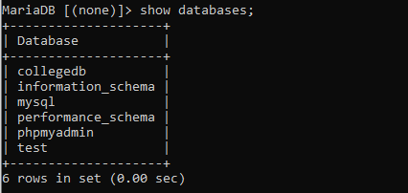
To Create database : The new database can be created by using the following SQL query. > create database <database-name>
Example: createdb.py
import MySQLdb
#Create the connection object
myconn = MySQLdb.connect("localhost","root","root")
#creating the cursor object
cur = myconn.cursor()
#executing the query
cur.execute("create database Collegedb")
print("Database created successfully")
#close the connection
myconn.close()
Output:
>>>python createdb.py
Database created successfully

Slide 252
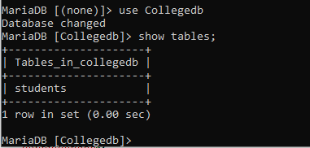
To Create table : The new table can be created by using the following SQL query. > create table <table-name> (column-name1 datatype, column-name2 datatype,…)
Example: createtable.py
import MySQLdb
#Create the connection object
myconn = MySQLdb.connect("localhost","root","root",”Colleged”)
#creating the cursor object
cur = myconn.cursor()
#executing the query
cur.execute("create table students(sid varchar(20)primary key,sname varchar(25),age int(10))")
print("Table created successfully")
#close the connection
myconn.close()
Output:
>>>python createtable.py
Table created successfully

Slide 253
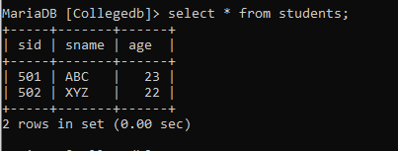
To Insert data into table : The data can be inserted into table by using the following SQL query. > insert into <table-name> values (value1, value2,…)
Example: insertdata.py
import MySQLdb
#Create the connection object
myconn = MySQLdb.connect("localhost","root","root",”Colleged”)
#creating the cursor object
cur = myconn.cursor()
#executing the query
cur.execute("INSERT INTO students VALUES ('501', 'ABC', 23)")
cur.execute("INSERT INTO students VALUES ('502', 'XYZ', 22)")
#commit the transaction
myconn.commit()
print("Data inserted successfully")
#close the connection
myconn.close()
Output:
>>>python insertdata.py
Data inserted successfully

Slide 254
To Read/Select data from table :: The data can be read/select data from table by using the following SQL query. >select column-names from <table-name>
fetchall() method returns all rows in the table.
fetchone() method returns one row from table.
Example: selectdata.py
import MySQLdb
#Create the connection object
myconn = MySQLdb.connect("localhost","root","root",”Colleged”)
#creating the cursor object
cur = myconn.cursor()
#executing the query
cur.execute("select * from students")
#fetching all the rows from the cursor object
result = cur.fetchall()
print("Student Details are :")
#printing the result
for x in result:
print(x);
#close the connection
myconn.close()
Output:
>>>python selectdata.py
Student Details are:
('501', 'ABC', 23)
('502', 'XYZ', 22)

Slide 255
fetchall() method returns all rows in the table.
fetchone() method returns one row from table.
Example: selectone.py
import MySQLdb
#Create the connection object
myconn = MySQLdb.connect("localhost","root","root",”Colleged”)
#creating the cursor object
cur = myconn.cursor()
#executing the query
cur.execute("select * from students")
#fetching all the rows from the cursor object
result = cur.fetchone()
print("One student Details are :")
#printing the result
print(result)
#close the connection
myconn.close()
Output:
>>>python selectone.py
One student Details are:
('501', 'ABC', 23)

Slide 256
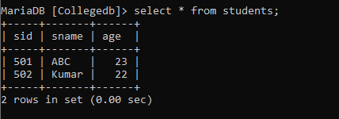
To Update data into table : The data can be updated in table by using the following SQL query. > update <table-name> set column-name=value where condition
Example: updatedata.py
import MySQLdb
#Create the connection object
myconn = MySQLdb.connect("localhost","root","root",”Colleged”)
#creating the cursor object
cur = myconn.cursor()
#executing the query
cur.execute("update students set sname='Kumar' where sid='502'")
#commit the transaction
myconn.commit()
print("Data updated successfully")
#close the connection
myconn.close()
Output:
>>>python updatedata.py
Data updated successfully

Slide 257
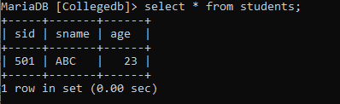
To Delete data from table : The data can be deleted from table by using the following SQL query. > delete from <table-name> where condition
Example: deletedata.py
import MySQLdb
#Create the connection object
myconn = MySQLdb.connect("localhost","root","root",”Colleged”)
#creating the cursor object
cur = myconn.cursor()
#executing the query
cur.execute("delete from students where sid='502'")
#commit the transaction
myconn.commit()
print("Data deleted successfully")
#close the connection
myconn.close()
Output:
>>>python deletedata.py
Data deleted successfully

Slide 258
DB-API for MySQL in Python
MySQLdb (python2.x)
Mysql.connector(python3.x)
#Import MySQLdb
import MySQLdb
#Create the connection object
myconn =MySQLdb.connect
("localhost","root","root",”Colleged”)
#Import mysql.connector
import mysql.connector
#Create the connection object
myconn=mysql.connector.connect
(host="localhost",user="root",
passwd="root",database="Colleged")

Slide 259
mysql.connector(in python3.x):: MySQL Connector enables Python programs to access MySQL databases.
Example: deletedata.py
import mysql.connector
#Create the connection object
myconn=mysql.connector.connect(host="localhost",user="root",passwd="root",
database="Collegedb")
#creating the cursor object
cur = myconn.cursor()
#executing the querys
cur.execute("delete from students where sid='502'")
#commit the transaction
myconn.commit()
print("Data deleted successfully")
#close the connection
myconn.close()
Output:
>>>python deletedata.py
Data deleted successfully

Slide 260
Week: 17 Web Scraping and Data Visualization

Slide 261


Slide 262
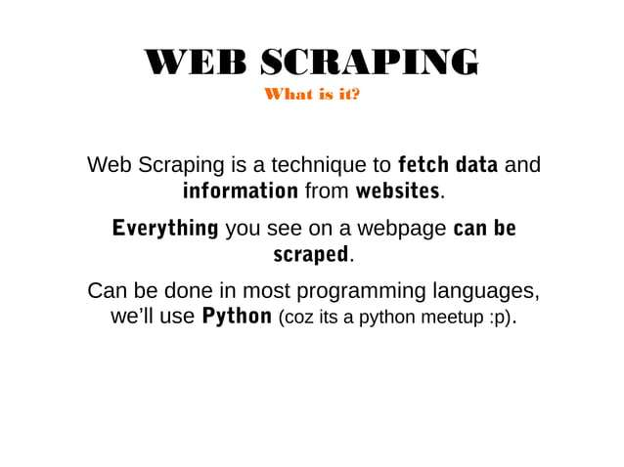

Slide 263
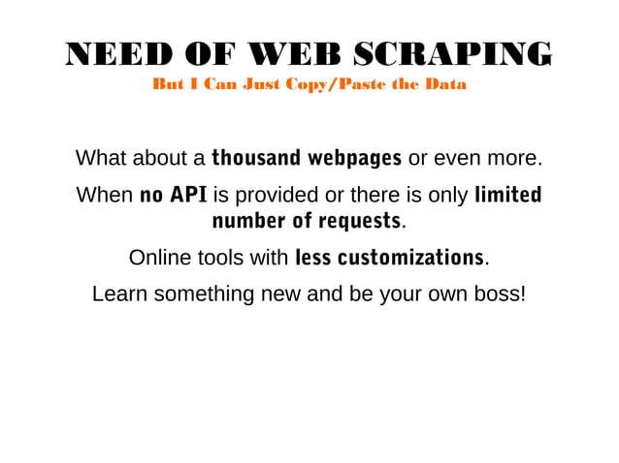

Slide 264


Slide 265
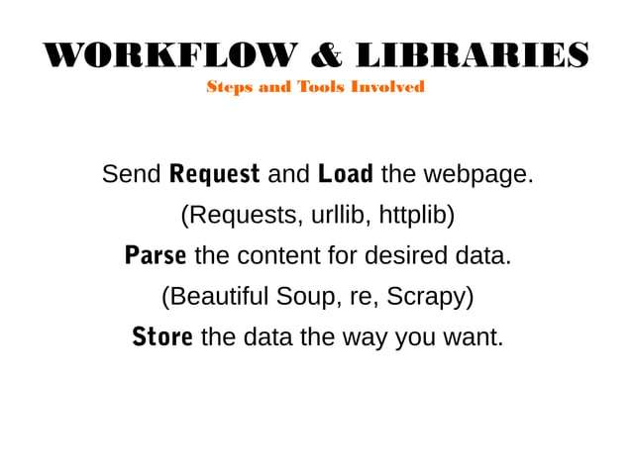

Slide 266


Slide 267
