Slide 1
Router
A Networking Device
Md. Tariqul Islam
Lecturer
Department of Computer Science and Engineering
University of Global Village, (UGV), Barisal.

Slide 2
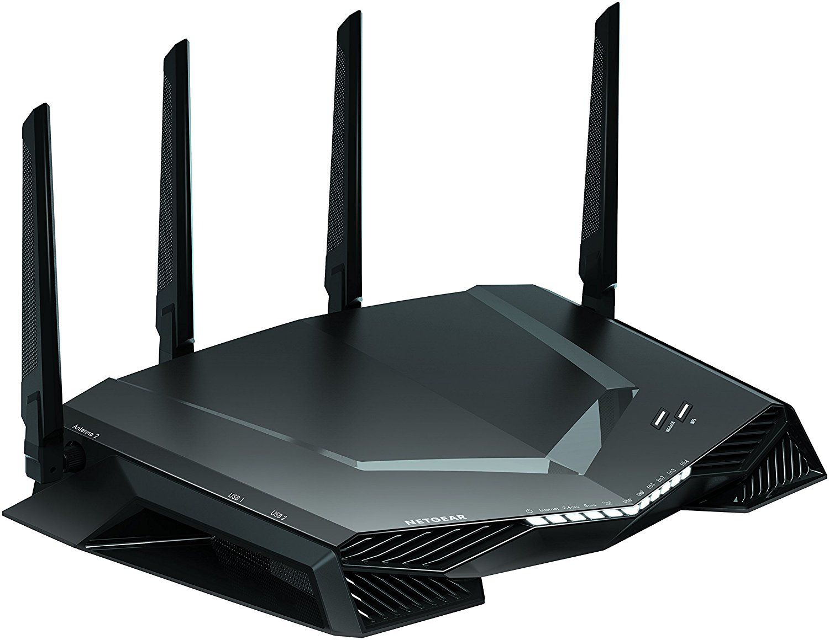
What is a router?
A router is a device that communicates between the internet and the devices in your home that connect to the internet. As the name implies, a router “routes” internet traffic between connected devices and the internet.

Slide 3
What is a router?
A router is a computer and networking device that forwards data packets between computer networks, including internetworks such as the global Internet.
It serves two primary functions:
  managing traffic between these networks by forwarding data packets to their intended IP addresses, and
  allowing multiple devices to use the same Internet connection.

Slide 4
Features of Router
A router works on the 3rd layer (Network Layer) of the OSI model, and it is able to communicate with its adjacent devices with the help of IP addresses and subnet.
A router provides high-speed internet connectivity with the different types of ports like gigabit, fast-Ethernet, and STM link port.
It allows the users to configure the port as per their requirements in the network.
Routers' main components are central processing unit (CPU), flash memory, RAM, Non-Volatile RAM, console, network, and interface card.
Routers are capable of routing the traffic in a large networking system by considering the sub-network as an intact network.
Routers filter out the unwanted interference, as well as carry out the data encapsulation and decapsulation process.
Routers provide the redundancy as it always works in master and slave mode.
It allows the users to connect several LAN and WAN.
Furthermore, a router creates various paths to forward the data.

Slide 5
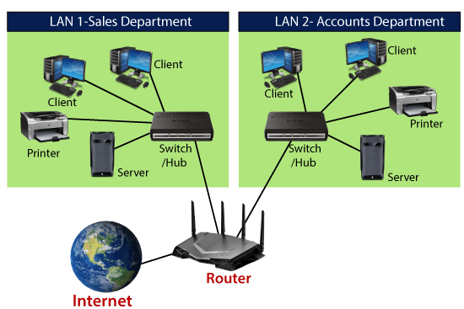
Features of Router

Slide 6
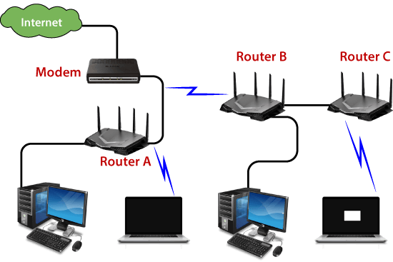
Features of Router

Slide 7
Types of Routers
There are several types of routers, but most routers pass data between LANs (local area networks) and WANs (wide area networks).
Routers come in various types to suit different networking needs.
Routers come in various types, each designed to cater to specific networking needs and requirements.
Let's explore the different types of routers with details under each category:

Slide 8
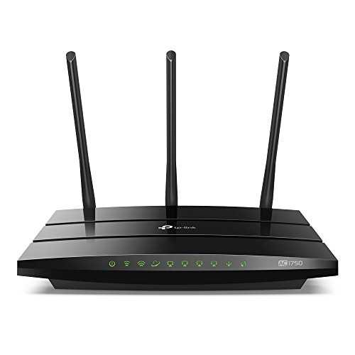
Types of Routers (Cont..)
Home Routers:
Designed for residential settings and small offices.
Provides basic functionalities to connect multiple devices to the internet through a single internet connection.
Often equipped with built-in wireless access points for Wi-Fi connectivity to devices within the home network.
Easy-to-use web-based interfaces for configuration and management.

Slide 9
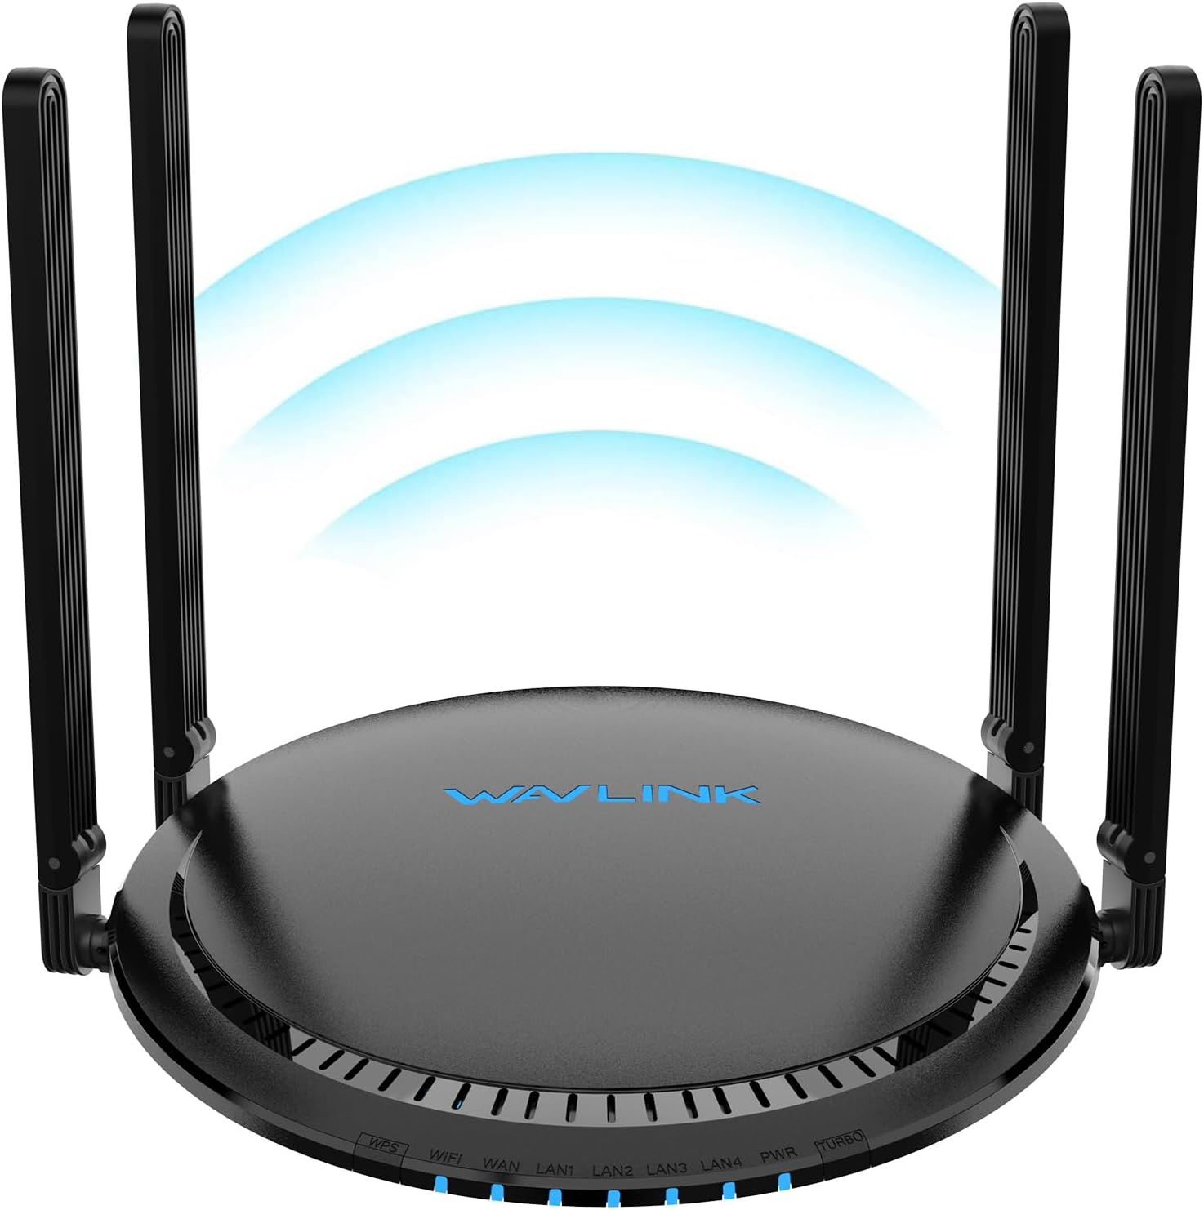
Types of Routers (Cont..)
Wireless Routers:
Also known as Wi-Fi routers.
Equipped with built-in wireless access points to enable devices to connect wirelessly to the network. Widely used in both home and small business environments.
Provides wireless connectivity and supports multiple devices simultaneously.

Slide 10
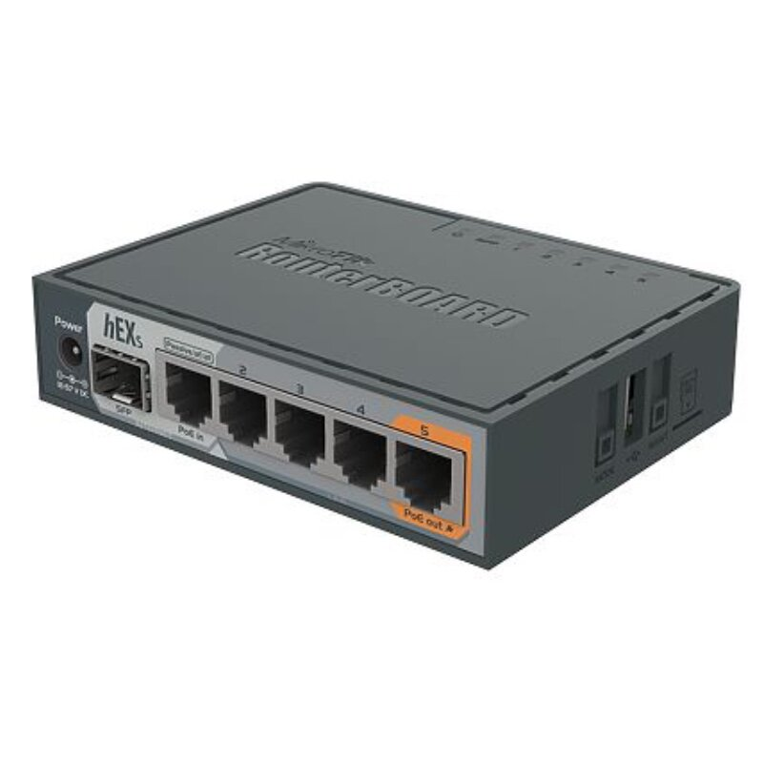
Types of Routers (Cont..)
Wired Routers:
Provides network connectivity through physical wired connections.
Equipped with Ethernet ports to connect devices via network cables.
Often used in environments where a stable and high-speed connection is required, such as in offices, data centers, and enterprise networks.

Slide 11
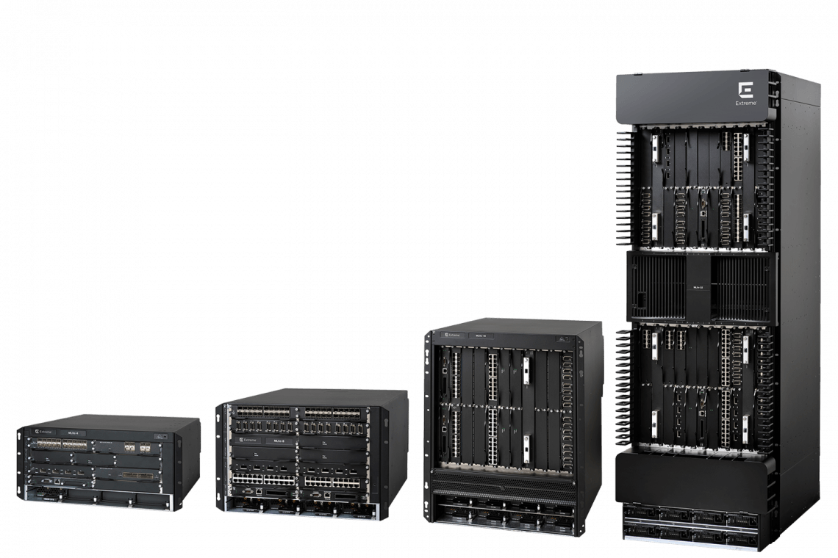
Types of Routers (Cont..)
Core/Edge Routers
Also known as boundary routers.
Used at the edge of a network where the network connects to external networks, such as the internet or another organization's network.
Responsible for routing data between the local network and external networks, implementing security measures, and managing traffic entering or leaving the network.

Slide 12
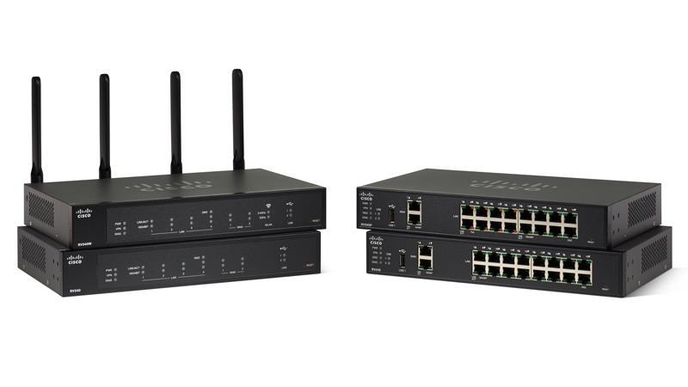
Types of Routers (Cont..)
Distribution Routers:
Found in large enterprise networks. Connects multiple local networks or segments.
Responsible for routing traffic between different LANs, ensuring efficient data flow between different parts of the network.
Performs tasks like VLAN segmentation and quality of service (QoS) management.

Slide 13
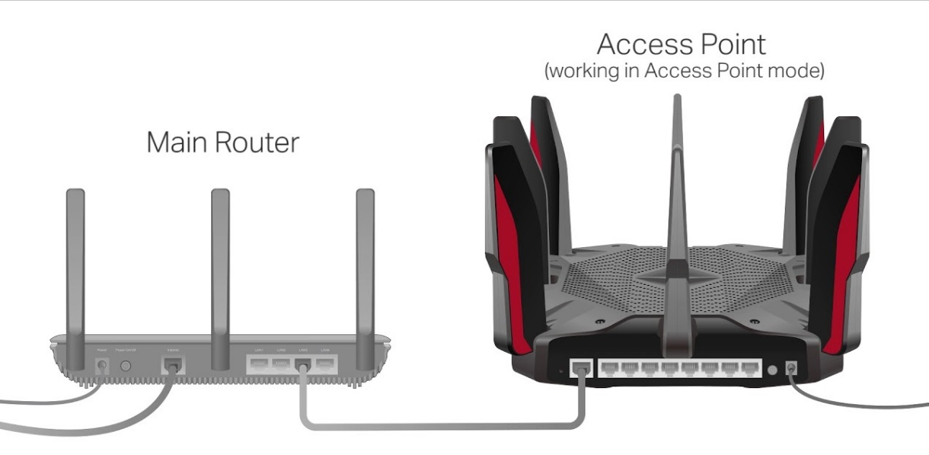
Types of Routers (Cont..)
Access Routers:
Used in environments like office buildings and campuses.
Provides connectivity to end-user devices within a local area network.
Serves as a gateway between the end-user devices and the core or distribution routers in the network.

Slide 14
Types of Routers (Cont..)
Virtual Routers:
Software-based routers that run on virtual machines or cloud platforms.
Offers the same functionalities as physical routers but are more flexible and scalable.
Commonly used in virtualized environments, data centers, and cloud computing infrastructure.

Slide 15
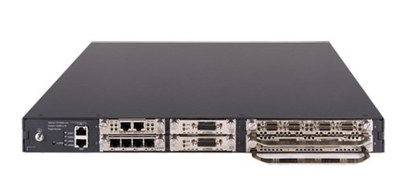
Types of Routers (Cont..)
Modular Routers:
Allows for the expansion of router capabilities through modular components or line cards.
Interchangeable interface cards for customization based on specific networking needs.
Often used in enterprise and data center environments.

Slide 16
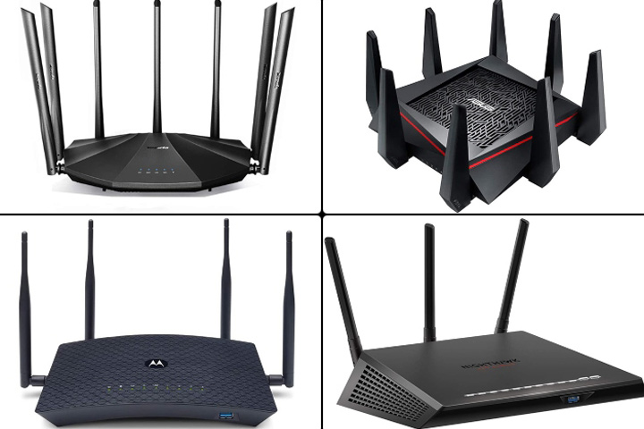
Types of Routers (Cont..)
SOHO Routers:
Designed for small business environments and home offices.
Offers a balance between features, price, and performance suitable for smaller networks.

Slide 17
Choosing the Best Wireless Router
Wi-Fi Standards Explained
The Institute of Electrical and Electronics Engineers (IEEE) is the body that sets Wi-Fi standards.
There’s a long list of different Wi-Fi protocols that support different ranges and speeds.
The “n” protocol is also known as Wi-Fi 4, “ac” is Wi-Fi 5, “ax” is marketed as Wi-Fi 6 or Wi-Fi 6E, and Wi-Fi 7 is “be.”
We recommend ax (Wi-Fi 6) as a minimum, and it will afford you some future-proofing even if you can’t take advantage right now.
Wi-Fi 6 and 6E aren't just about faster speeds; they also offer increased capacity, efficiency, performance, and security.

Slide 18
Choosing the Best Wireless Router (Cont..)
Wi-Fi Bands and Channels
Different Wi-Fi protocols support different frequencies or bands.
You'll mostly see routers that support 2.4 gigahertz (GHz) and 5 GHz.
When a router or device is dual-band, that means it supports both.
Tri-band routers broadcast three signals, which currently usually means two on the 5-GHz band and one on 2.4 GHz, though we are seeing more and more routers that include the 6-GHz band.
Wi-Fi 6 and earlier routers are limited to 2.4-GHz and 5-GHz bands; only Wi-Fi 6E routers offer the 6-GHz band today, but Wi-Fi 7 is fast approaching.

Slide 19
Choosing the Best Wireless Router (Cont..)
Wi-Fi Bands and Channels
Each of these bands is a chunk of frequency.
The 2.4-GHz band comprises 11 channels that are each 20 megahertz (MHz) wide.
The 5-GHz band has 45 channels, but they aren't limited to 20 MHz; they can also be bonded together to create 40-MHz or 80-MHz channels, which allows them to transmit more data.
The 6-GHz band supports 60 channels, and they can be as wide as 160 MHz.

Slide 20
WiFi Antennas Explained
WiFi antennas bolster the performance of wireless local area networks (WLANs).
They contribute to extending the WiFi range and ensuring a robust connection.
But behind this innovative device, there is the WiFi.

Slide 21
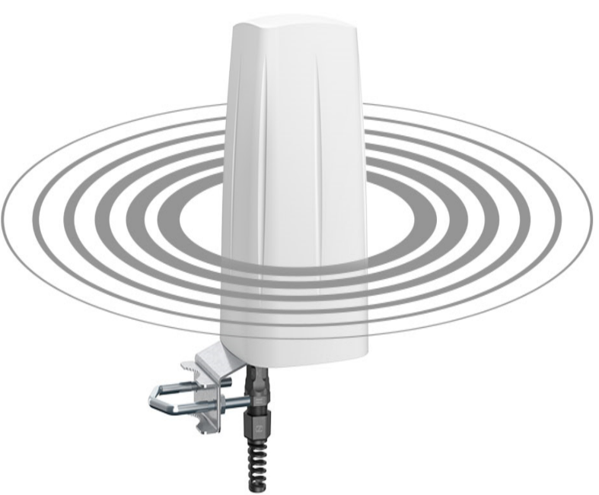
Types of WiFi Antennas
1. Omni-directional antenna
An omnidirectional antenna emits electromagnetic waves evenly in all directions. It forms a doughnut-shaped radiation pattern.
This type is commonly employed for indoor use, including WiFi routers and chipsets. By radiating signals in a 360-degree pattern, it provides widespread coverage. This makes it ideal for residential or small office environments.
You can find some of our Omni-directional Antennas here!

Slide 22
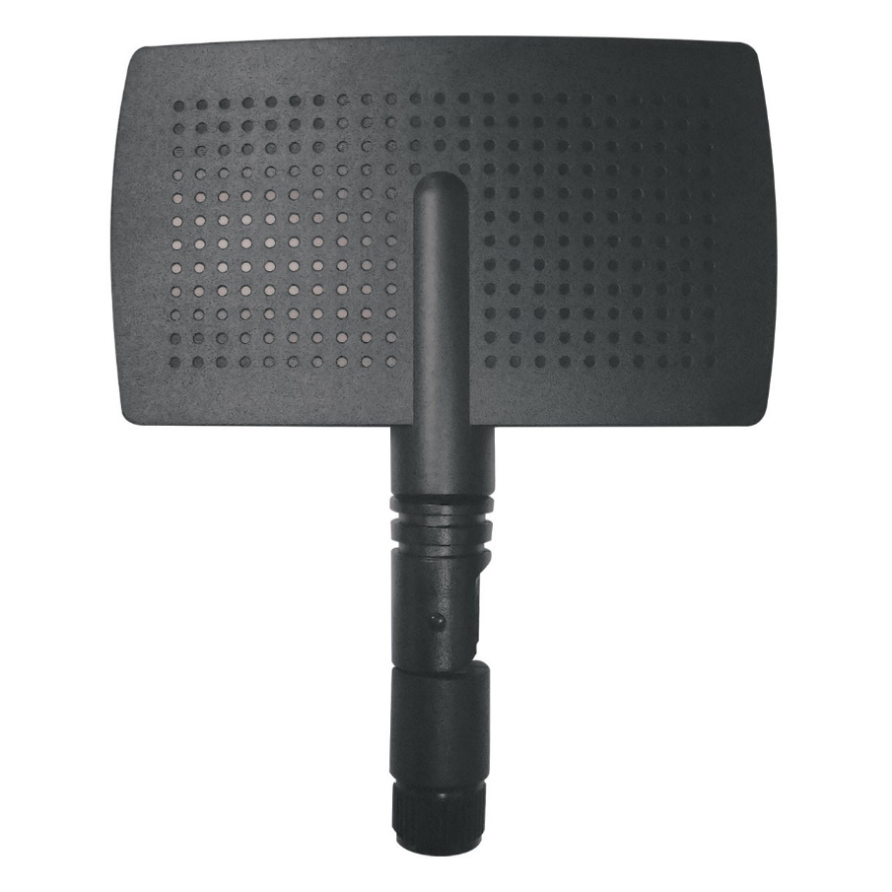
Types of WiFi Antennas
2. Semi-directional antenna
As the name suggests, semi-directional antennas transmit radio waves in a specific pattern. They offer a more focused approach compared to their omnidirectional counterpart. They are often used in a certain area or sector that requires enhanced signal strength.
This type strikes a balance between wider coverage and targeted signal distribution. All thanks to the controlled radiation pattern!

Slide 23
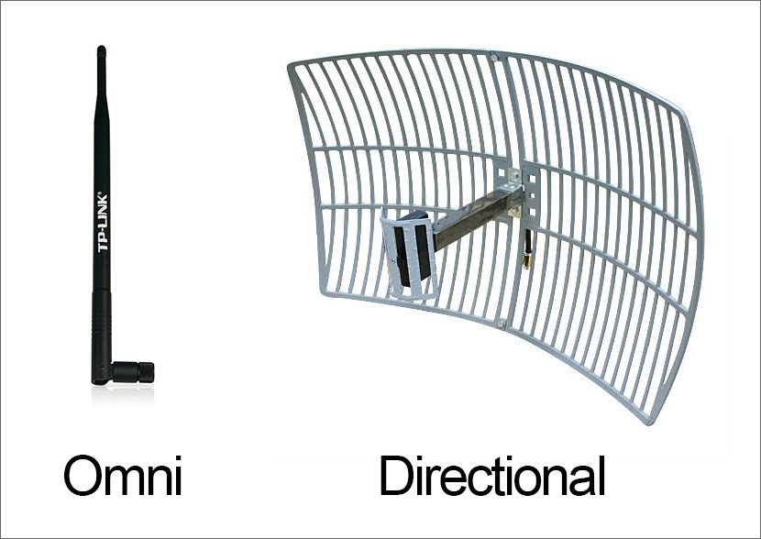
Types of WiFi Antennas
3. Directional antenna
Directional antennas are purpose-built to transmit energy in a specific direction. They allow for highly focused and precise signal transmission. These antennas find application in point-to-point communication scenarios. For instance, in situations where interference from unwanted noise needs to be minimised. Overall, this type offers exceptional gain and enables long-distance, high-speed data transfers.

Slide 24
Antenna, measured in dBi
Antennas come in various types, each designed to serve different purposes and environments.
The gain of an antenna, measured in dBi (decibels relative to isotropic), indicates how strongly the antenna can direct or receive signals.
Here’s a breakdown of common types of antennas categorized by their typical dBi ranges and their applications:

Slide 25
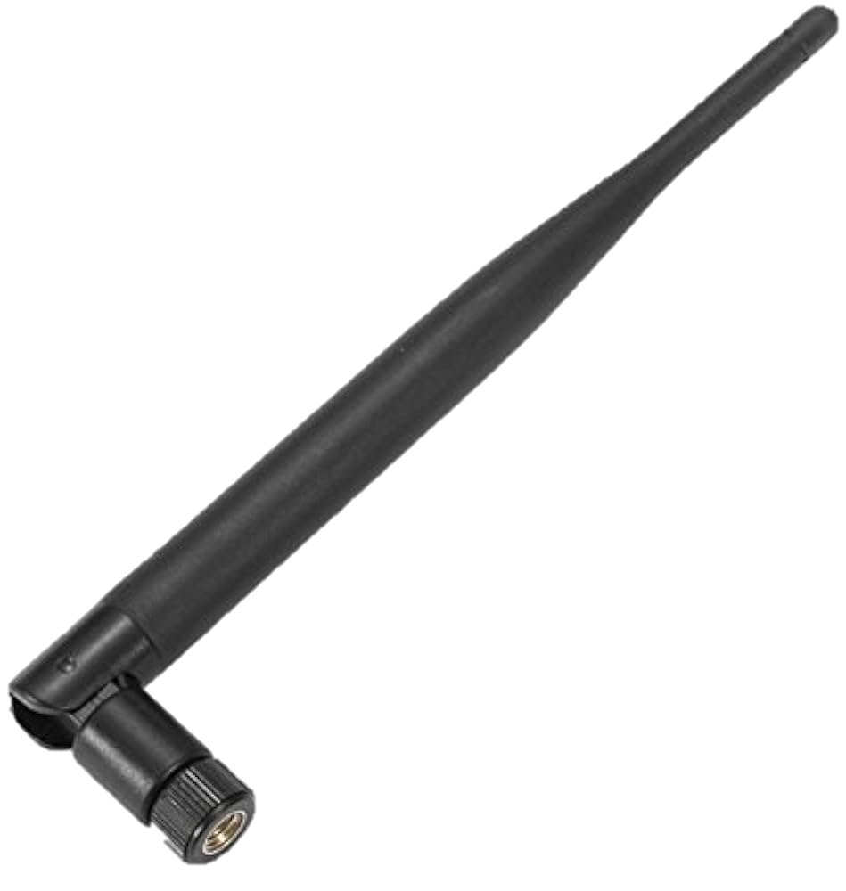
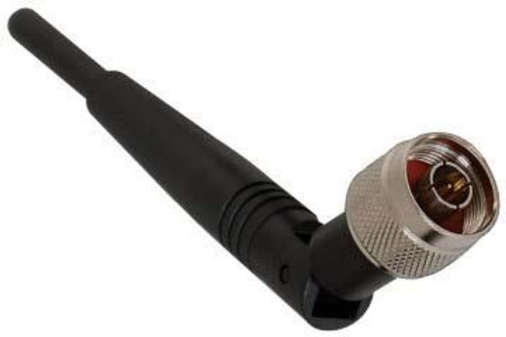
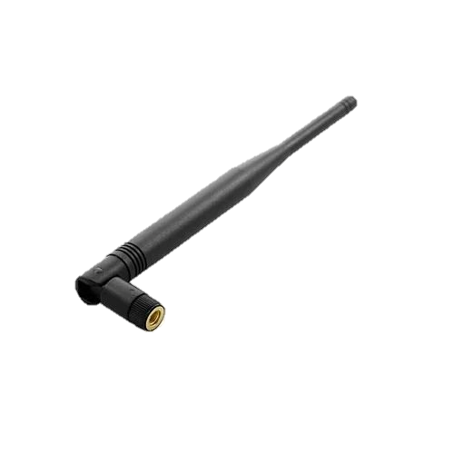
Low-Gain Antennas (0-6 dBi)
1. Dipole Antenna
  dBi Range: 2-3 dBi
  Characteristics: Simple, omnidirectional radiation pattern.
  Applications: Used in many consumer Wi-Fi routers, Bluetooth devices, and walkie-talkies.
2. Rubber Duck Antenna
  dBi Range: 2-5 dBi
  Characteristics: Flexible, omnidirectional, often used in portable devices.
  Applications: Commonly found on handheld radios and Wi-Fi routers.
3. Whip Antenna
  dBi Range: 2-6 dBi
  Characteristics: Typically omnidirectional with a long, flexible rod.
  Applications: Used in car antennas, handheld radios, and mobile devices.

Slide 26
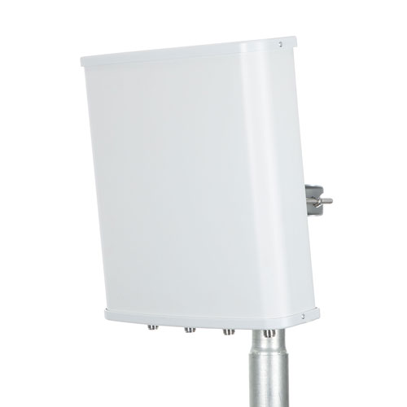
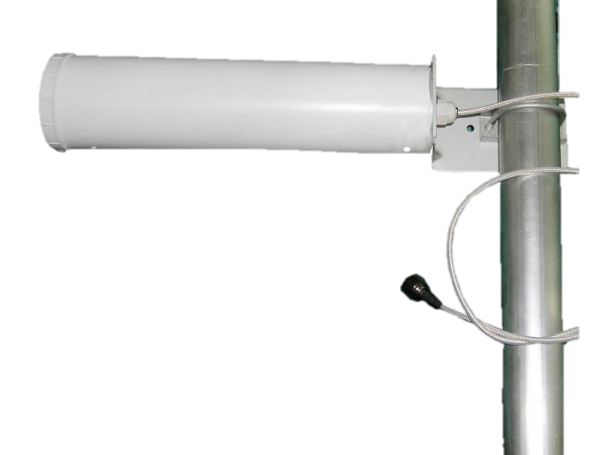
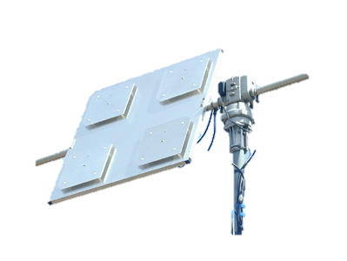
Medium-Gain Antennas (6-12 dBi)
4. Panel Antenna
  dBi Range: 6-12 dBi
  Characteristics: Directional, flat panel design, provides moderate gain.
  Applications: Used in building-to-building wireless links, point-to-multipoint networks.
5. Yagi Antenna
  dBi Range: 7-10 dBi
  Characteristics: Directional, with multiple elements arranged in a line.
  Applications: TV antennas, long-distance Wi-Fi, amateur radio.
6. Patch Antenna
  dBi Range: 6-9 dBi
  Characteristics: Directional, low-profile, usually square or rectangular.
  Applications: GPS, Wi-Fi, RFID systems.

Slide 27
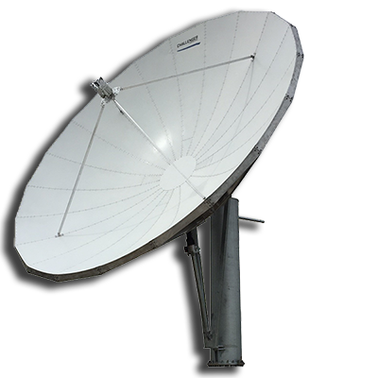
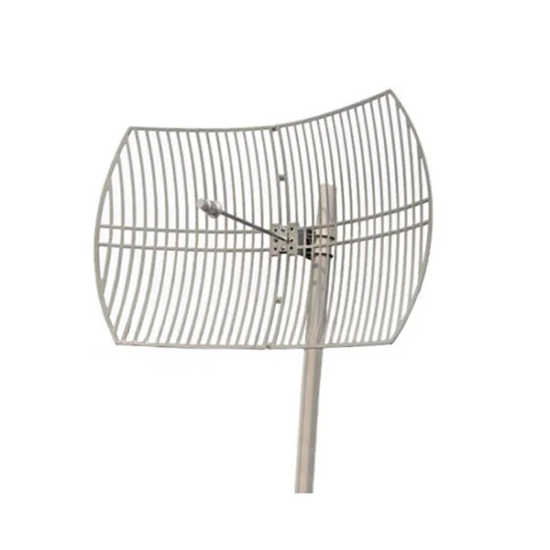
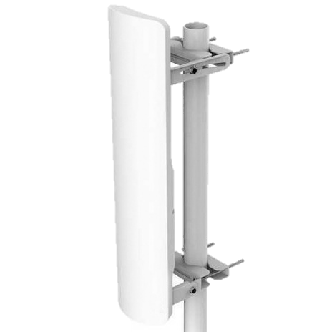
High-Gain Antennas (12-24+ dBi)
7. Parabolic Dish Antenna
  dBi Range: 20-30+ dBi
  Characteristics: Highly directional, dish-shaped reflector.
  Applications: Satellite communication, long-distance point-to-point links.
8. Grid Antenna
  dBi Range: 18-26 dBi
  Characteristics: Directional, grid structure reduces wind load.
  Applications: Long-distance Wi-Fi links, ISM band communication.
9. Sector Antenna
  dBi Range: 12-17 dBi
  Characteristics: Directional, covers a specific sector (e.g., 90°, 120°).
  Applications: Cellular base stations, Wi-Fi hotspots in large areas like stadiums.

Slide 28
Considerations for Choosing Antennas by dBi
Coverage Area:
  Low-Gain Antennas: Suitable for short-range, broad coverage.
  Medium-Gain Antennas: Balances range and coverage, good for moderate distances.
  High-Gain Antennas: Ideal for long-distance, focused communication.
Environment:
  Indoor: Low to medium-gain antennas are typically sufficient.
  Outdoor: High-gain antennas may be necessary for long-distance links or overcoming obstacles.
Interference and Obstacles:
  Higher gain antennas can provide stronger signals, but may be more susceptible to interference if not properly aligned.
Application Specific Needs:
  Mobile Devices: Typically use low-gain omnidirectional antennas.
  Fixed Point-to-Point Links: Benefit from high-gain directional antennas.

Slide 29
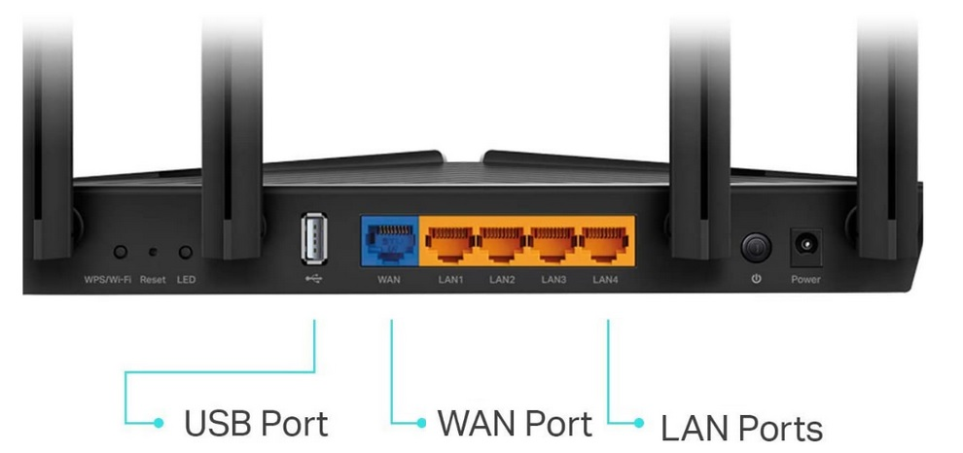
Common Types of Ports on a Router
WAN (Wide Area Network) Port
Purpose: Connects the router to the internet through a modem or an external network.
Common Type: Ethernet port (RJ-45).

Slide 30
Common Types of Ports on a Router
LAN (Local Area Network) Ports
Purpose: Connects local devices such as computers, printers, and other network devices.
Common Type: Ethernet ports (RJ-45), usually 4 or more.

Slide 31
Common Types of Ports on a Router
USB Ports
Purpose: Connects external storage devices, printers, or 3G/4G dongles for additional functionality.
Common Type: USB 2.0, USB 3.0, and sometimes USB-C.

Slide 32
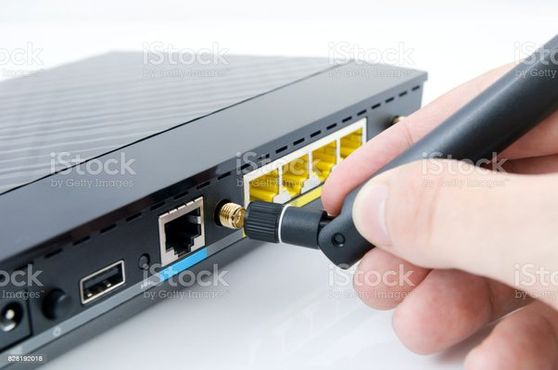
Common Types of Ports on a Router
Wi-Fi Antenna Ports
Purpose: Connects external antennas to the router to enhance wireless signal range and strength.
Common Type: SMA or RP-SMA connectors.

Slide 33
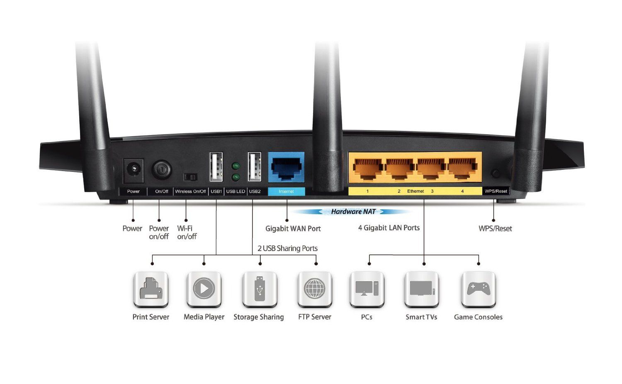
Common Types of Ports on a Router
Power Port
Purpose: Connects the router to a power source.
Common Type: DC power jack.

Slide 34
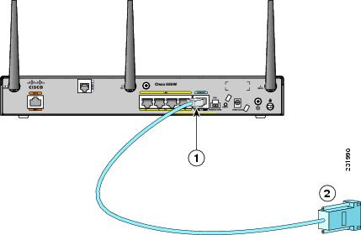
Common Types of Ports on a Router
Console Port
Purpose: Allows direct connection to the router for configuration and troubleshooting, often used by network administrators.
Common Type: RJ-45 or USB (micro-USB, USB-C).

Slide 35
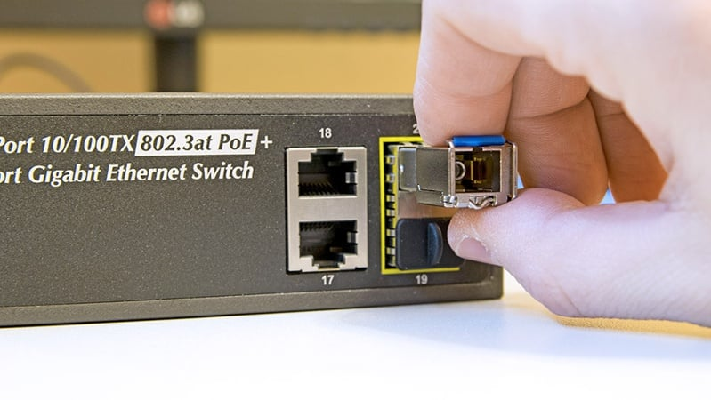
Common Types of Ports on a Router
SFP (Small Form-factor Pluggable) Port
Purpose: Used for high-speed fiber optic connections.
Common Type: SFP or SFP+ slots.

Slide 36
How to Configure a Home Router: Step by Step
Configuring a home router involves setting up the hardware and configuring the software settings to ensure secure and efficient network connectivity. Here’s a step-by-step guide to help you through the process:

Slide 37
Step 1: Unbox and Position Your Router
Unbox Your Router: Take the router out of its packaging and ensure you have all necessary components (router, power adapter, Ethernet cables, and user manual).
Position the Router: Place the router in a central location in your home to ensure the best wireless coverage. Avoid placing it near walls, metal objects, or electronic devices that can cause interference.

Slide 38
Step 2: Connect Your Router
Power On the Router: Plug in the router’s power adapter and turn it on.
Connect to the Modem: Use an Ethernet cable to connect the router’s WAN (or Internet) port to your modem’s LAN port.
Connect to a Computer: Connect your computer to one of the router’s LAN ports using another Ethernet cable. This is optional if you plan to set up the router using a wireless connection.

Slide 39
Step 3: Access the Router’s Configuration Page
Find the Default IP Address: Check the router’s manual for the default IP address (usually something like 192.168.1.1 or 192.168.0.1). This information is often found on a label on the router itself.
Open a Web Browser: On your connected computer, open a web browser and enter the router’s IP address in the address bar. Press Enter.
Log In: You’ll be prompted to enter a username and password. The default credentials are usually provided in the router’s manual or on a sticker on the router. Common defaults are: admin/admin or admin/password.

Slide 40
Step 4: Configure Internet Settings
Internet Connection Type: Follow the setup wizard or navigate to the Internet settings section. Select the appropriate connection type (e.g., DHCP, PPPoE, Static IP) as provided by your Internet Service Provider (ISP).
Enter ISP Information: If required, enter your ISP-provided username, password, and other necessary information.

Slide 41
Step 5: Configure Wireless Settings
Wireless Network Name (SSID): Go to the wireless settings section and set a unique name for your Wi-Fi network.
Security Mode: Select a security mode, preferably WPA2 or WPA3 for better security.
Password: Set a strong password for your Wi-Fi network to prevent unauthorized access.
Save Settings: Save your wireless settings.

Slide 42
Step 6: Configure Additional Settings (Optional)
Network Name (SSID): Change the default network name to something unique.
Password: Change the default password to a strong, unique one.
Guest Network: If you want to create a separate network for guests, configure the guest network settings.
Parental Controls: Set up parental controls if you need to restrict access to certain websites or limit internet usage times.
Firewall and Security Settings: Ensure that the router’s firewall is enabled and configure any additional security settings.

Slide 43
Step 7: Save and Reboot
Save Settings: Make sure to save all the changes you’ve made.
Reboot the Router: Some routers may require a reboot for the settings to take effect. Follow the prompts to reboot if necessary.

Slide 44
How To Change Your WiFi Channel on a Router
What Is a WiFi Channel?
WiFi routers use radio waves to transmit data to all your connected devices. These radio waves are divided into different “WiFi spectrum bands,” which are further divided into “WiFi channels.” Basically, a WiFi channel represents the frequency your router uses to transmit data.
If you think of WiFi bands like highways, then WiFi channels would be like lanes on those highways. In order to achieve the best internet speeds, you want to connect to the fastest WiFi band and the least-crowded WiFi channel.

Slide 45
How To Change Your WiFi Channel on a Router
Before you change your WiFi channel, you should make sure you’re connected to the best WiFi band.
There are currently three different WiFi bands available to choose from:
2.4 GHz = Slowest speeds, longest range
5 GHz = Faster speeds, lower range
6 GHz = Fastest speeds, shortest range

Slide 46
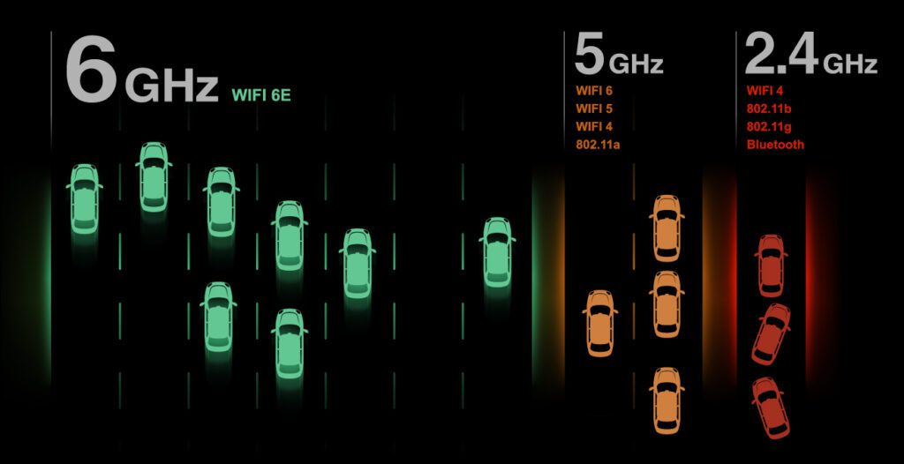
How To Change Your WiFi Channel on a Router

Slide 47
How To Change Your WiFi Channel on a Router
If you have a dual-band or tri-band router, you might be able to change your WiFi band simply by switching to a different WiFi network.
Usually, you can just look for networks with names that end in “5G,” 6G,” or “6E” to get the fastest speeds.
On the other hand, networks that end in “2G” are typically the slowest.

Slide 48
How To Change Your WiFi Channel on a Router
Important of WiFi Channel?
How to Configure?

Slide 49
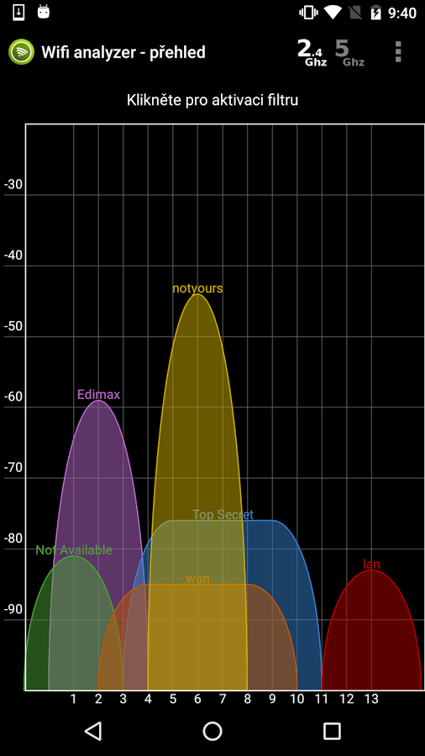
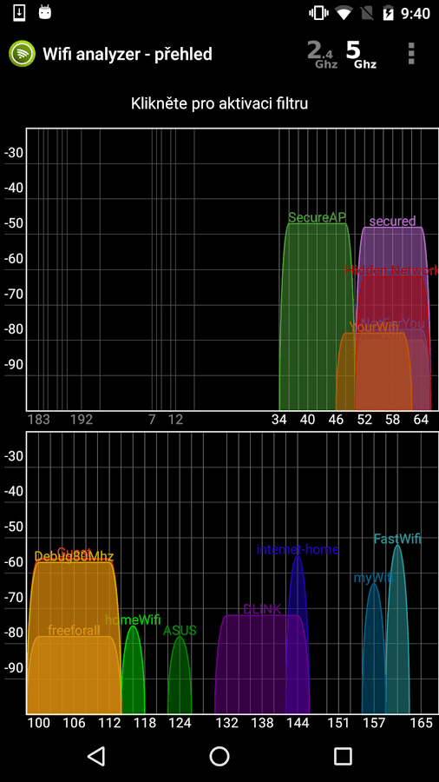
Wifi Analyzer
Wifi Analyzer will provide useful information about wireless signals around you.

Slide 50
Remote Management System (RMS)
Remote management means any type of administration or controlling the settings of the router that doesn't take place from within the place your router is e.g at home.
Your router provides a network, so anyone controlling the router from a different network is doing remote management.
Typically its seen as a bad security practice - all management of the router should be done on the network unless there's a clear business case for it, or if at home, shouldn't really be done at all.
If you can, switch it off. If you know its being used without your permission then change the password.

Slide 51
Remote Management System (RMS)
Important of RMS?
How to Configure?

Slide 52
Steps to Configure RMS on a Router:
Log into the Router’s Web Interface:
  Open a web browser and enter the router’s IP address (commonly 192.168.0.1 or 192.168.1.1).
  Enter the username and password to log in. The default credentials can often be found on the router or in the manual.
Locate the Remote Management Settings:
  Navigate to the section of the router’s web interface that pertains to remote management. This is typically found under settings like "Advanced," "Administration," "Management," or "Remote Management."
Enable Remote Management:
  Find the option to enable remote management and toggle it on.
  Specify the IP address range or specific IP addresses that are allowed to remotely manage the router. This enhances security by limiting access.
Set the Remote Management Port:
  Choose a port number for remote management. The default port is often 8080, but it’s recommended to change it to a less common port number for security reasons.

Slide 53
Steps to Configure RMS on a Router:
Set Access Permissions:
  Configure any additional access permissions or restrictions based on your requirements. This can include specifying which types of management activities are allowed remotely.
Save and Apply the Settings:
  Save the changes and apply the new settings. The router may need to reboot for the changes to take effect.
Test Remote Access:
  From a remote location, open a web browser and enter the router’s WAN IP address followed by the port number (e.g., http://<WAN_IP>:<PORT>).
  Log in with the router’s admin credentials to ensure that remote management is working correctly.

Slide 54
What is Firmware?
Firmware is a software that is embedded into a hardware device. Firmware controls how your device behaves.

Slide 55
What is router firmware?
Router firmware is computer software, often stored in a writable memory chip on the router, which helps the router control traffic. It contains instructions that tell the router how to function properly and securely as well as determine who should be allowed access to what type of data from your network. It also includes system settings, such as a password protection for administrator access and an encryption algorithm used for safe communication between devices. In short, it’s like an operating system for routers that allows them to better manage and protect your internet activities.

Slide 56
What are the benefits of using the latest version of router firmware?
Having the latest version of your router firmware can offer several advantages for both home and business networks. Some of the most common benefits include:
Increased security, as new versions may contain patches for known security vulnerabilities;
Improved performance, with increased speeds and better compatibility with connected devices;
Smart home/Internet of Things (IoT) support, allowing you to access and control compatible devices from anywhere in the world.
As a result, it is always recommended that you have the latest firmware installed on your router.

Slide 57
How To Update Router Firmware?
Identify Your Router Model and Firmware Version:
  Find your router model number and current firmware version. This information is usually available on a label on the router or in the router’s settings.
Download the Latest Firmware:
  Visit the manufacturer’s official website and navigate to the support or downloads section.
  Search for your router model and download the latest firmware version.
Back Up Your Router Configuration (Optional but recommended):
  Log into your router’s web interface (usually by entering the router’s IP address into a web browser).
  Navigate to the settings and find the option to back up your current configuration. Save this file to your computer.
Connect Your Computer to the Router:
  Use a wired (Ethernet) connection to avoid interruptions during the update process. Wireless updates can fail if the connection drops.
Access the Router’s Web Interface:
  Open a web browser and enter the router’s IP address (commonly 192.168.0.1 or 192.168.1.1).
  Log in using your username and password. If you haven't changed them, the default credentials can often be found in the router's manual or on a sticker on the router itself.

Slide 58
How To Update Router Firmware?
Upload the Firmware File:
  Navigate to the firmware upgrade section in the router’s web interface (often found under Administration, System, or Maintenance settings).
  Click the option to upload the new firmware and select the file you downloaded earlier.
Start the Firmware Upgrade:
  Confirm that you want to start the firmware upgrade.
  Wait for the process to complete. Do not turn off the router or disconnect it during the upgrade.
Reboot the Router:
  After the firmware update is complete, the router may automatically reboot. If not, manually reboot the router.
Restore Configuration (if needed):
  If you backed up your configuration earlier, you can restore it from the backup file.
  Navigate to the restore configuration section in the web interface and upload the backup file.
Verify the Update:
  Check the firmware version in the router’s web interface to ensure it has been updated to the latest version.
  Test your internet connection and router functionalities to make sure everything is working correctly.

Slide 59
Router log or System log
Definition: Router logs are records of events and activities that occur within a router.
These logs can include information about network traffic, connection attempts, system errors, configuration changes, and other events related to the router's operation.

Slide 60
Router log or System log
Types of Information:
  Traffic logs (incoming and outgoing)
  Connection attempts (successful and failed)
  Configuration changes
  System errors and warnings
  Security events (e.g., login attempts, firewall actions)

Slide 61
Importance of Router Logs and System Logs:
Router Logs:
Security: Router logs help in identifying and mitigating security threats such as unauthorized access attempts, network intrusions, and malware activities. They can be used to monitor firewall activity and detect suspicious traffic patterns.
Troubleshooting: Logs provide detailed information that can help diagnose and resolve network issues, connectivity problems, and hardware failures.
Performance Monitoring: By analyzing router logs, administrators can monitor network performance, bandwidth usage, and identify potential bottlenecks.
Compliance: For organizations that need to comply with regulatory standards, maintaining and analyzing router logs is crucial for auditing purposes.

Slide 62
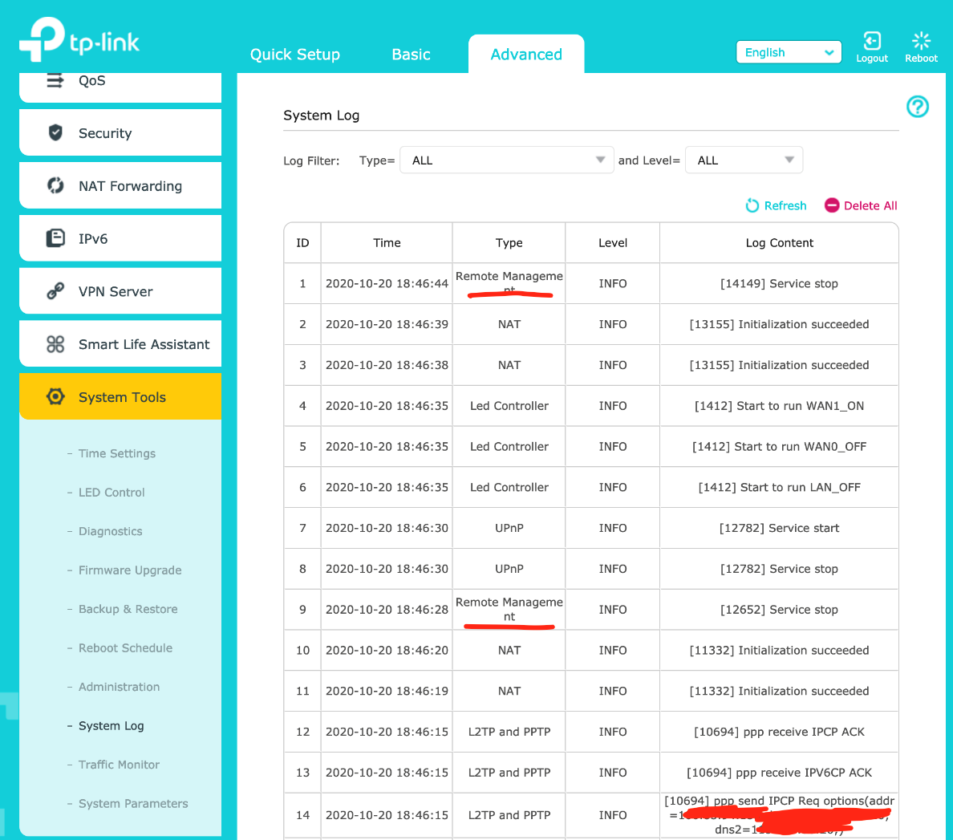
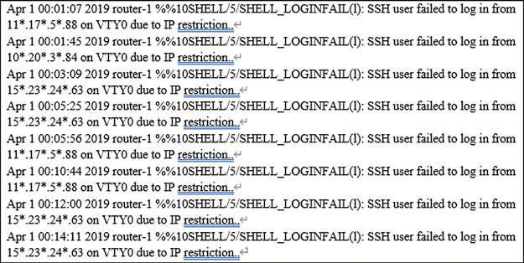
Graphical Sample of Router Logs or System Logs

Slide 63
MAC Address Colon Settings
Changing the MAC address of your router through MAC cloning involves configuring your router to use a different MAC address than its default or current one. This can be useful in certain situations, but it's important to understand the advantages, disadvantages, and steps involved:

Slide 64
MAC Address Colon Settings
Advantages of MAC Cloning:
Anonymity: Changing your router's MAC address can provide a level of anonymity on networks where MAC addresses are logged or tracked.
Troubleshooting: If your ISP or network provider has restrictions based on MAC addresses, cloning another device's MAC address can help bypass these restrictions.
Network Testing: Useful for testing purposes in network environments where MAC addresses play a role in access control.

Slide 65
MAC Address Colon Settings
Disadvantages of MAC Cloning:
Complexity: It can be technically challenging to find and enter a valid MAC address to clone, especially if not familiar with networking concepts.
Legal Considerations: In some jurisdictions, changing MAC addresses may be restricted or illegal due to potential misuse or security concerns.
Network Stability: Incorrectly cloning a MAC address or using one that's already in use on the network can cause connectivity issues and conflicts.

Slide 66
Steps to Change MAC Address via Cloning:
Access Router Settings:
  Log into your router’s web interface using its IP address (e.g., 192.168.1.1) and administrator credentials.
Locate MAC Address Settings:
  Look for a section labeled "MAC Address", "MAC Cloning", "Clone MAC Address", or similar in your router’s settings menu. This setting is typically found in the WAN (Wide Area Network) or Internet settings section.
Find MAC Address to Clone:
  Identify the MAC address you want to clone. This can be from a different device or network interface card (NIC).
Clone the MAC Address:
  Enter the MAC address you want to use (the one you want to clone) into the appropriate field in your router's settings.
Save Settings:
  After entering the new MAC address, save your changes by clicking "Save", "Apply", or "OK".
Restart Router (Optional):
  Some routers may require a restart for changes to take effect. Follow any prompts to restart your router after saving settings.

Slide 67
Step-by-Step Guide to Configure Two Routers
Connect to Router 2:
  Connect your computer to Router 2 using an Ethernet cable.
  Open a web browser and enter the router’s IP address (commonly 192.168.1.1 or 192.168.0.1) in the address bar.
  Log in using the router’s admin credentials.
Disable DHCP on Router 2:
  Go to the DHCP settings on Router 2 and disable the DHCP server. Router 1 will handle IP address assignments for the entire network.
Set Router 2’s IP Address:
  Assign Router 2 a static IP address within the same subnet as Router 1 but outside the range of Router 1's DHCP server (e.g., 192.168.1.2).
  Ensure that the IP address is not the same as Router 1 or any other device on the network.
Configure Wireless Settings:
  Set up the Wi-Fi network name (SSID) and password to match Router 1 exactly if you want to create a seamless network. Alternatively, use a different SSID for a separate network.
  Select a different channel from Router 1 to minimize interference (e.g., if Router 1 is on channel 1, set Router 2 to channel 6 or 11).
Connect Routers via Ethernet:
  Connect an Ethernet cable from one of the LAN ports on Router 1 to one of the LAN ports on Router 2 (use LAN-to-LAN connection). Do not use the WAN port on Router 2.
Save and Apply Changes:
  Save any changes made and log out from the router’s admin panel.

Slide 68
What is DHCP?
Definition:
DHCP (Dynamic Host Configuration Protocol) is a network management protocol used to automatically assign IP addresses and other network configuration parameters to devices on a network. It allows devices to communicate with each other over an IP network.
How DHCP Works:
Discovery: When a device (client) connects to a network, it sends a broadcast message (DHCPDISCOVER) to find available DHCP servers.
Offer: A DHCP server responds with a DHCPOFFER message, which includes an available IP address and other network configuration details.
Request: The client responds with a DHCPREQUEST message, indicating that it accepts the offered IP address.
Acknowledgment: The DHCP server sends a DHCPACK message to confirm the allocation, and the client can now use the assigned IP address.

Slide 69
How DHCP Works:
Discovery: When a device (client) connects to a network, it sends a broadcast message (DHCPDISCOVER) to find available DHCP servers.
Offer: A DHCP server responds with a DHCPOFFER message, which includes an available IP address and other network configuration details.
Request: The client responds with a DHCPREQUEST message, indicating that it accepts the offered IP address.
Acknowledgment: The DHCP server sends a DHCPACK message to confirm the allocation, and the client can now use the assigned IP address.

Slide 70
Why DHCP is Needed:
Simplifies Network Management: DHCP automates the process of assigning IP addresses, reducing the need for manual configuration. This is particularly useful in large networks with many devices.
Efficient IP Address Utilization: DHCP ensures efficient use of IP addresses by reassigning them from a pool of available addresses as devices join and leave the network.
Reduces Configuration Errors: Manual IP address assignment can lead to errors, such as duplicate IP addresses. DHCP minimizes such risks by managing IP assignments automatically.
Supports Mobility: In environments where devices frequently connect and disconnect (e.g., laptops, smartphones), DHCP provides the flexibility to dynamically assign IP addresses without manual intervention.
Centralized Control: DHCP allows network administrators to manage IP addresses and network configuration parameters centrally, making it easier to implement changes and updates.

Slide 71
Reasons to Enable DHCP:
Ease of Use: For most home and small office networks, enabling DHCP simplifies network setup and management. Devices can automatically obtain IP addresses and network settings.
Scalability: DHCP is essential for larger networks where manual IP address management would be impractical.
Dynamic IP Address Assignment: Enabling DHCP allows devices to join and leave the network without requiring manual reconfiguration, supporting dynamic network environments.
Automatic Configuration: DHCP can automatically provide not just IP addresses, but also other settings like DNS servers, default gateways, and subnet masks.

Slide 72
Reasons to Disable DHCP:
Security: In some cases, disabling DHCP can improve network security by preventing unauthorized devices from easily connecting to the network. Static IP addressing can help in more controlled environments.
Static IP Requirement: Certain network setups, like servers, printers, and other devices that need a consistent IP address, might require static IP configuration. In such cases, DHCP can be disabled or selectively used.
Network Stability: For networks with a very specific structure or where devices rarely change, static IP addresses can ensure stability and predictability.
Custom Configurations: Advanced network configurations might require specific settings that are better managed through static IP assignments rather than DHCP.

Slide 73
Assignment: 01 Marks: 05
Assignment Title: Home Router Configuration Comparison
Objective: To explore and compare the configuration options of home routers from different companies.
Instructions:
Router Selection:
  Choose Ten (10) different home router models from reputable companies. You may consider brands such as TP-Link, Linksys, Tenda, Netgear, ASUS, D-Link, Mercusys, Netis, Toto Link & Trendnet. (Any Model)
Online Research:
  Conduct online research to find the configuration settings for each of the following options:
  WAN Settings
  LAN Settings
  MAC Address Colon Settings
  Channel Settings
  Security Options Settings
  Remote Management Settings
  Logging and Monitoring Settings
  Firmware Settings
  Any other authentic or special setting

Slide 74
Assignment: 01 Marks: 05 (Cont...)
Screenshot Collection:
  Take screenshots of each configuration option for all ten routers. Ensure that the screenshots are clear and display the relevant information.
Analysis and Comparison:
  Provide a brief analysis and comparison of the configuration options across the different routers. Identify any unique features or differences among them.
Submission Guidelines:
  Create at least one-page summary for each router company. Include the company name, a brief overview of the router models researched, and key highlights of their configuration options with proper screenshot. Submit the soft copy of the assignment at: Submission Last Date: 16/07/2024
  Link: https://forms.gle/eNWJpxMGqPW2rY8D6
Note: Please be mindful of ethical considerations and respect the privacy policies of the router manufacturers while conducting your research and capturing screenshots.

