Slide 1
Optical Network Unit (ONU) Optical Network Terminal​ (ONT) OLT (Optical Line Termination )
Md. Tariqul Islam
Lecturer Department of Computer Science and Engineering
University of Global Village, (UGV), Barisal.

Slide 2
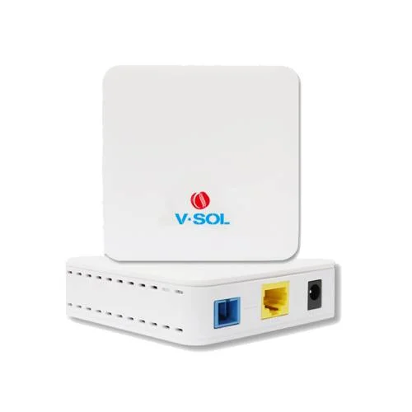
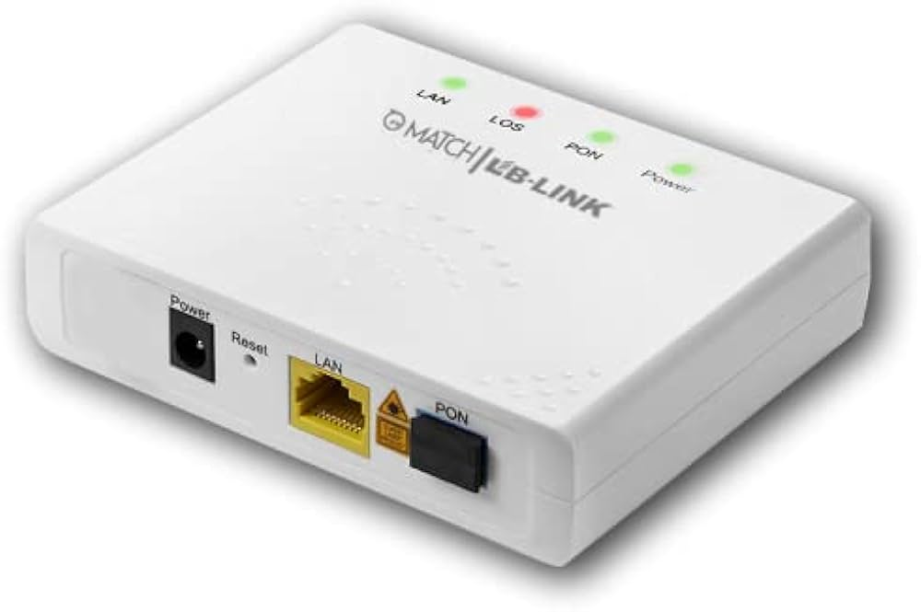
What is ONU?

Slide 3
What is ONU?
ONT stands for Optical Network Terminal. ONU stands for Optical Network Unit.
It is a device used in Fiber to the Home (FTTH) networks to connect end-users to the Passive Optical Network (PON).
It is a key component of the PON architecture and is typically installed at the customer premises.
The ONU converts optical signals transmitted over the fiber optic cable to electrical signals that can be used by the customer's equipment, such as a router or computer.
It also receives and sends data from the customer's equipment and transmits it back to the Optical Line Terminal (OLT) located at the service provider's central office.

Slide 4
Optical Network Terminal​ (ONT)
ONT is an interface between the Internet Service Provider (ISP) and the end user of fiber Internet.
It’s an integral part of the fiber optic internet system because it converts optical signals into information your computing devices can digest.
In other words, it works as a modem if you get your broadband Internet through Fiber to the Premises (FTTP).

Slide 5
OLT (Optical Line Termination )
The OLT also called Optical Line Terminal.
OLT is an endpoint of the passive optical network (PON).
OLT Main Function is converting electrical signal using by service provider equipment and Fiber optical signal used by the passive optical network (PON), its co-ordinate Multiplexing between end-user device ONU (Optical Network unit ) or ONT (Optical Network Terminals ).

Slide 6
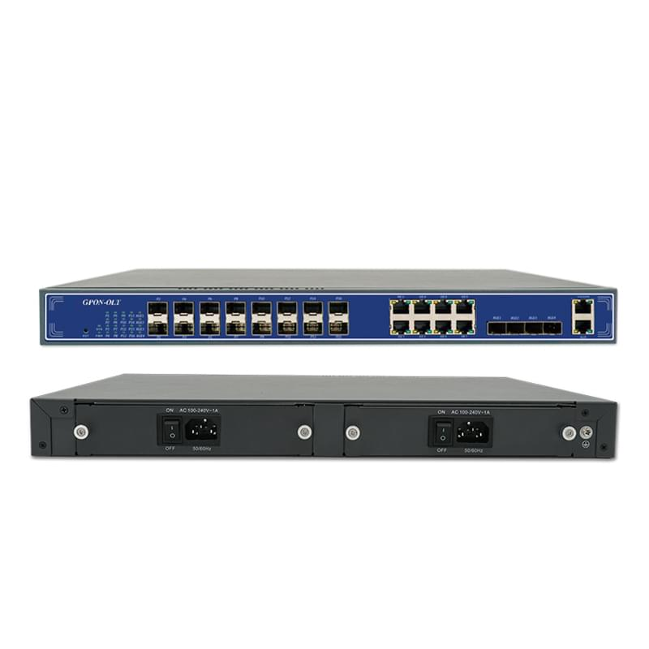
OLT (Optical Line Termination )

Slide 7
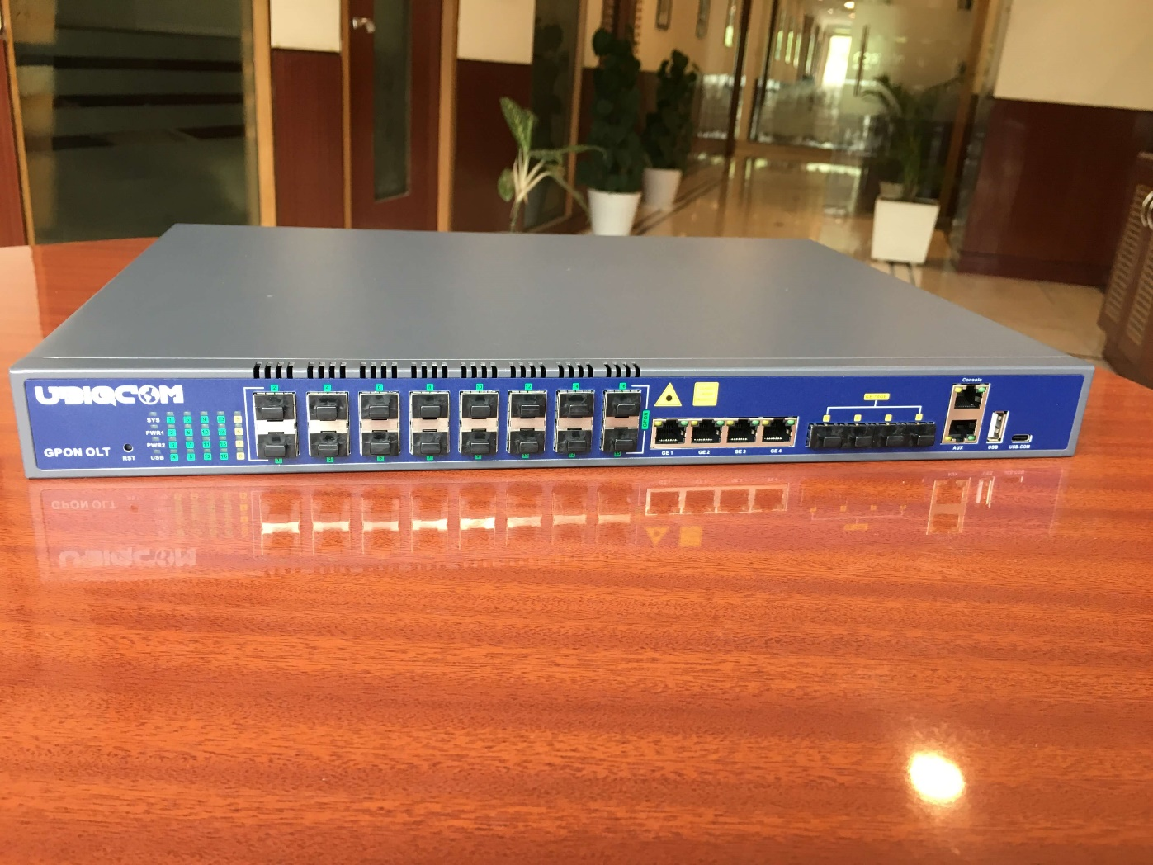
OLT (Optical Line Termination )

Slide 8
Classifications based on PON Standards
OLTs are categorized based on the PON standards they adhere to. The most common PON standards include:
- Gigabit Passive Optical Network (GPON): GPON is one of the most widely deployed PON technologies, offering high downstream and upstream bandwidth. GPON OLTs are designed to support various services, including broadband internet, voice, and video.
- Ethernet Passive Optical Network (EPON): EPON, also known as IEEE 802.3ah, leverages Ethernet technology for PONs. EPON OLTs provide high-speed data transmission and are commonly used for business and residential applications.

Slide 9
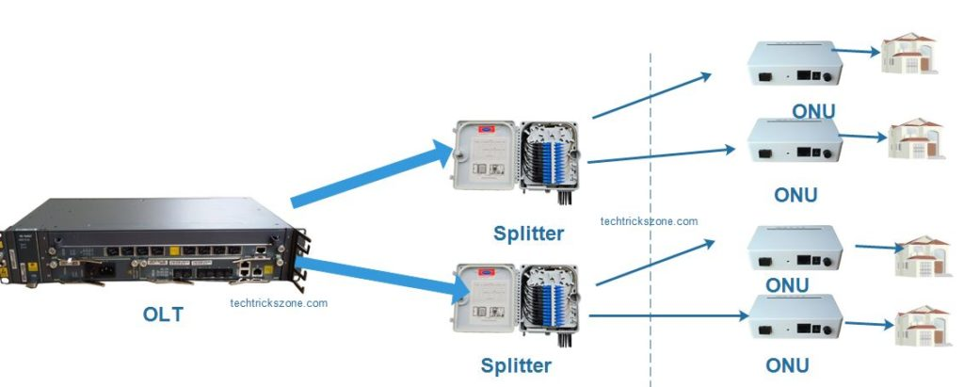
OLT to ONU

Slide 10
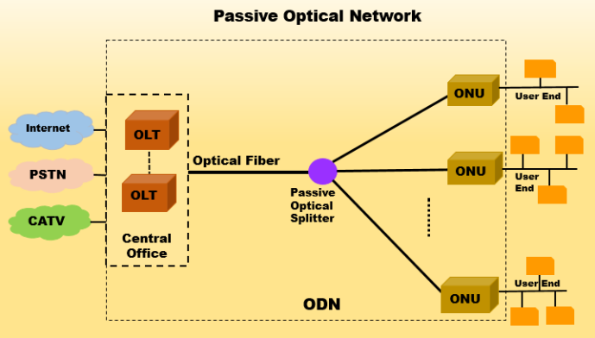
OLT to ONU

Slide 11
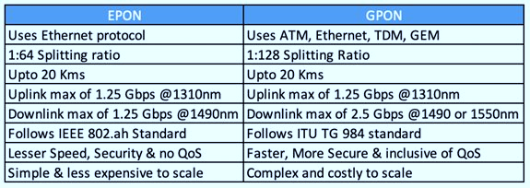
What's The Difference Between GPON And EPON?

Slide 12
Why ONU Is Quite Important in Network Architecture?
The ONU plays a critical role in modern network architecture for several reasons:
Efficient Data Transmission: Converting optical signals to electrical signals, the ONU ensures seamless data transmission over fiber optic cables. This boosts network efficiency, minimizes latency, and guarantees reliable connectivity.
Centralized Control: The ONU empowers service providers to centrally manage and control communication between optical fiber infrastructure and end-user devices. This facilitates efficient troubleshooting, provisioning, and monitoring of network performance.
Scalability: Serving as the termination point, the ONU enables network scalability. Service providers can connect multiple ONUs to a single optical line, expanding their capacity to serve a larger customer base while maintaining high-speed connections.
Cost-effectiveness: Leveraging PON network with ONUs reduces network deployment and maintenance costs for service providers. This cost-effectiveness allows the provision of affordable high-speed internet and other services to residential, commercial, and industrial users.

Slide 13
Features of ONU:
Select the broadcast data sent by the OLT.
Responding to range and power control commands from the OLT and making adjustments accordingly.
Caching and upstream transmission of the user's Ethernet data towards the OLT distribution window.
Offering data, IPTV, voice (using IAD), and other services for "triple-play" applications.
Featuring "Plug and Play" functionality based on automatic discovery and configuration.
Supporting the Dying Gasp function.
Highly sensitive light reception with low input light consumption.

Slide 14
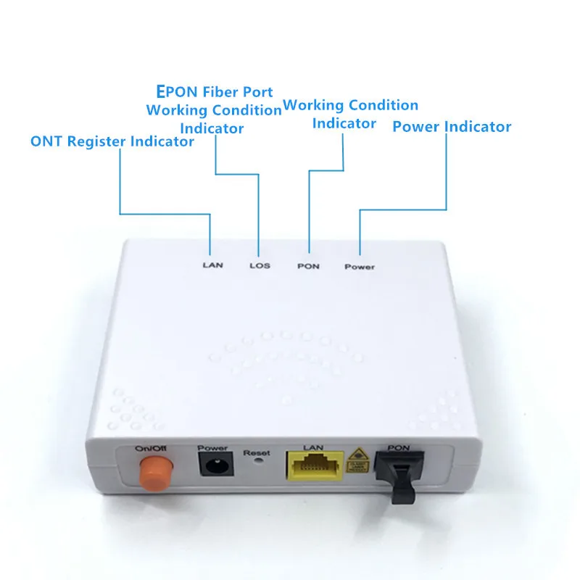
ONU Functions

Slide 15
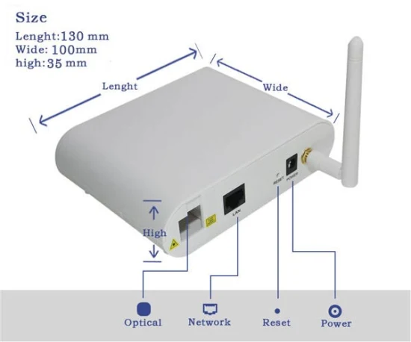
ONU Ports

Slide 16
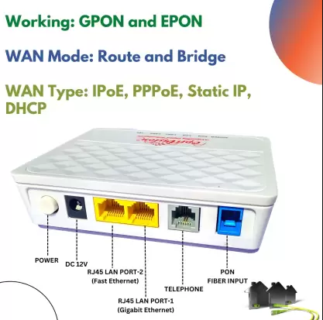
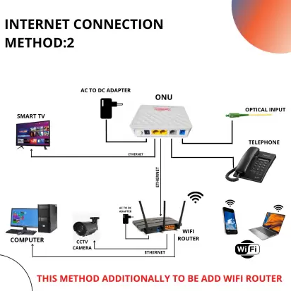
ONU Ports

Slide 17
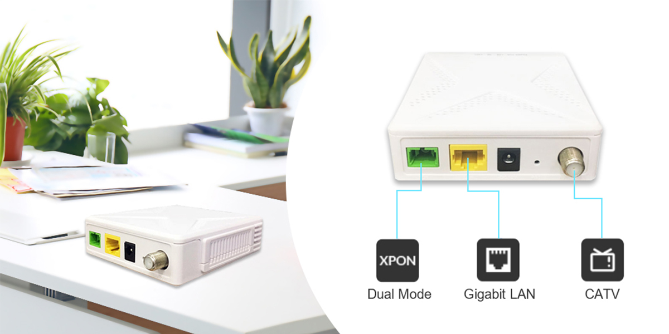
ONU Ports

Slide 18
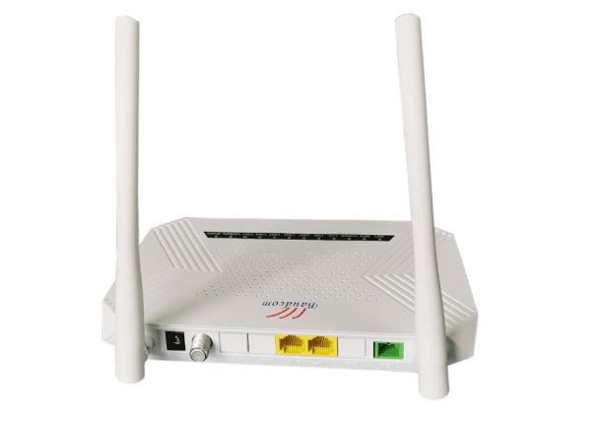
ONU With Router

Slide 19
Types of ONU
According to the different applicable standards and publishers, there are three types of ONU:
EPON ONU
GPON ONU
xPON ONU

Slide 20
Types of ONU
1. GPON (Gigabit PON)
GPON is a new generation of broadband (BPON)over Passive network access.
GPON provides high bandwidth speed up to 2.5Gbit/s.
The protocols used by GPON are ATM, GEM, and Ethernet.
2. EPON (Ethernet PON)
Full form of EPON is Ethernet Passive optical network.
EPON is an IEEE standard, used Ethernet to sending the data packet.
EPON and GEPON is a FAST Ethernet over fiber network up to 1.25 Gbit/s Download and upload data stream.

Slide 21
What is xPON?
XPON is the integration of GPON and EPON in terms of hardware and software.
On the one hand, the upstream and downstream rates of GPON are higher than that of EPON.
According to the downward compatibility of hardware, the mode of GPON network is considered as the standard of hardware indicators.
For instance, it offers multiple services including TDM, ATM, Ethernet, and CATV, which is the same as GPON.
On the other hand, the software will adopt the mode of automatic detection and switch. EPON/GPON OLT will deliver the network packets when ONU accesses them.
The network packets can’t be analyzed if ONU can’t match the OLT mode. At this point, xPON ONU will automatically restart and switch to the other mode after seconds.

Slide 22
How to Make EPON ONUs Compatible with a GPON OLT by Changing Firmware: Step-by-Step Process

Slide 23
Check Compatibility
Verify if your ONU hardware is capable of supporting GPON firmware.
Some hardware might not support both standards.
Forcing incompatible firmware might damage the device.

Slide 24
Gather Required Tools and Firmware
Obtain the GPON firmware file for your ONU model from the manufacturer or a trusted source.
Ensure you have the necessary tools:
- Computer
- Ethernet cables
- Possibly a TFTP server
Connect your computer to the ONU using an Ethernet cable.
Assign a static IP to your computer in the same range as the ONU’s management IP.

Slide 25
Access the ONU’s Management Interface
Open a web browser and enter the ONU’s management IP address.
Log in using the admin credentials.
Navigate to the firmware update section in the web interface.
Typically found under system maintenance or similar settings.

Slide 26
Upload and Install GPON Firmware
Upload the GPON firmware file you obtained earlier.
Follow the instructions to start the firmware upgrade process.
This might take several minutes.
Ensure the power remains stable during this process to avoid bricking the ONU.

Slide 27
Reconfigure the ONU
After the firmware upgrade is complete, the ONU may reset to factory settings.
Reconfigure it with the necessary parameters to connect to your GPON OLT.
You might need to re-enter settings such as VLAN IDs, PON parameters, and other specific configurations required by your network.

Slide 28
Assignment: 02 Marks: 05
What is ONU? Types of ONU? Basic functions of ONU.
What is ONT?
Differences between EPON, GPON, XPON.
How to convert an EPON to GPON ONU.
What are the advantage of use a XPON ONU?
What is OLT? Types of OLT? Basic functions of OLT.
Submission Last Date: 23/07/2024
Link:

