Slide 1
Lectures On:
Networking Commands
for Troubleshooting

Slide 2
Networking Commands for Troubleshooting
In networking there are various commands that can be used to check the connectivity of the networking devices and it is also required at time of troubleshooting of devices.
We will be discussing few of the networking commands such as:
      color help,
      ipconfig ,
      ipconfig/all ,
      nslookup ,
      tracert

Slide 3
PowerShell vs. CMD: What's the Difference?
PowerShell is a cross-platform Command-Line Interface (CLI) tool that replaced the Command Prompt (CMD) in Windows as of Windows 10 build 14971.
While the Command Prompt remains an option within the operating system, PowerShell aims to improve the CLI experience in Windows by introducing improved scripting support and pipelines.

Slide 4
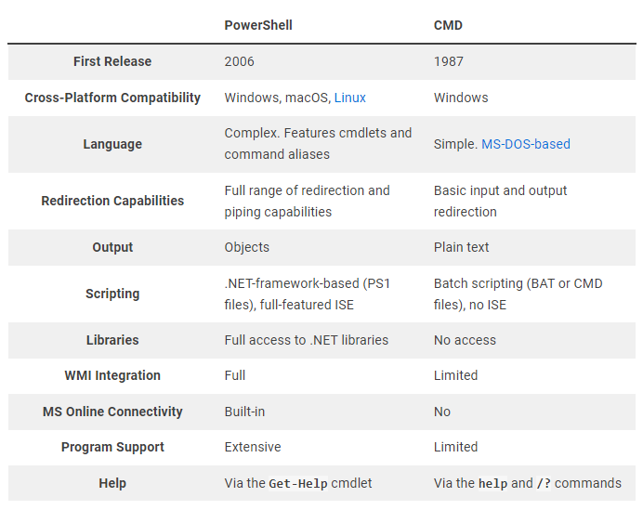
PowerShell vs. CMD: What's the Difference?

Slide 5
Why Use Commands?

Slide 6
Commands
First press windows+R button.
In the search option write cmd .
Then your command prompt will get open.

Slide 7
Some Basic Command
Mode 100/800
C (For New Comments)
CLS (For clean CMD)

Slide 8
Commands
    cd..(One Step Back Directory)
    dir (Files in Use Directory)
    cd FolderName (Folder Directory - Folder IN)
    Cd\ (Parent Directory)
    cd Desktop (Desktop Directory)
    mkdir FolderName (Create Folder)
    ren OldName NewName (Folder Rename Change)
    type nul> FileName (Create File)
    Del (Delete the File)
    Move (Move the File)

Slide 9
Commands
    wmic (To enter the software details directory)
    /output:c:\sample.txt product get name,version (Installed Software with Version)
    cpu (CPU Details)
    Exit (For Reurn)
    diskpart (For Disk Details)
    listdisk (Number of Disk and Details)
    select disk 0 (To select the disk)
    detail disk (Disk Details)
    Exit
    chkdsk (Check Errors in DIsk)
    driverquery (Driver Details)

Slide 10
1. Color Help
This command is used to change the color of the command prompt.
It gives various colors and the user can change accordingly.
You have to type color help and then choose from the appeared screen by starting the command with color A or color 3.
It helps in making the command prompt user friendly and making the screen according to user choice.

Slide 11
2. ipconfig
This networking commands is used to the IP configuration details.
This command provides you the details like IPv4 address ,Subnet Mask or Default Gateway.
Subnet mask- It can be understood as the boundary of our internet connection.
Default Gateway- It is the address of the router to which our computer first hits when the device we want to connect is out of our local network.

Slide 12
3. ipconfig/all
This command can be understood as the updated version of the ipconfig command.
This command tells us the physical address of our device.
It tells us various details of our computer such as IPv4,IPv6 default Gateway ,subnet mask ,also it tells to which devices our device is connected ,configuration details of the devices to which are devices are connected.
It also tells us about the DHCP(Dynamic Host Configuration Protocol)-The main use of DHCP is to automatically assign IP addresses to our devices .

Slide 13
4. nslookup
This command is use to transform the given searched words into their corresponding IP addresses.
Such as if i search for www.google.com website then our browser don’t search for www.google.com.
It search’s the corresponding IP address associated to the www.google.com.
www.nslookup.io

Slide 14
What is a ping?
A ping (Packet Internet or Inter-Network Groper) is a basic Internet program that allows a user to test and verify if a particular destination IP address exists and can accept requests in computer network administration.
Ping is also used diagnostically to ensure that a host computer the user is trying to reach is operating.
Any operating system (OS) with networking capability, including most embedded network administration software, can use ping.

Slide 15
5. ping
Test network connectivity.
Test network interface card.
Test DNS name resolution issues.

Slide 16
ping
Ping localhost - 127.0.0.1

Slide 17
6. tracert
This command can be understood as trace root. Which tells that our computer reaches or hits which-which server for reaching the particular root.
Here again we will search for www.google.com site and it tells us the path taken by our computer to reach the root server.
It tells us in maximum of 30 hops (30 node to node delivery).
We can search by giving the IP address and destination site name also.

Slide 18
7. Whois
Whois performs the registration record for the domain name or IP address that you specify.
Whois is a command-line utility used in Linux systems to retrieve information about domain names, IP addresses, and network devices registered with the Internet Corporation for Assigned Names and Numbers (ICANN).
The data received by Whois consists of the name and contact information of the domain or IP address owner, the registration and expiration date, the domain registrar, and the server information.
Whois command can be very useful for network administrators, web developers, and security professionals for achieving various tasks like checking network connectivity or troubleshooting.

Slide 19
7. Whois
https://learn.microsoft.com/en-us/sysinternals/downloads/whois
For Window:
      Install Whois
      Shift+Rigth Click
      ./whois Domain

Slide 20
Task List
tasklist
    PID – Process ID
    Memory-
taskkill /PID …..

Slide 21
Shut Down and Restart in System Bios
shutdown /r /fw /f /t 0

Slide 22
Some Other Small Comments:
HOSTNAME
getmac
SYSTEMINFO
net view
net share

Slide 23

“Thank You”

