Slide 1
Lectures On:
Email Server & Etiquette

Slide 2
Introduction to email
Do you ever feel like the only person who doesn't use email?
You don't have to feel left out.
If you're just getting started, you'll see that with a little bit of practice, email is easy to understand and use.
In this lesson, you will learn what email is, how it compares to traditional mail
How email addresses are written.
Discuss various types of email providers
Features and tools they include with an email account.

Slide 3
Getting to know email
Email (electronic mail) is a way to send and receive messages across the Internet.
It's similar to traditional mail, but it also has some key differences.
To get a better idea of what email is all about, take a look at the infographic below and consider how you might benefit from its use.

Slide 4
Getting to know email
Email (electronic mail) is a way to send and receive messages across the Internet.
It's similar to traditional mail, but it also has some key differences.
To get a better idea of what email is all about, take a look at the infographic below and consider how you might benefit from its use.

Slide 5
Email advantages
Productivity tools: Email is usually packaged with a calendar, address book, instant messaging, and more for convenience and productivity.
Access to web services: If you want to sign up for an account like Facebook or order products from services like Amazon, you will need an email address so you can be safely identified and contacted.
Easy mail management: Email service providers have tools that allow you to file, label, prioritize, find, group, and filter your emails for easy management. You can even easily control spam, or junk email.
Privacy: Your email is delivered to your own personal and private account with a password required to access and view emails.
Communication with multiple people: You can send an email to multiple people at once, giving you the option to include as few as or as many people as you want in a conversation.
Accessible anywhere at any time: You don’t have to be at home to get your mail. You can access it from any computer or mobile device that has an Internet connection.

Slide 6
Understanding email addresses
To receive emails, you will need an email account and an email address. Also, if you want to send emails to other people, you will need to obtain their email addresses. It's important to learn how to write email addresses correctly because if you do not enter them exactly right, your emails will not be delivered or might be delivered to the wrong person.
Email addresses are always written in a standard format that includes a username, the @ (at) symbol, and the email provider's domain.
The username is the name you choose to identify yourself.

Slide 7
About email providers
In the past, people usually received an email account from the same companies that provided their Internet access.
For example, if AOL provided your Internet connection, you'd have an AOL email address.
While this is still true for some people, today it's increasingly common to use a free web-based email service, also known as webmail. Anyone can use these services, no matter who provides their Internet access.

Slide 8
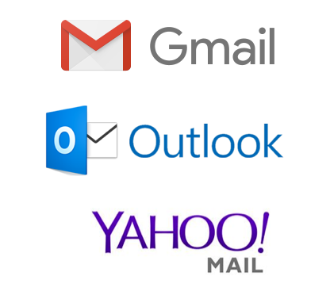
Webmail providers
Popular webmail providers are Yahoo!, Microsoft's Outlook.com (previously Hotmail), and Google's Gmail.
These providers are popular because they allow you to access your email account from anywhere with an Internet connection.
You can also access webmail on your mobile device.

Slide 9
Email productivity features
In addition to email access, webmail providers offer various tools and features. These features are part of a productivity suite—a set of applications that help you work, communicate, and stay organized. The tools offered will vary by provider, but all major webmail services offer the following features:

Slide 10
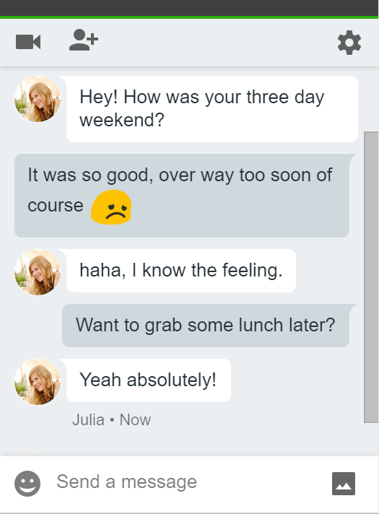
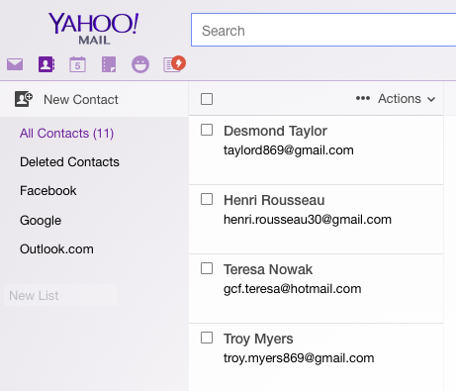

Slide 11
What is an email server?
A mail or email server is a software system responsible for email circulation between senders and recipients.
It handles the sending, receiving, routing, and storing of emails.
Think of it like our nervous system that manages the transmission of signals, ensuring they are delivered accurately to the intended recipients.

Slide 12
What is an email server?
While you interact with your personal emails via an email client
— a user-friendly interface like Gmail or Outlook (the frontend)
— email servers work in the backend, managing the flow of emails and transporting them from senders to recipients.

Slide 13
Core email server components
Mail submission agent (MSA)
accepts outgoing mail from an email client (also known as Mail User Agent) and passes it to a Mail Transfer Agent (MTA).
MSA typically performs initial processing and checks if the email is properly formatted and ready for delivery.

Slide 14
Core email server components
Mail transfer agent (MTA) – responsible for routing emails from a sender’s email server to a recipient’s email server. Read more about MTA in our dedicated post.

Slide 15
Core email server components
Mail delivery agent (MDA) – receives incoming emails from an MTA and stores them on a mail server’s storage system until a recipient accesses them via an email client.
Alongside these components, email servers rely on the Domain Name System (DNS). DNS is not a component of an email server itself, yet it plays an equally important role in the correct email delivery.
DNS translates domain names, like harry.potter@gmail.com, into corresponding IP addresses, such as 192.158.1.38 – a clear language MTAs use to communicate with each other for routing emails.

Slide 16
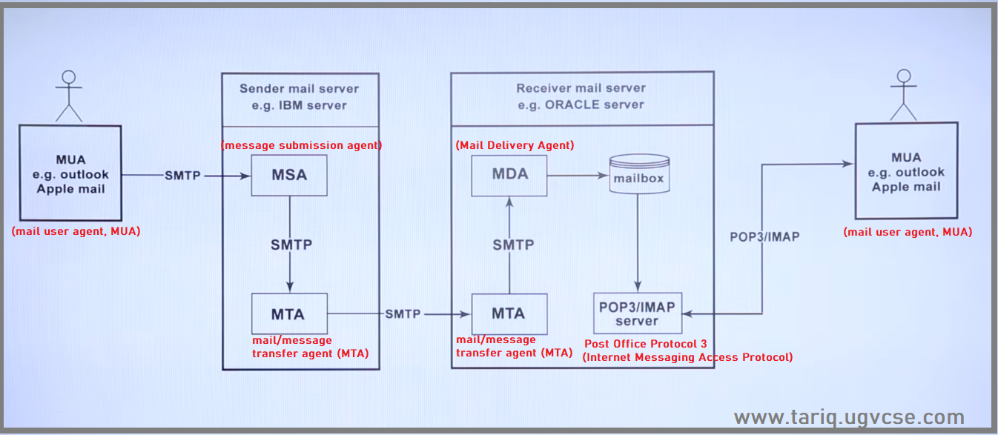

Slide 17
Email server protocols
To function properly, an email server uses protocols — a set of rules for sending and receiving emails.
Simple Mail Transfer Protocol (SMTP) – a protocol used for sending and relaying outgoing email messages from the sender’s MUA to the recipient’s mail server.

Slide 18
Email server protocols
Post Office Protocol version 3 (POP3) – a protocol used for retrieving emails from an email server. This works by downloading emails from the server to your device and then removing them from the server.
Internet Message Access Protocol (IMAP) – a protocol for retrieving emails from a mail server that allows multiple devices to access and manage the same mailbox. Unlike POP3, which takes emails from the server and often deletes them, IMAP keeps the emails on the server so that a recipient can access them on different devices.

Slide 19
Email server protocols
Sometimes, you may hear people refer to these protocols as servers, such as “SMTP server” or “IMAP server”. However, that’s not entirely accurate. The confusion comes from the fact that these protocols are often associated with server software that implements them.
For instance, when setting up an email server, you would install SMTP server software like Postfix, Sendmail, or Microsoft Exchange to manage the email sending via the SMTP protocol.

Slide 20
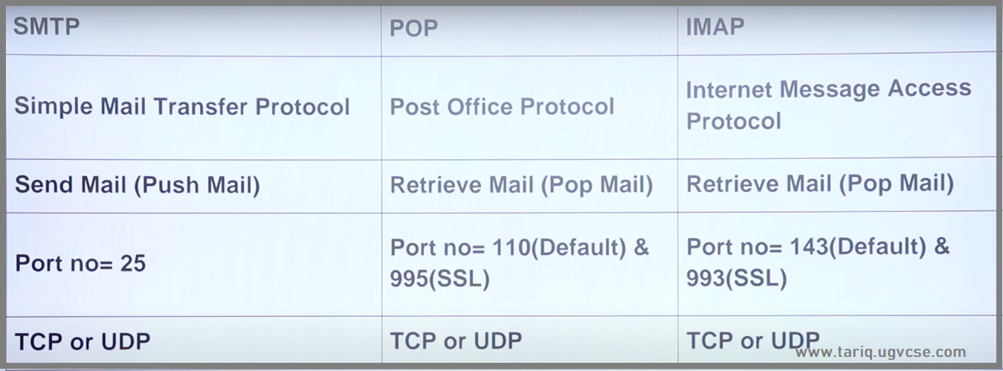

Slide 21
Important Records
When setting up or managing an email server, you often need to configure specific DNS records to ensure proper functionality, deliverability, and authentication of emails. Here's what the important records mean:

Slide 22
1. MX Record (Mail Exchange Record):
Purpose: Directs email to your mail server.
Function: Specifies which mail servers are responsible for receiving emails for your domain.
Priority: Lower numbers have higher priority (e.g., a priority of 10 is higher than 20).
Importance: Without an MX record, emails sent to your domain won't reach your mail server.
Host: @
Type: MX
Value: mail.example.com
Priority: 10

Slide 23
2. TXT Record (Text Record):
Purpose: Holds arbitrary text data, often used for domain verification and email authentication protocols.
Uses in Email Server:
  SPF (Sender Policy Framework): Prevents spammers from sending emails on behalf of your domain.
Host: @
Type: TXT
Value: v=spf1 include:example.com ~all

Slide 24
CNAME Record
3. CNAME Record (Canonical Name Record):Purpose: Maps an alias domain name to a canonical (true) domain name.
Use in Email Server:Often used to verify your domain ownership or set up custom domain-based email services.
For example:makefileCopy code
Host: mail
Type: CNAME
Value: ghs.googlehosted.com
Example Application: Setting up Google Workspace or Office 365.

Slide 25
Why These Records Are Important for Email Setup:
MX Records: Ensure emails are routed to the correct mail server.
TXT Records (SPF/DKIM/DMARC): Protect against spoofing and improve email deliverability.
CNAME Records: Simplify domain verification or aliasing for external email services.

Slide 26
Example Configuration for an Email Server: For the domain example.com:
Type | Host | Value | Priority
MX | @ | mail.example.com | 10
TXT | @ | v=spf1 include:example.com ~all
TXT | _dmarc | v=DMARC1; p=none; rua=mailto:dmarc@example.com
TXT | default._domainkey | v=DKIM1; k=rsa; p=PublicKeyHere
CNAME | mail | ghs.googlehosted.com

Slide 27
Bulk email capacity varies by email service provider (ESP):
Gmail
The daily sending limit for a free Gmail account is 500 emails, and the recipient limit per email is 500. A paid Google Workspace account allows up to 2,000 emails per day.
Office 365
The daily sending limit is 10,000 emails, and the recipient limit per email is 500.
Outlook.com
The daily sending limit is 5,000 emails, and the recipient limit per email is 500. The attachment size limit for files is 25 MB, but you can share larger files from OneDrive.

Slide 28
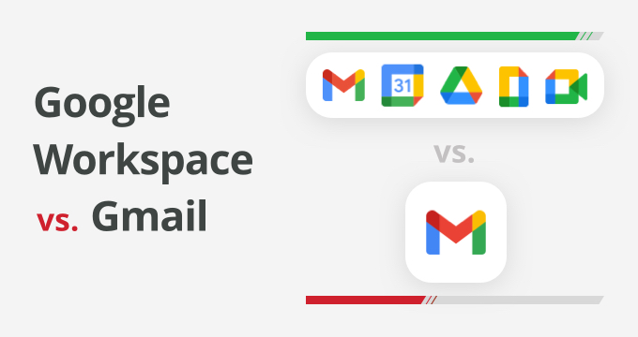
Gmail Workspace

Slide 29
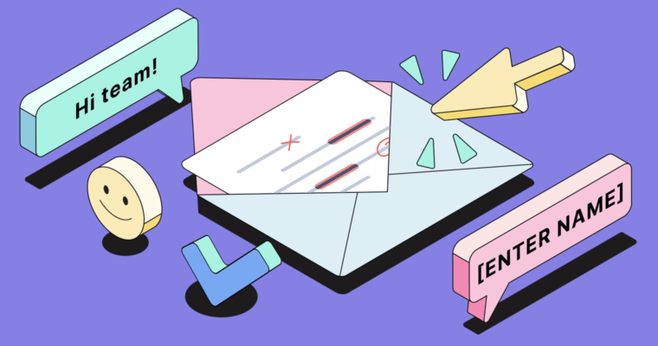
Email Etiquette

Slide 30
Rules For Email Etiquette

Slide 31

1. Proofread, proofread, proofread
Nothing undermines your professionalism like a grammar mistake or misspelling the recipient’s name.
Before you send an email, proofread it carefully or use Grammarly to ensure it’s free of grammar, spelling, and punctuation mistakes.
Also, double-check that all the details, including the spelling of the recipient’s name, are correct.

Slide 32
2. Write detailed subject lines
A good subject line is a preview of the email. Instead of a vague subject line like “Hello” or “Checking in,” address your message directly.
This way, the recipient immediately knows what the email is about and can respond appropriately.

Slide 33
3. Include a greeting
Start every email with an appropriate greeting. Examples of appropriate email greetings include these:
Dear [recipient’s name]
Hi [recipient’s name]

Slide 34
4. Include a sign-off
Your email should start with an appropriate greeting and end with an appropriate sign-off. Professional email sign-offs include these:
  Regards
  Best
  Sincerely
  Thanks
Cheers
After the sign-off, include your name.

Slide 35
5. Be concise
Conciseness is a key tenet of all professional communication. Don’t waste the recipient’s time with extraneous details or pack multiple conversations into one email.
Keep it focused so they can read it quickly and respond if necessary.

Slide 36
6. Be comprehensive
That said, don’t skimp on necessary information to keep your email concise. An important part of conciseness is mentioning every relevant piece of information in a single email.
As you proofread your email, read carefully to make sure you didn’t leave out any important information.
Having to send a second email to mention details you forgot to include in the first can be awkward and embarrassing.
It can also come across as unprofessional.

Slide 37
7. Wait 24 hours for follow-ups
Once you send an email, give the recipient time to respond.
The appropriate period to wait often depends on factors such as your relationship to the recipient and your message’s urgency.
But generally, it’s best to wait at least 24 hours before following up.
There’s another 24-hour rule in email etiquette: Respond to every email you receive within 24 hours.
This rule extends to phone calls and other forms of communication.
By responding promptly, you show the recipient you value their time.

Slide 38
8. Use an auto-reply when you’re away
Before you leave for vacation, set up your email autoresponder.
This is an automatic response to every email you receive that lets the sender know you’re away and unable to read emails.
In your auto-response, mention the dates you will be out of the office and a colleague whom the sender may contact with urgent matters.

Slide 39
9. Use bcc appropriately
Bcc stands for blind carbon copy. With bcc, you can send an email to a large group of people without showing the individual recipients’ email addresses. This way, none of the recipients can see who else received the email. They also can’t email each other through reply-all, which makes bcc a handy tool for avoiding cluttered inboxes.

Slide 40
10. Use cc appropriately
Unlike bcc, individuals who are cc’d (carbon copied) in an email can see who else received it. The purpose of cc is to include multiple recipients in an email while communicating that you don’t necessarily expect a reply from all of them. For example, you may send an email to a colleague in a different department and cc your manager so they’re aware of the conversation’s progress.

Slide 41
11. Be mindful of your tone
Use a professional tone in your business and academic emails. A casual tone can undermine your professionalism, and a curt tone can send the wrong message.
Be polite and warm, but also maintain a professional air by avoiding slang, casual greetings, and tangents.

Slide 42
12. Know when to use reply-all
When multiple people are copied on an email, you can hit reply-all to send your response to all of them.
Unless there’s a reason to do this, such as sharing critical information they all need to know, don’t hit reply-all.
Instead, reply to the email’s sender individually so you don’t spam others’ inboxes with a conversation that doesn’t directly involve them.

Slide 43
13. Be careful with emoji
Similarly, it’s generally best to stay away from emoji in professional emails. In certain cases, an emoji may be appropriate, such as the clapping hands emoji to celebrate a team success. When it comes to emoji in workplace emails, follow your manager’s lead to determine whether emoji are appropriate, and if so, which ones.

Slide 44
14. Describe any email attachments
If you have an attachment to share, explain to the recipient what it is and how you’d like them to interact with it—by reading, commenting, signing, etc. Sending an attachment without a description could leave the recipient puzzled—or even suspicious of a phishing attempt.

Slide 45
15. Reiterate in-person and phone conversations
After an in-person meeting or phone conversation, it’s often helpful to send a follow-up email that reiterates the topics you discussed. This achieves a few goals:
It keeps your discussion top-of-mind for all individuals involved.
It creates a “paper trail” you can reference in future discussions.
It can prevent misunderstandings and miscommunication by giving participants the opportunity to ask questions or clarify their statements.

Slide 46
16. Write to your audience
Although every email recipient should be treated with respect and consideration, you may need to adjust your language and level of detail according to whom you’re emailing.
For example, when emailing a colleague, you can use the same jargon and insider lingo you use in meetings.
However, someone outside your organization may not know this terminology, so it’s best to stick to plain language they’ll understand. Similarly, while you can often use familiar language with your classmates and coworkers, maintain a professional tone with professors, administrators, and company higher-ups.

Slide 47
Must Knows Features of Gmail
Sender Address Bar
CC/BCC
Subject Bar
Gmail Signature/ Insert Signature
Schedule Send
Email Templates
Confidential Mode
General Options

Slide 48
Must Knows Features of Gmail
Multiple Emails Addressing using Gmail Contact
Import mail and contacts
Forwarding and POP/IMAP
Undo send
Customize your address with . or +
Themes
Gmail offline mode
Keyboard shortcuts (shift + ?)

Slide 49
Must Knows Features of Gmail
Snooze
Labels
Mute noisy conversations
Multiple email signatures
Stars to organize messages
Vacation responder
Reduce space usage
Mail merge (Yet another mail merge)

Slide 50
Business email
A business email is an email address that includes your business’s custom domain name, such as yourname@yoursite.com, rather than a free personal email client such as businessname@gmail.com.
Professional email is a must-have for businesses of all sizes and it comes with a number of benefits from credibility to security.
Follow along to learn how to create a business email address easily, in just a few minutes.

Slide 51
Why Do I Need a Business Email?
Business email is a must-have for businesses for a number of reasons. Not only does it give you a way to separate your business email from your personal email, but it also looks more professional, is more memorable, offers more control and enhances your security.
Here’s why every business should use a professional email address:
Establishes credibility: When you send an email to potential customers from a professional email address, it has multiple benefits.
Brand consistency: Imagine sharing a business website address with a potential customer and then sending a proposal or product details from a personal email account. This confuses the prospect and a confused prospect is less likely to buy. When you send an email from your business email account, it improves brand consistency and hence chances of conversion.

Slide 52
Why Do I Need a Business Email?
More memorable: Unlike a personal email, a business email is directly associated with your business and website, making it easier to remember or recall.
Increases control: With business email, you can set up an admin and manage all email accounts. For example, you can set up new staff accounts, as well as remove old accounts and set up email forwarding.
Enhanced security: The best business email service providers offer enhanced security features to help you further safeguard your accounts. Using business email is advisable to not only enhance security for external communications but internal as well.
Professional communication demands professional email. On top of the above benefits, having business email also opens the door to more integrations, email addresses (e.g., lastname@yourbusiness.com) and a more organized business.

Slide 53
What Is Email Hosting
Email hosting is a service that hosts your email account and the files associated with it on a remote server. In addition to storing the emails and files, the email host also provides additional services such as:
  Routing received emails to your network
  Email authentication and security
  Email management and filtering
Each email hosting service provides different services and emphasizes different aspects of email management. You should choose one that meets your business email needs while also fitting your budget.

Slide 54
Lets make our own Business Email

Slide 55
Business email account using cPanel involves several steps
Step 1: Log into Your cPanel Account
  Open your web browser and navigate to your cPanel login page. This is usually provided by your hosting provider.
  Enter your username and password, then click on the "Log in" button.
Step 2: Locate the Email Section
  Once logged in, scroll down to the Email section.
  Click on Email Accounts.
Step 3: Create a New Email Account
  Click on the Create button to start setting up a new email account.

Slide 56
Business email account using cPanel involves several steps
Step 4: Fill in the Email Account Details
  Domain: Select the domain for your email account from the dropdown list.
  Username: Enter the desired email address (e.g., yourname@yourdomain.com).
  Password: Enter a strong password or use the password generator to create one. Make sure to note it down or store it securely.
  Storage Space: Allocate the storage space for the email account. You can set it to a specific limit or leave it as the default.

Slide 57
Business email account using cPanel involves several steps
Step 5: Configure Optional Settings (if needed)
Send Welcome Email with Instructions: If you want the new email account user to receive a welcome email with setup instructions, check this box.
Create a Folder for Plus Addressing: If you plan to use plus addressing, you can enable this option.
Step 6: Create the Account
Once all the details are filled in, click on the Create button at the bottom of the form.
Step 7: Access the New Email Account
After the email account is created, you will see it listed under the Email Accounts section.
You can access the email account by clicking on Check Email next to the account.

Slide 58
Business email account using cPanel involves several steps
Step 8: Configure Email Client (Optional)
  To configure your email client (e.g., Outlook, Thunderbird, etc.), click on Connect Devices next to the email account.
  cPanel will provide you with the necessary settings and configuration details for setting up your email client.
Additional Tips
  Email Forwarding: If you want to forward emails from this account to another email address, you can set up email forwarding in cPanel.
  Auto Responders: You can also set up auto responders for your email account if you want to send automatic replies to received emails.
By following these steps, you can create and manage a business email account using cPanel effectively.

Slide 59
Email Forwarding
Email forwarding allows you to automatically send incoming emails from one address to another. Here are the general steps for setting up email forwarding in a few common email services:

Slide 60
General Steps for Email Forwarding
Log into Your Email Account:
  Open your web browser and navigate to your email provider’s login page.
  Enter your email address and password to log in.
Access Email Settings:
  Look for a gear icon, settings menu, or profile icon. Click on it to access your email settings.
  This is typically found in the top right corner or under a menu.
Navigate to Forwarding Settings:
  In the settings menu, find the section related to email forwarding. This might be under labels such as "Mail Settings," "Forwarding," "Filters," or "POP/IMAP."
Add a Forwarding Address:
  Look for an option to add a forwarding address.
  Enter the email address to which you want to forward your emails.
  Confirm the forwarding address by following any prompts or instructions provided.

Slide 61
General Steps for Email Forwarding
Verify the Forwarding Address:
  Some providers require you to verify the forwarding address. This usually involves sending a confirmation email to the forwarding address.
  Log into the forwarding email account, find the confirmation email, and follow the verification steps (usually clicking a link or entering a code).
Enable Forwarding:
  After verification, go back to your original email settings.
  Enable the forwarding option, ensuring the correct forwarding address is selected.
  Configure additional options such as whether to keep a copy of forwarded emails in the original inbox or delete them after forwarding.
Save Changes:
  Save the changes to apply the forwarding settings.
  Look for a "Save," "Apply," or "Confirm" button in the settings menu.

Slide 62
Send Mail As:
Setting up the "Send mail as" feature allows you to send emails from one email account using another email account's address. Here are the general steps to set up the "Send mail as" feature:

Slide 63
General Steps for "Send mail as"
Log into Your Email Account:
  Open your web browser and navigate to your email provider’s login page.
  Enter your email address and password to log in.
Access Email Settings:
  Look for a gear icon, settings menu, or profile icon. Click on it to access your email settings.
  This is typically found in the top right corner or under a menu.
Navigate to Account Settings:
  In the settings menu, find the section related to accounts, sending, or mail settings. This might be under labels such as "Accounts," "Send mail as," or "Aliases."
Add Another Email Address:
  Look for an option to add another email address you own.
  Click on "Add another email address," "Add an alias," or a similar option.
Enter the Email Address:
  Enter the email address you want to use for sending emails.
  Optionally, enter a display name that you want recipients to see.

Slide 64
General Steps for "Send mail as"
Verify Ownership:
  The email provider will send a verification email to the address you entered.
  Log into the email account you want to add and look for the verification email.
  Follow the instructions to verify ownership, usually by clicking a link or entering a verification code.
Configure SMTP Settings:
  Some email providers may require you to configure SMTP settings. You’ll need the SMTP server address, port number, and login credentials for the email address you're adding.
  Enter the required information and save the settings.
Set Default Email Address (Optional):
  If you want to make this new email address your default "From" address when sending emails, look for an option to set it as default in the settings.
Save Changes:
  Save the changes to apply the new settings.
  Look for a "Save," "Apply," or "Confirm" button in the settings menu.

Slide 65


