Slide 1
Lectures On:
Network Attached Storage (NAS)

Slide 2

Network Server

Slide 3
What is network-attached storage (NAS)?
Network-attached storage (NAS) is dedicated file storage that enables multiple users and heterogeneous client devices to retrieve data from centralized disk capacity. Users on a local area network (LAN) access the shared storage via a standard Ethernet connection.

Slide 4
What is network-attached storage (NAS)?
NAS devices typically don't have a keyboard or display and are configured and managed with a browser-based utility.
Each NAS resides on the LAN as an independent network node, defined by its own unique IP address.
Essentially, a NAS device functions as a housing unit for hard drives with added intelligence for sharing and authorization of files. By utilizing Redundant Array of Independent Disks (RAID) technology, a NAS system can partition and replicate stored data across several hard drives, ensuring data resilience in the event of drive failures.

Slide 5
Introduction to NAS (Network-Attached Storage)
Definition: A NAS server is a specialized device or server for data storage that can be accessed over a network, allowing multiple users to share and access data from a centralized location.
Key Benefits:
Centralized storage management
Data backup and recovery
Remote access and sharing
Scalability and flexibility for expanding storage

Slide 6
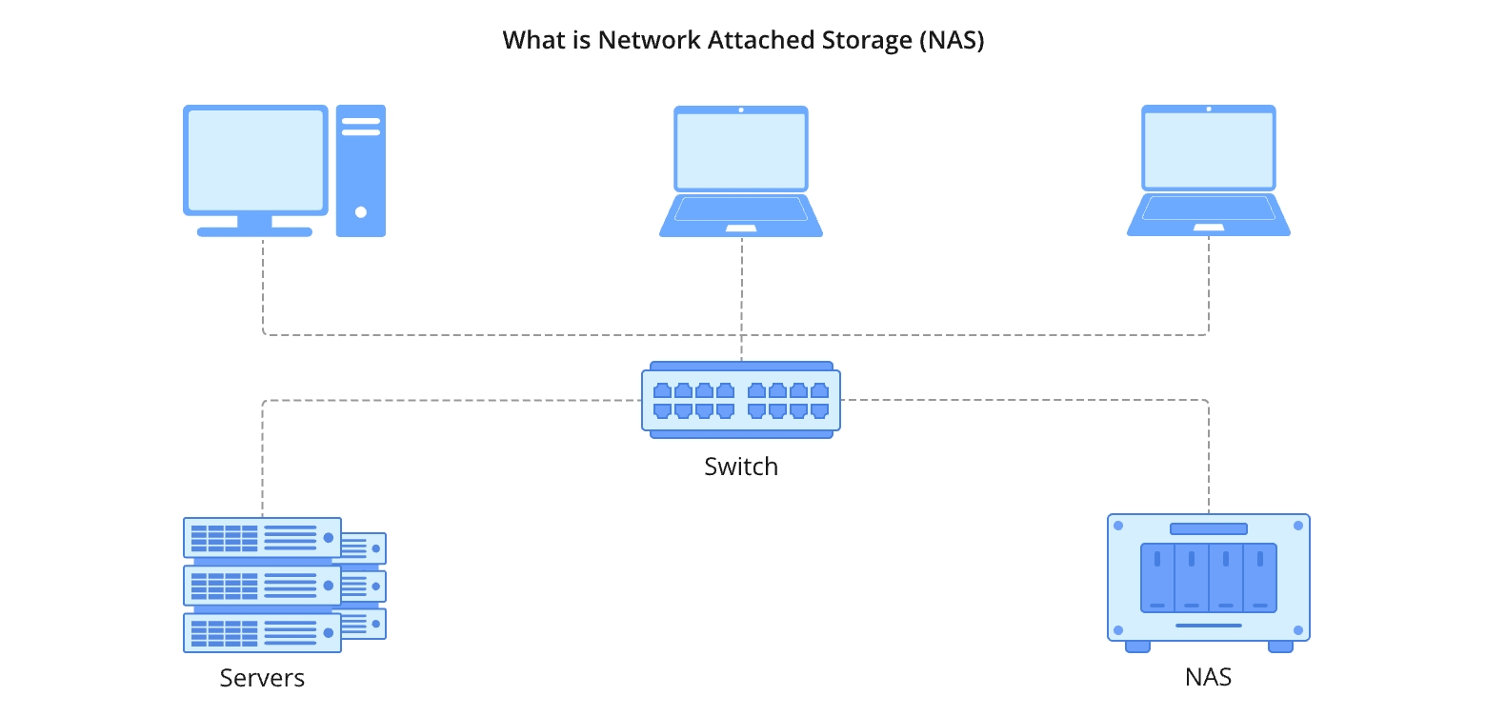

Slide 7
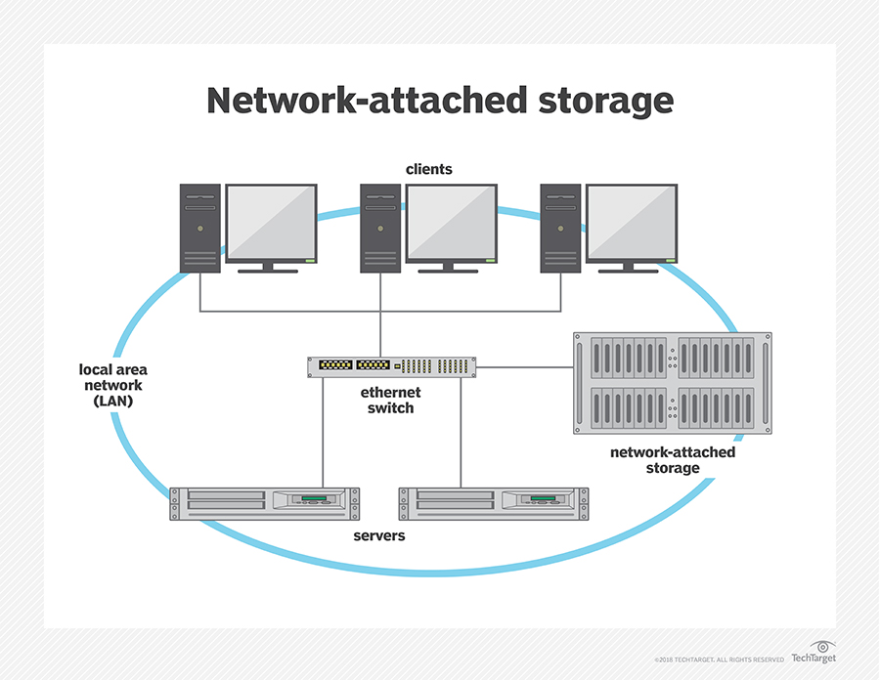

Slide 8
What is network-attached storage used for?
The purpose of network-attached storage is to enable users to collaborate and share data more effectively.
It is useful to distributed teams that need remote access or work in different time zones.
NAS connects to a wireless router, making it easy for distributed workers to access files from any desktop or mobile device with a network connection.
Organizations commonly deploy a NAS environment as a storage filer or the foundation for a personal or private cloud.

Slide 9
What is network-attached storage used for?
Some NAS products are designed for use in large enterprises. Others are for home offices or small businesses.
Devices usually contain at least two drive bays, although single-bay systems are available for noncritical data.
Enterprise NAS gear is designed with more high-end data features to aid storage management and usually comes with at least four drive bays.

Slide 10
What is network-attached storage used for?
Prior to NAS, enterprises had to configure and manage hundreds or even thousands of file servers. To expand storage capacity, NAS appliances are outfitted with more or larger disks; this is known as scale-up NAS. Appliances are also clustered together for scale-out storage.
In addition, most NAS vendors partner with cloud storage providers to give customers the flexibility of redundant backup.
Although collaboration is a virtue of network-attached storage, it can also be problematic. Network-attached storage relies on hard disk drives (HDDs) to serve data.
I/O contention can occur when too many users overwhelm the system with requests at the same time. Newer systems use faster solid-state drives (SSDs) or flash storage, either as a tier alongside HDDs or in all-flash configurations.

Slide 11
NAS use cases and examples
The type of HDD selected for a NAS device will depend on the applications to be used. Sharing Microsoft Excel spreadsheets or Word documents with co-workers is a routine task, as is performing periodic data backup. Conversely, using NAS to handle large volumes of streaming media files requires larger capacity disks, more memory and more powerful network processing.
At home, people use a NAS system to store and serve multimedia files and to automate backups. Home users rely on network-attached storage to do the following:
manage smart TV storage;
manage security systems and security updates;
manage consumer-based IoT components;
create a media streaming service;
manage torrent files;
host a personal cloud server; and
create, test and develop a personal website.

Slide 12
In the enterprise, NAS is used in the following ways:
as a backup target, using a NAS array, for archiving and disaster recovery;
for testing and developing web-based and server-side web applications;
for hosting messaging applications;
for hosting server-based, open source applications, such as customer relationship management, human resource management and enterprise resource planning applications; and
for serving email, multimedia files, databases and print jobs.

Slide 13
NAS components and how they work
A NAS device is fundamentally a dedicated storage server -- a specialized computer designed and intended to support storage through network access. Regardless of the size and scale of the network-attached storage, every NAS device is typically composed of four major components:

Slide 14
NAS components and how they work
CPU. The heart of every NAS is a computer that includes the central processing unit (CPU) and memory. The CPU is responsible for running the NAS OS, reading and writing data against storage, handling user access and even integrating with cloud storage if so designed. Where typical computers or servers use a general-purpose CPU, a dedicated device such as NAS might use a specialized CPU designed for high performance and low power consumption in NAS use cases.

Slide 15
NAS components and how they work
Network interface. Small NAS devices designed for desktop or single-user use might allow for direct computer connections, such as USB or limited wireless (Wi-Fi) connectivity. But any business NAS intended for data sharing and file serving will demand a physical network connection, such as a cabled Ethernet interface, giving the NAS a unique IP address. This is often considered part of the NAS hardware suite, along with the CPU.

Slide 16
NAS components and how they work
Storage. Every NAS must provide physical storage, which is typically in the form of disk drives. The drives might include traditional magnetic HDDs, SSDs or other non-volatile memory devices, often supporting a mix of different storage devices. The NAS might support logical storage organization for redundancy and performance, such as mirroring and other RAID implementations -- but it's the CPU, not the disks, that handle such logical organization.

Slide 17
NAS components and how they work
OS. Just as with a conventional computer, the OS organizes and manages the NAS hardware and makes storage available to clients, including users and other applications. Simple NAS devices might not highlight a specific OS, but more sophisticated NAS systems might employ a discrete OS such as Netgear ReadyNAS, QNAP QTS, Zyxel FW or TrueNAS Core, among others.

Slide 18
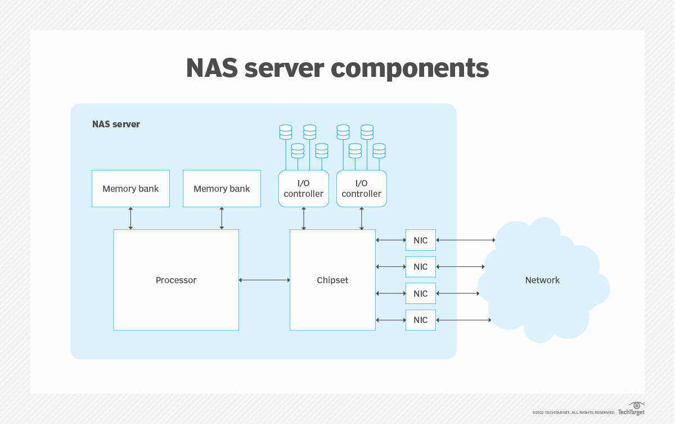

Slide 19
Top considerations for choosing NAS
Although the storage goals of NAS might seem straightforward, selecting a NAS device can be deceptively complex. Price considerations aside, enterprise NAS users should consider an array of factors in product selection, including the following:
Capacity. How much storage can the NAS provide? There are two major issues: the number of disks and the logical organization of those disks. As one simple example, if the NAS can hold two 4 TB disks, the capacity of the NAS can be 8 TB. But if those disks are configured as RAID 1 -- mirroring -- those two disks simply copy each other; so, the total usable capacity would only be 4 TB, but the storage would be redundant.

Slide 20
Top considerations for choosing NAS
Form factor. Where will the NAS be installed? The two principal form factors are rackmount and tower (standalone). An enterprise NAS can use a 2U or 4U rackmount form factor for installation into an existing data center rack. A tower or self-contained NAS can be a good choice for deployment in smaller department data closets or even on desktops.
Performance. How many users will the NAS support? It takes a finite amount of network and internal computing power to handle a storage request from the network and then translate that request into actual read/write storage tasks within the NAS. A busy NAS will demand higher levels of performance and internal caching to provide greater storage I/O and efficiently support more simultaneous users. Otherwise, users will need to wait longer (lag) for the NAS to service their storage request.

Slide 21
Top considerations for choosing NAS
Connectivity. How will the NAS connect to users and applications? Most NAS equipment includes one or more traditional Ethernet ports for cabled network connectivity. High-capacity network connectivity is essential for busy NAS devices in enterprise data centers. NAS designed for smaller, less-demanding environments can get by with Wi-Fi connectivity, while small NAS devices for end-users might supply a USB port for direct PC connectivity.
Reliability. How can the NAS handle problems? Reliability has three major layers: the reliability of the NAS itself, the reliability of the disks installed within the NAS and the reliability of the data stored on the disks. At the NAS level, the equipment itself should be designed to provide long, continuous service at the peak expected performance level. Disk reliability depends on the disks installed in the NAS; high-quality SAS disks can offer excellent error-correction and enormous mean time between failure figures, but all disk choices should include a replacement plan. Finally, the NAS handles RAID, replication and other means of maintaining data integrity within the device, but those features must be enabled and configured.

Slide 22
Top considerations for choosing NAS
Security. How is data protected on the NAS? Look for NAS equipment that provides native data encryption and strong network access controls to ensure that only authorized users and applications can access storage.
Usability and features. How easily can the NAS be set up and deployed? Look for NAS equipment that is easy to deploy and configure, and consider the features and functionality included with the NAS OS/software, such as data snapshots, data backups, data replication, automatic data tiering and RAID.

Slide 23
Types of NAS
Each business has a different scenario and requirement for a NAS device. Before getting a NAS storage solution, ensure that it has all the critical features to address your needs.
Different types of NAS may be found on the market based on: the amount of data they can store, the volume of data to be sent via the internet connection at a given time, the type of supported hard drive interface, the type of client connectivity, RAID support, and many more.

Slide 24
Types of NAS
Enterprise-level NAS
Midmarket NAS
Consumer-level NAS

Slide 25
Types of NAS
We will discuss all NAS devices based on the three must-have features in a NAS storage solution:
Scalability: Adaptability to growth without the need to create, pay for, and maintain several isolated points of storage.
Redundancy: Ability to prevent data loss and maintain continuity of service in the case of hardware failures, software viruses, lost internet connection, and other related incidents.
Manageability: Level of ease in setting up and maintaining the solution with minimal labor.

Slide 26
There are three main types of NAS devices. 1. Enterprise-level NAS
The enterprise-level NAS servers have high storage capacity, RAID support options, virtualization, clustering, and other innovative features.
Scalability: These features make it possible for businesses to scale up. The NAS server can provide connections to more than 1000 clients or users. A large company can expand swiftly across several locations with this extensive connection. Branch offices may access data remotely from a NAS device installed at the main office. It supports business applications such as email systems, accounting databases, payroll, video recording and editing, and data logging.
Redundancy: Enterprise-level NAS includes features like RAID and component redundancy to enhance disk performance, increase storage availability, and improve the ability of the system to operate without interruption in case of a hardware failure.
Manageability: Rack mounting is an enterprise-level NAS’s most important physical trait. With this feature, your servers are easily accessible and in one location, making maintenance, tracking down an issue, and troubleshooting more efficient.

Slide 27
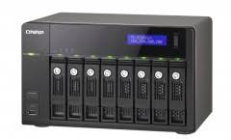
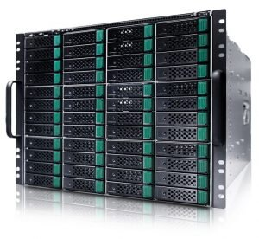
1. Enterprise-level NAS
Examples of Enterprise-level NAS devices are: Infortrend EonNAS 3310, Infortrend EonNAS 3510, Synology Diskstation RS10613XS+.

Slide 28
2. SMB (Small-Medium Business) Level NAS/ Midmarket NAS
A Small-Medium Business NAS setup typically consists of a few computer users who share a printer and an internet connection. You can share files across the network in this setup, but there is no clear access and storage system.
Scalability: If you’re planning to use NAS storage to scale up your file-sharing environment but only require 20-64 TB storage capacity, a Midmarket or SMB-level NAS server is for you. A NAS device with fast processors will provide a better overall file transfer performance.
This type of NAS server is scalable, but unlike the enterprise-level NAS, it connects to fewer users.
Redundancy: Most SMB-level/ midmarket NAS servers have RAID and virtualization support. This type of NAS provides redundancy features that simplify various functions like backing up data in a system or hardware failure. It uses multiple hard drives, so if one fails, another drive takes charge of the task.
Manageability: The clustering of these devices is not supported, leading to file system siloes if multiple NAS devices are required. Backing up data becomes problematic since it resides in various locations. These NAS servers have advanced processors suitable for hosting applications that support email systems, accounting databases, payroll, video recording and editing, data logging, etc.

Slide 29
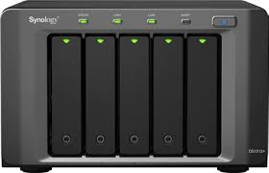
2. SMB (Small-Medium Business) Level NAS/ Midmarket NAS
Examples of a small business line of NAS are QNAP TS-569 PRO and Synology Diskstation DS1512+.

Slide 30
3. Consumer-level NAS
Consumer-level NAS servers are the cheapest among NAS types. These low-end NAS are designed mainly for home users who need only the bare minimum of connectivity.
Scalability: Consumer-level NAS is not as scalable as the Enterprise and SMB levels. It supports up to 20 TB of storage capacity, providing connectivity to at least 20 clients. You can store and backup home users’ data, stream media files, share and synchronize files, and have remote access to your data with this NAS server.
Redundancy: Consumer-level NAS usually doesn’t support RAID functionality, and cloud backup is unavailable. But you can share files privately with friends and family.
It can provide private users with a personalized media server to backup and synchronize files or edit remotely. It can also create a private network between users and the printer, making it easy to edit photos and transfer them for immediate printing.
Manageability: This type of NAS provides user-friendly features such as a printer server and media server capabilities. It also has a built-in backup and file syncing that makes sharing documents around the office effortless.

Slide 31
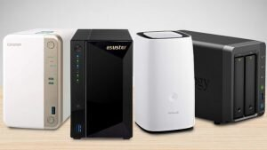
3. Consumer-level NAS
Examples of Consumer-level NAS are Netgear ReadyNAS Duo v2, Synology Diskstation DS 713+, and QNAP TS-212 Turbo NAS.

Slide 32
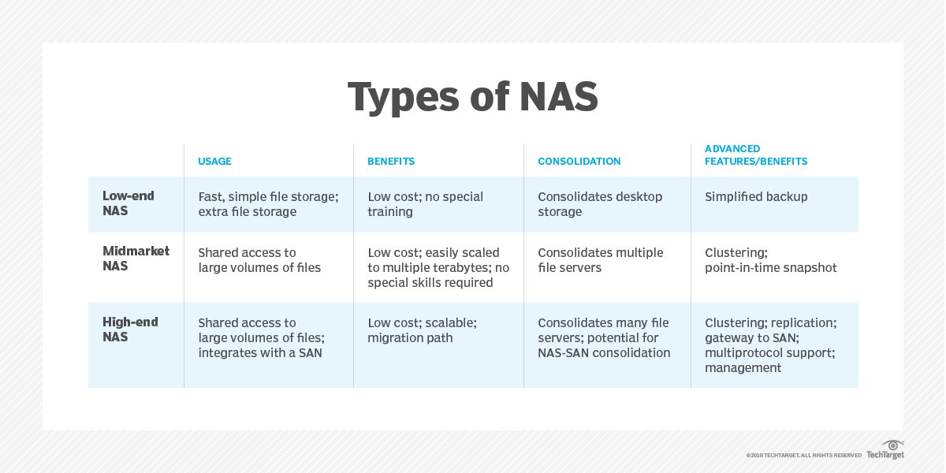

Slide 33
Conclusion
No matter what size they are, businesses generate more data throughout the years as they grow. One of the best solutions is a network-attached storage (NAS) device. Acquiring a NAS becomes an investment that should help businesses long-term.
As mentioned earlier in this article, it is essential to know how and why you need one to buy the right NAS. Not all NAS drives are built equal, and like most technology purchases, the best fit for your company’s needs depends on your budget and planned usage.

Slide 34
Types of Operating Systems for NAS Servers
There are several OS options designed specifically for NAS servers, including:
TrueNAS:
FreeBSD-based and popular among both home users and enterprises.
Features ZFS (Zettabyte File System) for reliability and performance.
OpenMediaVault:
Debian-based NAS OS.
Known for a user-friendly web interface, making it suitable for beginners.
Unraid:
Combines NAS and virtualization functionality.
Allows setting up Docker and VM environments.
Rockstor:
CentOS-based and focuses on BTRFS file system.
Offers similar reliability to ZFS but is often simpler to manage.
XigmaNAS:
Also based on FreeBSD, similar to TrueNAS.
Provides a lightweight option for home networks and small businesses.
Choosing the Right NAS OS: Consider factors like data protection (e.g., ZFS or BTRFS), ease of use, hardware compatibility, community support, and additional features such as Docker and VM support.

Slide 35
TrueNAS Installation Process - Step by Step
Download the TrueNAS ISO:
Visit the TrueNAS official website and download the latest TrueNAS ISO file.
Create a Bootable USB Drive:
Use Rufus or a similar tool to create a bootable USB drive with the TrueNAS ISO.
Open Rufus, select the downloaded ISO, and start the process.
Boot from USB and Start Installation:
Insert the bootable USB into the server/computer designated for NAS.
Boot into the BIOS and select the USB drive as the boot device.
Choose the "Install/Upgrade" option from the TrueNAS boot menu.

Slide 36
TrueNAS Installation Process - Step by Step
Select Installation Drive:
Choose the storage drive for installing TrueNAS. It’s recommended to use a dedicated SSD or smaller drive for the OS, separate from storage drives.
Confirm installation on the selected drive.
Set Up Root Password:
Follow prompts to set a root password, which will be used to access the TrueNAS web interface.
Complete Installation and Reboot:
Wait for the installation to complete and reboot the system.
Remove the USB drive once installation is finished.
Access TrueNAS Web Interface:
After reboot, the server will display an IP address.
Open a browser on a computer within the network and type this IP address to access the TrueNAS web interface.

Slide 37
Sharing a Drive Using TrueNAS - Step by Step
Log into TrueNAS Web Interface:
Enter the IP address in a browser and log in using the root password.
Set Up Storage Pool:
Go to Storage > Pools and click Add.
Select the drives for the storage pool, configure RAID if needed (e.g., RAID-Z for redundancy), and finalize the pool creation.
Create a Dataset:
Within the storage pool, create a Dataset for organizing files.
Configure permissions, compression, and other dataset options as needed.

Slide 38
Sharing a Drive Using TrueNAS - Step by Step
Enable Sharing (SMB for Windows, NFS for Linux):
Go to Sharing > SMB (for Windows) or NFS (for Linux/Mac).
Add a new share, select the dataset created earlier, and set up permissions.
Configure Access Permissions:
Define user and group access for the share. You can restrict or allow certain users to access or modify files.
Connect to Shared Drive:
On Windows: Open File Explorer, go to This PC > Map Network Drive, and enter the NAS IP and share path.
On Mac/Linux: Use Finder or File Manager to connect to the shared folder using the IP address.

Slide 39

“Thank You”

