Slide 1
Lectures On:
Media Converter (MC)

Slide 2
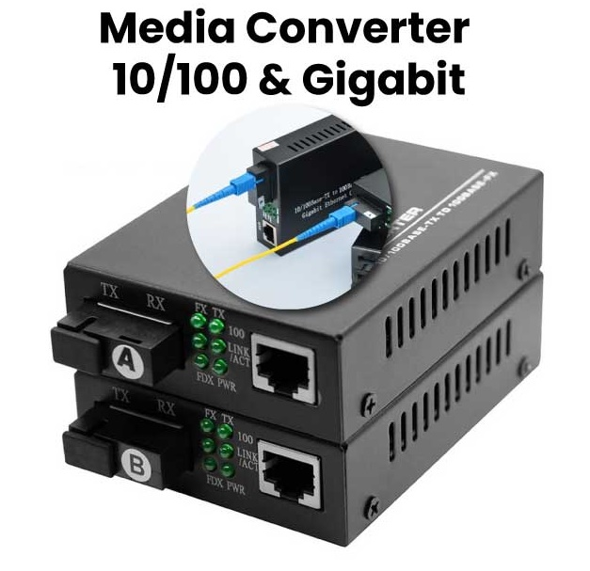
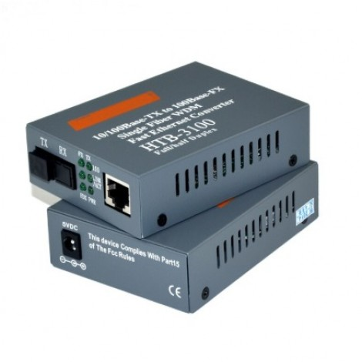
Media Converter (MC)

Slide 3
What is a Media Converter?
Media converters are flexible and cost-effective devices for implementing and optimizing fiber links in all types of networks.
The most common type of media converter is a device that functions as a transceiver converting the electrical signal used in copper Unshielded Twisted Pair (UTP) network cabling into light waves used in fiber optic cabling.

Slide 4
What is a Media Converter?
Fiber optic connectivity is necessary when the distance between two network devices exceeds the transmission distance of copper cabling.
Copper-to-fibber conversion using media converters enables two network devices with copper ports to be connected over extended distances via fibber optic cabling.
Media converters are available as Physical Layer or Layer 2 switching devices, and can provide rate-switching and other advanced switching features like VLAN tagging.
Media converters are typically protocol specific and are available to support a wide variety of network types and data rates.

Slide 5
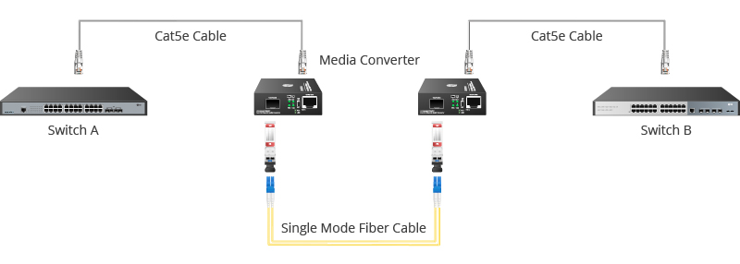
How Media Converter Works

Slide 6
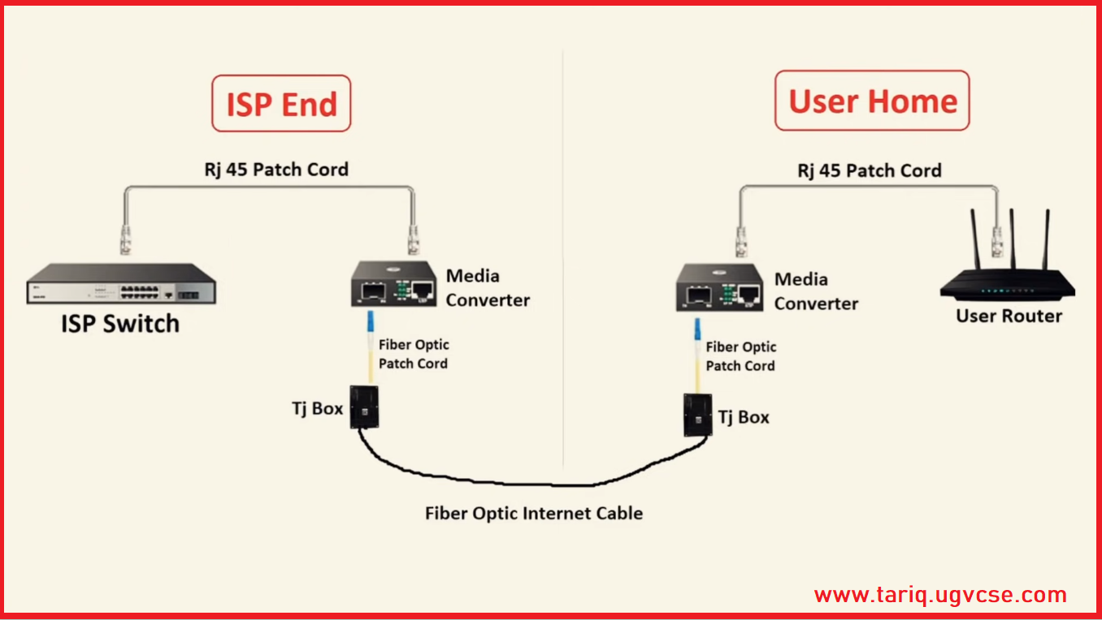
How Media Converter Works

Slide 7
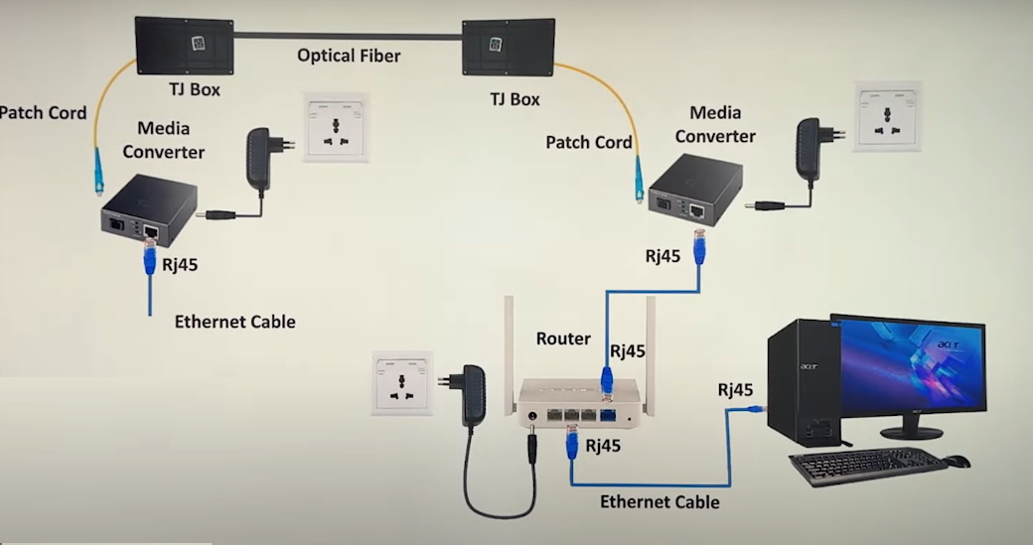

Slide 8
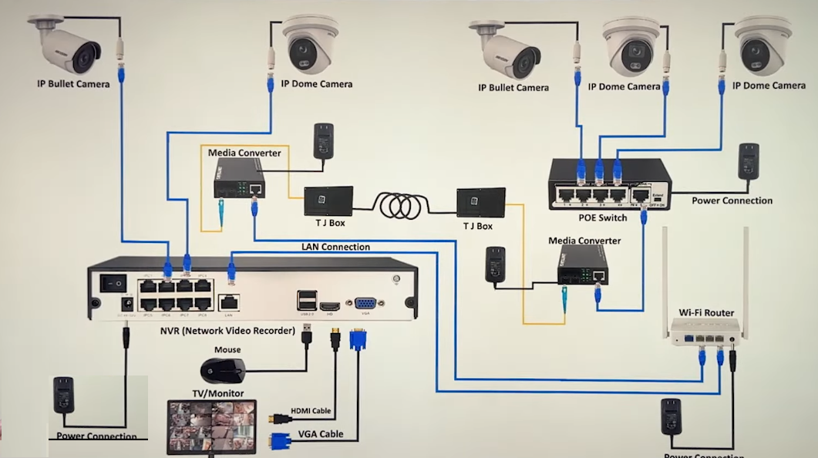

Slide 9
The Benefits of Media Converters
Network complexity, demanding applications, and the growing number of devices on the network are driving network speeds and bandwidth requirements higher and forcing longer distance requirements within the Local Area Network (LAN).
Media converters present solutions to these problems, by allowing the use of fiber when it is needed, and integrating new equipment into existing cabling infrastructure.
Media converters provide seamless integration of copper and fiber, and different fiber types in Enterprise LAN networks.
They support a variety of protocols, data rates and media types to create a more reliable and cost-effective network.

Slide 10
Demands on the Network are Increasing:
LANs and WANs are converging, and networks are growing in physical area
Budget constraints are pushing preservation of capital investment in legacy switches and routers
New network services are driving up bandwidth demand

Slide 11
Solutions Provided by Media Converters:
Increase network distances by converting UTP to fiber and extending fiber links Maintain investments in existing equipment
Increase the capacity of existing fiber with WDM wavelengths (when used with multiplexers)

Slide 12
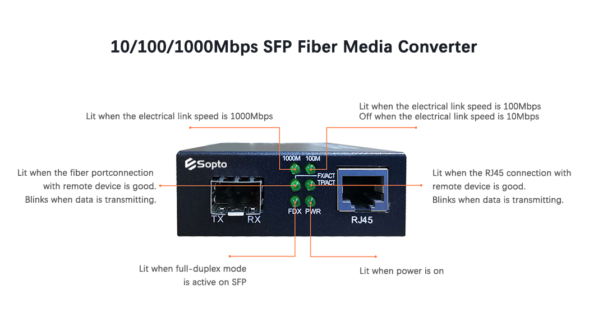
Indicator of MC

Slide 13
Types of Media Converters
There are a wide variety of copper-to-fiber and fiber-to-fiber media converters available that support different network protocols, data rates, cabling and connector types.

Slide 14
Copper-to-Fiber Media Converters
Supporting the IEEE 802.3 standard, Ethernet copper-to-fiber media converters provide connectivity for Ethernet, Fast Ethernet, Gigabit and 10 Gigabit Ethernet devices.
Some converters support 10/100 or 10/100/1000 rate switching, enabling the integration of equipment of different data rates and interface types into one seamless network.

Slide 15
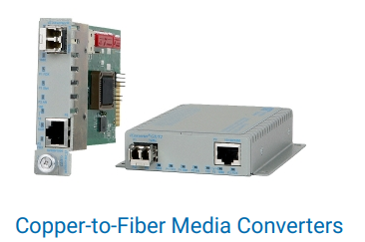
Copper-to-Fiber Media Converters

Slide 16
Copper-to-Fiber Media Converters
Fiber-to-fiber media converters provide connectivity between multimode and single-mode fiber, and between dual fiber and single-fiber.
In addition, fiber-to-fiber media converters support conversion from one wavelength to another, including standard wavelengths (1310, 1550) and CWDM wavelengths.
Fiber-to-fiber media converters are typically protocol independent and available for Ethernet, and TDM applications.

Slide 17
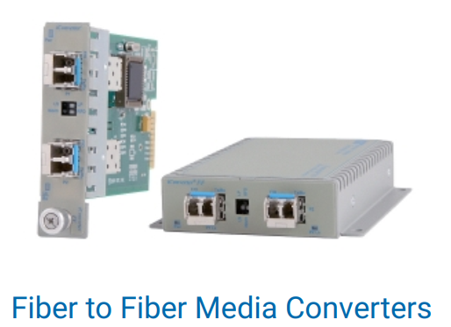
Copper-to-Fiber Media Converters

Slide 18
Standalone and Chassis-Based Media Converters
Media converters are available as compact standalone units that can be AC or DC powered.
Standalone media converters are deployed to convert one copper connection to fiber in a point-to-point deployment.
Chassis-based media converters are plug-in modules that can be installed in a variety of chassis configurations.
High-density, rack-mount chassis enable multiple fiber runs from copper switches in a star topology.
Compact chassis provide a fiber uplink and multiple copper for network edge deployments.
Chassis feature multiple power supplies for redundant power protection and data backplanes that provide connectivity between modules for flexible and scalable multi-port deployments.

Slide 19
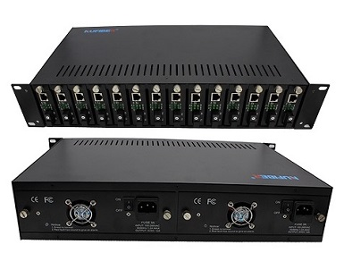
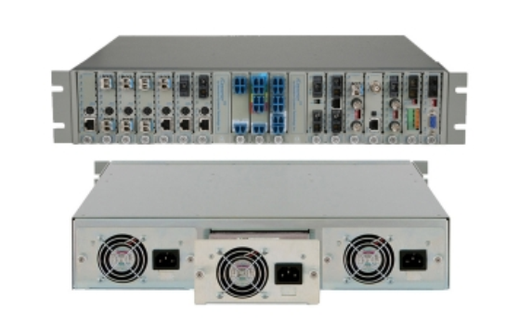
Chassis-Based Media Converters

Slide 20
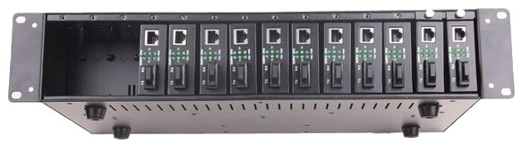
Chassis-Based Media Converters

Slide 21
Unmanaged and Managed Media Converters

Slide 22
Unmanaged Media Converters
Unmanaged media converters are easy-to-use plug-and-play devices, but most unmanaged converters require minimal configuration.
After connecting an unmanaged media converter to the power supply, they combine the hardware with auto-negotiation of data rates and duplex modes.
The basic configuration of duplex modes, auto-negotiation and crossover can be configured with DIP switches.
Unmanaged media converters can be configured with DIP switches such as remote fault indication, fault propagation and loopback modes.

Slide 23
Unmanaged Media Converters
Unmanaged media converters are easy-to-use plug-and-play devices, but most unmanaged converters require minimal configuration.
After connecting an unmanaged media converter to the power supply, they combine the hardware with auto-negotiation of data rates and duplex modes.
The basic configuration of duplex modes, auto-negotiation and crossover can be configured with DIP switches.
Unmanaged media converters can be configured with DIP switches such as remote fault indication, fault propagation and loopback modes.

Slide 24
Managed Media Converter
A managed media converter provides network monitoring, fault detection and remote configuration, which bring substantial benefits such as reduced operating costs and improved network reliability.
Managed media converters demand supplemental hardware to enable management, including SNMPv1, SNMPv2c, and SNMPv3. The additional hardware installed in the same chassis can be a management module or a media converter with integrated management capabilities.
Easily accessible DIP switches or Web, Telnet, SSH, SNMPv1/v2c/v3 or Serial Console management interfaces can be used to configure the mode of operation.

Slide 25
Benefits Managed Media Converter
Remote configuration
Managed media converters' remote configuration feature enables the device to troubleshoot and configure network equipment remotely. Remote configuration reduces network administrator trips to edge equipment, which reduces network operating costs (OPEX).
Network Monitoring
Network monitoring is the process of continuously inspecting the network for potential problems. Network monitoring informs the network engineer of problems such as slow traffic or component failure via text, email or other applications.
Fault Detection
In addition to being actively responsible for network problems, error management quickly isolates network errors to ensure security in the network and prevent them from spreading to other departments.

Slide 26
Managed Media Converter
https://www.youtube.com/watch?v=QUYIo3eT0ig
https://www.youtube.com/watch?v=mrB67v_mNGA
https://www.youtube.com/watch?v=89cN17LRLVc

Slide 27
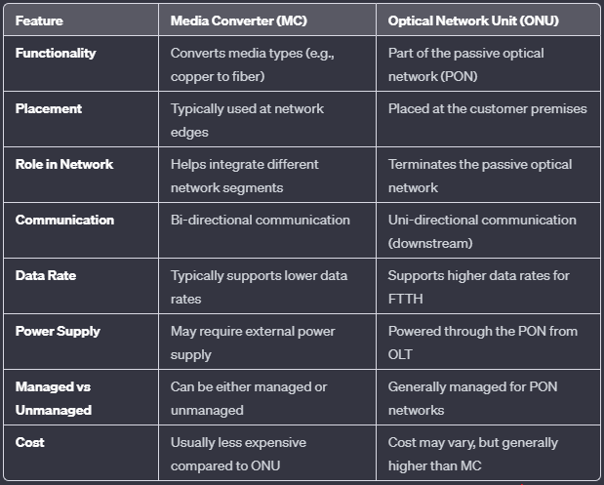
MC vs ONU

Slide 28

“Thank You”

