Slide 1
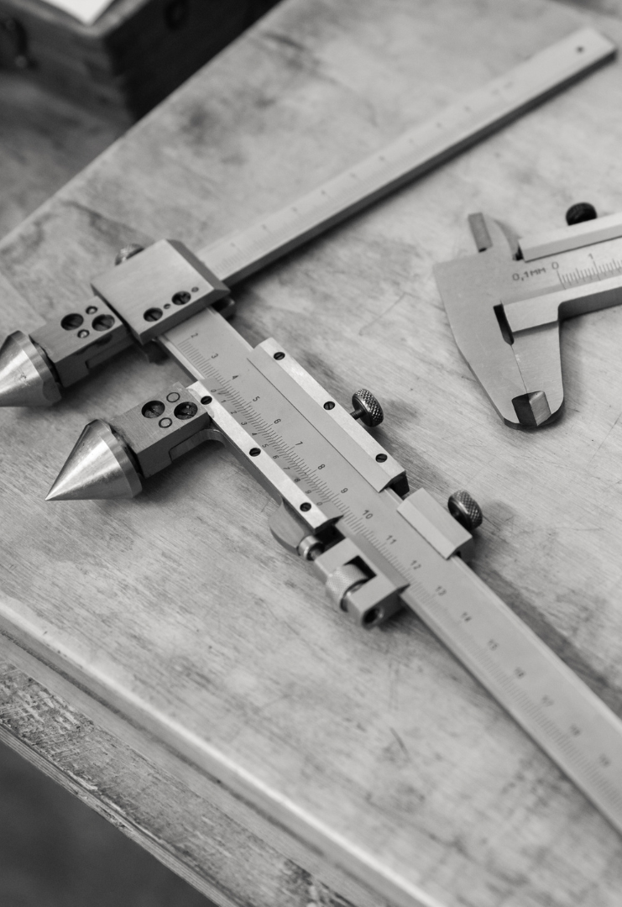

LAB MANUAL FOR
Measurement and quality control lab
DEPARTMENT OF MECHANICAL ENGINEERING
COURSE INFORMATION
COURSE NAME | Measurement and quality control lab
COURSE CODE | IPE 382
CREDIT | 1
ASSESMENT | 50

Slide 2
Course Learning Outcomes (CLOs)
The learning outcomes that are expected to be attained by the student at the end of the course are.
Sl. No. CLOs Domain of learning PLOs
1 | DISPLAY basic proficiency in operation of the apparatus and PERFORM the experiment to determine the solution of the engineering problems related to the subject. | Psychomotor | 1,2,3
2 | Communicate the learned concepts using different media i.e., verbal and written. As well as perform teamwork. | Affective | 5,6
3 | Manifest the professional responsibilities and norms of engineering practice. | Psychomotor, Affective | 7,10

Slide 3
CONTENT
Sl. No. | Title of the Experiment | Week
1 | Determination of modulus of elasticity of a mild steel specimen using strain gauges. (Bending Test) | 1
2 | Measurement of thread parameters using Optical Projector (Profile Projector) | 2-3
3 | Measurement of thread parameters using Toolmaker Microscope | 4-5
4 | Measurement of angle using Sine bar | 6-7
5 | Measurement of alignment using Autocollimator / Roller set | 8-9
6 | Measurement of cutting tool forces using Lathe tool Dynamometer, Measurement of torque & thrust force using Drill tool Dynamometer. | 10-11
7 | Measurement of Screw thread parameters using two wire or Three-wire method (Floating Carriage Micrometer) | 12-13
8 | Measurement of thickness by using Comparators | 14-15
9 | Measurement of gear tooth profile using gear tooth vernier/Gear tooth micrometer | 16
10 | Calibration of Micrometer using slip gauges | 17

Slide 4
INTRODUCTION
In science and engineering, objects of interest have to be characterized by measurement and testing. Measurement is the process of experimentally obtaining quantity values that can reasonably be attributed to a property of a body or substance.
Metrology is the science of measurement.
Metrology is also a fine avenue for discussing accuracy, error, and calibration
Testing is the technical procedure consisting of the determination of
characteristics of a given object or process, in accordance with a
specified method In metrology (the science of measurement), a standard is an object, system, or experiment that bears a defined relationship to a unit of measurement of a physical quantity.

Slide 5
NEED FOR MEASUREMENT
◻To determine the true dimensions of a part.
◻To increase our knowledge and understanding of the world.
◻Needed for ensuring public health and human safety.
◻To convert physical parameters into meaningful numbers.
◻To test if the elements that constitute the system function
as per the design.
◻For evaluating the performance of a system.
◻For studying some basic laws of nature.
◻To ensure interchangeability with a view to promoting mass production.
◻To evaluate the response of the system to a particular point.
◻Check the limitations of theory in actual situation.
◻To establish the validity of design and for finding new data and new designs.

Slide 6
METHODS OF MEASUREMENT
Direct comparison with Primary or Secondary Standard.
Indirect comparison with a standard through calibration system.
Comparative method.
Coincidence method
Fundamental method.
Contact method.
Transposition method.
Complementary method.
Deflection method.

Slide 7
Direct method: The value to be measured is directly obtained. Examples: Vernier calipers, Scales.
Indirect method: The value of quantity to be measured is obtained by measuring other quantities. Diameter measurement by using three wires.
Comparative method: In this method, the quantity to be measured is compared with other known value. Example: Comparators.
Coincidence method: The value of the quantity to be measured &determined is coincide with certain lines and signals.
Fundamental method: Measuring a quantity directly in related with the definition of that quantity
Contact method: The sensor or measuring tip of the instrument touches the area (or) diameter (or)surface to be measured.

Slide 8
Example: Vernier caliper.
Transposition method: In this method, the quantity to be measured is first balanced by a known value and then it is balanced
by other new known value. Example: Determination of mass by balancing methods.
Complementary method: The value of quantity to be measured is combined with known value of the same quantity. Example: Volume determination by liquid displacement.
Deflection method: The value to be measured is directly indicated by
a deflection of pointer. Example: Pressure measurement

Slide 9
Accuracy and Error
You may have heard the expression ―close enough for engineering.‖ It is a reference to accuracy— how good is the measurement (dimensional or otherwise)? More specifically, accuracy isa reference to the relative magnitude of the error in one or more measurements— how close is my measurement to the true value? Typically, one device (or technique, for that matter) is said to be more accurate than another because it gives measurements that have smaller errors.
Error in a measurement is classified into two types:
Bias errors and
Precision errors.

Slide 10
A measurement is accurate if both the precision error and bias error are low.
Figure 1 shows the relationship graphically. Precision error refers to the repeatability of a measurement: a group of measurements with a low precision error is always close to the same average value. However, this average value may not be the correct (i.e. true) value because of bias error. Bias error moves the average value away from the true value in a systematic (i.e. constant) way. On the other hand, a group of measurements with the correct average value, but showing a great deal of scatter has a low bias error and a large precision error. So, precision error is a consequence of repeatability and bias error is a consequence of constant offset errors.

Slide 11
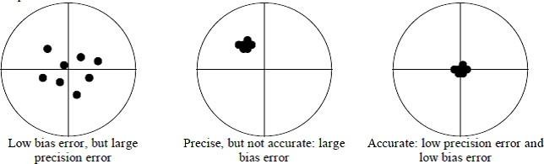
Calibration
Fig1. Relationship of Accuracy, Precision Error and Bias Error
A good measurement procedure is one which attempts to minimize these errors. An important part of this procedure is calibration— the procedure of verifying the accuracy of the measurement device itself by measuring known quantities and comparing the output of the measurement instrument to the expected values.
These “known quantities” are called standards. The primary standard is the internationally accepted definition of the quantity of interest, such as mass and length1, and is maintained at a facility in

Slide 12
France. A mirror standard is typically maintained in a national facility such NIST in the United States. Secondary standards are copies of the primary standard that are more accessible than the primary standard. These copies are rated, and can be certified as accurate to a certain level against the primary standard. For example, for verifying my electronic balance, I can purchase either ASTM Class 1 calibration masses, accurate to within 0.00025% of their rated mass, or NIST Class F masses, accurate to within 0.01%. Other than accuracy, the difference is a factor of ten in cost.
Note: Please note that this stated accuracy is an assessment of how closely these standards represent the true value relative to the primary standard.

Slide 13
EXPERIMENT NO. 1
DETERMINATION OF MODULUS OF ELASTICITY OF A MILD STEEL SPECIMEN USING STRAIN GAUGES.
Aim : To determine the Young‘s modulus of a given material and to draw graphs of bending stress v/s Bending strain.
Apparatus Required: Cantilever
beam with strain gauges,
Micro strain indicator, loading device, Weights.

Slide 14
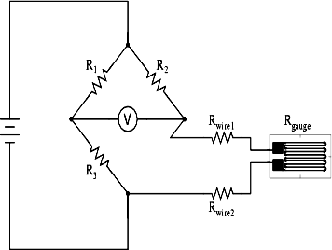
Theory:
+
A strain gauge is a long length of conductor
arranged in a zigzag pattern on a membrane. When it is stretched, its resistance increases.
Electrical resistance of a piece of wire is directly
proportional to the length and inversely to the area of the cross section. Resistance strain gage is based on that phenomenon
If a resistance strain gage is properly attached onto the surface of a structure which strain is to be measured, the strain gage wire/film will also elongate or contract with the structure, and as mentioned above, due to change in length and/or cross section, the resistance of the strain gage changes accordingly. This change of resistance is measured using a strain indicator (with the Wheatstone bridge

Slide 15
circuitry), and the strain is displayed by properly converting the change in resistance to strain.
Every strain gage, by design, has a sensitivity factor called the gage factor.
which correlates strain and resistance as follows:
Gage factor (F) = (D R / R) / e
Where:
R = Resistance of un-deformed strain gage
R = Change in resistance of strain gage due to strain
The objective is to experimentally determine the system sensitivity and compare it to the ideal sensitivity of a strain gage measurement system. The actual system sensitivity will then be used to determine the modulus of elasticity of a cantilever beam.

Slide 16
PROCEDURE:
A flat rectangular M.S. specimen is held as cantilever
The strain gauge is fixed and the strain indicator is calibrated.
A known weight is placed at the specified distance from the fixed end.
Strain indicator reading is noted down.
The experiment is repeated for different loads and the results are tabulated.
The graph of stress v/s strain is plotted an young‘s
modulus of elasticity is determined by graph.

Slide 17
OBSERVATION:-
Resistance of the strain gauge = Ω
Length measure from the cantilever beam to the load position:
L= m
Width of the cantilever beam: b= m Thickness of the cantilever beam: t= m

Slide 18

SL. no | Total weight F‟ |  | Bending moment M | Stress N/m2 | Strain meter reading in Micro strain | Young‟s modulus E
 | kg | N | N-m |  |  | N/m2
 |  |  |  |  | ×10-6
 |  |  |  |  | (ε)

Slide 19
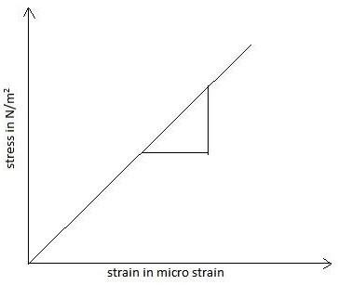
∆𝜎
𝐸 =
∆𝜀
Slope: (ΔY / ΔX) gives Young‘s modulus of specimen (from graph)
Result: Using the strain gauges, Young‗s Modulus of the given mild steel specimen has been determined.

Slide 20
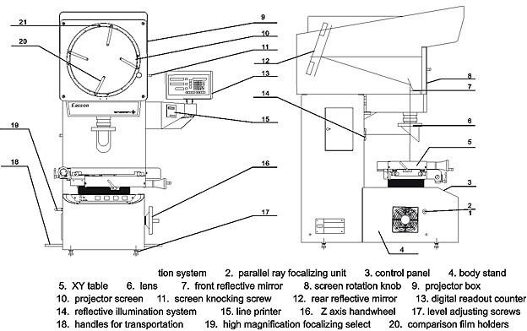
EXPERIMENT NO.2 MEASUREMENTS USING PROFILE PROJECTOR
Aim: To measure the thread parameter of given screw thread using profile projector.
Operators Required: Profile projector, thread specimen, gear. Theory: The optical comparator is a device that applies the principle of optics for the inspection of manufactured parts. The profile projector is basically an
optical instrument which makes use of enlarged instruments. The purpose of the optical projector is to compare the shape or profile of relatively small engineering

Slide 21
compound with an accurate standard or drawing. The projector magnifies the profile of specimen and shows this on the built in projection screen. From this screen there is usually grid that could be rotated 360 degrees. Therefore the XY axis of the screen could be aligned correctly using straight edge of machine part to analyze or measure. Dimension can be directly measured on the screen or compared to the standard reference.

Slide 22
Procedure:
Calculate the least count of micrometer of the projector.
Fix the given test specimen under the magnifying lens on the fixture provided.
Select a suitable magnification.
Switch on the projector and focus to obtain the clear image of the object on screen.
Adjust the reference axis (core wire) to a point of element by adjusting the micrometer and angular disc.
Note down the initial reading of micrometer. Thread parameters found using profile projector.
Major diameter = mm
Minor diameter = mm
Pitch of screw = mm
Depth of thread = mm
Angle of thread = degree

Slide 23
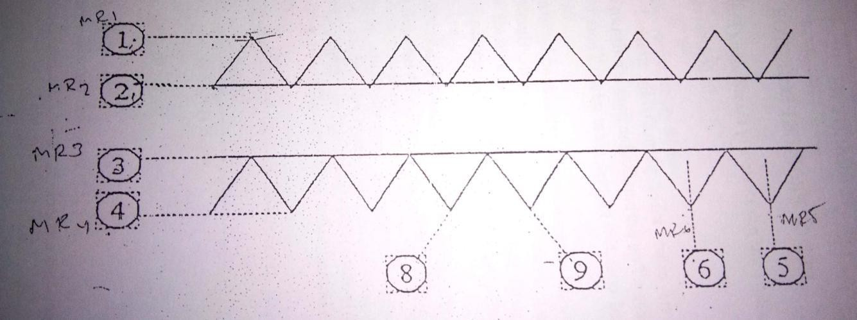
Observation:
Reading from the profile projector.
MR1=
MR2= MR3= MR4= MR5= MR6= MR7= MR8= MR9 =
N=number of threads between two end points

Slide 24
Major diameter= MR1-MR4
Minor diameter=MR2-MR3 Pitch diameter=MR2-MR4
depth of thread =MR1-MR2
depth of thread =MR3-MR4
Average depth =(A+B)/2 Pitch=MR5-MR6
Average pitch=(MR5-MR7)/2 Angle of
thread=MR8-MR9 Flank angle=(MR8- MR9)/2
Results:

Slide 25
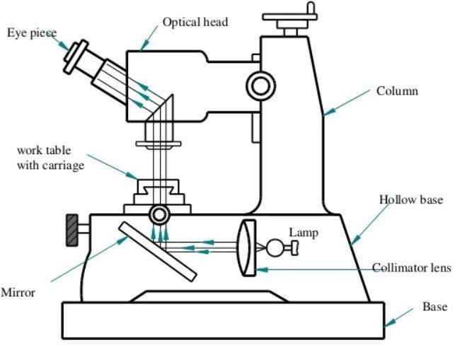
EXPERIMENT NO: 3
USE OF TOOL MAKER’S MICROSCOPE
AIM:
To determine the various thread parameters using a tool maker‘s
microscope.
APPARATUS REQUIRED:
1. Anvil Micrometer 2.Pointed Micrometer
3. Pitch gauge 4.Tool Maker‘s microscope.

Slide 26
PROCEDURE:
Before measuring different thread parameters on Tool maker‘s microscope, measure the major diameter, pitch diameter, the pitch of the thread using V- anvil micrometer, pointed micrometer and pitch gauge respectively. Then the different thread parameters like, major diameter, minor diameter, pitch diameter, pitch, average pitch and helix angle of the thread are determined by positioning the cross- wires at different positions as shown in the fig.1. Then different reading are taken at respective positions using the cross-wire and longitudinal micrometer. The angular readings are obtained with the help of the circular scale provided in the geometric head. The readings at different positions are tabulated as follows:

Slide 27
READINGS FROM MICROSCOPE.
(MR-Microscope Reading in mm) MR1=
MR2= MR3=
MR4= MR5= MR6=
MR7= MR8=
MR9=
N=No. of threads between two end points. Major diameter = MR1~MR4.
Minor diameter = MR2~MR3.
Pitch diameter = MR2~MR4 or MR1~MR3.

Slide 28
A) Depth of the Thread =MR1~MR2.
B) Depth of thread = MR3~MR4. Average Depth = (A=B)/2.
Pitch = MR5~MR6.
Average pitch = (MR5~MR7)/2. Angle of Thread =MR8~MR9.
Flank angle =(MR8~MR9)/2.
Reading of the Vernier caliper/depth gauge is given by the expression,
T.R= MSR+CVSD*LC
Observation:
Instrument:
Make: Range:
L.C :

Slide 29
Measurement using micrometer:
For taking the measurement, using micrometer place the specimen between
the anvils of the micrometer and rotate the thimble till the spacing between the anvils is slightly more than the dimension to be measured. Then rotate the ratchet screw till the jaws have proper contact with the specimen. The necessary pressure to be applied can be recognized from the ratchet arrangement. Sufficient pressure is obtained. Now lock the spindle and note down the micrometer reading.
L.C of the micrometer can be determined using the expression,
L.C= (Pitch)/(No. of HSD) Pitch scale reading (PSR)= Least count(L.C)=
No. of head scale divisions(HSD)=
Total reading (TR)=PSR+HSD*LC
Results: The pitch and angle of the given object is measured with toolmakers microscope are tabulated

Slide 30
EXPERIMENT NO : 4
USE OF SLIP GAUGES, SINE BARS AND SINE CENTERS
AIM:
To set the required angle using slip gauges and sine bar and to measure the taper angle of the given specimen using sine center and slip gauges.
APPARATUS REQUIRED:
1.Surface plate. 2.slip gauges. 3.Sine bar. 4.Bevel protractor combination square. 5.sine center. 6.Dial indicator. 7.Vernier
caliper. 8.Magnetic Stand/height gauge.

Slide 31
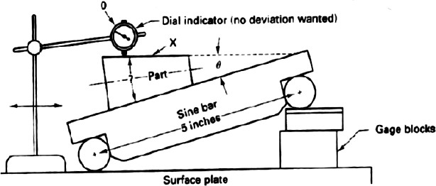
THEORY:
Sine bar is based upon laws of trigonometry. To set a given angle one roller of the bar is placed on the surface plate and the combination of slip gauges is inserted under the second roller as shown in the figure. If h is the height of the combination of the slip gauges, l is the distance between roller centers,
Therefore, θ = sin-1 (h/L)
Then the angle can be measured as a function of sine. Thus, it is
called Sine bar.

Slide 32
Requirements of a Sine bar:
The axes of the roller must be parallel to each other and the center distance L must be known.
The top surface of the bar must have a high degree of flatness.
The roller must be of identical diameters and round within a
close tolerance.
Depending upon the accuracy of the center distance, sine bars are graded as of A grade or B grad.B grade - Sine bars are guaranteed accurately up to
0.02 mm /meter of length and A grade sine bars are more accurate and guaranteed up to 0.01 mm/meter of length.

Slide 33
Procedure:
The sine bar is made to rest on surface plate with rollers contacting the datum.
Place the component on sine bar and lock it in position.
Lift one end of the roller of sine bar and place a pack of slip
gauge, underneath the roller.
Height of the slip gauges (h) should be selected such that the top surface of component is parallel to the datum plate.
Record the final height of the slip gauge combination for achieving parallelism.
Calculate inclination θ = sin-1 (h/L)

Slide 34
Setting the given sine bar to the given angle:
Take note of the given angle for which the top surface of the sine bar is to be set.
Theoretically calculate the height of the slip gauge required to lift
one end of sine bar such that top surface of the sine bar make the required slope. Approximate height of slip gauge used= Happ.
Happ. = dh xL mm
√ dh²+l²
Insert the selected combination of slip gauge under one end of the sine bar.
Use dial gauge with stand and traverse the plunger of the dial
gauge over a known length and check the slope of the sine bar
Limitations:
Sine bar is reliable for angles less than 15°, and the angle above 45°.
Slightly errors of the sine bar cause larger angular errors.
Size of the parts which can be impacted by sine bar is limited.

Slide 35
PROCEDURE:
To set the required angle using slip gauges and sine bar.
Measure the length of sine bar (Distance between the centers of two
rollers)
Calculate the height of the slip gauges required for setting the required angle using the formula, H=L x Sine◻ ◻
Select and clean the required sizes of slip gauges and wring them together to get the required dimension.
Place the plie of slip gauges below the roller of the sine bar carefully.
Check the setup angle using either a bevel protractor or combination
square (While using combination square ensure that the air bubbles lies in the mid position).
If found incorrect, change the slip gauge combination suitably and correct it to the required angle.

Slide 36
OBSERVATION:
Length of the sine bar, L= Angle to be set =
Slip gauge combination used =
To measure the angle of taper of a given tapered specimen using slip gauges and sine center
PROCEDURE:
First, the length of the tapered section, major and minor diameter of the
given specimen are measured using Vernier caliper/micrometer and the approximate half taper angle is calculated using the formula.
The taper specimen is mounted in between the centers of sine center and is placed over the surface plate. A Vernier height gauge/magnetic stand fitted with dial indicator is also placed on the surface plate.
Using the calculated value of taper angle, the required height of slip

Slide 37
gauges is calculated using the formula, H=L*sinθ and the combination is built
up. One end of the sine center is lifted up and one of its rollers is placed carefully on the pile of slip gauges.
Now to verify the angle, bring the height gauge near the work piece and make the tip of the dial indicator touch the diameter of the taper at one and make the dial indicator reading zero.
Now the height gauge or magnetic stand fitted with dial indicator is moved parallel to the work piece axis and the pointer is made to rest on the other end of the tapered length. If no deflection is observed in the indicator, the angle calculated is correct. Otherwise, the height of the slip gauges is to be corrected till we get the same reading on the dial indicator at both the taper end. The height to be corrected can be determined using the relation.

Slide 38
OBSERVATION:
𝐿
Length of the sine center
Length of the tapered portion
=L=
=L1=
3. Major diameter | =D=
4. Minor diameter | =d=
5. Height of slip gauge | =H=
6. Corrected height of slip gauge | =h=
7. Half tapered angle | =
8. Reading in dial indicator | =y=
Sl.no | ANGLE | SLIP GAUGE COMBINATON

Slide 39
EXPERIMENT NO.5
USE OF AUTO COLLIMATOR
AIM:
To determine the parallelly, perpendicularity of given specimen using Auto collimator.
APPARATUS REQUIRED :
1.Auto collimator square.
2.Surface plate
3.Highly polished mirror
4.Try

Slide 40
THEORY:
Auto-collimator is basically a telescope permanently focused for infinity. This is a sensitive extremely accurate optical instrument which is used in workshops for inspecting straightness, squareness and parallelism. The instrument uses the basic principle of reflection.
A plane parallel beam of light projected on to a plane reflecting surface placed normal to the beam is reflected back along the same path. When the surface is slightly tilted the reflected beam returns but in deviated path. The angle of direction is taken as a measure to check the straightness.

Slide 41
PRINCIPLE OF MEASUREMENT:
The optical arrangement adopted for autocollimator is as shown in fig. Light rays from the light source will be reflected partially in to the optical axis by half-reflecting layer in the prism. Then, passing through the objective the light rays become parallel and reach the mirror ‗M‘ placed at a distance in front of the objective. The light beam thus, reflected back by the mirror surface will pass through the objective again and further through the half-reflecting layer in the prism, forming an image S1 of the crosshair S on the rectile.

Slide 42
If the mirror is tilted by a minute angle of θº from position A to B, the reflected light beam, being inclined at 20º, will re-enter the objective, causing a displacement of ‗d‘ to the image of the crosshair. This interrelation can be expressed by the formula,
𝑑 = 𝑓 ∗ tan(2𝜃) = 2𝑓 ∗ 𝜃
where,
f is the focal length of the objective. By reading the value of d with the scale provided on the article the tilt angle of the mirror can be determined.
In the auto collimator Model-6D, two vertical and horizontal scales are engraved at right angles on the reticle with one division of l‘ and the fractional value of l‘ can be read down to 0.6‖ by moving the reticle precisely with the micrometer.

Slide 43
INITIAL SET UP:
Set the compensator ring to 100.
Set the reading of the micrometer to ‗zero‘.
Place the reflecting mirror on the work piece to be tested at a
distance between 0.9 to 1.4 meters.
Approximately align the collimator such that the green light is visible in the reflecting mirror when viewed from one side of the collimator tube.

Slide 44
Get the cross wire in the field of view by swinging the collimator tube along vertical and horizontal axis.
NOTE: While swinging the collimator tube, at most care must be taken, as these are chances of collimator tube hitting the surface plate and may cause damage. After getting the cross wires in the field of view lock all the locking knobs firmly.
Using the fine adjustment knobs provided at the bottom of the collimator bracket, bring the cross wires to align at the center of the scale. Then the measurements are made as explained below.

Slide 45
READING AND CALCULATIONS: (For Straightness Measurements)
Set the successive measuring points at some interval and call such points as C, D in the order from the autocollimator.
Move the mirror across various distances and make autocollimations at respective points in the tabular column, with the help of the autocollimator scale and the micrometer. This represents the differences in ‗θ‘ from the zero position with ‗±‘ sign according to the moving direction of the cross wire from the zero position.
Find the amount of linear variation corresponding to the angular values using the relation,
H = 𝐿 sin 𝜃
Where
h = Difference in height between two successive points. L = Length of successive measuring points.
θ = Angle noted between two successive points.
Then tabulate the reading of h in the tabular column.

Slide 46
Write the accumulated values in the next row an draw a graph will successive lengths on X-axis an d the accumulated reading at different points on Y-axis.
Join the end points by a straight line and tile this line such that it becomes parallel to the X- axis. Now transfer the perpendicular heights from this line to get the total deviation p present on the component. The height between the peak points on the positive and negative coordinates will indicate the error of straightness.

Slide 47
TABULATION:
SL. NO. | DETAILS | MEASURING POINTS
 |  |  | A | B | C | D | E
1. | Read out angles by auto collimator (difference from the read-out angle)
2. | (Deviations for each 100 mm)
3. | Accumulated values

Slide 48
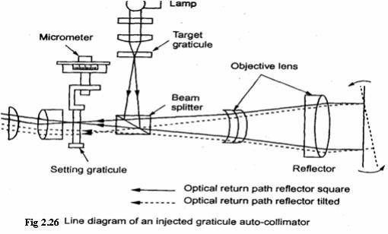
PRINCIPLE OF AUTOCOLLIMA
Results:
Measured the Straightness and Flatness of the given specimen using Auto Collimat

Slide 49
EXPERIMENT NO. 6 LATHE TOOL DYNAMOMET
AIM:
To determine cutting force and power absorbed in turning process on lathe.
APPARATUS REQUIRED:
Lathe tool Dynamometer.
APPARATUS DESCRIPTION:
The instrument comprises of digital display calibrated to read 3 forces at a time along X, Y, Z directions. It has been built in excitation supply with independent null balancing for respective strain gauge bridge. Within the given range, the display is calibrated for respective force.

Slide 50
SPECIFICATION:
Range of force: 500kgf in X,Y,Z directions.
Bridge Resistance: 350Ω
Bridge Voltage: J2V Max.
THEORY :
In machining or metal cutting operation the device used for
determination of cutting forces is known as a Tool Dynamometer or Force Dynamometer. Majority of dynamometers used for measuring the tool forces use the deflections or strains caused in the components, supporting the tool in metal cutting, as the basis for determining these forces.

Slide 51
In order that a dynamometer gives satisfactory results it should possess the following important characteristics:
It should be sufficiently rigid to prevent vibrations.
At the same time, it should be sensitive enough to record
deflections and strains appreciably.
Its design should be such that it can be assembled and disassembled easily.
A simpler design is always preferable because it can be used easily.
It should possess substantial stability against variations in time,
temperature, humidity etc.
It should be perfectly reliable.
The metal cutting process should not be disturbed by it, i.e.
no obstruction
should be provided by it in the path of chip flow or tool travel.

Slide 52
PROCEDURE:
Fix the lathe tool dynamometer in the tool post, using the central hole provided on the dynamometer. Ensure that the object being turned as a smooth surface and the tool tip exact at center height.
Plug the Power cable to the main supply.
Connect one end of the interconnecting cables to X,Y,Z output
socket of the dynamometer and the other end to the sensor socket on the front panel of the instrument.
Set the RED-CAL switch at READ position.
Switch on the instrument by placing the power on switch ON position.
Adjust the potentiometer such that the display reads zero.
Turn on the RED-CAL switch to CAL. Adjust the CAL-
Potentiometer until the display reads the range of force. Is

Slide 53
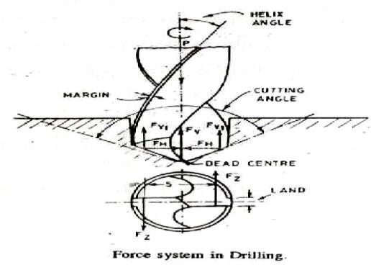
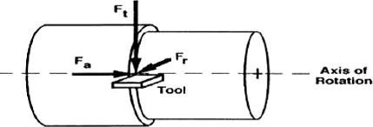
operation is to be conducted when dynamometer is not having any load applied on it.
Turn back the READ-CAL switch to READ position. Now the instrument is calibrated to read force value up to calibrated capacity of the dynamometer in respective X,Y,Z axis.
If a recording oscilloscope or oscilloscope is to be used to connect them to the recorder output terminals.
The forces applied on dynamometer are to be red on analog meter. Connect the 6-core cable provided with the instrument from back panel of the multi force
indicator to the back panel of analog display.

Slide 54
OBSERVATION:
Initial diameter of the specimen(D)= mm
Speed(N)= RPM
Depth of cut/pass=mm
TABULAR COLUMN:
SL NO. | FORCE IN kgf |  |  | DEPTH OF CUT (mm) | DIAMETER (mm) | RESULTAT FORCE(F) |  | CUTTIG SPEED VC (m/s) | POWER (WATTS)
 | FX | FY | FZ |  |  | kg | N

Slide 55
CALCULATIONS:
Diameter=Initial diameter-(2*Depth of cut) mm.
𝜋𝐷𝑁 𝑚
𝑐𝑢𝑡𝑡𝑖𝑛𝑔 𝑠𝑝𝑒𝑒𝑑 (𝑉𝐶) = _{1000 ∗ 60 𝑠}
Where D=Diameter of Work Piece in mm.
N=RPM.
Power=P=Fr x VC watts.
Where Fr=Resultant Force =√𝐹𝑥 ² + 𝐹𝑦 ² + 𝐹𝑧 ² N VC=Cutting Speed (m/s).
RESULTS:
The resultant forces are found out for different speeds (V) by lathe tool dynamometer

Slide 56
EXPERIMENT NO.7
TWO WIRE AND THREE WIRE METHOD OF EFFECTIVE DIAMETER MEASUREMENT USING FLOATING CARRIAGE MICROMETER.
AIM:
To determine the major and effective diameter of the given threaded component.
APPARATUS REQUIRED:
1. Floating carriage machine 2.Standard wires 3.Standard cylinder.
THEORY:
1.Two wire and three method of effective diameter measurement.
2. Care to be taken while handling Floating Carriage Diameter Measuring Machine.
3. Best size of wires.

Slide 57
Floating Carriage Micrometer (FCM):
Effective Diameter Measuring Micrometer (EDMM) is also commonly known as FCM or Floating Carriage Micrometer. This instrument is used for accurate measurement of 'Thread Plug Gauges'. Gauge dimensions such as Outside diameter, Pitch diameter, and Root diameter are measured with the help of this instrument. In order to ensure the manufacture of screw threads to the specified limits laid down in the appropriate standard it is essential to provide some means of inspecting the final product. For measurement of internal threads thread plug gauge is used and to check these plug gauges Floating Carriage Micrometer is used for measuring Major, Minor and Effective diameter.
The pitch diameter is the diameter of an imaginary cylinder which

Slide 58
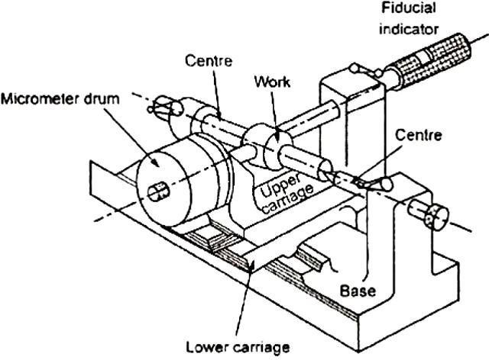
passes through the thread profile at such points as to make the widths of thread groove and thread ridge equal. The correct pitch diameter assures that the threaded product or thread gage is within required limits in producing interchange ability and strength. Periodic measurement of the pitch diameter is recommended to determine whether a thread gage is worn below tolerance.
Fig. Floating Carriage Micrometer

Slide 59
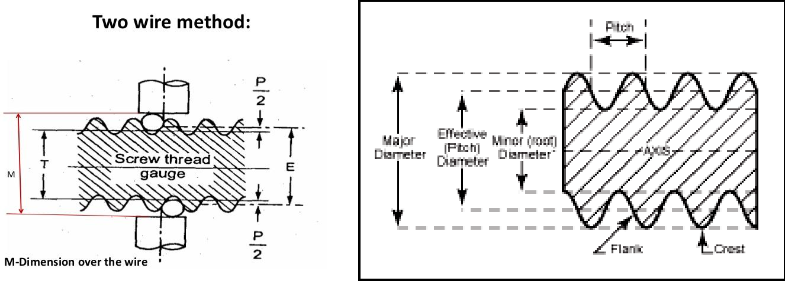
Two-wire method
The effective diameter cannot be measured directly but can be calculated from the measurements made.
Wires of exactly known diameters are chosen such that they contact the flanks at their straight portions
If the size of the wire is such that it contacts the flanks at the pitch line, it is called the best size of wire which can be
determined by the geometry of screw thread.
The screw thread is mounted between the centers and wires are placed in the grooves and reading is taken.

Slide 60
PROCEDURE:
PRINCIPLE OF MEASUREMENT:
The floating carriage diameter measuring machine is primarily used for measuring, major, and effective diameters of thread gauges and precision threaded components. The instrument has a meaning accuracy of 0.0002mm. It consists of a sturdy cast-iron base, two accurately aligned and adjustable centers. At right angles to the axis of centers, there is a freely moving measuring carriage mounted on ‗v‘-ways and carrying a micrometer and highly sensitive fiducial indicator. This carriage permits measurements to be taken along the center line and at right angles to the work. All measurements are made relative to a reference master gauge or plain cylinder standard. The diameter of the standard should be within 2.5mm of the effective diameter of the work to be measured.

Slide 61
The reading is taken on the diameter over the standard with cylinders/prisms in position depending upon the thread element to be measured. The standard is then replaced by the workpiece and the measurements are taken.
MAJOR DIAMETER MEASUREMENT:
The instrument is first present using a suitable cylindrical standard
and the reading (R) of the micrometer is noted. The standard is then replaced by the workpiece and second reading is taken. The major diameter of the given specimen can be determined using the expression.
F = D ± (R~R1)
where, F = Major diameter.
D = Diameter of the cylindrical standard used.
± = is determined by the relative size of the standard workpiece.

Slide 62
EFFECTIVE DIAMETER MEASUREMENT:
To determine the effective diameter of the thread, measurements are taken over the thread measuring wires which will be selected depending upon the size and form of thread by referring to the tables supplied.
The instrument is first present over a suitable cylindrical standard and selected thread measuring wires. The reading (Rs) of micrometer is noted.
Then the standard is replaced by the workpiece along with the wires introduced in the thread form as shown in fig. The second reading (Rw) of the micrometer is noted.
The effective diameter can be determined relation, E = D ± [(Rs – P) ~ Rw]
where, E = The effective diameter.
using the

Slide 63
D = Diameter of the standard cylinder.
P = A constant which is dependent on the diameter of cylinders
and the form of thread to be measured. It is also defined as the difference between the effective diameter and the diameter under
the standard wires.
The value of ‗p‘ can be calculated using the expression, P = [(0.86602 * p) – d] for 60 degree metric and
unified threads where, p = pitch of component.
d = mean diameter of the wires used.
the threaded

Slide 64
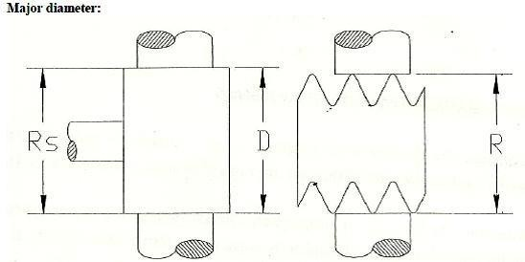
1.Measurement of major diameter:
RS= Micrometer reading over setting Master/Standard.
RW = micrometer reading over threaded work piece. D = Standard cylinder diameter
RS = MSR + (HSR x LC) + (CVD x LC)
RW = MSR + (HSR x LC) + (CVD x LC)

Slide 65
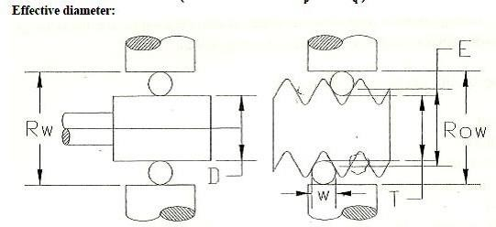
2.Measurement of effective diameter:
RESULTS:
Major Diameter
Minor Diameter Effective Diameter
= mm
= mm
= mm

Slide 66
EXPERIMENT NO.8 USE OF COMPARATORS
AIM:
To compare the dimensions of given specimens with appropriate standards using mechanical, electrical and pneumatic comparators.
APPARATUS REQUIRED:
Dial indicator
Dial mounting stand with fine adjustments.
Electrical comparator with probe and worktable
Pneumatic comparator with measuring gauges
Vernier caliper
6.Micrometer

Slide 67
TO FIND:
Average size of the component.
To plot the graph of variations.
To determine the variation with respect to given tolerance value.
To segregate the component under heading oversize, undersize and correct size.

Slide 68
PROCEDURE:
FOR USING MECHANICAL AND ELECTRICAL COMPARATOR:
1. First measure the dimension of given specimen
micrometer/Vernier caliper.
using
Select the appropriate standard/buildup the slip gauges to required height and pace it below the plunger.
Set the reading of the dial indicator to zero. Thus the standard dimension is set on the dial indicator.

Slide 69
The standard component/pile of slip gauges is removed, and the given specimen is introduced below plunger in place of the standard. Take the reading of the dial indicator at different point on the surface of the specimen. Then the average of all deviations is calculated, and the correct size of the specimen is determined.
A graph is plotted with the number of components in X-axis and the deviation on Y-axis.

Slide 70
USE OF PNEUMATIC COMPATOR.
Before measurement make certain that the compressed air is passed through the system and freely escapes from the gauge head nozzles.
Use masterpiece and zero adjuster set the tolerance limits and initial reference reading in the indicator.
Now the standard gauge is introduced in the bore of the component to be compared and the reading are tabulated.
The average size of component=standard size+- Average deviation
Result: The given specimen is tested for roughness using Tal surf and the different roughness parameters Ra, Rq, Ry, &Rzare tabulated in the tabular column.

Slide 71
TABULAR COLUMN FOR USE OF COMPARATORS
Sl. No. | Deviations |  |  |  |  | Average Deviation | Average size | Deviation from Given Tol. Value |  | Given Tolerance Value
 | 1 | 2 | 3 | 4 | 5 |  |  | +ve | -ve | Over size | Correct size | Under size
1
2
3
4
5
6
7
8
9
10

Slide 72
EXPERIMENT NO. 9 MEASURMENT OF GEAR ELEMENTS
Aim:
To measure the gear tooth profile for the given spur gear using Vernier gear tooth caliper.
Apparatus required:
Gear tooth vernier caliper
Disc micrometer
Outside micrometer
Mandrel
Dial indicator

Slide 73
Theory:
Gear tooth Vernier is used to measure the depth and thickness of the tooth in a same operation. The thickness of a tooth along the pitch line is measured by an adjustable tongue. Each of these is adjusted independently by screws on the graduated bars.
The caliper consists of two adjustable Vernier‘s that reference two dimensions on the gear and provide a measurement.
Vertical scale: Measures the depth of the teeth from the top of the pitch line.
Horizontal Scale: This is used to measure the Chordal Thickness of the
gear tooth.

Slide 74
PROCEDURE:
To start with the following data is noted about the given spur gear. Number of teeth, N=
(This is determined by number stamped on the side of the gear or alternatively by actual counting)
Pressure angle θ =
The pressure angle is taken as 14.5 or 20 degrees.
Module m=
The value of m can be found out by measuring the outside diameter or tip diameter 'do' and using relation.
𝑑𝑜 = 𝑚(𝑁 + 2)

Slide 75
1). MEASUREMENT OF TOOTH THICKNESS USING GEAR TOOTH VERNIER CALIPER:
The gear tooth vernier measures cordal thickness or thickness at pitch line of gear tooth. The vertical slide is set to depth (d) by means of its vernier plate, so that when it at rests on top of the gear tooth, the caliper jaws will be correctly positioned to measure across the pitch line of the gear tooth. The horizontal slide is then used to obtain the cordal thickness of gear tooth by means of its vernier plate.
Chordal addendum or depth to be set on the vertical side of the gear tooth vernier caliper is obtain using the expression.

Slide 76
Sl. No. | W (Theoretical) in mm | W (Actual) in mm | Error (mm)
Sl No. | Mt (Theoretical) in mm | Mt (Actual) in mm | Error (mm)

Slide 77
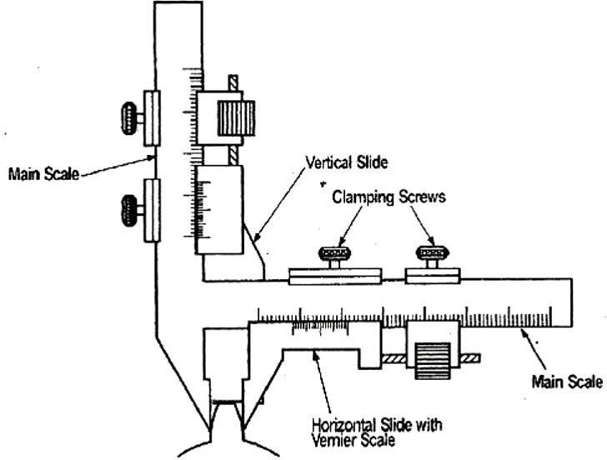
Chordal thickness, W theoritical =N m sin (90/N)
1. MEASUREMENT OF TOOTH SPAN BY DISC MICROMETRE:
In this method, the span of a convenient number of teeth is measured (The number of teeth is so chosen. Such that the measurement is made approximately at the pitch circle of the gear.)

Slide 78
2. MEASUREMENT OF RUN OUT:
The given gear is mounted on a mandrel and support between two centers. A dial indicator or test indicator, mounted on a stand is kept near the gear and the tip of the indicator is made to touch the tip of the tooth. The reading is set to zero. Then the gear is rotated tooth by tooth and deviations are noted. The maximum variation indicates the run out in the gear.
Eccentricity=Runout/2.
Hence eccentricity is found out.
Results:
The actual and theoretical tooth thickness of a gear is calculated by using Gear tooth vernier.

Slide 79
EXPERIMENT NO.10 CALIBRATION OF MICROMETER
Aim:
To calibrate the given micrometer over the entire range.
Apparatus Required:
Micrometer
Micrometer Stand
Slip Gauge Box

Slide 80
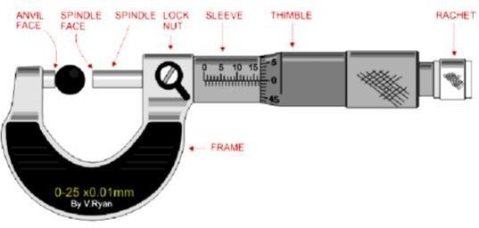
Theory:
It is one of the most common & most popular forms of measuring instrument for precise measurement with 0.01 mm accuracy. In addition, Micrometer screw gauges are available with 0.001 mm accuracy.
It classified as Outside Micrometer, Inside Micrometer, Screw thread Micrometer, Depth gauge
Micrometer.
Principle of Micrometer:
The Micrometer works on the principle of ―screw & nut. We know that when screw is turned through one revolution
it advances by one pitch distance
i.e. – one revolution of screw
corresponds to a linear movement of a distance equal to pitch of the thread.

Slide 81
Procedure:
The method of testing the accuracy of the micrometer involves, setting a known dimension across the measuring face of the micrometer and noting the reading. The known dimension is built up using a combination of slip gauges.
The sizes of these gauges are chosen in such a way as to test the micrometer not only at complete turns of its thimble but also intermediate portions. This is required as a check on the accuracy of the graduation on the thimble.
Starting from 'zero' the prescribed combination of slip gauges is built and introduced between the measuring faces of the micrometer and the reading is taken,
This is repeated till the range of the micrometer is covered. The readings are tabulated in the tabular column and a graph of the
actual readings (on X-axis) and cumulative error (on Y-axis) is plotted.
Total Error = Distance between the ordinates of the highest and
lowest points on the graph.

Slide 82
Observation:
Range of the Micrometer:
Value of 1 HSD = Pitch/Total No. of HSD
Least count of the Micrometer = LC = 1HSD – 1 VSD
Total Reading = PSR + (CHSD * Value of 1 HSD) + (Dial Reading * LC)

Slide 83
TABULAR COLUMN
 |  | Micrometer Reading |  | Cumulative Error
Sl. No (1) | Actual Reading (Slip Gauge) (2) | PSR + (CHSD * Value of 1 HSD) + (Dial Reading * LC) | ERROR (3)-(2)
 |  | (3)
Result:
Thus, the micrometer was calibrated using slip gauges.

Slide 84
CONTENT BEYOND SYLLABUS CALIBRATION OF VERNIER CALIPER USING SLIP GAUGE
Aim:
To calibrate the given Vernier Caliper using Slip Gauge
Apparatus Required:
Surface Plate,
Vernier scale,
Slip Gauge.

Slide 85
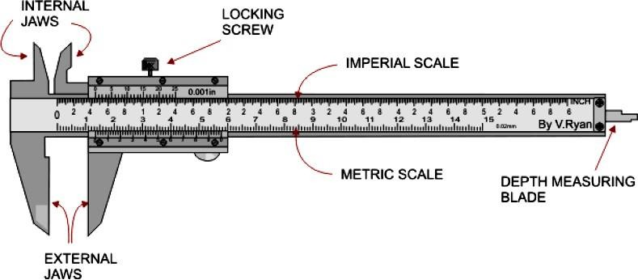
Theory:
Construction: The Vernier caliper consists of two scales: One is fixed while other is movable. The fixed scale called
main scale is calibrated on L
shaped frame and carries a fixed jaw. The movable scale called Vernier scale slides over the main scale and carries a movable jaw. In addition, an
arrangement is provided to lock the sliding scale on the fixed main scale.
For the precise setting of movable jaw, an adjustment screw is provided. The least count of Vernier caliper is 0.02mm

Slide 86
Principle:
Vernier Caliper is the most used instrument for measuring outer and inner diameters. It works on the principle of Vernier Scale which is some fixed units of length (e.g.,49mm) divided into 1 less or 1 more parts of the unit (e.g.,49mm are divided into 50 parts). The exact measurement with up to 0.02mm accuracy can be determined by the coinciding line between Main Scale and Vernier Scale. Total Reading =
M.S.R + L.C X V.C

Slide 87
Procedure for Calibration
The measuring instrument is placed on the surface plate and set for zero.
Clean the Vernier caliper fixed and movable jaws and slip gauges to be measured with cloth.
Vernier is checked for zero error.
Slip gauge is clamped between the jaws and the Vernier scale is tightened by screws.
Main scale and Vernier scale coincidence are noted for 5 different slip gauges.
Calculate the error and percentage error.
Plot the graph between
Slip gauge reading vs Total reading (Vernier caliper)
Slip gauge reading vs Error Result
Thus, the Vernier caliper was calibrated using slip gauges Error range = mm

Slide 88

Specification Formulae:
Least Count = 1 Main Scale Division – 1 Vernier Scale Division Vernier Scale Reading = Vernier Scale Coincidence X Least Count Total Reading = Main Scale Reading + Vernier Scale Reading Error = Slip gauge reading - Vernier caliper Reading

Slide 89
Tabular column:
Sl. No. | Slip Gauge Reading, mm | Vernier caliper Reading MSR+(VSD x LC), mm | Error | %Error
1
2
3
4
5
Error
% Error
= Slip gauge reading - Total reading
= (Slip gauge reading - Total reading) / Slip gauge reading

Slide 90
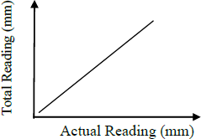
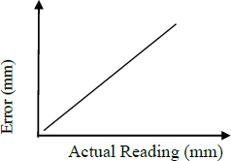
Model Graphs:
Results :
Thus, the Vernier caliper Reading was calibrated using slip gauges.
Error range = 0 - 0.16 mm

