Slide 1
IP Address
Course Code: CSE-311
Course Name: Computer Network and Security
Md. Tariqul Islam
Lecturer Department of Computer Science and Engineering
University of Global Village, (UGV)
874/322, C&B Road, Barisal.

Slide 2
Background
What is an IP Address?
All the computers of the world on the Internet Network communicate with each other with underground or underwater cables or wirelessly.
If I want to download a file from the internet or load a web page or literally do anything related to the internet, my computer must have an address so that other computers can find and locate mine in order to deliver that particular file or webpage that I am requesting.
In technical terms, that address is called IP

Slide 3
Background
What is an IP Address?
An Internet Protocol address (IP address) is a numerical label such as 192.0.2.1 that is connected to a computer network that uses the Internet Protocol for communication.
An IP address serves two main functions:
Network interface identification: Between a device and the network.
Location addressing: Geolocation is mapping

Slide 4
Background
IP Address in Networking
So we can say, In networking,
IP Address is short for Internet Protocol Address.
It is a unique address assigned to each computing device in an IP network.
ISP assigns IP Address to all the devices present on its network.
Computing devices use IP Address to identify and communicate with other devices in the IP network

Slide 5
Background
How to Find Your IP Address?
There are many tools available on the Internet that interprets your computer’s IP address and find your location. You can also try to find the IP address on your Windows 10, Mac, iPhone and Android phone.
For example, on Windows 10 follow the below instructions:
Right click on the Start menu and open Command Prompt.
Type ipconfig and hit enter.
You will see IP address of your computer as below.

Slide 6
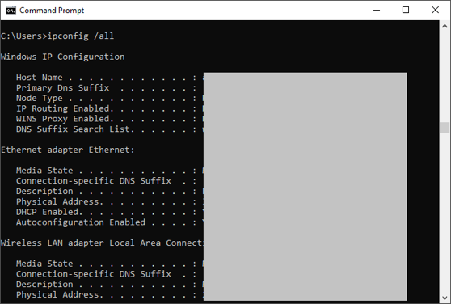
Background
How to Find Your IP Address?

Slide 7
Background
How to Find Your IP Address?
Follow the below instructions on Mac:
Press “Command + Spacebar” to open Spotlight Search.
Type “network utility” and open Network Utility app.
Select your network name under “Info” tab.
You can find the IP address of your Mac here.

Slide 8
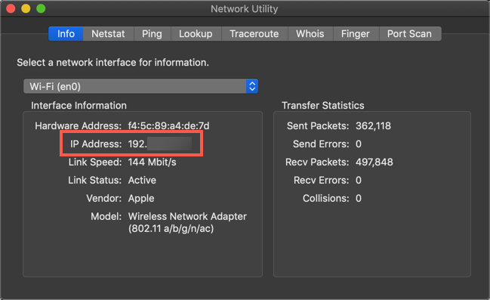
Background
How to Find Your IP Address?

Slide 9
Background
Classification of IP Address
An IP address is classified into the following types:
1. Public IP Address: This address is available publicly and it is assigned by your network provider to your router, which further divides it to your devices. Public IP Addresses are of two types,
Dynamic IP Address: When you connect a smartphone or computer to the internet, your Internet Service Provider provides you an IP Address from the range of available IP Addresses. Now, your device has an IP Address and you can simply connect your device to the Internet and send and receive data to and from your device. The very next time when you try to connect to the internet with the same device, your provider provides you with different IP Addresses to the same device and also from the same available range. Since IP Address keeps on changing every time when you connect to the internet, it is called a Dynamic IP Address.
Static or Real IP Address: Static address never changes. They serve as a permanent internet address. These are used by DNS servers. What are DNS servers? Actually, these are computers that help you to open a website on your computer. Static IP Address provides information such as device is located on which continent, which country, which city, and which Internet Service Provider provides internet connection to that particular device. Once, we know who is the ISP, we can trace the location of the device connected to the internet. Static IP Addresses provide less security than Dynamic IP Addresses because they are easier to track.

Slide 10
Background
Classification of IP Address
2. Private IP Address: This is an internal address of your device which are not routed to the internet and no exchange of data can take place between a private address and the internet.
3. Shared IP addresses: Many websites use shared IP addresses where the traffic is not huge and very much controllable, they decide to rent it to other similar websites so to make it cost-friendly. Several companies and email sending servers use the same IP address (within a single mail server) to cut down the cost so that they could save for the time the server is idle.
4. Dedicated IP addresses: A dedicated IP Address is an address used by a single company or an individual which gives them certain benefits using a private Secure Sockets Layer (SSL) certificate which is not in the case of a shared IP address. It allows to access the website or log in via File Transfer Protocol (FTP) by IP address instead of its domain name. It increases the performance of the website when the traffic is high. It also protects from a shared IP address that is black-listed due to spam.

Slide 11
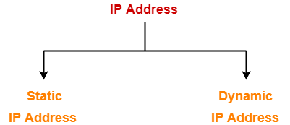
Background
Types of IP Address
IP Addresses may be of the following two types-
Static IP Address
Dynamic IP Address

Slide 12
Background
Types of IP Address
1. Static IP Address:
Static IP Address is an IP Address that once assigned to a network element always remains the same.
They are configured manually.
NOTE
Some ISPs do not provide static IP addresses.
Static IP Addresses are more costly than dynamic IP Addresses.

Slide 13
Background
Types of IP Address
2. Dynamic IP
Dynamic IP Address is a temporarily assigned IP Address to a network element.
It can be assigned to a different device if it is not in use.
DHCP or PPPoE assigns dynamic IP addresses.

Slide 14
Background
How to confirm a IP whether it is Public or Not?
At first you need to install MicroTorrent (u torrent) in your PC.
Then press Ctrl + G
You will get the port number here.
Copy it and go to canyouseeme.org.
Then pest the port number.
It will tell you whether your IP, assigned by your ISP, is a real IP or not.

Slide 15
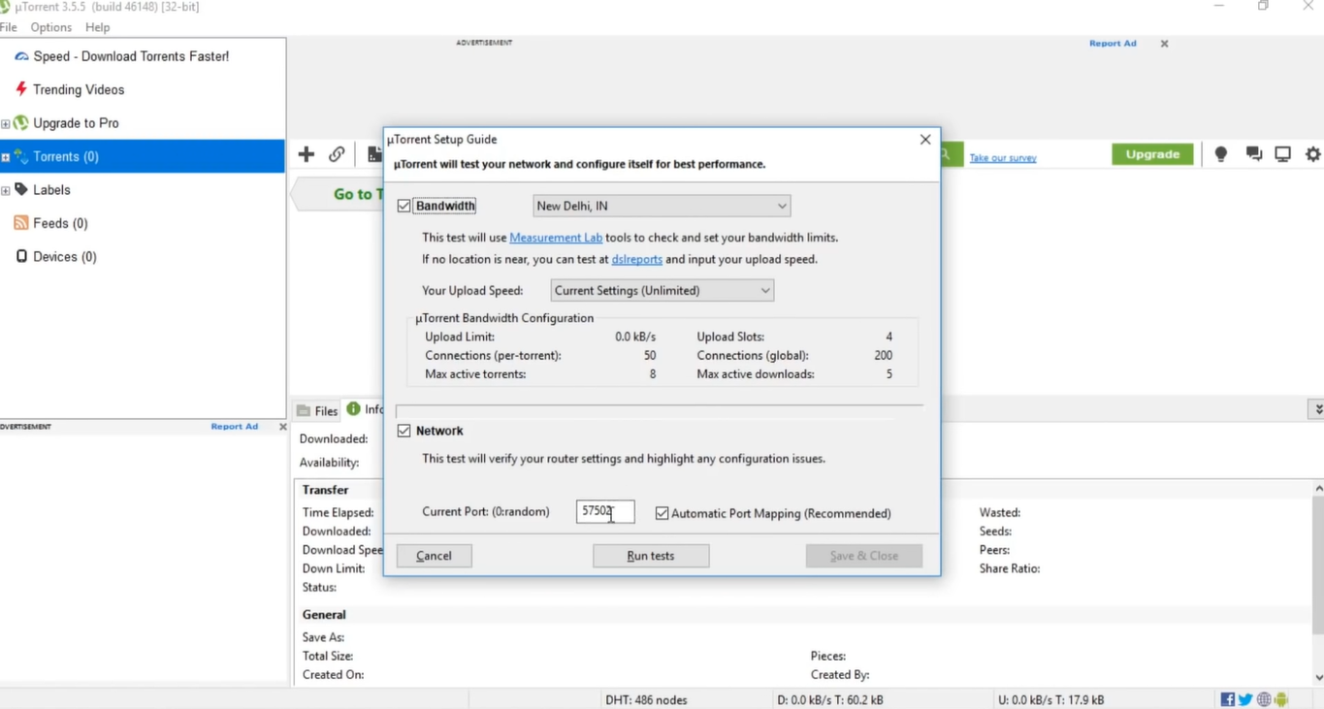

Slide 16
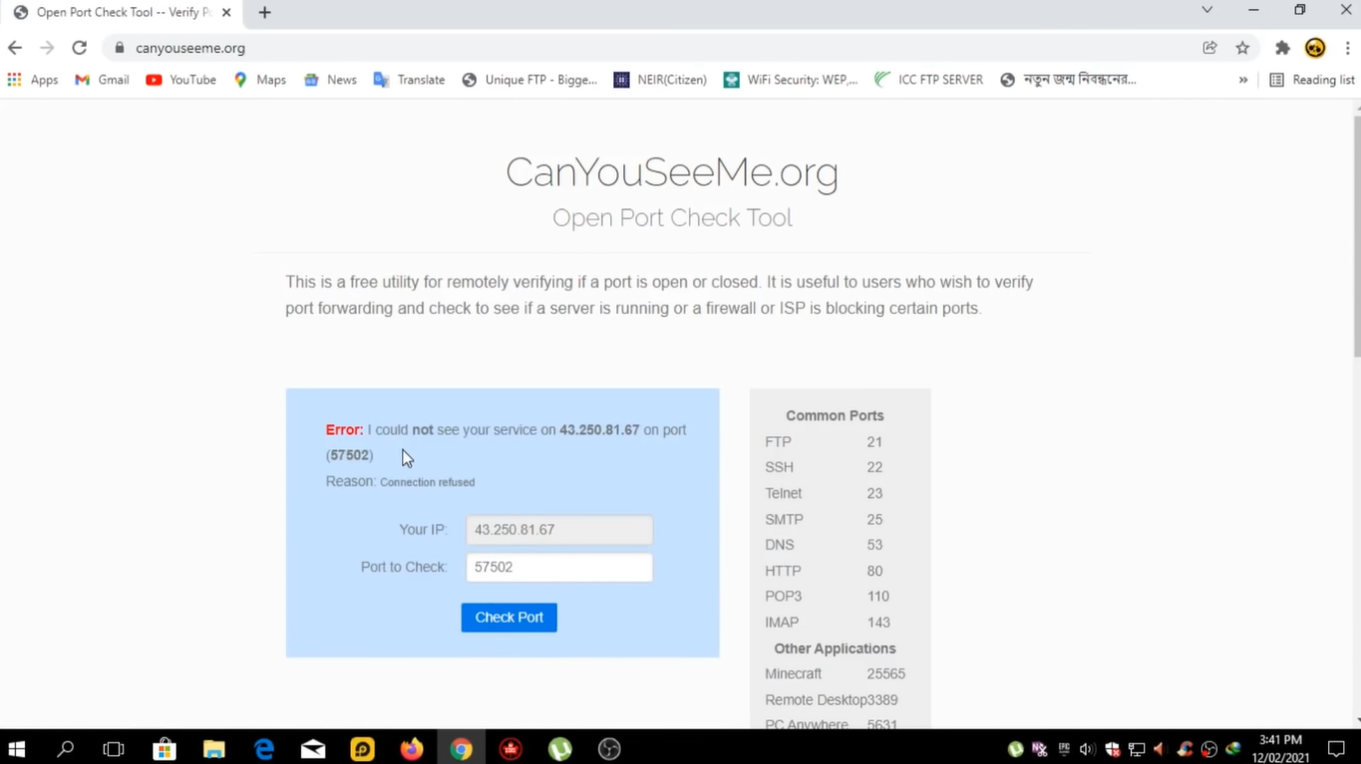

Slide 17
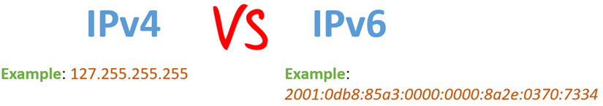
Background
Version of IP address
Two types of IP addresses are
1)IPV4 and
2) IPV6.

Slide 18
Background
Version of IP address
What is IPv4?
IPv4 is an IP version widely used to identify devices on a network using an addressing system.
It uses a 32-bit address scheme to store 2^32 addresses which is more than 4 billion addresses.
It is considered the primary Internet Protocol and carries 94% of Internet traffic.

Slide 19
Background
Version of IP address
What is IPv6?
IPv6 is the most recent version of the Internet Protocol.
This new IP address version is being deployed to fulfill the need for more Internet addresses.
It was aimed to resolve issues that are associated with IPv4.
With 128-bit address space, it allows 340 undecillion unique address space. IPv6 is also called IPng (Internet Protocol next generation).

Slide 20
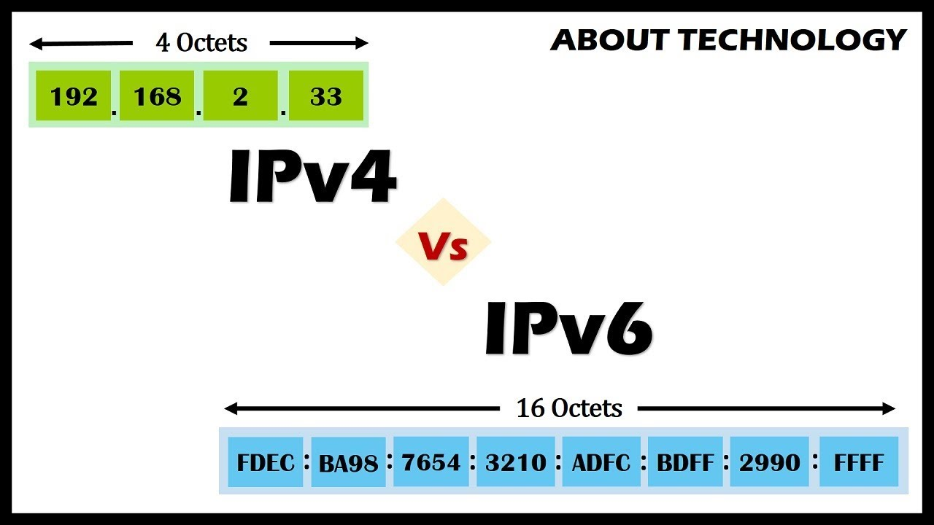
Background
Version of IP address

Slide 21
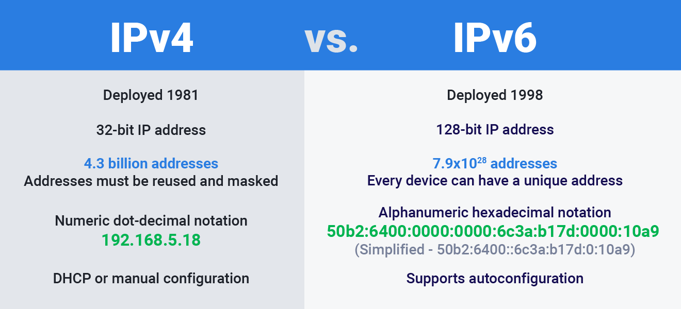
Background
IPv4 VS. IPv6

Slide 22
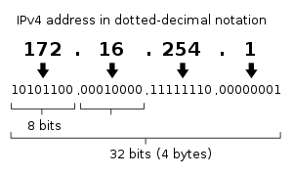
Background
IP Address Format
IP Address is a 32 bit binary address written as 4 numbers separated by dots.
The 4 numbers are called as octets where each octet has 8 bits.
The octets are divided into 2 components- Net ID and Host ID.

Slide 23
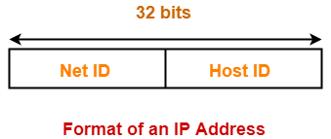
Background
IP Address Format
Network ID represents the IP Address of the network and is used to identify the network.
Host ID represents the IP Address of the host and is used to identify the host within the network.

Slide 24
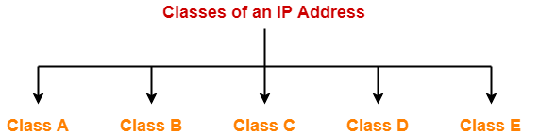
Background
Classful Addressing
In Classful Addressing System, IP Addresses are organized into following 5 classes-
Class A
Class B
Class C
Class D
Class E

Slide 25
Background
IP address classes
With an IPv4 IP address, there are five classes of available IP ranges: Class A, Class B, Class C, Class D and Class E, while only A, B, and C are commonly used. Each class allows for a range of valid IP addresses, shown in the following table.
Class | Address range | Supports
Class A | 1.0.0.1 to 126.255.255.254 | Supports 16 million hosts on each of 127 networks.
Class B | 128.1.0.1 to 191.255.255.254 | Supports 65,000 hosts on each of 16,000 networks.
Class C | 192.0.1.1 to 223.255.254.254 | Supports 254 hosts on each of 2 million networks.
Class D | 224.0.0.0 to 239.255.255.255 | Reserved for multicast groups.
Class E | 240.0.0.0 to 254.255.255.254 | Reserved for future use, or research and development purposes.

Slide 26
Background
What is an IP Address?
Class | Address Range | Subnet masking | Example IP | Leading bits | Max number of networks | Application
IP Class A | 1 to 126 | 255.0.0.0 | 1.1.1.1 | 8 | 128 | Used for large number of hosts.
IP Class B | 128 to 191 | 255.255.0.0 | 128.1.1.1 | 16 | 16384 | Used for medium size network.
IP Class C | 192 to 223 | 255.255.255.0 | 192.1.11. | 24 | 2097157 | Used for local area network.
IP Class D | 224 to 239 | NA | NA | NA | NA | Reserve for multi-tasking.
IP Class E | 240 to 254 | NA | NA | NA | NA | This class is reserved for research and Development Purposes.

Slide 27
Background
Fact‘s
The IP address space is managed globally by the Internet Assigned Numbers Authority (IANA), and by five regional Internet registries (RIRs) responsible in their designated territories for assignment to local Internet registries, such as Internet service providers (ISPs), and other end users. IPv4 addresses were distributed by IANA to the RIRs in blocks of approximately 16.8 million addresses each, but have been exhausted at the IANA level since 2011. Only one of the RIRs still has a supply for local assignments in Africa. Some IPv4 addresses are reserved for private networks and are not globally unique.

Slide 28
Different Classes Of IP’s In Hosting
Network ID– It is the part of the left-hand IP address that identifies the specific network where the device is located. In the normal home network, where the device has an IP address 192.168.1.32, the 192.168.1 part of the address will be the network ID. It is customary to fill in the last part that is not zero, so we can say that the device’s network ID is 192.168.1.0.
Hosting ID– The host ID is part of the IP address that was not taken by the network ID. Identifies a specific device (in the TCP / IP world, we call devices “host”) in that network. Continuing with our example of the IP address 192.168.1.32, the host ID will be 32- the unique host ID on the 192.168.1.0 network.

Slide 29
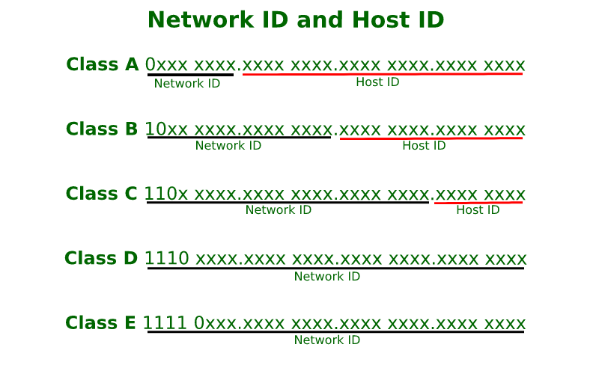
Background
Different Classes Of IP’s In Hosting

Slide 30
Background
Different Classes Of IP’s In Hosting
The different classes of IP’s are:
Class A
Class A IP’s are majorly used for large networks. Also, this kind of IPs are generally used by large organizations such as Google, Bing, Yahoo, etc., The huge benefit in this type of IP is you can host many numbers of devices to the IP address. The main thing is that class IP’s are generally used by Internet Service Providers (ISP). Additionally, the A-class IP’s are not used by many of the bloggers.
Class B
Class B IP’s are not mostly used by bloggers or business websites. These kinds of IP’s are used by medium-sized organizations and networks. The advantage of this kind of IP is, you can also host devices, but little less than the class A IP’s. Class B IP’s are not recommended for hosting the sites and also most of the users are not using these IP’s

Slide 31
Background
Different Classes Of IP’s In Hosting
Class C
When coming to class C IP’s, most of the PBN and SEO hosting sites are using it more. Because of the various benefits. This range of IP’s are used by the bloggers, business sites and personal sites. This C class IP’s are used for PBN and SEO hosting. The advantages of using c class IP’s are
Helps to boost the SEO of your sites
Improves ranking in search results
Increases traffic to the sites
Generally used for blogging and business sites

Slide 32
Background
Different Classes Of IP’s In Hosting
Class D & Class E
The Class D & E IP’s are used very less by the users. The D-class IPs are not used widely by the users and they are used only on special occasions. Whereas the class E IP’s are the reserved ones, which are used for research, scientific studies, etc., These two class IPs are not used in the public sector. Only used in private sectors. Also, the class E IP’s are not provided by the hosting providers for hosting the sites.

Slide 33
Background
loopback or localhost Address
Ranges 127.x.x.x are reserved for the loopback or localhost, for example, 127.0.0.1 is the loopback address.
The loopback addresses are built into the IP domain system, enabling devices to transmit and receive the data packets.
The loopback address 127.0.0.1 is generally known as localhost.
The loopback interface refers to the overall system by which network engineers can self-reference a device, or “ping” a device by sending its data packets back to itself.
How to test a network card using the loopback address? CMD>Ping> 127.0.0.1

Slide 34
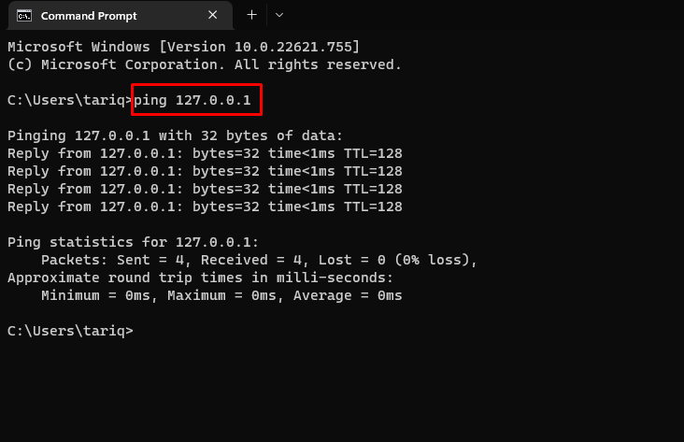

Slide 35
Background
Broadcasts Address
Broadcasts Address: A multipoint connection in IP networks that automatically reaches all nodes in the network without knowing the recipient addresses. For this purpose, a fixed reserved broadcast address exists in each network or subnet.

Slide 36
Background
IP Address Classification Based on Operational Characteristics:
According to operational characteristics, IP address is classified as follows:
Broadcast addressing– The term ‘Broadcast’ means to transmit audio or video over a network. A broadcast packet is sent to all users of a local network at once. They do not have to be explicitly named as recipients. The users of a network can open the data packets and then interpret the information, carry out the instructions or discard it. This service is available in IPv4. The IP address commonly used for broadcasting is 255.255.255.255
Unicast addressing– This address identifies a unique node on the network. Unicast is nothing but one-to-one data transmission from one point in the network to another. It is the most common form of IP addressing. This method can be used for both sending and receiving data. It is available in IPv4 and IPv6.

Slide 37
Background
IP Address Classification Based on Operational Characteristics:
Multicast IP addresses– These IP addresses mainly help to establish one-to-many communication. Multicast IP routing protocols are used to distribute data to multiple recipients. The class D addresses (224.0.0.0 to 239.255.255.255) define the multicast group.
Anycast addressing– In anycast addressing the data, a packet is not transmitted to all the receivers on the network. When a data packet is allocated to an anycast address, it is delivered to the closest interface that has this anycast address.

Slide 38
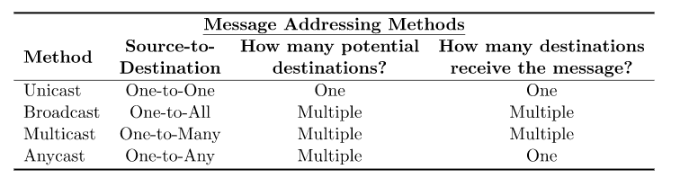
Background
IP Address Classification Based on Operational Characteristics:
https://www.baeldung.com/cs/multicast-vs-broadcast-anycast-unicast

Slide 39
Background
Subnetting: What is Subnet Mask?
Subnetting is the practice of dividing a network into two or smaller networks. It increases routing efficiency, which helps to enhance the security of the network and reduces the size of the broadcast domain.
IP Subnetting designates high-order bits from the host as part of the network prefix. This method divides a network into smaller subnets.
It also helps you to reduce the size of the routing tables, which is stored in routers. This method also helps you to extend the existing IP address base & restructures the IP address.

Slide 40
Background
What is CIDR notation?
CIDR format, or "Classless Inter-Domain Routing", released in 1993, is the industry standard for displaying IP addresses and their related subnets. It consists of a network prefix and the significant bits which determines the size of the IP block. Significant bits are in 8-bit groups that form Class A, B, and C blocks of IP addresses. An example of CIDR format is "255.254.0.0/16", which indicates there are 65,000 hosts in this range from "255.254.0.1" to "255.254.255.255".

Slide 41
Background
Problem:01
What do you mean by Subnet Mask? Let's consider an IP address provided to you like this: 192.168.10.0. Subnet Mask 255.255.255.224. Now find out the flowing terms:
a. Find the block address?
c. Find the number of subnets?
d. Find the number of hosts?
e. Determine the subnets address?
f. Determine the First valid hosts and Last valid hosts.
g. Determine Broadcast addresses.

Slide 42
Background
Problem:02
Let's consider an IP address provided to you like this: 192.231.232.116/27. Now find out the flowing terms:
a. Find the subnet mask?
b. Find the block address?
c. Find the number of subnets?
d. Find the number of hosts?
e. Determine the subnets address?
f. Determine the First valid hosts and Last valid hosts.
g. Determine Broadcast addresses.

Slide 43
Background
Problem:03
Suppose you are given an IP address of 192.168.10.0, and subnet mask 255.255.255.248. Find out the flowing term:
a. Find the block address?
c. Find the number of subnets?
d. Find the number of hosts?
e. Determine the subnets address?
f. Determine the First valid hosts and Last valid hosts.
g. Determine Broadcast addresses.

Slide 44
Background
Problem:04
Let consider an IP address provided to you like this: 192.119.204.116/26. Now find out the flowing terms:
a. Find the subnet mask?
b. Find the block address?
c. Find the number of subnets?
d. Find the number of hosts?
e. Determine the subnets address?
f. Determine the First valid hosts and Last valid hosts.
g. Determine Broadcast addresses.

Slide 45
Background
Problem:05
Let consider an IP address provided to you like this: 192.119.204.114/28. Now find out the flowing terms:
a. Find the subnet mask?
b. Find the block address?
c. Find the number of subnets?
d. Find the number of hosts?
e. Determine the subnets address?
f. Determine the First valid hosts and Last valid hosts.
g. Determine Broadcast addresses.

Slide 46
IP Address Solutions:
https://www.youtube.com/watch?v=dH5mOkzUN_U&list=PLgH5QX0i9K3p5OI88r3ob-otmKqIm_DbS

Slide 47
THANK YOU

