Slide 1
Lectures On:
MAC Address

Slide 2

Lets Know Abid
Hello!
My Name is Abid
Student at the University of Global Village
My student ID is 1231224

Slide 3
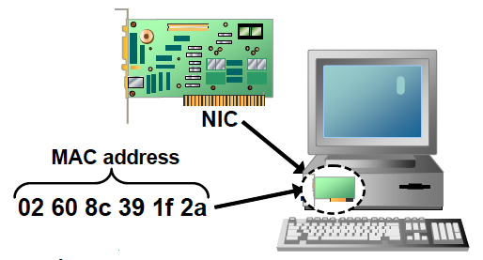
What is an MAC Address?
MAC address is the physical address, which uniquely identifies each device on a given network.

Slide 4
What is an MAC Address?
To make communication between two networked devices, we need two addresses: IP address and MAC address.
It is assigned to the NIC (Network Interface card) of each device that can be connected to the internet.
It stands for Media Access Control, and also known as Physical address, hardware address, or BIA (Burned In Address).

Slide 5
What is an MAC Address?
It is globally unique; it means two devices cannot have the same MAC address.
It is represented in a hexadecimal format on each device, such as 00:0a:95:9d:67:16.
It is 12-digit, and 48 bits long, out of which the first 24 bits are used for OUI(Organization Unique Identifier), and 24 bits are for NIC/vendor-specific.

Slide 6
What is an MAC Address?
It is provided by the device's vendor at the time of manufacturing and embedded in its NIC, which is ideally cannot be changed.
The ARP protocol is used to associate a logical address with a physical or MAC address
Note: Address Resolution Protocol (ARP)

Slide 7
MAC Address Definition?
o communicate or transfer data from one computer to another, we need an address. In Computer networks, various types of addresses are introduced; each works at a different layer. A MAC address, which stands for Media Access Control Address, is a physical address that works at the Data Link Layer. In this article, we will discuss addressing a DLL, which is MAC Address.

Slide 8
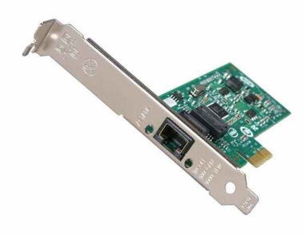
What is network interface card (NIC)?
Network Interface Card (NIC) is a hardware component that is present on the computer. It is used to connect different networking devices such as computers and servers to share data over the connected network. It provides functionality such as support for I/O interrupt, Direct Memory Access (DMA) interfaces, partitioning, and data transmission.
NIC is important for us to establish a wired or wireless connection over the network.
Network Interface Card is also known as Network Interface Controller, Network Adapter, Ethernet card, Connection card, and LAN (Local Area Network) Adapter.

Slide 9
What is network interface card (NIC)?
Purpose:
NIC allows both wired and wireless communications.
NIC allows communications between computers connected via local area network (LAN) as well as communications over large-scale network through Internet Protocol (IP).
NIC is both a physical layer and a data link layer device, i.e. it provides the necessary hardware circuitry so that the physical layer processes and some data link layer processes can run on it.

Slide 10
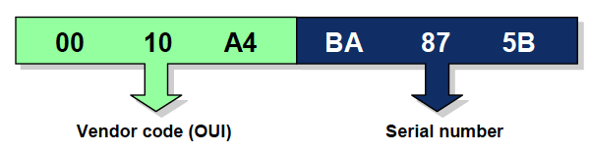
Format of MAC Address
MAC Address is a 12-digit hexadecimal number (6-Byte binary number), which is mostly represented by Colon-Hexadecimal notation.
The First 6-digits (say 00:40:96) of MAC Address identifies the manufacturer, called OUI (Organizational Unique Identifier). IEEE Registration Authority Committee assigns these MAC prefixes to its registered vendors.

Slide 11
Format of MAC Address
Here are some OUI of well-known manufacturers :
CC:46:D6 - Cisco
3C:5A:B4 - Google, Inc.
3C:D9:2B - Hewlett Packard
00:9A:CD - HUAWEI TECHNOLOGIES CO.,LTD
The rightmost six digits represent Network Interface Controller, which is assigned by the manufacturer.

Slide 12
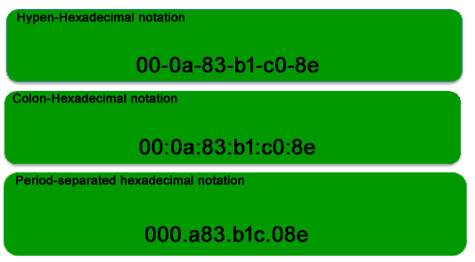
Format of MAC Address
MAC address is represented by Colon-Hexadecimal notation.
But this is just a conversion, not mandatory.
MAC address can be represented using any of the following formats:
Note: Colon-Hexadecimal notation is used by Linux OS and Period-separated Hexadecimal notation is used by Cisco Systems.

Slide 13
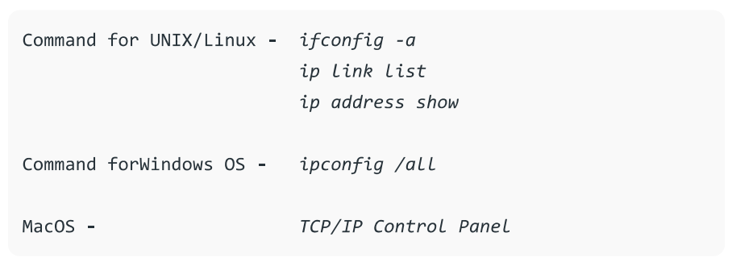
How to find MAC Address
Note – LAN technologies like Token Ring, and Ethernet use MAC Addresses as their Physical address but there are some networks (AppleTalk) that do not use MAC addresses.

Slide 14
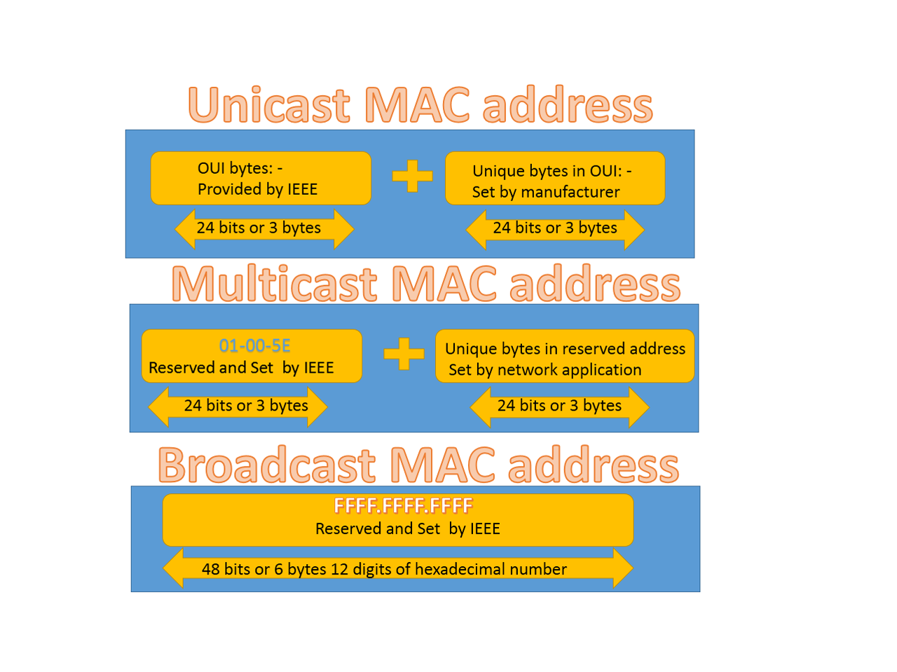
Types of MAC Address:
Types of MAC Address:
1. Unicast
2. Multicast
3. Broadcast

Slide 15
Types of MAC Address:
1. Unicast:
A Unicast addressed frame is only sent out to the interface leading to a specific NIC.
If the LSB (least significant bit) of the first octet of an address is set to zero, the frame is meant to reach only one receiving NIC.
MAC Address of source machine is always Unicast.

Slide 16
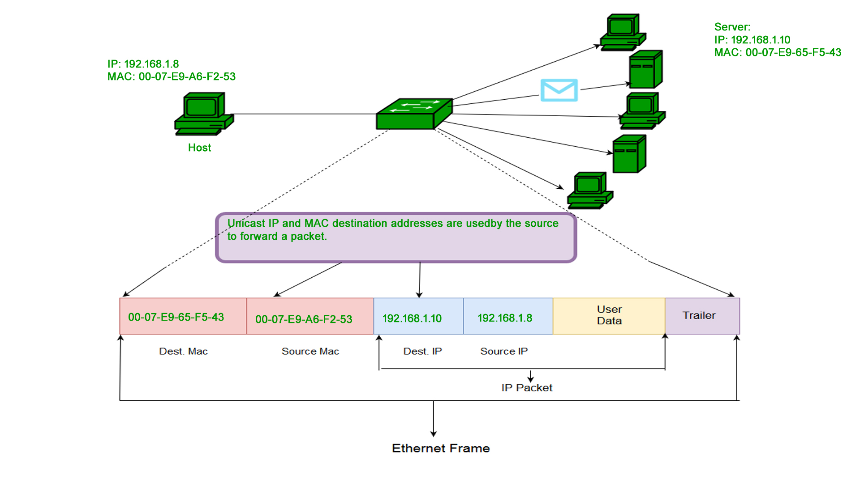
Types of MAC Address:
1. Unicast:

Slide 17
Types of MAC Address:
2. Multicast:
The multicast address allows the source to send a frame to a group of devices.
In Layer-2 (Ethernet) Multicast address, LSB (least significant bit) of the first octet of an address is set to one.
IEEE has allocated the address block 01-80-C2-xx-xx-xx (01-80-C2-00-00-00 to 01-80-C2-FF-FF-FF) for group addresses for use by standard protocols.

Slide 18
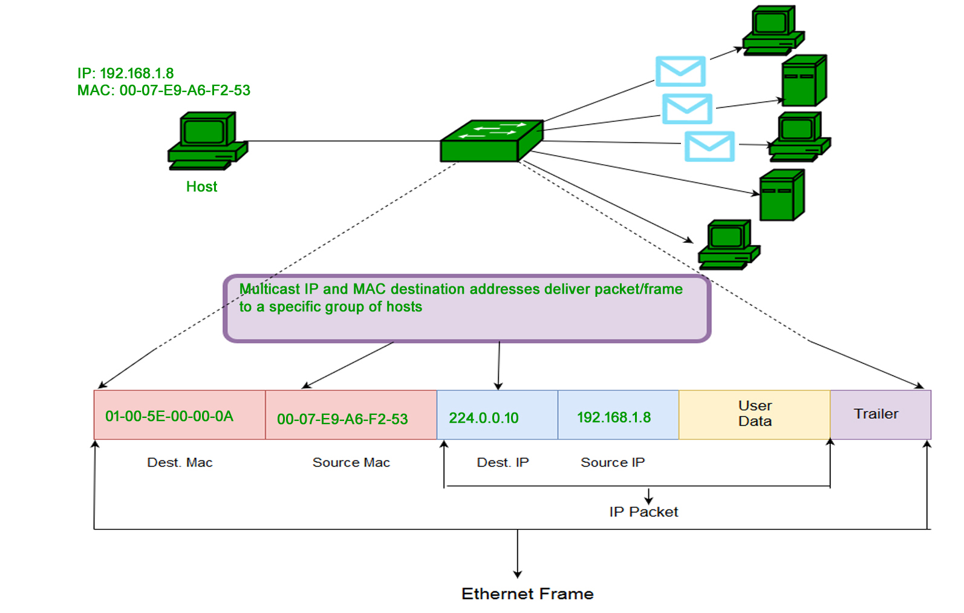
Types of MAC Address:
2. Multicast:

Slide 19
Types of MAC Address:
3. Broadcast:
Similar to Network Layer, Broadcast is also possible on the underlying layer( Data Link Layer).
Ethernet frames with ones in all bits of the destination address (FF-FF-FF-FF-FF-FF) are referred to as the broadcast addresses.
Frames that are destined with MAC address FF-FF-FF-FF-FF-FF will reach every computer belonging to that LAN segment.

Slide 20
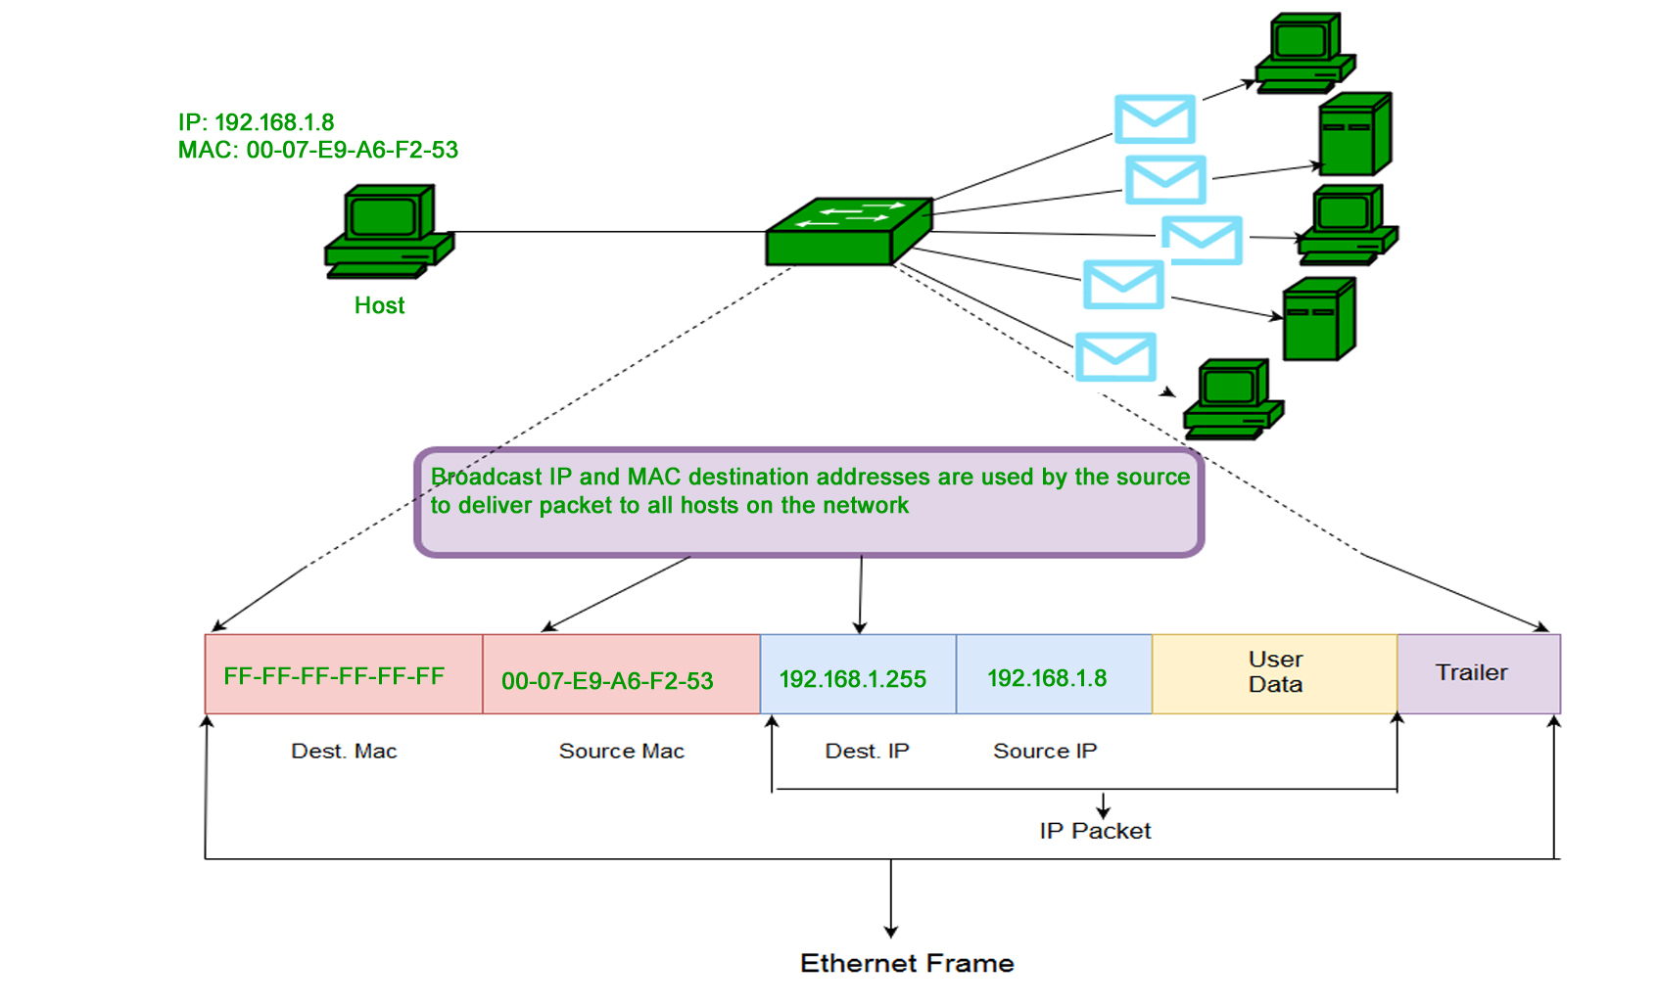
Types of MAC Address
3. Multicast:

Slide 21

“Thank You”

