Slide 1
Lectures On:
Network Server

Slide 2

Network Server

Slide 3
Network Servers
A network server is a powerful computer used to store files and run programs.
Having access to your own dedicated server can help to improve file management and security.
It may also make it easier for employees to collaborate.
Choosing the right server for your needs is essential.
You will need expert help to set up the server and maintain it.
They'll need to update its software and keep it protected.

Slide 4
Network Servers
A network server is a computer system that provides services, data, applications, or network management to other computers, known as clients, over a network.
The primary role of a network server is to manage and facilitate communication and resource sharing among networked devices.

Slide 5
What Is a Network Server?
Network servers are powerful computers or devices that act as central repositories within a network environment, offering a variety of shared resources to other computers in the network.
These resources include disk space, hardware access, printer usage, and email services.
Network servers are designed to guarantee higher stability, security, and performance compared to those in a client-server network; therefore, they are typically equipped with more superior components, such as powerful processors (CPUs), chipsets, memory, and disk systems.
These advanced components provide enhanced processing speeds, larger memory capacity, and broader storage capabilities, enabling network servers to handle complex and demanding workloads.
Moreover, network servers generally run specifically optimized operating systems engineered to be more robust, ensuring secure and stable operation around the clock (24/7).

Slide 6
Types of Network Servers
Network servers can be categorized based on their physical form factor, instruction set architecture, the number of processors they contain, and the types of applications they support.
By Server Form Factor
By Instruction Set
By the Number of Processors
By Applications

Slide 7
Types of Network Servers By Server Form Factor
Rack Server: Rack servers are space-efficient, scalable, and commonly used in medium to large enterprises. With a focus on high-density compute power, they easily fit into standardized server racks, facilitating server consolidation and simplified cabling.

Slide 8
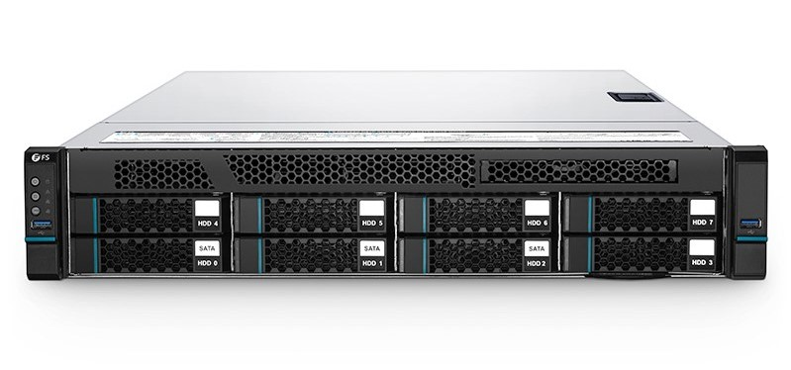
Rack Server

Slide 9
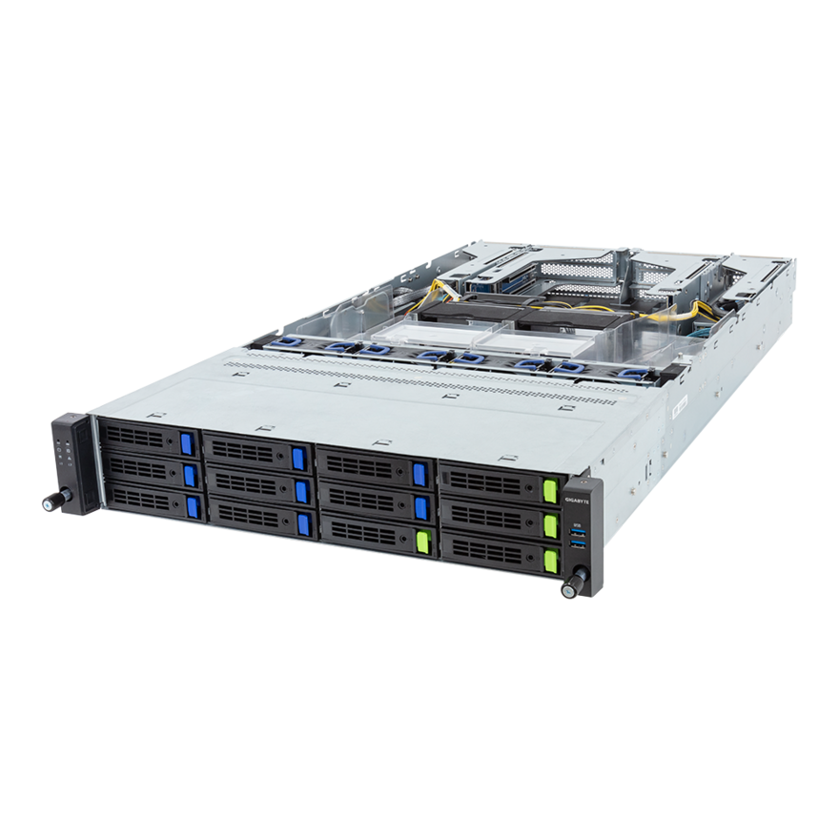

Slide 10
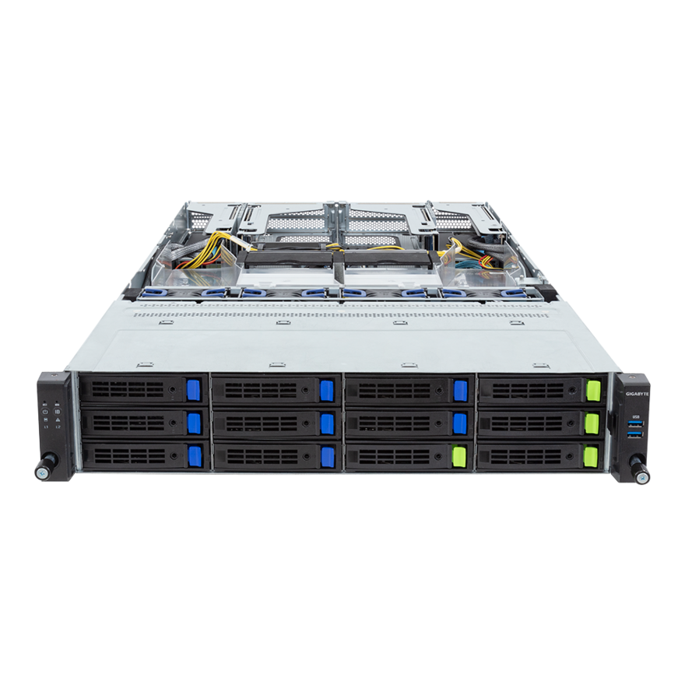

Slide 11
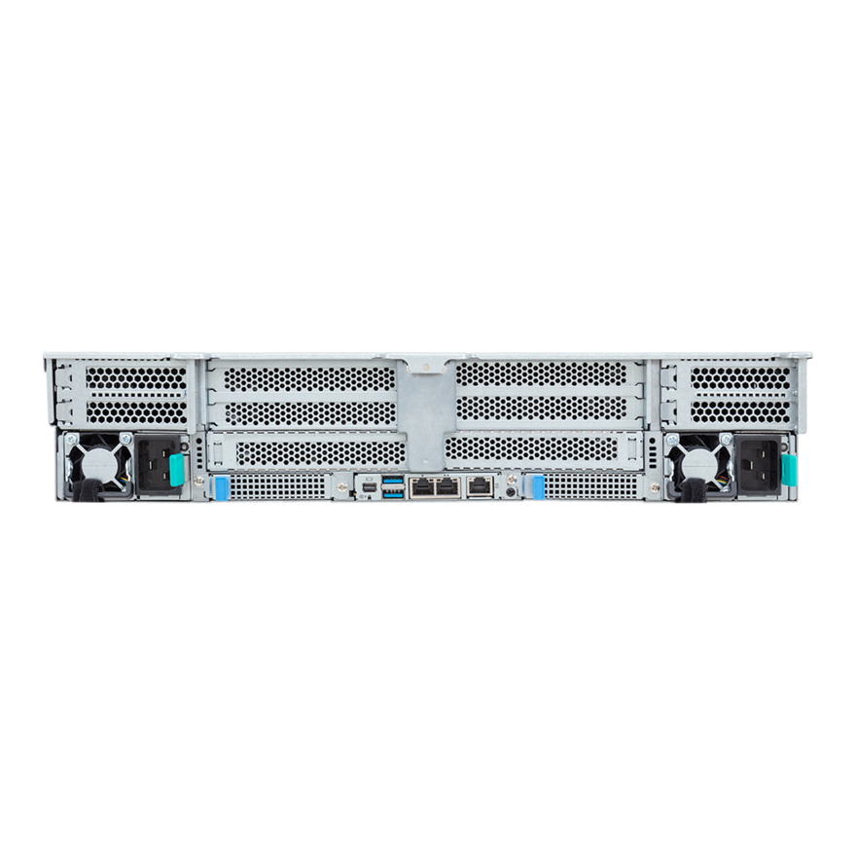

Slide 12
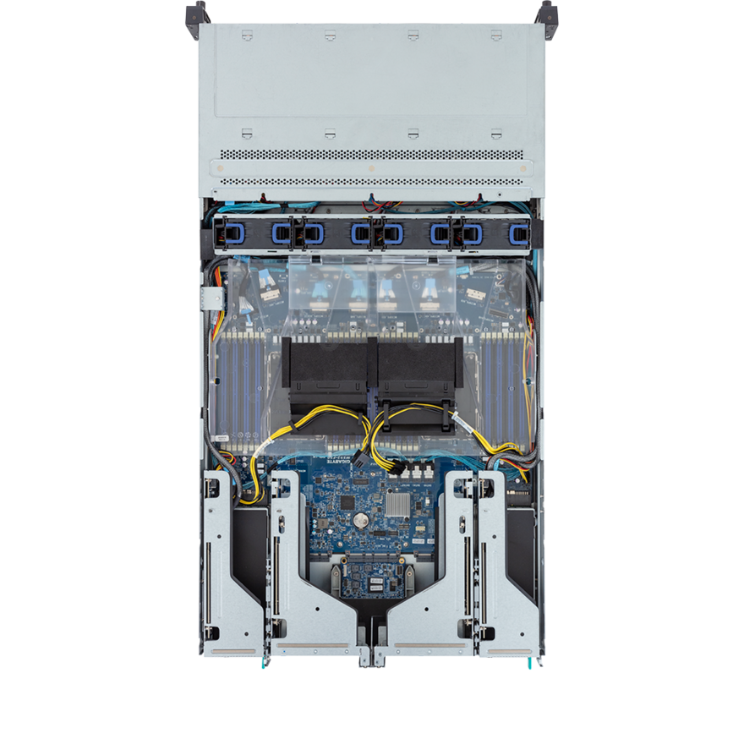

Slide 13
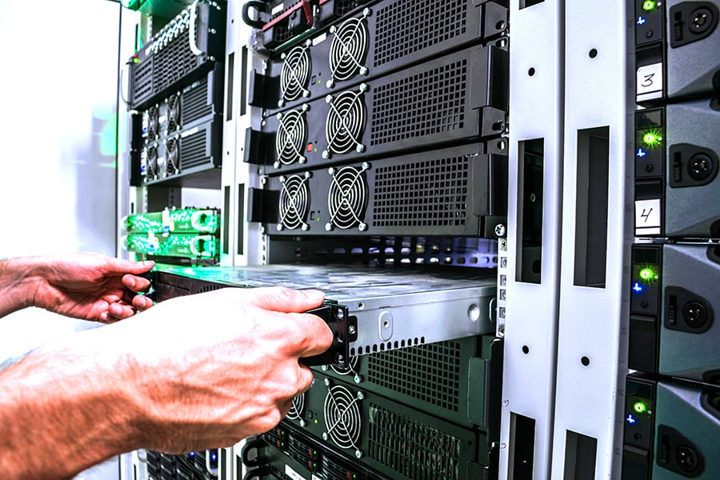

Slide 15
GPU Server
GPU Server: A GPU server is a high-performance server equipped with one or more Graphics Processing Units (GPUs). These servers are designed to handle compute-intensive tasks that benefit from the parallel processing capabilities of GPUs.

Slide 16
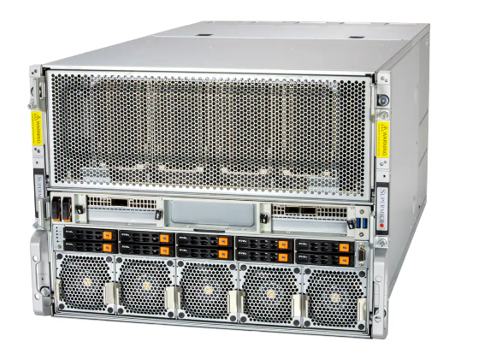

Slide 17
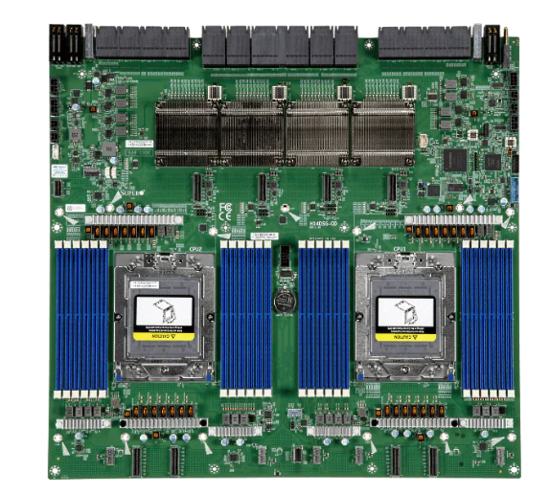

Slide 18
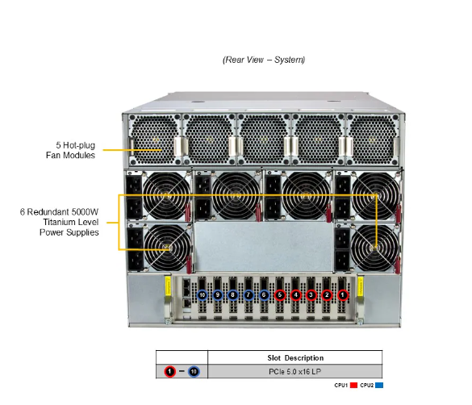

Slide 19
Tower Server:
Tower Server: Similar in appearance to traditional desktops, tower servers offer ample processing power without the need for special mounting equipment. They are ideal for small businesses with lower server deployment density.

Slide 20
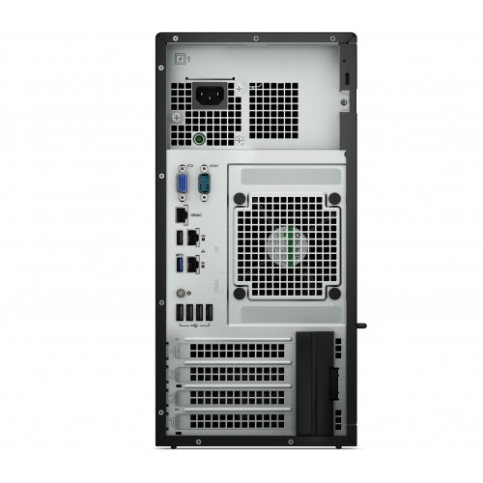
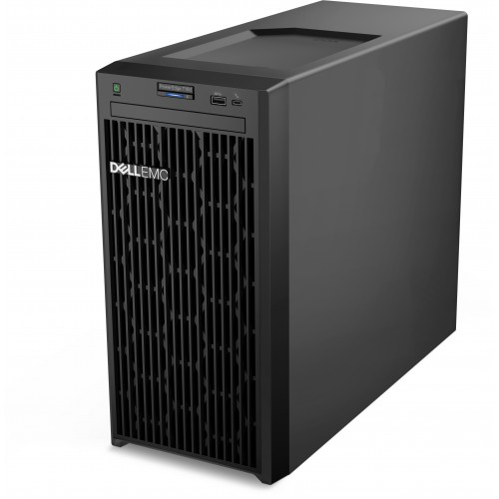

Slide 21
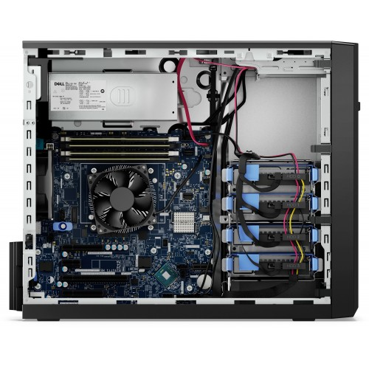

Slide 22
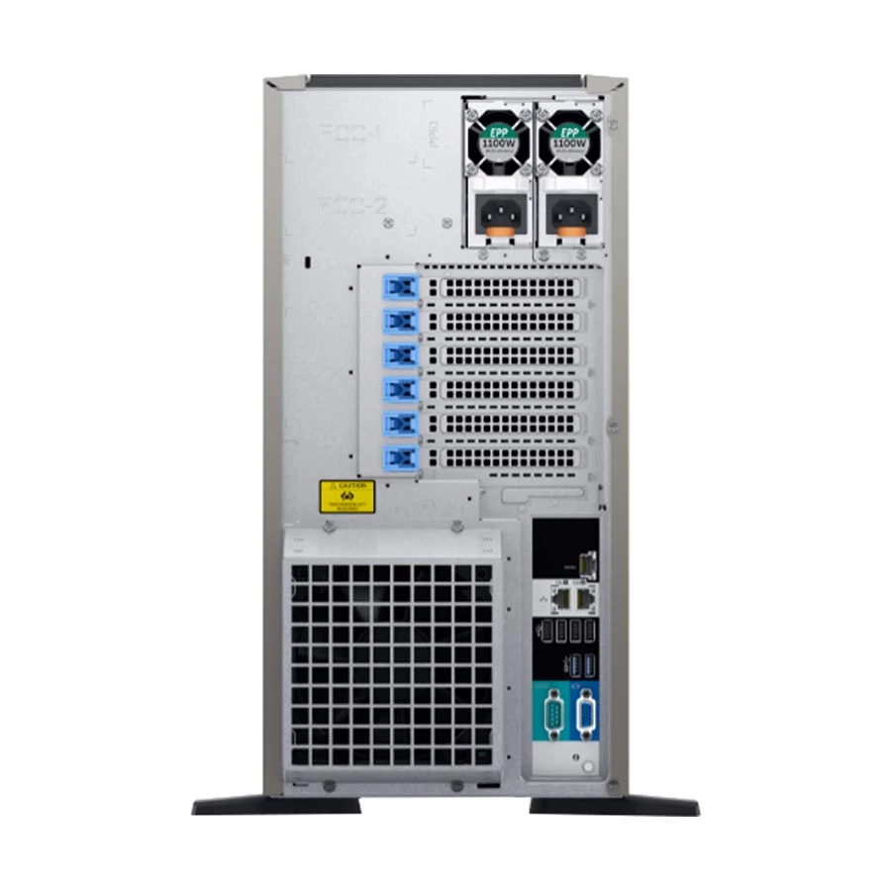
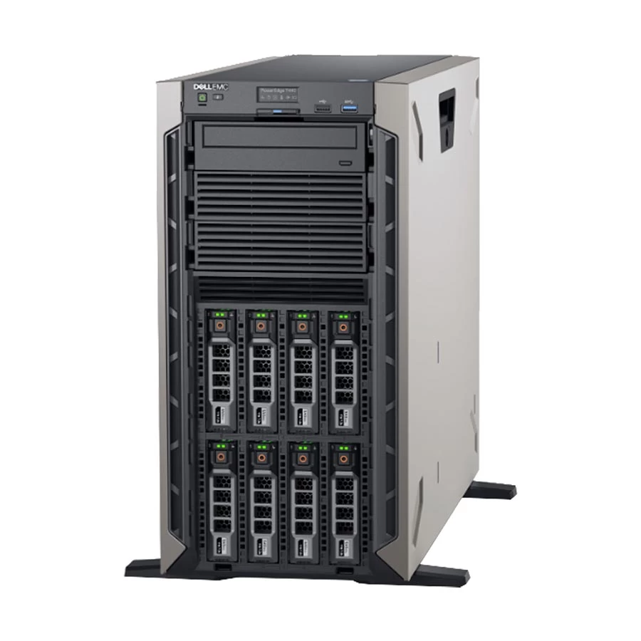

Slide 23
High-Density Servers
High-Density Servers: A High-Density Server refers to a computing server that is designed to have a large number of processing cores or nodes packed into a relatively small physical chassis or rack space. The goal of a high-density server is to maximize processing power while minimizing physical space and power consumption, resulting in an efficient use of data center resources.

Slide 24
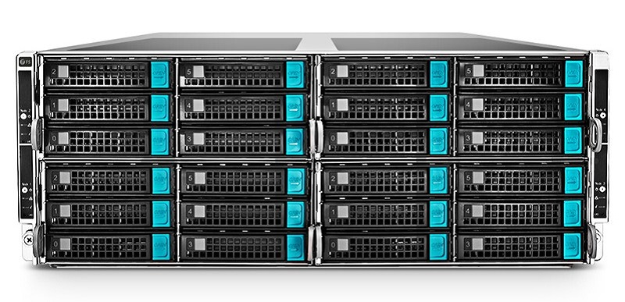

Slide 25
Blade Server:
Blade Server: Blade servers are high-density, compact servers designed for large data centers, offering high computing power with efficient space and energy usage. However, they may have higher initial setup costs.

Slide 26
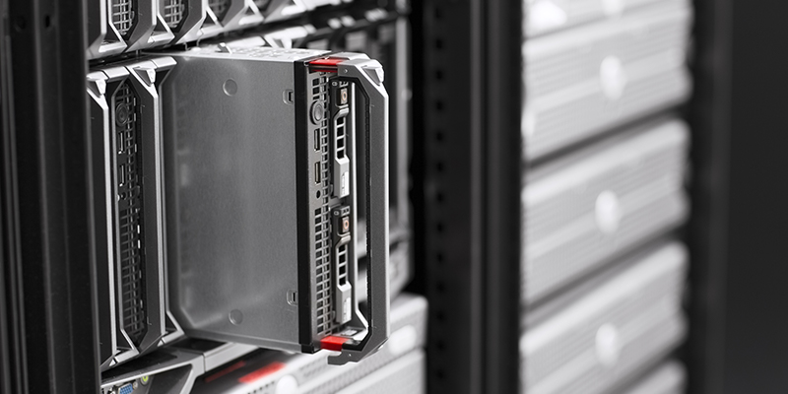

Slide 27
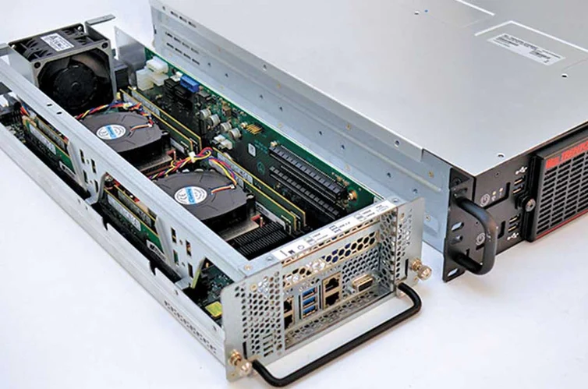

Slide 28
Cabinet Server
Cabinet Server: Cabinet servers offer an all-in-one solution by combining computing, networking, and storage. They're versatile, easy to manage, and support automated deployment across diverse applications.

Slide 29
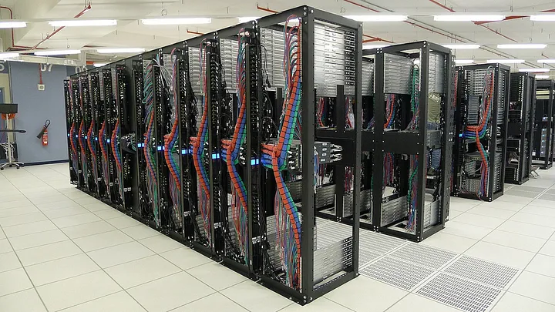

Slide 30


Slide 31
Types of Network Servers By Instruction Set
CISC Server (X86 Server): With its long-established instruction set, CISC servers execute programs sequentially, emphasizing compatibility and simplicity at the potential cost of optimal resource utilization and speed.
RISC Server: RISC servers operate with a simplified instruction set designed for efficiency in performing common tasks. They're usually more energy-efficient, though they may underperform on more complex tasks.
VLIW Server: Utilizing EPIC architecture, VLIW servers enable high levels of parallel processing. They can offer cost, power, and performance advantages over traditional designs.

Slide 32
Types of Network Servers By the Number of Processors
Network servers vary in the number of processors they support, with options ranging from single-processor servers to those with eight or more.
Dual-processor servers are particularly prevalent in many business environments due to their balanced performance and cost.

Slide 33
Types of Network Servers By Applications
Web server: Hosts and serves web pages to clients via the internet or an intranet, delivering requested web pages when a user accesses a website.
File server: Dedicated to storing and managing files, allowing users to save, retrieve, and share files over a network, essential for data accessibility and collaboration.
Database server: Hosts databases and manages data queries from clients, crucial for managing large volumes of data efficiently and securely, often used in business environments.
Mail server: Manages and facilitates email communication, storing emails, processing incoming and outgoing messages, and ensuring secure and efficient email delivery.
Application server: Hosts and executes specific applications, providing a platform for running software, services, or applications accessible to network users.

Slide 34
Types of Network Servers By Applications
Print server: Manages one or more printers and handles printing requests from clients, queuing print jobs, and managing print resources within a network.
Domain name system (DNS) server: Translates domain names into IP addresses, enabling users to access websites using familiar domain names instead of numerical IP addresses.
Virtual server: Uses virtualization technology to run multiple server instances on a single physical server, maximizing hardware utilization and providing flexibility in server management.
Proxy server: Acts as an intermediary between a client and another server, used for data caching, internet security, and to bypass restrictions.

Slide 35
Features of Network Servers
Handling Network Requests
A pivotal role of a network server is to process requests from client servers. Take web browsing as an example: when a user clicks a link, the server receives the request, locates the web page, and sends it back over HTTP. The browser then renders the page for the user to view.
Data Management
Servers are crucial for storing and transferring files across a network. With substantial storage capacities and database functionalities, they allow multiple clients to simultaneously access and manipulate shared data, streamlining collaborative efforts and business operations.

Slide 36
Features of Network Servers
Handling Network Requests
A pivotal role of a network server is to process requests from client servers. Take web browsing as an example: when a user clicks a link, the server receives the request, locates the web page, and sends it back over HTTP. The browser then renders the page for the user to view.
Data Management
Servers are crucial for storing and transferring files across a network. With substantial storage capacities and database functionalities, they allow multiple clients to simultaneously access and manipulate shared data, streamlining collaborative efforts and business operations.

Slide 37
Features of Network Servers
Security Enforcement
Network servers act as gatekeepers, shielding systems from unauthorized access and cyber threats. They scrutinize each inbound request, evaluating details like IP addresses to thwart potential attacks. This proactive monitoring ensures the integrity and safety of stored information.
Data Backup and Recovery
For data-centric organizations, servers provide indispensable backup solutions. Configured to duplicate critical data from primary servers, backup systems compress and store this information with minimal network impact. In case of any failure, data can be swiftly retrieved from these backups, safeguarding the continuity of business activities.

Slide 38
Features of Network Servers
Remote Access
Remote access technology provides users with the capability to connect to internal servers from an external network (usually the internet) and perform tasks as if they were accessing the server locally. Server administrators can carry out a range of management tasks through remote access functionality, such as system monitoring, configuration updates, software installation, or troubleshooting. Remote access is not limited to system administrators; ordinary users can also use this feature to remotely use applications or services.
Virtualization
Virtualization technology allows server hardware resources to be abstracted and divided into multiple independent virtual machines (VMs). Each virtual machine can run different operating systems and applications, isolated from one another as if on separate physical hardware. This technology enhances the utilization of resources, reduces hardware costs, and facilitates the rapid deployment of new services.

Slide 39
How to create a network server
Creating a network server involves several steps, each critical to ensuring that the server functions efficiently and securely within a network. Here’s a quick guide to setting up a network server.
1. Define the server’s purpose
The first step is to identify the primary function of the server. This decision will influence all subsequent choices, from hardware selection to software configuration. For example, a file server requires ample storage space, while a web server needs efficient processing power to handle web traffic.

Slide 40
How to create a network server
2. Select the hardware
The hardware selection should align with the server’s intended use. Key factors include:
Processor: A faster processor is necessary for high-performance tasks.
Memory: Sufficient RAM ensures smooth multitasking and efficient operation.
Storage: Choose between traditional HDDs for inexpensive storage or SSDs for faster access.
Network interface: Ensure the server has appropriate network interfaces for the intended network speed and type.

Slide 41
How to create a network server
3. Choose the operating system
The operating system (OS) should be chosen based on compatibility with the server’s tasks, security features, and the administrator’s familiarity. Windows Server is user-friendly and widely supported, while Linux offers flexibility and is often preferred for its robust security features.
4. Configure network settings
Proper network configuration is crucial for the server’s integration into the network. This involves:
Static IP address: Assign a static IP for reliable network identification.
DNS settings: Set up DNS settings for network name resolution.
Subnet mask and gateway: Define these to ensure the server communicates correctly on the network.

Slide 42
How to create a network server
5. Install and configure server software
Install software relevant to the server’s purpose. For instance, Apache or Nginx for web servers, or SQL Server for database servers. Configuration involves setting up user access, defining operation parameters, and optimizing performance based on expected loads.

Slide 43
How to create a network server
6. Set up security measures
Implementing robust security measures is critical. Some important types of security include:
Firewall: Install and configure a firewall to protect against unauthorized access.
User access control: Define user permissions to restrict access to sensitive data.
Data encryption: Implement encryption for data in transit and at rest.
Security updates: Regularly update all software to patch vulnerabilities.

Slide 44
How to create a network server
7. Test the server
Thorough testing is essential to ensure the server operates as intended. This includes load testing to gauge performance under peak conditions and security testing to verify that data protection measures are effective.

Slide 45
How to create a network server
8. Regular maintenance and monitoring
Ongoing maintenance is vital for long-term server health. Here are some things to check regularly:
Performance checks: Regularly monitor server performance and address any issues promptly.
Security log review: Regularly review security logs for any suspicious activity.
Software updates: Keep all server software updated to ensure security and stability.
Data backups: Perform regular data backups to prevent data loss in case of hardware failure or other issues.

Slide 46
Use cases of network servers
Network servers are versatile and play a crucial role in various scenarios across different industries. Understanding their use cases highlights their importance in modern computing environments. Here are some common applications:
Web hosting: Network servers are essential for hosting websites, serving content to users over the internet, crucial for businesses and organizations needing an online presence.
File storage and sharing: Used as centralized repositories for file storage and sharing, network servers facilitate secure and efficient document access and collaboration, especially in corporate environments.
Database management: Database servers store and manage large datasets, essential in sectors like banking, healthcare, and retail for fast and reliable data processing and analysis.
Email hosting: Email servers handle the storage and transfer of email communications, ensuring secure and efficient email operations within businesses.

Slide 47
Use cases of network servers
Application hosting: Application servers host and run business applications, providing resources necessary for software like CRM systems to function effectively for multiple users.
Virtualization: Network servers enable virtualization, allowing for multiple virtual machines on a single physical server, optimizing resource use and reducing costs, particularly in data centers.
Streaming media: Media servers specialize in storing and streaming multimedia content such as videos and audio, crucial in the entertainment industry and content delivery networks.

Slide 48
Use cases of network servers
Gaming: Gaming servers host multiplayer online games, managing game state and providing a seamless gaming experience for players worldwide.
E-commerce transactions: Network servers process e-commerce transactions in online retail, handling user authentication, payment processing, and ensuring secure online shopping experiences.
Remote work support: Vital for remote work, network servers support VPN access, file sharing, and application access, enabling productivity and collaboration for remote employees.

Slide 49
Conclusion
As technology continues to advance, network servers have become increasingly complex and powerful.
They are not only the core of modern network architectures but also the foundation that supports business operations and cloud computing.
There is a wide variety of network servers, ranging from different form factors, instruction set architectures, and processor counts, to those designed for specific applications, catering to the diverse needs of users.
As business and technological demands evolve, network servers will continue to progress, offering users more secure, reliable, and flexible services.

Slide 50

“Thank You”

