Slide 1
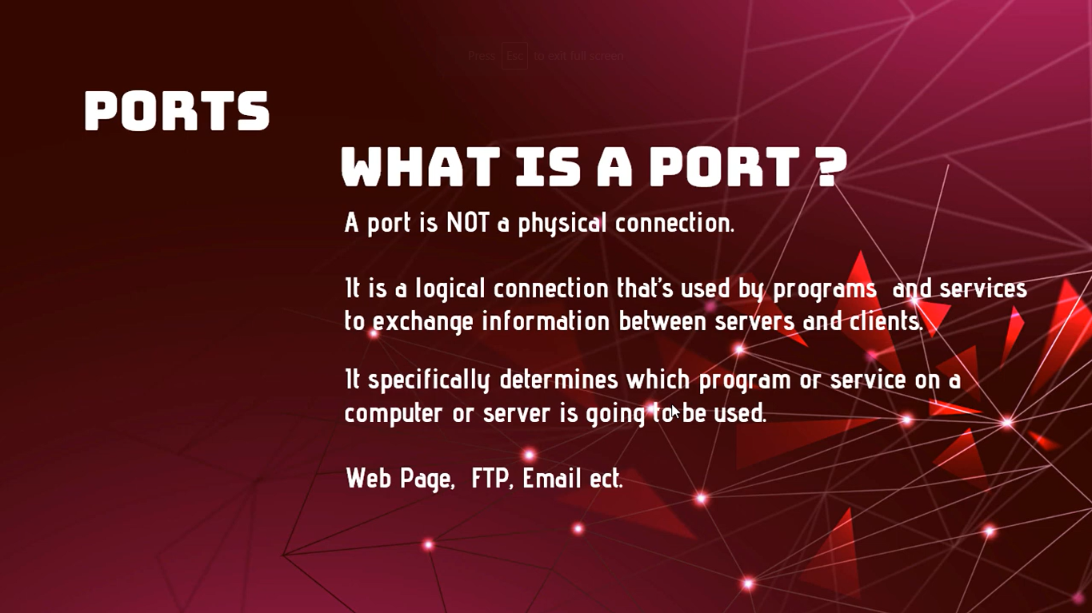
Basics of Ports in Computer Networking
Course Code: CSE-311
Course Name: Computer Network and Security
Md. Tariqul Islam
Lecturer
Department of Computer Science and Engineering
University of Global Village, (UGV)
874/322, C&B Road, Barisal.
1

Slide 3
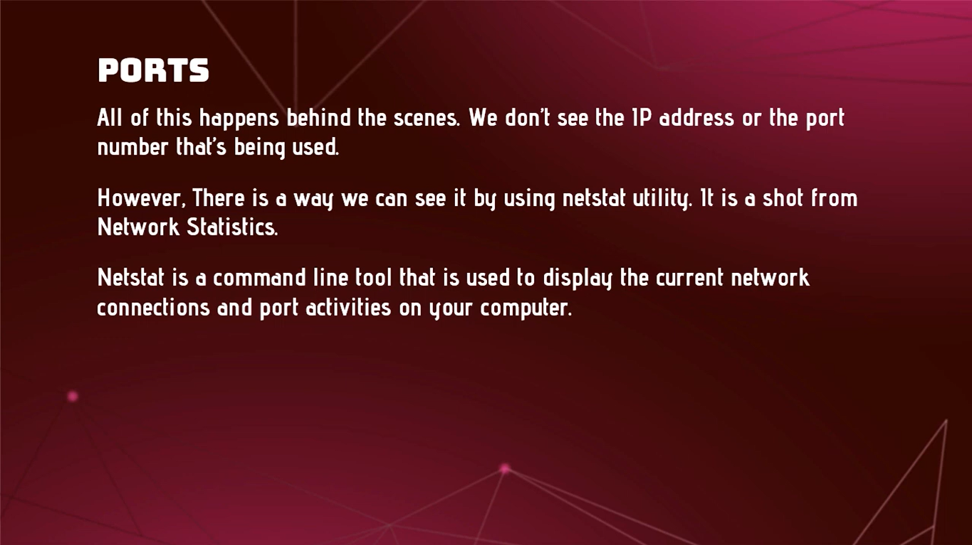

Slide 4
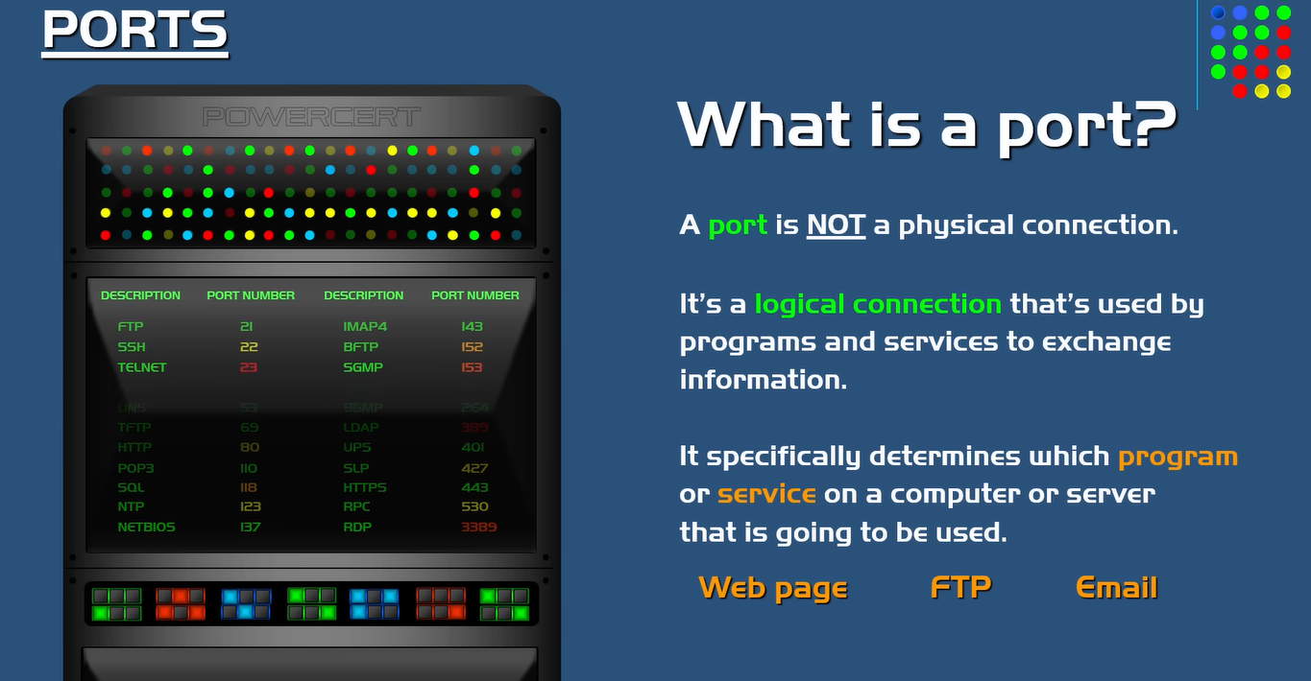

Slide 5
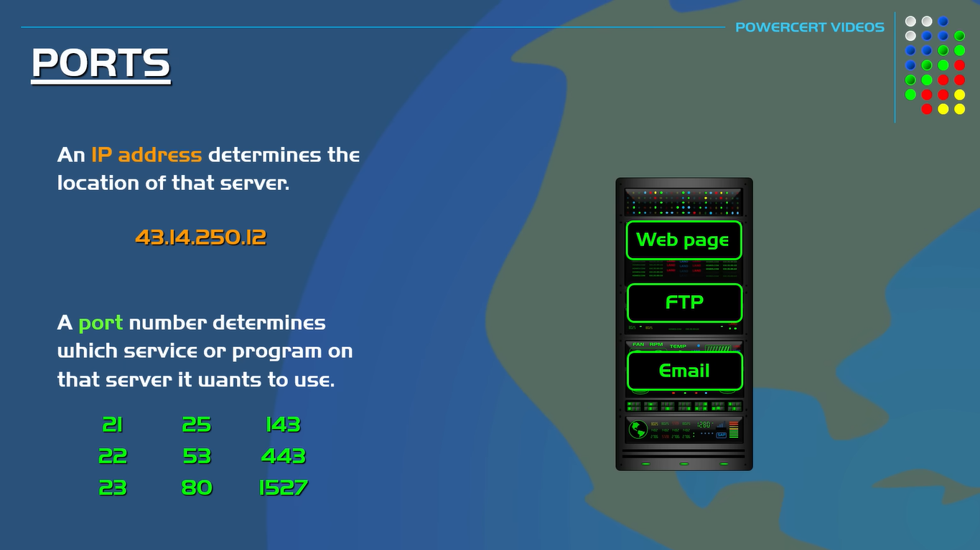
2096
2083

Slide 6
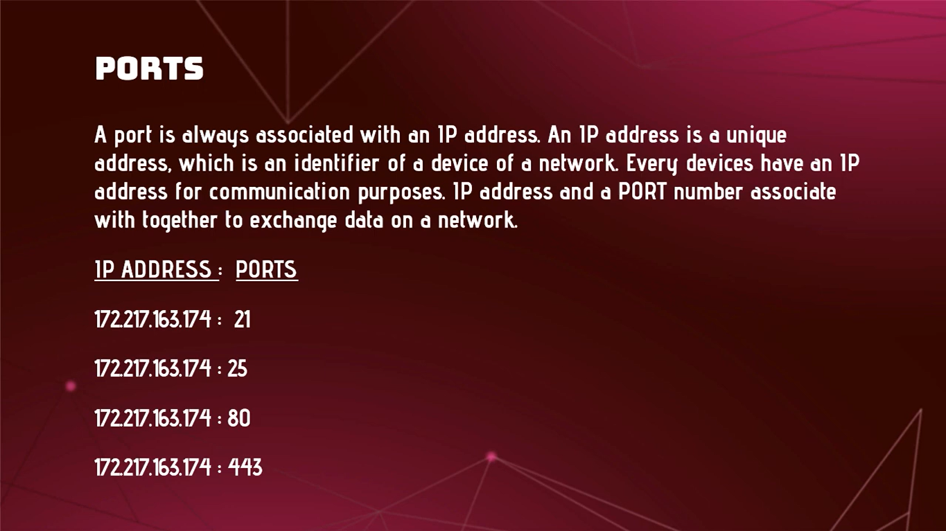

Slide 7
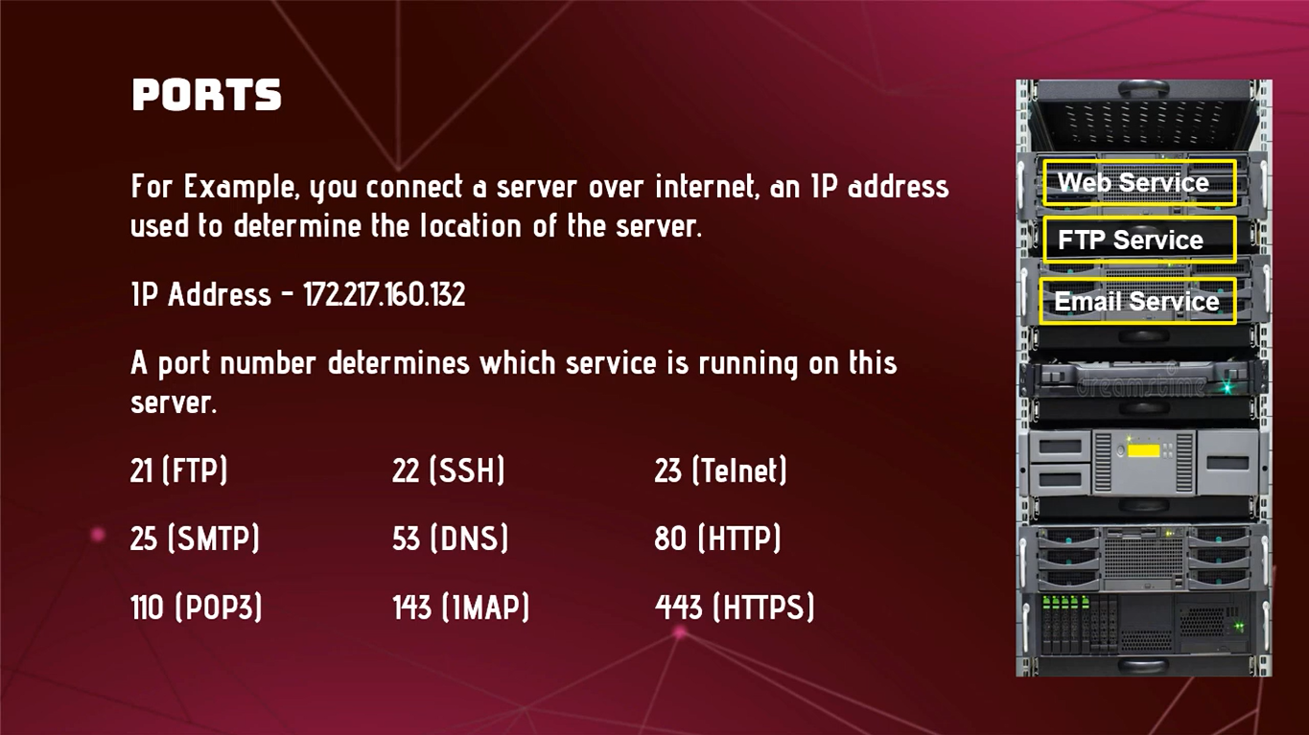

Slide 8
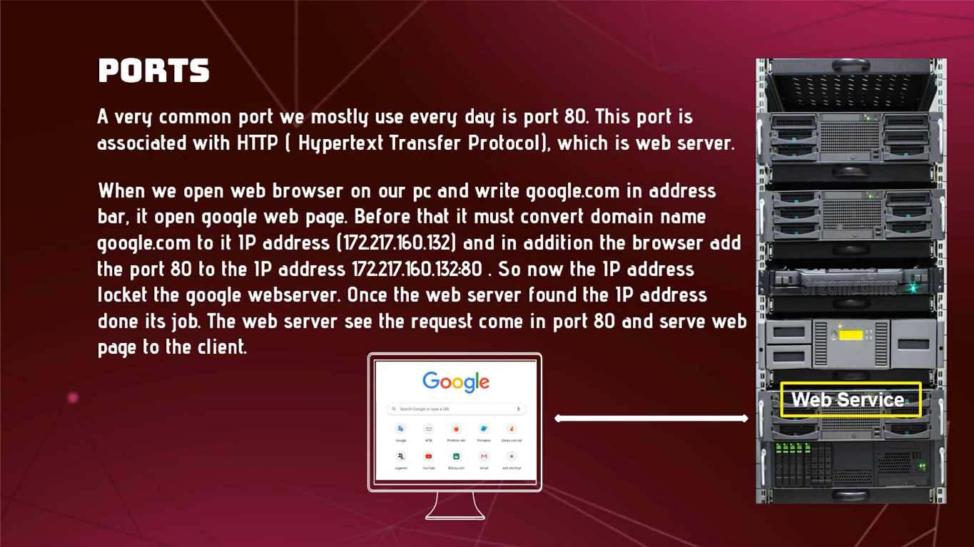

Slide 9
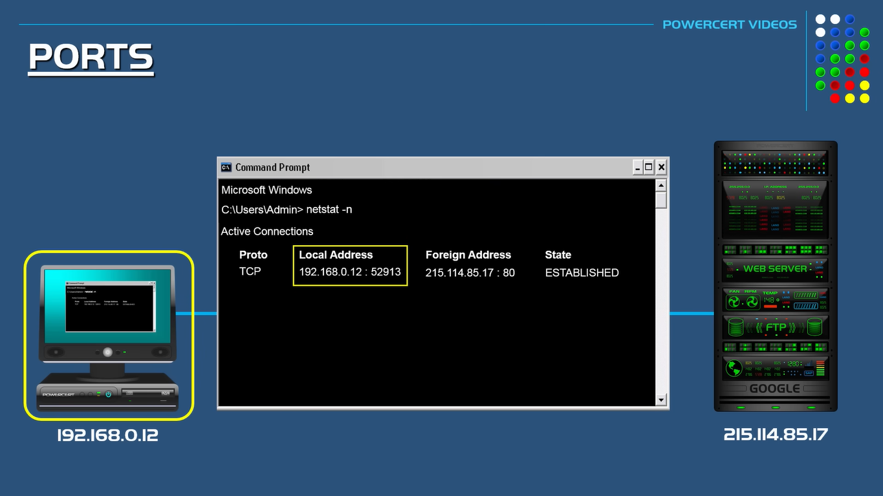

Slide 10
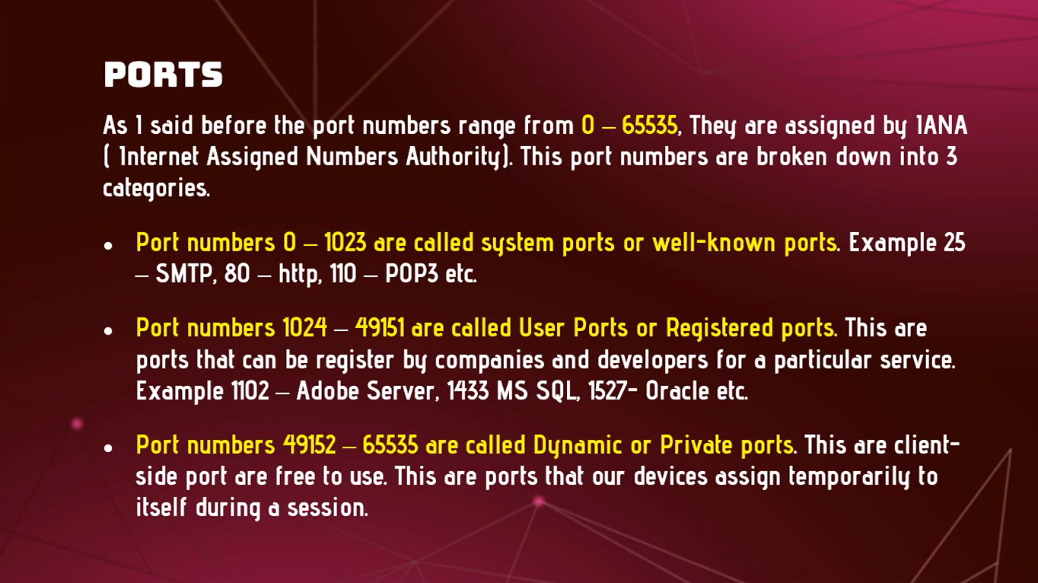

Slide 11
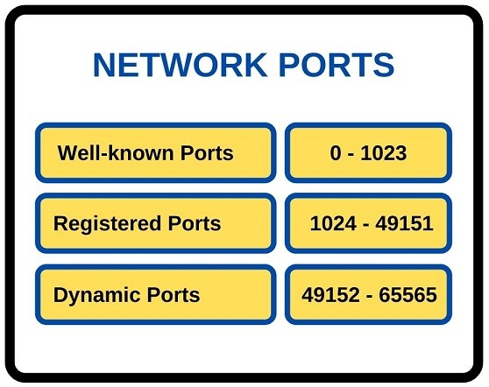

Slide 12
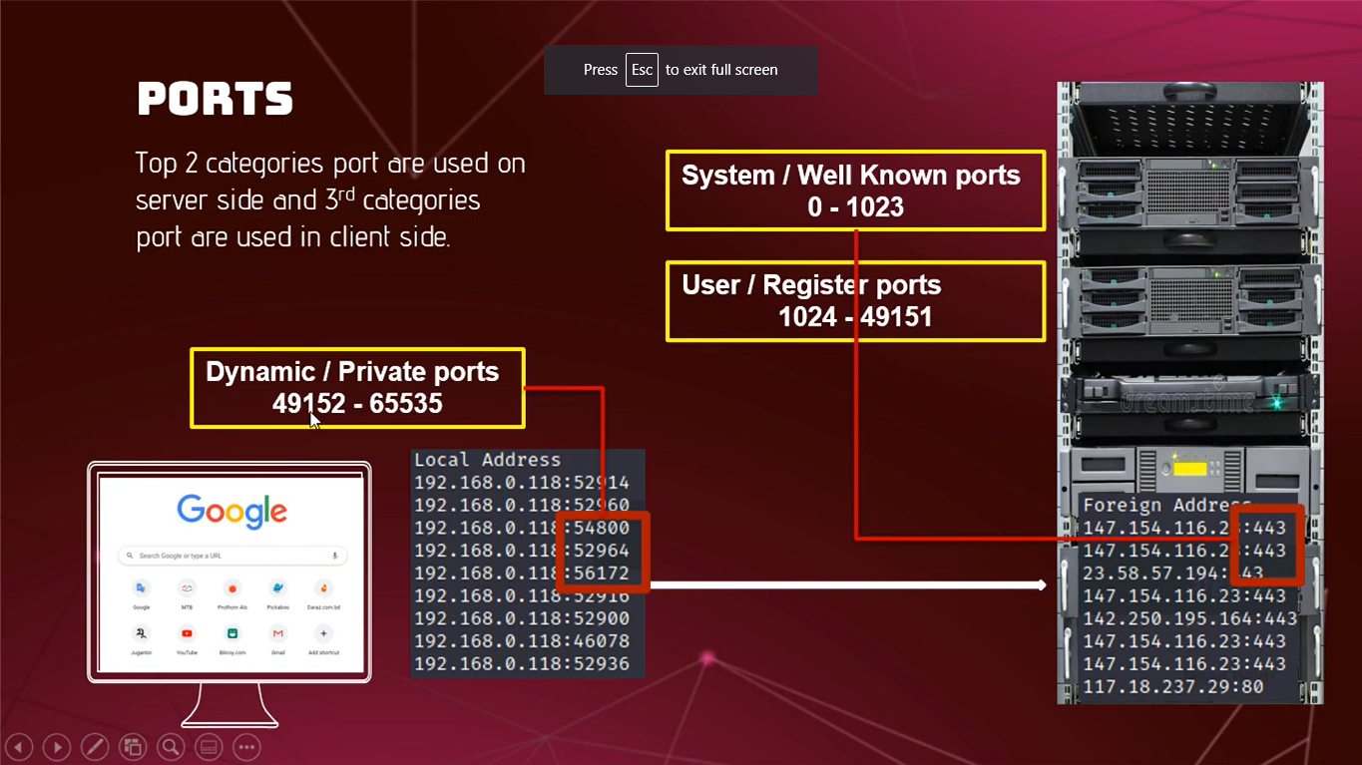

Slide 13
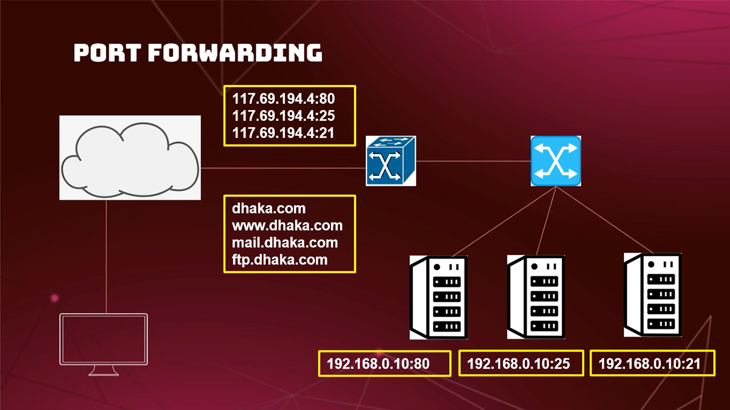

Slide 14
THANK YOU

