Slide 1


LAB MANUAL FOR
Production process lab
DEPARTMENT OF MECHANICAL ENGINEERING
COURSE INFORMATION
COURSE NAME | Production process
COURSE CODE | IPE 332
CREDIT | 1
ASSESMENT | 50

Slide 2
Course Learning Outcomes (CLOs)
The learning outcomes that are expected to be attained by the student at the end of the course are.
Sl. No. | CLOs | Domain of learning | PLOs
1 | DISPLAY basic proficiency in operation of the apparatus and PERFORM the experiment to determine the solution of the engineering problems related to the subject. | Psychomotor | 1,2,3
2 | Communicate the learned concepts using different media i.e., verbal and written. As well as perform teamwork. | Affective | 5,6
3 | Manifest the professional responsibilities and norms of engineering practice. | Psychomotor, Affective | 7,10

Slide 3
S.No. | NAME OF THE EXPERIMENT | Week
1 | MOLD MAKING & CASTING | 1,2,3
2 | SHEET METAL FORMING | 4,5,6
3 | ARC WELDING | 7,8,9
4 | BRAZING | 10,11,12
5 | Demonstration with few exercises | 13,14,15
RECOMMENDED READING:
Fundamental of Modern Manufacturing: Materials, Processes and Systems, Mikell P. Groover Fundamental of Manufacturing, G. K. Lal & S. K. Choudhury
Materials & Processes in Manufacturing, E. P. DeGarmo, J. T. Black and Kohser Manufacturing Engineering & Technology, S. Kalpakjian
E. P. Degarmo: Materials & Processes in Manufacturing, Macmillan.
The Science and Engineering of Materials, Askeland, Fuley, Wright and Balani

Slide 4
INTRODUCTION TO CASTING PROCESSES
Background
Casting is one of oldest and one of the most popular processes of converting materials into final useful shapes. Casting process is primarily used for shaping metallic materials; although it can be adopted for shaping other materials such as ceramic, polymeric and glassy materials. In casting, a solid is melted, treated to proper temperature and then poured into a cavity called mold, which contains it in proper shape during solidification. Simple or complex shapes can be made from any metal that can be melted. The resulting product can have virtually any configuration the designer desires.
Casting product range in size from a fraction of centimetre and fraction of kilogram to over 10 meters and many tons. Moreover, casting has marked advantages in production of complex shapes, of parts having hollow sections or internal cavities, of parts that contain irregular curved surfaces and of parts made from metals which are difficult to machine.

Slide 5
Several casting processes have been developed to suit economic production of cast products with desired mechanical properties, dimensional accuracy, surface finish etc. The various processes differ primarily in mold material (whether sand, metal or other material) and pouring method (gravity, pressure or vacuum). All the processes share the requirement that the material solidify in a manner that would avoid potential defects such as shrinkage voids, gas porosity and trapped inclusions. Any casting process involves three basic steps, i.e. mold making, melting and pouring of metals into the mold cavity, and removal and finishing of casting after complete solidification. One of the major classification of casting is done based on whether the mold is used again or it is prepared fresh every time. Sand casting is an example of expendable mold process or where the mold is broken after every casting to remove the component. In this lab, students will go practice this particular process by making the mold and then pouring the liquid metal into the mold to form a final component.

Slide 6
SAND CASTING PROCESSES
Sand is one of the cheaper, fairly refractory materials and hence commonly used for making mold cavities. Sand basically, contains grains of silica (SiO2) and some impurities. For mold making purposes sand is mixed with a binder material such as clay, molasses, oil, resin etc.
Green Sand Molding
In green sand molding process, clay (a silicate material) along with water (to activate clay) is used as binder. The mold making essentially consists of preparing a cavity having the same shape as the part to be cast. There are many ways to obtain such a cavity or mold, and in this demonstration you will learn to make it use a wooden ‘pattern’, metal ‘flasks’ and ‘green-sand’ as mold material.
A pattern is a reusable form having approximately the same shape and size as the part to be cast. A pattern can be made from wood, metal or plastic; wood being the most common material. Green sand refers to an intimate mixture of sand (usually river sand), bentonite clay (3-7 percent by weight of sand,

Slide 7
to provide bonding or adhesion between sand grains), and water (3-6 percent by weight of sand, necessary to activate the bonding action of the clay). Mixing the above ingredients in a sand4 muller best provides the intimate mixing action. In practice, a major part of this sand mixture consists of ‘return sand’, i.e. the reusable portion of the sand left after the solidified metal casting has been removed from the mold. Molding flasks are rectangular frames with open ends, which serve as containers in which the mold is prepared. Normally a pair of flasks is used; the upper flask is referred to as ‘cope’ and the lower one as ‘drag’. A riddle is a relatively coarse sieve. Riddling the green sand helps in breaking the lump and aerates the sand.
Sometimes the casting itself must have a hole or cavity in or on it. In that case the liquid metal must be prevented from filling certain portions of the mold. A ‘core’ is used to block-off portions of the mold from being filled by the liquid metal. A core is normally made using sand with a suitable binder like molasses. Core is prepared by filling the core-box with core sand to get the desired shape and the baking this sand core in an oven at suitable temperature. During mold making a suitable ‘gating system’ and a riser’ is also provided. The gating system is the

Slide 8
network of channels used to deliver the molten metal from outside the mold into the mold cavity. The various components of the gating system are pouring cup, sprue, runners and gates. Riser or feeder head is a small cavity attached to the casting cavity and the liquid metal of the riser serves to compensate the shrinkage in the casting during solidification. Fig. 1 below shows the various parts of a typical sand mold. Several hand tools, such as rammer, trowel, sprue pin, draw spike, slick, vent wire, gate cutter, strike off bar etc. are used as aids in making a mold.
Melting and Pouring of Metals
The next important step in the making of casting is the melting of metal. A melting process must be capable of providing molten metal not only at the proper temperature but also in the desired quantity, with an acceptable quality, and within a reasonable cost. In order to transfer the metal from the furnace into the molds, some type of pouring device, or ladle, must be used. The primary considerations are to maintain the metal at the proper temperature for pouring and to ensure that only quality metal will get into the molds. The operations involved in melting of metal in oil fired furnace/induction furnace and pouring of liquid metal into the mold cavity will be shown during the demonstration.

Slide 9
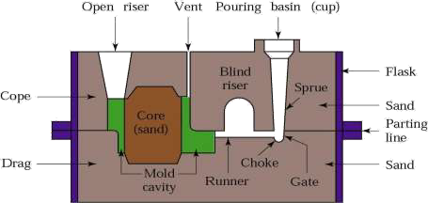
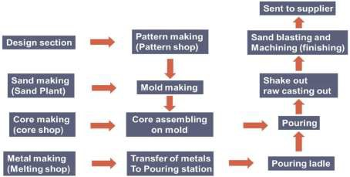
Removal and Finishing of Castings
After complete solidification, the castings are removed from the mold. Most castings require some cleaning and finishing operations, such as removal of cores, removal of gates and risers, removal of fins and flash, cleaning of surfaces, etc.

Slide 10
EXERCISE-1
MOLD MAKING & CASTING
Objective
1. To prepare a pattern for given object for lost form casting.
2. To prepare a Green sand mold from the prepared pattern.
3. To melt and pour Aluminum metal into the mold.
Equipment and Materials
Pattern, core box, molding flasks, molding tools, sand muller, riddle, sand, bentonite, core baking oven, thermocole, melting furnace, fluxes, pouring ladle, pyrometer, hacksaw, file.

Slide 11
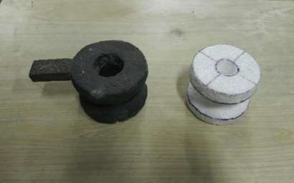
Procedure
Pattern for lost form casting
Fig. 3: Foam pattern and the corresponding cast object.
Mold Making
(i) Place the drag part of the molding flask and riddle molding green sand to a depth of 2 cm in the drag.
(ii) Place the pattern at the centre of the drag (flask)
(iii) Pack the sand carefully around the pattern as shown in figure 4. Heap more

Slide 12
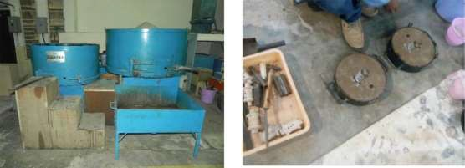
molding sand in the drag and ram with rammer carefully
(iv) Place the core half of the pattern over the drag pattern matching the guide pins and also place the gating system with sprue and riser in proper positions.
(v) Complete the cope half by repeating steps 3. Remove the extra sprue and riser pins and make a pouring basin.

Slide 13
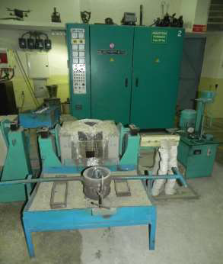
Melting and Pouring
(i) Melt the metal in the furnace. Use appropriate fluxes at proper stages and measure metal temperature from time to time.
Pour the molten metal into the pouring ladle at a higher temperature (say 100oC higher) than the pouring temperature. As soon as the desired pouring temperature is reached, pour the liquid metal into the mold in a steady
(ii)
stream with ladle close to the pouring basin of the mold. Do not allow any dross or slag to go in.
Allow sufficient time for the metal to solidify in the mold. Break the mold carefully and remove the casting.
Cut-off the riser and gating system from the casting and clean it for any sand etc.
(v) Inspect the casting visually and record any surface and dimensional defects observe.
(iii)
(iv)

Slide 14
INTRODUCATION TO METAL FORMING
SHEET METAL FORMING
Many products are manufactured from sheet metal involving combination of processes such as shearing, bending, deep drawing, spinning etc. These processes are characterized by localized deformation and configuration changes and are together called “Sheet Metal Forming”. These processes do not result in bulk shape change of the parts, but lead to configurational changes. Sheets have high surface area to volume ratio of starting metal which distinguishes these from bulk deformation. Sheet metal forming is often called ‘press working’ as presses are required to perform these operations. Parts are usually called stampings and usual tools involve punches and dies. Sheet metal operations can involve combination of stresses, eg.
Stretching of the metal (tensile stresses)
Bending of the metal (tensile and compressive stresses)
Cutting of the metal (shear stresses)

Slide 15
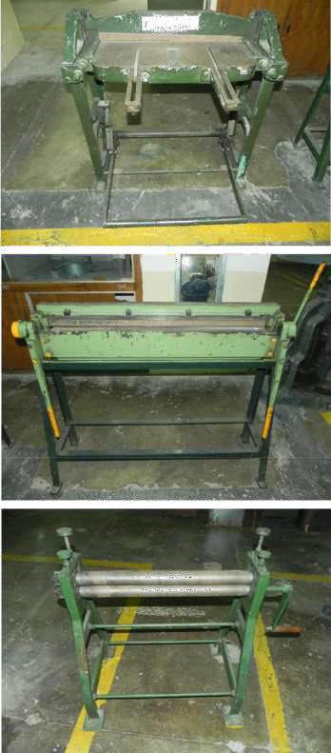
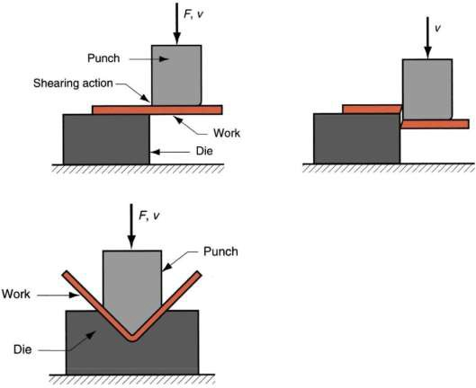
(a)
(b)
(c)

Slide 16
EXERCISE-2
SHEET METAL FORMING
Objective
(i) To prepare a sheet metal product (Funnel).
(ii) Report the various parameters for the various passes during the rolling of the given metal piece.
Equipment & material
Mallet, Hand Snip, Bench Vice, Grooving Tool, Scriber, Scale, Marker, Light Weight Hammer, Divider and Metal Sheet
Demonstration
Self secured sheet metal joints

Slide 17
(a) Internal grooved joint
Mark out portions of given sheets near edges to be joined with a marker. Fold the sheets at edges in the portion marked, first at right angles to the
plane of the sheet and then at 180० to the plane.
Insert one folded sheet into the other. Groove the seam using grooving die.
(b) Double grooved joint
Fold sheets after making them as per the instructions given. Cut a piece of sheet (called strap) of required width.
Strap width = (4x size of marked edges) + (4 x thickness of
sheet). Close the edges of the strap slightly.
Slip the strap on the bent edges of the sheets after bringing them.
(c) Knocked-up joint
Fold one sheet and close edges slightly. Bend one sheet to form a right angles band. Slip the second sheet in the folded one.
Close the right angled sheet using a mallet.

Slide 18
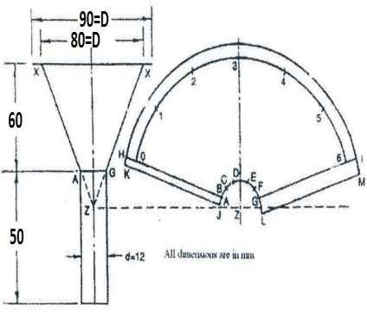
Fig. 8: Approximate dimensions of the funnel to be fabricated.
Procedure for funnel:
Draw the elevation on full scale
Complete the cone by extending the lines A and G
Choose a point Z and draw curves with Z as a center, and ZA and ZX as radius Draw the vertical line Z3, meeting the internal curve at D, and external curve at 3 Starting from D mark lengths DC, CB, BA, DE, EF and FG, each equal to nd/6.
Again starting from 3 mark length 3-2, 2-1, 1-0, 3-4, 4-5 and 5-6, each equal to πd/6. (D and d are major and minor diameters)

Slide 19
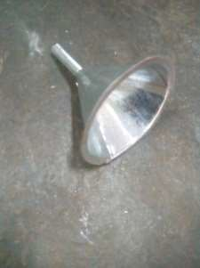
Draw another curve with Z as a center and ZX+5 mm as radius.
Joint AO and G6 and extend it to cut the outer curve at points H and I, respectively. Provide a margin of 5 mm on one side, and 10 mm on another side for joint.
Cut out the required portion and form the conical portion. Make the bottom half of the funnel.
Fig. 9: Final form of funnel to be fabricated in the lab.

Slide 20
INTRODUCTION TO JOINING PROCESSES
Objective
To study and observe the welding and brazing techniques through demonstration and practice (ARC, MAG, Brazing)
Background
Solid materials need to be joined together in order that they may be fabricated into useful shapes for various applications such as industrial, commercial, domestic, art ware and other uses. Depending on the material and the application, different joining processes are adopted such as, mechanical (bolts, rivets etc.), chemical (adhesive) or thermal (welding, brazing or soldering). Thermal processes are extensively used for joining of most common engineering materials, namely, metals. This exercise is designed to demonstrate specifically: gas welding, arc welding, resistance welding, brazing.

Slide 21
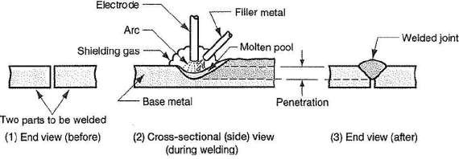
WELDING PROCESSES
Welding is a process in which two materials, usually metals, and is permanently joined together by coalescence, resulting from temperature, pressure, and metallurgical conditions. The particular combination of temperature and pressure can range from high temperature with no pressure to high pressure with any increase in temperature. Thus, welding can be achieved under a wide variety of conditions and numerous welding processes have been developed and are routinely used in manufacturing.
Fig. 10: Schematic of a welding process

Slide 22
To obtain coalescence between two metals following requirements need to be met: (1) perfectly smooth, flat or matching surfaces, (2) clean surfaces, free from oxides, absorbed gases, grease and other contaminants, (3e) metals with no internal impurities. These are difficult conditions to obtain. Surface roughness is overcome by pressure or by melting two surfaces so that fusion occurs. Contaminants are removed by mechanical or chemical cleaning prior to welding or by causing sufficient metal flow along the interface so that they are removed away from the weld zone friction welding is a solid state welding technique. In many processes the contaminants are removed by fluxing agents.The production of quality welds requires (1) a satisfactory heat and/or pressure source, (2) a means of protecting or cleaning the metal, and (3) caution to avoid, or compensate for, harmful metallurgical effects.

Slide 23
Arc Welding
In this process a joint is established by fusing the material near the region of joint by means of an electric arc struck between the material to be joined and an electrode. A high current low voltage electric power supply generates an arc of intense heat reaching a maximum temperature of approximately 5500OC. The electrode held externally may act as a filler rod (consumable electrode) or it is fed independently of the electrode (nonconsumable electrode). Due to higher levels of heat input, joints in thicker materials can be obtained by the arc welding process. It is extensively used in a variety of structural applications.
There are so many types of the basic arc welding process such as shielded metal arc welding (SMAW), gas metal arc welding (GMAW), gas tungsten arc welding (GTAW), submerged arc welding

Slide 24
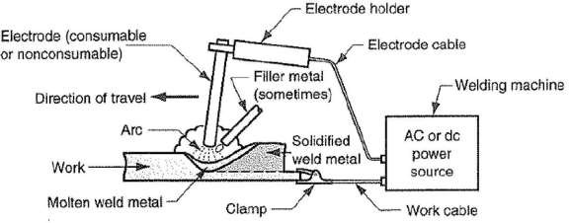
Fig. 11: Schematic of a shielded metal arc welding process.

Slide 25
EXERCISE-3
ARC WELDING
Objective
To prepare a butt joint with mild steel strip using MAG & MMAW technique
Equipment and materials
Welding unit, consumable mild steel wire, mild steel flats (100 x 25 x 5 mm), protecting gas, Wire Brush, Tongs etc.
Procedure
Clean the mild steel flats to be joined by wire brush.
Arrange the flat pieces properly providing the gap for full penetration for butt joint(gap ½ thicknesses of flats).
Practice striking of arc, speed and arc length control
Set the welding current, voltage according to the type of metal to be joined.
Strike the arc and make tacks at the both ends to hold the metal pieces together duringthe welding process
Lay beads along the joint maintaining proper speed and arc length.

Slide 26
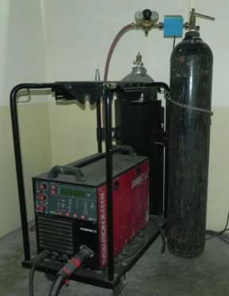
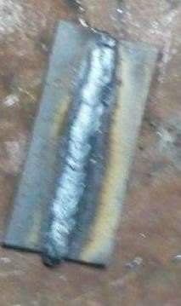
Fig. 12: Welding equipment and operation available in the Engineering Metallurgy Lab.

Slide 27
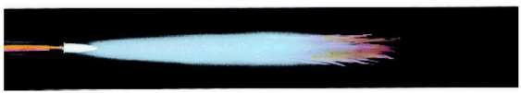
INTRODUCTION TO JOINING PROCESSES
Gas Welding
In this process, a joint is established by fusing the material near the region of joint by means of a gas flame. The common gas used is mixture of oxygen and
acetylene which on burning gives a flame temperature of 3500^{O}C. Hence this is also termed as Oxy Acetylene Welding (OAW). A filler rod is used to feed molten material in the gap at the joint region and establish a firm weld. The flame temperature can be controlled by changing the gas composition i.e. ratio of oxygen to acetylene. The color of flame changes from oxidizing to neutral to reducing flame.
Fig. 13: Oxyfuel gas welding flame used for gas welding as well as for Brazing.
BRAZING

Slide 28
In this process metal parts to be joined are heated to a temperature below the melting point of the parts but sufficient to melt the lower fusion point filler material which is used to fill the gap at the joint and establish a bond between the edges through the filler material. The filler metal is drawn through the joint through the capillarity action to create joint between the two pieces.
In this process, the base metal does not melt and hence the metallurgy of the base metal is not disturbed much. However, this also implies that the joints made by this process are not as strong as those made by welding. On the other hand, this process can establish joint between two dissimilar metals, through a proper choice of filler material. Unlike in welding the filler rod differs widely in composition from the parent material(s). Gas (oxy-acetylene mixture) is usually used for heating.

Slide 29
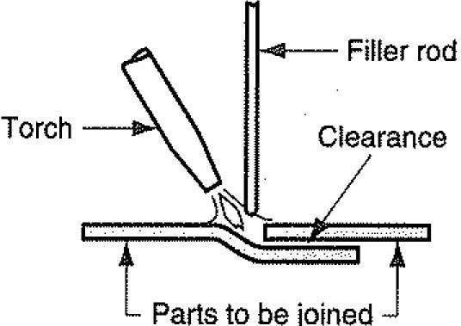
Fig. 14: Schematic of brazing operation.

Slide 30
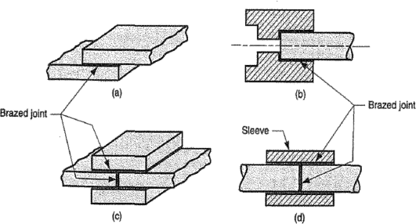
Fig. 15: Various kind of joints that can be obtained using brazing.

Slide 31
EXERCISE-4
BRAZING
Objective
To prepare a butt joint with mild steel strips using brazing technique.
Equipment & materials
Gas welding set, brazing wire, fluxes, mild steel strips (100 x 25 x 3 mm), wirebrush, tongs etc.
Procedure for Brazing
Clean the mild steel strip removing the oxide layer and flatten it. Keep the metal strip in butt position.
Tack at the two ends.
Lay brazing metal at the joint maintaining proper speed and feed.
Clean the joint and submit

Slide 32
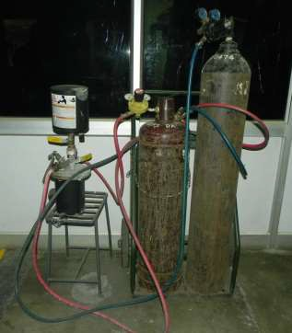
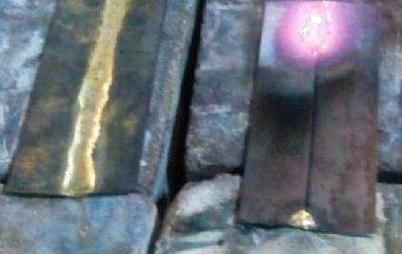
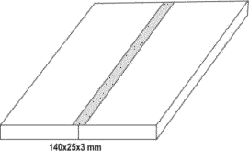

Slide 33
INTRODUCTION TO ROLLING, SWAGING, POWDER METALLURGY PROCESSES
Part -1: ROLLING
Objective
To study and observe the plain and grooved Rolling techniques through demonstration.
Rolling is the process of plastic deformation of metals by squeezing action as it passes between a pair of rotating rolls, either plane or grooved. The process may be carried out hot or cold. The most common rolling mill is the two -high rolling mill, which consists of two rolls usually mounted horizontally in bearings at their ends and vertically above each other. The rolls may be driven through couplings at their ends by spindles, which are coupled, to pinions (or gears), which transmit the power from the electric motor.
To control the relative positioning of rolls, a roll positioning system is employed on the mill stand. In small mills, such as the one in the laboratory, the roll positioning system called the ‘mill screw’ is hand driven, while in commercial
mills they are motor driven.

Slide 34
The two-high mills could be either reversing or non-reversing type. In the reversing type, which is the most common one, the direction of motion of the rolls can be reversed, and therefore the work can be fed into the mill from both sides by reversing the direction of rotation of rolls.
For rolling to take place the roll separation or roll gap must be less than the in going size of the stock. After rolling, the height of the stock is reduced and length is increased. The difference in height of ingoing and outgoing is called ‘draught’. Fig. 17 shows a flat piece of metal of thickness h1, through a pair of rolls of radius R. The AC is called the ‘arc of contact’. The angle θ subtended at the roll center by the arc of contact is called the ‘angle of contact’ and can be evaluated from
Cos θ = [1 – (ho – h1) /2R]
If there is no elastic deflection of rolls during rolling, the final thickness of metal
h1 is same as the roll gap. If elastic deflection of rolls occur, the final thickness of metal after rolling h1, is greater than the roll gap fixed before rolling.

Slide 35
Depending upon the condition under which the metal is introduced into the roll gap, two situations can occur:
The metal is gripped by the rolls and pulled along into the roll gap.
The metal slips over the roll surface.
The process of rolling depends upon the frictional forces acting between the surfaces of the roll and the metal. The condition of biting or gripping of metals into rolls is μ ≥ tan θ, where μ is the coefficient of friction between the roll and metal surfaces. The maximum value of θ (θmax = tan⁻¹λ) is often called the angle of bite. The average coefficient of friction can now be estimated as μ = tan θmax.
Rolling of a metal plate on a two high rolling mill will be demonstrated. The demonstration of the situations when (a) metal slips on the roll surface, and (b) metal is gripped by the rolls, would also be shown to you.

Slide 36
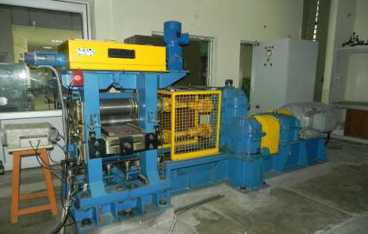
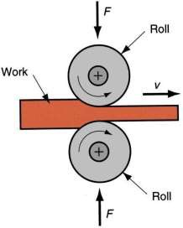

Slide 37
Part-2: SWAGING
Objective
To study and observe the Swaging techniques through demonstration.
In this process, the diameter of a rod or a tube is reduced by forcing it into a confining die. A set of reciprocation dies provides radial blows to cause the metal to flow inward and acquire the form of the die cavity. The die movements may be of in – and – out type or rotary. The latter type is obtained with the help of a set of rollers in a cage, in a similar action as in a roller bearing. The workpiece is held stationary and the dies rotate, the dies strike the workpiece at a rate as high as 10 - 20 strokes per second.
In tube swaging, the tube thickness and / or internal dia of tube can be controlled with the use of internal mandrels. For small – diameter tubing, a thin rod can be used as a mandrel; even internally shaped tubes can be swaged by using shaped mandrels and shows the process.

Slide 38
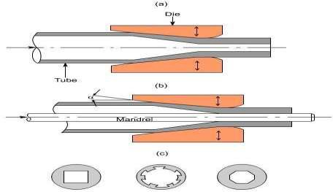
Fig. 19: Swaging mechanism.
(a) Swaging of tubes without a mandrel. Wall thickness is more in the die gap.
(b) Swaging with a mandrel. The final wall thickness of the tube depends on the mandrel diameter.
(c) Examples of cross-sections of tubes produced by swaging on shaped mandrels.
The process is quite versatile. The maximum diameter of work piece that can be swaged is limited to about 150 mm; work pieces as small as 0.5 mm diameter have been swaged. The production rate can be as high as 30 parts per minute depending upon the complexity of the part shape and the part handling means adopted.

Slide 39
The parts produced by swaging have tolerance in the range ± 0.05 mm to ± 0.5 mm and improved mechanical properties. Use of lubricants helps in obtaining better work surface finish and longer die life. Materials, such as tungsten and molybdenum are generally swaged at elevated temperatures as they have low ductility at room temperature. Hot swaging is also used to form long or steep tapers, and for large reductions.
Swaging is a noisy operation. The level of noise can be, however, reduced by proper mounting of the machine or by the use of enclosure.

Slide 40
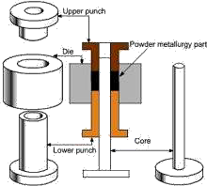
Part-3: POWDER METALLURGY
Objective
To study and observe the Powder Metallurgy techniques through demonstration.
Powder Metallurgy comprises a family of production technologies, which process a feedstock in powder form to manufacture components of various types. These production technologies generally involve all or most of the following process steps:
Powder production: Virtually all iron powders for PM structural part production are manufactured using either the sponge iron process or water atomization. Non ferrous metal powders used for other PM applications can be produced via a number of methods.
Mixing of powders: This can often involve the introduction of alloying additions in elemental powder form or the incorporation of a pressing lubricant.

Slide 41
Forming of the mixed powder into a compact: The dominant consolidation process involves pressing in a rigid toolset, comprising a die, punches and, possibly, mandrels or core rods. However, there are several other consolidation processes that are used in niche applications.
Sintering of the compact to enhance integrity and strength: This process step involves heating of the material, usually in a protective atmosphere, to a temperature that is below the melting point of the major constituent. In some cases, a minor constituent can form a liquid phase at sintering temperature; such cases are described as liquid phase sintering. The mechanisms involved in solid phase and liquid phase sintering are discussed briefly in a
later section.
Secondary operations: The application of finishing processes to the sintered part. In the Powder Metallurgy industry, such processes are often referred to as “secondary operations”.

Slide 42
EXERCISE-5
Demonstration with few exercises
Objective
To prepare a spring, square frame, ring, hemisphere and rivet joint with using various technique.
Equipment:
Ball peen hammer, Bench vice, Pliers, Hole punch, supporting rod & file etc.
Materials:-
Steel Rod, Wire and G I sheet.
Rolling
Swaging
Powder metallurgy
To learn a hole on a flat using drill machine.
To learn a surface grinding technique on a flat job using grinding machine.
To learn pipe cutting using horizontal machine.

Slide 43
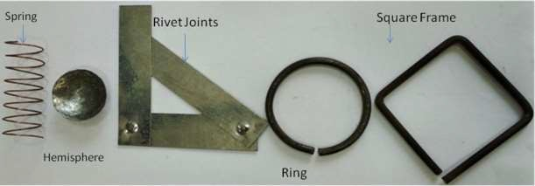
Student’s part: (These exercises are part of your project)
To make a ring with the help of mild steel rod (4.0 mm)
To make a spring with the help of mild steel wire copper coated (0.8 mm)
To bend a mild steel rod in a square frame.
To make a rivet having both fixed and movable joints using G I Sheet.
To make a hemisphere using GI Sheet with the help of anvil and ball pen hammer

