Slide 1
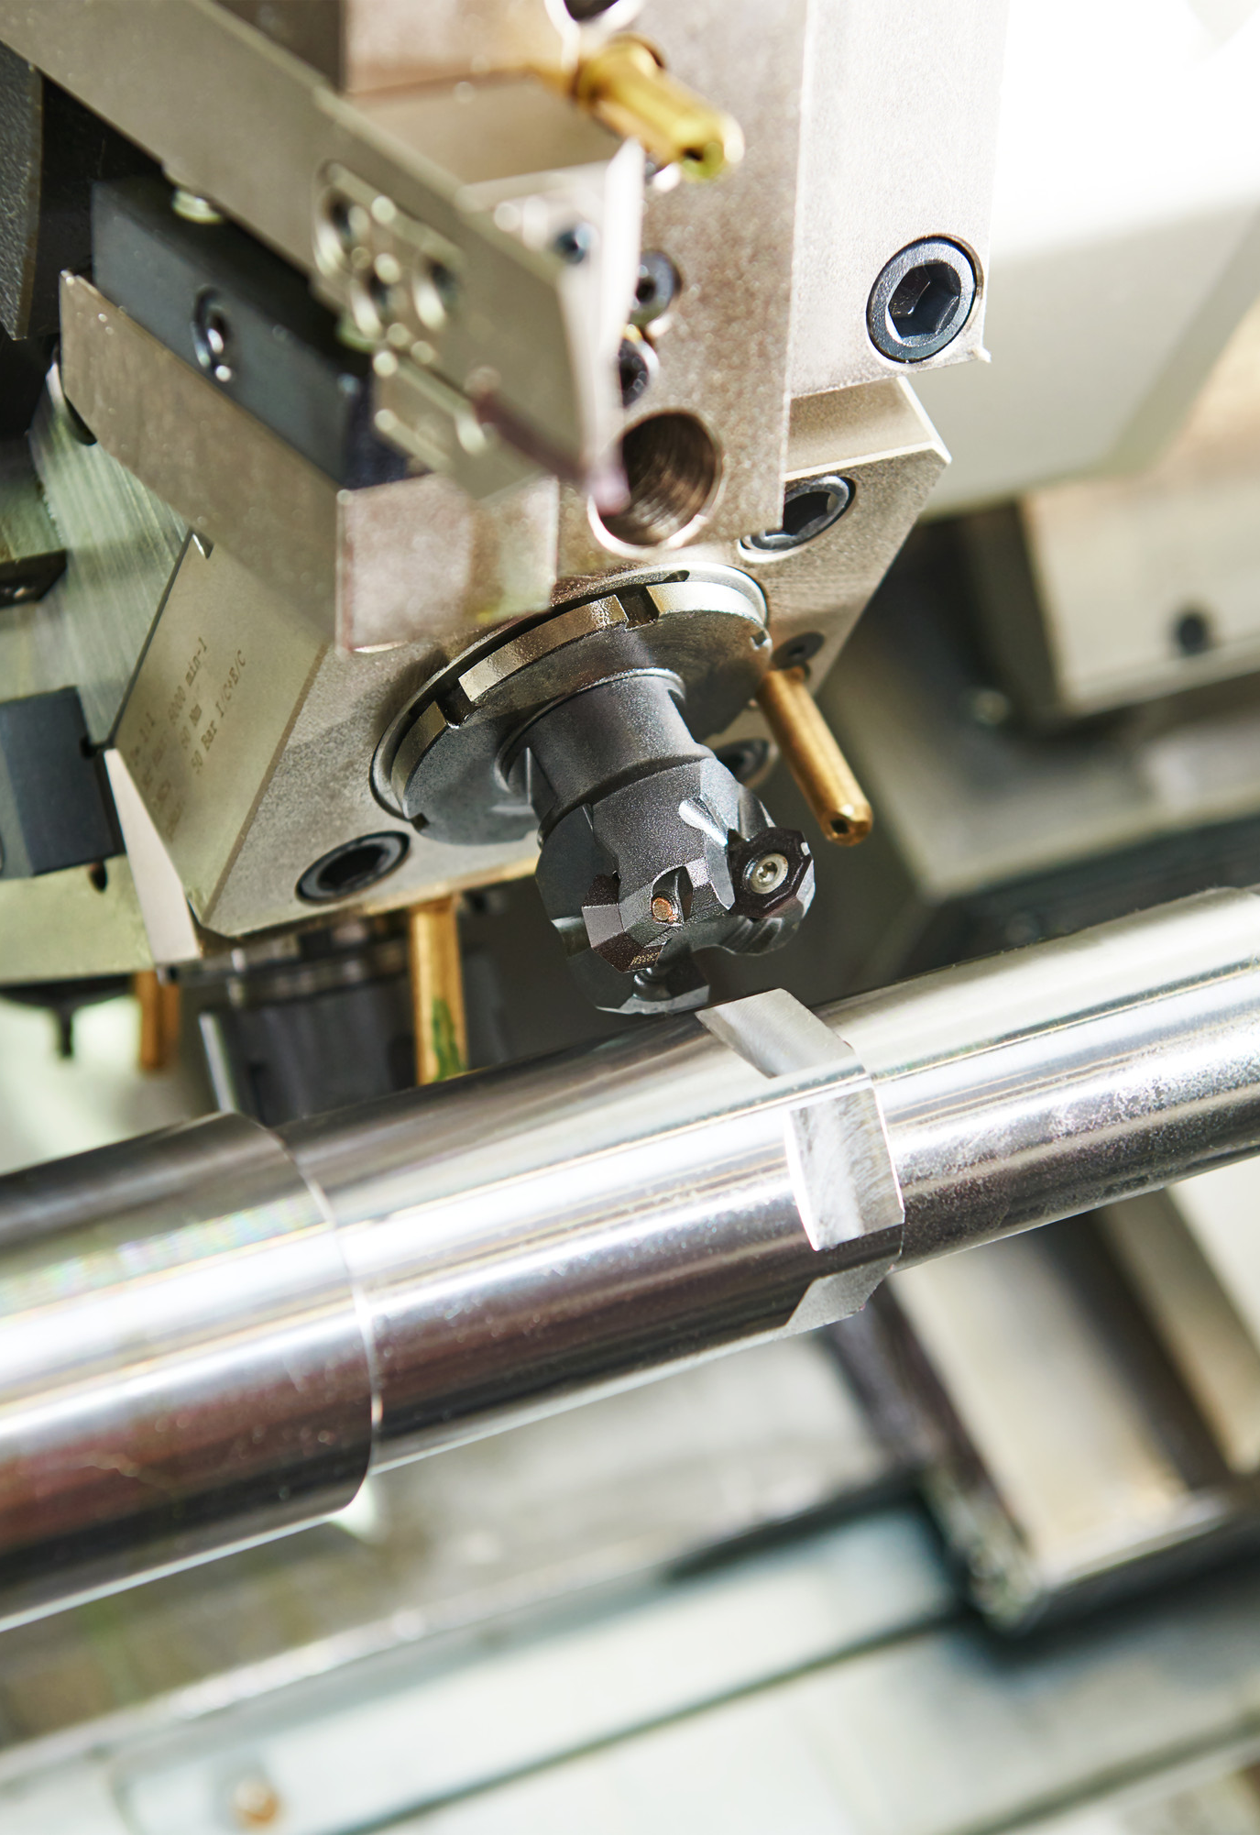

LAB MANUAL FOR
Machine tools lab
DEPARTMENT OF MECHANICAL ENGINEERING
COURSE INFORMATION
COURSE NAME | Machine tools lab
COURSE CODE | IPE 432
CREDIT | 1
ASSESMENT | 50

Slide 2
Course Learning Outcomes (CLOs)
The learning outcomes that are expected to be attained by the student at the end of the course are.
Sl. No. | CLOs | Domain of learning | PLOs
1 | DISPLAY basic proficiency in operation of the apparatus and PERFORM the experiment to determine the solution of the engineering problems related to the subject. | Psychomotor | 1,2,3
2 | Communicate the learned concepts using different media i.e., verbal and written. As well as perform teamwork. | Affective | 5,6
3 | Manifest the professional responsibilities and norms of engineering practice. | Psychomotor, Affective | 7,10

Slide 3
Sl.No. | NAME OF THE EXPERIMENT | Week
1 | INTRODUCTION TO GENERAL PURPOSE MACHINES | 1-2
2 | PLAIN TURNING AND CHAMFERING ON LATHE | 3-4
3 | STEP TURNING, TAPER TURNING, AND KNURLING ON LATHE | 5-6
4 | THREAD CUTTING ON A LATHE | 7-8
5 | DRILLING, REAMING AND TAPPING | 9-10
6 | DRILLING, REAMING, BORING, COUNTER BORING AND COUNTER SINKING | 11-12
7 | DOVETAIL CUTTING AND GROOVES BY SHAPER AND GRINDING OF MACHINE SURFACES BY SURFACE GRINDER | 13-14
8 | SUPER GEAR MILLING | 15-16

Slide 4
1.LATHE
EXPERIMENT NO.1
INTRODUCTION TO GENERAL PURPOSE MACHINES
1.1 INTRODUCTION
The lathe is one of the oldest machine tools. The main function of a lathe is to remove metal from a piece of work to give it the required shape and size. This accomplished by holding the work securely and rigidly on the machine and then turning it against cutting tool, which will remove, metal from the work in the form of chips. To cut the material properly the tool should be harder than the material of the work piece, should be rigidly held on the machine and should be fed or progressed in a definite way relative to the work.

Slide 5
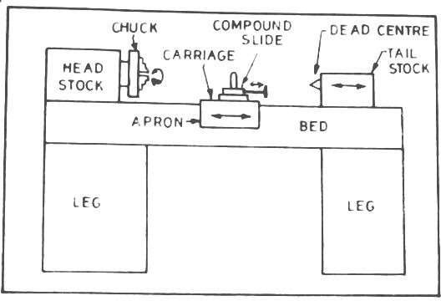
1.2 MAIN PARTS OF A LATHE
Figure No. 1: Block Diagram of Lathe

Slide 6
1.3 SPECIFICATIONS
The size of a lathe is expressed or specified by the following items and illustrated in the given figure no.2.
The height of the centers measured from the lathe bed.
The swing diameter over bed. This is the largest diameter of work that will revolve without touching the bed and is twice the height of the center measured from the bed of the lathe.
The length between centers. This is the maximum length of work that can be
mounted between the lathe centers.
The swing diameter over carriage. This is the largest diameter of work that will revolve over the lathe saddle, and is always less than the swing diameter over bed.
The maximum bar diameter. This is the maximum diameter of bar stock
that will pass through hole of the headstock spindle.
The length of bed. This indicates the approximate floor space occupied.

Slide 7
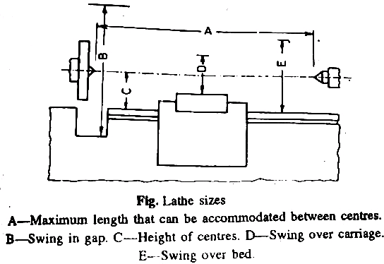
Fig No.2 Lathe sizes

Slide 8
2. DRILLING MACHINE
2.1 INTRODUCTION
The drilling machine is one of the most important machine tools in a workshop. As regards its importance it is second only to the lathe. The hole is generated by the rotating edge of a cutting tool known as the drill, which exerts large force on the work clamped on the table. As the machine tool exerts vertical pressure to originate a hole it is loosely called a “drill press”.

Slide 9
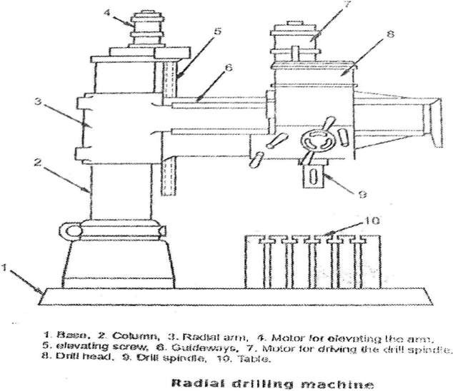
2.2 MAIN PARTS OF A RADIAL DRILLING MACHINE
Figure No.3

Slide 10
2.3 SPECIFICATIONS
The size of a drilling machine varies with the type of machine being considered.
A portable drilling machine is specified by the maximum diameter of the drill that it can hold.
The sensitive and upright drilling machines are specified by the diameter of the largest piece that can be centered under the spindle. Thus in the case of a 600 mm size upright drilling machine, the spindle placed at a distance is slightly greater than 300 mm from the front face of the column.
To specify a drilling machine fully further particulars such as the maximum size of drill that the machine can operate, table diameter, the maximum spindle travel, numbers of spindle speeds and feeds available, Morse taper number of the drill spindle, power input floor space required, net weight of the machine etc. are all needed.
The size of a radial drilling machine is specified by the diameter of the column and length of the arm. Other particulars such as maximum drilling radius, minimum drilling radius, spindle speeds and feeds, etc.

Slide 11
3. MILLING MACHINES
3.1 INTRODUCTION
A milling machine is a machine tool that removes metal as the work fed against a rotating multipoint cutter. The cutter rotates at a high speed and because of the multiple cutting edges it removes metal at a very fast rate. The machine can also hold one or more cutters at a time. This is a why a milling machine finds wide application in production work. This is superior to other machines as regards accuracy and better surface finish and is designed for machining a variety of tool room work.

Slide 12
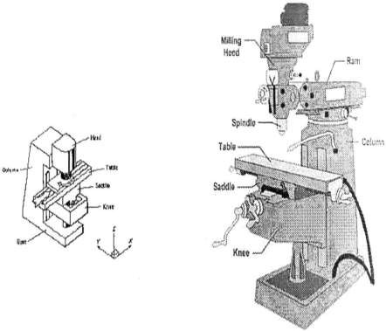
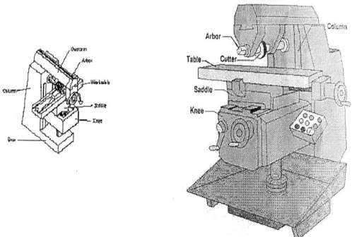
3.2 MAIN PARTS OF A MILLING MACHINE
Figure No.4 VERTICAL MILLING MACHINE
Figure No.5 HORIZONTAL MILLING MACHINE

Slide 13
3.3 SPECIFICATIONS
The size of the column and knee type milling machine is designated by the dimensions of the working surface of the table and its maximum length of longitudinal, cross and vertical travel of the table. The following are the typical size of a horizontal knee type- milling machine:
Table length X width = 1100 mm x 310 mm.
Power traverse: longitudinal x cross x vertical= 650 mm x 235 mm x 420 mm.
In addition to the above dimensions, number of spindle speed, number of feed, spindle nose taper, power available, net weight and the floor space required, etc. should also be stated in order to specify the machine fully.

Slide 14
4.PLANING MACHINES
4.1 INTRODUCTION
The planer like a shaper is a machine tool primarily intended to produce plane and flat surfaces by a single point cutting tool. A planer is very large and massive compared to a shaper and capable of machining heavy work piece which cannot be accommodated on a shaper table. The fundamental difference between a shaper and a planer is that in a planer the work which is supported on the table reciprocates past the stationary cutting tool and the feed is supplied by the lateral movement of the tool, whereas in a shaper the tool which is mounted upon the ram reciprocates and the feed is given by the crosswise movement of the table.

Slide 15
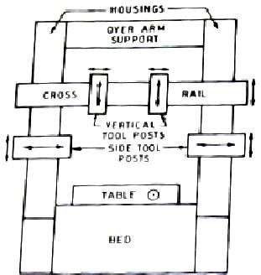

4.2 PLANING MACHINE PARTS
A standard double housing planer is illustrated in the
given figure. The principal parts of the planer are:
Bed
Table or platen
Tool head
Cross rail
Housing or column or upright
Driving and feed mechanism
4.3 SPECIFICATIONS
The size of a standard planer is specified by the size of the largest rectangular solid that can reciprocate under the tool. The size of the largest solid is known by the distance between the two housings, the height from the top of the table to the cross rail in its uppermost position, and the maximum length of table travel. The length of the table always almost equal to the table travel. Double housing planers range from 750mm X 750 mm X 2.5 m at the smallest up to 3000 mm X 3000 mm X 18.25 mm at the largest size.

Slide 16
Usually the distance between the housings and the height from the table to the cross rail in its highest position are equal. For this reason a planer may be roughly specified as 750 mm planer or 3000 mm planer.
The size of an open side planer is specified by the size of the largest job that can be machined on its table. The size of the largest job is determined by the height of the cross rail from the top of the table, the maximum length of table travel and the planning width. The maximum width of the job that can be machined is known as the planning width, which is determined by the distance from the table side of the column to the tool in the outer tool head in a vertical position. The tool head extends beyond the table width by nearly 300mm. Open side planers range from 900mm X 1200 mm X 2.5 mm to 2500 mm X 2800 mm
18.25mm. In addition to these basic dimensions, other particulars such as number of speeds and feeds available, power input, floor space required, net weight of the machine, type of drive, etc. are required to be stated in order to specify a planer fully.

Slide 17
5.SLOTTING MACHINES
5.1 INTRODUCTION
The slotting machine falls under the category of reciprocating type
of machine tool similar to a shaper or a planer. It operates almost on the same principle as that of a shaper. The major difference between a slotter and shaper is that in a slotter the ram holding the tool reciprocates in a vertical axis, whereas in a shaper the ram holding the tool reciprocates in a horizontal axis. A vertical shaper and a slotter are almost similar to each other as regards to their construction, operation, and use. The only difference being, in the case of a vertical shaper, the ram holding the tool may also reciprocate at an angle to the horizontal table in addition to the vertical stroke. The ram can be swiveled not more than 5° to the vertical. The slotter is used for cutting grooves, keyways and slots of various shapes, for making regular and irregular surface both internal and external, for handling large and awkward work pieces, for cutting internal or external gears and many other operations which cannot be conveniently machined in any other machine tool.

Slide 18
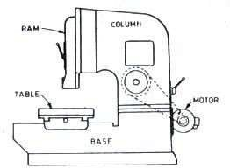
5.2 MAIN PARTS OF A SLOTTING MACHINE
Fig 7.. Main parts of a slotter.
5.3 SPECIFICATIONS
The size of a slotter like that of a shaper is specified by the maximum length of stroke of the ram, expressed in “mm”. The size of a general purpose or precision slotter usually ranges from 80 to 900 mm. To specify a slotter correctly the diameter of the table in mm, amount of cross and longitudinal travel of the table expressed in mm, number of speeds and feeds available, h.p. of the motor, floor space required, etc. should also be stated.

Slide 19
6.GRINDING MACHINES
6.1 INTRODUCTION
Grinding is metal cutting operation performed by means of a rotating abrasive when that acts as a tool. This is used to finish work pieces, which must show a high surface quality, accuracy of shape and dimension. Mostly grinding is the finishing operation because it removes comparatively little metal, 0.25 to 0.50 mm in most operations and the accuracy in dimensions is in the order of 0.0000025 mm. Grinding is also done to machine materials which are too hard for other machining methods that use cutting tools. Many different types of grinding machines have now been developed for handling various kinds of work to which the grinding process is applicable.

Slide 20
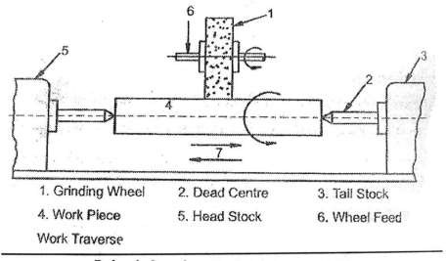
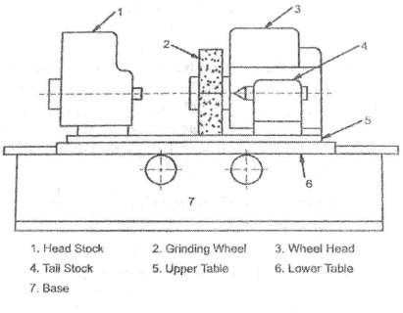
6.2 MAIN PARTS OF GRINDING MACHINES
Figure No.8BLOCKDIAGRAMOFAPLAIN CENTRE-TYPEGRINDER
Figure No.9. PRINCIPLE OF CYLINDRICAL GRINDING

Slide 21
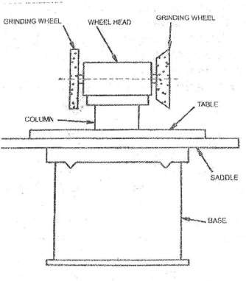
Figure No.10. TOOL AND CUTTER GRINDER

Slide 22
6.3 SPECIFICATIONS
Grinding machine size is specified according to the size of the largest work piece that can be amounted on the machine. The size of a cylindrical center type grinder is usually designated by the diameter and length both expressed in mm of the largest work piece the machine can nominally accommodate between centers. The diameter of the work piece should not exceed one half of the nominal capacity of the machine.
The size of the internal center type grinder is specified by the diameter of work piece that can be swung and the maximum length of stroke of wheel, all expressed in mm.For all types of surface grinders, particularly for a reciprocating grinder, the size is generally expressed in terms of table area and maximum height from table to wheel. The diameter of the chuck or table usually specifies the size of a rotary surface grinder. In contrast to cylinder- type grinders the actual working capacity of surface grinders is approximately equal to the nominal capacity.
The same general rules apply to tool and cutter grinders whenever applicable. In some cases, where the machines of not make use of tables, the size is specified by the maximum size of tool that can be sharpened or dressed.

Slide 23
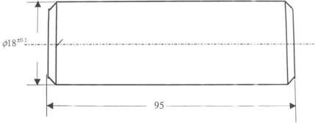
EXPERIMENT NO. 2
PLAIN TURNING AND CHAMFERING ON LATHE
1. AIM:
Plain turning and chamfering operations of Mild Steel round rod .
Fig No.11 : Plain turning and chamfering
2. MATERIAL REQUIRED:
MS round rod of φ25 x 150 mm.

Slide 24
3. TOOLS REQUIRED :
H.S.S. Single point cutting tool, chuck key, tool post key, vernier caliper, steel rule.
MEASURING INSTRUMENTS REQUIRED :
Vernier caliper ,outside caliper
EQUIPMENT REQUIRED:
Lathe
SEQUENCE OF OPERATIONS CHART:
S.No | Sequence of Operations | Cutting Tool used
1 | Facing | H.S.S. Single Point tool
2 | Rough Turning | H.S.S. Single Point tool
3 | Finish Turning | H.S.S. Single Point tool
4 | Chamfering | H.S.S. Single Point tool

Slide 25
6.1. FACING:
Facing is the operation of machining the ends of a piece of work to produce a flat surface square with the axis. This is also used to cut the work to the required length. The operation involves feeding the tool perpendicular to the axis of rotation of the work piece. A properly ground facing tool is mounted in a tool holder in the tool post. A regular turning tool may also be used for facing a large work piece. The cutting edge should be set at the same height as the center of the work piece.
A spindle speed is selected to give the proper surface speed at the outer edge of the face, and the lathe is started. The tool is brought in to clean stock from around the center for the desired depth of cut and then is fed
outward, generally by hand. The selection of hand-feed or power-feed depends
upon the length of the cut. The surface is finished to the size by giving usual roughing and finishing cuts. For roughing the average value of the cross feed is from 0.3 to 0.7mm per rev. and the depth of cut is from 2 to 5 mm, for finishing the feed is from 0.1 to 0.3 mm per rev. and the depth of cut is from
0.7 to 1 mm.

Slide 26
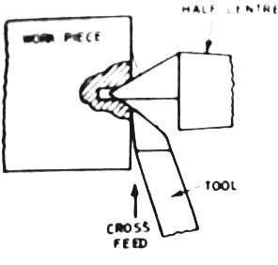
Fig. 12. Facing Operation
6.2.ROUGH TURNING:
The rough turning is the process of removal of excess material from the work piece in a minimum time by applying high rate of feed and heavy depth of cut. The roughing cut should be so made that the machine, the tool, and the work piece can bear the load and it does not make too rough a surface and spoil the centers. The depth of cut for roughing operations in average machine shop work is from 2 to 5 mm and the rate of feed is from 0.3 to 1.5 mm per revolution of the work.

Slide 27
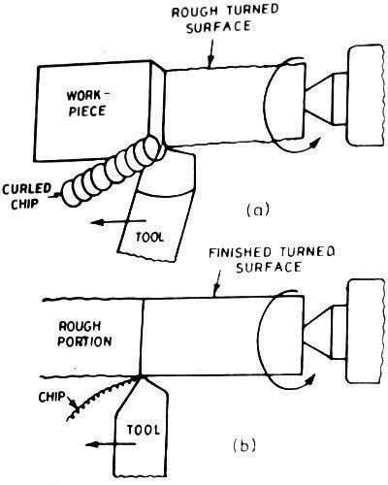

6.3.FINISH TURNING:
The finish turning operation requires high cutting speed, small feed, and a very small depth of cut to generate a smooth surface. A finish turning tool having sharp cutting edge is held securely on the tool post for this purpose. In finish turning operation shown in the figure, the depth of cut ranges from 0.5 to 1 mm and feed from 0.1 to 0.3 mm per revolution of the work piece. The cross feed micrometer dial is used to set an accurate depth of cut. After measuring the diameter of rough turned surface, the depth of cut.
After measuring the diameter of rough turned surface, the depth of cut to be given is determined by subtracting the finished diameter from the measured value. The tool is then made advance by half the above value by rotating the cross slide hand-wheel through required number of divisions on the dial. The machine is started and a trial cut is made from the end of the work to 5 or 6 mm by applying hand feed and a micrometer checks the finished diameter. Once the correct setting is made, the rest is finished by the automatic feed.

Slide 28
6.4 CHAMFERING:
Chamfering, illustrated in the given figure, is the operation of beveling the extreme end of a work piece. This is done to remove the burrs, to protect the end of the work piece from being damaged and to have a better look. The operation may be performed after knurling, rough turning, boring, drilling or thread cutting. Chamfering is an essential operation after thread cutting so that the nut may pass freely on the threaded work piece.
METAL CUTTING PARAMETERS:
  CUTTING SPEED:
The cutting speed (v) of a tool is the speed at which the metal is removed by the tool from the work piece. In a lathe it is the peripheral speed of the work past the cutting tool expressed in meters per minute.
Cutting speed =
𝜋𝑎𝑛
m/min 1,000
Where, ‘d ’ is the diameter of the work in ‘mm’, and ‘n’ is the r.p.m. of the work.

Slide 29
7.2. FEED:
The feed of a cutting tool in a lathe work is the distance the tool advances for each revolution of the work. Feed is expressed in mm/ rev.
7.3. DEPTH OF CUT:
The depth of cut (t) is the perpendicular distance measured from the machined surface to the uncut surface of the work piece. In a lathe the depth of cut is expressed as follows:
Depth of cut =
^{𝑑}1−^{𝑑}2
2
Where,
d1 = diameter of the work surface before machining in mm d2 = diameter of the machined surface in mm

Slide 30
8. PROCEDURE:
The work piece and HSS single point cutting tool are securely held in the chuck and tool post respectively.
Do the facing operation with single point cutting tool.
Do the rough turning and finish turning with turning tool.
Finally, the chamfering is done at the end of the work piece on both sides.
Measure the all dimensions with measuring instruments.
PRECAUTIONS:
  Operate the machine at optimal speeds.
  Do not take depth of cut more than 2 mm.
  Knurling should be done at slow speeds and apply lubricating oil while knurling
  Care should be taken to obtain the required accuracy.

Slide 31
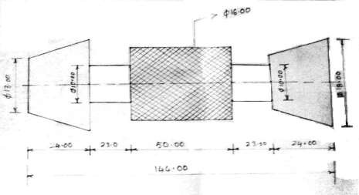
Experiment no. 3
STEP TURNING, TAPER TURNING, AND KNURLING ON LATHE
1. AIM:
To perform lathe operations such as plain turning, step turning, taper turning knurling and chamfering on a given material made of Mild Steel as shown in the figure.
Figure No.14 TAPER TURNING, STEP TURNING AND KNURLING.

Slide 32
2. MATERIAL REQUIRED:
A mild steel round bar of φ25x150 mm
3. TOOLS REQUIRED :
H.S.S. Single point cutting tool, chuck key, tool post key, vernier caliper, steel rule.
MEASURING INSTRUMENTS REQUIRED :
Vernier caliper ,outside caliper
EQUIPMENT REQUIRED:
Lathe

Slide 33
6. SEQUENCE OF OPERATIONS CHART:
S.No | Sequence of Operations | Cutting tool used
1. | Facing | H.S.S. Single Point Tool
2. | Rough Turning | H.S.S. Single Point Tool
3. | Finish Turning | HS.S. Single Point Tool
4. | Step Turning | Parting tool
5. | Taper Turning | HS.S. Single Point Tool
6. | Knurling | Knurling Tool
6.1 Facing:
Facing is the operation of machining the ends of a piece of work to produce a flat surface square with the axis. The operation involves feeding the tool perpendicular to the axis of rotation of the work piece. A regular turning tool may be used for facing a large work piece. The cutting edge should be set at the same height as the center of the work piece. The tool is brought into work piece from around the center for the desired depth of cut and then is fed outward, generally by hand perpendicular to the axis of rotation of the work piece is as shown in fig.no.1.

Slide 34
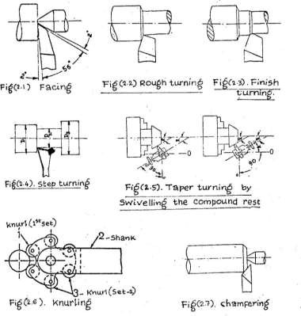
6.2. Rough Turning:
Rough turning is the operation of removal of excess material from the work piece in a minimum time by applying high rate of feed and heavy depth of cut. The depth of cut for roughing operations in machining the work ranges from 2 to 5 mm and the rate of feed is from 0.3 to 1.5 mm per revolution of the work is as shown in fig.no.2.
Figure No. 15 Types of Lathe Operations

Slide 35
6.3. Finish Turning:
A finish turning operation requires high cutting speed, small feed, and a very small depth of cut to generate a smooth surface. The depth of cut ranges from 0.5 to 1 mm and feed from 0.1 to 0.3 mm per revolution of the work piece is as shown in fig.no.3.
  Step Turning:
Step turning is the operation of making different diameters of desired length. The diameters and lengths are measured by means of outside caliper and steel rule respectively is as shown in fig.no.4.
  Taper Turning:
A taper may be defined as a uniform increase or decrease in diameter of a piece of work measured along its length. In a lathe, taper turning means to produce a conical surface by gradual reduction in diameter from a cylindrical work piece is as shown in fig.no.5.
The amount of taper in a work piece is usually specified by the ratio of the

Slide 36
difference in diameters of the taper to its length. This is termed as the conicity designated by the letter K.
K = (D-d)/L
Where, | D | = | Large diameter of taper in mm
 | d | = | Small diameter of taper in mm
 | L | = | length of tapered part in mm
A taper may be turned by any one of the following methods:
a) Form tool method
b) Tail stock set over method
c) Swiveling the compound rest and
d) Taper turning attachment
6.5.1. Taper turning by Swiveling the compound rest:
This method employs the principle of turning taper by rotating the work piece on the lathe axis and feeding the tool at an angle to the axis of rotation of the work piece. The tool mounted on the compound rest is attached to a circular base, graduated in degrees, which may be swiveled and clamped at any desired angle. Once the compound rest is set at the desired half taper

Slide 37
angle, rotation of the compound slide screw will cause the tool to be fed at that angle and generate a corresponding taper.
The setting of the compound rest is done by swiveling the rest at the half taper angle which is calculated by the equation.
Tan α = (D-d) / 2L Where α = Half taper angle
6.6. Knurling:
Knurling is the process of embossing a diamond shaped pattern on the
surface of a work piece. The purpose of knurling is to provide an effective gripping surface on a work piece to prevent it from slipping when operated by hand. Knurling is performed by a special knurling tool which consists of a set
of hardened steel rollers in a holder with the teeth cut on their surface in a
definite pattern. The tool is held rigidly on the tool post and the rollers are pressed against the revolving surface of work piece to squeeze the metal against

Slide 38
the multiple cutting edges, producing depressions in a regular pattern on the surface of the work piece. Knurling is done at the slowest speed and oil is flowed on the tool and work piece to dissipate heat generated during knurling. The feed varies from 1 to 2 mm per revolution is as shown in fig.no.2.6.
6.7. Chamfering:
Chamfering is the operation of beveling the extreme end of a work piece. This is done to remove the burrs, to protect the end of the work piece from being damaged and to have a better look. The operation may be performed after the completion of all operations. It is an essential operation after thread cutting so that the nut may pass freely on the threaded work piece is as shown in fig.no.2.7.

Slide 39
7. METAL CUTTING PARAMETERS:
7.1. Cutting Speed:
The cutting speed of a tool is the speed at which the metal is removed by the tool from the work piece. In a lathe, it is the peripheral speed of the work past the cutting tool expressed in meters/minute.
Cutting speed (V) = π DN/l000, m/min.
Where, D = Diameter of the work in min. N = RPM of the work
7.2. Feed:
The feed of a cutting tool in a Lathe work is the distance the tool advances for each revolution of the work. Feed is expressed in mm/rev.

Slide 40
7.3. Depth of Cut:
The depth of cut is the perpendicular distance measured from the machined surface to the uncut surface of the work piece.
Depth of cut = (dl-d2)/2
Where,
dl = Diameter of the work surface before
machining.
d2 = Diameter of the work surface after ma chining. While using HSS tool for turning mild steel work piece the following parameters are to be chosen.
Rough Turning Operation:
Cutting speed (V) = 25m/min, Feed (f) = 0.2 mm/rev, Depth of cut (t) = 1 mm

Slide 41
Finish Turning Operation:
Cutting speed (V) = 40m /min, Feed (f) = 0.1 mm/rev, Depth of cut (t) =
0.2 mm Tool Geometry:
Back rake angle = 7°, Side rake angle = 7°, End relief angle = 6° Side relief
angle = 6°, End cutting edge angle =15° Side cutting edge angle = 15°, Nose radius - 2 mm.

Slide 42
8. PROCEDURE:
The work piece and HSS single point turning cutting tool are securely held in the chuck and tool post respectively.
Operations such as facing, rough turning and finish turning are performed on a given mild steel bar one after the other in sequence up to the dimensions shown. Then the step turning is performed using parting tool,
Then the compound rest is swiveled by calculated half taper angle and taper is generated on the work piece. Rotation of the compound slide
screw will cause the tool to be fed at the half- taper angle,
HSS single point cutting tool is replaced by the knurling tool and knurling operation is performed at the slowest speed of the spindle,
The knurling tool is replaced by the HSS single point tool again, the work
piece is removed from the chuck and refixed with the unfinished part outside the chuck. This part is also rough turned, finish turned and facing is done for correct length,
Finally, the chamfering is done at the end of the work piece.
Measure the all dimensions using measuring instruments.

Slide 43
9. PRECAUTIONS:
Operate the machine at optimal speeds.
Do not take depth of cut more than 2 mm.
Knurling should be done at slow speeds and apply lubricating oil while knurling.
Care should be taken to obtain the required accuracy.

Slide 44
Experiment no. 4 THREAD CUTTING ON A LATHE
AIM:
V-thread cutting on a Lathe ( right hand and left hand metric threads ).
MATERIAL REQUIRED:
Mild steel round bar of φ25 X100mm
TOOLS REQUIRED :
H S. S. Single point cutting tool, Grooving tool, threading tool, thread
gauge, , chuck key, tool post key.
MEASURING INSTRUMENTS REQUIRED:
Vernier caliper, outside caliper

Slide 45
5. EQUIPMENT REQUIRED:
Lathe
6. SEQUENCE OF OPERATIONS CHART:
S.No | Sequence of Operations | Cutting tool used
1 | Facing | H.S.S Single point cutting tool
2 | Rough Turning | H.S.S Single point cutting tool
3 | Finish turning | H.S.S Single point cutting tool
4 | Step Turning | H.S.S Single point cutting tool
5 | Grooving | Grooving tool
6 | Thread cutting | Threading Tool
 | Chamfering | H.S.S Single point cutting tool

Slide 46
7. PRINCIPLE OF THREAD CUTTING:
The principle of thread cutting is to produce a helical groove on a cylindrical conical surface by feeding the tool longitudinally when the job is revolver between centers or by a chuck. The longitudinal feed should be equal to the pitch the thread to be cut per revolution of the work piece. The lead screw of the lathe through which the saddle receives its traversing motion, has a definite pitch and definite ratio between the longitudinal feed and rotation of the head stock spindle should therefore be found out so that the relative speeds of rotation of the work and the lead screw will result in the cutting of a screw of the desired pitch. This is affected by changing gears arranged between the spindle and the lead screw or by changing gear mechanism or feed box used in a modern lathe is as shown in fig. No.3.1.

Slide 47
Calculations for change-wheels, metric thread on English lead screw:
To calculate the wheels required for cutting a screw of certain pitch, it is necessary to know how the ratio is obtained and exactly where the driving and driven wheels are to be placed. Suppose the pitch of a lead screw is 12mm and it is required to cut a screw of 3mm pitch, then the lathe spindle must rotate 4 times the speed of the lead screw, which is
𝑆𝑝𝑖𝑛𝑑𝑙𝑒 𝑡𝑢𝑟𝑛 ₌ 4
means that we must have
𝐿𝑒𝑎𝑑 𝑠𝑐𝑟𝑒𝑤 𝑡𝑢𝑟𝑛 1
𝐷𝑟𝑖𝑣𝑒𝑟 𝑡𝑒𝑒𝑡ℎ ₌ 1
since a small gear rotates faster than a larger
𝐷𝑟𝑖𝑣𝑒𝑛 𝑡𝑒𝑒𝑡ℎ 4
one with which it is connected
Hence we may say,
Driver teeth / Driven teeth= pitch of the screw to be cut/ pitch of the lead screw. In BRITISH SYSTEM

Slide 48
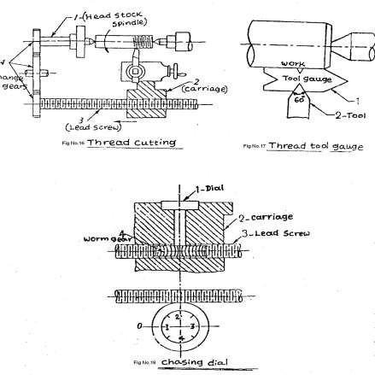
Driver teeth/ Driven teeth = threads per inch on work/ threads per inch on lead screw
. Often engine lathes are equipped with a set of gears ranging from 20 to 120 teeth in steps of 5 teeth and one translating gear of 127 teeth. The cutting of metric threads on a lathe with an English pitch lead screw may be carried out by a translating gear of 127 teeth The factor (127 / 5) comes from the fact that, 25.4 mm is equal to 1 inch. So it is made whole number by multiplying and dividing by 5, as (25.4x5)/5 =127/5.

Slide 49
8. THREAD CUTTING OPERATION:
In a thread cutting operation, the first step is to remove the excess material from the work piece to make its diameter equal to the major diameter of the screw thread. Change gears of correct size are then fitted to the end of the bed between the spindle and the lead screw. The shape or form of the thread depends on the shape of the cutting tool to be used. In a metric thread, the included angle of the cutting edge should be ground exactly 60° the top of the tool nose should be set at the same height as the center of the work piece. A thread tool gauge is usually used against the turned surface to check the cutting tool, So that each face of the tool may be equally inclined to the center line of the work piece as shown in fig (3.2).
The speed of the spindle is reduced by one half to one - fourth of the speed require for turning according to the type of the material being machined and the half- nut is then engaged . The depth of cut usually varies from 0.05 to 0.2 mm is given by advancing the tool perpendicular to the axis of the work. After the tool has produced a helical groove up to the desired length of the

Slide 50
work, the tool is quickly withdrawn by the use of the cross slide, the half-nut disengaged, and the tool is brought back to the starting position to give a fresh cut. Before re-engaging the half-nut it is necessary to ensure that the tool will follow the same path it has traversed in the previous cut, otherwise the job will be spoiled. Several cuts are necessary before the full depth of thread is reached. Arising from this comes the necessity to “pick -up “the thread which is accomplished by using a chasing dial or thread indicator.
8.1 Chasing dial or thread indicator:
The chasing dial is a special attachment used in modern lathes for accurate “picking up” of the thread. This dial indicates when to close the split of half nuts. This is mounted on the right end of the apron .It consists of a vertical shaft with a worm gear engaged with the lead screw. The top of the spindle has a revolving dial marked with lines and numbers. The dial turns with the lead screw so long the half nut is not engaged. If the half- nut is closed and the carriage moves along the dial stands still. As the dial turns, the graduations pass a fixed reference line. The half-nut is closed for all even threads when any line on the dial coincides

Slide 51
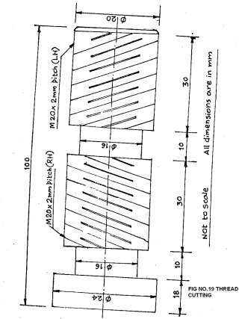
with the reference line. For all odd threads, the half-nut is closed at any numbered line on the dial determined from the charts. If the pitch of the thread to be cut is an exact multiple of the pitch of the lead screw, the thread is called even thread, if otherwise the thread is odd thread as shown in fig(3.3).
In a chasing dial, the rule for determining the dial division is: In case of metric threads, the product of the pitch of lead screw and the no. of teeth on the worm wheel must be an exact multiple of the pitch of the threads to be cut. In case of English threads, the product of the threads per inch to be cut and the number of teeth on the worm wheel must be an exact multiple of the number of threads per inch of the lead screw. For example, if the pitch of the lead screw is 6mm and the worm wheel have 15 teeth. The product will be 90. So any pitch which is exactly divisible by 90, such as 1, 1.25, 2, 2.25, 3, 3.75, 45, 5, 6, 7.5, 9, 10, 15, 30, 45,90 may be picked up when any line of the dial coincides with the reference line.

Slide 52
8.2. Right hand and left-hand thread:
If the bolt advances into the nut when rotated in clockwise direction, the thread is called right-hand thread. When cutting a right - hand thread the carriage must move towards the head stock. If the bolt advances into the nut when rotated in counter-clockwise direction, the thread is called left-hand thread, for a left-hand thread the carriage moves away from the head stock and towards the tail stock. The job moves as always in the anti- clockwise direction when viewed from the tail stock end. The direction at which the carriage moves in relation to the head stock is controlled by means of the tumbler gears or bevel gear feed reversing mechanism.

Slide 53
9. PROCEDURE:
1. The work piece and HSS single point cutting tool are fixed in chuck and tool post respectively.
2. Operations such as facing, rough turning finish turning and step turning are
performed on the given mild steel bar one after the other in sequence up to the dimensions shown.
3. Single point cutting tool is replaced by a grooving tool and grooving
operation is performed at half of the normal spindle speed.
The grooving tool is replaced by a threading tool. Right hand and Left-
hand metric threads are cut on the work 1/4 th of the piece up to the required length at of the spindle.
4. Threading tool is replaced by a single point cutting tool again and finally chamfering is done at right end of the work piece at normal spindle speed.

Slide 54
10. PRECAUTIONS:
Low spindle speeds should be used for accurate threads in thread cutting operation.
Ensure correct engage and dis-engage of half- nut.
Plenty of oil should be flowed on the work and tool during thread cutting.

Slide 55
Experiment no. 5 DRILLING, REAMING AND TAPPING
AIM:
To perform Drilling, reaming and tapping operations on a mild steel flat work piece
MATERIAL REQUIRED:
Mild steel flat of 70x50x14mm.
TOOLS REQUIRED :
  Drill bits of φ3 mm,φ 8.5mm, φ 9.8 mm,
  Floating reamer of φ 10 mm,
  M10 hand tap set,
  Vernier height gauge, surface plate,
  Center punch and ball peen hammer.

Slide 56
4. MEASURING INSTRUMENTS REQUIRED:
Vernier caliper, outside caliper,steel rule
EQUIPMENT REQUIRED:
Radial Drilling Machine
SEQUENCE OF OPERATIONS CHART:
Si No. | Operation | Tool s used
1. | Marking | Surface plate , vernier height gauge
2 | Punching | Center punch ,ball peen hammer
3. | Pilot hole drilling | Drill bit of φ 3 mm.
4. | Drilling | Drill bit of φ 8.5 mm, φ 9.8 mm.
5. | Reaming | Floating reamer of φ 10 mm
6. | Tapping( 1st stage) | M10 taper tap.
7. | Tapping(2nd stage) | M10 intermediate tap.
8. | Tapping(3rd stage) | M10 bottoming tap.

Slide 57




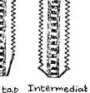
.J)rill,.,..cJ
FIGURE NO. 20. TYPES OF ORILLING OPERATIONS
To..pcr.to..p r.--t_{r}t'.".."., "e.dia.l 6ot_{t}r...c.,t.rtin9
FIG N0.21 ..,.,._,.,d ta.p SH

Slide 58
6.1. Marking:
Before drilling any hole on the given work piece, the center of the hole is located by drawing two lines at right angles to each other by means of Vernier height gauge placed on the surface plate.
  Punching:
After locating a center, an indentation is made at the point where the hole is to be drilled. Punching is done by means of center punch and ball peen hammer.
  Pilot hole drilling:
Before drilling a hole of larger diameter, a pilot hole of approximately > 3 mm which is slightly greater than the width of the chisel edge must be drilled. The reason is that, the action of the chisel edge during drilling is more pr less an extrusion process, so 80 to 85% of total thrust i.e., vertically upward force will come on chisel edge which increases the power requirement and decreases the tool-life. Therefore, to eliminate the thrust acting on the chisel edge, a pilot hole must be drilled.

Slide 59
6.4. Drilling:
Drilling is the operation of producing a cylindrical hole by removing metal by the rotating edge of a cutting tool called the drill. The drilling is one of the simplest methods of producing a hole. Drilling does not produce an accurate hole in a work piece and the hole location is not perfect. The internal surface of the hole so generated by drilling becomes rough and the hole is always slightly oversize than the drill used due to the vibration of the spindle and the drill is as shown in figure no.4.1.
6.5. Reaming:
Reaming is an accurate way of sizing and finishing a hole which has been already drilled. In order to finish a hole and to bring it to the accurate size, the hole is drilled slightly under size. The speed of the Reamer is made half that of drilling and automatic feed may be employed. The tool used for reaming is known as the reamer which has multiple cutting edges. Reamer cannot originate a hole. It simply follows the path which has been previously drilled and removes a very small amount of metal. The Material removed by this process is around 0.375 mm and for accurate work this should not exceed 0.125mm drill is as shown in figure no.4.2.

Slide 60
6.6.Tapping:
Tapping is the operation of cutting internal threads by means of a cutting tool called a tap. Tapping may be performed by hand or machine drill is as shown in figure no.4.3.
Tap:
A tap may be considered as a bolt with accurate threads cut on it and 3 or 4 flutes cut across the thread. The edges of the thread formed by the flutes are the cutting edges which are hardened and ground. The lower part of the tap is somewhat tapered, so that it can dig into the walls of the drilled hole. The upper part of the tap consists of a shank ending in a square for holding the tap in the machine spindle or by a wrench. Taps are made from carbon steel or H.S.S and are hardened and tempered. Taps are classified as
Hand tap and
Machine tap
Hand taps are usually made hi three sets as shown in Fig (9.4).
i) Taper tap (rougher), ii) Second tap (intermediate), iii) Bottoming tap (finisher).

Slide 61
Taper tap (rougher):
The end of the rougher has about 6 threads tapered .This is used to start the thread so that the threads are formed gradually as the tap is turned in to the hole.
Second tap (intermediate):
The intermediate is tapered back from the edge about 3 or 4
Threads .This is used after the rougher tap has been used to cut the thread as far as possible.
Bottoming tap (finisher):
This tap has full threads for the whole of its length. This is used to finish the work prepared by the other two taps.
Tap drill size:
The size of the tap being the outside diameter of its threads, it is necessary that the drilled hole must be smaller than the tap. The drill size which is sufficiently accurate for most cases
= Out side diameter X 0.8.

Slide 62
7. PROCEDURE:
Before drilling holes, centers of the holes are located on the work Piece by drawing two lines at right angles to each other using vernier height gauge and surface plate,
The indentations are made at the points where the holes are to be drilled
using center punch and ball peen hammer.
The Work piece is firmly fixed in the vice on a drilling machine and drill bit of φ 3 mm is held firmly by the self-centering chuck rotated along with the spindle,
Two pilot holes of φ 3 mm starting the Drilling machine.
φ 3 mm drill bit is replaced by φ8.5 mm drill bit and the drilling is performed in one of the previously drilled pilot hole.
φ 8.5 mm drill bit is replaced by φ 9.8 mm drill bit and the drilling is performed
in the second pilot hole.
are drilled at the chosen locations by

Slide 63
φ 9.8 mm drill bit is replaced by the reamer of φ 10 mm and the subsequent sizing and finishing of the hole is done by performing reaming operation in the second hole by giving hand feed.
Finally tapping operation is performed manually in three stages using taper tap, Intermediate tap and bottoming tap one after the other holding by a wrench.
PRECAUTIONS:
  Ensure that edges of the flat are perfectly square.
  Slightly lower speeds of the order of 25% less than drilling should be used
  Drilling should be performed only after pilot hole is made.
in reaming operation,

Slide 64
Experiment no. 6
DRILLING, REAMING, BORING, COUNTER BORING AND
COUNTER SINKING
AIM:
To perform Drilling, reaming, boring, counter boring and counter sinking operations on a mild steel flat work piece.
TOOLS REQUIRED:
  Drill bits of φ 3 mm and φ 9.8 mm
  Reamer of φ 10 mm diameter
  Boring tool (adjustable)
  Counter bore of φ 16 mm and φ 9.8 pilot
  Counter sink of φ 16 mm and 90°included angle
  Vernier height gauge and
  Surface plate

Slide 65
3. MATERIAL REQUIRED:
Mild steel flat of 70 x 50 x 14 mm
MEASURING INSTRUMENTS REQUIRED:
Vernier caliper, outside caliper, steel rule
EQUIPMENT REQUIRED:
Radial Drilling Machine

Slide 66
6. SEQUENCE OF OPERATIONS CHART:
S.No. | Operations | Tools used
i) | Marking | Vernier height gauge, surface plate
ii) | Punching | Center punch, Ball peen hammer
iii) | Pilot hole drilling | Drill bit of φ 3 mm
iv) | Drilling | Drill bit of φ 9.8 mm
v) | Reaming | Floating reamer of φ 10 mm
vi) | Boring | Boring tool (adjustable)
vii) | Counter boring | Counter bore of φ 16 mm and φ 9.8 mm
viii) | Counter sinking | Counter sink of φ 16 mm and 90° included angle
6.1 Marking:
Before drilling any hole on the given work piece, the center of the hole is located by drawing two lines at right angles to each other by means of Vernier height gauge placed on the surface plate.

Slide 67
6.2 Punching:
After locating a center, an indentation is made at the point where the hole is to be drilled. Punching is done by means of center punch and ball peen hammer.
  Pilot hole drilling:
Before drilling a hole of larger diameter, a pilot hole of approximately
< 3 mm which is slightly greater than the width of the chisel edge must be drilled. The reason is that, the action of the chisel edge during drilling is more or less an extrusion process, so 80 to 85% of total thrust i.e., vertically upward force will come on chisel edge which increases the power requirement and decreases the tool-life. Therefore, t o eliminate the thrust acting on the chisel edge, a pilot hole is made prior to drilling.
  Drilling:
Drilling is the operation of producing a cylindrical hole by removing metal by the rotating edge of a cutting tool called the drill. The drilling is one of the simplest methods of producing a hole. The internal surface of the hole so generated by drilling becomes rough and the hole is always slightly oversize than the drill used due to the vibration of the spindle and the drill is as shown in figure no.5.1.

Slide 68
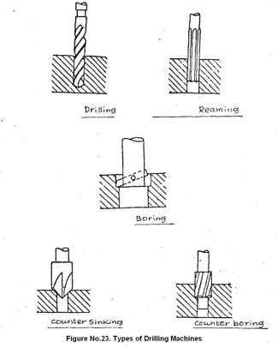
6.5 Reaming:
Reaming is an accurate way of sizing and finishing a hole, which has been already drilled. In order to finish a hole and to bring it to the accurate size, the hole is drilled slightly under size. The speed of the Reamer is, made half that of drilling and automatic feed may be employed. The tool used for reaming is known as the reamer, which has multiple cutting edges. Reamer cannot originate a hole. It simply follows the path, which has been previously drilled and removes a very small amount of metal.
The material removed by this process is around 0.375 mm and for accurate work this should not exceed 0.125mm is as shown in figure no.5.2.

Slide 69
6.6 Boring:
Boring is performed in a drilling machine for the following reasons.
To enlarge a hole by means of an adjustable cutting tool with only one cutting edge. This is necessary where suitable sized drill is not available or where hole diameter is so large that it cannot be ordinarily drilled.
To finish a hole accurately and to bring it to the required size.
To machine the internal surface of a hole already produced.
To correct out of roundness of the hole.
To correct the location of the hole as the boring tool follows an independent path with respect to the hole
The cutter is held in a boring bar which has a taper shank to fit into the spindle socket. For a perfect finishing of a hole, the job is drilled slightly undersize. In
precision machines, the accuracy is as high as 9 0.00125 mm. It is a slow process than reaming and requires several passes of the tool is as shown in figure no.5.3.

Slide 70
6.7 Counter boring:
Counter boring is the operation of enlarging the end of a hole cylindrically. The enlarged hole forms a square shoulder with the original hole. This is necessary in some cases to accommodate the heads of bolt, studs and pins. The tool used for counter boring is called a counter bore. The counter bores are made with straight or tapered shank to fit in the drill spindle. The cutting edges may have straight or spiral teeth. The tool is guided by a pilot which extends beyond the end of the cutting edges. The pilot fits into the small diameter hole having running clearance and maintains the alignment of the tool. These pilots may be interchanged for enlarging different sizes of holes. Counter boring can give accuracy of about 9 0.05 mm. The cutting speed for counter boring is 25 % less than that of drilling operation is as shown in figure no.5.4.

Slide 71
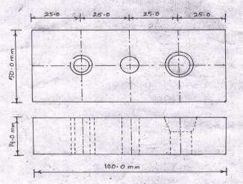
6.8 Counter sinking:
Counter sinking is the operation of making a cone-shaped enlargement of the end of a hole to provide a recess for a flat head screw or countersink rivet fitted into the hole. The tool used for countersinking is called a countersink. Standard counter sinks have 60°, 82° or 90° included angle and the cutting edges of the tool are formed at the conical surface. The cutting speed in counter sinking is 25 % less than that of drilling.

Slide 72
7. PROCEDURE:
Before drilling holes, centers of the holes are located on a work piece by drawing two lines at right angles to each other using vernier height gauge and surface plate.
Punching is done using center punch and ball been hammer at the located centers.
Work piece is firmly fixed in the vice on a drilling machine table and a drill bit of 3 mm diameter is held firmly by the self centering chuck rotated along with the spindle.
Three pilot holes of 3 mm diameter are drilled at the chosen locations by starting the drilling machine.
Drill bit of 3 mm diameter is replaced by the drill bit of 9.8 mm diameter and three holes are made in the previously drilled pilot holes.
The adjustable boring tool held in a boring bar replaces drill bit and the first hole is enlarged by 6 mm diameter. Now the final diameter becomes 16 mm.

Slide 73
Boring tool is replaced by the reamer of 10 mm diameter and the subsequent sizing and finishing of the remaining two holes is done by performing reaming operation by giving hand feed.
Reamer is replaced by the counter bore of 16 mm diameter and 9.8 mm pilot diameter; the end of a second hole is enlarged to form a square shoulder with the original hole.
Counter bore is replaced by the- countersink of 16 mm diameter and 90° included angle, the end of the third hole is enlarged conically
PRECAUTIONS:
  Ensure that the edges of the flat are perfectly square.
  Slightly lower speeds of the order of 25 % less than drilling should be used in Counter boring, countersinking and boring operations.
  Holes of larger diameter should never be drilled without a pilot hole.

Slide 74
Experiment no. 7
DOVETAIL CUTTING AND GROOVES BY SHAPER AND GRINDING OF MACHINE SURFACES BY SURFACE GRINDER
AIM:
i. To cut dovetail groove and slot on a given mild steel block using shaping machine,
ii. To finish the machined surfaces on a surface grinder.
MATERIAL REQUIRED:
Mild steel block of 82 x 60 x 40 mm.
TOOLS REQUIRED:
Roughing tool, Finishing tool, Dovetail cutting tool, parting or slotting tool, Try square, , vice, scriber, vernier height gauge , surface plate and grinding wheel.
EQUIPMENT REQUIRED:
Shaper and Surface Grinder

Slide 75
5. MEASURING INSTRUMENTS REQUIRED:
Vernier caliper, steel rule
6. SEQUENCE OF OPERATIONS CHART:
Sl.No | Operation | Cutting Tool used
i. | Machining horizontal surface | Roughing & Finishing tool.
ii. | Machining vertical surface. | Side cutting tool.
iii. | Machining angular [dovetail] surface. _ | Dovetail cutting tool.
iv. | Slotting | Parting or slotting tool.
v. | Finish grinding | Grinding wheel

Slide 76
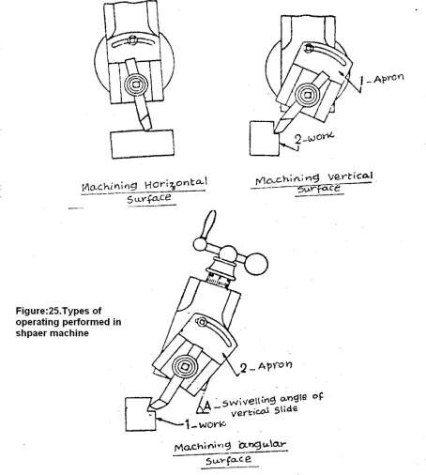
6.1. Machining Horizontal
Surface:
A shaper is mostly used to machine a flat, true surface on a work piece held hi a vice or other holding devices. After the work is properly held on the table, a planning tool is set in the tool
post with minimum overhang. The table is raised till there is a clearance of 25 to 30 mm between the tool and work piece. The table length and position of stroke are then adjusted. The length of stroke should be nearly 20 mm longer than the work and the position of stroke is so adjusted that the tool begins to move from a distance of 12 to 15 mm before the beginning of the cut and continues to move 5 to 8mm after the end of the cut. Proper cutting speed and feed is then adjusted is as shown in figure no.7.1.Short strokes should be given with high speed while long strokes with slow

Slide 77
6.2 Machining Vertical Surface:
speed. Both roughing and finishing cuts are performed to complete the job. For roughing cut speed is decreased but feed and depth of cut is increased. Depth of cut is adjusted by rotating the down feed screw of the tool head. The amount of depth of cut is adjusted by a micrometer dial. .The depth of cut for roughing work usually ranges from 1.5 to 3mm, while for finishing work it ranges from 0.075 to 0.2 mm. Feed is adjusted about one half the width of the cutting edge of the tool so that each cut will over lap the last cut giving a smooth surface finish
A vertical cut is made while machining the end of a work piece, squaring up a block or cutting a shoulder. The work is mounted in the vice or directly on the table and the surface to be machined is carefully aligned with the axis of the ram a side cutting tool is set on the tool post and the position and length of stroke is adjusted. The vertical slide is set exactly at zero position and the apron is swiveled in a direction away from the surface being cut. This is necessary to enable the tool to move upwards and away from the work during return stroke. This prevents the side of the tool from dragging on the planed vertical surface during return stroke. The down feed is given by rotating the

Slide 78
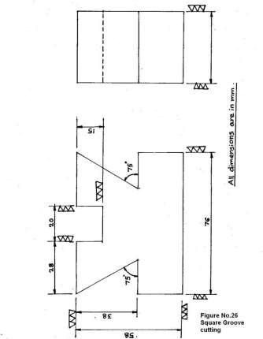
down feed screw by hand. - The feed is about 25 mm given at the end of each return stroke. Both roughing and finishing cuts are performed to complete the job is as shown in figure no.7.2.
6.3. Machining Angular Surface:
An angular cut is made at any angle other than a right angle to the horizontal or to the vertical plane. The work is set on the table and the vertical slide of the tool head is swiveled to the required angle either towards left or towards right from the vertical position. The apron is then further swiveled away from the work so that the tool will clear the work during return stroke. The down feed is given by rotating the down feed screw is as shown in figure no.7.3.

Slide 79
For cutting slots, a square nose tool similar to a parting tool is selected. The width of the cutting-edge ranges from 3 to 12 mm. As the tool penetrates deep into the work, clearance is provided all around the tool cutting edge to prevent it from rubbing against the work surface. As the tool is purely end cutting it has no side rake; slight back rake may be provided on the tool to promote easy flow of the chips. The speed is reduced while cutting a slot. The clapper block is locked in the clapper box to prevent the tool from lifting during return stroke. Lubrication is necessary on the work to prevent the cutting edge of the tool from wear due to dragging.
6.4Cutting-Slots:

Slide 80
6.5 Finish Grinding:
Grinding is a metal cutting operation performed by means of a rotating abrasive wheel that acts as a cutting tool. This is used to finish work pieces which must show a high surface quality, accuracy of shape and dimension. Mostly, grinding is the finishing operation because it removes comparatively little metal, usually 0.25 to 0.5 mm in most operations and the accuracy in dimensions is in the order of 0.00025 mm.
Surface grinding produces flat surface. The work may be ground by either the periphery or by the end face of the grinding wheel. The work piece is reciprocated at a constant speed below or on the end face of the grinding wheel.

Slide 81
7. PROCEDURE:
The work piece is firmly held in a vice fitted to the table and a roughing tool is set in the tool post with minimum overhang .
Excess material on the horizontal surface [ approximately 2mm depth ] is removed in one or two cuts using roughing tool.
Roughing tool is replaced by finishing tool and the horizontal surface is finished up to about 0.5mm depth .
Finishing tool is replaced by side cutting tool and vertical surfaces of the work piece are machined to ensure squareness of the block
The work piece is removed from the vise and its squareness is checked using try- Square.
Slot and dovetail grooves are marked on the work piece using vernier height

Slide 82
guage, surface plate and scriber . Again the work piece is firmly held in a vice fitted to the shaper table. vii. Side cutting tool is replaced by dovetail cutting tool and the vertical slide of the tool head is swivelled to 75 ° angle to the horizontal plane towards right.
Angular surface piece.
Dovetail groove on the other side is machined by changing the position of
the work piece in the vice.
Dovetail cutting tool is replaced by slotting tool and the slot is cut on the horizontal surface of the work piece .
The job is checked for its dimensions
Finally, the machine surfaces of the work piece are finished on the surface grinder.
or dovetail groove is machined at the right end of the work

Slide 83
8.PRECAUTIONS:
Lubricant should be used during slotting to prevent the cutting edge of the tool from wear due to dragging.
Work surface to be machined should be carefully aligned with the axis of the ram.
The length and position of stroke should be carefully adjusted.

Slide 84
Experiment no. 8 SUPER GEAR MILLING
AIM
To cut Involute spur gear teeth on a given blank using milling machine.
TOOLS EQUIPMENT REQUIRED:
Formed disc cutter, Dividing head spindle,.
EQUIPMENT REQUIRED
Horizontal Milling Machine
MATERIAL REQUIRED
Mild steel round blank of φ100 mm, 30mm thickness.

Slide 85
5. GEAR CUTTING BY FORMED DISC CUTTER:
The method of gear cutting by a formed disc cutter involves the mounting of a gear blank at the end of a dividing head spindle fitted on the table of a horizontal, column and knee type milling machine and then feeding the work
past a rotating, formed, peripheral type of cutter mounted on the horizontal arbor of the machine. The plane of rotation of the cutter is radial with respect to the blank. After one tooth space is formed, the next surface of the gear blank is brought under the cutter by rotating the dividing head spindle by a predetermined amount by indexing. The tooth profile of the formed cutter should correspond to the tooth space of the gear that again depends upon the module of the gear. The set of cutters used for cutting different numbers of gear teeth is shown in table no.(1).

Slide 86
Table. No (1)
Involute gear
Cutter no: |  | No. of teeth cut
NO: | 1 | 135 | to a rack
NO: | 2 | 55 | to 134 teeth
NO: | 3 | 35 | to 54 teeth
NO: | 4 | 26 | to 34 teeth
NO: | 5 | 21 | to 25 teeth
NO: | 6 | 17 | to 20 teeth
NO: | 7 | 14 | to 16 teeth
NO: | 8 | 12 | to 13 teeth

Slide 87
5.1.Spur gear proportions :
The first step in machining a spur gear is to determine the important gear tooth dimensions . The tip or outside diameter should be known to prepare the gear blank diameter. The tooth depth is necessary to calculate for setting the depth of cut of the cutter . From the module and the no . of teeth on the gear, the pitch circle diameter can be calculated .

Slide 88
Table No.(2)
Name of the tooth element | Symbol | Gear tooth proportions (pressure angle 20°)
Pitch diameter Addendum | d’ ha | Zm M
Dedendum | hf | 1.25m
Working depth | 2ha | 2m
Tooth depth | h | 2.25m
Outside diameter | d’+2ha | m(z+2)
Tooth thickness | s | 1.5708m
Clearance | hf-ha | 0.25m
Radins of fillet | r | 0.4mto0.45m

Slide 89
6 PROCEDURES:
i) Determine the important dimensions of gear tooth such as blank diameter, tooth depth and cutter pitch etc.,
(a) Blank diameter = m ( z + 2 ). mm
(b) Tooth depth
(c) Cutter pitch
= 2.25m , mm
= 3m, mm
Where m = module and Z = No.of teeth -
ii) Determine the index crank movement.
Index crank movement = 40 / N ( In simple indexing) Where N = No. of teeth
For example, Index crank movement for 54 teeth = 40 / 54 = 20 / 27.
The index crank will be moved by 20 holes in 27 hole circle for 54 times.
iii) Select the correct number of form cutter using the table (1)
iv) Select speed of the cutter, feed of the table and depth of cut. The speed
should be slightly lower than the plain milling operation and feed should be

Slide 90
normal and depth of cut is equal to tooth depth.
v) Bolt the dividing head and the tail stock on the table after setting their axis exactly perpendicular to the machine spindle.
vi) The cutter is next mounted on the arbor and it is then centered accurately with the dividing head spindle axis by adjusting the position of the table.
The alignment of the cutter with the work axis is checked by raising the table when the center line of the cutter touches the center point of the tail stock.
vii)
viii) The gear blank is next mounted between the two centers by a mandrel and is connected with the dividing head spindle by a carrier and catch plate.
ix) The proper index plate is next bolted on the dividing head and the positions of the crank pin and the sector arms are adjusted.
x) The table is raised till the cutter just touches the periphery of the gear blank

Slide 91
and the micrometer dial of the vertical feed screw is set to zero.
xi) The table is next raised to give the required depth of cut by turning dial through the calculated no. of divisions .
xii) The machine is started, and the feed is applied to finish the first tooth space of the gear.
xiii) After the end of the cut, the table is brought back to the starting position
and the blank is indexed for the next tooth space.
xiv) The operation is repeated till all the gear teeth are cut.
7. PRECAUTIONS:
The alignment of the cutter with the work axis must be checked.
The cutter must be centered accurately with the dividing head spindle axis.

