Slide 1
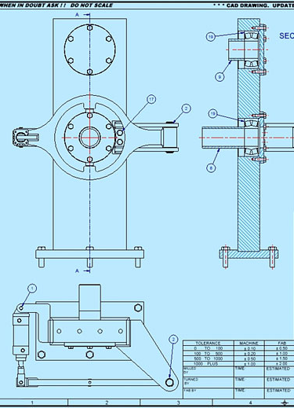

LAB MANUAL FOR
Machine design 2 lab
DEPARTMENT OF MECHANICAL ENGINEERING
COURSE INFORMATION
COURSE NAME | Machine design 2 lab
COURSE CODE | ME 344
CREDIT | 1
ASSESMENT | 50

Slide 2
Course Learning Outcomes (CLOs) The learning outcomes that are expected to be attained by the student at the end of the course are.
Sl. No. | CLOs | Domain of learning | PLOs
1 | DISPLAY basic proficiency in operation of the apparatus and PERFORM the experiment to determine the solution of the engineering problems related to the subject. | Psychomotor | 1,2,3
2 | Communicate the learned concepts using different media i.e., verbal and written. As well as perform teamwork. | Affective | 5,6
3 | Manifest the professional responsibilities and norms of engineering practice. | Psychomotor, Affective | 7,10

Slide 3
List of Experiments
Sl. No. | List of design of machine element | Week
1. | Design of shaft | 1-2
2. | Design of rigid coupling | 3-4
3. | Design of flexible coupling | 5-6
4. | Design of helical spring | 7-8
5. | Design of leaf spring | 9-10
6 | Design of brake | 11-12
7 | Design of clutches | 13-14
8. | Design of Journal Bearing | 15-16

Slide 4
Experiment 1: Design of Shaft
AIM OF THE EXPERIMENT:
Calculate the value of diameters of shaft for given loads and layout.
2.OVERVIEW OF SHAFTS
A shaft is a rotating member usually of circular cross-section (solid or hollow), which transmits power and rotational motion.
Machine elements such as gears, pulleys (sheaves), flywheels, clutches, and sprockets are mounted on the shaft and are used to transmit power from the driving device (motor or engine) through a machine.
Press fit, keys, dowel, pins and splines are used to attach these machine elements on the shaft.
The shaft rotates on rolling contact bearings or bush bearings.
Various types of retaining rings, thrust bearings, grooves and steps in the shaft are used to take up axial loads and locate the rotating elements.
Couplings are used to transmit power from drive shaft (e.g., motor) to the driven shaft (e.g., gearbox, wheels).

Slide 5
DESIGNING OF SHAFT
Designing shaft is to calculated value its diameters at critical section. The critical section is a section on the shaft which is highly stressed. The value stresses are calculated with the help of layout and free body diagram.
The shafts may be designed on the basis of:
1. Strength, and 2. Rigidity and stiffness.
In designing shafts on the basis of strength, the following cases may be considered :
Shafts subjected to twisting moment or torque only,
Shafts subjected to bending moment only,
Shafts subjected to combined twisting and bending moments, and
Shafts subjected to axial loads in addition to combined torsional and bending loads.

Slide 6
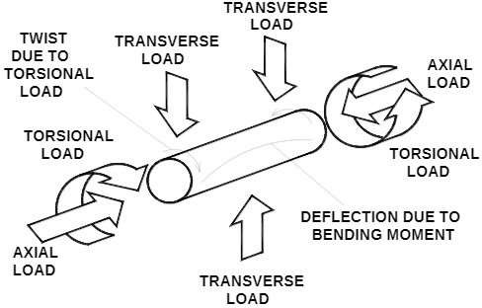
3.1.Consideration s in shaft design:
4. LOADS ON SHAF
Deflection and rigidity
Stress and strength
Frequency response
Size and spacing of components
Material selection, material treatments
Assembly, manufacturing & servicing constraints

Slide 7
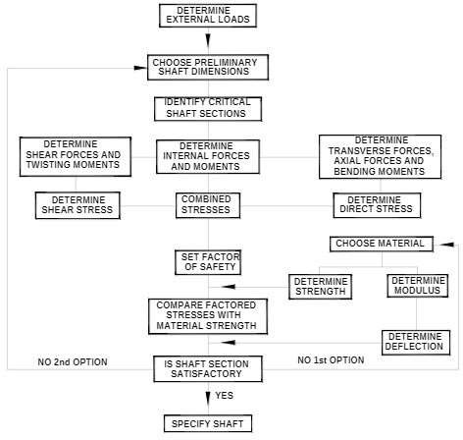
5. FLOW CHART FOR

Slide 8
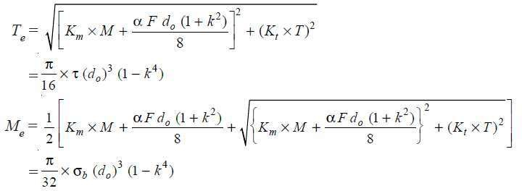


L/k > 115
6. COMMON FORMULA TO SHAFT DESIGN:
DESIGN SHAFT IN COMBINED LOADING:
L/k < 1
Where alpha is column factor
k = ^{di} _{d}
o

Slide 9
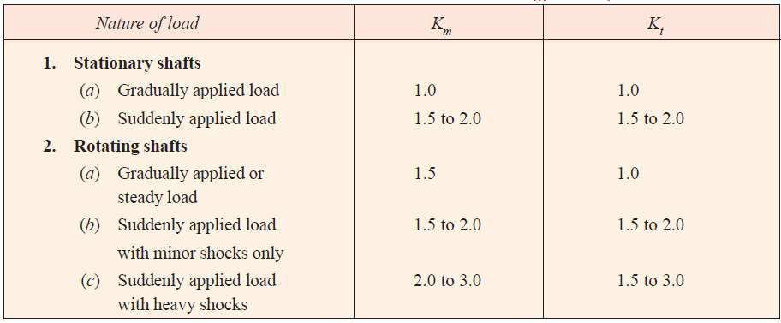
Km = Combined shock and fatigue factor for bending, and
Kt = Combined shock and fatigue factor for torsion.
Value of Km and Kt by using following table:

Slide 10
7. VALUE BENDING STRESS AND SHEAR STRESS IS OBTAINED FROM DESIGN DATA BOOK FOR THE SELECTED MATERIAL:
Prob.
A hollow shaft of 0.5 m outside diameter and 0.3 m inside diameter is used to drive a propeller of a marine vessel. The shaft is mounted on bearings 6 metre apart and it transmits 5600 kW at 150 r.p.m. The maximum axial propeller thrust is 500 kN and the shaft weighs 70 kN. Determine :
1. The maximum shear stress developed in the shaft, and
2. The angular twist between the bearings.

Slide 11
Experiment 2: Design of a rigid coupling
AIM OF THE EXPERIMENT:
Find the value of dimensions of rigid coupling.
THEORY:
Shafts are usually available up to 7 metres length due to inconvenience in transport. In order to have a greater length, it becomes necessary to join two or more pieces of the shaft by means of a coupling.
Purposes of couplings:
I. To provide for the connection of shafts of units that are manufactured separately such as a motor and generator and to provide for disconnection for repairs or alternations.
II. To provide for misalignment of the
shafts or to introduce mechanical
flexibility.
III. To reduce the transmission of shock loads from one shaft to another.
IV. To introduce protection against overloads.
V. It should have no projecting parts.

Slide 12
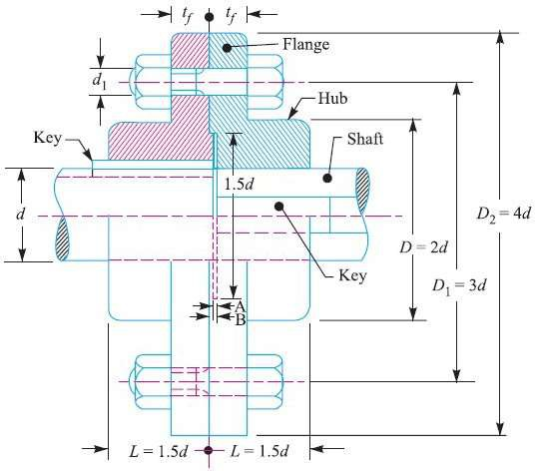
The usual proportions for an unprotected type cast iron flange coupling, as shown in figure above, are as follows :
If d is the diameter of the shaft or inner diameter of the hub, then

Slide 13

Outside diameter of hub, D = 2 (d) Length of hub, L = 1.5 (d) Pitch circle diameter of bolts, D1 = 3(d)
Outside diameter of flange,
D2 = D1 + (D1 – D) = 2 D1 – D = 4 d
Thickness of flange, tf = 0.5 d
Number of bolts = 3, for d up to 40 mm
= 4, for d up to 100 mm
= 6, for d up to 180 mm
3. DESIGN FOR HUB
The hub is designed by considering it as a hollow shaft, transmitting the same torque (T) as that of a solid shaft.
The outer diameter of hub is usually taken as twice the diameter of shaft.

Slide 14

Therefore, from the above relation, the induced shearing stress in the hub may be checked.
The length of hub (L) is taken as 1.5 d.
The material of key is usually the same as that of shaft. The length of key is taken equal to the length of hub.
4. DESIGN FOR FLANGE
The flange at the junction of the hub is under shear while transmitting the torque. Therefore, the torque transmitted,
T = Circumference of hub × Thickness of flange × Shear stress of flange × Radius of hub
5. DESIGN FOR BOLTS
The bolts are subjected to shear stress due to the torque transmitted. The number of bolts (n)

Slide 15
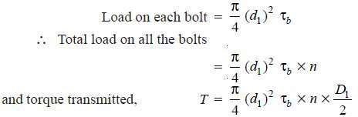


depends upon the diameter of shaft and the pitch circle diameter of bolts (D1) is taken as 3 d. We know that
Prob:
Design a cast iron protective type flange coupling to transmit 15 kW at 900 r.p.m. from an electric motor to a compressor. The service factor may be assumed as 1.35. The following permissible stresses may be used:
Shear stress for shaft, bolt and key material = 40 MPa Crushing stress for bolt and key = 80 MPa
Shear stress for cast iron = 8 MPa Draw a neat sketch of the coupling.

Slide 16
Experiment 3: Design of Flexible coupling
AIM OF THE EXPERIMENT:
Find the value of dimensions of rigid coupling.
THEORY:
Flexible coupling is used to join the abutting ends of shafts when they are not in exact alignment. In a direct electric drive from an electric motor to a machine tool, a flexible coupling is used so as to permit an axial misalignment of the shaft without undue absorption of the power which the shaft are transmitting. Following are the different types of flexible couplings :
1. Bushed pin flexible coupling, 2. Oldham's coupling, and 3. Universal coupling.

Slide 17
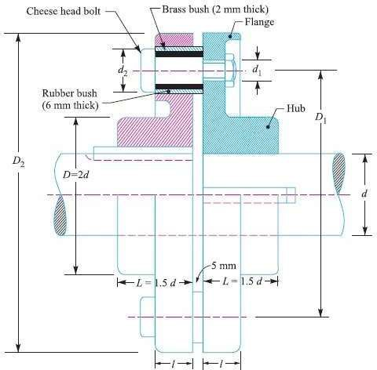
Bushed pin flexible coupling

Slide 18
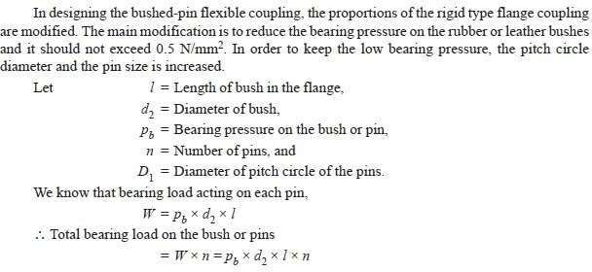

Slide 19
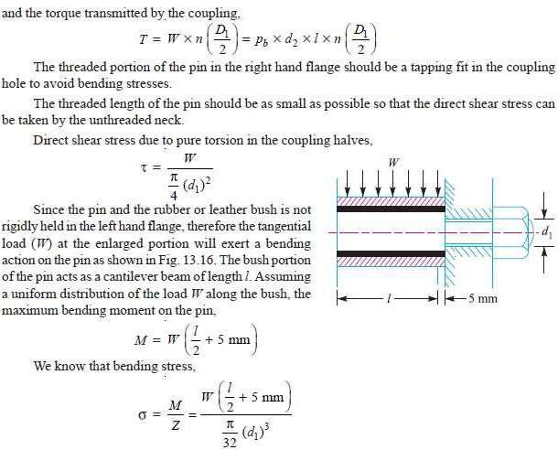

Slide 20
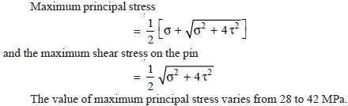
Since the pin is subjected to bending and shear stresses, therefore the design must be checked either for the maximum principal stress or maximum shear stress by the following relations,
Prob.
Design a bushed-pin type of flexible coupling to connect a pump shaft to a
motor shaft transmitting 32 kW at 960 r.p.m. The overall torque is 20 percent more than mean torque. The material properties are as follows :
(a) The allowable shear and crushing stress for shaft and key material is 40 MPa and 80 MPa respectively.
(b) The allowable shear stress for cast iron is 15 MPa.
(c) The allowable bearing pressure for rubber bush is 0.8 N/mm2.
(d) The material of the pin is same as that of shaft and key. Draw neat sketch of the coupling.

Slide 21

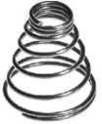
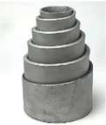

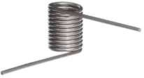
Experiment 4: Design of Helical Spring
1. AIM OF THE EXPERIMENT:
Design a helical spring based on given maximum force and deflection to consider. Analyze the steps involved in designing the helical spring.
2. OBJECTIVE FOR THE DESIGN:
The spring should possess sufficient strength to withstand the external load.
It should have different load-deflection characteristic.
It should not buckle under the external load.
3. TYPES OF SPRINGS:
Helical spring
Torsional
Conical or volute spring

Slide 22
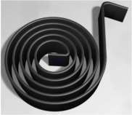
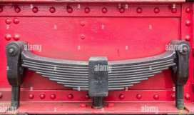


Disc spring
Laminated or leaf spring

Slide 23
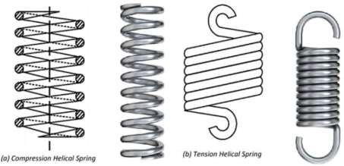


3.1. Two basic types of helical spring:
(i) Compression spring: shorten under the action of external load
(ii) Extension spring: elongate under the action of external load
Compression helical
Extension helical

Slide 24
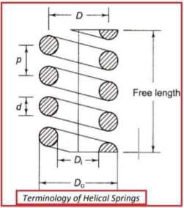
4. HELICAL COMPRESSION SPRING DESIGN:
The main dimensions of a helical spring subjected to
compressive force are shown in the figure. They are:
d = wire diameter of the spring (mm)
Di = inner diameter of the spring (mm)
Do = inner diameter of the spring (mm)
D = mean diameter of the spring (mm) D = (Di + Do) / 2
p = pitch of the spring (mm)
C = Spring index = D / d
For lower C values (C < 3): The actual stresses in the wire are excessive due to curvature effect.
For higher C values (C > 15): Spring is prone to buckling and tangle easily during handling.
A spring index from 4 to 12 is considered best from manufacturing conditions.

Slide 25
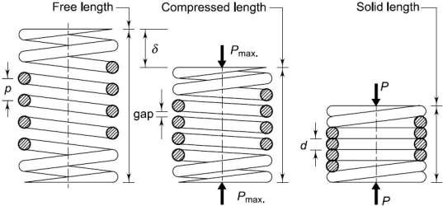
5. TERMINOLOGIES USED IN HELICAL SPRINGS:
Solid Length: It is defined as the axial length of the spring, which when compressed, the adjacent coils touch each other. No compression is possible beyond this point.
Solid length = Ntd, Nt = Total no. of coils.
Compressed Length: It is defined as the axial length of the spring, which is subjected to maximum compressive force. In this case, the spring is subjected to a maximum deflection of δ. Some gap is

Slide 26
provided between the adjacent coils to prevent their clashing.
Clashing allowance = 15% of maximum deflection. Also, 1 - 2 mm gap between the adjacent coils is provided as a thumb rule.
Total gap = (Nt - 1)xGap between adjacent coils.
Free Length: It is defined as the axial length of the unloaded spring. In this case, no external force acts on the spring.
Free length = compressed length + δ
= solid length + total axial gap + δ
Pitch: It is defined as the axial distance between the adjacent coils in the uncompressed state. p = free length/(Nt - 1)
Stiffness: k = P/ δ
P = Axial Spring Force
δ = Axial deflection of spring corresponding to force P.

Slide 27


1. PROCEDURES FOR DESIGNING A HELICAL SPRING:
The basic procedure for the design of helical spring consists of following steps :
For the given application, maximum spring force (P) and corresponding deflection (δ) are to be estimated. In some cases, maximum spring force (P) and the stiffness (k) of the spring is specified.
A suitable spring material is to be selected and its ultimate tensile strength has to be ascertained. The permissible shear stress for the spring wire is estimated by :
τP = 0.3 - 0.5 σ UT
Depending on the application, appropriate spring index (C) has to be choosen. In general, a 'C' value of 8 is considered as a good value. However, 'C' value should not be less than 3.
The Wahl's factor is to be calculated using the following relationship :
The wire diameter (d) is evaluated
The mean diameter (D) of the coil is obatined

Slide 28
(vii)The number of active coils
Depending upon the type of the ends for a spring, the no. of inactive coils are determined. Total no. of coils (Nt ) can be found out by adding no. of active and inactive coils.
The solid length of the spring
Total axial gap between the coils = Nt - 1 x gap between adjacent coils. In some cases, total gap is taken as 15% of the maximum displacement.
Free length of the spring is to be determined using, Free length = Solid length + total gap + δ
(xiii)
(xi)
Pitch (p) of the spring is found out as, The stiffness (k) is calculated using,

Slide 29
Experiment 5: Design of Leaf Spring
AIM OF THE EXPERIMENT:
Find dimension of leave spring and assure that the value of stresses are within the limit.
1.THEORY:
Leaf springs (also known as flat springs) are made out of flat plates. The advantage of leaf spring over helical spring is that the ends of the spring may be guided along a definite path as it deflects to act as a structural member in addition to energy absorbing device. Thus the leaf springs may carry lateral loads, brake torque, driving torque etc., in addition to shocks.

Slide 30
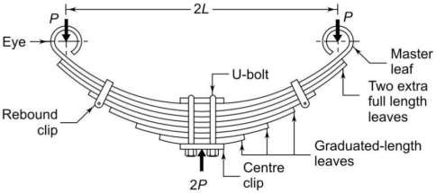
L = length of the cantilever or half the length of semi-elliptic spring (mm)
P = force applied at the end of the spring (N)
Pf = portion of P taken by the extra full-length leaves (N)
Pg = portion of P taken by the graduated-length leaves (N)
The group of graduated-length leaves along with the master leaf can be treated as a triangular plate, as shown in Fig. give in next slide. In this case, it is assumed

Slide 31
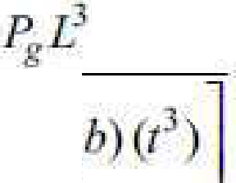
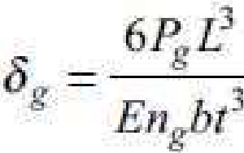
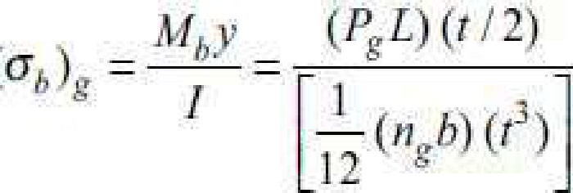
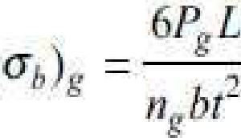
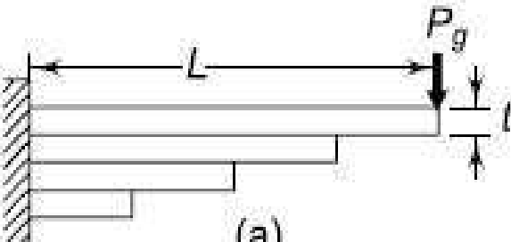
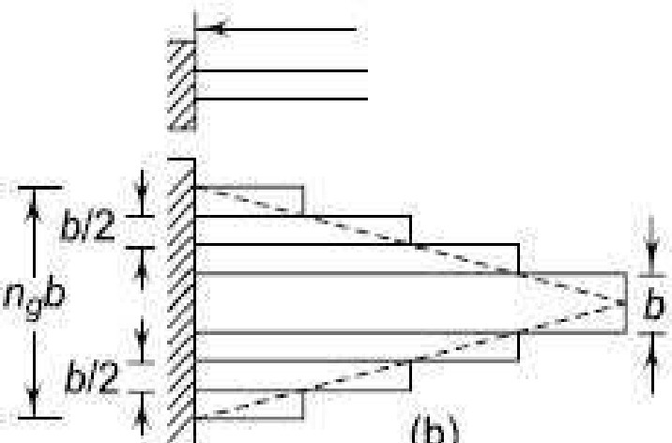
pf!
. g =
"' . 2E·l-.ma•
°'="
'E[-1"
I .l
"'
a)
1_it
P:r;
L-
==--- i:-

Slide 32
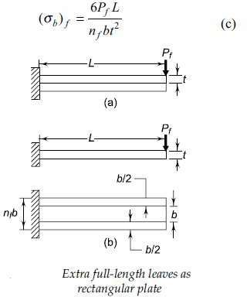
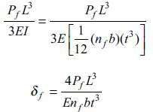
The deflection at the load point is given by,

Slide 33
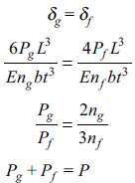
Since the deflection of full-length leaves is equal to the deflection of graduated- length leaves,

Slide 34
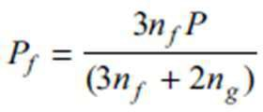
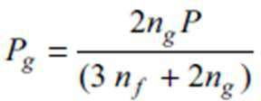
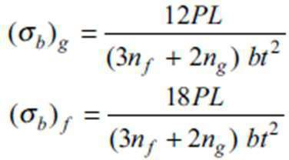

Bending stresses in full-length leaves are 50% more than those in graduated- length leaves.

Slide 35
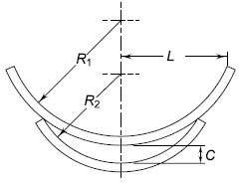
3. NIPPING OF LEAF SPRINGS
One of the methods of equalising the stresses in different leaves is to pre- stress the spring. The pre-stressing is achieved by bending the leaves to different radii of curvature, before they are assembled with the centre clip. The initial gap C between the extra full-length leaf and the graduated- length leaf before the assembly, is called a ‘nip’.

Slide 36

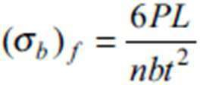

The deflection at the end of the spring is determined as given below:
The deflection of the multi-leaf spring due to the external force P is the same

Slide 37
Prob:
A semi-elliptic leaf spring used for automobile suspension consists of three extra full-length leaves and 15 graduated-length leaves,
including the master leaf. The centre-to-centre distance between two eyes of the spring is 1 m. The maximum force that can act on the spring is 75 kN. For
each leaf, the ratio of width to thickness is 9:1. The modulus of elasticity of the leaf material is 207 000 N/mm2. The leaves are pre-stressed in such a way that
when the force is maximum, the stresses induced in all leaves are same and equal to 450 N/mm2. Determine
(i) the width and thickness of the leaves;
(ii) the initial nip; and
(iii) the initial pre-load required to close the gap C between extra full-length leaves and graduated- length leaves.

Slide 38
Experiment 6: Design of Brake
1. AIM OF THE EXPERIMENT: To design a block brake with short shoe.
2. THEORY: A brake is defined as a mechanical device that is used to absorb the energy possessed by a moving system or mechanism by means of friction. The primary purpose of brake is to slowdown or completely stops the motion of a moving system, such as rotating drum, machine or vehicle. It is also used to hold the parts of the system in position at rest.
3. TYPES OF BRAKES:
I. Mechanical Brakes: These are operated by mechanical means such as levers, spring &pedals. Type of block brakeis Block Brake, Internal Brake or External Shoe Brake, disc brake, band brake.
II. Hydraulic & pneumatic brakes: These are operated by fluid pressure such as oil or air pressure.
III. Electrical brakes:
These are operated by magnetic forces.

Slide 39
4. ENERGY EQUATIONS:
The braking torque depend upon the amount of energy absorb by the brake. For a translating
body, the kinetic energy (K.E) absorbed by brake during
Braking Period: K.E.² = 1/2 m(v1²-v ²)
For a rotating body: K.E=1/2 I(w1² –w2²)
In hoist application
The potential energy(P.E) stored by the brake during braking period = mghWhere h=distance by which mass m falls during braking period.
E=MTϴ
Where E= total energy absorbed by the brake.
MT= braking torque
ϴ= angle through which brake drum rotate during the braking period.

Slide 40
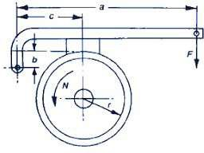
5. DESIGN OF A BLOCK BRAKE WITH SHORT SHOE:
A block brake consists of a simple block, which is pressed against the rotating drum by mean of lever. The friction between the block & brake drum causes the retardation of drum.
Fig. 1.1 Single Block Brake
The analysis is based on following assumption:
1. The block is rigidly attached to the lever.
2. The angle of contact between the block and brake drum is small resulting in a uniform pressure distribution. Considering the forces acting on the brake drum, MT= µNR, where R=radius of brake drum.
The dimensions of block are determined by the following expression: N=plω

Slide 41
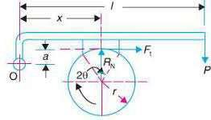
Where p = permissible pressure between block & brake drum. l &ω= length and width of the block respectively.
Generally, drum dia./4< ω <drum dia./2
Fig. 1.2. Free Body Diagram (Clockwise Rotation)
Considering the equilibrium of forces in vertical and horizontal direction: .
Taking moment of forces acting on the lever about hinge point 0. Using Equations:
P×b-N×a+μN × C=0

Slide 42
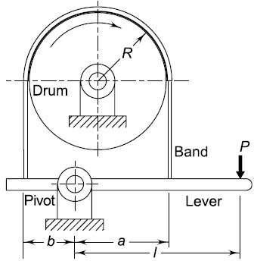
Case 1: a>µC: partially self energising brake. Case 2: a=µC: self locking brake
Case 3: a<µC: uncontrolled braking and grabbing condition.
6. TO DESIGN A DIFFERENTIAL BAND BRAKE:
The band brake in which one of the band passes through the fulcrum is called simple band brake, while the band brakes in which neither of the band end passes through the fulcrum iscalled differential band brake.

Slide 43
Experiment 7: Design of clutch
1. AIM OF THE EXPERIMENT: To understand the functioning of a friction clutch and obtain the dimensions of a friction clutch for a given application.
2. THEORY:
Clutch: Clutch is a mechanical device used to engage and disengage power transmission from a driving shaft to a driven shaft. Different types of clutches:
Clutch Terminology
1. Crank Shaft
2. Flywheel
3. Friction Disk or clutch disk
4. Pressure Plate
5. Friction Lining
6. Diaphragm spring, kept between pressure plate and outer cover
7. Splines
8. Cover or cover of pressure plate
9. Friction Material: Asbestos fibre

Slide 44
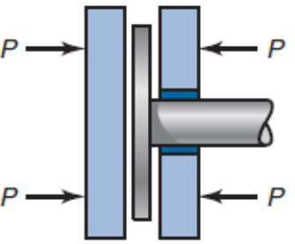
Figure 1: Clutches force balance

Slide 45
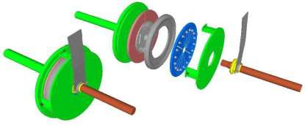
Figure 2: Different parts of a friction clutch

Slide 46
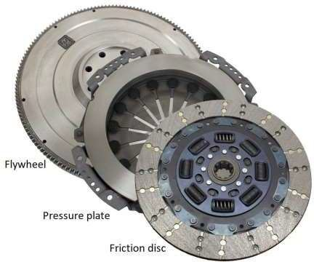
Figure 3: Actual pictures of a clutches
Positive clutches: Positive clutches have no slip. Simultaneously, they can not be engaged and disengaged in rotating conditions

Slide 47
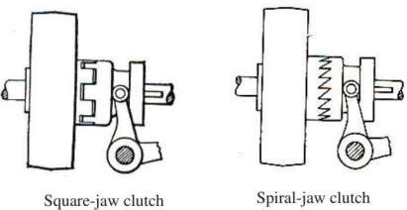
Cones: green and blue
cone
Figure 4: Positive clutches

Slide 48
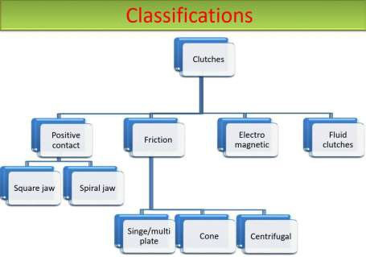
cone 2. Shaft: the blue is sliding on splines 3. Friction material: usually on the green cone 4. Spring: brings the blue cone back after using clutch control 5. Clutch control: separating both cones by pressing
6. Rotating direction: both directions of the axis are possible

Slide 49
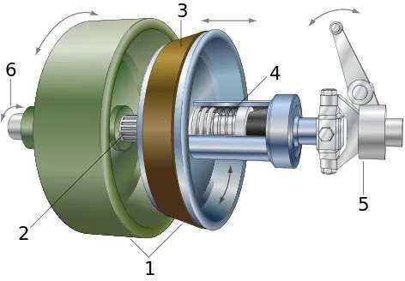
Figure 5: Cone clutch
Derivations for frictional torque:
The pressure between the contacting surfaces should have a uniform distribution over the surface. In such cases, wear will be greater at a larger diameter. The loss of material due to higher wear results in a change in pressure profile. The disk will now follow the uniform wear condition. A new clutch is close to uniform pressure condition and a worn-out clutch follows a uniform wear condition.
1. Uniform pressure condition: We need an expression for torque

Slide 50
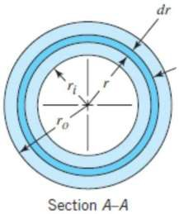
in axial force, friction coefficient, and disc size.
Figure 6: Differential ring of thickness dr.

Slide 51




The normal force acting on a differential ring element is given by
Here, p is the (uniform) pressure. The total normal force acting on the plate is
.
The torque that is produced due to frictional forces is given by,
Here the coefficient of friction is f.
The total torque that can be developed is given by,
Replacing the pressure p in terms of axial force P, and for N number of plates,

Slide 52
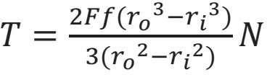


2. Uniform wear theory: Wear rate is proportional to friction work, i.e., friction force times the rubbing velocity.
Hence, for uniform wear, we have
Expression of torque is given by
Exercise: A plate clutch consists of one pair of contacting surfaces. The inner and outer diameters of the friction disk are 120 and 250 mm respectively. The coefficient of friction is 0.12 and the permissible intensity of pressure is 2 N/mm 2. Assuming uniform wear theory, calculate the power transmitting capacity of the clutch at 750 rpm. Calculate the power transmitting capacity of the clutch using the uniform pressure theory.

Slide 53
Experiment 8: Design of Journal Bearing
1. AIM OF THE EXPERIMENT: Design of journal bearing
2. THEORY: Journal bearings are mechanical components used to support shafts of a machine. Journal bearings are therefore designed to carry radial loads. The load carrying capacity is developed due to the generation of pressure by the fluid film formed in the clearance space between the bearing and journal. The shape of the clearance space is shown in Figure 1. The expression for film thickness can be easily determined from the geometry of the film shape.

Slide 54
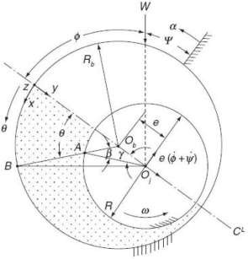
Figure 1. Journal bearing geometry
Material: Cast iron, alloy steel, bronze, aluminium etc.
Design equations:
Eccentricity (e) = distance ObOj, where Ob= axis of bearing, Oj = axis of journal
Radial clearance (c) = Rb - R, where Rb = radius of bearing, R= radius of journal
o

Slide 55
Eccentricity ratio (ɛ) = ^{e}
C
(^{R})^{2 µN}, where µ = viscosity of
o
^{Somerf} lubricant, 𝑁 = shaft
ield numbe r (S) =
speed
C p

Slide 56
Sliding velocity (U) = ωR , ω =2πN
Film thickness (h) = AB which is the film thickness at B at angle θ from line of action
For simplicity assumed ^{e} << 1, so then
h = Rb - ^{R} sin[𝜃 − 𝑠𝑖𝑛⁻¹ ( ^{e} 𝑠𝑖𝑛 𝜃)]
sin0 R
h = c(1+ ɛ cos θ)
L= length of bearing
R
Infinitely long bearing approximation (L/2R) > 2,
_{p = (}6µURɛ₎ (2+ ɛ cos0)sin 0
where, P = Pressure
W_{r} = Radial load
W_{t} = Normal load
W = Total load carrying capacity
Ф = Attitude angle
𝑓 = Coefficient of friction
_{C}2
(2+ ɛ²)(1+ ɛ cos0)²
W_{r} = 12µ𝑈𝐿 (^{R})
2 _{ɛ}2
C (2+ ɛ²)(1-ɛ²)
2
W = 6µ𝑈𝐿 (^{R})
rrɛ
^{C} (2+ ɛ²)(1-ɛ²)^{1/}2
t
W= 6µ𝑈𝐿 ( )
R ² ɛ[rr²-ɛ²(rr²-4)] ^{1/2}
C (2+ ɛ²)(1-ɛ
2₎
Ф= 𝑡𝑎𝑛⁻¹ (^{W} ) = (^{rr√1-ɛ2}
)
Wr
2ɛ
_{𝑆=} (2+ ɛ² )(1-ɛ²) ₍
1 (rr²(1-ɛ²))+4ɛ²
)
6rrɛ
_{𝑓= C (} ɛ sinФ ₊ 2rr² S
)
R 2
(1-ɛ²)^{1/}2
Infinitely short bearing approximation (L/2 R) < 1

Slide 57
p = ^{3µU} (^{L2} − 𝑦²)
ɛ sin 0
(1+ɛ cos 0 )²
where, P = Pressure
W_{r} = Radial load
W_{t} = Normal load
W = Total load carrying capacity
Ф = Attitude angle
𝑓 = Coefficient of friction
𝑄_{L} = Leakage flow rate
F = Friction force
RC² 4
3 _{ɛ}2
(1-ɛ²)²
W
r
= −
µUL _{C}2
_{Wt =} µUL TCɛ
3
^{4C2} (1-ɛ²)^{3/}2
_{W=} µUL³ ɛ
[(𝜋²(1 − ɛ²) + 16ɛ²]^{1/2}
4C² (1-ɛ²)²
Ф= 𝑡𝑎𝑛⁻¹ (^{W} ) = (^{rr√1-ɛ2}
)
Wr
4ɛ
𝑆=
(1-ɛ² ²
)
TCɛ[(rr²(1-ɛ²)+1 ɛ²] ^{1/}2
2R ²
( )
2rr²S R (1-ɛ²)^{1/}2
L
𝑓= ^{C} (
)
𝑄_{L} = ɛULc
_{F =} µULR 2rr
C
(1-ɛ²)^{1/}2

Slide 58
Finite journal bearing design: For finite journal bearing, solution of Raimondi and Boyd method can be used. Dimensionless performance parameters are available in the form of Charts and tables. It can be used for solving problems.
Power loss (𝑃t) = 2πRNF
where J = mechanical equivalent of
heat
𝑐_{p} = specific heat
Temperature rise (ΔT) = 𝑄_{L}
P
]pCp
Refer machine design data book for required data if needed.
Problems:
Problem 1: Write a computer program for design of journal bearing.
Problem 2: A full journal bearing of width 20 cm with a journal of diameter 10 cm has diametric clearance of 100 micro meters. The journal rotates at 1200 rpm. The absolute viscosity of lubricant at 20° C is 0.04 Pas. For an eccentricity ratio of 0.6, determine the minimum film thickness, load carrying capacity, attitude angle, Sommerfeld number, friction factor. Mass density, and specific heat of the oil at constant pressure may be taken as 900 kg/m3 and 2.0 J/g/0K, respectively.

Slide 59
Problem 3: A journal bearing is operating under following operating conditions: Journal diameter = 20 cm, bearing length = 10 cm and journal speed = 600 r.p.m. Clearance ratio may be chosen between 0.5, 1, 1.5, and 2.0 mm/m. Select a clearance ratio and determine load carrying capacity, oil flow rate, power loss, and temperature rise of lubricant while the viscosity of the oil at 38°C is 100cS and at 100°C is 12cS. Specific gravity of the oil is 0.9. The bearing is designed to run at an eccentricity ratio 0.6.

