Slide 1

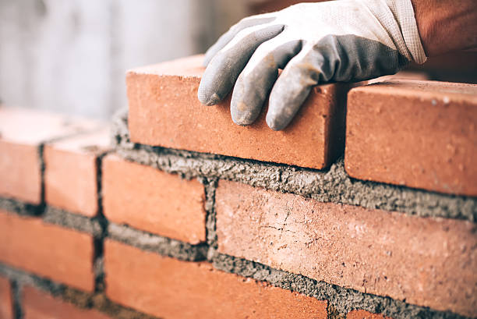
Engineering Materials -I
CE 0732-1101
Prepared By
Somen Saha
Lecturer
Department of Civil Engineering
University of Global Village (UGV), Barishal

Slide 2
BASIC COURSE INFORMATION
Course Title | Engineering Materials
Course Code | CE 0732-1101
Credits | 04
CIE Marks | 120
SEE Marks | 80
Exam Hours | 2 hours (Mid Exam) 3 hours (Semester Final Exam)
Level | 1st Semester

Slide 3
Engineering Materials-I
COURSE CODE: CE 0732-1101
CREDIT:04 TOTAL MARKS:200 CIE MARKS: 120
SEE MARKS: 80
Mid Exam Hours 2
Semester End Exam Hours 3
Course Learning Outcomes (CLOs): After completing this course successfully, the students will be able to-
CLO 1
Understand the types of engineering materials and different properties of materials and develop skills to determine them
.
Identify different type of engineering material such as brick , cement etc to construct structures without failure
CLO 2
.
Analysis the materials for using in realistic civil engineering projects giving proper considerations for special needs
and constrains.
Assess the ability to apply knowledge of material properties to select the right material for a specific civil
engineering project..
CLO 3
CLO 4

Slide 4
SL | Content of course | Hrs | CLOs
1 | Brick: Constituents of brick clay, characteristics, specifications, classification and uses of bricks, | 8 | CLO1, CLO2
2 | Aggregate: Classification and properties of aggregate, grading of aggregate, testing of aggregate, classification, properties, tests and function of sand. | 8 | CLO3
3 | Cement: Point of difference between cement and lime, composition of ordinary cement, functions of various ingredients of cement, physical properties of Portland cement, types and tests of cement | 8 | CLO2, CLO4
4 | Mortar and plaster: Types of mortar, functions of sand and surki in mortar, uses of mortar, preparation of cement mortar, precautions in using mortars Ferrocement | 8 | CLO1, CLO3
Text Book:
Engineering Materials Book by Dr. M. A. Aziz
Engineering Material by ER R.K Rajput

Slide 5
ASSESSMENT PATTERN
CIE- Continuous Internal Evaluation (120 Marks)
SEE- Semester End Examination (80 Marks)
Bloom’s Category | Tests
Remember | 10
Understand | 15
Apply | 15
Analyze | 15
Evaluate | 15
Create | 10
Bloom’s Category Marks (out of 120) | Tests (60) | Assignments (20) | Quizzes (20) | External Participation in Curricular/Co-Curricular Activities (20)
Remember | 10 |  | 10 | Attendance 20
Understand | 10 |  | 10
Apply | 10
Analyze | 10
Evaluate | 10
Create | 10 | 20

Slide 6
Couse plan specifying content, CLOs, teaching learning and assessment strategy mapped with CLOs
Week | Topic | Teaching Learning Strategy | Assessment Strategy | Corresponding CLOs | Pages No.
1 | Introduction to Engineering Materials, | Lecture discussion, group work | Quiz, Written Exam | CLO1 | 8-22
2 | Properties of Engineering Materials, | Oral Presentation, debate | Assignment, Written, Quiz | CLO1 | 8-22
3 | Brick (Constituents of brick clay) | Video lecture, Field visit | Report Writing, Demonstration | CLO2, CLO3 | 24-33
4 | Brick (characteristics of brick) | Lecture | Viva, Quiz | CLO2, CLO3 | 34-39
5 | Brick (Classification of brick) | Project exhibition | Project, Field visit | CLO2, CLO3 | 41-48
6 | Brick(Bonds and uses of bricks,) | Discussion, Video Presentation | Quiz, Written Exam | CLO2, CLO4 | 50-64
7 | Aggregate(Classification and properties of aggregate) | Case-based Learning, Demonstration | Assignment , Written, Quiz | CLO2, CLO4 | 66-71
8 | Aggregate (grading of aggregate, testing of aggregate) | Lecture, discussion, group work | Report Writing, Demonstration | CLO1, CLO3 | 73-76
9 | Aggregate (function of sand and fineness modulus.) | Oral Presentation, debate | Viva, Quiz | CLO1 | 78-91

Slide 7
10 | Cement(Definition , History & Cement Chemistry) | Video lecture | Project, Field visit | CLO2,CLO4 | 93-97
11 | Cement (physical properties of cement) | Lecture | Quiz, Written Exam | CLO2, CLO4 | 99-102
12 | Cement (types and uses of cement) | Project exhibition | Assignment , Written, Quiz | CLO1, CLO3 | 104-116
13 | Wood (Seasoning of wood) | Discussion, Video Presentation | Report Writing, Demonstration | CLO1 | 118-123
14 | Lime | Case-based Learning, Demonstration | Viva, Quiz | CLO3 | 125-127
15 | Ferrocement | Lecture, discussion, group work | Project, Field visit | CLO2, CLO4 | 129-144
16 | Morter & Grout | Oral Presentation, debate | Quiz, Written Exam | CLO1, CLO3 | 146-148
17 | Practice, Excercise, problem solving & review class | Group discussion | Assignment , Written, Quiz | CLO1

Slide 8
Introduction of Engineering materials
Week 1

Slide 9
Chapter 1
Properties of Engineering Materials
What is an Engineering Materials?
Any material which is used on applied in engineering purposes
is known as Engineering material
Examples of Engineering materials
Metals
Ceramics
Polymers
Composites
Semiconductor
Biomaterial
Concrete etc

Slide 10
Examples of Civil Engineering materials
Bricks
Timber
Aggregate
Cement
Reinforcement (M.S Bar)
Concrete (sand + cement + khoa + water)
Paint
Glass
Tiles
Fittings ( water supply, sewage line Etc)

Slide 11
Properties of Engineering materials
Week 2

Slide 12
Basic properties of Engineering materials Classification of Properties:
Physical Properties:
Are those properties of a material which can be observed and measured. Example :Size, Shape, Density, Porosity Etc.
Mechanical Properties:
Are those properties of a material which can be measured and compute by mechanical means. Example: Strength, Elasticity, plasticity, stiffness, Ductility, malleability, Hardness, Brittleness, etc
Chemical Properties:
Are those properties of a material which can be measured and observed by chemical means. Example : Corrosion resistance , Alkalinity , Acidity,
Chemical composition Etc. 4.Electrical Properties:
Are those properties of a material which can be measured and compute by electrical means. Example : Conductivity, Dielectric permittivity,
Dielectric strength etc.

Slide 13
5.Thermal Properties:
Are those properties of a material which can be measured and compute by thermal means. Example : Specific heat, Thermal Expansion Etc
Assignment
1. Difference between physical
property and mechanical property?

Slide 14
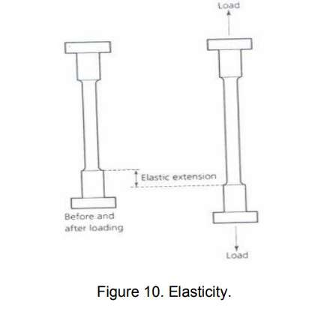
Details about different Mechanical Properties:
1.Elasticity : It is the ability of a material to deform under load and return to its original size and shape when the load is removed

Slide 15
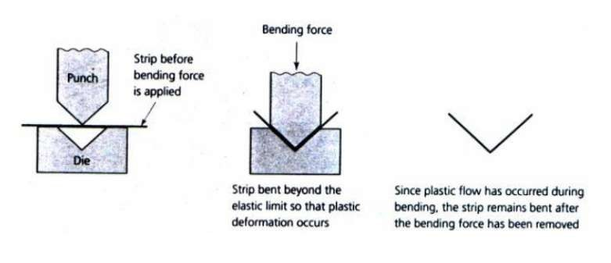
2.Plasticity:
It is the state of a material which has been loaded beyond its elastic limit so as to cause the material to deform permanently. Under such conditions the material takes a permanent set and will not return to its original size and shape when the load is removed.

Slide 16

3.Stress:
When a material is subjected to an external force, a resisting force is set up within the component. The internal resistance force per unit area acting on a material or intensity of the forces distributed over a given section is called the stress at a point.
σ = P/A

Slide 17
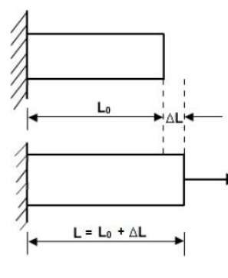
4.Strain
The displacement per unit length (dimensionless) is known as strain.
εt = ∆L/ Lo

Slide 18
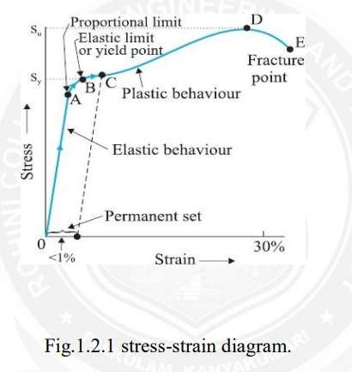

Slide 19
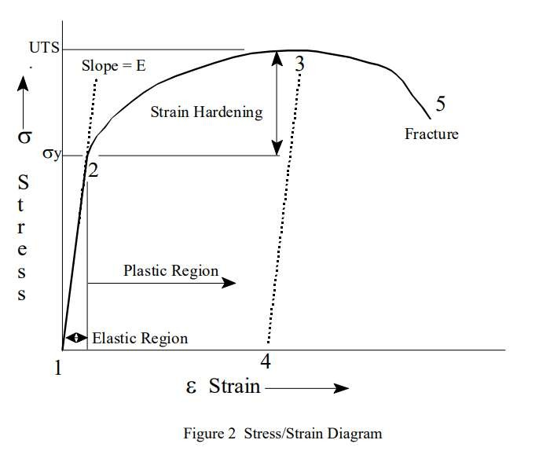

Slide 20
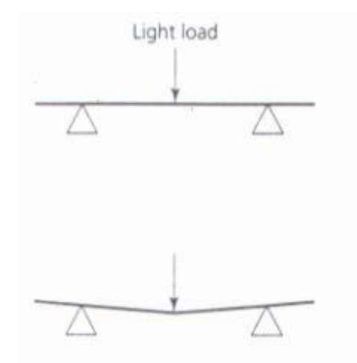
5.Stiffness
It is the measure of a material's ability not to deflect under an applied load. Example : Glass is stiffer material.

Slide 21
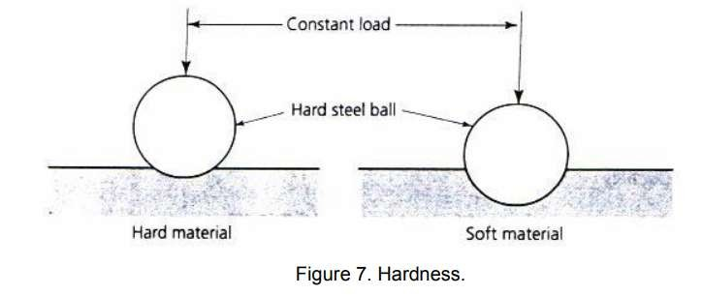
6.Hardness
It is the ability of a material to withstand scratching.

Slide 22
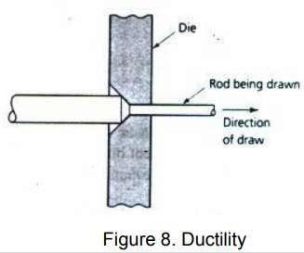
7.Ductility
It refer to the capacity of substance to undergo deformation under tension without rupture. Example: Mild steel , Bitumen

Slide 23
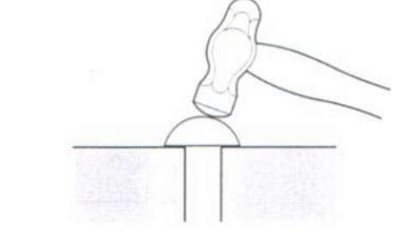
8.Malleability
Malleability of a material is its ability to be flattered into thin sheets without cracking by hot or cold working. Example: Mild steel , Gold

Slide 24
9.Brittleness
It is the property of a material that shows little or no plastic deformation before fracture when a force is applied. Example : Glass

Slide 25
Brick ( Constituents of Brick Clay)
Week 3

Slide 26
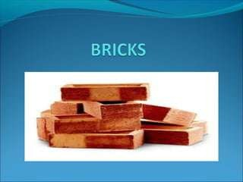

Slide 27
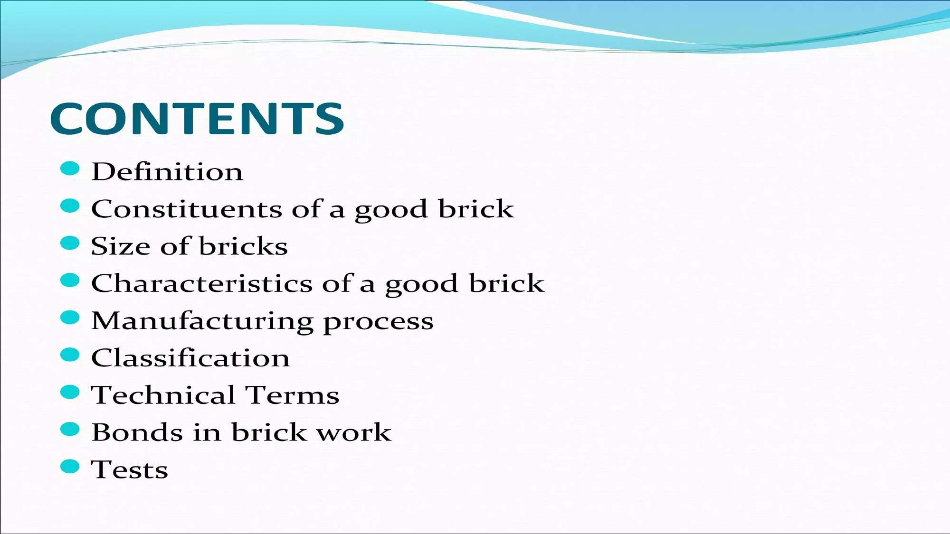

Slide 28
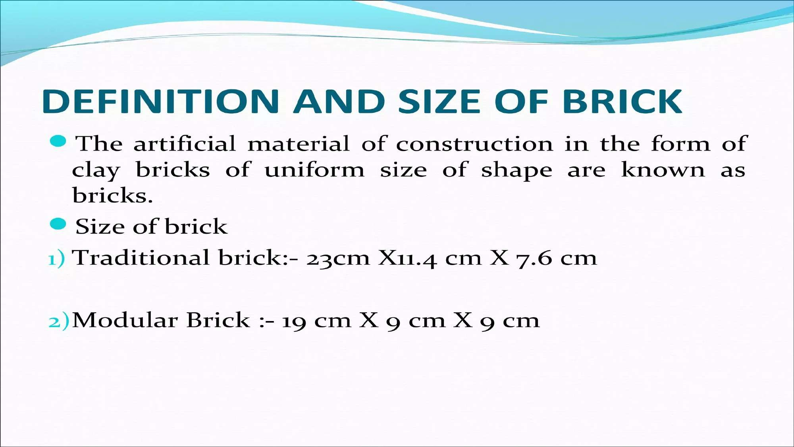

Slide 29
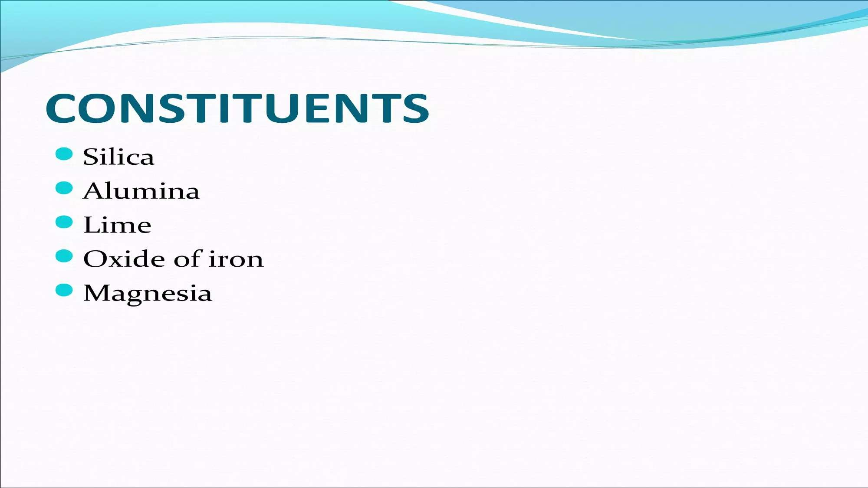

Slide 30
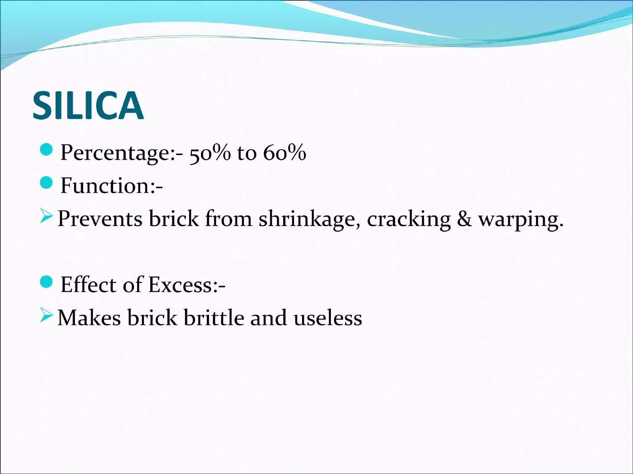

Slide 31
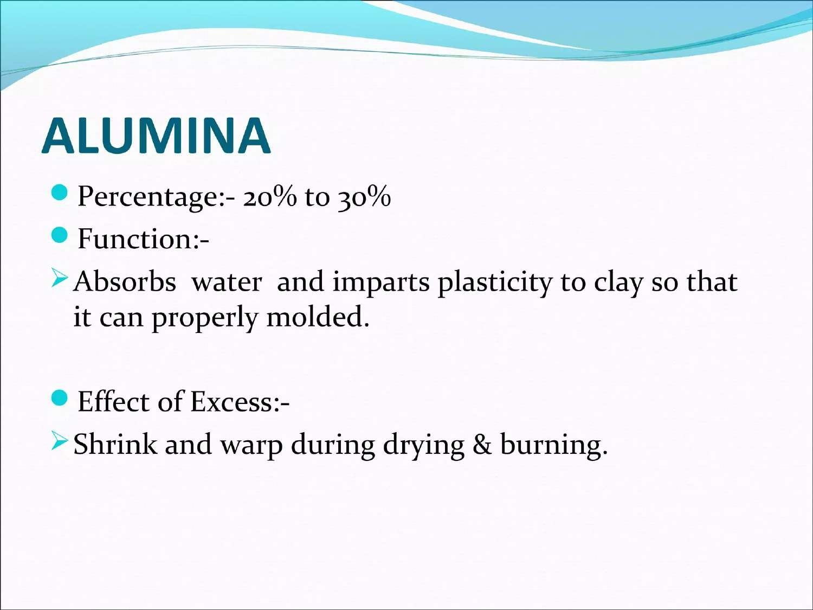

Slide 32
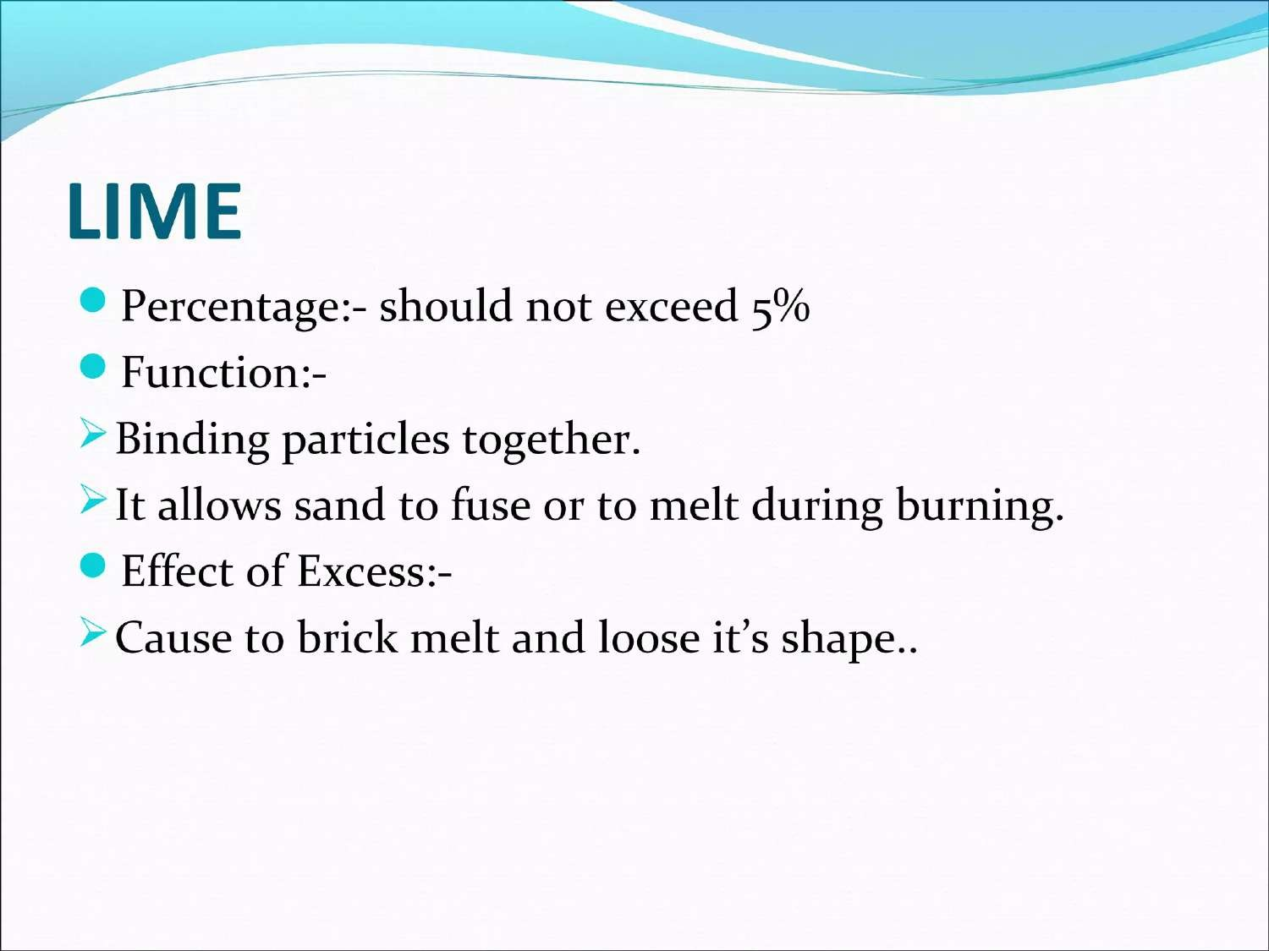

Slide 33
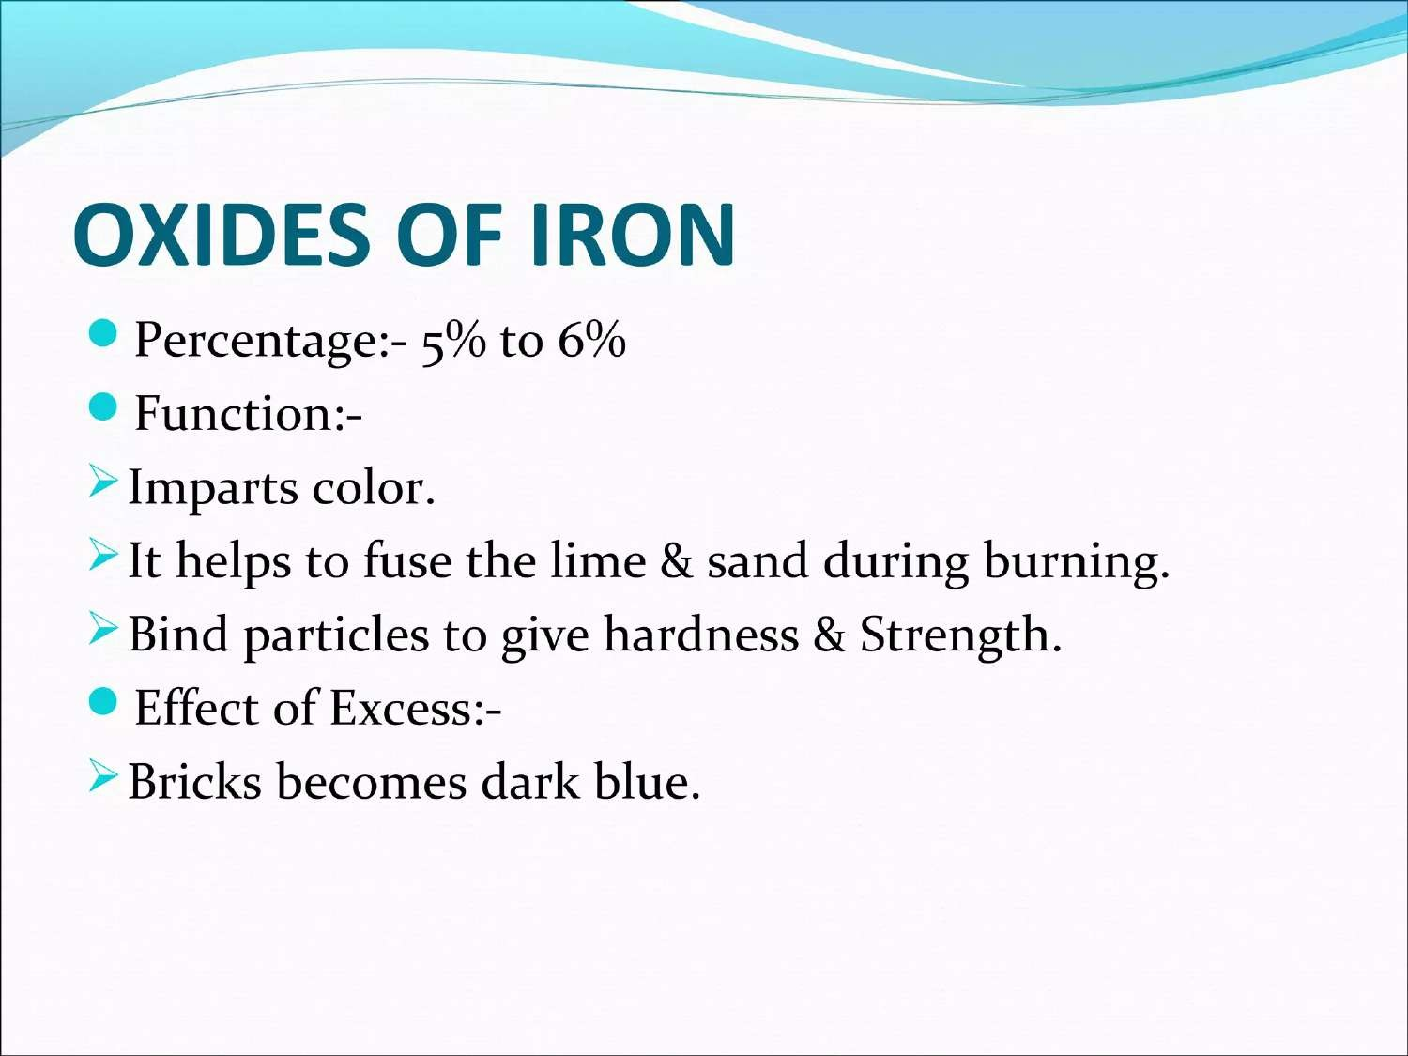

Slide 34
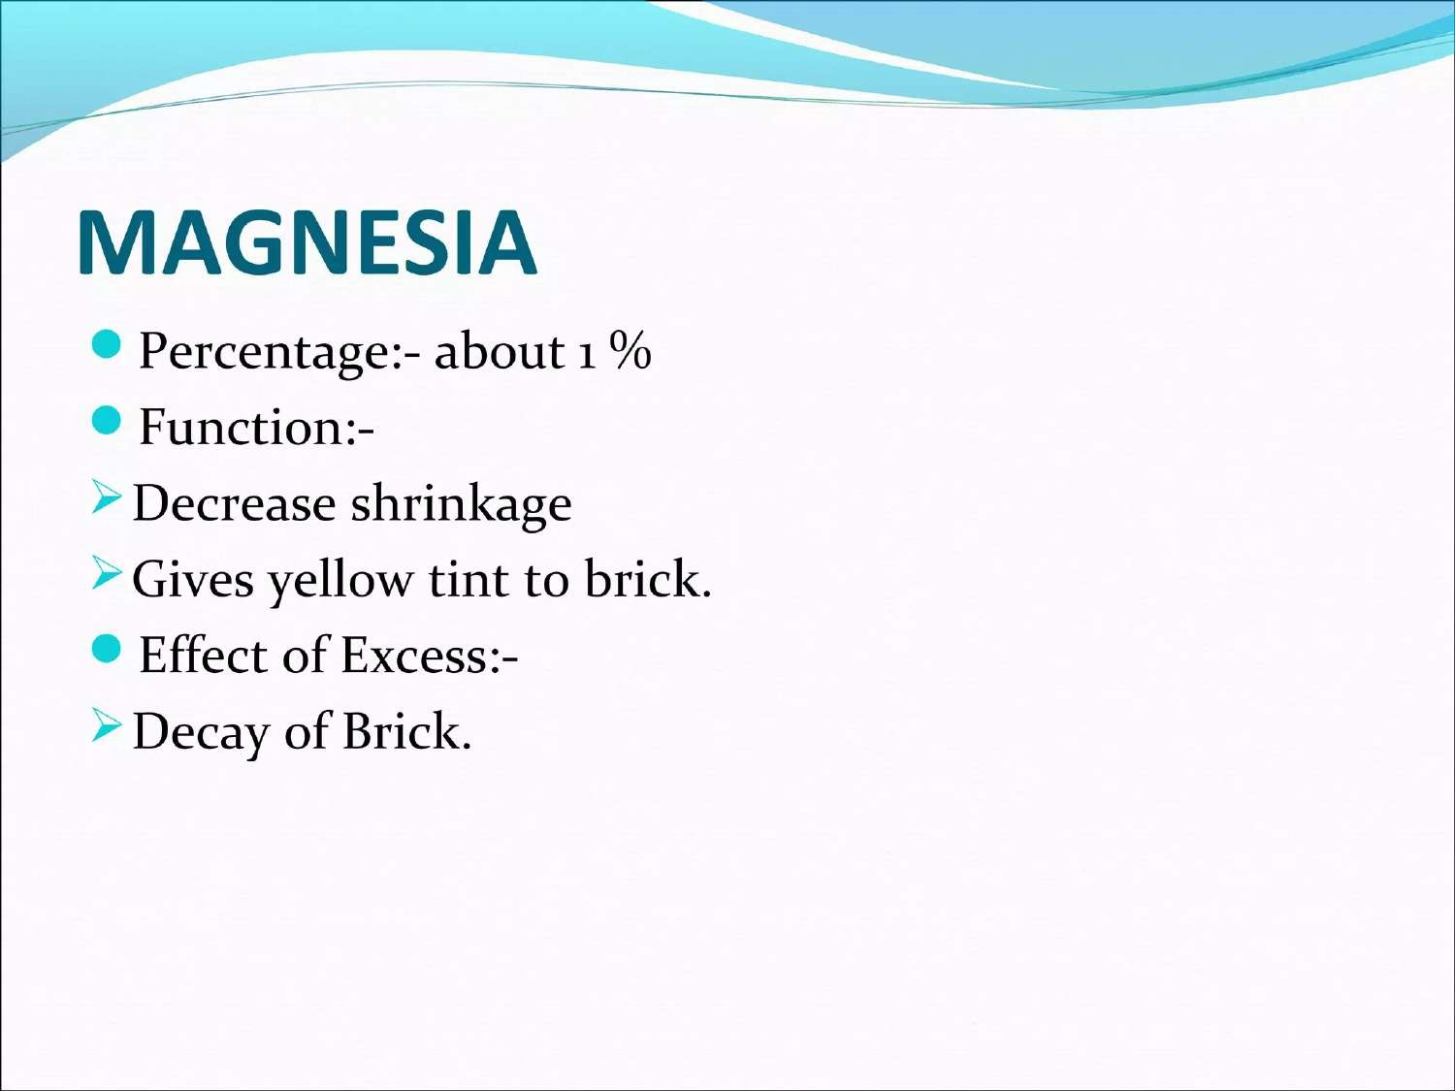

Slide 36
Brick ( Characteristics of Brick )
Week 4

Slide 37
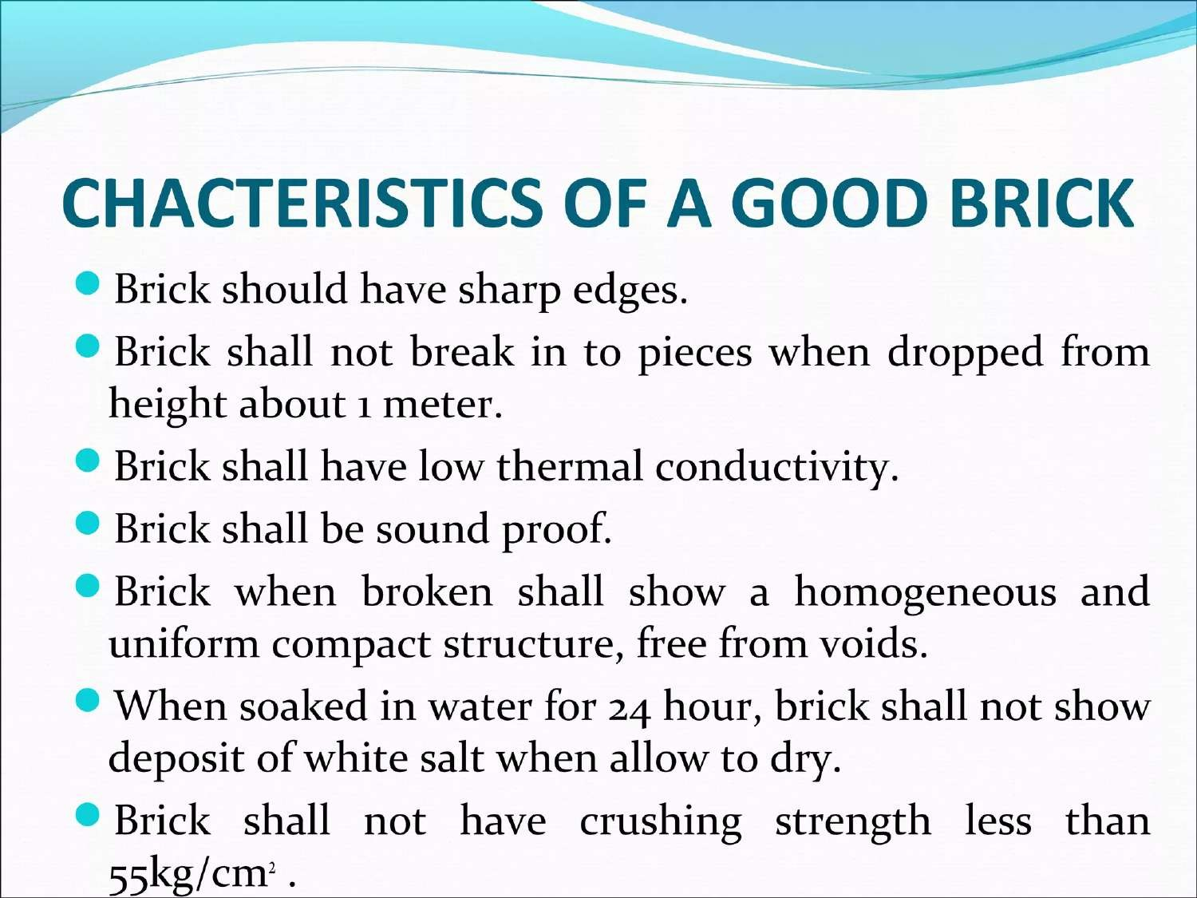

Slide 38
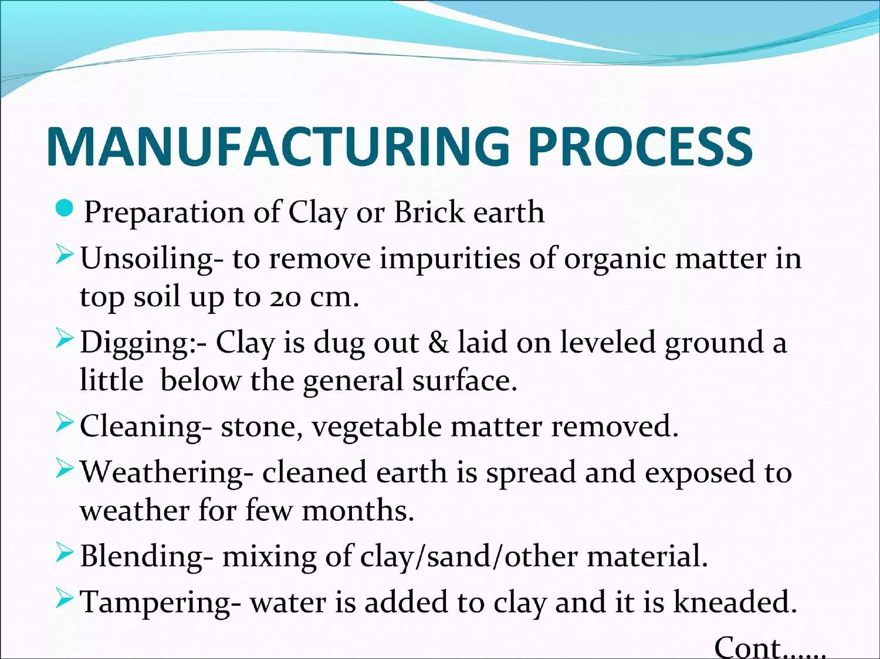

Slide 39
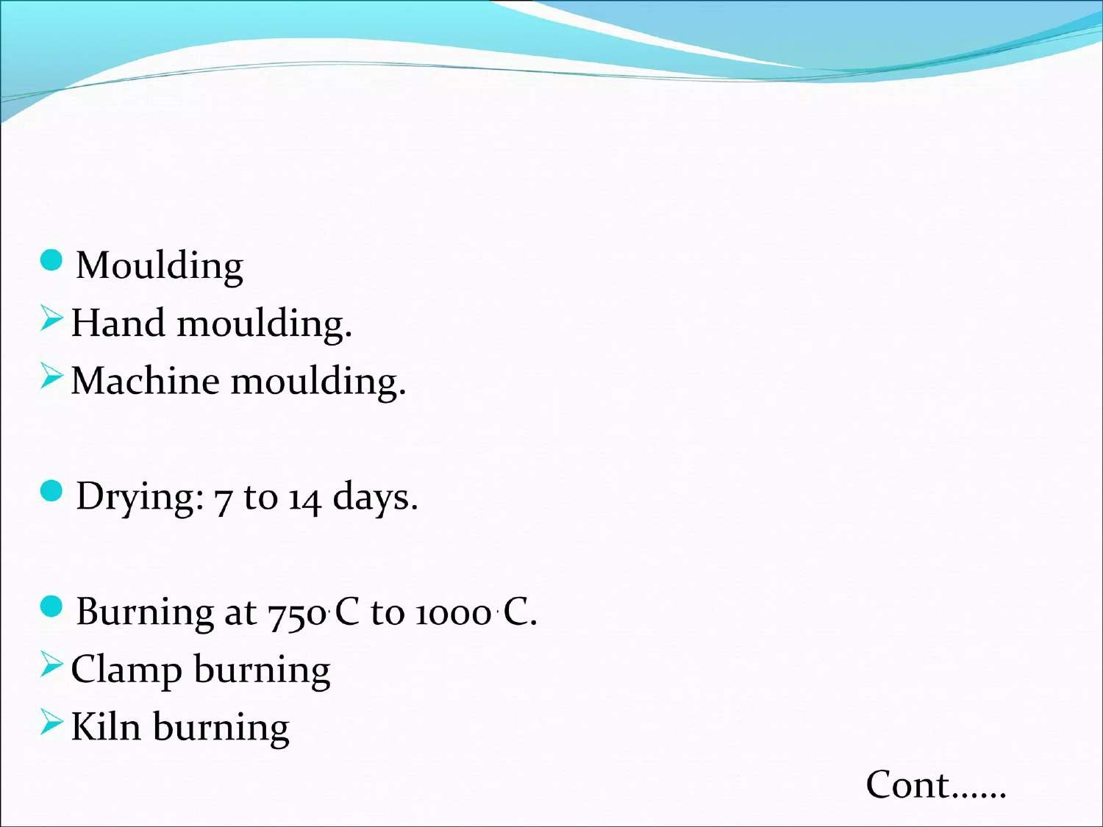

Slide 40
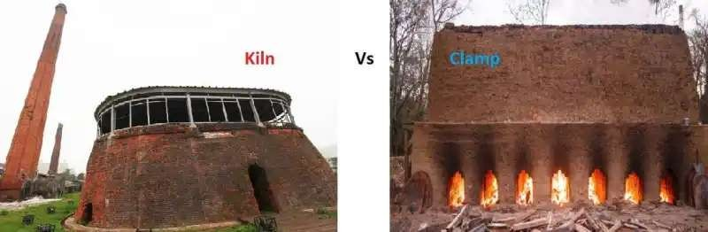

Slide 41
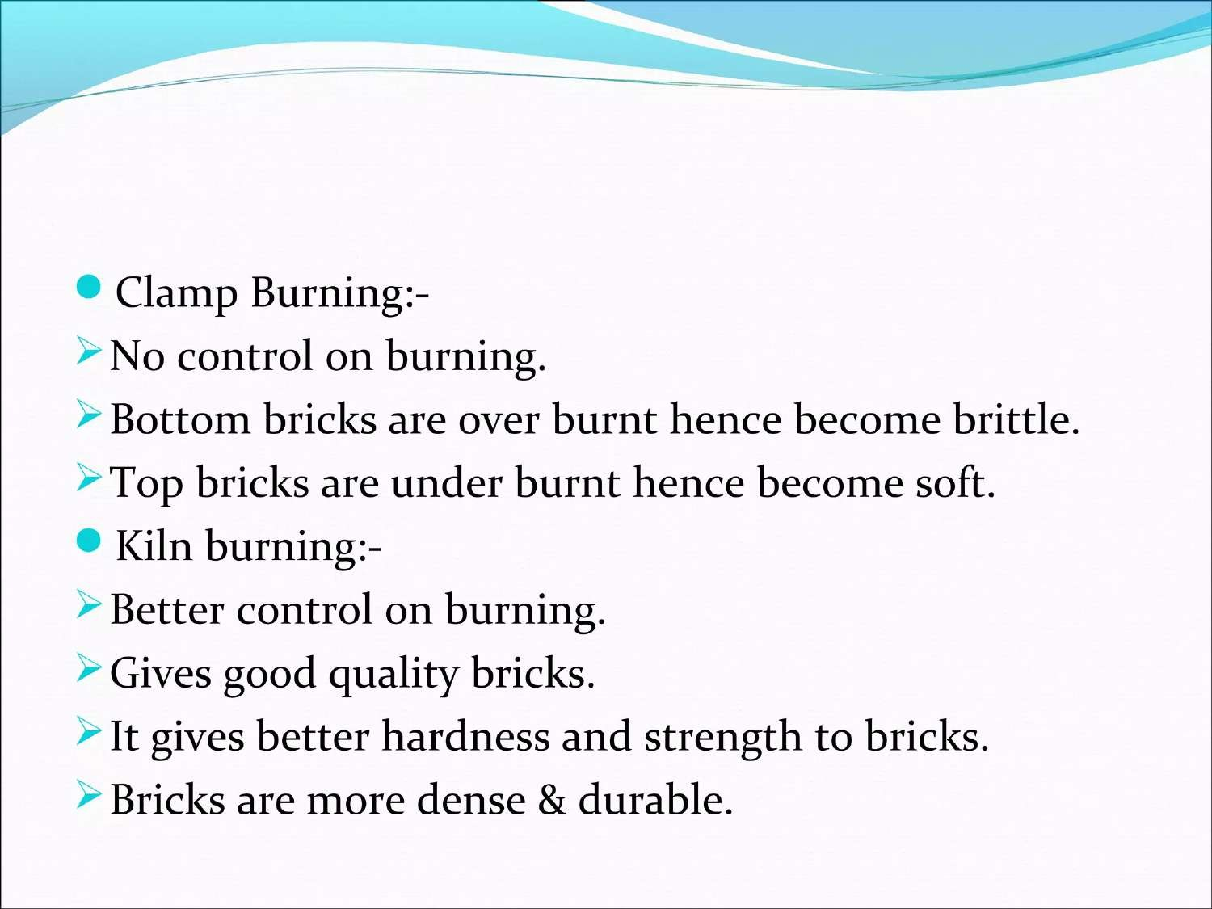

Slide 42
Brick ( Specification of Brick)
Week 5

Slide 43
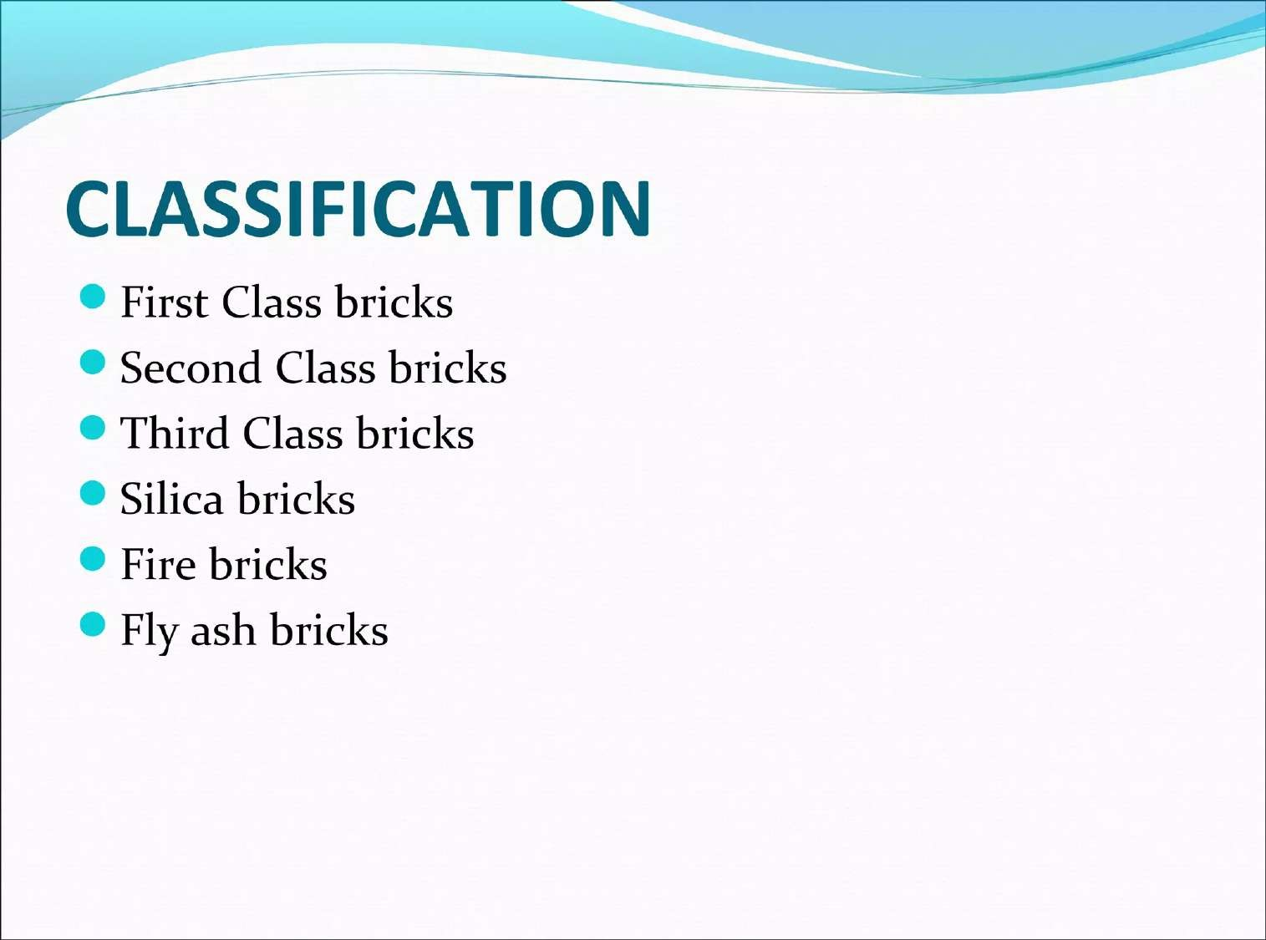

Slide 44
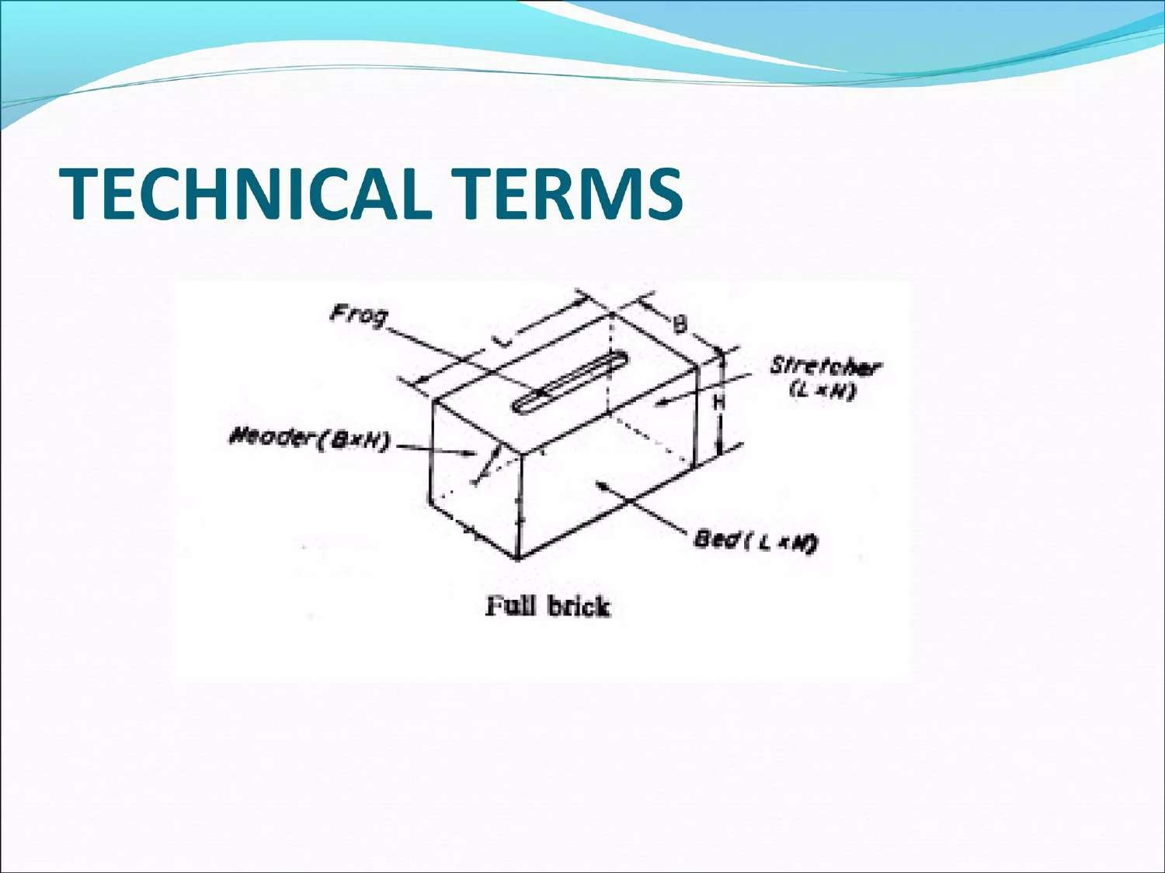

Slide 45
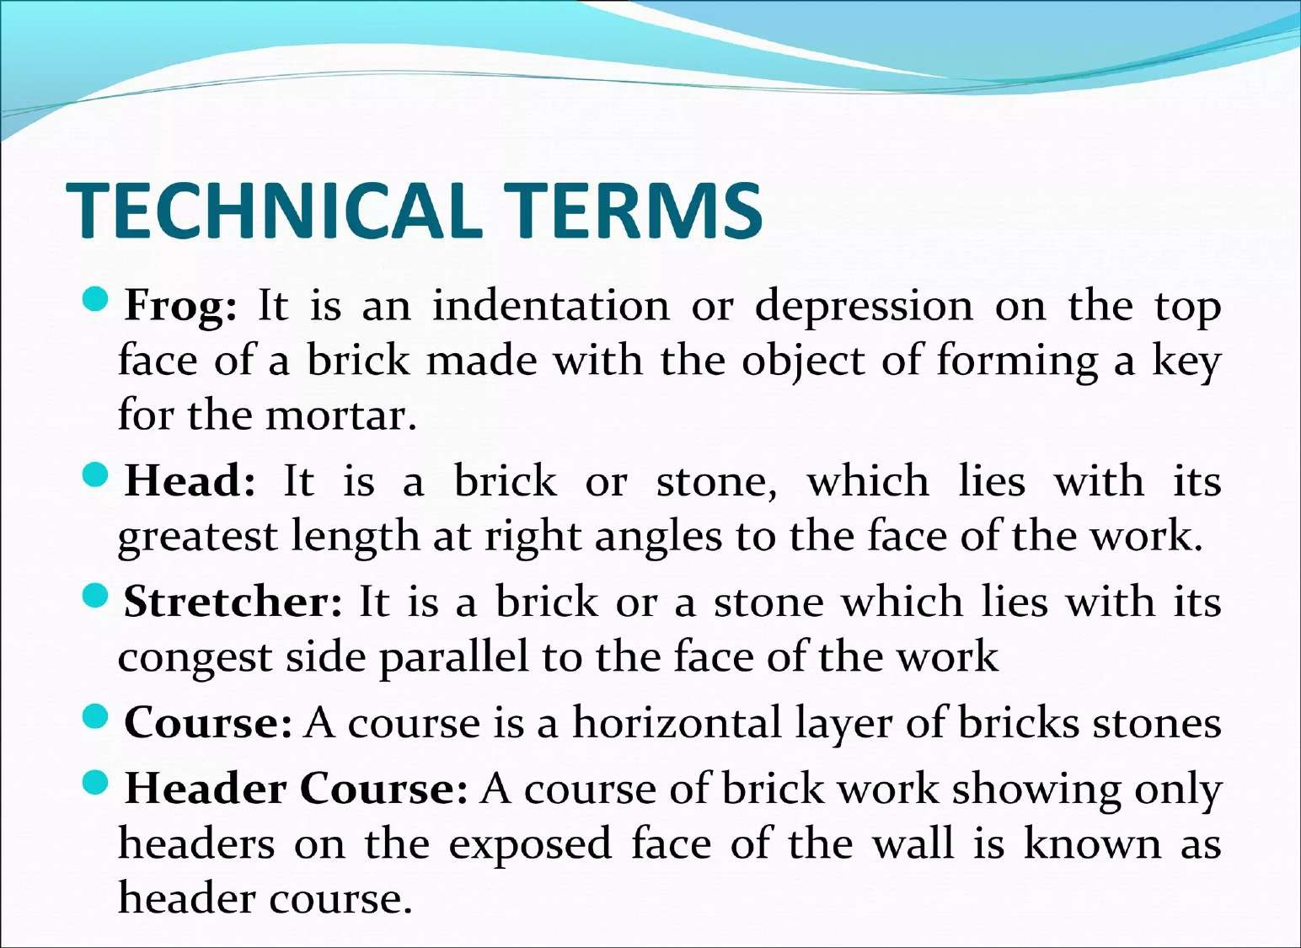

Slide 46
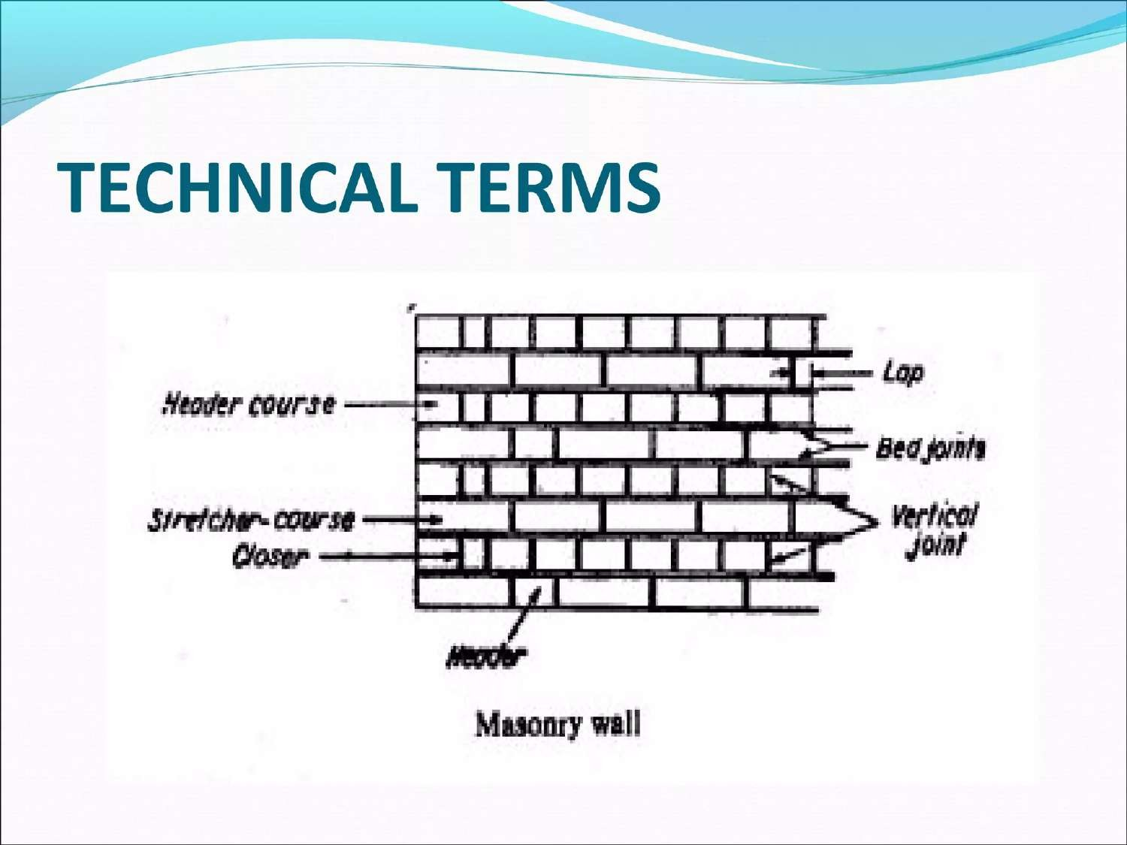

Slide 47
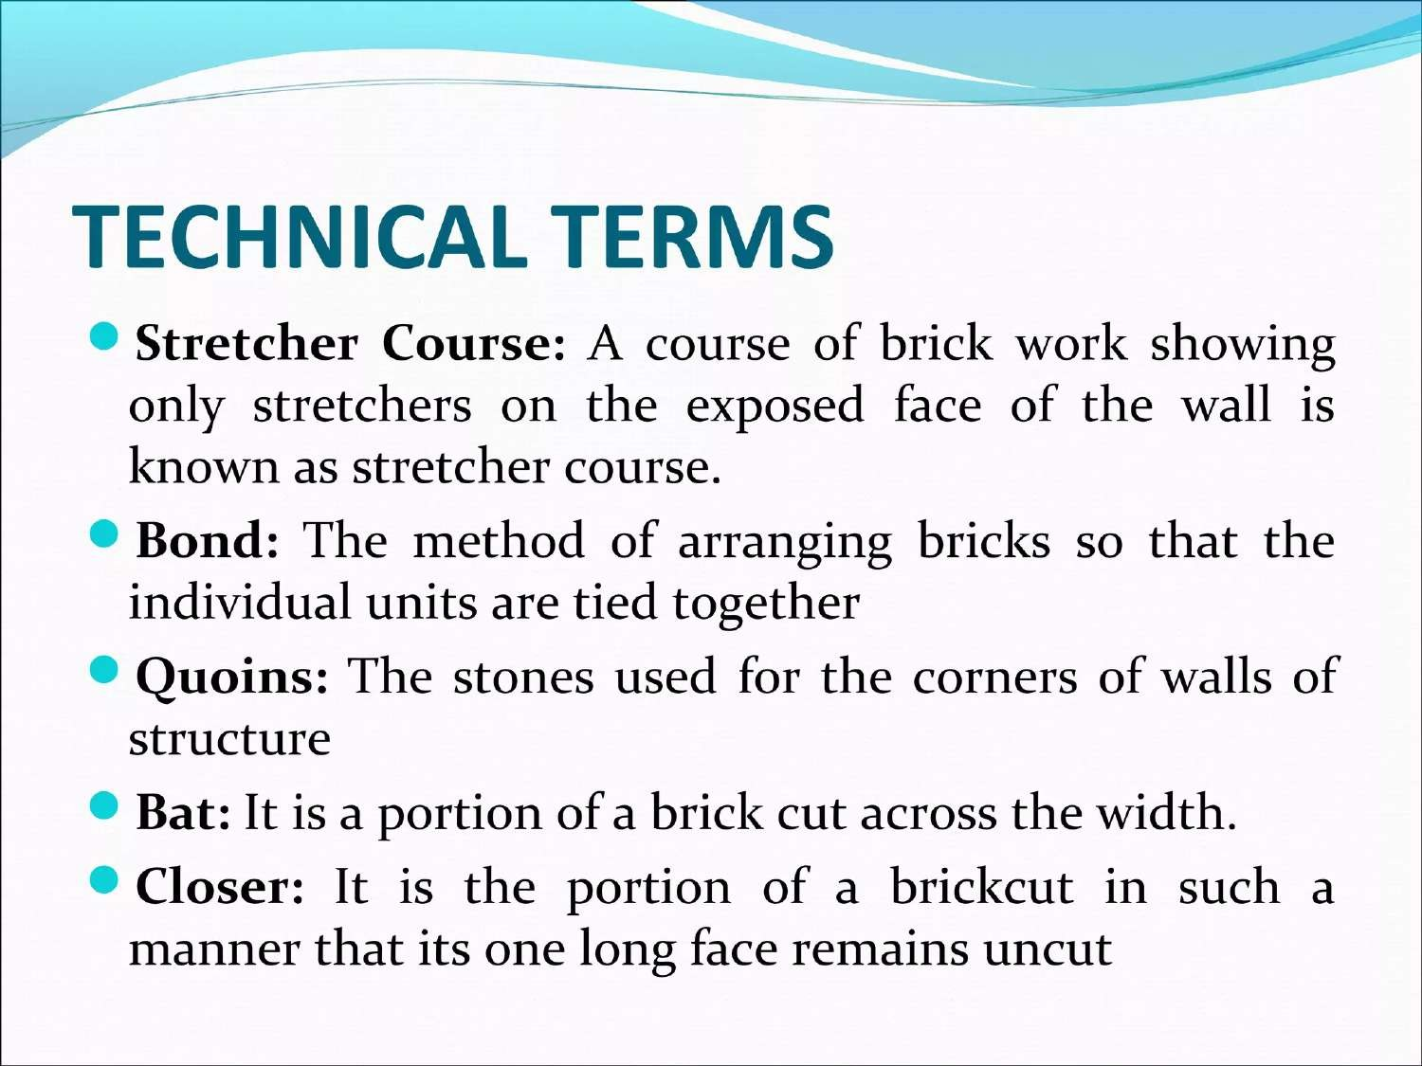

Slide 48
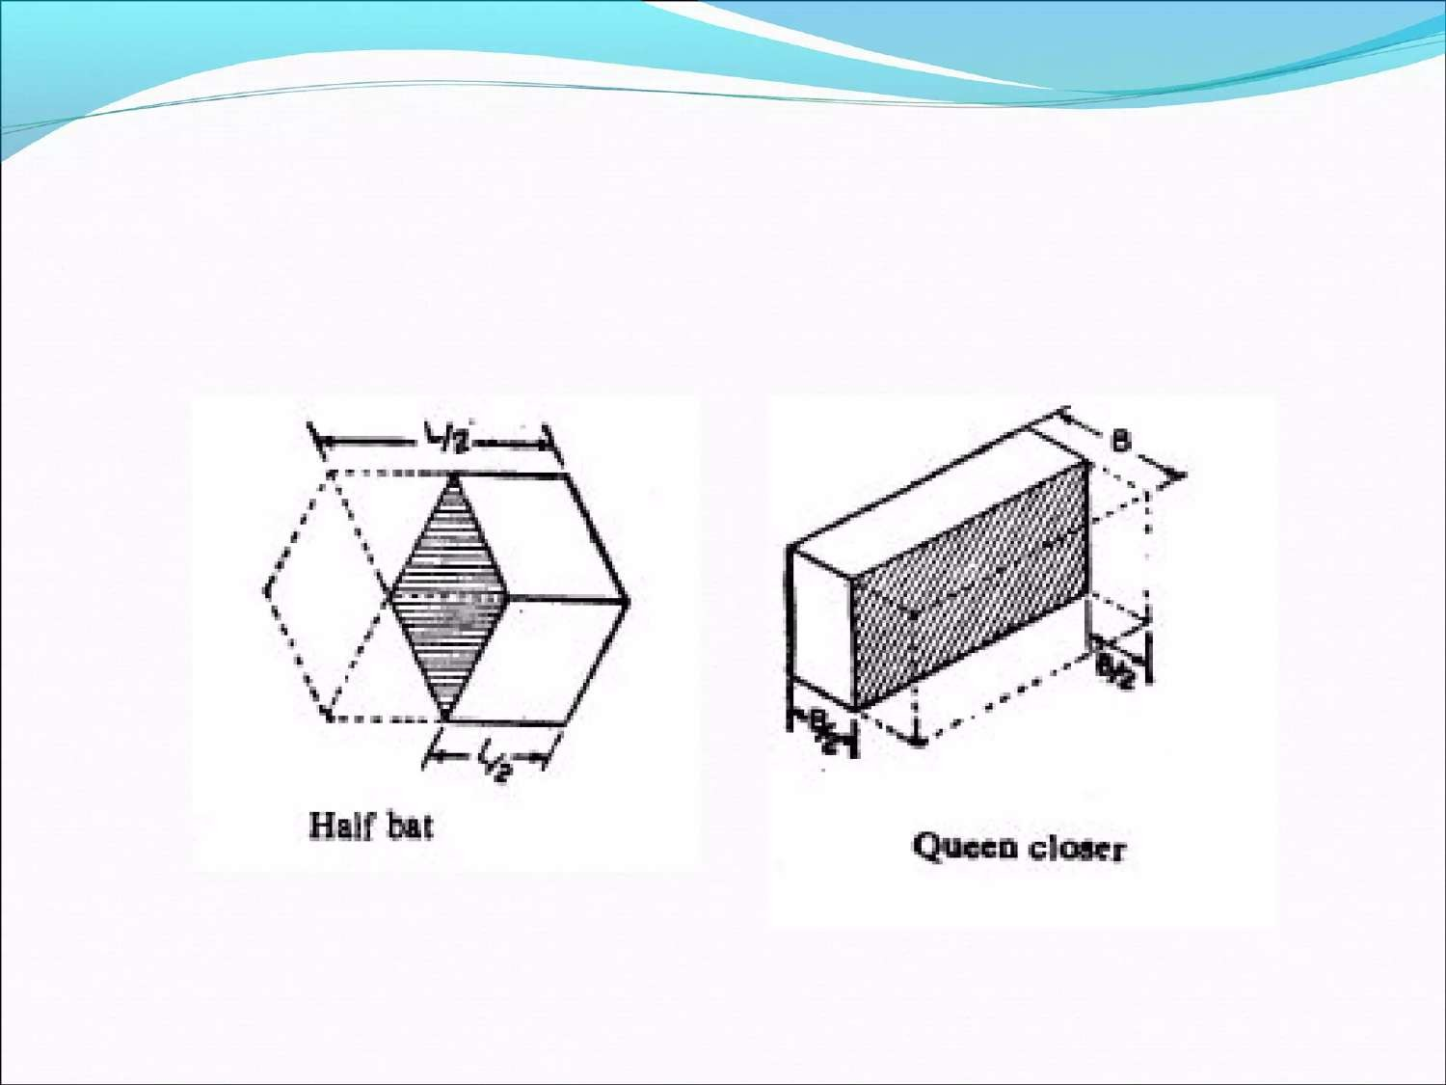

Slide 49
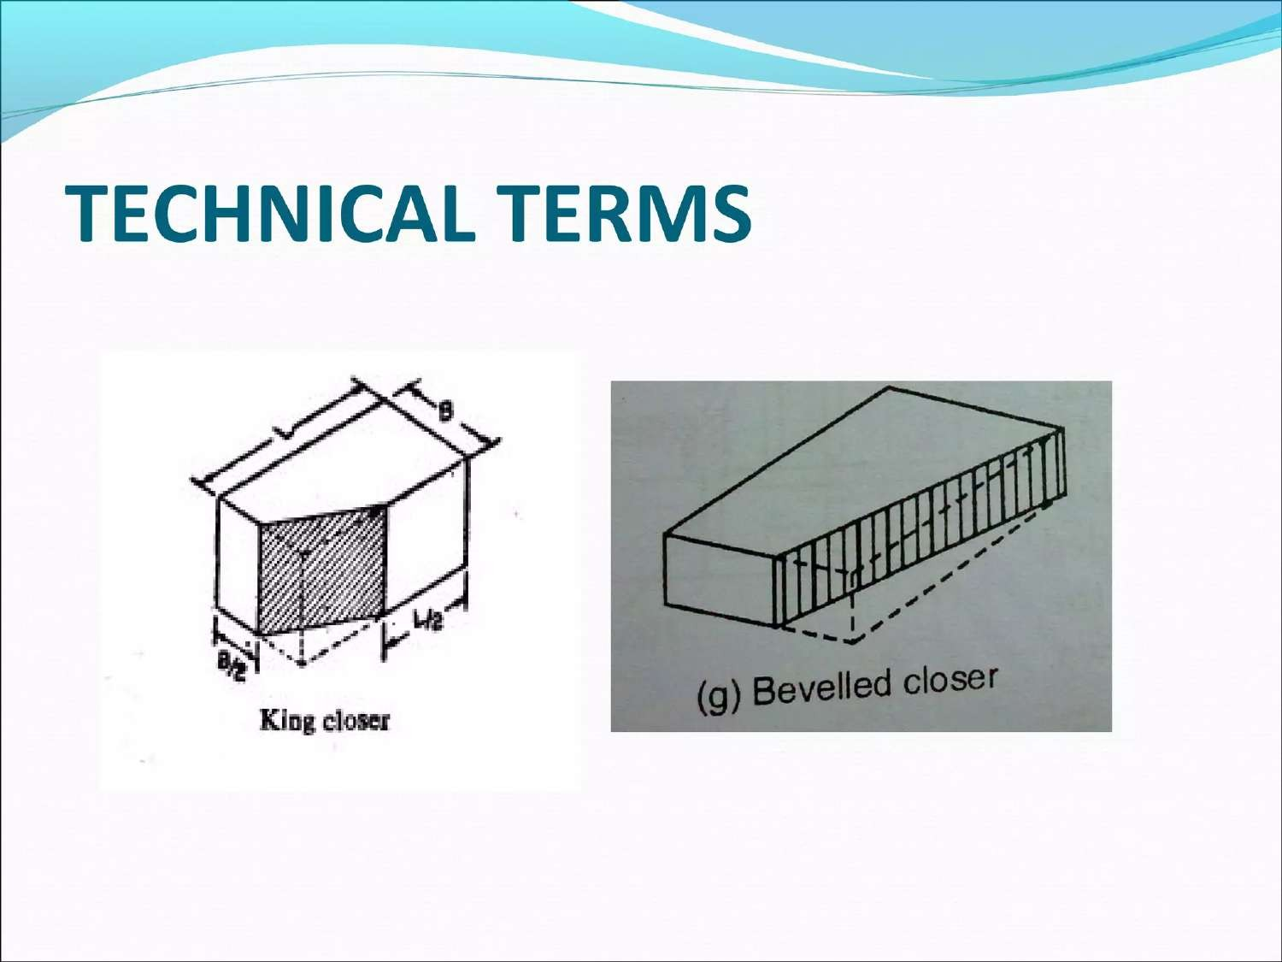

Slide 50
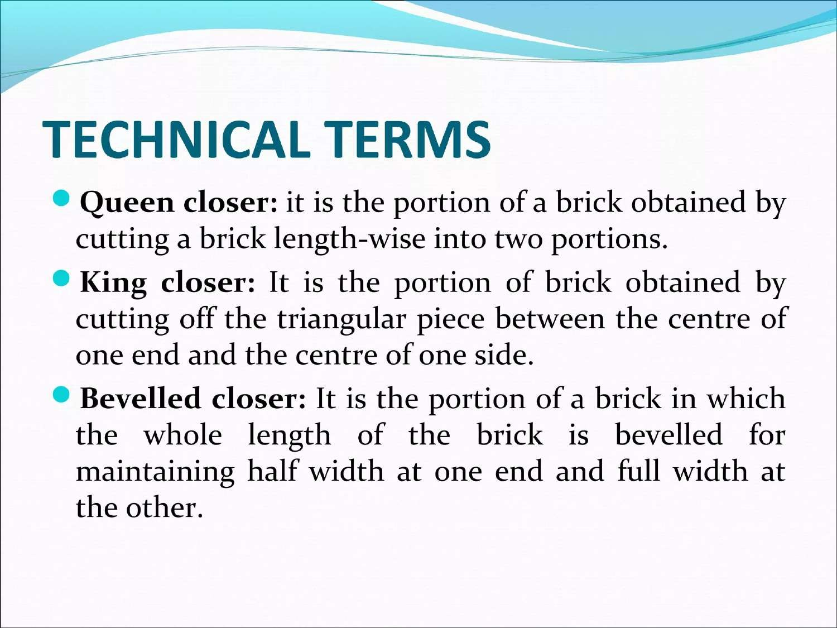

Slide 51
Brick ( Bonds and Uses of Brick )
Week 6

Slide 52
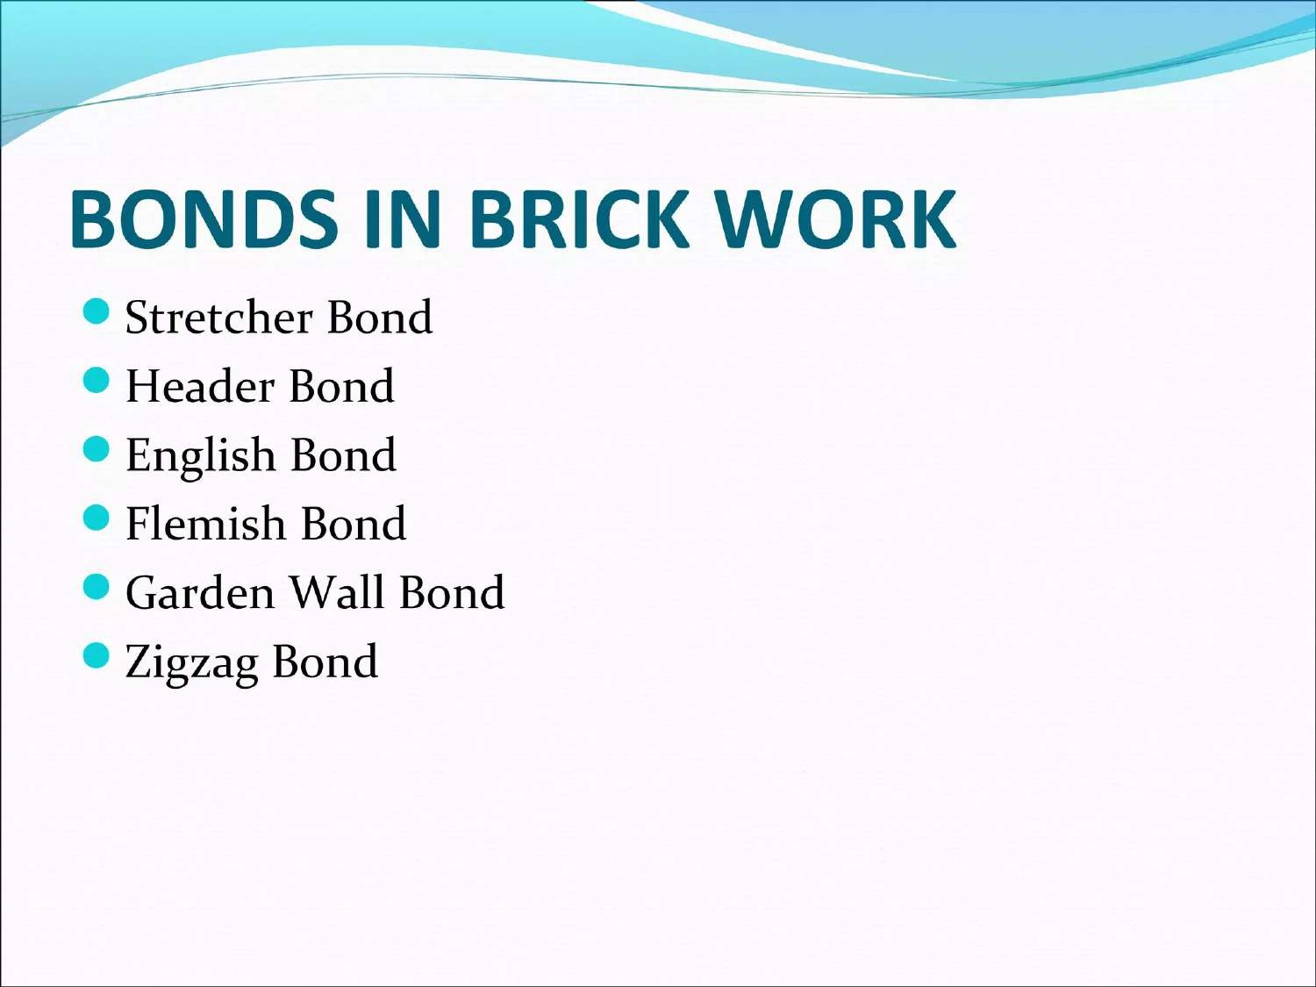

Slide 53
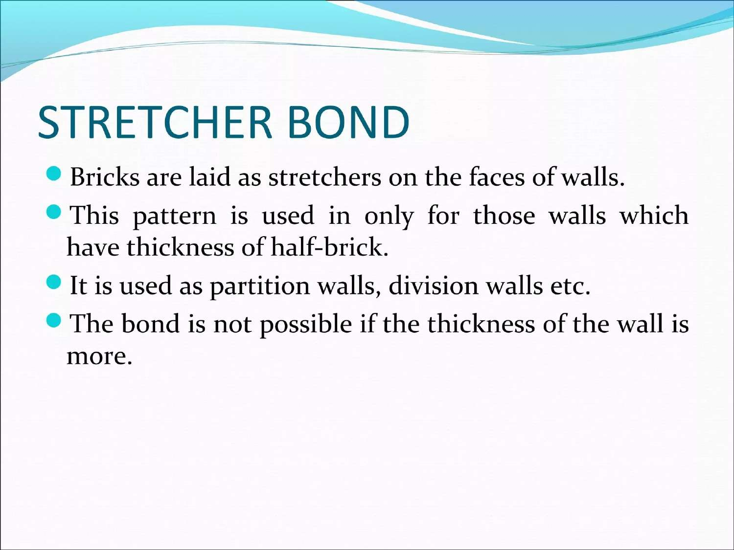

Slide 54
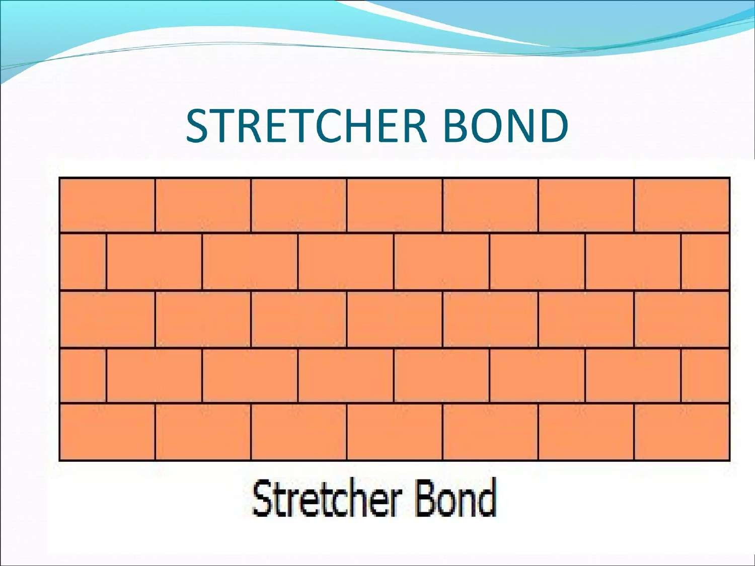

Slide 55
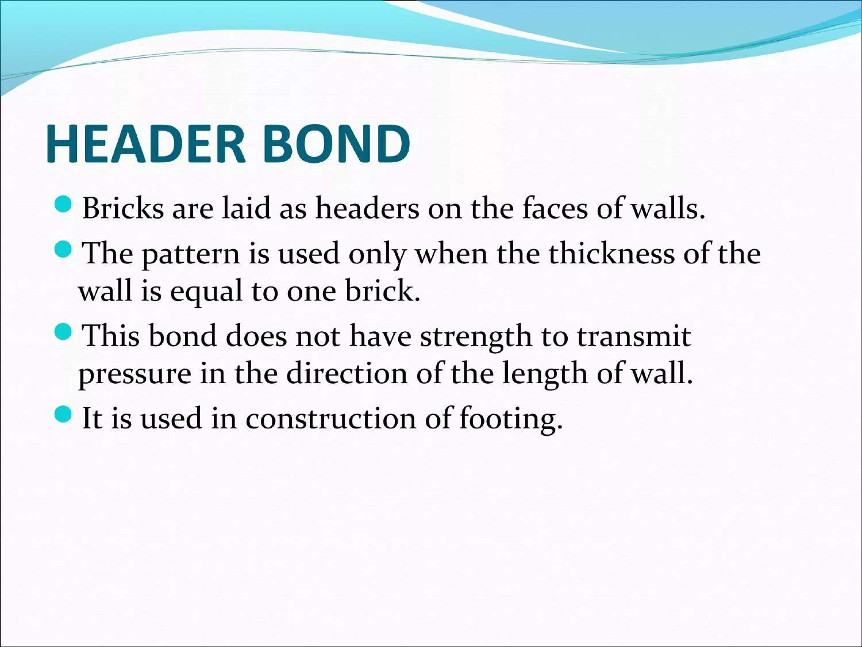

Slide 56
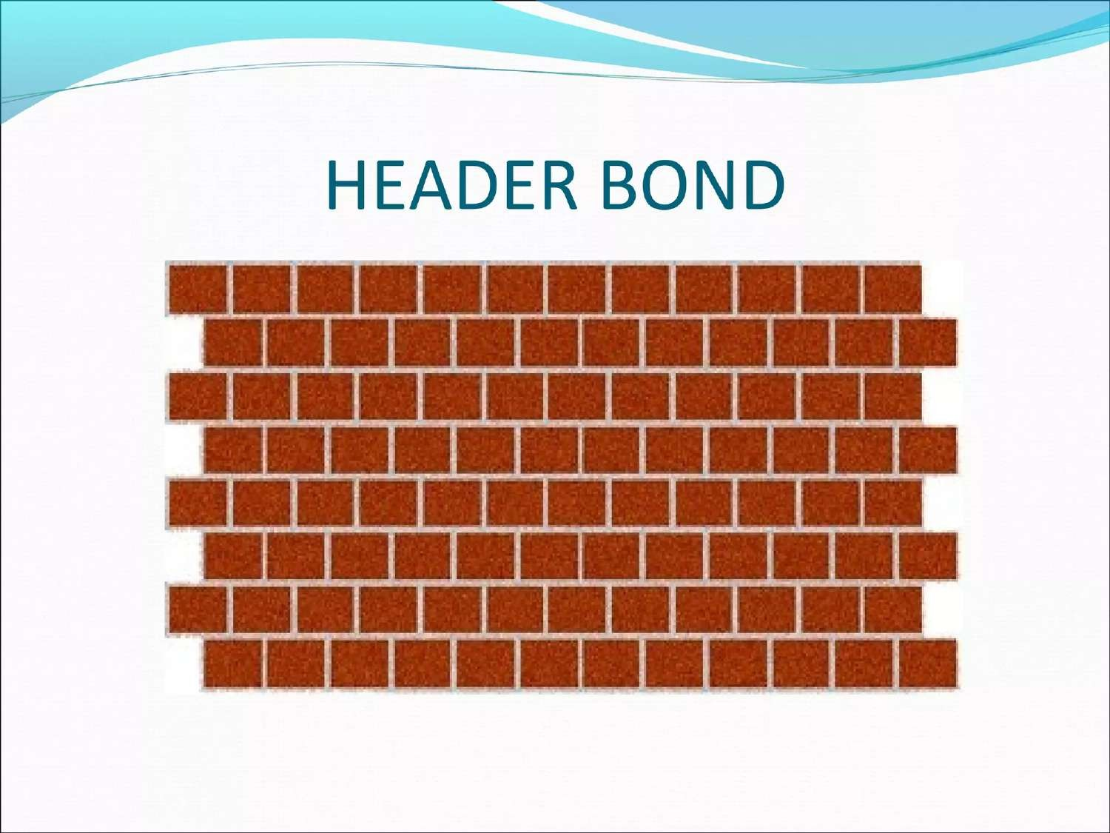

Slide 57
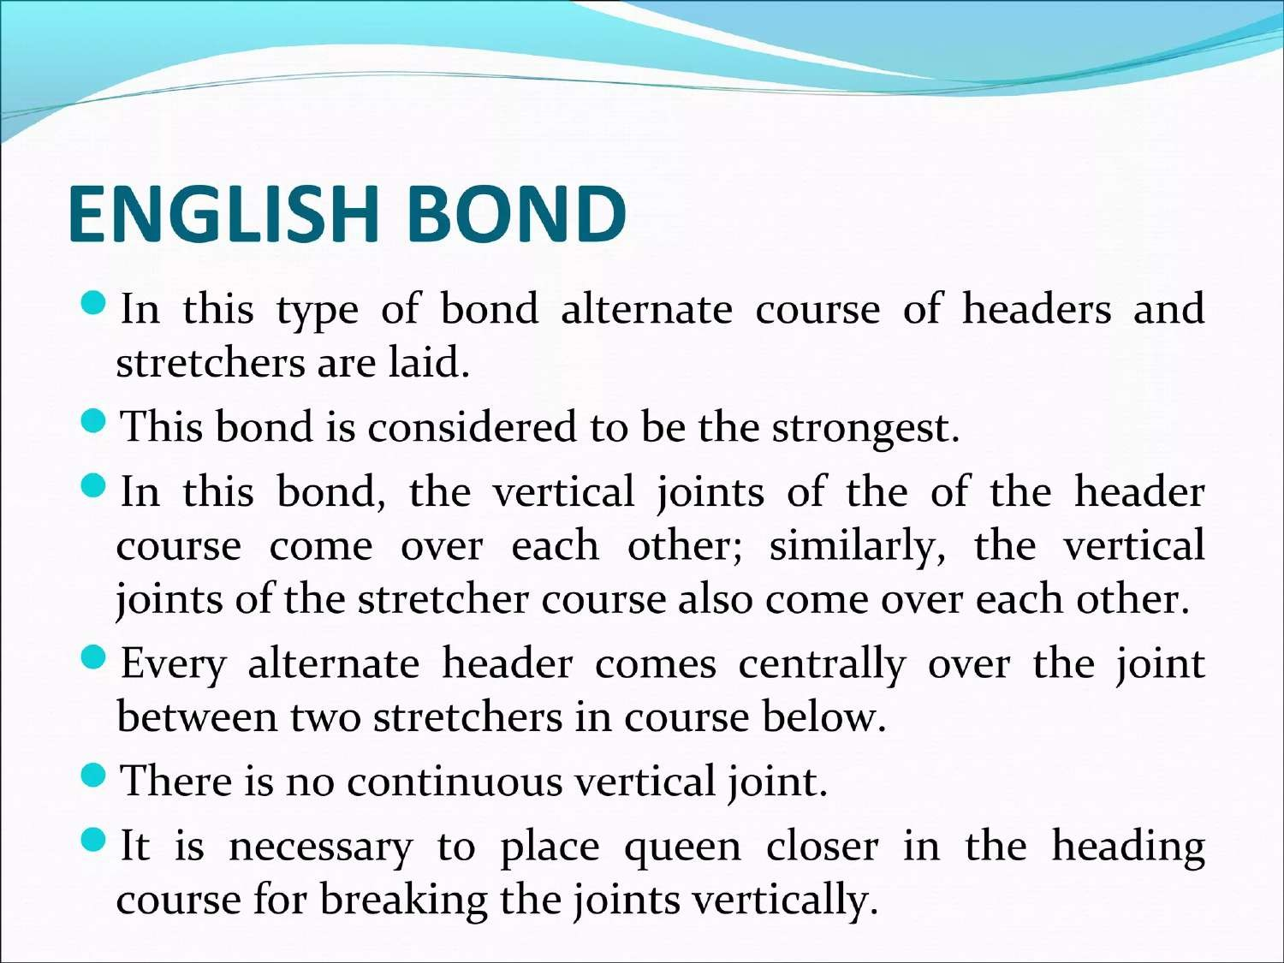

Slide 59
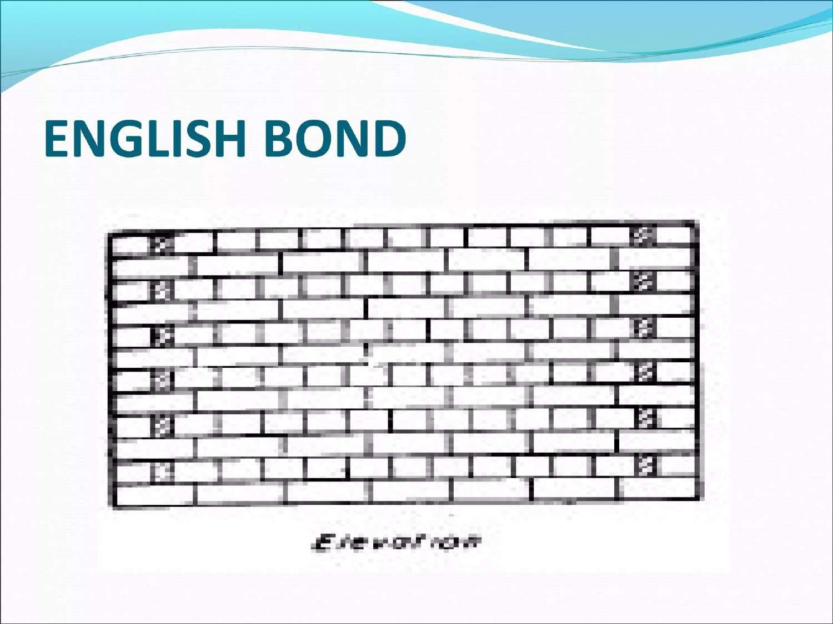

Slide 60
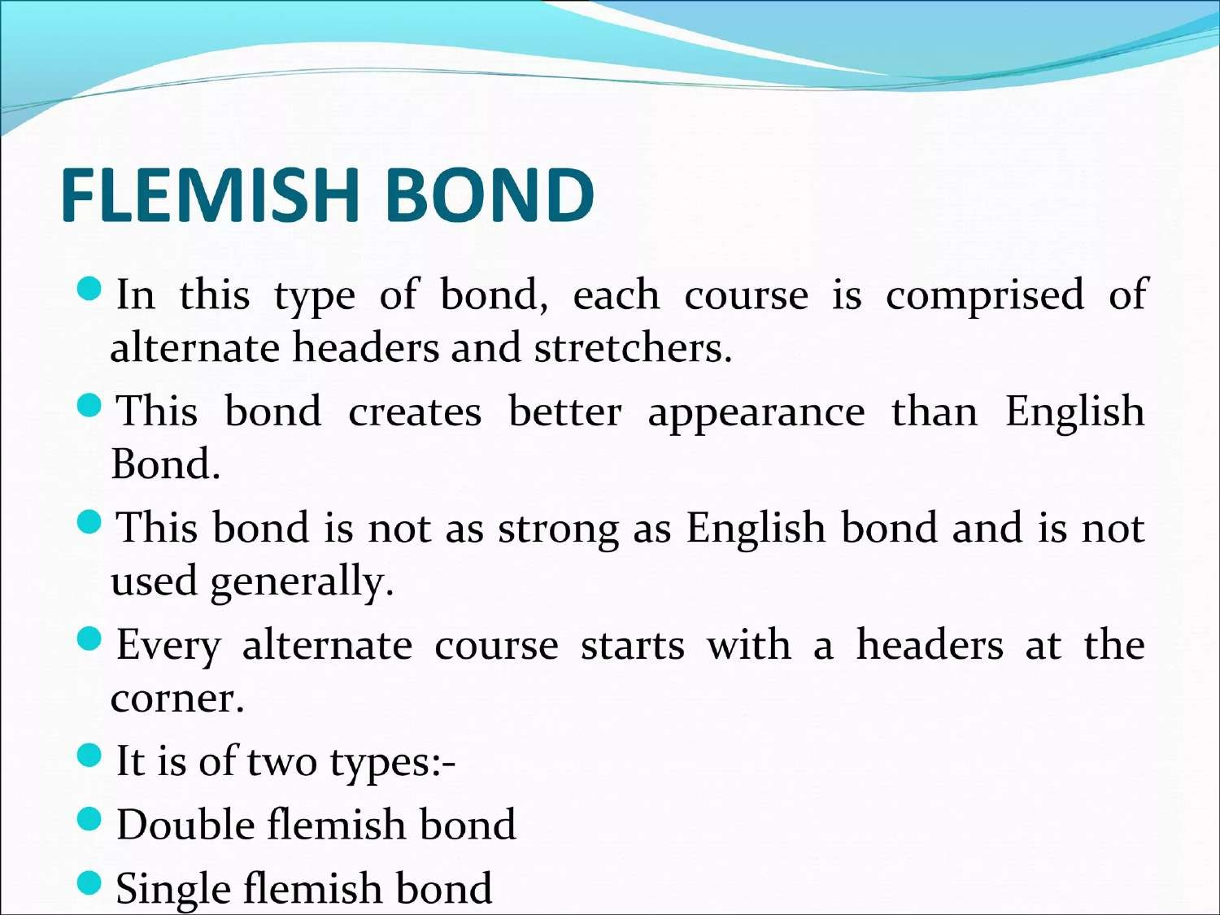

Slide 61
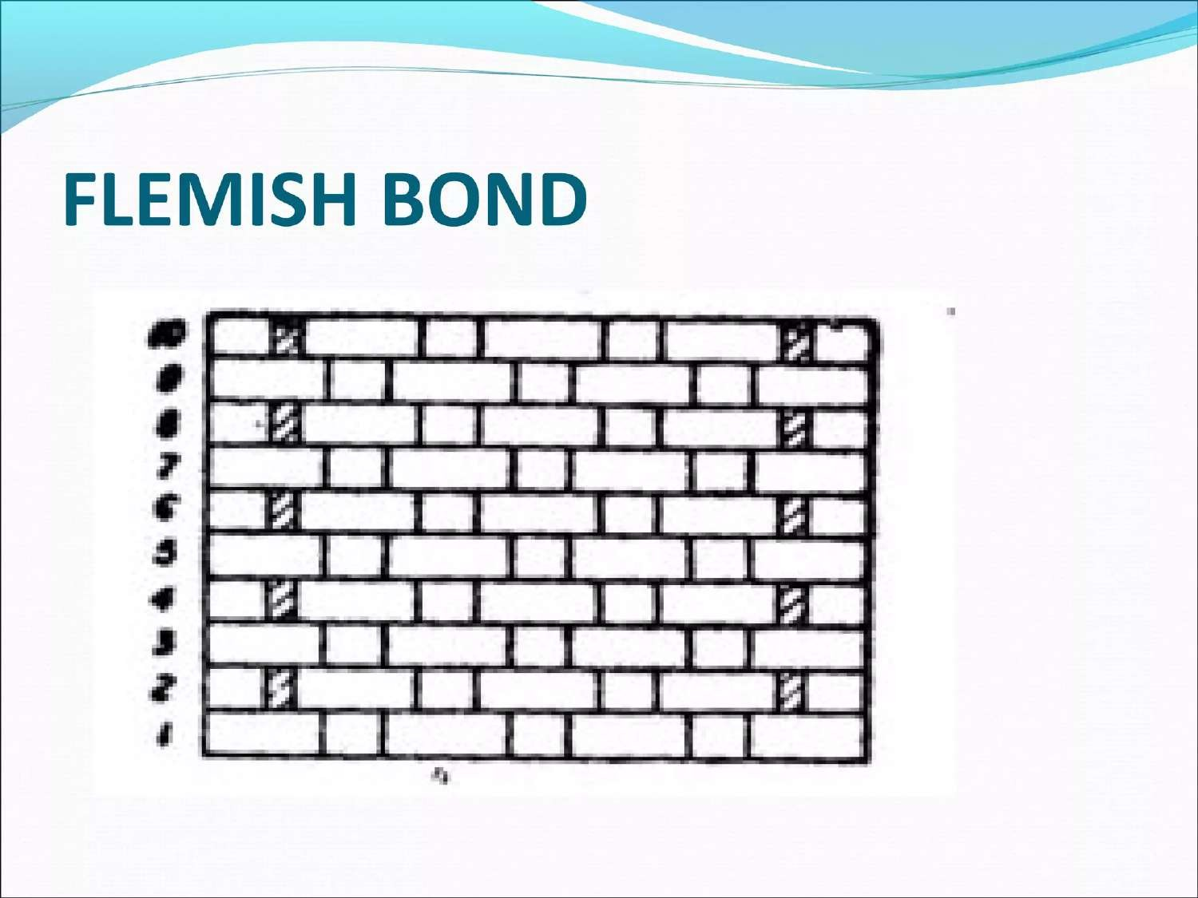

Slide 62
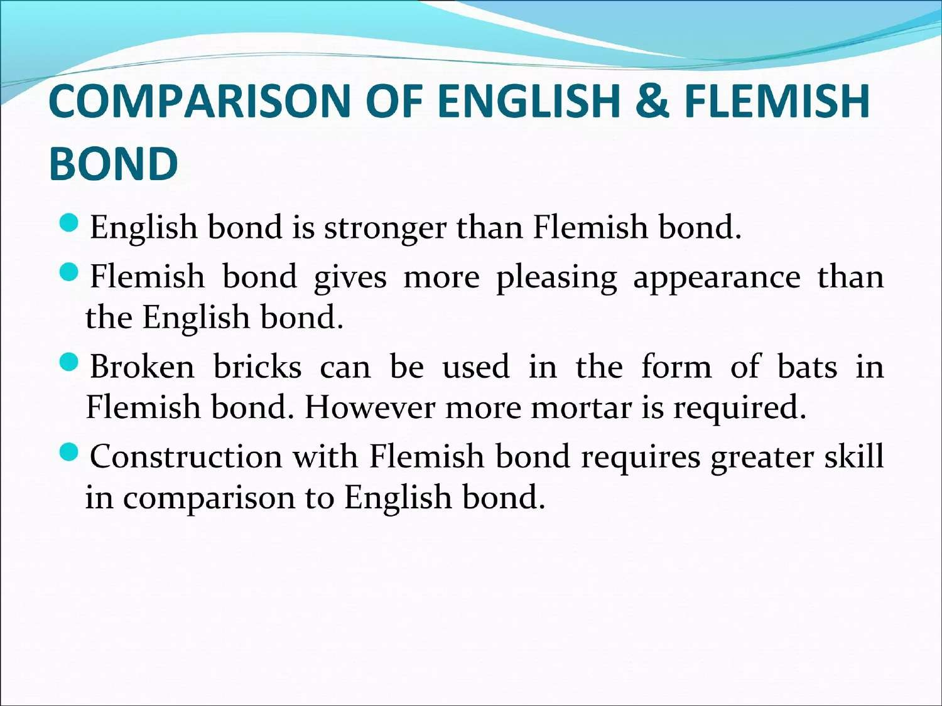

Slide 63
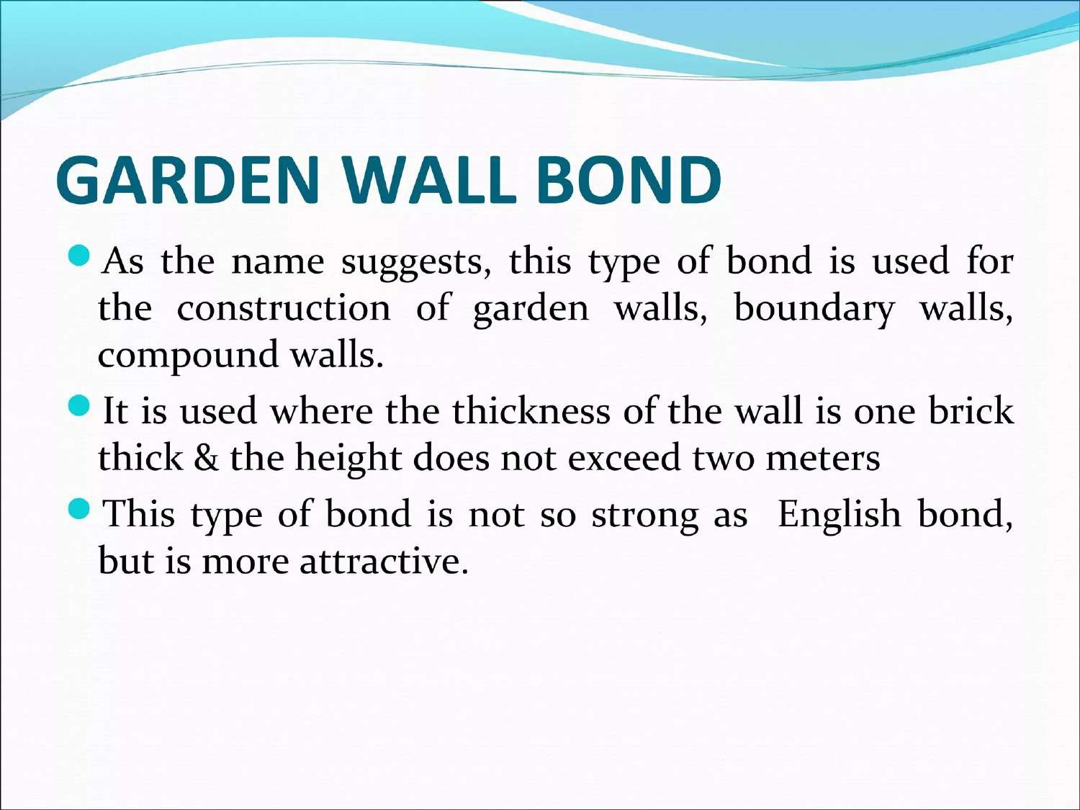

Slide 64
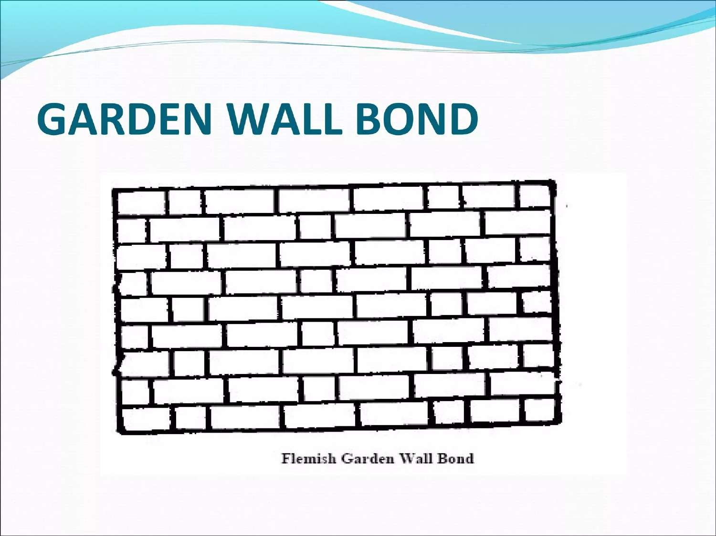

Slide 65
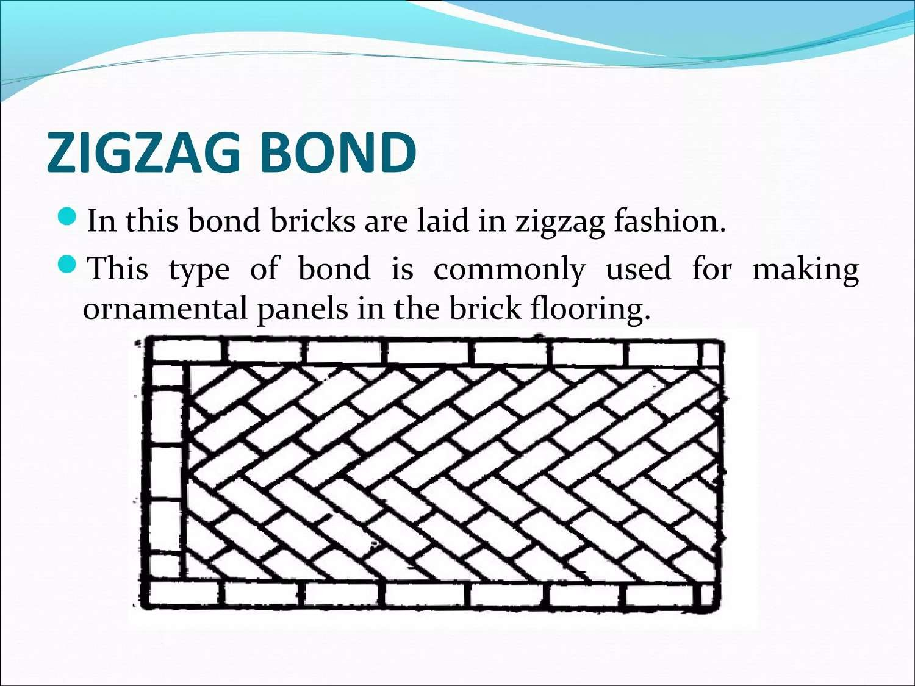

Slide 66
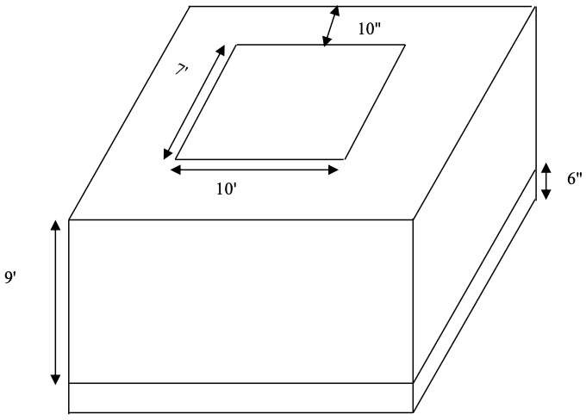

Slide 67
Aggregate(Classification and properties of aggregate)
Week 7

Slide 68
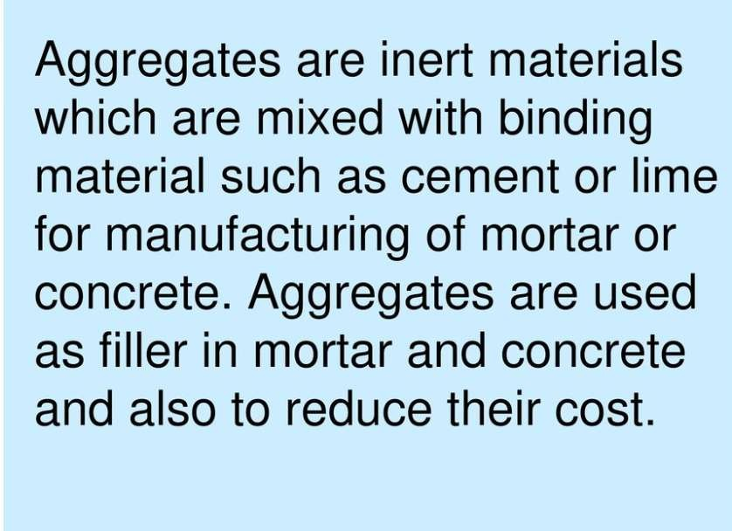

Slide 69
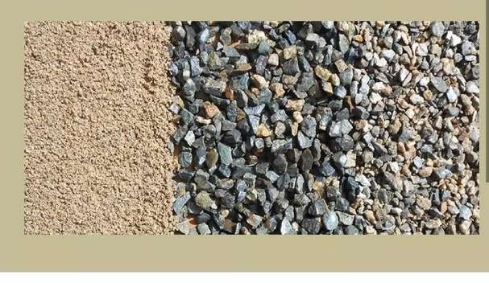

Slide 70
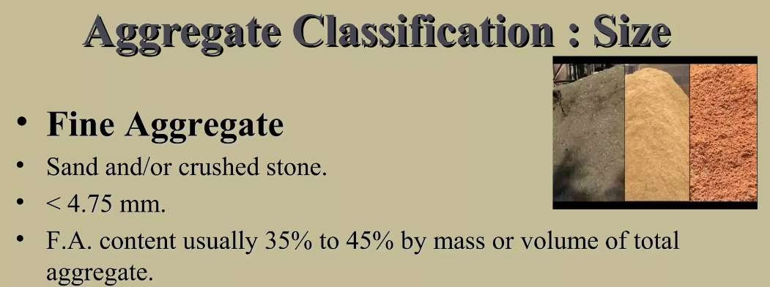

Slide 71
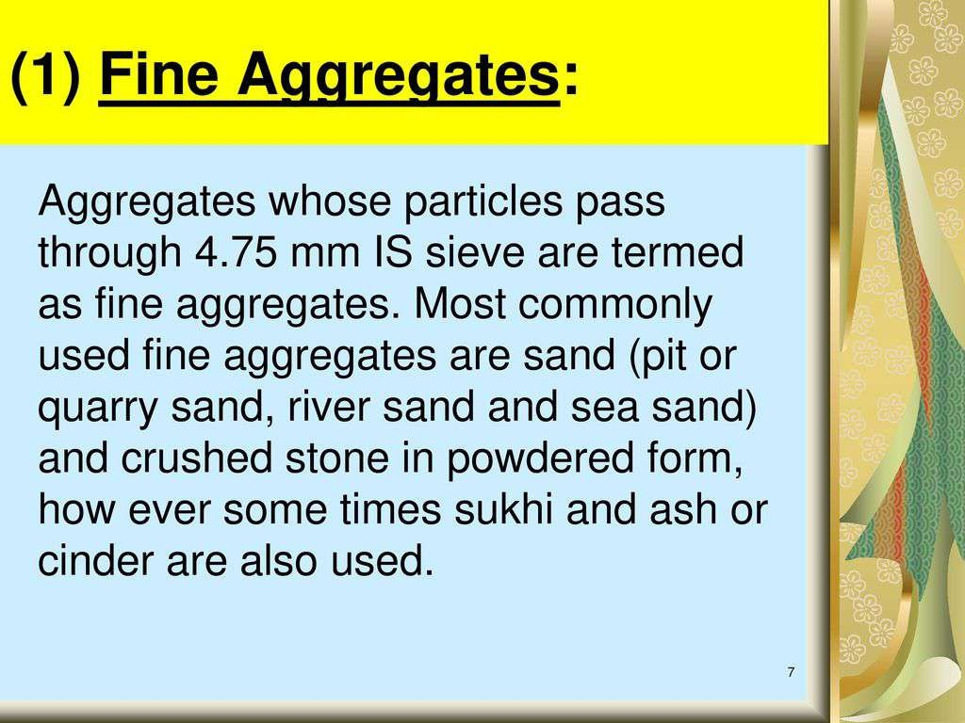

Slide 72


Slide 73


Slide 74
Aggregate (grading of
aggregate, testing
of aggregate)
Week 8

Slide 75


Slide 76


Slide 77


Slide 78


Slide 79
Aggregate (function of sand and fineness
modulus.)
Week 9

Slide 80


Slide 81


Slide 82


Slide 83


Slide 84


Slide 85


Slide 86


Slide 87


Slide 88


Slide 89


Slide 90


Slide 91


Slide 92


Slide 93


Slide 94
Cement(Definition , History & Cement Chemistry)
Week 10

Slide 95


PROPERTIES & USES OF CEMENT
WHAT IS CEMENT?
Cement, one of the most important building materials, is a binding agent that sets and hardens to adhere to building units such as stones, bricks, tiles, etc. Cement generally refers to a very fine powdery substance chiefly made up of limestone (calcium), sand or clay (silicon), bauxite (aluminum) and iron ore, and may include shells, chalk, marl, shale, clay, blast furnace slag, slate. The raw ingredients are processed in cement manufacturing plants and heated to form a rock-hard substance, which is then ground into a fine powder to be sold. Cement mixed with water causes a chemical reaction and forms a paste that sets and hardens to bind individual structures of building materials.
FIG: CEMENT

Slide 96
Cement is an integral part of the urban infrastructure. It is used to make concrete as well as mortar, and to secure the infrastructure by binding the building blocks. Concrete is made of cement, water, sand, and gravel mixed in definite proportions, whereas mortar consists of cement, water, and lime aggregate. These are both used to bind rocks, stones, bricks, and other building units, fill or seal any gaps, and to make decorative patterns. Cement mixed with water silicates and aluminates, making a water repellant hardened mass that is used for water- proofing.

Slide 97
HISTORY OF CEMENT
Cement, though different from the refined product found nowadays, has been used in many forms since the advent of human civilization. From volcanic ashes, crushed pottery, burnt gypsum and hydrated lime to the first hydraulic cement used by the Romans in the middle ages, the development of cement continued to the 18th century, when James Parker patented Roman cement, which gained popularity but was replaced by Portland cement in the 1850s.
In the 19th century, Frenchman Louis Vicat laid the foundation for the chemical composition of Portland cement and in Russia, Egor Cheliev published the methods of making cement, uses of cement and advantages. Joseph Aspdin brought Portland cement to the market in England and his son, William Aspdin, developed the “modern” Portland cement, which was soon in quite high demand. But the real father of Portland cement is considered to be Isaac Charles Johnson, who contributed immensely by publishing the process of developing meso-Portland cement in the kiln.

Slide 98
In the 19th century, Rosendale cement was discovered in New York. Though its rigidity made it quite popular at first, the market demand soon declined because of its long curing time and Portland cement was again the favorite. However, a new blend of Rosendale-Portland cement, which is both highly durable and needs less curing time, was synthesized by Catskill Aqueduct and is now often used for highway or bridge construction.
The cement used today has undergone experimentation, testing and significant improvements to meet the needs of the present world, such as developing strong concretes for roads and highways, hydraulic mortars that endure sea water and stucco for wet climates. Different kinds of modern cement, most of them known as Portland cement or blends, including blast furnace cement, Portland fly-ash cement, Portland pozzolan cement, pozzolan-lime cement, slag-lime cement, etc.

Slide 99
CEMENT CHEMISTRY
Cement is chiefly of two kinds based on the way it is set and hardened: hydraulic cement, which hardens due to the addition of water, and non-hydraulic cement, which is hardened by carbonation with the carbon present in the air, so it cannot be used underwater.
Non-hydraulic cement is produced through the following steps (lime cycle):
Calcination: Lime is produced from limestone at over 825°C for about 10 hours. (CaCO3 → CaO + CO2)
Slaking: Calcium oxide is mixed with water to make slaked lime. (CaO +
H2O → Ca(OH)2)
Setting: Water is completely evaporated.
The cement is exposed to dry air and it hardens after time-consuming reactions. (Ca(OH)2 + CO2 → CaCO3 + H2O)
On the other hand, hydraulic cement is mainly made up of silicates and oxides:
Belite (2CaO·SiO2);
Alite (3CaO·SiO2);
Tricalcium aluminate/ Celite (3CaO·Al2O3)
Brownmillerite (4CaO·Al2O3·Fe2O3)
The ingredients are processed in the kiln in cement plants. Complete chemistry of the reactions is still a subject of research.
PROPERTIES OF CEMENT
Cement is popular binding material due to its properties. There are many tests including physical and lab test for testing out different properties of cement.
Properties of cement can be divided into two types-
Physical properties
Chemical properties

Slide 100
Cement (physical properties of cement)
Week 11

Slide 101


FIG: DIAGRAM OF CEMENT PROPERTIES
a. Physical Properties of Cement:
Physical properties of cement are characterized by the structure, composition and physical parameters of cement. All of the physical properties are very much important parameters to control the quality of cement while production as well as casting on construction site.
Some of the physical parameters are listed below,
Fineness of cement
Soundness
Consistency
Strength
Setting time
Heat of hydration
Loss of ignition
Bulk density
Specific gravity (Relative density)

Slide 102
Fineness of Cement
The particle size of cement is very much important parameter and responsible for bond and strength of cement. More will be the surface area of cement particle; more will be the strength of cement. The test to find out Fineness of cement is also termed as Fineness test for cement.
Soundness of Cement
Here the soundness of cement referred as expansion or shrinkage of cement after hardening. Both expansion and shrinkage of cement can be harmful for construction and can reduce the strength of cement and bondage also. The tests to find out soundness of cement is Le Chatelier test and Autoclave Test.
Consistency of Cement
The consistency of cement is nothing but working with cement paste with ease. Or in other words, consistency also defined as the ability of cement paste to flow and work with easily. Consistency of cement can be measured by Vicat test.
Strength of Cement
There are three types of strengths of cement are measured, Compressive strength, tensile strength and Flexural strength.
Compressive strength:In this test the resistance of cement against the compressive load will be tested and this strength is termed as compressive strength.Tests to measure the compressive strength: Compressive Cube test
Tensile strength: In this test the resistance of cement against the tensile
load will be tested and this strength is termed as Tensile strength. Tests to measure the tensile strength: Tensile test
Flexural strength: In this test the resistance of cement against the
flexural load will be tested and this strength is termed as flexural strength. Tests to measure the Flexural strength: Flexural test
Setting Time of Cement
Setting time of cement is termed as time required for cement to set. Setting time is also has two types,
Initial setting time: Time required for cement paste to gets a rigidity. (Generally, varies from 30-45 minutes)

Slide 103
Final setting time: time required for cement paste to completely gets harden. (Generally, varies up to 10 hours)
Standard Tests to measure setting time:
Time of Setting of Hydraulic Cement by Vicat Needle
Time of Setting of Hydraulic Cement by Gillmore Needles
Time of Setting of Hydraulic-Cement Paste by Gillmore Needles
Heat of Hydration
When water is added into the cement the reaction is takes place which generates heat and this process of formation heat is known as heat of hydration. Heat of hydration is important parameter in term of bond, curing and strength of cement. Standard Test: Heat of Hydration of Hydraulic Cement
Loss of Ignition
Heating up the cement sample up to 900 – 1000°C cause weight loss in cement sample due to heating, this loss of weight is termed as loss of Ignition of cement. Standard Test: Chemical Analysis of Hydraulic Cement
Bulk density
When cement is mixed with water, the water replaces areas where there would normally be air. Because of that, the bulk density of cement is not very important.
Cement has a varying range of density depending on the cement composition percentage.
The density of cement may be anywhere from 62 to 78 pounds per cubic foot.
Specific Gravity (Relative Density)
Specific gravity pf cement is important parameter while calculating the cement quantity for the concrete.
Generally, for Portland cement specific gravity is 3.15. Test to measure the specific gravity: Density of cement

Slide 104
b. Chemical Properties of Cement:
Chemical properties of cement is properties comes by the basic raw materials of cement. Cement is generally made up of limestone, sand, clay, aluminium, iron ores and can be included chalk, shale, clay, various slags, slate, marl.
Following are the some of the chemical properties of cement:
Tricalcium aluminate (C3A)
Tricalcium silicate (C3S)
Dicalcium silicate (C2S)
Ferrite (C4AF)
Magnesia (MgO)
Sulphur trioxide
Iron oxide/ Ferric oxide
Alkalis
Free lime
Silica fumes
Alumina
•
•
•
•

Slide 105
Cement (types and uses of cement)
Week 12

Slide 106
TYPES OF CEMENT
Cement is mainly classified into two categories depending on the hardening and setting mechanism. These are-
Hydraulic Cement
Non-hydraulic Cement
Along with these main types, depending on the composition and characteristics there are many types of cement. Followings are the other cement types:
Ordinary Portland Cement (OPC)
Portland Pozzolana Cement (PPC)
Rapid Hardening Cement
Quick Setting Cement
Low Heat Cement
Sulphate Resisting Cement
Blast Furnace Cement
High Alumina Cement
White Cement 10.Colored Cement 11.Air Entraining Cement 12.Expansive Cement 13.Hydrophobic Cement
Hydraulic Cement
As the name indicates, hydraulic cement is those which harden by hydration in the presence of water. Limestone, clay, and gypsum are the main raw material to produce hydraulic cement. This raw material is burned at a very high temperature to manufacture Hydraulic Cement.
Non-Hydraulic Cement
The non-hydraulic cement doesn't require water to get harden. It gets with the help of carbon dioxide (CO2) from the air. This type of cement needs dry conditions to harden. Lime, gypsum plasters, and oxychloride are the required raw material to produce non-hydraulic cement. Example: slaked lime is a non- hydraulic cement.
Ordinary Portland Cement (OPC)
In usual construction work, Ordinary Portland Cement is widely used.

Slide 107
Portland cement clinker is a hydraulic material which shall consist of at least two- thirds by mass of calcium silicates, (3 CaO·SiO2, and 2 CaO·SiO2), the remainder consisting of aluminium- and iron-containing clinker phases and other compounds. The ratio of CaO to SiO2 shall not be less than 2.0. The magnesium oxide content (MgO) shall not exceed 5.0% by mass.
European Standard EN 197-1
The composition of Ordinary Portland Cement:
Argillaceous or silicates of alumina (clay and shale)
Calcareous or calcium carbonate (limestone, chalk, and marl)
Uses of Ordinary Portland Cement
It is used for general construction purposes.
It is also used in most of the masonry works.
Portland Pozzolana Cement (PPC)
Pozzolans are natural or synthetic materials that contain silica in reactive forms. It reacts with calcium hydroxide generated by hydrating cement to form additional cementations materials when it is finely divided. The composition of Portland Pozzolana Cement:
OPC clinker
Gypsum
Pozzolanic Materials (Fly ash, volcanic ash, and Calcined clay or silica fumes.)
Uses of Portland Pozzolana Cement
PPC is usually used in hydraulic structures, marine structures, construction near the seashore, dam construction, etc.
It is also used in pre-stressed and post-tensioned concrete members.
As it gives a better surface finish, it is used in decorative and art structures.
It is also used in the manufacture of precast sewage pipes.
Difference Between OPC and PPC
In the following table the main differences between OPC and PPC cement are given:

Slide 108
 | Content | OPC | PPC
1 | Definition/ Components | A mixture of limestone and other raw materials like argillaceous, calcareous, gypsum is prepared and then grinded to prepare OPC. | PPC is prepared by adding Pozzolanic materials to OPC. So, the main components are OPC clinker, gypsum and pozzolani materials (15~35%) which includes calcined clay, volcanic ash, fly ash or silica fumes.
2 | Strength | Initial strength is higher than PPC. | PPC has higher strength than OPC over a longer period of time.
3 | Heat of hydration | Generates more heat than PPC in hydration reaction which makes it less suitable for mass casting. | It has a slow hydration process and thus generates less heat than OPC.
4 | Durability | Less durable in aggressive weather. | More durable in aggressive weather.
5 | Cost | Costlier than PPC. | Cheaper than OPC.
6 | Environmental Impact | Emits CO2 during the manufacturing process. | It constitutes industrial and natural waste which makes it eco-friendly.
7 | Application/ uses | It is suitable where fast construction is required but not suitable for mass concreting due to | It is suitable for all types of construction work. For example RCC casting of buildings, mass concreting for bridges and even

Slide 109
 | Content | OPC | PPC
 |  | heat issue as mentioned above. | plastering and other non- structural works.
8 | Setting Time | Lower than PPC. Its initial setting time is 30 minutes and final setting time is 280 minutes. Its faster setting time helps faster construction. | Setting time of PPC us higher than OPC. Its initial setting time is 30 minutes and final setting time is 600 minutes. Its slower setting time helps to get better finishing.
9 | Fineness | OPC has finiteness of 225 sq.m/kg. It has lower fineness than PPC. So, it has higher permeability resulting lower durability. | OPC has finiteness of 300 sq.m/kg. It has higher fineness than OPC. So, it has lower permeability resulting in higher durability.
10 | Grades available | 33 Grade, 43 Grade, and 53 Grade OPC cement are available. | No specified grade of PPC cement is available.
11 | Workability | Lower than PPC. | Higher than OPC.
12 | Resistance against chemical attack | It has lower resistance against alkalis, sulphates, chlorides etc. | It has higher resistance against alkalis, sulphates, chlorides etc.
Rapid Hardening Cement
When finely grounded Tri-calcium silicate (C3S) is present in OPC with higher content, it gains strength more quickly than OPC. This type of OPC is called

Slide 110
Rapid Hardening Cement. It’s initial Setting Time 30 minutes and Final Setting Time 600 minutes.
Uses of Rapid Hardening Cement
Rapid hardening cement is mostly used where rapid construction is needed like the construction of pavement.
It also gives high strength.
Quick Setting Cement
Quick setting cement is the cement which sets in a very short time. The initial setting time is 5 minutes and the final setting time is 30 minutes. The composition of Quick Setting Cement:
Clinker
Aluminum sulfate (1% to 3% by weight of clinker)
The aluminum sulfate increases the hydration rate of silicate.
Uses of Quick Setting Cement
It is used in underwater construction.
It is also used in rainy & cold weather conditions.
It is used a higher temperature where water evaporates easily.
Used for anchoring or rock bolt mining and tunneling
Low Heat Cement
It is a spatial type of cement which produces low heat of hydration during the setting. Some chemical composition of Ordinary Portland Cement is modified to reduce the heat of hydration. The chemical composition of low heat cement:
A low percentage (5%) of tricalcium aluminate (C3A)
A higher percentage (46%) of declaiming silicate (C2S).
Uses of Low Heat Cement
It is used for the construction of dam’s large footing, large raft slabs, and wind turbine plinths.
It is also used for the construction of chemical plants.

Slide 111
Sulphate Resisting Cement
Sulfate resisting cement is used to resist sulfate attacks in concrete. Due to the lower percentage of Tricalcium aluminate, the production of calcium sulpho- aluminates gets reduced.
Uses of Sulphates resisting Cement
Construction in contact with soils or groundwater having more than 0.2% or 0.3 % g/l sulfate salts respectively.
Concrete surfaces subjected to alternate wetting and drying such as bridge
piers, concrete surface in the tidal zone, apron, Building near the seacoast.
Effluent treatment plans, Chimney, Chemical industries, water storage, sumps, drainage works, Cooling towers, Coastal protective works such as sea walls, breakwaters, tetrapods, etc.
Blast Furnace Cement
Portland cement clinker and granulated blast furnace slag are intergraded to make blast furnace cement. A maximum of 65 percent of the mixture could be comprised of blast furnace slag.
Uses of Blast Furnace Cement
It is highly sulfate resistant
Frequently used in seawater construction.
High Alumina Cement
High Alumina cement is obtained by mixing calcining bauxite (it’s an aluminum ore) and ordinary lime with clinker during the manufacture of OPC. In which the total amount of alumina content should not be lesser than 32% and it should maintain the ratio by weight of alumina to the lime between 0.85 to 1.30.
Uses of High Alumina Cement
It is used where concrete structures are subjected to high temperatures like workshops, refractory, foundries, etc.
It also used where the concrete is subjected to frost and acidic action.
White Cement
White cement is quite similar to Ordinary Portland Cement except for color. Amounts of iron oxide and manganese oxide are low in White Cement. It is expensive then OPC so not economical for ordinary work.

Slide 112
Uses of White Cement
It is usually used in decorative work.
It can also use for traffic barriers, tile grouts, swimming pools, roof tiles patching materials, and terrazzo surfaces.
Colored Cement
To make 5 to 10 percent of suitable pigments are ground with OPC. Types of pigments are selected according to the desired color.
Uses of Colored Cement
Colored cement is used for different decorative work.
Air Entraining Cement
It is seen that entrainment of air or formation of gas bubbles while applying cement increases resistance to frost action, fire, scaling, and other similar defects. Air-entraining cement is a special type of cement which entrains tinny air bubbles in concrete.
It is produced by grinding minute air entertaining materials with clinker by adding some resinous materials e.g. vinsol resin to ordinary portland cement.
When the water in concrete gets frizzed due to low temperature, it expands. When air-entraining cement, the air voids in concrete provides space for water to expand without cracking concrete. But this type of cement does not provide high strength in concrete.
Uses of Air-Entraining Cement
Especially it is used in areas where the temperature is very low.
It also resists the Sulphet attack.
It is used where the de-icing chemical is used.
Expansive Cement
In the hydration process, the expansive cement expands its volume. It can be possible to overcome shrinkage loss by using expansive cement.
There are three types of expansive cement:
K Type expansive cement
M Type expansive cement
S Type expansive cement

Slide 113
K Type expansive cement
Raw materials of these types of cement
Portland cement
Anhydrous tetracalcium trialuminate sulfate (C4A3S)
Calcium sulfate (CaSO4)
•
Lime (CaO).
M Type Expansive Cement
Raw materials of these types of cement
Portland cement clinkers
Calcium sulfate.
S Type Expansive Cement
Raw materials of these types of cement
Portland cement clinkers
Calcium sulfate (High amount)
Tricalcium aluminate (C3A) (High amount)
Uses of Expansive cement
It is used in the construction of the pre-stressed concrete component.
It is also used for sealing joints and grouting anchor bolt.
In the construction of different hydraulic structures, this type of cement is used.
Hydrophobic Cement
To resist the hydration process in the transportation or storage stage, clinkers are ground with water repellent film substance such as Oleic Acid or Stearic Acid. These chemicals form a layer on the cement particle and do not allow water to mix and start the hydration process. When cement and aggregate are thoroughly mixed in the mixer, protective layers break and start normal hydration with some air-entrainment which increases workability.
Uses of Hydrophobic Cement
Usually, it is used in the construction of water structures such as dams, spillways, or other submerged structures.

Slide 114

It is also used in the construction of underground structures like tunnel etc.
CEMENT MANUFACTURE

Slide 115
Stage of Cement Manufacture
There are six main stages of cement manufacturing process.
Stage 1
Raw Material Extraction/Quarry
The raw cement ingredients needed for cement production are limestone (calcium), sand and clay (silicon, aluminum, iron), shale, fly ash, mill scale and bauxite. The ore rocks are quarried and crushed to smaller pieces of about 6 inches. Secondary crushers or hammer mills then reduce them to even smaller size of 3 inches. After that, the ingredients are prepared for pyroprocessing.
Stage 2
Grinding, Proportioning and Blending
The crushed raw ingredients are made ready for the cement making process in the kiln by combining them with additives and grinding them to ensure a fine homogenous mixture. The composition of cement is proportioned here depending on the desired properties of the cement. Generally, limestone is 80% and remaining 20% is the clay. In the cement plant, the raw mix is dried (moisture content reduced to less than 1%); heavy wheel type rollers and rotating tables blend the raw mix and then the roller crushes it to a fine powder to be stored in silos and fed to the kiln.
Stage 3
Pre-Heating Raw Material
A pre-heating chamber consists of a series of cyclones that utilizes the hot gases produced from the kiln in order to reduce energy consumption and make the cement making process more environment-friendly. The raw materials are passed through here and turned into oxides to be burned in the kiln.
Stage 4 Kiln Phase
The kiln phase is the principal stage of the cement production process. Here, clinker is produced from the raw mix through a series of chemical reactions between calcium and silicon dioxide compounds. Though the process is complex, the events of the clinker production can be written in the following sequence:
Evaporation of free water
Evolution of combined water in the argillaceous components
Calcination of the calcium carbonate (CaCO3) to calcium oxide (CaO)
Reaction of CaO with silica to form dicalcium silicate

Slide 116
Reaction of CaO with the aluminum and iron-bearing constituents to form the liquid phase
Formation of the clinker nodules
Evaporation of volatile constituents (e. g., sodium, potassium, chlorides, and sulfates)
Reaction of excess CaO with dicalcium silicate to form tricalcium silicate
The above events can be condensed into four major stages based on the change of temperature inside the kiln:
100°C (212°F): Evaporation of free water
100°C (212°F)-430°C (800°F): Dehydration and formation of oxides of silicon, aluminum, and iron
900°C (1650°F)-982°C (1800°F): CO2 is evolved and CaO is produced through calcination
1510°C (2750°F): Cement clinker is formed
The kiln is angled by 3 degrees to the horizontal to allow the material to pass through it, over a period of 20 to 30 minutes. By the time the raw-mix reaches the lower part of the kiln, clinker forms and comes out of the kiln in marble-sized nodules.
Stage 5
Cooling and final grinding
After exiting the kiln, the clinker is rapidly cooled down from 2000°C to 100°C- 200°C by passing air over it. At this stage, different additives are combined with the clinker to be ground in order to produce the final product, cement. Gypsum, added to and ground with clinker, regulates the setting time and gives the most important property of cement, compressive strength. It also prevents agglomeration and coating of the powder at the surface of balls and mill wall. Some organic substances, such as Triethanolamine (used at 0.1 wt.%), are added as grinding aids to avoid powder agglomeration. Other additives sometimes used are ethylene glycol, oleic acid and dodecyl-benzene sulphonate.
The heat produced by the clinker is circulated back to the kiln to save energy. The last stage of making cement is the final grinding process. In the cement plant, there are rotating drums fitted with steel balls. Clinker, after being cooled, is transferred to these rotating drums and ground into such a fine powder that each pound of it contains 150 billion grains. This powder is the final product, cement.

Slide 117
Stage 6 Packing and Shipping
Cement is conveyed from grinding mills to silos (large storage tanks) where it is packed in 20-40 kg bags. Most of the product is shipped in bulk quantities by trucks, trains or ships, and only a small amount is packed for customers who need small quantities.
Chemical Reactions during Cement Manufacturing Process
The reactions that take place (after evaporation of free water) between the reactants in the kiln phase of cement making process are as follows:
Clay Decomposition:
Si2Al2O5(OH)2 → 2 SiO2 + Al2O3 + 2 H2O (vapor)
KAlSi3O8 (orthoclase) + 0.5 SO2 + 0.25 O2 → 3 SiO2 + 0.5 Al2O3 + 0.5 K2SO4
Dolomite Decomposition:
CaMg(CO3)2 → CaCO3 + MgO + CO2
KMg3AlSi3O10(OH)2 + 0.5 SO2 + 0.25 O2 → 0.5 K2SO4 + 3 MgO + 0.5
Al2O3 + 3 SiO2 + H2O (vapor)
Low Temperature Calcite Decomposition:
2 CaCO3 + SiO2 → Ca2SiO4 + 2 CO2
2 MgO + SiO2 → Mg2SiO4
Ca5(PO4)3OH + 0.25 SiO2 → 1.5 Ca3(PO4)2 + 0.25 Ca2SiO4 + 0.5 H2O
(vapour)
4. Alumina and Oxide Reaction:
12 CaCO3 + 7 Al2O3 → Ca12Al14O33 + 12 CO2
4 CaCO3 + Al2O3 + Fe2O3 → Ca4Al2Fe2O10 + 4 CO2
4 CaCO3 + Al2O3 + Mn2O3 → Ca4Al2Mn2O10 + 4 CO2
Reaction of Remaining Calcite:
CaCO3 → CaO + CO2
Sintering:
Ca2SiO4 + CaO → Ca3SiO5

Slide 118
USES OF CEMENT
Cement is a very useful binding material in construction. The applications of cement over various fields of construction have made it a very important civil engineering material.
Some of the numerous functions of cement are given below.
It is used in mortar for plastering, masonry work, pointing, etc.
It is used for making joints for drains and pipes.
It is used for water tightness of structure.
It is used in concrete for laying floors, roofs and constructing lintels, beams, stairs, pillars etc.
It is used where a hard surface is required for the protection of exposed
surfaces of structures against the destructive agents of the weather and certain organic or inorganic chemicals.
It is used for precast pipes manufacturing, piles, fencing posts etc.
It is used in the construction of important engineering structures such as bridges, culverts, dams, tunnels, lighthouses etc.
It is used in the preparation of foundations, watertight floors, footpaths
etc.
It is employed for the construction of wells, water tanks, tennis courts, lamp posts, telephone cabins, roads etc.

Slide 119


Slide 120

What is Wood?
A hard substance that forms the branches and trunks of trees and can be used as a building material, for making things. A porous and fibrous hard structured plant stem which is the secondary xylem of the vascular tissue consisting of cellulose, hemicellulose and lignin can be defined as wood. It’s a supportive organ of woody plants forming the branches and stems give them a firm structure.
What Is Wood Seasoning?
Seasoning of timber is the process by which moisture content in the timber is reduced to required level. By reducing moisture content, the strength, elasticity and durability properties are developed. A well-seasoned timber has 15% moisture content in it.
Methods of Seasoning of Timber
There are two methods of Seasoning of timber which are explained below
Natural seasoning
Artificial seasoning
Natural Seasoning of Timber
Natural seasoning is the process in which timber is seasoned by subjecting it to the natural elements such as air or water. Natural seasoning may be water seasoning or air seasoning.
Water Seasoning
Water seasoning is the process in which timber is immersed in water flow which helps to remove the sap present in the timber. It will take 2 to 4 weeks of time and after that the timber is allowed to dry. Well-seasoned timber is ready to use.

Slide 121

Air Seasoning
In the process of air seasoning timber logs are arranged in layers in a shed. The arrangement is done by maintaining some gap with the ground. So, platform is built on ground at 300mm height from ground. The logs are arranged in such a way that air is circulated freely between logs. By the movement of air, the moisture content in timber slowly reduces and seasoning occurs. Even though it is a slow process it will produce well-seasoned timber.
Artificial Seasoning of Timber
Natural seasoning gives good results but takes more time. So, artificial seasoning of timber is developed nowadays. By artificial seasoning, timber is seasoned with in 4-5 days. Here also different methods of artificial seasoning are there and they are as follows.
Seasoning by Boiling
Chemical seasoning
Kiln seasoning
Electrical seasoning
Seasoning by Boiling
Seasoning of timber is also achieved by boiling it in water for 3 to 4 hours. After boiling timber is allowed to drying. For large quantity of timber boiling is difficult so, sometimes hot steam is passed through timber logs in enclosed room. It also gives good results. The boiling or steaming process develops the strength and elasticity of timber but economically it is of heavier cost.
Chemical Seasoning
In case of chemical seasoning, timber is stored in suitable salt solution for some time. The salt solution used has
the tendency to absorb water from the timber. So, the moisture content is

Slide 122


removed and then timber is allowed to drying. It affects the strength of the timber.
Kiln Seasoning
In this method timber is subjected to hot air in air tight chamber. The hot air circulates in between the timber logs and reduces the moisture content. The temperature inside the chamber is raised with the help of heating coils. When the required temperature is obtained moisture content and relative humidity gets reduced and timber gets seasoned. Even though it is costly process it will give good results strength
wise.
Electrical Seasoning
In the method of electrical seasoning timber is subjected to high frequency alternating currents. The resistance of timber against electricity is measured at every interval of

Slide 123

time.
Uses of Wood in Different Sectors
Wood is a plant part having multipurpose uses those are impossible to deny and difficult to note all in our daily life. From the ancient time wood is used by human and this continuation still remains in the modern civilization. A few of many uses of wood are mentioned below:
Construction and Fencing
Home Construction:
During the early periods, use of wood in domestic construction was a common scene and this is still followed in this twenty-first century. In different parts of the world in the making of houses, wood is used commonly like the flooring, frames of doors and windows for its strength and internment quality.
e.g. Deodar (Cedrus deodara), walnut wood (Juglans sp) is used in Pakistan widely, teak (Tectona grandis) in South Asia and all over the world, Chir pine (Pinus roxburghii) etc. In Bangladesh during construction of buildings woods from mango (Mangifera indica),
burflower tree (Neolamarckia cadamba) are used for casting and piling.
Fencing and Decorating Gardens:

Slide 124
In modern decoration system woods are also used for building the fencing and simple decoration for artificial gardening inside a home or on roofs.
e.g. Cedar (Cedrus libani), redwood (Sequoia semipervirens), Shorea sp, Acacia sp.
Household Uses
Utensils:
Utensils made up of wood instead of plastic and steel are a symbol of elegance which increases the charm and loveliness of the home corners.
e.g. Black walnut (Juglans nigra) wood is used in the west for home utensils.
Hand Tools:
The handles of most common hand tools made of wood help as heat resistant when they are kitchenware used in an oven and closes the chance to shock while used on electricity.
Art Industry
Artworks:
For artworks such as statues, sculptures, carvings and making decorative objects woods are widely used. The frames of art board, color plate are also made from wood in many cases.
e.g. Pine (Pinus sp), maple (Acer sp), cherry (Prunus sp) wood for framing work.
Musical instrument:
The musical instruments such as Piano, violin, cello, drums, flute, guitar, double bass and a number of other music instruments material requires wood for making a perfect tune.
e.g. Mahogany (Swietenia macrophylla), maple, ash wood (Fraxinus sp) for guitars.
Sports Equipment
Wooden Toys:
These are preferred to plastic towards the health conscious people which were supposed as a fashion before. Plastic is nothing but the combination of chemicals which is hazardous to children's health. Cricket, hockey, billiard, table tennis etc. Toys and sports equipment have long made use of wood for handles and main parts.
e.g. Willow (Salix sp) wood for cricket, tennis bat; Mulberry (Morus sp) wood for hockey sticks.
Commercial Uses
Furniture:

Slide 125
At present, the market for wooden furniture is very profitable. No one can deny the demand for wooden furniture as it is a sign of aristocracy since ancient time.
e.g. Teak (Tectona grandis) wood is the best for making furniture. Some other woods from Mahogany (Swietenia macrophylla), Shimul (Bombax ceiba), Sundari, Jackfruit (Artocarpus heterophyllus), Mango trees are used in south Asia for making different types of furniture.
Shipbuilding:
Ships and rural fishing boats were made from wood. For constructing boats and ships wood is one of the most important construction material. Hardwood and softwood were used in the past for ship industry.
e.g. Teak, shal (Shorea robusta), mango, Arjun (Terminalia arjuna) were frequently used in the past. Now Cypress (Cupressaceae sp), redwood (Sequoioideae sp), white oak (Quercus alba) are water resistant and used for shipbuilding and boat building. Woods like kauri (Agathis australis) is used for making the frames of ships.
Fuel:
Wood is an age-old source of energy all over the world. Before the exploration of gas, fuel was the main source we can also define as only one source of energy that people used by burning as woods were available in the forest easily. Generally, sticks, pellets, sawdust, and charcoal are used as an energy source from wood. Usually, woods from cheap plants are used in this sector.
Stationary:
Some stationaries like paper pencil are made of wood. Wood pulp is used for making paper. Wood is used for making pencils too.
e.g. in the past Cyper papyrus trees were used to make paper. In Bangladesh woods from Keora (Sonneratia apetala), Bine (Avicennia alba), Sundari (Heritiera fomes), Kakra (Bruguiera gymnorhyza), Geoa (Excoecaria agallocha) are used for making pulp of paper.
Dhundal wood (Xylocarpus granatum) is used for pencil production.

Slide 126


Slide 127
Lime
Lime as Building Material
Before the invention of portland cement, lime was used as the chief cementing material in the construction industry.
Today, the use of lime has become very limited and is sometimes used in places where lime is locally available and the availability of portland cement is scarce.
Lime is not available in nature in its free state, as it reacts with CO2 to form calcium carbonate.
Lime also has some unique applications such as its addition to cement mortar increases the workability and delays the setting time, thus the mortar can be used for longer periods after mixing.
Manufacturing of Lime
The raw material for the manufacturing of Lime is Limestone (CaCO3). Lime is obtained from limestone through a process known as calcination.
Other raw materials from which Lime can be manufactured are kankars, shell, corals and chalk.
The heating of limestone to a temperature of about 900°c in the presence of air to obtain lime is known as calcination.
The quick lime produced by calcination is very unstable and if left exposed it will react with carbon dioxide present in the atmosphere and revert back to calcium carbonate.
To avoid this, stabilization of quick lime has to be done, which is achieved by sprinkling water over quick lime, known as slaking.
Slaking of lime, which is an exothermic reaction, converts the quick lime to calcium hydroxide (Hydrated lime), which is in powdered form.
The slaked lime so produced is sieved through IS sieve 3.5 and is used for various construction purposes like making mortar, lime putty, white washing, etc.

Slide 128
Characteristics of Lime
Lime has good plasticity and has high workability.
It has good cementitious properties and is suitable for masonry works.
It stiffens easily and has high resistance to moisture. Because of its
high water retentiveness, shrinkage on drying is small compared to cement.
Classification of Lime
The properties of a Lime depends on the percentage of impurities present in it. Generally, lime is classified into three types.
Rich or Fat Lime :
This lime is produced by the calcination of nearly purest form of limestone, chalk, marble, etc.
Its color is perfectly white.
It should have impurities of clay less than 5 percent.
It slakes vigorously and volume becomes 2 to 3 times.
Since the slaking process is vigorous for this lime, care must be taken to avoid any fire hazards.
It sets slowly in the presence of air, thus it is not suitable for thick wall joints or in wet conditions.
Fat lime is extensively used in the manufacturing of cement,
metallurgical industry, white washing, etc.
Hydraulic Lime :
This lime is produced by the moderate burning of limestone which contains small proportions of clay, iron oxide and other impurities.
It has impurities in the range of 5 to 30 percent.
The increase in the percentage of clay makes the slaking difficult and increases its hydraulic property.
Care must be taken during the slaking of this lime, as any excess
addition of water will cause the lime to harden.
Depending on the percentage of clay present, it is further classified into feebly, moderately and eminently hydraulic lime.

Slide 129
Poor Lime :
This lime is also known as lean lime or impure lime.
It contains clay impurities more than 30%.
It slakes very slowly and forms a thin paste when mixed with water.
It is muddy white in color.
It sets or hardens very slowly and has poor binding properties.
This lime is used for the construction of interior structures and at places where the availability of good lime is less.
Storage of Lime on Site
Basically lime reacts with moisture present in the atmosphere and even on the ground surface. Hence proper care must be taken while storing lime on site.
To avoid the air slaking of lime, they should be stored in compact heaps and in insulated spaces.
It should be kept under covered and closed space when in the form of hydrated lime and they should be used within a week when in the form of quick lime.

Slide 130


Slide 131


Slide 132


Slide 133


Slide 134


Slide 135


Slide 136


Slide 137


Slide 138


Slide 139


Slide 140


Slide 141


Slide 142


Slide 143


Slide 144


Slide 145


Slide 146


Slide 147


Slide 148
Mortar & Grout
Mortar and grout are both used in the field of construction which are cement based product. Despite both being cement based products, they have different properties, different uses and serve different purposes. The major difference found in the mortar and grout is its fluidity property.
Mortar
Mortar is a mixture of cement, sand and water made into a thick paste that is used to bind two surfaces with each other. It is majorly used in the building projects as a binding material between stones, concrete and bricks.
Grout
Grout is a highly viscous material which is used as a filler to fill spaces or the joints between ceramic or stone tiles. Grout is a binder, but it is certainly not an adhesive and the tiles stay in place because of the mortar below them and not because of the grout.
Difference Between Mortar and Grout
The differences between mortar and grout are mentioned below in detail :
SN | Properties | Mortar | Grout
1 | Material | Cement, sand, lime and water | Cement, water and sand, epoxy, acrylic and polymer
2 | Water- Cement Ratio | Less | More
3 | Primary Function | The primary function of the cement mortar is to act as a binder in brick or stone masonry | The primary function of the grout is to act as a filler material in tilling work and cracks.
4 | Stiffness | Stiffer | Less stiff
5 | Workability | It sticks well on a trowel and the workability is more. | As the water content is more, it is difficult to handle it with trowel or other tools.
6 | Viscosity | Low | Highly viscous

Slide 149
7 | Color | Usually takes the color of cement | Comes in various colors as per the requirement
8 | Types | Cement Mortar Lime Mortar Surki Mortar Gauged Mortar Mud Mortar | Sanded grout Un-sanded or wall grout Epoxy grout Furan grout Acrylic grout
9 | Porosity | Non-porous | Quite porous, holds waters in it even after hardening.
10 | Curing | Mortar needs curing for hardening process | Grout does not need extra water for curing; the initial quantity provided is enough for hardening
11 | Setting Time | Setting time is more when compared to grout | Setting time is less when compared to Mortar
12 | Application | Used as a bonding material in stone, concrete and brick masonry. Used in plastering works to hide the joints and to improve appearance. | Used as a filler in tiles and cracks. Grouting is done to avoid cracks or bedding planes in weak area or ground. Grouting is used for strengthing of ground for dam foundation.

Slide 150


Slide 151


