Slide 1


Engineering Mechanics
CE 0732-2101
Prepared By
Somen Saha
Lecturer
Department of Civil Engineering
University of Global Village (UGV), Barishal

Slide 2
BASIC COURSE INFORMATION
Course Title | Engineering Mechanics
Course Code | CE 0732-2101
Credits | 04
CIE Marks | 120
SEE Marks | 80
Exam Hours | 2 hours (Mid Exam) 3 hours (Semester Final Exam)
Level | 3rd Semester

Slide 3
Engineering Mechanics
CREDIT:04 TOTAL MARKS:200 CIE MARKS: 120
SEE MARKS: 80
COURSE CODE: C E 0715-2101
Mid Exam Hours 2
Semester End Exam Hours 3
Course Learning Outcomes (CLOs): After completing this course successfully, the students will be able to-
CLO 1
Define and explain principles of engineering mechanics (example- system of forces) related to civil engineering domain.
Understand and learn relationship among physical process, kinetics and kinematics.
Differentiate concepts of principles of engineering mechanics (i.e. statics and dynamics) for different
simple situations..
Prepare free body diagrams of real case phenomenon considering engineering mechanics point of view and formulate Load acting on a body, Resultant forces acting on body, direction, magnitude and position of forces acting on a body.
CLO 2
CLO 3
CLO 4

Slide 4
SL | Content of Course | Hrs | CLOs
1 | Force System & Resultant Force: Types of acting Force & Force System (parallel, colinear, concurrent), Parallelogram Theory, Method of Resolution, Varignon Theorem, Law Of Triangle, Problem Solving on Parallelogram Theory &amp; Triangle Theory, Problem Solving on Varignon & method, Problem Solving on method of resolution | 6 | CLO1
2 | Free body diagram : Understanding forces , Drawing FBD, Applying FBD, Decomposing forces into x and y components ,Applying FBDs to complex situations with multiple objects and forces ,Using FBDs in conjunction with work and energy concepts. | 6 | CLO4
3 | Centre of Gravity: Centroid, Methods of Centre of Gravity, Centre of Gravity by Geometrical Considerations, Axis of Reference, Centre of Gravity of Symmetrical Sections, Centre of Gravity of Unsymmetrical Sections, Centre of Gravity of Solid Bodies. | 7 | CLO2,CLO3, CLO4
4 | Friction: Static, Dynamic Friction, Co efficient of Friction, Law of Static and Dynamic Friction, Ladder,Wedge and Screw Friction, Problems solving on Friction. | 7 | CLO2,CLO3, CLO4
5 | Truss : Introduction to truss , Applying loads, Truss components, Simple truss analysis, Truss design consideration. | 6 | CLO2,CLO3, CLO4
Text Book:
1. 1) A Textbook of Engineering Mechanics- R.S Khurmi
2) Vector Mechanics for Engineers ( Statics)- Beer& Johnston

Slide 5
ASSESSMENT PATTERN
CIE- Continuous Internal Evaluation (120 Marks)
SEE- Semester End Examination (80 Marks)
Bloom’s Category | Tests
Remember | 10
Understand | 15
Apply | 15
Analyze | 15
Evaluate | 15
Create | 10
Bloom’s Category Marks (out of 120) | Tests (60) | Assignments (20) | Quizzes (20) | External Participation in Curricular/Co-Curricular Activities (20)
Remember | 10 |  | 10 | Attendance 20
Understand | 10 |  | 10
Apply | 10
Analyze | 10
Evaluate | 10
Create | 10 | 20

Slide 6
Couse plan specifying content, CLOs, teaching learning and assessment strategy mapped with CLOs
Week | Topic | Teaching-Learning Strategy | Assessment Strategy | Corresponding CLOs | Page No
1 | Introduction to Engineering Mechanics, Force system & principle of moment | Lecture, discussion, group work | Quiz, Written Exam | CLO1 | 7-35
2 | Force Components & Resultant Force | Oral Presentation, debate | Assignment, Written, Quiz | CLO4 | 37-53
3 | Force Components & Resultant Force | Video lecture, Field visit | Report writing, Demonstration | CLO2, CLO4 | 37-53
4 | Types of supports in structure | Lecture | Viva, Quiz | CLO1, CLO4 | 55-59
5 | Free body diagram related Theory | Project exhibition | Project, Field visit | CLO4 | 61-65
6 | Free body diagram related problems | Discussion, Video Presentation | Quiz, Written Exam | CLO4 | 66-81
7 | Free body diagram related problems | Case-based Learning, Demonstration | Assignment, Written, Quiz | CLO2, CLO4 | 66-81
8 | Center of gravity related theory | Lecture, discussion, group work | Report writing, Demonstration | CLO04, CLO3 | 83-94
9 | Center of gravity related problems | Oral Presentation, debate | Viva, Quiz | CLO1 | 96-103
10 | Friction related theory | Video lecture | Project, Field visit | CLO3 | 105-130

Slide 7
11 | Friction related theory | Lecture | Quiz, Written Exam | CLO2, CLO4 | 105-130
12 | Friction related problems | Project exhibition | Assignment, Written, Quiz | CLO1, CLO3 | 132-152
13 | Friction related problems | Discussion, Video Presentation | Report writing, Demonstration | CLO3 | 132-152
14 | Truss related theory | Case-based Learning, Demonstration | Viva, Quiz | CLO3 | 154-163
15 | Truss related problems | Lecture, discussion, group work | Project, Field visit | CLO2, CLO4 | 165-183
16 | Truss related problems | Oral Presentation, debate | Quiz, Written Exam | CLO2, CLO3 | 165-183
17 | Practice and Exercise, Practice and Exercise, Practice and Exercise | Video lecture | Assignment, Written, Quiz | CLO2 | 184

Slide 8
Introduction to Engineering Mechanics, Force system & Principle of moment
Week 1

Slide 9
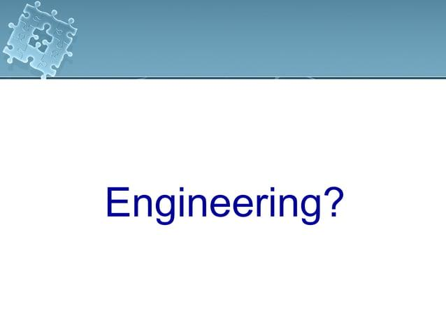

Slide 10
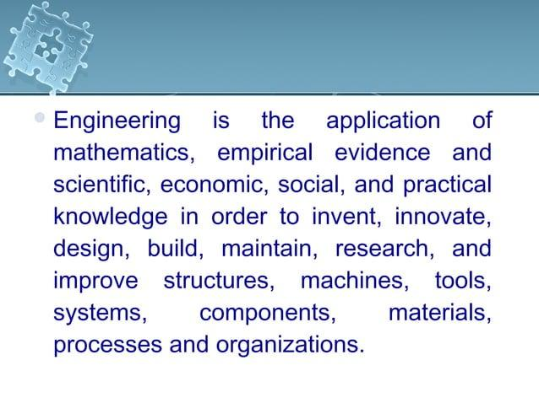

Slide 11
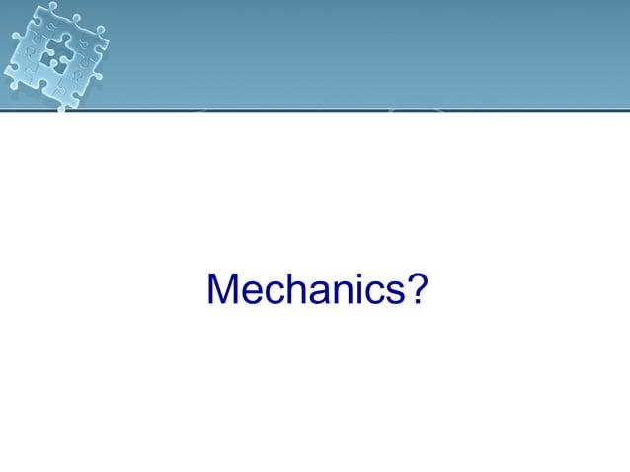

Slide 12
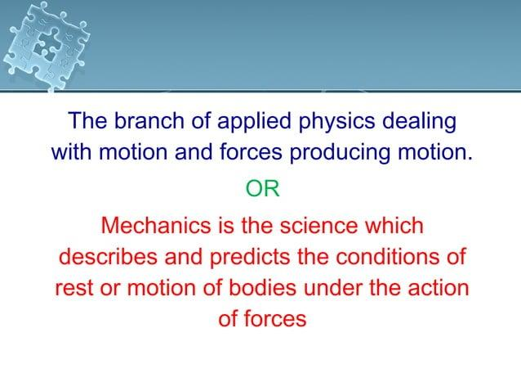

Slide 13
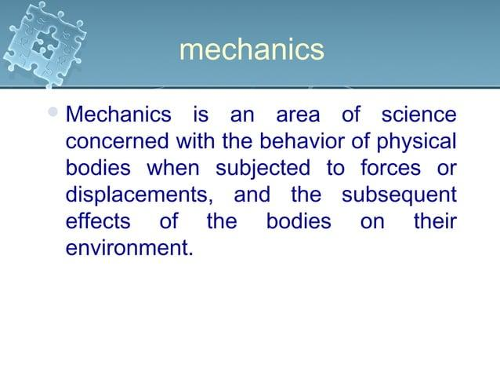

Slide 14
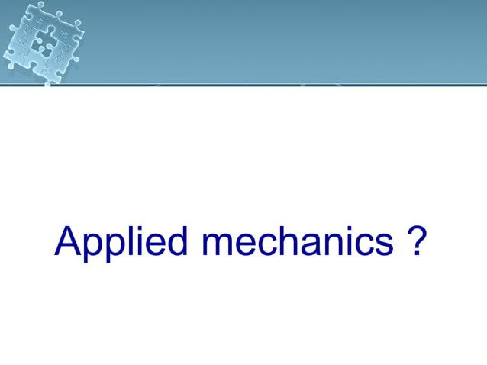

Slide 15
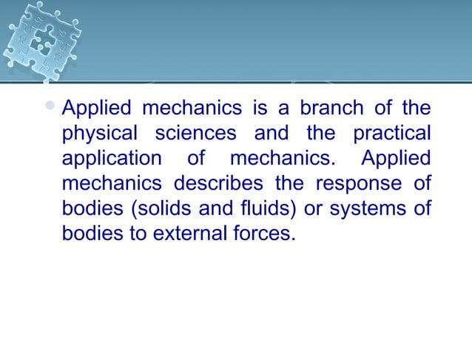

Slide 16
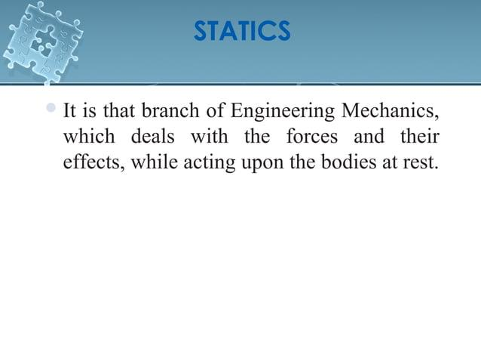

Slide 17
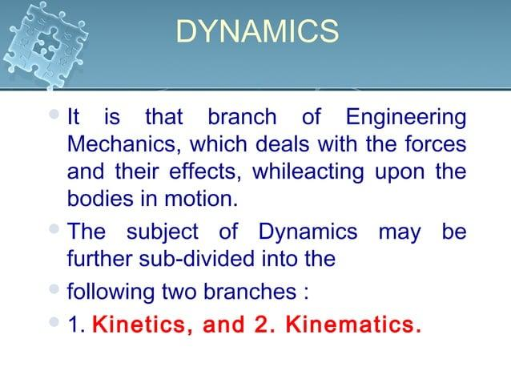

Slide 18
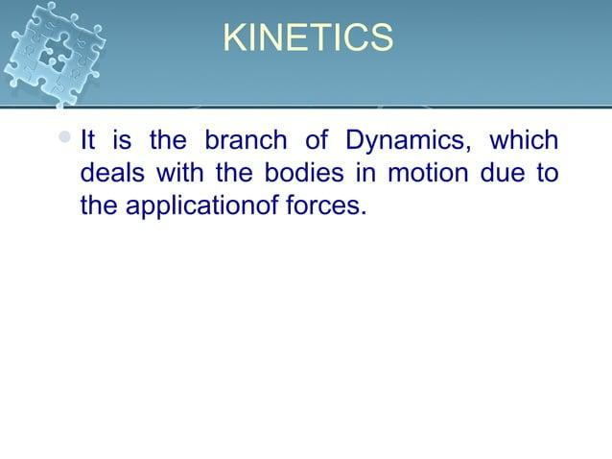

Slide 19
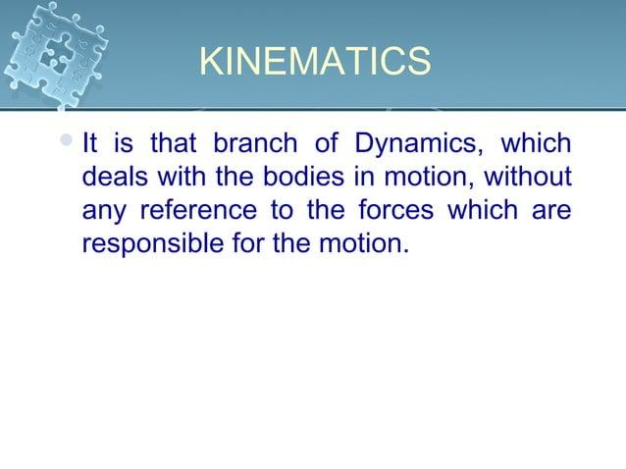

Slide 20
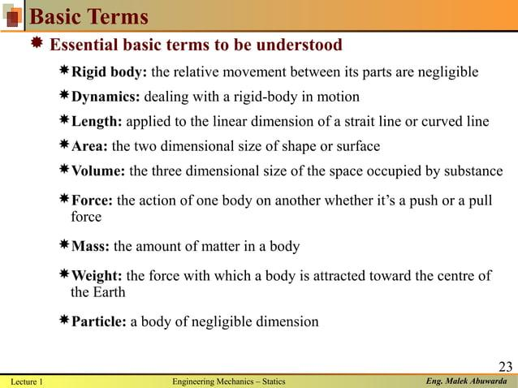

Slide 21
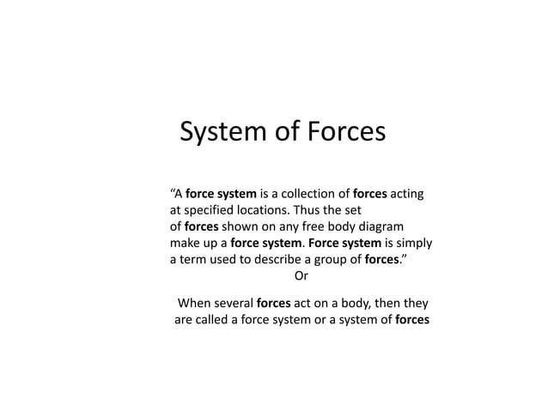

Slide 22
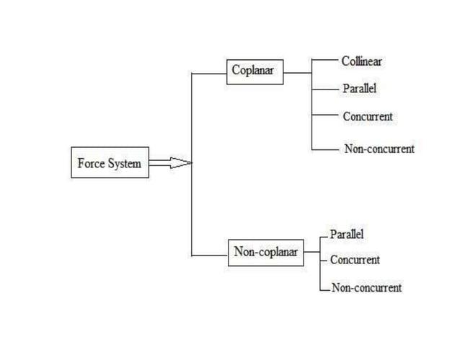

Slide 23
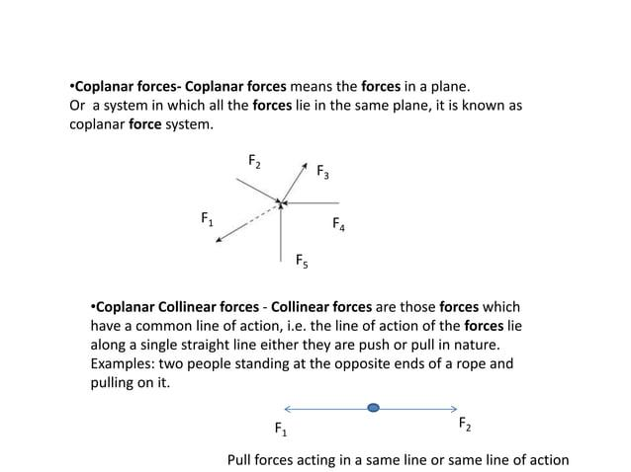

Slide 24
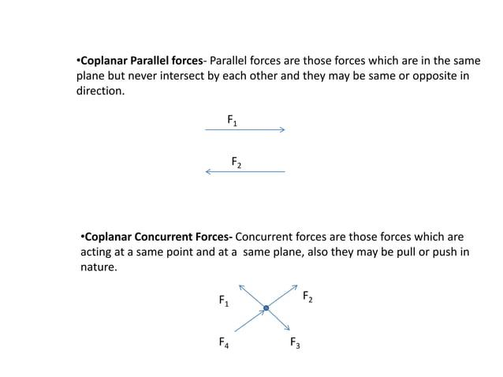

Slide 25
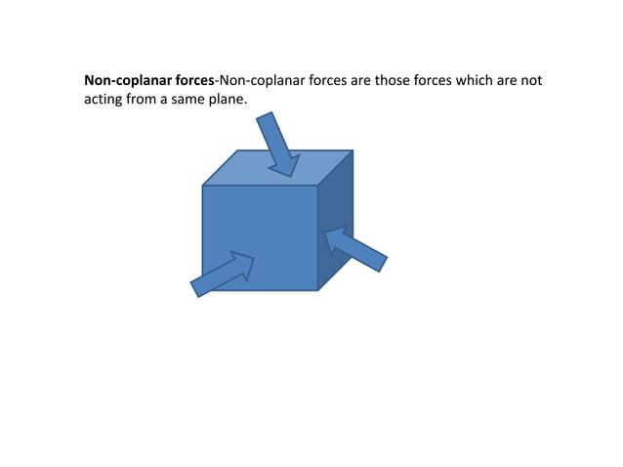

Slide 26
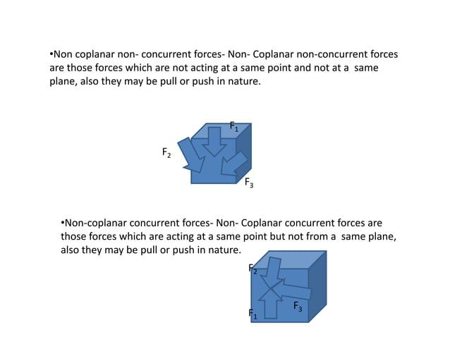

Slide 27
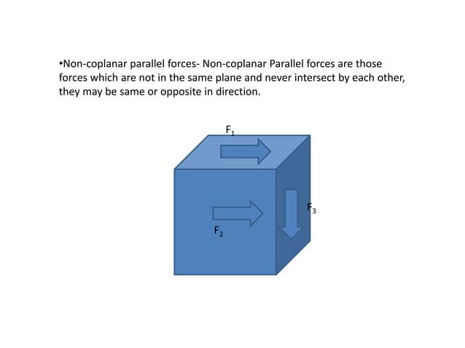

Slide 28
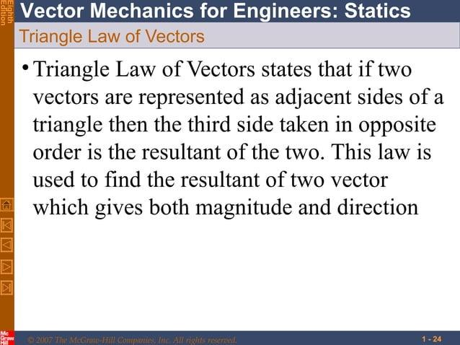

Slide 29
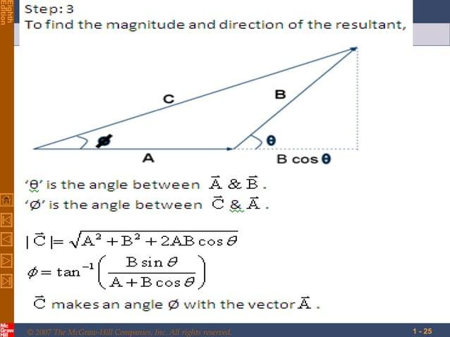

Slide 30
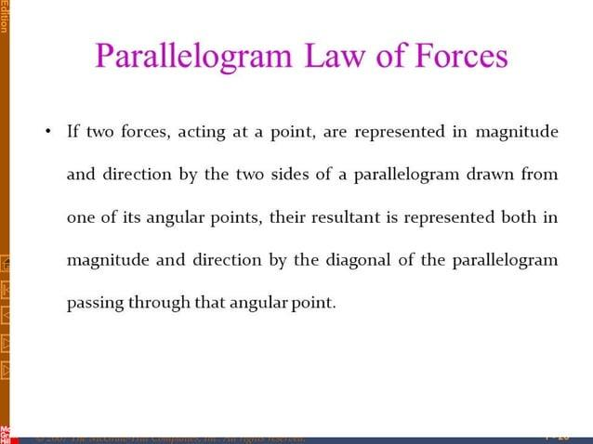

Slide 31
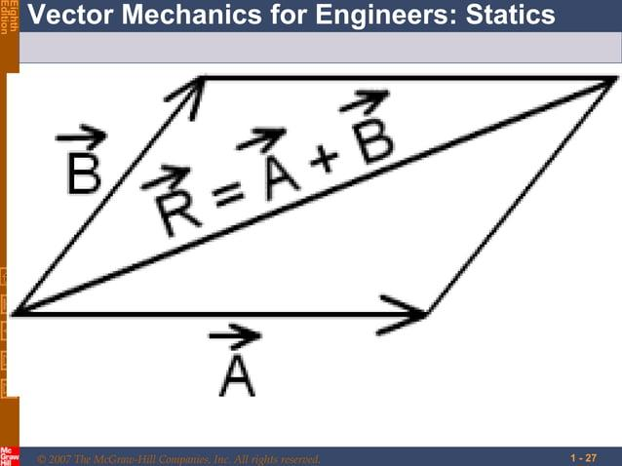

Slide 32
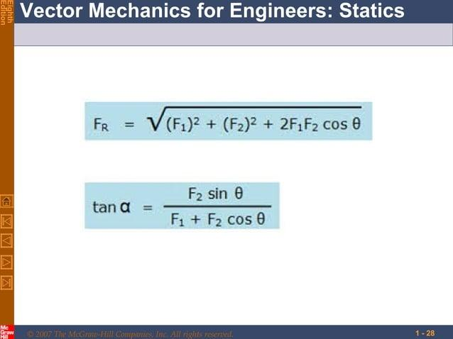

Slide 33
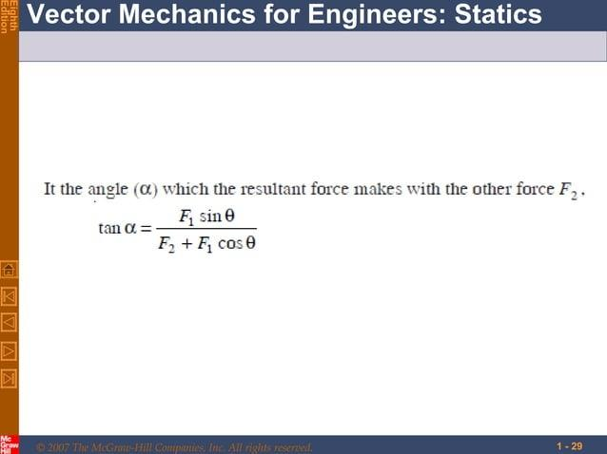

Slide 34
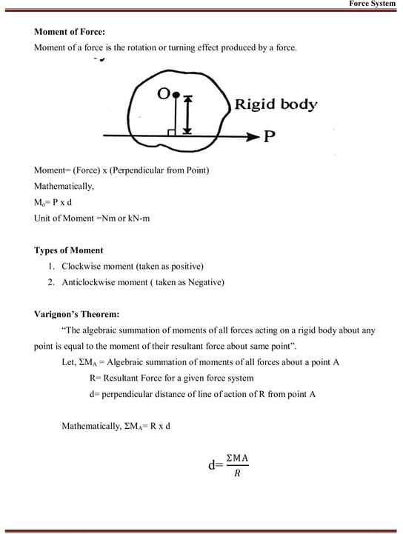

Slide 35
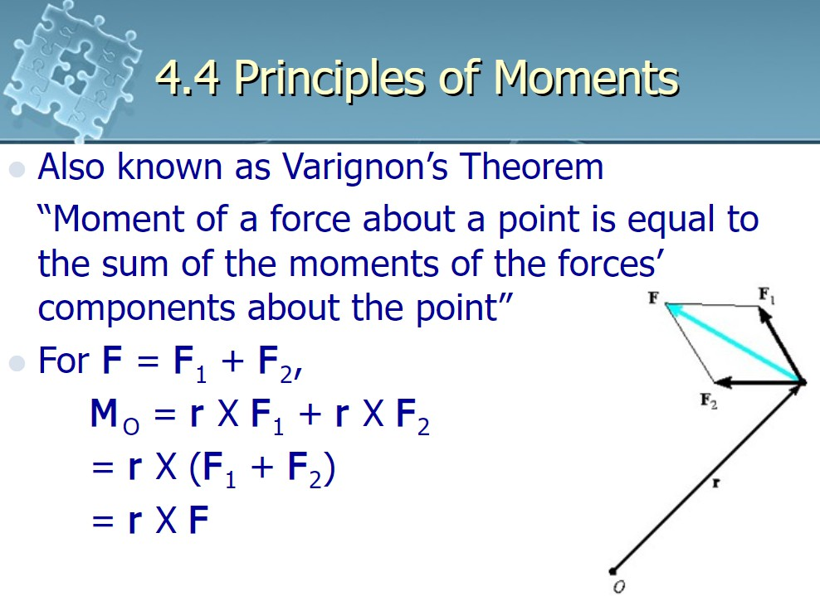

Slide 36
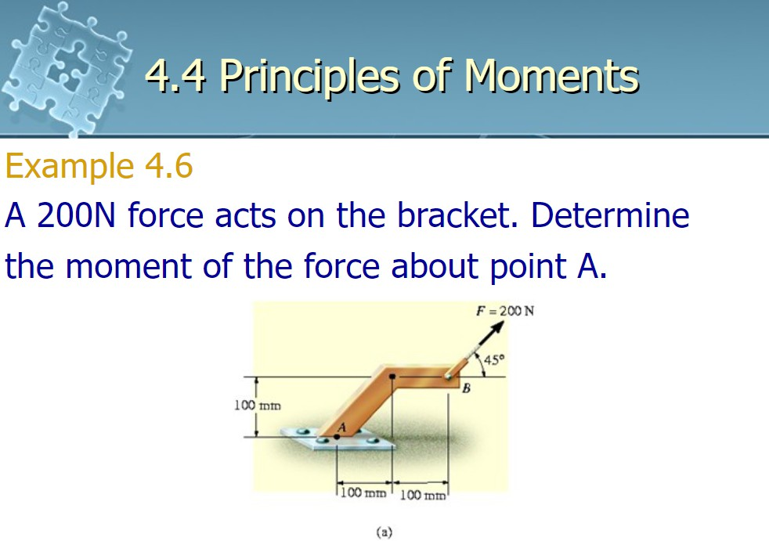

Slide 37
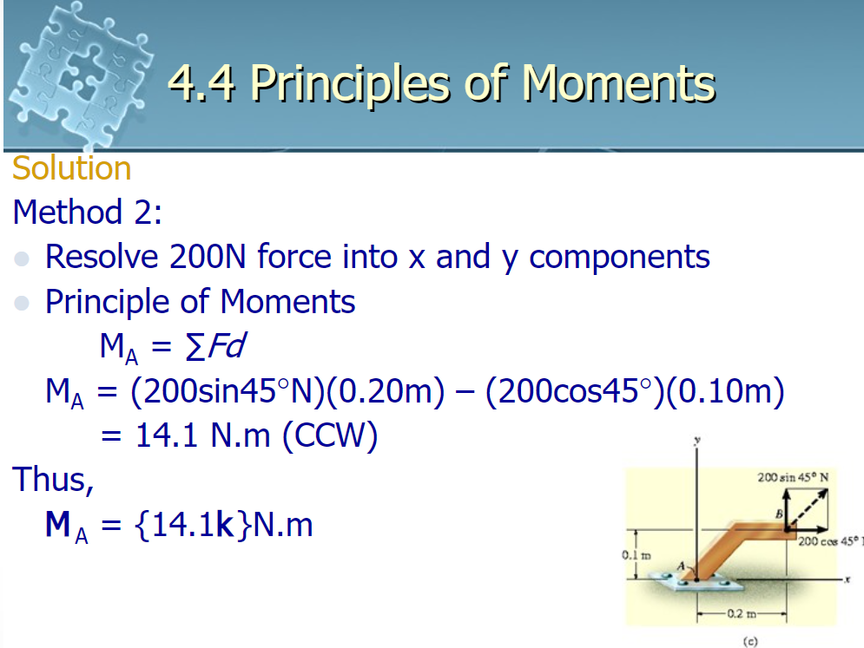

Slide 38
Force Components & Resultants
Week 2-3

Slide 39
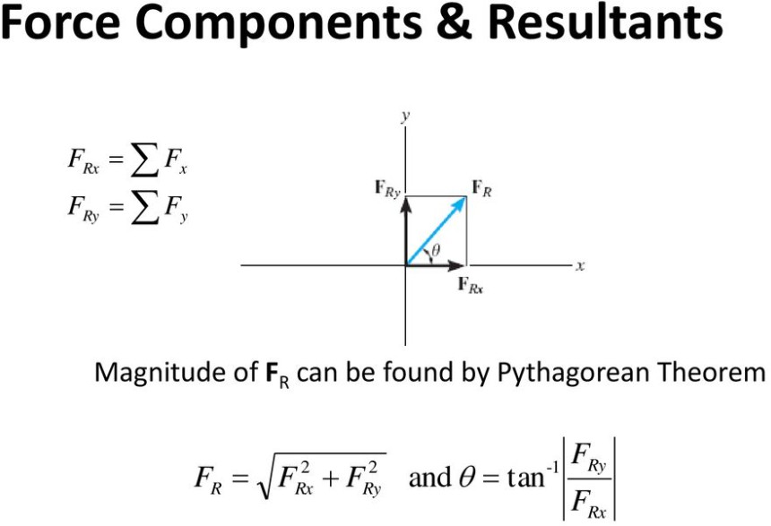

Slide 40
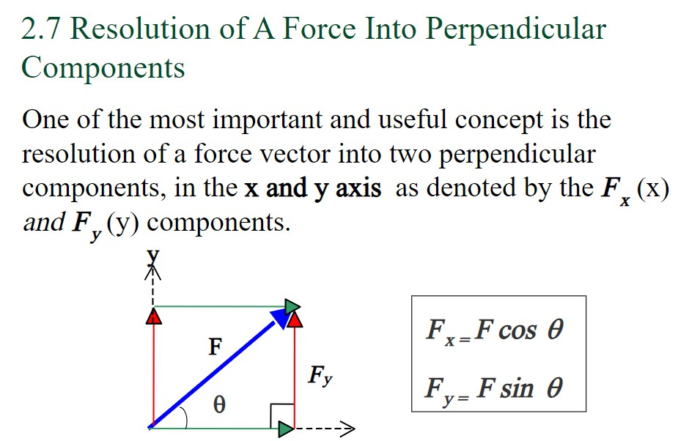
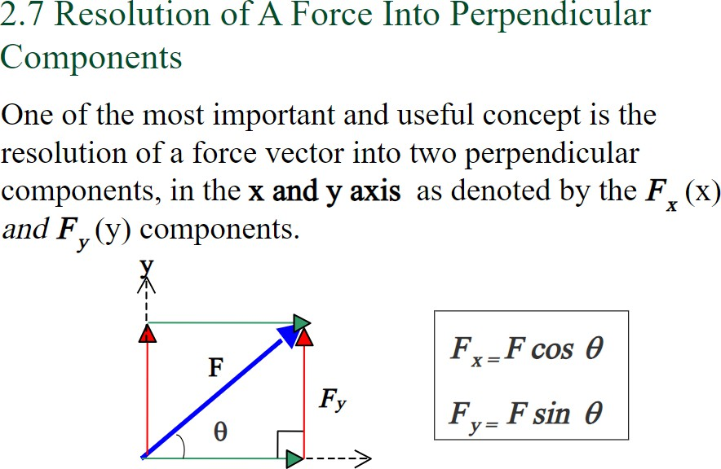

Slide 41
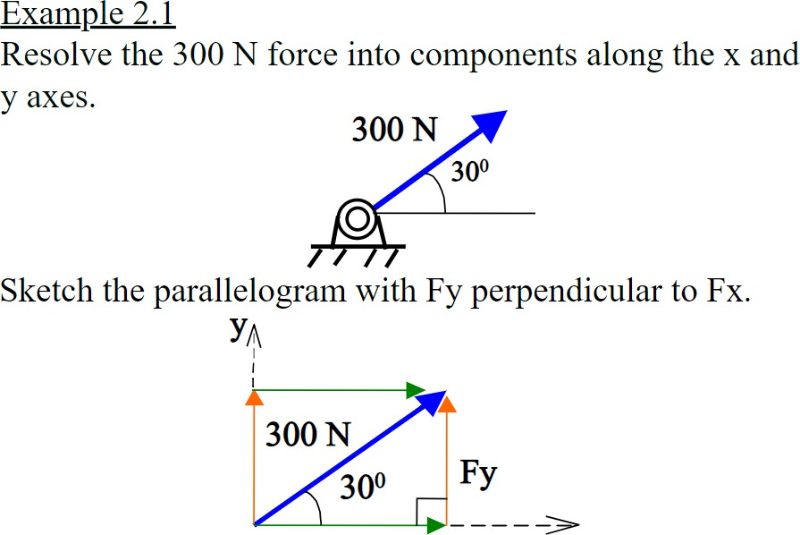

Slide 42
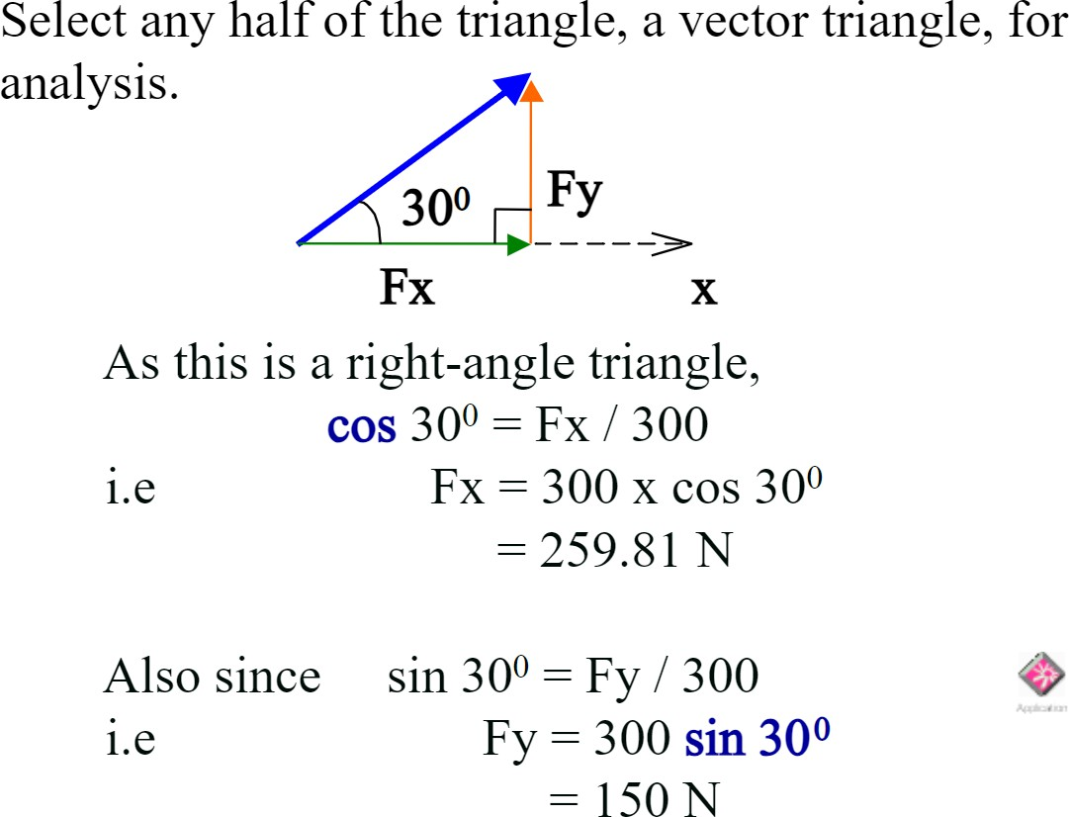

Slide 43
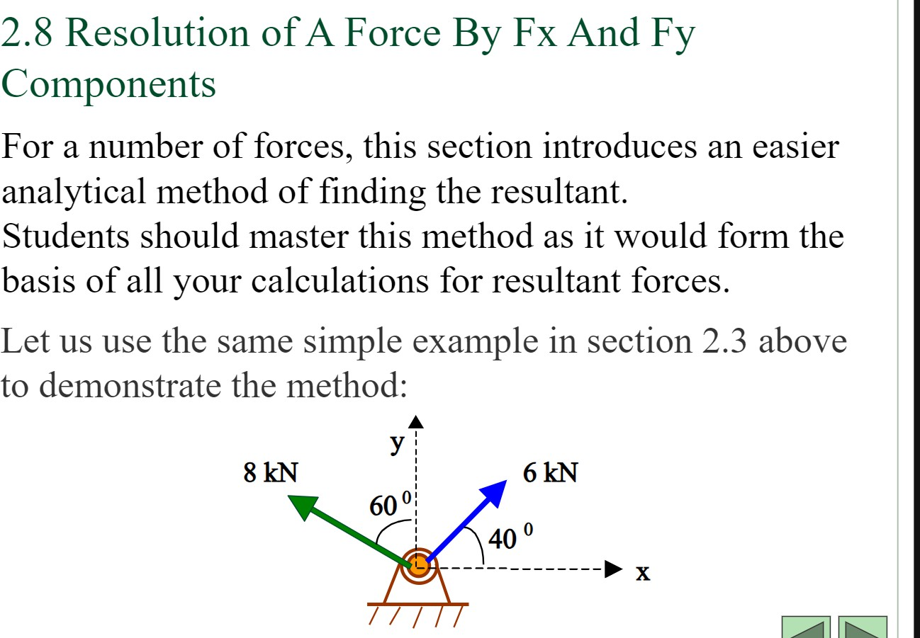

Slide 44
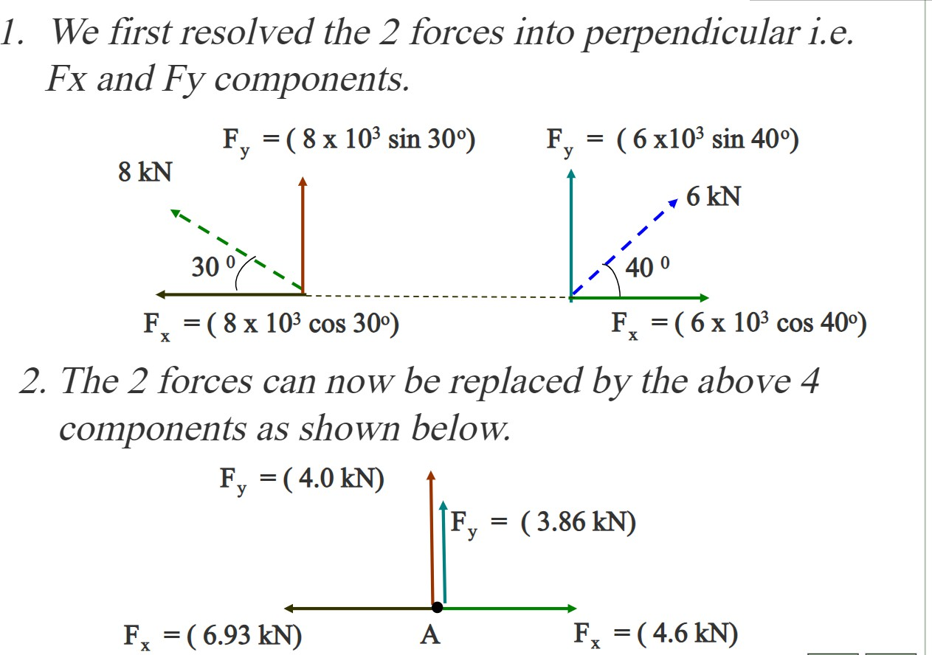

Slide 45
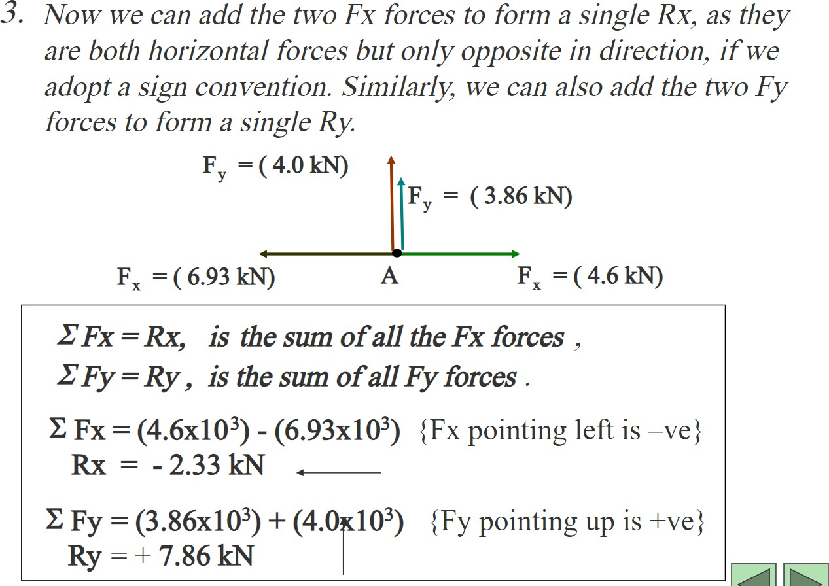

Slide 46
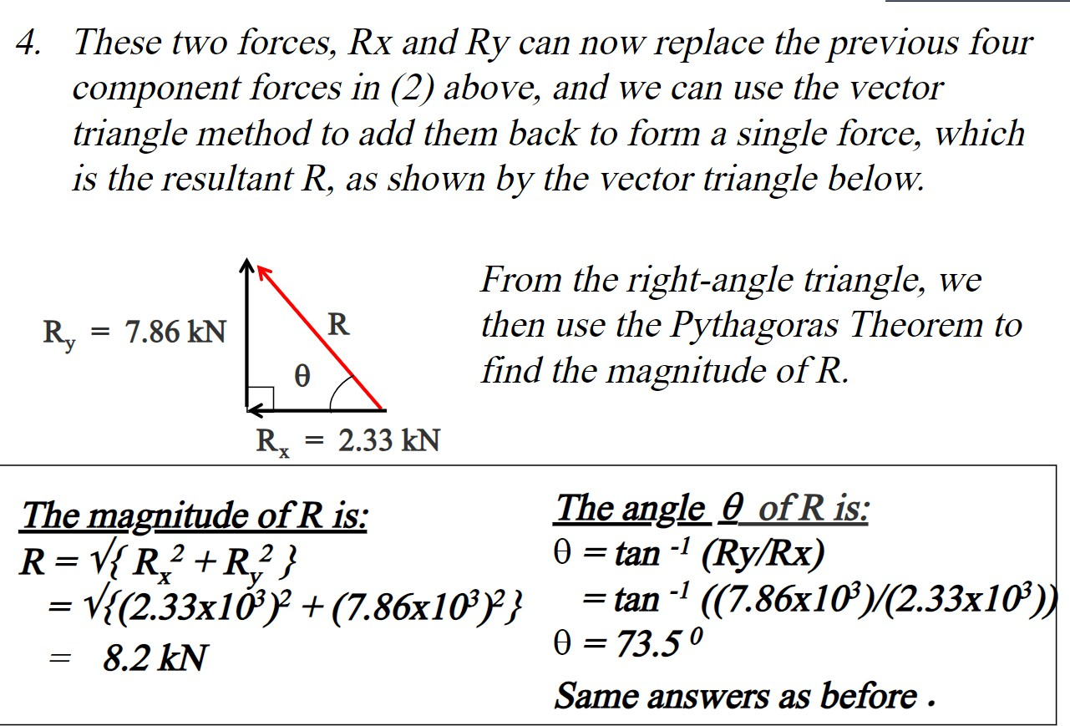

Slide 47
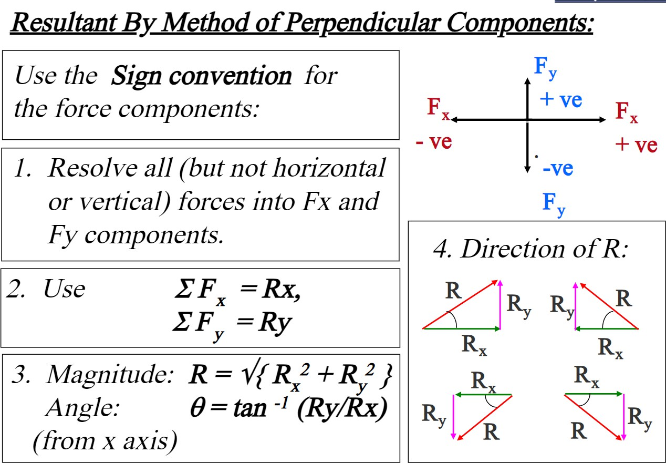

Slide 48
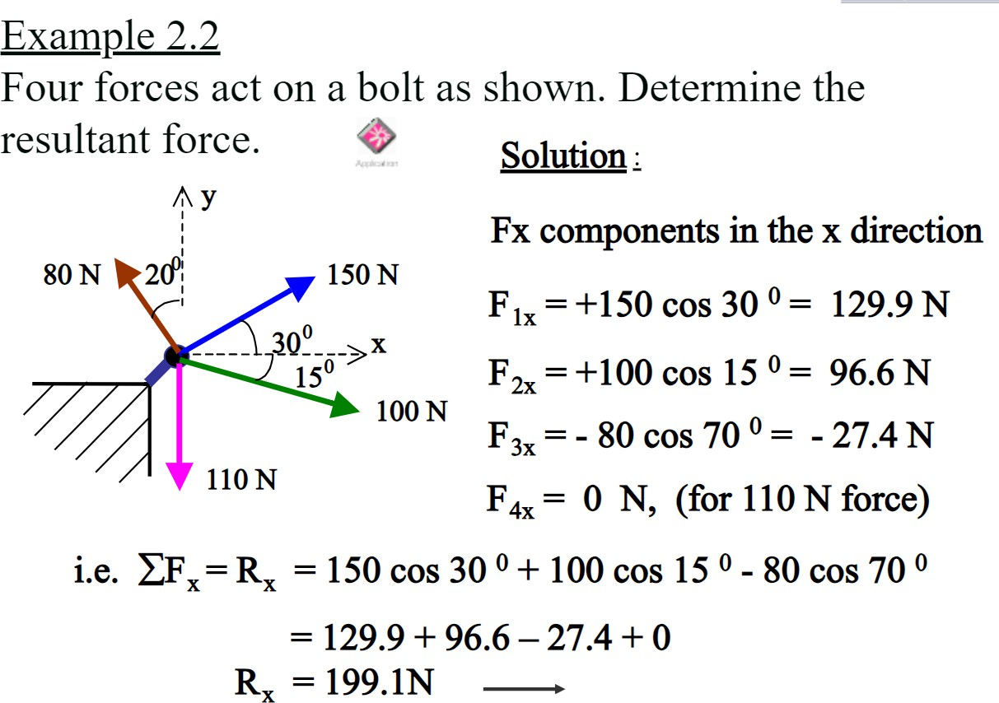

Slide 49
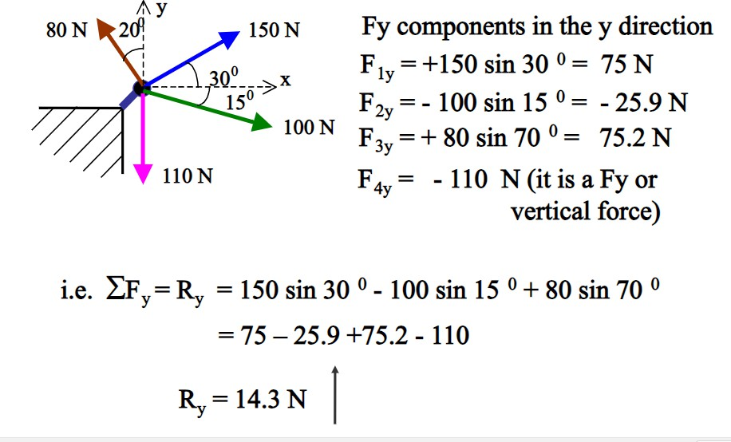

Slide 50
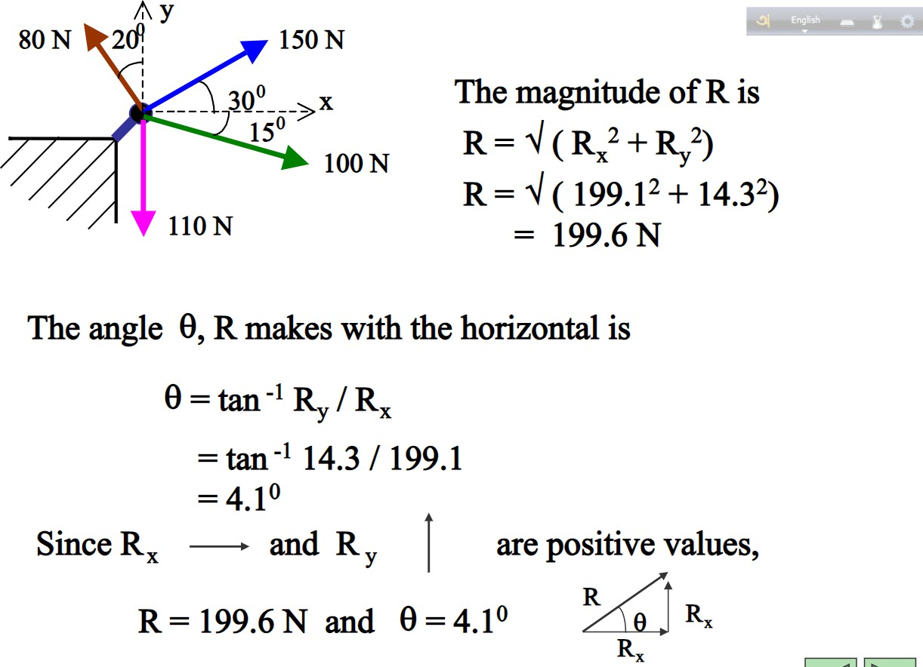

Slide 51
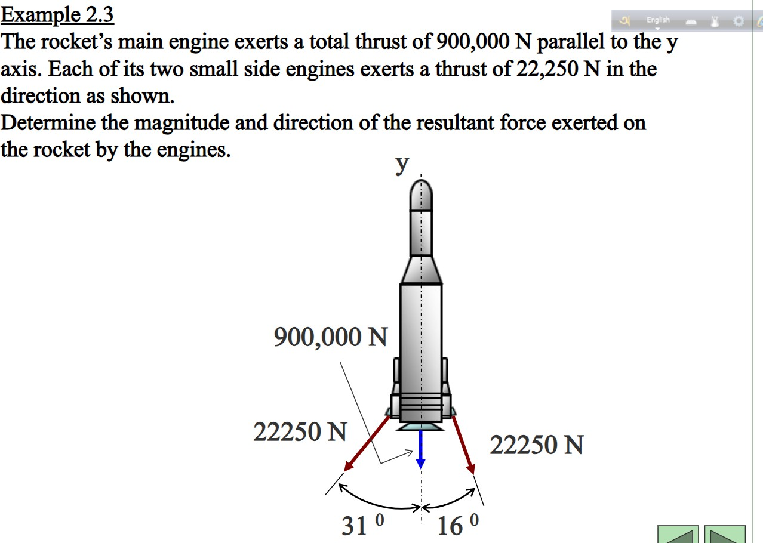

Slide 52
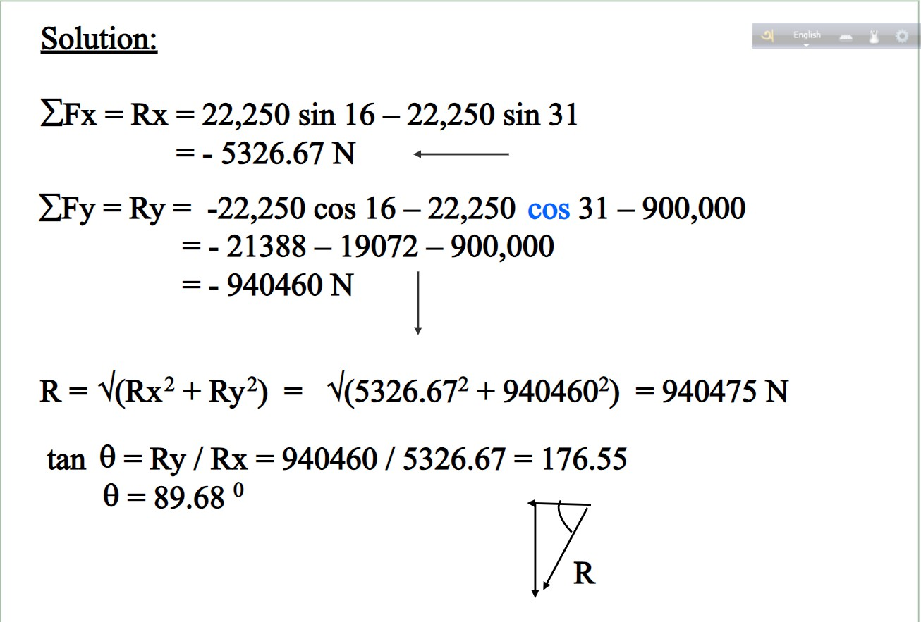

Slide 53
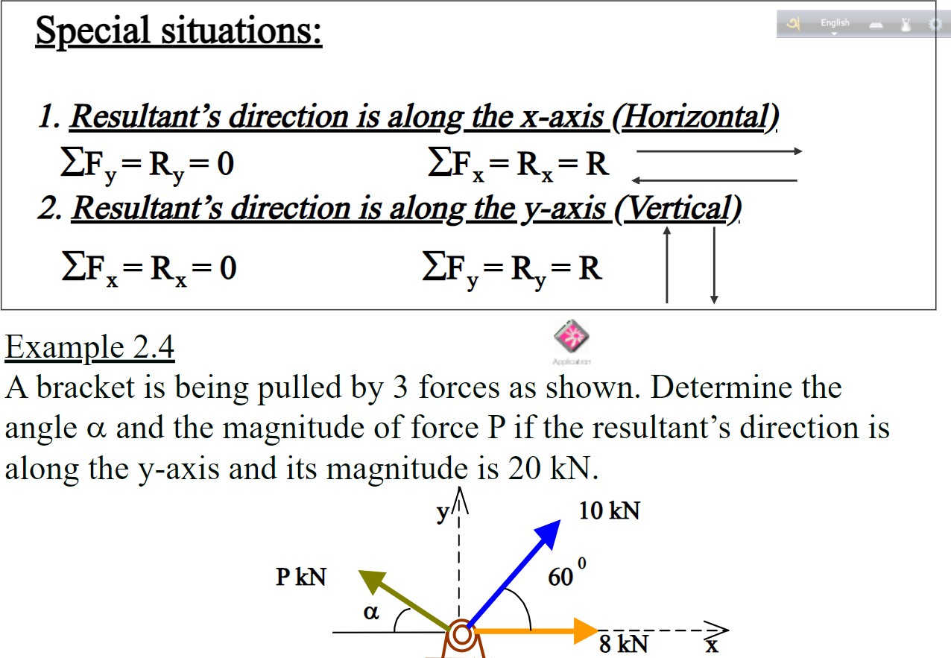

Slide 54
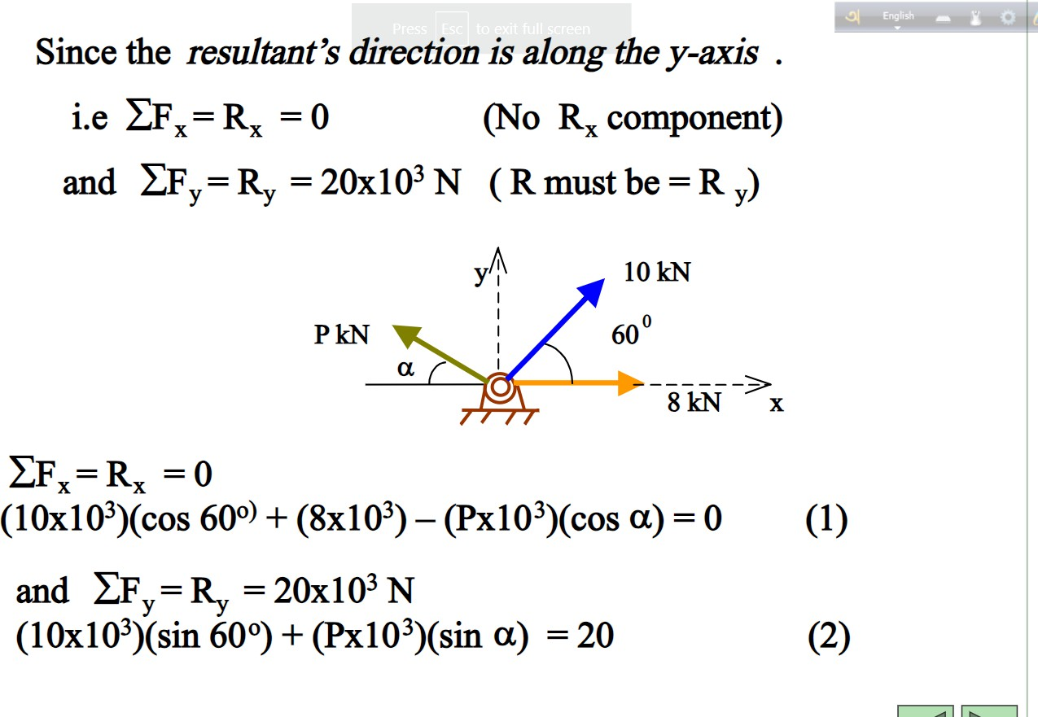

Slide 55
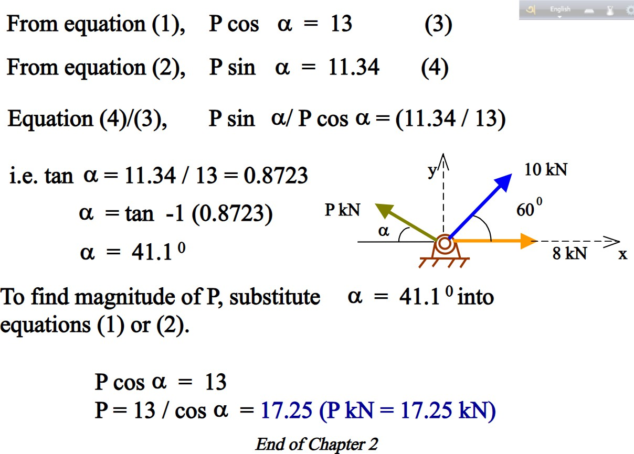

Slide 56
Types of Supports in Structure
Week 4

Slide 57
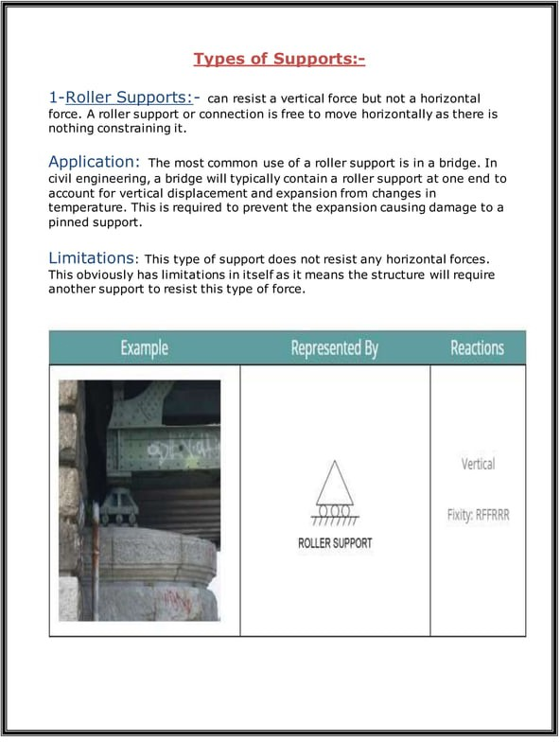

Slide 58
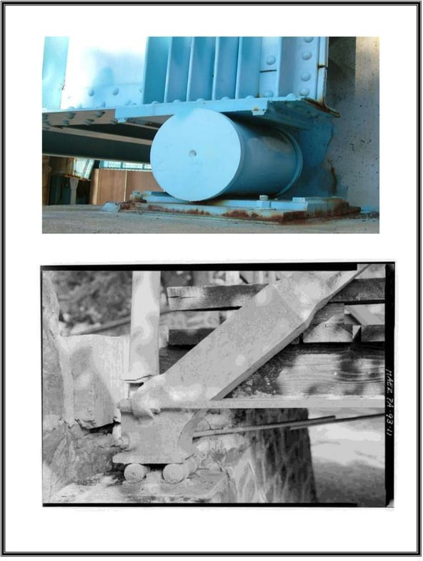

Slide 59
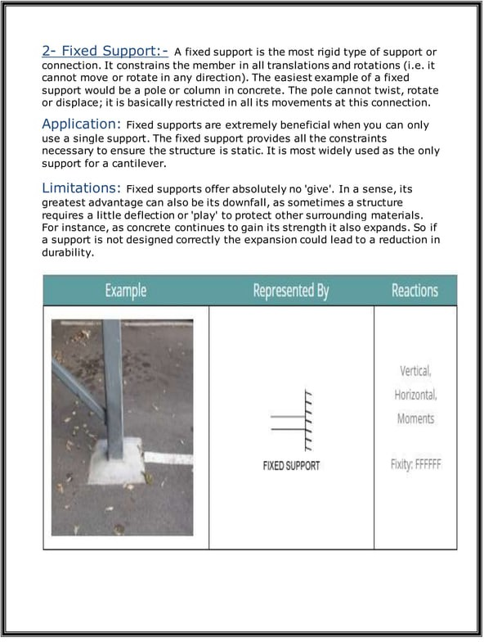

Slide 60


Slide 61


Slide 62
Free Body Related theory Week 5

Slide 63
Equilibrium
When all the sums of the forces of the system in certain directions and the sum of moments of the forces with respect to certain axes are zero for any particular force system, its resultant is
zero, and the body on which the system acts is in equilibrium.
The conditions assuring equilibrium of a body with a particular type of force system can therefore be expressed as a set of algebraic equations which must be satisfied. By means of these conditions, it is possible to determine one or more unknown forces or reactions acting on a body which is in equilibrium.
Free body Diagrams
Is a sketch of a body, a portion of a body, or two or more bodies completely isolated or free from all other bodies, showing the forces exerted by all other bodies on the one being considered.
Procedure for drawing a free body diagram
1. Draw outlined shape
Imagine the particle to be isolated or cut (free) from its surroundings by drawing its outlined shape.
2-Show all forces
Indicate on this sketch all the forces that acts on the particle. These forces can be active forces, which tend to set the particle in motion. Or they can be reactive forces which are the result of
the constraints or support that tend to prevent motion.

Slide 64

The forces that are known should be labeled with their proper magnitudes and directions.
Letters are used to represent the magnitudes and directions of forces that are unknown.
Note
All cables will be assumed to have negligible weight and they cannot stretch. Also, a cable can support only a tension or pulling force and this force always acts in the direction of the cable.

Slide 65



Slide 66


Slide 67

Examples of Free Body Diagrams

Slide 68
Free body diagram related problems
Week 6-7

Slide 69


Examples
Example (1):-
Draw the free body diagram of the uniform beam shown in figure. The beam has a mass of 100 kg.
Solution:-
F.B.D

Slide 70




Example(2):-
Two smooth pipes, each having a mass of 300kg, are supported by the forked tines of the tractor. Draw the F,B.D for each pipe and both pipes together.
Solution:-

Slide 71


Example(3):-
Draw the F.B.D of the unloaded platform that is suspended off the edge of the oil rig shown in figure. The platform has a mass of 200kg.
Solution:-

Slide 72

H.W 6
Make whatever changes or addition are necessary in each case to form a correct and complete F.B.D.

Slide 73
4.2 General Procedure for the Solution of Problems in Equilibrium.
Determine the given data and the unknown.
Draw the F.B.D for the member on which the unknown forces are acting.
Determine the type of force system acting on the F.B.D and the number of independent equations of equilibrium.
Compare the number of unknown on the F.B.D with the number of independent equations of equilibrium.
If the number of equations=the number of unknowns, then start the solution.
If the number of unknown > the number of independent equations, then draw F.B.D. for another body and repeat step 3 and 4.
If the number of unknowns in the second F.B.D = the number of equations then solve the problem. If it is not repeat step 4-6
If there are still too many unknowns after drawing F.B.D for all bodies, then the problem is statically indeterminate.
4.2.1 Equations of Equilibrium for Concurrent Coplanar Force System.
The resultant of a concurrent, coplanar force system is a single force through the point of concurrence. When this resultant force is zero, the body on which the force system acts is in equilibrium. The equations necessary to ensure a zero resultant are the equations of equilibrium.

Slide 74

A.
∑ F_{x} = 0 ∑ F_{y} = 0
The resultant is zero. B.
∑ F_{x} = 0 ∑ M_{A} = 0
The sum of the moments of the forces of the system with respect to an axis through A is equal to zero, where A is any point not on the y axis, the resultant will be zero because the moment
arm from A to the y axis is not zero.
C.
∑ M_{A} = 0 ∑ M_{B} = 0
Where line AB does not pass through the point of concurrence of the forces of the system.
Note:-
For a collinear force system

Slide 75
A.∑ F_{x} = 0
Where the x axis is parallel to the force. B.∑ M_{A} = 0
Where A is not on the action line of the forces of the collinear system.

Slide 76


Examples
Example(1):
Determine the tension in cables BA and BC necessary to support the 60kg cylinder shown in figure.
Solution:-
From(a)
↑ ∑ 𝐹_{𝑦} = 0
TBD − 60(9.81) = 0
From (b)
→∑Fx =0
∴ TBD = 60(9.81)N
TCcos45−(45)TA =0 → TA =0.8839TC (1) ↑∑Fy =0
TCsin45+(35)TA −60(9.81)=0 (2)
Subs (1) in (2)
TC sin 45 + (35) (0.8839TC) − 60(9.81) = 0 ∴𝑇𝐶 =476N ,𝑇𝐴 =420𝑁

Slide 77



Example(2):-
The 300N shaft M and the 500N shaft N are supported as shown in the figure. Neglecting friction at the contact surfaces P,Q,R and S, determine the reaction at R and S on shaft N.
Solution:-
From F.B.D of M
↑ ∑ F_{y} = 0
(b)
Q sin 40 − 300 = 0
∴ Q = 467N on M
From the F.B.D. of N
↑ ∑ F_{y} = 0
S − 500 − Qsin 40 = 0
∴ S = 800N ↑ on N
→ ∑ F_{x} = 0
R − Q cos 40 = 0
∴. R = 358N → on N

Slide 78



Example (3):-
Determine the tensile force in chain D of the chain system shown in figure.
Solution:-
cos 40
(2)
cos 30
Subs (2) in (1)
cos 40
TC _{cos 30} sin 30 + TC sin 40 − 6000 = 0
∴ TC = 5555.5N
From F.B.D (a)
↑ ∑ F_{y} = 0
(a)

Slide 79


Slide 80


Slide 81


Slide 82


Slide 83


Slide 84
Center of gravity related theory
Week 8

Slide 85


Slide 86


Slide 87


Slide 88


Slide 89


Slide 90


Slide 91


Slide 92


Slide 93


Slide 94


Slide 95


Slide 96


Slide 97
Center of gravity related problems
Week 9

Slide 98


Slide 99


Slide 100


Slide 101


Slide 102


Slide 103


Slide 104


Slide 105


Slide 106
Friction related theory Week 10-11

Slide 107


Slide 108


Slide 109


Slide 110


Slide 111


Slide 112


Slide 113


Slide 114


Slide 115


Slide 116


Slide 117


Slide 118


Slide 119


Slide 120


Slide 121


Slide 122


Slide 123


Slide 124



Slide 125




Slide 126


Slide 127


Slide 128


Slide 129


Slide 130


Slide 131


Slide 132


Slide 133
Friction related problems
Week 12-13

Slide 134


Slide 135


Slide 136


Slide 137


Slide 138


Slide 139


Slide 140


Slide 141


Slide 142


Slide 143


Slide 144


Slide 145


Slide 146


Slide 147


Slide 148


Slide 149


Slide 150


Slide 151


Slide 152


Slide 153


Slide 154


Slide 155
Truss Related theory Week 14

Slide 156


Equilibrium of rigid body
Equations of equilibrium become
∑ F_{x} = 0 ∑ F_{y} = 0 ∑ M _{A} = 0
There are three unknowns and number of equation is three.
Therefore, the structure is statically determinate
The rigid body is completely constrained

Slide 157



Equilibrium of rigid body
More unknowns than equations
Fewer unknowns than equations, partially constrained
Equal number unknowns and equations but improperly constrained

Slide 158

Structural Analysis
Engineering Structure
An engineering structure is any connected system of members built to support or transfer forces and to safely withstand the loads applied to it.

Slide 159



Structural Analysis
Statically Determinate Structures
To determine the internal forces in the structure, dismember the structure and analyze separate free body diagrams of individual members or combination of members.

Slide 160


Structural Analysis: Plane Truss
Truss: A framework composed of members joined at their ends to form a rigid structure
Joints (Connections): Welded, Riveted, Bolted, Pinned
Plane Truss: Members lie in a single plane

Slide 161




Structural Analysis: Plane Truss
Simple Trusses
Basic Element of a Plane Truss is the Triangle
Three bars joined by pins at their ends 🡪 Rigid Frame
– Non-collapsible and deformation of members due to induced internal strains is negligible
Four or more bars polygon 🡪 Non-Rigid Frame
How to make it rigid or stable?
by forming more triangles!
Structures built from basic triangles
🡪Simple Trusses

Slide 162



Structural Analysis: Plane Truss
Basic Assumptions in Truss Analysis
All members are two-force members.
Weight of the members is small compared with the force it supports (weight may be considered at joints)
No effect of bending on members even if weight is considered
External forces are applied at the pin connections
Welded or riveted connections
Pin Joint if the member centerlines are concurrent at the joint
Common Practice in Large Trusses
Roller/Rocker at one end. Why?
to accommodate deformations due to temperature changes and applied loads.
otherwise it will be a statically indeterminate truss

Slide 163


Structural Analysis: Plane Truss
Truss Analysis: Method of Joints
Finding forces in members
Method of Joints: Conditions of equilibrium are satisfied for the forces at each joint
Equilibrium of concurrent forces at each joint
only two independent equilibrium equations are involved Steps of Analysis
Draw Free Body Diagram of Truss
Determine external reactions by applying equilibrium equations to the whole truss
Perform the force analysis of the remainder of the truss by Method of Joints

Slide 164




Structural Analysis: Plane Truss
Method of Joints
Start with any joint where at least one known load exists and where not more than two unknown forces are present.
FBD of Joint A and members AB and AF: Magnitude of forces denoted as AB & AF
-
-
Tension indicated by an arrow away from the pin Compression indicated by an arrow toward the pin
Magnitude of AF from Magnitude of AB from
Analyze joints F, B, C, E, & D in that order to complete the analysis

Slide 165

Structural Analysis: Plane Truss
Method of Joints
Zero Force Member
Negative force if assumed sense is incorrect
Check Equilibrium
Show forces on members

Slide 166
Truss related problems
Week 15-16

Slide 167

Method of Joints: Example
Determine the force in each member of the loaded truss by Method of Joints

Slide 168




Method of Joints: Example
Solution

Slide 169




Method of Joints: Example
Solution

Slide 170
Structural Analysis: Plane Truss
When more number of members/supports are present than are needed to prevent collapse/stability
🡪 Statically Indeterminate Truss
cannot be analyzed using equations of equilibrium alone!
additional members or supports which are not necessary for maintaining the equilibrium configuration 🡪 Redundant
Internal and External Redundancy
Extra Supports than required 🡪 External Redundancy
Degree of indeterminacy from available equilibrium equations
Extra Members than required 🡪 Internal Redundancy
(truss must be removed from the supports to calculate internal redundancy)
Is this truss statically determinate internally?
Truss is statically determinate internally if m + 3 = 2j
m = 2j – 3 m is number of members, and j is number of joints in truss
L06

Slide 171
Structural Analysis: Plane Truss
Internal Redundancy or
Degree of Internal Static Indeterminacy
Extra Members than required 🡪 Internal Redundancy
Equilibrium of each joint can be specified by two scalar force equations 🡪
2j equations for a truss with “j” number of joints
🡪 Known Quantities
For a truss with “m” number of two force members, and maximum 3 unknown support reactions 🡪 Total Unknowns = m + 3
(“m” member forces and 3 reactions for externally determinate truss)
Therefore:
m + 3 = 2j🡪Statically Determinate Internally
A necessary condition for Stability
but not a sufficient condition since
m + 3 > 2j🡪Statically Indeterminate Internally _{one or more members can be}
m + 3 < 2j🡪Unstable Truss
arranged in such a way as not to contribute to stable configuration of the entire truss

Slide 172
Structural Analysis: Plane Truss
Why to Provide Redundant Members?
To maintain alignment of two members during construction
To increase stability during construction
To maintain stability during loading (Ex: to prevent buckling of compression members)
To provide support if the applied loading is changed
To act as backup members in case some members fail or require strengthening
Analysis is difficult but possible

Slide 173











Structural Analysis: Plane Truss
Zero Force Members

Slide 174


Structural Analysis: Plane Truss

Slide 175




Structural Analysis: Plane Truss
Zero Force Members: Conditions
If only two non-collinear members form a truss joint and no external load or support reaction is applied to the joint, the two members must be zero force members
If three members form a truss joint for which two of the members are collinear, the third member is a zero-force member provided no external force or support reaction is applied to the joint

Slide 176

Structural Analysis: Plane Truss
Special Condition
When two pairs of collinear members are joined as shown in figure, the forces in each pair must be equal and opposite.

Slide 177

Method of Joints: Example
Determine the force in each member of the loaded truss by Method of Joints.
Is the truss statically determinant externally? Is the truss statically determinant internally?
Are there any Zero Force Members in the truss?
Yes Yes No

Slide 178





Method of Joints: Example
Solution

Slide 179


Method of Joints: Example
Solution

Slide 180
P
P
DETERMINATE
DETERMINATE
P
P
INDETERMINATE
INDETERMINATE
P
P
INDETERMINATE
DETERMINATE

Slide 181

Example
SOLUTION:
Based on a free-body diagram of the entire truss, solve the 3 equilibrium equations for the reactions at E and C.
Joint A is subjected to only two unknown member forces. Determine these from the joint equilibrium requirements.
In succession, determine unknown member forces at joints D, B, and E from joint equilibrium requirements.
Using the method of joints, determine the force in each member of the truss.
All member forces and support reactions are known at joint C. However, the joint equilibrium requirements may be applied to check the results.

Slide 182

Example
SOLUTION:
Based on a free-body diagram of the entire truss, solve the 3 equilibrium equations for the reactions at E and C.
∑ ^{M} C
= 0
= (10 kN )(12 m )+ (5 kN )(6 m )− E (3 m )
E = 50kN ↑
∑ F_{x} = 0 = C_{x}
C_{x} = 0
∑ ^{F}y
= 0 = −10kN - 5 kN + 50 kN + C_{y}
C_{y} = 35 kN ↓

Slide 183



Example
Joint A is subjected to only two unknown member forces. Determine these from the joint equilibrium requirements.
10 kN F F
F_{AB} = 7.5 kN T
₌ AB ₌ AD
4 3 5
F = 12.5 kN C
AD
There are now only two unknown member forces at joint D.
^{F}DB ^{= F}DA
F_{DB} = 12.5 kN T F_{DE} = 15 kN C
F_{DE} = 2(³ )F_{DA}
5

Slide 184


Example
There are now only two unknown member forces at joint B. Assume both are in tension.
∑ F = 0 = −5kN − (
12kN)− F
4
4
y 5
5 BE
F_{BE} = −18.75 kN
F = 18.75 kN C
BE
∑ F = 0 = F − 7.5kN − ³ (12.5kN)− ³ (18.75)
x BC 5 5
F_{BC} = +26.25 kN
F_{BC} = 26.25 kN T
There is one unknown member force at joint
E. Assume the member is in tension.
∑
F = 0 = F +15kN + (18.75kN)
x 5 EC
3 3
5
F_{EC} = −43.75 kN
F = 43.75 kN C
EC

Slide 185


Example
All member forces and support reactions are known at joint C. However, the joint equilibrium requirements may be applied to check the results.
∑
F = − 26.25 + (43.75) = 0 (checks)
3
x 5
∑ F = −
35 + (
43.75) = 0 (checks)
y
4
5

Slide 186
Practice And Exercise
Week 17

