Slide 1
Fluid Mechanics
C E 0732-2203
Prepared By
Somen Saha
Lecturer
Department of Civil Engineering
University of Global Village (UGV), Barishal

Slide 2
BASIC COURSE INFORMATION
Course Title | Fluid Mechanics
Course Code | CE 0732-2203
Credits | 03
CIE Marks | 90
SEE Marks | 60
Exam Hours | 2 hours (Mid Exam) 3 hours (Semester Final Exam)
Level | 4th Semester

Slide 3
Fluid Mechanics
COURSE CODE: C E 0732-2203
CREDIT:03 TOTAL MARKS:150 CIE MARKS: 90 SEE MARKS:60
Mid Exam Hours 2
Semester End Exam Hours 3
Course Learning Outcomes (CLOs): After completing this course successfully, the students will be able to-
CLO 1
Understand the scope of fluid mechanics fluid properties, Fluid static’s Manometers and pressure gages,
pressure head, center of pressure
CLO 2
Analyze Kinematics of fluid flow. Fluid flow concept and basic continuity equations, Bernoulli’s equation, Heads in fluid flow.
Develop the understanding about the application of hydrostatic forces.
Determine Pipe flow: general equation for pipe flow and minor losses in pipe flow. Fluid measurements: pitot tube, orifice, venturimeter.
CLO 3
CLO 4
CLO 5
Develop Foundational knowledge of pumps and Pump components and
their functions

Slide 4
SL | Content of Course | Hrs | CLOs
1 | Fluid Properties: Fluid Definition, Fluid Properties- Density, Specific Weight, volume, gravity, Viscosity, Dynamic & kinamatic viscosity, Newton Law of Viscosity, Variation of Viscosity due to Temperature, Surface , Tension, Capilary action of Fluid,Vapor Pressure & Cavitation, Adhesive and Cohesive force. | 4 | CLO1
2 | Fluid pressure: Fluid pressure, Pressure head, Pascal law, Absolute pressure, Gauge pressure, atmospheric pressure Tube Gauge (Piezometer, simple, differential Manometer), Mechanical Gauge. | 5 | CLO1
3 | Fluid Dynamics: Fluid flow concepts, bernouli’s equation : Pressure, velocity, Energy Calculation through Pipes | 4 | CLO2
4 | Hydrostatics: Total Pressure ,Centre of Pressure of a Horizontally Immersed Surface Total Pressure on Vertically Immersed Surface, Total Pressure on Inclined Immersed Surface, Centre of Pressure of a Inclined Immersed Surface | 5 | CLO3
5 | Flow through pipe : Pipe design criterion, calculating discharge and energy losses. | 4 | CLO 4

Slide 5
6 | Flow through orifice: Classification of orifice, Flow through orifice, Hydraulic co efficient, Experimental determination of coefficient . | 5 | CLO 4
7 | Pump: Foundational knowledge of pumps and Pump components and their functions. Difference between centrifugal pump and rotary pump | 5 | CLO 5
Reference Book
Fluid Mechanics- Frank M. White
Fluid Mechanics & Hydraulic Machines- Dr. R. K. Bansal
A Textbook of Hydraulics ,Fluid Mechanics & Hydraulic Machines- R.S Khurmi

Slide 6
ASSESSMENT PATTERN
CIE- Continuous Internal Evaluation (90 Marks)
SEE- Semester End Examination (60 Marks)
Bloom’s Category | Tests
Remember | 10
Understand | 10
Apply | 10
Analyze | 15
Evaluate | 10
Create | 5
Bloom’s Category Marks (out of 120) | Tests (60) | Assignments (20) | Quizzes (20) | External Participation in Curricular/Co-Curricular Activities (20)
Remember | 10 |  | 10 | Attendance 15
Understand | 5 |  | 5
Apply | 10
Analyze | 10
Evaluate | 5
Create | 5 | 15

Slide 7
Couse plan specifying content, CLOs, teaching learning and assessment strategy mapped with CLOs
Week | Topic | Teaching-Learning Strategy | Assessment Strategy | Corresponding CLOs | Page NO
1 | Introduction to Fluid mechanics | Lecture, discussion, group work | Quiz, Written Exam | CLO1 | 9-22
2 | Fluid Properties | Oral Presentation, debate | Assignment, Written, Quiz | CLO1 | 24-46
3 | Fluid Properties | Video lecture, Field visit | Report writing, Demonstration | CLO 1 | 24-46
4 | Fluid pressure | Lecture | Viva, Quiz | CLO 1 | 48-56
5 | Measurement of fluid pressure | Project exhibition | Project, Field visit | CLO 1 | 58-68
6 | Fluid Dynamics | Discussion, Video Presentation | Quiz, Written Exam | CLO 2 | 70-84
7 | Fluid Dynamics | Case-based Learning, Demonstration | Assignment, Written, Quiz | CLO 2 | 70-84
8 | Hydrostatics | Lecture, discussion, group work | Report writing, Demonstration | CLO3 | 86-91
9 | Hydrostatics | Oral Presentation, debate | Viva, Quiz | CLO3 | 86-91
10 | Flow through Pipes | Video lecture | Project, Field visit | CLO4 | 93-99

Slide 8
11 | Flow through Pipes | Lecture | Quiz, Written Exam | CLO4 | 93-99
12 | Flow through orifice | Project exhibition | Assignment, Written, Quiz | CLO4 | 101-114
13 | Flow through orifice | Discussion, Video Presentation | Report writing, Demonstration | CLO4 | 101-114
14 | Pump | Case-based Learning, Demonstration | Viva, Quiz | CLO5 | 116-122
15 | Reciprocating Pump | Lecture, discussion, group work | Project, Field visit | CLO5 | 118-134
16 | Centrifugal Pump | Oral Presentation, debate | Quiz, Written Exam | CLO5 | 128-135
17 | Practice and Exercise, Practice and Exercise, Practice and Exercise | Video lecture | Assignment, Written, Quiz | CLO5 | 136

Slide 9
Introduction to Fluid mechanics
Week 1

Slide 24
Fluid Properties
Week 2-3

Slide 40
I .3.4 Variation ot Viscosity with Temperature. Temperature affects the viscosity. The viscosity of liquids decreases with the increase of temperature while the viscosity of gases increases with the increase of tcmpcraturG. This is duc to reason tfiat thc viscous forces in a fluid arc due to cohesive forces and molecular momenmm transfer. In liquids, the cohesive forces predominates the molecular momentum transfer, due to closely packed molecules and with the increase in temperature, the cohesive forces decreases with the result of decreasing viscosity. But in case of gases thc cohcsivc forces arc small and molecular inomcntum transfer prcdoininatcs. With the increase in mmperaturc, molecular momentum transfer increases and hence viscosity increases. Thc relation bctwccn viscosity and temperature for liquids and gascs arc:

Slide 48
Fluid Pressure
Week 4

Slide 58
Measurement of fluid pressure
Week 5

Slide 70
Fluid Dynamics
Week 6-7

Slide 71































































Slide 72


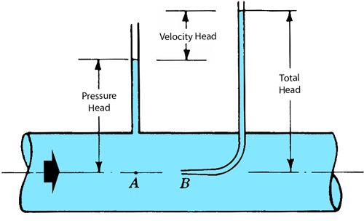

Slide 73



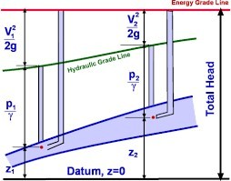









Slide 74































































Slide 75
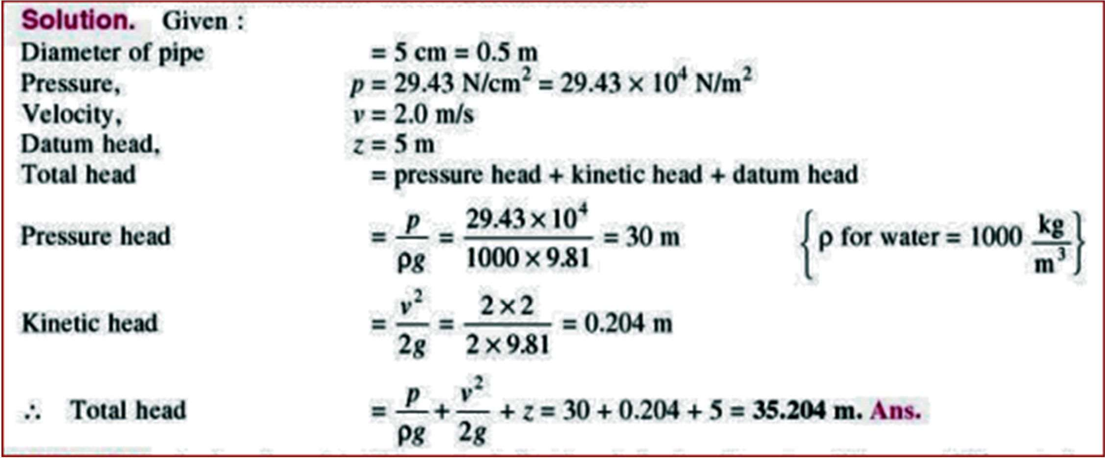

Slide 76























Slide 77










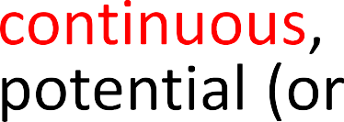
























Slide 78






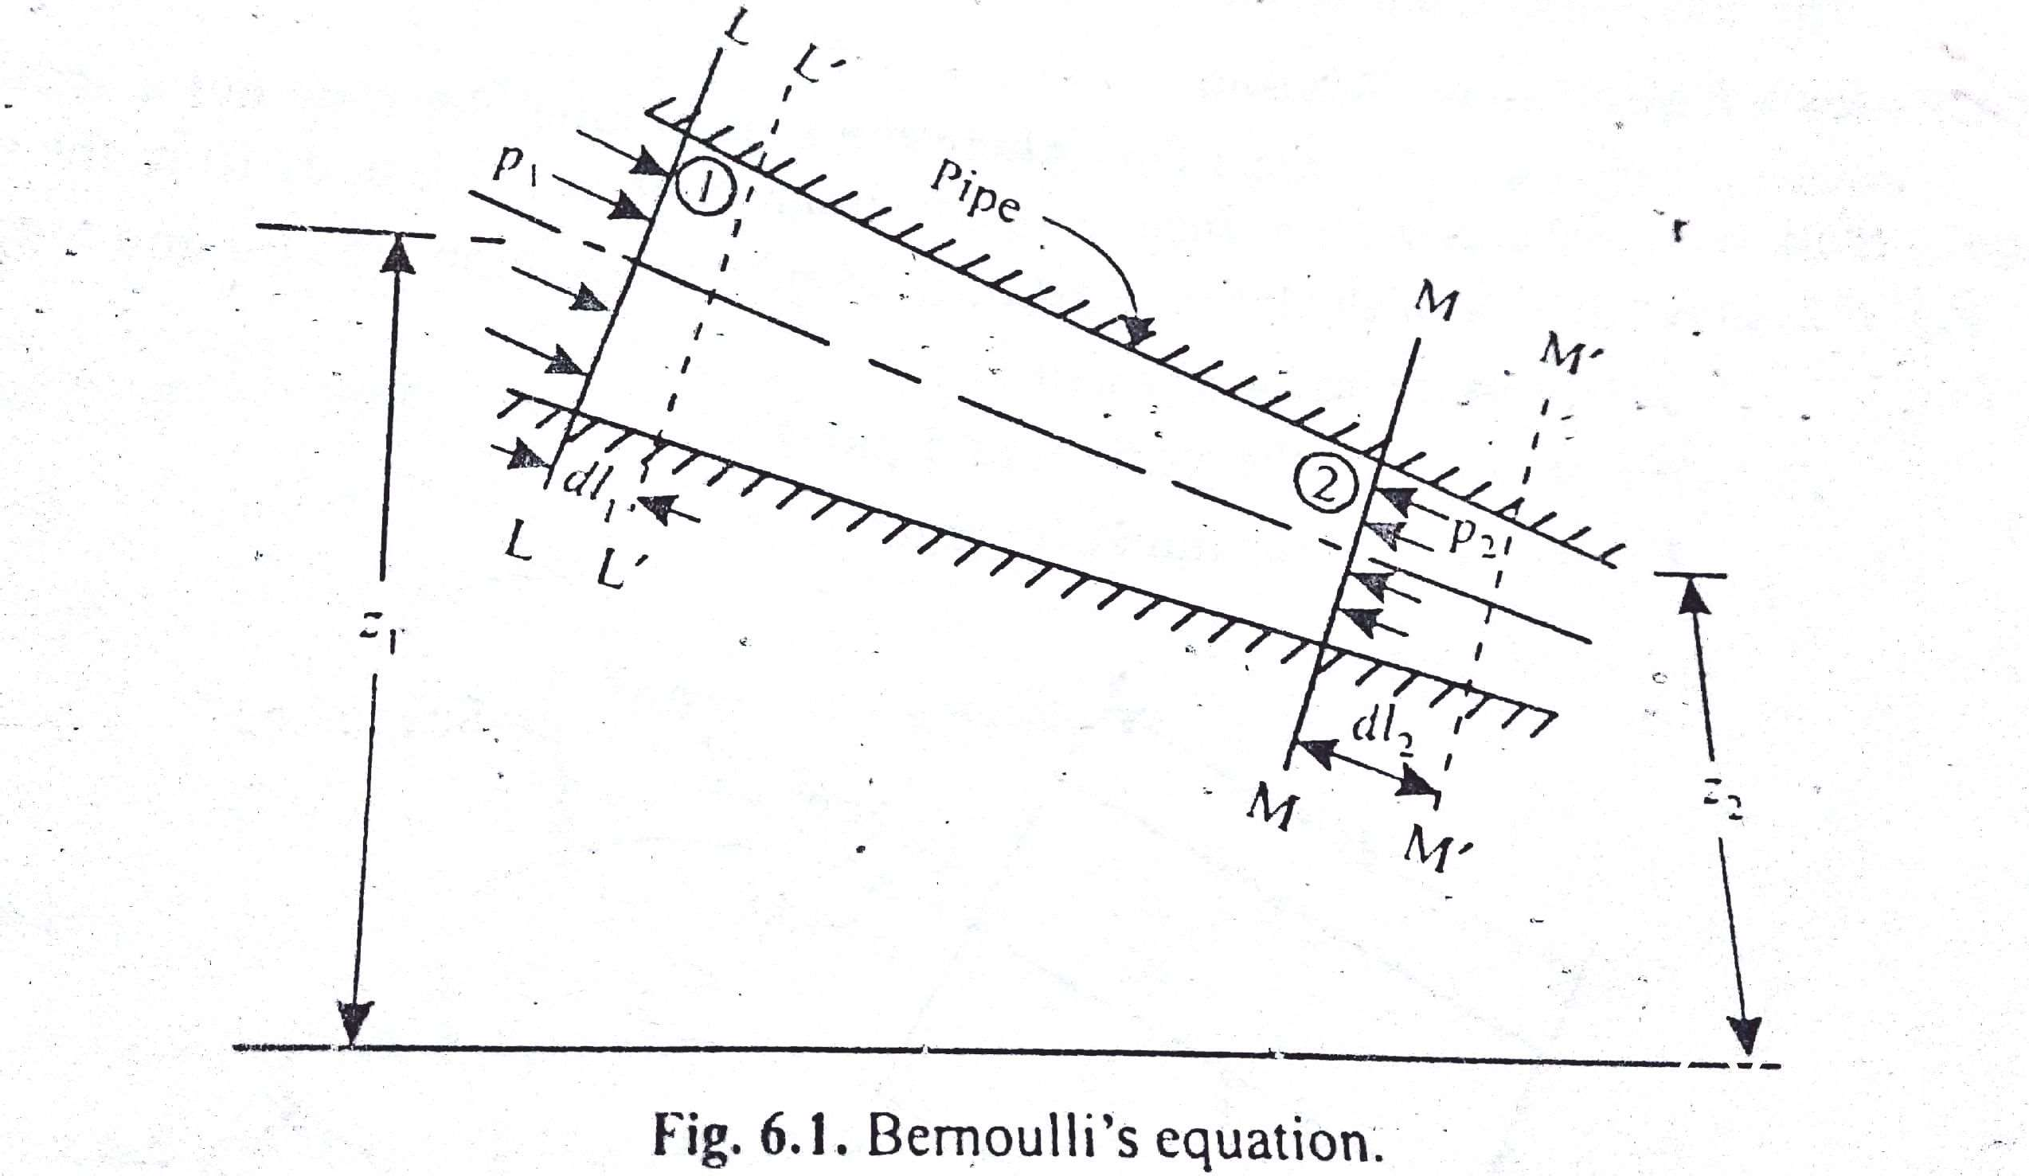

Slide 79

















































Slide 80



























Slide 81
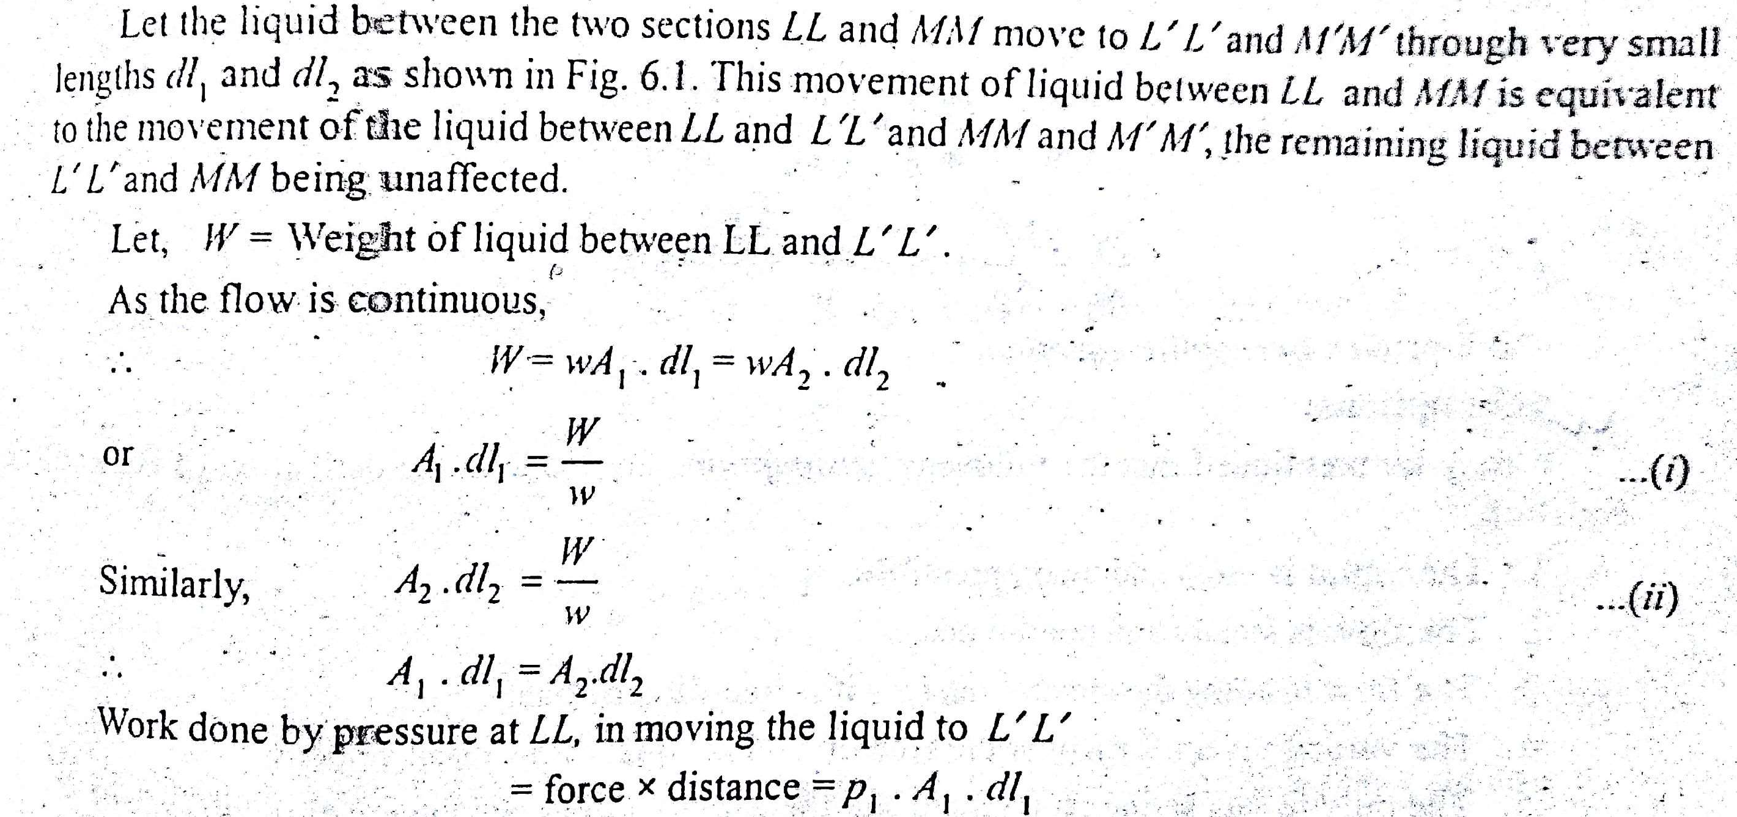

Slide 82
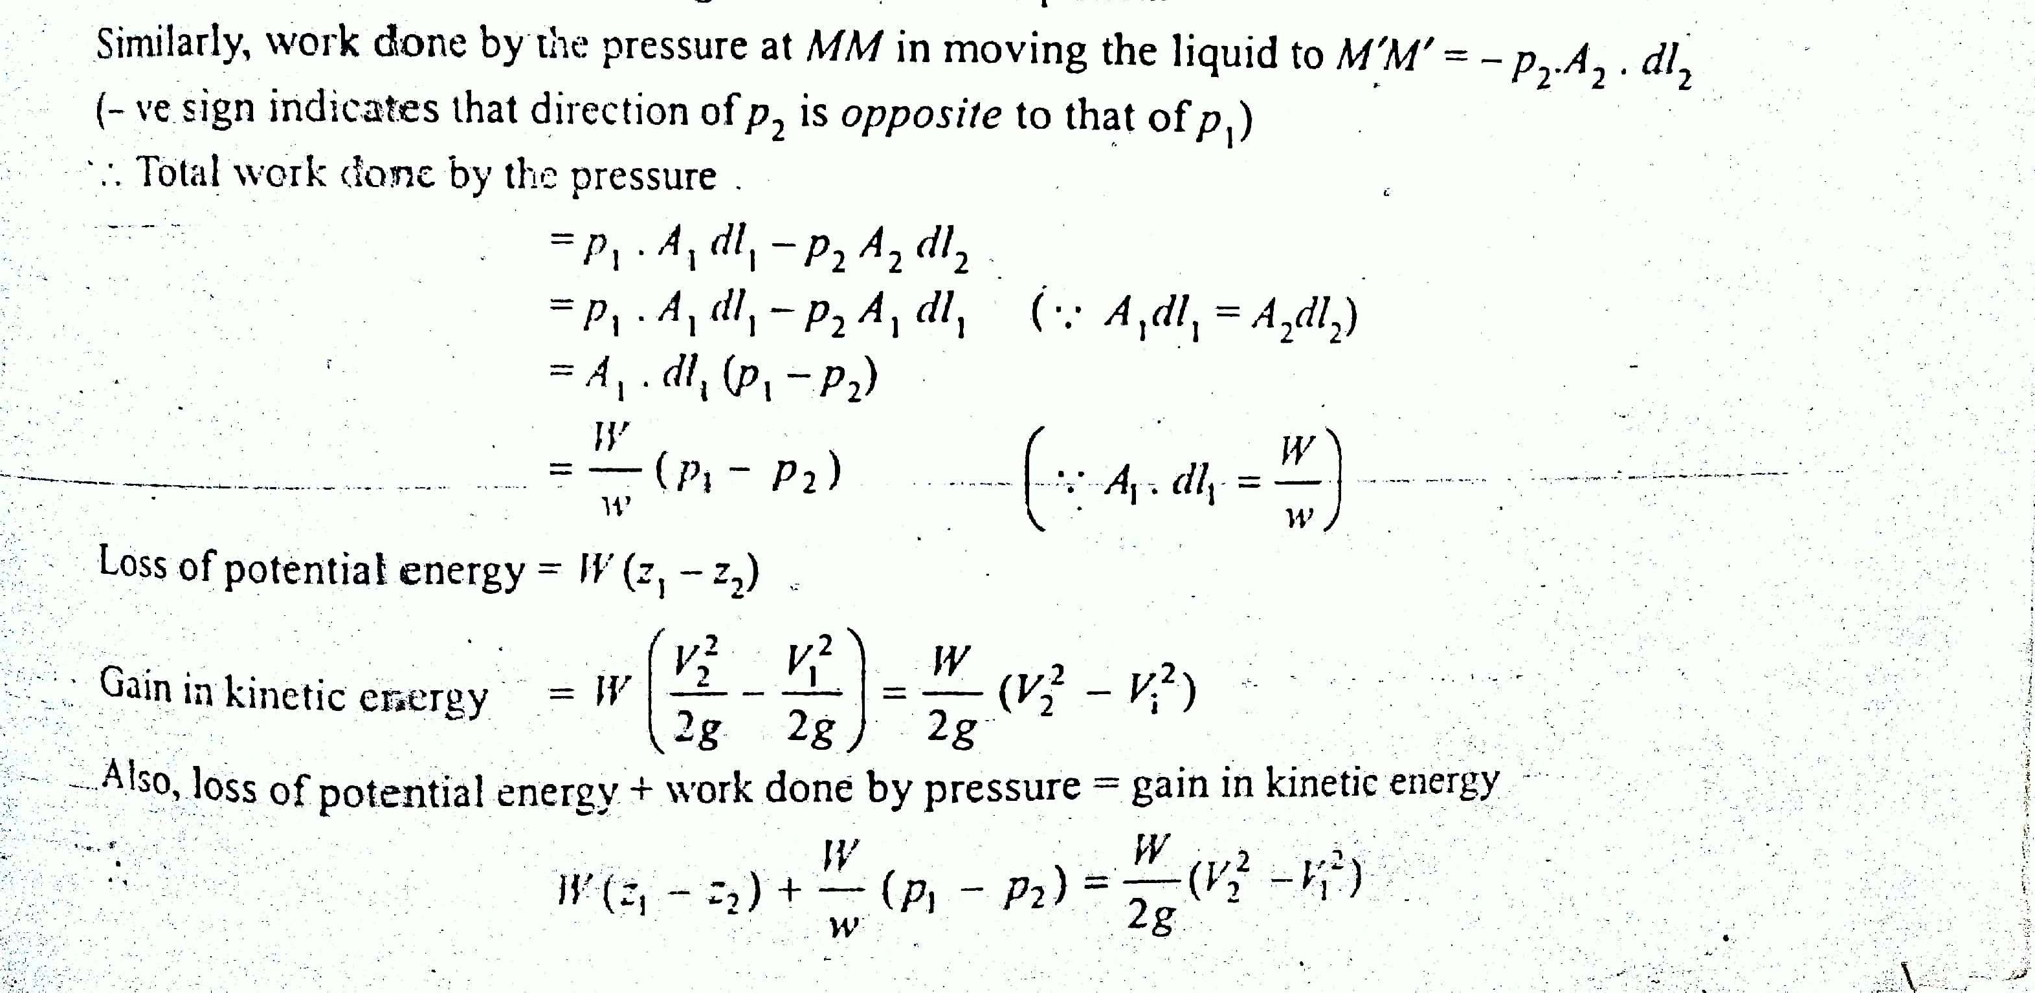

Slide 83















































































Slide 84


































































Slide 85
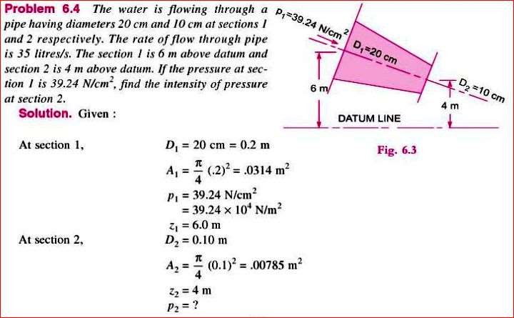



Slide 86
Hydrostatics
Week 8-9

Slide 87
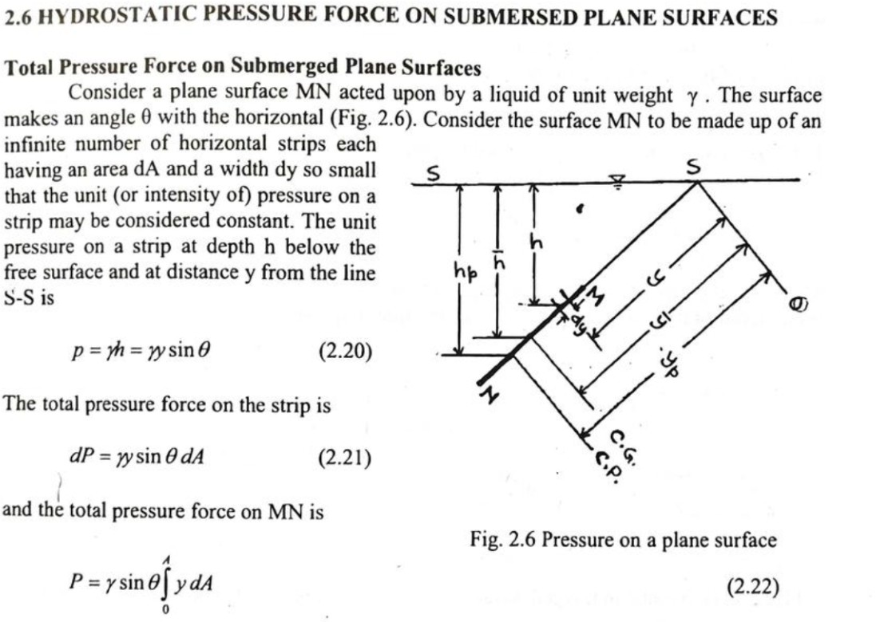

Slide 88
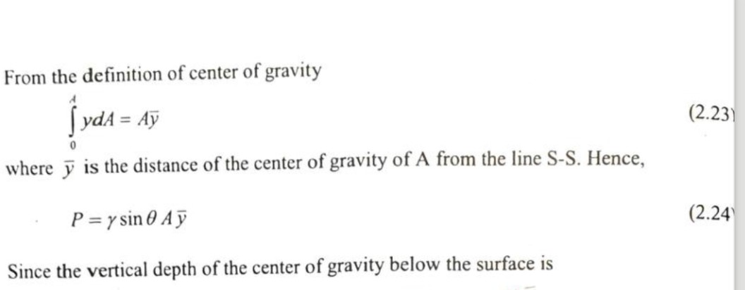
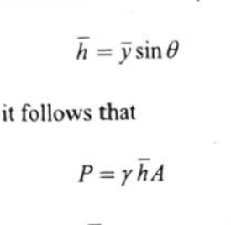

Slide 89
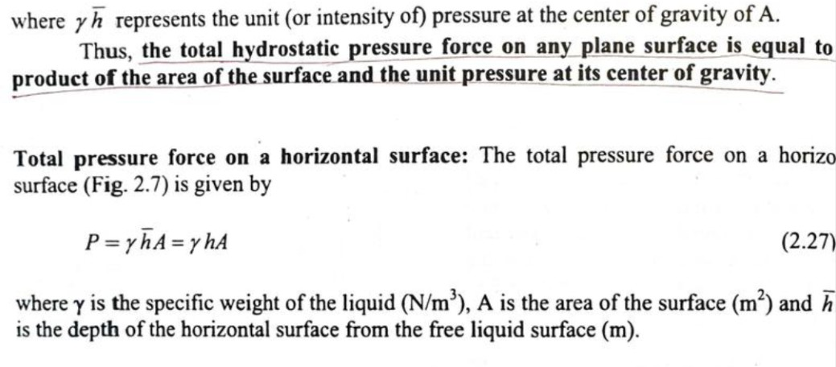
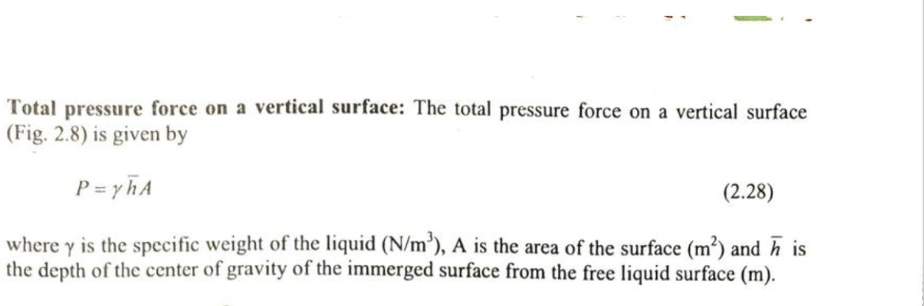

Slide 90
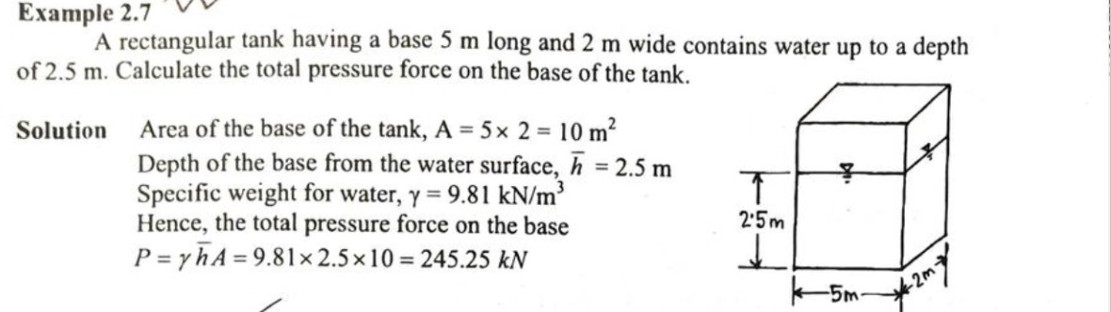

Slide 91
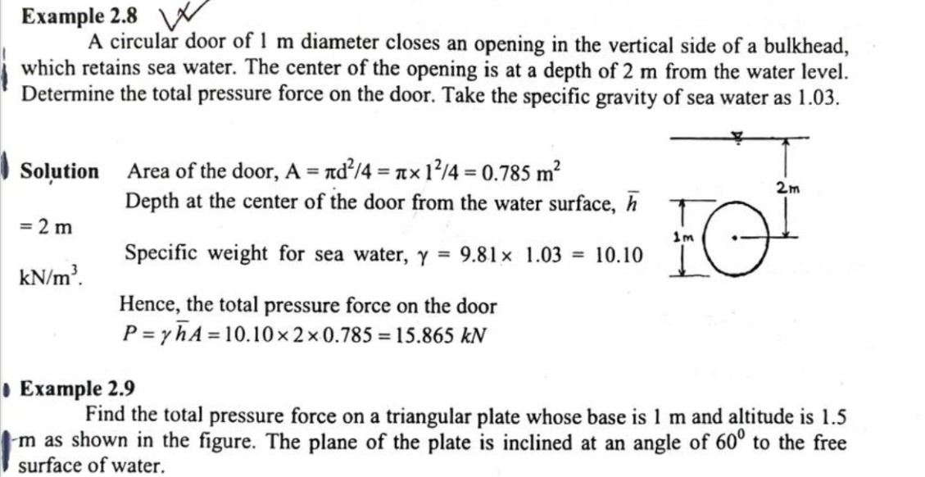

Slide 92
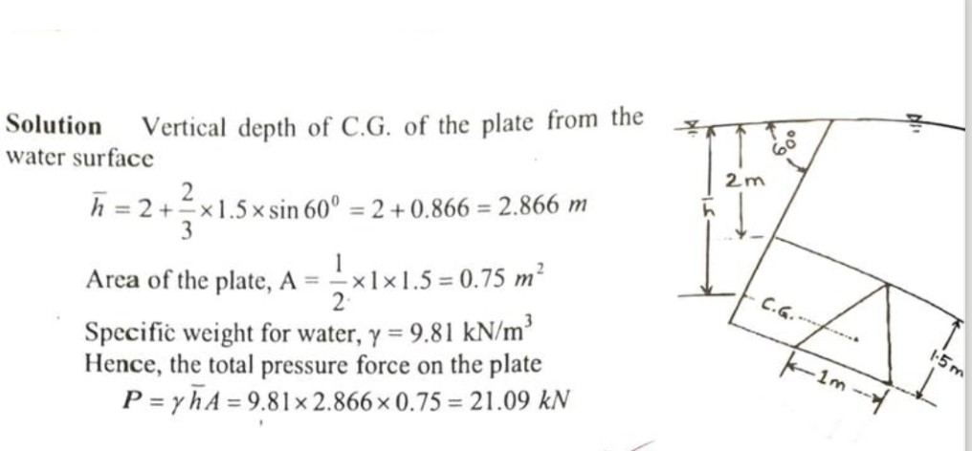

Slide 93
Flow Through Pipes
Week 10-11

Slide 94

















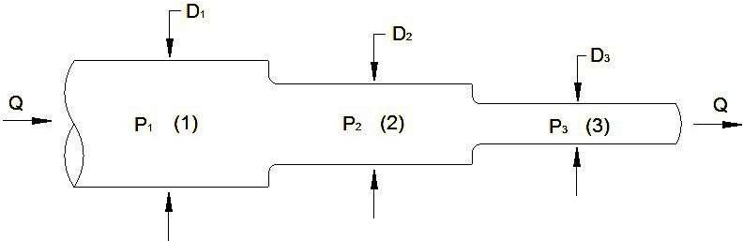

Slide 95















































Slide 96



































Slide 97
































Slide 98













































Slide 99

































Slide 100










Slide 101
Flow Through Orifice
Week 12-13

Slide 102


































































Slide 103


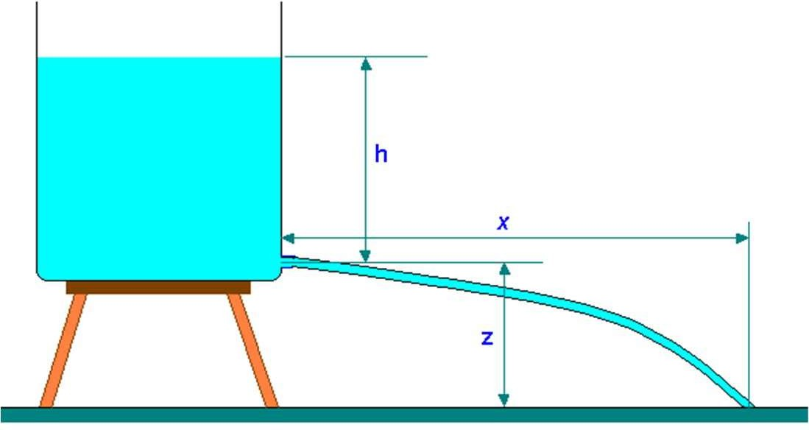





































Slide 104












































Slide 105







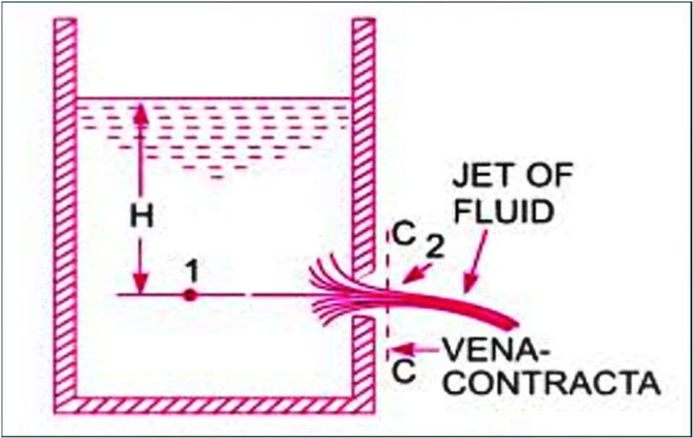
































Slide 106



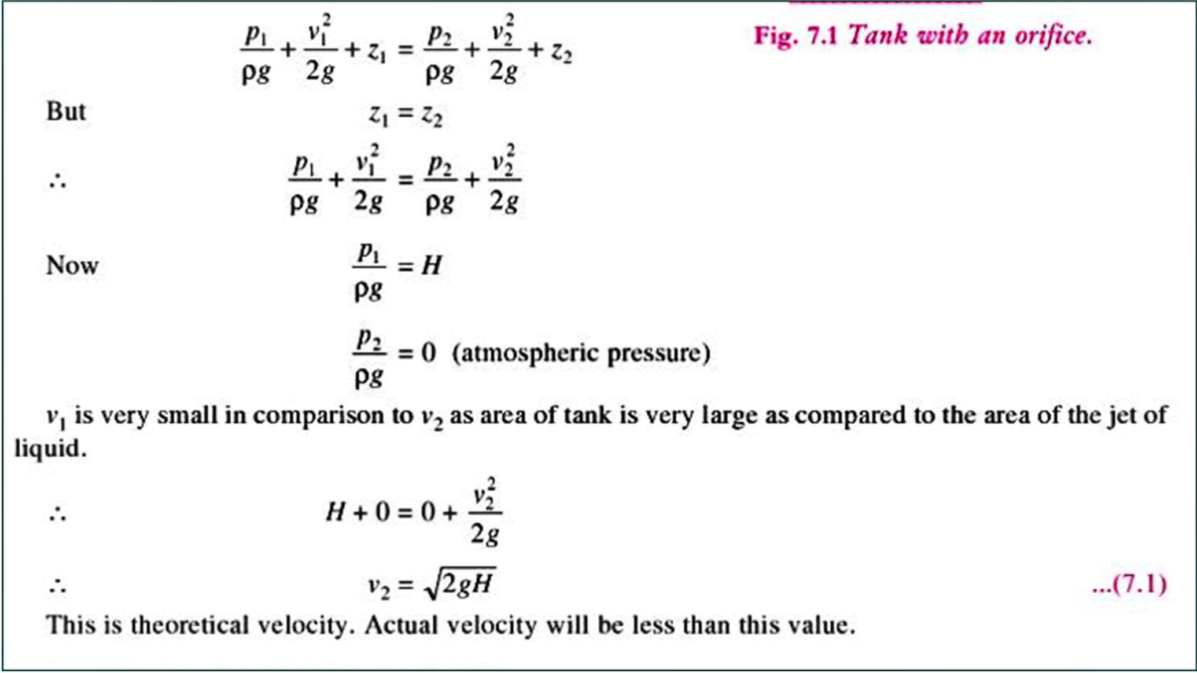

Slide 107



































































Slide 108












































































Slide 109





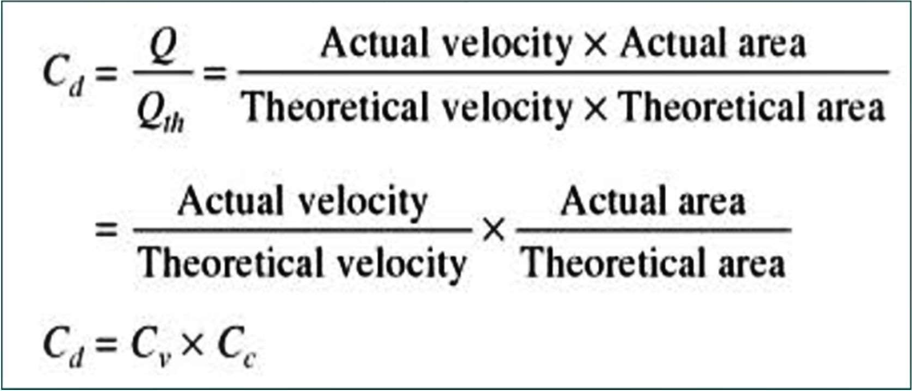

Slide 110

















Slide 116
Pump
Week 14

Slide 124
Reciprocating Pump
Week 15

Slide 128
Centrifugal Pump
Week 16

Slide 137
Practice and Exercise
Week 17

