Slide 1


Mechanics of Solid -II
CE 0732-3107
Prepared By
Somen Saha
Lecturer
Department of Civil Engineering
University of Global Village (UGV), Barishal

Slide 2
BASIC COURSE INFORMATION
Course Title | Mechanics of solid-II
Course Code | CE 0732-3107
Credits | 03
CIE Marks | 90
SEE Marks | 60
Exam Hours | 2 hours (Mid Exam) 3 hours (Semester Final Exam)
Level | 5th Semester

Slide 3
Mechanics Of Solid-II
COURSE CODE: CE 0732-3107 | CREDIT:03
 | TOTAL MARKS:150
Mid Exam Hours 2 | CIE MARKS: 90
Semester End Exam Hours 3 | SEE MARKS:60
Course Learning Outcomes (CLOs): After completing this course successfully, the students will be able to-
CLO 1 | Introduce problems associated with symmetric and unsymmetrical bending of beams, enable students to solve problems of stresses due to axial load and bending.
CLO 2 | Understand the concepts of Bending stress, shear stress and its application
CLO 3 | Familiarize with principles of stress transformation, Mohr’s circle of stress along with application in solving problems.
CLO 4 | Solve problems related to Combined stress and Torsion

Slide 4
SL | Content of Course | Hrs | CLOs
1 | Introduction to Mechanics of Solids II. Review of different types of loading, support, internal forces, stresses (axial, bending and shear), deformation and strain. | 5 | CLO 1
2 | Bending Stress -Key concepts include bending moment and shear force diagrams, stress distribution, deflection analysis, and design considerations for various beam types and loading conditions. | 6 | CLO 2
3 | Horizontal shear stress Key concepts include its types (direct, torsional, bending), distribution across various cross-sections, shear flow in thin-walled members, and its crucial role in the design and analysis of beams, machine components, and connections. | 5 | CLO2
4 | Combined stresses considering axial load and bending moment (uni-axial and biaxial) Solution of problems for symmetric and un-symmetric beam bending | 6 | CLO 3
5 | Principal Stresses in Two-Dimensional Problems, Maximum Shear Stresses in Two- Dimensional Problems and Mohr;s Circle of Stress for Two-Dimensional Problems | 6 | CLO 3
6 | Principle of torsion, Angle of Twist, Maximum Shearing stress | 6 | CLO$

Slide 5
ASSESSMENT PATTERN
CIE- Continuous Internal Evaluation (90 Marks)
SEE- Semester End Examination (60 Marks)
Bloom’s Category | Tests
Remember | 10
Understand | 10
Apply | 10
Analyze | 15
Evaluate | 10
Create | 5
Bloom’s Category Marks (out of 120) | Tests (60) | Assignments (20) | Quizzes (20) | External Participation in Curricular/Co-Curricular Activities (20)
Remember | 10 |  | 10 | Attendance 15
Understand | 5 |  | 5
Apply | 10
Analyze | 10
Evaluate | 5
Create | 5 | 15

Slide 6
Couse plan specifying content, CLOs, teaching learning and assessment strategy mapped with CLOs
Week | Topic | Teaching-Learning Strategy | Assessment Strategy | Corresponding CLOs | Page No
1 | Introduction to Mechanics of Solids II. Fundamental Concept of stress & strain | Lecture, discussion, group work | Quiz, Written Exam | CLO1 | 9-10
2 | Stress & Strain related problems -I | Oral Presentation, debate | Assignment, Written, Quiz | CLO1 | 12-20
3 | Stress & Strain related problems -II | Video lecture, Field visit | Report writing, Demonstration | CLO 1 | 22-36
4 | Bending Stress Related theory | Lecture | Viva, Quiz | CLO 1 | 38-43
5 | Expression for bending Stress | Project exhibition | Project, Field visit | CLO 1 | 45-57
6 | Bending stress related problem | Discussion, Video Presentation | Quiz, Written Exam | CLO 2 | 59-70
7 | Shear stress related theory | Case-based Learning, Demonstration | Assignment, Written, Quiz | CLO 2 | 72-78
8 | Distribution of Shear stress | Lecture, discussion, group work | Report writing, Demonstration | CLO3 | 80-84

Slide 7
9 | Shear Stress related Problem | Oral Presentation, debate | Viva, Quiz | CLO3 | 86-100
10 | Torsion | Video lecture | Project, Field visit | CLO4 | 102-108
11 | Torsion | Lecture | Quiz, Written Exam | CLO4 | 102-108
12 | Combined Stress | Project exhibition | Assignment, Written, Quiz | CLO4 | 110-125
13 | Combined Stress | Discussion, Video Presentation | Report writing, Demonstration | CLO4 | 110-125
14 | Mohr Circle construction Principle | Case-based Learning, Demonstration | Viva, Quiz | CLO5 | 126-129
15 | Mohr Circle Related Problem | Lecture, discussion, group work | Project, Field visit | CLO5 | 131-139
16 | Mohr Circle Related Problem | Oral Presentation, debate | Quiz, Written Exam | CLO5 | 131-139
17 | Practice and Exercise, Practice and Exercise, Practice and Exercise | Video lecture | Assignment, Written, Quiz | CLO5 | 140
Reference Book
1. Engineering Mechanics of Solids: Egor P. Popov, Pearson
2. Strength of Materials: Andrew Pytel &amp; Ferdinand L. Singer, Harpercollins College Div.
3. Mechanics of Materials: Russell C. Hibbeler, Pearson

Slide 8
Introduction to Mechanics of Solids II. Fundamental Concept of stress & strain
Week 1

Slide 9
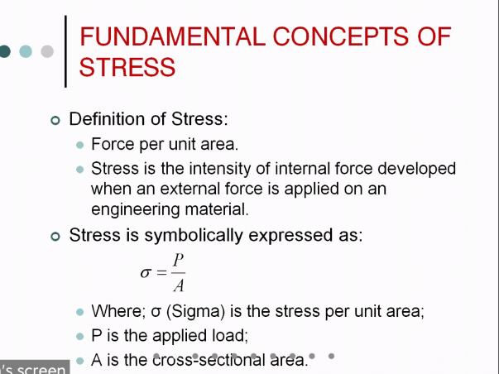

Slide 10
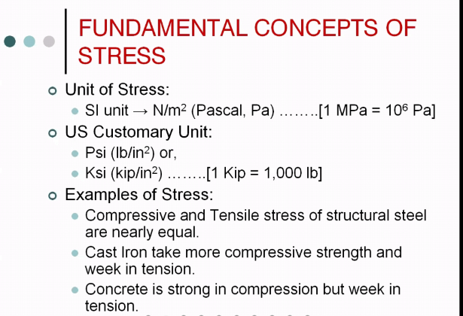

Slide 11
Stress & Strain related problems –I
Week- II

Slide 12
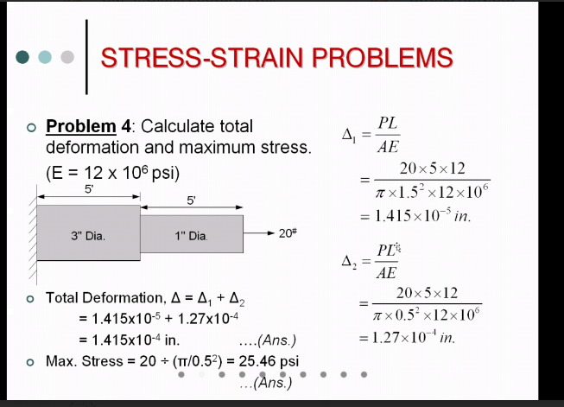

Slide 13
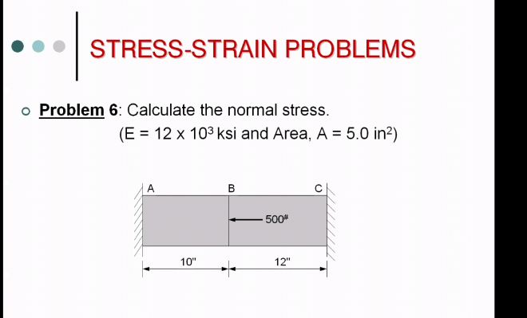

Slide 14
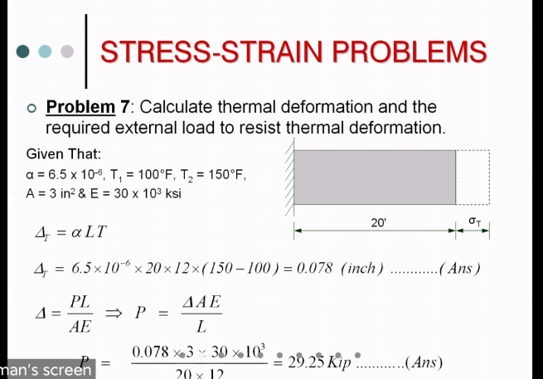

Slide 15
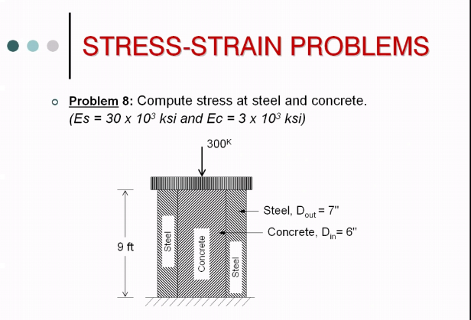

Slide 16
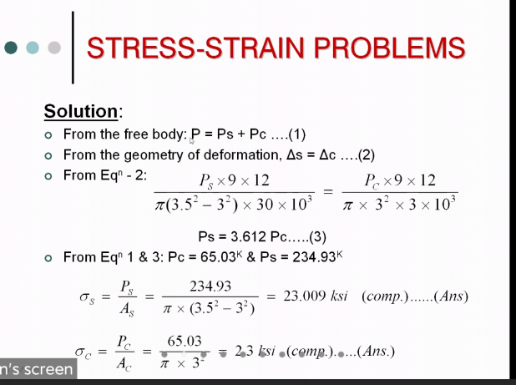

Slide 17
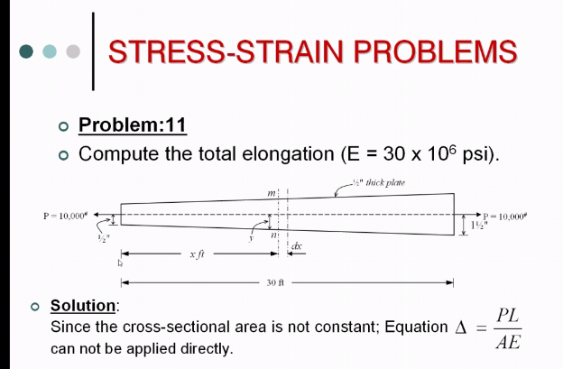

Slide 18
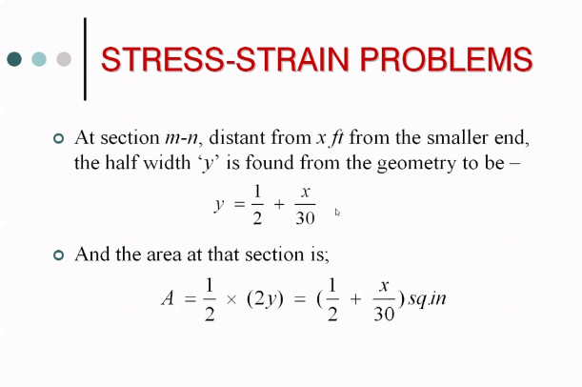
0.5” thick plate

Slide 19
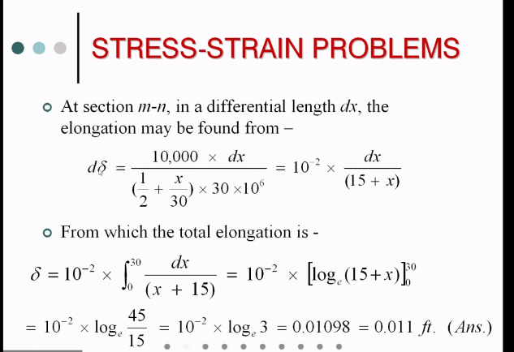

Slide 20
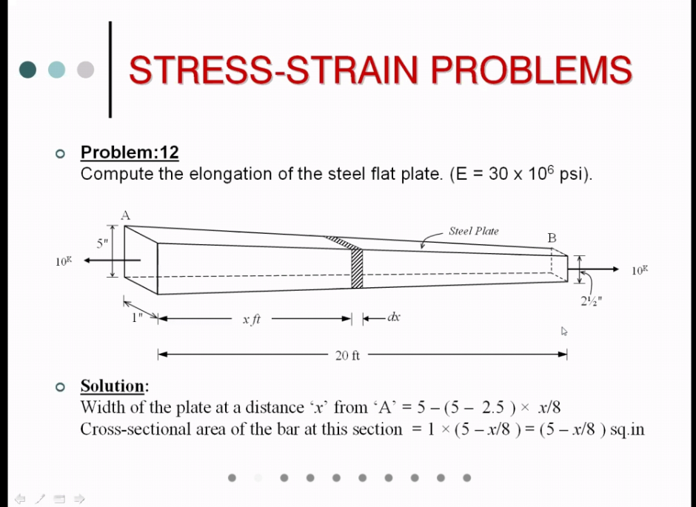

Slide 21
Stress & Strain related problems –II
Week 3

Slide 22
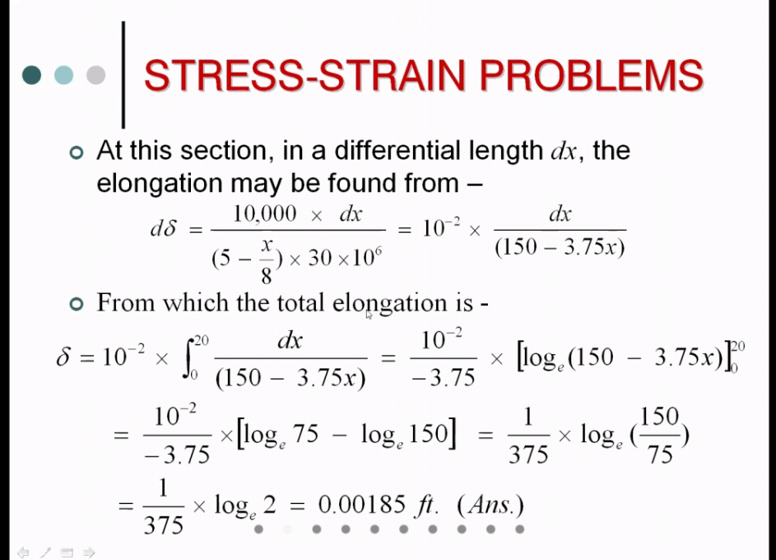

Slide 23
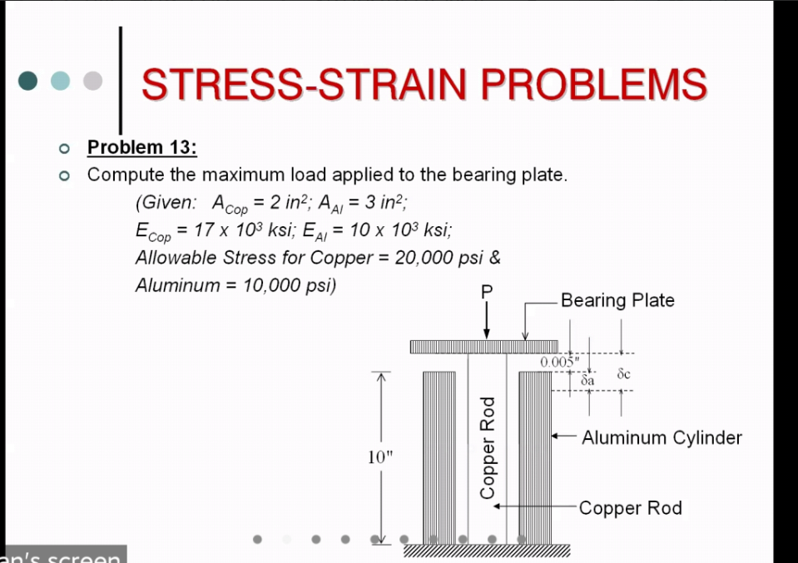

Slide 24
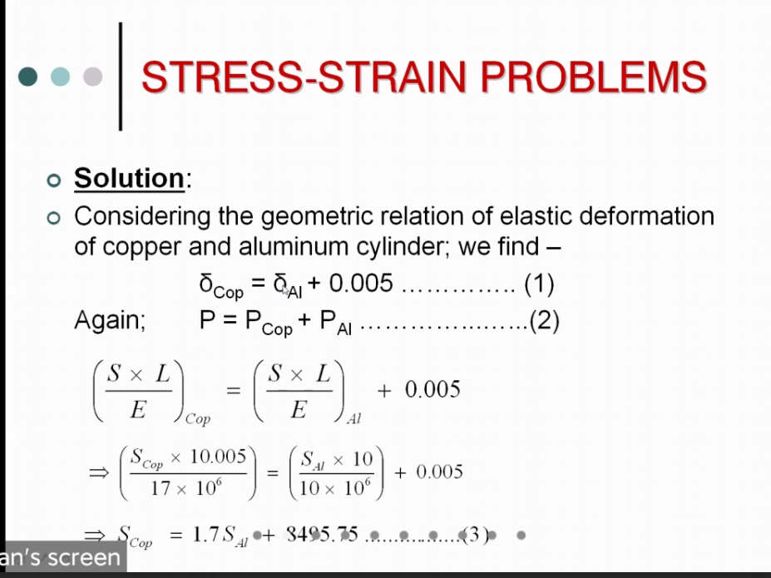

Slide 25
Equation (ii) is the governing relation between stress Using Sal= 10000 psi we get Scu=25495.75 psi Which is
over stressed There fore Cu Governs and corresponding stress is Determined from equation (iii)
20000=1.7 Sal+8495.75
Sai=6767 .21 Psi

Slide 26
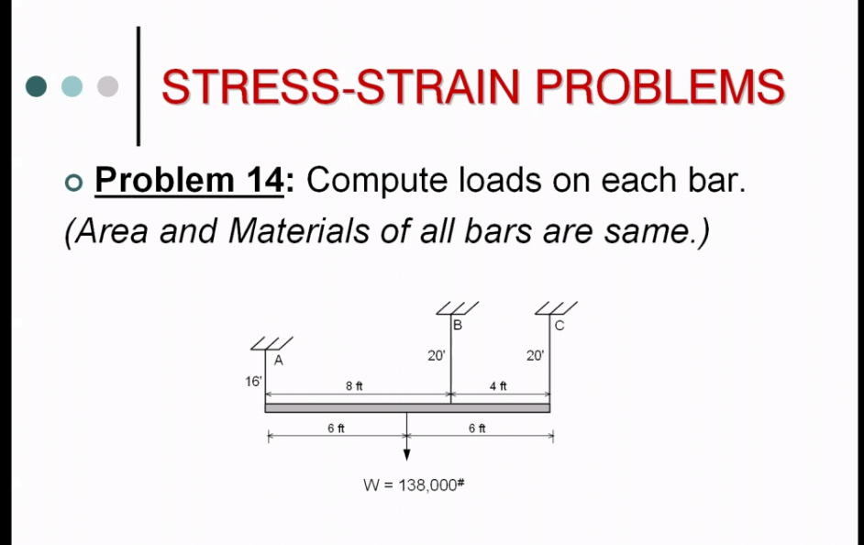

Slide 27
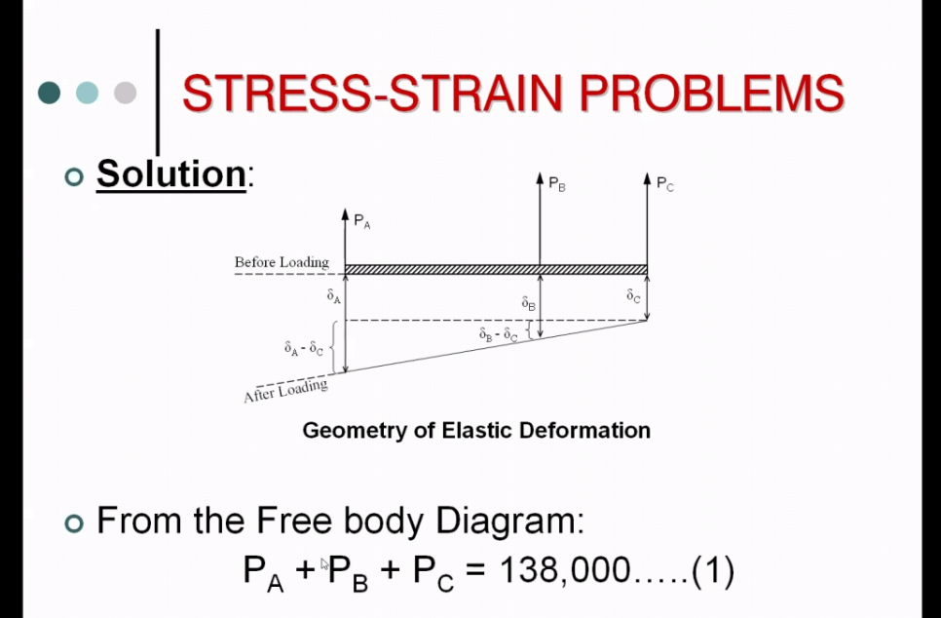

Slide 28
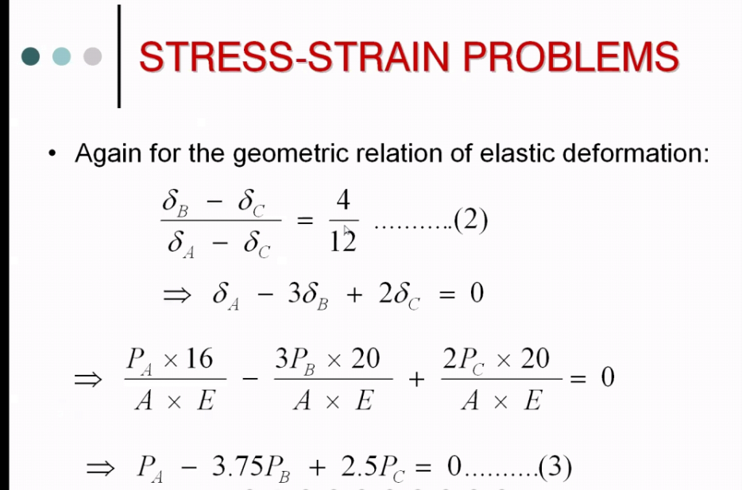

Slide 29
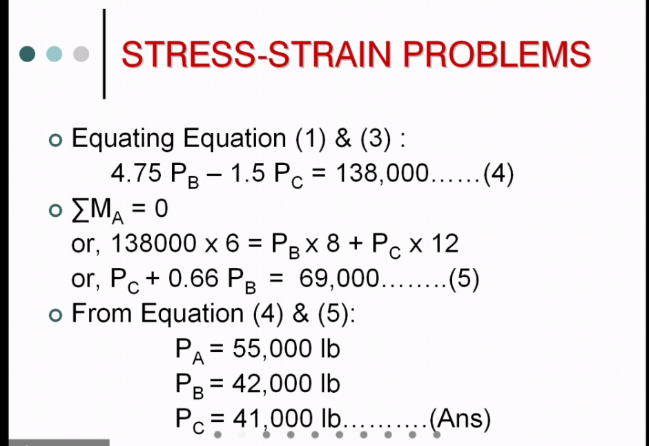

Slide 30
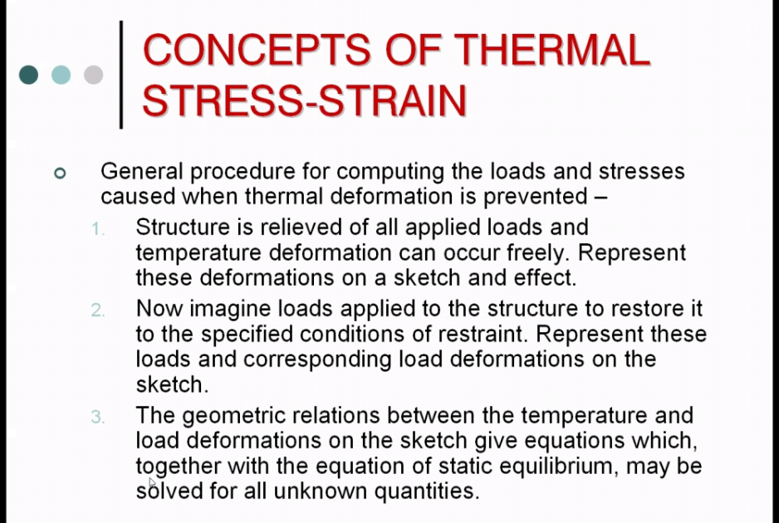

Slide 31
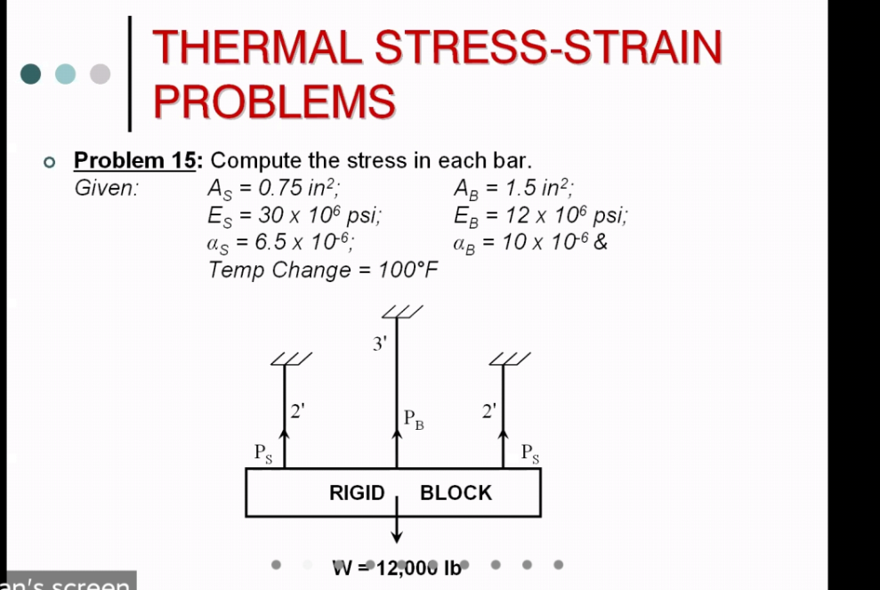

Slide 32
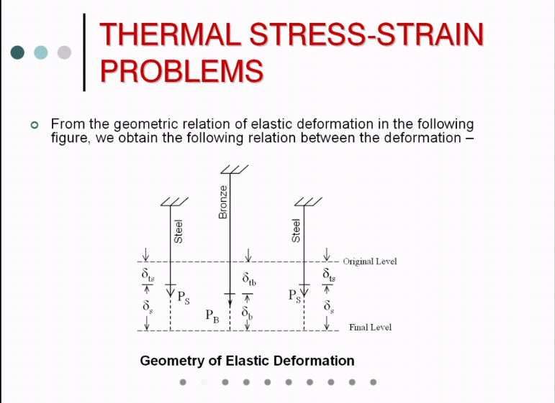

Slide 33
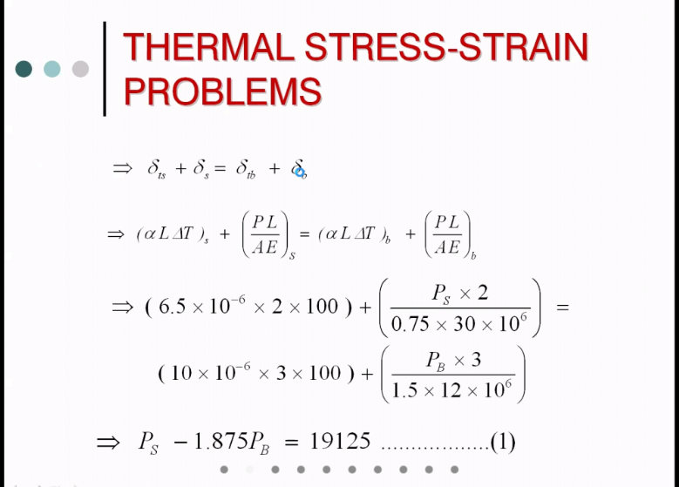

Slide 34
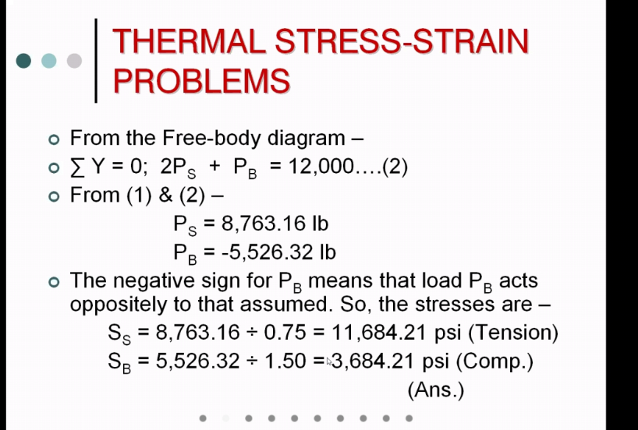

Slide 35
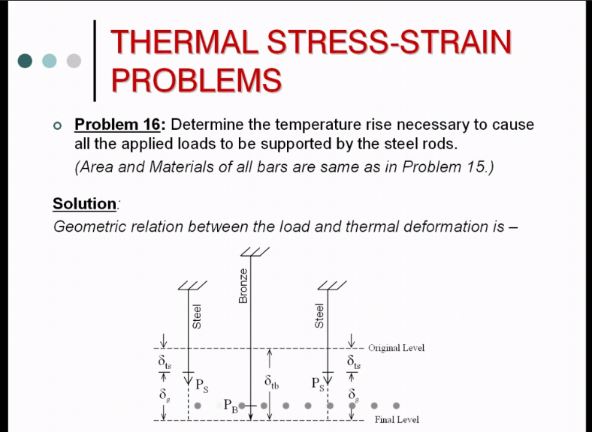

Slide 36
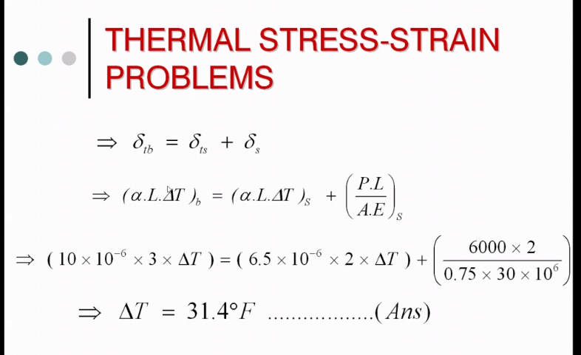

Slide 37
Bending Stress Related theory
Week 4

Slide 43
Theory of Simple Bending
It can also be seen that the top layer has been shortened maximum and the decrease in length of the layer decreases if we proceed towards the neutral surface N-N.
This means that the compressive stress will be maximum at the top layer.
Similarly the increase in length will be maximum at the bottom layer.
Hence the amount of by which a layer increases or decreases in length depends upon the position of the layer with respect to N-N.
This theory is known as theory of simple bending.

Slide 44
Expression for bending Stress
Week 5

Slide 52

Expression for Bending Stress

Slide 58
Bending stress related problem
Week 6

Slide 59
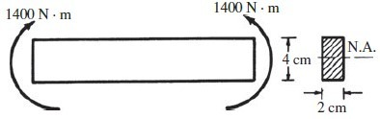
Example #1
A beam is loaded by a couple of 1400 N-m at each of its ends, as shown in Figure. Determine the maximum bending stress in the beam and indicate the variation of bending stress over the depth of the beam.

Slide 60

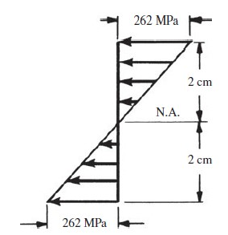
Solution:

Slide 61
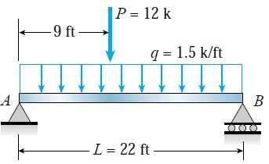
Example #2
A simple beam AB of span length 22 ft supports a uniform load of intensity 1.5 k/ft and a concentrated load 12 k. The concentrated load acts at a point 9.0 ft from the left-hand end of the beam. The beam has a cross section of width b = 9.0 in. and height h = 27 in.

Slide 62
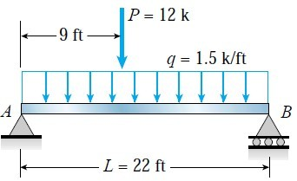
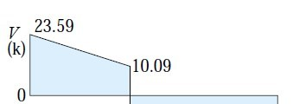

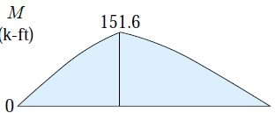
∑M_{A} = 0
1.5 *22*22/2 + 12*9 – R_{B}*22 =
0
R_{B}= 21.41k R_{A} = 23.59k
R_{A}
R_{B}
Shear at point load = R_{A} – 1.5*9
= 23.59 – 13.5
= 10.09 k
Moment at point load = R_{A} * 9 – 1.5*9*9/2
= 23.59*9 – 13.5*4.5
= 151.6 k-ft

Slide 63
Moment of inertia I = bh³/12
= 9*(27)³/12
h = 27 in.
= 14,762.25
in⁴
c= h/2 = 13.5 in
Maximum bending stress
_{σ =} Mc ₌ 151.6*12*13.5 _{= 1.663ksi} I 14762.25
b = 9 in.
1663 psi
1663 psi

Slide 64
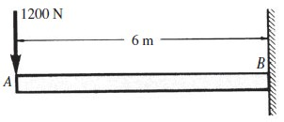
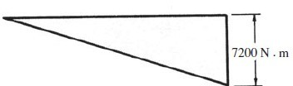
A steel cantilever beam 6 m in length is subjected to a concentrated load of 1200 N acting at the free end of the bar. Determine the magnitude and location of the maximum tensile and compressive bending stresses in the beam.

Slide 65
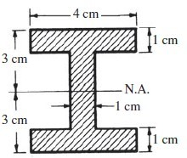


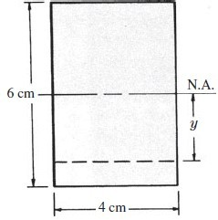


Slide 66
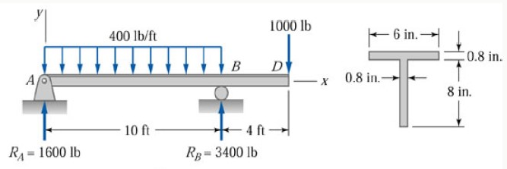
Example #3
The beam shown in Figure below has the T-shaped cross section. Determine the values and locations of the maximum tensile and compressive bending stresses.

Slide 67
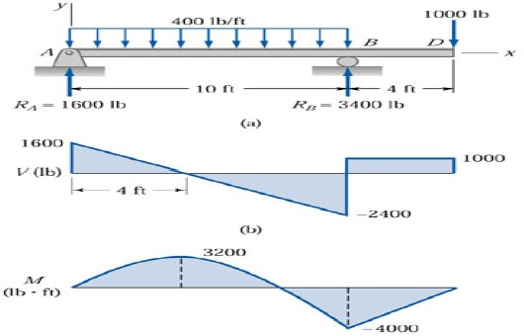

Slide 68
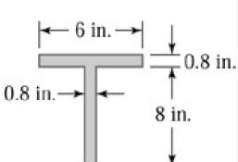
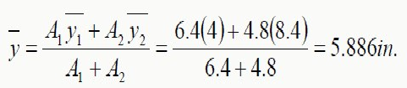


c_{top} = 8.8 – 5.886 = 2.914 in.
N.A.
Ý
c_{bottom} = 5.886

Slide 69


Stress at x =4ft.

Slide 70


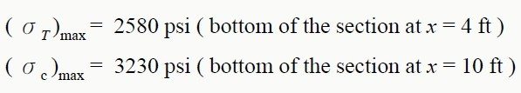
Stress at x = 10ft.

Slide 71
Shear stress related theory
Week 7

Slide 79
Distribution of Shear stress
Week 8

Slide 85
Shear Stress related Problem
Week 9

Slide 101
Torsion
Week 10-11

Slide 109
Combined Stress
Week 12-13

Slide 110
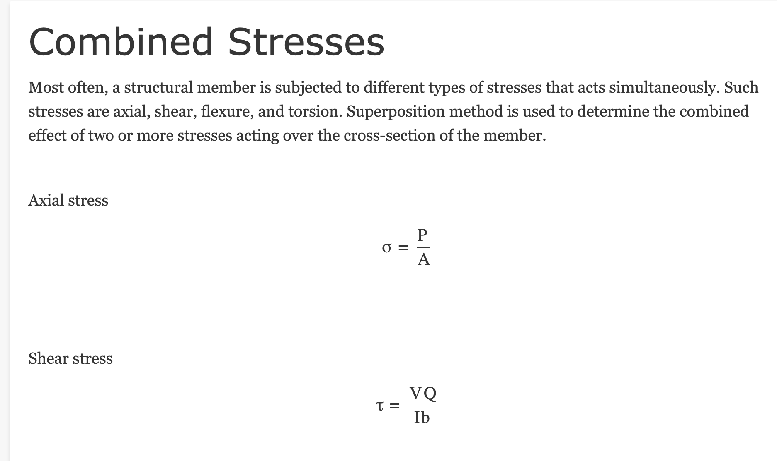

Slide 111
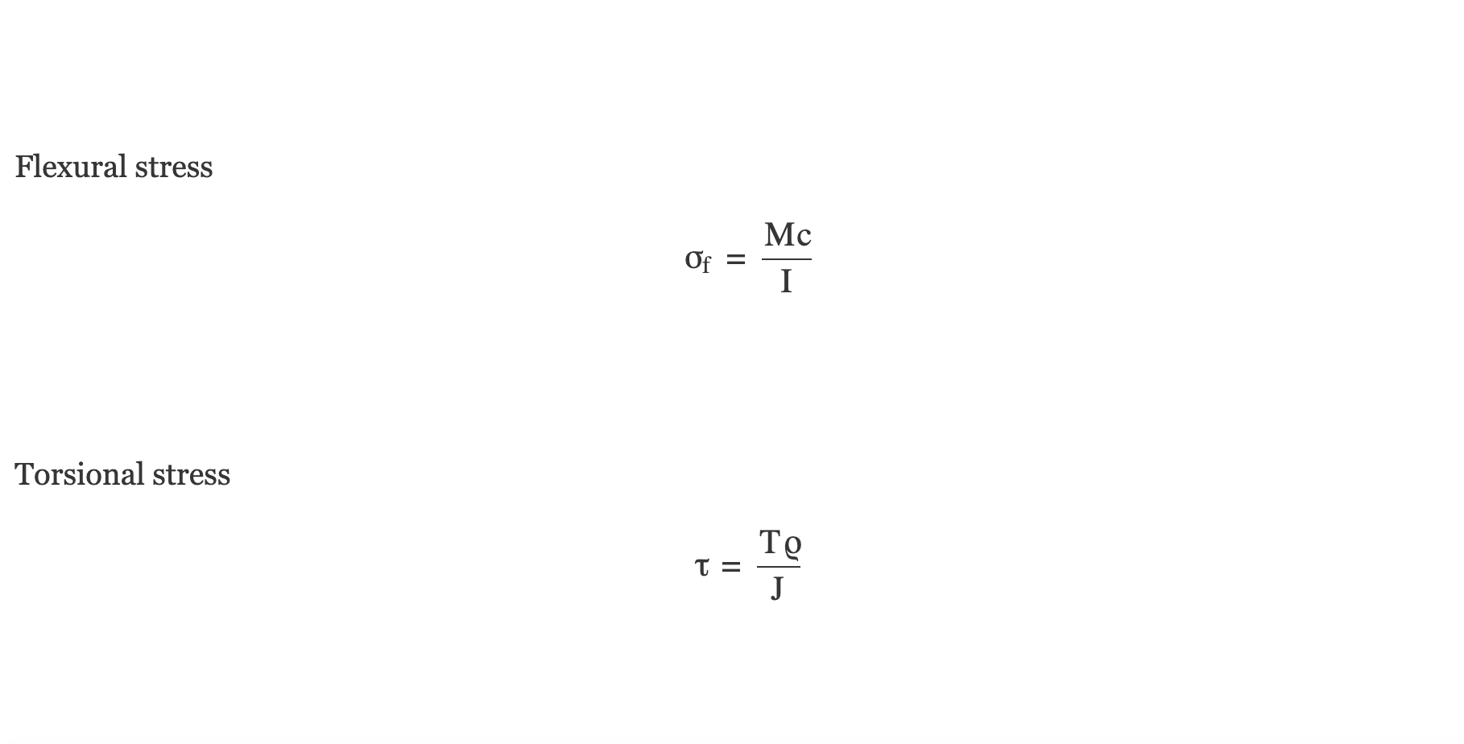

Slide 112
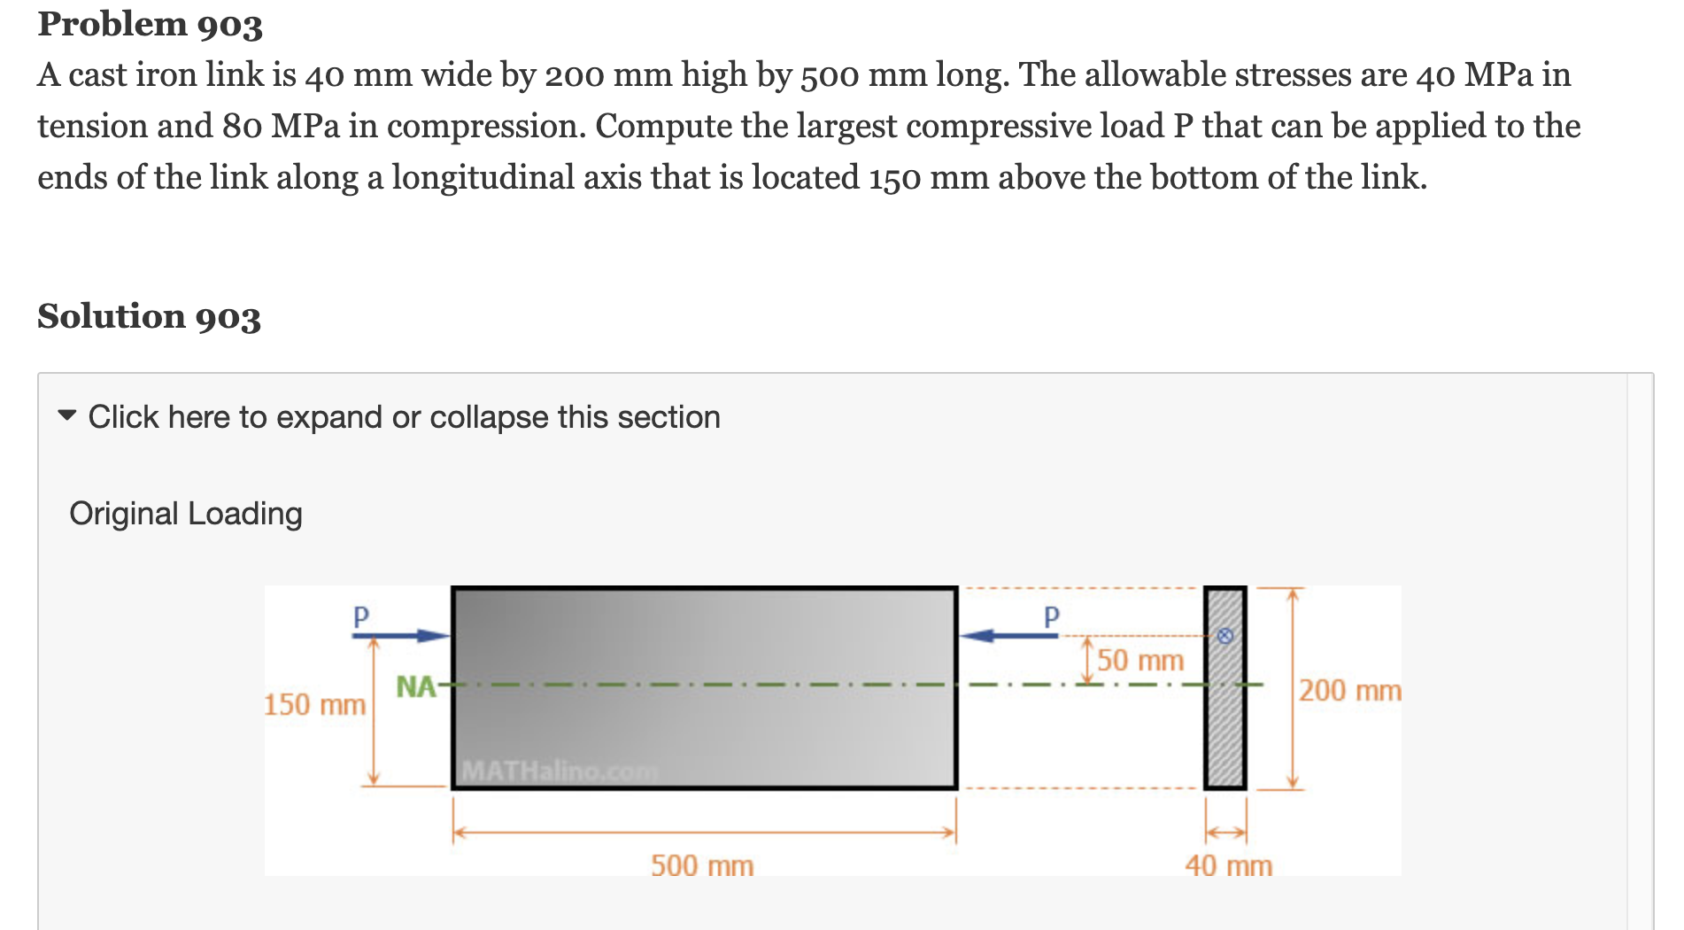

Slide 113
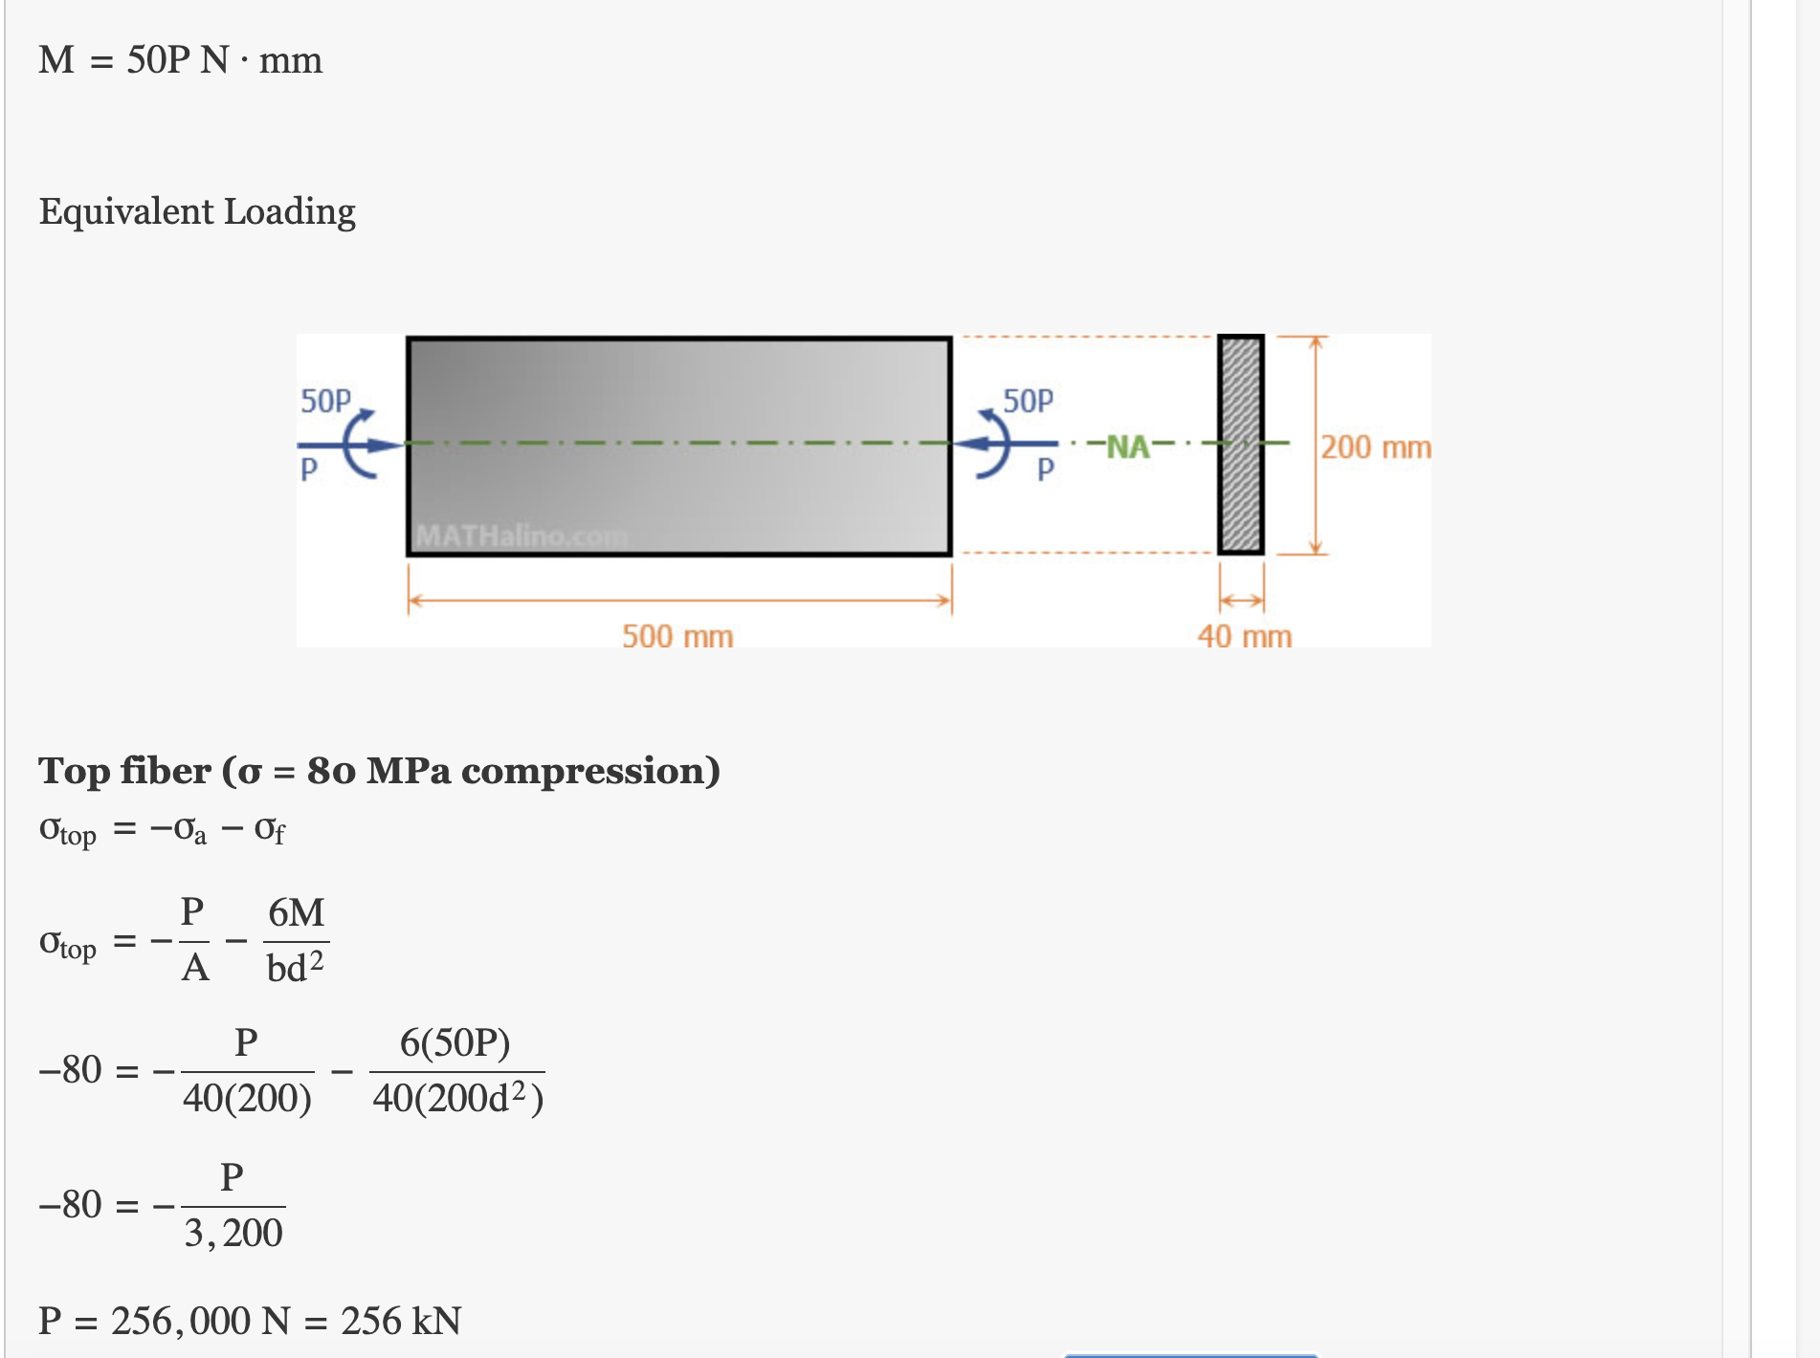

Slide 114
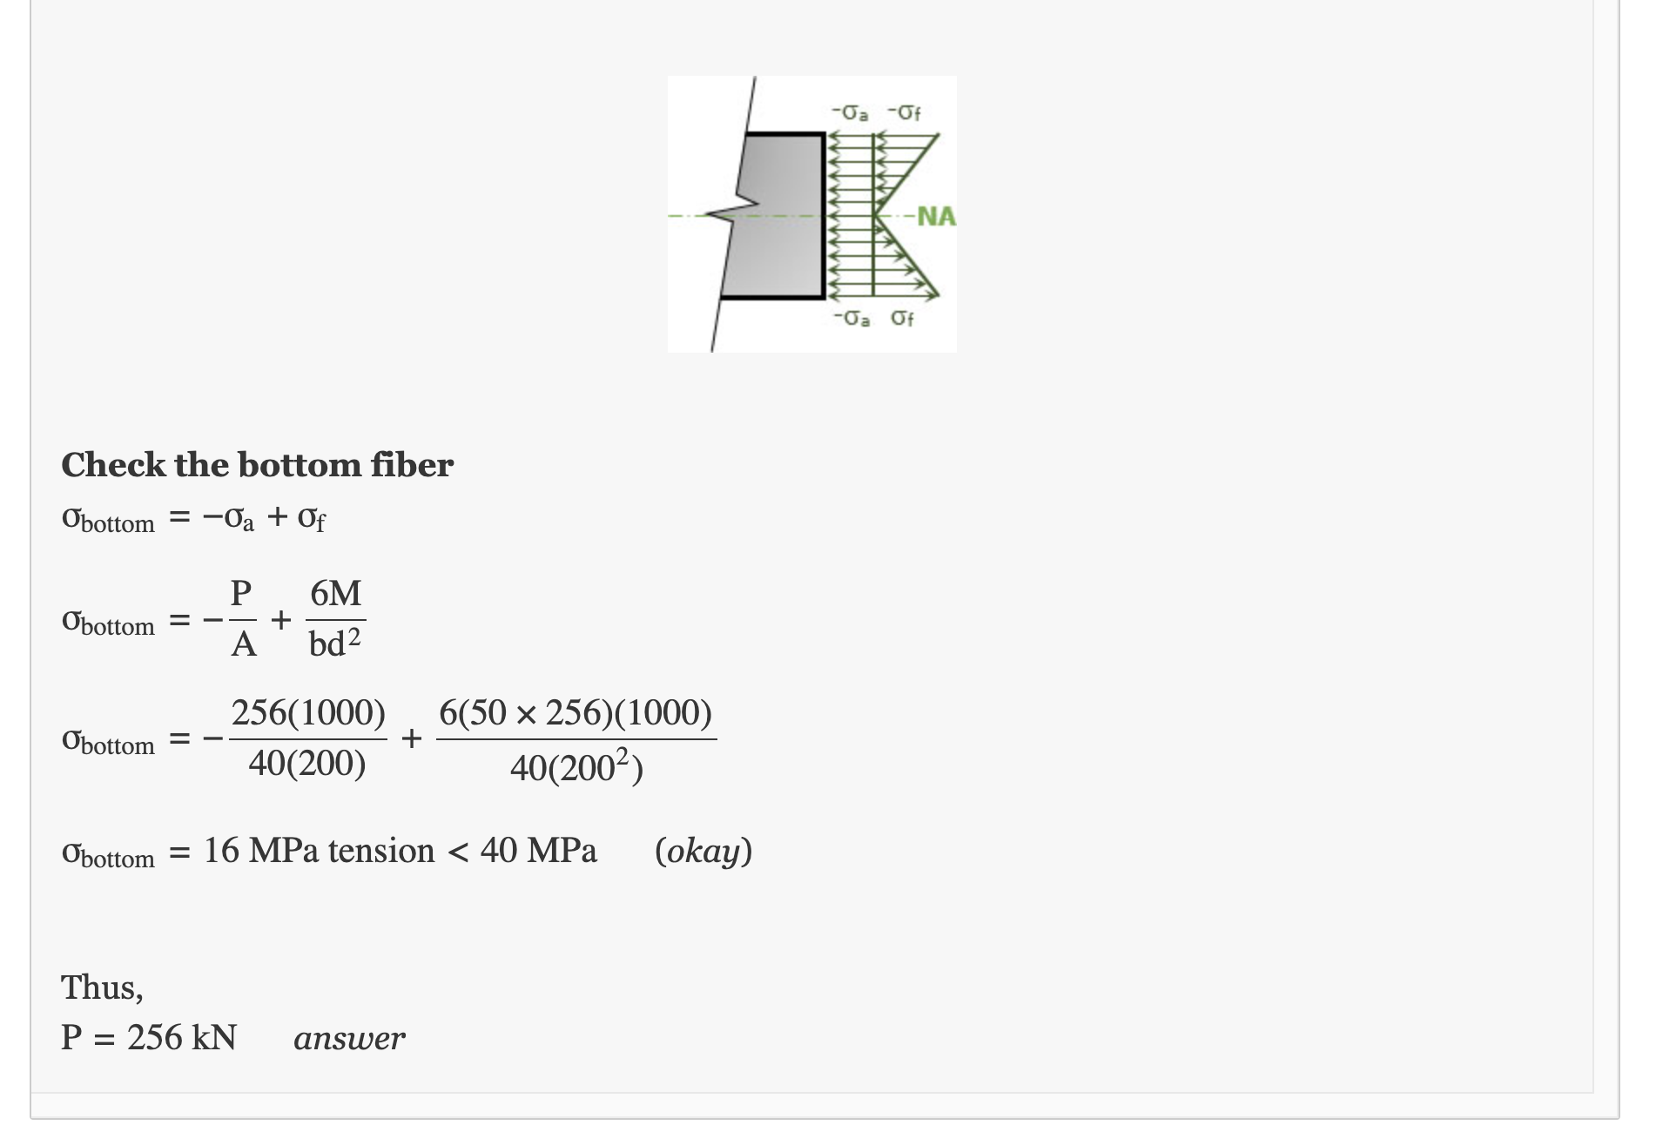

Slide 115
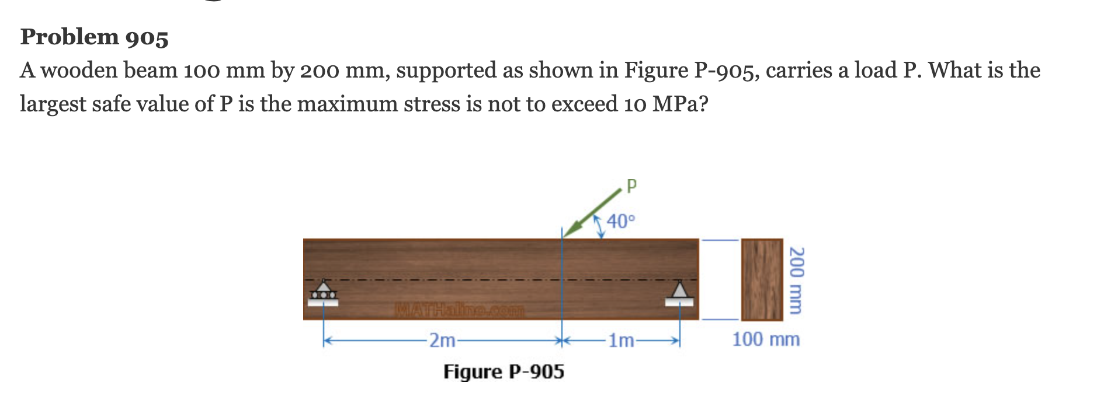

Slide 116
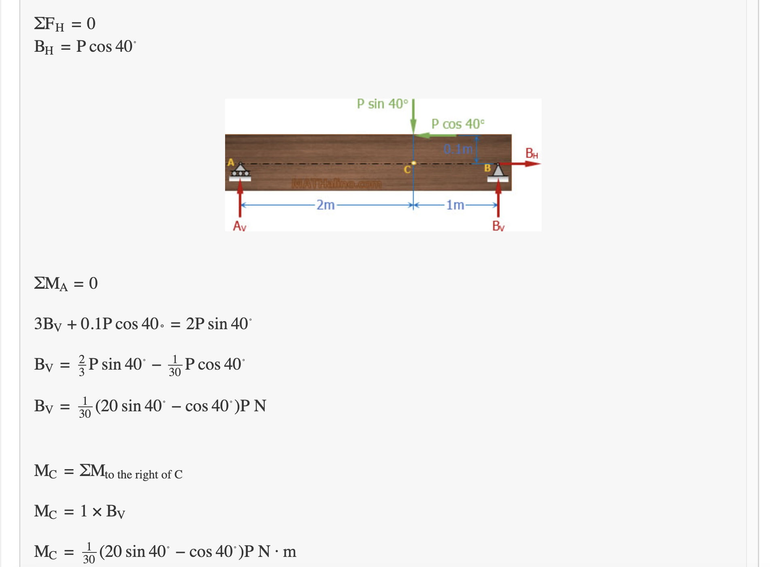

Slide 117
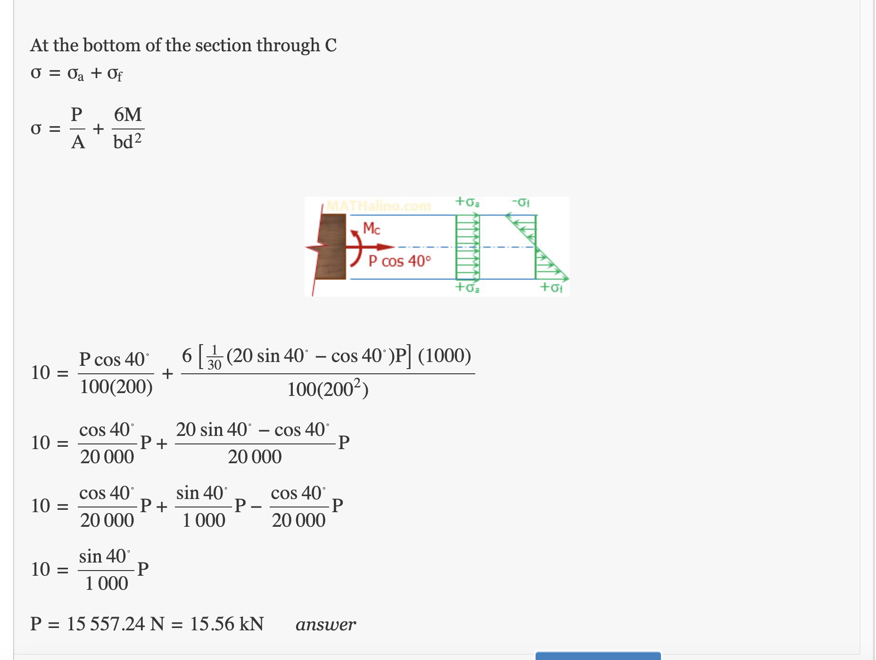

Slide 118
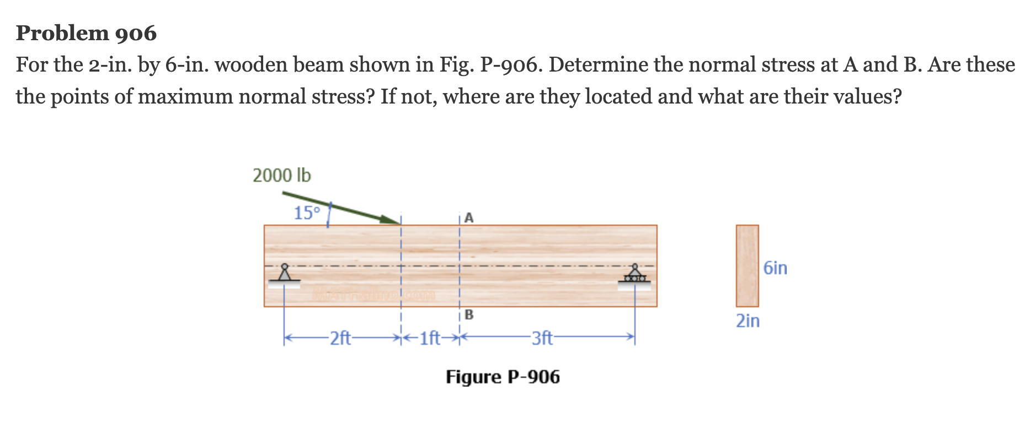

Slide 119
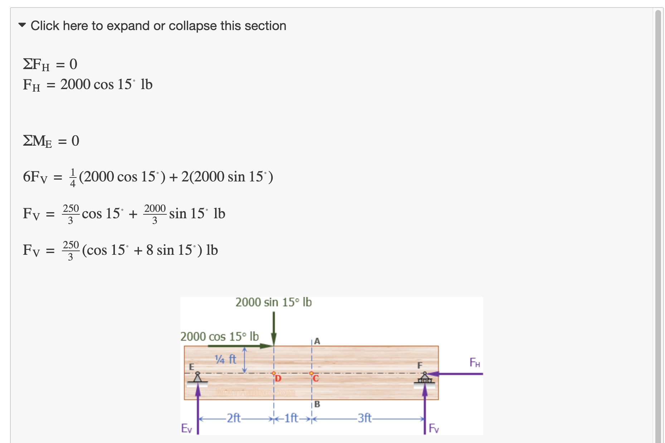

Slide 120


Slide 121


Slide 122


Slide 123


Slide 124


Slide 125


Slide 126
Mohr Circle construction Principle
Week 14

Slide 130
Mohr Circle Related Problem
Week 15-16

Slide 140
Practice and Exercise, Practice and Exercise, Practice and Exercise
Week 17

