Slide 1

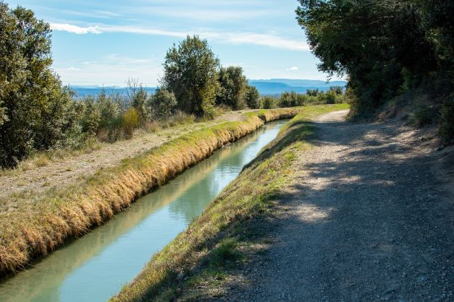
Open Channel Flow
CE 0732-3105
Prepared By
Somen Saha
Lecturer
Department of Civil Engineering
University of Global Village (UGV), Barishal

Slide 2
BASIC COURSE INFORMATION
Course Title | Open Channel Flow
Course Code | CE 0732-3105
Credits | 03
CIE Marks | 90
SEE Marks | 60
Exam Hours | 2 hours (Mid Exam) 3 hours (Semester Final Exam)
Level | 5th Semester

Slide 3
Open Channel Flow
COURSE CODE: CE 0732-3105 | CREDIT:03
 | TOTAL MARKS:150
Mid Exam Hours 2 | CIE MARKS: 90
Semester End Exam Hours 3 | SEE MARKS:60
Course Learning Outcomes (CLOs): After completing this course successfully, the students will be able to-
CLO 1 | Ability to explain and apply fundamental concepts, techniques, and engineering knowledge used in open channel Hydraulics
CLO 2 | Apply continuity, momentum and energy equation on open channel flow system and solve real life problems
CLO 3 | Ability to explain the theories of uniform flow, gradually varied flow, critical flow and identify different flow profiles in channels .
CLO 4 | Perform hydraulic analysis and design of lined and unlined channels.

Slide 4
SL | Content of Course | Hrs | CLOs
1 | Open Channel flow: Introduction to open channel flow,its classification and Comparison between Open Channel Flow and Pipe Flow | 4 | CLO1
2 | Channel Geometry: Flow area, wetted perimeter, hydraulic radius, topwidth ,hydraulic depth. | 5 | CLO1
3 | State of Flow : Effect of viscosity and gravity in open channel flow | 4 | CLO2
4 | Velocity Profile & Velocity Distribution Coefficient | 5 | CLO2
5 | Energy & momentum principles: Specific energy and curve, critical flow, critical depth & condition for minimum specific energy | 4 | CLO 2

Slide 5
6 | Normal depth: Chezy and Manning equations . | 5 | CLO 3
7 | Channel transition: Types of channel transition and uses of channel transition | 5 | CLO 3
8 | Hydraulic jump |  | CLO3
9 | Design of channel | 4 | CLO4

Slide 6
ASSESSMENT PATTERN
CIE- Continuous Internal Evaluation (90 Marks)
SEE- Semester End Examination (60 Marks)
Bloom’s Category | Tests
Remember | 10
Understand | 10
Apply | 10
Analyze | 15
Evaluate | 10
Create | 5
Bloom’s Category Marks (out of 120) | Tests (60) | Assignments (20) | Quizzes (20) | External Participation in Curricular/Co-Curricular Activities (20)
Remember | 10 |  | 10 | Attendance 15
Understand | 5 |  | 5
Apply | 10
Analyze | 10
Evaluate | 5
Create | 5 | 15

Slide 7
Couse plan specifying content, CLOs, teaching learning and assessment strategy mapped with CLOs
Week | Topic | Teaching-Learning Strategy | Assessment Strategy | Corresponding CLOs | Page No
1 | Introduction to open channel flow & Comparison between Open Channel Flow and Pipe Flow | Lecture, discussion, group work | Quiz, Written Exam | CLO1 | 8-20
2 | Channel Geometry & Problem related to Channel Geometry | Oral Presentation, debate | Assignment, Written, Quiz | CLO1 | 21-30
3 | Types of flow | Video lecture, Field visit | Report writing, Demonstration | CLO 1 | 32-35
4 | State of Flow & velocity Profile | Lecture | Viva, Quiz | CLO 1 | 37-43
5 | Velocity Distribution Coefficient | Project exhibition | Project, Field visit | CLO 1 | 45-50
6 | Specific Energy Curve | Discussion, Video Presentation | Quiz, Written Exam | CLO 2 | 52-58
7 | Different Condition For minimum Specific Energy and Critical Flow | Case-based Learning, Demonstration | Assignment, Written, Quiz | CLO 2 | 60-65
8 | Related Problems | Lecture, discussion, group work | Report writing, Demonstration | CLO3 | 67-80
9 | Normal Depth related Theory | Oral Presentation, debate | Viva, Quiz | CLO3 | 83-86
10 | Normal Depth related Math | Video lecture | Project, Field visit | CLO3 | 88-93

Slide 8
11 | Channel Transition | Lecture | Quiz, Written Exam | CLO3 | 95-103
12 | Theory Related To Channel Design | Project exhibition | Assignment, Written, Quiz | CLO4 | 105-113
13 | Math Related To Channel Design | Discussion, Video Presentation | Report writing, Demonstration | CLO4 | 115-116
14 | Hydraulic Jump Related theory | Case-based Learning, Demonstration | Viva, Quiz | CLO4 | 118-137
15 | Hydraulic Jump Related theory | Lecture, discussion, group work | Project, Field visit | CLO4 | 118-137
16 | Hydraulic Jump Related Math | Oral Presentation, debate | Quiz, Written Exam | CLO4 | 139-142
17 | Practice and Exercise, Practice and Exercise, Practice and Exercise | Video lecture | Assignment, Written, Quiz | CLO4 | 143
Reference Book
1) Fluid 1. Ven Te Chow, 1959. Open channel Hydraulics
2. Chaundhury, M.H. 2008, Open Channel Flow, 2nd Edition
3. Yunus Cengel and John Cimbala, Fluid Mechanics Fundamentals and Applications, 3rd Edition

Slide 9
Introduction to open channel flow & Comparison between Open Channel Flow and Pipe Flow
Week 1

Slide 10


OPEN-CHANNEL FLOW
Open-channel flow is a flow of liquid (basically water) in a conduit with a free surface.
That is a surface on which pressure is equal to local atmospheric pressure.
Free surface
^{P}atm
^{P}atm

Slide 11
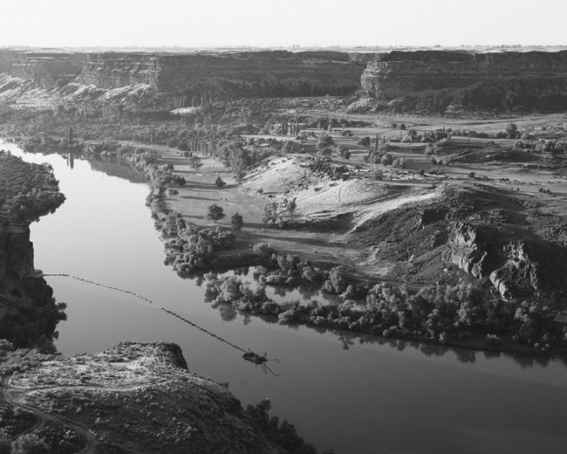
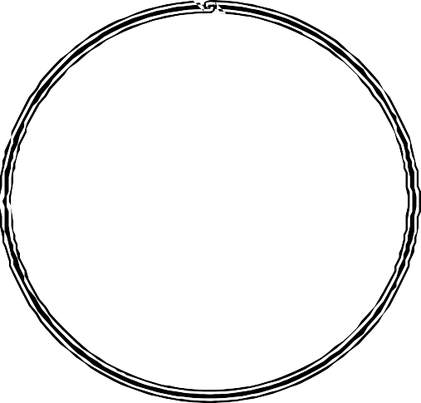

Classification of Open-Channel Flows
Open-channel flows are characterized by the presence of a liquid-gas interface called the free surface.
Natural flows: rivers, creeks, floods, etc.
Human-made systems:
fresh-water aquaducts,
irrigation, sewers, drainage ditches, etc.
p=p_{atm}

Slide 12

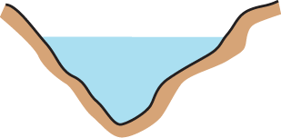
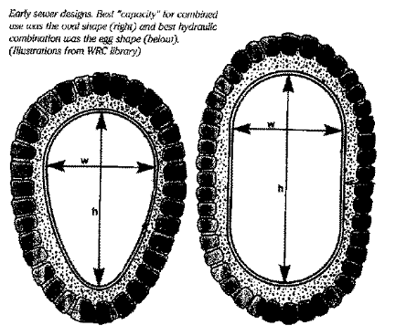

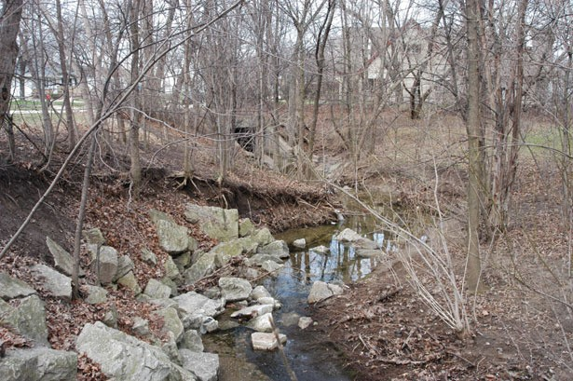
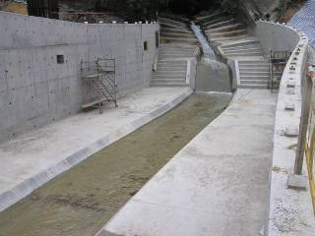
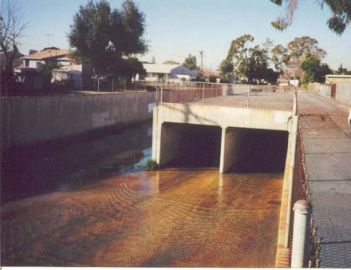
Open channels
Natural channels
Artificial channels
Open cross section
Covered cross section

Slide 13

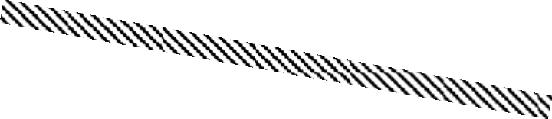
Comparison of Open Channel Flow and Pipe Flow
¹ 2
V ²/2g
EGL HGL
1
h_{f}
EGL
P₁/γ
V ²/2g
V ²/2g
1
V ²/2g
2
2
HGL
P₂/γ
y₁
y₂
Pipe centerline
z
Channel bottom
1
z
z
z
2
1
2
Datum line
Datum line
1
Pipe Flow
2
Open-Channel Flow

Slide 14
Comparison of Open Channel Flow & Pipe Flow
OCF must have a free surface
A free surface is subject to atmospheric pressure
The driving force is mainly the
component of gravity along the flow direction.
HGL is coincident with the free surface.
Flow area is determined by the
geometry of the channel plus
the level of free surface, which is likely to change along
the flow direction and with as well as time.
No free surface in pipe flow
No direct atmospheric pressure, hydraulic pressure only.
The driving force is mainly the pressure force along the flow direction.
HGL is (usually) above the conduit
Flow area is fixed by the pipe dimensions The cross section of a pipe is usually circular..

Slide 15
Comparision of Open Channel Flow & Pipe Flow
The cross section may be of any from circular to irregular forms of natural streams, which may change along the flow direction and as well as with time.
Relative roughness changes with the level of free surface
The depth of flow, discharge and the slopes of channel bottom and of the free surface are interdependent.
6) The cross section of a pipe is usually circular
The relative roughness is a fixed quantity.
No such dependence.

Slide 16
Kinds of Open Channel
Canal
Flume
Chute
Drop
Culvert
Open-Flow Tunnel

Slide 17
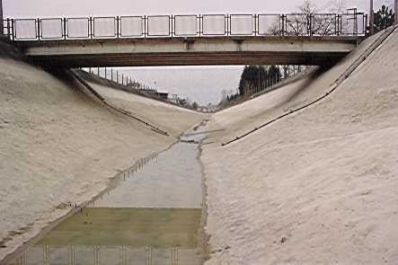
Kinds of Open Channel
CANAL is usually a long and mild-sloped channel built in the ground.

Slide 18
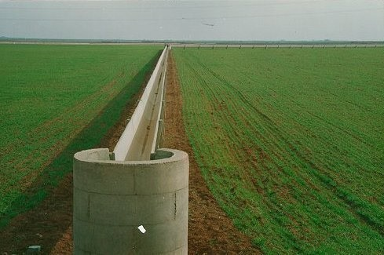
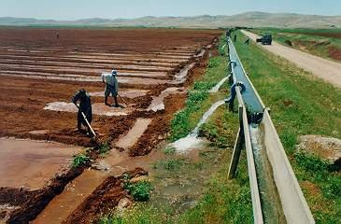
Kinds of Open Channel
FLUME is a channel usually supported on or above the surface of the ground to carry water across a depression.

Slide 19
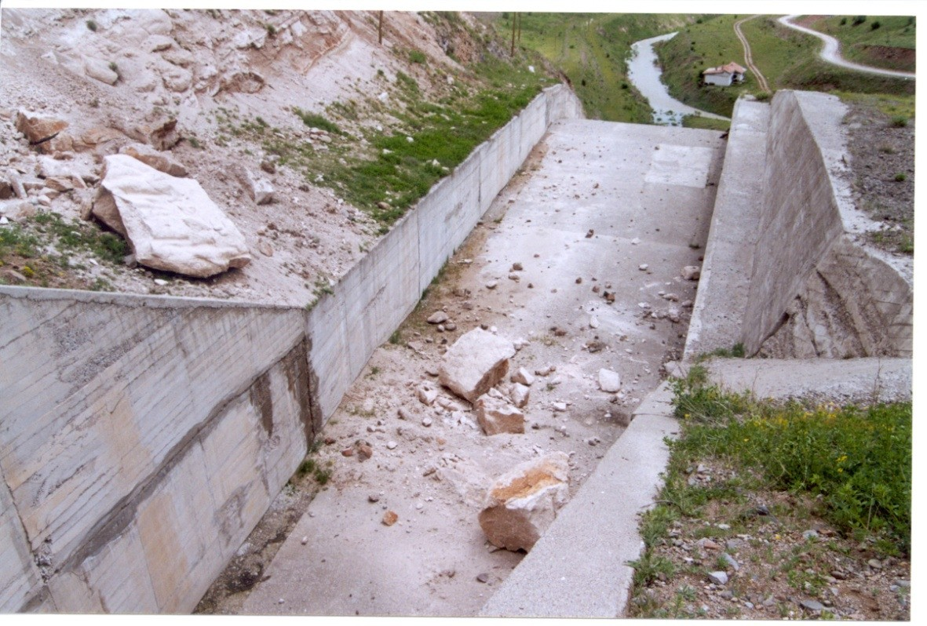
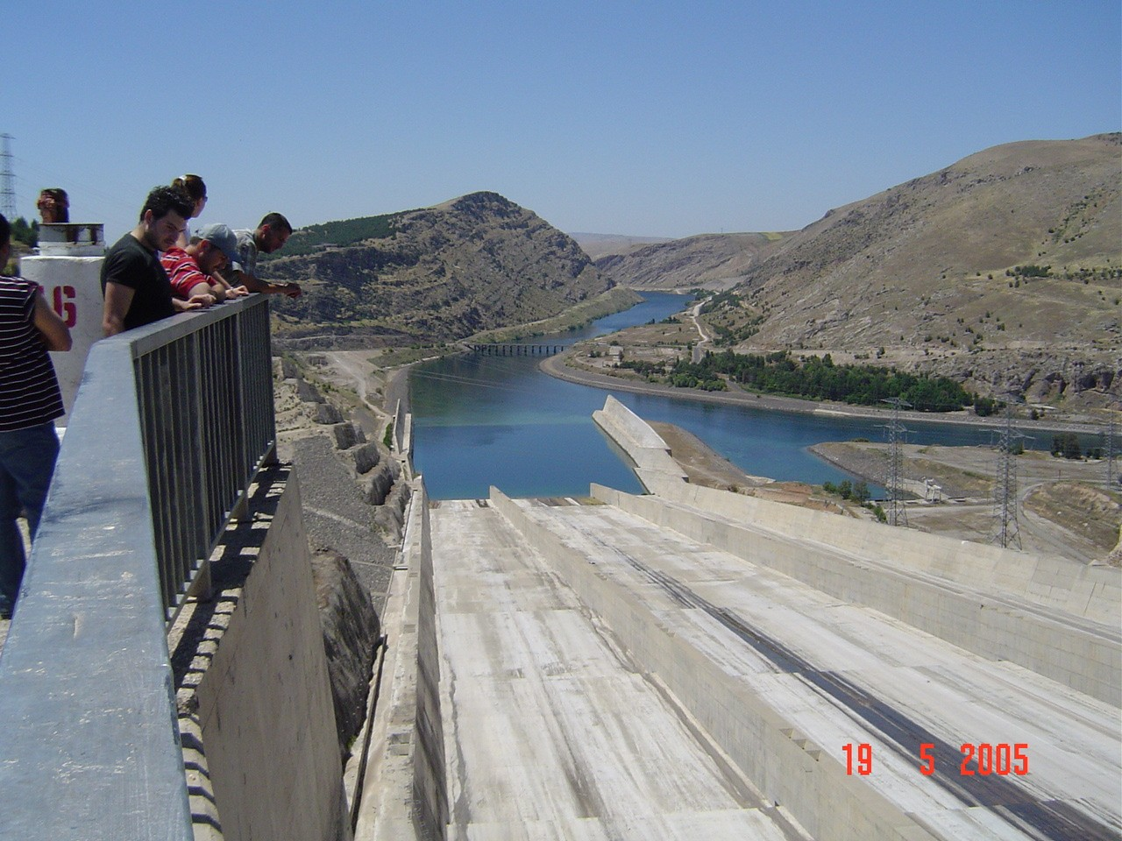
Kinds of Open Channel
CHUTE is a channel having steep slopes.

Slide 20
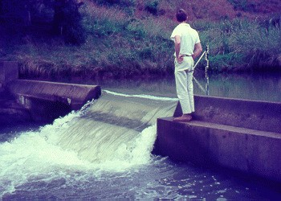
Kinds of Open Channel
DROP is similar to a chute, but the change in elevation is affected in a short distance.

Slide 21
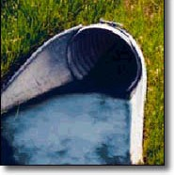
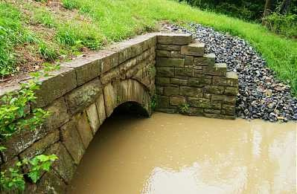
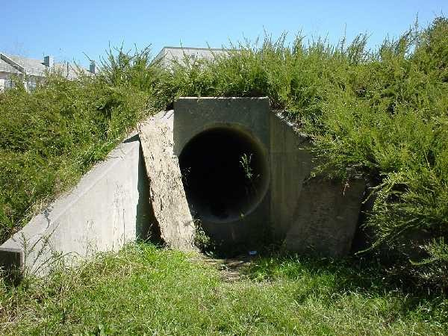
Kinds of Open Channel
CULVERT is a covered channel flowing partly full, which is installed to drain water through highway and railroad embankments.

Slide 22
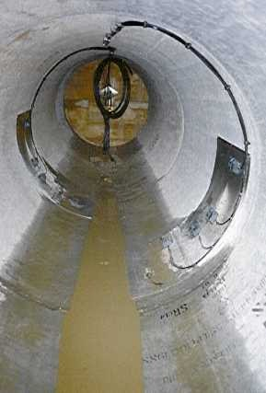
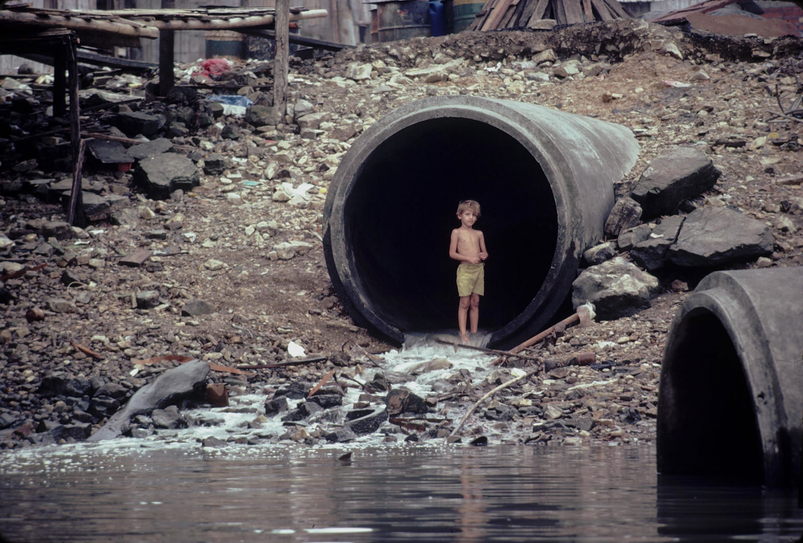
Kinds of Open Channel
OPEN-FLOW TUNNEL is a comparatively long covered channel used to carry water through a hill or any obstruction on the ground.

Slide 23
Channel Geometry & Problem related to Channel Geometry
Week 2

Slide 24
Channel Geometry
A channel built with constant cross section and constant bottom slope is called a PRISMATIC CHANNEL.
Otherwise, the channel is NONPRISMATIC.

Slide 25
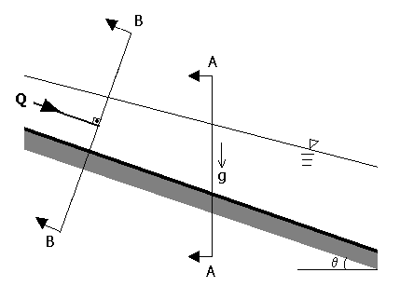
THE CHANNEL SECTION is the cross section of a channel taken normal to the direction of the flow.
THE VERTICAL CHANNEL SECTION is the vertical section passing through the lowest or bottom point of the channel section.
d
The channel section (B-B) y
The vertical channel section (A-A)

Slide 26

Geometric Elements of Channel Section
THE DEPTH OF FLOW, y, is the vertical distance of the lowest point of a channel section from the free surface.
y
θ
d
h
θ
z
Datum

Slide 27

Geometric Elements of Channel Section
THE DEPTH OF FLOW SECTION, d, is the depth of flow normal to the direction of flow.
θ is the channel bottom slope
d = ycosθ.
y
d
θ
h
θ
z
For mild-sloped channels y ≈ d.
Datum

Slide 28

Geometric Elements of Channel Section
THE TOP WIDTH, T,
is the width of the channel section at the free surface.
THE WATER AREA, A,
is the cross-sectional area of the flow normal to the direction of flow.
THE WETTED PERIMETER, P,
is the length of the line of intersection of the channel wetted surface with a cross- sectional plane normal to the direction of flow.
THE HYDRAULIC RADIUS, R = A/P,
is the ratio of the water area to its wetted perimeter.
THE HYDRAULIC DEPTH, D = A/T,
is the ratio of the water area to the top width.
T
d
P
A = A(d)

Slide 29
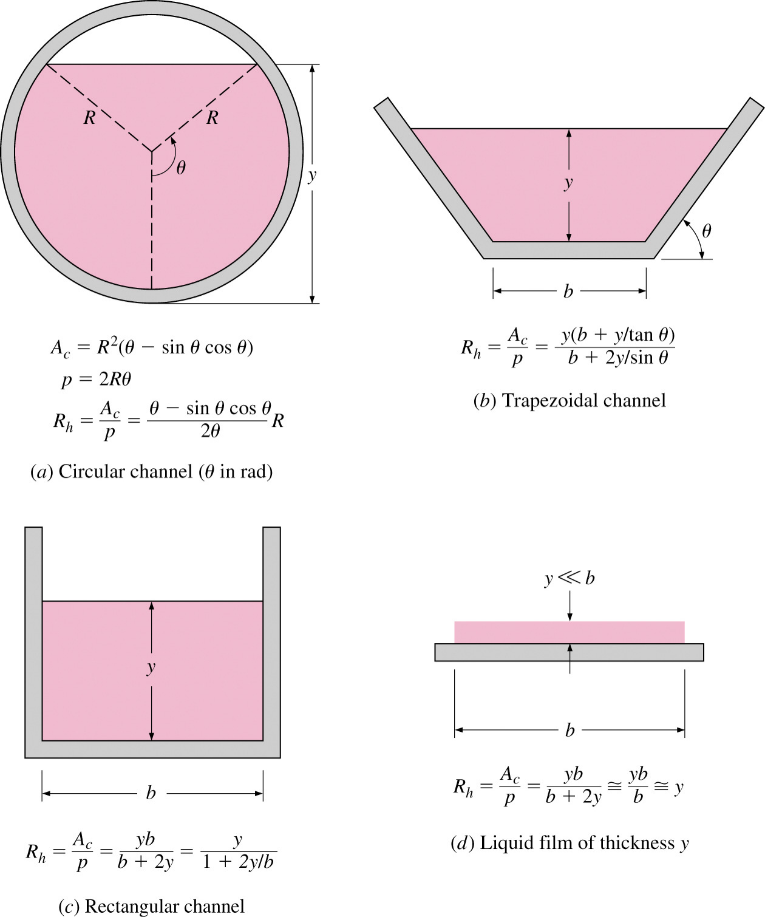
Channel Geometry
The wetted perimeter does not include the free surface.
Examples of R for common geometries shown in Figure at the left.

Slide 30
Geometric elements for different channel cross sections
 | rectangular | trapezoidal |  |  |  | triangular | circular | parabolic
 | B h b | 1 m | B b |  | h | B 1 h m | B D h θ | B h
flow area A | bh | (b + mh)h |  |  |  | mh ² | ¹ (θ − sin θ )D² 8 | ² Bh 3
wetted perimeter P | b + 2h | b + 2h | 1 + m² |  |  | 2h 1+ m² | ¹ θ D 2 | 8 h² * B + 3 B
hydraulic radius | bh | (b + mh)h |  |  |  | mh | 1  sin θ  _{4 }1 − _{θ } D  | 2B² h *
R_{h} | b + 2h | b + 2h 1 + m² |  |  |  | 2 1 + m² |  | 3B² + 8h²
top width B | b | b + 2mh |  |  |  | 2mh | (sin θ / 2)D or 2 h(D − h) | ³ Ah 2
hydraulic depth D_{h} | h | (b + mh)h b + 2mh |  |  |  | 1 _{h} 2 | θ − sin θ  D  sin θ / 2  8 | 2 _{h} 3
*
Valid for If
0 < ξ ≤ 1
ξ > 1
where then
ξ = 4h / B P = (B / 2) [ 1 + ξ ² + (1/ ξ ) ln(ξ + 1 + ξ ² )]

Slide 31
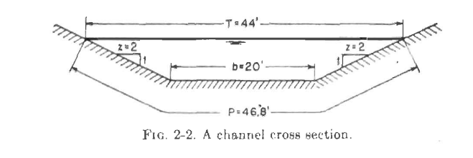
Example 2-1. Compute the hydraulic radius, hydraulic depth, and section factor Z of the trapezoidal channel section in Fig. 2-2. The depth of Bow is 6 ft.

Slide 32
P = 20 + 2 X 6 V5 =46.8 ft;
A=0 .5(20 + 44) X 6 = 192.0ft²;
R =192 /46.8 = 4.10 ft;
D = 192/44 = 4.37 ft; and
Z = 192*√4.37 =401 ft^{2.5},.

Slide 33
Types of flow
Week 3

Slide 34
Types of Flow
Criterion: Change in flow depth with respect to time and space
OCF
Time is a criterion
Steady flow (∂y/∂t=0)
Unsteady flow (∂y/∂t≠0)
Space is a criterion
Uniform Flow (∂y/∂x=0)
Varied Flow (∂y/∂x≠0)
Uniform Flow (∂y/∂x=0)
Varied Flow (∂y/∂x≠0)
GVF
RVF
GVF
RVF

Slide 35
Types of Flow
Criterion: Change in discharge with respect to time and space
OCF
Time is a criterion
Steady flow (∂Q/∂t=0)
Unsteady flow (∂Q/∂t≠0)
Space is a criterion
Continuous Flow (∂Q/∂x=0)
Spatially- Varied Flow (∂Q/∂x≠0)
Continuous Flow (∂Q/∂x=0)
Spatially-Varied Flow
(∂Q/∂x≠0)

Slide 36
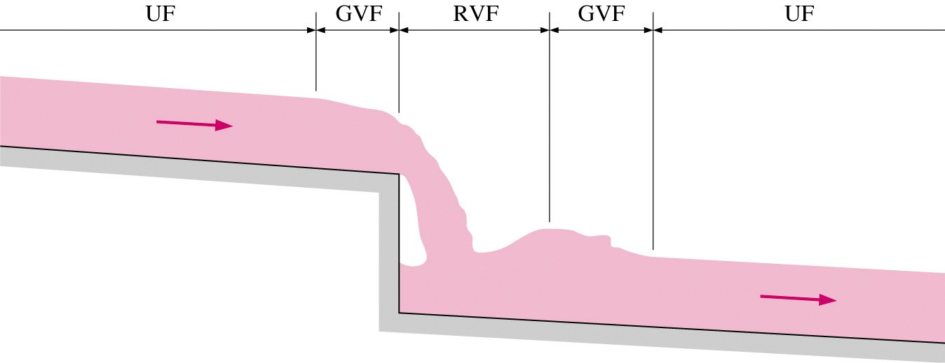
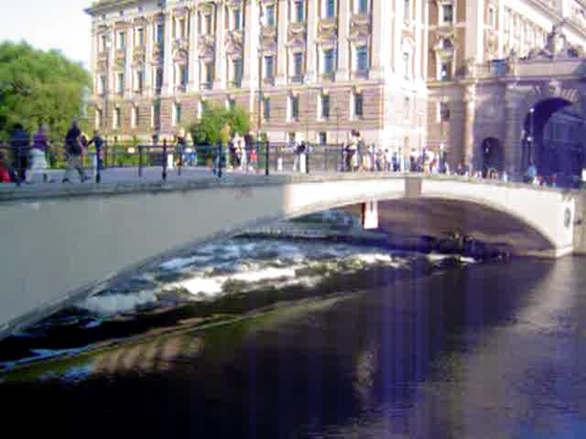
Classification of Open-Channel Flows
Obstructions cause the flow depth to vary.
Rapidly varied flow (RVF) occurs over a short distance near the obstacle.
Gradually varied flow (GVF) occurs over larger distances and usually connects UF and RVF.

Slide 37
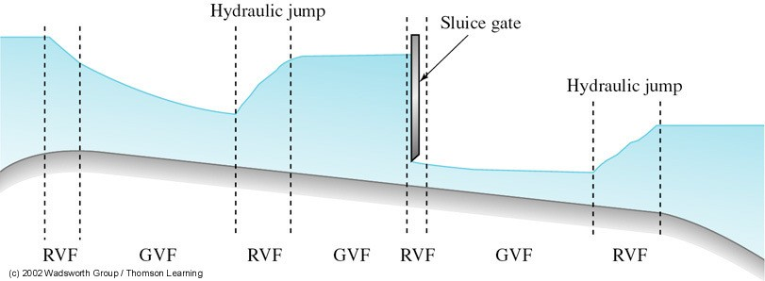
Steady non-uniform flow in a channel.

Slide 38
State of Flow & velocity Profile
Week 4

Slide 39
State of Flow
The state or behavior of open-channel flow is governed basically by the effects of viscosity and gravity relative to the inertial forces of the flow.

Slide 40
State of Flow
Effect of viscosity:
Re = ^{VR}
υ
Note that R in Reynold number is Hydraulic Radius
Laminar OCF, Re < 500
OCF
Transitional OCF, 500 < Re < 1000
Turbulent OCF, Re > 1000

Slide 41
Effect of Gravity
In open-channel flow the driving force (that is the force causing the motion) is the component of gravity along the channel bottom. Therefore, it is clear that, the effect of gravity is very important in open-channel flow.
In an open-channel flow Froude number is defined as:
Inertia Force
_{V} 2
V
F =
, and F² == or F =
r
r r
Gravity Force gD
gD
In an open-channel flow, there are three types of flow depending on the value of Froude number:
F_{r}>1 F_{r}=1 F_{r}<1
Supercritical Flow Critical Flow Subcritical Flow

Slide 42
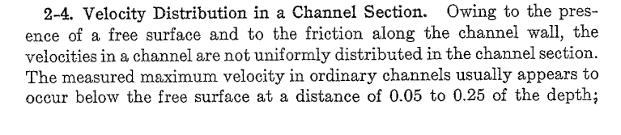
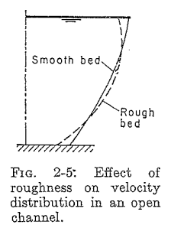

Slide 43
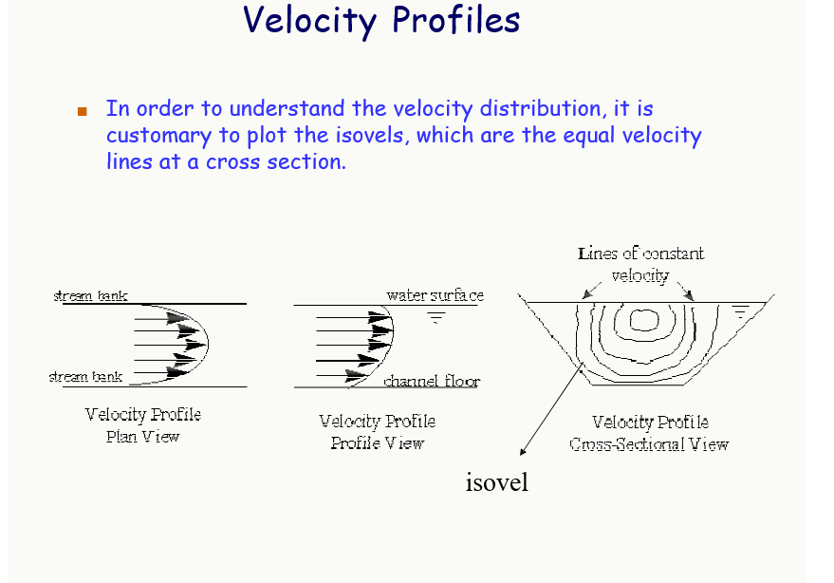

Slide 44
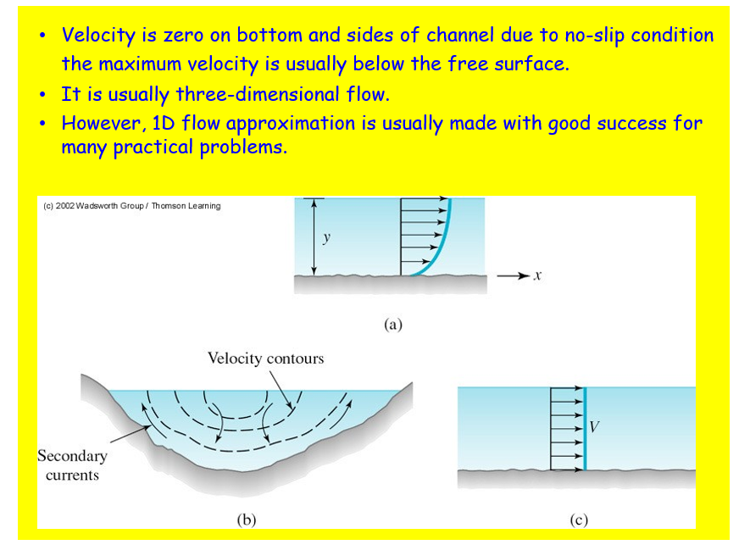

Slide 45
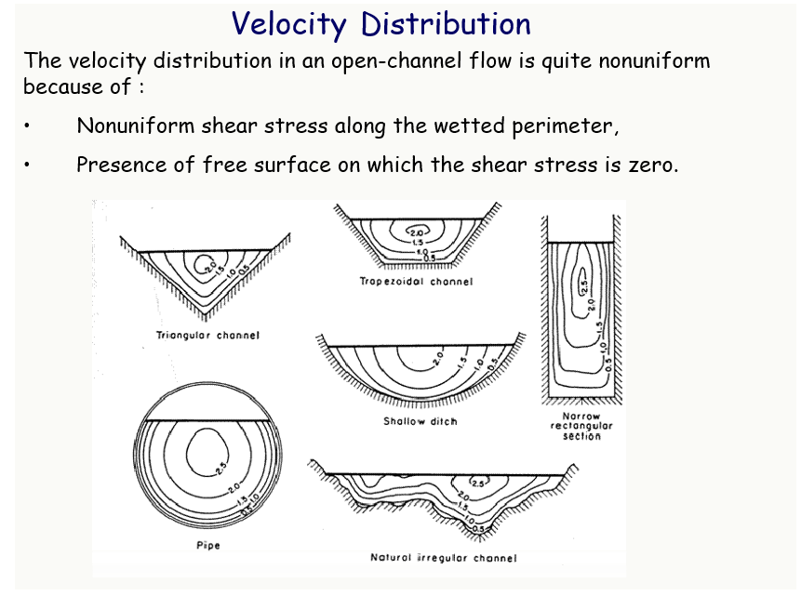

Slide 46
Velocity Distribution Coefficient
Week 5

Slide 47
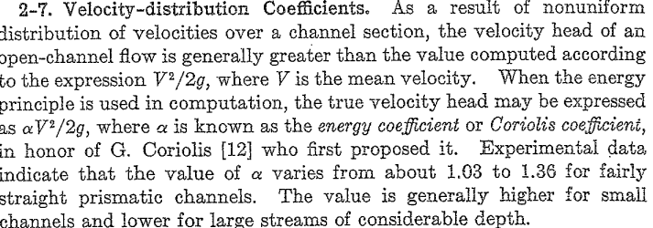

Slide 48
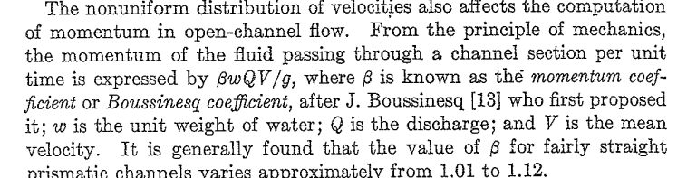

Slide 49
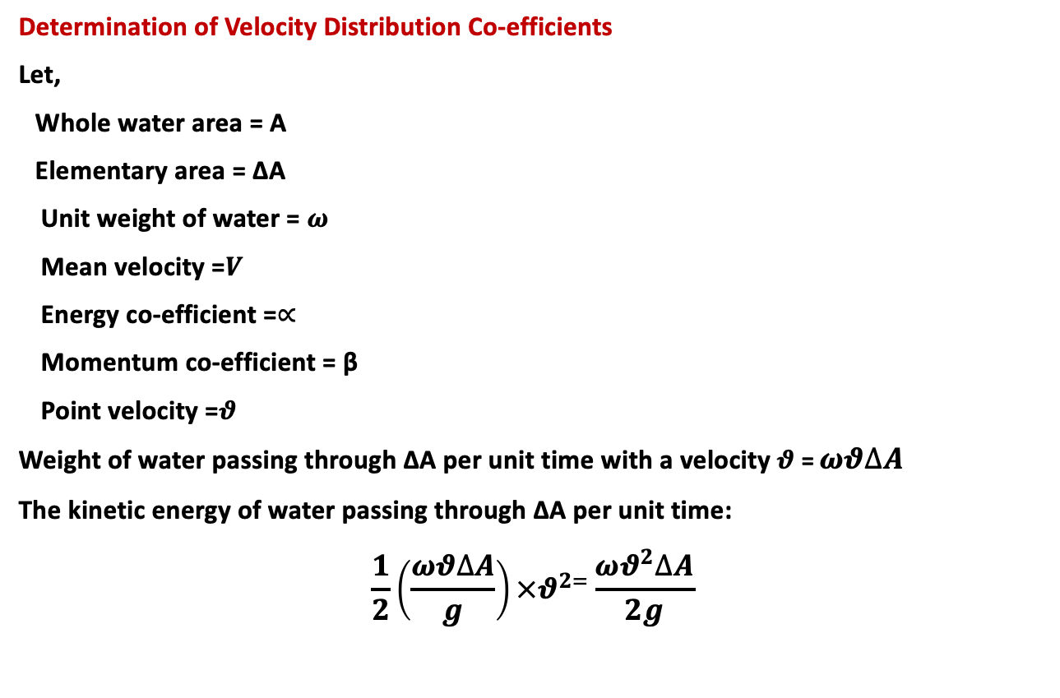
Determination of Velocity Distribution Co-efficients
Let,
Whole water area = A
Elementary area = ΔA
Unit weight of water = $ω$
Mean velocity =$V$
Energy co-efficient =$∝$
Momentum co-efficient = β
Point velocity =$θ$
Weight of water passing through ΔA per unit time with a velocity $θ$= $ωθ∆A$
The kinetic energy of water passing through ΔA per unit time:
$$\frac{1}{2}\left(\frac{ωθ∆A}{g}\right)×θ^{2=}\frac{ωθ^{2}∆A}{2g}$$

Slide 50
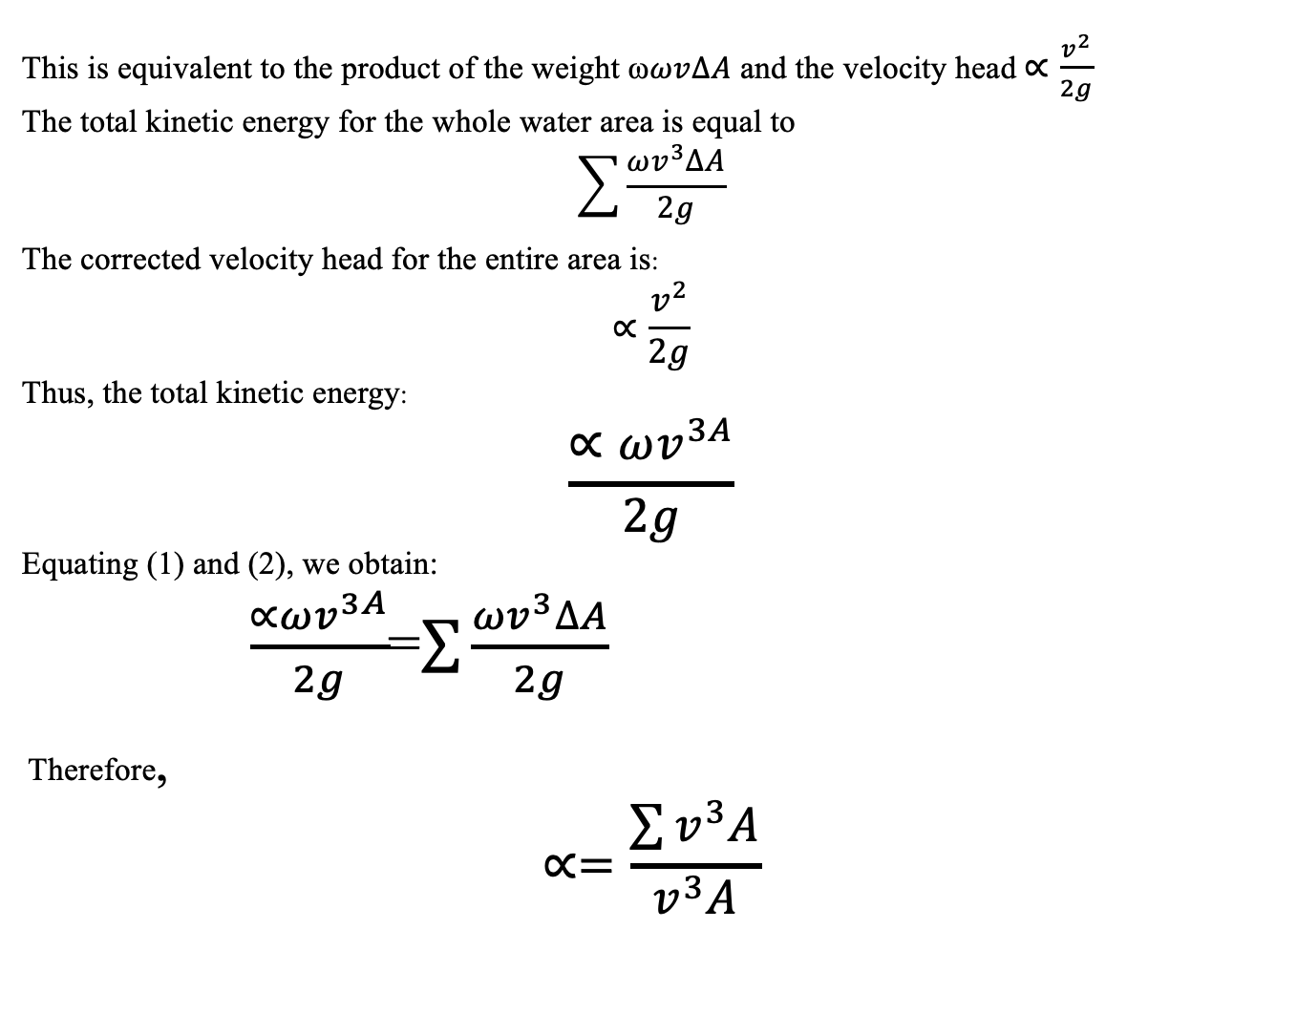
This is equivalent to the product of the weight ω$ωv∆A$ and the velocity head$∝\frac{v^{2}}{2g}$
The total kinetic energy for the whole water area is equal to
$$\sum{\frac{ωv^{3}∆A}{2g}}$$
The corrected velocity head for the entire area is:
$$∝\frac{v^{2}}{2g}$$
Thus, the total kinetic energy:
$$\frac{∝ωv^{3A}}{2g}$$
Equating (1) and (2), we obtain:
$\frac{∝ωv^{3A}}{2g}$=$\sum{\frac{ωv^{3}∆A}{2g}}$
Therefore,
$$∝=\frac{\sum{v^{3}A}}{v^{3}A}$$

Slide 51
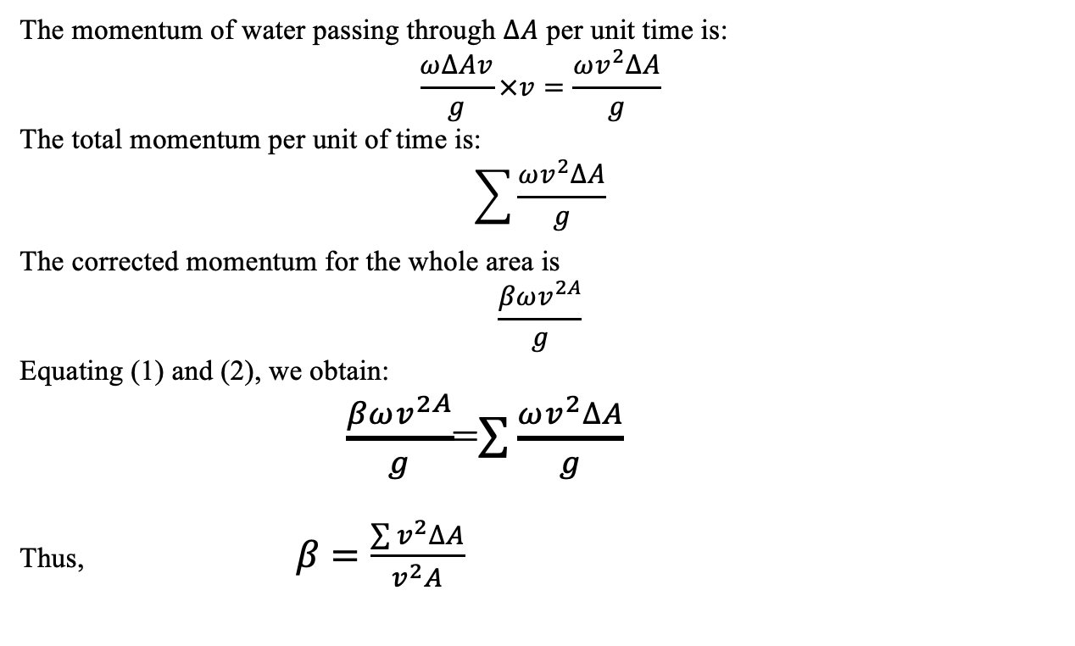
The momentum of water passing through $∆A$ per unit time is:
$$\frac{ω∆Av}{g}×v=\frac{ωv^{2}∆A}{g}$$
The total momentum per unit of time is:
$$\sum{\frac{ωv^{2}∆A}{g}}$$
The corrected momentum for the whole area is
$$\frac{βωv^{2A}}{g}$$
Equating (1) and (2), we obtain:
$\frac{βωv^{2A}}{g}$=$\sum{\frac{ωv^{2}∆A}{g}}$
Thus, $β=\frac{\sum{v^{2}∆A}}{v^{2}A}$

Slide 52
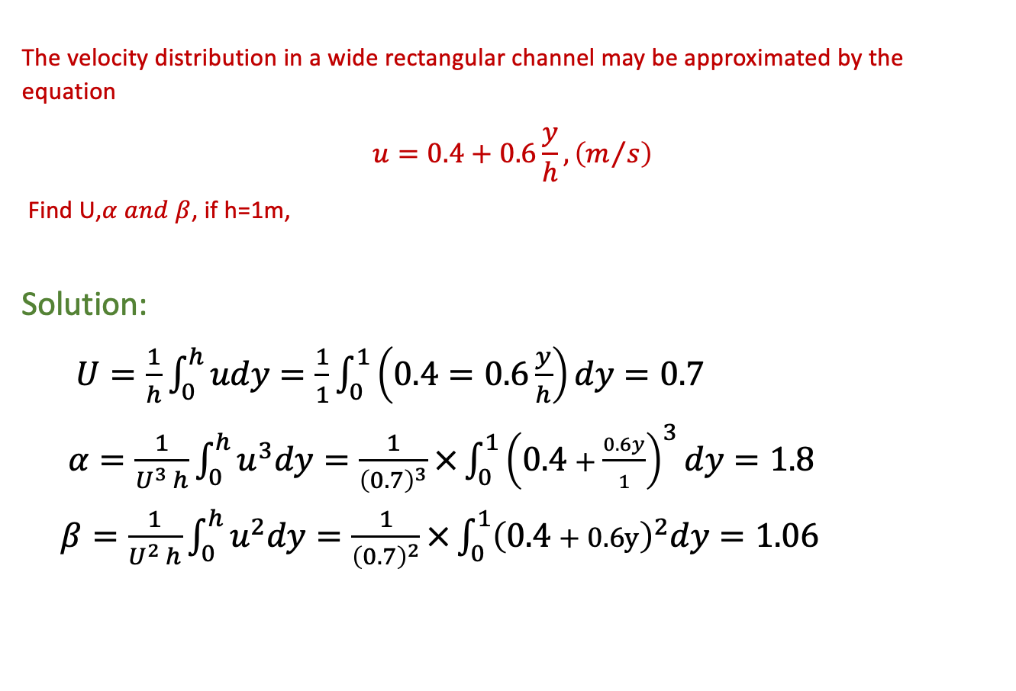
The velocity distribution in a wide rectangular channel may be approximated by the equation
$$u=0.4+0.6\frac{y}{h},\left(m/s\right)$$
Find U,$α and β$, if h=1m,
Solution:
$U=\frac{1}{h}\int_{0}^{h}{udy=\frac{1}{1}}\int_{0}^{1}{\left(0.4=0.6\frac{y}{h}\right)}dy=0.7$
$α=\frac{1}{U^{3 }h}\int_{0}^{h}{u^{3}dy}=\frac{1}{{\left(0.7\right)}^{3}}×\int_{0}^{1}{{\left(0.4+\frac{0.6y}{1}\right)}^{3}dy=1.8}$
$β=\frac{1}{U^{2 }h}\int_{0}^{h}{u^{2}dy}=\frac{1}{{\left(0.7\right)}^{2}}×\int_{0}^{1}{{\left(0.4+0.6y\right)}^{2}dy}=1.06$

Slide 53
Specific Energy Curve & Critical flow
Week 6

Slide 54
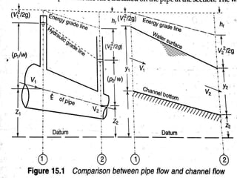

Slide 55
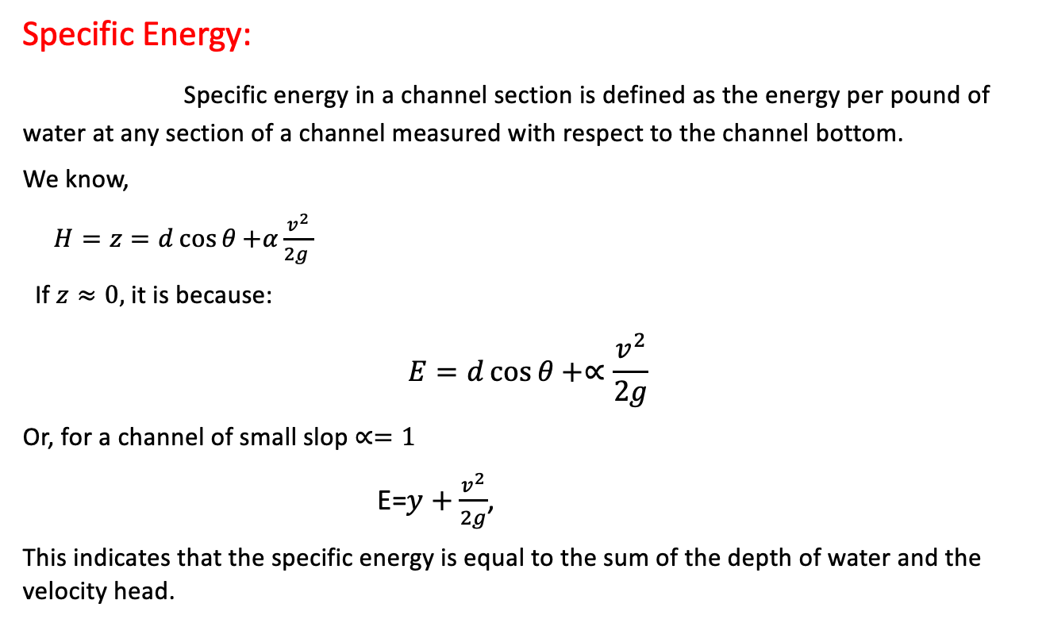
Specific Energy:
Specific energy in a channel section is defined as the energy per pound of water at any section of a channel measured with respect to the channel bottom.
We know,
$H=z=d\cos{θ}{+α\frac{v^{2}}{2g }}$
If$z≈0,$it is because:
$$E=d\cos{θ+∝\frac{v^{2}}{2g}}$$
Or, for a channel of small slop $∝=1$
E=$y+\frac{v^{2}}{2g}$,
This indicates that the specific energy is equal to the sum of the depth of water and the velocity head.

Slide 56
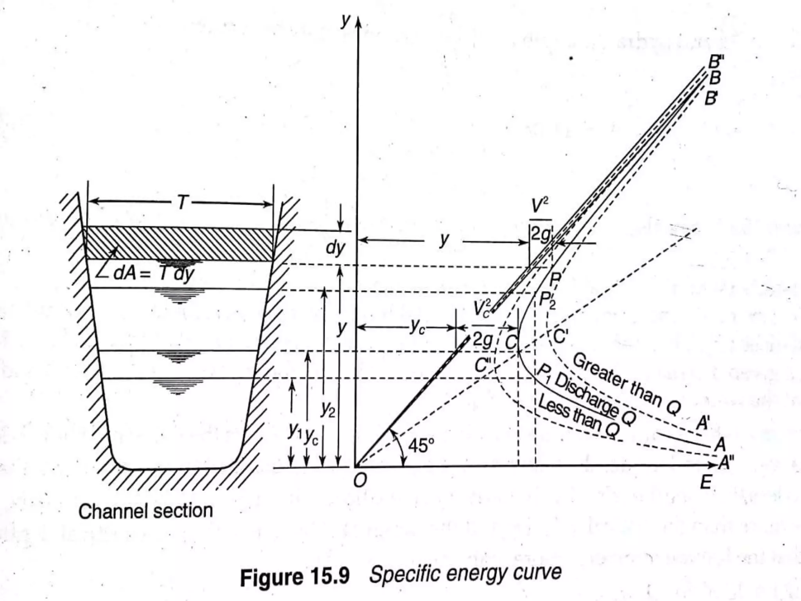

Slide 57
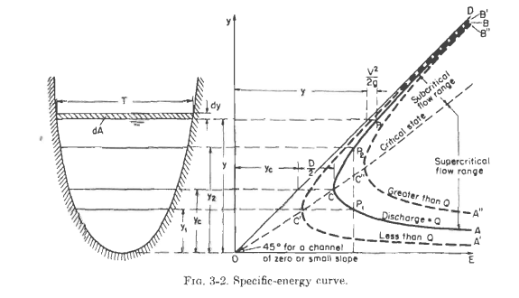

Slide 58
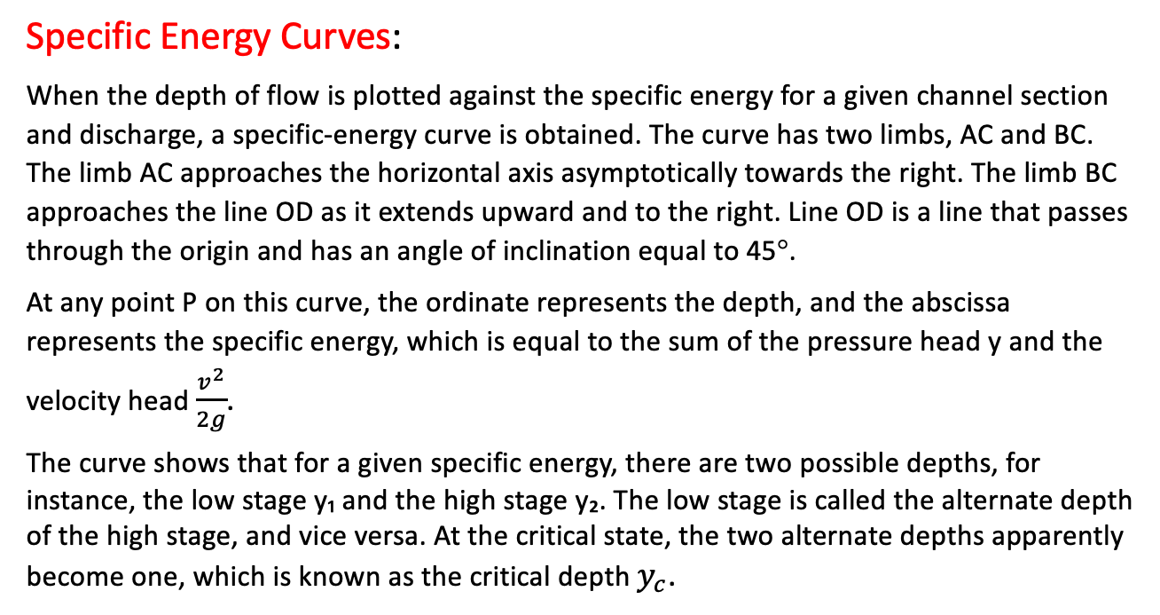
Specific Energy Curves:
When the depth of flow is plotted against the specific energy for a given channel section and discharge, a specific-energy curve is obtained. The curve has two limbs, AC and BC. The limb AC approaches the horizontal axis asymptotically towards the right. The limb BC approaches the line OD as it extends upward and to the right. Line OD is a line that passes through the origin and has an angle of inclination equal to 45°.
At any point P on this curve, the ordinate represents the depth, and the abscissa represents the specific energy, which is equal to the sum of the pressure head y and the velocity head $\frac{v^{2}}{2g}$.
The curve shows that for a given specific energy, there are two possible depths, for instance, the low stage y₁ and the high stage y₂. The low stage is called the alternate depth of the high stage, and vice versa. At the critical state, the two alternate depths apparently become one, which is known as the critical depth $y_{c}$.

Slide 59
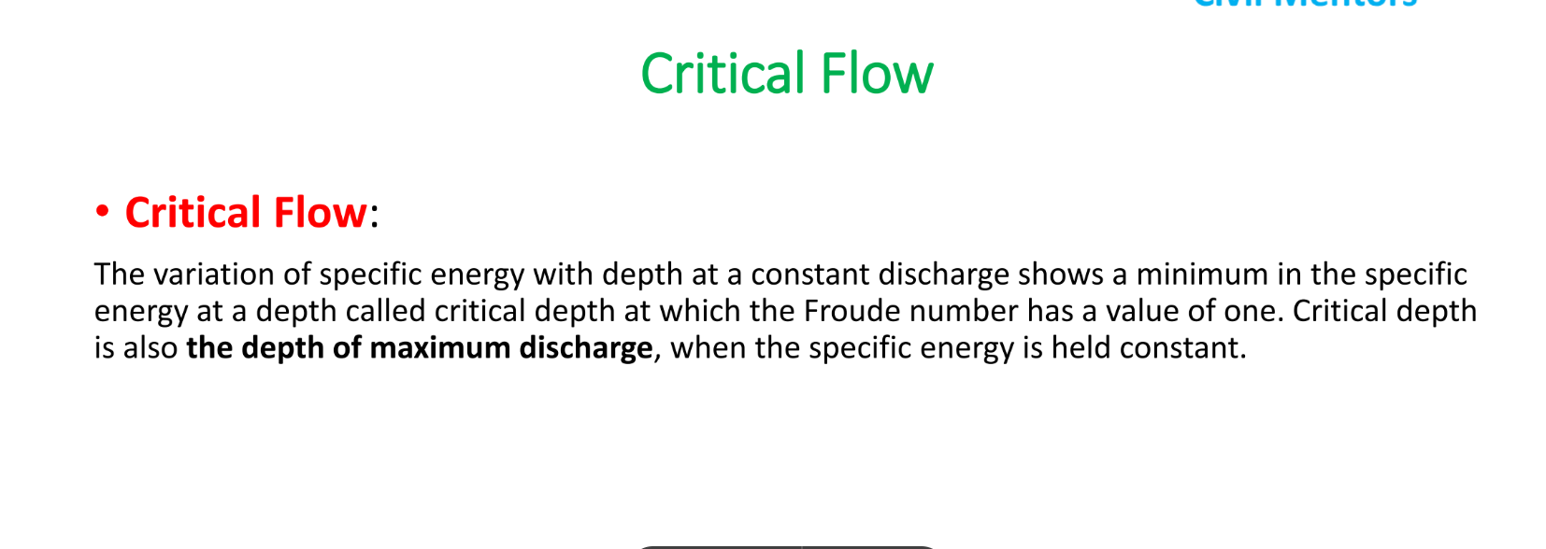

Slide 60
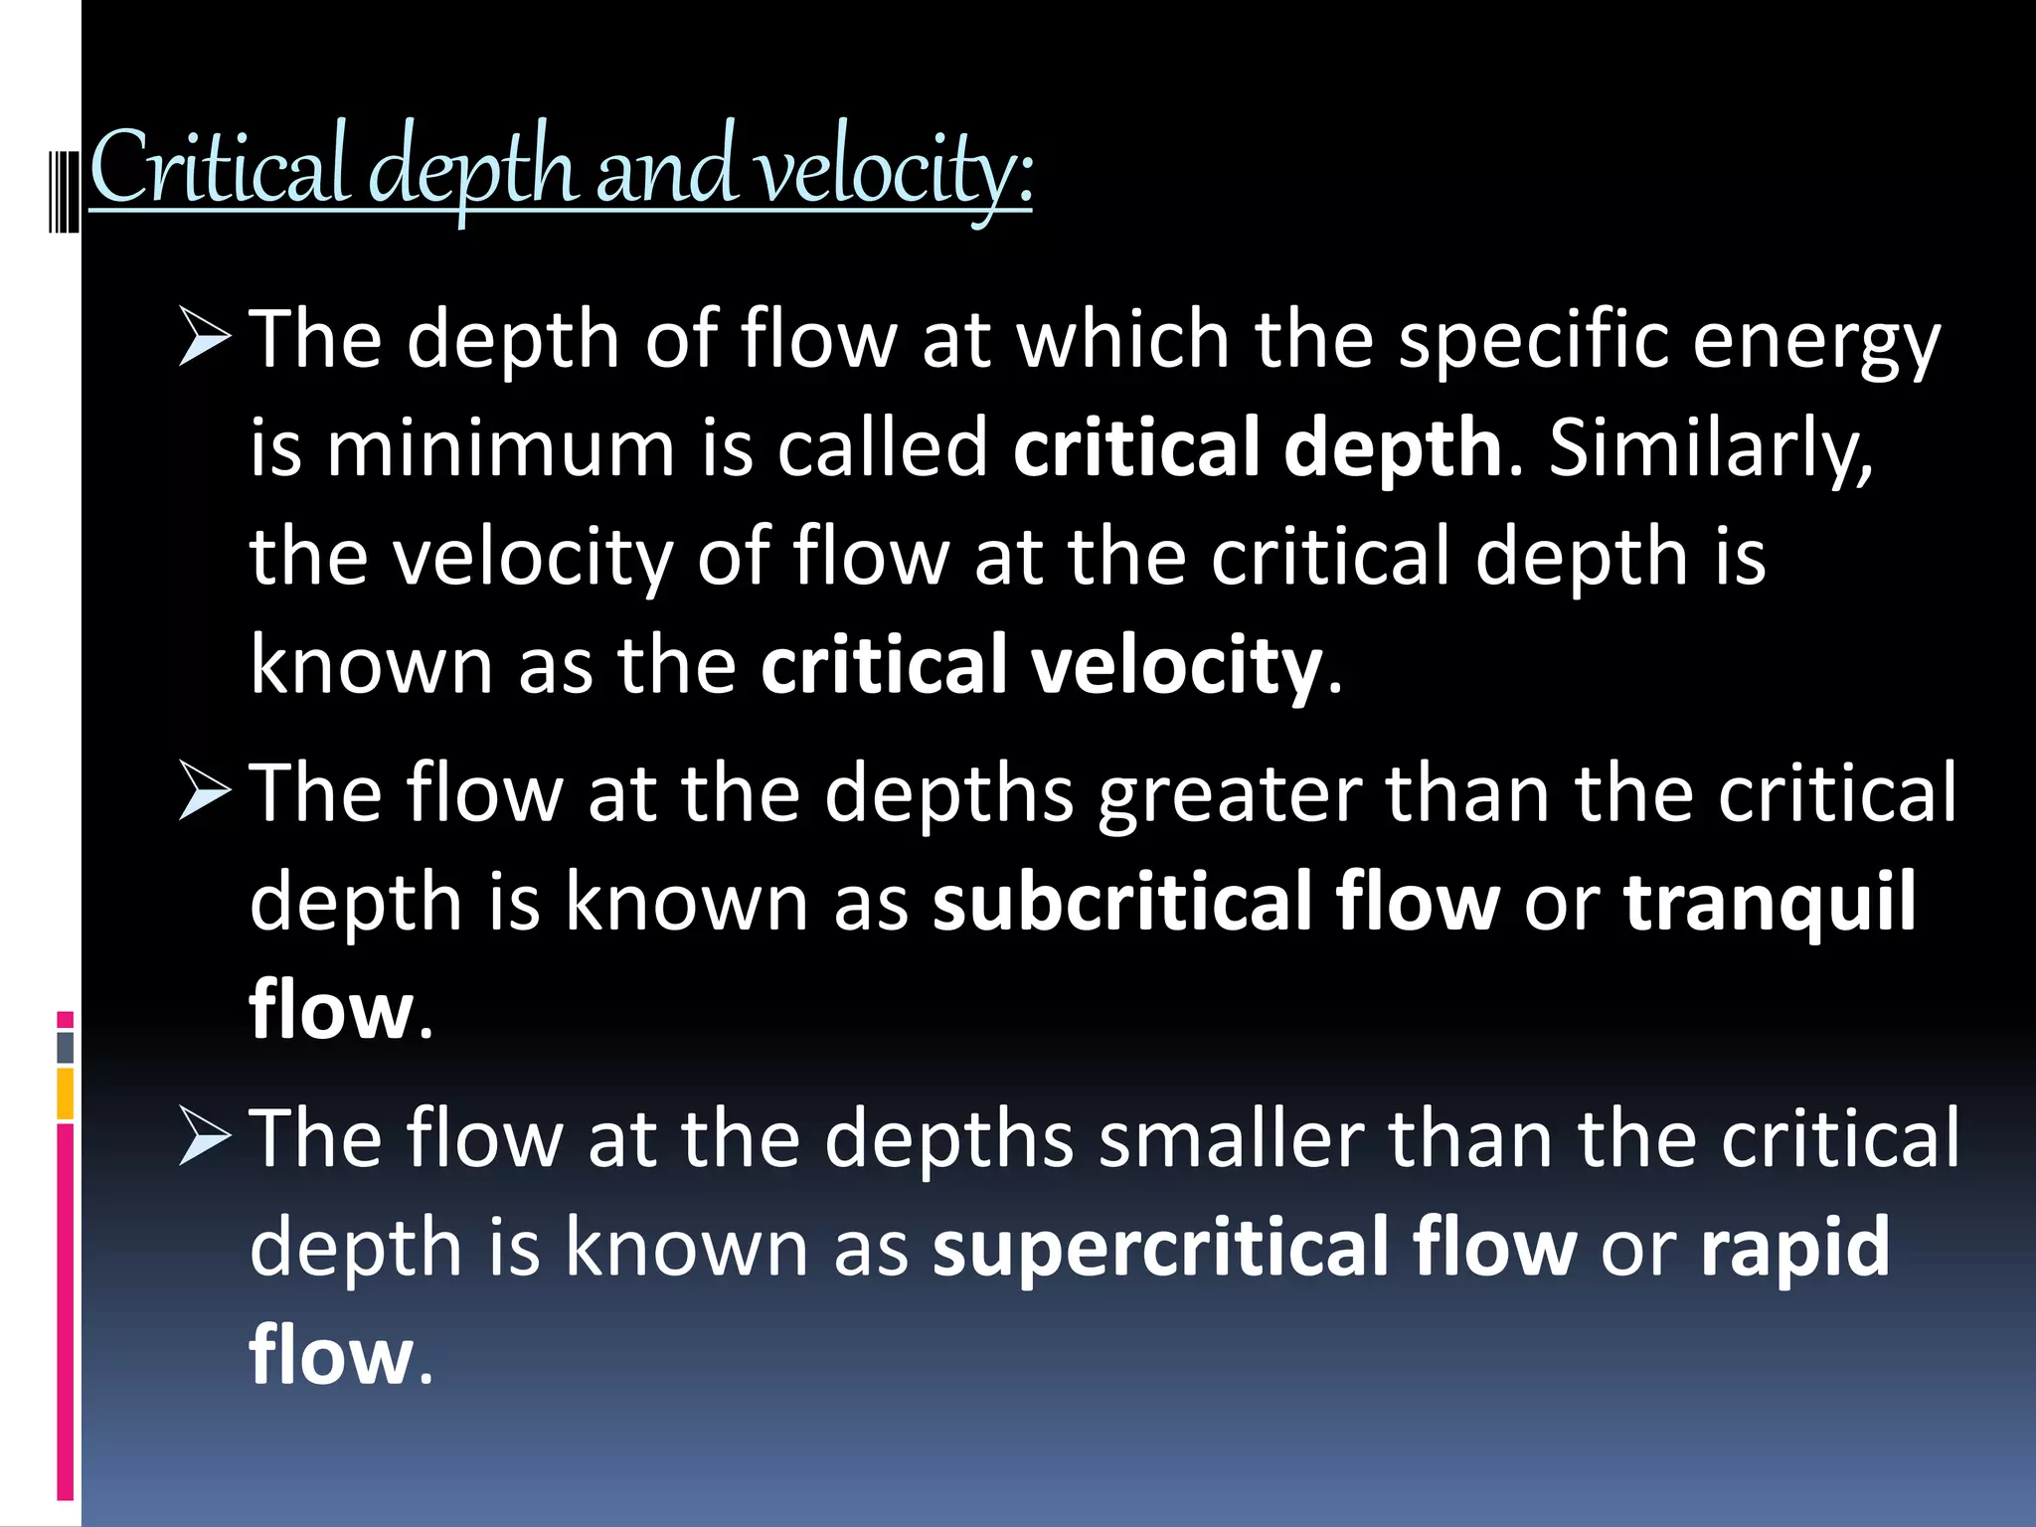

Slide 61
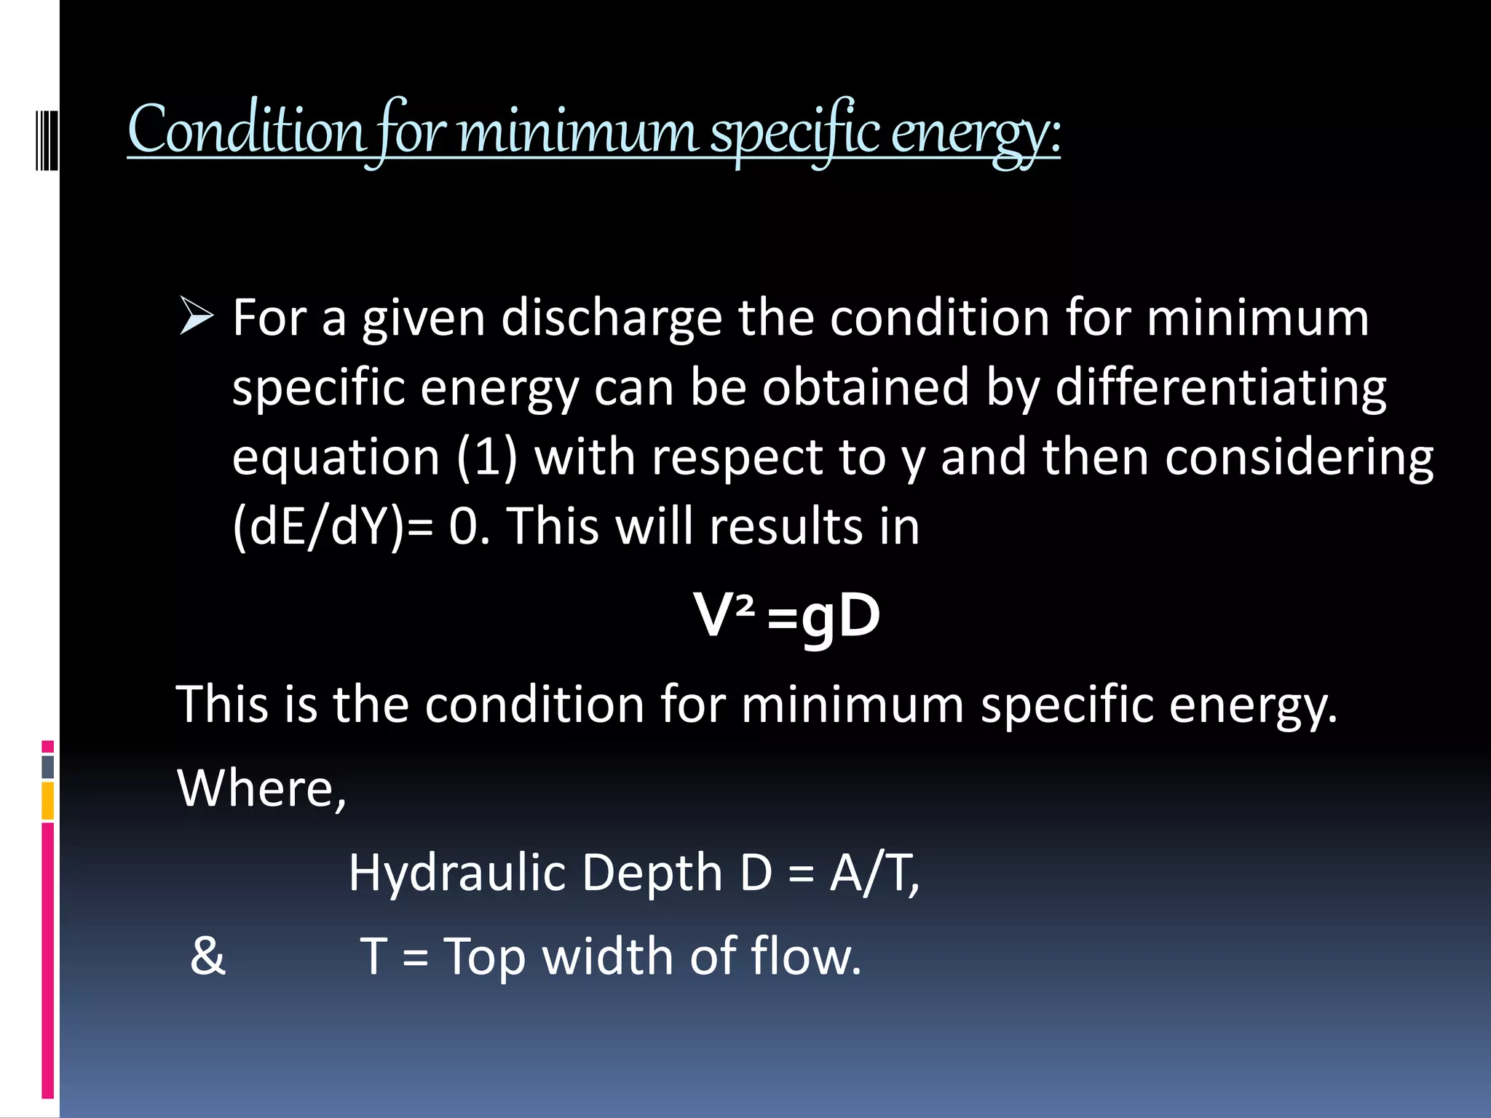

Slide 62
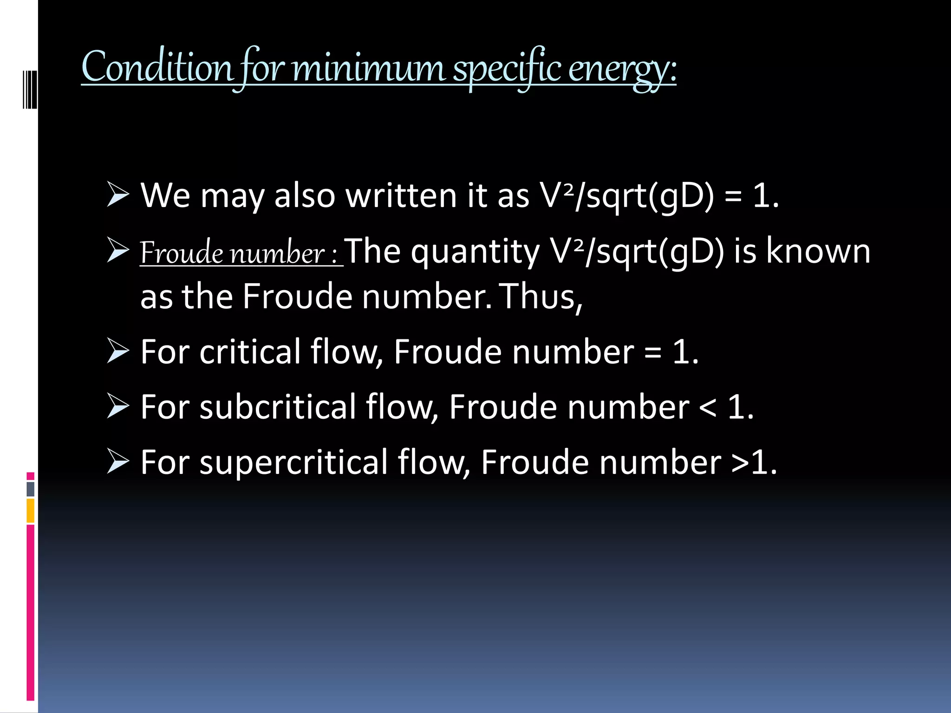

Slide 63
Different Condition For minimum Specific Energy and Critical Flow
Week 8

Slide 64
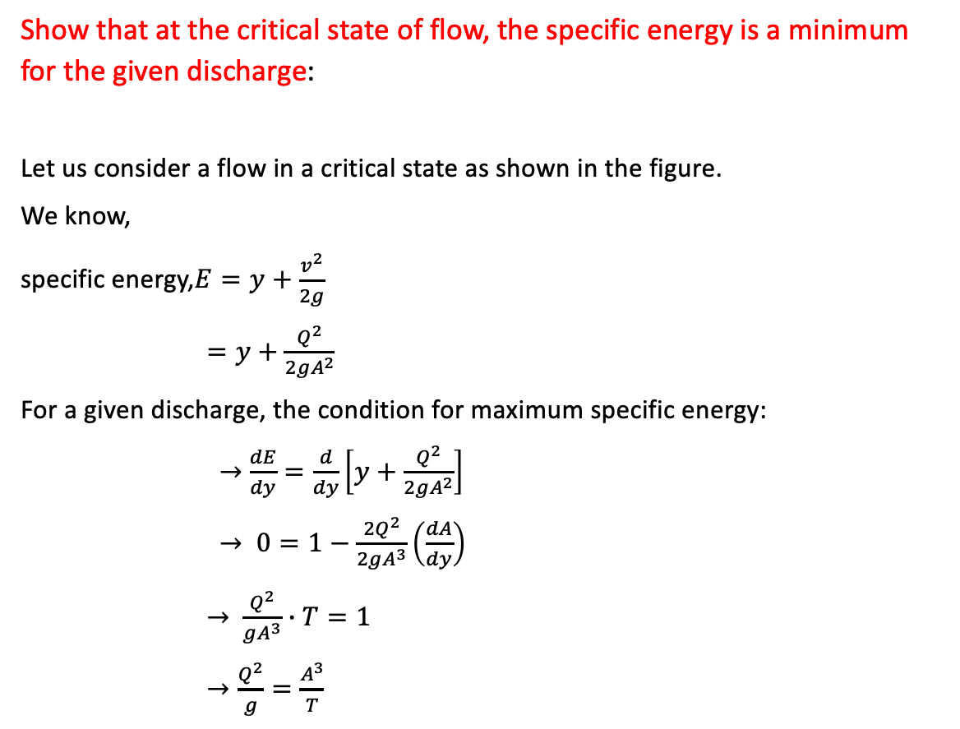
Show that at the critical state of flow, the specific energy is a minimum for the given discharge:
Let us consider a flow in a critical state as shown in the figure.
We know,
specific energy,$E=y+\frac{v^{2}}{2g}$
$=y+\frac{Q^{2}}{2gA^{2}}$
For a given discharge, the condition for maximum specific energy:
$→$ $\frac{dE}{dy}=\frac{d}{dy}\left[y+\frac{Q^{2}}{2gA^{2}}\right]$
$→$ $0=1−\frac{{2Q}^{2}}{2gA^{3}}\left(\frac{dA}{dy}\right)$
$→$ $\frac{Q^{2}}{gA^{3}}∙T=1$
$→\frac{Q^{2}}{g}=\frac{A^{3}}{T}$

Slide 65
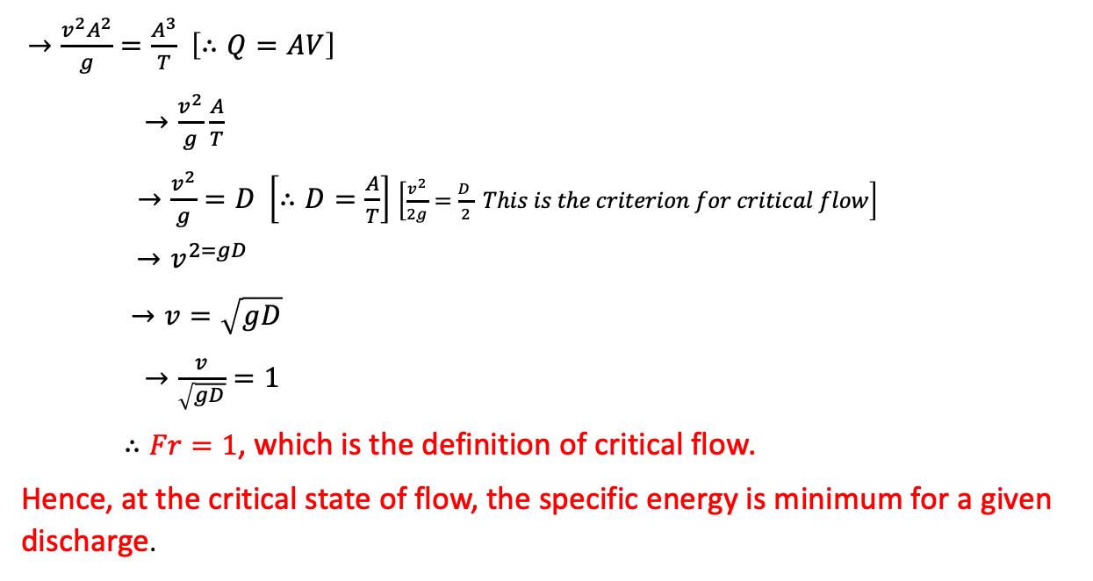
$→\frac{v^{2}A^{2}}{g}=\frac{A^{3}}{T}$ $\left[∴Q=AV\right]$
$→\frac{v^{2}}{g}$ $\frac{A}{T}$
$→\frac{v^{2}}{g}=D \left[∴D=\frac{A}{T}\right]$ $\left[\frac{v^{2}}{2g}=\frac{D }{2} This is the criterion for critical flow\right]$
$→v^{2=gD}$
$→v=\sqrt{gD}$
$→\frac{v}{\sqrt{gD}}=1$
$∴Fr=1$, which is the definition of critical flow.
Hence, at the critical state of flow, the specific energy is minimum for a given discharge.

Slide 66
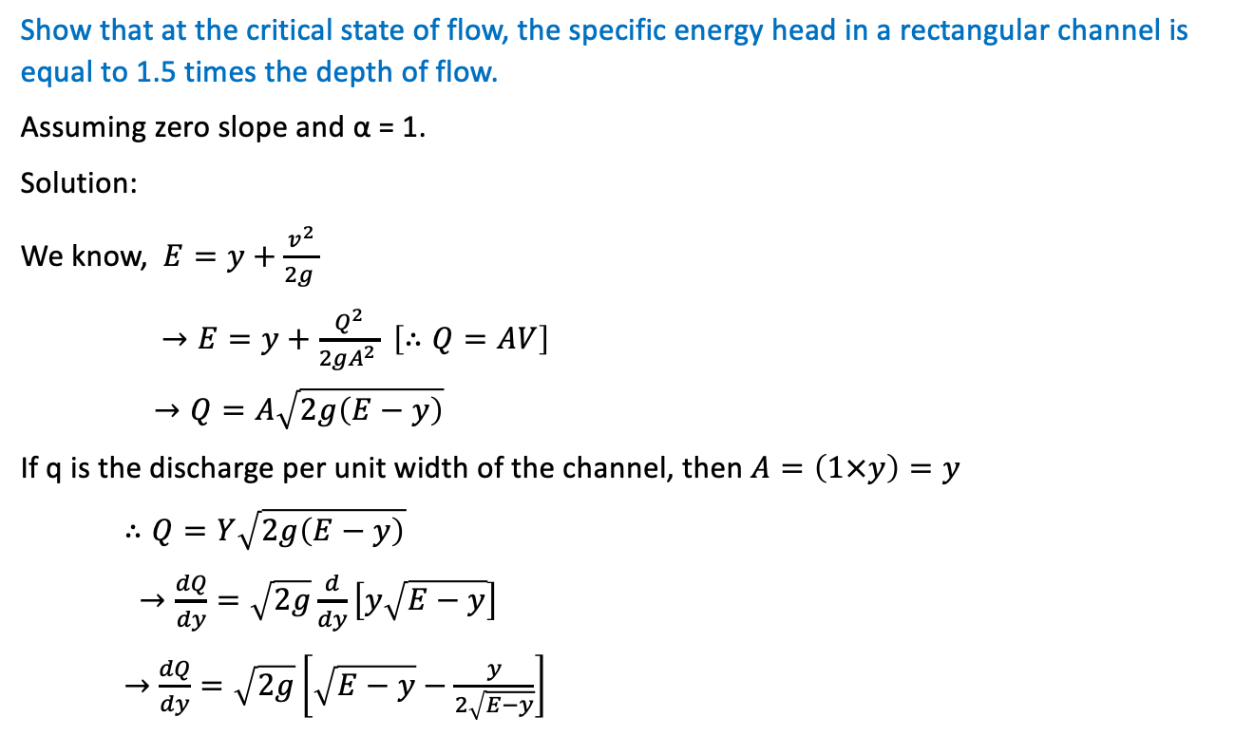
Show that at the critical state of flow, the specific energy head in a rectangular channel is equal to 1.5 times the depth of flow.
Assuming zero slope and α = 1.
Solution:
We know, $E=y+\frac{v^{2}}{2g }$
$→E=y+\frac{Q^{2}}{2gA^{2 }} \left[∴Q=AV\right]$
$→Q=A\sqrt{2g\left(E−y\right)}$
If q is the discharge per unit width of the channel, then $A=\left(1×y\right)=y$
$∴Q=Y\sqrt{2g\left(E−y\right)}$
$→\frac{dQ}{dy}=\sqrt{2g}\frac{d}{dy}\left[y\sqrt{E−y}\right]$
$→$ $\frac{dQ}{dy}=\sqrt{2g}\left[\sqrt{E−y}−\frac{y}{2\sqrt{E−y}}\right]$

Slide 67

For critical state of flow,$\frac{dQ}{dy}=0 and y=y_{c}$
$\sqrt{E−y_{c}}=\frac{y_{c}}{2\sqrt{E−y_{c}}}$
$→2\left(E−y_{c}\right)=y_{c}$
$→$2E=3$y_{c}$
$→E=1.5y_{c}$
For the critical state of flow, F=1=$\frac{V}{\sqrt{gD}}$
$→v_{c}=\sqrt{gD}$
$→v_{c }=\sqrt{gy_{c}}$
$→v_{c^{2 }}=gy_{c}$
$→\frac{Q^{2}}{A_{c^{2}}}=gy_{c}$
$→$ $\frac{Q^{2}}{{\left(by_{c}\right)}^{2}}$=$gy_{c}$
$→{y_{c} }^{3}=\frac{Q^{2}}{b^{2}g}$

Slide 68
Related Problems
Week 8

Slide 69


Slide 70


Slide 71


Slide 72


Slide 73

$∗$A trapezoidal channel has a bottom width of 6m and side slopes of 2:1. Compute the discharge and determine the state of flow in this channel if the depth of flow is 1.5m and the mean velocity of flow is 2.30 m/s. If elementary waves are created in this channel, determine the speed of the wave fronts upstream & downstream.
Solution:
$B=b+2sh=6+2×1.5=12m$
$A=\left(b+sh\right)h=13.5m^{2}$
$P=b+2\sqrt{1+s^{2 }}$ $h=12.71m$
$R=\frac{A}{P }$ $=1.06m$
$D=\frac{A}{B}=1.13m$
$∴Q=AV=13.5×2.3=31.05{m^{3}}/s$
Re$=\frac{VR}{V}=\frac{2.3×1.06}{{10}^{−6}}$ =$2.44×{10}^{6}>12500$
$Fr=\frac{VR}{\sqrt{gD}}=\frac{2.3}{\sqrt{9.81×1.13}}=0.69<1$
Therefore, the flow in the channel is subcritical turbulent.

Slide 74


Slide 75


Slide 76


Slide 77


Slide 78


Slide 79


Slide 80


Slide 81


Slide 82



Slide 83



Slide 84
Normal Depth related Theory
Week 9

Slide 85




Slide 86


Slide 87


Slide 88


Slide 89
Normal Depth related Math
Week 10

Slide 90


Slide 91


Slide 92


Slide 93


Slide 94


Slide 95


Slide 96
Channel Transition
Week 11

Slide 97


Slide 98


Slide 99


Slide 100


Slide 101


Slide 102


Slide 103


Slide 104


Slide 105


Slide 106
Theory Related To Channel Design
Week 12

Slide 107


Slide 108


Slide 109


Slide 110


Slide 111


Slide 112


Slide 113


Slide 114


Slide 115


Slide 116
Math Related To Channel Design
Week 13

Slide 117


Slide 118


Slide 119
Hydraulic Jump Related theory
Week 14-15

Slide 120


Definition of Hydraulic Jump
A hydraulic jump is a phenomenon in the science of hydraulics which is frequently observed in open channel flow such as rivers and spillways. When liquid at high velocity discharges into a zone of lower velocity, a rather abrupt rise occurs in the liquid surface.

Slide 121



Hydraulic Jump Cont…

Slide 122


Hydraulic Jump Cont…

Slide 123


Hydraulic Jump Cont…

Slide 124

Hydraulic Drop and Jump

Slide 125

Effect of Hydraulic Jump
It is very common in the field of hydraulics to use hydraulic jump. It is used to perform
different functions. Some of the effects of the hydraulic jump are as under:
Actually the hydraulic jump usually acts as the energy dissipater. It distributes the surplus energy of water.

Slide 126

Effect of Hydraulic Jump Cont..
Burrendong Dam spillway showing fully lined chute and full energy
dissipator.

Slide 127
Effect of Hydraulic Jump Cont.…
Due to the hydraulic jump, many noticeable disturbances are created in the flowing
water like eddies, reverse flow.
Usually when the hydraulic jump takes place, the considerable amount of air is trapped in the water. That air can be helpful in removing the wastes in the streams that are causing pollution.
Hydraulic jump also make the work of different hydraulic structures, effective like weirs, notches and flumes etc.

Slide 128

Applications of Hydraulic Jump:
01. Usually hydraulic jump reverses the flow of water. phenomenon can be used to mix chemicals for water purification.
This
Weir in Riverfront Park, WA (left) and Hydraulic Jump in Coagulation Chamber (right)

Slide 129
Applications of Hydraulic Jump Cont..
Hydraulic jump usually maintains the high water level on the down stream side. This high water level can be used for irrigation purposes.
Hydraulic jump can be used to remove the air from water supply and sewage lines to prevent the air locking.
It prevents the scouring action on the down stream side of the dam structure.

Slide 130
Classification of Jumps
As mentioned earlier, the supercritical flow Froude number influences the characteristics of the hydraulic jump. Bradley and Peterka, after extensive experimental investigations, have classified the hydraulic jump into five categories as shown in Figure 28.4. The hydraulic jump is the phenomenon that occurs where there is an abrupt transition from supercritical (inertia dominated) flow to sub critical (gravity dominated) flow. The most important factor that affects the hydraulic jump is the initial Froude number F1.

Slide 131

Classification of Jumps Cont..

Slide 132


Classification of Jumps Cont..

Slide 133



Slide 134


Slide 135


Slide 136


Slide 137


Slide 138


Slide 139


Slide 140
Hydraulic Jump Related Math
Week 16

Slide 141


Slide 142


Slide 143


Slide 144


Slide 145
Practice and Exercise
Week 17

