Slide 1

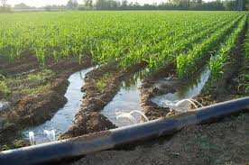
Irrigation & Flood Control
CE 4201
Prepared By
Somen Saha
Lecturer
Department of Civil Engineering
University of Global Village (UGV), Barishal

Slide 2
Irrigation & Flood Control
COURSE CODE: CE 4201 | CREDIT:04
 | TOTAL MARKS:200
Mid Exam Hours 2 | CIE MARKS: 120
Semester End Exam Hours 3 | SEE MARKS: 80
Course Learning Outcomes (CLOs): After completing this course successfully, the students will be able to-
CLO 1 | Designing irrigation systems, including canals, structures, and pumping systems..
CLO 2 | Evaluating the water requirements of different crops and irrigation methods
CLO 3 | Developing flood control measures, such as dams, levees, and floodways.
CLO 4 | Applying hydraulic and hydrologic principles to the design and analysis of irrigation and flood control systems.

Slide 3
BASIC COURSE INFORMATION
Course Title | Irrigation & Flood Control
Course Code | CE 4201
Credits | 04
CIE Marks | 120
SEE Marks | 80
Exam Hours | 2 hours (Mid Exam) 3 hours (Semester Final Exam)
Level | 7th Semester

Slide 4
SL | Content of Course | Hrs | CLOs
1 | Irrigation: Definition, Purpose, Benefits, Classification & Details of different types irrigation system, Duty & Delta ,Consumptive use& Evapotranspiration, Details on different method of irrigation, Details on Conductivity & SAR. | 15 | CLO1, CLO2
2 | Flood : Definition ,Causes, Types ,Losses of flood , method of estimation of design flood, Structural and non structural measures for flood Management, Design of irrigation canal | 15 | CLO3
3 | Hydraulic structure: Head Diversion and storage diversion work | 4 | CLO4
Text Book:
1. Irrigation Engineering &amp; Hydraulic Structures – Santosh Kumar Garg
2. Irrigation &amp; Water resource Engineering – G.L Asawa

Slide 5
ASSESSMENT PATTERN
CIE- Continuous Internal Evaluation (120 Marks)
SEE- Semester End Examination (80 Marks)
Bloom’s Category | Tests
Remember | 10
Understand | 15
Apply | 15
Analyze | 15
Evaluate | 15
Create | 10
Bloom’s Category Marks (out of 120) | Tests (60) | Assignments (20) | Quizzes (20) | External Participation in Curricular/Co-Curricular Activities (20)
Remember | 10 |  | 10 | Attendance 20
Understand | 10 |  | 10
Apply | 10
Analyze | 10
Evaluate | 10
Create | 10 | 20

Slide 6
Couse plan specifying content, CLOs, teaching learning and assessment strategy mapped with CLOs
Week | Topic | Teaching-Learning Strategy | Assessment Strategy | Corresponding CLOs | Page No
1 | Introduction , Definition, Purpose, Benefits of Irrigation | Lecture, discussion, group work | Quiz, Written Exam | CLO1, CLO2 | 7-10
2 | Classification and details of different types of irrigation system | Oral Presentation, debate | Assignment, Written, Quiz | CLO1, CLO2 | 11-17
3 | Duty & Delta | Video lecture, Field visit | Report writing, Demonstration | CLO1,CLO2 | 19=23
4 | Duty & Delta related problems | Lecture | Viva, Quiz | CLO1, CLO2 | 25-33
5 | Consumptive Use and Evapotranspiration | Project exhibition | Project, Field visit | CLO1, CLO2 | 35-44
6 | Different method of irrigation | Discussion, Video Presentation | Quiz, Written Exam | CLO1, CLO2 | 45-61
7 | Details on Conductivity & SAR | Case-based Learning, Demonstration | Assignment, Written, Quiz | CLO1, CLO2 | 63-66
8 | Head Diversion & Storage Diversion work | Lecture, discussion, group work | Report writing, Demonstration | CLO1, CLO2 | 68-74
9 | Definition of Flood and its Causes | Oral Presentation, debate | Viva, Quiz | CLO3 | 76-81
10 | Types And losses of Flood | Video lecture | Project, Field visit | CLO3 | 83-90

Slide 7
11 | Method Of Estimation of design flood | Lecture | Quiz, Written Exam | CLO3 | 92-134
12 | Method Of Estimation of design flood | Project exhibition | Assignment, Written, Quiz | CLO3 | 92-134
13 | Structural & Non Structural measures for flood management | Discussion, Video Presentation | Report writing, Demonstration | CLO3 | 136-155
14 | Structural & Non Structural measures for flood management | Case-based Learning, Demonstration | Viva, Quiz | CLO3 | 157-161
15 | Design of irrigation canal | Lecture, discussion, group work | Project, Field visit | CLO3 | 163-183
16 | Design of irrigation canal | Oral Presentation, debate | Quiz, Written Exam | CLO3 | 163-183
17 | Practice and Exercise, Practice and Exercise, Practice and Exercise | Video lecture | Assignment, Written, Quiz | CLO3 | 184

Slide 8
Introduction , Definition, Purpose, Benefits of Irrigation
Week 1

Slide 9
Irrigation: Irrigation can be defined as the process of artificially supplying water to soil for raising crops. It is a science of planning and designing an efficient, low-cost, economic irrigation system tailored to fit natural conditions. It is the engineering of controlling and harnessing the various natural resource of water by the construction of dams and reservoirs, canals and finally distributing the water to the agricultural fields.
Necessity of irrigation:
The necessity of irrigation can be summarized in the following
Less Rainfall: When the total rainfall is less than needed for the crop, artificial supply is necessary. In such a case irrigation works may be constructed at a place where more water is available and then to convey the water to the area where there is deficiency of water.
Non uniform rainfall: The rainfall in a particular area may not be uniform over the crop period. During the early periods of the crop, rains may be there, but no rain water may be at the end, with the result that either the yield may be less or the crop may die altogether. By the collection of water during the excess period water may be supplied to the crop during the period when there may be no rainfall.

Slide 10
Purpose of irrigation:
Commercial hips with additional water:
The rainfall in a particular area may be sufficient to raise the usual crops but more water may be necessary for raising commercial and cash crops.
Controlled water supply:
By the construction of proper distribution system, the yield of the crop may be increased because of controlled supply of water.
Adds water to the soil to supply the moisture essential for the plant growth.
Saves the crops from drying during short duration drought.
Cools the soil and the atmosphere and thus makes more favorable environment for healthy growth.
Washes out or dilutes salts in the soil.
Reduce the hazard of soil piping.
Softens the tillage pans.

Slide 11
Benefits of irrigation:
Increase in food production.
Protection from famine.
Cultivation of cash crops.
Elimination of mixed cropping.
Addition of wealth of the country.
Increase in prosperity of people.
Generation of hydro-electric power.
✓ Domestic and industrial water supply.
✓ Inland navigation.
✓ Improvement of communication.
✓ General development of the country

Slide 12
Classification and details of different types of irrigation system
Week 2

Slide 13
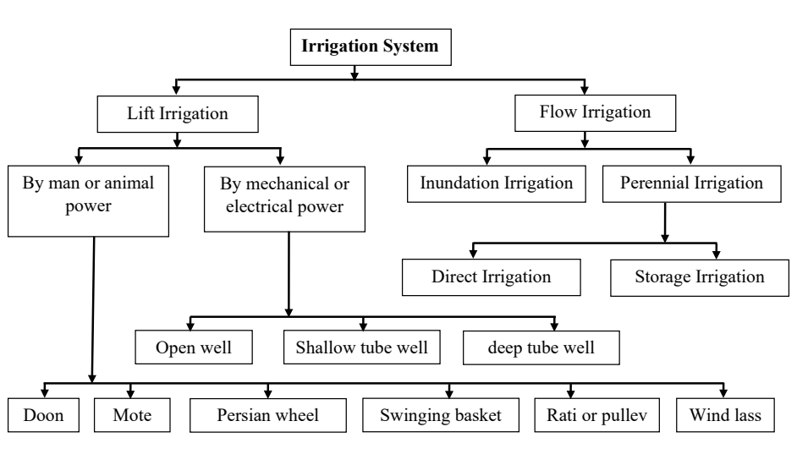

Slide 14
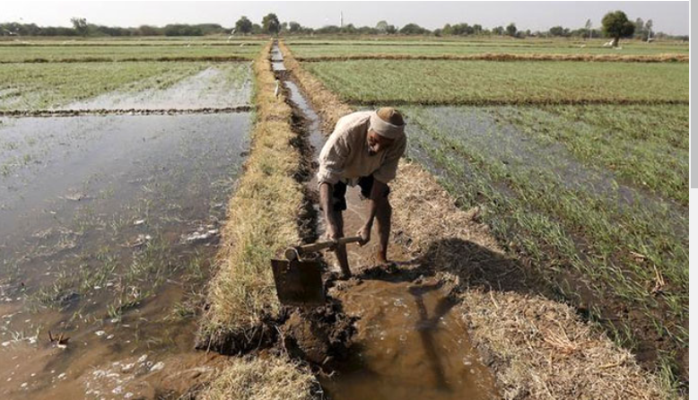
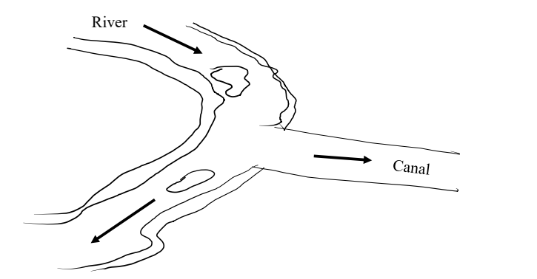
Flow Irrigation: When water flows under gravitational pull through the artificial canal towards the agricultural land, it is termed as flow irrigation.
Mainly two types:
Inundation irrigation system: In this system, a canal is excavated from the bank of the inundation river. In this case water flows to the agricultural land in rainy season only. There is no regulator at the head of the canal to control the flow of water. The bed level of the canal is fixed at such level that the water can flow through the canal only when the water level of the river rises above the canal bed. Again the flow of water through the canal stops automatically when the water level of the river falls below the canal bed.

Slide 15
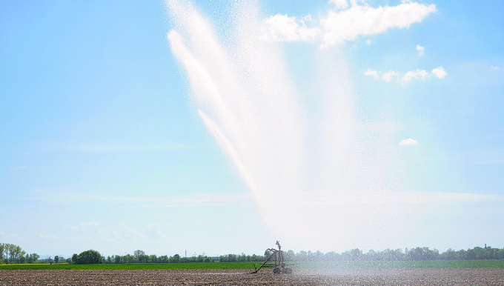
2. Perennial system of irrigation: In this system, a weir or a barrage is constructed across the perennial river to raise the water level on the up stream side or a dam is constructed to form a storage reservoir. The main canal is constructed on either side or both the banks of a river. Regulator is constructed at the head of the canal to control the flow of water through the canal towards the agricultural land.

Slide 16
Q. Which one you will choose between direct irrigation or storage irrigation method?
Direct irrigation scheme is adopted in circumstances where the river is perennial and has a normal flow throughout the irrigation season, never less at any time then the requirements of the field. On the contrary, storage irrigation system is adopted where the river flow is either not perennial or where flow is insufficient during certain parts of the crop season for irrigation requirement.

Slide 17
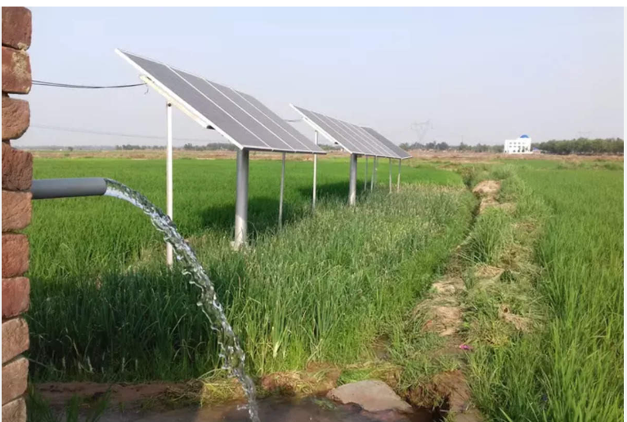
Lift Irrigation: When water is lifted from surface sources or underground sources by man or animal, mechanical or electrical power and directly supplied to the agricultural land, then it is known as lift irrigation.

Slide 18
Advantages:
The farmers can supply water to their fields according to the requirement.
Reducing the chance of water logging.
No water loss due to conveyance.
Initial cost is low.
The duty of water is high.
The maintenance cost is low.
More than one crop can be grown in a year on the same land.

Slide 19
Disadvantages:
In the summer the surface water may be dried up and the water table may go down below the suction head. Hence, lift irrigation from the surface source and from the shallow tube well may fail in summer.
If the lifting mechanism fails due to mechanical or electrical failure, then water cannot be supplied until the mechanism is restored.
The well water has no silt content. The yield of crop therefore depends on chemical fertilizer, which is costly.
The lift irrigation in consideration with the yield of crop is not cost effective.

Slide 20
Duty & Delta
Week 3

Slide 21
Crop Period:
Crop period is defined as the total time that elapses between the showing of the crops and its harvesting. Thus crop period represents the total time during which the crop remains in the field.
Base Period: Base period is defined as the total time between the first watering done for the preparation of the land for sowing of a crop and the last watering done before its harvesting. It is thus evident that the crop period is slightly more than the base period for any crop.
Duty:
Duty of water is the relation between the area of land irrigated and the quantity of water required to be supplied for growing a crop. It is denoted by D.
Delta:
Delta is defined as the total depth of water over the irrigated land required by a crop grown on it during the entire base period of the crop. It is denoted by symbol

Slide 22
Delta:
The depth of water required every time, generally varies depending upon the type of the crop.
• The total depth of water required a crop to nature is called delta.
Factor affecting the duty:
1) Soil Moisture
• In clayey soil less water is required since its retentive capacity is more.
• Pervious soil it will be more.
.

Slide 23
2) Topography:
• Uniform distribution depends on topography.
• If the area is sloping the lower portion will get more water than the flat portion, & hence Water requirement is increase
3) Nature of rainfall:.
If rainfall is high over the crop period water requirement becomes less, otherwise it will be more.
4) Nature of crop irrigated:
• Dry crop required less water where as wed crop required more water.
5) Method of cultivation:
• If the fields are properly ploughed it will have high retentive capacity & the number of watering are reduced.

Slide 24
6) Season of crop:
• Less irrigation water is required for rainy season crop and the duty increased.
• If the crop grown in summer, more irrigation water is required & the duty gets decreased
7) System of Irrigation:
• In perennial irrigation, continuous supply of water is given & hence water table is kept high & percolation losses is minimized
• In inundation type wastage is more by deep percolation.
8) Canal Condition:
• Well maintained canal will have more duty as the losses is less.

Slide 25
Improving Duty
1. The water losses can be reduced by having the irrigated area nearer to the head of the canal.
2. Evaporation losses can be minimized by using the water as quickly as possible.
3. Water losses can be minimized by lining the canals.
4. The cultivators should be trained to use water economically without wasting.
5. The soil properties should be studied by establishing research stations in villages.

Slide 26
Duty & Delta related problems
Week 4

Slide 27
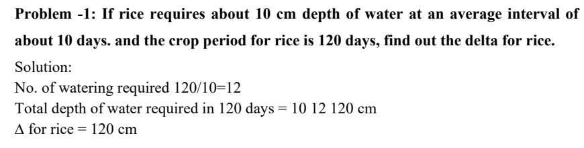

Slide 28
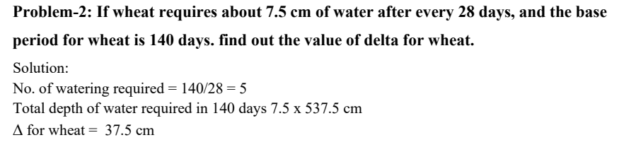

Slide 29
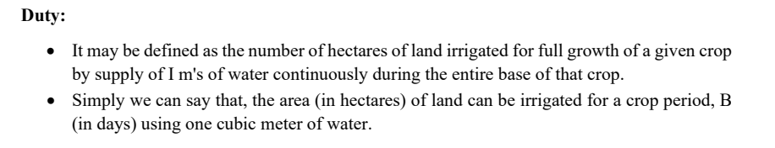
Factors on which duty depends:
1. Type of crop
2. Climate and Season
3. Type of use
4. Efficiency of cultivation method

Slide 30
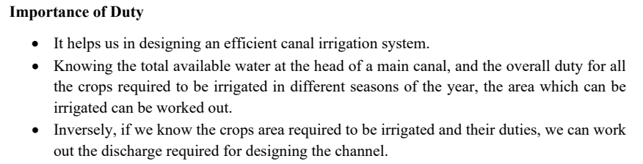

Slide 31
Measures for improving duty of water:
The duty of canal water can certainly be improved by effecting economy in the use of water by resorting to the following precautions and practices:
(1) Proper Ploughing:
Ploughing should be done properly and deeply so that the moisture retaining capacity of soil is increase.
(2) Methods of supplying water:
The method of supplying water to the agriculture land should be decided according to the field and soil conditions. For example,
- Furrow method For crops sown ion rows
- Contour method For hilly areas
- Basin For orchards
- Flooding For plain lands

Slide 32
(3) Canal Lining:
It is provided to reduce percolation loss and evaporation loss due to high velocity.
(4) Minimum idle length of irrigation Canals:
The canal should be nearest to the command area so that idle length of the canal is minimum and hence reduced transmission losses.
(5) Quality of water:
Good quality of water should be used for irrigation. Pollution en route the canal should be avoided.
(6) Crop rotation:
The principle of crop rotation should be adopted to increase the moisture retaining capacity and fertility of the soil.

Slide 33
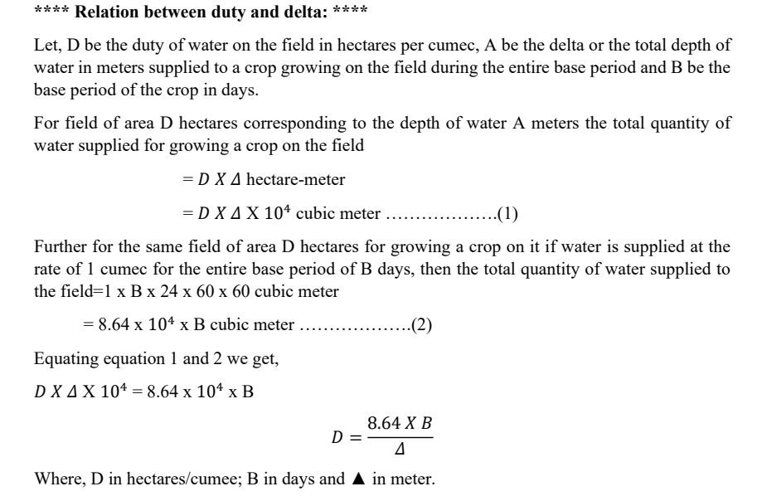

Slide 34
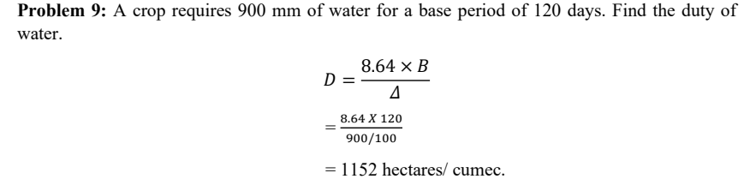

Slide 35
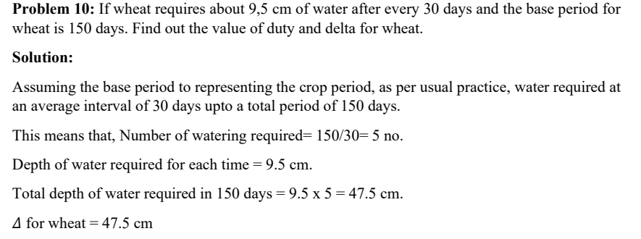

Slide 36
Consumptive Use and Evapotranspiration
Week 5

Slide 37
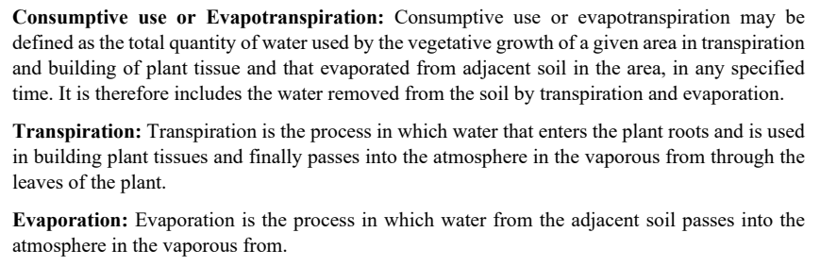

Slide 38
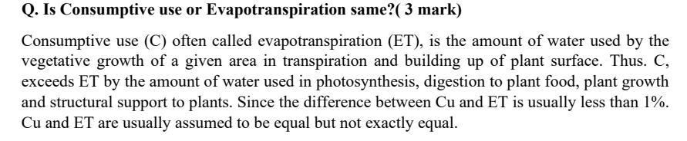

Slide 39
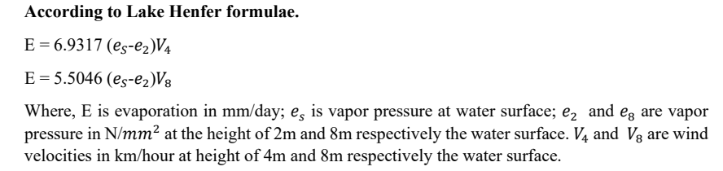

Slide 40
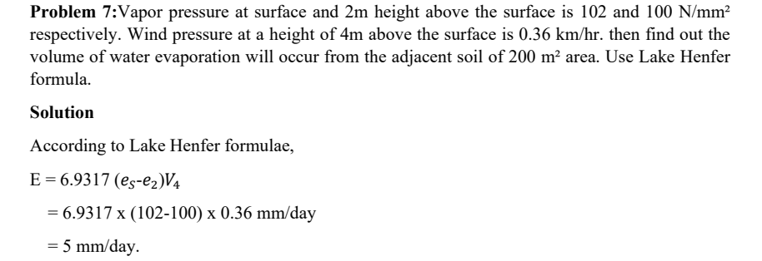

Slide 41
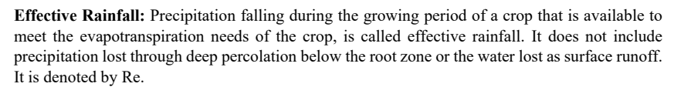

Slide 42
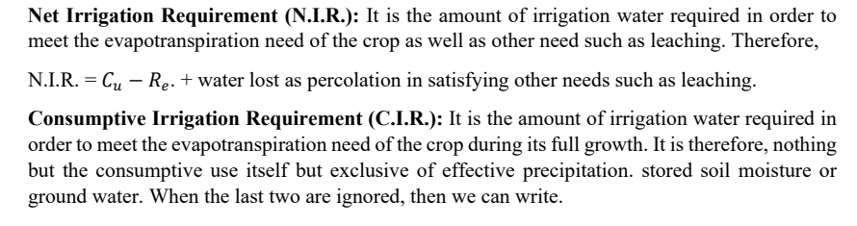

Slide 43
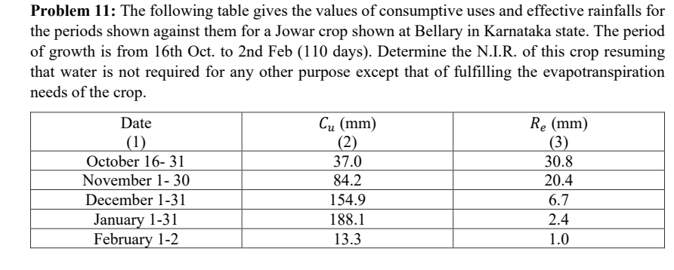

Slide 44
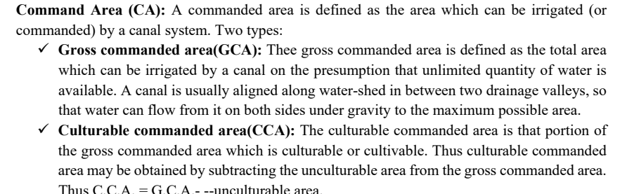

Slide 45
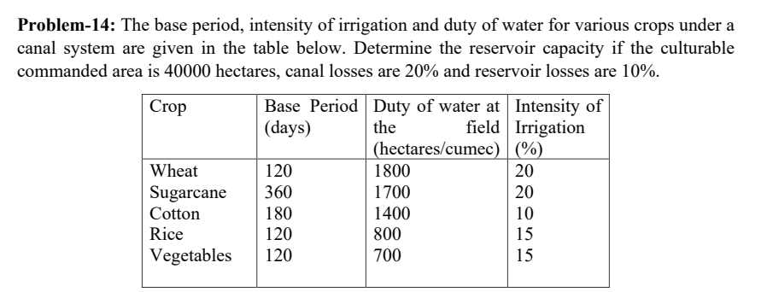

Slide 46
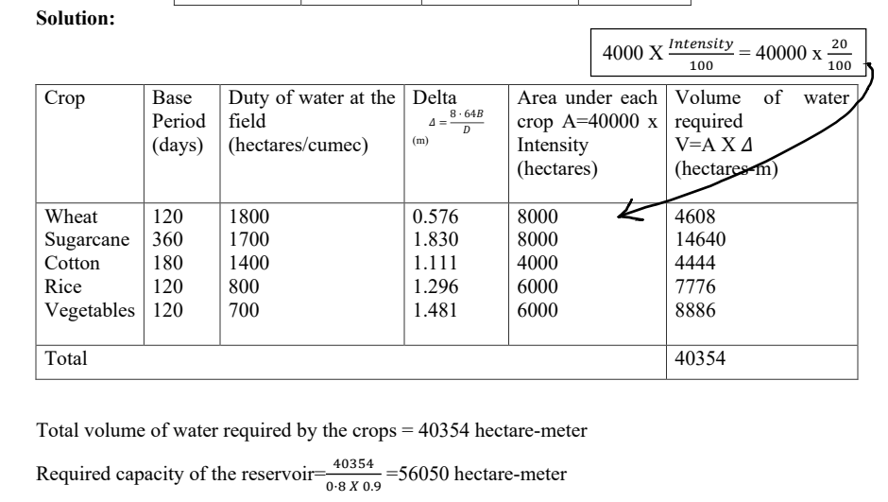

Slide 47
Different method of irrigation
Week 6

Slide 48
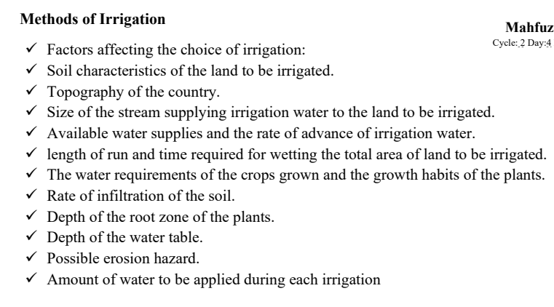


Slide 49
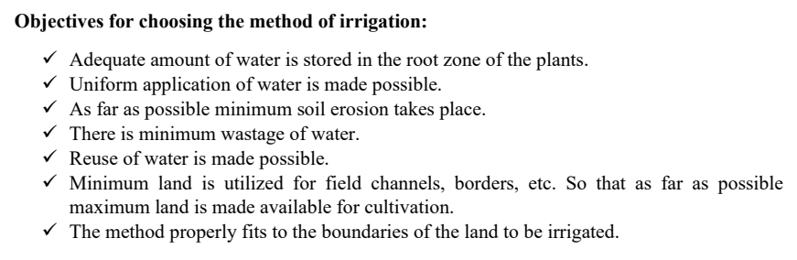

Slide 50
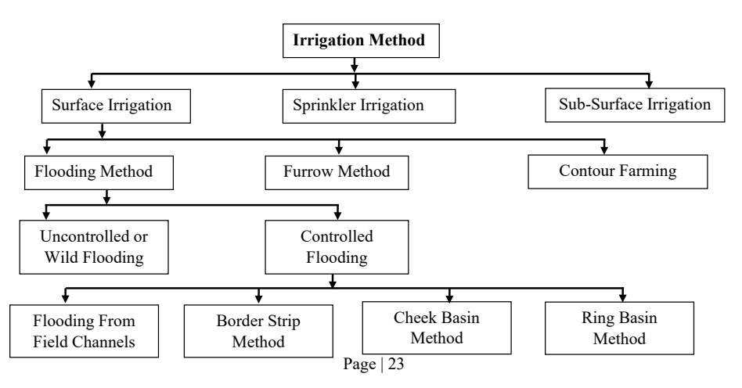

Slide 51
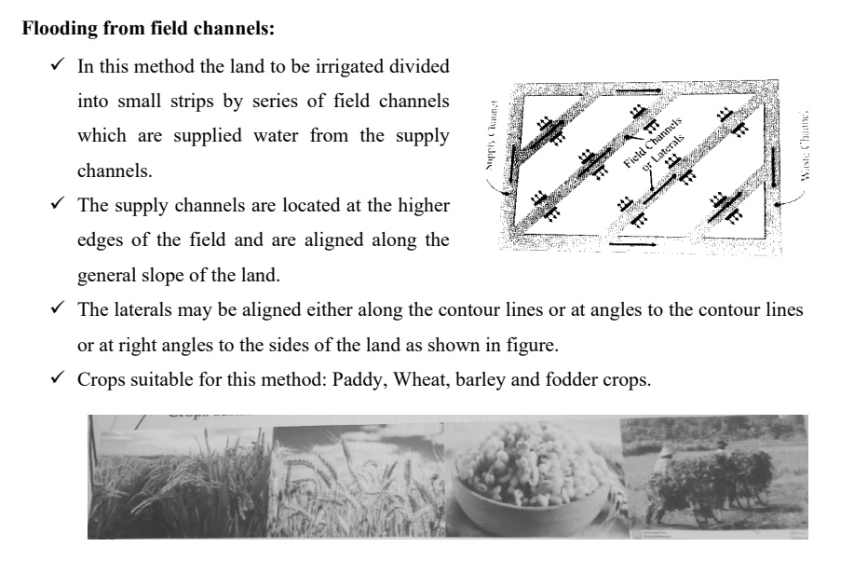

Slide 52
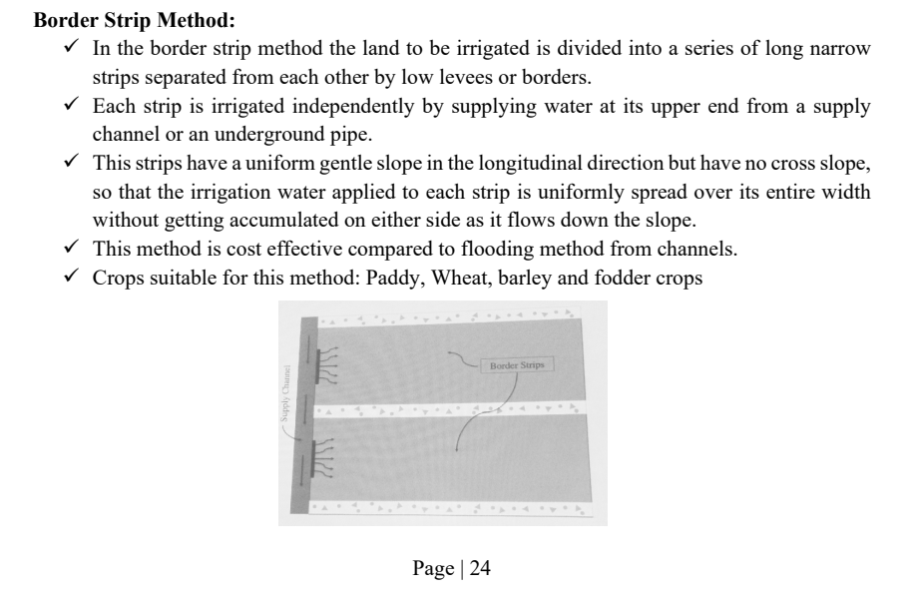

Slide 53
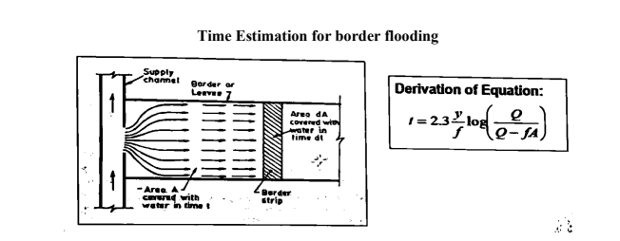

Slide 54
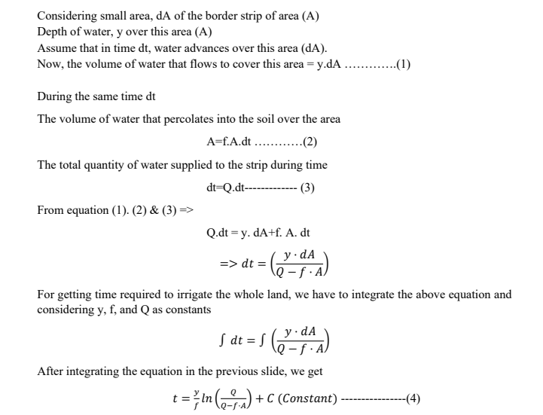

Slide 55



Slide 56


Slide 57
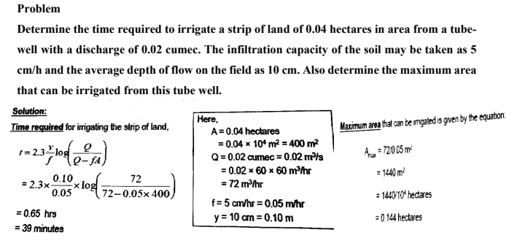

Slide 58
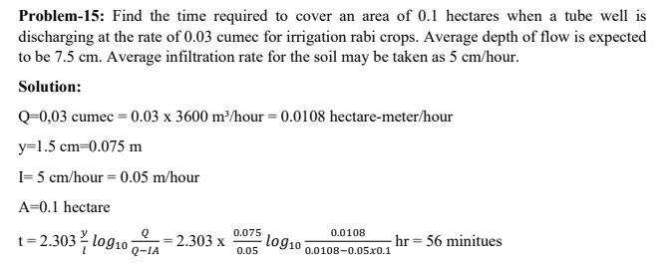

Slide 59
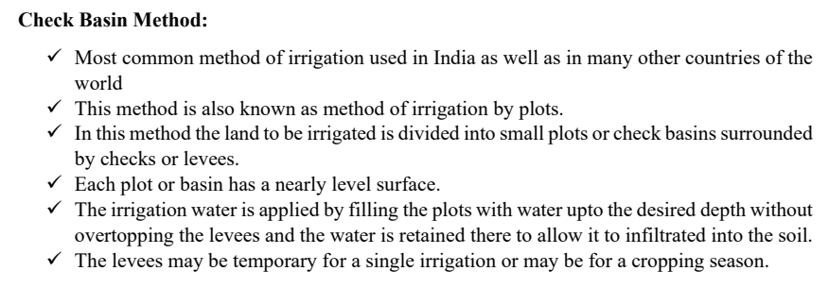
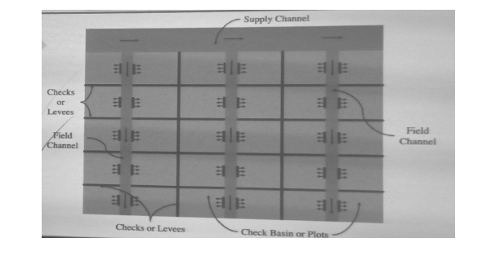

Slide 60
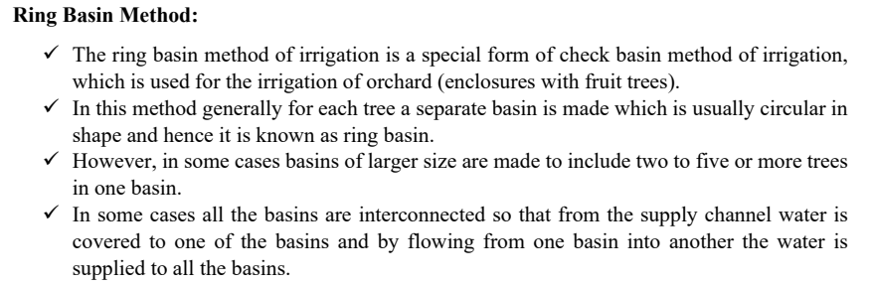
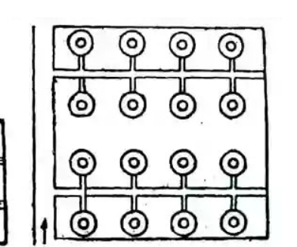
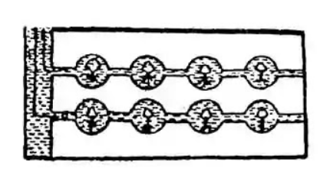

Slide 61
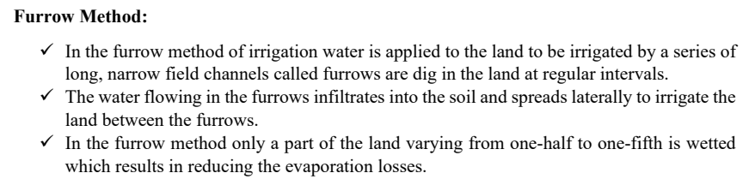
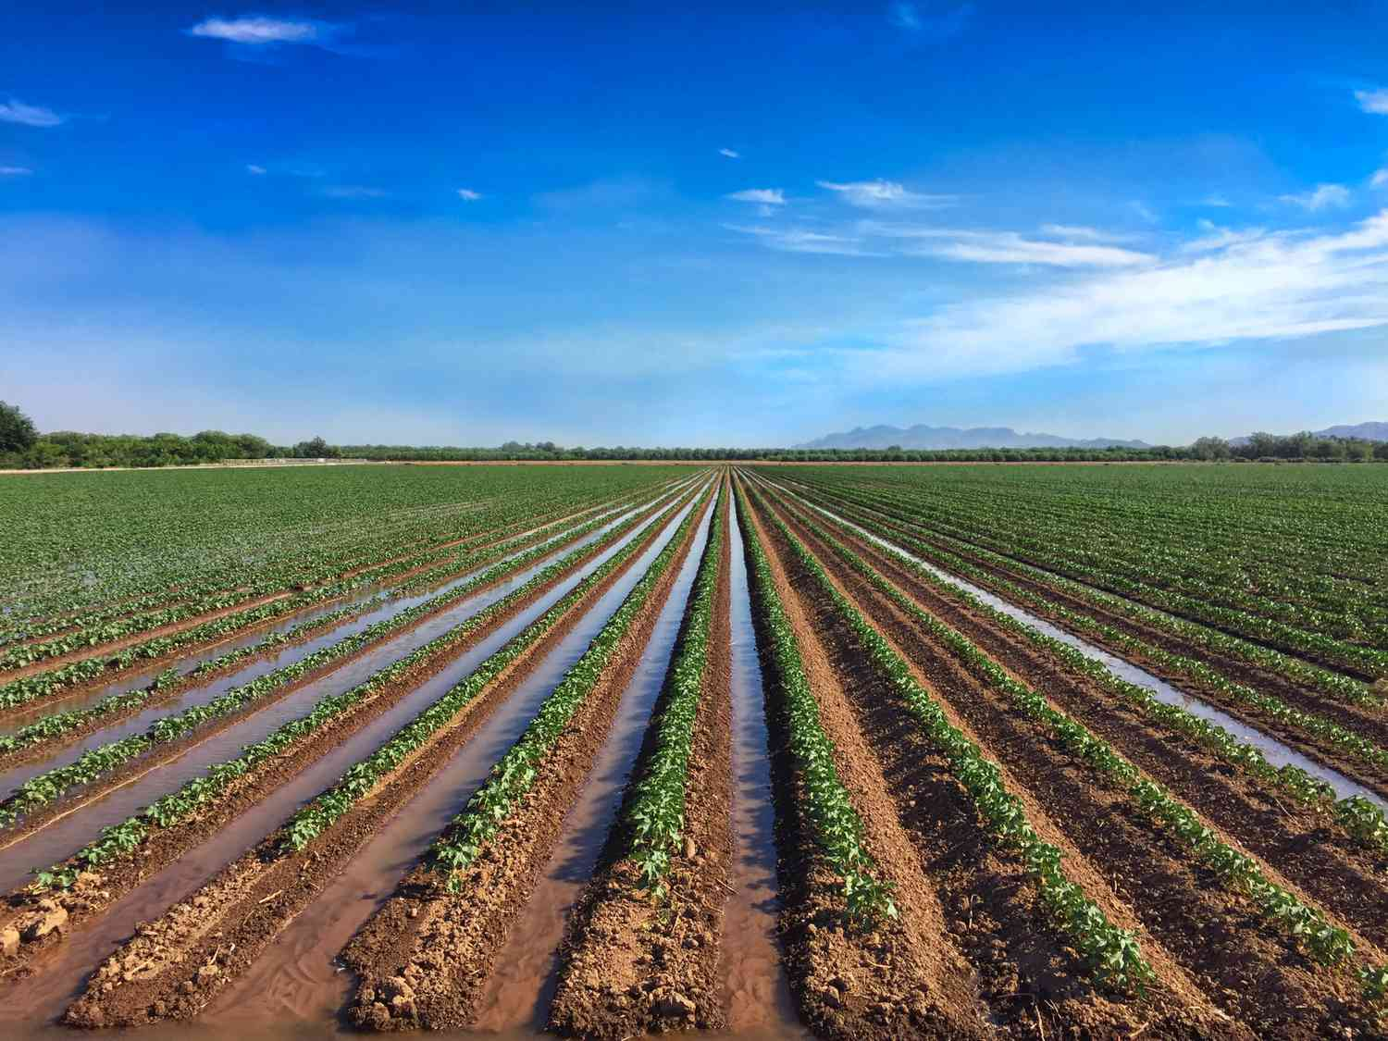

Slide 62
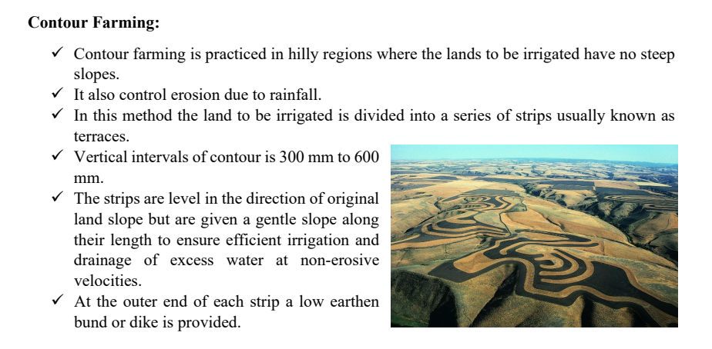

Slide 63
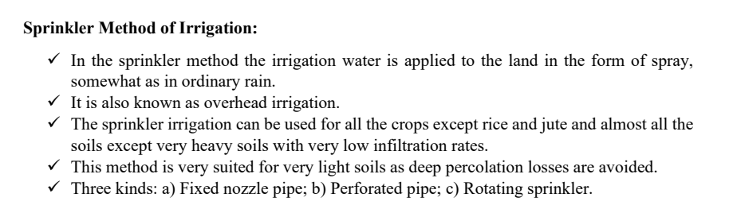

Slide 64
Details on Conductivity & SAR
Week 7

Slide 65
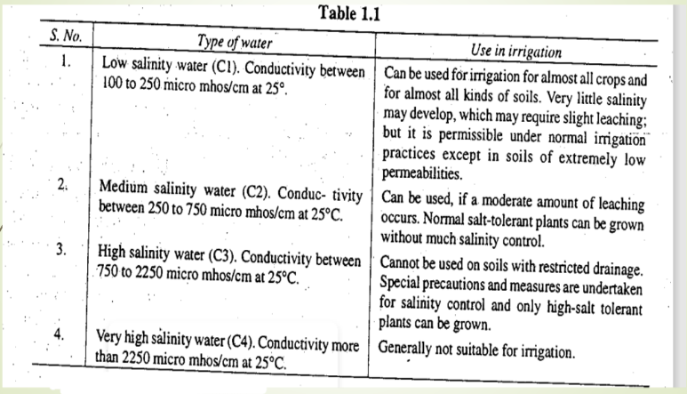

Slide 66
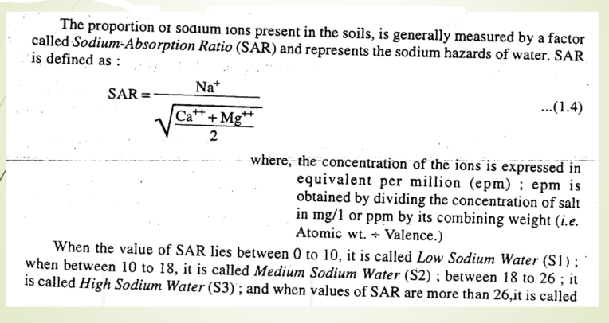

Slide 67
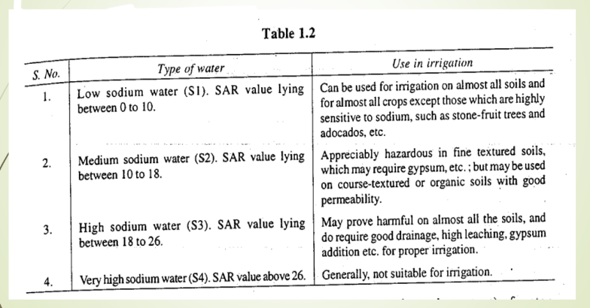

Slide 68
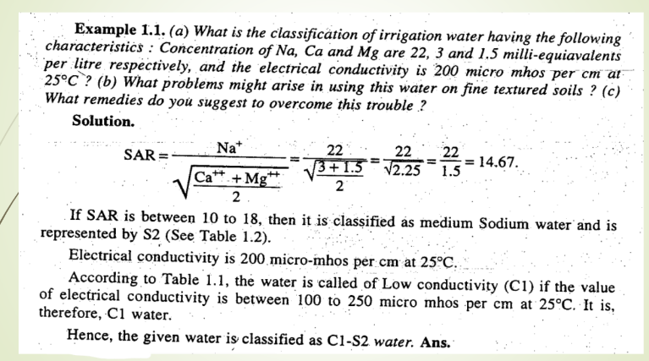

Slide 69
Head Diversion & Storage Diversion work
Week 8

Slide 70
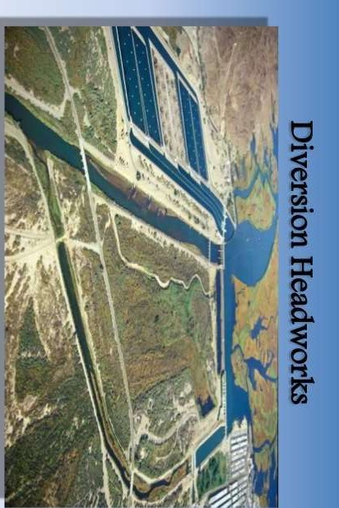

Slide 72
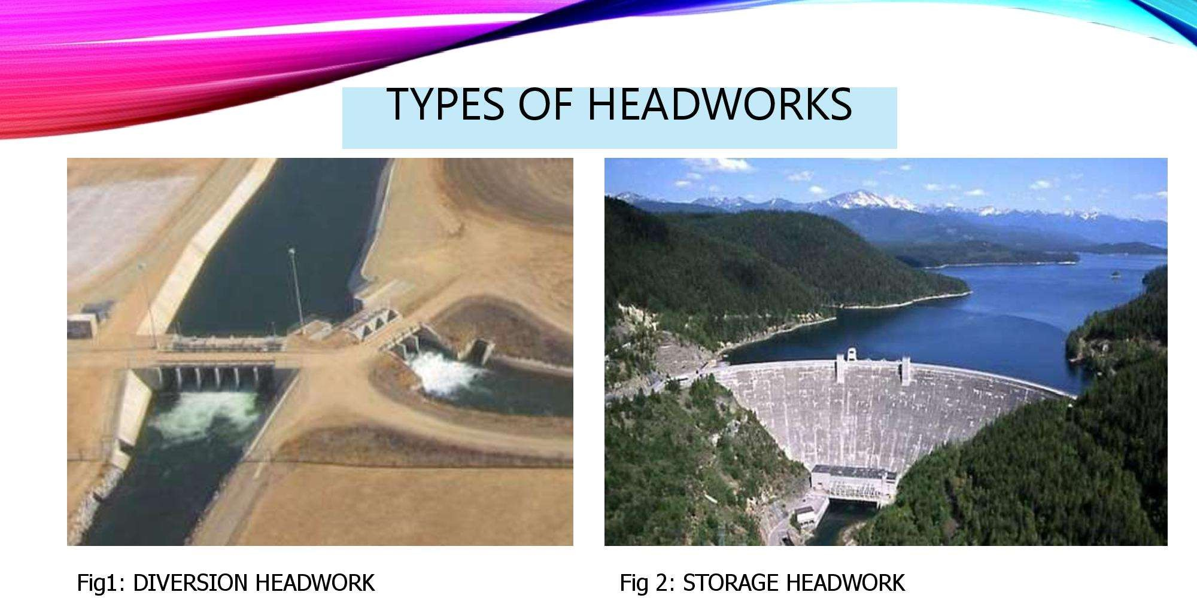

Slide 73
Types of diversion head works
Headworks may be divided into two classes:
Diversion headwork
Storage headwork
Diversion headwork:
To divert required supply to canal from the river. They are two types.
Temporary spurs or bunds: which are temporary and constructed every year after floods
Permanent weirs and barrages
Storage headwork:
A storage headwork comprises the construction of a dam across the river. It stores water during the period of excess supplies in the river and releases it when demand overtakes available supplies.

Slide 74
Weir:
The weir is a solid obstruction put across the river to raise its water level and divert the water into the canal. If a weir also stores water for tiding over small periods of short supplies, it is called a storage weir.
The main difference between a storage weir and a dam is only in height and the duration for which the supply is stored.
Barrage:
The function of a barrage is similar to that of weir, but the heading up of water is effected by the gates alone. No solid obstruction is put across the river.
The crest level in the barrage is kept at a low level.

Slide 75
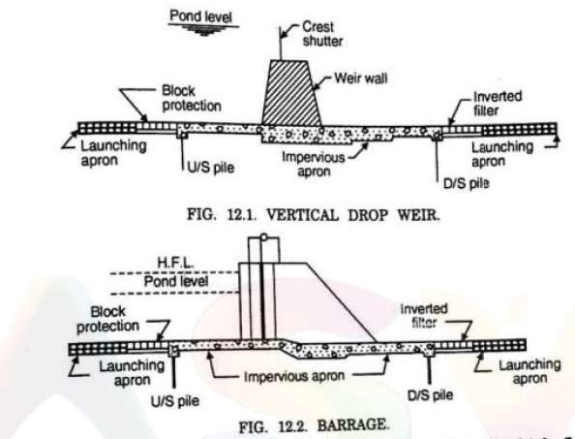

Slide 76
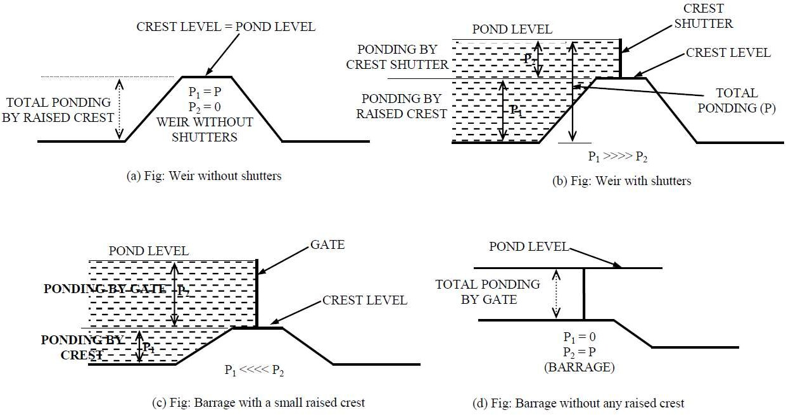

Slide 77
Definition of Flood and its Causes
Week 9

Slide 78
Flood and It’s Causes
Introduction
A Flood is usually caused by rain, heavy thunderstorms and thawing of snow. It is considered to be a temporary condition of two or more acres of dryland either;
Overflow with tidal water
Rapid runoff/surface water
Mud flows

Slide 79
Definition of Flood
✓An area goes under and remain under water for sometimes, it is called inundation. When inundation causes damage to property and crops, disrupts communication and bring harmful effect to human beings as well as flora and fauna, then it is called as Flood.
✓It is not possible to prevent the flood but it is possible to reduce the damage due to flood by adopting various flood controlling measures. This flood control and flood management is defined as the reduction of Flood damage.

Slide 80
Causes of Flood:
Severe flood causes mainly by Three reasons:
Local intense rainfall
Huge transboundary inflows
Cyclone induced surges
Overall Causes of Flood:
Increase of surface runoff due to heavy rainfall and longer storm duration.
Inadequate cross drainage work.

Slide 81
Contraction of river section.
Catchment area with steep slope increases runoff and increases sediment inflow.
Bank erosion.
Changing of river course from time to time.
Silting up of riverbed.
Obstruction of river flow.
Negligence in discharge observation.

Slide 82
Causes of Flood in Bangladesh:
Two types of causes are responsible for flood in Bangladesh
Natural causes
Human related causes
Natural Causes:
Most of the country consists of huge flood plain and delta.
70% of the total area is less than 1m above the mean sea level.
Tropical storms bring heavy rains and coastal flooding.
Snow melting from Himalayas takes place in late spring and summer.
Bangladesh experiences heavy rains especially over high lands.
10% of the total area made up of lakes and rivers.

Slide 83
Human related causes:
Deforestation in Nepal and Himalayas increases the runoff, which adds the deposition and flooding downstream.
Urbanization of flood plain rapidly increasing the magnitude and frequency of flood.
Building of Dams in India has increased the problem of sedimentation in Bangladesh.
Global warming.
Poorly maintained embankment leak and collapse at the time of high discharges.

Slide 84
Types and losses of flood
Week10

Slide 85
Where does Flooding occurs?
Flooding is the most worldwide natural disaster; it occurs in every country wherever there is rainfall and coastal hazards.
They are most likely to happen in tropical countries.
Most flooding occurs during the spring.
Most common floods happen around the world largest river.
Types of Flood
Most common type of flood is as follows:
Riverine Flood/ Fluvial Floods
Flash Flood/ Pluvial Floods
Strom Surge/ Coastal Flood
Dam Failure
10

Slide 86
Riverine Flood / Fluvial Flood
A Fluvial or River Flood occurs when the water level in a river, lake or stream rises and overflows onto the surrounding banks, shores as well as neighboring lands. Excessive rainfall over an extended period can causes a river to exceed its capacity.
It can be caused by heavy snow melt and ice jams.
The nature of riverine flood can vary significantly in terms of timing and depth between different location.

Slide 87
Flash Flood / Pluvial Flood
Pluvial Flood or Flash Flood is a rapid flooding (sudden local flood) of low- lying areas such as depressions, dry lakes, etc. due to extremely heavy rainfall associated with severe thunderstorms, tropical storm, ice/snow melting etc.
It is characterized by an intense, high velocity torrent of water that occurs in an existing river channel with little or no notice.
Flash Floods are very dangerous and destructive not only because of the force of water, but also it can roll boulders, tear out trees, the tearing/hurtling debris often swept up in the flow, destroy buildings, scour out channels etc.
Planting vegetations to retain extra water and construction of floodways can be used to control of such floods.

Slide 88
Strom Surges / Coastal Flood
✓Storm is an abnormal rise in water level in coastal areas, over and above the usual tide limit, caused by forces generated from severe storm winds, waves and low atmospheric pressure.
✓Storm surge is extremely dangerous, because it is capable of flooding large coastal areas. Extreme flooding can occur in coastal areas particularly when storms are coinciding with normal high tide, resulting in storm height is up to normal high tide 20ft or more in some cases.
✓Along the coast, storm is often the greatest threat associated with a tropical storm like hurricane.

Slide 89
Dam Failure
✓A dam failure is a catastrophic type of failure characterized by the sudden, rapid and uncontrolled release of impounded water or the possibility/likelihood of such an uncontrolled release.
Although dam failures are rare, there effects can be significant.
✓Sub-standard construction materials or techniques and spillway design error are mainly responsible for dam failure.

Slide 90
Benefits/Advantages of Flood
Flood is not always harmful to us. It has some advantages as well. Some are given below:
Flood makes soil fertile.
The replenishment of essential nutrients of soil is possible with flood waters.
Awareness:
After flood, people become aware for facing any type of flooding condition in future. For that reason, the probability of loss will be decreased day by day.
Flood offers groundwater recharge.

Slide 91
Losses of Flood
Losses due to flood can be classified into two types.
Tangible losses
Intangible losses
Intangible losses and Benefits
The intangible losses are those which can not be estimated (Immaterial) in money values. The following are the intangible losses.
Loss of human life
Loss of health due to diseases caused by flood.
Loss caused by social distress.
Loss due to hindrance in development works of towns or cities.
All above losses will be converted to benefits, if the flood control works are done
successfully.
16

Slide 92
Tangible losses and benefits
The tangible losses are those which can be estimated in terms of some money values. The following are the tangible losses.
Damage of personal properties like building, furniture, etc.
Loss of crops.
Contamination of well.
Loss due to disruption of trade, business, etc.
Loss due to disruption of road and railway communications.
Additional expenditure for the safety against flood.
Additional expenditure for medical care.
All above losses will be converted to benefits, if the flood control works are done
successfully.
17

Slide 93
Method Of Estimation of design flood
Week 11-12

Slide 94
“Design Flood”
The flood adopted for the design of flood control project is known as design flood.
➢It may be either maximum probable flood or standard projected flood or a flood corresponding to same desired frequency of occurrence depending upon the degree of protection that should be provided by the flood control project.

Slide 95
Importance of Design Flood:
It is adopted for the design of hydraulic structures like spillways, bridge openings, flood banks.
It is directly related to the project feature.
It can be adopted for-
Prevention of damage to structure downstream.
Loss of life and property elimination.
Prevention of damage to crops.
Reduction in diseases resulting from inundation of flood water.
Higher yields from intense cultivated of protected land.

Slide 96
Ordinary Flood
Ordinary Flood is normal type of flood which occurs once or more times in the estimated life of the project.
Standard Project Flood
Any Flood greater than ordinary flood is known as standard project flood.
The Flood likely to occur from the combination of
most
severe
meteorological and hydrological condition but excluding extreme rare combination is called standard project flood or SPF.
20

Slide 97
Maximum Probable Flood
The maximum probable flood is defined as the flood that may be expected from the most severe combination of Critical, Meteorological and Hydrological condition, that are reasonably possible in that region.
This is very large flood indeed and is very rarely used in the design except for reservoir spillways where failure would lead to great damage and loss of life.

Slide 98
Method of Estimation of Design Flood:
Application of suitable factor of safety to maximum observed flood or maximum historical flood.
Empirical flood formulae.
Envelope Curve.
Frequency Analysis.
Rational Method.
Concentration Time method.
Unit Hydrograph method.

Slide 99
Envelope Curve:
Each flood hydrology study should consider information on the flood peak and the volumes that have been experienced in the hydrologic region. This information is presented in the form of a curve enveloping the data points representing the peak discharge or the flow volume for specified time duration versus the drainage area contributing to the flood runoff. This curve is called envelope curve.
This curve must be hydro-meteorologically homogenous. As much as data you have, the reliability of curve will be increased.

Slide 100
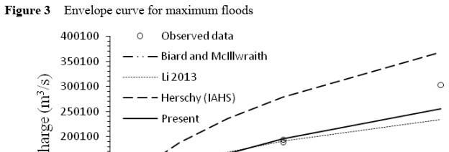

Fig. Envelope Curve

Slide 101

Fig. Envelope Curve

Slide 102





Slide 103








Slide 104
Rational Method
The rational method is a simple technique for estimating a design discharge from a small watershed areas of up to about 200 acres (80 hectares) with no significant flood storage. It was developed by Kuichling (1889) for small drainage basins in urban areas. This method provides the designer with a peak discharge value, but does not provide a time series of flow nor flow volume.
It is assumed that the maximum flood flow is produced by a certain rainfall intensity, which lasts for a time equal or greater than the period of concentration time.

Slide 105
Assumptions in rational method
Here are several assumptions that form the basis for rational method hydrology:
Drainage areas are smaller than 200 acres.
Peak flow occurs when the entire catchment is contributing.
Rainfall is distributed uniformly over the drainage area.
Rainfall intensity is uniform throughout the duration of the storm.
The calculated runoff is directly proportional to the rainfall intensity
Rational coefficients are independent of the intensity of the rainfall.

Slide 106

30

Slide 107

31

Slide 108


Simplified Table of Rational Method Runoff Coefficients
Ground Cover | Run-off Coefficient, C
Residential areas | 0.3 - 0.75
Business areas | 0.5 - 0.95
Industrial areas | 0.5 - 0.95
Asphalt streets | 0.7 - 0.95
Brick streets | 0.7 - 0.85
Concrete streets | 0.7 - 0.95
Roofs | 0.75 - 0.95
Parks, cemeteries | 0.1 - 0.25
Unimproved areas | 0.1 - 0.3
Forest | 0.05 - 0.25
Cultivated land | 0.08-0.41 | 32

Slide 109


Limitations of Rational Method

Slide 110




Time of Concentration
h

Slide 111





Slide 112










Slide 113







Slide 114






 | C1= 0.20
 | C1= 0.10
 | C3= 0.35

Slide 115




Slide 116



40

Slide 117



Slide 118





Slide 119








Slide 120



Slide 121





Slide 122


Annual Series and Partial Series:
The figure shows the composition of annual and partial series.
Taking the maximum flood data annual series is prepared.

Slide 123

Constant
Reduced by Gumbel

Slide 124


Constant
Reduced by Gumbel

Slide 125







Slide 126





50

Slide 127




Slide 128

Gumbel’s distribution table: (see table 14.3, Reddy)

Slide 129





Slide 130







Slide 131





Slide 132



Slide 133






Slide 134




Slide 135



Slide 136





Return Period (years)
100 | 485
50 | 445
60

Slide 137
Structural& Non Structural measures for flood management
Week 13-14

Slide 138




Flood Management
Question: What do you mean by flood management?
Ans. The term flood management or flood control is commonly used to denote all the measures that are adopted to reduce the damages of life and properties due to flood.
Total flood control is neither possible nor desirable.
Fig. Flood Management Plan
61

Slide 139
Factors governing flood damage:
There are many factors which governs the flood damage. Urban flood and Rural flood need to be treated differently.
Urban Flood:
Duration of rainfall
Extent of rainfall
Rural Flood:
Flow velocity
Flood duration
Contamination
Sediment concentration
Lead time and information content of flood warning
Depth of rainfall

Slide 140
Options for Flood Management Flood management can be done into two ways
Structural measures
Non-structural measures
Structural Measures
Structural measures are any physical construction to avoid or reduce the possible effects/impacts of hazard or the application of emerging techniques or engineering technology to achieve the hazard resistance and resilience system.

Slide 141
Structural Options
➢Storage Reservoir
➢Levees and Flood Wall
➢Flood Ways
➢Channel Improvement
➢Watershed Management

Slide 142
Storage reservoir
Storage reservoirs are constructed to store the water in the rainy season and to release it later when the river flow is low.
The purpose of a storage reservoir is to temporarily store a portion of flood water so that flood peaks are flattened out. The reservoir may be ideally situated immediately at upstream so that the river can discharge with in the safe capacity.

Slide 143

Storage Reservoir serve as the following function:
Irrigation
Water supply
Hydroelectric power generation
Flood control
Navigation
Recreation
Development of fish and wild life

Slide 144




Upstream
Peak
Inflow hydrograph
Controlled release outflow
Flow
= safe channel capacity
S T O
R A
Controlled release
G E
Downstream

Slide 145

Levees and Flood Wall
Levees: Levees are earthen banks constructed parallel or along the course of the river to confined it to a fixed course and limited cross sectional width. As, it is earthen embankments, considerable care and maintenance is required.
Flood wall: Concrete or masonry structures to confined the river in a manner similar to the levees are known as flood walls.

Slide 146

Flood wall: Concrete or masonry structures to confined the river in a manner similar to the levees are known as flood walls.
Function: They are used to protect the important structures against floods.
Meandering River
Levee
Top/Crown
Levee
Important
structures
Land side
Water side
Levee
Flood Wall
Cross section
PLAN

Slide 147

Floodways
✓Floodways are natural or manmade channels into which a part of the flood will be diverted during high stages.
✓The location of floodways are controlled essentially by the topography.
Flood ways
Upstream
Downstream
Flood ways
A floodway on a gravel road
70

Slide 148

Channel Improvement
Widening
Deepening

Slide 149
(ii) Reduction of the channel roughness:
Function:
removing of sand bars.
prevention of cropping on riverbeds near banks.
removing of broken/falling tree.
Fallen Tree
Sand Bars

Slide 150

(iii) Short Circuiting (Realignment):
Short circuiting of mender loops by providing cutoff channels, leading to increase the slope.
Cut off

Slide 151


6 m
200 m
6m
1
6 m
1
200 m

Slide 152





9 m
9 m
9 m
1
1
194 m

Slide 153








Slide 154





6 m
6 m
1
1
6 m
b

Slide 155







Slide 156


Watershed Management
Watershed management is a term used to describe the process of implementing the land use plan, practice and water management practices to protect and improved the quality of water and other natural resources within a watershed by managing the use of this land and water resources in a comprehension.

Slide 157
Aims of Watershed management
To cut down and delay the runoff before it gets into water.
To reduce the soil erosion.
To absorb more water in the soil or to increase the infiltration
capacity.
To modify the peak flow.
To enhance the groundwater recharge.
80

Slide 158
Non-Structural method
Some of the non-structural method are:-
Flood forecasting and Warning system
Emergency Evacuation
Flood Proofing
d) Flood Plain Zoning
Flood Insurance
Flood forecasting and warning system
Flood Forecasting indicate the probability/likelihood of heavy rainfall over the specified area for a period of time in advance.

Slide 159
Flood Warning system means the working out of flood hydrograph at a given point sufficiently in advance with the help of flood hydrograph of some gauges upstream.
Flood forecasting system consists of 4 important phases.
Observation of operational data
Transmission of operational data
Formulation of forecasting
Issue of forecasting
Flood Warnings Key
Severe flood warning: Severe flooding - danger to life.
Flood warning: Flooding is expected - immediate action required.
Flood alert: Flooding is possible - be prepared.

Slide 160
b) Emergency evacuation
The process of urgent immediate escape of people and important materials away from the flood affected area.
The success of this method is completely related with good forecasting and warning system.
c) Flood Proofing
Flood proofing means to remodel or rebuild, using the materials and methods that will prevent or minimize damage from future floods. In cases where certain isolated units of high
value are threatened by flooding, they may be individually flood proofed. The benefits to flood-proofing:
By protecting your home from damage, flood proofing will save you money and aggravation during the next flood.
Protecting your house from future flood damage will increase your property's resale value.

Slide 161
Many flood proofing measures can be easily worked during repair and rebuilding, reducing your costs.
Some financial assistance programs can help pay for flood-proofing.
By preparing for the next flood, you regain control over your future - a guaranteed way to reduce your level of anxiety and stress. You don't have to wait for the government to act; you can take care of protecting your home when you are ready.

Slide 162

d) Flood plain zoning
Flood plain zoning means dividing the entire flood plain area into different zones and to restrict the occupancy of different zones of the flood plain to use which will suffer little or no damage during floods.
It is one of the non- structural flood mitigation measures.

Slide 163
e) Flood Insurance
Flood insurance is a type of property insurance that covers a dwelling for losses sustained by water damage specifically due to flooding caused by heavy or prolonged rain, melting snow, coastal storm surges, blocked
storm drainage systems, or levee dam failure.
Flood insurance policies are available for all residential and commercial properties.

Slide 164
Design of irrigation canal
Week 15-16

Slide 165
Design of Irrigation Canal/Channel
Canal:
Canals are waterways, channels, or artificial waterways, for water conveyance, or to service water transport vehicles. It is generally trapezoid in shape constructed on the ground to carry water on the fields either from the river or a reservoir or a tank.
They may also help with irrigation. It can be thought of as an artificial version of a river.

Slide 166


Figure: Canals

Slide 167
Irrigation Canal or Channel
Bank
Components of cross-section:
FSL
Free Board
Side slopes
Berms
Filling
Filling
Freeboard
Banks
Dowla and Service roads
Back Berm or Counter Berms
Spoil Banks
Borrow Pits
Berm
Cutting
Bed
Fig. A typical cross section of an irrigation canal

Slide 168

Side Slopes
The side slopes should be such that they are stable, depending upon the type of soil. A comparatively steeper slope can be provided in cutting rather than in filling, as the soil in the former case shall be more stable.
In cutting ----- 1H: 1V to 1.5 H: 1V In filling ------ 1.5 H: 1V to 2H: 1V
90

Slide 169

Berm
Berm is the horizontal distance left at the ground surface between the toe of the bank and the top edge of the cutting.
Berm
filling
filling
cutting
The berm is provided in such a way that the bed line and the bank line remain parallel. If s1: 1 is the slope in cutting and s2:1 in filling, then the initial berm width = (s2 – s1) d1.

Slide 170
Purposes of providing Berms:
They protect the banks from erosion due to wave action.
They give additional strength to the banks and provide protection against erosion and breaches.
They provide a scope for future widening of the canal.
Berms can be used as a borrow pits for excavating soils to be used for filling.

Slide 171
Free Board
The gap/margin/vertical distance between FSL and top of the bank level is known as freeboard.
The amount of freeboard in a channel is governed by the consideration of the following:
Size of the channel
Location
Water surface fluctuation etc.

Slide 172


The generally provided values of freeboard are given in the table below:
 | Extent of freeboard (m)
1 to 5 | 0.50
5 to 10 | 0.60
10 to 30 | 0.75
30 to 150 | 0.90
Purposes of providing Free board:
1.The main purpose of providing freeboard is navigation. 2.Freeboard is provided to prevent overtopping of the dam crest by waves.
3.Freeboard also provides an additional measure of safety of the dam.

Slide 173


Banks
The primary purpose of banks in to retain water. This can be used as means of communication and as inspection paths. They should be wide enough, so that a minimum cover of 0.50 m is available above the saturation line.

Slide 174
Dowla and Service road
Dowla:
Dowla is provided on the side of the inspection road. It is provided as a measure of safety for driving on the service road. It also prevents the erosion on the inner bank slope due to rain.
Dowlas are 0.3m high and top width is kept 0.3 to 0.6m, side slopes of
1.5:1 to 2:1 provided along the bank.
Service Road:
Service roads are provided on canals for inspection purposes and may simultaneously serve as the means of communication in remote areas.
They are provided 0.4 to 1.0m above FSL, depending upon the size of the channel.

Slide 175


0.3m to 0.6m 1.5:1
0.3m
Fig. Dowla and Service road

Slide 176


Saturation Line
The saturation line is the line up to which banks get saturated after the canal runs for some time. The saturation gradient in ordinary loam soil (clay, mud etc.) the slope is generally 4:1.
Why saturation gradient line is important?
It is border line between the saturation and unsaturation part.
It helps to determine the quantity of flow.

Slide 177

Back Berm/Counter Berm/Pusta
Even after providing sufficient section for bank embankment, the saturation gradient line may cut the downstream end of the bank. In such cases, the saturation line can be kept covered at least by 0.5m with the help of counter berms as shown in figure below.

Slide 178

Spoil Banks
When the earthwork in excavation exceeds earthworks in filling, even after providing maximum width of bank embankments, then the extra earth has to be disposed economically in the slope of another bank are called spoil banks. The soil is deposited in the form of heaves.
To dispose of this earth by mechanical transport, etc. may become very costly, and an economical mode of its disposal may be found in the form of collecting this soil on the edge of the bank embankment itself.
100

Slide 179

Borrow Pits
When earthwork in filling exceeds the earthwork in excavation, the earth has to be brought from somewhere. The pits, which are dug for bringing earth, are known as Borrow Pits.
If such pits are excavated outside the channel are known as external borrow pits, if with in the channel are known as internal borrow pits.

Slide 180
Design Requirements:
The borrow pits should start from a point at a distance more than 5m from the toe for small channels, and 10m for large channels.
The width of these pits b, should be less than half the width of the canal B, and should be dug in the entire portion.
The depth of these pits should be equal to or less than 1 m.
Longitudinally, these pits should not run continuous, but a minimum space of L/2 should be left between two consecutive pits, (where L is the length of one pits).

Slide 181



Balancing Depth
If the depth of cutting is such that the quantity of excavation is equal to the earth filling required for making the banks, for achieving maximum economy and for a given cross section, there should be only one depth, for which a balance between cutting and filling will occur.
This depth of cutting is known as balancing depth.

Slide 182
Problem 1: Calculate the balancing depth for a channel section having a bed width equal to 18 m and side slopes 1H:1v in cutting and 2:1 in filling. The bank embankments are kept 3m higher than the ground level(berm level) & crest width of the bank is kept as 2m.
2m
Solution:
2
3m
1
d
d
6m
6m
d
1
1
18m

Slide 183






Slide 184
Problem 2: The following depth refer to an irregular canal: Bed width=1m
side slope =2H:1v(filling)
=1H:1v (cutting)
Top width of embankment on either side of canal=3m. Full supply depth=5m, free board=1m, GL=100m.
Balancing depth =?(Draw neat sketches)
Solve:
3m
2
1m
1
6-d
5m
d
d
2(6-d)
2(6-d)
d
1
1
1m
106

Slide 185


Slide 186
Practice And Exercise
Week 17

