Slide 1


HUM 4103
Project Planning and Management
Prepared By-
Md. Rejoan Chowdhury
Lecturer
Dept. of Civil Engineering
University of Global Village (UGV), Barishal

Slide 2
Project Planning and Management
COURSE CODE: HUM 4103 CREDIT: 04
MID EXAMINATION: 2 HOURS CIE MARKS: 120
SEMESTER END EXAMINATION: 3 HOURS SEE MARKS: 80
Course Learning Outcomes (CLOs): After completing this course, students will be able to-
CLO 01 Understand the concepts of project planning and management.
CLO 02 Distinguish PERT and CPM.
CLO 03 Create bar chart and project status report.
CLO 04 Apply PDCA for continuously developed projects.
CLO 05 Determine time estimates, critical path, internal rate of return, payback
period, net present value, schedule and cost status.
CLO 06 Evaluate status of a project.

Slide 3
Sl. | Course Contents | Hours | CLOs
1 | Project, elements and characteristics of project, project planning, project management, achievement of project management, role of project manager, characteristics of an effective project manager. | 6 | CLO 1
2 | Activity, schedule, bar chart and its development. | 2 | CLO 3
3 | Phases of project management, CPM, PERT, objective of PERT and CPM, critical path, critical path evaluation, expected time, comparison of PERT and CPM. | 4 | CLO 2
4 | Optimistic, pessimistic and most likely time estimate, expected time and standard deviation, critical path determination, benefits and limitations of PERT. | 6 | CLO 5
5 | Internal rate of return, payback period, suitability and benefits of payback period, determination of internal rate of return, payback period and net present value. | 4 | CLO 5
6 | Introduction to PDCA, use of PDCA, four steps, practical example, benefits. | 2 | CLO 4

Slide 4
Sl. | Course Contents | Hours | CLOs
7 | Project monitoring, objectives, questions to be answered, earned value analysis, benefits, calculation, gathering work performance information, determination of schedule status and cost status. | 4 | CLO 5
8 | Project review, objectives, benefits, three tiers of players, steps to conduct a review, categories of project review, project status reports and purposes, structure of a project status report. | 4 | CLO 6

Slide 5
Week | Topic | Teaching Learning Strategy | Assessment Strategy | CLOs | Page No.
1 | Concepts of project and Program | Lecture, Discussion | Mid, Final | CLO 1 | 8-17
2-3 | Concepts of project planning and management | Lecture, Discussion | Mid, Final | CLO 1 | 18-32
4 | Project scheduling (bar chart) | Lecture, Discussion | Assignment, Mid, Final | CLO 3 | 33-42
5-6 | PERT and CPM | Lecture, Discussion | Assignment, Mid, Final | CLO 2 | 43-64
7-9 | PERT: Time estimates | Lecture, Discussion | Assignment, Class Test, Mid, Final | CLO 5 | 65-79
10-11 | Cashflow analysis | Lecture, Discussion | Problem solving, Class Test, Final | CLO 5 | 80-84
12 | PDCA | Lecture, Discussion | Mid, Final | CLO 4 | 85-95

Slide 6
Week | Topic | Teaching Learning Strategy | Assessment Strategy | CLOs | Page No.
13-14 | Project monitoring and earned value management | Lecture, Discussion | Case study, Final | CLO 5 | 96-112
15-16 | Project review | Lecture, Discussion | Final | CLO 6 | 113-129
References
1. Project Planning & Control With PERT & CPM - Dr. B.C. Punmia & K.K. Khandelwal
2. PERT & CPM - L.S.Srinath

Slide 7
ASSESSMENT PATTERN
CIE-Continuous Internal Evaluation (120 Marks)
Bloom’s Category Marks (out of 120) | Tests (60) | Assignments (20) | Quizzes (20) | External Participation in Curricular/Co-Curricular Activities (20)
Remember | 10 |  | 10 | Attendance 20
Understand | 10 |  | 10
Apply | 10
Analyze | 10
Evaluate | 10
Create | 10 | 20
SEE- Semester End Examination (80 Marks)
Bloom’s Category | Tests
Remember | 10
Understand | 15
Apply | 15
Analyze | 15
Evaluate | 15
Create | 10

Slide 8
Concepts of
Project and Program
(Week 1)

Slide 9
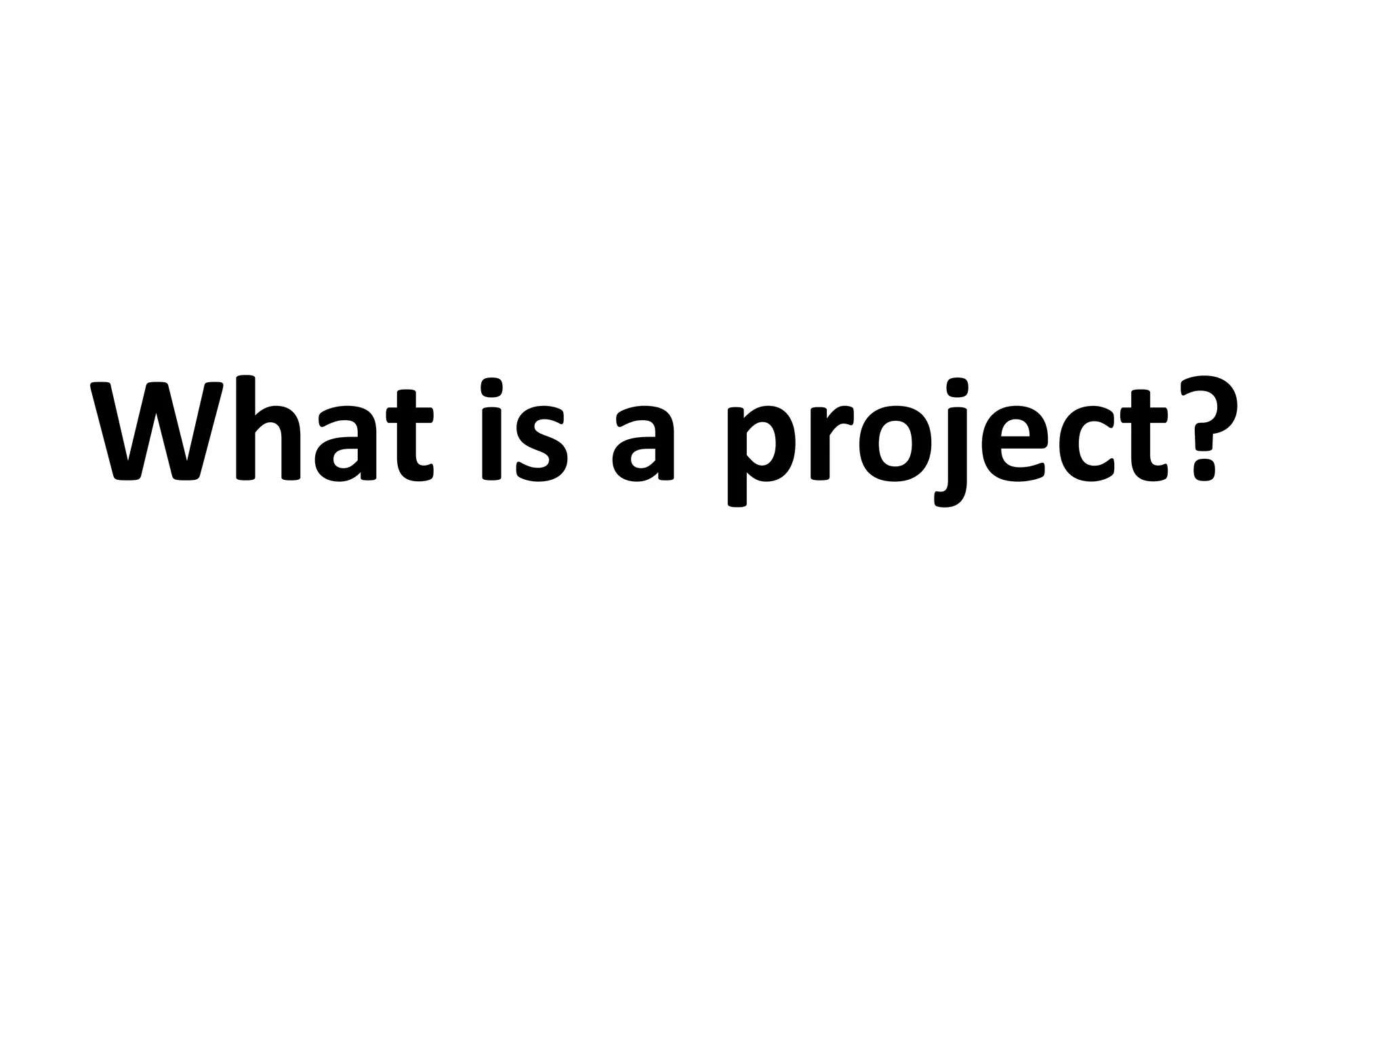

Slide 10
A project is defined as a sequence of tasks that must be completed to attain a certain outcome.
According to the Project Management Institute (PMI), the term Project refers to-
”any temporary endeavor with a definite beginning and end”.

Slide 11
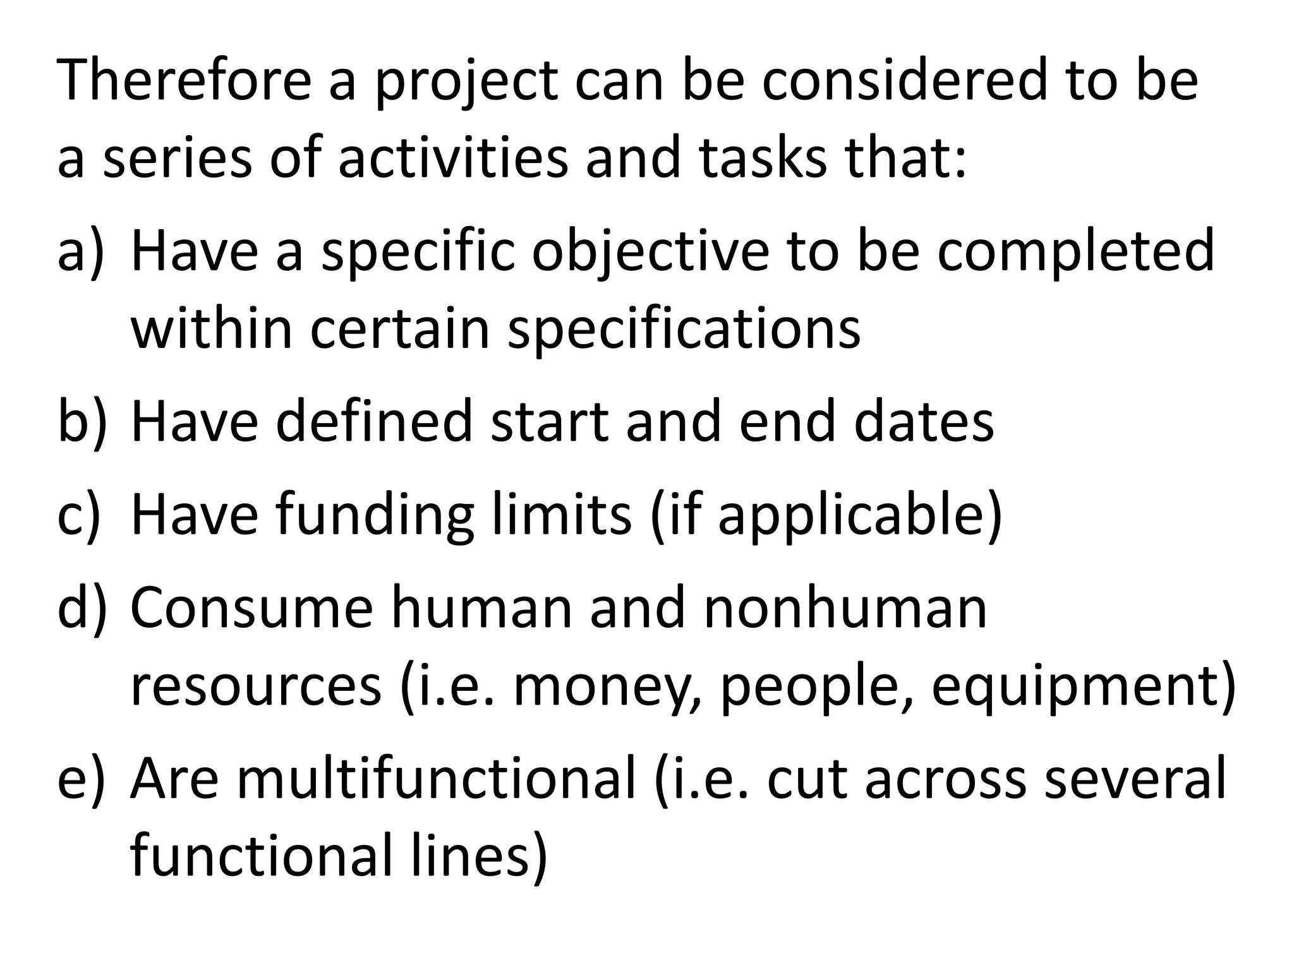

Slide 12
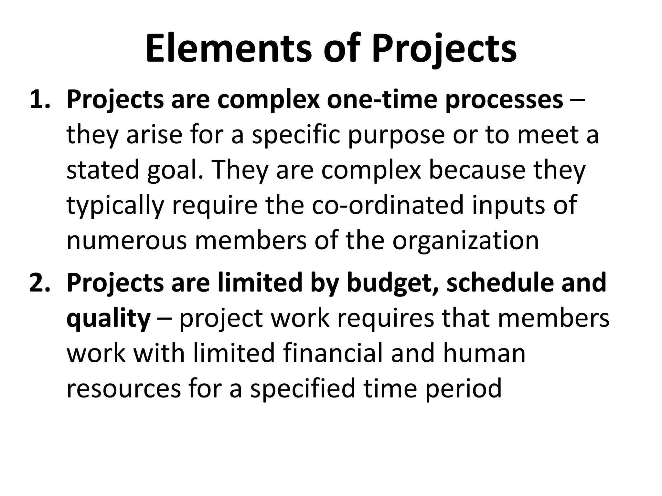

Slide 13
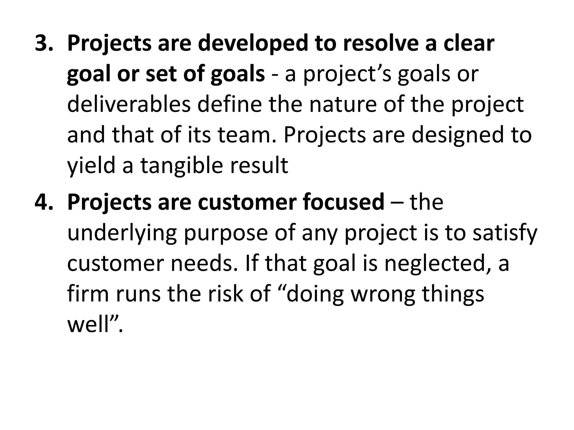

Slide 14
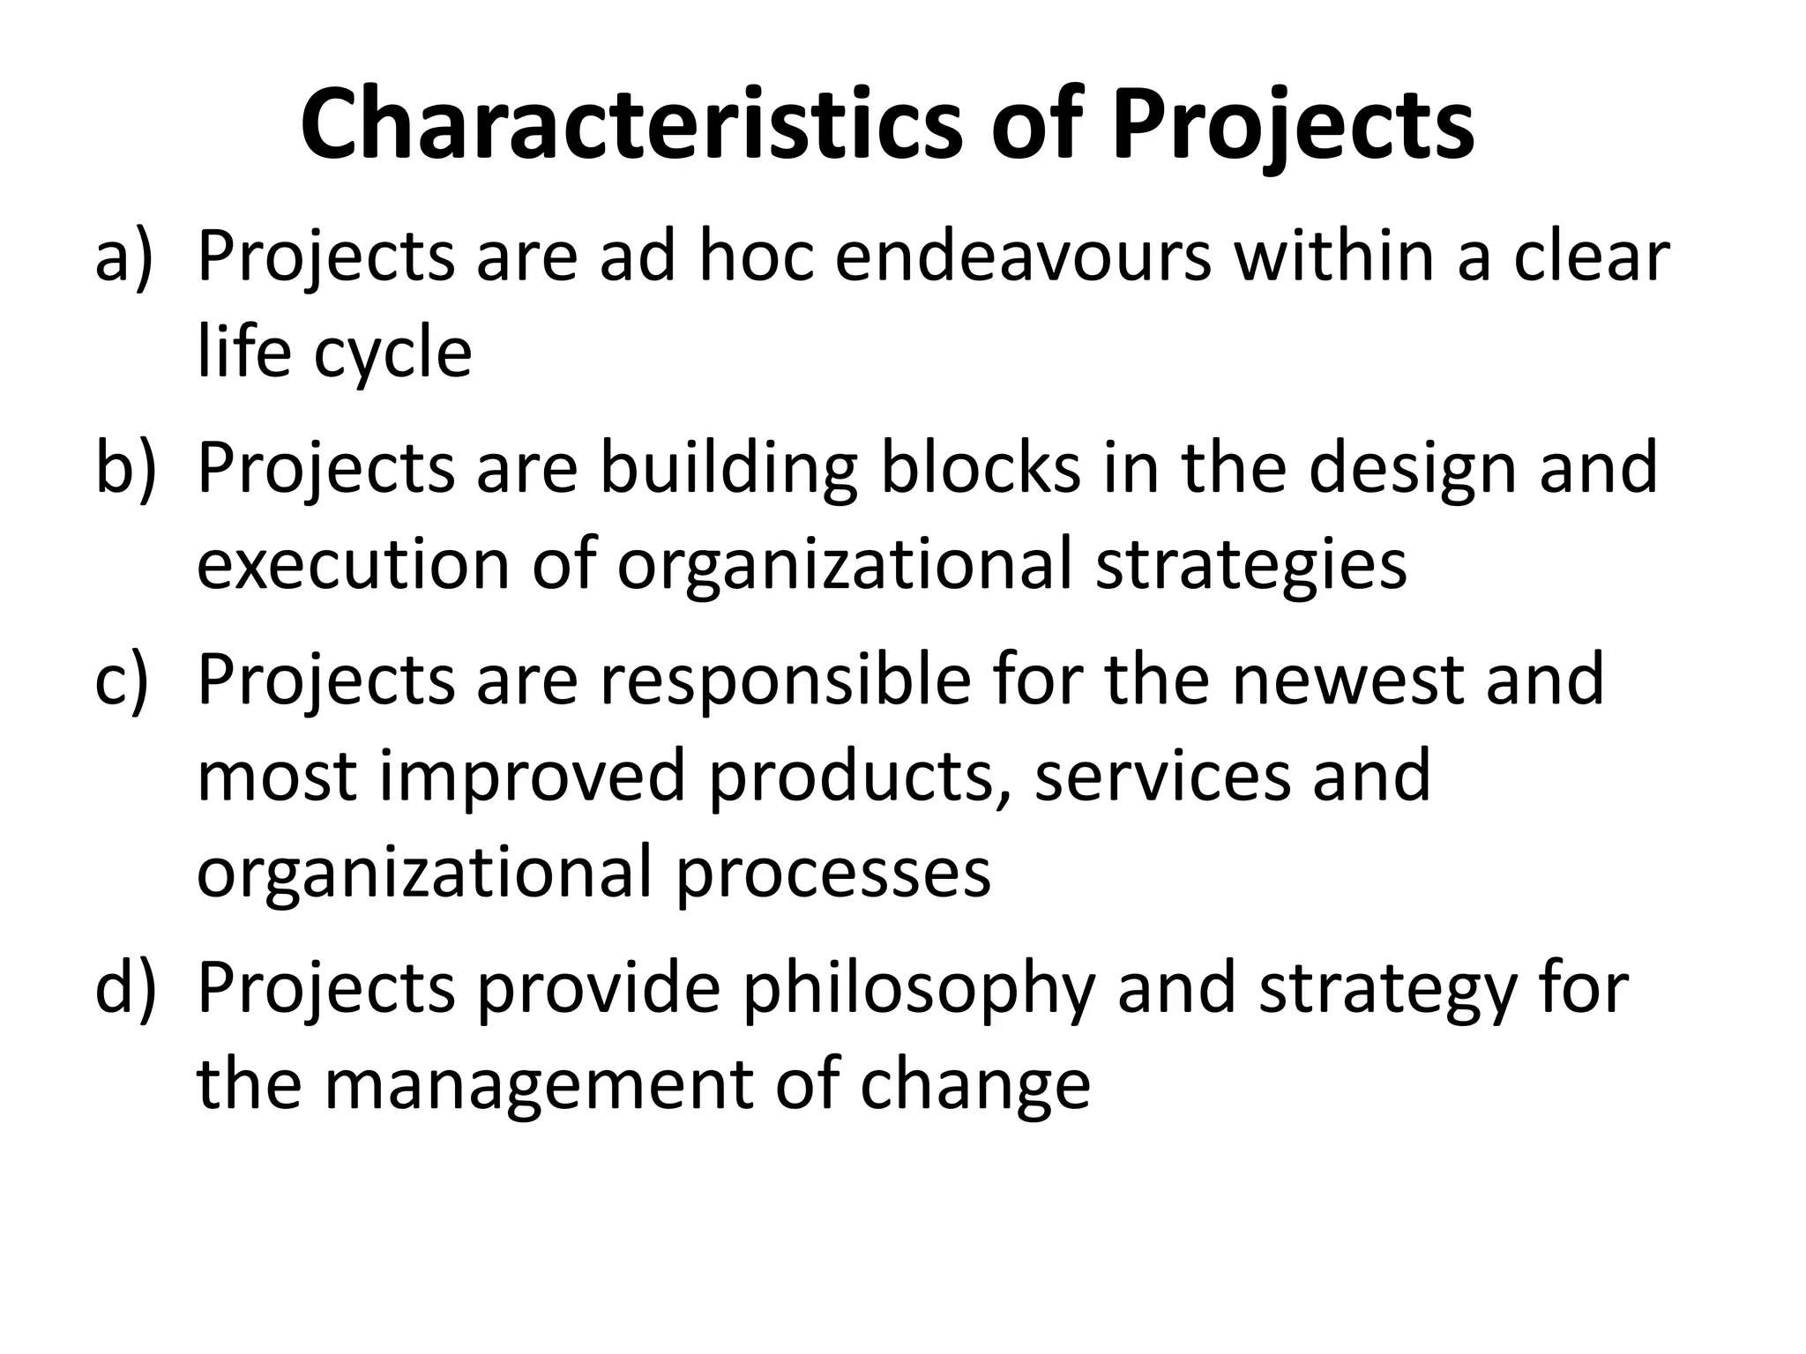

Slide 15
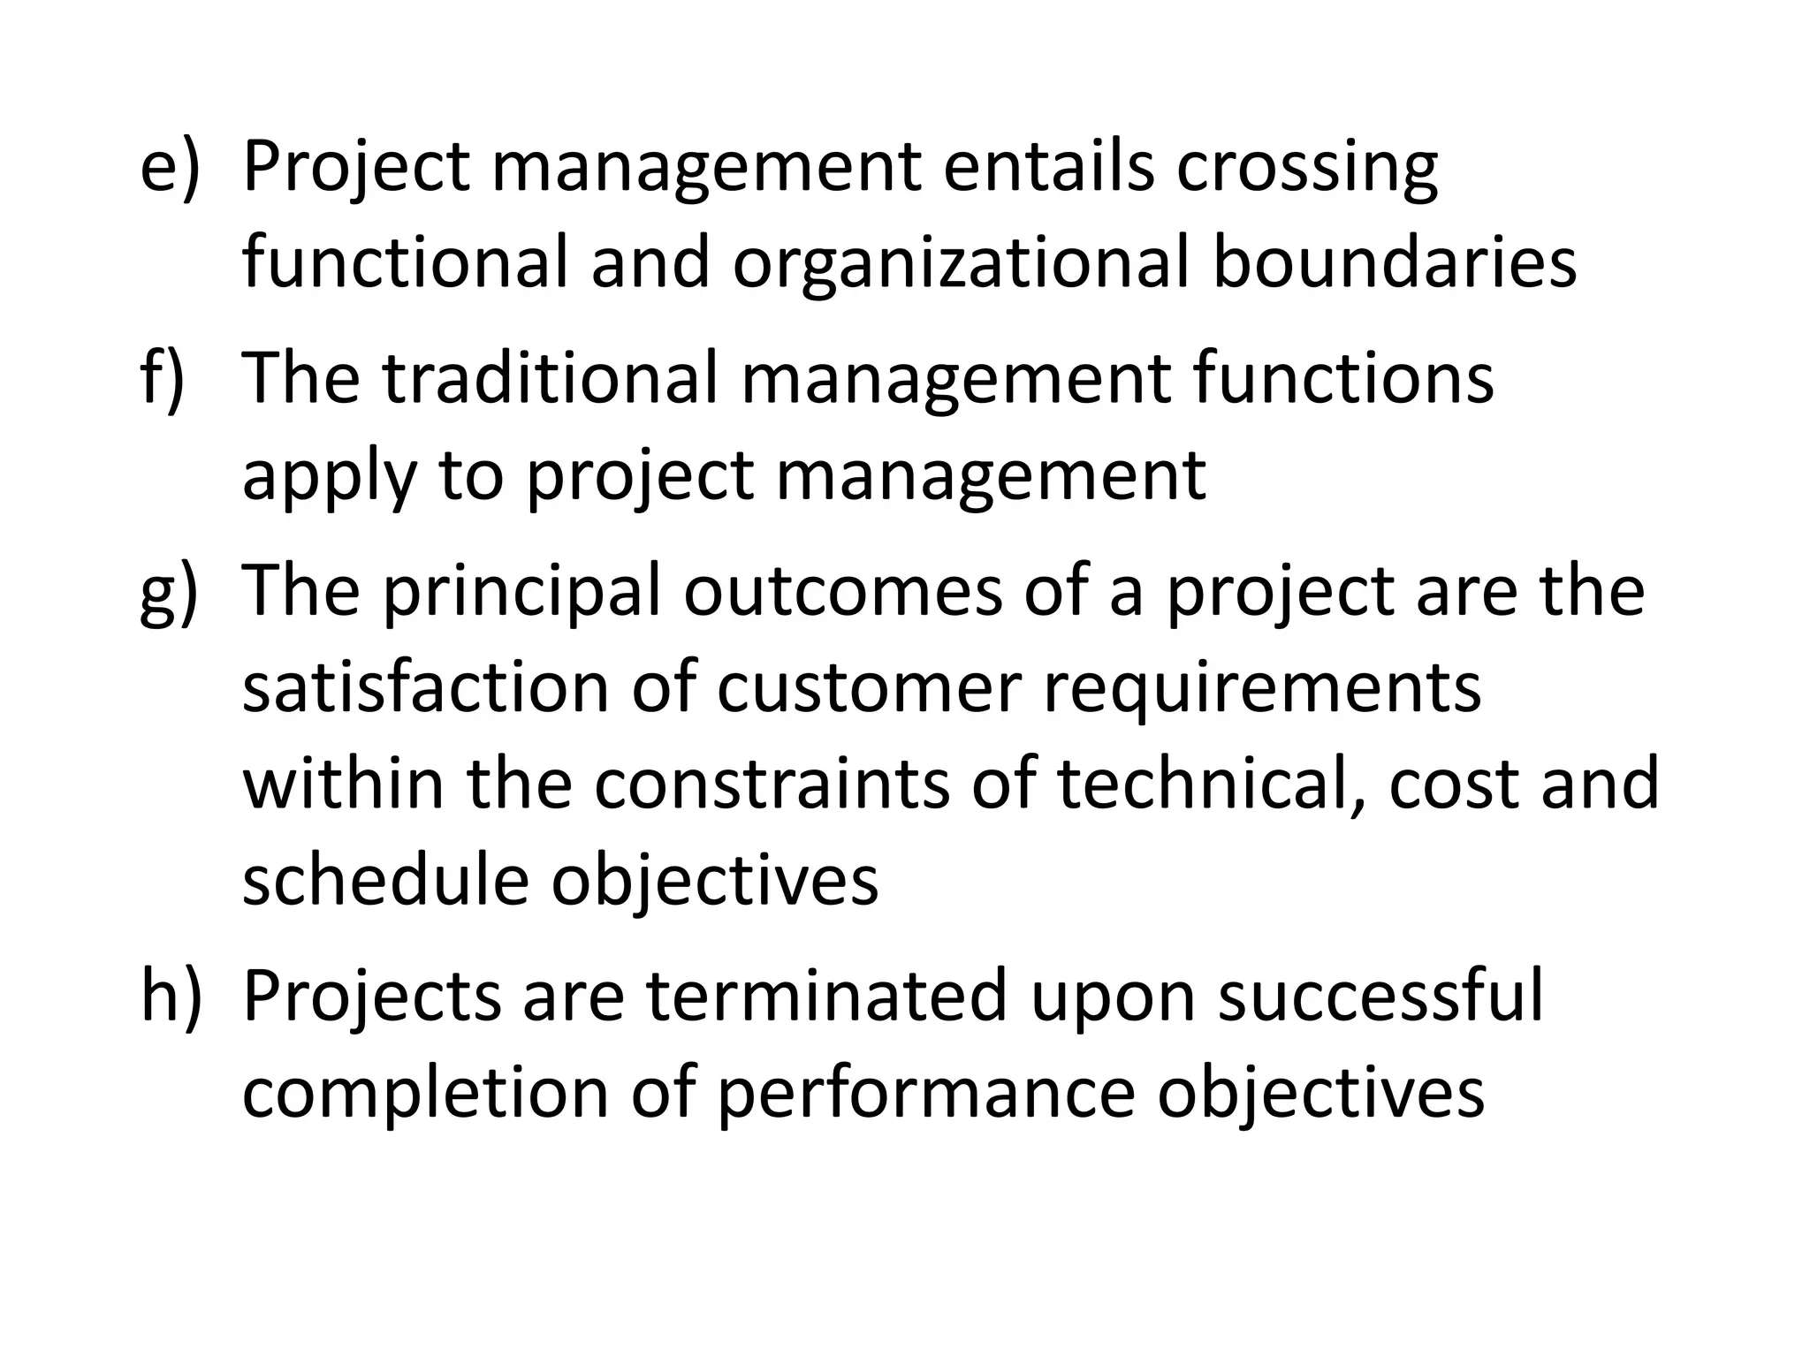

Slide 16
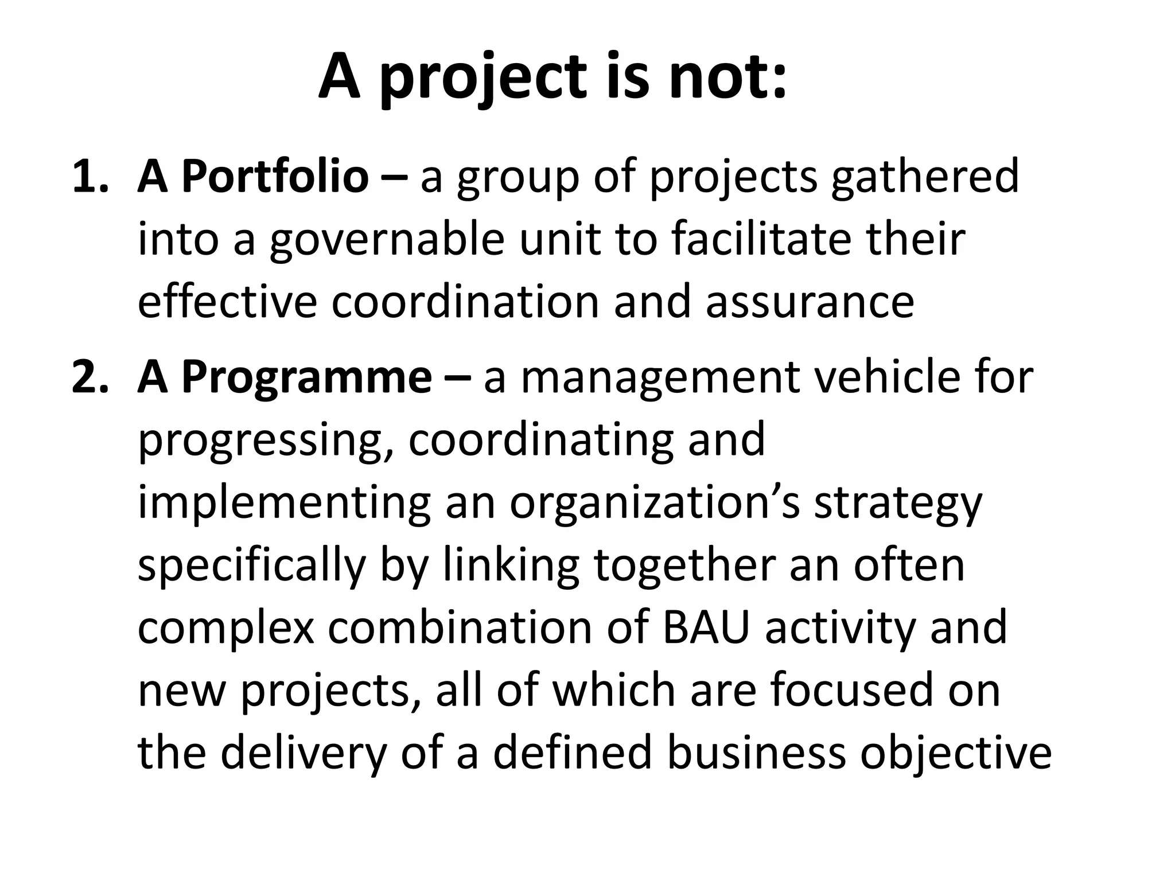

Slide 17
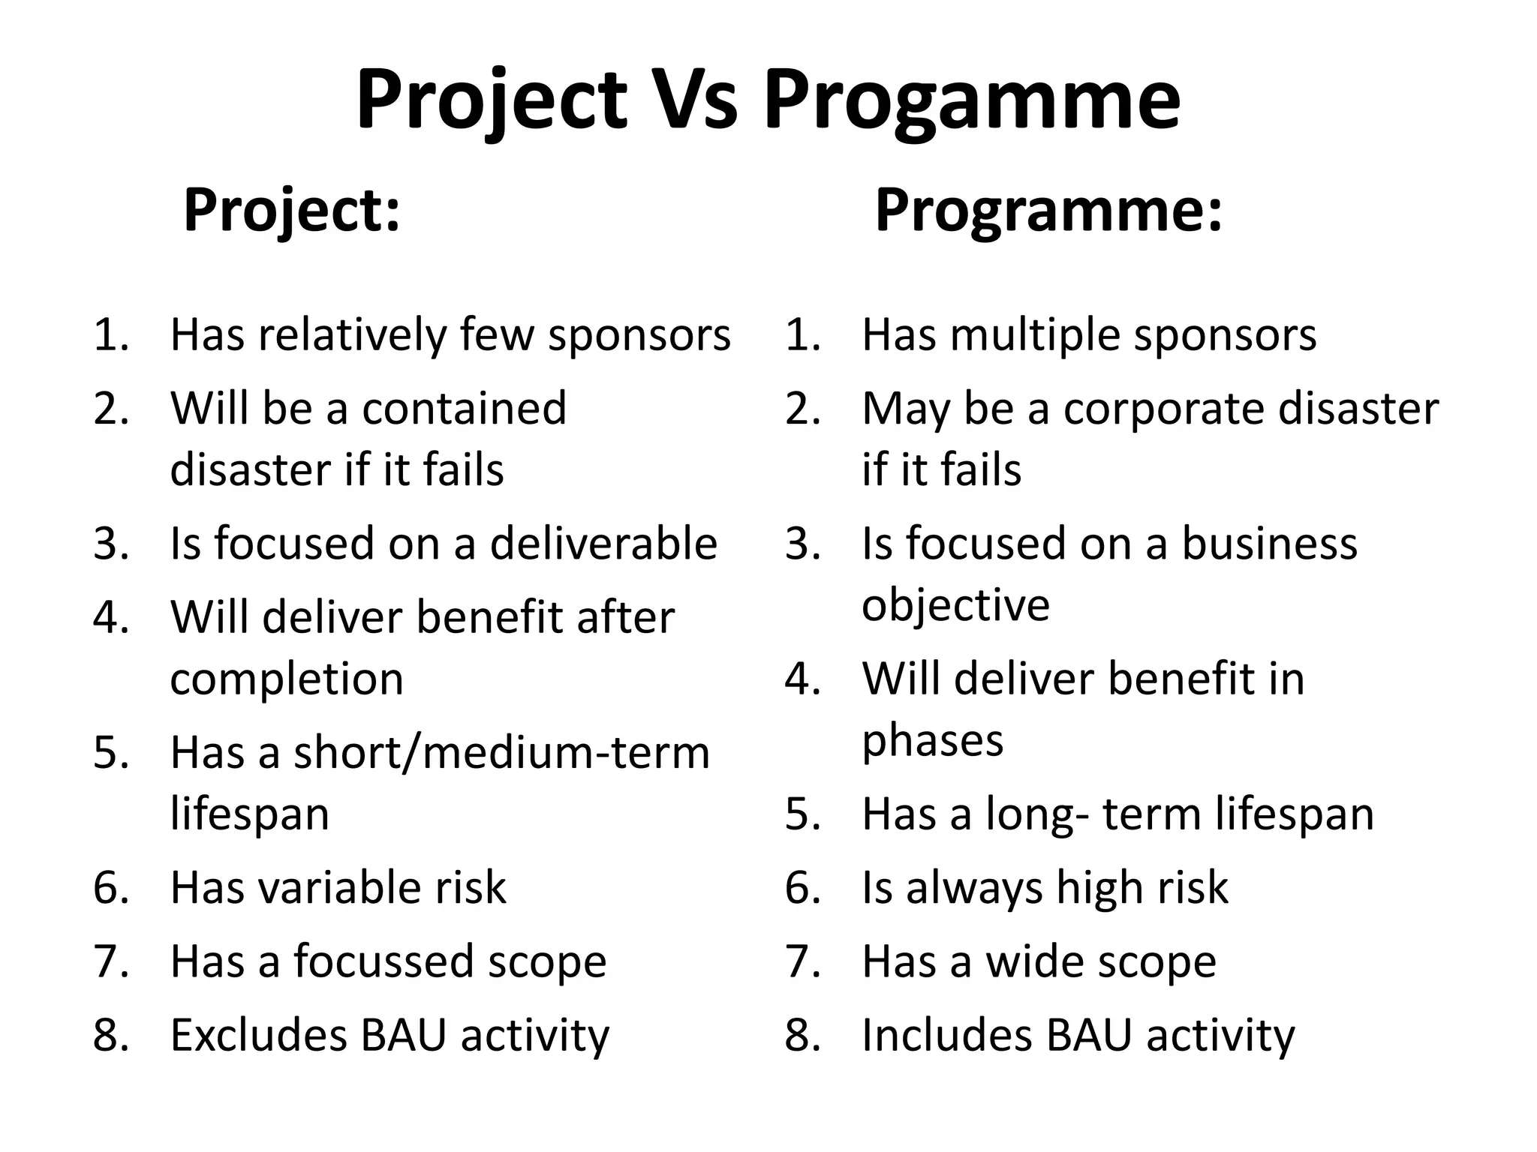

Slide 18
Concepts of Project Planning and Management
(Week 2-3)

Slide 19
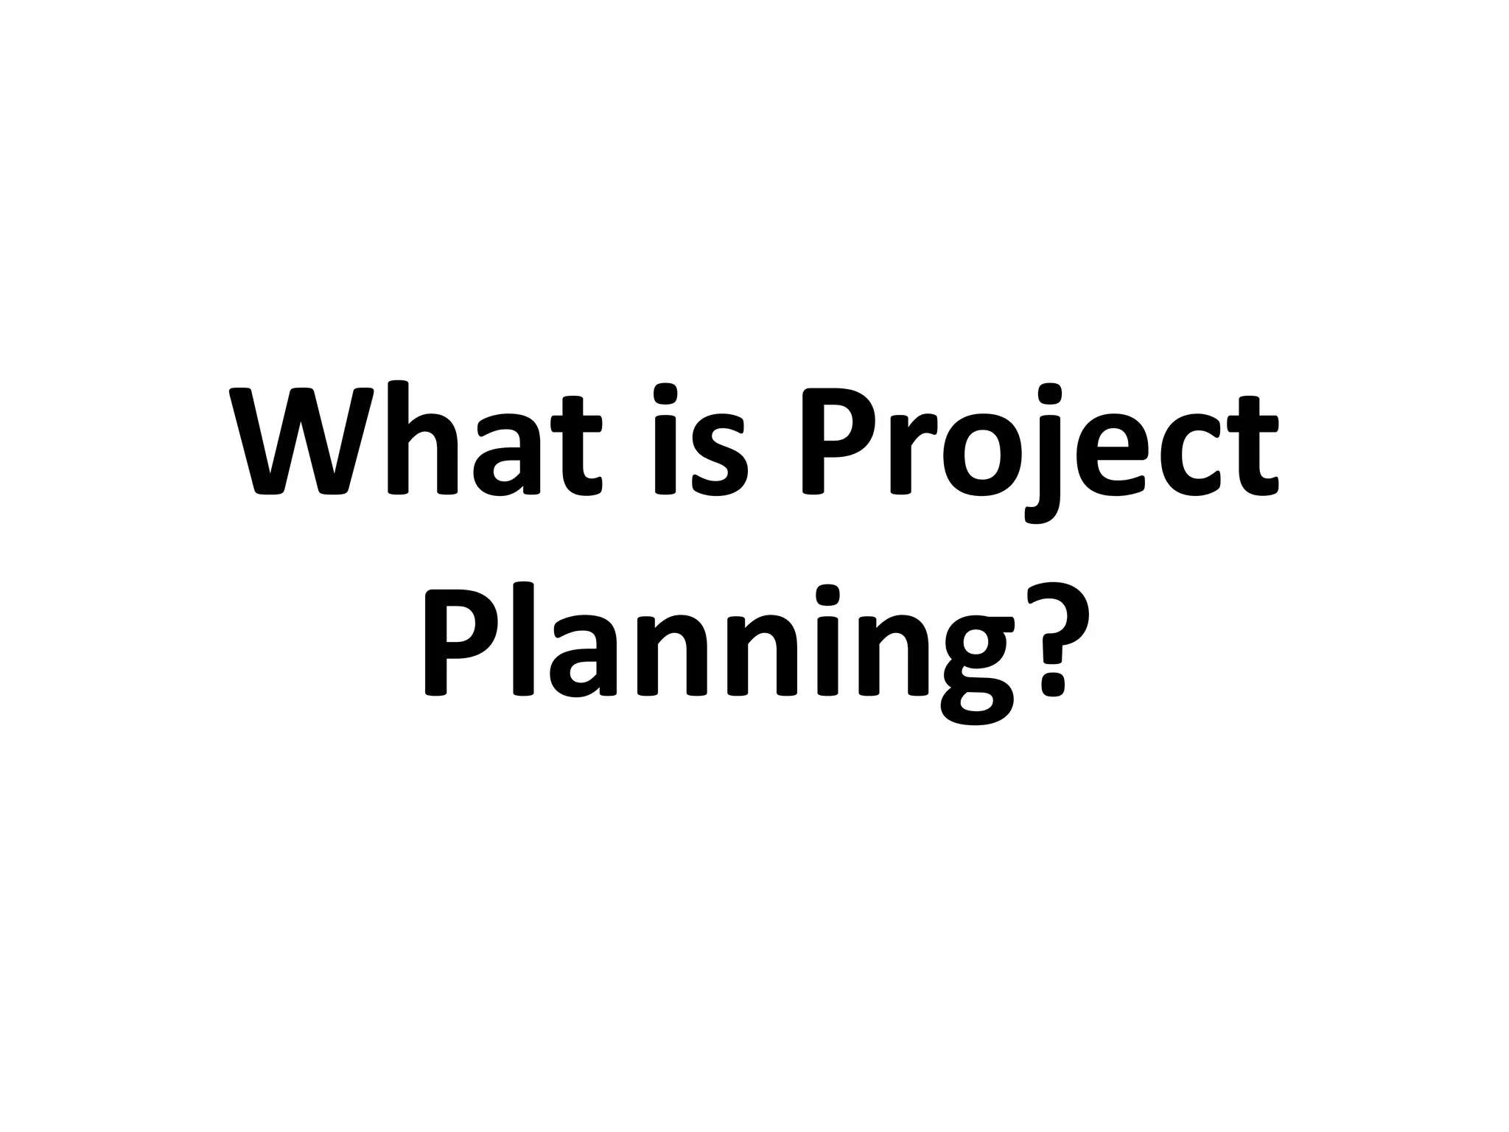

Slide 20
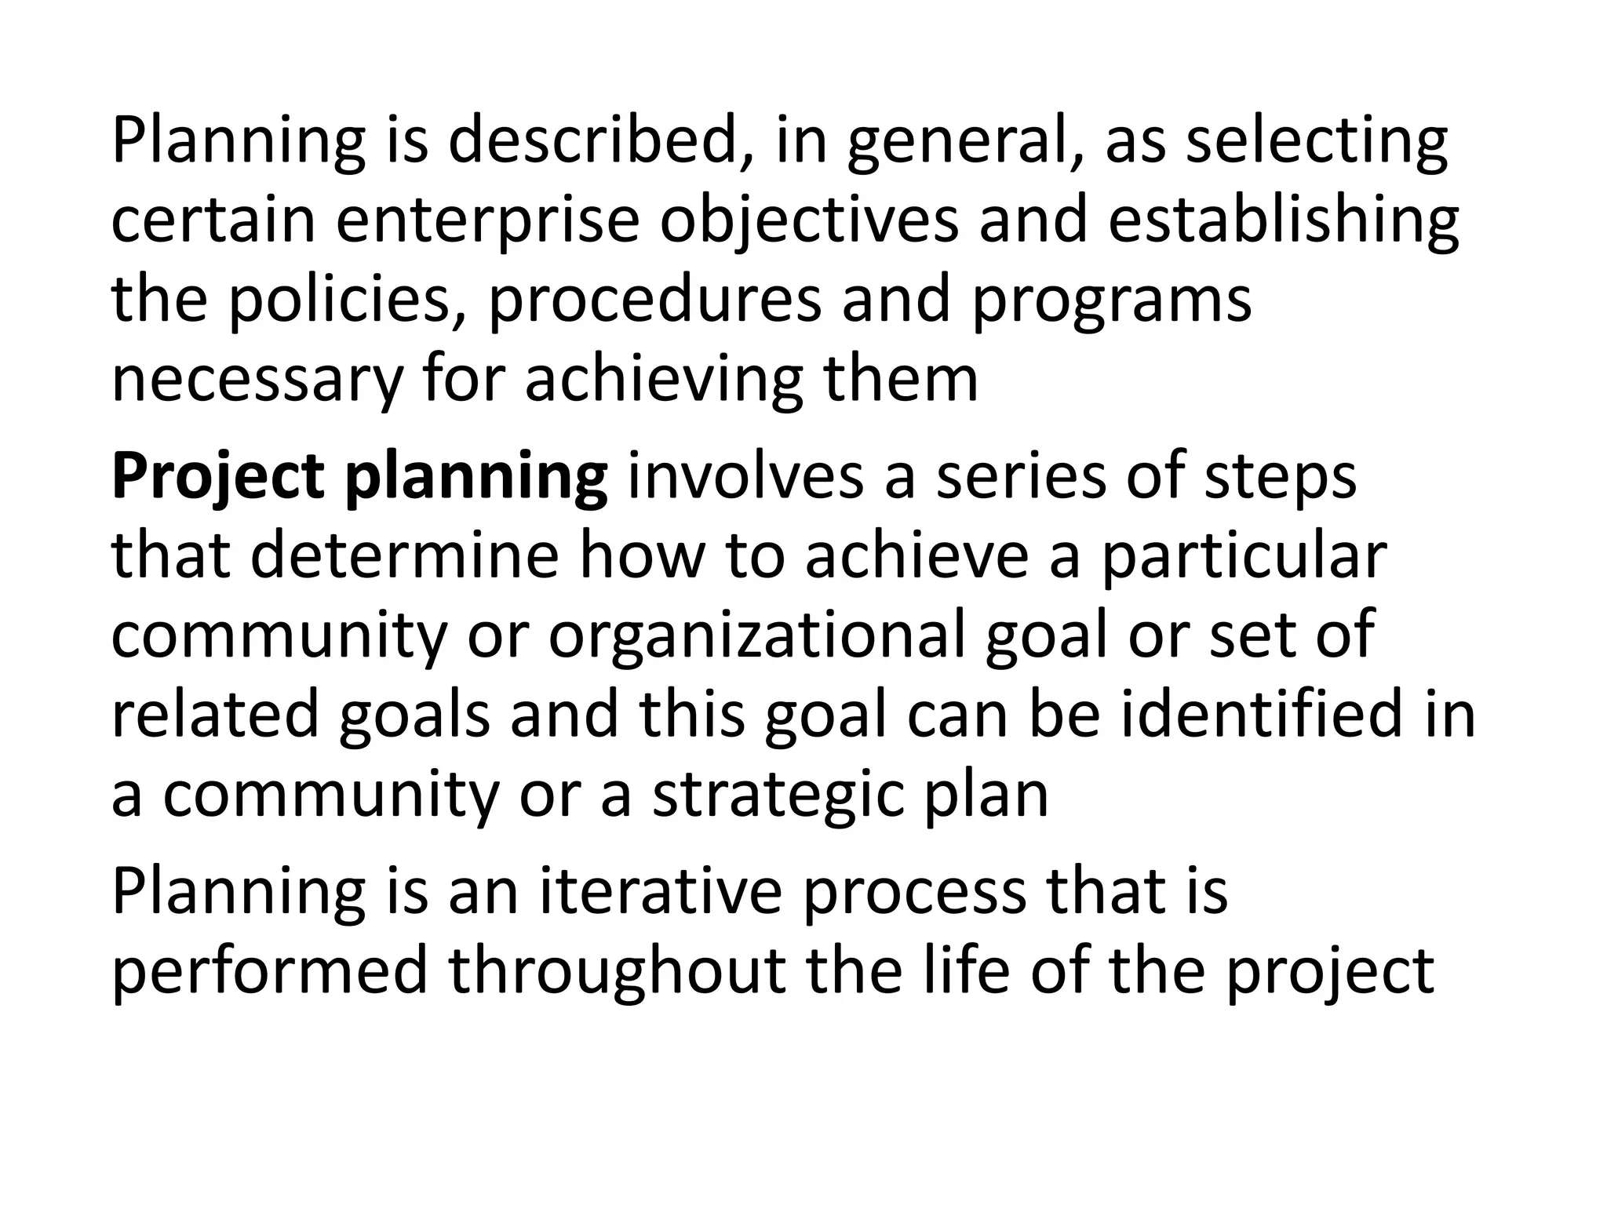

Slide 21
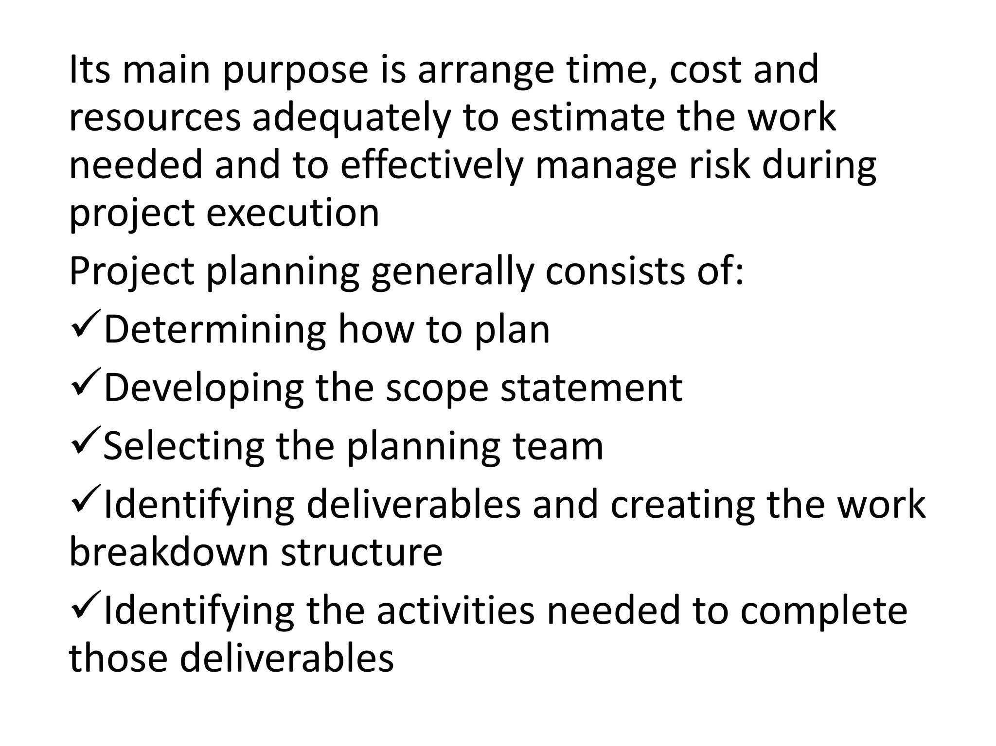

Slide 22
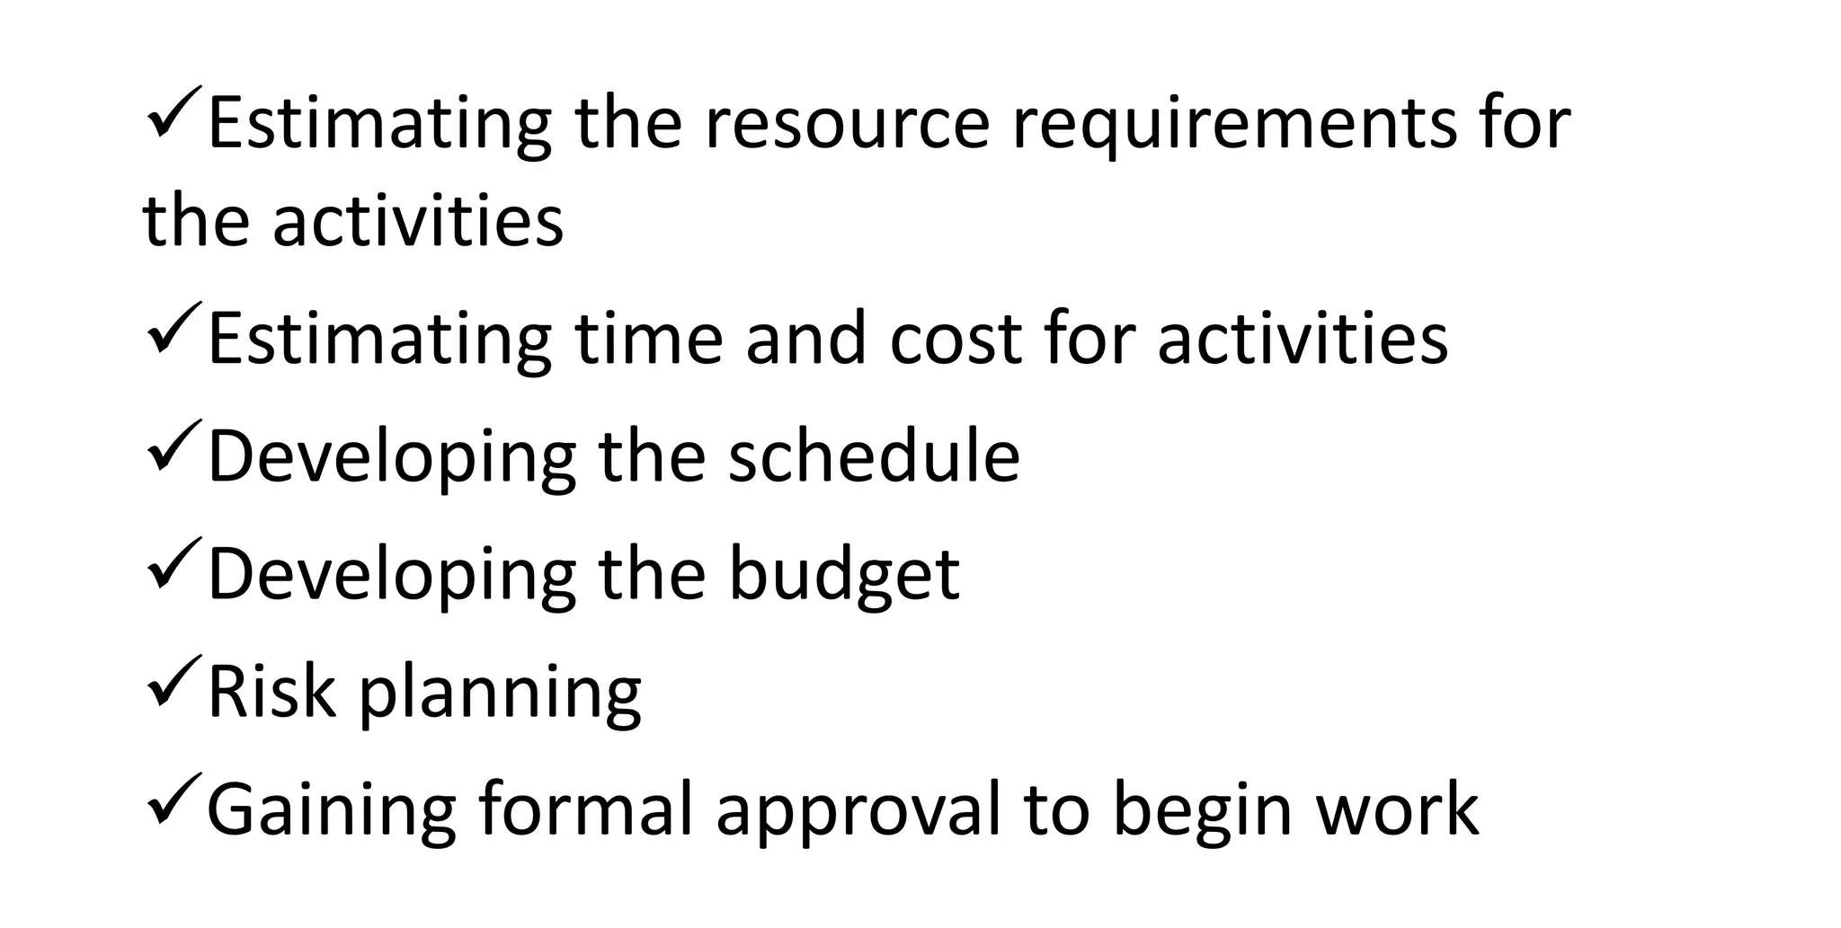
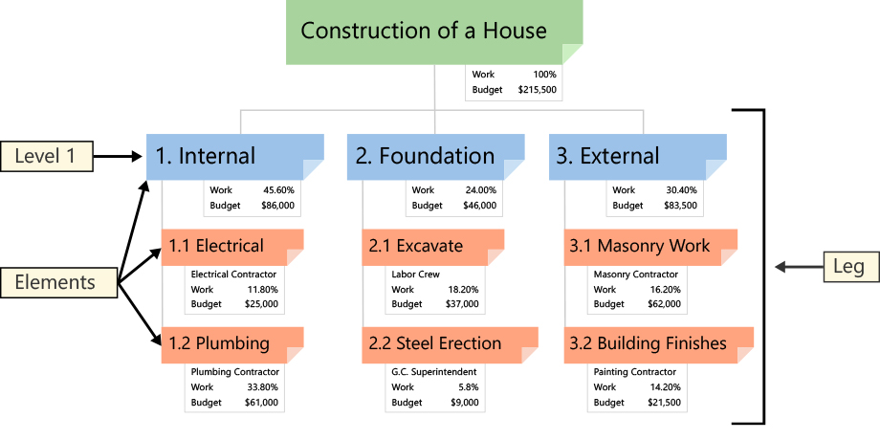
Real life example of
Work Breakdown Structure

Slide 23
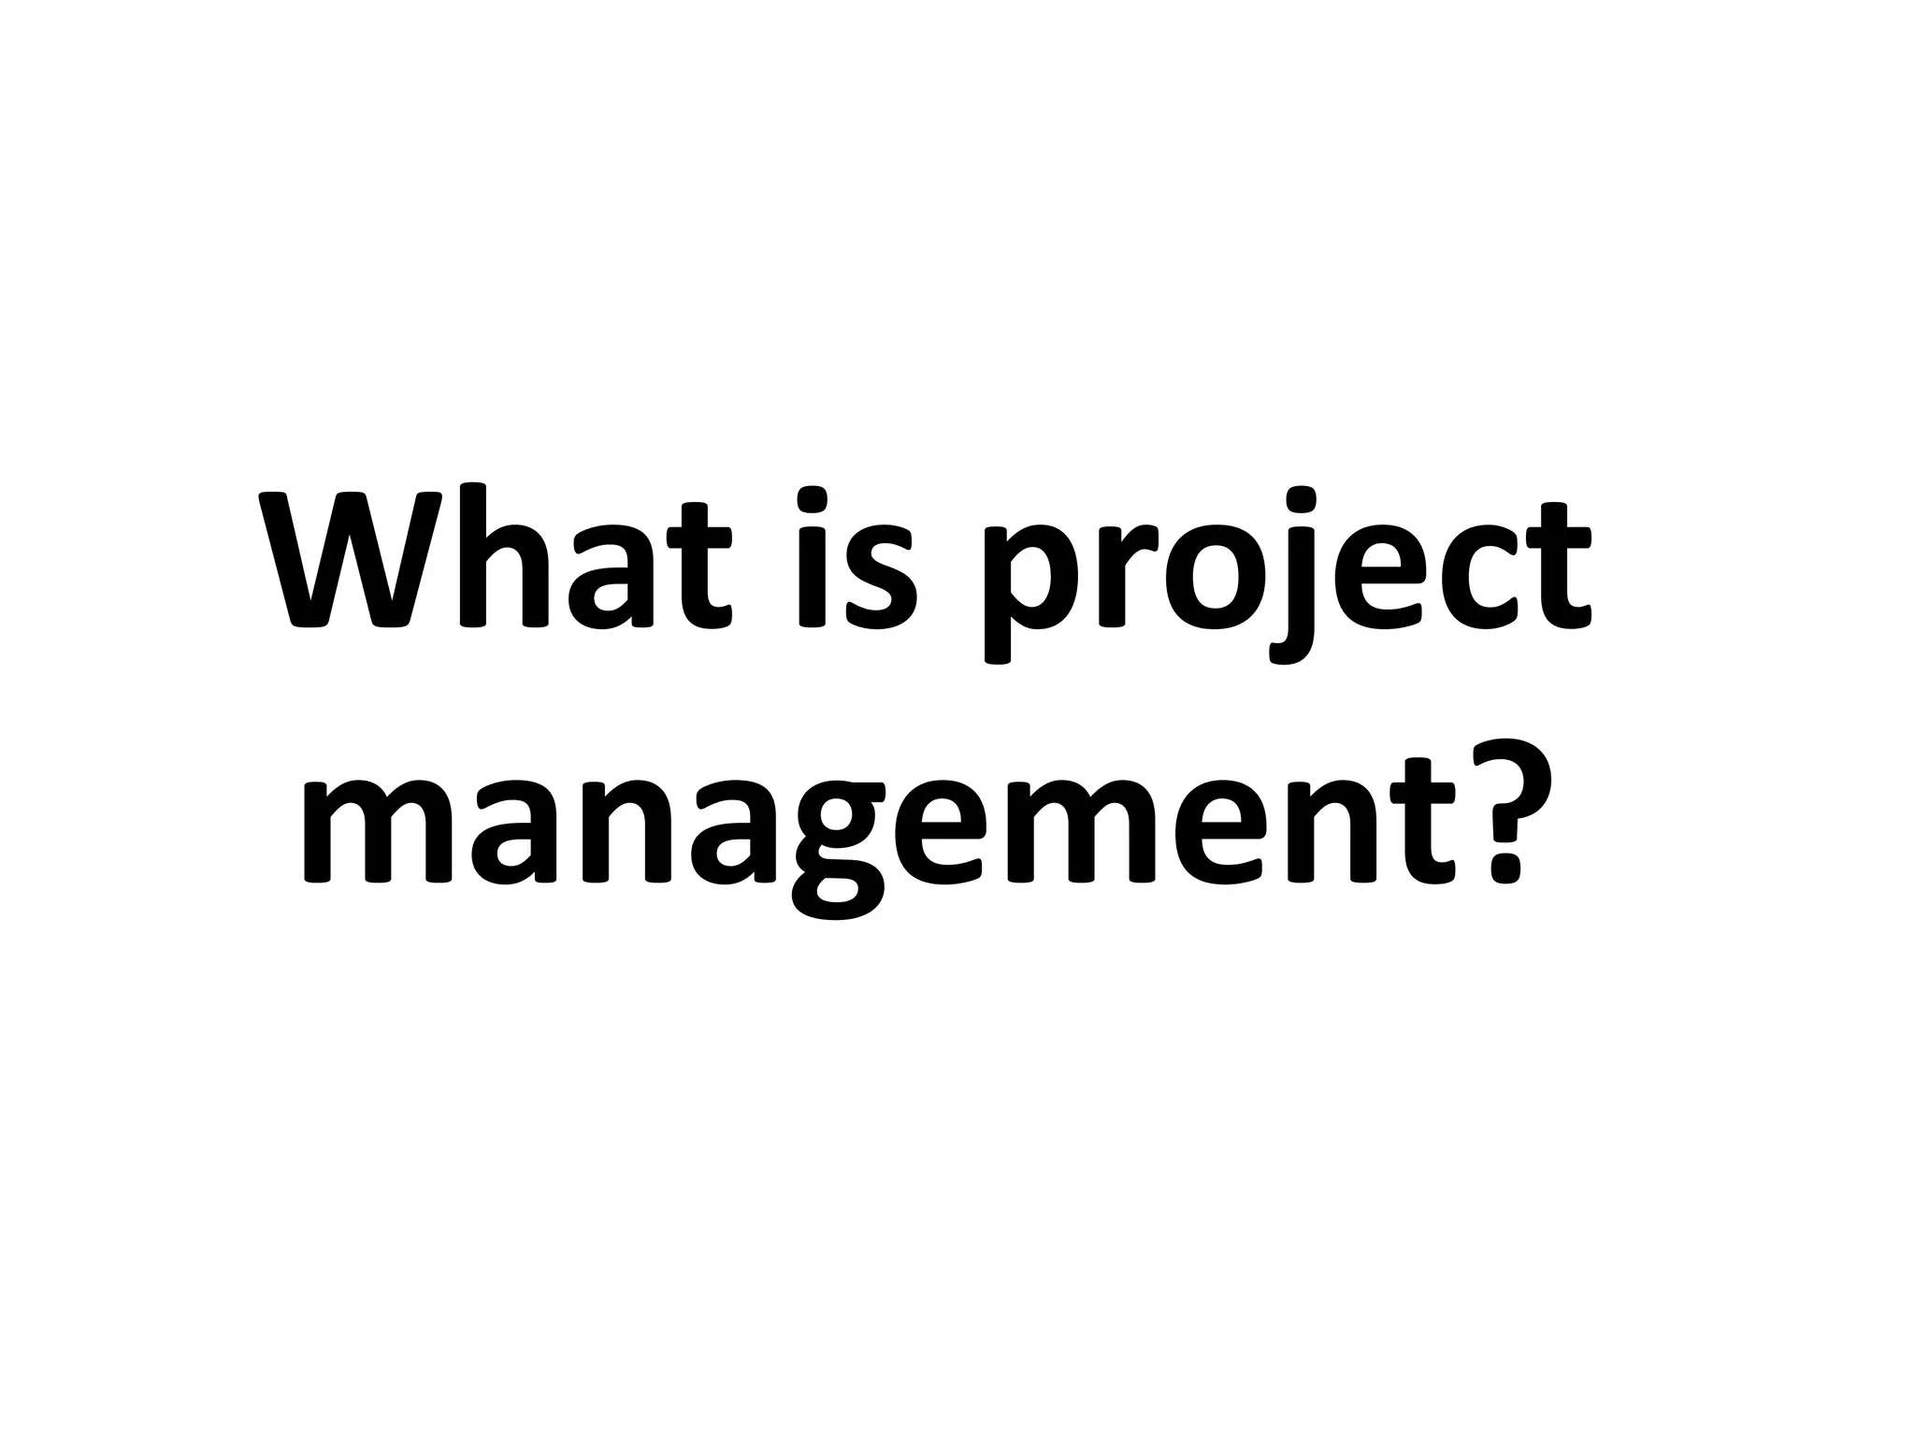

Slide 24
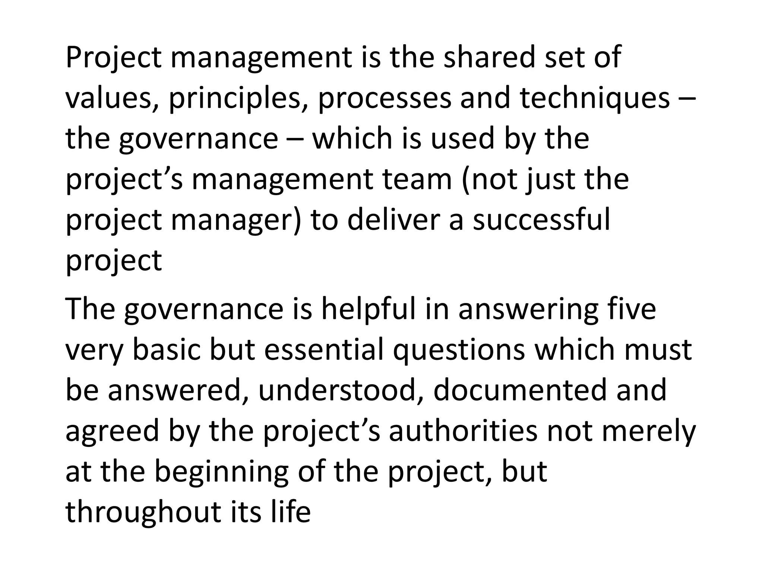

Slide 25
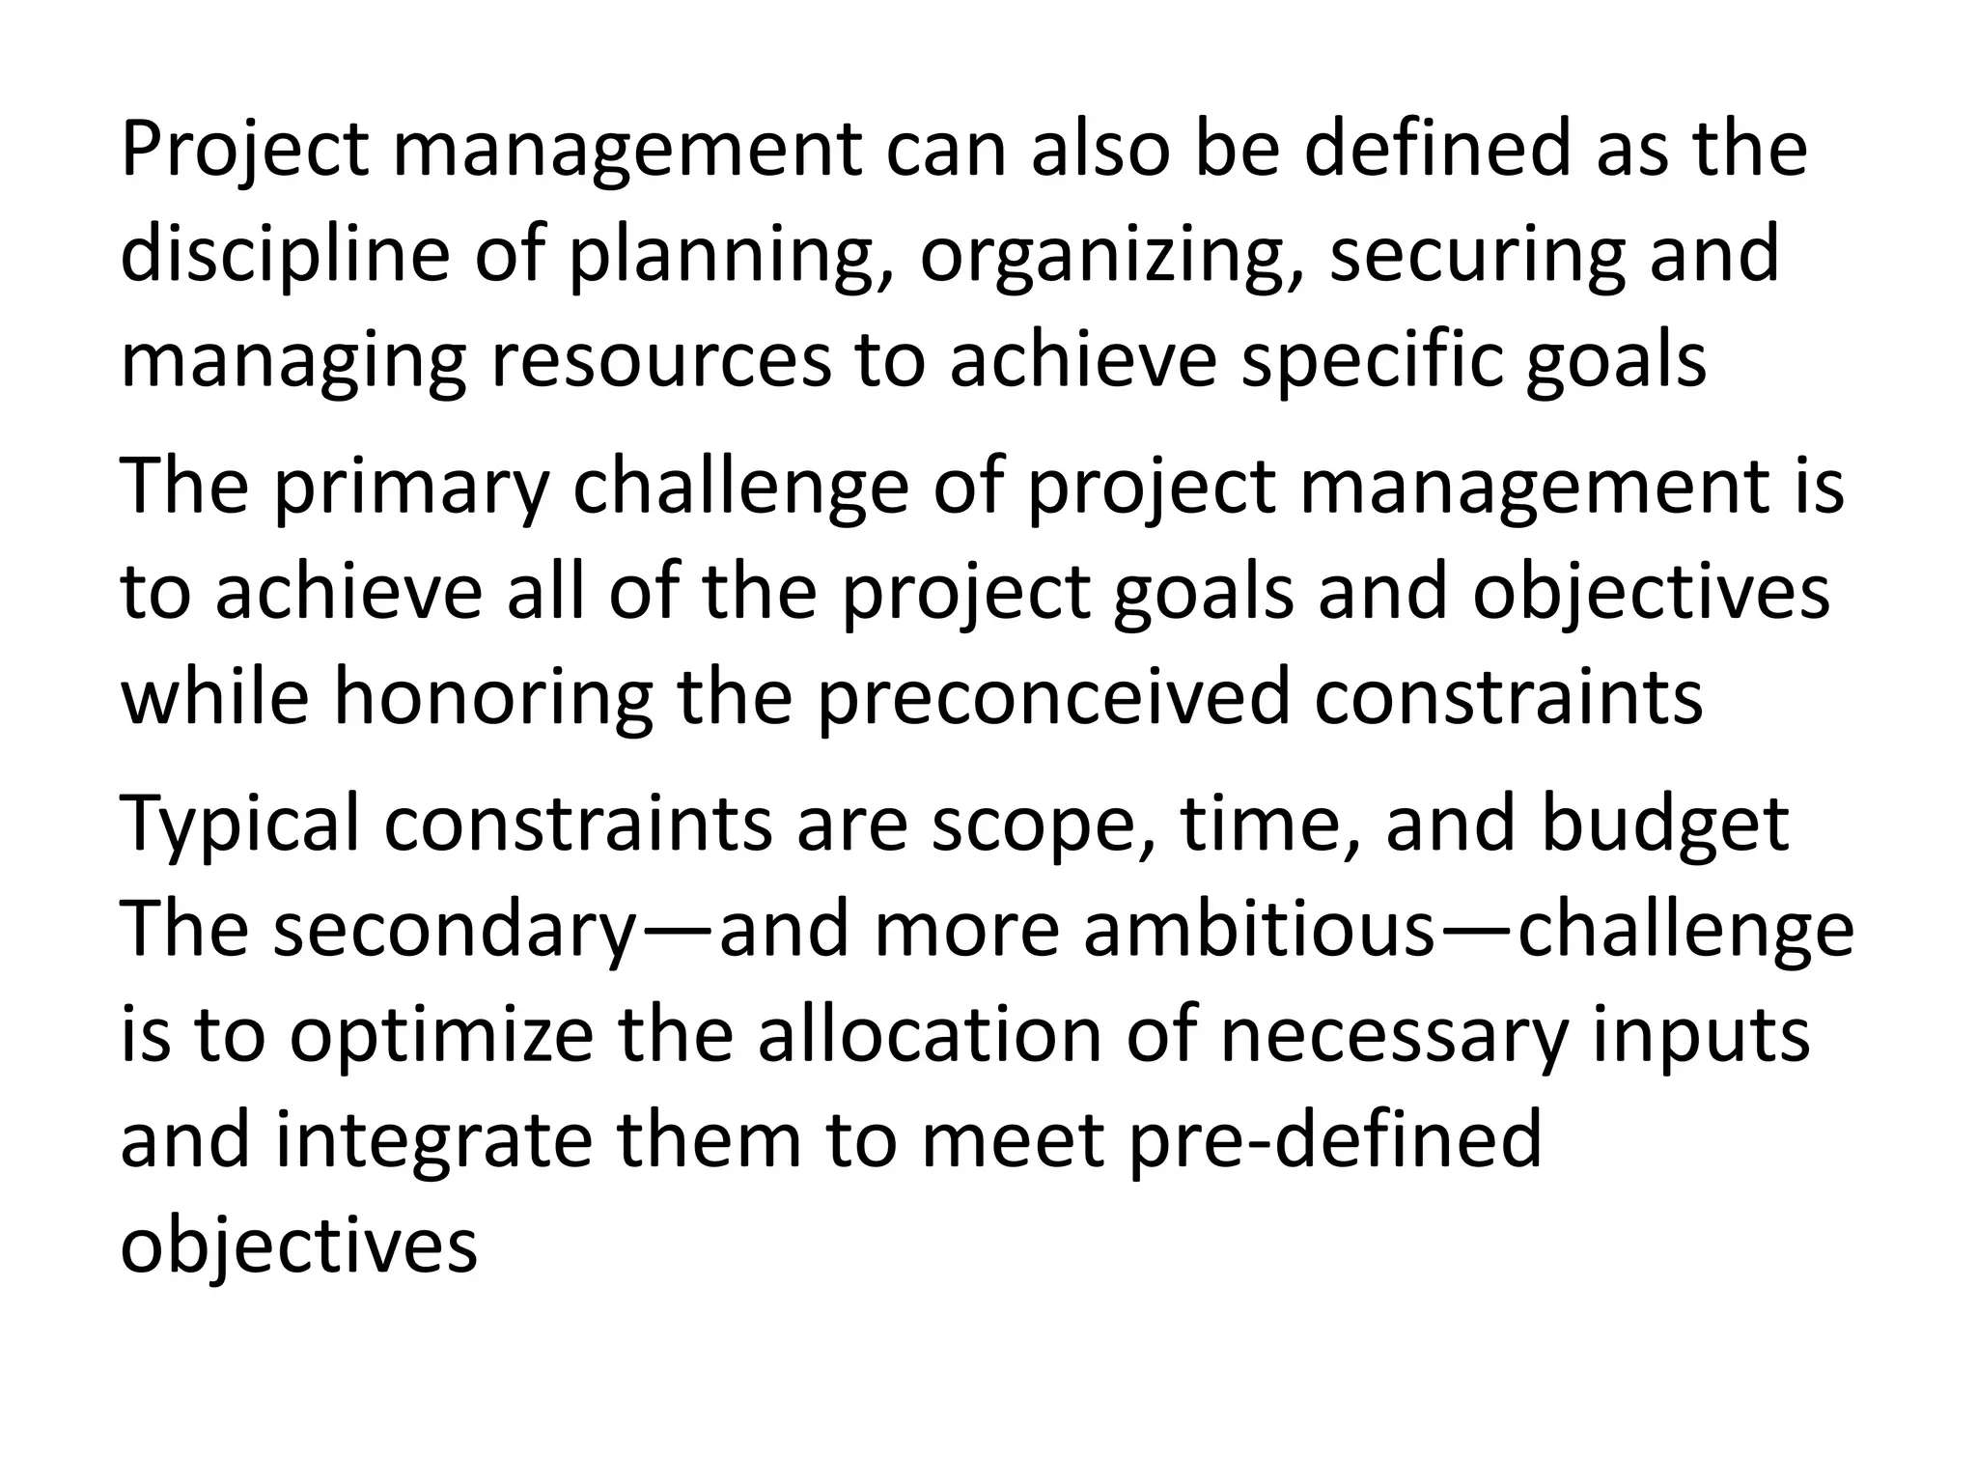

Slide 26
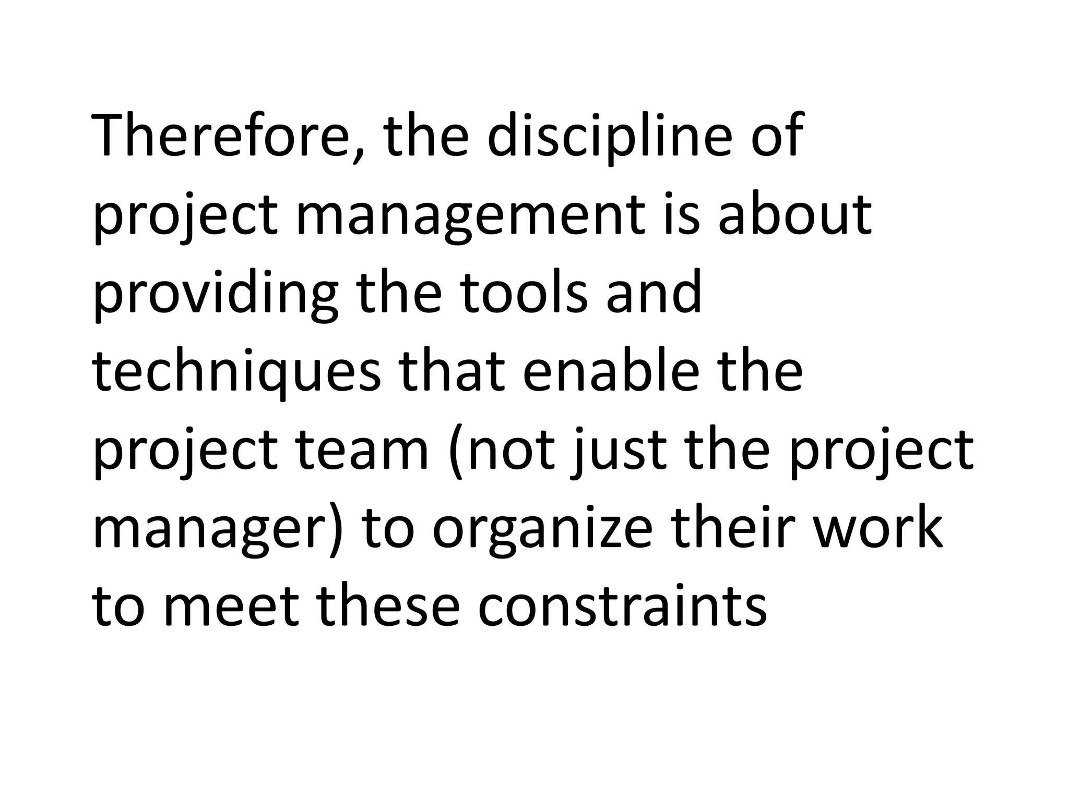

Slide 27
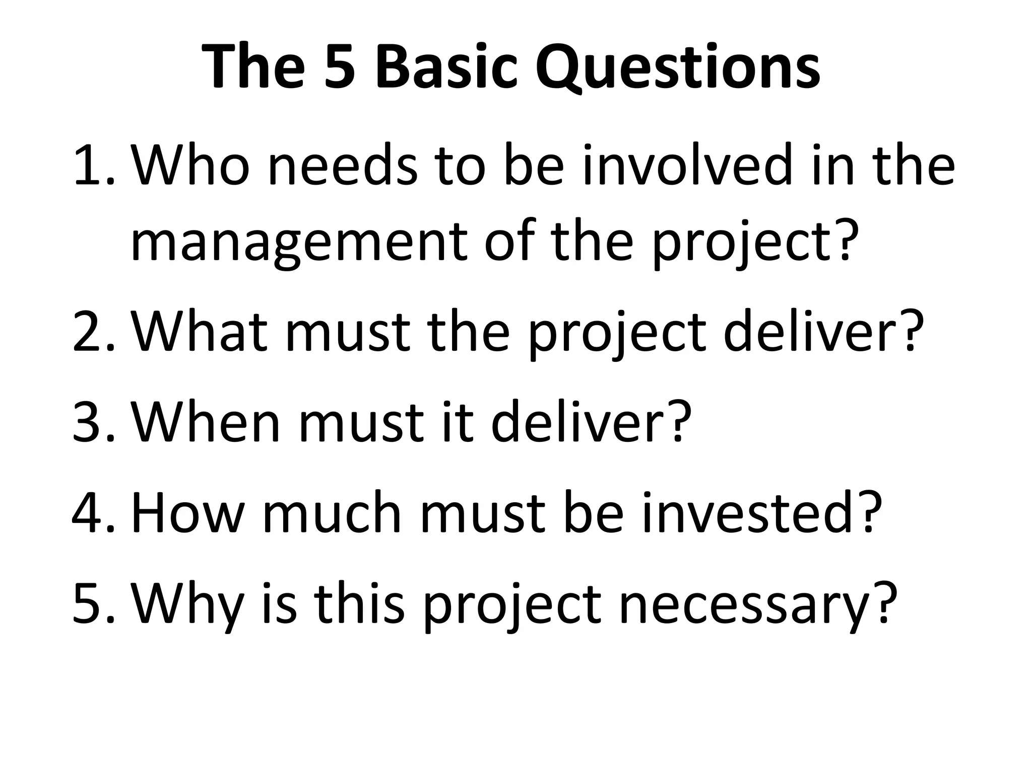

Slide 28
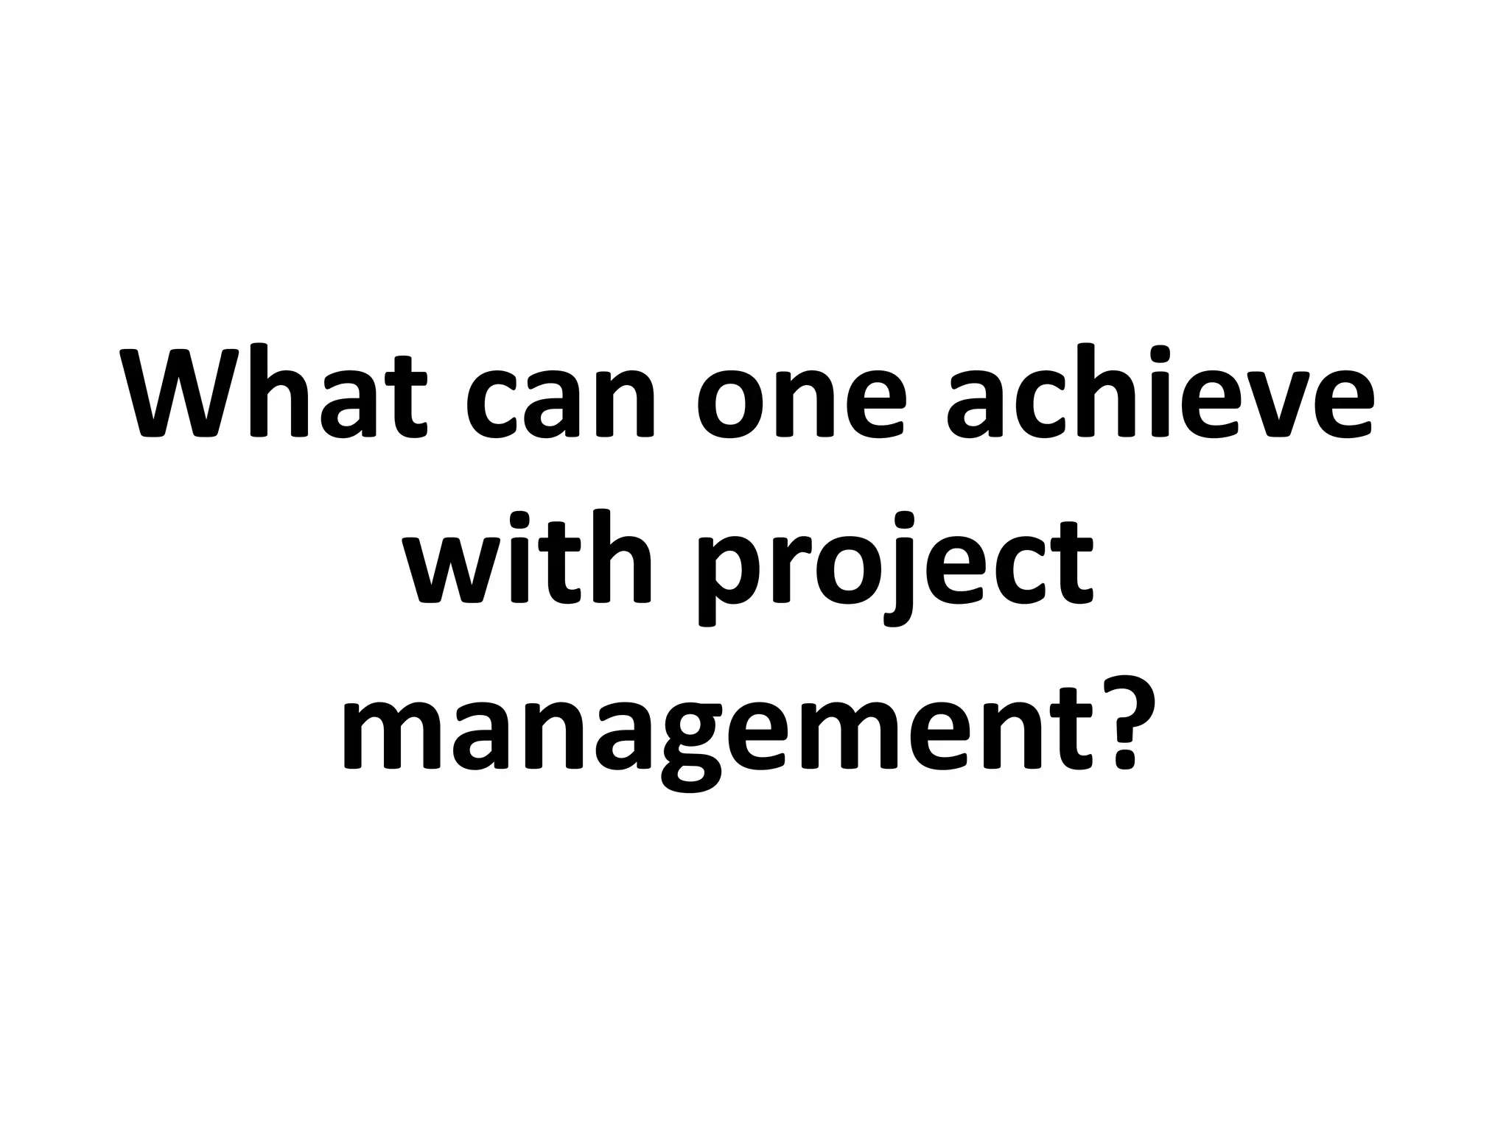

Slide 29
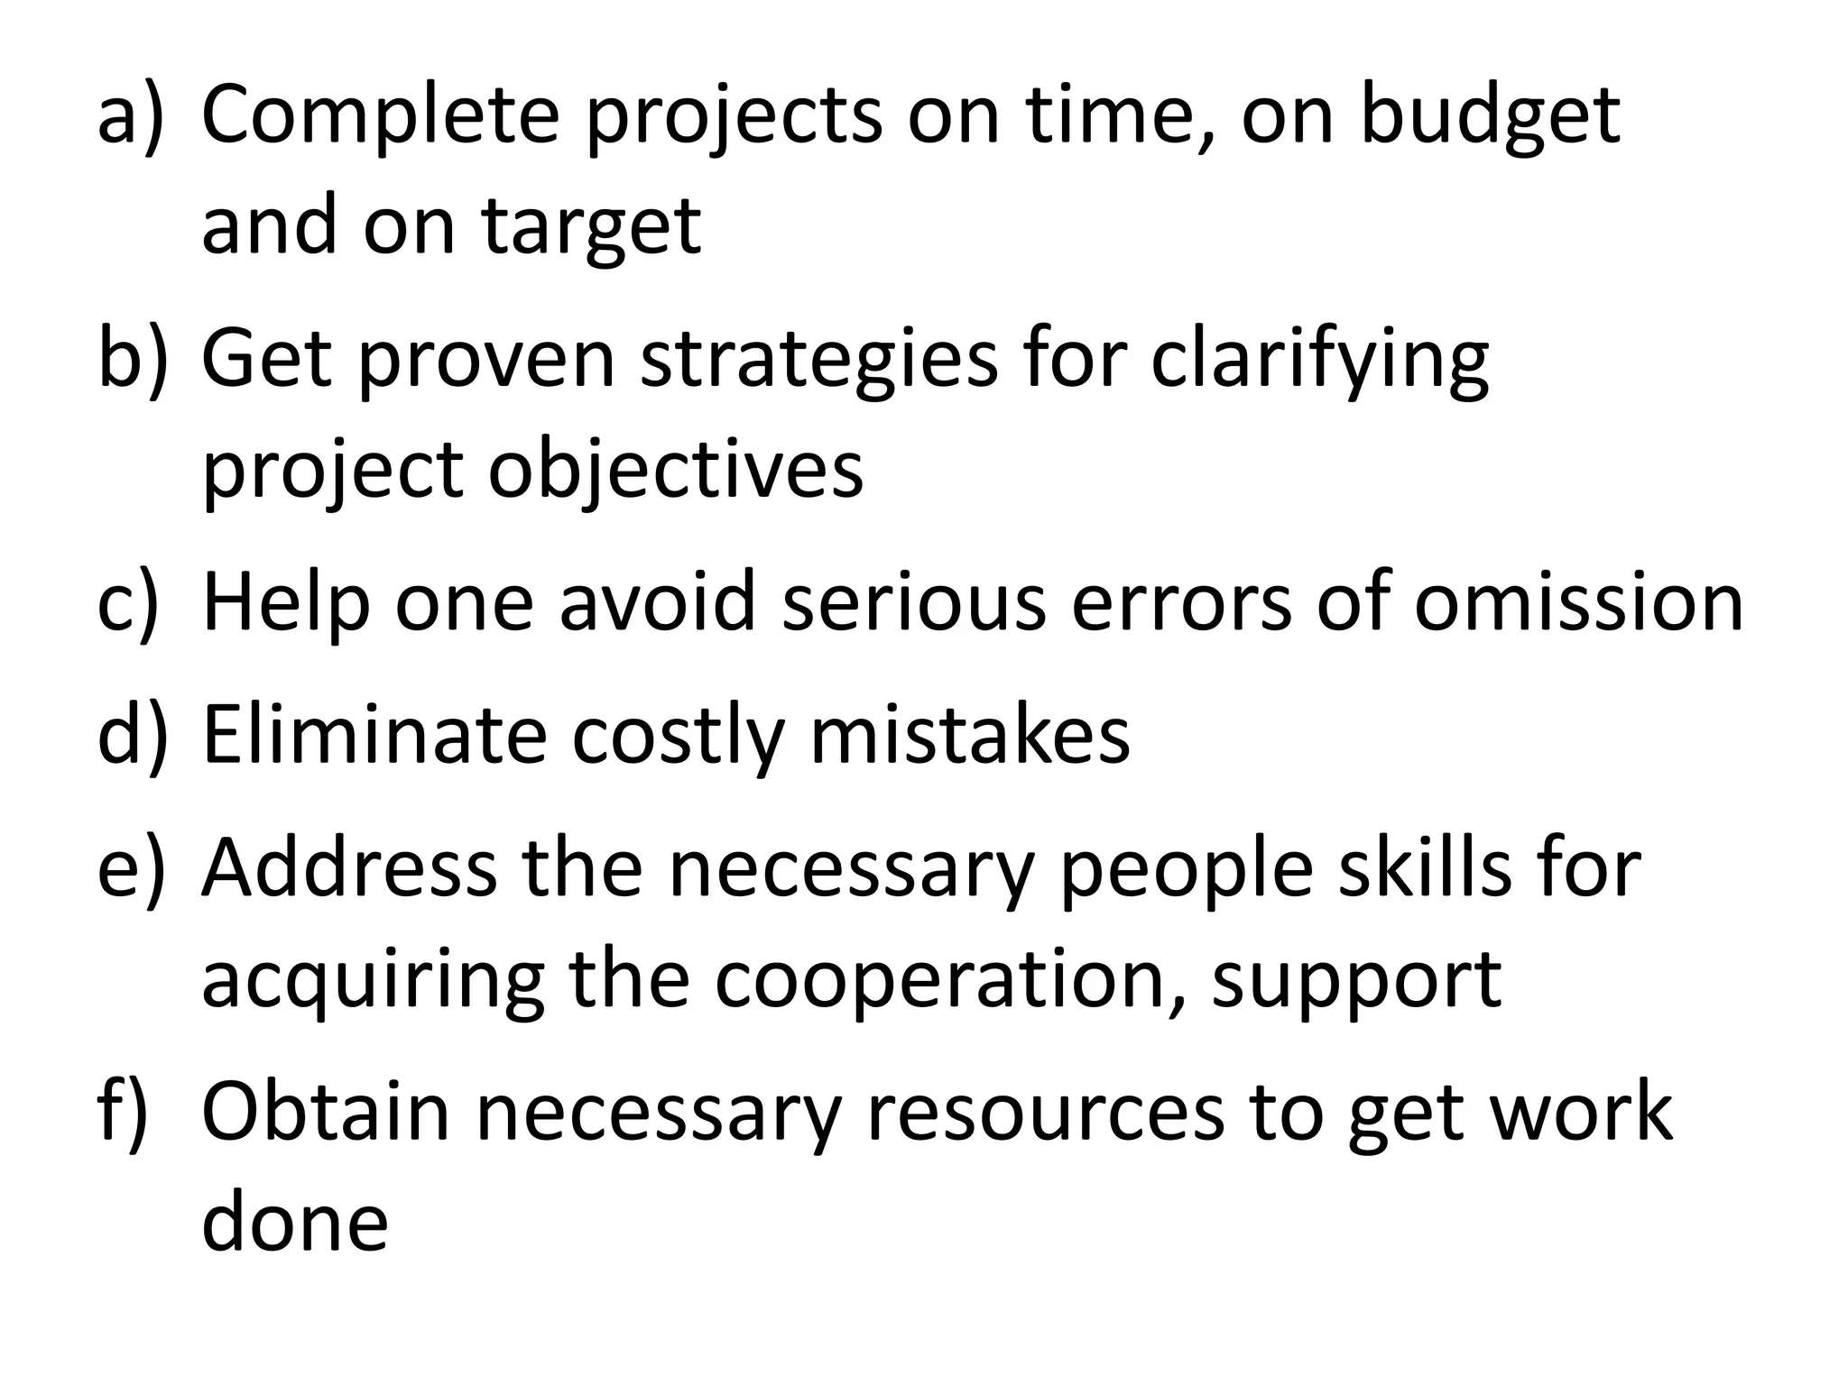

Slide 30
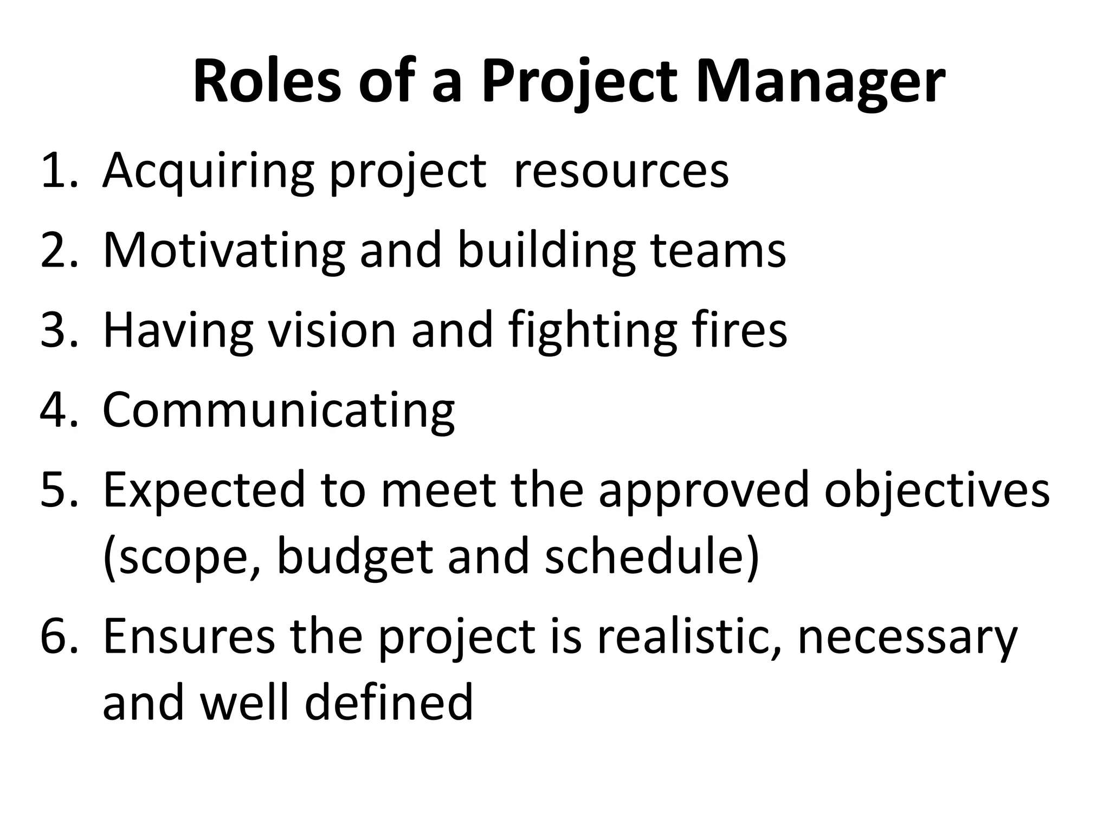

Slide 31
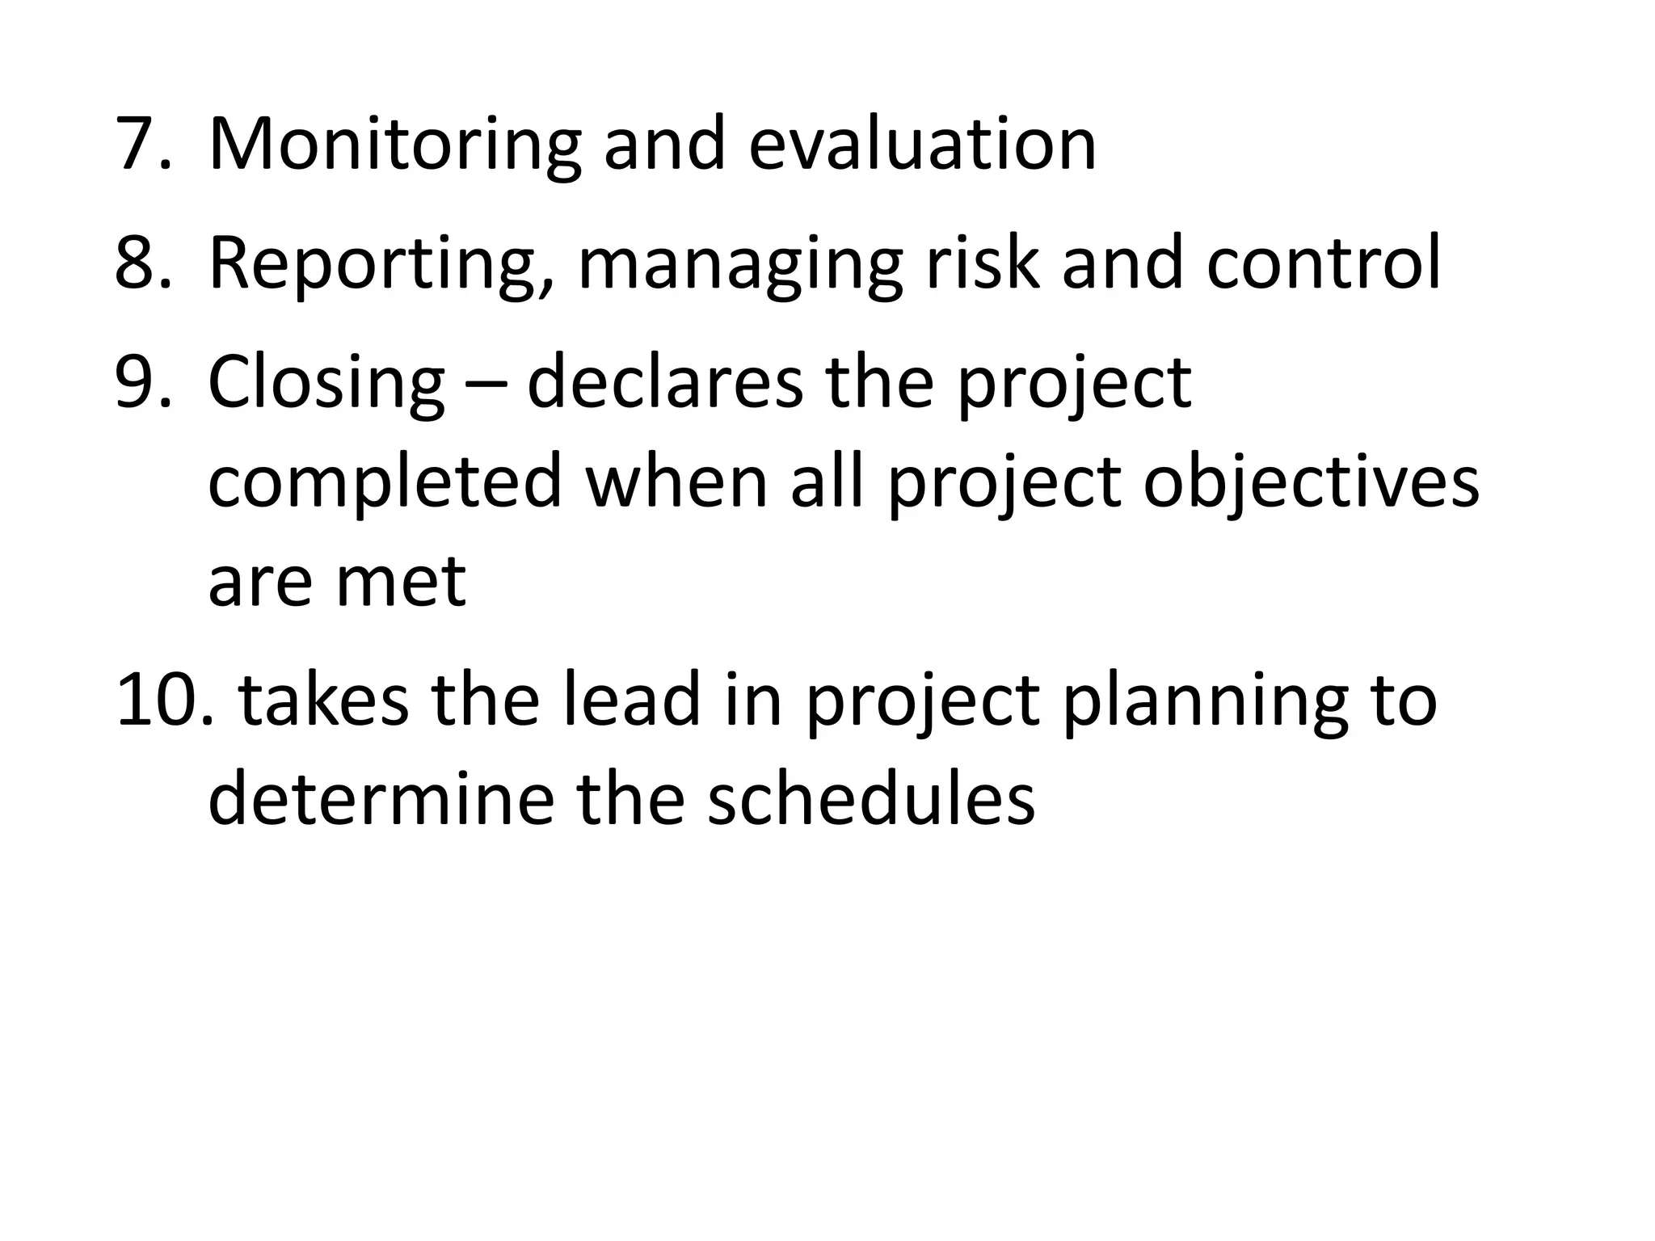

Slide 32
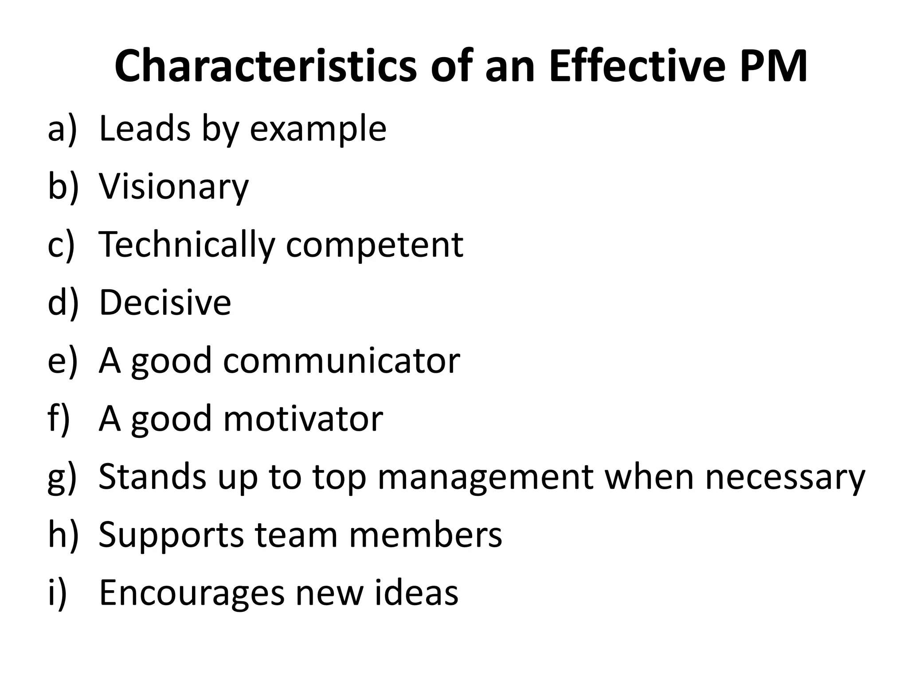

Slide 33
Project Scheduling (Bar chart)
(Week 4)

Slide 34
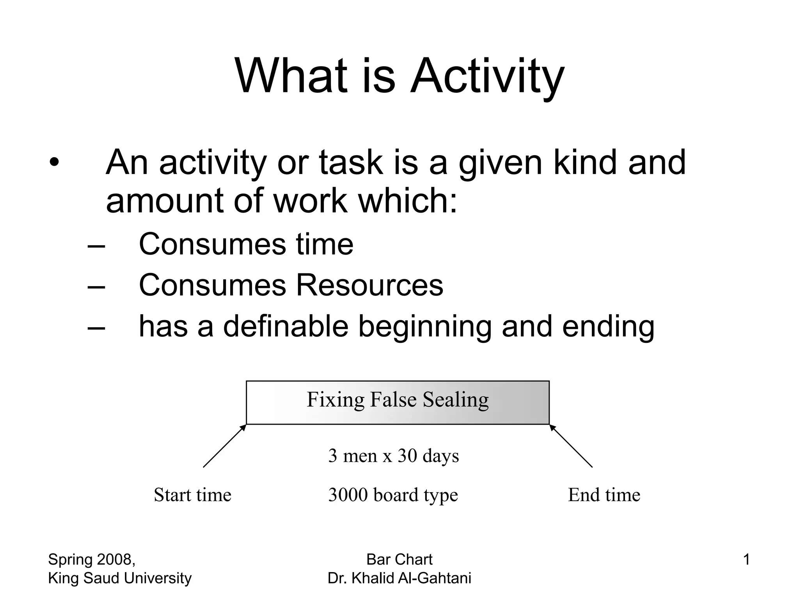
Fixing False Ceiling

Slide 35
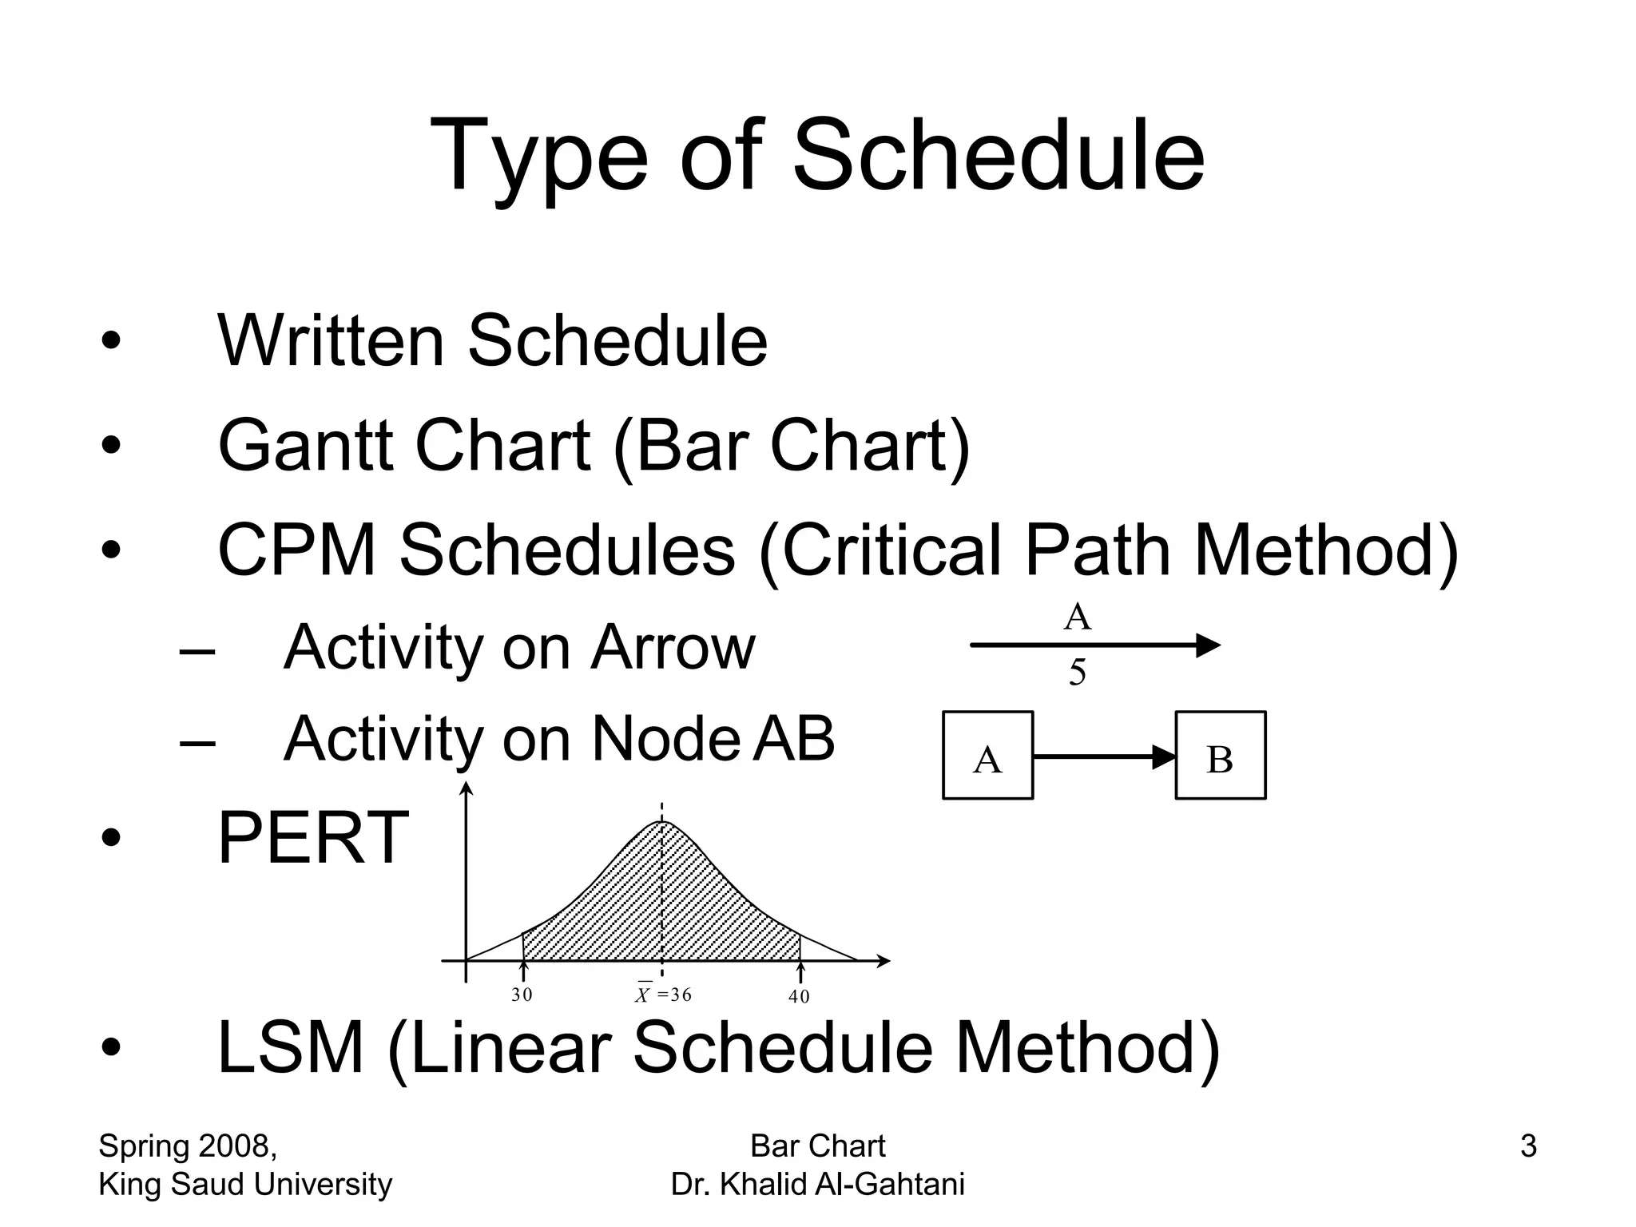

Slide 36
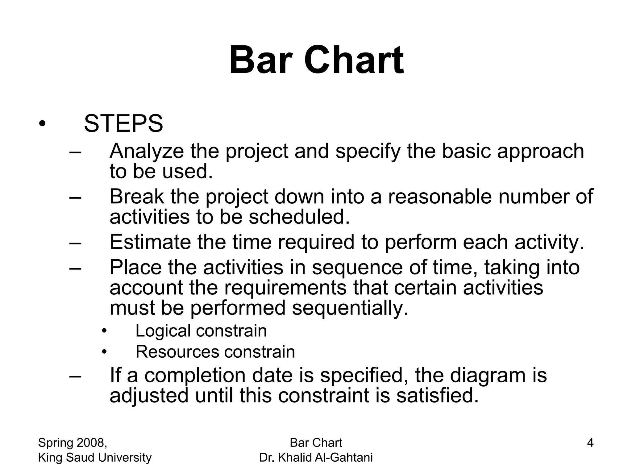

Slide 37
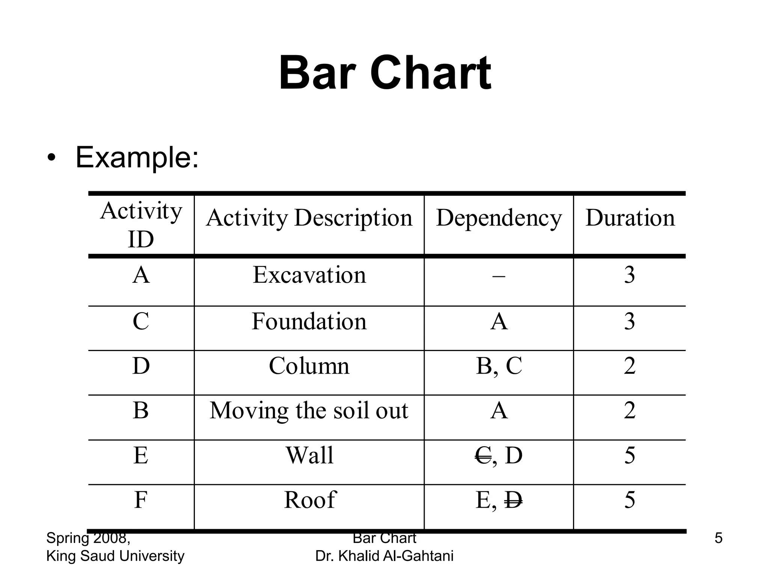
D
D

Slide 38
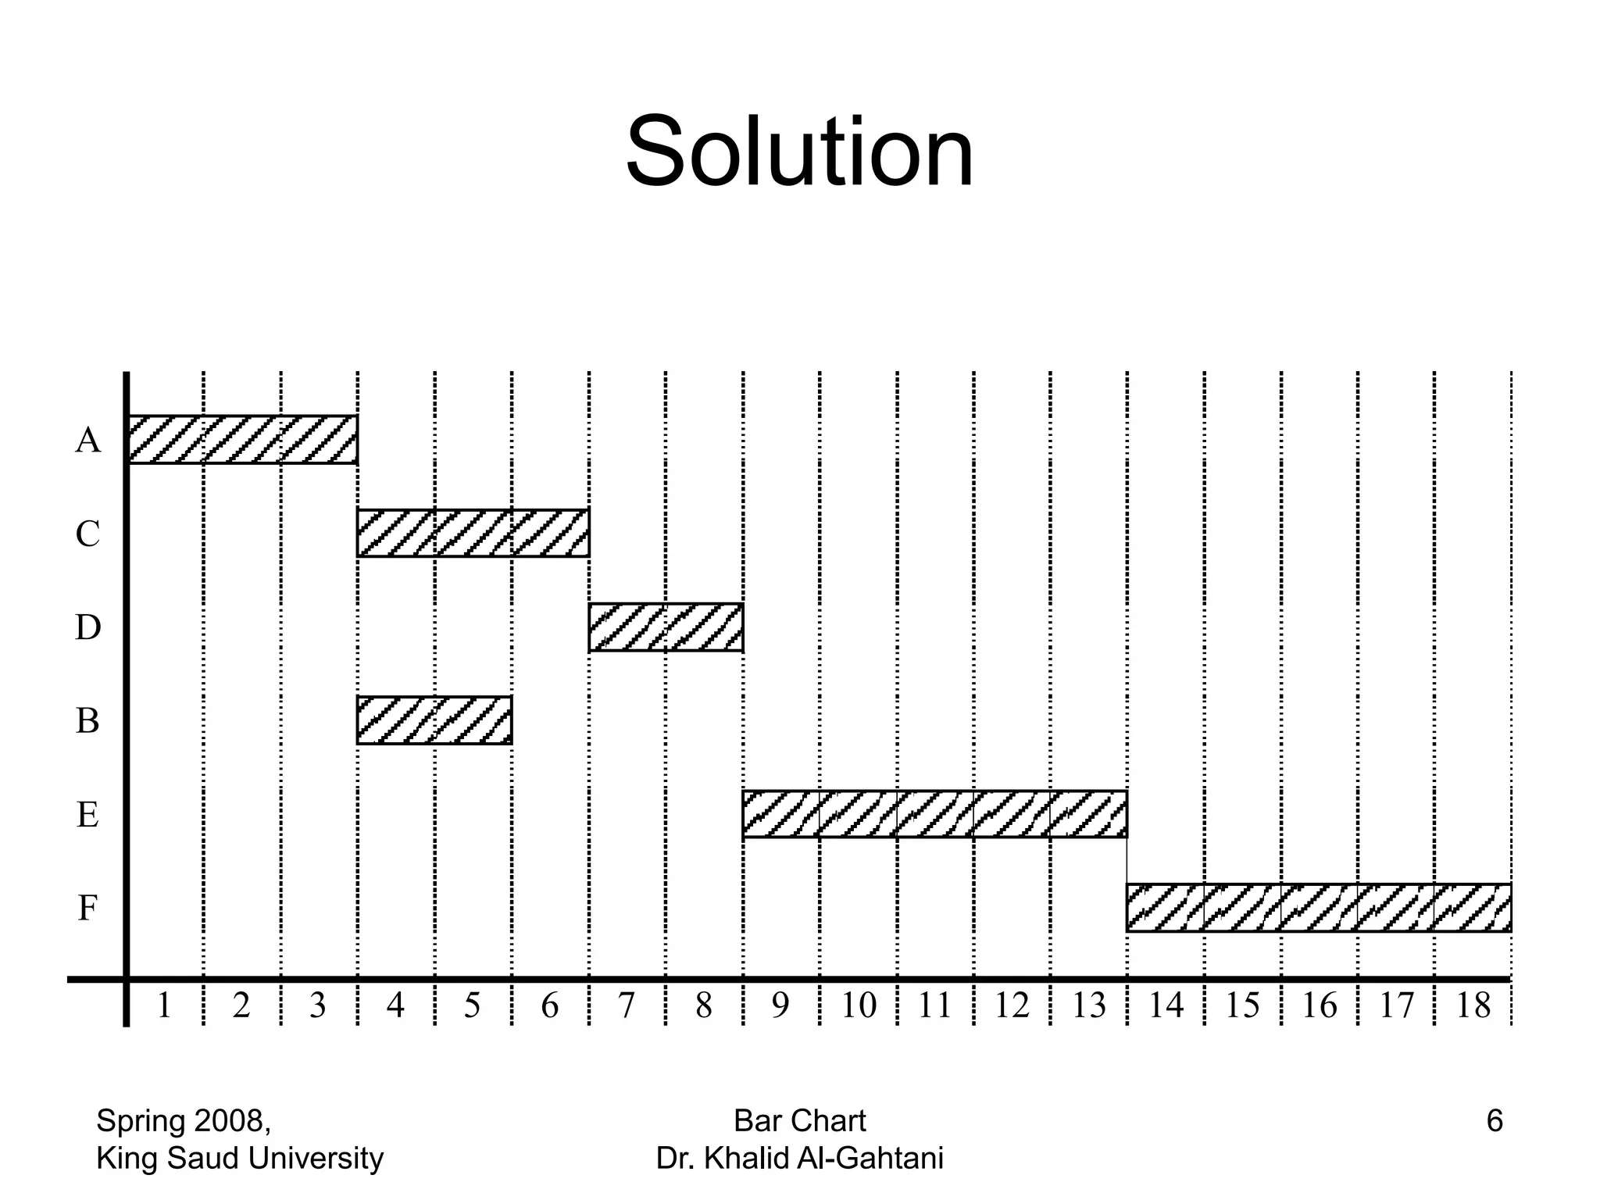

Slide 39
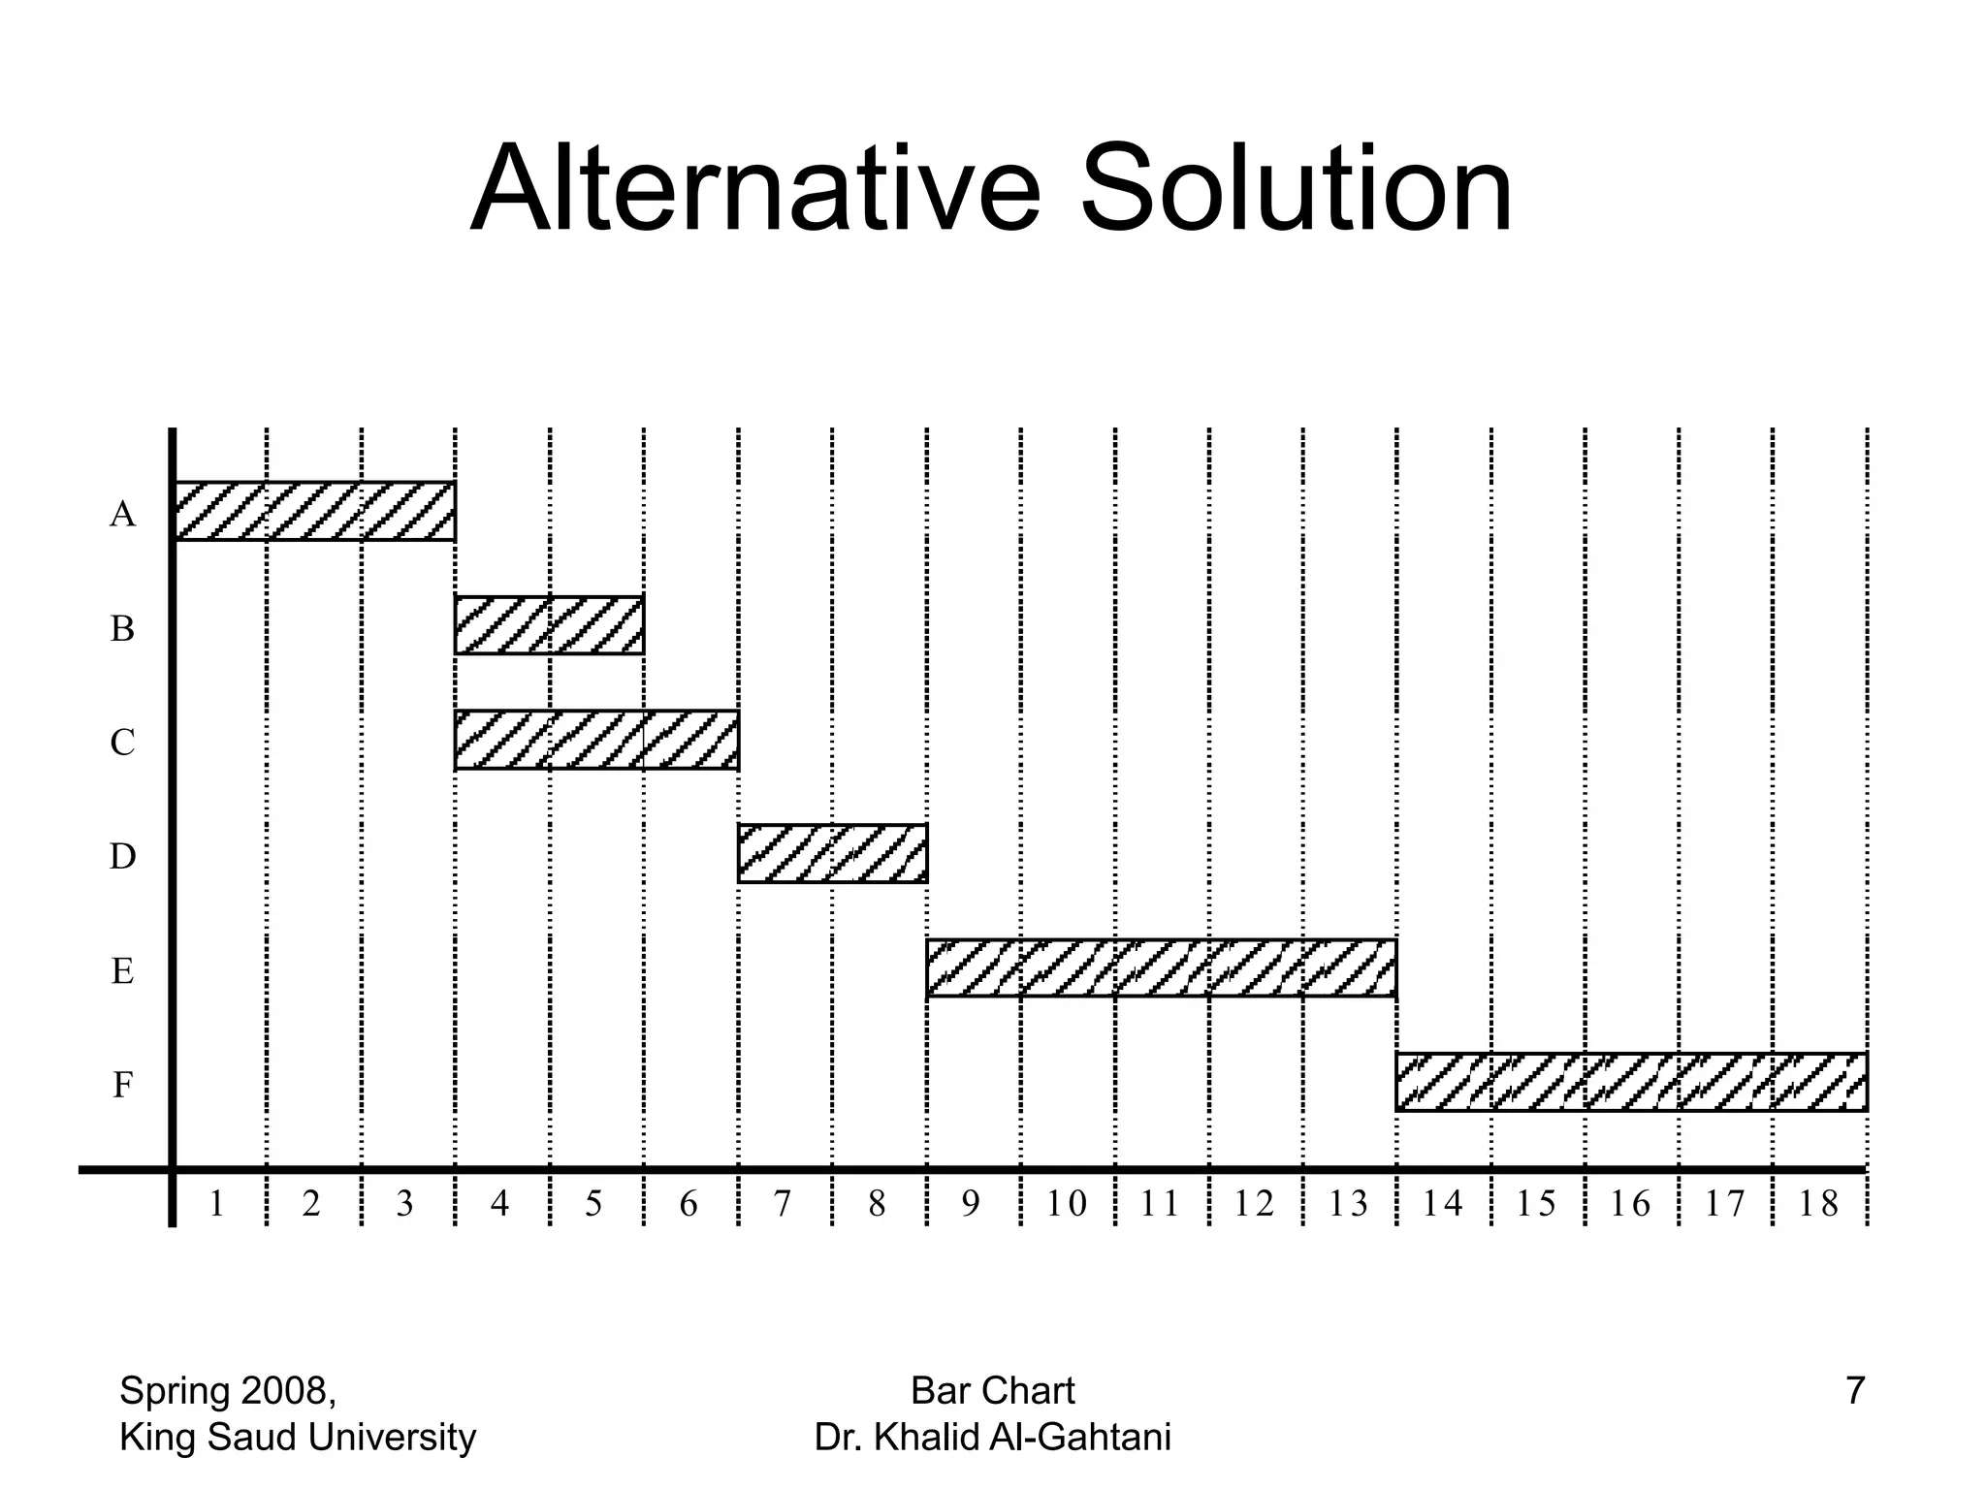

Slide 40
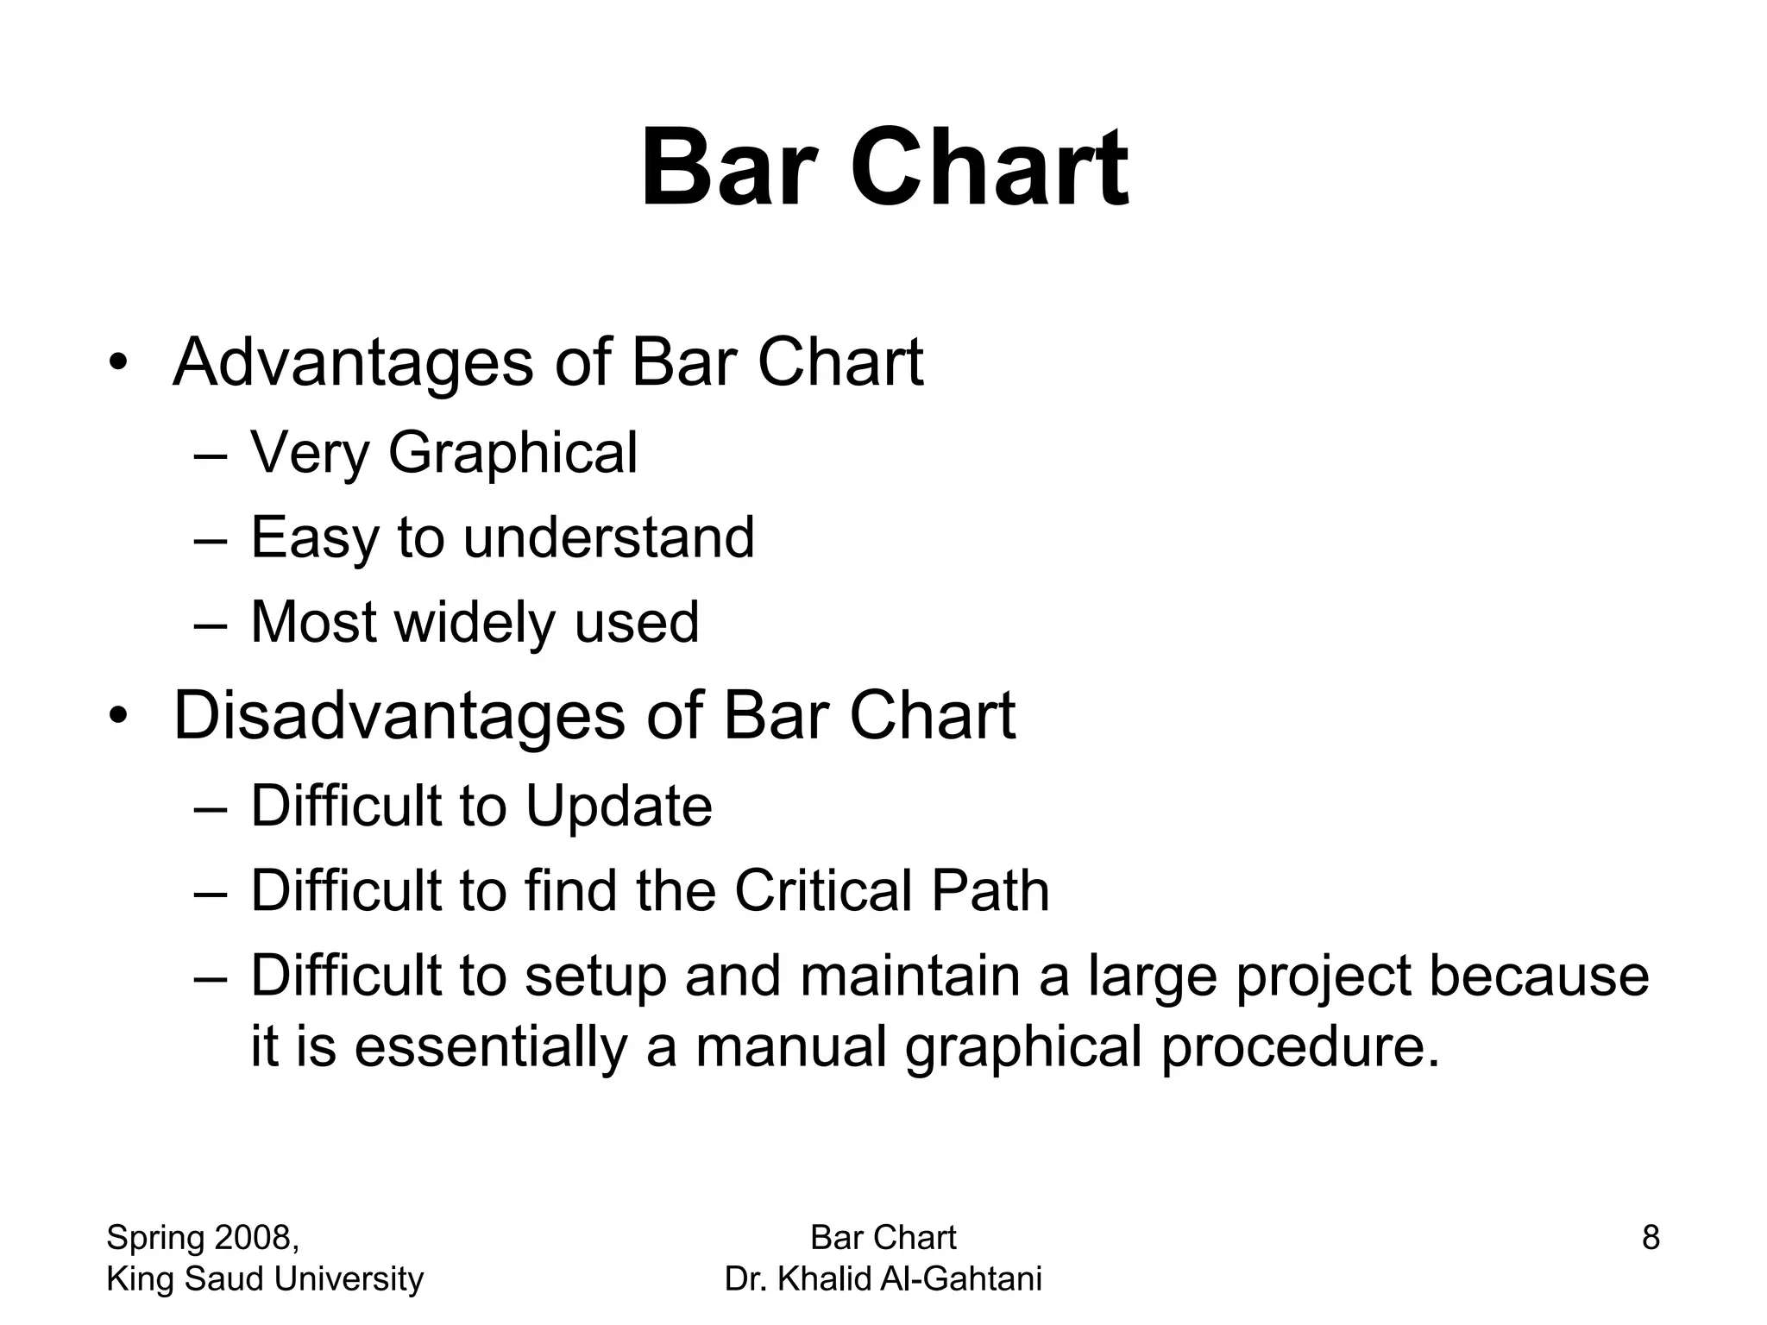

Slide 41
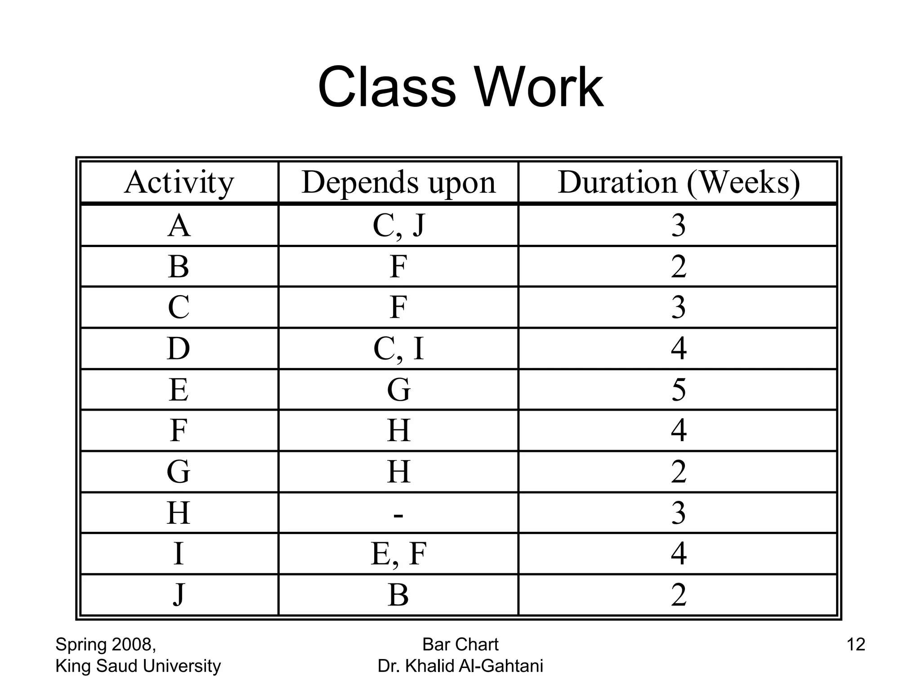

Slide 42
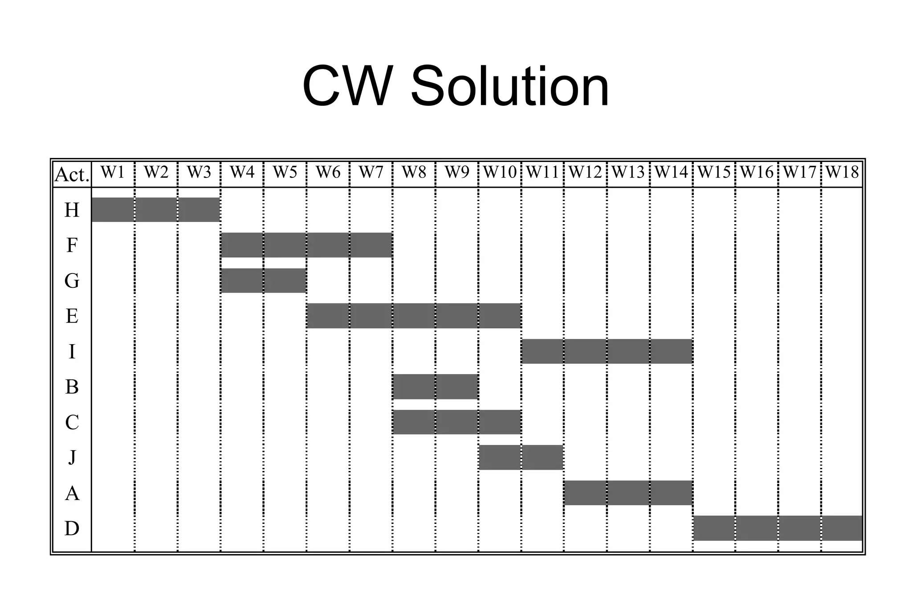

Slide 43
PERT and CPM
(Week 5-6)

Slide 44
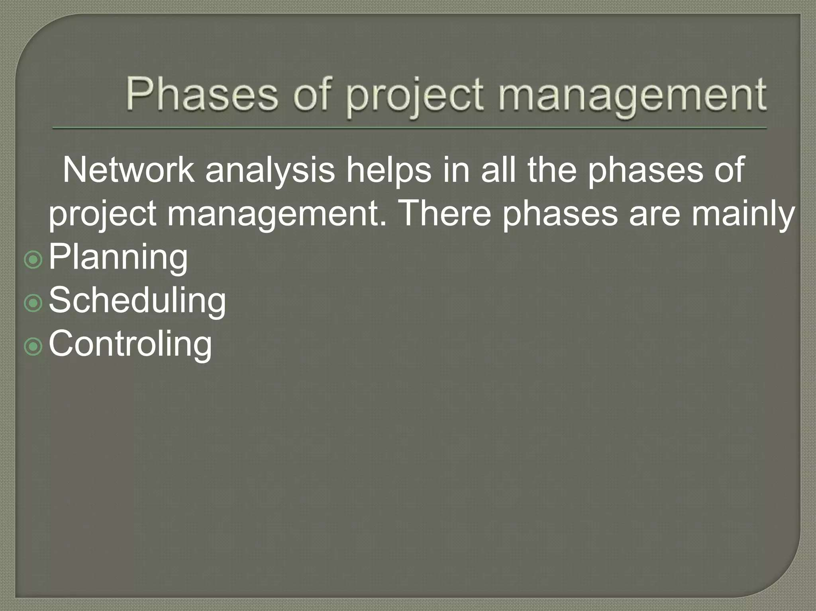

Slide 45
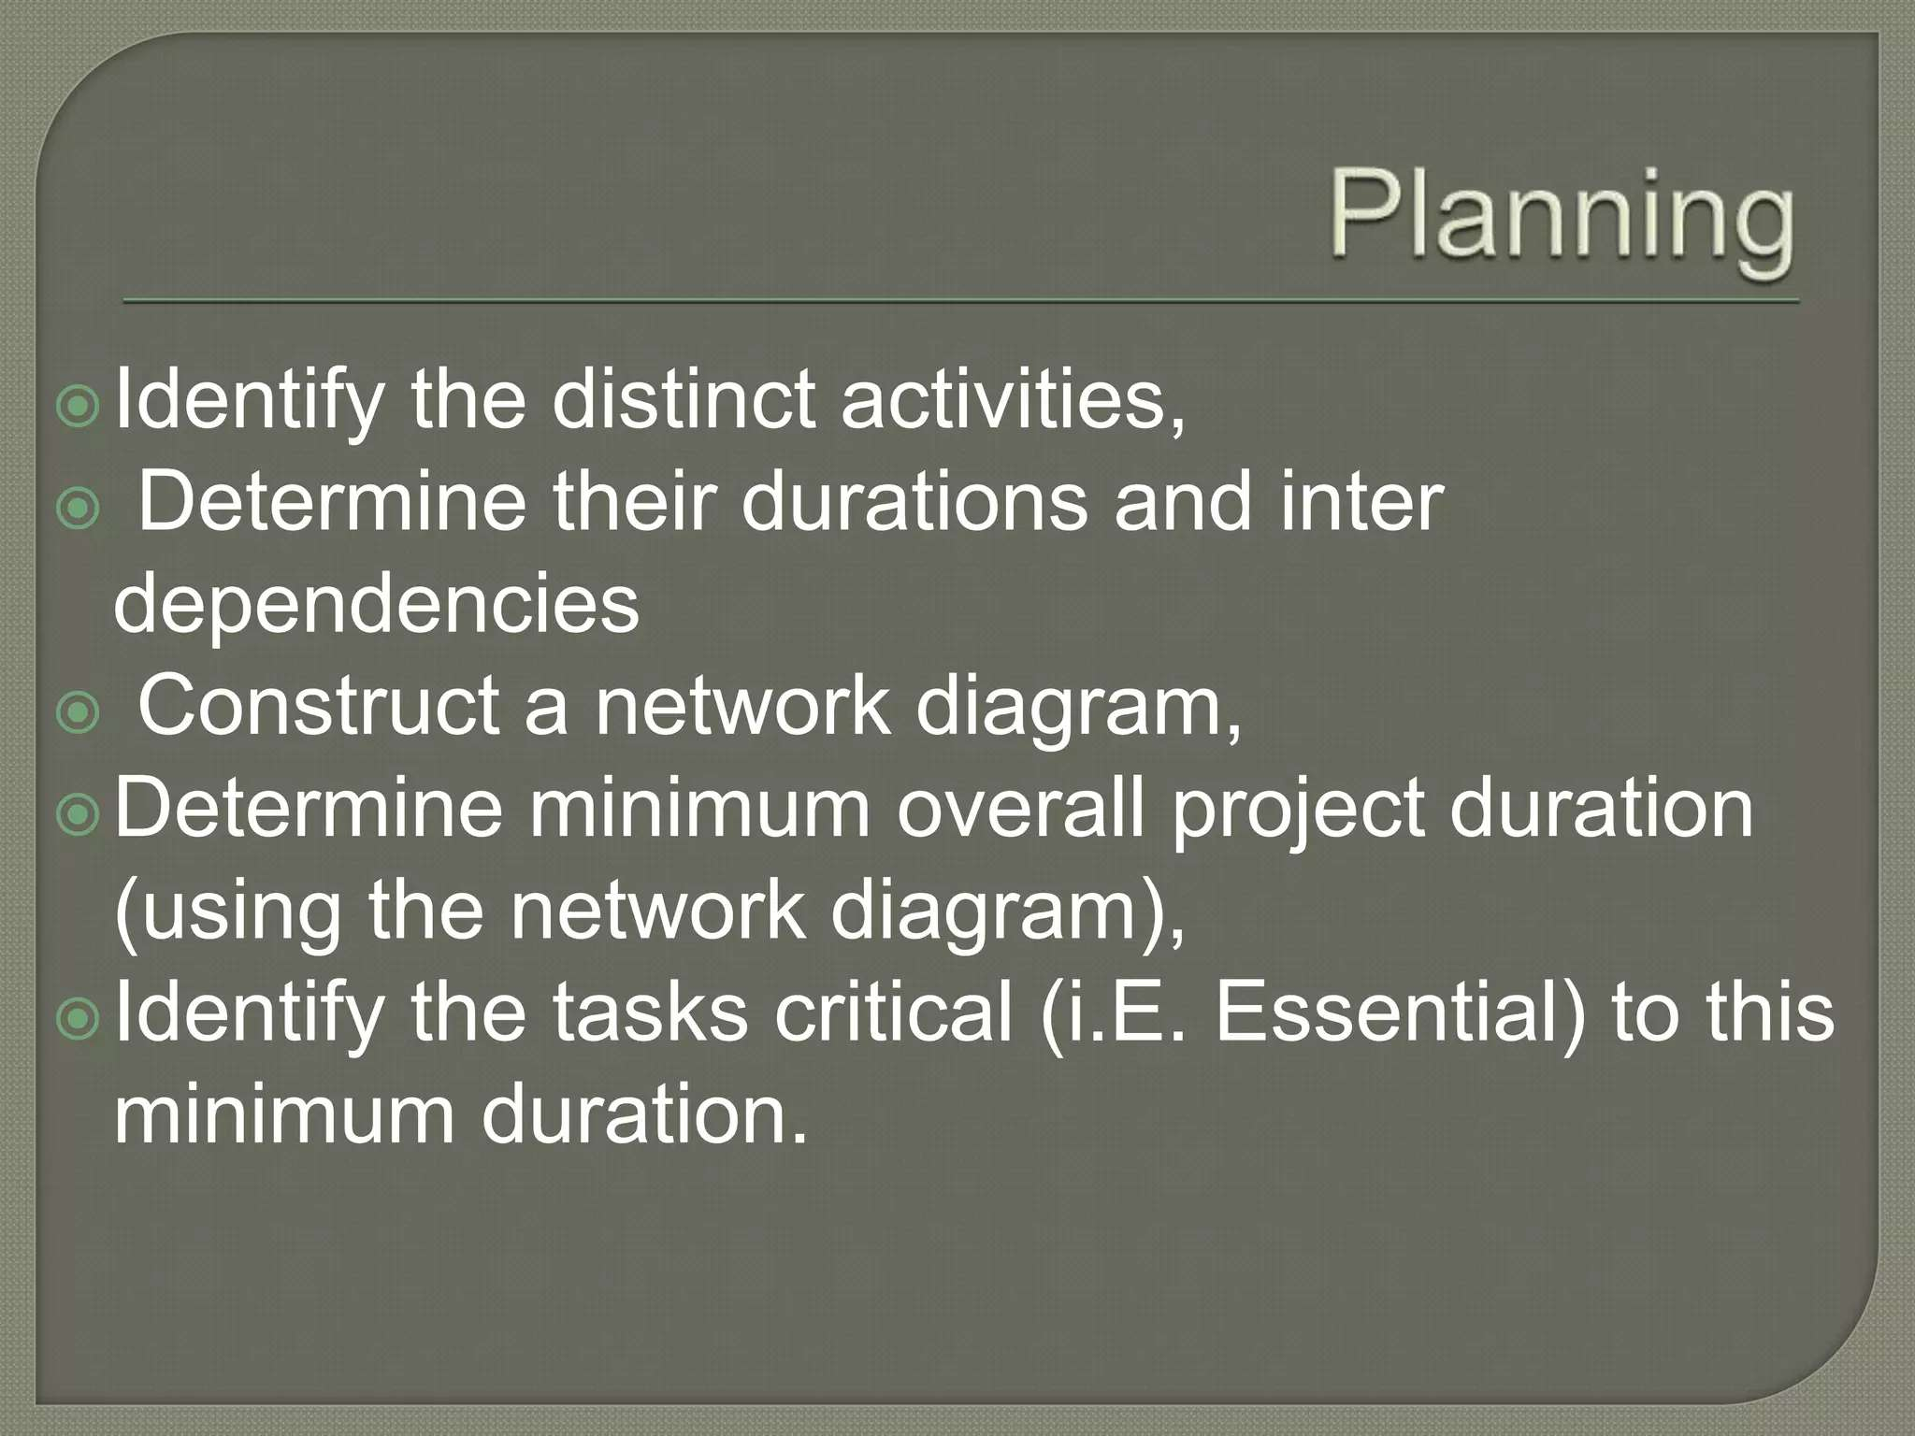

Slide 46
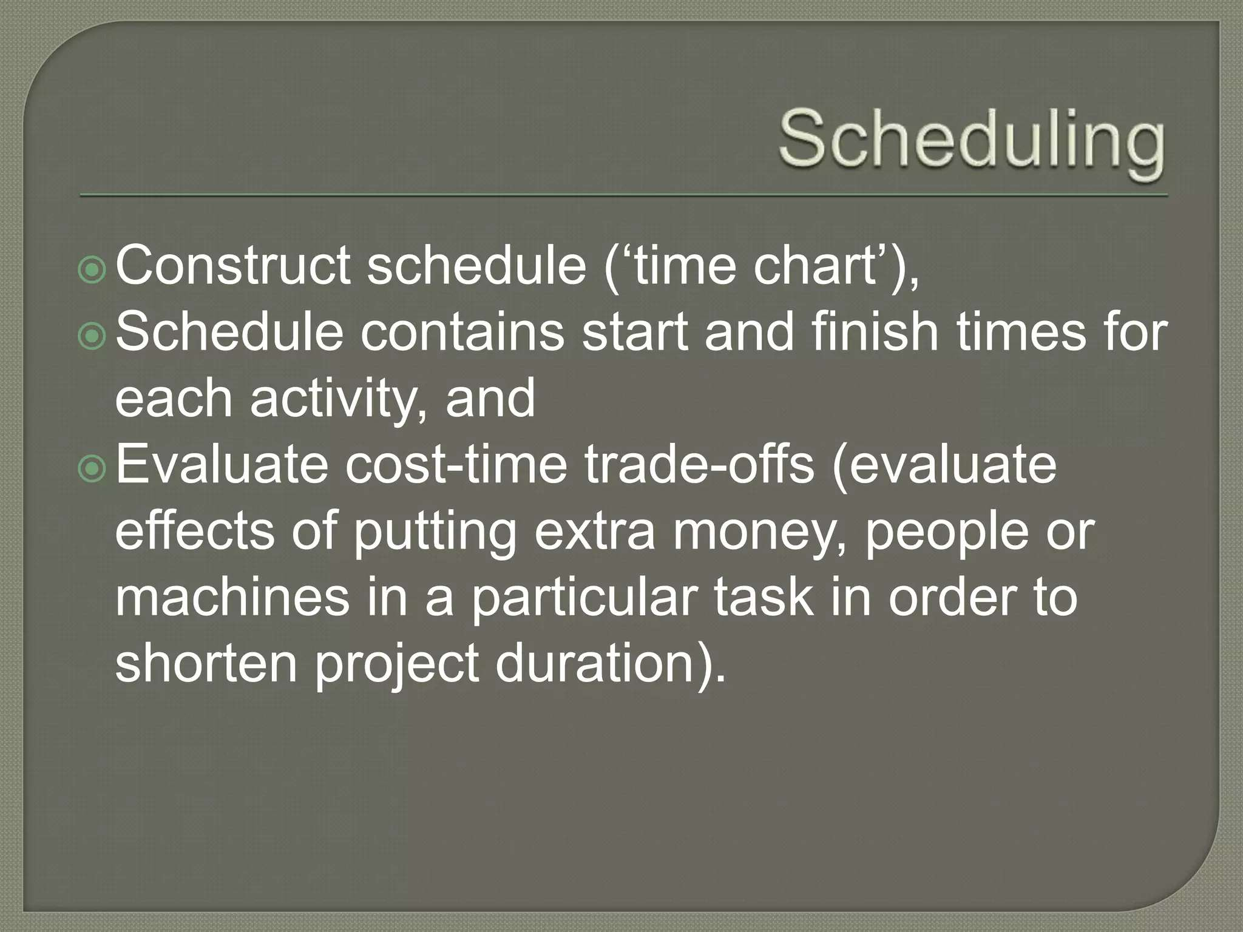

Slide 47
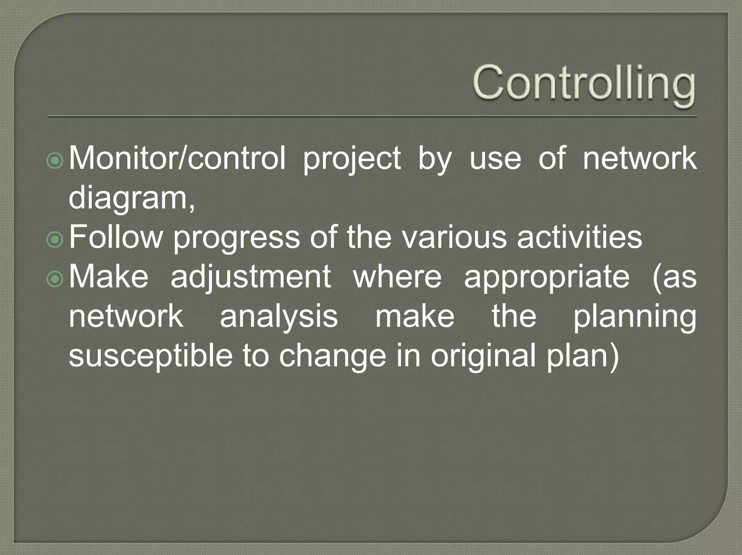

Slide 48
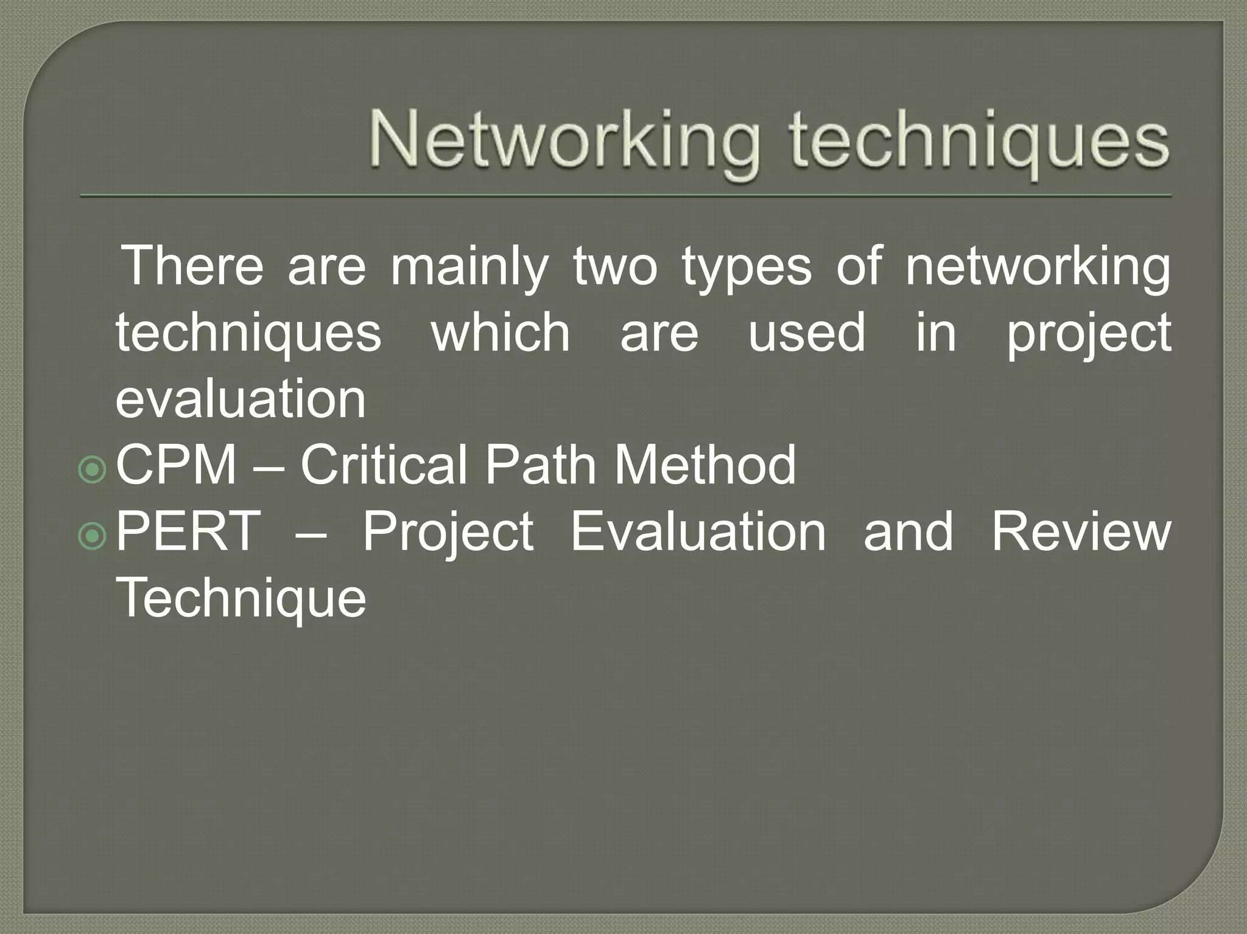

Slide 49
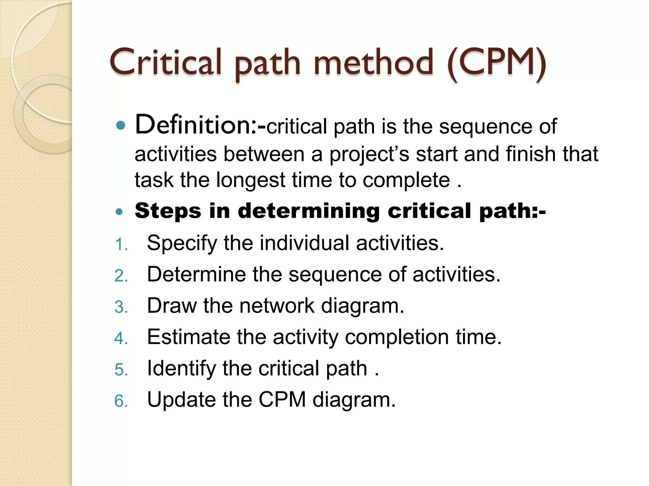

Slide 50
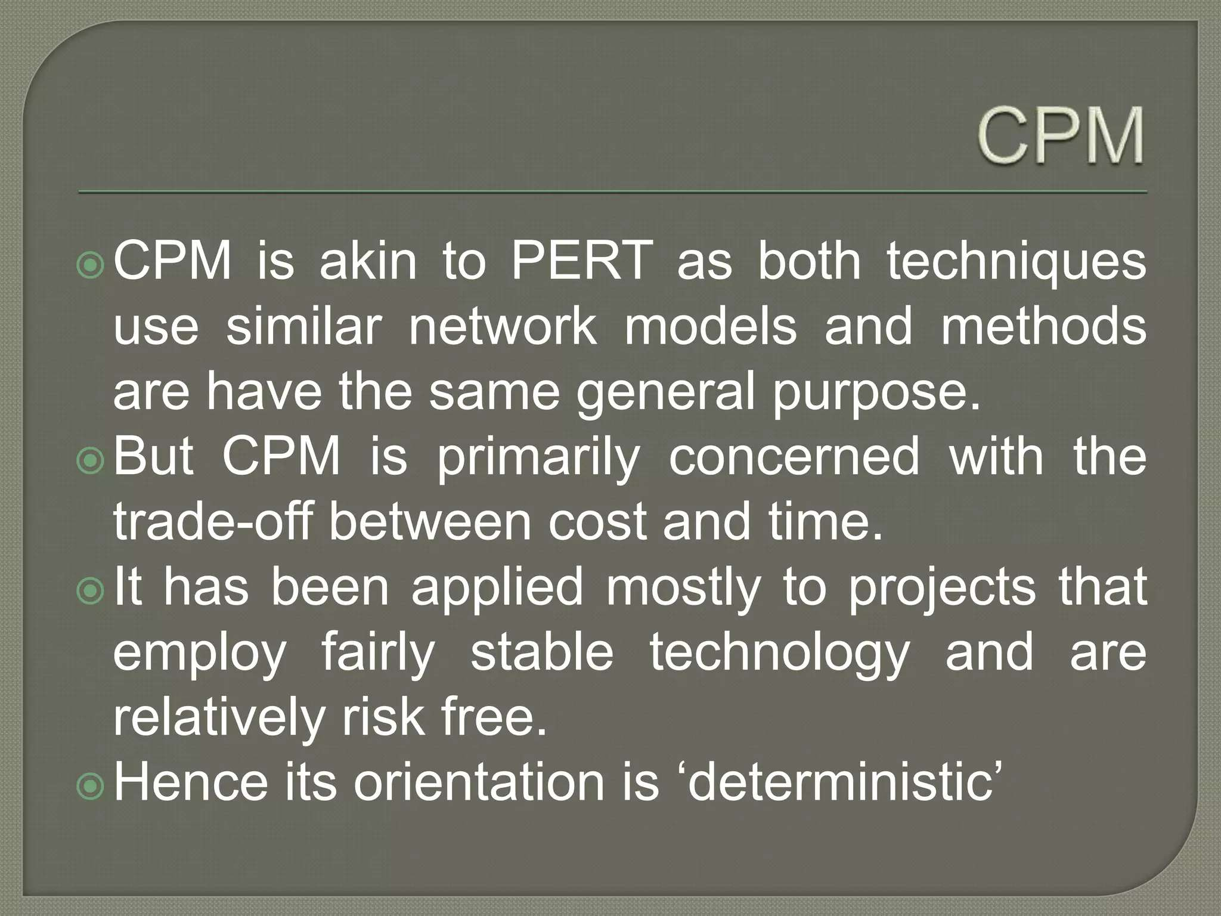

Slide 51
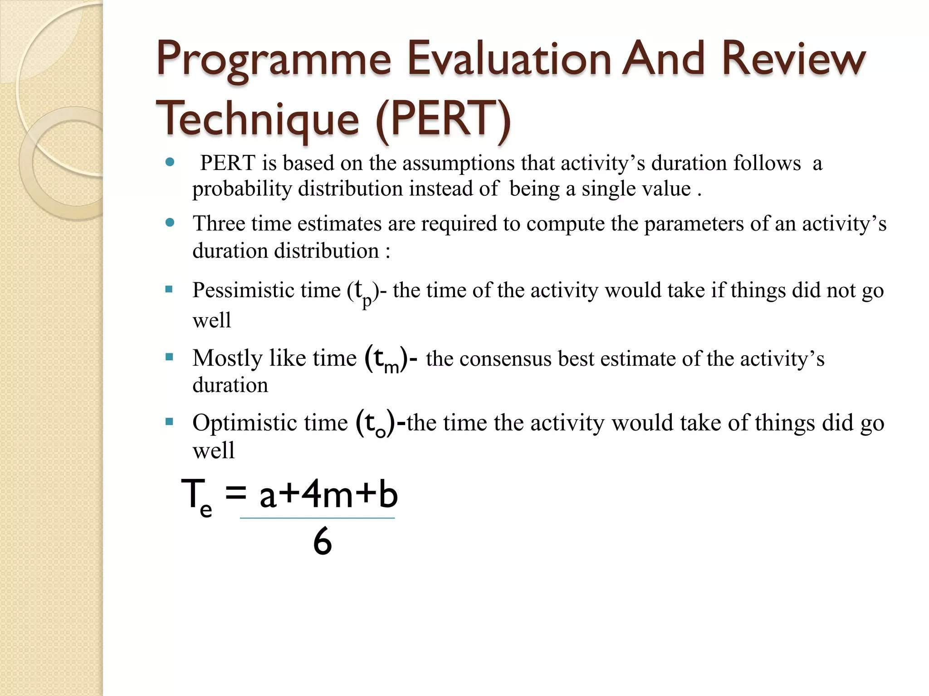

Slide 52
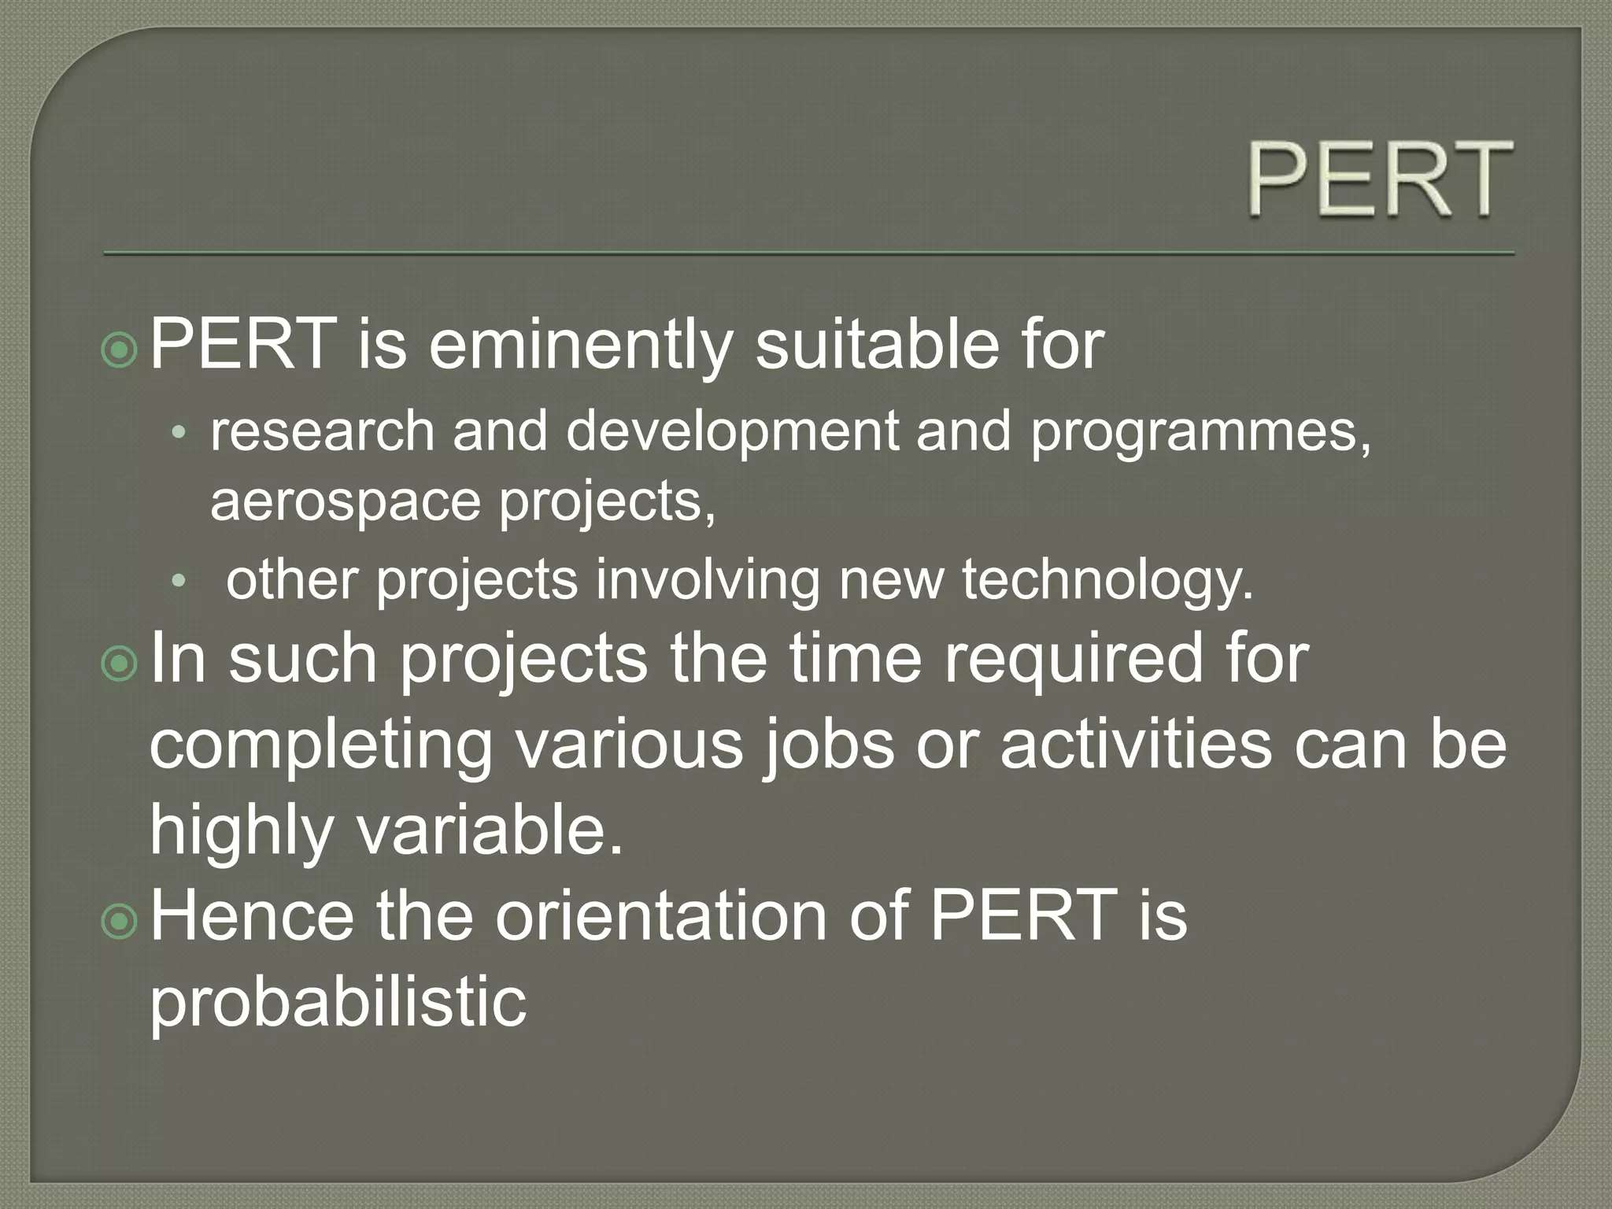

Slide 53
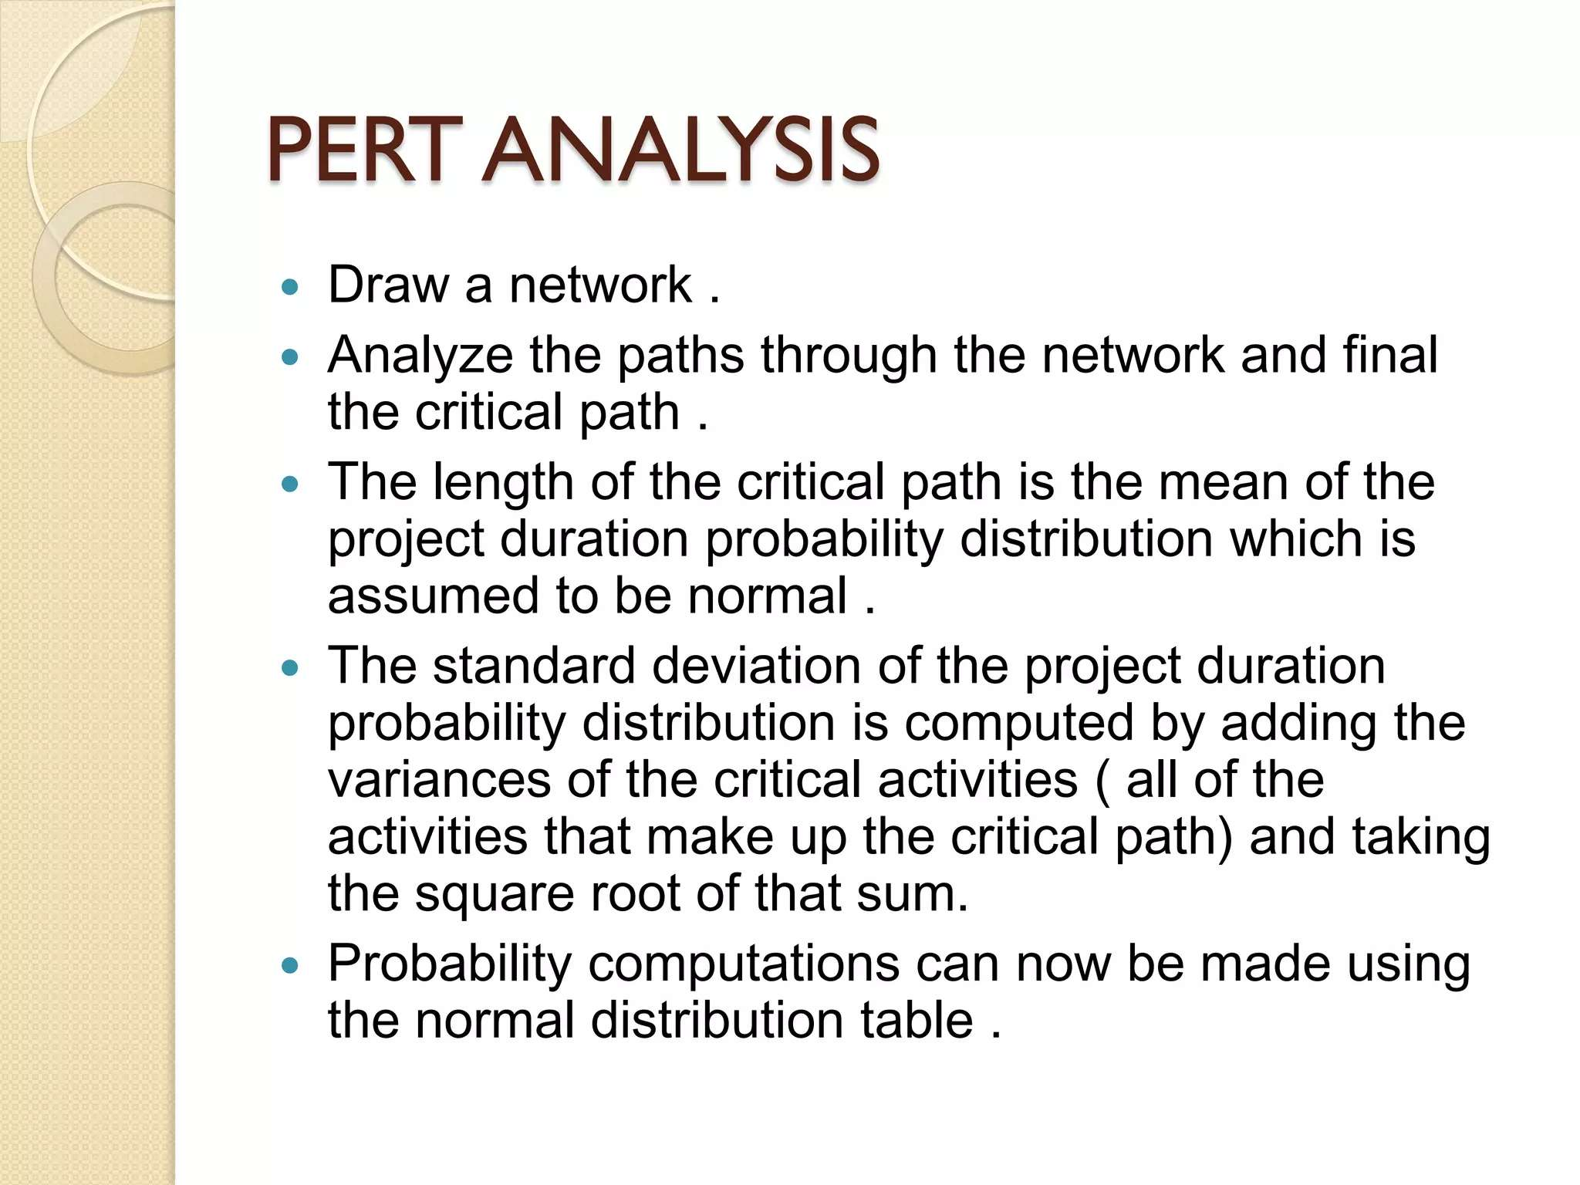

Slide 54
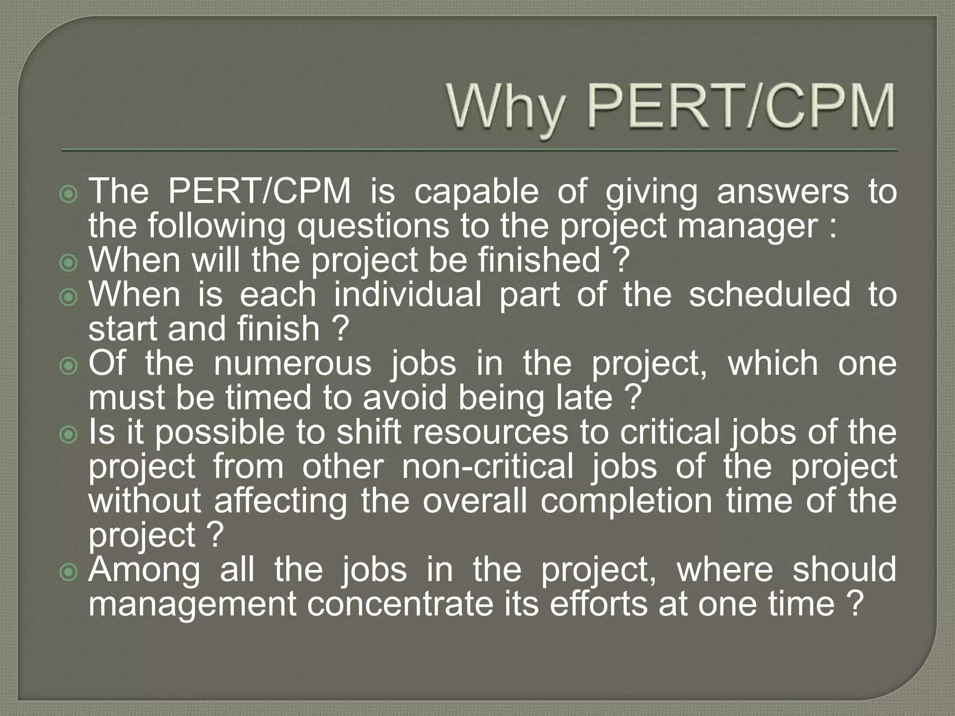

Slide 55
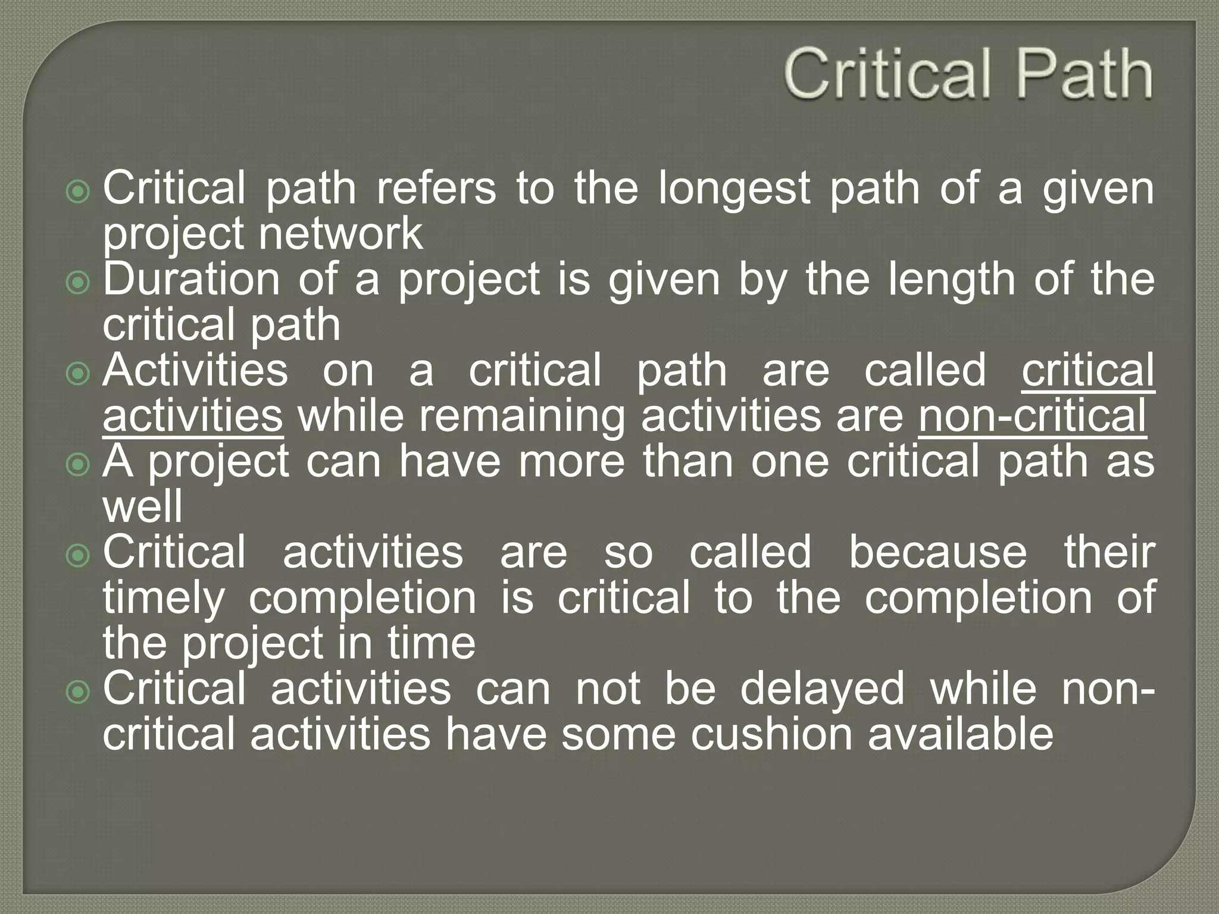

Slide 56
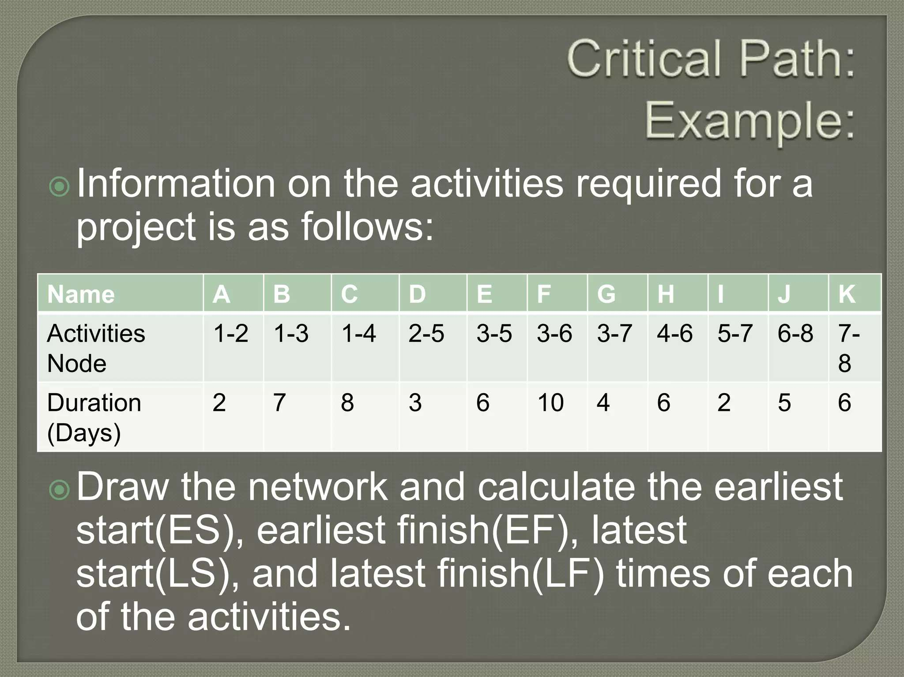

Slide 57
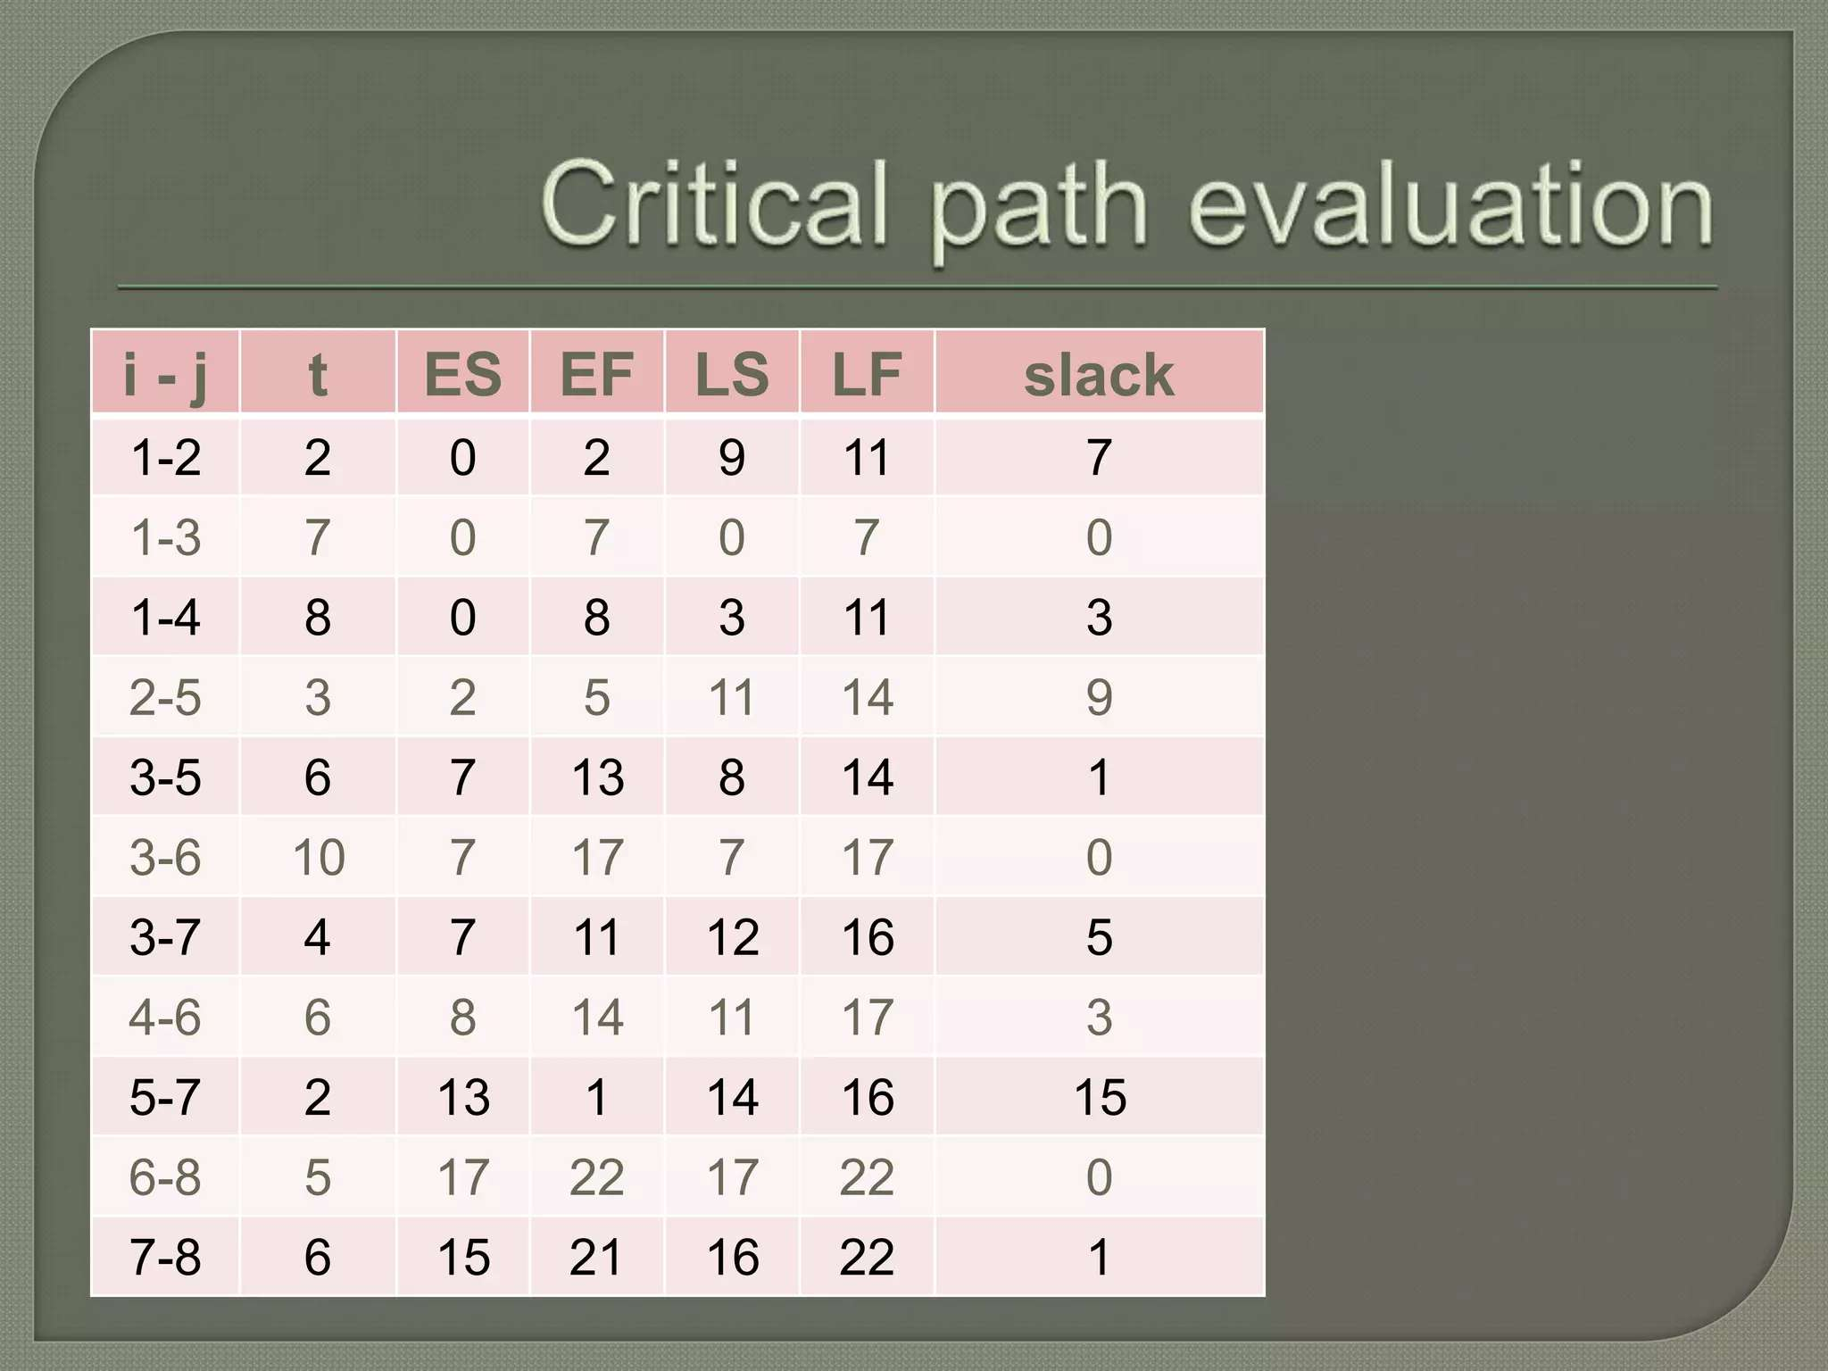

Slide 58
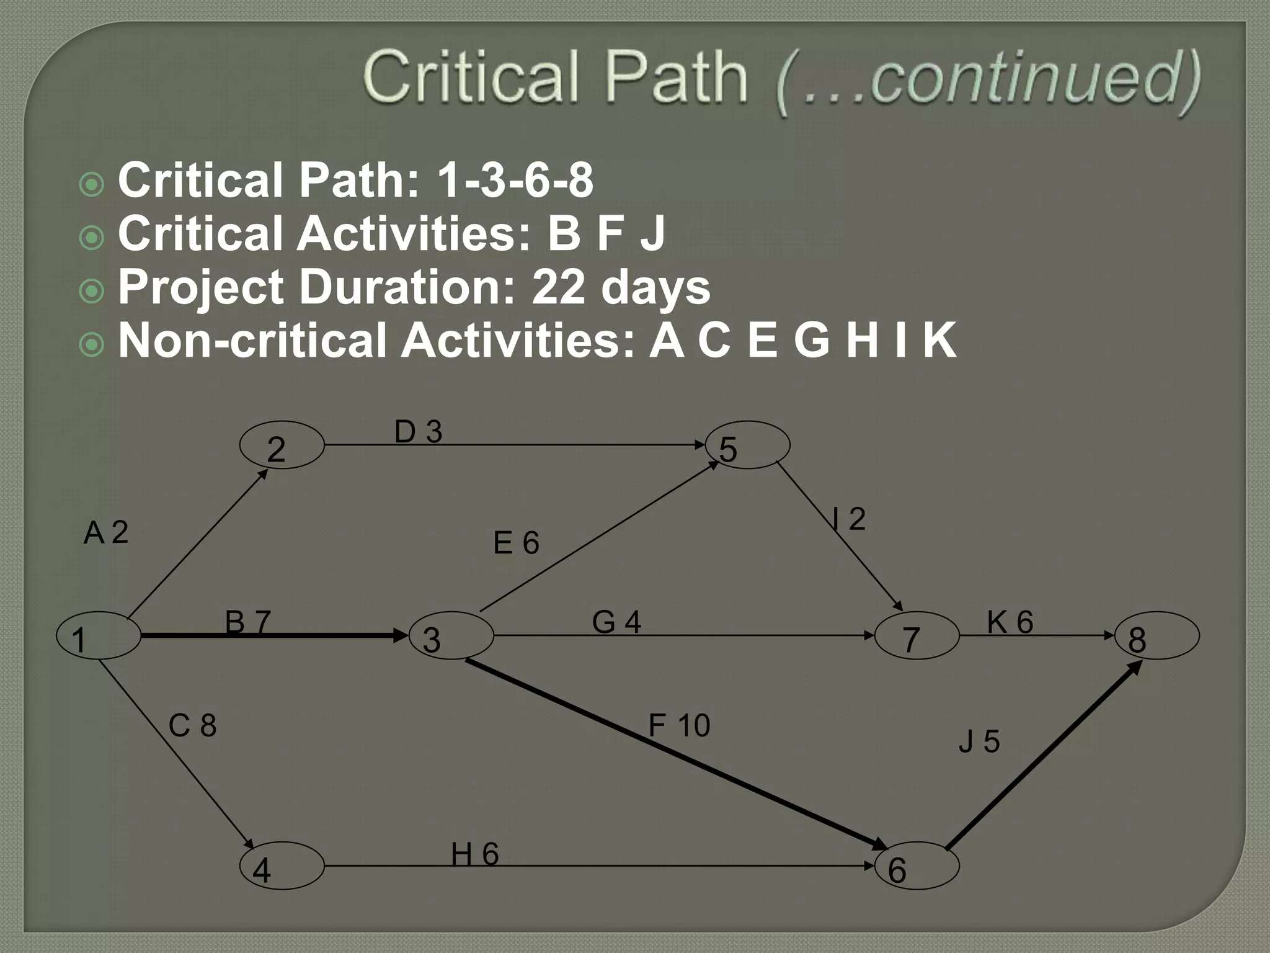

Slide 59
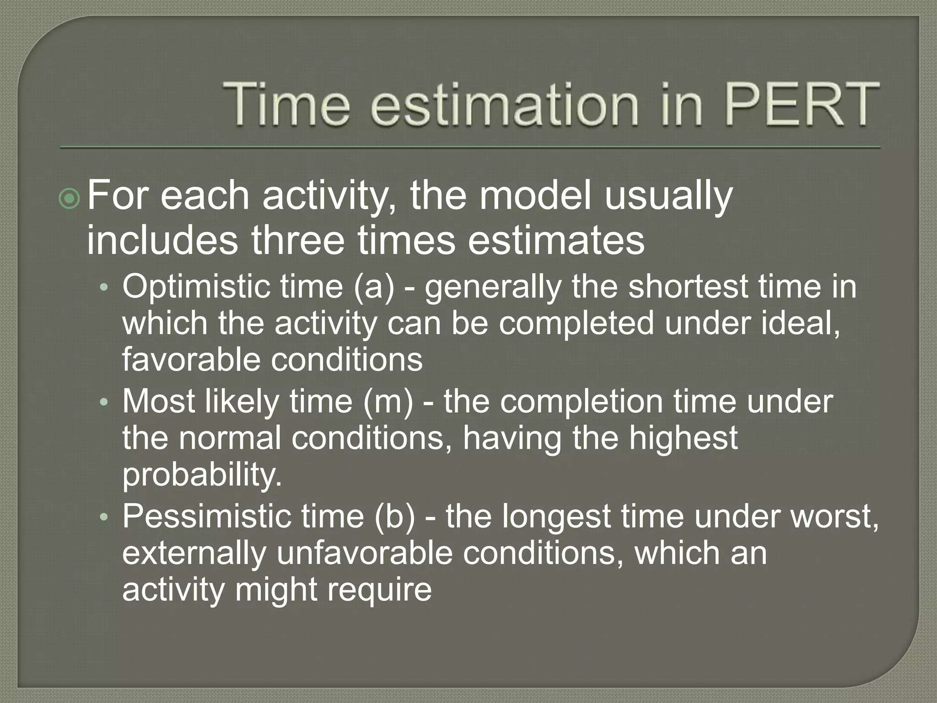

Slide 60
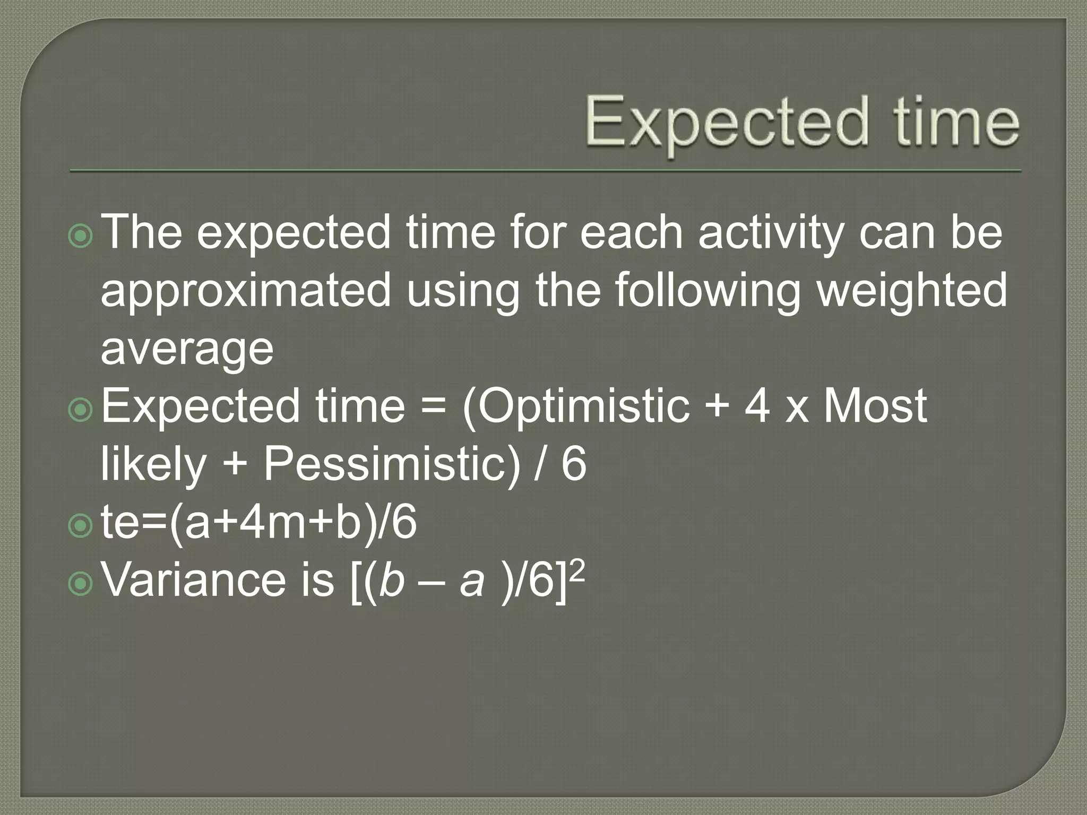

Slide 61
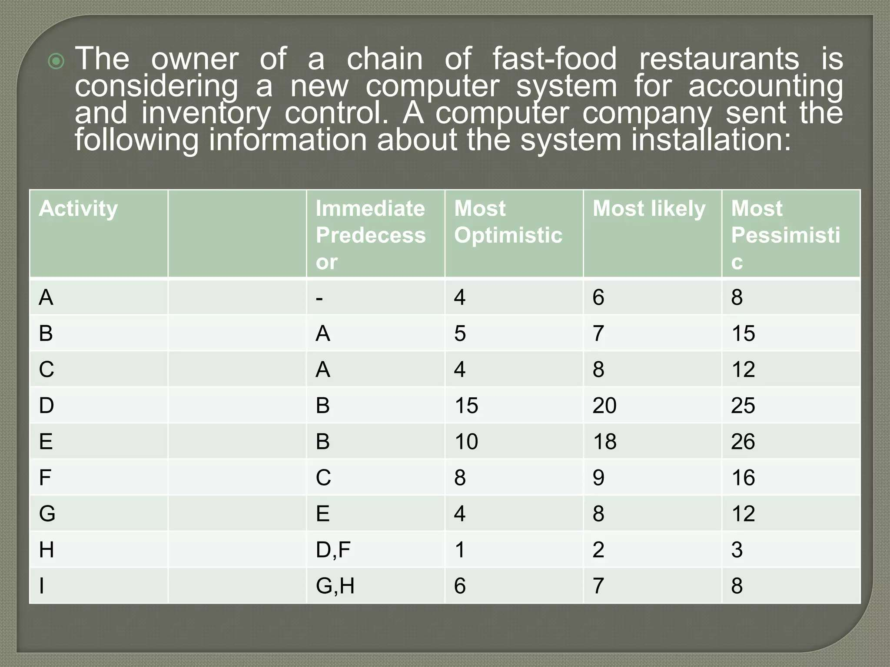

Slide 62


Slide 63


Slide 64


Slide 65
PERT: Time Estimates
(Week 7-9)

Slide 66


Slide 67


Slide 68


Slide 69


Slide 70


Slide 71


Slide 72


Slide 73


Slide 74


Slide 75


Slide 76


Slide 77


Slide 78


Slide 79


Slide 80
Cash Flow Analysis
(Week 10-11)

Slide 81
Cash Flow Analysis
Internal Rate of Return (I.R.R): I.R.R of a project is the discount rate which makes its net present value equals to zero.
Payback period (PBP) is a period required for saving in cost.
PBP = (Investment cost) / (Saving or net cash flow per year).
Suitability of PBP: i. The project should be small & it is finished within a short period.
ii. When the project is profitable as soon as the investment is made.
Advantage of PBP: i. It is very simple to operate and easy to understand.
ii. Partial risk is considered.

Slide 82
Cash Flow Analysis
Example 01: A cash-flow profile with two interest period consists of A0 = +1000, A1 = -2500, A2 = +1540. Find I.R.R per interest period.
Solution:
We know, NPV=0.
Now, 0=𝐴0𝑥 +𝐴1𝑥+𝐴2
» 1000𝑥 −2500𝑥+1540=0
» x = 1.4 or 1.1 [140% or 110%]
Now, I=x-1=1.4-1=0.4=40% or,
I=x-1=1.1-1=0.1=10% [Ans]

Slide 83
Cash Flow Analysis
Example 02: For a project, total project cost $4.6M. Cash flows of $1M for 5 years. Find out PBP. If interest rate=0.3% / month, then what is the net present value (NPV)? Is it acceptable or not? Explain.
Solution: Part 01:
For PBP 1 year, cash-flow=-4.6+1=-3.6M $
For PBP 2 year, cash-flow =-4.6+2=-2.6M $
For PBP 3 year, cash-flow =-4.6+3=-1.6M $
For PBP 4 year, cash-flow =-4.6+4=-0.6M $
For PBP 5 year, cash-flow =-4.6+5=+0.4M $;
So, the PBP is 5 years.

Slide 84

Cash Flow Analysis
Part 02:
= -0.097 (NPV)
The resultant NPV isn’t acceptable as this is negative. [Ans.]

Slide 85
PDCA
(Week 12)

Slide 86


Slide 87


Slide 88


Slide 89


Slide 90


Slide 91


Slide 92


Slide 93


Slide 94
Practical Example
An example of PDCA being used in our industry:
The Architect will interpret what the customer wants with a design (Plan)
Then they will use the information to create a model (Do)
The team will run analysis and confirm design (Check) &
The model will be updated until ready for fabrication (Act)

Slide 95


Slide 96
Project Monitoring and Earned Value Management
(Week 13-14)

Slide 97
Project Monitoring
Project Monitoring refers to the process of keeping track of all project-related metrics including team performance and task duration, identifying potential problems and taking corrective actions necessary to ensure that the project is within scope, on budget and meets the specified deadlines.
It clarifies the objectives of the project, links the activities to the objectives, sets the target, reports the progress to the management and keeps the management aware of the problems which crop up during the implementation of the project.

Slide 98
Why Project monitoring?
Project Monitoring
To assess the project results
To improve process planning
To promote learning
To understand stakeholder’s perspectives
To ensure accountability

Slide 99
Questions have to be answered through Project Monitoring
Project Monitoring
Are tasks being carried out as planned?
Are there any unforeseen consequences that arise as a result of these tasks?
How is your team performing at a given period of time?
What are the elements of the project that needs changing?
What is the impact of these changes?
Will these actions lead you to your expected results?

Slide 101
Earned Value Analysis
Earned value analysis is the project monitoring tool that is used to measure project progress which compares the actual work completed at any time with respect to the original budget and schedule.
It also compares the work achieved with the cost of achieving that work. From these three pieces of data, performance can be trended and metrics calculated to express the status of the project.
This is the practice of determining how much of the contract budget has been ‘earned’ on the basis of the actual progress which has been made to date and comparing this to the amount of cost incurred and to the planned value.

Slide 102


Slide 103
Earned Value Calculation
Performing the earned value calculation at each predefined status points is a 5 step process.
Gather Work Performance Information
Determine Schedule Status
Determine Cost Status
Forecasting
Reporting

Slide 104
Gathering Work Performance Information
To start, the project manager gathers four pieces of information for each task:
Budget at Completion (BAC)
Planned Value (PV)
Earned Value (EV)
Actual Cost (AC)
These are the inputs to the earned value analysis.

Slide 105
Budget at Completion (BAC): Refers to the budget of each task. This is determined during project planning phase.
Planned Value (PV): Also called the Budgeted Cost of Work Scheduled (BCWS). It is the amount that the project is supposed to be complete up to that status point.
Earned Value (EV): Also called the Budget Cost of Work Performed (BCWP), the EV is the measure of the work performed at a specific point in time, expressed in terms of the approved budget authorized for that work. It is the amount that the project is actually complete up to that status point.

Slide 106
Actual Cost (AC): Also called the Actual Cost of Work Performed (ACWP), the AC is the realized cost for the work performed during a specific time period. It is the actual cost of the work up to that status point. Generally, employee hours need to be converted into a cost, and all project costs need to be added up, such as the following items:
Labor
Materials
Equipment
Fixed cost items, like subcontractors

Slide 107
Determine Schedule Status
It’s time to answer the question:
How far ahead or behind schedule is the project?
To do this, we will calculate two variables from the initial four we gathered from the project data, above:
Schedule Variance (SV)
Schedule Performance Index (SPI)

Slide 108
Schedule Variance (SV): The schedule variance, usually abbreviated SV, tells how far ahead or behind schedule the task is in terms of the task budget. It is expressed in terms of the task budget, not the actual hours or days ahead or behind schedule.
The formula is:
SV = EV – PV
If SV is negative, the task is behind schedule.
If SV is zero, the task is on schedule
If SV is positive, the task is ahead of schedule.

Slide 109
Schedule Performance Index (SPI): The Schedule Performance Index, normally abbreviated SPI, is similar to the Schedule Variance (SV). It also tells how far ahead or behind schedule the task is in terms of the task budget, but it is a relative measure rather than an absolute one.
The formula is:
SPI = EV / PV
If SPI is less than 1, the task is behind schedule.
If SPI is one, the task is on schedule
If SPI is greater than 1, the task is ahead of schedule.

Slide 110
Determine Cost Status
In this step, we seek to answer the following question.
How far over or under budget is the project?
To do this we will calculate two more variables from the initial four we gathered from the project data.
1. Cost Variance (CV)
2. Cost Performance Index (CPI)

Slide 111
Cost Variance (CV): The Cost Variance, usually abbreviated CV, is the amount that the task is over or under its budget. It must be calculated for each task and summed to produce the overall project’s cost variance.
The formula is:
CV = EV – AC
If CV is negative, the task is over budget.
If CV is zero, the task is on budget.
If CV is positive, the task is under budget.

Slide 112
Cost Performance Index (CPI): The Cost Performance Index, usually abbreviated CPI, like the Cost Variance, is a measure of the cost performance of the project.
The formula is:
CPI = EV / AC
If CPI is less than 1, the task is over budget.
If CPI is one, the task is on budget.
If CPI is greater than 1, the task is under budget.

Slide 113
Project Review
(Week 15-16)

Slide 114
Project Review
What is project review?
A Project Review is an assessment of the status of a project, at a particular point in time.
Project management review or project review is conducted to measure the deliverables produced by the project, then the results of the review are documented on the Project Review form which is presented to the sponsor for approval.

Slide 115

Project Review
Why project review is needed?
Project review helps us by stating whether the-
Project is currently delivering to schedule.
Budget allocated was sufficient at this point.
Deliverables have been produced and approved.
Risks have been controlled and mitigated.
Issues were identified and resolved.
Changes were properly managed.
Project is on track.
??

Slide 116
Project Review
Benefits of project review
A review can-
Actually help, especially with identifying risks and issues.
Encourage good practices.
Assist in project manager and management development.
Provide early warning.
Save money in the long run.

Slide 117

Project Review
Three tiers of players in the project review
After having some basic knowledge about project review, one question arises about who are involved in this process. The answer of this question is shown in diagram below:
Figure: Three tiers of players in the project review

Slide 118
Project Review
Three tiers of players in the project review
The project: Includes project board members, sponsors, project manager, team leaders and project team members.
The stakeholders: Includes organizational senior management and non executives, organizational governance, and local community.
The reviewers: The project assurance team – whether internal or external to the project.

Slide 119
Project Review
Steps to conduct a project review
Being aware of scope of the project.
Preparation of arranging schedules of interviews.
Taking sponsor, project manager and stakeholder’s interview. For all of the meetings, try to follow the same questions. This will allow any misunderstandings to be corrected before the final conclusions are reached.
Analysis of every data from the whole project.
Draft Conclusion: This will allow sponsor, project manager and stakeholder to understand the findings and importantly, the reasons for the findings.
Publish final review report.

Slide 120
Project Review
Categories of project review
Initial review
Milestone review
Pre-implementation review
Post-implementation review

Slide 121
Project Review
Initial review
The Initial Project Review highlights areas of risk and determines the approach to the management of project risks identified for the duration
of the project. This review supports the Project Manager through risk
assessment. The review can be carried out at any stage of the project
and can be repeated when necessary.

Slide 122
Project Review
Milestone review
The Milestone Project Reviews are generally executed immediately after a milestone has been reached. They are meant to determine whether the phase has been completed correctly, whether the desired deliverables have been produced and whether these include a sufficient level of detail.
Depending on the nature of the project, one or more milestones may qualify for a Project Milestone Review.

Slide 123
Project Review
Pre-implementation review
Pre-implementation Reviews highlight areas that require attention during the intensive care phase or in future projects. This type of project review helps the Project Manager by identifying ‘showstoppers’ and by focusing the effort in addressing these issues.
Such review is generally performed just before the final go-live date to determine whether progress was made on the management of the previously identified risks.

Slide 124
Project Review
Post-implementation review
Post-implementation Project Reviews take place after the implementation date or completion of the project.
While conducting this review, following activities should be followed:
Conduct a gap analysis.
Determine whether the project goals are achieved.
Determine the satisfaction of stakeholders.
Determine the project’s cost and benefits.
Identify lessons learned and areas for further improvements.
Report findings and recommendations.

Slide 125
Project Review
The importance of post project reviews
Post project reviews are a valuable way for teams to improve their performance and skills.
They offer a mechanism to help fuel continuous improvement as well as improve team morale.
It is important to get as many stakeholders as possible in the review since it helps to review all parts of the project.
This provides a mechanism to clear up misunderstandings and other issues.
Good planning and post meeting follow-up is crucial to make these reviews a success.

Slide 126
Project Review
Project status report and it’s purposes
A project status report is a document that summarizes a project’s overall progress against the projected project plan.
Project status report facilitates the following:
Provide transparency into the progress toward milestones.
Help identify issues and risks, so course correction can happen quickly.
Pinpoint the progress of work done by individuals, teams, and resources.
Prevent unpleasant surprises (to team members, clients, and stakeholders).
Furnish a method for keeping project members and leaders accountable.
Present the right information to the intended audiences.

Slide 127
Project Review
Structure of a project status report
For a status report to be comprehensive, it must include the following elements:
Summary/Overall Health of the Project.
Facts on the project progress (full information on accomplishments, timelines, and most importantly, project milestones).
Target vs. Actual Accomplishments.
Analysis.
Risks and issues (problems and challenges that the team faced).

Slide 128
Project Review
Structure of a project status report
Action(s) taken to respond towards risks and issues.
Resources (to see how the resources are used or consumed).
Budget (to conclude if the project is under or over budget).
Schedule (to find if the project is on schedule or late).
Recommendations.

Slide 129
Thanks for Your Attention!

