Slide 1
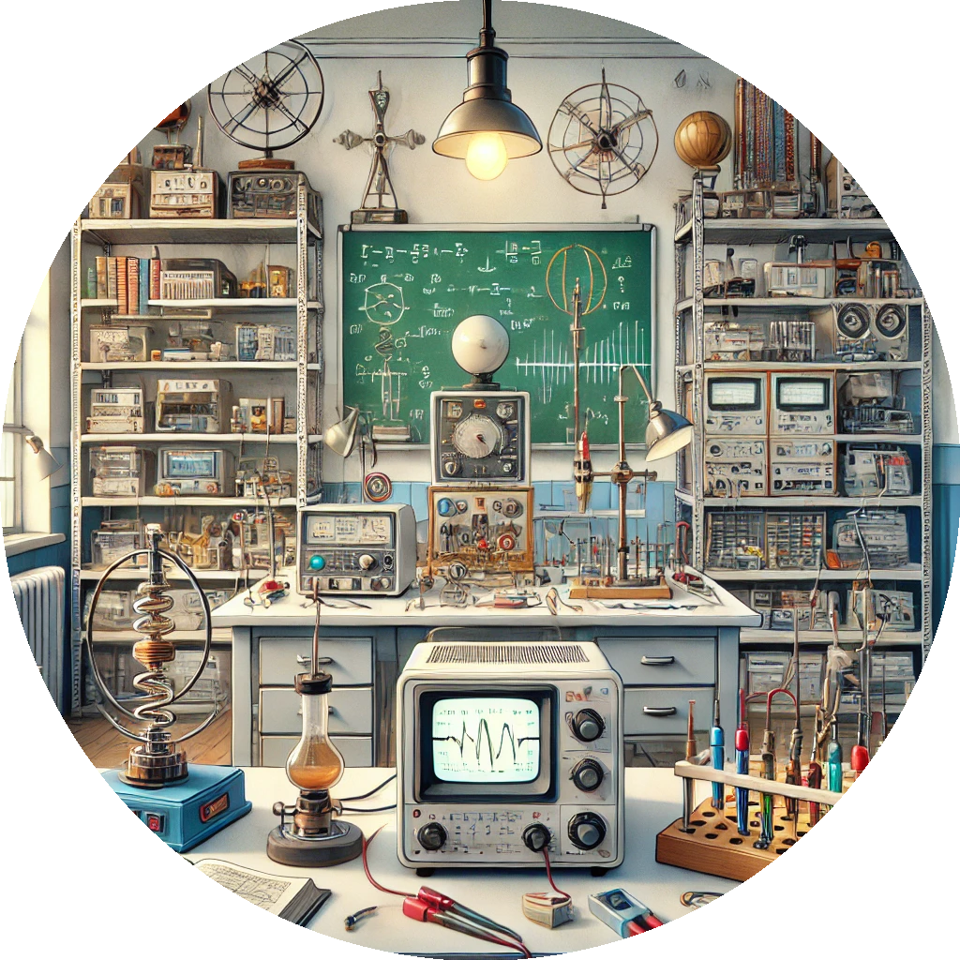

Md. Hasibur Rahman
Lecturer
Department of Physics & Astronomy,
University of Global Village, Barishal

Slide 2
Course Title: Physics-I, Electricity, Magnetism & Properties of Matter Sessional Rationale: This course provides hands-on experience with fundamental physics concepts through practical experiments. It covers mechanics, electricity, magnetism, and material properties, helping students understand oscillations, resistance, and magnetic fields. Participants will develop experimental skills, learn to operate instruments and analyze data. The course emphasizes problem-solving and the practical applications of physics, building a strong foundation in experimental and analytical methods.

Slide 3

Assessment Method | (100%)
Class Assessment
Conduct of Lab Test /Class Performance | 25%
Report Writing/Programming | 15%
Mid-Term Evaluation (Exam/Project/assignment) | 20%
Final Evaluation (Exam/Project/assignment) | 30%
Viva Voce / Presentation | 10%
Total | 100%
ASSESSMENT STRATEGY

Slide 4
CLO 1:
Demonstrate the ability to measure physical quantities such as acceleration due to gravity, spring constant, resistance, and modulus of rigidity using standard experimental techniques and apparatus.
CLO 2:
Analyze and interpret experimental data to determine electrical properties like specific resistance, internal resistance, and EMF, applying concepts of electricity and magnetism effectively.
CLO 3:
Apply problem-solving skills to verify fundamental laws of physics, such as the laws of series and parallel resistances and the principles of oscillatory motion and magnetism.
CLO 4:
Develop proficiency in using laboratory instruments and tools, while enhancing data accuracy, teamwork, and reporting skills through experimental practice.
Course learning outcomes (CLO):
After successful completion of the course Physics-I, Electricity, Magnetism & Properties of Matter, students will be able to

Slide 5
TEACHING METHODOLOGY
Weeks | Intended topics to be covered | Teaching and Learning Strategy | Corresponding CLOs
1 | Introductory class: Brief discussion on the total syllabus, basic requirements of the course, evaluation system of the course, grouping, visit to different sections of the laboratory, introduction to different basic equipment | Lecture and Oral Presentation | CLO1, CLO2
2 | Determination of the gravitational acceleration g using a simple pendulum. | Lecture and Oral Presentation | CLO1, CLO2
3 | Experimental Work | Experimental | CLO3, CLO4
3 | Determination of the spring constant and effective mass and hence to calculate the rigidity modulus of the material of the spring | Lecture and Oral Presentation | CLO1, CLO2
5 | Experimental Work | Experimental | CLO3, CLO4
4 | Determination of the modulus of rigidity of a wire by the method of oscillation (dynamic method) | Lecture and Oral Presentation | CLO1, CLO2
7 | Experimental Work | Experimental | CLO3, CLO4

Slide 6
TEACHING METHODOLOGY
Weeks | Intended topics to be covered | Teaching and Learning Strategy | Corresponding CLOs
5 | Determination of the specific resistance of a wire using a meter Bridge. | Lecture and Oral Presentation | CLO1, CLO2
 | Experimental Work | Experimental | CLO3, CLO4
6 | To determine the resistance of a galvanometer by the half-deflection method. | Lecture and Oral Presentation | CLO1, CLO2
3 | Experimental Work | Experimental | CLO3, CLO4
7 | To determine a high resistance by the method of deflection. | Lecture and Oral Presentation | CLO1, CLO2
5 | Experimental Work | Experimental | CLO3, CLO4
8 | To determine the value of an unknown resistance and verify the law of series and parallel resistances using a post office box | Lecture and Oral Presentation | CLO1, CLO2
7 | Experimental Work | Experimental | CLO3, CLO4

Slide 7
TEACHING METHODOLOGY
Weeks | Intended topics to be covered | Teaching and Learning Strategy | Corresponding CLOs
9 | To determine the internal resistance of a cell by a Potentiometer. | Lecture and Oral Presentation | CLO1, CLO2
 | Experimental Work | Experimental | CLO3, CLO4
10 | To compare the EMF of two cells with a Potentiometer | Lecture and Oral Presentation | CLO1, CLO2
3 | Experimental Work | Experimental | CLO3, CLO4
11 | To determine the horizontal component of the earth's magnetic field and the magnetic moment of a magnet by improving the magnetometer | Lecture and Oral Presentation | CLO1, CLO2
5 | Experimental Work | Experimental | CLO3, CLO4
12 | Review Class | Lecture
13 | Review Class | Lecture
14 | Student Practice Class | Observation
15 | Student Practice Class | Observation
16 | Student Practice Class | Observation
17 | Lab Exam | Observation

Slide 8

Reference Book
1. Practical Physics by Dr.Giasuddin Ahmad and,Md. Shahabuddin.
2.B.Sc Practical Physics- C.L Arora.
3. B.Sc Practical Physics-Harnam Singh.
4. B.Sc Practical Physics-Kalimuddin

Slide 9
List of the Experiments
Expt.01 Determination of the gravitational acceleration g using a simple pendulum.
Expt.02 Determination of the spring constant and effective mass and hence to calculate the rigidity modulus of the material of the spring
Expt.03 Determination of the modulus of rigidity of a wire by the method of oscillation (dynamic method)
Expt.04 Determination of the specific resistance of a wire using a meter Bridge.
Expt.05 To determine the resistance of a galvanometer by the half-deflection method.
Expt.06 To determine a high resistance by the method of deflection.
Expt.07 To determine the value of an unknown resistance and verify the law of series and parallel resistances using a post office box.
Expt.08 To determine the internal resistance of a cell by a Potentiometer.
Expt.09 To compare the EMF of two cells with a Potentiometer.
Expt.10 To determine the horizontal component of the earth's magnetic field and the magnetic moment of a magnet by improving the magnetometer

Slide 10
1st Week
Topic: Introductory Class

Slide 11

Introductory Class:
A brief discussion on the total syllabus,
Basic requirements of the course, evaluation system of the course, grouping, visit to different sections of the laboratory,
Introduction to different basic equipment

Slide 12
Course Requirements
Let me outline the key expectations:
Attendance: You must attend at least 75% of the classes to be eligible for evaluation. Missing sessions will impact your grade unless excused for valid reasons.
Preparation: Before coming to the lab, review the experiment assigned for the week. Bring the manual, take notes, and be ready to experiment.
Lab Reports: You’ll submit a report detailing your observations and conclusions for every experiment. These reports are critical for your learning and will contribute 30% of your final grade.
Active Participation: Engage in discussions and group activities.

Slide 13

Laboratory Grouping:
To make the sessions efficient and collaborative, you’ll work in small groups. Each group will share equipment and responsibilities. Group assignments will be shared later today.
In your groups, ensure tasks are evenly distributed.
For example:
One person handles measurements.
Another records observations.
A third ensures calculations are correct.
Teamwork is critical for your success.

Slide 14
Laboratory Tour and Equipment Introduction:
Tour: Show students the various sections of the lab: optics, thermodynamics, and acoustics.
Equipment Demonstration:
Optical Bench: Used for precise optical measurements.
Spectrometer: For prism and diffraction grating experiments.
Sonometer: To study sound and frequency.
Acoustic Transducer: Measures sound velocity.
Electrical Apparatus: For experiments related to heat and energy transfer.
Laboratory Safety Guidelines:
Safety is a priority in our lab. Here are some essential rules:
Wear appropriate attire: Lab coats and closed-toe shoes are mandatory.
Handle equipment carefully: If you’re unsure about using any apparatus, ask for help.
Keep the lab clean: No food, drinks, or distractions like mobile phones.
Emergency procedures: Familiarize yourself with the location of fire extinguishers, first aid kits, and emergency exits.

Slide 15

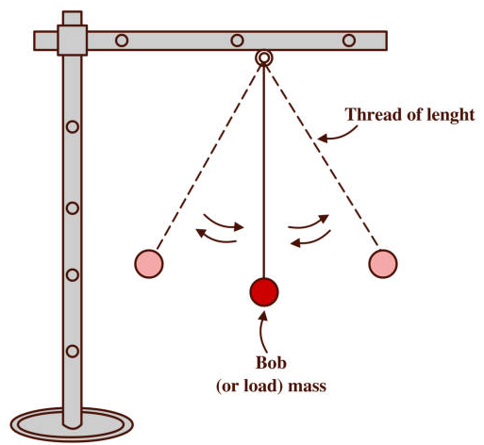
2nd Week
Topic:
Determination of the gravitational acceleration g using a simple pendulum

Slide 16
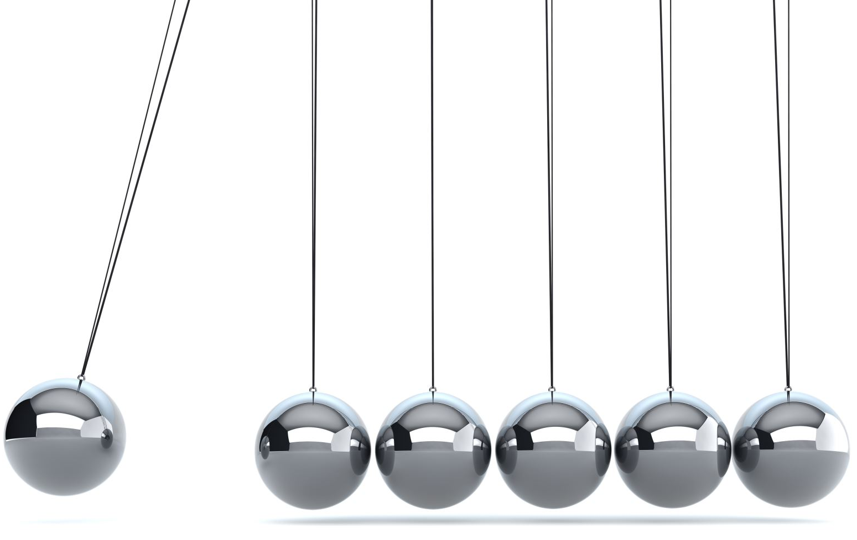
Experiment:
Determination of Gravitational Acceleration (g) Using a Simple Pendulum
Theory
A simple pendulum consists of a small mass (bob) attached to a light, inextensible string suspended from a fixed point. When displaced slightly from its equilibrium position and released, the pendulum undergoes simple harmonic motion.
The time period T of a simple pendulum is given by:
T = 2π √(L/g)
where:
T = Time period of the pendulum
L = Length of the pendulum
g= Acceleration due to gravity
Squaring both sides:
T² = 4π² (L/g)
By plotting T² vs. L, we can determine g from the slope.

Slide 17
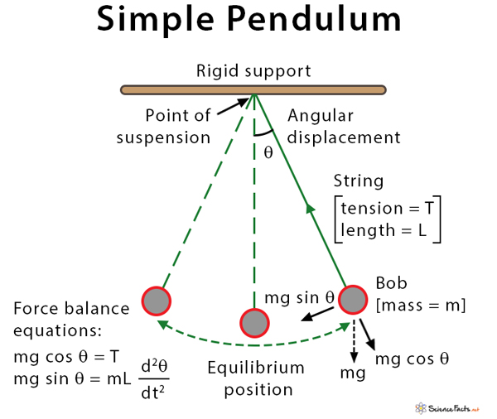

Slide 18

Apparatus
1. A rigid stand with a clamp
2. A long inextensible string
3. A small metal bob
4. A stopwatch
5. A meter scale
6. A protractor (optional for precise angular displacement)

Slide 19
Procedure
Set up the simple pendulum by suspending the bob from fixed support using the string.
Measure the length L of the pendulum from the fixed support to the center of the bob using a meter scale.
Displace the bob slightly (about 5∘ to 10∘) and release it gently to ensure simple harmonic motion.
Start the stopwatch when the bob crosses the mean position and record the time for 10 complete oscillations.
Repeat the measurement for at least five different lengths of the pendulum.
Calculate T = Time for 10 oscillations / 10.
7. Plot T² vs. L and find the slope to determine g.

Slide 20
Serial No. | Length (L) (m) | Time for 10 Oscillations (s) | Time Period (T) (s) | T² (s²)

Slide 21
3rd Week
Topic:
Determination of the spring constant and effective mass and hence to calculate the rigidity modulus of the material of the spring

Slide 22

Exptiment.02
Determination of the spring constant and effective mass and hence to calculate the rigidity modulus of the material of the spring

Slide 23
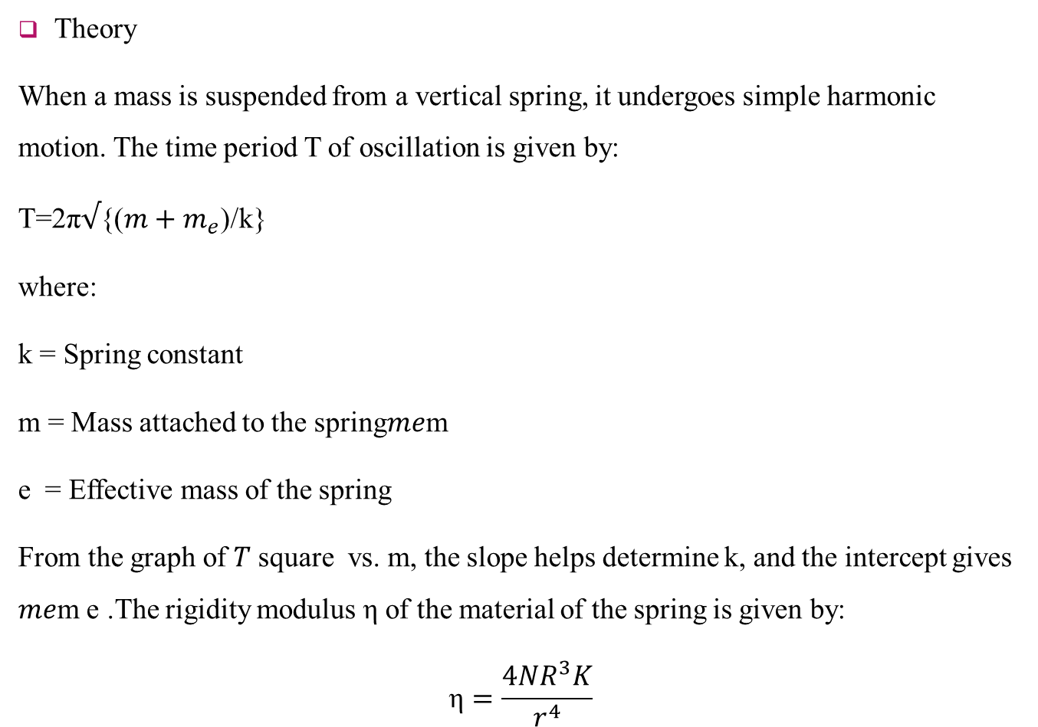
Theory
When a mass is suspended from a vertical spring, it undergoes simple harmonic motion. The time period T of oscillation is given by:
T=2π$√${(${m+m}_{e}$)/k}​ ​
where:
k = Spring constant
m = Mass attached to the spring𝑚𝑒m
e​ = Effective mass of the spring
From the graph of 𝑇 square vs. m, the slope helps determine k, and the intercept gives 𝑚𝑒m e​ .The rigidity modulus η of the material of the spring is given by:
$$\text{η}=\frac{4NR^{3}K}{r^{4}}$$

Slide 24
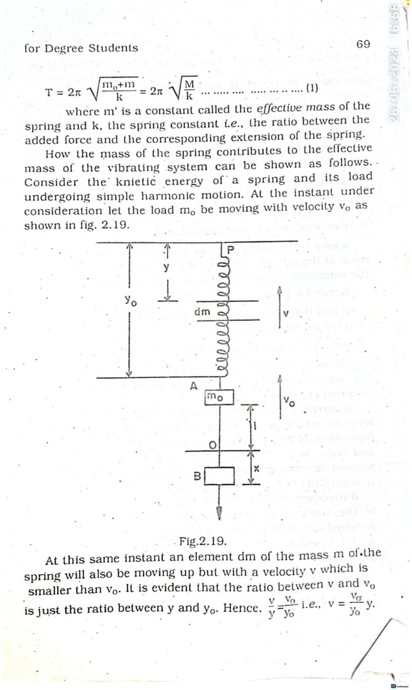

Slide 25
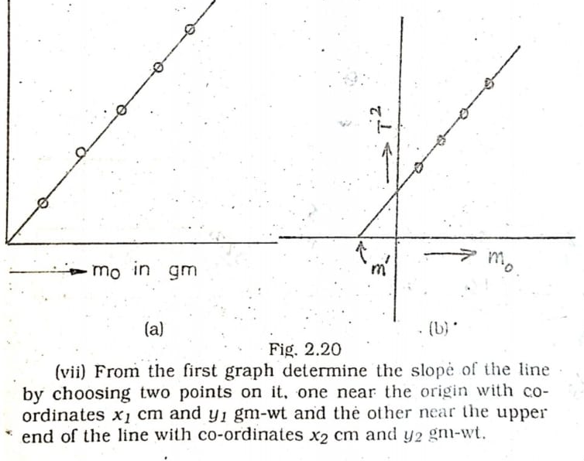

Slide 26
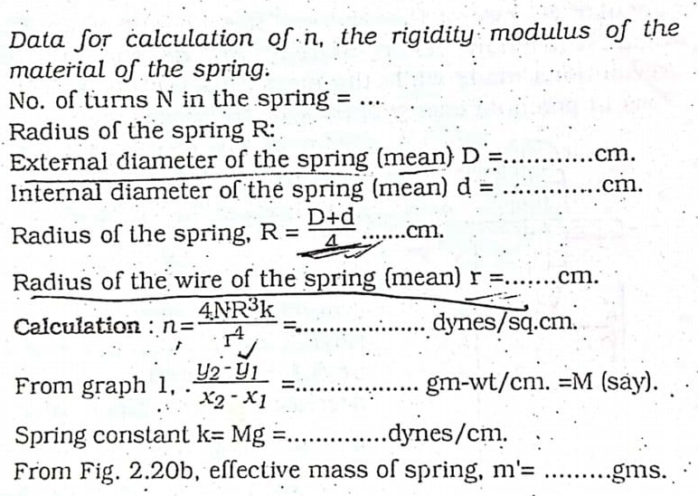

Slide 27
Serial No. | Mass (kg) | Extension (m) | Time for 10 Oscillations (s) | Time Period (T) (s) | T² (s²)

Slide 28
4th Week
Topic:
Determination of the modulus of rigidity of a wire by the method of oscillation (dynamic method)

Slide 29
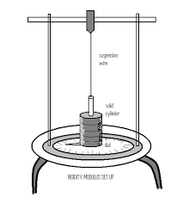
Experiment.03
Determination of the modulus of rigidity of a wire by the method of oscillation (dynamic method)

Slide 30
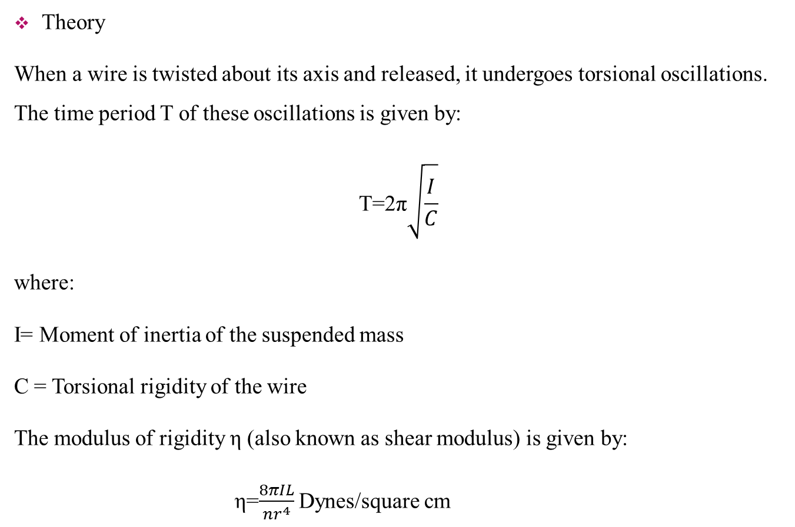
Theory
When a wire is twisted about its axis and released, it undergoes torsional oscillations. The time period T of these oscillations is given by:
$$\text{T}\text{=2}\text{π}\sqrt{\frac{I}{C}}\text{​​}$$
where:
I= Moment of inertia of the suspended mass
C = Torsional rigidity of the wire
The modulus of rigidity η (also known as shear modulus) is given by:
η=$\frac{8πIL}{nr^{4}}$Dynes/square cm

Slide 31
where:
L = Length of the wire
R = Radius of the wire
By determining T, I and C, we can compute the modulus of rigidity η.
Apparatus
Torsion pendulum setup
Circular disc
Stopwatch
Vernier calipers
Screw gauge
Meter scale

Slide 32
Procedure
Suspend the circular disc using the wire from a rigid support.
Measure the radius R of the wire using a screw gauge.
Measure the length L of the wire using a meter scale.
Twist the disc slightly and release it gently to allow free torsional oscillations.
Measure the time for 10 complete oscillations using a stopwatch.
Calculate the time period T as:
T= {Time for 10 oscillations/10}
Calculate the moment of inertia III of the disc using:
Compute the torsional rigidity C using the equation for T, then determine the modulus of rigidity η.

Slide 33
Serial No. | Length of Wire (m) | Radius of Wire (m) | Time for 10 Oscillations (s) | Time Period (T) (s) | Modulus of Rigidity (η) (N/m²)

Slide 34
5th Week
Topic:
Determination of the specific resistance of a wire using a meter Bridge

Slide 35
Experiment Name:
Determination of the Specific Resistance of a Wire Using a Meter Bridge
Theory:
A meter bridge is based on the principle of the Wheatstone bridge, which states that:
A meter bridge is based on the principle of the Wheatstone bridge, which states that:
(R1 / R2) = (L1 / L2)
Using this principle, the resistance of the given wire (R) is determined and then its specific resistance (ρ) is calculated using:
ρ = (R × A) / L
where:
R = Resistance of the wire
A = Cross-sectional area of the wire
L = Length of the wire

Slide 36
Apparatus
Meter bridge
Galvanometer
Battery
Resistance box
Connecting wires
Vernier calipers
Screw gauge
Procedure
1. Connect the unknown resistance (wire) in the right gap of the meter bridge.
2. Place a known resistance in the left gap.
3. Connect the battery, galvanometer, and jockey to form a Wheatstone bridge circuit.
4. Slide the jockey along the wire until the galvanometer shows zero deflection.

Slide 37
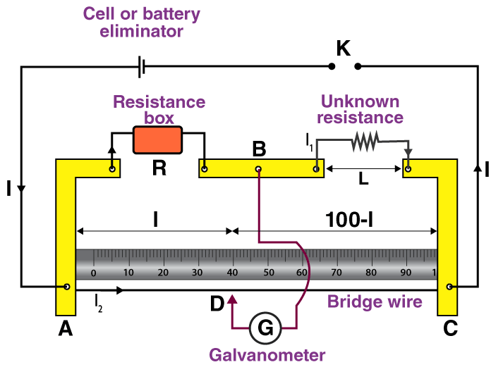

Slide 38
5. Note the balancing length (L1 and L2).
6. Calculate R using the Wheatstone bridge principle.
7. Measure the diameter of the wire using a screw gauge and compute the cross-sectional area (A).
8. Compute the specific resistance (ρ) using the formula.

Slide 39
Serial No. | Balancing Length L1 (cm) | Balancing Length L2 (cm) | Resistance R (Ω) | Specific Resistance ρ (Ωm)

Slide 40
6th Week
Topic:
Determination of the Resistance of a Galvanometer by the Half-Deflection Method

Slide 41
Experiment:
Determination of the Resistance of a Galvanometer by the Half-Deflection Method
Theory:
The half-deflection method is used to determine the resistance of a galvanometer (G) by connecting it in a circuit with a known resistance and measuring the deflections. The method is based on Ohm's law and Kirchhoff’s voltage law.
If the current through the galvanometer produces a deflection θ, and a shunt resistance Rs​ is connected in parallel with it, then the deflection reduces to half (θ/2). The resistance of the galvanometer is then given by:
G=Rs​(θ/2θ​−1)=Rs​

Slide 42
Apparatus
Galvanometer
Battery (low voltage DC source)
Rheostat
High resistance box
Low resistance box
Key
Connecting wires

Slide 43
Procedure
Connect the circuit as per the circuit diagram, ensuring the galvanometer is in series with the resistance box and the battery.
Adjust the rheostat to obtain a steady deflection θ in the galvanometer.
Insert a known shunt resistance Rs​ (from the resistance box) parallel to the galvanometer.
Note the new deflection θ ensuring it is approximately half of the initial deflection (θ/2).
Calculate the resistance of the galvanometer
Repeat the experiment with different values of Rs​ and take the average value of G.

Slide 44
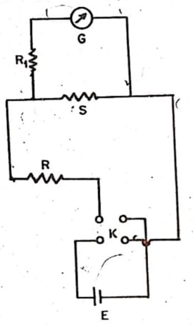

Slide 45
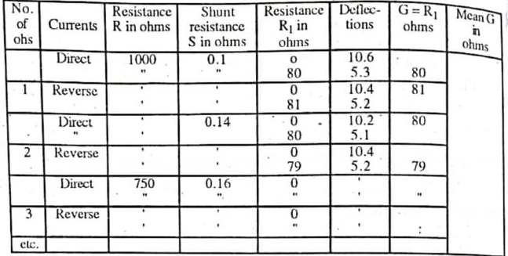

Slide 46
7th Week
Topic:
To determine a high resistance by the method of deflection

Slide 47
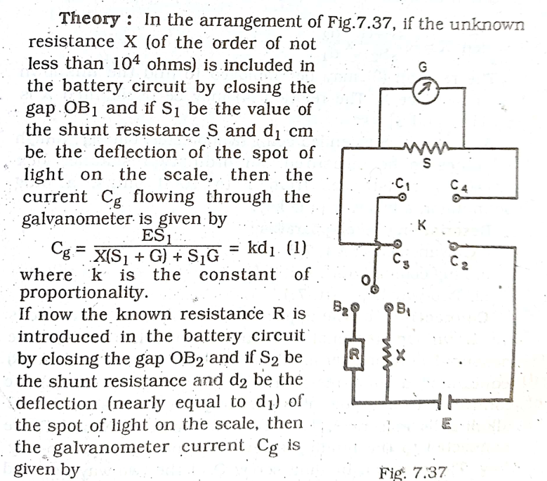

Slide 48
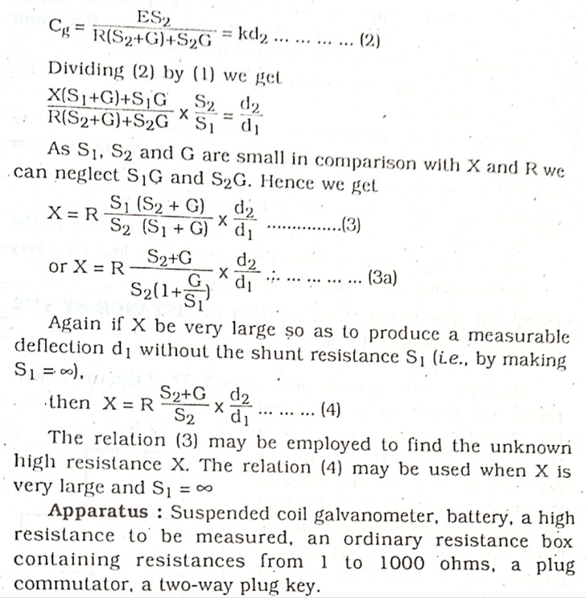

Slide 49
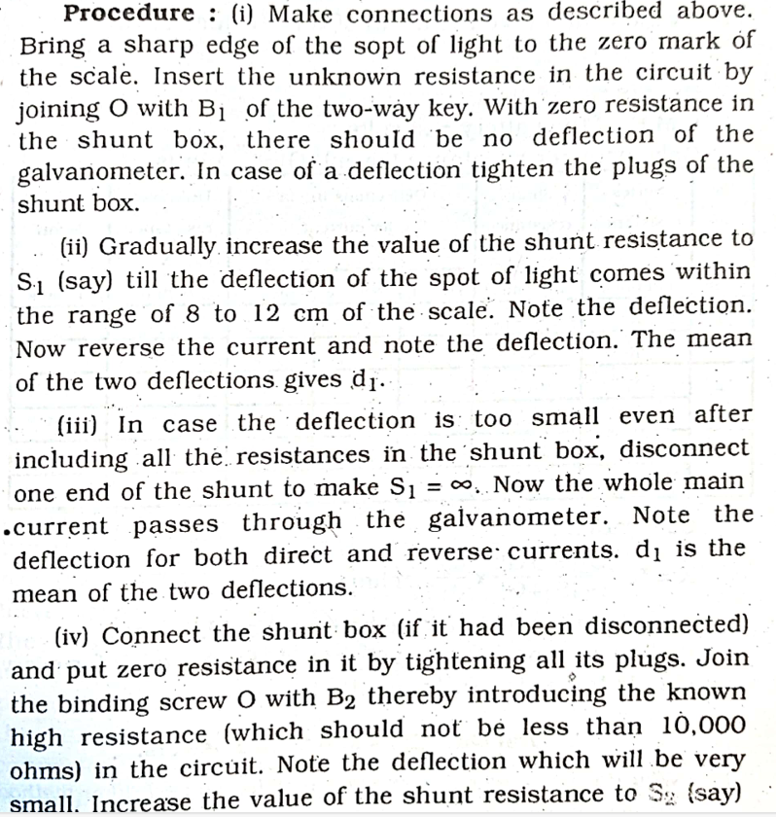

Slide 50
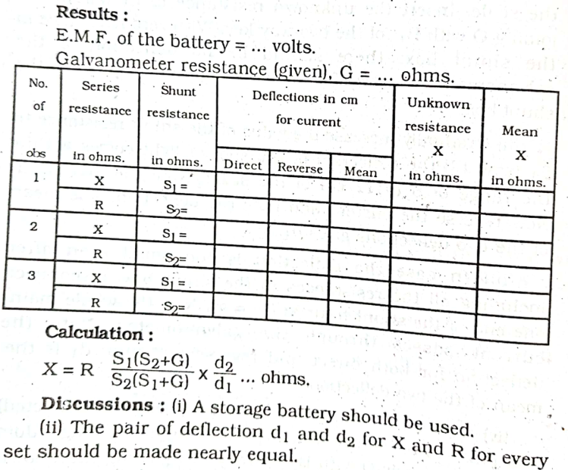

Slide 51
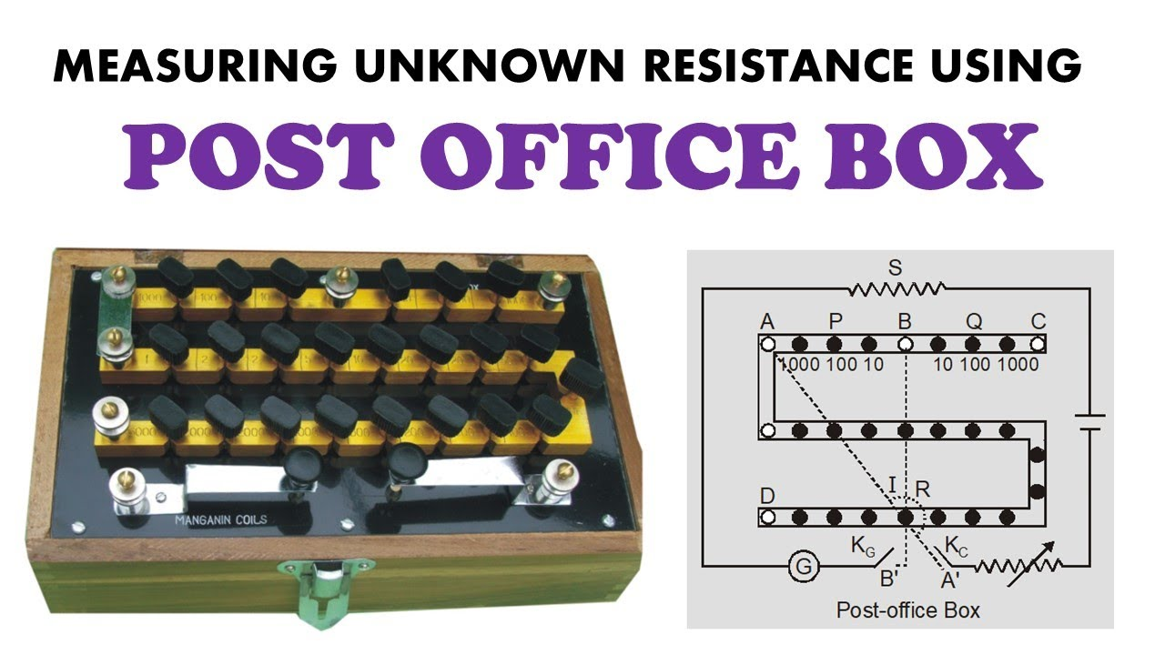
8th Week
Topic:
To determine the value of an unknown resistance and verify the law of series and parallel resistances using a post office box.

Slide 52
Experiment Name :
Determination of an Unknown Resistance and Verification of Series and Parallel Laws Using a Post Office Box
Theory
A Post Office Box is a practical application of the Wheatstone Bridge principle. The ratio of resistances in the bridge circuit is given by:
P/Q=R/X
where:
P and Q are known resistances,
R is a standard resistance,
X is the unknown resistance.

Slide 54
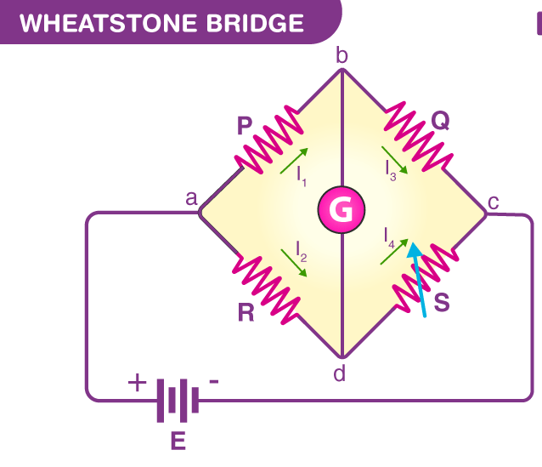

Slide 55
The bridge is balanced when no current flows through the galvanometer, allowing the unknown resistance to be calculated as:
X=R×Q/P
The laws of series and parallel resistances are verified by measuring individual resistances and their combinations.
Apparatus
Post Office Box
Galvanometer
Battery
Jockey
Unknown resistance wire
Connecting wires

Slide 56
Procedure
1. Determination of Unknown Resistance
2. Connect the unknown resistance X in the right gap of the Post Office Box.
3. Select appropriate values for the known resistances P and Q.
4. Close the circuit and use the jockey to find the null point (zero deflection on the galvanometer).
5. Adjust P and Q until the null point is found.
6. Use the formula X=R×QP Measure two resistances

Slide 57
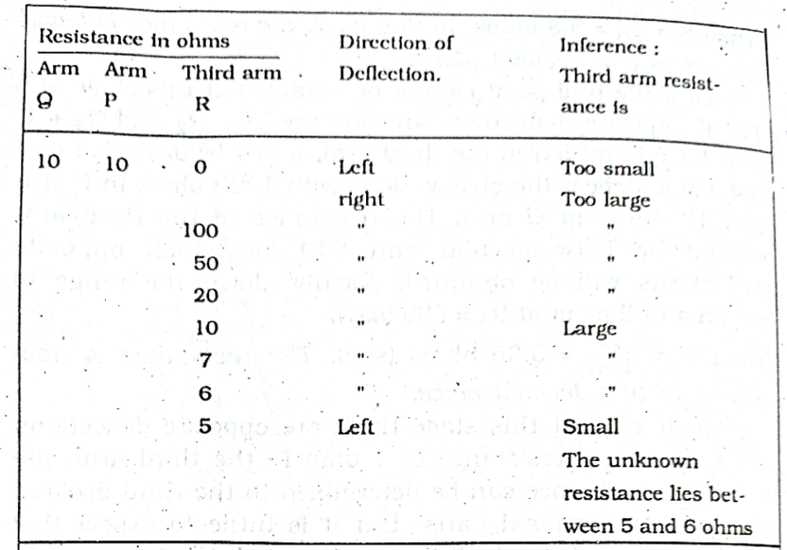

Slide 58
9th Week
Topic:
Experiment Name: To determine the internal resistance of a cell by a Potentiometer.

Slide 59
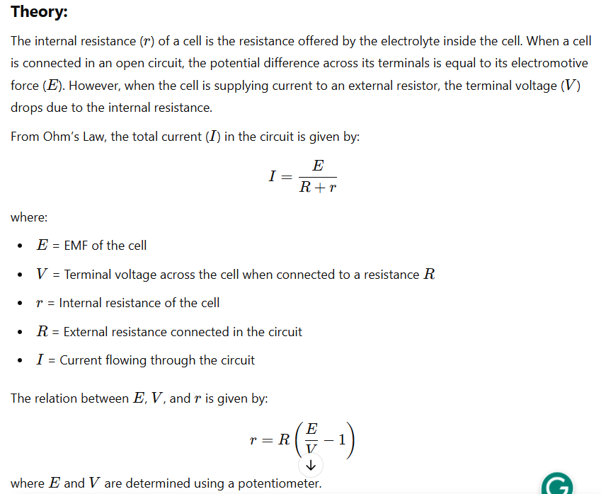

Slide 60
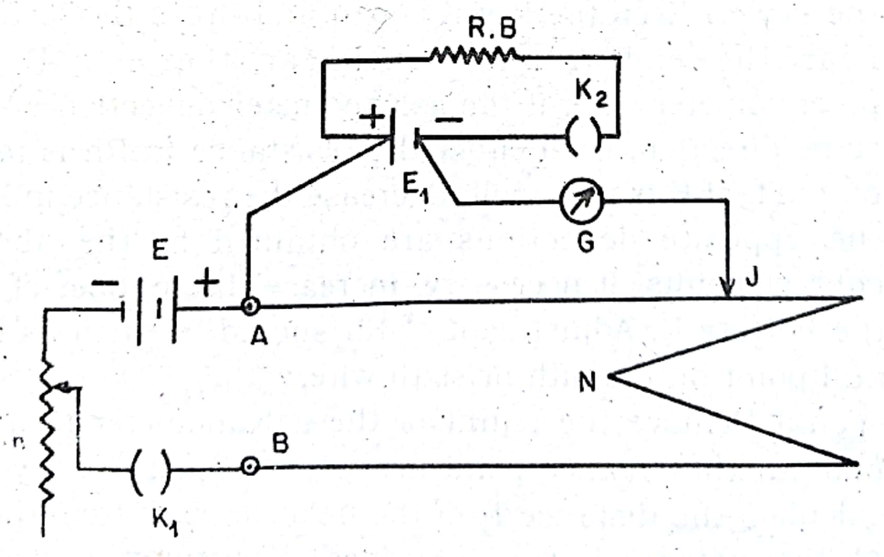

Slide 61
Potentiometer (10-wire or a long uniform wire)
Battery (or accumulator)
A primary cell (whose internal resistance is to be determined)
Galvanometer
High resistance box
Rheostat
Key (switch)
Connecting wires
Jockey
Apparatus:

Slide 62
Procedure:
1. Calibration of the Potentiometer:
Connect the battery, key, rheostat, and potentiometer in series.
Adjust the rheostat so that a steady current flows through the potentiometer wire.
Use a jockey to find the null point for the standard cell and determine the potential gradient.
2. Measurement of EMF (E):
Connect the positive terminal of the cell (whose internal resistance is to be found) to the positive end of the potentiometer.
Use a galvanometer and jockey to find the balancing length l​ (where there is no deflection)..
3. Measurement of Terminal Voltage (V):
Introduce a known external resistance R in series with the cell.
Connect the cell back to the potentiometer circuit, ensuring the circuit is closed through R.
Find the new balancing length l​ using the potentiometer.
Determine the Voltage
4. Calculate of Internal Resistance (r)

Slide 63
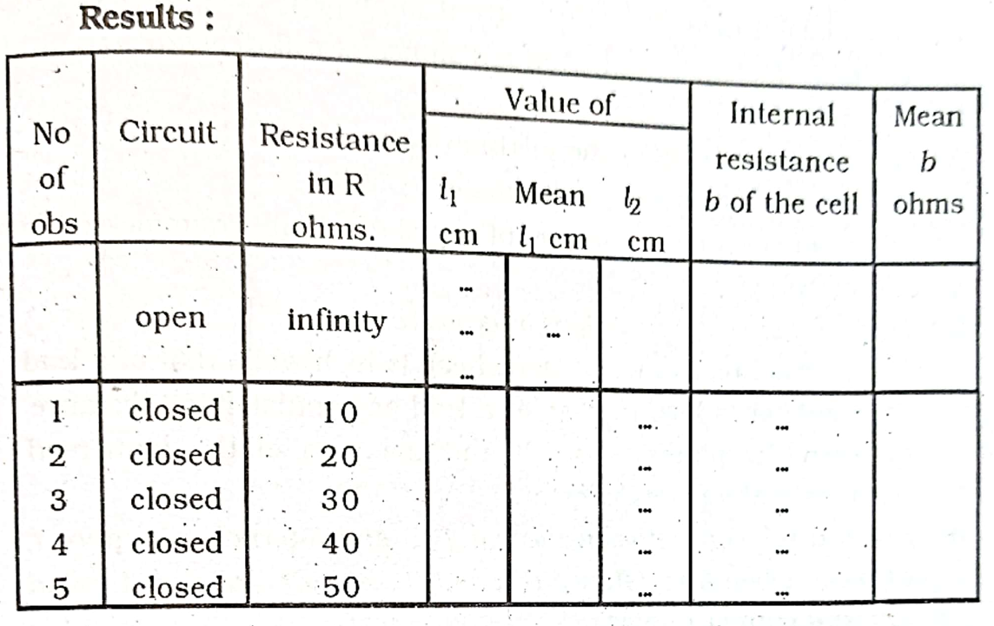

Slide 64
10th Week
Topic:
To compare the EMF of two cells with a Potentiometer.

Slide 65
Experiment Name:
To compare the EMF of two cells with a Potentiometer
Theory:
Using a voltmeter, it is possible to measure only the potential difference between the two terminals of a cell, but using a potentiometer, we can determine the value of emf of a given cell. Where E₁ and E₂ are EMFs of two cells, l₁ and l₂ are the balancing lengths when E₁ and E₂ are connected to the circuit respectively, and φ is the potential gradient along the potentiometer wire.
E₁ /E₂ = φ l₁ /φ l₂ = l₁ /l₂

Slide 66
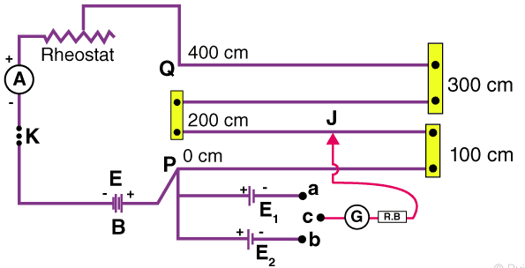

Slide 67
Potentiometer
Daniel Cell
Leclanche Cell
low resistance Rheostat
Ammeter
Voltmeter
Galvanometer
Keys
Set Square
Jockey
Resistance Box
Connecting wires
Piece of sandpaper
Apparatus

Slide 68
Procedure
Connect the circuit as shown in the figure.
With the help of sandpaper, remove the insulation from the ends of connecting copper wire.
Measure the EMF (E) of the battery and the EMFs (E₁ and E₂) of the cell and see if E₁ > E and E₂ > E.
Connect the positive pole of the battery to the zero ends (P) of the potentiometer and the negative pole through the one-way key, low resistance rheostat, and the ammeter to the other end of the potentiometer (Q).
Connect the positive poles of the cells to the terminal at the zero ends (P) and the negative poles to the terminals a and b of the two-way key.
Connect the common terminal c of the two-way key through a galvanometer (G) and a resistance box to the jockey J.
Take maximum current from the battery by making the rheostat resistance zero.
Insert the plugin, the one-way key through the resistance box and the galvanometer to the jockey J.
Take out the 2000 Ω plug from the resistance box.
Note down the direction of the deflection in the galvanometer by pressing the jockey at zero ends.

Slide 69
11. Now, press the jockey at the other end of the potentiometer wire. If the deflection is in the opposite direction to that in the first case, the connections are correct.
12. Push the jockey smoothly over the potentiometer up to a point where the galvanometer shows no deflection.
13. Put the 2000 Ω plug back into the resistance box and obtain the null point position accurately with the help of the set square.
14. Note the length l₁ of the wire for the cell E₁.15. Note the current as indicated by the ammeter.
15. Disconnect the cell E₁ from the plug
16. Connect E₂ by inserting the plug into the gap of the two-way key.
17. Take out a 2000 ohms plug from the resistance box and slide the jockey along the potentiometer wire and obtain no deflection position.
18. Put 2000 ohms plug back in the RB and obtain null for E₂.
19. Note the length L₂ of wire in this position for the cell E₂.
20. By increasing the current and adjusting the rheostat, we get three sets of observations.

Slide 70
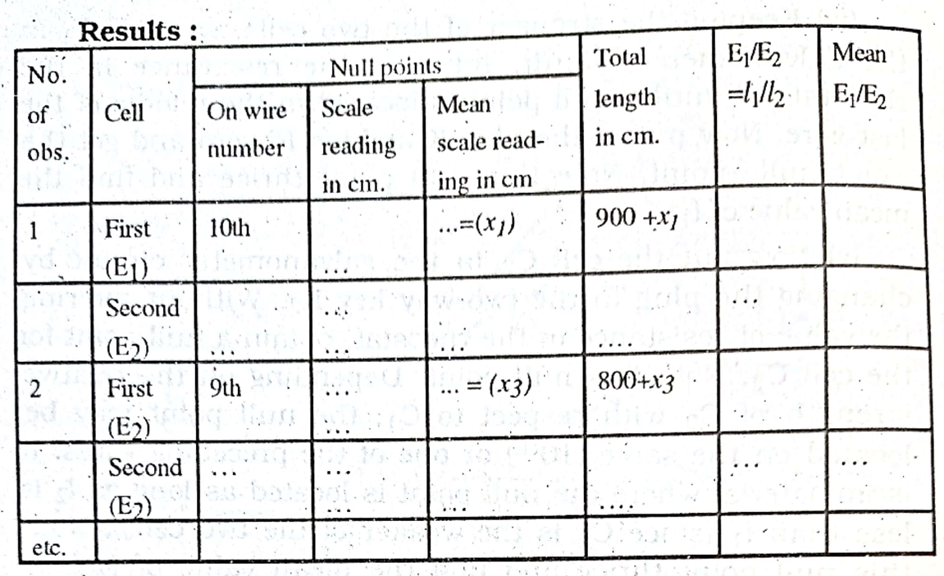

Slide 71
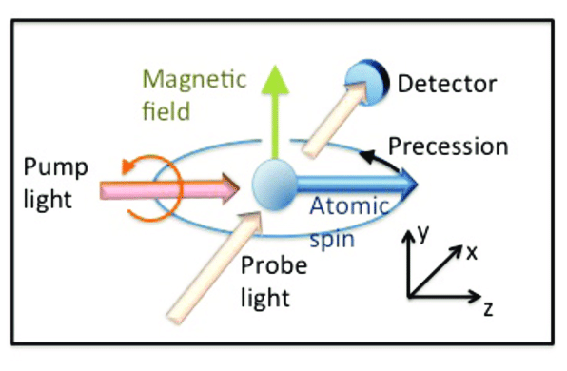
11th Week
Topic:
To determine the horizontal component of the earth's magnetic field and the magnetic moment of a magnet by improving the magnetometer

Slide 72
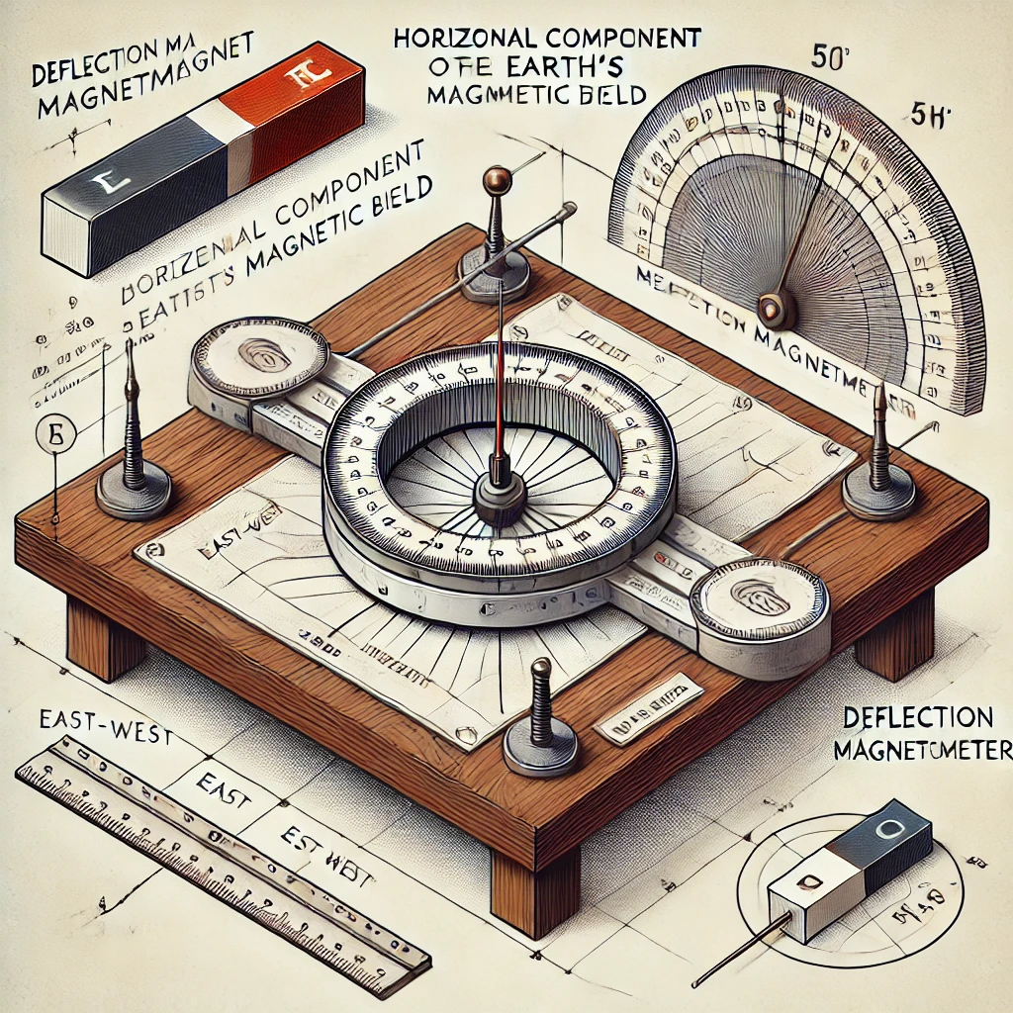

Slide 73
Experiment Name:
To determine the horizontal component of the earth's magnetic field and the magnetic moment of a magnet by improving the magnetometer.
Theory:
The Earth’s magnetic field has two components:
Horizontal Component – The part of the Earth’s field acting parallel to the surface.
Vertical Component ​ – The part acting perpendicular to the surface.
A bar magnet placed in a uniform magnetic field experiences a torque that aligns it with the field. Using a deflection magnetometer in the Tan-A position, we can determine BH​ and the magnetic moment (M) of the magnet.
The magnetic moment of a magnet is given by:
M=md
where
m = pole strength of the magnet
d = distance between poles (magnet length)

Slide 74
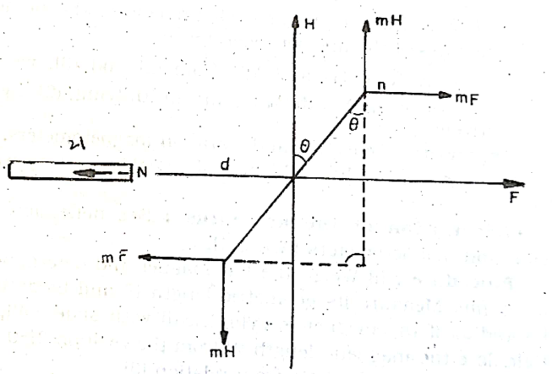

Slide 75
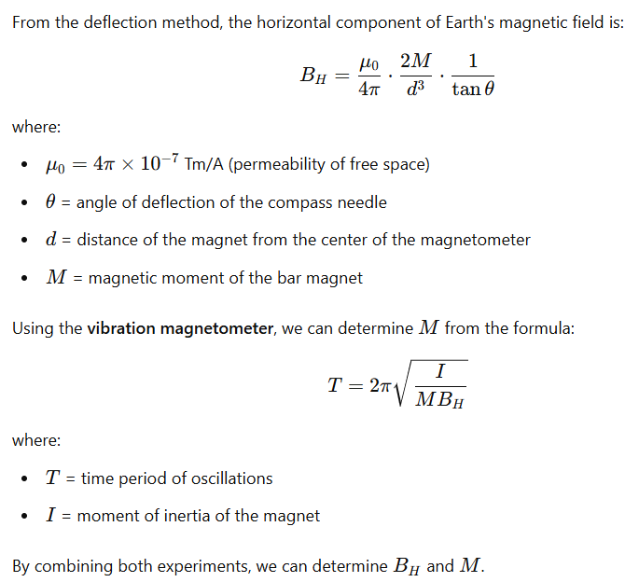

Slide 76
Improved magnetometer (deflection and vibration magnetometer)
Bar magnet
Compass needle
Stopwatch
Meter scale
Stand with pivoted magnet system
Apparatus:

Slide 77
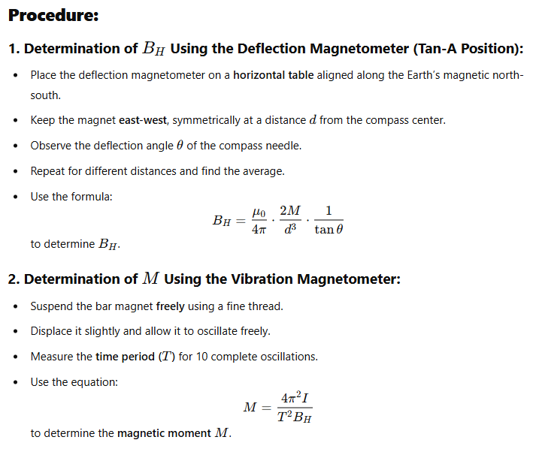

Slide 78
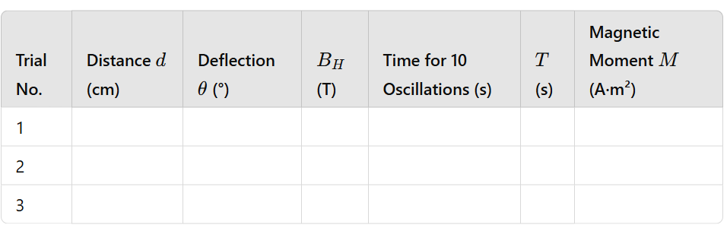

Slide 79
11, 12, 13, 14, 16, 17th Weeks are Covered by Review class, Practice Class and Final Exam

Slide 80

Any Question ?

Slide 81
The End

Slide 82


