Slide 1
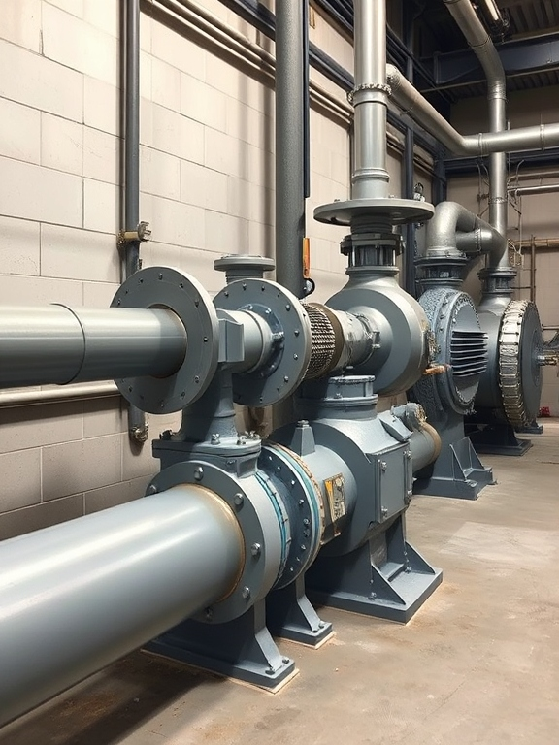

Lecture on
Fluid Machinery
Prepared By :
Anisul Islam
Lecturer
Department of ME (UGV)

Slide 2
BASIC COURSE INFORMATION
Course Title | Fluid Machinery
Course Code | ME-421
Credits | 03
CIE Marks | 90
SEE Marks | 60
Exam Hours | 2 hours (Mid Exam) 3 hours (Semester Final Exam)
Level | 7th Semester

Slide 3
















Course Learning Outcomes (CLOs):
CLO 2
CLO 4
  Apply the concepts of Valves, Pumps, Turbine and Compressor in Pipe design
Calculate both Pump and Turbine Efficiency to maintain smooth operation
CLO 1
CLO 3
  Understand functions of various valves, pump, turbine and Compressor
Analyze Complex problems on Pump, Compressor and Turbine Design

Slide 4
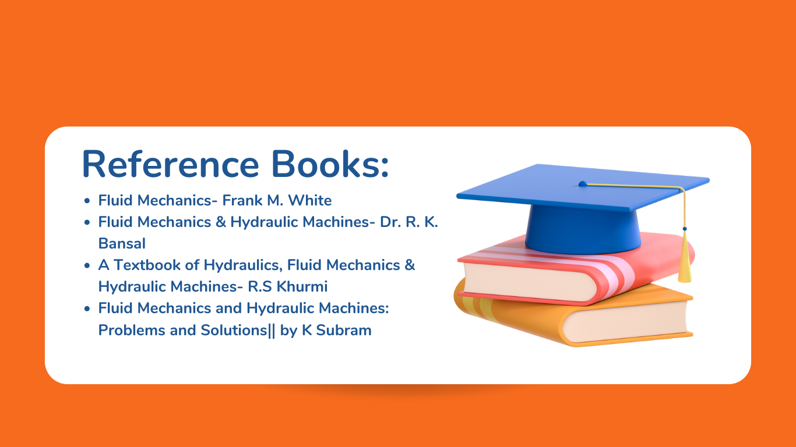

Slide 5
Serial No | Course Content | Hours | CLOs
01. | Valve, Valve Types, Application, Valve Design, P & ID Symbol | 06 | CLO 1, CLO 2
02. | Compressor, Compressor Types, Compressor Design | 06 | CLO 1,CLO 2, CLO 3
03. | Turbine, Turbine Types, Application, Turbine Design, Problem Solving | 12 | CLO 1, CLO 3,CLO 4
04. | Pump, Pump Types, Application, Pump Design, Problem Solving | 10 | CLO 1, CLO 3,CLO 4

Slide 6
ASSESSMENT PATTERN
CIE- Continuous Internal Evaluation (90 Marks)
Bloom's Category Marks (out of 90) | Tests (45) | Assignments (10) | Class Test (20) | Quiz (5) | External Participation in Curricular/Co-Curricular Activities (10)
Remember | 5 |  | 10 | 05
Understand | 5 | 05 | 10
Apply | 10 |  |  |  | 10
Analyze | 15
Evaluate | 10
Create |  | 05

Slide 7
SEE- Semester End Examination (60 Marks)
Bloom's Category | Test
Remember | 10
Understand | 10
Apply | 10
Analyze | 10
Evaluate | 10
Create | 10

Slide 8
Week No. | Topics | Teaching Learning Strategy | Assessment strategy | Alignment To CLO
1. | Gate, Globe and Ball Valve Application and Working Principle | Lecture, PPT | Quiz, Written exam, CT | CLO 1
2. | Butterfly, Foot, Pressure relief, Check Valve Application and Working Principle | Lecture, Video Presentation, PPT, Problem Practice | Quiz, Written exam, CT | CLO 1
3. | Valve Design , P& ID Symbol | Lecture, PPT, Video Presentation | Assignment, Quiz, Written exam, CT | CLO 1, CLO 2
4. | Compressor & Compressor Types | Lecture, Problem Practice, Video Presentation, PPT | Assignment, Quiz, Written exam, CT | CLO 2

Slide 9
Week No. | Topics | Teaching Learning Strategy | Assessment strategy | Alignment To CLO
5. | Compressor (Working Principle) | Lecture, Video Presentation, PPT | Quiz, Written exam, CT | CLO 2, CLO 3
6. | Compressor Design | Lecture, Video Presentation, PPT, Problem Solving | Quiz, Written exam, CT | CLO 3
7. | Turbine Classifications | Lecture, Oral Presentation, Video Presentation, PPT | Assignment, Quiz, Written exam, CT | CLO 1
8. | Turbine Design | Lecture, Oral Presentation, Video Presentation, PPT, Problem Practice | Assignment, Quiz, Written exam, CT | CLO 3,CLO 4

Slide 10
Week No. | Topics | Teaching Learning Strategy | Assessment strategy | Alignment To CLO
9. | Turbine Selection | Lecture, Oral Presentation, PPT | Quiz, Written exam, CT | CLO 3,CLO 4
10. | Turbine Specific Speed, Turbine Characteristics Curve | Lecture, PPT | Assignment, Quiz, Written exam, CT | CLO 3,CLO 4
11. | Turbine Performance, Draft Tube & Surge Tank | Lecture, Oral Presentation, PPT | Assignment, Quiz, Written exam, CT | CLO 3,CLO 4
12. | Problem Solving on Turbine | Lecture, PPT, Problem Solving | Assignment, Quiz, Written exam, CT | CLO 3,CLO 4

Slide 11
Week No. | Topics | Teaching Learning Strategy | Assessment strategy | Alignment To CLO
13. | Pump Classifications | Lecture, Oral Presentation, Video Presentation, PPT | Assignment, Quiz, Written exam, CT | CLO 1
14. | Centrifugal Pump | Lecture, Oral Presentation, Video Presentation, PPT | Assignment, Quiz, Written exam, CT | CLO 3, CLO 4
15. | Reciprocating Pump | Lecture, Oral Presentation, Video Presentation, PPT | Assignment, Quiz, Written exam, CT | CLO 3, CLO 4
16. | Reciprocating Pump | Lecture, Oral Presentation, Video Presentation, PPT | Assignment, Quiz, Written exam, CT | CLO 3, CLO 4
17. | Problem solving on Pump | Lecture, PPT, Problem Solving |  | CLO 4

Slide 12
Week | Topic | Page No.
1 | Gate, Globe and Ball Valve Application and Working Principle | 13-26
2 | Butterfly, Foot, Pressure relief, Check Valve Application and Working Principle | 27-40
3 | Valve Design , P& ID Symbol | 41-49
4 | Compressor & Compressor Types | 50-52
5 | Compressor (Working Principle) | 53-58
6 | Compressor Design | 59-71
7 | Turbine Classifications | 72-74
8 | Turbine Design | 75-82
9 | Turbine Selection | 83-91
10 | Turbine Specific Speed, Turbine Characteristics Curve | 92-101
11 | Turbine Performance, Draft Tube & Surge Tank | 102-107
12 | Problem Solving on Turbine | 108-109
13 | Pump Classifications | 110-121
14 | Centrifugal Pump | 122-132
15 | Centrifugal Pump | 133-148
16 & 17 | Reciprocating Pump & Problem Solving | 149-163

Slide 13

Week -1
Lecture
on
Valve
Gate, Globe and Ball Valve Application and Working Principle

Slide 14
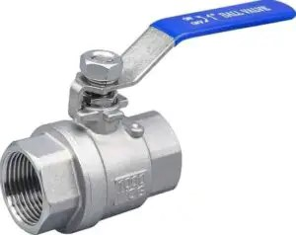
What is a Valve?
In simple terms, a valve is an internal component that controls and regulates the flow of fluid in a system by closing, opening, or partially cutting off the flow of a fluid for various reasons. Therefore, the valves are used to regulate the fluid’s flow and pressure within a system.
Valves are critical components in piping systems for controlling the flow of fluids, vapors, or gases. They offer an effective way to regulate the volume and pressure of gases or liquids that pass through pipelines.
It is important to understand which valve type is required for a specific application before installing it in pipework systems.
- Neil Armstrong

Slide 15
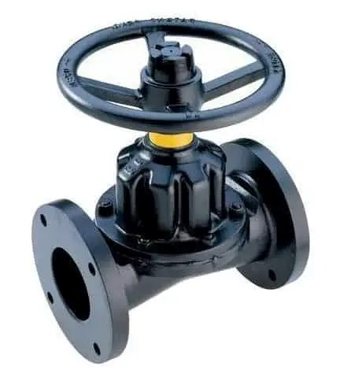
Types of Valves
Following are the main types of valves:
Gate valve
Globe valve
Ball valve
Butterfly valve
Check valve
Needle valve
Diaphragm valve
Solenoid valve
Control valve
Relief or pressure relief valve
Piston valve
Safety valve
Rotary valve
Thermostatic mixing valve
Pressure regulating valve
- Neil Armstrong

Slide 16
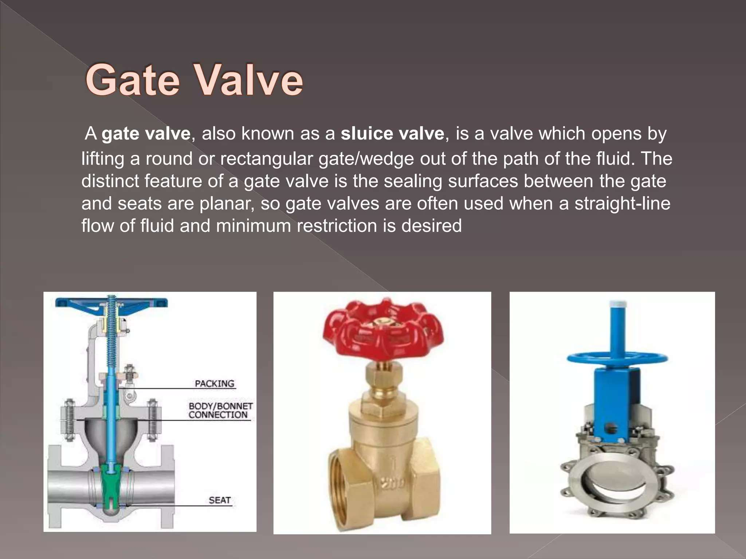

Slide 17
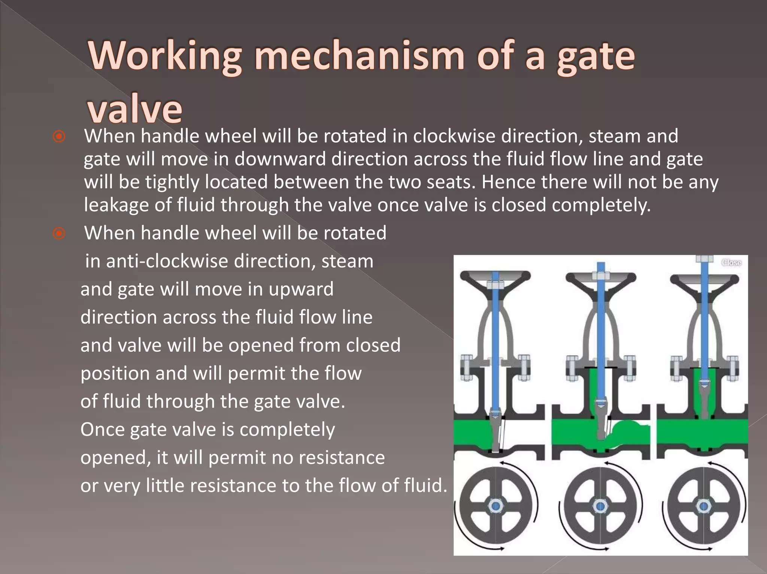

Slide 18
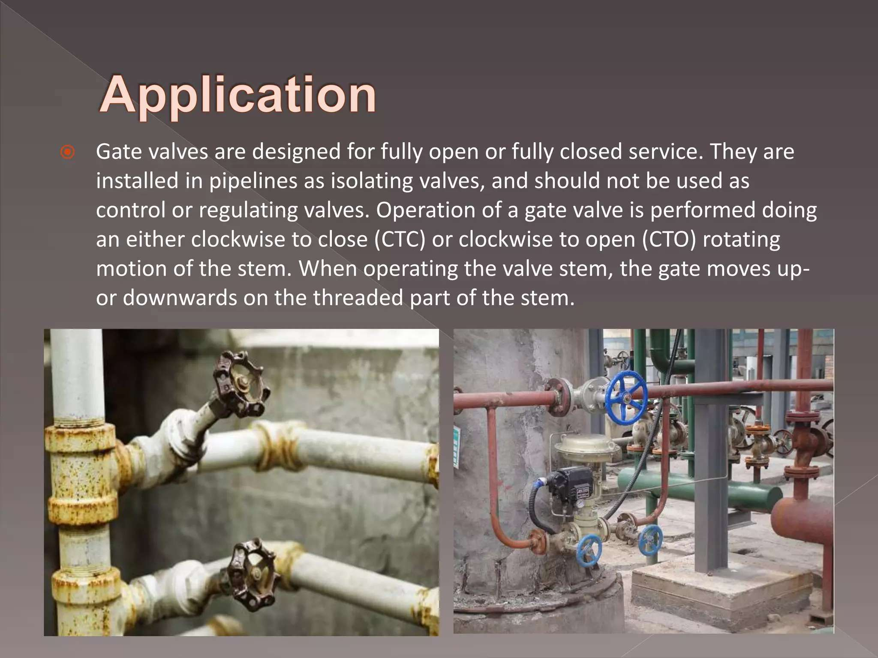

Slide 19
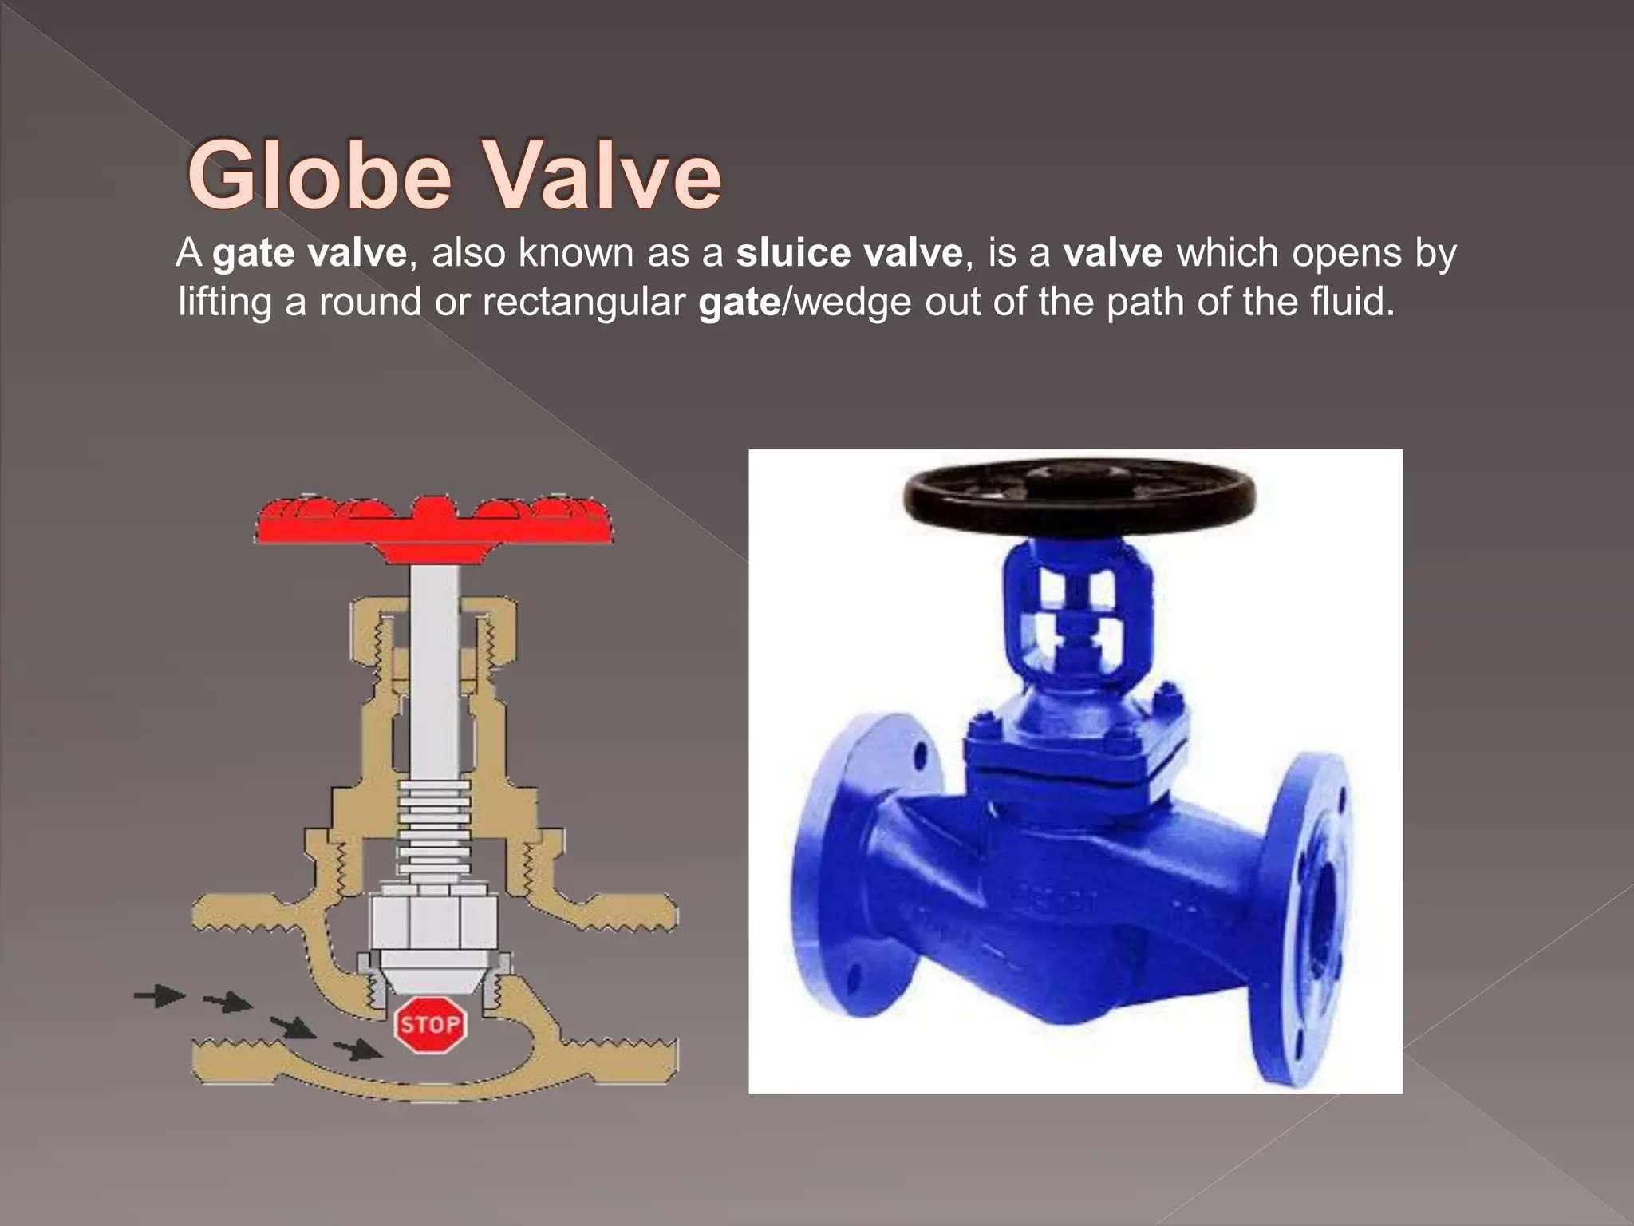

Slide 20
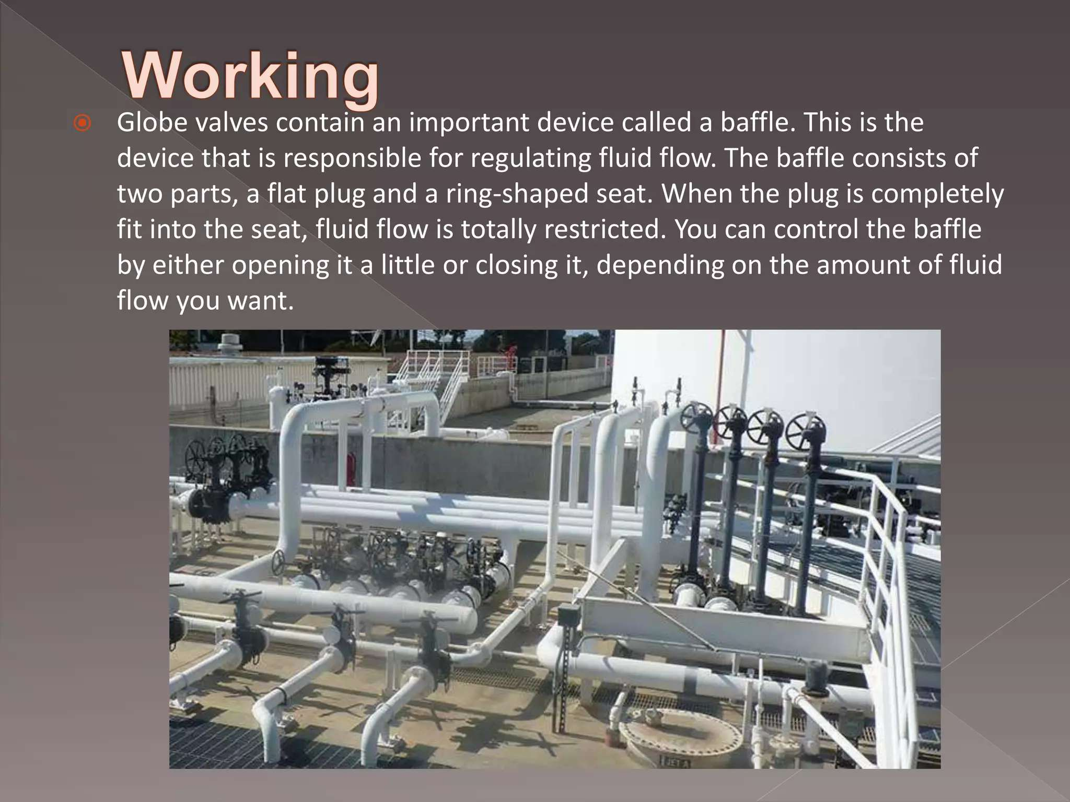

Slide 21
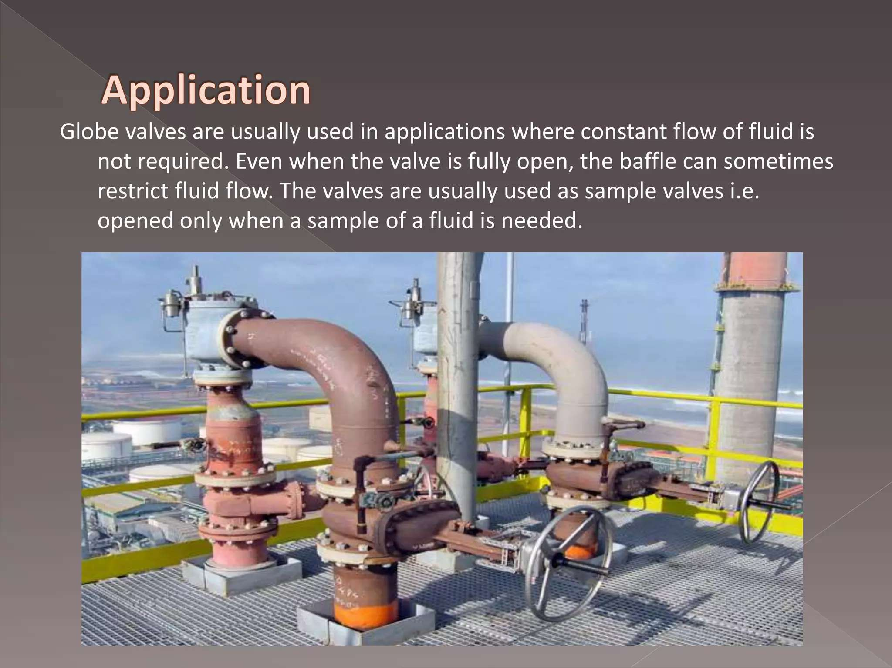

Slide 22
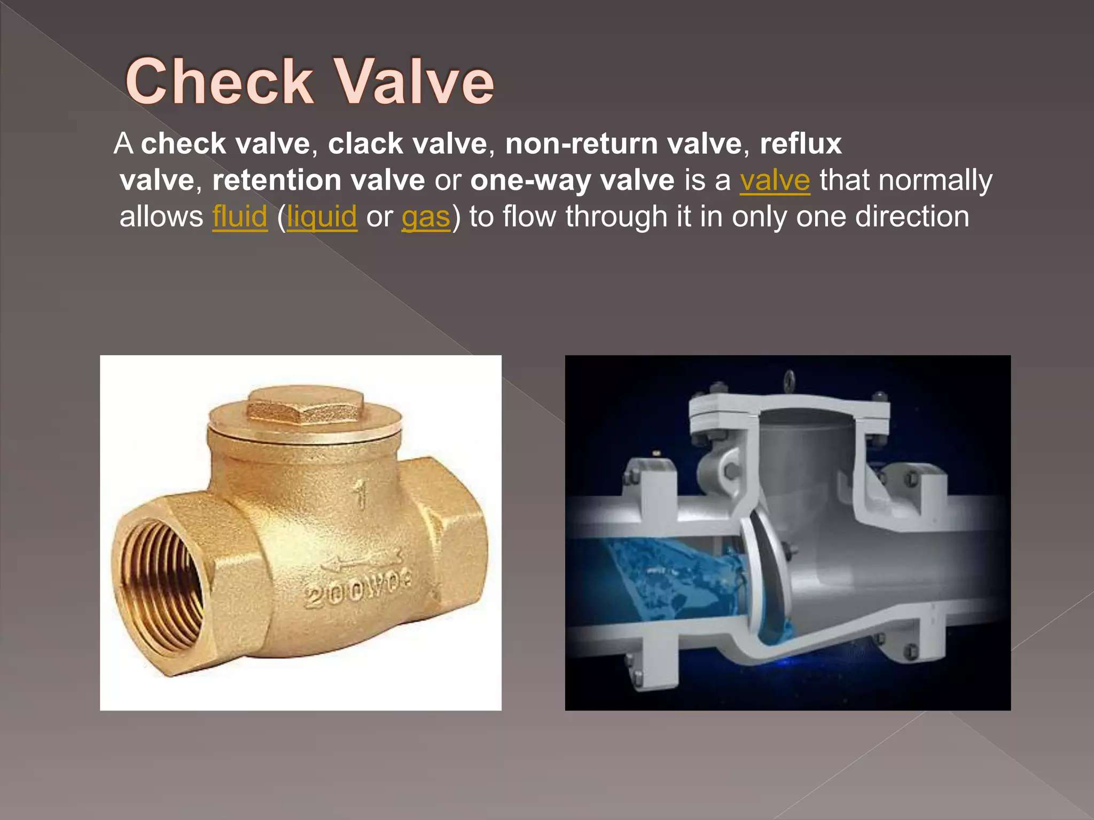

Slide 23
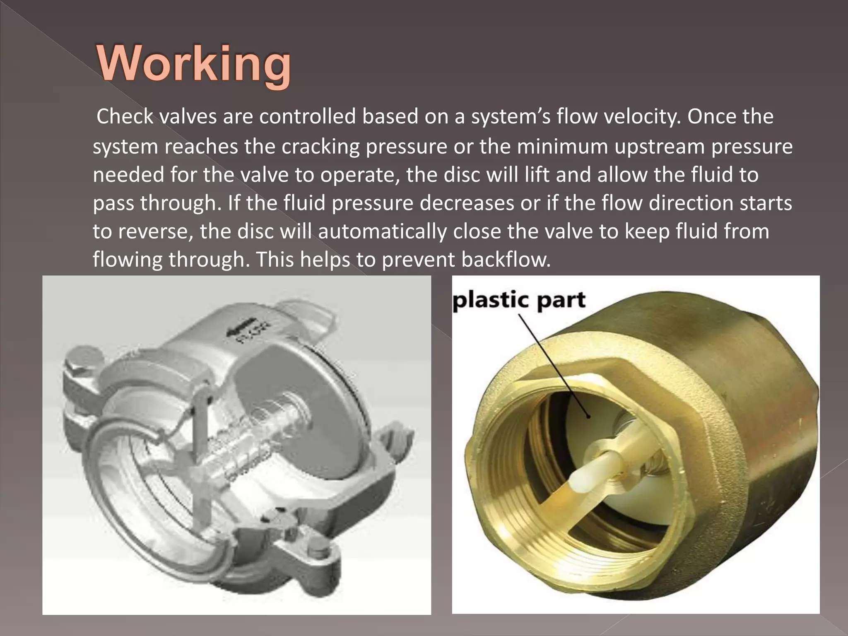

Slide 24
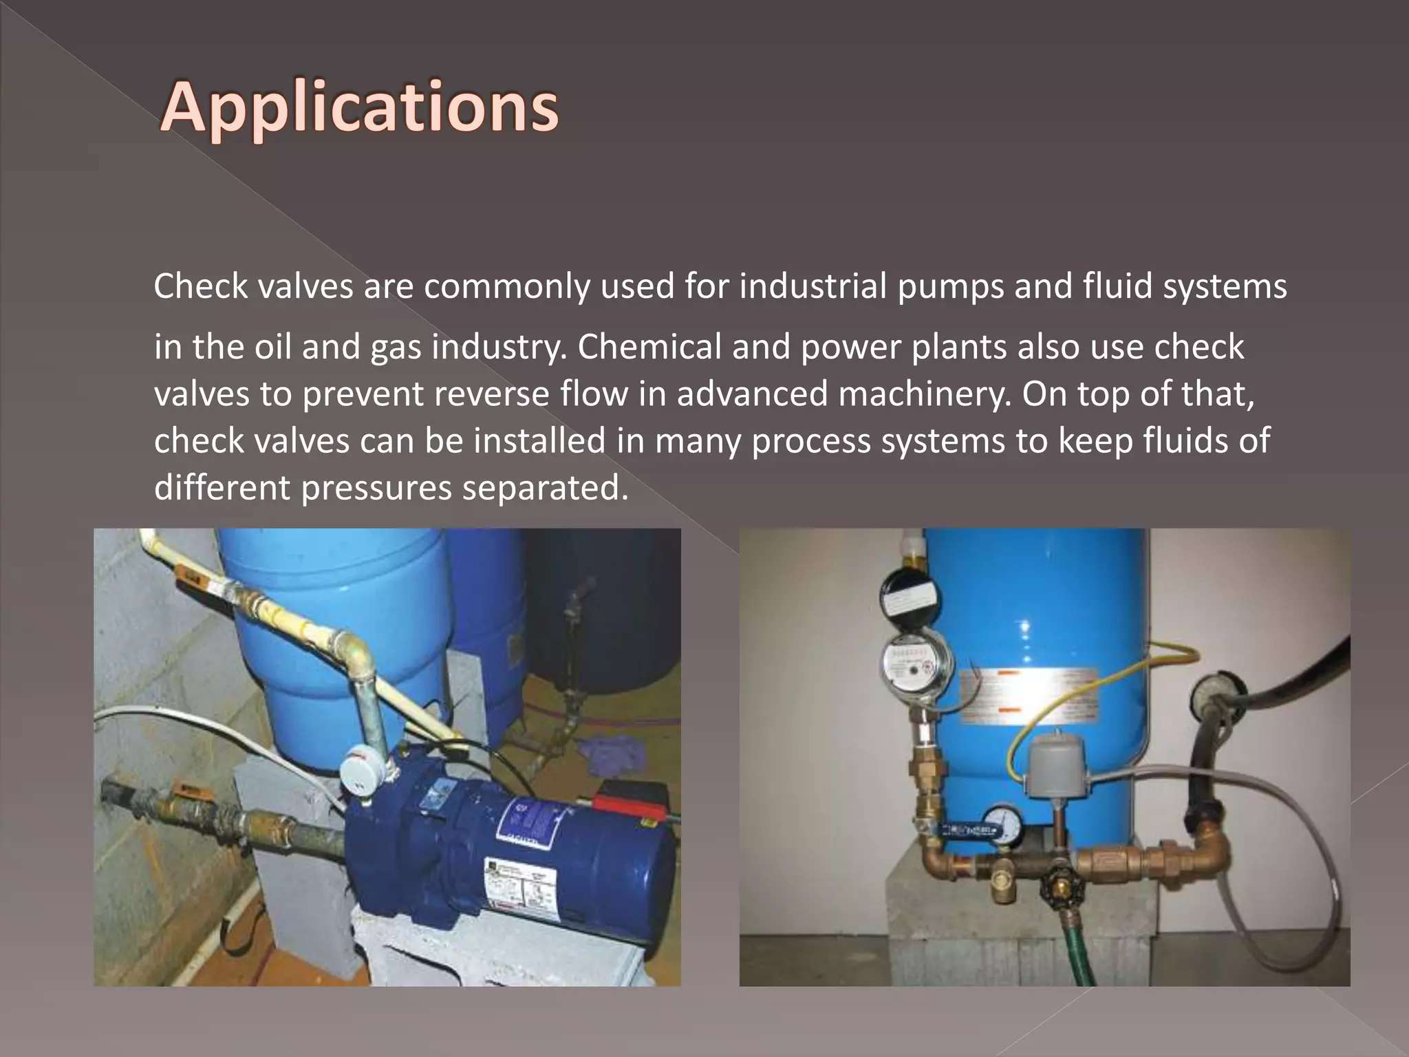

Slide 25
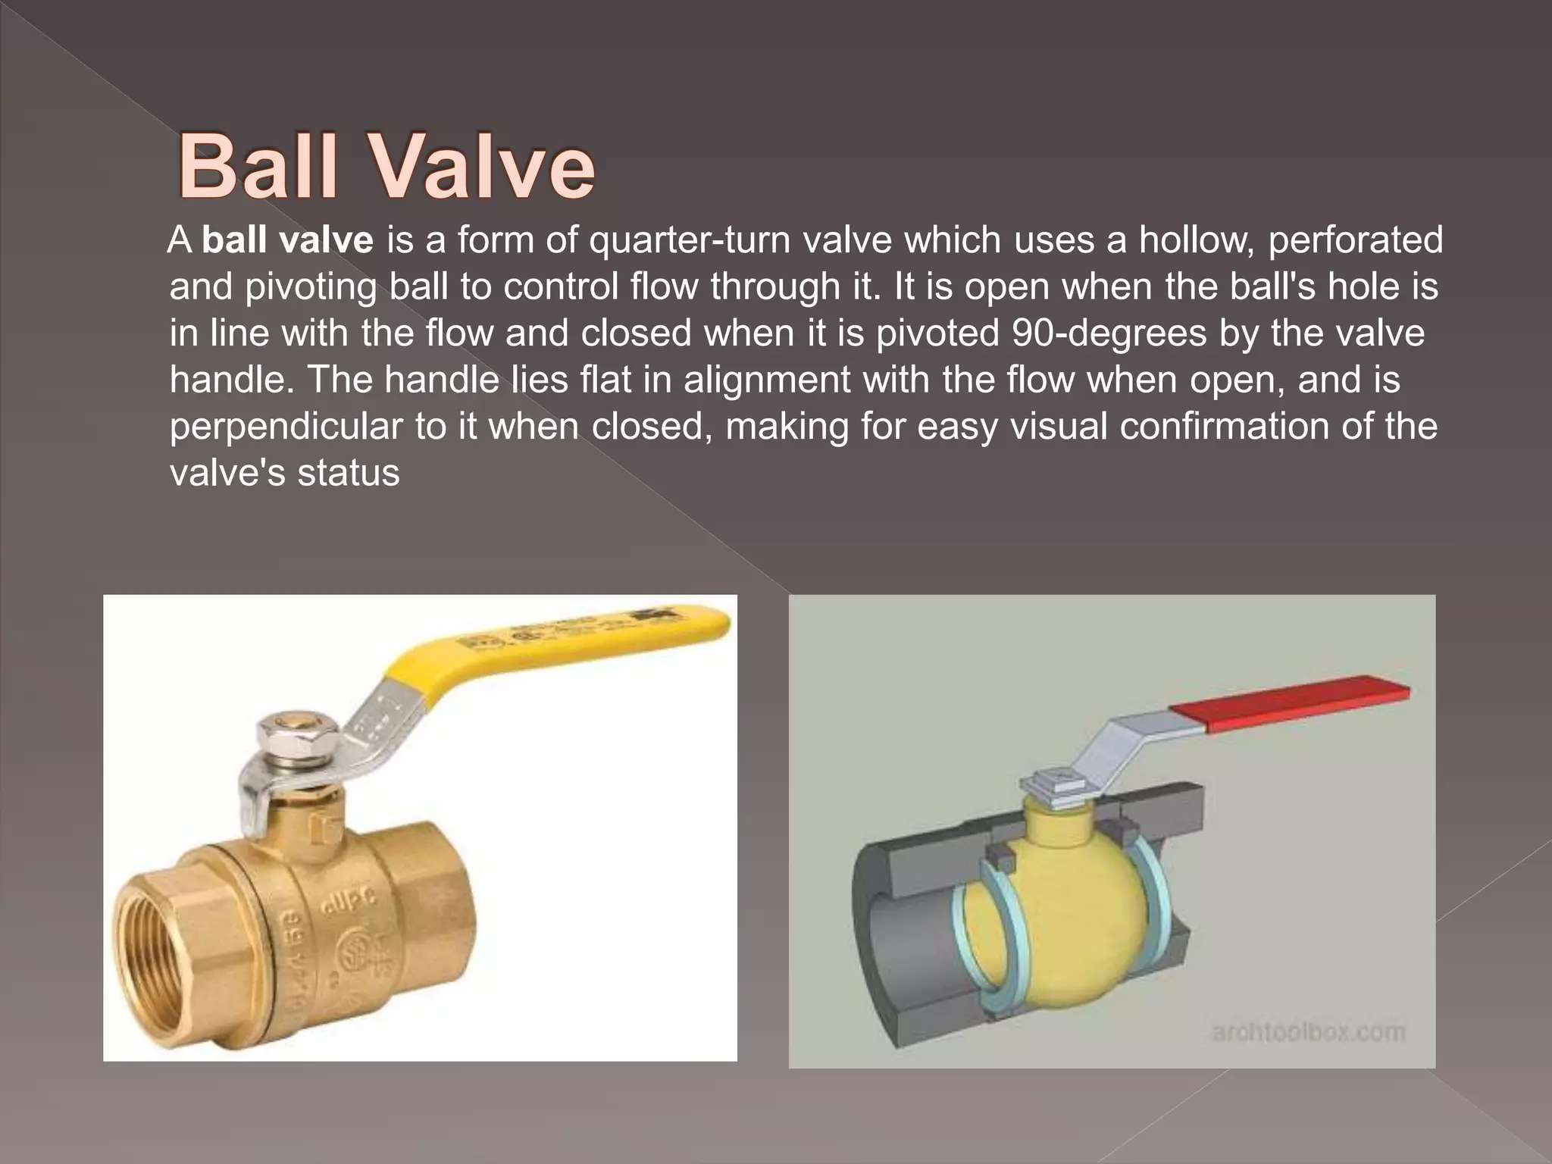

Slide 26
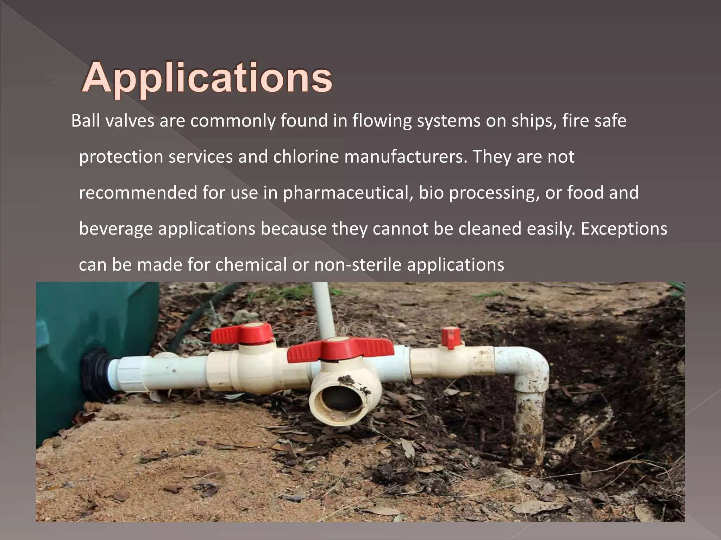

Slide 27
Week -2
Lecture
on
Valve
Butterfly, Foot, Pressure relief, Check Valve Application and Working Principle

Slide 28
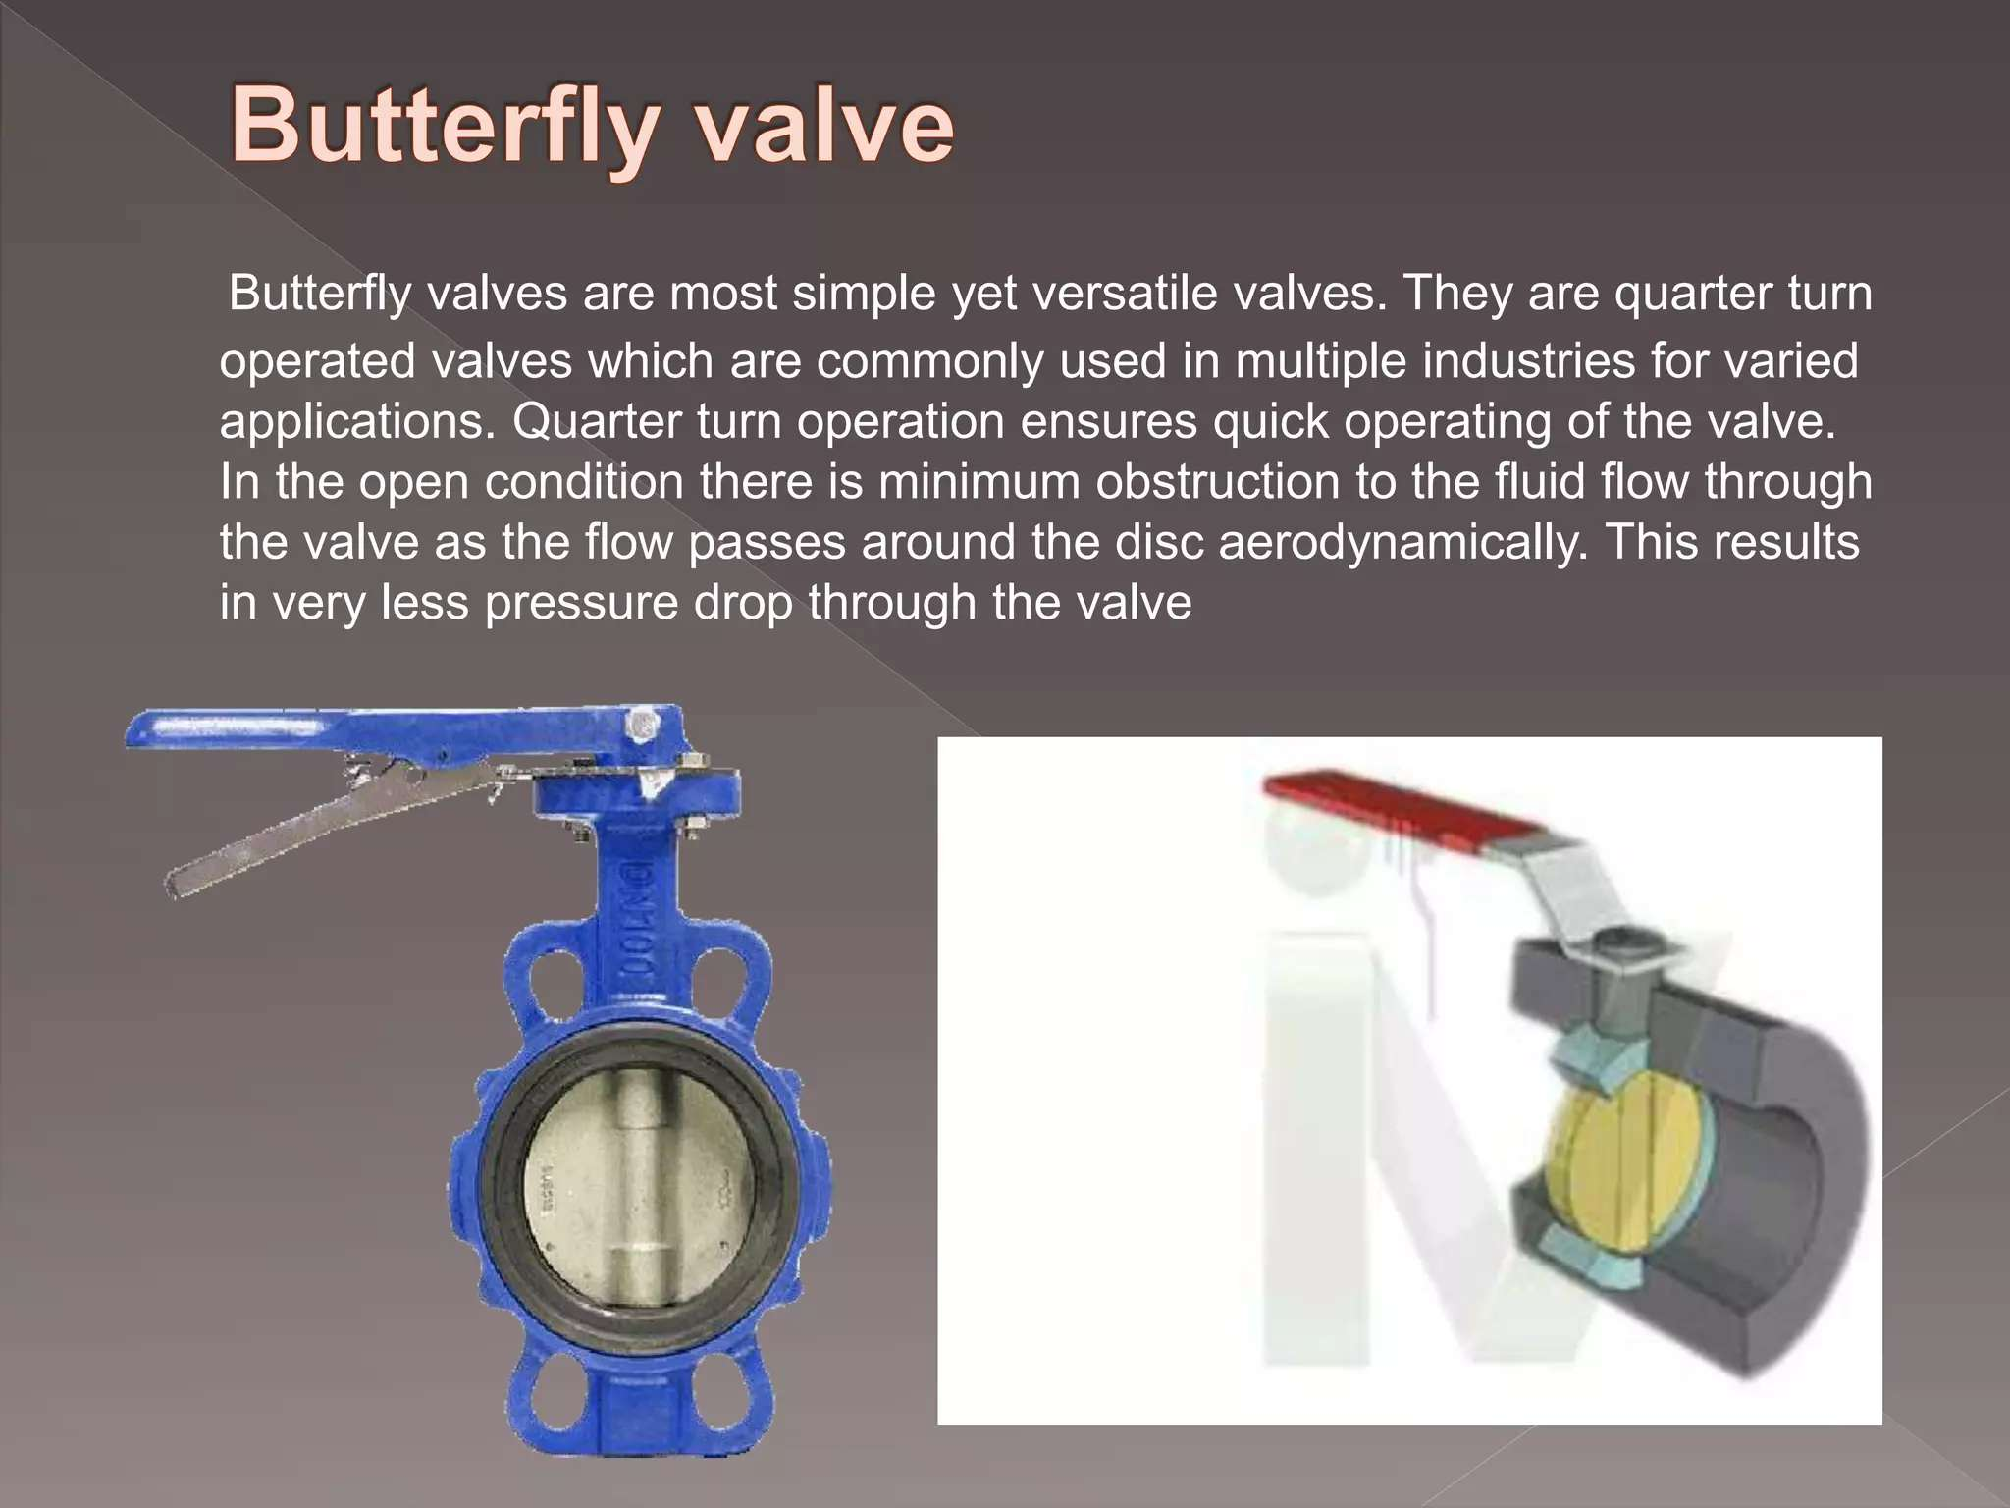

Slide 29
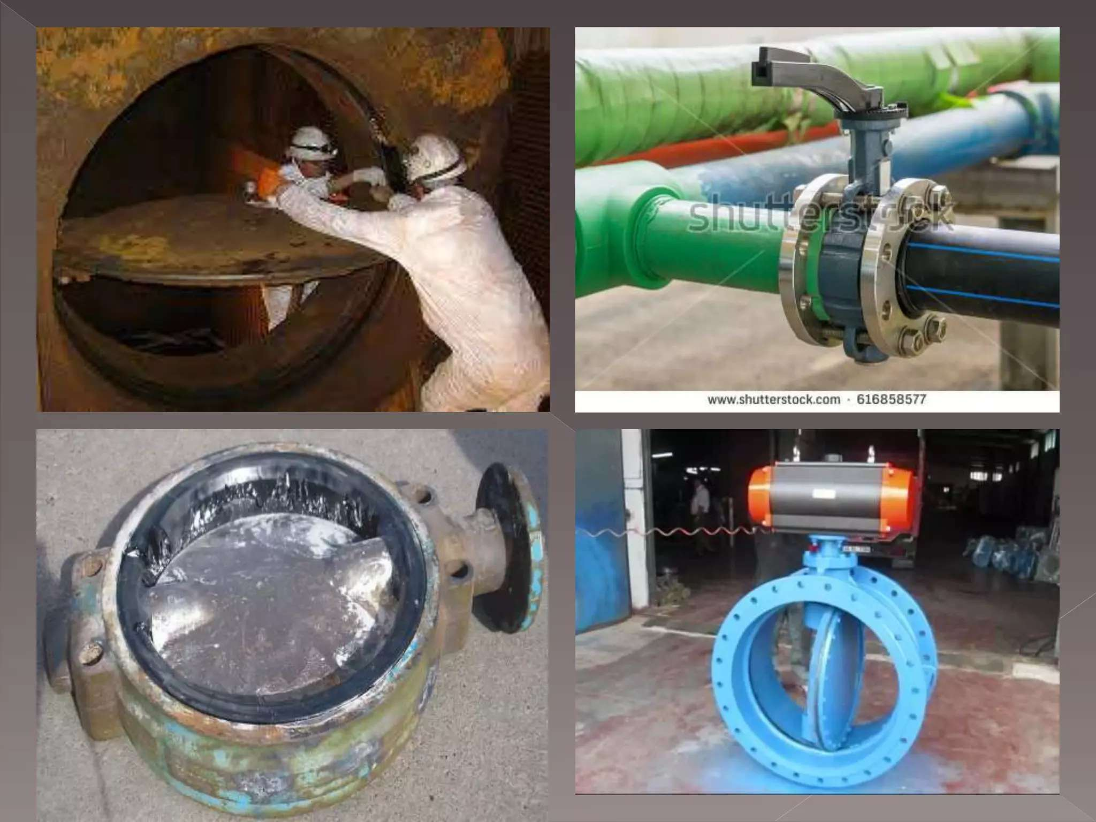

Slide 30
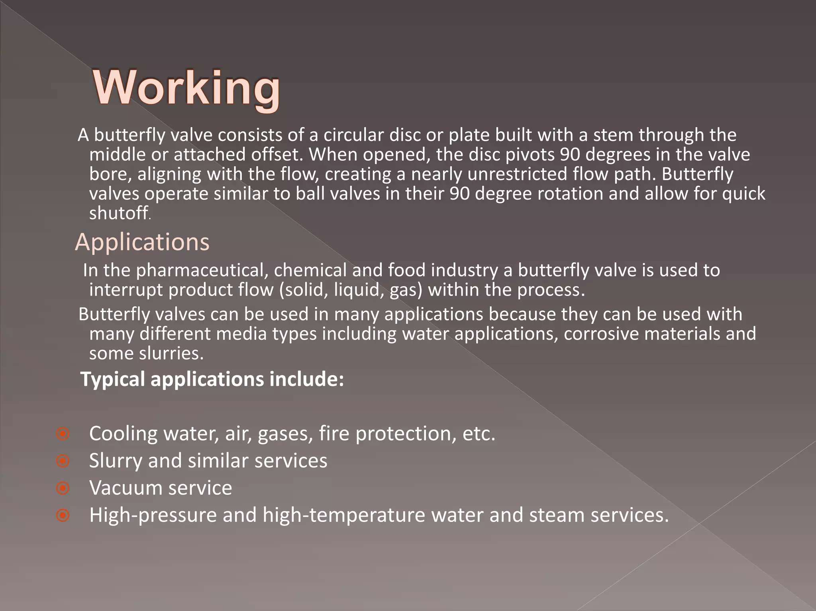

Slide 31
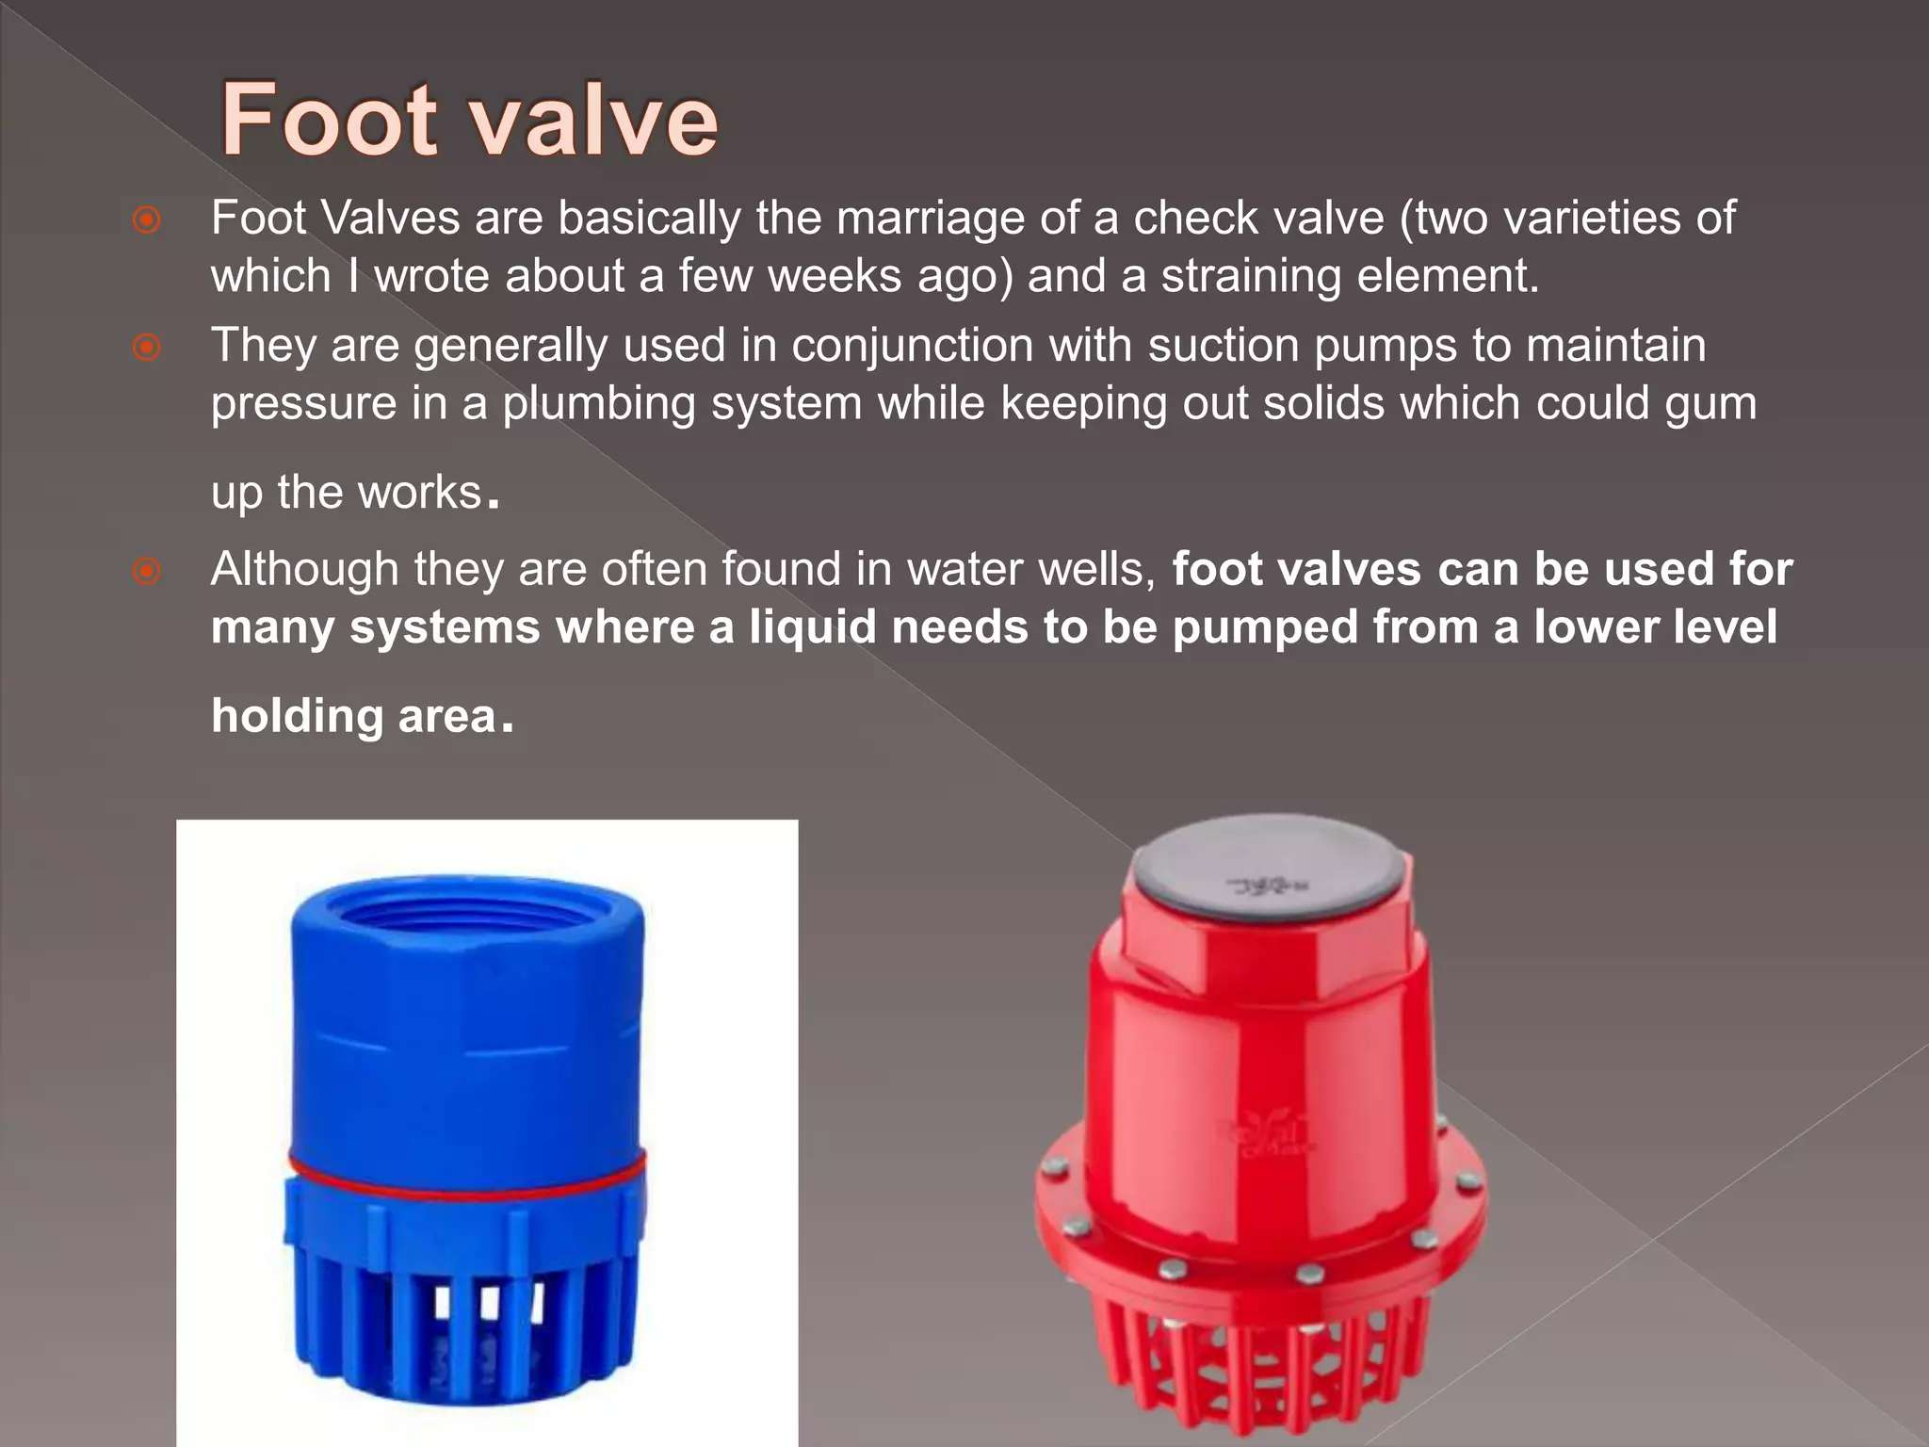

Slide 32
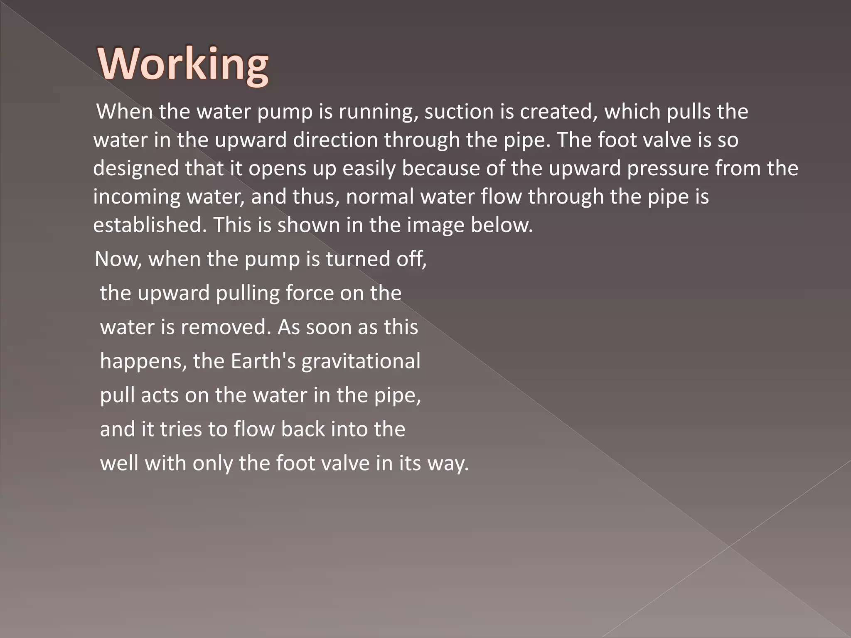

Slide 33
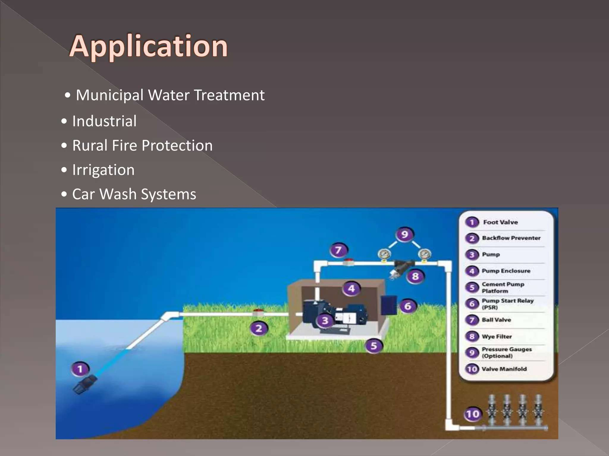

Slide 34
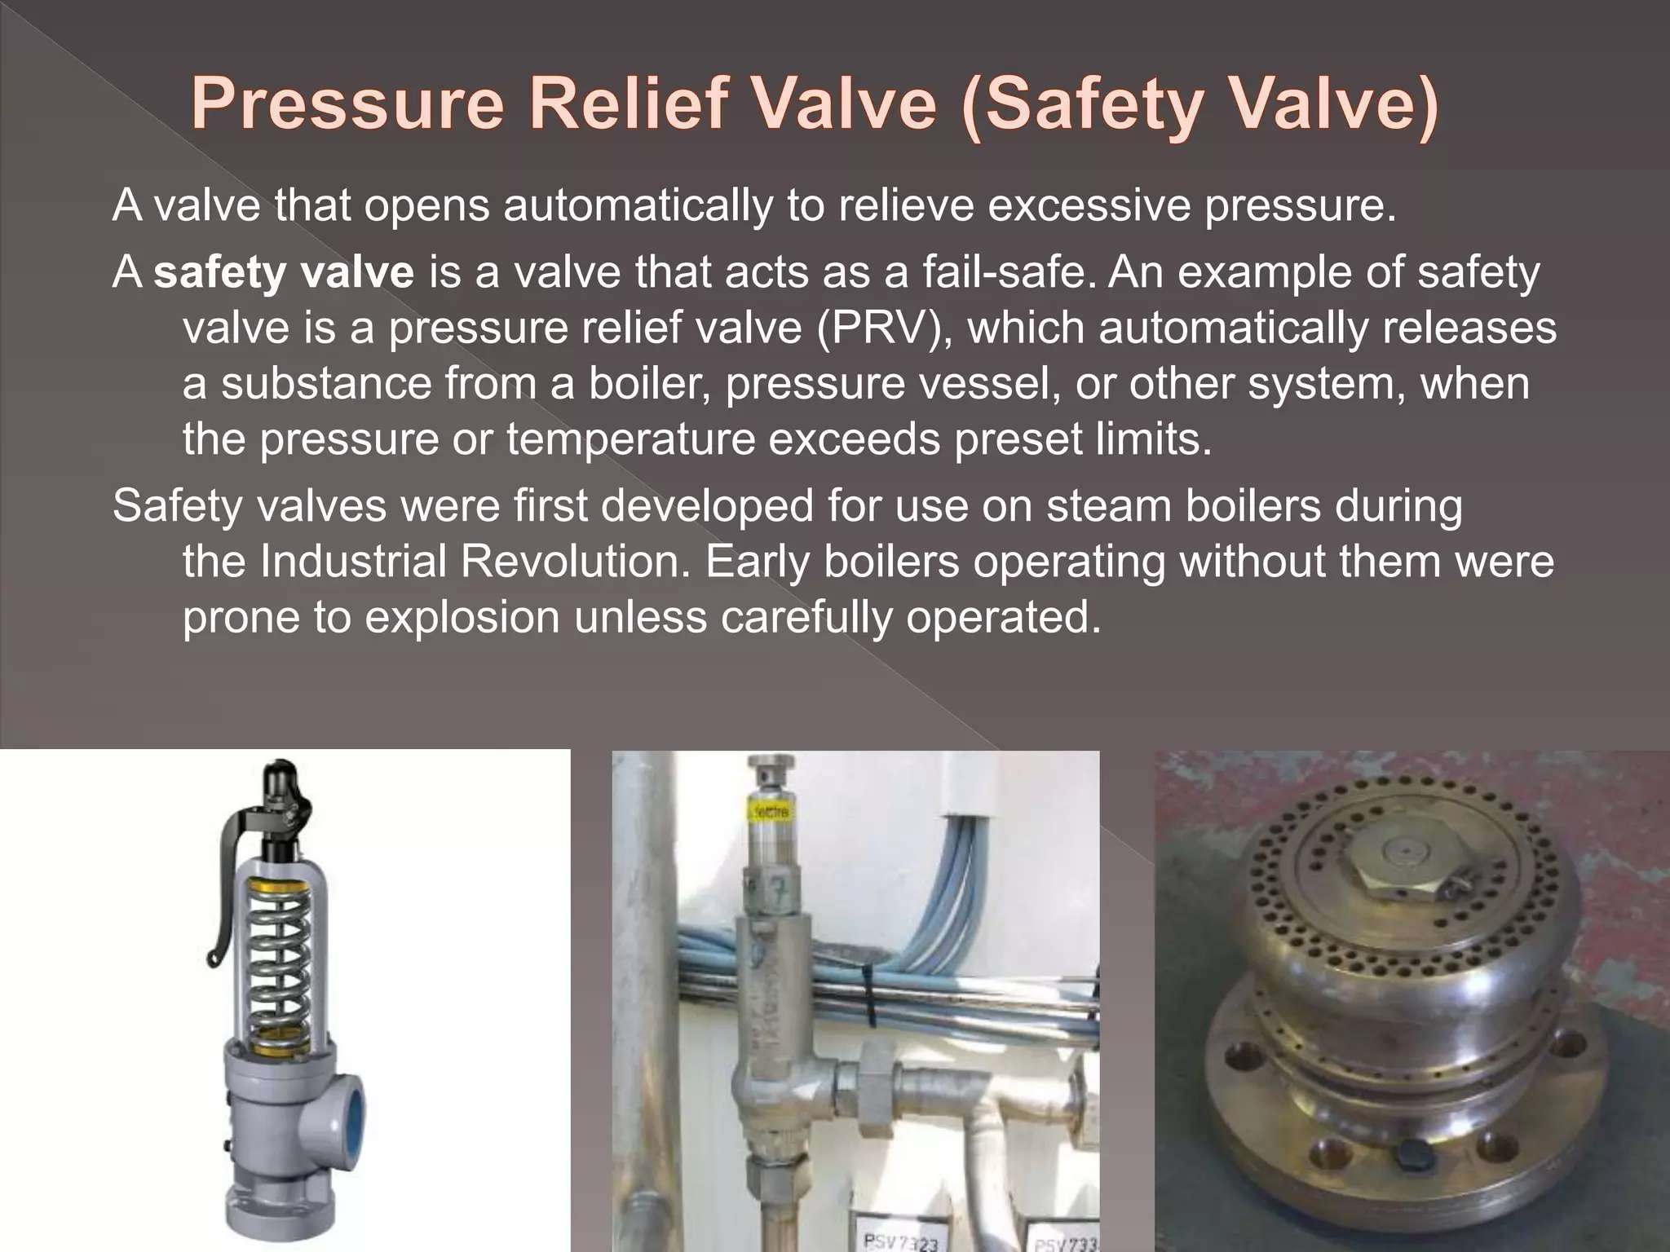

Slide 35
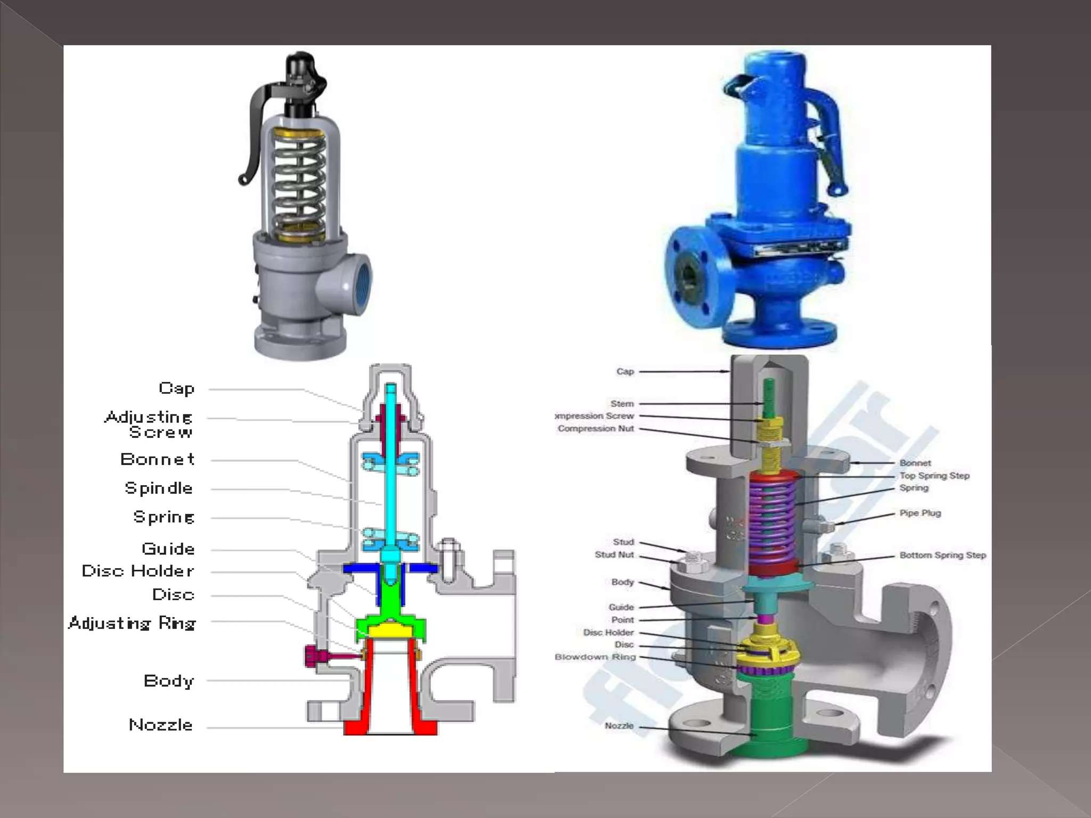

Slide 36
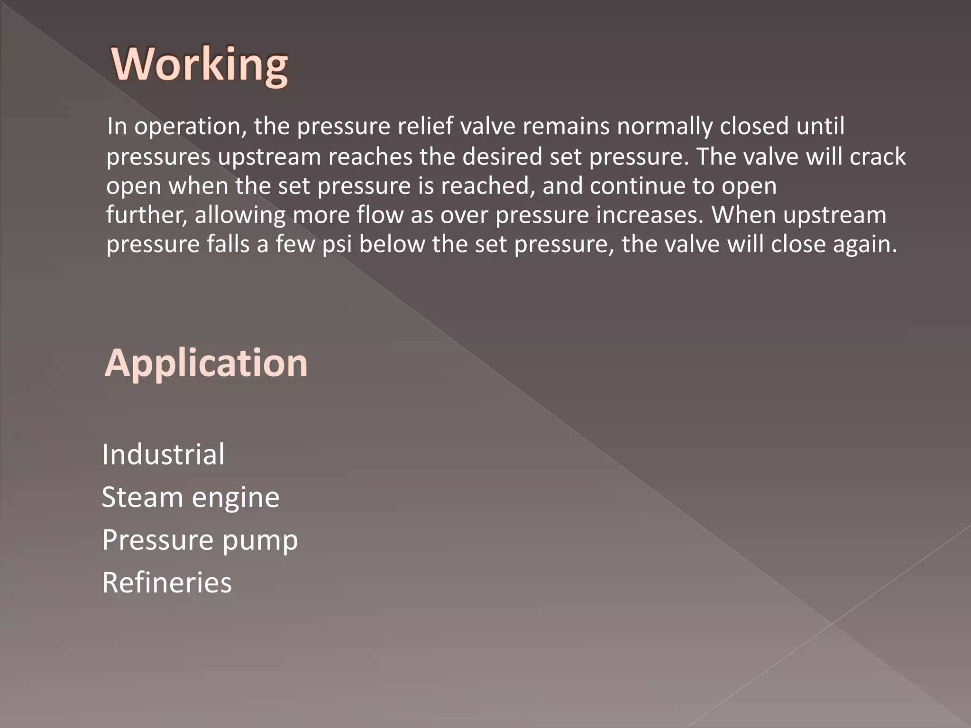

Slide 37
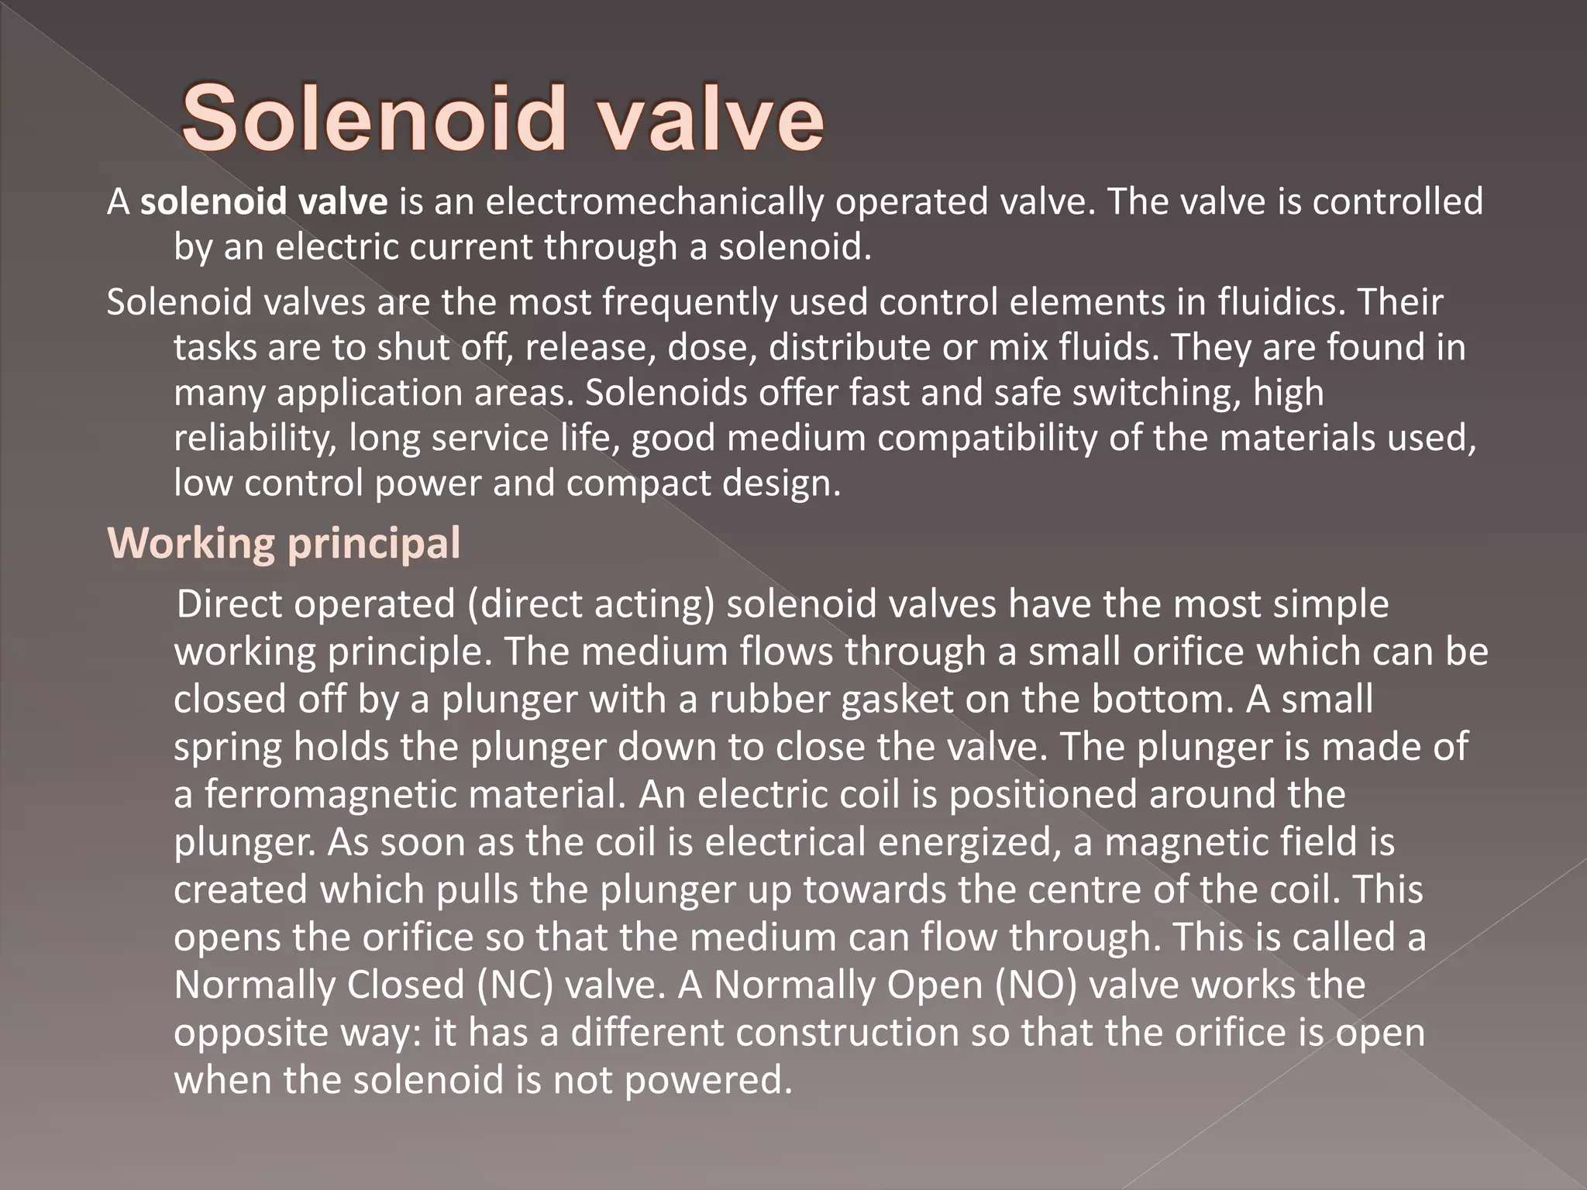

Slide 38
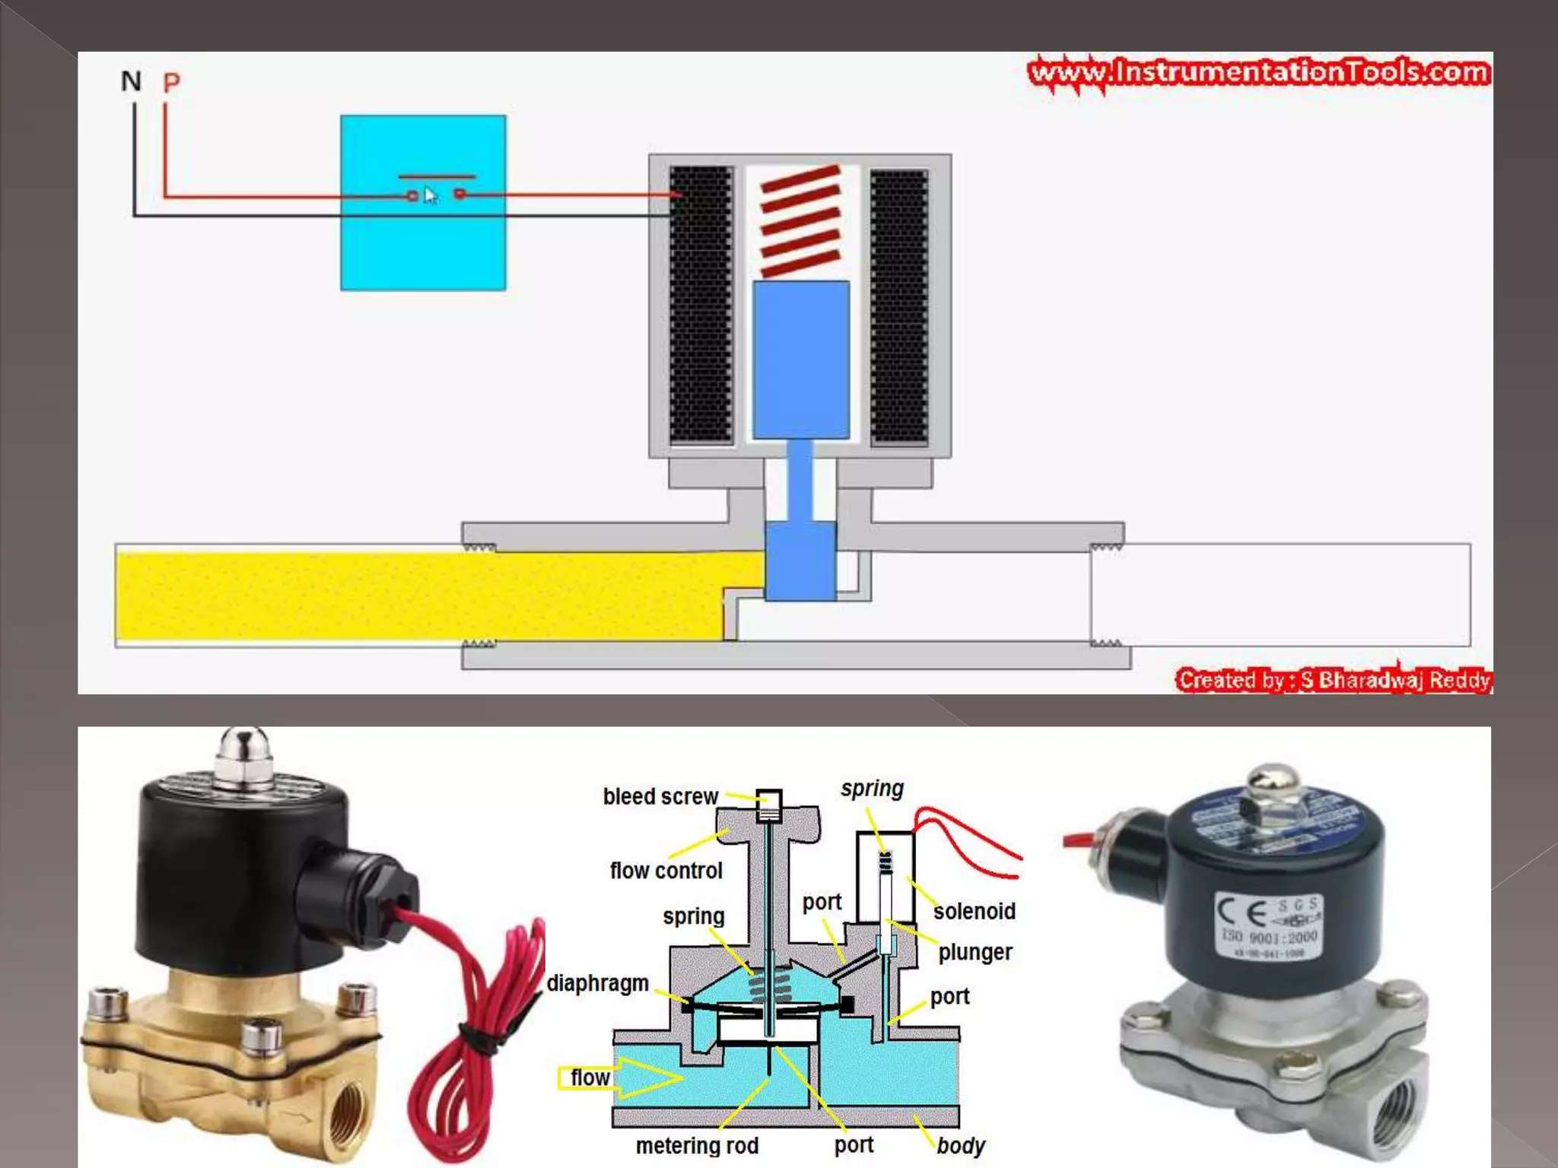

Slide 39
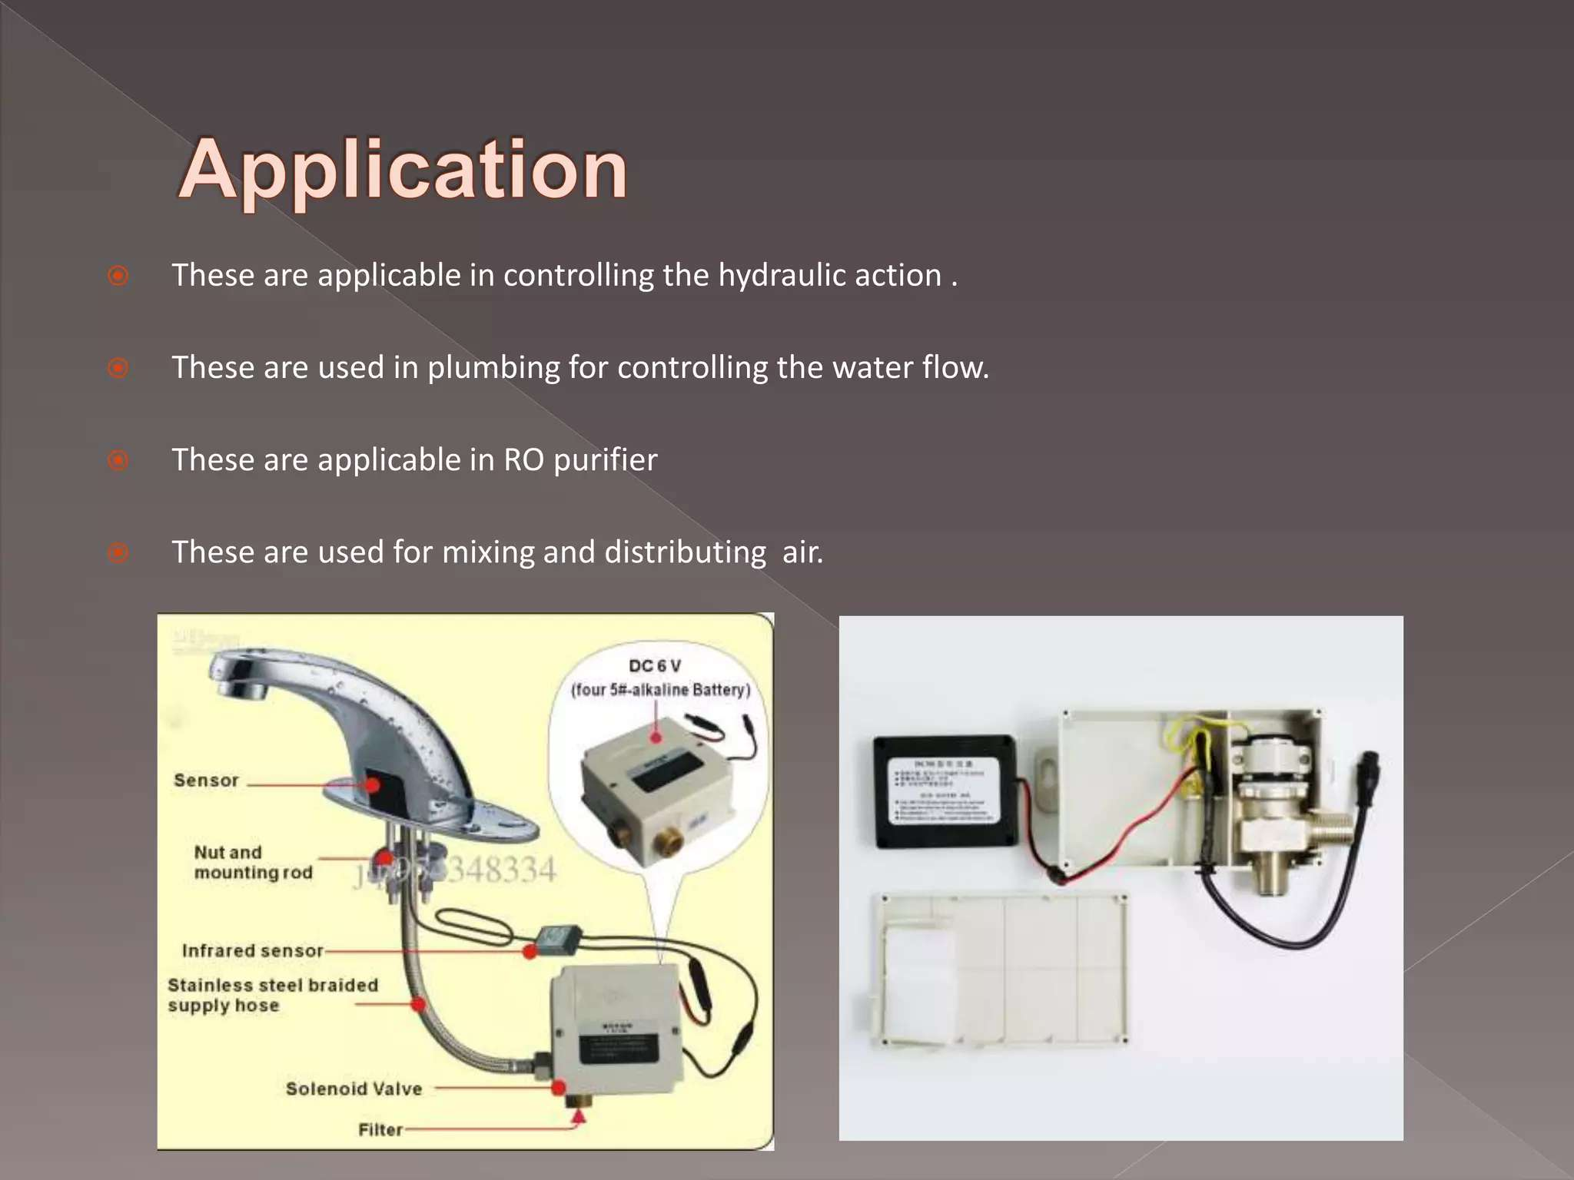

Slide 40
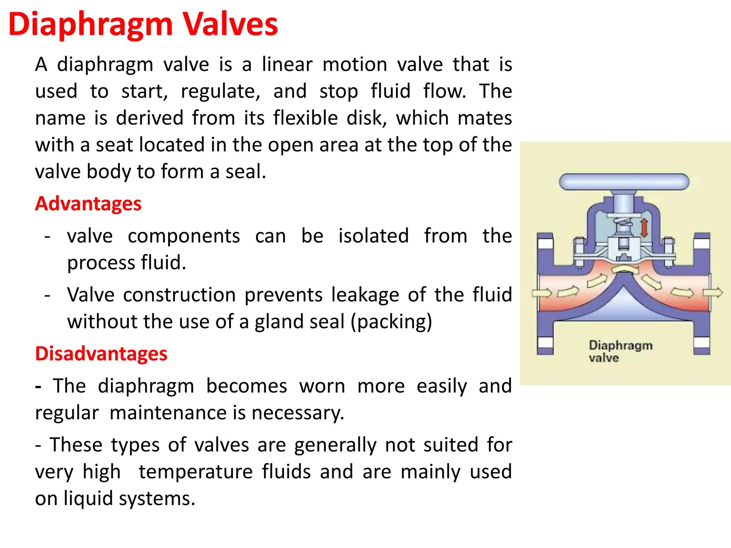

Slide 41
Week -3
Lecture
on
Valve
Valve Design , P& ID Symbol

Slide 42
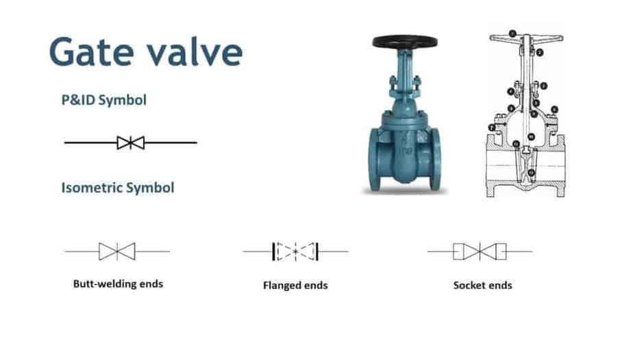
Your best quote that reflects your approach… “It’s one small step for man, one giant leap for mankind.”
- Neil Armstrong

Slide 43
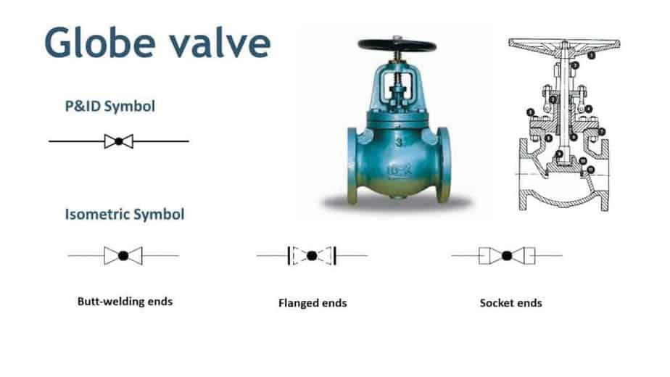
Your best quote that reflects your approach… “It’s one small step for man, one giant leap for mankind.”
- Neil Armstrong

Slide 44
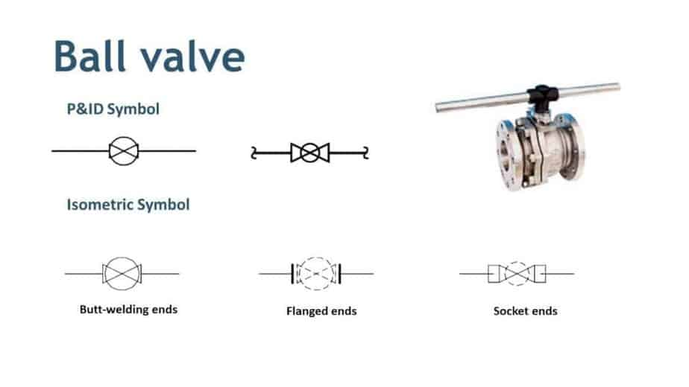
Your best quote that reflects your approach… “It’s one small step for man, one giant leap for mankind.”
- Neil Armstrong

Slide 45
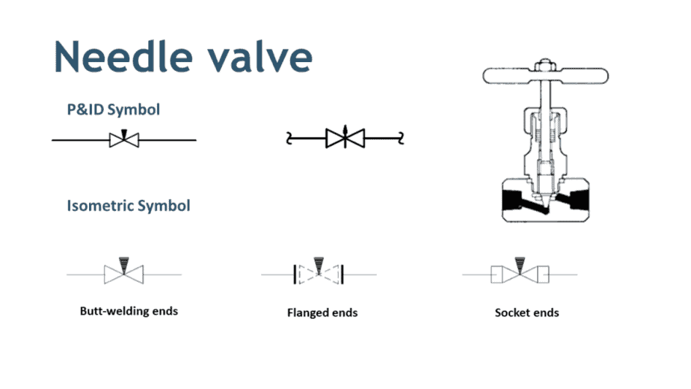
Your best quote that reflects your approach… “It’s one small step for man, one giant leap for mankind.”
- Neil Armstrong

Slide 46
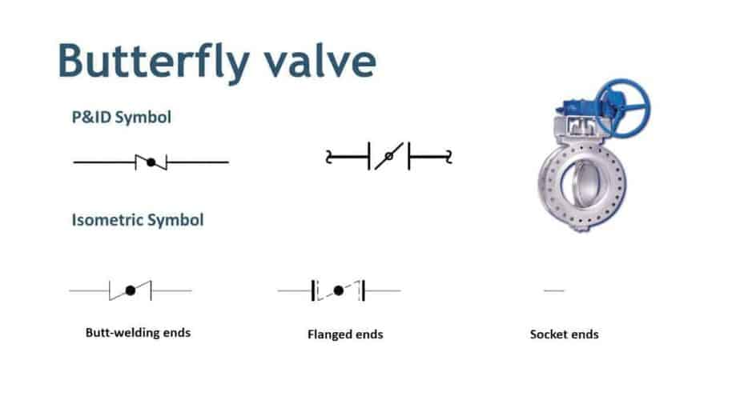
Your best quote that reflects your approach… “It’s one small step for man, one giant leap for mankind.”
- Neil Armstrong

Slide 47
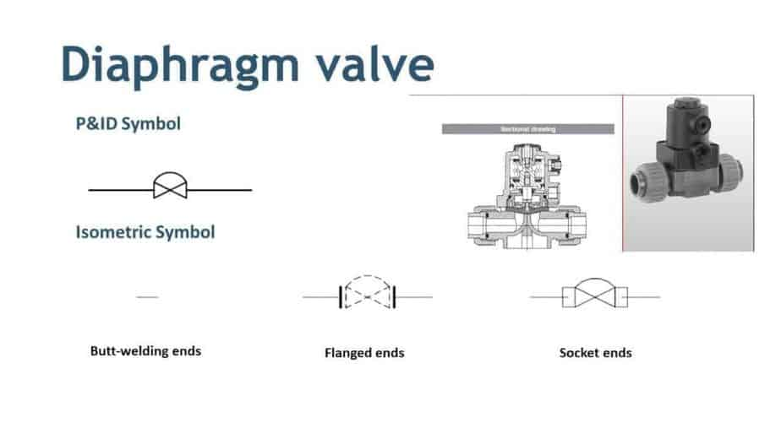
Your best quote that reflects your approach… “It’s one small step for man, one giant leap for mankind.”
- Neil Armstrong

Slide 48
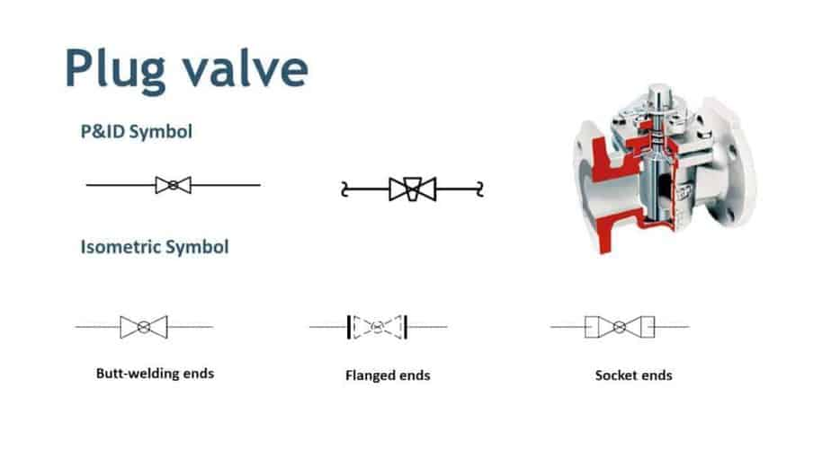
Your best quote that reflects your approach… “It’s one small step for man, one giant leap for mankind.”
- Neil Armstrong

Slide 49
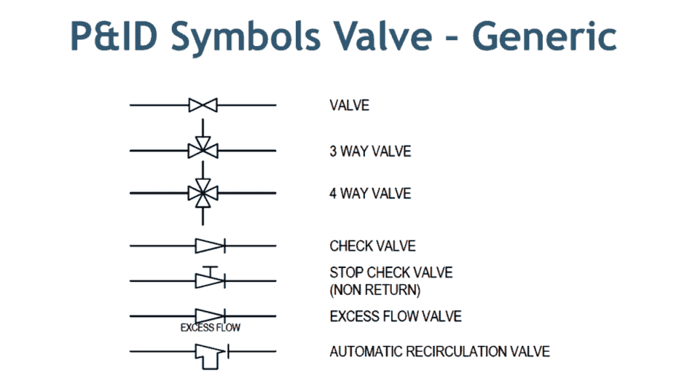
Your best quote that reflects your approach… “It’s one small step for man, one giant leap for mankind.”
- Neil Armstrong

Slide 50
Week -4
Lecture
on
Compressor & Compressor Types

Slide 51
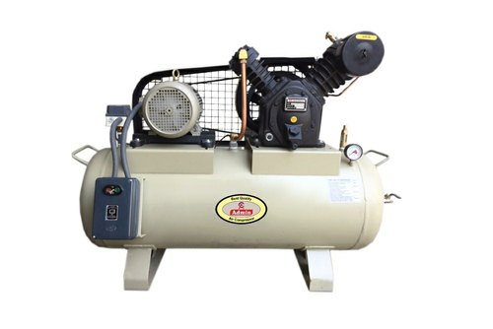
Your best quote that reflects your approach… “It’s one small step for man, one giant leap for mankind.”
Compressor:
The compressor is pretty much an important component in most industrial machines and even for some household applications. From internal combustion engines to refrigerators the compressors are used and have a very important role in the operations. They have a wide range of applications. Let’s know more about them in detail.
The compressor is basically, increases the pressure of the fluid by reducing its volume.
The word compression obviously means reducing the volume of fluid.
Later the fluid will be used for various applications or further processes.
The gases are compressible and the compressor makes the best use of that characteristics.
- Neil Armstrong

Slide 52
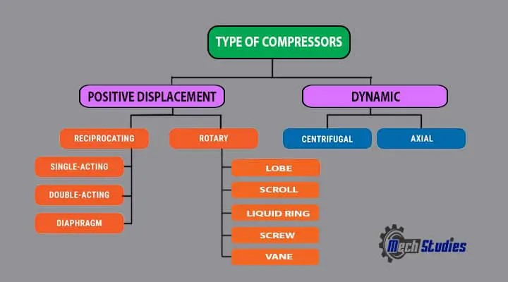
- Neil Armstrong

Slide 53
Week -5
Lecture
on
Compressor Working Principle

Slide 54
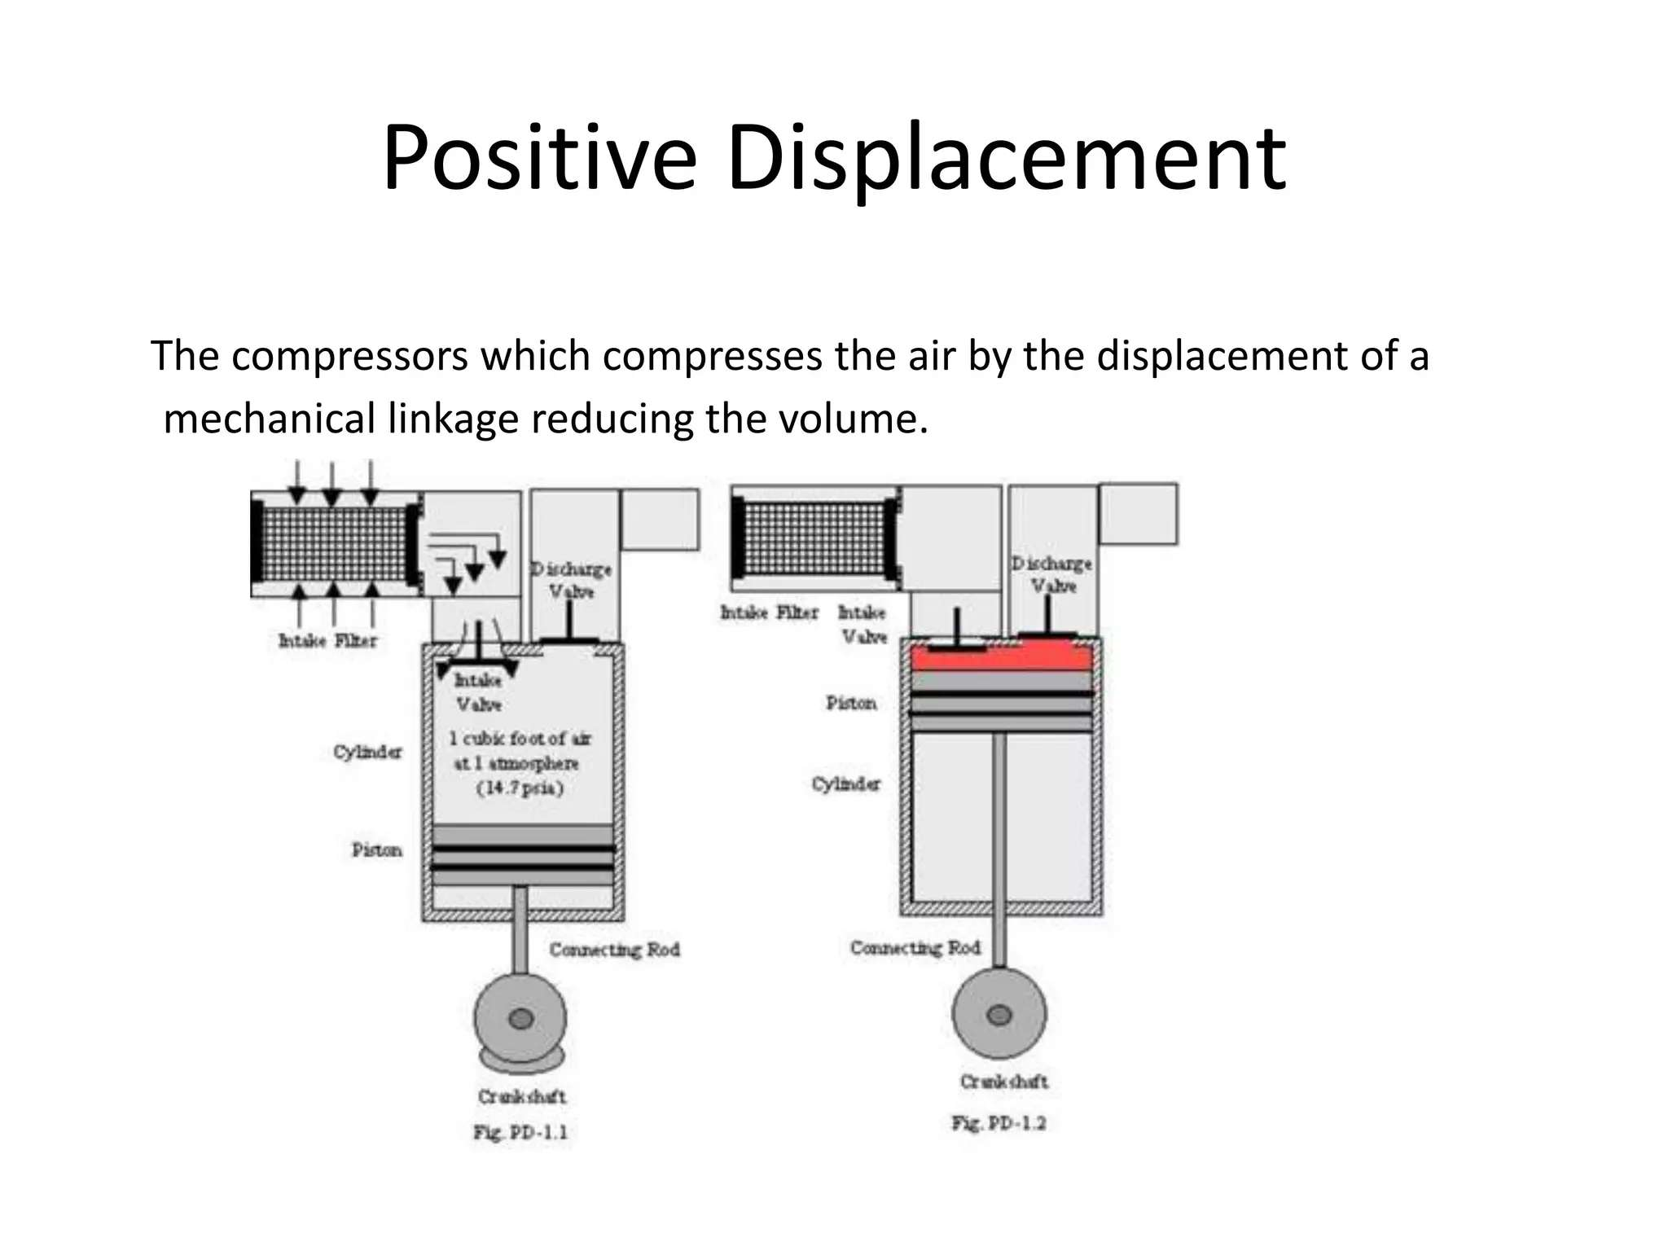

Slide 55
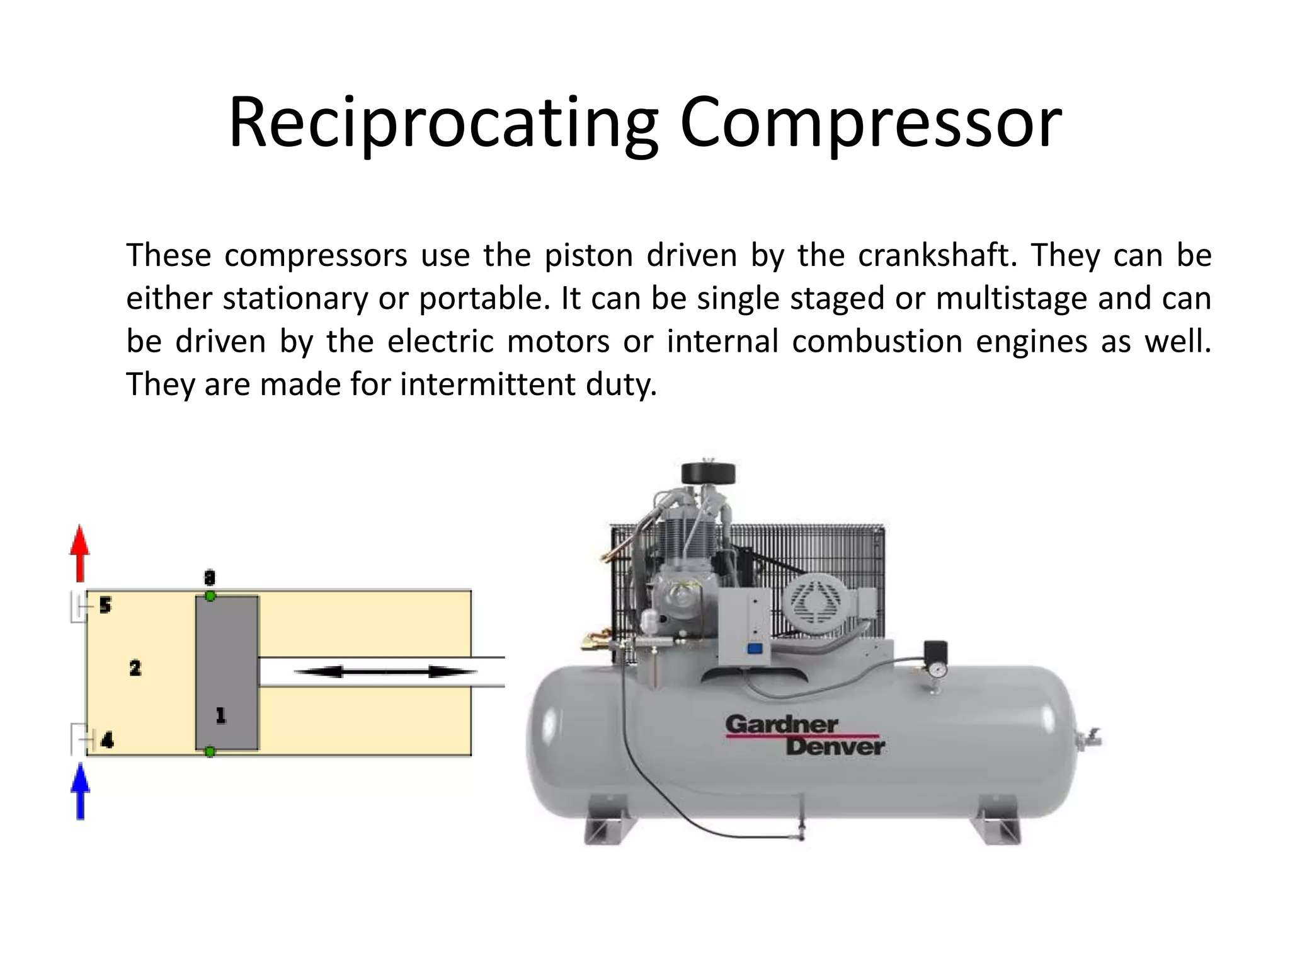

Slide 56
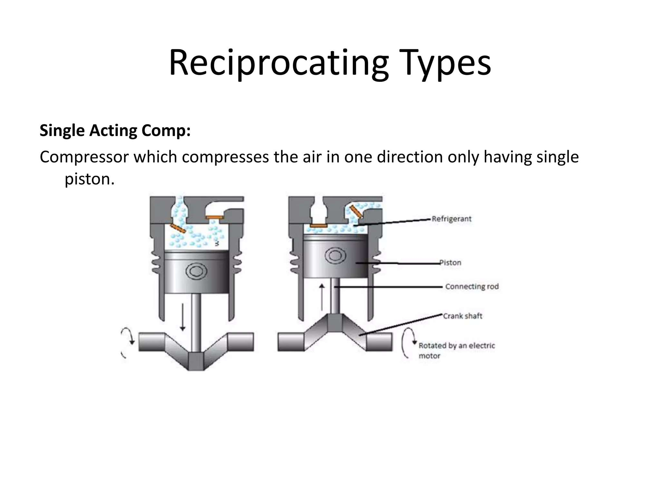

Slide 57
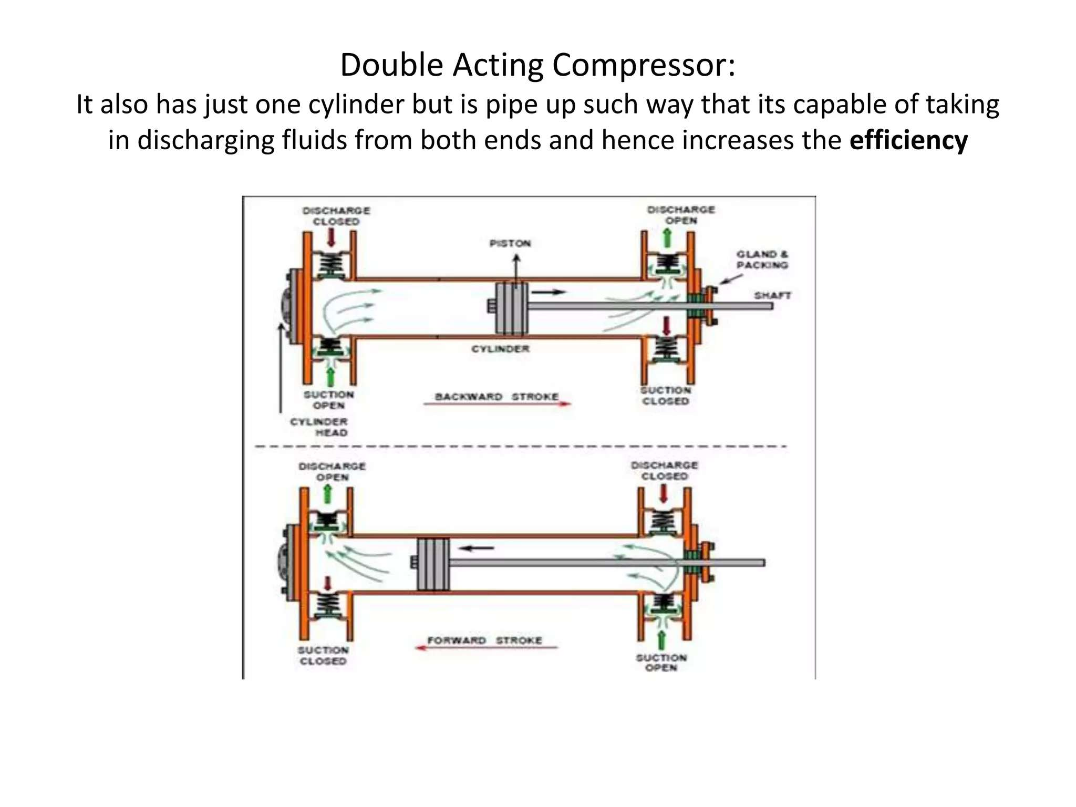

Slide 58
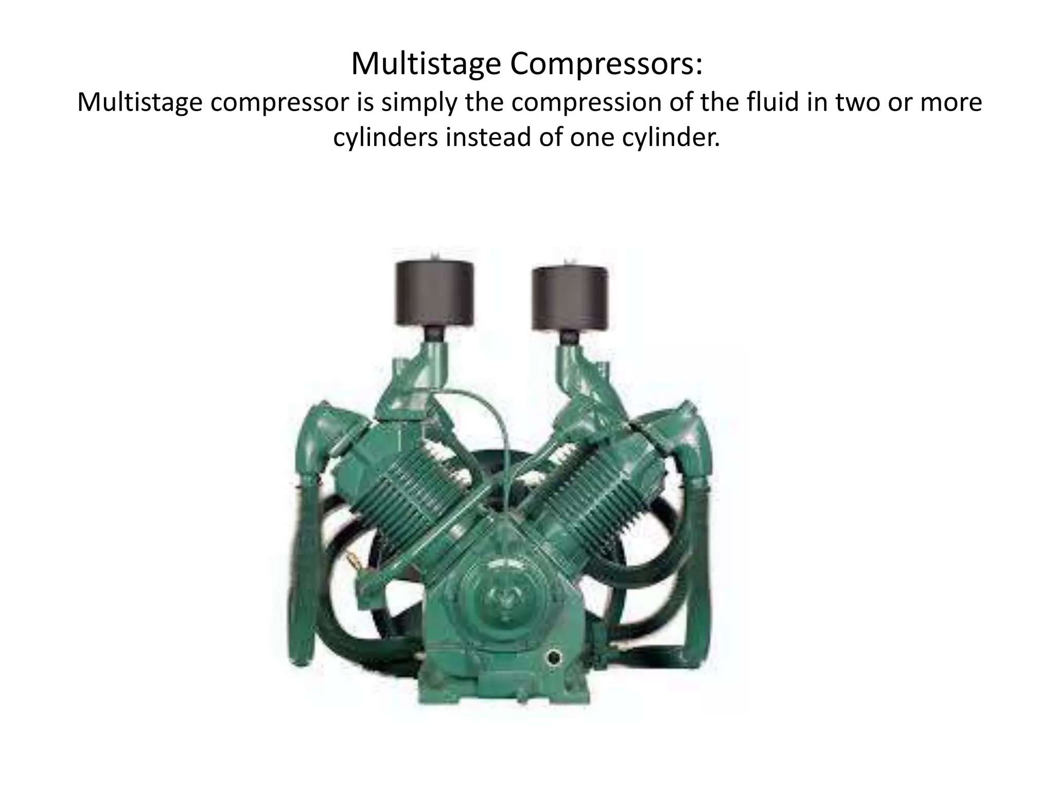

Slide 59
Week -6
Lecture
on
Compressor Design

Slide 60
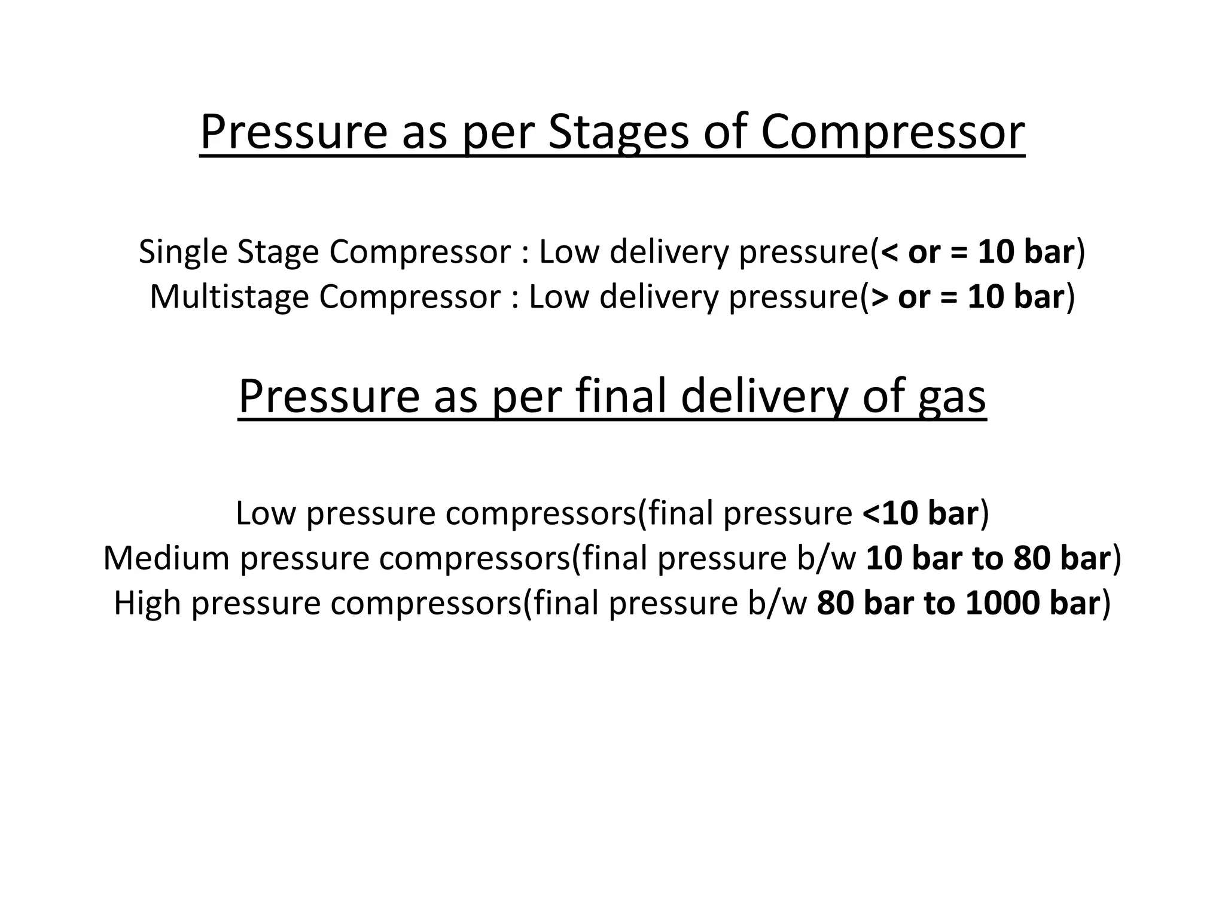

Slide 61
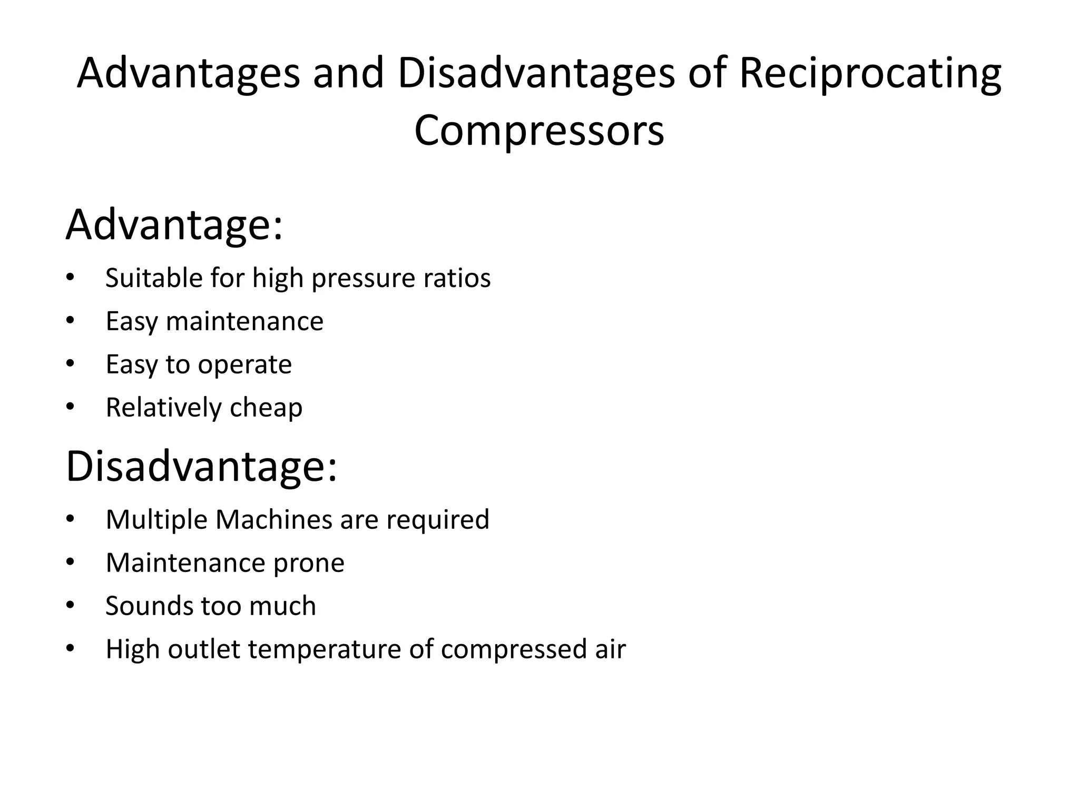

Slide 62
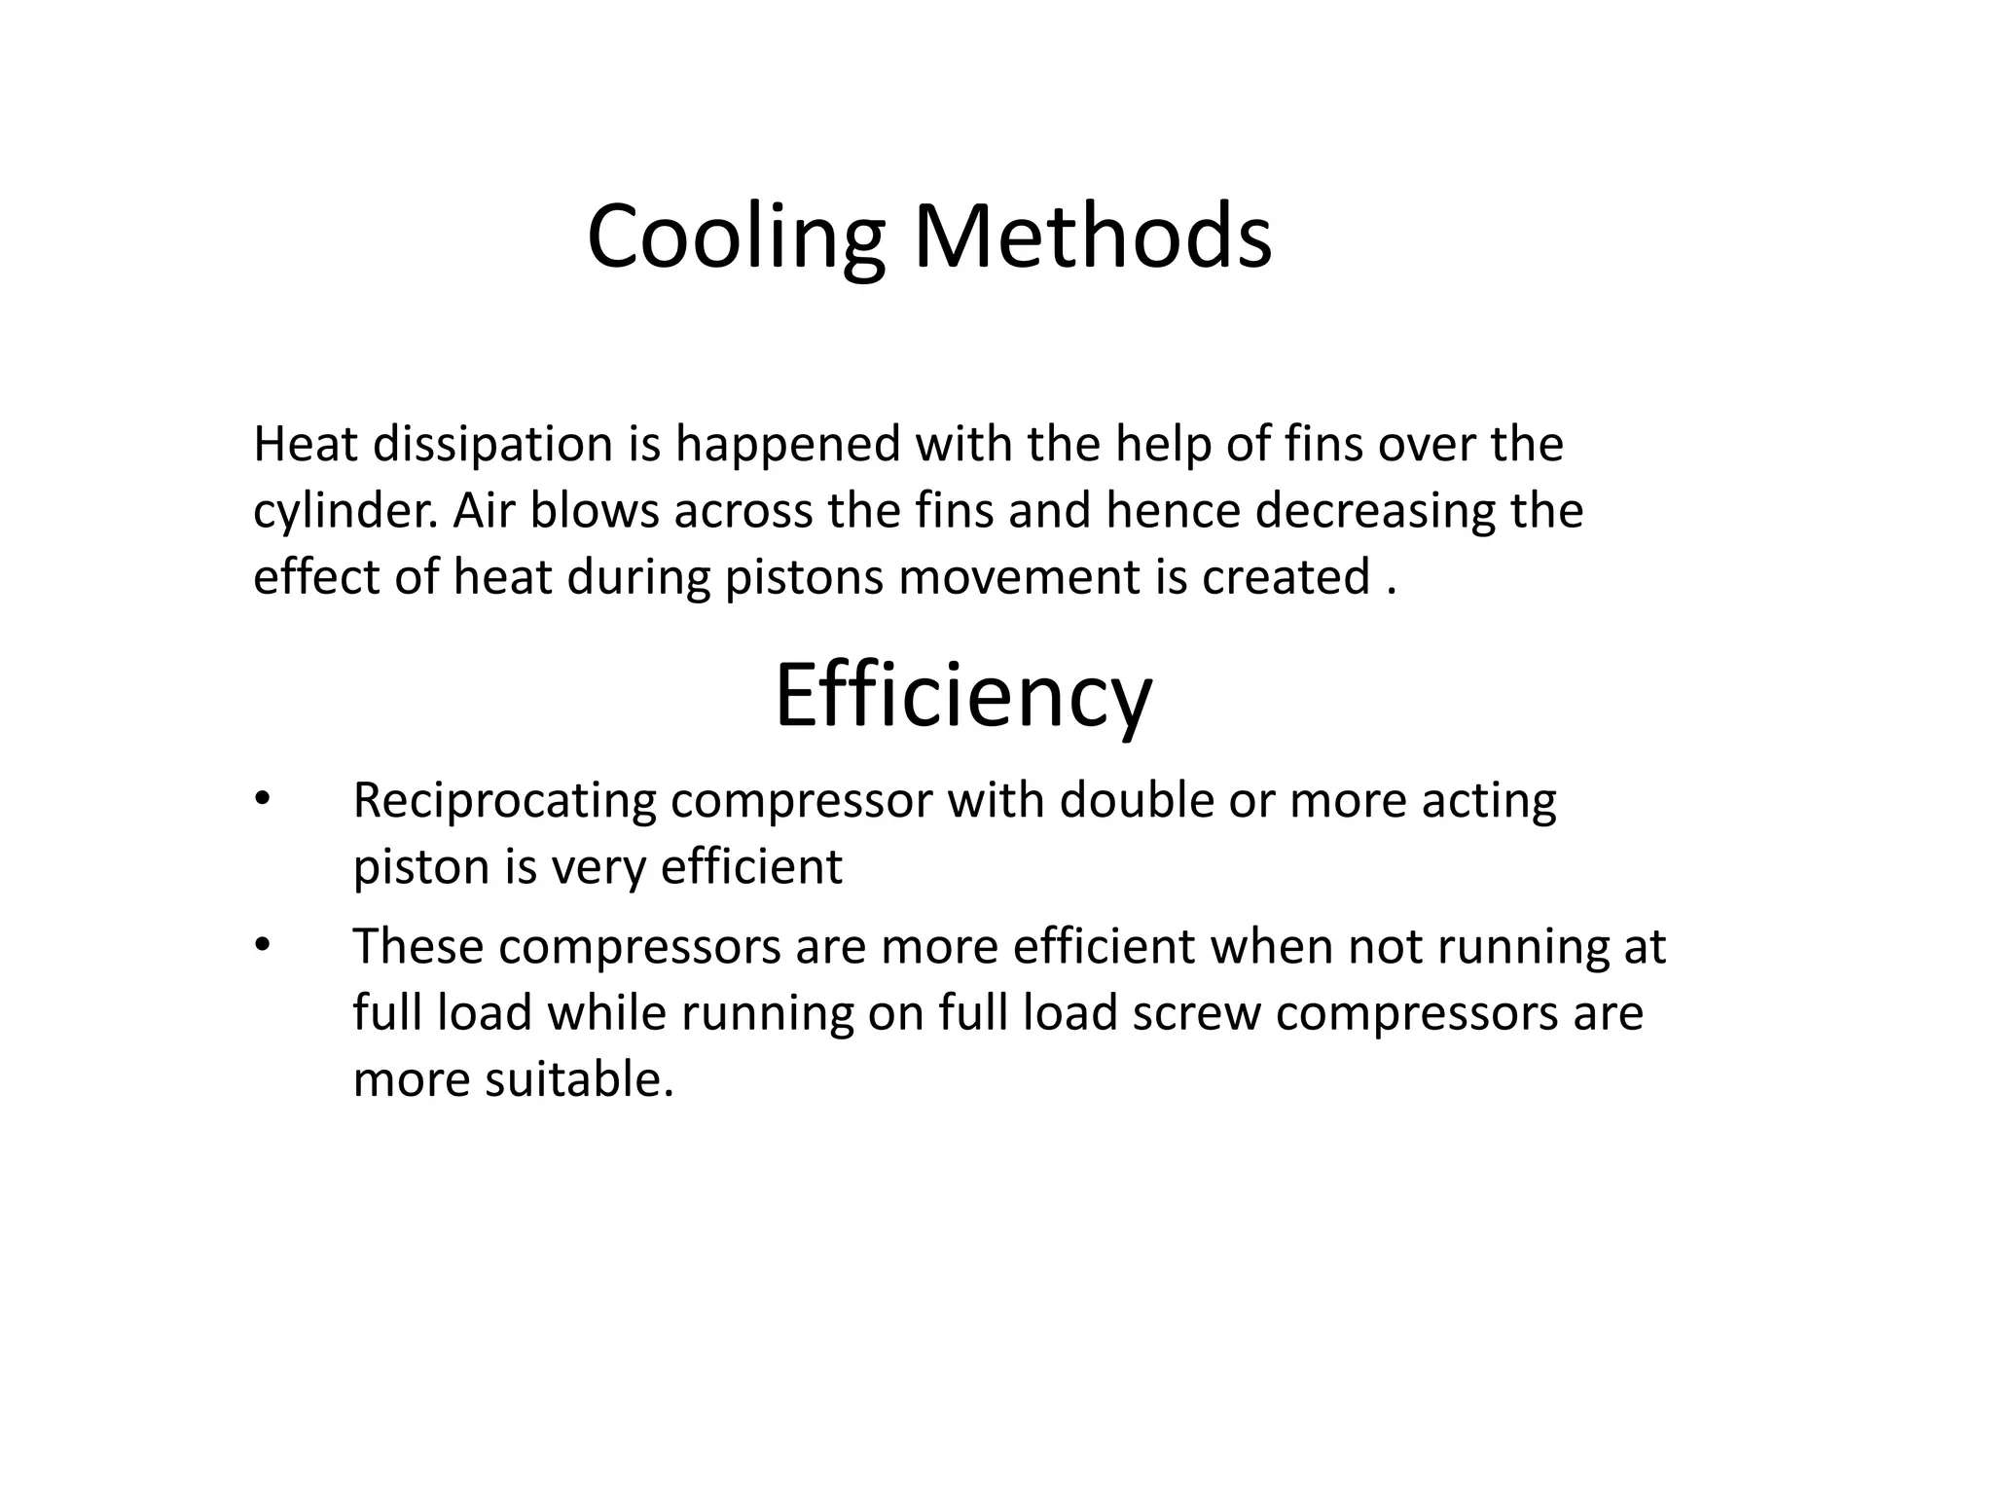

Slide 63
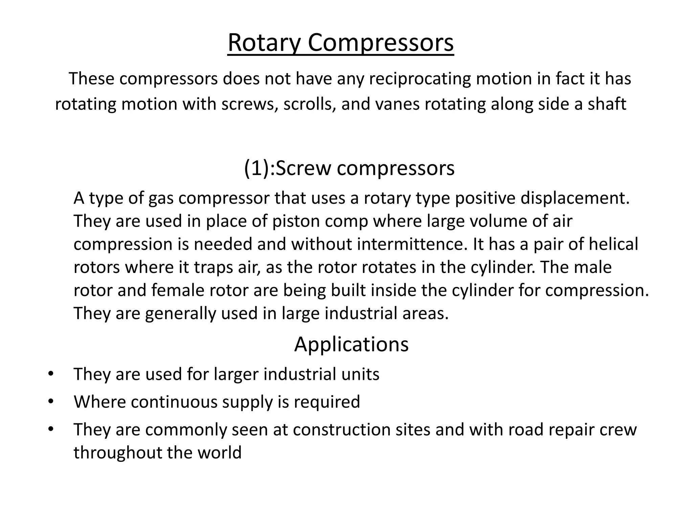

Slide 64
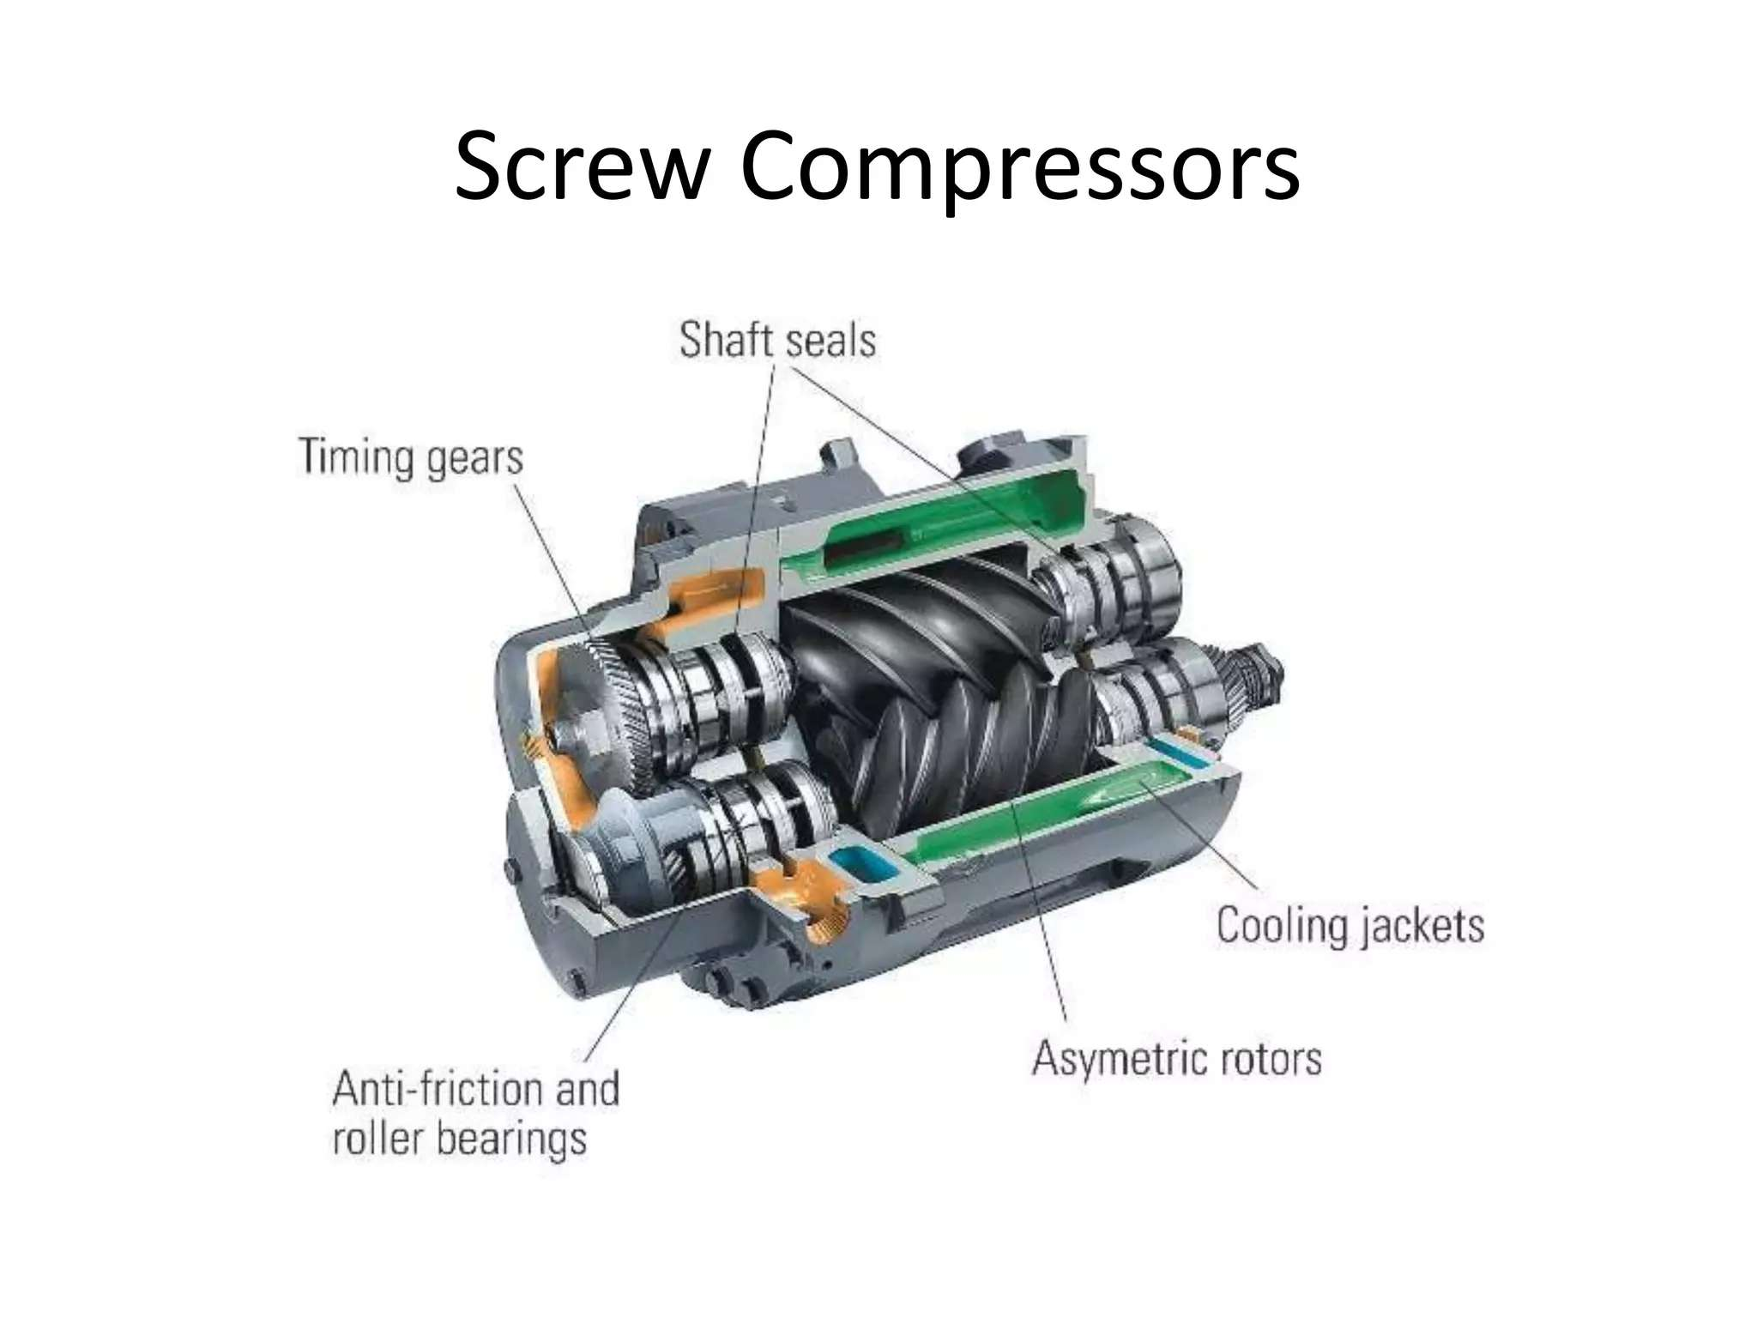

Slide 65
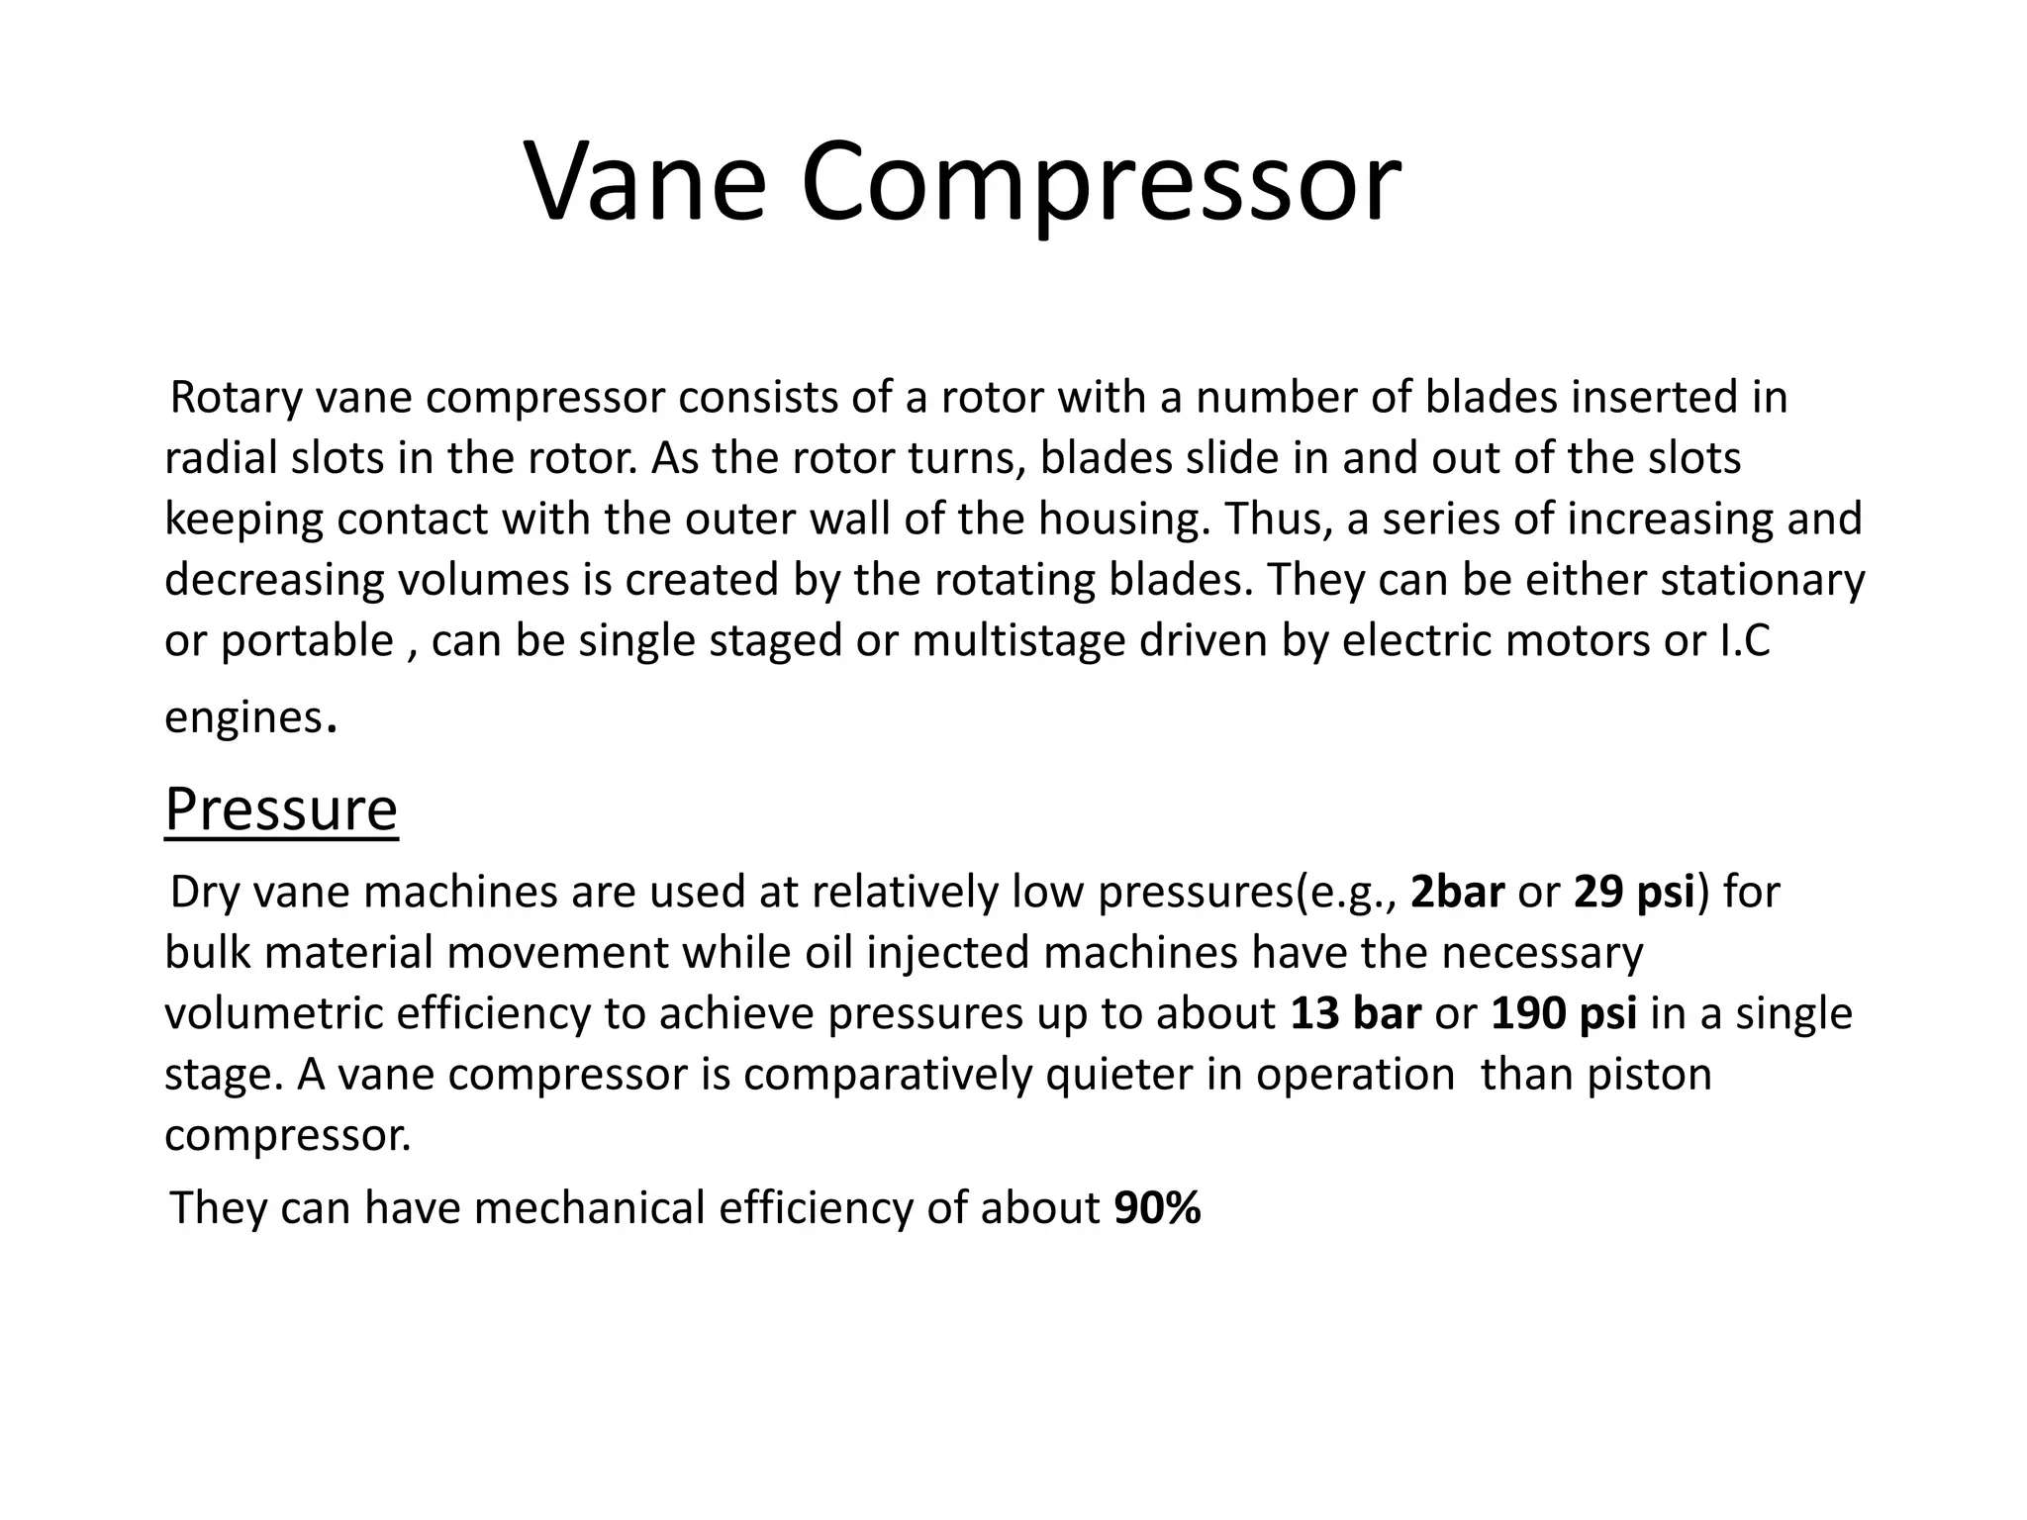

Slide 66
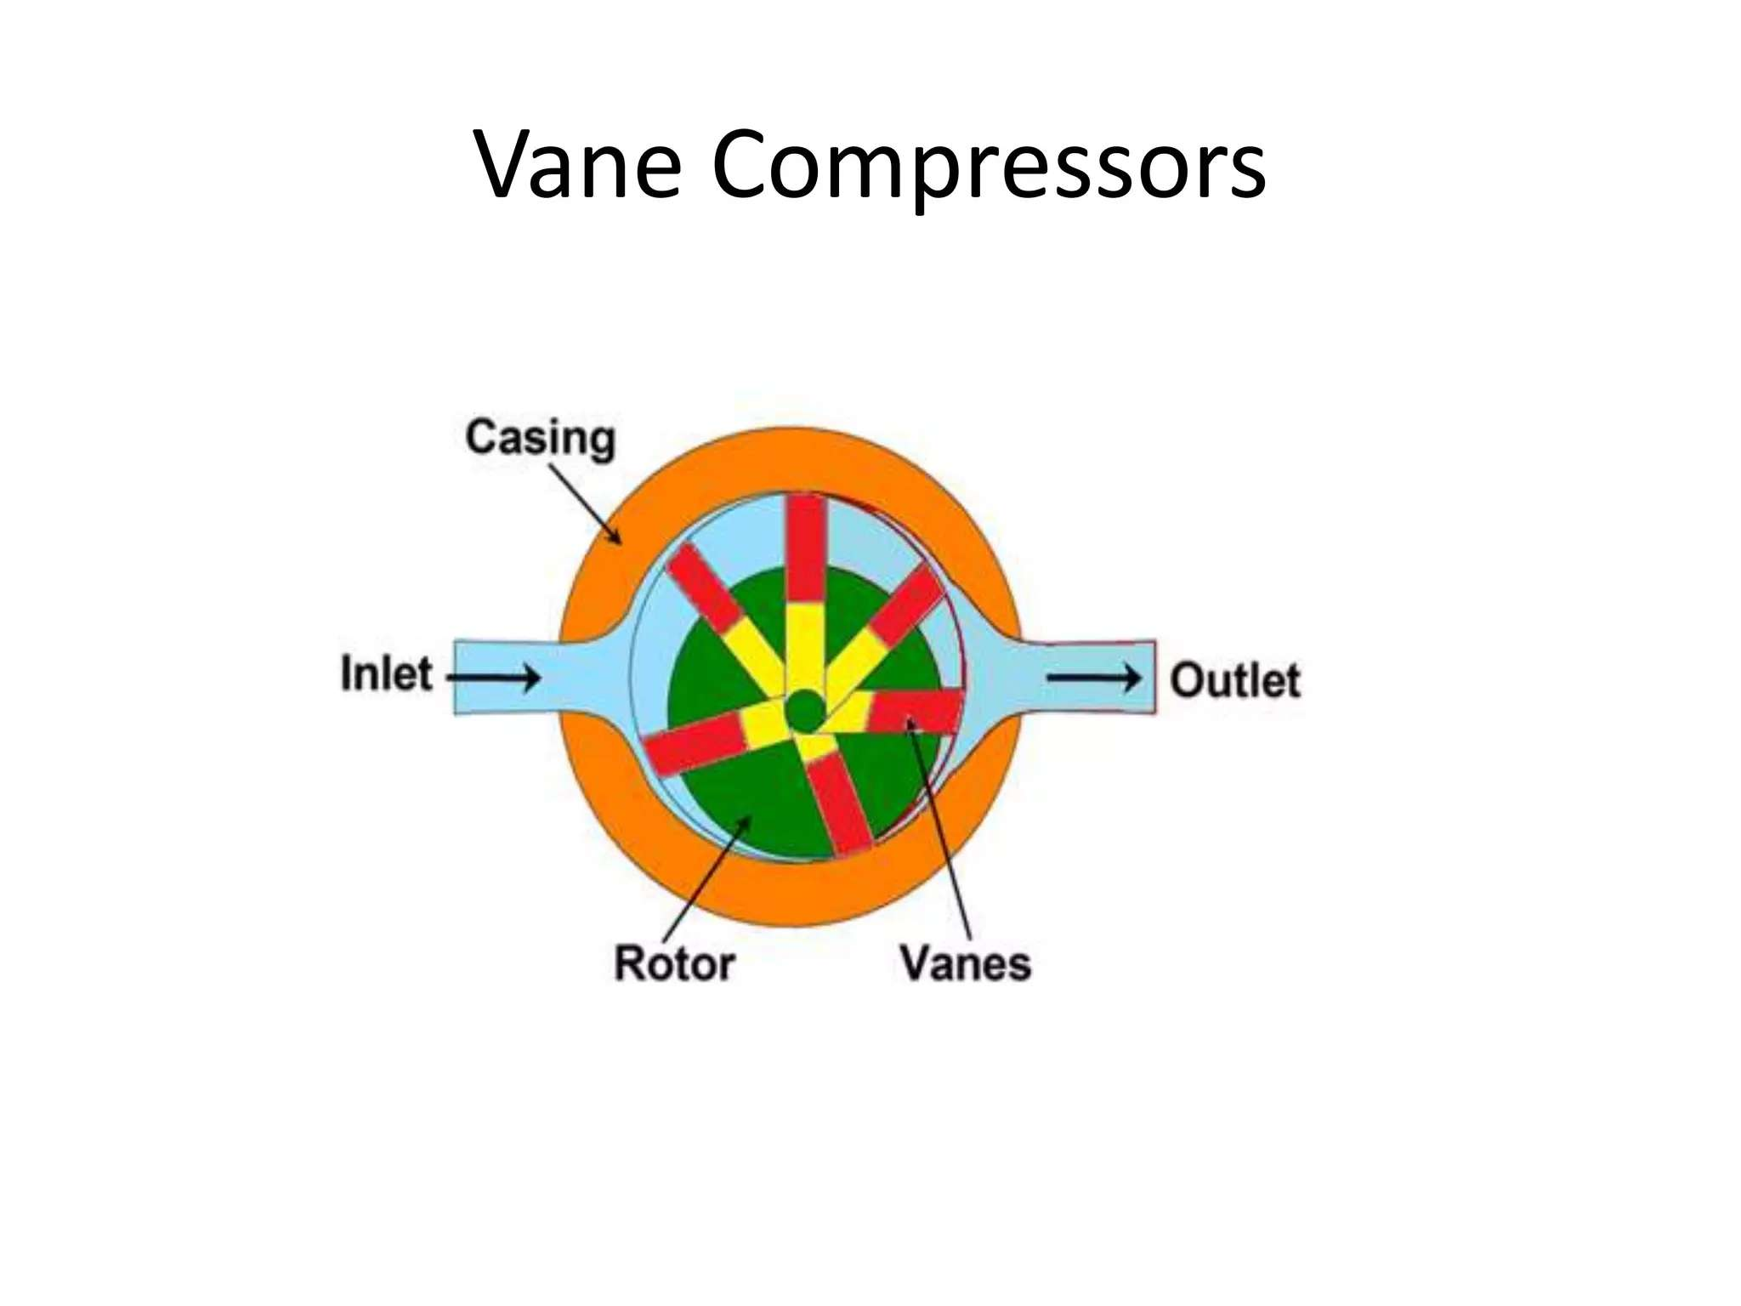

Slide 67


Slide 68


Slide 69


Slide 70


Slide 71


Slide 72
Week -7
Lecture
on
Turbine Classifications

Slide 73



Slide 74


Slide 75
Week -8
Lecture
on
Turbine Design

Slide 76


Slide 77


Slide 78


Slide 79


Slide 80


Slide 81


Slide 82


Slide 83
Week -8
Lecture
on
Turbine Selection

Slide 84


Slide 85


Slide 86


Slide 87


Slide 88


Slide 89


Slide 90


Slide 91


Slide 92
Week -9
Lecture
on
Turbine Specific Speed, Turbine Characteristics Curve

Slide 93


Slide 94

- Neil Armstrong

Slide 95


Slide 96


Slide 97


Slide 98


Slide 99


Slide 100


Slide 101


Slide 102
Week -11
Lecture
on
Turbine Performance, Draft Tube & Surge Tank

Slide 103


Slide 104


Slide 105


Slide 106


Slide 107


Slide 108
Week -11
Lecture
on
Problem Solving
(Turbine)

Slide 109







Mathematical Problems on Turbine
Mathematical problems related to Turbine will be practiced and solved during classroom sessions. Problems from the prescribed reference book will be addressed, and additional practice materials will be provided to enhance understanding and proficiency.

Slide 110

Week -13
Lecture
on
Pump Classification

Slide 111


Slide 112


Slide 113


Slide 114


Slide 115


Slide 116


Slide 117


Slide 118


Slide 119


Slide 120


Slide 121


Slide 122

Week -14
Lecture
on
Centrifugal Pump

Slide 123

Fluid Machinery: Pumps, Turbines, and Compressors
1
2
Pumps
Turbines
Pumps are used to increase the pressure of a fluid and move it from one point to another.
Turbines convert fluid energy (kinetic or potential) into mechanical energy. They are used in power generation and other applications.
3
Compressors
Compressors increase the pressure and density of a gas. They are essential in refrigeration, air conditioning, and other industries.

Slide 124


Slide 125


Slide 126


Slide 127


Slide 128


Slide 129


Slide 130


Slide 131


Slide 132


Slide 133
Week -15
Lecture
on
Centrifugal Pump

Slide 134


Slide 135


Slide 136


Slide 137


Slide 138


Slide 139


Slide 140


Slide 141


Slide 142


Slide 143


Slide 144


Slide 145


Slide 146


Slide 147


Slide 148


Slide 149

Week -16
Lecture
on
Reciprocating Pump

Slide 150


Slide 151


Slide 152


Slide 153


Slide 154


Slide 155


Slide 156


Slide 157


Slide 158


Slide 159


Slide 160


Slide 161


Slide 162
Week -17
Lecture
on
Problem Solving on Pump

Slide 163
Mathematical Problems on Pump
Mathematical problems related to Pump will be practiced and solved during classroom sessions. Problems from the prescribed reference book will be addressed, and additional practice materials will be provided to enhance understanding and proficiency.

Slide 164










Thanks
For
Your Attention

