Slide 1
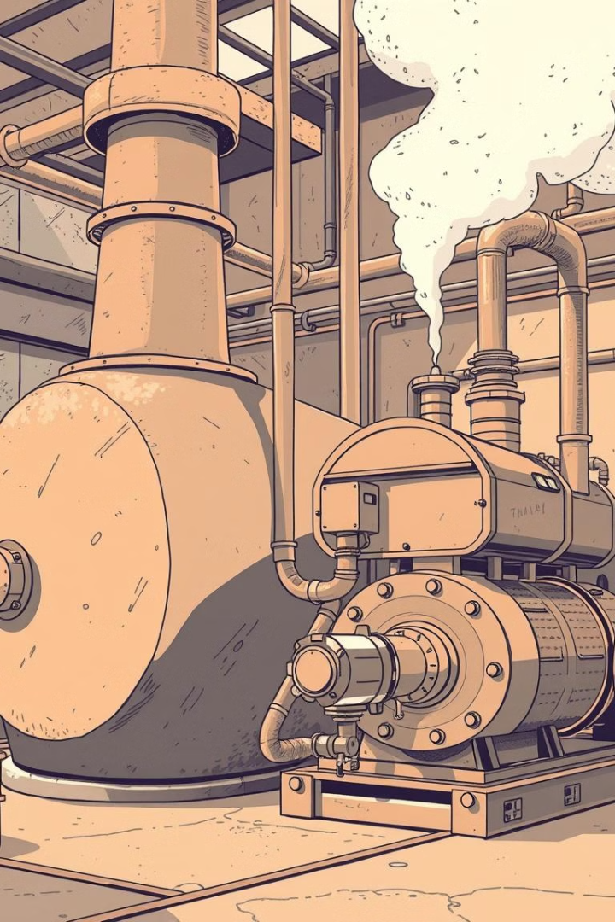

Lecture
on
Engineering Thermodynamics
Prepared by
Anisul Islam
Lecturer
Department of Mechanical Engineering (UGV)

Slide 2
Engineering Thermodynamics Course Code: 0715-2103 Credits: 03
 | CIE Marks: 90
Exam Hours: 03 SEE Marks: 60
CLO1 | After Completing this Course a Student will be able to Define and differentiate between key thermodynamic concepts like system, surroundings, boundary, state, process, and cycle.
CLO2 | After Completing this Course a Student will be able to Explain the Zeroth, First, Second, and Third Laws of Thermodynamics and their applications in engineering systems.
CLO3 | After Completing this Course a Student will be able to Apply the concepts of work, heat, and energy to analyze various thermodynamic processes.
CLO4 | After Completing this Course a Student will be able to Analyze the working principles of various power cycles, including Carnot, Rankine, Otto, and Diesel cycles.
CLO5 | After Completing this Course a Student will be able to Calculate the thermal efficiency and work output of power cycles.
CLO6 | After Completing this Course a Student will be able to Evaluate the factors affecting the performance of gas turbine and Steam Turbine systems.
CLO7 | After Completing this Course a Student will be able to Explain the working principles of refrigeration and heat pump cycles, including vapor-compression and absorption cycles.
CLO8 | After Completing this Course a Student will be able to Analyze the factors affecting the performance of refrigeration and heat pump systems.

Slide 3
S. L | Content of Course | Hrs | CLOs
1 | System, Surroundings, Types of Boundaries, Specific Heat, Sensible heat, Enthalpy, Entropy, Internal Energy, Intensive, Extensive Property and difference, Isochoric Process, Reversible and Irreversible Process, Isobaric Process, Adiabatic Process, Isothermal Process, Polytropic Process, laws of Thermodynamics, | 8 | CLO 1, CLO 2
2 | Heat Pump, Heat Engine, Refrigerator and their differences, Carnot Cycle (PV and TS diagram with Efficiency), Otto Cycle (PV and TS diagram with Efficiency), Ericson and Stirling Cycle (PV and TS diagram with Efficiency), Diesel Cycle (PV and TS diagram with Efficiency) | 4 | CLO 3, CLO 4
3 | Rankine Cycle (PV and TS diagram with Efficiency), Rankine Cycle with Reheat and Regeneration and intercooling, Bryton Cycle (PV and TS diagram with Efficiency), Difference between Steam and Gas Turbine, Combined Cycle (PV & TS diagram), Difference between SI and CI, Difference between Two stroke and Four Stroke Cycle, | 6 | CLO 5, CLO 6
4 | Refrigeration Effect, COP, TOR, Refrigerant, Vapor Compression Refrigeration System, Calorific Value Types, Bomb Calorimeter, Problem Solving on Calculation of Amount of Fuel (by Air and Mass) | 2 | CLO 7, CLO 8
5 | Boiler Types, Construction and Working Principle, Boiler Draught, Problem Solving, Boiler Mountings and accessories | 4 | CLO 7, CLO 8
6 | IC Engine, Classification, Components, Cycle, Performance, Valve Timing Diagram | 8 | CLO 3, CLO 4

Slide 4
Reference Books:
Engineering Thermodynamics- P K Nag
A Textbook of Thermal Engineering- R.S Khurmi
Engineering Thermodynamics- Work and Heat Transfer- R.K Rajput

Slide 5
ASSESSMENT PATTERN
CIE- Continuous Internal Evaluation (90 Marks)
Bloom's Category Marks (out of 90) | Tests (45) | Assignments (10) | Class Test (20) | Quiz (5) | External Participation in Curricular/Co-Curricular Activities (10)
Remember | 5 |  | 10 | 05
Understand | 5 | 05 | 10
Apply | 10 |  |  |  | 10
Analyze | 15
Evaluate | 10
Create |  | 05

Slide 6
SEE- Semester End Examination
(60 Marks)
Bloom's Category | Test
Remember | 10
Understand | 10
Apply | 10
Analyze | 10
Evaluate | 10
Create | 10

Slide 7
 | Course Plan Specifying Content, CLOs, Teaching Learning Strategy and Assessment Strategy
Week | Topics | Teaching Learning Strategy | Assessment Strategy | Corresponding CLOs
1 | System, Surroundings, Types of Boundaries, Specific Heat, Sensible heat Enthalpy, Entropy, Internal Energy Intensive, Extensive Property and difference , | Lecture, Oral Presentation, PPT | Quiz, Written exam, CT | CLO 1
2 | Isobaric Process, Adiabatic Process Isothermal Process, Polytropic Process | Lecture, Oral Presentation, PPT | Assignment, Quiz, Written exam | CLO 1
3 | zeroth law and 1st law of Thermodynamics | Lecture, Oral Presentation, PPT | Quiz, Written exam, CT | CLO 2
4 | 2nd and 3rd Law of Thermodynamics | Lecture, Oral Presentation, PPT | Quiz, Written exam, CT | CLO 2

Slide 8
 | Course Plan Specifying Content, CLOs, Teaching Learning Strategy and Assessment Strategy
Week | Topics | Teaching Learning Strategy | Written exam | Corresponding CLOs
5 | Heat Pump, Heat Engine, Refrigerator and their differences Carnot Cycle (PV and TS diagram with Efficiency) | Lecture, Oral Presentation, Video Presentation, PPT | Assignment, Written exam, Quiz, CT | CLO 3, CLO 4
6 | Otto Cycle (PV and TS diagram with Efficiency) Ericson and Stirling Cycle (PV and TS diagram with Efficiency), Diesel Cycle (PV and TS diagram with Efficiency) | Lecture, Oral Presentation, Video Presentation, PPT | Assignment, Quiz, Written exam, CT | CLO 3, CLO 4
7 | Rankine Cycle (PV and TS diagram with Efficiency) Rankine Cycle with Reheat and Regeneration and intercooling | Lecture, Oral Presentation, Video Presentation, , Group discussion, | Assignment, Quiz, Written exam , CT | CLO 4, CLO 5

Slide 9
 | Course Plan Specifying Content, CLOs, Teaching Learning Strategy and Assessment Strategy
Week | Topics | Teaching Learning Strategy | Assessment Strategy | Corresponding CLOs
8 | Bryton Cycle (PV and TS diagram with Efficiency) | Lecture, Oral Presentation, Video Presentation, PPT | Quiz, Written exam, CT | CLO 5, CLO 6, CLO 4
9 | Bryton Cycle Improvement (PV and TS diagram with Efficiency) | Lecture, Oral Presentation, Video Presentation, PPT | Assignment, Quiz, Written exam, CT | CLO 4, CLO 5
10 | Vapor Compression Cycle | Lecture, Oral Presentation, Video Presentation, | Assignment, Quiz, Written exam | CLO 7

Slide 10
 | Course Plan Specifying Content, CLOs, Teaching Learning Strategy and Assessment Strategy
Week | Topics | Teaching Learning Strategy | Assessment Strategy | Corresponding CLOs
11 | Boiler Classification, components | Lecture, Oral Presentation, Video Presentation, PPT | Assignment, Quiz, Written exam, CT | CLO 7
12 | Boiler Mountings and accessories, Boiler Draught, Problem Solving | Lecture, Oral Presentation, Video Presentation, PPT | Quiz, Written exam, CT | CLO 7
13 | IC Engine (Components and Classification) | Lecture, Oral Presentation, Video Presentation, PPT | Assignment, Quiz, Written exam, CT | CLO 7, CLO 8
14 | IC Engine (Cycle and Efficiency, Performance) | Lecture, Oral Presentation, Video Presentation, PPT | Quiz, Written exam | CLO 3, CLO 4
15 | IC Engine (Two stroke and Four Stroke Engine, Petrol and Diesel engine) | Lecture, Oral Presentation, Video Presentation, PPT | Quiz, Written exam, CT | CLO 3, CLO 4
16 | IC Engine ( Valve Timing Diagram) | Lecture, Oral Presentation, Video Presentation, PPT | Quiz, Written exam, CT | CLO 3, CLO 4
17 | Review Class on Problem solving | Group discussion

Slide 11
Week -1
Lecture
on
Basic Thermodynamics Concept and Applications
(12-25)

Slide 12
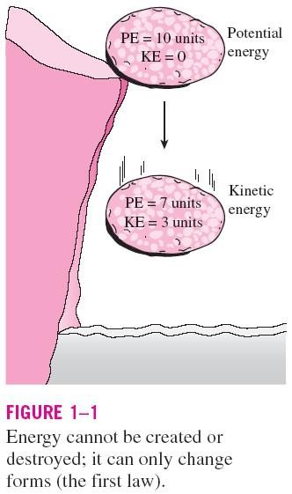
THERMODYNAMICS AND ENERGY
Thermodynamics: The science of
energy.
Energy: The ability to cause changes.
The name thermodynamics stems from the Greek words therme (heat) and dynamis (power).
Conservation of energy principle: During an interaction, energy can change from one form to another but the total amount of energy remains constant.
Energy cannot be created or destroyed.
The first law of thermodynamics: An expression of the conservation of energy principle.
The first law asserts that energy is a thermodynamic property.
3

Slide 13
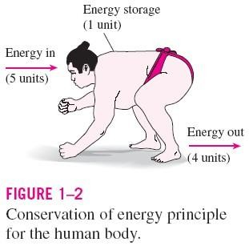
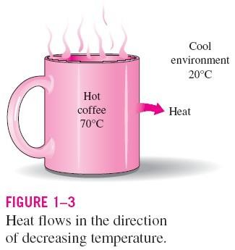
The second law of thermodynamics: It asserts that energy has quality as well as quantity, and actual processes occur in the direction of decreasing quality of energy.
Classical thermodynamics: A macroscopic approach to the study of thermodynamics that does not require a knowledge of the behavior of individual particles.
It provides a direct and easy way to the solution of engineering problems and it is used in this text.
Statistical thermodynamics: A microscopic approach, based on the average behavior of large groups of individual particles.
It is used in this text only in the supporting role.
4

Slide 14
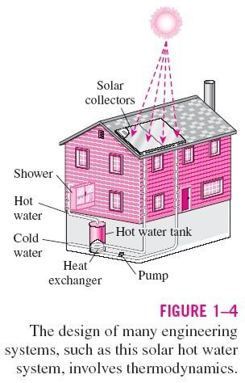
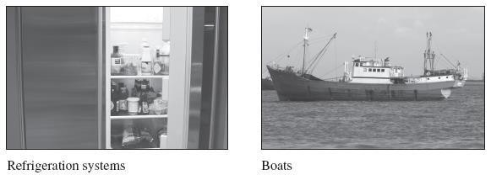
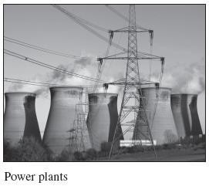
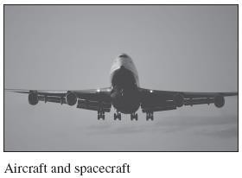
Application Areas of Thermodynamics
All activities in nature involve some interaction between energy and matter; thus, it is hard to imagine an area that does not relate to thermodynamics in some manner.

Slide 15
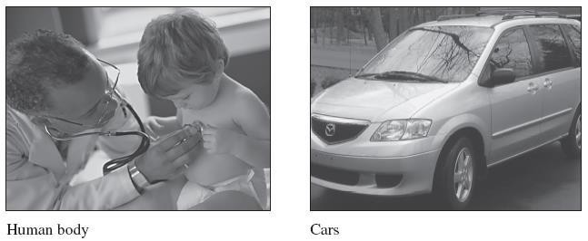
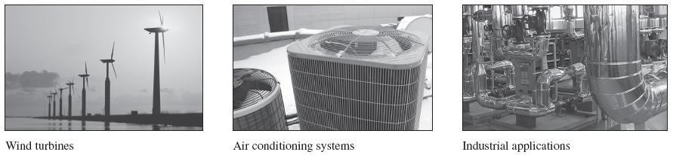

Slide 16
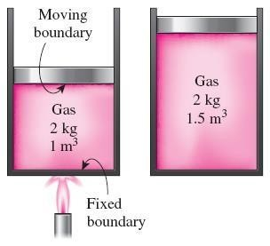
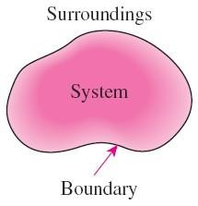
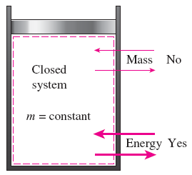
SYSTEMS AND CONTROL VOLUMES
System: A quantity of matter or a region in space chosen for study.
Surroundings: The mass or region outside the system
Boundary: The real or imaginary surface that separates the system from its surroundings.
The boundary of a system can be fixed or movable.
Systems may be considered to be closed or open.
Closed system (Control mass): A fixed amount of mass, and no mass can cross its boundary

Slide 17
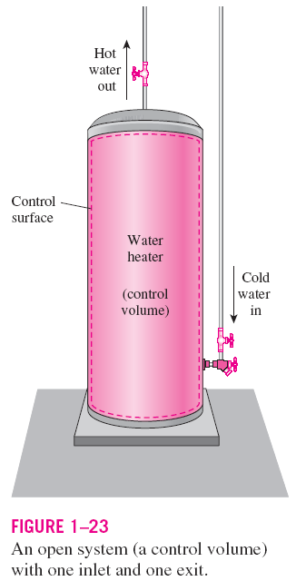
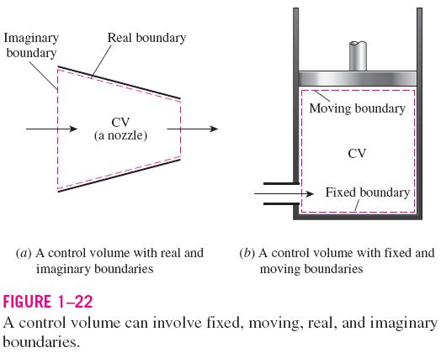
Open system (control volume): A properly selected region in space.
It usually encloses a device that involves mass flow such as a compressor, turbine, or nozzle.
Both mass and energy can cross the boundary of a control volume.
Control surface: The boundaries of a control volume. It can be real or imaginary.
15

Slide 18
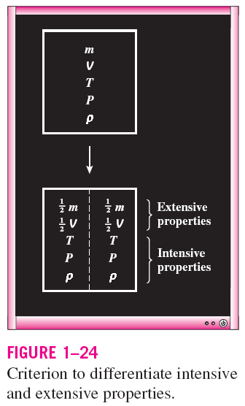
PROPERTIES OF A SYSTEM
Property: Any characteristic of a system.
Some familiar properties are pressure P, temperature T, volume V, and mass m.
Properties are considered to be either intensive or extensive.
Intensive properties: Those that are independent of the mass of a system, such as temperature, pressure, and density.
Extensive properties: Those whose values depend on the size— or extent—of the system.
Specific properties: Extensive properties per unit mass.
16

Slide 19
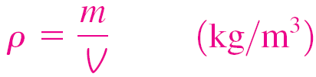
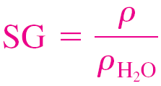
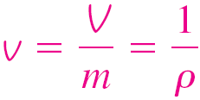
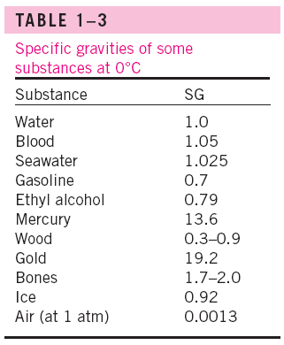
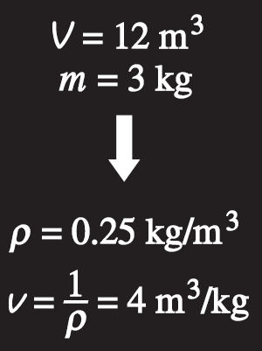

DENSITY AND SPECIFIC GRAVITY
Density
Specific gravity: The ratio
of the density of a substance to the density of some standard substance at a specified temperature (usually water at 4°C).
Specific volume
Specific weight: The weight of a unit volume of a substance.
Density is mass per unit volume; specific volume is volume per unit mass.
18

Slide 20
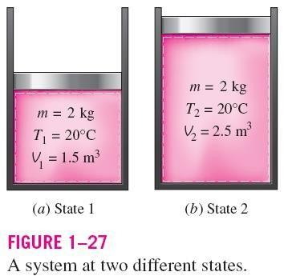
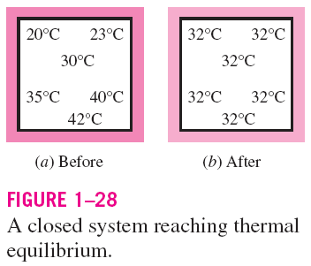
STATE AND EQUILIBRIUM
Thermodynamics deals with equilibrium
states.
Equilibrium: A state of balance.
In an equilibrium state there are no unbalanced potentials (or driving forces) within the system.
Thermal equilibrium: If the temperature is the same throughout the entire system.
Mechanical equilibrium: If there is no change in pressure at any point of the system with time.
Phase equilibrium: If a system involves two phases and when the mass of each phase reaches an equilibrium level and stays there.
Chemical equilibrium: If the chemical composition of a system does not change with time, that is, no chemical reactions occur.
19

Slide 21
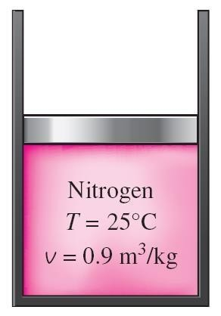
The State Postulate
The number of properties required to fix the state of a system is given by the state postulate:
The state of a simple compressible system is completely specified by two independent, intensive properties.
Simple compressible system: If a system involves no electrical, magnetic, gravitational, motion, and surface tension effects.
The state of nitrogen is fixed by two independent, intensive properties.

Slide 22
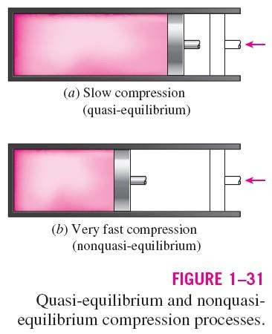
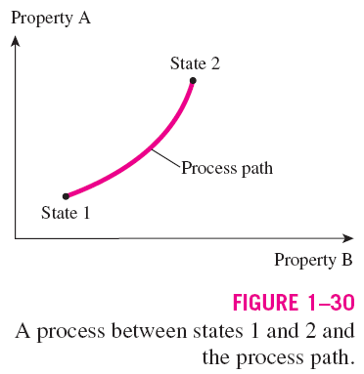
PROCESSES AND CYCLES
Process: Any change that a system undergoes from one equilibrium state to another.
Path: The series of states through which a system passes during a process.
To describe a process completely, one should specify the initial and final states, as well as the path it follows, and the interactions with the surroundings.
Quasistatic or quasi-equilibrium process: When a process proceeds in such a manner that the system remains infinitesimally close to an equilibrium state at all times.
21

Slide 23
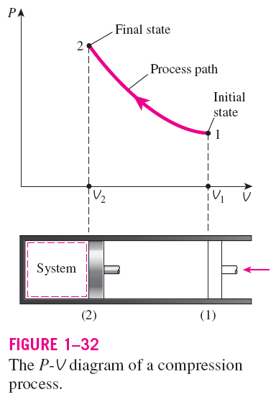
Process diagrams plotted by employing thermodynamic properties as coordinates are very useful in visualizing the processes.
Some common properties that are used as coordinates are temperature T, pressure P, and volume V (or specific volume v).
The prefix iso- is often used to designate a process for which a particular property remains constant.
Isothermal process: A process during which the temperature T remains constant.
Isobaric process: A process during which the pressure P remains constant.
Isochoric (or isometric) process: A process during which the specific volume v remains constant.
Cycle: A process during which the initial and final states are identical.

Slide 24
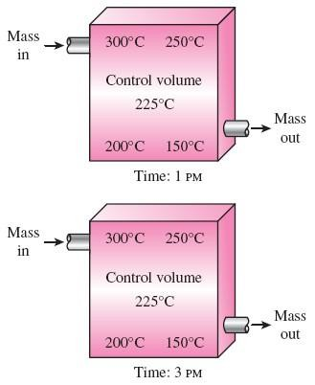
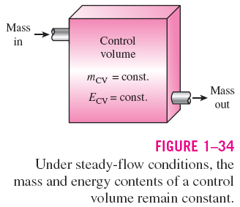
The Steady-Flow Process
The term steady implies no change with time. The opposite of steady is unsteady, or transient.
A large number of engineering devices operate for long periods of time under the same conditions, and they are classified as steady-flow devices.
Steady-flow process: A process during which a fluid flows through a control volume steadily.
Steady-flow conditions can be closely approximated by devices that are intended for continuous operation such as turbines, pumps, boilers, condensers, and heat exchangers or power plants or refrigeration systems.
During a steady- flow process, fluid properties within
the control volume may change with position but not
with time.
23

Slide 25
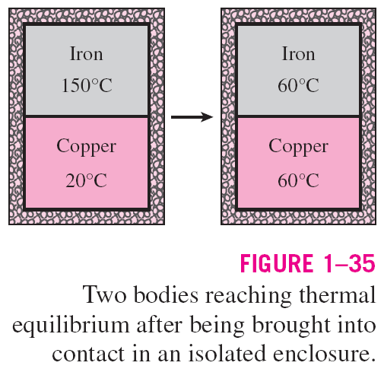
TEMPERATURE AND THE ZEROTH LAW OF THERMODYNAMICS
The zeroth law of thermodynamics: If two bodies are in thermal equilibrium with a third body, they are also in thermal equilibrium with each other.
By replacing the third body with a thermometer, the zeroth law can be restated as two bodies are in thermal equilibrium if both have the same temperature reading even if they are not in contact.

Slide 26
Week -2
Lecture
on
Thermodynamic Process (27-36)

Slide 27


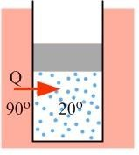


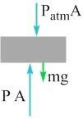
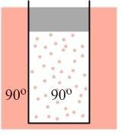

15-1 The First Law of Thermodynamics
Consider a cylinder of ideal gas sealed with a piston, a system we examined in Chapter 14. Let’s explore what happens to the system’s energy when the temperature increases.
EXPLORATION 15.1 – Adding heat to a cylinder
A cylinder of ideal gas, as in Figure 15.1, is sealed with a piston that can move up or down without friction. The top of the piston is exposed to the atmosphere. The ideal gas in the cylinder is initially at room temperature, 20°C. The cylinder is then placed in a water bath that is maintained at a constant temperature of 90°C.
Figure 15.1: A cylinder sealed with a piston that can move up or down without friction. The cylinder is initially at room temperature, 20°C.
Step 1 – Describe qualitatively what happens to this gas system when it is placed in the water bath.
Because the temperature of the gas in the cylinder is lower than that of the water
bath, heat will be transferred from the water into the gas. This is shown in Figure
15.2. This transfer of energy will continue until the gas in the cylinder reaches 90°C, the same temperature as the water bath. At that point, thermal equilibrium will be reached and the energy transfer will stop.
Step 2 – Describe what happens to the energy transferred as heat from the water bath to the ideal gas. Increasing the temperature of the gas means increasing the internal energy of the gas. Thus, some of the heat Q transferred to the gas causes a change in internal energy, . However, something else
Figure 15.2: When the cylinder is placed in a water bath that is maintained at a temperature higher than the gas, heat is naturally transferred from the water bath into the cylinder until thermal equilibrium is reached.
must change for the gas to satisfy the condition set by the ideal gas law, As we discussed in Chapter 14, in a
cylinder in which the piston is free to move, the pressure is determined by the forces on the piston’s free-body diagram (see Figure 15.3).
Figure 15.3: Applying Newton’s second law to the free-body diagram tells us that, with the piston at equilibrium, the pressure of the gas is given by
, where A is
the area of the top or bottom of the piston.
When the gas temperature reaches 90°C, the piston is at a new equilibrium position, but the pressure in the cylinder is the same as it was before – nothing has changed on the free-body diagram. Thus, to satisfy the ideal gas law, the volume occupied by the gas increases when the pressure increases. This is shown in Figure
15.4. The expanding gas does a positive amount of work
W, exerting an upward force and causing an upward displacement of the piston. Like the change in internal energy, the work W comes from the heat Q transferred from the water bath into the gas. Thus, some of the transferred heat goes into raising the internal energy of the system, and some goes into doing work.
Figure 15.4: When thermal equilibrium is reached, the gas occupies a larger volume because the temperature is higher, maintaining a constant pressure.

Slide 28
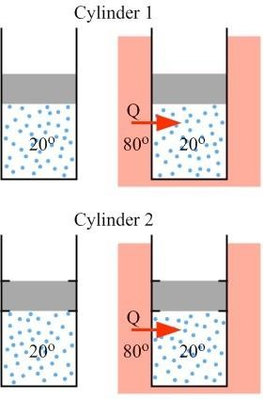

Key Idea: Heat transferred between a system and its surroundings can be transformed into two other forms of energy. Some (or even all, in certain cases) of the heat goes into changing the internal energy of the gas (corresponding to a temperature change) while the remaining heat goes into doing work. This statement of energy conservation is the first law of thermodynamics, which is defined more formally below. Related End-of-Chapter Exercises: 1 and 13.
The first law of thermodynamics is a statement of energy conservation as it relates to a thermodynamic system. Heat, which is energy transferred into or out of a system, can be transformed into (or come from) some combination of a change in internal energy of the system and the work done by (or on) the system.
. (Equation 15.1: The First Law of Thermodynamics)
Q is positive when heat is added to a system, and negative when heat is removed.
is positive when the temperature of a system increases, and negative when it decreases.
W is positive when a system expands and does work, and negative when the system is compressed.
EXAMPLE 15.1 – Some numerical calculations
Let’s do two numerical calculations related to Exploration 15.1. Let’s say that 3500 J is transferred to the cylinder as heat. The work done by the gas while the heat is being transferred is 1400 J. (a) Calculate the change in internal energy experienced by the gas in the cylinder. (b) If the change in internal energy can be calculated, in this case, using the equation
, calculate the number of moles of gas in the cylinder.
SOLUTION
We can calculate the change in internal energy by re-arranging the equation for the first law.
.
Now, we can solve for the number of moles by re-arranging the equation that was given for the change in internal energy.
Essential Question 15.1: Figure 15.5 shows two cylinders containing equal amounts of the same ideal gas in the same initial state – the gas in the two cylinders has the same pressure, volume, and temperature. The difference between them is that, in cylinder 1, the piston sealing the cylinder is free to move up or down without friction, while the piston in cylinder 2 is fixed so the volume occupied by the gas is constant. Both cylinders are initially at 20°C, but are then placed in a water bath that is maintained at a constant temperature of 80°C and allowed to
come to equilibrium. In this process, which cylinder has more
heat transferred to it? Which cylinder experiences a larger change in internal energy?
Figure 15.5: The piston in cylinder 1 is free to move without friction, while the piston in cylinder 2 is fixed in place so the gas occupies a constant volume.

Slide 29
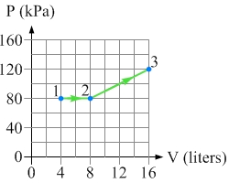

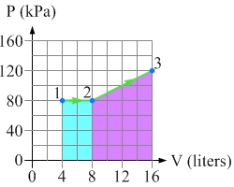

Answer to Essential Question 15.1: Coming to equilibrium means reaching the same temperature as the water bath. Thus, both cylinders will experience the same change in temperature, +60°C. Internal energy is directly related to temperature. Because the same number of moles of the same type of gas experiences the same temperature change, the change in internal energy is the same in both cases. The difference between the cylinders is that the gas in cylinder 1 will expand when the temperature increases, so the gas does work moving the piston. No work is done by the gas in cylinder 2. Thus is larger than . More heat needs to be added to cylinder
1 than cylinder 2, the difference corresponding to the work done by the gas in cylinder 1.
15-2 Work, and Internal Energy
The first law involves three parameters. Heat (Q) involves a transfer of energy into or out of a system. Let’s now explore the ideas of work (W) and change in internal energy ( ).
For the case of the cylinder in section 15-1, the work done by the gas on the piston is the magnitude of the force the gas exerts on the piston multiplied by the magnitude of the piston’s displacement, .
Using the fact that F = PA, and that the volume and height are related by area:
.
Thus, for a constant pressure process we have:
. (Eq. 15.2: Work done at constant pressure)
If the pressure changes, Equation 15.2 does not apply. Is there a general method of finding work that is valid in all cases? Consider now the two processes shown in the P-V diagram in Figure 15.6.
Figure 15.6: The P-V diagram shows an expansion from state 1 to state 2 at constant pressure, followed by another expansion that takes the system to state 3 along the path indicated.
For the constant pressure process, in which the system expands from state 1 to state 2, Equation 15.2 tells us that the work done by the gas in that process is . This is the area under the
curve defining the process. For the expansion from state 2 to state 3, which is not at constant pressure, the work is still equal to the area under the curve defining the process. This gives us our general method of finding work. The two shaded areas shown in Figure 15.7 represent the work done by the gas in the two processes.
Work: A practical way to calculate the work done by a gas in a particular thermodynamic process is to find the area under the curve for that process on the P-V diagram.
W = area under the curve on the P-V diagram. (Equation 15.3: Work done by a gas)
Figure 15.7: The area of the rectangular region under the 1 to 2 process is the work done by the gas in the expansion from state 1 to state 2. The area of the region under the 2 to 3 process is the work done by the gas in moving from state 2 to state 3.

Slide 30
EXAMPLE 15.2A – Calculating the work
Find the work done by the gas in the two processes shown in Figure 15.6.
SOLUTION
For the constant-pressure 1 to 2 process, the work is the area of a rectangle, as in Figure 15.7.
W_{1→2} = PΔV = (80 kPa)(8.0 L − 4.0 L) = (80 × 10³ Pa)(4.0 × 10⁻³ m³ ) = +320 J.
For the expansion from state 2 to 3, the work is the area under the 2 to 3 line in Figure
15.7. This is equal to the area of a rectangle, with the top of the rectangle at the average pressure.
W_{2→3} = P_{av} ΔV = (100 kPa)(16 L − 8.0 L) = (100 × 10³ Pa)(8.0 × 10⁻³ m³ ) = +800 J.
Let’s turn now to the change in internal energy. The change in internal energy is independent of the process that moves a system from one state to another. Thus, if we know what the change in internal energy is for one process, we can apply that to all processes.
Change in internal energy: If the temperature of an ideal gas changes, the change in internal energy of the gas is proportional to the change in temperature. If there is no change in temperature, there is no change in internal energy (as long as the number of moles of gas remains constant).
. (Equation 15.4: Change in internal energy)
Monatomic: Diatomic: Polyatomic:
CV is the heat capacity at constant volume, which we will examine in Section 15-3. If we just want the internal energy, we remove the deltas.
. (Equation 15.5: Internal energy of an ideal gas)
EXAMPLE 15.2B – Calculating the change in internal energy
Consider again the P-V diagram shown in Figure 15.6. If the gas is diatomic, find the change in internal energy associated with the two processes shown on the diagram.
SOLUTION
To do this, we will combine the ideal gas law with the information on the graph.
.
Plugging in ₅the values for the pressures and volumes shown on the P-V diagram gives:
⎡(80 kPa)(8.0 L)− (80 kPa)(4.0 L)⎤ = 1600 J − 800 J = +800 J.
ΔE =
int,1→2 ₂ ⎣ ⎦
Using a similar process for the expansion from state 2 to state 3 gives:
ΔE = ⁵ ⎡(120 kPa)(16.0 L)− (80 kPa)(8.0 L)⎤ = 3800 J − 1600 J = +2200 J.
int,2→3 ₂ ⎣ ⎦
Related End-of-Chapter Exercises: 14, 16, 46, 47.
Essential Question 15.2: If we did not know the path taken on the P-V diagram, in Figure 15.6, from state 2 to state 3, could we still find the work or the change in internal energy? Explain.

Slide 31
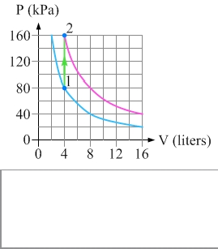

Answer to Essential Question 15.2: An important distinction between work and the change in internal energy is that the work depends on the process involved in taking a system from one state to another, while the change in internal energy depends only on the initial and final states. Thus, if we do not know the path taken on the P-V diagram, we can not find the work – different processes have different amounts of work associated with them. On the other hand, we can find the change in internal energy, because we know the pressure and volume of the initial and final states. No matter what the process, for a diatomic ideal gas the change in internal energy in moving from state 2 to state 3 will be the +2200 J we calculated in Example 15.2B.
15-3 Constant Volume and Constant Pressure Processes
Let’s consider once again two different thermodynamic processes, one in which heat is added to a system at constant volume, and the other when heat is added at constant pressure.
EXPLORATION 15.3A – A constant-volume process
A sample of monatomic ideal gas is initially at a temperature of 200 K. The gas occupies a constant volume. Heat is then added to the gas until the temperature reaches 400 K. This process is shown on the P-V diagram in Figure 15.8, where the system moves from state 1 to state 2 by the process indicated. The diagram also shows the cylinder in state 1 and again in state 2. The figure also shows the 200 K isotherm (lower) and the 400 K isotherm (higher).
Step 1 – Find the number of moles of gas in the cylinder.
Applying the ideal gas law to state 1 gives:
Figure 15.8: A P-V diagram showing a constant-volume process that moves a system of monatomic ideal gas from state 1 to state 2.
.
Step 2 – Find the work done in this process.
The work done is the area under the curve for the process. Because there is no area under the curve in a constant-volume process the work done by the gas is zero: .
Step 3 – Find the change in internal energy for this process.
In a constant-volume process all the heat added goes into changing the internal energy of the gas.
Because the gas is monatomic we have . This gives:
.
Step 4 – Find the heat added to the gas in this process. The First Law of Thermodynamics tells us that , but if the work done by the gas is zero we have . In this case we have Q = +480 J.
Key ideas for a constant-volume process: There is no work done by the gas: The heat added to the gas is equal to the change in internal energy:
Related End-of-Chapter Exercises: 17, 18.
.
.

Slide 32
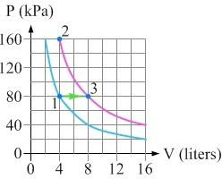

EXPLORATION 15.3B – A constant-pressure process
The system from the previous Exploration is now taken from state 1 to state 3 (in which, like state 2, the system is at 400 K) by the constant-pressure process indicated in Figure 15.9.
Step 1 – Find the work done in this process. The work done by the gas in this process is the area under the curve on the P-V diagram. Because the pressure is constant we can use Equation 15.2:
.
Figure 15.9: A P-V diagram showing a constant-pressure process that moves a system of monatomic ideal gas from state 1 to state 3.
Step 2 – Find the change in internal energy for this process. Because the temperature change is the same, the change in internal energy is the same as it is in the constant-volume process:
.
Step 3 – Find the heat added to the gas. Applying the First Law of Thermodynamics gives:
Key ideas for a constant-pressure process: The work done by the gas is given by Equation
15.2: . Related End-of-Chapter Exercises: 3, 19 – 21.
Heat Capacity
In Chapter 13, we used to find the heat needed to change the temperature of a
substance of mass m and specific heat c. For gases, a more convenient equation is
, where C is known as the heat capacity. The value of the heat capacity
depends on the process the gas follows when the heat is added. At constant volume, when the work done is zero:
, (Eq. 15.6: Heat needed to change temperature at constant volume)
where
is the heat capacity at constant volume. As mentioned in Section 15-2, we apply
to all processes, because the change in internal energy is process independent.
Monatomic: Diatomic: Polyatomic:
In contrast, the heat needed to change temperature at constant pressure is given by:
, (Eq. 15.7)
where is the heat capacity at constant pressure.
Monatomic: Diatomic: Polyatomic:
Essential Question 15.3: In Exploration 15.3B, 800 J of heat added to the system of monatomic ideal gas at 200 K increases the system’s temperature to 400 K via a constant-pressure process. If the same 800 J of heat is added to the system, starting in state 1, but the volume is kept constant what will the final temperature of the system be? What about the final pressure?

Slide 33

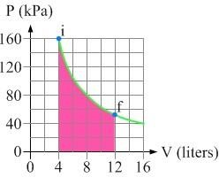

Answer to Essential Question 15.3: In a constant-volume process, for a monatomic ideal gas:
.
Solving for the temperature change when 800 J of heat is added, we get:
.
Because the initial temperature is 200 K, the final temperature is 200 K + 333 K = 533 K. Applying the ideal gas law, gives the corresponding pressure:
.
15-4 Constant Temperature and Adiabatic Processes
Let’s now consider two more thermodynamic processes, the constant temperature (also known as isothermal) process and the adiabatic process.
A constant-temperature (isothermal process: Because the temperature is constant there is no change in internal energy. The First Law of Thermodynamics tells us that, in this case, , and it
can be shown (using calculus is the most straightforward way to prove this) that:
. (Eq. 15.8: Heat and work for an isothermal process)
EXAMPLE 15.4A – Add heat at constant temperature
700 J of heat is added to a system of ideal gas, while the temperature is kept constant at 400 K. The system initially has a pressure of 160 kPa and occupies a volume of 4.0 liters.
Is this possible? Can temperature remain constant while heat is added? Explain.
Sketch this process on a P-V diagram, keeping in mind the following question: When heat is added at constant temperature does the gas pressure increase, as in a constant- volume process, or does the volume increase, as in a
constant-pressure process?
What are the final values of the gas pressure and the volume of the gas?
SOLUTION
This is possible. The first law of thermodynamics tells us that heat Q is converted into some combination of internal energy and/or work. When the temperature is constant we have the special case of no change in internal energy, so all the heat is converted into work.
(b) The temperature is constant so the process proceeds along an isotherm, shown in Figure 15.10. Because Q is positive, and , the work is also positive. Positive work means that
the volume must increase, so the pressure drops to keep the temperature constant.
Figure 15.10: A P-V diagram corresponding to heat being added to a system at constant temperature. The final pressure and volume are calculated in part (c). The area corresponding to the work done by the gas is shown shaded.

Slide 34
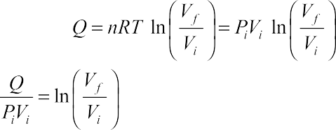



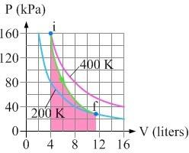





(c) First, let’s re-write Eq. 15.8 using the ideal gas law:
.
Isolating the logarithm on the right side gives:
.
Taking the exponential of both sides:
.
The final volume is thus:
.
Solving for the final pressure gives:
.
An adiabatic process: In an adiabatic process no heat is added to or removed from the gas (i.e., Q
= 0). Examples include systems insulated so no heat is exchanged with the surroundings, and systems in which processes happen so fast that there is no time to add or remove heat. Because Q = 0 for an adiabatic process the First Law of Thermodynamics tells us that . The energy for any
work done comes from the change in the system’s internal energy.
, (Equation 15.9: Equation for an adiabatic process on the P-V diagram)
where is the ratio of the heat capacity at constant pressure to the heat capacity at constant volume:
(Equation 15.10: The constant for an adiabatic process.
EXAMPLE 15.4B – Analyzing an adiabatic process
A system of monatomic ideal gas experiences an adiabatic expansion that moves it from an initial state, at 400 K, to a final state at a temperature of 200 K. The process is shown on the P-V diagram in Figure
15.11. Calculate the values of the final pressure and volume.
SOLUTION
Because the gas is monatomic, we have:
.
From Equation 15.9, we know that: From the ideal gas law, we have Combining these results leads to
, as well as
.
Figure 15.11: The P-V diagram for the adiabatic expansion.
.
(Equation 15.11)
Solving for the final volume gives:
.
The final pressure is thus: P = P (V / V )^{γ} = (160 kPa)
^{⎛ 4.0 L ⎞ 5 / 3} = 28 kPa .
f i i f
⎜⎝ 11.31 L⎥⎠
Related End-of-Chapter Exercises for this section: 4, 22 – 27.
Essential Question 15.4: How much work is done by the gas in Example 15.4B?

Slide 35
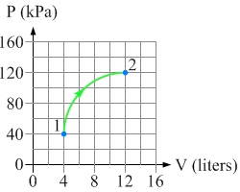

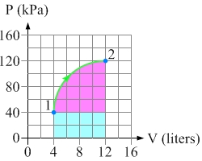

Answer to Essential Question 15.4: The work done by the gas in the expansion is shown by the area shaded in red in Figure 15.11. We can find a numerical value for the work done by applying the First Law of Thermodynamics, . Because Q = 0, we have:
.
We could solve for the number of moles of gas, but let’s instead apply the ideal gas law:
15-5 A Summary of Thermodynamic Processes
There is no single step-by-step strategy that can be applied to solve every problem involving a thermodynamic process. Instead let’s summarize the tools we have to work with. These tools can be applied in whatever order is appropriate to solve a particular problem.
Tools for Solving Thermodynamics Problems
The P-V diagram can help us to visualize what is going on. In addition, the work done by a gas in a process is the area under the curve defining that process on the P-V diagram.
The ideal gas law, .
•
The first law of thermodynamics, .
The general expression for the change in internal energy,
.
In specific special cases (see the summary in Figure 15.14), there are additional relationships that can be used to relate the different parameters.
EXAMPLE 15.5 – Applying the tools
A system of monatomic ideal gas is taken through the process shown in Figure 15.12. For this process find (a) the work done by the gas, (b) the change in internal energy, and (c) the heat added to the gas.
Figure 15.12: The process that moves the system from state 1 to state 2 follows a circular arc on the P-V diagram that covers ¼ of a circle.
SOLUTION
(a) The area under the curve has been split into two parts in Figure 15.13, a ¼-circle and a rectangle. Each box on the P-V diagram measures 20 kPa 2.0 L, representing an area of 40 J. The rectangular area covers 8 boxes, for a total of 320 J of work. The radius of the
quarter-circle is four boxes, so the area of that quarter circle is given by:
.
Thus, the total work done by the gas is 320 J + 500 J = 820 J.
(b) The gas is monatomic, so Combining Eq. 15.4 with the ideal gas law:
.
Figure 15.13: To find the work done by the gas here, it is simplest to split the area under the curve into two pieces, a ¼-circle and a rectangle.

Slide 36
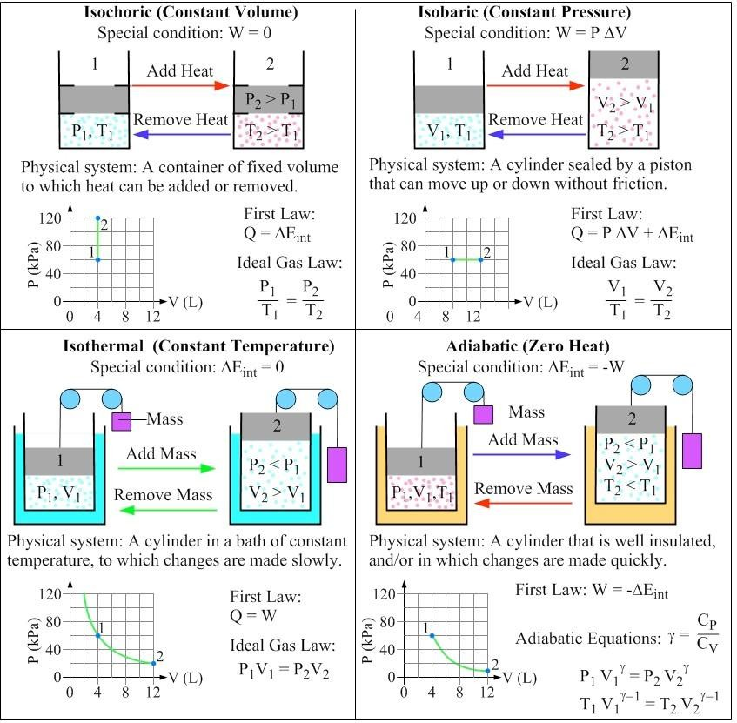

(c) Using the first law of thermodynamics:
.
Figure 15.14: A summary of four special-case thermodynamic processes. For each, we see the special condition associated with that process; a pictorial representation and description in words of a corresponding physical system; a P-V diagram for the process; and equations we can apply to solve problems associated with the process.
Related End-of-Chapter Exercises for this section: 6, 7, 28 – 31.
Essential Question 15.5: Compare the P-V diagrams for the isochoric and isobaric processes in Figure 15.14. Assuming these pertain to the same system, and state 1 is the same in both cases, in which case is the change in internal energy larger? In which case is more heat involved?

Slide 37
Week -3
Lecture
on
Laws of Thermodynamics (38-48)

Slide 38

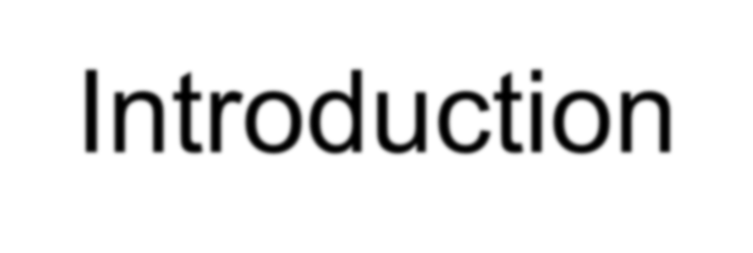

Introduction
According to British scientist C. P. Snow, the three laws of thermodynamics can be (humorously) summarized as
You can’t win
You can’t even break even
You can’t get out of the game

Slide 39
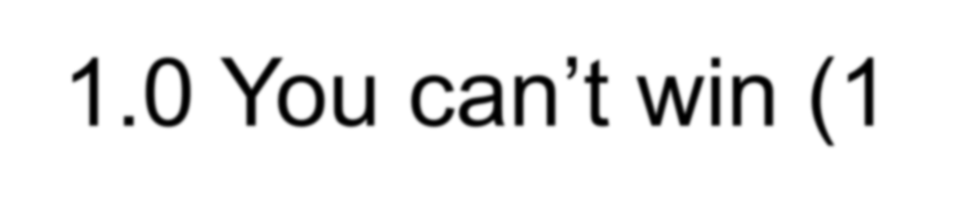
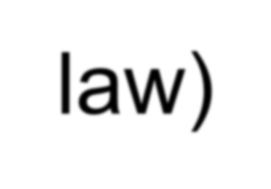
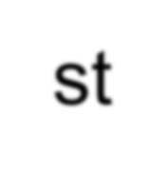
1.0 You can’t win (1st law)
The first law of thermodynamics is an extension of the law of conservation of energy
The change in internal energy of a system is equal to the heat added to the system minus the work done by the system
ΔU = Q - W

Slide 40
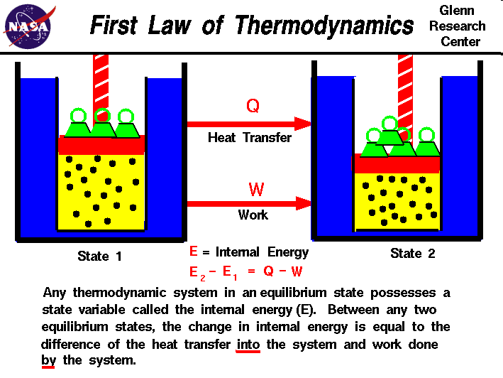

Slide 41
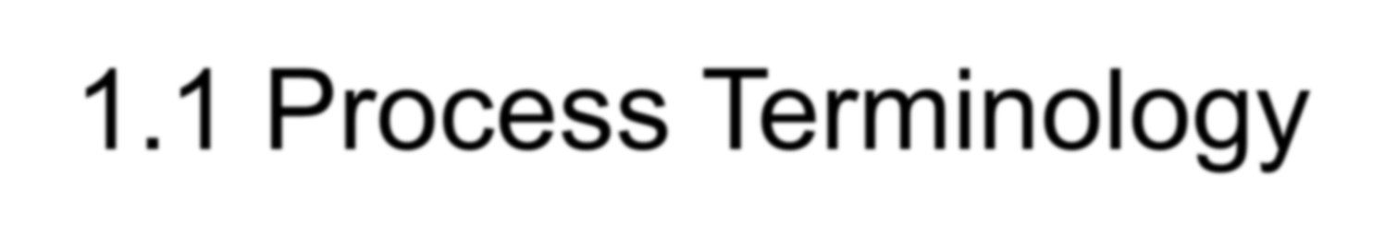
1.1 Process Terminology
Adiabatic – no heat transferred
Isothermal – constant temperature
Isobaric – constant pressure
Isochoric – constant volume

Slide 42

1.1.1 Adiabatic Process
An adiabatic process transfers no heat
– therefore Q = 0
ΔU = Q – W
When a system expands adiabatically, W is positive (the system does work) so ΔU is negative.
When a system compresses adiabatically, W is negative (work is done on the system) so ΔU is positive.

Slide 43

1.1.2 Isothermal Process
An isothermal process is a constant temperature process. Any heat flow into or out of the system must be slow enough to maintain thermal equilibrium
For ideal gases, if ΔT is zero, ΔU = 0
Therefore, Q = W
– Any energy entering the system (Q) must leave as work (W)

Slide 44

1.1.3 Isobaric Process
An isobaric process is a constant pressure process. ΔU, W, and Q are generally non- zero, but calculating the work done by an ideal gas is straightforward
W = P·ΔV
Water boiling in a saucepan is an example of an isobar process

Slide 45

1.1.4 Isochoric Process
An isochoric process is a constant volume process. When the volume of a system doesn’t change, it will do no work on its surroundings. W = 0
ΔU = Q
Heating gas in a closed container is an isochoric process

Slide 46

1.2 Heat Capacity
The amount of heat required to raise a certain mass of a material by a certain temperature is called heat capacity
Q = mc_{x}ΔT
The constant c_{x} is called the specific heat of substance x, (SI units of J/kg·K)

Slide 47

1.2.1 Heat Capacity of Ideal Gas
C_{V} = heat capacity at constant volume
C_{V} = 3/2 R
C_{P} = heat capacity at constant pressure
C_{P} = 5/2 R
For constant volume
Q = nC_{V}ΔT = ΔU
The universal gas constant R = 8.314 J/mol·K

Slide 48



2.0 You can’t break even (2nd Law)
Think about what it means to not “break even”. Every effort you put forth, no matter how efficient you are, will have a tiny bit of waste.
The 2nd Law can also be stated that heat flows spontaneously from a hot object to a cold object (spontaneously means without the assistance of external work)

Slide 49
Week-4
Lecture
on
Laws of Thermodynamics (50-57)

Slide 50


Slide 51



2.1 Concerning the 2nd Law
The second law of thermodynamics introduces the notion of entropy (S), a measure of system disorder (messiness)
U is the quantity of a system’s energy, S is
the quality of a system’s energy.
Another C.P. Snow expression:
– not knowing the 2nd law of thermodynamics is the cultural equivalent to never having read Shakespeare

Slide 52

2.2 Implications of the 2nd Law
Time marches on
If you watch a movie, how do you know that you are seeing events in the order they occurred?
If I drop a raw egg on the floor, it becomes extremely “disordered” (greater Entropy) – playing the movie in reverse would show pieces coming together to form a whole egg (decreasing Entropy) – highly unlikely!

Slide 53

2.3 Direction of a Process
The 2nd Law helps determine the preferred direction of a process
A reversible process is one which can change state and then return to the original state
This is an idealized condition – all real processes are irreversible

Slide 54



3.0 You can’t get out (3rd Law)
No system can reach absolute zero
This is one reason we use the Kelvin temperature scale. Not only is the internal energy proportional to temperature, but you never have to worry about dividing by zero in an equation!
There is no formula associated with the 3rd Law of Thermodynamics

Slide 55



3.1 Implications of 3rd Law
MIT researchers achieved 450 picokelvin in 2003 (less than ½ of one billionth!)
Molecules near these temperatures have been called the fifth state of matter:
Bose-Einstein Condensates
Awesome things like super-fluidity and super- conductivity happen at these temperatures
Exciting frontier of research

Slide 56

4.0 The Zeroth Law
The First and Second Laws were well entrenched when an additional Law was recognized
If objects A and B are each in thermal equilibrium with object C, then A and B are in thermal equilibrium with each other
Allows us to define temperature relative to an established standard

Slide 57


Slide 58
Week-5
Lecture
on
Thermodynamic Cycle (59-68)

Slide 59




Consists of a seriës o£ thermodyn arñic procèsses, whic h tdke p1aEe in a specific order and t rte initial coriditiDns are resrored a t the end of the procezses.
•Convc rt'some head input Inro a mechanicat york ourput
7.neat pvoip cycles
-transfer heat from how to high temperatures by using mechanicat work as the input

Slide 60
reversed Cemot cycle
B‹ayton cyde
Otto cycle
Diesel cycla
sdrling cycle
Erlcson cycle
Regeneratlve gas turbGe cycle
Intercoofln$, reheat regenerative
s cycles
Combined brat4nn-rankine.tycle
Itankine cycle fleheet cycle
Supercr|ticaT rankine cycle Regenerative cycle
Vapor ref/4geration wc!e Multistage vapor refrigeration cycle
Absorption refrigeration cycle
- Heat pump

Slide 61





öerween a high temperaiure reservoir and a
low remperatúre reservoir
la rn a I Cy ct e: !d ea Pawe r TI er roo dynui Ì C y c!ø
1-2 Adlabatlc Reverslble compresslan. The completely insulated cylinder aIlo' s no heat trănśfer during this revenible prócesi.
2-3 Isothermal Expansion. Heat is tranšferred rèvenibly from the high tempera'túre reśervoir ał the i:ónstanŁ tempera'ture T«. The plstoń In' the cylinder' is w\thdravm and the volurrie Increases.
3-4 Adiabaefc Reversible Gpøps[gn, The .f;yTinder is
completely insulated so thaF ne heät tiansfer occun durir\g thls reuemible process. The piston Tn the ¢yTinder continues to be withdrawn ąnd the vuIume Increasing
ü An İdeal cycle that uses reversible processes to form irs cycle ojseration
4-1 Isotherñ*aI Go‹npresclon. Heat is tmnsferred reversibly ta the Ion temperature reservoir at the constant temperature The plstan continues œ compress
the working substance untİl
the original volume,
temperature, and pressure are reached, thereby
compJerlng the cycle.

Slide 62






Isentrogic expansion añd œmpresslon proteus
TsochermaT Cat aàäicTon an'd rëjectlon proc'ess
r . r, ra-ci
_{i} E. Cycle'Effïclency
e=

Slide 63


otto Cycle
< is a spark ignition type engine
two constant volume and two isentropic process
heat is transferred during the two isentropic (constant volume) process
maximum temperature occur afier combustion or before expansion
e if compression ratio increases, it's cycle efficiency will increase
cyEle Efficiency depends on compression ratio and it's specific heat ratio
typical compression ratio is 8.0
P-V and T-5 DIAGRAM

Slide 64





.'Process.2-3: Conscăńt Volüme Hëat A'dälilon:
Pročeśs 3-4: țsențiopjc\Expa”ńsjon

Slide 65
Week-6
Lecture
on
Thermodynamic Cycle
and
Problem Solving
(70-73)

Slide 66


3. Diesel Cycle
is a compression-ignition type of engine
two isentropiE, one constant pres surR and one constant voJume process
P-V and T-S DIAGRAM

Slide 67






Process I-2: Isentropic Compression
Process 2-3: Constant Pressure Heat Addition
Process 4-1: Constant Volume Heat RejeclJon
Process 3-4: lsentropic Expansion

Slide 68



Formulas: Diesel Cycle
A ga = heat added = mcr (/’s - T'z)
6 4c = heat rejected = mc›. (7\ - ’/”› )
C. W = work = fia OR
P. e = Cycle Efficiency
i” - = compression rat ie •
e
ft = E xp artsion ratio =
e =1 -
K/ - V; = Volume of fuel injec ed
E. Ty
l r
'—' ’ - coFDpressionratio
where c- clearance volume
where: '\ =

Slide 69
Example:
A diesel cycle has a compression ratio of 6 and cut oN ratio of 2. If heat added is 1S00KJ, Find the heat rejected. Ans. BS7.60KJ
In an air standard diesel cycle, compression starts at 100Kpa and 300 *K. The compression ratio is 12 and the maximum cycle temperature is 2000 ”K. determine the cycle efficiency. Ans. S4.22%
A diesel cycle has a compression ratio of 8 and initial temperature of 34 ”C. If the maximum temperature of the cycle is 2000 ”K, find the Heat rejected. 726.RFP/kg
A diesel cycle has a cycle efficiency of S8%. If heat added is 1600KJ/Kg, Find the work. Ans.
A diesel has a compression ratio of 8 and cut off ratio of 2.5. Find the cycle efficiency. Ans.
45.97 fi›

Slide 70
Week-7
Lecture
on
Rankine Cycle
(75-86)

Slide 71


RANKINE CYCLE: THE IDEAL CYCLE FOR VAPOR POWER CYCLES
Many of the impracticalities associated with the Carnot cycle can be eliminated by superheating the steam in the boiler and condensing it completely in the condenser. The cycle that results is the Rankine cycle, which is the ideal cycle for vapor power plants. The ideal Rankine cycle does not involve any internal irreversibilities.
The simple ideal Rankine cycle.

Slide 72






Energy Analysis of the Ideal Rankine Cycle
Steady-flow energy equation
The efficiency of power plants in the U.S. is often expressed in terms of heat rate, which is the amount of heat supplied, in Btu’s, to generate 1 kWh of electricity.
The thermal efficiency can be interpreted as the ratio of the area enclosed by the cycle on a T-s diagram to the area under the heat-addition process.

Slide 73



DEVIATION OF ACTUAL VAPOR POWER CYCLES FROM IDEALIZED ONES
The actual vapor power cycle differs from the ideal Rankine cycle as a result of irreversibilities in various components.
Fluid friction and heat loss to the surroundings are the two common
sources of irreversibilities.
Isentropic efficiencies
Deviation of actual vapor power cycle from the ideal Rankine cycle.
The effect of pump and turbine irreversibilities on the ideal Rankine cycle.

Slide 74

HOW CAN WE INCREASE THE EFFICIENCY OF THE RANKINE CYCLE?
The basic idea behind all the modifications to increase the thermal efficiency
of a power cycle is the same: Increase the average temperature at which heat is transferred to the working fluid in the boiler, or decrease the average temperature at which heat is rejected from the working fluid in the condenser.
Lowering the Condenser Pressure (Lowers T_{low,avg})
To take advantage of the increased efficiencies at low pressures, the condensers of steam power plants usually operate well below the atmospheric pressure. There is a lower limit to this pressure depending on the temperature of the cooling medium
Side effect: Lowering the condenser pressure increases the moisture content of the steam at the final stages of the turbine.
The effect of lowering the condenser pressure on the ideal Rankine cycle.

Slide 75

Superheating the Steam to High Temperatures (Increases T_{high,avg})
Both the net work and heat input increase as a result of superheating the steam to a higher temperature. The overall effect is an increase in thermal efficiency since the average temperature at which heat is added increases.
Superheating to higher temperatures decreases the moisture content of the steam at the turbine exit, which is desirable.
The temperature is limited by
The effect of superheating the steam to higher temperatures on the ideal Rankine cycle.
metallurgical considerations. Presently the highest steam temperature allowed at the turbine inlet is about 620°C.

Slide 76


Increasing the Boiler Pressure (Increases T_{high,avg})
For a fixed turbine inlet temperature, the cycle shifts to the left and the moisture content of steam at the turbine exit increases. This side effect can be corrected by reheating the steam.
Today many modern steam power plants operate at supercritical pressures (P > 22.06 MPa) and have thermal efficiencies of about 40% for fossil-fuel plants and 34% for nuclear plants.
A supercritical Rankine cycle.
The effect of increasing the boiler pressure on the ideal Rankine cycle.

Slide 77

THE IDEAL REHEAT RANKINE CYCLE
How can we take advantage of the increased efficiencies at higher boiler pressures without facing the problem of excessive moisture at the final stages of the turbine?
Superheat the steam to very high temperatures. It is limited metallurgically.
Expand the steam in the turbine in two stages, and reheat it in between (reheat)
The ideal reheat Rankine cycle.

Slide 78

The single reheat in a modern power plant improves the cycle efficiency by 4 to 5% by increasing the average temperature at which heat is transferred to the steam.
The average temperature during the reheat process can be increased by increasing the number of expansion and reheat stages. As the number of stages is increased, the expansion and reheat processes approach an isothermal process at the maximum temperature.
The use of more than two reheat stages is not practical. The theoretical improvement in efficiency from the second reheat is about half of that which results from a single reheat.
The reheat temperatures are very close or equal to the turbine inlet temperature.
The optimum reheat pressure is about one-fourth of the maximum cycle pressure.
The average temperature at which heat is transferred during reheating increases as the number of reheat stages is increased.

Slide 79

THE IDEAL REGENERATIVE RANKINE CYCLE
Heat is transferred to the working fluid during process 2-2’ at a relatively low temperature. This lowers the average heat-addition temperature and thus the cycle efficiency.
In steam power plants, steam is extracted from the turbine at various points. This steam, which could have produced more work by expanding further in the turbine, is used to heat the feedwater instead. The device where the feedwater is heated by regeneration is called a regenerator, or a feedwater heater (FWH).
The first part of the heat-addition process in the boiler takes place at relatively low temperatures.
A feedwater heater is basically a heat exchanger where heat is transferred from the steam to the feedwater either by mixing the two fluid streams (open feedwater heaters) or without mixing them (closed feedwater heaters).

Slide 80



Open Feedwater Heaters
An open (or direct-contact) feedwater heater is basically a mixing chamber, where the steam extracted from the turbine mixes with the feedwater exiting the pump. Ideally, the mixture leaves the heater as a saturated liquid at the heater pressure.
The ideal regenerative Rankine cycle with an open feedwater heater.

Slide 81

Closed Feedwater Heaters
Another type of feedwater heater frequently used in steam power plants is the closed feedwater heater, in which heat is transferred from the extracted steam to the feedwater without any mixing taking place. The two streams now can be at different pressures, since they do not mix.
The ideal regenerative Rankine cycle with a closed feedwater heater.

Slide 82

The closed feedwater heaters are more complex because of the internal tubing network, and thus they are more expensive. Heat transfer in closed feedwater heaters is less effective since the two streams are not allowed to be in direct contact. However, closed feedwater heaters do not require a separate pump for each heater since the extracted steam and the feedwater can be at different pressures.
Open feedwater heaters are simple and inexpensive and have good heat transfer characteristics. For each heater, however, a pump is required to handle the feedwater.
A steam power plant with one open
and three closed feedwater heaters.
Most steam power plants use a combination of open and closed feedwater heaters.

Slide 83
Week-8
Lecture
on
Bryton Cycle
(88-98)

Slide 84
Brayton cycle
The Brayton cycle was proposed by George Brayton in 1870 for use in reciprocating engines.
Modern day gas turbines operate on Brayton cycle and work with rotating machinery.
Gas turbines operate in open-cycle mode, but can be modelled as closed cycle using air- standard assumptions.
Combustion and exhaust replaced by constant pressure heat addition and rejection.

Slide 85
Ideal Brayton cycle
The Brayton cycle consists of four internally reversible processes:
1-2 Isentropic compression (in a compressor)
2-3 Constant-pressure heat addition
3-4 Isentropic expansion (in a turbine)
4-1 Constant-pressure heat rejection

Slide 86






Ideal Brayton cycle
^{q}in
Isobaric
^{q}in
3
P
Isentropic
2
3
T
2
4
^{q}out
1
4
1
^{q}out
v
s
Brayton cycle on P-v and T-s diagrams

Slide 87
Ideal Brayton cycle
The energy balance for a steady-flow process can be expressed as:
(q_{in} − q_{out} ) + (w_{in} − w_{out} ) = Δh
The heat transfer to and from the working fluid can be written as :
q_{in} = h₃ − h₂ = c_{p} (T₃ − T₂ )
^{q}out
= h₄ − h₁ = c_{p} (T₄ −T₁)

Slide 88
Ideal Brayton cycle
The thermal efficiency of the ideal Brayton cycle under the cold air standard assumptions becomes:
₌ ^{w}net ₌ ₁₋ ^{q}out
₌ ₁₋ T₄ − T₁ ₌ ₁₋ T₁ (T₄ / T₁ −1)
η
th,Brayton
q q
T − T T (T / T −1)
in in 3 2 2 3 2
Processes 1- 2 and 3- 4 are isentropic and
P₂ = P₃ and P₄ = P₁ .
T
_{⎛ P ⎞}(γ −1)/ γ _{⎛ P ⎞}(γ −1)/ γ
T
Therefore, 2 _{= ⎜} 2 _{⎟ = ⎜} 3 ⎟
₌ 3
T₁
⎝ ^{P}1 ⎠ ⎝ ^{P}4 ⎠
T₄

Slide 89
Ideal Brayton cycle
Substituting these equations into the thermal efficiency relation and simplifying:
1
η
= 1−
th,Brayton
_{r} (γ −1)/ γ
p
P
where, r =
2
is the pressure ratio.
p
P
1
The thermal efficiency of a Brayton cycle is therefore a function of the cycle pressure ratio and the ratio of specific heats.

Slide 90
Ideal Brayton cycle with regeneration
Regeneration can be carried out by using the hot air exhausting from the turbine to heat up the compressor exit flow.
The thermal efficiency of the Brayton cycle increases as a part of the heat rejected is re-used.
Regeneration decreases the heat input (thus fuel) requirements for the same net work output.

Slide 91



Ideal Brayton cycle with regeneration
3
^{q}in
T
^{q}regen
5’
5
4
Regeneration
2
6
^{q}saved^{=q}regen
1
^{q}out
s
T-s diagram of a Brayton cycle with regeneration

Slide 92
Ideal Brayton cycle with regeneration
The extent to which a regenerator approaches an ideal regenerator is called the effectiveness, ε and is defined as
^{ε = q}regen,act ^{/ q}regen,max
= (h₅ - h₂)/(h₄ - h₂)
Under the cold-air-standard assumptions, the thermal efficiency of an ideal Brayton cycle with regeneration is:
⎛ _{T} ⎞
1
η
th,regen = 1− ⎜ _{T} ⎟(r_{p} )
(γ −1)/ γ
⎝ 3 ⎠
The thermal efficiency depends upon the temperature as well as the pressure ratio.

Slide 93
Ideal Brayton cycle with intercooling, reheating and regeneration
The net work of a gas-turbine cycle is the difference between the turbine work output and the compressor work input.
It can be increased by either decreasing the compressor work or increasing the turbine work, or both.
The work required to compress a gas between two specified pressures can be decreased by carrying out the compression process in stages and cooling the gas in between: multi-stage compression with intercooling.

Slide 94
Ideal Brayton cycle with intercooling, reheating and regeneration
Similarly the work output of a turbine can be increased by: multi-stage expansion with reheating.
As the number of stages of compression and expansion are increased, the process approaches an isothermal process.
A combination of intercooling and reheating can increase the net work output of a Brayton cycle significantly.

Slide 95
Week-9
Lecture
on
Bryton Cycle
(100-109)

Slide 96
Ideal Brayton cycle with intercooling, reheating and regeneration
Polytropic process paths
P
D C
Work saved as a result of intercooling
A
Intercooling
B
Isothermal process path
1
v
Work inputs to a single-stage compressor (process: 1AC) and a two-stage compressor with intercooling (process: 1ABD).

Slide 97






Ideal Brayton cycle with intercooling, reheating and regeneration
6 8
T
^{q}in
^{q}regen
5
9
7
4
2
10
^{q}saved^{=q}regen
3
1
^{q}out
s
T-s diagram of an ideal gas-turbine cycle with intercooling, reheating, and regeneration

Slide 98
Actual/Real Brayton cycle
Actual Brayton cycles differ from the ideal cycles in all the four processes.
The compression process and expansion processes are non-isentropic.
Pressure drop during heat addition and heat rejection.
The presence of irreversibilities causes the above deviations.

Slide 99


Actual/Real Brayton cycle
Pressure drop
T
3
^{q}in
2a
2s
4s
4a
^{q}out
1
s
Actual Brayton cycle T-s diagram

Slide 100
Actual/Real Brayton cycle
The deviation of actual compressors and turbines from the isentropic versions can be accounted for by using the isentropic efficiencies.
₌ Isentropic work ≅ h_{2s}
− ^{h}1
η
C
Actual work Actual work
^{h}2a
− ^{h}1
≅ h₃ − h_{4a}
η =
T
Isentropic work h₃ − h_{4s}
Where, 2a and 4a are the actual states at the compressor and turbine exit and 2s and 4s are the corresponding isentropic states.

Slide 101
Actual/Real Brayton cycle
As a result of non-isentropic compression and expansion, the compressor needs more work than the ideal cycle and turbine generates less work.
Isentropic efficiencies reflect the amount of deviation of the actual compression/expansion processes from the ideal.
Total pressure losses in the heat addition/rejection processes also need to be considered.

Slide 102
Actual/Real Brayton cycle
Other differences between ideal and actual Brayton cycles
Change of specific heats with temperature
Heat exchanger effectiveness (in case of regenerative cycles)
Mass flow rate of fuel
Combustion efficiency
These parameters are often used in actual cycle analysis.

Slide 103
Actual/Real Brayton cycle
Variants of the simple Brayton cycle
Reheating
Intercooling
Regeneration
Actual cycles with the above will be different from the ideal cycles in terms of the irreversibilities present.
Isentropic efficiencies, total pressure losses, heat exchanger effectiveness for each additional components of the cycle.

Slide 104
Actual/Real Brayton cycle
Actual Brayton cycle with intercooling
Isentropic efficiencies of each stage of intercooling
Heat exchanger effectiveness of the intercooling duct
Actual Brayton cycle with reheating
Isentropic efficiencies of each stage of reheating
Total pressure loss and combustion efficiency during reheating

Slide 105
Actual/Real Brayton cycle
Actual Brayton cycle with regeneration
– Heat exchanger effectiveness
Actual Brayton cycle with all three of these modifications need to be analysed considering the above discussed irreversibilities.

Slide 106
Week-10
Lecture
on
Vapor Compression Cycle
(111-128)

Slide 107

1. VAPOUR COMPRESSION CYCLE
Basic components of the vapour compression refrigeration system
Compressor
Condenser
Thtottling Device
Evaporador

Slide 108

Vapour Compression Cycle

Slide 109




The transfer of heat from a low-\enipera\ure regio 1 io a high-lenJperaiure one requires special devices. called! refrigerators.
',’’
Rafrigeralors and heal pumps are essentially the came devices; lhey differ in lheir objectives only.
I”
The objective of a refrigerator is to remove hea\ fO,) from lie cold rne‹liurfi; lhe objective uf 9 heat pump is to supply heat (Q„) lo a warm medium.

Slide 110
Unit of’ Refrigeration
The unit of refrigeration is kW or TR
TON OF REFRIGERATION ( TR )
1 TR = 12’000 Btu/hr BRI›T5H UNITS
1 TR = 3.5 17 KW 5I UNITS

Slide 111

THE IDEAL VAPOR-COI¥IPRESSION REFRIGERATION CYCLE
The vapor•compresaion refrigeration cycle is the ideal model for refrigeration systems. Unlike lhe reversed Carnal cyeIe, lha refrigerant is vaporizad completely before it is comprossed and the turbine is ropla d with a tflroltling device.
Schematic and T-s diagram for the ideal
vapor-compression refrigeration cycle

Slide 112





Vapor Compression Refrigeration System
IDEAL CONDITIONS
Condensing: Constant Pr. (P ) Expansion: ant E th lpy Evaporation: Constant Pr.{P,) Compression: Constant Entropy (S)
$'n per I.in
€ on slant Temperature fine tett of dome: Vertical
Within dome: Horizontal Rlght of dome: Curved down
c, t,«. ,i
, ,q, „,t , ,.\,y,g
II,
sf0•T:kTTT..5 J'TJJ
IDEAL CONOfYIOK
''.H•›k RelYigerant is IeoK vapor at end of evap. AN0
| t,
y\, Refrigerant Ts 10a liquid at and of coWansar

Slide 113

The Refrigeration°Cycle on p-h Chart
h, h,

Slide 114
Functions of Cooiponents of a Vapor
Compression Refrigeration System
Evaporator
Extract heat liam ihe producPair and use it as the latent heat of vaporisation ofthe mfîïgeræit
COITÏpI9SSO£
Raise temperature of refrigerant to well abDve that DC surroundings to facilitate transfer of energy to surroundings in condenser
Condenser
Transfer energy from the refrigerant to the surroundings (air/water) Sligbt\y sub-cool tbe refrigerant to minimire amount of vapor genereted as it passes through the expansion valve
Expansion valve
S erVe BS meteri Rg deYiCe fOr fiOW Of Fefrigerant
— Expand the liquid refrigerant from the compressor pressiire io the
evaporator pressure (with minimal conversion to vapor)

Slide 115



The ideal vaporwompression refrigeration cycle involves an Irreversible (throttllng)
process la moke it a more realistic model for fhe ac uel systems. Replacing lhe expansion valve by a turbine is riot practical since the adr1ed benefits cannot iuslify Ihe added cost and complexity,
SIeedy-flow energy balance
An ordinary household refrigerator.
The P•Ii diagram of an ideal vapor- compression refrigeration cycIe_{1,}

Slide 116
Refrigeration Cycle Efficiency
The refrigeration cycle efficiency is known as
COEFFICIENT OF PERFORMANCE
(COPES) = Refrigeration Effect »‹,
Work Done u »
(COPREfit
(COPY›) = Condenser Heat Rejection «,
Work Done »
1 7

Slide 117
Pressure-Enthalpy Diagram for R-12
Ideal Condhions
Specific EnthaTpy {M/kg}

Slide 118

Pressure-Enthalpy Diagram for R-12
”” ndenser Pressure
Conde»sation
Degree of super-heating
Nole
Specific F-nthaIpy (M/kg)

Slide 119

Actual Vapor-comprRssion Refrigeration Cycle
An aclual vapor-compression refrigeration cycle diPers from the ideal One in several ways. owing mostly to the irreversibilities that occur in various components, mainly due lo fluirJ frirIi‹Jz1 (cavses pressure drops) and heai ir: nsfer we or from the surroundings, The TOP drri easrs as a resL:\l nf irrcversiFiIi!i s.
Features of
Actual Vapor-Com pression Cycle
Heat transfers between refrigerant and cold and warm regions are not re versi ble.
n- Refrigerant temperature in evaporator is less than
T,
>- Refrigerant temperature in condenser is greater
,•
>- Irreversible heat lransfers have negative effect on performance.

Slide 120

Isentropic Compressor Efficiency
y The isentropic compressor efficiency is the ratio of the minimum theoretical work input to the actual work input. each per unit of mass flowing
›xork requ red i an isentropic compress on from compressor inlet
state la Edie e xit pre s sure
\vork requlred in an actual compression from compressor
inlet state \o exit pressure

Slide 121


Actual Vapor-Compression Cycle
Example: The table provides steady-state operating data for a vapor-compression refrigeration cycle using R-134x as the working fluid. For a refrigerant mass flow rate of 0.08 kg/s, determine the
compressor power, in LW,
refrigeration capacity, in tons,
coefficient of performance,
isentropic compressor efficiency.
1B

Slide 122






Actual Vapor-Compression Cycle
8t e | 1 | 1s | 3 | 3 | 4
0.›^{g kg} (280.15 — 241.35^{) kJ}
s kg \ kJ/s
(b) The refrigeration capacity is
= 3. I kW
0.08' (2J1.35 —91.49)
19

Slide 123




Actual Vapor-Compression Cycle
(c) The coefficient of performance is
t241 ,33-91.49)kJ/kg
(280.15 - 24L3SJM/'kg
3.86

Slide 124








Actual Vapor-Compression Cycle
State | T | 2 | • | J | 4
ikJ/kçj | :J I.31 | :7z.3'› | *xi,i. i | u i.*'› | '›i.J'›
'•
(d) The isentropic compressor efficiency is

Slide 125
Week-11
Lecture
on
Boiler
(130-140)

Slide 126

Boilers
Steam is extensively used for various applications such as power production, industrial processes, work interaction, heating etc. With the increasing use of steam in different engineering systems the steam generation technology has also undergone various developments starting from 100 B.C. when Hero of Alexandria invented a combined reaction turbine and boiler.
Boiler, also called steam generator is the engineering device which generates steam at constant pressure. It is a closed vessel, generally made of steel in which vaporization of water takes place. Heat required for vaporization may be provided by the combustion of fuel in furnace, electricity, nuclear reactor, hot exhaust gases, solar radiations etc.
Earlier boilers were closed vessels made from sheets of wrought iron which were lapped, riveted and formed into shapes of simple sphere type or complex sections such as the one shown in Fig. 1.1. It is the ‘Wagon boiler’ o
According to A.S.M.E. (American Society of Mechanical Engineers, U.S.A.) code a boiler is defined as a combination of apparatus for producing, furnishing or recovering heat together with the apparatus for transferring the heat so made available to water which could be heated and vaporized to steam form.
Boiler technology got revolutionized during Second World War, when the need arose for the boilers to supply steam to field installations. Field requirements were critical as the boiler installation and commissioning should take place in minimum time. Therefore the ‘Package boilers’ which were complete with all auxiliaries as one unit came up and gradually transformed into modern boiler having lot of accessories and mountings. Thus in a boiler other than heat supplying unit, shell and tubes, a number of other devices are

Slide 127
used for its control, safe and efficient operation. Devices which are mounted on boiler for its control and safe operation are called “mountings” while devices which are mounted on boiler for improving its performance are called “accessories”. Thus boiler mountings are necessary while boiler accessories are optional.
Types of Boilers
Boilers are of many types. Depending upon their features they can be classified as given under:
(a) Based upon the orientation/axis of the shell: According to the axis of shell boiler can be classified as vertical boiler and horizontal boiler.
(i)
(ii)
(iii)
Vertical boiler has its shell vertical. Horizontal boiler has its shell horizontal. Inclined boiler has its shell inclined.
(b) Based upon utility of boiler: Boilers can be classified as
(i)
Stationery boiler, such boilers are stationery and are extensively used in power plants, industrial processes, heating etc.
Portable boiler, such boilers are portable and are of small size. These can be of the following types,
(ii)
Locomotive boiler, which are exclusively used in locomotives.
Marine boiler, which are used for marine applications.
(c) Based on type of firing employed: According to the nature of heat addition process boilers can be classified as,
(i)
Externally fired boilers, in which heat addition is done externally i.e. furnace is outside the boiler unit. Such as Lancashire boiler, Locomotive boiler etc.
Internally fired boilers, in which heat addition is done internally i.e. furnace is within the boiler unit. Such as Cochran boiler, Bobcock Wilcox boiler etc.
(ii)
(d) Based upon the tube content: Based on the fluid inside the tubes, boilers can be,
(i)
Fire tube boilers, such boilers have the hot gases inside the tube and water is outside surrounding them. Examples for these boilers are, Cornish boiler, Cochran boiler, Lancashire boiler, Locomotive boiler etc.
Water tube boilers, such boilers have water flowing inside the tubes and hot gases surround them. Examples for such boilers are Babcock-Wilcox
boiler, Stirling boiler, La-Mont boiler, Benson boiler etc.
(ii)
Based on type of fuel used: According to the type of fuel used the boilers can be,
Solid fuel fired boilers, such as coal fired boilers etc.
Liquid fuel fired boilers, such as oil fired boilers etc.

Slide 128
(iii)
Gas fired boilers, such as natural gas fired boilers etc.
(f) Based on circulation: According to the flow of water and steam within the boiler circuit the boilers may be of following types,
(i)
Natural circulation boilers, in which the circulation of water/steam is caused by the density difference which is due to the temperature variation. Forced circulation boilers, in which the circulation of water/steam is caused by a pump i.e. externally, assisted circulation.
(ii)
(g) Based on extent of firing: According to the extent of firing the boilers may be,
(i)
Fired boilers, in which heat is provided by fuel firing.
(iii)
Unfired boilers, in which heat is provided by some other source except fuel firing such as hot flue gases etc.
Supplementary fired boilers, in which a portion of heat is provided by fuel firing and remaining by some other source.
(iv)
Fire and Water tube Boilers
Fire tube boilers are those boilers in which hot gases (combustion products) flow inside the tubes and water surrounds them. Water extracts heat for its phase transformation from the hot gases flowing inside the tubes, thus heat is indirectly transferred from hot gas to water through a metal interface.
Such boilers came up in eighteenth century and were extensively used for steam

Slide 129

generation in variety of applications. With the passage of time and coming up of another types of boilers the fire tube boilers have lost their charm to some extent due to limitations in terms of steam pressure. Fire tube boilers are used for applications having small steam requirement. Different types of fire tube boilers have been discussed ahead.
Water tube boilers are those boilers in which water flows inside the tubes and hot gases surround them. This type of boilers came up as a solution to the problem of explosion faced in fire tube boilers when the pressure and steam generation capacity were increased. In such boilers the shell behaved as heated pressure vessel subjected to internal pressure which set up tensile stresses (hoop stress) in walls.
Mathematically, this stress can be given as, Hoop stress = P*D/ (2t)
Where P is internal working pressure, D is diameter of shell and t is thickness of shell wall.
Above expression shows that if ‘P’ (pressure) increases then either ‘D’ (diameter) should be decreased or‘t’ (thickness) be increased to keep stress within acceptable limits. While increasing thickness the mass of boiler and cost of manufacturing both increase therefore the reduction of ‘D’ (diameter) is an attractive option. This became the basis for water tube boilers in which small diameter of tube facilitated quite high pressure steam generation.
Such boilers came up in late eighteenth and nineteenth century. George Babcock and Stephen Wilcox gave straight-tube boiler of water tube boiler type in 1867 which was subsequently modified and developed as present ‘Babcock and Wilcox boiler’.

Slide 130

Water tube boilers may be further classified based on type of tubes employed. These can be Straight water tube boilers and Bent water tube boilers. Straight water tube boilers are those in which tubes carrying water are straight from one end to the other end. At the two ends headers are provided.
In general water comes down from drum into down header and after passing through tubes get heated and evaporated to steam which is carried back to drum through up-comer header or riser. Circulation of water is caused by the density difference as density of feed water is more than density of hot water/wet/dry steam due to lower temperature of feed water.
Bent water tube boilers are those in which bent tubes are employed for carrying water. Bent water tubes are advantageous over straight water tubes in many respects. Bent tubes offer better access into boiler and ease of inspection and maintenance. Also tube arrangement can be modified so as to maximize heating surface and exposure of tubes to

Slide 131
hot gases.
Circulation is better in case of bent tube boilers as compared to straight tube, since the orientation of tubes in case of former is generally at inclination from vertical while for later it is horizontal. Stirling boiler is one such boiler. In water tube boilers the heat distribution generally occurs amongst economizer tubes, evaporator tubes, super heater tubes. Hottest gases are designed to come in contact with super heater tubes. The evaporator tubes are in between super heater and economizer tubes.
Simple Vertical Boiler
Simple vertical boiler shown in Fig. 1.4 has a vertical boiler shell of cylindrical shape. It has fire box of cylindrical type inside the shell. Vertical passage of tubular type called uptake is provided over fire box for exhaust of flue gases. Cross tubes are provided for improving water circulation and increasing heating surface. At the bottom of fire box a fire grate is provided for burning fuel. Total heating surface area is about 7–10 times grate area. Man hole and hand holes are provided in the shell for access to inside of shell. Hot gases raising from fire grate go upwardly and heat the water contained in shell and tubes.
Steam generated in shell can be tapped through a steam stop valve placed on the crown of shell. Such boilers have steam generation capacity up to 1000 kg per hour and maximum steam pressure up to 10 bar. Size of the boiler ranges from 0.6 m diameter to 2 m diameter and height from 1.2 m to 4 m high. Boiler efficiency is nearly 50%.

Slide 132


Slide 133
Cochran Boiler
This is a fire tube boiler of vertical type and came up as a modification over the simple vertical boiler in order to maximize heating surface. Total heating surface area is 10 –25 times the grate area. It has cylindrical shell with hemispherical crown. Hemispherical geometry offers maximum volume space for given mass of material and is also very good for strength and maximization of radiant heat absorption. Figure. 1.5 shows the schematic of Cochran boiler with various mountings upon it. Fire box is also of hemispherical form. Flue gases flow from fire box to refractory material lined combustion chamber through a flue pipe. Incomplete combustion if any can get completed in combustion chamber and hot gases subsequently enter into tubes. After coming out of fire tubes hot gases enter into smoke box having chimney upon it. As the fire box is separately located so any type of fuel such as wood, paddy husk, oil fuel etc. can be easily burnt. These boilers are capable of generating steam up to pressure of 20 bar and steam generating capacity from 20 kg/hr to 3000 kg/hr. Boilers have dimensions ranging from 1m diameter and 2 m height to 3 m diameter and 6 m height. Efficiency of such boilers ranges between 70 and 75%.

Slide 134


Slide 135

Lancashire Boiler
It is a horizontal fire tube boiler. General arrangement in the boiler is shown in Fig. 1.6.
Boiler is mounted on brickwork setting with front end of shell sloping about 1: 250 for emptying the shell. It has a circular shell connected to end plates supported by gusset plates. Two fire tubes run throughout the length of the boiler. Fire tubes are of diameter less than half the diameter of shell and diameter of fire tubes is reduced as shown to have access to lower side of boiler.
Fire Bridge is provided to prevent fuel from falling over the end of furnace. Fire bridge also helps in producing a better mixture of air and gases for perfect combustion by partly enveloping the combustion space. Hot gases start from grate area, enter into fire tubes and come out at back of boiler from where these gases flow towards the front of boiler through bottom flue. Upon reaching the front these hot gases flow through the side flues and enter the main outlet. Outlet passage may also be used commonly by more than one boilers. About 85% of actual heat transferred is transferred through surface of fire tubes while 15% is transferred through bottom and side flues.
Plan, elevation and side views of Lancashire boiler shown in figure explain the furnace,
different firetubes, bottom flues, side flues etc. Dampers are provided at the end of side flues for regulating the pressure difference (draught) for exit of burnt gases. Other mountings and accessories are shown in the elevation of Lancashire boiler.

Slide 136

Cornish Boiler
This is a horizontal fire tube boiler having single flue gas tube. General arrangement is very similar to Lancashire boiler. Water surrounds the flue gas tube in the shell. Hot flue gases after passing through the tube are divided into two portions at the end of boiler and pass through side flue passages to reach upto the front of boiler and then enter into bottom flue gas passage for escaping out through chimney after traversing the entire length of bottom passage. Hot gases thus traverse complete length of passage from end to end of boiler thrice i.e. through main flue gas tube, side flues and bottom flues. Heat transfer is more from side flues than bottom flue due to sedimentation in bottom. These boilers are generally capable of producing steam up to the rate of 1350 kg/hr and maximum steam pressure up to 12 bar. Shell is generally of length 4 to 7 m and diameter
1.2 to 1.8 m.
Locomotive Boiler
These boilers were invented for getting steam to run a steam engine used in locomotives. These are fire tube type of boilers. It has basically three parts i.e. smoke box, shell and fire box. Figure 1.8 shows a general arrangement in locomotive boiler.
Inside fire box the fuel (coal) is burnt over the grate. For feeding fuel the fire hole is used. Hot gases produced in fire box are diverted by fire brick arch and enter into the fire tubes surrounded with water. Steam produced gets collected in a steam drum fitted on top

Slide 137
Week-12
Lecture
on
Boiler
(142-154)

Slide 138
of the shell. Arrangement for super heating is there in these boilers.
As shown the wet steam goes through inlet headers of super heater and after passing through tubes, it returns to the outlet header of super heater and is taken out for steam engine. A very large door is provided at the end of smoke box so as to facilitate cleaning and maintenance of complete boiler.
As it is a moving boiler, therefore, its chimney is completely eliminated. For expelling the burnt gases (draught) the exhaust steam coming out from steam engine is being used. Thus it is an artificial draught used in these boilers for expelling burnt gases.
Babcock and Wilcox Boiler
It is a water tube boiler suitable for meeting demand of increased pressure and large evaporation capacity or large sized boiler units. Figure 1.9 shows the Babcock and Wilcox boiler. It has three main parts:
(i)
(ii)
(iii)
Steam and water drum Water tubes
Furnace.
Steam and water drum is a long drum fabricated using small shells riveted together. End cover plates can be opened as and when required. Mountings are mounted on drum as shown. Drum is followed by water tubes which are arranged below drum and connected to one another and drum through headers. Header in which water flows from drum to tubes is called down take header while headers in which flow is from tubes to drum is called uptake header.
Soot deposition takes place in mud box which is connected to down take header. “Blow off cock” for blowing out the sediments settled in mud box is shown in figure. Super heater tubes are also shown in the arrangement, which are U-shape tubes placed horizontally between drum and water tubes. Superheating of steam is realized in super heater tubes.
Below the super heater and water tubes is the furnace, at the front of which fuel feed hopper is attached. Mechanical stoker is arranged below the hopper for feeding fuel. Bridge wall and baffles made of fire resistant bricks are constructed so as to facilitate hot gases moving upward from the grate area, then downwards and again upwards before escaping to the chimney. A smoke box is put at the back of furnace through which smoke goes out via chimney, put at top of smoke box. A damper is used for regulating pressure difference (draught) causing expulsion of hot gases.

Slide 139

The complete boiler unit with all mountings and accessories is suspended by steel slings from girders resting on steel columns. It is done so as to permit free expansion and contraction of boiler parts with temperature.
High Pressure Boiler
High pressure boilers generally operate in supercritical range. Need of such boilers is felt because high pressure and temperature of steam generated in boiler improves plant efficiency. These boilers have forced circulation of water/steam in the boiler. This forced circulation is maintained by employing suitable pump. The steam drum is of very small size and in some cases it may be even absent too. This is because of using forced circulation. In case of natural circulation drum size has to be large. Schematic of high pressure boiler is shown in figure 1.10. In fact the high pressure boilers have been possible because of availability of high temperature resistant materials. Here direct heating of water tubes is done by the excessively hot gases present in fire box. The fire box has large volume as otherwise exposed water tubes shall melt. Heat is picked by number of parallel tubes containing water. These parallel tubes appear as if it is a wall

Slide 140

due to close spacing of tubes. Water circulation circuit is shown in line diagram.
High pressure boilers may have natural circulation in case the steam pressure desired lies between 100 and 170 bar and size is not constraint. High pressure boilers have capability of generating larger quantity of steam per unit of furnace volume.
High pressure boilers are disadvantageous from safety point of view and therefore, stringent reliability requirements of mountings is there.
Benson Boiler
It is a water tube boiler capable of generating steam at supercritical pressure. Figure 1.11 Shows the schematic of Benson boiler. Mark benson, 1992 conceived the idea of generating steam at supercritical pressure in which water flashes into vapour without any latent heat requirement. Above critical point the water transforms into steam in the absence of boiling and without any change in volume i.e. same density. Contrary to the bubble formation on tube surface impairing heat transfer in the normal pressure boilers, the supercritical steam generation does not have bubble formation and pulsations etc. due to it. Steam generation also occurs very quickly in these boilers. As the pressure

Slide 141

and temperatures have to be more than critical point, so material of construction should be strong enough to withstand thermal stresses. Feed pump has to be of large capacity as pressure inside is quite high, which also lowers the plant efficiency due to large negative work requirement. Benson boilers generally have steam generation pressure more than critical pressure and steaming rate of about 130–135 tons/hr. Thermal efficiency of these boilers is of the order of 90%.
La Mont Boiler
This is a water tube boiler having forced circulation. Schematic showing the arrangement inside boiler is given in Fig. 1.12. Boiler has vertical shell having three distinct zones having water tubes in them, namely evaporator section, superheater section and economizer section.
Feed water is fed from feed pump to pass through economizer tubes. Hot water from economizer goes into drum from where hot feed water is picked up by a circulating pump. Centrifugal pump may be steam driven or of electric driven type. Pump increases pressure and water circulates through evaporation section so as to get converted into steam and enters back to drum. Steam available in drum enters into superheater tubes and after getting superheated steam leaves through steam main.

Slide 142

Boiler Mountings and Accessories
Boiler mountings and accessories have been defined earlier and shown on the different boilers. Different mountings are
(i)
(ii)
(iii)
(iv)
(v)
(vi)
(vii)
(viii)
(ix)
Water level indicator Safety valves
High steam and low water safety valves Fusible plug
Pressure gauge
Stop valve
Feed check valve
Blow off cock Manhole and mud box

Slide 143

Various boiler accessories are:
(i)
(ii)
(iii)
(iv)
Superheater Economiser Air preheater Feed pump
Water level indicator: It is used for knowing the level of water in boiler as water level inside boiler should not go below a certain limit. General arrangement is shown in Fig.
1.13 with the different parts in it. It has two tubes one is front glass tube while other is metal tube. Water level is seen through glass tube which is made strong enough to withstand high steam pressure and temperature. Two control cocks are provided for
regulating steam and water passage from boiler to glass tube.
For blow off purpose a blowing cock is also provided as shown. In case of breakage of glass tube the possibility of accident is prevented by providing two balls. As glass tube breaks the rush of water and steam carries the two balls with it and closes the openings for glass tube, thus water and steam flowing out can be prevented. Numbers of other types of water level indicators are also available.

Slide 144

Safety valve: Its function is to prevent the steam pressure from exceeding a limiting maximum pressure value. Safety valve should operate automatically by releasing excess steam and bring pressure down within safe limits. These are of different types such as ‘dead weight safety valve’, ‘lever safety valve’ ‘spring loaded safety valve’ etc. Figure
1.14 gives the general description of ‘dead weight safety valve’.
It has a large vertical pipe on the top of which a valve seat is fixed. Valve rests upon this valve seat. A weight carrier is hung on the top of valve upon which cast iron rings enclosed in cast iron cover are placed in weight carrier as dead weight.
When the pressure of steam exceeds the total weight of valve, it is lifted and falls back as steam pressure gets reduced.
It has a large vertical pipe on the top of which a valve seat is fixed. Valve rests upon this valve seat. A weight carrier is hung on the top of valve upon which cast iron rings enclosed in cast iron cover are placed in weight carrier as dead weight.
When the pressure of steam exceeds the total weight of valve, it is lifted and falls back as steam pressure gets reduced.
Fusible plug: It is a safety device used for preventing the level of water from going

Slide 145

down below a critical point and thus avoid overheating. Fusible plug is mounted at crown plate of combustion chamber.
Fusible plug has gun metal body and a copper plug put with fusible metal at interface of copper plug and gun metal body. As water level goes down the heat available from furnace could not be completely utilized for steam formation and so the overheating may cause melting of fusible metal.
Fusible metal is a low melting point metal. Thus upon melting of lining the copper plug falls down and water falls from this opening onto furnace and thus quenches fire.
Pressure gauge: It is mounted at front top. Generally Bourdon type pressure gauge are being used for pressure measurement. Pressure is continuously monitored so as to avoid occurrence of over shooting of boiler pressure. Although safety devices to protect boiler against pressure rising beyond a limit are provided but pressure gauges are also used for monitoring pressure.
Stop valve: It regulates the flow of steam from the boiler as shown in Fig 1.15. This is generally mounted on highest part of boiler shell and performs function of regulating the flow of steam from boiler. Stop valve generally has main body of cast steel, valve, valve seat and nut etc. are of brass. Stop valve can be easily operated by rotating the hand wheel which causes lifting or lowering of spindle, thus causing opening or closing of valve.

Slide 146

Feed check valve: It is a non return valve at the end of delivery pipe from feed water pump and is placed on boiler shell slightly below normal water level. Figure 1.16 shows the arrangement in a feed check valve. It has a check valve whose opening and closing are regulated by the position of spindle. By hand wheel rotation the position of spindle can be altered suitably. Feed check valve permits unidirectional flow of water from feed pump to be boiler shell. Under normal running the pressure of feed water coming from pump is more than pressure inside the boiler and so the feed water continues to enter the shell. While during the non working of feed pump the pressure in boiler shell is more and so the check valve gets closed.
Blow off cock: It is used for periodical cleaning by discharging the water and sediments from bottom of boiler. Figure 1.17 shows the blow off cock. Blow off cock is fitted to the bottom of boiler shell. Blow off cock has a plug of conical type put into the mating casing. Plug position is altered for opening and closing the flow. Plug has rectangular opening which when comes in line with inlet and outlet passage then blow off cock is open and when opening is not in line then cock is closed. Plug is rotated by spindle.

Slide 147


Blow off cock also helps in regulating the salt concentration as frequent draining helps in throwing out the salt deposited over period of time. Opening blow off cock removes deposited sediments in boiler.
Superheater: Its purpose is to super heat steam and is a type of heat exchanger in which steam flows inside tubes and hot gases surround it. Figure 1.18 shows the smooth tube hairpin type super heater (Sudgen’s superheater) and convective and radiant superheater.
In hair pin superheater the steam generated is passed through isolating valve to U-shaped steel tubes. Superheated steam leaves superheater through tube connected to steam stop valve. Hot gases from fire tube are diverted over superheater tubes by damper as shown. These hot gases upon passing over steel tubes leave boiler through bottom flue. The convective and radiant superheater as shown has two set of tubes picking up heat through convection and radiation.
Fig 1.18

Slide 148
Economizer: It is also a heat recovery device in which feed water is heated from heat available with exhaust gases. Thus hot feed water available from economizer lowers the fuel requirement in combustion. It is also a type of heat exchanger having exhaust gas and feed water as two fluids. General arrangement in economizer is shown in Fig. 1.19. Economizer also helps in removal of dissolved gases by preheating of water and thus minimizes tendency of corrosion and pitting. Hotter feed water also reduces thermal strain in boiler parts. Economizer is located in the boiler structure so as to expose the economizer surface to hot gases. Its location varies with the boiler designs. Typical economizer called Green’s economizer as shown in Fig. 1.19 has vertical pipes of cast iron fitted with two headers at bottom and top respectively. Feed water passes through bottom header, economizer tubes and top header to boiler. Thus economizer is simply a heat exchanger where heat is transferred from hot flue gases to water inside the tubes through metal interface. Top header is also provided with a safety valve so as to avoid explosion due to excessive pressure of water developing inside economizer tubes. Bottom header is also provided with a blow off valve so as to throw out the sediments deposited in feed water. Economizer is also provided with scrapers fitted to clean pipes from the deposition of soot carried by the flue gases. Continuous scrapping is always desired so as to maximize heat transfer rate. Economizer also has a by pass provided so that flue gases can be diverted when economizer is out of full or part operation due to failure or cleaning purpose or feed water temperature control.

Slide 149

Air preheater: It is used for recovering the heat going along with exhaust gases by the air before being sent to furnace. Heat is recovered by passing exhaust gases through an air to air heat exchanger as shown in Fig. 1.20. Air preheaters are generally placed after economizer and before chimney. Air when preheated before supply to furnace/combustion chamber helps in achieving ‘faster rate of combustion’, ‘possibility of burning inferior quality coal/fuel’ and ‘increased rate of evaporation from boiler’ etc.
Air preheaters are of tubular type, plate type and regenerative type. This classification of air preheaters bases upon the kind of arrangement used for heat exchange between two fluids. Generally, tubular type air preheater are generally used in small boilers. Tubular air preheater has hot flue gases passing inside tubes and air blown over these tubes.

Slide 150


In case of plate type air preheater there are number of plates having air and flue gases flowing through alternative spacing. In regenerative type air preheater there is a wire mesh rotor which is alternatively heated and cooled by the hot flue gases and air to be used for combustion.
Feed pump: Feed pump is used for sending water into boiler at the pressure at which steam generation takes place. It is generally of three types i.e. centrifugal pump, reciprocating pump and injectors.
A reciprocating type feed pump is shown in Fig. 1.21. In boilers the pumps raise feed water pressure to the value more than the highest operating pressure of boiler. Pumps also have capability to deliver feed water in excess to the maximum evaporation rate of boiler. This excess capacity of feed pump is generally 15–20% of maximum continuous rating

Slide 151
Week-13
Lecture
on
IC Engine Components
(156-170)

Slide 152



Slide 153

Engine
Device transforms one form of energy to another form
Heat engine- Engine which converts thermal energy in to mechanical energy. Ex: steam engine
Classified as
External Combustion engines (EC Engines)
Internal combustion engines(IC Engines)

Slide 154
In an External combustion engine, working fluid gets energy by burning fossil fuels or any other fuel outside the mechanical engine system, thus the working fluid does not come in contact with combustion products.
Steam engine, where the working fluid is steam.
Stirling engine, where the working fluid is air.
In an Internal combustion engine, combustion takes place within working fluid of the engine, thus fluid gets contaminated with combustion products.
Petrol & Diesel engines are examples of internal combustion engine, where the working fluid is a mixture of air and fuel

Slide 155


I C Engine

Slide 156

Engine Components

Slide 157


Engine (Exploded View)
Cylinder Head Cover
Cylinder Head
Intake
Manifold
Exhaust Manifold
Camshaft Pulley
CamshaR
Engine Block
Crankshaft
Timing Bait
Alterfiator

Slide 158


Cylinder
The hollow cylindrical structure closed at one end with cylinder head in which the pistons reciprocate back and forth
Made of hard and high thermal conductivity materials
Combustion of fuel takes place inside the cylinder
Cylinder head
Covers one end of the cylinder and consists of valves/ports & spark plug/injector

Slide 159
Piston
It is a cylindrical component which is fitted perfectly inside the cylinder providing a gas tight space with piston rings and lubricants.
The main function of piston is to transmit the force exerted by the burning of fuel to the connecting rod.
Piston Rings
The outer periphery is provided with several grooves in to which the piston rings are fitted
The upper ring is known as compression ring and the lower one is called oil rings
Water jackets
Through which cooling water is circulated to prevent overheating of the engine

Slide 160





Piston crown
Top compression ring
Second compression ring
>Oil control ring
Wrist pin Snap ring
Piston skirt
Connecting rod shaft
,
2. Cylinder
Bearings
Connecting rod cap
Connecting rod bolts

Slide 161

Connecting rod
Element which interconnects piston and the crank.
Transforms the reciprocating motion of the piston in to rotary motion of the crankshaft
Two ends: 1. Small end-connected to the piston by Gudgeon pin
2. Big end-connected to the crankshaft by Crank pin
Crank and crank shaft
Crank is the rotating member which receives power from the connecting rod and transmits to the crank shaft
Crank shaft is the principal rotating part of the engine which controls the sequence of reciprocating motions of the piston

Slide 162


Flywheel
Heavy wheel mounted on the crank shaft
It absorbs the energy during power stroke and release it during non power stroke
Reduce the torque and speed fluctuations
Absorbs vibration from the crankshaft
Supports for clutch mechanism
Valves
Provided in the cylinder head for the admission of fresh air/air fuel mixture in to the engine cylinder and for rejection of burnt gases
Operated by cams and camshaft
Inlet manifold
The metal tube which connects the intake system to the inlet valve of the engine
Exhaust/ outlet manifold
Connects exhaust system to the exhaust valve of the engine

Slide 163


Combus‘tion
chambe
secom

Slide 164


Spark plug
Spark plug is located near the top of the cylinder of SI engine
It initiates the combustion of the fuel

Slide 165


Fuel injector
Purpose of fuel injector is to supply the metered quantity of fuel at high pressure in to the cylinder of CI engine/ MPFI engine
Fuel pump : Electrically or mechanically driven pump to supply fuel from the fuel tank (reservoir) to the engine.
Fuel tank
Fuel pump
Fuel filter
Fuel line, delivery
Fuel rail
Injector
Pressure regulator
Fuel line, return

Slide 166



Nomenclature

Slide 167
Week-14
Lecture
on
IC Engine Classification, Working Principle
(172-183)

Slide 168
Top Dead Center (TDC): Position of the piston when it stops at the furthest point away from the crankshaft.
Top because this position is at the top of the engines (not always), and dead because the piston stops as this point. In some engines TDC is not at the top of the engines(e.g: horizontally opposed engines, radial engines,etc,.)
When the piston is at TDC, the volume in the cylinder is a minimum called the clearance volume
Bottom Dead Center (BDC): Position of the piston when it stops at the point closest to the crankshaft.
Some sources call this Crank End Dead Center (CEDC) because it is not always at the bottom of the engine.
Stroke (L) : Distance traveled by the piston from one extreme position to the other : TDC to BDC or BDC to TDC.

Slide 169
Bore (d) :It is defined as cylinder diameter or piston face diameter; piston face diameter is same as cylinder diameter( minus small clearance).
Swept volume/Displacement volume (V_{s}) : Volume displaced by the piston as it travels through one stroke.
Swept volume is defined as stroke times bore.
Clearance volume (V_{c}): It is the minimum volume of the cylinder available for the charge (air or air fuel mixture) when the piston reaches at its outermost point (top dead center or inner dead center) during compression stroke of the cycle.
Minimum volume of combustion chamber with piston at TDC.
Compression ratio (r) : The ratio of total volume to clearance volume of the cylinder is the compression ratio of the engine.
Compression ratio for SI engines varies form 8 to 12 and for CI engines it varies from 12 to 24

Slide 170


Classification of IC engine
Based on working cycle
Otto cycle( eg. SI engine)
Diesel cycle( eg. CI engine)
Dual cycle

Slide 171

Based on application
Mobile
Stationary
Based on no. of cylinders
Single cylinder
Multi cylinder
Based on fuel used
Solid fuel( eg. coal)
Liquid fuel( eg. diesel)
Gaseous fuel (Natural gas)
Based on cooling system
Air cooling
Liduid cooling
Based on number of strokes per cycle
Two stroke
Four stroke

Slide 172

Classification based on ignition
Spark Ignition engines
(ex. Gasoline/Petrol Engine)
Compression Ignition engines
(ex. Diesel Engine)
INTERNAL COMBUSTION ENGINES

Slide 173




Configuration
Vertical Engines
Horizontal Engines
Inline Engines: The cylinders are arranged in a line, in a single bank.
V Engines: The cylinders are arranged in two banks, set at an angle to one another.
Opposed cylinder Engines: The cylinders are arranged in two banks on opposite sides of the engine
Radial Engines: The cylinders are arranged radially and equally spaced

Slide 174


Slide 175

Number of Strokes
Four stroke engine : It has four piston strokes over two revolutions for each cycle.
Two stroke engine : It has two piston strokes over one revolution for each cycle.
4 Stroke engine

Slide 176

1. Suction/Intake stroke
Intake of air-fuel mixture in cylinder through intake manifold when piston moves from TDC to BDC.
– The piston travel from TDC to BDC with the intake valve open and exhaust valve closed.

Slide 177

2. Compression stroke
When the piston reaches BDC, the intake valve closes and the piston travels back to TDC with all valves closed.
This compresses air-fuel mixture, raising both the pressure and temperature in the cylinder.
Near the end of the compression stroke the spark is given, and the combustion is initiated.

Slide 178

3. Expansion stroke/Power stroke
With all valves closed the high pressure created by the combustion process pushes the piston away from the TDC.
– This is the stroke which produces work output of the engine cycle.
As the piston travels from TDC to BDC, cylinder volume is increased, causing pressure and temperature to drop.
–

Slide 179

4. Exhaust stroke
– With the exhaust valve
remaining open, the piston
travels from BDC to TDC in the exhaust stroke.
This pushes most of the remaining exhaust gases out of the cylinder into the exhaust system at about atmospheric pressure, leaving only that trapped in the clearance volume when the piston reaches TDC.
–

Slide 180
Week-15
Lecture
on
IC Engine
(SI and CI Engine)
(185-195)

Slide 181

P-v Diagrams of S I & CI Engines

Slide 182


T-s Diagrams of S I & CI Engines

Slide 183

Comparison

Slide 184

Stroke 1
The air fuel mixture in the cylinder compressed
Air fuel mixture enters the crank case through inlet port
Towards the end of the stroke, the fuel air mixture is ignited using the spark from the spark plug

Slide 185

Stroke 2
Piston moves downward due to the expansion of the gases
Near the end of stroke, piston uncovers exhaust port and burnt gases escape through the port.
Transfer port is uncovered and compressed air fuel mixture from the crankcase flows in to the cylinder

Slide 186

Two stroke engine

Slide 187
Advantages
Two-stroke engines do not have valves, construction and lowers their weight.
which
simplifies
their
Two-stroke engines fire once every revolution, while four-stroke
gives two-stroke
engines fire once every two revolutions. This
engines a significant power boost.
Theoretically Two-stroke engines develops twice the power into the same space because there are twice as many power strokes per revolution.
More uniform torque on crank shaft hence it requires a lighter flywheel than that for a four-stroke engine

Slide 188
Disadvantages
The engines do not last as long due to poor lubrication.
You have to mix engine oil with gasoline.
The engines do not use fuel efficiently.
These engines produce a lot of pollution.

Slide 189
Description | Four Stroke | Two stroke
No of strokes/ cycle Power stroke | 4 1 for every two revolutions | 2 1 for every revolutions
Turning moment | Less uniform | More uniform
Power/weight | less | more
Cooling/lubrication | lesser | greater
Mixing of fresh fuel and exhaust gases | Less (exhaust stroke) | More
Inlet and exhaust | Valves required | No valves, only ports
Initial cost | more | less
Volumetric/thermal efficiency | More | lower

Slide 190

P-v diagram of two stroke petrol engine

Slide 191
VALVE TIMING DIAGRAMS
Valve timingis the regulation of the points in the cycle at which the valves are set to open and close.
Reasons for actual valve timing:-
Mechanical Factor: - valves cannot be closed and opened abruptly because they are operated by cams. So that the opening of the valve must commence ahead of the time. (designed dead center)
Dynamic Factor: - actual valve timing is set taking into considering the dynamic effects of gas flow.

Slide 192
Week-16
Lecture
on
IC Engine
Valve Timing Diagram
(197-202)

Slide 193

VALVE TIMING DIAGRAM FOR A FOUR-STROKE SI ENGINE

Slide 194
Intake valve timing
The intake valve starts to open 10⁰-20⁰ before TDC.
This is to ensure that the valve will be fully open and a fresh charge starts to flow into the cylinder as soon as the piston reaches TDC.
As the piston moves out in the suction stroke, the fresh charge is drawn in through the intake valve, when the piston reaches the BDC and starts to move in the compression stroke, the inertia of the entering fresh tends to cause it to continue to move into cylinder.
To take this advantage, inlet valve is closed 10⁰-60⁰ after TDC so that maximum air is taken in.
This is called ram effect.

Slide 195
Exhaust valve timing
Opening of exhaust valve earlier reduces the pressure near the end of the power stroke and thus causes some loss of useful work on this stroke.
But it decreases the work necessary to expel the burned gases, results in overall gain in output.
Closing of exhaust valve is delayed few degrees after TDC helps to scavenge the cylinder by carrying out a greater mass of exhaust gas due to its inertia force.
This results in increased volumetric efficiency.

Slide 196
Valve overlap
It is a period when both the intake and exhaust valves are open at the same time.
15º for low speed engines and 30º for high speed engines.
This overlap should not be excessive otherwise it will allow the burned gases to be sucked into the intake manifold, or the fresh charge to escape through exhaust valve.

Slide 197

VALVE TIMING DIAGRAM FOR A FOUR- STROKE CYCLE DIESEL ENGINE

Slide 198

VALVE TIMING DIAGRAM FOR A TWO- STROKE CYCLE PETROL ENGINE

Slide 199

VALVE TIMING DIAGRAM FOR A TWO- STROKE CYCLE DIESEL ENGINE

Slide 200












Thanks For Your Attention

