Slide 1
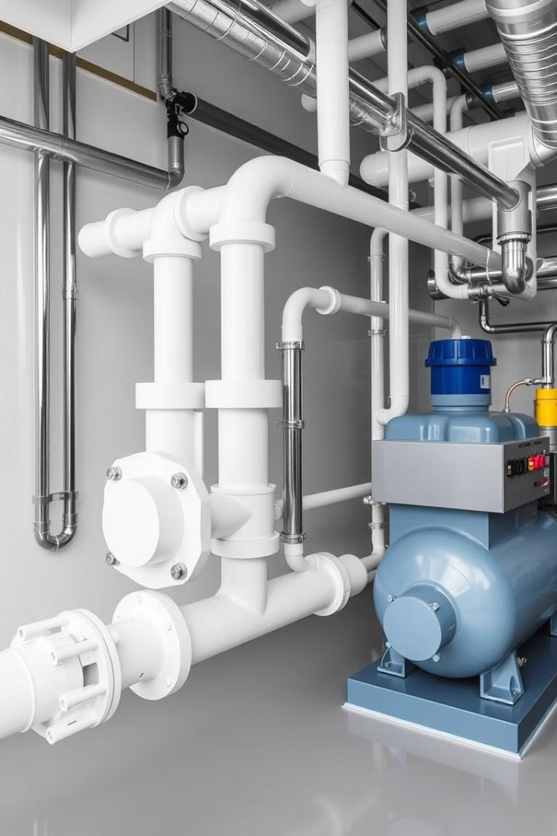

Lecture
on
Fluid Mechanics I
Prepared by
Anisul Islam
Lecturer
Department of ME, UGV

Slide 2
BASIC COURSE INFORMATION
Course Title | Fluid Mechanics I
Course Code | ME 0715-3121
Credits | 03
CIE Marks | 90
SEE Marks | 60
Exam Hours | 2 hours (Mid Exam) 3 hours (Semester Final Exam)
Level | 5th Semester

Slide 3
CLO1 | After Completing this Course a Student will be able to Understand fluid Properties, Fluid Pressure
CLO2 | After Completing this Course a Student will be able to Explain Velocity and Head loss, Pipe friction, Pump Functioning
CLO3 | After Completing this Course a Student will be able to Apply the concepts of Fluid Properties, Statistics and Dynamics.
CLO4 | After Completing this Course a Student will be able to Analyze Complex problems on Fluid flow, Pump Selection
CLO5 | After Completing this Course a Student will be able to Calculate and Evaluate losses on pipes, Pipe design, Pump efficiency

Slide 4


Slide 5
S. L | Content of Course | Hrs | CLOs
1 | Fluid Properties, Fluid Types, Newtons Law of Viscosity, Surface Tension , Capillary Action, Problem Solving | 4 | CLO 1, CLO 3
2 | Fluid Pressure, Atmospheric, Gauge , Vacuum Pressure, Pitot Tube, Stagnation Pressure, Piezometric Tube, Manometer, Types of Manometer, Problem Solving on Fluid Pressure | 06 | CLO 1, CLO 3
3 | Fluid flow Through Pipes | 06 | CLO 2, CLO 4, CLO 5
4 | Fluid Dynamics | 08 | CLO 3, CLO 4
5 | Pumps, Types of Pumps, Centrifugal and Reciprocating Pump, Problem Solving on Pumps | 08 | CLO 2, CLO 4, CLO 5

Slide 6
ASSESSMENT PATTERN
CIE- Continuous Internal Evaluation (90 Marks)
Bloom's Category Marks (out of 90) | Tests (45) | Assignments (10) | Class Test (20) | Quiz (5) | External Participation in Curricular/Co-Curricular Activities (10)
Remember | 5 |  | 10 | 05
Understand | 5 | 05 | 10
Apply | 10 |  |  |  | 10
Analyze | 15
Evaluate | 10
Create |  | 05

Slide 7
SEE- Semester End Examination (60 Marks)
Bloom's Category | Test
Remember | 10
Understand | 10
Apply | 10
Analyze | 10
Evaluate | 10
Create | 10

Slide 8
 | Course Plan Specifying Content, CLOs, Teaching Learning Strategy and Assessment Strategy
Week | Topics | Teaching Learning Strategy | Assessment Strategy | Corresponding CLOs
1 | Fluid Properties ( Density, Specific Weight, Specific Volume, Specific Gravity) | Lecture, Oral Presentation, PPT | Quiz, Written exam | CLO 1, CLO 3
2 | Fluid Types, Newtons Law of Viscosity, Surface Tension , Capillary Action, Problem Solving | Lecture, Oral Presentation, PPT | Quiz, Written exam | CLO 1, CLO 3
3 | Fluid Pressure, Atmospheric, Gauge , Vacuum Pressure, Pitot Tube, Stagnation Pressure, Piezometric Tube | Lecture, Oral Presentation, PPT | Quiz, Written exam, CT | CLO 1, CLO 3
4 | Manometer, types of Manometer | Lecture, Oral Presentation, PPT | Quiz, Written exam, CT | CLO 1, CLO 3

Slide 9
 | Course Plan Specifying Content, CLOs, Teaching Learning Strategy and Assessment Strategy
Week | Topics | Teaching Learning Strategy | Written exam | Corresponding CLOs
5 | Problem Solving on Manometer | Lecture, Oral Presentation, Video Presentation, PPT | Assignment, Written exam, Quiz CT | CLO 1, CLO 3
6 | Fluid flow Through Pipes | Lecture, Oral Presentation, PPT | Assignment, Quiz, Written exam, CT | CLO 2, CLO 4, CLO 5
7 | Fluid flow Through Pipes | Lecture, Oral Presentation, Video Presentation, PPT | Assignment, Quiz, Written exam, CT | CLO 2, CLO 4, CLO 5

Slide 10
 | Course Plan Specifying Content, CLOs, Teaching Learning Strategy and Assessment Strategy
Week | Topics | Teaching Learning Strategy | Assessment Strategy | Corresponding CLOs
8 | Fluid Flow Through Pipes | Lecture, Oral Presentation, PPT | Quiz, Written exam, Assignment, CT | CLO 2, CLO 4, CLO 5
9 | Fluid Dynamics | Lecture, Oral Presentation, Video Presentation, PPT | Quiz, Written exam, Assignment, CT | CLO 3, CLO 4
10 | Fluid Dynamics | Lecture, Oral Presentation, PPT | Assignment, Quiz, Written exam | CLO 3, CLO 4

Slide 11
 | Course Plan Specifying Content, CLOs, Teaching Learning Strategy and Assessment Strategy
Week | Topics | Teaching Learning Strategy | Assessment Strategy | Corresponding CLOs
11 | Fluid Dynamics Problem Solving | Lecture, Oral Presentation, PPT | Assignment, Quiz, Written exam, CT | CLO 3, CLO 4
12 | Fluid Dynamics Problem Solving | Lecture, Oral Presentation, PPT | Quiz, Written exam, CT | CLO 3, CLO 4
13 | Pumps, Types of Pumps, Centrifugal and Reciprocating Pump, Problem Solving on Pumps | Lecture, Oral Presentation, Video Presentation, PPT | Assignment, Quiz, Written exam, CT | CLO 2, CLO 4, CLO 5
14 | Pumps, Types of Pumps, Centrifugal and Reciprocating Pump, Problem Solving on Pumps | Lecture, Oral Presentation, Video Presentation, PPT | Quiz, Written exam | CLO 2, CLO 4, CLO 5
15 | Pumps, Types of Pumps, Centrifugal and Reciprocating Pump, Problem Solving on Pumps | Lecture, Oral Presentation, Video Presentation, PPT | Assignment, Quiz, Written exam, CT | CLO 2, CLO 4, CLO 5
16 | Pumps, Types of Pumps, Centrifugal and Reciprocating Pump, Problem Solving on Pumps | Lecture, Oral Presentation, Video Presentation, PPT | Assignment, Quiz, Written exam, CT | CLO 2, CLO 4, CLO 5
17 | Review Class on Problem solving | Group discussion

Slide 12
Week | Topic | Page No.
1 | Fluid Properties | 13-23
2 | Fluid Properties | 25-49
3 | Fluid Pressure | 51-58
4 | Fluid Pressure (Manometer) | 59-67
5 | Fluid Pressure (Manometer equation and Problem Solving) | 69-80
6 | Bernoulli Equation | 82-94
7 | Reynolds Number | 96-109
8 | Flow Through Pipes | 111-127
9 | Fluid Kinematics | 129-132
10 | Fluid Kinematics | 134-139
11 | Fluid Kinematics | 140-144
12 | Problem Solving on Fluid Kinematics | 145-149
13 | Pumps and its Classification | 151-161
14 | Centrifugal Pump | 163-172
15 | Centrifugal Pump | 174-188
16 | Reciprocating Pump | 190-201

Slide 13

Week -1
Lecture
on
Fluid Properties

Slide 14
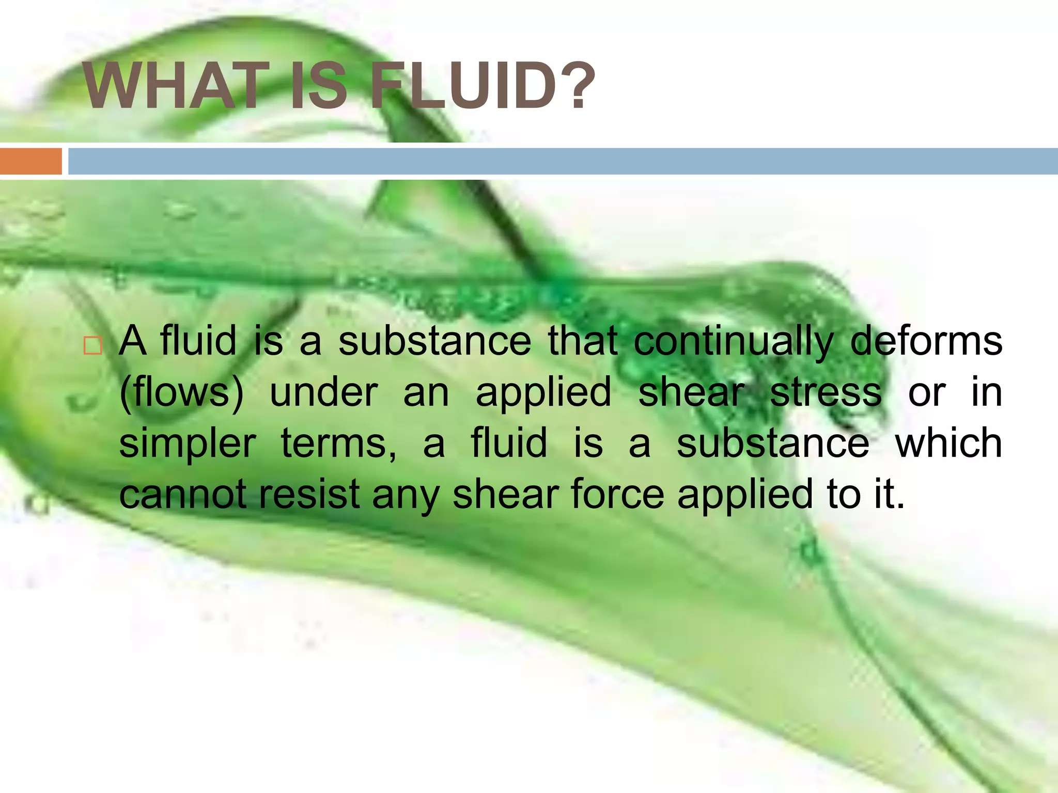

Slide 15
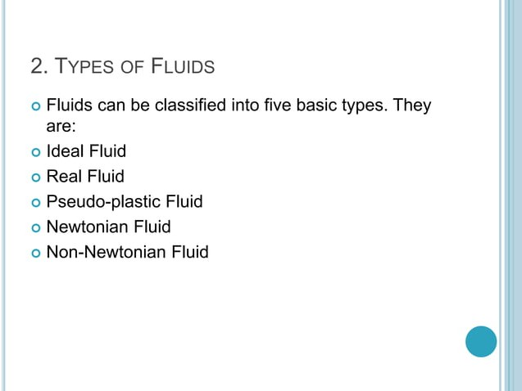

Slide 16
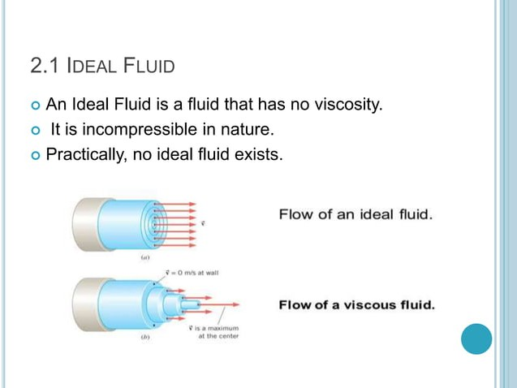

Slide 17
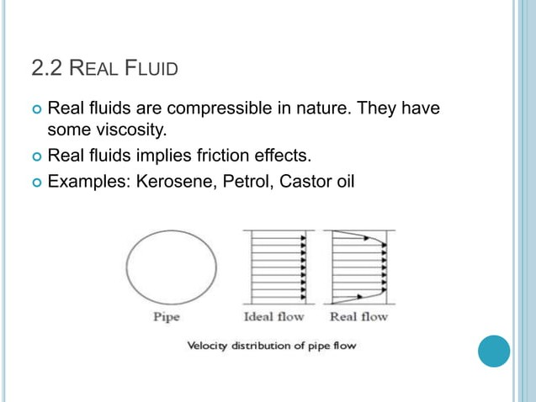

Slide 18
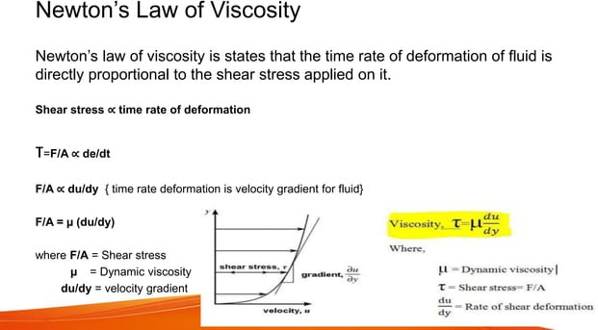

Slide 19
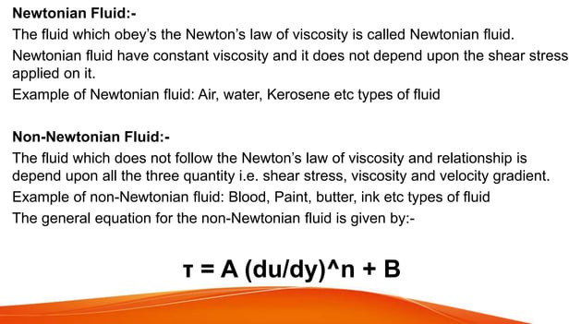

Slide 20
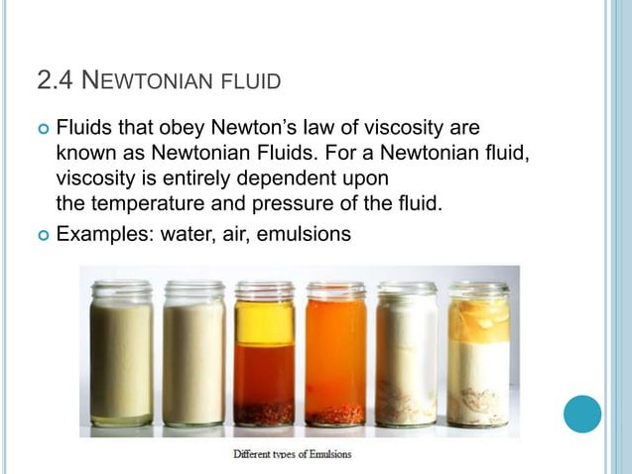

Slide 21
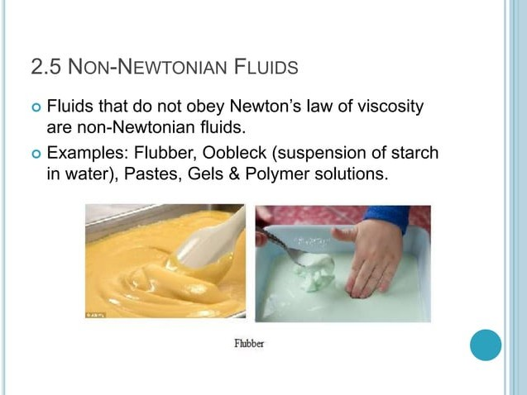

Slide 22
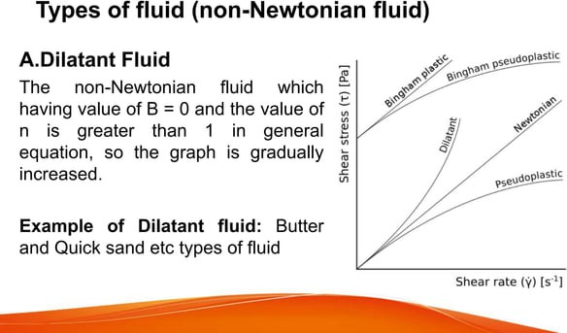

Slide 23
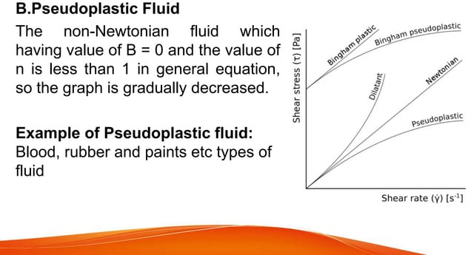

Slide 24
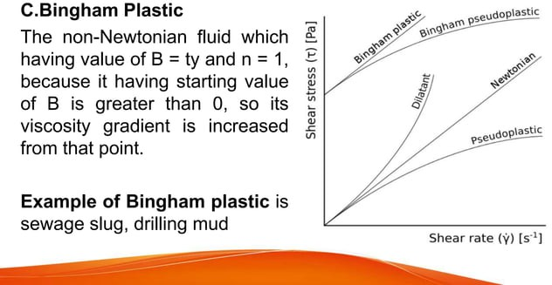

Slide 25
Week -2
Lecture
on
Fluid Properties

Slide 26
Fluid Properties: Density, Viscosity, and Surface Tension
Density
Viscosity
Surface Tension
Density measures the mass of a fluid per unit volume. It plays a crucial role in buoyancy and determining how a fluid responds to external forces.
Viscosity represents a fluid's resistance to flow. It impacts the speed of flow, energy losses, and the formation of boundary layers.
Surface tension arises from cohesive forces within a liquid, creating a thin film at its surface. It influences droplet formation, capillary action, and the behavior of bubbles.

Slide 27
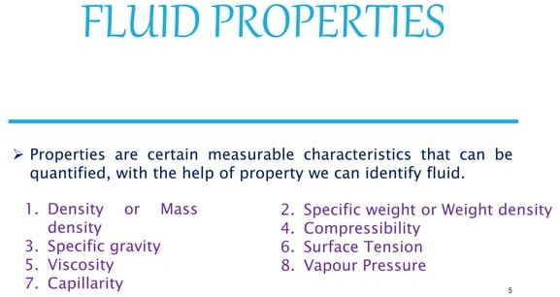

Slide 28
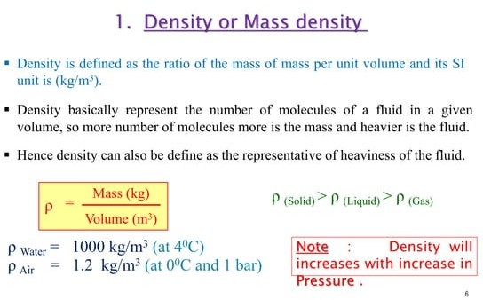

Slide 29
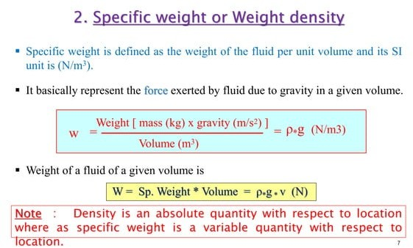

Slide 30
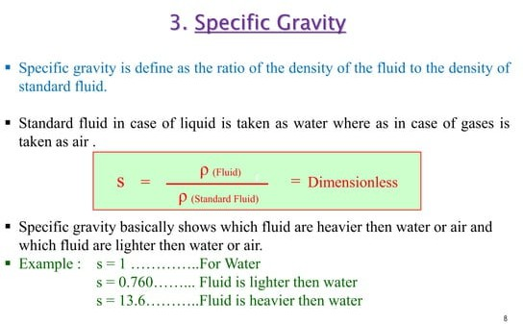

Slide 31
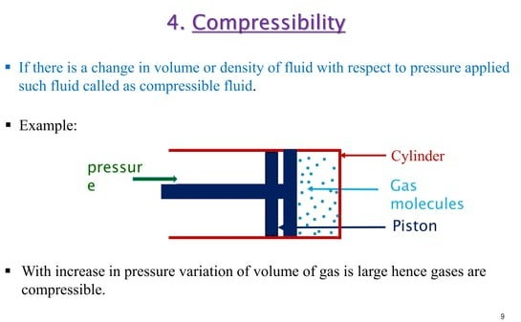

Slide 32
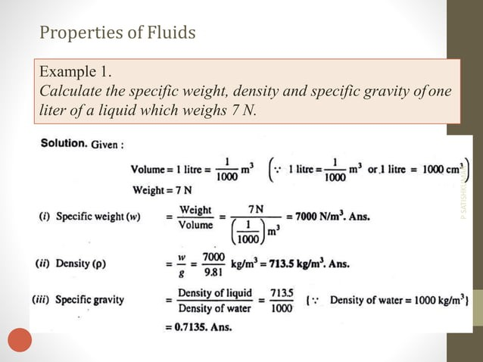

Slide 33
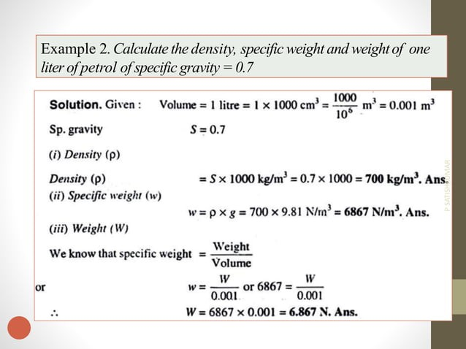

Slide 34
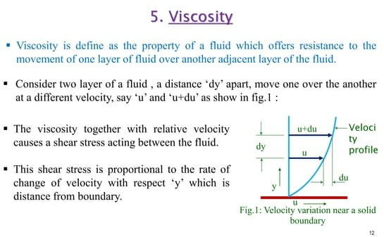

Slide 35
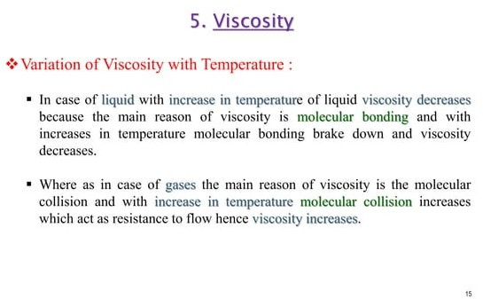

Slide 36
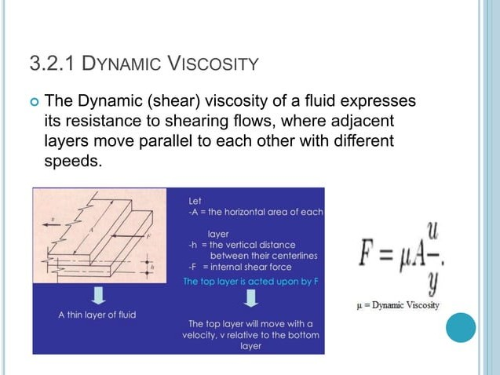

Slide 37
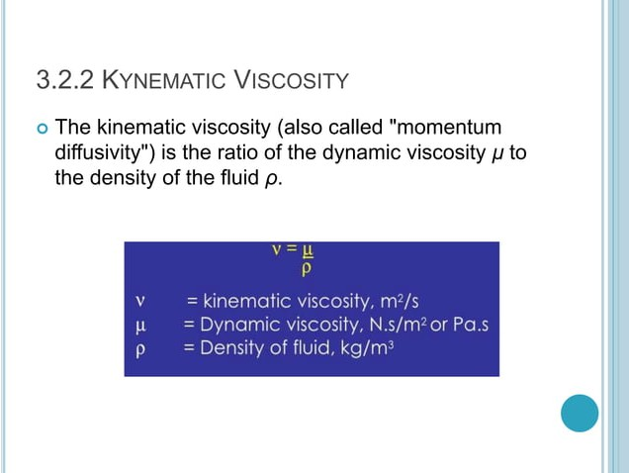

Slide 38
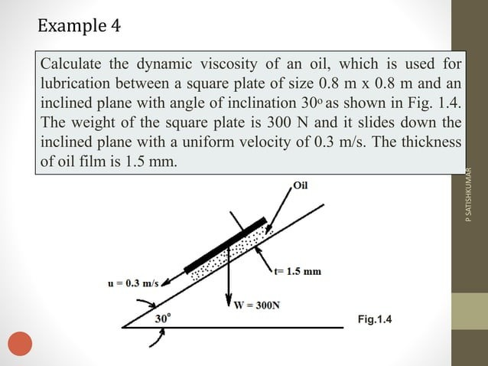

Slide 39
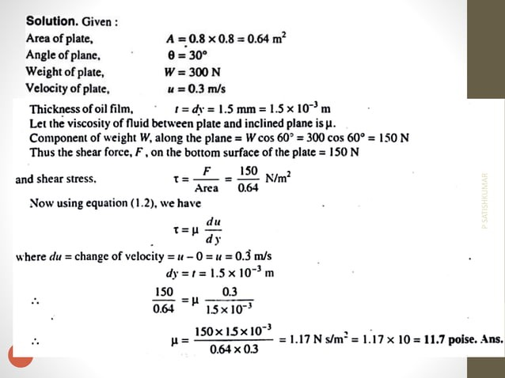

Slide 40
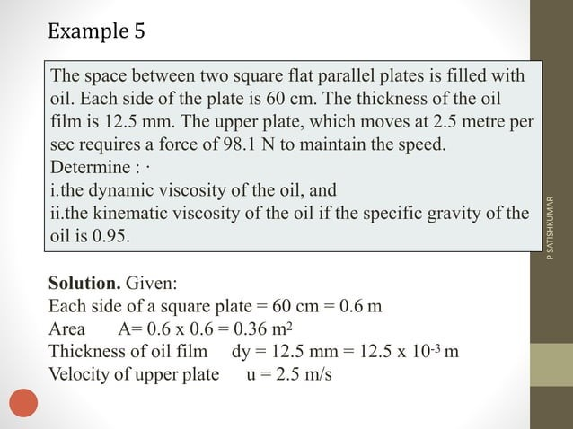

Slide 41
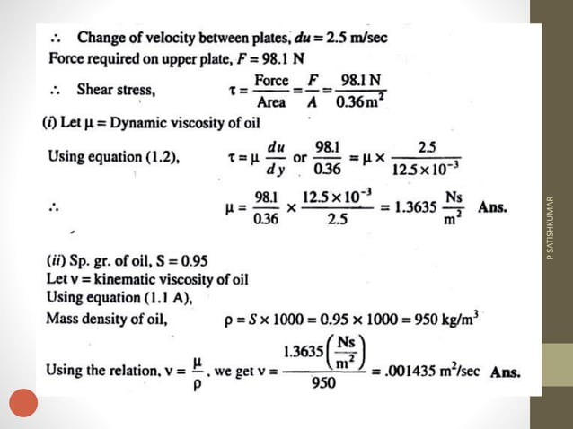

Slide 42
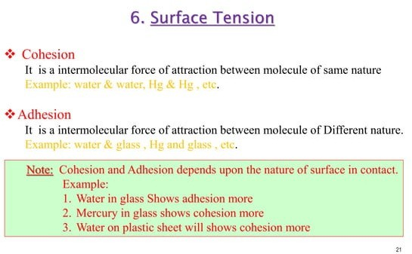

Slide 43
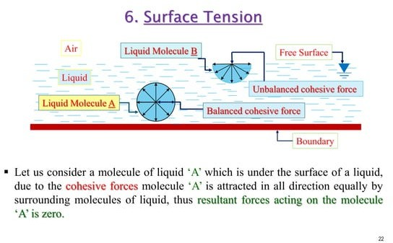

Slide 44
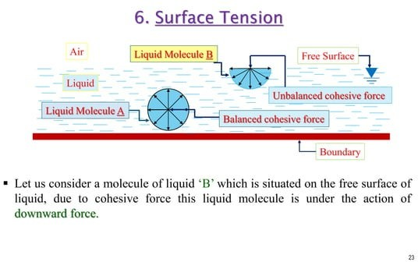

Slide 45
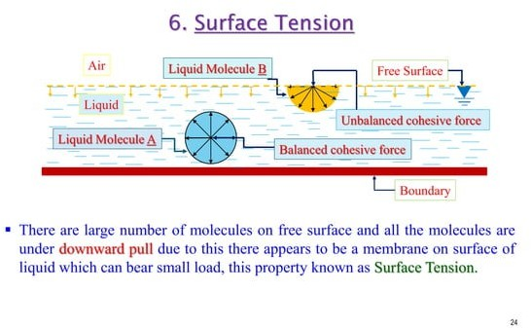

Slide 46
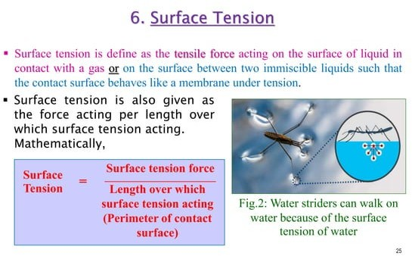

Slide 47
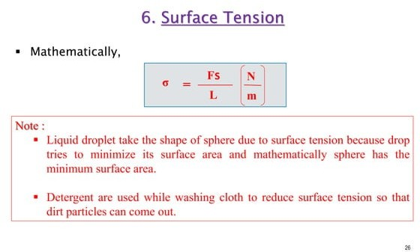

Slide 48
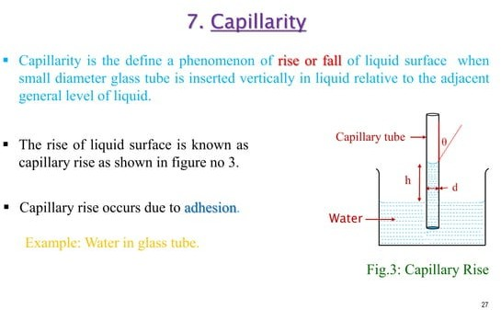

Slide 49
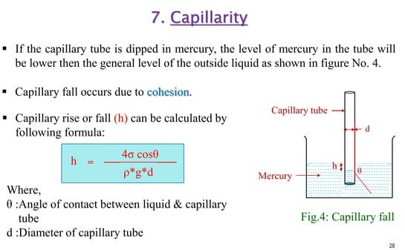

Slide 50
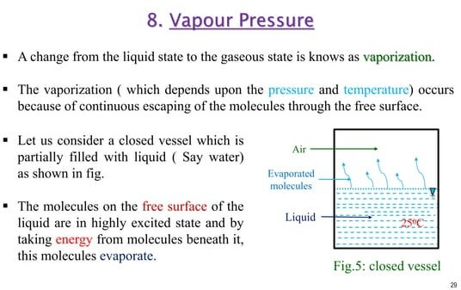

Slide 51
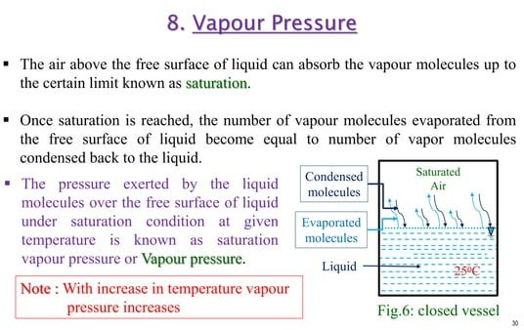

Slide 52
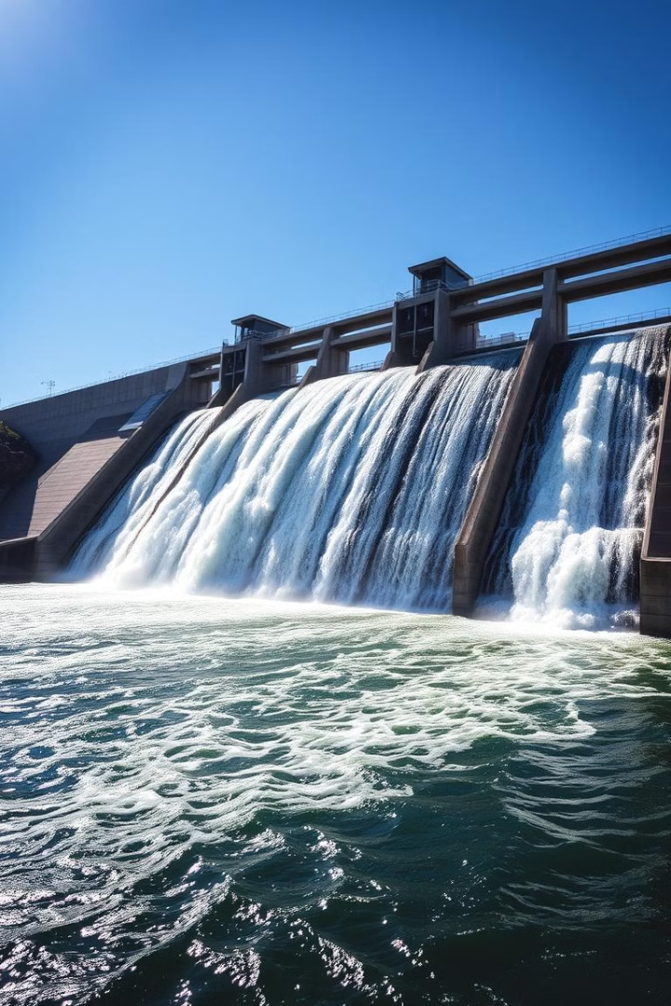
Week -3
Lecture
on
Fluid Pressure

Slide 53
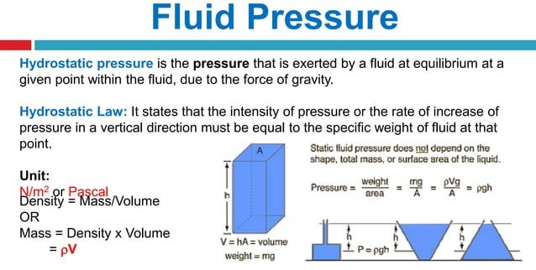

Slide 54
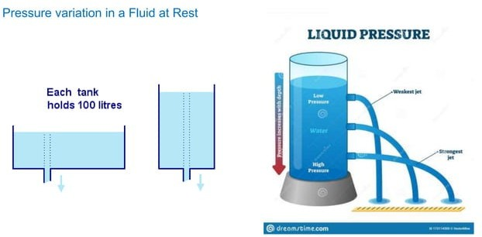

Slide 55
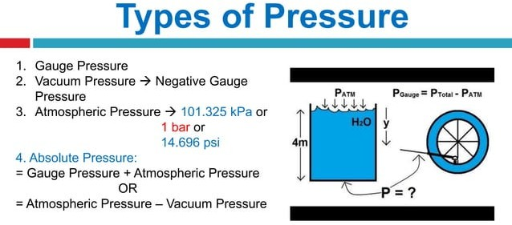

Slide 56
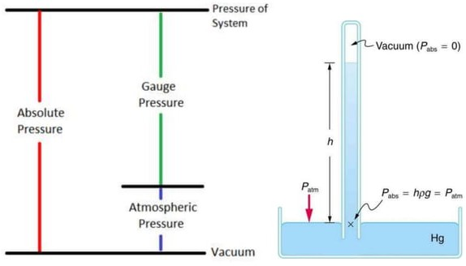

Slide 57
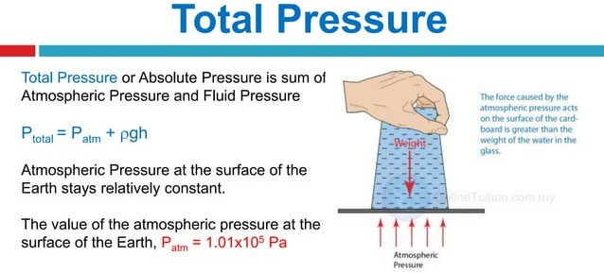

Slide 58
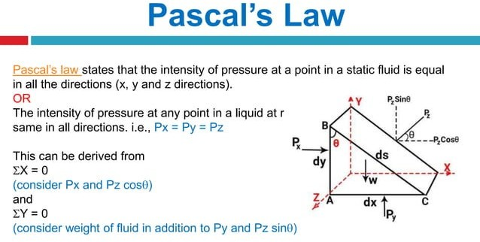

Slide 59
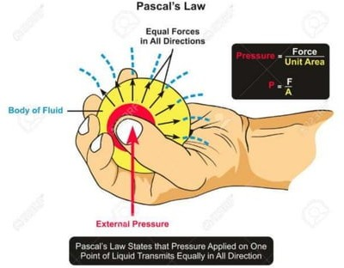

Slide 60
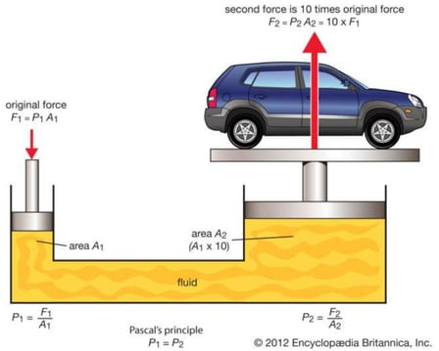

Slide 61
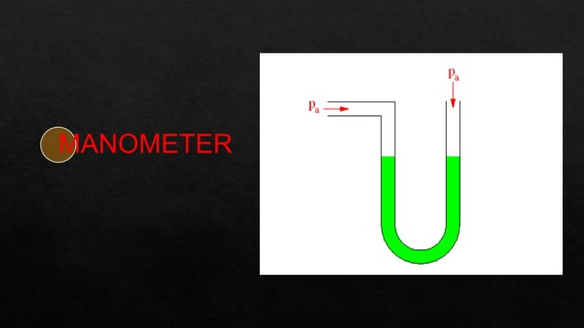
Week -4
Lecture
on
Manometer

Slide 62
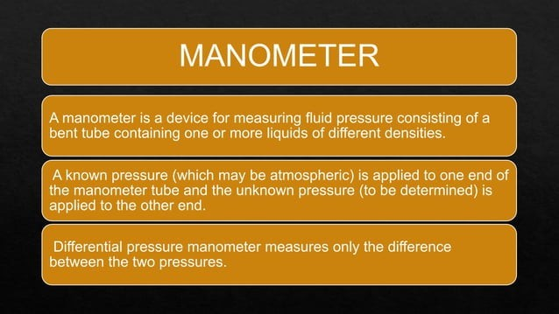

Slide 63
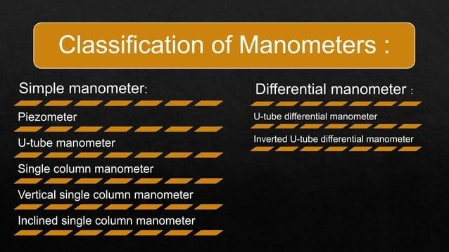

Slide 64
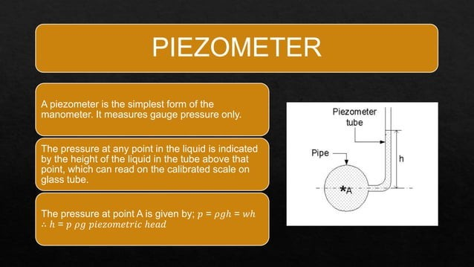

Slide 65


Slide 66


Slide 67


Slide 68


Slide 69


Slide 70

Week -5
Lecture
on
Manometer Equation
&
Problem Solving

Slide 71


Slide 72


Slide 73


Slide 74


Slide 75


Slide 76


Slide 77


Slide 78


Slide 79


Slide 80


Slide 81


Slide 82


Slide 83

Week -6
Lecture
on
Bernoulli Equation

Slide 84



Bernoulli's Principle and Its Applications
Conservation of Energy
Applications
Bernoulli's principle is a statement of energy conservation for an ideal fluid. It relates pressure, velocity, and height along a streamline.
Bernoulli's principle is applied in numerous applications, including aircraft lift generation, venturi meters, and fluid pumps.

Slide 85


Slide 86


Slide 87


Slide 88


Slide 89


Slide 90


Slide 91


Slide 92


Slide 93


Slide 94


Slide 95


Slide 96


Slide 97


Slide 98


Week -7
Lecture
on
Reynolds Number

Slide 99


Slide 100


Slide 101


Slide 102


Slide 103


Slide 104


Slide 105


Slide 106


Slide 107


Slide 108


Slide 109


Slide 110


Slide 111


Slide 112


Slide 113

Week -8
Lecture
on
Flow Through Pipes

Slide 114


Slide 115


Slide 116


Slide 117


Slide 118


Slide 119


Slide 120


Slide 121


Slide 122


Slide 123


Slide 124


Slide 125


Slide 126


Slide 127


Slide 128


Slide 129


Slide 130


Slide 131

Week -9
Lecture
on
Flow Kinematics

Slide 132


Slide 133


Slide 134


Slide 135


Slide 136
Week -10
Lecture
on
Flow Kinematics

Slide 137


Slide 138


Slide 139


Slide 140


Slide 141


Slide 142
Week -11
Lecture
on
Flow Kinematics

Slide 143


Slide 144


Slide 145


Slide 146


Slide 147
Week -12
Lecture
on
Fluid Kinematics
Problem Solving

Slide 148


Slide 149


Slide 150


Slide 151


Slide 152


Slide 153

Week -13
Lecture
on
Pump Classification

Slide 154


Slide 155


Slide 156


Slide 157


Slide 158


Slide 159


Slide 160


Slide 161


Slide 162


Slide 163


Slide 164


Slide 165

Week -14
Lecture
on
Centrifugal Pump

Slide 166

Fluid Machinery: Pumps, Turbines, and Compressors
1
2
Pumps
Turbines
Pumps are used to increase the pressure of a fluid and move it from one point to another.
Turbines convert fluid energy (kinetic or potential) into mechanical energy. They are used in power generation and other applications.
3
Compressors
Compressors increase the pressure and density of a gas. They are essential in refrigeration, air conditioning, and other industries.

Slide 167


Slide 168


Slide 169


Slide 170


Slide 171


Slide 172


Slide 173


Slide 174


Slide 175


Slide 176
Week -15
Lecture
on
Centrifugal Pump

Slide 177


Slide 178


Slide 179


Slide 180


Slide 181


Slide 182


Slide 183


Slide 184


Slide 185


Slide 186


Slide 187


Slide 188


Slide 189


Slide 190


Slide 191


Slide 192

Week -16
Lecture
on
Reciprocating Pump

Slide 193


Slide 194


Slide 195


Slide 196


Slide 197


Slide 198


Slide 199


Slide 200


Slide 201


Slide 202


Slide 203


Slide 204


Slide 205












Thank You For Your Attention

