Slide 1
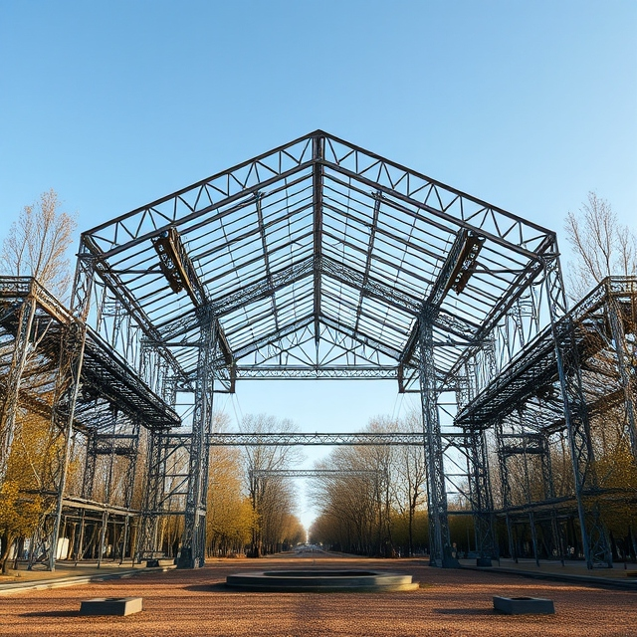

Lecture
on
Mechanics of Solids
Prepared by
Anisul Islam
Lecturer
Department of ME, UGV

Slide 2

Course Title | Mechanics of Solids
Course Code | ME 0715-2243
Credits | 03
CIE Marks | 90
SEE Marks | 60
Exam Hours | 2 hours (Mid Exam) 3 hours (Semester Final Exam)
Level | 4th Semester
BASIC COURSE INFORMATION

Slide 3
Mechanics of Solids-I
Course Code: ME 0715-2243 | CREDIT:03
 | TOTAL MARKS:150
Mid Exam Hours 2 | CIE MARKS: 90
Semester End Exam Hours 3 | SEE MARKS: 60
Course Teacher: Anisul Islam
Course Learning Outcomes (CLOs): After completing this course successfully, the students will be able to-
CLO 1 | Understand the types of loads and stresses in different loaded members and develop skills to determine them.
CLO 2 | Identify the magnitude of safe loads and stresses to operate individual members and structures without failure.
CLO 3 | Perform structural design by determining the value of shear force and bending moment at a given point for structural members such as a beam, column, frame, etc.
CLO 4 | Assess the deflections and deformations of loaded flexural members.

Slide 4
SL | Content of Course | Hrs | CLOs
1 | Introduction and analysis of internal forces: Tension, compression, axial stress, strain, shear stress, shear force, bending moment, deformation, stress-strain diagram, elasticity, rigidity, yield strength, ultimate strength, strain hardening, strain softening, elastic limits, plastic limit, fracture point, ductility, engineering stress-strain, true stress-strain, bone shear failure, hardness, brittleness, resilience and toughness. | 8 | CLO1, CLO 2
2 | Definition of some mechanical properties of materials: Poisson’s ratio, definition of torque and torsion, stresses in thin walled pressure vessels: hoop and longitudinal stress, Thermal Stress-strain Equation, Problem Solving, Thin Walled Pressure Vessel Equation | 8 | CLO2, CLO 3
3 | Shear Force and Bending Moment Diagram, Bending Stress, Equation, Problem Solving | 6 | CLO2, CLO3
4 | Torsion and Mohr's Circle | 10 | CLO3, CLO4
Text Book:
Strength of Materials (4th ed.). Pytel, A. & Singer, F. L., Harper Collins Inc., 1987; ISBN: 0-06-350599-1
Mechanics of Materials. Beer and Johnston; McGraw- Hill, 2009; ISBN: 0073529389
Mechanics of Materials (9th ed.). Hibbeler, R. C., Pearson Prentice Hall, 2014; ISBN: 10: 0-13-3254429

Slide 5
ASSESSMENT PATTERN
CIE- Continuous Internal Evaluation (90 Marks)
SEE- Semester End Examination (60 Marks)
Bloom’s Category | Tests
Remember | 10
Understand | 10
Apply | 10
Analyze | 15
Evaluate | 10
Create | 5
Bloom’s Category Marks (out of 90) | Tests (45) | Assignments (15) | Quizzes (15) | External Participation in Curricular/Co-Curricular Activities (15)
Remember | 10 |  | 10 | Attendance 15
Understand | 5 |  | 5
Apply | 10
Analyze | 10
Evaluate | 5
Create | 5 | 15

Slide 6
Course plan specifying content, CLOs, teaching learning and assessment strategy mapped with CLOs
Week | Topic | Teaching-Learning Strategy | Assessment Strategy | Corresponding CLOs
1 | Tension, compression, axial stress, strain, Shear stress, shear force, bending moment, deformation | Lecture, discussion, group work | Quiz, Written Exam | CLO1
2 | Tensile stress-strain diagram | Oral Presentation, Lecture, discussion, group work | Assignment, Written, Quiz | CLO1
3 | Elasticity, rigidity, yield strength, ultimate strength, Elastic limits, plastic limit and fracture point, Strain hardening and strain softening properties | Video lecture | Report writing, Demonstration | CLO1
4 | Details of ductility, True stress-strain Diagram, Bone shear failure | Lecture | Viva, Quiz | CLO1, CLO2
5 | Hardness and brittleness, Resilience and toughness, Poisson’s ratio and torque | Lecture, discussion, group work | Project, Field visit | CLO2
6 | hoop stress and longitudinal stress | Discussion, Video Presentation | Quiz, Written Exam | CLO2
7 | SFD and BMD Problem solving | Case-based Learning, Demonstration | Assignment, Written, Quiz | CLO2
8 | Thin Walled Pressure Vessel Equation, Problem Solving | Lecture, discussion, group work | Report writing, Demonstration | CLO2
9 | Thermal Stress-strain Equation | Oral Presentation, debate | Viva, Quiz | CLO2
10 | Expression for bending Stress | Video lecture | Project, Field visit | CLO3

Slide 7
Course plan specifying content, CLOs, teaching learning and assessment strategy mapped with CLOs
Week | Topic | Teaching-Learning Strategy | Assessment Strategy | Corresponding CLOs
11 | Bending stress related problem | Lecture, Oral Presentation | Quiz, Written Exam | CLO3
12 | Torsion | Lecture, discussion, | Assignment, Written, Quiz | CLO3
13 | Torsion | Discussion, Video Presentation | Report writing, Demonstration | CLO 3
14 | Mohr Circle construction Principle | Case-based Learning, Demonstration | Viva, Quiz | CLO3
15 | Mohr Circle Related Problem | Lecture, discussion, group work | Project, Field visit | CLO4
16 | Mohr Circle Related Problem | Oral Presentation | Quiz, Written Exam | CLO4
17 | Practice and Exercise, Practice and Exercise, Practice and Exercise | Group Discussion | Assignment, Written, Quiz | CLO3, CLO4

Slide 8
Basic Materials Properties
Week 1
Pages (9-16)

Slide 9
Tension and Compression
Tension and compression are forces that act on materials, causing them to stretch or squeeze in different ways:
Tension
A pulling or stretching force that causes a material to elongate or deform. Tension is often referred to as positive stress.
Compression
A pushing or squeezing force that causes a material to shorten or deform. Compression is often referred to as negative stress.

Slide 10

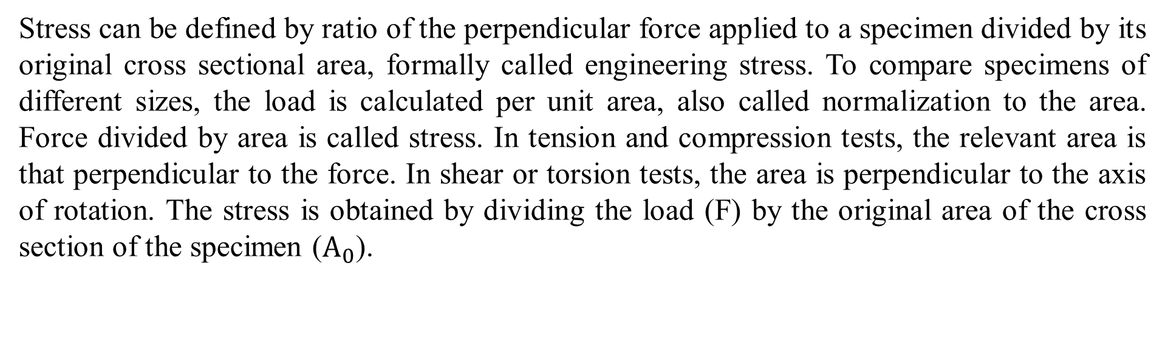
Axial Stress and Strain
Stress can be defined by ratio of the perpendicular force applied to a specimen divided by its original cross sectional area, formally called engineering stress. To compare specimens of different sizes, the load is calculated per unit area, also called normalization to the area. Force divided by area is called stress. In tension and compression tests, the relevant area is that perpendicular to the force. In shear or torsion tests, the area is perpendicular to the axis of rotation. The stress is obtained by dividing the load (F) by the original area of the cross section of the specimen ($A_{0}$).

Slide 11

Axial Stress and Strain
Strain is the ratio of change in length due to deformation to the original length of the specimen, formally called engineering strain. strain is unit less, but often units of m/m (or mm/mm) are used.
The strain used for the engineering stress-strain curve is the average linear strain, which is obtained by dividing the elongation of the gage length of the specimen, by its original length.

Slide 12
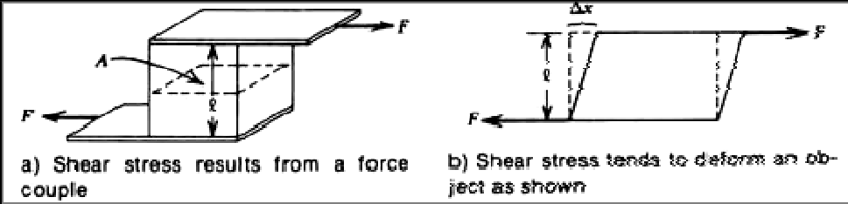
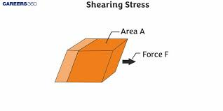
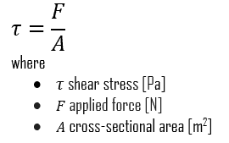
Shear Stress
Tensile and compressional stress can be defined in terms of forces applied to a uniform rod.
Shear stress is defined in terms of a couple that tends to deform a joining member.

Slide 13
Shear force definition
Shear force is a force acting in a direction that's parallel to a surface or cross section of a body. The word shear in the term is a reference to the fact that such a force can cut, or shear, through the surface or object under strain. In solid mechanics, shearing forces are unaligned forces pushing one part of a body in one specific direction, and another part of the body in the opposite direction. When the forces are collinear (aligned into each other), they are called compression forces.
Longitudinal direction
Cross-section

Slide 14
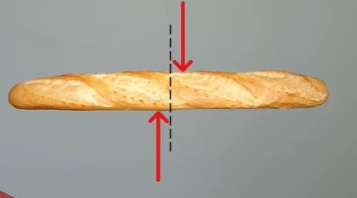
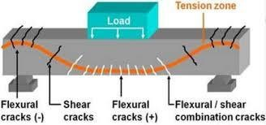
Shear force example
Example: Cutting bread, Cutting paper, beam bending, drawing picture, sliding cash note, painting, brushing teeth, bone shear failure etc.
Figure: Shear force example

Slide 15
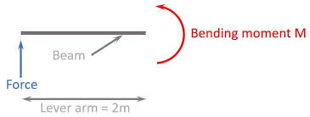
Bending Moment
Bending moment is the internal resistance of a structural element to bending when an external force is applied. It's a measure of the effect of a load that causes a structural member to bend.
Bending moment = Force x Distance
Deformation
In civil engineering, deformation is the change in shape or size of an object due to an applied force or change in temperature.
Figure: Bending moment

Slide 16
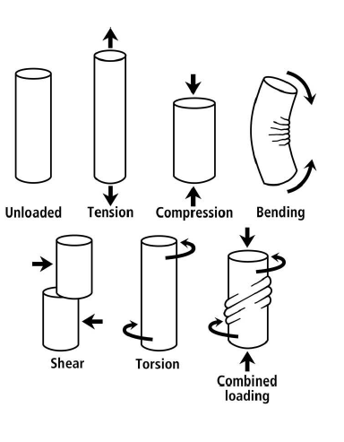
Figure: Different types of loading condition in material.

Slide 17
Basic Materials Properties
Week 2
Pages (17-18)

Slide 18
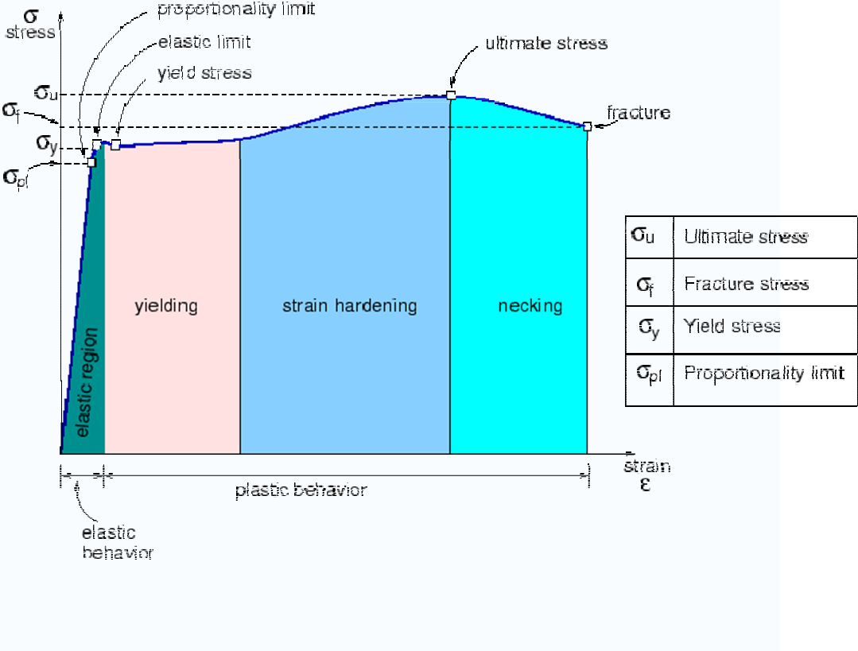
Figure: Tensile stress-strain diagram of reinforcement.

Slide 19
Basic Materials Properties
Week 3
Pages (20-23)

Slide 20
A tensile stress-strain diagram, also known as a stress-strain curve, illustrates the relationship between a material's stress and strain. The curve can be used to determine a material's characteristic values, such as its elastic behavior and tensile strength.
Some properties of a tensile stress-strain diagram include:
Proportional limit: The highest stress at which stress and strain are directly proportional. This is the point on the curve where the deviation from the straight-line portion begins.
Elastic limit: The greatest stress a material can withstand without any permanent strain.
Yield strength: The stress required to produce a small amount of plastic deformation.
Modulus of resilience: The work done on a unit volume of material as the force increases from zero to the elastic limit. It is also known as Young's modulus of elasticity, and is analogous to the stiffness of a spring.

Slide 21
Hooke’s Law
For materials stressed in tension, at relatively low levels, stress and strain are proportional through:
Here, constant E is known as the modulus of elasticity, or Young’s modulus.
Within the linear region, a specific type of material will always follow the same curves despite different physical dimensions. Thus, it can say that the linearity and slope are a constant of the type of material only. In tensile and compressional stress, this constant is called the modulus of elasticity or Young's modulus (E). So,
where stress = F/A in N/m² strain = Dl/l unit less
E = Modulus of elasticity in N/m²

Slide 22
The modulus of elasticity has units of stress, that is, N/m². The following table gives the modulus of elasticity for several materials. In an exactly similar fashion, the shear modulus is defined for shear stress-strain as modulus of elasticity.
Material | Modulus (N/m²)
Aluminum | 6.89 x 10¹⁰
Copper | 11.73 X 10'° 20.70 X 10¹⁰
Steel | 2.1 x 10⁸

Slide 23
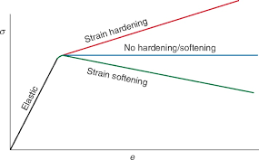
Strain hardening refers to a material becoming stronger and harder with increasing strain, while strain softening means a material becomes weaker with increasing strain; essentially, in strain hardening, stress increases with deformation, whereas in strain softening, stress decreases with deformation as strain increases.

Slide 24
Basic Materials Properties
Week 4
Pages (25-28)

Slide 25
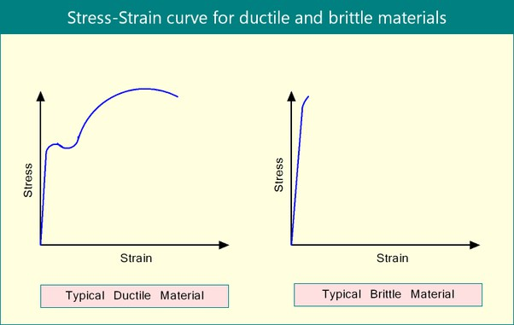
Ductility:
Ductility describes the extent to which a material (or structure) can undergo large deformations before fracture. The term is used in earthquake engineering to designate how well a building will endure large lateral displacements imposed by ground shaking.
A ductile structure's ability to dissipate energy during an earthquake is, therefore, also advantageous as it will keep deforming without reaching ultimate failure or collapse. An example of a ductile structure is a properly detailed steel frame with that will enable it to undergo large deformations before the onset of failure.

Slide 26
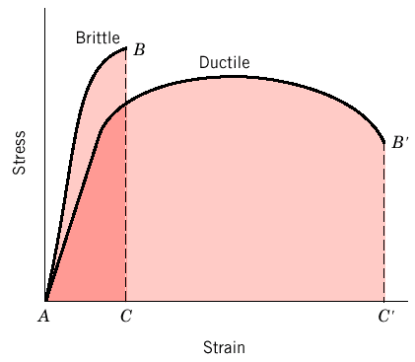
Figure: Brittle vs Ductile Material.

Slide 27
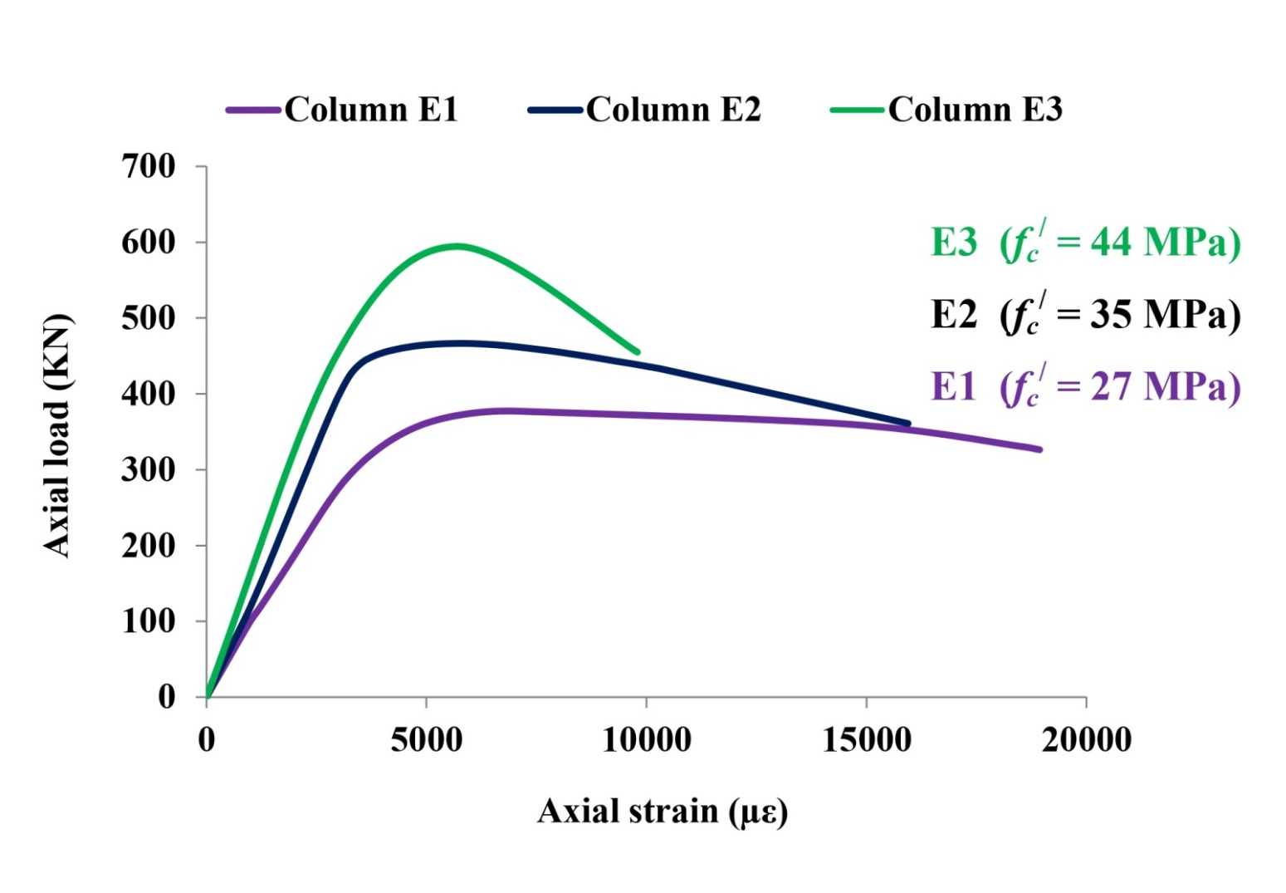

Figure: What do you think which colour exhibits less ductile behaviour?????.

Slide 28
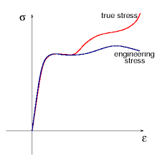
True Stress versus Engineering Stress
While both "stress" and "strain" measure deformation in a material, the key difference between "true stress/strain" and "engineering stress/strain" lies in how the cross-sectional area is considered: "engineering" calculations use the original cross-sectional area of the material, while "true" calculations use the instantaneous, changing cross-sectional area during deformation, making true stress/strain values always higher than engineering stress/strain, especially at large deformations.

Slide 29
Basic Materials Properties
Week 5
Pages (30-33)

Slide 30
Hardness
Hardness is the resistance of a material to localized plastic deformation. Hardness is a measure of a material's resistance to permanent deformation. Toughness is a measure of how much deformation a solid material can undergo before fracturing. Hardness is often inversely related to ductility, so the ductile metals mentioned above typically have relatively low hardness.
The product EI is termed the "beam stiffness", or sometimes the "flexural rigidity". It is often given the symbol Σ. It is a measure of how strongly the beam resists deflection under bending moments.

Slide 31
Stiffness is how a component resists elastic deformation when a load is applied. Hardness is resistance to localized surface deformation.
The modulus of rigidity, also known as shear modulus, is defined as the ratio of shear stress to shear strain of a structural member. This property depends on the material of the member: the more elastic the member, the higher the modulus of rigidity.
Stiffness is the extent to which an object resists deformation in response to an applied force.
Elastic modulus is a measure of stiffness. Steel is stiffer than rubber thus its modulus is higher.
Stiff → not easily bent or changed in shape. Rigid → unable to bend or be forced out of shape, not flexible.
Rigidity, on the other hand, refers to the opposite property of elasticity. It is the inability of a material to deform under an external force. Flexibility is the ability of a material to bend, twist or stretch without breaking. This property depends on the material's elasticity and plasticity.

Slide 32
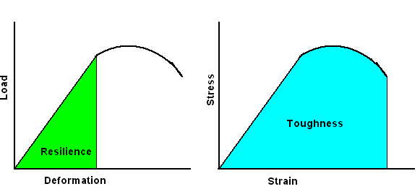
Resilience
The resilience of the material is the triangular area underneath the elastic region of the curve. In physics and engineering, resilience is defined as the capacity of a material to absorb energy when it is deformed elastically and then, upon unloading to have this energy recovered.
Toughness
The area underneath the stress-strain curve is the toughness of the material- i.e. the energy the material can absorb prior to rupture.. It also can be defined as the resistance of a material to crack propagation. The ability of a metal to deform plastically and to absorb energy in the process before fracture is termed toughness. A material with high strength and high ductility will have more toughness than a material with low strength and high ductility.
Comparison between resilience and toughness of metals

Slide 33

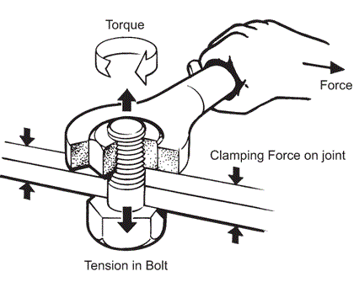
Poisson ratio
Poisson ratio is the ratio of transverse contraction (or expansion) strain to longitudinal extension strain in the direction of stretching force. Tensile deformation is considered positive and compressive deformation is considered negative.
Torque (Twisting Moment)
Torque typically refers to the tendency of a force to rotate an object around an axis. It is commonly used in the context of engines, vehicles, and rotating machinery. Torque is a measure of the rotational force applied to an object and is typically expressed in units such as newton-meters or foot-pounds.

Slide 34
Basic Materials Properties
Week 6
Pages (35-36)

Slide 35
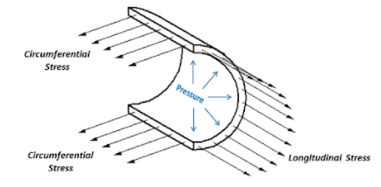
Hoop stress and longitudinal stress are two types of stress that occur in cylindrical pipes:
Hoop stress
Also known as tangential stress, this stress runs around the pipe in a ring-like pattern. It's caused by internal pressure and acts perpendicular to the pipe's axis and radius.
Longitudinal stress
This stress runs up the pipe in an axial direction. It occurs when the length of the pipe changes due to normal stress.
The relationship between hoop stress and longitudinal stress depends on the thickness of the pipe wall relative to its radius:
Thin-walled pipes
In most practical engineering applications, the hoop stress is about twice the magnitude of the longitudinal stress. This is because the wall thickness is small compared to the radius..
Longitudinal stress and Hoop stress

Slide 36
Thick-walled pipes
In these cases, the relationship between the two types of stress is more complex and may require more advanced analysis.
Click this link
Hoop Stress
Longitudinal Stress

Slide 37
SFD & BMD Problem Solving
Week 7
Pages (38-59)

Slide 38
Problem-1: Find the SFD (Shear Force Diagram) & BMD (Bending Moment Diagram) of the following beam.
5 K
A
10′

Slide 39
Solution:
5 K
A
M_{A} = 50 K-ft.
10′
∑ F_{y} = 0
=> 5 - R_{A} = 0
=> R_{A} = 5 K.
R_{A} = 5 K
5 K
5 K
SFD
∑ M_{A} = 0
=> 5 x 10 - M_{𝐴} = 0
=> M_{𝐴} = 50 K-ft.
0 K-ft.
50 K-ft.
BMD

Slide 40
Problem-2: Find the SFD (Shear Force Diagram) & BMD (Bending Moment Diagram) of the following beam.
5 K
A
10′

Slide 41
Solution:
5 K
A
M_{A} = 50 K-ft.
10′
∑ F_{y} = 0
R_{A} = 5 K
=> 5 - R = 0
A
=> R_{A} = 5 K.
5 K
5 K
SFD
∑ M_{A} = 0
=> 5 x 10 - M_{𝐴} = 0
0 K-ft.
=> M = 50 K-ft.
𝐴
50 K-ft.
BMD

Slide 42
Problem-3: Find the SFD (Shear Force Diagram) & BMD (Bending Moment Diagram) of the following beam.
10′
A
5 K

Slide 43
Solution:
R_{A} = 5 K
10′
M_{A} = 50 K-ft.
A
5 K
∑ F_{y} = 0
=> - 5 + R_{A} = 0
=> R_{A} = 5 K.
5 K
5 K
SFD
∑ M_{A} = 0
=> 5 x 10 - M_{𝐴} = 0
50 K-ft.
0 K-ft.
=> M = 50 K-ft.
𝐴
BMD

Slide 44
Problem-4: Find the SFD (Shear Force Diagram) & BMD (Bending Moment Diagram) of the following beam.
5 K
₅′
₅′
A

Slide 45
Solution:
5 K
A
₅′
₅′
M_{A} = 25 K-ft.
∑ F_{y} = 0
=> 5 - R_{A} = 0
=> R_{A} = 5 K.
R_{A} = 5 K
 | SFD
 | BMD
5 K
5 K
∑ M_{A} = 0
=> - 5 x 5 + M_{𝐴} = 0
0 K-ft.
=> M = 25 K-ft.
𝐴
25 K-ft.

Slide 46
Problem-5: Find the SFD (Shear Force Diagram) & BMD (Bending Moment Diagram) of the following beam.
A
3 k/ft.
₅′

Slide 47
Solution:
A
3 k/ft.
M_{A} = 50 K-ft.
₅′
∑ F_{y} = 0
=> 3 x 5 - R = 0
R_{A} = 15 K
A
1⁰ Curve SFD
2⁰ Curve BMD
=> R_{A} = 15 K.
0 K
15 K
∑ M_{A} = 0
2
=> ^{𝑤𝑙} - M = 0
𝐴
0 K-ft.
2
37.5 K-ft.
3 𝑥 5²
=> M_{𝐴} =
= 37.5 K-ft.
2

Slide 48
Solution:
5 K
5 K
3 k/ft.
10′
₅′
₅′
₅′
 | SFD
 |  | 1⁰ Curve
 | BMD
1⁰ Curve SFD
2⁰ Curve BMD
SFD
1⁰ Curve
BMD

Slide 49
Problem-6: Find the SFD (Shear Force Diagram) & BMD (Bending Moment Diagram) of the following beam.
A
3 k/ft.
₅′

Slide 50
Solution:
A
3 k/ft.
M_{A} = 37.5 K-ft.
₅′
∑ F_{y} = 0
=> 3 x 5 - R_{A} = 0
=> R_{A} = 15 K.
R_{A} = 15 K
15 K
1⁰ Curve
0 K
SFD
∑ M_{A} = 0
2
=> ^{𝑤𝑙} - M = 0
𝐴
0 K-ft.
2⁰ Curve
2
37.5 K-ft.
3 𝑥 5²
=> M_{𝐴} =
= 37.5 K-ft.
BMD
2

Slide 51
Problem-7: Find the SFD (Shear Force Diagram) & BMD (Bending Moment Diagram) of the following beam.
3 k/ft.
A
₅′
₅′

Slide 52
Solution:
3 k/ft.
A
₅′
₅′
M_{A} = 112.5 K-ft.
R_{A} = 15 K
∑ F_{y} = 0
=> 3 x 5 - R_{A} = 0
=> R_{A} = 15 K.
1⁰ Curve 15 |  | K
 | SFD
2⁰ Curve 37.5 K |  | -ft. 1⁰ Cu
 | BMD
0 K
15 K
∑ M_{A} = 0
=> wl (5 + ^{𝑙}) - M = 0
0 K-ft.
2
𝐴
112.5 K-ft.
rve
=> M =3 x 5 (5 + ⁵)= 112.5 K-ft.
𝐴
2

Slide 53

Problem-8: Find the SFD (Shear Force Diagram) & BMD (Bending Moment Diagram) of the following beam.
10 k/ft.
₉′
A

Slide 54

w k/ft.
10 k/ft.
∑ F_{y} = 0
=> 0.5 x 9 x 10 - R_{A} = 0
=> R_{A} = 45 K.
X
Solution:
M_{A} = 135 K-ft.
₉′
A
R_{A} = 45 K
∑ M_{A} = 0
=> Area x cantorial distance - M_{𝐴} = 0
X
2⁰ Curve SFD
3⁰ Curve BMD
0 K
=> 0.5 x 9 x 10 x ⁹ - M = 0
3
𝐴
45 K
=> M = 135 K-ft.
𝐴
10 ₌ 𝑤
9 𝑥
=> w =
V = - ¹ . x . (¹⁰ . x)
0 K-ft.
x
2
9
2
= - ^{5 𝑥} [0≤x≤9]
10
. x
135 K-ft.
9
9
M = - ^{5 𝑥} . ^{𝑥} [0≤x≤9]
2
x
9
3

Slide 55
Problem-9: Find the SFD (Shear Force Diagram) & BMD (Bending Moment Diagram) of the following beam.
10 k/ft.
_{A 6}′

Slide 56
w k/ft.
10 k/ft.
X
V = 30 - ¹ . x . (¹⁰ . x)
10 𝑤
𝑥
Solution:
x
2 6
5 𝑥²
=
= 30 -
6
6
=> w = ¹⁰ . x
A
₆′
[0≤x≤6]
M_{x} = - 120 + 30x -
[0≤x≤6]
6
M_{A} = 120 K-ft.
𝑥 3
5 𝑥²
.
R_{A} = 30 K
6
X
30 K
2⁰ Cu
SFD
3⁰ Curve BMD
rve
0 K
x | V_{x} (kip) | M_{x} (kip-ft.)
0 | 30 | - 120
2 | 26.67 | - 62.22
4 | 16.67 | - 17.78
6 | 0 | 0
0 K-ft.
120 K-ft.

Slide 57
Problem-10: Find the SFD (Shear Force Diagram) & BMD (Bending Moment Diagram) of the following beam.
10 K
10 K
₃′
₆′
₃′
A
B

Slide 58
10 K
10 K
Solution:
A
B
₃′
₆′
₃′
∑ M_{A} = 0
=> 10 x 3 + 10 x (6 + 3) - R
R_{A} = 10 K
R_{B} = 10 K
B
x 12 = 0
10 K
0 K
30 K | SFD -ft. 30 | K-ft.
 | BMD
=> R_{B} x 12 = 30 + 90 = 120
=> R = 120/12 = 10 K
10 K
B
∑ F_{y} = 0
=> R_{A} + R_{B} - 10 - 10 = 0
=> R_{A} = 20 - R_{B} = 20 – 10 = 10 K
0 K-ft.

Slide 60
Thin Walled Pressure Vessel
Week 8
Pages (61-73)

Slide 61
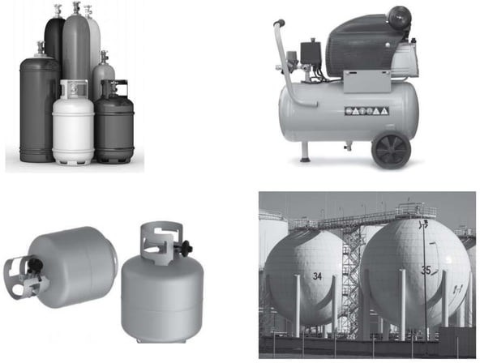

Slide 62
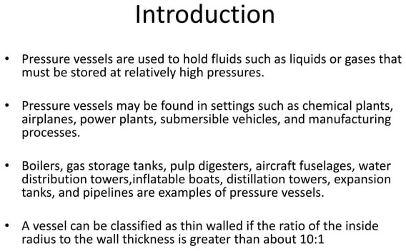

Slide 63
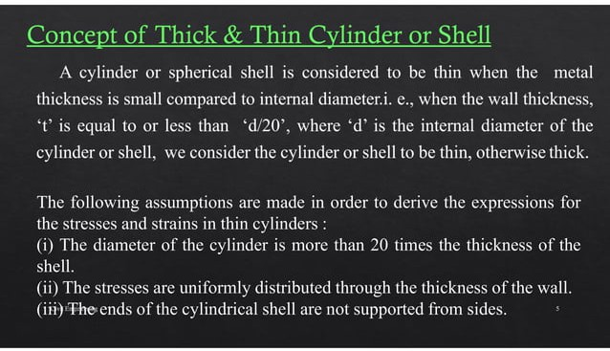

Slide 64
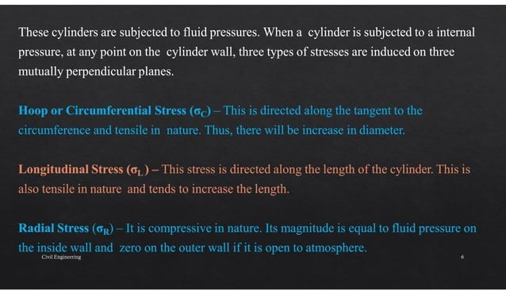

Slide 65
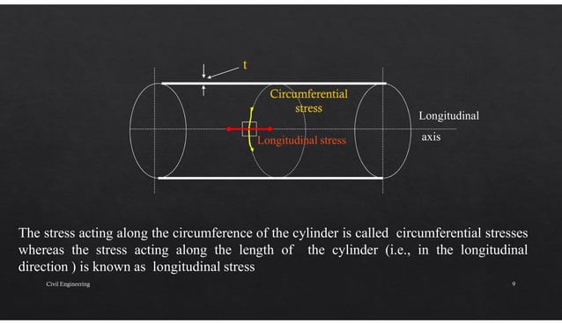

Slide 66
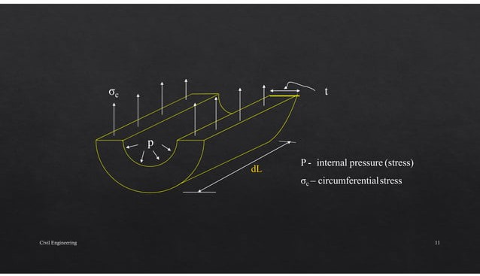

Slide 67
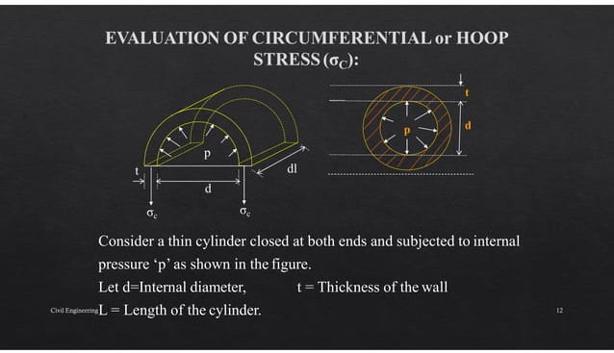

Slide 68
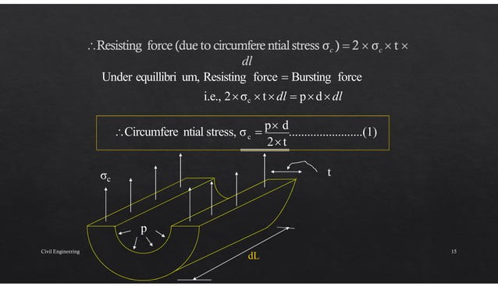

Slide 69
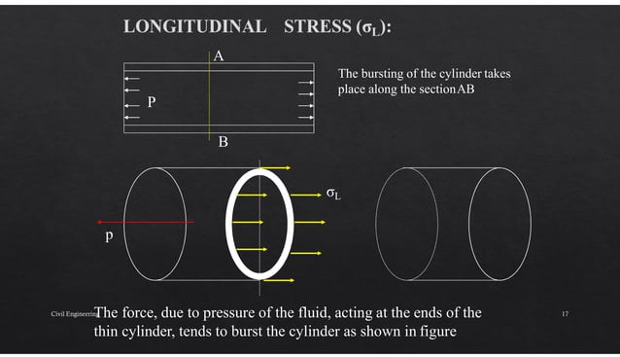

Slide 70
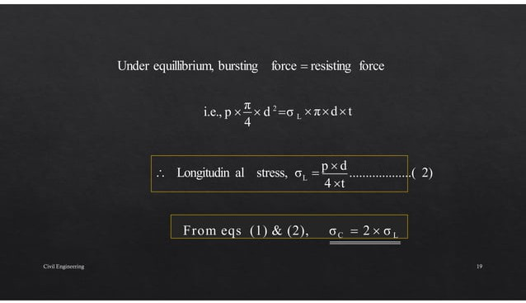

Slide 71
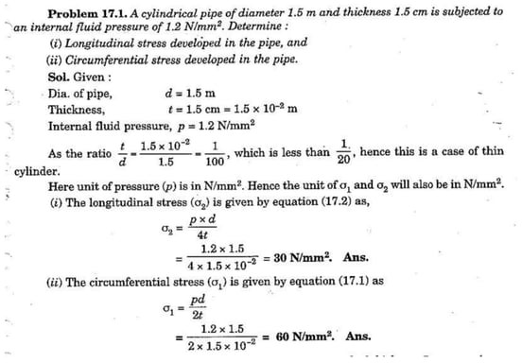

Slide 72
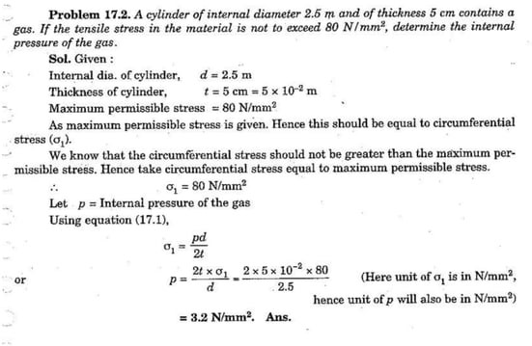

Slide 73
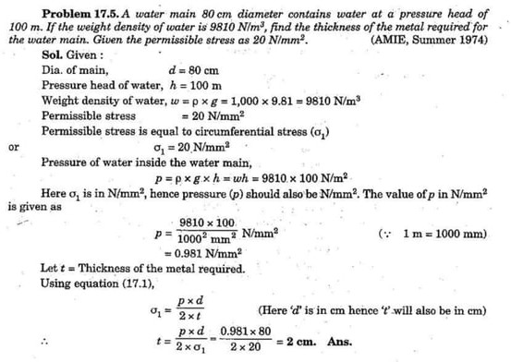

Slide 74
Thermal Stress-Strain
Week 9
Pages (75-80)

Slide 75
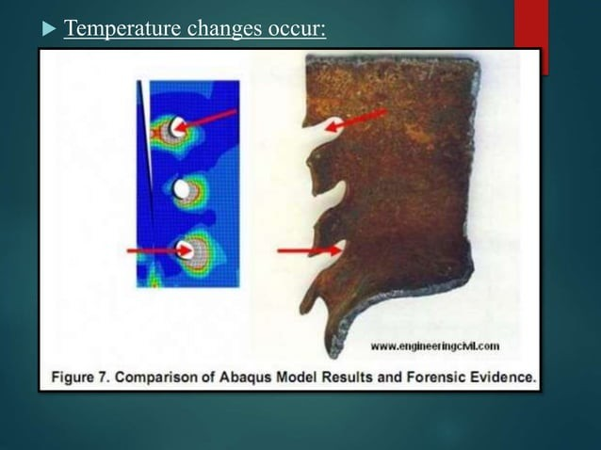

Slide 76
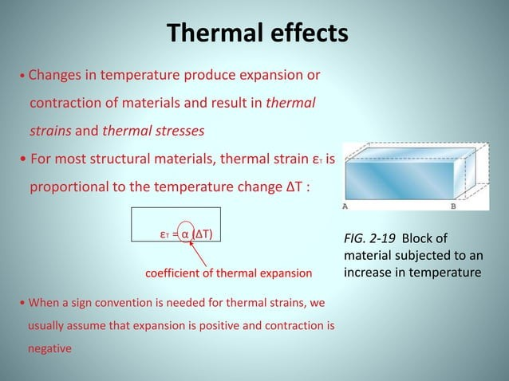

Slide 77
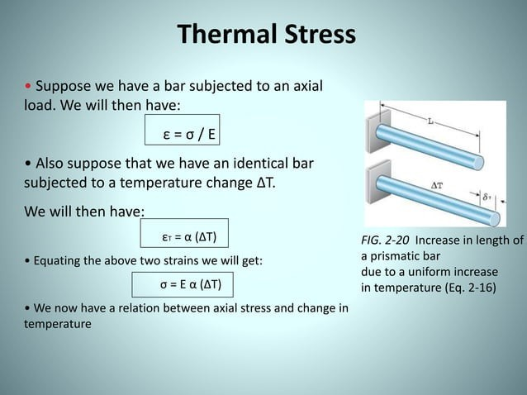

Slide 78
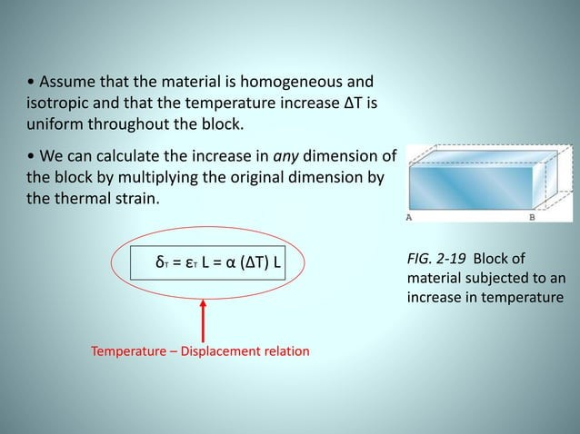

Slide 79
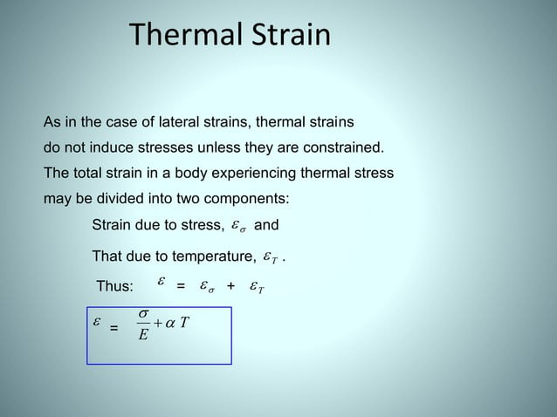

Slide 80
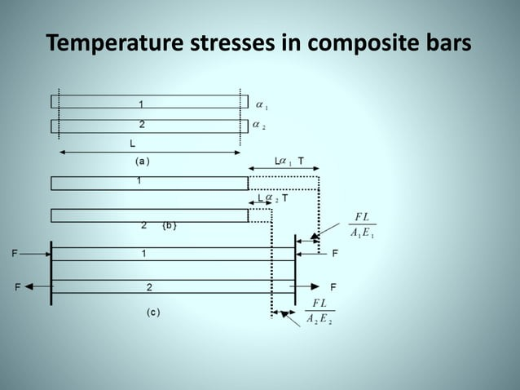

Slide 81
Expression for bending Stress
Week 10
Pages (82-94)

Slide 89

Expression for Bending Stress

Slide 95
Bending stress related problem
Week 11
Pages (96-102)

Slide 96
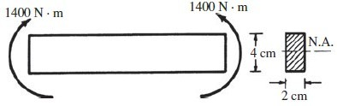
Example #1
A beam is loaded by a couple of 1400 N-m at each of its ends, as shown in Figure. Determine the maximum bending stress in the beam and indicate the variation of bending stress over the depth of the beam.

Slide 97

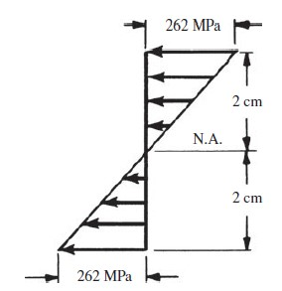
Solution:

Slide 98
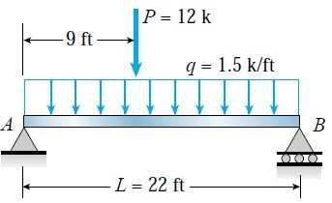
Example #2
A simple beam AB of span length 22 ft supports a uniform load of intensity 1.5 k/ft and a concentrated load 12 k. The concentrated load acts at a point 9.0 ft from the left-hand end of the beam. The beam has a cross section of width b = 9.0 in. and height h = 27 in.

Slide 99
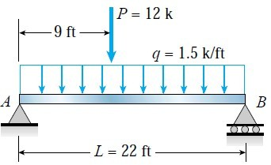
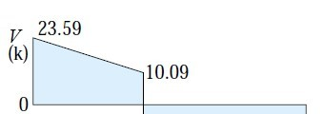

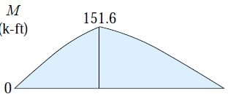
∑M_{A} = 0
1.5 *22*22/2 + 12*9 – R_{B}*22 =
0
R_{B}= 21.41k R_{A} = 23.59k
R_{A}
R_{B}
Shear at point load = R_{A} – 1.5*9
= 23.59 – 13.5
= 10.09 k
Moment at point load = R_{A} * 9 – 1.5*9*9/2
= 23.59*9 – 13.5*4.5
= 151.6 k-ft

Slide 100
Moment of inertia I = bh³/12
= 9*(27)³/12
h = 27 in.
= 14,762.25
in⁴
c= h/2 = 13.5 in
Maximum bending stress
_{σ =} Mc ₌ 151.6*12*13.5 _{= 1.663ksi} I 14762.25
b = 9 in.
1663 psi
1663 psi

Slide 101
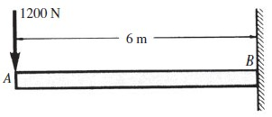
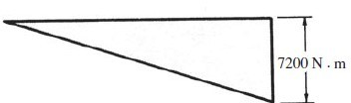
A steel cantilever beam 6 m in length is subjected to a concentrated load of 1200 N acting at the free end of the bar. Determine the magnitude and location of the maximum tensile and compressive bending stresses in the beam.

Slide 102
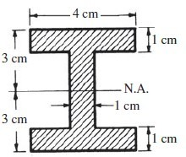


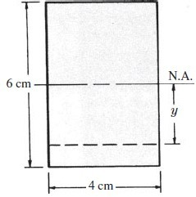


Slide 103
Torsion
Week 12-13
Pages (104-108)

Slide 109
Mohr Circle construction Principle
Week 14
Pages (110-112)

Slide 113
Mohr Circle Related Problem
Week 15-16
Pages (114-122)

Slide 123
Thank You

