Slide 1

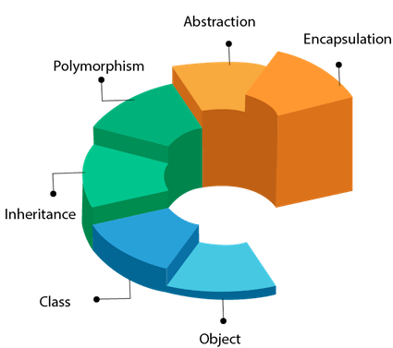
Object Oriented Programming CSE-0613-2203
Md. Riadul Islam
Assistant Professor
Dept. of Computer Science and Engineering(CSE)
University of Global Village (UGV)

Slide 2

University of Global Village (UGV), Barishal
Content of the Object-Oriented Programming University Student (UGV) Format
Program: Bachelor of Science in Computer Science Engineering (CSE)

Slide 3
^{Course Code} CSE-0613-2203
Name of Course Title | Object-Oriented Programming
Course Type | Core Course
Level | 4th Semester
Academic Session | Summer 2024
Name(s) of AcademicCourse teacher(s) | Md. Riadul Islam Assistant Professor, CSE. Mobile: 01842611852 E-mail: riadnwu@gmail.com
Consultation Hours:
Object-Oriented Programming
Course Code: CSE-0613-2203 | Credits: 03
Exam Hours: 03 | CIE Marks: 90
Course for 4th Semester, Bachelor of Science in Computer Science Engineering (CSE) | SEE Marks: 60

Slide 4
1. Rationale for the inclusion of the program
Rationale for the inclusion of the course/module in the program | The Object-Oriented Programming (OOP) course serves as a foundational exploration into the principles and practices of designing and implementing software using the object-oriented paradigm. It offers students an opportunity to grasp the essential concepts and methodologies crucial for effective software development and maintenance. This course begins by elucidating the core principles of OOP, including fundamental concepts such as classes, objects, inheritance, polymorphism, encapsulation, and abstraction.
Pre-requisite (if any) | Data Structure
Status | One of the core courses of CSE
Credit Value (hours) | 3 (3 hours)
Total Marks | 150
Number | Section | Topics
1 | Introduction to Object-Oriented Programming | - Definition and history of OOP - Basic concepts: classes, objects, inheritance, polymorphism - Advantages and applications of OOP
2 | Classes and Objects | - Definition and creation of classes and objects - Constructors and destructors - Access specifiers: public, private, protected
3 | Inheritance and Polymorphism | - Concept of inheritance and types: single, multiple, multilevel, hierarchical, hybrid - Method overriding and method overloading - Runtime polymorphism and dynamic binding
4 | Encapsulation and Abstraction | - Definition and importance of encapsulation - Abstract classes and interfaces - Data hiding and

Slide 5
 |  | access control mechanisms
5 | Constructors and Destructors | Types of constructors: default, parameterized, copy constructors - Destructor basics and importance Constructor overloading
6 | Operator Overloading | - Concept and need for operator overloading - Overloading unary and binary operators - Overloading insertion and extraction operators
7 | Templates and Generic Programming | - Definition and use of templates - Function templates and class templates - Template specialization and instantiation
8 | Exception Handling | - Basics of exception handling: try, catch, throw - Standard exceptions and user-defined exceptions - Exception handling best practices
9 | File Handling | - File streams and operations - Reading from and writing to files - File modes and error handling in file operations
10 | Standard Template Library (STL) | - Introduction to STL - Components of STL: containers, algorithms, iterators - Using STL for common data structures: vectors, lists, maps, sets
11 | Design Patterns | - Introduction to design patterns - Types of design patterns: creational, structural, behavioral - Examples of common design patterns: Singleton, Factory, Observer
12 | Hands-on Projects and Practical Implementation | - Implementing OOP concepts in programming languages like C++, Java, Python - Hands-on projects to apply OOP principles to real-world problems

Slide 6
3. Course Objectives:
Upon completing this Object-Oriented Programming course, students will be able to:
Understand and explain the fundamental concepts and applications of OOP
Grasp the core principles of OOP, including its history, development, and key components such as classes, objects, inheritance, polymorphism, encapsulation, and abstraction.
Explore the various applications of OOP in different branches of computer science and engineering, such as software development, game development, and systems programming.
Discuss case studies and examples where OOP has been successfully implemented to solve complex problems and improve software design and maintenance.
Apply OOP techniques to solve real-world problems
Learn about different types of OOP techniques, including design patterns and principles like SOLID.
Gain hands-on experience with popular OOP languages and environments such as C++, Java, and Python.
Develop skills to analyze problem statements, design appropriate class structures, implement solutions, and evaluate their performance on real-world datasets.
Work on practical projects that involve applying OOP techniques to address specific problems, such as developing user interfaces, managing data in applications, and creating reusable software components.
Implement advanced OOP concepts in software development
Understand the role of advanced OOP concepts in efficient software development.
Learn about advanced OOP features such as multiple inheritance, interfaces, abstract classes, and generics/templates, and their applications.
6 | P a g e
Prepared By: Md. Riadul Islam Assistant Professor, Dept. Of CSE
University Of Global Village (UGV), Barishal

Slide 7
Design and implement complex software systems using OOP to enhance software performance, manage resources efficiently, and solve computational problems.
Develop software solutions that leverage advanced OOP features for better performance and scalability.
Analyze and interpret OOP performance
Acquire skills in analyzing the performance of OOP designs using techniques such as design patterns, code refactoring, and software metrics.
Learn methods for extracting meaningful insights from software performance data, including runtime analysis, memory usage, and efficiency trade-offs.
Develop the ability to interpret the results of performance analyses and communicate findings effectively to both technical and non-technical audiences.
Apply statistical and analytical methods to solve performance-related problems, such as identifying bottlenecks, optimizing code, and resource allocation.
Evaluate the ethical implications and societal impact of OOP
Explore the ethical considerations surrounding the use of OOP, including issues related to software reliability, maintainability, and security.
Discuss the potential societal impacts of OOP, such as software accessibility, impact on employment, and digital divide.
Examine regulatory frameworks and guidelines for the responsible development and deployment of software.
Reflect on the role of computer scientists and engineers in ensuring that OOP is used ethically and responsibly for the benefit of society.
7 | P a g e
Prepared By: Md. Riadul Islam Assistant Professor, Dept. Of CSE
University Of Global Village (UGV), Barishal

Slide 8
4. Course Learning Outcome (CLO) at the end of the course, the students will be able to-
No. | Course Outcomes
CO1 | Understand and apply object-oriented programming principles and techniques.
CO2 | Analyze the design, efficiency, and correctness of object-oriented software.
CO3 | Design and implement software solutions using OOP to solve real-world problems.
CO4 | Apply OOP principles to optimize and enhance software design and performance.
8 | P a g e
Prepared By: Md. Riadul Islam Assistant Professor, Dept. Of CSE
University Of Global Village (UGV), Barishal

Slide 9
4. ASSESSMENT PATTERN
Quizzes: Altogether 4 quizzes may be taken during the semester, 2 quizzes will be taken for midterm and 2 quizzes will be taken for final term. Out of these 2 quizzes for each term, average of best 2 quizzes will be counted. No makeup quizzes will be taken. Students are stronglyrecommended not to miss any quizzes
Assignments: Altogether 4 assignments may be taken during the semester, 2 assignments will be taken for midterm and 2 assignments will be taken for final term. Out of these 2 assignments for each term, average of best 2 assignments will be counted. The students will be given assignment during the class which they have to prepare at home and will submit on or before the duedate. No late submission of assignment will be accepted
Presentation: The students will have to form a group of maximum 4 members. The topic of the presentation will be given to each group andstudents will have to do the group presentation on the given topic.
Classroom Participation: All the students are encouraged to come to class prepared, take part in the classroom discussion, make thoughtfulcontribution, and participate actively in all classroom activities

Slide 10
Bloom's Category Marks (out of 90) | Tests (45) | Assignments (15) | Quizzes (15) | Attenda nce (15)
Remember | 5 | 03
Understand | 5 | 04 | 05
Apply | 15 | 05 | 05
Analyze | 10
Evaluate | 5 | 03 | 05
Create | 5
Bloom's Category | Test
Remember | 7
Understand | 7
Apply | 20
Analyze | 15
Evaluate | 6
Create | 5

Slide 11
9. Textbooks and other resources
Category | Details
Conducted Textbook | Herbert Schildt, C++ The Complete Reference, FourthEdition, Tata McGraw Hill Publication.
Reference Books | Robert Lafore, Object Oriented Programming in C++, Fourth Edition, SAMS publications.
Other Resources: | Online Tutorials, YouTube, Simulation video, Animation video, etc. https://drive.google.com/drive/folders/1L_PsvRwotmMnF WewQkFn4Devk-J-78x_?usp=sharing

Slide 12
Basic Concepts Of Objects Oriented Programming week-1

Slide 13
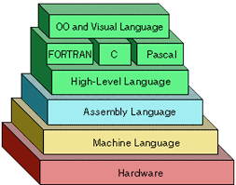
Introduction
Programmers write instructions in various programming languages to perform their computation tasks such as:
Machine level Language
Assembly level Language
High level Language

Slide 14
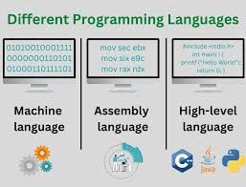
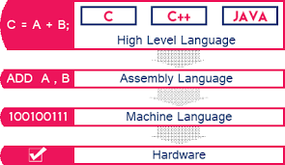
Introduction cont.

Slide 15
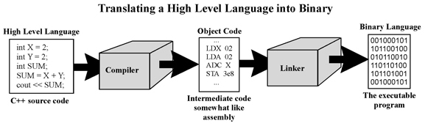
Introduction cont.

Slide 16
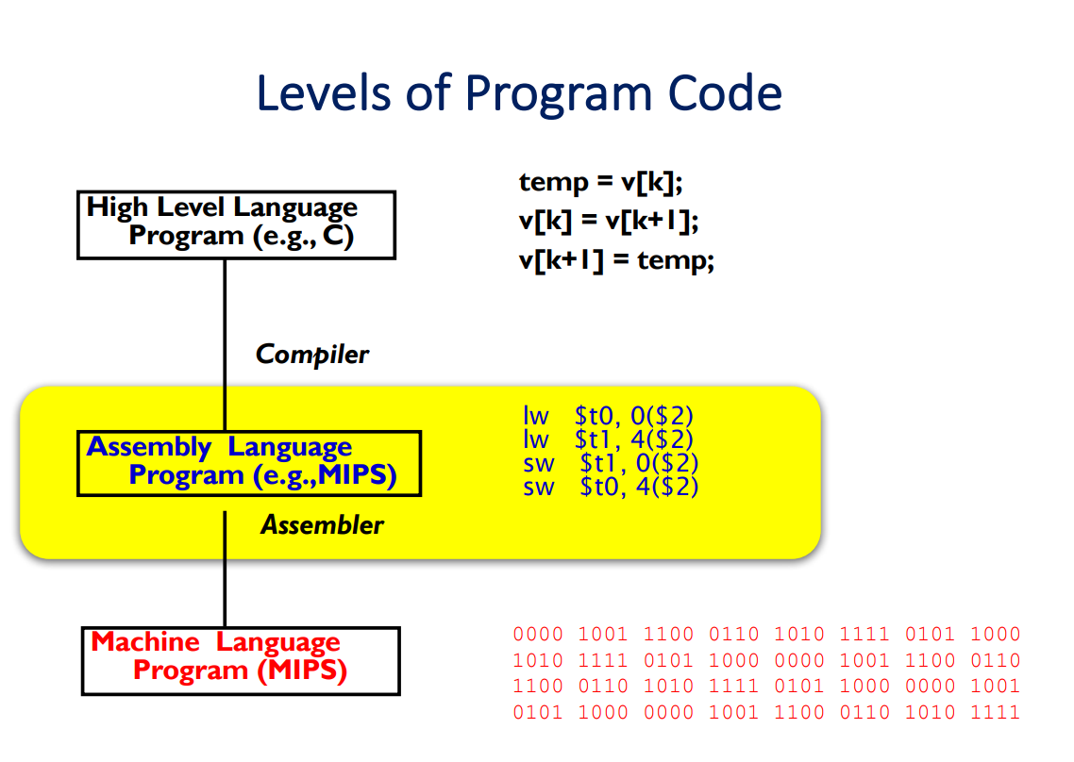
Introduction cont.
Assembly Language is the interface between higher level languages (C++, Java, etc) and machine code (binary).
For a compiled language, the compiler transforms higher level code into assembly language code.

Slide 17
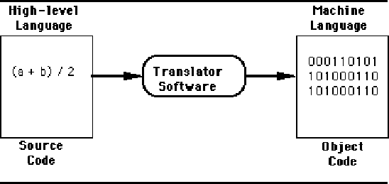
Machine level Language
Machine code or machine language is a set of instructions executed directly by a computer's central processing unit (CPU).
instruction performs a very specific task, such as a load, a jump, or an ALU operation on a unit of data in a CPU register or memory.
Every program directly executed by a CPU is made up of a series of such instructions.

Slide 18
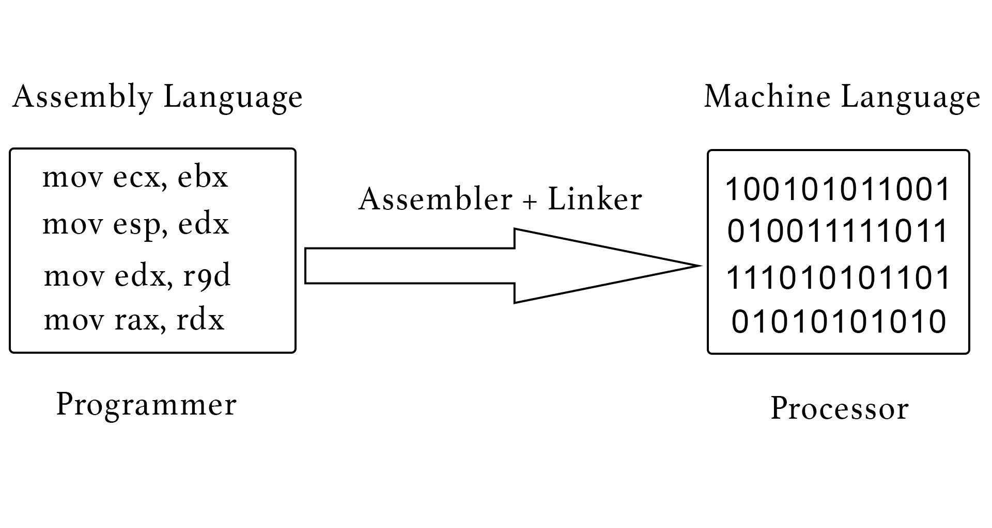
Assembly level Language
An assembly language (or assembler language) is a low-level programming language for a computer, or other programmable device, in which there is a very strong (generally one-to-one) correspondence between the language and the architecture's machine code instructions.
Assembly language is converted into executable machine code by a utility program referred to as an assembler; the conversion process is referred to as assembly, or assembling the code.

Slide 19

High level Language
High-level language is any programming language that enables development of a program in much simpler programming context and is generally independent of the computer's hardware architecture.

Slide 20
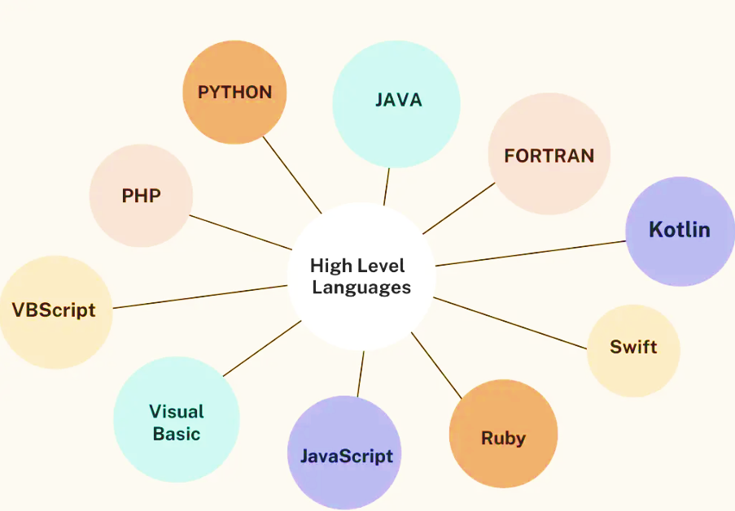
High level Language
High-level language has a higher level of abstraction from the computer, and focuses more on the programming logic rather than the underlying hardware components such as memory addressing and register utilization.
The first high-level programming languages were designed in the 1950s. Now there are dozens of different languages, including Ada , Algol, BASIC, COBOL, C, C++, JAVA, FORTRAN, LISP, Pascal, and Prolog.

Slide 21
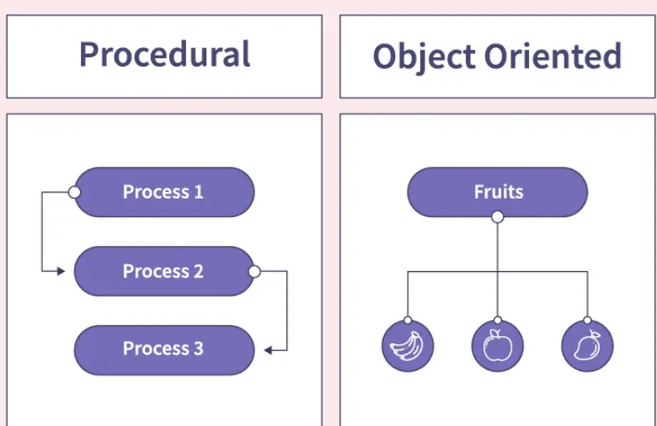
High level Language
The high-level programming languages are broadly categorized in to two categories:
Procedure oriented programming(POP) language.
Object oriented programming(OOP) language.

Slide 22
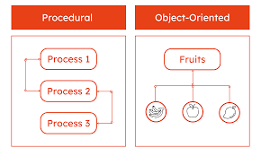
Procedure oriented programming(POP) language

Slide 23
Procedure Oriented Programming Language
In the procedure oriented approach, the problem is viewed as sequence of things to be done such as reading , calculation and printing.
Procedure oriented programming basically consist of writing a list of instruction or actions for the computer to follow and organizing these instruction into groups known as functions.

Slide 24
Procedure Oriented Programming Language
The disadvantage of the procedure oriented programming languages is:
Global data access
It does not model real word problem very well
No data hiding

Slide 25
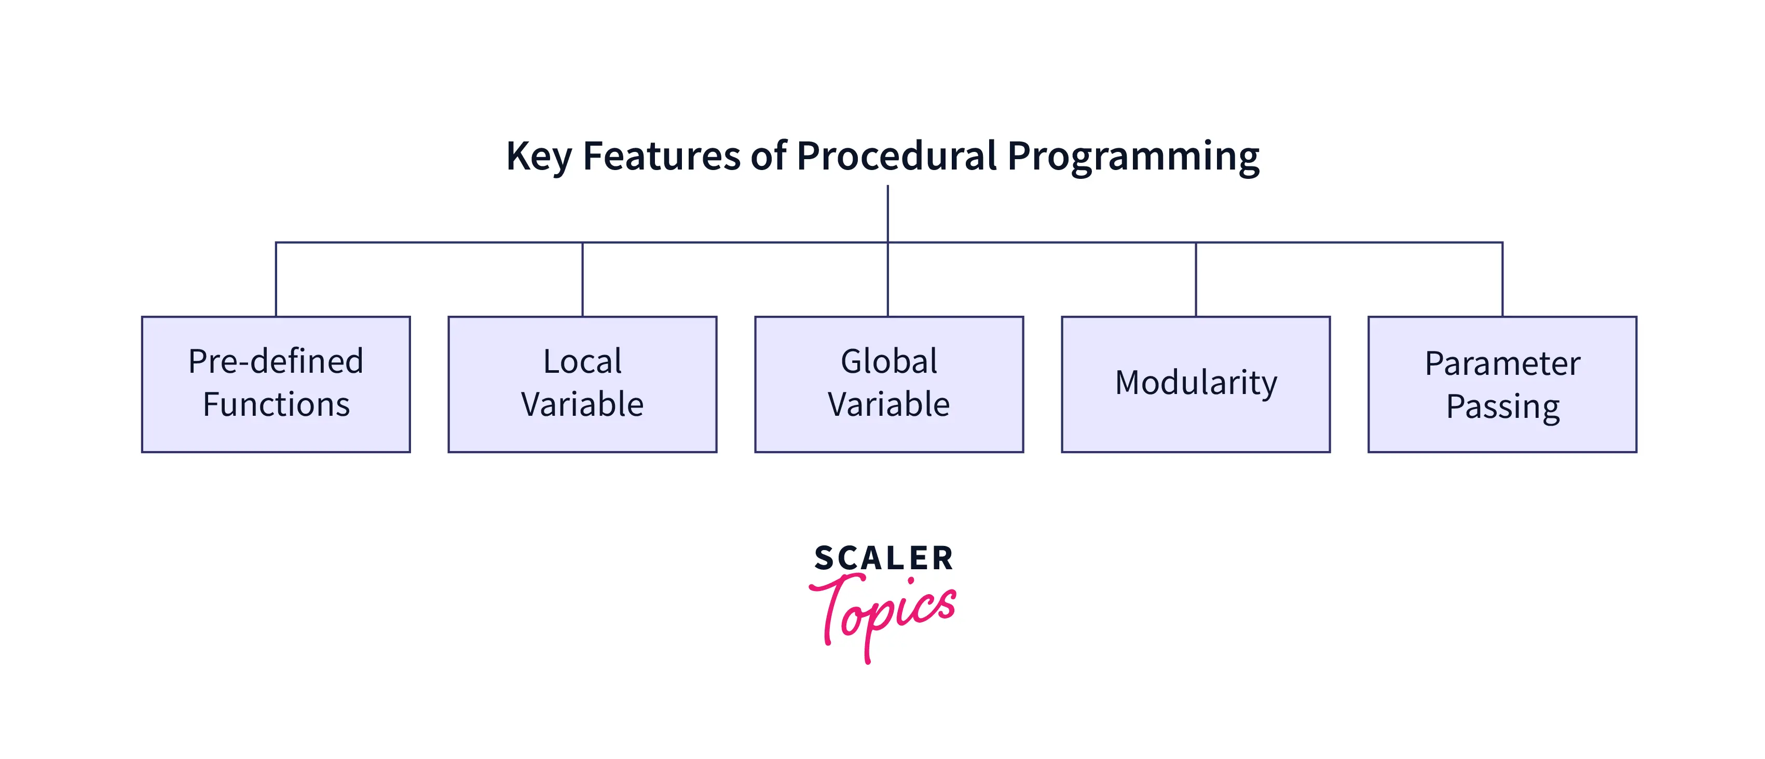
Characteristics Of Procedure Oriented Programming
Emphasis is on doing things(algorithm)
Large programs are divided into smaller programs known as functions.
Most of the functions share global data
Data move openly around the system from function to function
Function transforms data from one form to another.
Employs top-down approach in program design

Slide 26
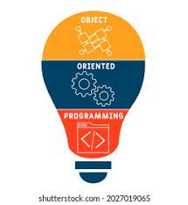
Object-oriented programming(OOP) language

Slide 27
Object oriented programming(OOP) language
“Object oriented programming as an approach that provides a way of modularizing programs by creating partitioned memory area for both data and functions that can be used as templates for creating copies of such modules on demand”.

Slide 28
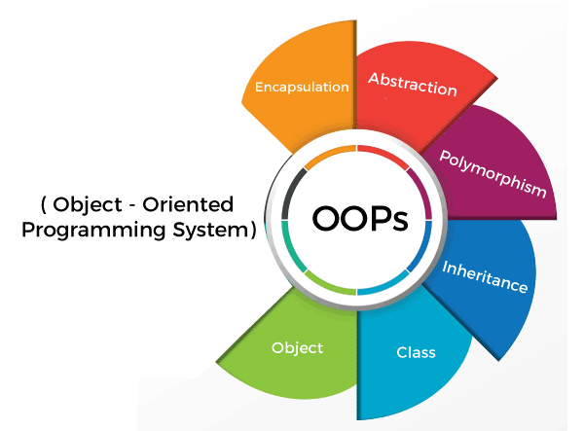
Features of the Object Oriented programming
Features of the Object Oriented programming
Emphasis is on doing rather than procedure.
programs are divided into what are known as objects.
Data structures are designed such that they characterize the objects.
Functions that operate on the data of an object are tied together
Data is hidden and can’t be accessed by external functions.
Objects may communicate with each other through functions.
New data and functions can be easily added.
Follows bottom-up approach in program design.

Slide 29
Basic Concepts Of OOP

Slide 30
Basic Concepts Of OOP
Objects
Classes
Data abstraction and encapsulation
Inheritance
Polymorphism
Dynamic binding
Message passing

Slide 31
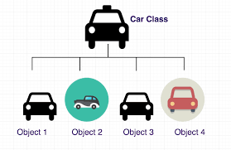
Objects
Objects
Objects are the basic run-time entities in an object-oriented system.
They may represent a person, a place, a bank account, a table of data or any item that the program must handle.
The fundamental idea behind object oriented approach is to combine both data and function into a single unit and these units are called objects.

Slide 32
Objects
The term objects means a combination of data and program that represent some real word entity.
The program part of the object may be collection of programs
In general even any user –defined type-such as employee may be used.

Slide 33
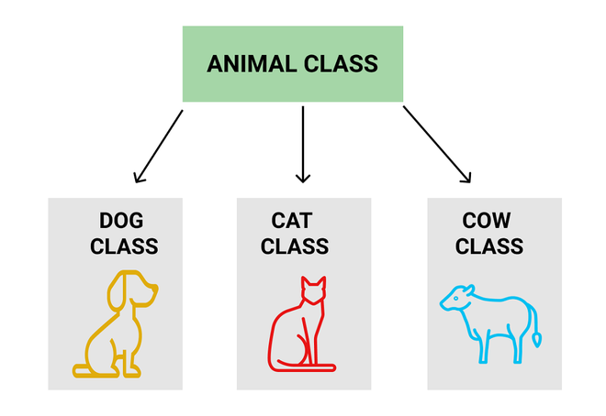
Classes
A group of objects that share common properties for data part and some program part are collectively called as class.
In C ++ a class is a new data type that contains member variables and member functions that operate on the variables.

Slide 34
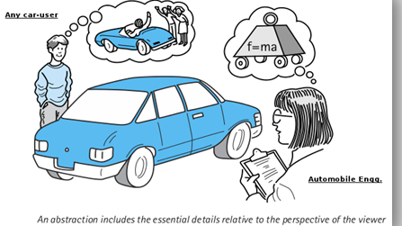
Data Abstraction
Abstraction refers to the act of representing essential features without including the back ground details or explanations.
Classes use the concept of abstraction and are defined as size, width and cost and functions to operate on the attributes.

Slide 35
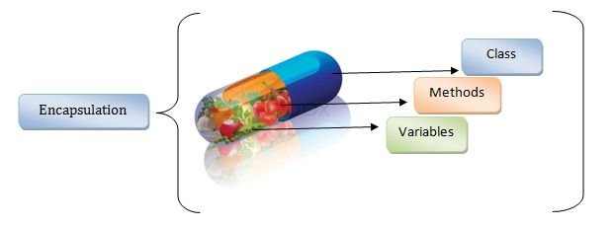
Data Encapsulation
The wrapping up of data and function into a single unit (called class) is known as encapsulation.
The data is not accessible to the outside world and only those functions which are wrapped in the class can access it.
These functions provide the interface between the objects data and the program.

Slide 36
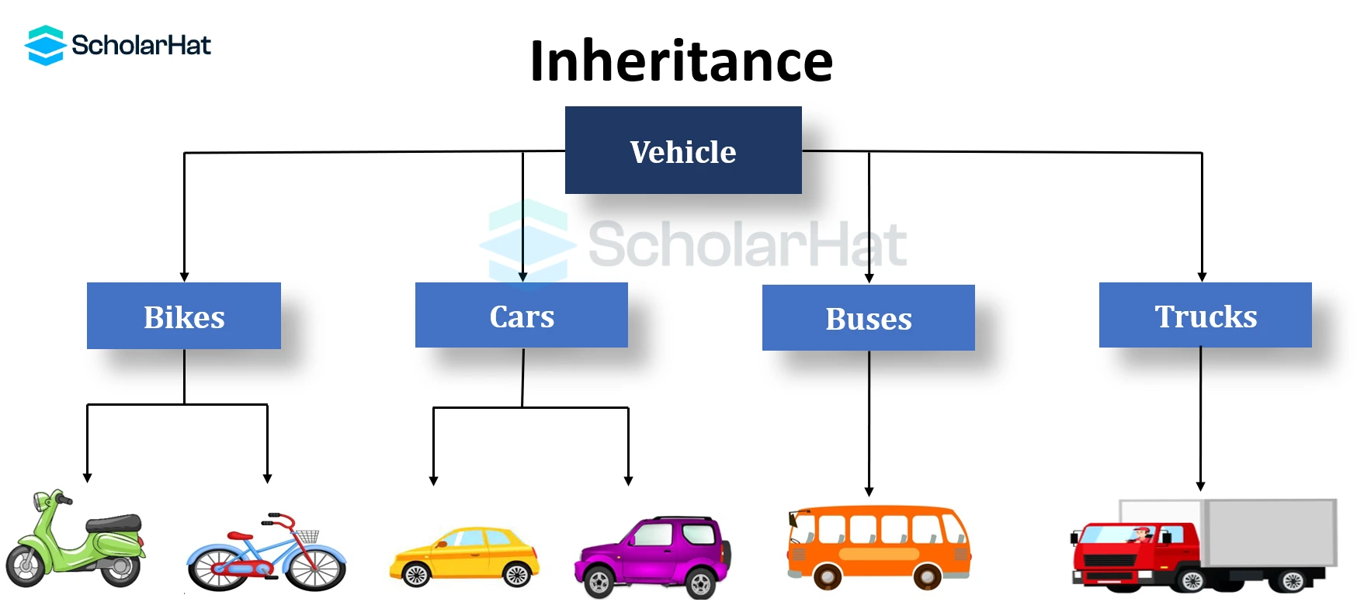
Inheritance
Inheritance is the process by which objects of one class acquire the properties of another class.
In the concept of inheritance provides the idea of reusability.
This mean that we can add additional features to an existing class with out modifying it.
This is possible by designing a new class will have the combined features of both the classes.

Slide 37

Polymorphism
Polymorphism means the ability to take more than one form. An operation may exhibit different instance. The behaviour depends upon the type of data used in the operation.
A language feature that allows a function or operator to be given more than one definition. The types of the arguments with which the function or operator is called determines which definition will be used.
Overloading may be operator overloading or function overloading.

Slide 38
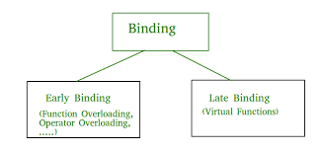
Dynamic binding
Binding refers to the linking of a procedure call to the code to the executed in response to the call.
Dynamic binding means the code associated with a given procedure call is not known untill the time of the call at run-time.
It is associated with a polymorphic reference depends upon the dynamic type of that reference.

Slide 39
Message Passing
Message passing :
An object oriented program consists of a set of objects that communicate with each other.
A message for an object is a request for execution of a procedure and therefore will invoke a function (procedure) in the receiving object that generates the desired result.
Message passing involves specifying the name of the object, the name of the function (message) and information to be sent.

Slide 40
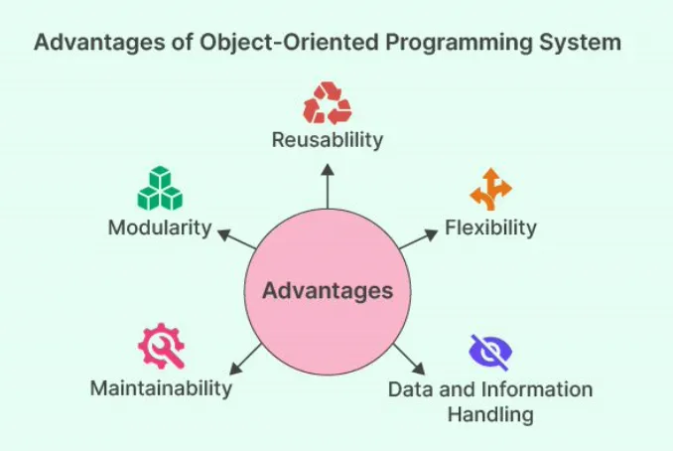
Benefits of OOP
Through inheritance we can eliminate redundant code and extend the use of existing classes.
We can build programs from the standard working modules that communicate with one another, rather than having to start writing the code from scratch.
This leads to saving of development time and higher productivity.
This principle of data hiding helps the programmer to build secure programs that can’t be invaded by code in other parts of the program.

Slide 41
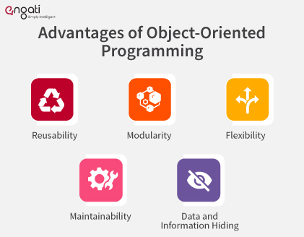
Benefits of OOP
It is possible to have multiple instances of an object to co-exist with out any interference.
It is easy to partition the work in a project based on objects.
Object-oriented systems can be easily upgraded from small to large systems.
Message passing techniques for communication between objects makes the interface description with external systems much simpler.
Software complexity can be easily managed.

Slide 42
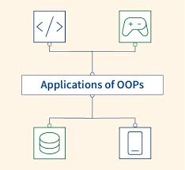
Application of OOP
The most popular application of oops up to now, has been in the area of user interface design such as windows. There are hundreds of windowing systems developed using OOP techniques.
Real business systems are often much more complex and contain many more objects with complicated attributes and methods. OOP is useful in this type of applications because it can simplify a complex problem.

Slide 43

Application of OOP
The promising areas for application of OOP includes.
Real – time systems.
Simulation and modeling
Object oriented databases.
Hypertext,hypermedia and expertext.
Al and expert systems.
Neural networks and parallel programming.
Dicision support and office automation systems.
Cim / cam / cad system.

Slide 44

Basics of C++ week-2

Slide 45
Basics of C++
C ++ is an object oriented programming language
C ++ was developed by Jarney Stroustrup at AT & T Bell lab, USA in early eighties.
C ++ was developed from c and simula 67 language.
C ++ was early called ‘C with classes’.

Slide 46
C++ Comments
C++ introduces a new comment symbol //(double slash).
Comments start with a double slash symbol and terminate at the end of line.
A comment may start any where in the line and what ever follows till the end of line is ignored.
Note that there is no closing symbol.
The double slash comment is basically a single line comment.
Multi line comments can be written as follows:
/* this is an example of c++ program */

Slide 47


Program Style
Bottom-line: Make programs easy to read and modify,
Follow a consistent naming convention for variables, functions, and classes. Common conventions include:
Camel Case: myVariableName
Snake Case: my_variable_name
Pascal Case: MyClassName
Proper comments help others (and yourself) understand your code.
Single-line comments
Multi-line comments

Slide 48
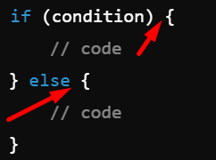
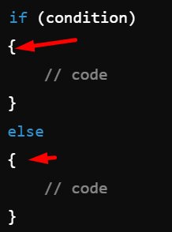
Program Style cont.
K&R Style
Indentation and Bracing Style Proper indentation and the placement of braces ({}) greatly enhance code readability. There are several widely used bracing styles in C++:
K&R Style (Kernighan and Ritchie): The opening brace is on the same line as the control statement, and the closing brace is aligned with the control statement.
Allman Style: Each brace is placed on its own line.
Allman Style

Slide 49
Program Style cont.
Use const wherever possible to indicate variables, parameters, and return types that should not change.
Use exceptions (try-catch blocks) or return error codes to handle errors gracefully.
Avoid the use of global variables to reduce coupling and potential side effects across different parts of your program.
Avoid code duplication by using functions, classes, or templates for reusable code.

Slide 50
Libraries
C++ Standard Libraries
#include <Library_Name>
Directive to "add" contents of library file to your program
Called "preprocessor directive"
Executes before compiler, and simply "copies" library file into your program file
C++ has many libraries
Input/output, math, strings, etc.

Slide 51
Namespaces
Namespaces defined:
Collection of name definitions
For now: interested in namespace "std"
Has all standard library definitions we need
Examples: #include <iostream> using namespace std;
Includes entire standard library of name definitions
#include <iostream>using std::cin; using std::cout;
Can specify just the objects we want

Slide 52
Operators In C++
<< | insertion operator
>> | extraction operator
: : | scope resolution operator
: :* | pointer to member declarator
* | pointer to member operator
.* | pointer to member operator
-> | access members via a pointer.
Delete | memory release operator
Endl | line feed operator
New | memory allocation operator
Setw | field width operator
C++ has a rich set of operators.
All C operators are valid in C++ also.
C++ introduces some new operators.

Slide 53
Input and Output (I/O)
In C++, input and output (I/O) operations are performed using streams provided by the Standard Input/Output Library (iostream).
The two primary streams for input and output are:
cin: For input (standard input, typically from the keyboard).
cout: For output (standard output, typically to the console).

Slide 54
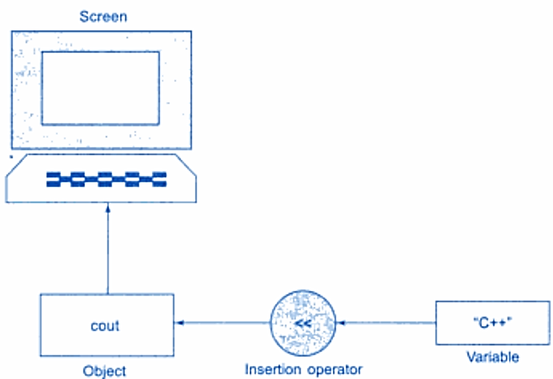

cout
In C++, cout (short for "console output") is used to output data to the standard output device, typically the console. It is part of the input/output stream provided by the <iostream> header.
How cout Works:
The cout object works with the insertion operator (<<) to send data to the output stream.
You can output various data types (integers, floating-point numbers, characters, strings, etc.) using cout.

Slide 55
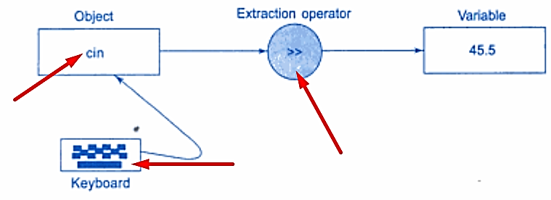

cin
In C++, cin (short for "console input") is used to receive input from the user through the keyboard. It is part of the standard input/output stream and is provided by the <iostream> header.
The cin object uses the extraction operator (>>) to read data from the input buffer and store it into a variable.
It automatically converts the input to the appropriate type based on the variable’s type.
cin ignores leading whitespace (spaces, tabs, and newlines) but stops reading when it encounters whitespace after the input (except for getline() when used for strings).

Slide 56
Cin Whitespace Handling
Whitespace Handling:
cin ignores leading whitespace (like spaces, tabs, and newlines).
For strings, cin reads only a single word until it encounters whitespace.
read a whole line, you should use getline().
Using getline() for Strings: If you want to input an entire line of text, including spaces, you need to use getline() instead of cin.
cin is a simple and commonly used way to handle user input in C++. It works well for various types of input, but for more complex cases like reading a full string with spaces, getline() is a better option.

Slide 57
Other I/O Manipulators
C++ provides several manipulators to control the formatting of input and output. Some common manipulators include:
setw(n): Sets the width of the output field.
setprecision(n): Sets the number of decimal places to display for floating-point numbers.
fixed: Forces output of floating-point numbers in fixed-point notation.
showpoint: Forces display of the decimal point and trailing zeros.
hex, oct, dec: Changes the base for numeric output to hexadecimal, octal, or decimal.

Slide 58
Tokens
The smallest individual units in program are known as tokens. C++ has the following
i. Keywords
ii. Identifiers
iii. Constants
iv. Strings
v. Operators

Slide 59
Keywords
The keywords implement specific C++ language feature.
They are explicitly reserved identifiers and can’t be used as names for the program variables or other user defined program elements.
The keywords not found in ANSI C are shown in red letter.

Slide 60
C++ Keywords:
asm | double | new | switch
auto | else | operator | template
break | enum | private | this
case | extern | protected | throw
catch | float | public | try
char | for | register | typedef
class | friend | return | union
const | goto | short | unsigned
continue | if | signed | virtual
default | inline | sizeof | void
delete | long | struet | while

Slide 61
Identifiers in C++
Identifiers in C++ are names used to identify variables, functions, classes, objects, and other user-defined items. They are critical for giving a meaningful name to a program entity. Here are some key rules and characteristics regarding identifiers in C++:
Allowed Characters: Identifiers can contain letters (both uppercase and lowercase), digits (The name can’t start with a digit), and underscores (_).
Example: myVar, counter_1, sumTotal
Starting Character: An identifier must begin with a letter or an underscore (_), but not a digit.
Valid: _myVar, sumTotal
Invalid: 1counter, 2sum

Slide 62
Identifiers in C++
Case Sensitivity: Identifiers in C++ are case-sensitive.
For example, myVar and MyVar would be considered different identifiers.
Keywords Restriction: Identifiers cannot be the same as any C++ keyword (such as int, class, while, etc.).
Invalid: int, float, return
No Special Characters: Special characters like @, #, $, %, &, etc., are not allowed in identifiers.
Invalid: my$Var, sum#Total

Slide 63
Data types in C++

Slide 64
Built-in Data Types

Slide 65
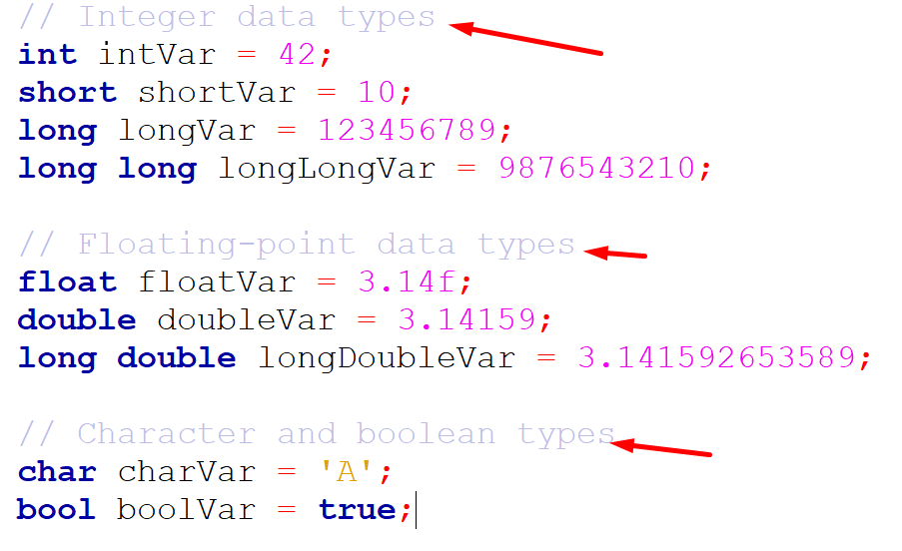
built-in data
These are the fundamental types of data, including
Integer types: int, short, long, long long
Floating-point types: float, double, long double
Character type: char
Boolean type: bool
Void type: void

Slide 66
User-Define Data Types week-3

Slide 67
Struct

Slide 68
Struct in C++
In C++, a structure (or struct) is a user-defined data type that allows grouping together different variables under a single name.
Unlike classes, structures in C++ default to public access for their members.
Key Points: Public by default:
Unlike classes, members of a structure are public by default.
Accessing members: Use the dot operator (.) to access structure members.
Member functions: Structures can also have member functions just like classes.

Slide 69
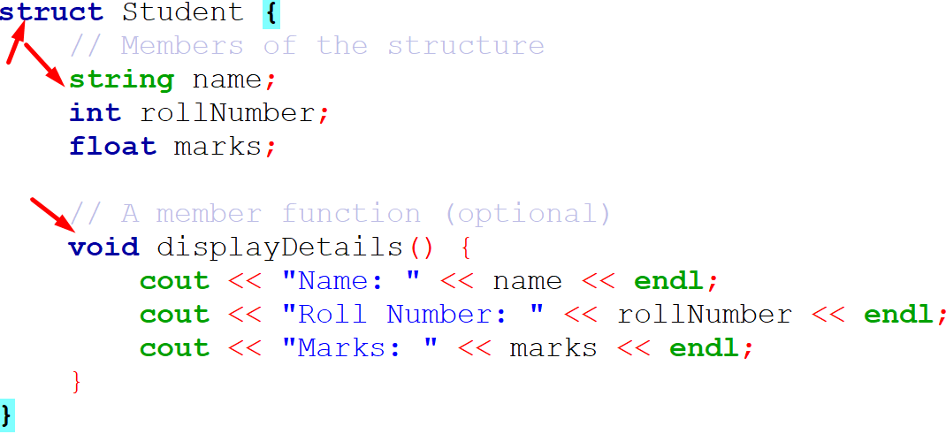
Struct in C++
Explanation:
The struct Student defines a structure with three members: name, rollNumber, and marks.
The displayDetails() function inside the structure is used to print the details of the student.
In the main() function, a Student object named student1 is created, and values are assigned to its members.

Slide 70
struct in C vs. C++:
Summary of struct in C vs. C++:
Feature | struct in C | struct in C++
Member functions | Not allowed | Allowed (just like in class)
Constructors/Destructors | Not allowed | Allowed
Inheritance | Not supported | Supported
Access specifiers | Not available (all members public) | Available (public by default)
Encapsulation | Not possible (no private members) | Possible (can define private members)
Polymorphism (Virtual Functions) | Not supported | Supported (like in class)

Slide 71
Union

Slide 72
Union in C++
In C++, a union is a special class type that allows storing different data types in the same memory location.
Unlike a struct, where each member has its own memory location, in a union, all members share the same memory location.
This means only one member can hold a value at any given time, and modifying one member will affect the others.
union unionName {
dataType1 member1;
dataType2 member2;};

Slide 73
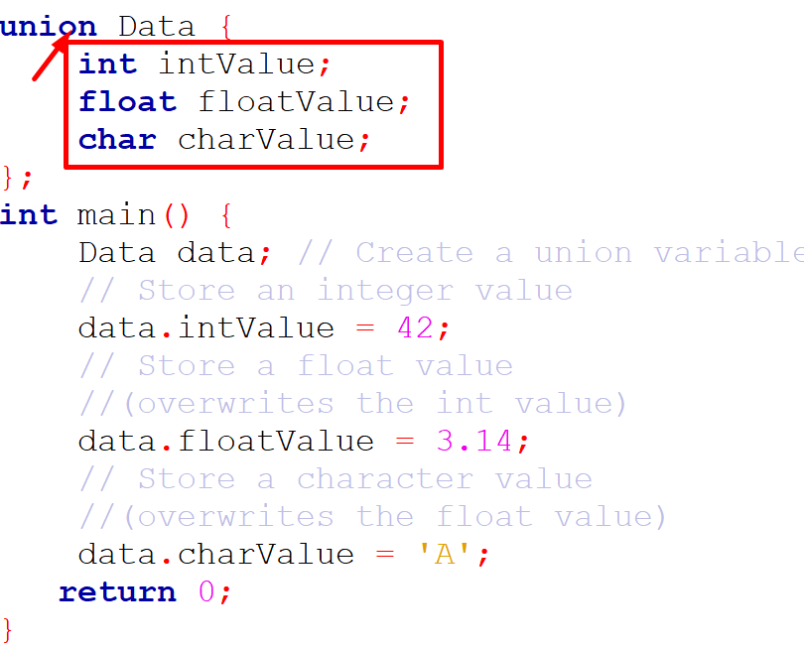
Union in C++

Slide 74
enumerated

Slide 75
enumerated
In C++, an enum (short for enumeration) is a user-defined data type that consists of integral constants.
You can use an enum to assign names to a set of values, which makes the code more readable and manageable.
Syntax:
enum enum_name { value1, value2, value3, ... };

Slide 76
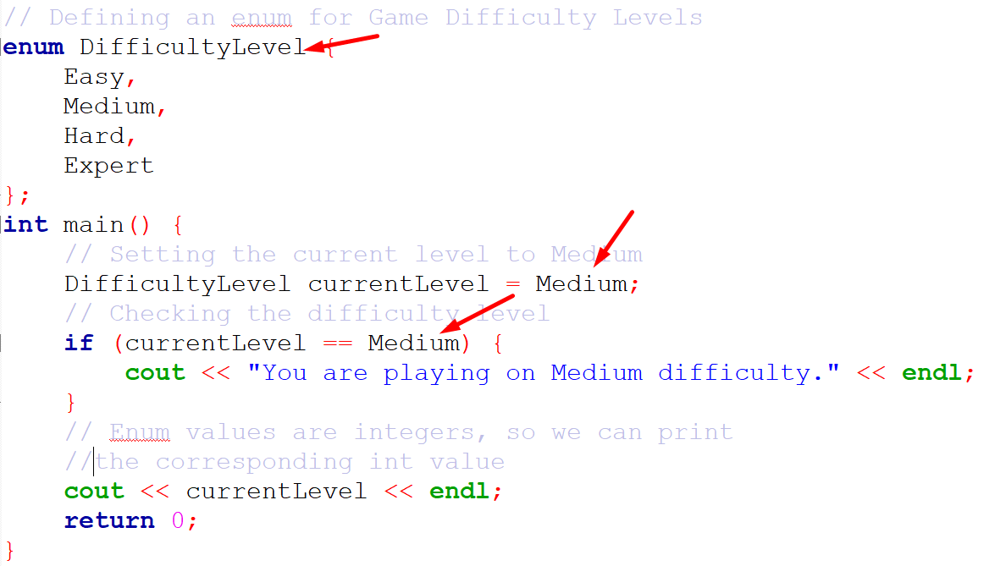
enumerated

Slide 77
enumerated
Explanation:
The enum DifficultyLevel has four values: Easy, Medium, Hard, and Expert.
By default, Easy is assigned the value 0, Medium is 1, Hard is 2, and Expert is 3.
In the main function, the variable currentLevel is assigned the value Medium.
When you print currentLevel, it will output 1 because Medium is the second item (starting from 0).

Slide 78
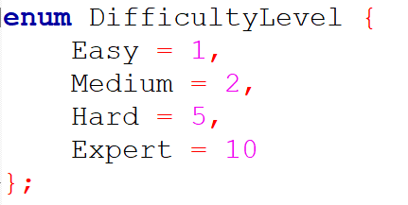
enumerated
Customizing Enum Values:
You can assign custom values to the enum constants if desired:

Slide 79
Drive Data Types week-4

Slide 80
Array

Slide 81
Array
An array in C++ is a collection of elements of the same data type, stored in contiguous memory locations.
Arrays are static, meaning their size must be specified at the time of declaration and cannot be changed.
Syntax for a 1D Array:
data_type array_name[array_size];

Slide 82
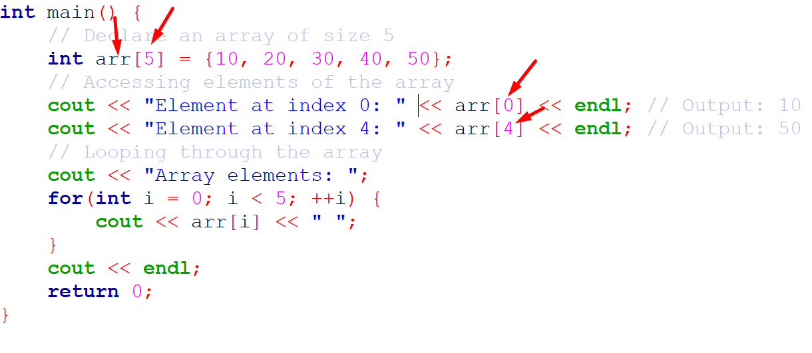
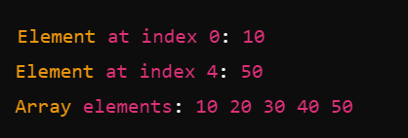
Array
Example of Declaring, Initializing, and Accessing an Array:
Output:

Slide 83
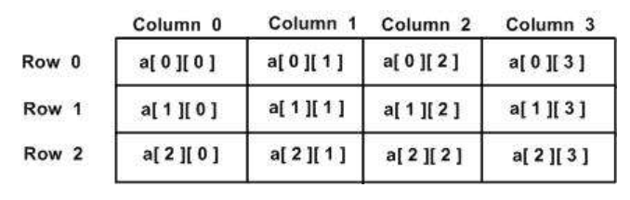
2d-Array
In C++, a 2D array is essentially an array of arrays.
You can define a 2D array with a specific number of rows and columns, and then access or manipulate its elements using two indices: one for the row and one for the column.
Syntax for a 2D Array:
data_type array_name[rows][columns];

Slide 84
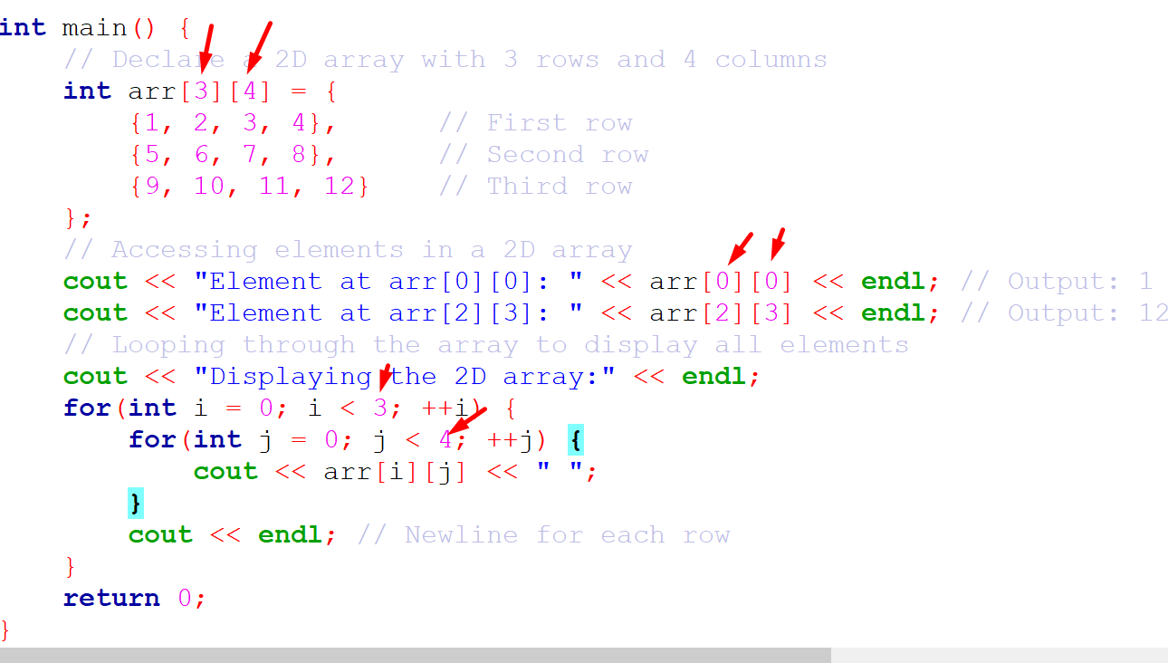
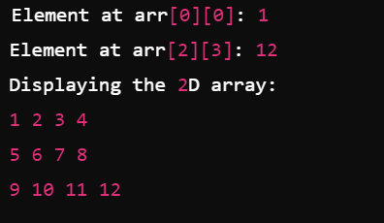
2d-Array
Output:

Slide 85
2d-Array
Explanation:
Declaration and Initialization: The 2D array arr[3][4] has 3 rows and 4 columns.
It is initialized with specific values.
Accessing Elements: arr[0][0] accesses the first element, and arr[2][3] accesses the last element of the array.
Looping: Two nested for loops are used to iterate through the rows and columns, printing the elements.

Slide 86
pointer

Slide 87
pointer
A pointer in C++ is a variable that stores the memory address of another variable.
Pointers are used to directly access and manipulate memory locations, which can be powerful but must be done with care.
Key concepts about pointers:
Declaration: A pointer is declared by specifying the type of the variable it will point to, followed by an asterisk (*).
Address-of operator (&): It gives the memory address of a variable.
Dereference operator (*): It accesses the value stored at the memory address that the pointer points to.

Slide 88
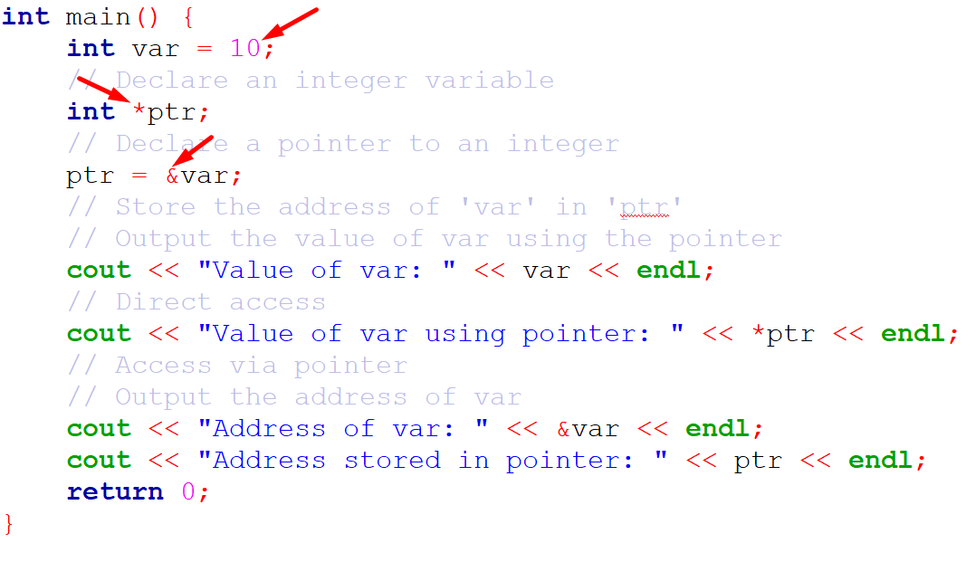
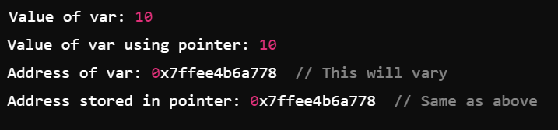
pointer
Output:

Slide 89
pointer
Explanation:
int var = 10; declares an integer variable var and assigns it the value 10.
int *ptr; declares a pointer ptr that can store the address of an integer.
ptr = &var; assigns the address of var to the pointer ptr.
*ptr dereferences the pointer to access the value of var through the pointer.
It accesses the value stored at the memory address that the pointer points to.

Slide 90
pointer
Explanation:
int var = 10; declares an integer variable var and assigns it the value 10.
int *ptr; declares a pointer ptr that can store the address of an integer.
ptr = &var; assigns the address of var to the pointer ptr.
*ptr dereferences the pointer to access the value of var through the pointer.
It accesses the value stored at the memory address that the pointer points to.

Slide 91
references

Slide 92
references
In C++, references provide an alias (another name) for an existing variable. A reference allows you to work with the original variable directly without creating a copy, making it useful for passing arguments to functions or returning values from functions without unnecessary copying.
Key Points About References in C++:
Declared using the & symbol.
Must be initialized when created (you cannot have an uninitialized reference).
A reference is not a separate object, but another name for the original variable.
Changes made to the reference affect the original variable.

Slide 93
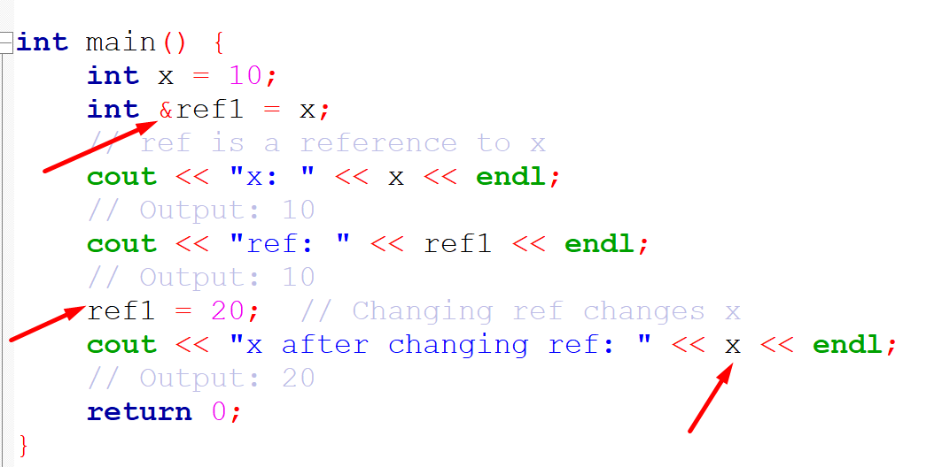
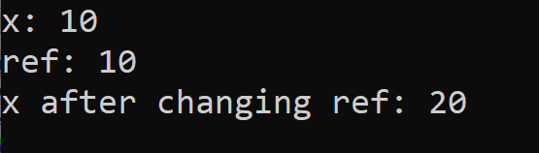
references
Explanation:
int &ref = x; creates a reference ref to the variable x. Both ref and x refer to the same memory location.
Changing the value of ref (ref = 20;) changes the value of x since ref is just an alias for x.
Output:

Slide 94
Some Keywords week-5

Slide 95
const

Slide 96
const
In C++, the const keyword is used to make a variable, pointer, or object constant, meaning its value cannot be modified after initialization.
There are several ways to use const in C++, including with
Variables
pointers,
function argument
Here are some common example: const with Pointers

Slide 97
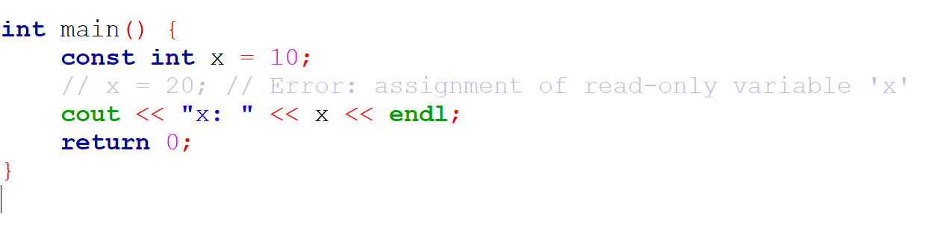
const with Variables
A const variable cannot be modified after it is initialized.
In this example, x is a constant, so trying to modify x will result in a compilation error.

Slide 98
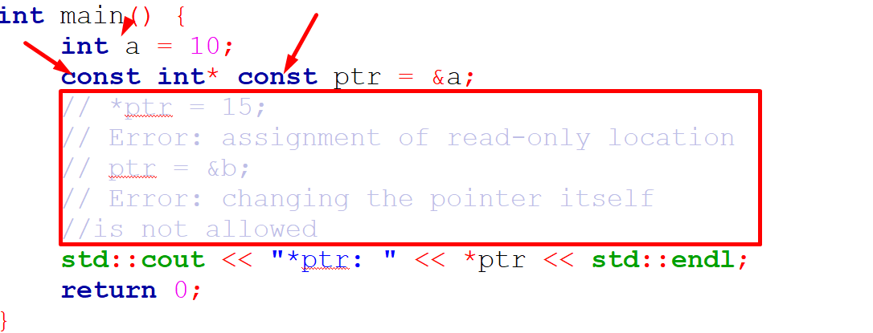
const with Pointers
There are different ways to use const with pointers depending on what you want to make constant
Constant pointer to a constant value: Neither the pointer nor the value it points to can be modified.

Slide 99
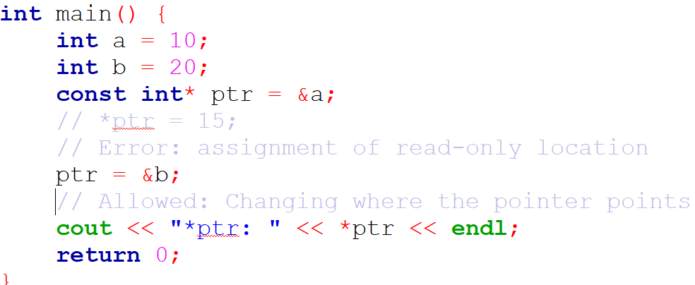
const with Pointers
Pointer to a constant value: The value pointed to by the pointer is constant (cannot be changed)
But the pointer itself can be modified to point elsewhere.

Slide 100
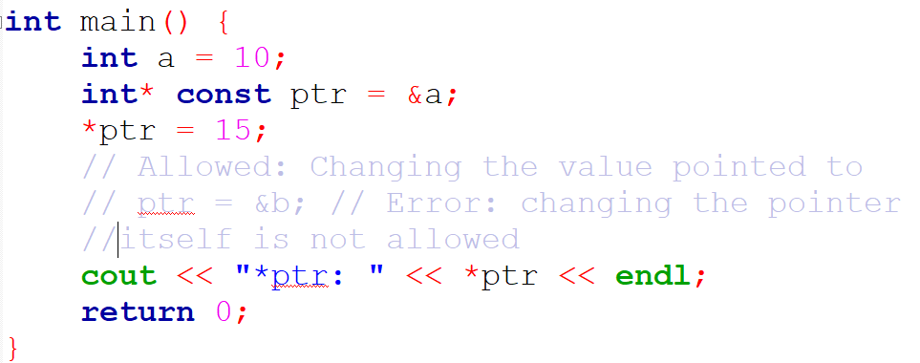
const with Pointers
Constant pointer to a non-constant value: The pointer itself cannot be changed, but the value it points to can be modified.

Slide 101
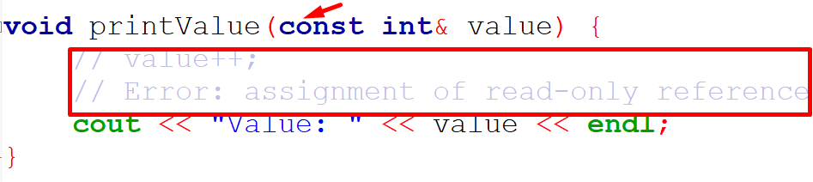
const in Function Arguments
You can pass arguments to a function as const to ensure that they cannot be modified inside the function.
In this case, value is passed by reference, but it is const, meaning the function is not allowed to modify value.

Slide 102
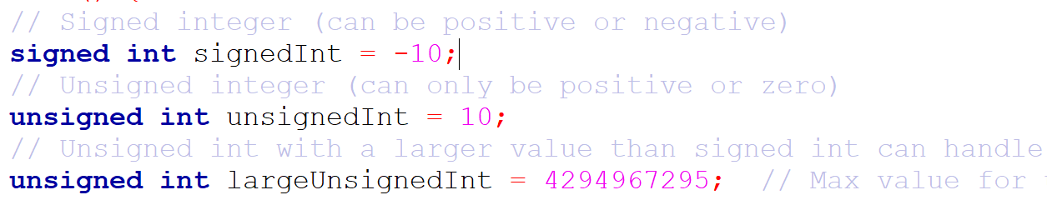
signed and unsigned
In C++, both signed and unsigned are used to modify the range of numeric data types like int and char.
The default for most numeric types (e.g., int) is signed.
signed: Can store both positive and negative values.
unsigned: Can only store non-negative values but provides a larger range for positive numbers.

Slide 103
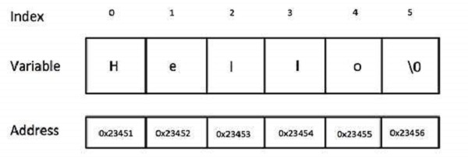
string
string (from the STL) std::string is a part of the C++ Standard Library, used to handle text (sequences of characters).
It provides a more flexible and powerful way to work with strings than using raw character arrays.

Slide 104
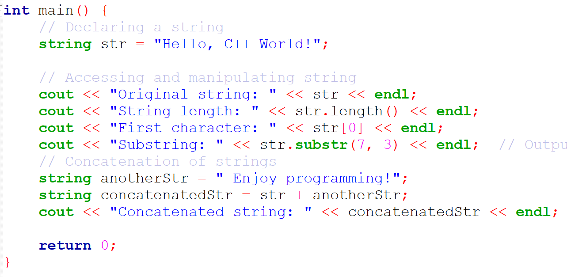
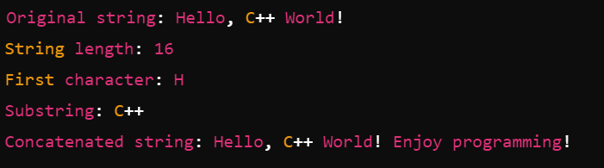
string
Output:

Slide 105

auto
In C++, the auto keyword is used for type inference, allowing the compiler to automatically deduce the type of a variable from its initializer.
This makes code easier to read and write, especially with complex types or when using templates.

Slide 106
static
In C++, the static keyword has different meanings depending on the context in which it is used.
It can be applied to variables (both global and local), member variables of a class, and member functions of a class.
Let's break down the use of static in each context:
Static Global Variables
Static Local Variables

Slide 107


Static Global Variables
A static global variable limits the visibility of the variable to the file in which it is declared.
This makes it internal linkage, meaning it is not accessible from other files in the program.
globalVar is accessible only within the file where it is defined.
Output:

Slide 108


Static Local Variables
A static local variable inside a function retains its value between function calls.
Normally, a local variable is destroyed once the function ends, but a static local variable keeps its value across multiple calls to the function.
Output:
Output:

Slide 109

Control Structures week-6

Slide 110

Control Structures

Slide 111
Conditional

Slide 112
if-else
if-else Statement
The if-else statement is used when you want to test a condition and execute code based on whether that condition is true or false.
It can handle complex conditions, and multiple else if branches can be used.
if (condition) {
// Code block if condition is true
} else if (another_condition) {
// Code block if another_condition is true
} else {
// Code block if all conditions are false
}

Slide 113

if-else
Explanation:
The program checks whether the entered number is positive, negative, or zero and prints the corresponding message.
if checks the first condition (number > 0), and if it’s true, the associated block is executed.
else if is used to check additional conditions (number < 0).
else provides a default action if none of the previous conditions are true.

Slide 114

switch
The switch statement is used when you need to select one out of many options based on the value of a single variable (typically an integer or a character).
It’s more efficient than a series of if-else statements when testing the same variable for equality against different values.

Slide 115
if-else vs switch
Aspect | if-else | switch
Conditions | Can evaluate complex conditions. | Only evaluates equality of a single value.
Data Types | Works with all data types (int, float, string, etc.). | Works with int, char, or enum types.
Efficiency | Less efficient with many conditions. | More efficient for checking multiple values of the same variable.
Range Checking | Can handle ranges (x > 10, x < 5, etc.). | Cannot check ranges directly (only equality).
Fall-through | Does not allow fall-through between conditions. | Allows fall-through between cases unless break is used.
Usage | Used for complex conditions or when multiple different variables are involved. | Used when comparing a single variable against multiple constant values.

Slide 116
try, catch, and throw
In C++, try, catch, and throw are used to handle exceptions (runtime errors) in a safe and controlled way.
This mechanism is known as exception handling.
throw: Used to signal (raise) an exception.
try: Block of code where exceptions might occur.
catch: Block of code that handles the exception.

Slide 117


try, catch, and throw
Output:

Slide 118
Loops

Slide 119

Loops
In C++, for, while, and do-while are control flow statements used to create loops.
They allow you to execute a block of code multiple times based on certain conditions.

Slide 120



for Loop
The for loop is typically used when the number of iterations is known beforehand.
It consists of three parts: initialization, condition, and increment/decrement.

Slide 121


while Loop
The while loop is used when the number of iterations is not known beforehand and depends on a condition.
loop continues as long as the condition is true.

Slide 122


do-while Loop
The do-while loop is similar to the while loop, but it guarantees that the code block will execute at least once, since the condition is checked after the code block is executed.

Slide 123
Key Differences Between Loops
Aspect | for Loop | while Loop | do-while Loop
Usage | When the number of iterations is known. | When the number of iterations is not known. | When at least one iteration is required.
Condition Check | At the beginning of each iteration. | At the beginning of each iteration. | At the end of each iteration.
Execution Guarantee | May not execute if the condition is false. | May not execute if the condition is false. | Will execute at least once, regardless of condition.

Slide 124
When to Use Each Loop
for Loop: Best used when you know the exact number of iterations beforehand (e.g., iterating through arrays).
while Loop: Suitable for situations where you want to repeat a block of code an indefinite number of times based on a condition.
do-while Loop: Ideal when you want to ensure the code block runs at least once before checking the condition.

Slide 125
Common C++ Libraries week-7

Slide 126
File handling <fstream>

Slide 127
Introduction to File Handling
What is file handling? → Reading from and writing to files.
Why use it? → Store data permanently, share data between programs.
Header file needed → #include <fstream>
File handling classes from <fstream>:
Class | Purpose
ifstream | Read from files
ofstream | Write to files
fstream | Read and write files

Slide 128

Opening and Closing Files
Create a file and write text into it, then close it.
This program creates a file named example.txt and writes a single line of text to it.
The ofstream class is used for writing data to a file, and the file is automatically created if it does not exist.
After writing, close() is called to free system resources and ensure the data is saved correctly.

Slide 129

Writing to a File
Writes name and age into a text file
This program demonstrates how to write multiple lines of data to a text file.
It checks if the file opened successfully before writing, to prevent errors like missing permissions or invalid paths.
Finally, close() ensures that all the written content is saved to disk.

Slide 130

Reading from a File
Reads the file line by line and displays it.
This example reads a file line by line using getline().
The ifstream class opens the file in read mode and stores each line into a string variable.
It continues reading until the end of the file is reached, then closes it.

Slide 131

File Modes in C++
ios::in → Read mode
ios::out → Write mode (overwrites)
ios::app → Append mode
ios::ate → Move to end when opened
ios::binary → Binary mode
ios::trunc → Remove existing contents

Slide 132

Append Mode
Adds new data to the end of the file without overwriting it.
Here, the file is opened in append mode using ios::app.
Append mode adds new data to the end of the file instead of overwriting existing content.
This is useful for logs, where you want to keep past records intact.

Slide 133

Copy File
This program copies the contents of one file to another.
The rdbuf() method transfers all bytes from the source file stream to the destination.
Using binary mode ensures that all data, including special characters, is copied exactly.

Slide 134
std::map in C++

Slide 135

Introduction to std::map
Definition: std::map is an associative container that stores key-value pairs in sorted
std::map is an associative container that stores key-value pairs in sorted order (by key).
Header: #include <map>
Properties:Keys are unique.
Automatic sorting using < operator by default.
Search, insert, and delete operations have O(log n) complexity.

Slide 136

Declaring a Map
Define a map to store keys and values of a specific type.
A map stores key–value pairs in sorted order of keys.
Here, int is the key type, and string is the value type.
By default, sorting is ascending, and keys must be unique.

Slide 137

Inserting Elements in a std::map
Inserting elements into a std::map adds a new key-value pair.
You can insert using the insert() method or the [] operator.
insert() won’t overwrite if the key exists, while [] will insert or update the key’s value.
This code inserts two key-value pairs into the map using insert() and the [] operator.
Then it prints all pairs in ascending order of keys.insert() adds new pairs only if the key doesn’t exist, while [] inserts or updates the key’s value.

Slide 138

Accessing Elements
Accessing Elements
The [] operator returns a reference to the value for a given key.at() also returns the value but throws an exception if the key is missing.
Use at() when you need safe access without modifying the map.

Slide 139

Updating Values
Updating is done by assigning a new value to an existing key
If the key is not found, it will be inserted automatically.
This makes [] both an accessor and an inserter.

Slide 140

Searching for a Key
find() searches for a key and returns an iterator to it if found, otherwise end().
This searches for key 3 in students.
If found, it prints "Charlie". Otherwise, "Not found" is printed.

Slide 141

Checking if a Key Exists
count() returns the number of elements with the given key (either 0 or 1 in map).
Checks if key 2 exists in the map.
Since map allows only unique keys, count() will return 1 if it exists, 0 otherwise.

Slide 142

Deleting Elements
Elements can be removed using erase() by key, iterator, or range.
This removes the entry with key 1 ("Alice") from the map.
The size of the map decreases by one.

Slide 143


Iterating Over a Map
This program demonstrates how to declare and initialize a std::map using initializer lists, a feature introduced in C++11.
The map stores key-value pairs where keys are integers and values are strings.
The map automatically sorts the entries by keys in ascending order.
The students’ map is initialized with three key-value pairs: (1, "Alice"), (2, "Bob"), and (3, "Charlie").

Slide 144

Using Structs as Values in std::map
When you want to store multiple related pieces of information as the value in a std::map, a good approach is to define a struct or class that groups those fields together.
In the example, a Student struct holds three fields: id, name, and email.
The map uses an integer key (like a roll number) to uniquely identify each student, and the value is a Student struct instance containing all their info.

Slide 145


Using Structs as Values in std::map
The program inserts two students and iterates over the map to print all details, showing how multiple related values can be stored and accessed easily.

Slide 146
Function

Slide 147
Function
In C++, functions are used to encapsulate a block of code that performs a specific task. The use of functions offers several advantages:
Code Reusability: Once you define a function, you can reuse it throughout the program by calling it multiple times without rewriting the same code.
Modularity: Functions allow you to break down large, complex problems into smaller, manageable pieces (modules), making the program easier to understand and maintain.
Improved Readability: Functions help structure the program more logically, making the code more readable. It is easier to understand what each part of the code does by looking at its function name.

Slide 148
Function Cont.
Easier Debugging: Errors can be isolated more easily in functions. If something goes wrong, you can debug a specific function rather than the whole program.
Avoid Redundancy: Functions reduce redundancy, meaning that you can write a piece of code once and use it many times, leading to cleaner and more efficient code.
Abstraction Functions: abstract away the details of their implementation, allowing the user to focus on what the function does rather than how it does it.

Slide 149

Main Function
In C++, the main function is the entry point of any C++ program. It is the first function that gets executed when the program starts and the place where the program ends.
Key Points about the main Function:
Only One main: Every C++ program must have exactly one main function. Without it, the program will not compile or run.
Return Type: The return type of main is int, meaning it should return an integer value. Typically, a return value of 0 indicates successful program execution, while a non-zero value indicates an error.

Slide 150
Main Function Cont.
Arguments: main can accept arguments, which are typically used for handling command-line input. These arguments are argc (argument count) and argv (argument vector).
Execution: The execution of the program begins from main. The code inside the main function is what gets executed, and once the function completes, the program terminates.

Slide 151
function prototype
A function prototype in C++ is a declaration of a function that informs the compiler about the function's name, return type, and parameters without providing the full definition of the function.
It is typically placed at the beginning of a program or in a header file.
The purpose of a function prototype is to allow functions to be called before they are defined.
In C++, the function body is where the actual code or logic of the function is written.
It consists of a block of statements that define what the function does.
The function body is placed inside curly braces {} after the function's declaration.

Slide 152

function prototype
Structure of a Function Definition:
Return Type: The type of value the function will return (e.g., int, void).
Function Name: The name used to call the function.
Parameters: Variables that receive values from the calling function.
Function Body: The block of code inside {} that performs the operation.

Slide 153

Call by Value
In call by value, the actual value of the argument is passed to the function.
A copy of the argument is made, and changes made to the parameter inside the function do not affect the original variable.

Slide 154

Call by Reference
In call by reference, the actual memory address of the argument is passed to the function, allowing the function to modify the original variable directly.
Changes made inside the function are reflected in the original variable.

Slide 155

Call by Pointer
In call by pointer, the memory address (pointer) of the variable is passed to the function.
The function can use this pointer to access and modify the original variable.
Like call by reference, changes made inside the function will affect the original variable, but the syntax involves pointers.

Slide 156

Return by Reference
When a function returns by reference, it returns a reference (alias) to the original variable. This allows the caller to access and modify the original value directly.
The returned reference should point to a valid object or variable.
Returning by reference can be more efficient than returning by value, especially for large objects, as it avoids copying.
Be cautious not to return a reference to a local variable, as it goes out of scope when the function ends, leading to undefined behavior.

Slide 157

Return by Pointer
When a function returns a pointer, it returns the memory address of a variable. The caller can then use this pointer to access or modify the value at that memory address.
The function must ensure the returned pointer points to a valid memory location
Returning pointers is useful when dealing with dynamic memory allocation or when you want to return a null pointer to indicate failure.
Like returning by reference, care must be taken not to return a pointer to a local variable (stack memory), as this would lead to undefined behavior.

Slide 158
Differences
Method | What is Passed | Can Modify Original Variable? | Syntax in Function Definition
Call by Value | A copy of the argument | No | void func(int x)
Call by Reference | A reference to the argument | Yes | void func(int &x)
Call by Pointer | A pointer to the argument | Yes | void func(int *x)

Slide 159
inline function

Slide 160

inline function
In C++, an inline function is a function where the compiler attempts to expand the function's code at the point of each function call rather than performing a normal function call.
This can result in faster execution because it avoids the overhead associated with a typical function call, such as pushing parameters to the stack, jumping to the function's memory location, and returning control back to the caller.

Slide 161
Inline Functions cont.
How Inline Functions Work
When you declare a function as inline, you are making a request to the compiler to expand the code in place where the function is called, rather than executing the function through the normal call mechanism.
However, it is important to note that inline is just a request, and the compiler may choose to ignore the request if it deems the function too complex or unsuitable for inlining.
Advantages of Inline Functions
Performance Boost: For small functions, eliminating the overhead of function calls can make the program run faster.
Code Readability: Even though the function call is replaced with the actual code, it still maintains the readability and structure of the function.

Slide 162
Inline Functions cont.
Limitations of Inline Functions:
Large Functions: If the function is large, inlining it can actually increase the binary size of the program, which may negatively impact performance (this is known as code bloat).
Recursive Functions: Inline functions cannot be recursive, or inlining would result in infinite expansion.
Compiler’s Decision: The compiler may choose not to inline a function even if it is declared as inline, especially if the function contains loops, recursion, or other complex structures.

Slide 163
Default Arguments And Function Overloading week-8

Slide 164
default arguments
In C++, default arguments allow you to provide default values for function parameters, which are used when the caller of the function does not supply values for those parameters.
Default arguments are specified in the function declaration or prototype, and they allow for more flexibility in function calls by making some parameters optional.

Slide 165


default arguments

Slide 166

Function overloading
Function overloading in C++ is a feature that allows multiple functions with the same name to exist in the same scope, provided they differ in the type or number of their parameters.
Key Points:
Same Function Name: Multiple functions share the same name.
Different Parameter List: Functions must differ in the number, type, or order of parameters.
Return Type Doesn't Matter: Function overloading is not based on return type. The compiler resolves which function to call based on the parameter list only.

Slide 167

Function overloading cont.

Slide 168
Ambiguity Problem with Default Arguments and Function Overloading
When using function overloading and default arguments together in C++, there are potential issues that can lead to ambiguity, making it difficult for the compiler to determine which function to call.
The key issue arises when default arguments in one overloaded function conflict with the parameter lists of other overloaded functions.
The main problem occurs when the combination of default arguments and function overloading creates ambiguous situations where the compiler cannot decide which function to call.

Slide 169

Ambiguity Problem with Default Arguments and Function Overloading

Slide 170


Recursive Functions in C++
Recursion is a programming technique where a function calls itself to solve smaller instances of the same problem.
It is particularly useful for problems that can be broken down into similar sub-problems, like tree traversal, factorial calculation, and dynamic programming problems such as Fibonacci sequence generation.

Slide 171
Function Templates

Slide 172

Function Templates
Function templates allow you to write a single generic function that can operate with different data types without rewriting the function for each type.
The compiler generates the appropriate function version based on the argument types you use when calling the function.
This helps reduce code duplication and increases code reusability.

Slide 173

Function Templates Cont.
This example defines a function template swapValues that swaps two variables of any type T.
In main(), it swaps two integers and then two doubles by calling the same template function.
The compiler generates two versions of swapValues: one for int and one for double, enabling type-safe generic code without duplication.

Slide 174
Class and Object week-9

Slide 175

Class in C++
In C++, a class is a blueprint for creating objects. It encapsulates data members (variables) and member functions (methods) into a single unit, following the principles of object-oriented programming (OOP), such as encapsulation, abstraction, inheritance, and polymorphism.
Class: Defines a new data type that groups data members (attributes) and member functions (methods).
Object: An instance of a class. A class is like a blueprint, and an object is a concrete instance of that blueprint.
Access Specifiers: public, private, and protected control the visibility of members.

Slide 176

class declaration
In C++, a class declaration inside a header file typically defines the blueprint for an object, and the function definitions can be placed outside the class declaration.
Here's the syntax for declaring a class and defining its member functions inside the class.

Slide 177

Member Functions Inside the Class
In C++, member functions can be defined inside the class, and when defined this way, they are implicitly treated as inline functions.
A member function is a function that operates on an instance (object) of a class and has access to the data members of the class.

Slide 178


Member Functions Outside The Class
In C++, you can declare member functions outside the class definition by providing their declarations within the class and defining them outside the class using the scope resolution operator (::)

Slide 179

class object
In C++, a class object is an instance of a class. When you create an object, memory is allocated for it, and you can access its members (variables and functions) based on the access specifiers (public, private, protected) defined in the class.

Slide 180

Data Hiding And Encapsulation week-10

Slide 181
Encapsulation
Encapsulation is a broader concept that involves bundling the data (attributes) and the methods (functions) that operate on that data into a single unit, called a class.
It is the mechanism of restricting access to some of the object's components and only exposing necessary functionalities.
To achieve data abstraction by providing a public interface to interact with the object's data, while keeping the actual data and internal workings hidden.
By using private, protected, and public access specifiers to control the visibility and accessibility of data and functions inside a class.
The class acts as a protective capsule that hides its data, while allowing controlled access via public methods.

Slide 182

data hiding
In C++, data hiding is a key concept in object-oriented programming, achieved by controlling access to the members (data and functions) of a class.
This is done using access specifiers like private, protected, and public.

Slide 183
data hiding cont.
Private members are accessible only within the class itself, and not from outside.
This ensures that the internal implementation details of the class are hidden from the user, protecting the integrity of the data.

Slide 184

Data Hiding Vs. Encapsulation
Data Hiding:
The member variable value is declared as private, so it cannot be accessed directly from outside the class.
This is an example of data hiding.
The user of the class cannot directly modify or view value but has to go through public methods, ensuring the data's integrity.

Slide 185
Data Hiding Vs. Encapsulation
Encapsulation:
The methods getValue() and setValue(int value) are public methods that provide controlled access to the private member variable.
These methods encapsulate the internal workings and expose only the necessary interface.
setValue() checks if the value is valid before modifying the value , which is an example of controlled access and data protection.

Slide 186
this Pointer

Slide 187
this Pointer
The this pointer is a special pointer available to all non-static member functions of a class.
It is implicitly passed to the member functions and points to the current object (the object that invoked the function).
This pointer is an essential part of how C++ works with objects and provides a way for member functions to access the calling object.

Slide 188


this Pointer
The this pointer is a special pointer available to all non-static member functions of a class. It is implicitly passed to the member functions and points to the current object (the object that invoked the function).
This pointer is an essential part of how C++ works with objects and provides a way for member functions to access the calling object.

Slide 189
Nesting Member Functions

Slide 190

Nesting Member Functions
In C++, nesting member functions refers to a situation where one member function of a class calls another member function from the same class.
This is a common practice to keep code organized and to allow for modular function behavior.

Slide 191

nesting member functions cont.
showResult(): This public function calls the private add() function to calculate the sum of two numbers.
add(): This is a private member function that performs the addition of two numbers.

Slide 192
Memory Allocation For Class Objects week-11

Slide 193

Memory Is Allocated For Class Objects
Common for All Objects (Shared Memory for Member Functions):Member functions are shared among all objects of the class.
Memory for member functions is allocated once when the class is defined, not when each object is created.
This is because member functions do not hold data;
they act on the data (variables) that each object possesses individually.
.

Slide 194
Memory Is Allocated For Class Objects
Memory Created for Each Object (Instance Variables):
Member variables (data members) are unique for each object.
Every time an object is created, memory is allocated for its member variables.
In the image, Object 1, Object 2, and Object 3 each have their own separate memory for member variable 1 and member variable 2.
The member variables hold the data for each object, and memory for these variables is created when the objects are defined.

Slide 195


Memory Is Allocated For Class Objects
The addresses of fun_var for both objects will likely be the same (or very close), as member_fun() is executed in the same context of stack memory.
The addresses of number will be different for obj1 and obj2, as they refer to separate instances of MyClass.

Slide 196
Static Data Member

Slide 197
Static Data Member
In C++, a static member is a class member that is shared by all instances of the class.
Static members can be variables or functions, and they are associated with the class itself rather than any specific object.
This means that static members are shared across all objects of the class, and they can be accessed without creating an instance of the class.
A static member variable is allocated only once, regardless of how many objects are created from the class.
All objects share the same copy of that variable.
This means every object has access to the same memory location for the static member, and changes made to that variable through one object will be reflected in all other objects.

Slide 198

static data member cont.
The static member variable number2 is declared inside the class using the static keyword.
Static member variables are shared among all objects of the class.
There is only one copy of the static variable, regardless of how many objects are created.
Static member variables must be defined outside the class.
This is necessary because they exist at the class level, not the instance level.
Inside the member function member_fun(), both the regular and static member variables are accessed

Slide 199


static data member cont.
number1 is unique for each object, so its address will differ for each object (obj1, obj2).
number2 is static, meaning its address will be the same for all objects (obj1, obj2) because only one copy of number2 exists.

Slide 200
Friend Function

Slide 201

Friend Function
In C++, a friend function is a function that is not a member of a class but is given access to the class's private and protected members.
Normally, only member functions of a class can access its private and protected members.
However, by declaring a function as a friend, the class gives that function access to its internal data.

Slide 202
Characteristics of Friend Functions
A friend function is not a member of the class, yet it can access the private and protected members of the class.
A friend function has access to the private and protected members of a class, which otherwise would not be accessible from outside the class.
A friend function is declared inside the class, but its definition is written outside the class.
It is prefixed with the friend keyword in the class declaration.

Slide 203
Characteristics of Friend Functions
A friend function can be a global function or a member function of another class.
Friendship is not inherited, which means derived classes do not inherit the friend functions of their base classes.
A single friend function can be declared as a friend by multiple classes, allowing it to access the private members of more than one class.
Since a friend function is not a member of the class, it does not have a this pointer (unlike member functions of the class).

Slide 204

Friend Functions Example
MyClass is a class with a private member variable number1 and a private member function display_member_fun().
These cannot be accessed directly from outside the class.
The function display_friend(MyClass oj) is declared as a friend function of the class MyClass.
Being a friend function allows it to access private members (variables and functions) of the class directly, which would otherwise be inaccessible.

Slide 205
Friend Functions Example cont.
Since display_friend is a friend of MyClass, it can directly access the private member number1.
Here, the function assigns 100 to number1.
Even though display_member_fun() is private, the friend function can call it. This function prints the message "member function".

Slide 206


Friend Functions Example cont.
An object oj of class MyClass is created.
The private members (number1 and display_member_fun()) cannot be accessed directly through oj in the main() function.
The friend function display_friend() is called directly with the object oj as an argument.
The friend function can access the private member variable and member function of oj, despite them being private.
Friend functions are not called using an object of the class, as they are not class members.
Instead, they are called like normal non-member functions.

Slide 207
MID EXAM

Slide 208
Constructors week-12

Slide 209

Constructors in C++
In programming, constructors are special methods used to initialize objects in classes.
They allow for setting up initial conditions for the object when it's created, such as assigning default values to its properties.
Constructors are a core feature in object-oriented programming (OOP) and are often recognized by their unique characteristics in different languages.

Slide 210
Characteristics of Constructors
1.Automatic Invocation on Object Creation
A constructor is automatically called when a new instance of a class is created, so it’s never explicitly called like regular methods.
Developers don’t need to call the constructor directly; it’s implicitly invoked during object creation.
2. Same Name as the Class
In most languages (e.g., Java, C++, and PHP), a constructor must have the same name as the class, which differentiates it from other methods.
3. No Return Type
No Return Type Specified: Constructors don’t have a return type, not even void, as their purpose is solely to initialize objects rather than return values.
Constructors initialize the object's state without returning any output.

Slide 211
Characteristics of Constructors Cont.
4. Multiple Constructors (Overloading)
Constructor Overloading: Many languages support constructor overloading, allowing multiple constructors with different parameter lists to coexist within a single class.
5. Cannot Be Called Directly
Implicit Call Only: You cannot invoke a constructor as you would with regular methods. It's only called indirectly through object instantiation.
6. Inheritance and Constructors
Inherited Behavior: In languages like Java and C++, if a class inherits another class, the constructor of the superclass is automatically called before the subclass constructor.
Chained Constructors: Constructors can call each other in a chain (e.g., a parameterized constructor calling a default constructor), typically via the this or super keywords.

Slide 212

Types of Constructors
Default Constructor: A constructor with no parameters. It initializes objects with default values.
Parameterized Constructor: Accepts parameters to assign specific values to object properties at creation.
Copy Constructor: Creates a new object as a copy of an existing object (common in C++).

Slide 213
Default Constructor

Slide 214
Default Constructor
In C++, a default constructor is a type of constructor that takes no parameters.
Its primary purpose is to initialize an object with default values.
If no constructor is explicitly defined for a class, the compiler automatically provides a default constructor,
which initializes the object with default values for its members (if applicable).

Slide 215

Characteristics of a Default Constructor
No Parameters: The default constructor has no parameters, so it doesn't take any arguments.
Implicit Creation: If no other constructors are defined, the compiler generates a default constructor automatically.
Automatic Initialization: It initializes the object with default values, which can be user-defined if explicitly written.

Slide 216
Parameterized Constructor

Slide 217

Parameterized Constructor
In C++, a parameterized constructor is a constructor that takes one or more parameters, allowing you to initialize an object with specific values at the time of creation.
This type of constructor provides flexibility in object initialization, letting you set object properties with custom values instead of default ones.

Slide 218
Characteristics of a Parameterized Constructor
Takes Parameters: Unlike the default constructor, a parameterized constructor requires arguments, enabling the assignment of specific values to data members.
Overloading Possibility: Parameterized constructors can be overloaded, meaning you can have multiple constructors with different parameter lists within the same class.
No Return Type: As with all constructors, parameterized constructors have no return type.

Slide 219
Characteristics of a Parameterized Constructor Cont.
Automatic Invocation with Arguments: When an object is created with arguments, the parameterized constructor is automatically called.
Improves Code Flexibility: Enables the creation of objects in different states without needing setter methods after instantiation.

Slide 220
Overloading Parameterized Constructor
In C++, constructor overloading allows a class to have multiple constructors with different parameter lists.
This enables objects to be initialized in different ways based on the arguments passed.
Overloaded constructors are a form of function overloading where each constructor has the same name as the class but a unique set of parameters.

Slide 221
Characteristics of Overloaded Constructors
Same Name, Different Parameters: Each overloaded constructor shares the same name as the class but has different numbers or types of parameters.
Flexible Initialization: Allows objects to be created with varying levels of detail, providing default or customized values depending on the use case.
Code Reusability: Avoids the need to create multiple classes for similar initialization logic, as one class can handle various initialization needs.
Automatic Selection: The compiler determines which constructor to use based on the arguments provided during object creation.

Slide 222


Overloading Parameterized Constructor Example

Slide 223
Copy Constructor week-13

Slide 224
Copy Constructor
In C++, a copy constructor is a special constructor used to create a new object as a copy of an existing object.
It takes a reference to an object of the same class as an argument, copying the values of each data member from the original object to the new one.
Copy constructors are essential when you want to duplicate objects, especially when they contain dynamically allocated resources, ensuring a deep copy rather than a shallow

Slide 225
Copy Constructor Cont.
Copies Another Object: The copy constructor creates a new object that’s an exact copy of an existing object of the same class.
One Argument: It takes one argument, which is a reference to the object you want to copy.
Automatic Call: The copy constructor is automatically called in certain situations, like:
When you create a new object from an existing one, e.g., MyClass obj2 = obj1;
When an object is passed by value to a function or returned by value.

Slide 226

Copy Constructor Cont.
Default by Compiler: If you don’t define your own copy constructor, C++ will create a simple one for you.
However, this default one might only do a "shallow copy" (copying values as they are), which can lead to issues if the class contains pointers or other dynamic data.

Slide 227


Copy Constructor Cont.
Output:

Slide 228
Destructor

Slide 229
Destructor in C++
In C++, a destructor is a special member function of a class that is automatically called when an object goes out of scope or is explicitly deleted.
The destructor’s main role is to release resources the object may have acquired during its lifetime, such as dynamically allocated memory or file handles.
A destructor has the same name as the class, but it starts with a ~ symbol.
Destructors don’t take any arguments and cannot be overloaded, meaning each class can have only one destructor.

Slide 230
Destructor in C++
A destructor is automatically called when:
An object goes out of scope (e.g., at the end of a function or block).
An object is deleted explicitly using the delete keyword.
Destructors don’t return a value, not even void.
Destructors are essential for freeing memory and other resources like file handles or network connections to prevent resource leaks.

Slide 231


Destructor in C++ Example

Slide 232
Inheritance week-14

Slide 233
Inheritance
Inheritance is a key feature of object-oriented programming (OOP) in C++, allowing a class (called a derived or child class) to inherit properties and behaviors (data members and member functions) from another class (called a base or parent class).
This promotes code reuse, extensibility, and polymorphism.
Types of Inheritance in C++Single Inheritance: A derived class inherits from one base class.
Multiple Inheritance: A derived class inherits from more than one base class.
Multilevel Inheritance: A class inherits from a derived class, forming a chain.Hierarchical Inheritance: Multiple classes inherit from a single base class.Hybrid Inheritance: A combination of the above types, often involving multiple and multilevel inheritance.

Slide 234

Inheritance
Inheritance is a key feature of object-oriented programming (OOP) in C++, allowing a class (called a derived or child class) to inherit properties and behaviors (data members and member functions) from another class (called a base or parent class).

Slide 235
Types of Inheritance

Slide 236

Types of Inheritance

Slide 237
Single Inheritance
The Inheritance in which a single sub class is inherited from a single base class Is known as the single inheritance.

Slide 238

Single Inheritance Example

Slide 239

Multiple Inheritance
In Multiple Inheritance ,a class can inherit more than one class.
In this types of inheritance a single child class can have multiple parent classes.

Slide 240

Multiple Inheritance

Slide 241

Hierarchical Inheritance
In this sort of inheritance, multiple subclass derived form single superclass.

Slide 242

Hierarchical Inheritance

Slide 243

Multilevel Inheritance

Slide 244
Hybrid Inheritance

Slide 245


Inheritance and Access Modifiers

Slide 246

Inheritance and Access Modifiers

Slide 247
Method Overriding week-15

Slide 248

Method Overriding

Slide 249

Ambiguity Resolution

Slide 250
Create Objects in Heap
Creating objects in the heap refers to the dynamic allocation of memory for objects at runtime.
In programming, especially in languages like C++ and Java, memory can be managed in two main regions: stack and heap.
Heap Memory:
Heap is a memory area in RAM used for dynamic memory allocation.
Objects created in the heap remain in memory until they are explicitly deleted (or garbage-collected in languages like Java).
Heap memory allows for more flexible and persistent storage, suitable for objects that need to outlive the function in which they were created or require a variable amount of memory.

Slide 251

Create Objects in Heap
A class sum is defined with a public member function display().The display() function outputs "In Heap" to the console.
In the main() function, a pointer oj of type sum is declared.
The new operator is used to allocate memory for the sum object in the heap and initialize it.
The expression new sum() creates an instance of the class sum and returns a pointer to this object.
The oj pointer now points to this dynamically allocated object in heap memory.
The -> operator is used to call the display() method on the heap-allocated object through the pointer oj.
This outputs "In Heap" to the console.

Slide 252
Benefits And Drawbacks of Heap Allocation
Benefits of Heap Allocation
Persistence Across Scopes: Objects in the heap are not limited by the scope of a function, so they can be accessed and modified as long as they’re not deleted.
Flexibility: The amount of memory allocated can vary at runtime, making it ideal for handling data where size isn’t fixed at compile time.
Control Over Lifespan: You control when to allocate and deallocate memory, allowing efficient use of resources.
Drawbacks of Heap Allocation:
Manual Memory Management: In languages like C++, you must remember to delete objects, or you risk memory leaks.
Slower Access: Accessing heap memory can be slower than stack memory because of the need to manage pointers.

Slide 253
Create Objects in Stack
Creating objects on the stack refers to allocating memory for an object within the scope of a function, usually automatically managed by the system.
The memory for stack objects is allocated when the object is created and deallocated when the object goes out of scope.
Stack memory is typically used for local variables.
In C++, objects can be created on the stack simply by declaring them as local variables.
Stack objects are automatically destroyed when they go out of scope, so there's no need to manually delete them.
The pointer to a stack object, however, can be used to access its members and methods, but the object itself is still in stack memory.

Slide 254

Create Objects in Stack
The object oj is declared as a local variable inside the main() function.
It is automatically created on the stack when the function starts and automatically destroyed when the function ends.
The class sum has a member function display(), which prints "In Stack" to the console.
sum *pt; declares a pointer pt that will point to an object of type sum.pt = &oj; assigns the address of the oj object (which is located on the stack) to the pointer pt.
pt->display(); calls the display() function of the oj object through the pointer pt. The pointer pt holds the address of the stack-allocated oj object, so calling pt->display() will invoke the display() method of the oj object.

Slide 255
Benefits And Drawbacks of Objects in Stack
Benefits
Faster Memory Management: Stack memory is managed automatically and very quickly, as it simply involves incrementing or decrementing the stack pointer.
Automatic Deallocation: Objects created on the stack are automatically deallocated when they go out of scope (when the function ends), reducing the risk of memory leaks.
Simplicity: No need to explicitly delete objects, unlike heap-allocated objects.
Drawbacks :
Limited Size: Stack space is limited compared to heap memory. If too much memory is allocated on the stack (e.g., for large objects), it may cause a stack overflow.
Short Lifetime: Stack objects exist only within the scope of the function in which they are created. Once the function returns, the object is destroyed.

Slide 256

Virtual Function

Slide 257
Abstraction And Interfaces week-16

Slide 258

Pure Virtual Function
A pure virtual function in C++ is a function declared in a base class that must be overridden in any derived class.
It is declared by assigning 0 to the function declaration

Slide 259
Interfaces
An interface is a concept used in OOP to define a contract or blueprint that derived classes must adhere to.
In C++, an interface is implemented using an abstract class that contains only pure virtual functions.
Characteristics of an Interface:
Contains only pure virtual functions.
Cannot have data members or function implementations (except in rare cases with modern C++ for default implementations).

Slide 260



Pure Virtual Function & Interfaces
Output:

Slide 261
Abstraction in C++
Abstraction is one of the key principles of object-oriented programming (OOP).
It refers to the concept of hiding the implementation details of a class and exposing only the essential features.
By using abstraction, we focus on what an object does rather than how it does it.
In C++, abstraction is typically achieved using:
Abstract classes (classes with at least one pure virtual function)
Interfaces (abstract classes containing only pure virtual functions)

Slide 262

Abstraction in C++
Explanation Abstract Class: The Vehicle class has a pure virtual function start(). It cannot be instantiated directly.
Derived Classes: Car and Bike override the start() function to provide specific implementations.
Polymorphism: Using pointers to the Vehicle class, the start() function calls the appropriate implementation based on the derived class type.

Slide 263


Abstraction in C++ Cont.
Output:

Slide 264
Generalization and Specialization week-16

Slide 265

Generalization and Specialization
In object-oriented design, Generalization and Specialization describe how classes relate hierarchically, specifically in terms of inheritance.

Slide 266
Generalization and Specialization
Generalization:
It is the process of extracting shared characteristics (attributes or methods) from two or more classes and creating a common parent class.
Purpose: To reduce redundancy and create reusable code.
Example: Car and Truck are generalized into a parent class Vehicle.

Slide 267
Generalization and Specialization
Specialization
It is the process of creating more specific classes from a general parent class by adding unique characteristics or behaviors.
To extend functionality and tailor behavior to specific requirements.
From the generalized class Vehicle, we create specialized classes Car and Truck.

Slide 268
Generalization and Specialization
Aspect | Generalization | Specialization
Definition | Combining common features into a base class. | Adding unique features to derived classes.
Direction | Bottom-up (from specific to general). | Top-down (from general to specific).
Example Classes | Creating a Vehicle class from Car and Truck. | Adding unique features to Car and Truck.

Slide 269
Association, Composition, and Aggregation week-17

Slide 270

Association
In C++, an association is a relationship between two classes where one class “has a” relationship with the other class.
In other words, an instance of one class has an instance of the other class as a member.
This is a way of modeling real-world relationships between objects in an object-oriented programming language.
These relationships can vary based on their nature and purpose.
The two main types of associations are Aggregation, and Composition.

Slide 271
Association
For example, consider a class “Person” and a class “Address”.
If a person “has an” address, we can say that there is an association between the two classes.
In this example, an instance of the “Person” class has an instance of the “Address” class as a member, representing the association between the two classes.
Associations in C++ define the relationships between objects of different classes.
One-to-One
One-to-Many
Many-to-Many

Slide 272

One-to-One Association
In a one-to-one association, one object of a class is directly associated with one object of another class.
This relationship implies that each object in one class can be uniquely linked to exactly one object in the other class.
This demonstrates a one-to-one relationship where one person has one unique passport.

Slide 273

One-to-Many Association
A One-to-Many Association represents a relationship where one object of a class is associated with multiple objects of another class.
Let's model a relationship between a Teacher and their Students, where one teacher teaches multiple students.
This simple example demonstrates a One-to-Many Association, where one Teacher is associated with multiple Students.

Slide 274

Many-to-Many Association
In a many-to-many association, multiple objects of one class are related to multiple objects of another class.
For example, a student can enroll in multiple courses, and a course can have multiple students enrolled in it.

Slide 275
Aggregation
In C++, aggregation is a special type of association between classes that represents a weaker relationship.
In an aggregation relationship, one class is a container for objects of another class, but it is not responsible for the creation or destruction of those objects.
This relationship is often referred to as a “has-a” relationship, because one class has objects of another class as members.
An aggregation relationship is represented in C++ as an object of one class containing pointers to objects of another class.
The contained objects are said to be part of the containing object, but they can exist independently of the containing object.
If the containing object is destroyed, the contained objects are not automatically destroyed along with it.

Slide 276
Aggregation Example
For example, consider a class Department and a class Employee.
If a department "has many" employees, we can say that there is an aggregation relationship between the two classes.
An instance of the Department class contains pointers to objects of the Employee class, representing the aggregation relationship between the two classes.
The contained objects employees can exist independently of the containing object Department, and if the Department object is destroyed, the Employee objects are not automatically destroyed along with it.

Slide 277
Composition
In C++, composition is a special type of association between classes that represents a stronger relationship than a regular association.
In a composition relationship, one class is the owner of the other class and is responsible for its creation and destruction. This relationship is often referred to as a “has-a” relationship, because one class has an instance of another class as a member.
A composition relationship is represented in C++ as an object of one class being contained within another class. The contained object is said to be a part of the containing object, and it cannot exist independently of the containing object. If the containing object is destroyed, the contained object is automatically destroyed along with it.

Slide 278
Composition Example
For example, consider a class Car and a class Engine.
If a car "has an" engine, we can say that there is a composition relationship between the two classes.
An instance of the Engine class is contained within an instance of the Car class, representing the composition relationship between the two classes.
The contained object engine cannot exist independently of the containing object Car, and if the Car object is destroyed, the Engine object is automatically destroyed along with it.

Slide 279
IsA and HasA Relationship week-18

Slide 280
IsA and HasA Relationship
In object-oriented programming, Is-A and Has-A relationships represent two fundamental ways classes relate to each other in C++.
Is-A Relationship
Represents inheritance.
A class (subclass) is a specialized version of another class (base class).
Example: A Car is a Vehicle.
Has-A Relationship
Represents Association, composition or aggregation.
A class contains an object of another class as a member.
Example: A Car has an Engine.

Slide 281
IsA and HasA Relationship Differences
Aspect | Is-A Relationship | Has-A Relationship
Definition | Inheritance: One class is a type of another. | Association, Composition or Aggregation: One class contains another.
Example | Car is a Vehicle. | Car has an Engine.
Implementation | Achieved using inheritance (class A : public B). | Achieved using member objects.
Dependency | Base class methods can be reused in the derived class. | Member objects are used for functionality.

Slide 282
FINAL EXAM

