Slide 1


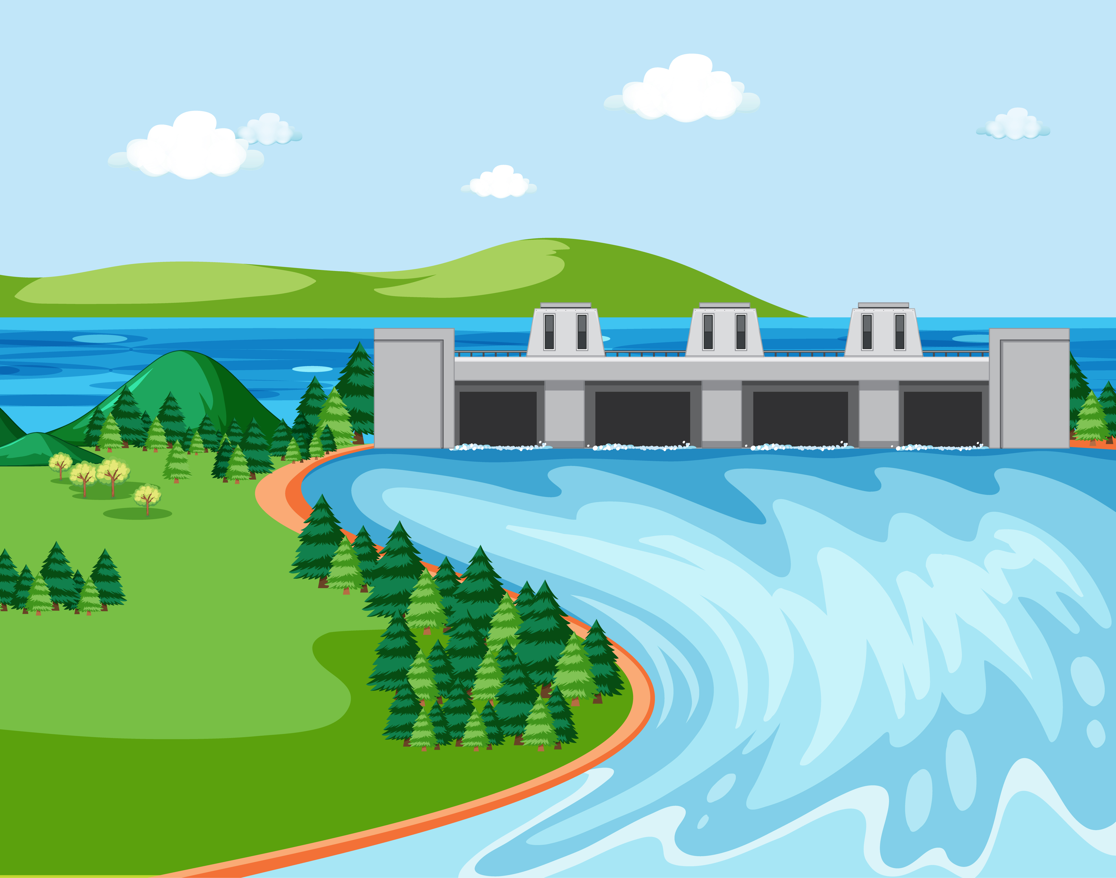
ENVIRONMENTAL
ENGINEERING
I
Prepared By
Somen Saha
Lecturer
Department of Civil Engineering
University of Global Village (UGV), Barishal

Slide 2
Course Title | Environmental Engineering I
Course Code | CE 0732-3205
Credits | 03
CIE Marks | 90
SEE Marks | 60
Exam Hours | 2 hours (Mid Exam) 3 hours (Semester Final Exam)
Level | 6th Semester
BASIC COURSE INFORMATION

Slide 3

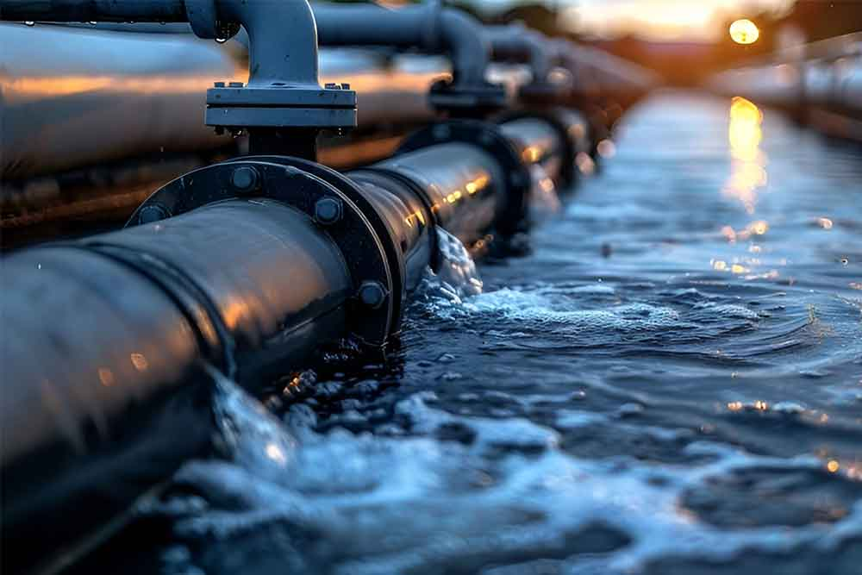
Environmental Engineering-I
COURSE CODE: CE 0712-3205 | CREDIT:01
 | TOTAL MARKS:150
 | CIE MARKS: 90
Semester End Exam Hours 3 | SEE MARKS: 60
Course Learning Outcomes (CLOs): After completing this course successfully, the students will be able to-
CLO 1 | Explain the fundamental concepts of environmental engineering including water, air, and noise pollution.
CLO 2 | Analyze the physical, chemical, and biological characteristics of water and wastewater.
CLO 3 | Design basic water treatment processes such as sedimentation, coagulation, filtration, and disinfection.
CLO 4 | Evaluate different methods of wastewater collection, conveyance, and treatment.
CLO 5 | Describe the roles of environmental legislation and standards in protecting public health.
CLO 6 | Demonstrate teamwork and ethical responsibility while working on environmental projects or case studies.

Slide 4
SL | Content of Course | Hours | CLOs
1 | Environmental Engineering: Definition, Key areas, Introduction of water supply engineering & Elements of water supply system. | 04 | CLO1
2 | Water demand: Per capita consumption, The design period of water supply system, Mathematics of water demand. | 05 | CLO3
3 | Quality of water: Different types of parameter, Sanitary Significance, Hydrogen-Concentration, Alkalinity of water, Mathematics of Alkalinity, Hardness of water. | 10 | CLO2, CLO4
4 | BOD & COD: Introduction & Definition of Biochemical Oxygen Demand (BOD) & Chemical Oxygen Demand (COD) & Dissolve Oxygen | 05 | CLO1, CLO3
5 | BOD & COD: Calculation of Biochemical Oxygen Demand (BOD) & Chemical Oxygen Demand (COD). | 10 | CLO1
6 | Disinfection: Water treatment system, Sterilization | 05 | CLO3
7 | Chlorination: Introduction of Chlorination, Chlorination curve, Chlorine Demand & Mathematics problem of Chlorination. | 10 | CLO3
8 | Practice, Review/Reserved Day, Self study, Problem Solve | 05 | CLO1
Text Books:
1. Introduction to Environmental Engineering by David A Cornwell and Mackenzie L Davis
2. Environmental Engineering and Science by Gilbert M. Masters

Slide 5
ASSESSMENT PATTERN
CIE- Continuous Internal Evaluation (30 Marks)
SEE- Semester End Examination (20 Marks)
Bloom’s Category | Tests
Remember | 10
Understand | 10
Apply | 10
Analyze | 15
Evaluate | 10
Create | 05
Bloom’s Category Marks (out of 100) | Tests (60) | Assignment (20) | Quizzes (20) | External Participation in Curricular/Co-Curricular Activities (20)
Remember | 10 |  | 10 | Attendance 15
Understand | 05 |  | 05
Apply | 10
Analyze | 10
Evaluate | 05
Create | 05 | 15

Slide 6
Environmental Engineering-I
Course plan specifying content, CLOs, teaching learning and assessment strategy mapped with CLOs
Week | Topic | Teaching-Learning Strategy | Assessment Strategy | Corresponding CLOs
1 | Introduction of Environment Engineering | Lecture, discussion, | Quiz, Written Exam | CLO1
2 | Introduction of Water Supply Engineering, Definition of Water Supply System | Oral Presentation, Debate | Assessment, Quiz | CLO3
3 | Water demand | Video Lecture, Group Discussion | Viva, Quiz | CLO2, CLO4
4 | Mathematical Problem on Water Demand | Lecture, Group discussion, | Quiz, Assignment | CLO1, CLO3
5 | Quality of Water | Oral Presentation, Debate | Written Exam, Viva | CLO3, CLO4

Slide 7
6 | Hydrogen-Concentration (pH) | Lecture, discussion, | Quiz, Written Exam | CLO1
7 | Alkalinity of Water | Oral Presentation, Debate | Assessment, Viva | CLO3
8 | Mathematical problem on Alkalinity | Lecture, Group discussion, | Quiz, Assignment | CLO2, CLO4
9 | Hardness of Water | Video Lecture, Group Discussion | Viva, Quiz | CLO1, CLO3
10 | Biochemical Oxygen Demand (BOD) | Oral Presentation, Debate | Written Exam, Viva | CLO3, CLO4
11 | Chemical Oxygen Demand (COD) | Lecture, discussion, Debate | Quiz, Written Exam | CLO3, CLO4

Slide 8
12 | Mathematical Problem on Biochemical Oxygen Demand (BOD) &Chemical Oxygen Demand (COD) | Lecture, Group discussion, | Quiz, Written Exam, Assignment | CLO1
13 | Disinfection: Water Treatment Systems | Oral Presentation, Debate | Assessment, Viva | CLO3
14 | Chlorination Curve with Break Point | Lecture, Group discussion, | Quiz, Assignment | CLO2, CLO4
15 | Mathematical Problem on Chlorination | Video Lecture, Group Discussion | Viva, Quiz | CLO1, CLO3
16 | Practice, Exercise & Review | Oral Presentation, Debate | Written Exam, Viva | CLO3, CLO4
17 | Problem Solving Day | Lecture, discussion, Debate | Quiz, Written Exam | CLO3, CLO4

Slide 9


Week 01
Introduction of Environment Engineering

Slide 10
Introduction to Environmental Engineering
Environmental Engineering is the branch of civil engineering that focuses on protecting human health and the environment. It involves the application of science and engineering principles to improve and sustain the quality of air, water, and land resources. The goal is to create systems and technologies that minimize pollution, manage waste, and ensure safe and sustainable natural resource use.
2. Key areas in environmental engineering include:
Water treatment and management: Ensuring the availability of clean drinking water, treating wastewater, and managing stormwater.
Air quality control: Reducing air pollution from industries, vehicles, and other sources.
Waste management: Developing systems for managing solid and hazardous waste in an environmentally stored manner.
Soil remediation: Cleaning up contaminated land to make it safe for future use.
Sustainable development: Promoting practices that reduce environmental impacts and preserve natural resources.

Slide 11
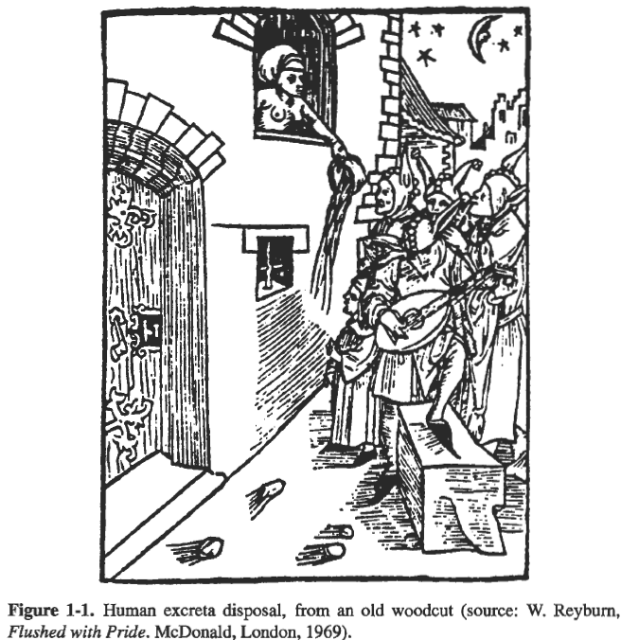
3. Environmental engineers design and operate systems for:
Water supply and treatment
Wastewater collection and treatment
Air pollution control
Solid waste management
Noise pollution reduction
Environmental impact assessment
Sustainable development practices

Slide 12
4. Key Objectives of Environmental Engineering:
Protect public health by providing clean water and sanitation.
Reduce environmental pollution from industrial and municipal sources.
Conserve natural resources through sustainable engineering.
Comply with environmental laws and regulations.
Key Objectives
Clean water & Sanitation
Reduce Environmental Pollution
Conserve Natural Resources
Execute Laws & Regulations

Slide 13
Week 02
Introduction of Water Supply Engineering, Definition of Water Supply System

Slide 14
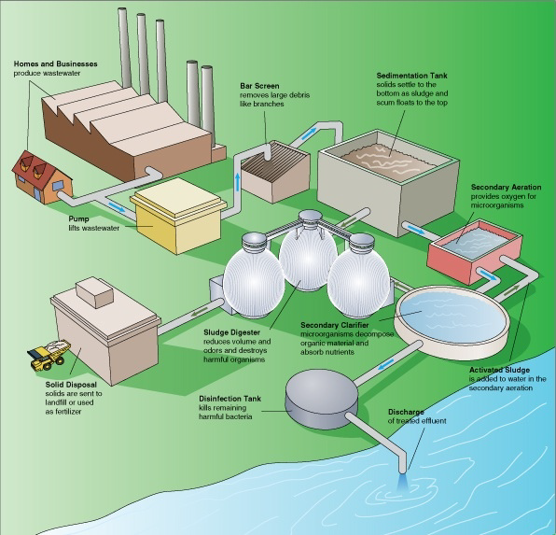
1. Introduction of Water Supply Engineering:
Water Supply Engineering is a vital branch of civil and environmental engineering that deals with the planning, design, construction, and maintenance of systems that provide safe and adequate water to meet the needs of a population.
2. Distilled Water/Pure Water:
Distilled Water /Pure Water refers to water that has undergone a purification process to remove impurities, including minerals, contaminants and microorganisms.

Slide 15
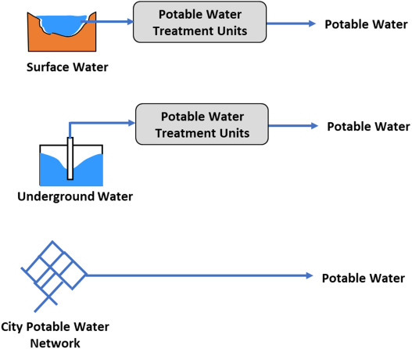
3. What is potable and palatable water? Which one do you choose for drinking water and why?
Potable Water: Water that is safe to drink and free from harmful contaminants such as bacteria, viruses, chemicals, and pollutants.
Key Characteristics:
Meets health and safety standards for human consumption.
Free from pathogens and toxic substances.
May or may not taste good, but it is safe to drink.

Slide 16
Palatable Water: Water that is pleasant to taste, with no undesirable flavors, odors, or color.
Key Characteristics:
Appealing taste, smell, and appearance.
May or may not meet safety standards for drinking.
Can be free from contaminants, but not necessarily.
To reduce water borne diseases and foster healthy living, potable water is better than palatable water. Because It ensures that the water is free from harmful substances and pathogens that can cause illness.
Definition of Water Supply System: It is a network of pipelines of various sizes with control valves for
carrying and supplying water to the consumers.
Objectives of Water Supply System:
To supply water in adequate quantity.
To safe and wholesome water to the consumer.
To make water easily available to the consumer.

Slide 17
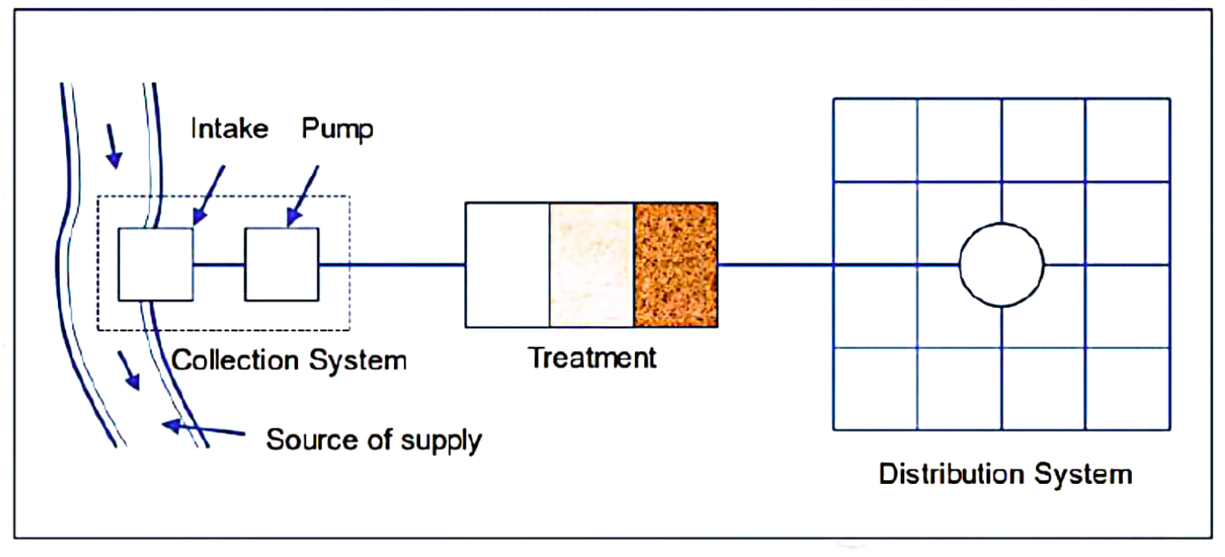
4. Draw the flow diagram of essential elements of the water supply system.
Flow diagram of essential elements of water supply system:
Source of supply
Collection system
Treatment
Distribution system

Slide 18
5. Describe the elements of the water supply system.
Elements of water supply system:
Sources of supply: Surface water and ground water are the main sources of water for water supply.
The main considerations for the selection of a source of water supply are (i) quantity (ii) quality and (iii) cost.
Collection system: It is dependent on the source of the water supply. An intake with pumping facilities are
required if the water is to be collected from a surface water source. Dug wells or tube wells are common collection devices for ground water.
Treatment or purification work: The water collected directly from the source may not be safe for drinking
because of different impurities. Aim of purification is to supply pure drinking water to the consumers. The most common methods used for purification works are: (i) screening, (ii) sedimentation, (iii) coagulation, (iv) disinfection and (v) aeration.
Distribution system: A distribution system is needed to deliver water to individual consumers. To flow water in
supply pipes under pressure, the purified water is normally stored in an elevated reservoir. Types of distribution system:
(i) Dead end/tree system and (ii) Grid iron system.

Slide 19
6. State planning and design considerations of a municipal water supply system.
Planning and design considerations of a municipal water supply system:
a) Estimate the future population of the community.
b) Location of a reliable source of water of adequate quality.
c) Design of a suitable collection system.
d) Provision for the necessary storage of water
e) Determination of the physical, chemical and biological characteristics of the water.
f) Design of various units of the treatment plant.
g) Design of the distribution system.
h) Provision for the establishment of an organization which will maintain and operate the supply, distribution and treatment facilities.
i) Provision for preventing deterioration of water quality
j) Suitability should be preferred in planning, designing and pricing the water supply.

Slide 20
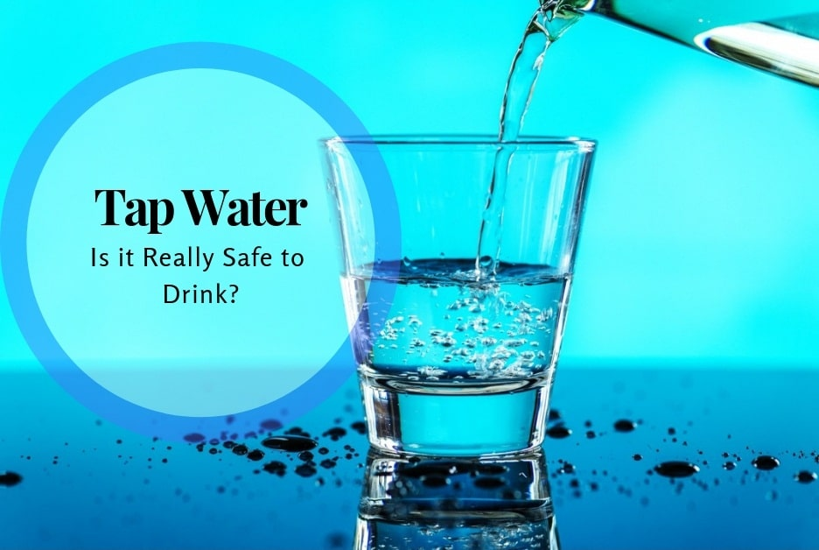
7. What are the basic requirements of drinking water?
Basic requirements of drinking water:
a) It should be free from bacteria.
b) It should be tasty, odor-free and cool
c) It should be free from objectionable matter
d) It should not be saline to cause a salty taste.
e) It should be colorless and sparkling.
f) It should have dissolved oxygen and be free from carbonic acid so that it may remain fresh.

Slide 21
Week 03
Water demand

Slide 22

Define per capita consumption of water. What are the factors affecting per capita consumption of water?
The average quantity of water required per person per day for domestic purposes is called per capita demand. This is obtained by dividing the total quantity of water required by the total population.
$≫Per Capita Demand=\frac{Total Yearly Quantity ot Water}{Design Population × 365}$
$$≫q=\frac{Qf}{Pf × 365} lpcd or gpcd$$
The factors affecting per capita consumption of water:
a) Size of city | g) Sewage facilities
b) Characteristics of the consumers | h) Water rates
c) Climate condition | i) Types of supply
d) Industries and commerce | j) Availability of private supply
e) Pressure of water | k) Efficiency of the management
f) Quality of water | l) Number of inhabitants.

Slide 23
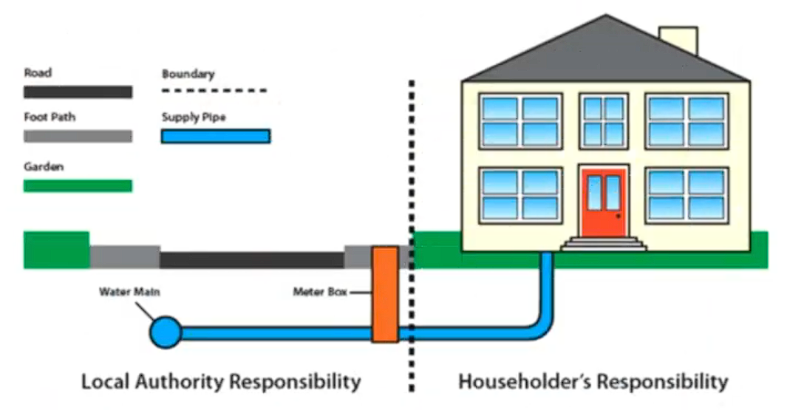
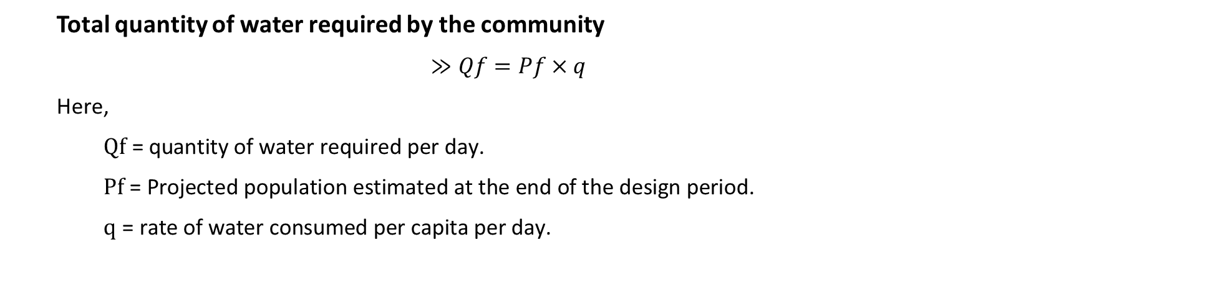
Total quantity of water required by the community
$≫Qf=Pf×q$
Here,
$\text{Q}\text{f}\text{ = }\text{quantity} \text{of} \text{water} \text{required} \text{per} \text{day}\text{.}$
$\text{P}\text{f}\text{ = }\text{Projected} \text{population} \text{estimated} \text{at} \text{the} \text{end} \text{of} \text{the} \text{design} \text{period}\text{.}$
$\text{q}\text{ = }\text{rate} \text{of} \text{water} \text{consumed} \text{per} \text{capita} \text{per} \text{day}\text{.}$

Slide 24
2. Water demand/ Consumption of water for various purposes:
Residential/ Domestic Use: Drinking, cooking, bathing, washing, and sanitation.
Commercial Use: Offices, hotels, restaurants, malls, and public institutions.
Public Use: Public parks, firefighting, street cleaning, public fountains.
Industrial Use: Manufacturing, cooling, chemical processes, cleaning, and energy production.
Agricultural Use: Irrigation, livestock farming, aquaculture.
Institutional Use: Schools, hospitals, government buildings.
Losses/Leakages: Unaccounted-for water due to system leaks or unauthorized use.
Fire Protection: Water reserved for firefighting and emergency uses.
Recreational Use: Swimming pools, water parks, sports facilities.
Environmental and Ecological Use: Preserving wetlands, maintaining ecosystems, and supporting aquatic life.

Slide 25
3. What are the methods of population estimation/population forecasting?
Methods of population estimation:
Arithmetical Increase Method.
Incremental Increase Method.
Decreasing growth method.
Graphical extension/ curvilinear method.
Graphical comparison method/Modified curvilinear method.
Geometric progression method/Empirical method.
Least square parabolic method.
4. Define the design period of the water supply system.
Design period: The number of years for which the designs of the water supply scheme have been done is known as the design period. Most water supply schemes are designed for a design period of 22-30 years, which is a fairly good period.

Slide 26
Week 04
Mathematical Problem on Water Demand

Slide 27

Geometric increase/progression method for population estimation:
Future population,
For annual consideration,
$Pf={Pp(1+r) }^{n}$
Where,
$Pf\text{= }\text{Present} \text{population}$
$n$ = Design period/number of years to be considered.
$r$ = Rate of yearly/annual population growth,
$r=\sqrt[n′]{\frac{P_{2}}{P_{1}}}−1$
And P1 & P2 are population data of two dates of n' number of years apart.
For Decade consideration:
$Pf={Pp(1+R) }^{m}$
Where,
$Pf\text{= }\text{Present} \text{population}$
$m$ = Design period/number of years to be considered.
$R$ = Rate of yearly/annual population growth,
$R=\sqrt[m′]{\frac{P_{2}}{P_{1}}}−1$
And P1 & P2 are population data of two dates of m' number of decades apart.

Slide 28
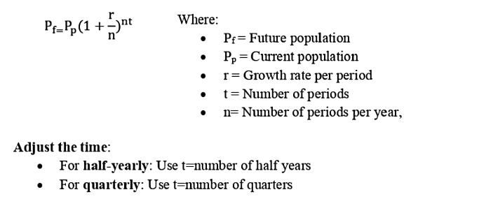

The arithmetic means of the growth rates,
$r=\frac{r_{1+}r_{2+}r_{3+}r_{4..………}}{t}$
The geometric mean of the growth rates,
$r=\sqrt[t]{r_{1}×r_{2}×r_{3}×r_{4……..}}$
To calculate half-yearly or quarterly future population when the growth rate is given yearly,
follow these steps:
1. Convert the yearly growth rate:
• For half-yearly : Divide the annual growth rate by 2.
• For quarterly : Divide the annual growth rate by 4.
Apply the growth formula:
Use the compound growth formula:.

Slide 29

Problem-01: If the present population of a city is 100,000 and the annual growth rate is 8%, compounded semiannually, what will the population be after 5 years?
Solution:
We know,
$⇒Pf={100000×(1+\frac{0.08}{2}) }^{2×5}$
$⇒Pf=148024.43=148025$
Given:
• Initial population, Pp=100,000
• Annual growth rate, r=8%=0.8
• Time, t=5years
• Compounded semiannually: Number of periods per year, n=2
$$Pf={Pp(1+\frac{r}{n}) }^{nt}$$

Slide 30
Week 05
Quality of Water

Slide 31
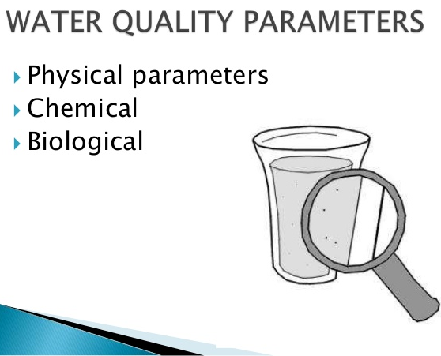
1. Briefly describe the quality of water in physical, chemical and biologicals views.
Water quality refers to the chemical, physical, and biological characteristics of water. Let's break it down:
1. Physical Parameters:
• These include attributes like electrical conductivity, salinity, total dissolved solids, turbidity, temperature, color, and taste and odor.
• For example, turbidity measures the cloudiness or haziness of water due to suspended particles, while temperature affects the solubility of gases and overall ecosystem health.
2. Chemical Parameters:
• These encompass properties such as pH, acidity, alkalinity, hardness, chlorine, and dissolved oxygen.
• pH indicates whether water is acidic, neutral, or alkaline. Dissolved oxygen is crucial for aquatic organisms, while
chlorine levels affect water disinfection.
3. Biological Parameters:
• These relate to living organisms in water. Indicator organisms are commonly used to assess water quality.
• For instance, the presence of specific bacteria or algae can indicate pollution or contamination.

Slide 32
2. Briefly describe source and significance of select water quality parameters.
1. pH (Potential of Hydrogen):
• Source: pH measures the acidity or alkalinity of water. It ranges from 0 to 14, with 7 being neutral. Acidic water has a pH below 7, while alkaline water has a pH above 7.
• Significance: pH affects chemical reactions, nutrient availability, and aquatic life. For example, fish and other organisms have specific pH tolerance ranges.
• Standard: 6.5 to 8.5 (BD & WHO)
2. Color:
• Source: Color in water is primarily due to the presence of colored organic substance, metals such as iron, manganese, or highly colored industrial wastes.
• Significance: Not accepted due to aesthetic reason.
• Standard: 15 Hazen unit (BD & WHO)

Slide 33
3. Dissolved Oxygen (DO):
• Source: DO comes from the atmosphere (through diffusion) and photosynthesis by aquatic plants.
• Significance: Adequate DO is crucial for aquatic organisms. Low DO levels can harm fish and other aquatic life, leading to hypoxia. fish and other organisms have specific pH tolerance ranges.
• Standard: 1000 mg/L (BD & WHO)
4. Turbidity:
• Source: Turbidity results from suspended particles (such as clay, silt, or algae) in water.
• Significance: High turbidity affects light penetration, aquatic plant growth, and sediment transport. It can also indicate pollution.
5. Total Dissolved Solids (TDS):
• Source: TDS includes minerals, salts, and organic matter dissolved in water.
• Significance: Elevated TDS affects taste, corrosion, and water hardness. It's essential for drinking water quality.
• Standard: 10 NTU (BD) & 5 NTU (WHO).

Slide 34
6. Chlorine Residual:
• Source: Chlorine is added during water treatment for disinfection.
• Significance: Chlorine residual ensures safe drinking water by killing harmful microorganisms. However, excessive chlorine can be harmful.
3. Write down the sanitary significance of the following impurities:
a) Arsenic (As) & b) Lead (Pb)
1. Arsenic (As):
• Source: Arsenic is naturally present in the Earth's crust and can contaminate water through geological processes or human activities (e.g., mining, industrial discharges).
• Significance:
Toxicity: Arsenic is highly toxic and can cause various health issues, including skin lesions, cardiovascular diseases, diabetes, and cancers (such as skin, lung, and bladder cancer).
Chronic Exposure: Long-term exposure to low levels of arsenic in drinking water can lead to serious health consequences.
Regulation: The World Health Organization (WHO) recommends a maximum allowable concentration of 10 µg/L (micrograms per liter) in drinking water.
Standard: 0.05 mg/L (BD) and 0.01 mg/L (WHO)

Slide 35
2. Lead (Pb):
• Source: Lead exposure occurs mainly through contaminated water (e.g., old pipes, plumbing), lead- based paints, and industrial processes.
• Significance:
Neurotoxicity: Lead affects the nervous system, especially in children. It can lead to developmental delays, learning disabilities, and behavioral problems.
Cardiovascular Effects: Chronic lead exposure increases the risk of hypertension, heart disease, and stroke.
Renal Damage: Lead can harm the kidneys and cause kidney dysfunction.
Regulation: The U.S. Environmental Protection Agency (EPA) sets a maximum contaminant level goal (MCLG) of zero for lead in drinking water.
Standard: 0.01 mg/L (BD).
4. Write the difference between Acts & Rules.
Acts are formal laws passed by the legislature, outlining the legal framework for a subject. It requires pass in the parliament.
Rules: Rules are detailed instructions issued under an Act, explaining how to apply its principles. Acts are broad and stable; Rules are specific and adaptable. It does not require pass in parliament, and it is made by authority.

Slide 36
5. Explain the effects of turbidity in water?
Turbidity in water, which is the measure of its cloudiness or haziness, can have several effects:
• Reduces clarity, making water appear cloudy or opaque.
• Impairs water quality, affecting taste and odor.
• Hinders ecological productivity by affecting light penetration.
• Provides a medium for microbial growth, potentially harboring harmful pathogens like bacteria, viruses, and parasites, which can cause health issues such as nausea and diarrhea.
• Increases treatment costs for drinking water and can degrade habitat quality for wildlife.
6. Write down the standard value of the following parameters: a) Arsenic b) BOD5 at 20°C c) Iron d) TDS e) Turbidity f) Total Coliform g) Faucal Coliform.
Parameters | Unit | ECR value (BD Standard) | WHO Standard
Arsenic | (mg/L) | 0.05 | 0.01
BOD₅ (20°C) | (mg/L) | 0.02 | -
Iron | (mg/L) | 0.3-1.0 | 0.3
TDS | (mg/L) | 1000 | 1000
Turbidity | JTU or NTU | 10 | 5
Total Coliform | Nil/100ml | 0 | 0
Faucal Coliform | Nil/100ml | 0 | 0

Slide 37
Drinking Water Standards:
SL no | Water Quality Parameter | ECR value/BD Standards (mg/L) | WHO Standards/ Guideline
1 | Arsenic(As) | 0.05 | 0.01
₂ | Chloride(Cl) | 150-600 | 250
3 | Chloride (Residual) | 0.2 | 0.6-1.0
4 | BOD₅ (20°C) | 0.2 | -
5 | Chemical Oxygen Demand (COD) | 4 | -
6 | Color | 15 Hazen | 15 Hazen
7 | Copper (CU) | 1 | 1
8 | Fluoride (F) | 1 | 1.5
9 | Hardness (as Caco₂) | 200-500 | 500
10 | Aluminum (A) | 0.2 | 0.2
11 | Iron (Fe) | 0.3-1.0 | 0.3
12 | Lead (Pb) | 0.05 | 0.01
13 | Manganese (Mg) | 0.1 | 0.1
14 | Nitrate (NO₃) | 10 | 50
15 | Oduor | Odorless | -
16 | PH | 6.5-8.5 | 6.5-8.5
17 | Salinity | 0% | -
18 | Sodium (Na) | 200 | 200

Slide 38
19 | Total Dissolved Solid (TDS) | 1000 | 1000
20 | Turbidity | 10 JTU/NTU | 05 JTU/NTU
21 | Dissolved Oxygen (DO) | 6 | -
22 | Temperature | 20°C-30°C | -
23 | Total Coliform (Tc) | 0 (Nil/100ml) | 0 (Nil/100ml)
24 | Faucal Coliform (Fc) | 0 (Nil/100ml) | 0 (Nil/100ml)

Slide 39
Week 06
Hydrogen-Concentration (pH)

Slide 40
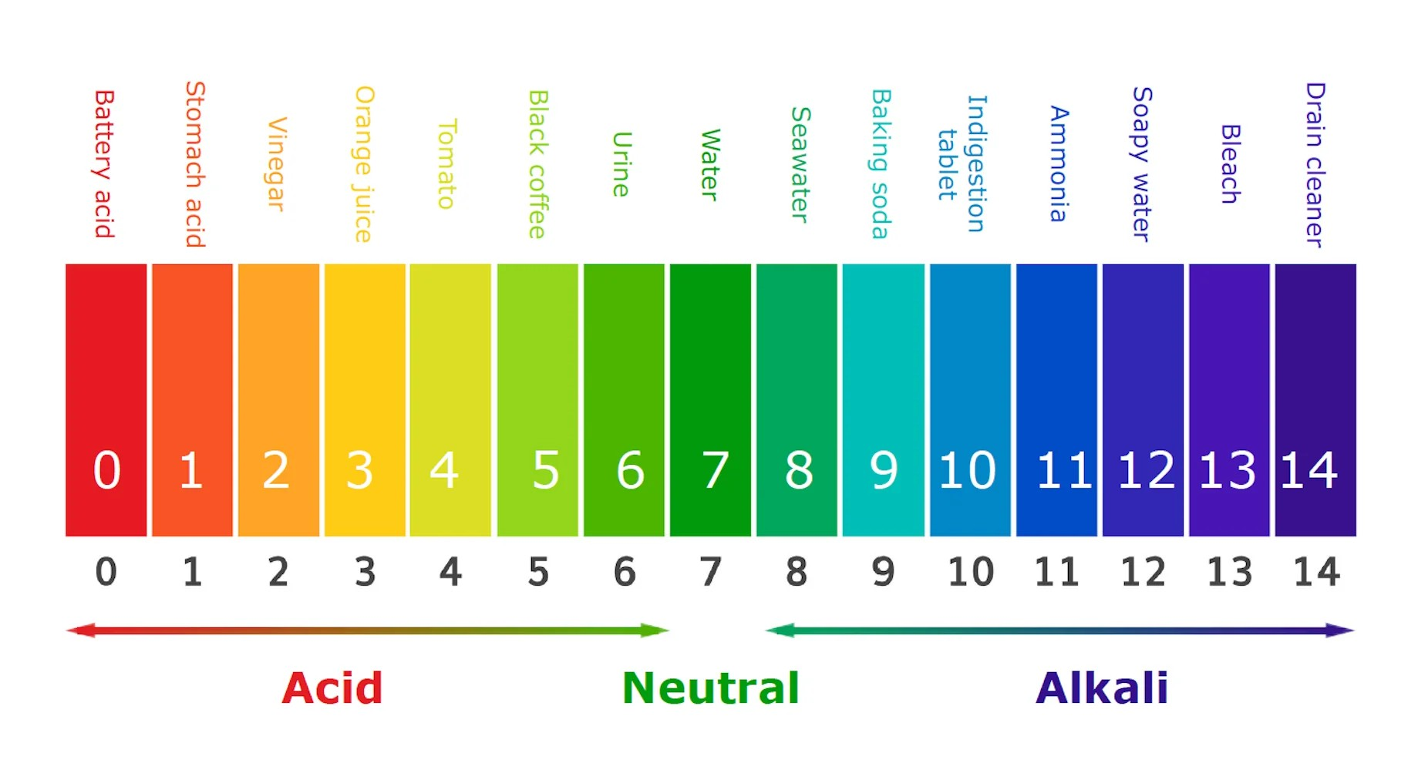

Write done the definition of P^{H}.
P^{H}: P^{H} is defined as the negative logarithm of the hydrogen ion concentration. pH is a figure expressing the acidity or alkalinity of a solution on a logarithmic scale on which 7 is neutral, lower values are more acid, and higher values are more alkaline.
$P^{H}=−\log_{10}\left[H+\right]$
2. Write done the definition of P^{H}.
P^{OH}:P^{OH} is a measure of the hydroxide ion concentration in a solution. It is defined as the negative logarithm of the hydroxide ion (OH-) concentration. The formula to calculate P^{OH} is:
$P^{oH}=−\log_{10}\left[OH−\right]$

Slide 41
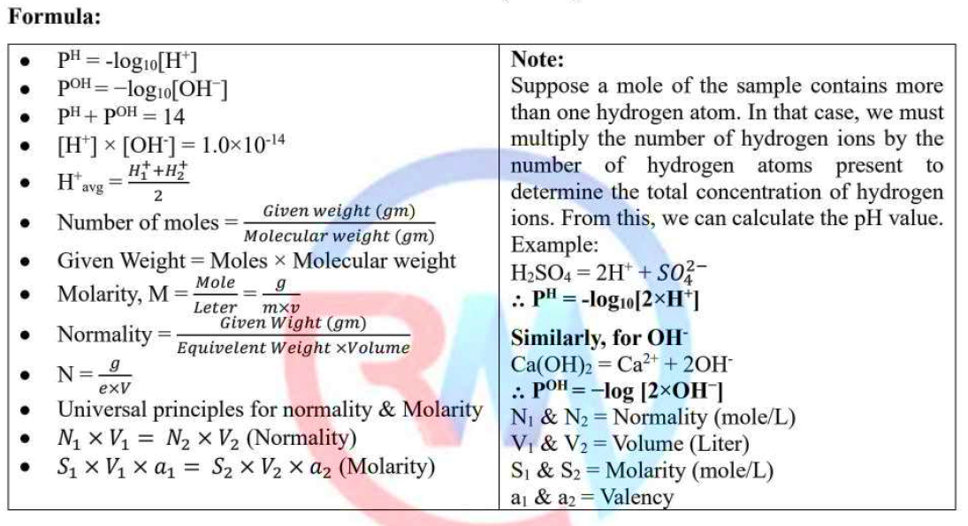

Prove that P^{H}+P^{OH}=14.
We know,
The ionization of water can be represented as: H2O = H+ + OH- .
The ionization constant (Kw) for water is the product of the concentrations of hydrogen ions ([H+]) and hydroxide ions ([OH-]):
Kw = [H+][OH-] = 10⁻¹⁴
-log (Kw) = -log ([H+][OH-])
14 = -log₁₀[H+] + (-log₁₀[OH-])
$∴$PH+POH = 14. (Proved)

Slide 42
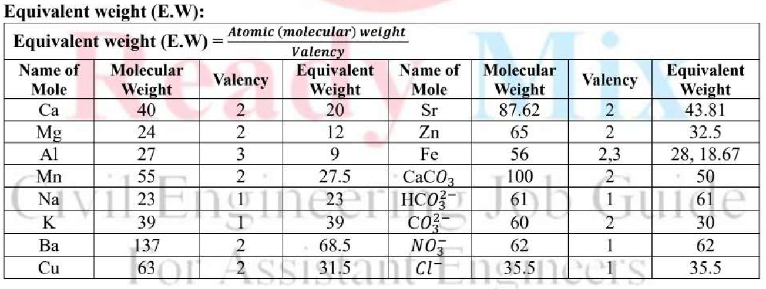

Slide 43
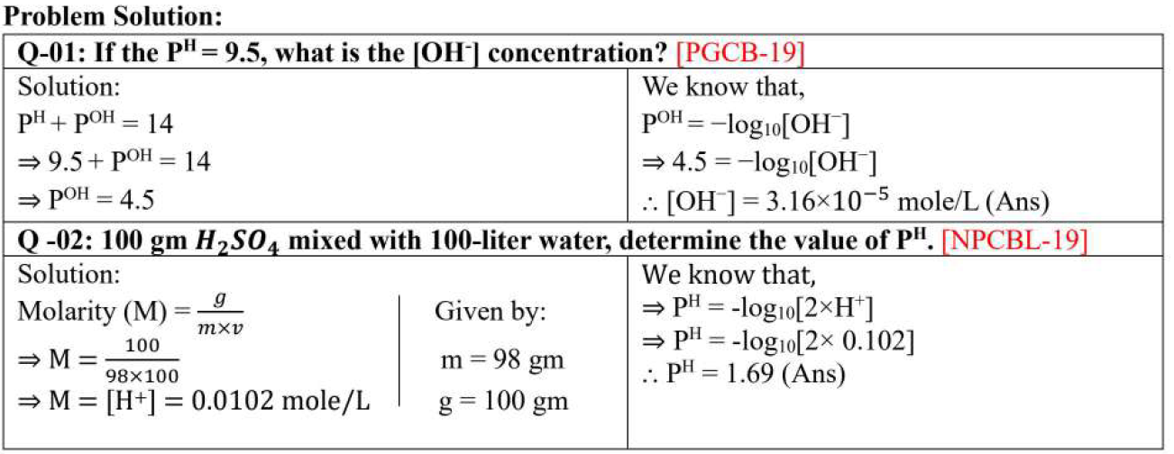

Slide 44
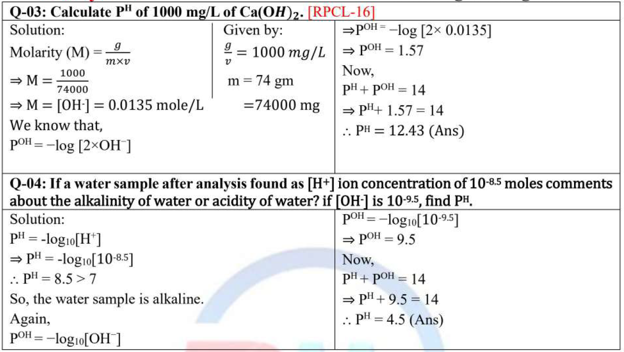

Slide 45
Week 07
Alkalinity of Water

Slide 46

1. Define Alkalinity of Water
Alkalinity: The alkalinity of water refers to its capacity to neutralize acids. It is primarily determined by the presence of bicarbonate (${HCO}_{3}^{−}$) carbonate (${HCO}_{3}^{2−}$) and hydroxide (OH⁻) ions in the water.
These ions can react with acids, effectively buffering the pH of the water.
The mathematical formula to calculate alkalinity is:
$\text{Alkalinity}\text{ (}\text{mg}\text{/}\text{L}\text{)=}\frac{\text{Equivalent} \text{weight} \text{of} \text{acid} \text{used}\text{ × }\text{Normality} \text{of} \text{acid} \text{used} \text{×} \text{50,000}}{\text{Volume} \text{of} \text{water} \text{sample}}$ as CaCO₃
1. P-Alkalinity (Phenolphthalein Alkalinity):
Definition: P-alkalinity represents the alkalinity due to hydroxide (OH⁻) ions and half of the carbonate (${CO}_{3}^{2−})$ alkalinity.
Indicator: Measured using phenolphthalein indicator, which changes color at a pH endpoint of around 8.3.
$\text{P}\text{−}\text{alkalinity}\text{ = }\text{Total} \text{Hydroxide}\text{ +}\frac{1}{2} ×Carbonate\text{=}\text{OH}\text{−}\text{+}$ $\frac{1}{2} ×{CO}_{3}^{2−}$
2. M-Alkalinity (Methyl Orange Alkalinity):
Definition: M-alkalinity represents the total alkalinity of the water Expand more It considers all contributors to alkalinity, including hydroxide (OH⁻ ) ions, carbonate (${CO}_{3}^{2−}$) ions, and bicarbonate (${HCO}_{3}^{−}$) ions.
Indicator: Methyl Orange - This indicator changes color from orange to red pink at a pH endpoint of around 4.5.
M - Alkalinity = [OH⁻] + [HCO₃⁻] + [CO₃²⁻]

Slide 47
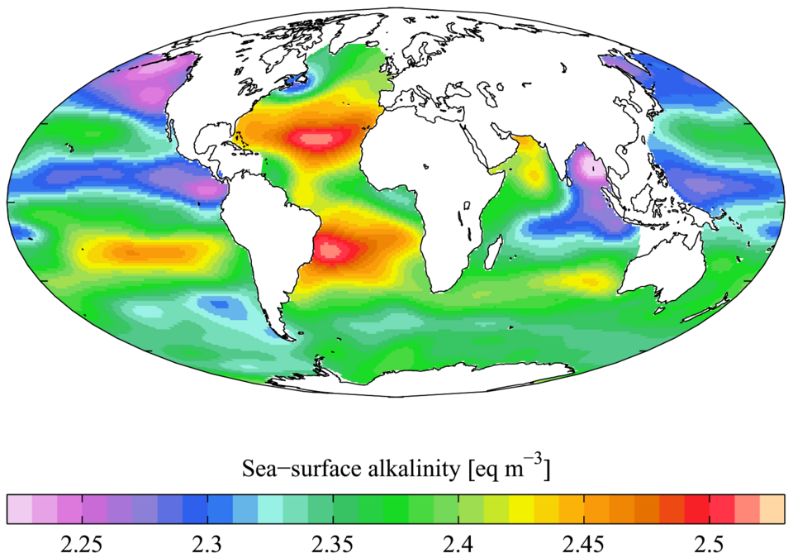
2. Total Alkalinity:
Definition: Total alkalinity is the measure of a water's capacity to neutralize acids or its buffering capacity. It includes all the bases in water and is expressed as parts per million (ppm) or milligrams per liter (mg/L) of calcium carbonate (CaCO₃).
Total Alkalinity = [HCO₃⁻] + [CO₃²⁻] + [OH⁻] - [H⁺]

Slide 48
Week 08
Mathematical problem on Alkalinity

Slide 49
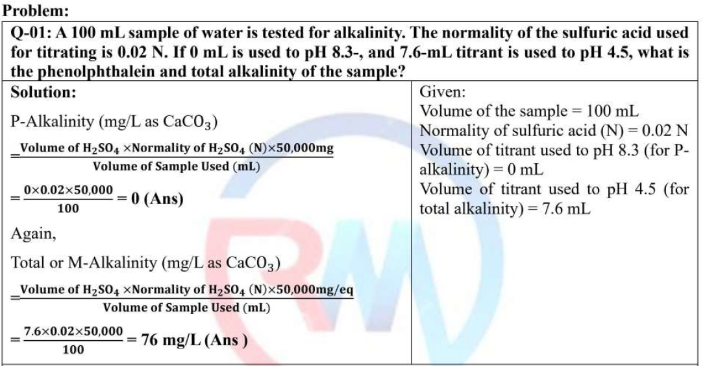

Slide 50
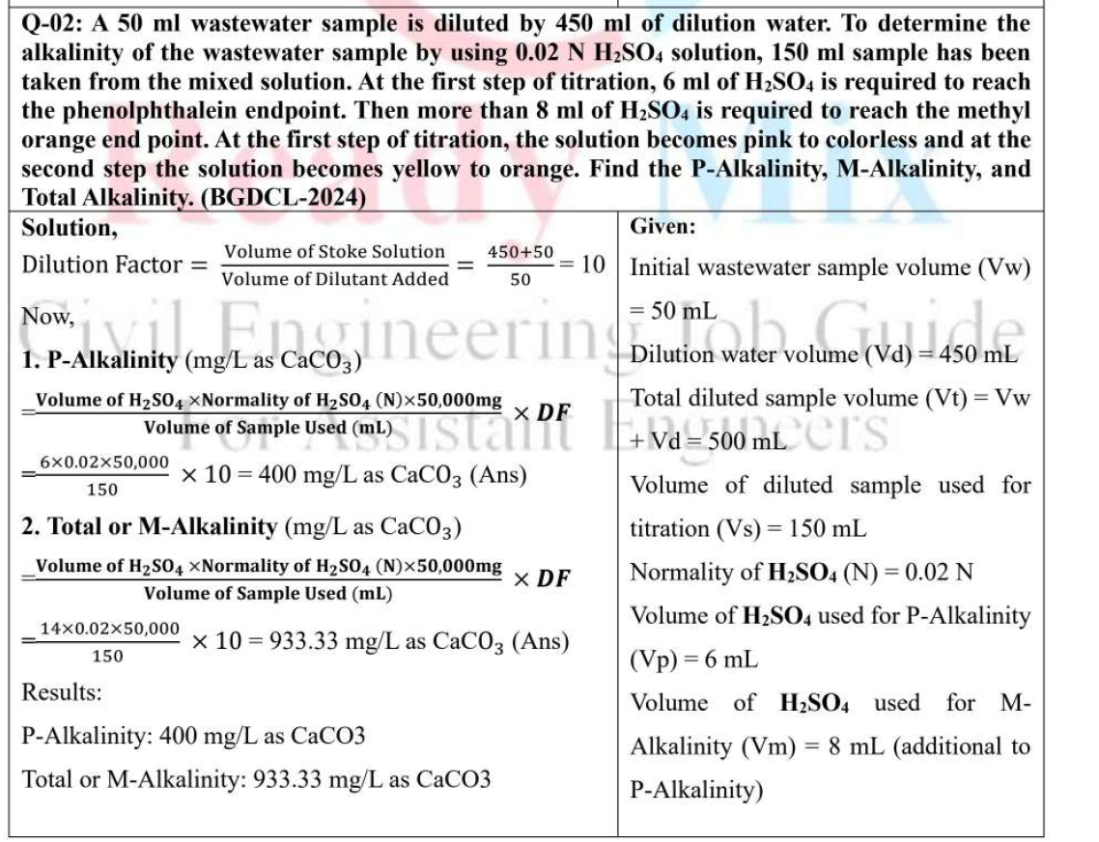

Slide 51
Week 09
Hardness of Water

Slide 52
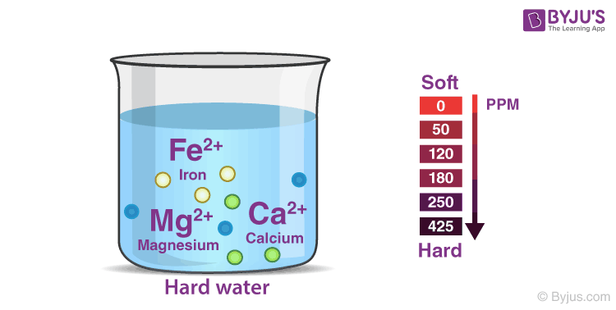
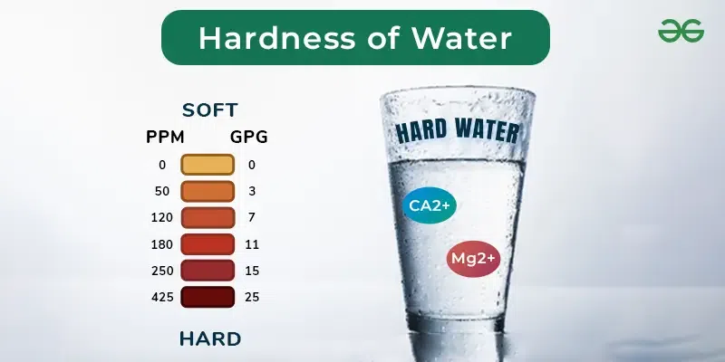
1. Write down the definition of Hardness.
Hardness: Hardness is defined as the presence of multivalent cations in water (i.c all but the monovalent cations). The most common hardness causing are (Major): Ca²+ & Mg²⁺; other included (Minor) Fe²⁺, Al³⁺, Ba²⁺, Mn²⁺, Sr²⁺, etc.

Slide 53
2. Types of Hardness.
Temporary Hardness/ Carbonate Hardness (CH): This type of hardness is caused by the presence of bicarbonate minerals, mainly calcium bicarbonate Ca(HCO3)2 and magnesium bicarbonate Mg(HCO3)2. Temporary hardness can be removed by boiling the water or by adding certain chemicals that precipitate the bicarbonate ions, such as lime (calcium hydroxide) or washing soda (sodium carbonate).
Permanent Hardness/Non-Carbonate Hardness (NCH): Permanent hardness is due to the presence of dissolved sulfates, chlorides, and nitrates of calcium and magnesium, which cannot be removed by boiling. It usually requires ion exchange methods, reverse osmosis, or other water-softening techniques to reduce permanent hardness.
The principal negative effects of water hardness include:
a) Mineral Buildup: Causes scaling in pipes and appliances, reducing efficiency and lifespan.
b) Soap Scum: Hard water reacts with soap, leading to increased usage and scum residue.
c) Spotty Dishes: Leaves unsightly spots and film on dishes and glassware.
d) Low Pressure: Can clog pipes, resulting in reduced water flow.

Slide 54
Total Hardness (TH):
TH represents the molar concentrations of all multivalent cations in water (except monovalent cations).
It includes calcium (Ca), magnesium (Mg), strontium (Sr), barium (Ba), iron (Fe), manganese (Mn), aluminum (Al), and other cations.
TH can be approximated as the sum of Ca and Mg concentrations:
TH ≈ [Ca] + [Mg]
The correct formula includes additional cations:
TH = [Ca] + [Mg] + [Sr] + [Ba] + [Fe] + [Mn] + [Al] + ...
Carbonate Hardness (CH):
CH is the part of TH related to anionic content (carbonates).
It is directly related to alkalinity: CH=Alkalinity
CH is also called "temporary hardness" because Ca and Mg carbonates precipitate upon heating.
Non-carbonate Hardness (NCH):
NCH is the difference between TH and CH: [NCH=TH-CH]
It includes Ca and Mg associated with sulfates, chlorides, or nitrates.
NCH is called "permanent hardness" because these cations do not precipitate upon heating.

Slide 55
Hardness Standard of water:
Hardness Range (ppm – mg/L as CaCO₃) | Class | Degree of Hardness
0-55 | 1 | Soft
56-100 | 2 | Slightly Hard
101-200 | 3 | Moderately Hard
201-300 | 4 | Very Hard
3. How to remove the temporary hardness of water?
1. Boiling:
Principle: When the water is boiled, the bicarbonate salts decompose, forming insoluble carbonates that precipitate out.
Process: Heat the water to its boiling point. The insoluble carbonates will settle at the bottom. Filter the water to remove the sediment.
Chemical reaction:
Ca(HCO3)2(aq) → CaCO3(s) + CO2(g) + H2O(l)
Mg(HCO3)2(aq) → MgCO3(s) + CO2(g) + H2O(l)
2. Clark's Method:
Principle: Lime water (calcium hydroxide) is added to the hard water. The calcium hydroxide reacts with bicarbonates to form insoluble calcium carbonate.

Slide 56
Process: Add a calculated amount of lime water to the hard water. The calcium carbonate precipitate
can be filtered out.
Chemical reaction:
Ca(HCO₃)₂(aq) + Ca(OH)₂(aq) → 2CaCO₃(s) + 2H₂O(l)
Mg(HCO₃)₂(aq) + Ca(OH)₂(aq) → MgCO₃(s) + CaCO₃(s) + 2H₂O(l)
4. Discuss the removal process of the permanent hardness of water
Permanent hardness is caused by the presence of dissolved sulfate and chloride salts of calcium and magnesium. It cannot be removed by boiling. Here are some common methods with their corresponding
Chemical equations:
1. Ion Exchange:
Chemical reaction:
CaSO₄(aq) + 2NaR(s) → CaR₂(s) + Na₂SO₄(aq)
MgCl₂(aq) + 2NaR(s) → MgR₂(s) + 2NaCl(aq)
2. Lime-Soda Process:
Chemical reactions:
CaSO₄(aq) + Na₂CO₃(aq) → CaCO₃(s) + Na₂SO₄(aq)
MgCl₂(aq) + Ca(OH)₂(aq) → Mg(OH)₂(s) + CaCl₂(aq)

Slide 57
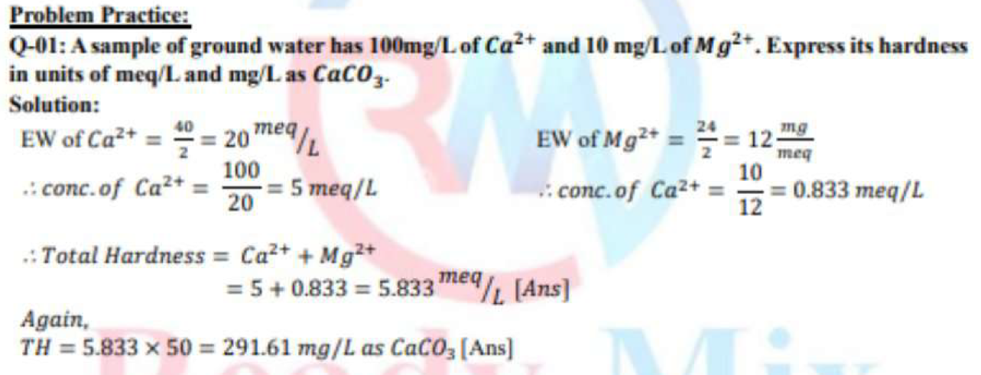
3. Reverse Osmosis:
Reverse osmosis is a physical process that uses pressure to force water through a semi-permeable membrane, leaving behind dissolved salts.
4. Calgon Process (Sodium Hexametaphosphate)
Process: Calgon forms complexes with calcium and magnesium, preventing them from contributing to hardness.
Chemical reaction:
Ca²⁺ + [NaPO₃]₆ → Ca[NaPO₃]₆

Slide 58
Week 10
Biochemical Oxygen Demand (BOD)

Slide 59
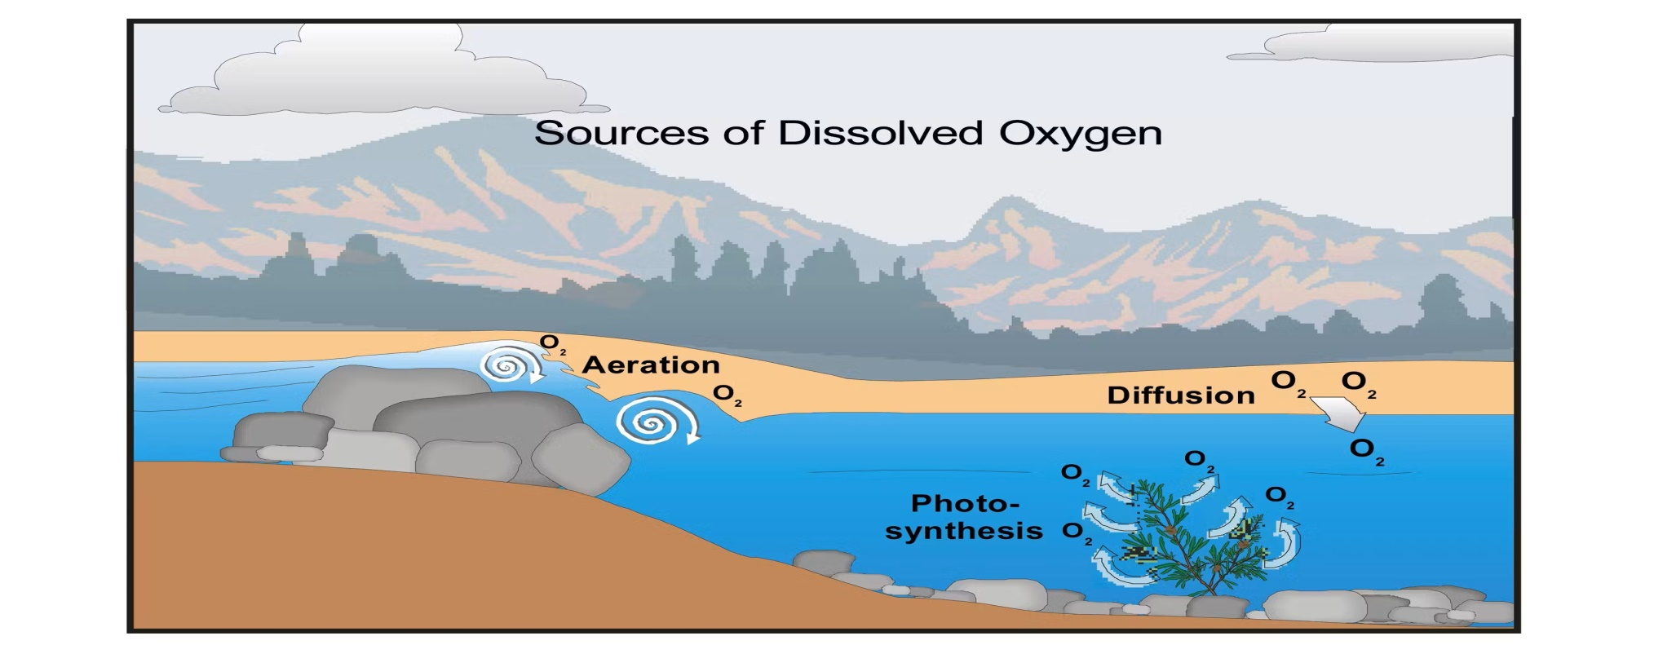
Write down the definition of Biochemical Oxygen Demand (BOD).
Biochemical Oxygen Demand (BOD) is the amount of oxygen required by microorganisms (Bacteria) to oxidize organic wastes (Biodegradable) aerobically is called Biochemical Oxygen Demand (BOD). Used as a means of measuring the polluting strength of domestic and industrial waste.
Organic matter in waste + O2 in water → CO2 + H2O
Agent : Bacteria
Condition : Aerobic
Unit : mg/L
Standard Specification for Drinking water: 0.2 mg/L (According to ECR - 97)

Slide 60
2. Draw Typical Bacterial Growth Pattern and briefly discuss the growth pattern.
Typical Bacterial Growth Pattern:
1. Lag Phase:
(a) Cell numbers do not increase.
(b) The Bacteria are internally active.
2. Log Phase:
(a) Logarithmic growth occurs
(b) Bacteria grow as fast as they are able to in the waste.
(c) In this phase food must be in ample supply, but a low concentration is desired in the treated waste.
3. Stationary Phase:
(a) The no. of new cells is approximately balanced by those that die
(b) Population cell density does not change
4. Death or Decline Phase:
(a) When death rate exceeds the growth rate; the culture enters the death phase.
(b) The population density steadily declines.

Slide 61
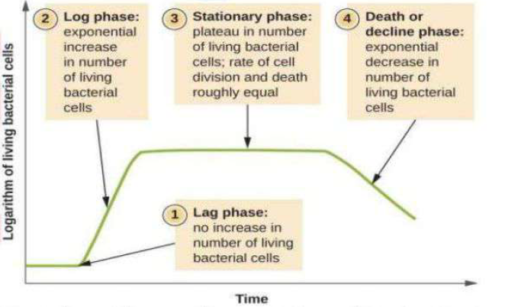

Slide 62
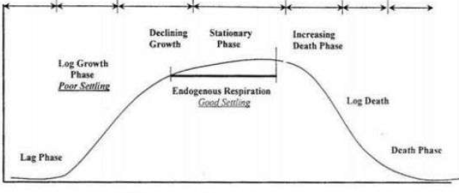
3. Write done the definition of Dissolve Oxygen.
Dissolve Oxygen (DO): Dissolved oxygen (DO) is the amount of oxygen that is present in water. Water bodies receive oxygen from the atmosphere and from aquatic plants. DO level ≤ 2.0 mg/L, some fish and other aquatic animal species may be distressed and some species may even die due to suffocation. As a rule of thumb DO level of 4 mg/L should be maintained.
4. Write down the applications of BOD in Sanitary Engineering
Applications of BOD in Sanitary Engineering:
(i) It gives the quality of natural wastes, waste water and effluents.
(ii) It determines the polluting strength and polluting load of the sewage of waste water.
(iii) It is required to design treatment facilities.
(iv) It is used in pollution and self-purification studies of water bodies.

Slide 63
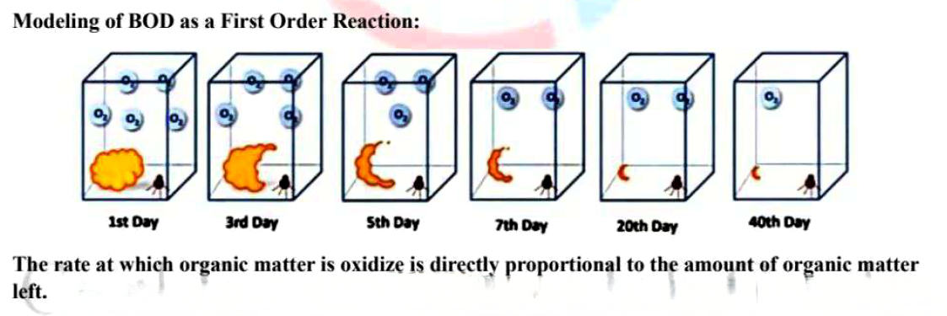
3. Discuss the reason of BOD Calculation.
BOD calculated for
(i) Determination of the size of waste treatment facilities
(ii) Measurement of the efficiency of some treatment processes.
4. Define 5 days BOD or BOD₅.
5 days BOD: The amount of oxygen required by microorganisms (Bacteria) to oxidize organic wastes (Biodegradable) aerobically in 5 days and 20°C temperature is called Biochemical Oxygen Demand (BOD).
BOD generally calculated after 5 days:
(i) DO (Dissolved Oxygen) is maximum at 5 days.
(ii) 80-95% decomposition occurs at days.
(iii) Bacterial process happens within 5 days..
5. BOD Rate Equation

Slide 64
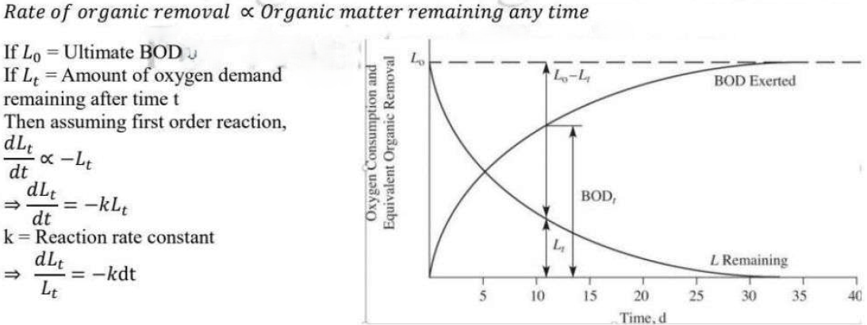
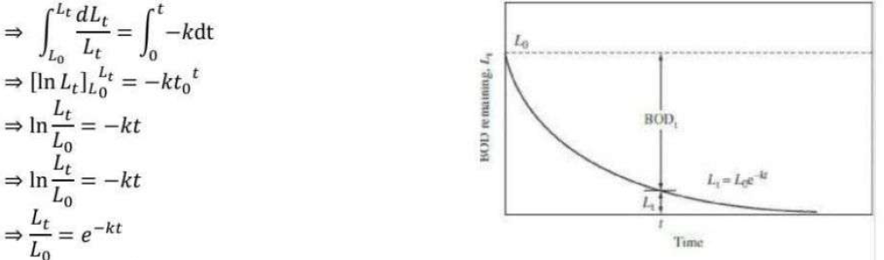

Slide 65
Week 11
Chemical Oxygen Demand (COD)

Slide 66
Write down the definition of Chemical Oxygen Demand (COD).
Chemical Oxygen Demand (COD) is the total amount of oxygen required by Strong chemical oxidation agent to oxidize organic matter (Both biodegradable and non-biodegradable) in acid condition is called Chemical Oxygen Demand (COD). Used as a means of quantifying the amount of oxidizable pollutants of domestic and industrial waste.
Agent : KMnO4, K2Cr2O7
Condition : Acid
Unit : mg/L
Standard Specification of Drinking water: 4.0 mg/L (According to ECR - 97)
Chemical Equation :
C₆H₁₂O₆ + O₂ (KMnO₄ or K₂Cr₂O₇) → 6CO₂ + 6H₂O + Energy
2. Explain with scientific reasoning why COD values are always higher than BOD in water or wastewater samples.
COD measures as both biodegradable and non-biodegradable matter while BOD measures only biodegradable matter only. For this reason, COD is always higher than BOD.

Slide 67
3. Write down the importance and limitations of COD calculation.
Importance of COD Calculation:
(i) When biologically resistance organic matter is present.
(ii) COD can be oxidized many substances chemically that cannot be oxidized biologically only.
(iii) Short time (about 3 hours) required for evaluation.
Limitation of COD Calculation:
(i) Inability of differentiate between biodegradable and non-biodegradable materials.
(ii) Does not provide any evidence of the rate at which biologically active material would be stabilized.
4. Analyze the difference between BOD and COD.
Difference between BOD and COD:
BOD | COD
1. Biological oxidation process | 1. Chemical oxidation process
2. Performed by aerobic organisms (Bacteria) | 2. Performed by Chemical reagents (KMnO₄, K₂Cr₂O₇)
3. BOD value is determined by 5 days. | 3. COD can be measured within few days (about 3hours)
4. BOD value is lower than COD | 4. COD value is always higher than BOD
5. Measures biodegradable organics only | 5. Measures biodegradable and non-biodegradable organics

Slide 68
3. Theoretical Oxygen Demand (TheoD):
Organic matter of animal or vegetable origin in wastewater is generally a combination of carbon, hydrogen, oxygen, nitrogen and other elements. If the chemical composition of an organic matter is known then the amount of oxygen required to oxidize it to carbon dioxide and water can be calculated using stoichiometry. The amount of oxygen is known as theoretical oxygen demand (TheoD). If that oxidation is carried out by bacteria, then it is BOD, if by chemical process then it is COD. If a combination of both then it is TheoD.

Slide 69
Week 12
Mathematical Problem on Biochemical Oxygen Demand (BOD) &Chemical Oxygen Demand (COD)

Slide 70
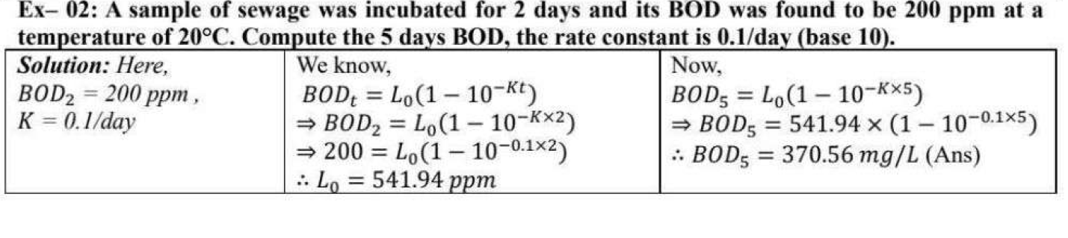
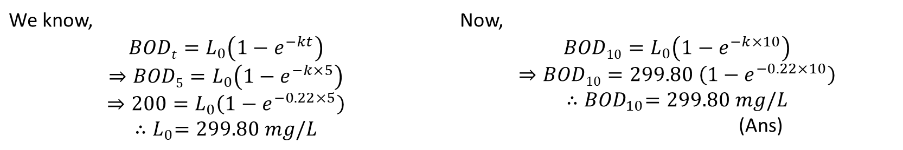
The amount of BOD₅ in a sewage found 200 mg/L at temperature 20°C. If k = 0.22/day, then determine the BOD₁₀ at the same temperature.
Solution:
Here,
BOD₅ = 200 mg/L
k = 0.22/day
We know, $$BODt=L_{0}\left(1−e^{−kt}\right)$$ $$⇒BOD5=L_{0}\left(1−e^{−k×5}\right)$$ $$⇒200=L_{0}\left(1−e^{−0.22×5}\right)$$ $${∴L}_{0}=299.80 mg/L$$ | Now, $$BOD10=L_{0}\left(1−e^{−k×10}\right)$$ $$⇒BOD10=299.80 \left(1−e^{−0.22×10}\right)$$ $${∴BOD}_{10}=299.80 mg/L$$ (Ans)

Slide 71
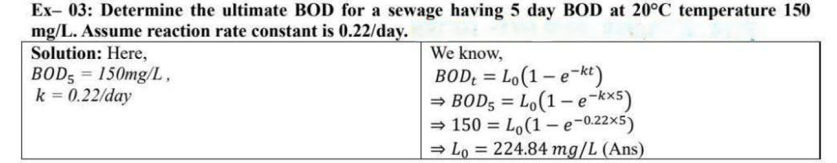

Slide 72
Week 13
Disinfection: Water Treatment Systems

Slide 73
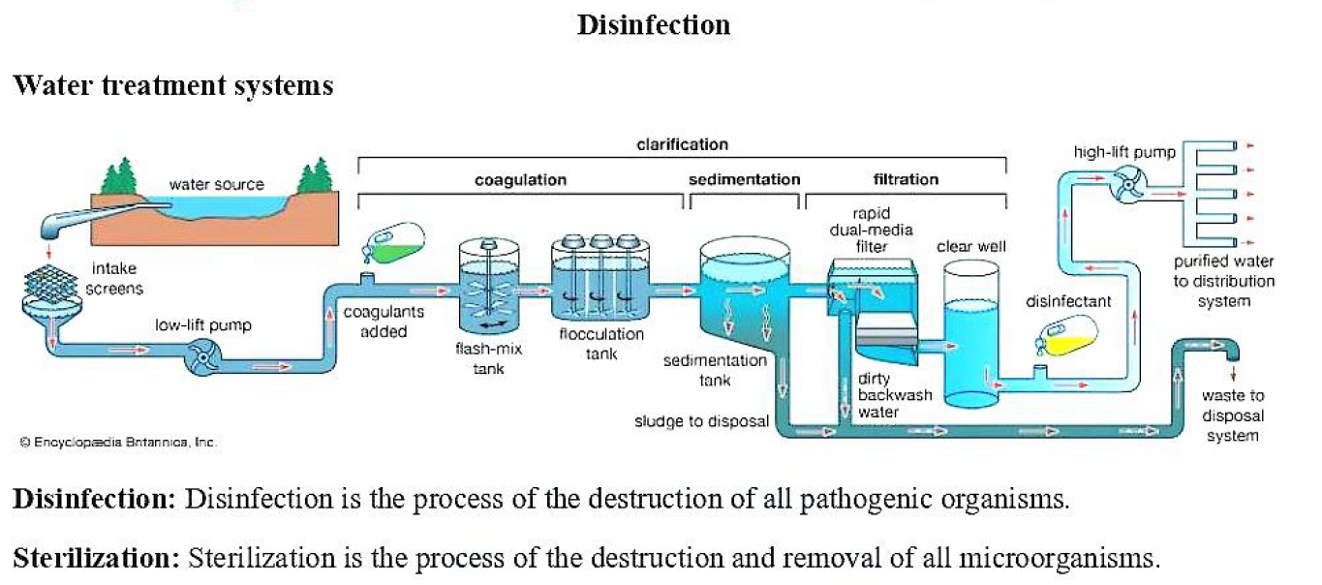
Explain the important requirements of a good disinfectant used in water treatment.
Requirements of good disinfectants:
They should destroy all the harmful pathogenic organisms in the water.
They should not take more time to kill pathogens.
They should be economical and easily available.
They should not require high skill for their application.
After their treatment, the water should not become toxic and objectionable to the user.

Slide 74
2. Write down some methods of disinfection of water:
Chlorination
UV Disinfection
Ozonation
Boiling
Filtration (with Disinfectants)
3. Describe the main characteristics of chemical disinfection used in water treatment.
Characteristics of chemical disinfection:
Quick and effective in killing pathogenic micro-organisms.
Not imparting taste, odor, color and turbidity.
Not toxic to human and animal life.
Readily available at moderate cost.
Easy to handle, transport, apply and control.
Easy to detect and measure in water.

Slide 75
Week 14
Chlorination Curve with Break Point

Slide 76
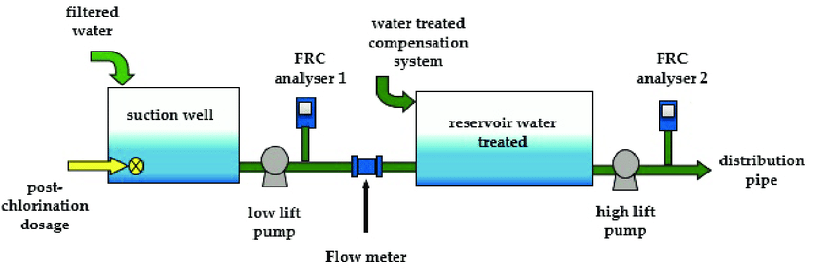
Define Chlorination.
Chlorination: The use of chlorine in water to disinfectant of water is called chlorination. It has become practically universal in the disinfection of water.
Reason for chlorination is used for disinfection: Chlorine is one of the most versatile chemicals used in water and wastewater treatment. This powerful oxidizing agent is used for,
It is readily available.
It is cheap.
Easy to apply.
Easy to transport and not harmful for man.
It is very toxic organism.
Control of taste and odor.

Slide 77
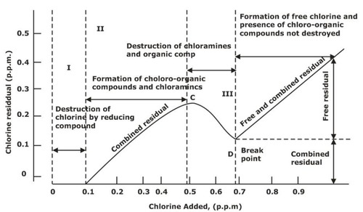
2. Draw Chlorination Curve with break point.

Slide 78
A chlorination curve with breakpoint illustrates how chlorine reacts in water as it's added:
Initial Demand: Chlorine reacts with contaminants, and no residual chlorine is detected.
Chloramine Formation: Chlorine reacts with ammonia, forming chloramines, causing a slight increase in chlorine residual.
Breakpoint: Chlorine demand is met, and chloramines are destroyed, leading to a drop in chlorine residual.
Free Chlorine Residual: After the breakpoint, any additional chlorine remains as free chlorine, ensuring disinfection.
Combined chlorine: Combined chlorine, also known as chloramines, is the chlorine that has reacted with organic amines or ammonia in water. This reaction occurs when free chlorine, which is the active form of chlorine used for disinfection, combines with contaminants like sweat, urine, and other nitrogenous compounds.

Slide 79
Week 15
Mathematical Problem on Chlorination

Slide 80
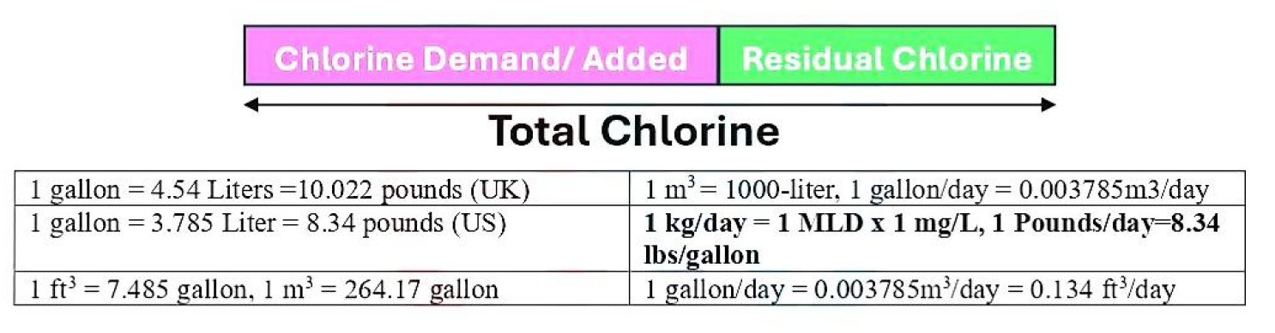
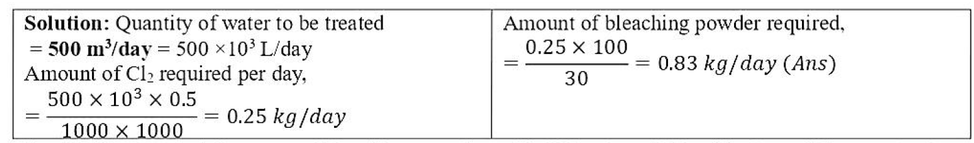
1. 500 m³/day water is to be supplied from a water treatment plant with chlorine concentration of 0.5 mg/L. If bleaching powder that is used for chlorine has contains 30% available Cl2 (by weight), Find out the amount of bleaching powder in kg/day.

Slide 81
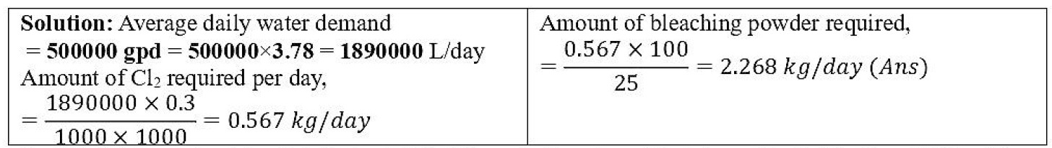
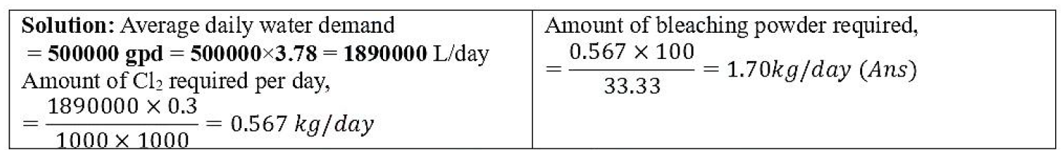
2. It is required to disinfectant 500,000 gpd of water with 0.3 mg/L of chlorine. If bleaching powder that contains 25% of available chlorine is used, how much bleaching powder is needed to treat the daily flow of water.
3. It is required to disinfectant 500,000 gpd of water with 0.3 mg/L of chlorine. If bleaching powder that contains 33.33% of available chlorine is used, how much bleaching powder is needed to treat the daily flow of water.

Slide 82
Week 16
Practice, Exercise & Review

Slide 83
Week 17
Problem Solving Day

Slide 84



