Slide 1



TRANSPORTATION
ENGINEERING-II
Prepared By
Somen Saha
Lecturer
Department of Civil Engineering
University of Global Village (UGV), Barishal

Slide 2
Course Title | Transportation Engineering II
Course Code | CE 0732-4105
Credits | 04
CIE Marks | 120
SEE Marks | 80
Exam Hours | 2 hours (Mid Exam) 3 hours (Semester Final Exam)
Level | 7th Semester
BASIC COURSE INFORMATION

Slide 3



Transportation Engineering-II
COURSE CODE: CE 0732-4105 | CREDIT:04
 | TOTAL MARKS:200
 | CIE MARKS: 120
Semester End Exam Hours 4 | SEE MARKS: 80
Course Learning Outcomes (CLOs): After completing this course successfully, the students will be able to-
CLO 1 | Describe the types and functions of different pavement structures used in highway systems.
CLO 2 | Explain the concept of load transfer mechanisms in rigid pavements and their structural significance.
CLO 3 | Differentiate between flexible and rigid pavements based on construction, behavior, and materials.
CLO 4 | Apply Standard procedures to design a basic flexible pavement using AASTHO method
CLO 5 | Analyze the structural performance of rigid pavement components under wheel loads.

Slide 4
SL | Content of Course | Hours | CLOs
1 | Pavement: Definition of Pavement, Functions and Desirable Characteristic of Pavement, Types of Pavements and their Components , Load Transfer Mechanism of different Pavement System, Comparison between Flexible & Rigid Pavement | 14 | CLO1
2 | Rigid Pavement: Joint types & Load Transfer, Reinforcement Details of Rigid Pavement Rigid Pavement Design | 20 | CLO3
3 | Flexible Pavement: Distresses of Flexible Pavement, Equivalent Single wheel load, Flexible pavement design by different method. | 20 | CLO2, CLO4
Text Books:
Highway Engineering by Khanna and Justo
Traffic Engineering and Control by Kadiyali

Slide 5
ASSESSMENT PATTERN
CIE- Continuous Internal Evaluation (30 Marks)
SEE- Semester End Examination (20 Marks)
Bloom’s Category | Tests
Remember | 10
Understand | 10
Apply | 10
Analyze | 15
Evaluate | 10
Create | 05
Bloom’s Category Marks (out of 100) | Tests (60) | Assignment (20) | Quizzes (20) | External Participation in Curricular/Co-Curricular Activities (20)
Remember | 10 |  | 10 | Attendance 15
Understand | 05 |  | 05
Apply | 10
Analyze | 10
Evaluate | 05
Create | 05 | 15

Slide 6
Transportation Engineering-II
Course plan specifying content, CLOs, teaching learning and assessment strategy mapped with CLOs
Week | Topic | Teaching-Learning Strategy | Assessment Strategy | Corresponding CLOs
1 | Definition of Pavement, Functions and Desirable Characteristic of Pavement | Lecture, discussion, | Quiz, Written Exam | CLO1
2 | Types of Pavements and their Components | Oral Presentation, Debate | Assessment, Quiz | CLO3
3 | Load Transfer Mechanism of different Pavement System | Video Lecture, Group Discussion | Viva, Quiz | CLO2, CLO4
4 | Comparison between Flexible & Rigid Pavement | Lecture, Group discussion, | Quiz, Assignment | CLO1, CLO3
5 | Rigid Pavement: Joint types & Load Transfer | Oral Presentation, Debate | Written Exam, Viva | CLO3, CLO4

Slide 7
6 | Reinforcement Details of Rigid Pavement | Lecture, discussion, | Quiz, Written Exam | CLO1
7 | Rigid Pavement Design | Oral Presentation, Debate | Assessment, Viva | CLO3
8 | Distresses of Flexible Pavement-1 | Lecture, Group discussion, | Quiz, Assignment | CLO2, CLO4
9 | Distresses of Flexible Pavement-2 | Video Lecture, Group Discussion | Viva, Quiz | CLO1, CLO3
10 | Distresses of Flexible Pavement-3 | Oral Presentation, Debate | Written Exam, Viva | CLO3, CLO4
11 | ESAL Part-01 | Lecture, discussion, Debate | Quiz, Written Exam | CLO3, CLO4

Slide 8
12 | ESAL Part-02 | Lecture, Group discussion, | Quiz, Written Exam, Assignment | CLO1
13 | ESAL Part-03 | Oral Presentation, Debate | Assessment, Viva | CLO3
14 | AASTHO Method | Lecture, Group discussion, | Quiz, Assignment | CLO2, CLO4
15 | Mathematical Problem on AASTHO Method | Video Lecture, Group Discussion | Viva, Quiz | CLO1, CLO3
16 | Practice, Exercise & Review | Oral Presentation, Debate | Written Exam, Viva | CLO3, CLO4
17 | Problem Solving Day | Lecture, discussion, Debate | Quiz, Written Exam | CLO3, CLO4

Slide 9


Week 01
Definition of Pavement, Functions and Desirable Characteristic of Pavement

Slide 10
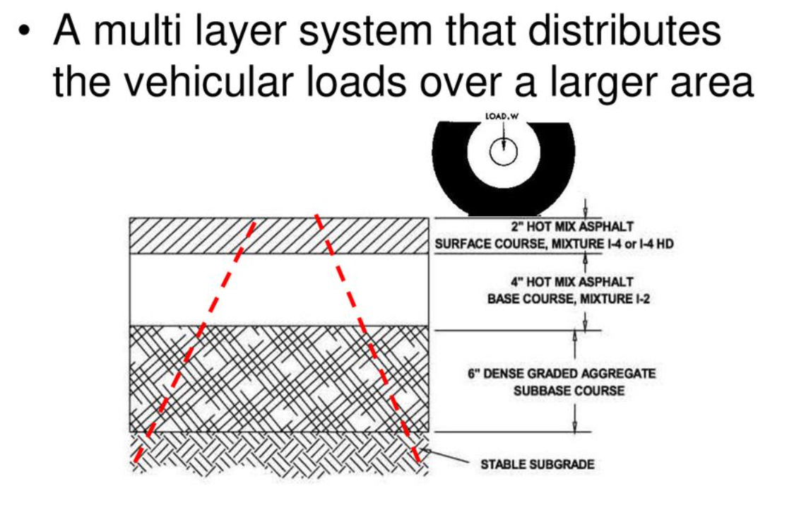
1. Definition of Pavement
  A multi-layer system that distributes the vehicular loads over a larger area. Highway pavement is a structure consisting of superimposed layers of selected and processed materials whose primary function is to distribute the applied vehicle load to the sub grade. It can also be defined as "structure which separates the tires of vehicles from the under lying foundation."
    Pavement is the upper part of roadway, airport or parking area structure
    It includes all layers resting on the original ground
    It consists of all structural elements or layers, including shoulders

Slide 11
2. Functions of Pavement
  Reduce and distribute the traffic loading so as not to damage the subgrade Provide vehicle access under all-weather conditions.
  The pavement waterproofs the roadway surface by draining moisture away from the load-bearing areas and the subgrade.
  Wheel abrasion on subgrade materials is reduced or eliminated.
  It gives the driver a visual perspective of the horizontal and vertical alignment of the travel path.
  Provide safe, smooth and comfortable ride to road users without undue delays and excessive wear & tear (vehicle depreciation).
  Meet environmental and aesthetics
3. Desirable Characteristic of Pavement
  Sufficient thickness to spread loading to a pressure intensity tolerable by subgrade.
  Sufficiently strong to carry imposed stress due to traffic load.
  Pavement material should be impervious to penetration of surface water which could weaken subgrade and subsequently pavement.
  Pavement surface should be skid resistant.
  Pavement materials should be non-frost susceptible.

Slide 12
Week 02
Types of Pavements and their Components

Slide 13
Types of Pavement
  Pavements are the durable surfaces laid down on roads, runways, parking areas, and similar infrastructure to provide smooth and safe passage for vehicles and pedestrians. Based on structural behavior and materials used, pavements are generally classified into three main types:
Pavement
Flexible Pavement
Rigid Pavement
Composite Pavement

Slide 14
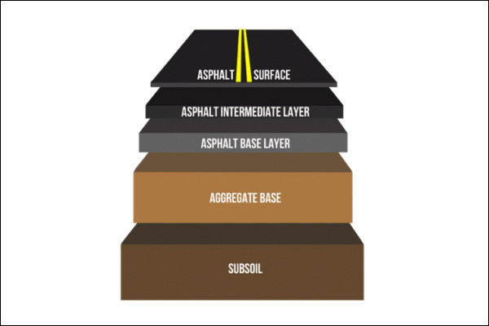
Flexible Pavement
    Made of multiple layers of materials (typically bituminous).
    Transmits loads to the subgrade gradually.
    Has the ability to flex and adjust slightly under loads.
    Example: Bitumen roads or asphalt pavements.
Components
    Surface Course – Asphalt or bituminous mix providing smooth ride and weather resistance.
    Binder Course – Intermediate bituminous layer that adds structural support.
    Base Course – Crushed stone or stabilized aggregates distributing the load.
    Sub-base Course – Provides drainage and additional load spreading.
    Subgrade – Compacted natural soil layer that acts as the foundation.

Slide 15
Rigid Pavement
    Constructed using reinforced or plain cement concrete (PCC).
    Has high flexural strength and distributes loads over a wider area.
    Less deformation under traffic loads, but more susceptible to cracking.
    Example: Concrete highways, airport runways.
Components
    Concrete Slab (Surface Course) – Main load-carrying layer made of PCC.
    Base Course – May be granular or stabilized material beneath the slab.
    Sub-base Course – Optional layer for drainage and frost protection.
    Subgrade – Natural soil foundation, must be strong and well-prepared.

Slide 16
Composite Pavement
    Combination of flexible and rigid pavements.
    Often includes a concrete base with an asphalt overlay.
    Used to take advantage of both pavement types (e.g., strength of concrete and flexibility of bitumen).
    Example: Rehabilitation of old concrete roads using asphalt layers.
Components
    Asphalt Overlay – Bituminous surface for improved flexibility and comfort.
    Concrete Base Layer – Rigid layer providing structural support.
    Base/Sub-base – Same as in rigid or flexible systems.
    Subgrade – Soil foundation, properly compacted.

Slide 17
Week 03
Load Transfer Mechanism of different Pavement System

Slide 18
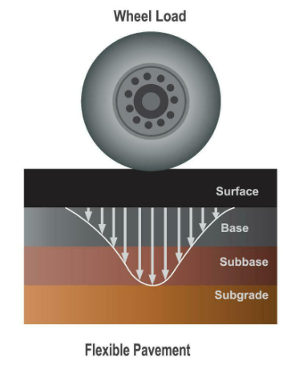
1. Load Distribution Mechanism of Flexible Pavement
Mechanism:
    Load is distributed layer by layer in a trapezoidal or cone-shaped pattern.
    The surface layer (asphalt) is flexible, so it cannot spread the load widely.
    Each lower layer carries less stress but over a wider area.
    High stress is concentrated near the top and reduces with depth.
Key Points:
    Load transfer depends heavily on layer thickness and quality.
    Requires multiple layers to ensure safe stress levels on the subgrade.
    Layered system works together to reduce deformation and failure.

Slide 19
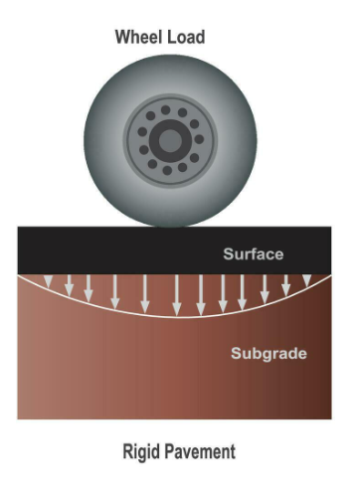
2. Load Distribution Mechanism of Rigid Pavement
Mechanism:
    Load is distributed over a wider area almost immediately due to the
    high flexural strength of concrete.
    The concrete slab acts as a beam or plate, spreading loads more
    uniformly to the base and subgrade.
    Stress is mostly transferred by slab action, not by layers.
Key Points:
    Less dependence on lower layers for strength.
    Concrete handles most of the stress itself.
    The subgrade must support a larger area but lower stress.

Slide 20
Week 04
Comparison between Flexible & Rigid Pavement

Slide 21
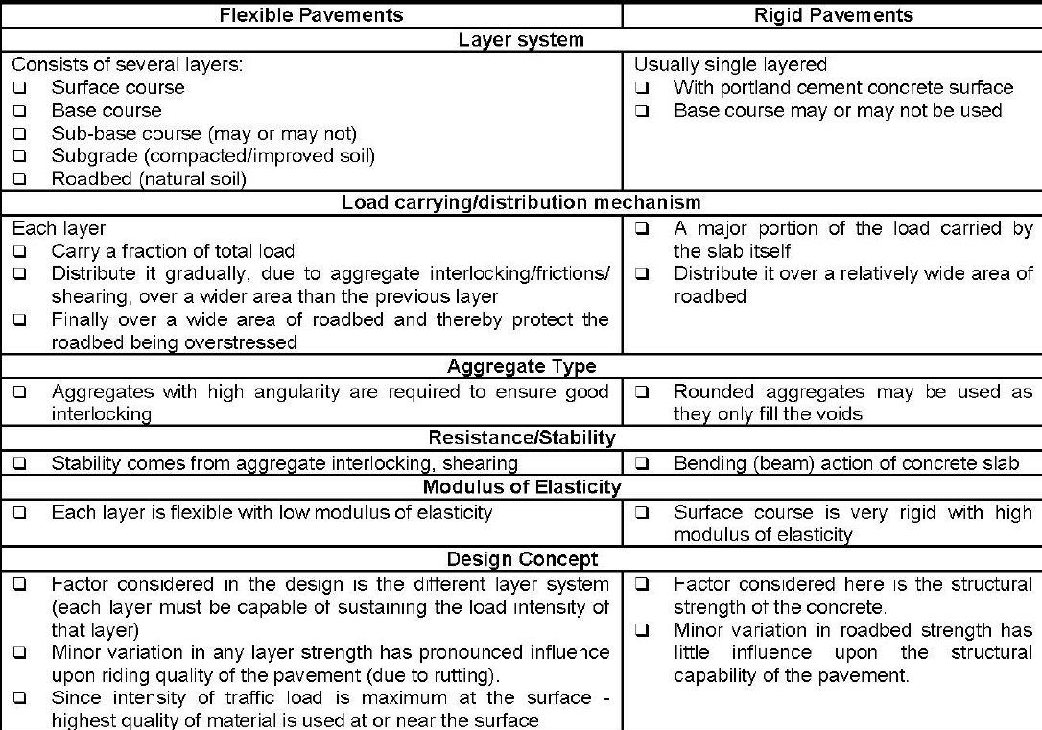
1. Comparison between Flexible & Rigid Pavement

Slide 22
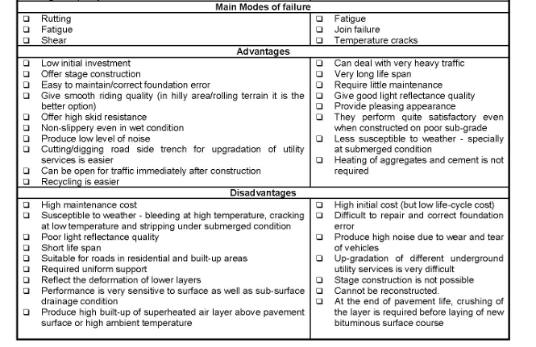

Slide 23
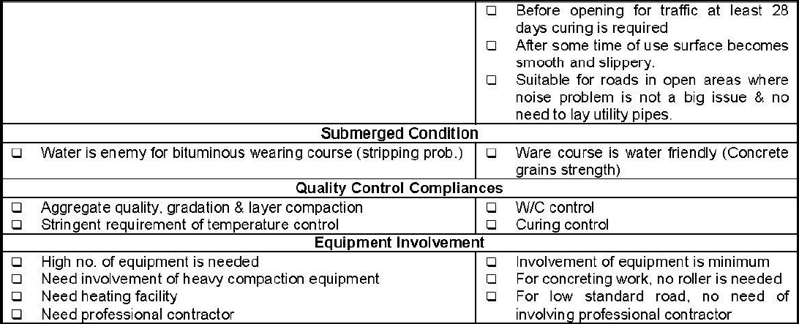

Slide 24
Week 05
Rigid Pavement: Joint types, Load Transfer & Response

Slide 25
1. Explain the reasons Joints are used in rigid Pavement
  To reduce influence of weathering
  To control cracks
  To accommodate pavement movements
2. difference between tie bars and dowel bars
  Tie bars are deformed rebars or connectors used for holding faces of rigid slabs in contact to maintain aggregate interlock. Tie bars are not load transferring device. For instance, tie bars are used in longitudinal joints in concrete pavement.
  Dowel bars are smooth round bars which mainly serve as load transfer device across concrete joints. They are placed across transverse joints of concrete pavement to allow movement to take place.

Slide 27
3. Different Types of joint.
  Direction-wise
    Longitudinal joints
    Transverse joints .
  Function-wise
    Contraction Joints
      are used to prevent irregular shrinkage cracks.
      are used to make sure that cracking will occur at a predetermined desired location.
      are used to relieve tensile stress resulting from contraction and warping of the concrete.
      constructed by cutting a groove at the pavement surface; groove may be formed by sawing or by placing a metal strip.
      Load transfer usually is accomplished by aggregate interlock. However, dowel bars may be used to transfer load across the joints.
      to permit freedom of movement dowel should be lubricated plain bars.

Slide 28
    Expansion Joints
      are used to permit thermal expansion of slab and to prevent blowup at the slab edges.
      are used to relieve compressive stress resulting from expansion of the concrete.
      constructed with a clean break throughout the depth of the slab.
      usually joint opening of 19mm (3/4") to 25mm (1") is used dowel bars are used to transfer load across the joints.
      to permit freedom of movement, dowel bars must be smooth and lubricated on at least one side.
      an expansion cap must also be provided to allow space for dowel bar to move during the expansion process.
      filler (cork/plastic/rubber) and sealant materials are needed to concealed the joints to reduce infiltration of water or pumping effect and to reduce clogging of joint with hard material or chance of blowup problem.
      expansion joints are susceptible to pumping action.
      periodic maintenance is required.

Slide 29
    Construction Joints
        are used at the transition from old to new construction, such as at the end of a day’s pour or at longitudinal joints.
        Load transfer at construction joints is achieved through the use of dowel bars.
        deformed of hooked tie bars are used to hold/anchored two adjacent segments firmly to prevent movement.

Slide 30
    Isolation Joints
      Introduction of "expansion" joints on a regular spacing tends to allow slabs to migrate because contraction joints in interior areas of a concrete pavement open unnecessarily. This unintended consequence degrades the effectiveness of aggregate interlock at the contraction joints and reduces the overall performance of the pavement. That is why, the traditional "expansion" joint has been modified to "isolation".
      Are used to separate intersecting pavements and to isolate embedded fixtures within or along the pavement such as in-pavement drains.
      Where horizontal and vertical differences in movement (or dissimilar axis) of the pavements and traffic loads are anticipated, a thickened edge isolation is necessary to reduce edge tensile stress in the pavement.
      If the isolation joint is used along a pavement non-load area, then a simple butt joint is required.
      Undoweled isolation joints allow the pavement freedom of movement laterally and an embedded fixture freedom of movement vertically, with no mechanical interconnection. Separation with each is provided with a non-extruding compressible material.

Slide 31
4. Load Transfer in Perpendicular Joints

Slide 32
5. Rigid Pavement Response
  Rigid pavements respond to loading in a variety of ways that affect performance (both initial and long-term). The three principal responses are:
    Curling stress: Differences in temperature between the top and bottom surfaces of a PCC slab will cause the slab to curl. Since slab weight and contact with the base restrict its movement, stresses are create.
    Load stress: Loads on a PCC slab will create both compressive and tensile stresses within the slab and any adjacent one (as long as load transfer efficiency is > 0).
    Shrinkage/Expansion: In addition to curling, environmental temperatures will cause PCC slabs to expand (when hot) and contract (when cool), which causes joint movement.
Contraction (due to Temperature Drop, T)
Expansion (due to Temperature Rise, T)

Slide 35
Week 06
Reinforcement Details of Rigid Pavement

Slide 36
1. Reinforcement Details of Rigid Pavement
  Types of Reinforcement
  Temperature/distributed reinforcements
    used to control the width of the crack opening and not to prohibit the formation of cracks.
    not to increase structural capability of the pavements.
    smaller in sizes.
    applied in the slab, usually in both directions in the form of welded wire-mesh or bar-mat.
    amount depend on length of panel & thickness of slab.
  Dowel bars
    used as a load transferring device (with high shearing strength i.e. with large x-sectional area).
    used to reduce deflection of slab edge and to control pumping effect.
    25mm (#8) or 32mm (#10) in size, 600mm (2') long and spaced @200mm (8") to 300mm (12") c/c.
    applied only in longitudinal direction and across the expansion & contraction joints.
    to allow freedom of movement of the slab, dowel bars must be smooth and lubricated.
    become necessary for longer span i.e. >12m or 40' (due to excessive movements of expansion joints).
    they are placed at mid-depth of the slab.

Slide 37
  Tie bars
    are used to tie two adjacent slabs together.
    the bars are not so heavy and are smaller than dowel bars & spaced at greater intervals.
    usually 12mm (#4) - 19mm (#5) bars are used.
    length of tie bars are determined from bond criterion.
    must be deformed or hooked and must be firmly anchored into the concrete to function properly.

Slide 38
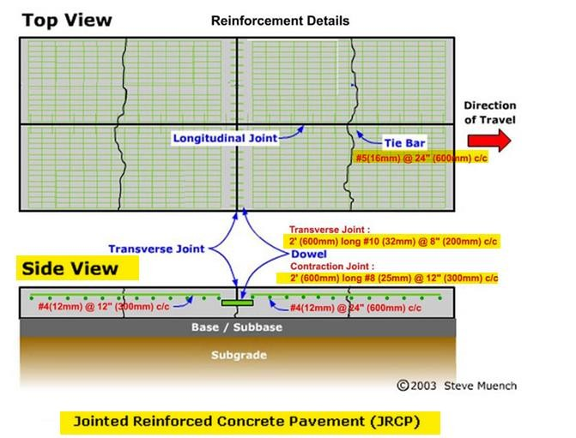

Slide 39
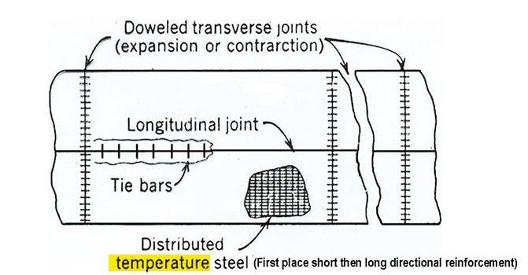

Slide 40
Week 07
Rigid Pavement Design

Slide 41

Modulus of subgrade reaction:
  The modulus of subgrade reaction (denoted as k-value) is a measure of the subgrade soil's support capacity for rigid pavements. It is defined as the ratio of pressure applied to the subgrade to the resulting deflection or settlement. The k-value is essential in pavement design, as it reflects the stiffness of the subgrade and influences how the pavement will distribute loads.
  $K=\frac{P}{Δ }kN/m³,kg/m³,or psi/in$
where:
p: Applied pressure (typically in kN/m² or psi),
Δ: Resulting deflection or settlement of the subgrade (typically in mm or inches).
Displacement or deformation equation by Burmester Method:
𝑭𝒐𝒓 𝑭𝒍𝒆𝒙𝒊𝒃𝒍𝒆 𝑷𝒂𝒗𝒆𝒎𝒆𝒏𝒕 $Δ=\frac{1.5×p×a}{Es}×F2$
𝑭𝒐𝒓 𝑹𝒊𝒈𝒊𝒕 𝑷𝒂𝒗𝒆𝒎𝒆𝒏𝒕 $Δ=\frac{1.18×p×a}{Es}×F2$
Where:
Δ: Deformation of the pavement (in units related to the load and modulus of elasticity)
p: Applied load (force per unit area, typically in Pascals or psi)
a: Contact area or radius of the loaded area (in meters or feet, depending on units used)
Es: Modulus of subgrade reaction or modulus of elasticity of the subgrade soil
F2: Load distribution factor, which accounts for factors like material properties and pavement structure

Slide 42

Ex-1: A plate load test is carried out on subgrade soil using a 300mm radius rigid plate. A load of 5 tons resulted in a deflection of 1.2 mm. Determine the elastic modulus of the soil. If the Poisson ratio is 0.5.
Solution:
Here,
$P=\frac{5×1000×10}{π×3002}=0.176N/{mm}^{2}$
𝐹2=1
For Rigit Plate
$$Δ=\frac{1.18×p×a}{Es}×F2$$
$$⇒1.2=\frac{1.18×0.176×300}{Es}×1$$
$$⇒Es=51.92 Mpa$$

Slide 43
Week 08
Distresses of Flexible Pavement-1

Slide 44
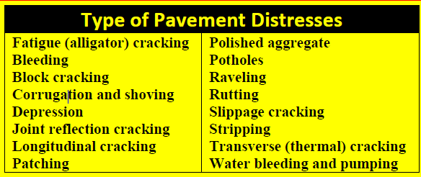
Flexible Pavement
  Properly designed and maintained Hot Mix Asphalt (HMA) pavements can provide many years of satisfactory service. However, like all pavements, HMA pavements can be damaged by certain conditions. This section is a summary of the major flexible pavement distresses. Each distress discussion includes:
    Identifying basic HMA pavement damage
    Providing some insight into why particular surface distresses are problematic.
    Providing typical causes of the distress.
    Suggest some basic repair strategies.
  The most common pavement distresses in Bangladesh are low to moderate severity alligator (fatigue) cracking. ravelling and potholes. Mix stability problems like rutting, corrugation and shoving are also common.

Slide 45
2. Pavement Distresses: Fatigue, Bleeding, Corrugation and Shoving, Depression, Joint Reflection Cracking, Longitudinal Cracking, Patching, Potholes, Raveling, Rutting, Slippage Cracking.
Fatigue (Alligator) Cracking: Fatigue cracking, also known as alligator cracking due to its resemblance to the skin of an
alligator, is a common type of distress observed in asphalt pavements. It typically appears as interconnected cracks forming a pattern resembling the scales of an alligator's skin. Fatigue cracking occurs due to repeated loading from traffic and is often indicative of structural weakness in the pavement. Fatigue cracking is primarily caused by the repetitive application of heavy loads from passing vehicles. Over time, these repeated loading cycles lead to the development of cracks in the asphalt pavement surface. Factors such as inadequate pavement thickness, subgrade support, or asphalt mix design can exacerbate the formation of fatigue cracks.

Slide 46
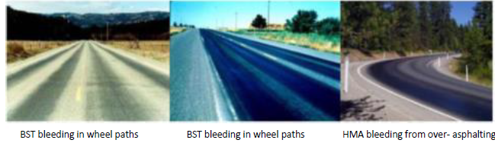
Bleeding: Bleeding in asphalt pavements refers to the upward movement of asphalt binder towards the pavement surface, resulting in a layer of excess asphalt on the surface. It is a type of pavement distress characterized by the formation of a shiny, dark, or brownish film on the pavement surface, often accompanied by a sticky or tacky texture. Bleeding typically occurs when the asphalt binder in the pavement becomes overheated, causing it to soften and flow upward towards the surface. Factors contributing to bleeding include excessive asphalt content, high ambient temperatures, prolonged exposure to sunlight, inadequate compaction during construction, or poor drainage conditions.

Slide 47
Corrugation and Shoving: Corrugation, also known as wash boarding or rippling, refers to the formation of small, parallel
waves or ripples along the surface of the pavement, resembling the shape of a washboard. Corrugation is often caused by localized areas of pavement instability, typically associated with insufficient compaction during construction, inadequate mix design, or the presence of underlying pavement defects. It can also result from heavy traffic loads or vehicle braking forces concentrated in specific areas. Shoving is the displacement or movement of asphalt pavement material in the direction of traffic flow, resulting in localized areas of deformation or pushing. Shoving typically occurs in areas subjected to heavy braking, turning, or acceleration forces, such as intersections, stop signs, or traffic signals. It can be caused by a combination of factors, including insufficient compaction, low asphalt binder viscosity, high temperatures, or inadequate pavement support.

Slide 48
Week 09
Distresses of Flexible Pavement-2

Slide 49
Depression: Depressions in flexible pavement refer to localized areas where the pavement surface has sunk or settled below the surrounding pavement level. These depressions can vary in size and depth and are typically indicative of underlying issues with the pavement structure or support layers. Depressions often occur due to settlement of the underlying base or subgrade layers beneath the flexible pavement. This settlement may result from inadequate compaction during construction, poor soil conditions, or water infiltration leading to subgrade instability. Heavy or repeated traffic loads can cause localized pavement deformation and settlement, particularly in areas such as intersections, bus stops, or areas where vehicles frequently stop or
turn. Depressions may also form over utility cuts or trenches where pavement materials have been excavated and reinstated, leading to differential settlement between the repaired area and the surrounding pavement.

Slide 50
Joint Reflection Cracking: Joint reflection cracking is a common distress observed in asphalt pavements, particularly in
overlays where new asphalt is placed over existing pavement with underlying joints or cracks. These cracks propagate upward from the existing pavement joints or cracks through the overlay, reflecting the distresses from the underlying layers to the surface. Existing joints or cracks in the underlying pavement can experience movement due to thermal expansion and contraction, traffic loading, or subgrade settlement. This movement causes the cracks to propagate upward through the overlay, resulting in joint reflection cracking. Differences in stiffness or support between the existing pavement and the overlay can lead to differential movement, causing stress concentrations at the interface between the two layers and promoting crack propagation. Poor bonding between the overlay and the existing pavement can exacerbate joint reflection cracking by allowing moisture infiltration, reducing the effectiveness of load transfer, and increasing the likelihood of crack propagation.

Slide 51
Longitudinal Cracking: Longitudinal cracking is a common distress observed in asphalt pavements, where cracks form parallel
to the direction of traffic flow. These cracks can vary in length, depth, and severity, and they often indicate underlying issues with the pavement structure or environmental conditions. Changes in temperature cause asphalt pavement to expand and contract. Longitudinal cracking can occur when the pavement is unable to accommodate these temperature-induced movements, leading to tensile stresses and crack formation. As asphalt pavement ages, it becomes more susceptible to fatigue cracking, which can manifest as longitudinal cracks. Factors such as repeated traffic loading, heavy loads, and inadequate pavement design can accelerate the development of longitudinal cracks. Longitudinal cracking can also result from structural deficiencies in the pavement, such as inadequate thickness, poor compaction, weak base layers, or inadequate drainage. These issues create stress concentrations within the pavement, increasing the likelihood of crack formation. High traffic volumes, heavy vehicles, and dynamic loading can exacerbate longitudinal cracking by subjecting the pavement to increased stress and fatigue. Additionally, distresses such as rutting, roughness, or settlement can contribute to crack initiation and propagation.

Slide 52
Patching: Patching in pavement maintenance refers to the process of repairing localized areas of damage or distress on the pavement surface. These areas, often referred to as potholes or defects, can result from various factors such as traffic loading, environmental conditions, or pavement deterioration. Patching aims to restore the pavement's integrity, smoothness, and
functionality. Heavy vehicles, repeated traffic loads, and dynamic forces can cause localized areas of distress on the pavement surface, leading to cracking, rutting, or potholes. Freeze-thaw cycles, moisture infiltration, temperature fluctuations, and exposure to sunlight can exacerbate pavement deterioration, leading to the formation of cracks, surface degradation, or pavement weakening. Asphalt pavements naturally deteriorate over time due to aging, oxidation, and wear and tear, resulting in the development of cracks, raveling, or other surface defects.

Slide 53
Week 10
Distresses of Flexible Pavement-2

Slide 54
Potholes: Potholes are localized areas of pavement distress characterized by bowl-shaped holes or depressions in the road surface. They typically result from the combined effects of traffic loading, environmental factors, and pavement deterioration. Water infiltrates cracks and pores in the pavement surface. During freezing temperatures, the water expands, causing pavement materials to crack and weaken. When the ice thaws, the pavement contracts, further exacerbating the damage and creating voids beneath the surface. Heavy vehicles, repeated traffic loads, and dynamic forces contribute to the degradation of pavement materials, leading to the formation of cracks, rutting, and surface distress. Asphalt pavements naturally degrade over time due to aging, oxidation, and exposure to environmental factors such as sunlight, moisture, and temperature fluctuations. This deterioration weakens the pavement structure, making it more susceptible to damage and pothole formation Inadequate drainage or improper pavement slope can lead to water pooling on the pavement surface, accelerating pavement deterioration and increasing the likelihood of pothole formation.

Slide 55
Raveling: Raveling is a pavement distress characterized by the gradual disintegration or separation of aggregate particles from the surface of the asphalt pavement. It often manifests as the loss of fine aggregate particles, resulting in a rough, porous, and
deteriorating pavement surface. Over time, asphalt pavements are subjected to aging and weathering effects, such as exposure to sunlight, moisture, and temperature fluctuations. These environmental factors can degrade the asphalt binder, weaken the bond between aggregate particles, and contribute to the loss of fines from the pavement surface. Heavy traffic loads, especially from vehicles with high axle loads or frequent braking and turning movements, can accelerate pavement deterioration and raveling. Dynamic loading and shear forces exerted by vehicle tires can cause aggregate particles to loosen and dislodge from the pavement surface. Inadequate compaction during pavement construction, improper mix design, insufficient asphalt binder content, or inadequate bonding between pavement layers can lead to raveling. These deficiencies create weak zones within the pavement structure, making it more susceptible to surface distresses. Water infiltration into the pavement structure can weaken the asphalt binder-aggregate bond, promote stripping or debonding, and facilitate the loss of fines from the pavement surface. Freezethaw cycles and moisture-induced expansion and contraction can exacerbate raveling in cold climates.

Slide 56
Rutting: Rutting is a pavement distress characterized by the formation of longitudinal depressions or tracks in the wheel paths caused by the permanent deformation of the pavement surface under repeated traffic loading. It is one of the most common and visible forms of distress in asphalt pavements and can lead to reduced ride quality, increased vehicle operating costs, and safety concerns. Rutting is primarily caused by the repeated passage of vehicles, especially heavy trucks or buses, which exert high axle loads and shear stresses on the pavement surface. Over time, the cumulative effects of traffic loading can result in permanent deformation and compaction of the asphalt pavement. Elevated pavement temperatures, particularly during hot weather or under direct sunlight, can soften the asphalt binder and increase its susceptibility to deformation. The combination of high temperatures and heavy traffic loading exacerbates rutting, leading to more rapid pavement deterioration. Inadequate pavement thickness, insufficient asphalt binder content, improper mix design, or weak subgrade support can contribute to rutting by reducing the pavement's ability to withstand traffic induced stresses and strains. Water infiltration into the pavement structure can weaken the asphalt binder-aggregate bond, reduce pavement stiffness, and increase susceptibility to rutting. Poor drainage, surface water accumulation, and subgrade saturation exacerbate moisture-related rutting.

Slide 57
Slippage Cracking: Slippage cracking, also known as longitudinal cracking, is a form of pavement distress characterized by cracks that develop parallel to the direction of traffic flow. These cracks often occur in the wheel paths or areas where vehicles frequently stop or accelerate, such as intersections, stop signs, or traffic signals. Slippage cracking typically occurs when there is inadequate bonding between the asphalt overlay and the underlying pavement layer or surface course. Factors such as insufficient tack coat application, surface contamination, or pavement oxidation can compromise the bond, leading to crack initiation and propagation. Heavy braking, acceleration, or turning movements exerted by vehicles can induce shear stresses and tensile forces on the pavement surface, causing it to slide or slip relative to the underlying layers. This movement can lead to the formation of longitudinal cracks parallel to the direction of traffic flow. Over time, asphalt pavements are subjected to aging and weathering effects, such as exposure to sunlight, moisture, and temperature fluctuations. These environmental factors can degrade the asphalt binder, weaken the pavement structure, and increase susceptibility to cracking and distress. Design deficiencies such as inadequate asphalt thickness, poor drainage, or weak pavement support layers can contribute to slippage cracking by creating stress concentrations and reducing pavement durability and resistance to traffic loading.

Slide 58
Week 11
ESAL Part-01

Slide 59
ESAL (Equivalent Single Axle Load):
  ESAL is a unit used in pavement design to represent the cumulative damage caused by traffic over a specific period. It essentially converts the effect of various vehicle weights and axle configurations into a single standard axle load (usually an 18,000-pound single axle). It is also represented as ESWL (Equivalent Single wheel Load).
2. Reason of using ESAL:
  Represents the number of times an equivalent single axle load (ESLF) has passed over a specific section of pavement.
  Higher ESAL signifies greater cumulative pavement damage.
  Used to predict pavement fatigue life and determine maintenance or reconstruction needs.
3. Purpose of ESAL:
  To estimate cumulative pavement damage from traffic over time.
  To design pavement thickness and structure based on expected traffic loads.
  To perform pavement life-cycle analysis and maintenance planning.

Slide 60
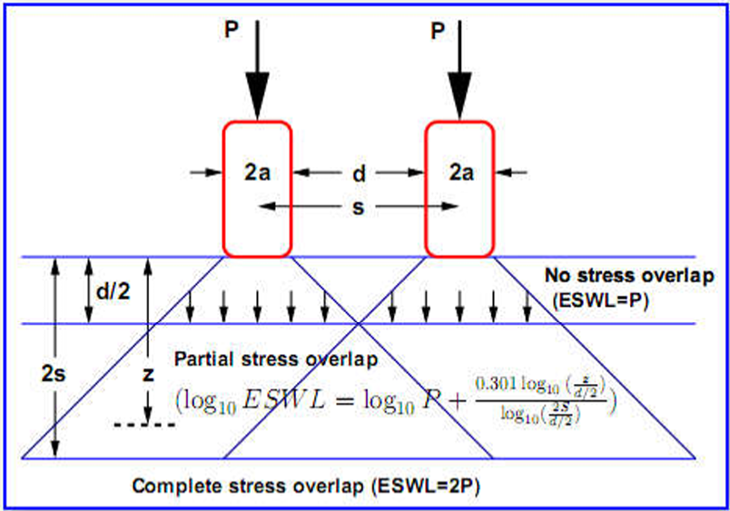
ESAL (Equivalent Single Axle Load):

Slide 61
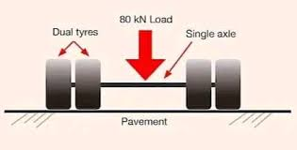
4. Standard Axle:
  A Single axle with dual wheels carrying a load of 80kN (8 Tones or 18000lb) is defined as the standard axle.
    The tire contact area is given as 4.5in. (11 cm) radius and 13.5in. (34 cm) rim apart.
    Contact pressure is given as 70 lb/in²
    Tire Contact Area: π × 4.5² × 4 = 255.601 in²
    Total single-axle load = (255.601 in² × 70 lb/in²) = 17,892 lb (approximately 18,000 lb)

Slide 62
5. A few terms are given below:
  Initial Traffic Number (ITN): The average number of ESALs (Equivalent Single Axle Loads) per day in the first year of a pavement design analysis period.
  Design Traffic Number (DTN): The average number of ESALs per day over the entire pavement design analysis period.
  Calculation: Total ESAL applications over the design days divided by the number of traffic days.
Example: 6,000,000 ESALs over 20 years equals 300,000 ESALs per year or 1,000 DTN per day. (approximately 18,000 lb)
Types | kN | Kip
Single Axle with Single Wheel | 65 | 14.5
Single Axle with Dual Wheel | 80 | 18
Tandem Axle with Dual Wheel | 148 | 33
Tridem Axle with Dual Wheel | 224 | 50

Slide 63
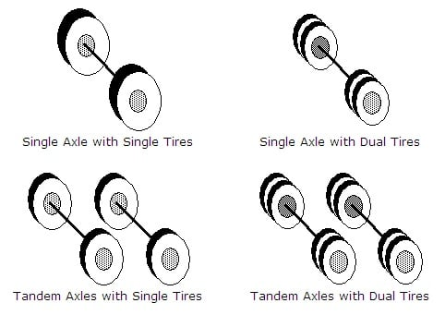
5. Traffic Load

Slide 64
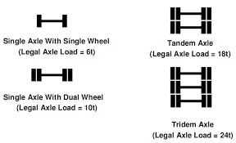
6. Axal Load Configurations

Slide 65

7. ESLF/LEF/RDF:
  ESLF could represent the factor that converts the damage caused by an axle with a specific weight to the damage caused by a standard axle.
ESLF:
    Represents the damaging effect of a single axle with a specific weight.
    It's a standard unit used to compare the damaging effects of different axle loads.
    Common base values for ESLF are 8,000 kg (18,000 lbs) or 16,000 kg (35,000 lbs).
  This conversion is often based on the fourth power of the ratio between the axle load and the standard axle load.
$$\text{ESAF}\text{/}\text{LEF}\text{/}\text{RDF}\text{ =}{\left(\frac{\text{Load} \text{on} \text{a} \text{Single} \text{Axle}}{\text{Load} \text{on} \text{Standard} \text{Axle}}\right)}^{4}$$
$$\text{ESAF}\text{/}\text{LEF}\text{/}\text{RDF}\text{ =}{\left(\frac{L_{x}}{L_{s}}\right)}^{4}$$

Slide 66

For Tandem and Tridem Axles
$$\text{ESAF}\text{/}\text{LEF}\text{/}\text{RDF}\text{ =}{\left(\frac{\text{Load} \text{on} \text{a} \text{given} \text{tandem} \text{or} \text{tridem} \text{Axle}}{\text{Load} \text{on} \text{Standard} \text{tandem} \text{or} \text{tridem} \text{Axle}}\right)}^{4}$$
Where,
ESLF = Equivalent Single Load Factor
LEF = Load Equivalency Factor
RDF = Relative Damage Factor
Example:
      For example, a load equivalency factor of 2.5 means that one pass of a specific vehicle causes an equivalent amount of damage as two and a half passes of the standard vehicle.
Other Example:
      Consider two Axles A and B
      A-Axle = 36 kips
      Damage caused per pass by A-Axle: ESAF/LEF/RDF = (36/18)⁴ = 16
      It means that the A-Axle causes the same amount of damage per pass as caused by 16 passes of the standard 18-kip axle.

Slide 67
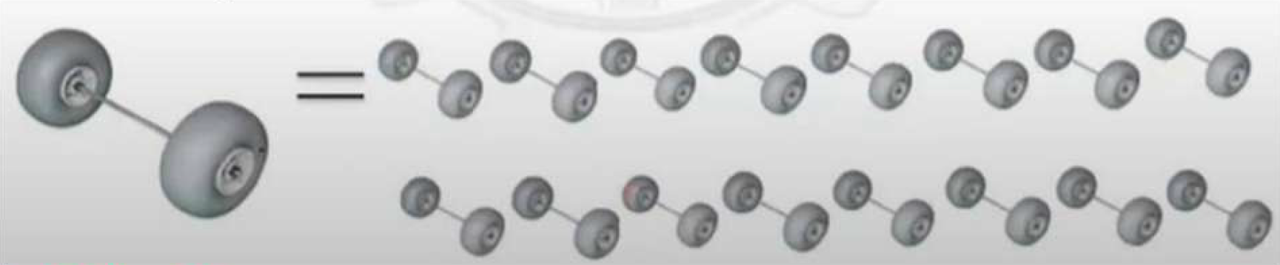

    B-Axle = 9 kips
    Damage caused per pass by B-Axle =${\left(\frac{9}{16}\right)}^{4}$= $\frac{1}{16}$= 0.0625
    It means that 16 (1/0.0625) passes of the B-axle cause the same amount of damage as caused by 1 pass of the standard 18-kip axle.

Slide 68

8. Impact on roads by different types of vehicles:
    To determine the ESAL, the number of different types of vehicles such as cars, buses, single-unit track, and multiple-unit trucks expected to use the facility during its lifetime must be known.
    The total ESAL applied on the highway during its design period can be determined only after the design period and traffic growth factors are known.
    The design period is the number of years the pavement will effectively continue to carry the traffic load without requiring an overly. Flexible highway pavements are usually designed for a 20-year period.
    The growth rate ranges from 3-6% and in some cases up to 10%.
ESAL = ESLF x No. of reptation x Time = ${\left(\frac{L_{x}}{L_{s}}\right)}^{4}$x N x t
If ADT or AADT and the percentage of commercial vehicles are given, then:
ESAL = ESLF x No. of reptation x Time = ${\left(\frac{L_{x}}{L_{s}}\right)}^{4}$x N x t x ADT or AADT x Percentage
If two or more vehicles are given, then:
$$ESAL=\left[{\left(\frac{L_{x}}{L_{s}}\right)}_{1}^{4}×N_{1}+{\left(\frac{L_{x}}{L_{s}}\right)}_{2}^{4}×N_{2}+………………………\right]×time$$

Slide 69
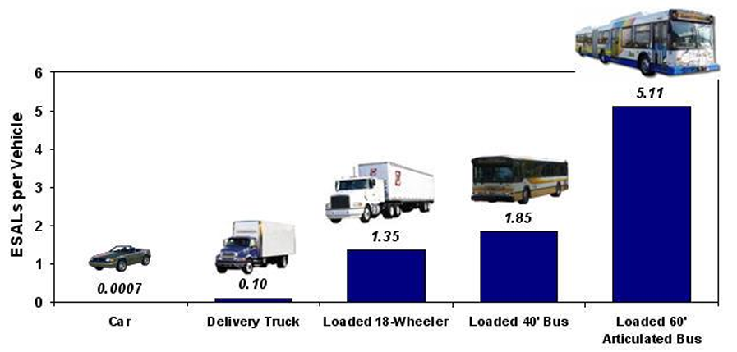
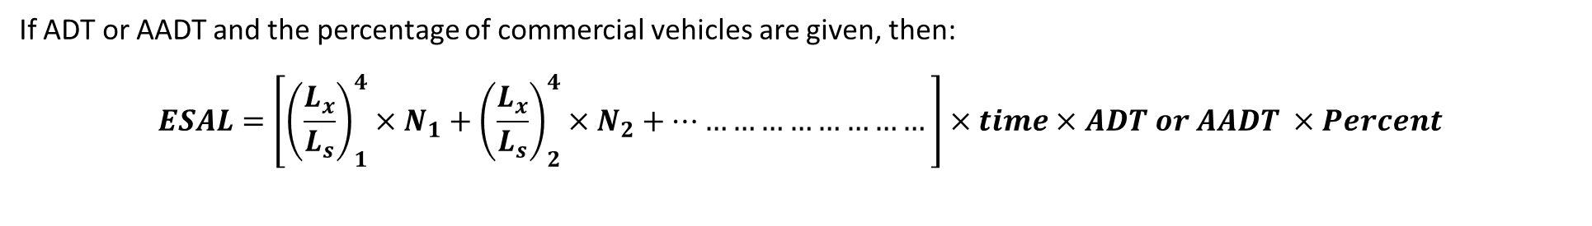
If ADT or AADT and the percentage of commercial vehicles are given, then:
$$ESAL=\left[{\left(\frac{L_{x}}{L_{s}}\right)}_{1}^{4}×N_{1}+{\left(\frac{L_{x}}{L_{s}}\right)}_{2}^{4}×N_{2}+………………………\right]×time×ADT or AADT ×Percent$$

Slide 70
Week 12
ESAL Part-02

Slide 71

EX-01: Determine ESAL for load repletion is 1.5 million and axle load is 120 kN.
Solution:
Given,
Axle Load (L_{x}) = 120 kN
Repetition N = 1.5x10⁶
Standard L_{s} = 80 kN
Now,
ESAL = ESLF x No. of reptation x Time
ESAL = ${\left(\frac{L_{x}}{L_{s}}\right)}^{4}$x N
ESAL = ${\left(\frac{120}{80}\right)}^{4}$x 1.5x10⁶
ESAL = 7.59 x 10⁶
So, ESAL = 7.59 Million (Ans)

Slide 72

EX-02: A two-way lane road ADT is 4000. If the commercial vehicle is 45% and the load is 27 kip. Calculate the ESAL for the commercial vehicle in one direction.
Solution:
Given,
ADT for one direction = $\frac{4000}{2}$ =2000
Percentage = 45% = 0.45
Lx = 27 kip
Now,
ESAL = ${\left(\frac{L_{x}}{L_{s}}\right)}^{4}$x ADT × Percentage
ESAL = ${\left(\frac{27}{18}\right)}^{4}$x 2000 x 0.45
ESAL = 4556
So, ESAL = 4556 (Ans)

Slide 73

EX-03: Determine ESAL for 1 million when axle load is 20000 lb.
Solution:
Given,
      Axle Load (L_{x})= 20000 lb
      Repetition N = 1x10⁶
      Standard L_{s} = 18000 lb
Now,
ESAL = ESLF x No. of reptation x Time
ESAL = ${\left(\frac{L_{x}}{L_{s}}\right)}^{4}$x N
ESAL = ${\left(\frac{20000}{18000}\right)}^{4}$x 1x10⁶
ESAL = 1.524 x 10⁶
So, ESAL = 1.524 Milllon (Ans)

Slide 74

EX-04: Axle Load of 27 kips and 36 kips are repeated 30 and 15 times respectively Single Axle Load (ESAL) in a year.
Solution:
Given,
      Axle Load (L₁) = 27 kips
      Repetition N₁ = 30
      Axle Load (L₂) = 36 kips
      Repetition N₂ = 15
      Standard Lₛ = 18000 lb
      Time = 1 year = 365 days
Now,
$ESAL=\left[{\left(\frac{L_{x}}{L_{s}}\right)}_{1}^{4}×N_{1}+{\left(\frac{L_{x}}{L_{s}}\right)}_{2}^{4}×N_{2}\right]×time$
$ESAL=\left[{\left(\frac{27}{18}\right)}_{1}^{4}×30+{\left(\frac{36}{18}\right)}_{2}^{4}×15\right]×365$
ESAL = 143034.37
So, ESAL = 143034.37 (Ans)

Slide 75
Week 13
ESAL Part-03

Slide 76

If Present ESAL, Design life, and growth Rate is given and Future ESAL is wanted :
$$\text{Design} \text{ESAL}\text{ = }\text{ESALP}\text{ ×}\frac{{\left(1+r\right)}^{n}−1}{r}$$
  Ex-01: If the traffic using the pavement grows at an annual rate of 4%. Determine the design ESAL for a 20-year design period. Assume the present ESAL is 78900.
Solution:
    Given,
    r=4%=0.04
    n=20
    ESAL_{P}=78900
Now,
$\text{Design} \text{ESAL}\text{ = }\text{ESALP}\text{ ×}\frac{{\left(1+r\right)}^{n}−1}{r}$
$\text{Design} \text{ESAL}\text{ =78900}$ $\text{×}\frac{{\left(1+0.04\right)}^{20}−1}{0.04}$
$\text{Design} \text{ESAL}\text{ = 2349490 }\left(Ans\right)$

Slide 77

If ADT, Truck Factor, Directional distribution, Lane distribution, Growth rate, etc. given
The ESAL can be also calculated using the following formula
$$\text{ESAL}\text{ = 365 }\text{×} \text{ADT} \text{×} \text{G} \text{×} \text{TKS} \text{×} \text{DD} \text{×} \text{LD} \text{×} \text{TF}$$
$$\text{ESAL}\text{ = 365 }\text{×} \text{ADT} \text{×}\frac{{\left(1+r\right)}^{n}−1}{r}\text{×}\text{TKS} \text{×} \text{DD} \text{×} \text{LD} \text{×} \text{TF}$$
Here,
    ADT: Average daily traffic (total number of vehicles).
    TKS: Percentage of truck traffic.
    DD: Directional distribution of truck traffic.
    LD: Lane distribution of truck traffic.
    TF: Average truck factor =$\frac{ Σ Number of axles ×Load Equivalency Factor}{Number of Vehicles}×N_{i}×F_{Ei}$
    G: Annual traffic growth factor = $\frac{{\left(1+r\right)}^{n}−1}{r}$
    $N_{i}$= Number of axles on each vehicle in category i
    $F_{Ei}$ = Load equivalency factor for axle category i (ESLF)
    r = growth rate.

Slide 78

We can also write this equation like:
$$\text{ESAL}\text{ = 365 }\text{×} \text{AADT} \text{×}\frac{{\left(1+r\right)}^{n}−1}{r}\text{×}\text{f}\text{d} \text{×} \text{N}\text{i} \text{×} \text{F}\text{Ei}$$
$$\text{ESAL}\text{ = 365 }\text{×} \text{AADT} \text{×}\frac{{\left(1+r\right)}^{n}−1}{r}\text{×}\text{f}\text{d} \text{×} \text{T}\text{f} \text{×} \text{P}\text{i}$$
Here,
    AADT = Average Annual Daily traffic (vehicle/day) [First, find for one lane]
    F_{d}: Design lane factor
    $N_{i}$= Number of axles on each vehicle in category I
    $F_{Ei}$ = Load equivalency factor for axle category i (ESLF)
    T_{f} =Truck factor
    P_{i}=Percent of truck
    r = growth rate.

Slide 79

  Ex-01: A two-lane major rural highway has an AADT of 4000 during the first year of traffic, 25% trucks, 4% annual growth rate and 50% on the design lane. If the truck factors is as shown in 0.38, compute the ESAL for a design period of 20 years.
Solution:
Given,
P_{i}=0.25
f_{DL}=0.50
T.F= 0.38
n= 20 Years
r= 0.04
Now,
$\text{ESAL}\text{ = 365 × }\text{AADT}\text{ ×}\frac{{\left(1+r\right)}^{n}−1}{r}\text{×}\text{fd}\text{ × }\text{Tf}\text{ × }\text{Pi}$
$\text{ESAL}\text{ = 365 × 4000 ×}\frac{{\left(1+0.04\right)}^{20}−1}{0.04}\text{×0.50 × 0.38 × 0.25}$
ESAL= 2065200 (Ans)

Slide 80
  Ex-02: A coal mining company wanted to construct a road. The following data are gotten in the first service year. The vehicle growth rate is 10% for the first five years and then it will be unchanged. Determine the ESAL for a total of 20 years.
Solution:
Vehicle Types | No of Vehicles | Truck factor
2 axle - 4 tires | 18500 | 0.005
2 axle - 6 tires | 21900 | 0.23
3 axles | 9250 | 0.66
5 axles | 9250 | 1.13
Vehicle Types | No of Vehicles | Truck factor | AADT x TF for 1st year | No of Vehicles After 5 Years | AADT x TF for 5th Year
2 axle - 4 tires | 18500 | 0.005 | 92.5 | 29785 | 148.975
2 axle - 6 tires | 21900 | 0.23 | 5037 | 35271 | 8112.33
3 axles | 9250 | 0.66 | 6105 | 14898 | 9832.68
5 axles | 9250 | 1.13 | 10452.5 | 14868 | 16834.74
Total ADT |  |  | 21687 |  | 34928.73

Slide 81

    ESAL for starting 5 Years:
    $\text{ESAL}\text{ = 365 }\text{×} \text{ADT} \text{×}\frac{{\left(1+r\right)}^{n}−1}{r}$
    $\text{ESAL}\text{ = 365 }\text{×}\text{ 21687 }\text{×}\frac{{\left(1+0.1\right)}^{5}−1}{0.1}$
    $\text{ESAL}\text{ =48.33 }\text{x}\text{ 106}$
    For the Remaining 15 years
    ESAL=34928.73 x 15 x 365 =191.23 x 10⁶
    For a total of 20 years
    ESAL =$\text{48.33 }\text{x}\text{ 106 + 191.23 }\text{x}\text{ 106}$
    = 239.56 x $\text{10}\text{6}\text{ (}\text{Ans}\text{)}$

Slide 82
Week 14
AASTHO Method

Slide 83
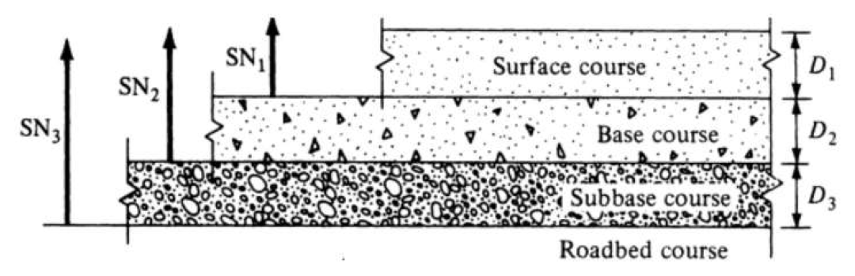
1. Define structural Number
Structural Number (SN): The Structural Number (SN) represents the overall structural requirement needed to sustain the design’s traffic loadings. It is an abstract number that expresses the structural strength of a pavement of soil support (MR ), total traffic expressed in ESALs, terminal serviceability and environment.
The 1993 AASHTO guide gives the expression for SN as
SN = a₁D₁ + a₂D₂m₂ + a₃D₃m₃

Slide 84

Here,
a₁, a₂, a₃ = Structural-layer coefficients of the wearing surface, base and sub-base layers respectively
D₁, D₂, D₃ = Thickness of the wearing surface, base and sub-base layers respectively
m₂, m₃ = Drainage coefficients for base and sub-base respectively
The basic design equation given in the 1993 guide is
$$\text{log}\text{₁₀ }\text{W}\text{₁₈=}\text{ZRS}\text{₀ + 9.36 }\text{log}\text{₁₀(}\text{SN}\text{ + 1) – 0.20 +}\frac{\text{log}\text{₁₀}\left[\frac{\text{(}\text{ΔPSI}\text{)}}{\text{(4.2 – 1.5)}}\right]}{0.4+\left[\frac{\text{1094}}{\text{(}\text{SN}\text{ + 1)⁵·¹⁹}}\right]}+\text{2.32 }\text{log}\text{₁₀ }\text{Mr}\text{ 8.07}$$

Slide 85
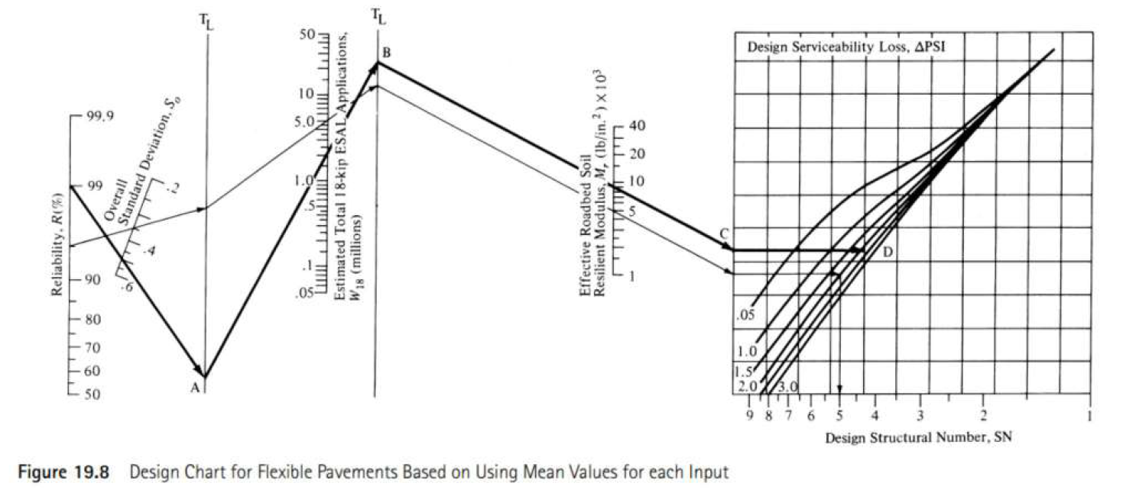

Slide 86
  Where,
  W₁₈ = Predicted number of 18,000 – lb (80 kN) single – axle load applications
  Z_{R}= Standard normal deviation for a given reliability
  S₀= Overall standard deviation
  SN = Structural number indicative of the total pavement thickness
  ΔPSI =p_{i}– p_{t}
  p_{i} = Initial serviceability index
  p_{t} = Terminal serviceability index
  M_{r}= Resilient modulus (lb/in²)

Slide 87
Week 15
Mathematical Problem on AASTHO Method

Slide 88
  EX-01: In AASHTO flexible pavement design, the required structural number (SN) of asphalt pavement to protect the roadbed soil is 6.5. Fill the following table according to the given data.
  Check SN₃ = a₁m₁D₁ + a₂m₂D₂ + a₃m₃D₃
Layer | Material | Modulus of resilient (E) psi | Layer coefficient (a) |  | Layer drainage coefficient | Structural number (SN) | Layer thickness (D) inch
Asphalt Course (AC) | Asphalt | 400,000 | a₁ = 0.169LN(E_{AC}) - 1.764 | 0.42 | m₁ = 1 |  | D₁ = 7.62
Base Course (BS) | Granular | 30,000 | a₂ = 0.249Log₁₀(E_{BS}) - 0.977 | 0.14 | m₂ = 1.2 | SN₁ = 3.2 | D₂ = 7.74
Sub-base Course (SB) | Granular | 11,000 | a₃ = 0.227Log₁₀(E_{SB}- 0.977 | 0.08 | m₃ = 1.2 | SN₂ = 4.5 | D₃ = 20.83
Compacted Subgrade | Compacted roadbed | 5,700 |  |  |  | SN₃ = 6.5

Slide 89
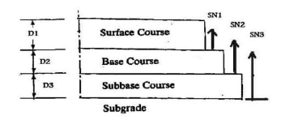
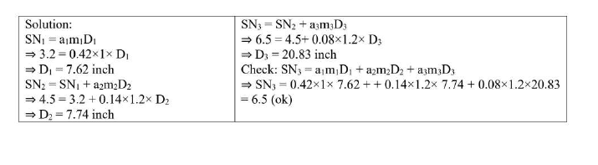

Slide 90
Week 17
Problem Solving Day

Slide 91
Week 16
Problem Solving Day

Slide 92




