Slide 1
Introduction to Operating System

Slide 2
Operating System
An Operating System (OS) is a collection of software that manages computer hardware resources and provides common services for computer programs. When you start using a Computer System then it's the Operating System (OS) which acts as an interface between you and the computer hardware. The operating system is really a low level Software which is categorized as a System Software and supports a computer's basic functions, such as memory management, tasks scheduling and controlling peripherals etc.

Slide 3
What is Operating System?
An Operating System (OS) is an interface between a computer user and computer hardware. An operating system is a software which performs all the basic tasks like file management, memory management, process management, handling input and output, and controlling peripheral devices such as disk drives and printers.

Slide 4
Computer System consists of
Generally, a Computer System consists of the following components:
Computer Users
Application Software's
System Software's
Computer Hardware

Slide 5
Computer System consists of
Computer Users are the users who use the overall computer system.
Application Softwares are the softwares which users use directly to perform different activities. These softwares are simple and easy to use like Browsers, Word, Excel, different Editors, Games etc. These are usually written in high-level languages, such as Python, Java and C++.

Slide 6
Computer System consists of
System Softwares are the softwares which are more complex in nature and they are more near to computer hardware. These software are usually written in low-level languages like assembly language and includes Operating Systems (Microsoft Windows, macOS, and Linux), Compiler, and Assembler etc.
Computer Hardware includes Monitor, Keyboard, CPU, Disks, Memory, etc.

Slide 7
So now let's put it in simple words:
If we consider a Computer Hardware is body of the Computer System, then we can say an Operating System is its soul which brings it alive ie. operational. We can never use a Computer System if it does not have an Operating System installed on it.

Slide 8
Operating System - Examples
There are plenty of Operating Systems available in the market which include paid and unpaid (Open Source). Following are the examples of the few most popular Operating Systems:

Slide 9
Operating System - Examples
Windows: This is one of the most popular and commercial operating systems developed and marketed by Microsoft. It has different versions in the market like Windows 8, Windows 10 etc and most of them are paid.
Linux This is a Unix based and the most loved operating system first released on September 17, 1991 by Linus Torvalds. Today, it has 30+ variants available like Fedora, OpenSUSE, CentOS, UBuntu etc. Most of them are available free of charges though you can have their enterprise versions by paying a nominal license fee.
MacOS This is again a kind of Unix operating system developed and marketed by Apple Inc. since 2001.
iOS This is a mobile operating system created and developed by Apple Inc. exclusively for its mobile devices like iPhone and iPad etc.
Android This is a mobile Operating System based on a modified version of the Linux kernel and other open source software, designed primarily for touchscreen mobile devices such as smartphones and tablets.
Some other old but popular Operating Systems include Solaris, VMS, OS/400, AIX, z/OS, etc.

Slide 10
List of Common Operating Systems

Slide 11
List of Common Operating Systems
Windows OS
Developer : Microsoft
Key Features : User-friendly interface, software compatibility, hardware support, Strong gaming support.
Advantages : Easy to use for most users, Broad support from third-party applications ,Frequent updates and support.
Typical Use Cases : Personal computing, Business environment, Gaming.

Slide 12
List of Common Operating Systems
macOS
Developer : Apple.
Key Features : Sleek, intuitive user interface, Strong integration with other Apple products, Robust security features, High performance and stability.
Advantages : Optimized for Apple hardware, Seamless experience across Apple ecosystem, Superior graphics and multimedia capabilities.
Typical Use Cases : Creative industries (design, video editing, music production), Personal computing, Professional environments.

Slide 13
List of Common Operating Systems
Linux
Developer : Community-driven (various distributions).
Key Features : Open-source and highly customizable, Robust security and stability, Lightweight and can run on older hardware, Large selection of distributions (e.g., Ubuntu, Fedora, Debian).
Advantages : Free to use and distribute, Strong community support, Suitable for servers and development environments.
Typical Use Cases : Servers and data centers, Development and programming, Personal computing for tech enthusiasts.

Slide 14
List of Common Operating Systems
Unix
Developer: Originally AT&T Bell Labs, various commercial and open-source versions available
Key Features: Multiuser and multitasking capabilities, Strong security and stability, Powerful command-line interface, Portability across different hardware platforms
Advantages: Reliable and robust performance, Suitable for high-performance computing and servers, Extensive support for networking
Typical Use Cases: Servers and workstations, Development environments, Research and academic settings

Slide 15
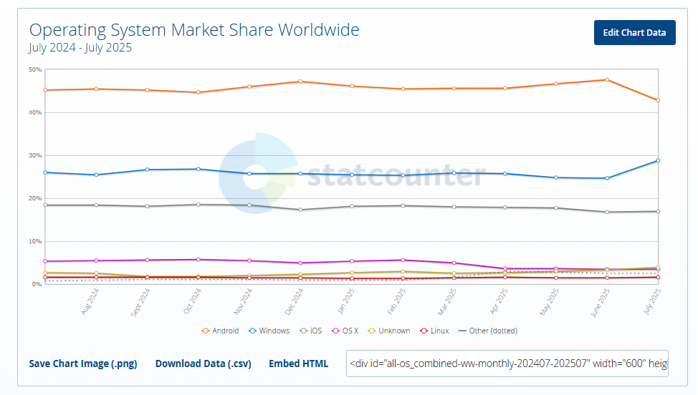
Operating System Market Share
https://gs.statcounter.com/os-market-share

Slide 16
History of Operating System
The operating system has been evolving through the years. The following table shows the history of OS.
Era | Key Developments | Examples
1956 | The first Operating System was GM-NAA I/O in 1956 by General Motors. | GM-NAA I/O (1956)
1960s | IBM developed a time sharing system TSS/360 | OS/360, DOS/360 and TSS/360
1970s | Unix popularized simplicity and multitasking; rise of personal computers with basic OSs. | Unix (1971), CP/M (1974)
1980s | GUI-based OSs gained traction; networking features became standard. | Apple Macintosh (1984), Windows (1985)
1990s | Open-source Linux emerged; GUIs in Windows and Mac OS improved. | Linux (1991), Windows 95 (1995)
2000s-Present | Mobile OSs dominated; cloud and virtualization technologies advanced computing. | iOS (2007), Android (2008)

Slide 17
Advantages of Operating System
It is helpful to monitor and regulate resources.
It can easily operate since it has a basic graphical user interface to communicate with your device.
It is used to create interaction between the users and the computer application or hardware.
The performance of the computer system is based on the CPU.
The response time and throughput time of any process or program are fast.
It can share different resources like fax, printer, etc.
It also offers a forum for various types of applications like system and web application.

Slide 18
Disadvantage of the Operating System
It allows only a few tasks that can run at the same time.
It any error occurred in the operating system; the stored data can be destroyed.
It is a very difficult task or works for the OS to provide entire security from the viruses because any threat or virus can occur at any time in a system.
An unknown user can easily use any system without the permission of the original user.
The cost of operating system costs is very high.

Slide 19
Why to Learn Operating System
If you are aspiring to become a Great Computer Programmer then it is highly recommended to understand how exactly an Operating System works inside out. This gives opportunity to understand how exactly data is saved in the disk, how different processes are created and scheduled to run by the CPU, how to interact with different I/O devices and ports.
There are various low level concepts which help a programmer to Design and Develop scalable softwares. Bottom line is without a good understanding of Operating System Concepts, it can't be assumed someone to be a good Computer Application Software developer, and even it is unimaginable imagine someone to become a System Software developer without knowing Operating System in-depth.
If you are a fresher and applying for a job in any standard company like Google, Microsoft, Amazon, IBM etc then it is very much possible that you will be asked questions related to Operating System concepts.

Slide 20
Target Audience
This tutorial has been prepared for the Computer Science Professionals and Students specially for BCA, MCA, B.Tech, M.Tech Engineering Students to help them understand the basic to advanced concepts related to an Operating System in general. Operating System is one of the core concepts in every University teaching Computer Science and this subject has a lot of weight from exams point of view.

Slide 21
Prerequisites
Before you start learning Operating System using this tutorial, we are making an assumption that you are already aware of Computer Fundaments like What is Computer Hardware, CPU, Primary Memory, Secondary Memory, Devices, Files etc. If you are not already aware of these concepts then it will be difficult to understand various concepts related to Operating System and so it is highly recommended to go through our Computer Fundamentals Tutorial before attempting to learn Operating System.

Slide 22
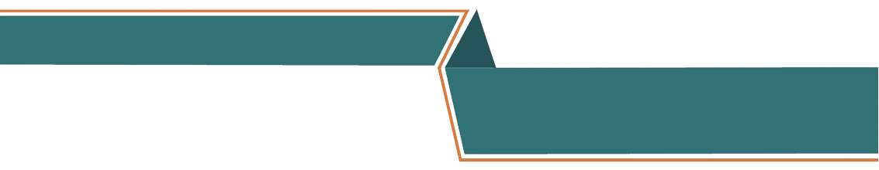
“Thank You”

