Slide 1
Lectures On:
Types of Operating System

Slide 2
Types of Operating System
Batch Operating System
Multiprogramming Operating System
Multitasking or Time-Sharing Operating System
Multiprocessing Operating System
Embedded Operating System
Real-Time Operating System
Distributed Operating System
Network Operating System

Slide 3
Batch Operating System
In Batch Operating System, there is no direct interaction between user and computer.
Therefore, the user needs to prepare jobs and save offline mode to punch card or paper tape or magnetic tape.
After creating the jobs, hand it over to the computer operator; then the operator sort or creates the similar types of batches like B2, B3, and B4.
Now, the computer operator submits batches into the CPU to execute the jobs one by one.
After that, CPUs start executing jobs, and when all jobs are finished, the computer operator provides the output to the user.

Slide 4
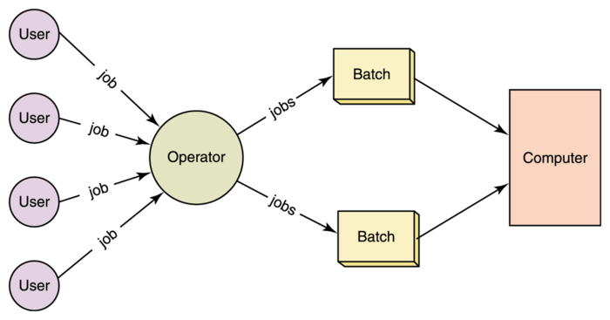

Slide 5
Multiprogramming Operating System
Due to the CPU's underutilization and the waiting for I/O resource till that CPU remains idle.
It shows the improper use of system resources.
Hence, the operating system introduces a new concept that is known as multiprogramming.
A multiprogramming operating system refers to the concepts wherein two or more processes or programs activate simultaneously to execute the processes one after another by the same computer system. When a program is in run mode and uses CPU, another program or file uses I/O resources at the same time or waiting for another system resources to become available.
It improves the use of system resources, thereby increasing system throughput.
Such a system is known as a multiprogramming operating system.

Slide 6
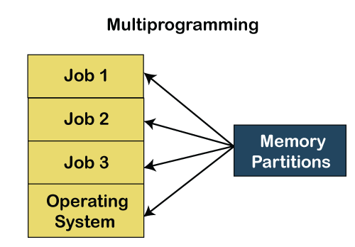
Multiprogramming Operating System

Slide 7
Multitasking Time-Sharing Operating System
It is the type of operating system that allows us to connect many people located at different locations to share and use a specific system at a single time.
The time-sharing operating system is the logical extension of the multiprogramming through which users can run multiple tasks concurrently.
Furthermore, it provides each user his terminal for input or output that impacts the program or processor currently running on the system.
It represents the CPU's time is shared between many user processes. Or, the processor's time that is shared between multiple users simultaneously termed as time-sharing.

Slide 8
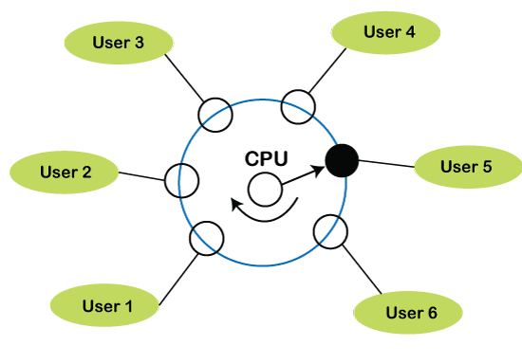
Time-Sharing Operating System

Slide 9
Multiprocessing Operating System
It is the type of operating system that refers to using two or more central processing units (CPU) in a single computer system.
However, these multiprocessor systems or parallel operating systems are used to increase the computer system's efficiency.
With the use of a multiprocessor system, they share computer bus, clock, memory and input or output device for concurrent execution of process or program and resource management in the CPU.

Slide 10
Embedded Operating System
The Embedded operating system is the specific purpose operating system used in the computer system's embedded hardware configuration.
These operating systems are designed to work on dedicated devices like automated teller machines (ATMs), airplane systems, digital home assistants, and the internet of things (IoT) devices.

Slide 11
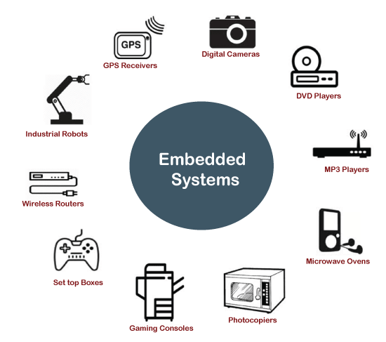
Embedded Operating System

Slide 12
Real-Time Operating System
A real-time operating system is an important type of operating system used to provide services and data processing resources for applications in which the time interval required to process & respond to input/output should be so small without any delay real-time system.
For example, real-life situations governing an automatic car, traffic signal, nuclear reactor or an aircraft require an immediate response to complete tasks within a specified time delay.
Hence, a real-time operating system must be fast and responsive for an embedded system, weapon system, robots, scientific research & experiments and various real-time objects.

Slide 13
Types of the real-time operating system:
Hard Real-Time System These types of OS are used with those required to complete critical tasks within the defined time limit. If the response time is high, it is not accepted by the system or may face serious issues like a system failure. In a hard real-time system, the secondary storage is either limited or missing, so these system stored data in the ROM.
Soft Real-Time System A soft real-time system is a less restrictive system that can accept software and hardware resources delays by the operating system. In a soft real-time system, a critical task prioritizes less important tasks, and that priority retains active until completion of the task. Also, a time limit is set for a specific job, which enables short time delays for further tasks that are acceptable. For example, computer audio or video, virtual reality, reservation system, projects like undersea, etc.

Slide 14
Distributed Operating system
A distributed operating system provides an environment in which multiple independent CPU or processor communicates with each other through physically separate computational nodes.
Each node contains specific software that communicates with the global aggregate operating system.
With the ease of a distributed system, the programmer or developer can easily access any operating system and resource to execute the computational tasks and achieve a common goal.
It is the extension of a network operating system that facilitates a high degree of connectivity to communicate with other users over the network.

Slide 15
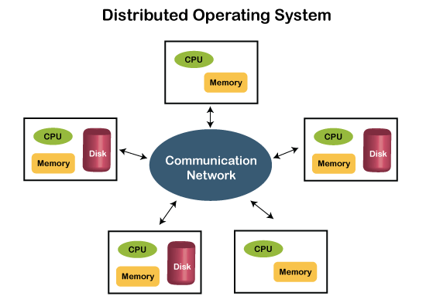
Distributed Operating System

Slide 16
Network Operating System
A network operating system is an important category of the operating system that operates on a server using network devices like a switch, router, or firewall to handle data, applications and other network resources.
It provides connectivity among the autonomous operating system, called as a network operating system.
The network operating system is also useful to share data, files, hardware devices and printer resources among multiple computers to communicate with each other.

Slide 17
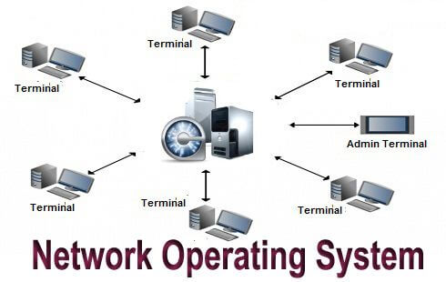
Network Operating System

Slide 18
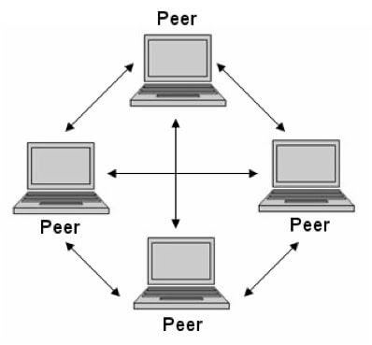
Types of network operating system
Peer-to-peer network operating system: The type of network operating system allows users to share files, resources between two or more computer machines using a LAN.

Slide 19
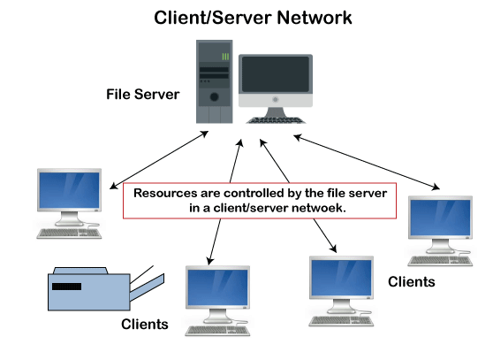
Types of network operating system
Client-Server network operating system: It is the type of network operating system that allows the users to access resources, functions, and applications through a common server or center hub of the resources. The client workstation can access all resources that exist in the central hub of the network. Multiple clients can access and share different types of the resource over the network from different locations.

Slide 20
Advantages of Operating System
It is helpful to monitor and regulate resources.
It can easily operate since it has a basic graphical user interface to communicate with your device.
It is used to create interaction between the users and the computer application or hardware.
The performance of the computer system is based on the CPU.
The response time and throughput time of any process or program are fast.
It can share different resources like fax, printer, etc.
It also offers a forum for various types of applications like system and web application.

Slide 21
Disadvantage of the Operating System
It allows only a few tasks that can run at the same time.
It any error occurred in the operating system; the stored data can be destroyed.
It is a very difficult task or works for the OS to provide entire security from the viruses because any threat or virus can occur at any time in a system.
An unknown user can easily use any system without the permission of the original user.
The cost of operating system costs is very high.

Slide 22
Installing an Operating System: Practical Steps
Step-by-Step Guide to Install OS (Windows/Linux)
Prerequisites:
ISO File: Download the ISO file of the OS from its official website (e.g., Microsoft, Ubuntu).
Bootable USB Tool: Download and install Rufus or another bootable USB creator tool.
Creating a Bootable USB:
Open Rufus and select the downloaded ISO file.
Insert a USB flash drive and select it in Rufus.
Configure settings (e.g., partition scheme) and click Start to make the USB bootable.

Slide 23
Installing an Operating System: Practical Steps
Installing the OS:
Insert Bootable USB into the computer and restart.
Enter the BIOS/UEFI settings (usually by pressing F2, F12, or Del).
Set the USB as the primary boot device and restart.
Follow the on-screen prompts:
Choose language, time zone, and keyboard layout.
Select Installation Type (e.g., fresh install, upgrade).
Partition the drive as necessary (be cautious if there’s existing data).
Proceed with the installation. This may take some time.
Post-Installation Setup:
Configure basic settings (user accounts, network settings).
Install drivers and updates if necessary.
Set up any necessary software or tools (for labs, programming tools, etc.).

Slide 24
Dual-Boot Setup:
Dual-booting allows a computer to have two operating systems installed on the same machine, providing the option to select which OS to load at startup. Here’s a step-by-step guide for setting up a dual-boot system, commonly done with Windows and a Linux distribution.

Slide 25
How to Set Up Dual-Boot: Windows and Linux
1. Prepare for Installation
Backup Your Data: Before proceeding, back up all important files. Dual-booting can affect partitions, and data loss is possible if not done carefully.
Check Disk Space: Ensure you have enough space on your hard drive for both OSes. Linux generally requires at least 20 GB, though 50 GB is recommended for better performance.
2. Create Installation Media
Download ISO Files: Download the Linux ISO file (e.g., Ubuntu, Fedora) from its official website.
Create a Bootable USB for Linux:
Use Rufus or another bootable USB creator to make a Linux bootable USB.
Follow the tool’s prompts to select the ISO and configure the bootable drive.

Slide 26
How to Set Up Dual-Boot: Windows and Linux
3. Partition Your Hard Drive in WindowsOpen Disk Management in Windows (press Win + R, type diskmgmt.msc, and press Enter).Shrink Volume to make space for Linux:Right-click your main partition (usually C:) and select Shrink Volume.Specify the amount of space to shrink (e.g., 50 GB or more) and click Shrink. This will create unallocated space.

Slide 27
How to Set Up Dual-Boot: Windows and Linux
4. Boot from the Linux USB
Restart Your Computer and enter the BIOS/UEFI settings (typically by pressing F2, F12, or Del during startup).
Set the USB Drive as the primary boot device and restart.
Your computer should now boot into the Linux installation setup.

Slide 28
How to Set Up Dual-Boot: Windows and Linux
5. Install Linux Alongside Windows
When prompted, choose the installation type Install Linux alongside Windows or Something Else (manual partitioning).
If you selected Something Else:
Select the unallocated space created in step 3.
Create the following partitions:
Root (/): Allocate around 20-30 GB (ext4 format).
Swap (optional): Allocate space equal to your RAM size (useful if you have limited RAM).
Home (/home): Allocate the remaining space for personal files and settings.
Confirm your partition choices and proceed with installation.

Slide 29
How to Set Up Dual-Boot: Windows and Linux
6. Complete the Installation
Continue through the installation steps, setting up your user account and other settings.
Once the installation completes, remove the USB drive and restart the computer.
7. Select OS at Boot with GRUB
On reboot, you’ll see the GRUB bootloader screen. GRUB allows you to choose which OS to boot.
Use the arrow keys to select either Windows or Linux and press Enter.

Slide 30

“Thank You”

