Slide 1
Lectures On:
Operating System - Processes

Slide 2
Program
A program is a piece of code which may be a single line or millions of lines. A computer program is usually written by a computer programmer in a programming language. For example, here is a simple program written in C programming language −
#include <stdio.h>
int main()
{
printf("Hello, World! \n");
return 0;
}

Slide 3
Program
A computer program is a collection of instructions that performs a specific task when executed by a computer. When we compare a program with a process, we can conclude that a process is a dynamic instance of a computer program.
A part of a computer program that performs a well-defined task is known as an algorithm. A collection of computer programs, libraries and related data are referred to as a software.

Slide 4
Operating System - Processes
A process is basically a program in execution. The execution of a process must progress in a sequential fashion
To put it in simple terms, we write our computer programs in a text file and when we execute this program, it becomes a process which performs all the tasks mentioned in the program.
A process is defined as an entity which represents the basic unit of work to be implemented in the system.

Slide 5
Processes four sections:
When a program is loaded into the memory and it becomes a process, it can be divided into four sections stack, heap, text and data. The following image shows a simplified layout of a process inside main memory −

Slide 6
Processes four sections:
Stack
Heap
Text
Data

Slide 7
Processes four sections:
S.N. | Component & Description
1 | Stack The process Stack contains the temporary data such as method/function parameters, return address and local variables.
2 | Heap This is dynamically allocated memory to a process during its run time.
3 | Text This includes the current activity represented by the value of Program Counter and the contents of the processor's registers.
4 | Data This section contains the global and static variables.

Slide 8
Process Life Cycle or States of a Process

Slide 9
Process Life Cycle
When a process executes, it passes through different states. These stages may differ in different operating systems, and the names of these states are also not standardized.

Slide 10
Process Life Cycle
Process Life Cycle in Operating System is one of the five states in which a process can be starting from the time it has been submitted for execution, till the time when it has been executed by the system.
Here we will learn detailed explanation about each states.
Think of it like a human life – you’re born, you grow, do tasks, take breaks, and eventually reach the end.

Slide 11
A process can be in any of the following states –
New state/Start/Initial
Ready state
Running state
Waiting state
Terminated

Slide 12
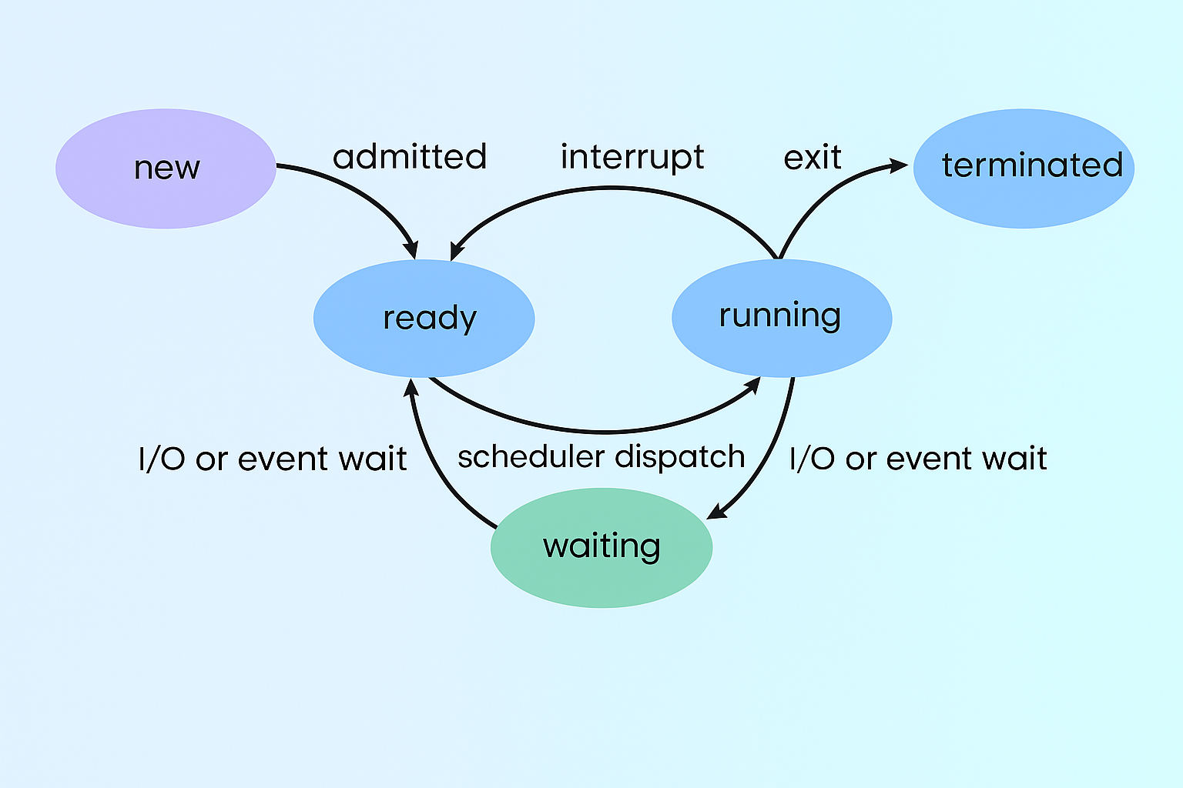
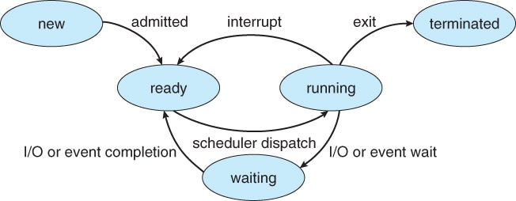
Process states:
Process Life Cycle/Stages of a Process in Life Cycle
I/O or event completion

Slide 13
Process Life Cycle
1.New/Start/Initial: This is the initial state when a process is first started/created.
2. Ready State
When a process is in the “Ready” state, it means it’s prepared to run but is patiently waiting for its turn to be executed by the CPU. It’s like an athlete at the starting line, all geared up and eager to start the race.
3. Running State
In the “Running” state, the process is actively being executed by the CPU. It’s in full swing, accomplishing its tasks. Think of it as the athlete sprinting down the track, putting in their best effort.
4. Terminated State
When a process completes its assigned task, it enters the “Terminated” state. It’s like the athlete crossing the finish line, signaling the end of the race. At this point, the process has finished its job and is ready to be removed from the system.
5. Waiting State
Sometimes, a process needs to pause temporarily, perhaps because it’s waiting for some input or for a certain event to occur. In this “Waiting” state, the process is on hold, not actively using the CPU. It’s akin to the athlete taking a brief break during the race.

Slide 14
Process Life Cycle
1.New/Start/Initial: This is the initial state when a process is first started/created.
Imagine an athlete just getting out of the locker room, putting on their gear, and walking toward the starting line.

Slide 15

Process Life Cycle
2. Ready State
When a process is in the “Ready” state, it means it’s prepared to run but is patiently waiting for its turn to be executed by the CPU. It’s like an athlete at the starting line, all geared up and eager to start the race.

Slide 16

Process Life Cycle
3. Running State
In the “Running” state, the process is actively being executed by the CPU. It’s in full swing, accomplishing its tasks. Think of it as the athlete sprinting down the track, putting in their best effort.

Slide 17

Process Life Cycle
4. Terminated State
When a process completes its assigned task, it enters the “Terminated” state. It’s like the athlete crossing the finish line, signaling the end of the race. At this point, the process has finished its job and is ready to be removed from the system.

Slide 18

Process Life Cycle
5. Waiting State
Sometimes, a process needs to pause temporarily, perhaps because it’s waiting for some input or for a certain event to occur. In this “Waiting” state, the process is on hold, not actively using the CPU. It’s akin to the athlete taking a brief break during the race.

Slide 19
Process State Resides in RAM?
Process State | Resides in RAM?
New | ❌ No
Ready | ✅ Yes
Running | ✅ Yes
Waiting / Blocked | ✅ Yes
Suspended | ❌ No
Terminated | ❌ No

Slide 20
Where the Process is Stored (When Not in RAM):
Process State | Stored Location (if not in RAM) | Explanation
New | On Disk (or in process control block / OS queue) | The program is loaded from disk (e.g., hard drive or SSD), but hasn’t been moved into RAM yet.
Suspended | In Secondary Storage (Disk/Swap) | The process is temporarily removed from RAM and stored in swap space or disk to free up RAM.
Terminated | Removed completely (Log/info may be in system logs) | After completion, the process is cleared from RAM. If needed, logs or traces are saved on disk.

Slide 21
Summery
A process generally transitions through the following 5 or 7 states:
New – The process is being created
Ready – The process is in RAM, waiting for CPU allocation
Running – The process is currently using the CPU
Waiting / Blocked – The process is waiting for some input/output operation
Terminated – The process has finished execution

Slide 22
Here is the explanation: New State
Once a program is loaded into the RAM, it enters the “new” state. At this point, it’s not yet ready for execution. The operating system’s Long-Term Scheduler, also known as the Job Scheduler, comes into play. This scheduler decides which processes from the “new” state are allowed to enter the “ready” state based on system resources, workload, and scheduling policies. When a process is selected, it’s moved from “new” to “ready.”

Slide 23
Here is the explanation: Ready State
In the “ready” state, processes are prepared for execution, but they’re not actively running. The Short-Term Scheduler, also known as the CPU Scheduler, takes over. Its job is to select a process from the “ready” state and allocate the CPU to it. This moves the process into the “running” state, where it actively utilizes the CPU.

Slide 24
Here is the explanation: cont.
When a process completes its execution, it transitions to the “terminated” state. In this state, the process is finished and will eventually be removed from memory.

Slide 25
Here is the explanation: cont.
If a process encounters an event that causes it to be temporarily unable to proceed (such as waiting for user input or for data from a slow I/O device), it enters the “waiting” state. This can happen due to factors like I/O operations, synchronization, or communication events. Once the event it’s waiting for occurs, the process can move back to the “ready” state.

Slide 26
Here is the explanation: cont.
The Schedule Dispatcher is a component responsible for managing the execution of processes. It’s responsible for context switching, which involves saving the state of the currently running process, loading the state of the next process, and handing control of the CPU to it. This ensures that processes take turns executing efficiently.

Slide 27
Real-life Practice of Process States in Windows
1. New / Start / Initial State
What it means (theoretically): A process is just created but hasn't yet started running.
How to demonstrate:
Open Task Manager → Go to "Details" tab.
Right-click → Open new application (e.g., Notepad or Calculator).
As soon as you open it, it appears in the process list — this represents the New → Ready transition.

Slide 28
Real-life Practice of Process States in Windows
2. Ready State
Theoretically: Process is ready to run, waiting for CPU time.
Real View: Windows doesn’t label a “Ready” state directly, but when you see a process with "Status" = Suspended or low CPU usage, it often means it's ready and just waiting.
How to demonstrate: Open several programs (e.g., Notepad, Paint, Word) quickly.
Only one or two processes will use CPU at a time.
Others will be waiting in Ready state — look at CPU column in Task Manager > Processes or Details tab.

Slide 29
Real-life Practice of Process States in Windows
3. Running State
Theoretically: Process is currently being executed by the CPU.
How to demonstrate:
In Task Manager, under Processes, sort by CPU.
The processes with non-zero CPU usage are in the Running state.
Example: Open a browser and play a YouTube video.
The browser’s process (e.g., chrome.exe) will be Running, using CPU.

Slide 30
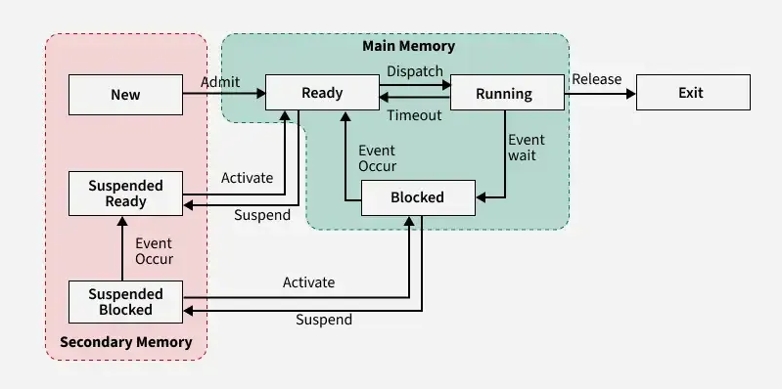
The Seven-State Model

Slide 31
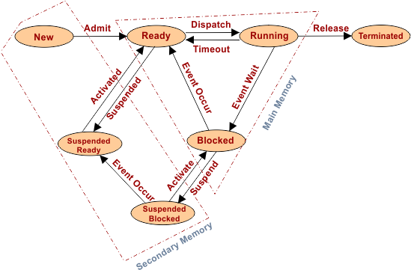
The Seven-State Model

Slide 32
The Seven-State Model
New State: In this step, the process is about to be created but not yet created. It is the program that is present in secondary memory that will be picked up by the OS to create the process.
Ready State: New -> Ready to run. After the creation of a process, the process enters the ready state i.e. the process is loaded into the main memory. The process here is ready to run and is waiting to get the CPU time for its execution. Processes that are ready for execution by the CPU are maintained in a queue called a ready queue for ready processes.
Run State: The process is chosen from the ready queue by the OS for execution and the instructions within the process are executed by any one of the available processors.
Blocked or Wait State: Whenever the process requests access to I/O needs input from the user or needs access to a critical region(the lock for which is already acquired) it enters the blocked or waits state. The process continues to wait in the main memory and does not require CPU. Once the I/O operation is completed the process goes to the ready state.
Terminated or Completed State: Process is killed as well as PCB is deleted. The resources allocated to the process will be released or deallocated.

Slide 33
The Seven-State Model
Suspend Ready: Process that was initially in the ready state but was swapped out of main memory(refer to Virtual Memory topic) and placed onto external storage by the scheduler is said to be in suspend ready state. The process will transition back to a ready state whenever the process is again brought onto the main memory.
Suspend Wait or Suspend Blocked: Similar to suspend ready but uses the process which was performing I/O operation and lack of main memory caused them to move to secondary memory. When work is finished it may go to suspend ready.

Slide 34
The Seven-State Model
In simple terms (Suspend Ready):The process was in the Ready state, but due to lack of space in RAM, it was moved out to secondary storage. It will return to the Ready state when there's space in RAM again.
Suspend Wait / Suspend Blocked:
🔸 These processes were already in the Blocked / Waiting state — meaning they were waiting for some input/output operation.
🔸 But since there wasn't enough space in RAM, they were also moved out to secondary storage (like a hard disk).
🔸 Once their waiting (I/O) task is done, they will be moved to the Suspend Ready state.
➡️ In simple terms: The process was in Waiting, and due to low RAM space, it was moved out. It will return later.

Slide 35
Process Control Block (PCB)
Think of the PCB as a special file for a process. It contains important information that helps the operating system manage and keep track of what the process is doing.

Slide 36
Process Control Block (PCB)
A Process Control Block is a data structure maintained by the Operating System for every process. The PCB is identified by an integer process ID (PID). A PCB keeps all the information needed to keep track of a process as listed below in the table −

Slide 37
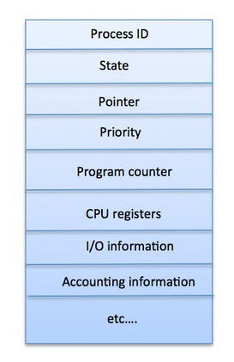
Process Control Block (PCB)
The architecture of a PCB is completely dependent on Operating System and may contain different information in different operating systems. Here is a simplified diagram of a PCB −

Slide 38
Process Control Block (PCB)
S.N. | Information & Description
1 | Process State The current state of the process i.e., whether it is ready, running, waiting, or whatever.
2 | Process privileges This is required to allow/disallow access to system resources.
3 | Process ID Unique identification for each of the process in the operating system.
4 | Pointer A pointer to parent process.
5 | Program Counter Program Counter is a pointer to the address of the next instruction to be executed for this process.

Slide 39
Process Control Block (PCB)
S.N. | Information & Description
6 | CPU registers Various CPU registers where process need to be stored for execution for running state.
7 | CPU Scheduling Information Process priority and other scheduling information which is required to schedule the process.
8 | Memory management information This includes the information of page table, memory limits, Segment table depending on memory used by the operating system.
9 | Accounting information This includes the amount of CPU used for process execution, time limits, execution ID etc.
10 | IO status information This includes a list of I/O devices allocated to the process.

Slide 40
Process Control Block (PCB)
The PCB is maintained for a process throughout its lifetime, and is deleted once the process terminates.

Slide 41
Why PCB is Important ?
Imagine you’re working on a big project and need to take a break. The PCB helps the computer remember exactly where you left off. It’s like a magic trick that keeps everything in order!
The PCB also helps the computer make decisions about which task to work on next and ensures that everything runs smoothly and efficiently.

Slide 42

“Thank You”

