Slide 1
Lectures On:
System Structure/Architecture for an Operating System

Slide 2
Operating System - Architecture
An operating system allows the user application programs to interact with the system hardware.
Since the operating system is such a complex structure, its architecture plays an important role in its usage.
Each component of the Operating System Architecture should be well defined with clear inputs, outputs and functions.

Slide 3
System Structure/Architecture for an Operating System
A system structure for an operating system is like the blueprint of how an OS is organized and how its different parts interact with each other.
Because operating systems have complex structures, we want a structure that is easy to understand so that we can adapt an operating system to meet our specific needs.
Similar to how we break down larger problems into smaller, more manageable subproblems, building an operating system in pieces is simpler.
The operating system is a component of every segment.
The strategy for integrating different operating system components within the kernel can be thought of as an operating system structure.

Slide 4
Import Terms
In operating system Architecture, we've two major terms which defines the major components of the operating systems.
Kernal − Kernal is the central component of an operating system architecture in most of the implementation. A kernal is responsible for all major operations and interaction with the hardware. A kernal manages memory, processor, input/output devices and provides interface to application programs to interact with hardware components.
Shell − Shell is an interface of an operating system. It can be command line interface or a graphical user interface. User interacts with an operating system using shell. Application programs can also use shell interface to interact with underlying operating system.

Slide 5
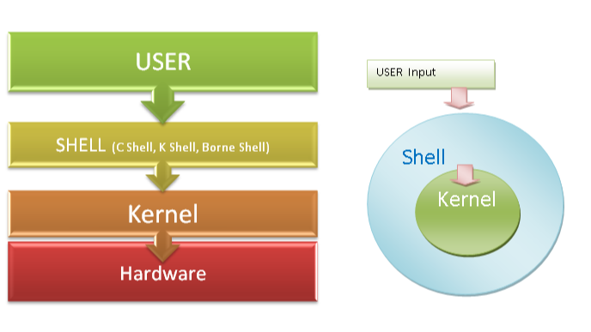
Kernal & Shell

Slide 6
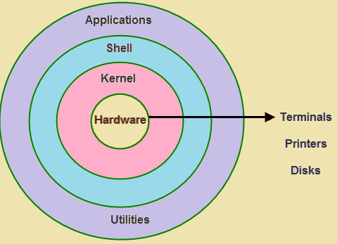
Kernal & Shell

Slide 7
Are Kernel and Shell Part of the Operating System?
Kernel – The Core Part of the OS
The kernel directly interacts with the hardware.
It controls all the low-level operations such as:
  RAM management
  CPU scheduling
  File system access
  Input/Output devices
So, the Kernel is the heart of the operating system.
Without the kernel, the OS cannot function.

Slide 8
Are Kernel and Shell Part of the Operating System?
Shell – The Interface Part of the OS
The shell takes input from the user and sends it to the kernel.
It can be:
  Command Line Shell (e.g., Bash, CMD)
  Graphical Shell (e.g., Windows Explorer, GNOME)
  So, the Shell is also part of the OS, but not the core.
  It acts as a bridge between the user and the kernel.

Slide 9
Are Kernel and Shell Code or Hardware?
Kernel:
The kernel is software, meaning it is a program written in code.
It is a part of the operating system that directly controls hardware resources.
The kernel is real — but not a physical object.
It is a very low-level software, usually written in C, C++, and some parts in Assembly language.

Slide 10
Are Kernel and Shell Code or Hardware?
Shell:
The shell is also software.
It acts as a middle layer between the user and the kernel.
There are different types of shells:
CLI Shells (e.g., Bash, CMD)
GUI Shells (e.g., Windows Explorer, GNOME)
The shell is real, just not visible like physical hardware.
It is a user interface program built using programming languages like C, Python, or Shell scripting.

Slide 11
Why Are Shell and Kernel Separated in an Operating System?
1. Different Responsibilities
Kernel | Shell
Controls hardware directly | Takes user input and passes to Kernel
Manages CPU, RAM, I/O, and files | Acts as interface for commands
Runs core system operations | Accepts input via CLI or GUI

Slide 12
2. Security & Stability
The kernel is sensitive and deals with low-level, critical system functions.
If the shell was merged with the kernel, a small user mistake (e.g., wrong command) could crash or harm the entire system.

Slide 13
3. Flexibility
There are different types of shells:
  CLI shells like Bash, Zsh, etc.
  Graphical shells like Windows Explorer, GNOME Shell
Users can change the shell without touching the kernel.

Slide 14
Modular Design Principle
In software engineering, we follow a principle called:
"Divide and Conquer“
It means breaking complex systems into manageable parts.
By separating kernel and shell:
The OS becomes easier to build, test, and maintain.
Developers can update one part without affecting the other.

Slide 15
Summary:
Aspect | Kernel | Shell
Type | Core part of OS | Interface part of OS
Responsibility | Manages hardware & system resources | Interacts with the user
Security | Highly protected | User-facing, customizable
Replaceable? | No | Yes (you can change the shell)

Slide 16
"Different OS – Kernel, Shell and Other Information"
OS Name | Kernel Name | Kernel Type | Shell Name(s) | Shell Access | GUI? | OS Type
Windows (10/11) | NTOSKRNL | Hybrid | cmd, PowerShell, Windows Terminal | Built-in (CLI via GUI) | Yes | Closed Source
Linux (Ubuntu, Fedora, etc.) | Linux Kernel | Monolithic (modular support) | bash, sh, zsh, fish | Direct (GUI & CLI-based) | Optional | Open Source
macOS | XNU (X is Not Unix) | Hybrid (based on BSD & Mach) | bash, zsh | Terminal App | Yes | Closed Source (partly open BSD)
Android | Modified Linux Kernel | Monolithic | sh, adb shell | ADB (Developer mode) | Yes (touch GUI) | Open Source (AOSP), Closed UI
iOS | XNU | Hybrid | Internal shell only (restricted) | Not user-accessible | Yes | Closed Source
FreeBSD | FreeBSD Kernel | Monolithic | sh, tcsh, bash | CLI + optional GUI | Optional | Open Source
Chrome OS | Linux Kernel (modified) | Monolithic | crosh, bash, sh | Developer Mode | Yes | Partially Open
Kali Linux | Linux Kernel | Monolithic | bash, zsh | Direct CLI access | Yes | Open Source
Arch Linux | Linux Kernel | Monolithic | bash, zsh | Full CLI (GUI optional) | Optional | Open Source
Windows Server | NT Kernel | Hybrid | PowerShell, cmd | Full admin access | Optional | Closed Source

Slide 17
Popular Architectures/ Structures
Following are various popular implementations of Operating System architectures.
Simple Architecture
Monolith Architecture
Micro-Kernel Architecture
Exo-Kernel Architecture
Layered Architecture
Modular Architecture
Virtual Machine Architecture

Slide 18

Simple Architecture
There are many operating systems that have a rather simple structure.
These started as small systems and rapidly expanded much further than their scope.
A common example of this is MS-DOS. It was designed simply for a niche amount for people.
There was no indication that it would become so popular.

Slide 19
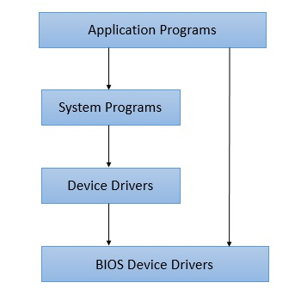
Simple Architecture/Structure

Slide 20
Advantages
Easy Development - In simple operation system, being very few interfaces, development is easy especially when only limited functionalities are to be delivered.
Better Performance - Such a system, as have few layers and directly interacts with hardware, can provide a better performance as compared to other types of operating systems.

Slide 21
Disadvantages
Frequent System Failures - Being poorly designed, such a system is not robust. If one program fails, entires operating system crashses. Thus system failures are quiet frequent in simple operating systems.
Poor Maintainability - As all layers of operating systems are tightly coupled, change in one layer can impact other layers heavily and making code unmanageable over a period of time.

Slide 22
Monolith Architecture
In monolith architecture operating system, a central piece of code called kernel is responsible for all major operations of an operating system. Such operations includes file management, memory management, device management and so on. The kernal is the main component of an operating system and it provides all the services of an operating system to the application programs and system programs.
The kernel has access to the all the resources and it acts as an interface with application programs and the underlying hardware. A monolithic kernel architecture promotes timesharing, multiprogramming model and was used in old banking systems.

Slide 23
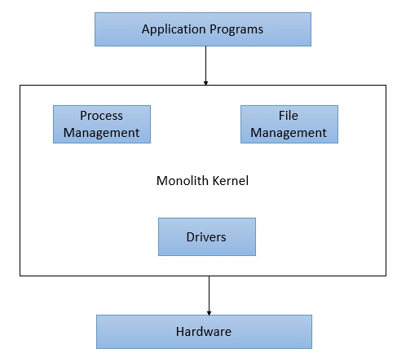
Monolith Architecture

Slide 24
Advantages
Easy Development - As kernel is the only layer to develop with all major functionalities, it is easier to design and develop.
Performance - As Kernel is responsible for memory management, other operations and have direct access to the hardware, it performs better.

Slide 25
Disadvantages
Crash Prone - As Kernel is responsible for all functions, if one function fails entire operating system fails.
Difficult to enhance - It is very difficult to add a new service without impacting other services of a monolith operating system.

Slide 26
Micro-Kernel Architecture
As in case monolith architecture, there was single kernel, in micro-kernel, we have multiple kernels each one specilized in particular service. Each microkernel is developed independent to the other one and makes system more stable. If one kernel fails the operating sytem will keep working with other kernel's functionalities.

Slide 27
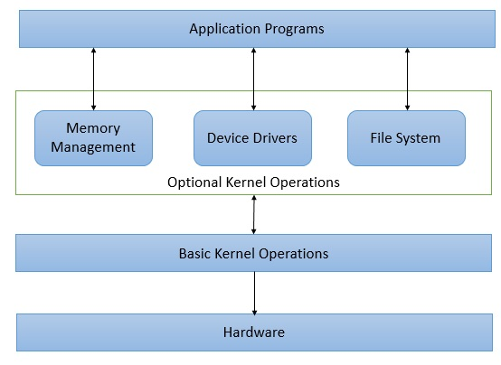
Micro-Kernel Architecture

Slide 28
Advantages
Reliable and Stable - As multiple kernels are working simultaneously, chances of failure of operating sytem is very less. If one functionlity is down, operating system can still provide other functionalities using stable kernels.
Maintainability - Being small sized kernels, code size is maintainable. One can enhance a microkernel code base without impacting other microkernel code base.

Slide 29
Disadvantages
Complex to Design - Such a microkernel based architecture is difficult to design.
Performance Degradation - Multi kernel, Multi-modular communication may hamper the performance as compared to monolith architecture.

Slide 30
Exo-Kernel Architecture
Exo-Kernal Architecture operating system was designed and developed at MIT. The aim of this design was to keep Kernel size minimal while allowing the application programs to manage hardware resources directly. The purpose of removing abstraction of operating system for hardware resources was to enable application programmer to write high performance code while exo-kernel handles other operations.

Slide 31
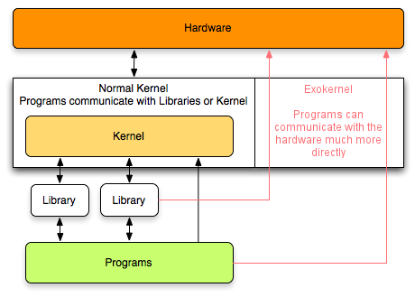
Exo-Kernel Architecture

Slide 32
Advantages
High Performance - As application program can allocate memory, a better designed code can make optimal use and perform better.
Application Control - As resource management is not secured by operating system, application program has more control over system resources and can write custom operations on system resources.

Slide 33
Disadvantages
Unreliable and Unsafe - As security is in application program level, a poorly written code can ruin the system.
Complex Design - Exo-Kernel designing is complicated.

Slide 34
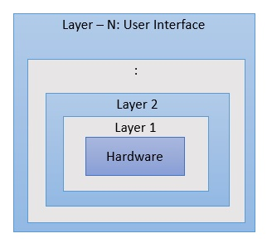
Layered Architecture
One way to achieve modularity in the operating system is the layered approach. In this, the bottom layer is the hardware and the topmost layer is the user interface.

Slide 35
An image demonstrating the layered approach is as follows −

Slide 36
Layered Architecture
As seen from the image, each upper layer is built on the bottom layer. All the layers hide some structures, operations etc from their upper layers.
One problem with the layered architecture is that each layer needs to be carefully defined. This is necessary because the upper layers can only use the functionalities of the layers below them.

Slide 37
Advantages
High Customizable - Being layered, each layer implmentation can be customized easily. A new functionality can be added without impacting other modules as well.
Verifiable - Being modular, each layer can be verified and debugged easily.

Slide 38
Disadvantages
Less Performant - A layered structured operating system is less performant as compared to basic structured operating system.
Complex designing - Each layer is to planned carefully as each layer communicates with lower layer only and a good design process is required to create a layered operating system.

Slide 39
Modular Architecture
Modular architecture operating system works on the similar princhiple as a monolith but with better design. A central kernal is responsible for all major operations of operating system. This kernal has set of core functionality and other services are loaded as modules dynamically to the kernal at boot time or at runtime. Sun Solaris OS is one of the example of Modular structured operating system.

Slide 40
Advantages
High Customizable - Being modular, each module implmentation can be customized easily. A new functionality can be added without impacting other modules as well.
Verifiable - Being modular, each layer can be verified and debugged easily.

Slide 41
Disadvantages
Less Performant - A modular architecture operating system is less performant as compared to basic structured operating system.
Complex designing - Each module is to planned carefully as each module communicates with kernal. A communication API is to be devised to facilitate the communication.

Slide 42
Virtual Machine Architecture
In this kind of architecture, hardware like CPU, memory, hard disks are abstracted into virtual machines. User can use them with actually configure them using execution contexts. Virtual machine takes a good amount of disk space and is to be provisioned. Muliple virtual machines can be created on a single physical machine.

Slide 43
Advantages
High Customizable - Being virtual, functionality are easily accessible, can be customized on need basis.
Secure - Being virtual, and no direct hardware access, such systems are highly secured.

Slide 44
Disadvantages
Less Performant - A virtual structured operating system is less performant as compared to modular structured operating system.
Complex designing - Each virtual component of the machine is to planned carefully as each component is to abstract underlying hardware.

Slide 45

“Thank You”

