Slide 1
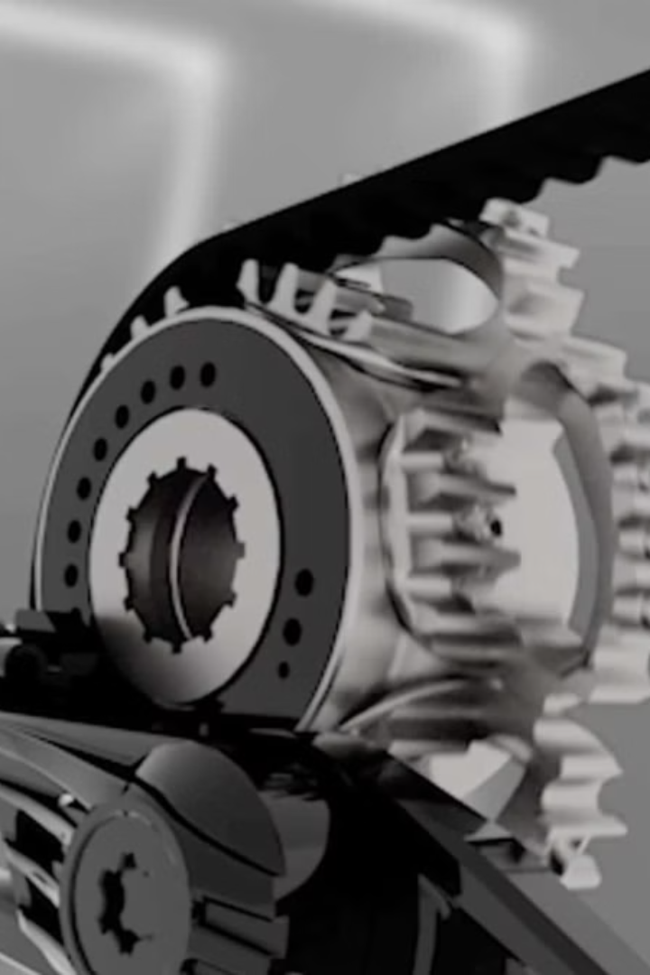

Lecture
on
Engineering Mechanics: Statics
Prepared by
Anisul Islam
Lecturer
Department of ME (UGV)

Slide 2
BASIC COURSE INFORMATION
Course Title | Engineering Mechanics
Course Code | ME 0715-2101
Credits | 03
CIE Marks | 90
SEE Marks | 60
Exam Hours | 2 hours (Mid Exam) 3 hours (Semester Final Exam)
Level | 3rd Semester

Slide 3
Engineering Mechanics
COURSE CODE: ME 0715-2101
CREDIT:03 TOTAL MARKS:150 CIE MARKS: 90
SEE MARKS: 60
Mid Exam Hours 2
Semester End Exam Hours 3
Course Learning Outcomes (CLOs): After completing this course successfully, the students will be able to-
CLO 1
Define and explain principles of engineering mechanics (example- system of forces) related to civil engineering domain.
Understand and learn relationship among physical process, kinetics and kinematics.
Differentiate concepts of principles of engineering mechanics (i.e. statics and dynamics) for different
simple situations..
Prepare free body diagrams of real case phenomenon considering engineering mechanics point of view and formulate Load acting on a body, Resultant forces acting on body, direction, magnitude and position of forces acting on a body.
CLO 2
CLO 3
CLO 4

Slide 4
SL | Content of Course | Hrs | CLOs
1 | Force System & Resultant Force: Types of acting Force & Force System (parallel, colinear, concurrent), Parallelogram Theory, Method of Resolution, Varignon Theorem, Law Of Triangle, Problem Solving on Parallelogram Theory &amp; Triangle Theory, Problem Solving on Varignon & method, Problem Solving on method of resolution | 6 | CLO1
2 | Free body diagram : Understanding forces , Drawing FBD, Applying FBD, Decomposing forces into x and y components ,Applying FBDs to complex situations with multiple objects and forces ,Using FBDs in conjunction with work and energy concepts. | 6 | CLO4
3 | Centre of Gravity: Centroid, Methods of Centre of Gravity, Centre of Gravity by Geometrical Considerations, Axis of Reference, Centre of Gravity of Symmetrical Sections, Centre of Gravity of Unsymmetrical Sections, Centre of Gravity of Solid Bodies. | 6 | CLO2,CLO3, CLO4
4 | Friction: Static, Dynamic Friction, Co efficient of Friction, Law of Static and Dynamic Friction, Ladder,Wedge and Screw Friction, Problems solving on Friction. | 10 | CLO2,CLO3, CLO4
5 | Truss : Introduction to truss , Applying loads, Truss components, Simple truss analysis, Truss design consideration. | 4 | CLO2,CLO3, CLO4
Text Book:
1) A Textbook of Engineering Mechanics- R.S Khurmi
2) Vector Mechanics for Engineers ( Statics)- Beer& Johnston

Slide 5
ASSESSMENT PATTERN
CIE- Continuous Internal Evaluation (90 Marks)
Bloom's Category Marks (out of 90) | Tests (45) | Assignments (10) | Class Test (20) | Quiz (5) | External Participation in Curricular/Co-Curricular Activities (10)
Remember | 5 |  | 10 | 05
Understand | 5 | 05 | 10
Apply | 10 |  |  |  | 10
Analyze | 15
Evaluate | 10
Create |  | 05

Slide 6
SEE- Semester End Examination (60 Marks)
Bloom's Category | Test
Remember | 10
Understand | 10
Apply | 10
Analyze | 10
Evaluate | 10
Create | 10

Slide 7
Couse plan specifying content, CLOs, teaching learning and assessment strategy mapped with CLOs
Week | Topic | Teaching-Learning Strategy | Assessment Strategy | Corresponding CLOs
1 | Introduction to Engineering Mechanics, Force system & principle of moment | Lecture, open Discussion, PPT | Quiz | CLO1
2 | Force Components & Resultant Force | Oral Presentation, Lecture, PPT, Discussion | Written exam, Quiz, CT | CLO4
3 | Force Components & Resultant Force | Oral Presentation, Lecture, PPT, Discussion | Assignment, Written, Quiz, CT | CLO2, CLO4
4 | Review on Lami, Method of Resolution and Varignons Theorem | Oral Presentation, Lecture, PPT, Discussion | Assignment, Written, Quiz, CT | CLO2, CLO4
5 | Problem Solving on Resultant Force | Oral Presentation, Lecture, PPT, Discussion | Assignment, Written, Quiz, CT | CLO2, CLO4
6 | Types of Supports in Structure | Oral Presentation, Lecture, PPT, Discussion | Written, Quiz, CT | CLO 1, CLO4
7 | Center of gravity related theory | Oral Presentation, Lecture, PPT, Discussion | Assignment, Written, Quiz | CLO2, CLO4
8 | Center of gravity related Problem Solving | Oral Presentation, Lecture, PPT, Discussion | Assignment, Written, Quiz, CT | CLO4, CLO3
9 | Center of gravity related problem Solving | Oral Presentation, Lecture, PPT, Discussion | Assignment, Written, Quiz, CT | CLO4, CLO3
10 | Friction related theory | Oral Presentation, Lecture, PPT, Discussion | Written, Quiz, CT | CLO3

Slide 8
11 | Friction related theory | Oral Presentation, Lecture, PPT, Discussion | Written, Quiz, CT | CLO2, CLO4
12 | Friction related problems | Oral Presentation, Lecture, PPT, Discussion | Assignment, Written, Quiz, CT | CLO3
13 | Friction related problems | Oral Presentation, Lecture, PPT, Discussion | Assignment, Written, Quiz, CT | CLO3
14 | Ladder and Wedge Friction | Oral Presentation, Lecture, PPT, Discussion | Assignment, Written, Quiz, CT | CLO3
15 | Simple Truss Problems | Oral Presentation, Lecture, PPT, Discussion | Assignment, Written, Quiz, CT | CLO2, CLO4
16 | Simple Truss Problems | Oral Presentation, | Assignment, Written, Quiz, CT | CLO2, CLO3
17 | Review, Practice and Exercise | Group Discussion

Slide 9
Week -1
Lecture
On
Introduction to Engineering Mechanics, Force systems, Types of Force & Principle of moment
(10-35)

Slide 10
Introduction to Engineering Mechanics ,Statics
Engineering Mechanics
Statics
Engineering mechanics is the branch of engineering that applies physics and mathematical methods to analyze the behavior of physical systems subjected to forces and displacements. It encompasses various sub-disciplines, including statics, dynamics, and mechanics of materials. It's the foundation for designing structures, machines, and many other engineered systems.
Statics is the subfield of engineering mechanics that deals specifically with bodies at rest, or in a state of constant motion. It focuses on analyzing forces that are balanced, resulting in no net force or acceleration. The primary concern is understanding equilibrium conditions and ensuring structural stability.
Applications
Structures, machines, and many other engineering systems

Slide 11
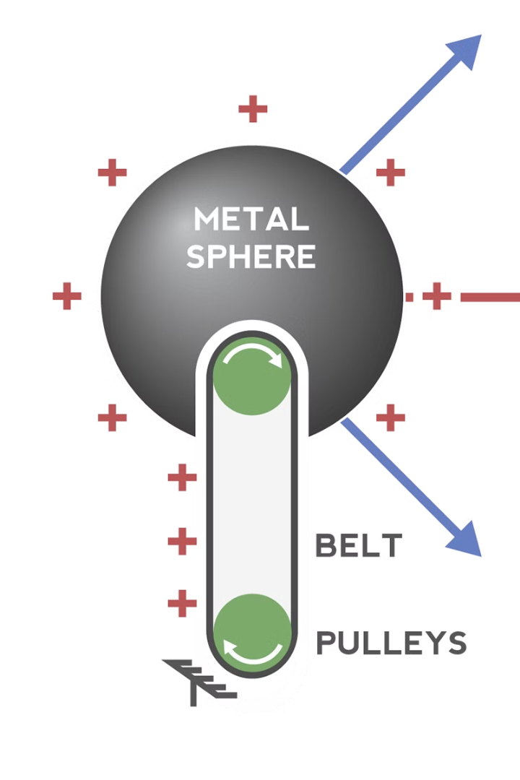
Fundamental Concepts & Principles
1
Force
2
Moment
Push or pull that can cause motion or deformation
Tendency of a force to rotate an object
3
Equilibrium
State of balance where all forces and moments cancel out

Slide 12
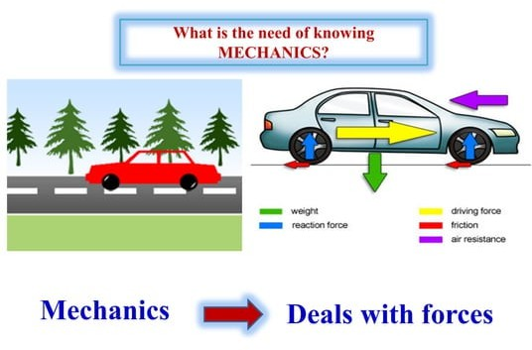

Slide 13
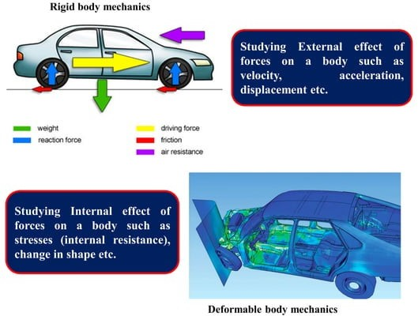

Slide 14
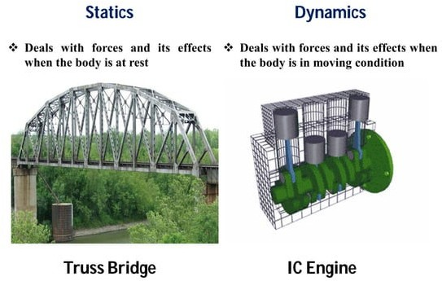

Slide 15
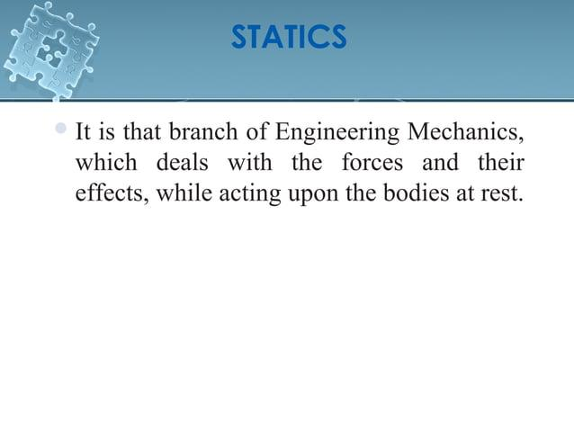

Slide 16
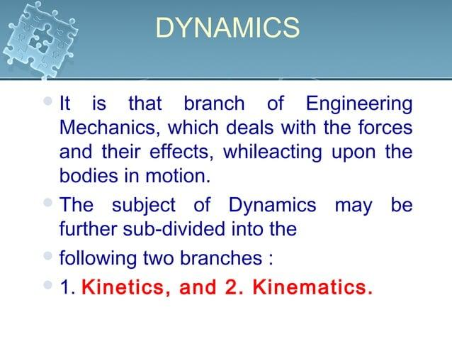

Slide 17
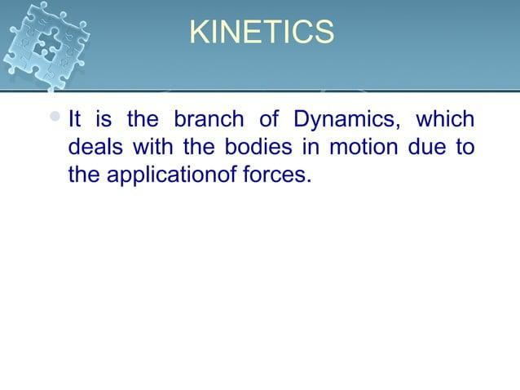

Slide 18
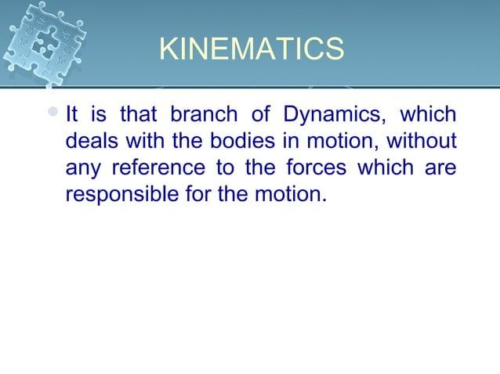

Slide 19
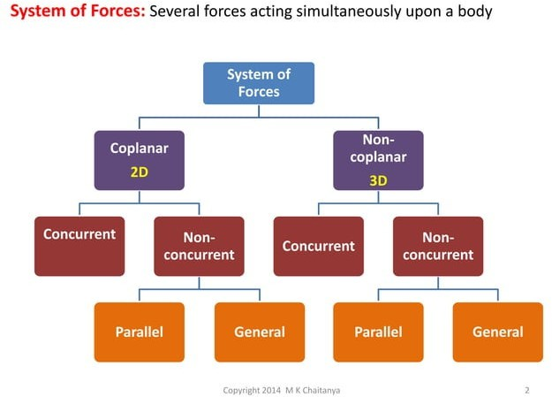

Slide 20
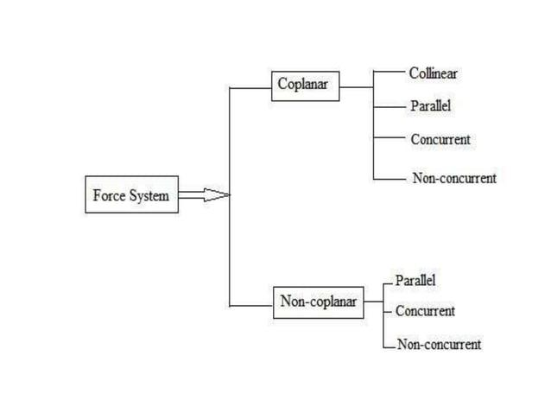

Slide 21
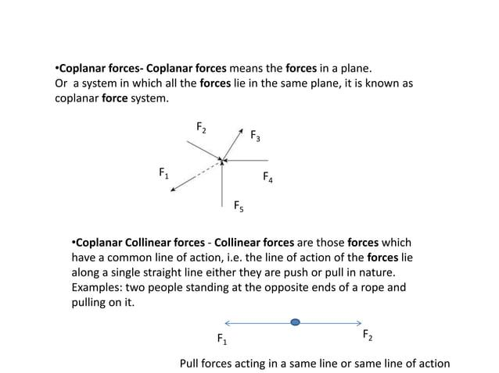

Slide 22
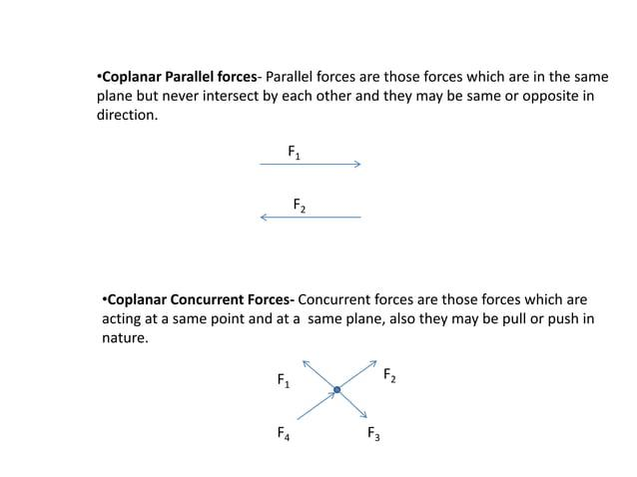

Slide 23
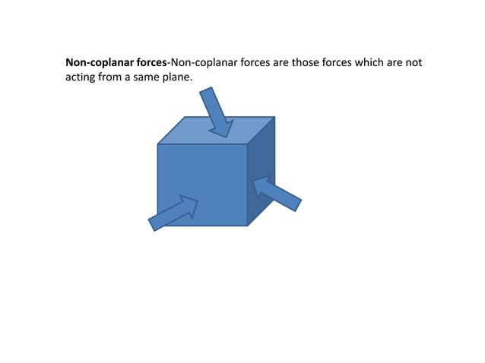

Slide 24
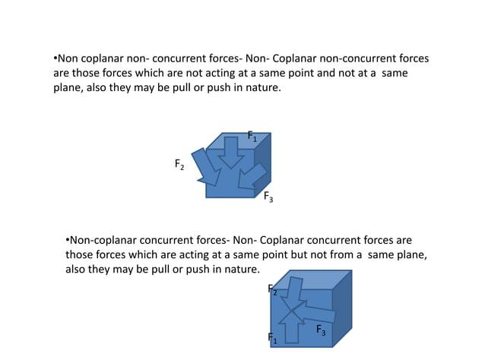

Slide 25
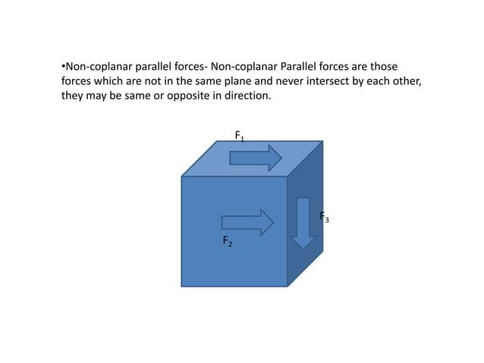

Slide 26
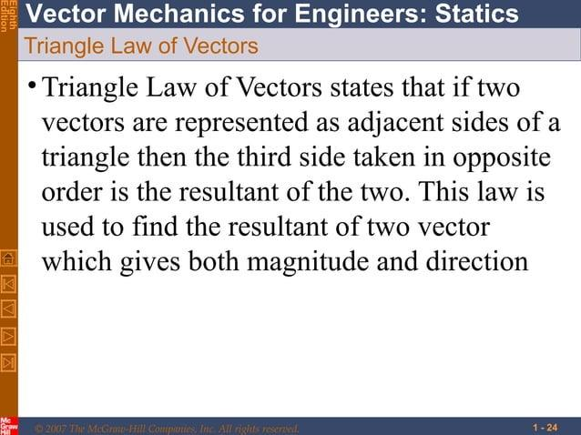

Slide 27
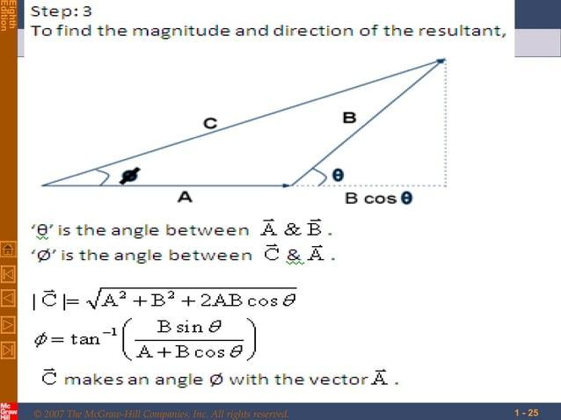

Slide 28
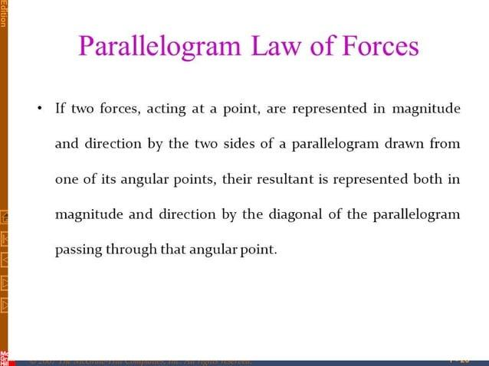

Slide 29
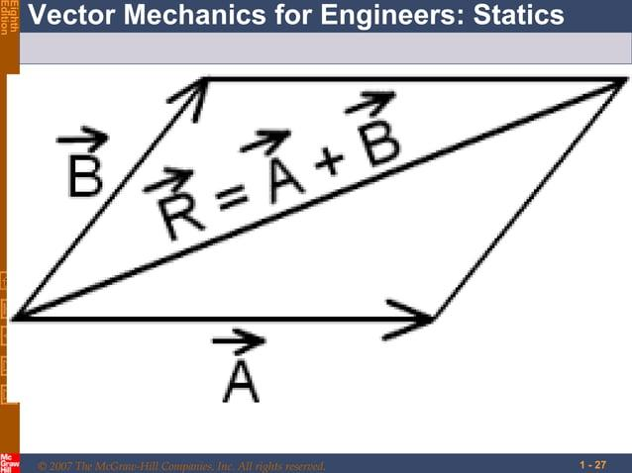

Slide 30
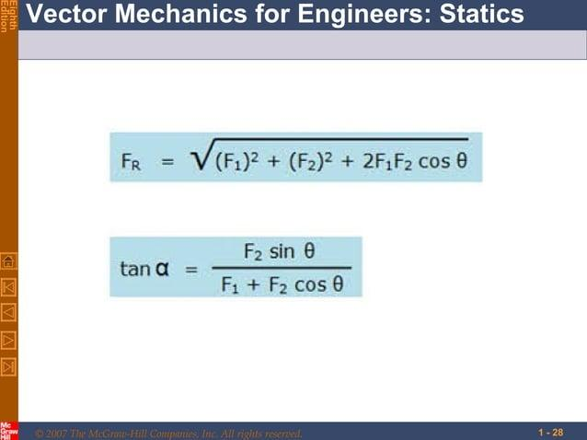

Slide 31
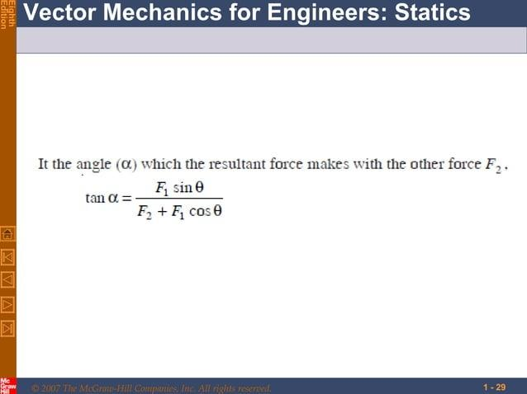

Slide 32
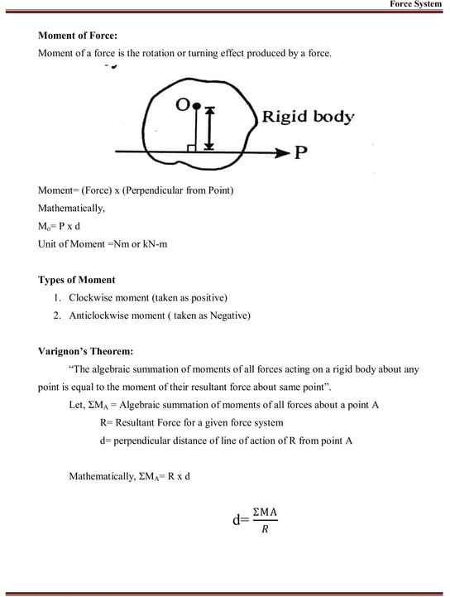

Slide 33
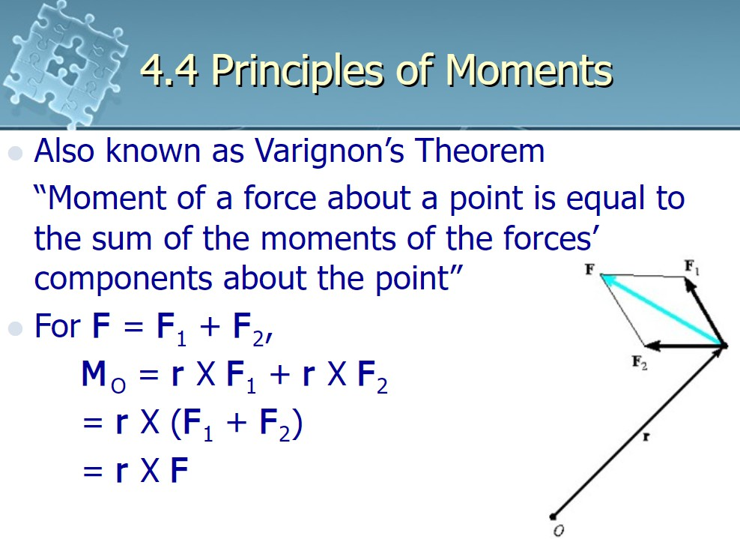

Slide 34
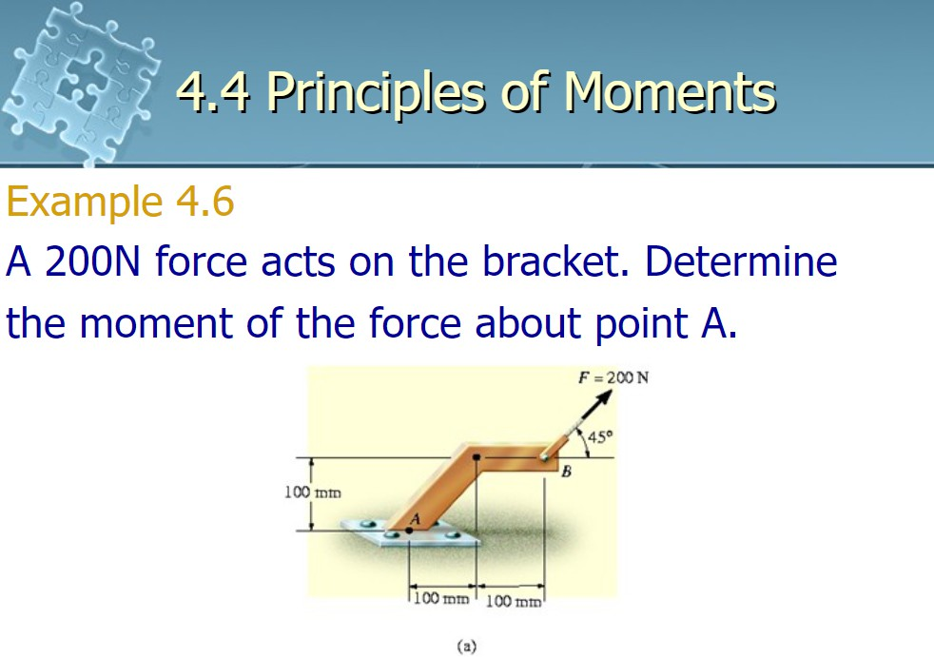

Slide 35
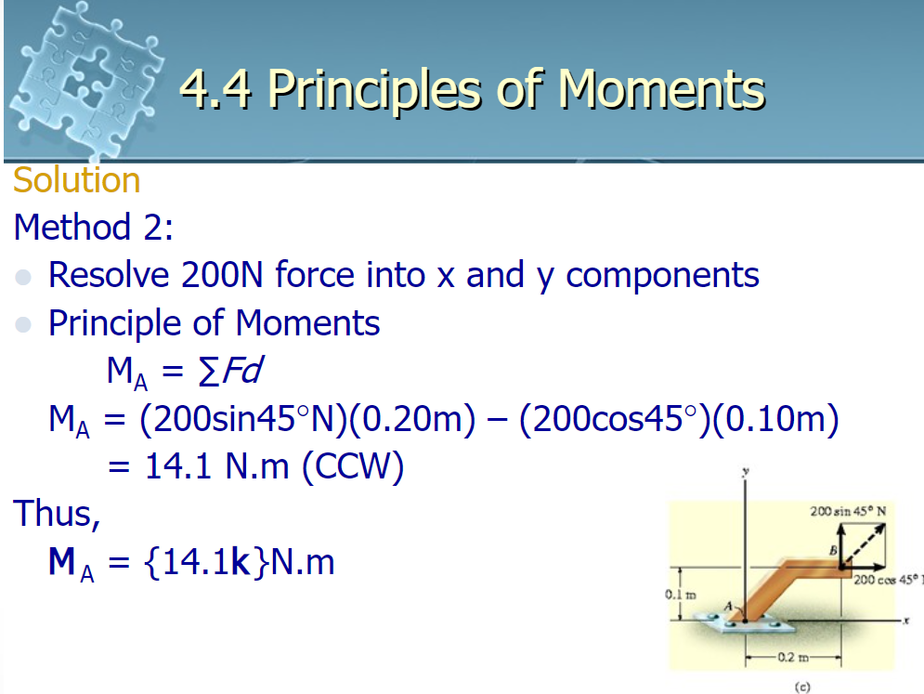

Slide 36
Week -2
Lecture
On
Force Components & Resultant Force
(36-53)

Slide 37
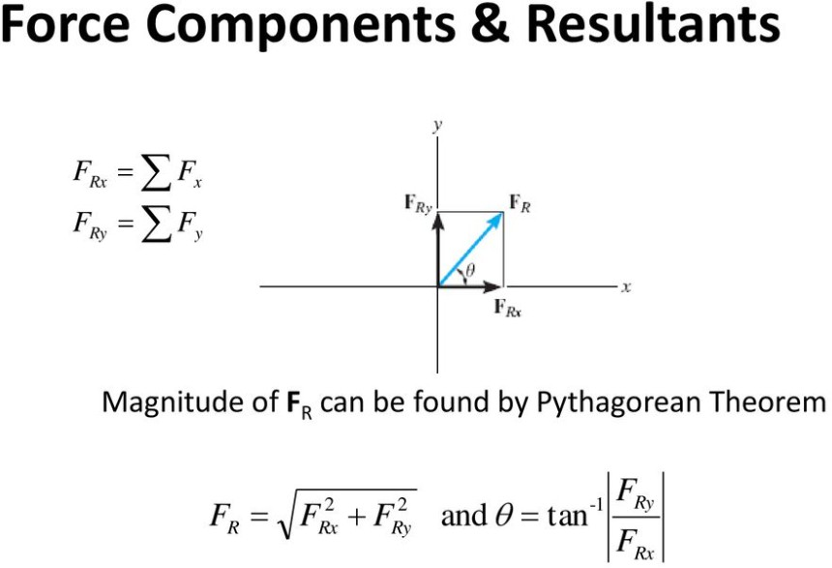

Slide 38
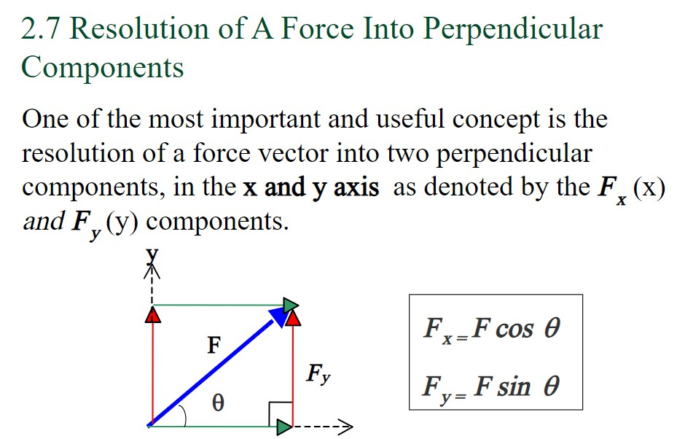
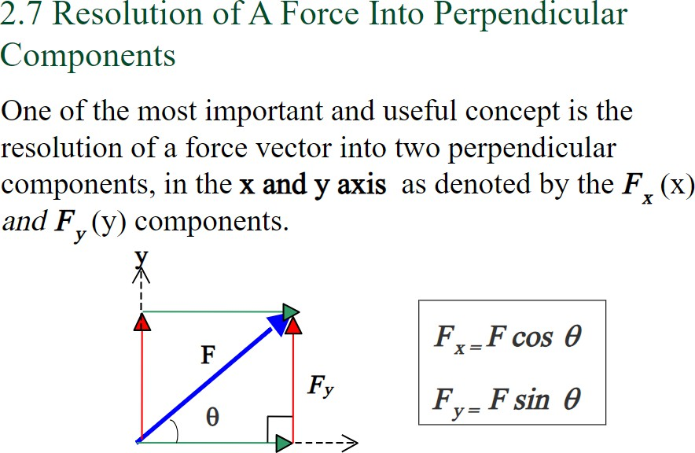

Slide 39
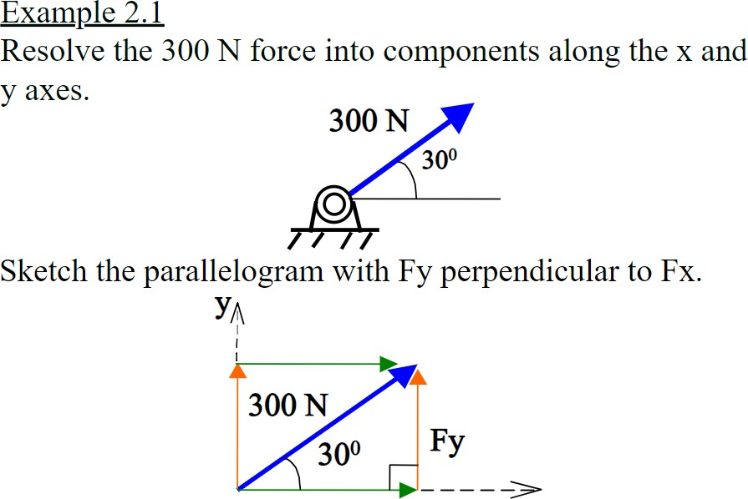

Slide 40
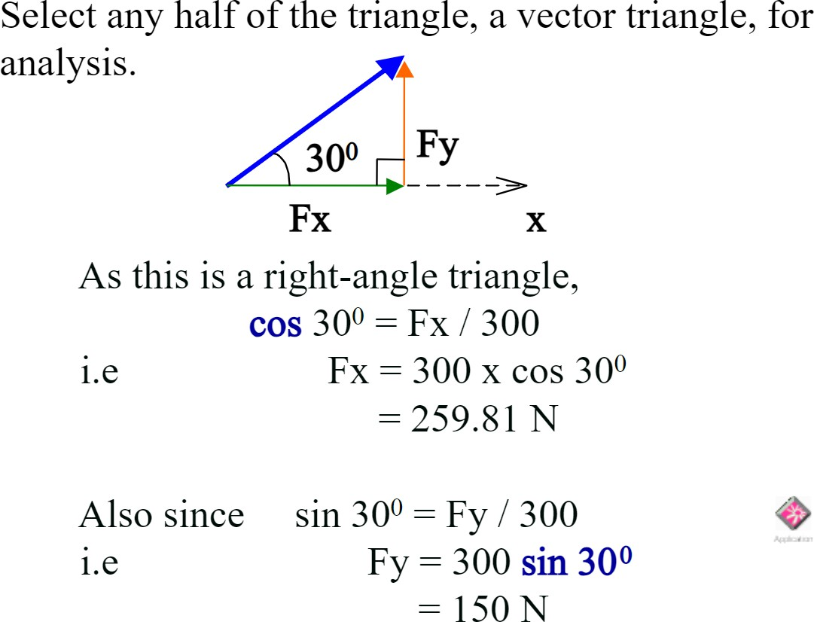

Slide 41
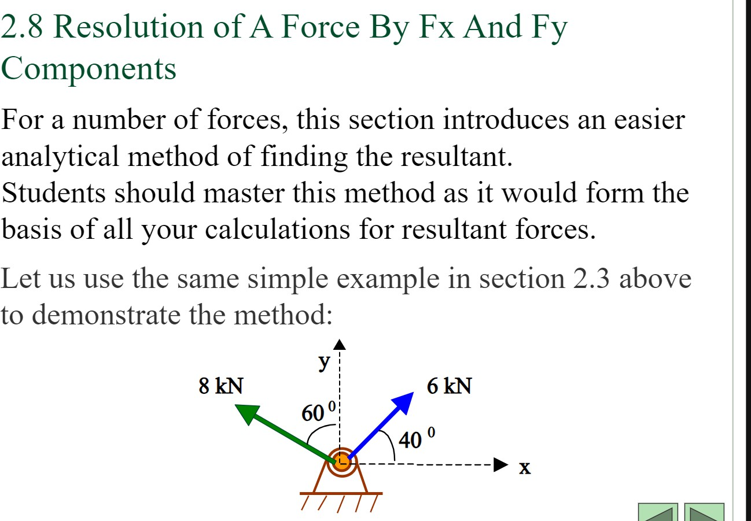

Slide 42
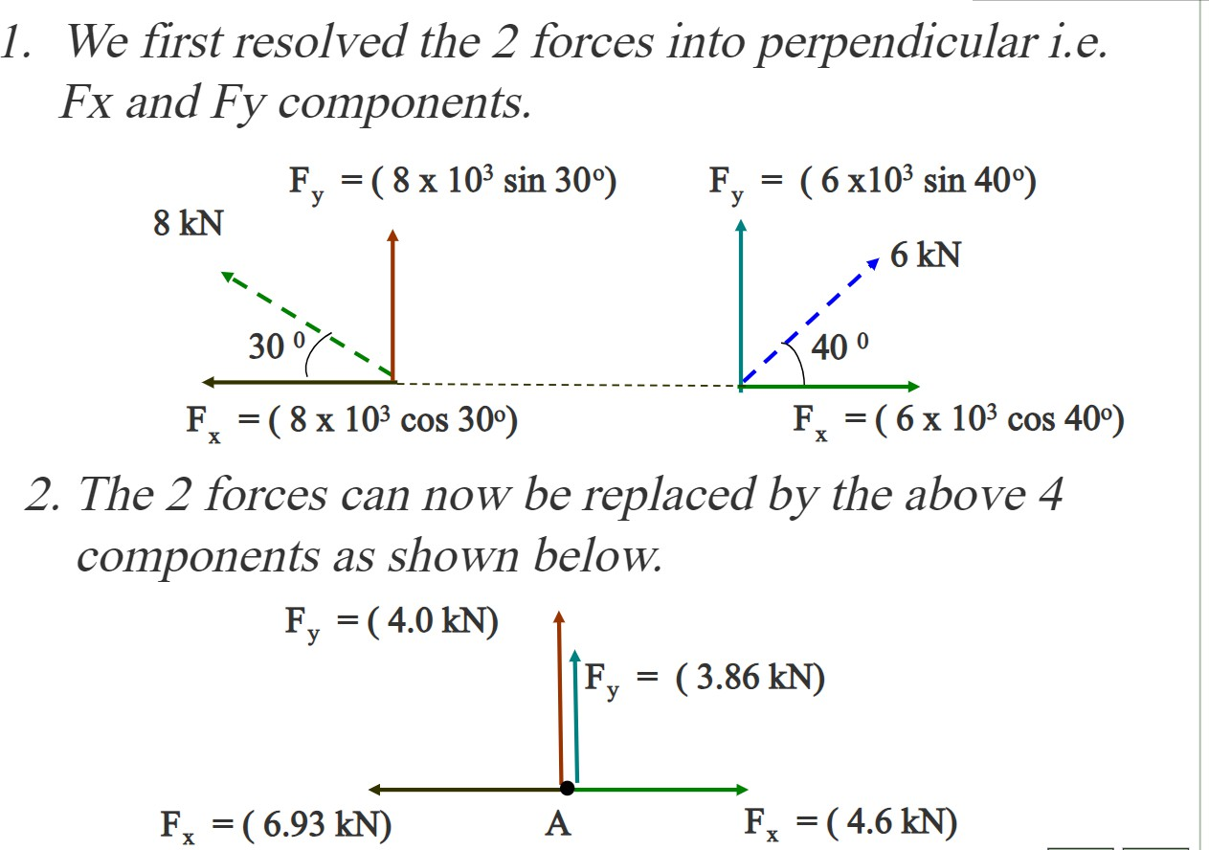

Slide 43
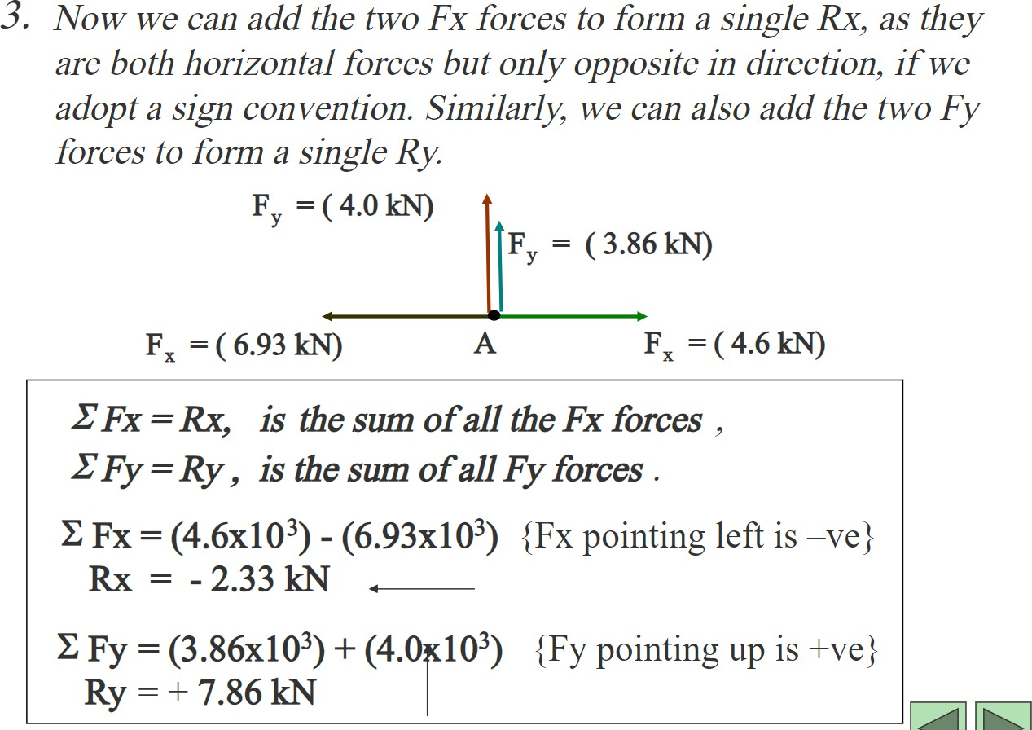

Slide 44
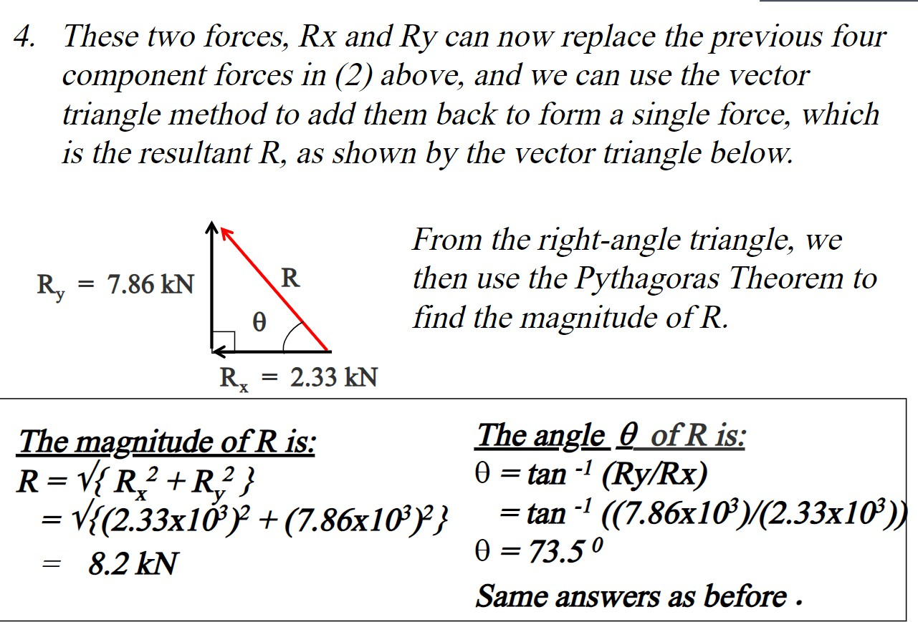

Slide 45
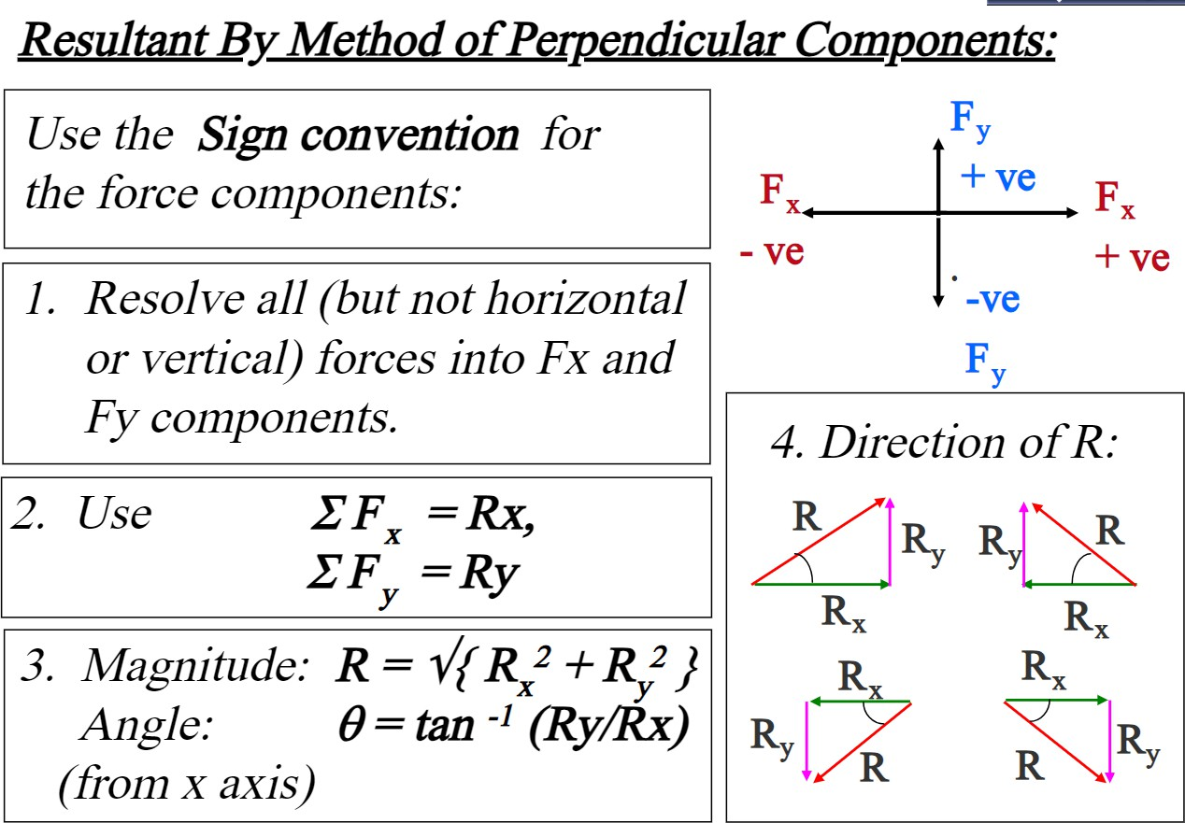

Slide 46
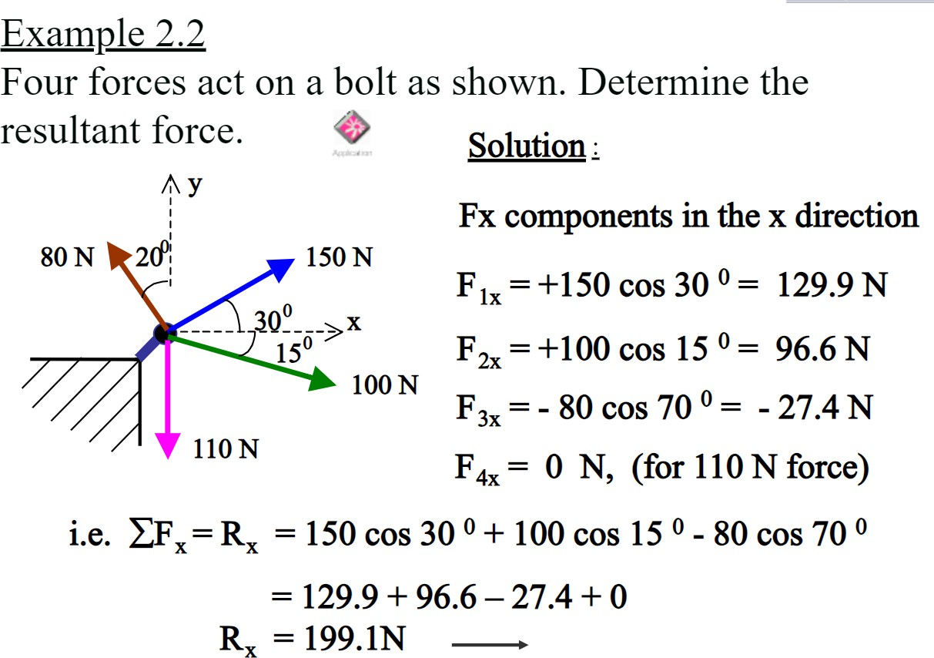

Slide 47
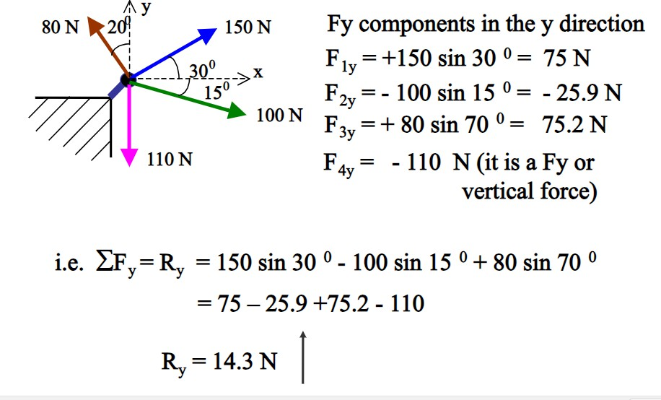

Slide 48
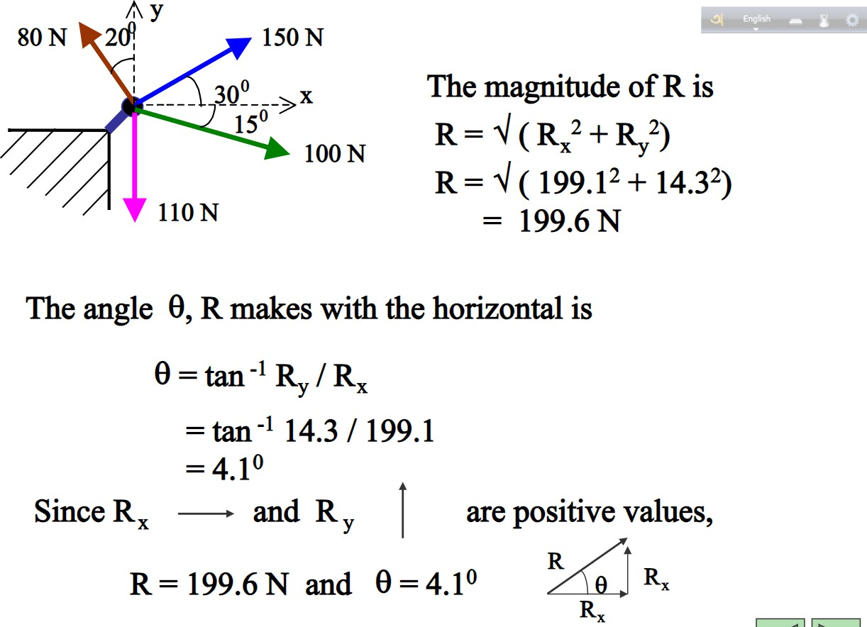

Slide 49
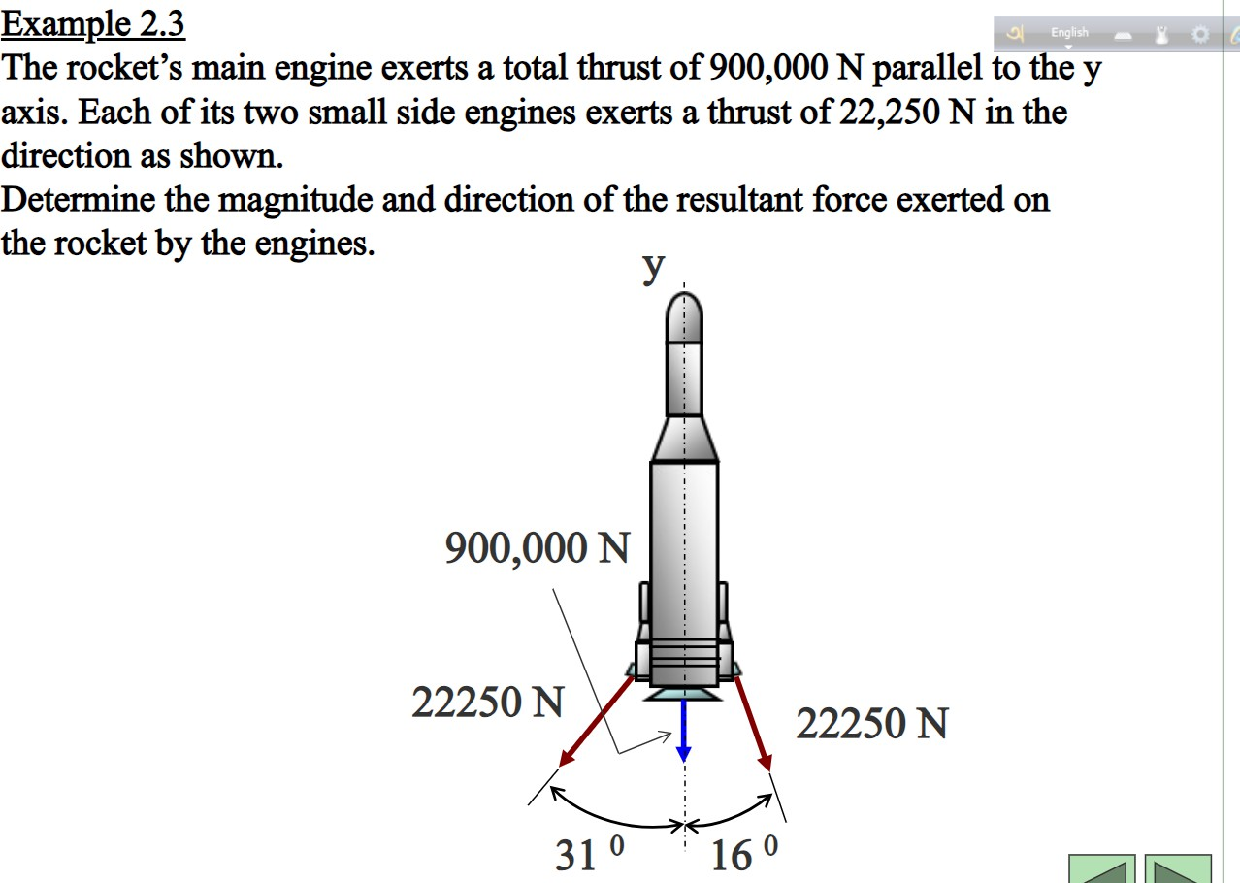

Slide 50
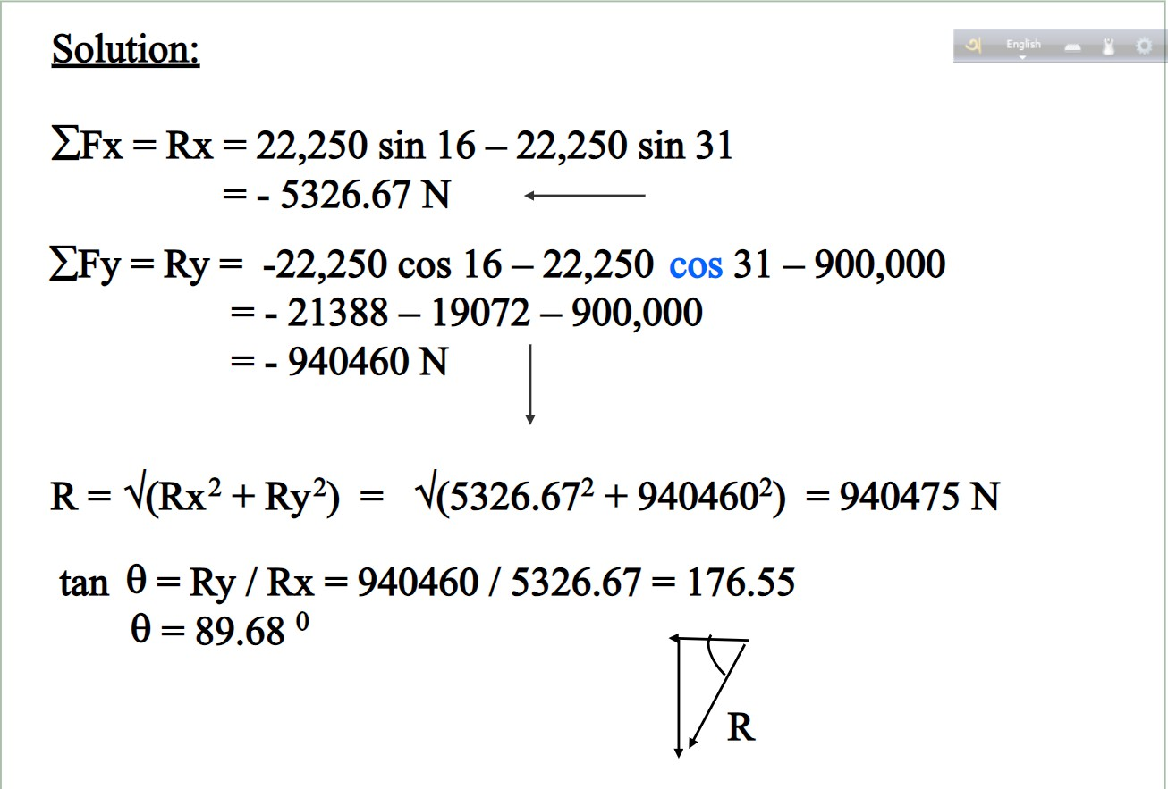

Slide 51
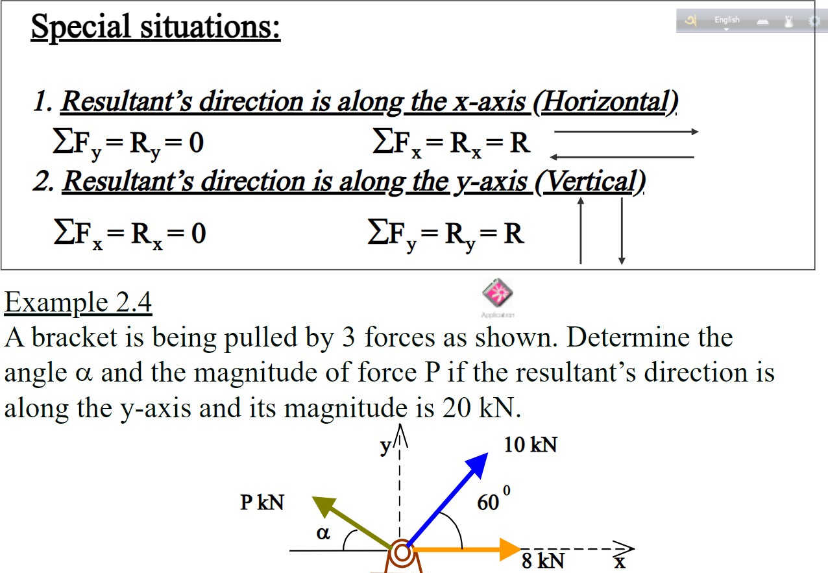

Slide 52
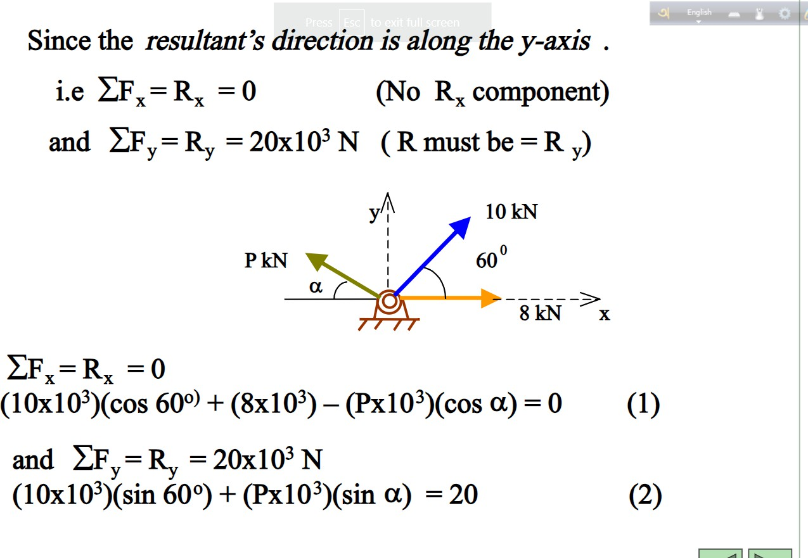

Slide 53
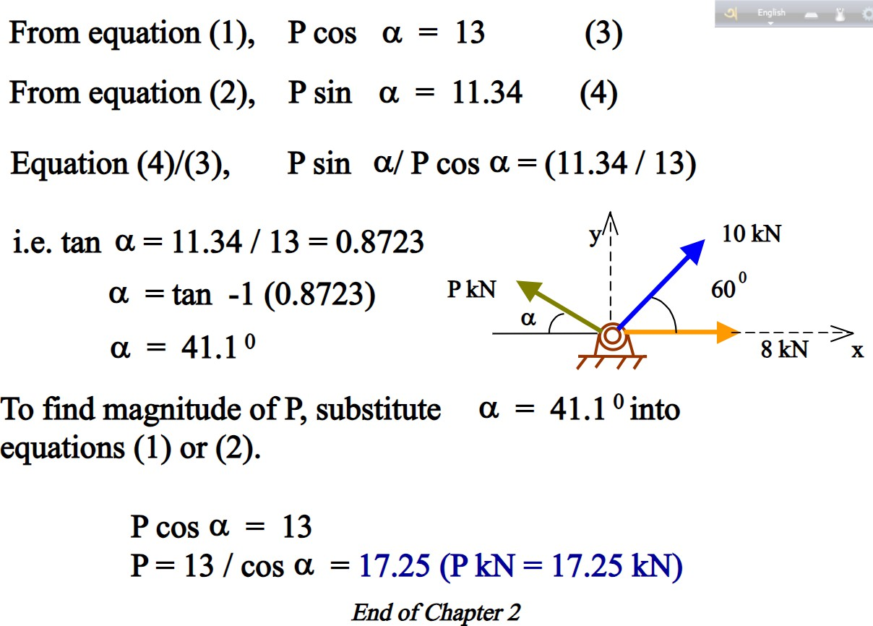

Slide 54
Week -3
Lecture
On
Force Components & Resultant Force
(54-61)

Slide 55
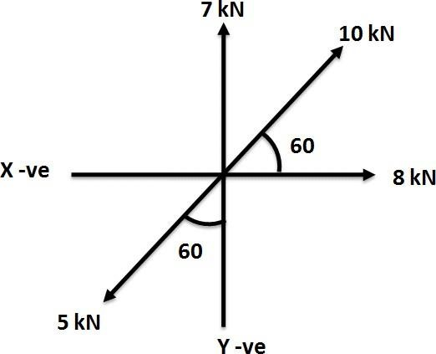
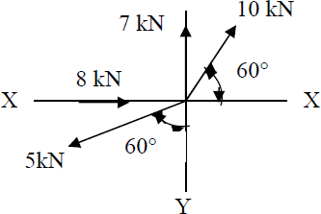
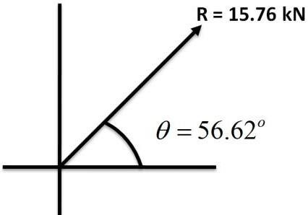
Example 1: - Find resultant of a force system shown in Figure
Answer:
1) Given Data P1 = 8 kN P2 = 10 kN P3 = 7 kN P4 = 5 kN
θ1 = 0
θ2 = 60
θ = 90
3
θ4 = 270 − 60 = 210
Summation of horizontal force
∑H = P₁ cosθ1 + P₂ cosθ2 + P₃ cosθ3 + P₄ cosθ4 = 8.67kN(→)
Summation of vertical force
∑V = P₁ sinθ1 + P₂ sinθ2 + P₃ sinθ3 + P₄ sinθ4 = 13.16kN(↑)
Resultant force
R = (∑H )² + (∑V )² = 15.76kN
5) Angle of resultant
tanθ = ^{∑V} = 1.518
∑ H
θ = 56.62

Slide 56
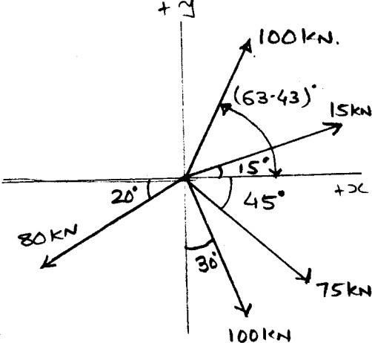

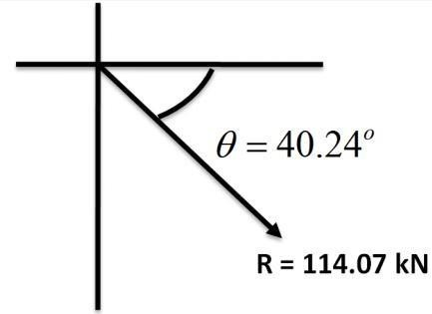
Example 2 Find magnitude and direction of resultant for a concurrent force system shown in Figure
Answer
1) Summation of horizontal force
→ (+Ve)
← (-Ve)
∑ H = +15 Cos 15º + 100Cos (63.43)º − 80Cos20º + 100Sin30º + 75Cos45º = +87.08 kN (→ )
Summation of vertical force
↑ (+Ve) ↓ (-Ve)
∑ V = +15 Sin 15º + 100Sin (63.43)º − 80Sin20º + 100Cos30º + 75Sin45º = −73.68 kN ( ↓ )
Resultant force
R = (∑H )² + (∑V )² = 114.07kN
Angle of resultant
tanθ = = 0.846
∑ H
θ = 40.24
Angle of resultant with respect to positive x – axis

Slide 57
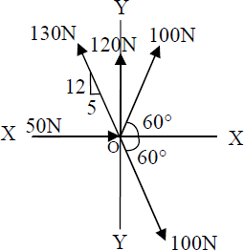


Example 3 Determine magnitude and direction of resultant force of the force system shown in fig.
Answer
12
tan β = = 2.4 5
1) Summation of horizontal force
→ (+Ve)
∴β = 67.38⁰
← (-Ve)
∑ H = +50 + 100 Cos 60º − 130Cos (67.38)º + 100Cos30º + 100Cos60º = +100 N (→ )
Summation of vertical force
↑ (+Ve) ↓ (-Ve)
∑ V = +100Sin60º + 120 + 130Sin (67.38)º − 100Sin60º − 100Sin60º = +240 N ( ↑ )
Resultant force
R = (∑H )² + (∑V )² = 260N
Angle of resultant
tanθ = = 2.4
∑ H
θ = 67.38º
Angle of resultant with respect to positive x – axis

Slide 58


Example: 4 A system of four forces shown in Fig. has resultant 50 kN along + X - axis. Determine mag- nitude and inclination of unknown force P.
Answer
As the R= 50N & directed along + X – axis.
∑H = +50N and ∑V = 0N
Now, ∑ 𝐻 = +150 + P Cos θ − 100 Sin 30° − 200 Cos 60° = 50 N
∴ P Cosθ = 50 ( 1 ) Now, ∑ V = +P Sin θ − 100 Cos 30° − 200 Sin 60° = 0
∴ P Sinθ = 86.60 ( 2 )
From Equation (1) & (2).
tan θ =
86.60
50
tan θ = 1.732
∴ θ = 60º
∴ P = 100 N

Slide 59



Example: 5 Find the magnitude of the force P, required to keep the 100 kg mass in the position by strings as shown in the Figure
Answer:
Free Body Diagram will be as show in fig. and there are three coplanar concurrent forces which are in equili- brium so we can apply the lami‟s theorem.
P Q R
sinα sin β sinγ
= =
.′ .
P
TAB 100
= =
Sin 150 Sin 90 Sin 120 P = 566.38 N
TAB = 1132.76 N

Slide 60





Example: 6 A cylindrical roller 600mm diameter and weighing 1000 N is resting on a smooth inclined surface, tied firmly by a rope AC of length 600mm as shown in fig. Find tension in rope and reaction at B
Answer:
Free Body Diagram will be as show in fig. and there are three coplanar concurrent forces which are in equili- brium so we can apply the lami‟s theorem.
P Q
R
= =
sinα sin β sinγ
Tac
Rb 1000
.′ .
= =
Sin 120 Sin 120 Sin 120
Tac = 1000 N
RB = 1000 N
Example: 7 A boat kept in position by two ropes as shown in figure. Find the drag force on the boat.
Answer:
According to law of parallelogram
R =
=
= 45.51N
∴α = 30.32⁰
_{tanα =} Q sinθ ₌ 30sin 50
P + Q cosθ 20 + 30 cos 50

Slide 61


Example: 8 For a coplanar, non-concurrent force system shown in Fig. determine magnitude, direction and position with reference to point A of resultant force.
Answer
To find out magnitude & direction of R
Summation of horizontal force
ΣH = +500 Sin 45º − 800Cos 30º + 1000 = +660.73 N (→)
Summation of vertical force
∑ V = −500 Cos45º + 850 + 800Sin30º = +896.45 N (↑ )
Resultant force
R =
(∑H )² + (∑V )² = √(660.73)² + (896.45)² = 1113.64 𝑁
Angle of resultant
896.45
tan θ =
660.73
∴ θ = 53.61º
Here, we have to also locate the „R‟ @ pt. A Let the „R‟ is located at a dist^{n} x from A in the horizontal direc- tion.
Now this dist^{n} „X‟ can be achived by using varignon‟s principle. First, Take the moment @ A of all the forces.
MALL= + (500 Sin 45° X 1.4 ) + ( 850 X 1.8 ) + ( 800 Sin 30° X 1.8 ) + 400
= + 3144.97 N-m [ ⮧ ] ( 1 )
Now moment of „R‟ @ point „ A „
MR = + (R Sin 𝜃. 𝑋) = + (∑F𝑦. 𝑥 ) = 896.45. 𝑥 (2)
( 1 ) = ( 2 )
896.45 X = 3144.97 X = 3.51 m

Slide 62


Example: 9 Find magnitude, direction and location of resultant of force system with respect to point ‘O’ shown in fig.
Answer
Summation of horizontal forces
𝛴𝐻 = +30 𝐶𝑜𝑠 30º − 50 + 40𝑆𝑖𝑛 45º = + 4.265 𝐾𝑁 ( →)
Summation of vertical forces
𝛴𝑉 = +30 𝑆𝑖𝑛30º + 60 − 40 𝐶𝑜𝑠 45º = +46.72 𝐾𝑁 ( ↑)
Resultant force
R =
Angle of resultant
(∑H )² + (∑V )² = √(4.265)² + (46.72)² = 46.91 𝐾𝑁
tan θ =
46.72
4.265
∴ θ = 84.78
Now,as we requred to find out the position of „R‟ with respect to the point „O‟. Take the moment of all the forces @ point „O „ we have,
M0= +(30 Cos30° X 1) – (30 Sin30° X 1) + (60 X 2)+ (50 X 2)-(40 Cos45° X 1) + (40 Sin45° X 1)
M0= + 230.98 KN- unit ( ⮧ ) (1)
Now, moment of „R‟ @ Pt. „O‟
(considering „R‟ lies at a distance x from the point „O‟ in the horizontal direction )
MR = + (R Sin𝜃 X ) = (∑Fy.x)
MR = +46.72.X (2)
According to varignon’s principle
∴ 46.72 X = 230.98
∴ X = 4.94 unit

Slide 63
Week - 4 & 5
Lecture
On
Review on Lami, Method of Resolution and Varignons Theorem
(64-75)

Slide 64


Slide 65


Slide 66


Slide 67


Slide 68


Slide 69


Slide 70


Slide 71


Slide 72


Slide 73


Slide 74


Slide 75


Slide 76
Week -6
Lecture
On
Types of Supports in Structure
(77-84)

Slide 77


Slide 78


Slide 79


Slide 80


Slide 81


Slide 82



Slide 83


Slide 84

Examples of Free Body Diagrams

Slide 85
Week -7
Lecture
On
Centroid
(86-97)

Slide 86


Slide 87


Slide 88


Slide 89


Slide 90


Slide 91


Slide 92


Slide 93


Slide 94


Slide 95


Slide 96


Slide 97


Slide 98
Week -8
Lecture
On
Centroid
(99-106)

Slide 99


Slide 100


Slide 101


Slide 102


Slide 103


Slide 104


Slide 105


Slide 106


Slide 107
Week -9
Lecture
On
Centroid
(108-112)

Slide 108



CENTRE OF GRAVITY OF SYMMETRICAL SECTIONS
Section, whose centre of gravity is required to be found out, and is symmetrical about X-X axis or Y-Y axis the procedure for calculating the centre of gravity of the body is to calculate either
̅xo r 𝑦.̅ This is due to the reason that the centre of gravity of the body will lie on the axis of symmetry.
Example 4.1. Find the centre of gravity of a channel section 100 mm × 50 mm × 15 mm.
Solution: As the section is symmetrical about X-X axis, therefore its centre of gravity will lie on this axis. Now split up the whole section into three rectangles ABFJ, EGKJ and CDHK as shown in Fig 4.5.
Let the face AC be the axis of reference.
Fig 4.5
We know that distance between the centre of gravity of the section and left face of the section
AC,
Example 4.2 An I-section has the following dimensions in mm units: Bottom flange = 300 × 100
Top flange = 150 × 50
Web = 300 × 50
Determine mathematically the position of centre of gravity of the section.
Solution. As the section is symmetrical about Y-Y axis, bisecting the web, therefore its centre of gravity will lie on this axis. Now split up the section into three rectangles as shown in Fig. 4.6

Slide 109





Let bottom of the bottom flange be the axis of reference.
Fig 4.6
We know that distance between centre of gravity of the section and bottom of the flange,
Example 4.3 Find the centroid of the T-section as shown in figure 4.7 from the bottom
Fig 4.7

Slide 110



Soln:
Due to symmetry, the centroid lies on Y-axis and it is at distance of 80 mm from the bottom.
Example 4.3 Determine the centroid of the following figure.
Fig 4.8
Soln:

Slide 111





Example 4.4 A body consists of a right circular solid cone of height 40 mm and radius 30 mm placed on a solid hemisphere of radius 30 mm of the same material. Find the position of centre of gravity of the body.
Fig 4.9
Solution.As the body is symmetrical about Y-Y axis, therefore its centre of gravity will lie on this axis as shown in Fig. Let bottom of the hemisphere (D) be the point of reference.
Hemisphere
Right circular cone
Distance between centre of gravity of the body and bottom of hemisphere D,

Slide 112





CENTRE OF GRAVITY OF UNSYMMETRICAL SECTIONS
Sometimes, the given section, whose centre of gravity is required to be found out, is not symmetrical either about X-X axis or Y-Y axis. In such cases, we have to find out both the values of ̅xand ̅y
Example 4.5. Find the centroid of an unequal angle section 100 mm × 80 mm × 20 mm. Solution :
As the section is not symmetrical about any axis, therefore we have to find out the values of x
and y for the angle section. Split up the section into two rectangles as shown in Fig.4.10 Let left face of the vertical section and bottom face of the horizontal section be axes of reference.
Fig. 4.10
We know that distance between centre of gravity of the section and left face,
Similarly, distance between centre of gravity of the section and bottom face,
Example 4.6. A semicircle of 90 mm radius is cut out from a trapezium as shown in Fig
4.11 .Find the position of the centre of gravity of the figure.
Fig 4.11

Slide 113
Week – 10 & 11
Lecture
On
Friction
(113-137)

Slide 114


Slide 115


Slide 116


Slide 117


Slide 118


Slide 119


Slide 120


Slide 121


Slide 122


Slide 123


Slide 124


Slide 125


Slide 126


Slide 127


Slide 128


Slide 129



Slide 130




Slide 131


Slide 132


Slide 133


Slide 134


Slide 135


Slide 136


Slide 137


Slide 138
Week – 12 & 13
Lecture
On
Friction
(139-159)

Slide 139


Slide 140


Slide 141


Slide 142


Slide 143


Slide 144


Slide 145


Slide 146


Slide 147


Slide 148


Slide 149


Slide 150


Slide 151


Slide 152


Slide 153


Slide 154


Slide 155


Slide 156


Slide 157


Slide 158


Slide 159


Slide 160
Week – 14
Lecture
On
Friction
(161-177)

Slide 161

3.3 APPLICATIONS OF FRICTION
Ladder friction
Wedge friction
Screw friction.
LADDER FRICTION
The ladder is a device for climbing or scaling on the roofs or walls. It consists of two long uprightsof wood, iron or rope connected by a number of crosspieces called rungs. These running serve as steps.Consider a ladder AB resting on the rough ground and leaning against a wall, as shown in figure 3.9.
Fig 3.13
As the upper end of the ladder tends to slip downwards, thereforethe direction of the force of friction between the ladder and the wall (Fw) will be upwards as shown in the figure. Similarly, as the lowerend of the ladder tends to slip away from the wall, therefore the directionof the force of friction between the ladder and the floor (Ff) will betowards the wall as shown in the figure.Since the system is in equilibrium, therefore the algebraic sumof the horizontal and vertical components of the forces must also beequal to zero.
Note: The normal reaction at the floor (Rf) will act perpendicular of the floor. Similarly, normal reaction of the wall (Rw) will also act perpendicular to the wall.
Example 3.6 A uniform ladder of length 3.25 m and weighing 250 N is placed against a smooth vertical wall with its lower end 1.25 m from the wall. The coefficient of friction between theladder and floor is 0.3.What is the frictional force acting on the ladder at the

Slide 162

point of contact between the ladder andthefloor? Show that the ladder will remain in equilibrium in this position.
Solution.Given: Length of the ladder (l) = 3.25 m; Weight of the ladder (w) = 250 N;
Distance between the lower end of ladder and wall = 1.25 m and coefficient of friction between theladder and floor (μf) = 0.3.
Frictional force acting on the ladder. The forces acting on the ladder.
LetFf= Frictional force acting on the ladder at thePoint of contact between the ladder and floor, and
Rf = Normal reaction at the floor.
Since the ladder is placed against a smooth vertical wall, therefore there will be no friction at the point of contact between the ladder and wall.
Resolving the forces vertically, Rf= 250 N
From the geometry of the figure, we find that
BC = √(3.25)– (1.25) = 3.0 m
Taking moments about B and equating the same,
Ff× 3 = (Rf× 1.25) – (250 × 0.625) = (250 × 1.25) – 156.3 = 156.2 N
Ff = 52.1 N
Equilibrium of the ladder
We know that the maximum force of friction available at the point of contact between the ladder and the floor
μRf= 0.3 × 250 = 75 N
Thus, we see that the amount of the force of friction available at the point of contact (75 N) is more than the force of friction required for equilibrium (52.1 N). Therefore, the ladder will remain
inan equilibrium position.
Example 3.7 A ladder 5 meters long rests on a horizontal ground and leans against asmooth vertical wall at an angle 70° with the horizontal. The weight of the ladder is 900

Slide 163

N and acts at its middle. The ladder is at the point of sliding, when a man weighing 750N stands on a rung 1.5metre from the bottom of the ladder.
Calculate the coefficient of friction between the ladder and the floor.
Fig 3.15
Solution. Given: Length of the ladder (l) = 5 m; Angle which the ladder makes with the horizontal (α) = 70°; Weight of the ladder (w1) = 900 N; Weight of man (w2) = 750 N and distancebetween the man and bottom of ladder = 1.5 m.
Forces acting on the ladder are shown in Fig.
Let μf = Coefficient of friction between ladder and floor and
Rf = Normal reaction at the floor. Resolving the forces vertically, Rf = 900 + 750 = 1650 N ...(i)
∴ Force of friction at A
Ff = μf× Rf= μf× 1650 ...(ii)
Now taking moments about B, and equating the same,
Rf× 5 sin 20° = (Ff× 5 cos 20°) + (900 × 2.5 sin 20°)+ (750 × 3.5 sin 20°)
= (Ff× 5 cos20°) + (4875 sin 20°)
= (μf× 1650 × 5 cos 20°) + 4875 sin 20°
and now substituting the values ofRfandFf from equations (i) and (ii) 1650 × 5 sin 20° = (μf× 1650 × 5 cos 20°) + (4875 sin 20°)
Dividing both sides by 5 sin 20°, 1650 = (μf× 1650 cot 20°) + 975
= (μf× 1650 × 2.7475) + 975 = 4533 μf+ 975
_{∴ µ} _{=0.15}
WEDGE FRICTION:
A wedge is, usually, of a triangular or trapezoidal in cross-section. It is, generally, used forslightadjustments in the position of a body i.e. for tightening fits or keys for shafts. Sometimes, awedge is also used for lifting heavy weights as shown in fig.3.16

Slide 164


It will be interesting to know that the problems on wedges are basically the problems ofequilibrium on inclined planes. Thus, these problems may be solved either by the equilibrium method or by applying Lami‟s theorem. Now consider a wedge ABC, which is used to lift the body DEFG.
Let W = Weight fo the body DEFG,
P = Force required to lift the body, and
μ = Coefficient of friction onthe planes AB, AC and DE such that tan φ = μ.
It will be interesting to know that the problems on wedges are basically the problems of equilibrium on inclined planes. Thus, these problems may be solved either by the equilibrium method or by applying Lami‟s theorem. Now consider a wedge ABC, which is used to lift the body DEFG.
Let W = Weight of the body DEFG,
P = Force required to lift the body, and
μ = Coefficient of friction onthe planes AB, AC and DE such that tan φ = μ.
A little consideration will show that when the force is sufficient to lift the body, the slidingwill take place along three planes AB, AC and DE will also occur as shown in Fig. 3.17 (a) and (b).
The three reactions and the horizontal force (P) may now be found out either by graphical method or analytical method as discussed below:

Slide 165

GRAPHICAL METHOD
First of all, draw the space diagram for the body DEFG and the wedge ABC as shown inFig.3.18 (a). Now draw the reactions R1, R2 and R3 at angle f with normal to the faces
DE, AB and AC respectively (such that tan φ = μ).
Now consider the equilibrium of the body DEFG. We know that the body is in equilibrium- under the action of
Its own weight (W) acting downwards
Reaction R1 on the face DE, and
Reaction R2 on the face AB.
Now, in order to draw the vector diagram for the above mentioned three forces, takesome
suitable point l and draw a vertical line lm parallel to the line of action of the weight(W) and cut off lm equal to the weight of the body to some suitable scale. Through l drawa line parallel to the
reaction R1.
Similarly, through m draw a line parallel to the reactionR2, meeting the first line at n as shown in Fig. 3.18(b).
Now consider the equilibrium of the wedge ABC. We know that it is equilibrium underthe action of
Force acting on the wedge (P),
Reaction R2 on the face AB, and
Reaction R3 on the face AC.
Now, in order to draw the vector diagram for the above mentioned three forces, through mdraw
a horizontal line parallel to the force (P) acting on the wedge. Similarly, through ndraw a line
parallel to the reaction R3 meeting the first line at O as shown in Fig.3.18 (b).
4. Now the force (P) required on the wedge to raise the load will be given by mo. to thescale.
EXAMPLE 3.8 A block weighing 1500 N, overlying a 10° wedge on a horizontal floor andleaning against a vertical wall, is to be raised by applying a horizontal force to the

Slide 166

wedge. Assuming the coefficient of friction between all the surface in contact to be 0.3, Determine the minimum horizontal force required to raise the block.
Fig 3.19
Solution. Given: Weight of the block (W) = 1500 N; Angle of the wedge (α) = 10° and coefficient of friction between all the four surfaces of contact (μ) = 0.3 = tan φ or φ = 16.7°.
P = Minimum horizontal force required to raise the block.
The example may be solved graphically or analytically. But we shall solve it by both the method
Graphical method
First of all, draw the space diagram for the block DEFG and the wedge ABC as shown in Fig.3.19 (a). Now draw reactions R1, R2 and R3 at angles of φ (i.e. 16.7° with normal to the faces DE, AB and AC respectively.
Take some suitable point l, and draw vertical line lm equal to 1500 N to some suitable scale (representing the weight of the block). Through l, draw a line parallel to the reaction R1. Similarly, through m draw another line parallel to the reaction R2 meeting the first line at n.
Now through m, draw a horizontal line (representing the horizontal force P). Similarly,through n draw a line parallel to the reaction R3 meeting the first line at O as shown in Fig.(b).
Now measuring mo to the scale, we find that the required horizontal force
P = 1420 N. Ans.

Slide 167
Week – 15
Lecture
On
Simple Truss Problems
(186-195)

Slide 168


Equilibrium of rigid body
Equations of equilibrium become
∑ F_{x} = 0 ∑ F_{y} = 0 ∑ M _{A} = 0
There are three unknowns and number of equation is three.
Therefore, the structure is statically determinate
The rigid body is completely constrained

Slide 169



Equilibrium of rigid body
More unknowns than equations
Fewer unknowns than equations, partially constrained
Equal number unknowns and equations but improperly constrained

Slide 170

Structural Analysis
Engineering Structure
An engineering structure is any connected system of members built to support or transfer forces and to safely withstand the loads applied to it.

Slide 171



Structural Analysis
Statically Determinate Structures
To determine the internal forces in the structure, dismember the structure and analyze separate free body diagrams of individual members or combination of members.

Slide 172


Structural Analysis: Plane Truss
Truss: A framework composed of members joined at their ends to form a rigid structure
Joints (Connections): Welded, Riveted, Bolted, Pinned
Plane Truss: Members lie in a single plane

Slide 173




Structural Analysis: Plane Truss
Simple Trusses
Basic Element of a Plane Truss is the Triangle
Three bars joined by pins at their ends 🡪 Rigid Frame
– Non-collapsible and deformation of members due to induced internal strains is negligible
Four or more bars polygon 🡪 Non-Rigid Frame
How to make it rigid or stable?
by forming more triangles!
Structures built from basic triangles
🡪Simple Trusses

Slide 174



Structural Analysis: Plane Truss
Basic Assumptions in Truss Analysis
All members are two-force members.
Weight of the members is small compared with the force it supports (weight may be considered at joints)
No effect of bending on members even if weight is considered
External forces are applied at the pin connections
Welded or riveted connections
Pin Joint if the member centerlines are concurrent at the joint
Common Practice in Large Trusses
Roller/Rocker at one end. Why?
to accommodate deformations due to temperature changes and applied loads.
otherwise it will be a statically indeterminate truss

Slide 175


Structural Analysis: Plane Truss
Truss Analysis: Method of Joints
Finding forces in members
Method of Joints: Conditions of equilibrium are satisfied for the forces at each joint
Equilibrium of concurrent forces at each joint
only two independent equilibrium equations are involved Steps of Analysis
Draw Free Body Diagram of Truss
Determine external reactions by applying equilibrium equations to the whole truss
Perform the force analysis of the remainder of the truss by Method of Joints

Slide 176




Structural Analysis: Plane Truss
Method of Joints
Start with any joint where at least one known load exists and where not more than two unknown forces are present.
FBD of Joint A and members AB and AF: Magnitude of forces denoted as AB & AF
-
-
Tension indicated by an arrow away from the pin Compression indicated by an arrow toward the pin
Magnitude of AF from Magnitude of AB from
Analyze joints F, B, C, E, & D in that order to complete the analysis

Slide 177

Structural Analysis: Plane Truss
Method of Joints
Zero Force Member
Negative force if assumed sense is incorrect
Check Equilibrium
Show forces on members

Slide 178
Week – 16
Lecture
On
Simple Truss Problems
(179-197)

Slide 179

Method of Joints: Example
Determine the force in each member of the loaded truss by Method of Joints

Slide 180




Method of Joints: Example
Solution

Slide 181




Method of Joints: Example
Solution

Slide 182
Structural Analysis: Plane Truss
When more number of members/supports are present than are needed to prevent collapse/stability
🡪 Statically Indeterminate Truss
cannot be analyzed using equations of equilibrium alone!
additional members or supports which are not necessary for maintaining the equilibrium configuration 🡪 Redundant
Internal and External Redundancy
Extra Supports than required 🡪 External Redundancy
Degree of indeterminacy from available equilibrium equations
Extra Members than required 🡪 Internal Redundancy
(truss must be removed from the supports to calculate internal redundancy)
Is this truss statically determinate internally?
Truss is statically determinate internally if m + 3 = 2j
m = 2j – 3 m is number of members, and j is number of joints in truss
L06

Slide 183
Structural Analysis: Plane Truss
Internal Redundancy or
Degree of Internal Static Indeterminacy
Extra Members than required 🡪 Internal Redundancy
Equilibrium of each joint can be specified by two scalar force equations 🡪
2j equations for a truss with “j” number of joints
🡪 Known Quantities
For a truss with “m” number of two force members, and maximum 3 unknown support reactions 🡪 Total Unknowns = m + 3
(“m” member forces and 3 reactions for externally determinate truss)
Therefore:
m + 3 = 2j🡪Statically Determinate Internally
A necessary condition for Stability
but not a sufficient condition since
m + 3 > 2j🡪Statically Indeterminate Internally _{one or more members can be}
m + 3 < 2j🡪Unstable Truss
arranged in such a way as not to contribute to stable configuration of the entire truss

Slide 184
Structural Analysis: Plane Truss
Why to Provide Redundant Members?
To maintain alignment of two members during construction
To increase stability during construction
To maintain stability during loading (Ex: to prevent buckling of compression members)
To provide support if the applied loading is changed
To act as backup members in case some members fail or require strengthening
Analysis is difficult but possible

Slide 185











Structural Analysis: Plane Truss
Zero Force Members

Slide 186


Structural Analysis: Plane Truss

Slide 187




Structural Analysis: Plane Truss
Zero Force Members: Conditions
If only two non-collinear members form a truss joint and no external load or support reaction is applied to the joint, the two members must be zero force members
If three members form a truss joint for which two of the members are collinear, the third member is a zero-force member provided no external force or support reaction is applied to the joint

Slide 188

Structural Analysis: Plane Truss
Special Condition
When two pairs of collinear members are joined as shown in figure, the forces in each pair must be equal and opposite.

Slide 189

Method of Joints: Example
Determine the force in each member of the loaded truss by Method of Joints.
Is the truss statically determinant externally? Is the truss statically determinant internally?
Are there any Zero Force Members in the truss?
Yes Yes No

Slide 190





Method of Joints: Example
Solution

Slide 191


Method of Joints: Example
Solution

Slide 192
P
P
DETERMINATE
DETERMINATE
P
P
INDETERMINATE
INDETERMINATE
P
P
INDETERMINATE
DETERMINATE

Slide 193

Example
SOLUTION:
Based on a free-body diagram of the entire truss, solve the 3 equilibrium equations for the reactions at E and C.
Joint A is subjected to only two unknown member forces. Determine these from the joint equilibrium requirements.
In succession, determine unknown member forces at joints D, B, and E from joint equilibrium requirements.
Using the method of joints, determine the force in each member of the truss.
All member forces and support reactions are known at joint C. However, the joint equilibrium requirements may be applied to check the results.

Slide 194

Example
SOLUTION:
Based on a free-body diagram of the entire truss, solve the 3 equilibrium equations for the reactions at E and C.
∑ ^{M} C
= 0
= (10 kN )(12 m )+ (5 kN )(6 m )− E (3 m )
E = 50kN ↑
∑ F_{x} = 0 = C_{x}
C_{x} = 0
∑ ^{F}y
= 0 = −10kN - 5 kN + 50 kN + C_{y}
C_{y} = 35 kN ↓

Slide 195



Example
Joint A is subjected to only two unknown member forces. Determine these from the joint equilibrium requirements.
10 kN F F
F_{AB} = 7.5 kN T
₌ AB ₌ AD
4 3 5
F = 12.5 kN C
AD
There are now only two unknown member forces at joint D.
^{F}DB ^{= F}DA
F_{DB} = 12.5 kN T F_{DE} = 15 kN C
F_{DE} = 2(³ )F_{DA}
5

Slide 196


Example
There are now only two unknown member forces at joint B. Assume both are in tension.
∑ F = 0 = −5kN − (
12kN)− F
4
4
y 5
5 BE
F_{BE} = −18.75 kN
F = 18.75 kN C
BE
∑ F = 0 = F − 7.5kN − ³ (12.5kN)− ³ (18.75)
x BC 5 5
F_{BC} = +26.25 kN
F_{BC} = 26.25 kN T
There is one unknown member force at joint
E. Assume the member is in tension.
∑
F = 0 = F +15kN + (18.75kN)
x 5 EC
3 3
5
F_{EC} = −43.75 kN
F = 43.75 kN C
EC

Slide 197


Example
All member forces and support reactions are known at joint C. However, the joint equilibrium requirements may be applied to check the results.
∑
F = − 26.25 + (43.75) = 0 (checks)
3
x 5
∑ F = −
35 + (
43.75) = 0 (checks)
y
4
5

Slide 198












Thanks For Your Attention

