Slide 1



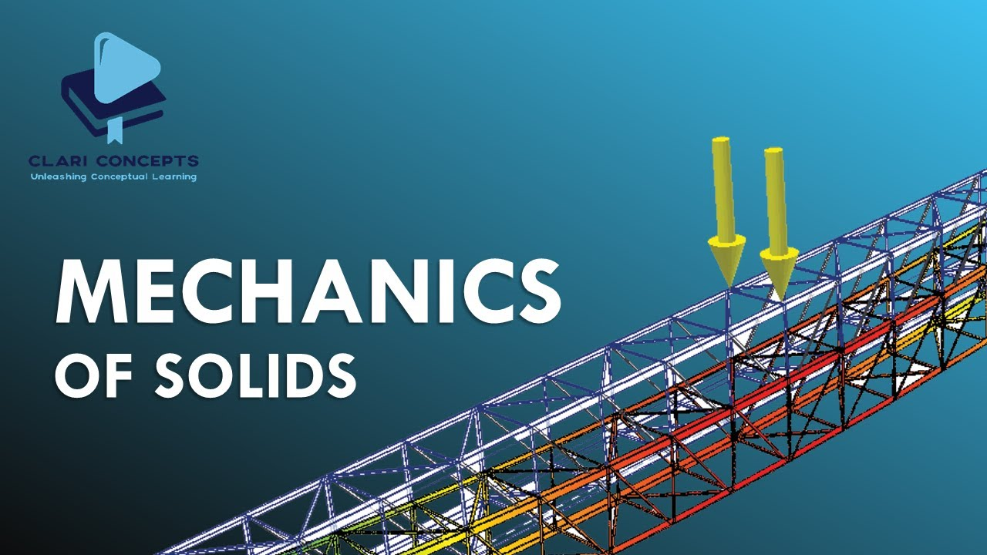



University of Global Village (UGV), Barishal
Mechanics of Solids-I
Content of Theory Course
Prepared By
Rubieyat Bin Ali
Assistant Professor & HOD
Department of Civil Engineering
University of Global Village (UGV), Barishal
Program: B.Sc. in CE

Slide 2
Course Title | Mechanics of Solids-I
Course Code | CE 0732-2205
Credits | 03
CIE Marks | 90
SEE Marks | 60
Exam Hours | 2 hours (Mid Exam) 3 hours (Semester Final Exam)
Level | 4th Semester
BASIC COURSE INFORMATION

Slide 3
Mechanics of Solids-I
Course Code: CE 0732-2205 | CREDIT:03
 | TOTAL MARKS:150
Mid Exam Hours 2 | CIE MARKS: 90
Semester End Exam Hours 3 | SEE MARKS: 60
Course Teacher: Rubieyat Bin Ali
Course Learning Outcomes (CLOs): After completing this course successfully, the students will be able to-
CLO 1 | Understand the types of loads and stresses in different loaded members and develop skills to determine them.
CLO 2 | Identify the magnitude of safe loads and stresses to operate individual members and structures without failure.
CLO 3 | Perform structural design by determining the value of shear force and bending moment at a given point for structural members such as a beam, column, frame, etc.
CLO 4 | Assess the deflections and deformations of loaded flexural members.

Slide 4
SL | Content of Course | Hrs | CLOs
1 | Introduction and analysis of supports and connections: Roller support, hinged/pinned support, fixed support and simple support. | 8 | CLO1
2 | Introduction and analysis of internal forces: Tension, compression, axial stress, strain, shear stress, shear force, bending moment, deformation, stress-strain diagram, elasticity, rigidity, yield strength, ultimate strength, strain hardening, strain softening, elastic limits, plastic limit, fracture point, ductility, engineering stress-strain, true stress-strain, bone shear failure, hardness, brittleness, resilience and toughness. | 8 | CLO1, CLO2
3 | Definition of some mechanical properties of materials: Poisson’s ratio, definition of torque and torsion, stresses in thin walled pressure vessels: hoop and longitudinal stress, Introduction to different types of loading and supports. | 9 | CLO2, CLO3
4 | Shear force and bending moment diagram under different conditions: Roller, hinged, fixed support, uniformly distributed and varying load, inclined load and special frame, Slope and deflection of beams, elastic curve, method of area moment and double integration. | 9 | CLO3, CLO4
Text Book:
Strength of Materials (4th ed.). Pytel, A. & Singer, F. L., Harper Collins Inc., 1987; ISBN: 0-06-350599-1
Mechanics of Materials. Beer and Johnston; McGraw- Hill, 2009; ISBN: 0073529389
Mechanics of Materials (9th ed.). Hibbeler, R. C., Pearson Prentice Hall, 2014; ISBN: 10: 0-13-3254429

Slide 5
ASSESSMENT PATTERN
CIE- Continuous Internal Evaluation (90 Marks)
SEE- Semester End Examination (60 Marks)
Bloom’s Category | Tests
Remember | 10
Understand | 10
Apply | 10
Analyze | 15
Evaluate | 10
Create | 5
Bloom’s Category Marks (out of 90) | Tests (min 4) (45) | Assignments (min 4) (15) | Quizzes (15) | External Participation in Curricular/Co-Curricular Activities (15)
Remember | 10 |  | 10 | Attendance/Field Visit/Presentation/Project Exhibition (15)
Understand | 5 |  | 5
Apply | 10
Analyze | 10
Evaluate | 5
Create | 5 | 15

Slide 6
Course plan specifying content, CLOs, teaching learning and assessment strategy mapped with CLOs
Week | Topic | Teaching-Learning Strategy | Assessment Strategy | Corresponding CLOs
1 | Definition of support and connection, Importance of connection | Lecture, discussion, group work | Quiz, Written Exam | CLO1
2 | Details of roller support, Details of hinged/pinned support or connection | Oral Presentation, debate | Assignment, Written, Quiz | CLO1
3 | Fixed and simple support | Video lecture, Field visit | Report writing, Demonstration | CLO1
4 | Tension, compression, axial stress, strain, Shear stress, shear force, bending moment, deformation | Lecture | Viva, Quiz | CLO1, CLO2
5 | Tensile stress-strain diagram | Project exhibition | Project, Field visit | CLO2
6 | Elasticity, rigidity, yield strength, ultimate strength, Elastic limits, plastic limit and fracture point, Strain hardening and strain softening properties | Discussion, Video Presentation | Quiz, Written Exam | CLO2
7 | Details of ductility, True stress-strain Diagram, Bone shear failure | Case-based Learning, Demonstration | Assignment, Written, Quiz | CLO2
8 | Hardness and brittleness, Resilience and toughness, Poisson’s ratio and torque | Lecture, discussion, group work | Report writing, Demonstration | CLO2
9 | hoop stress and longitudinal stress | Oral Presentation, debate | Viva, Quiz | CLO2
10 | SFD and BMD for Roller support, BMD for hinged and fixed support | Video lecture | Project, Field visit | CLO3

Slide 7
Course plan specifying content, CLOs, teaching learning and assessment strategy mapped with CLOs
Week | Topic | Teaching-Learning Strategy | Assessment Strategy | Corresponding CLOs
11 | BMD for uniformly distributed load, varying load and inclined load | Lecture | Quiz, Written Exam | CLO3
12 | BMD for frame structure, free moment and link | Project exhibition | Assignment, Written, Quiz | CLO3
13 | BMD for large continuous beam and cantilever beam, Two degree area calculation | Discussion, Video Presentation | Report writing, Demonstration | CLO13
14 | Distance determination from two degree area and similar triangle | Case-based Learning, Demonstration | Viva, Quiz | CLO3
15 | Slope and deflection of beams and Elastic curve | Lecture, discussion, group work | Project, Field visit | CLO4
16 | Double integration method and Area moment method | Oral Presentation, debate | Quiz, Written Exam | CLO4
17 | Practice and Exercise, Practice and Exercise, Practice and Exercise | Video lecture | Assignment, Written, Quiz | CLO3, CLO4

Slide 8
Support and Connections
Week 1
Pages 9-13

Slide 9
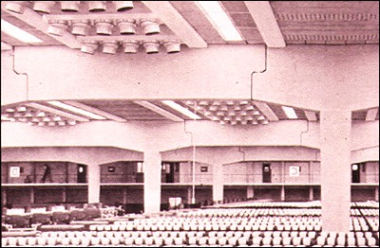
Support and Connections: Definition
In civil engineering, supports and connections are critical components of a structure that ensure its stability and safety:
Supports
Points or areas of a structure that connect to the ground or other elements to transfer forces. Supports can be located at the ends, midpoints, or other intermediate points of a structural element. The type of support determines the type of load it can resist.
Connections
The way a built structure joins to its foundation. Connection detailing is important in both steel and concrete structures, but the details differ based on the material properties.

Slide 10










Main Key Factors of Support and Connection in Civil Engineering Point of view
Distributing loads: Supports distribute loads and pressures from the structure to the ground.
Limiting deflection: Supports limit the deflection of a structure.
Decreasing vibrations: Supports decrease vibrations in a structure.
Load bearing capacity: The type of support connection affects the load bearing capacity of each element in the structure.

Slide 11
Importance
Structural systems transfer their loading through a series of elements to the ground.
This is accomplished by designing the joining of the elements at their intersections. Each connection is designed so that it can transfer, or support, a specific type of load or loading condition. In order to be able to analyse a structure, it is first necessary to be clear about the forces that can be resisted, and transferred, at each level of support throughout the structure. The actual behaviour of a support or connection can be quite complicated. Structural steel systems have either welded or bolted connections. Precast reinforced concrete systems can be mechanically connected in many ways, while cast-in-place systems normally have monolithic connections. Timber systems are connected by nails, bolts, glue or by engineered connectors. No matter the material, the connection must be designed to have a specific rigidity.

Slide 12
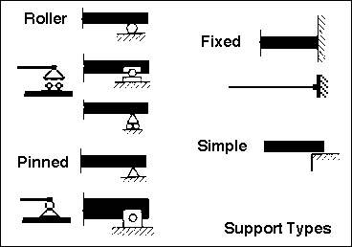
Support and Connections: Types
The three common types of connections which join a built structure to its foundation are; roller, pinned and fixed. A fourth type, not often found in building structures, is known as a simple support. This is often idealized as a frictionless surface). All of these supports can be located anywhere along a structural element. They are found at the ends, at midpoints, or at any other intermediate points. The type of support connection determines the type of load that the support can resist. The support type also has a great effect on the load bearing capacity of each element, and therefore the system.

Slide 13
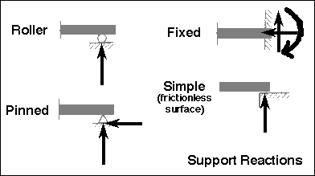
Support and Connections: Reactions
In engineering mechanics, support reactions are forces and moments exerted by the supports or connections that hold a structure or mechanical system in equilibrium. These reactions are critical for analysing and designing structures, as they determine how external loads are distributed within the system.

Slide 14
Support and Connections
Week 2
Pages 15-18

Slide 15
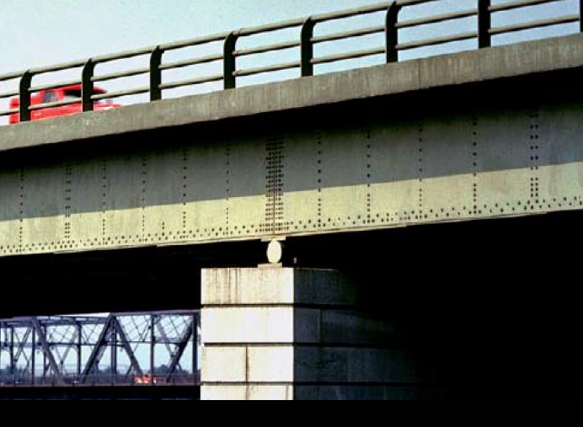
ROLLER SUPPORTS
Roller supports are free to rotate and translate along the surface upon which the roller rests. The surface can be horizontal, vertical, or sloped at any angle. The resulting reaction force is always a single force that is perpendicular to, and away from, the surface. Roller supports are commonly located at one end of long bridges. This allows the bridge structure to expand and contract with temperature changes. The expansion forces could fracture the supports at the banks if the bridge structure was "locked" in place. Roller supports can also take the form of rubber bearings, rockers, or a set of gears which are designed to allow a limited amount of lateral movement.
Figure: Roller Support

Slide 16
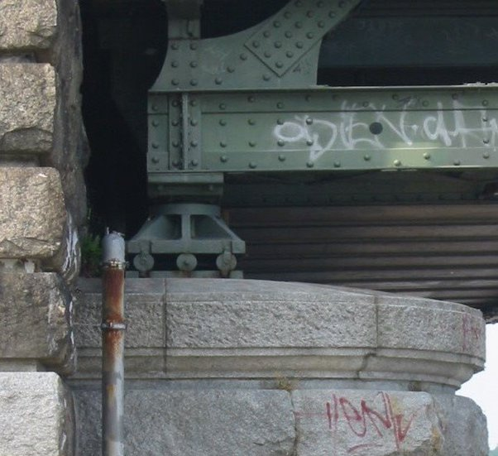
ROLLER SUPPORTS
A roller support cannot provide resistance to a lateral forces. Imagine a structure (perhaps a person) on roller skates. It would remain in place as long as the structure must only support itself and perhaps a perfectly vertical load. As soon as a lateral load of any kind pushes on the structure it will roll away in response to the force. The lateral load could be a shove, a gust of wind or an earthquake. Since most structures are subjected to lateral loads it follows that a building must have other types of support in addition to roller supports.
Figure: Roller Support

Slide 17
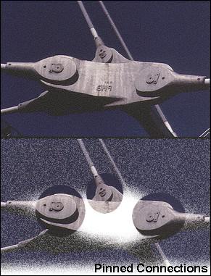
PINNED SUPPORTS/CONNECTIONS
A pinned support can resist both vertical and horizontal forces but not a moment. They will allow the structural member to rotate, but not to translate in any direction. Many connections are assumed to be pinned connections even though they might resist a small amount of moment in reality. It is also true that a pinned connection could allow rotation in only one direction; providing resistance to rotation in any other direction
Figure: Pinned Connection

Slide 18
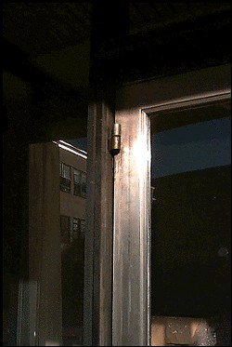
PINNED SUPPORTS/CONNECTIONS
The knee can be idealized as a connection which allows rotation in only one direction and provides resistance to lateral movement. The design of a pinned connection is a good example of the idealization of the reality. A single pinned connection is usually not sufficient to make a structure stable. Another support must be provided at some point to prevent rotation of the structure. The representation of a pinned support includes both horizontal and vertical forces.
Figure: Pinned Connection

Slide 19
Support and Connections
Week 3
Pages 20-22

Slide 20
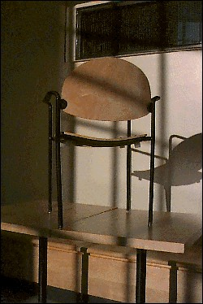
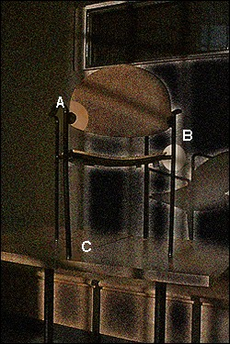
FIXED SUPPORTS
Fixed supports can resist vertical and horizontal forces as well as a moment. Since they restrain both rotation and translation, they are also known as rigid supports. This means that a structure only needs one fixed support in order to be stable. All three equations of equilibrium can be satisfied. A flagpole set into a concrete base is a good example of this kind of support. The representation of fixed supports always includes two forces (horizontal and vertical) and a moment.
Figure: Fixed Support

Slide 21
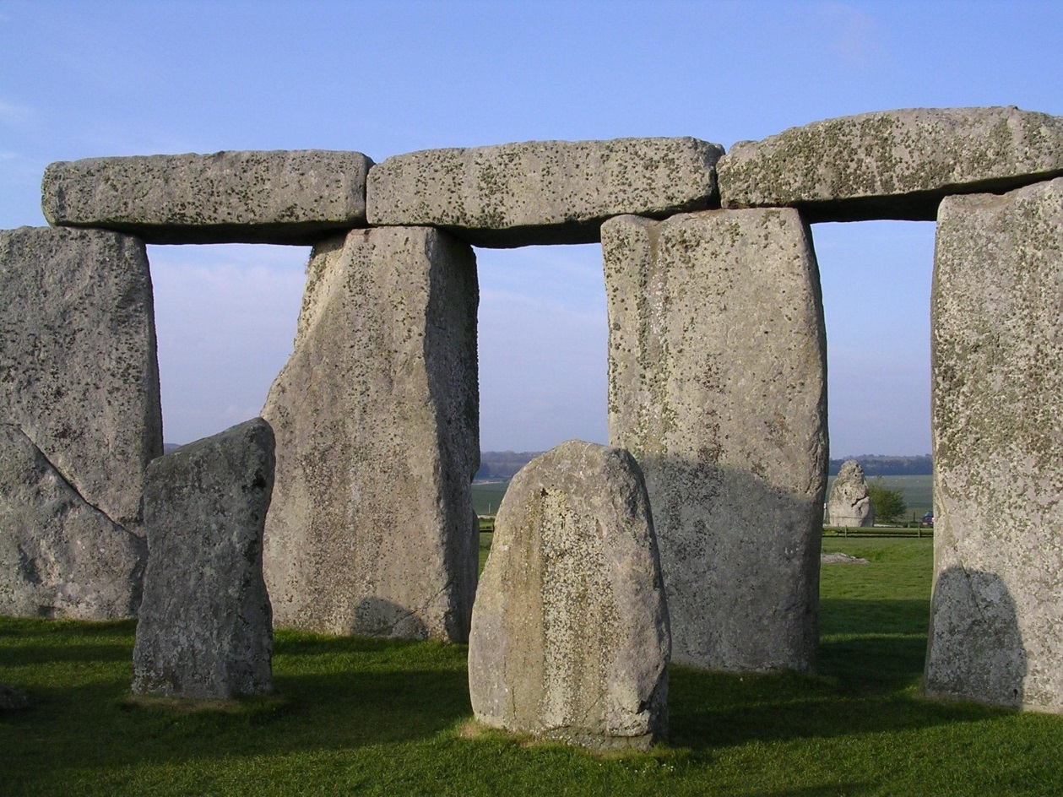
SIMPLE SUPPORTS
Simple supports are idealized by some to be frictionless surface supports. This is correct in as much as the resulting reaction is always a single force that is perpendicular to, and away from, the surface. However, are also similar to roller supports in this. They are dissimilar in that a simple support cannot resist lateral loads of any magnitude. The built reality often depends upon gravity and friction to develop a minimal amount of frictional resistance to moderate lateral loading.
Figure: Simple Support

Slide 22
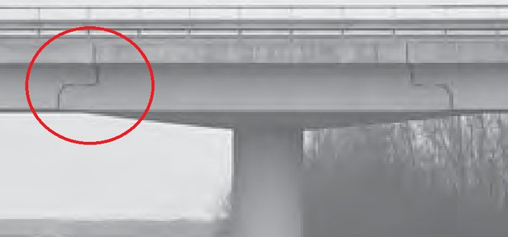
SIMPLE SUPPORTS
For example, if a plank is laid across gap to provide a bridge, it is assumed that the plank will remain in its place. It will do so until a foot kicks it or moves it. At that moment the plank will move because the simple connection cannot develop any resistance to the lateral load. A simple support can be found as a type of support for long bridges or roof span. Simple supports are often found in zones of frequent seismic activity.
Figure: Simple Support
Lecture Courtesy: Massachusetts Institute of Technology (MIT)

Slide 23
Basic Materials Properties
Week 4
Pages 24-31

Slide 24
Tension and Compression
Tension and compression are forces that act on materials, causing them to stretch or squeeze in different ways:
Tension
A pulling or stretching force that causes a material to elongate or deform. Tension is often referred to as positive stress.
Compression
A pushing or squeezing force that causes a material to shorten or deform. Compression is often referred to as negative stress.

Slide 25

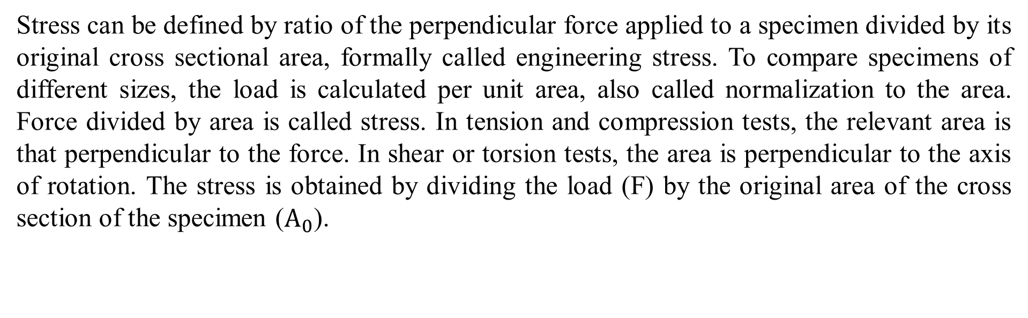
Axial Stress and Strain
Stress can be defined by ratio of the perpendicular force applied to a specimen divided by its original cross sectional area, formally called engineering stress. To compare specimens of different sizes, the load is calculated per unit area, also called normalization to the area. Force divided by area is called stress. In tension and compression tests, the relevant area is that perpendicular to the force. In shear or torsion tests, the area is perpendicular to the axis of rotation. The stress is obtained by dividing the load (F) by the original area of the cross section of the specimen ($A_{0}$).

Slide 26

Axial Stress and Strain
Strain is the ratio of change in length due to deformation to the original length of the specimen, formally called engineering strain. strain is unit less, but often units of m/m (or mm/mm) are used.
The strain used for the engineering stress-strain curve is the average linear strain, which is obtained by dividing the elongation of the gage length of the specimen, by its original length.

Slide 27
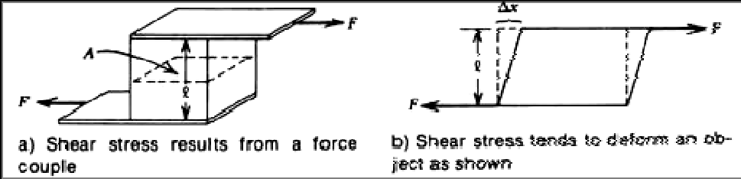
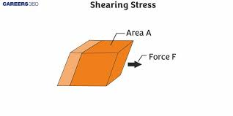
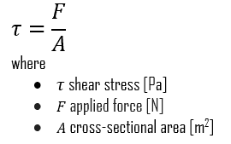
Shear Stress
Tensile and compressional stress can be defined in terms of forces applied to a uniform rod.
Shear stress is defined in terms of a couple that tends to deform a joining member.

Slide 28
Shear force definition
Shear force is a force acting in a direction that's parallel to a surface or cross section of a body. The word shear in the term is a reference to the fact that such a force can cut, or shear, through the surface or object under strain. In solid mechanics, shearing forces are unaligned forces pushing one part of a body in one specific direction, and another part of the body in the opposite direction. When the forces are collinear (aligned into each other), they are called compression forces.
Longitudinal direction
Cross-section

Slide 29
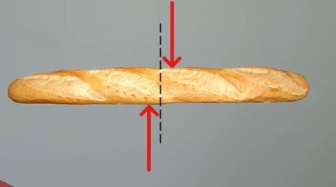
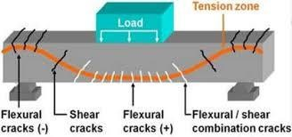
Shear force example
Example: Cutting bread, Cutting paper, beam bending, drawing picture, sliding cash note, painting, brushing teeth, bone shear failure etc.
Figure: Shear force example

Slide 30
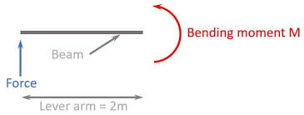
Bending Moment
Bending moment is the internal resistance of a structural element to bending when an external force is applied. It's a measure of the effect of a load that causes a structural member to bend.
Bending moment = Force x Distance
Deformation
In civil engineering, deformation is the change in shape or size of an object due to an applied force or change in temperature.
Figure: Bending moment

Slide 31
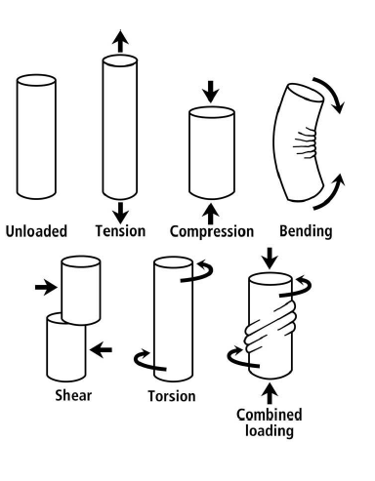
Figure: Different types of loading condition in material.

Slide 32
Basic Materials Properties
Week 5
Pages 33

Slide 33
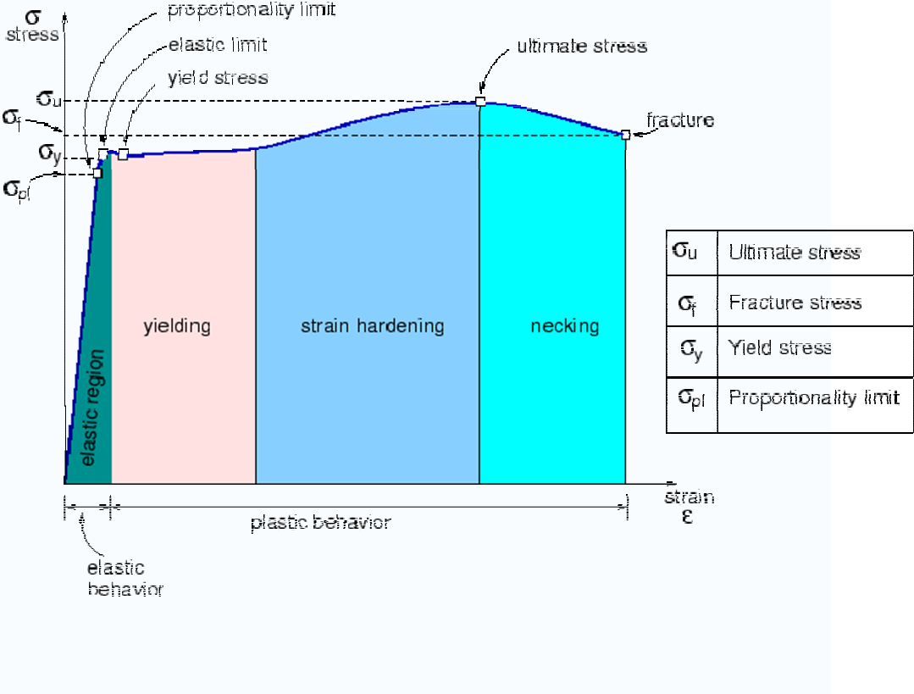
Figure: Tensile stress-strain diagram of reinforcement.

Slide 34
Basic Materials Properties
Week 6
Pages 35-38

Slide 35
A tensile stress-strain diagram, also known as a stress-strain curve, illustrates the relationship between a material's stress and strain. The curve can be used to determine a material's characteristic values, such as its elastic behavior and tensile strength.
Some properties of a tensile stress-strain diagram include:
Proportional limit: The highest stress at which stress and strain are directly proportional. This is the point on the curve where the deviation from the straight-line portion begins.
Elastic limit: The greatest stress a material can withstand without any permanent strain.
Yield strength: The stress required to produce a small amount of plastic deformation.
Modulus of resilience: The work done on a unit volume of material as the force increases from zero to the elastic limit. It is also known as Young's modulus of elasticity, and is analogous to the stiffness of a spring.

Slide 36
Hooke’s Law
For materials stressed in tension, at relatively low levels, stress and strain are proportional through:
Here, constant E is known as the modulus of elasticity, or Young’s modulus.
Within the linear region, a specific type of material will always follow the same curves despite different physical dimensions. Thus, it can say that the linearity and slope are a constant of the type of material only. In tensile and compressional stress, this constant is called the modulus of elasticity or Young's modulus (E). So,
where stress = F/A in N/m² strain = Dl/l unit less
E = Modulus of elasticity in N/m²

Slide 37
The modulus of elasticity has units of stress, that is, N/m². The following table gives the modulus of elasticity for several materials. In an exactly similar fashion, the shear modulus is defined for shear stress-strain as modulus of elasticity.
Material | Modulus (N/m²)
Aluminum | 6.89 x 10¹⁰
Copper | 11.73 X 10'° 20.70 X 10¹⁰
Steel | 2.1 x 10⁸

Slide 38
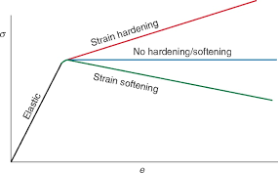
Strain hardening refers to a material becoming stronger and harder with increasing strain, while strain softening means a material becomes weaker with increasing strain; essentially, in strain hardening, stress increases with deformation, whereas in strain softening, stress decreases with deformation as strain increases.

Slide 39
Basic Materials Properties
Week 7
Pages 40-43

Slide 40
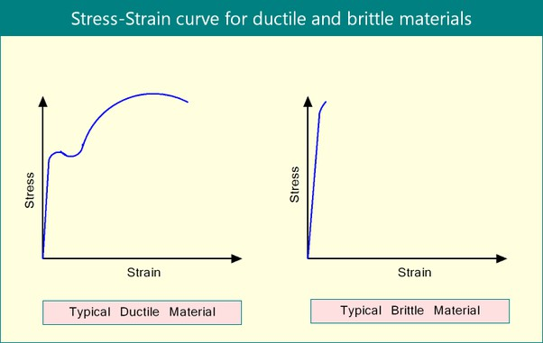
Ductility:
Ductility describes the extent to which a material (or structure) can undergo large deformations before fracture. The term is used in earthquake engineering to designate how well a building will endure large lateral displacements imposed by ground shaking.
A ductile structure's ability to dissipate energy during an earthquake is, therefore, also advantageous as it will keep deforming without reaching ultimate failure or collapse. An example of a ductile structure is a properly detailed steel frame with that will enable it to undergo large deformations before the onset of failure.

Slide 41
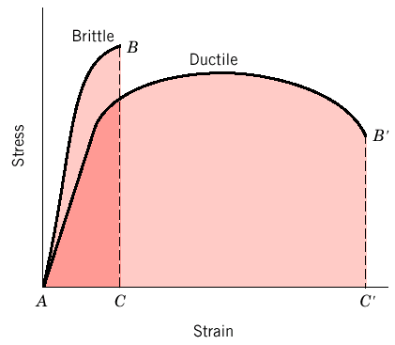
Figure: Brittle vs Ductile Material.

Slide 42
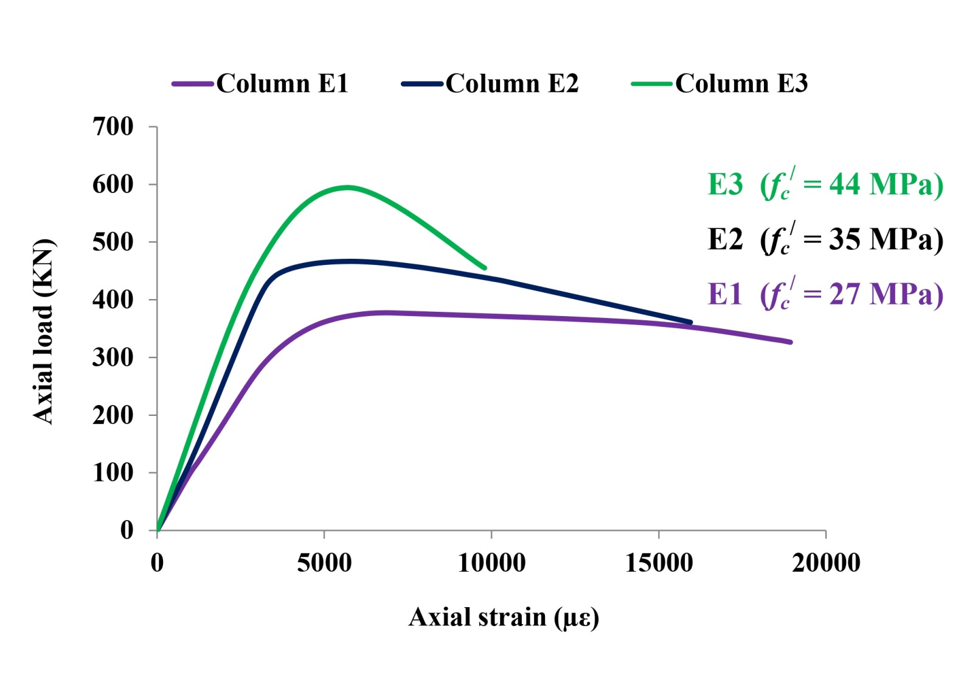

Figure: What do you think which colour exhibits less ductile behaviour?????.

Slide 43
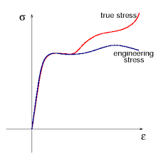
True Stress versus Engineering Stress
While both "stress" and "strain" measure deformation in a material, the key difference between "true stress/strain" and "engineering stress/strain" lies in how the cross-sectional area is considered: "engineering" calculations use the original cross-sectional area of the material, while "true" calculations use the instantaneous, changing cross-sectional area during deformation, making true stress/strain values always higher than engineering stress/strain, especially at large deformations.

Slide 44
Basic Materials Properties
Week 8
Pages 45-48

Slide 45
Hardness
Hardness is the resistance of a material to localized plastic deformation. Hardness is a measure of a material's resistance to permanent deformation. Toughness is a measure of how much deformation a solid material can undergo before fracturing. Hardness is often inversely related to ductility, so the ductile metals mentioned above typically have relatively low hardness.
The product EI is termed the "beam stiffness", or sometimes the "flexural rigidity". It is often given the symbol Σ. It is a measure of how strongly the beam resists deflection under bending moments.

Slide 46
Stiffness is how a component resists elastic deformation when a load is applied. Hardness is resistance to localized surface deformation.
The modulus of rigidity, also known as shear modulus, is defined as the ratio of shear stress to shear strain of a structural member. This property depends on the material of the member: the more elastic the member, the higher the modulus of rigidity.
Stiffness is the extent to which an object resists deformation in response to an applied force.
Elastic modulus is a measure of stiffness. Steel is stiffer than rubber thus its modulus is higher.
Stiff → not easily bent or changed in shape. Rigid → unable to bend or be forced out of shape, not flexible.
Rigidity, on the other hand, refers to the opposite property of elasticity. It is the inability of a material to deform under an external force. Flexibility is the ability of a material to bend, twist or stretch without breaking. This property depends on the material's elasticity and plasticity.

Slide 47
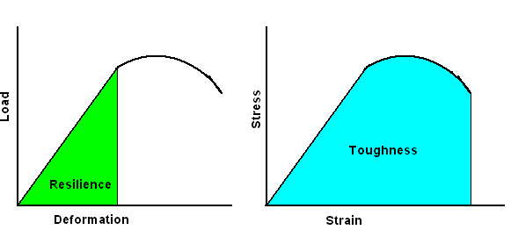
Resilience
The resilience of the material is the triangular area underneath the elastic region of the curve. In physics and engineering, resilience is defined as the capacity of a material to absorb energy when it is deformed elastically and then, upon unloading to have this energy recovered.
Toughness
The area underneath the stress-strain curve is the toughness of the material- i.e. the energy the material can absorb prior to rupture.. It also can be defined as the resistance of a material to crack propagation. The ability of a metal to deform plastically and to absorb energy in the process before fracture is termed toughness. A material with high strength and high ductility will have more toughness than a material with low strength and high ductility.
Comparison between resilience and toughness of metals

Slide 48

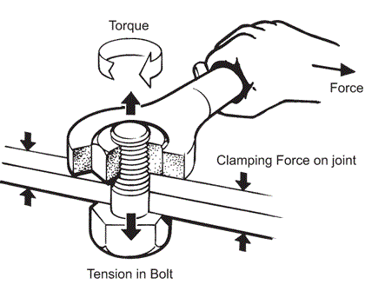
Poisson ratio
Poisson ratio is the ratio of transverse contraction (or expansion) strain to longitudinal extension strain in the direction of stretching force. Tensile deformation is considered positive and compressive deformation is considered negative.
Torque (Twisting Moment)
Torque typically refers to the tendency of a force to rotate an object around an axis. It is commonly used in the context of engines, vehicles, and rotating machinery. Torque is a measure of the rotational force applied to an object and is typically expressed in units such as newton-meters or foot-pounds.

Slide 49
Basic Materials Properties
Week 9
Pages 50-51

Slide 50
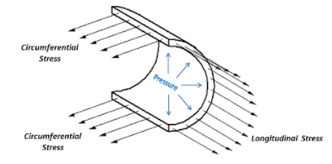
Hoop stress and longitudinal stress are two types of stress that occur in cylindrical pipes:
Hoop stress
Also known as tangential stress, this stress runs around the pipe in a ring-like pattern. It's caused by internal pressure and acts perpendicular to the pipe's axis and radius.
Longitudinal stress
This stress runs up the pipe in an axial direction. It occurs when the length of the pipe changes due to normal stress.
The relationship between hoop stress and longitudinal stress depends on the thickness of the pipe wall relative to its radius:
Thin-walled pipes
In most practical engineering applications, the hoop stress is about twice the magnitude of the longitudinal stress. This is because the wall thickness is small compared to the radius..
Longitudinal stress and Hoop stress

Slide 51
Thick-walled pipes
In these cases, the relationship between the two types of stress is more complex and may require more advanced analysis.
Click this link
Hoop Stress
Longitudinal Stress

Slide 52
Shear Force and Bending moment diagram
Week 10
Pages 53-67

Slide 53

Moment and Bending moment
Moment: It is the product of force and perpendicular distance between line of action of the force and the point about which moment is required to be calculated.
Bending Moment (BM): The moment which causes the bending effect on the beam is called Bending Moment. It is generally denoted by ‘M’ or ‘BM’.

Slide 54

SIGN CONVENTION FOR SHEAR FORCE
F
F
F
F
+ ve shear force
- ve shear force

Slide 55




























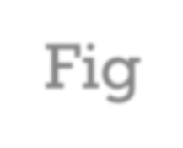












SIGN CONVENTION FOR BENDING MOMENTS
The bending moment is considered as Sagging Bending Moment if it tends to bend the beam to a curvature having convexity at the bottom as shown in the Fig. given below. Sagging Bending Moment is considered as positive bending moment.
Convexity
Fig. Sagging bending moment [Positive bending moment ]

Slide 56





























SIGN CONVENTION FOR BENDING MOMENTS
Similarly the bending moment is considered as hogging bending moment if it tends to bend the beam to a curvature having convexity at the top as shown in the Fig. given below. Hogging Bending Moment is considered as Negative
Bending Moment.
Convexity
Fig. Hogging bending moment [Negative bending moment ]

Slide 57










SHEAR FORCE AND BENDING MOMENT DIAGRAMS
(SFD & BMD)
Shear Force Diagram (SFD):
The diagram which shows the variation of shear force along the length of the beam is called Shear Force Diagram (SFD).
Bending Moment Diagram (BMD):
The diagram which shows the variation of bending moment along the length of the beam is called Bending Moment Diagram (BMD).

Slide 58




Point of Contra flexure [Inflection point]:
It is the point on the bending moment diagram
where bending moment changes the sign from positive to negative or vice versa.
It is also called ‘Inflection point’. At the point of
inflection point or contra flexure the bending moment is zero.

Slide 59
SFD & BMD Full Math

Slide 60
Problem-1: Find the SFD (Shear Force Diagram) & BMD (Bending Moment Diagram) of the following beam.
5 K
A
10′

Slide 61
Solution:
5 K
A
M_{A} = 50 K-ft.
10′
∑ F_{y} = 0
=> 5 - R_{A} = 0
=> R_{A} = 5 K.
R_{A} = 5 K
5 K
5 K
SFD
∑ M_{A} = 0
=> 5 x 10 - M_{𝐴} = 0
=> M_{𝐴} = 50 K-ft.
0 K-ft.
50 K-ft.
BMD

Slide 62
Problem-2: Find the SFD (Shear Force Diagram) & BMD (Bending Moment Diagram) of the following beam.
5 K
A
10′

Slide 63
Solution:
5 K
A
M_{A} = 50 K-ft.
10′
∑ F_{y} = 0
R_{A} = 5 K
=> 5 - R = 0
A
=> R_{A} = 5 K.
5 K
5 K
SFD
∑ M_{A} = 0
=> 5 x 10 - M_{𝐴} = 0
0 K-ft.
=> M = 50 K-ft.
𝐴
50 K-ft.
BMD

Slide 64
Problem-3: Find the SFD (Shear Force Diagram) & BMD (Bending Moment Diagram) of the following beam.
10′
A
5 K

Slide 65
Solution:
R_{A} = 5 K
10′
M_{A} = 50 K-ft.
A
5 K
∑ F_{y} = 0
=> - 5 + R_{A} = 0
=> R_{A} = 5 K.
5 K
5 K
SFD
∑ M_{A} = 0
=> 5 x 10 - M_{𝐴} = 0
50 K-ft.
0 K-ft.
=> M = 50 K-ft.
𝐴
BMD

Slide 66
Problem-4: Find the SFD (Shear Force Diagram) & BMD (Bending Moment Diagram) of the following beam.
5 K
₅′
₅′
A

Slide 67
Solution:
5 K
A
₅′
₅′
M_{A} = 25 K-ft.
∑ F_{y} = 0
=> 5 - R_{A} = 0
=> R_{A} = 5 K.
R_{A} = 5 K
 | SFD
 | BMD
5 K
5 K
∑ M_{A} = 0
=> - 5 x 5 + M_{𝐴} = 0
0 K-ft.
=> M = 25 K-ft.
𝐴
25 K-ft.

Slide 68
Shear Force and Bending moment diagram
Week 11
Pages 69-81

Slide 69
Problem-5: Find the SFD (Shear Force Diagram) & BMD (Bending Moment Diagram) of the following beam.
A
3 k/ft.
+ D
₅′
+ I
n = (1/n+1) * ab
b
I
Small
n = (n/n+1) * ab
+ D
a
Short Formula

Slide 70
Solution:
A
3 k/ft.
M_{A} = 50 K-ft.
₅′
∑ F_{y} = 0
=> 3 x 5 - R = 0
R_{A} = 15 K
A
1⁰ Curve SFD
2⁰ Curve BMD
=> R_{A} = 15 K.
0 K
15 K
∑ M_{A} = 0
2
=> ^{𝑤𝑙} - M = 0
𝐴
0 K-ft.
2
37.5 K-ft.
3 𝑥 5²
=> M_{𝐴} =
= 37.5 K-ft.
2

Slide 71
Solution:
5 K
5 K
3 k/ft.
10′
₅′
₅′
₅′
 | SFD
 |  | 1⁰ Curve
 | BMD
1⁰ Curve SFD
2⁰ Curve BMD
SFD
1⁰ Curve
BMD

Slide 72
Problem-6: Find the SFD (Shear Force Diagram) & BMD (Bending Moment Diagram) of the following beam.
A
3 k/ft.
₅′

Slide 73
Solution:
A
3 k/ft.
M_{A} = 37.5 K-ft.
₅′
∑ F_{y} = 0
=> 3 x 5 - R_{A} = 0
=> R_{A} = 15 K.
R_{A} = 15 K
15 K
1⁰ Curve
0 K
SFD
∑ M_{A} = 0
2
=> ^{𝑤𝑙} - M = 0
𝐴
0 K-ft.
2⁰ Curve
2
37.5 K-ft.
3 𝑥 5²
=> M_{𝐴} =
= 37.5 K-ft.
BMD
2

Slide 74
Problem-7: Find the SFD (Shear Force Diagram) & BMD (Bending Moment Diagram) of the following beam.
3 k/ft.
A
₅′
₅′

Slide 75
Solution:
3 k/ft.
A
₅′
₅′
M_{A} = 112.5 K-ft.
R_{A} = 15 K
∑ F_{y} = 0
=> 3 x 5 - R_{A} = 0
=> R_{A} = 15 K.
1⁰ Curve 15 |  | K
 | SFD
2⁰ Curve 37.5 K |  | -ft. 1⁰ Cu
 | BMD
0 K
15 K
∑ M_{A} = 0
=> wl (5 + ^{𝑙}) - M = 0
0 K-ft.
2
𝐴
112.5 K-ft.
rve
=> M =3 x 5 (5 + ⁵)= 112.5 K-ft.
𝐴
2

Slide 76

Problem-8: Find the SFD (Shear Force Diagram) & BMD (Bending Moment Diagram) of the following beam.
10 k/ft.
₉′
A

Slide 77

w k/ft.
10 k/ft.
∑ F_{y} = 0
=> 0.5 x 9 x 10 - R_{A} = 0
=> R_{A} = 45 K.
X
Solution:
M_{A} = 135 K-ft.
₉′
A
R_{A} = 45 K
∑ M_{A} = 0
=> Area x cantorial distance - M_{𝐴} = 0
X
2⁰ Curve SFD
3⁰ Curve BMD
0 K
=> 0.5 x 9 x 10 x ⁹ - M = 0
3
𝐴
45 K
=> M = 135 K-ft.
𝐴
10 ₌ 𝑤
9 𝑥
=> w =
V = - ¹ . x . (¹⁰ . x)
0 K-ft.
x
2
9
2
= - ^{5 𝑥} [0≤x≤9]
10
. x
135 K-ft.
9
9
M = - ^{5 𝑥} . ^{𝑥} [0≤x≤9]
2
x
9
3

Slide 78
Problem-9: Find the SFD (Shear Force Diagram) & BMD (Bending Moment Diagram) of the following beam.
10 k/ft.
_{A 6}′

Slide 79
w k/ft.
10 k/ft.
X
V = 30 - ¹ . x . (¹⁰ . x)
10 𝑤
𝑥
Solution:
x
2 6
5 𝑥²
=
= 30 -
6
6
=> w = ¹⁰ . x
A
₆′
[0≤x≤6]
M_{x} = - 120 + 30x -
[0≤x≤6]
6
M_{A} = 120 K-ft.
𝑥 3
5 𝑥²
.
R_{A} = 30 K
6
X
30 K
2⁰ Cu
SFD
3⁰ Curve BMD
rve
0 K
x | V_{x} (kip) | M_{x} (kip-ft.)
0 | 30 | - 120
2 | 26.67 | - 62.22
4 | 16.67 | - 17.78
6 | 0 | 0
0 K-ft.
120 K-ft.

Slide 80
Problem-10: Find the SFD (Shear Force Diagram) & BMD (Bending Moment Diagram) of the following beam.
10 K
10 K
₃′
₆′
₃′
A
B

Slide 81
10 K
10 K
Solution:
A
B
₃′
₆′
₃′
∑ M_{A} = 0
=> 10 x 3 + 10 x (6 + 3) - R
R_{A} = 10 K
R_{B} = 10 K
B
x 12 = 0
10 K
0 K
30 K | SFD -ft. 30 | K-ft.
 | BMD
=> R_{B} x 12 = 30 + 90 = 120
=> R = 120/12 = 10 K
10 K
B
∑ F_{y} = 0
=> R_{A} + R_{B} - 10 - 10 = 0
=> R_{A} = 20 - R_{B} = 20 – 10 = 10 K
0 K-ft.

Slide 82
Shear Force and Bending moment diagram
Week 12
Pages 83-98

Slide 83
Problem-11: Find the SFD (Shear Force Diagram) & BMD (Bending Moment Diagram) of the following beam.
10 K
4 K
₃′
₆′
₃′
A
B

Slide 84
10 K
4 K
Solution:
A
B
₃′
₆′
₃′
∑ M_{A} = 0
=> 10 x 3 + 4 x (6 + 3) - R
R_{A} = 8.5 K
R_{B} = 5.5 K
B
x 12 = 0
8.5 K
0 K
=> R_{B} x 12 = 30 + 36 = 66
1.5 K
=> R = 66/12 = 5.5 K
5.5 K
B
∑ F_{y} = 0
=> R_{A} + R_{B} - 10 - 4 = 0
SFD
25.5 K-ft.
16.5 K-ft.
=> R_{A} = 14 - R_{B} = 14 – 5.5 = 8.5 K
0 K-ft.
BMD

Slide 85

Problem-12: Find the SFD (Shear Force Diagram) & BMD (Bending Moment Diagram) of the following beam.
4 K/ft.
10′
A
B

Slide 86

Solution:
4 K/ft.
A
B
10′
∑ M_{A} = 0
R_{A} = 20 K
R_{B} = 20 K
=> (4 x 10) x ¹⁰ - R
x 10 = 0
2
=> R_{B} x 10 = 200
B
20 K
0 K
 | SFD
0.5 x 20 x 5 |  | = 50 K-ft.
 | BMD
=> R_{B} = 200/10 = 20 K
∑ F_{y} = 0
=> R_{A} + R_{B} - 4 x 10= 0
=> R_{A} = 40 - R_{B} = 40 – 20 = 20 K
20 K
0 K-ft.

Slide 87
Problem-13: Find the SFD (Shear Force Diagram) & BMD (Bending Moment Diagram) of the following beam.
6 K
3 K/ft.
A
B
₆′
₃′
₃′

Slide 88



Solution:
6 K
3 K/ft.
A
B
₆′
₃′
₃′
∑ M_{A} = 0
=> (3 x 6) x 3 + 6 x (6 + 3) - R_{B} x 12 = 0
=> R_{B} x 12 = 54 + 54 =108
=> R_{B} = 108/12 = 9 K
∑ F_{y} = 0
=> R_{A} + R_{B} - 3 x 6 - 6 = 0
=> R_{A} = 24 - R_{B} = 24 – 9 = 15 K
R_{A} = 15 K
R_{B} = 9 K
15 K
₁′
0 K
₅′
3 K
9 K
6
(15+3)
SFD
15 x
= 5′
0 K-ft.
BMD

Slide 89
Problem-14: Find the SFD (Shear Force Diagram) & BMD (Bending Moment Diagram) of the following beam.
5 K
3 K/ft.
A
B
C
10′
₅′

Slide 90
Solution:
5 K
3 K/ft.
B
A
C
10′
₅′
∑ M_{A} = 0
=> (3 x 10) x 5 + 5 x (10 + 5) - R_{B} x 10 = 0
=> R_{B} x 10 = 150 + 75 = 225
=> R_{B} = 225/10 = 22.5 K
∑ F_{y} = 0
=> R_{A} + R_{B} - 3 x 10 - 5 = 0
=> R_{A} = 35 - R_{B} = 35 – 22.5 = 12.5 K
R_{A} = 12.5 K
R_{B} = 22.5 K
12.5 K
0 K
5.833′
5 K
4.167′
17.5 K
SFD
26.06 K-ft.
0 K-ft.
25 K-ft.
BMD

Slide 91
Problem-15: Find the SFD (Shear Force Diagram) & BMD (Bending Moment Diagram) of the following beam.
6 K
12 K
2 K/ft.
A
B
E
₂′
₂′
C
₂′
D
₂′

Slide 92

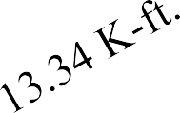
6 K
12 K
2 K/ft.
Solution:
B
E
A
₂′
₂′
C
₂′
D
₂′
∑ M_{B} = 0
=> - (2 x 2) x 1 + 6 x 2 + 12 x 4 - R
=> R_{E} x 6 = 34
=> R_{E} = 34/6 = 9.33 K
R_{B} = 12.67 K
8.67 K
R_{E} = 9.33 K
E
x 6 = 0
2.67 K
0 K
0 K
4 K
9.33 K
∑ F = 0
SFD
y
=> R_{B} + R_{E} - 2 x 2 - 6 - 12 = 0
=> R_{B} = 22 - R_{E} = 22 – 9.33 = 12.67 K
0 K-ft.
0 K-ft.
4 K-ft.
BMD

Slide 93

Problem-16: Find the SFD (Shear Force Diagram) & BMD (Bending Moment Diagram) of the following beam.
3 K/ft.
2 K/ft.
A
C
₆′
10′
B

Slide 94
Solution:
3 K/ft.
2 K/ft.
C
A
₆′
B
10′
∑ M_{B} = 0
R_{B} = 20.8 K
R_{C} = 8.2 K
=> - (0.5 x 6 x 3) x (¹ x 6) + 2 x 10 x 5 -
3
11.8 K
R_{C} x 10 = 0
4.1′
=> R_{C} x 10 = 82
=> R_{C} = 82/10 = 8.2 K
∑ F_{y} = 0
=> R_{B} + R_{C} - 0.5 x 6 x 3 – 2 x 10= 0
=> R_{B} = 29 - R_{C} = 29 – 8.2 = 20.8 K
0 K
0 K
9 K
5.9′
8.2 K
SFD
16.81 K-ft.
0 K-ft.
0 K-ft.
18 K-ft.
BMD

Slide 95

Problem-17: Find the SFD (Shear Force Diagram) & BMD (Bending Moment Diagram) of the following beam.
6 K
12 K
3 K/ft.
A
D
E
2′ B
₂′
C
₂′
₃′

Slide 96
6 K 12 K
3 K/ft.
Solution:
D
E
A
₂′
2′ B
C
₂′
₃′
∑ M_{A} = 0
=> 6 x 2 + 12 x 4 – 0.5 x 3 x 3 x (6 + ² x
3) - R_{D} x 6 = 0
=> R_{D} = 16 K
3
R_{A} = 6.5 K
6.5 K
R_{D} = 16 K
4.5 K
0.5 K
0 K
0 K
11.5 K
SFD
13 K-ft.
14 K-ft.
0 K-ft.
0 K-ft.
9 K-ft.
BMD

Slide 97
Problem-18: Find the SFD (Shear Force Diagram) & BMD (Bending Moment Diagram) of the following beam.
10 K
10 K-ft.
2 K/ft.
A
₂′
₄′
₂′
D
B
C

Slide 98
10 K
10 K-ft.
2 K/ft.
Solution:
B
C
A
∑ M_{B} = 0
=> - 10 + 2 x 4 x 2 + 10 x 6 - R_{C} x 4 = 0
=> R_{C} = 66/4 = 16.5 K
₂′
₄′
₂′
D
R_{B} = 1.5 K
R_{C} = 16.5 K
3.25′
10 K
0 K
1.5 K
0 K
0.75′
6.5 K
SFD
0 K-ft.
9.11 K-ft.
0 K-ft.
10 K-ft.
20 K-ft.
BMD

Slide 99
Shear Force and Bending moment diagram
Week 13
Pages 100-127

Slide 100
Problem-19: Find the SFD (Shear Force Diagram) & BMD (Bending Moment Diagram) of the following beam.
6 K
3 K/ft.
2 K/ft.
A
B
C
₂′
₁′
₁′
₃′
D

Slide 101
6 K
3 K/ft.
2 K/ft.
Solution:
B
C
A
D
∑ M_{B} = 0
=> - 2 x 2 x 1 + 6 x 1 + 0.5 x 3 x 3 x (2 +
₂′
₁′
₁′
₃′
R = 4.5 K
R_{C} = 10 K
² x 3) - R
x 2 = 0
B
3
C
4.5 K
=> R_{C} = 20/2 = 10 K
0.5 K
0 K
0 K
4 K
5.5 K
SFD
0 K-ft.
3.5 K-ft.
0 K-ft.
4 K-ft.
9 K-ft.
BMD

Slide 102

Problem-20: Find the SFD (Shear Force Diagram) & BMD (Bending Moment Diagram) of the following beam.
6 K
_{2 K/ft.} 10 K-ft.
3 K/ft.
B
C D
A
₃′
₄′ ₂′
₃′
E

Slide 103
3 K/ft.
6 K
_{2 K/ft.} 10 K-ft.
Solution:
B
C D
A
₃′
₄′ ₂′
₃′
E
∑ M = 0
B
=> - 0.5 x 3 x 3 x ¹ x 3 + 6 x 4 + 2 x 2 x 5
R = 8.25 K
3
R = 6.25 K
D
+ 10 - R_{D} x 6 = 0
B
=> R_{D} = 49.5/6 = 8.25 K
1.75 K
0 K
0 K
4.25 K
4.5 K
8.25 K
SFD
2.5 K-ft.
0 K-ft.
0 K-ft.
4.5 K-ft.
10 K-ft.
BMD

Slide 104

Problem-21: Find the SFD (Shear Force Diagram) & BMD (Bending Moment Diagram) of the following beam.
10 K
3 K/ft.
2 K/ft.
4
C D
₂′ ₂′ ₂′
3
A
₃′
₃′
F
B
E

Slide 105

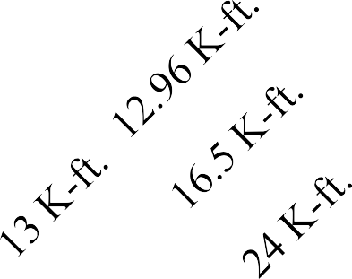

8 K
3 K/ft.
2 K/ft.
D
F
Solution:
A
C
₂′ ₂′ ₂′
6 K
₃′
₃′
x 10 = 8 K
B
E
3
x 10 = 6 K
R_{B} = 9.25 K
R_{E} = 11.75 K
4
4²+3²
4²+3²
10 K
3 K/ft.
2 K/ft.
4
3
1.75 K
1.875′
A
C
₂′
D
₂′ ₂′
F
8 K
₃′
₃′
0.25 K
0 K
0 K
0.125′
3.75 K
B E
∑ M_{B} = 0
=> - 3 x 3 x 1.5 + 2 x 2 x 3 + 8 x 9 - R_{E} x
6 = 0
=> R_{E} = 11.75 K
9 K
SFD
0 K-ft.
0 K-ft.
BMD

Slide 106
Problem-22: Find the SFD (Shear Force Diagram) & BMD (Bending Moment Diagram) of the following beam.
8 K
F
5 K
4 K/ft.
C
D
A
₃′ ₄′
₄′
₅′
E
B

Slide 107


=> - 15 + 4 x4 x 2 + 8 x 13 - R_{D} x 8 = 0
∑ M_{B} = 0
=> R_{D} = 15.125 K
15 K-ft.
4 K/ft.
C
8 K
F
5 K
4 K/ft.
C
8 K
Solution:
₃′
B
D
D
A
₃′
₄′
₄′
₅′
E
A
₃′ ₄′
₄′
E
5
′
F
B
5 K
R_{B} = 8.875 K
R_{D} = 15.125 K
8.875 K
1.78′
8 K
5 K
15 K-ft.
A
8 K
0 K
0 K
15 K-ft.
4 K/ft.
C
2.22′
7.125 K
D
A
₃′
₄′
₄′
₅′
E
SFD
B
0 K-ft.
F
0 K
5 K
5 K
0 K-ft.
SFD
BMD
0 K-ft.
₃′
11.5 K-ft.
15 K-ft.
40 K-ft.
5 K
A
0 K
5 K
15 K-ft.
0 K-ft.
BMD

Slide 108


Problem-23: Find the SFD (Shear Force Diagram) & BMD (Bending Moment Diagram) of the following beam.
8 K
10 K
Link
4 K/ft.
B
C
D
A
₃′
₃′ ₂′
₆′
E

Slide 109





=> 8 x 3 + 10 x 6 - R_{D} x 8 = 0
∑ M_{A} = 0
=> R_{D} = 10.5 K
8 K
10 K
D
8 K
B
Solution:
^{10 K} 4 K/ft.
A
C
D
₃′
₃′ ₂′ A
E
B
C
₃′
₃′ ₂′ ₆′
R_{B} = 7.5 K
R_{D} = 10.5 K
R_{D} = 10.5 K
4 K/ft.
E
7.5 K
0 K
135 K-ft.
0 K
₆′
0.5 K
10.5 K
R_{E} = 34.5 K
SFD
0 K
10.5 K
0 K
SFD
34.5 K
0 K-ft.
0 K-ft.
0 K-ft.
0 K-ft.
135 K-ft.
BMD
BMD

Slide 110
Problem-24: Find the SFD (Shear Force Diagram) & BMD (Bending Moment Diagram) of the following beam.
15 kN/m.
10 kN-m.
A
C
E
1 m
3 m
5 m
1 m
D
B

Slide 111

15 kN/m.
10 kN-m.
A
C
E
Solution:
B
1 m
3 m
5 m
1 m
∑ M_{C} = 0
=> - 15 x 4 x 2 + 10 - R_{B} x 3 = 0
=> R_{B} = 36.67 K
D
R_{B} = 36.67 K
21.67 K
R_{D} = 23.33 K
1.56 m
1.75 K
0 K
0 K
1.44 m
23.33 K
SFD
8.1 K-ft.
0 K-ft.
0 K-ft.
10 K-ft.
BMD

Slide 112
Problem-25: Find the SFD (Shear Force Diagram) & BMD (Bending Moment Diagram) of the following beam.
50 K/ft.
500 K
B
C
E
F
A
₆′
₈′
₇′
300 K
₈′
6 D

Slide 113
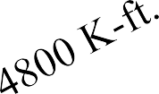


50 K/ft.
500 K
Solution:
B
C
E
F
A
₆′
₈′
₇′
300 K
₈′
6 D
∑ M = 0
A
=> 50 x 8 x 10 + 500 x 20 – 300 x 28 -
R_{F} x 36 = 0
=> R_{F} = 160 K
R_{A} = 440 K
R_{F} = 160 K
440 K
160 K
40 K
0 K
0 K
460 K
SFD
0 K-ft.
0 K-ft.
1120 K-ft.
BMD

Slide 114


Problem-26: Find the SFD (Shear Force Diagram) & BMD (Bending Moment Diagram) of the following beam.
Link
12 K/ft.
10 K/ft.
B
C
A
₈′
₈′
D
₆′
12′

Slide 115
=> - 40 x 8 + 0.5 x 6 x12 x ² x 6 + 0.5 x 12 x 12 x (6 + ¹ x 12) - R
∑ M = 0
D
x 18 = 0
=> R = 30.22 K
C
3 3
D
12 K/ft.
Solution:
R_{B} = 40 K
12 K/ft.
C
10 K/ft.
B
₈′
D
₆′
12′
B
C
A
₈′ ₈′
D
₆′
12′
440 K
R_{C} = 117.78 K
R_{D} = 30.22 K
10 K/ft.
77.78 K
A
B
41.78 K
₈′
0 K
40 K
0 K
30.22 K
R_{A} = 40 K
R_{B} = 40 K
SFD
40 K
0 K
0 K
40 K
30.22 x 12 – 0.5 x 12 x 12 x ¹ x 12 = 74.64 K-ft.
SFD
3
0 K-ft.
0 K-ft.
80 K-ft.
320 K-ft.
BMD
0 K-ft.
0 K-ft.
BMD

Slide 116
Problem-27: Find the SFD (Shear Force Diagram) & BMD (Bending Moment Diagram) of the following beam.
40 K
20 K/ft.
A
C
₄′
B
₁′
₂′
D

Slide 117
40 K
20 K/ft.
Solution:
C
A
₄′
B
₁′
₂′
D
∑ M_{A} = 0
=> (20 x 4) x 2 + 40 x 7 - R
=> R_{C} = 88 K
R_{A} = 32 K
R_{C} = 88 K
C
x 5 = 0
32 K
0 K
2.4′
40 K
1.6′
48 K
SFD
25.6 K-ft.
0 K-ft.
32 K-ft.
80 K-ft.
BMD

Slide 118
Problem-28: Find the SFD (Shear Force Diagram) & BMD (Bending Moment Diagram) of the following beam.
8 K
5 K
10 K/ft.
A
C
₄′
₃′
B
₃′
₂′
D

Slide 119
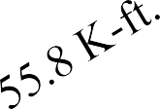
8 K
5 K
10 K/ft.
Solution:
A
C
₄′
₃′
B
₃′
₂′
D
∑ M_{A} = 0
=> 10 x 4 x 2 + 8 x 7 + 5 x 12 - R
R_{A} = 33.4 K
33.4 K 0.66′
0 K
R_{C} = 19.6 K
C
x 10 = 0
5 K
=> R = 19.6 K
C
6.6 K
14.6 K
3.34′
SFD
53.3 K-ft.
33.8 K-ft.
0 K-ft.
10 K-ft.
BMD

Slide 120
Problem-29: Find the SFD (Shear Force Diagram) & BMD (Bending Moment Diagram) of the following beam.
50 K
150 K-ft.
2 K/ft.
A
E
₄′ ₄′
₄′
D
₄′
B
C

Slide 121
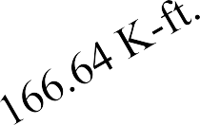

50 K
150 K-ft.
2 K/ft.
Solution:
A
E
₄′
B
₄′
₄′
D
₄′
C
∑ M_{A} = 0
=> 50 x 4 – 150 + 2 x 8 x 12 - R
=> R_{D} = 20.17 K
R_{A} = 45.83 K
R_{D} = 20.17 K
D
x 12 = 0
45.83 K
8 K
0 K
4.17 K
12.17 K
SFD
183.32 K-ft.
0 K-ft.
16 K-ft.
BMD

Slide 122
Problem-30: Find the SFD (Shear Force Diagram) & BMD (Bending Moment Diagram) of the following beam.
B
C
10 K
10′
A
D
15′

Slide 123
∑ F_{x} = 0
=>𝐻_{𝐴} = 𝐻_{𝐷} = 10/2 = 5 K
∑ M_{A} = 0
=> 10 x 10 –R_{D} x 15 = 0
=> R_{D} = 6.67 K
10 K
Solution:
B
C
B
C
10 K
10′
A
D
A
D
25 K-ft.
5 K
5 K
6.67 K
15′
B
5 K
5 K
15
′
C
10 K
6.67 K
25 K-ft.
6.67 K
6.67 K
6.67 K
0 K
25 K-ft.
0 K-ft.
6.67 K
0 K
0 K
25 K-ft.
0 K-ft.
0 K
6.67 K
25 K-ft.
0 K-ft.
0 K
6.67 K
5 K ^{B}
C
5 K
0 K
BMD
AFD
SFD
25 K-ft.
5 K
SFD
BMD
AFD
(+)
0 K-ft.
25 K-ft.
10 K
0 K
SFD
25 K-ft.
5 K
(-)
5 K
0 K
0 K-ft.
0 K
6.67 K
BMD
5 K
A
6.67 K
10 K
0 K
0 K-ft.
6.67 K
0 K
D
0 K
(-)
6.67 K
AFD

Slide 124
Problem-31: Find the SFD (Shear Force Diagram) & BMD (Bending Moment Diagram) of the following beam.
B
C
10 K
E
F
10′
A
D
15′

Slide 125
∑ F_{x} = 0
=>𝐻_{𝐴} = 𝐻_{𝐷} = 10/2 = 5 K Assume, 𝐵𝑀_{𝐸} = 𝐵𝑀_{𝐹} = 0
∑ M_{E} = 0 [Considering AE part only]
=> 5 x 5 –M_{A} = 0 => M_{A} = 25 K
B
E
C F
25 K-ft.
5 K ^{D}
3.33 K
B
C
10 K
10 K
Solution:
E
F
D
10′
A
5 K
25 K-ft.
A
3.33 K
25 K-ft.
B
5 K
∑ M_{A} = 0
=> - 25 - 25 + 10 x 10 - 𝑉_{𝐷} x 15 = 0
=> V_{D} = 3.33 K; V_{A} = - 3.33 K
15′
15′
C
10 K
5 K
25 K-ft.
3.33 K
3.33 K
3.33 K
0 K
25 K-ft.
0 K-ft.
3.33 K
0 K
0 K
3.33 K
25 K-ft.
0 K-ft.
0 K
25 K-ft.
0 K-ft.
5 K ^{B}
0 K
3.33 K 5 K
B
0 K
SFD
BMD
AFD
SFD
25 K-ft.
SFD
BMD
AFD
(+)
25 K-ft.
0 K-ft.
25 K-ft.
25 K-ft.
(-)
25 K-ft.
5 K
5 K
0 K
0 K-ft.
25 K-ft.
0 K
3.33 K
BMD
A
10 K
0 K
10 K
0 K
0 K-ft.
25 K-ft.
3.33 K
0 K
A
5 K
5 K
0 K
(-)
3.33 K
AFD
3.33 K

Slide 126

Problem-32: Find the SFD (Shear Force Diagram) & BMD (Bending Moment Diagram) of the following beam.
Link
2 K/ft.
8 K-ft.
B
C
D
A
₄′
₄′
₄′

Slide 127

∑ M_{B} = 0 => 8 - R_{D} x 8 = 0 => R_{D} = 1 K
Solution:
8 K-ft.
2 K/ft.
8 K-ft.
D
B
₄′
₄′
B
C
D
A
C
4
′
4
′
4
′
R_{B} = 1 K
R_{D} = 1 K
R_{D} = 10.5 K
2 K/ft.
0 K
1 K
0 K
1 K
12 K-ft.
B
A
₄′
R_{A} = 7 K
R_{B} = 1 K
SFD
7 K
0 K
 |  | 0.5′
3.5′ SFD |  | 0.25
 | BMD
0 K
1 K
4 K-ft.
0 K-ft.
0 K-ft.
K-ft.
4 K-ft.
0 K-ft.
12 K-ft.
0 K-ft.
BMD

Slide 128
Shear Force and Bending moment diagram
Week 14
Pages 129-174

Slide 129
Problem-33: Find the SFD (Shear Force Diagram) & BMD (Bending Moment Diagram) of the following beam.
400 lb/ft.
600 lb
200 lb/ft.
A
B
₁′ C
₂′
₄′
D
₂′
E

Slide 130
400 lb/ft.
600 lb
Solution:
200 lb/ft.
∑ M_{B} = 0
=> - 400 x 2 x 1 + 600 x 1 +
200 x 6 x 4 - R_{D} x 5 = 0
=> R_{D} = 920 lb
A
B
₂′
₁′ C ₄′
D
₂′
E
R_{B} = 1680 lb
R_{D} = 920 lb
880 lb
400 lb
2.6′
0 lb
0.5′ _{0 lb}
520 lb
800 lb
1.4′
SFD
276 lb-ft.
80 lb-ft.
0 lb-ft.
0 lb-ft.
400 lb-ft.
800 lb-ft.
BMD

Slide 131
Problem-34: Find the SFD (Shear Force Diagram) & BMD (Bending Moment Diagram) of the following beam.
40 lb
8 lb
2 lb/ft.
C
₂′
A
₄′
₄′
D
B

Slide 132
40 lb
8 lb
2 lb/ft.
∑ M_{B} = 0
=> 2 x 8 x 4 + 40 x 4 + 8 x 10 -
R_{C} x 8 = 0
=> R_{C} = 38 lb
Solution:
C
A
₄′
₄′
₂′
D
B
R_{A} = 26 lb
R_{C} = 38 lb
26 lb
18 lb
8 lb
0 lb
0 lb
22 lb
30 lb
SFD
80 lb-ft.
88 lb-ft.
0 lb-ft.
0 lb-ft.
16 lb-ft.
BMD

Slide 133
Problem-35: Find the SFD (Shear Force Diagram) & BMD (Bending Moment Diagram) of the following beam.
2 lb/ft.
B
C
A
₆′
₆′
₅′
D

Slide 134
2 lb/ft.
B
C
∑ M_{D} = 0
=> - 2 x 6 x 3 + M_{D} = 0
=>M_{D}= 36 lb-ft.
2 lb/ft.
Solution:
A
₆′
₆′
₅′
36 lb-ft.
D
B
36 lb-ft.
C
A
R_{D} = 12 lb
₆′
₆′
12 lb
12 lb
36 lb-ft.
0 lb-ft.
0 lb
0 lb
0 K
0 K
B
12 lb
SFD
BMD
AFD
36 lb-ft. ₅′
SFD
36 lb-ft.
(-)
D
0 K
36 lb-ft.
0 lb-ft..
12 K
0 K
0 lb-ft.
0 lb-ft.
12 lb
36 lb-ft.
BMD

Slide 135
Problem-36: Find the SFD (Shear Force Diagram) & BMD (Bending Moment Diagram) of the following beam.
10 lb
1 lb/ft.
1 lb/ft.
B C D
2.5′
A
₅′
₅′
E
2.5′

Slide 136
10 lb
1 lb/ft.
1 lb/ft.
Solution:
∑ M = 0
B C D
2.5′
B
=> 1 x 5 x 2.5 + 10 x 7.5 + 1 x
5 x 12.5 - R_{E} x 15 = 0
=> R_{E} = 10 lb
A
₅′
₅′
E
2.5′
R_{A} = 10 lb
R_{E} = 10 lb
10 lb
5 lb
0 lb
0 lb
5 lb
10 lb
SFD
50 lb-ft.
37.5 lb-ft.
37.5 lb-ft.
0 lb-ft.
0 lb-ft.
BMD

Slide 137
Problem-37: Find the SFD (Shear Force Diagram) & BMD (Bending Moment Diagram) of the following beam.
10 lb
Link
20 lb-ft.
A
C
D
₂′
₃′
₃′ ₃′
E
B

Slide 138
=> 10 x 2 - R_{C} x 5 = 0
∑ M_{A} = 0
=> R_{C} = 4 lb
10 lb
10 lb
Solution:
C
A
20 lb-ft.
₂′
B
₃′
A
C
D
₂′ _{B}
₃′
₃′
₃′
E
R_{A} = 6 lb
R_{C} = 4 lb
R_{C} = 4 K
20 lb-ft.
D
E
6 lb
C
₃′
R_{E} = 4 lb
44 K-ft.
0 lb
0 lb
₃′
4 lb
SFD
0 lb
4 lb
0 lb
4 lb
12 lb-ft.
SFD
0 lb-ft.
0 lb-ft.
0 lb-ft.
0 lb-ft.
12 lb-ft.
32 lb-ft.
44 lb-ft.
BMD
BMD

Slide 139
Problem-38: Find the SFD (Shear Force Diagram) & BMD (Bending Moment Diagram) of the following beam.
100 k
12 k/ft.
B
C
A
₈′
₈′
D
₆′
12′

Slide 140
Solution:
12 K/ft.
100 k
∑ M_{C} = 0
C
D
A
2
₈′
B
₈′
₆′
12′
=> - 100 x 8 + 0.5 x 6 x12 x x 6 + 0.5 x
3
12 x 12 x (6 + ¹ x 12) - R
x 18 = 0
3
=> R_{D} = 3.55 K
D
R_{C} = 204.45 K
R_{D} = 3.55 K
104.45 K
68.45 K
0 K
0 K
3.55 K
100 K
SFD
- 3.55 x 12 + 0.5 x 12 x 12 x ¹ x
12 = 245.4 K-ft.
3
0 K-ft.
0 K-ft.
800 K-ft.
BMD

Slide 141

Problem-39: Find the SFD (Shear Force Diagram) & BMD (Bending Moment Diagram) of the following beam.
6 k/ft.
9 k
Link
8 k/ft.
A
C
D
₆′
_{B 2}′
₄′

Slide 142
6 k/ft.
9 k
Solution:
8 k/ft.
C
∑ M_{C} = 0
A
₄′
D
₆′
_{B 2}′
=> 0.5 x 6 x 6 x ¹ x 6 + 9 x 6 + 8 x 4 x 10 -
3
R_{D} x 12 = 0
R_{A} = 24.83 K
R_{D} = 34.17 K
=> R_{D} = 34.17 K
24.83 K
0 K
6.83 K
0 K
2.17 K
34.17 K
SFD
76.98 K-ft.
72.64 K-ft.
0 K-ft.
0 K-ft.
BMD

Slide 143
Problem-40: Find the SFD (Shear Force Diagram) & BMD (Bending Moment Diagram) of the following beam.
3 k
2 k
A
C
10′
B
10′

Slide 144
Solution: | 70 K-ft. | A | 10′ | 3 k B | 10′ | 2 k C | ∑ M_{A} = 0 => M_{A} = 3 x 10 + 2 x 20 = 70 k-ft. ∑ F_{y} = 0
 |  | R_{A} = 5 K |  |  |  |  | => R_{A} = 3 K + 2 K = 5 K
5 K _{2 K} 0 K 0 K SFD 0 K-ft. 0 K-ft. 20 K-ft. 70 K-ft. BMD

Slide 145
Problem-41: Find the SFD (Shear Force Diagram) & BMD (Bending Moment Diagram) of the following beam.
6 k/ft.
B
A
₆′
C
₆′

Slide 146
Solution:
w k/ft.
6 k/ft.
∑ M_{A} = 0
=> 0.5 x 6 x 6 x
X
B
A
₆′
C
1
3
₆′
x 6 - R_{C} x 12 = 0
6 - X
=> R = 3 K
R = 3 K
C
R = 15 K
C
A
15 K
0 K
2.45′
0 K
3.55′
3 K
6 ₌ 𝑤
SFD
V = 15 - ¹ . [6 + (6-x)] . x
x
2
6 (6−𝑥)
=> w = (6 - x)
3 x 8.45 + 0.
1
5 x 2.45 x 2.45 x x 2.45
3
2
=> 0 = 15 - ^{12 𝑥 − 𝑥}
= 22.89 K-ft.
2
18 K-ft.
=> x = 3.55′
0 K-ft.
0 K-ft.
BMD

Slide 147
Problem-42: Find the SFD (Shear Force Diagram) & BMD (Bending Moment Diagram) of the following beam.
2 lb/ft.
C
A
₆′
B
₆′
D

Slide 148
2 lb/ft.
∑ M_{D} = 0
=> - 2 x 6 x 3 + 2 x 6 x 3 + M_{D} = 0
=>M_{D}= 0 lb-ft.
Solution:
A
₆′
B
₆′
C
₅′
0 lb-ft.
D
2 lb/ft.
0 lb-ft.
A
C
R_{D} = 24 lb
₆′
B
24 lb
₆′
24 lb
0 lb-ft.
12 lb
0 K
0 K
B
0 lb
0 lb
₅′
0 lb-ft.
SFD
BMD
AFD
12 lb
0 lb-ft.
(-)
SFD
D
0 K
0 lb-ft..
24 K
0 K
0 lb-ft.
0 lb-ft.
36 lb-ft.
24 lb
BMD

Slide 149
Problem-43: Find the SFD (Shear Force Diagram) & BMD (Bending Moment Diagram) of the following beam.
10 K
10 K
2 k/ft.
A
B
₅′
₅′
₅′

Slide 150
10 K
10 K
2 k/ft.
Solution:
A
B
₅′
₅′
₅′
∑ M_{A} = 0
=> 10 x 5 + 2 x 5 x 7.5 + 10 x 10 -
R_{B} x 15 = 0
=> R_{B} = 15 K
R_{A} = 15 K
R_{B} = 15 K
15 K
0 K
15 K
SFD
48.75 K-ft.
30 K-ft.
30 K-ft.
0 K-ft.
BMD

Slide 151
Problem-44: Find the SFD (Shear Force Diagram) & BMD (Bending Moment Diagram) of the following beam.
6 K
5 K/ft.
6 K-ft.
A
B
C
₆′
₅′
₅′

Slide 152
6 K
5 K/ft.
Solution:
6 K-ft.
A
B
C
₆′
₅′
₅′
∑ M_{A} = 0
=> 6 + 6 x 6 + 5 x 5 x 13.5 - R
R_{A} = 3.5 K
R_{B} = 34.5 K
B
x 11 = 0
25 K
=> R = 34.5 K
B
0 K
0 K
3.5 K
9.5 K
SFD
0 K-ft.
15 K-ft.
21 K-ft.
62.5 K-ft.
BMD

Slide 153
Problem-45: Find the SFD (Shear Force Diagram) & BMD (Bending Moment Diagram) of the following beam ABC.
10 K
₂′
A
₁′
C
₅′
B
₅′

Slide 154
10 K
10 K
₂′
Solution:
20 K-ft.
A
C
A
₁′
C
₅′
B
₅′
₅′
B
₅′
R_{A} = 3 K
R_{C} = 7 K
3 K
0 K
0 K
7 K
SFD
∑ M_{B} = 0
=> M_{B} = 10 x 2 = 20 k-ft. [Clockwise]
35 K-ft.
15 K-ft.
∑ M = 0
A
=> 20 + 10 x 5 - R_{C} x 10 = 0
=> R_{C} = 7 K
0 K-ft.
0 K-ft.
BMD

Slide 155
Problem-46: Find the SFD (Shear Force Diagram) & BMD (Bending Moment Diagram) of the following beam ABC.
100 K
Link
1
B
1
A
D
15′
₆′
₆′
C

Slide 156

1
x 100 = 50 2 K
50 2 K
1²+1²
100 K
Solution:
¹ x 100 = 50 2 K 1
A
₆′
1²+1²
1
15′
B
C
A
D
15′ B
₆′ ₆′
C
R_{A} = 28.28 K
R_{C} = 99 K
∑ M_{A} = 0
=> 50 2 x 21 - R_{C} x 15 = 0
=> R_{C} = 99 K
50 2 K
28.28 K
 | SFD
 |  | 424.26 K-ft
 | BMD
0 K
0 K
0 K
D
C
SFD
BMD
0 K
0 K
0 K-ft.
0 K-ft.
.
0 K-ft.
0 K-ft.

Slide 157
Problem-47: Find the SFD (Shear Force Diagram) & BMD (Bending Moment Diagram) of the following beam ABC.
10 K
C
B
₈′
10′
A

Slide 158
10 K
∑ M_{A} = 0
=>M_{A}= 10 x 8 lb-ft. = 80 lb-ft.
Solution:
B
₈′
C
10′
10 K
A
80 lb-ft.
80 lb-ft.
B
10 lb
C
₈′
R_{A} = 10 lb
10 lb
10 lb
0 lb-ft.
0 K
0 K
B
0 lb
0 lb
SFD
BMD
AFD
12 lb
80 lb-ft. _{10′}
80 lb-ft.
(-)
SFD
A
0 K
0 lb-ft..
80 lb-ft.
10 K
0 K
0 lb-ft.
0 lb-ft.
80 lb-ft.
10 lb
BMD

Slide 159

Problem-48: Find the SFD (Shear Force Diagram) & BMD (Bending Moment Diagram) of the following beam ABC.
6 K/ft.
2 K/ft.
6 K
B
E
A
₄′
₅′
C 2′ D 2′

Slide 160
6 K/ft.
2 K/ft.
6 K
Solution:
B
E
A
₄′
₅′
C
2′ D 2′
∑ M_{B} = 0
=> - 0.5 x 4 x 6 x ¹ x 4 + 2 x 5 x 2.5 + 6 x
R = 5.67 K
7 - R_{E} x 9 = 0
=> R_{E} = 5.67 K
3
R = 22.33 K
E
B
10.33 K
0.33 K
0 K
0 K
5.67 K
12 K
SFD
10.65 K-ft.
11.34 K-ft.
0 K-ft.
0 K-ft.
16 K-ft.
BMD

Slide 161
Problem-49: Find the SFD (Shear Force Diagram) & BMD (Bending Moment Diagram) of the following beam ABC.
50 K
200 K-ft.
25 K
10 K/ft.
A
B
₁′
₂′
C
2.5′
1.5′

Slide 162
50 K
200 K-ft.
25 K
10 K/ft.
Solution:
A
B
₁′
₂′
C
2.5′
1.5′
∑ M_{A} = 0
=> 10 x 2.5 x 1.25 + 200 + 50 x 4 +
25 x 7 - R_{B} x 5 = 0
=> R_{B} = 120 K
R = 21.25 K
R_{B} = 121.25 K
A
25 K
0 K
21.25 K
0 K
46.25 K
96.25 K
SFD
46.25 K-ft.
0 K-ft.
0 K-ft.
84.375 K-ft.
50 K-ft.
153.75 K-ft.
BMD

Slide 163
Problem-50: Find the SFD (Shear Force Diagram) & BMD (Bending Moment Diagram) of the following beam ABC.
10 K
4 K
A
B
C
D
E
F
10′
10′
10′
₅′
₅′
10′
20′

Slide 164
10 K
4 K
A
B
C
D
E
F
Solution:
₅′
10′
10′
10′
₅′
10′
20′
10 K
2 K
4 K
2 K
A
B
C D
₅′ ₅′
D
E
F
₅′
C
₅′
10′
10′
20′
R_{A} = 4.5 K
R_{B} = 7.5 K
R_{C} = 2 K R_{D} = 2 K
R_{F} = 0.5 K
R_{E} = 2.5 K
4.5 K
2 K
2 K
0 K
0.5 K
0 K
0 K
0 K
2 K
0 K
0 K
5.5 K
SFD
2 K
SFD
10 K-ft.
SFD
45 K-ft.
0 K-ft.
0 K-ft.
0 K-ft.
0 K-ft.
BMD
0 K-ft.
0 K-ft.
10 K-ft.
10 K-ft.
BMD
BMD

Slide 165
Problem-51: Find the SFD (Shear Force Diagram) & BMD (Bending Moment Diagram) of the following beam ABC.
10 K
10 K
2 K/ft.
A
B
C
D
E
F
25′
25′
25′
25′
25′
25′
25′

Slide 166

10 K
10 K
2 K/ft.
A
B
C
D
E
F
Solution:
25′
10 K
25′
25′
25′
25′
25′
25′
25 K
25 K
10 K
2 K/ft.
A
B
D
E
F
₅′
C
₅′
10′
10′
C
25′
D
10′
10′
R_{C} = 25 K
R_{D} = 25 K
R_{A} = 1.25 K
R_{B} = 36.25 K
R_{E} = 36.25 K
R_{F} = 1.25 K
11.25 K
25 K
25 K
0 K
1.25 K
0 K
0 K
0 K
0 K
0 K
1.25 K
25 K
11.25 K
SFD
25 K
SFD
312.5 K-ft.
SFD
0 K-ft.
0 K-ft.
0 K-ft.
0 K-ft.
BMD
0 K-ft.
0 K-ft.
12.5 K-ft.
125 K-ft.
12.5 K-ft.
BMD
BMD

Slide 167
Problem-52: Find the SFD (Shear Force Diagram) & BMD (Bending Moment Diagram) of the following beam.
4 K/ft.
15 K-ft.
B
C
D
A
₃′
₅′
₅′

Slide 168
Solution:
4 K/ft.
15 K-ft.
B
C
D
A
₃′
₅′
₅′
∑ M_{B} = 0
=> - 4 x 3 x 1.5 + 15 - R_{D} x 10 = 0
=> R_{D} = - 0.3 K
R_{B} = 12.3 K
R_{D} = 0.3 K
0.3 K
0 K
0 K
12 K
SFD
0 K-ft.
0 K-ft.
1.5 K-ft.
.
18 K-ft.
16.5 K-ft
BMD

Slide 169
Problem-53: Find the SFD (Shear Force Diagram) & BMD (Bending Moment Diagram) of the following beam.
2 K
1 K/ft.
A
B
₄′
₂′

Slide 170
Solution:
2 K
1 K/ft.
A
B
₄′
₂′
∑ M_{A} = 0
=> 1 x 6 x 3 + 2 x 4 - R_{B} x 6 = 0
=> R_{𝐵} = 4.33 K
R_{A} = 3.67 K
R_{B} = 4.33 K
3.67 K
0.33′
1.4 K
0 K
4.33 K
0 K
0.33 K
3.67′
2.33 K
SFD
6.73 K-ft.
6.68 K-ft.
0 K-ft.
0 K-ft.
BMD

Slide 171


Problem-54: Find the SFD (Shear Force Diagram) & BMD (Bending Moment Diagram) of the following beam.
3 K/ft.
50 K
10 K
2 K/ft.
Link
A
B
C
₆′
₈′
₄′
₄′ _{D 2}′
₂′
E

Slide 172
∑ M = 0 => - 0.5 x 6 x 3 x ¹ x 6 + 50 x 8 + 2 x 4 x 14 + 5 x 16 - R
C
x 12 = 0
=> R = 47.83 K
B
3
C
Solution:
3 K/ft.
50 K
10 K
50 K 2 K/ft. R
D
= 5 K
3 K/ft.
B
C
2 K/ft.
C
₄′ ₄′ _{D 2}′
10 K
A
₆′
₈′
₄′
₄′
D
B
A
E
6
′
8
′
2
′
R_{B} = 24.17 K
R_{C} = 47.83 K
13 K
A
B
15.17 K
5 K
0 K
₂′ ₂′
0 K
9 K
34.83 K
R = 5 K
R = 5 K
D
E
SFD
5 K
0 K
103.36 K-ft.
0 K
5 K
0 K-ft.
0 K-ft.
SFD
10 K-ft.
18 K-ft.
35.96 K-ft.
BMD
0 K-ft.
0 K-ft.
BMD

Slide 173
Problem-55: Find the SFD (Shear Force Diagram) & BMD (Bending Moment Diagram) of the following beam.
10 K 10 K
2 K/ft.
C
₅′
A
₅′
D
B
20′

Slide 174
∑ M_{A} = 0 => -10 x 10 – 10 x 5 + 2 x 20 x 10 - R_{D} x 20 = 0
=> R_{D} = 10.5 K
10 K 10 K
Solution:
2 K/ft.
C
₅′
A
₅′
D
B
20′
R_{C} = 47.5 K
R_{D} = 12.5 K
27.5 K
0 K
10 K
6.25′
0 K
12.5 K
13.75′
20 K
SFD
39.0625 K-ft.
0 K-ft.
0 K-ft.
50 K-ft.
150 K-ft.
BMD

Slide 175
Beam Deflection
Week 15
Pages 176-181

Slide 176
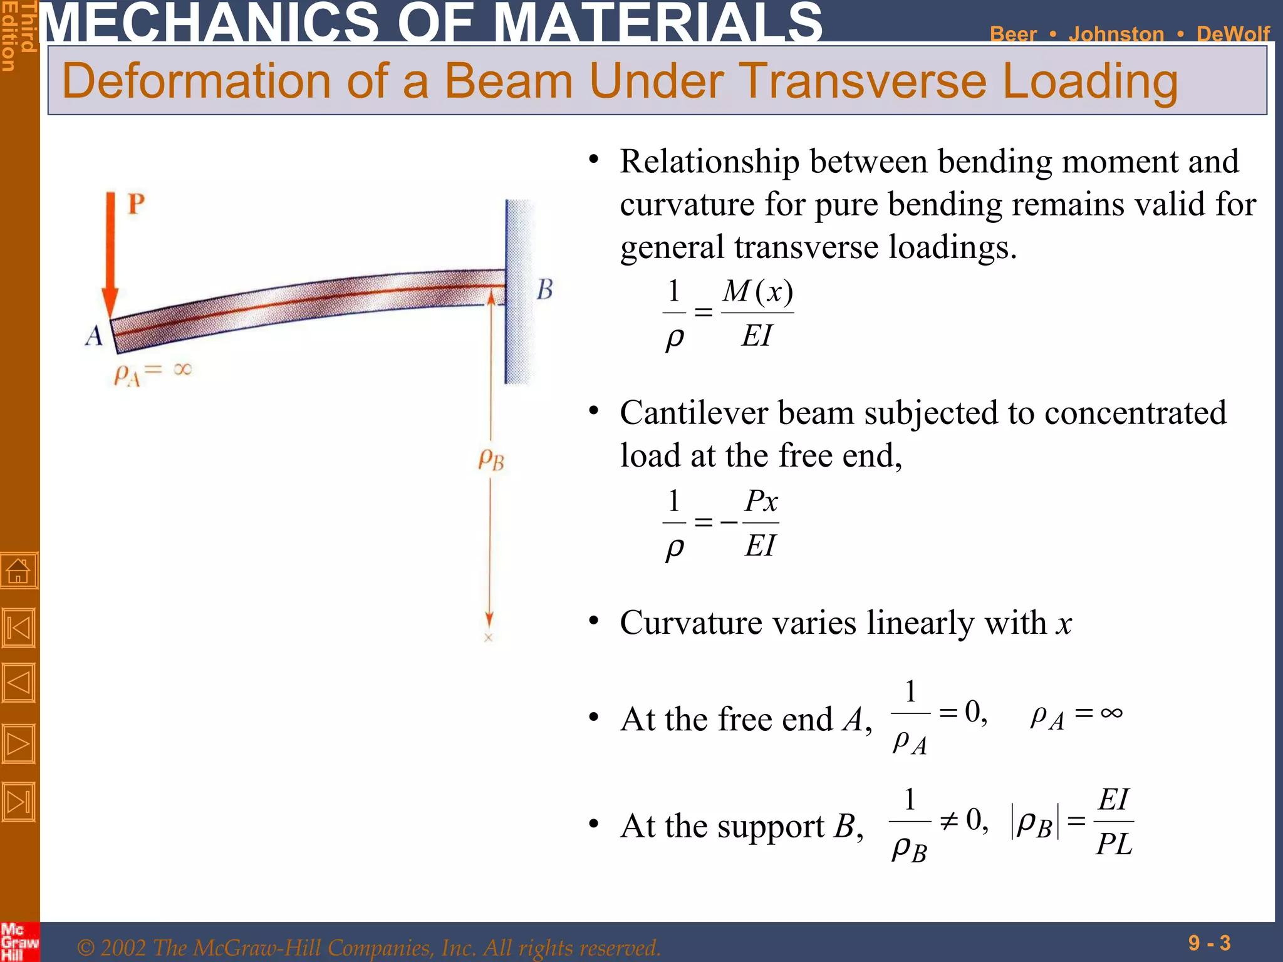

Slide 177
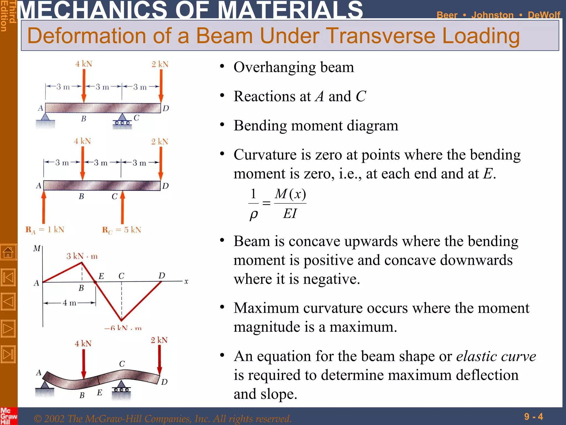

Slide 178
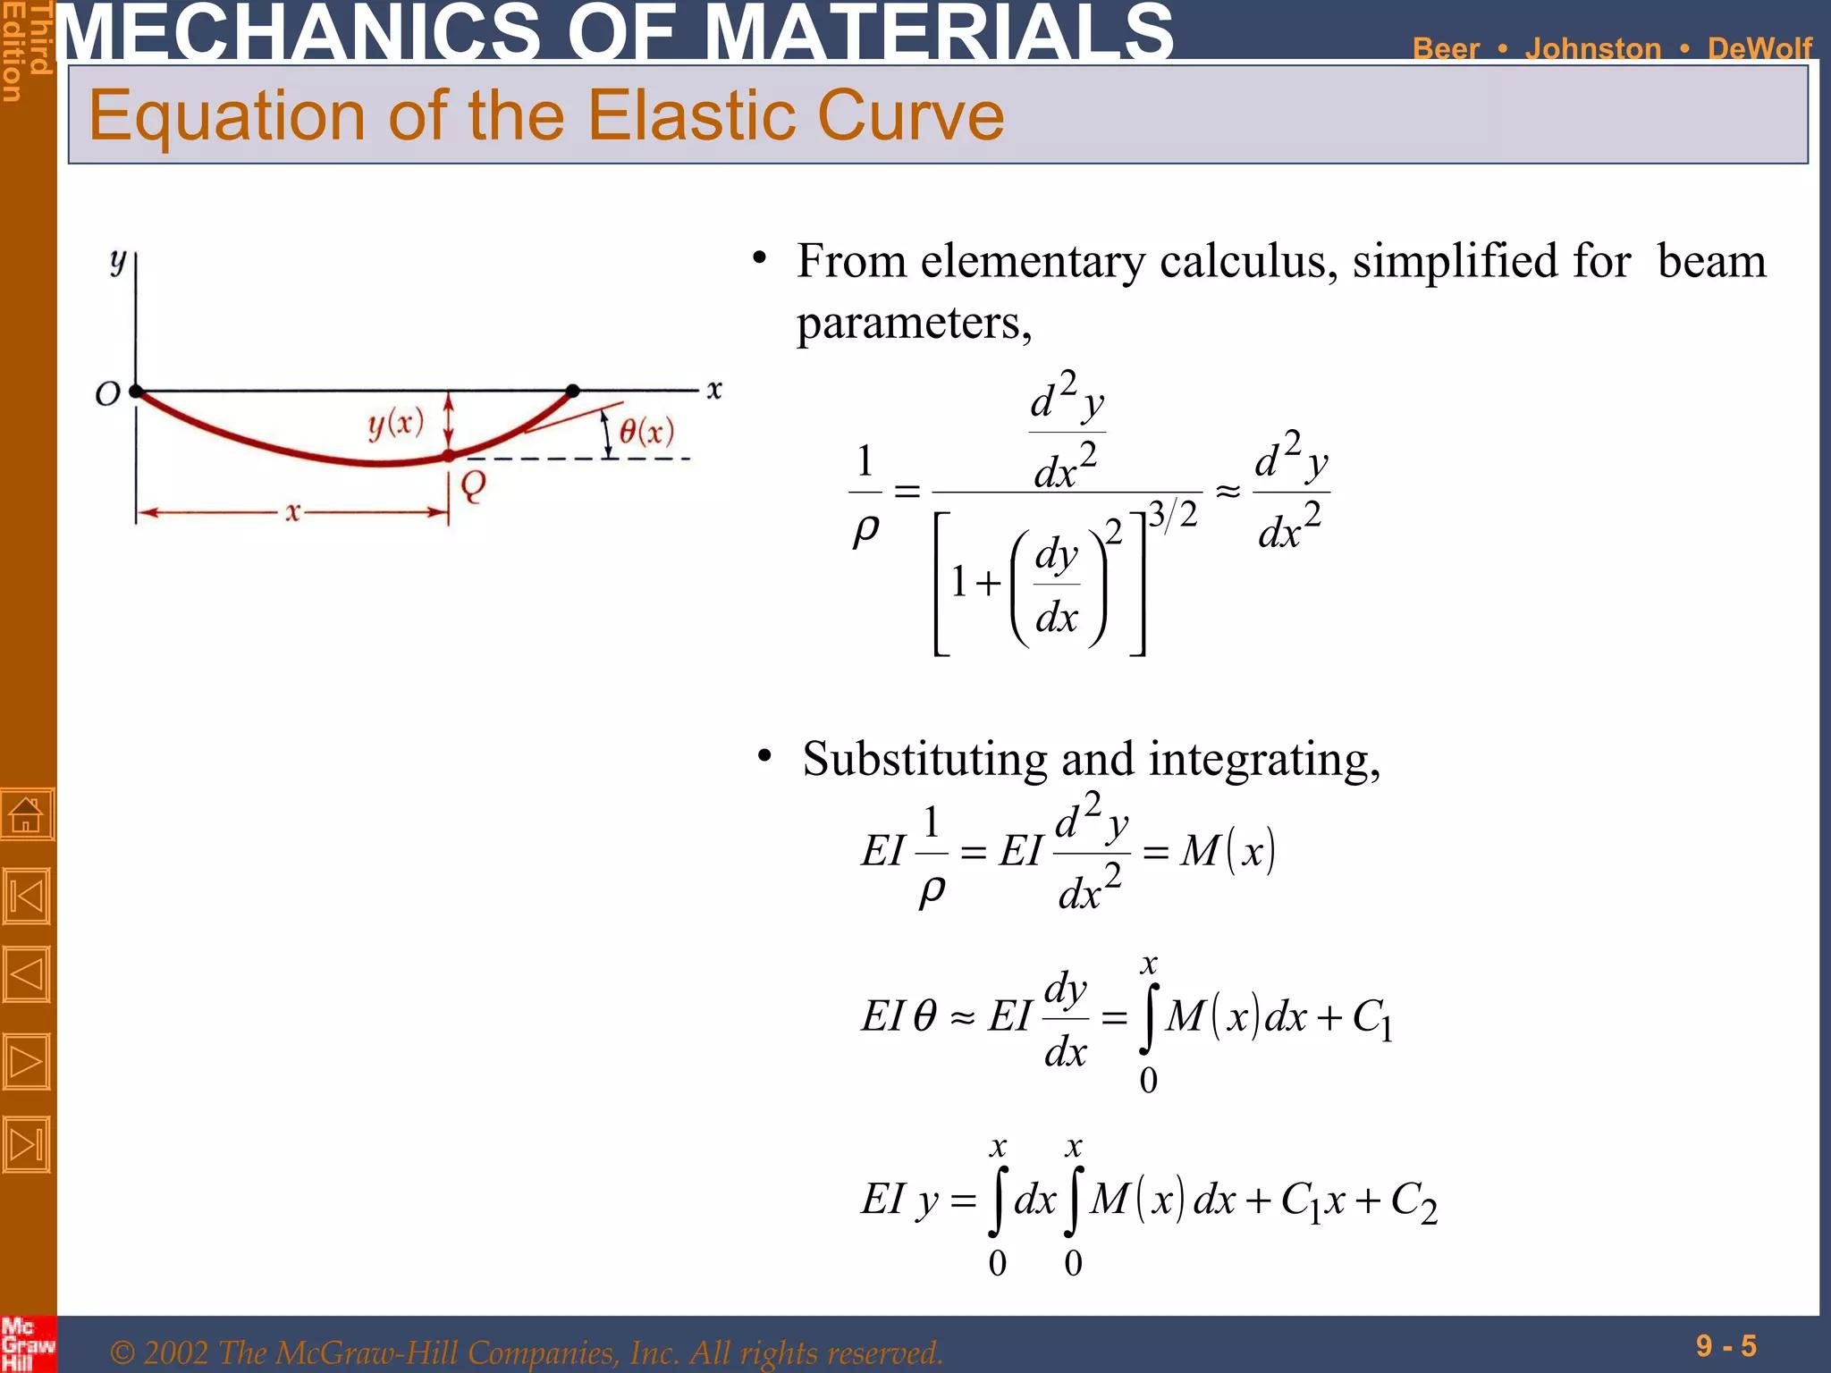

Slide 179
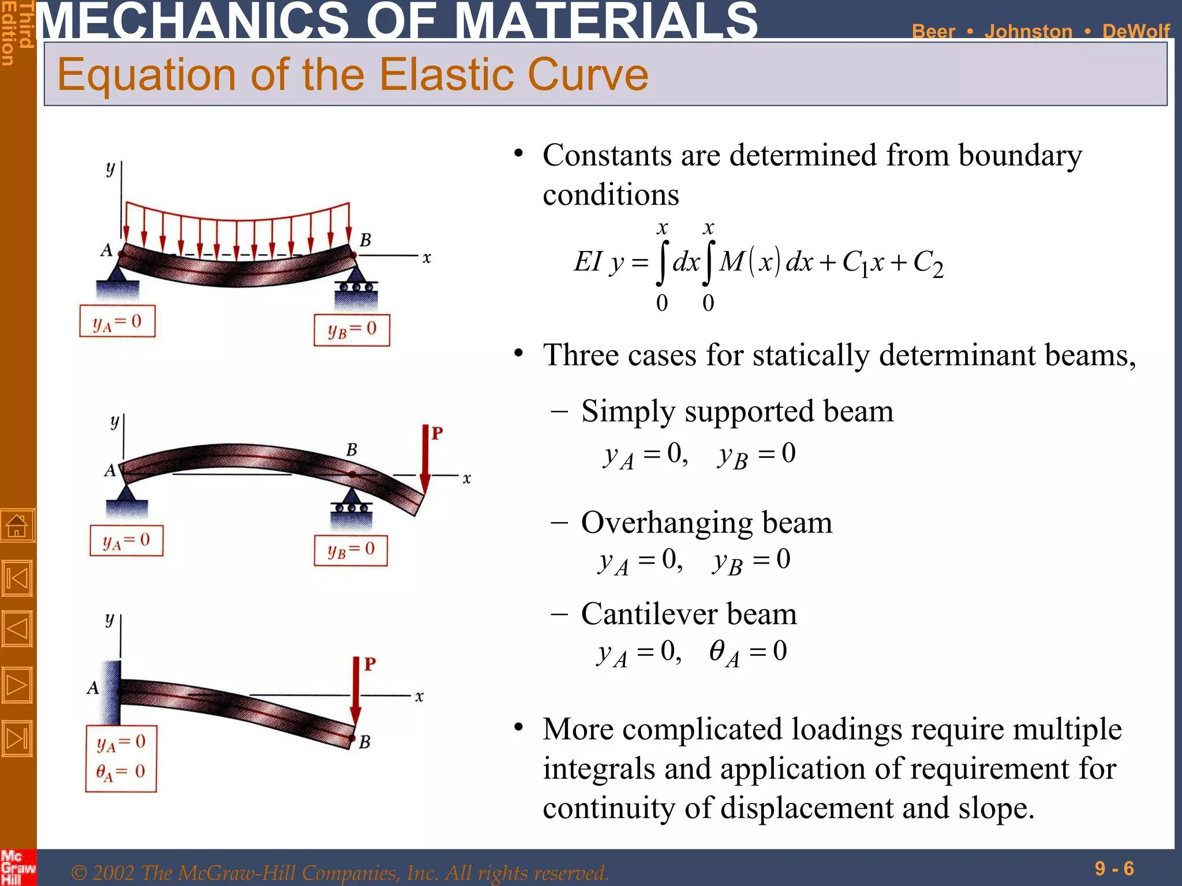

Slide 180
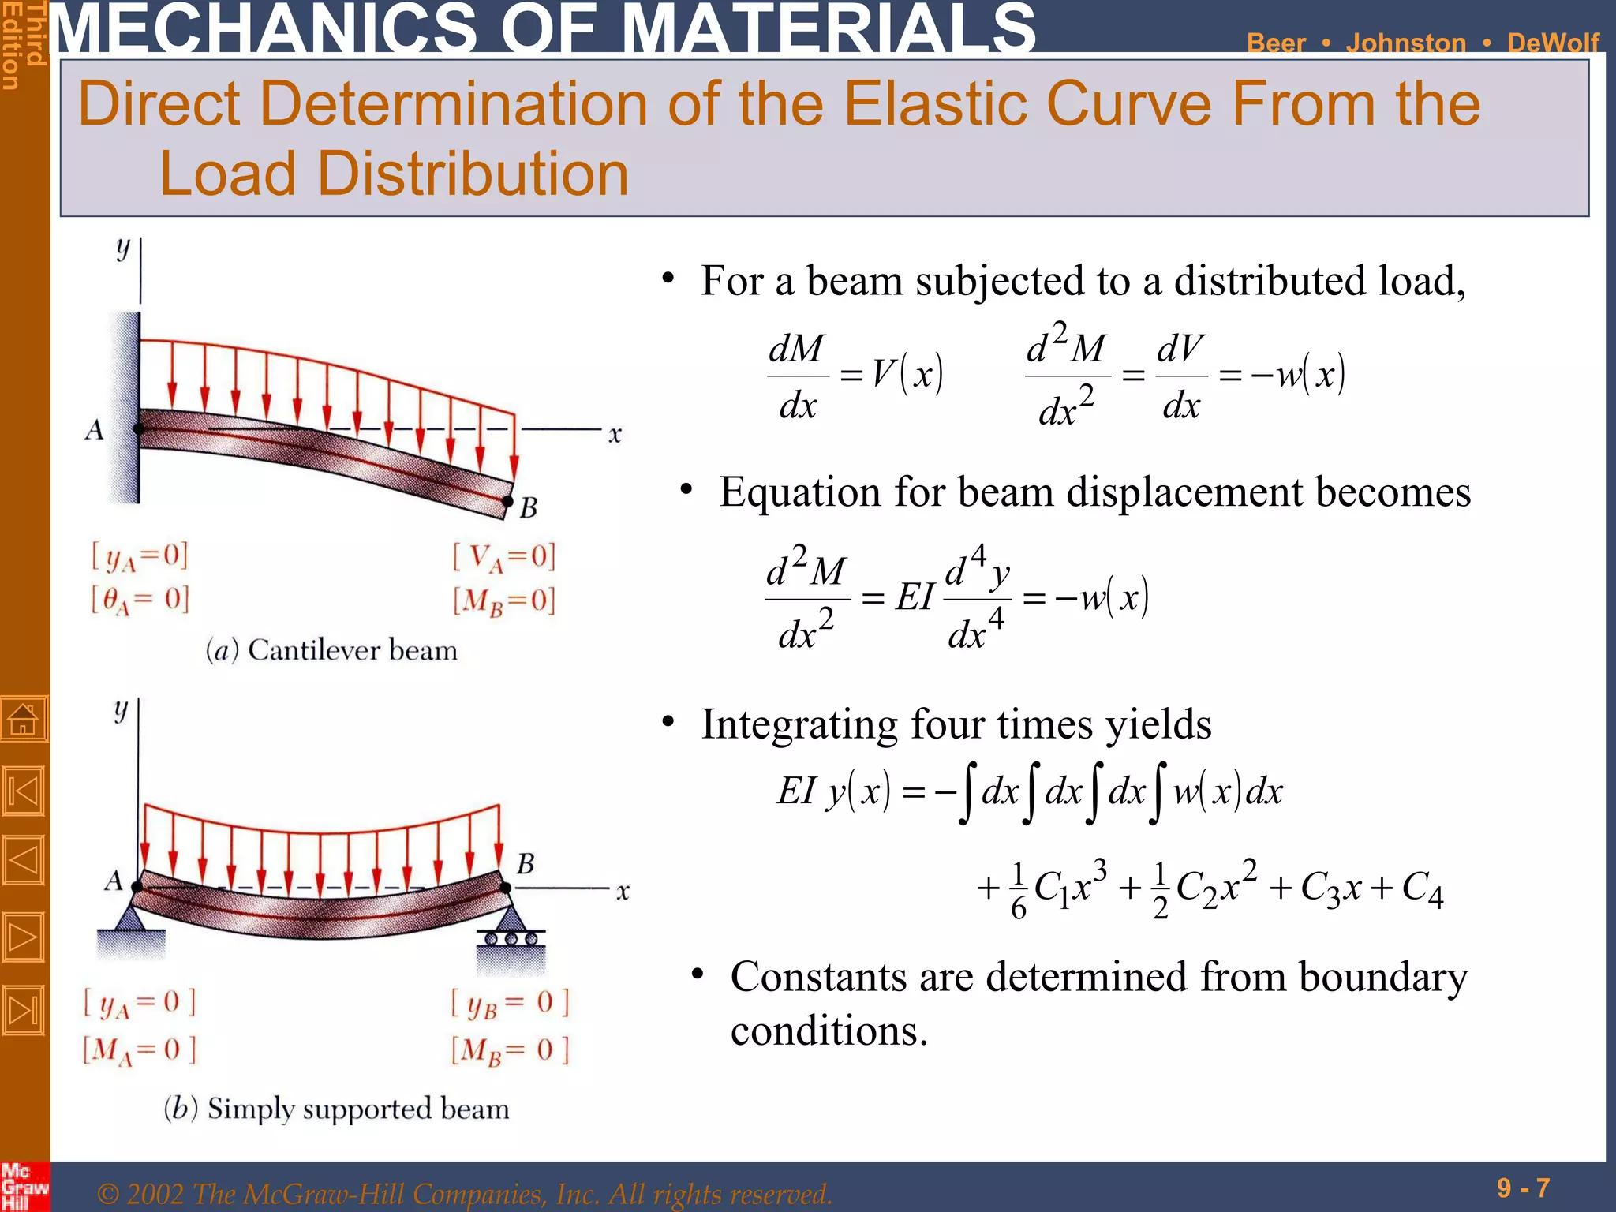

Slide 181
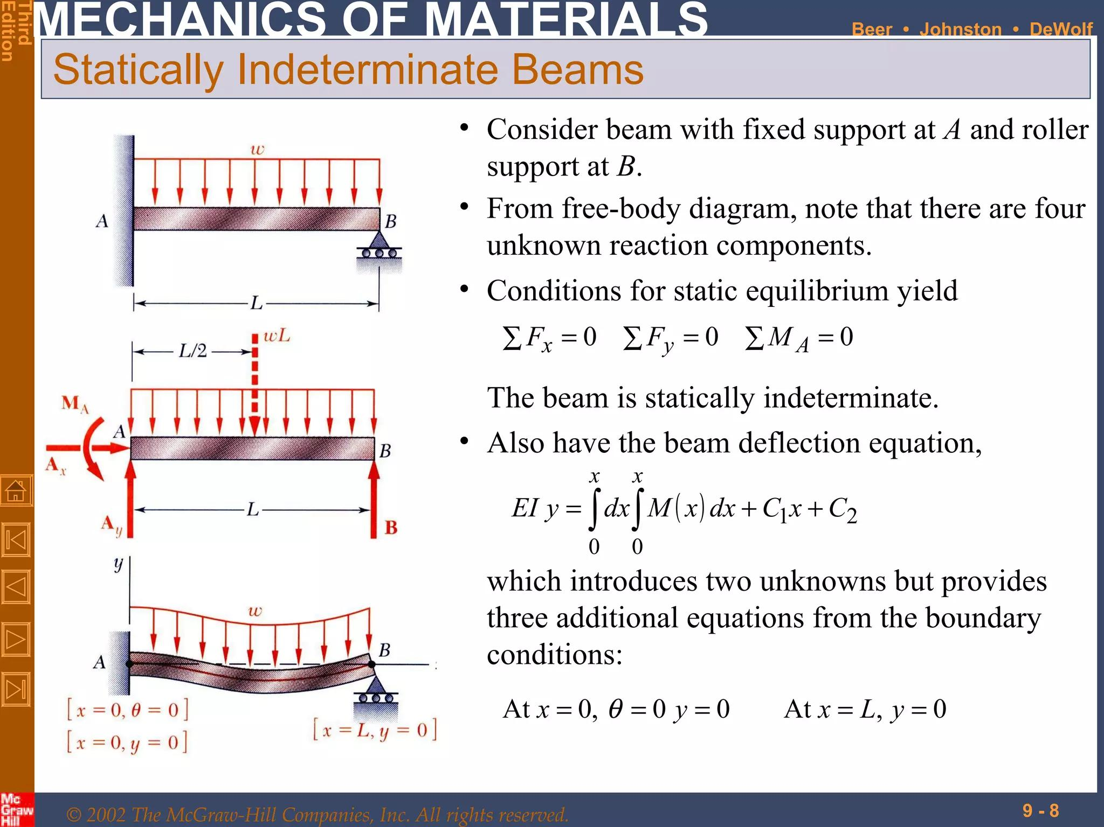

Slide 182
Beam Deflection Methods
(Double Integration and
Area Moment)
Week 16
Pages 183-204

Slide 183
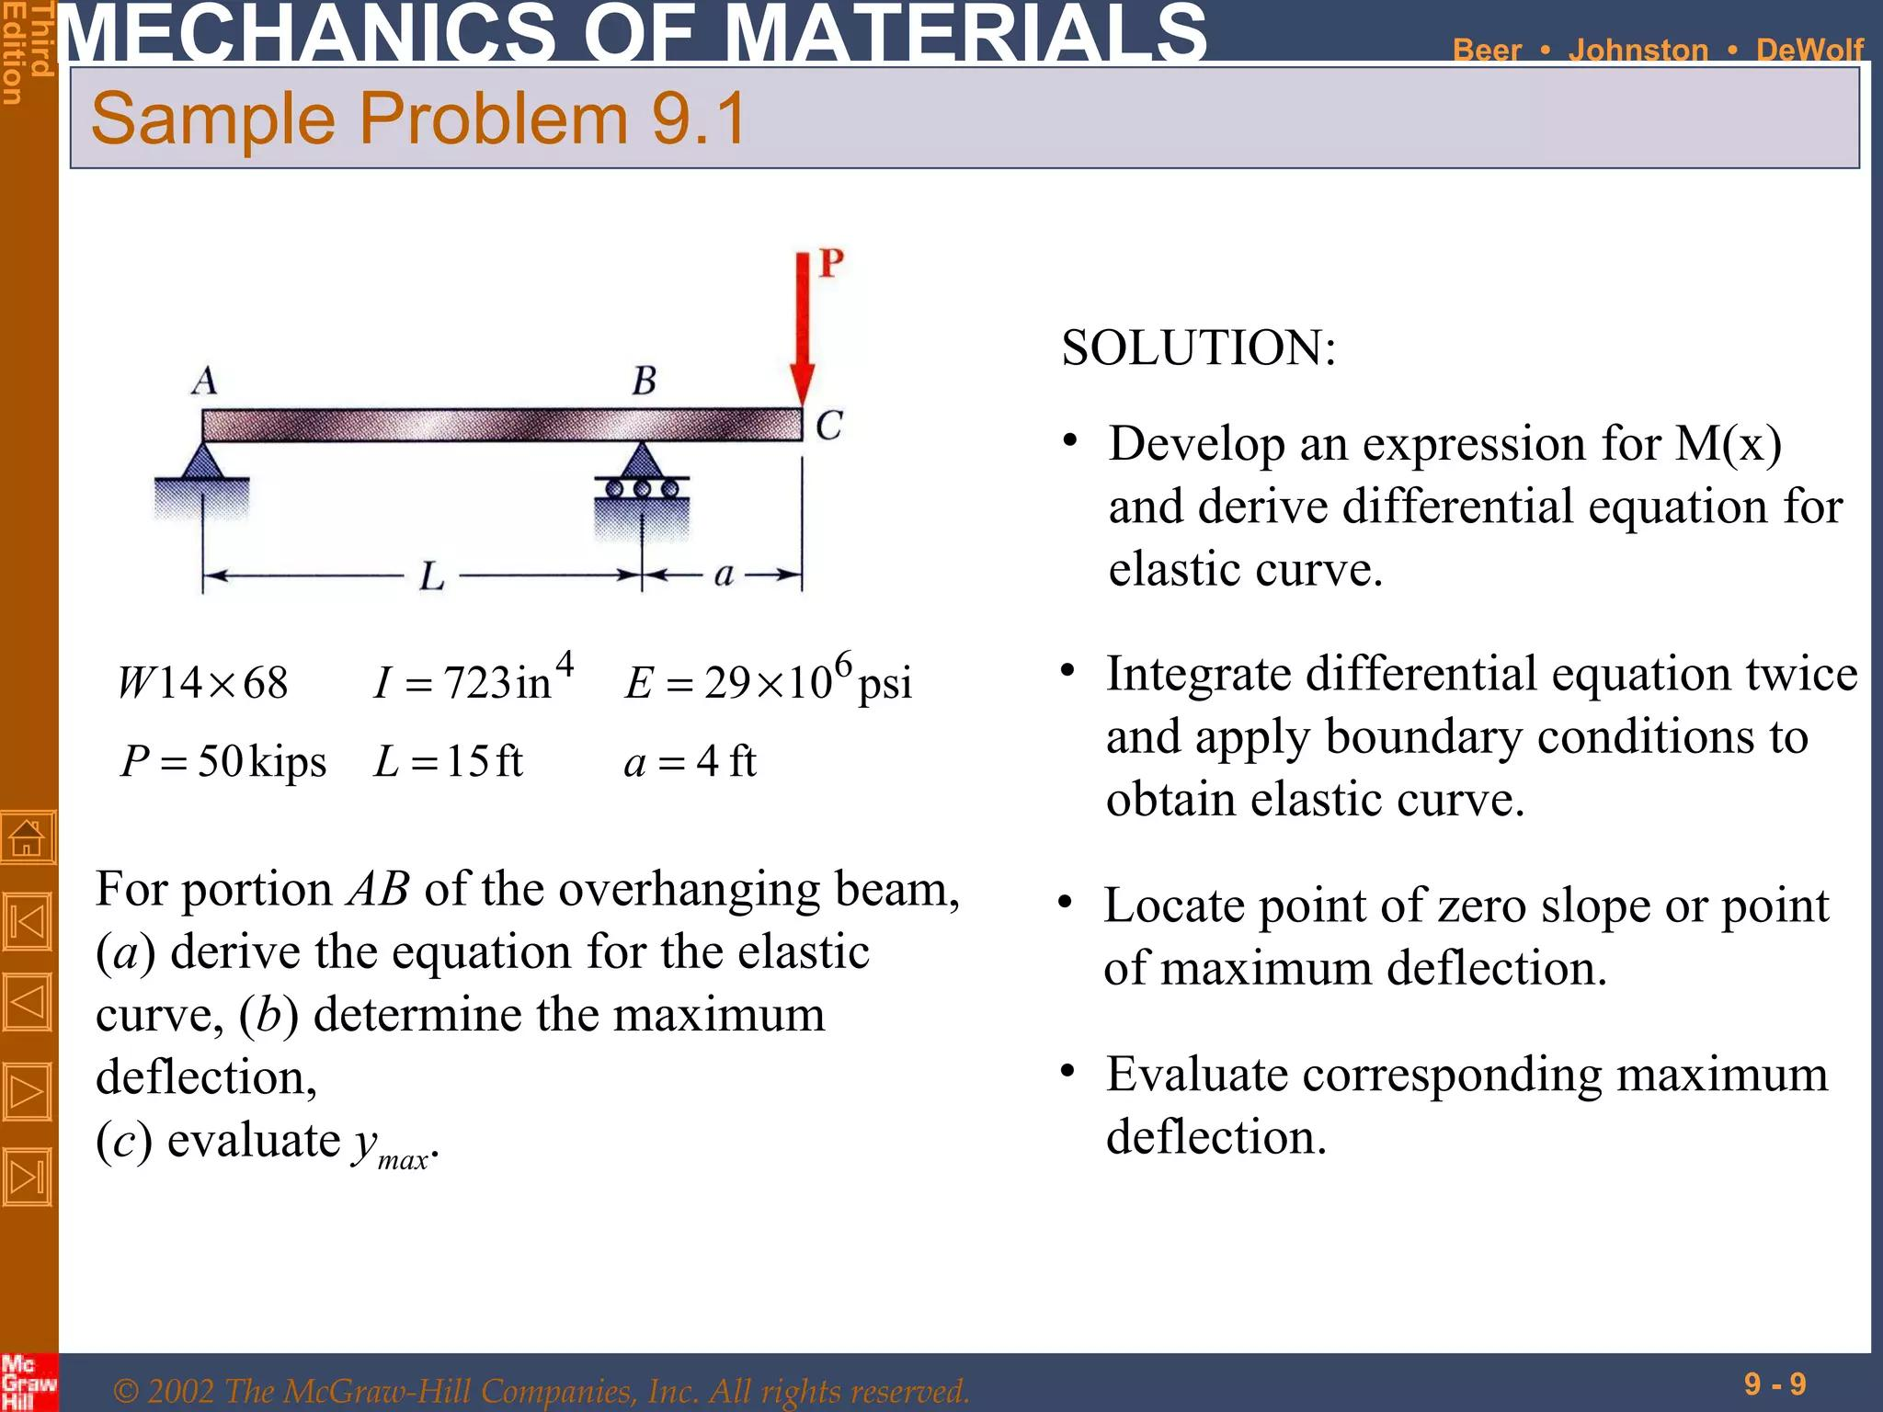

Slide 184
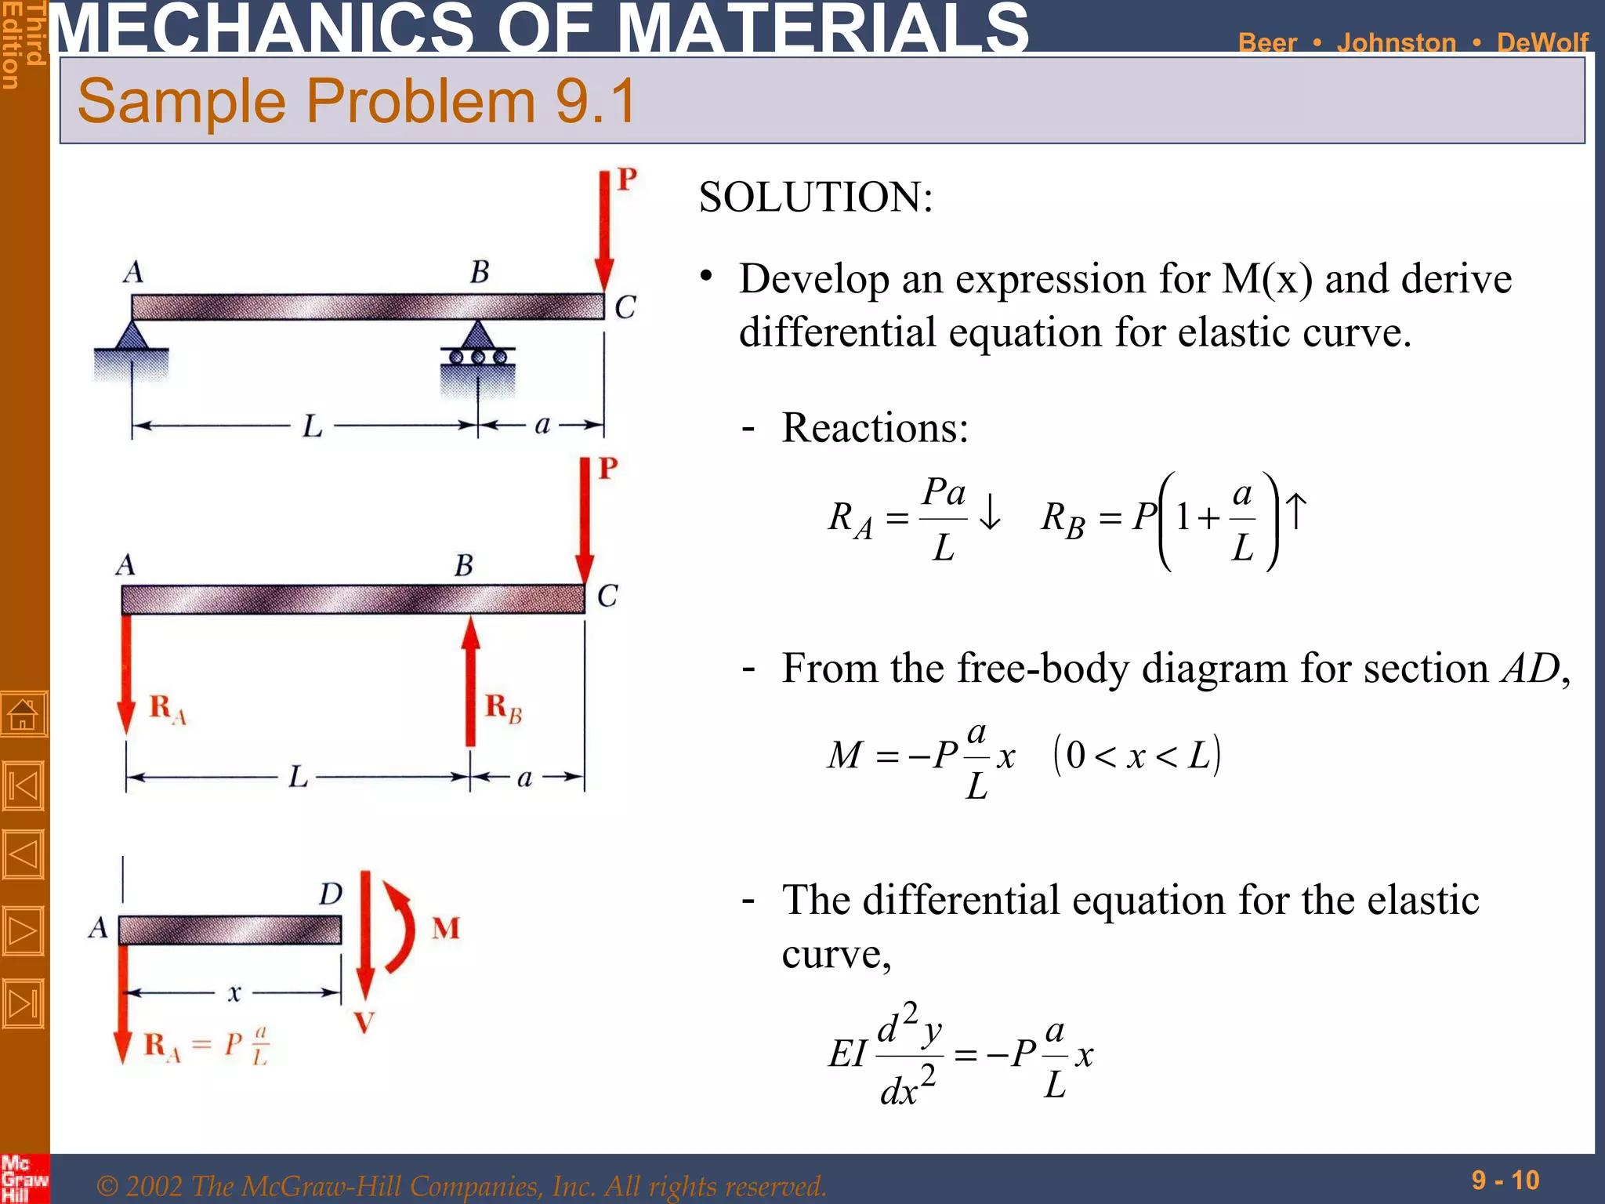

Slide 185
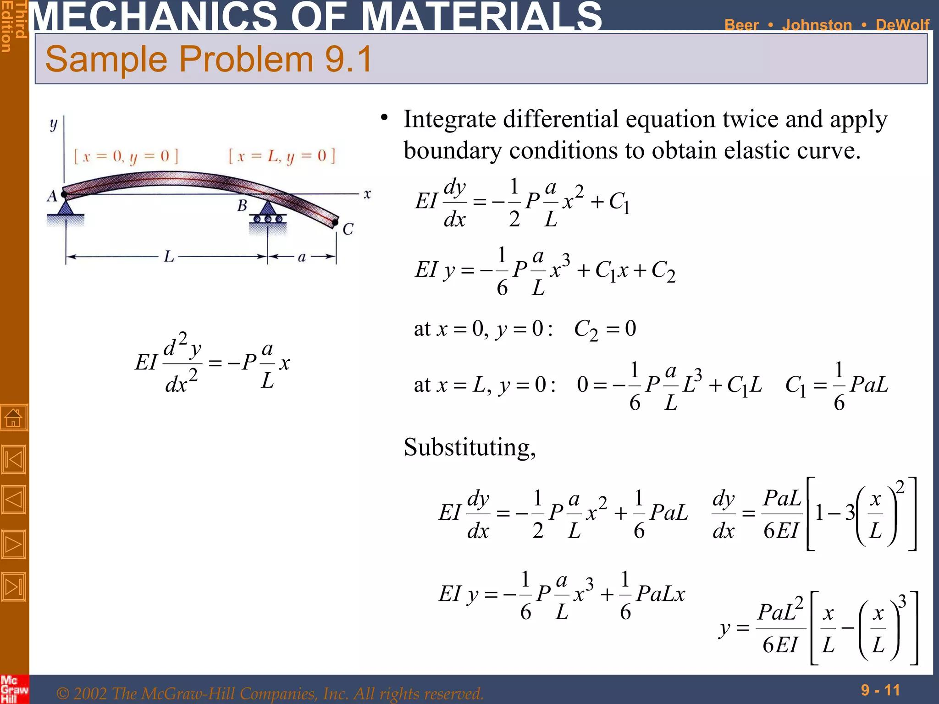

Slide 186
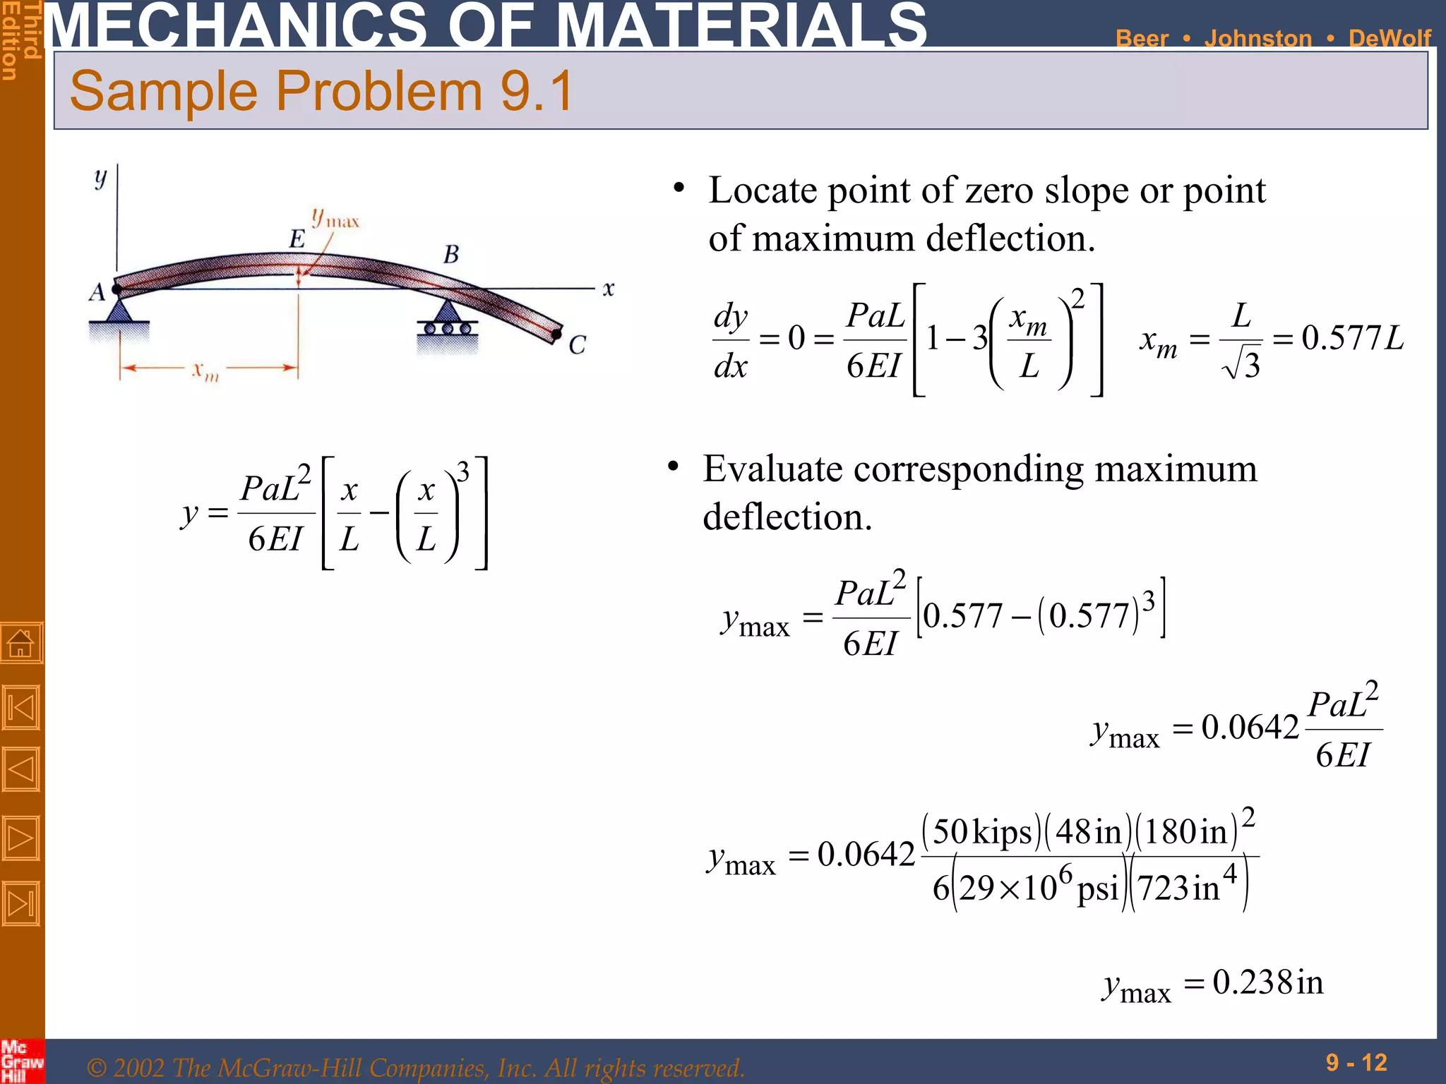

Slide 187
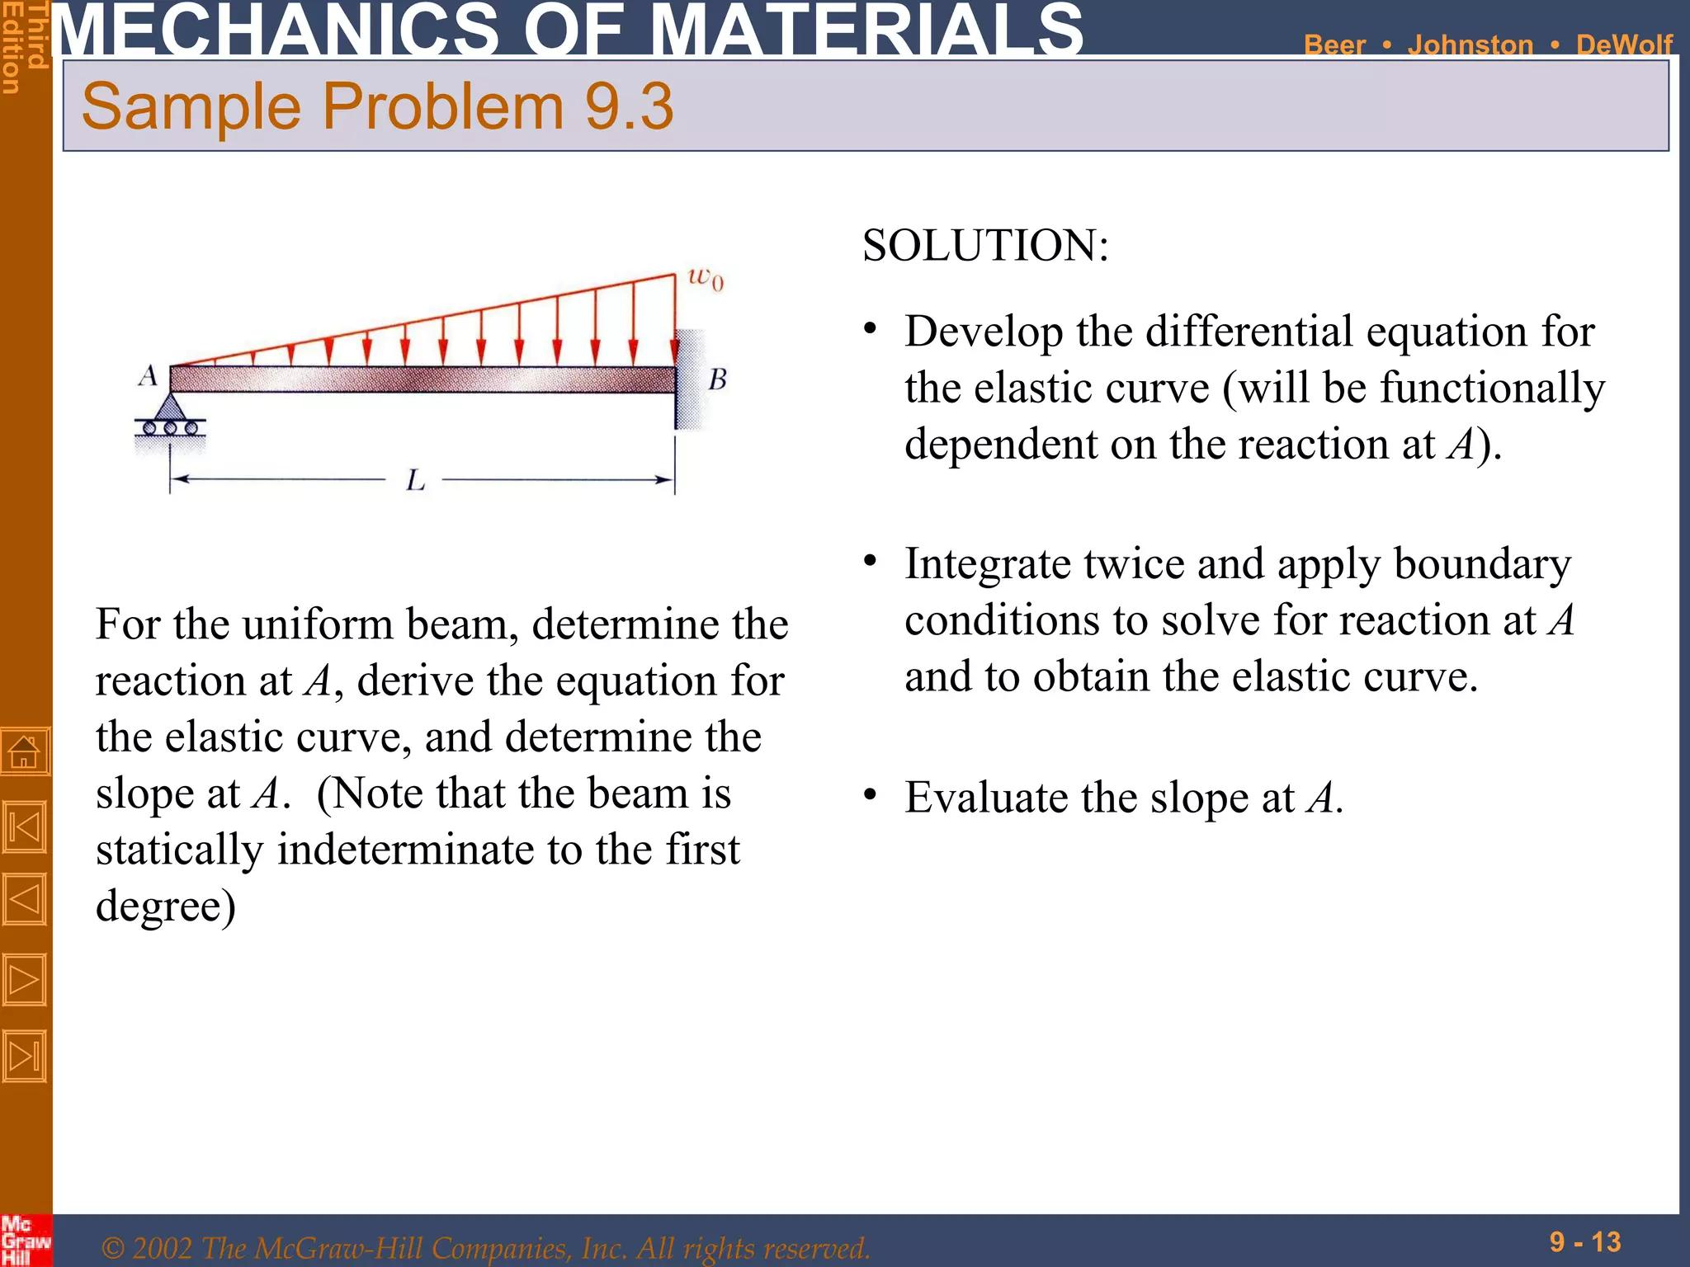

Slide 188
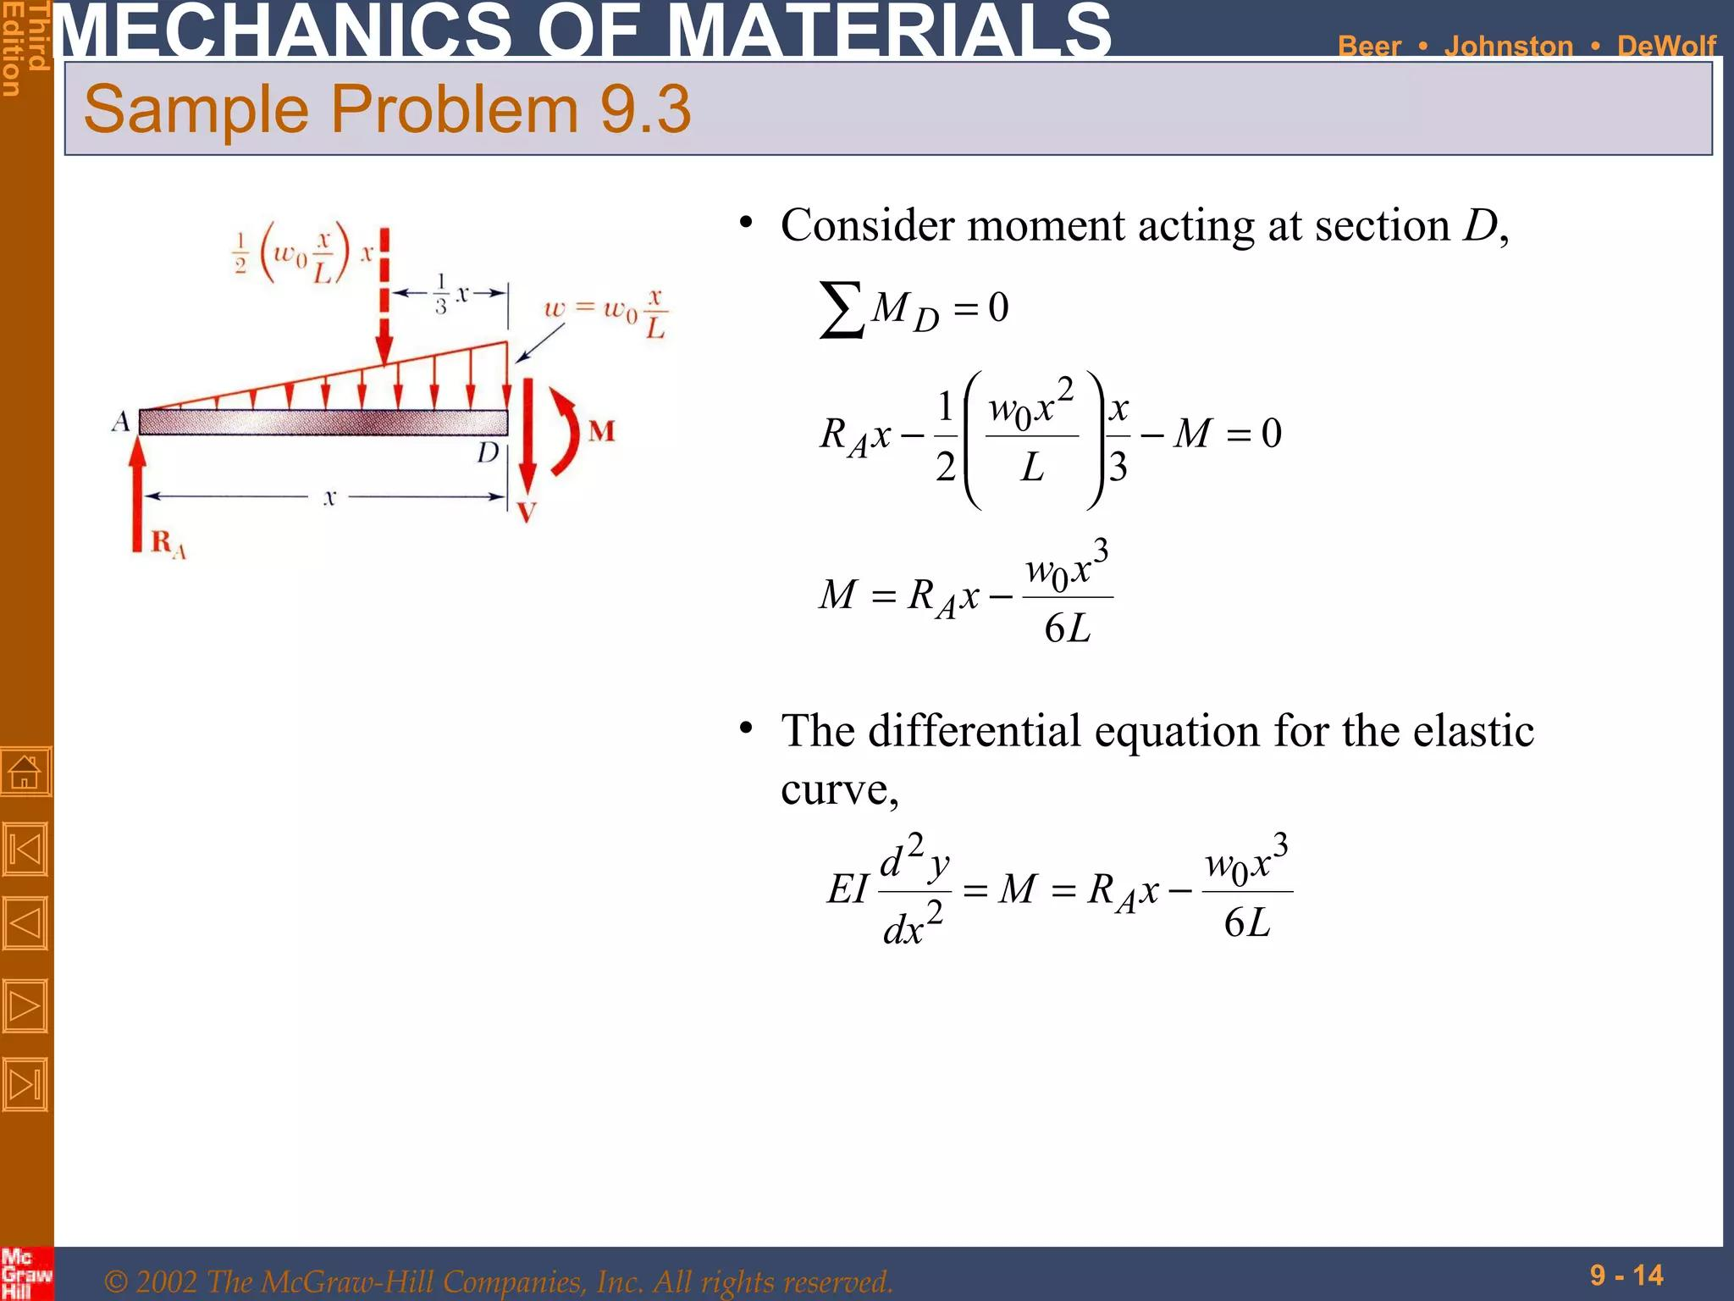

Slide 189
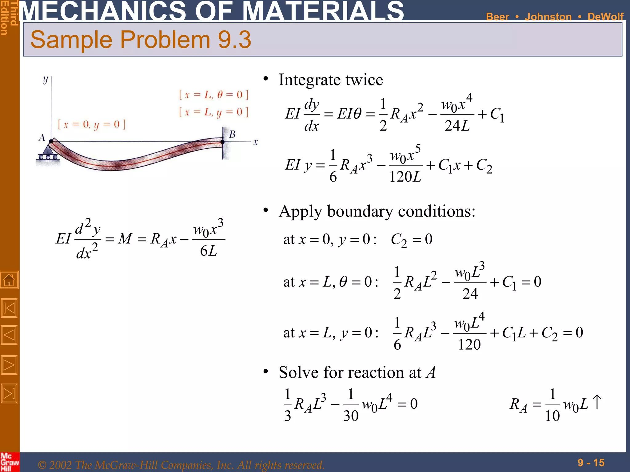

Slide 190
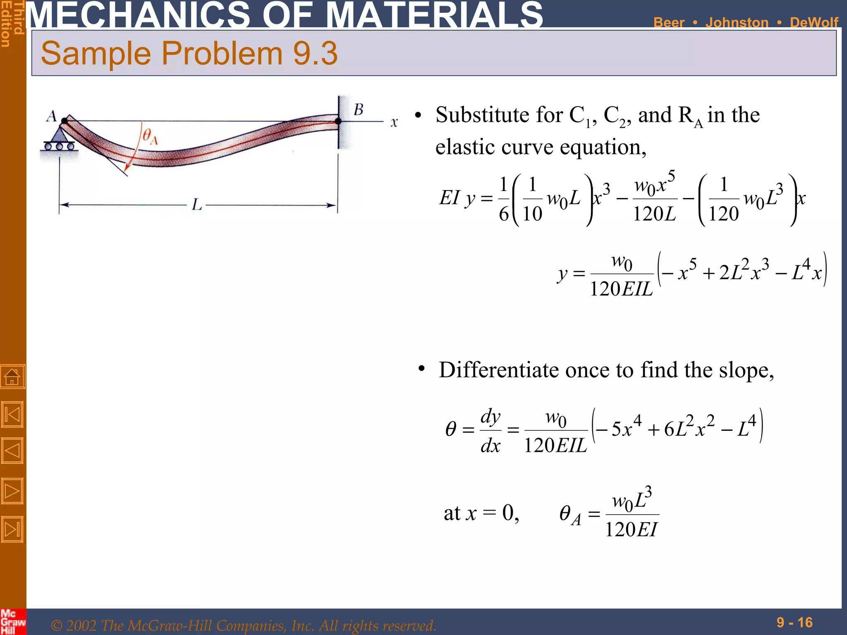

Slide 191
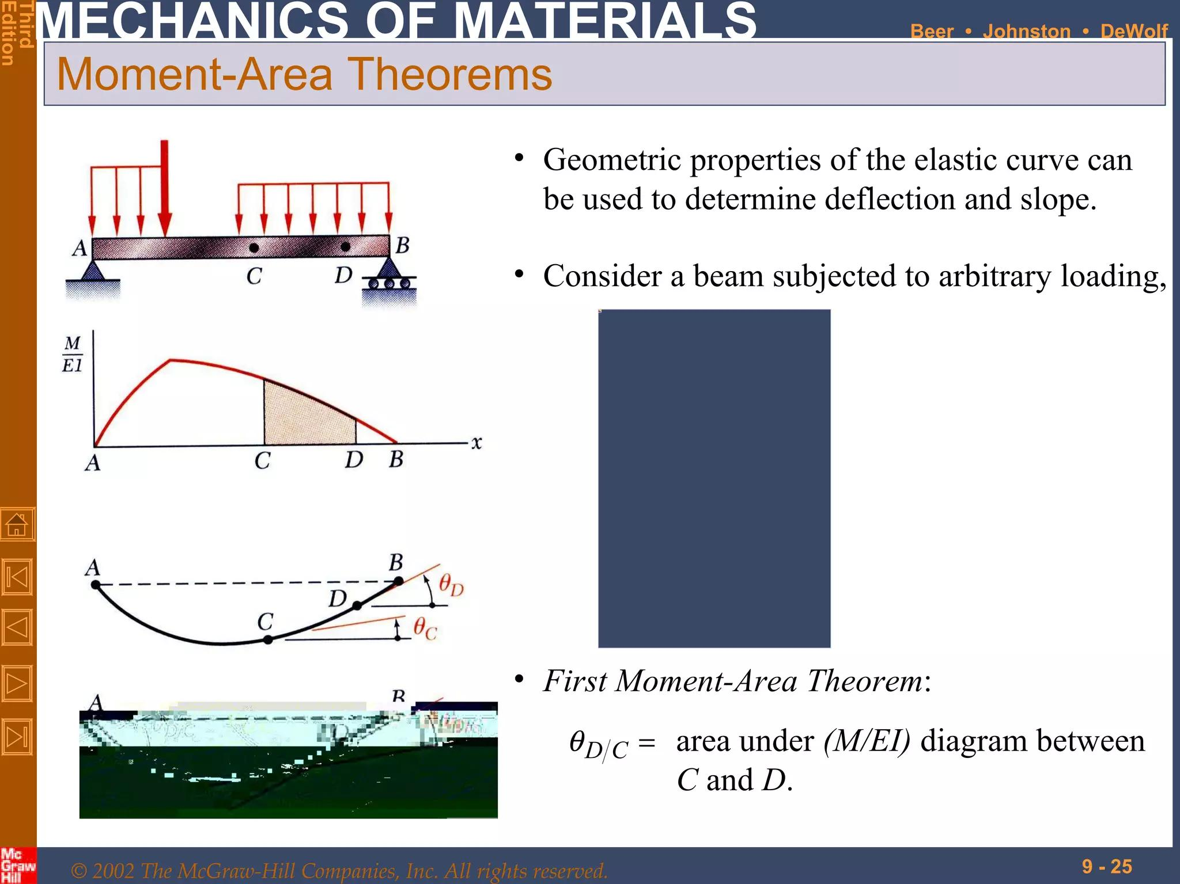

Slide 192


Slide 193


Slide 194


Slide 195


Slide 196


Slide 197


Slide 198


Slide 199


Slide 200


Slide 201




Important Figures

Slide 202

Important Figures

Slide 203
Important Links
Beam Deflection 1
Beam Deflection 2
Beam Deflection 3
Beam Deflection 4
Beam Deflection 5

Slide 204
Flexural Rigidity (EI)
Flexural Strength Flexural strength is a measure of a beam's ability to withstand bending and resist failure. It's a measure of a beam's tensile strength, and is determined by the highest stress the material can withstand before it fails. Flexural Rigidity (EI)
In plain simple words, without mathematical formula, for the benefit of non-civil engineers, it is a measure of the resistance to bending. The more difficult it is to bend it, the higher the flexural stiffness.
A plastic scale bends easily. It has very poor flexural stiffness.
The solid pen is not so easy to bend. Its “flexural stiffness” is high.
The relationship between stiffness and ductility is sort of opposite kind. A stiff material cannot be bent or, elongated at ease. But a ductile material can be bent, elongated, hammered without causing any fracture. A stiff material cannot permanently deform like a ductile material.
Hardness (KN/m²) and stiffness (KN/m) are both properties of materials that measure how they resist deformation, but they measure different types of deformation and have different units of measurement.

Slide 205
Week 17

Slide 206

Any Questions?

Slide 207
Thank you for your kind attention
Courtesy/Acknowledgement
Massachusetts Institute of Technology
Texas Tech University
Rajshahi University of Engineering & Technology
Mumbai Institute of Technology
Dhaka International University
Daffodil International University
Special Thanks: Faruque Abdullah (RUET/DIU)

