Slide 1

Quality Control
Course Code: IPE 381 | CREDIT:03
 | TOTAL MARKS:150
Mid Exam Hours 2 | CIE MARKS: 90
Semester End Exam Hours 3 | SEE MARKS: 60
Course Teacher: Iftekhar Mahmud

Slide 2
Course Learning Outcomes (CLOs): After completing this course successfully, the students will be able to-
CLO 1 CLO 2 CLO 3 CLO 4 | determine several quality concept. define Quality Assurance System and Total Quality Management, apply Problem Solving Techniques calculate, analyse and interpret quality costs.
CLO 5 | analyse Measurement System
CLO 6 | raise data collection assurance
CLO 7 | explain the main attributes of Statistical Quality Control,

Slide 3
SL | Content of Course | Hrs | CLOs
1 | Introduction, Definition of Quality, Methods of control chance causes and assignable causes,Seven statistisfial tools ,problem solving methodology ( PDCA ), seven management Tools ,SQC Benefits and limitations, Quality function Quality assurance,Quality audit, Quality cost, Quality circle, Team of Quality circle,Benefits. | 8 | CLO1
2 | Theory of Control Charts, control chart for variables X & R Chart, Standard deviationchart, Process capability studies Control Chart for attributes, fraction defective and of defective charts chart sensitivity Control chart for non conformities ( p, np chart, c &u charts ) problems using SQC tables | 8 | CLO3, CLO4
3 | Acceptance sampling, Fundamental concepts & terms ,Operation characteristic curves(OC curves) AQL, LTPD, AOQL, sampling plans for single ,Double Multiple sampling plan,sequential sampling plan,Dodge Roming sampling plans Lot by Lotacceptance sampling by Attributes ,AQL system for Lot by Lot sampling,Acceptancesampling by variables. | 9 | CLO2, CLO6
4 | Quality policy, Quality planning, designing for quality, Manufacturing for quality,Quality philosophies by Deming and Jurang, Crosby & Muller,TQM definition,customer focus, Top Management commitment, Team work, Implementation of TQM,Concepts of Kaizen, 5S, just in time JIT, Taguchi methods, need for ISO 9000,clausesof ISO 9000 Implementation,Case studies. | 9 | CLO5, CLO7
Text Book:
Introduction to Statistical Quality Control - Douglas C. Montgomery
Statistical Quality Control – Grant & Lavenworth

Slide 4
Course plan specifying content, CLOs, teaching learning and assessment strategy mapped with CLOs
Week | Topic | Teaching-Learning Strategy | Assessment Strategy | Corresponding CLOs
1 | Introduction, Definition of Quality, Methods of control chance causes and assignable causes, | Lecture, discussion, group work | Quiz, Written Exam | CLO1
2 | causes,Seven statistisfial tools ,problem solving methodology ( PDCA ) | Oral Presentation, debate | Assignment, Written, Quiz | CLO1
3 | seven management Tools ,SQC Benefits and limitations, Quality function | Video lecture, Field visit | Report writing, Demonstration | CLO1
4 | Quality assurance,Quality audit, Quality cost, Quality circle, Team of Quality circle,Benefits | Lecture | Viva, Quiz | CLO1, CLO3
5 | Theory of Control Charts, control chart for variables X & R Chart, Standard deviationchart | Project exhibition | Project, Field visit | CLO1
6 | Process capability studies Control Chart for attributes, fraction defective and of defective charts chart | Discussion, Video Presentation | Quiz, Written Exam | CLO1
7 | sensitivity Control chart for non conformities ( p, np chart, c &u charts ) problems using SQC tables | Case-based Learning, Demonstration | Assignment, Written, Quiz | CLO1, CLO4
8 | Acceptance sampling, Fundamental concepts & terms ,Operation characteristic curves(OC curves) AQL | Lecture, discussion, group work | Report writing, Demonstration | CLO3, CLO4
9 | LTPD, AOQL, sampling plans for single ,Double Multiple sampling plan,sequential sampling plan, | Oral Presentation, debate | Viva, Quiz | CLO2
10 | Dodge Roming sampling plans Lot by Lotacceptance sampling by Attributes | Video lecture | Project, Field visit | CLO2
11 | ,AQL system for Lot by Lot sampling,Acceptancesampling by variables. | Lecture | Quiz, Written Exam | CLO3, CLO4
12 | Quality policy, Quality planning, designing for quality, Manufacturing for quality | Project exhibition | Assignment, Written, Quiz | CLO3, CLO3
13 | quality philosophies by Deming and Jurang, Crosby & Muller,TQM definition,customer focus | Discussion, Video Presentation | Report writing, Demonstration | CLO1
14 | Top Management commitment, Team work, | Case-based Learning, Demonstration | Viva, Quiz | CLO1
15 | Implementation of TQM,Concepts of Kaizen, 5S, | Lecture, discussion, group work | Project, Field visit | CLO3, CLO4
16 | just in time JIT, Taguchi methods, ; | Oral Presentation, debate | Quiz, Written Exam | CLO3, CLO4
17 | need for ISO 9000,clausesof ISO 9000 Implementation,Case studies | Video lecture | Assignment, Written, Quiz | CLO3, CLO4

Slide 5
Week 1

Slide 6
What is Quality ?
Quality is-
Fitness for use,
Fulfilling customers demands,
Degree to which specified meeting the demand of the customer.

Slide 7
Components or Dimensions of Quality
Garvin (1987) provides an excellent discussion of eight components or dimensions of quality. His key points concerning these dimensions of quality as follows :
Performance (will the product do the intended job?) : Potential customers usually evaluate a product to determine if it will perform certain specific functions and determine how well it performs them . For example, you could evaluate spreadsheet software packages for a PC to determine which data manipulation operations they perform. You may discover that one outperforms another with respect to the execution speed.
Reliability(how often does the product fail) : Complex products, such as many appliances, automobiles, or airplanes, will usually require some repair over their service life. For example, you should expect that an automobile will require occasional repair, but if the car requires frequent repair, we say that it is unreliable. There are many industries in which the customer’s view of quality is greatly impacted by the reliability dimension of quality .

Slide 8
Components or Dimensions of Quality(Contnd)
Durability (how long does the product last?): This is the effective service life of the product. Customers obviously want products that perform satisfactorily over a long period of time. The automobile and major appliance industries are examples of businesses where this dimension of quality is very important to most customers.
Serviceability (how easy is it to repair the product?): There are many industries in which the customer’s view of quality is directly influenced by how quickly and economically a repair or routine maintenance activity can be accomplished. Examples include the appliance and automobile industries and many types of service industries (how long did it take a credit card company to correct an error in your bill?).

Slide 9
Components or Dimensions of Quality(Contnd)
Aesthetics (what does the product look like?): This is the visual appeal of the product, often taking into account factors such as style, color, shape, packaging alternatives, tactile characteristics, and other sensory features. For example, soft-drink beverage manufacturers have relied on the visual appeal of their packaging to differentiate their product from other competitors.
Features (what does the product do?): Usually, customers associate high quality with products that have added features; that is, those that have features beyond the basic performance of the competition. For example, you might consider a spreadsheet software package to be of superior quality if it had built-in statistical analysis features while its competitors did not.

Slide 10
Components or Dimensions of Quality(Contnd)
Perceived Quality (what is the reputation of the company or its product?): In many cases, customers rely on the past reputation of the company concerning quality of its products. This reputation is directly influenced by failures of the product that are highly visible to the public or that require product recalls, and by how the customer is treated when a quality-related problem with the product is reported. Perceived quality, customer loyalty, and repeated business are closely interconnected. For example, if you make regular business trips using a particular airline, and the flight almost always arrives on time and the airline company does not lose or damage your luggage, you will probably prefer to fly on that carrier instead of its competitors.

Slide 11
Components or Dimensions of Quality(Contnd)
Conformance to Standards (is the product made exactly as the designer intended?): We usually think of a high-quality product as one that exactly meets the requirements placed on it. For example, how well does the hood fit on a new car? Is it perfectly flush with the fender height, and is the gap exactly the same on all sides? Manufactured parts that do not exactly meet the designer’s requirements can cause significant quality problems when they are used as the components of a more complex assembly. An automobile consists of several thousand parts. If each one is just slightly too big or too small, many of the components will not fit together properly, and the vehicle (or its major subsystems) may not perform as the designer intended.
Quality control is very good if reduction of variability is maintained.
Product quality fails if size of product differs.
So early detection variability and correction is required to maintain quality.

Slide 12
Total Quality Management
Total quality management (TQM) is a strategy for implementing and managing quality improvement activities on an organization wide basis. TQM began in the early 1980s, with the philosophies of Deming and Juran as the focal point.
It evolved into a broader spectrum of concepts and ideas, involving participative organizations and work culture, customer focus, supplier quality improvement, integration of the quality system with business goals, and many other activities to focus all elements of the organization around the quality improvement goal.
Typically, organizations that have implemented a TQM approach to quality improvement have quality councils or high-level
teams that deal with strategic quality initiatives, workforce-level teams that focus on routine production or business activities, and cross-functional teams that address specific quality improvement issues.

Slide 13
Cont’d
TQM has only had moderate success for a variety of reasons, but frequently because
there is insufficient effort devoted to widespread utilization of the technical tools of variability reduction.
Many organizations saw the mission of TQM as one of training. Consequently,
many TQM efforts engaged in widespread training of the workforce in the philosophy of quality improvement and a few basic methods. This training was usually placed in the hands of human resources departments, and much of it was ineffective.
The trainers often had no real
idea about what methods should be taught, and success was usually measured by the percentage of the workforce that had been “trained,” not by whether any measurable impact on business results had been achieved.

Slide 14
Cont’d
Some general reasons for the lack of conspicuous success of TQM include –
Lack of top-down, high-level management commitment and involvement;
Inadequate use of statistical methods and insufficient recognition of variability reduction as a prime objective,
General as opposed to specific business-results-oriented objectives,
Too much emphasis on widespread training as opposed to focused technical education.

Slide 15
Cont’d
Another reason for the erratic success of TQM is that many managers and executives
have regarded it as just another “program” to improve quality. During the 1950s and 1960s, programs such as Zero Defects and Value Engineering abounded, but they had little real impact on quality and productivity improvement. During the heyday of TQM in the 1980s, another popular program was the Quality is Free initiative, in which management worked on identifying the cost of quality (or the cost of nonquality, as the Quality is Free devotees so cleverly put it). Indeed, identification of quality costs can be very useful (we discuss quality costs in Section 1.4.3), but the Quality is Free practitioners often had no idea about what to do to actually improve many types of complex industrial processes.
In fact, the leaders of this initiative had no knowledge about statistical methodology and completely failed to understand its role in quality improvement. When TQM is wrapped around an ineffective program
such as this, disaster is often the result.

Slide 16
Week 2

Slide 17
Acceptance-Sampling
The third area of quality control and improvement that we discuss is acceptance sampling. This is closely connected with inspection and testing of product, which is one of the earliest aspects of quality control, dating back to long before statistical methodology was developed for quality improvement. Inspection can occur at many points in a process.
Acceptance sampling, defined as the inspection and classification of a sample of units selected at random from a larger batch or lot and the ultimate decision about disposition of the lot, usually occurs at two points: incoming raw materials or components, or final production.

Slide 18
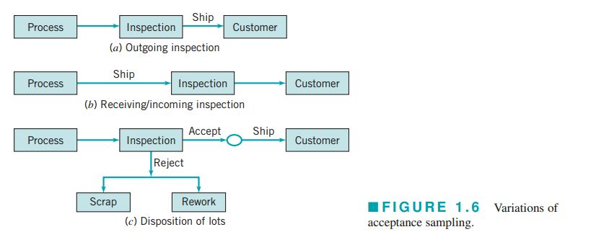
Cont’d
Several different variations of acceptance sampling are shown in Fig. 1.6.
In Fig. 1.6a, the inspection operation is performed immediately following production, before the product is shipped to the customer. This is usually called outgoing inspection.
Figure 1.6b illustrates incoming inspection; that is, a situation in which lots of batches of product are sampled as they are received from the supplier.
Various lot-dispositioning
decisions are illustrated in Fig. 1.6c.

Slide 19
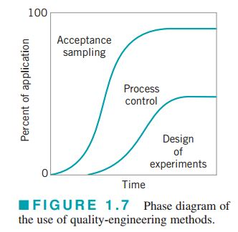
Cont’d
Modern quality assurance systems usually place less emphasis on acceptance sampling and attempt to make statistical process control and designed experiments the focus of their efforts. Acceptance sampling tends to reinforce the conformance-to-specification view of quality and does not have any feedback into either the production process or engineering design or development that would necessarily lead to quality improvement.
Figure 1.7 shows the typical evolution in the use of these
techniques in most organizations. At the lowest level of
maturity, management may be completely unaware of
quality issues, and there is likely to be no effective
organized quality improvement effort.

Slide 20
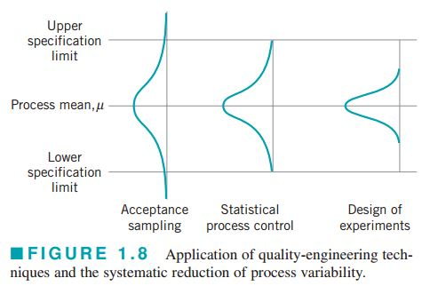
Cont’d
Frequently there will be some modest applications of acceptance-sampling and inspection methods, usually for incoming parts and materials. The first activity as maturity increases is to intensify the use of sampling inspection. The use of sampling will increase until it is realized that quality cannot be inspected or tested into the product.
At that point, the organization usually begins to focus on process improvement. Statistical process control and experimental design potentially have major impacts on manufacturing, product design activities, and process development. The systematic introduction of these methods usually marks the start of substantial quality, cost, and productivity improvements in the organization. At the highest levels of maturity, companies use designed experiments and statistical process control methods intensively and make relatively modest use of acceptance sampling.

Slide 21
Concept about Quality Costs
What are Quality Costs ?
Quality costs are those catagories of costs that are associated with producing , identifying , avoiding or reparing the products that do not meet the requirements.

Slide 22
Types of Quality Costs
Broadly there are 4 types:
Prevention Costs
Aprraisal Costs
Internal Failure Costs
External failure Costs

Slide 23
Prevention Costs
Prevention costs are those costs associated with efforts in design and manufacturing that are directed toward the prevention of non-conformance.
Non-conforming product means failed product.

Slide 24
Types of prevention Costs
Quality planning and Engineering : Costs associated with the creation of the overall quality plan, the inspection plan, the reliability plan, the data system and all specialized plans and activities of the quality assurance function.
New products review : The cost of the review of new or unique products during the development and preproduction.
Product/process design : Costs incurred during the design of the product or the selection of the production processes that are intended to improve the overall quality of the product.
Example : The moment of rotating a motor or at which rpm it would be rotated

Slide 25
Types of prevention Costs (Contd.)
Process control : The cost of confirming the design is being implemented right or not.
Burn-in : The cost is inspecting in pre-shipment operation of the product to prevent early-life failures in the field.
Training : The cost of developing, preparing, implementing, operating and maintaining formal training programs for quality.
Quality data acquisition and analysis : The cost of running the quality data system to acquire and analyze data on product and process performance.

Slide 26
Appraisal Costs
Appraisal costs are those costs associated with measuring, evaluating or auditing products, components and purchased materials to ensure conformance to the standards that have been imposed.

Slide 27
Types of Appraisal Costs
The major subcategories are as follows:
Inspection and test of incoming material: Costs associated with the inspection and testing of all vendor supplied material.
Product Inspection and Test: The cost of checking the conformance of the product throughout its various stages of manufacturing.
Materials and services consumed: The cost of material and products consumed in a destructive test, or devalued by reliability tests.
Maintaining accuracy of test equipment: The cost of operating a system that keeps the measuring instruments and equipment in calibration.

Slide 28
Internal Failure Costs
Internal failure costs are incurred when products, components, materials and services fail to meet quality requirements and this failure is discovered prior to delivery of the product to the customer.

Slide 29
Types of Internal Failure Costs
The major subcategories are as follows:
Scrap: The net loss of labor, material and overhead resulting from defective product that cannot be used economically, be repaired or used.
Rework: The cost of correcting noncomforting units so that they meet specifications.
Retest: The cost of reinspection and retesting of products.
Failure analysis: The cost incurred to determine the causes of product failure.
Downtime: The cost of idle production facilities that results from noncomformance to requirements.
Yield Losses: The cost of process yields that are lower than might be attainable by improved controls.
Downgrading: The price differential between the normal selling price and any selling price that might be obtained for a product that does not meet the customer’s requirement.

Slide 30
External Failure Costs
External failure costs occur when the product does not perform satisfactorily after it is supplied to the customer.

Slide 31
Types of External Failure Costs
The major subcategories are as follows:
Complaint adjustment: All costs of investigation and adjustment of justified complaints attributable to the noncomforting product.
Return product/material: All the costs associated with receipt, handling and replacement of the noncomforming product or material that is returned from the field.
Warranty charges: All costs involved in service to customers under warranty contracts.
Liability costs: Costs or awards incurred as a result of the product liability litigation.
Indirect Costs: In addition to direct operating costs of external failures, there are a significant number of indirect costs. Some of them are: i)Loss of business reputation, ii) Loss of future business, iii) Loss of market share

Slide 32
Week 3

Slide 33
Methods of and philosophy of statistical control
Chapter overview and learning objectives:
This chapter has three objectives.
1)The first is to present basic statistical process
(SPC) problem solving tolls, called the magnificent seven , and to illustrate how this tools form a cohesive,
practical framework for quality improvement.
2) The second objective is to describe statistical basis of the Shewhart control chart.
3)The third objective is to discuss and illustrate some practical issues in the implementation of SPC.

Slide 34
To produce quality product:
The process must be stable and repeatable(all the products will be of same type, size)
The process must be capable of operating with little variability around the target or nominal value.
If the quality of the product is okay then the quality is under control.
If the quality is not okay then we have to take preventive measures

Slide 35
Statistical process control (SPC) is a powerful collection of problem solving tools useful in achieving process stability and improving capability through the reduction of variability.
Seven major tools of SPC is –
1) Histogram or stem-and-leaf plot
2) Check sheet
3) Pareto chart
4) Cause-and-effect diagram
5) Defect concentration diagram
6) Scatter Diagram
7) Control chart (most widely used)
These tools are often called “The Magnificent Seven” and are an important part of SPC. It is used to reduce variability so that quality can be improved .

Slide 36
Causes of quality variation
Chance causes
Assignable causes
Exists some inherent causes which are small but unavoidable
These are determined , findable and can be corrected.
Large amount of quality variation can be removed

Slide 37
To keep process under control (correcting Assigned Causes)
Quality Product without variability
Target:
Main sources of Assignable causes:
There are 3 main causes-
  Improperly Adjusted or controlled machines,
  Operator errors,
  Defective raw materials.

Slide 38
Histogram:
A graph of the observed frequencies versus the ring diameter is shown below. This display is called a histogram.
Fig : Histogram for piston ring diameter.

Slide 39
Week 4

Slide 40
Pareto chart :
The Pareto Chart is simply a frequency distribution (or Histogram) of attribute (ascending order) data arranged category.
Fig : Pareto Chart

Slide 41
In analyzing the tank defect problem, the team elected to lay out the major categories of tank defects as machines, materials, methods, personnel, measurement, and environment.
A brainstorming session ensued to identify the various sub causes in each of these major categories and to prepare the diagram in Fig.
Then through discussion and the process of elimination, the group decided that materials and methods contained the most likely cause categories.

Slide 42
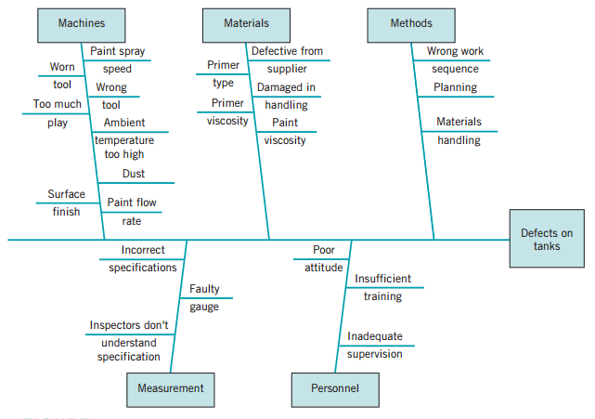
Cause & Effect Diagram:
Fig: Cause-and-effect diagram for the tank defect problem.

Slide 43
How to Construct/ Steps in Constructing Cause & Effect Diagram:
Define the problem or effect to be analyzed,
Form the team to perform the analysis,
Draw the effect box and centre line,
Specify the major potential cause categories and join them as boxes connected to the centre line.
Identity the possible causes and classify them into the categories in step 4.
Rank orders the causes to identify those that seem most likely to impact the problem.
Take corrective action.
Example :Defects of tank (metal tank)

Slide 44
Control Chart:
A control chart is one of the primary techniques of statistical process control (SPC).
A typical control chart is shown in Fig. This chart plots the averages of measurements of
a quality characteristic in samples taken from the process versus time (or the sample number).
The control chart is a very useful process monitoring technique; when unusual sources of variability are present, sample averages will plot outside the control limits.
Systematic use of a control chart is an excellent way to reduce variability.

Slide 45
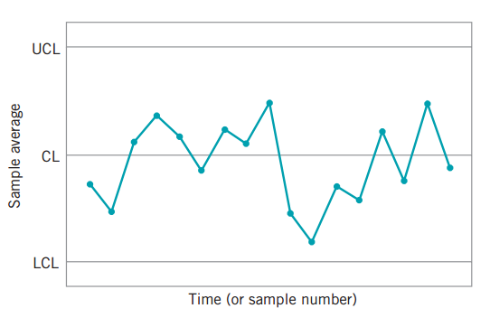
Fig: A typical control chart

Slide 46
Week 5

Slide 47
Process under control:
All the points must be within the control limits.
There must be a random nature of the plotted points.
Types Of Errors in Analyzing Control Chart:
Type I Error or α Control:
Concluding the process is out of control when it is in control.
Type II Error Or β Control:
Concluding the process is in control when the process is actually out of control.

Slide 48
Advantages of control charts:
It improves the productivity.
Effective in Deflect preventation.
Prevent unnecessary process adjustment.
Provide Diagnostic Information.
Provide information about process adaptability.

Slide 49
Choice of Control Limits:
Specifying the control limits is one of the critical decisions that must be made in designing a control chart.
By moving the control limits farther from the center line, we decrease the risk of a type I error.
However, widening the control limits will also increase the risk of a type II error—that is, the risk of a point fallling between the control limits when the process is really out of control.
If we move the control limits closer to the centre line ,the opposite effect is obtained .
The risk of type I error is increased, while the risk of type II error is decreased.
N.B: Comparison of three –sigma and 0.001 probability limits for the x’ chart ( see Book).

Slide 50
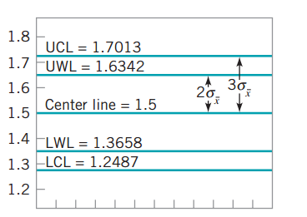
Warning Limits on Control Charts
Some analysts suggest using two sets of limits on control charts, such as they shown in fig below.
The outer limits—say, at three-sigma—are the usual action limits.
The inner limits, usually at two-sigma ,are called warning limits.
Sample number
Figure: An chart with two sigma and three sigma warning limits.

Slide 51
Choice of Control Limits
Specifying the control limits is one of the critical decisions that must be made in designing a control chart .By moving the control limits farther from the center line ,we decrease the risk of a type I error – that is ,the risk of a point falling beyond the control limits, indicating an out of control condition when no assignable cause is present .However, widening the control limits will also increase the risk of a type II error –that is the risk of a point falling between the control limits when the process is really out of control if we move the control limits closer to the center line ,the opposite effect is obtained : The risk of type I error is increased , while the risk of type II error is decreased.

Slide 52
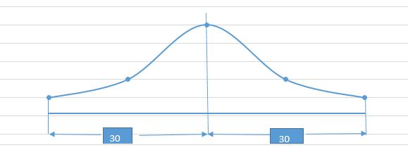
The USA use 30 control limit. Though they use 30 control limit ,some data remains out of the area(.27%).Remaining some points out of the area do not mean Out of Control
Area =99.73%

Slide 53
Week 6

Slide 54
Sample Size and Sampling Frequency
In designing a control chart ,we must specify both the sample size to use and the frequency of sampling .in general , larger samples will make it easier to detect small shifts in the process . when choosing the sample size , we must keep in mind the size of the shift that we are trying to detect . if the process shift is relatively large , then we use smaller sample size than those that would be employed if the shift of interest were relatively small.
By taking big and nearby sample we get accurate result but it is not economical.
In a word, small sample at short interval-good result achieved-most widely used and large sample at large interval vice versa. .

Slide 55
Causes of Process Being Out of Control
It suggests that the process is out of control if either
1.One points plots outside the three-sigma control limits.
2.Two out of three consecutive points plot beyond the two-sigma warning limits.
3.Four out of five consecutive points plot at a distance of one-sigma or beyond from the center line.
4.Eight consecutive points on one side of the center line.

Slide 56
Analysis of Patterns on Control Charts
A control chart may indicate an out of control condition either when one or more points fall beyond the control limits or when the plotted points exhibit some nonrandom pattern of behavior.
For example consider the chart of figure. Although all 25 points fall within the control limits, the points do not indicate statistical control because their pattern is very non random in appearance.
Specifically, we note that 19 of 25 points plot below the center line ,while only 6 of them plot above. If the points are truly random , we should expect a more even distribution of them above and below the center line .

Slide 57
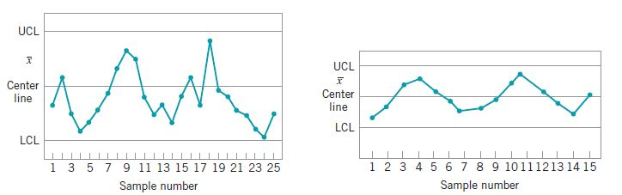

We also observe that following the fourth point ,five points in a row increase in magnitude. This arrangement of points is called a run.
Since the observations are increasing , we could call this a run up. Similarly, a sequence of decreasing points is called a run down.
Run Up
Run Down
Figure: An $\overline{x}$ control chart
Figure: an $\overline{x}$ control with cyclic pattern

Slide 58
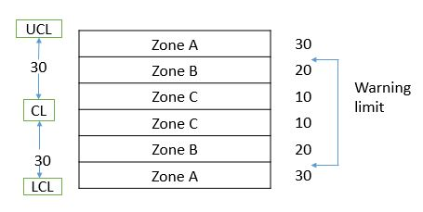
Pattern Recognition
The western Electric Handbook(1956) suggests a set of decision rules for detecting non random patterns on control charts.
Zonal: (4 Rules) If any of the c1 Rules is noticed in Control Chart the process is out of control.

Slide 59
Cont’d
Specifically, it suggests concluding that the process is out of control if either is present in any of the chart.[Sensitizing Rules]
1.One points plots outside the three sigma limits.
2.Two out of three consecutive points plot beyond the 2 sigma (warning limit) or in Zone A.
3.Four out of five consecutive points plot at a distance of one sigma or beyond the center line(in Zone C).
4.Eight consecutive points on one side of the center line.
5. Six points in the row steadily incre3asing or decreasing (Run)

Slide 60
Cont’d
6. 15 points in a row in zone C.
7. 14 points in a row alternately up and down
8. 8 points in a row on both side of the center line but none in zone C
9. An unequal and nonrandom pattern
10. One or more points near warning or control lines.

Slide 61
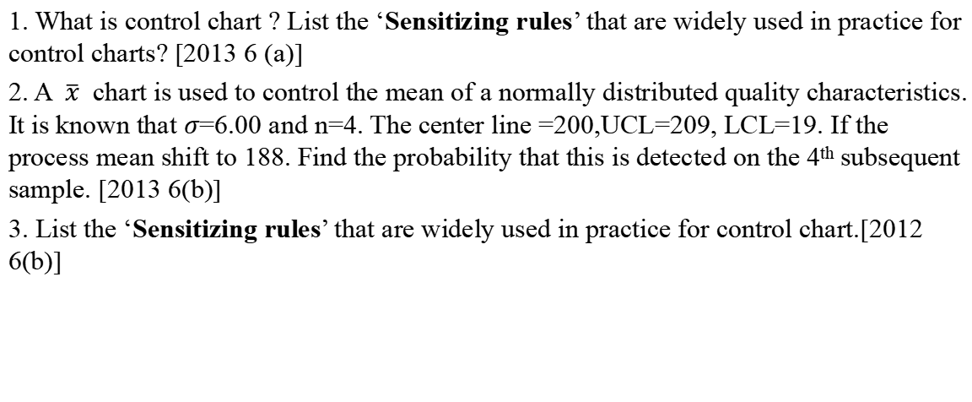
Related questions
1. What is control chart ? List the ‘Sensitizing rules’ that are widely used in practice for control charts? [2013 6 (a)]
2. A $\overline{x}$ chart is used to control the mean of a normally distributed quality characteristics. It is known that $σ$=6.00 and n=4. The center line =200,UCL=209, LCL=19. If the process mean shift to 188. Find the probability that this is detected on the 4th subsequent sample. [2013 6(b)]
3. List the ‘Sensitizing rules’ that are widely used in practice for control chart.[2012 6(b)]

Slide 62
Methods of and philosophy of statistical control
Chapter overview and learning objectives:
This chapter has three objectives.
1)The first is to present basic statistical process
(SPC) problem solving tolls, called the magnificent seven , and to illustrate how this tools form a cohesive,
practical framework for quality improvement.
2) The second objective is to describe statistical basis of the Shewhart control chart.
3)The third objective is to discuss and illustrate some practical issues in the implementation of SPC.

Slide 63
To produce quality product:
The process must be stable and repeatable(all the products will be of same type, size)
The process must be capable of operating with little variability around the target or nominal value.
If the quality of the product is okay then the quality is under control.
If the quality is not okay then we have to take preventive measures

Slide 64
Week 7

Slide 65
Statistical process control (SPC) is a powerful collection of problem solving tools useful in achieving process stability and improving capability through the reduction of variability.
Seven major tools of SPC is –
1) Histogram or stem-and-leaf plot
2) Check sheet
3) Pareto chart
4) Cause-and-effect diagram
5) Defect concentration diagram
6) Scatter Diagram
7) Control chart (most widely used)
These tools are often called “The Magnificent Seven” and are an important part of SPC. It is used to reduce variability so that quality can be improved .

Slide 66
Causes of quality variation
Chance causes
Assignable causes
Exists some inherent causes which are small but unavoidable
These are determined , findable and can be corrected.
Large amount of quality variation can be removed

Slide 67
To keep process under control (correcting Assigned Causes)
Quality Product without variability
Target:
Main sources of Assignable causes:
There are 3 main causes-
  Improperly Adjusted or controlled machines,
  Operator errors,
  Defective raw materials.

Slide 68
Histogram:
A graph of the observed frequencies versus the ring diameter is shown below. This display is called a histogram.
Fig : Histogram for piston ring diameter.

Slide 69
Pareto chart :
The Pareto Chart is simply a frequency distribution (or Histogram) of attribute (ascending order) data arranged category.
Fig : Pareto Chart

Slide 70
In analyzing the tank defect problem, the team elected to lay out the major categories of tank defects as machines, materials, methods, personnel, measurement, and environment.
A brainstorming session ensued to identify the various sub causes in each of these major categories and to prepare the diagram in Fig.
Then through discussion and the process of elimination, the group decided that materials and methods contained the most likely cause categories.

Slide 71
Week 8

Slide 72
Cause & Effect Diagram:
Fig: Cause-and-effect diagram for the tank defect problem.

Slide 73
How to Construct/ Steps in Constructing Cause & Effect Diagram:
Define the problem or effect to be analyzed,
Form the team to perform the analysis,
Draw the effect box and centre line,
Specify the major potential cause categories and join them as boxes connected to the centre line.
Identity the possible causes and classify them into the categories in step 4.
Rank orders the causes to identify those that seem most likely to impact the problem.
Take corrective action.
Example :Defects of tank (metal tank)

Slide 74
Control Chart:
A control chart is one of the primary techniques of statistical process control (SPC).
A typical control chart is shown in Fig. This chart plots the averages of measurements of
a quality characteristic in samples taken from the process versus time (or the sample number).
The control chart is a very useful process monitoring technique; when unusual sources of variability are present, sample averages will plot outside the control limits.
Systematic use of a control chart is an excellent way to reduce variability.

Slide 75
Fig: A typical control chart

Slide 76
Process under control:
All the points must be within the control limits.
There must be a random nature of the plotted points.
Types Of Errors in Analyzing Control Chart:
Type I Error or α Control:
Concluding the process is out of control when it is in control.
Type II Error Or β Control:
Concluding the process is in control when the process is actually out of control.

Slide 77
Advantages of control charts:
It improves the productivity.
Effective in Deflect preventation.
Prevent unnecessary process adjustment.
Provide Diagnostic Information.
Provide information about process adaptability.

Slide 78
Week 9

Slide 79
Choice of Control Limits:
Specifying the control limits is one of the critical decisions that must be made in designing a control chart.
By moving the control limits farther from the center line, we decrease the risk of a type I error.
However, widening the control limits will also increase the risk of a type II error—that is, the risk of a point fallling between the control limits when the process is really out of control.
If we move the control limits closer to the centre line ,the opposite effect is obtained .
The risk of type I error is increased, while the risk of type II error is decreased.
N.B: Comparison of three –sigma and 0.001 probability limits for the x’ chart ( see Book).

Slide 80
Warning Limits on Control Charts
Some analysts suggest using two sets of limits on control charts, such as they shown in fig below.
The outer limits—say, at three-sigma—are the usual action limits.
The inner limits, usually at two-sigma ,are called warning limits.
Sample number
Figure: An chart with two sigma and three sigma warning limits.

Slide 81
Choice of Control Limits
Specifying the control limits is one of the critical decisions that must be made in designing a control chart .By moving the control limits farther from the center line ,we decrease the risk of a type I error – that is ,the risk of a point falling beyond the control limits, indicating an out of control condition when no assignable cause is present .However, widening the control limits will also increase the risk of a type II error –that is the risk of a point falling between the control limits when the process is really out of control if we move the control limits closer to the center line ,the opposite effect is obtained : The risk of type I error is increased , while the risk of type II error is decreased.

Slide 82
The USA use 30 control limit. Though they use 30 control limit ,some data remains out of the area(.27%).Remaining some points out of the area do not mean Out of Control
Area =99.73%

Slide 83
Sample Size and Sampling Frequency
In designing a control chart ,we must specify both the sample size to use and the frequency of sampling .in general , larger samples will make it easier to detect small shifts in the process . when choosing the sample size , we must keep in mind the size of the shift that we are trying to detect . if the process shift is relatively large , then we use smaller sample size than those that would be employed if the shift of interest were relatively small.
By taking big and nearby sample we get accurate result but it is not economical.
In a word, small sample at short interval-good result achieved-most widely used and large sample at large interval vice versa. .

Slide 84
Causes of Process Being Out of Control
It suggests that the process is out of control if either
1.One points plots outside the three-sigma control limits.
2.Two out of three consecutive points plot beyond the two-sigma warning limits.
3.Four out of five consecutive points plot at a distance of one-sigma or beyond from the center line.
4.Eight consecutive points on one side of the center line.

Slide 85
Analysis of Patterns on Control Charts
A control chart may indicate an out of control condition either when one or more points fall beyond the control limits or when the plotted points exhibit some nonrandom pattern of behavior.
For example consider the chart of figure. Although all 25 points fall within the control limits, the points do not indicate statistical control because their pattern is very non random in appearance.
Specifically, we note that 19 of 25 points plot below the center line ,while only 6 of them plot above. If the points are truly random , we should expect a more even distribution of them above and below the center line .

Slide 86
We also observe that following the fourth point ,five points in a row increase in magnitude. This arrangement of points is called a run.
Since the observations are increasing , we could call this a run up. Similarly, a sequence of decreasing points is called a run down.
Run Up
Run Down
Figure: An $\overline{x}$ control chart
Figure: an $\overline{x}$ control with cyclic pattern

Slide 87
Week 10

Slide 88
Pattern Recognition
The western Electric Handbook(1956) suggests a set of decision rules for detecting non random patterns on control charts.
Zonal: (4 Rules) If any of the c1 Rules is noticed in Control Chart the process is out of control.

Slide 89
Cont’d
Specifically, it suggests concluding that the process is out of control if either is present in any of the chart.[Sensitizing Rules]
1.One points plots outside the three sigma limits.
2.Two out of three consecutive points plot beyond the 2 sigma (warning limit) or in Zone A.
3.Four out of five consecutive points plot at a distance of one sigma or beyond the center line(in Zone C).
4.Eight consecutive points on one side of the center line.
5. Six points in the row steadily incre3asing or decreasing (Run)

Slide 90
Cont’d
6. 15 points in a row in zone C.
7. 14 points in a row alternately up and down
8. 8 points in a row on both side of the center line but none in zone C
9. An unequal and nonrandom pattern
10. One or more points near warning or control lines.

Slide 91
Related questions
1. What is control chart ? List the ‘Sensitizing rules’ that are widely used in practice for control charts? [2013 6 (a)]
2. A $\overline{x}$ chart is used to control the mean of a normally distributed quality characteristics. It is known that $σ$=6.00 and n=4. The center line =200,UCL=209, LCL=19. If the process mean shift to 188. Find the probability that this is detected on the 4th subsequent sample. [2013 6(b)]
3. List the ‘Sensitizing rules’ that are widely used in practice for control chart.[2012 6(b)]

Slide 92

Process Capability:
P= ($\frac{LSL −\overset{̿}{x}}{\hat{σ}}$) + [1- ϕ($\frac{USL −\overset{̿}{x}}{\hat{σ}}$)]
= ϕ($\frac{25.9−26.5}{0.15477})+$ [1- ϕ($\frac{26.9−26.5}{0.15477})]$
= ϕ(-3.88) + [1- ϕ(2.58)]
=[1-0.99995] + [1-0.99506]
=0.00005+0.00494
=0.00499 or 0.499% (Ans)

Slide 93
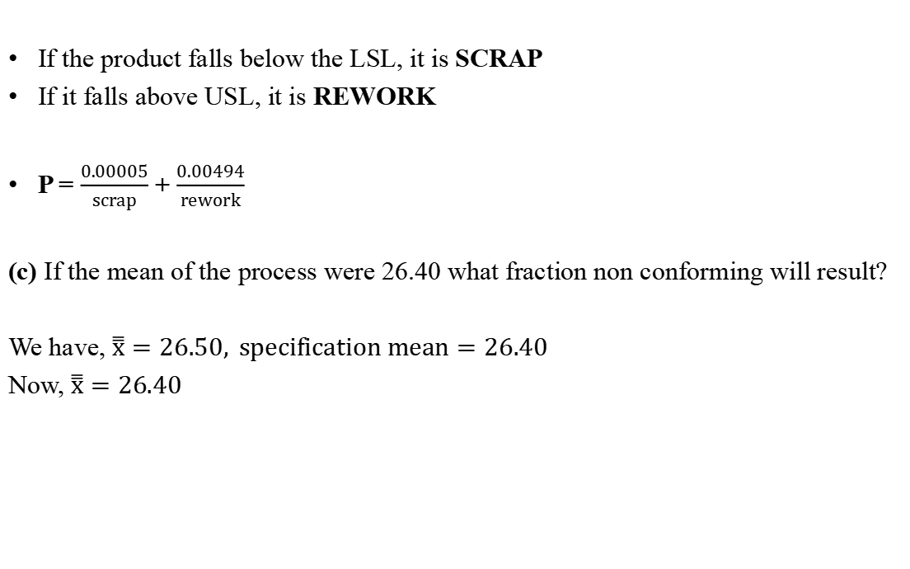
If the product falls below the LSL, it is SCRAP
If it falls above USL, it is REWORK
P = $\frac{0.00005}{scrap}$ + $\frac{0.00494}{rework}$
(c) If the mean of the process were 26.40 what fraction non conforming will result?
We have, $\overset{̿}{x}=26.50, specification mean=26.40$
Now, $\overset{̿}{x}=26.40$

Slide 94
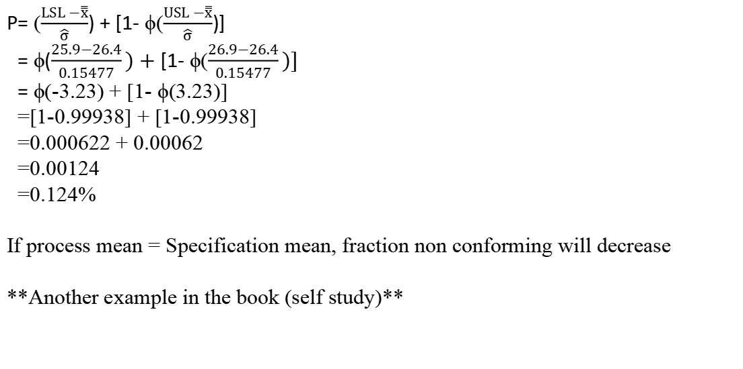
Process mean ≠ specification mean If they are equal, fraction non-conforming will decrease
P= ($\frac{LSL −\overset{̿}{x}}{\hat{σ}}$) + [1- ϕ($\frac{USL −\overset{̿}{x}}{\hat{σ}}$)]
= ϕ($\frac{25.9−26.4}{0.15477})+$ [1- ϕ($\frac{26.9−26.4}{0.15477})]$
= ϕ(-3.23) + [1- ϕ(3.23)]
=[1-0.99938] + [1-0.99938]
=0.000622 + 0.00062
=0.00124
=0.124%
If process mean = Specification mean, fraction non conforming will decrease
**Another example in the book (self study)**

Slide 95
Week 11

Slide 96
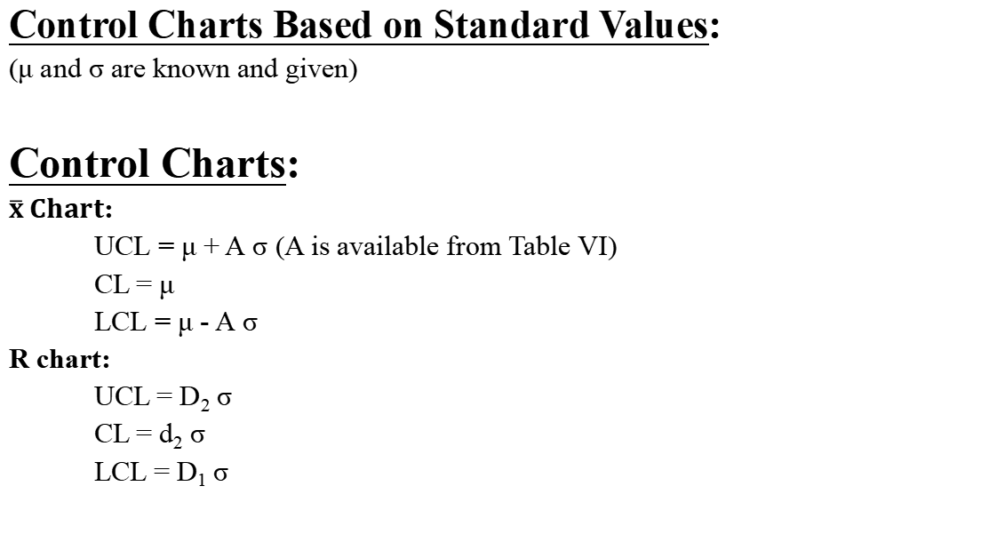
Control Charts Based on Standard Values:
(μ and σ are known and given)
Control Charts:
$\overline{x} Chart$:
UCL = μ + A σ (A is available from Table VI)
CL = μ
LCL = μ - A σ
R chart:
UCL = D₂ σ
CL = d₂ σ
LCL = D₁ σ

Slide 97
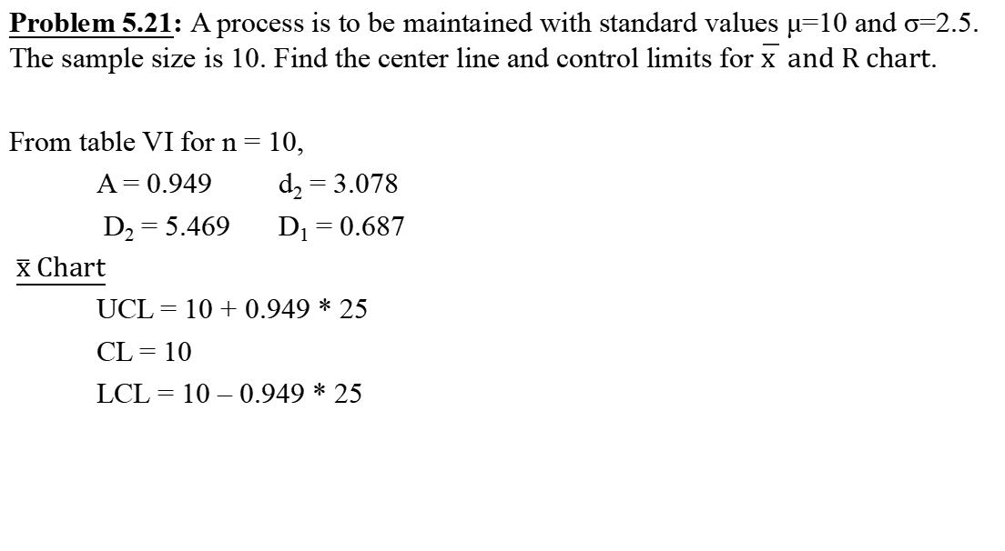
Problem 5.21: A process is to be maintained with standard values μ=10 and σ=2.5. The sample size is 10. Find the center line and control limits for $\overline{x } and R chart$.
From table VI for n = 10,
A = 0.949 d₂ = 3.078
D₂ = 5.469 D₁ = 0.687
$\overline{x} Chart$
UCL = 10 + 0.949 * 25
CL = 10
LCL = 10 – 0.949 * 25

Slide 98
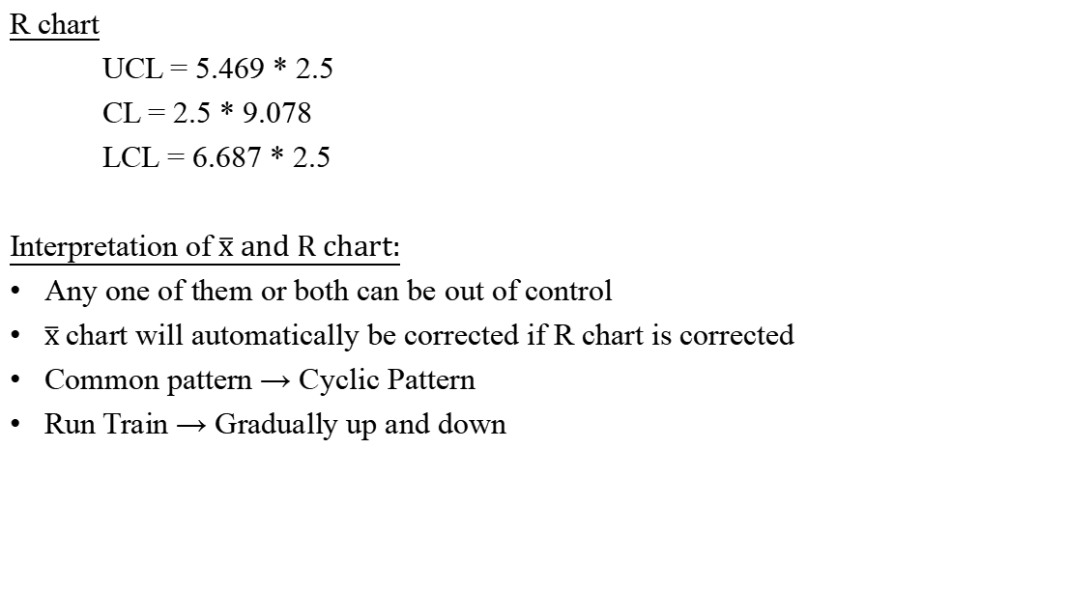
R chart
UCL = 5.469 * 2.5
CL = 2.5 * 9.078
LCL = 6.687 * 2.5
Interpretation of $\overline{x} and R chart:$
Any one of them or both can be out of control
$\overline{x}$chart will automatically be corrected if R chart is corrected
Common pattern → Cyclic Pattern
Run Train → Gradually up and down

Slide 99
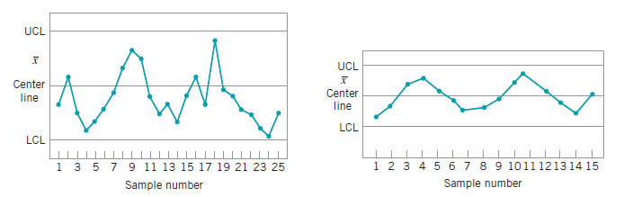

Interpretation of $\overline{x}$ & R charts:
Some common patterns and their causes:
1.0 Cyclic patterns : Values will gradually be increasing and decreasing.
Fig: An x control chart. Fig: An chart with a cyclic pattern

Slide 100

Fig: Variability with the cyclic pattern
Cyclic pattern in x̅ charts:
1.Systematic environmental change such as temperature : Example of
the temperature of a machine.
2.Operator fatigue: When the operator is in fresh , work done well
but after becoming get tired noise works done.
3.Regular rotation of operator or machine .

Slide 101
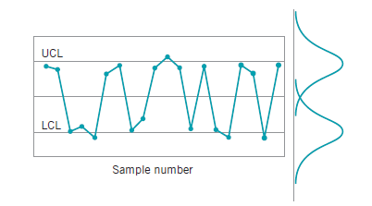
4.Fluctuation of voltage or some other variable in the production equipment:
If the cyclic pattern are observed in R chart then
1.Maintenance schedule
2.Operator fatigue
3.Tool wear
2.0 Mixture pattern:
Fig :A Mixture pattern

Slide 102
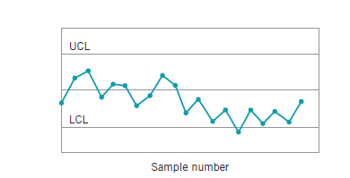
Explanation : Most of the point near the control limits. Very few points near the center line.
Causes:
1.Over control : Unnecessary process control adjustment by the operator.
2.Output products from several sources : Example is the parallel machine.
Fig: Parallel machine

Slide 103
3.0 Shift in the process level:
Causes:
1.Introduction of new operator
method, raw material, machine etc.
2.Change in inspection method or standard
3.Change in either in the skill, attentiveness,
motivation of the operator.
Fig: shift in the process level

Slide 104
Week 12

Slide 105
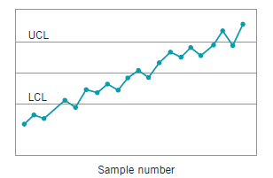
4.0 Trend: Continuous movement of data in one direction.
Fig: A trend in process level

Slide 106
Causes:
1.Trends are usually due to a gradual wearing out or deterioration of a tool or some
other critical process component.
2.Operator fatigue : They can also result from human causes, such as operator fatigue or the
presence of supervision.
3.Deterioration of environment conditions:
4.Accumulation of waste products : If waste products or chips are not removed from lathe then it happens.

Slide 107
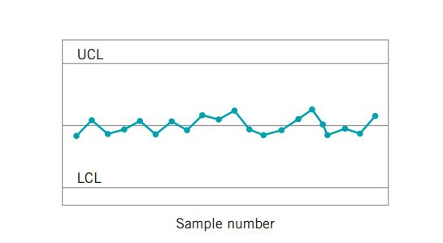
5.0 Stratification:
A tendency for the points to cluster artificially around the center line is marked lack of natural variability in the observed pattern.
Causes : 1. One potential cause of stratification is incorrect calculation of control limits.
2. This pattern may also result when the sampling process collects one or more units from several different underlying distributions within each subgroup.

Slide 108
Lecture continue…..
6.0 Higher portion of points near or outside control limits. Same as mixture process.

Slide 109
Problem 6-1:
The data is given the number of non-conforming bearings in a sample of size 100. Construct a fraction non-conforming control chart for these data. If any points plot out of control, assume that assignable causes can be found and determine the revised control limits.
Sample no. | Number of non-conforming assemblies | Sample fraction non-conforming
1 | 7 | 0.07
2 | 4 | 0.04
3 | 1 | 0.01
4 | 3 | 0.03
5 | 6 | 0.06
6 | 8 | 0.08
7 | 10 | 0.10
8 | 5 | 0.05
9 | 2 | 0.02
10 | 7 | 0.07

Slide 110

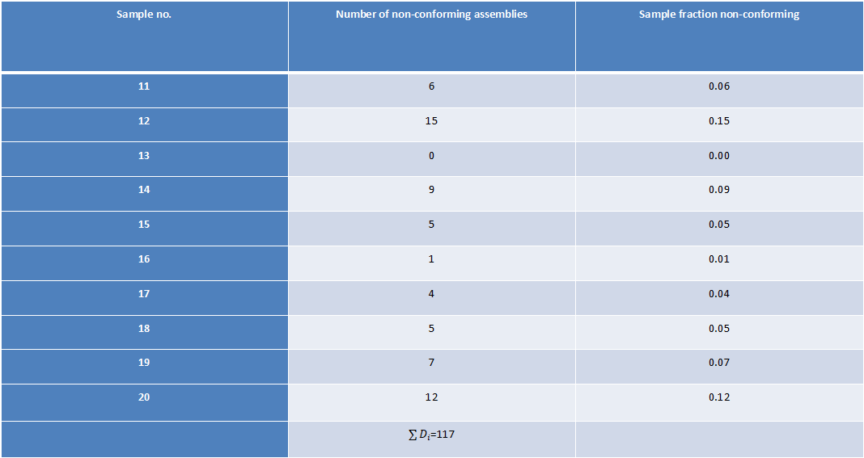
Sample no. | Number of non-conforming assemblies | Sample fraction non-conforming
11 | 6 | 0.06
12 | 15 | 0.15
13 | 0 | 0.00
14 | 9 | 0.09
15 | 5 | 0.05
16 | 1 | 0.01
17 | 4 | 0.04
18 | 5 | 0.05
19 | 7 | 0.07
20 | 12 | 0.12
 | $\sum{D_{i}}$=117
$$n=100 , m=20$$

Slide 111
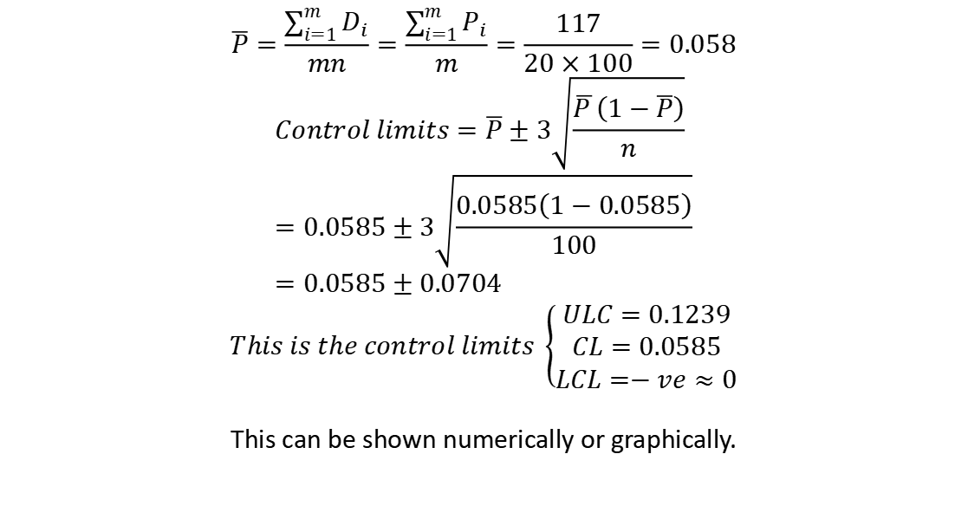
$$\overline{P}=\frac{\sum_{i=1}^{m}{D_{i}}}{mn}=\frac{\sum_{i=1}^{m}{P_{i}}}{m}=\frac{117}{20×100}=0.058$$
$$Control limits=\overline{P}±3\sqrt{\frac{\overline{P }\left(1−\overline{P}\right)}{n}} \\ =0.0585±3\sqrt{\frac{0.0585\left(1−0.0585\right)}{100}} \\ =0.0585±0.0704$$
$$This is the control limits \left\{\begin{aligned}ULC=0.1239 \\ CL=0.0585 \\ LCL=−ve≈0\end{aligned}\right.$$
This can be shown numerically or graphically.

Slide 112
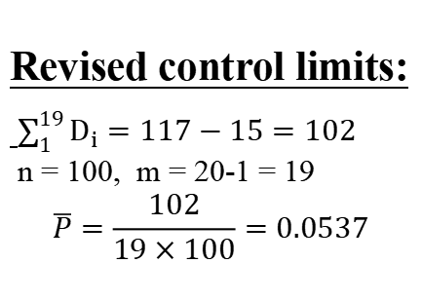
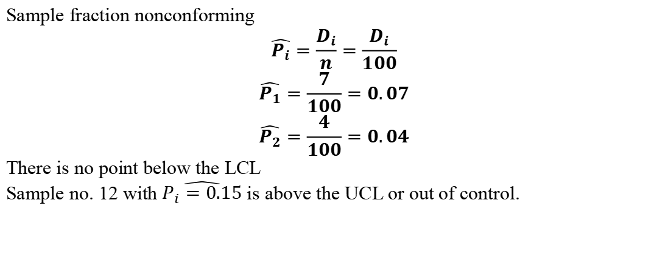
Sample fraction nonconforming
$$\hat{P_{i}}=\frac{D_{i}}{n}=\frac{D_{i}}{100}$$
$$\hat{P_{1}}=\frac{7}{100}=0.07$$
$$\hat{P_{2}}=\frac{4}{100}=0.04$$
There is no point below the LCL
Sample no. 12 with $\hat{P_{i}=0.15}$ is above the UCL or out of control.
Revised control limits:
$\sum_{1}^{19}{D_{i}}=117−15=102$
n = 100, m = 20-1 = 19
$$\overline{P}=\frac{102}{19×100}=0.0537$$
Sample size n=100
Note that, Number of sample can be changed.

Slide 113
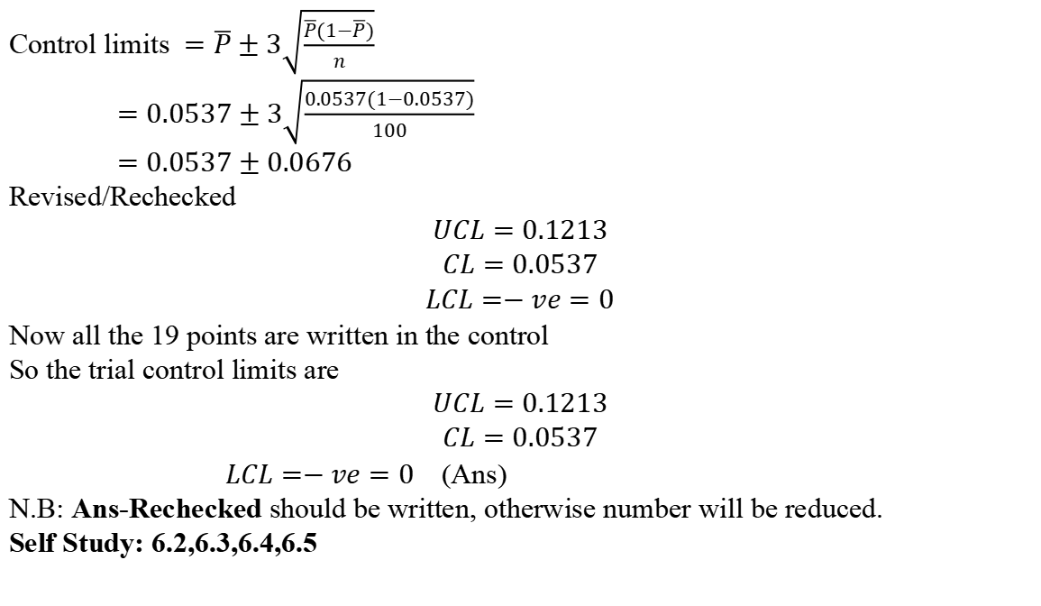
Control limits $=\overline{P}±3\sqrt{\frac{\overline{P}(1−\overline{P})}{n}}$
$=0.0537±3\sqrt{\frac{0.0537(1−0.0537)}{100}}$
$=0.0537±0.0676$
Revised/Rechecked
$$UCL=0.1213$$
$$CL=0.0537$$
$$LCL=−ve=0$$
Now all the 19 points are written in the control
So the trial control limits are
$$UCL=0.1213$$
$$CL=0.0537$$
$LCL=−ve=0$ (Ans)
N.B: Ans-Rechecked should be written, otherwise number will be reduced.
Self Study: 6.2,6.3,6.4,6.5

Slide 114
Week 13

Slide 115
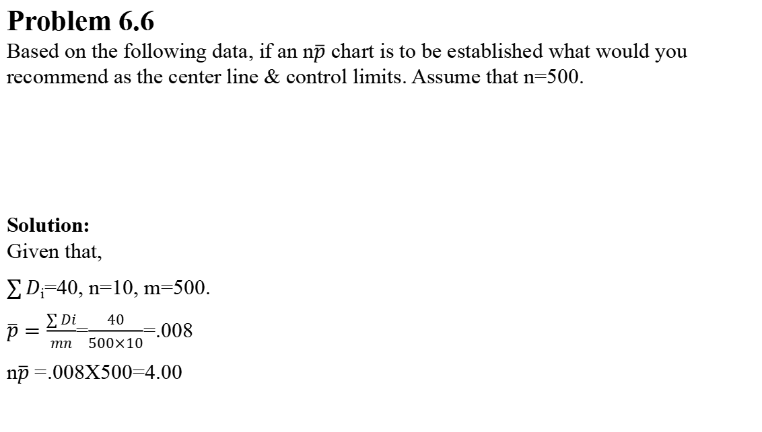
Problem 6.6
Based on the following data, if an n$\overline{p}$ chart is to be established what would you recommend as the center line & control limits. Assume that n=500.
Solution:
Given that,
$\sum{D}$_{i}=40, n=10, m=500.
$\overline{p}=\frac{\sum{Di}}{mn}$=$\frac{40}{500×10}$=.008
n$\overline{p}$ =.008X500=4.00
Day | 1 | 2 | 3 | 4 | 5 | 6 | 7 | 8 | 9 | 10
Number of non-conforming unit | 3 | 4 | 3 | 2 | 6 | 12 | 5 | 1 | 2 | 2

Slide 116

Now trial control limits are:
VCL = n$\overline{p}$+3$\sqrt{n\overline{p}(1−\overline{p})}$
= 4+3x1.99198=9.97594
CL = 4
LCL = 4-3x1.99198
=-ve$≅$0
Sample no 6 is out of control limit.
Revised control limit
n = 500, m = 10-1 = 9
$\sum{D}$_{i}=40-12=28
$∴\overline{p}$=$\frac{28}{500×9}$=0.006
n$\overline{p}$=500$×$0.006=3.00

Slide 117
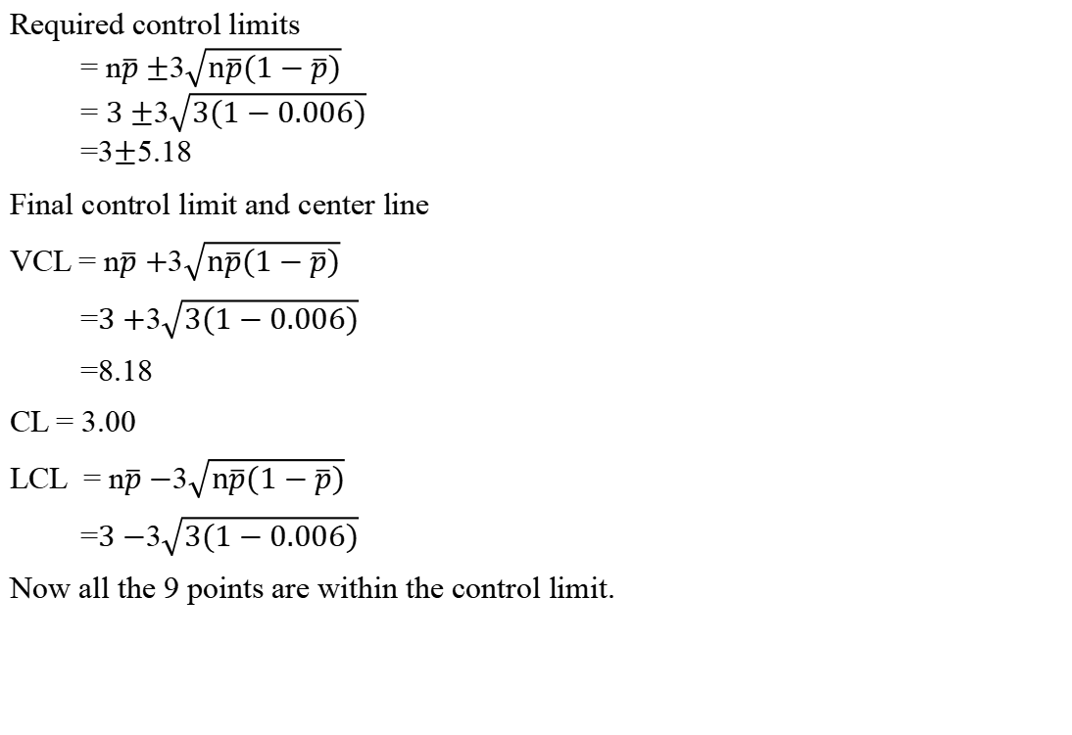
Required control limits
= n$\overline{p}±$3$\sqrt{n\overline{p}(1−\overline{p})}$
= $3±$3$\sqrt{3(1−0.006)}$
=3$±$5.18
Final control limit and center line
VCL = n$\overline{p}+$3$\sqrt{n\overline{p}(1−\overline{p})}$
=$3+$3$\sqrt{3(1−0.006)}$
=8.18
CL = 3.00
LCL = n$\overline{p}−$3$\sqrt{n\overline{p}(1−\overline{p})}$
=$3−$3$\sqrt{3(1−0.006)}$
Now all the 9 points are within the control limit.

Slide 118
Problem 6.37
A paper mill uses a control chart to monitor the imperfection in finished rolls of paper. Production output is inspected for 20 days and the resulting data are shown here. Use these data to set up a control chart for nonconformities per roll of paper. Does the process appear to be in statistical control? What center line and control limits would you recommended for controlling future production ?
Day | Number of Rolls produced | Total Number of Imperfections
1 | 18 | 12
2 | 18 | 14
3 | 24 | 20
4 | 22 | 18
5 | 22 | 15
6 | 22 | 12
7 | 20 | 11
8 | 20 | 15
9 | 20 | 12
10 | 20 | 10
11 | 18 | 18
12 | 18 | 14
13 | 18 | 9
14 | 20 | 10
15 | 20 | 14
16 | 20 | 13
17 | 24 | 16
18 | 24 | 18
19 | 22 | 20
20 | 21 | 17

Slide 119
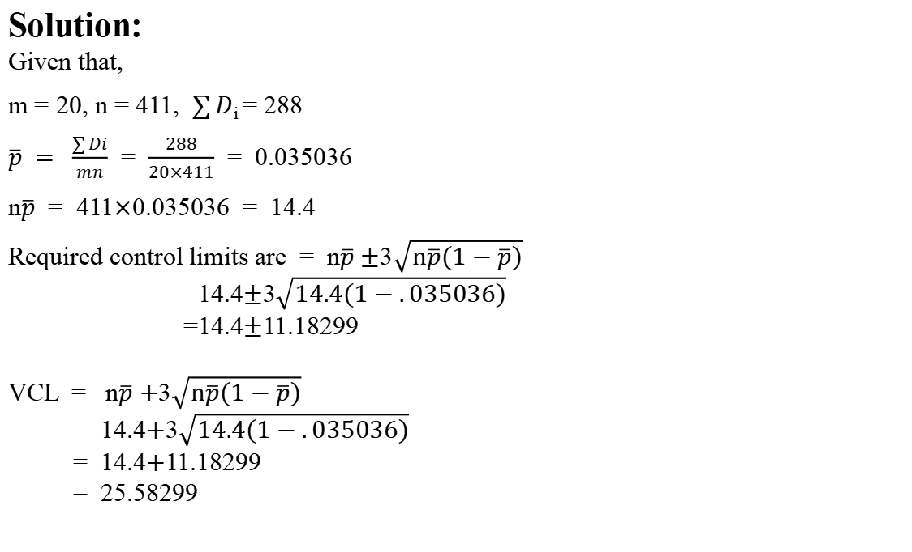
Solution:
Given that,
m = 20, n = 411, $\sum{D}$_{i} = 288
$\overline{p} = \frac{\sum{Di}}{mn}$ = $\frac{288}{20×411}$ = 0.035036
n$\overline{p}$ = 411$×$0.035036 = 14.4
Required control limits are = n$\overline{p}±$3$\sqrt{n\overline{p}(1−\overline{p})}$
=14.4$±$3$\sqrt{14.4(1−.035036)}$
=14.4$±$11.18299
VCL = n$\overline{p}+$3$\sqrt{n\overline{p}(1−\overline{p})}$
= 14.4$+$3$\sqrt{14.4(1−.035036)}$
= 14.4$+$11.18299
= 25.58299

Slide 120
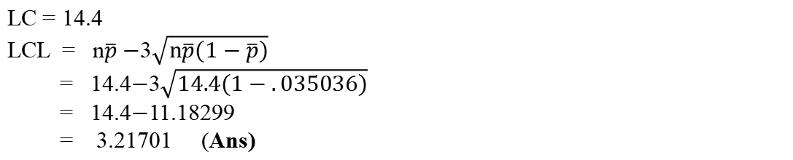
LC = 14.4
LCL = n$\overline{p}−$3$\sqrt{n\overline{p}(1−\overline{p})}$
= 14.4$−$3$\sqrt{14.4(1−.035036)}$
= 14.4$−$11.18299
= 3.21701 (Ans)

Slide 121
Week 14

Slide 122
Control Charts for Non Conformities (Defects)
Non conformity or Defect:
Unit
Conforming
Non conforming
Must have at least one non conformity or defect.

Slide 123
Control Charts for Non Conformities (Defects)
Total number of non conformities in a unit
Average number of non conformities per unit

Slide 124
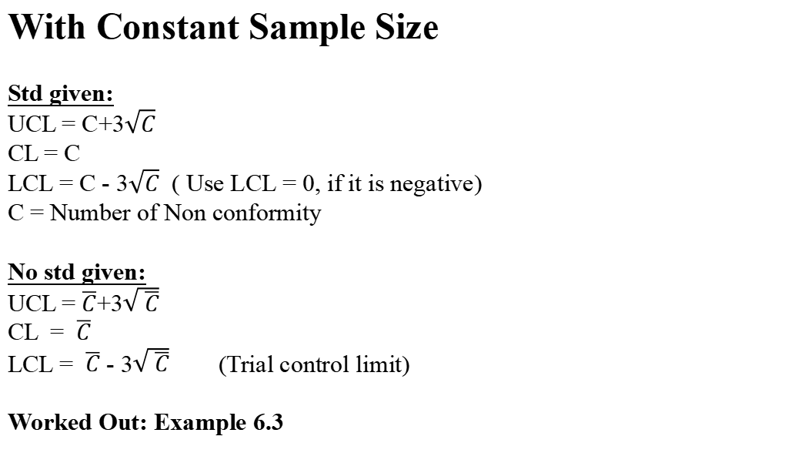
With Constant Sample Size
Std given:
UCL = C+3$\sqrt{C}$
CL = C
LCL = C - 3$\sqrt{C}$ ( Use LCL = 0, if it is negative)
C = Number of Non conformity
No std given:
UCL = $\overline{C}$+3$\sqrt{ \overline{C}}$
CL = $\overline{C}$
LCL = $\overline{C}$ - 3$\sqrt{ \overline{C}}$ (Trial control limit)
Worked Out: Example 6.3

Slide 125
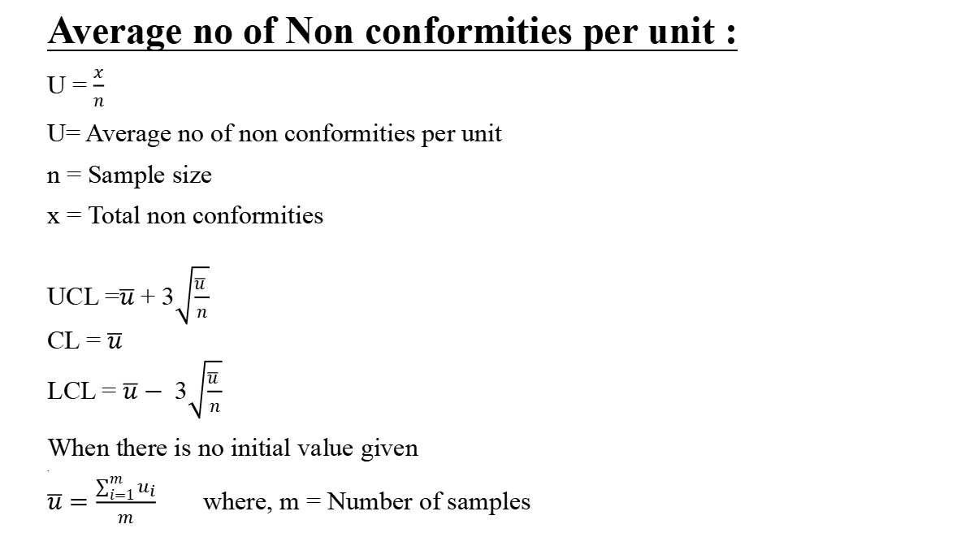
Average no of Non conformities per unit :
U = $\frac{x}{n}$
U= Average no of non conformities per unit
n = Sample size
x = Total non conformities
UCL =$\overline{u}$ + 3$\sqrt{\frac{\overline{u} }{n}}$
CL = $\overline{u}$
LCL = $\overline{u}−$3$\sqrt{\frac{\overline{u} }{n}}$
When there is no initial value given
.
$\overline{u}=\frac{\sum_{i=1}^{m}{u_{i}}}{m}$ where, m = Number of samples

Slide 126
With variable sample size:
There are 3 methods:
i) Variable with control limits,
ii) Approximate set of control limits with average sample size,
iii) Standardised control limits.
Work Out: Example- 6.5

Slide 127
Week 15

Slide 128
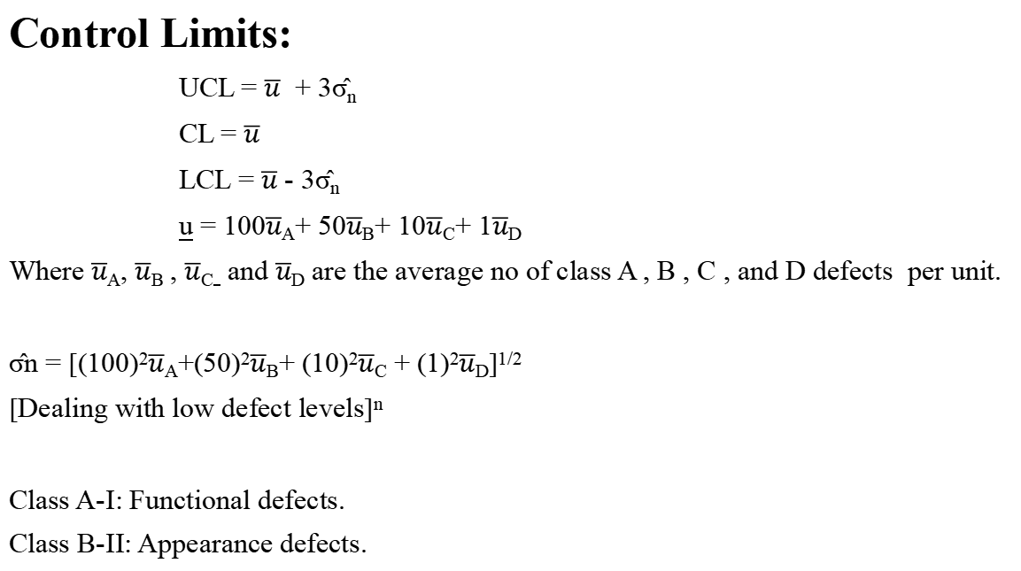
Control Limits:
UCL = $\overline{u}$ + 3σ̂_{n}
CL = $\overline{u}$
LCL = $\overline{u}$ - 3σ̂_{n}
u = 100$\overline{u}$_{A}+ 50$\overline{u}$_{B}+ 10$\overline{u}$_{C}+ 1$\overline{u}$_{D}
Where $\overline{u}$_{A}, $\overline{u}$_{B} , $\overline{u}$_{C} and $\overline{u}$_{D} are the average no of class A , B , C , and D defects per unit.
σ̂n = [(100)²$\overline{u}$_{A}+(50)²$\overline{u}$_{B}+ (10)²$\overline{u}$_{C} + (1)²$\overline{u}$_{D}]^{1/2}
[Dealing with low defect levels]^{n}
Class A-І: Functional defects.
Class B-ІІ: Appearance defects.

Slide 129
Demerit systems:
Class A defects – Very serious
Class B defects – Serious
Class C defects – Moderately serious
Class D defects – Minor serious
Demerit Weights:
A = 100
B = 50
C = 10
D = 1

Slide 130
Demerits in a Unit:
d_{i} = 100×C_{iA} + 50×C_{iB} + 10×C_{ic} + 1×C_{iD}
C_{iA} = No of class A defects in the unit
C_{iB} = No of class B defects in the unit
C_{iC} = No of class C defects in the unit
C_{iD} = No of class d defects in the unit

