Slide 1

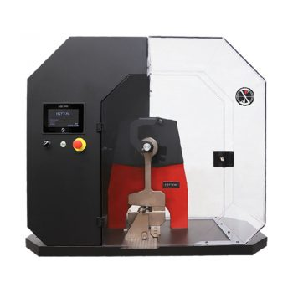
Lab Manual on Mechanics of Solids
Prepared By :
Anisul Islam
Lecturer
Department of ME (UGV)

Slide 2
COURSE INFORMATION
COURSE INFORMATION
Course Title | Mechanics of Solids Sessional | Lecture Contact Hours | 34
Course Code | ME 0715-2244
PRE-REQUISITE | Solid Mechanics Theory, Metallic Materials theory | Credit Total Marks | 01 50
CIE 20 SEE 30
SEE exam time: 2 Hours
By understanding the properties and behavior of metals through testing, industries can make informed decisions about their usage, leading to safer, more reliable products and structures.

Slide 3
Course Learning Outcomes (CLOs)
The learning outcomes that are expected to be attained by the student at the end of the course are
Sl. No. | CLOs | Domain of learning
1 | Understand the concepts to develop a clear understanding of the theoretical concepts related to hardness, toughness, and tensile strength, including their definitions, significance, and interrelationships. | Cognitive
2 | Analyze the experimental data to learn how to collect, analyze, and interpret experimental data to determine the mechanical properties of materials. | Psychomotor
3 | Apply skills to Cultivate critical thinking and problem-solving abilities by troubleshooting experimental issues and analyzing results. | Psychomotor
4 | Evaluate the limitations of the testing methods and suggest improvements | Psychomotor, Affective
5 | Manifest the professional responsibilities and norms of engineering practice. | Affective

Slide 4
Course Learning Outcomes (CLOs)
The learning outcomes that are expected to be attained by the student at the end of the course are
Sl. No. | Content | Hours | CLOs
1 | Basic Introduction on Hardness, Toughness, Tension, Compression, Shear force, torsion and Mechanical Properties | 04 | CLO 1
2 | Hardness Testing | 08 | CLO2, CLO3, CLO 4
3 | Toughness Testing | 08 | CLO2, CLO3
4 | Tension and Compression Testing | 06 | CLO2, CLO3, CLO 4
5 | Torsion Testing | 04 | CLO2, CLO3, CLO 4
6 | Practice, Review/Reserved Day, Lab Report Assessment, Self-study | 04 | CLO 2 CLO 4
7 | Lab Test, Viva, Quiz, Overall Assessment, Skill Development Test (Competency) | During Sessional | CLO 1 CLO 3

Slide 5

REFERENCE BOOKS
"An Introduction to Solid Mechanics" by S. H. Crandall
"Introduction to Solid Mechanics" by James M. Pitarresi
"Mechanical Metallurgy" by George E. Dieter "Engineering Metallurgy" by Dhanalakshmi Srinivasan

Slide 6
ASSESSMENT PATTERN
CIE- Continuous Internal Evaluation (20 Marks)
SEE- Semester End Examination (30 Marks)
SEE- Semester End Examination (50 Marks) (should be converted in actual marks (30)
Bloom’s Category Cognitive | Tests (20)
Remember | 05
Understand | 07
Apply | 08
Analyze | 07
Evaluate | 08
Create | 05
Bloom’s Category Psychomotor | Practical Test (30)
Imitation | 10
Manipulation | 5
Precision | 5
Articulation | 5
Naturalization | 5

Slide 7
CIE- Continuous Internal Evaluation (40 Marks) (should be converted in actual marks (20)
Bloom’s Category Marks (out of 60) | Lab Report (10) | Continuous lab performance (10) | Presentation & Viva (10) | External Participation in Curricular/Co-Curricular Activities (10)
Remember |  |  | 02 | Attendance 10
Understand | 05 | 04 | 03
Apply |  | 02
Analyze |  | 02
Evaluate | 05 | 02
Create |  |  | 05

Slide 8
 | Course Plan Specifying Content, CLOs, Teaching Learning Strategy and Assessment Strategy
Week | Topics | Teaching Learning Strategy | Assessment Strategy | Corresponding CLOs
1 | Basic Introduction on Hardness, Toughness, Tension, Compression, Shear force, torsion and Mechanical Properties | Lecture, Oral Presentation | Quiz | CLO1
2 | Rockwell Hardness Testing | Lecture, discussion, Video Presentation, Experiment | Lab Report Assessment, viva, Lab Test, Quiz | CLO2, CLO3, CLO 4
3 | Brinell Harness Testing | Lecture, discussion, Video Presentation, Experiment | Lab Report Assessment, viva, Lab Test, Quiz | CLO2, CLO3, CLO 4
4 | Practice on Rockwell and Brinell Hardness Testing | Group Discussion, Experiment Practice | Skill Development Test | CLO2, CLO3, CLO 4
5-6 | Izod Impact Testing | Lecture, discussion, Video Presentation, Experiment | Lab Report Assessment, viva, Lab Test, Quiz | CLO2, CLO3
7 | Charpy Impact Testing | Lecture, discussion, Video Presentation, Experiment | Lab Report Assessment, viva, Lab Test, Quiz | CLO2, CLO3
8 | Practice on Impact Testing | Group Discussion, Experiment Practice | Skill Development Test | CLO2, CLO3

Slide 9
 | Course Plan Specifying Content, CLOs, Teaching Learning Strategy and Assessment Strategy
Week | Topics | Teaching Learning Strategy | Assessment Strategy | Corresponding CLOs
9 | Tensile Testing | Lecture, discussion, Video Presentation, Experiment | Lab Report Assessment, viva, Lab Test, Quiz | CLO2, CLO3, CLO 4
10 | Compression Testing | Lecture, discussion, Video Presentation, Experiment | Lab Report Assessment, viva, Lab Test, Quiz | CLO2, CLO3, CLO 4
11 | Practice on Tensile and Compression Testing | Group Discussion, Experiment Practice | Skill Development Test | CLO2, CLO3, CLO 4
12-13 | Torsion Testing | Lecture, discussion, Video Presentation, Experiment | Lab Report Assessment, viva, Lab Test, Quiz | CLO2, CLO3, CLO 4
14-15 | Practice, Review/Reserved Day, Lab Report Assessment, Self-study | Group Discussion, Experiment Practice | Skill Development Test | CLO 2 CLO 4
16-17 | Lab Test, Viva, Quiz, Overall Assessment, Skill Development Test (Competency) | Group Discussion, Experiment Practice | Skill Development Test | CLO 1 CLO 3

Slide 10
Indexing
Sl. No. | Week | Content | Page No.
1 | Week 01 | Basic Introduction on Hardness, Toughness, Tension, Compression, Shear force, torsion and Mechanical Properties | 11-30
2 | Week 02-03 | Rockwell Hardness Testing | 31-50
3 | Week 04-05 | Brinell Hardness Testing | 51-64
4 | Week 06-10 | Impact Testing | 65-79
5 | Week 11-12 | Tensile Testing | 80-96
6 | Week 13-14 | Compression Testing | 97-109
7 | Week 15-16 | Torsion Testing | 110-120

Slide 11
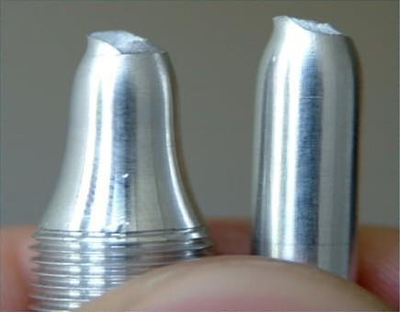
Week - 1
Mechanical Properties of
Metal

Slide 12
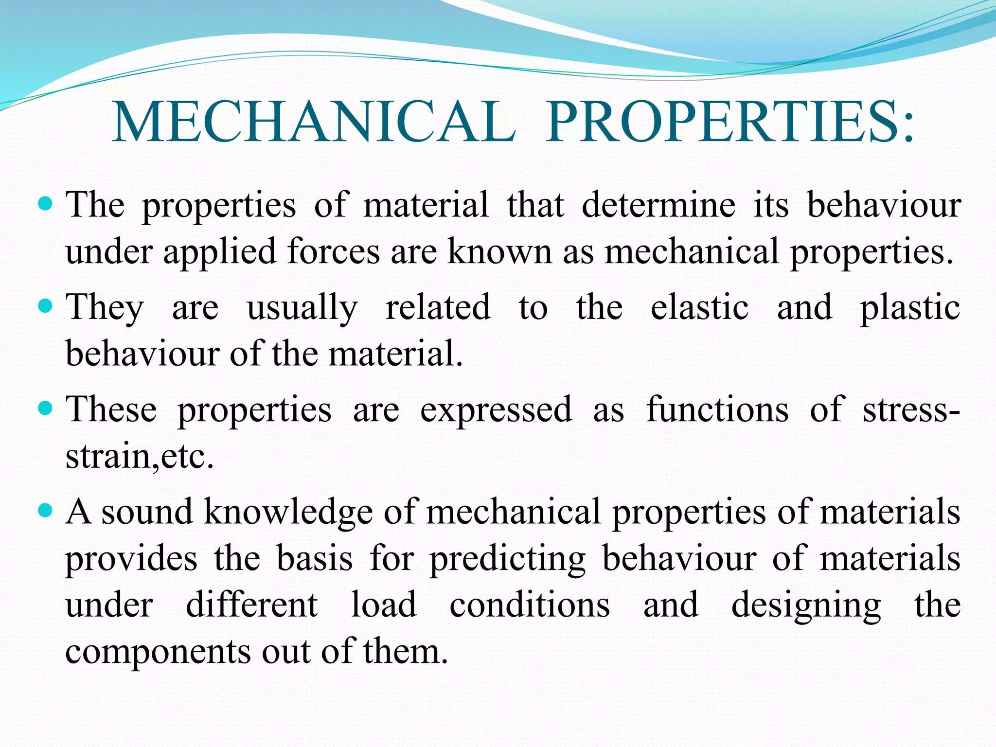
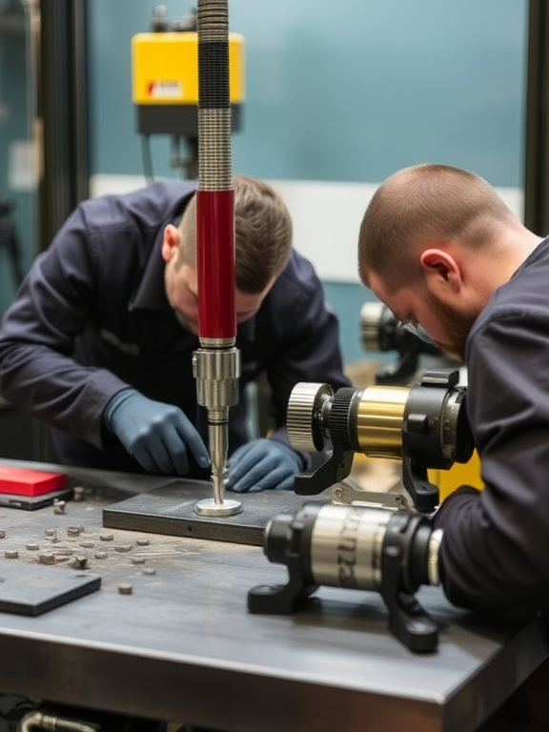

Slide 13
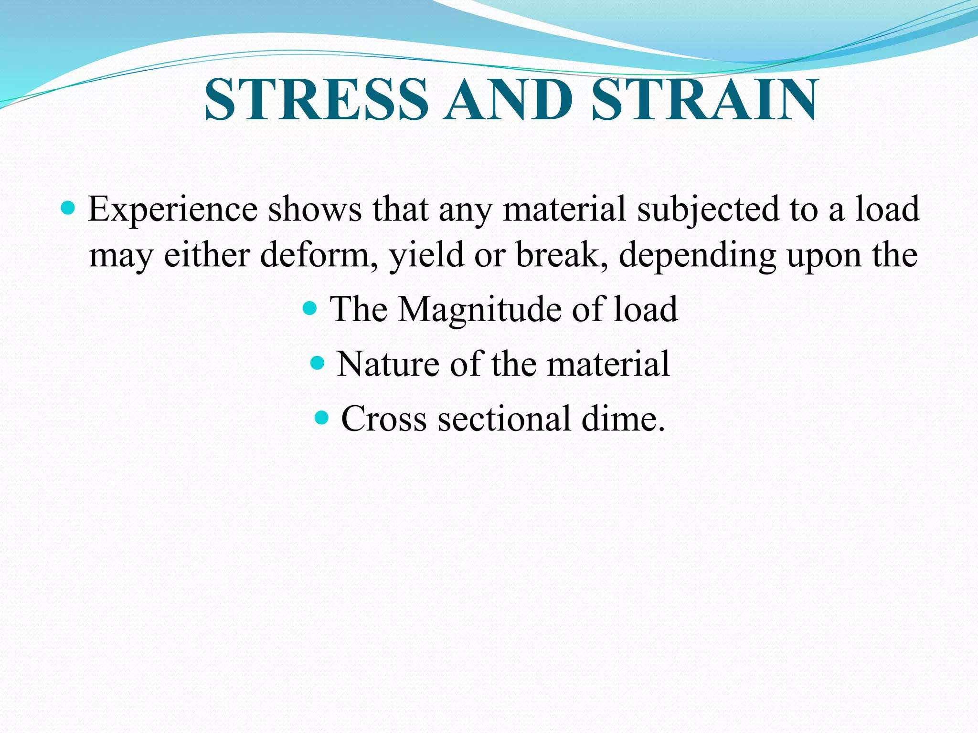

Slide 14
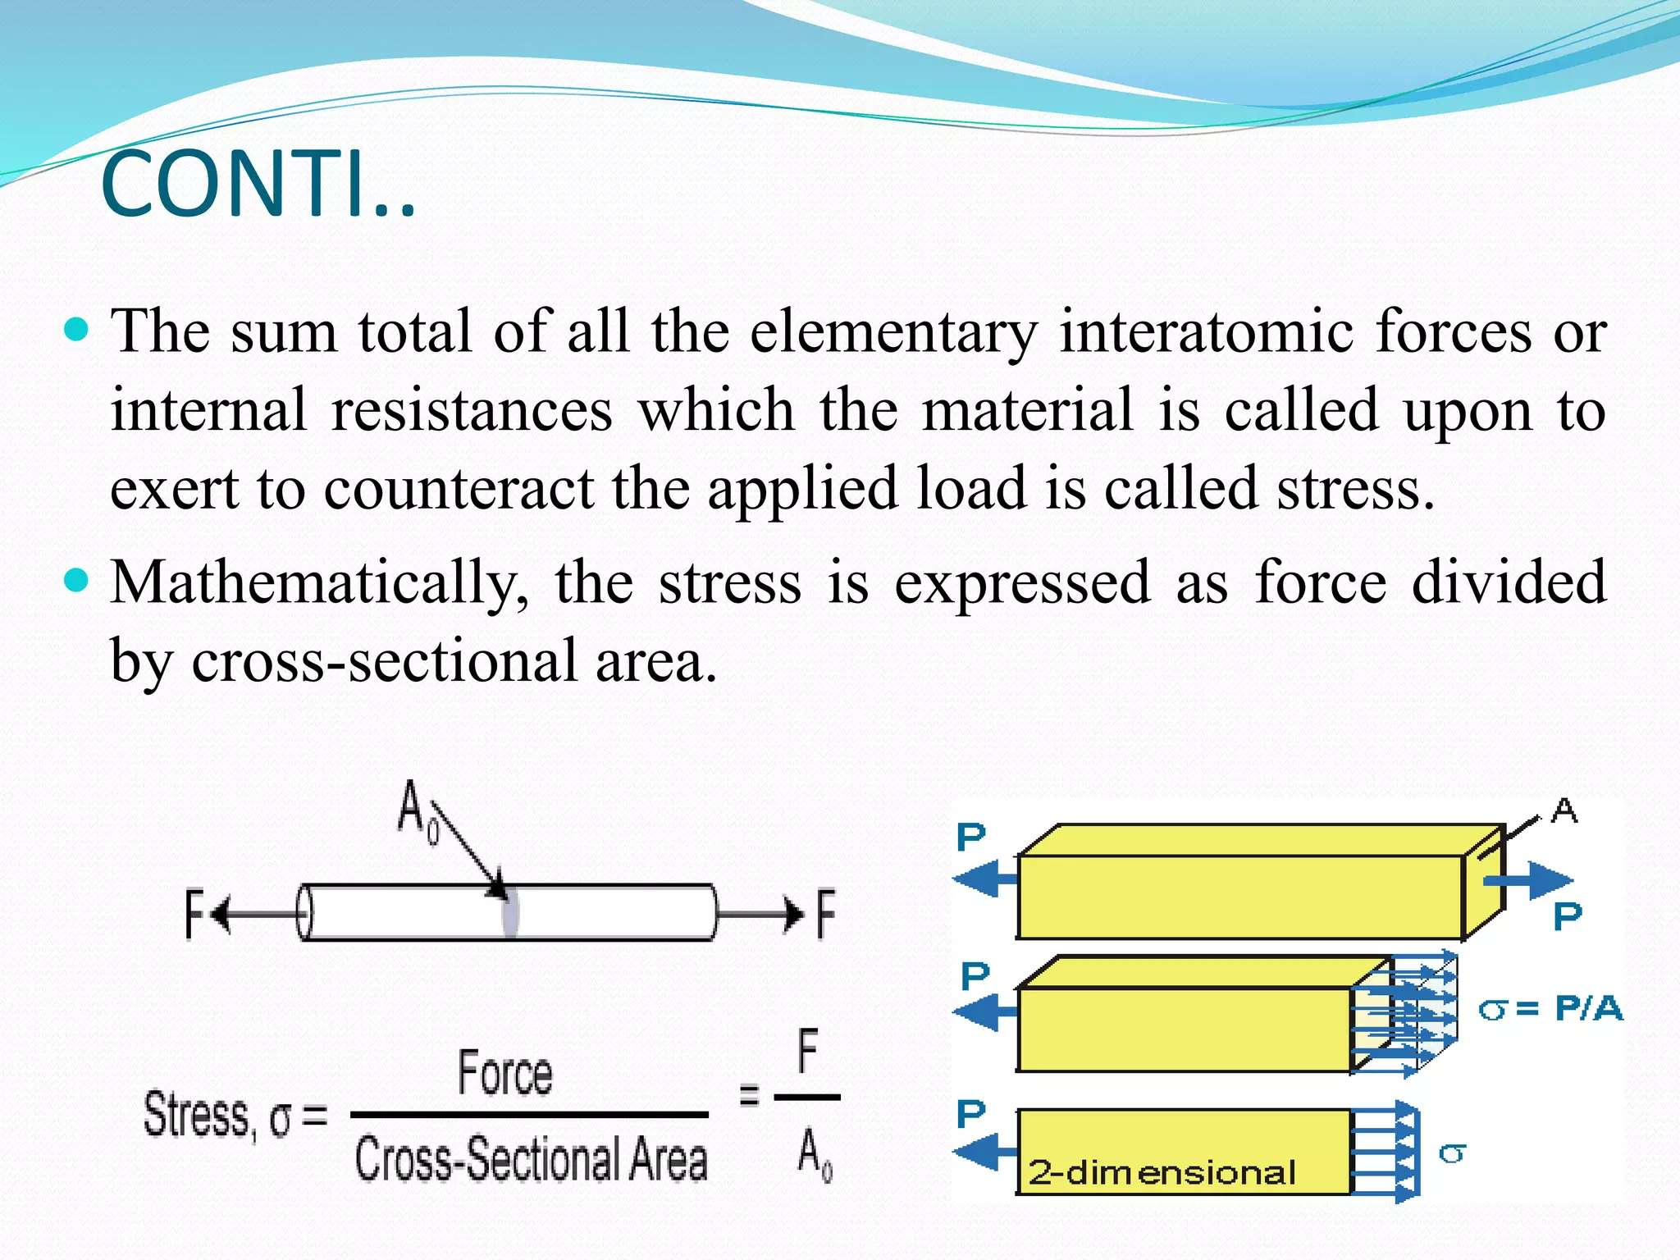

Slide 15
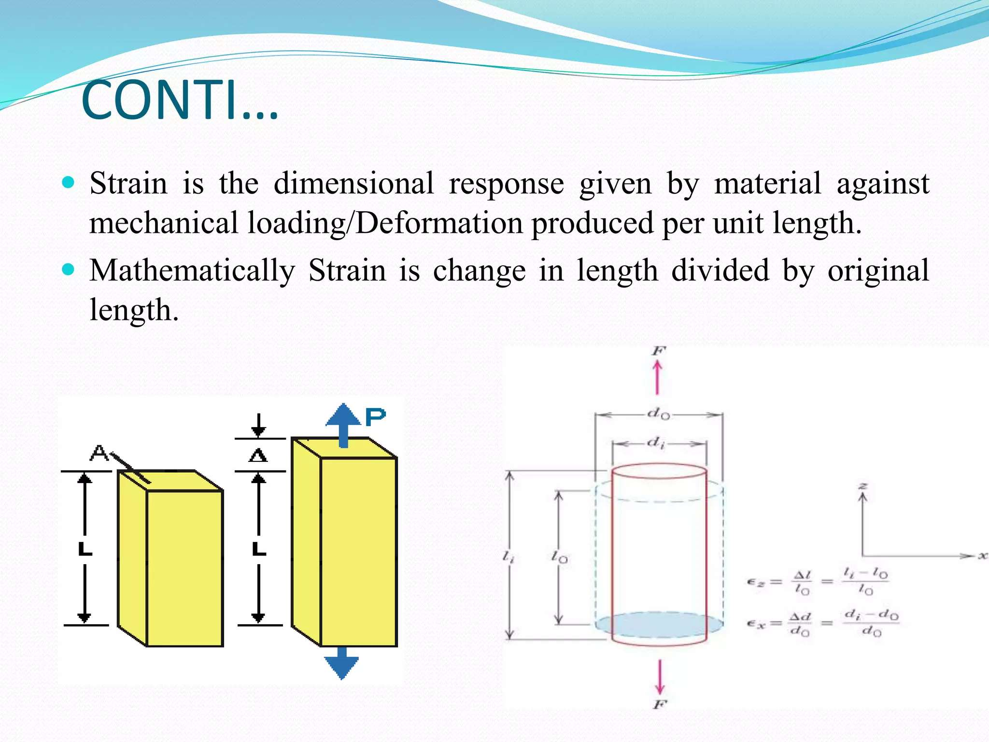

Slide 16
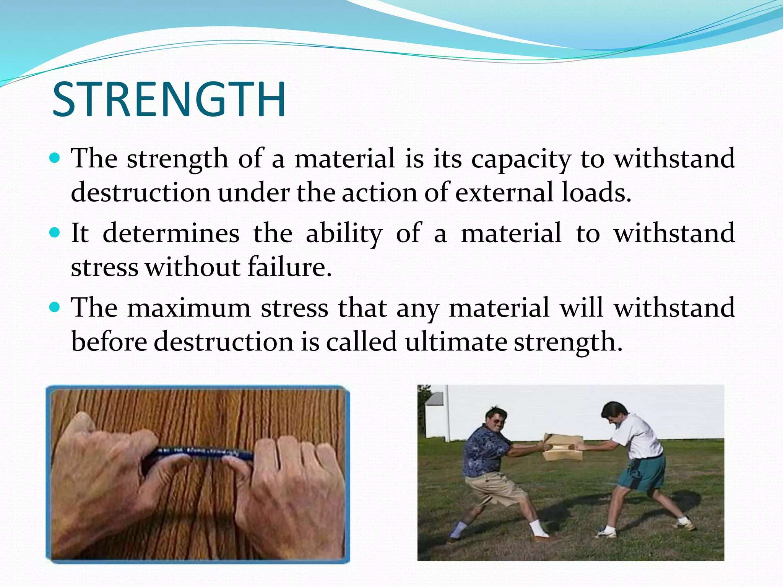

Slide 17
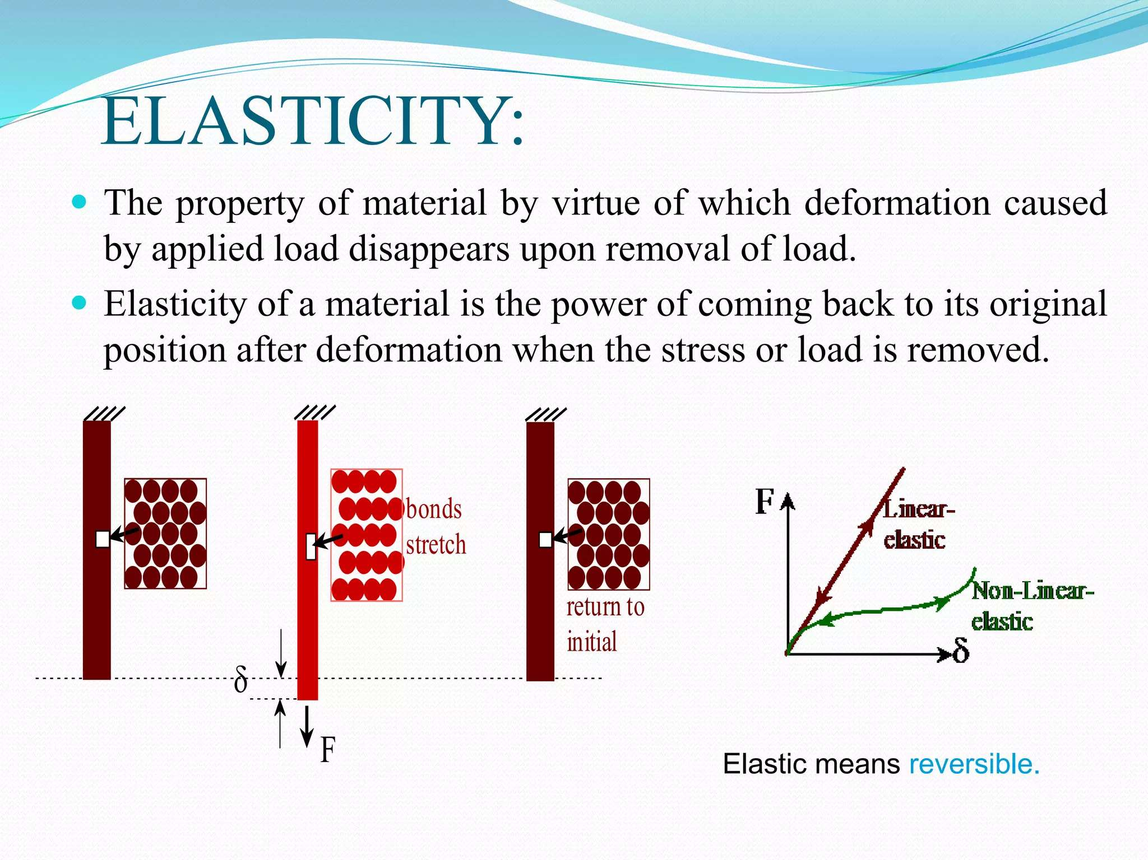

Slide 18
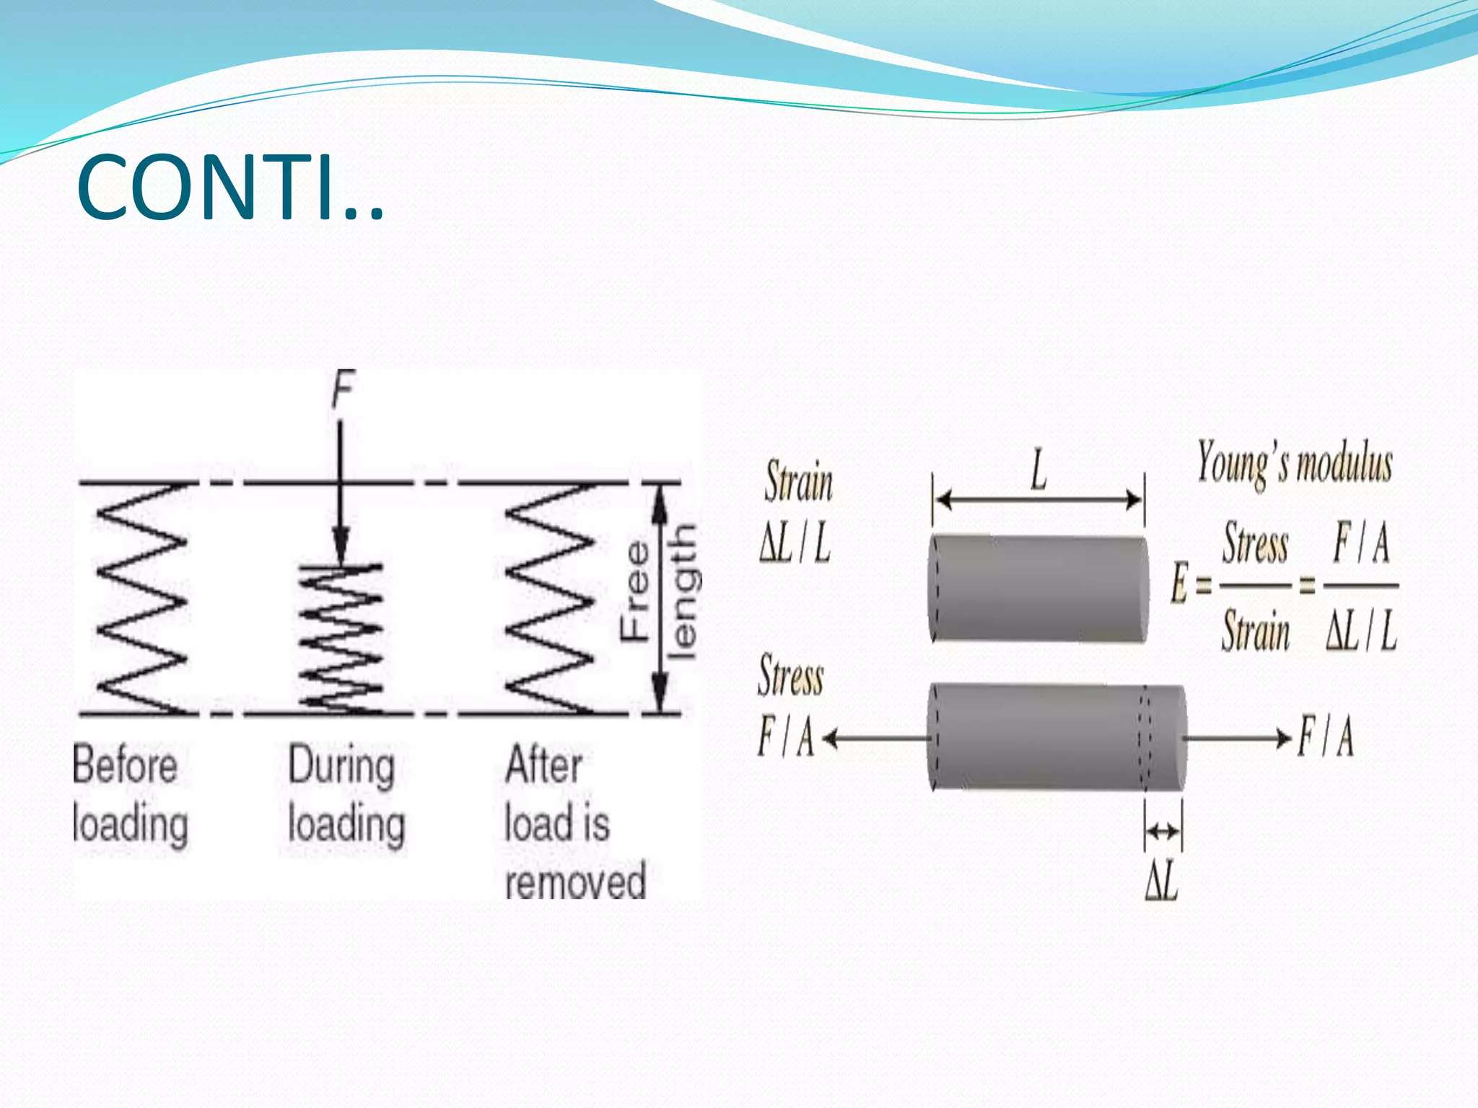

Slide 19
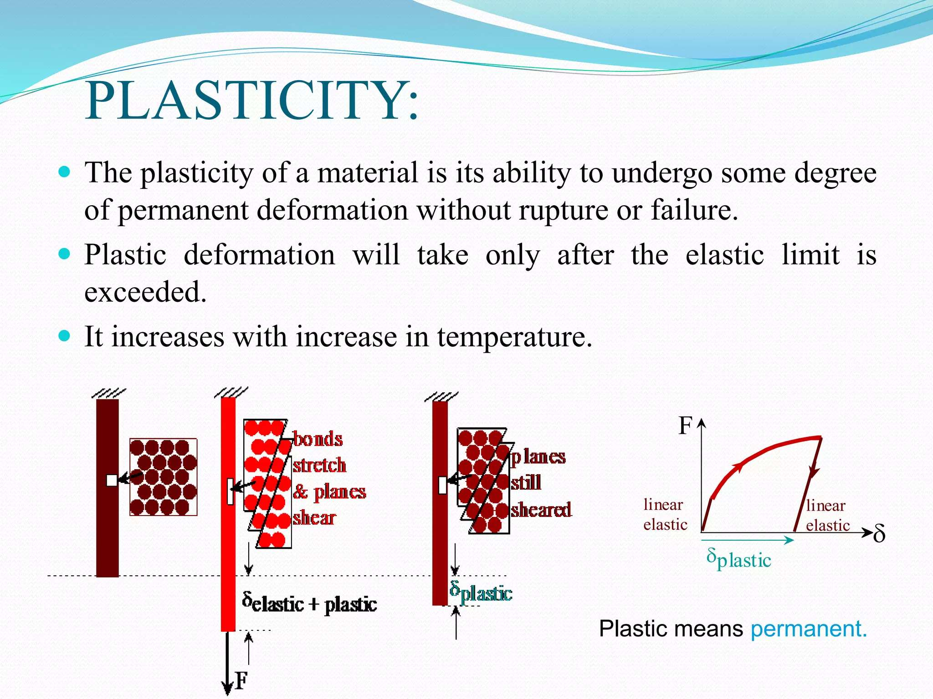

Slide 20
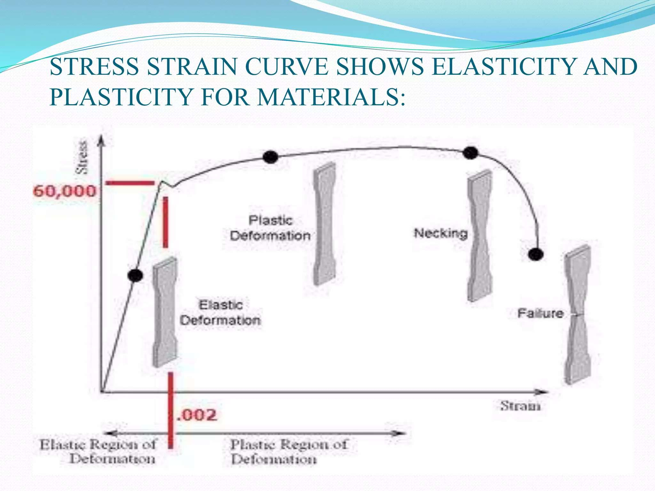

Slide 21
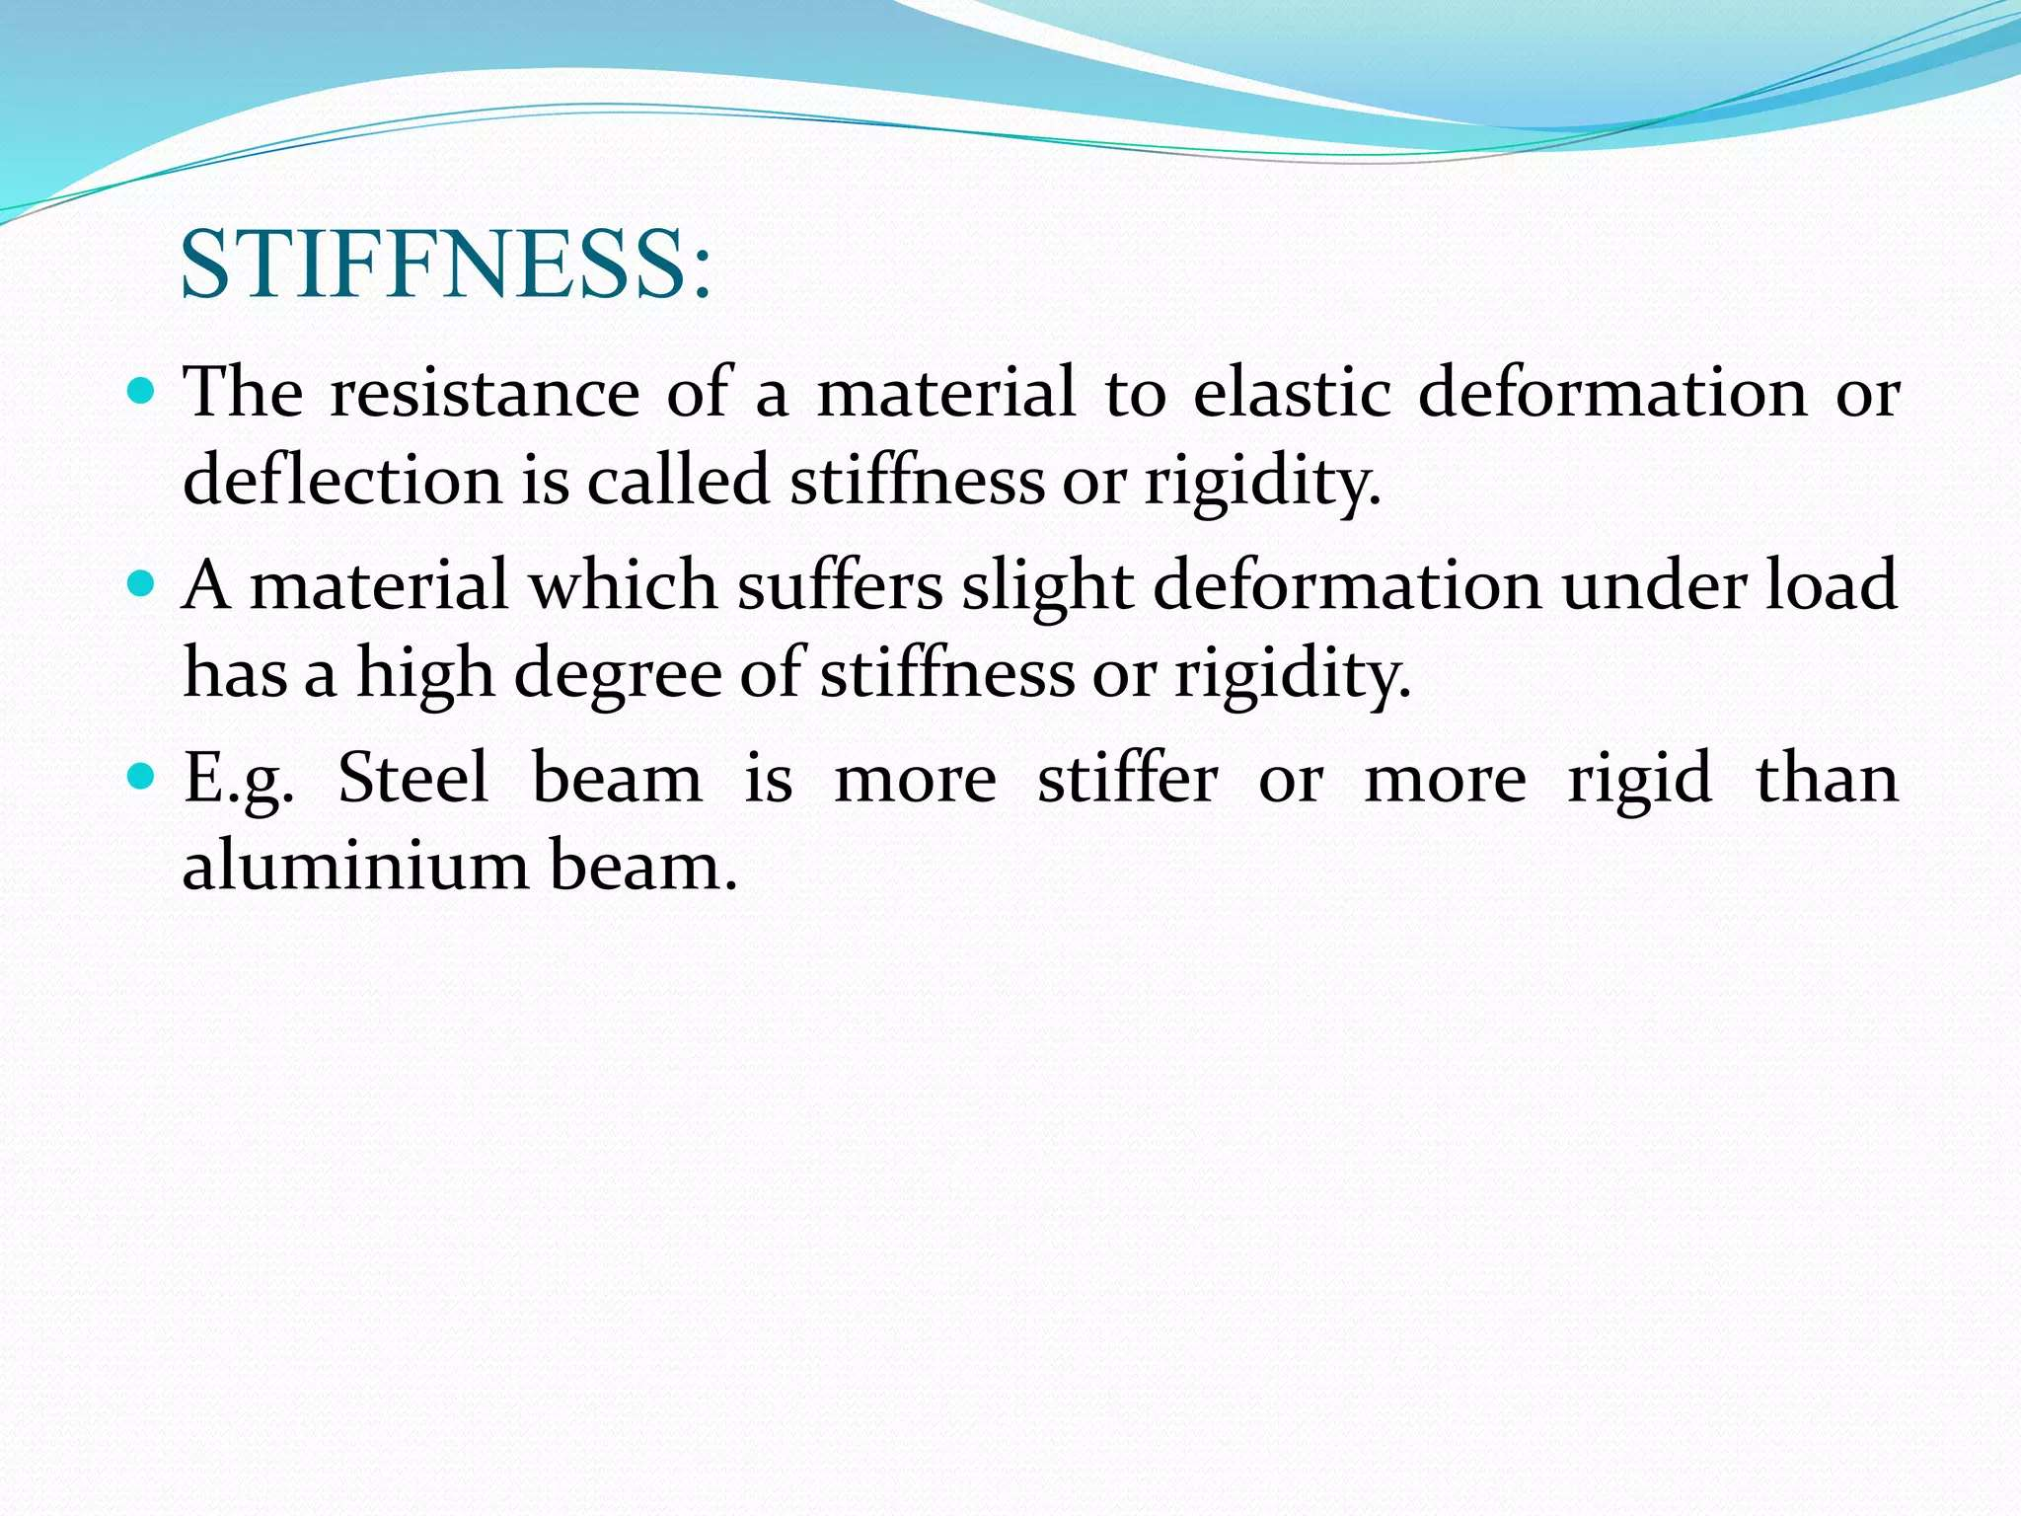

Slide 22
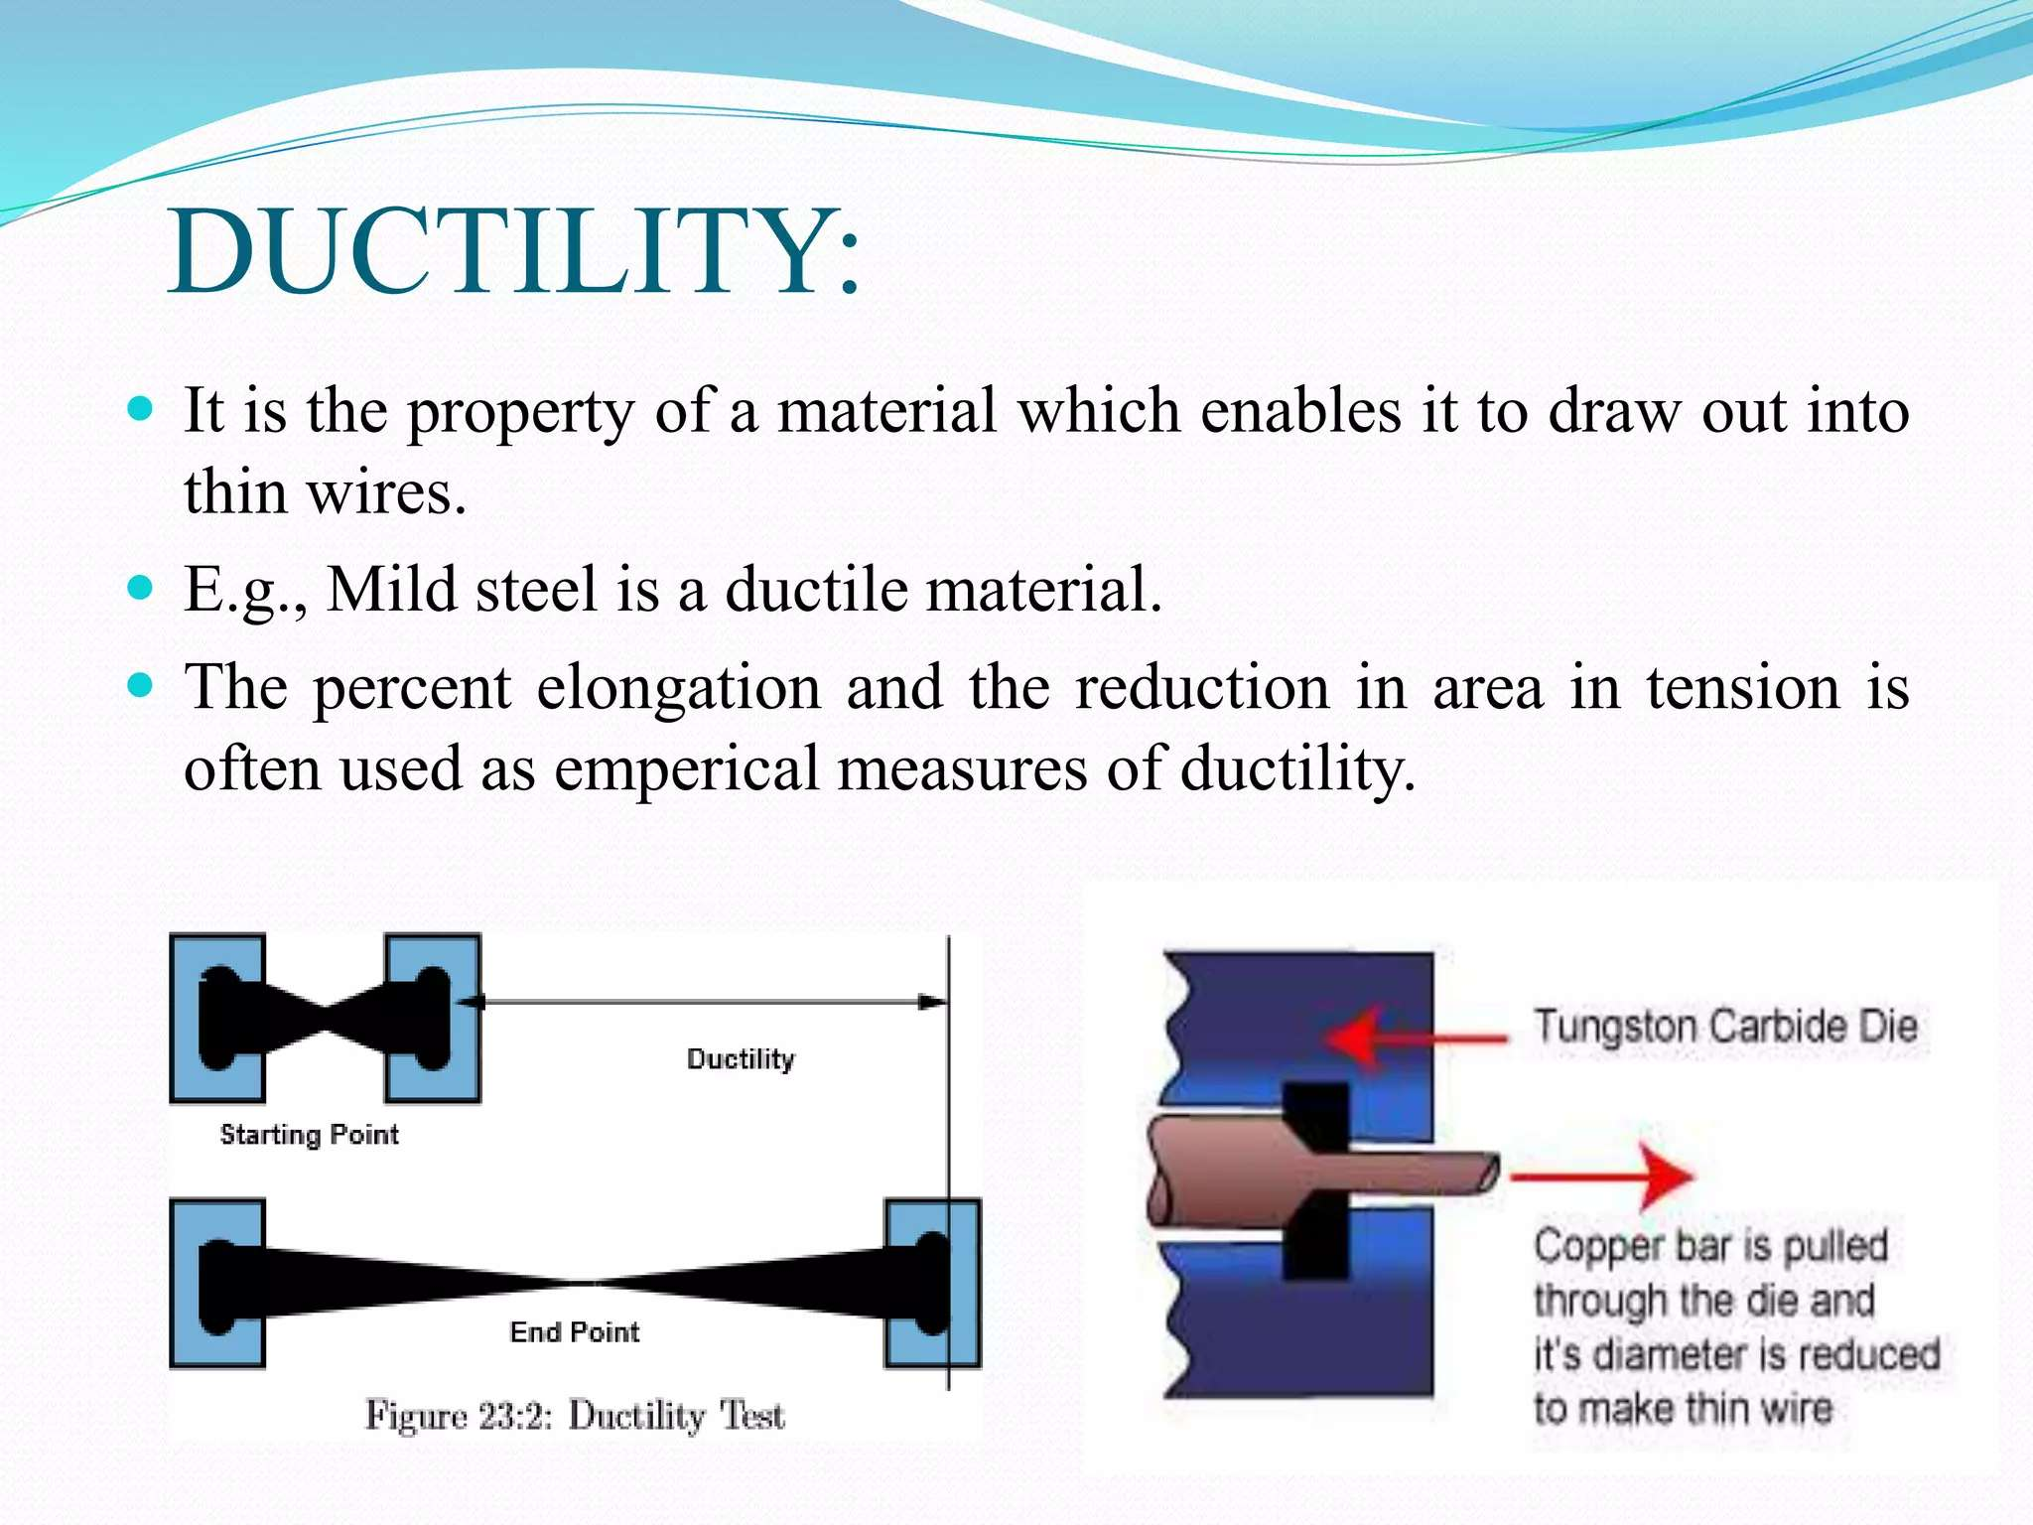

Slide 23
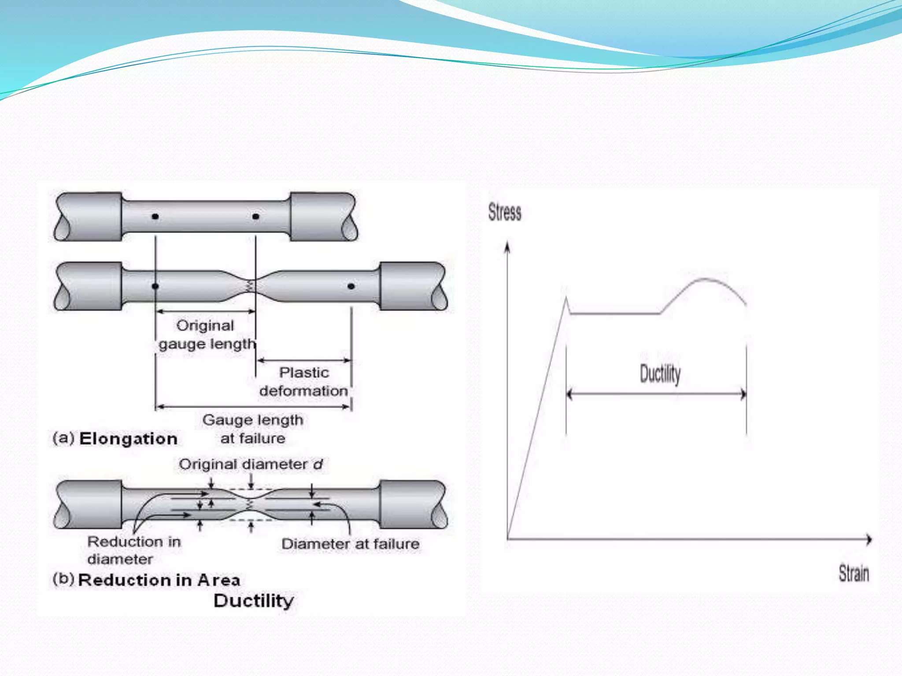

Slide 24
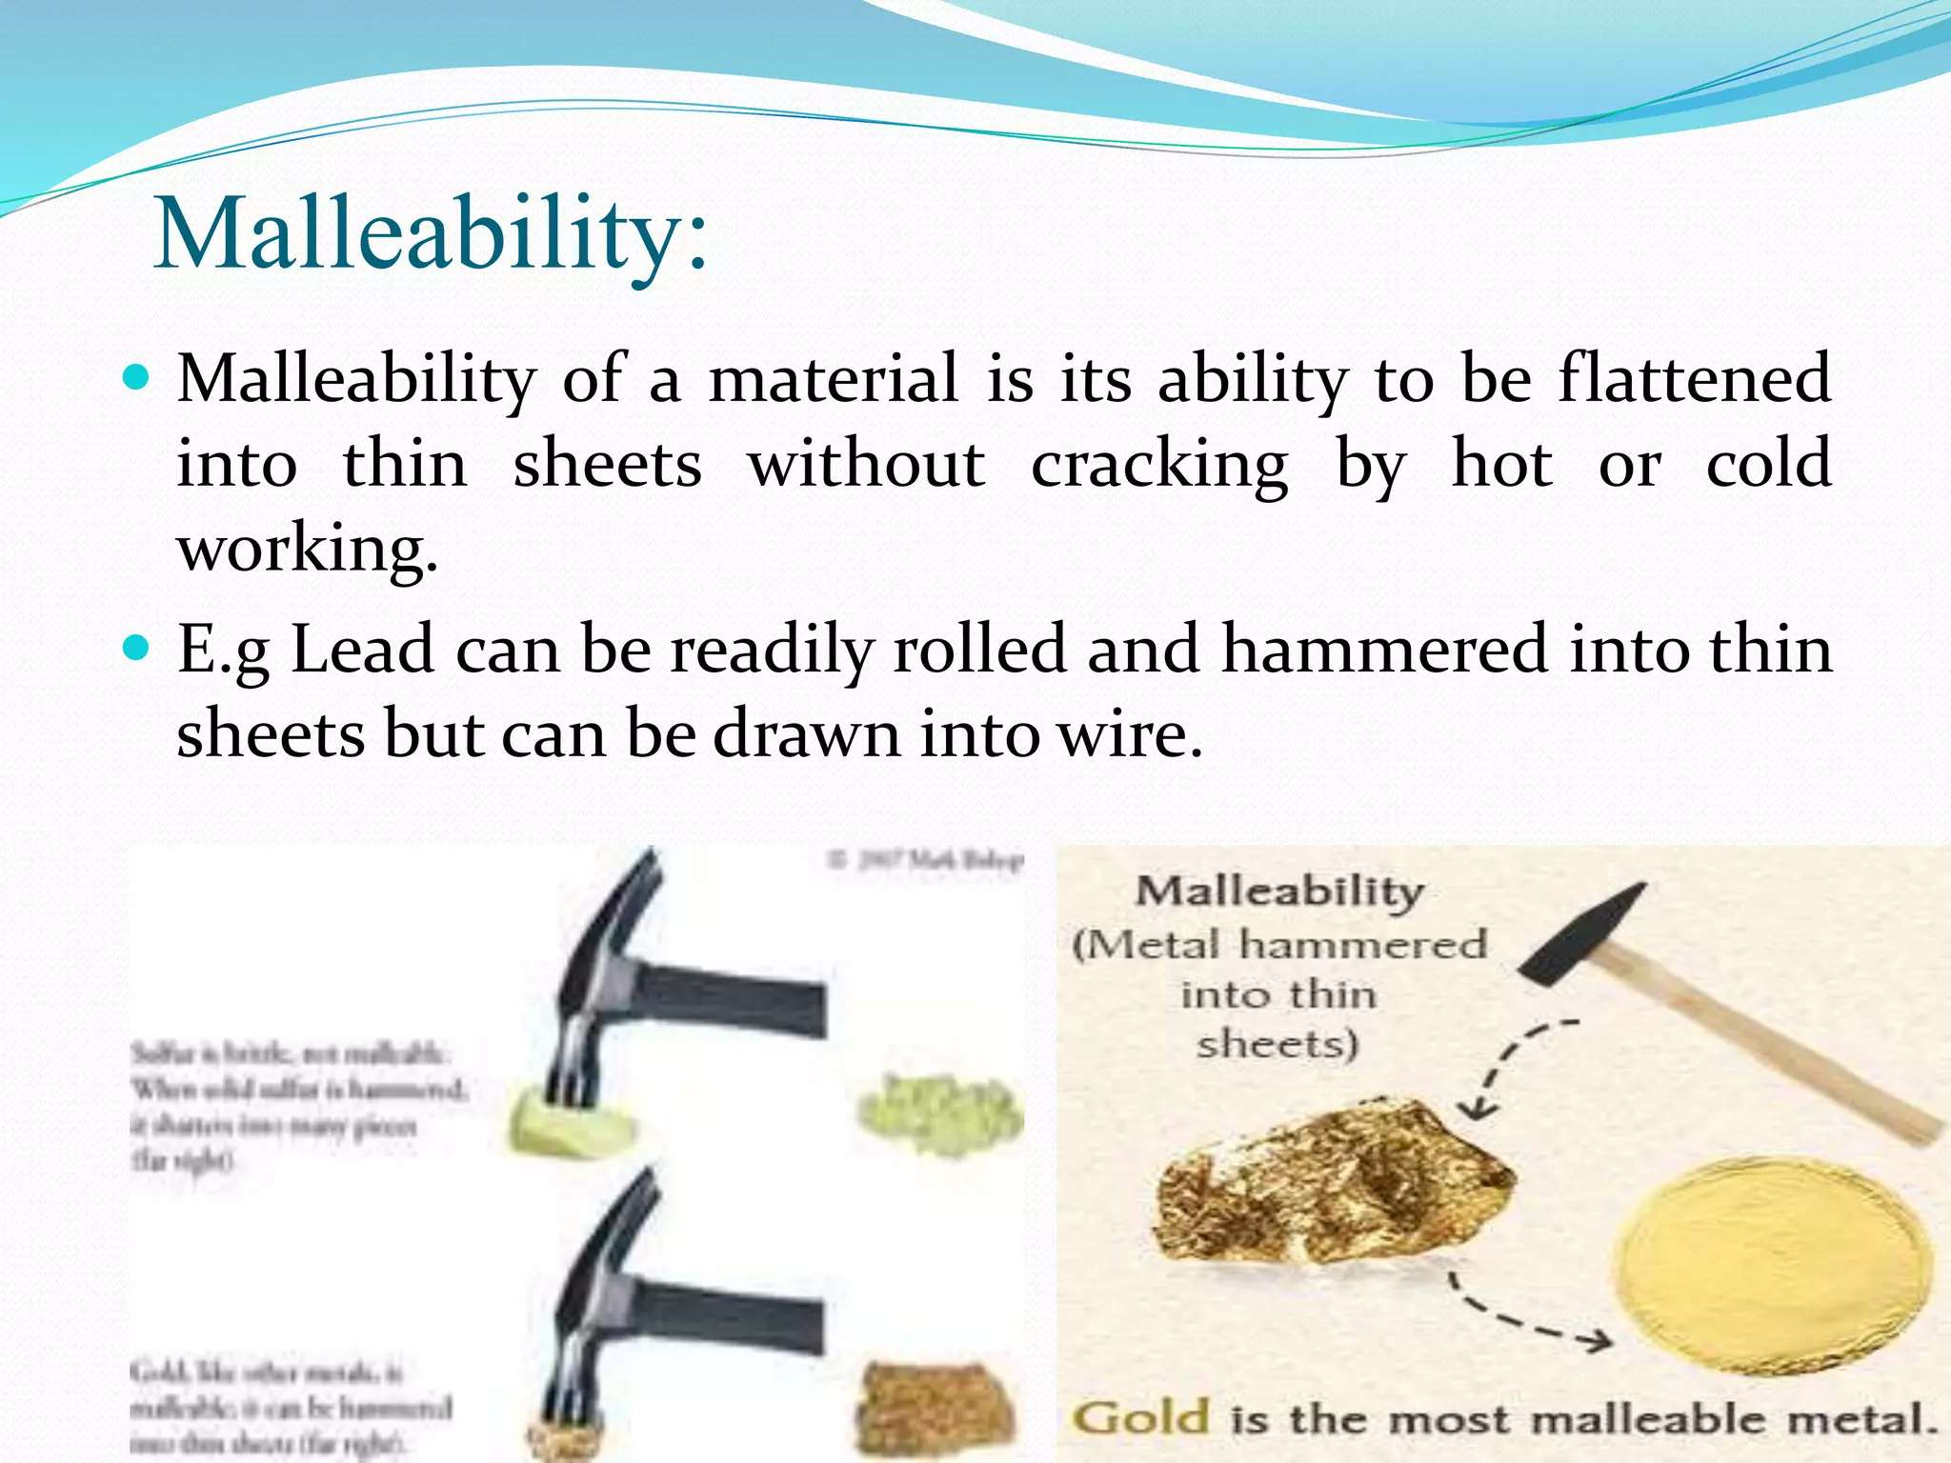

Slide 25


Slide 26
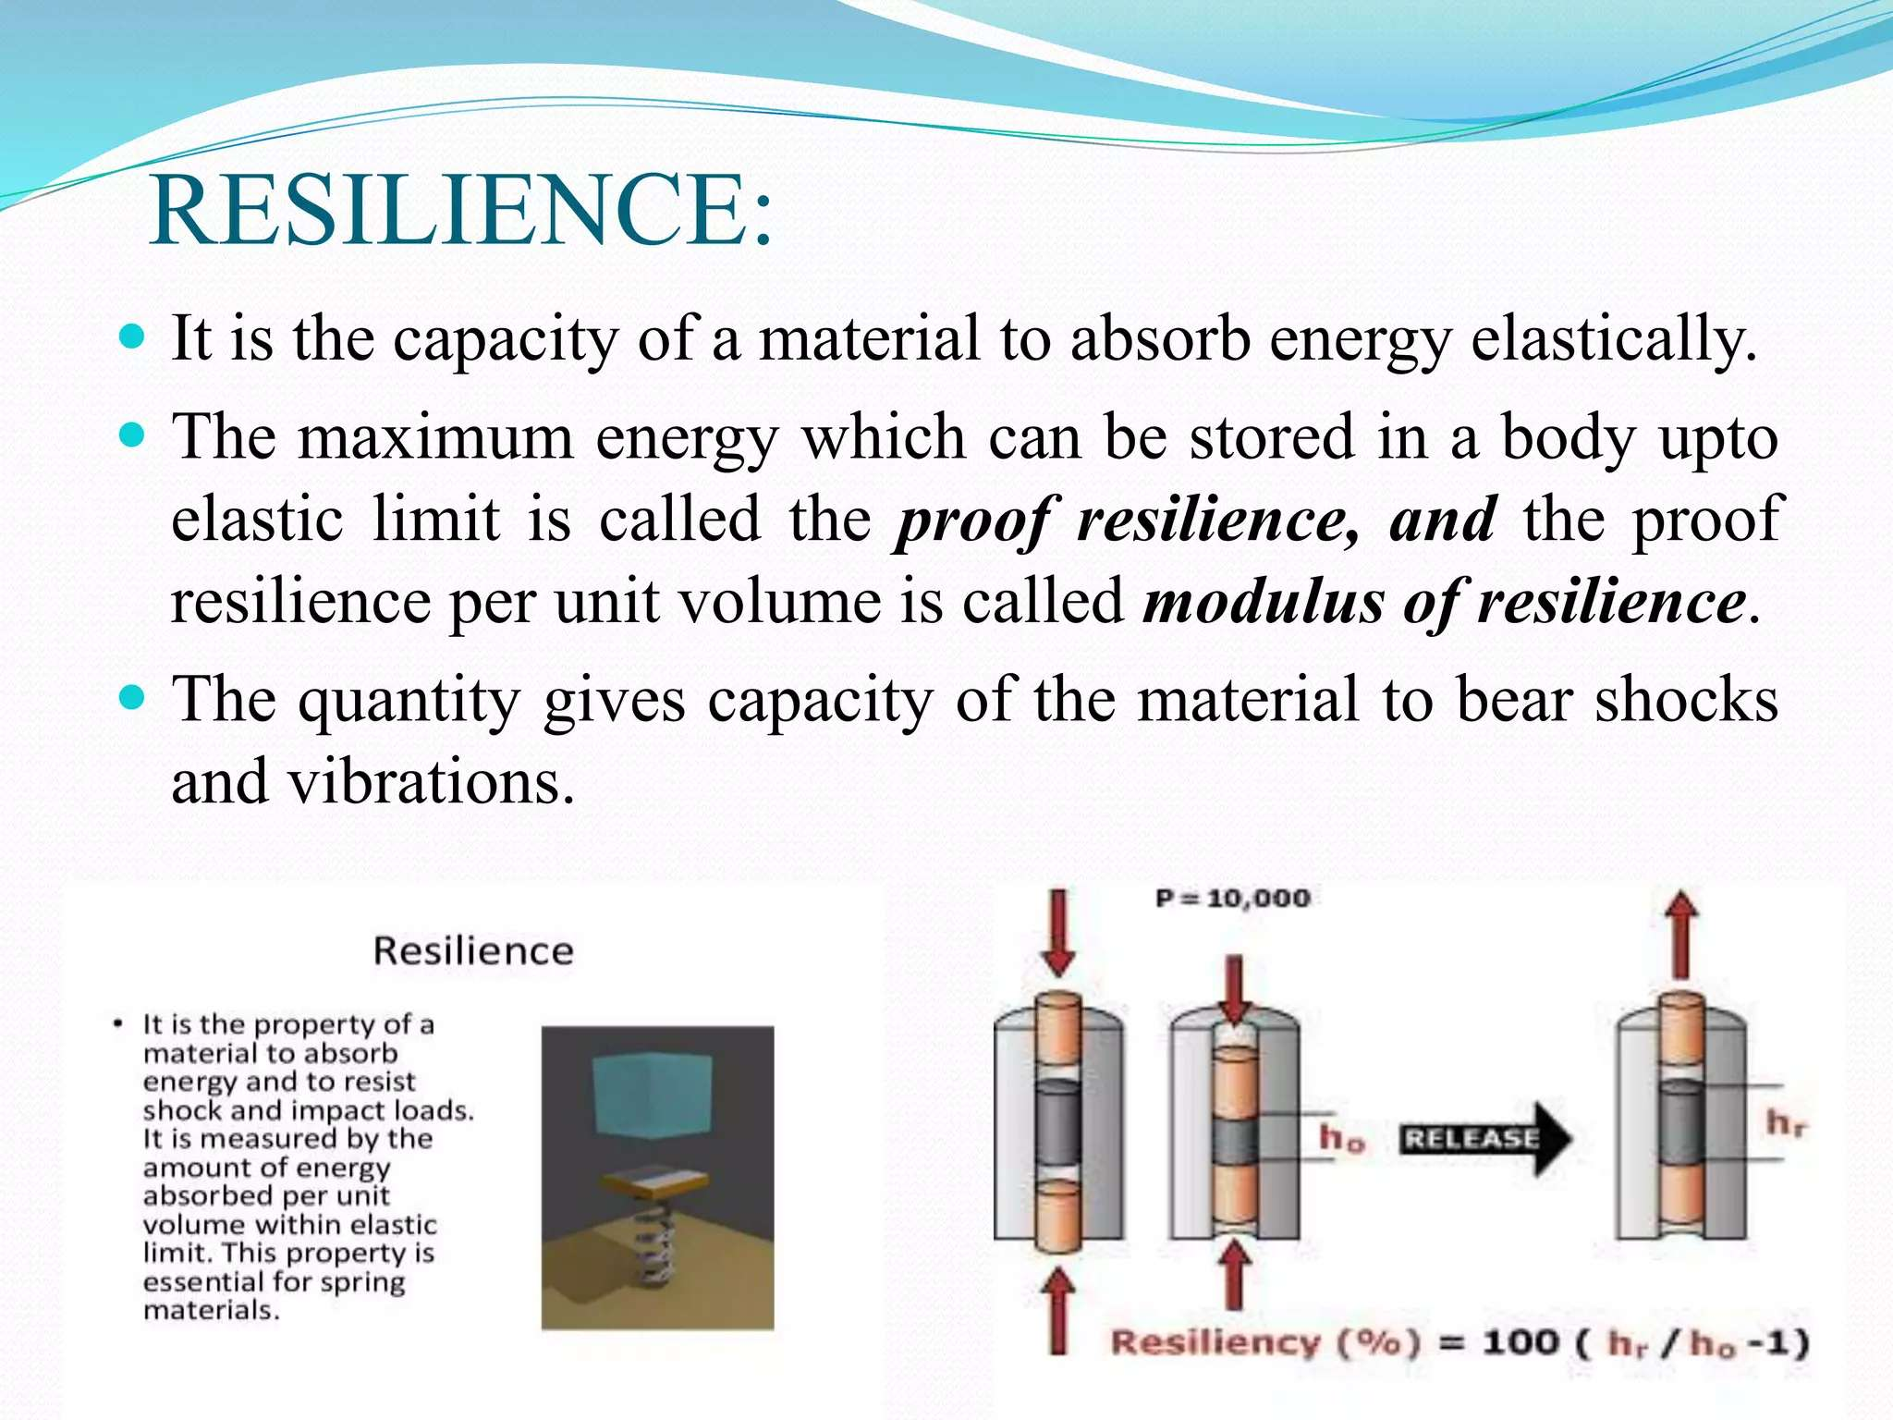

Slide 27
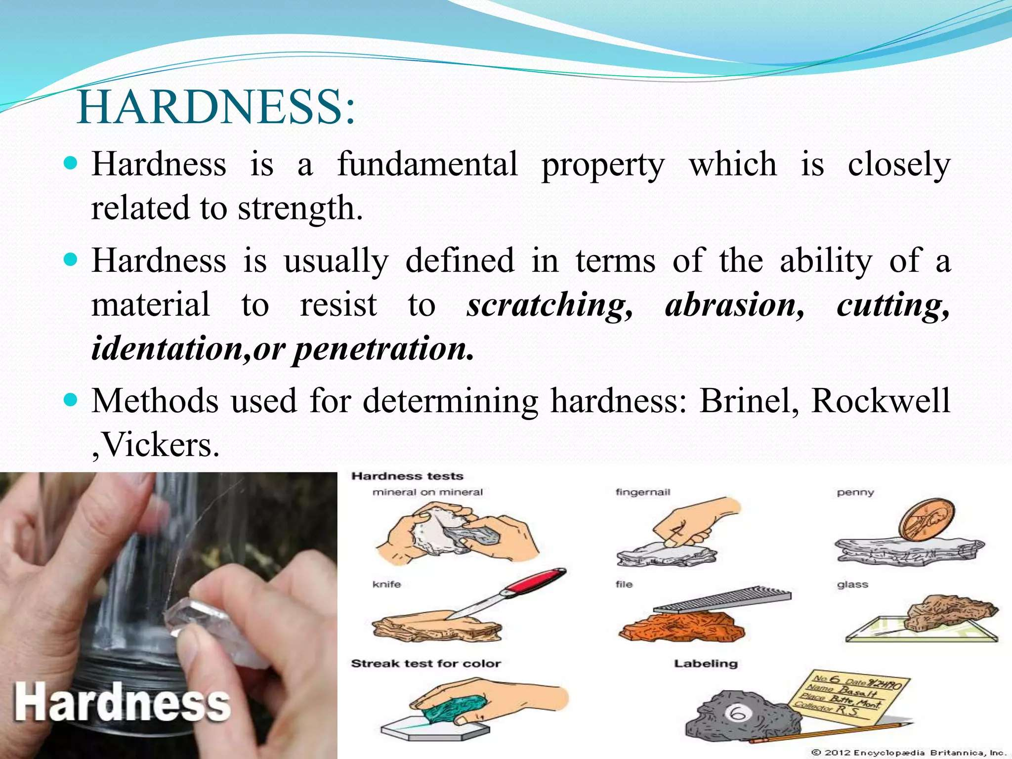

Slide 28
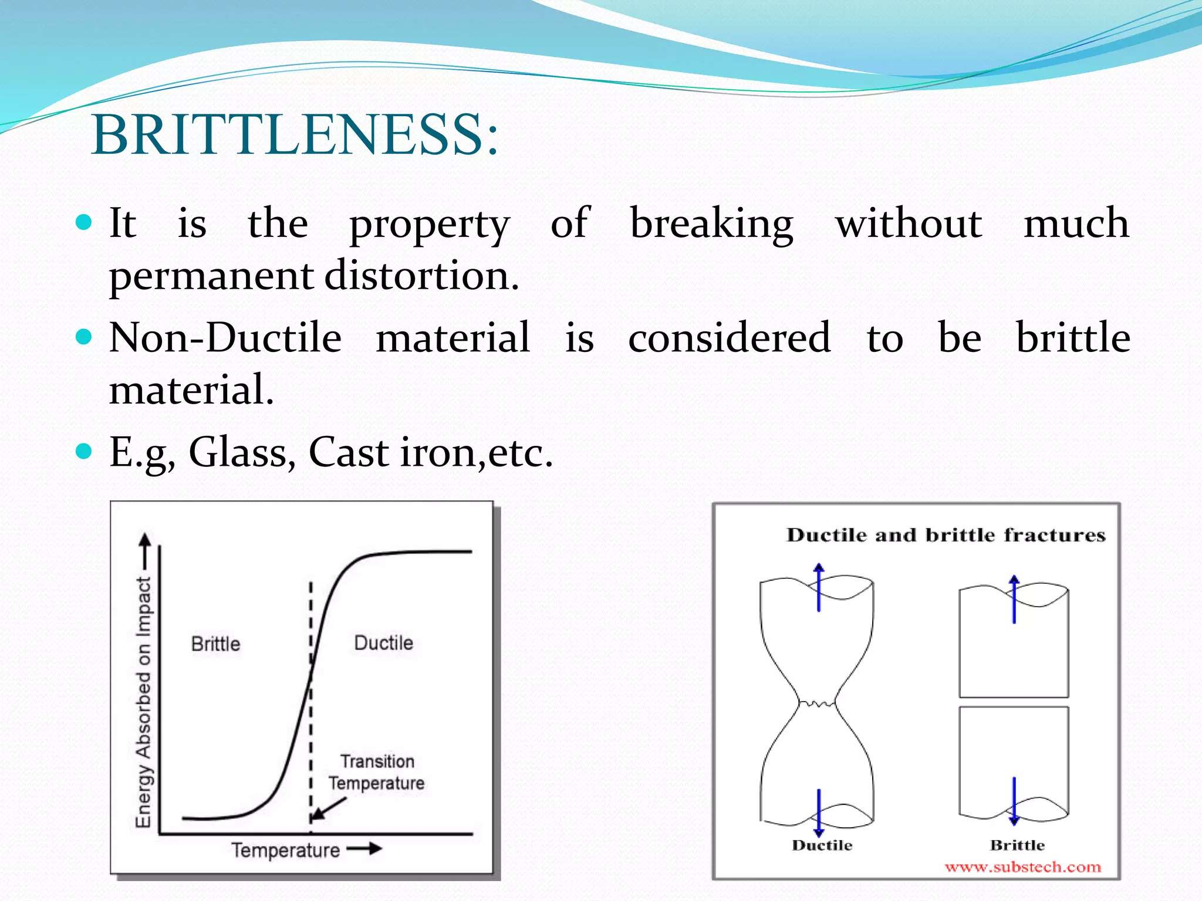

Slide 29
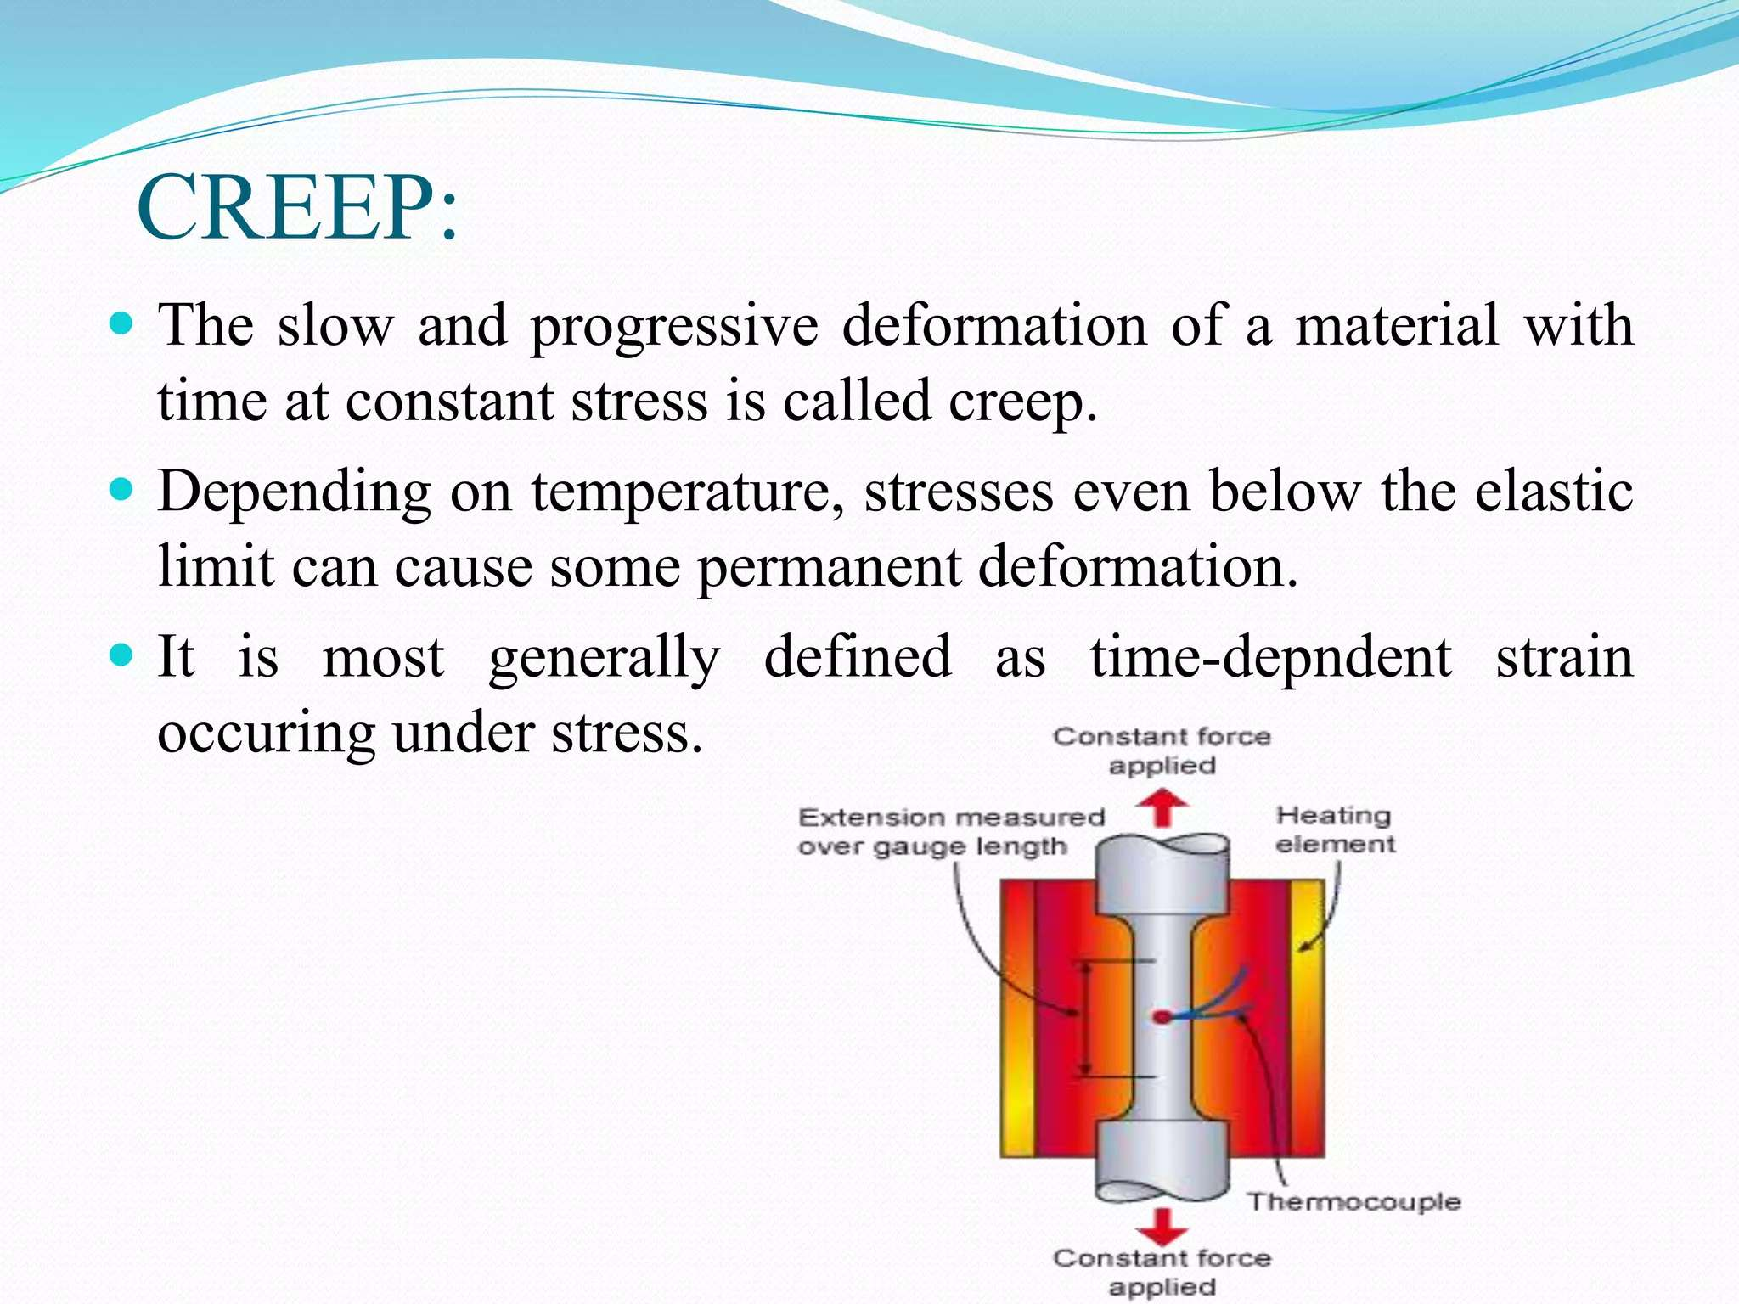

Slide 30
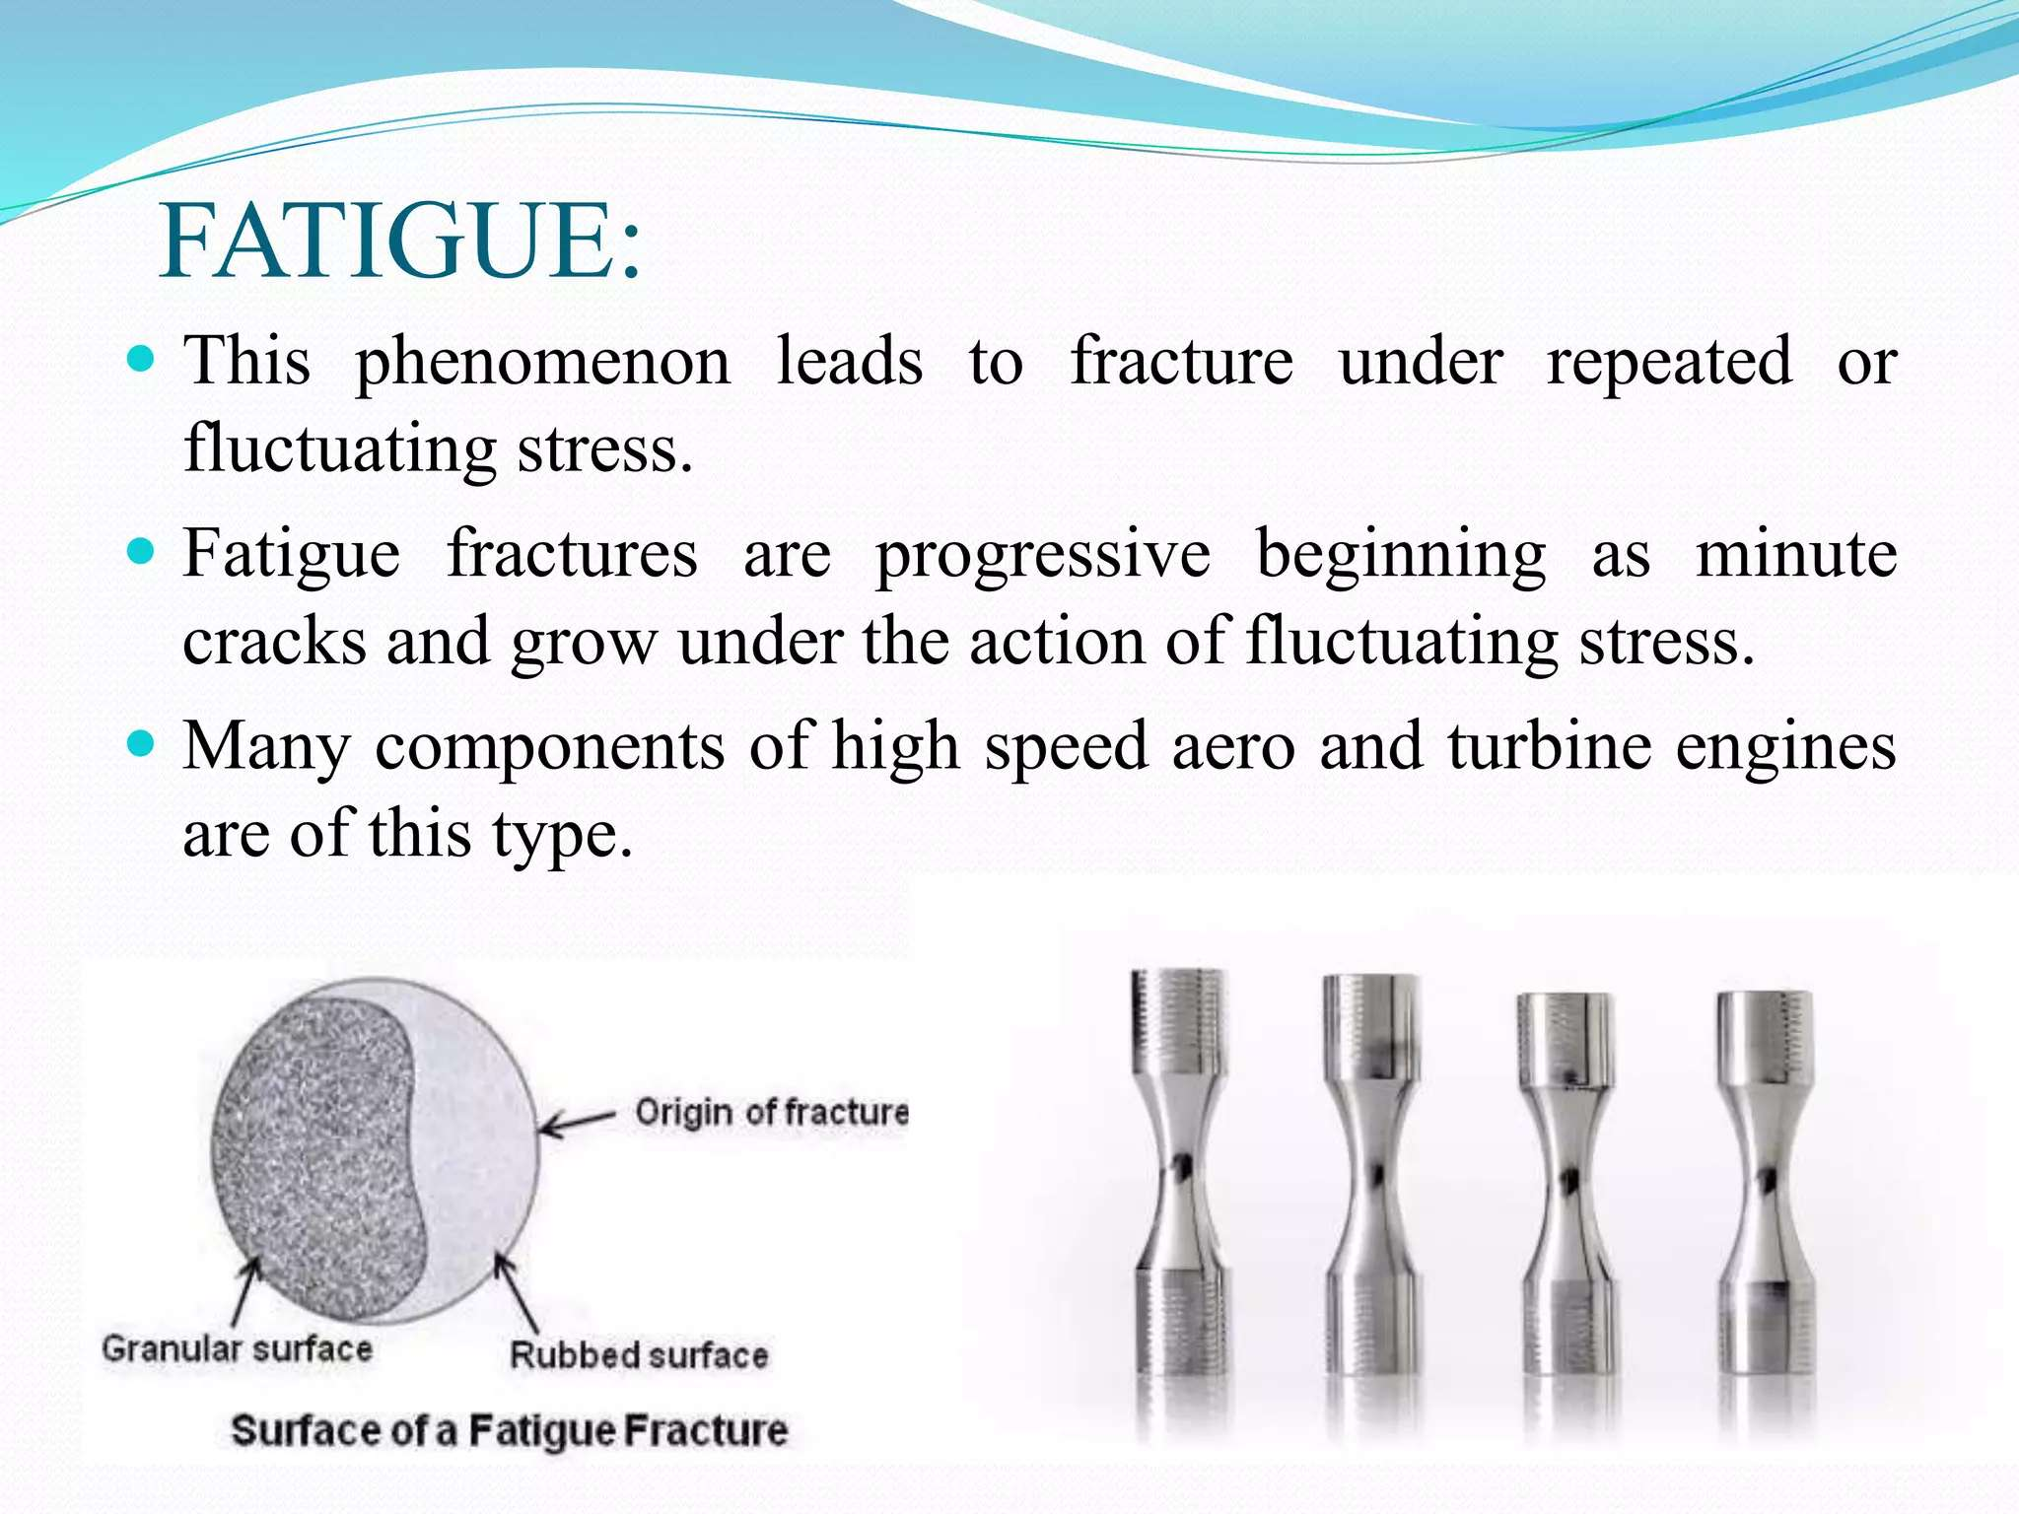

Slide 31
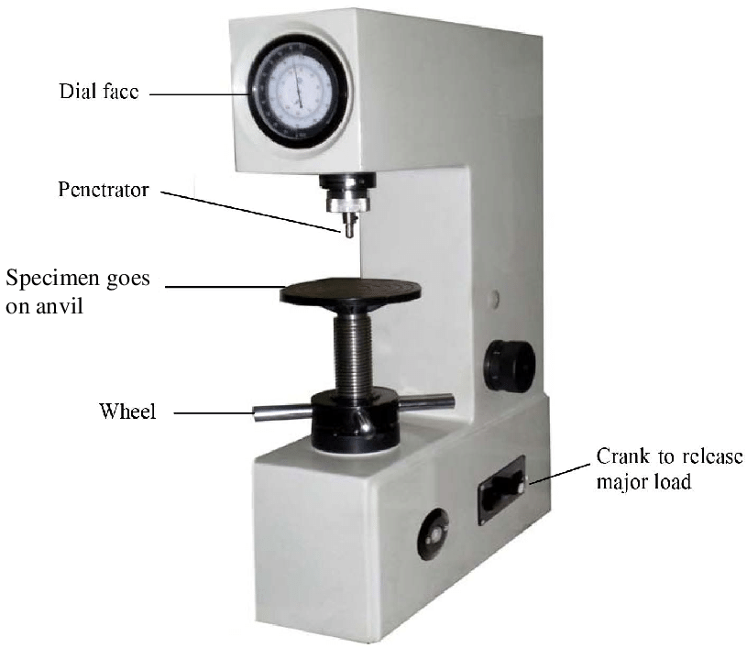
Week
(2-3)
Rockwell Hardness Testing

Slide 32
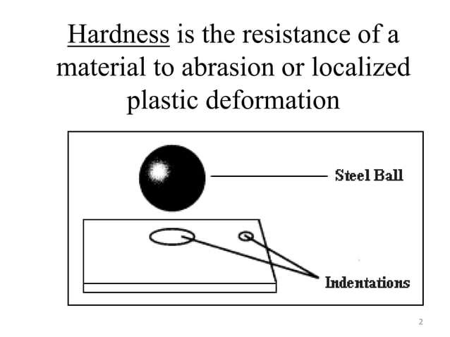

Slide 33
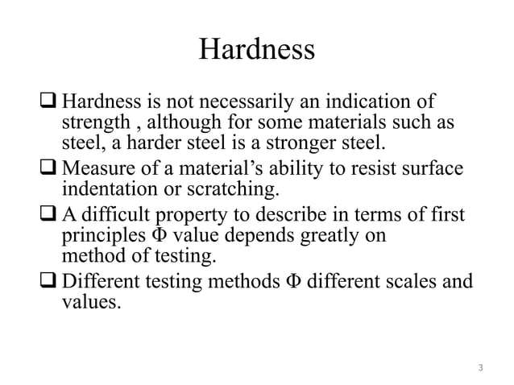

Slide 34
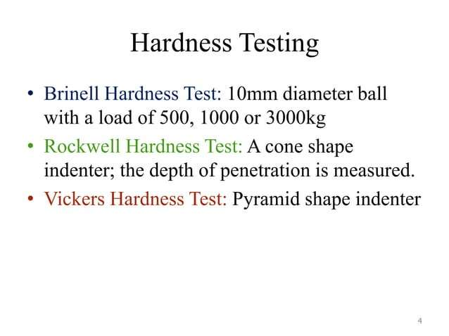

Slide 35
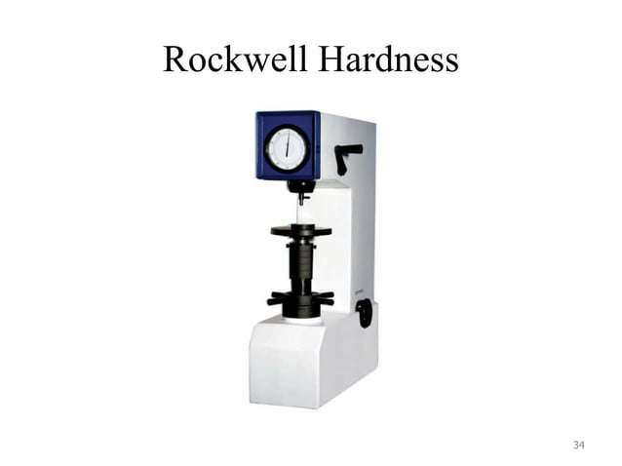

Slide 36
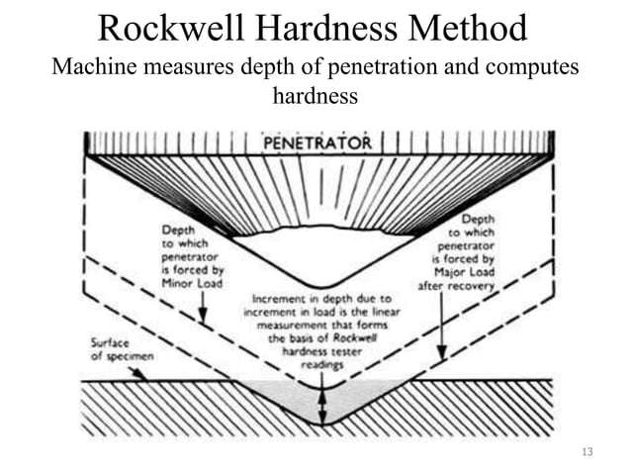

Slide 37
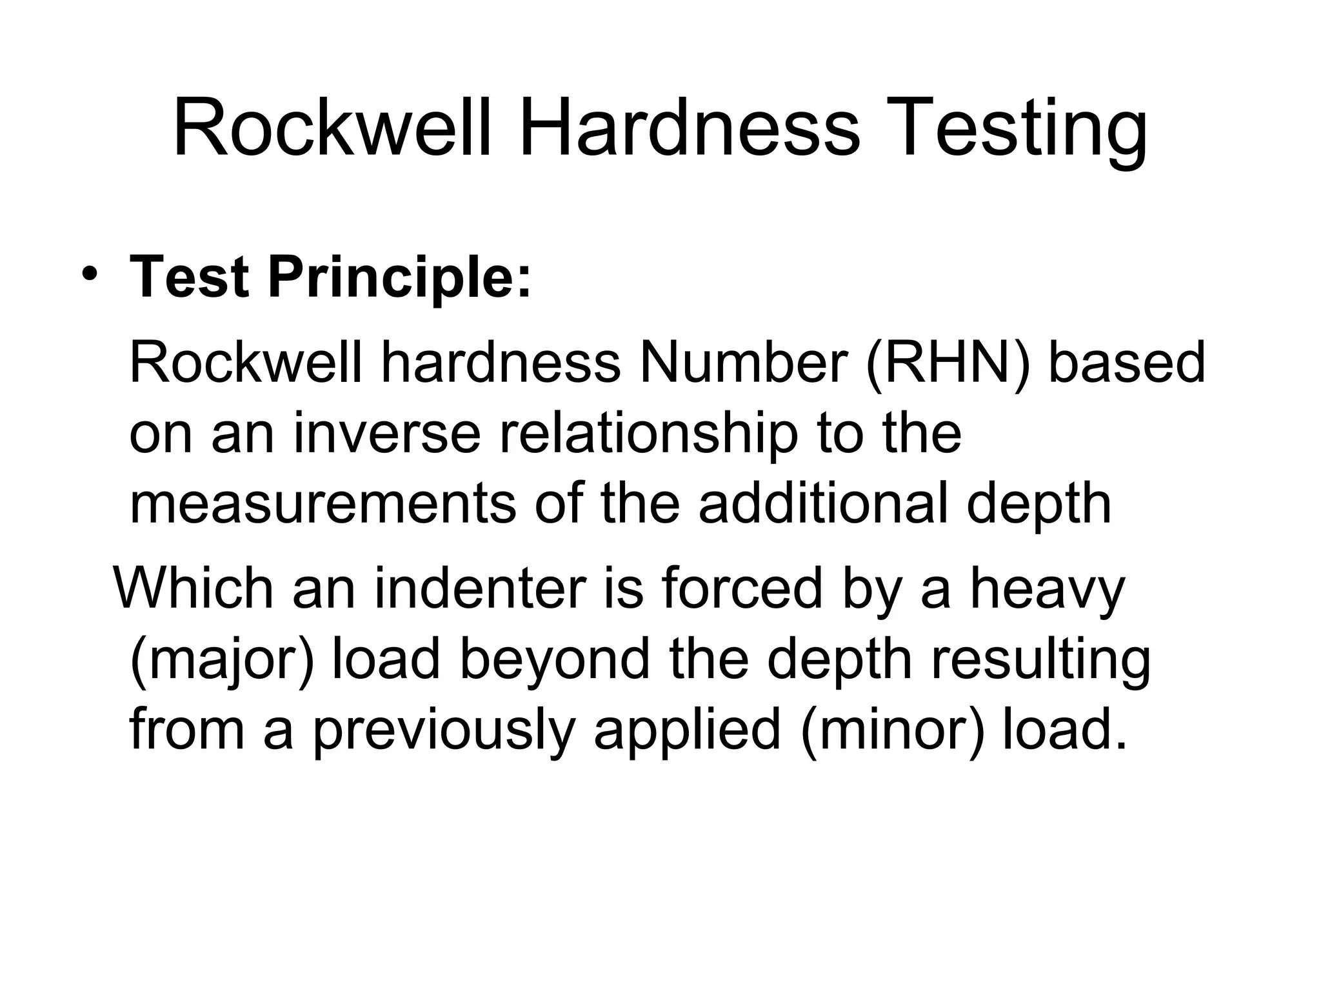

Slide 38
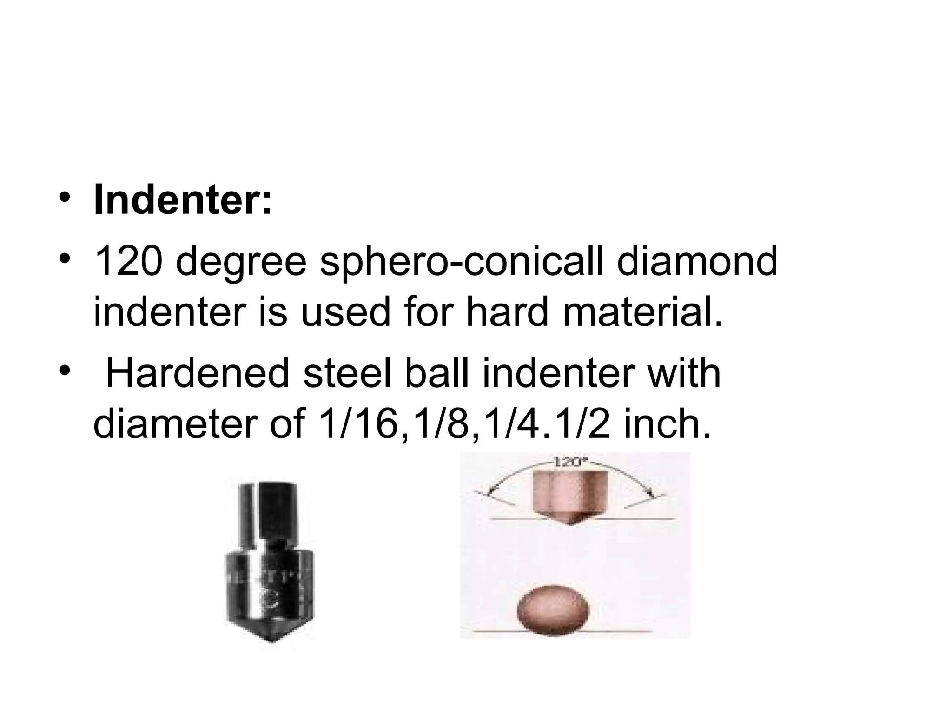

Slide 39
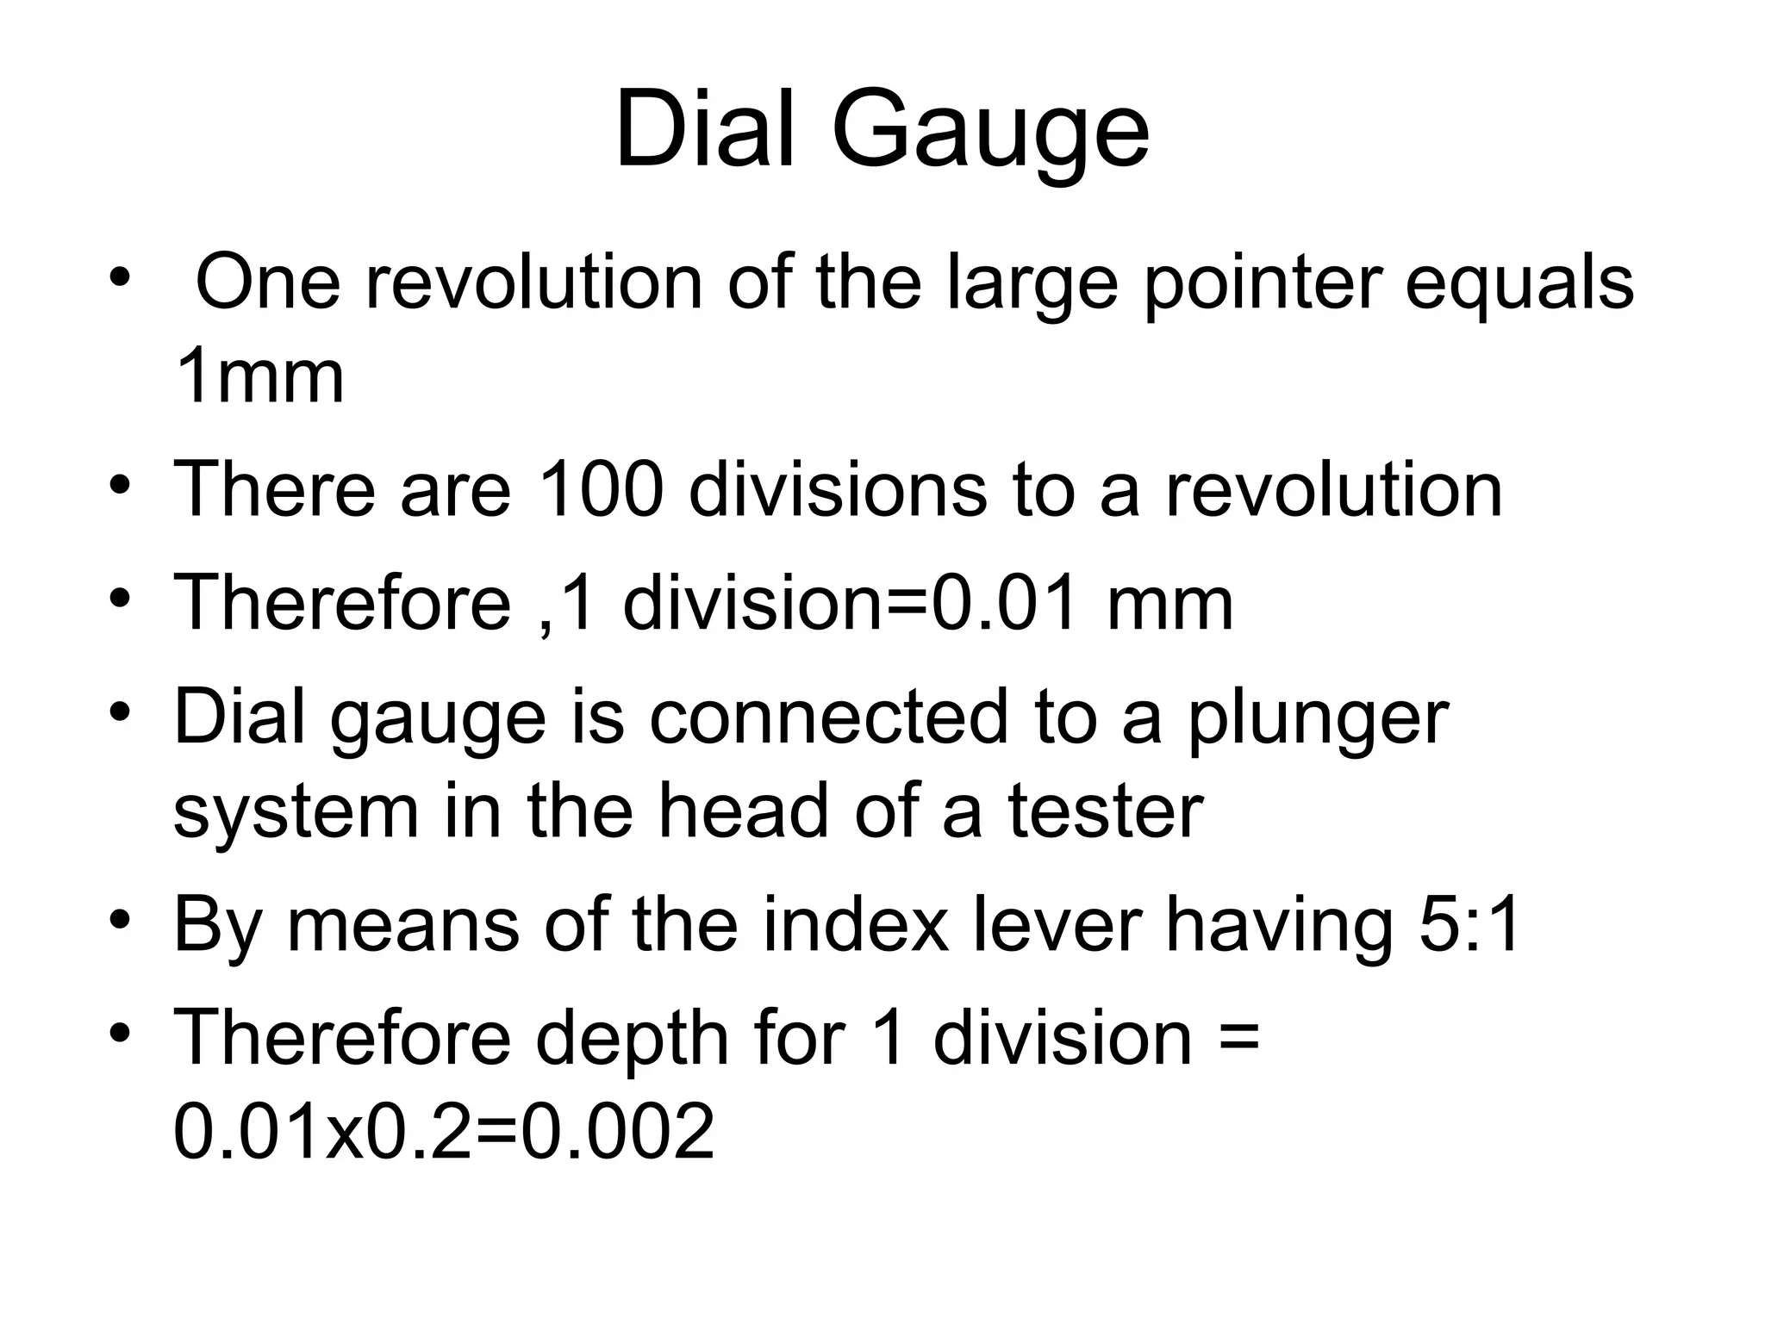

Slide 40
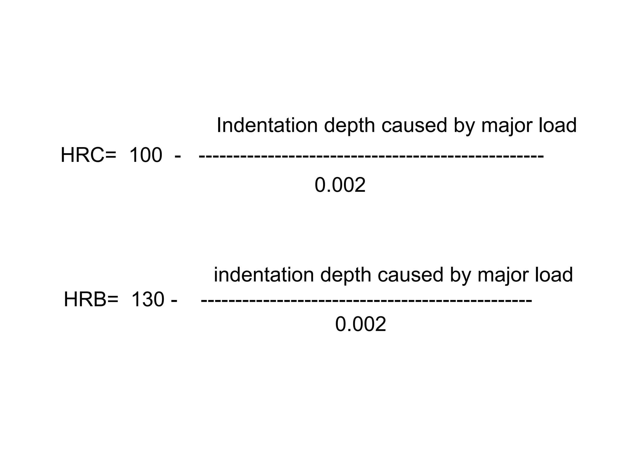

Slide 41
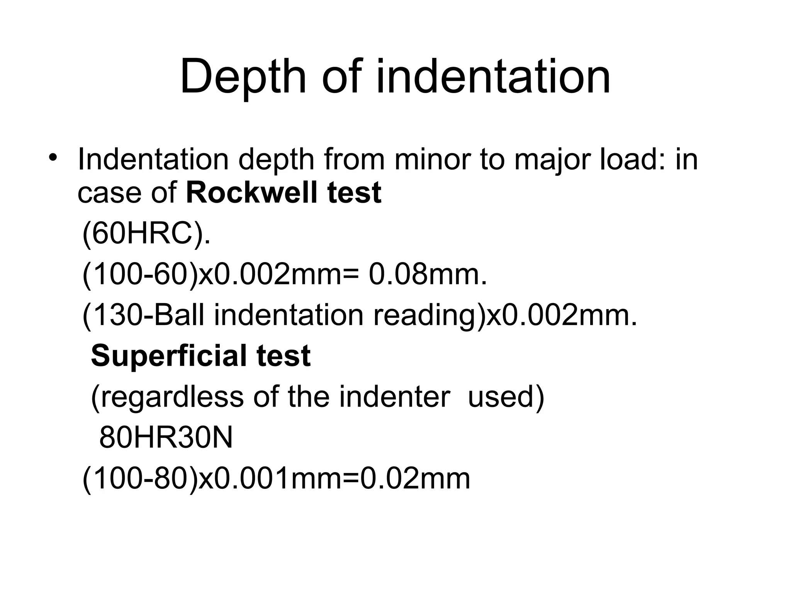

Slide 42
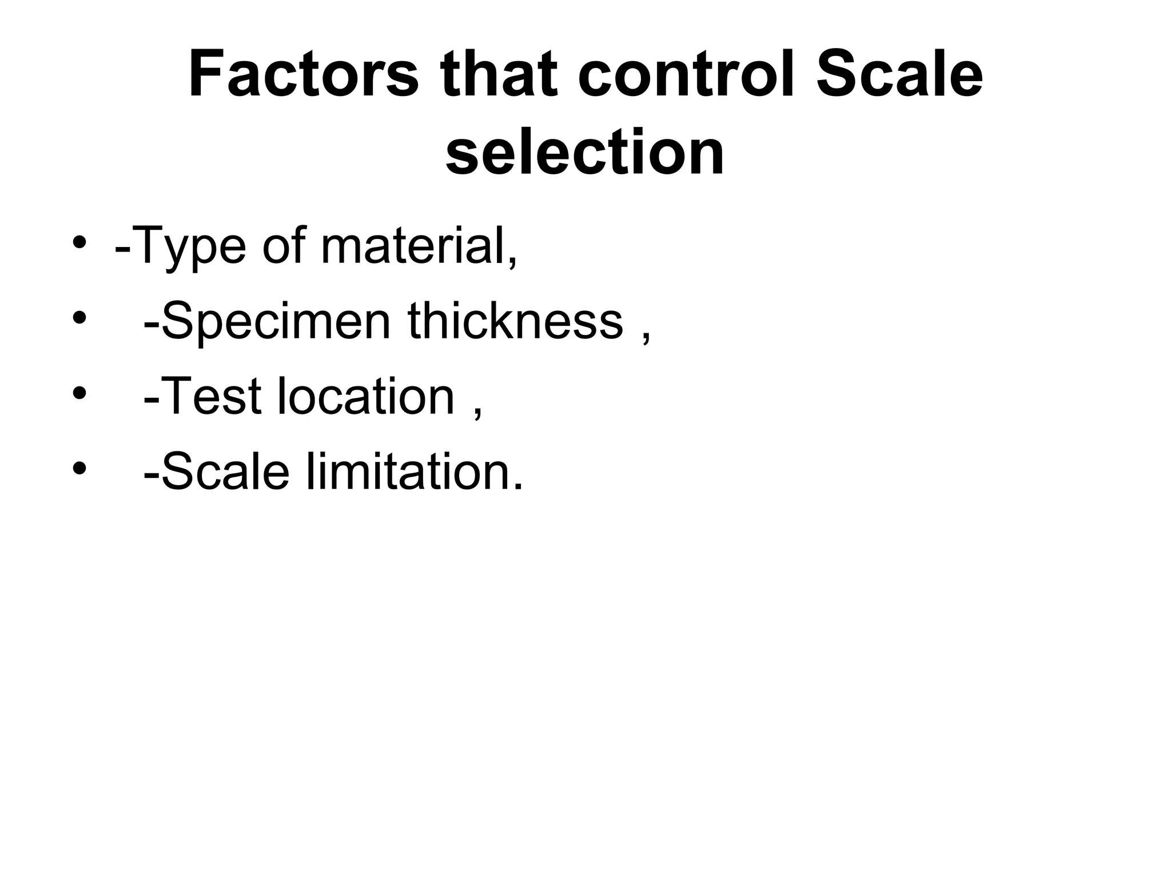

Slide 43
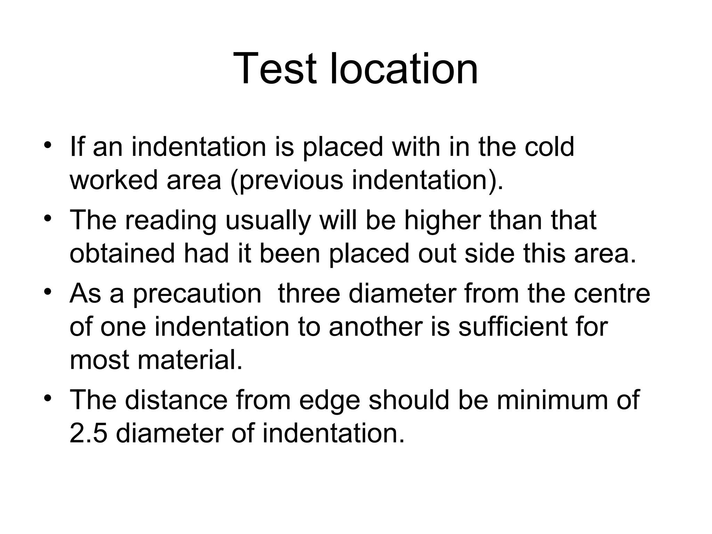

Slide 44
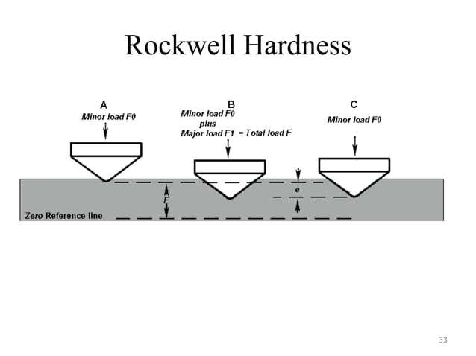

Slide 45
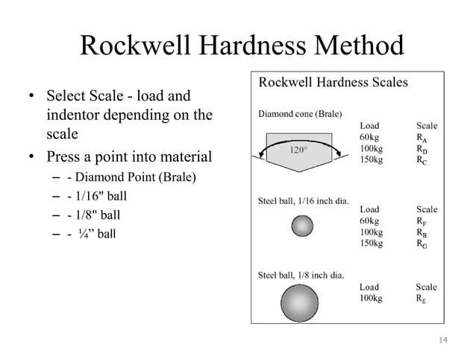

Slide 46
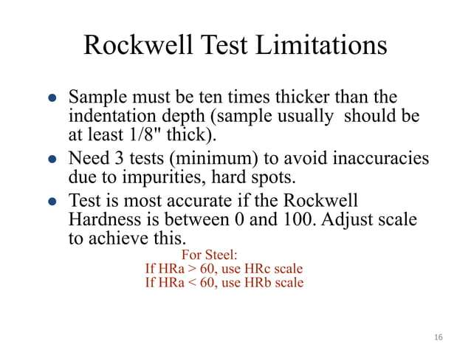

Slide 47
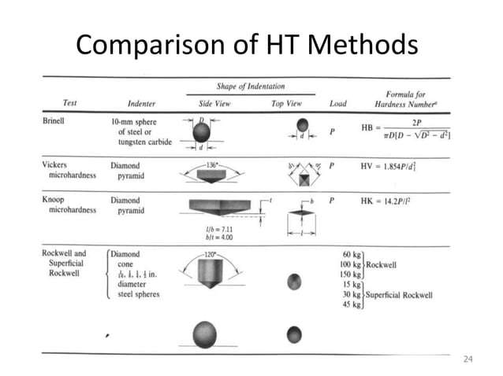

Slide 48
EXPERIMENT -1
ROCKWELL HARDNESS TEST
AIM: To determine the Rockwell hardness of the given test specimen.
APPARATUS:
Rockwell hardness testing machine, test specimen.
THEORY:
Hardness-the resistance of a metal to plastic deformation against indentation scratching, abrasion or cutting.The depth of penetration of the indenter measures the hardness of a material by this Rockwell’s hardness test method. The depth of penetration is inversely proportional to the hardness. Both ball or diamond cone types of indenters are used in this test. There are three scales on the machine for taking hardness readings.
Scale „A- with load 60kgf or 588.8N and diamond indenter is used for performing tests on steel and shallow case hardened steel.
Scale „B- with load 100kgf or 980.7 N and 1.588mm dia ball indenter is used for performing tests on soft steel, malleable iron, copper and aluminum alloys.
Scale „C- with load 150kgf or 1471 N and diamond indenter is used for performing tests on steel, hard cost steel, deep case hardened steel , other metals which harder.
First minor load is applied to overcome the film thickness on the metal surface. Minor load also eliminates errors in the depth of measurement due to spring of the machine frame or setting down of the specimen and table attachments.
The Rockwell hardness is derived from the measurement of the depth of the impression. This
method of test is suitable for finished or machined parts of simple shapes.
PROCEDURE:
Select the load by rotating the nob and fix the suitable indenter.
Clean the test piece and place on the special anvil or worktable of the machine.
Turn the capstan wheel to evaluate the test specimen into contact with the indenter point.
Further turn the wheel for three rotations forcing the test specimen against the indenter. This will ensure the minor load has been applied.
As soon as the pointer comes to rest pull the handle in the reverse direction slowly. This
releases the major but not the minor load. The pointer will now rotate in the reverse direction.

Slide 49
6. .
OBSERVATIONS:
Material of the specimen
Thickness of test specimen
Hardness scale used
Test no | Material | Rockwell Scale of weights Scale weight indent |  |  | Rockwell number |  |  | Average Rockwell no.
 |  |  |  |  | 1 | 2 | 3
PRECAUTIONS:
For testing cylindrical test specimens use V-type platform.
Calibrate the machine occasionally by using standard test blocks.
For thin metal prices place another sufficiently thick metal piece between the test specimen and the platform to avoid any damage, which may likely occur to the platform.
After applying major load wait for some time to allow the needle to come to rest. The waiting time may vary from 2 to 8 seconds.
The surface of the test piece should be smooth and even and free from oxide scale and foreign matter.
Test specimen should not be subjected to any heating of cold working.
The distance between the centers of two adjacent indentation should be at least 4 times the diameter of the indentation and the distance from the center of any indentation
to the edge of the test piece should be at least 2.5 times the diameter of the indentation.

Slide 50
Calculation Part:
RESULT:
EXERCISE PROBLEMS
Perform the same experiment for two different materials i.e., Alluminum and Mild Steel

Slide 51
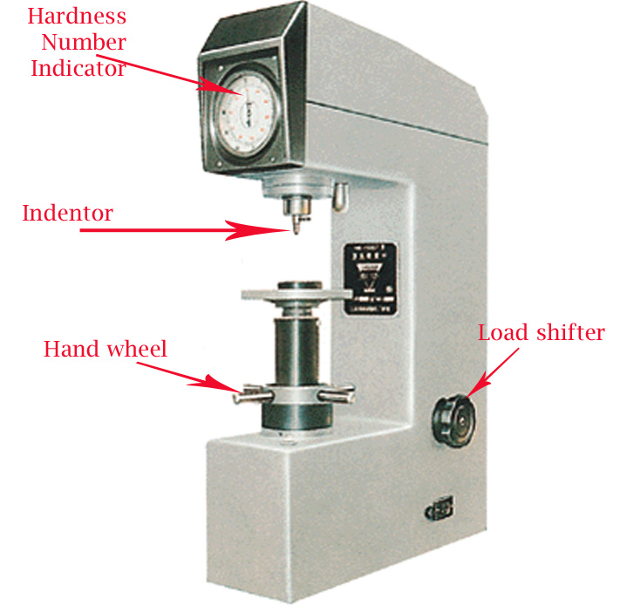
Week
(4-5)
Brinell Hardness Testing

Slide 52
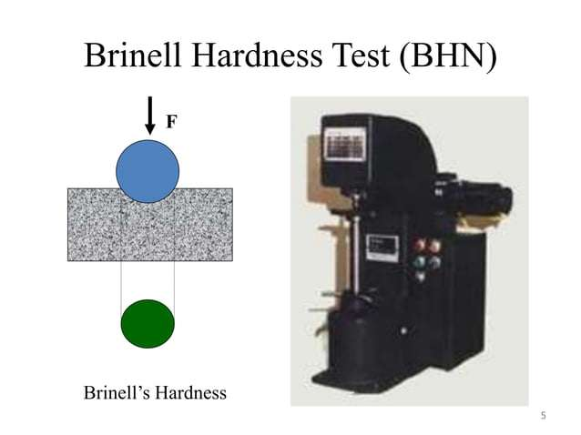

Slide 53
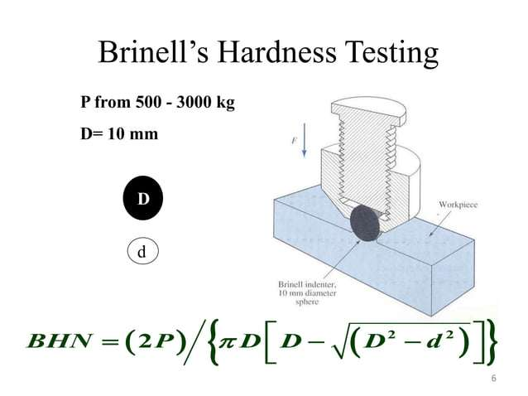

Slide 54
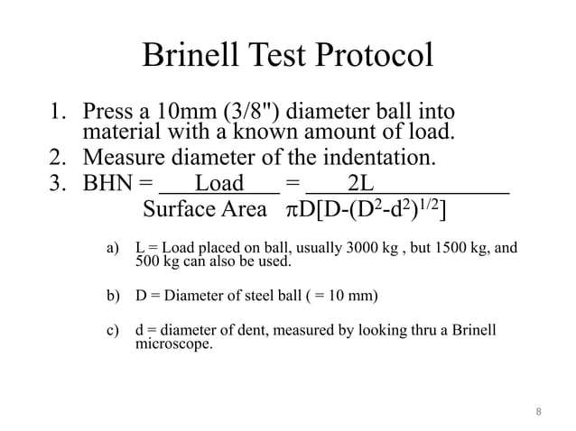

Slide 55
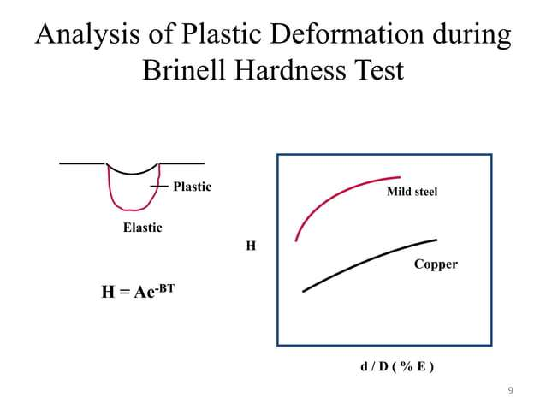

Slide 56
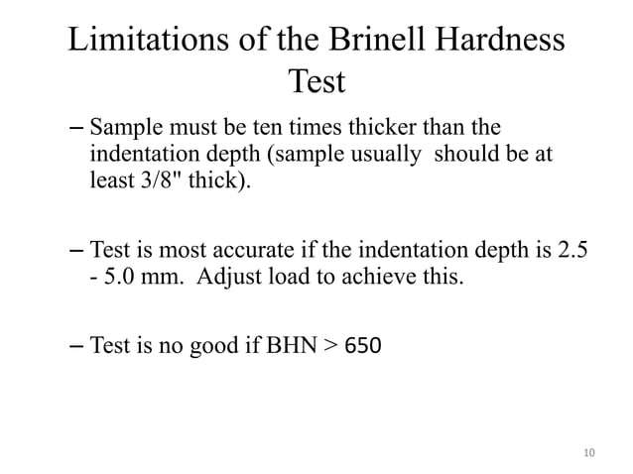

Slide 57
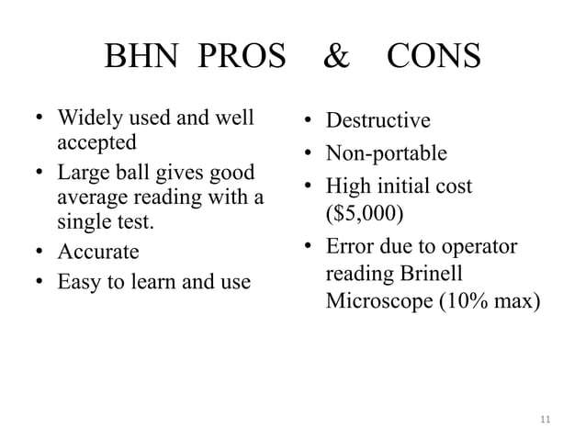

Slide 58
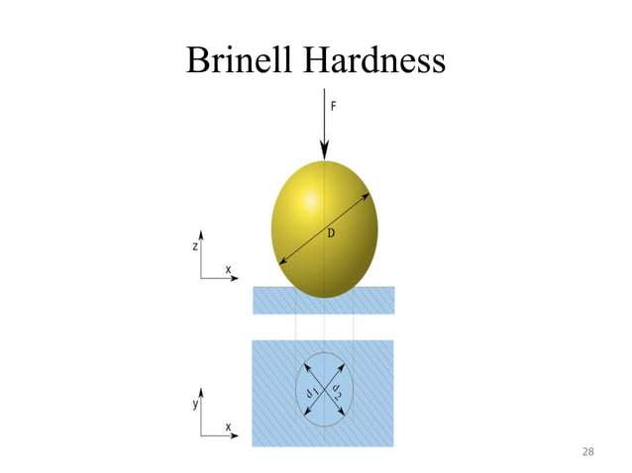

Slide 59
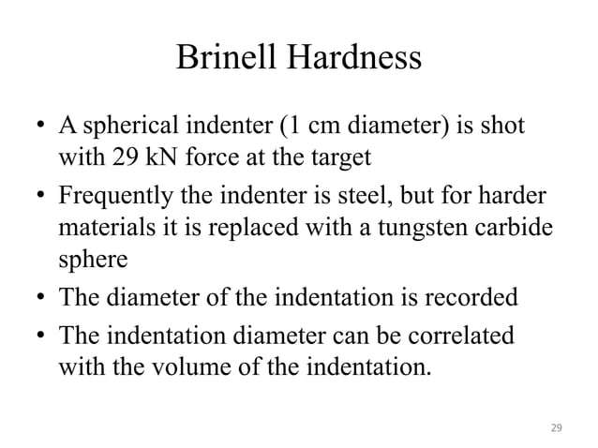

Slide 60
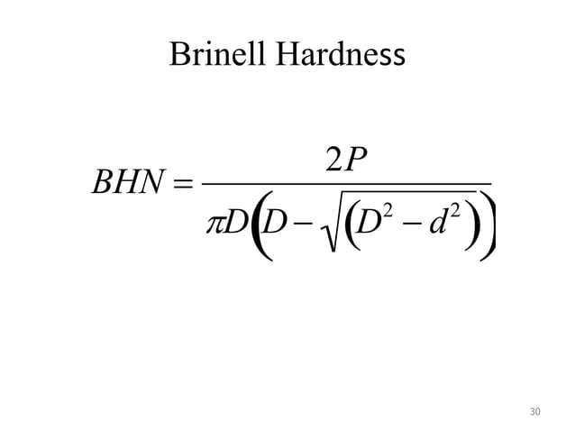

Slide 61
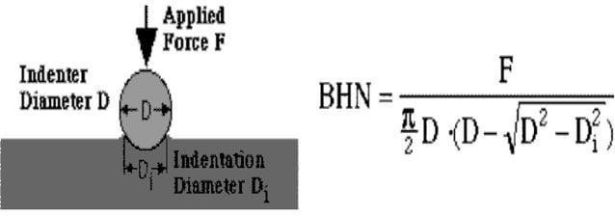
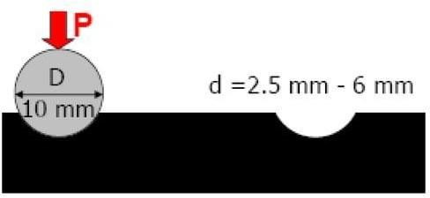

Slide 62
EXPERIMENT -2
BRINELLS HARDNESS TEST
AIM: To determine the Brinells hardness of the given test specimen. APPARATUS: Brinells hardness machine, test specimen, Brinells Microscope.
THEORY:
Indentation Hardness-
A number related to the area or to the depth of the impression made by an indenter or fixed geometry under a known fixed load.This method consists of indenting the surface of the metal by a hardened steel ball of specified diameter D mm under a given load F kgf and measuring the average diameter d mm of the impression with the help of Brinell microscope fitted with a scale. The Brinell hardness HB is defined, as the quotient of the applied force F divided by the spherical area of the impression.
HB= Test load in kgf/surface area of indentation
=2F/ {πD (D- D²- d²)} kg/mm² Where F = Applied load in kg
D = Diameter of the specified ball in mm d = Diameter of impression in mm
PROCEDURE:
Select the proper size of the ball and load to suit the material under test.
Clean the test specimen to be free from any dirt and defects or blemishes.
Mount the test piece surface at right angles to the axis of the ball indenter plunger.
Turn the platform so that the ball is lifted up.
By shifting the lever applies the load and waits for some time.
Release the load by shifting the lever.
Take out the specimen and measure the diameter of indentation by means of the Brinell microscope.
Repeat the experiments at other positions of the test piece.
Calculate the value of HB.

Slide 63
OBSERVATIONS:
Test piece material
Diameter of the ball” D “
Load section F/D²
Test load
Load application time
Least count of Brinell Microscope
S. No | Diameter |  |  | F in kg | D in mm | Average HB Kg/mm²
 | (d1) | (d2) | (d1+d2)/2

Slide 64
PRECAUTIONS:
The surface of the test piece should be clean
The testing machine should be protected throughout the test from shock or vibration.
The test should be carried out at room temperature.
The distance of the center of indentation from the edge of test piece should be at least 2.5 times the diameter of the indentation and the distance between the center of the two adjacent indentations should be at least 4 times the diameter of the indentation.
The diameter of each indentation should be measured in two directions at right angles and the mean value readings used the purpose of determining the hardness number.

Slide 65

Week (06-10)
Impact Testing
Izod Test
Charpy Test

Slide 66


Slide 67


Slide 68


Slide 69


Slide 70


Slide 71


Slide 72


Slide 73


Slide 74


Slide 75
EXPERIMENT -3
IZOD IMPACT TEST
AIM: To perform the izod impact test on materials.
APPARATUS: Izod impact test machine, test specimen, vernier calipers, steel rule.
IMPACT STRENGTH: The resistance of a material to fracture under sudden load application
MATERIALS: Two types of test pieces are used for this test as given.
Square cross-section
Round cross-section.
THEORY: The type of test specimen used for this test is a Square Cross-section
The specimen may have single, two or three notches. The testing machine should have the following specifications.
The angle between top face of grips and face holding the specimen vertical=90⁰ The angle of tip of hammer =75⁰±1⁰
The angle between normal to the specimen and underside face of the hammer atstriking point=10⁰±1⁰
Speed of hammer at impact=3.99m/sec Striking energy=168N-m or Joules Angle of drop of
pendulum =90⁰ Effective weight of pendulum=21.79kg Minimum value of scale graduation=2 Joules.
Permissible total friction loss of corresponding energy=0.50%
Distance from the axis of rotation of distance between the base of specimen notch and the point of specimen hit by the hammer=22mm±0.5mm
The longitudinal axes of the test piece shall lie in the plane of swing of the center of gravity of the hammer. The notch shall be positioned so that it is in the plane of the hammer .the notch shall be positioned its plane of symmetry coincides with the top face of the grips .for setting the specimen the notch impact strength I is calculated according to the following relation.
where I= impact strength in joules/m²

Slide 76
PROCEDURE:
For conducting Izod test, a proper striker is to be fitted firmly to the bottom of the hammer with the help of the clamming piece.
The latching take for izod test is to be firmly fitted to the bearing housing at the side of the columns.
The frictional loss of the machine can be determined by free fall test, raise the hammer by hands and latch in release the hammer by operating lever the pointer will then indicate the energy loss due to friction. From this reading confirm that the friction loss is not exceeding 0.5% of the initial potential energy. Otherwise frictional loss has to be added to the final reading.
The specimen for izod test is firmly fitted in the specimen support with the help of clamping screw and élan key. Care should be taken that the notch on the specimen should face to pendulum striker.
After ascertaining that there is no person in the range of swinging pendulum, release the pendulum to smash the specimen.
Carefully operate the pendulum brake when returning after one swing to stop the oscillations.
Read-off position of reading pointer on dial and note indicated value.
Remove the broken specimen by loosening the clamping screw.
The notch impact strength depends largely on the shape of the specimen and the notch. The values determined with other specimens therefore may not be compared with each other.
OBSERVATION TABLE:
S .No | A(Area of cross section of specimen) | K Impact energy observed | I Impact Strength

Slide 77
Calculation Part :
RESULT:
EXERCISE PROBLEMS
Perform the same experiment for two different materials i.e., Alluminum and Mild Steel

Slide 78
Experiment No: 04
AIM : To study the Impact testing machine and perform the Impact tests ( Charpy)
THEORY :- In manufacturing locomotive wheels, coins, connecting rods etc. the components are subjected to impact (shock) loads. These loads are applied suddenly. The stress induced in these components are many times more than the stress produced by gradual loading. Therefore, impact tests are performed to asses shock absorbing capacity of materials subjected to suddenly applied loads. These capabilities are expressed as (i) Rupture energy (ii) Modulus of rupture and (iii) Notch impact strength.
Two types of notch impact tests are commonly-
In charpy test, the specimen is placed as ‘cantilever beam’. The specimens have V-shaped notch of 45°. U- shaped notch is also common. The notch is located on tension side of specimen during impact loading. Depth of notch is generally taken as t.5 to t/3 where ‘t’ is thickness of the specimen.
SPECIFICATION OF M/C AND SPECIMEN DETAILS :
Its specifications along-with their typical values are as follows:
Impact capacity = 300joule
Least count of capacity (dial) scale = 2joule
Weight of striking hammer = 18.7 kg.
•
•
•
Angle of hammer before striking = 160° Distance between supports = 40mm.
Striking velocity of hammer = 5.6m/sec. Specimen size = 55x10x10 mm.
Type of notch = V-notch Angle of notch = 45°

Slide 79
PROCEDURE :-
1. Lift the hammer to an appropriate knife edge position and notch the energy stored in the hammer. For the standard charpy test the energy stored should be 164j.
2.
3.
Locate the test specimen on the m/c supports.
Release the hammer. The hammer will break the piece and shoot up the other side
of the specimen.
4.
5.
Note the residual energy indicated on the scale by the hammer.
Impact strength of the test specimen is the difference of the initial energy stored in
hammer and the residual energy.
OBSERVATION :-
S.No. | Initial Energy (E1) in joule | Residual Energy (E2) in Joule | Absorb Energy (E1-E2)
CALCULATION :-
Modulus of rupture = Rupture / Effective volume of specimen
Notch impact strength = Absorb energy / Effective cross section area
PRECAUTIONS :-
The specimen should be prepared in proper dimensions.
Take reading more frequently.
Make the loose pointer in contact with the fixed pointer after setting the pendulum.
Do not stand in front of swinging hammer or releasing hammer.
Place the specimen proper position.
RESULT :- The impact strength of given specimen = ------- joule/mm²

Slide 80



Week (11-12)
Tensile Testing

Slide 81


Slide 82


Slide 83


Slide 84


Slide 85


Slide 86


Slide 87


Slide 88


Slide 89


Slide 90


Slide 91


Slide 92


Slide 93
EXPERIMENT -5
TENSILE TEST
AIM:
To conduct tensile test on a mild steel specimen and determine the following
1. Limit of proportionality
3. Upper yield point
5. Ultimate strength
7. Young`s Modulus
2. Elastic Limit
4. Lower yield point
6. Fracture strength
8. Percentage elongation
10. Ductility
12. True stress & true strain
9. Percentage reduction in area
11. Toughness
13. Malleability
APPARATUS: Universal testing machine, specimen, steel rule, vernier caliper, micrometer
THEORY:
The tensile test is most applied one of all mechanical tests. In this test, a test specimen is fixed into grips connected to a straining device and to a load-measuring device. (One end in stationary grips and the others are in movable grips). If the applied load is small enough, the deformation of any solid body is entirely elastic. An elastically deformed solid will return to its original form as soon as load is removed. However if the load is too large, the material can be deformed permanently. The initial part of the tension curve, which represents the manner in which solid undergoes plastic deformation is termed as plastic. The stress below which the deformation is essentially entirely elastic is known as the elastic limit of the material. In some materials like mild steel a sudden drop in load indicating both an upper and lower yield point denotes the onset of plastic deformation. However some materials do not exhibit a sharp yield point. During plastic deformation at lager extensions, strain hardening cannot compensate for the decrease in section and thus the load passes through a maximum and then begins to decrease. At this stage the ultimate strength, which is defined as the ration of the load on the specimen to the original cross-section area, reaches a maximum value. Until this point the deformation is uniform at all the sections of the specimen. Further loading will eventually cause „neck‟ formation and rupture follows. Usually a tension test is conducted at room temperature; the tensile load is applied slowly. During this test either round or flat specimens may be used. The load on the specimen is applied mechanically or hydraulically depending on the type of testing machine.

Slide 94
Nominal/Engg stress and Nominal/Engg strain:
Original C/S area = A0 (mm²) Original gauge length = L0 (mm) Increase in gauge length = δL0 Nominal stress = P/A0 (N/ mm²) Nominal strain = δL0/L0
Limit of Proportionality:
Stress is proportional to strain up to this point. Normal Stress = PA/ PO
Normal Strain = (δ LO) A/LO
Elastic limit:
When the load is removed at “B” , the specimen will go back to original Dimensions i.e LO and δ
AO Nominal stress =
PB/AO
Normal Strain = (δ LO) B/LO
If the specimen is loaded beyond elastic limit it will undergo permanent strain ie. Plastic deformation.
Upper yield point:
Nominal stress = PC/AO Nominal strain = (δ LO) D/LO
Lower yield point:
Nominal stress = PD/AO Nominal strain = (δ LO) D/LO
Ultimate load or maximum load point:
Nominal ultimate stress = PE/AO Nominal strain = (δ LO) E/LO
Fracture Load point F:
Nominal fracture stress = PF/AO Nominal strain at fracture = (δ LO) F/LO

Slide 95
PROCEDURE:
Measure the original gauge length and diameter of the specimen.
Insert the specimen into grips of the test machine.
Begin the load application and record load vs elongation data.
Take the readings more frequently as yield point is approached.
Measure elongation values.
Continue the test till fracture occurs.

Slide 96
RESULTS AND DISCUSSIONS:
1. Plot the Engg. Stress strain curve and determine the following
Limit of proportionality | = | (N/mm²)
Yield strength | = | (N/mm²)
Ultimate strength | = | (N/mm²)
Young`s modulus | = | (N/mm²)
Percentage elongation | = | %
Percentage reduction in area | = | %
Fracture strength | = | (Nominal /Engg)
Toughness | = | Area under stress – strain curve up to
 |  | fracture
Malleability
Plot True Stress, True strain curve after calculating true – stress and true strain values at various points.
Estimate
Strength coefficient
Strain hardening coefficient
Determine whether the material is ductile or brittle
Comment on the results.
S.No | Load | Deformation | Stress | Strain | E

Slide 97
Week (13-14)
Compression Testing

Slide 98


Slide 99


Slide 100


Slide 101


Slide 102


Slide 103


Slide 104


Slide 105


Slide 106


Slide 107


Slide 108

Compression Test
Objective:
The compression test is used to:
Observe the stress - strain behavior of some metals under compression load.
Determine the strength and other properties of various materials.
Introduction:
In theory the compression test is just the opposite the tensile test. However, there are special limitations on the compression test:
Appling a truly axial load is difficult.
There is always a tendency for bending stresses to be set up.
Friction between the heads of the testing machine or bearing plates and the end surfaces of the sample.
Theory:
For a compression test, the stress – strain diagrams have different shapes from those of for tension. Ductile metals such as steel, aluminum, and copper have proportional limits in compression very close to those in tension; and therefore the initial regions of their compression stress – stain diagrams are very similar to the tension diagrams. However, when yielding begins, the behavior is quite different. In a tension test, the specimen is stretched, necking may occur, and fracture ultimately takes place. When a small specimen of ductile material is compressed, it begins to bulge outward on the sides and become barrel shaped. With increasing load, the specimen is flattened out, thus offering increased resistance to further shortening (which means the stress-strain curve goes upward). These characteristics are illustrated in Fig. 1, which shows a compression stress-strain diagram for copper.
Brittle materials in compression typically have an initial linear region followed by a region in which the shortening increases at a higher rate than does the load. Thus, the compression stress-strain diagram has a shape that is similar to the shape of the tensile diagram. However, brittle materials usually reach much higher ultimate stresses in compression than in tension. Also, unlike ductile materials in compression, brittle materials actually fracture or break at the maximum load.

Slide 109
Apparatus:
Same apparatus of tension test, but the clamps of the tension test were replaced by the compression jig parts.
Precautions:
Machined surfaces should be finished to 1.6μm or better.
Test specimens ends should be flat and parallel within .0005 in/in.
Test specimens should be loaded concentrically.
Procedure:
Measure Do and Lo at three locations along the circumference, or any other dimensions of the used specimen.
Do
Lo
Lubricate bearing surfaces using suitable lubricant.
Start the machine, and apply a compressive force to the ends of the specimen until failure occurs.
The results are taken as a load deflection curve.
Results & Analysis:
From the load – deflection curve construct the stress – strain curve.
From the stress – strain curve determine the following properties for tested material:
Proportional limit.
Yield point.
Yield stress for an offset of .2%.
Ultimate and fracture stress.
Percentage elongation and reduction in area at fracture.
Modulus of Elasticity.
Modulus of Resilience.
Modulus of Toughness.
Shear Modulus of elasticity (G)
Bulk Modulus of elasticity (K).
Compare between engineering and true stress measures and comment on the difficulty in obtaining a uniform measure in tension and compression with the engineering stress - strain.
Comment in the calculated values of E, G, and ν as compared to known values in tension.
In compression test a greater load is necessary to cause yielding than that required in tension test for the same sample. State the reason.

Slide 110

Week (15-16)
Torsion Testing

Slide 111


Slide 112


Slide 113


Slide 114


Slide 115


Slide 116


Slide 117
EXPERIMENT -7
TORSION TEST
AIM: To conduct torsion test on mild steel or cast iron specimen to find modulus of rigidity or to find angle of twist of the materials which are subjected to torsion.
APPARATUS:
A torsion test machine along with angle of twist measuring attachment.
Standard specimen of mild steel or cast iron.
Steel rule.
Vernnier caliper or a micrometer.
THEORY:
For transmitting power through a rotating shaft it is necessary to apply a turning
force. The force is applied tangentially and in the plane of transverse cross section. The torque or twisting moment may be calculated by multiplying two opposite turning moments. It is said to be in pure torsion and it will exhibit the tendency of shearing off at every cross section which is perpendicular to the longitudinal axis.
Torsion equation:
Torsion equation is given by below
T / IP = Cθ/L = τ/R
T= maximum twisting torque (Nmm) IP = polar moment of inertia (mm⁴)
τ =shear stress (N/mm²) C=modulus of rigidity (N/mm²⁾ θ=angle of twist in radians
L=length of shaft under torsion (mm)
Assumptions made for getting torsion equation
The material of the shaft is uniform throughout.
The shaft, circular in section remain circular after loading.

Slide 118
Plane sections of shaft normal to its axis before loading remain plane after the torque have been applied.
The twist along the length of the shaft is uniform throughout.
The distance between any two normal-sections remains the same after the application of torque.
Maximum shear stress induced in the shaft due to application of torque does not exceed its elastic limit.
PROCEDURE:
Select the suitable grips to suit the size of the specimen and clamp it in the machine by adjusting sliding jaw.
Measure the diameter at about the three places and takeaverage value.
Choose the appropriate loading range depending upon specimen.
Set the maximum load pointer to zero
Carry out straining by rotating the hand wheel or by switching on the motor.
Load the members in suitable increments, observe and record strain reading.
Continue till failure of the specimen.
Calculate the modulus of rigidity C by using the torsion equation.
Plot the torque –twist graph (T Vs θ)
OBSERVATIONS:
Gauge length L = Polar moment of inertia IP =
Modulus of rigidity
C =TL/ I_{P} θ =
S.No | Twisting Moment Kgf Nm |  | Angl e of Twist Degr ees Radians |  | Modulus of rigidity C | Average C N/mm

Slide 119
Calculation Part:
RESULT:
Exercise
Perform the same experiment for two different cross sections on a given specimens For Mild Steel and Alluminum

Slide 120


