Slide 1
CSE 405: Artificial Intelligence
Md. Riadul Islam
Assistant Professor
Dept. of CSE, UGV
Source
Presentation of Dr. Chhavi Kashyap
Presentation of Dr. Son Kuswadi
Others

Slide 2
CSE 405: Artificial Intelligence
Course Code: | CSE-405 | Credits: | 03
 |  | CIE Marks: | 60
Exam Hours: | 03 | SEE Marks: | 40
Course Learning Outcome (CLOs): After Completing this course successfully, the student will be able to…
CLO | Description
CLO1 | Understand the history and progression of Artificial Intelligence, including foundational concepts and milestones.
CLO2 | Develop and structure machine learning models using basic algorithms and techniques.
CLO3 | Design and implement AI systems using advanced frameworks and tools like TensorFlow and PyTorch.
CLO4 | Explain the roles of supervised, unsupervised, and reinforcement learning in AI applications.
CLO5 | Create and preprocess datasets for training and validating AI models using Python libraries like Pandas and NumPy.
CLO6 | Add functionality to AI models, such as natural language processing, computer vision, and recommendation systems.
CLO7 | Implement and optimize neural networks for efficient performance in real-world scenarios.
CLO8 | Use AI techniques to analyze and interpret data for decision-making and predictions.
CLO9 | Design and evaluate AI workflows, pipelines, and architectures for scalability and performance.
CLO10 | Ensure AI systems adhere to ethical standards, fairness, and interpretability in real-world applications.

Slide 3
Summary of Course Content
Sl. | Course Content | HRs | CLOs
1 | History and Evolution of Artificial Intelligence | 2 | CLO1
2 | Introduction to Machine Learning and AI Platforms | 2 | CLO1, CLO2
3 | Basics of Machine Learning Algorithms and Techniques | 6 | CLO2
4 | Advanced Neural Networks and Deep Learning Concepts | 4 | CLO2, CLO3
5 | Data Preprocessing and Feature Engineering | 6 | CLO3
6 | Supervised vs. Unsupervised Learning | 3 | CLO4
7 | Model Training and Validation | 5 | CLO5
8 | Natural Language Processing and Computer Vision | 4 | CLO6
9 | AI Workflow: Links, Pipelines, and Architecture | 3 | CLO7
10 | Data Visualization and Presentation | 4 | CLO8
11 | AI Project Management and File Organization | 2 | CLO9
12 | Ethics, Usability, and Testing in AI Systems | 3 | CLO10
13 | Introduction to Reinforcement Learning and AI Frameworks | 3 | CLO2, CLO6
14 | Advanced Topics: Generative AI, Transfer Learning, and Optimization Techniques | 4 | CLO6, CLO7

Slide 4
Assessment Pattern
CIE- Continuous Internal Evaluation (60 Marks)
Bloom's Category Marks (out of 60) | Tests (30) | Assignments (10) | Quizzes (10) | Attendance (10)
Remember | 5 |  | 3
Understand | 5 | 2 | 2
Apply | 5 | 3 | 5
Analyze | 5
Evaluate | 5
Create | 5 | 5
SEE- Semester End Examination (40 Marks)
Bloom's Category | Test
Remember | 5
Understand | 5
Apply | 10
Analyze | 5
Evaluate | 5
Create | 10

Slide 5
Course Plan
Week No | Topics | Teaching Learning Strategy(s) | Assessment Strategy(s) | Alignment to CLO
1 | History and Evolution of AI | Lecture, Discussion, Videos | Quiz on AI history and milestones | CLO1
2 | Introduction to Machine Learning Platforms | Lecture, Hands-on Practice | Classroom Q&A, Assignment on identifying AI tools and libraries | CLO1, CLO2
3 | Basics of Machine Learning Algorithms | Lecture, Coding Practice | Lab Exercise: Implement a basic ML algorithm | CLO2
4 | Neural Networks and Deep Learning Basics | Lecture, Hands-on Coding | Lab Exercise: Build a simple neural network | CLO2, CLO3
5 | Data Preprocessing and Feature Engineering | Lecture, Demonstration, Coding Practice | Assignment: Clean and preprocess a dataset | CLO3
6 | Supervised vs. Unsupervised Learning | Lecture, Group Discussion | Quiz on learning techniques with examples | CLO4
7 | Model Training and Validation | Lecture, Hands-on Practice | Lab Exercise: Train and validate a machine learning model | CLO5
8 | Natural Language Processing Basics | Lecture, Coding Practice | Project: Perform text classification using NLP | CLO6
9 | Computer Vision Fundamentals | Lecture, Hands-on Practice | Lab Exercise: Implement image classification | CLO6, CLO7
10 | AI Workflow and Pipelines | Lecture, Demonstration | Assignment: Design an AI workflow | CLO7
11 | Data Visualization and Presentation | Lecture, Hands-on Practice | Assignment: Visualize a dataset with charts and graphs | CLO8
12 | Ethics, Usability, and Testing in AI | Lecture, Case Studies | Group Discussion: Evaluate AI models for fairness and usability | CLO9, CLO10
13 | Reinforcement Learning Basics | Lecture, Hands-on Coding | Lab Exercise: Implement a basic RL algorithm | CLO2, CLO6
14 | Transfer Learning and Optimization | Lecture, Coding Practice | Lab Exercise: Fine-tune a pre-trained model | CLO6, CLO7
15 | Advanced AI Frameworks and Tools | Lecture, Coding Practice | Assignment: Solve a problem using TensorFlow or PyTorch | CLO3
16 | AI Project Development and Integration | Lecture, Group Project Work | Final Project: Build and present a functional AI application | CLO1-CLO10

Slide 6
Introduction Week-1

Slide 7
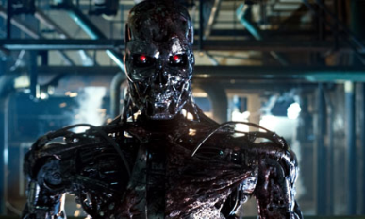
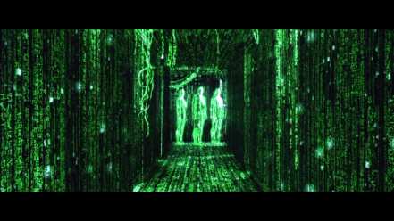
AI in Fiction
An intelligent killing robot
Smart machines that took over the human race and made them live in a simulated world

Slide 8
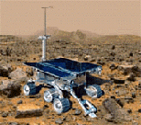

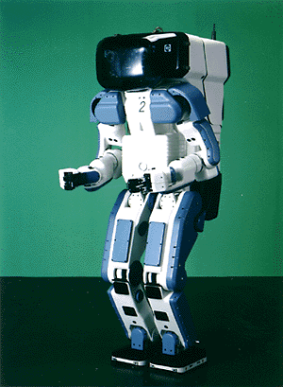



What’s interesting with AI
Search engines
Science
Medicine/
Diagnosis
Appliances
Labor
Movies Recommendation
slide mostly borrowed from Laurent Itti

Slide 9
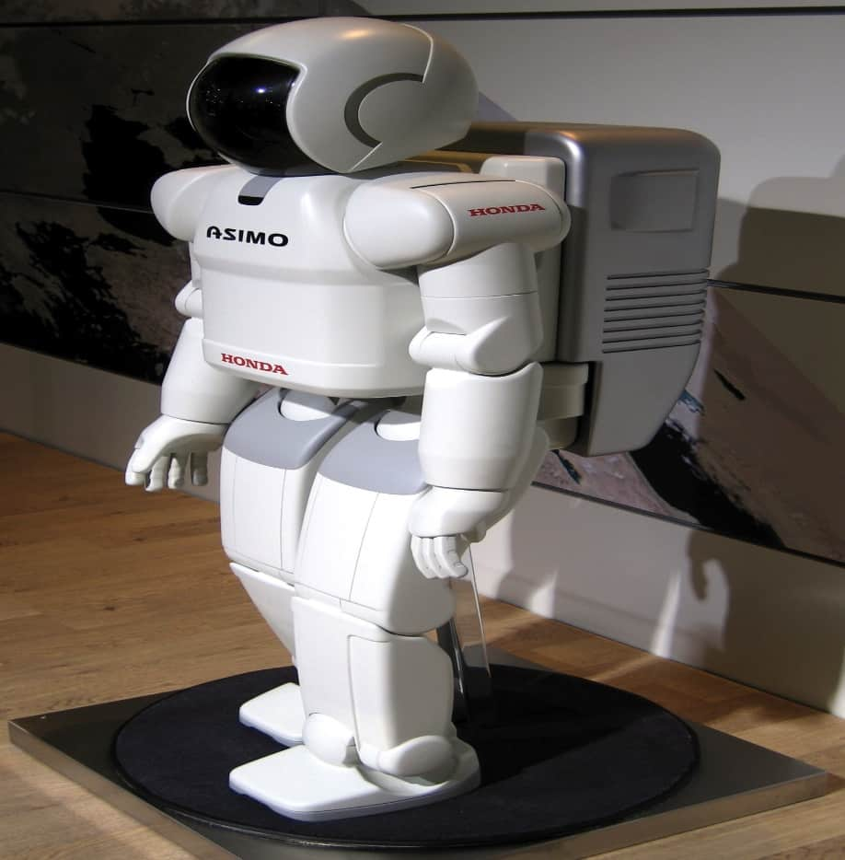
What’s interesting with AI
Honda AISMO
Advanced Step in Innovation MObility
Humanoid Robot
Capable of recognizing:
Moving objects
Postures
Gestures
Handshake
Sounds
Capable of walking and running
http://en.wikipedia.org/wiki/ASIMO

Slide 10
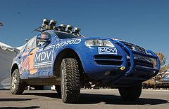
What’s interesting with AI
Darpa Grand Challenge
To nurture the development of autonomous ground vehicles
Competition of Driverless vehicles
2004
1 million
Mojave Desert
Follows a route of 240 km
No one won: best completed 12 km
2005
2 million dollar prize
3 narrow tunnels, 100 sharp turns
Twisted pass with a drop-off one one side
Five succeeded
Winner: 6:54 hours, Stanford Racing Team – Stanely
Urban Grand Challenge
2007
2 million dollar
AirForce Base
To obey to all traffic rules
96 km within less than 6 hours
CMU team won – with 4:10
stanely
http://en.wikipedia.org/wiki/DARPA_Grand_Challenge

Slide 11
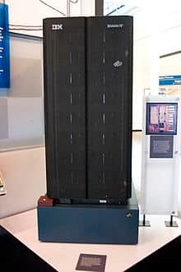
What’s interesting with AI
1996, Deep Blue first machine to beat chess world champion
But lost in the series – 4 to 2
1997, won the series 3.5 to 2.5
Search 6 to 8 moves a head
The evaluation function is set by the system after examining thousands of master games
http://en.wikipedia.org/wiki/Deep_Blue_(chess_computer)

Slide 12
Problems with Imitating Humans
The human thinking process is difficult to understand: how does the mind raises from the brain ?
Think also about unconscious tasks such as vision and speech understanding.
Humans are not perfect ! We make a lot of systemic mistakes:

Slide 13
Relations to Other Fields
Philosophy
Logic, methods of reasoning and rationality.
Mathematics
Formal representation and proof, algorithms, computation, (un)decidability, (in)tractability, probability.
Economics
utility, decision theory (decide under uncertainty)
Neuroscience
neurons as information processing units.
Psychology/Cognitive Science
how do people behave, perceive, process information, represent knowledge.
Computer engineering
building fast computers
Control theory
design systems that maximize an objective function over time
Linguistics
knowledge representation, grammar
slide mostly borrowed from Max Welling

Slide 14
AI History
Gestation of AI (1934 - 1955)
In 1943, proposed a binary-based model of neurons
Any computable function can be modeled by a set of neurons
A serious attempt to model brain
1950, Turing’s “Computing Machinery and Intelligence ”: turing test, reinforcement learning and machine learning
The Inception of AI (1956)
Dartmouth meeting to study AI
an AI program ”Logic Theorist” to prove many theorems
Early Enthusiasm and great Expectation (1952-1969)
General Problem Solver imitates the human way of thinking
LISP (AI programming language) was defined
1965, Robinson discovered the resolution method – logical reasoning
AI Winter (1966-1973)
Computational intractability of many AI problems
Neural Network starts to disappear

Slide 15
AI History
Knowledge-based systems (1969-1979)
Use domain knowledge to allow for stronger reasoning
Becomes an Industry (1980-now)
Digital Equipment Corporation selling R1 “expert sytem”
From few million to billions in 8 years
The return of neural network (1986-now)
With the back-propagation algorithm
AI adopts scientific method (1987-now)
More common to base theorems on pervious ones or rigorous evidence rather than intuition
Speech recognition and HMM
Emergence of intelligent agent (1995-now)
search engines, recommender systems,….
Availability of very large data sets (2001 – now)
Worry more about the data

Slide 16
The State of the Art
Robotics Vehicle
DARPA Challenge
Speech Recognition
United Airlines
Autonomous Planning and Scheduling
Remote Agent: Plan and control spacecraft
MAPGEN: daily planning of operations on NASA’s exploration Rover
Game Playing
IBM Deep Blue
Spam Fighting
Logistic Planning
DART – Dynamic Analysis and Replacing Tool
Gulf War 1991
To plan the logistic for transportation of 50k vehicles, cargo and people
Generated in hour a plan that could take weeks
Robotics
Machine Translation
Statistical models

Slide 17
Summary
This course is concerned with creating rational agents: artificial rationality.
AI has passed the era of infancy and is now attacking real life, complex problems, and it is succeeding in many of them.
The history of AI has had a turbulent history with many ups and downs, phenomenal successes and deep disappointments resulting in fund cutbacks and economic losses.
AI has flourished in the last two decades and it the researchers mentality shifted towards a rigorous scientific methodology:
Firm theoretical basis & Serious experiments

Slide 18
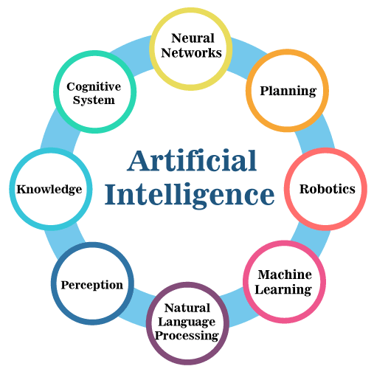
Area of AI

Slide 19
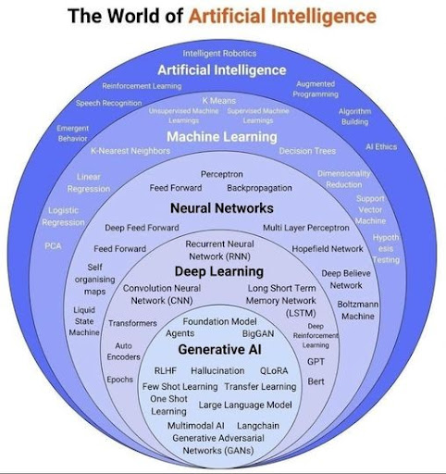
Area of AI

Slide 20
word "artificial"
The word "artificial" refers to something that is made or created by humans rather than occurring naturally.
It is often used to describe objects, processes, or systems that mimic or replicate natural ones but are designed and constructed by people.
Common Contexts:
Man-made items, like artificial flowers or synthetic materials.
Machines or software designed to perform tasks that typically require human intelligence.
Substances created to imitate natural flavors or colors in food.

Slide 21

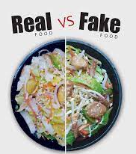
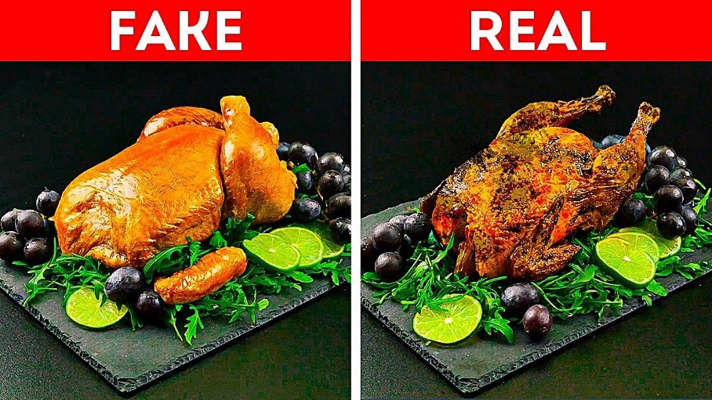
word "artificial"

Slide 22
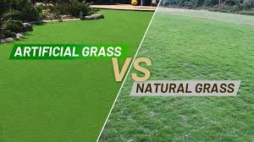
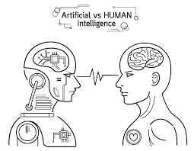
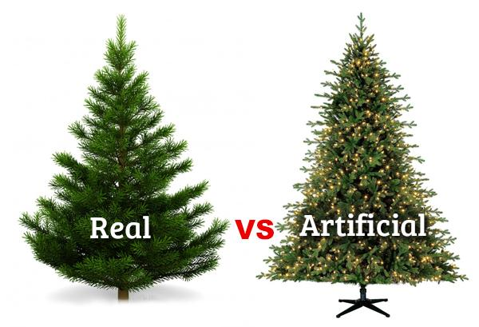
word "artificial"

Slide 23
word " Intelligence"
Intelligence refers to the ability to acquire, understand, and apply knowledge and skills.
It encompasses a range of cognitive processes such as reasoning, learning, problem-solving, critical thinking, creativity, and adapting to new situations.
Intelligence can manifest in various forms, including linguistic, logical-mathematical, emotional, social, and spatial, depending on the context and domain of activity.

Slide 24

Artificial Intelligence (AI)
What is AI?
Artificial Intelligence (AI) refers to the simulation of human intelligence in machines programmed to think, learn, and make decisions.

Slide 25
Is AI only mimic human intelligence?
AI (Artificial Intelligence) isn't limited to mimicking human intelligence; it can also model other forms of intelligence found in nature.
While much of AI development has been inspired by human cognitive processes, it has expanded beyond human-centric functions.
Nature-Inspired AI e.g. Swarm Intelligence, Evolutionary Algorithms.

Slide 26
Artificial Intelligence: 4 Perspectives Week-2

Slide 27
Artificial Intelligence: 4 Perspectives
AI
Acting humanly
Thinking rationally
Acting rationally
Thinking humanly

Slide 28
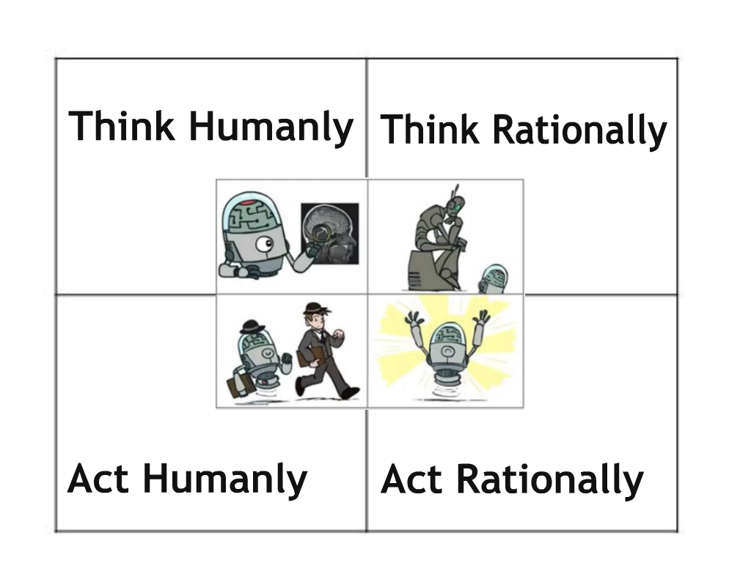
Artificial Intelligence: 4 Perspectives

Slide 29
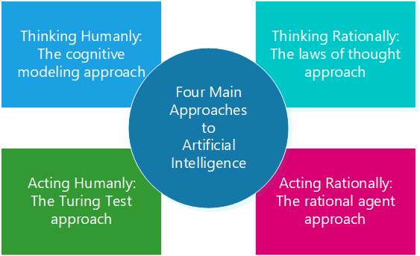
Artificial Intelligence: 4 Perspectives

Slide 30
Act Like Humans
Acting HumanlyDefinition: AI aims to act in ways that mimic human behavior.
“The art of creating machines that perform functions that require intelligence when performed by people” (Kurzweil, 1990)
Examples:
Chatbots: Virtual assistants like ChatGPT, Siri, or Alexa hold conversations in natural language, mimicking human interaction.
Humanoid Robots: Robots like Sophia express emotions and interact with humans.

Slide 31
Act Like Humans
Acting HumanlyDefinition: AI aims to act in ways that mimic human behavior.
“The art of creating machines that perform functions that require intelligence when performed by people” (Kurzweil, 1990)
Examples:
Chatbots: Virtual assistants like ChatGPT, Siri, or Alexa hold conversations in natural language, mimicking human interaction.
Humanoid Robots: Robots like Sophia express emotions and interact with humans.

Slide 32
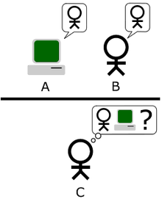
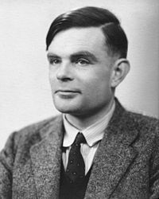
Acting Humanly: The Turing Test
http://en.wikipedia.org/wiki/Turing_test
Alan Turing
1912-1954
To be intelligent, a program should simply act like a human

Slide 33
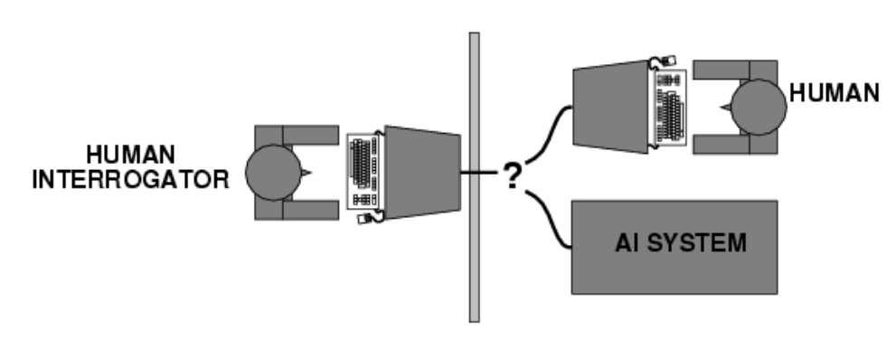
Acting Humanly: The Turing Test
The Turing Test, proposed by Alan Turing (1950), was designed to provide a satisfactory operational definition of intelligence.
Turing defined intelligent behavior as the ability to achieve human-level performance in all tasks, sufficient to fool an interrogator.
Roughly speaking, the test he proposed is that the computer should be interrogated by a human via a teletype, and passes the test if the interrogator cannot tell if there is a computer or a human at the other end.

Slide 34
Acting Humanly
To pass the Turing test, the computer/robot needs:
Natural language processing to communicate successfully.
Knowledge representation to store what it knows or hears.
Automated reasoning to answer questions and draw conclusions using stored information.
Machine learning to adapt to new circumstances and to detect and extrapolate patterns.
These are the main branches of AI.

Slide 35
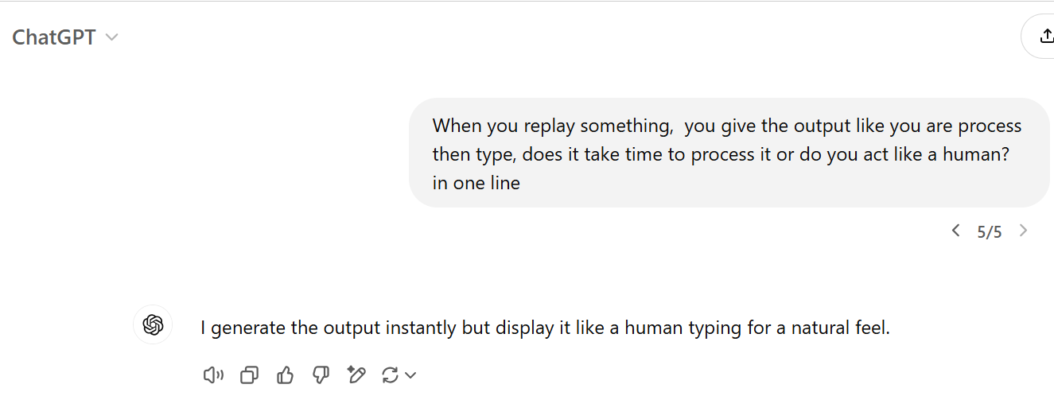
Acting Humanly

Slide 36
Think Like Humans
AI replicates human thought processes, focusing on reasoning and problem-solving.
The automation of activities that we associate with human thinking, activities such as decision-making, problem solving, learning,…(Bellman, 1978)
Examples:
Cognitive Modeling: Simulating human thinking for tasks like medical diagnoses (e.g., IBM Watson).
Game AI: Systems like Deep Blue mimicking human strategies in chess.

Slide 37
Thinking Humanly
Real intelligence requires thinking → think like a human !
First, we should know how a human think
Introspect ones thoughts
Physiological experiment to understand how someone thinks
Brain imaging – MRI…
Then, we can build programs and models that think like humans
Resulted in the field of cognitive science: a merger between AI and psychology.

Slide 38
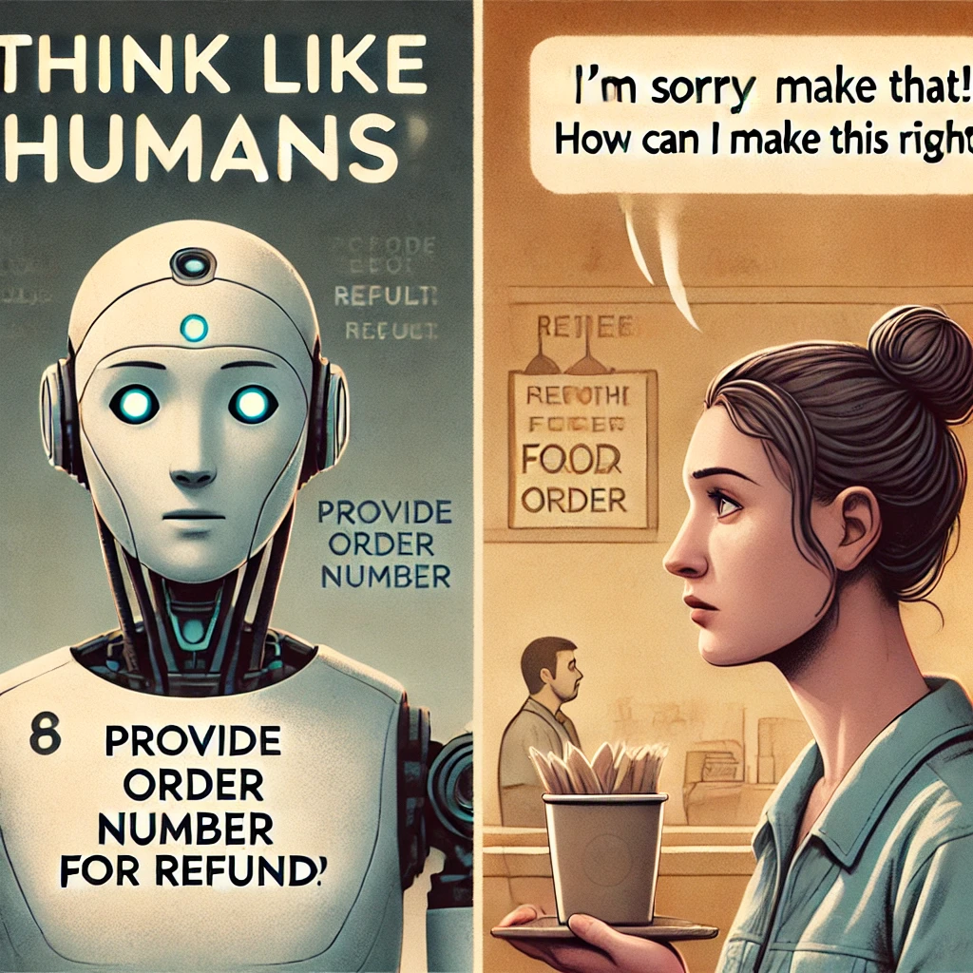
Thinking Humanly
Scenario: You are designing a customer service chatbot for a restaurant.
Robot-Like Thinking:
Customer: "I'm upset about my last order!“
Chatbot: "Please provide your order number. Refunds are processed within 3 business days."
Human-Like Thinking:
Customer: "I'm upset about my last order!“
Chatbot: "I'm really sorry to hear that! Can you tell me what went wrong? I'd like to help make this right."

Slide 39
Cognitive Modeling
What is cognitive modeling?
Cognitive modeling is an area of computer science that deals with simulating human problem-solving and mental processing in a computerized model. Such a model can be used to simulate or predict human behavior or performance on tasks similar to the ones modeled and improve human-computer interaction.

Slide 40
Thinking Rationally
AI models reasoning using formal logic and mathematics.
Examples:
Prolog Systems: AI programmed with logical rules to make decisions.
Optimization Algorithms: Solving complex problems like shortest path in logistics.
Scenario:
Example: You are planning a road trip and need to determine the most efficient route to visit multiple cities. You have a map with the distances between each city, and your goal is to minimize the total travel distance.

Slide 41
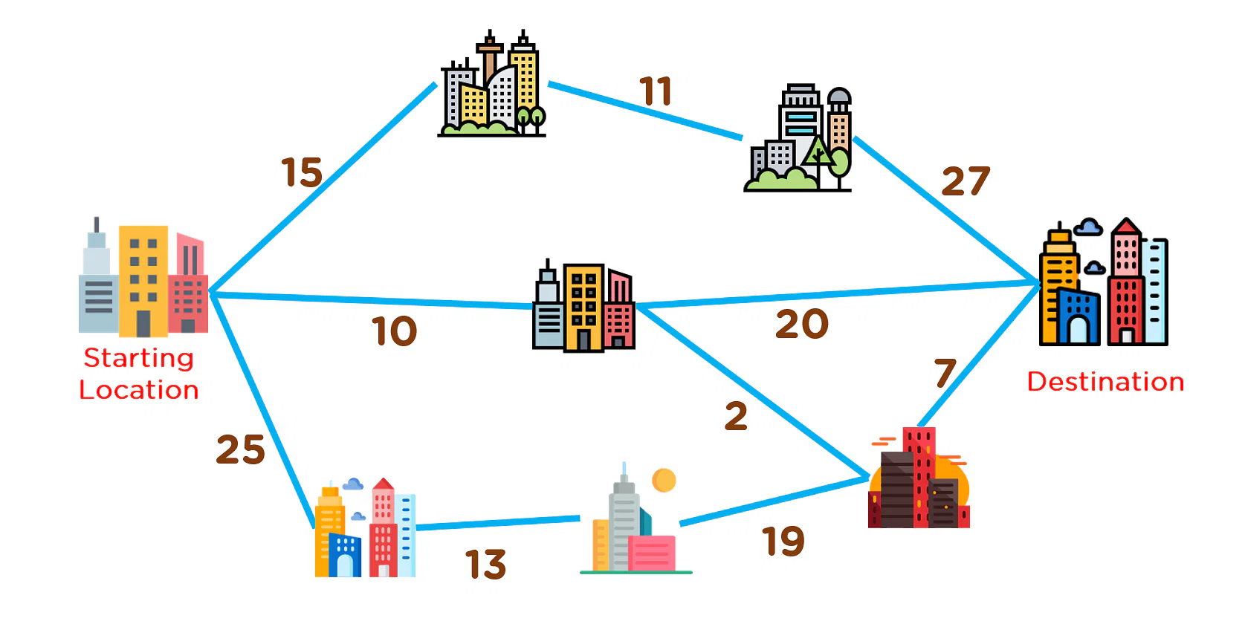
Thinking Rationally
Step 1: Gather Information
Obtain a map or a table with distances between cities.
Identify the cities you want to visit (e.g., City A, City B, City C, City D).
Step 2: Analyze the Data
Use logical reasoning to evaluate all possible routes.
Calculate the total distance for each route.
Step 3: Apply Rational Decision-Making
Choose the route with the shortest total distance.
Consider constraints like time, fuel, and road conditions.

Slide 42
Acting Rationally
AI focuses on achieving goals logically and efficiently, without necessarily mimicking humans.
Examples:
Autonomous Vehicles: Tesla’s self-driving cars prioritize safety and efficiency.
Smart Assistants: Tools like Google Calendar provide optimal scheduling solutions.

Slide 43
Acting Rationally
Acting Rationally: acts as to achieve the best outcome
Logical thinking is only one aspect of appropriate behavior
Sometimes there is no correct way to do, yet something must be done.
Instead of insisting on how the program should think, we insist on how the program should act: we care only about the final result.
Advantages:
more general than “thinking rationally” and more
Mathematically principled; proven to achieve rationality unlike human behavior or thought

Slide 44

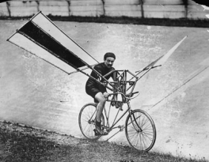

Acting Rationally
This is how birds fly
Humans tried to mimic
birds for centuries
This is how we finally achieved “artificial flight”

Slide 45
Intelligent Agents Week-3

Slide 46
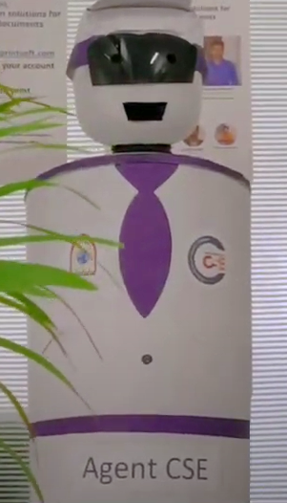
Agents
An agent is anything that can be viewed as perceiving its environment through sensors and acting upon that environment through actuators
In AI, an agent is an entity that perceives its environment through sensors, processes information, and takes actions to achieve specific goals.
Human agent:
Sensors: eyes, ears, and other organs
Actuators: hands, legs, mouth, and other body parts
Robotic agent:
Sensors: cameras and infrared range finders
Actuators: various motors

Slide 47
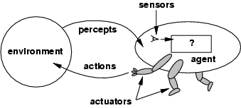
Agents
The agent function maps from percept histories to actions: [f: P* → A]
Percept history is also known as percept sequence.

Slide 48
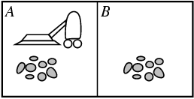
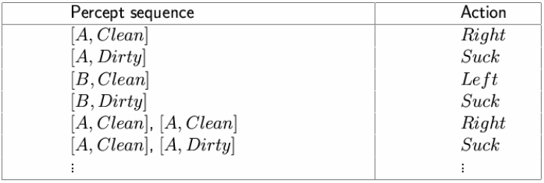
Vacuum-cleaner world
Percepts: location and contents, e.g., [A,Dirty]
Actions: Left, Right, Suck, NoOp
A vacuum-cleaner agent

Slide 49
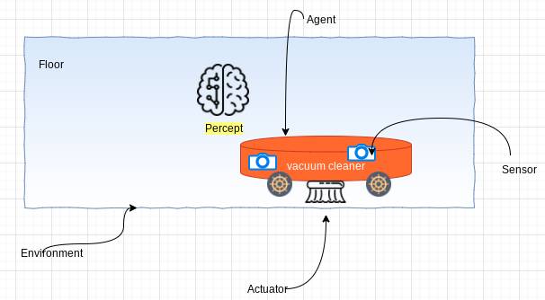
Rational agents
An agent should strive to "do the right thing", based on
what it can perceive and
the actions it can perform
The right action is the one that will cause the agent to be most successful
Performance measure: An objective criterion for success of an agent's behavior
E.g., performance measure of a vacuum-cleaner agent could be
amount of dirt cleaned up,
amount of time taken,
amount of electricity consumed,
amount of noise generated, etc.

Slide 50
Rational agents
A rational agent is one that does the right thing, based on what it can perceive and the actions it can perform.
The right action is the one that will cause the agent to be most successful.
How and when will you evaluate the agent’s success.
Performance measure : The criteria that determines how successful the agent is?
E.g., performance measure of a vacuum-cleaner agent could be amount of dirt cleaned up, amount of time taken, amount of electricity consumed, amount of noise generated, etc.

Slide 51
Rational agents
The when of evaluating performance is also important. If we measured how much dirt the agent had cleaned up in the first hour of the day, we would be rewarding those agents that start fast (even if they do little or no work later on) and punishing those that work consistently.
Thus ,we want to measure performance over the long run, be it an eight-hour shift or a lifetime.

Slide 52
Rational agent
What is rational at any given time depends on four things:
The performance measure that defines the criterion of success.
The action that the agent can perform.
The agents percept sequence to date.
The agent’s prior knowledge of the environment.
This leads to a definition of a rational agent:-
“ For each possible percept sequence, an rational agent should select an action that is expected to maximize its performance measure, given the evidence provided by the percept sequence and whatever built-in knowledge the agent has.”

Slide 53
Rational agents
Rationality is distinct from omniscience.
An omniscient agent knows the actual outcome of its actions and can act accordingly.
Agents can perform actions in order to modify future percepts so as to obtain useful information (information gathering, exploration).
An agent is autonomous if its behavior is determined by its own experience (with ability to learn and adapt).
A rational agent should be autonomous – it should learn what it can to compensate for partial or incorrect prior knowledge.

Slide 54
Designing an intelligent/rational agent:PEAS
Task environment – are essentially the ‘problems’ to which rational agents are ‘solutions’.
Task environment specified by PEAS:
Performance measure
Environment
Actuators
Sensors
Must first specify the setting for intelligent agent design

Slide 55
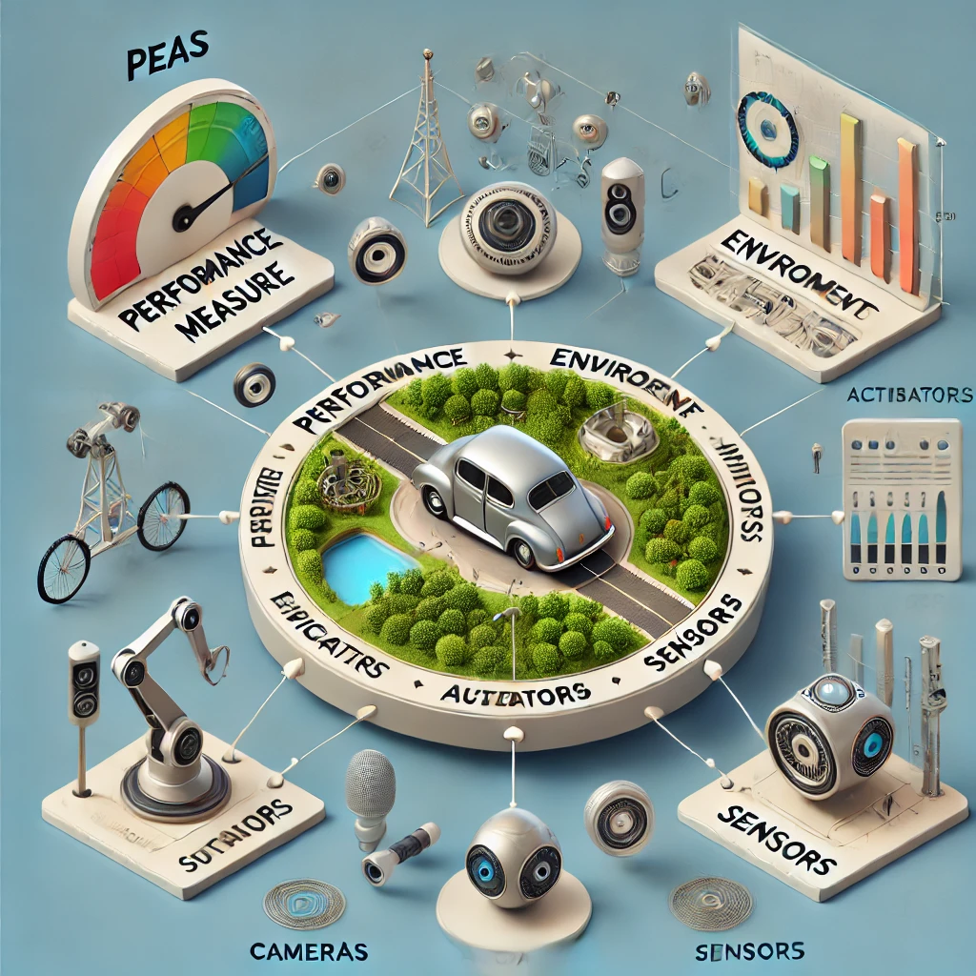
PEAS
Performance measure:
An objective criterion for measuring the degree of success of an agent's behaviour.
The performance measure is defined by the designer
Environment:
An agent operates in a particular environment. The environment can restrict the behaviours and actions of an agent.
Obviously, the more restricted the environment, the easier the agent design is, since the agent has to deal with less factors of the environment

Slide 56
PEAS
Actuators:
An actuator is the mechanism by which a control system acts upon an environment.
The control system can be simple (a fixed mechanical or electronic system), software-based (e.g. a printer driver, robot control system), a human, or any other input.
Sensors:
A sensor is a device which detects or measures a physical property and records, indicates, or otherwise responds to it

Slide 57
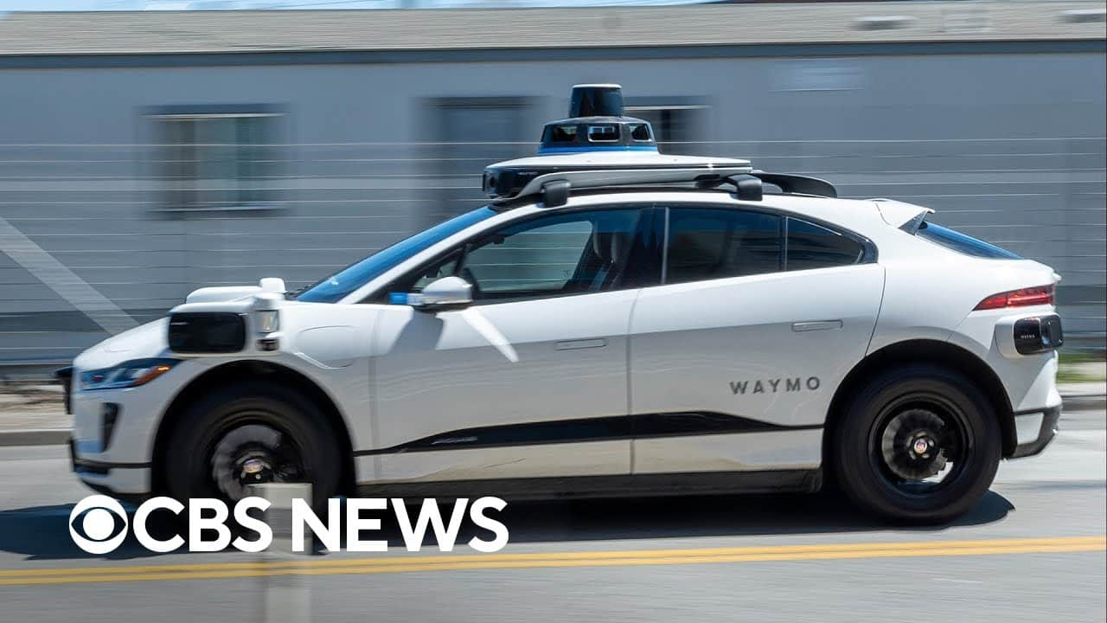
PEAS: Example 1
Agent: Automated taxi driver
Performance measure: Safe, fast, legal, comfortable trip, maximize profits
Environment: Roads, other traffic, pedestrians, customers
Actuators: Steering wheel, accelerator, brake, signal, horn Sensors: Cameras, sonar, speedometer, GPS, odometer, engine sensors, keyboard

Slide 58

PEAS : Example 2
Agent: Interactive English tutor
Performance measure: Maximize student's score on test
Environment: Set of students
Actuators: Screen display (exercises, suggestions, corrections)
Sensors: Keyboard

Slide 59
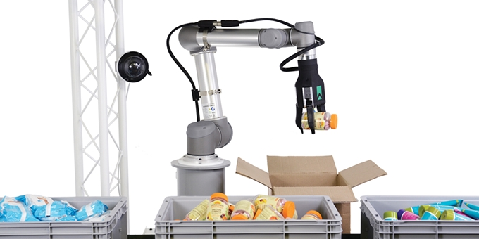
PEAS : Example 3
Agent: Part-picking robot
Performance measure: Percentage of parts in correct bins
Environment: Conveyor belt with parts, bins
Actuators: Jointed arm and hand
Sensors: Camera, joint angle sensors

Slide 60
Omniscience Agent
Omniscience agent knows the actual outcome of its actions, and can act accordingly.
Omniscience agent is impossible.
Aim: For each possible percept sequence a rational agent should select an action
In summary, rational at any time depends on 4 things
The performance measure (degree of success)
Percept sequence (perception history)
Knowledge about the environment
The performed actions

Slide 61
Mapping (Percept seq to actions )
A rule transfer percept sequences to action.
Very long list.
Mapping describe agents then ideal mapping describe ideal agents
Square root problem (Program and mapping table e.g).

Slide 62
Autonomy
Agent actions are completely based on the built-in knowledge (mapping table) then the agent called lacks autonomy. (e.g. clock)
Behavior can be based on both
Its own experience
Built-in-knowledge
Truly autonomous intelligent agent should be avoid unsuccessful result (e.g. dung beetle).

Slide 63
Rational agents
Rationality is distinct from omniscience (all-knowing with infinite knowledge)
Agents can perform actions in order to modify future percepts so as to obtain useful information (information gathering, exploration)
An agent is autonomous if its behavior is determined by its own experience (with ability to learn and adapt)

Slide 64
Ideal Rational agents
For each possible percept sequence, an ideal rational agent should do whatever action is expected to maximize its performance measure, on the basis of the evidence provided by the percept sequence and whatever built-in knowledge the agent has.

Slide 65
Agents programs And Environment types Week-4

Slide 66
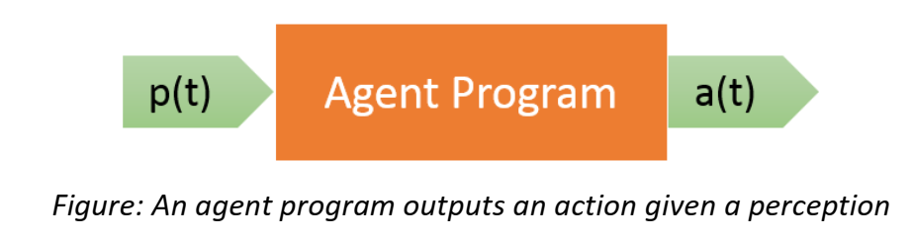
Agents programs
A designer develops an agent program that implements an agent function.
An agent program has the current perception p(t) as input.
An agent program can store the previous perceptions p(0), p(1), ..., p(t–1).
An agent program has an action a(t) as output.
An agent programs is the real implementation of an agent which runs on a physical architecture.

Slide 67
Agent functions and programs
An agent is completely specified by the agent function mapping percept sequences to actions
An agent function (or a small equivalence class) is rational
Aim: find a way to implement the rational agent function concisely

Slide 68
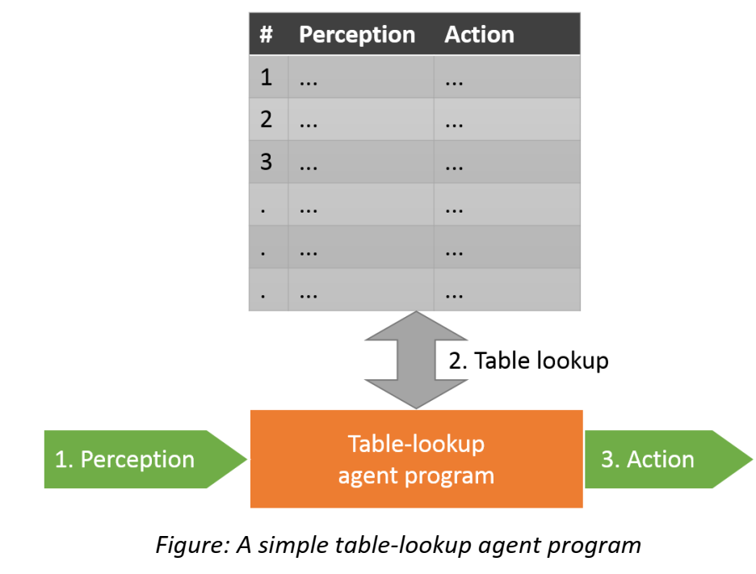
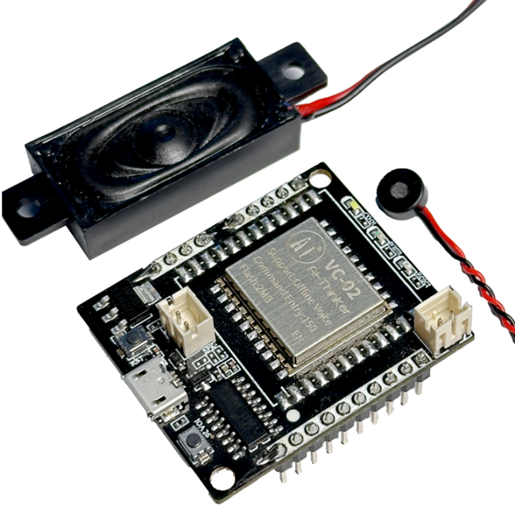
A simple agent program

Slide 69
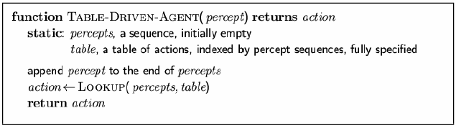
Table-lookup agent
Drawbacks:
Huge table
Take a long time to build the table
No autonomy
Even with learning, need a long time to learn the table entries

Slide 70
Types of Agents programs
Agents can be classified into different types based on their complexity:
Simple Reflex Agents – Act based on predefined rules (e.g., thermostat adjusting temperature).
Model-Based Reflex Agents – Maintain an internal state to handle partially observable environments.
Goal-Based Agents – Take actions based on defined goals (e.g., a chess-playing AI).
Utility-Based Agents – Optimize actions based on a utility function to maximize performance.
Learning Agents – Improve performance over time using machine learning (e.g., self-driving cars).

Slide 71
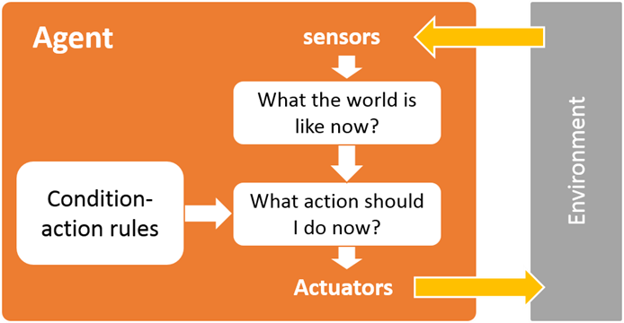
Simple Reflex Agents
A simple reflex agent selects actions based on its current perception or the world and not based on past perceptions. Therefore, no memory is required.
Every possible perception is connected with an action called condition-action rule which has the form: If condition then action

Slide 72
Simple Reflex Agents Cont.
What is the world like now?
This refers to the agent's current percept, which is the immediate input it receives from the environment.
The agent uses this information to understand the current state of the world (as far as it can perceive it).
What action should I do now?
Based on the current percept, the agent selects an action using predefined condition-action rules (if-then rules). These rules map specific percepts to specific actions.

Slide 73
Simple Reflex Agents Cont.
The simple reflex agent has a library of such rules so that if a certain situation should arise and it is in the set of Condition-action rules the agent will know how to react with minimal reasoning.
These agents are simple to work with but have very limited intelligence
May fall in deadlock or infinite loop.

Slide 74
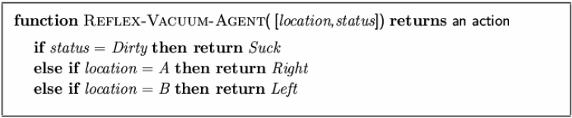
Simple reflex agents Cont.
These agents select actions on the basis of current percept, ignoring the rest of the percept history.
Agent program for a vacuum-cleaner agent

Slide 75
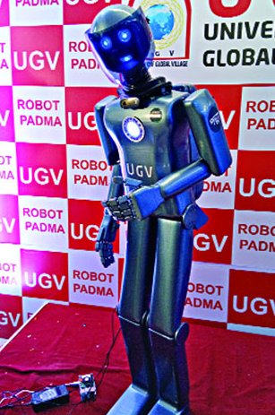
Simple Reflex Agents Cont.
Example:
Vacuum Cleaner Agent
Robot Padma
Limitations:
No Memory: The agent does not remember past states or actions, which can lead to inefficiencies (e.g., repeatedly moving between clean locations).
Reactive Only: The agent cannot plan ahead or learn from experience.
Robot Padma

Slide 76
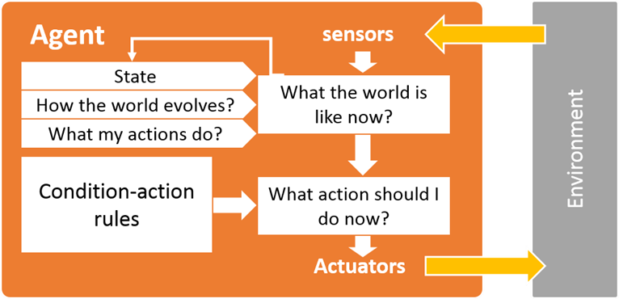
Model based reflex agents
Model-based reflex agents are made to deal with partial accessibility; they do this by keeping track of the part of the world it can see now.
It does this by keeping an internal state that depends on what it has seen before so it holds information on the unobserved aspects of the current state.

Slide 77
Model based reflex agents Cont.
In order to update this internal state we need 2 things:
Information on how the world evolves on its own?
How the world is affected by the agents actions?
Needed because sensors do not usually give the entire state of the world at each input.
so perception of the environment is captured over time.
"State" used to encode different "world states" that generate the same immediate percept.

Slide 78
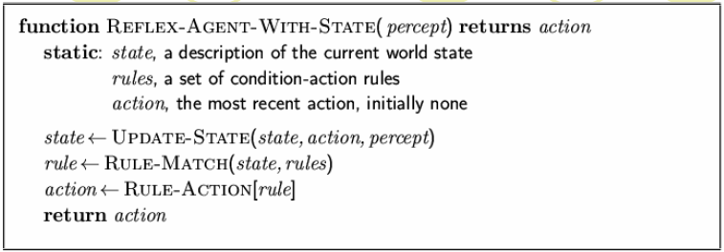
Model-based reflex agents Cont.

Slide 79
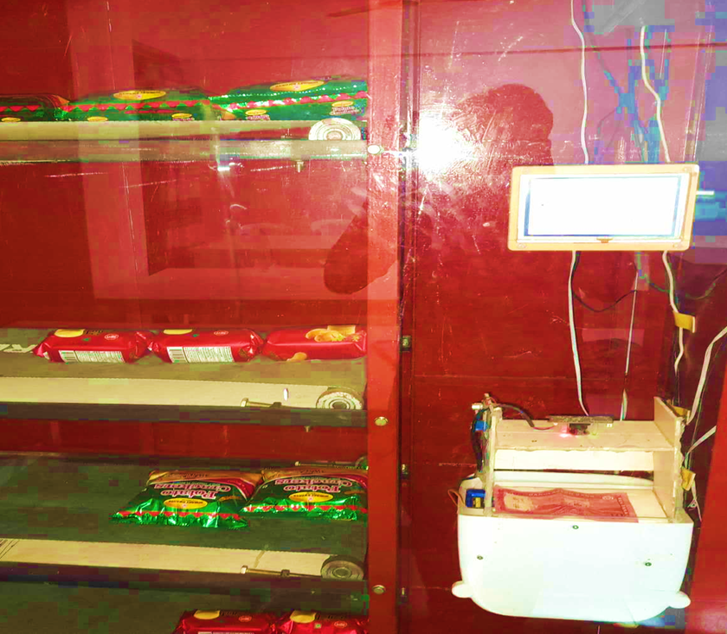
Model based reflex agents Cont.
Example:
UGV Vending Machine
Vacuum Cleaner Agent (Model-Based)
Advantages of Model-Based Reflex Agents:
The agent can operate effectively in environments where not all information is directly observable.
The agent can remember past states and actions, which helps in planning and avoiding repetitive behaviors.
Limitations:
Maintaining an internal model increases the complexity of the agent.
Updating the internal model and making decisions based on it can be computationally expensive.
UGV Vending Machine

Slide 80
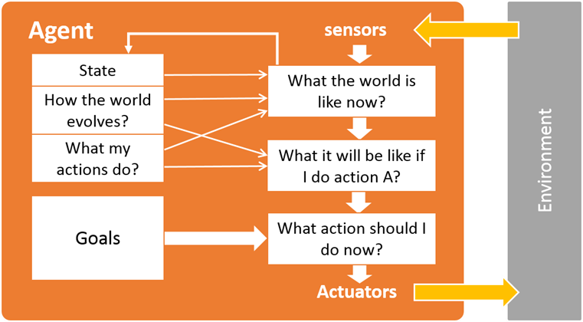
Goal-based agents
Keeping track of the current state is often not enough -- need to add goals to decide which situations are good.
A goal-based agent has a set of goals or desirable situations.
The agent can use these goals with a set of actions and their predicted outcomes to see which action sequence is most likely to achieve the goal(s).

Slide 81
Goal-based agents Cont.
Achieving the goals can take one or more actions.
Search and planning are two subfields in AI devoted to finding sequences of actions to achieve an agents goals.
Although the goal-based agent does a lot more work that the reflex agent this makes it much more flexible because the knowledge used for decision making is represented explicitly and can be modified.

Slide 82
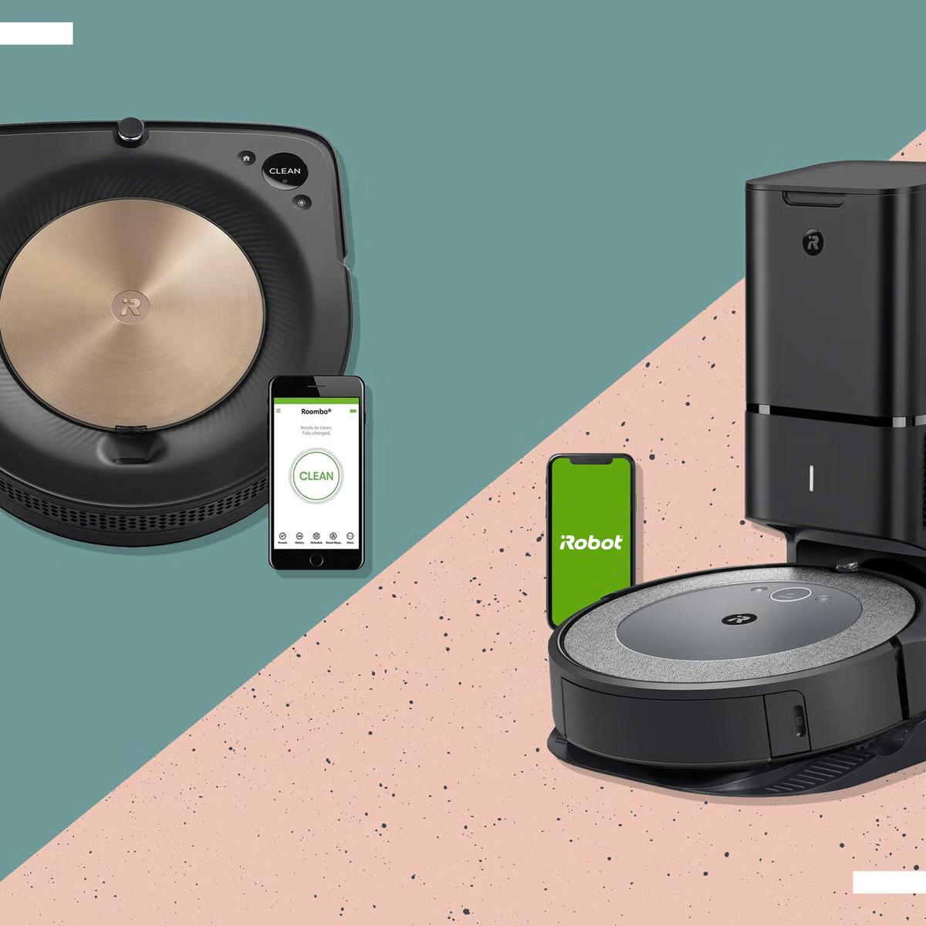
Goal-based agents Cont.
Example:
Self-Driving Car (Goal-Based Agent)
iRobot Roomba s9+
DeepSeek
Advantages:
Efficient Decision-Making
Flexibility in Different Scenarios
Better Problem-Solving
Can Handle Complex Tasks
Disadvantages:
High Computational Cost
Slower Decision-Making
Limited Learning Ability
Requires Accurate Models
iRobot Roomba s9+

Slide 83
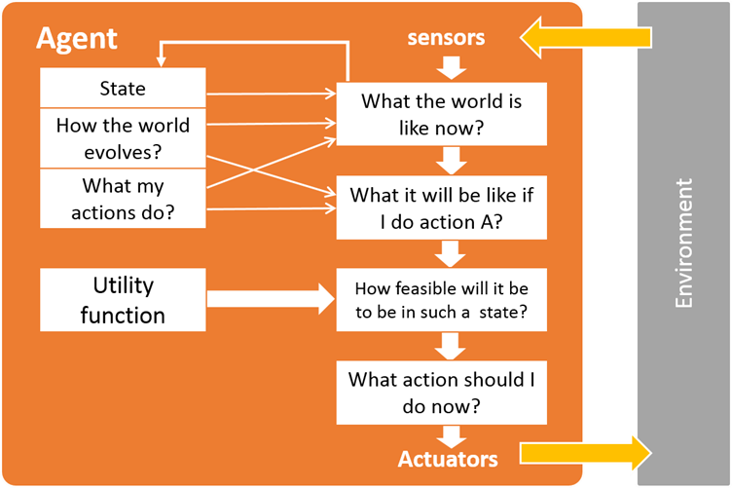
Utility-based agents
Utility based agents have the means to decide among multiple possible alternatives called utility function.
A goal specifies a crude distinction between a feasible and unfeasible state, but often need a more general performance measure that describes "degree of feasibility"

Slide 84
Utility-based agents Cont.
Utility function indicates a measure of success or feasibility when at a given state.
Allows decisions comparing choice between conflicting goals, and choice between likelihood of success and importance of goal (if achievement is uncertain)

Slide 85
Utility-based agents
Goals sometimes are not enough to generate high quality behavior.
For example, out of many possible routes a taxi can follow, some are quicker, safer, more reliable and cheaper than others.
The degree of happiness while achieving a goal is represented by utility.
A utility function maps a state (or a sequence of states) onto a real number which describes the degree of happiness.

Slide 86

Utility-based agents Cont.
Examples:
Personalized Recommendation Systems e.g. Amazon
Smart Home Systems.

Slide 87
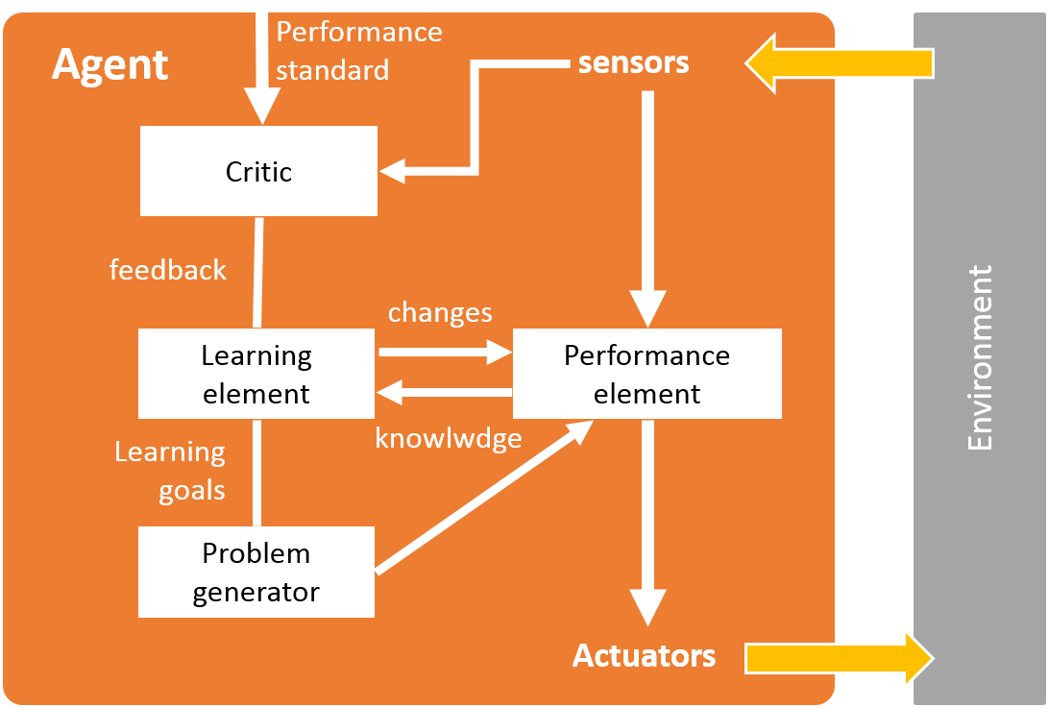
Learning agents
When we expand our environments we get a larger and larger amount of tasks, eventually we are going to have a very large number of actions to pre-define.
Another way of going about creating an agent is to get it to learn new actions as it goes about its business, this still requires some initial knowledge but cuts down on the programming greatly.
This will allow the agent to work in environments that are unknown.

Slide 88
Environment types
Fully observable (vs. partially observable): An agent's sensors give it access to the complete state of the environment at each point in time.
Deterministic vs. non-deterministic (stochastic): The next state of the environment is completely determined by the current state and the action executed by the agent. (If the environment is deterministic except for the actions of other agents, then the environment is strategic)
Episodic (vs. sequential): The agent's experience is divided into atomic "episodes" (each episode consists of the agent perceiving and then performing a single action), and the choice of action in each episode depends only on the episode itself.

Slide 89
Environment types
Static (vs. dynamic): The environment is unchanged while an agent is deliberating.
The environment is semi dynamic if the environment itself does not change with the passage of time but the agent's performance score does.
Discrete (vs. continuous): A limited number of distinct, clearly defined percepts and actions.
Single agent (vs. multiagent): An agent operating by itself in an environment.

Slide 90
Assumptions
Static or dynamic?
Fully or partially observable?
Discrete or continuous?
Deterministic or stochastic?
Episodic or sequential?
Single agent or multiple agent?

Slide 91
Environment types
Chess with Chess without Taxi driving
a clock a clock
Fully observable Yes Yes No
Deterministic Strategic Strategic No
Episodic No No No
Static Semi Yes No
Discrete Yes Yes No
Single agent No No No
The environment type largely determines the agent design
The real world is (of course) partially observable, stochastic, sequential, dynamic, continuous, multi-agent

Slide 92
Search Week-5

Slide 93
Search
Search permeates all of AI
What choices are we searching through?
Problem solving Action combinations (move 1, then move 3, then move 2...)
Natural language Ways to map words to parts of speech
Computer vision Ways to map features to object model
Machine learning Possible concepts that fit examples seen so far
Motion planning Sequence of moves to reach goal destination
An intelligent agent is trying to find a set or sequence of actions to achieve a goal
This is a goal-based agent

Slide 94
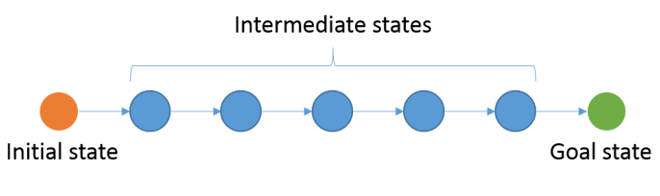
State Space search
State space search is the process of searching for a sequence of actions that take from an initial state to a goal state to formulate solution for a given problem.

Slide 95
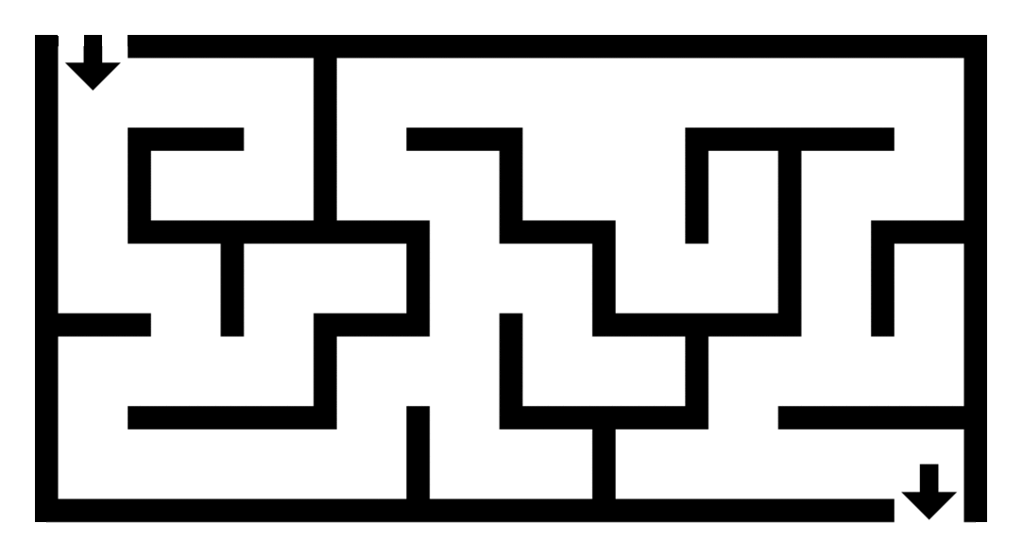
Problem-solving Agent
SimpleProblemSolvingAgent(percept)
state = UpdateState(state, percept)
if sequence is empty then
goal = FormulateGoal(state)
problem = FormulateProblem(state, g)
sequence = Search(problem)
action = First(sequence)
sequence = Rest(sequence)
Return action

Slide 96
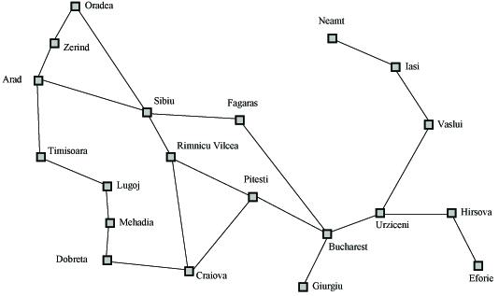
Search Example
Formulate goal: Be in Bucharest.
Formulate problem: states are cities, operators drive between pairs of cities
Find solution: Find a sequence of cities (e.g., Arad, Sibiu, Fagaras, Bucharest) that leads from the current state to a state meeting the goal condition

Slide 97
Search Space Definitions
State
A description of a possible state of the world
Includes all features of the world that are pertinent to the problem
Initial state
Description of all pertinent aspects of the state in which the agent starts the search
Goal test
Conditions the agent is trying to meet (e.g., have $1M)
Goal state
Any state which meets the goal condition
Thursday, have $1M, live in NYC
Friday, have $1M, live in Valparaiso
Action
Function that maps (transitions) from one state to another

Slide 98
Search Space Definitions
Problem formulation
Describe a general problem as a search problem
Solution
Sequence of actions that transitions the world from the initial state to a goal state
Solution cost (additive)
Sum of the cost of operators
Alternative: sum of distances, number of steps, etc.
Search
Process of looking for a solution
Search algorithm takes problem as input and returns solution
We are searching through a space of possible states
Execution
Process of executing sequence of actions (solution)

Slide 99
Problem Formulation
A search problem is defined by the
Initial state (e.g., Arad)
Operators (e.g., Arad -> Zerind, Arad -> Sibiu, etc.)
Goal test (e.g., at Bucharest)
Solution cost (e.g., path cost)

Slide 100

Example Problems – Towers of Hanoi
States: combinations of poles and disks
Operators: move disk x from pole y to pole z subject to constraints
cannot move disk on top of smaller disk
cannot move disk if other disks on top
Goal test: disks from largest (at bottom) to smallest on goal pole
Path cost: 1 per move
Towers of Hanoi applet

Slide 101
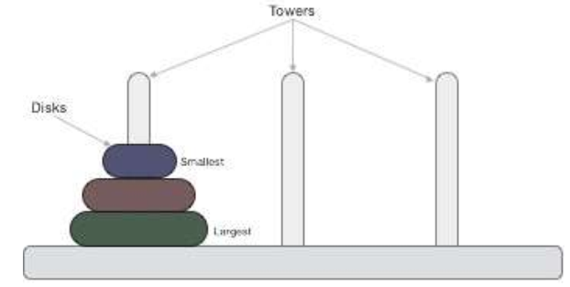
Tower of Hanoi
A few rules to be followed for Tower of Hanoi are −
Only one disk can be moved among the towers at any given time.
Only the "top" disk can be removed.
No large disk can sit over a small disk.
Tower of Hanoi puzzle with n disks can be solved in minimum 2n−1 steps.
This presentation shows that a puzzle with 3 disks has taken 23−1 = 7 steps.

Slide 102
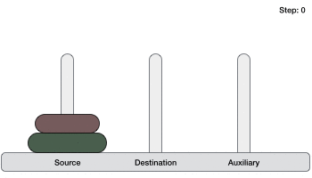

Tower of Hanoi
To write an algorithm for Tower of Hanoi, first we need to learn how to solve this problem
with lesser amount of disks, say → 1 or 2. We mark three towers with
name, source, destination and aux (only to help moving the disks). If we have only one
disk, then it can easily be moved from source to destination peg.
If we have 2 disks –
First, we move the smaller (top) disk to aux peg.
Then, we move the larger (bottom) disk to destination peg.
And finally, we move the smaller disk from aux to destination peg.

Slide 103



Tower of Hanoi

Slide 104

Example Problems – Rubik’s Cube
States: list of colors for each cell on each face
Initial state: one specific cube configuration
Operators: rotate row x or column y on face z direction a
Goal: configuration has only one color on each face
Path cost: 1 per move
Rubik’s cube applet

Slide 105
Example: The 8-puzzle
Start
Goal
1 | 2 | 3
8 |  | 4
7 | 6 | 5
1 | 2 | 3
4 | 5 | 6
7 | 8
2

Slide 106
Example: N Queens
4 Queens
5

Slide 107
uninformed search
search strategy that uses no problem- specific knowledge

Slide 108
informed search
search strategy that uses problem-specific knowledge to find solutions more efficiently

Slide 109
Blind vs. Heuristic Strategies
Blind (or un-informed) strategies have no additional information except available in problem definition
Generate successors and distinguish a goal state from a non goal state.
Heuristic (or informed) strategies know whether one non goal state is more promising than others.

Slide 110
State Space Search types
State Space Search are two types:
Uninformed Blind search: hese methods explore the state space without any domain-specific knowledge. Examples include:
Breath first search (BFS)
Depth first search (DFS)
Iterative deepening depth first search
Uniform cost search
Bi-directional search
Informed Heuristic Search: These methods use domain-specific heuristics to guide the search process efficiently. Examples include:
Best first search (BFS)
Greedy best-first search
A* search
Hill-climbing search

Slide 111
Breadth-First Search Week-6

Slide 112
Breadth-First Search
Generate children of a state, QueueingFn adds the children to the end of the open list
Level-by-level search
Order in which children are inserted on open list is arbitrary
In tree, assume children are considered left-to-right unless specified differently
Number of children is “branching factor” b

Slide 113
breadth-first search
search algorithm that always expands the shallowest node in the frontier
stack
last-in first-out data type

Slide 114


Slide 115


Slide 116

Solve this Eight Puzzle using BFS

Slide 117

Solve this Eight Puzzle using BFS

Slide 118
Analysis
Assume goal node at level d with constant branching factor b
Time complexity (measured in #nodes generated)
1 (1st level ) + b (2nd level) + b² (3rd level) + … + b^{d} (goal level) + (b^{d+1} – b) = O(b^{d}+1)
This assumes goal on far right of level
Space complexity
At most majority of nodes at level d + majority of nodes at level d+1 = O(b^{d+1})
Exponential time and space
Features
Simple to implement
Complete
Finds shortest solution (not necessarily least-cost unless all operators have equal cost)

Slide 119
Analysis
See what happens with b=10
expand 10,000 nodes/second
1,000 bytes/node
Depth | Nodes | Time | Memory
2 | 1110 | .11 seconds | 1 megabyte
4 | 111,100 | 11 seconds | 106 megabytes
6 | 10⁷ | 19 minutes | 10 gigabytes
8 | 10⁹ | 31 hours | 1 terabyte
10 | 10¹¹ | 129 days | 101 terabytes
12 | 10¹³ | 35 years | 10 petabytes
15 | 10¹⁵ | 3,523 years | 1 exabyte

Slide 120
Depth-First Search Week-7

Slide 121
Depth-First Search
QueueingFn adds the children to the front of the open list
BFS emulates FIFO queue
DFS emulates LIFO stack
Net effect
Follow leftmost path to bottom, then backtrack
Expand deepest node first

Slide 122


Slide 123


Slide 124

Example Problems – Eight Queens
States: locations of 8 queens on chess board
Initial state: one specific queens configuration
Operators: move queen x to row y and column z
Goal: no queen can attack another (cannot be in same row, column, or diagonal)
Path cost: 0 per move
Eight queens applet

Slide 125
N-Queens Problem
The N-Queens problem is a classic problem in computer science and combinatorial optimization.
The problem is to place N queens on an N×N chessboard in such a way that no two queens threaten each other
No two queens share the same row, column, or diagonal.
Backtracking is a common technique used to solve the N-Queens problem efficiently.

Slide 126
N-Queens Algorithm
Here's how you can implement the backtracking algorithm to solve the N-Queens problem:
Start with an empty board.
Place a queen in the first row and recursively try to place queens in subsequent rows.
For each row, try placing the queen in each column. If a queen can be placed in a column without conflicting with existing queens, mark that cell and recursively move to the next row.
If all queens are placed without conflicts, a solution is found.
If at any point, there are no valid positions for the queen in the current row, backtrack to the previous row and try placing the queen in another column.

Slide 127

N-Queens: Example
Let's illustrate the backtracking algorithm with a mathematical example for N = 4. The chessboard as an N × N matrix.
Now, we start placing queens using the backtracking algorithm:
Set Q1 to 1st row of 1st column.
Set Q2 to 2nd row of 3rd column.
Q3 has no place to 3rd row.
Backtrack to Q2 and set 2nd row of 4th column.
Set Q3 to 3rd row of 2nd column.

Slide 128
N-Queens: Example
Q4 has no place to set.
Backtrack to Q3 and Q3 has no new place to sate.
Backtrack to Q2 and Q2 has no new place to sate.
Backtrack to Q1 and set 1st row of 2nd column.
Set Q2 to 2nd row of 4th column.
Set Q3 to 3rd row of 1st column.
Set Q4 to 4th row of 3rd column.

Slide 129

DFS 8 Puzzles using DFS

Slide 130
Analysis
Time complexity
In the worst case, search entire space
Goal may be at level d but tree may continue to level m, m>=d
O(b^{m})
Particularly bad if tree is infinitely deep
Space complexity
Only need to save one set of children at each level
1 + b + b + … + b (m levels total) = O(bm)
For previous example, DFS requires 118kb instead of 10 petabytes for d=12 (10 billion times less)
Benefits
May not always find solution
Solution is not necessarily shortest or least cost
If many solutions, may find one quickly (quickly moves to depth d)
Simple to implement
Space often bigger constraint, so more usable than BFS for large problems

Slide 131

Comparison of Search Techniques
 | DFS | BFS
Complete | N | Y
Optimal | N | N
Heuristic | N | N
Time | b^{m} | b^{d+1}
Space | bm | b^{d+1}

Slide 132
Avoiding Repeated States
Can we do it?
Do not return to parent or grandparent state
In 8 puzzle, do not move up right after down
Do not create solution paths with cycles
Do not generate repeated states (need to store and check potentially large number of states)

Slide 133
Iterative Deepening Search Week-8

Slide 134
Iterative Deepening Strategy
It combines the benefit of depth first search and bredth first search.
Like DFS its memory requirement is
Like BFS it is complete if b is finite and optimal if step cost is equal

Slide 135
Iterative Deepening Strategy
Repeat for k = 0, 1, 2, …:
Perform depth-first with depth cutoff k
Complete
Optimal if step cost =1
Time complexity is: db + (d-1)b² + … + (1) b^{d} = O(b^{d})
Space complexity is: O(bd)

Slide 136

Iterative deepening search l =0

Slide 137

Iterative deepening search l =1

Slide 138

Iterative deepening search l =2

Slide 139

Iterative deepening search l =3

Slide 140
Solve this Eight Puzzle using IDS

Slide 141
Solve this Eight Puzzle using IDS
Limit:0
Limit:2
Limit:1
Limit:3

Slide 142
Iterative Deepening Search
DFS with depth bound
QueuingFn is enqueue at front as with DFS
Expand(state) only returns children such that depth(child) <= threshold
This prevents search from going down infinite path
First threshold is 1
If do not find solution, increment threshold and repeat

Slide 143
Analysis
What about the repeated work?
Time complexity (number of generated nodes)
[b] + [b + b²] + .. + [b + b² + .. + b^{d}]
(d)b + (d-1) b² ⁺ … + (1) b^{d}
O(b^{d})

Slide 144
Analysis
Repeated work is approximately 1/b of total work
Negligible
Example: b=10, d=5
N(BFS) = 1,111,100
N(IDS) = 123,450
Features
Shortest solution, not necessarily least cost
Is there a better way to decide threshold? (IDA*)

Slide 145
Uniform Cost Search (Branch&Bound)

Slide 146
Uniform Cost Search (Branch&Bound)
QueueingFn is SortByCostSoFar
Cost from root to current node n is g(n)
Add operator costs along path
First goal found is least-cost solution
Space & time can be exponential because large subtrees with inexpensive steps may be explored before useful paths with costly steps
If costs are equal, time and space are O(b^{d})
Otherwise, complexity related to cost of optimal solution

Slide 147

UCS Example

Slide 148

UCS Example

Slide 149

Bidirectional Search
Search forward from initial state to goal AND backward from goal state to initial state
Can prune many options
Considerations
Which goal state(s) to use
How determine when searches overlap
Which search to use for each direction
Here, two BFS searches
Time and space is O(b^{d/2})

Slide 150

Informed Searches Week-9

Slide 151
Informed Searches
Best-first search, Hill climbing, Beam search, A*, IDA*, RBFS, SMA*
New terms
Heuristics
Optimal solution
Informedness
Hill climbing problems
Admissibility
New parameters
g(n) = estimated cost from initial state to state n
h(n) = estimated cost (distance) from state n to closest goal
h(n) is our heuristic
Robot path planning, h(n) could be Euclidean distance
8 puzzle, h(n) could be #tiles out of place
Search algorithms which use h(n) to guide search are heuristic search algorithms

Slide 152
Best-First Search
QueueingFn is sort-by-h
Best-first search only as good as heuristic
Example heuristic for 8 puzzle: Manhattan Distance

Slide 153
Best-First Search
Best-First Search (general framework)
Chooses which node to expand based on a scoring function:
f(n)=g(n)+h(n)or some variation
f(n) = g(n) + h(n) \quad \text{or some variation}f(n)=g(n)+h(n)or some variation
Here:
g(n)g(n)g(n) = cost so far (sum of previous costs)
h(n)h(n)h(n) = heuristic estimate to goal (present estimate)
Depending on how you define f(n)f(n)f(n), you get different algorithms (UCS, Greedy BFS, A*).

Slide 154

Example

Slide 155
H(n) for some problems
8-puzzle
W(n): number of misplaced tiles
Manhatten distance
Gaschnig’s heuristic
8-queen
Number of future feasible slots
Min number of feasible slots in a row
Travelling salesperson
Minimum spanning tree

Slide 156
Solve this Eight Puzzle using BFS

Slide 157
Comparison of Search Techniques
 | DFS | BFS | UCS | IDS | Best
Complete | N | Y | Y | Y | N
Optimal | N | N | Y | N | N
Heuristic | N | N | N | N | Y
Time | b^{m} | b^{d+1} | b^{m} | b^{d} | b^{m}
Space | bm | b^{d+1} | b^{m} | bd | b^{m}

Slide 158
Greedy Best-First Search
Greedy Best-First Search
Special case where only the present heuristic is used:
f(n)=h(n)f(n) = h(n)f(n)=h(n)
Ignores the past path cost (g(n)g(n)g(n)).
That’s why it’s called “greedy” — it only looks at what seems best right now, not considering the cost already paid.

Slide 159
greedy best-first search
search algorithm that expands the node that is closest to the goal, as estimated by a heuristic function h(n)

Slide 160
Heuristic function?
 |  |  |  |  |  |  |  |  |  |  | B
A

Slide 161
Heuristic function?
 |  |  |  |  |  |  |  |  |  |  | B
 |  |  |  |  |  |  | D
 | C
A

Slide 162
Heuristic function? Manhattan distance.
B
D
C
A

Slide 163


Slide 164
Solve this Eight Puzzle using GBFS

Slide 165


Greedy Best first search
h(n) = number of
misplaced tiles

Slide 166
A* Search

Slide 167
A*
QueueingFn is sort-by-f
f(n) = g(n) + h(n)
Note that UCS and Best-first both improve search
UCS keeps solution cost low
Best-first helps find solution quickly
A* combines these approaches

Slide 168
Power of
If heuristic function is wrong it either
overestimates (guesses too high)
underestimates (guesses too low)
Overestimating is worse than underestimating
A* returns optimal solution if h(n) is admissible
heuristic function is admissible if never overestimates true cost to nearest goal
if search finds optimal solution using admissible heuristic, the search is admissible

Slide 169

Example of A*

Slide 170
A* search
search algorithm that expands node with lowest value of g(n) + h(n)
g(n) = cost to reach node
h(n) = estimated cost to goal

Slide 171


Slide 172

Project analysis slide 8
Solve this Eight Puzzle using A*

Slide 173

Solve this Eight Puzzle using A*

Slide 174

Optimality of A*
Suppose a suboptimal goal G₂ is on the open list
Let n be unexpanded node on smallest-cost path to optimal goal G₁
f(G₂) = g(G₂) since h(G₂) = 0
>= g(G₁) since G₂ is suboptimal
>= f(n) since h is admissible
Since f(G₂) > f(n), A* will never select G₂ for expansion

Slide 175
Comparison of Search Techniques
 | DFS | BFS | UCS | IDS | Best | HC | Beam | A*
Complete | N | Y | Y | Y | N | N | N | Y
Optimal | N | N | Y | N | N | N | N | Y
Heuristic | N | N | N | N | Y | Y | Y | Y
Time | b^{m} | b^{d+1} | b^{m} | b^{d} | b^{m} | bm | nm | b^{m}
Space | bm | b^{d+1} | b^{m} | bd | b^{m} | b | bn | b^{m}

Slide 176
Beam Search Week-10

Slide 177
Beam Search
Queueing Fn is sort-by-h
Only keep best (lowest-h) n nodes on open list
n is the “beam width”
n = 1, Hill climbing
n = infinity, Best first search

Slide 178

Example Beam

Slide 179
Comparison of Search Techniques
 | DFS | BFS | UCS | IDS | Best | HC | Beam
Complete | N | Y | Y | Y | N | N | N
Optimal | N | N | Y | N | N | N | N
Heuristic | N | N | N | N | Y | Y | Y
Time | b^{m} | b^{d+1} | b^{m} | b^{d} | b^{m} | bm | nm
Space | bm | b^{d+1} | b^{m} | bd | b^{m} | b | bn

Slide 180
IDA*
Series of Depth-First Searches
Like Iterative Deepening Search, except
Use A* cost threshold instead of depth threshold
Ensures optimal solution
QueuingFn enqueues at front if f(child) <= threshold
Threshold
h(root) first iteration
Subsequent iterations
f(min_child)
min_child is the cut off child with the minimum f value
Increase always includes at least one new node
Makes sure search never looks beyond optimal cost solution

Slide 181

Example of IDA*

Slide 182
Analysis
Some redundant search
Small amount compared to work done on last iteration
Dangerous if continuous-valued h(n) values or if values very close
If threshold = 21.1 and value is 21.2, probably only include 1 new node each iteration
Time complexity is O(b^{m})
Space complexity is O(m)

Slide 183
Comparison of Search Techniques
 | DFS | BFS | UCS | IDS | Best | HC | Beam | A* | IDA*
Complete | N | Y | Y | Y | N | N | N | Y | Y
Optimal | N | N | Y | N | N | N | N | Y | Y
Heuristic | N | N | N | N | Y | Y | Y | Y | Y
Time | b^{m} | b^{d+1} | b^{m} | b^{d} | b^{m} | bm | nm | b^{m} | b^{m}
Space | bm | b^{d+1} | b^{m} | bd | b^{m} | b | bn | b^{m} | bm

Slide 184
Adversarial Search Week-11

Slide 185
Minimax

Slide 186
Minimax
MAX (X) aims to maximize score.
MIN (O) aims to minimize score.

Slide 187
Game
S0 : initial state
Player(s) : returns which player to move in state s
Actions(s) : returns legal moves in state s
Result(s, a) : returns state after action a taken in state s
Terminal(s) : checks if state s is a terminal state
Utility(s) : final numerical value for terminal state s

Slide 188
Minimax
Given a state s:
MAX picks action a in Actions(s) that produces highest value of Min-Value(Result(s, a))
MIN picks action a in Actions(s) that produces smallest value of Max-Value(Result(s, a))

Slide 189
Minimax
function MAX-VALUE(state): if TERMINAL(state):
return UTILITY(state)
v = -∞
for action in ACTIONS(state):
v = MAX(v, MIN-VALUE(RESULT(state, action))) return v

Slide 190
Minimax
function MIN-VALUE(state): if TERMINAL(state):
return UTILITY(state)
v = ∞
for action in ACTIONS(state):
v = MIN(v, MAX-VALUE(RESULT(state, action))) return v

Slide 191
9
5
3
9

Slide 192
8
9
8
5
3
9
2
8

Slide 193

Tic-Tac-Toe Games Using Minmax

Slide 194
Tic-Tac-Toe Games Using Minmax
O X X
X O X
O
X
O
O
O
O
X
X
O
O X X
X X O
X O X
-1
0
1

Slide 195
Initial State

Slide 196
Player(s)
Player(
) = X
Player(
) = O
X

Slide 197
Actions(s)
X O
X ) = {
O
,
}
Actions(
O
X
O
X
O

Slide 198
Result(s, a)
X O
O X O
Result(
,
O
) =
O
X
X
O
X
X
X
O
X
O

Slide 199
Terminal(s)
O
Terminal(
) = false
O
X
X O X
O X
Terminal(
) = true
O
X
X O X

Slide 200
Utility(s)
O X
Utility(
) = 1
O
X
X O X
O X X
Utility(
) = -1
X
O
O X O

Slide 201
PLAYER(s) = O
Min-Value:
0
 | X | O
O | X | X
X |  | O
O | X | O
O | X | X
X |  | O
 | X | O
O | X | X
X | O | O
Max-Value:
1
Max-Value:
0
O | X | O
O | X | X
X | X | O
X | X | O
O | X | X
X | O | O
Value:
1
Value:
0

Slide 202
1
Max-Value:
 | X | O
O | X
X |  | O
PLAYER(s) = X
Min-Value:
0
 | X | O
O | X | X
X |  | O
Min-Value:
-1
X | X | O
O | X
X |  | O
Value:
1
 | X | O
O | X
X | X | O
O | X | O
O | X | X
X |  | O
 | X | O
O | X | X
X | O | O
X | X | O
O | X | O
X |  | O
X | X | O
O | X
X | O | O
Max-Value:
1
Max-Value:
0
Value:
-1
Max-Value:
0
O | X | O
O | X | X
X | X | O
X | X | O
O | X | X
X | O | O
X | X | O
O | X | X
X | O | O
Value:
1
Value:
0
Value:
0

Slide 203
255,168
total possible Tic-Tac-Toe games

Slide 204
288,000,000,000
total possible chess games after four moves each

Slide 205
10
29000
total possible chess games (lower bound)

Slide 206
Alpha-Beta Pruning

Slide 207
Alpha-beta pruning
“Alpha-beta pruning is an optimization technique for the Minimax algorithm that reduces the number of nodes evaluated in a game tree by cutting off branches that are guaranteed not to influence the final decision.”
The Minimax algorithm is an adversarial search algorithm that involves a Depth-First-Search(DFS) on the game tree.

Slide 208
Alpha-beta pruning
It uses two values, alpha and beta, to track the best possible outcome for the maximizing and minimizing players, respectively, pruning branches where alpha >= beta, indicating a worse-than-available option.
This allows AI to make decisions faster in two-player, zero-sum games like chess and checkers by eliminating unproductive parts of the search tree without changing the outcome.

Slide 209
Parameters of the Alpha Beta Pruning
Alpha(α): The best choice(highest utility/value) found till the current state on the path traversed by the maximizer.
Beta(β): The best choice(lowest utility/value) found till the current state on the path traversed by the minimizer.

Slide 210



Conditions of the Alpha Beta Pruning Algorithm

Slide 211


Alpha Beta Pruning Example
https://www.scaler.com/topics/artificial-intelligence-tutorial/alpha-beta-pruning/

Slide 212


Alpha Beta Pruning Example Cont.

Slide 213


Alpha Beta Pruning Example Cont.

Slide 214


Alpha Beta Pruning Example Cont.

Slide 215

Alpha Beta Pruning Example Cont.

Slide 216


Alpha Beta Pruning Example Cont.

Slide 217
Alpha Beta Pruning Example Cont.

Slide 218
Knowledge Week-12

Slide 219
knowledge-based agents
agents that reason by operating on internal representations of knowledge

Slide 220

Knowledge
Knowledge
If it didn't rain, Ankon visited B1 today.
Ankon visited B1 or B2 today, but not both.
Action: Ankon visited B2 today.
Decision:
Ankon did not visit B1 today.
It rained today.

Slide 221
Logic

Slide 222
sentence
an assertion about the world
in a knowledge representation language

Slide 223
Propositional Logic

Slide 224
Proposition Symbols
P
Q
R

Slide 225
Logical Connectives
∧
and
∨
or
¬
not
→
implication
↔
biconditional

Slide 226
Not (¬)
P | ¬P
false | true
true | false

Slide 227
And (∧)
P | Q | P ∧ Q
false | false | false
false | true | false
true | false | false
true | true | true

Slide 228
Or (∨)
P | Q | P ∨ Q
false | false | false
false | true | true
true | false | true
true | true | true

Slide 229
Implication (→)
P | Q | P → Q
false | false | true
false | true | true
true | false | false
true | true | true

Slide 230
Biconditional (↔)
P | Q | P ↔ Q
false | false | true
false | true | false
true | false | false
true | true | true

Slide 231
model
assignment of a truth value to every propositional symbol (a "possible world")

Slide 232
P: It is raining.
model
Q: It is a Tuesday.
{P = true, Q = false}

Slide 233
knowledge base
a set of sentences known by a knowledge-based agent

Slide 234
Entailment
α ⊨ β
In every model in which sentence α is true, sentence β is also true.

Slide 235
inference
the process of deriving new sentences from old ones

Slide 236
Inference
P: It is a Tuesday.
Q: It is raining.
R: Harry will go for a run.
KB:(P ∧ ¬Q) → R
Inference:

Slide 237
Inference Algorithms

Slide 238
Does
KB ⊨ α
?

Slide 239
Model Checking

Slide 240
Model Checking
To determine if KB ⊨ α:
Enumerate all possible models.
If in every model where KB is true, α is true, then
KB entails α.
Otherwise, KB does not entail α.

Slide 241
P: It is a Tuesday. Q: It is raining. R: Harry will go for a run. KB: (P ∧ ¬Q) → R
P | Q | R | KB
false | false | false | false
false | false | true | false
false | true | false | false
false | true | true | false
true | false | false | false
true | false | true | true
true | true | false | false
true | true | true | false

Slide 242
MID EXAM

