Slide 1



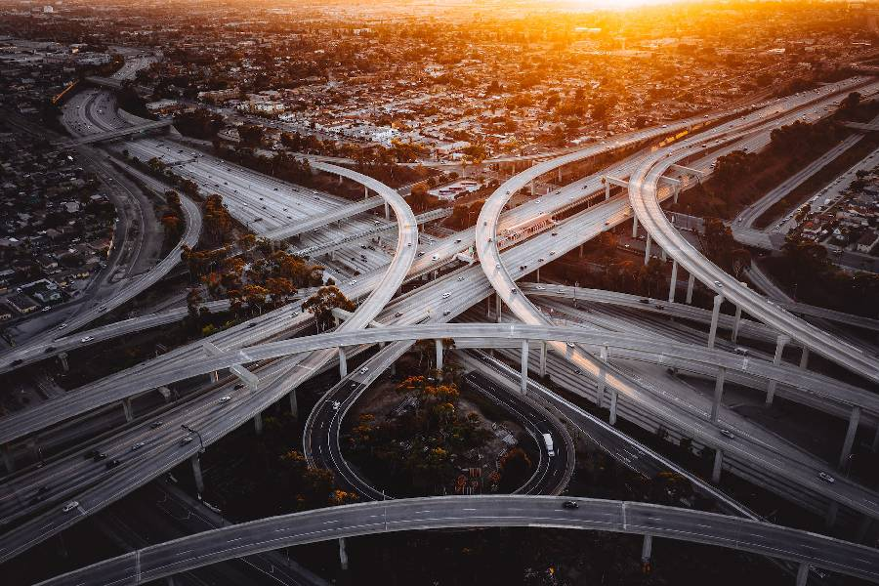



University of Global Village (UGV), Barisal
Transportation Engineering-I
Content of Theory Course
Prepared By
Rubieyat Bin Ali
Assistant Professor & HOD
Department of Civil Engineering
University of Global Village (UGV), Barishal
Program: B.Sc. in CE

Slide 2
Course Title | Transportation Engineering-I
Course Code | 0732-3207
Credits | 04
CIE Marks | 120
SEE Marks | 80
Exam Hours | 2 hours (Mid Exam) 3 hours (Semester Final Exam)
Level | 6th Semester
BASIC COURSE INFORMATION

Slide 3
Transportation Engineering-I
Course Code: 0732-3207 | CREDIT:04
 | TOTAL MARKS:200
Mid Exam Hours 2 | CIE MARKS: 120
Semester End Exam Hours 3 | SEE MARKS: 80
Course Teacher: Rubieyat Bin Ali
Course Learning Outcomes (CLOs): After completing this course successfully, the students will be able to-
CLO 1 | Understand the basic elements of a transportation system and their classification.
CLO 2 | Apply knowledge to calculate stopping and passing sight distances.
CLO 3 | Calculate elements for designing horizontal and vertical curves.
CLO 4 | Predict traffic volume on roadway segments using traffic assignment procedures.

Slide 4
Course plan specifying content, CLOs, teaching learning and assessment strategy mapped with CLOs
Week | Topic | Teaching-Learning Strategy | Assessment Strategy | Corresponding CLOs
1 | Transportation Engineering basic | Lecture, discussion, group work | Quiz, Written Exam | CLO1
2 | Classification of Roads | Oral Presentation, debate | Assignment, Written, Quiz | CLO1
3 | Road Pattern | Video lecture, Field visit | Report writing, Demonstration | CLO1
4 | Highway Planning Survey | Lecture | Viva, Quiz | CLO1, CLO2
5 | Highway Alignment | Project exhibition | Project, Field visit | CLO2
6 | Lane and Way Concept | Discussion, Video Presentation | Quiz, Written Exam | CLO2
7 | Highway Geometric Design-I | Case-based Learning, Demonstration | Assignment, Written, Quiz | CLO2
8 | Highway Geometric Design-II | Lecture, discussion, group work | Report writing, Demonstration | CLO2
9 | Highway Geometric Design-III | Oral Presentation, debate | Viva, Quiz | CLO2
10 | Traffic Volume Study-I | Video lecture | Project, Field visit | CLO3

Slide 5
Course plan specifying content, CLOs, teaching learning and assessment strategy mapped with CLOs
Week | Topic | Teaching-Learning Strategy | Assessment Strategy | Corresponding CLOs
11 | Traffic Volume Study-II | Lecture | Quiz, Written Exam | CLO3
12 | Signal Study | Project exhibition | Assignment, Written, Quiz | CLO3
13 | Traffic Movement | Discussion, Video Presentation | Report writing, Demonstration | CLO13
14 | Traffic Flow Characteristics | Case-based Learning, Demonstration | Viva, Quiz | CLO3
15 | Traffic Operation | Lecture, discussion, group work | Project, Field visit | CLO4
16 | Parking and Lighting Study | Oral Presentation, debate | Quiz, Written Exam | CLO4
17 | Accident Study | Video lecture | Assignment, Written, Quiz | CLO3, CLO4

Slide 6
Transportation Engineering Basic
Week 1
Pages 6-17

Slide 7
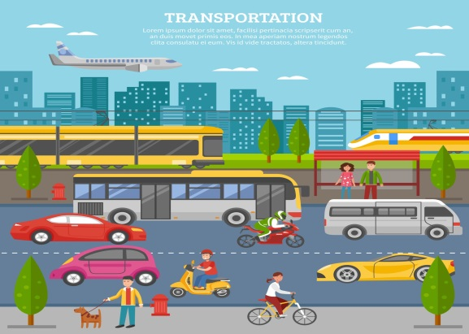
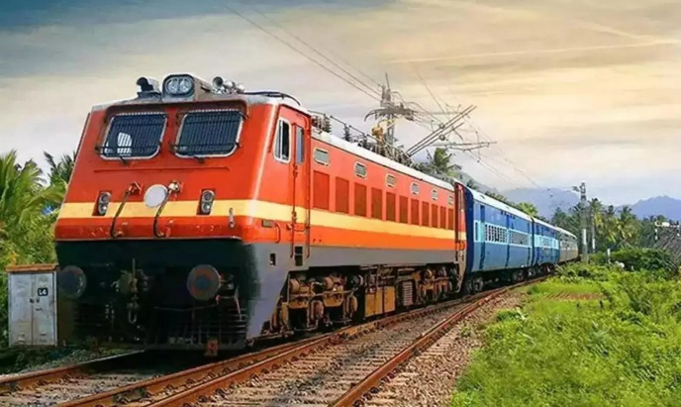
Transportation:
Transportation is a system by which persons and goods can be shifted from one place to another by any sort of vehicle.
Highway
Railway

Slide 8
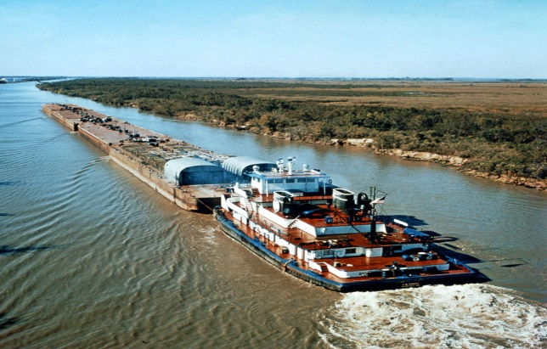

Importance:
Transportation engineering deals with the transhipment of persons and goods from one place to another by any sorts of vehicle. For rapid economical, industrial, social, and cultural development of any country, a good system of transportation is very essential. A good system of transportation includes a good network of highways, railways, waterways and airways.
Waterway
Airway

Slide 9
Importance:
In the production stages, transportation is required for carrying raw materials. In the distribution stage, transportation is required from production centres to the marketing centres and later to the retailers and consumers for distribution. In big metropolitan cities, reaching the working places requires a good system of transportation. For this reason, inadequate transportation facilities could retard economic and social development of a country.

Slide 10

As blood circulation through body arteries is essential for well-being of a human, similarly a good system of transportation is essential for well-being of a nation.

Slide 11

Transportation engineering is the branch of civil engineering focused on the planning, design, operation, and management of transportation systems and facilities to ensure the safe, efficient, and environmentally compatible movement of people and goods. This involves applying scientific principles and technology to various modes of transport, including highways, railways, airports, waterways, and public transit systems.
Transportation engineering

Slide 12
Important roles of transportation:
It gives place utility of goods.
It gives time utility.
It bridges the space between consumer and producer.
It facilitates the exploration of natural resources.
It facilitates international trade and commerce.
It helps in fighting natural calamities like floods, cyclones, earthquakes, and famine.
It is very importance for the defense of country.
The pattern of growth of towns and cities is determined by transportation network.
Transportation is a promoter of tourism.

Slide 13
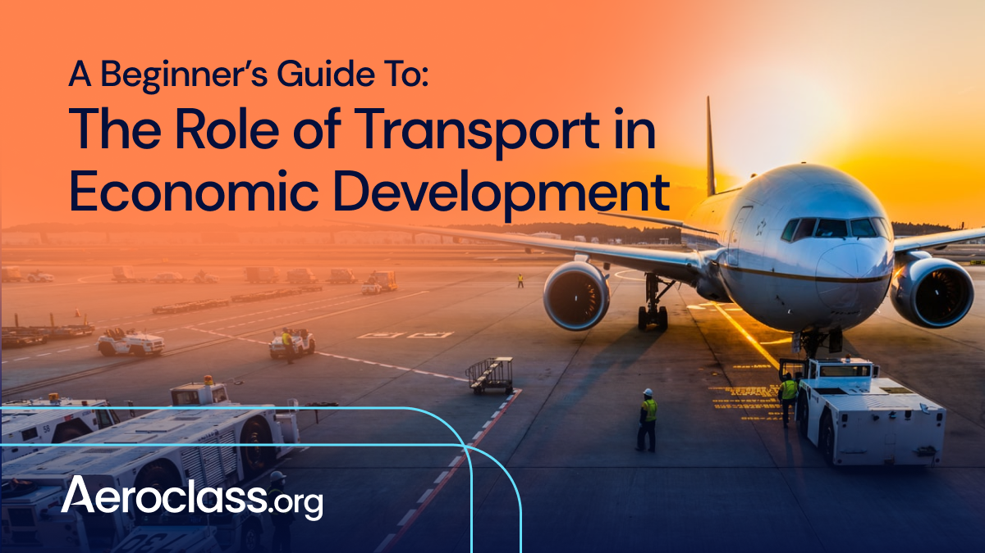
Transportation in economic activities of the country:
In economic activity two important factors is well known:
Production
Consumption for human wants
The importance of transportation in economic activity is to be found in its effect on both human wants for goods and satisfaction through production and distribution. It may be said that, increasing productivity and its efficient transportation can lower the costs of products. The transportation cost is always an influencing factor on consumer for the price of commodities.
Transportation in economic activities

Slide 14
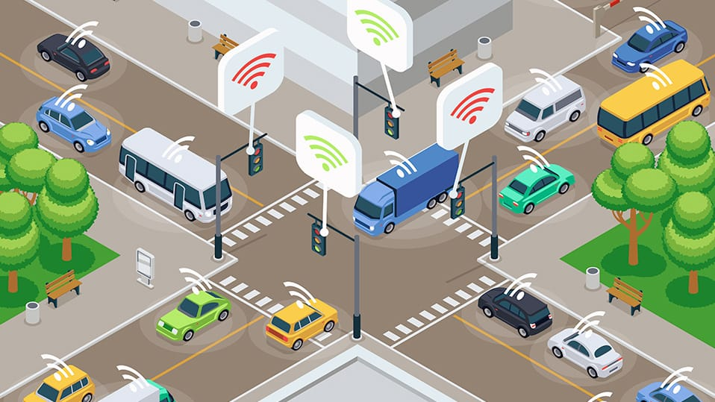
Social effect of transportation:
The various effects of transportation may be elaborated as follows:
Sectionalism and transportation:
Improved transportation has important implication in reducing sectionalism within the country. Under developed colonies and tribes are improving their living condition since transportation facilities has improved.
Social effect of transportation

Slide 15
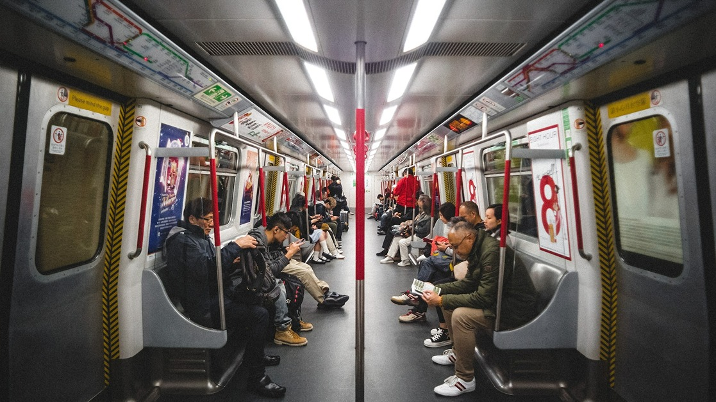
Social effect of transportation:
Concentration of population into urban areas:
The prosperity and employment opportunities of urban area attract the population from other areas resulting in enhanced economic activities.
Aspects of safety law and order:
i) To maintain law and order at home, it is required to have an efficient system of transport network.
ii) For rushing aids to areas affected by an emergency, transport facilities are essential.
Social effect of transportation

Slide 16
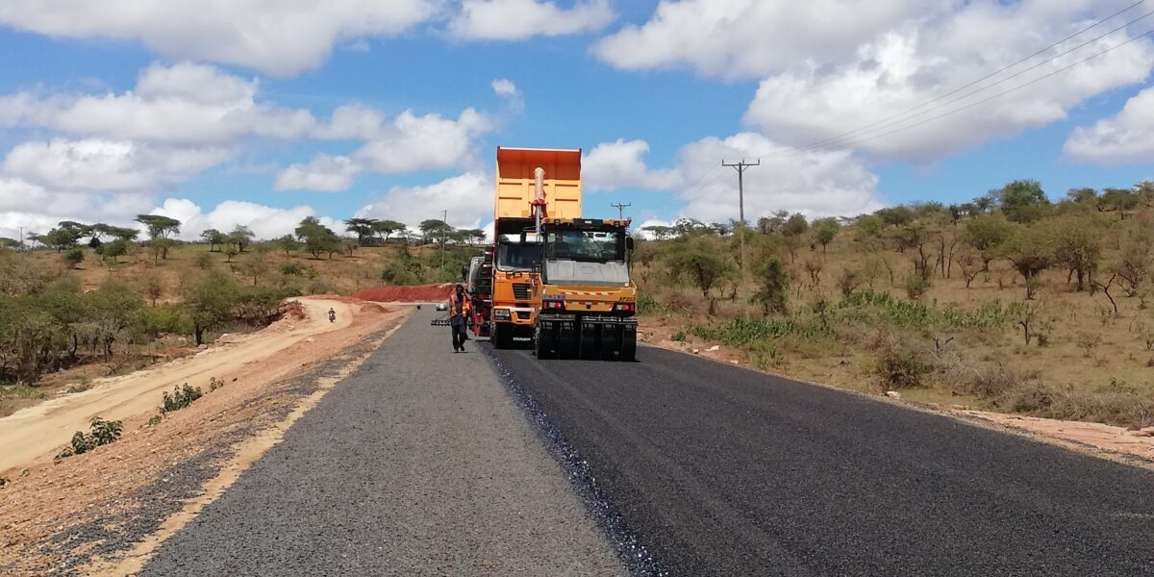
Role of transportation in rural development:
With over 75% of the population of the country living in the villages, the development of urban centers does not indicate the overall development of the country. The following are the important roles played by the transportation:
1. To rush the supply of the fertilizers, pesticides, improved quality seeds and other inputs for agriculture, good and adequate transportation system is essential.

Slide 17
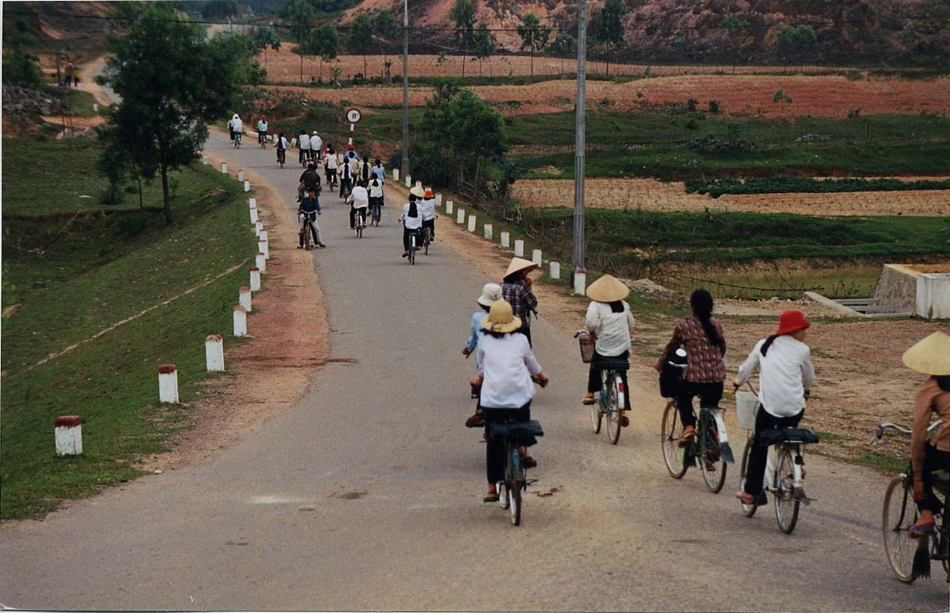
Role of transportation in rural development:
2. Good transportation also helps to decrease the wastage of vegetables, fruits and such articles.
3. It helps villagers to send their children to the cities for education, health care and other such needs.
So, with the improvement in transportation facilities in rural areas, helps in balance development of the country as a whole.

Slide 18
Classification of Roads
Week 2
Pages 18-27

Slide 19
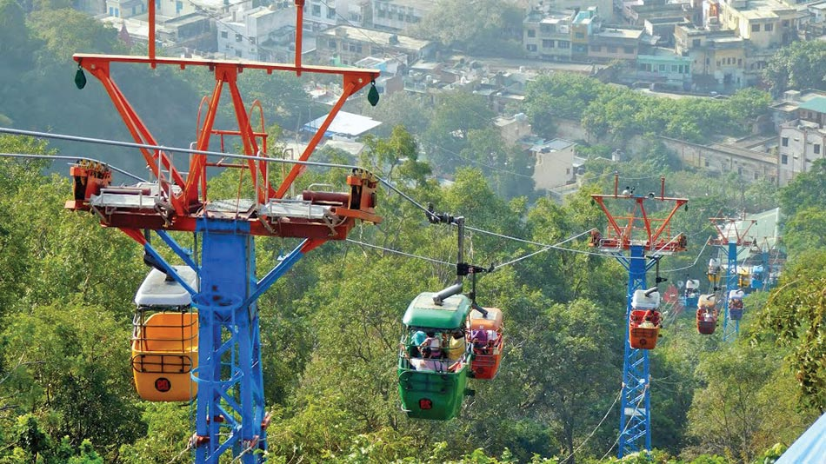
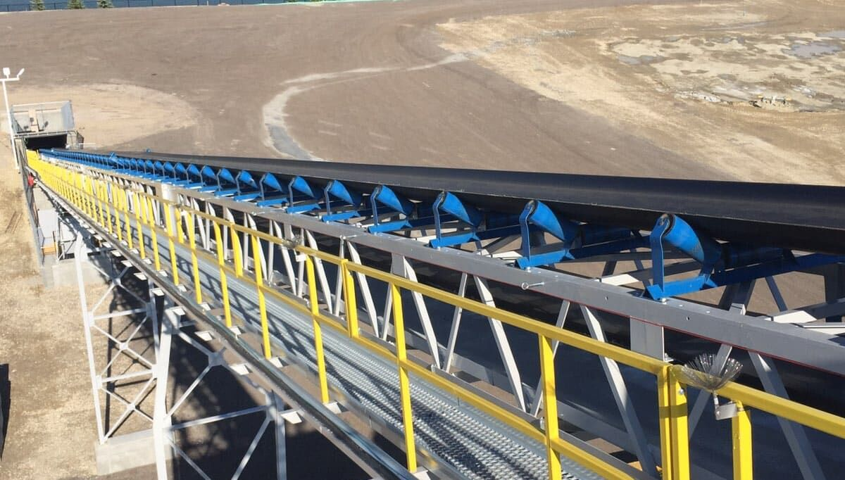
Modes of transportation:
Roadways
Railways
Waterways
Airways
Rope ways
Belt conveyors
Pipe ways
Rope ways
Belt conveyors

Slide 20

Modes of transportation:
Roadways
Railways
Waterways
Airways
Rope ways
Belt conveyors
Pipe ways
Pipe ways

Slide 21
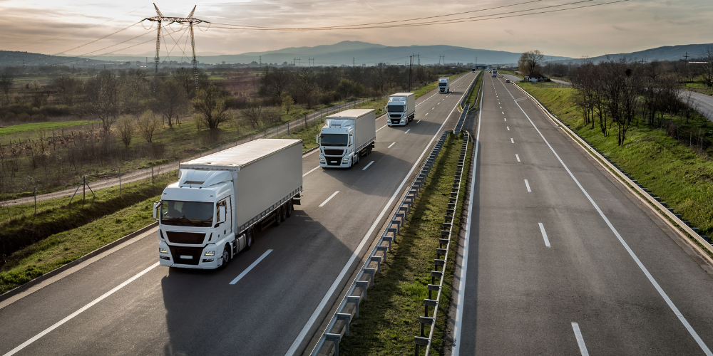
Important Characteristics of Road Transport:
Road is used by all sorts of vehicle.
Road transport requires a relatively small investment by the government.
Road transport offers complete freedom to road users to transport vehicle from one lane to another.
Road transport is cheaper and time saving in particular for short distance travel.
Road Transport

Slide 22
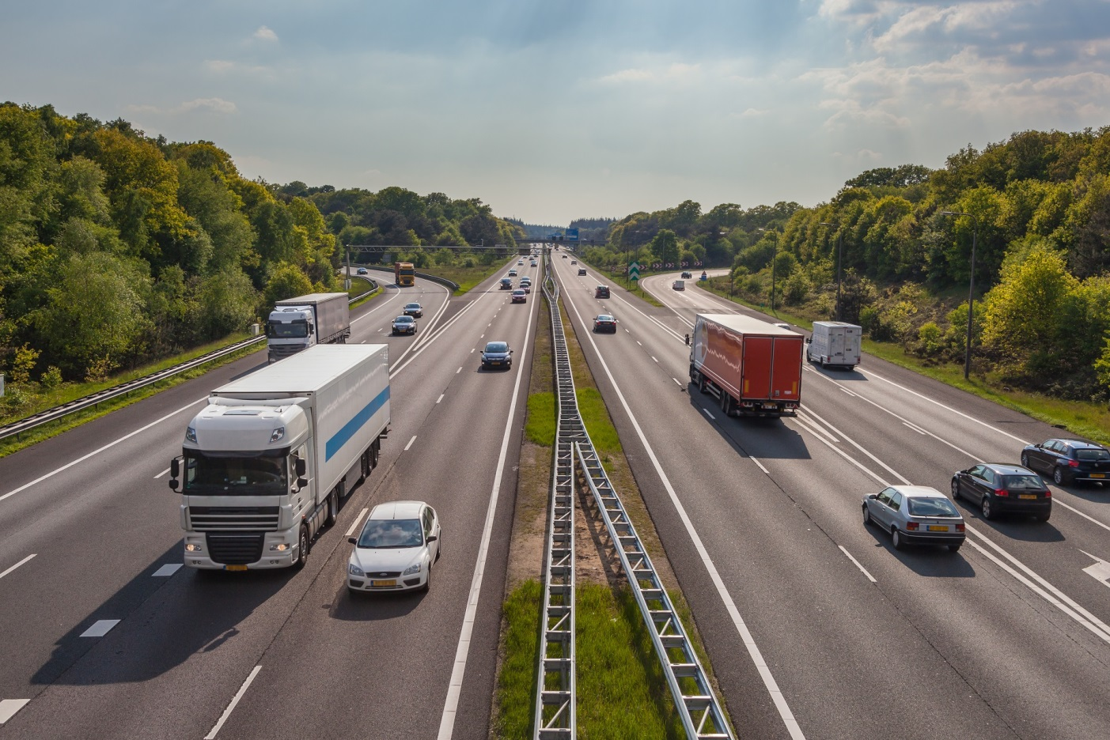
Important Characteristics of Road Transport:
Road transport offers itself to the whole community alike of all systems of transportation.
Movements on roads are not time bound as in case of railways or air ways.
Speed of movement is directly related with the degree of casualty.

Slide 23
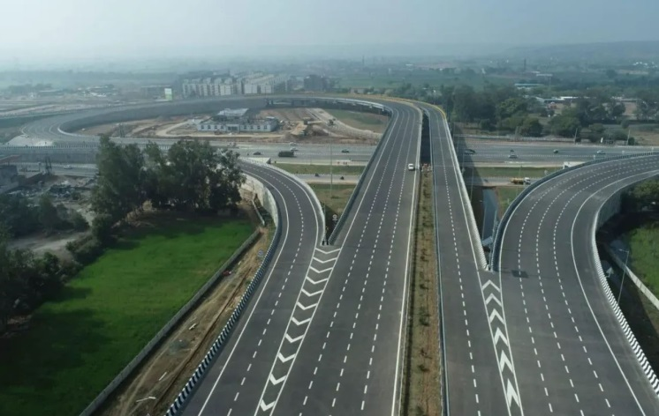
Classification of Roads:
Traffic volume, load transported, location and function
Expressway:
An expansive roadway designed for high-speed traffic that has two or more lanes in each direction with a median strip separating opposing traffic.
Expressway

Slide 24
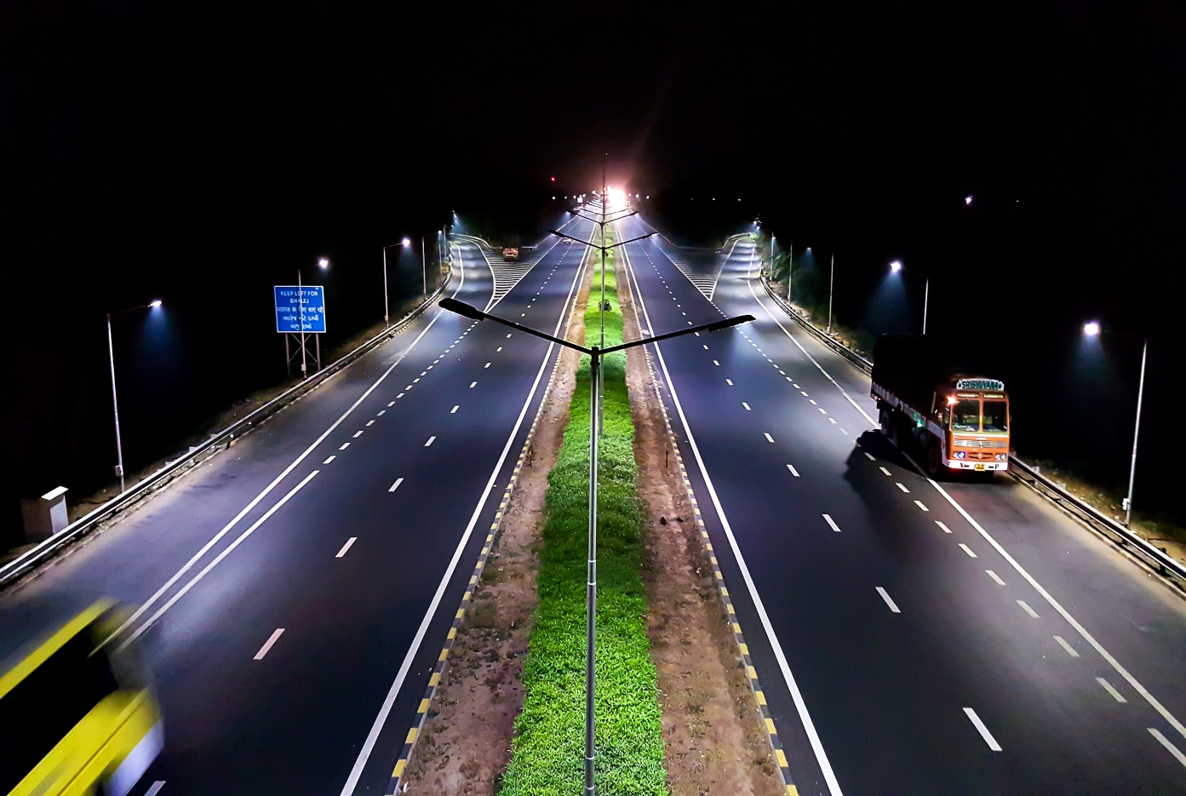
Classification of Roads:
State Highway (SH):
State highways are arterial roads of a state, connecting up with the national highways of adjacent state, district headquarters and important cities within the states and serving as the main arteries for traffic to and from district roads.
State Highway

Slide 25
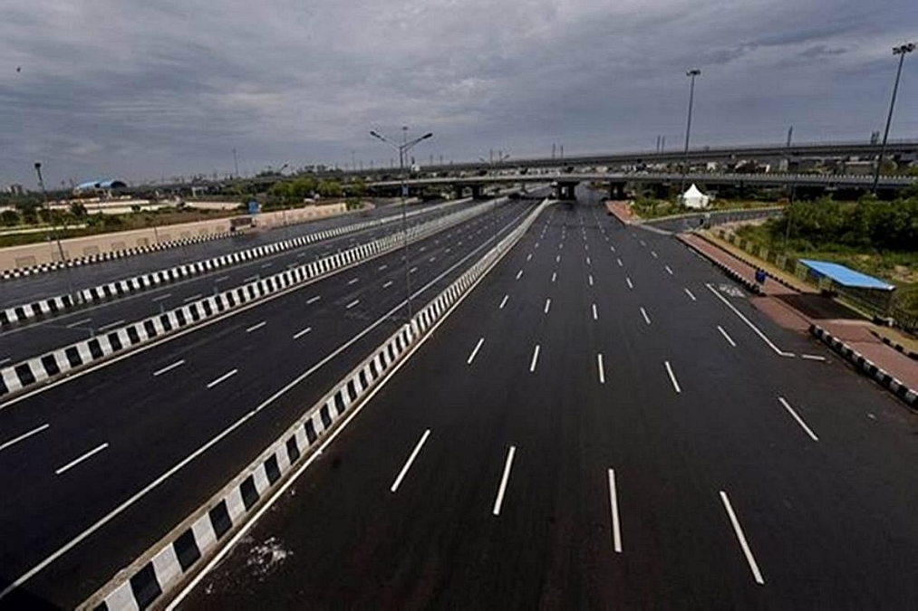
Classification of Roads:
National Highway (NH):
National highways are main highways which are connecting national capital with divisional headquarters, district headquarters, port cities and international highways.
National Highway

Slide 26
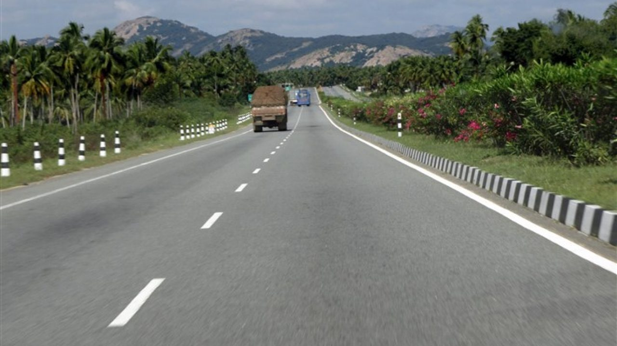
Classification of Roads:
Major District Roads (MDR):
Major District Roads are important roads within a district serving areas of production and markets, and connecting those with main highways of district.
Other District Roads (ODR):
Other District Roads are roads serving rural areas within a district serving areas of production and markets.
Major District Roads

Slide 27
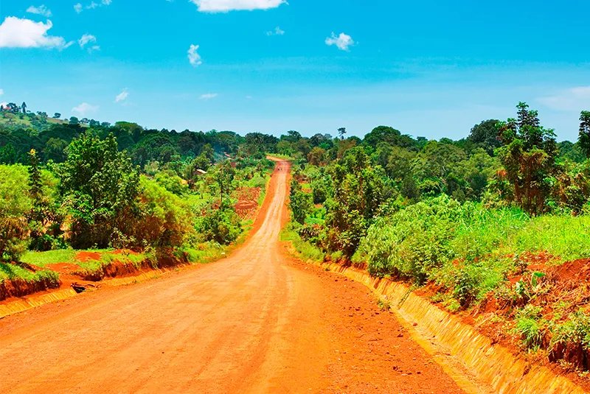
Classification of Roads:
Village Roads (VR):
Village roads are roads connecting villages or groups of villages with each other to the nearest road of a highway category.
Village Roads (VR)

Slide 28
Road Pattern
Week 3
Pages 28-36

Slide 29
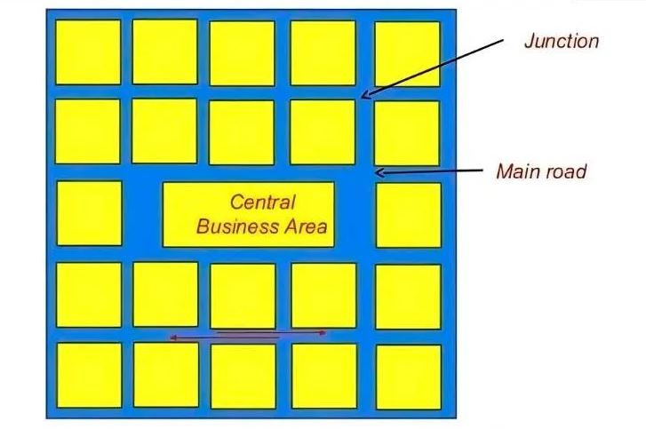
Road Pattern:
Road patterns are the spatial arrangements of roadways within a given area, designed to facilitate movement and connectivity. Common road patterns include rectangular, radial, hexagonal, and minimum travel patterns. Each pattern has its own advantages and disadvantages depending on factors like land use, traffic flow, and emergency response.
Rectangular/Grid Pattern

Slide 30
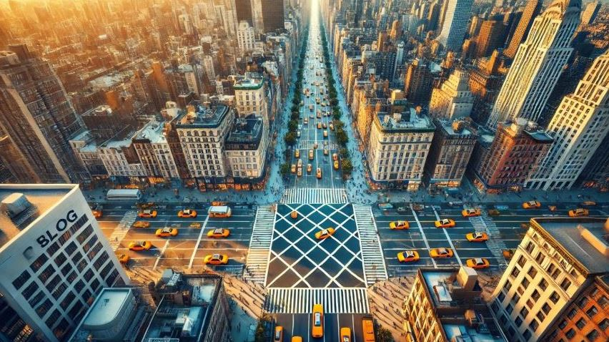
Road Pattern:
Here's a breakdown of the different road patterns:
1. Rectangular/Grid Pattern:
Roads intersect at right angles, creating a grid-like network of blocks.
Advantages: Simple to plan and construct, easy to navigate for pedestrians and vehicles.
Disadvantages: Can lead to congestion, especially at intersections, and may not be ideal for areas with irregular terrain.
Example: Often found in older cities and towns, where streets are laid out in a grid, like in Manhattan.
Rectangular/Grid Pattern

Slide 31
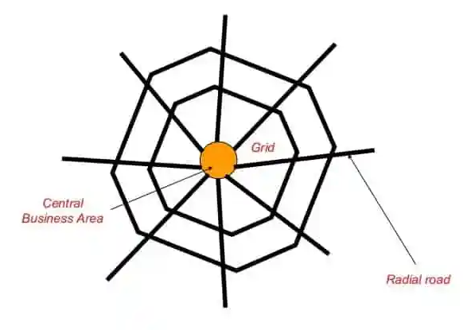
Road Pattern:
Here's a breakdown of the different road patterns:
2. Radial/Star Pattern:
Roads radiate outward from a central point, like spokes on a wheel, often combined with other patterns like blocks or circles.
Advantages:
Can reduce congestion in the central area, can be aesthetically pleasing.
Radial/Star Pattern

Slide 32
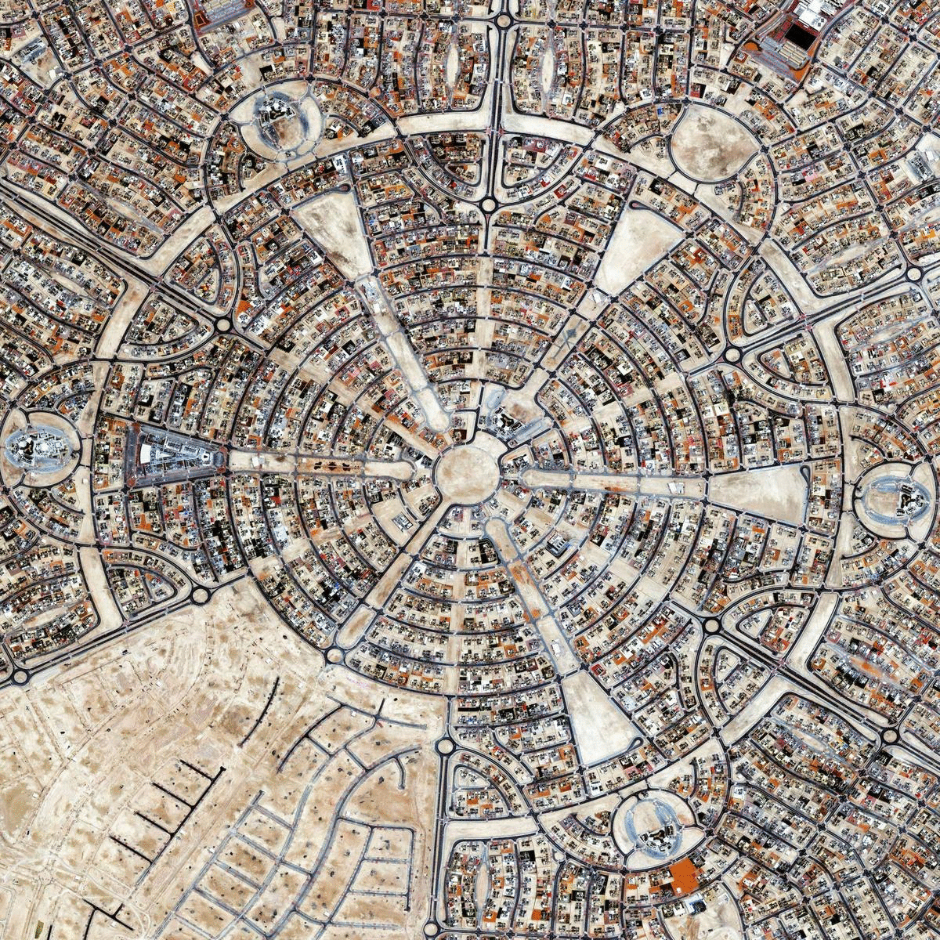
Road Pattern:
Here's a breakdown of the different road patterns:
2. Radial/Star Pattern:
Disadvantages:
May require careful design to avoid awkward intersections and ensure smooth traffic flow, can be more complex to plan and construct.
Example:
Some areas of Washington D.C. utilize a radial pattern with major avenues extending from a central point.
Radial Pattern (Washington D.C.)

Slide 33
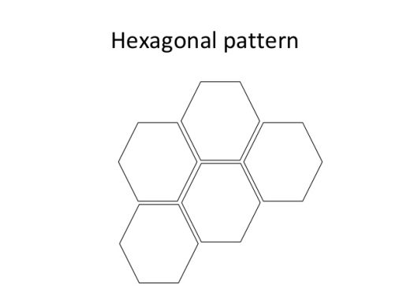
Road Pattern:
Here's a breakdown of the different road patterns:
3. Hexagonal Pattern:
Roads are arranged in a hexagonal grid, with three roads meeting at each corner.
Advantages:
Efficient land use, potential for reduced travel distances compared to rectangular grids.
Hexagonal Pattern

Slide 34
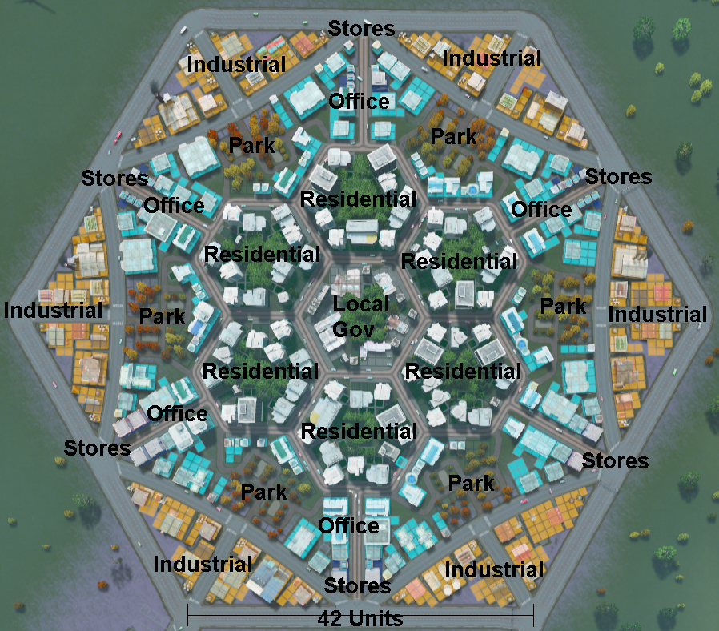
Road Pattern:
Here's a breakdown of the different road patterns:
3. Hexagonal Pattern:
Disadvantages:
Complex intersections require careful design and traffic management, potentially higher construction costs.
Example:
While less common, hexagonal patterns can be found in some planned communities.
Hexagonal Road Pattern

Slide 35
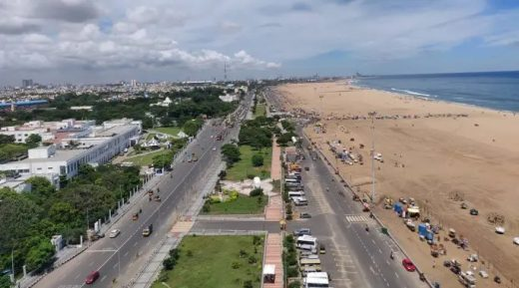
Road Pattern:
4. Linear Pattern:
Roads are arranged in a straight line, often along a coast, river, or transportation corridor.
Advantages: Simple to construct, efficient for traffic following the linear route.
Disadvantages: Limited connectivity can create congestion if the linear route is the only option.
Example: Coastal towns or settlements along a river.
Linear Road Pattern

Slide 36
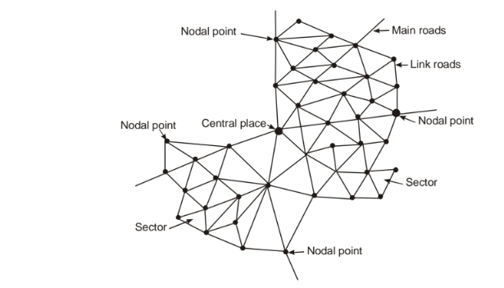
Road Pattern:
5. Minimum Travel Pattern:
This divides the area into sectors to minimize distances to a central point.
Advantages: Reduces travel time and distance to the city center.
Disadvantages: Can be less flexible for general traffic flow.
Minimum Travel pattern

Slide 37
Highway Planning Survey
Week 4
Pages 37-44

Slide 38
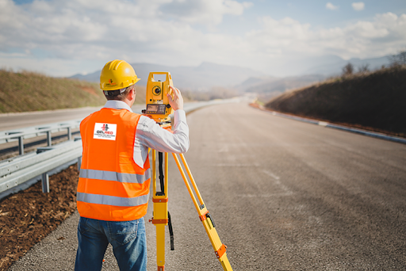
Highway Planning Survey:
For assessing the road length requirement, field surveys are to be carried out to collect the data. This field survey for collecting factual data is called highway planning survey.
Highway Planning Survey

Slide 39
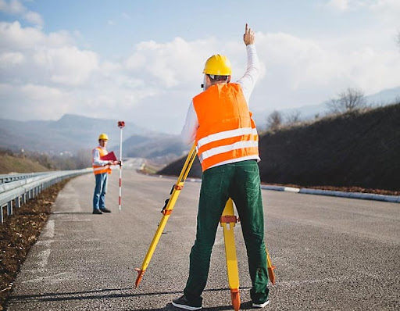
Objectives:
To plan a road network to provide safe, efficient, economic, comfortable and speedy movement of goods and people but at minimum cost.
To plan a road system, which could provide maximum utility and could be constructed within the available resources during the plan period under consideration.
Highway Planning Survey

Slide 40
Objectives:
To plan for anticipated future development and future needs.
To fix up date wise priorities for development of each road link based on utility.
To work out financial system.
Highway Planning Survey

Slide 41
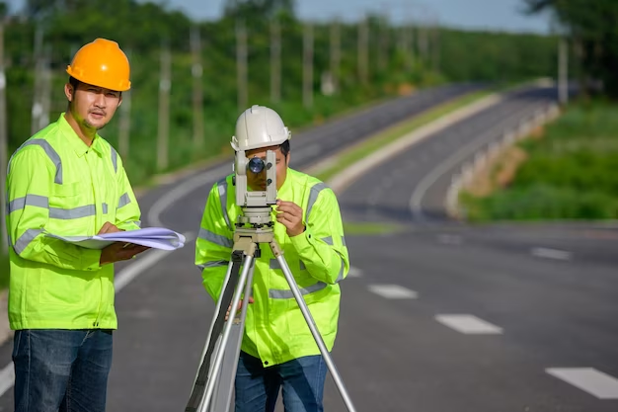
Necessity:
In present time, planning is considered as the prerequisite before attempting any development program. Thus, highway planning is the basic need of highway development. When limited funds are available, planning is of great importance.
Highway Planning Survey

Slide 42
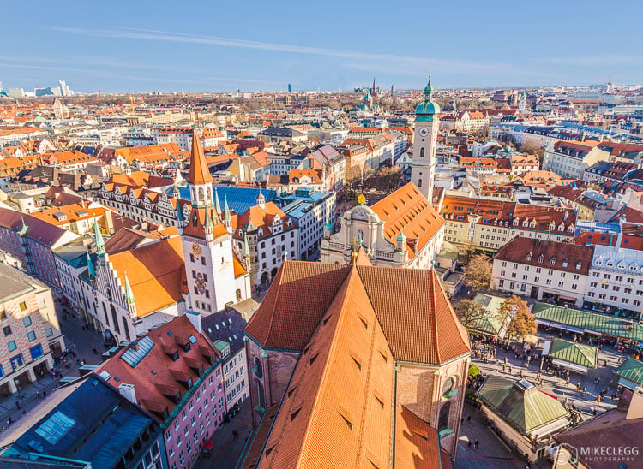
It consists of the following studies:
Economic studies:
Population and its growth
Agricultural and industrial development
Income per capita
Banking
Economic studies

Slide 43

It consists of the following studies:
2. Financial Studies:
Source of income
Revenue from taxation
Living standards
Local taxes
Financial Studies

Slide 44
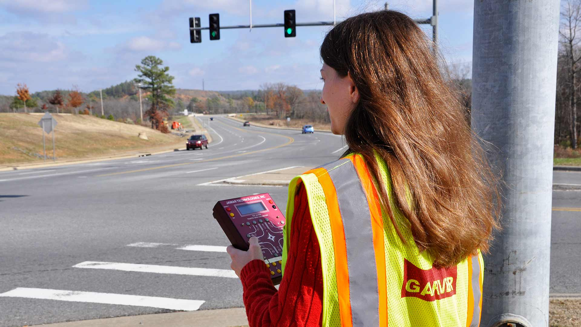
It consists of the following studies:
3. Road use studies:
Traffic volume studies
Traffic flow pattern
Accident study
Growth of vehicular traffic
Mass transportation facilities
Road Use Studies

Slide 45
Highway Alignment
Week 5
Pages 47-66

Slide 46
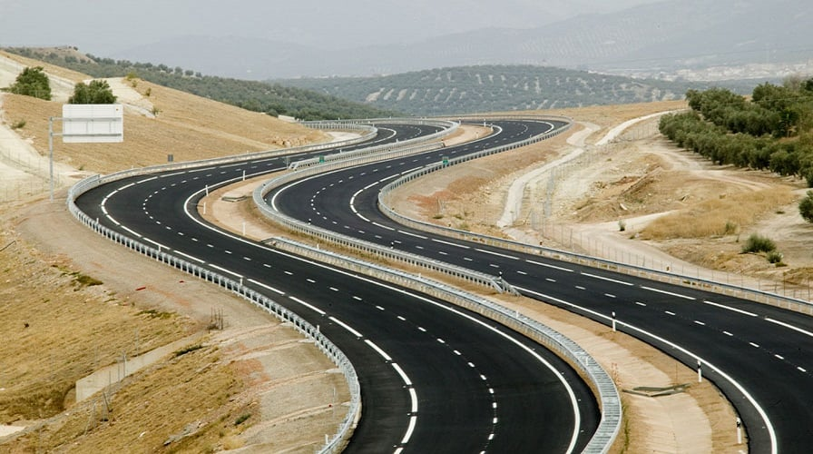
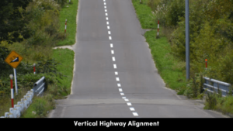
Highway Alignment:
The position or layout of the center line of highway on the ground is called highway alignment. Two types (Horizontal & Vertical alignment)
Horizontal Alignment

Slide 47
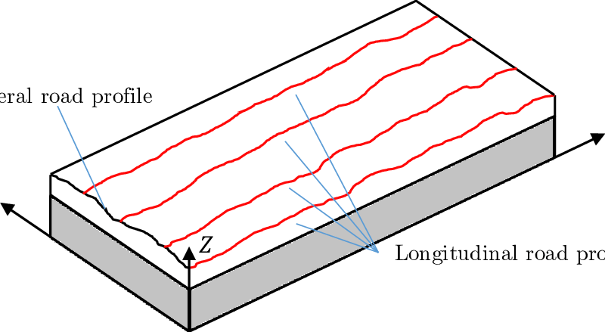
Disadvantages of improper alignment:
Increase in accident rate
Increase in construction cost
Increase in maintenance cost
Increase in vehicle operation cost
Highway Alignment consists major three drawings:
Plan of the road
Longitudinal Profile
Cross section

Slide 48
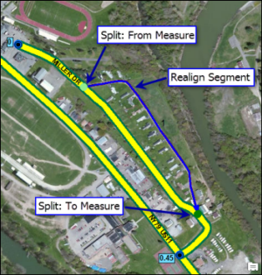
Highway Re-alignment:
Highway re-alignment, in the context of road construction, refers to the process of changing the existing path or layout of a highway. This involves altering the center line of the road on the ground, either horizontally or vertically, to improve its overall functionality, safety, or efficiency.
Re-alignment is often necessary to address issues like:
Congestion: Shifting a road away from congested areas to improve traffic flow.
Safety: Correcting dangerous curves or inadequate sight distances to reduce accidents.
Highway Re-alignment

Slide 49
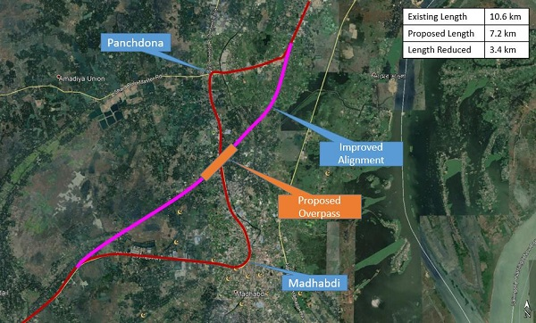
Highway Re-alignment:
Capacity: Increasing the number of lanes or improving traffic flow on a road that needs to handle more traffic volume.
Drainage: Relocating a road to better accommodate drainage and prevent water-related issues.
Accessibility: Re-aligning a road to better connect with new infrastructure like train stations or airports.
Construction: Changes in terrain or new construction projects may necessitate road realignment.
Highway Re-alignment

Slide 50
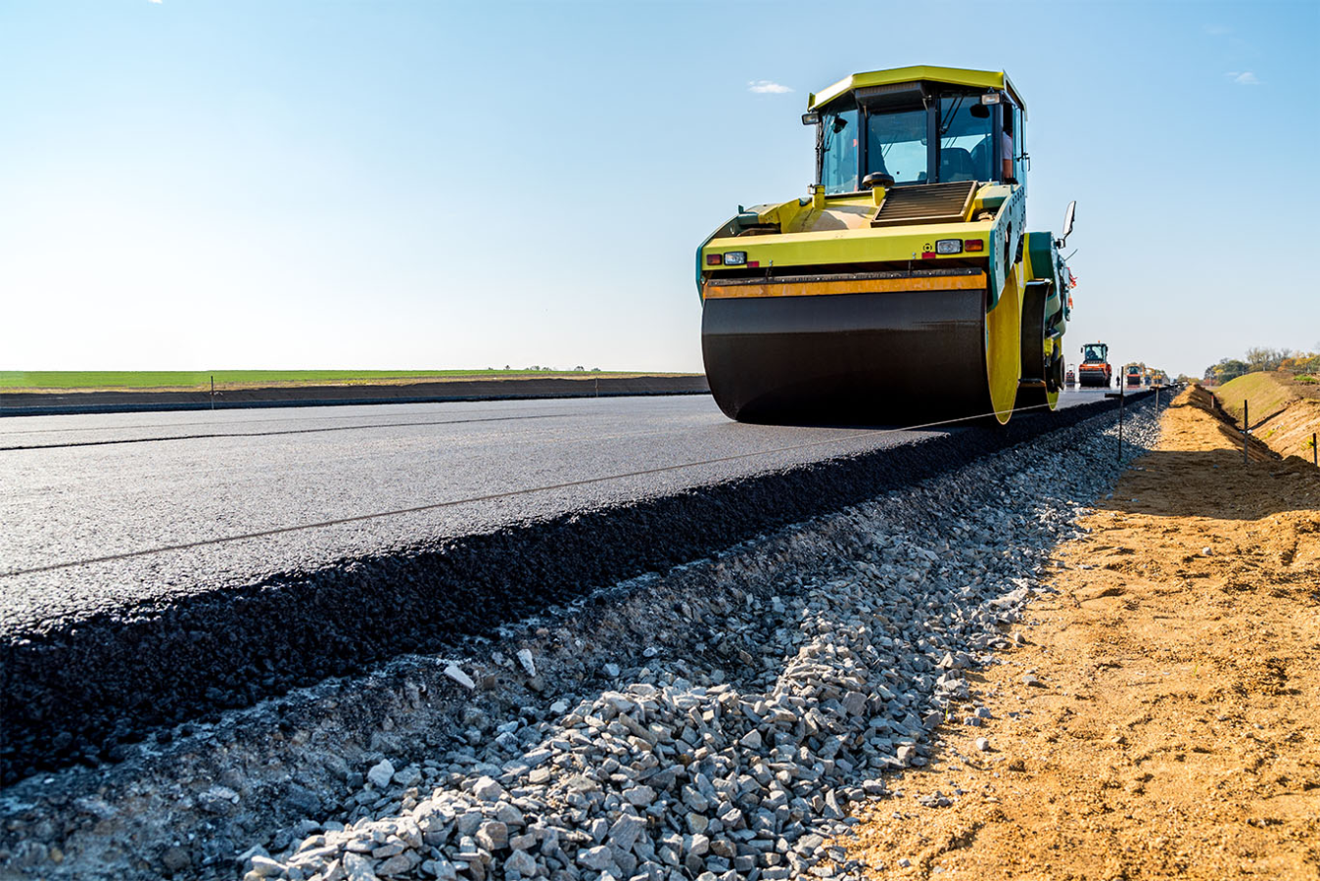
Important stages for the construction of new highway project:
Map Study
Reconnaissance Survey
Location of Final Alignment
Material Survey
Design
Earthwork
Pavement Construction
Constructional Quality Control

Slide 51
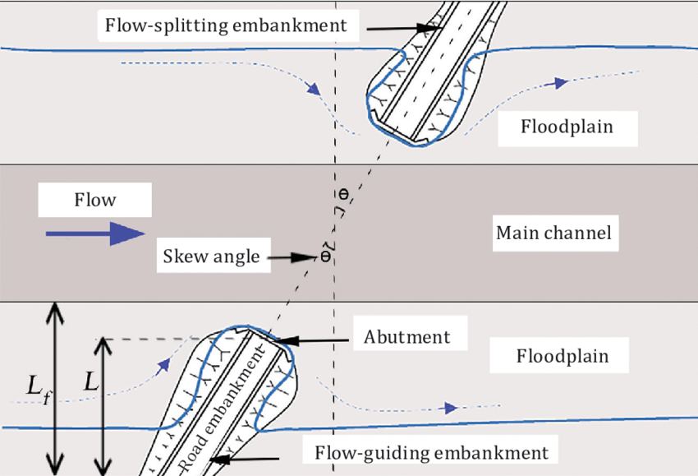
A skew crossing in a bridge refers to a bridge where the bridge's longitudinal axis is not perpendicular to the feature it crosses, such as a road, river, or another bridge.
Skew crossing

Slide 52
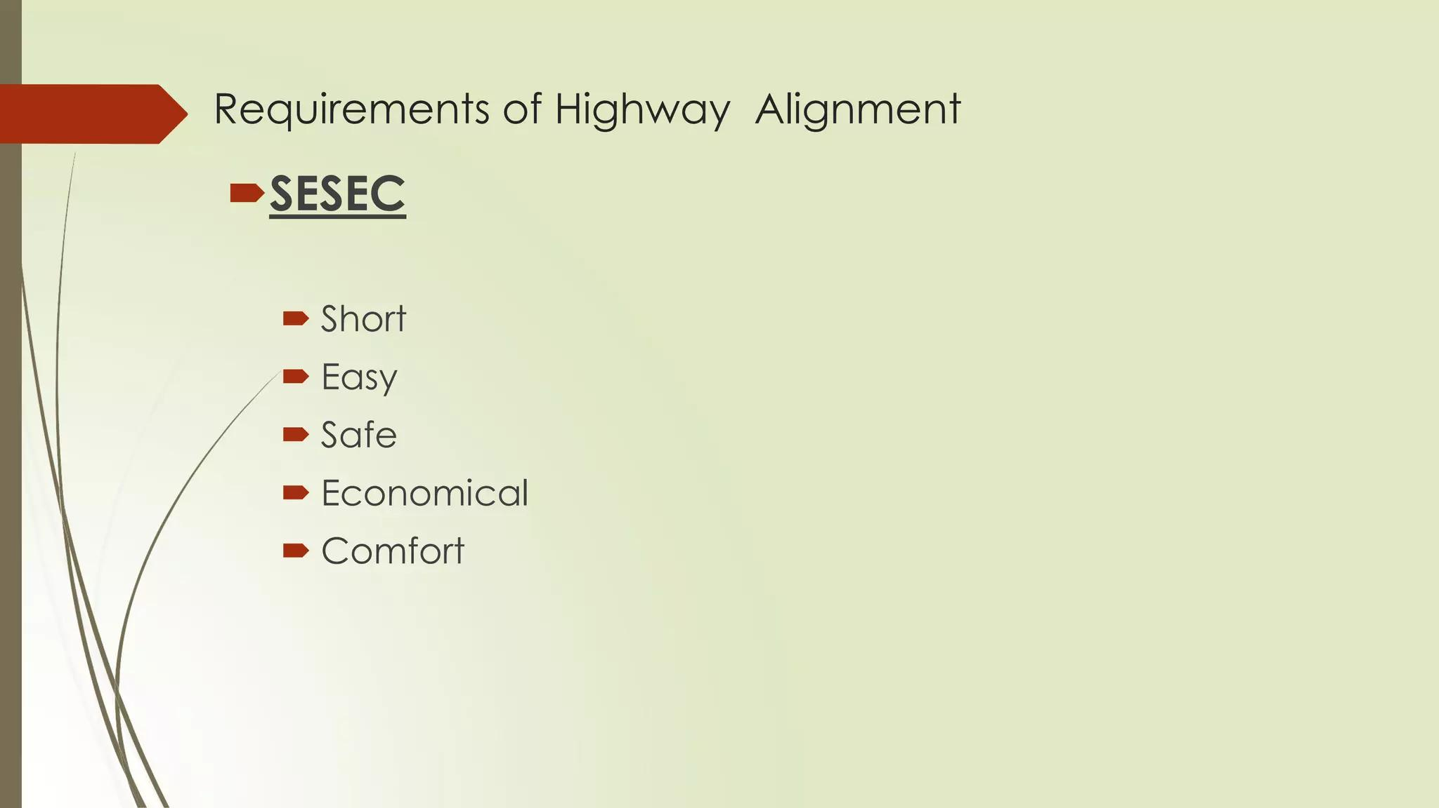

Slide 53
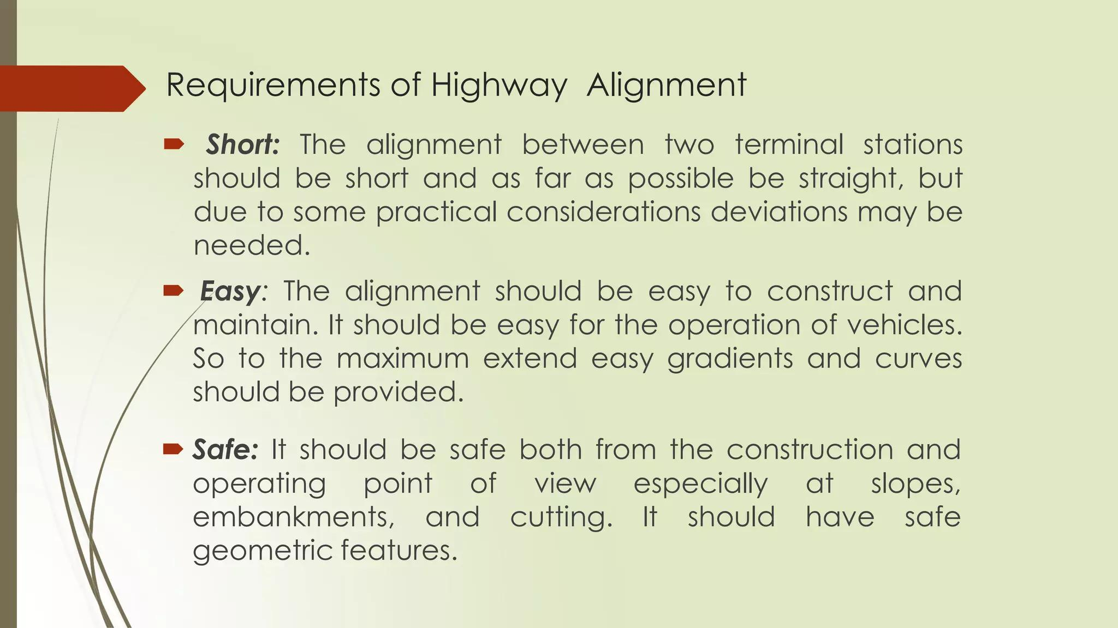

Slide 54
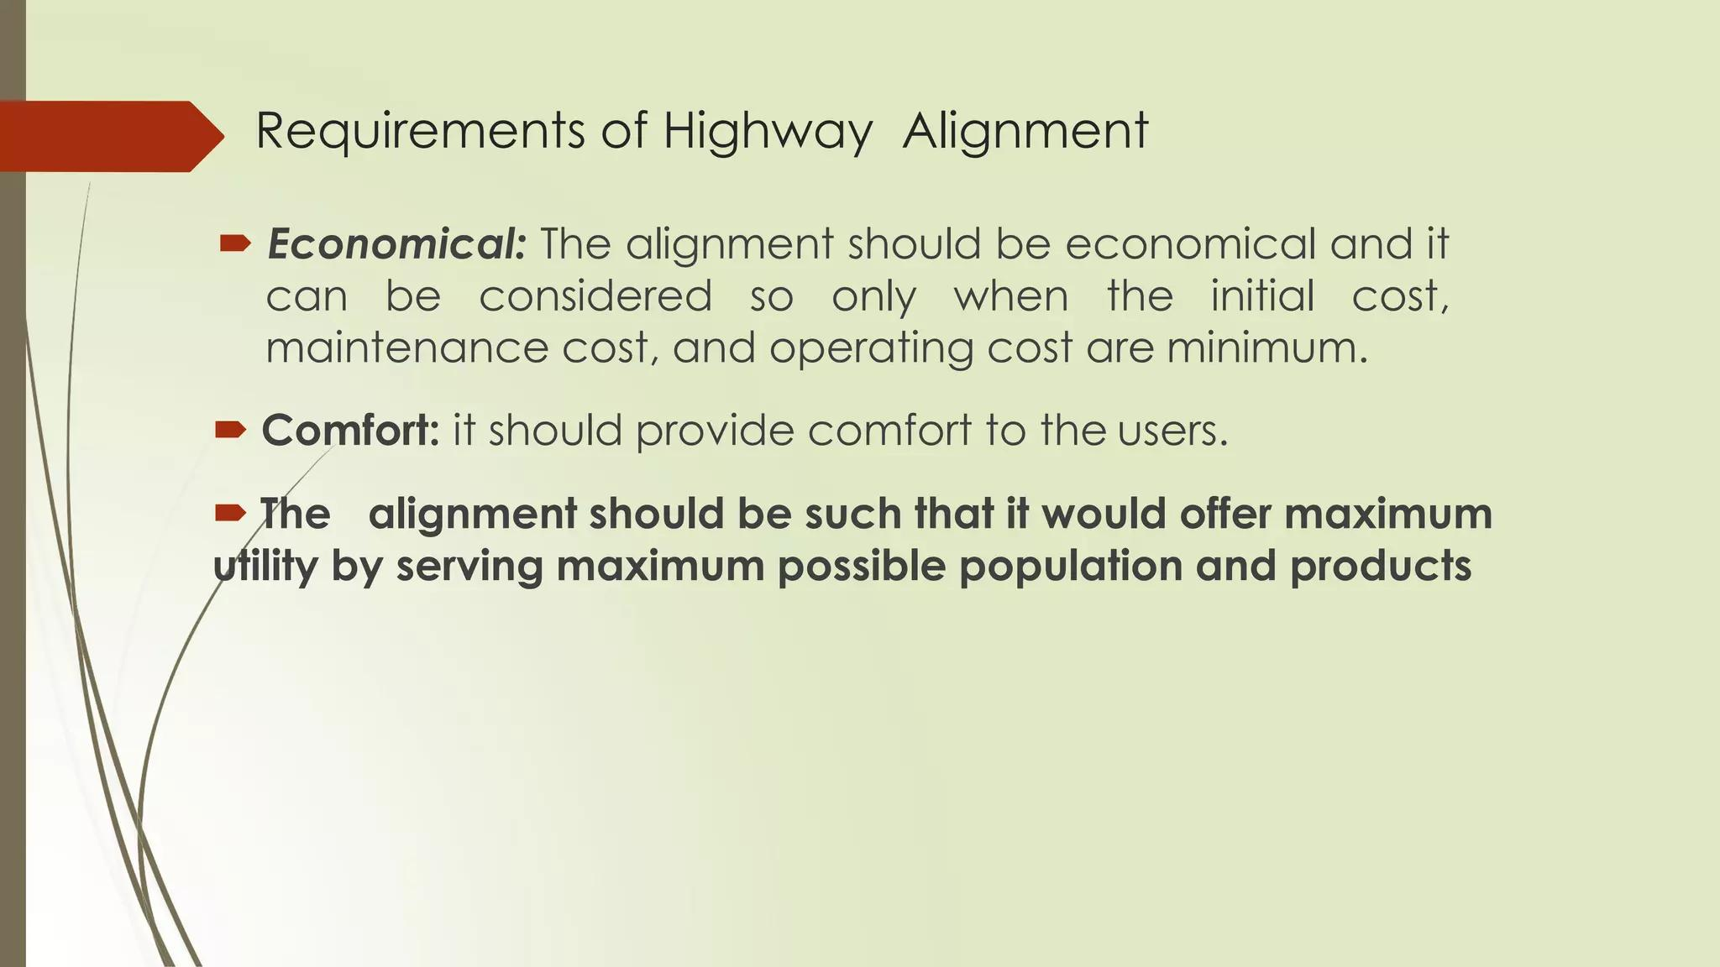

Slide 55
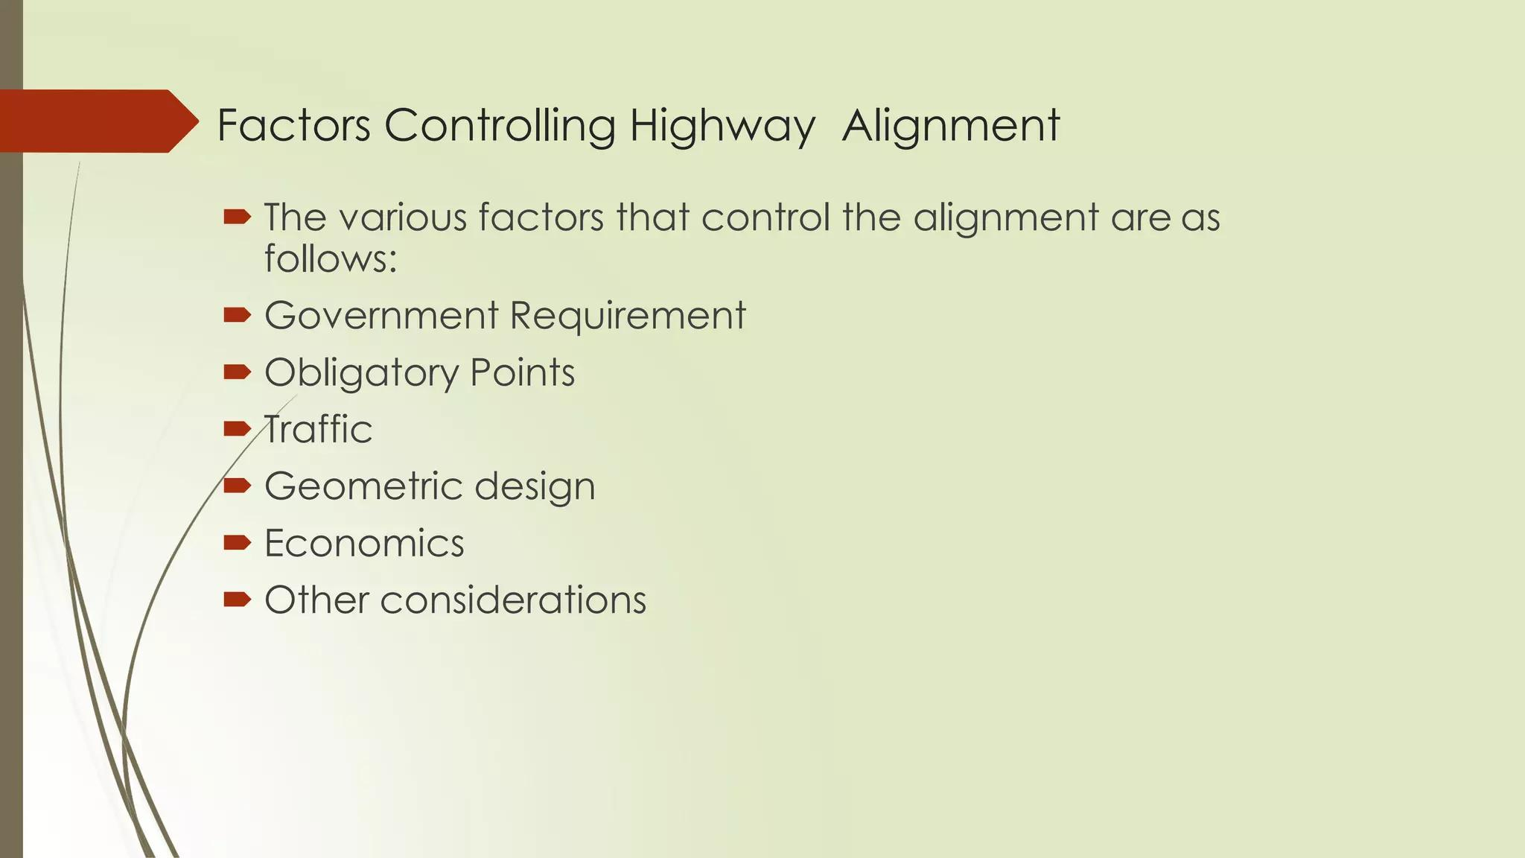

Slide 56
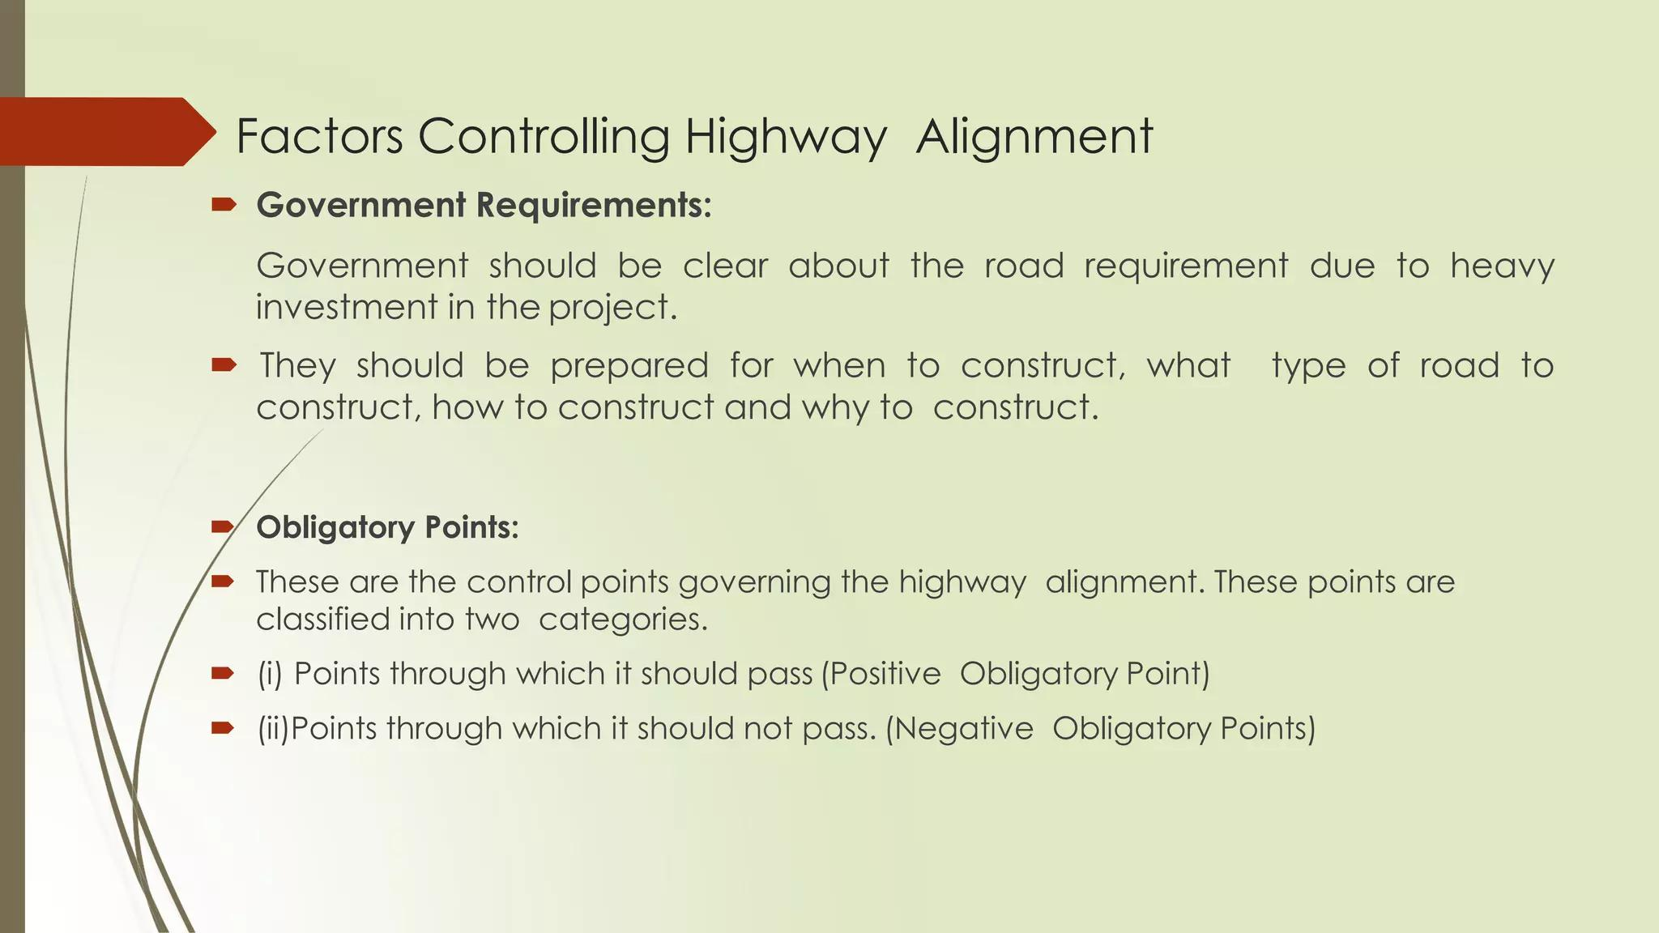

Slide 57
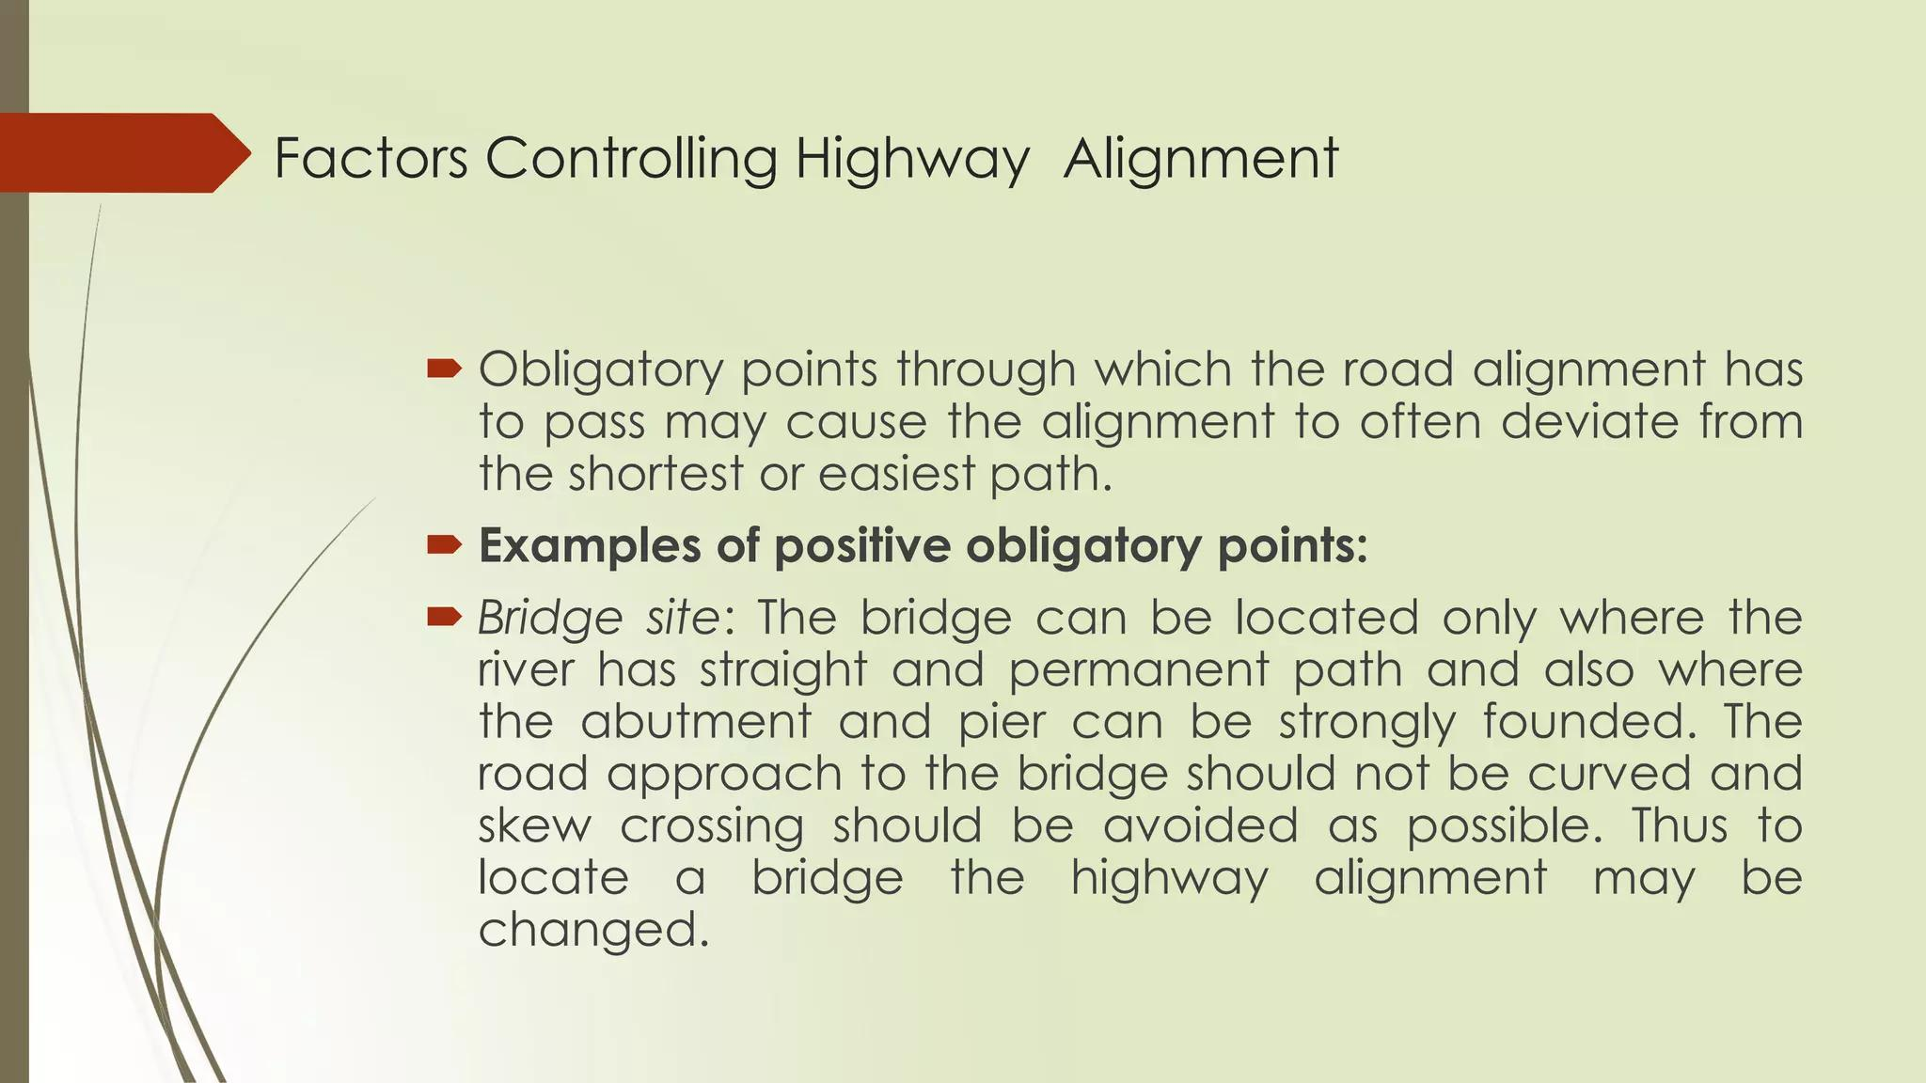

Slide 58
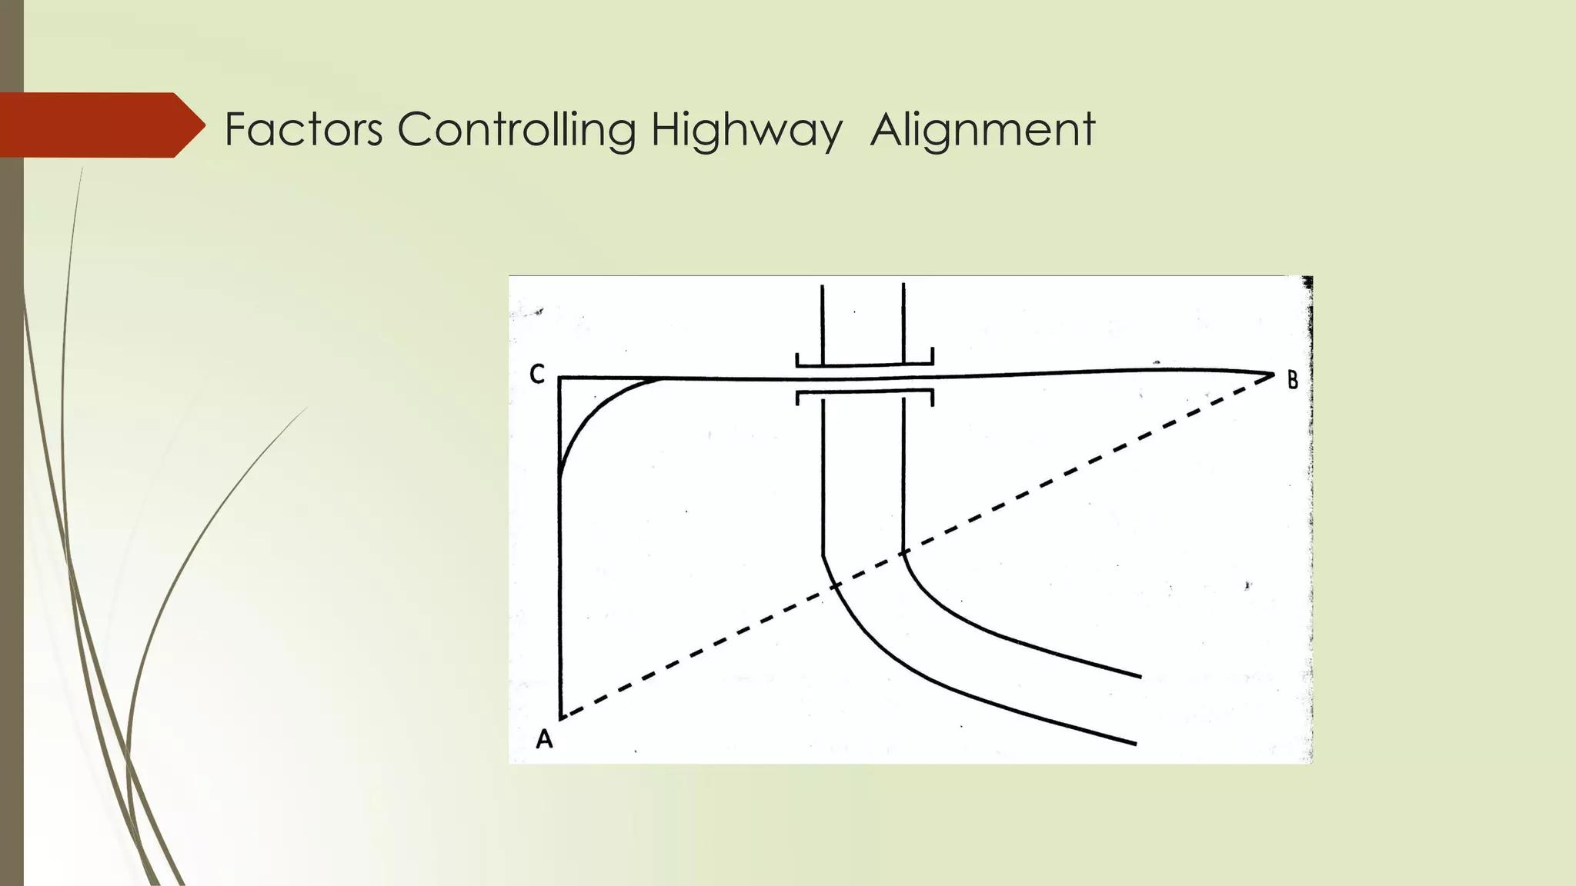

Slide 59
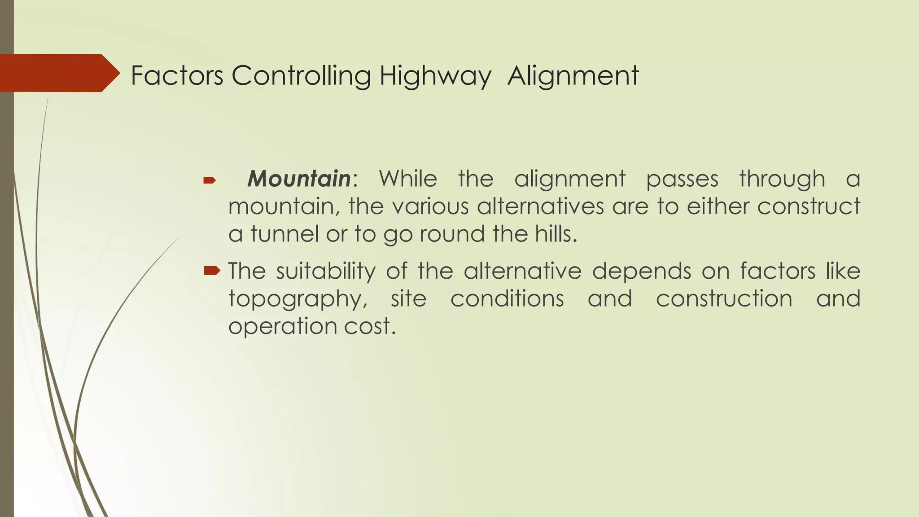

Slide 60
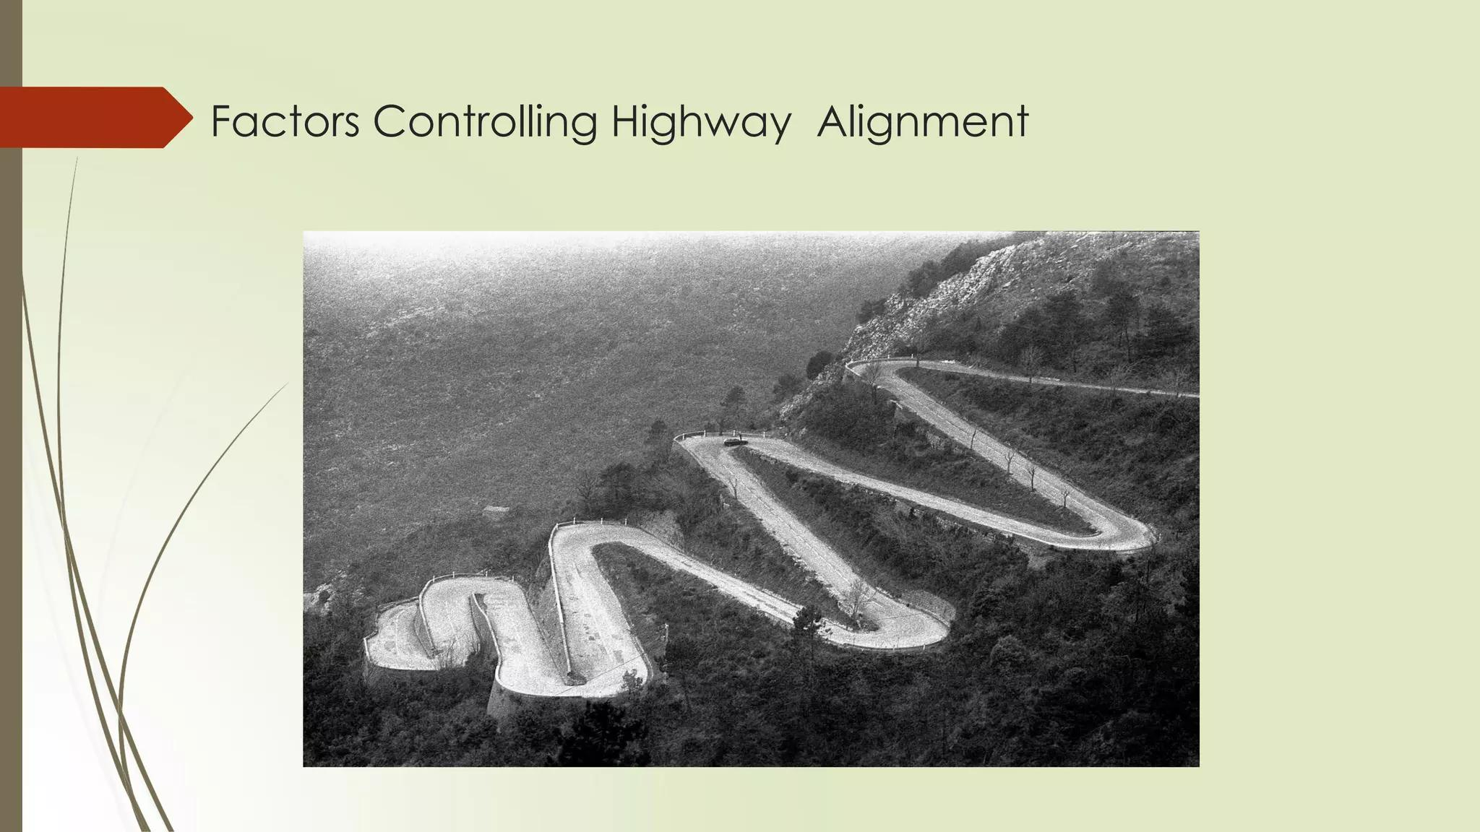

Slide 61
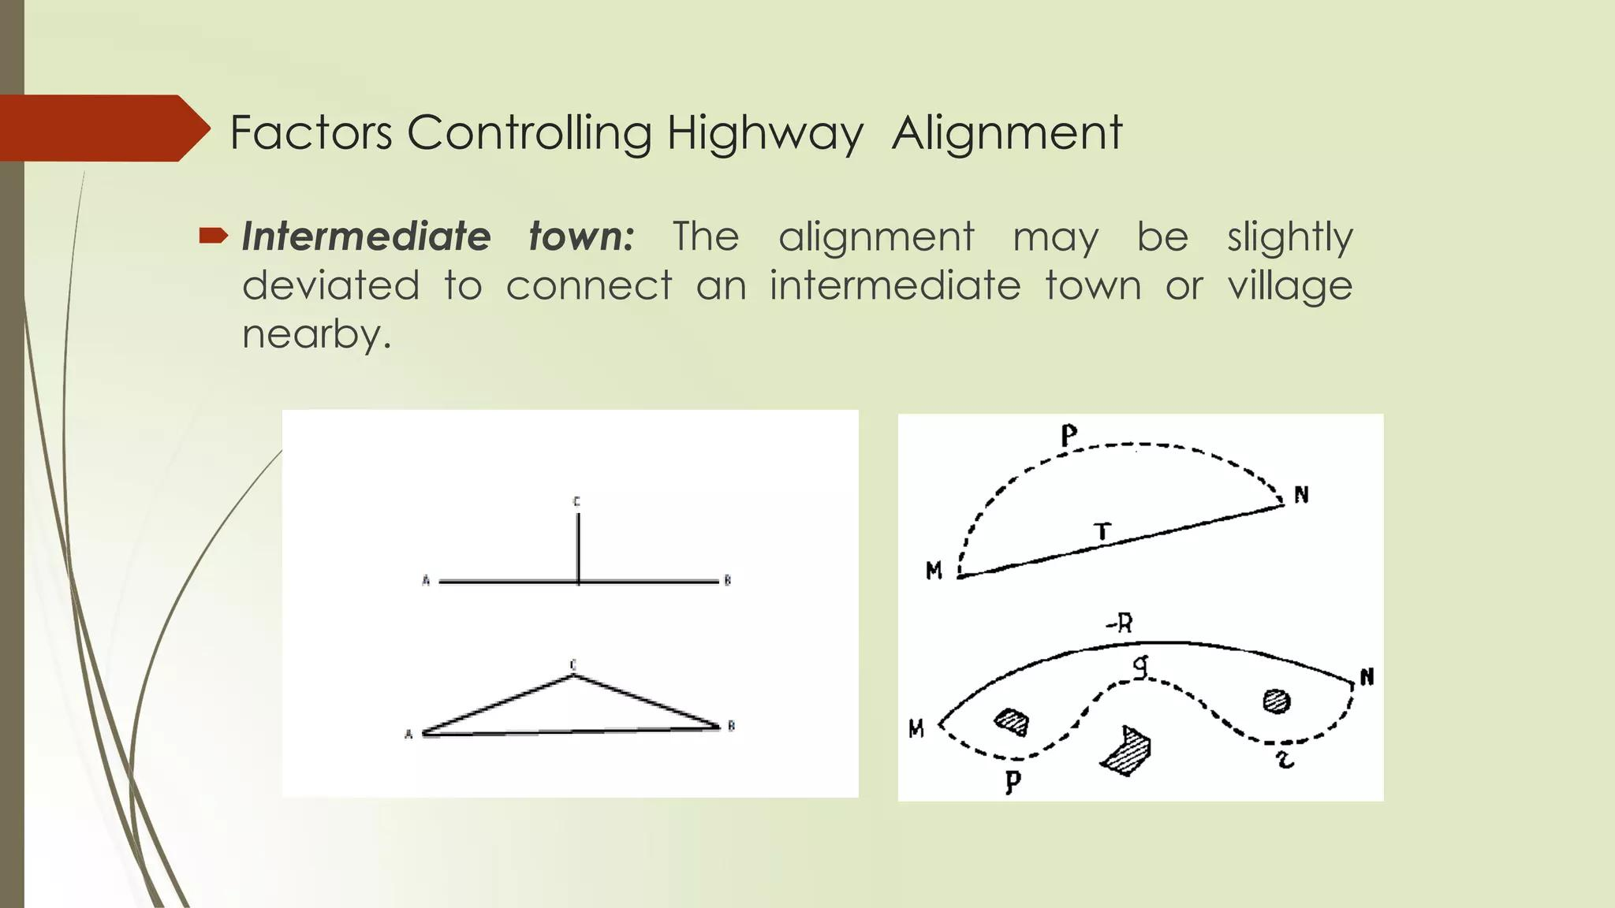

Slide 62
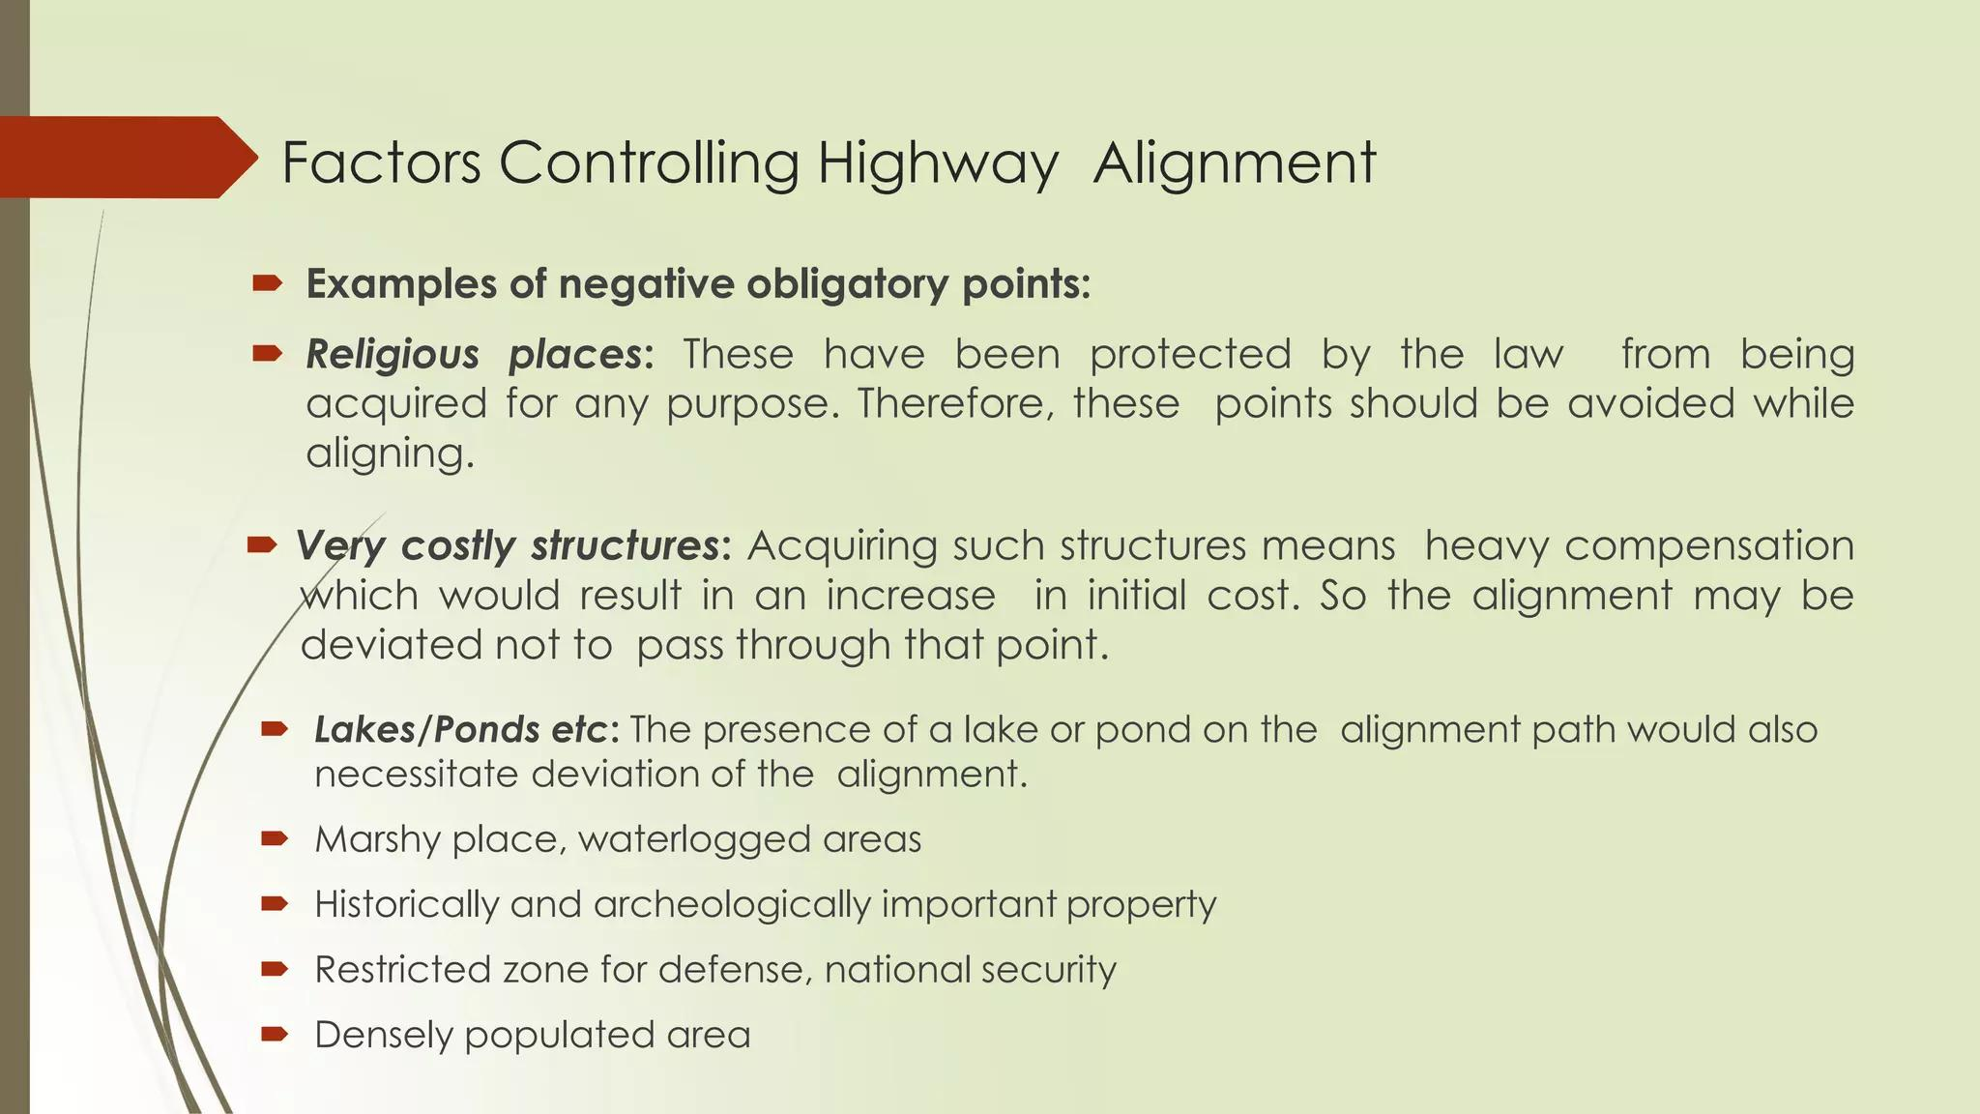

Slide 63
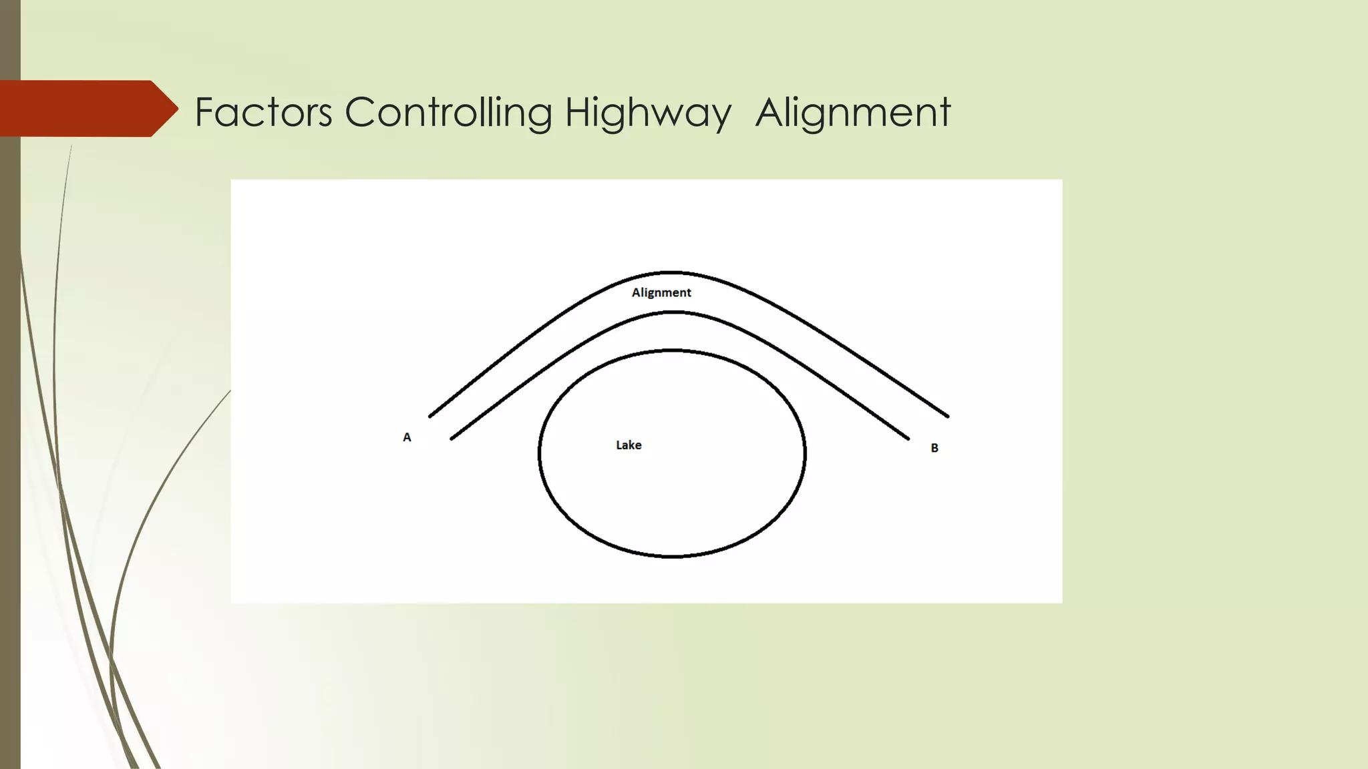

Slide 64


Slide 65


Slide 66


Slide 67
Lane and Way Concept
Week 6
Pages 67-77

Slide 68

The "four-lane concept" generally refers to a road designed with two lanes in each direction, allowing for two-way traffic flow.
A one-way street is a street either facilitating only one-way traffic, or designed to direct vehicles to move in one direction. One-way streets typically result in higher traffic flow as drivers may avoid encountering oncoming traffic or turns through oncoming traffic.

Slide 69

Do two vehicles simultaneously move in one lane one way road?
No, two vehicles cannot simultaneously and safely occupy the same lane on a one-way road. A one-way road, by definition, has only one lane for traffic traveling in one direction. Attempting to have two vehicles occupy the same lane would lead to a collision.
A lane defines a division of a road marked off with painted lines and intended to separate single lines of traffic according to speed or direction.

Slide 70


The standard width for a through lane on a highway is typically 12 feet (3.7 meters). However, lane widths can vary based on several factors, including road type, traffic volume, and design vehicle. The standard width of a truck is typically 2.55 meters (8.4 feet). The average width of a private car is 1.94 meters (6.36 feet).
Yes, a two-lane road can be a one-way street. This configuration is common and offers several benefits, such as increased traffic capacity and the ability to create specialized lanes like carpool or bus lanes.

Slide 71


Yes, a two-lane, two-way road is a common type of roadway where one lane is used for traffic traveling in each direction. These roads are typically undivided, meaning there's no physical barrier separating the opposing traffic lanes, and they can range from rural highways to residential streets.

Slide 72


A four-lane road is a road that has two lanes of traffic traveling in each direction. It's a type of road designed to handle more traffic volume than a two-lane road, facilitating smoother and faster traffic flow.

Slide 73


Slide 74


Yes, a five-lane road is possible. It typically involves a center lane used for turning or as a buffer, flanked by two lanes in each direction.
Six Lane Road

Slide 75

Way means the direction of vehicle movement
An emergency lane, also known as a hard shoulder or shoulder, is a designated area alongside a highway or major road, typically on the far left side, intended for use in emergency situations. It provides a safe space for vehicles experiencing breakdowns, for emergency responders to access accident scenes, and for other authorized vehicles in urgent situations. Using the emergency lane for non-emergency purposes is illegal and can have serious consequences.

Slide 76

Generally, the emergency lane is reserved for the use of ambulances, fire and rescue, police, and enforcement agencies. This lane will facilitate them to avoid traffic and get to their destination quickly.
A feeder road is a secondary road that directs traffic to a more major road like a highway or turnpike. It essentially acts as a collector, gathering traffic from local areas and funneling it towards larger roadways. These roads are often found parallel to highways, allowing for local access while minimizing disruption to through traffic.

Slide 77


Slide 78
Highway Geometric Design
Week 7-9
Pages 78-144

Slide 79
Importance of highway geometry design:
Highway geometry design is critically important in transportation engineering because it directly affects the safety, efficiency, capacity, and comfort of road users. It involves the physical layout and dimensions of the highway, such as alignment, cross-section, sight distance, and intersections.
Proper curvature and sight distances ensure drivers can see obstacles in time to react.
Good geometry reduces congestion and bottlenecks.
Smooth horizontal and vertical alignments allow for consistent speeds.
Optimized design reduces construction and maintenance costs.
Good design considers future traffic volumes, avoiding costly upgrades.
Promotes sustainable development by integrating with terrain and minimizing cut-and-fill operations.

Slide 80

Elements of highway geometric design:
Cross-section elements
Sight distance consideration
Horizontal alignment details
Vertical alignment details
Intersection elements

Slide 81
Skid:
Wheel slide without revolving, is known as skidding. In skidding phenomenon the distance travelled by wheel on road is greater than the circumfacial movement of the wheel.
Slip:
In slip, distance travelled by wheel on road surface is always less than the circumfacial movement of the wheel. In sands, rear driving wheels generally slip. On wet road surface, slip may also take place.

Slide 82
Carriage Way:
In transportation engineering, a carriageway is the part of a road, bridge, or highway specifically designed for vehicular traffic, consisting of one or more traffic lanes and potentially including shoulders. It is the physical area where vehicles travel, from single-lane to multi-lane highways, and its width is determined by the volume of traffic and the number of lanes required for safe and efficient movement.
Shoulder in Road:
A road shoulder is the paved or graded area on the side of a road or highway, adjacent to the traffic lanes, that serves multiple purposes. It provides a safety buffer for vehicles to pull over in emergencies, protects the pavement edge, and can be used by emergency services.

Slide 83

81

Slide 84


Slide 85

Shoulder in Road

Slide 86

Camber:
Transverse slope given to the road surface is called camber. It is sometime called cross-slope. It is provided mainly to drain-off water from the road surface. A 1 in 20 camber on a road means there is a 1 unit vertical rise for every 20 units of horizontal distance across the road's width.
Crown:
In straight roads the central highest point is called crown.

Slide 87


Reflecting Characteristics of road pavement:
Color of the road surface affects visibility condition. Light brown colored surfaces although give good visibility at night, but produce glare and put lot of strain in drivers eyes during bright sun. On the other hand, bitumen surfaces provide poor visibility at night specially when surface is wet, but do not produce glare at bright sun.
Reflecting Characteristics of road pavement

Slide 88
Excessive cambers should not be provided unnecessarily because of the following reasons:
Most of the vehicles will tend to move along the central line of the road and thus road capacity is affected.
Because of tilt, high loaded vehicles may topple over easily.
Due to rapid flow of rain water, cross-ruts may develop on road surface.
During overtaking operation, vehicles trend to drag, causing uncomfortable situations.
Three types of cambers are in use. They are parabolic or elliptical, straight slopped and composite cambers.

Slide 89


Slide 90

Kerb:
A kerb (or curb in American English) is the raised, border-like edge of a road made of stone or concrete, separating the carriageway (the part where vehicles drive) from the pavement or footpath. Kerbs serve multiple purposes, including providing a physical barrier to keep vehicles on the road, directing rainwater drainage, defining road edges, and enhancing the overall appearance of a street.
kerbs
In rural roads, submerged kerbs are sometimes provided.

Slide 91

89

Slide 92

90

Slide 93

91

Slide 94


Slide 95
A road margin is the section of a road beyond the carriageway (the main traffic lanes) and on the roadway itself, encompassing elements like shoulders, parking areas, bus bays, cycle tracks, footpaths, and service or frontage roads. These margins serve crucial functions, such as providing a safe area for stopped vehicles, draining rainwater, and accommodating pedestrians and cyclists, thus contributing to overall road safety and functionality.
Bus Bays: Areas where buses can pull over to pick up and drop off passengers, reducing disruption to traffic flow.
Service Roads/Frontage Roads: Roads that run parallel to the main highway, providing access and reducing congestion on the expressway.

Slide 96

In transportation engineering, a slip road is a short connecting road that allows vehicles to smoothly enter or exit a major highway.
In transportation engineering, a median/traffic separator is the physical space separating opposing lanes of traffic on divided roadways, like highways, freeways, and some major streets.
In transportation engineering, L-turn and R-turn lanes refer to left-turn lanes and right-turn lanes, respectively. These are dedicated lanes at intersections or driveways that allow vehicles to turn left or right without interfering with through traffic.
Median in road

Slide 97


Flaring is the gradual outward expansion of a roadway’s width (typically near intersections or entrances) to provide additional space for turning, merging, or separating traffic movements.
A bus lay-by (also called a bus bay, bus turnout, or bus pull-out) is a specially designed indented area along the side of a roadway where buses can pull out of the traffic lane to pick up or drop off passengers without blocking the flow of traffic.
Bus lay-by

Slide 98

Design Speed:
The design speed of a road is the maximum safe speed for which road components like curves and sight distances are geometrically designed. The concept of minimum speed may apply to a minimum safe operating speed or a minimum design speed for specific features, like 20 km/h for hairpin bends on hill roads, but the primary term refers to the selected target speed for geometric design.

Slide 99


Stopping Sight Distance (SSD) is the minimum distance to safely stop a vehicle, Intermediate Sight Distance (ISD) is twice SSD used as a substitute for Overtaking Sight Distance (OSD), and Overtaking Sight Distance (OSD) is the total distance required to safely overtake a slow-moving vehicle by passing it in the oncoming lane. ISD is less than OSD and greater than SSD, serving as a compromise when a full OSD cannot be achieved.

Slide 100


Sight Distance:
Sight distance is the actual distance along the road surface which a driver from a specified height above the carriage way has visibility of stationary or moving objects.
Three sight distance situations are considered in the design:
Stopping sight distance (SSD).
Safe overtaking or passing sight distance (OSD).
Safe sight distance for entering into uncontrolled intersections.
Overtaking or passing sight distance (OSD)
Sight Distance

Slide 101

Head light sight distance:
This is the distance visible to a driver during night driving under the illumination of the vehicle head lights.
Conditions for sight distance:
Driver travelling at the design speed has sufficient sight distance or length of road visible ahead to stop the vehicle, in case of any obstruction on the road ahead, without collision.
Driver travelling at the design speed should be able to safely overtake, at reasonable intervals, the slower vehicles without causing obstruction or hazard to traffic of opposite direction.
Driver entering an uncontrolled intersection has sufficient visibility to enable him to take control of his vehicle and to avoid collision with another vehicle.
Head light sight distance

Slide 102
Stopping sight distance (SSD):
The minimum sight distance available on a highway at any spot should be of sufficient length to stop a vehicle travelling at design speed, safely without collision with any other obstruction.
SSD depends on:
Total reaction time of the driver
Speed of vehicle
Efficiency of brakes
Frictional resistance between the roads and tires
Gradient of the road

Slide 103
Total Reaction time:
Reaction time of the driver is the time taken from the instant the object is visible to the driver to the instant the brakes are effectively applied.
The total reaction time may be split-up into two parts:
Perception time:
The perception time is the time required for a driver to realize that brakes must be applied.
Brake reaction time:
The brake reaction time also depends on several factors including skill of the driver, type of the problems and various other environmental factors.

Slide 104

PIEV Theory:
In traffic engineering, the PIEV theory quantifies a driver's total reaction time by breaking it into four sequential stages: Perception, Intellection (or Intelligence), Emotion, and Volition. This theory helps in understanding driver behavior and is crucial for designing highway elements like sight distances, ensuring road safety by accounting for the time it takes a driver to recognize a hazard, process the situation, react emotionally, and finally initiate an action.
PIEV Theory

Slide 105

The Four Components of PIEV:
Perception:
The time it takes for the eye to detect a hazard and for the resulting sensation to be transmitted through the nervous system to the brain.
Intellection:
The time the brain takes to analyze and understand the situation, distinguishing it from other stimuli, and forming a clear thought about what needs to be done.
PIEV Theory

Slide 106

The Four Components of PIEV:
Emotion:
The periods during which emotional responses, such as fear, anger, or other mental disturbances, influence the driver's perception and decision-making process.
Volition:
The time elapsed from the moment the decision is made until the physical action, such as applying the brakes, is executed.
PIEV Theory

Slide 107

Lag Distance:
The distance travelled by the vehicle during the total reaction time known as lag distance.
Braking Distance:
The distance travelled by the vehicle after the application of the brakes, to a dead stop position which is known as the braking distance.
Stopping Distance

Slide 108
Importance of sight distance:
It reduces the possibility of collision
It helps the driver to run at design speed
It is a vital factor for safe vehicle operation
It helps to reduce traffic jam
It is essential for fast moving vehicles to overtake slow moving vehicles

Slide 109

Sight distance at intersection
Sight Distance in Highway Engineering – Types and ...Intersection sight distance is the required clear and unobstructed length of roadway that allows a driver to see conflicting traffic and traffic control devices, enabling them to safely react, stop, or enter the intersection. It is defined by a sight triangle, the area free of obstructions like vegetation or parked cars, which ensures drivers can perceive hazards with enough time to avoid a collision. This distance is crucial for both signalized and unsignalized intersections and is calculated considering factors such as vehicle speed, driver reaction time, and road conditions.
Sight distance at intersection

Slide 110
Derivation of SSD
Please Click the link
For solving mathematical problems (See 4.2, 4.3, 4.4 and 4.5) (Chapter 4 of uploaded book; Highway Geometric Design) (Highway Engineering By Khanna and Justo)

Slide 111


Overtaking zone:
An overtaking zone is a section of a highway designated and designed for safe overtaking of slower vehicles when sufficient overtaking sight distance isn't available for the entire highway. These zones are characterized by wider roads and clear signage at the start and end. The length of an overtaking zone is typically determined by the overtaking sight distance (OSD), with a minimum recommended length of three times the OSD and a desirable length of five times the OSD.
Overtaking zone
Overtaking sight distance

Slide 112
Derivation of OSD
Please Click the link
For solving mathematical problems (See 4.6 and 4.7) (Chapter 4 of uploaded book; Highway Geometric Design) (Highway Engineering By Khanna and Justo)

Slide 113


Super elevation/Can’t/Banking:
In order to counteract the effect of centrifugal force and to reduce the tendency of the vehicle to overturn or skid, the outer edge of the pavement is raised respect to the inner edge, thus proving the transverse slope throughout the length of the horizontal curve. This transverse indication to the pavement surface is known as super elevation/Can’t/Banking.
super elevation

Slide 114

Analysis of super elevation:
The forces acting on the vehicles while moving on a circular curve of radius R meters, at speed V m/s are:
The centrifugal force (P = $\frac{W V^{2}}{g R}$) acting horizontally outwards through the center of gravity (CG).
The weight W of the vehicle acting vertically downwards through the CG.
The frictional force developed between the wheels and pavement counteractions transversely along the pavement surface towards the center of curve.

Slide 115


Slide 116


Slide 117


Slide 118


Slide 119


Slide 120


Slide 121


Slide 122


Slide 123


Slide 124


Slide 125


Slide 126


Slide 127


Slide 128
Super Elevation
For solving mathematical problems (See 4.8, 4.9 and 4.10) (Chapter 4 of uploaded book; Highway Geometric Design) (Highway Engineering By Khanna and Justo)

Slide 129


Extra widening of pavement on a horizontal curve is the additional width provided to the roadway on curves beyond the normal lane width to ensure safety and accommodate vehicle movement, accounting for the "off-tracking" effect where a vehicle's rear wheels follow a different path than the front wheels, and for the psychological tendency of drivers to steer slightly outward for better clearance and visibility. It's the phenomenon ("off-tracking") where the rear wheels of a vehicle, especially a long truck or trailer, do not follow the same path as the front wheels when turning, thus sweeping a wider arc than the front wheels.

Slide 130



Slide 131
Extra Widening
For Analysis of Extra Widening on Curves (See 4.4.6 section: Mechanical & psychological widening, Example: 4.14) (Chapter 4 of uploaded book; Highway Geometric Design) (Highway Engineering By Khanna and Justo)

Slide 132


Slide 133


Slide 134


Slide 135


Slide 136


Slide 137


Slide 138


Slide 139


Slide 140



Slide 141


Slide 142


Slide 143


Slide 144


Slide 145
Traffic Volume Study
Week 10-11
Pages 145-166

Slide 146
Traffic Engineering:
Traffic engineering is the branch of civil engineering that deals with the planning, design, and operation of traffic systems to ensure safe and efficient movement of people and goods. It involves analyzing traffic flow, optimizing signal timings, and managing roadway infrastructure to reduce congestion and accidents.
Objectives of traffic engineering:
Ensure safe movement of vehicles and pedestrians on roadways.
Improve traffic flow efficiency to reduce congestion and delays.
Enhance road user convenience through better design and control systems.
Minimize environmental impact by reducing emissions and fuel consumption.

Slide 147


Road User Characteristics:
Physical characteristics – vision, hearing, and reaction time affect how users perceive and respond to traffic situations.
Mental characteristics – decision-making ability and understanding of traffic rules vary among users.
Emotional characteristics – stress, anger, or impatience can influence driving behavior.
Experience and skill level – differs between novice, regular, and professional drivers.
Age-related factors – younger and older users may have slower reactions or limited physical abilities.

Slide 148
Traffic Volume Study
Q. What is traffic volume/flow?
The total number of vehicles that pass over a given point or section of a lane or roadway in unit time.
• It can be expressed in terms of hourly, daily, monthly, early periods.
• But generally is expressed as vph or vpd.
• It is the actual counted vehicle over a certain period.
Q. What is rate of flow?
The equivalent hourly rate at which at which vehicle pass over a given point or section of a lane or roadway
during a given time interval less than 1 hour.
• It represents projected data.
Methods of counting
1. Manual counting method…type of vehicle…long duration is not possible.
2. Automatic counting method…vice versa

Slide 149
Q. What is PCE/PCU?
It is the method of expressing various types of vehicles having different physical and dynamic characteristics in a common equivalent unit. Here one car is considered as one unit. In respect of its road occupancy and operational requirements each type of vehicle is equivalent to a number of passenger cars and this is called the passenger car equivalent/unit(PCE/PCU).
Representation of traffic volume data
1.ADT or Average Daily Traffic
The Average Daily Traffic (ADT), also referred to as mean daily traffic, is the average number of vehicles that travel through a specific point of a road over a short duration time period (often 7 days or less). It is estimated by dividing the total daily volumes during a specified time period by the number of days in the period.
ADT = 𝑁𝑢𝑚𝑏𝑒𝑟 𝑜𝑓 𝑣𝑒ℎ𝑖𝑐𝑙𝑒𝑠 𝑐𝑟𝑜𝑠𝑠𝑖𝑛𝑔 𝑎 𝑐𝑟𝑜𝑠𝑠 𝑠𝑒𝑐𝑡𝑖𝑜𝑛 𝑜𝑓 𝑎 𝑟𝑜𝑎𝑑 𝑖𝑛 𝑁 𝑑𝑎𝑦𝑠
𝑁 𝑑𝑎𝑦𝑠

Slide 150
2.AADT or Average Annual Daily Traffic
AADT stands for Annual Average Daily Traffic, and it's a measure of the average daily traffic volume on a road or highway over the course of a year. It's calculated by dividing the total traffic volume for a year by 365 days. AADT is expressed in vehicles per day (vpd). AADT is used in project planning to estimate future traffic volumes.
AADT = 𝑁𝑢𝑚𝑏𝑒𝑟 𝑜𝑓 𝑣𝑒ℎ𝑖𝑐𝑙𝑒𝑠 𝑐𝑟𝑜𝑠𝑠𝑖𝑛𝑔 𝑎 𝑐𝑟𝑜𝑠𝑠 𝑠𝑒𝑐𝑡𝑖𝑜𝑛 𝑜𝑓 𝑎 𝑟𝑜𝑎𝑑 𝑖𝑛 365 𝑑𝑎𝑦𝑠
365
3.AAWDT or Average Annual Week Daily Traffic
AAWDT = 𝑁𝑢𝑚𝑏𝑒𝑟 𝑜𝑓 𝑣𝑒ℎ𝑖𝑐𝑙𝑒𝑠 𝑐𝑟𝑜𝑠𝑠𝑖𝑛𝑔 𝑎 𝑐𝑟𝑜𝑠𝑠 𝑠𝑒𝑐𝑡𝑖𝑜𝑛 𝑜𝑓 𝑎 𝑟𝑜𝑎𝑑 𝑖𝑛 𝑤𝑒𝑒𝑘 𝑑𝑎𝑦𝑠 𝑜𝑓 𝑎 𝑦𝑒𝑎𝑟
𝑁𝑜.𝑜𝑓 𝑤𝑒𝑒𝑘 𝑑𝑎𝑦𝑠 𝑖𝑛 𝑎 𝑦𝑒𝑎𝑟

Slide 151
Expansion Factor (An approach to convert the short term data to long term data)
1. HEF or Hourly Expansion Factor (This factor is used to expand counts of durations shorter than 24hr to 24 hr)
HEF = 𝑡𝑜𝑡𝑎𝑙 𝑛𝑢𝑚𝑏𝑒𝑟 𝑜𝑓 𝑡𝑟𝑎𝑓𝑓𝑖𝑐 𝑖𝑛 24 ℎ𝑟
𝑛𝑢𝑚𝑏𝑒𝑟 𝑜𝑓 𝑡𝑟𝑎𝑓𝑓𝑖𝑐 𝑓𝑜𝑟 𝑎 𝑝𝑎𝑟𝑡𝑖𝑐𝑢𝑙𝑎𝑟 ℎ𝑜𝑢𝑟
2. DEF or Daily Expansion Factor (This factors are used to determine weekly vol. from counts of 24 hr duration)
DEF = 𝑡𝑜𝑡𝑎𝑙 volume for a week
Volume for a particular day
3. MEF or Monthly Expansion Factor (This factor is used to determine AADT from the ADT for a given month)
MEF = AADT
ADT for a particular Month

Slide 152


Slide 153


Slide 154


Slide 155
Design hourly volume (DHV):
Design hourly volume (DHV) is the number of vehicles that travel through a specific section of a roadway during the peak hour, or design hour.
Design hour: 30th highest volume hour of the year.
Q. In a particular section of a road the number of vehicles passing per hour is given in the table. If the hourly expansion factor is 42 then find the total number of vehicles passing through out the whole day.
Vehicle type | PCU factor | Flow (veh/hr)
Bus | 3 | 41
Car | 1 | 263
Micro | 1.5 | 55
Motorcycle | 0.5 | 48
Non-Motorised Transport | 0.5 | 43
PHF or Peak Hour Expansion Factor
PHF = 𝑃𝑒𝑎𝑘 ℎ𝑜𝑢𝑟 𝑡𝑟𝑎𝑓𝑓𝑖𝑐 𝑣𝑜𝑙𝑢𝑚𝑒
𝑝𝑒𝑎𝑘 ℎ𝑜𝑢𝑟 𝑡𝑟𝑎𝑓𝑓𝑖𝑐 𝑓𝑙𝑜𝑤 𝑟𝑎𝑡𝑒

Slide 156

Q…Total traffic flow in a day with respect to time is shown in the graph. From the time we will find the peak hour.

Slide 157

The Peak Hour Factor (PHF) does not have a unit, as it is a ratio comparing traffic volumes. It is calculated by dividing the total hourly traffic volume by the product of the peak 15-minute traffic volume and four (for the number of 15-minute intervals in an hour), resulting in a dimensionless number between 0 and 1.
The formula for the Peak Hour Factor is: PHF = (Total Hourly Volume) / (Peak 15-minute Volume * 4)

Slide 158
Speed Study
Types of speed:
1. Time mean speed:
Time mean speed is point measurement. Time mean speed is obtained when the sum of all speed values of all vehicles passing a point is divided by the total number of vehicles observed. It gives arithmetic mean of the spot speeds.
Vt = 𝛴𝑣𝑖
𝑁
……... where,
Vi = individual speed
N=number of vehicles
2. Space mean speed:
Space mean speed (SMS) is the average speed of all vehicles occupying a specific section of roadway over a given time period. It's calculated dividing the distance traveled by the average travel time.

Slide 159


Slide 160


Slide 161



Slide 162

The following travel times were measured for vehicles as they traversed a 2.0-mile segment of highway. Compute the time mean speed (TMS) and space mean speed (SMS) for this data:-
Vehicle | Travel Time
1 | 155
2 | 145
3 | 144
4 | 168
5 | 126
6 | 132
Journey speed = (Total distance of a trip) / (Total time taken including all stops & delays)

Slide 163

V_{avg} = ∑ (v x f) / (∑f = 100)

Slide 164


Slide 165


Slide 166

The Z value (or Z-score) is a statistical measure that indicates how many standard deviations a data point is from the mean.
Specific Z-value corresponding to a percentile or confidence level
Yes, exactly! In transportation engineering, particularly in a before-and-after spot speed study, the symbols μ₁ (or u₁) and μ₂ (or u₂) are commonly used to represent the mean speeds before and after an intervention or treatment.
and
Screen line: Road line

Slide 167
Signal Study
Week 12
Pages 167-177

Slide 168
Traffic Signal:
A traffic signal is a signaling device positioned at road intersections to control the flow of vehicles and pedestrians. It uses colored lights (red, yellow, and green) to indicate stop, caution, and go.
Advantages:
Regulates traffic flow to reduce congestion and improve efficiency at intersections.
Enhances road safety by minimizing the risk of accidents and collisions.
Provides orderly movement for both vehicles and pedestrians.
Facilitates right-of-way rules, especially at busy or complex junctions.
Disadvantages:
Can cause delays and increased travel time during low traffic periods.
May lead to driver frustration and potential signal violations if not well-timed.
Installation and maintenance can be costly and require regular upkeep.

Slide 169
Traffic Signal Controller:
Manual traffic signal controllers are operated by traffic personnel and are suitable for temporary or emergency situations but can be inefficient and error-prone. Automated controllers use timers or sensors to manage traffic flow efficiently and consistently, though they involve higher setup and maintenance costs.
Online traffic signal controllers are connected to a central system, allowing real-time monitoring and coordination for efficient traffic management. Offline controllers operate independently with preset timings, offering simpler setup but lacking adaptability to real-time traffic conditions.
The main types of traffic signal controllers:
Fixed-Time Controller – Operates on a preset timing cycle regardless of traffic conditions.
Actuated Controller – Adjusts signal timing based on real-time traffic detected by sensors.
Semi-Actuated Controller – Only minor roads have sensors; the main road has fixed timing.
Adaptive Controller – Uses advanced algorithms and real-time data to optimize traffic flow dynamically.
Isolated traffic signal controllers operate independently without coordination with nearby signals (single intersections). Linked controllers work in synchronization with other signals to optimize traffic flow across multiple intersections.

Slide 170

Isolated Traffic Signal Design

Slide 171

Isolated Traffic Signal Design

Slide 172


Placement of signals

Slide 173

Example of inter-green and all red period

Slide 174

Modern Trend
❑ For greater brightness use of LED/Fiber optic cluster instead of single incandescent based lighting
system.
❑ Display of digital clock signal along with signal (Count Down).
❑ Increasing use of adaptive/ self optimizing signal controller.

Slide 175


Slide 176


Slide 177


Slide 178
Traffic Movement
Week 13
Pages 178-182

Slide 179

Traffic movement pattern – O-D (Origin-Destination) diagram – refers to the flow of people or vehicles between specific starting points (origins) and destinations within a city. It helps analyze travel demand, route choices, and urban mobility for better traffic planning and management.
Screen line: Road line
O-D (Origin-Destination) diagram

Slide 180

Causes of traffic congestion:
High vehicle volume exceeding road capacity.
Traffic accidents or road incidents causing blockages.
Poor traffic signal timing leading to inefficient flow.
Road construction and maintenance reducing lane availability.
Illegal parking or roadside loading/unloading.
Bottlenecks at intersections, merges, or narrow lanes.
Lack of public transportation options, increasing car usage.
Weather conditions like rain or fog slowing down traffic.
Special events causing sudden surges in traffic volume.
Driver behavior such as sudden braking, lane changing, or rubbernecking.

Slide 181
The four steps of transportation modeling, explained briefly:
Trip Generation – Estimates the number of trips originating and ending in each zone based on land use, population, and economic factors.
Trip Distribution – Determines where the generated trips are going, matching origins with destinations using models like the gravity model.
Modes Choice (Modal Split) – Analyzes how people choose different modes of transport (car, bus, train, etc.) for their trips.
Traffic Assignment – Allocates the trips to specific routes or networks to predict traffic volumes on roads or transit lines.
These steps help planners understand and manage urban travel patterns effectively.

Slide 182
Mathematics
For Solving mathematical problems, please see Example: 1, 2, 3 & 4 from pdf: Click this (Transportation planning & traffic engineering)

Slide 183
Traffic Flow Characteristics
Week 14
Pages 183- 189

Slide 184


Traffic flow: Flow (q) is the rate at which vehicles pass a point on a highway during a time period. It can be determined by:
q = $\frac{n x 3600}{T}$ veh/hr
Where, n = Number of vehicles passing a point in the roadway in T sec.
q = The flow (veh/hr)
Traffic Density (k): Sometimes referred to as concentration, is the number of vehicles travelling over a unit length of highway at an instant in time. The unit length is usually 1 km, thereby making vehicles per km (veh/km) unit of density, It can be determined by:
k = $\frac{n x 1000}{L}$ veh/km
Where, n = Number of vehicles
k = Density (veh/km)
L = Length of the road (m) that is occupied by n number of vehicles

Slide 185


Time Headway: Time headway (h) is the difference between the time, the front of a vehicle arrives at a point on the highway and the time, the front of the next vehicle arrives at the same point. The time headway is usually expressed in seconds.
It can be determined by:
q = $\frac{3600}{h}$
Where, q = Flow (veh/hr)
h = time headway in second
Space Headway: Space headway (s) is the distance between the front of a vehicle and the front of the following vehicle and is usually expressed in meters.
It can be determined by: k = $\frac{1000}{s}$
Where, k = density (veh/km)
S = length (m)

Slide 186

Flow-Density Relationships: The general equation relating flow, density, and space mean speed is given as:
Flow = density x space mean speed
q = k x v
$\frac{3600}{h}$ = $\frac{1000}{s}$ x v
Jam Density: The density at which the speeds of vehicles become zero is called jam density. It is denoted as k_{j.}
As v = 0, hence q = 0.
Free flow speed: When there is no vehicle in the observed length of the road, then the traffic density becomes zero. At that instant the velocity of a vehicle of a vehicle will be maximum. This maximum velocity is free flow speed.

Slide 187

Greenshields Model: Greenshields carried out one of the earliest recorded works in which he studied the relationship between speed and density. He hypothesized that a linear relationship existed between speeds (v_{s}) and density (k) which he expressed as:
V_{s} = V_{f} (1 - $\frac{k}{k_{j}}$)
Where, V_{f} = Free flow velocity (Veh/hr)
K_{j} = jam density (veh/km)
Derive the equation for maximum flow:

Slide 188

Flow density relation curve:

Slide 189

Questions 1: The average spacing between vehicles in a traffic stream is 50 m. What is the traffic density (in veh/km).
Questions 2: In a one lane one-way homogeneous traffic stream the observed average headway is 3 sec. what is traffic flow rate (veh/hr)?
Questions 3: Estimate the mean speed at point where the density is 175 veh/mile and flow is 1000 veh/hr.
Questions 4: In speed density relationship, V_{s} = 65 (1 - $\frac{k}{116}$) Determine the following condition,
i) Free flow, jam density, maximum flow density
ii) Flow density and flow speed

Slide 190
Traffic Operation
Week 15
Pages 190-203

Slide 191

Traffic Sign
Regulatory Signs: These signs inform road users of traffic laws and regulations that must be followed. Common examples include stop signs, speed limits, and no-entry signs.
Warning Signs: These signs warn drivers of potential hazards or changes in road conditions ahead. They help ensure safety by encouraging caution.
Informational/Guide Signs: These provide helpful information such as directions, distances, or nearby facilities. They assist drivers in navigating roads and reaching destinations.

Slide 192


Warning Signs

Slide 193


A dotted white line on a road signifies separation of traffic lanes moving in the same direction, allowing drivers to change lanes or overtake if it is safe to do so. If the dotted line is shorter and dashed, it may indicate that the lane is ending or changing use.

Slide 194

A traffic island is a raised or painted area on the road that directs traffic flow and ensures pedestrian safety.
Pedestrian Islands: Provide a safe refuge for pedestrians crossing wide roads, usually located mid-crosswalk.
Channelizing Islands: Guide and separate traffic into specific paths, improving flow and reducing conflicts at intersections.
Rotary Islands: Central islands in roundabouts that direct vehicles in a circular path, aiding in continuous traffic movement.
Diverging Islands: Separate traffic moving in different directions at intersections, helping vehicles to diverge smoothly.
Pedestrian Islands

Slide 195



Slide 196



Diverging Sign
Diverging Islands
Merging Islands

Slide 197

A road intersection is a point where two or more roads meet or cross, allowing vehicles and pedestrians to change direction or route.
Different types of road intersections

Slide 198


Slide 199

Grade-separated islands are raised structures used at intersections where roads cross at different levels (grades) to separate traffic flows and improve safety and efficiency.
Grade-separated islands

Slide 200

Advantages of Grade-Separated Islands:
Ensure smoother and uninterrupted traffic flow by eliminating direct crossing conflicts.
Improve safety by reducing the chances of collisions at busy intersections.
Increase road capacity and efficiency, especially in high-traffic areas.
Disadvantages of Grade-Separated Islands:
High construction and maintenance costs due to complex design and infrastructure.
Require more space, making them unsuitable for densely built-up urban areas.
Can be visually intrusive and may disrupt local accessibility or pedestrian movement.
Channelized Intersection: An intersection where traffic is guided into specific paths using islands or markings to improve flow and safety.
Unchannelized Intersection: An intersection without physical guides, where vehicles move freely without defined paths, often leading to potential conflicts.

Slide 201
Overpass: A bridge that allows one road to cross over another without intersecting.
Underpass: A roadway or tunnel that passes beneath another road or railway.
Bypass: A road built around a town or congested area to divert through traffic.
Flyover: A high-level bridge that enables traffic to cross over another road or junction, similar to an overpass.
Intersection: A point where two or more roads meet or cross at the same level, often controlled by signals or signs.
Interchange: A junction where roads cross at different levels (grades) using ramps or bridges, allowing uninterrupted traffic flow without direct crossing.

Slide 202


Diamond Interchange
Rotary Interchange

Slide 203


Partial Cover leaf Interchange
Full Cover leaf Interchange

Slide 204
Parking & Lighting study
Week 16
Pages 204-215

Slide 205
A parking study in transportation is a systematic analysis conducted to assess the supply, demand, and usage patterns of parking facilities in a specific area. It aims to evaluate how parking spaces are utilized, identify problems like shortages or inefficiencies, and recommend solutions to improve parking management and planning.
Key Objectives of a Parking Study:
Determine Parking Demand: Analyze how many vehicles need parking during different times of the day.
Assess Parking Supply: Count and categorize existing parking spaces (on-street, off-street, public, private, etc.).
Evaluate Utilization: Measure how often and how long parking spaces are occupied.
Identify Problems: Pinpoint issues like illegal parking, underused facilities, or excessive congestion.
Plan for the Future: Support urban planning, zoning, and traffic management by forecasting future parking needs.

Slide 206




Types of parking facilities designed for traffic needs: On-street parking, off-street parking (surface lots and parking garages), park-and-ride lots, multi-level parking structures, and automated parking systems.
On-street parking
Off-street parking
Park-and-ride lots parking
Automated parking systems

Slide 207
Key points to keep in mind when designing an off-street parking facility:
Site Location and Accessibility: Ensure easy entry and exit with minimal disruption to traffic flow; proximity to destinations is crucial.
Capacity and Layout: Design for adequate number of spaces with efficient circulation, considering vehicle sizes and turning radii.
Safety and Security: Include proper lighting, surveillance, pedestrian pathways, and emergency access to enhance user safety.
Drainage and Pavement Design: Plan for effective water drainage and use durable pavement materials to withstand vehicular loads.
Compliance with Regulations: Follow local zoning laws, accessibility standards (e.g., for disabled users), and environmental guidelines.
Disadvantages of off-street parking:
High Land and Construction Costs: Off-street parking facilities require significant space and investment, especially in urban areas where land is expensive.
Encourages Car Dependency: By prioritizing car storage, it can discourage the use of public transportation and contribute to urban sprawl.

Slide 208
Design Factors for Highway Lighting:
Road Classification and Function
Type of road (e.g., expressway, arterial, local) influences lighting standards and intensity.
Traffic Volume and Speed
Higher traffic and speed demand brighter and more uniform lighting for safety.
Illumination Levels and Uniformity
Adequate brightness and consistent light distribution are essential for driver visibility and comfort.
Mounting Height and Pole Spacing
Affects light spread, intensity, and number of poles required.
Luminaires and Light Source Type
Choice of LED, sodium vapor, or other lights impacts energy use, maintenance, and visibility.
Glare Control and Light Pollution
Proper design minimizes glare for drivers and prevents spillover into surrounding areas.
Environmental and Weather Conditions
Consider fog, rain, dust, and surrounding landscape that may affect lighting effectiveness.
Power Supply and Energy Efficiency
Efficient wiring, power source availability, and low energy consumption reduce operational costs.
Maintenance and Accessibility
Design for easy access to lighting equipment for repairs and regular maintenance.
Safety and Security Requirements
Lighting must ensure pedestrian and vehicular safety, especially at intersections and pedestrian crossings.

Slide 209


Vertical Spacing of Street lighting

Slide 210


Lateral Spacing of Street lighting

Slide 211


Rajshahi city street lighting

Slide 212
Designing street lighting involves technical, aesthetic, safety, and environmental considerations. Here's a comprehensive overview of the street lighting design process:
a. Light Source Options
LED (Preferred): Energy-efficient, long life, dimmable
HPS (High Pressure Sodium)
MH (Metal Halide)
Solar-powered LED for remote/rural areas
b. Color Temperature
3000K–4000K preferred for street lighting (warmer for residential areas) (76°C + 273.15 = 349.15K)
c. Mounting Height
6–9 m for residential
9–12 m for urban arterials
12–15 m for highways
d. Pole Spacing
2.5 to 3.5 times the mounting height (adjust for uniformity)
e. Arrangement
Staggered
Opposite
Single-sided
Central median (for wide roads)
f. Setback Distance
Typically 0.6–1.5 m from edge of curb to avoid vehicle collision.

Slide 213

Highway Lighting

Slide 214

Highway Lighting

Slide 215

A delay study is a traffic engineering analysis conducted to measure and evaluate the time lost by vehicles due to various causes such as traffic signals, congestion, intersections, pedestrian crossings, or roadway conditions.
Traffic congestion

Slide 216
Accident Study
Week 17
Pages 216-221

Slide 217
A road accident is an unexpected and unintended event on a road involving at least one vehicle, resulting in injury, death, or property damage.
Common causes of road accidents:
Over-speeding
Driving under the influence (alcohol or drugs)
Distracted driving (mobile phone use, eating, etc.)
Reckless or aggressive driving
Violation of traffic rules (e.g., running red lights)
Poor road conditions (potholes, lack of signage)
Vehicle defects or failure (brake failure, tire bursts)
Weather conditions (fog, rain, low visibility)

Slide 218
Some preventive measures of road accident:
Follow speed limits and drive at safe speeds.
Avoid drunk or drug-impaired driving.
Do not use mobile phones or get distracted while driving.
Always wear seat belts and ensure passengers do the same.
Obey all traffic signals and road signs.
Ensure regular vehicle maintenance (brakes, lights, tires).
Use helmets when riding two-wheelers.
Drive cautiously in bad weather and low-visibility conditions.

Slide 219

Collision diagram

Slide 220

Any Questions?

Slide 221
Thank you for your kind attention

