Slide 1

Production
Process
Course Code: IPE 331 | CREDIT:03
 | TOTAL MARKS:150
Mid Exam Hours 2 | CIE MARKS: 90
Semester End Exam Hours 3 | SEE MARKS: 60
Course Teacher: Iftekhar Mahmud

Slide 2
Course Learning Outcomes (CLOs): After completing this course successfully, the students will be able to-
CLO 1 CLO 2 CLO 3 CLO 4 | Apply appropriate manufacturing processes for a product and determine its parameters. Analyze process dynamics and performance of different manufacturing processes. Recommend cost-effective material options based upon net part shape, operating environment, cost constraints. Develop a mathematical or empirical model of basic parts and assemblies that includes manufacturing considerations and documentation.
CLO 5 | Ascertain product and process quality levels using precision measurement tools and statistical quality control.
CLO 6 | Describe how to mitigate production problems using risk management and root cause analysis tools.

Slide 3
SL | Content of Course | Hrs | CLOs
1 | Introduction, Definition of Quality, Methods of control chance causes and assignable causes,Seven statistisfial tools ,problem solving methodology ( PDCA ), seven management Tools ,SQC Benefits and limitations, Quality function Quality assurance,Quality audit, Quality cost, Quality circle, Team of Quality circle,Benefits. | 8 | CLO1
2 | Theory of Control Charts, control chart for variables X & R Chart, Standard deviationchart, Process capability studies Control Chart for attributes, fraction defective and of defective charts chart sensitivity Control chart for non conformities ( p, np chart, c &u charts ) problems using SQC tables | 8 | CLO3, CLO4
3 | Acceptance sampling, Fundamental concepts & terms ,Operation characteristic curves(OC curves) AQL, LTPD, AOQL, sampling plans for single ,Double Multiple sampling plan,sequential sampling plan,Dodge Roming sampling plans Lot by Lotacceptance sampling by Attributes ,AQL system for Lot by Lot sampling,Acceptancesampling by variables. | 9 | CLO2, CLO6
4 | Quality policy, Quality planning, designing for quality, Manufacturing for quality,Quality philosophies by Deming and Jurang, Crosby & Muller,TQM definition,customer focus, Top Management commitment, Team work, Implementation of TQM,Concepts of Kaizen, 5S, just in time JIT, Taguchi methods, need for ISO 9000,clausesof ISO 9000 Implementation,Case studies. | 9 | CLO5, CLO7
Text Book:
Introduction to Statistical Quality Control - Douglas C. Montgomery
Statistical Quality Control – Grant & Lavenworth

Slide 4
Course plan specifying content, CLOs, teaching learning and assessment strategy mapped with CLOs
Week | Topic | Teaching-Learning Strategy | Assessment Strategy | Corresponding CLOs
1 | Introduction, Definition of Quality, Methods of control chance causes and assignable causes, | Lecture, discussion, group work | Quiz, Written Exam | CLO1
2 | causes,Seven statistisfial tools ,problem solving methodology ( PDCA ) | Oral Presentation, debate | Assignment, Written, Quiz | CLO1
3 | seven management Tools ,SQC Benefits and limitations, Quality function | Video lecture, Field visit | Report writing, Demonstration | CLO1
4 | Quality assurance,Quality audit, Quality cost, Quality circle, Team of Quality circle,Benefits | Lecture | Viva, Quiz | CLO1, CLO3
5 | Theory of Control Charts, control chart for variables X & R Chart, Standard deviationchart | Project exhibition | Project, Field visit | CLO1
6 | Process capability studies Control Chart for attributes, fraction defective and of defective charts chart | Discussion, Video Presentation | Quiz, Written Exam | CLO1
7 | sensitivity Control chart for non conformities ( p, np chart, c &u charts ) problems using SQC tables | Case-based Learning, Demonstration | Assignment, Written, Quiz | CLO1, CLO4
8 | Acceptance sampling, Fundamental concepts & terms ,Operation characteristic curves(OC curves) AQL | Lecture, discussion, group work | Report writing, Demonstration | CLO3, CLO4
9 | LTPD, AOQL, sampling plans for single ,Double Multiple sampling plan,sequential sampling plan, | Oral Presentation, debate | Viva, Quiz | CLO2
10 | Dodge Roming sampling plans Lot by Lotacceptance sampling by Attributes | Video lecture | Project, Field visit | CLO2
11 | ,AQL system for Lot by Lot sampling,Acceptancesampling by variables. | Lecture | Quiz, Written Exam | CLO3, CLO4
12 | Quality policy, Quality planning, designing for quality, Manufacturing for quality | Project exhibition | Assignment, Written, Quiz | CLO3, CLO3
13 | quality philosophies by Deming and Jurang, Crosby & Muller,TQM definition,customer focus | Discussion, Video Presentation | Report writing, Demonstration | CLO1
14 | Top Management commitment, Team work, | Case-based Learning, Demonstration | Viva, Quiz | CLO1
15 | Implementation of TQM,Concepts of Kaizen, 5S, | Lecture, discussion, group work | Project, Field visit | CLO3, CLO4
16 | just in time JIT, Taguchi methods, ; | Oral Presentation, debate | Quiz, Written Exam | CLO3, CLO4
17 | need for ISO 9000,clausesof ISO 9000 Implementation,Case studies | Video lecture | Assignment, Written, Quiz | CLO3, CLO4

Slide 5
Week 1

Slide 6
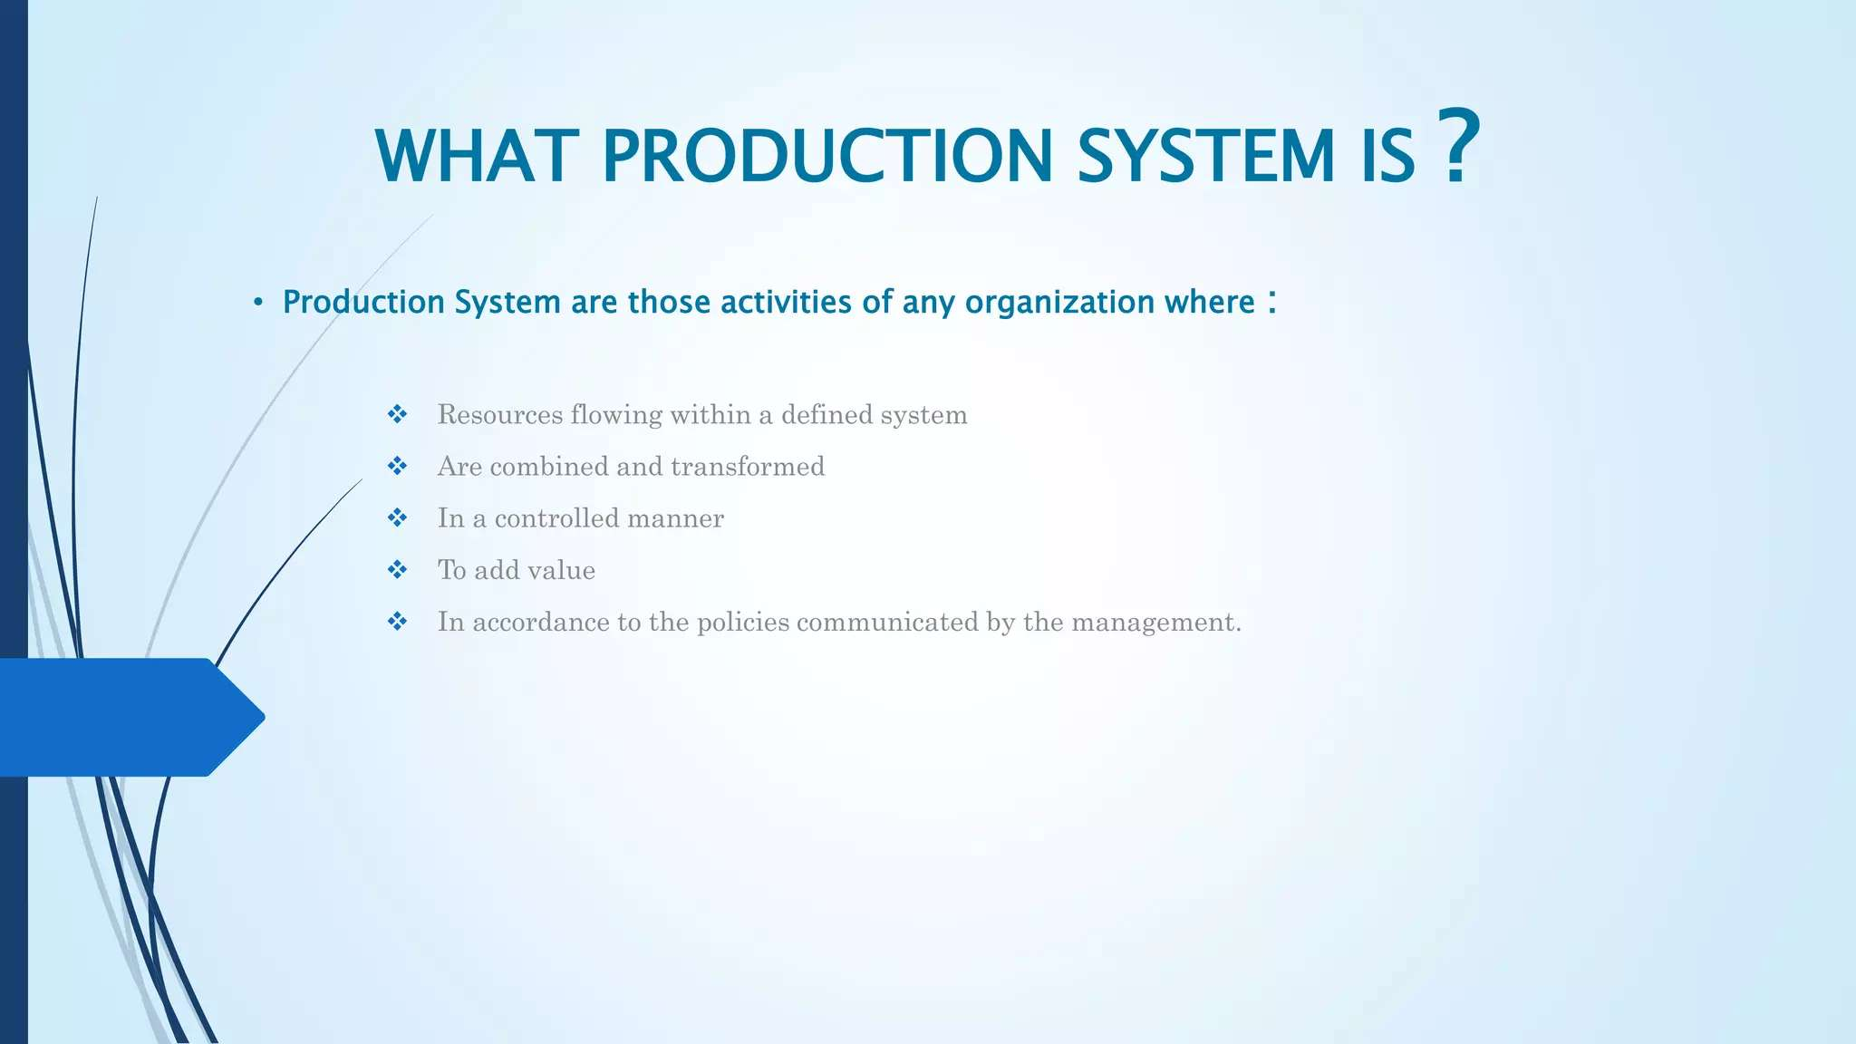

Slide 7
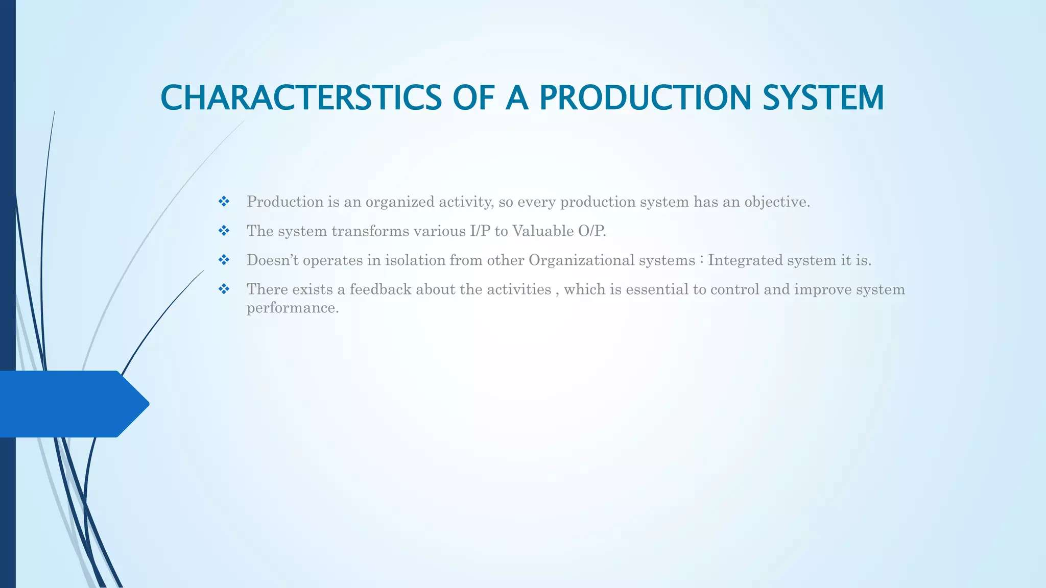

Slide 8
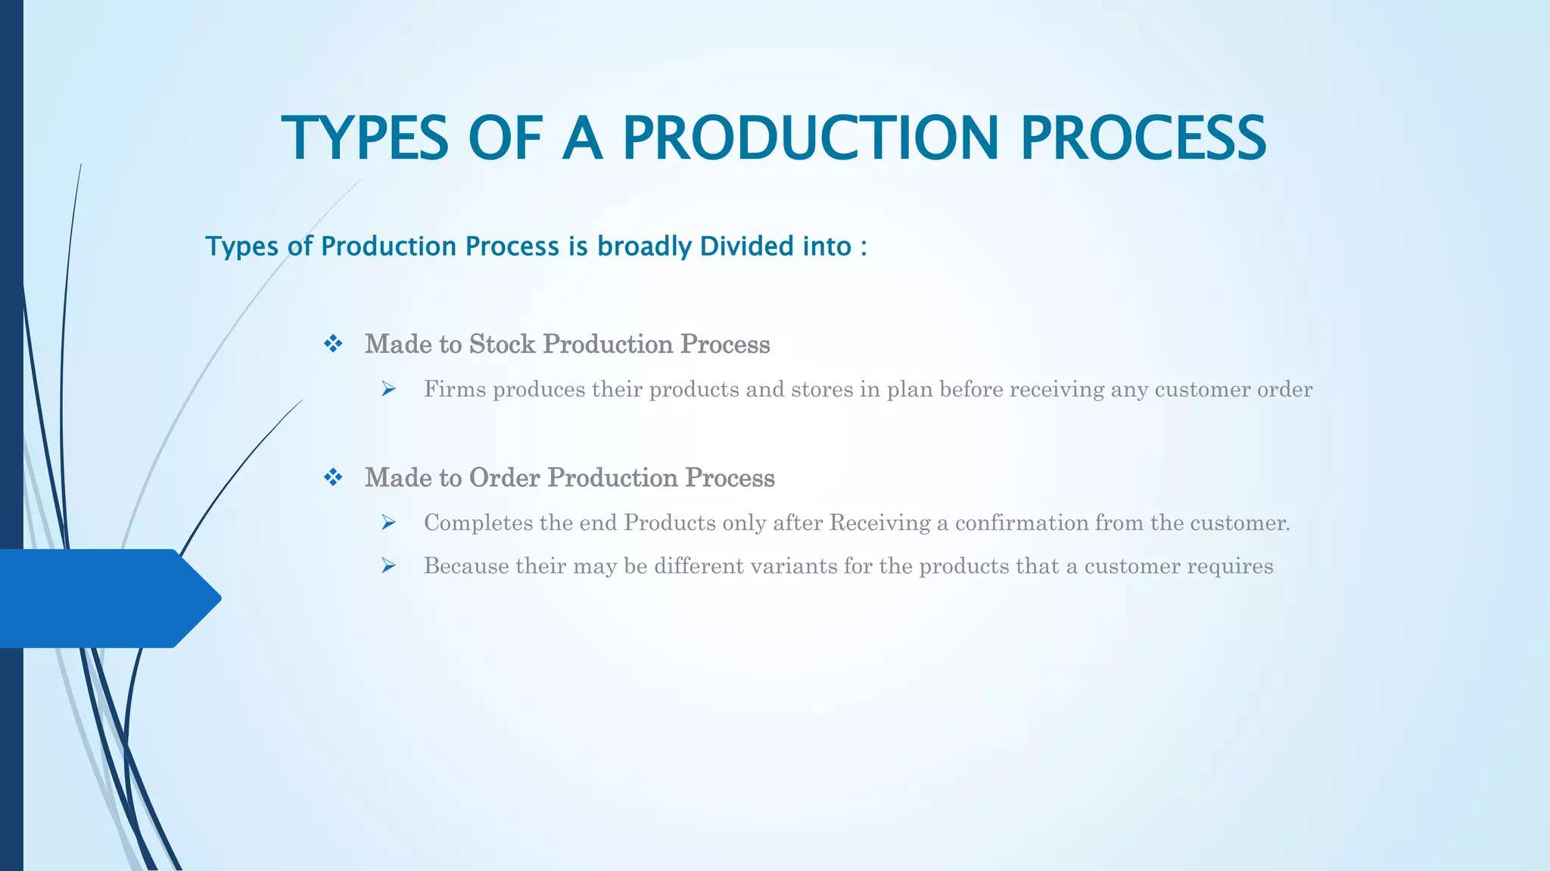

Slide 9
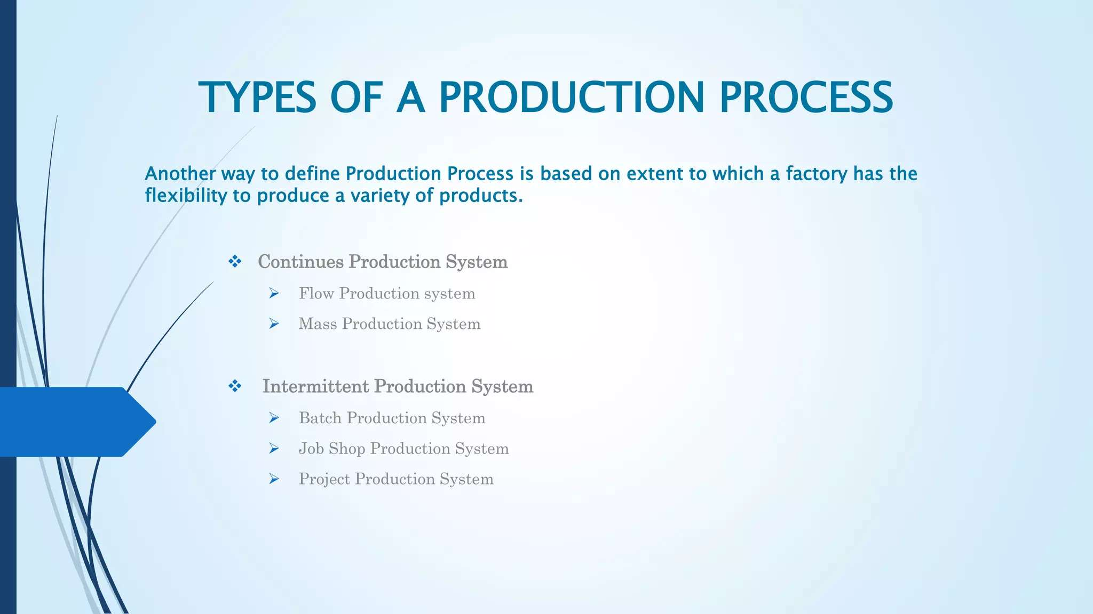

Slide 10
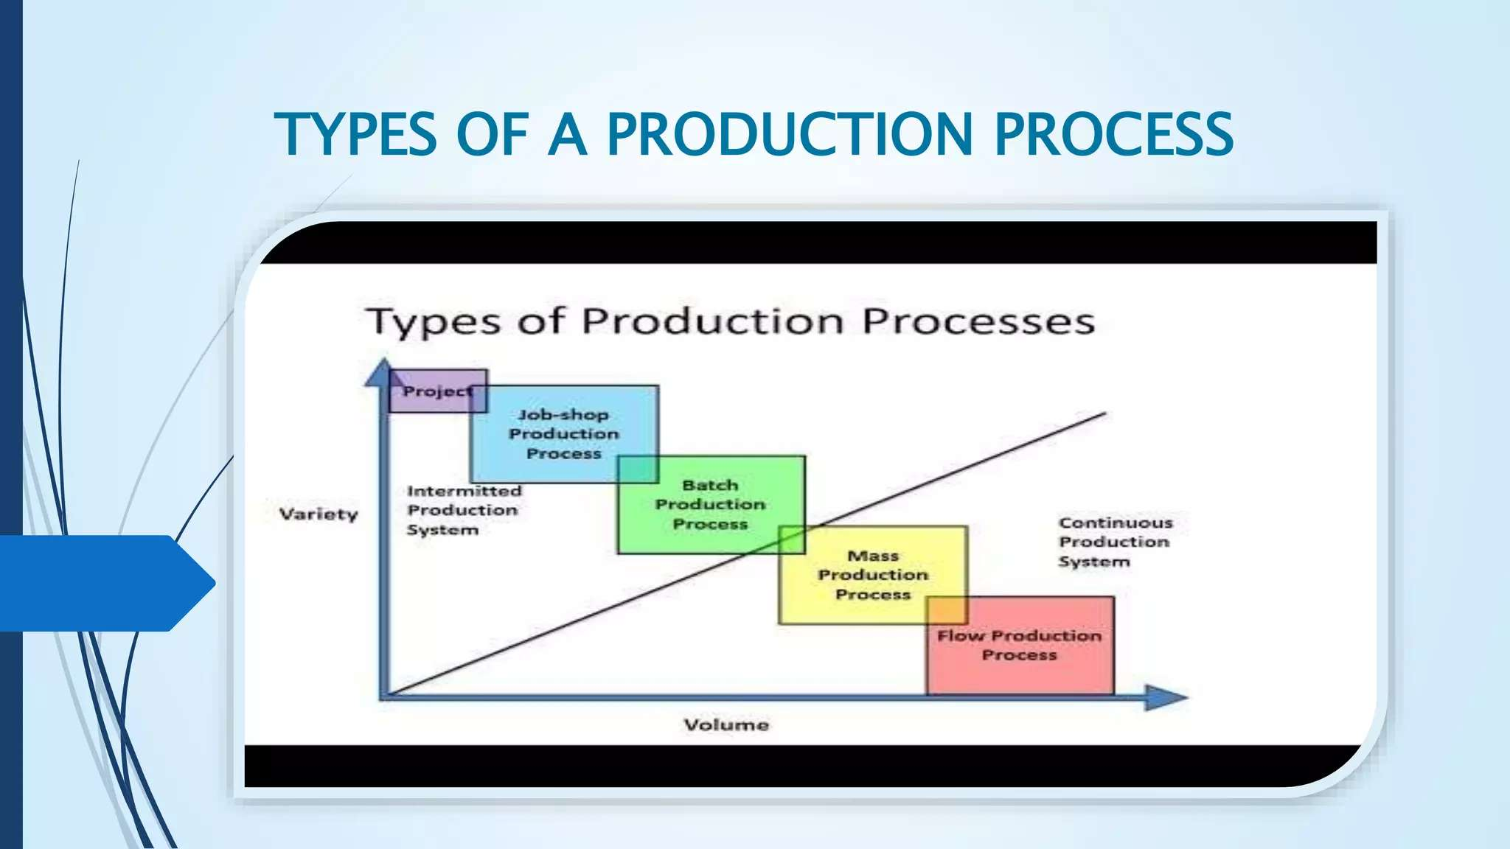

Slide 11
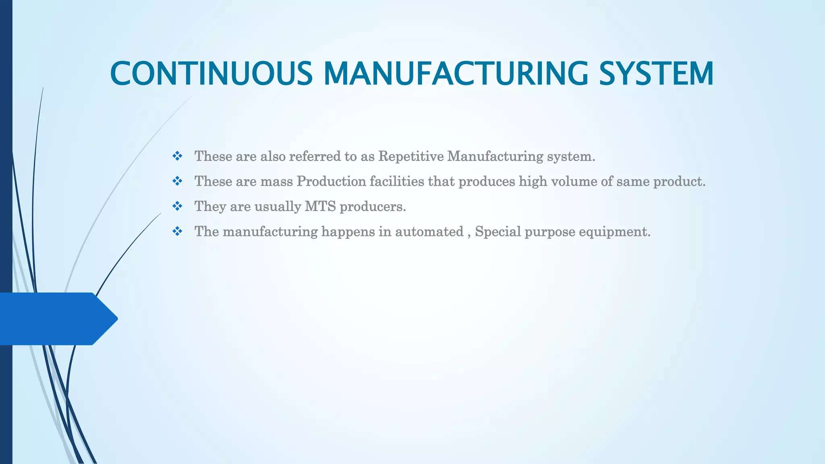

Slide 12
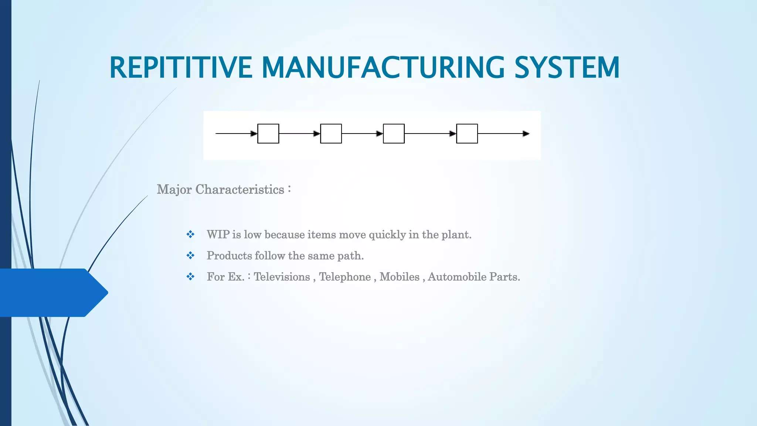

Slide 13
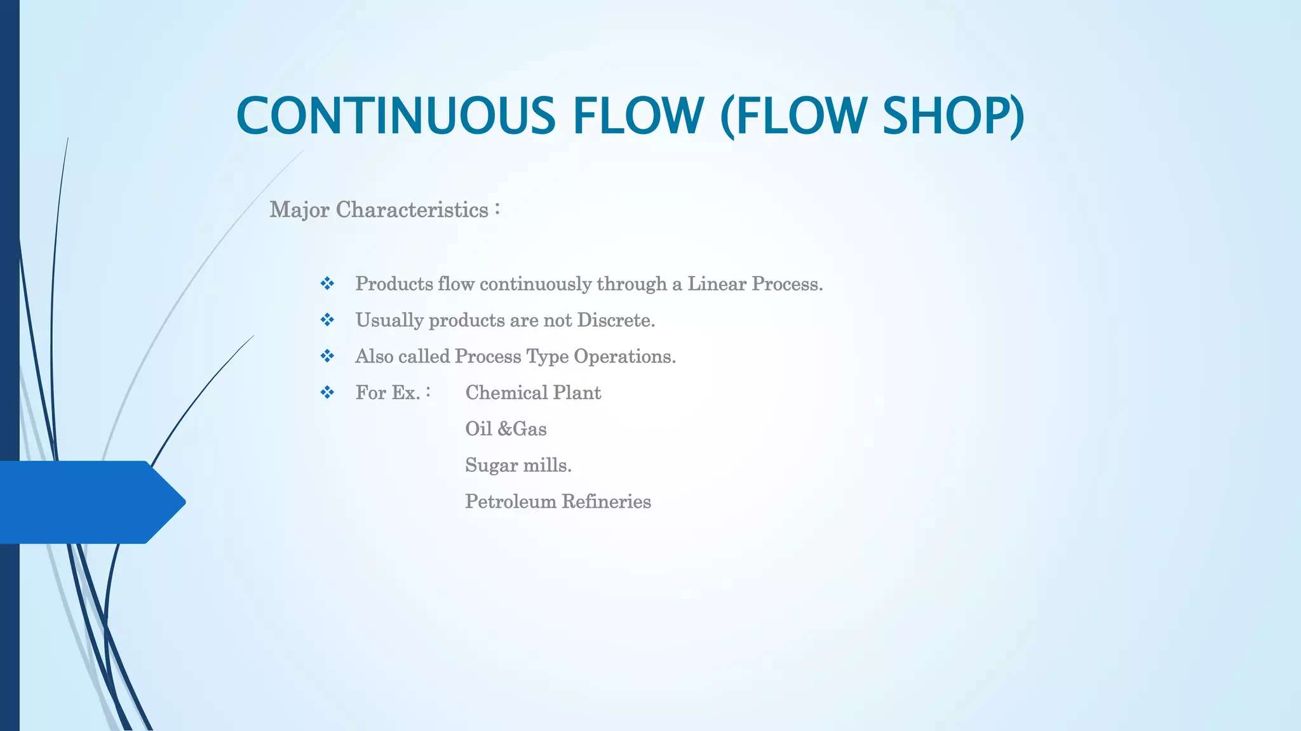

Slide 14
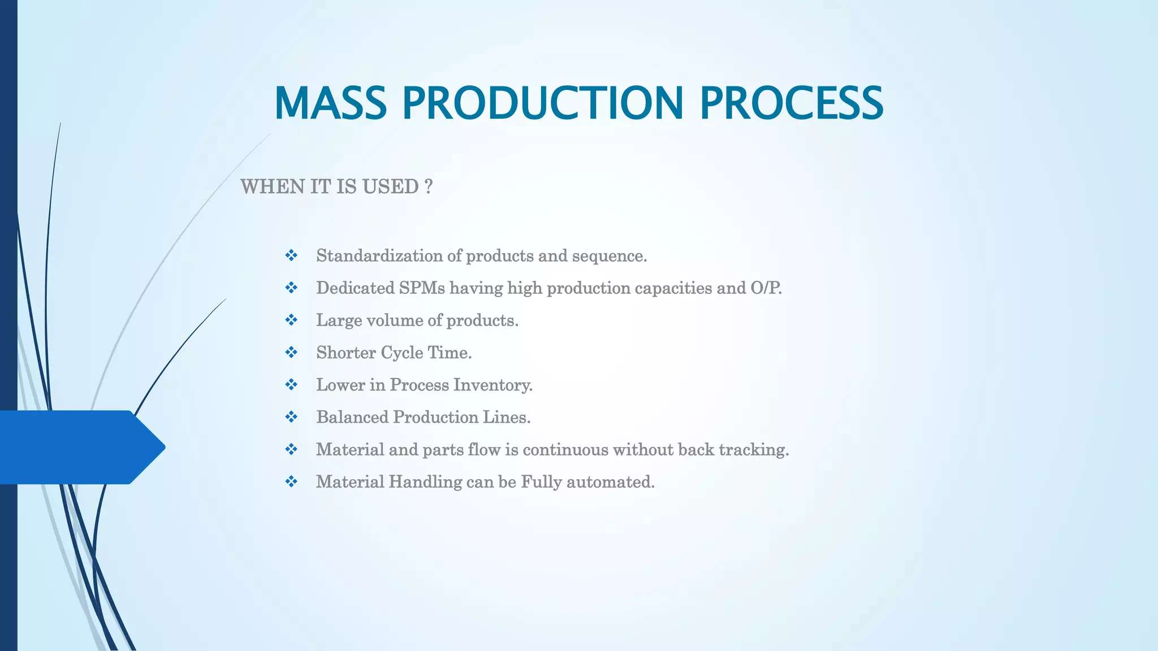

Slide 15
Week 2

Slide 16
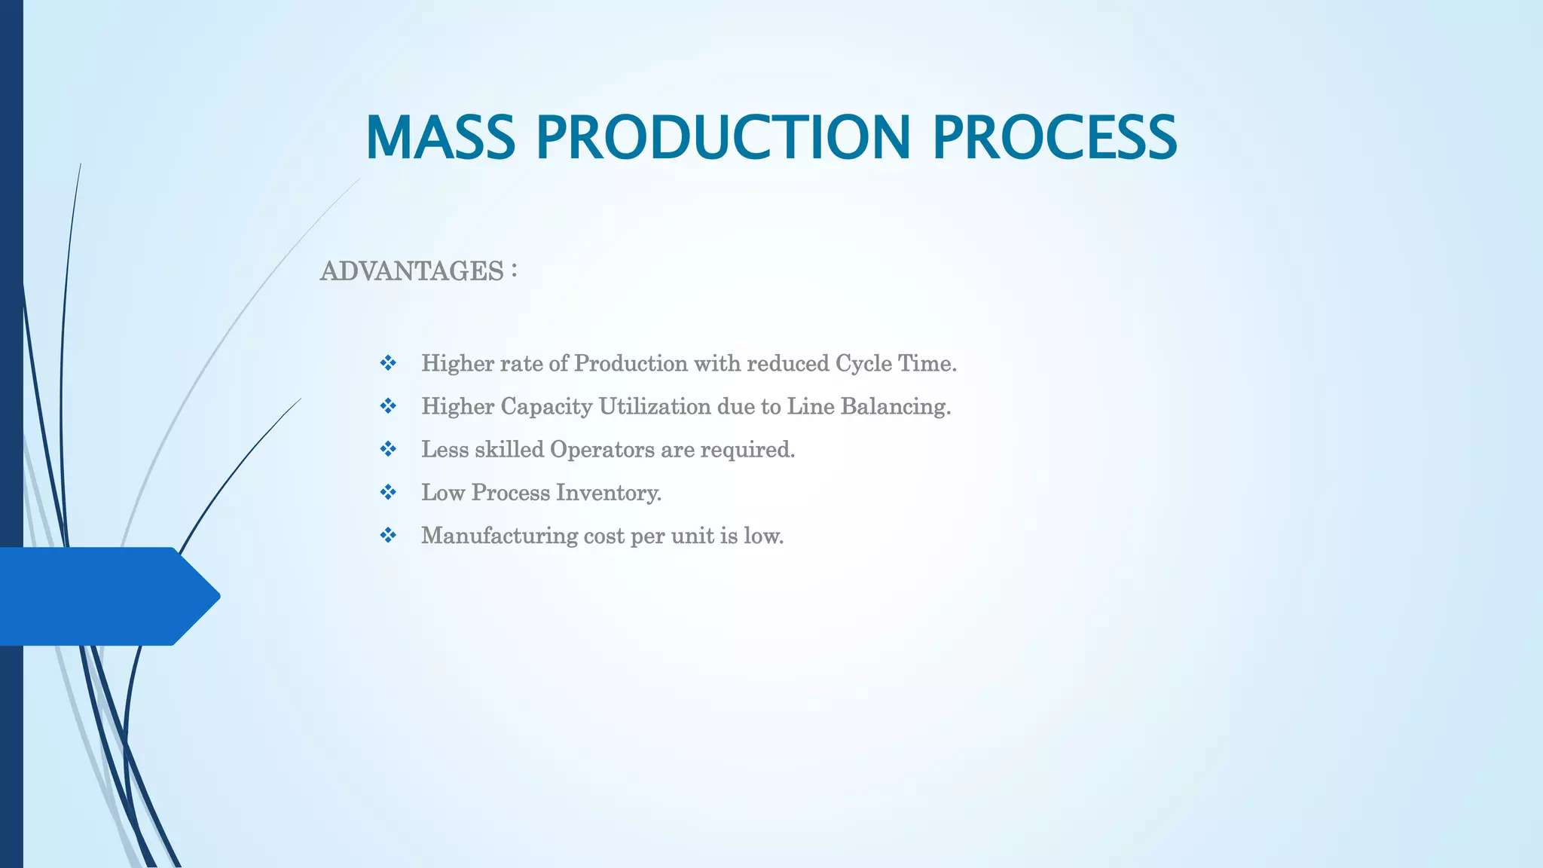

Slide 17
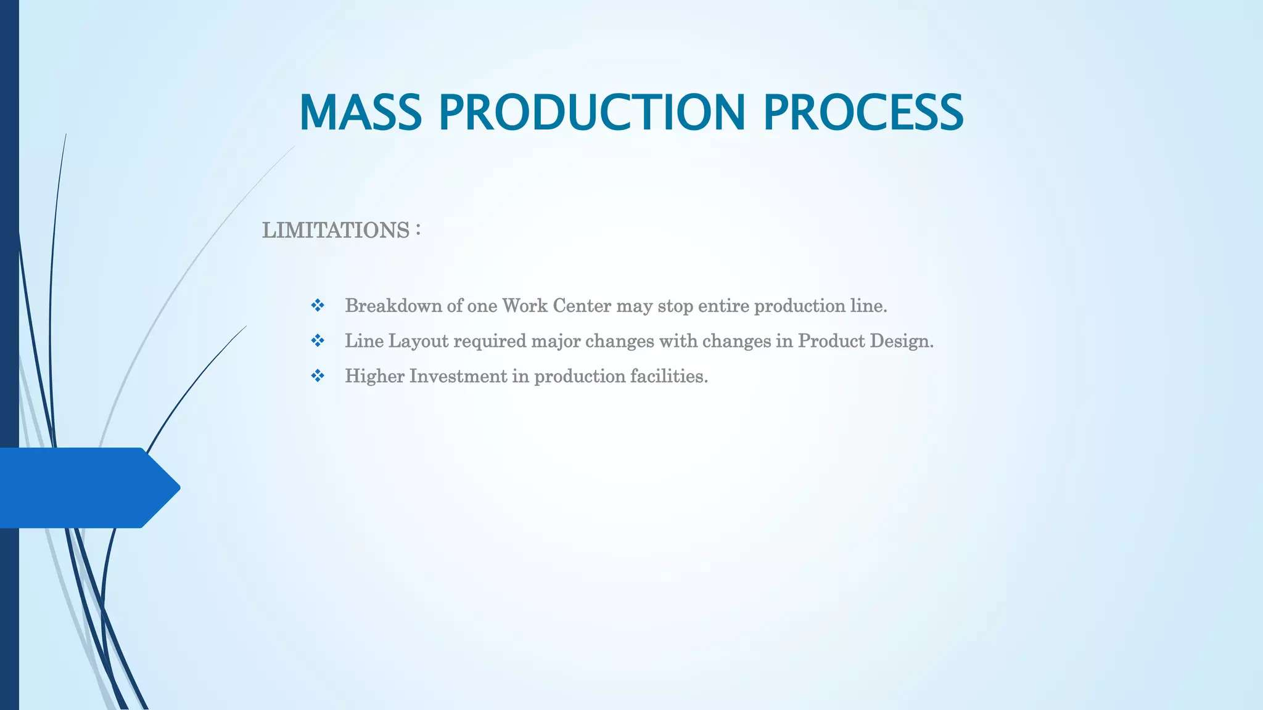

Slide 18
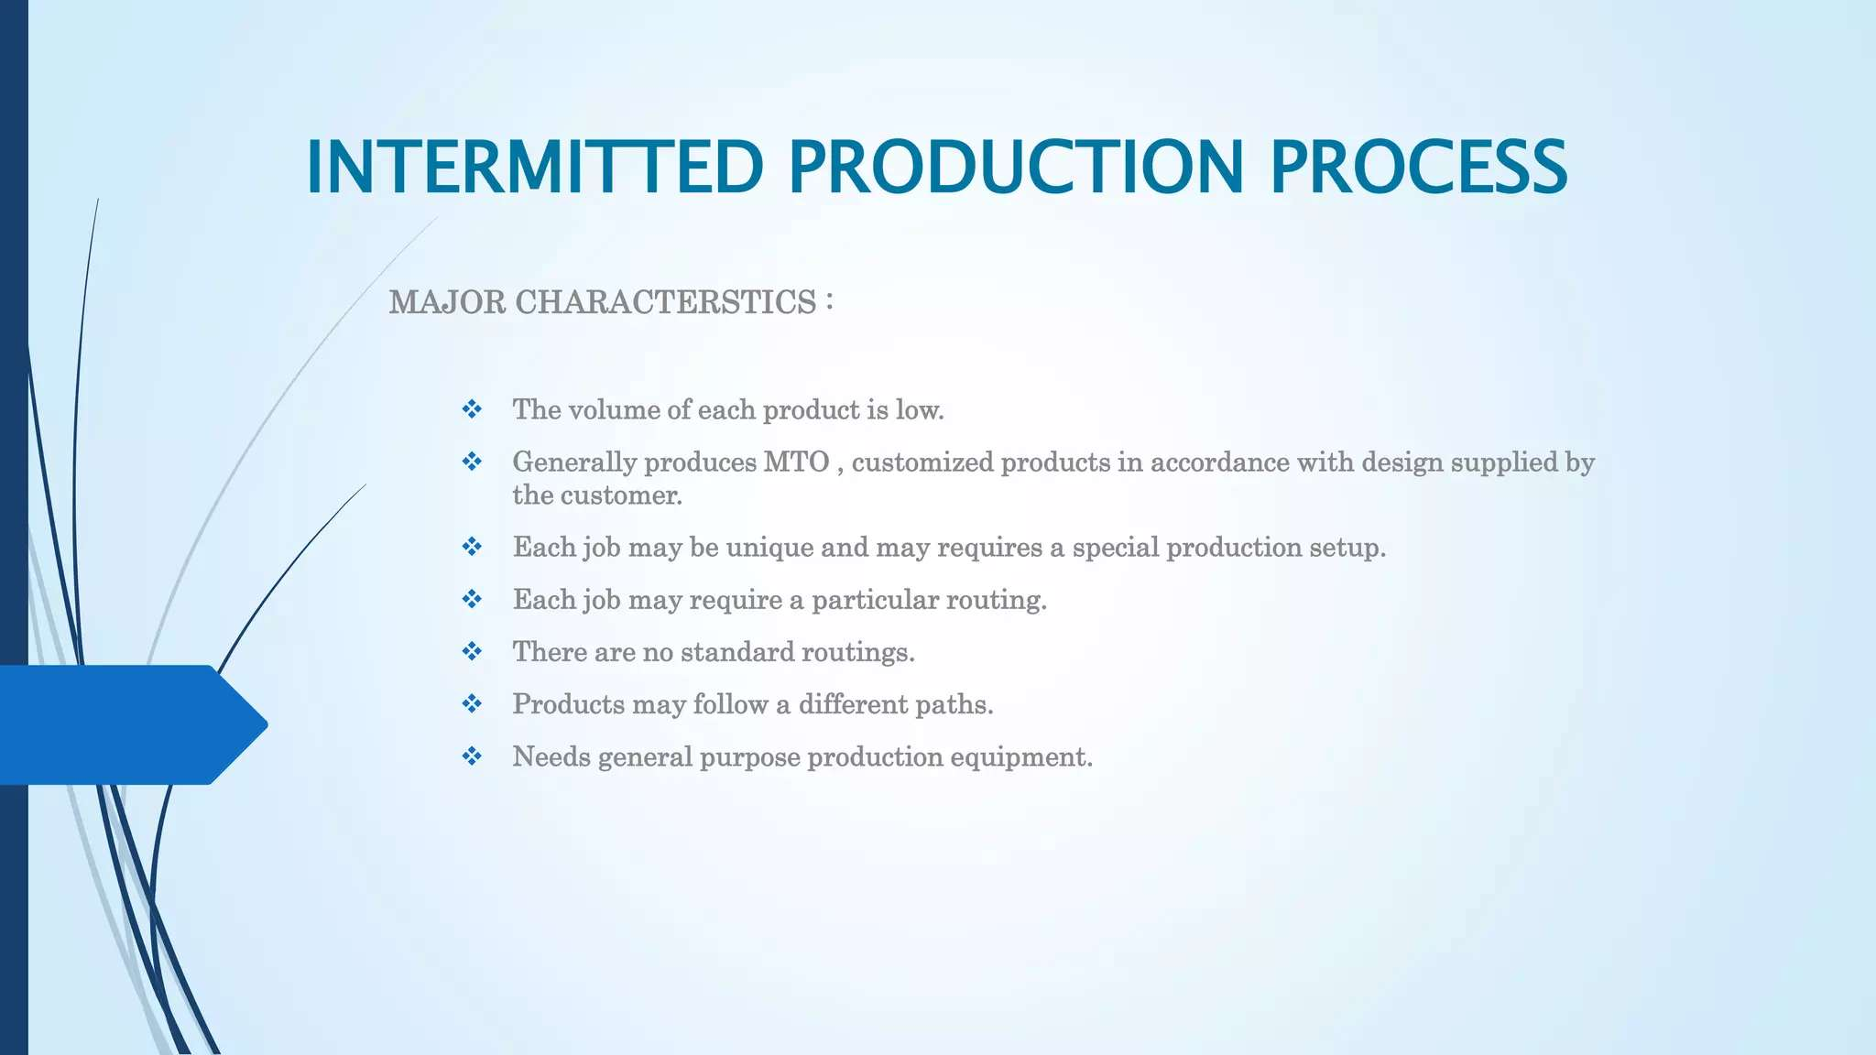

Slide 19
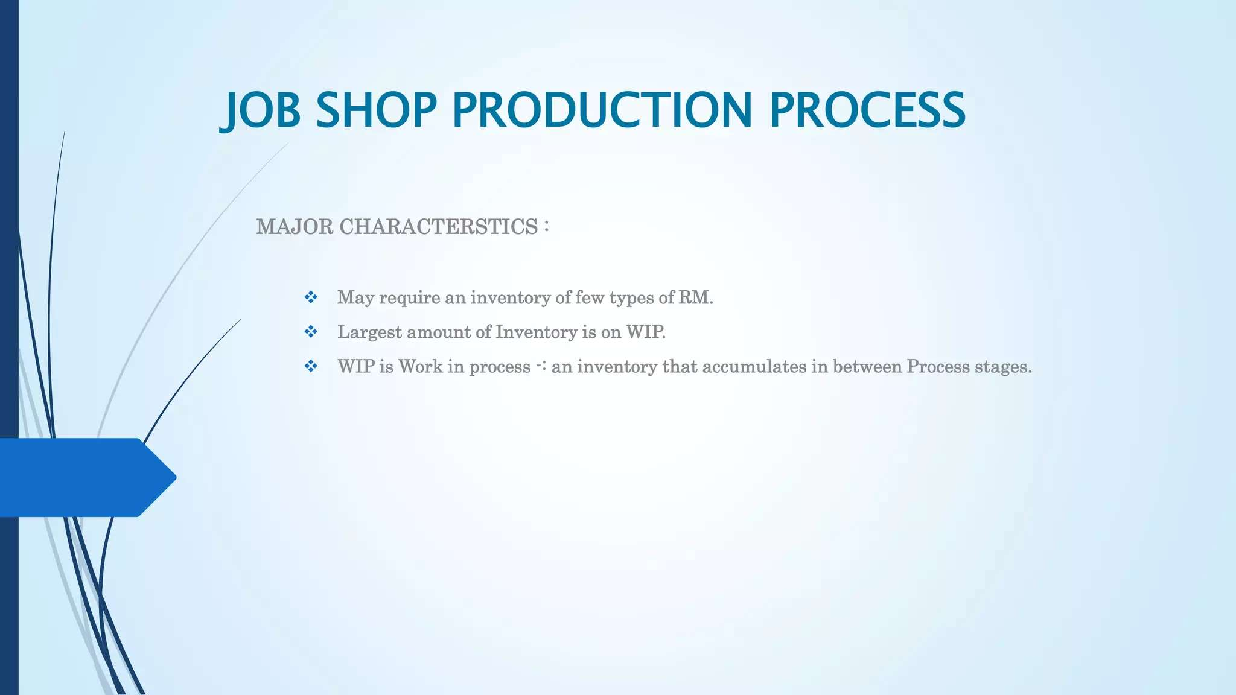

Slide 20
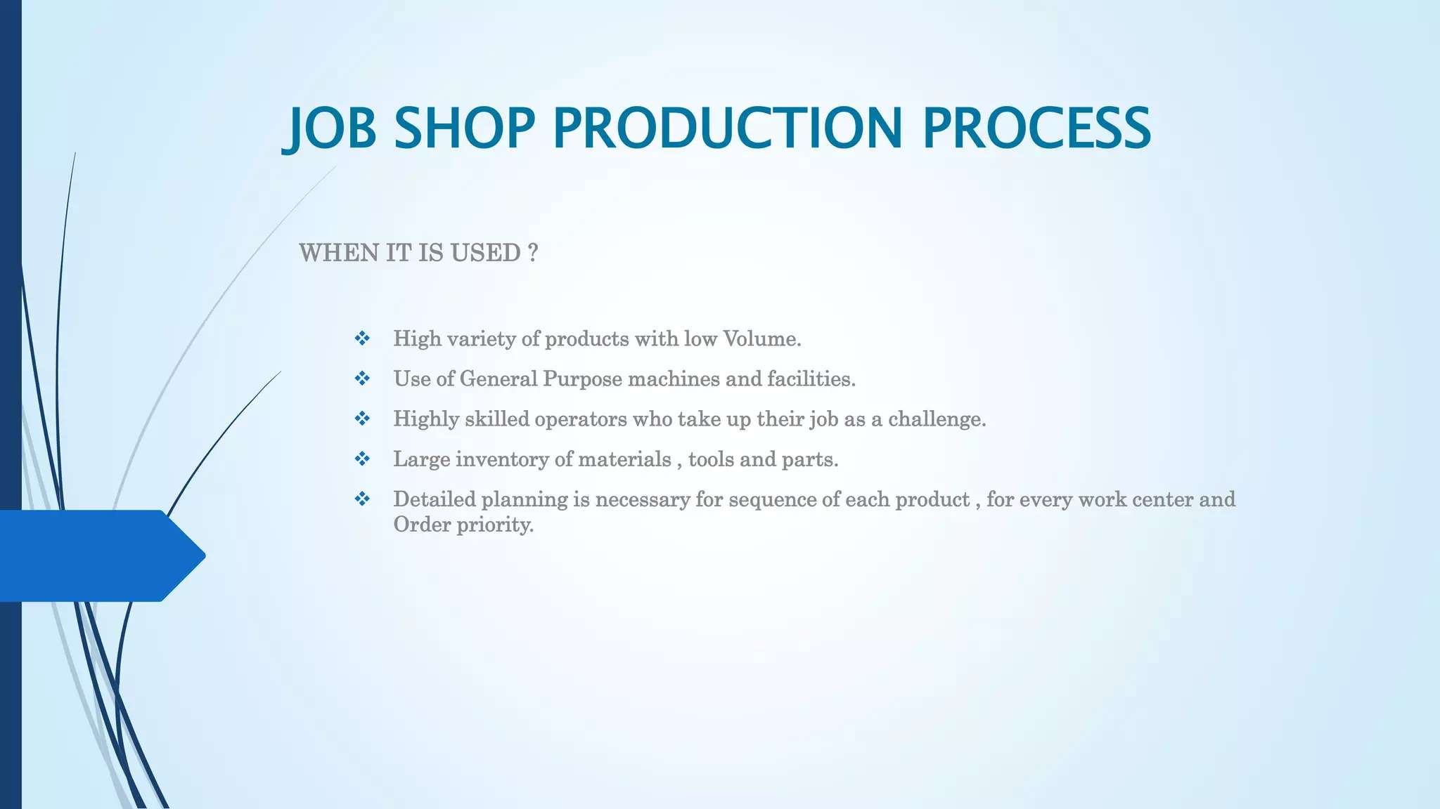

Slide 21
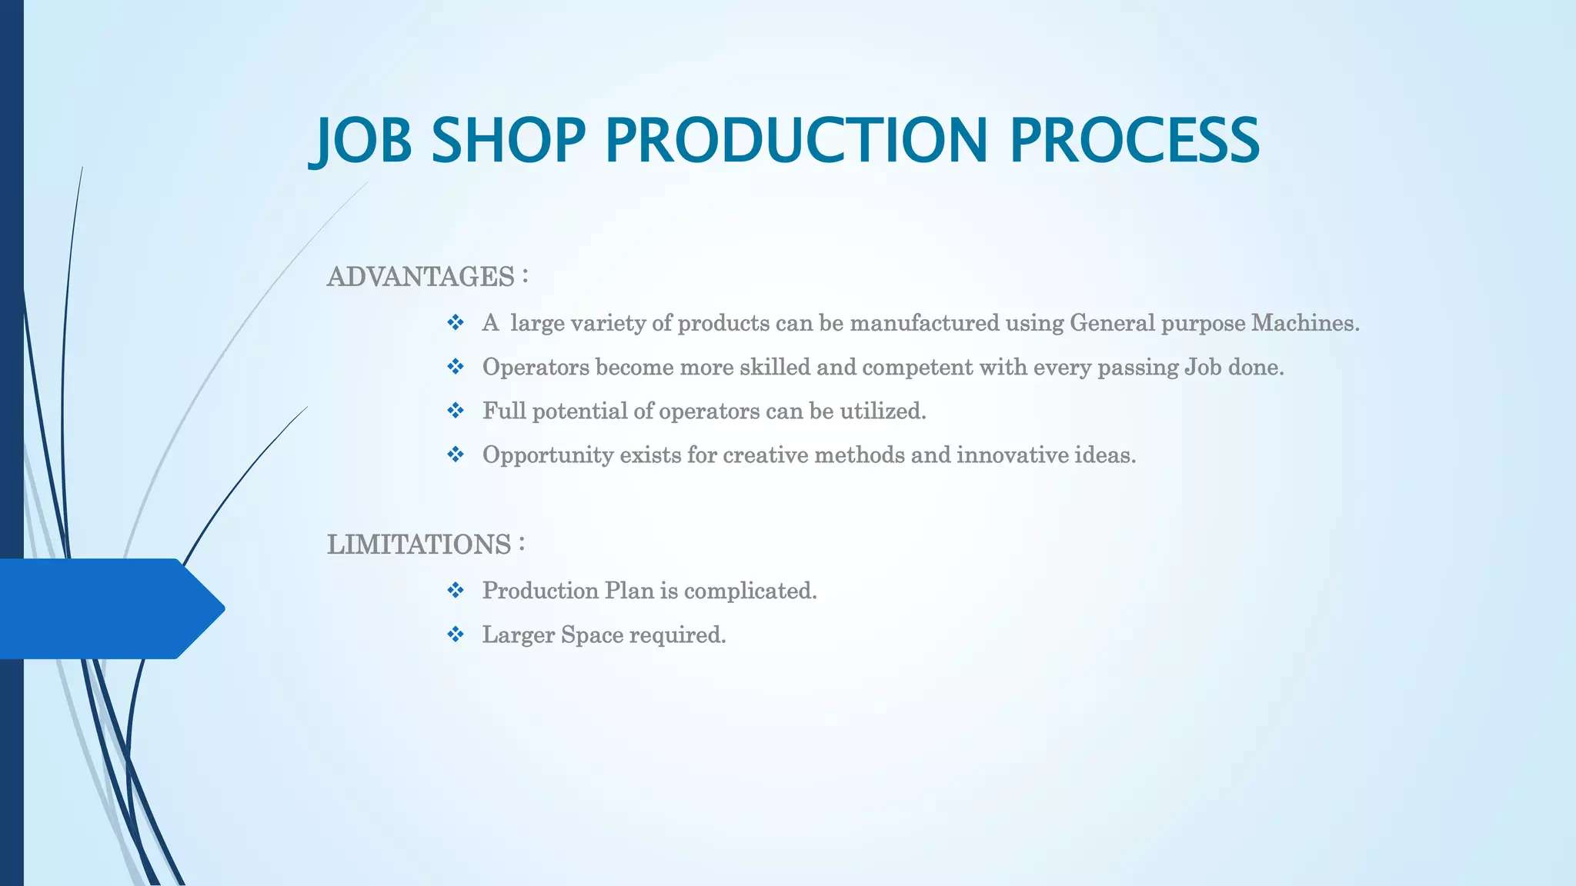

Slide 22
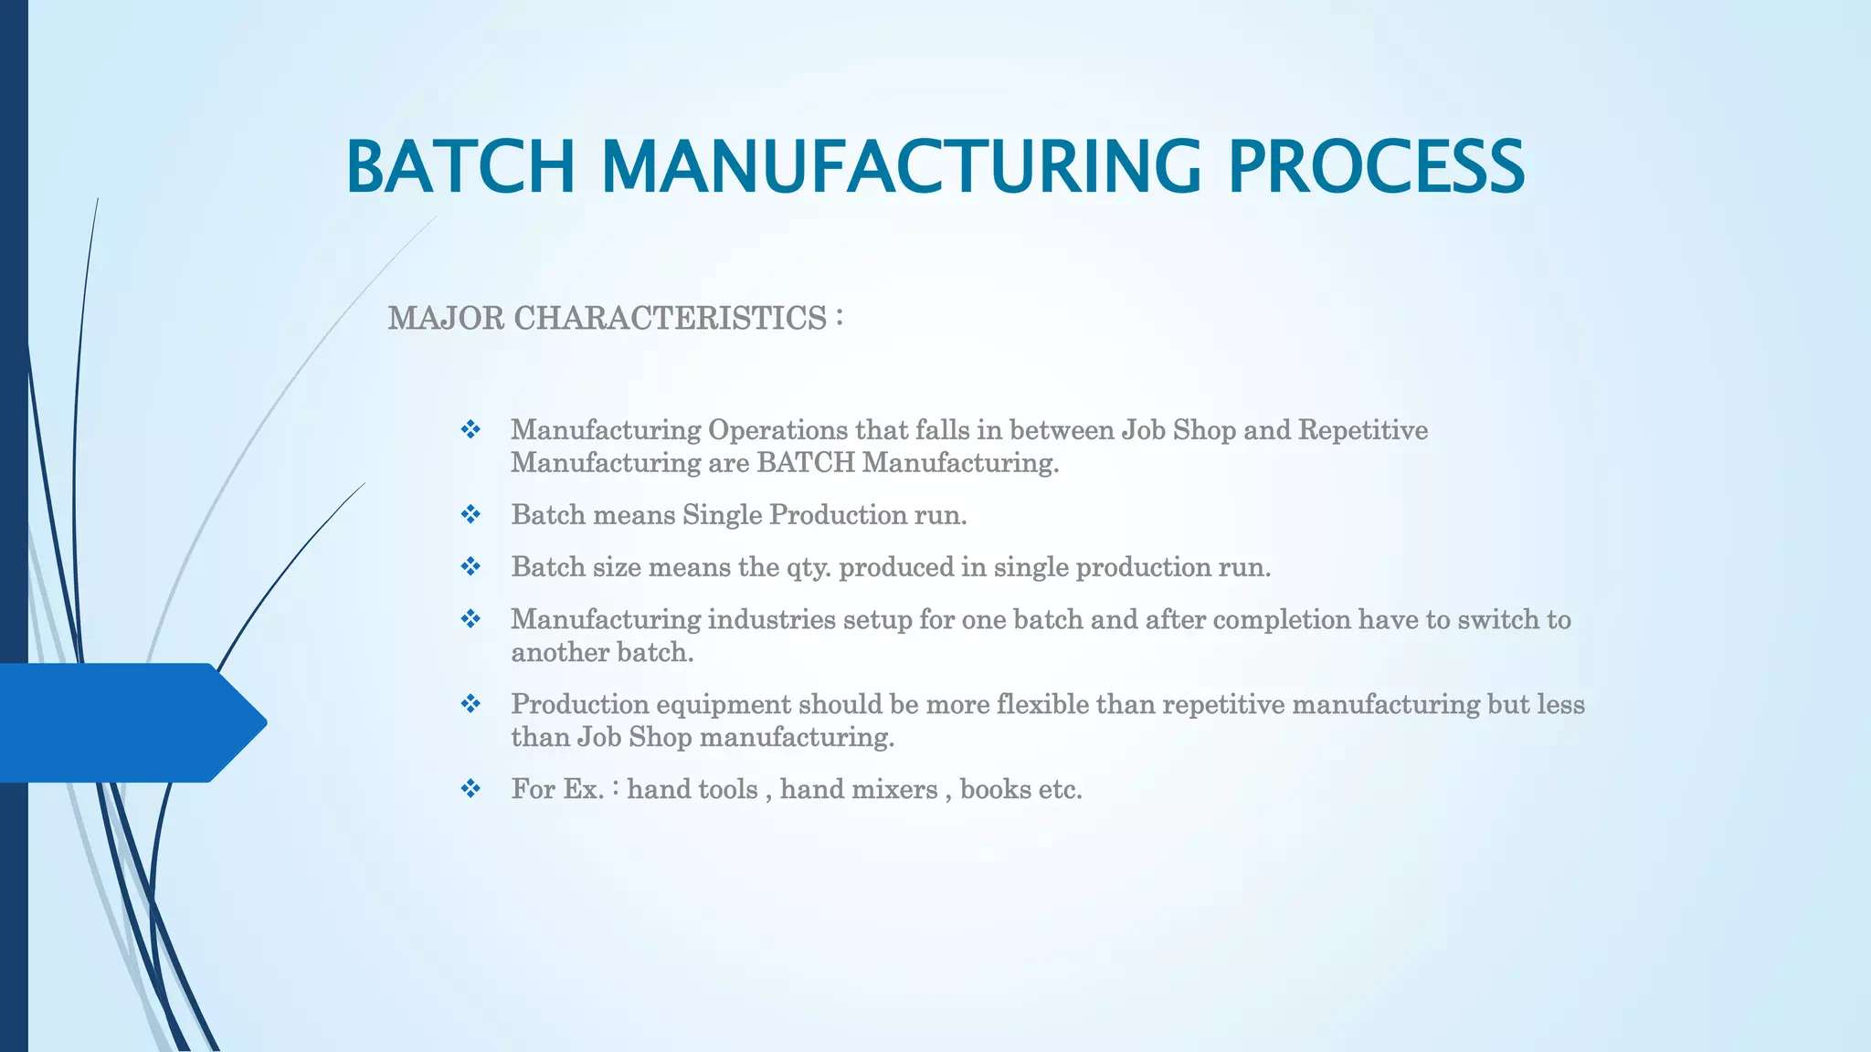

Slide 23
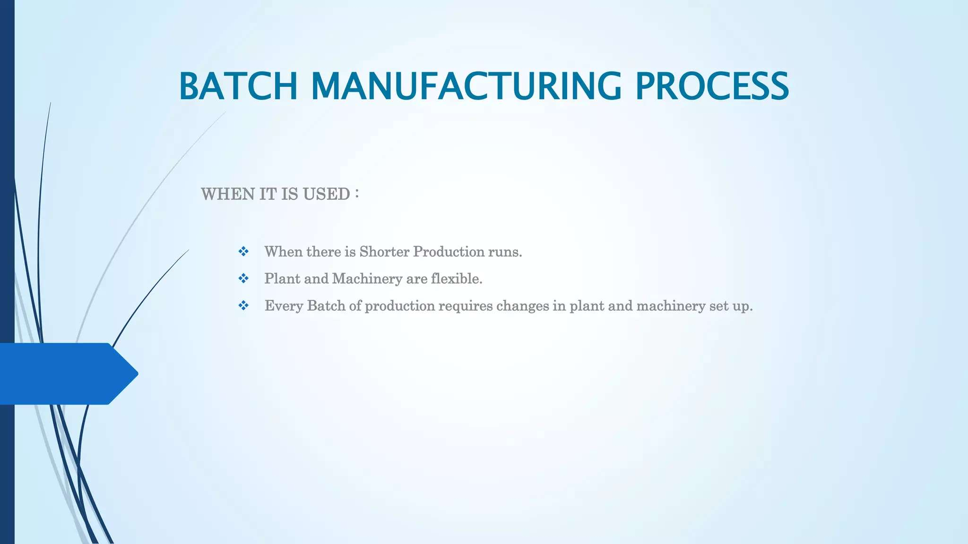

Slide 24
Week 3

Slide 25
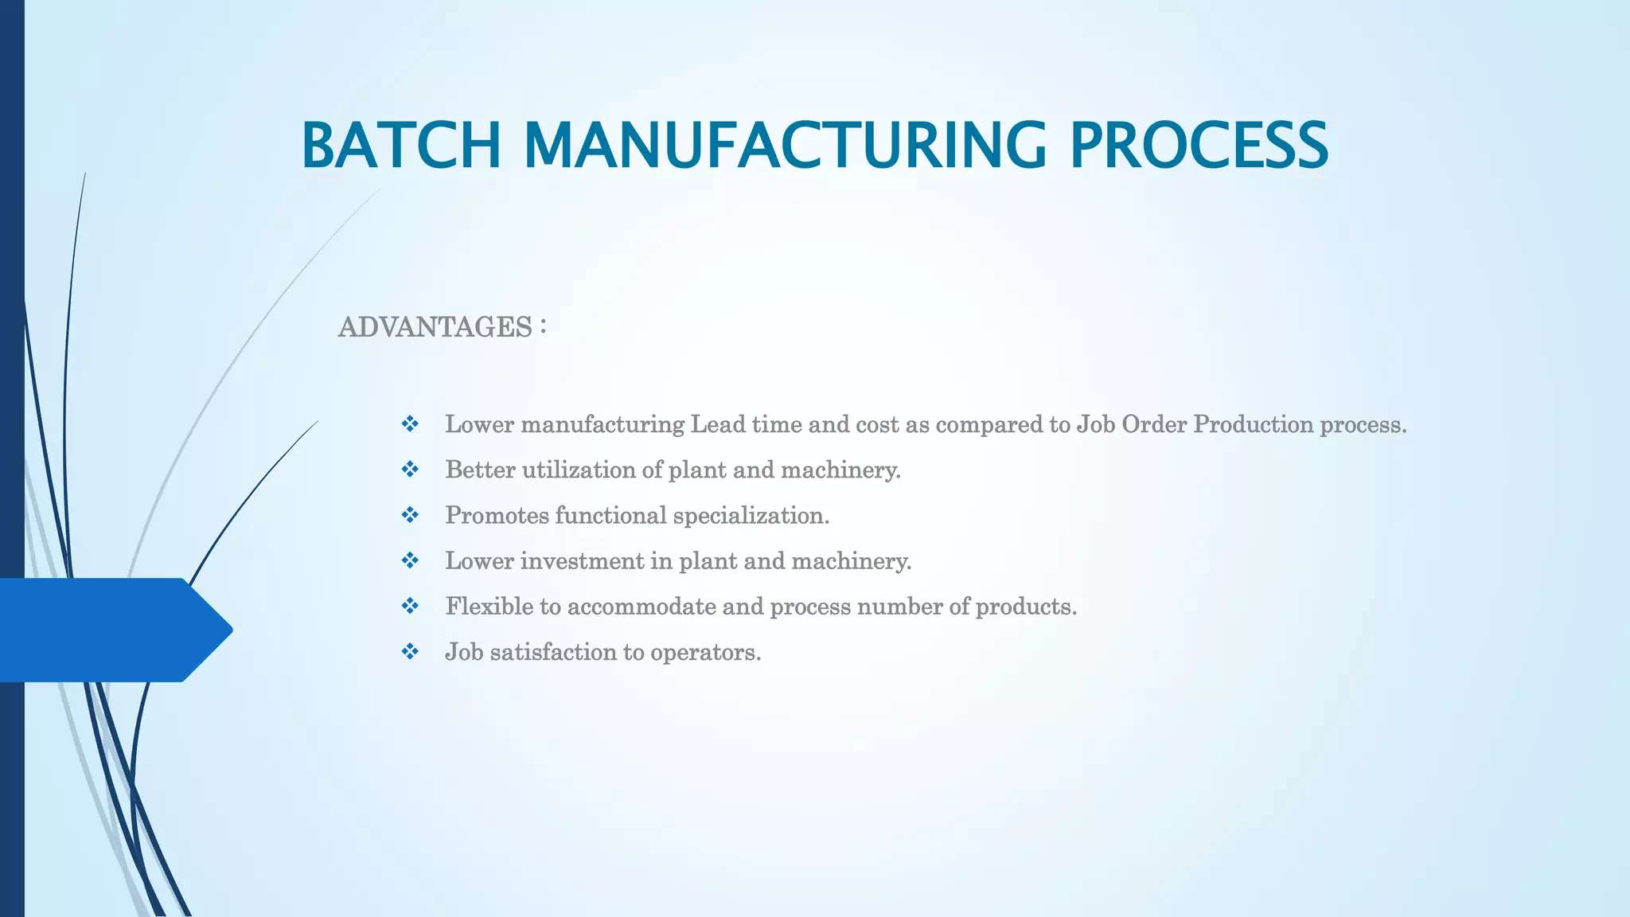

Slide 26
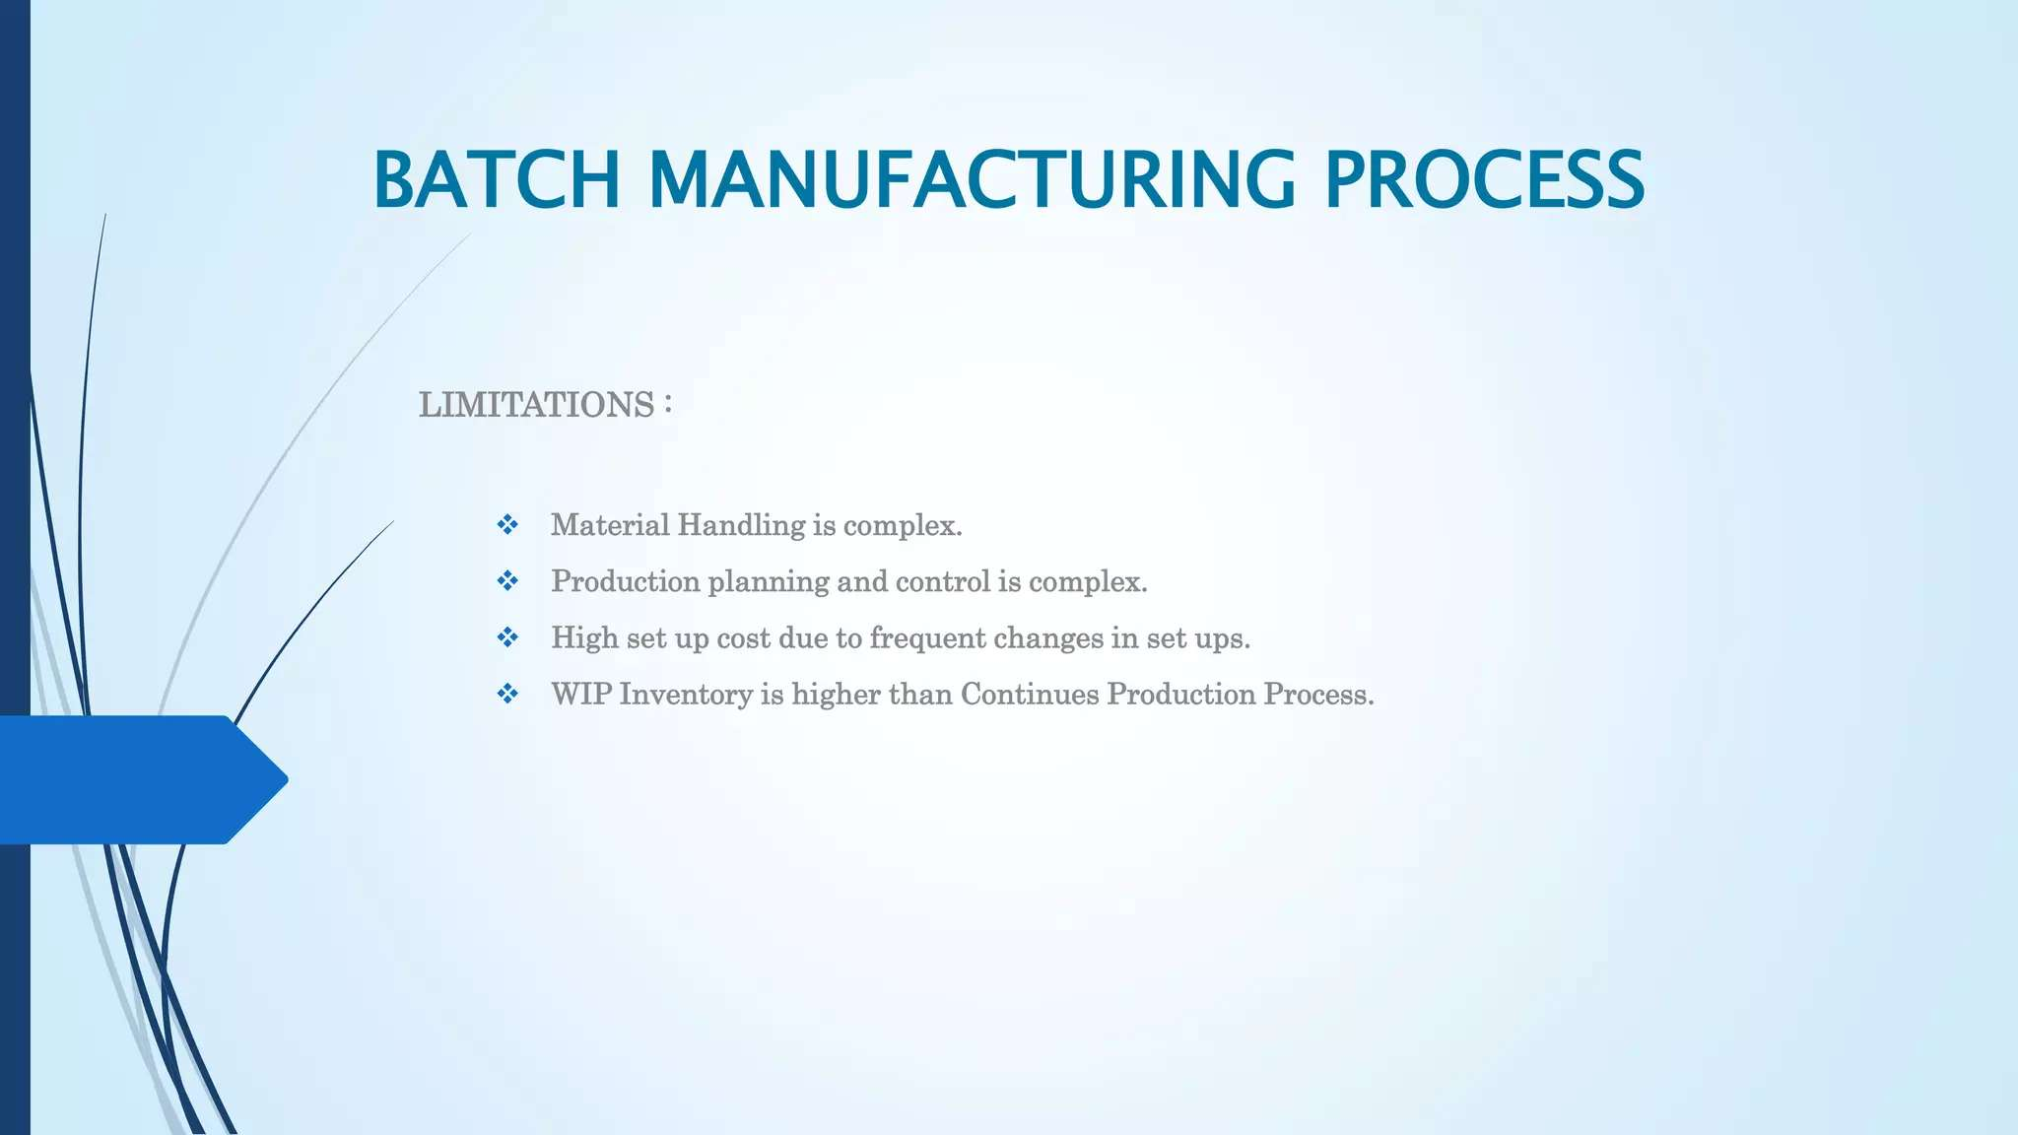

Slide 27
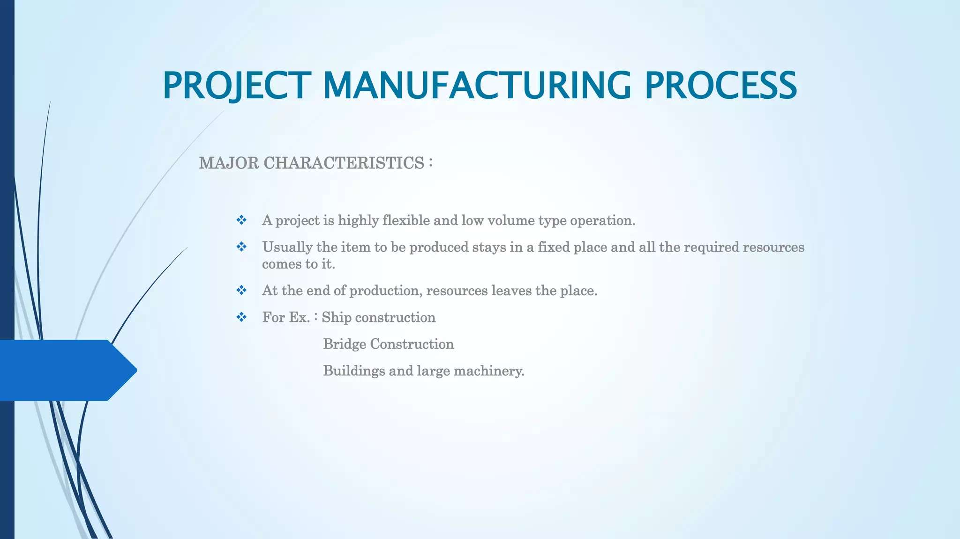

Slide 28
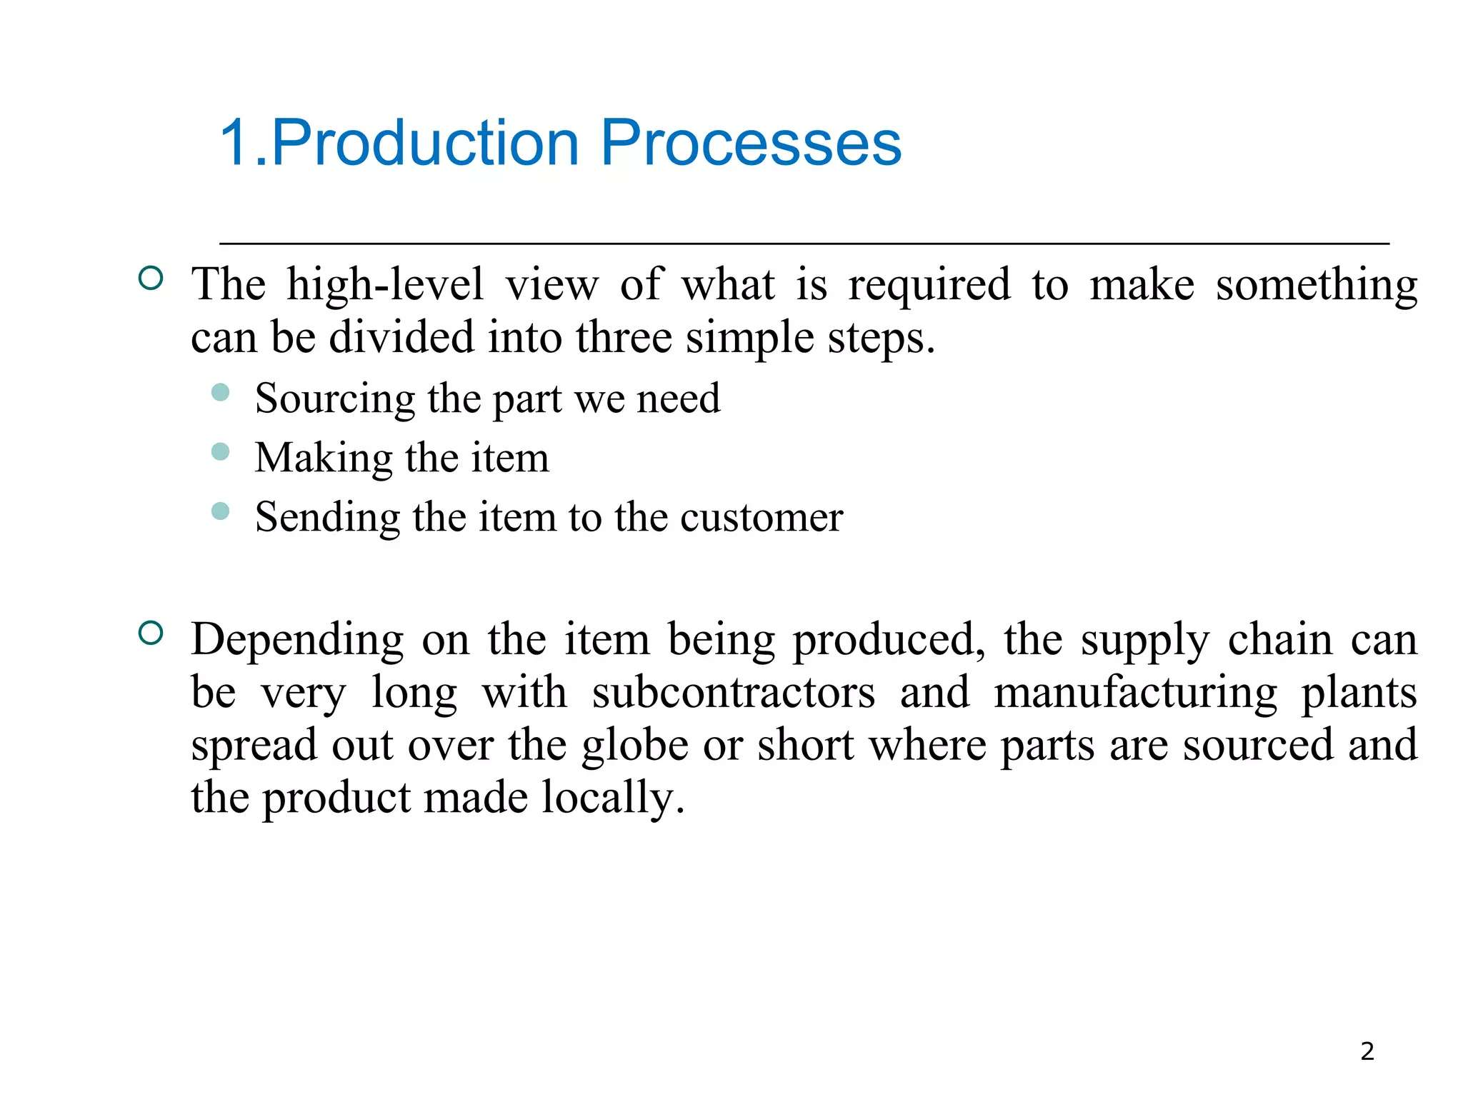

Slide 29
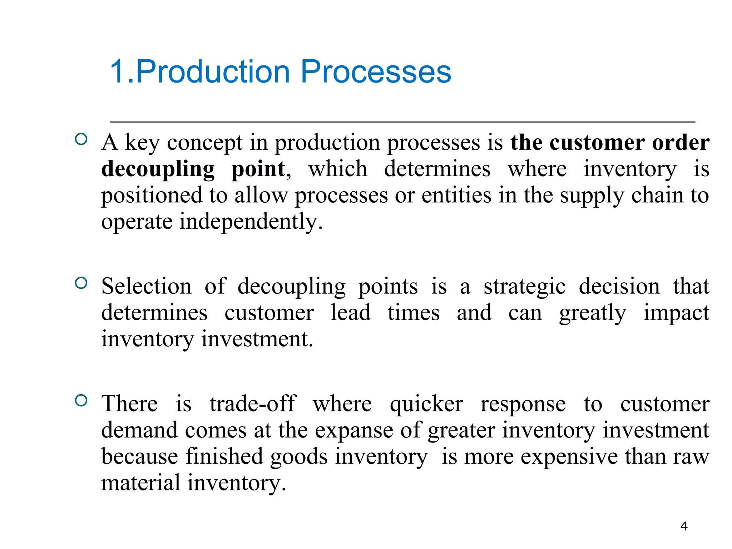

Slide 30
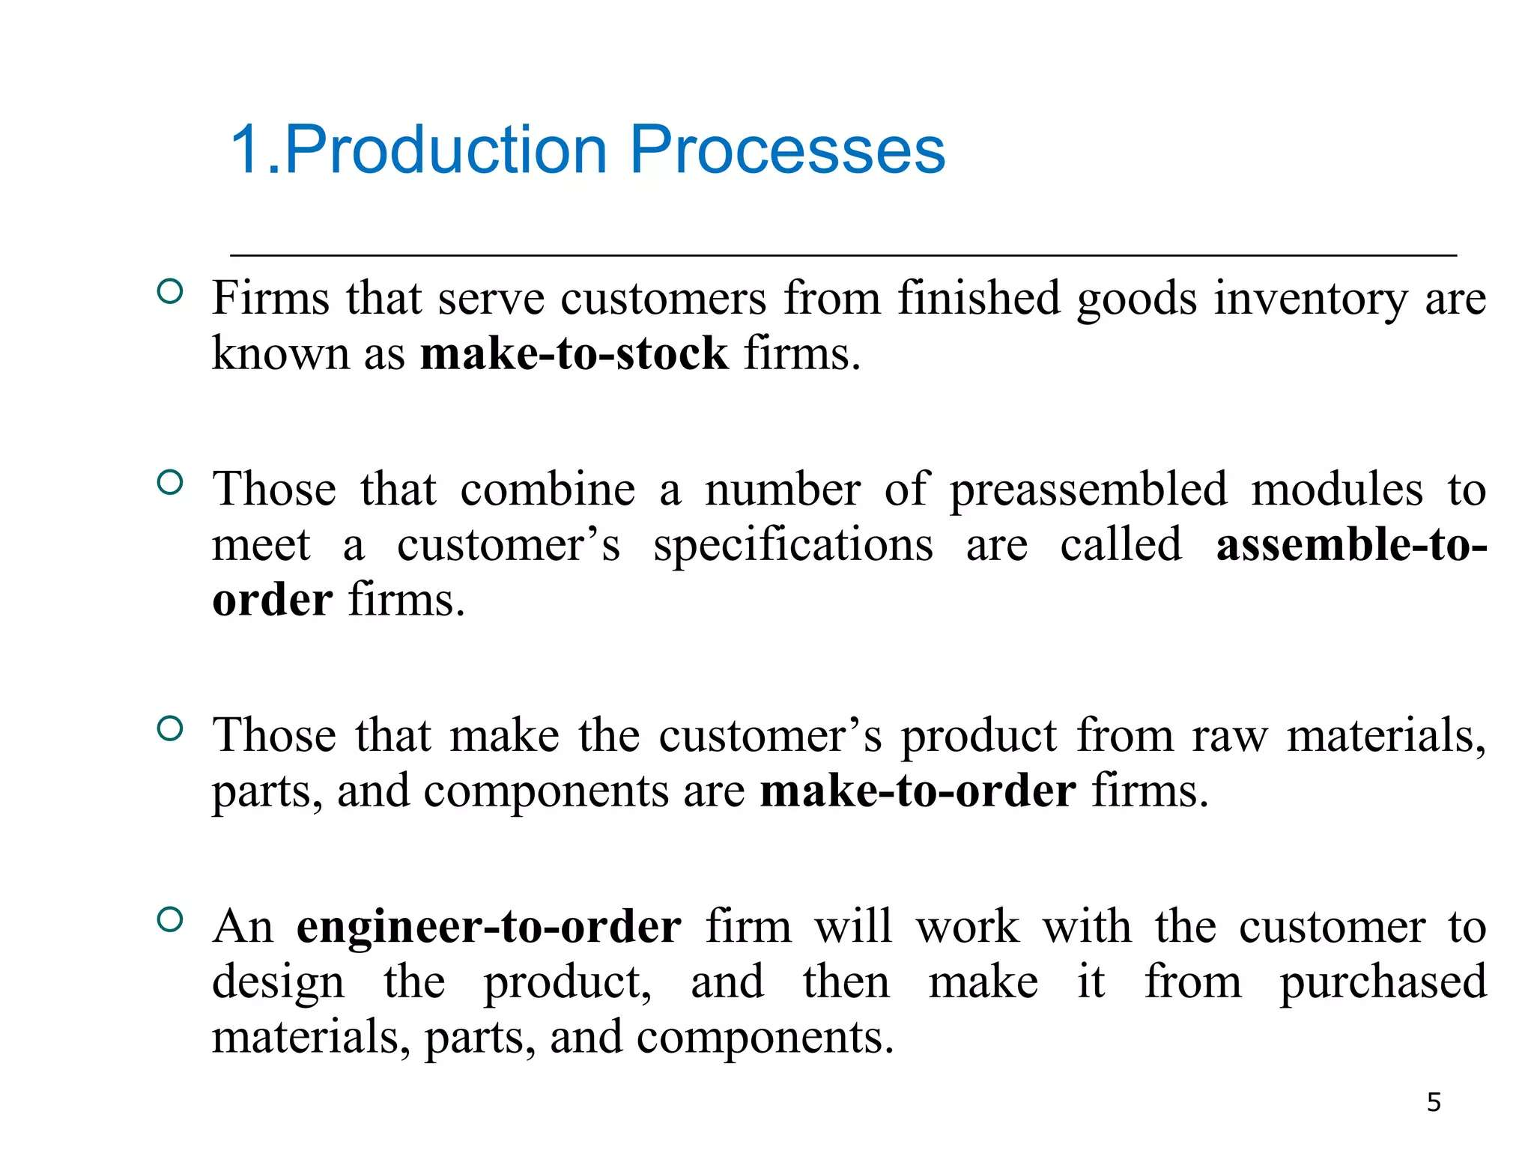

Slide 31
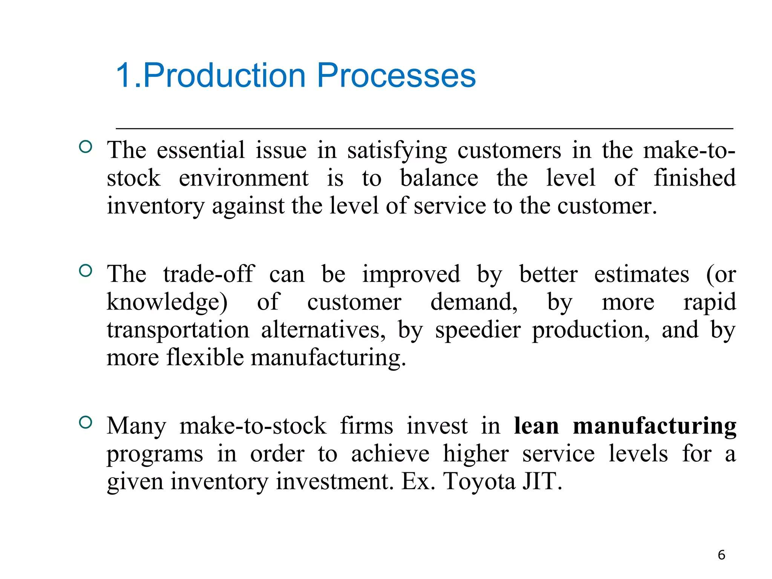

Slide 32
Week 4

Slide 33
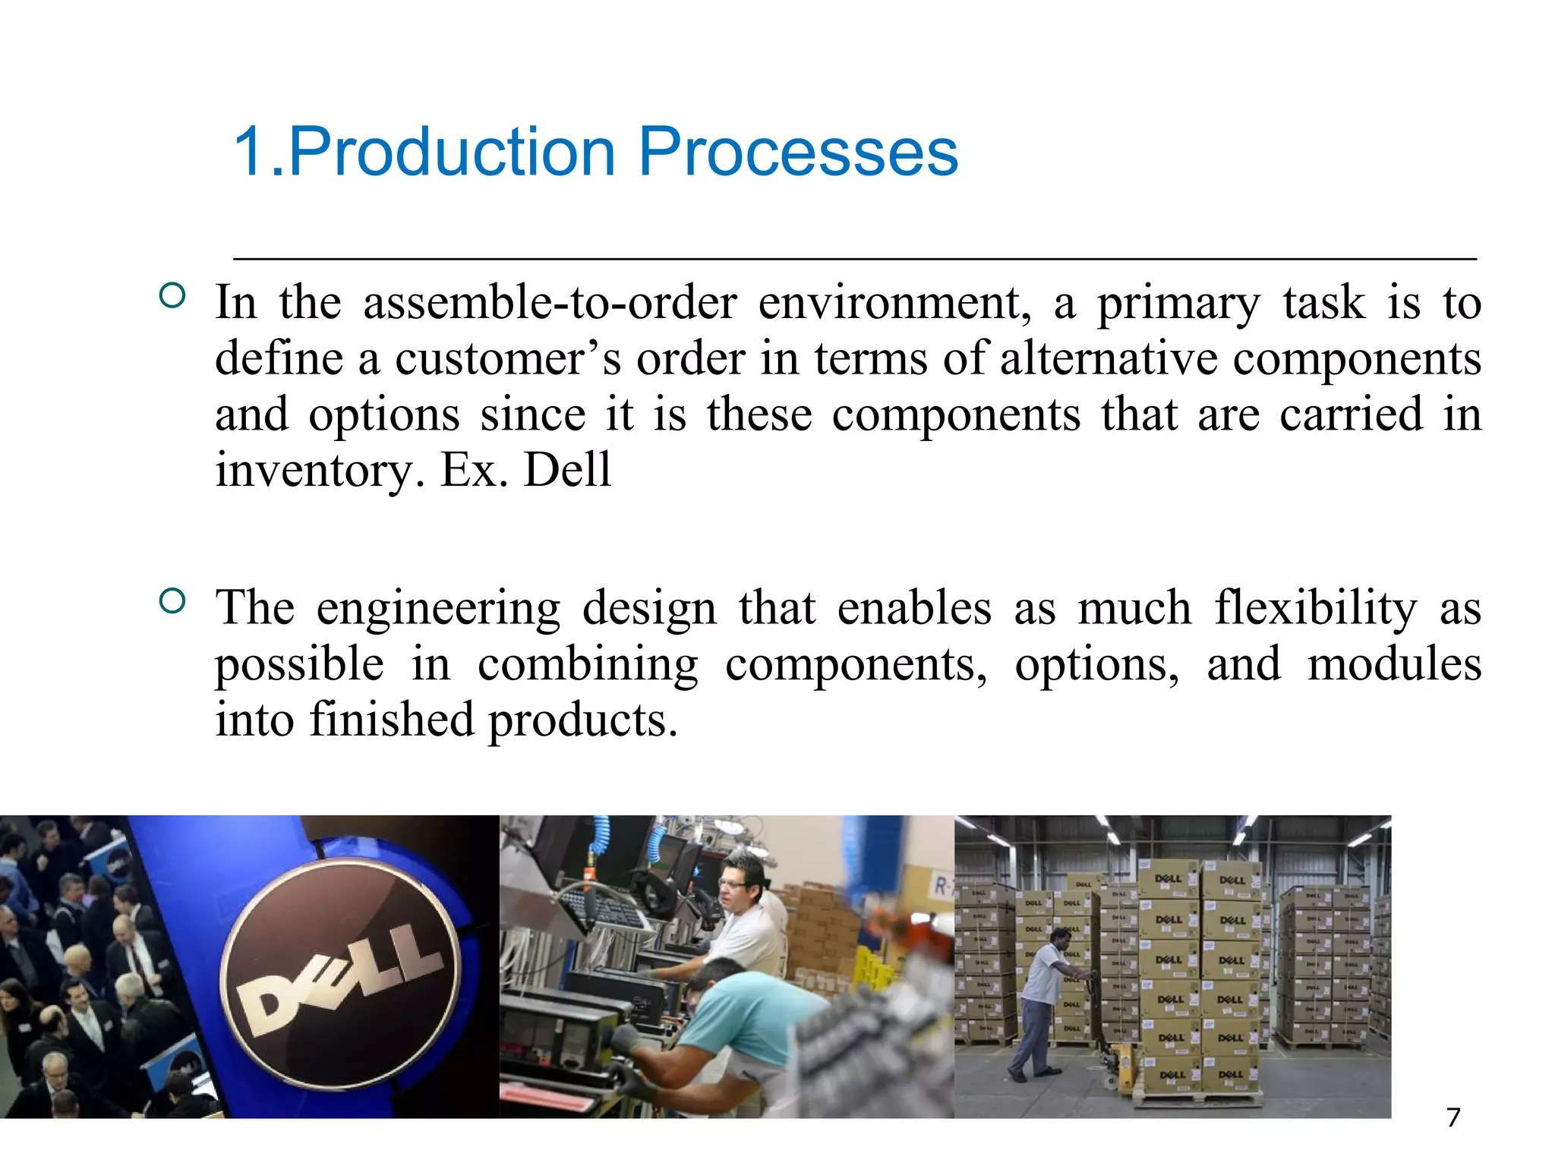

Slide 34
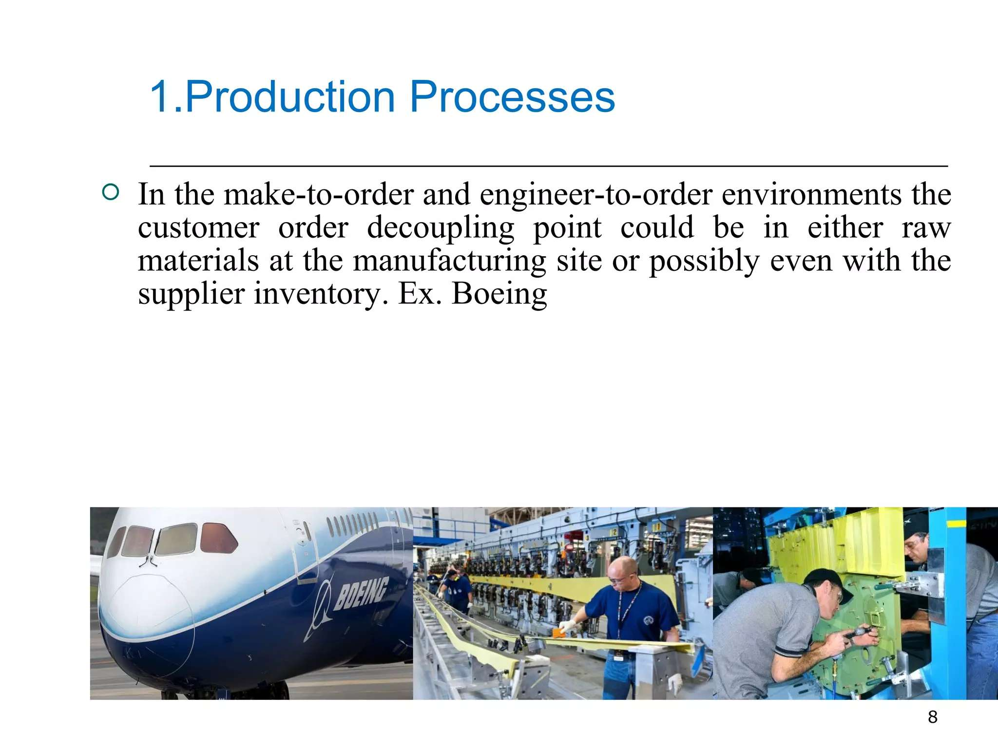

Slide 35
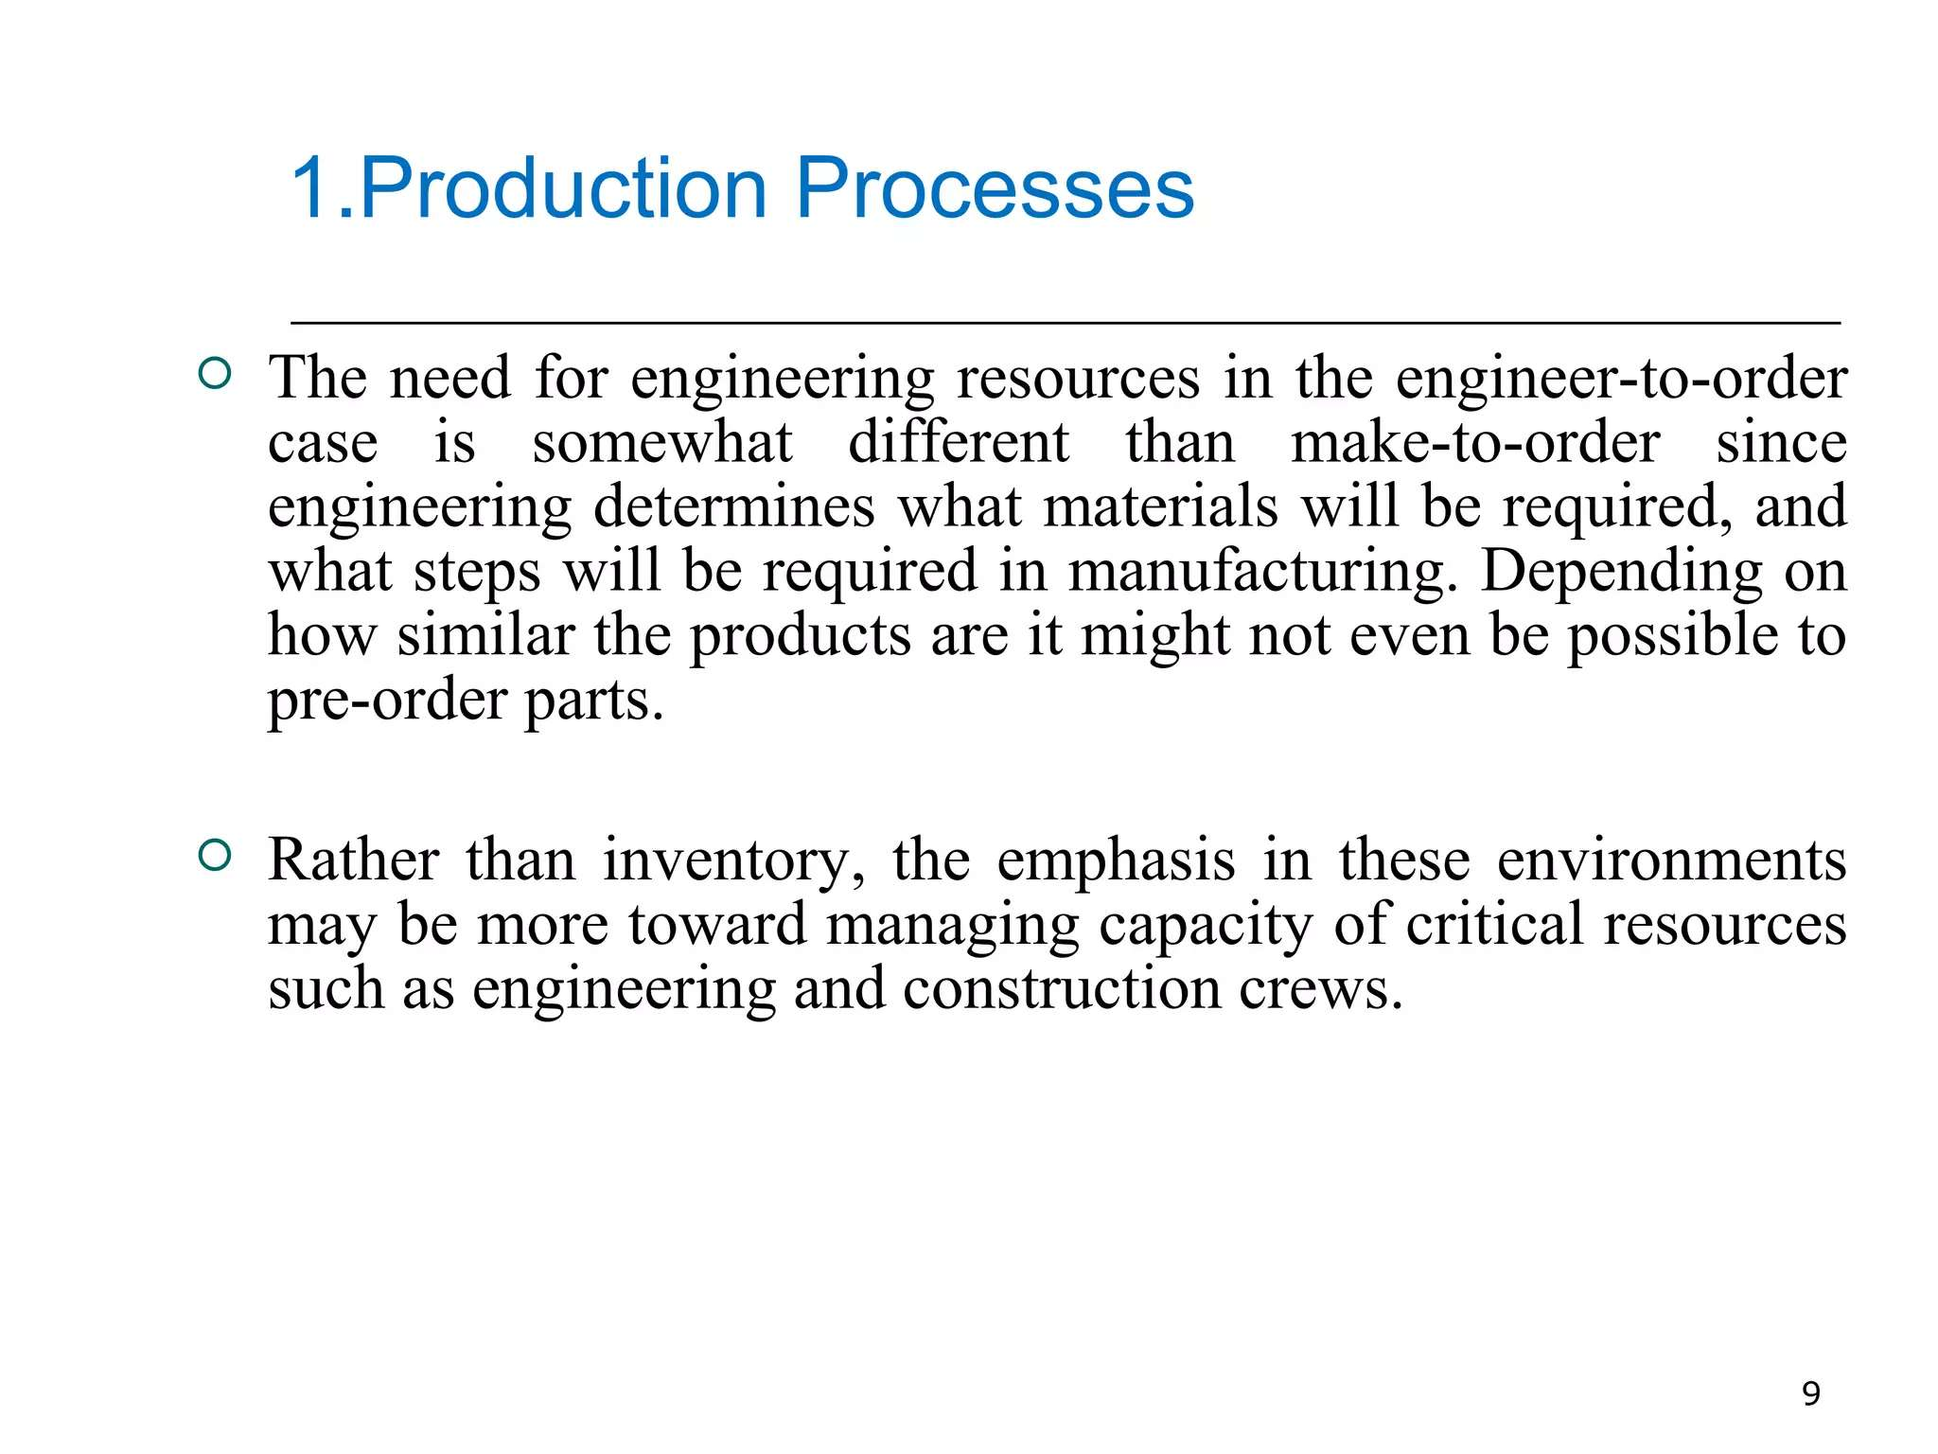

Slide 36
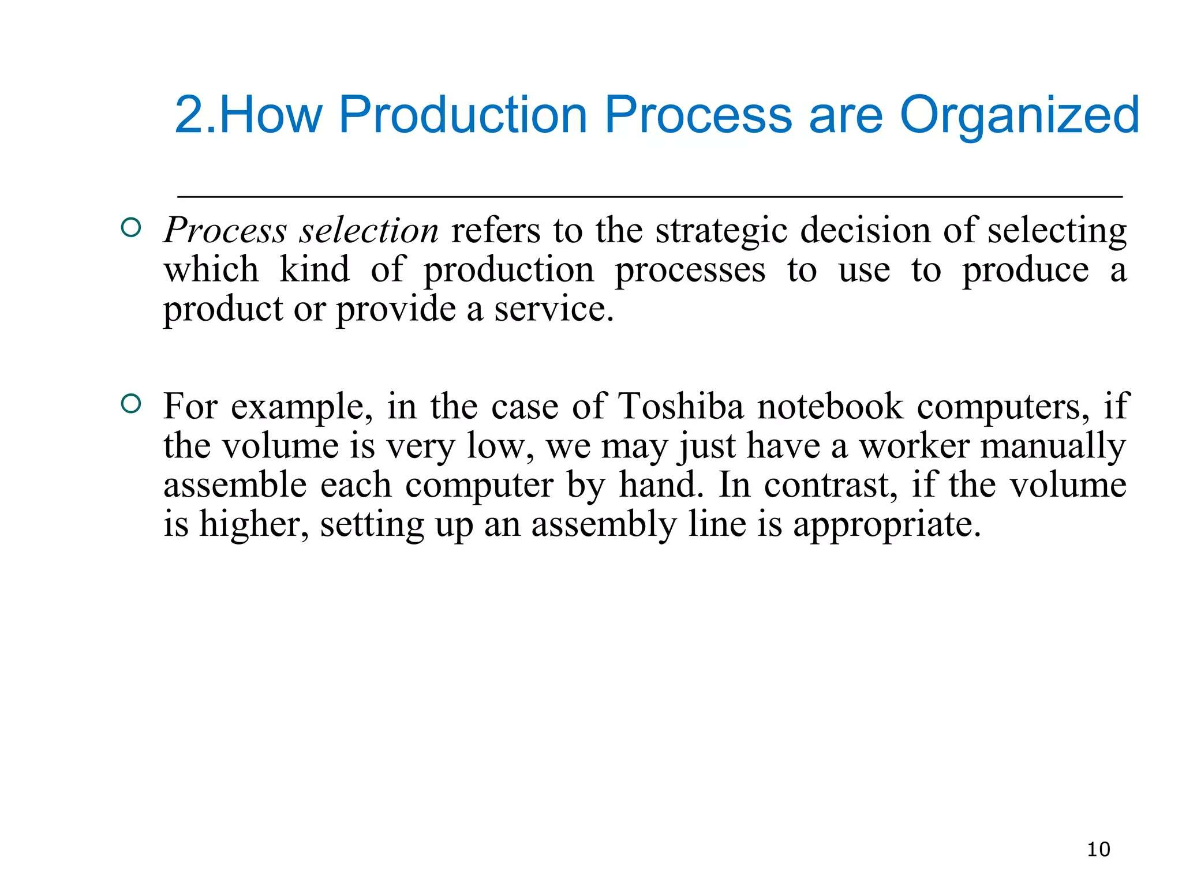

Slide 37
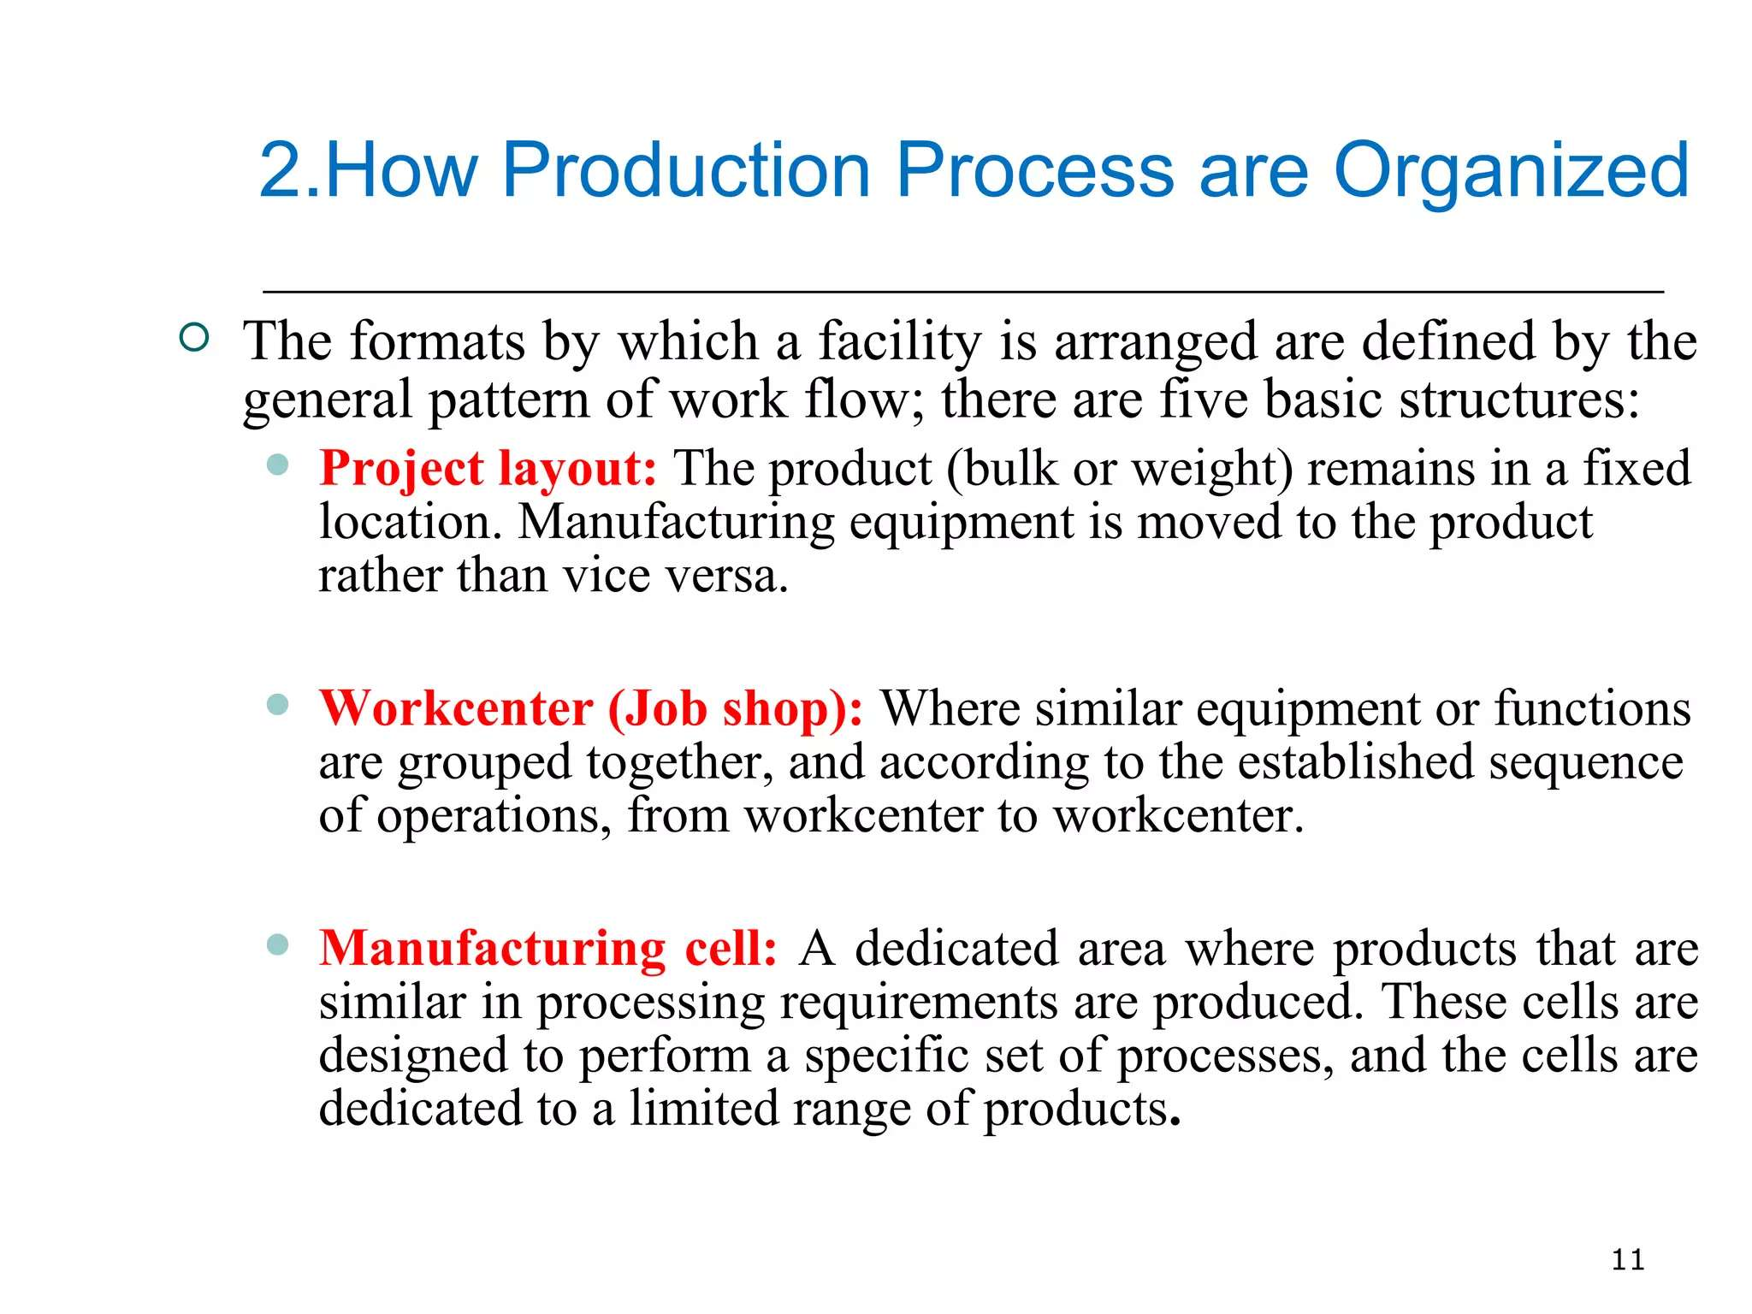

Slide 38
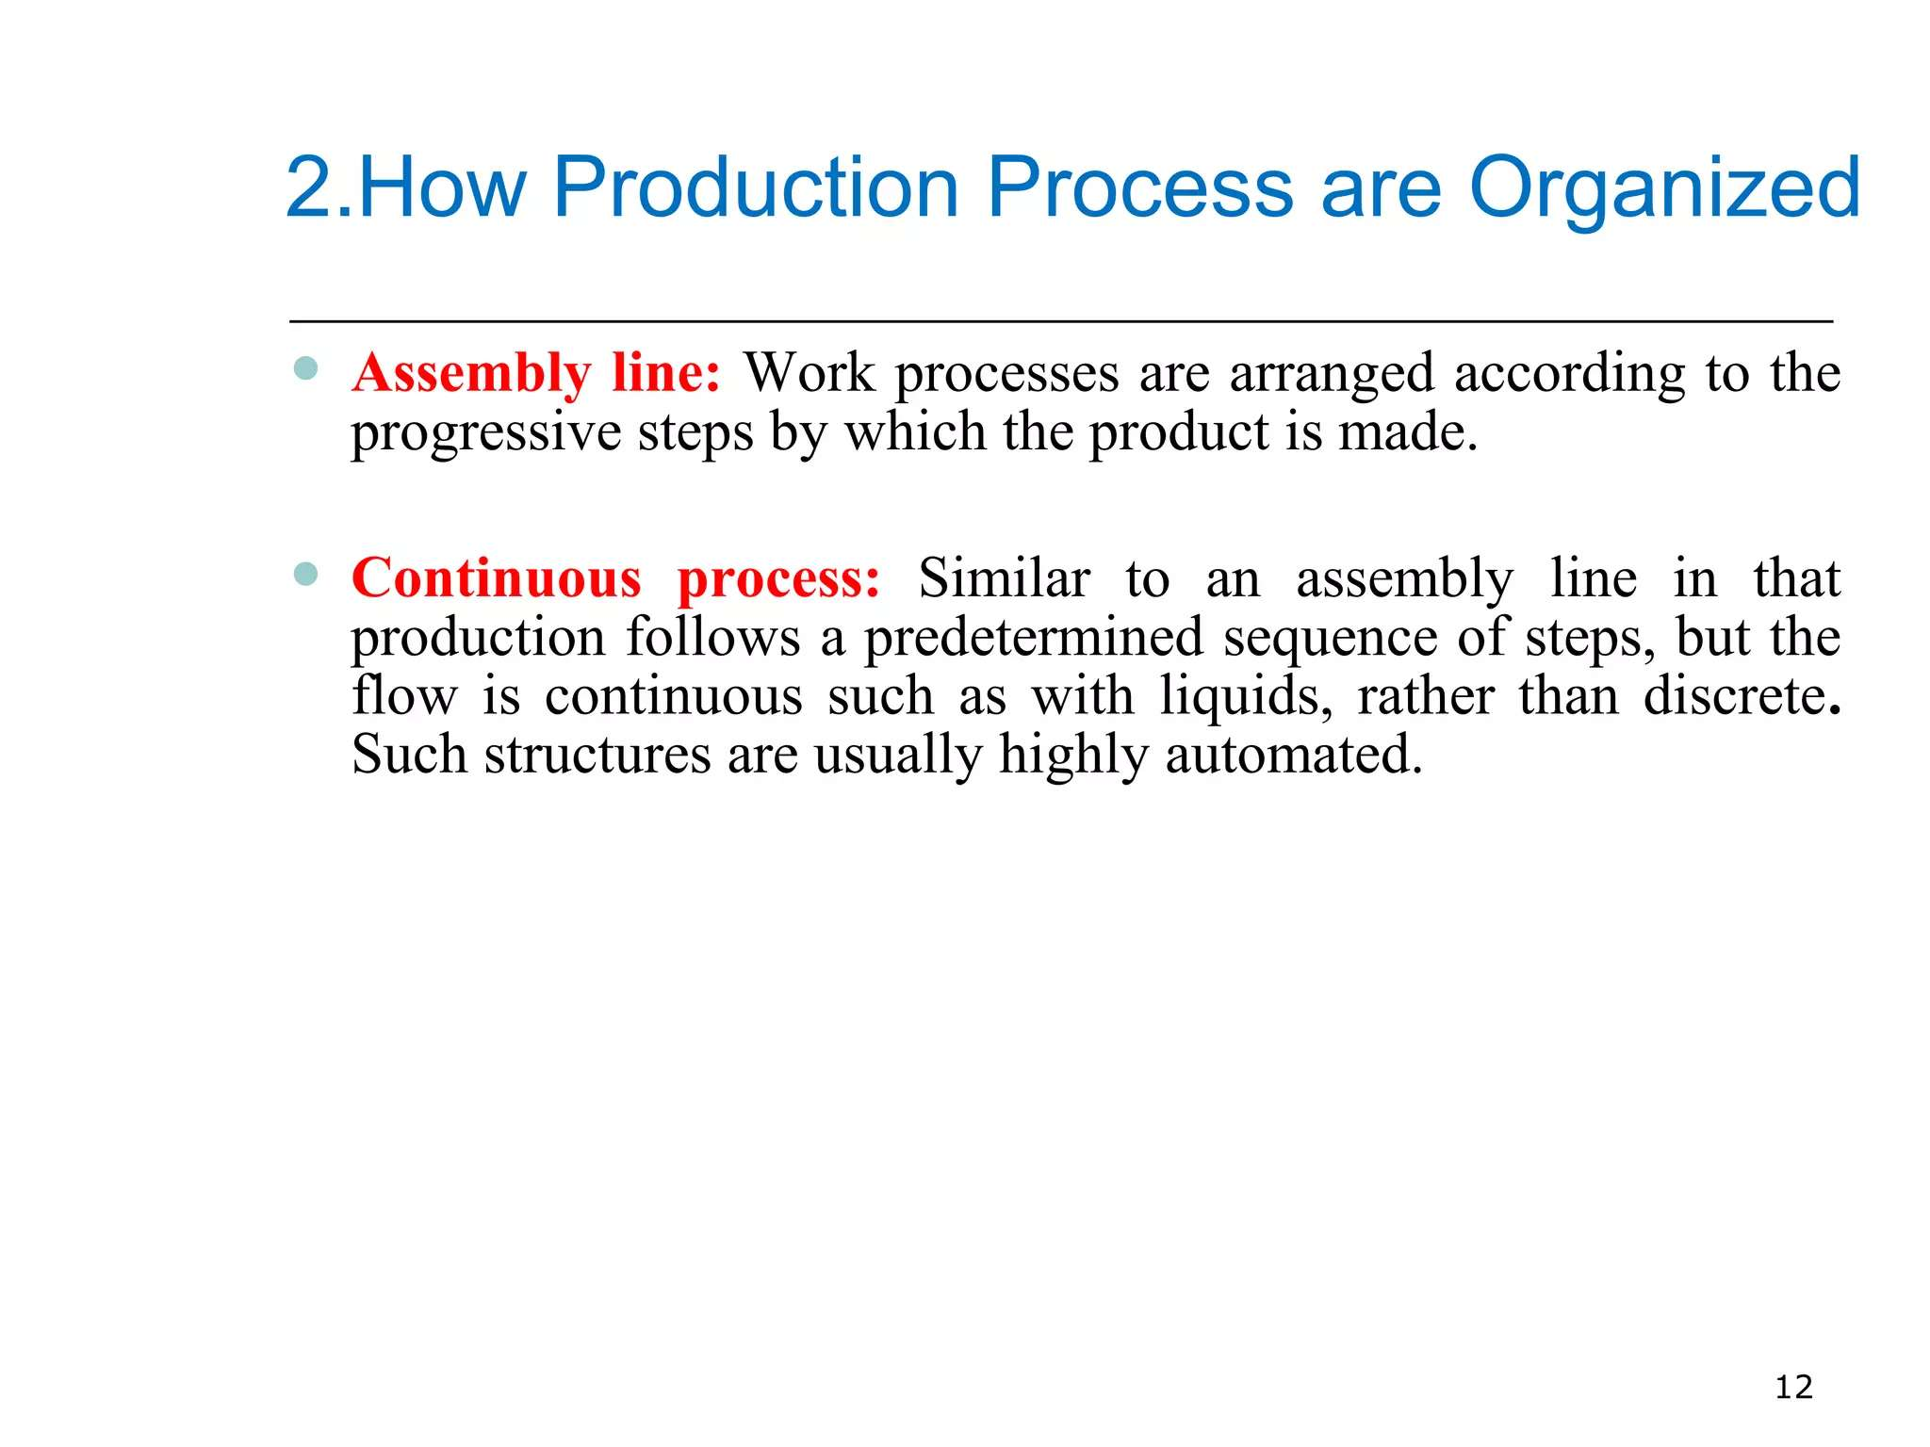

Slide 39
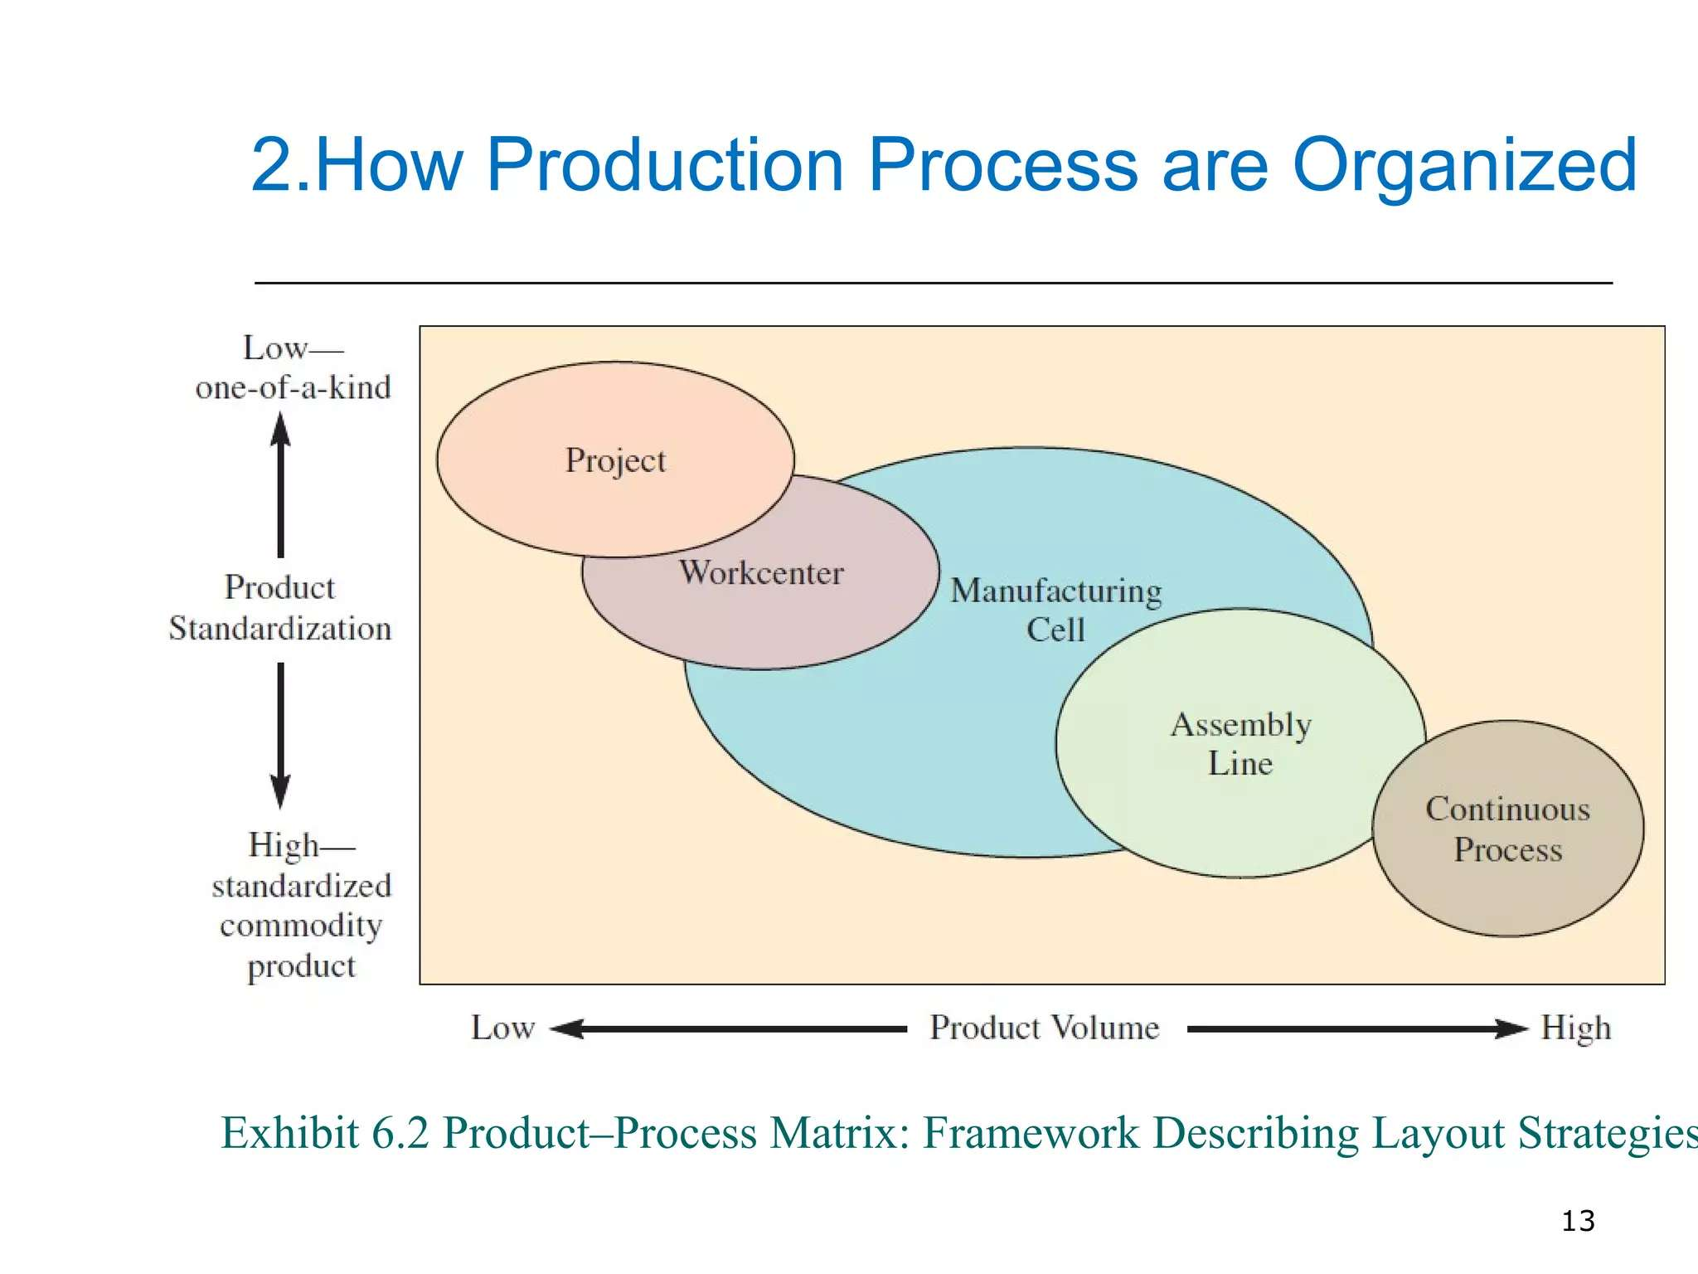

Slide 40
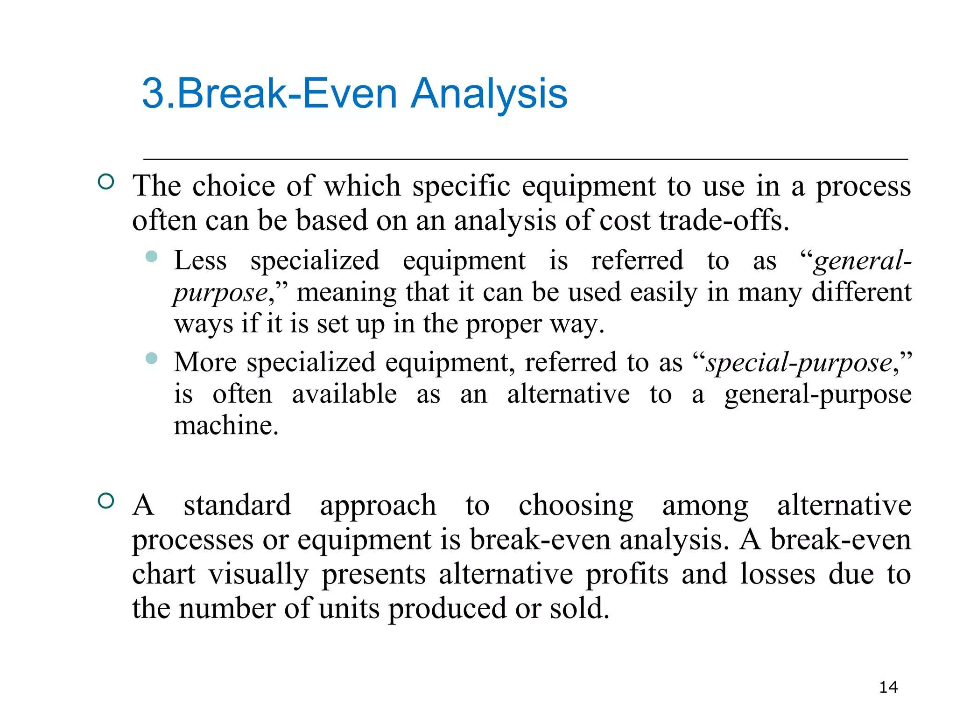

Slide 41
Week 5

Slide 42
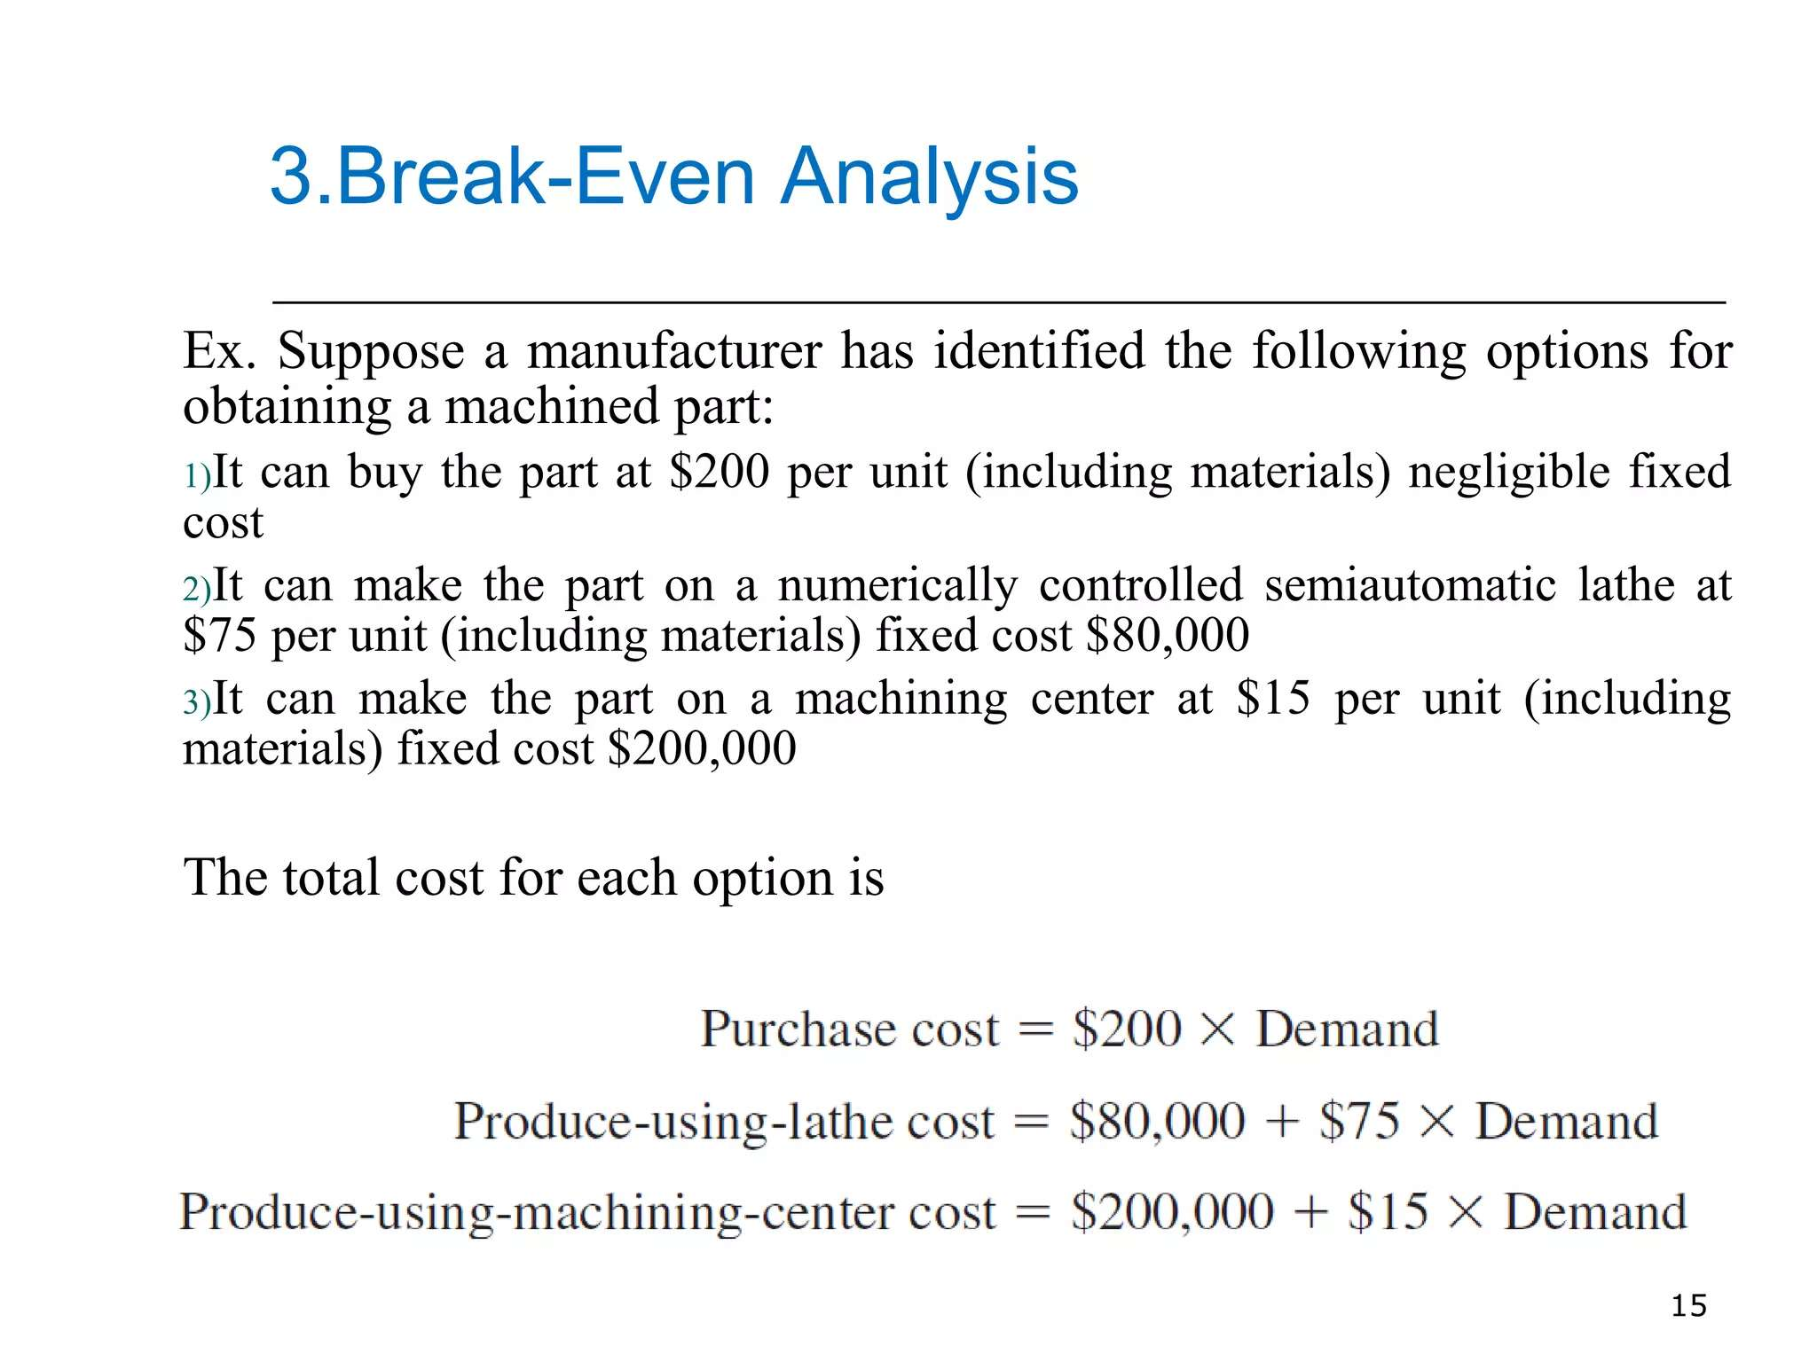

Slide 43
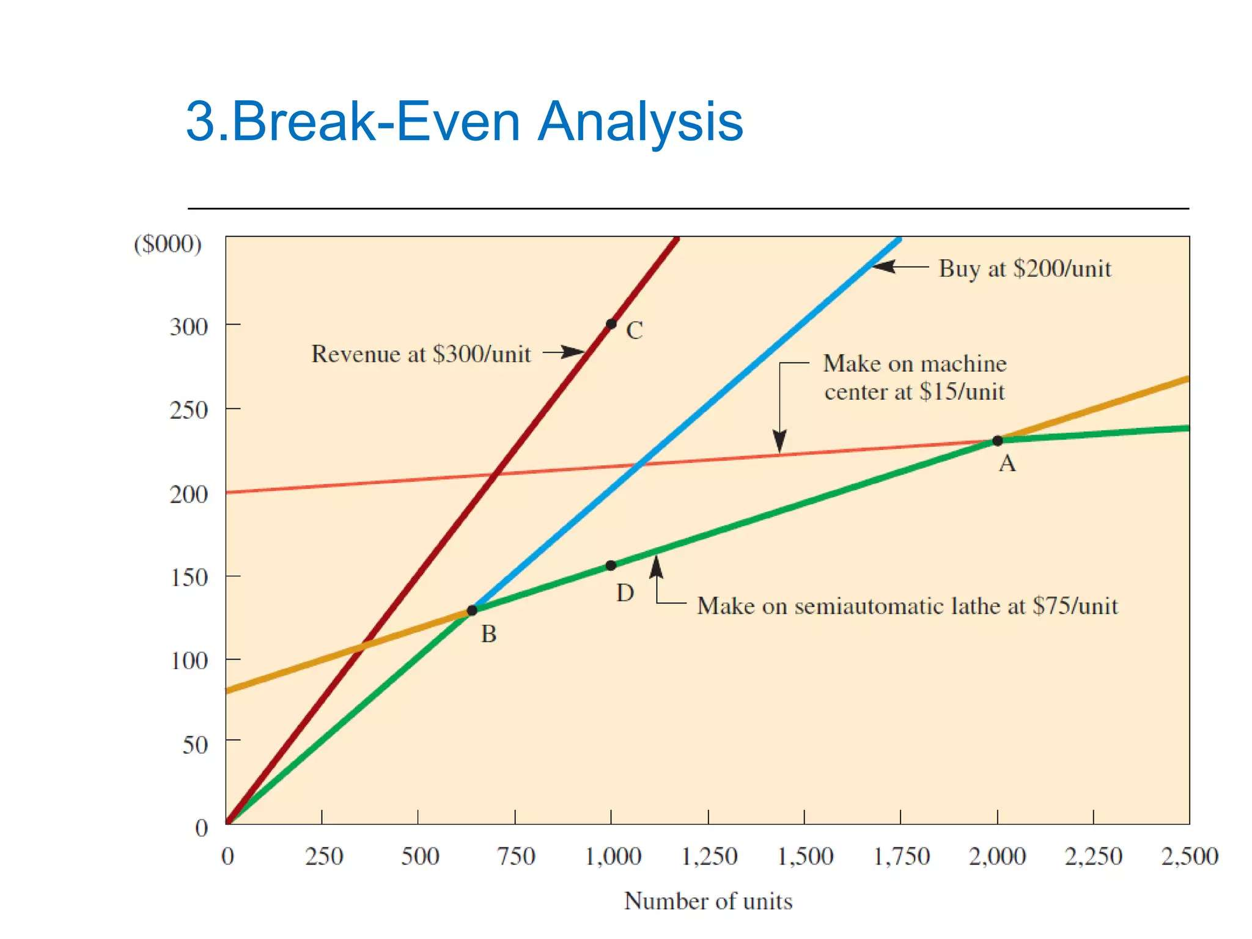

Slide 44
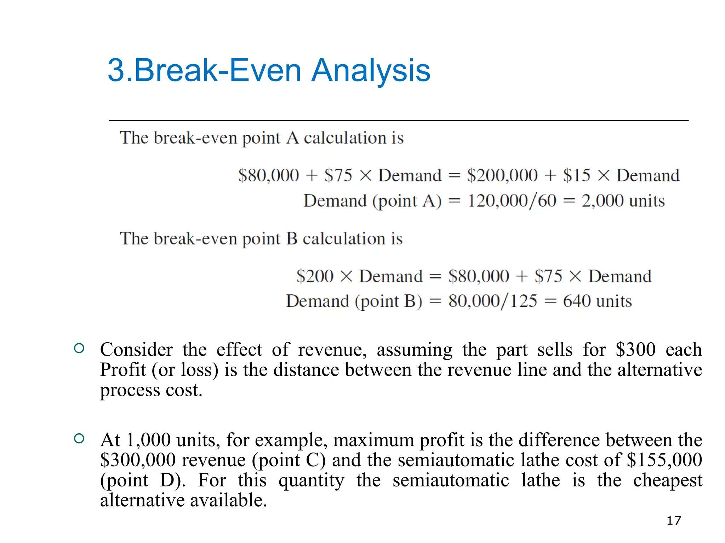

Slide 45
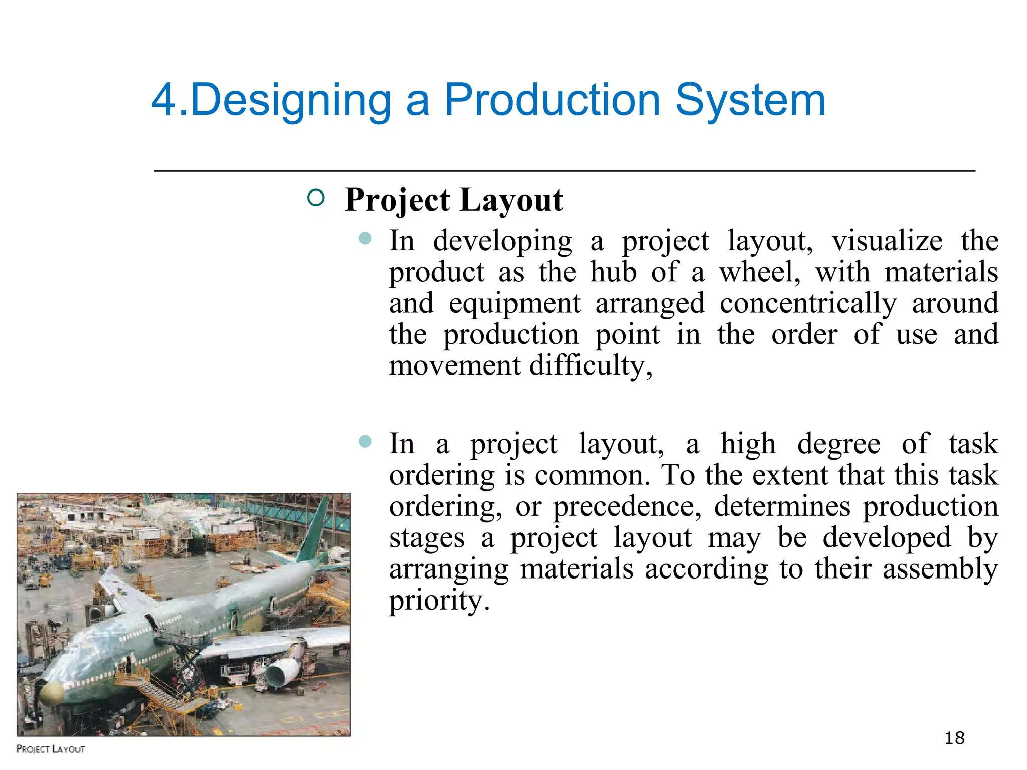

Slide 46
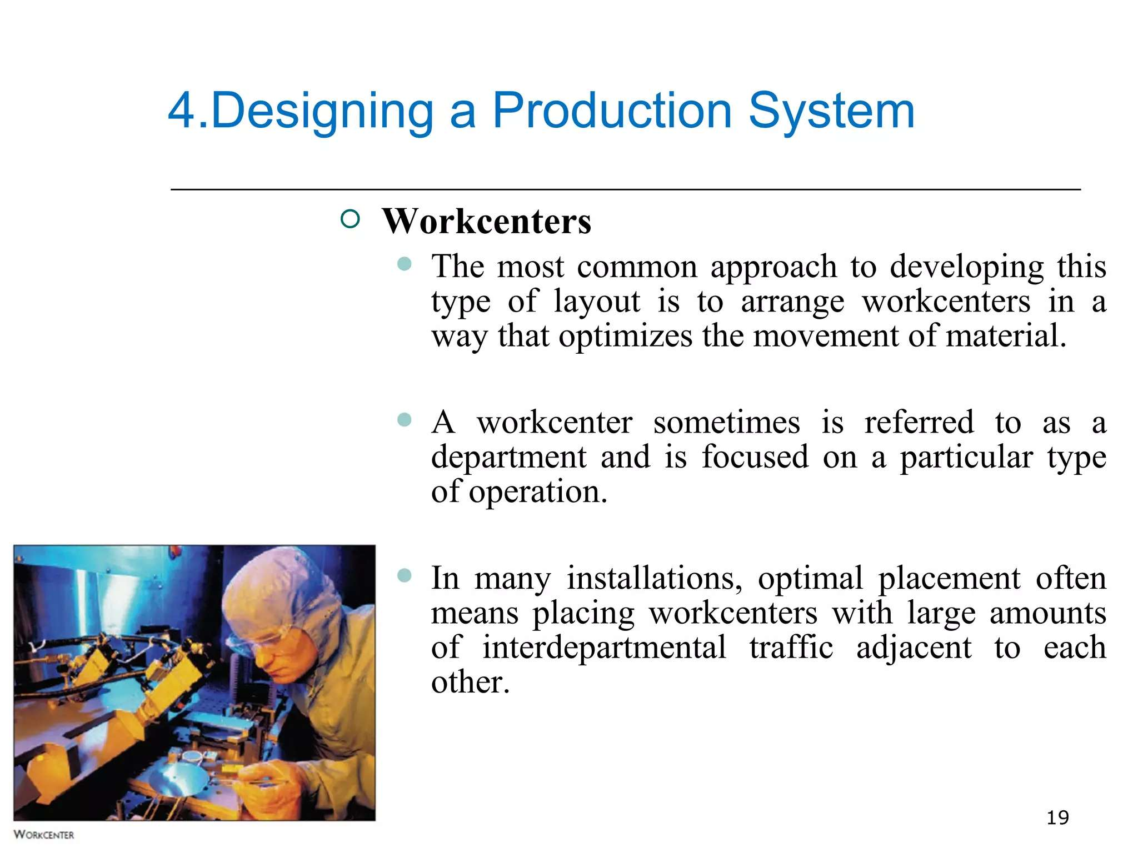

Slide 47
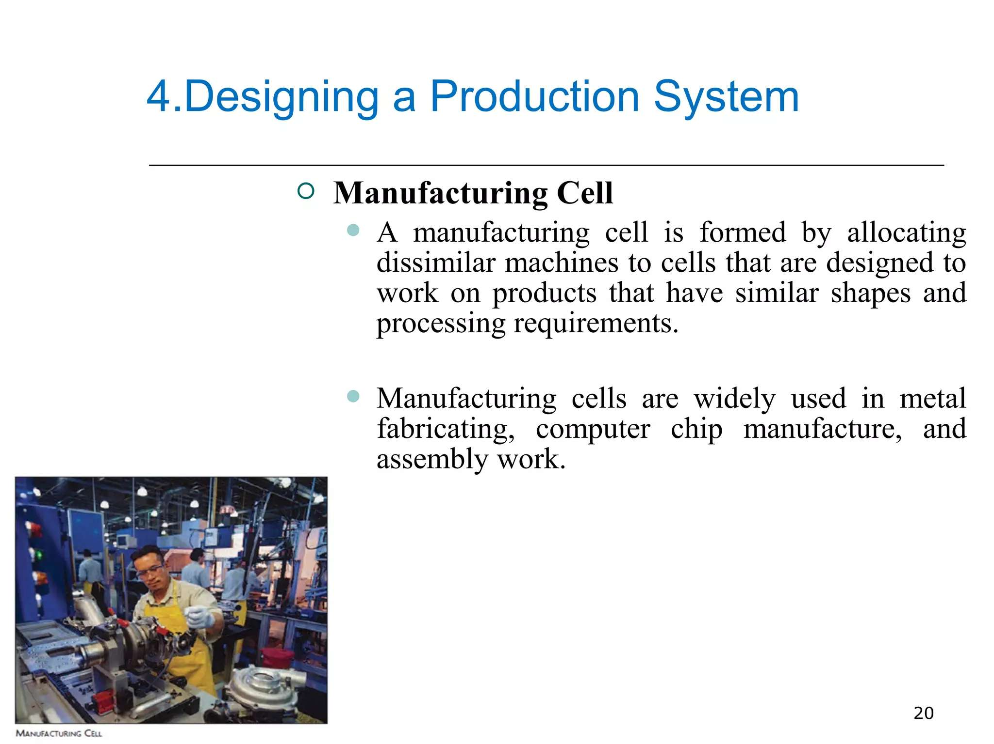

Slide 48
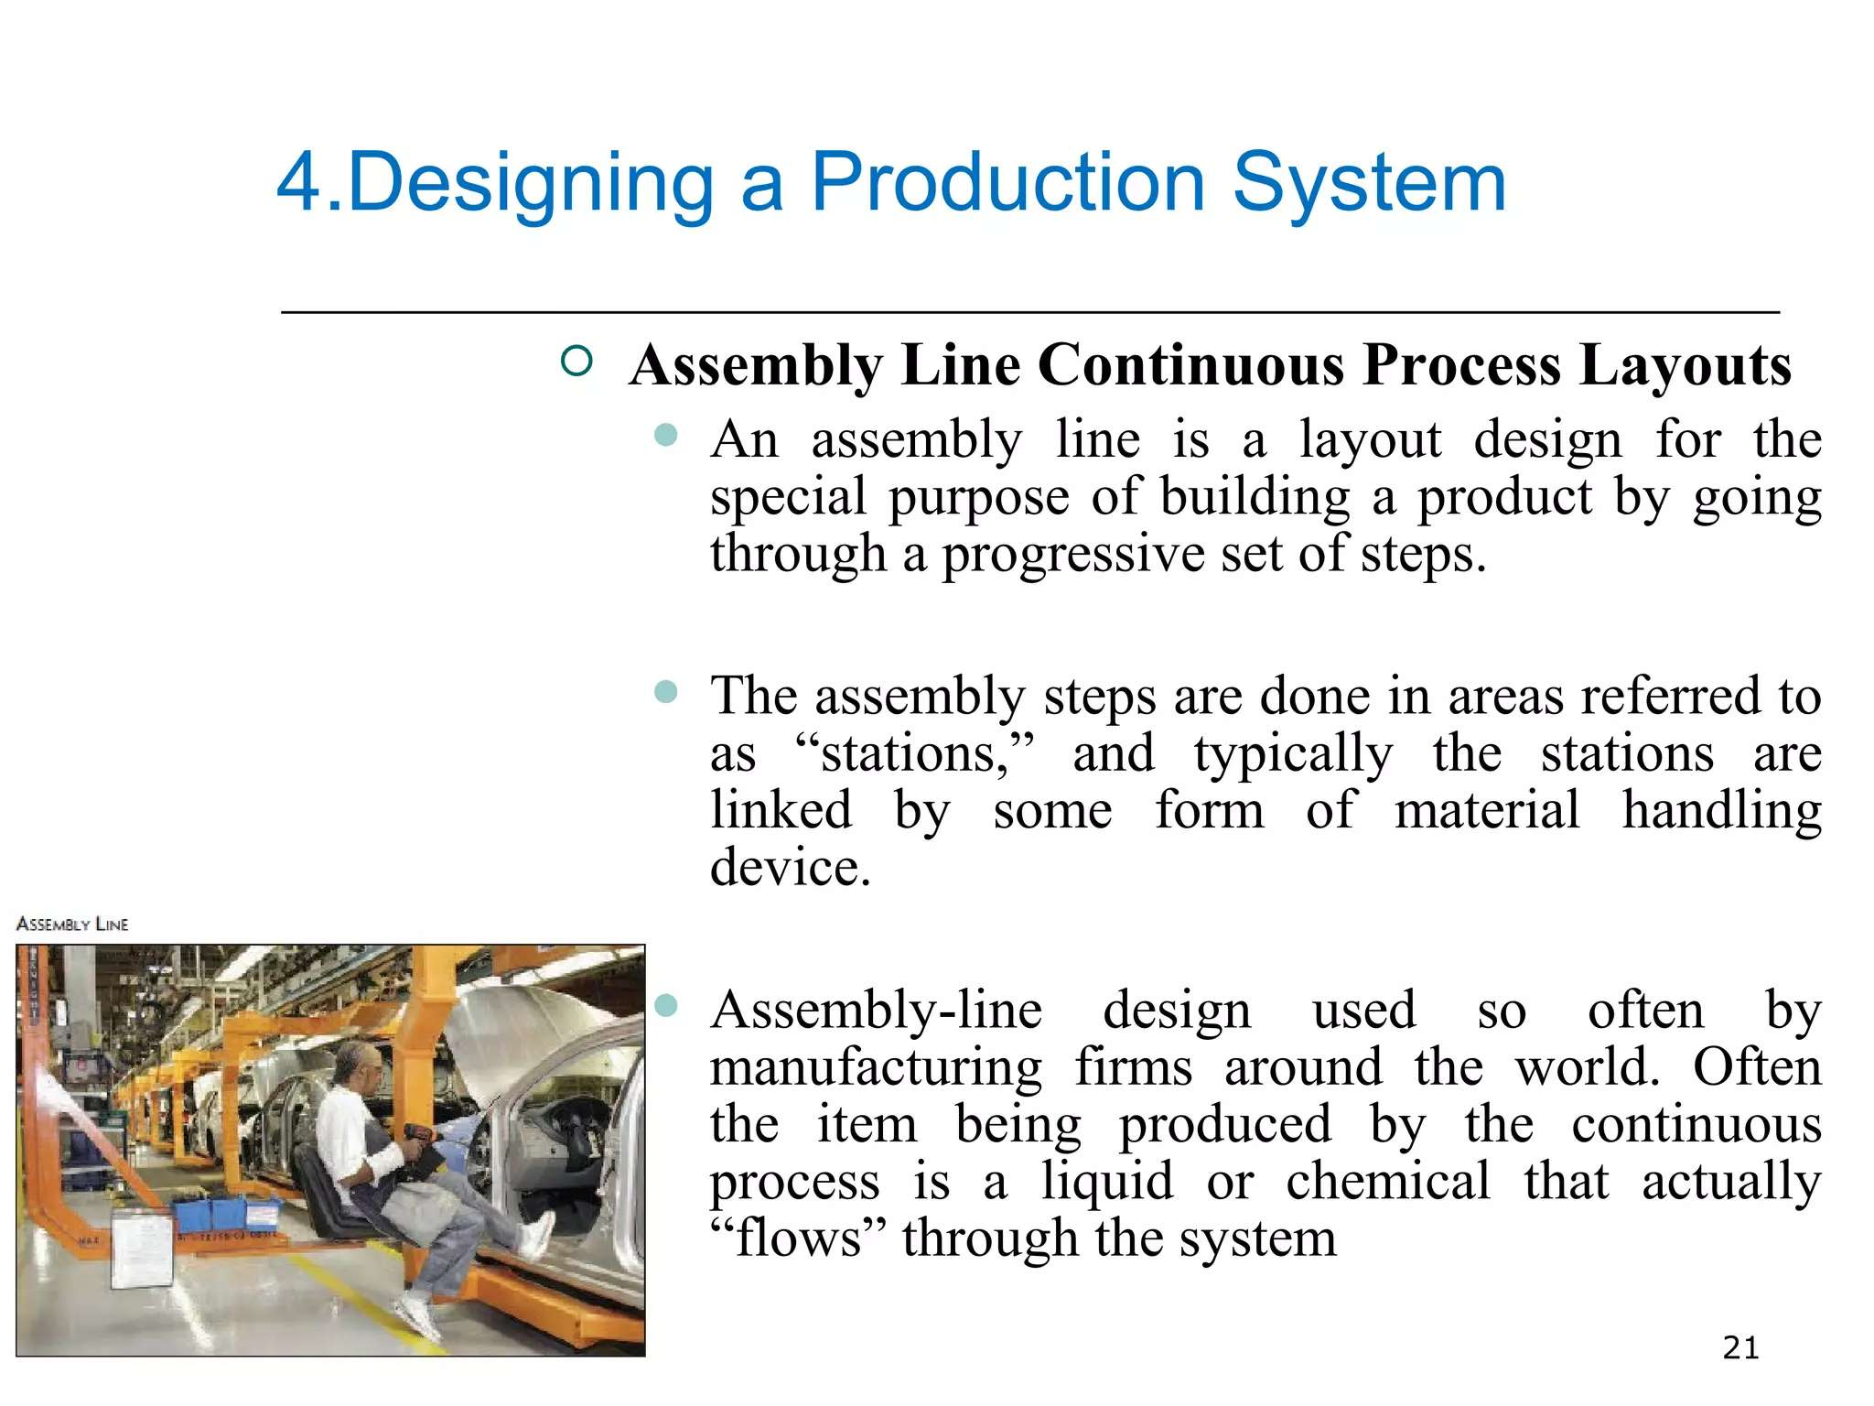

Slide 49
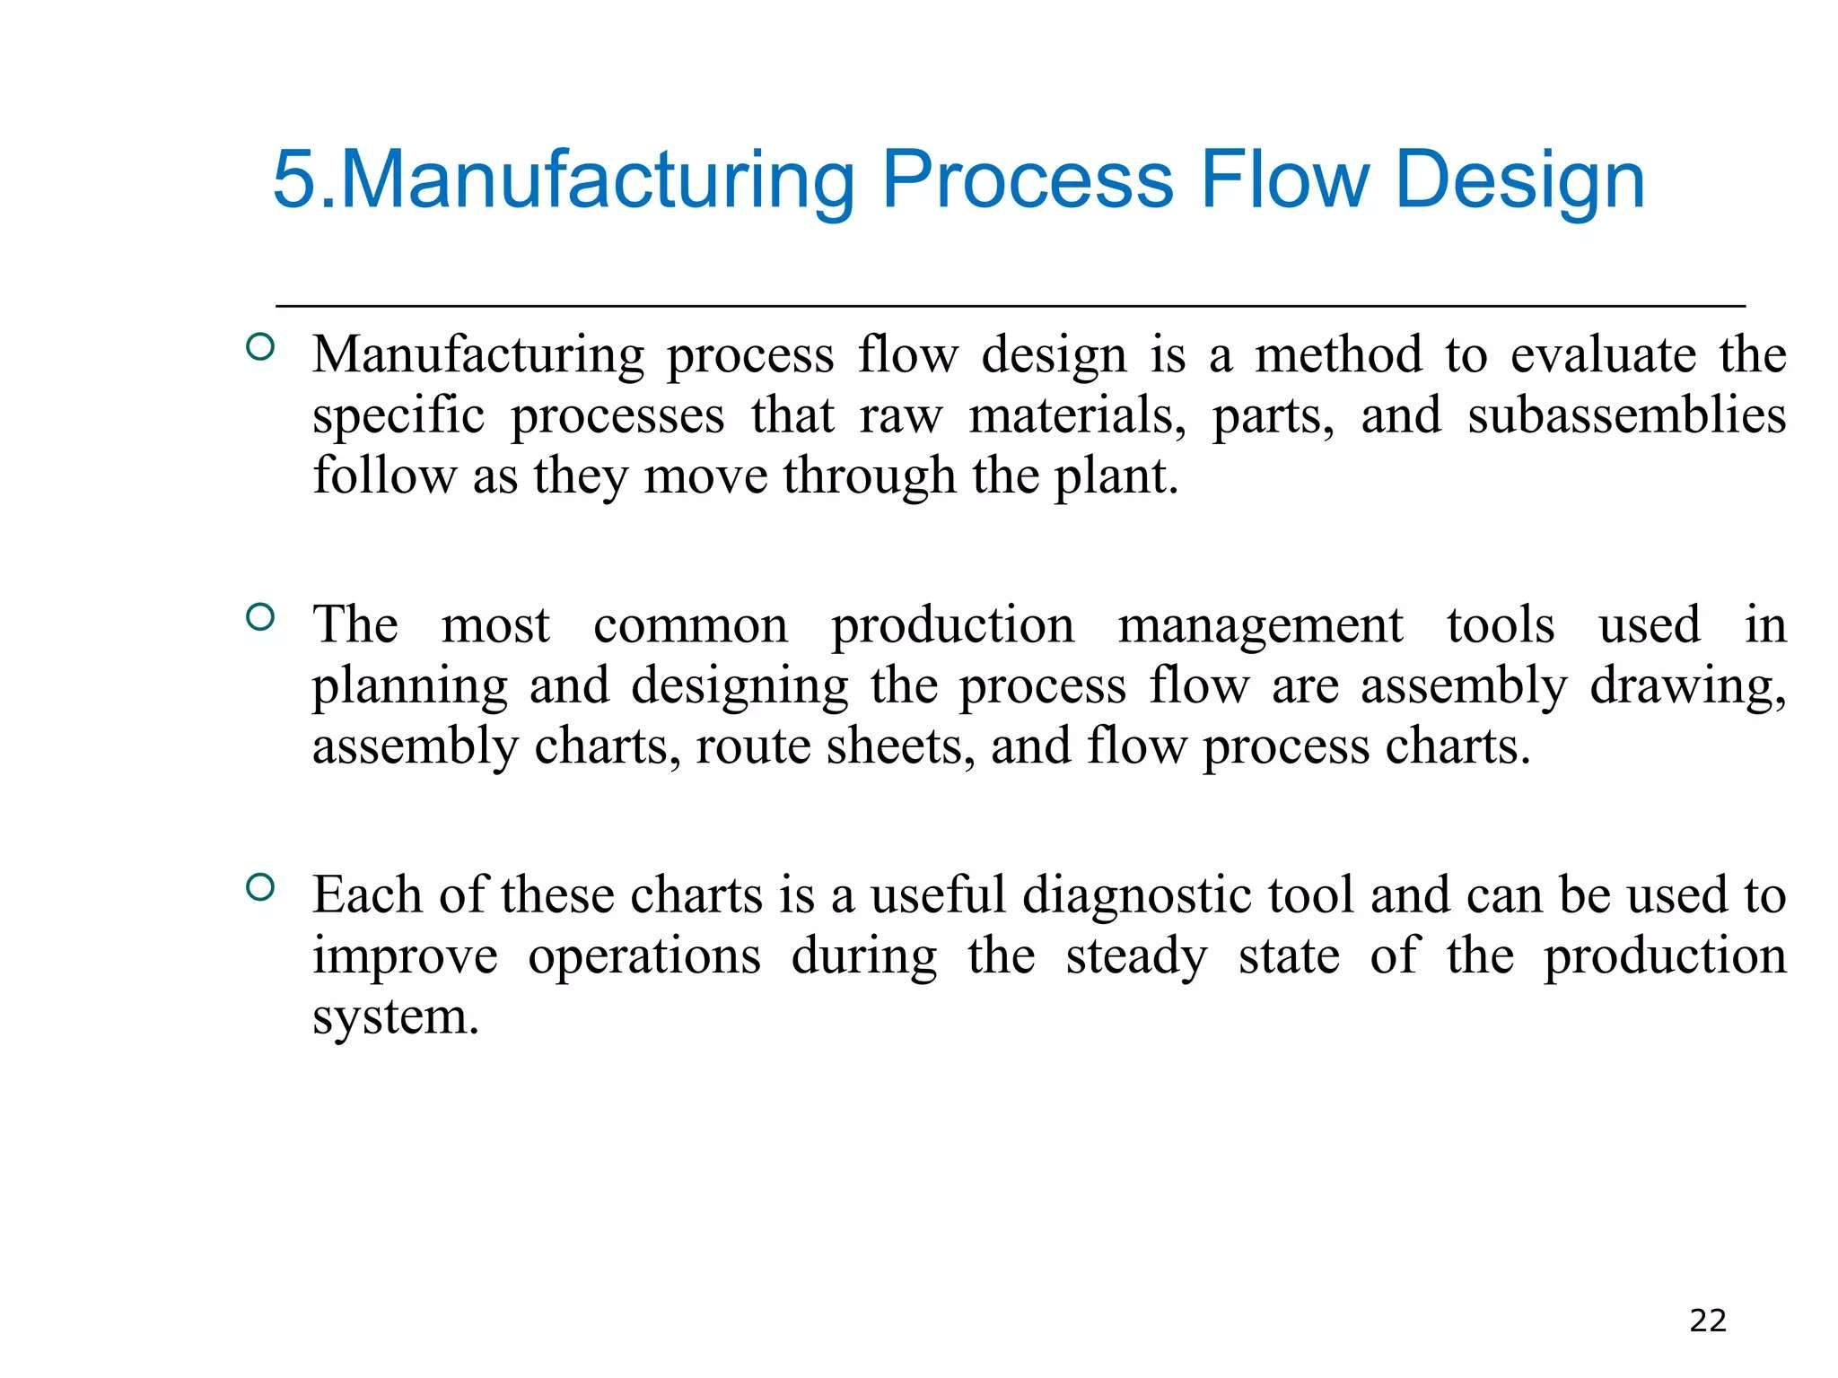

Slide 50
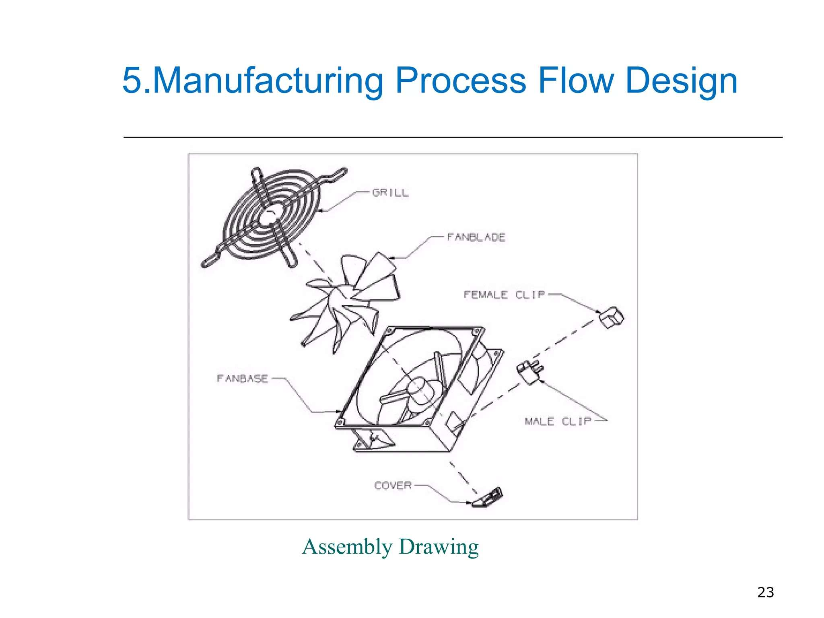

Slide 51
Week 6

Slide 52
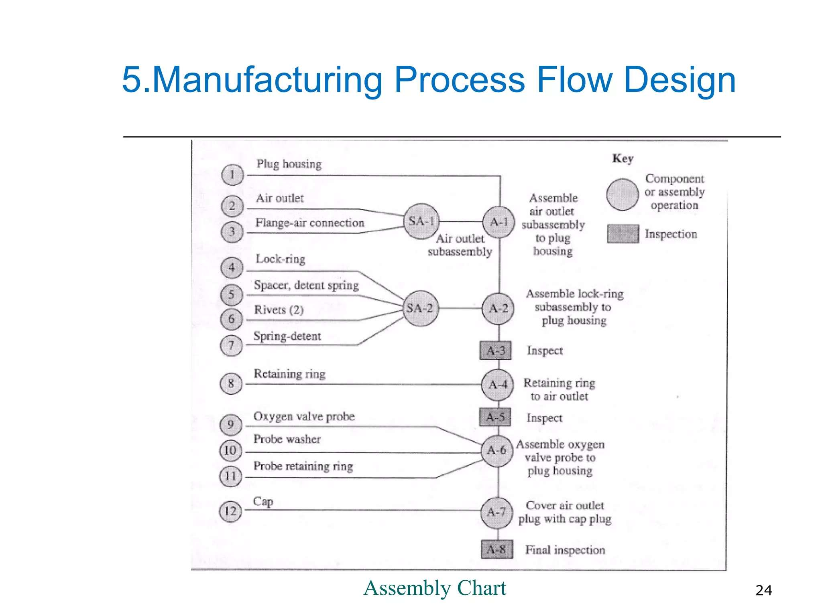

Slide 53
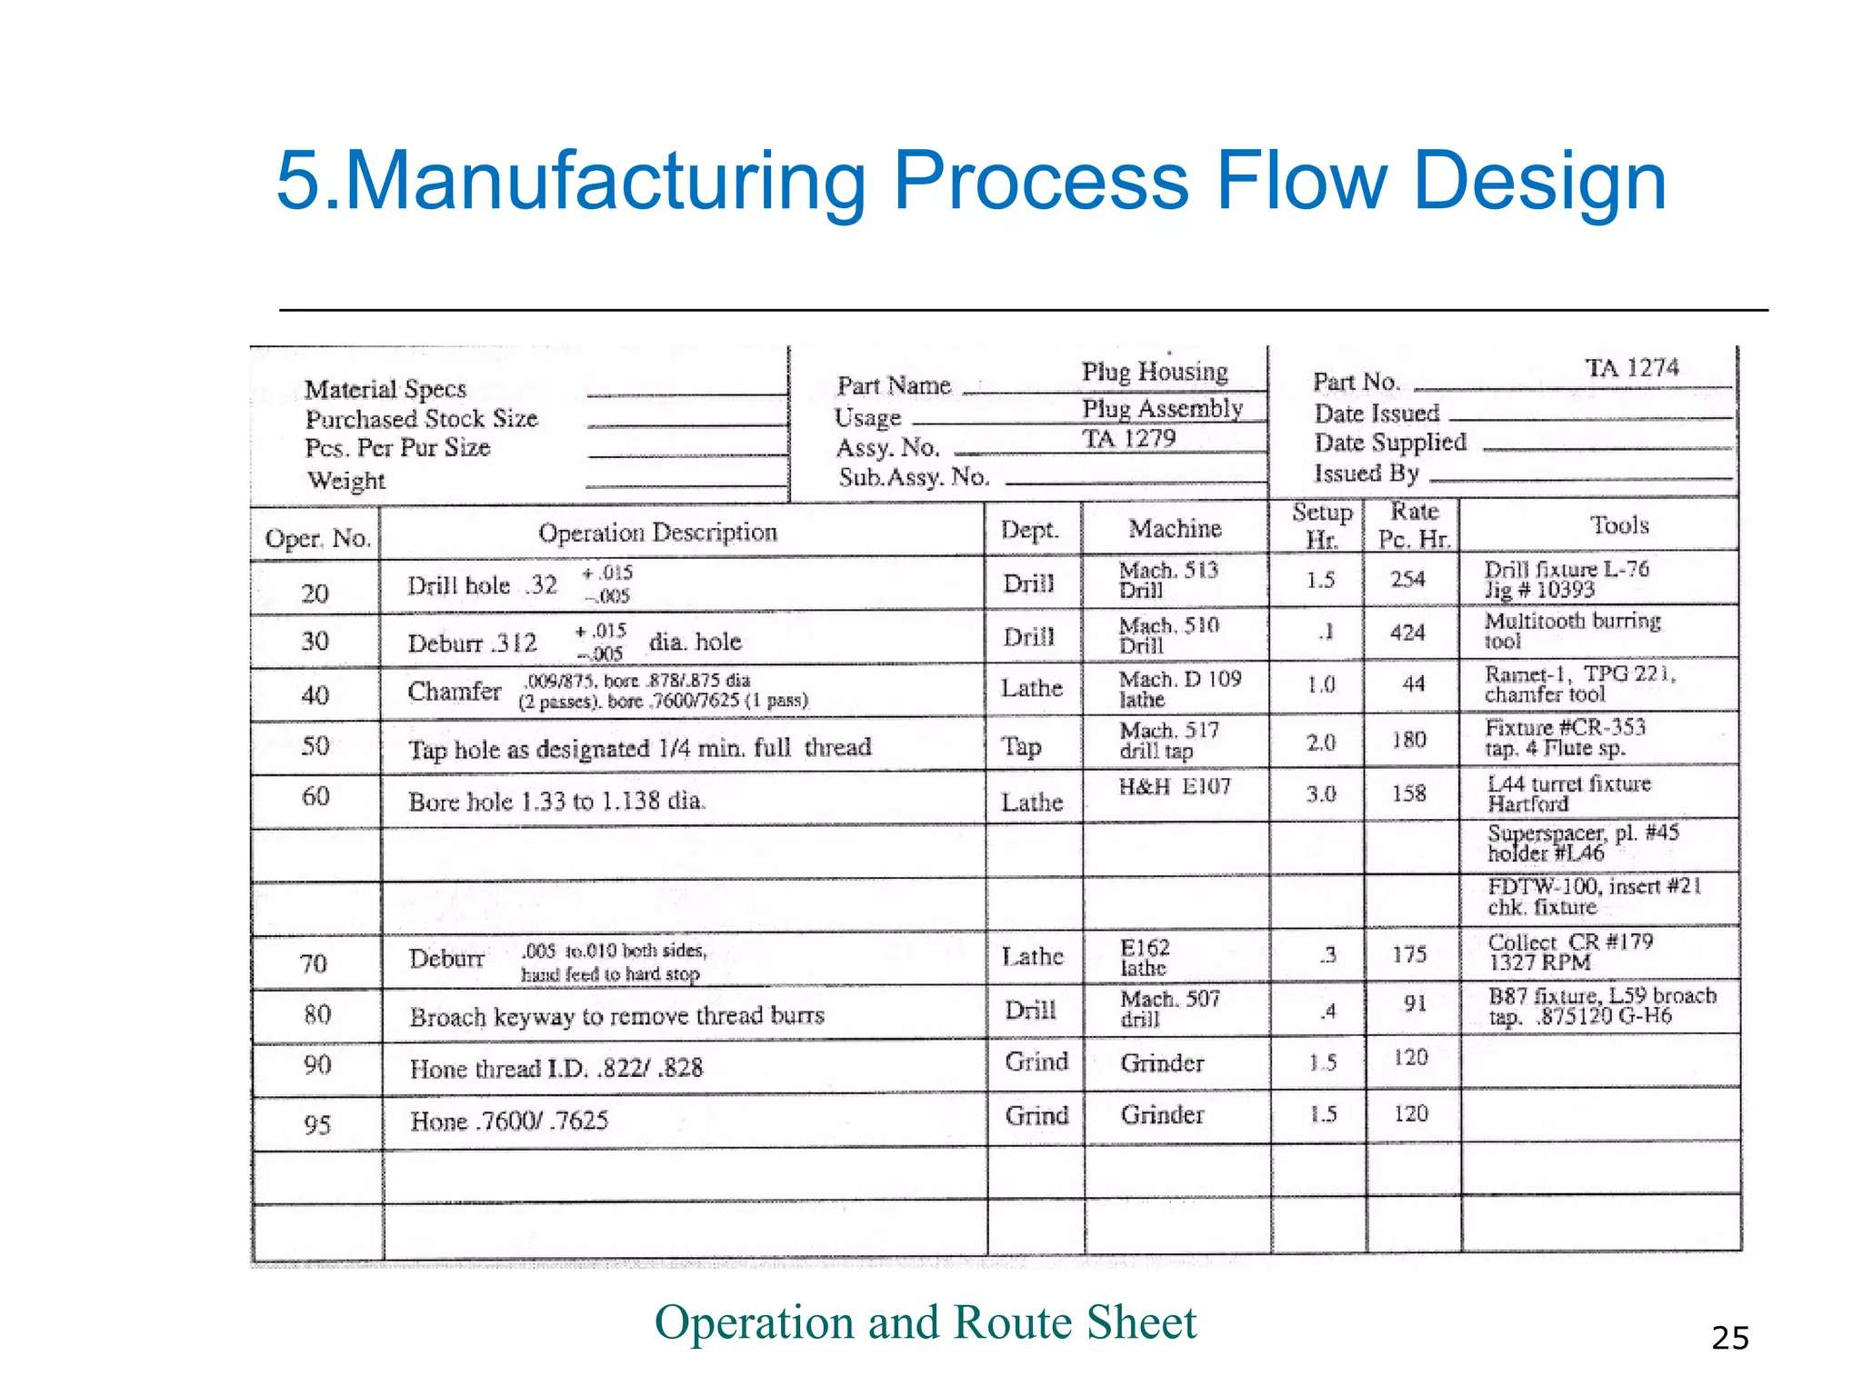

Slide 54
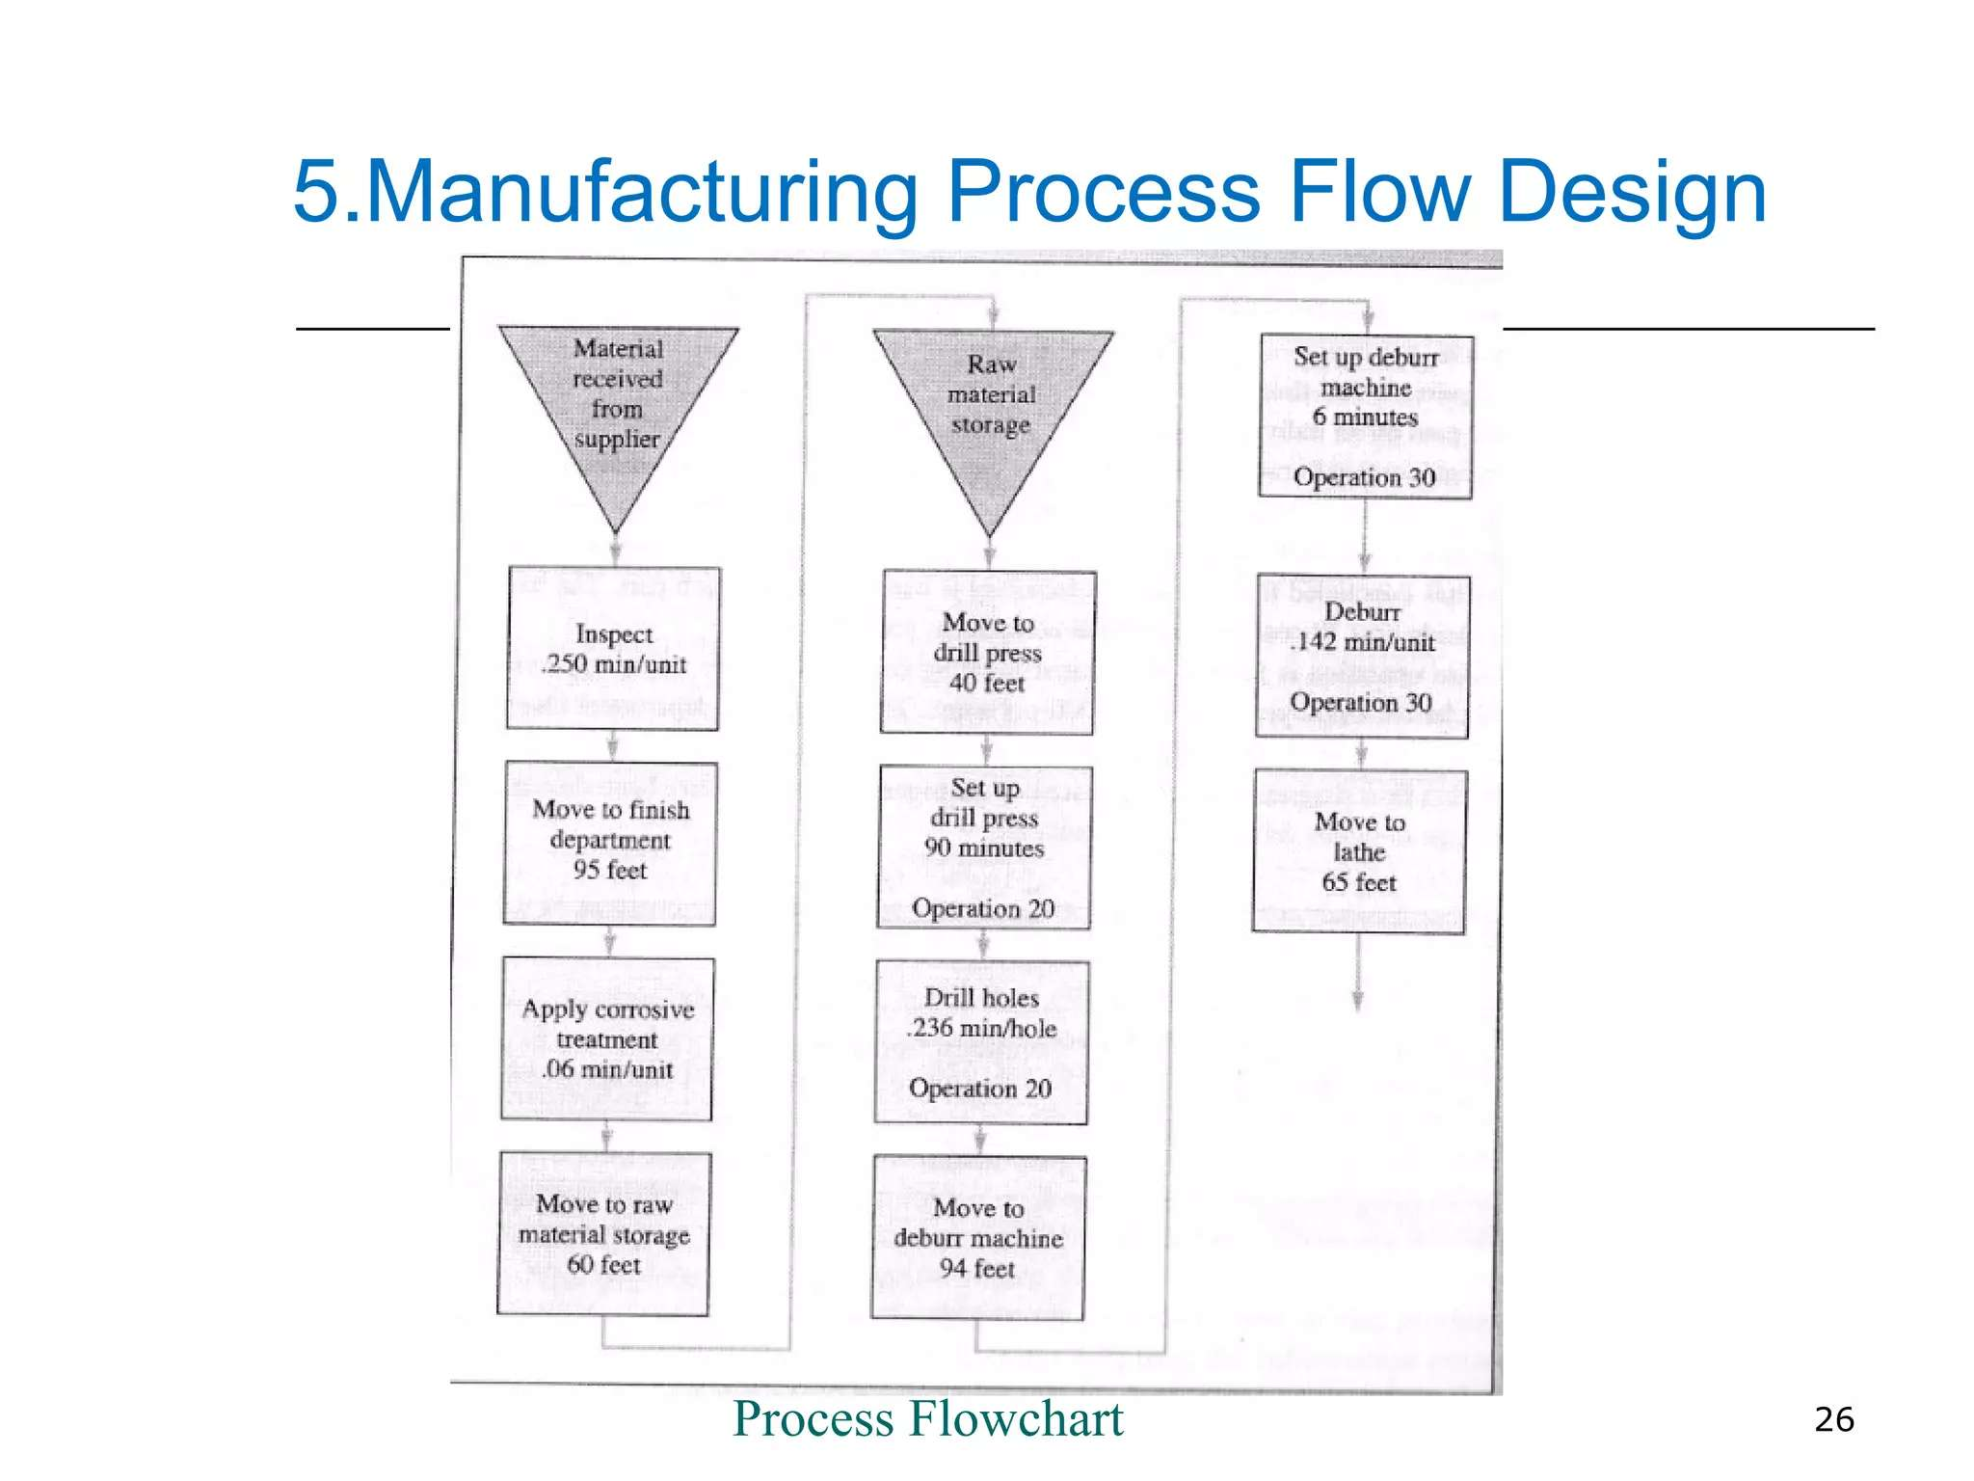

Slide 55
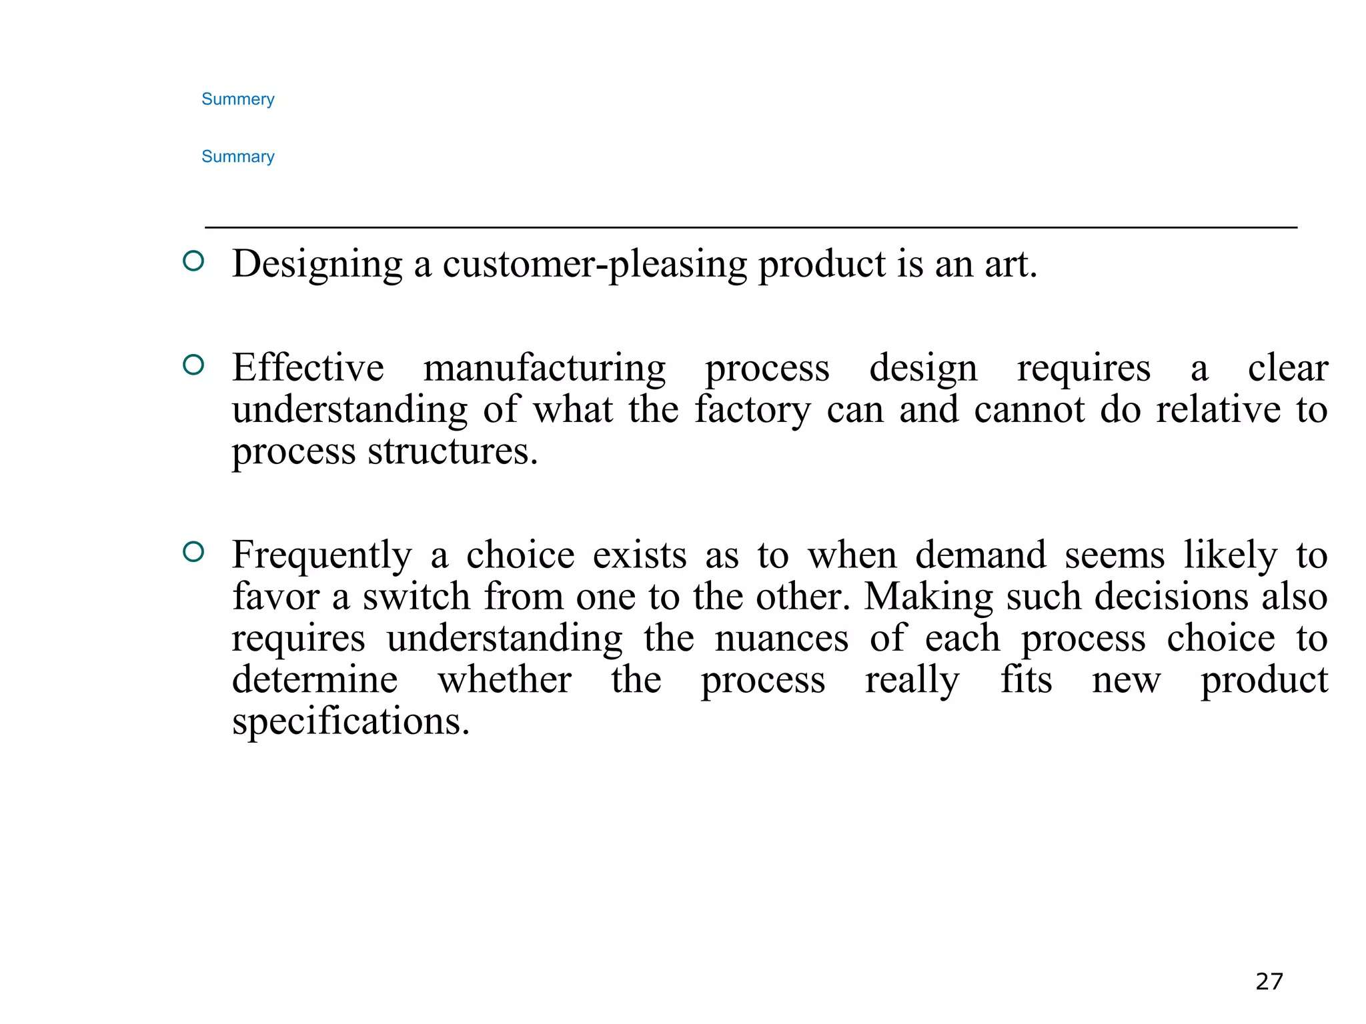

Slide 56
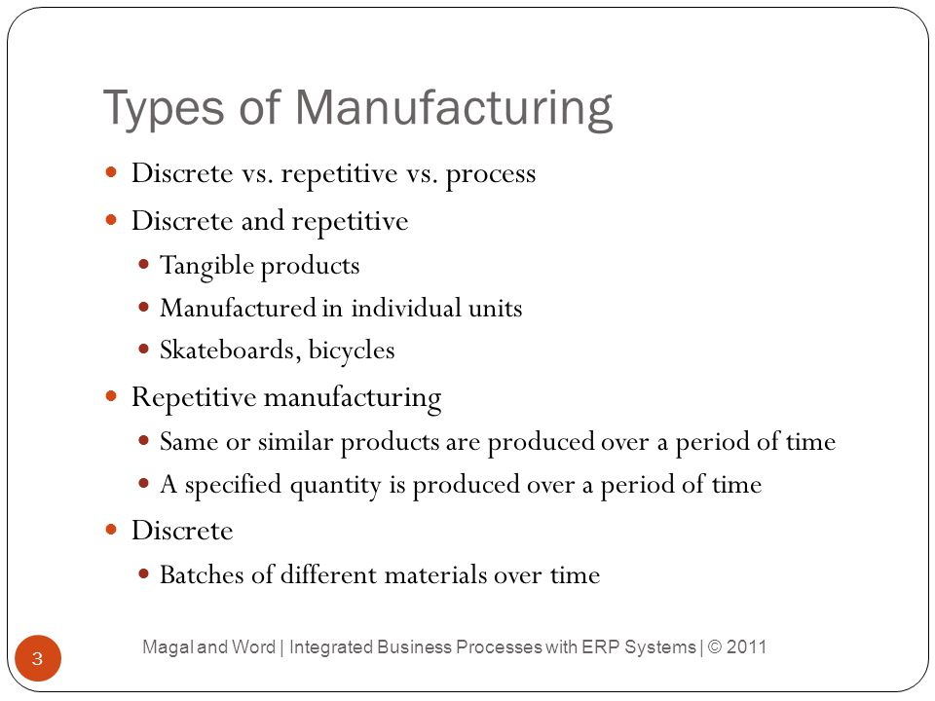

Slide 57
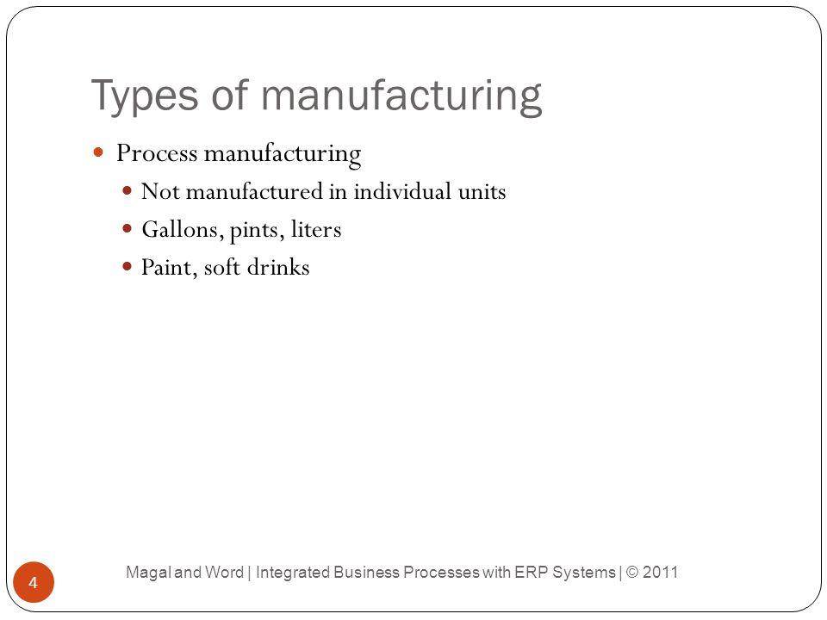

Slide 58
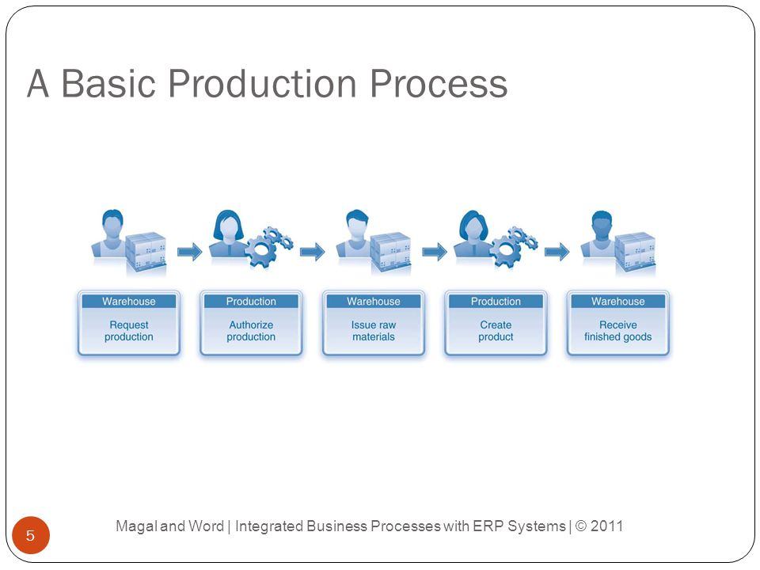

Slide 59
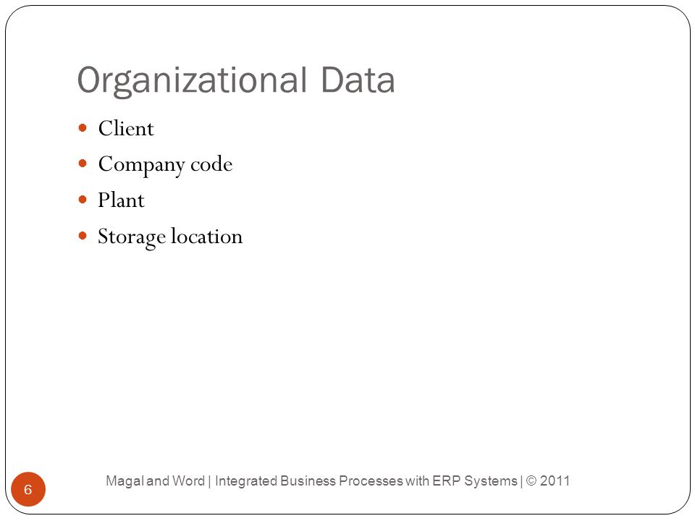

Slide 60
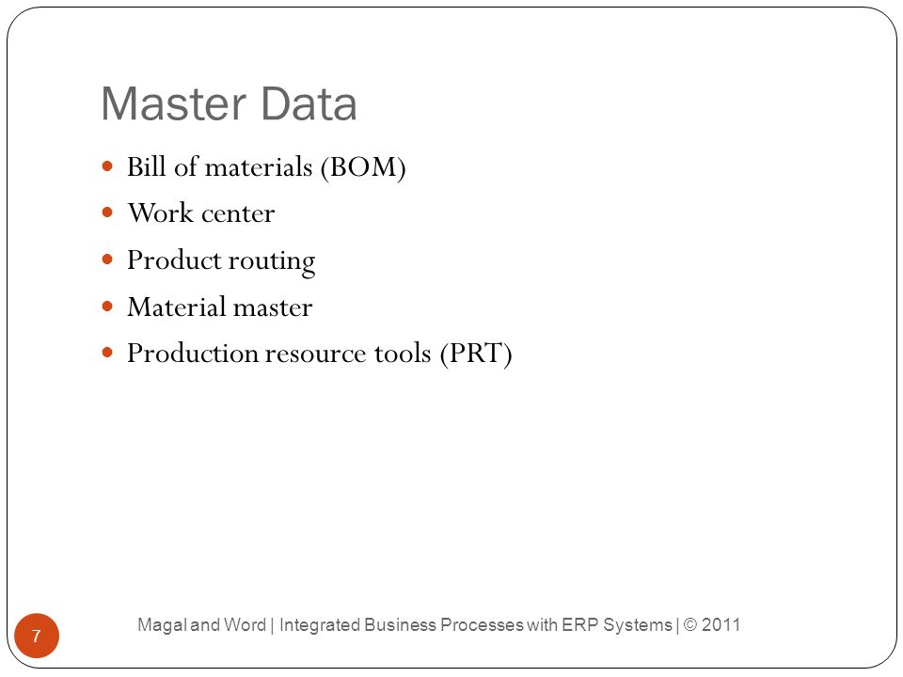

Slide 61


Slide 62
Week 7

Slide 63


Slide 64


Slide 65


Slide 66


Slide 67


Slide 68


Slide 69


Slide 70


Slide 71


Slide 72
Week 8

Slide 73


Slide 74


Slide 75


Slide 76


Slide 77


Slide 78


Slide 79


Slide 80


Slide 81


Slide 82
Week 9

Slide 83


Slide 84


Slide 85


Slide 86


Slide 87


Slide 88


Slide 89


Slide 90


Slide 91


Slide 92


Slide 93
Week 10

Slide 94


Slide 95


Slide 96


Slide 97


Slide 98


Slide 99


Slide 100


Slide 101


Slide 102


Slide 103


Slide 104


Slide 105


Slide 106
Week 11

Slide 107


Slide 108


Slide 109


Slide 110


Slide 111


Slide 112


Slide 113


Slide 114


Slide 115


Slide 116


Slide 117


Slide 118
Week 12

Slide 119


Slide 120


Slide 121


Slide 122


Slide 123


Slide 124


Slide 125


Slide 126


Slide 127


Slide 128


Slide 129


Slide 130


Slide 131
Week 13

Slide 132


Slide 133


Slide 134


Slide 135


Slide 136


Slide 137


Slide 138


Slide 139


Slide 140


Slide 141


Slide 142


Slide 143


Slide 144


Slide 145


Slide 146


Slide 147


Slide 148


Slide 149
Week 14

Slide 150


Slide 151


Slide 152


Slide 153


Slide 154


Slide 155


Slide 156


Slide 157


Slide 158


Slide 159


Slide 160


Slide 161
Week 15

Slide 162


Slide 163


Slide 164


Slide 165


Slide 166


Slide 167


Slide 168


Slide 169


